Slide 1
04. RELIGIOUS HISTORY OF THE CHRISTIAN ERA
by David Lee Burris

Slide 2
Relgious History of the Christian Era Ppt. Series
Papacy
Monarchical Episcopacy
Sacraments
Five Worship Activities
Denominations
Theological Debates

Slide 3
THESIS & ANTI-THESIS THEOLOGY
PLATO(Teacher) VERSUS ARISTOTLE(Student)
IRENAEUS(2nd Cent) VERSUS AUGUSTINE (4th)
AUGUSTINIAN VERSUS PELAGIAN NEMESIS
AUGUSTINIAN(Old)/THOMISM(New Church)
DESIDERIUS ERASMUS VS. MARTIN LUTHER
MARTIN LUTHER VERSUS ULRICH ZWINGLI
MARTIN LUTHER VERSUS JOHN CALVIN
JACOB ARMINIUS VERSUS JOHN CALVIN

Slide 4
THESIS & ANTI-THESIS THEOLOGY
PLATO(Teacher) VERSUS ARISTOTLE(Student)

Slide 5
PLATO | ARISTOTLE
Idealism | Realism
Republic | Politics
The “Ideal” State | A Working Government
TRANSCEND Human Selfishness | ACKNOWLEDGE Human Selfishness
Social Unity | Balance

Slide 6
ARISTOTLE THRU THE AGES
Aristotle will always be significant to scholars as the most famous student of Plato.
His works on logic are among the classics. He basically believed existence is related to substance and that everything is caused by something else – uniform theory.
His practical philosophy proved more controversial. He states that our souls are formed by habits, skills, and virtues. These same virtues are like skills in that they are formed by practice – by working at it. The other way our souls are shaped is through perception.
Aristotle has remained an ageless figure and forever thought provoking as regards his postulation - in purely physical terms - of an “Unmoved Mover” – an irreducible final cause to the universe.

Slide 7
Debate Begins With Aristotle: How Are People Changed Within?
“To Be Is To Do” - Or - “To Do Is To Be”
“Excellence is an art won by training and habituation. We do not act rightly because we have virtue or excellence, but rather we have those because we have acted rightly. We are what we repeatedly do… Excellence, then is not an act but a habit.”
* Disputing Human Nature!

Slide 9
COUNTERING THE COUNTERFACTUAL TEST
Bible Says You Are In Charge Of Your Own Heart
Jeremiah 4: 4 – “Remove the foreskin of your hearts”
Jeremiah 9: 13 – “Stubbornly followed their hearts”
Jeremiah 18: 11 – “Act according to his evil heart”
Ezekiel 18:31 – “Make Yourselves A New Heart & A New Spirit!”

Slide 10
????????????

Slide 11
In Athens Paul Preaches Of Another Hill
400 YRS: REFINED GOLD MEAN
TO DIALECTIC MATERIALISM
THESIS
SYNTHESIS
ANTI-THESIS

Slide 12
In Athens Paul Preaches Of Another Hill
D. L. Burris: 400 Years Religiously Evolved From Tribal Deities To Polytheistic Assimilation
Second Notation: The Point Of A Stoic Type Bridge To Early Christianity –
Earliest Christians Appealed W/I Philosophically Competitive Context W/ Center Stoic
Natural Inclinations = Stoic Affinities; Cosmos Order & Lawful Creation Rationale = Creative
Power Rational & Inexhaustible; Lawful Continuity Needs Continuous Agent Logos & Divine
Fire Constant Creative Dynamic Force; Reject Chaos By Obeying Principles Of Order
Conformance & Obedient Faith Conformance Configured To The Nomological Reasoning Of
The Stoical Cosmology.
David Lee Burris:
The Homeric Myth presupposes the viewpoint that humans are useful to the gods but are not objects of their affection!
Acts 17: 17 In The Marketplace Paul Preaches Both Jesus & His Resurrection
Acts 17: 18 Epicurean Materialists & The Stoic Practitioners (v 21) Wanted Paul For Themselves So They Brought Him To Mar’s Hill.
Mar’s Hill Was A Place For Honoring The City Gods Through Prayers & Sacrifice Although Neither Of These Groups Were Really Religious.
Gods Not Moral Beings Nor Demand Men To Be
Both Groups Had Accommodated These Practice Based Official Religions So As To Remain Public.
Oral Societies Considered The Written Word Disguise & Not Elastic Enough To Reveal Depth – Deep Truth Was To Be Discovered From Questioning An Original Source At A Forum.
Writings Were Either Transcripts Of These Deliberative Dialogues Or Doctrinal Defenses Using This Stylistic Form.
Following From Verse 22 Is An Actual Record.

Slide 13
In Athens Paul Preaches Of Another Hill
David Lee Burris:
Religion Was A Communal Experience In The Pagan World; The Four Great Truths Of The Stoics: We are unhappy, anxious, and full of suffering – because of our passions – but we can attain peace of mind – by cultivating apatheia i.e. passionlessness or in modern terms “be cool”
Paul Probably Had A Mixed Audience Of Pagans & Philosophers Who Both Soon Thought He Was An Ancient Atheist As Antiquity Defined It.
This Would Be The Concern Of The Pagan Religionists Who Feared Offending The Designated Deities That Protect The City.
This Would Be To The Delight Of The Cognitive Elite Of Philosophical Thinkers.
Paul Proceeded – Like Socrates – To Show Himself Only Really Religious Person There.
Paul Exposed The Practice Based Ritual Religions Of The Pagans As Belief Systems Without Substance.
Paul Then Told - In Meta-Narrative Style - The Story Of - “The Meaning Of Life” - To The Philosophers.
God Create All Out Of Chaos Not Nothing!

Slide 14
In Athens Paul Preaches Of Another Hill
David Lee Burris:
“Great Thoughts Reduced To Practice Become Great Acts” - William Hazlit
Below Border Friezes Of Mythological Creation Stories He Told Not Of Gods In Human Form But Humans In Gods Form.
When He Told Of A God Who Would Be Man & Was Crucified For The Purpose Of Our Redemption – It Was Too Much For Them.
Most Of Both Groups Left Paul At Very Mention Of The Resurrection; Even For These “Lovers Of Wisdom” Accustomed To Hearing Of Strange Religions This Was Different – It Had A Demanding Worldview.
Belief In The Ideas Of This New Religion Had Consequence; It Was A Way Of Life That Required An Active Faith.
Satan Kept His Thumbprint On Most Here Who Kept Their False Consciousness Of Philosophical & Religious Relativism.

Slide 15
In Athens Paul Preaches Of Another Hill
Most Continued Then As They Continue Today Wrapped Tight In Their Ego-Centric World Where Man Is Not Responsible Before God Or Answerable For His Actions In This Life.
Most Continued Then As They Continue Today To Prefer Truth In Riddle Rather Than Revelation – Unsolved Mystery Over Message Clarity – Symbol Over Substance.
Most Continued Then As They Continue Today Avoiding Absolute Concepts & Total Commitment.
Most Continued Then As They Continue Today With An Intolerance For Pure Truth Preferring Its Administration As Medicine - In Small Doses & Sugarcoated!

Slide 16
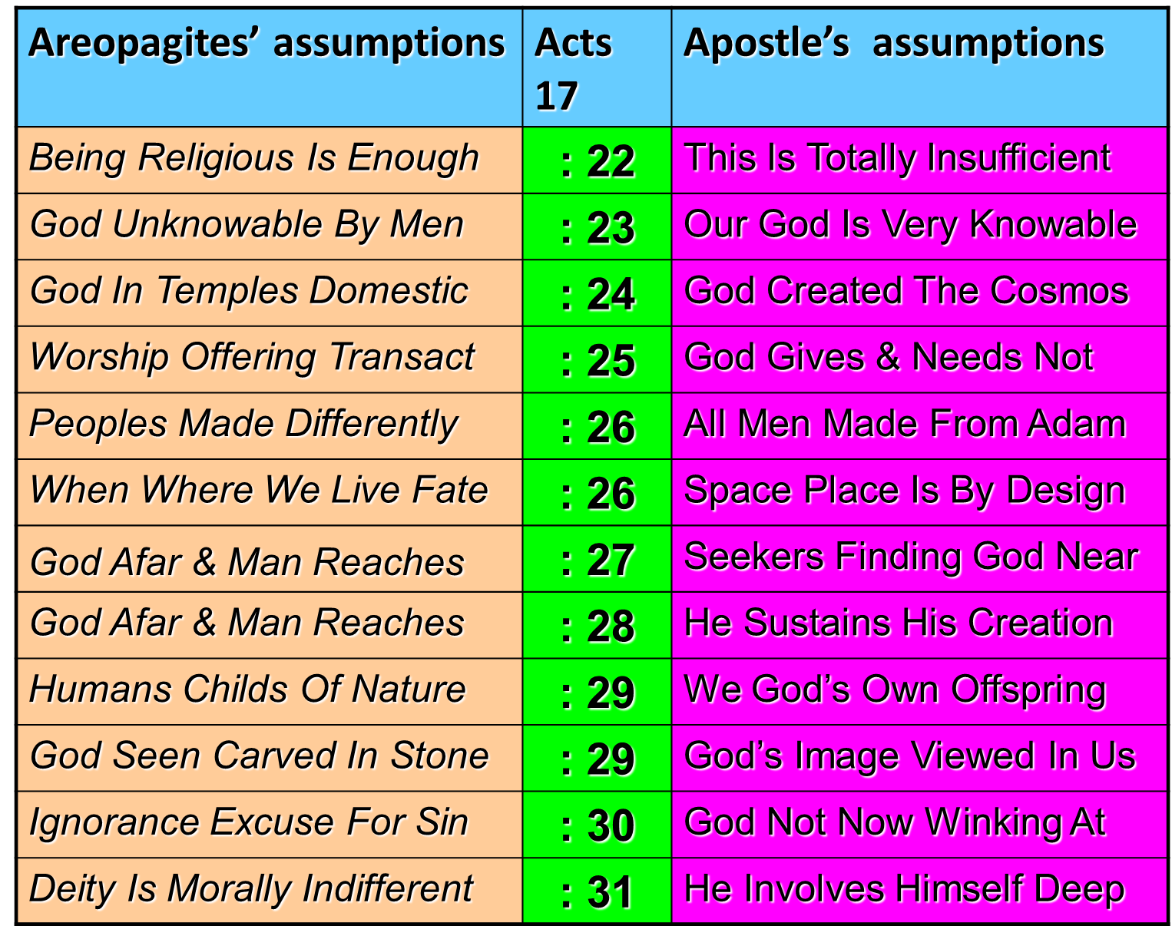

Slide 17
SYNCRETISM
“The attempt to assimilate differing or opposite doctrines and practices, especially between philosophical and religious systems, resulting in a new system altogether in which the fundamental structure & tenets of each have been changed. Syncretism of the gospel occurs when its essential character is confused with elements from the culture.”
* Dictionary Of Theological Terms, Grenz & Guretzki

Slide 18
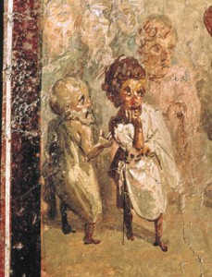
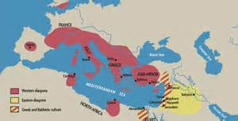
Two onlookers appear to be the Greek philosophers Socrates and Aristotle. The presence of these men in a O.T. Biblical scene suggests that the owner of this house wanted to draw a parallel between the Classical Greek sages & Solomon’s wisdom in the Hebrew Bible. Alinari/Art Resource, NY
Period Jews Proselyte
The Gentile Godfearer
Western Diaspora Followed Written Testament
Eastern Diaspora Followed Written & Oral Law
Seleucid Capital Of Antioch Judaism
Ptolemy Golah of Jewish Hellenism

Slide 19
The Antiochene School Of Theology Practiced An Approach To Scriptural Interpretation With Literal Emphasis Rather Than Spiritual Meanings Not Immediately Evident From The Text
Antioch Center Of Christian Theology

Slide 20
The Alexandrian School Was Influenced By Plato’s Philosophy & Basically Believed That The Bible Was Best Understood As An Allegorical Morality Rather Than As A Literal Interpretation.
Alexandria Center Of Christian Theology

Slide 21
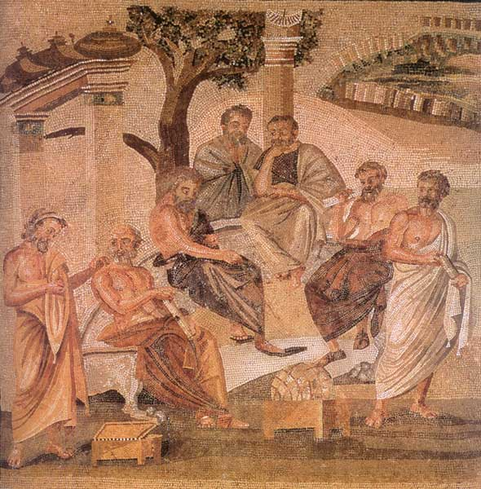
Post-Nicene Christian Thinkers Reopen Plato’s Greek Academy
Among the Apostolically Acquainted Church Fathers – were writers of Christian Apology – literature genre required both for defense and offense. In other words, it was mandated to defend Christians & Christianity and combat false religion of two types - either Roman Paganism or Greek Philosophy. In the process of explanation and instruction it was teaching – it was not being taught.
Neo-Platonism is termed for the teachings of antiquity’s final great pagan philosopher – Plotinus. He called the higher god (the) “One” – for that force transcending all qualities, mysterious and unknowable, completely incomprehensible to the human mind. The One is the highest pinnacle of reality, the undivided Unity from which everything else, in all its diversity, cascades. This reality becomes less “real” and less good the further down from the One it goes. Thus, for Plotinus, evil has no existence itself but is simply the absence of good, in the same way darkness is the absence of light. The physical world, being the furthest from the One, is the least real and good part of existence. In summation, his concept was of a simple trinity of - One, Intelligence, & Soul.

Slide 22
Post-Nicene Christian Thinkers Reopen Plato’s Greek Academy
Christians of the fourth century and beyond were attracted to this concept of “The One” equating it to “The Godhead” and incorporating “The Son” by renaming the World Soul “The Logos.” The same consensus seeming to reject the unqualified proposition of simple evil in single dimension as an absence of good – accepting instead a concept of complex evil and complicated suffering . The concept of graduated degrees or shades of good and evil has had a mixed reception over the generations among different Christian audiences; Completely rejected by dual determinists - acceptance seems to be correlated to an similar acceptance of the related doctrine of degreed reward & punishment.
As those personally familiar with the Apostles and those intimate with them in turn passed from the religious scene – the church transitioned from the Apologists to the Theologians – doctrine systematists and polemic writers that by the Dark Ages managed to so convolute and complicate the simple scripture as first received that Theology had become the “queen science” and Theologians regarded as the most learned of scholars. This next era witnessed within the field of theological science the shift from a scripture systemizing process of text to that of a synthesis process with philosophical tenet. Thus, with the move from apology to theology we have the marriage of Holy Scripture with Human Philosophy and the birth of Christian Platonism – the religious landscape would never be the same.

Slide 24
50 YEARS IN THE CHURCH OF ROME Chiniquy on Education of Catholic Priests
“The models of eloquence which we learned by heart were almost exclusively taken from Pagan literature. In the same manner Pagan models of wisdom, of honour, of chastity were offered to our admiration. Jesus Christ with His soul-saving Gospel, as well as His apostles, had not the liberty to speak to us – these were all put in the (forbidden) Index.”

Slide 25
THESIS & ANTI-THESIS THEOLOGY
PLATO(Teacher) VERSUS ARISTOTLE(Student)
IRENAEUS(2nd Cent) VERSUS AUGUSTINE (4th)

Slide 26
The Church Across The Ages
David Lee Burris:
He said there was no inside track to salvation. He also said the creation was good and that evil came about only because of man’s sin and rebellion.
of people, events
life and faith from
Glimpses
Irenaeus: John's Spiritual Grandson
When Irenaeus, which means “peaceable”, was about forty years old, Polycarp assigned him to the troubled Lyons area of Gaul to advance the evangelistic efforts there. Strange as it may seem, leading a flock that endured harsh atrocities wasn’t his greatest problem – the more insidious threat came from heretics. Some said Jesus was only a spirit manifestation; others said He was only a man. Most of the heresies were forms of Gnosticism, the belief that people could be saved through a special, secret knowledge. Like a physician studying a disease, Irenaeus analyzed the varieties of gnostic beliefs in detail & studied Scripture to combat the false ideas infecting the church. He wrote a multi-volume work called Against Heresies clearly setting forth the basic doctrines shown in Scripture. He further summarized these teachings copied & called Rule of Faith.

Slide 27
David Lee Burris:
Christian Emperor Theodosius invited Thessalonians to free games but sent his troops into the circus with orders to kill the 10,000 men, women, and children.
“The first recorded instance of Christians killing Pagans occurred shortly after {status change year 313}. In short order, the militant church extended its power by conquering lands & peoples throughout Europe, compelling them to become baptized Christians or die… As Charlemagne instructed his Christian troops in their conquest of the Saxons: ‘If there is anyone of the Saxon people lurking among them unbaptized, and if he scorns to come to baptism & stay a pagan - let him die’”.
Orthodox Versus HERETIC
Heresies are inaccurate choices in light of non-negotiable realities: “Heresy is an opinion or doctrine in philosophy, politics, science, art, etc., at variance with those generally accepted as authoritative” (Oxford English Dictionary) Heresies are incorrect choices, based on some generally accepted authority. From a Christian perspective, heresies are claims contradicting the clear objective truths described in the Bible. Irenaeus (the ancient apologist and disciple of Ignatius and Polycarp) made careful distinctions between heresies and apostolic truth. In “Against Heresies”, Irenaeus laid out the heretical claims of some of his errant contemporaries, and compared these claims to the truths he had been taught by Polycarp (the disciple of the Apostle John). Irenaeus referred to his own beliefs as “orthodox”. This word is derived from two Greek root words: Orthodox = Ortho (Right) + Dox (Belief) In essence, Irenaeus used the word to describe those beliefs supported by the apostolic, Biblical teaching. The idea of a “right belief” presumes there are objectively accurate Christian truths, and the Bible is the authority upon which we discover these “right beliefs”. Like all humans, Christians ground truths in an authoritative text. - COLD CASE CHRISTIANITY
- Gregory Boyd, Myth Of A Christian Nation

Slide 28
Irenics Vs. Polemics
“The practice of debating and discussing Christian doctrine with other Christians with whom there are matters of genuine theological disagreement. It involves the friendly rigorous task of doing theological reflection together within the community of faith.”
* Dictionary Of Theological Terms, Grenz & Guretzki

Slide 29
The Irenaean Theodicy (130-202)
The Augustinian theodicy is a soul deciding theodicy.
The Irenaean theodicy is soul making theodicy.
This means that Augustinian theodicy is concerned with judgment. Irenaeus is more concerned with the development of humanity.

Slide 30
Work called: Against Heresies………. Forward looking theodicy.
2 stages in creation: 1) ‘Image of God’. 2) ‘Likeness of God’
Two main aspects:
1. It is through suffering that human souls are made noble –
the world is a ‘vale of soul making’ – a person-making world.
2. One of the ways in which this ‘test’ is carried out is through faith – God’s purpose cannot easily be discerned, but believers continue to believe despite the evidence. They freely become aware of and accept God. This faith becomes a virtue.

Slide 31
We are in an immature moral state, though we have the potential for moral perfection.
Evil is necessary for our moral development.
Throughout our lives we change from being human animals to what Irenaeus called ‘children of God’. This is a choice made after struggle and experience, as we freely chose God rather than our baser instincts.
God brings in suffering for the benefit of humanity. From it we learn positive values, and about the world and around us.
Man is redeemed through his own actions.

Slide 32
Suffering and evil are:
Useful as a means of knowledge. Hunger leads to pain and leads to a desire to feed. Knowledge of pain prompts humans to seek to help others in pain (moral growth).
If we were programmed to ‘do the right thing’ there would be no moral value to our actions. ‘We would never learn the art of goodness in a world designed as a complete paradise’ (Swinburne).

Slide 33
Strengths
Evil can facilitate growth – it does develop a deep moral understanding.
Allows room for the development of higher morality.

Slide 34
Problems/criticisms
Irenaeus argued that everyone goes to heaven. This would appear unjust, in that evil goes unpunished. Morality becomes pointless.

Slide 35
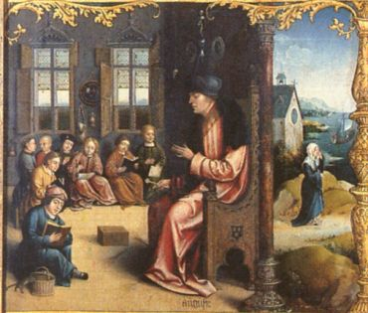
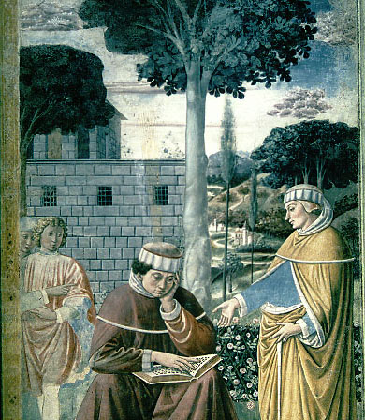
Augustinian Iconography I

Slide 36
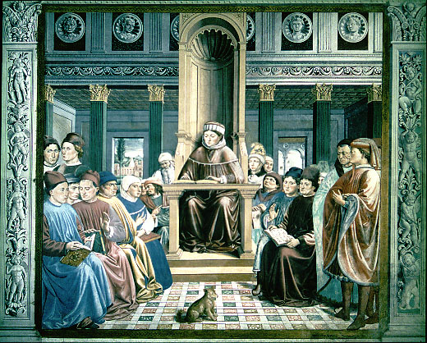
Augustine Of Hippo
David Lee Burris:
Cicero convinced him that “truth” was life’s supreme goal.
- Chief architect of the great schism between the Eastern & Western Churches.
- He excelled at every subject except Greek. This fact would have major theological consequences later.
- In his youth he was known in lifestyle as dissipate and was said to admire Cicero over Christ.
- In early manhood he became an adamant defender of the Manichee heresy – a form or type of Gnosticism.
- In Confessions 7.9.25 he records the pivotal moment he changed course. He heard a child’s voice in the neighboring garden repeat as part of a Milanese game: “Take up and read.” Augustine took this as a divine command and picked up the Bible to read whatever caught his eye. He focused on Romans 13: 13, 14.
He entered a cloistered lifestyle of reflection and contemplation but with conversion did not cease to be a Neoplatonist. In fact, his admitted role model at this point became the great Plotinus.

Slide 37
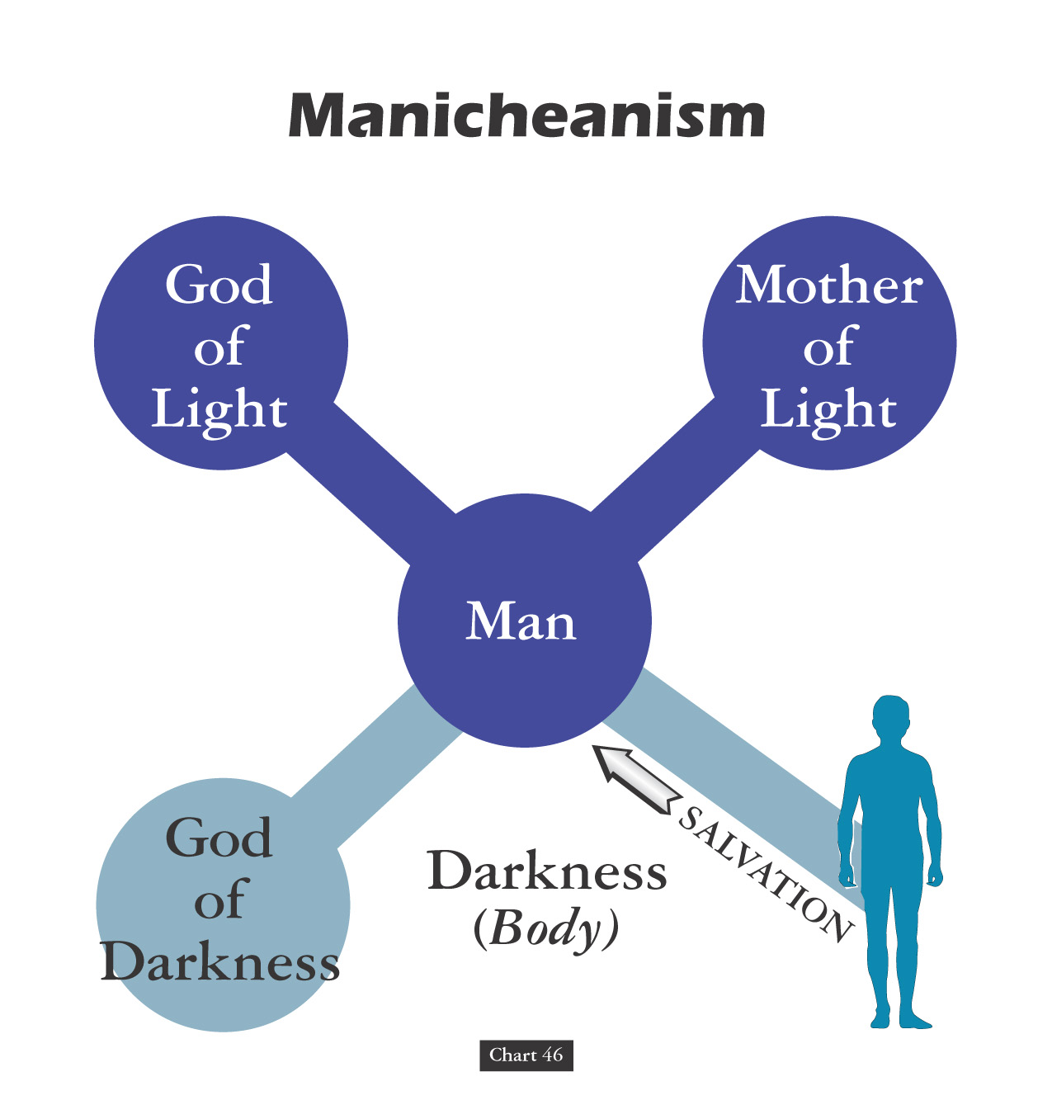
DITHEISM

Slide 38
Augustine Of Hippo
"I would not believe the Gospel
unless the authority of
the Catholic Church would
move me to do so!"
- On Tradition He Wrote -

Slide 39
Augustine Versus Donatists

Slide 40
DOCTOR OF THE CHURCH
“Augustine was the first theologian to align the church in an official way with the use of the sword, & it happened to be against a fellow Christian group, the Donatists. Among other things, the Donatists believed that the alliance between the church and the state that had been forged since Constantine was undermining the purity and integrity of the church, and they wanted to keep the church pure. Though Augustine had previously spoken against the use of coercion for religious purposes, his ongoing battle with the Donatists led him to reverse his view.”
- Gregory Boyd, Myth Of A Christian Nation

Slide 41
“Augustine now justified the use of force by arguing that inflicting temporal pain to help someone avoid eternal pain is justified. Since God had given the church the power of the sword, Augustine reasoned, it had a responsibility to use it to further God’s purposes in the world just as a stern father has a responsibility to beat his child for his own good. Since God sometimes uses terror for the good of humans, we who are God’s representatives on earth – the church – may use terror for the sake of the gospel. If the end justifies it, the use of violence as a means to that end is justified. Page 78
- Gregory Boyd, Myth Of A Christian Nation

Slide 42
David Lee Burris:
Christian Emperor Theodosius invited Thessalonians to free games but sent his troops into the circus with orders to kill the 10,000 men, women, and children.
“The first recorded instance of Christians killing Pagans occurred shortly after {status change year 313}. In short order, the militant church extended its power by conquering lands & peoples throughout Europe, compelling them to become baptized Christians or die… As Charlemagne instructed his Christian troops in their conquest of the Saxons: ‘If there is anyone of the Saxon people lurking among them unbaptized, and if he scorns to come to baptism & stay a pagan - let him die’”.
“The Church Triumphant was quite different from the Church of the Martyrs. The small groups of early Christians consisted generally of simple men who accepted the simple message of Christ in the face of terrible risks, and they lived their faith, striving to emulate the life of the Master. But after the Edict of Milan it became advantageous to join the victorious religion, and easy conversion helped to increase the numbers of the ‘faithful’ geometrically.”
- Gregory Boyd, Myth Of A Christian Nation

Slide 43
David Lee Burris:
Christian Emperor Theodosius invited Thessalonians to free games but sent his troops into the circus with orders to kill the 10,000 men, women, and children.
“The first recorded instance of Christians killing Pagans occurred shortly after {status change year 313}. In short order, the militant church extended its power by conquering lands & peoples throughout Europe, compelling them to become baptized Christians or die… As Charlemagne instructed his Christian troops in their conquest of the Saxons: ‘If there is anyone of the Saxon people lurking among them unbaptized, and if he scorns to come to baptism & stay a pagan - let him die’”.
“It was difficult now to separate the saints from the self-seekers, or the devotees from the Laodiceans. To the great majority of these ‘converts in prosperity’ conversion meant no significant change in their old ways of life. Old practices and superstitions were translated into the new religion. The hosts of saints took the place of the pagan gods, and many of the ancient deities suffered only a change of name. The date of Christmas was set on the birthday of Mithras, the most joyous celebration of the pagan world, and several other Christian celebrations were created to replace popular pagan feasts and holidays.”
- Gregory Boyd, Myth Of A Christian Nation

Slide 44
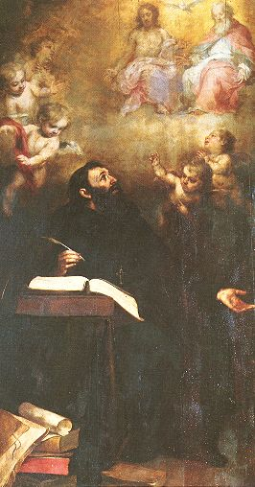
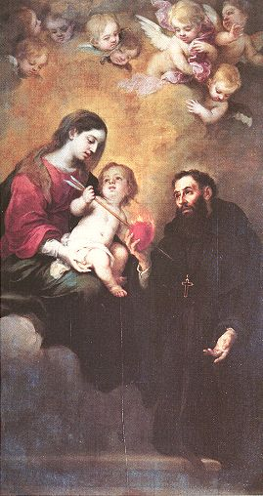
Augustinian Iconography II

Slide 45
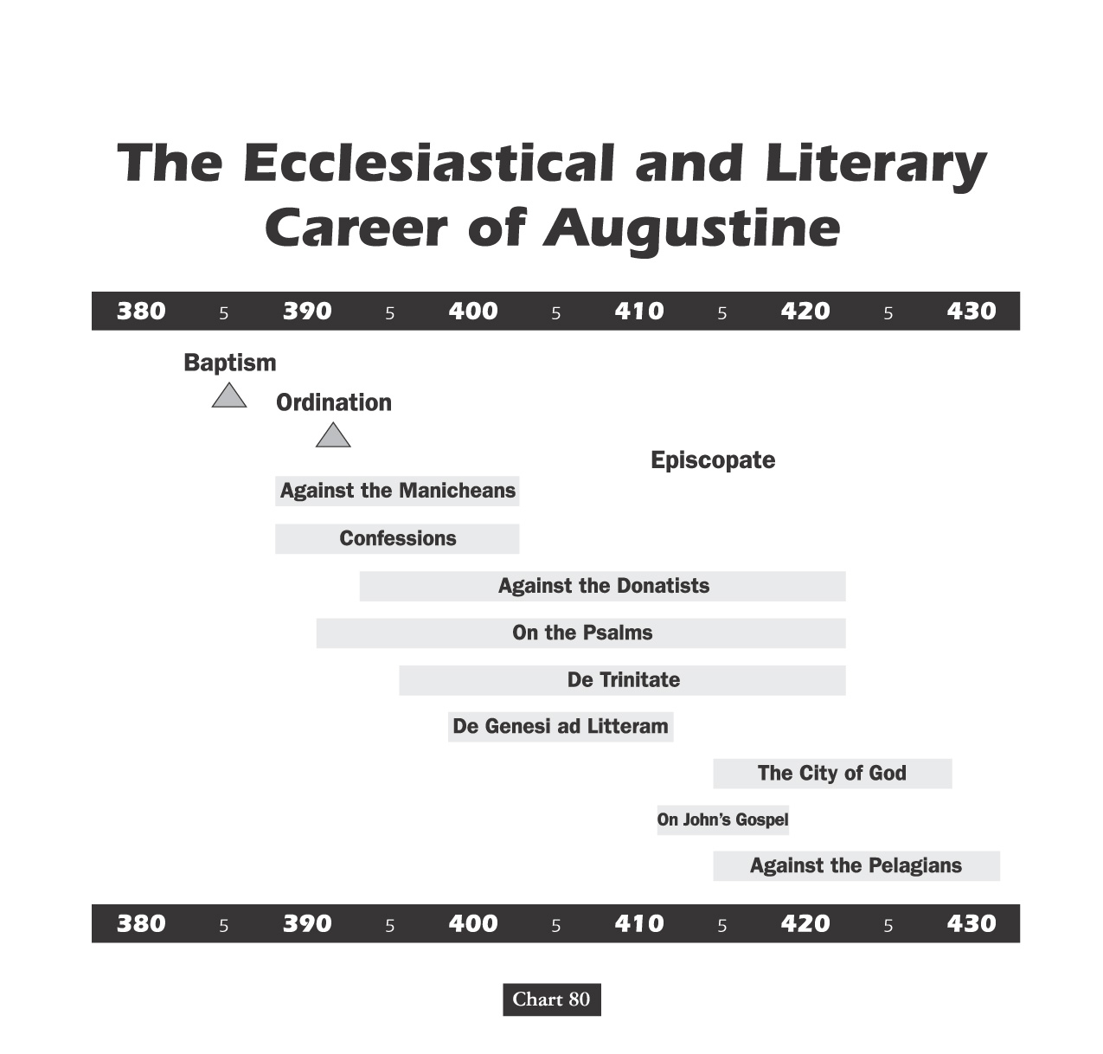

Slide 46
Augustine’s Theodicy
The Fall and Original Sin

Slide 47
David Lee Burris:
Christian Emperor Theodosius invited Thessalonians to free games but sent his troops into the circus with orders to kill the 10,000 men, women, and children.
C. S. LEWIS @FALLEN NATURE:
VERTICAL CONSCIOUSNESS & COMMUNION
“The first recorded instance of Christians killing Pagans occurred shortly after {status change year 313}. In short order, the militant church extended its power by conquering lands & peoples throughout Europe, compelling them to become baptized Christians or die… As Charlemagne instructed his Christian troops in their conquest of the Saxons: ‘If there is anyone of the Saxon people lurking among them unbaptized, and if he scorns to come to baptism & stay a pagan - let him die’”.
“That man in a perfect state of living to bring glory to God and having dominion over all the things including physical functions and animals, attempts to assert his own will against God’s and thus is reduced to living by the rules of nature and not by the spirit. So, a new type of “man” sinned himself into being. A man who lives according to the rules of nature.”
- Gregory Boyd, Myth Of A Christian Nation

Slide 48
Augustine’s Theodicy The Fall and Original Sin
Adam and Eve were made in the image of God: like God they were rational beings and had a moral nature
In their state of original blessedness, Adam and Eve, like the angels, had free will, and could choose to do what is good, and had the ability not to sin.
They were also blessed more with gifts of immortality & an immediate knowledge of God.

Slide 49
Augustine’s Theodicy The Fall and Original Sin
Evil first appeared among those creatures who had free will
The Fall:
First some angels rebelled against the God, the Supreme Good
These fallen angels in turn tempted Adam and Eve to rebel against God

Slide 50
Augustine’s Theodicy The Fall and Evil
Consequences of Adam and Eve’s Sin (“Original Sin”) for humanity:
Death: loss of the gift of immortality
Ignorance: loss of the knowledge & intimacy with God
Moral Evil:
Corruption of our moral nature, causing loss of the inner harmony between reason and the passions.
The passions now dominated rational thought (concupiscence), inclining one to sin.
The ability not to sin was replaced by an inability not to sin.
This corrupted moral nature and the guilt of the original sin is bequeathed to our progeny
Natural Evil:
Part of God’s punishment for Adam’s and Eve’s sin:
“nature red in tooth and claw”
Earthquakes, storms, etc.

Slide 51
Augustine’s Theodicy The Fall and Original Sin
Consequences of Adam and Eve’s Sin
The image of God in Adam & Eve was damaged, although not destroyed
Because of their sin, Adam and Eve became less real, had less being and less goodness
Became less human
Augustine believed human nature was transmitted in the sexual act. The corruption of Adam’s moral nature and the guilt of his sin (= Original Sin) was passed on to his children through his seed, and so on to all subsequent generations
Baptism removes the guilt of the Original Sin, but not the corruption of the human moral nature

Slide 52
INHERITING ORIGINAL SIN THE BLAST FROM THE PAST
Posterity’s Uncritical Acceptance Of Augustine’s Christian Platonism
Their understanding of conception, shaped by a patriarchal culture, would have been some variation of the dominant Aristotelian theory. On this view, the male semen provides the formative principle for life. The female menstrual blood supplies the matter for the fetus, and the womb the medium for the semen’s nurture. The man’s seed transmits his logos (rational cause) and pneuma (vital heat/animating spirit), for which the woman’s body is the receptacle. In this way the male functions as the active, efficient cause of reproduction, and the female functions as the provider of the matter to which the male seed gives definition. In short, the bodily substance necessary for a human fetus comes from the mother, while the life force originates with the father.

Slide 53
INHERITING ORIGINAL SIN THE BLAST FROM THE PAST
Posterity’s Uncritical Acceptance Of Augustine’s Christian Platonism
Platonists believed that all physical objects are simply copies of eternal, immaterial templates or Forms. This means that two objects of the same kind have a sort of connection because they both depend on the same Form. So the terrible taint of Adam can spread to those who share his Form, the Form of humanity. This inheritance concept of fatalistic disposition and consequence can similarly be linked to classic theories of genetics. It was believed that everything children inherit is received from the father alone. The mother contributed nothing material to fetal development and served simply as an incubator. It was considered a matter of simple common sense that embryo existed entire in seed form within the male before implantation. The father once existed in seed form in his father too, and so on – and so on - all the way back to the Garden of Eden - similar to a set of Russian Dolls.

Slide 54
Ideological Development: Christian Religion
Julian Defended Origen Against Augustine:
“[God] it is, you say who judges in this way; he is the persecutor of newborn children; he it is who sends tiny babies to eternal flames. It would be right and proper to treat you as beneath argument: you have come so far from religious feeling, from civilized feeling, so far indeed from mere common sense, in that you think that your Lord is capable of committing a crime against justice such as is hardly conceivable even among the barbarians.”

Slide 55
David Lee Burris:
Christian Emperor Theodosius invited Thessalonians to free games but sent his troops into the circus with orders to kill the 10,000 men, women, and children.
“The first recorded instance of Christians killing Pagans occurred shortly after {status change year 313}. In short order, the militant church extended its power by conquering lands & peoples throughout Europe, compelling them to become baptized Christians or die… As Charlemagne instructed his Christian troops in their conquest of the Saxons: ‘If there is anyone of the Saxon people lurking among them unbaptized, and if he scorns to come to baptism & stay a pagan - let him die’”.
Original Error @ ORIGINAL SIN
Inter-Generational Sinful Consequence (Exodus 34: 7)
Not Sin Inherent - Or - Guilt Imputed
(Ezekiel 18: 19 – 32)
- Gregory Boyd, Myth Of A Christian Nation
JESUS REVISITS MISCONCEPTION @JOHN 9: 1 - 5

Slide 56
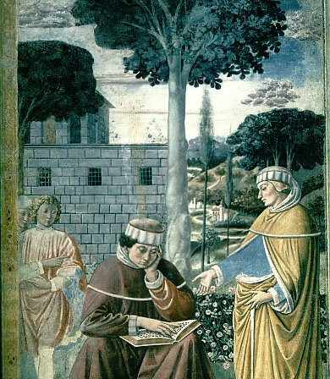
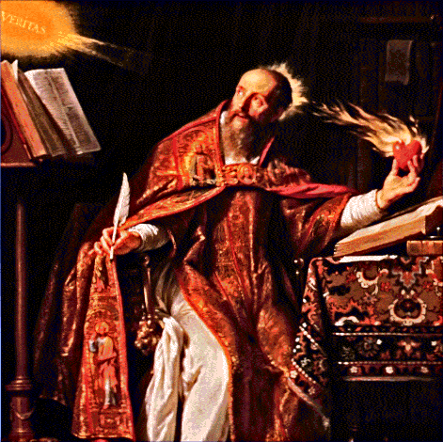
ROMANS
CHAPTER
SEVEN
Verse
Seven

Slide 57
The Life of Augustine of Hippo
Augustine also faced a crisis of the faithful when a monk named Pelagius taught that human nature is not sinful.
Augustine contended that the sin of Adam so completely corrupted all of humanity that no one naturally desires to do what is right. * Like With the Pear Tree.
* {From His Confessions A Great Youthful Indiscretion}
No Original Sin In Judaism
Forbidden Fruit Creates Desire

Slide 58
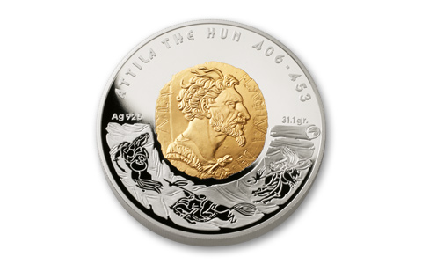
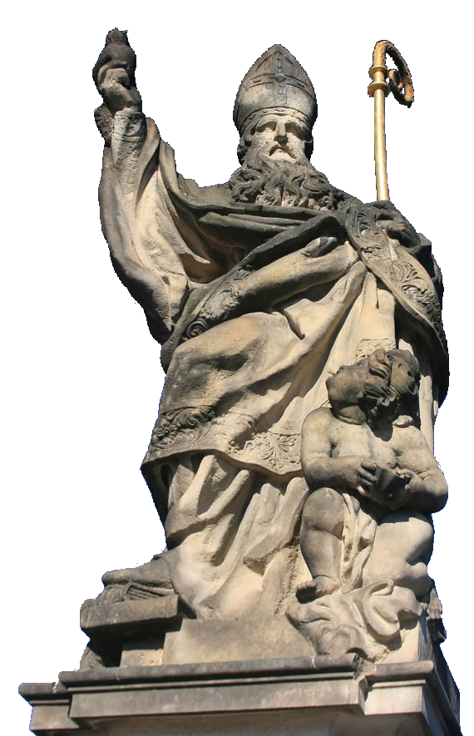
Augustine linked separate doctrines:
Augustine argued that sexual relations transmit the sin nature.
Infant baptism, Augustine claimed, purges the primal sin.
Augustine of Hippo
Notes:
Image © Tiberiu Stan

Slide 59
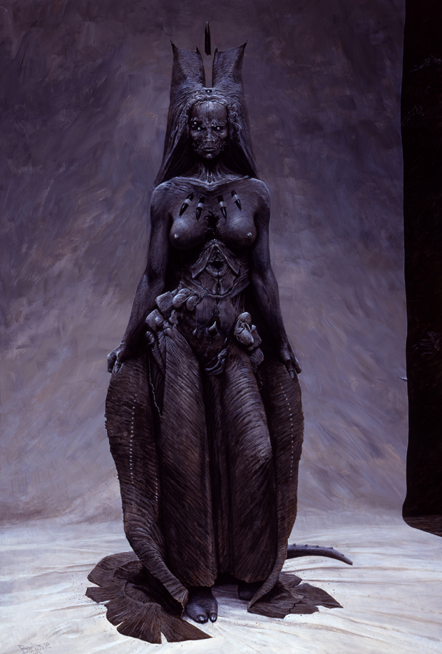
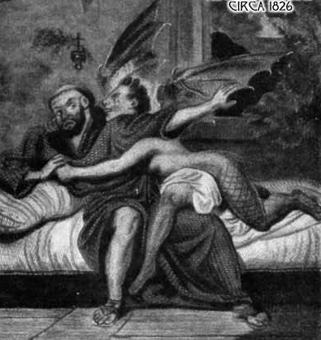
Augustine Emphasis of Eve’s Action
Augustine argued that sexual relations transmit the sin nature.
[Woe]man & [Flee]male:
The Spiritual Succubus
Notes:
Image © Tiberiu Stan

Slide 60
On Man’s Other Inescapable Behavior
According to Augustine, most notable, was making war. It had gone on since time immemorial and was therefore, according to him, natural to mankind.
Thus evolved the theory of “just war,” whose successful establishment completed a virtual revolution in the Christian overview of right and wrong, and ushered in centuries of mass killings and destruction.
Political language is designed to make lies sound truthful and murder respectable. – G. Orwell
Augustine of Hippo
Notes:
Image © Tiberiu Stan

Slide 65
THESIS & ANTI-THESIS THEOLOGY
PLATO(Teacher) VERSUS ARISTOTLE(Student)
IRENAEUS(2nd Cent) VERSUS AUGUSTINE (4th)
AUGUSTINIAN VERSUS PELAGIAN NEMESIS

Slide 66
The Holy Man Pelagius The Holy City & The Great Augustine
J. Hill, The History Of Christian Thought, pg. 78:
“Now that Christianity was the official religion and rather fashionable, standards of behavior had fallen in the church. When Pelagius arrived in Rome from his native Britain, he was shocked at what he saw. He was even more shocked when he found that some people justified their sinful life theologically. They told him they had no power to overcome original sin. It was impossible to do anything good unless God directly brought it about by an act of grace. So if we are predestined to sin or grace, why make any effort?
Matters came to a head one day when Pelagius was attending a reading of Augustine’s Confessions. The reader came to the line where Augustine implores God: ‘Command what you will, and give what you command.’ Pelagius was outraged at the implication that God should control his creatures like puppets, and he angrily shouted down the hapless reader.”

Slide 68
When Institutional Independent “Paulicians” Took To Public Debate Byzantine Monks They Reported: “ “Only the New Testament was accepted among them as rule for faith and church practice; they rejected the worship of the Mother of God and of the saints… each Sunday they assembled in places of prayer which are not worthy to be named thus, since they use neither altar or wall for pictures of the saints, nor a place for keeping the holy vessels; they use neither incense nor chrism oil. They despise and scorn the baptism of the church and say infants have no faith.”

Slide 70
FORMED FRAMED FATALLY FLAWED
CREATED CONGENITAL COMPLETE
Versus

Slide 72
ORIGINAL STATE INNATE CORRUPTION
ORIGINAL STATE INNATE PERFECTION
Versus

Slide 73
Augustinian–Pelagian Controversy AUGUSTINE - and/or - PELAGIUS
David Lee Burris: PRE-FIGURE OF FRAME OF ARGUMENTATION
Augustine Pre-Orthodox Protestant Monergism & Pelagius Catholic Synergism
An Abbreviated Augustine:
Augustine argued that by Adam’s first sin, by which the entire human race participated, sin came into the world, corrupting every person both physically and morally. Everyone, being of Adam, is born into the world with a nature that is so corrupted that they can do nothing but sin – the exercise of the will is limited to only evil options (freedom being defined as the capacity to make choices in conformity with one’s desires). Therefore, for Augustine, the need for grace was central. We are heirs of a disfigured condition that has clouded the capacity of our wills as to even an awareness of Christ – much less – a desire for Him. The effect of the unmerited favor of God is twofold: 1st – God reveals the wonder of His Son’s redeeming mercies; 2nd He strengthens the will so that humankind can freely embrace Christ as the sinner’s only hope of forgiveness. This grace is irresistible. Because we cannot be saved against our will – the wills of men are made complaint.
Three Basic Postulates:
Monk Pelagius taught that there was no connection between what Adam did & the state wherein we are born; Ours’ also is a voluntary condition - the same as that of Adam before his fall. He and his followers opposed the doctrines of Adamic Unity & guilt by birth inheritance.
The doctrine of inherited inability discarded, the corollary was embraced – the freedom of humanity’s will. Although the human will is inhibited by negative example we retain the ability to choose between good & evil. The will is defined as a determining power, not a selecting agent of the presented available options.
Grace is an assisting gift that is availed from God by way of human choice. This “illuminating grace” influences humankind toward voluntary cooperation with God; it is a resistible grace.

Slide 74
SEMI-PELAGIANIST TENETS
Humankind Comes Into This World Healthy
While We Inherit The Corruption & Death Of Adam We Are Morally Only Partially Disabled
We Only Need Assistance In Terms Of Divine Strengthening Of God-Given Natural Abilities.
God Does Most Of What Is Needed To Save Sinners But Not Everything That Is Required.
Those Who Perish Do So Against God’s Will.
Predestination: Foresight Not Foreknowledge!

Slide 75
SEMI-PELAGIANISM: The Cassian Controversy
************** News 529 A.D. *************** Moderate Augustinianism Prevailed This Year When Bishops Of Rome At The Orange Synod Rejected The Mediating Position Of John Cassion.
- CAUSATIVE COOPERATIVE ABILITY - Salvation As A Second Act Of Grace: This view argues that God’s action may at times follow the sinner’s repentance and at other times precede it.

Slide 77
THESIS & ANTI-THESIS THEOLOGY
PLATO(Teacher) VERSUS ARISTOTLE(Student)
IRENAEUS(2nd Cent) VERSUS AUGUSTINE (4th)
AUGUSTINIAN VERSUS PELAGIAN NEMESIS
AUGUSTINIAN(Old)/THOMISM(New Church)

Slide 78
THE AUGUSTINIAN MONASTERY Inevitable Crisis Of Ultimate Authority
The Augustinian theological assumption enabled the West to put confidence in human logic, language and rational knowledge (all the way from intuition and empirical observations to doctrines and creeds). During the Middle Ages, the medieval (Augustinian) monasteries began doing something that became unique to Christianity. When a young man devoted his life to seek and serve God, the monastery required him to spend years studying religious discipline, religious & secular law, philosophical logic, theological rationale, speech rhetoric, languages, literature, mathematics, music, and practical arts such as agriculture, animal husbandry, medicine and metallurgy. Therefore, the monastery – which was an institution for cultivating religious life – began producing a peculiarly rational person, capable of thinking, researching, developing technology, writing books, developing capitalism, science and complex, rational legal and political systems.

Slide 79
THE AUGUSTINIAN UNIVERSITY Pursuit Of Knowledge: Mixed Message
Why Did The Western Church Consider Scholarship
& The Making Of New Discovery A Divine Calling?
The idea came from the Bible via Augustine. He taught that God was a rational being & the human mind (not just the human “soul”) was made in God’s image. Therefore, our rationality was qualitatively different from that in the animal brain. God gave us a mind like His own so that we might know Him and understand & govern his creation as his children. For Augustine this meant that, according to the Bible, to be godly required us to cultivate our minds – the instrument of knowing God and his creation.

Slide 80
Theology: Queen Science In Medieval Tower Of Knowledge
WRITTEN GRAMMAR
KNOWLEDGE LOGIC
SPEECH RHETORIC
ARITHMETIC MATH
MUSICAL READING
GEOMETRIC MATH
ASTRONOMY & PHYSICS
APOLOGY & THEOLOGY

Slide 81
Drawing From A Polluted Stream
Sir Robert Anderson stated: “Of all the errors that later centuries developed in the teachings of the church, scarcely one cannot be found in embryo in ‘his’ writings.”
B.B. Warfield states: “Augustine [not an inspired writer] determined for all time the doctrine of grace.”

Slide 82
From Augustine Unto Aquinas
Church history short courses have sometimes reduced the process of church reform and counter reform to a conflict between establishment Catholic Thomism & reactive Conservative Augustinianism. Medieval religious history cannot be so simplified. However, it is true that the church of the middle ages adopted Thomas Aquinas’ philosophy. Moreover, It emphasized his teaching that man’s will was not totally corrupted. By faith and utilizing the means of grace held within the sacraments dispensed by the hierarchy, man could achieve salvation. Augustine believed that man’s will was so totally depraved that he could do nothing toward his own salvation.

Slide 83
NEW FIELD OF RELIGIOUS STUDIES Neutrality In The Pursuit Of Knowledge
Many people are unaware that Religious Studies and Theology are not synonymous. Generally, the difference can be understood as the difference between the university and the seminary; in other words, a difference of perspective—the view from the outside or from the inside. The study of Religion has historically allied itself with science and reason as an interdisciplinary field using the methodologies of History, Linguistics, Anthropology — including Archaeology — and other university disciplines. One of its basic “rules” is that the scholar investigates religions of the contemporary world or of the past (such as ancient Israel) as a neutral observer & reporter with no religious agenda (even if we know no one can be fully impartial). Scholars of Religion do not aim to tell people what to believe or how to live.
By contrast, a Theologian studies her own religion as a believer—as a Jew or a Christian, for example—allied with faith and authority. What she discovers about, say, the influence of ancient Mesopotamian law on the Ten Commandments (Exodus 20:1–17; Deuteronomy 5:6–21), she will seek to reconcile with existing Christian or Jewish belief. What is problematic is that the border between the two disciplines can very easily overlap, especially in the subfield of Religious Studies that is Biblical Studies.

Slide 84
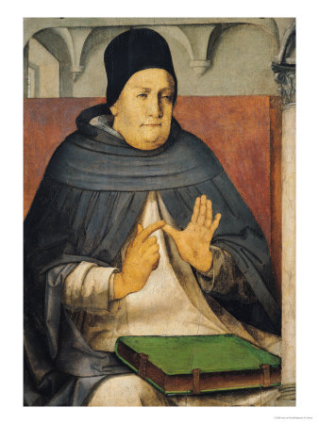
“Dumb-Ox” to Scholastic Doctor
Thomas Aquinas’ parents tried to keep him from becoming a monk.
But he became both a monk and the supreme scholar of his era.
His Summa Theologica, though never finished, fills more than 4,000 pages.
Thomas Aquinas (1225–1274)
Notes:
“Portrait of St. Thomas” by Joos van Ghent (c. 1475)

Slide 85
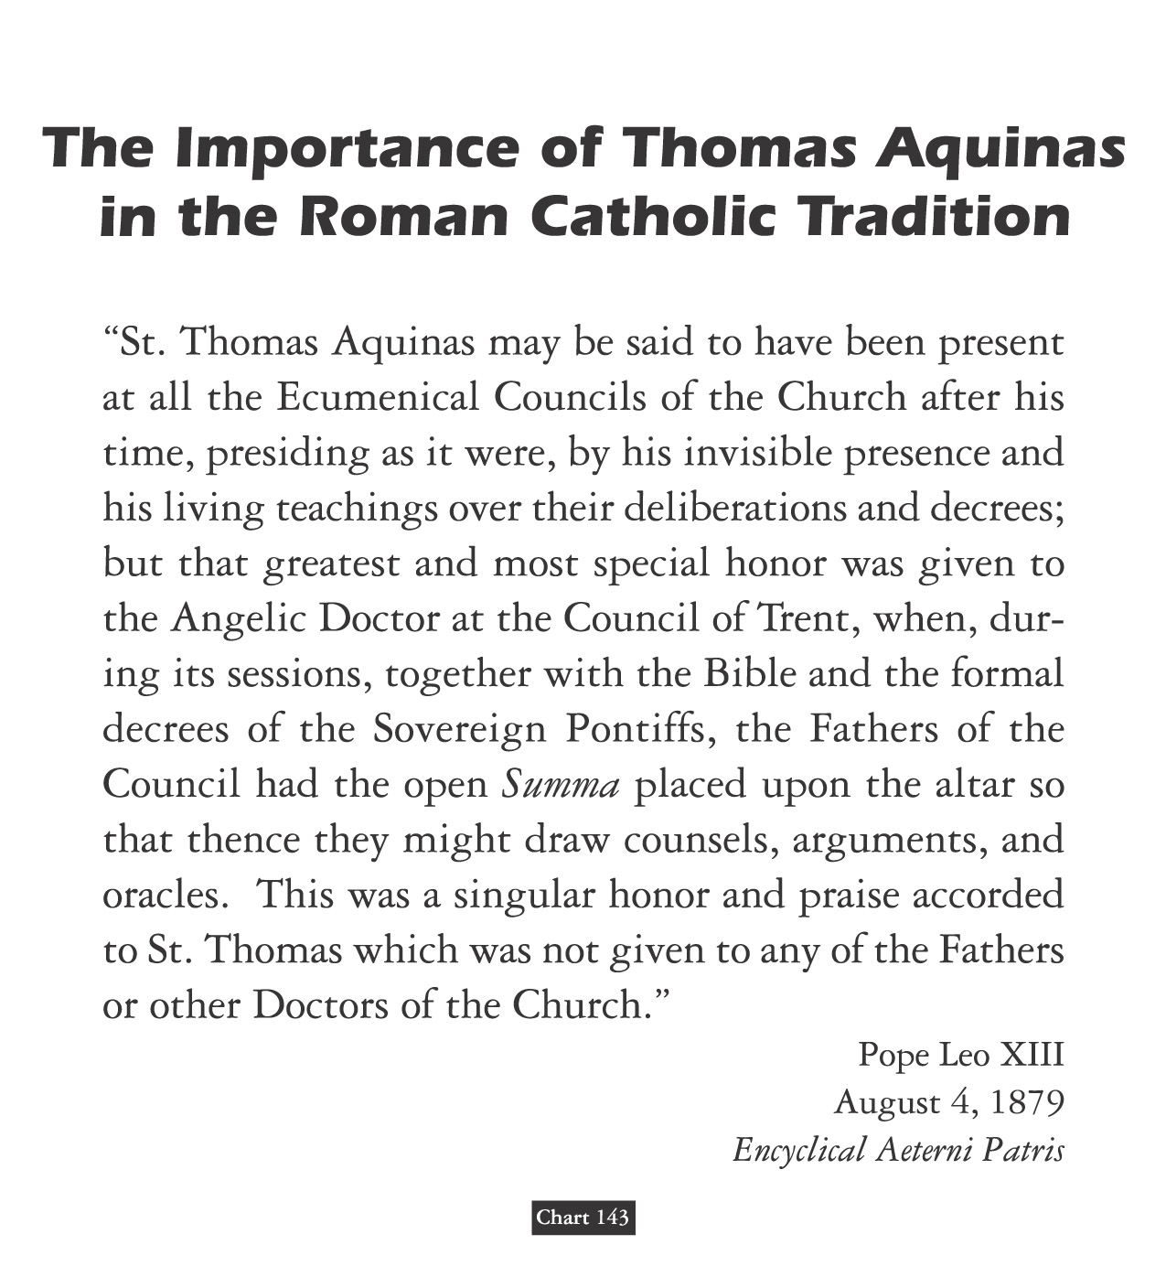
David Lee Burris:
Summa Theologica discusses 512 theological points, including whether an angel can sin!
Summa Theologica: Harmony Of Reason & Revelation

Slide 86
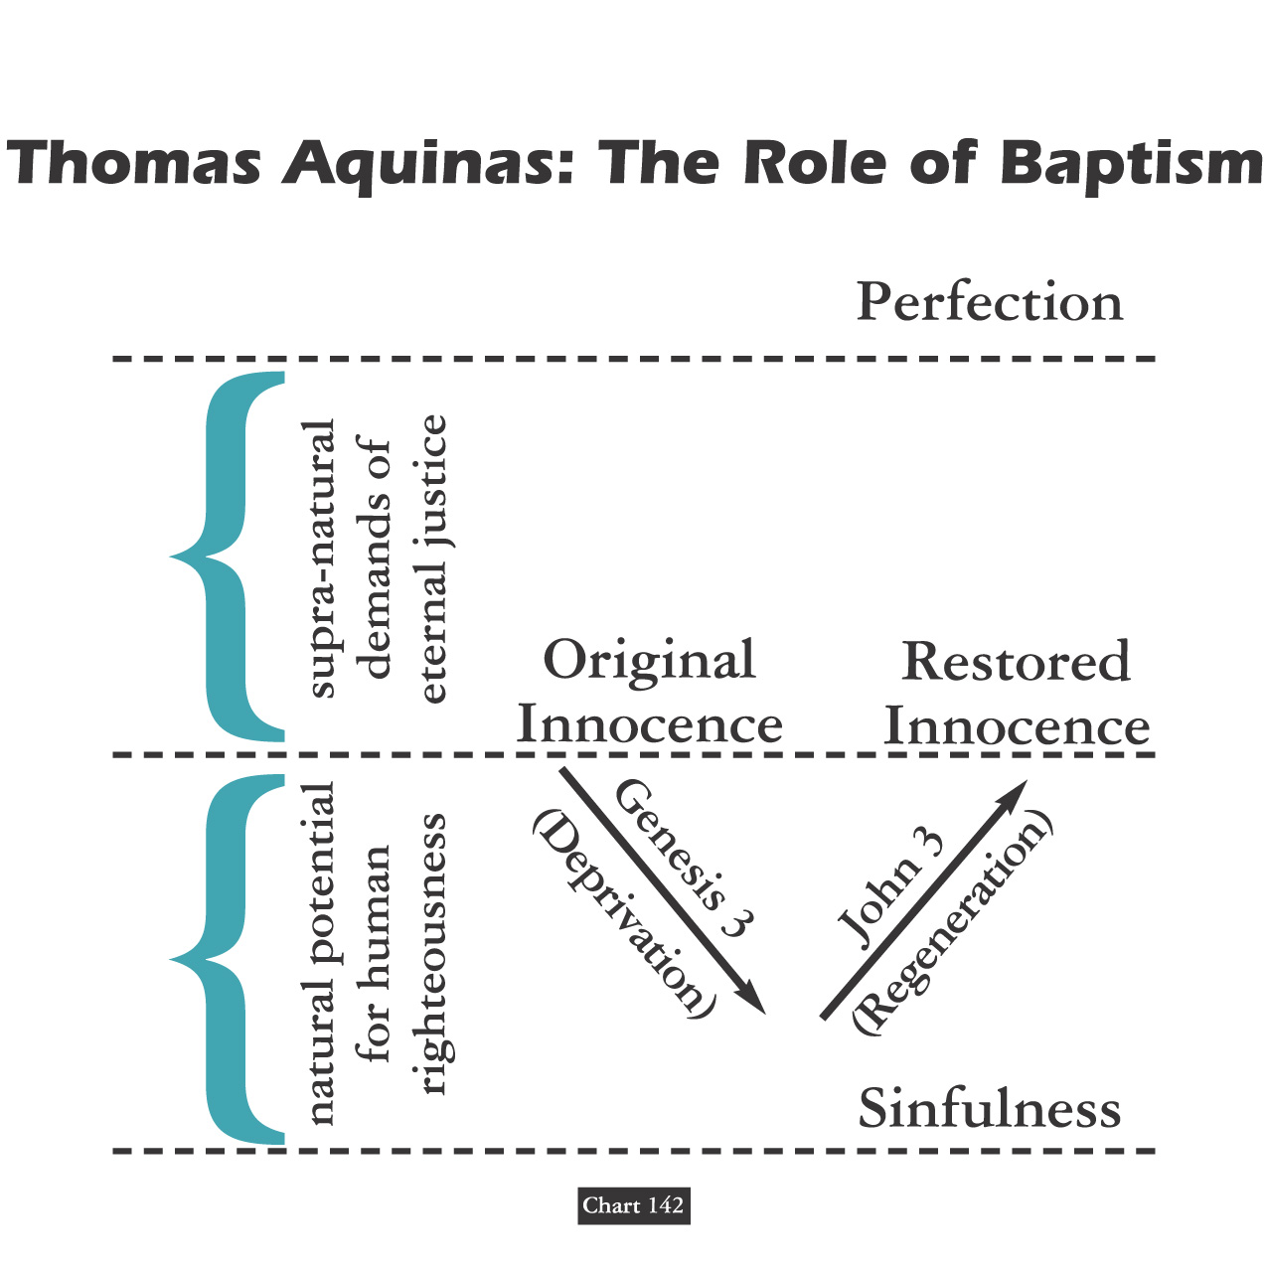

Slide 89
EACH SIDE OF EVERY SCHISM DEBATES
AUGUSTINE NOT GOD'S HOLY WORD!

Slide 90
THESIS & ANTI-THESIS THEOLOGY
PLATO(Teacher) VERSUS ARISTOTLE(Student)
IRENAEUS(2nd Cent) VERSUS AUGUSTINE (4th)
AUGUSTINIAN VERSUS PELAGIAN NEMESIS
AUGUSTINIAN(Old)/THOMISM(New Church)
DESIDERIUS ERASMUS VS. MARTIN LUTHER

Slide 91
Augustinian Spirituality Setting Paradigm
Story: Earthly Pilgrimage To Eternal Happiness
Morality: Those Virtues To Travel Beatific Road
Start: Accept Received Faith Until Seeing For Self
Move: Drive Engine Love Both Propels / Attracts
Human Free-Will Incapable Love Overwhelming
Counterfactual Test Proves Love – Gift Of Grace
Compatibilists: God’s Grace & Man’s Free Will
Doctrine Of Grace Includes Human Merit Concept
Anselm’s Augustinian Prayer Seeks Grace & Faith
Private Confession Created Penitential Conscience {No Preaching/Pastoral Care – 24/7 Paid Prayers}
Piety Focus: Habits Of Heart / Art Of Dying Well
Salvation: Inner Examination & Outer Experience

Slide 92
David Lee Burris:
Sometimes They Found Alliance Sometimes They Worked Apart!

Slide 93
Dominant Augustinian Paradigm Secular & Sectarian Applications
DIFFERENT RENAISSANCE EXPERIENCES:
The Italian Renaissance -
Fascination With Greek Classics
The Teutonic Renaissance -
Fascination With Greek Gospels

Slide 94
Dominant Augustinian Paradigm Secular & Sectarian Applications
DIFFERENT RENAISSANCE EXPERIENCES:
The Italian Renaissance -
Continuing Expressions Of Explicit Support
The Teutonic Renaissance -
Break In Tacit Contract Of Systemic Support

Slide 95
PLATO | ARISTOTLE
Idealism | Realism
Republic | Politics
The “Ideal” State | A Working Government
TRANSCEND Human Selfishness | ACKNOWLEDGE Human Selfishness
Social Unity | Balance

Slide 96
ARISTOTLE THRU THE AGES
Aristotle will always be significant to scholars as the most famous student of Plato.
His works on logic are among the classics. He basically believed existence is related to substance and that everything is caused by something else – uniform theory.
His practical philosophy proved more controversial. He states that our souls are formed by habits, skills, and virtues. These same virtues are like skills in that they are formed by practice – by working at it. The other way our souls are shaped is through perception.
Aristotle has remained an ageless figure and forever thought provoking as regards his postulation - in purely physical terms - of an “Unmoved Mover” – an irreducible final cause to the universe.

Slide 97
Debate Begins With Aristotle: How Are People Changed Within?
“To Be Is To Do” - Or - “To Do Is To Be”
“Excellence is an art won by training and habituation. We do not act rightly because we have virtue or excellence, but rather we have those because we have acted rightly. We are what we repeatedly do… Excellence, then is not an act but a habit.”
* Disputing Human Nature!

Slide 99
COUNTERING THE COUNTERFACTUAL TEST
Bible Says You Are In Charge Of Your Own Heart
Jeremiah 4: 4 – “Remove the foreskin of your hearts”
Jeremiah 9: 13 – “Stubbornly followed their hearts”
Jeremiah 18: 11 – “Act according to his evil heart”
Ezekiel 18:31 – “Make Yourselves A New Heart & A New Spirit!”

Slide 100
Luther Critique’s Clairvaux: Spiritual Maturity & Progress
FIRST – Love Of Self For Your Own Sake.
SECOND – Love Of God For Your Own Sake.
THIRD – Love Of God For God’s Sake.
FOURTH – Love Of Self For God’s Sake.

Slide 101
Luther On The Gravity Of Sin: Mankind Is Incurvatus In Se
Humanity Has Curved In Upon Itself
With Meaning Twisted
& Our Ideals Warped
* Spiritual Physics Of Heavy Mass

Slide 102
What did People believe at the Start of the 16th Century?
If you died with a dirty Soul you would go to either Purgatory or straight to hell.
You had to go to Church and get the Priest to clean your Soul.
If you died with a clean Soul you would go to heaven.
Notes:
I would use the zoom facility of my interactive whiteboard to zoom in on the different sections of this picture.
If you haven’t got this facility then you could crop the picture to the scene you prefered

Slide 104
What did People believe at the Start of the 16th Century?
If you went on a Crusade or a Pilgrimage you could earn time out of Purgatory
You could buy a special letter from the Pope called an Indulgence which was like a get out of jail for free card but for Purgatory.
Notes:
This would be a good point to play the Blackadder video: The Archbishop of Canterbury – The scene to do with the selling of relics

Slide 105
Martin Luther: Epic Life & Tale
David Lee Burris:
Later Strong German Resistance To Practical Application Of Lightening Rod Points To Particular Problem Referencing Teutonic Culture.
Thunderous Close Call Thinks Divine Numinous With Deliverance – Change Career Choice: From Legal Study To Mendicant Scholar
Bad News Theology Gospel Of Condemnation Salvation: Self-Accusation
Rome Road Trip - Trip
Tower Study Event Good News Of Promise Justification: Faith / Grace
Luther Three Stages 1516 – Negative Young 1520 – Positive Mature Late Life – Regression

Slide 106
MARTIN LUTHER VISITS ROME

Slide 107
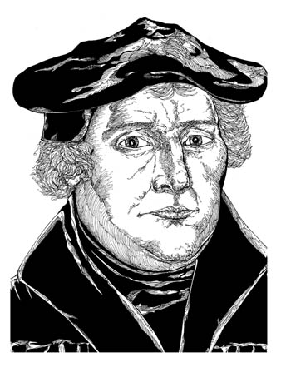
Martin Luther the Monk
While studying the Greek New Testament, Luther saw that God imputes his righteousness to anyone who truly trusts Jesus.
“The passage of Paul,” Luther said, “became my gateway to heaven.”
Martin Luther
Notes:
Illustration by Stephen Hesselman

Slide 108
Martin Luther and Indulgences
In 1517, Pope Leo X allowed alms to be given to the Church in exchange for “indulgences.”
It was believed that indulgences released Christians from the temporal punishments for their sins.
Pope Leo X
Notes:
Image: Pope Leo X, File:Ara Coeli (12).jpg available at www.wikipedia.com

Slide 109
MARTIN LUTHER DISPUTES

Slide 110
The Protestant Principle
“The Protestant principle suggests that believers ought to read & seek to understand the scriptures, and that church practice ought be continually subjected to the scrutiny of Scripture.”
* Dictionary Of Theological Terms, Grenz & Guretzki

Slide 111
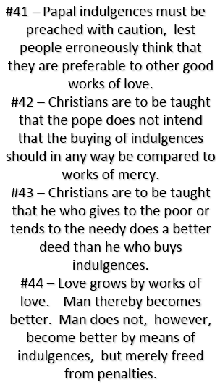
Martin Luther Was Trained Philosophically In Nominalism!

Slide 112
Okham's Razor
“Main axiom of nominalist philosopher William of Occam, namely, that principles employed to explain phenomenon should not be multiplied without necessity… O’ razor was used to eliminate the supernatural from view!”
* Dictionary Of Theological Terms, Grenz & Guretzki

Slide 113
Martin Luther, the Wild Pig
Martin Luther wanted to debate the validity of indulgences.
On October 31, 1517, Luther nailed a list of 95 theses (topics for debate) on a chapel door in Wittenberg, Germany.
In response Pope Leo X declared, “Arise, O Lord. A wild (alcoholic) pig has invaded the Lord’s vineyard!”
Notes:
Image: © David Crooks

Slide 114
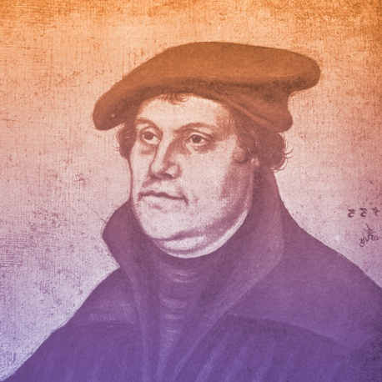
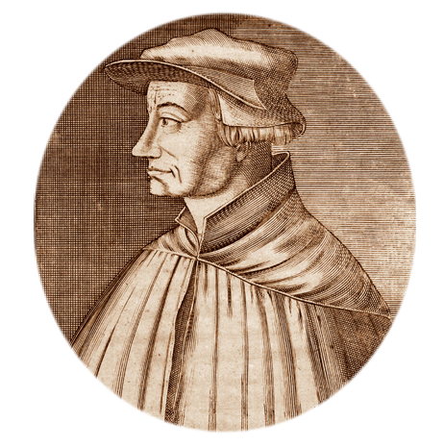
1519
Martin Luther questions papal infallibility (belief that the pope is preserved from error in matters of faith and morals) and begins New Testament sermon series, starting a new era of preaching
Martin Luther
Ulrich Zwingli begins New Testament sermons, thus ushering in the Swiss reformation
Ulrich Zwingli

Slide 115
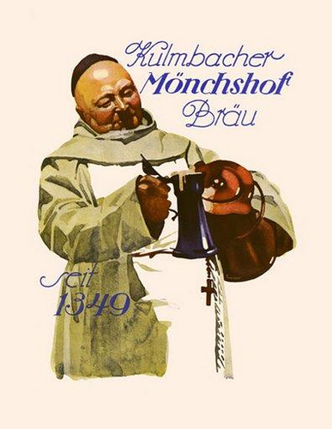
WHERE DID THEY COME FROM? The Pulpit System
Altar Replaced With Pulpit:
Luther had the entire area ripped out of the front of the church. High up on one of the pillars of the church was a rostrum or pulpit which the Catholic priest had climbed up by means of a circular staircase to read dutifully the weekly announcements to the faithful flock below. Luther had one of those pulpits placed in the front & center of the building, where the altar had been. That was new. Brand new. And so, was born the Protestant pulpit!
TODAY'S TEN A.M. TIME FOR
PROTESTANT SUNDAY SERVICES
ARE STILL IN ACCOMMODATION
TO LUTHER'S HEAVY HANGOVERS!

Slide 116
WHERE DID THEY COME FROM? The Pulpit System & Participatory Music
Altar Replaced With Pulpit:
Luther had the entire area ripped out of the front of the church. High up on one of the pillars of the church was a rostrum or pulpit which the Catholic priest had climbed up by means of a circular staircase to read dutifully the weekly announcements to the faithful flock below. Luther had one of those pulpits placed in the front & center of the building, where the altar had been. That was new. Brand new. And so, was born the Protestant pulpit!
Congregational Singing
Martin Luther & followers understood the importance that music can play in a healthy spiritual life and encouraged singing in church.
They also stressed the importance of hymns sung in the native languages of worshipers as a means for facilitating more personal involvement for churchgoers.
This led to the creation of a new kind of music, called the chorale.

Slide 118
Priesthood Of Believers
“The Reformation principle that declares the privilege & freedom of all believing Christians is to stand before God in personal communion through Christ, directly receiving forgiveness without the necessary recourse to human intermediaries.”
* Dictionary Of Theological Terms, Grenz & Guretzki

Slide 119
David Lee Burris: Salvation Is ~ EXTRA NOS ~ “Outside Of Ourselves”
Even Elect’s Sin Of Disbelief Forgiven Beforehand
Luther Versus Erasmus
Monergistic
Synergistic
Controversy

Slide 120
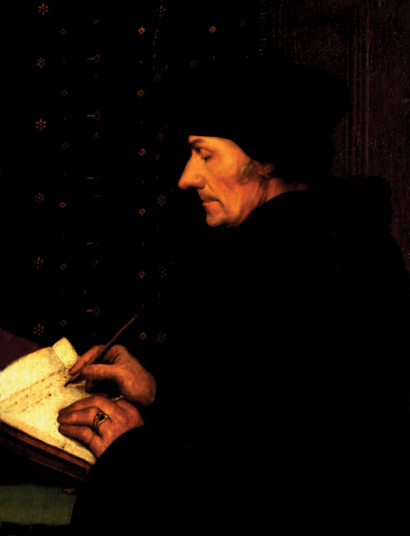
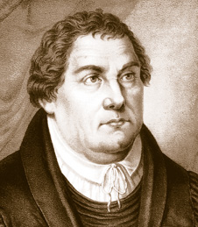
AD 1524
Luther & Erasmus
Erasmus
1500 BC 500 BC AD 1 AD 500 AD 1000 AD 1500 AD 1900 AD 2000

Slide 121
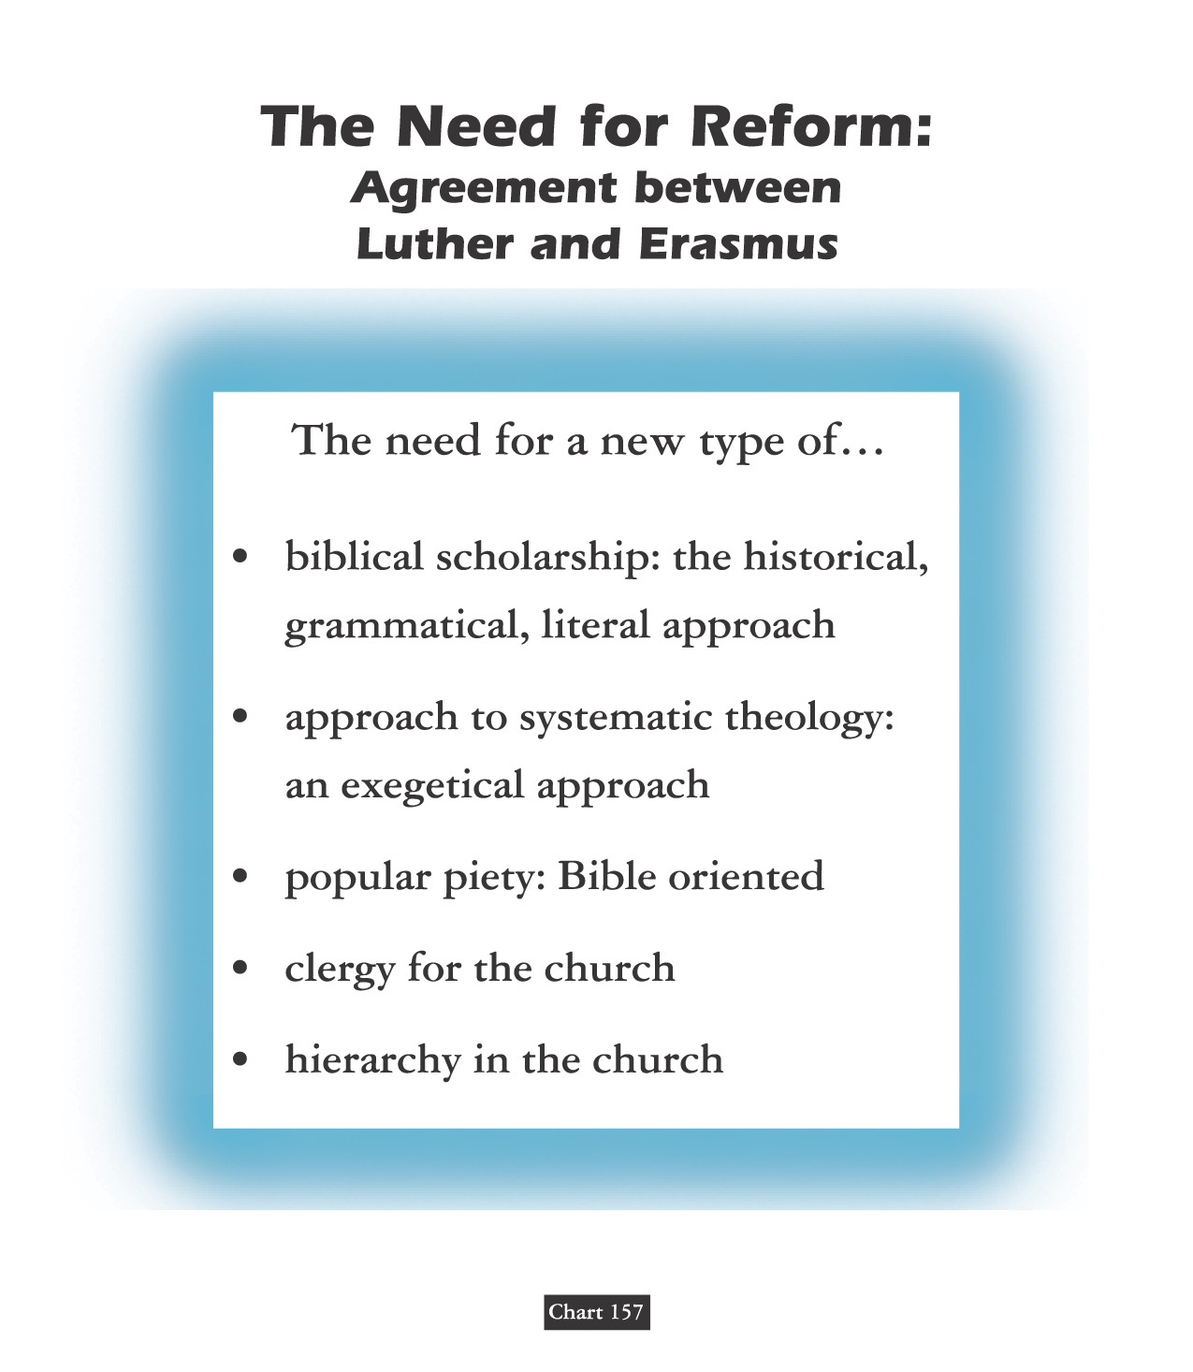
Clear Text & Pure Faith

Slide 123
SALVATION:
A L L
O F
G O D ?

Slide 124
Erasmus publishes On Freedom of the Will, his famous attack on Luther’s denial of free will
1524

Slide 125
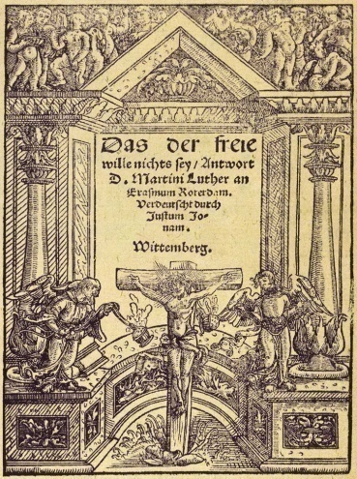
1525
Martin Luther writes Bondage of the Will (a response to Erasmus)
Bondage of the Will
Luther’s work describes the absolute inability of humankind in our fallen state to act morally, a clear opposite to Erasmus’ humanistic ideal.
1526
HERESY IS ALL AROUND: To read the work of a heretic is an excommunicable criminal offense!

Slide 126
AD 1524
Luther & Erasmus
131 Christians Everyone Should Know:
Before the turning point – which would eventually consume the humanist (which at the time meant student of the humanities, not one who praises humanity above all else) – Erasmus became famous for his other writings. He said he wrote to ‘correct the errors of those whose religion is usually composed of ceremonies and observances of a material sort and neglect the things that conduce to piety.’ He became famous for his biting satire, In Praise of Folly, which attacked monastic and ecclesiastic corruption. He lambasted miracles supposedly performed by images, indulgences, and what he felt were useless church rites.
Erasmus
1500 BC 500 BC AD 1 AD 500 AD 1000 AD 1500 AD 1900 AD 2000

Slide 127
AD 1524
Luther & Erasmus
Erasmus’s enemies accused him of inspiring the schismatic Luther. And indeed, Erasmus found much he liked in the German’s writings, describing him to Leo X as a ‘mighty trumpet of gospel truth.’ At the same time he privately told his printer to stop printing Luther’s writings because he didn’t want his own efforts tangled with the Reformer’s. For four years, Erasmus pleaded moderation to both sides. But when pressed, he sided with the pope. ‘I am not so made as to fly in the face of the Vicar of Christ,’ he assured Leo. Still, he hated the bickering and intolerance of both sides: ‘I detest dissension because it goes both against the teachings of Christ and against a secret inclination of nature. I doubt that either side in the dispute can be suppressed without grave loss. It is clear that many of the reforms for which Luther calls are urgently needed.’
Erasmus
1500 BC 500 BC AD 1 AD 500 AD 1000 AD 1500 AD 1900 AD 2000

Slide 128
AD 1524
Luther & Erasmus
“Between Scylla & Charybdis”
His mediating position, however, didn’t satisfy either side: ‘My only wish is that now that I am old, I be allowed to enjoy the results of my efforts,’ he wrote. ‘But both sides reproach me & seek to coerce me. Some claim that since I do not attack Luther I agree with him, while the Lutherans declare that I am a coward who has forsaken the gospel.’ Indeed, Luther attacked him as a ‘Moses who would die in the wilderness ‘without entering the promised land.’ And the Roman Catholic church forbade his writings. ‘Had I not seen it, nay, felt it myself,’ he wrote, ‘I should never have believed anyone who said theologians could become so insane!”
Erasmus
1500 BC 500 BC AD 1 AD 500 AD 1000 AD 1500 AD 1900 AD 2000

Slide 129
LUTHER - & / V. – ERASMUS Neo-Platonist - New Humanist From Friends Unto Enemies
Erasmus was the leading representative of Renaissance Humanism self-dedicated in the recovery of classical languages and literature – Old Latin, Greek, Hebrew. Learning Greek and Hebrew helped both the secular humanists like Erasmus & church reformers like Luther.
Erasmus discovered documentation of the Donation of Constantine fake & fraud.
His criticism of superstitious reverence for religious images was of major influence to Zwingli.
He satirized individual popes, not the office of the papacy. He similarly wrote against abuses of the office. This made him a favorite of Luther who went further by attacking persons & principles.
In Luther’s opinion, the central problem was that the Pope was now an anti-Christ; In Erasmus’s opinion, the central problem was an environment of worldly corruption that had too long permeated Christendom and had finally worked its way to the top church official.

Slide 130
LUTHER - & / V. – ERASMUS Neo-Platonist - New Humanist From Friends Unto Enemies
Erasmus was the leading representative of Renaissance Humanism self-dedicated in the recovery of classical languages and literature – Old Latin, Greek, Hebrew. Learning Greek and Hebrew helped both the secular humanists like Erasmus & church reformers like Luther.
He could not join his admirer Luther for these reasons - ultimately pressured by the Catholic Church to take a loyal stand - specifically to apply his skills of composition to counter those of Luther - he then wrote in literary disagreement with Luther on the subject of free will.
Erasmus posited that grace restores free will. Luther insists on equating our free will with one-sided “willfulness.”
Luther replies in print the next year - by way of - On The Bondage Of The Will – it is essentially self-explanatory by his selection of the title as it relates to the state of our human rebellion against Almighty God.

Slide 131
David Lee Burris: Salvation Is ~ EXTRA NOS ~ “Outside Of Ourselves”
Even Elect’s Sin Of Disbelief Forgiven Beforehand
Class Discussion Question:
Does Synergism
Dilute The Doctrine
Of Divine Initiative?

Slide 132
PROVISION:
A L L
O F
G O D !

Slide 133
TEACHES TO ALL SEEKERS!

Slide 134
THE TILT & PIVOT POINT
TRANSFORMATION OF
THEORETICAL SCHISM
TO PRACTICAL SCHISM

Slide 135
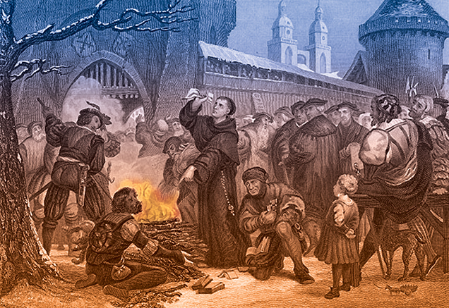
Comes the Perfect Storm
BLOODY BULLS
Luther burns the document

Slide 136
1521
Martin Luther is excommunicated by the pope
At Diet of Worms (Worms is a city in Germany, pronounced “vormps”) Luther refuses to recant writings
In politics, a Diet is a formal assembly for purposes of debating issues and making decisions.
The term comes from the Latin dies, “day.”

Slide 137
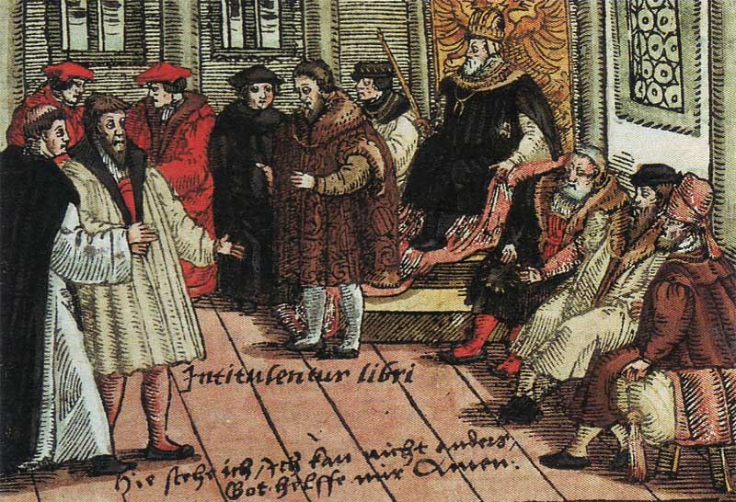
The Edict of Worms banned the reading or possession of Luther’s writings.
It condemned Luther as a heretic and an outlaw, permitting anyone to kill Luther without legal consequence.
The edict was not enforced.
Luther in Worms

Slide 139
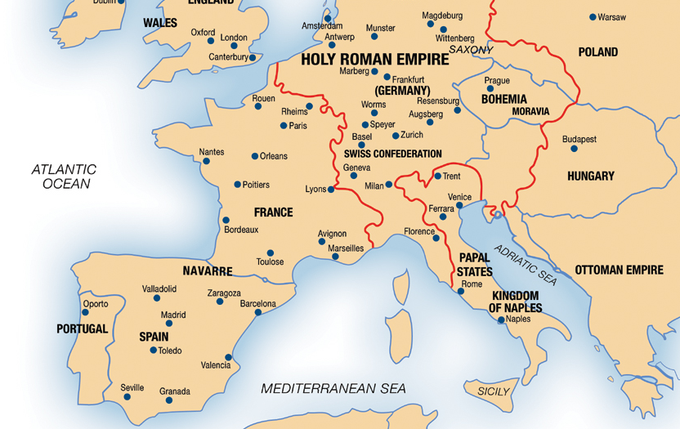
1521
For safety’s sake and to avoid assassins - Luther self isolates.
Luther then begins a project of translating the Bible into German

Slide 141
PART I. - LUTHER’S GOSPEL Story Not Journey Metaphor
Luther’s Gospel is essentially something all Christians believe: the story of Christ dying for us sinners. What is new & controversial is Luther’s doctrine about the Gospel - about how we are changed simply by believing it.
Definition: The gospel is the good news about Christ, a story containing his promises. The four gospels are different ways of telling this one story.
Content: What the gospel says is what is summarized in the creed. The content of the gospels is included in the O. T. because it prophesies and promises Christ’s coming.
Doctrines In The Gospel: The Gospel contains teachings.
Doctrines About The Gospel: Teachings as to how the Gospel of Christ saves us.
Gospel As Promise: According to Luther’s doctrine about the Gospel, it is not only a story, but also a promise contained in the story, about how Christ is given to believers.
Pro me: Faith in the Gospel means not just believing that the story is true – fides historica – but also believing that what Christ did he did “for me.” The “pro me” aspect does not mean the story is all about me but that I am included because He died “for me.”

Slide 142
event

Slide 143
Subtext IB: Hearing The Gospel Christ The Gift Not The Road
For the mature Luther, the Gospel includes a divine promise of forgiveness, which forbids us from regarding ourselves as God’s enemies. In The Freedom of a Christian, Luther described this as a wedding vow that gives us a divine bridegroom, together with all that is his.
Modifies the Augustinian paradigm of spirituality, because Christ is not just the way, the road we take on our pilgrimage to God, but God coming to us and making Himself ours.
Gospel and Law are two different genres with two different purposes and two different effects on those that believe them.
The Law tells us what to do and cannot by itself save us. Its first purpose is “civil” to restrain and punish evil outwardly. Its second purpose is in its causal relation to our “evangelical despair” which in turn humbles and prepares us to receive gladly the gospel of good news.
Whereby Law is about ritual ceremony and proper technique or obedience and what we do, Gospel is about what Christ does. The Gospel is not so much for gleaning practical advice as it is for having a practical effect.
The Gospel contains words that change those that believe them from the inside out. Thus, In its effect, God’s Gospel – cheers, comforts, & consoles.

Slide 144
"Ordo Salutis"
“Latin, meaning ‘order of salvation,’ that is, succession of events in God’s salvific program. Although both the Catholic and Reformed traditions believe salvation comes only through Christ, they diverge dramatically regarding the ordo salutis.”
* Dictionary Of Theological Terms, Grenz & Guretzki

Slide 145
Subtext IB: Hearing The Gospel Christ The Gift Not The Road
For the mature Luther, the Gospel includes a divine promise of forgiveness, which forbids us from regarding ourselves as God’s enemies. In The Freedom of a Christian, Luther described this as a wedding vow that gives us a divine bridegroom, together with all that is his.
Luther’s Famous Motto: “Believe It & You Have It!” -- Words That Do What They Say!
Explanatory Follow-up: “The promise[of God] gives what the commandment requires.”
However, we are at the same time righteous and sinners.
Because all our righteousness comes by faith, all sin is unbelief.
Love of God is less like a longing and desire for our heavenly home and more like gladness and gratitude for a gift already received.
Lutherans separated from Catholics even in such spiritual disciplines as corporate and personal prayer.

Slide 146
ASSENSUS
“A latin term referring to the intellectual assent to or acceptance of a theological truth. While the biblical concept of faith includes the idea of assensus, it should not be equated with saving faith… for, as James notes, ‘even the demons believe’, that is, they give intellectual assent while not exercising saving faith in Christ.”
* Dictionary Of Theological Terms, Grenz & Guretzki

Slide 150
Faith Only - Without Works Free Of Self-Chosen Works
David Lee Burris: Internally Disputed With George Major. Luther’s Two Main Points Were Ideas With Consequence – Ultimate Success Achieved Spiritual Progress Ceased – Ultimate Paradise Proximate Idealism – Peasant Revolt Against Feudalism With 100,000 Casualties Duration Between State Religions
Luther distinguishes Law and Gospel: one is God’s commandment telling us what to do, the other is His promise of what He does for us. Since salvation comes simply by believing, a question arises: what need is there for good works? Treatise On Good Works answers this.
God saves us through faith in order to give us in love to our neighbors.
The gift of Christ fills us to the brim and overflows in gifts and service to other people.
We Become Christ To One Another: Luther calls this our “proper righteousness” the imperfect but real change in our lives as a result of the “alien righteousness.”
To Clarify Relation Between Faith & Works Luther Distinguishes Different Kinds Of Righteousness: A. The crucial distinction between person and work, who we are and what we do – symbolized by tree and fruit. B. As the tree must be good before the fruit is, so the person must be righteous before he can do good works. C. What makes a person good is alien – of another – righteousness – which is Christ in the heart making us a new creature. D. Alien righteousness is passive, it is God’s doing, not ours; proper righteousness is active because it consists of works we do.
Luther’s Two Main Points On Faith & Good Works: 1. “A Christian is perfectly free, lord of all, subject to none” because Christians are inwardly freed by faith from sin, death, and the devil. 2. “A Christian is a perfectly dutiful servant of all, subject to all” because Christians serve their neighbors outwardly with works of love.
Self-chosen works include any moralism or spirituality that adds extra than the 10 Commandments.

Slide 152
II. FAITH IS NOT THE GIFT SALVATION IS THE GIFT Exposition of Ephesians 2:8
David Lee Burris: Internally Disputed With George Major. Luther’s Two Main Points Were Ideas With Consequence – Ultimate Success Achieved Spiritual Progress Ceased – Ultimate Paradise Proximate Idealism – Peasant Revolt Against Feudalism With 100,000 Casualties Duration Between State Religions
“And that not of yourselves; it is the gift of God. Which of the two things is meant – salvation or faith? The grammatical structure and the analogy of the passage favor the former view, ‘Your salvation is not of yourselves,’…” – The Pulpit Commentary
“The words, ‘through faith’ speak of the instrument or means whereby the sinner avails himself of this salvation which God offers him in pure grace… The word ‘that’ is touto, ‘this,’ a demonstrative pronoun of the neuter gender. The Greek word ‘faith’ is feminine in gender and therefore touto could not refer to ‘faith’…” – Word Studies from the Greek New Testament
“What is the meaning of ‘this,’ which is given of God and is not from yourselves? Since ‘faith’ is a word of feminine gender, and ‘this’ & ‘it’ are neuter gender, normal grammar disallows referring back to ‘faith.’ Ken Boles
* In other words, this verse reaffirms tenet that although salvation unmerited – it is not without condition.

Slide 154
III. Grace & Justification
David Lee Burris:
Catholic View – Intrinsic Justification - God Infuses
Protestant View – Extrinsic Justification - God Imputes
The doctrine of justification - how one becomes right before God – is the most characteristic legacy of the Reformation. Luther’s position can be contrasted with both the Catholic doctrine of sanctifying grace and the Reformed emphasis on forensic or imputed justification.
Catholicism Combines Augustinian Grace Doctrine W/ Aristotelian Virtue Theory: In Catholic doctrine, grace is both a divine gift (Augustine) & part of our very souls (Aristotle). Aristotle taught that virtues are like skills formed by practice. The Catholic doctrine of justification teaches that grace is necessary because the virtues of faith, hope, and love are not acquired by practice.
This grace is itself a form in our souls called created grace to distinguish it from uncreated grace which is God Himself in action.
Reasons Protestant Reformers Reject Catholic Created Grace Doctrine: Grace is the term for God’s action toward us not the thing created. Grace is not a habit or something to be possessed. Specifically, it is not the building block of earned merit. Furthermore, it is not acquired as a skill thru repetition. Finally, the product of the process, souls inwardly formed, is by its assumptions rejected.

Slide 156
III. Grace & Justification
The doctrine of justification - how one becomes right before God – is the most characteristic legacy of the Reformation. Luther’s position can be contrasted with both the Catholic doctrine of sanctifying grace and the Reformed emphasis on forensic or imputed justification.
Justification Event Not Process: Protestants delimit justification solely to the remission of personal sins;. Instead they utilize the term sanctification for those transformative spiritual changes occurring within the individual but that happen shortly after justification.
Two Protestant Schools Of Thought On Justification: Luther held to Aristotle’s second way of soul formation – through perception – an eye is informed by what it sees – in this case – the ear in hearing the Gospel reforms the soul from the bottom up. The Swiss Reformers held to a courtroom verdict type imputation of innocence.
According to Luther the conscience can be either unaware or awakened. Hearing the precepts of God makes men anxious or fearful but hearing the Gospel comforts & quiets them. Lastly, Luther claimed men are born with God inside but located by looking beyond the self.

Slide 157
HAMARTOLOGY
“The term used to refer to the theological investigation of sin(from Greek hamartia, ‘sin’). Hamartology concerns itself with understanding the origin, nature, extent, and consequences of sin. Furthermore, hamartology seeks to understand how sin is transmitted throughout the human race and how sin opposes God’s purposes for creation.”
* Dictionary Of Theological Terms, Grenz & Guretzki

Slide 158
(Pre)determined & Destined God Of Love, Care, Mercy?
How does the pessimism of Luther’s predestination form from his optimistic view on grace? The deep concept here is the doctrine of election or God’s choice to be gracious to some undeserving sinners & not others & thus to transform the gospel good news into the bad news of - some chosen instead of others – rather than – some for the sake of others
Augustine defines predestination as God’s eternal knowledge of how he will distribute the gift of grace. He insists also that even the making of the choice to receive grace is encompassed in the gift of grace.
The continuing controversy surrounding such reasoning is not the philosophical problem about determinism and free will as much as the theological doctrine of election.
Augustine, Luther, and Calvin all affirm the compatibility of divine determinism and free will: God controls all earthly events and all human choices without undermining the free will of the creature of conscience and intellect.
The Augustinian Tradition argues that God’s distribution of grace is unequal but not unjust. No one gets worse than they deserve but some get degrees of better.

Slide 159
(Pre)determined & Destined God Of Love, Care, Mercy?
How does the pessimism of Luther’s predestination form from his optimistic view on grace? The deep concept here is the doctrine of election or God’s choice to be gracious to some undeserving sinners & not others & thus to transform the gospel good news into the bad news of - some chosen instead of others – rather than – some for the sake of others
Faith to the highest degree can be recognized in those who are without doubt and question but simply trust God’s good mercy as much as the justice of His judgment.
Luther addressed the related pastoral problems and clergy concerns by several suggestions: a) Do not be preoccupied with the subject of predestination. b) The eternal decree of “hidden God” (Deus absconditus) is none of our business. c) Stay focused on the “revealed God” or Jesus Christ. c) Since you have faith which is a gift – you have the assurance of salvation as well. {Note: Dutch & English Calvinists later split on an “State of Grace Evidentiary Test” – whether either proving lifestyle change or testimony of subjective experience is enough.}
All three writers critically misread the Apostle Paul in his mention of Jacob & Esau in Romans 9. Contextually, Paul should be understood as referring to the two nations that ultimately descended from them – Israel & Edom.
Genesis 12 states Israel was chosen as a blessing of others. This should be self-evident when we observe Christ as the chosen one of God.

Slide 160
David Lee Burris:
Southern German peasants remained in the Roman Catholic Church partly because of this apparent betrayal of them by Luther.
IN THE LEAST
100000 DEATHS
1524 ~ 1525
German Peasant's Revolt

Slide 161
“First, their synagogues should be set on fire,…
their homes should be destroyed and they should be put under one roof,
or in a stable, like Gypsies, in order that they may realize
that they are not masters in our land.
But if still considered too dangerous after this,
then these ‘poisonous bitter worms’
should be stripped of their belongings
which they have extorted usuriously from us
And be driven out of the country for all time.”

Slide 163
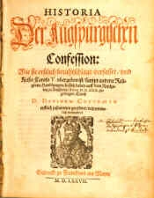
The Diet of Augsburg attempts to calm rising tension between Protestantism and Roman Catholicism.
* Like Occam Before Him, Luther Princely Protected
Luther, being an outlaw, cannot attend.
Philipp Melanchthon, Luther’s friend and collaborator on the German Bible translation, presents the Augsburg Confession, a statement of Lutheran beliefs.
The Augsburg Confession

Slide 164
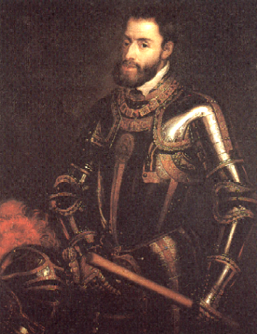
1555
Peace of Augsburg (Germany) allows each ruler to determine religion of his region
The Peace of Augsburg was a treaty signed between Charles V and Protestant princes; it established the first permanent legal basis for the dual existence of Lutheranism and Catholicism in Germany.
Charles V

Slide 166
Martin Luther: SIN BOLDLY! Written in 1521 to Melanchthon
David Lee Burris:
What Real Difference In Attitude With This Verse – “Free from the law – oh happy condition, we may sin as we please & still have remission”?
“God does not save those who are only imaginary sinners. Be a sinner, and let your sins be strong, but let your trust in Christ be stronger… No sin can separate us from Him, even if we were to kill or commit adultery thousands of times each day. Pray hard for you are quite a sinner.” *
* The Mythical Relationship of Odin’s Sons Thor & Loki

Slide 167
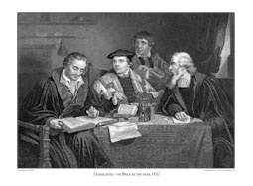
Translating From Vulgate Into Vernacular
LUTHER ADDS "ALONE" TO TEXT OF ROMANS 3:28!
LUTHER INSERTS "ONLY" IN 3:20 & 4:15!

Slide 169
David Lee Burris:
Quaker Saying - “I lift thee up – thou lift me up – and together we ascend to heaven!”
The Book Of James, The First Chapter…
“Pure & undefiled religion before God & the Father is this: to visit orphans and widows in their trouble, and to keep oneself unspotted from the world.”

Slide 172
OF JAMES 2: "BEFORE GOD JUSTIFIED BY FAITH ALONE"
OF JAMES 2: "BEFORE PEOPLE JUSTIFIED THRU WORKS"
Translating From Vulgate Into Vernacular

Slide 173
Battle For The Book Of James
250 A.D. - Origen quotes James extensively.
350 A.D. – Eusebius acknowledges James as both canonical and orthodox. However, he categorizes it along with other of the catholic epistles as “disputed texts” – i.e. the “universal letters” of James 1 & 2, Peter 1 & 2, 3rd John, and the Book of Jude.
450 A.D. – Church Bishops reject all universal letters.
Book Of James Considered Canon For 1,000 Years!
1500 A.D. – Erasmus’ Commentary Doubted James!
German & Swiss Reformer Consider N.T. Apocrypha!

Slide 174
JAMES CHAPTER TWO

Slide 175
Part One: Faith Presented Unbiased
The setting is that of an assembly of the saints where two men enter, one rich and dressed accordingly and the other poor and typically dressed. The presentation of faith observers will note is seen in the treatment these two visitors receive. When the two men are treated differently, the royal law, “Thou shalt love thy neighbor as thyself” has been violated and the faith has been shamefully misrepresented.

Slide 176
Part Two: The Law Of Liberty
No point of the law may be violated with impunity. Christians must speak and act in harmony with the law of liberty. “We must be uniform in our practice of faith.” … The primary reason is because judgment is coming! Mercy will be sought & found by those extending mercy to others and denied those lacking in such compassion extended toward their fellowman.

Slide 177
Part Three: Justification By Works
The three main points within this chapter are unified by its theme of “the demonstration of faith.” Salvation is emptied out of a faith void of demonstration(v. 14). An obvious requirement of daily sustenance left unsupplied constitutes a “dead faith” (vv. 15-17). James wrote, “Yea, a man may say, Thou hast faith, and I have works: show me thy faith without thy works, and I will show thee my faith by my works” (v.18). The existence of faith is verified in the corresponding actions it generates. Moreover, the only time the term ‘faith only’ appears in the Bible is verse 24: “Ye see then how that by works a man is justified, and not by faith only!”
...not by faith only!

Slide 178
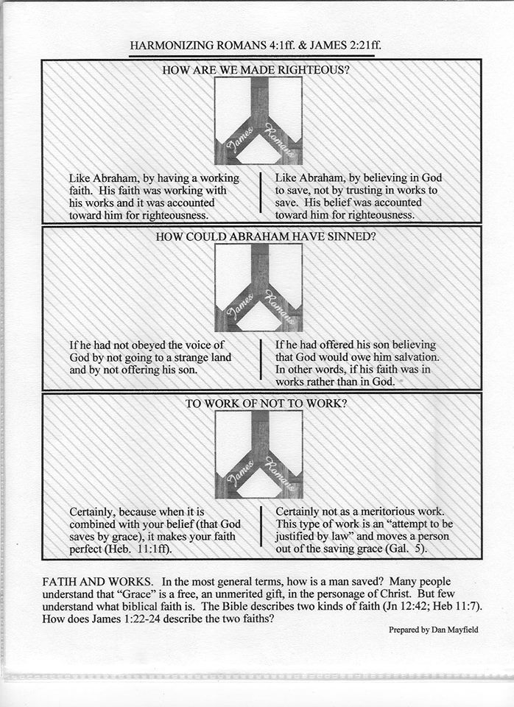

Slide 179
Part Four: Necessary Conclusions
The royal law and the law of liberty find expression in the subject of justification by works. The law of God establishes the rule of conduct or action and limits behaviors & activities to the standard of acceptability as authorized by the revealed word of God, the Bible. Thus, we must be unbiased in our presentation of faith, vv. 1–9. We must be uniform in our practice of faith, vv. 10-13. Finally, we must also be undaunted in our performance of faith, vv. 14-26. Together, this is the “demonstration of faith” about which James wrote.

Slide 182
Lutheranism After Luther Philip Melanchthon & Lutheran Slippage
We all know the proverbial pun that the man is head of the family and the wife the neck, but it is the neck that turns the head.
It was something like that in Melanchthon’s relationship to Luther. He not only helped Luther but was in awe of him.
Nevertheless, as we have seen, it was probably Melanchthon and not Luther who turned the Reformation against the Swiss, causing the first great division in Protestantism.
Moreover, it was Melanchthon and not Luther who wrote the first Lutheran systematic theology. Loci Communes (commonplaces) was the first Protestant theology and it was Melanchthon who negotiated with Roman Catholicism at Augsburg in 1530, though Luther was in the background keeping his associate in line.
* Source: Ligonier Ministries Church History Handouts

Slide 183
Lutheranism After Luther Philip Melanchthon & Lutheran Slippage
Nevertheless, Melanchthon never agreed with Luther’s profound Augustinianism, though he never dared differ with him openly while Luther lived.
After Luther’s death in 1546, immediately and openly Melanchthon differed, and Lutheranism gradually slipped back to medieval semi-Augustinianism adopting a more synergistic view of salvation.
After the controversies within Lutheranism settled and the Book of Concord was adopted in 1580, the Lutheran movement had become Luther-anism, not Lutherism.
They agreed with the Reformed up to the point that regeneration preceded faith but then made that faith resistible – a thought alien to the mind of Luther!
* Source: Ligonier Ministries Church History Handouts

Slide 184
A Reformer Becomes Conservative By Coming Into Power; And As Soon As Ever He Is Able To Do Anything, He Desires To Do Nothing!
Gilbert Chesterton

Slide 185
Later Swiss Reformation Zwingli – Calvin - Radical
David Lee Burris:
Heinrich Bullinger was the conciliatory successor to Zwingli & after he was removed from the religious scene most Zwingli groups merged with those of Calvin forming the Reformed Churches of Switzerland.
Three types of Reformation theology developed in Swiss territories. The German-speaking cantons of the northern part of the country followed Zwingli’s view of the Reformation. Those in the south, led by Geneva, followed the views of John Calvin. In addition, the radicals of the Reformation, known as Anabaptists, developed an extreme wing among those who had worked with Zwingli. From Zurich the Anabaptist movement spread thru Switzerland, Germany, and Holland, where, under Menno Simons, it had a steady development.
* Source: Christianity Through The Ages by Dr. Earle Cairns

