Slide 1
05. RELIGIOUS HISTORY OF THE CHRISTIAN ERA
by David Lee Burris

Slide 2
Relgious History of the Christian Era Ppt. Series
Papacy
Monarchical Episcopacy
Sacraments
Five Worship Activities
Denominations
Theological Debates

Slide 3
THESIS & ANTI-THESIS THEOLOGY
PLATO(Teacher) VERSUS ARISTOTLE(Student)
IRENAEUS(2nd Cent) VERSUS AUGUSTINE (4th)
AUGUSTINIAN VERSUS PELAGIAN NEMESIS
AUGUSTINIAN(Old)/THOMISM(New Church)
DESIDERIUS ERASMUS VS. MARTIN LUTHER
MARTIN LUTHER VERSUS ULRICH ZWINGLI
MARTIN LUTHER VERSUS JOHN CALVIN
JACOB ARMINIUS VERSUS JOHN CALVIN

Slide 4
EACH SIDE OF EVERY SCHISM DEBATES
AUGUSTINE NOT GOD'S HOLY WORD!

Slide 5
THESIS & ANTI-THESIS THEOLOGY
PLATO(Teacher) VERSUS ARISTOTLE(Student)
IRENAEUS(2nd Cent) VERSUS AUGUSTINE (4th)
AUGUSTINIAN VERSUS PELAGIAN NEMESIS
AUGUSTINIAN(Old)/THOMISM(New Church)
DESIDERIUS ERASMUS VS. MARTIN LUTHER

Slide 6
Augustinian Spirituality Setting Paradigm
Story: Earthly Pilgrimage To Eternal Happiness
Morality: Those Virtues To Travel Beatific Road
Start: Accept Received Faith Until Seeing For Self
Move: Drive Engine Love Both Propels / Attracts
Human Free-Will Incapable Love Overwhelming
Counterfactual Test Proves Love – Gift Of Grace
Compatibilists: God’s Grace & Man’s Free Will
Doctrine Of Grace Includes Human Merit Concept
Anselm’s Augustinian Prayer Seeks Grace & Faith
Private Confession Created Penitential Conscience {No Preaching/Pastoral Care – 24/7 Paid Prayers}
Piety Focus: Habits Of Heart / Art Of Dying Well
Salvation: Inner Examination & Outer Experience

Slide 7
David Lee Burris:
Sometimes They Found Alliance Sometimes They Worked Apart!

Slide 8
Dominant Augustinian Paradigm Secular & Sectarian Applications
DIFFERENT RENAISSANCE EXPERIENCES:
The Italian Renaissance -
Fascination With Greek Classics
The Teutonic Renaissance -
Fascination With Greek Gospels

Slide 9
Dominant Augustinian Paradigm Secular & Sectarian Applications
DIFFERENT RENAISSANCE EXPERIENCES:
The Italian Renaissance -
Continuing Expressions Of Explicit Support
The Teutonic Renaissance -
Break In Tacit Contract Of Systemic Support

Slide 10
PLATO | ARISTOTLE
Idealism | Realism
Republic | Politics
The “Ideal” State | A Working Government
TRANSCEND Human Selfishness | ACKNOWLEDGE Human Selfishness
Social Unity | Balance

Slide 11
ARISTOTLE THRU THE AGES
Aristotle will always be significant to scholars as the most famous student of Plato.
His works on logic are among the classics. He basically believed existence is related to substance and that everything is caused by something else – uniform theory.
His practical philosophy proved more controversial. He states that our souls are formed by habits, skills, and virtues. These same virtues are like skills in that they are formed by practice – by working at it. The other way our souls are shaped is through perception.
Aristotle has remained an ageless figure and forever thought provoking as regards his postulation - in purely physical terms - of an “Unmoved Mover” – an irreducible final cause to the universe.

Slide 12
Debate Begins With Aristotle: How Are People Changed Within?
“To Be Is To Do” - Or - “To Do Is To Be”
“Excellence is an art won by training and habituation. We do not act rightly because we have virtue or excellence, but rather we have those because we have acted rightly. We are what we repeatedly do… Excellence, then is not an act but a habit.”
* Disputing Human Nature!

Slide 14
COUNTERING THE COUNTERFACTUAL TEST
Bible Says You Are In Charge Of Your Own Heart
Jeremiah 4: 4 – “Remove the foreskin of your hearts”
Jeremiah 9: 13 – “Stubbornly followed their hearts”
Jeremiah 18: 11 – “Act according to his evil heart”
Ezekiel 18:31 – “Make Yourselves A New Heart & A New Spirit!”

Slide 15
Luther Critique’s Clairvaux: Spiritual Maturity & Progress
FIRST – Love Of Self For Your Own Sake.
SECOND – Love Of God For Your Own Sake.
THIRD – Love Of God For God’s Sake.
FOURTH – Love Of Self For God’s Sake.

Slide 16
Luther On The Gravity Of Sin: Mankind Is Incurvatus In Se
Humanity Has Curved In Upon Itself
With Meaning Twisted
& Our Ideals Warped
* Spiritual Physics Of Heavy Mass

Slide 17
What did People believe at the Start of the 16th Century?
If you died with a dirty Soul you would go to either Purgatory or straight to hell.
You had to go to Church and get the Priest to clean your Soul.
If you died with a clean Soul you would go to heaven.
Notes:
I would use the zoom facility of my interactive whiteboard to zoom in on the different sections of this picture.
If you haven’t got this facility then you could crop the picture to the scene you prefered

Slide 19
What did People believe at the Start of the 16th Century?
If you went on a Crusade or a Pilgrimage you could earn time out of Purgatory
You could buy a special letter from the Pope called an Indulgence which was like a get out of jail for free card but for Purgatory.
Notes:
This would be a good point to play the Blackadder video: The Archbishop of Canterbury – The scene to do with the selling of relics

Slide 20
Martin Luther: Epic Life & Tale
David Lee Burris:
Later Strong German Resistance To Practical Application Of Lightening Rod Points To Particular Problem Referencing Teutonic Culture.
Thunderous Close Call Thinks Divine Numinous With Deliverance – Change Career Choice: From Legal Study To Mendicant Scholar
Bad News Theology Gospel Of Condemnation Salvation: Self-Accusation
Rome Road Trip - Trip
Tower Study Event Good News Of Promise Justification: Faith / Grace
Luther Three Stages 1516 – Negative Young 1520 – Positive Mature Late Life – Regression

Slide 21
MARTIN LUTHER VISITS ROME

Slide 22
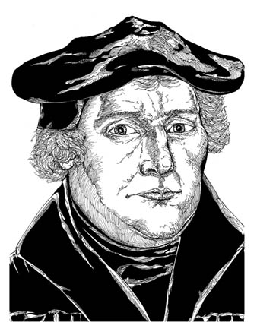
Martin Luther the Monk
While studying the Greek New Testament, Luther saw that God imputes his righteousness to anyone who truly trusts Jesus.
“The passage of Paul,” Luther said, “became my gateway to heaven.”
Martin Luther
Notes:
Illustration by Stephen Hesselman

Slide 23
Martin Luther and Indulgences
In 1517, Pope Leo X allowed alms to be given to the Church in exchange for “indulgences.”
It was believed that indulgences released Christians from the temporal punishments for their sins.
Pope Leo X
Notes:
Image: Pope Leo X, File:Ara Coeli (12).jpg available at www.wikipedia.com

Slide 24
MARTIN LUTHER DISPUTES

Slide 25
The Protestant Principle
“The Protestant principle suggests that believers ought to read & seek to understand the scriptures, and that church practice ought be continually subjected to the scrutiny of Scripture.”
* Dictionary Of Theological Terms, Grenz & Guretzki

Slide 26
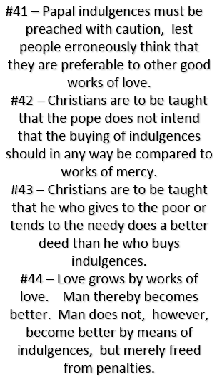
Martin Luther Was Trained Philosophically In Nominalism!

Slide 27
Okham's Razor
“Main axiom of nominalist philosopher William of Occam, namely, that principles employed to explain phenomenon should not be multiplied without necessity… O’ razor was used to eliminate the supernatural from view!”
* Dictionary Of Theological Terms, Grenz & Guretzki

Slide 28
Martin Luther, the Wild Pig
Martin Luther wanted to debate the validity of indulgences.
On October 31, 1517, Luther nailed a list of 95 theses (topics for debate) on a chapel door in Wittenberg, Germany.
In response Pope Leo X declared, “Arise, O Lord. A wild (alcoholic) pig has invaded the Lord’s vineyard!”
Notes:
Image: © David Crooks

Slide 29
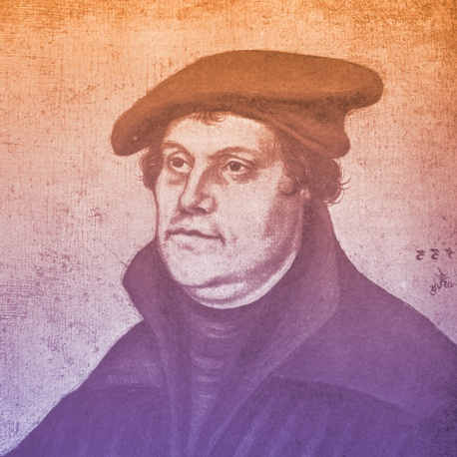
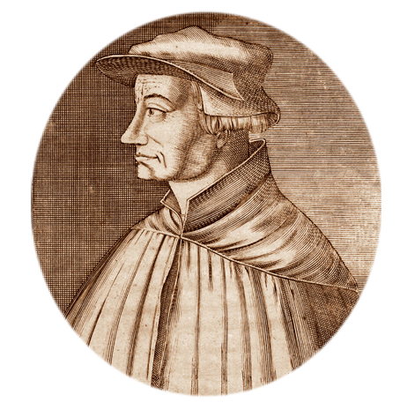
1519
Martin Luther questions papal infallibility (belief that the pope is preserved from error in matters of faith and morals) and begins New Testament sermon series, starting a new era of preaching
Martin Luther
Ulrich Zwingli begins New Testament sermons, thus ushering in the Swiss reformation
Ulrich Zwingli

Slide 30
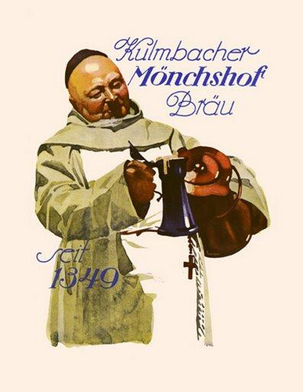
WHERE DID THEY COME FROM? The Pulpit System
Altar Replaced With Pulpit:
Luther had the entire area ripped out of the front of the church. High up on one of the pillars of the church was a rostrum or pulpit which the Catholic priest had climbed up by means of a circular staircase to read dutifully the weekly announcements to the faithful flock below. Luther had one of those pulpits placed in the front & center of the building, where the altar had been. That was new. Brand new. And so, was born the Protestant pulpit!
TODAY'S TEN A.M. TIME FOR
PROTESTANT SUNDAY SERVICES
ARE STILL IN ACCOMMODATION
TO LUTHER'S HEAVY HANGOVERS!

Slide 31
WHERE DID THEY COME FROM? The Pulpit System & Participatory Music
Altar Replaced With Pulpit:
Luther had the entire area ripped out of the front of the church. High up on one of the pillars of the church was a rostrum or pulpit which the Catholic priest had climbed up by means of a circular staircase to read dutifully the weekly announcements to the faithful flock below. Luther had one of those pulpits placed in the front & center of the building, where the altar had been. That was new. Brand new. And so, was born the Protestant pulpit!
Congregational Singing
Martin Luther & followers understood the importance that music can play in a healthy spiritual life and encouraged singing in church.
They also stressed the importance of hymns sung in the native languages of worshipers as a means for facilitating more personal involvement for churchgoers.
This led to the creation of a new kind of music, called the chorale.

Slide 33
Priesthood Of Believers
“The Reformation principle that declares the privilege & freedom of all believing Christians is to stand before God in personal communion through Christ, directly receiving forgiveness without the necessary recourse to human intermediaries.”
* Dictionary Of Theological Terms, Grenz & Guretzki

Slide 34
David Lee Burris: Salvation Is ~ EXTRA NOS ~ “Outside Of Ourselves”
Even Elect’s Sin Of Disbelief Forgiven Beforehand
Luther Versus Erasmus
Monergistic
Synergistic
Controversy

Slide 35
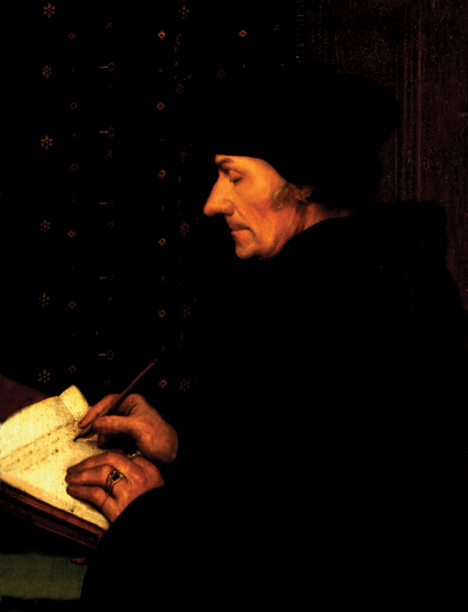
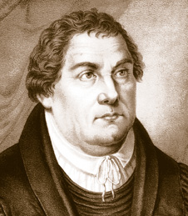
AD 1524
Luther & Erasmus
Erasmus
1500 BC 500 BC AD 1 AD 500 AD 1000 AD 1500 AD 1900 AD 2000

Slide 36
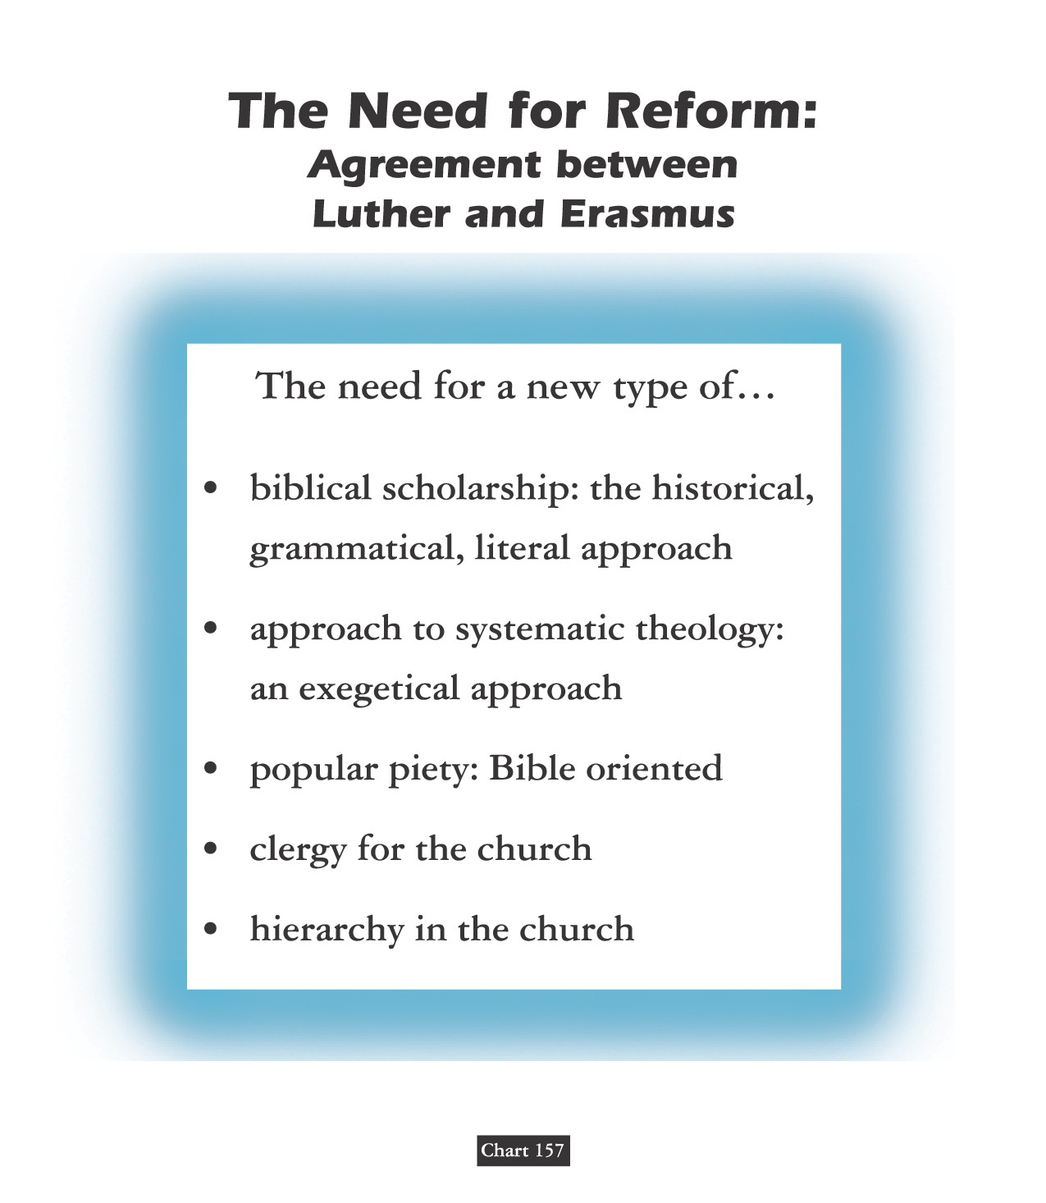
Clear Text & Pure Faith

Slide 38
SALVATION:
A L L
O F
G O D ?

Slide 39
Erasmus publishes On Freedom of the Will, his famous attack on Luther’s denial of free will
1524

Slide 40
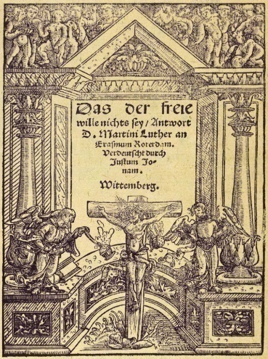
1525
Martin Luther writes Bondage of the Will (a response to Erasmus)
Bondage of the Will
Luther’s work describes the absolute inability of humankind in our fallen state to act morally, a clear opposite to Erasmus’ humanistic ideal.
1526
HERESY IS ALL AROUND: To read the work of a heretic is an excommunicable criminal offense!

Slide 41
AD 1524
Luther & Erasmus
131 Christians Everyone Should Know:
Before the turning point – which would eventually consume the humanist (which at the time meant student of the humanities, not one who praises humanity above all else) – Erasmus became famous for his other writings. He said he wrote to ‘correct the errors of those whose religion is usually composed of ceremonies and observances of a material sort and neglect the things that conduce to piety.’ He became famous for his biting satire, In Praise of Folly, which attacked monastic and ecclesiastic corruption. He lambasted miracles supposedly performed by images, indulgences, and what he felt were useless church rites.
Erasmus
1500 BC 500 BC AD 1 AD 500 AD 1000 AD 1500 AD 1900 AD 2000

Slide 42
AD 1524
Luther & Erasmus
Erasmus’s enemies accused him of inspiring the schismatic Luther. And indeed, Erasmus found much he liked in the German’s writings, describing him to Leo X as a ‘mighty trumpet of gospel truth.’ At the same time he privately told his printer to stop printing Luther’s writings because he didn’t want his own efforts tangled with the Reformer’s. For four years, Erasmus pleaded moderation to both sides. But when pressed, he sided with the pope. ‘I am not so made as to fly in the face of the Vicar of Christ,’ he assured Leo. Still, he hated the bickering and intolerance of both sides: ‘I detest dissension because it goes both against the teachings of Christ and against a secret inclination of nature. I doubt that either side in the dispute can be suppressed without grave loss. It is clear that many of the reforms for which Luther calls are urgently needed.’
Erasmus
1500 BC 500 BC AD 1 AD 500 AD 1000 AD 1500 AD 1900 AD 2000

Slide 43
AD 1524
Luther & Erasmus
“Between Scylla & Charybdis”
His mediating position, however, didn’t satisfy either side: ‘My only wish is that now that I am old, I be allowed to enjoy the results of my efforts,’ he wrote. ‘But both sides reproach me & seek to coerce me. Some claim that since I do not attack Luther I agree with him, while the Lutherans declare that I am a coward who has forsaken the gospel.’ Indeed, Luther attacked him as a ‘Moses who would die in the wilderness ‘without entering the promised land.’ And the Roman Catholic church forbade his writings. ‘Had I not seen it, nay, felt it myself,’ he wrote, ‘I should never have believed anyone who said theologians could become so insane!”
Erasmus
1500 BC 500 BC AD 1 AD 500 AD 1000 AD 1500 AD 1900 AD 2000

Slide 44
LUTHER - & / V. – ERASMUS Neo-Platonist - New Humanist From Friends Unto Enemies
Erasmus was the leading representative of Renaissance Humanism self-dedicated in the recovery of classical languages and literature – Old Latin, Greek, Hebrew. Learning Greek and Hebrew helped both the secular humanists like Erasmus & church reformers like Luther.
Erasmus discovered documentation of the Donation of Constantine fake & fraud.
His criticism of superstitious reverence for religious images was of major influence to Zwingli.
He satirized individual popes, not the office of the papacy. He similarly wrote against abuses of the office. This made him a favorite of Luther who went further by attacking persons & principles.
In Luther’s opinion, the central problem was that the Pope was now an anti-Christ; In Erasmus’s opinion, the central problem was an environment of worldly corruption that had too long permeated Christendom and had finally worked its way to the top church official.

Slide 45
LUTHER - & / V. – ERASMUS Neo-Platonist - New Humanist From Friends Unto Enemies
Erasmus was the leading representative of Renaissance Humanism self-dedicated in the recovery of classical languages and literature – Old Latin, Greek, Hebrew. Learning Greek and Hebrew helped both the secular humanists like Erasmus & church reformers like Luther.
He could not join his admirer Luther for these reasons - ultimately pressured by the Catholic Church to take a loyal stand - specifically to apply his skills of composition to counter those of Luther - he then wrote in literary disagreement with Luther on the subject of free will.
Erasmus posited that grace restores free will. Luther insists on equating our free will with one-sided “willfulness.”
Luther replies in print the next year - by way of - On The Bondage Of The Will – it is essentially self-explanatory by his selection of the title as it relates to the state of our human rebellion against Almighty God.

Slide 46
David Lee Burris: Salvation Is ~ EXTRA NOS ~ “Outside Of Ourselves”
Even Elect’s Sin Of Disbelief Forgiven Beforehand
Class Discussion Question:
Does Synergism
Dilute The Doctrine
Of Divine Initiative?

Slide 47
PROVISION:
A L L
O F
G O D !

Slide 48
TEACHES TO ALL SEEKERS!

Slide 49
THE TILT & PIVOT POINT
TRANSFORMATION OF
THEORETICAL SCHISM
TO PRACTICAL SCHISM

Slide 50
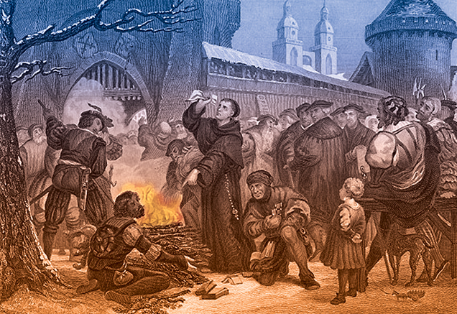
Comes the Perfect Storm
BLOODY BULLS
Luther burns the document

Slide 51
1521
Martin Luther is excommunicated by the pope
At Diet of Worms (Worms is a city in Germany, pronounced “vormps”) Luther refuses to recant writings
In politics, a Diet is a formal assembly for purposes of debating issues and making decisions.
The term comes from the Latin dies, “day.”

Slide 52
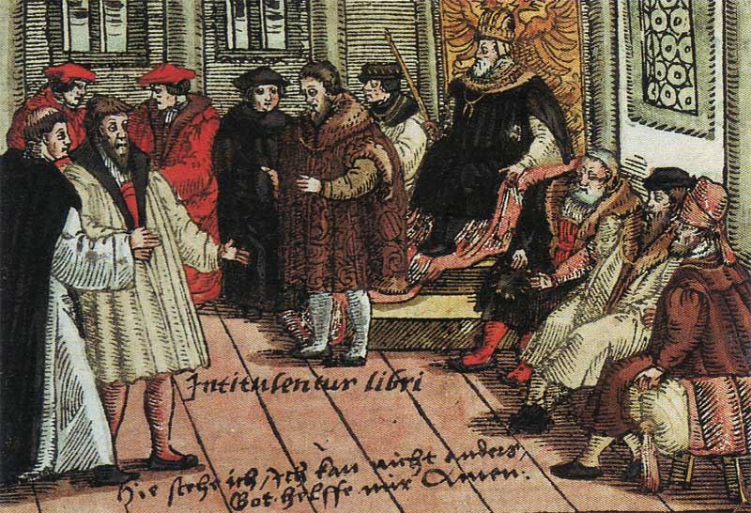
The Edict of Worms banned the reading or possession of Luther’s writings.
It condemned Luther as a heretic and an outlaw, permitting anyone to kill Luther without legal consequence.
The edict was not enforced.
Luther in Worms

Slide 54
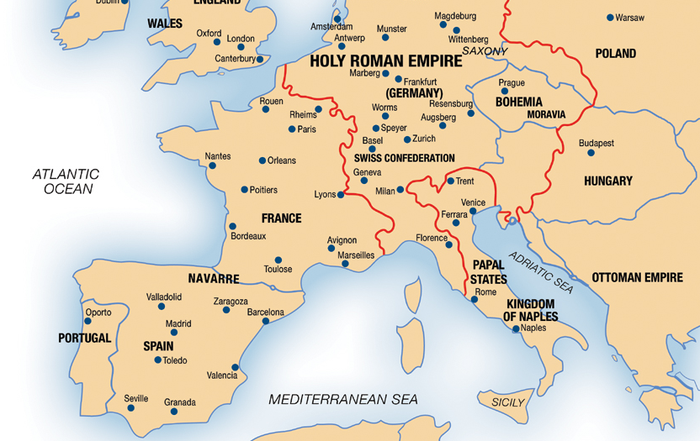
1521
For safety’s sake and to avoid assassins - Luther self isolates.
Luther then begins a project of translating the Bible into German

Slide 56
PART I. - LUTHER’S GOSPEL Story Not Journey Metaphor
Luther’s Gospel is essentially something all Christians believe: the story of Christ dying for us sinners. What is new & controversial is Luther’s doctrine about the Gospel - about how we are changed simply by believing it.
Definition: The gospel is the good news about Christ, a story containing his promises. The four gospels are different ways of telling this one story.
Content: What the gospel says is what is summarized in the creed. The content of the gospels is included in the O. T. because it prophesies and promises Christ’s coming.
Doctrines In The Gospel: The Gospel contains teachings.
Doctrines About The Gospel: Teachings as to how the Gospel of Christ saves us.
Gospel As Promise: According to Luther’s doctrine about the Gospel, it is not only a story, but also a promise contained in the story, about how Christ is given to believers.
Pro me: Faith in the Gospel means not just believing that the story is true – fides historica – but also believing that what Christ did he did “for me.” The “pro me” aspect does not mean the story is all about me but that I am included because He died “for me.”

Slide 57
event

Slide 58
Subtext IB: Hearing The Gospel Christ The Gift Not The Road
For the mature Luther, the Gospel includes a divine promise of forgiveness, which forbids us from regarding ourselves as God’s enemies. In The Freedom of a Christian, Luther described this as a wedding vow that gives us a divine bridegroom, together with all that is his.
Modifies the Augustinian paradigm of spirituality, because Christ is not just the way, the road we take on our pilgrimage to God, but God coming to us and making Himself ours.
Gospel and Law are two different genres with two different purposes and two different effects on those that believe them.
The Law tells us what to do and cannot by itself save us. Its first purpose is “civil” to restrain and punish evil outwardly. Its second purpose is in its causal relation to our “evangelical despair” which in turn humbles and prepares us to receive gladly the gospel of good news.
Whereby Law is about ritual ceremony and proper technique or obedience and what we do, Gospel is about what Christ does. The Gospel is not so much for gleaning practical advice as it is for having a practical effect.
The Gospel contains words that change those that believe them from the inside out. Thus, In its effect, God’s Gospel – cheers, comforts, & consoles.

Slide 59
"Ordo Salutis"
“Latin, meaning ‘order of salvation,’ that is, succession of events in God’s salvific program. Although both the Catholic and Reformed traditions believe salvation comes only through Christ, they diverge dramatically regarding the ordo salutis.”
* Dictionary Of Theological Terms, Grenz & Guretzki

Slide 60
Subtext IB: Hearing The Gospel Christ The Gift Not The Road
For the mature Luther, the Gospel includes a divine promise of forgiveness, which forbids us from regarding ourselves as God’s enemies. In The Freedom of a Christian, Luther described this as a wedding vow that gives us a divine bridegroom, together with all that is his.
Luther’s Famous Motto: “Believe It & You Have It!” -- Words That Do What They Say!
Explanatory Follow-up: “The promise[of God] gives what the commandment requires.”
However, we are at the same time righteous and sinners.
Because all our righteousness comes by faith, all sin is unbelief.
Love of God is less like a longing and desire for our heavenly home and more like gladness and gratitude for a gift already received.
Lutherans separated from Catholics even in such spiritual disciplines as corporate and personal prayer.

Slide 61
ASSENSUS
“A latin term referring to the intellectual assent to or acceptance of a theological truth. While the biblical concept of faith includes the idea of assensus, it should not be equated with saving faith… for, as James notes, ‘even the demons believe’, that is, they give intellectual assent while not exercising saving faith in Christ.”
* Dictionary Of Theological Terms, Grenz & Guretzki

Slide 65
Faith Only - Without Works Free Of Self-Chosen Works
David Lee Burris: Internally Disputed With George Major. Luther’s Two Main Points Were Ideas With Consequence – Ultimate Success Achieved Spiritual Progress Ceased – Ultimate Paradise Proximate Idealism – Peasant Revolt Against Feudalism With 100,000 Casualties Duration Between State Religions
Luther distinguishes Law and Gospel: one is God’s commandment telling us what to do, the other is His promise of what He does for us. Since salvation comes simply by believing, a question arises: what need is there for good works? Treatise On Good Works answers this.
God saves us through faith in order to give us in love to our neighbors.
The gift of Christ fills us to the brim and overflows in gifts and service to other people.
We Become Christ To One Another: Luther calls this our “proper righteousness” the imperfect but real change in our lives as a result of the “alien righteousness.”
To Clarify Relation Between Faith & Works Luther Distinguishes Different Kinds Of Righteousness: A. The crucial distinction between person and work, who we are and what we do – symbolized by tree and fruit. B. As the tree must be good before the fruit is, so the person must be righteous before he can do good works. C. What makes a person good is alien – of another – righteousness – which is Christ in the heart making us a new creature. D. Alien righteousness is passive, it is God’s doing, not ours; proper righteousness is active because it consists of works we do.
Luther’s Two Main Points On Faith & Good Works: 1. “A Christian is perfectly free, lord of all, subject to none” because Christians are inwardly freed by faith from sin, death, and the devil. 2. “A Christian is a perfectly dutiful servant of all, subject to all” because Christians serve their neighbors outwardly with works of love.
Self-chosen works include any moralism or spirituality that adds extra than the 10 Commandments.

Slide 67
II. FAITH IS NOT THE GIFT SALVATION IS THE GIFT Exposition of Ephesians 2:8
David Lee Burris: Internally Disputed With George Major. Luther’s Two Main Points Were Ideas With Consequence – Ultimate Success Achieved Spiritual Progress Ceased – Ultimate Paradise Proximate Idealism – Peasant Revolt Against Feudalism With 100,000 Casualties Duration Between State Religions
“And that not of yourselves; it is the gift of God. Which of the two things is meant – salvation or faith? The grammatical structure and the analogy of the passage favor the former view, ‘Your salvation is not of yourselves,’…” – The Pulpit Commentary
“The words, ‘through faith’ speak of the instrument or means whereby the sinner avails himself of this salvation which God offers him in pure grace… The word ‘that’ is touto, ‘this,’ a demonstrative pronoun of the neuter gender. The Greek word ‘faith’ is feminine in gender and therefore touto could not refer to ‘faith’…” – Word Studies from the Greek New Testament
“What is the meaning of ‘this,’ which is given of God and is not from yourselves? Since ‘faith’ is a word of feminine gender, and ‘this’ & ‘it’ are neuter gender, normal grammar disallows referring back to ‘faith.’ Ken Boles
* In other words, this verse reaffirms tenet that although salvation unmerited – it is not without condition.

Slide 69
III. Grace & Justification
David Lee Burris:
Catholic View – Intrinsic Justification - God Infuses
Protestant View – Extrinsic Justification - God Imputes
The doctrine of justification - how one becomes right before God – is the most characteristic legacy of the Reformation. Luther’s position can be contrasted with both the Catholic doctrine of sanctifying grace and the Reformed emphasis on forensic or imputed justification.
Catholicism Combines Augustinian Grace Doctrine W/ Aristotelian Virtue Theory: In Catholic doctrine, grace is both a divine gift (Augustine) & part of our very souls (Aristotle). Aristotle taught that virtues are like skills formed by practice. The Catholic doctrine of justification teaches that grace is necessary because the virtues of faith, hope, and love are not acquired by practice.
This grace is itself a form in our souls called created grace to distinguish it from uncreated grace which is God Himself in action.
Reasons Protestant Reformers Reject Catholic Created Grace Doctrine: Grace is the term for God’s action toward us not the thing created. Grace is not a habit or something to be possessed. Specifically, it is not the building block of earned merit. Furthermore, it is not acquired as a skill thru repetition. Finally, the product of the process, souls inwardly formed, is by its assumptions rejected.

Slide 71
III. Grace & Justification
The doctrine of justification - how one becomes right before God – is the most characteristic legacy of the Reformation. Luther’s position can be contrasted with both the Catholic doctrine of sanctifying grace and the Reformed emphasis on forensic or imputed justification.
Justification Event Not Process: Protestants delimit justification solely to the remission of personal sins;. Instead they utilize the term sanctification for those transformative spiritual changes occurring within the individual but that happen shortly after justification.
Two Protestant Schools Of Thought On Justification: Luther held to Aristotle’s second way of soul formation – through perception – an eye is informed by what it sees – in this case – the ear in hearing the Gospel reforms the soul from the bottom up. The Swiss Reformers held to a courtroom verdict type imputation of innocence.
According to Luther the conscience can be either unaware or awakened. Hearing the precepts of God makes men anxious or fearful but hearing the Gospel comforts & quiets them. Lastly, Luther claimed men are born with God inside but located by looking beyond the self.

Slide 72
HAMARTOLOGY
“The term used to refer to the theological investigation of sin(from Greek hamartia, ‘sin’). Hamartology concerns itself with understanding the origin, nature, extent, and consequences of sin. Furthermore, hamartology seeks to understand how sin is transmitted throughout the human race and how sin opposes God’s purposes for creation.”
* Dictionary Of Theological Terms, Grenz & Guretzki

Slide 73
(Pre)determined & Destined God Of Love, Care, Mercy?
How does the pessimism of Luther’s predestination form from his optimistic view on grace? The deep concept here is the doctrine of election or God’s choice to be gracious to some undeserving sinners & not others & thus to transform the gospel good news into the bad news of - some chosen instead of others – rather than – some for the sake of others
Augustine defines predestination as God’s eternal knowledge of how he will distribute the gift of grace. He insists also that even the making of the choice to receive grace is encompassed in the gift of grace.
The continuing controversy surrounding such reasoning is not the philosophical problem about determinism and free will as much as the theological doctrine of election.
Augustine, Luther, and Calvin all affirm the compatibility of divine determinism and free will: God controls all earthly events and all human choices without undermining the free will of the creature of conscience and intellect.
The Augustinian Tradition argues that God’s distribution of grace is unequal but not unjust. No one gets worse than they deserve but some get degrees of better.

Slide 74
(Pre)determined & Destined God Of Love, Care, Mercy?
How does the pessimism of Luther’s predestination form from his optimistic view on grace? The deep concept here is the doctrine of election or God’s choice to be gracious to some undeserving sinners & not others & thus to transform the gospel good news into the bad news of - some chosen instead of others – rather than – some for the sake of others
Faith to the highest degree can be recognized in those who are without doubt and question but simply trust God’s good mercy as much as the justice of His judgment.
Luther addressed the related pastoral problems and clergy concerns by several suggestions: a) Do not be preoccupied with the subject of predestination. b) The eternal decree of “hidden God” (Deus absconditus) is none of our business. c) Stay focused on the “revealed God” or Jesus Christ. c) Since you have faith which is a gift – you have the assurance of salvation as well. {Note: Dutch & English Calvinists later split on an “State of Grace Evidentiary Test” – whether either proving lifestyle change or testimony of subjective experience is enough.}
All three writers critically misread the Apostle Paul in his mention of Jacob & Esau in Romans 9. Contextually, Paul should be understood as referring to the two nations that ultimately descended from them – Israel & Edom.
Genesis 12 states Israel was chosen as a blessing of others. This should be self-evident when we observe Christ as the chosen one of God.

Slide 75
David Lee Burris:
Southern German peasants remained in the Roman Catholic Church partly because of this apparent betrayal of them by Luther.
IN THE LEAST
100000 DEATHS
1524 ~ 1525
German Peasant's Revolt

Slide 76
“First, their synagogues should be set on fire,…
their homes should be destroyed and they should be put under one roof,
or in a stable, like Gypsies, in order that they may realize
that they are not masters in our land.
But if still considered too dangerous after this,
then these ‘poisonous bitter worms’
should be stripped of their belongings
which they have extorted usuriously from us
And be driven out of the country for all time.”

Slide 78
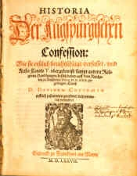
The Diet of Augsburg attempts to calm rising tension between Protestantism and Roman Catholicism.
* Like Occam Before Him, Luther Princely Protected
Luther, being an outlaw, cannot attend.
Philipp Melanchthon, Luther’s friend and collaborator on the German Bible translation, presents the Augsburg Confession, a statement of Lutheran beliefs.
The Augsburg Confession

Slide 79
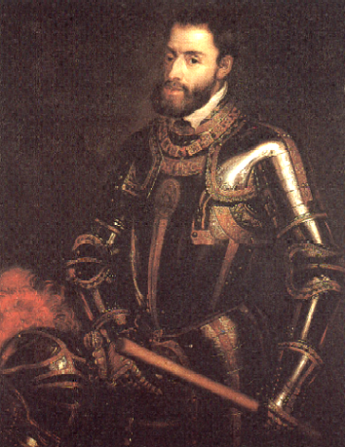
1555
Peace of Augsburg (Germany) allows each ruler to determine religion of his region
The Peace of Augsburg was a treaty signed between Charles V and Protestant princes; it established the first permanent legal basis for the dual existence of Lutheranism and Catholicism in Germany.
Charles V

Slide 81
Martin Luther: SIN BOLDLY! Written in 1521 to Melanchthon
David Lee Burris:
What Real Difference In Attitude With This Verse – “Free from the law – oh happy condition, we may sin as we please & still have remission”?
“God does not save those who are only imaginary sinners. Be a sinner, and let your sins be strong, but let your trust in Christ be stronger… No sin can separate us from Him, even if we were to kill or commit adultery thousands of times each day. Pray hard for you are quite a sinner.” *
* The Mythical Relationship of Odin’s Sons Thor & Loki

Slide 82
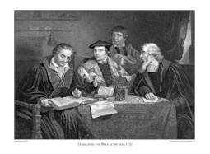
Translating From Vulgate Into Vernacular
LUTHER ADDS "ALONE" TO TEXT OF ROMANS 3:28!
LUTHER INSERTS "ONLY" IN 3:20 & 4:15!

Slide 84
David Lee Burris:
Quaker Saying - “I lift thee up – thou lift me up – and together we ascend to heaven!”
The Book Of James, The First Chapter…
“Pure & undefiled religion before God & the Father is this: to visit orphans and widows in their trouble, and to keep oneself unspotted from the world.”

Slide 87
OF JAMES 2: "BEFORE GOD JUSTIFIED BY FAITH ALONE"
OF JAMES 2: "BEFORE PEOPLE JUSTIFIED THRU WORKS"
Translating From Vulgate Into Vernacular

Slide 88
Battle For The Book Of James
250 A.D. - Origen quotes James extensively.
350 A.D. – Eusebius acknowledges James as both canonical and orthodox. However, he categorizes it along with other of the catholic epistles as “disputed texts” – i.e. the “universal letters” of James 1 & 2, Peter 1 & 2, 3rd John, and the Book of Jude.
450 A.D. – Church Bishops reject all universal letters.
Book Of James Considered Canon For 1,000 Years!
1500 A.D. – Erasmus’ Commentary Doubted James!
German & Swiss Reformer Consider N.T. Apocrypha!

Slide 89
JAMES CHAPTER TWO

Slide 90
Part One: Faith Presented Unbiased
The setting is that of an assembly of the saints where two men enter, one rich and dressed accordingly and the other poor and typically dressed. The presentation of faith observers will note is seen in the treatment these two visitors receive. When the two men are treated differently, the royal law, “Thou shalt love thy neighbor as thyself” has been violated and the faith has been shamefully misrepresented.

Slide 91
Part Two: The Law Of Liberty
No point of the law may be violated with impunity. Christians must speak and act in harmony with the law of liberty. “We must be uniform in our practice of faith.” … The primary reason is because judgment is coming! Mercy will be sought & found by those extending mercy to others and denied those lacking in such compassion extended toward their fellowman.

Slide 92
Part Three: Justification By Works
The three main points within this chapter are unified by its theme of “the demonstration of faith.” Salvation is emptied out of a faith void of demonstration(v. 14). An obvious requirement of daily sustenance left unsupplied constitutes a “dead faith” (vv. 15-17). James wrote, “Yea, a man may say, Thou hast faith, and I have works: show me thy faith without thy works, and I will show thee my faith by my works” (v.18). The existence of faith is verified in the corresponding actions it generates. Moreover, the only time the term ‘faith only’ appears in the Bible is verse 24: “Ye see then how that by works a man is justified, and not by faith only!”
...not by faith only!

Slide 93
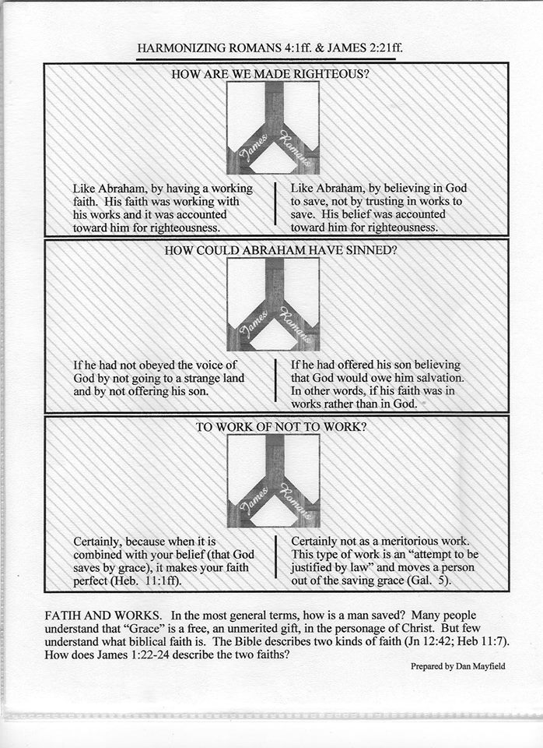

Slide 94
Part Four: Necessary Conclusions
The royal law and the law of liberty find expression in the subject of justification by works. The law of God establishes the rule of conduct or action and limits behaviors & activities to the standard of acceptability as authorized by the revealed word of God, the Bible. Thus, we must be unbiased in our presentation of faith, vv. 1–9. We must be uniform in our practice of faith, vv. 10-13. Finally, we must also be undaunted in our performance of faith, vv. 14-26. Together, this is the “demonstration of faith” about which James wrote.

Slide 97
Lutheranism After Luther Philip Melanchthon & Lutheran Slippage
We all know the proverbial pun that the man is head of the family and the wife the neck, but it is the neck that turns the head.
It was something like that in Melanchthon’s relationship to Luther. He not only helped Luther but was in awe of him.
Nevertheless, as we have seen, it was probably Melanchthon and not Luther who turned the Reformation against the Swiss, causing the first great division in Protestantism.
Moreover, it was Melanchthon and not Luther who wrote the first Lutheran systematic theology. Loci Communes (commonplaces) was the first Protestant theology and it was Melanchthon who negotiated with Roman Catholicism at Augsburg in 1530, though Luther was in the background keeping his associate in line.
* Source: Ligonier Ministries Church History Handouts

Slide 98
Lutheranism After Luther Philip Melanchthon & Lutheran Slippage
Nevertheless, Melanchthon never agreed with Luther’s profound Augustinianism, though he never dared differ with him openly while Luther lived.
After Luther’s death in 1546, immediately and openly Melanchthon differed, and Lutheranism gradually slipped back to medieval semi-Augustinianism adopting a more synergistic view of salvation.
After the controversies within Lutheranism settled and the Book of Concord was adopted in 1580, the Lutheran movement had become Luther-anism, not Lutherism.
They agreed with the Reformed up to the point that regeneration preceded faith but then made that faith resistible – a thought alien to the mind of Luther!
* Source: Ligonier Ministries Church History Handouts

Slide 99
A Reformer Becomes Conservative By Coming Into Power; And As Soon As Ever He Is Able To Do Anything, He Desires To Do Nothing!
Gilbert Chesterton

Slide 100
Later Swiss Reformation Zwingli – Calvin - Radical
David Lee Burris:
Heinrich Bullinger was the conciliatory successor to Zwingli & after he was removed from the religious scene most Zwingli groups merged with those of Calvin forming the Reformed Churches of Switzerland.
Three types of Reformation theology developed in Swiss territories. The German-speaking cantons of the northern part of the country followed Zwingli’s view of the Reformation. Those in the south, led by Geneva, followed the views of John Calvin. In addition, the radicals of the Reformation, known as Anabaptists, developed an extreme wing among those who had worked with Zwingli. From Zurich the Anabaptist movement spread thru Switzerland, Germany, and Holland, where, under Menno Simons, it had a steady development.
* Source: Christianity Through The Ages by Dr. Earle Cairns

Slide 101
THESIS & ANTI-THESIS THEOLOGY
PLATO(Teacher) VERSUS ARISTOTLE(Student)
IRENAEUS(2nd Cent) VERSUS AUGUSTINE (4th)
AUGUSTINIAN VERSUS PELAGIAN NEMESIS
AUGUSTINIAN(Old)/THOMISM(New Church)
DESIDERIUS ERASMUS VS. MARTIN LUTHER
MARTIN LUTHER VERSUS ULRICH ZWINGLI

Slide 102
1519
Martin Luther questions papal infallibility (belief that the pope is preserved from error in matters of faith and morals) and begins New Testament sermon series, starting a new era of preaching
Martin Luther
Ulrich Zwingli begins New Testament sermons, thus ushering in the Swiss reformation
Ulrich Zwingli

Slide 103
The Church Across The Ages
David Lee Burris:
European Royal Dynasties – including Louie & Marie – related across national boundaries – uniformly used personal Swiss Body Guards – lacking basic trust in their own countrymen!
of people, events
life and faith from
Glimpses
ZURICH REFORM UNDER ZWINGLI
“Born in Wildhaus, Switzerland, on New Year’s Day in 1484, Zwingli received a good education in the classics and was ordained a priest in 1506. He served as parish priest in Glarus from 1506 to 1516.
A key event during that period aroused his patriotic fervor and perhaps began to undermine his confidence in the Roman church. One of the major industries for the Swiss then was mercenary service. They would hire out their young men to fight in others wars, including battles for the pope. (You can see the Swiss Guard today policing the Vatican in their colorful uniforms.) Zwingli accompanied the Swiss troops as chaplain in September of 1515, and saw 6000 of his young countrymen slaughtered in the service of the pope at the Battle of Marignan in Italy. He returned home determined to abolish the mercenary practice of ‘selling blood for gold.’ It would cost him his parish at Glarus but helped pave the way for his call to Zurich later.”

Slide 104
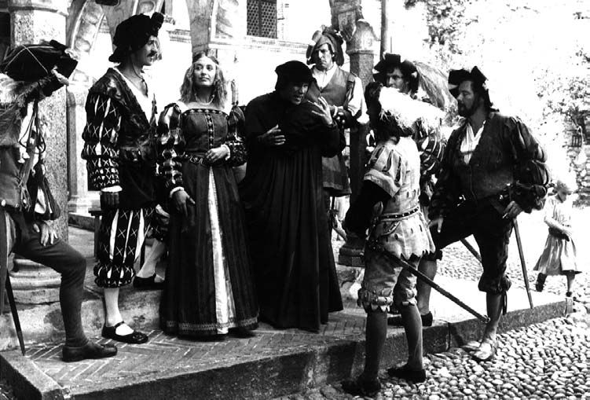
The Church Across The Ages
of people, events
life and faith from
Glimpses
ZURICH REFORM UNDER ZWINGLI
“The year 1516, was decisive for him. He moved on to become priest at Einsiedein, apparently put a sexual affair with a barber’s daughter behind him, and met the great scholar Erasmus. He immersed himself in the Greek New Testament published by Erasmus. (He actually hand copied out of this edition all of Paul’s epistles and learned them by heart.) His preaching began to take on a decidedly evangelical tone.
On January 1st 1519, his 35th birthday, he became pastor at the central church in Zurich. Here he was able to work toward prohibiting the mercenary service. As soon as he arrived, he announced that, rather than preach from prescribed texts of the lectionary, he was going to preach through the Gospel of Matthew. This was a bold step in that day!
The dreaded plague arrived in Zurich the same year as Zwingli. He did his best to minister to his people. More than one-fourth of the 9,000 people of the city fell victim. Zwingli caught the plague, too. In his three-month recovery, he learned life-changing lessons of man’s dependence on God that made his trust in God’s Word rock-solid.
The Affair of the Sausages:
The Eating of Sausage During Lent

Slide 105
The Church Across The Ages
of people, events
life and faith from
Glimpses
ZURICH REFORM UNDER ZWINGLI
“The rituals & doctrines of the Church did not square with his reading of Scripture. He preached what he found in the Bible – even when it meant going against long-accepted church teachings. As a result, controversy spread. A public debate was held on disputed matters of faith and doctrine by the Zurich city council. On January 29, 1523, the council issued a ruling backing Zwingli and issued a decree that he and the other pastors in the region were ‘to preach nothing but what can be proved by the holy gospel and the pure holy scriptures.’
Reforms were implemented, Catholic images removed, the mass replaced with a simplified service emphasizing preaching, and communion celebrated more as a‘spiritual’ reception of Christ.”

Slide 106
The Church Across The Ages
of people, events
life and faith from
Glimpses
ZURICH REFORM UNDER ZWINGLI
“Despite this vote of confidence, Zwingli could expect that the Catholic loyalists would resist him, and they did. He did not expect that perhaps his greatest trials would come from within – some of his closest followers were not content with the speed at which he was pressing the church reforms. They became known as Anabaptists. They were particularly agitated over the practice of infant baptism, which they rejected. Another public debate was called to consider the issue. The Zurich council ruled against the Anabaptists, so these ‘radicals’ defied the council. They ‘re-baptized’ themselves as adult believers. When they continued in their legal defiance, some were put to death.”

Slide 107
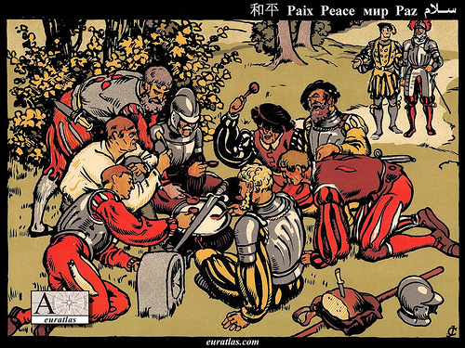
The first war of Kappel was a conflict in 1529 between the Protestant and the Catholic cantons of the Swiss Confederacy. It ended, without any battle, with the first peace of Kappel. Under the lead of Ulrich Zwingli, the Protestant canton and city of Zürich had concluded with the other Protestant cantons a defence alliance. The Catholic cantons in response had formed an alliance with Austria. After numerous minor incidents and provocations from both sides, Zürich declared war on 8 June and marched to Kappel at the border to Zug. By mediation of the Federal Council, open war was barely avoided. Legend has it that instead of fighting, the two armies peacefully shared a milk soup, the Kappeler Milchsuppe, cooked in a pot placed exactly on the cantonal border between Zürich and Zug, while a peace was negotiated. The Catholics provided the milk, the Protestants the bread.

Slide 108
The Church Across The Ages
of people, events
life and faith from
Glimpses
ZURICH REFORM UNDER ZWINGLI
“Catholic resistance in the rural cantons could not be overcome and eventually resulted in actual fighting. When war came, Zwingli joined the Zurich troops as an armed soldier against the Catholics in what is known as the 2nd Kappell War. The same Zwingli who had worked so hard to eliminate the mercenary service and had earlier even condemned war itself now took up arms, convinced it was necessary in the service of God and the Gospel. He was killed in battle on October 11, 1531, his body hacked to pieces and disgraced by his enemies.” (Protestant Reformer Martin Luther reportedly rejoiced at news of these events.)

Slide 109
The Church Across The Ages
of people, events
life and faith from
Glimpses
ZWINGLI & LUTHER !
“The reforms under Luther in Germany and Zwingli in Switzerland had many parallels, and the two agreed on most essential points of doctrine.
Phillip Landgrave of the city of Hesse was eager to join their movements in political, military, and religious unity, thereby strengthening the Protestant front against the growing Catholic pressure.
He brought the two of them together to meet in doctrinal discussion at Marburg. Fifteen articles of faith were on the agenda and agreement was quickly reached on fourteen of them. But on the last item – the Eucharist – no concord could be reached and the trading of insults turned ugly!”

Slide 110
Swiss Reformers & Lutherans Separate Over Lord’s Supper
David Lee Burris: Zwingli Had Just Bested The Local Catholic Bishop In Debate
Latin “Hocus Pocus” Or Aristotelian Principle Debate?; Catholics Crucify Anew At Mass?
Agreement Then Holding Today Over Three Sola’s:
- Sola Fida = by faith alone, apart from works - Sola Gratia = by grace alone, without merit - Sola Scriptura = by scripture alone, without add
Protestantism Landscape Of State & Territorial Churches With Swiss & German Branches
Swiss Reform Movement Soon Split Into Three: Puritan, Presbyterian, & Congregational Variants
Had Historic 1529 Meeting Worked – One Protestant Reform Church
Long List Agreed All But Item Of Nature Of Elements In Communion: Luther Materialist; Zwingli Memorialism
Both Seriously Thought The Lord’s Supper One Of The Two Marks Of The True Church Differing Christlogical Not Sacramental
Debate Centers Over Interpretive Differences Relating To The Relative Symbolism Or Literalness Of John 6: 63.

Slide 111
Swiss Reformers & Lutherans Separate Over Lord’s Supper
David Lee Burris:
Both Lutheran & Catholic Arguments Pointless With Recent Translations Of 1Cor. 10: 16;
For Luther, the bread was the body of Christ. That is what Christ said. Luther wrote on the velvet cloth “Hoc est corpus meum!” The Swiss reminded Luther that Christ also called Himself the vine and the door. Oecolampadius asked, “Martin, how is Christ any more present in the sacrament if He is corporeally present than He is when spiritually and dynamically? “I don’t know,” answered Luther, “but if Christ told me to eat dung I’d do it knowing it was good for me.” Not to believe Christ’s words was to be of another spirit!
TWO IRONIC POSTSCRIPTS:
Luther later saw a copy of Calvin’s writings on the Lord’s Supper (essentially like Oecolampadius’ views) and seemed to agree with it
Manschreck, a Melanchthon authority, says that it was Melanchthon who stiffened Luther against the Swiss view of the Eucharist, fearing it would make reunion with Rome impossible!
Agreement Then Holding Today Over Three Sola’s:
- Sola Fida = by faith alone, apart from works - Sola Gratia = by grace alone, without merit - Sola Scriptura = by scripture alone, without add
Zwingli Focused On Contextual Understanding Of Apostles Present For The Omnipresence Of His Fleshly Body
Latter Lutherans Later Label: of extra Calvinisticum or contrary position “Christ is God outside flesh”
Luther’s case described as “distinctive ubiquity” or that “Christ’s human body or corporal presence everywhere”
Connected to Doctrine of Communicatio Idiomatum or sharing of properties and the “blessed exchange”
Theologians Explain As Emphasis Disagreement Since Orthodox Agree One Person Of Two Natures: Emphasis Either On Differences Or Similarities; Position Of Swiss Reformers: Luther Denatures Jesus’ Body

Slide 112
1536
Luther agrees to the Wittenberg Concord defining the Lord’s Supper in an attempt to resolve differences with other reformers, but the Swiss Zwinglians reject the document
The Wittenberg Concord (covenant) was signed by Reformed and Lutheran leaders to resolve different beliefs about the Real Presence of Christ’s body and blood in the Eucharist.

Slide 113
The Church Across The Ages
of people, events
life and faith from
Glimpses
ZWINGLI & LUTHER !
“Zwingli interpreted the presence of Christ in the Eucharist in a more spiritual & more metaphorical way than Luther could accept. Thus a significant opportunity for expanded unity within the reform Protestant movement ended in division. Argument over the Lord’s Supper – a sign of the oneness of God’s people, rather than bringing together these two stalwart defenders of Scripture, instead drove a mean wedge between them!”

Slide 114
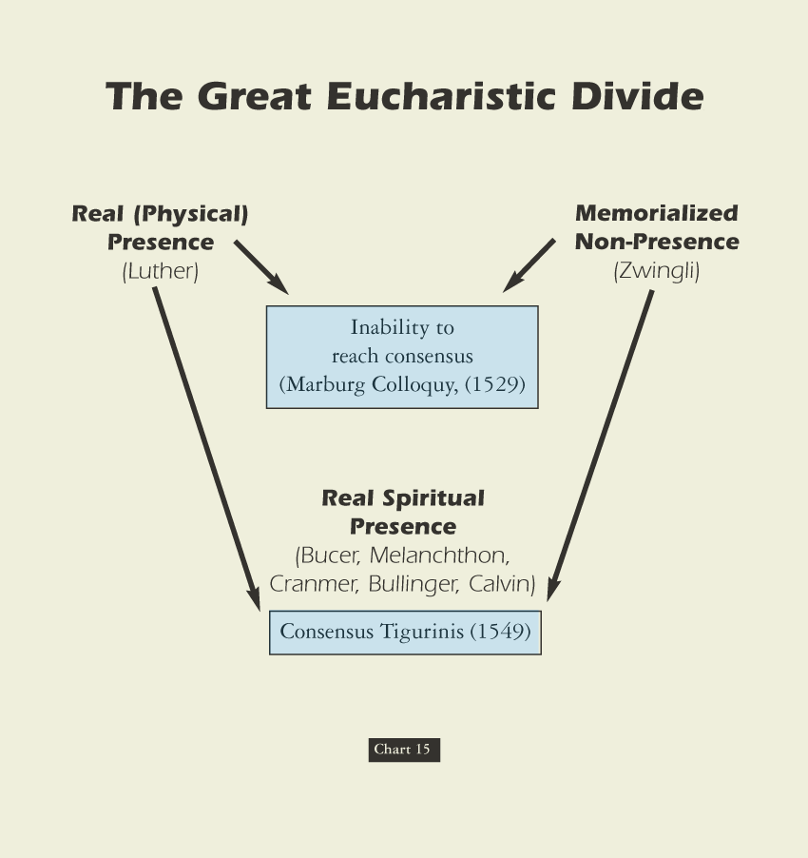
David Lee Burris:
Luther was coupled with milder Oecolampadius of Basel & Zwingli with Melanchthon

Slide 115
The Principle Of Godly Worth
The meaning of worship. “The formation of ‘worship’ is a key to its meanings and how they developed. The word is formed of worth and –ship, and its original meaning in Old English (about 888) was ‘the condition of being worthy, worthiness.’ This meaning was extended in late Old English (about 1000) to ‘the respect and honor shown someone worthy,’ found in such phrases as to do worship ‘to pay respect or show honor,’ and to have or hold in worship ‘to show honor to,’ always referring to a person of distinction.” - Semantic Antics

Slide 116
The question of worthiness. By Luther’s lifetime, the phrase for the communion ceremony and host had been altered & with it a change of emphasis. The term Eucharistia, which means thanksgiving, had been replaced with Missa, which means the dismissal of the unworthy. Worthiness itself had metamorphized in meaning from a subjective and introspective responsibility to an objective meaning measured by works.
psychoanalysis & History
YOUNG MAN LUTHER
By Erik H Erikson
Significant Development Influencing German-Swiss Reformation & Scottish Restoration

Slide 117
Communion Concession & Conscience Crisis: 1st Corinthians 11: 27-29 KJV Misinterpreted
David Lee Burris:
N.T. Worthiness Of Manner Consistent With O.T. Passover Practice.
Proper grammatical reading of these verses is difficult from the older versions and translations. The term “unworthily”
occurs twice – each time an adverb modifying an action verb – eat & drink or eateth & drinketh. Contextually in this
sense “unworthily” relates to manner of partaking – not of the people partaking. Verses 27 & 29 similarly admonish as
how serious this remembrance celebration is to the heart of God. Neglecting to so somberly discern the symbolic nature
of communion elements is to share guilt in the cruel death of His Son – we crucify Christ afresh and consume eternal
death rather than eternal life. None are “worthy” and this is where our thoughts should be per our Verse 28 – so that
we can partake in a “worthy manner.” Luther – Zwingli – John Calvin – all seemed to miss this very simple Bible truth.
As we related earlier Luther & Zwingli agree on how to resolve 14 of 15 items of difference between them. The contentious 15th item is that of the Lord’s Supper. Although their discussion on this occasion obsessed on the eucharist – Luther objected as well to the memorial practice of open communion. Luther referred to this practice as “manducatio indignorum” or “eating by the unworthy.” According to this Lutheran Doctrine the unworthy receive Christ’s body to their own harm – this behavior is not among those deemed harmless and therefore indifferent to God.
The nature of the disagreement between the two reform camps is difficult to determine. First, the two sides disagree as to how important the disagreement is – Luther has it as highest priority demanding conformity while Zwingli wants a “soul freedom” of opinion on the issue. Second, there is an underlying disagreement about basic spirituality and the power of external things. This disagreement goes all the way down to a basic dispute about the person of our Lord and Savior Jesus Christ, and the universal or limited nature of His atonement sacrifice.
In follow-up, not giving up, the Strasbourg reformer Martin Bucer worked out a compromise with the Lutherans in 1536 called the Wittenberg Concord, but the agreement did not last because it was ambiguous on the issue of “manducatio indignorum.”
Furthermore, in a third attempt, Calvin makes another compromise proposal with the Lutherans which endorses the functional language of sacrament and - in effect - its related aspect of closed communion.

Slide 118
Communion Concession & Conscience Crisis: 1st Corinthians 11: 27-29 KJV Misinterpreted
Proper grammatical reading of these verses is difficult from the older versions and translations. The term “unworthily”
occurs twice – each time an adverb modifying an action verb – eat & drink or eateth & drinketh. Contextually in this
sense “unworthily” relates to manner of partaking – not of the people partaking. Verses 27 & 29 similarly admonish as
how serious this remembrance celebration is to the heart of God. Neglecting to so somberly discern the symbolic nature
of communion elements is to share guilt in the cruel death of His Son – we crucify Christ afresh and consume eternal
death rather than eternal life. None are “worthy” and this is where our thoughts should be per our Verse 28 – so that
we can partake in a “worthy manner.” Luther – Zwingli – John Calvin – all seemed to miss this very simple Bible truth.
The Backdrop Setting To This Background Material – Considering The Separate Motivations Of The Major Players:
Luther is more concerned with preserving the priesthood administered sacramental system existing since the fourth century than he is in merger with the Swiss Church or any group which actually practices the “priesthood of all believers.” From his publication on “The Babylonian Captivity Of The Church” he only criticized the abuses of the sacramental system and questioned the specific interdict and special excommunication powers of the papal office. Of the seven sacraments then in practice – he did recognize only two – baptism & communion. Luther redefines the standard threshold using a modified version of the traditional Augustinian definition of sacrament. Since the sacraments are founded on Christ’s promise - they are to be received only by faith – faith of family or faith of persons. The other five “sacraments” are reduced simply to church practices – except for penance which he places in an uncertain status. As regards communion – it is only for those recognized by the church as being faithful.
In his heart simply a reformer – his motivation is the eventual re-unification with the Catholic Church – making it once again into that which is truly Catholic in meaning. The Lutheran Church has the mission of preserving this golden age pattern of the fourth century for the duration.
Calvin just like Zwingli desires the dream of one Protestant church entity - totally rejecting further attempts at reunification or even reform of the Catholic Church. Calvin learns from reports of Zwingli’s meeting with Luther that hopes of progress and eventual realization of this dream require the ending of avoidance and focused attention on this communion controversy.

Slide 119
Communion Concession & Conscience Crisis: 1st Corinthians 11: 27-29 KJV Misinterpreted
Proper grammatical reading of these verses is difficult from the older versions and translations. The term “unworthily”
occurs twice – each time an adverb modifying an action verb – eat & drink or eateth & drinketh. Contextually in this
sense “unworthily” relates to manner of partaking – not of the people partaking. Verses 27 & 29 similarly admonish as
how serious this remembrance celebration is to the heart of God. Neglecting to so somberly discern the symbolic nature
of communion elements is to share guilt in the cruel death of His Son – we crucify Christ afresh and consume eternal
death rather than eternal life. None are “worthy” and this is where our thoughts should be per our Verse 28 – so that
we can partake in a “worthy manner.” Luther – Zwingli – John Calvin – all seemed to miss this very simple Bible truth.
Through triangulation Calvin formulates an intermediate position between that of his predecessor and Luther that for all intents and purposes accommodates Luther on his major point of sacramental language - making of the memorial itself the “means of grace.” John Calvin considers this a minor point on a not so important tangential issue. However, it has the significant effect of closing the self-examined communion – with church officials being allowed to start to share in that examination of worthiness.
In other words, neither the Ideologue Reformers Luther and Zwingli or the Ideologue Systematizer Calvin are purists – by the evidence of their doctrinal disconnects they can all be defined more precisely as compromisers to a greater or lesser degree. As is so often the case these weaknesses of message at a base level correspond at to huge flaws of character. These leaders evidenced over time less of a desire to glorify God than to aggrandize themselves. As a group they paved the way for rightly convicted, sincerely motivated, and uncompromisingly dedicated leaders.
The doctrinal outcomes of these egregious errors throughout the Protestant world was to harden denominational boundaries and reinforce judgmental attitudes. Through their theological traditions everyone seems to have passed over the middle verse of the proof text.
Zwingli’s outward badge of participation in the Christian community had devolved to literalistic badges of identification – a mark of worthiness prerequisite to participation. This Protestant tradition of judging the faith of another was and is as abusive as the Catholic point system of penance which determined participation in the communion sacrament.

Slide 120
Communion Concession & Conscience Crisis: 1st Corinthians 11: 27-29 KJV Misinterpreted
Proper grammatical reading of these verses is difficult from the older versions and translations. The term “unworthily”
occurs twice – each time an adverb modifying an action verb – eat & drink or eateth & drinketh. Contextually in this
sense “unworthily” relates to manner of partaking – not of the people partaking. Verses 27 & 29 similarly admonish as
how serious this remembrance celebration is to the heart of God. Neglecting to so somberly discern the symbolic nature
of communion elements is to share guilt in the cruel death of His Son – we crucify Christ afresh and consume eternal
death rather than eternal life. None are “worthy” and this is where our thoughts should be per our Verse 28 – so that
we can partake in a “worthy manner.” Luther – Zwingli – John Calvin – all seemed to miss this very simple Bible truth.
Both major religious bodies had accomplished the establishment of closed communion as a universal norm. The communion practices of the four major Protestant offshoots of the Swiss Reform movement were just variations on this courtroom theme. It Was Time Overdue To Reconcile This Remembrance Ceremony To That Of The Spirit Of The New Covenant!
The communal nature of communion has been taken out – that which was intended to unite man with man and them together with God had been perversely twisted. In the Be-atitudes Christ speaks to this ideal in Matthew 5: 23–26.
These effects taken as a whole paved the way for one with a healing message of brotherly love - worship that is in doctrinal rather than dogmatic conformity – preaching lifestyle of collective submission where there is Biblical authority and the ideal of respect for personal opinions and choices where there is no direct scripture or obvious example of necessary application.
Bible Students With Sensitive Consciences Are Ripened & Ready For Change When They Hear Alexander Campbell. But first he has to have his own heart pricked as we see happen in the opening scene of our docu-drama. We witness the moment when Alexander Campbell comes to the fundamental realization that – although the human creation as a whole has performed miserably thus not being worthy of reward - yet without any merit of our own – God has made us all worthy!
He Did Not Send His Son For Some Persons And Not For Others!
CHRIST DIED ON THE CRUEL CROSS SO THE ENTIRE HUMAN RACE COULD BE SAVED!

Slide 122
EXEMPLARISM
“The belief that Jesus’ life and ministry is primarily an example to humans of how to live uprightly before God rather than as a means of providing something that humans cannot gain on their own.”
* Dictionary Of Theological Terms, Grenz & Guretzki

Slide 123
EXPIATION
“The belief that sin is cancelled out by being covered over. For Christians, expiation suggests that Christ’s death covers our sin.”
* Dictionary Of Theological Terms, Grenz & Guretzki

Slide 124
IMPUTATION
“A transfer of benefit or harm from one individual to another. In theology imputation may be used negatively to refer to the transfer of sin and guilt of Adam to the rest of humankind. Positively, imputation refers to the righteousness of Christ transferred to those who believe on him for salvation.”
* Dictionary Of Theological Terms, Grenz & Guretzki

Slide 125
PROPITIATION
“Atoning Sacrifice; An offering that turns away the wrath of God directed against sin.”
* Dictionary Of Theological Terms, Grenz & Guretzki

Slide 126
Vicarious Atonement
“Literally, ‘in place of.’ Hence in that Jesus died ‘for us,’ that is, took upon himself the consequences of human sin.”
* Dictionary Of Theological Terms, Grenz & Guretzki

Slide 127
Purpose-Fact-Focus-Result
David Lee Burris:
Without Proper Theology Of God Religion Degenerates Into Both Superstition & Legalism
Views Of The Atonement
Abelard | No Need | Optional | Virtue | Imitation
Socinian | No Need | Optional | Repent | Repent
Ransom to Satan | Liberate | Required | Payment To Satan | BondageRelease
Grotian | Govern | Optional | Virtue | Stop Sin
Arminian | & Save | Required | Retribute | Past Sin
Anselm | & Save | Required | Retribute | All Sin

Slide 128
ATONEMENT THEORIES
DESCRIPTION
Moral Influence
A Positive Example Of Love In Action
Ransoming
Buys Lost From Sin Gains The Victory!
Satisfaction
Appease God’s Honor Robbed By Our Sin
Penal Substitution
He’s Legal Stand-In He Bears Our Guilt

Slide 129
The act by which God restores a relationship of harmony and unity between Himself and human beings. The word can be broken into three parts which express this great truth in simple but profound terms: "at-one-ment." Through God's atoning grace and forgiveness, we are reinstated to a relationship of at-one-ment with God, in spite of our sin.

Slide 130
ROLE
REVERSAL

Slide 131
He was numbered with transgressors
in public reputation.
He was numbered with transgressors
in the courts of law.
The whole mob numbered Him with
transgressors when He was on trial.
He bears the transgressor’s scourging.
He also bears the felon’s cross.
From: Spurgeon's Sermon On Isaiah 53

Slide 132
He trades places so He could better
become the transgressor’s advocate.
He trades places that He might plead
with the transgressor.
He trades places so that sinners may
feel drawn to Him.
He on the transgressor’s list that we
might be written in the roll of saints.
He trades places to challenge Justice.

Slide 133
Incarnate Substance Trans-mutes To Communion Presence Debate
Roman Catholic Church: Transubstantiation of the elements’ substance into Jesus’s real flesh & blood regardless of appearance.
German Lutheran Reform: Consubstantiation of the elements’ substance that stays the same & coexists w/ the real flesh & blood.
Eastern Greek Orthodox: Theosis Images Doctrine views the elements types of Christ’s 2 natures that transport to His presence.
Swiss Reformer Position: Memorial Remembrance representation & symbol not of the divine substance or presence of His body.

Slide 134
SOTERIOLOGY
“Literally, ‘the study of salvation.’ This topic within the corpus of systematic theology deals with the work of the triune God in bringing creation, and especially humans, to enjoy the divine purpose for existence; ‘objective’ soteriology speaks of the life, death, resurrection & exaltation of Christ in relation to human salvation; ‘subjective’ soteriology deals with the process whereby individuals are brought to God’s saving goals.”
* Dictionary Of Theological Terms, Grenz & Guretzki

Slide 135
Religious
Soteriological Exclusivity
Divergence

Slide 136
“In an effort to be entirely faithful to Torah, many Jews had begun to accentuate the need to separate themselves from contamination. Right standing with God increasingly became a matter of keeping oneself unstained by actions, by things, and by people who did not adequately keep Torah. You didn’t gather with them, you didn’t consort with them, and you most certainly did not eat with them. So if you were proclaiming a kingdom not about separation but about reconciliation, how would you go about doing that? Well, you could start by having dinner with people. [In a culture obsessed with honor and shame, which considered eating with the disreputable as a blow to one’s own standing] Jesus constantly stepped around the politics of holiness, daring to interact with the unclean and the disenfranchised. He did so with the presumption not that their uncleanness would taint him, but that his purity would renew them.”

Slide 137
When Is An Example Binding?
The rule of harmony. An example is never to be taken in such a way as to violate the teaching of undoubted Scripture in direct statements. The teaching of scripture is harmonious @who/what/when/where/how etc.
The rule of uniformity. Uniformity in essential details must be present in any example for the action involved to be considered binding.
The rule of universality. No example of action is to be regarded as binding when it cannot be universally applied.
The rule of materiality. To be binding, an example must have a material connection or relation to the situation under consideration. (Acts chapter 20: verses 1 - 17.)

Slide 138
Zwingli LED THE PROTESTANT REFORMER OPPOSITION TO ADULT RE-BAPTISM
David Lee Burris:
Heinrich Bullinger was the conciliatory successor to Zwingli & after he was removed from the religious scene most Zwingli groups merged with those of Calvin forming the Reformed Churches of Switzerland.

Slide 139
MAJORITARIAN
MAGISTERIALS

Slide 140
1529
The Same Diet Of Spires – Which Protested Restrictions Of Religious Liberty – Condemned Anabaptists:
“Every Anabaptist and rebaptized person of either sex should be put to death by fire, sword, or some other way.”

Slide 141
ALL CONSIDERED
ADULT CONVERSION
AS CULTURALLY ALIEN

Slide 142
1551
The Diet Of Augsburg Decreed:
“Judges and jurors who have scruples against pronouncing the death sentence on Anabaptists will be removed from office and punished by fine and imprisonment.”

Slide 143
THE M I L L S T O N E
MATTHEW EIGHTEEN: VERSE SIX
OFTEN APPLIED LITERALLY
IN PROTESTANT INQUISITION

Slide 144
1528
The Count Of Alzey in area of the Palatinate, after he had 350 Anabaptists executed, exclaimed:
“What shall I do, the more I kill, the greater becomes their number!”

Slide 145
Pretext: Text Outside Of Context
David Lee Burris:
Hubris Followed By Nemesis – God Of Arrogance Precedes Goddess Of Vengeance
Webster’s Definition Of Pretext: A purpose or motive alleged or an appearance assumed in order to cloak the real intention or state of affairs.
Previous To Pretext: Fear & Pride

Slide 146
Reason For Resistance To Re-Baptism Ana-Baptists: Light - End Of Tunnel – Oncoming Train Opposition Invested: Out On Far Limb - Good / Evil Decision Tree
Counter-Intuitive Doubting:
“The Philosophy Of One Century Is The Common Sense Of The Next.”
Henry Ward Beecher
Derailment Of Entrainment Thought:
“The low. almost imperceptible process, part biological, part
cognitive, by which people adapt
& eventually adopt, the prevailing
rhythms surrounding them.”
“Traditio” – ritual handed down generation to generation supposedly from church fathers. A situation similar to the twisted traditions addressed by Jesus in the Beatitudes; Ritual Tradition – incremental from deathbed exception to routine norm. The necessity of clinical baptism of Constantine by pouring was now the convenient option preferred by the healthy. The family baptism of believers in the early church is now an infant initiation equivalent to that of the circumcision administered by the priesthood of the old law. Both paedocommunion and paedobaptism are commonplace.
Not any understanding adults have been baptized by immersion and as an act of obedient conscience for about 1,000 years. Incrementalism of Dialectic Synthesis; Negative cascading consequences of wrong previous decisions: Luther uses this as an argument that to accept this Anabaptist tenet would be to suggest that no one had been saved in a millennium and all were burning in Hell. This is inconceivable to him. He believes the infant practice an “adiaphora” or an innovation indifferent to God. He was especially against it due to the introspection associated with such an act.

Slide 147
Reason For Resistance To Re-Baptism Ana-Baptists: Light - End Of Tunnel – Oncoming Train Opposition Invested: Out On Far Limb - Good / Evil Decision Tree
David Lee Burris:
Zwingli Was Ready To Compromise Over Infant Baptism For Sake Of Unity But The AnaBaptists In His Flock Refused To Follow Along. Zwingli Eventually Turned Against Them As Both Enemies Of Church & State. They opposed the state in this world and tended to undermine the military. Initially they were theocratic in orientation but from an early negative experience they had adopted a pacifist position.
Those baptized by John - REBAPTISED!
Counter-Intuitive Doubting:
“The Philosophy Of One Century Is The Common Sense Of The Next.”
Henry Ward Beecher
Derailment Of Entrainment Thought:
“The low, almost imperceptible process, part biological, part
cognitive, by which people adapt
& eventually adopt, the prevailing
rhythms surrounding them.”
Additionally, Luther feared the possibility people would want to repeat a ceremony meant to be done only once. Furthermore, there was a consensus in the conventional wisdom of the time that everyone should be baptized only once.
Moreover, Zwingli also was incensed and added to the debate. Zwingli went so go far as to suggest that infants can have faith - quoting as passage proof – Luke 1: 41. Agreeing to the re-baptism proposition to take care of oneself seems at the same time to be admitting that our dearly departed loved ones have in an innocent ignorance earned an eternal punishment. Furthermore, this is was not an asymmetrical argument with the AnaBaptists that could be somehow compromised. They even utilized this concept aggressively in terms of an evangelism tool with an terrible tendency and unfortunate consequences. Their expressed conviction at the least closed doors of opportunity – however, it usually aroused anger and sometimes heated hostility. Re-baptism, although absolutely accurate theologically – in the Middle Ages went against the grain - both emotionally and intellectually. The Dark Age mentality could not even admit to the witness of their own eyes when Galileo proved Aristotle wrong – their thinking had become locked and completely entrained.

Slide 148
Reason For Resistance To Re-Baptism Ana-Baptists: Light - End Of Tunnel – Oncoming Train Opposition Invested: Out On Far Limb - Good / Evil Decision Tree
Counter-Intuitive Doubting:
“The Philosophy Of One Century Is The Common Sense Of The Next.”
Henry Ward Beecher
Derailment Of Entrainment Thought:
“The low, almost imperceptible process, part biological, part
cognitive, by which people adapt
& eventually adopt, the prevailing
rhythms surrounding them.”
Ritual Rationale – An argument of attack was seldom made according to spiritual rescue – a regime cleansing from an inheritance of original sin. Rather more frequently a weaker defensive position was taken identical to that offered for the “benign custom” of arranged childhood marriage. Both were treated as legally valid although empty signs that were not rendered efficacious until respectively either confirmed or consummated. Another after marriage illustration of comparison noted that after being matched as children any incidents of infidelity and adultery could be straightened simply by way of a willingness to forgive and/or reconcile – it did not require contractual remarriage – because the childhood marriage was still valid according to law.
The Swiss Reformed specifically stated that infant baptism was a sign of future faith like was circumcision – an indication that the child will be raised in covenant community and loving family as a Christian and valid until the youth makes profession of faith which makes them also a member of the universal church. I speculate that this also is most probably that time period commencing the Roman Catholic practice of newborn Godparent selection. I do not believe there is any fixed date of doctrinal departure for this specific practice so this is only an educated guess on my part.
Boys Alone Circumcised!

Slide 151
Reason For Resistance To Re-Baptism Ana-Baptists: Light - End Of Tunnel – Oncoming Train Opposition Invested: Out On Far Limb - Good / Evil Decision Tree
Counter-Intuitive Doubting:
“The Philosophy Of One Century Is The Common Sense Of The Next.”
Henry Ward Beecher
Derailment Of Entrainment Thought:
“The low, almost imperceptible process, part biological, part
cognitive, by which people adapt
& eventually adopt, the prevailing
rhythms surrounding them.”
“Ex Opera Operato” – It was valid as ritual because it was worked in a certain way and with specific words repeated.
Sequence of Sacramental Sin Structure: 1) Baptism Itself The External Sign; 2) Signifies The Inner Gift Of Rebirth In Christ; 3) Faith Brings Outward Sign & Inner Gift Together.
Christian Identity Based Not On Belief But By “Christening” Served Institutional Interest: In state-church systems membership in the civil religion from birth was like an inheritance of ascribed citizenship. It proved the benefits of social control through complementary hierarchies – one of the temporal sword and one of the spiritual sword. The Lutheran & Anglican Reformations were especially Magisterial – with territorial realignments of church and state with trade in triad determining dominance.
The AnaBaptists were of the people and envisioned a church without entangling alliances. This put them completely out of place on the whole of the European Continent.
Served State & Church Cross Interest!

Slide 154
Ascribed Citizenship: Ascriptive Doctrine by which a person is ascribed citizenship by virtue of circumstances beyond their control.

Slide 155
Consentual Citizenship: 1) Englishman John Locke makes this distinction and/or recommendation as an alternative to birthright citizenship. 2) It is based on mutual acceptance of the community by individual citizens. 3) It naturalizes forward & in reverse.

Slide 156
BELIEVERS BAPTISM FREE WILL!

Slide 157
Church Membership Voluntary!

Slide 158
Heavenly Citizenship Consentual!

Slide 159
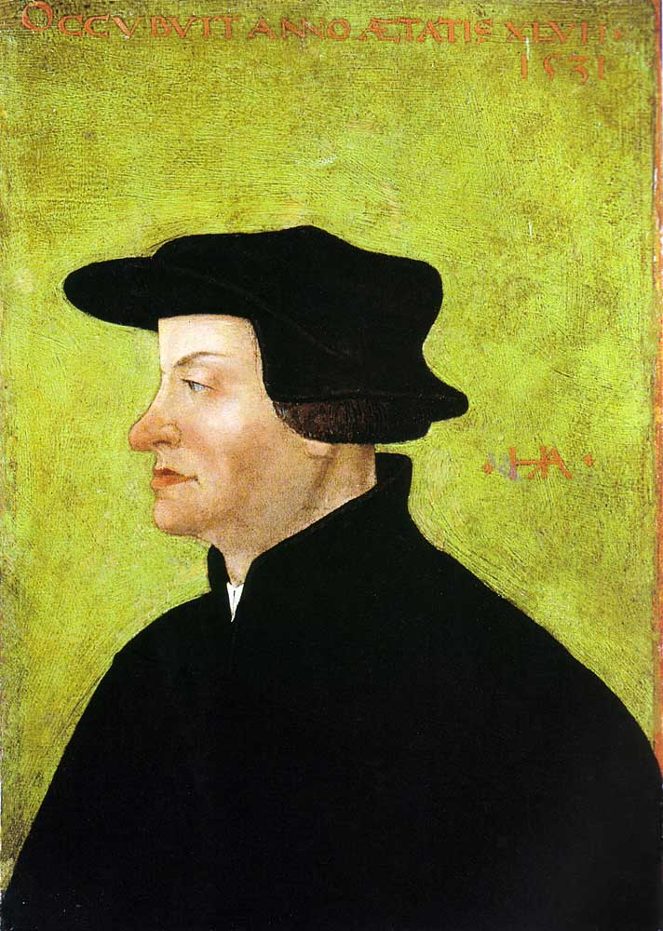
1531
Tyndale refuses Henry the VIII’s invitation to return to England
Ulrich Zwingli urges civil war in Switzerland to force remaining Catholic districts to accept Protestantism
Zwingli is killed in the Battle of Kappel
Ulrich Zwingli

Slide 161
THESIS & ANTI-THESIS THEOLOGY
PLATO(Teacher) VERSUS ARISTOTLE(Student)
IRENAEUS(2nd Cent) VERSUS AUGUSTINE (4th)
AUGUSTINIAN VERSUS PELAGIAN NEMESIS
AUGUSTINIAN(Old)/THOMISM(New Church)
DESIDERIUS ERASMUS VS. MARTIN LUTHER
MARTIN LUTHER VERSUS ULRICH ZWINGLI
MARTIN LUTHER VERSUS JOHN CALVIN

Slide 162
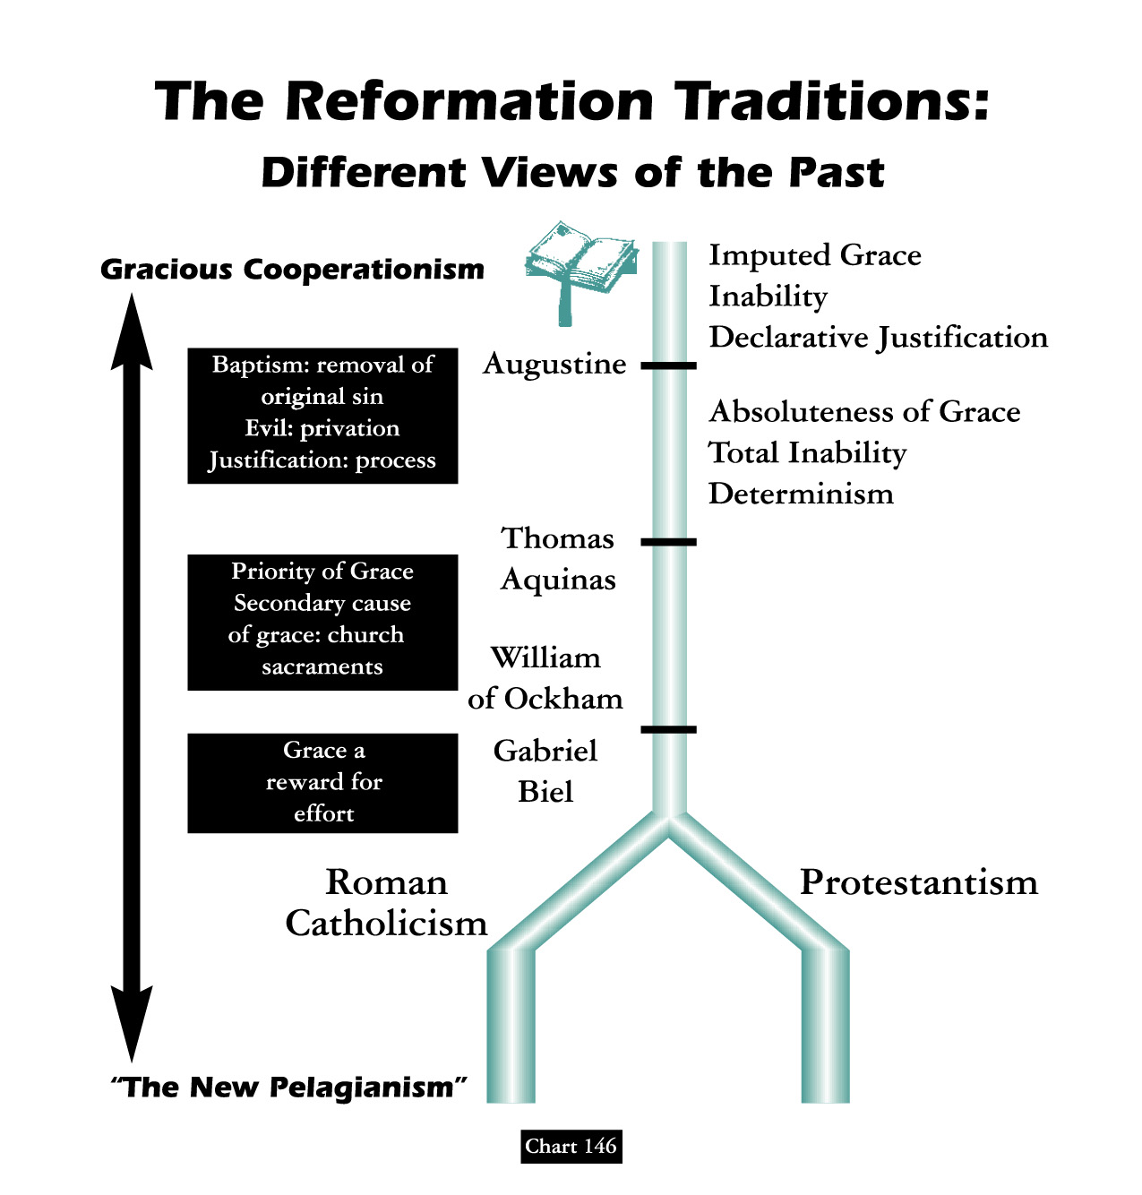

Slide 163
CONVICTION: PREVENIENT GRACE
“The word ‘prevenient’ is based upon two Latin words which mean ‘to come before.’ Thus prevenient or preliminary grace refers to the operation of God’s grace before we turn to God. Implied is the concept that God’s drawing grace precedes the human response of faith.”

Slide 164
SEMI-PELAGIANISM
1. The God Who Draws
Calvinists believe that unregenerate people are so depraved that, left to themselves, they would never repent, believe and follow Jesus. And they are absolutely correct on that point. Jesus Christ said, ‘No man can come to Me unless the Father who sent me draws him’ [John 6: 44]
Contrary to what some Calvinist theologians try to tell us, however, the word draw doesn’t actually mean drag in the Greek language - per lexicon.

Slide 165
SEMI-PELAGIANISM
1. The God Who Draws
And if God ‘draws’ people, that clearly indicates that people have a say in the matter of whether or not they will yield to His drawing. Thus, Christ not only affirmed that our salvation requires the work of God’s grace from the very start, but He also affirmed that each person will use his or her God-given ability to either resist or not resist God’s gracious drawing.

Slide 166
SEMI-PELAGIANISM
1. The God Who Draws
As I’ve already stated, Calvinists believe that God draws only those whom He has allegedly predestined, and that He draws them so strongly that they can’t resist. He supposedly draws them ‘irresistibly.’
Non-Calvinists, on the other hand, believe that God could draw people irresistibly, but that He doesn’t. If He did, those who are irresistibly drawn, having no choice in the matter, would be virtual robots, and it could hardly be said they love God, as love is predicated on free choice. One wonders what God would desire with a group of robots. It could hardly be said that they have a relationship with them.

Slide 167
SEMI-PELAGIANISM
1. The God Who Draws
Non-Calvinists see the Bible as a book about people who resist God’s drawing. The Old Testament, in particular, is a story of people who resisted Him, and most of them, as descendants of Israel, were specifically chosen by Him. They were chosen by Him yet they resisted Him.
And when God sent His Son into the world ‘that it might be saved’ the majority whom He came to save rejected Him – even the Bible students. [John 1: 11]

Slide 168
SEMI-PELAGIANISM
1. The God Who Draws
Calvinists sometimes point out special people in the Bible, like the Apostle Paul, who certainly had a strong drawing from God the day he came to Christ. But because Saul(Paul) was struck down on the road to Damascus by a blinding light, does that prove his personal will had no part to play in his salvation? Could he have ignored his experience and continued his plan to persecute Christians? Of course he could. [See - Hebrews 13: 5; 1st Corinthians 9:27]

Slide 169
SEMI-PELAGIANISM
1. The God Who Draws
May I also point out that God’s very strong drawing of Paul is not typical, and so it can’t rightly serve as a typical example of how God generally deals with people. Moreover, God’s strong drawing of Paul was a manifestation of God’s drawing of you, me, and everyone else who ever heard Paul’s words quoted in the gospel. God did not strongly draw Paul just for Paul’s sake, but to draw you as well!

Slide 170
SEMI-PELAGIANISM
1. The God Who Draws
Moreover, Paul believed he was specially singled out by God because he was the foremost sinner, so that ‘Jesus Christ might demonstrate His perfect patience, as example for those who would believe in Him for eternal life’ (1st Timothy 1:16) That is, God wanted every sinner to have hope because of His great mercy towards Paul. Thus Paul’s special drawing does not buttress the idea of God’s alleged pre-selection of a few; rather, it affirms God’s universal love and mercy offered to every sinner.

Slide 171
Martin Luther Vrs. John Calvin Opposite Theology & Personality
David Lee Burris:
Heinrich Bullinger was the conciliatory successor to Zwingli & after he was removed from the religious scene most Zwingli groups merged with those of Calvin forming the Reformed Churches of Switzerland.
Luther and Calvin differed theologically as well as personally. Luther emphasized preaching; but Calvin was interested in the development of a formal system of theology. Both accepted the authority of the Bible; but Luther’s main emphasis was upon justification by faith whereas Calvin stressed the sovereignty of God. Luther held to con- -substantiation as the proper explanation of the Lord’s Supper; but Calvin rejected the physical presence of Christ in favor of the spiritual presence of Christ by faith in the hearts of the participants. Luther only rejected what the the Scriptures would not approve; but Calvin refused everything of the past that could not be proved by Scriptures. Luther believed in predestination of the elect but said little about election to condemnation. Calvin held to a double election to salvation and to condemnation based on the will of God, and he rejected any idea of merit on the part of the elect or foreknowledge on the part of God, in the sense that God elected to salvation those He foreknew would believe.
* Source: Christianity Through The Ages by Dr. Earle Cairns

Slide 172
THE RE-MIXED CHURCH “Boundaries Drawn & Limits Set”
THE LEGACY OF MARTIN LUTHER:
In chapter one of a book by Heinrich Bohmer: “The Rationalists stood so far removed from Luther in their religious views that they were wholly unable to understand his religious personality. The struggles of his soul were to them a disease, his doctrines of sin and justification were at best looked upon as a “perversion,” or as “the dangerous dogmatic extravagance of a great and courageous, but at times one-sided spirit.” Even sincere Protestants with Semler placed “the learned and righteous Erasmus” above him. Men who were wholly apathetic to religion, as, for instance, Frederick the Great, judged him to be “a raving monk and barbarous writer,” or taking their cue from Voltaire spoke of him as a man who had missed his calling. These radicals, however, found one phase in the character of the “regenerator of the church,” which appealed to them: his hatred of the priests and his ardor in the cause of the “freedom of conscience.”

Slide 173
THE RE-MIXED CHURCH “Boundaries Drawn & Limits Set”
THE IMPORTANCE OF ULRICH ZWINGLI:
In the introduction of a book by Edward Peters: “Like Erasmus and Luther, Zwingli influenced the thought of reformers & Catholics alike, and the dissident strains of the Zurich reform movement influenced many communities and touched the reformation of England & Scotland. With Erasmus and Luther, Zwingli represents both traditional and novel strains of thought and programs for ecclesiastical and social reform.”

Slide 174
THE RE-MIXED CHURCH “Boundaries Drawn & Limits Set”
In the introduction of a book by Edward Peters:
“The intellectual and institutional world in which these men lived & worked was that of late medieval Christendom. They reflected & extended that world & the influence of their work helped to change it.”
“Erasmus was a former monk released from his vows who practiced the still-novel career of an independent man of letters. Luther was a professor of theology at the new University of Wittenberg in Saxony. His theological development was highly personal and concentrated upon the reform of dogma and the eradication of institutional abuses. Both men’s thought reached out into a wider and more cosmopolitan world. Erasmus was the friend of popes, the emperor’s tutor, a correspondent of kings, prelates, civil servants, and scholar’s alike. Luther came quickly to the attention of the highest authorities in the Christian world. Zwingli shared at different times the interests of Erasmus & Luther…

Slide 175
THE RE-MIXED CHURCH “Boundaries Drawn & Limits Set”
In the introduction of a book by Edward Peters:
“The intellectual and institutional world in which these men lived & worked was that of late medieval Christendom. They reflected & extended that world & the influence of their work helped to change it.”
“The reform programs of Erasmus and Luther concentrated upon learning, individual spiritual development, and broad problems of ecclesiology; hence, they appealed to a wide range of thought and could be applied across a broad band of social and political structures. Zwingli, on the other hand, concentrated his reform ideas upon a practical, almost juridical center and his work shaped the unique social institution created by the Reformation, the urban theocracy. His work in Zurich set the pattern for later reforms at Geneva under Calvin.”

Slide 176
Sociology Of Denominationalism Social Sources; H. Richard Niebuhr; 1929
“One will fail completely to understand Roman Catholicism if one blinds one’s eyes to influence of the Latin spirit and the institutions of the Caesars upon its conception of Christianity and its formulation of doctrine. The spirit and the doctrines of Lutheranism derive not only from the New Testament but from Luther’s German temperament & from the political conditions of the church in Germany. Calvinism was no less influenced in its temper & theology by national character and by the interests of the economic class to which it especially appealed…” pg. 16

Slide 177
Salvation A Free Gift
Or A Treasury Of Merit?

Slide 178
by Bob Taylor of the Firm Foundation
Five points of John Calvin
Along With All Catholicism
3. Rationale Fallacious Grounded
There is no coattail righteousness in the Bible - The righteousness of other people is not imputed to us. I am not a child of God simply because someone else is; I am not sober, righteous, and godly because someone else is. I am not on my way to heaven simply because somebody else is. There is no coattail righteousness taught in the Bible. In the realm of politics a man might sweep into lesser office by catching hold of the coattail of a much more popular politician. But no one is going to heaven by hanging onto the righteousness of another.

Slide 179
by Bob Taylor of the Firm Foundation
Five points of John Calvin
Along With All Catholicism
3. Rationale Fallacious Grounded
There is no coattail righteousness in the Bible - Transferred or borrowed righteousness is not taught in Holy Writ. The foolish virgins in Matthew 25 thought they could borrow righteousness, preparation and readiness from the wise five in that famed, familiar parable. They requested of the wise five what couldn’t be transferred or transmitted – righteousness and readiness to meet the Lord in peace!
It is also an egregious error, yet one widely held, that Deity transfers to us the personal righteousness of God the Father or the personal righteousness of Jesus Christ.

Slide 180
by Bob Taylor of the Firm Foundation
Five points of John Calvin
Along With All Catholicism
3. Rationale Fallacious Grounded
There are only two ways a person might be justified or counted righteous. I know of no 3rd alternative. (1) If a person never sinned & always maintained absolutely perfect obedience, he would be counted as righteous or justified simply upon the basis that he had never violated a single statute of the Lord’s will. Were this ever the case, then man might well glory and boast that he had earned or merited his heavenly salvation. His justification then would be a matter of debt–not of grace or favor. (2) The second way is for God to declare man justified by grace (God’s part) through an obedient faith (man’s part).

Slide 181
by Bob Taylor of the Firm Foundation
Five points of John Calvin
Along With All Catholicism
3. Rationale Fallacious Grounded
Righteousness is not something transferred to us. We do not inherit it – nor - we do not borrow it from those we think have a superabundance of it.
Peter told the first Gentiles to be converted under God’s glorious Gospel that acceptance to God comes from fearing (respecting) God and working righteousness. God’s plan of righteousness is revealed in the Gospel from “faith to faith” (Romans 1:16, 17). Those at Corinth had become righteous when they came into Christ Jesus (1st Cor. 1:30). They had become a washed, a sanctified, and a justified people (1st Cor. 6:11). This is how they became righteous. They remained in a righteous, justified or saved state as long as they did the Father’s will.

Slide 182
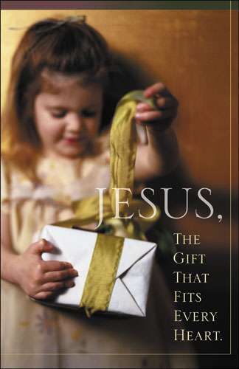
Salvation Is A Free Gift!
Acts Chapter 13: Verse 47
Romans Chapter 3: Verse 24
Romans Chapter 6: Verse 23
Romans Chapter 8: Verse 32
Romans Chapter 13: Verse 11
2 Corinthians Chapter 6: Verse 2
Ephesians Chapter 2: Verse 8
Titus Chapter 2: Verse 11
Hebrews Chapter 2: Verse 3

Slide 183
A Pardon Rejected
During the presidency of Andrew Jackson, George Wilson robbed a federal payroll from a train and in the process killed a guard. The court convicted him and sentenced him to hang. Because of public sentiment against capital punishment, however, a movement began to secure a presidential pardon for Wilson, and eventually Jackson intervened with a pardon. Amazingly, Wilson refused it.
Since this had never happened before, the Supreme Court was asked to rule on whether someone could indeed refuse a presidential pardon. Chief Justice John Marshall handed down the court’s decision: “A pardon is a parchment whose only value must be determined by the receiver of the pardon. It has no value apart from that which the receiver gives to it. George Wilson has refused to accept the pardon. We cannot conceive why he would do so, but he has. Therefore, George Wilson must die.” “Pardon,” declared the Supreme Court, “must not only be granted, it must be accepted.” Mr. George Wilson, as punishment for his crime, was hanged.
Likewise, God, through His mercy, has provided every human being pardon from their sins. However, that pardon must be accepted in the way God has ordained. Those who do not accept the pardon will perish. - selected

Slide 184
Iconoclastic French Reformer John Calvin Makes His Mark
By the 1550’s half of the city’s population was made up of foreign immigrants; when they left again, they spread Calvin’s ideas and practices throughout Europe. Many of them had received training at Calvin’s academy, the first great Protestant university.
His writings were of such high quality that even his theological opponents complemented them as to their style.
Where Luther extended on the argumentation of Augustine - Calvin brought the Augustinian argument to its natural and logical conclusion.
In his Institutes he quotes Augustine 228 times or two and one-half times all the other ancients taken together.
His most unique doctrine was that of the invisible and visible church. With some modification it is still adhered to today.
When he died in 1564, at his own request, his grave was marked only by a plain stone. Although his grave site is unknown & without epitaph – Calvin etched his life and his mind upon the whole world.

Slide 185
Calvin's Contribution To The
Destiny & Determinism Debate:
HUMAN MORAL RESPONSIBILITY

Slide 186
REFORMATION QUOTATIONS: THE DIFFERENCES BETWEEN JUSTIFICATION & SANCTIFICATION
JOHN CALVIN
“He [Paul] clearly indicates that to be justified means something different from being made new creatures & sanctified.”

Slide 187
Calvin’s Interpretation Of The Divine Sovereignty
“The confession of the sovereignty of God has become the hallmark of authentic Calvinism.” Evangelical Dictionary
From The Westminster Confession: “God from eternity, did unchangeably ordain whatsoever comes to pass.”

Slide 188
Calvin’s Interpretation Of God’s
Sovereignty Is Somewhat Flawed
MANY OF THE THINGS THAT HAPPEN IN THIS WORLD ARE NOTHING BUT THE OUTCOME OF THE SELFISH WILL OF SINFUL MEN IN DEFIANCE AGAINST THE DESIRED DIVINE WILL OF GOD!
THE BIBLE TEACHES THE FREE WILL-MORAL AGENCY OF MAN!

Slide 189
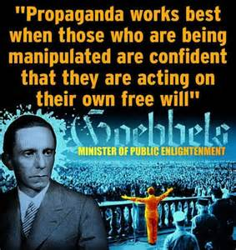

Slide 190
Fate & Free Will:
Agent Causation
- Versus -
Causal Determinism
- Versus -
Classical Compatibilism

Slide 191
INHERITING ORIGINAL SIN THE BLAST FROM THE PAST
Posterity’s Uncritical Acceptance Of Augustine’s Christian Platonism
Original sin would have God condemn men to an eternal hell for doing exactly what He forced them to do by transferring Adam’s sinful nature to them. Thus, the logical inference of original sin is that all the sins of mankind are ultimately traceable to God! The doctrine of original sin strikes at the very moral nature of God as He is portrayed in Scripture. God is perfectly holy, good, and righteous. Sin is so repugnant and diametrically opposed to God’s nature that He cannot even lie or be tempted by evil. Neither does He tempt men to sin. How, then, can Calvinists possibly reconcile the doctrine of original sin with the moral nature of God? The doctrine of original sin would logically require a total revamping of man’s concept of God. It is a slap in the face of God! Yet, original sin is perhaps the most pervasive, hallmark doctrine of Protestantism and Roman Catholicism. Let no one ever say that it does not matter what one believes. It matters to God!

Slide 192
INHERITING ORIGINAL SIN THE BLAST FROM THE PAST
Posterity’s Uncritical Acceptance Of Augustine’s Christian Platonism
Further testimony is borne to the heinousness of this doctrine in the fact that Protestants and Catholics make Jesus exempt from original sin. Of course, it would heap outrage upon outrage for them not to do so, but their having to do it only makes their error all the more conspicuous. Catholics have also seen fit to make Mary an exception to the rule by virtue of the doctrine of immaculate conception. If it is right for God to transfer Adam’s sin nature to his descendants, why would it be wrong for Him to do so in the case of Jesus? The practical need to make Jesus an exception is quite understandable, but the query is directed at the moral right to make Jesus an exception to that which blights all men. If it would have been wrong to transfer Adam’s sin nature to Jesus, why is it right for Him to do so in the cases of other men? How is it right to do to men what it would be wrong to do to Jesus? It appears that there is a double standard. The Catholics simply issue what amounts to an ipse dixit about it in the case of Mary. If God could arrange for Jesus to be born without original sin, why couldn’t He have arranged the very same thing for all men? Is God “a respector of persons”(Acts 10: 34)? Moreover, if Jesus had to be made like His brethren in all things(Hebrews 2) & was tempted in all things they are (chap. 4), how is it that He was preserved from the very thing that compels them to sin? If God gave to men that from which He preserved Jesus, then Jesus is different from His brethren in a most radical, fundamental, and irreconcilable way! The Hebrews writer’s claim becomes nothing.

Slide 193
INHERITING ORIGINAL SIN THE BLAST FROM THE PAST
Posterity’s Uncritical Acceptance Of Augustine’s Christian Platonism
Proponents of original sin sense this difficulty and try to resolve it by saying that Jesus’ virgin birth was necessitated by the need to preserve Him from original sin. For several reasons this solution falls short of its aim: (1) It would not resolve the moral dilemma for Calvinists, even if it were true! (2) Nowhere in the Scriptures is a doctrine of original sin assigned as a basis for Jesus’ virgin birth! (3) Sinfulness, or a sinful nature, is not genetically transferable anyway! (4) Even though Jesus was virgin-born, He was still a physical descendant of Adam because His mother was! Finally, when all is said and done, it may be observed that the real problem of original sin lies not in how it is transmitted but by the very fact that it is transmitted at all! No conceivable answer can absolve God from the responsibility He would have to bear for the sins of men if He creates them with sinful natures that compel them to sin. Calvinism is rotten at its taproot! Original sin, since it defies and defiles the very nature of God, is as fundamentally wrong as any false doctrine could be!

Slide 194
CALVIN COMPLETES AUGUSTINE Lapsarianism: Problems Both Philosophical & Theological
David Lee Burris:
Synod Of Dort: Elect Never Can Fall So Far As To “Forfeit The Grace Of Adoption Or State Of Justification – They Are Never Entirely Forsaken Into Eternal Ruin.”
Three Moral Wills Of Deity
Decretive Will or God as Sovereign
Preceptive Will or God’s Will that we react in a certain way even if we are free to chose.
Dispositional Will or that which is pleasing to God.
Infra-lapsarianism [also sub-lapsarianism]:
God created man wholly but permitted him to fall through the
self-determination of his free will. God made up His mind
about man’s punishment after the fall not before.
The Aquinas-Augustinian Modification:
The Future Not Fully Written – Omniscient God operates
through “Middle Knowledge.”
Middle Knowledge is the theological term for the parental space
given God’s children.God knows us doubly as our Creator & in
relationship as our Father. Theologian Augustine conceived
man as having an actual free choice within God’s pre-choice.
John Calvin would have nothing to do with this nonsense. He
agreed with the Lutheran concept regarding decisions of the
Hidden rather than revealed God & supported the school called
Supra-lapsarianism [also “deus absconditus”]
God before time and at the beginning with man decided the
masses of men would be lost – pre-destination of happy remedy
becomes fore-ordained fatalism of doom. In their pastoral care
dealing with the “evangelical despair” due to this belief in the
Doctrine of Election this school incorporated Luther’s idea of –
The Three Lamps Of Reason:
Light of Nature – Natural Law & Reason
Light of Grace – Faith & Gospel Resurrect
Light of Glory – We See How Just In Hereafter
Initial Dispute Calvinists Versus Arminians:
Repeating Pelagius – this would ascribe to God a two-fold
ignorance – one of His own creature & two of His own command.
Post-Augustine Free Will Modification
1. The Intentional Will Of God - would be what God would prefer to happen.
2. The Circumstantial Will Of God -would be what God does due to the circumstances arising that He did not intend.
3. The Ultimate Will Of God - is what God can ultimately achieve in the various circumstances of life due to the sinful rebellion of man.

Slide 195
Closeted Calvinism: Abominable Fantasy & Double Predestination
David Lee Burris:
Double Predestination Essene Concept Found In Dead Sea Scrolls!
Predestination is a religious doctrine according to which a person’s ultimate destiny, whether it be salvation or damnation, is determined by God alone prior to, and apart from, any worth or merit on the person’s part.
In some cases, it is claimed that God only determines those to be saved; in others, that his determinate purpose includes both those to be saved and those to be condemned. The latter teaching is called double predestination.
In other words, Double Predestination is the belief God creates some people who’s purpose in existing is to be sent to Hell!

Slide 196
CONCEALED CALVIN: Abominable Fantasy & Double Predestination
In His “Institutes” Book Calvin Said:
“In conformity, therefore, to the clear doctrine of the Scripture, we assert, that by an eternal and immutable counsel, God has once for all determined, both whom he would admit to salvation, and whom he would condemn to destruction… As God seals his elect by vocation and justification, so by excluding the reprobate from knowledge of his name and the sanctification of his Spirit, he affords an indication of the judgment that awaits them.”
This double doctrine of John Calvin was strongly affirmed by the Synod of Dort (1619) in Holland and in the Westminster Confession (1647) in England.

Slide 197
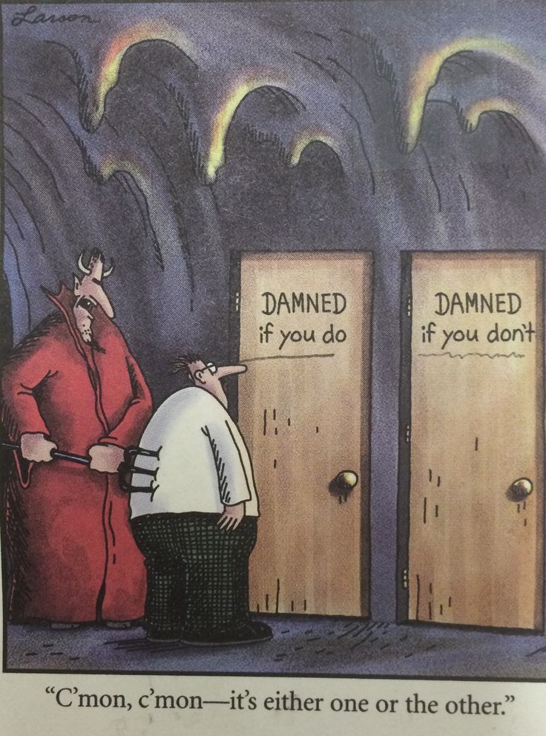

Slide 198
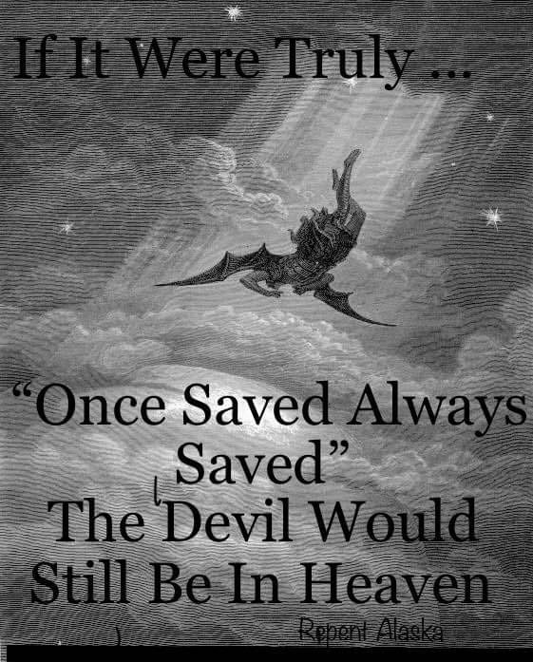

Slide 199
DISPUTING ELECTION
Universalism & Reincarnation
Salvation By Grace – Infant Inclusive
Choice Conditioned By Imputed Faith
Salvation By Grace & Human Choice
Salvation Only To The Elect & All Infants
Salvation Only To Elect & Elect Infants
Fatalism: No Elect, No God, & No Hope

Slide 200
by Jesus People on Errors of Calvin
Five points of Calvinism
(T.U.L.I.P.)
2. Grace of God Is Redefined
One of the most common arguments that Calvinists use revolves around a unique definition of grace. “If people are saved ‘by grace alone,’” they say, “then people can’t play any part in their salvation. Salvation must be 100% the work of God if it is truly salvation by grace.” Calvinists have even labeled their distinctive doctrines as ‘the doctrines of grace,’ as if none else have a theology of grace!

Slide 201
by Jesus People on Errors of Calvin
Five points of Calvinism
(T.U.L.I.P.)
2. Grace of God Is Redefined
Calvinism’s distinctive doctrines could be better called ‘the doctrines of damnation,’ because they promise damnation to the majority of people. God offers no grace and no hope of salvation for them, as they are doomed from before they were born to an eternal hell!

Slide 202
by Jesus People on Errors of Calvin
Five points of Calvinism
(T.U.L.I.P.)
2. Grace of God Is Redefined
Calvinists believe that God could have saved everyone just as easily as He saved those whom He allegedly predestined for salvation, but He was pleased to save only a small minority of those He created in His image. The rest He was pleased to foreordain to hell. We cannot help but ask, ‘If God is love, what kind of love is that?’ John Wesley, founder of the Methodists, answered, ‘That is the kind of love that makes one’s blood run cold!

Slide 203
by Jesus People on Errors of Calvin
Five points of Calvinism
(T.U.L.I.P.)
2. Grace of God Is Redefined
Does salvation by grace require that human beings play no part in their salvation?
Imagine if I were bankrupt, but someone paid my debts and gave me a fresh start by means of a million dollar check & some great business advice. Would you say that my financial recovery was not ‘by grace alone’ because I had to deposit the check into my bank account in order to enjoy the benefits of my benefactor? Of course not.

Slide 204
by Jesus People on Errors of Calvin
Five points of Calvinism
(T.U.L.I.P.)
2. Grace of God Is Redefined
Does salvation by grace require that human beings play no part in their salvation?
So if such logic would be considered absurd by anyone & everyone, why is the same logic, when applied to salvation, swallowed by Calvinists?
Why do Calvinists accuse non-Calvinists of not having a gospel of grace simply because we maintain that those who are saved are those who, as the Bible teaches, don’t resist God’s gracious drawing? If you accept a birthday gift, is that a ‘work’ that lessens the grace of the giver?

Slide 205
by Jesus People on Errors of Calvin
Five points of Calvinism
(T.U.L.I.P.)
2. Grace of God Is Redefined
Calvinist logic that sets grace against human response is not a logic that can be supported by any scripture. There are no verses in the Bible that tell us that if salvation is of grace, then human free will plays no part in the salvation process. Rather, the Bible affirms that salvation is all of grace & also affirms that those who are saved are those who, by their own wills, do not resist God’s gracious drawing.
Calvinists elevate human reasoning above Scripture’s revelation, making God’s grace and human responsibility mutually exclusive concepts, while the Bible makes them mutually inclusive.

Slide 206
by Jesus People on Errors of Calvin
Five points of Calvinism
(T.U.L.I.P.)
2. Grace of God Is Redefined
Applying the same kind of human logic, we could claim that, because salvation is by grace alone and human responsibility plays no part, Christians can sin all they want without eternal consequences. Yet the same Bible that affirms salvation is by grace alone also affirms that the unrighteous ‘will not inherit the kingdom of God’ (1st Cor. 6: 9, 10). Does your will have anything to do with your not stealing? If your answer is yes, then you have just admitted that your will plays a part in whether or not you will inherit eternal life.

Slide 207
by Jesus People on Errors of Calvin
Five points of Calvinism
(T.U.L.I.P.)
2. Grace of God Is Redefined
Salvation is by grace from beginning to end - God graciously draws everyone in the world by means of His creation & their God-given consciences. He awes them and convicts them. He expects every person whom He so draws to seek Him{Acts 7:26, 27}. Those who seek Him do so only because of His gracious initiative. And Jesus promised that those who seek will find {Matt. 7:7}. Scripture affirms that God ‘is a rewarder of those who seek Him {Hebrews 11: 6}. If people are incapable of seeking God, as some claim, then we would have to wonder why the Bible says otherwise.

Slide 208
T.U.L.I.P.
CALVINISM
IS GOSPEL
REDACTED!

Slide 209
The Trouble With Tulips: Romans & Reformed Theology
By - Benjamin Witherington III
“They have a hard time understanding that holy love doesn’t involve determinism, however subtle. Indeed love, if it is real love, must be freely given and freely received, for God has chosen to relate to us as persons, not automata. They have a hard time dealing with the idea that God programmed into the system a certain amount of indeterminacy, risk, and freedom. And maybe, just maybe the good old Evangelical lust for certainty leads us all to quickly to fill in gaps and silences of Scripture, driving us to bad exegesis.”

Slide 210
The Trouble With Tulips: Romans & Reformed Theology
By - Benjamin Witherington III
“There are in fact profound exegetical problems with the T.U.L.I.P. theology of Calvinism and to a lesser extent Lutheranism. These theological ideas are linked, and, with the exception of the ‘T’ and the ‘L,’ are necessary corollaries of each other. For example, if one believes that God has predetermined people to be saved from before the foundation of the world, then of course election is unconditional, grace is irresistible, and perseverance is inevitable. These three linked ideas do not necessarily require the notion of total depravity or limited atonement.”

Slide 211
The Trouble With Tulips: Romans & Reformed Theology
By - Benjamin Witherington III
“There is then a logical consistency to this cluster of linked ideas, and it is the logic and coherency that seem to make it compelling, rather than its real exegetical ability. And of course the danger of any such necessary linking of ideas is that if one link in the chain is dropped then the chain ceases to hold. For example, if it can be demonstrated that apostasy from the true faith is not merely possible but is an idea that Christians are regularly warned against in the New Testament, then there is something wrong not only with the notion of perseverance but also with the ideas of irresistible grace and predetermination.”

Slide 212
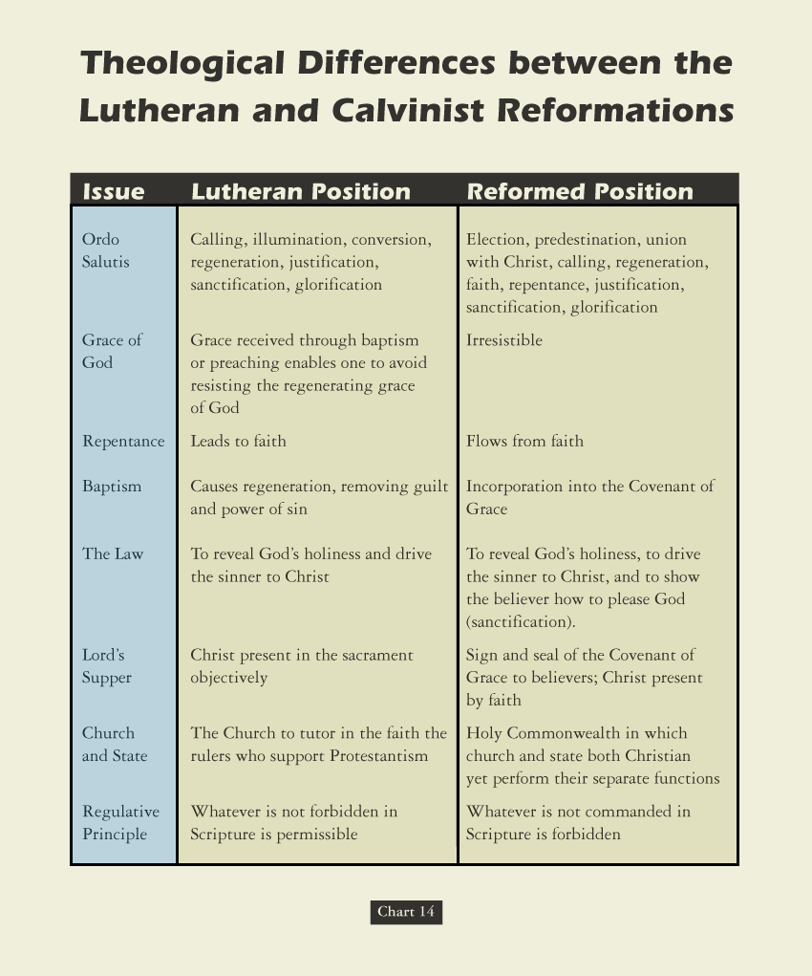
By The Time Of The Saxon Visitation Or Lifestyle Articles Of 1595 Reconciliation Highly Unlikely!

Slide 213
Two Views On Sola Scriptura
Two Groups - Different Weights – Internal & External Evidences

Slide 214
Two Views @ Regulative Principle
German Reformers: Do any worship activity not specifically forbidden
Swiss Reform: Only allow in service what Bible specifically approved

Slide 215
The Regulative Principle states that Christians are to do nothing in worship except that which has been prescribed or commanded in Scripture. Not only does this principle underscore the fact that God has revealed in His Word how he desires to be worshiped, but it also wonderfully safeguards worship from the innovations of sinful mankind. Calvin once remarked that our minds are idol factories, always inventing new objects of worship and dreaming up new ways in which to worship. The Regulative Principle takes very seriously both the truthfulness of God's Word and the deceitfulness of men's hearts.

Slide 216
THESIS & ANTI-THESIS THEOLOGY
PLATO(Teacher) VERSUS ARISTOTLE(Student)
IRENAEUS(2nd Cent) VERSUS AUGUSTINE (4th)
AUGUSTINIAN VERSUS PELAGIAN NEMESIS
AUGUSTINIAN(Old)/THOMISM(New Church)
DESIDERIUS ERASMUS VS. MARTIN LUTHER
MARTIN LUTHER VERSUS ULRICH ZWINGLI
MARTIN LUTHER VERSUS JOHN CALVIN
JACOB ARMINIUS VERSUS JOHN CALVIN

Slide 219
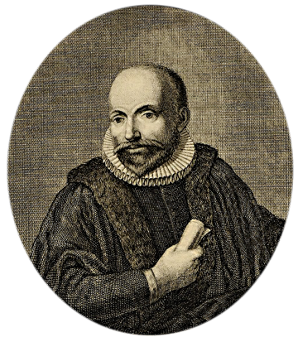
1601
Dutch Reformed theologian Jacobus Arminius sets forth doctrines emphasizing man’s ability to choose Christ and Christ’s death for all people (Arminianism)
Arminius’ studies of Paul’s Epistle to the Romans led him to disagree with Calvin’s doctrine of predestination, which claimed that God’s will determines ahead of time what the destiny of groups and individuals will be.

Slide 220
James ARMINIUS (Jacob) Dutch Scholar (1560 –1609)
On The Source Of Authority & Truth: The Holy Scriptures rest on the character of God, its author. Therefore, since God is true, His claims must be true.
On The Work Of Christ & The Cross: Christ died as a sacrifice for sin, an offering of Himself to the Father – that the Father might show how much He hates sin and hereafter effectually deter us from it.
On The Gift Of Grace, Sin & Salvation: 1st - The inheritance from Adam includes neither guilt nor sinful inclination of the will. Humankind is punishable only for sins each has committed, having received no inherited corruption from Adam but merely disordered sensibilities. 2nd – Humanity can resist God’s distribution of saving grace as well as lose the grace cooperatively received.

Slide 221
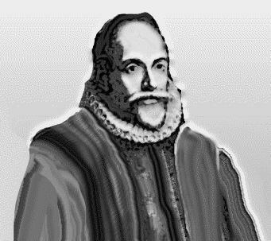
Jacob Arminius
While preparing to defend Calvin’s view of predestination, Arminius became convinced that Calvin was wrong.
The followers of Arminius summarized his views in the Remonstrance.
Jacob Arminius

Slide 222
The Arminian Remonstrance
The five points of the Remonstrance:
1. Every good human action occurs because of God’s grace; humans do nothing righteous on their own.
2. God saves every person choosing to trust Jesus.
3. Jesus died for everyone.
4. People can freely choose to accept or reject Jesus.
5. Scripture does not clearly state whether Christians can forfeit their salvation.

Slide 223
Response at the Synod of Dort
The five points of Calvinism:
1. No human being naturally desires God; by nature, every person is spiritually dead.
2. If someone trusts Jesus, it is because God chose to regenerate that person.
3. Jesus died for everyone who would trust in him.
4. When God regenerates someone, the person will not reject God’s grace.
5. Every authentic believer will persevere in faith and good works until the end.

Slide 224
Five points of Arminianism
1. Free will or human ability
Free will consists of our ability to choose good over evil
We have the power to cooperate with God’s grace or resist it.

Slide 225
Five points of Arminianism
2. Conditional election
God’s choice (election) determined by knowledge of what man would do (foreseen faith).
Our choice of God, not God’s choice of us, is cause of salvation.

Slide 226
Five points of Arminianism
3. Universal redemption or general atonement
Jesus’ death and resurrection made it possible for all to be saved, but is effective only for those who choose to accept it.

Slide 227
Five points of Arminianism
4. Resistible grace
Our free will limits the Holy Spirit’s ability to draw us toward salvation; God’s grace can be resisted.
5. Falling from grace
Salvation can be lost, as it requires our cooperation.

Slide 228
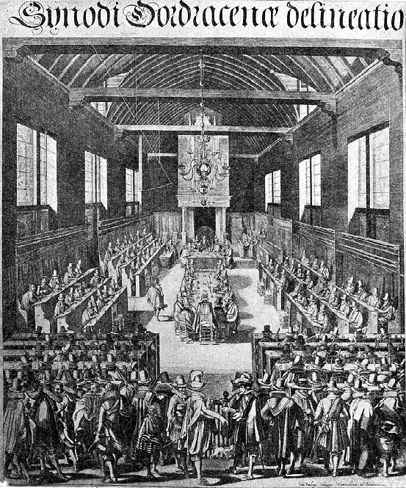
1618
Dutch Reformed Synod of Dordt, the Netherlands denounces Arminianism
The Synod responds to Arminius’ five criticisms of Calvinism with five points of Calvinism
The Synod of Dordt

Slide 229
Five points of Calvinism
(T.U.L.I.P.)
1. Total depravity (inability)
Sin affects every part of human nature, resulting in our inability to choose good over evil.

Slide 230
Five points of Calvinism
(T.U.L.I.P.)
1. Total depravity (inability)
Sin affects every part of human nature, resulting in our inability to choose good over evil.
We must be regenerated by the Holy Spirit in order to believe.

Slide 231
Five points of Calvinism
(T.U.L.I.P.)
2. Unconditional election
God’s choice (election) determined not by our foreseen response (faith); rather, faith and repentance are also gifts given by God.
God’s choice of us, not our choice of God, is the cause of salvation.

Slide 232
Five points of Calvinism
(T.U.L.I.P.)
3. Limited atonement
Jesus’ death and resurrection actually saved the elect.
It guarantees everything necessary for salvation, including the gift of faith.

Slide 233
Five points of Calvinism
(T.U.L.I.P.)
4. Irresistible grace
The Holy Spirit’s call is irresistible.
God’s grace never fails to result in salvation for those to whom it is extended.

Slide 234
Five points of Calvinism
(T.U.L.I.P.)
5. Perseverance of the saints
Salvation cannot be lost, as it is completely powered by God.
Thus the elect will persevere (be preserved) to the end.

Slide 235
Arminianism vs. Calvinism
The Arminian Remonstrance | The Calvinist response at the Synod of Dort
“Man cannot, of himself, think, will, or effect what is good.” | “Apart from regeneration, no one is willing to return to God.”
“God has from all eternity determined to save those who would believe.” | “Before the foundation of the world, God chose particular people in Christ to salvation.”
“Jesus Christ died for all men.” | “Christ redeemed only those who were chosen from eternity.”
“Grace is not irresistible.” | “Regeneration bends the will back to God.”
“Whether believers are capable of forsaking their life in Christ, must be more particularly determined.” | “God is faithful, powerfully preserving the converted in grace to the end.”

Slide 236
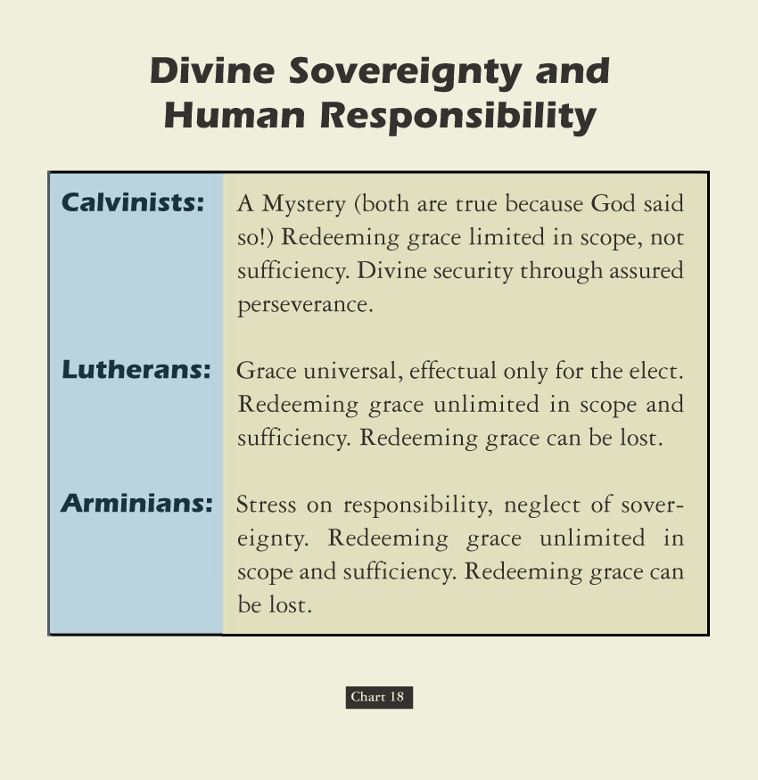

Slide 237
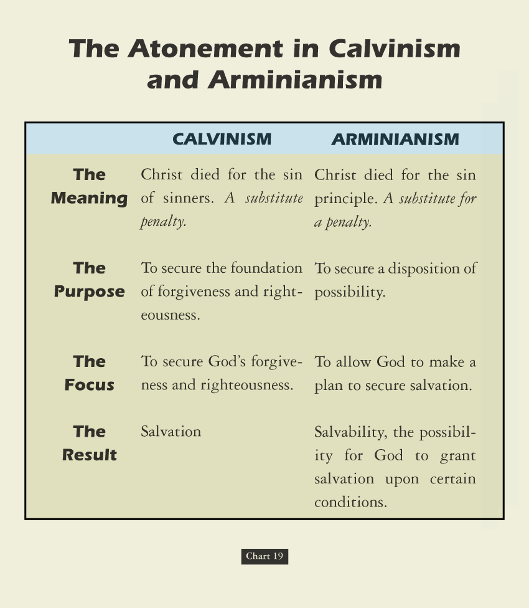

Slide 238
BOOK – CHAPTER - VERSE
PRO – Isaiah 6: 9 - 11 | Total Depravity | CON – 2 Peter 3: 9
PRO – Romans 9: 13 | Unconditional Election | CON – Rev. 22: 17
PRO – Luke 13: 23, 24 | Limited Atonement | CON – 1 Timothy 2: 4
PRO – John 6: 44 | Irresistible Grace | CON – John 6: 45
PRO – John 10: 27, 28 | Perseverance “once always” | CON – Galatians 5: 4

Slide 239
Wilted Wreath – Garden Flower
TULIPS OF DEATH OR LIFE
T - otal Inherent Depravity
U - nconditional Election
L - imited Atonement
I - rresistible Grace
P - erseverance Of The Saints
T - remendous Value
U - nfathomable Love
L - imitless Opportunity
I - rrefutable Goodness
P - romises To The Saints

Slide 240
Matthew 7: Fruits Of Calvin Tulip Mania & Depression
David Lee Burris:
1 - Is Man Semi-Consciously Sin Sick Needing Medicine Or Unconsciously Sin Deceased & Needs To Be Made To See The Kingdom Before It Can Be Entered?; How Significantly Different Is This Concept From The Idea Of “Prevenient Grace” Criticized By Calvinists?; How Different From The Catholic View Of The Catalyzed Process Of “Congruous Merit”?
2- Ancient Gnosticism Claimed Rabbinic Practice Of Different & Deeper Teaching Of Crowds Versus Disciples. Extreme Calvinism Equally Makes Our God Relate To Us As “A Respecter Of Persons” By Requiring Personal Revelation To Authenticate Salvation – i.e. Charismatics
Bible Abused, Word Confused, Truth Obfuscated
Makes God The Greatest Respecter Of Persons
Blinder To God’s Good Grace & Cross Of Love
Makes Of All Men Victims & Our God Merciless
Leads To View Of Mankind Being Beyond Blame
Broadcasting Bad News Stymies Scripture Studies
Substitutes Subjective Experience For Elect Proof
Robs The Human Race Of Its God-Given Dignity
Framed Inherited Sin & Infant Baptism Doctrines
Dishonors God & Denies Us His Justice & Mercy

Slide 243
The teachings & tenets of Arminius entered the Church of England under the Episcopal Stuarts and were propagated by the father of the Methodist Revival, John Wesley, who himself lived and died a member of the Anglican or Church of England.

