Slide 1
06. RELIGIOUS HISTORY OF THE CHRISTIAN ERA
by David Lee Burris

Slide 2
Relgious History of the Christian Era Ppt. Series
Papacy
Monarchical Episcopacy
Sacraments
Five Worship Activities
Denominations
Theological Debates

Slide 3
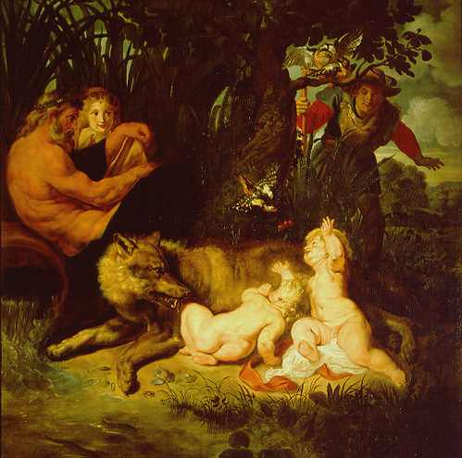
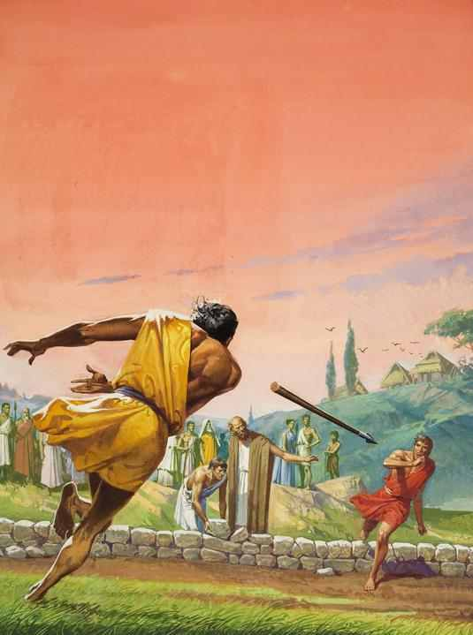
“so perish every one that shall leap over my wall!”

Slide 4
The Thirteenth Century: Salvation By The Church
The church administered baptism to the infants, which brought their regeneration.
The church administered confirmation, which brought the strengthening Holy Spirit.
The church administered the Eucharist, which fed the people with the body of Christ for the Christian journey.
The church in the confession administered forgiveness and required penitence for sins committed.
The church by extreme unction prepared the soul for transition to heaven, usually indirect through purgatory.
For the clergy the church administered indelible orders and for the laity marriage.
* Source: Ligonier Ministries Church History Handouts

Slide 5
Replacement Christology: ECCLESIOLOGY

Slide 6
Reunion or Renewal?
In 1541, Protestant and Roman Catholic leaders met in Germany, to determine whether it might be possible to reunite.
Although much agreement was reached, these two issues prevented reunion:
Papal power
The presence of Christ in Communion

Slide 7
Reunion or Renewal?
The Council of Trent (1545–1563)
Was called for by Pope Paul III in 1538 to be a reforming council.
Attempted to renew the Roman Catholic Church and to correct abuses related to the selling of indulgences and of church offices.
Declared works to be a necessary addition to obtain salvation and gave Scripture and church tradition equivalent authority.

Slide 8
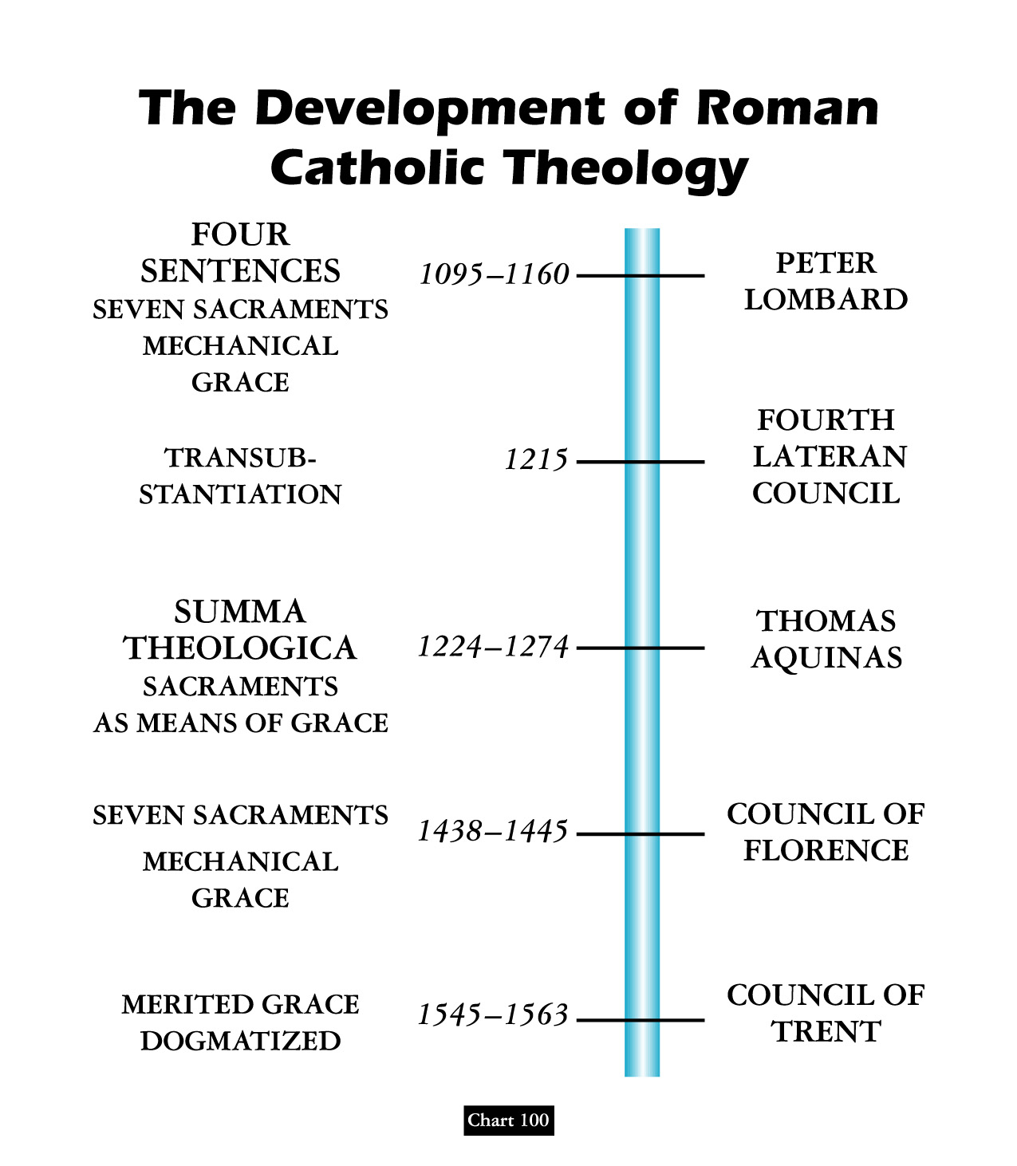
Note: Protestants Not Allowed To Attend

Slide 9
1545
The Council met variously from 1545 to 1563.
It had three specific purposes:
First to define and codify the Catholic doctrine.
To reform the life of the Catholic church.
To suppress heresy.
Things decided by the Trent Council:
Tradition and Scripture were put on an equal basis for authority.
The seven sacraments were decided on and declared.
The apocryphal books* were declared canonical.
The Index, which placed a ban on reading certain books was originated.

Slide 10
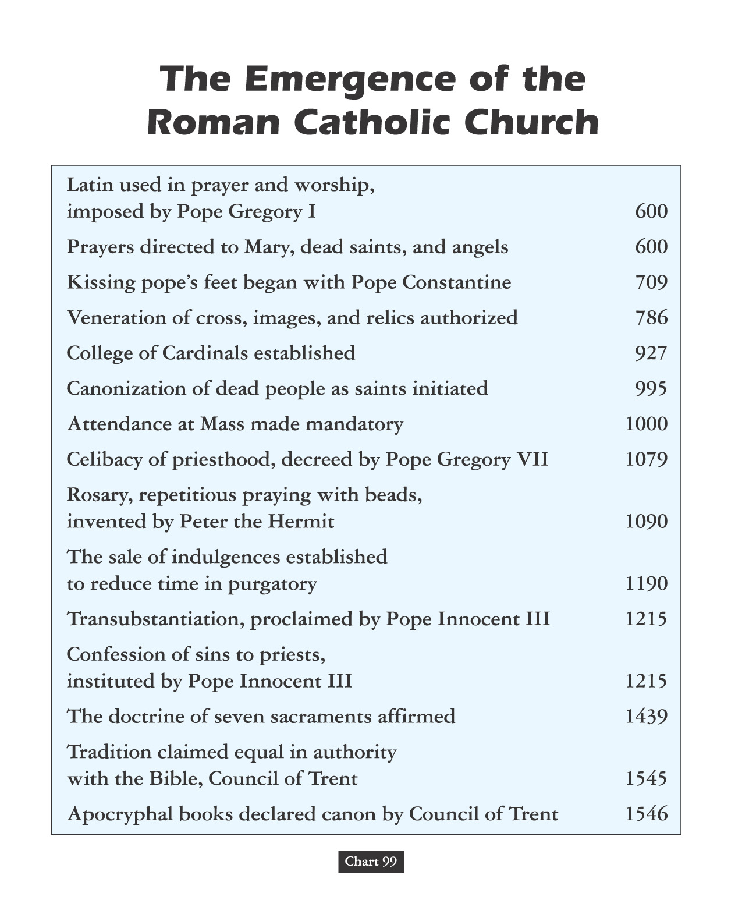

Slide 11
* Official Doctrine Of Indulgences Modified Only Once On 01-01-1967

Slide 12
Church
History
The Apostasy
Doctrines Enacted at Church Councils
Clergy/Laity System
Sprinkling for Immersion
Infant Baptism
Celibacy
Instrumental Music
Transubstantiation
Indulgences
Worship of Mary
Veneration of Relics
Purgatory
Confessionals
Images
Penance
Extreme Unction
Confirmation
Nuns, Primacy of Peter
Forbidding to Eat Meats
Religious Holidays

Slide 13
1545-1563 Council of Trent (Italy) Roman Catholic Counter-Reformation condemns indulgence profiteering, immorality of clergy, nepotism (the appointing of family members to church offices), and Protestantism
But For The Imperial Interference Of Emperor Ferdinand - Worship With Instruments Of Music Would Have Been Considered Abolished By The 16th Century Council Of Trent & Church History Would Have Taken Another Very Different Direction! *
1545
Thomas Aquinas taught against instrumental accompany in worship service.

Slide 14
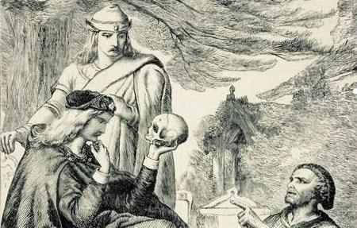
The Golden Age For The Counter-Reform Was The First Millennium HRE & Before The Second Schism!
The Golden Age For The German & Swiss Reformers Was The Imperial Era Of Emperor Constantine!

Slide 15
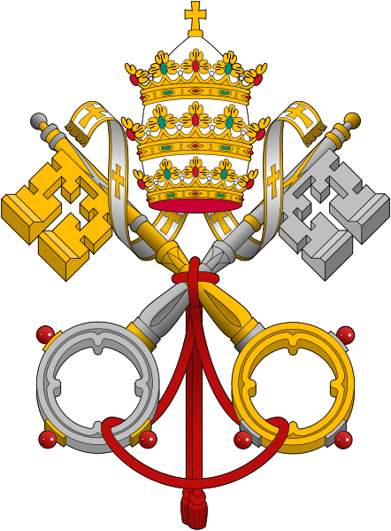
Counter-Reformation

Slide 17
1860 PIUS IX PAPACY: The Pope & Mary Deified
The Papacy’s Pretorian Black-Robed Jesuit Order

Slide 18
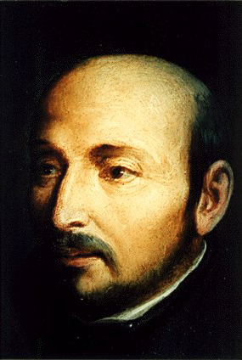
1522
Ignatius Loyola while recovering in the hospital reads Saints’ Lives & develops a “military” vision of Christianity whereby God’s armies represented by the ancient Catholic Church are at war with the armies of the devil, represented by the Protestants!
Ignatius Loyola

Slide 19
1534
Roman Catholic priest Ignatius Loyola founds Society of Jesus (Jesuits) in Paris to spread Counter-Reformation and to evangelize
The religious society became known as the Jesuit order of monks. It is the missionary order of present-day Catholicism!
Ignatius Loyola

Slide 20
The three main ideas of Jesuitism are:
“Intentionalism” – the end justifies the means.
“Mental Reservation” – one is not bound to state the whole truth when on oath.
“Probabilism” - if a thing is probable, it is good.
1534
Ignatius Loyola

Slide 21
The Doctrine Of Mental Reservation:
According to this teaching, one could conform outwardly to some requirement without giving consent of the mind, if this seemed expedient for advancing some “higher purpose” and not be held responsible for the outward act or word.
1534
Ignatius Loyola

Slide 22
THE DOCTRINE OF PROBABILISM:
According to this teaching, if, in a given situation calling for an ethical decision any one authoritative writer in the church’s tradition defended a course of action, that advice had enough probability of being right to make it a basis of action. Since it is possible to find this type authority for almost any act in given circumstances, their system is of a situational ethic.
Aristotelian Modal Model of Probability Is Abused!
1534
Ignatius Loyola

Slide 23
PROPAGANDA AND/OR COERCION
The Roman Church had two weapons of coercion to back up the propaganda of the Jesuits - the Inquisition and the Index. The Index was a list of books the faithful were not permitted to read. It was called the Roman Index of Prohibited Books & a special Congregation of the Index, created in 1571, was charged by the pope with the task of keeping the list up-to-date.
1534
Ignatius Loyola

Slide 24
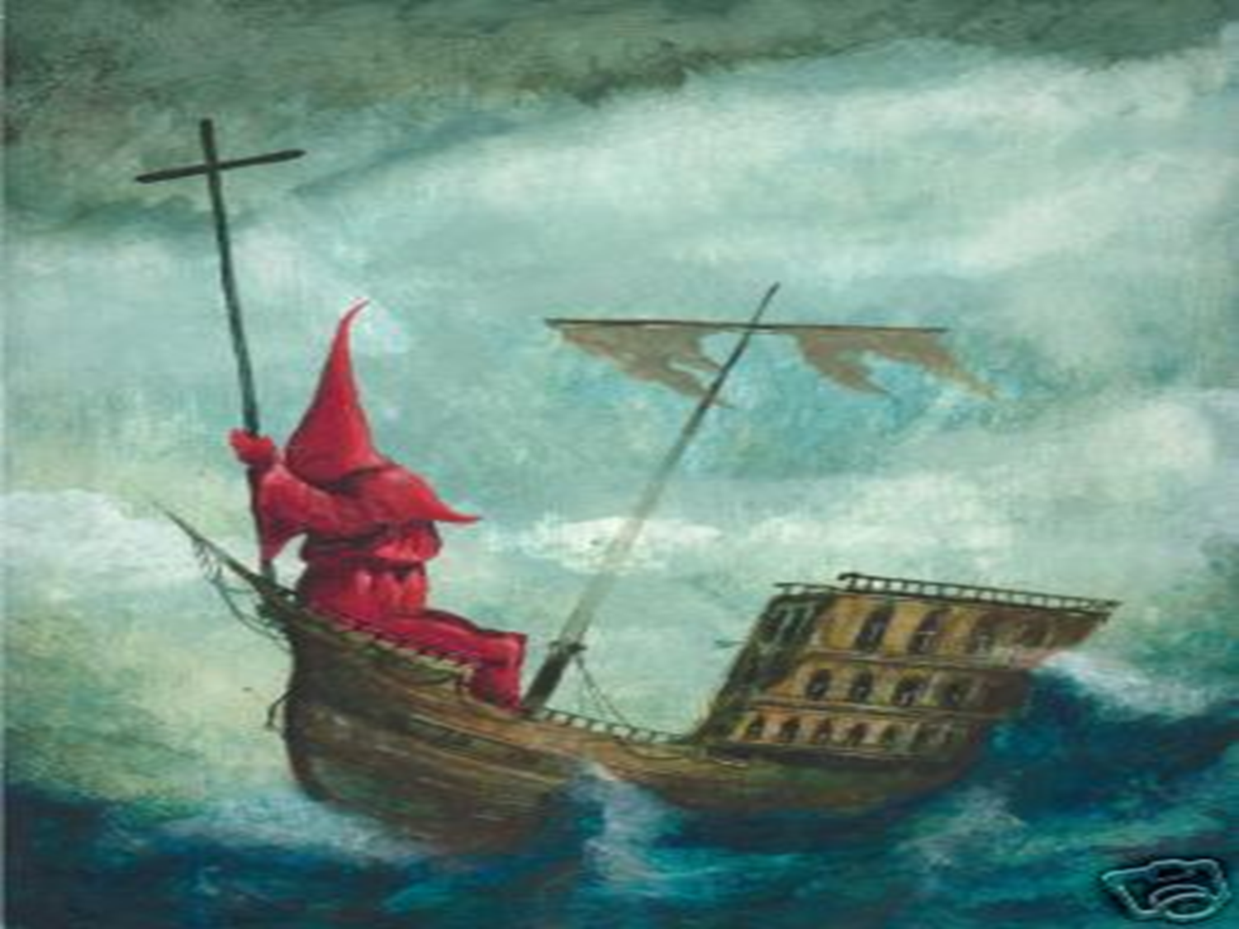
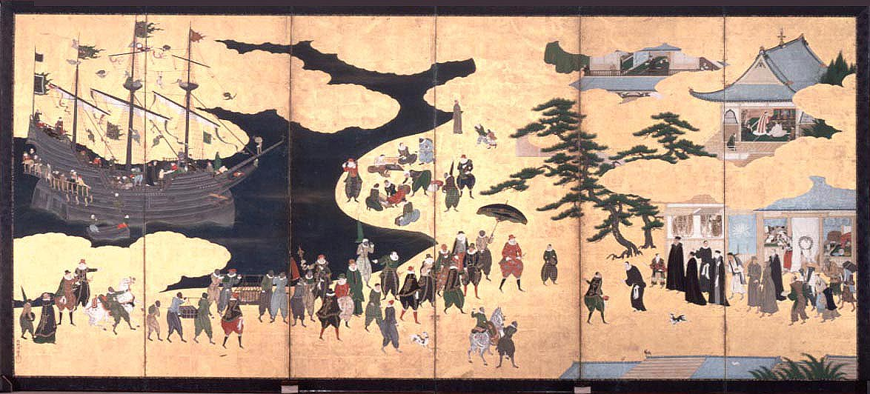

Slide 25
Encomienda and Enslavement
European diseases and brutality destroyed so many natives that there were no longer sufficient laborers for the sugar plantations.
The solution? Enslavement & importation of Africans.
Some settlers even claimed that, according to Genesis 9: 25, God intended Africans to be slaves.

Slide 26
David Lee Burris:
He warned saying that they were subject to being mocked “by those who have read of more and worse things in the history of the world.”
Papacy Owned Slaves
Father Sandoval, a Catholic priest in the Americas wrote to Brother Luis Brandaon, a Church official in Africa, asking if the enslavement of Africans was legal according to Church doctrine. Brother Brandaon’s response, dated March 12, 1610, answered, ‘Your Reverence writes me that you would like to know whether the Negroes who are sent to your parts have been legally captured. To this I reply that I think your Reverence should have no scruples on this point, because this is a matter which has been questioned by the Board of Conscience in Lisbon, and all its members are learned and conscious men. We have been here ourselves for forty years and never did they consider the trade as illicit. Therefore we and the Fathers of Brazil buy these slaves for our service without any scruple.”

Slide 28
1860 PIUS IX PAPACY: The Pope & Mary Deified
The Papacy’s Pretorian Black-Robed Jesuit Order
Papal States as Church-State Establishment Model

Slide 29
The 18th Century Invented the Idea of Progress
Optimism Has Its Limits
But…
1780 – 1914

Slide 30
Church Outright Owns Much Of The Old World
“Moreover, once property had found its way into ecclesiastical hands, it very rarely slipped from their grasp. While a private individual might find it expedient to sell this or that piece of land, an immortal institution held what it had in perpetuity.
The result was an accumulation of French property which amounted to ten percent of the most fertile cultivable area. Contemporaries chose to believe that the figure was much higher – Barbier, the Paris diarist, for example, put it as high as a third. In Naples, it was thought that the Church owned two-thirds, although this was certain exaggeration.
More confidence can be placed in the share of 23 per cent cited for Lombardy or 20-40% for the Papal States. Secure are the estimates of 56 per cent for Bavaria and 40% for Lower Austria. In Castile the Church owned about 1/7 of all arable land. In Russia, where ownership of human beings rather than land was a better guide to wealth, the 1678 census showed the higher clergy owned ~20% of all serfs.”
- page 364 @ Prelates, Tim Blanning, The Pursuit of Glory

Slide 31
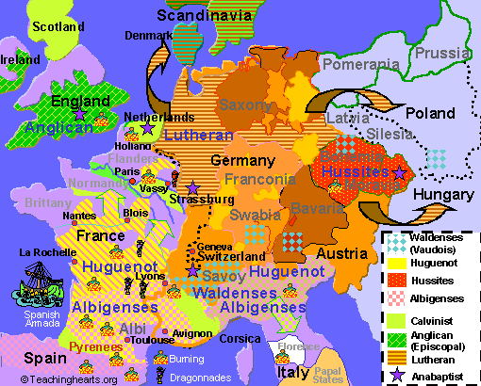
THE HOLY ROMAN EMPIRE IS OFFICIALLY DISSOLVED IN 1806

Slide 32
David Lee Burris:
Final defeat by Guiseppi Garibaldi – Italian patriot under King Victor Emmanuel – destroyed the Catholic forces in 1859!
Vatican City has railway, electric plant, courts, and jails.
papal states from eighth century until 19th

Slide 33
Resisting the Modern Age: Papal State Inquisition
“On July 26, 1826, fully six centuries after the first heretic was burned by the newly created Inquisition, the inquisitors took their last human life. A schoolteacher named Cayetano Ripoll was charged as a heretic because he professed the principles of Deism, and he was “relaxed” like countless thousands before him. The last of the inquisitors could not bring themselves to burn him alive & the death sentence was administered by strangling him with a garrote. To affirm their solidarity with the old and enduring traditions of the Inquisition, however, the dead body was stuffed into a wooden barrel decorated with painted red flames and buried in unconsecrated ground.” - J. Kirsch, Grand Inquisitor’s Manual

Slide 34
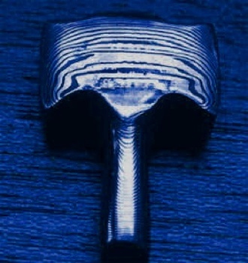
Resisting the Modern Age: Papal State Stockyard Execution
Mazzatello (abbreviated mazza) was a method of capital punishment used by the Papal States from the late 18th century to 1870. The method was named after the implement used in the execution: a large, long-handled mallet or pole-ax. The condemned would be led to a scaffold in a public square of Rome, accompanied by a priest (the confessor of the condemned); the platform also contained a coffin and the masked executioner, dressed in black. A prayer would first be said for the condemned’s soul. Then, the mallet would be raised, and swung in the air to gain momentum, and then brought down on the head of the prisoner, similar to a contemporary method of slaughtering cattle in stockyards. Because this procedure could merely stun the condemned rather than killing him instantly, the throat of the prisoner would then be slit with a knife.

Slide 35
Resisting the Modern Age: Papal State Rat Torture
A cheap and effective way to torture someone was with the use of rats. There were many variants, but the most common was to force a rat through a victim's body (usually the intestines) as a way to escape. This was done as follows: The victim was completely restrained & tied to the ground or on any horizontal surface. A rat was then placed on his stomach covered by a metallic container. As the container was gradually heated, the rat began to look for a way out - through the victim's body. Digging a hole usually took a few hours of agonizing pain for the victim. This almost invariantly resulted in death.

Slide 36
1860 PIUS IX PAPACY: The Pope & Mary Deified
The Papacy’s Pretorian Black-Robed Jesuit Order
Papal States as Church-State Establishment Model
Pius Supports the South in the American Civil War

Slide 37
Nineteenth Century:
EUROPEAN HISTORY
I N T E R S E C T S
AMERICAN HISTORY

Slide 38
2. Resisting the Modern Age
A letter from Pope Pius IX to Jefferson Davis, leader of the rebellious States during the American Civil War. ILLUSTRIOUS AND HONORABLE PRESIDENT. Salutations: We have just received with all suitable welcome the persons sent by you to place in our hands your letter, dated the 23rd of September last. Not slight was the pleasure we experienced when we learned, from those persons and the letter, with what feelings of joy and gratitude, you were animated, illustrious and honorable President, as soon as you were informed of our letters to our venerable brother, John, Archbishop of New York, and John Archbishop of New Orleans, dated the 18th of October of last year, and in which we have with all our strength exerted and exhorted those venerable brothers that in their episcopal piety and solicitude, they should endeavor, with the most ardent zeal, and in our name to bring about the end of that fatal civil war which has broken out in those countries in order that the American people may obtain peace and concord and dwell charitably together. It is particularly agreeable to us that you illustrious and honorable President, and your people, were animated with the same desires of peace and tranquillity which we have in our letters inculcated upon our venerable brothers. May it please God at the same time to make the other peoples of America and their rulers, reflecting seriously how terrible is civil war, and what calamities it engenders, listen to inspirations of a calmer spirit and adopt resolutely the part of peace. As for us, we shall not cease…
(Signed) Pius IXth.

Slide 39
2. Resisting the Modern Age
From the book, A Memoir of Jefferson Davis in two volumes, completed by his wife Varina Davis after his death. According to that book the main hope of the Confederate States of America lay in the military intervention of foreign countries. This letter gave de facto recognition to the Rebellion.
President Abe Lincoln on reading it exclaimed! "This letter of the Pope has entirely changed the nature and ground of the war." As King of the Papal States, the Pope was the only foreign power to do so.
After this letter was published, President Lincoln was visited by a close friend (ex-priest Charles Chiniquy who he had legal represented long ago). Chiniquy tells us what transpired next:

Slide 40
2. Resisting the Modern Age
LETTER FROM FORMER CATHOLIC PRIEST CHINIQUY TO PRESIDENT LINCOLN:
My dear President I answered, it is just that letter which brought me to your presence again. That letter is a poisoned arrow thrown by the Pope at you personally; it is your death warrant. Before the letter, every Catholic could see that their church as a whole was against this free Republic. However, a good number of liberty-loving Irish, German and French Catholics, following more the instincts of their noble nature than the degrading principles of their church, enrolled themselves under the banners of liberty, and have fought like heroes. To detach these men from the rank and file of the Northern armies, and force them to help the cause of the rebellion, became the main object of the Jesuits. Secret pressing letters were addressed from Rome to the bishops, ordering them to weaken your armies by detaching those men from you. The bishops refused; for they would be exposing themselves as traitors and be shot. But they advised the Pope to acknowledge, at once, the legitimacy of the Southern republic, and to take Jeff Davis under his supreme protection, by a letter, which would be read everywhere. That letter tell every Roman Catholic that you are a bloodthirsty tyrant fighting against a government which the infallible and holy Pope of Rome recognizes as legitimate. The Pope, by this letter, tells his blind slaves that you are outraging the God of heaven and earth, by continuing such a bloody. By this letter of the Pope to Jeff Davis you are not only an apostate, as you were thought before, whom every man had the right to kill, according to the canonical laws of Rome: but you are more vile, criminal and cruel that the horse thief, the public bandit, and the lawless brigand, robber and murderer. And my dear President, this is not a fancy imagination on my part, it is the unanimous explanation given me by a great number of the priests of Rome, with whom I have had occasion to speak on that subject. In the name of God, and in the name of our dear country, which is in so much need of your services, I plead that you pay more attention to protect your precious life, and not continue to expose it as you have done till now.

Slide 41
* Jesuit Accused As Assassin Pope Clement XIV (1769)

Slide 42
2. Resisting the Modern Age
The President told the former Priest his views on the Jesuits:
So many plots have already been made against my life, that it is a real miracle that they have all failed. But can we expect that God will make a perpetual miracle to save my life? I believe not. The Jesuits are so expert in those deeds of blood that Henry IV (king of France who was assassinated by the Jesuit Revaillac for giving liberty to his people), said that it was impossible to escape them, and he became their victim, though he did all he could to protect himself. My escape from their hands, since the letter of the Pope to Jefferson Davis has sharpened a million of daggers to pierce my breast, would be more that a miracle. . . . I know that Jesuits never forget nor forsake. Man must not care how and where he dies, provided he dies at the post of honor and duty.

Slide 43
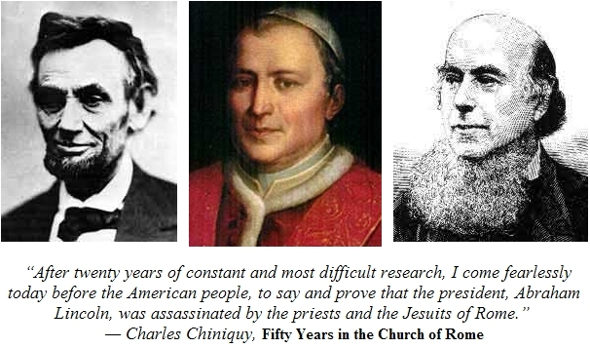
When the notorious John Wilkes Booth broke his leg right after he shot Lincoln
He had tripped over an American flag!

Slide 44
1860 PIUS IX PAPACY: The Pope & Mary Deified
The Papacy’s Pretorian Black-Robed Jesuit Order
Papal States as Church-State Establishment Model
Pius Supports the South in the American Civil War
Series of Events Leading to Papal Infallibility Tenet

Slide 45
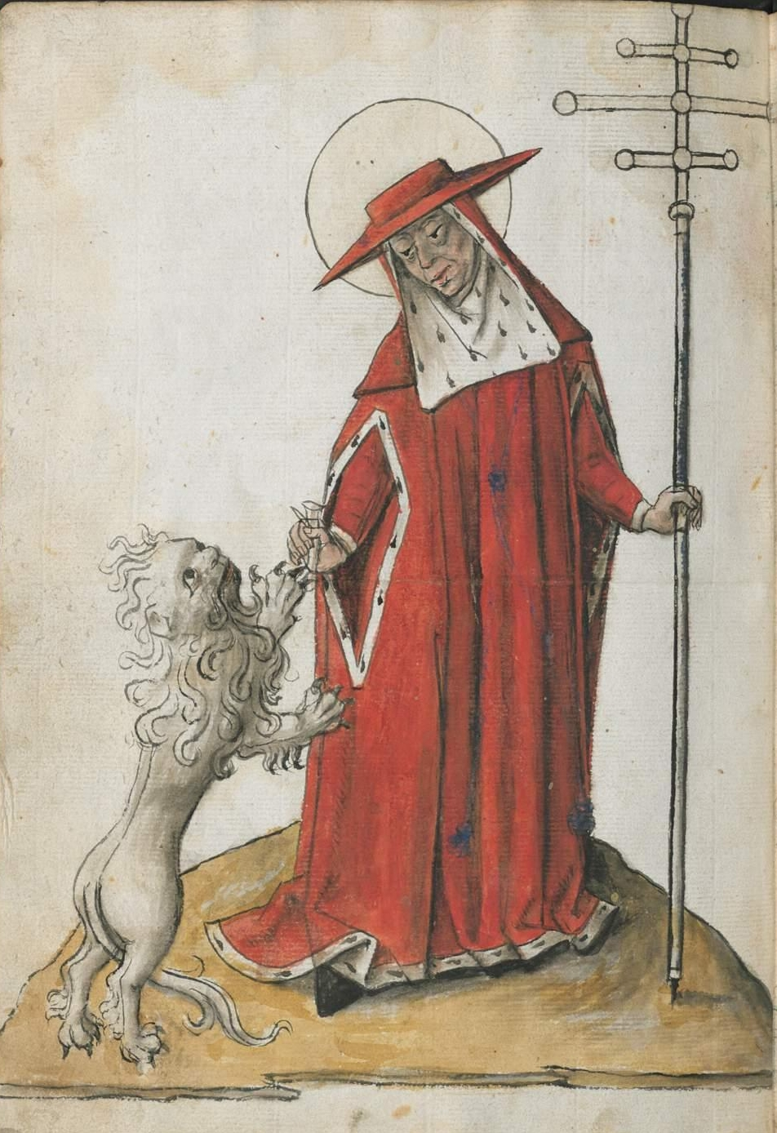
David Lee Burris:
Final defeat by Guiseppi Garibaldi – Italian patriot under King Victor Emmanuel – destroyed the Catholic forces in 1859!
Vatican City has railway, electric plant, courts, and jails.
THE LAST PAPAL EMPEROR

Slide 46
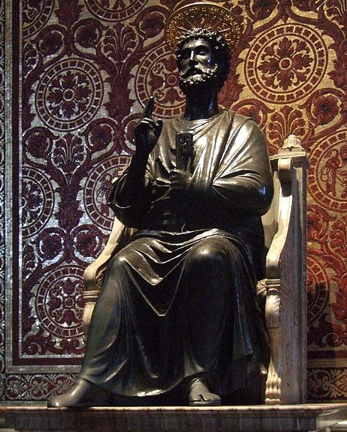
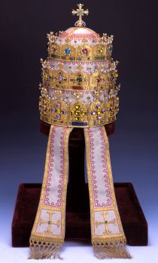
BOTH ITEMS OF PIUS IX

Slide 47
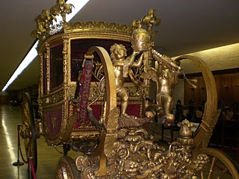
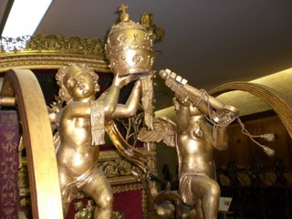

Slide 48
Pope Pius IX & His Royal Travel Train Car

Slide 49
Replacement Christology: APOTHEOSIS

Slide 50
PONTIFEX MAXIMUS
“In essence, the pontiffs were those who built bridges between the world of humans and the world of the gods. In the late 300s, the emperor Gratian abandoned the title in favor of Pope Damasus I, and from that time it has become one of the hereditary titles of the bishop of Rome, the pope.”

Slide 51
THE PAPAL TRADITION OF CHOOSING A NEW NAME STARTS WITH MERCURIUS IN A.D. 533 RENAMING HIMSELF JOHN THE SECOND. THIS PRACTICE WAS PRIOR ASSOCIATED WITH ROYAL DYNASTY.

Slide 52
UNTO KING'S SCEPTER
FROM SHEPHERD'S STAFF

Slide 53
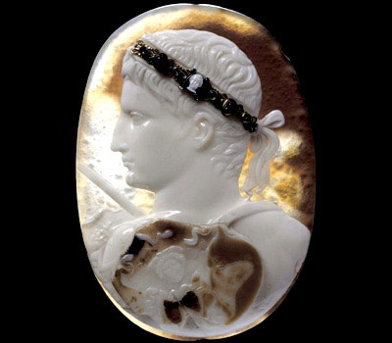
Emperor
APOTHEOSIS

Slide 54
Papacy: Tracing Through Titles
Bishop Of Rome
Roman Province Metropolitan
Primate Of Italy
Patriarch of the West
Successor of Prince of the Apostles
Sovereign Pontiff Universal Church
Vicar Of Christ

Slide 55
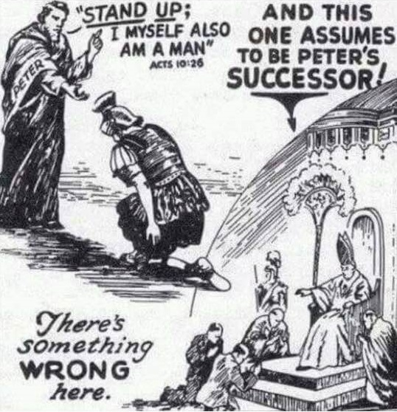

Slide 56
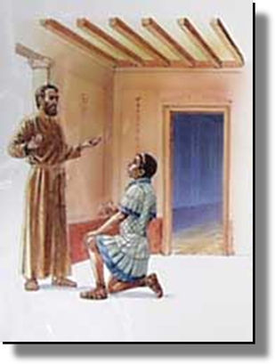
ACTS 10: 26
PETER: "Stand up, I myself am also a man!"

Slide 57
Was Peter the First Pope?
David Lee Burris:
Oldest Continuously Functioning Institution In World Still Can’t Trace Origins To Apostles!
This tradition that the Apostle Peter held the papal office from A.D. 42 to A.D. 67 started early in the third century.
26 church congregants are noted by their names in the first fifteen verses of Paul’s Letter to the Romans in chapter 16. Peter is not even casually mentioned although this point of time overlaps with that of his supposed service term there.
Acts 12 – Peter was held this period in prison in Jerusalem.
“But it is said on all sides , Was not St. Peter at Rome? Was he not crucified with his head down? Are not the pulpits in which he taught, the altars at which he said the mass, in this eternal city? St. Peter having been in Rome, my venerable brethren, rest only on tradition… Scaliger, one of the most learned of men, has not hesitated to say St. Peter’s episcopate and residence at Rome ought to be classed with ridiculous legends.” 1870 Vatican Council; Bishop Strossmayer
1870 VATICAN COUNCIL

Slide 58
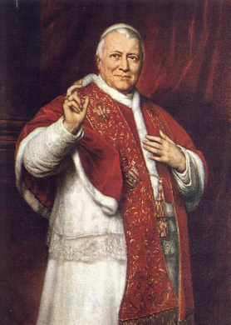
2. Resisting the Modern Age
Pope Pius IX denounced the idea that he “should harmonize himself with recent civilization.”
He said also 8/15/1859:
“The absurd and erroneous doctrines of ravings in defense of liberty of conscience are a most pestilential error!”
Pope Pius IX

Slide 59
2. Resisting the Modern Age
In December of 1864, the pope issued what may well be the most controversial papal document of modern times, the encyclical Quanta cura, with an accompanying Syllabus of Errors.
While the encyclical itself received relatively little attention, the Syllabus - listing the eighty propositions associated with modern life that no good Catholic could subscribe to – was different.
Pope Pius IX

Slide 60
2. Resisting the Modern Age
1864 Errors Syllabus Stated:
No Catholic could believe in freedom of speech, freedom of the press, or the freedom of religion.
Catholics were forbidden to believe that the pope could live without a state of his own or that there was a separation of church and state.
Pope Pius IX

Slide 61
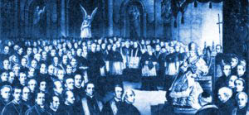
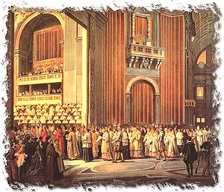
2. Resisting the Modern Age
Pope Pius IX denounced the idea that he “should harmonize himself with recent civilization.”
He assembled the First Vatican Council in 1868.

Slide 62
* Jesuit Accused As Assassin Pope Clement XIV (1769)
THE LAST PAPAL ROMAN EMPEROR
NEW BLACK ROBED PRAETORIANS

Slide 63
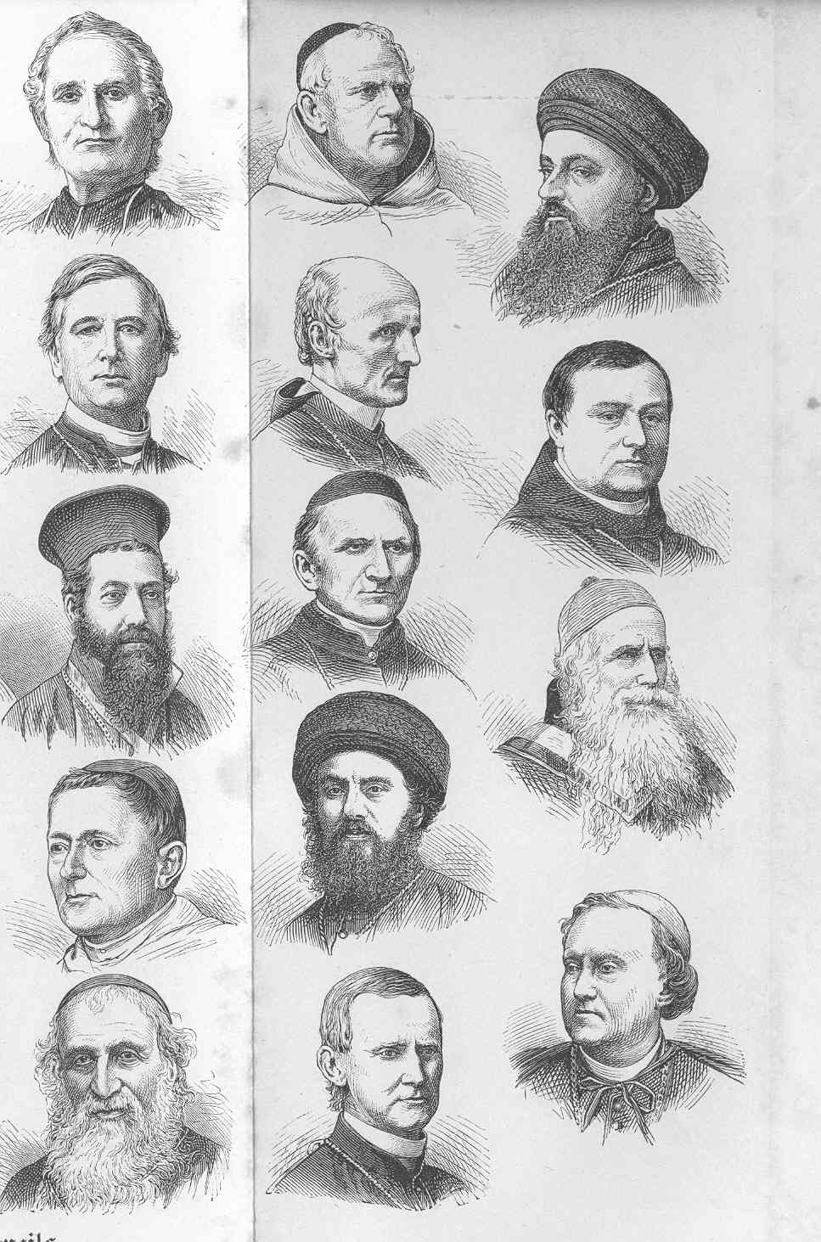
Italian History Author David I. Kertzer Writes:
“The intellectual leader of the movement against the Council and against papal infallibility was a man who would not be in Rome for the historic gathering. The redoubtable Ignaz von Dollinger, Germany’s most renowned Church historian and one of Europe’s most influential Catholic theologians, was convinced that the Council would be a calamity for the Church. In the newspaper Allgemeine Zeitung, Dollinger accused the Jesuits and the pope himself of preparing an ‘ecclesiastical revolution.’ A papal seizure of power was planned that, he warned, would undermine the bishops’ authority & create a papal dictatorship. It was but the last step, the Church historian argued, in a centuries-long drive toward centralization that had produced ‘a tumor that is disfiguring the Church & causing it to suffocate.’ ”

Slide 64
Italian History Author David I. Kertzer Writes:
“Hostility towards the Jesuits was evident among the American prelates attending the Council as well. A few days before the Council began, Bernard McQuaid, bishop of Rochester, New York, wrote to a colleague at home: ‘Since coming to Europe, I have heard much of the question of the infallibility of the Pope, which with us in America was scarcely talked of. The feeling is very strong, pro and con. It seems that the Jesuits have been at the bottom of it, and have been preparing the public mind for it for the past two years. They have not made friends for themselves by the course they have followed, and if in any way the harmony of the Council is disturbed, it will be by the introduction of this most unnecessary question.’ He concluded, ‘There is no telling what the Jesuits will do, and from the manner in which they are sounding out the Bishops, I am inclined to think that they will succeed in having the question forced upon us. In my humble opinion, and almost every American Bishop whose opinion I have heard agrees with me, it will be a great calamity for the Church.’ Or as the bishop of Pittsburgh lamented three months into the Council, ‘It will kill us; we shall have to swallow what we have vomited up; In the past we have always denied accusations [that Catholics view the pope as a kind of deity], but if infallibility is pronounced, how will we be able to defend ourselves?’ ”
“He who rides a tiger is afraid to dismount.”

Slide 65
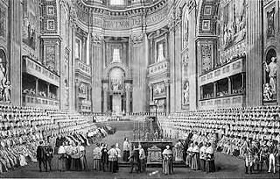
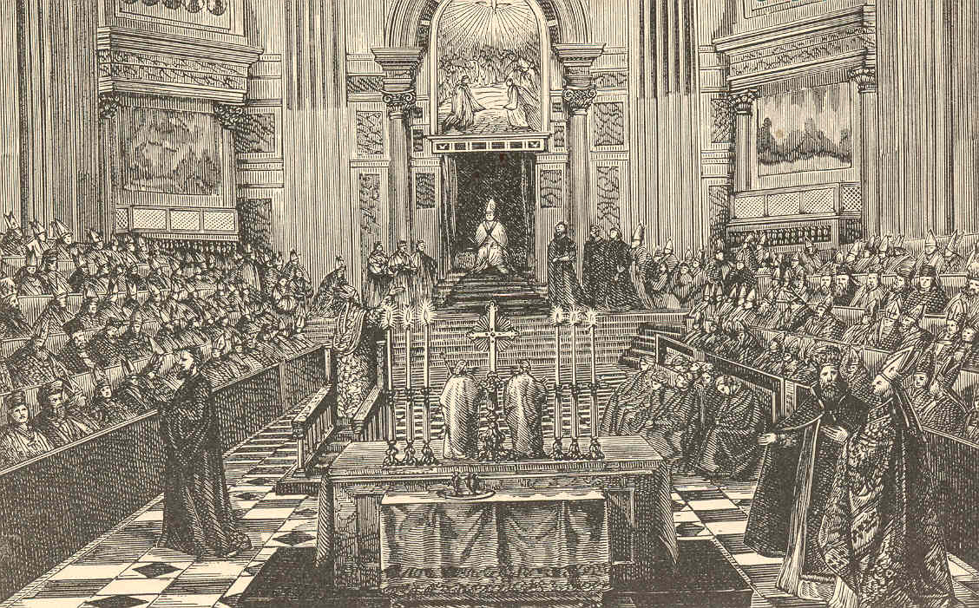
2. Resisting the Modern Age
He assembled the First Vatican Council in 1868.
The council declared the Roman Pope to be infallible whenever he “defines a doctrine.”

Slide 66
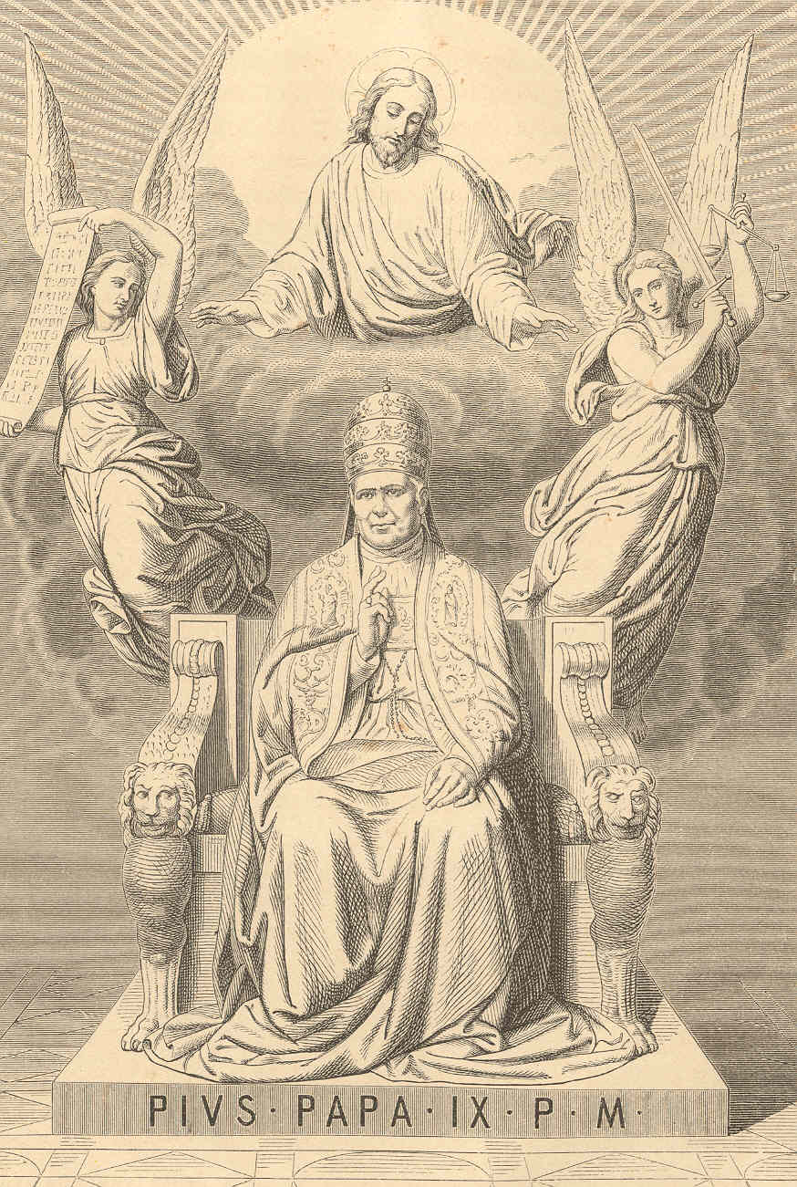
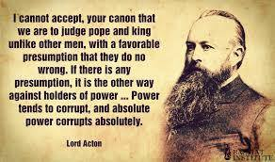
THE FIRST INFALLIBLE POPE

Slide 67
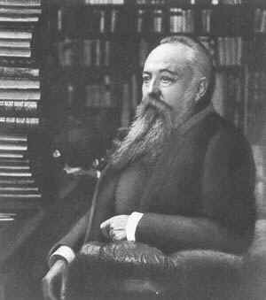
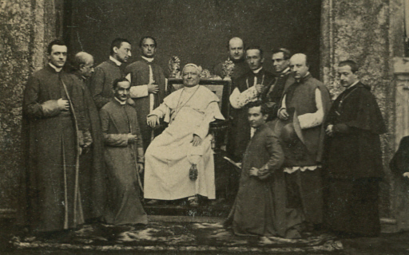
2. Resisting the Modern Age
The Whig Lord Acton was aghast at the imprudence of declaring a new doctrine on papal infallibility during such unsettled times, coining his pithy aphorism "Power corrupts, absolute power corrupts absolutely" in an attempt to dissuade theologians from proceeding further down a now discredited, as he and many European political leaders saw it, path of absolutism.

Slide 68
1860 PIUS IX PAPACY: The Pope & Mary Deified
The Papacy’s Pretorian Black-Robed Jesuit Order
Papal States as Church-State Establishment Model
Pius Supports the South in the American Civil War
Series of Events Leading to Papal Infallibility Tenet
Series of Events Leading to Designation as Royalty

Slide 69
2. Resisting the Modern Age
Pope Pius appeared initially as a progressive.
Whereas, the prior pope, Gregory XVI had forbid gas street lighting in the papal states as against the natural order, Pius 9 had them installed.
However, his personal war against the religious freedom of a city republic in 1849 and Italian unity show him unenlightened.
Pope Pius IX

Slide 70
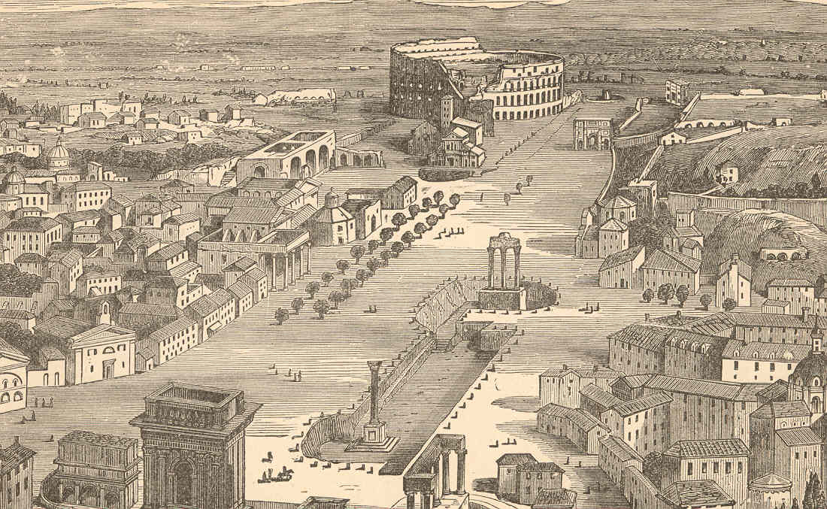
POPE PIUS IX CALLS IN FRENCH TROOPS

Slide 71
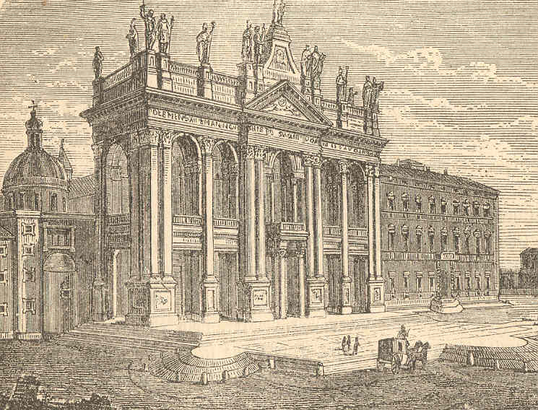
interactive version of Nolli’s map

Slide 72
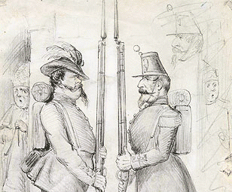
This pencil caricature depicts King Victor Emmanuel II of Italy and Napoleon III as soldiers changing guard, while Pope Pius IX peers around the corner. The caricature relates to the intricate maneuvering in the mid-19th century among France, Austria, the Papal States, and Italian nationalists that preceded the unification of Italy. French and Austrian troops had been in Rome to protect the Papal States since 1850, when Pius IX began to fear the rise of anti-papal nationalists. In 1858, the Sardinians entered into an agreement with Napoleon III to fight Austria for the regions of Lombardy and Venetia – one of the first wars of Italian unification. The drawing is almost certainly from early 1858, before Napoleon III entered into a separate agreement with the Austrian king that circumvented Victor Emmanuel. The caricature, which was published in Punch on October 8, 1864, is signed and dated by John Tenniel (1820-1914), a British illustrator. Tenniel was recognized as a gifted political cartoonist, but is best known for his illustrations for the original Alice in Wonderland.

Slide 73
THE FRENCH LEAVE ONCE HE HAS HIMSELF DECLARED INFALLIBLE;
ITALIAN CENTRAL GOVERNMENT TAKES CONTROL OF THE CITY!

Slide 74
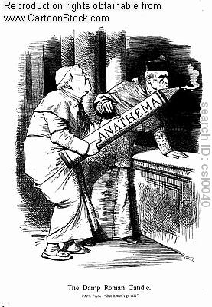

Slide 75
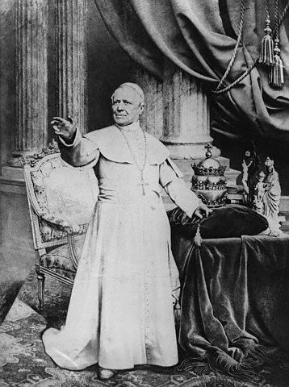
In 1871 the Law of Guarantees was enacted by the Italian parliament, which explicitly recognized the Pope’s person to be sacred and inviolable, and that any insult or injury to the Pope was to be regarded as an insult or injury to a king’s person.

Slide 76
THE FIRST PONTIFF DEMI-GOD

Slide 77
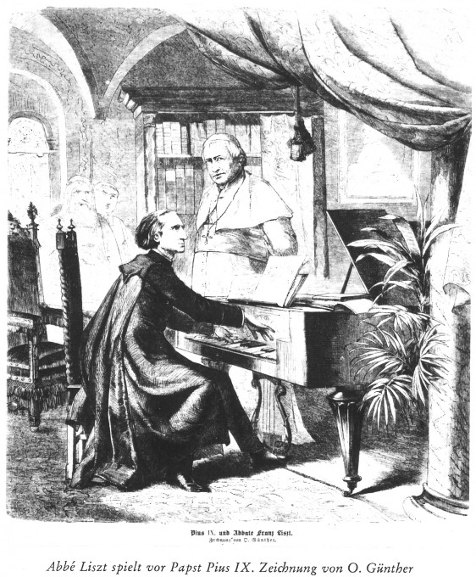
POPE PIUS IX WAS REFERRED TO
AS THE VICE-GOD OF HUMANITY
&1870’S HYMNS ADDRESSED TO
THE POPE RATHER THAN GOD
- CHRISTIAN HISTORY GUIDEBOOK

Slide 79
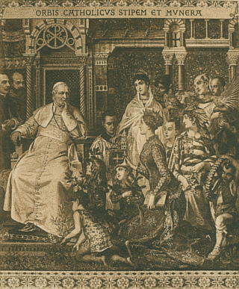

Slide 80
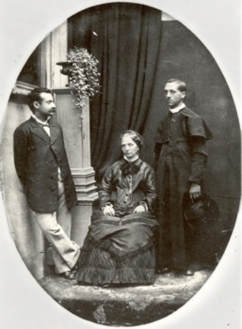
Relationship: The Pope and Kidnapped Son
On the evening of 23 June 1858, in Bologna, then part of the Papal States, police arrived at the home of a Jewish couple, Salomone (”Momolo”) and Marianna Padovani Mortara, to seize one of their eight children, six-year-old Edgardo, and transport him to Rome to be raised as a ward of the state. The police had orders from Holy Office authorities in Rome, authorized by Pope Pius IX. Church officials had been told that a 14-year-old Catholic servant girl of the Mortaras, Anna Morisi, had baptized Edgardo while he was ill because she feared that he would otherwise die and go to Hell. According to Catholic Church doctrine, Edgardo’s baptism, even if illicit under canon law, was valid and made him a Christian. At the time, non-Christians could not raise a Christian child, even their own. Edgardo was taken to a house for Catholic converts in Rome, maintained at state expense. His parents were not allowed to see him for several weeks, and then not alone. Pius IX took a personal interest in the case, raising the child as his son (albeit a kidnapped one), and all appeals to the Church were rebuffed. Church authorities told them that they could have Edgardo back if they abandoned their faith & converted to Catholicism, but they refused.
Despite international protests (including those from the United States government), Pope Pius IX did not relinquish Edgardo who eventually went on to become a priest. He was also a vehement supporter of the Vatican taking the first steps towards making Pius IX a saint. Pictured above is Mortara as a priest on the right, and his mother seated.

Slide 81
Last Recording Vienna Boy’s Choir w/ Castratos

Slide 82
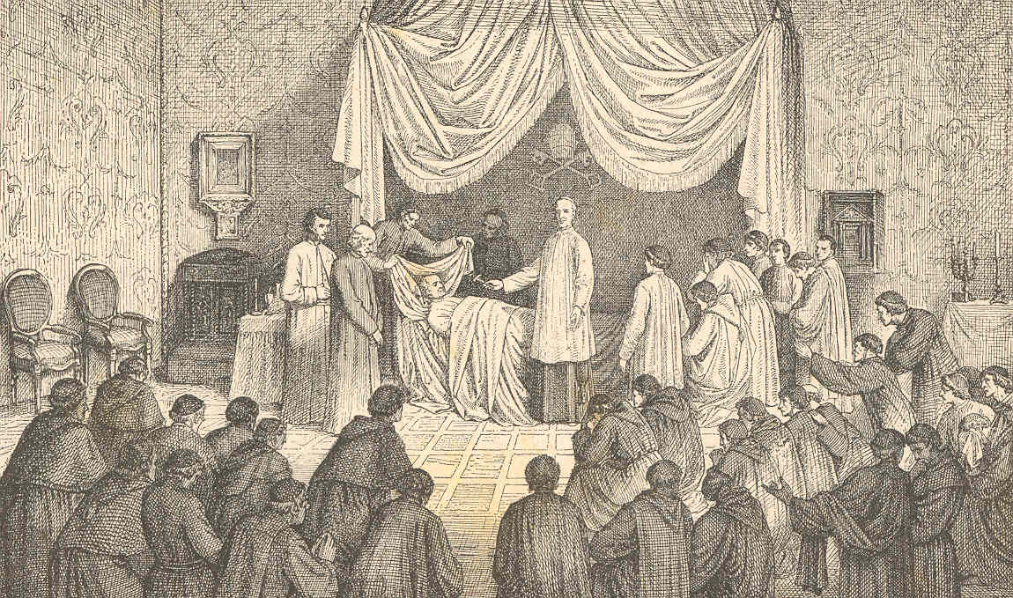
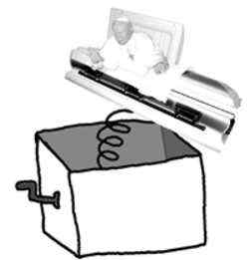
Period Writer Turgenev Portrays Death As A Net Fisher
When Pius IX died in 1878, Romans were so mad at him that they stopped the funeral procession & tried to throw his body in the Tiber. Only the militia saved him from a watery grave!!

Slide 83
1860 PIUS IX PAPACY: The Pope & Mary Deified
The Papacy’s Pretorian Black-Robed Jesuit Order
Papal States as Church-State Establishment Model
Pius Supports the South in the American Civil War
Series of Events Leading to Papal Infallibility Tenet
Series of Events Leading to Designation as Royalty
Mariology’s Benchmark : Immaculate Conception

Slide 84
Three Trends of Early Errors
Apostle Paul’s Convert Clement Is Received As If He Were An Apostle
Alexandria School Through Origen Defines Trinity Concept Sequential
Asia Minor School Thru Its Irenaeus Explains Mary By Contrasting To Eve
Organization Pattern
Doctrinal Pattern
Worshiping Pattern

Slide 85
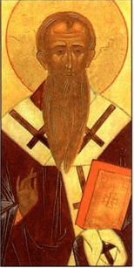
When was Gospel of Judas written?
Historians have known about Gospel of Judas since AD 180.
Rejected by church father Irenaeus of Lyons in AD 180.
Irenaeus
IRENAEUS REDIRECTED FROM SOME
FALSE DOCTRINE & STARTS ANOTHER

Slide 86
FROM EMPHASIS ON EVE TO THE FOCUS ON MARY
“So the Lord now manifestly came to his own, and, born by his own created order which he himself bears, he by his obedience on the tree renewed [and reversed] what was done by disobedience in [connection with] a tree; and [the power of] that seduction by which the virgin Eve, already betrothed to a man, had been wickedly seduced was broken when the angel in truth brought good tidings to the Virgin Mary, who already [by her betrothal] belonged to a man. As the human race was subjected to death through [the act of] a virgin, so was it saved by a virgin, and thus the disobedience of one virgin was precisely balanced by the obedience of another.”

Slide 87
Significant & Important:
David Lee Burris:
Both Philosophy & Paganism Combine to Produce The Mariology We Know Today!
DEBATES ABOUT JESUS’ NATURE TRACK THAT OF MARY’S STATUS

Slide 88
Counter-Christology: MARIOLOGY

Slide 89
EARLY ERROR BUILT ON THREE FALSE ASSUMPTIONS
#1 Assumption: Paul Convert Clement Received As Apostle
#2 Assumption: Origen Explains Trinity Concept Sequential
#3 Assumption: Irenaeus Portrays Jesus Mother @Anti-Eve
READ – Romans 5: 12 – 21 & 1st Corinthians 15: 20 -24, 45 - 48

Slide 90
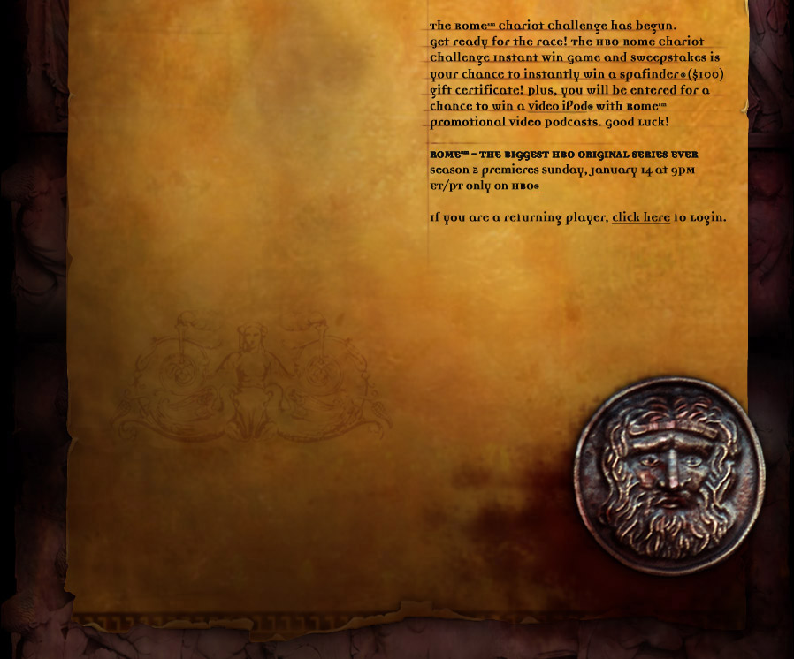
The veneration of Mary, the mother of Jesus,
which was to lead to the adoption of the
doctrines of her immaculate conception in 1854
and her miraculous assumption to heaven in 1950,
developed rapidly by 590*.
The Nestorian and other Christological
controversies of the fourth century
resulted in the acceptance of her as
the 'Mother of God' and entitled her to
special honors in the liturgy.
* From the Non-Canonical
ProtoEvangelium of James

Slide 91
THE HELL HARROWING
“The descent motif common to most mythologies about hell also usually contains an element of “harrowing,” or distressing, of hell. This is where a hero or savior has to go to hell and shut it down, or defeat its ruler or bring somebody back… This is what the line in the Apostle’s Creed is about ‘He descended into Hell, the third day he arose again from the dead.’…After Jesus had been crucified he went to hell – not to suffer, but to battle with the Devil, whom he defeated. He chained up Satan and cast him into a fiery pit where he was to stay for a thousand years. As well as closing down hell, Jesus rescued Adam & other ancient souls...” Craze, Hell

Slide 92
THE HELL HARROWING
According to tradition, Jesus closed hell for a thousand years. However, this caused problems for theologians and for believers. If hell is closed what happens to the souls of the wicked? - “The early Christians were obligated to introduce the concept of a sort of waiting room, where souls would stay for the thousand years until hell was open again. They found a ready-made idea – limbo – that they freely borrowed from the Romans, who had borrowed it from the Greeks. This was all fine until the year 1000AD, when Satan’s banishment was supposed to end… But nothing happened. The theologians set to work and said that Satan was now out and about in the world – tempting and tormenting – and that hell was still closed but that there was another place where sinners would be punished. This was purgatory. It was a cross between limbo and hell. But if Satan was absent, who was to run it? Jesus’ mother, the Virgin Mary, was called back from heaven, where she had been asleep (the Dormition). She was given the keys of to look after, & the running of purgatory. She does not administer any punishments – in fact, her main job seems to be protecting the souls of the sinners from the wrath of her son…”
- Richard Craze, Hell, pages 44, 45

Slide 93
Church
History
The Apostasy
Doctrines Enacted at Church Councils
Clergy/Laity System
Sprinkling for Immersion
Infant Baptism
Celibacy
Instrumental Music
Transubstantiation
Indulgences
Worship of Mary
Veneration of Relics
Purgatory
Confessionals
Images
Penance
Extreme Unction
Confirmation
Nuns, Primacy of Peter
Forbidding to Eat Meats
Religious Holidays

Slide 94
INHERITING ORIGINAL SIN THE BLAST FROM THE PAST
Posterity’s Uncritical Acceptance Of Augustine’s Christian Platonism
Further testimony is borne to the heinousness of this doctrine in the fact that Protestants and Catholics make Jesus exempt from original sin. Of course, it would heap outrage upon outrage for them not to do so, but their having to do it only makes their error all the more conspicuous. Catholics have also seen fit to make Mary an exception to the rule by virtue of the doctrine of immaculate conception. If it is right for God to transfer Adam’s sin nature to his descendants, why would it be wrong for Him to do so in the case of Jesus? The practical need to make Jesus an exception is quite understandable, but the query is directed at the moral right to make Jesus an exception to that which blights all men. If it would have been wrong to transfer Adam’s sin nature to Jesus, why is it right for Him to do so in the cases of other men? How is it right to do to men what it would be wrong to do to Jesus? It appears that there is a double standard. The Catholics simply issue what amounts to an ipse dixit about it in the case of Mary. If God could arrange for Jesus to be born without original sin, why couldn’t He have arranged the very same thing for all men? Is God “a respector of persons”(Acts 10: 34)? Moreover, if Jesus had to be made like His brethren in all things(Hebrews 2) & was tempted in all things they are (chap. 4), how is it that He was preserved from the very thing that compels them to sin? If God gave to men that from which He preserved Jesus, then Jesus is different from His brethren in a most radical, fundamental, and irreconcilable way! The Hebrews writer’s claim becomes nothing.

Slide 95
INHERITING ORIGINAL SIN THE BLAST FROM THE PAST
Posterity’s Uncritical Acceptance Of Augustine’s Christian Platonism
Proponents of original sin sense this difficulty and try to resolve it by saying that Jesus’ virgin birth was necessitated by the need to preserve Him from original sin. For several reasons this solution falls short of its aim: (1) It would not resolve the moral dilemma for Calvinists, even if it were true! (2) Nowhere in the Scriptures is a doctrine of original sin assigned as a basis for Jesus’ virgin birth! (3) Sinfulness, or a sinful nature, is not genetically transferable anyway! (4) Even though Jesus was virgin-born, He was still a physical descendant of Adam because His mother was! Finally, when all is said and done, it may be observed that the real problem of original sin lies not in how it is transmitted but by the very fact that it is transmitted at all! No conceivable answer can absolve God from the responsibility He would have to bear for the sins of men if He creates them with sinful natures that compel them to sin. Calvinism is rotten at its taproot! Original sin, since it defies and defiles the very nature of God, is as fundamentally wrong as any false doctrine could be!

Slide 97
The Marian Medieval World
“Jesus is almost always portrayed as a babe in Mary’s arms and even appears as a babe in acclaimed apparitions, which are then honored in shrines in many countries. There are nearly a thousand such shrines in France alone. One would have to search long and hard throughout the world to discover more than a handful of Catholic shrines honoring Jesus.”

Slide 98
Mary Saves By Her Scapular
Our Lady gave St. Simon a scapular for the Carmelites with the following promise, saying : Receive, My beloved son, this habit of thy order: this shall be to thee and to all Carmelites a privilege, that whosoever dies clothed in this shall never suffer eternal fire .... It shall be a sign of salvation, a protection in danger, and a pledge of peace. Another important aspect of wearing the Scapular is the Sabbatine Privilege. This concerns a promise made by Our Lady to Pope John XXII. In a papal letter he issued, he recounted a vision that he had had. He stated that the Blessed Virgin had said to him in this vision, concerning those who wear the Brown Scapular: "I, the Mother of Grace, shall descend on the Saturday after their death and whomsoever I shall find in Purgatory, I shall free, so that I may lead them to the holy mountain of life everlasting."

Slide 99
THE NEW IRENIC MEDIATRIX ORTHODOXY:
The Second Major Mariology Dogma: Mary’s Perpetual Virginity’
This Council of Lateran 649 A.D. Decision Determined that
Jesus Christ was without siblings. See – Matt 12:46; 13:55
The Second Major Mariology Doctrine Was Pronounced
By Pope Pius December 8, 1854 @ “Ineffabilis Deus”
Mother Mary Was Born Without Original Sin!

Slide 100
Counter-Reformation
AN INFALLIBLE
ROMAN PONTIFF
AN IMMACULATE MOTHER of MARY

