Slide 1
CHURCH HISTORY AS FAMILY HISTORY
Family Tree: Restoration Movement Branch: Scotland’s Enlightenment
By David Lee Burris

Slide 2
Family History From Family Bibles: Physical Births & Spiritual Rebirths
EVER OPENED UP someone else’s old photo album?
Grandparents, aunts, second cousins, old Ford Model Ts, big hats. Or boat cars and poodle skirts. People smiling into long-vanished sunsets and sunrises. At first, it seems confusing. Maybe you can pick out an era, but these aren’t your grandparents and your second cousins, your stories, or your inside jokes.
But then you talk to the people who own the photo album. You listen to their stories and the photos come alive. You learn what it meant to be part of that family in all its struggles and heartaches and joys. What it meant to live at that moment in history.
What does this photo album teach the rest of us? Things we already knew, but things it is good to remember. The centrality of the Bible. The centrality of the body of Christ. How American culture and the Christian message influenced each other.
And how difficult it is to be “simply Christian.” Even when you go whole hog. Traditions and human constructions can turn out to be, in the end, inescapable. But also inescapable, in the end, is the grace of God. Thanks be to God, who redeems all constructions. – Editoral Notes Christian History Special Issue Stone-Campbell Movement

Slide 3
Family History From Family Bibles: Physical Births & Spiritual Rebirths
DENOMINATIONS = DEGREES OF REFORM

Slide 4
Three Trends of Early Errors
Apostle Paul’s Convert Clement Is Received As If He Were An Apostle
Alexandria School Through Origen Defines Trinity Concept Sequential
Asia Minor School Thru Its Irenaeus Explains Mary By Contrasting To Eve
Organization Pattern
Doctrinal Pattern
Worshiping Pattern

Slide 5
Analogy Of Faith
“Principle of interpretation that suggests that clearer passages of Scripture should be used to interpret obscure or difficult passages.”
* Dictionary Of Theological Terms, Grenz & Guretzki

Slide 6
Analogy Of Faith
“For Augustine the analogy of faith requires that scripture never be interpreted in such a way that it violates the church’s summary of Christian faith (i.e. the Apostle’s Creed.)”
* Dictionary Of Theological Terms, Grenz & Guretzki

Slide 7
From Augustine Unto Aquinas
Church history short courses have sometimes reduced the process of church reform and counter reform to a conflict between establishment Catholic Thomism & reactive Conservative Augustinianism. Medieval religious history cannot be so simplified. However, it is true that the church of the middle ages adopted Thomas Aquinas’ philosophy. Moreover, It emphasized his teaching that man’s will was not totally corrupted. By faith and utilizing the means of grace held within the sacraments dispensed by the hierarchy, man could achieve salvation. Augustine believed that man’s will was so totally depraved that he could do nothing toward his own salvation.

Slide 8
Analogy Of Faith
“For Luther, Christ is the analogy of faith, so that scripture needs always to be interpreted as testifying to Christ.”
* Dictionary Of Theological Terms, Grenz & Guretzki

Slide 9
Analogy Of Faith
“For Calvin, the analogy of faith assumes because the Spirit oversaw its writing, Scripture and the Spirit together interpret other parts of Scripture.”
* Dictionary Of Theological Terms, Grenz & Guretzki

Slide 10
SOTERIOLOGY
“Literally, ‘the study of salvation.’ This topic within the corpus of systematic theology deals with the work of the triune God in bringing creation, and especially humans, to enjoy the divine purpose for existence; ‘objective’ soteriology speaks of the life, death, resurrection & exaltation of Christ in relation to human salvation; ‘subjective’ soteriology deals with the process whereby individuals are brought to God’s saving goals.”
* Dictionary Of Theological Terms, Grenz & Guretzki

Slide 11
Religious
Soteriological Exclusivity
Divergence

Slide 12
A DEFINITION OF EXCESS MEANING Amplifying Tertullian’s Amplification
Counter-Intuitive Doubting:
“The Philosophy Of One Century Is The Common Sense Of The Next.”
Henry Ward Beecher
Derailment Of Entrainment Thought:
“The low, almost imperceptible process, part biological, part
cognitive, by which people adapt
& eventually adopt, the prevailing
rhythms surrounding them.”
“Grant that, in days gone by, there was salvation by means of bare faith, before the passion and resurrection of the Lord. But now that faith has been enlarged, and is become a faith which believes in His nativity, passion, and resurrection, there has been an amplification added with the sacrament, viz, the sealing act of baptism; the clothing, in some sense, of the faith which before was bare, and which cannot exist now without its proper law.” - Tertullian, On Baptism

Slide 13
Religious
Regulative Principle
Divergence

Slide 14
Family History From Family Bibles: Physical Births & Spiritual Rebirths
DENOMINATIONS = DEGREES OF REFORM
SACRAMENTAL/LITURGICAL TRADITIONIST
Reformation Regulative Principle Divide:
German Reformers - “Do any worship act not specifically forbidden.”
Swiss Reformers – “Only allow in service worship what specifically approved.”

Slide 15
THE REFORMER IS ALWAYS RIGHT ABOUT WHAT IS WRONG. HE IS GENERALLY WRONG ABOUT WHAT IS RIGHT!
G. K. CHESTERTON

Slide 16
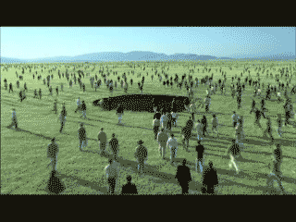
David Lee Burris:
Matters Of Ultimate Truth Taken Very Seriously
FROM DEBATE
UNTO DENOMINATIONS

Slide 17
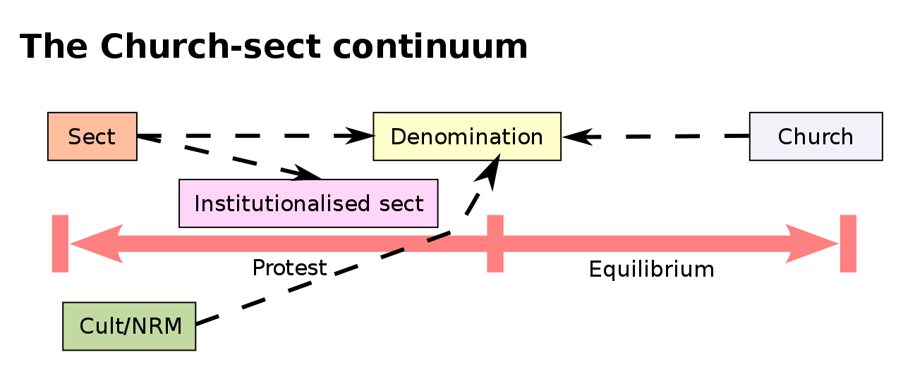

Slide 18
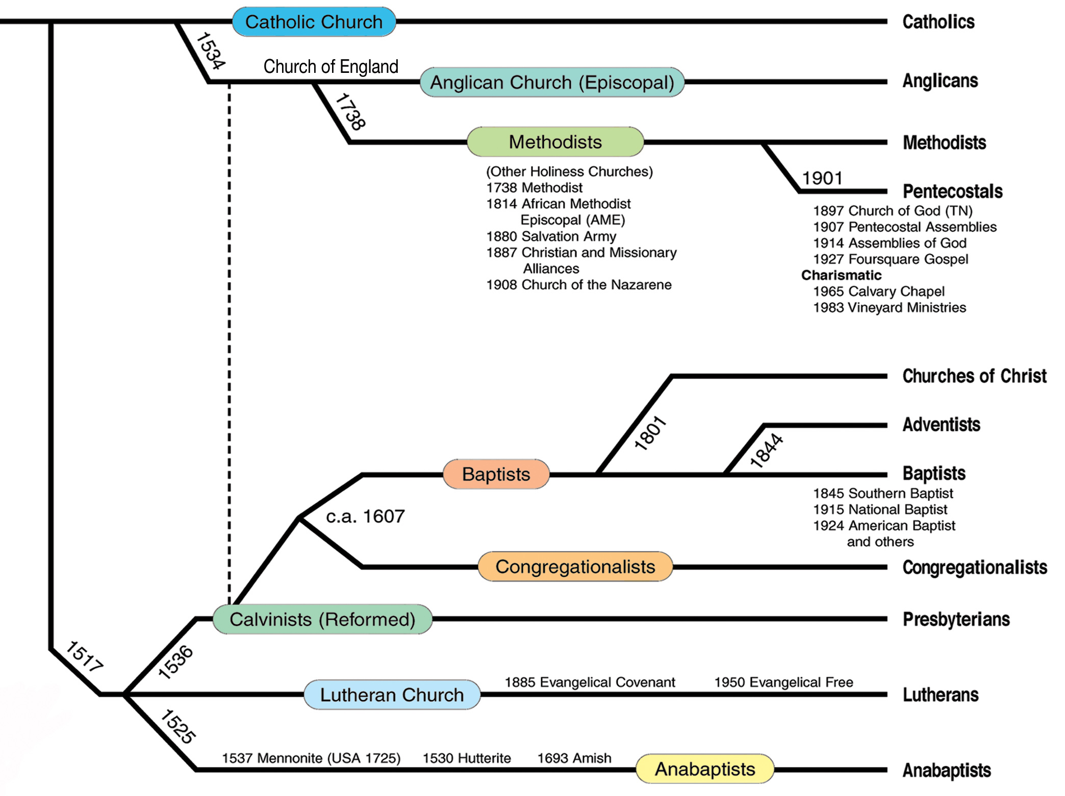

Slide 19
GERMAN
AD 1525
In 1525, Protestants in Zurich began the practice of baptizing believers (usually adults) only.
This marked the beginning of the Anabaptist movement.
Anabaptists

Slide 20
SACRAMENTAL
AD 1525
In 1525, Protestants in Zurich began the practice of baptizing believers (usually adults) only.
LITURGICAL

Slide 21
SWISS REFORM
AD 1536
Presbyterians
In 1536, John Calvin wrote Institutes of the Christian Religion.
This marked the beginning of the Calvinist (Presbyterian/Reformed) movement.

Slide 22
BELIEF SYSTEM:
EQUAL & LOCAL
Presbyterians
AD 1612
In 1612, John Smyth and other English Puritans formed the Baptist Church.
In his 1607 Principles & Inferences Concerning The Visible Church he wrote that there was no hierarchy & all officers were subject to the laity.
Baptists

Slide 23
BELIEF SYSTEM:
Lay Ministry
Anglicans
AD 1738
The 2nd Reformation!
In 1738, the conversion of John and Charles Wesley, already devout Anglican ministers, sparked the “Great Awakening,” a revival in England.
This marked the beginning of the Methodist Church and what has been labeled the second phase English Arminian Reformation.
Charles Westley himself remained in the Church of England Episcopal Church & Anglican Communion.
Methodists

Slide 24
First Awakening:
LEVELED CLERGY
Sacramental Religion
AD 1801
Charismatic Religion
Institutional Development FROM THE 2ND GREAT AMERICAN AWAKENING

Slide 25
Presbyterian Seceders Intermediate Affliation
Baptists
AD 1830
Mahoning Association Expels Thomas & Alexander Campbell.
This was one of two historical marks that began the American Churches of Christ.
Churches of Christ

Slide 26
Family History From Family Bibles: Physical Births & Spiritual Rebirths
DENOMINATIONS = DEGREES OF REFORM
SACRAMENTAL/LITURGICAL TRADITIONALIST
ANTI-TRADITIONAL REVIVALISTS MOVEMENT

Slide 27
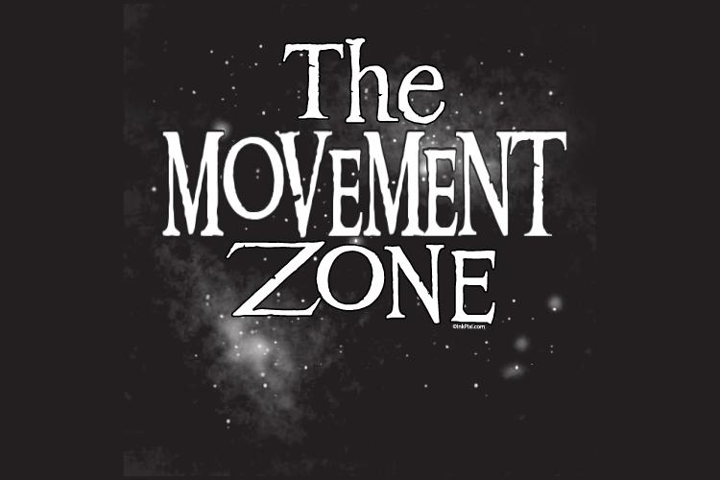

Slide 28
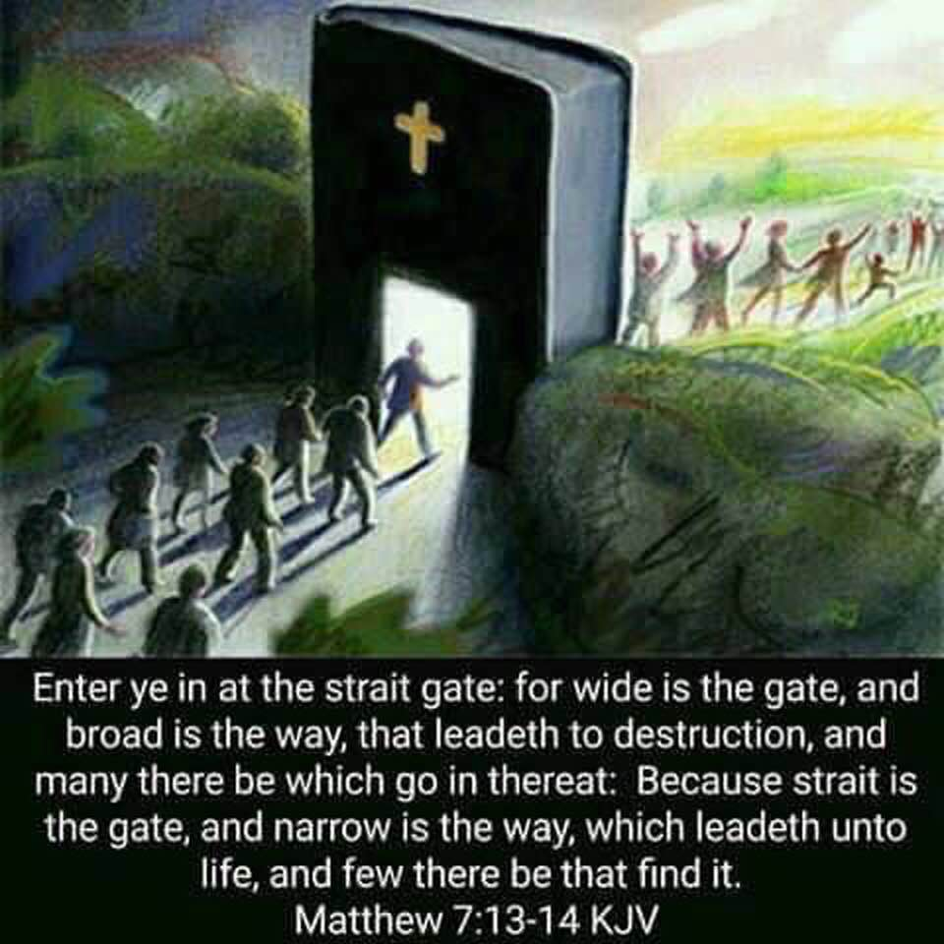

Slide 29
Multiple Branches Of One Vine?

Slide 30
No Denominations At Lystra!
No Denominations At Corinth!

Slide 31
EXCLUSIVITY
“Just as there are as many ‘faiths’ or acceptable systems of belief through which a person living today can be saved as there are Gods – and there is only one: “One God and Father of all, who is above all, and through all, and in you all” (Eph. 4: 4). - just as there are as many bodies of saved people or churches as there are Gods in heaven. There is one and only one. The reason is because the same text affirms, ‘There is one body.’”
*
* Getwell Church Of Christ Bulletin 4-16-07

Slide 32
ONENESS LESSON
SCRIPTURE REFERENCE
“My Church”
Matthew 16: 18
“The Church”
Ephesians 1: 22
“One Body”
Ephesians 4: 4
“One Fold”
John 10: 16
“One Family”
1st Timothy 3: 15
“No Divisions”
1st Cor. 1: 10

Slide 35
CHRIST & THE CHURCH
KINGDOM
BODY
Government
Unity
CHURCH
KINGDOM
HOUSEHOLD
BODY-CHRIST
Family
Ownership
HOUSEHOLD
CHRIST

Slide 37
“Denominations Are Sinful”
by – Garland M. Robinson
“Since the words denomination & denominationalism are not found in the Bible, they must be defined from other sources. A denominational body is defined as ‘a part of a whole or one of a series of units.’ Webster defines denominationalism as: ‘devotion to denominational principles/interests. The emphasizing of denominational differences to the point of being narrowly exclusive.’ ‘An act of denominating, a value or size of a series of values or sizes (as of money), a religious organization whose congregations are united in their adherence to its beliefs and practices.’ ”
*
* “Seek The Old Paths” Newsletter April, 2009

Slide 38
“Denominations Are Sinful”
by – Garland M. Robinson
“A quarter is a denomination (a part ) of a dollar, but not the whole dollar. Each denominational church claims to be a part of the whole, but not the whole church. Many sincere and devoted people are involved in denominationalism. They are trying to go to Heaven and expect to get there in and through a denominational church.”
“A most appropriate question to ask is: are denominational churches just different ways of going to Heaven? No they are not. The Bible teaches that denominationalism is wrong and sinful. God’s word condemns denominationalism, which is division.”
*
* “Seek The Old Paths” Newsletter April, 2009

Slide 39
“Denominations Are Sinful”
by – Garland M. Robinson
“Denominationalism contradicts and condemns the Lord’s Prayer for unity. On the night in which Jesus was betrayed, He prayed for His apostles, saying… ‘ Neither pray I for these alone, but for them also which shall believe on me through their word; That they all may be one; as thou, Father, art in me, and I in thee, that they also may be one in us: that the world may believe that thou hast sent me. And the glory which thou gavest me I have given them; that they may be one, even as we are one: I in them, and thou in me, that they may be made perfect in one.” {JOHN 17: 20 – 23}
*
* “Seek The Old Paths” Newsletter April, 2009

Slide 41
BELIEFS RECEIVED & LEARNED RELIGION:
“If the source of our learning is corrupt, our learning will be no better! It’s not enough to be taught. We must concern ourselves with where and by whom we were taught – 2 Tim. 1:5. In order for one’s religion to be learned, there must be a process of teaching, learning, and knowing. Concerning Christianity – we are taught of God & learned of the Father – John 6: 44, 45. As Christians , we should ask ourselves why we believe as we do. Where did we learn it? We should be able to go to the scriptures and say, ‘Here is why I believe as I do. I learned it from the Bible!’” - - Marlin Kilpatrick

Slide 43
Family History From Family Bibles: Physical Births & Spiritual Rebirths
DENOMINATIONS = DEGREES OF REFORM
SACRAMENTAL/LITURGICAL TRADITIONALIST
ANTI-TRADITIONAL REVIVALISTS MOVEMENT
SCOTTISH RATIONALISM

Slide 44
Scottish Reformation Heritage
As far back as the late fourteenth century, John Wyclif taught the absolute authority of the Scriptures and condemned Roman doctrines not found in the Bible. This tradition of Sola Scriptura continued and found controversial new voice in John Knox who taught the supreme authority of God’s Holy Word as contained in canonical Scriptures.
Several Derivatives Of Scottish Emphasis On Sola Scriptura:
State Grants Ecclesiastical Independence Of Local Churches
In Scotland the move for religious independence was closely connected to Scottish Nationalism.
Presbyter Government Form Within Local Autonomy Context
Presbyterianism was introduced into Scotland by John Knox who was influenced by John Calvin’s presbyterian church-state structure in Geneva.
John Knox’s Scottish Adoption-Adaptation Of Calvin’s Theology
The aspects adopted were those especially colored by John Calvin’s legal background as a lawyer. This manner of thought stresses such major concepts as God’s sovereignty, man’s depravity, faith and eternal destination as acts of God, and a legal obligation to keep God’s commands.
SPIRITUAL TERRAFORMATION

Slide 45
Enlightenment Rationalism: Ideals Political & Religious
Intellectual Movement With Focus On Inner Self
Legitimate Authority Is Not Of Church Or Clergy
Reason vs. Revealed: Self - Defines & Discovers
Kant Religion: Moral Givenness / Imperative Duty
Theology : Experience-based - Subjective / Private
Descartes: Our Knowledge Of Divine Deductive
Locke Empiricism: All Knowledge Is Inductive
Labeled: “Scottish Common Sense Philosophy”
Know: Reflection, Reduction, Analysis, Analogy
Scottish Entitlement Theories : Politics & Religion
John Locke: “The Reasonableness of Christianity”

Slide 46
The Origins Of SOCIAL THEORY
Relations To Power & Religious Roleplay

Slide 47
Family History From Family Bibles: Physical Births & Spiritual Rebirths
DENOMINATIONS = DEGREES OF REFORM
SACRAMENTAL/LITURGICAL TRADITIONALIST
ANTI-TRADITIONAL REVIVALISTS MOVEMENT
SCOTTISH RATIONALISM
LOCKEAN NATURALISM

Slide 48
NATURAL LAW & NATURAL MAN Paul’s Usage of the term Psuchikos Anthroopos
Biblically, in each of the five cases that “psuchikos” is used the term is contrasted with “pneumatikos” or with the spiritual. The contrast in 1st Corinthians 2: 14 is between a man inspired of God and one who has no such revelation (1Cor.2.12ff).
Paul seems to have adopted the Jewish understanding which denoted physical life as opposed to the supernatural life.

Slide 49
NATURAL LAW & NATURAL MAN Paul’s Usage of the term Psuchikos Anthroopos
Paul seems to have adopted the Jewish understanding which denoted physical life as opposed to supernatural life.
The scriptural context of the Biblical term, “psuchikos anthroopos” is inspiration not salvation. The “natural man” tried to find, by his own wisdom, the “things” of God, but such must be revealed. Reference:
1st Corinthians Chapter Two & Verse Ten

Slide 50
Augustine Mixes Horizontal & Vertical Loves
Jesus Christ Reduces the O.T. Ten Commandments of 5 Vertical Loves & 5 Horizontal Loves to Three Verses:
Matthew 22: 37 - 39 – “You shall love the Lord your God with all your heart, with all your soul, and with all your mind; This is the first and great commandment; And the second is like it: ‘You shall love your neighbour as yourself’.”
God
Angels
Humans
Horses
Insects
Rocks
Nothing
SCALE OF BEING
REVIEW: Matt 15: 3-6; Mark 7: 9-13; John 13: 35;De 10:19; Matt 5: 43-48

Slide 51
“THE CHAIN OF BEING”
In 1500, most European men and women were what we would call Roman Catholic, at least in western Europe. That was to change during the sixteenth century, thanks to the Protestant Reformation. Even in the 17th century, however, both Protestants and Catholics shared or reacted against a common set of assumptions dating back to the Middle Ages.
All European men, women, and children were taught about and, so far as we know believed in God. Atheists were virtually unknown; perhaps it wasn’t thought of, or perhaps it was just a very dangerous opinion to express. All Europeans believed, further that God created the universe, ordered it, and was active in its daily working.

Slide 52
“THE CHAIN OF BEING”
All European men, women, and children were taught about and, so far as we know believed in God. Atheists were virtually unknown; perhaps it wasn’t thought of, or perhaps it was just a very dangerous opinion to express. All Europeans believed, further that God created the universe, ordered it, and was active in its daily working.
‘There’s a special providence in the fall of every sparrow,’ as William Shakespeare would have it. A comprehensive metaphor, for it took into account God and all the creatures in his universe, was the one that later historians dubbed ‘The Great Chain of Being.’ When late medieval and early modern men thought about the universe, they thought of it as the Ptolemaic universe; that is, as a series of concentric spheres with Earth in the middle center.

Slide 53
“THE CHAIN OF BEING”
The Hierarchy of the Universe. In 1500, most people believed that, moving from the outer sphere inward, there were the stars, the planets, the sun, the moon, and the center, Earth. At the center of Earth were the flames of hell. This implies that they thought of a hierarchy arranged as follows: God, who dwelt everywhere but especially beyond the stars; angels, who traversed the heavens between God and man; man, who dwelt erect on the Earth; animals, on the Earth cut closer to it; plants, closer still; finally stones, which are literally on the Earth.
Those at top of this hierarchy were closer to God than were those at the bottom. Thus, church steeples aspired to heaven. Thus, when one attends a royal palace, one ascends to meet the sovereign.

Slide 54
“THE CHAIN OF BEING”
The Hierarchy of the Universe. In 1500, most people believed that, moving from the outer sphere inward, there were the stars, the planets, the sun, the moon, and the center, Earth. At the center of Earth were the flames of hell. This implies that they thought of a hierarchy arranged as follows: God, who dwelt everywhere but especially beyond the stars; angels, who traversed the heavens between God and man; man, who dwelt erect on the Earth; animals, on the Earth cut closer to it; plants, closer still; and finally stones, which are literally on the Earth.
The second thing about the Chain is that humankind is half-way down the Chain, suspended between the angels and the animals. Contemporaries thought that each rank in the Chain partook a little bit of the rank above it and below it. Therefore, man was both half angel and half beast.
The third thing about the Chain is that, apart from God, each of the ranks in the Chain could be further divided. Thus, medieval theologians did not just think of angels. There are seraphim, cherubim, thrones, denominations, virtues, powers, principalities, archangels, and angels. The animal hierarchy, too, could be similarly divided. Is not the lion the king of the beasts? Is not the eagle nobler than the sparrow? Etc. And so, also with man.

Slide 55
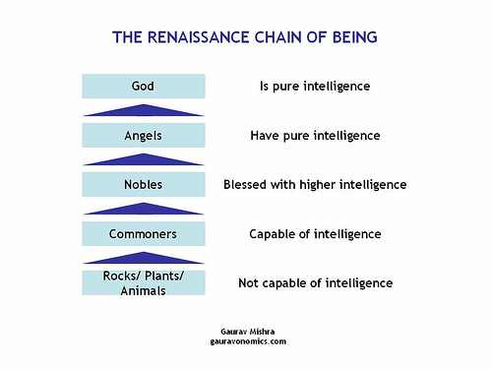
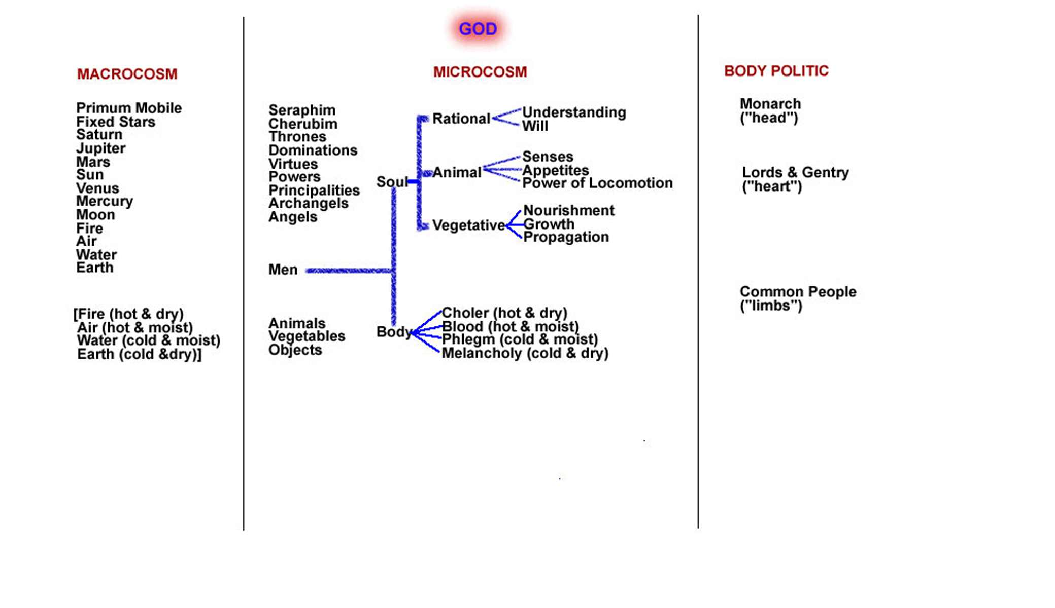

Slide 56
“THE CHAIN OF BEING”
The Higher & Lower Ranks of Man.
The second thing about the Chain is that humankind is half-way down the Chain, suspended between the angels and the animals. Contemporaries thought that each rank in the Chain partook a little bit of the rank above it and below it. Therefore, man was both half angel and half beast.
The third thing about the Chain is that, apart from God, each of the ranks in the Chain could be further divided. Thus, medieval theologians did not just think of angels. There are seraphim, cherubim, thrones, denominations, virtues, powers, principalities, archangels, and angels. The animal hierarchy, too, could be similarly divided. Is not the lion the king of the beasts? Is not the eagle nobler than the sparrow? Etc. And so, also with man.
The fourth thing about the Great Chain of Being is that the top of the Chain is analogous to the head of the whole Chain: God himself. In other words, the king in the country, the father in the family, the lion among beasts, and, of course, the professor in the classroom all represent God and are placed at the top of their respective chains by God. They wield God’s power in his stead and so are to be obeyed as God himself.

Slide 57
^{PARADIGM} SHIFT
Questioning: Love Order + Being Chain = Divine Right

Slide 58
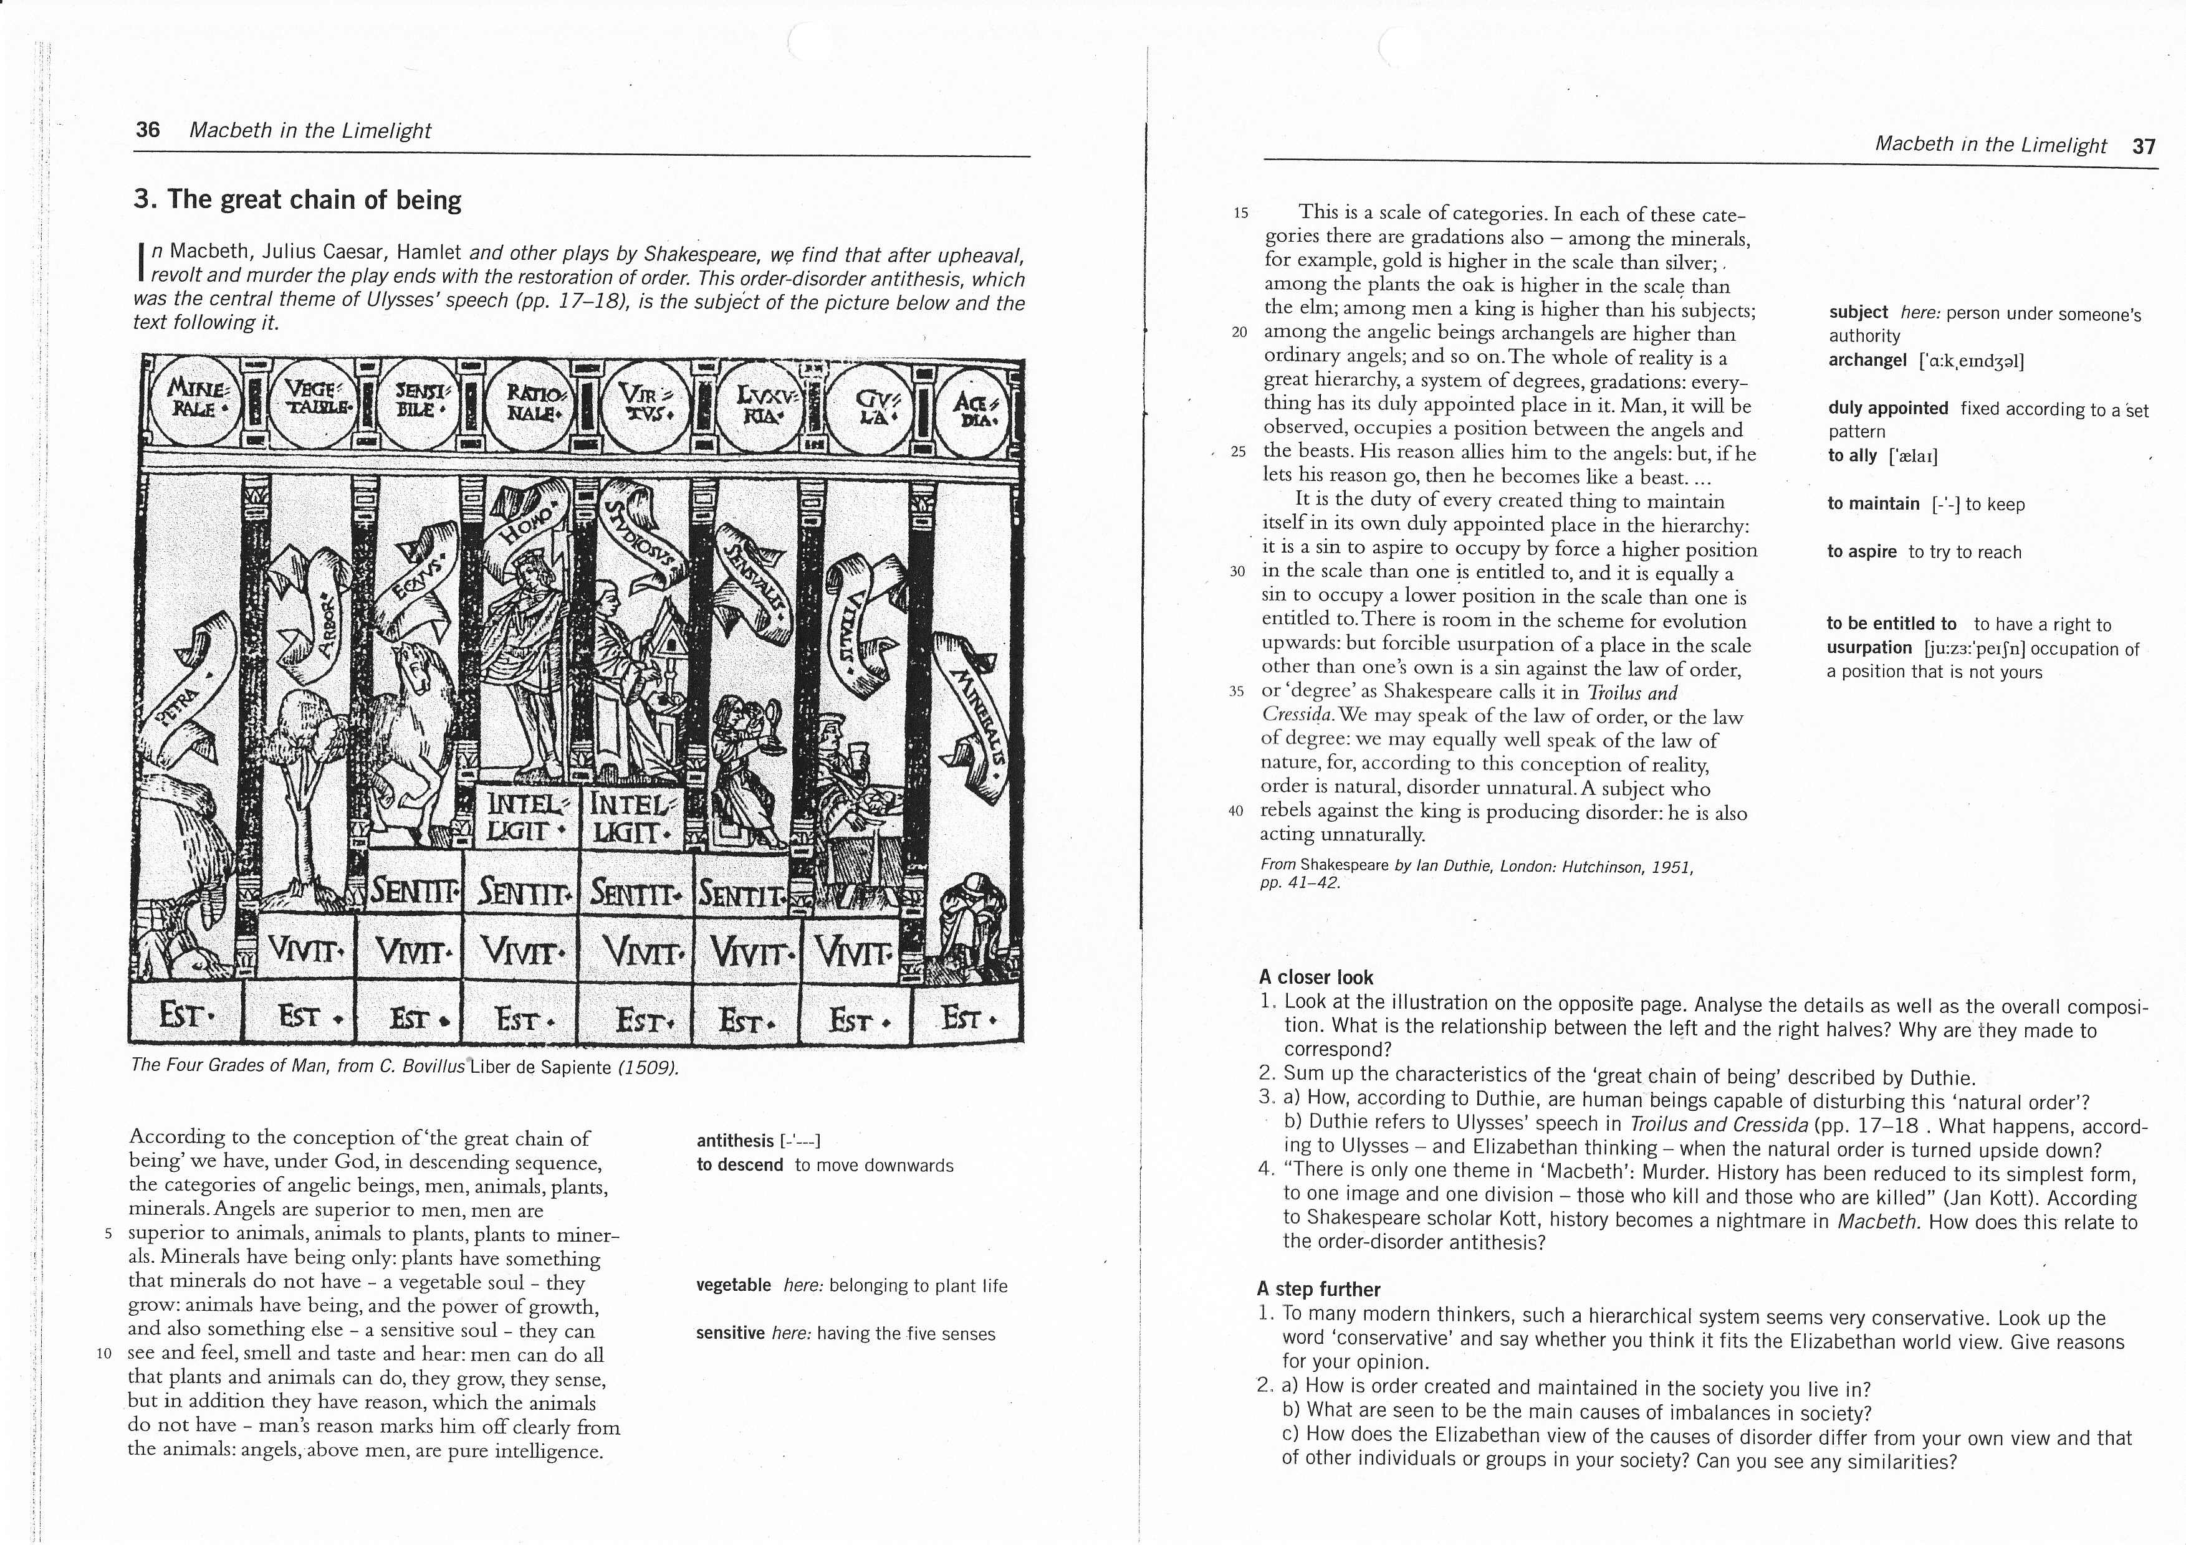
What was going on in the colonies leading up to the Declaration of Independence? Were these hotheads that were just looking for a fight?
Not hardly. History shows us, through the documents and petitions they submitted on a continual basis to King George, through their writings and through their activities, that they were a people who truly believed they were in a covenantal relationship with their king and with God. They believed that a political contract existed between the three parties.
And just like a marriage contract that has been violated, King George continued to violate the spiritual and political compact that existed between himself and the colonists in America. After all means of reconciliation with the king were attempted and spurned, it was with the greatest of sorrow that the colonists decided that a covenantal lawsuit, a suit against the kind seeking a "divorce" from England, was in order.
"The Declaration of Independence was a kind of covenant lawsuit, not unlike those of the Old Testament. It was intended to send a message to both Parliament and Crown that the rule of law would be upheld, regardless of their tyrannies.“ -- George Mason
Two to three hundred years of Reformation history contributed to the ideas and worldview contained in one of the greatest documents ever composed... the Declaration of Independence. And despite the modern-day attempts to cut the Founders off from their spiritual roots and heritage, the men who stood in the gap, those men who petitioned the king time and time again, were God-fearing men who were attempting to do what they had to do within all the boundaries of law--man's law and God's law.
However, God's law trumps all else, and the greatest concept that God endowed man was freedom.
"Where the Spirit of the Lord is, there is liberty. And where there is liberty, there is a covenant community standing fast in its defense." -- Samuel Adams
THE EUROPEAN CHAIN OF BEING

Slide 59
Calvin and (Thomas) Hobbes
Thomas Hobbes: Authored The Leviathan(1651)
Held the belief that people in a nutshell were stupid…
Well intentioned, but stupid.
Citizens need a strong leader to tell them what to do.
Given the chance, they will mess up society.
In nature…“no society; and which is worst of all, continual fear, and danger of violent death; and the life of man, solitary, poor, nasty, brutish, and short.”

Slide 60
All in the Fine Print..
Social Contact: An agreement among a society in order to cooperate for social benefits.
Locke: People give up the right to enact justice in exchange for life, liberty and gain the right to impartial protection of property.
Monopoly on violence.

Slide 61
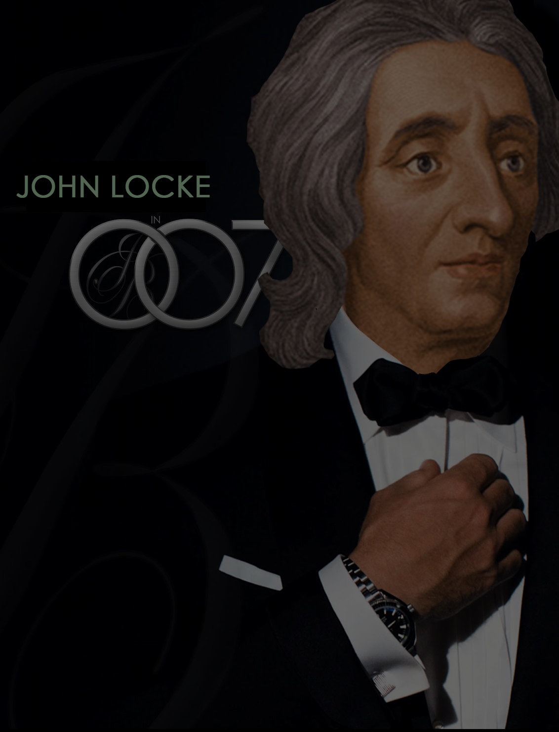
Locke in Your Rights
John Locke: Author of Second Treatise on Government (1689)
Coined the term “Natural Rights”
Rights that every human has from their birth.
Right to happiness, life, freedom etc.
Why would the founders follow him?

Slide 62
Family History From Family Bibles: Physical Births & Spiritual Rebirths
DENOMINATIONS = DEGREES OF REFORM
SACRAMENTAL/LITURGICAL TRADITIONALIST
ANTI-TRADITIONAL REVIVALISTS MOVEMENT
RATIONALISM + NATURALISM

Slide 63
The Restoration Movement Rejects Dogmas & Revisits Received Doctrines.

Slide 64
PUT AWAY Preconceived Predetermined PREJUDICE
David Lee Burris:
Humanity’s Utopistic Separation Over High Executive & Upper Management Policy
Wrestling With Scripture

Slide 65
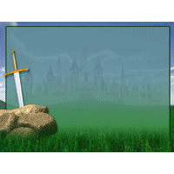
SEDIMENTARY FORMATIONS
Deposited Traditions
Spiritual Sword Received Faiths

Slide 66
Analogy Of Faith
“Principle of interpretation that suggests that clearer passages of Scripture should be used to interpret obscure or difficult passages.”
* Dictionary Of Theological Terms, Grenz & Guretzki

Slide 67
Analogy Of Faith
“For Luther, Christ is the analogy of faith, so that scripture needs always to be interpreted as testifying to Christ.”
* Dictionary Of Theological Terms, Grenz & Guretzki

Slide 68
Analogy Of Faith
“For Calvin, the analogy of faith assumes because the Spirit oversaw its writing, Scripture and the Spirit together interpret other parts of Scripture.”
* Dictionary Of Theological Terms, Grenz & Guretzki

Slide 70
Church Identifiers
Proof Texts
Founder/Foundation Jesus Christ
Matthew 16: 18
Member Profile Baptism Added
Acts 2: 41
Action Focus Save Souls
Phil 4: 14-18
Professed Doctrine The New Testament
Ephesians 2: 20
Organic Structure Local Congregation
Acts 14: 23
Physical Location All The Nations
Matt 28: 18-20

Slide 72
Family History From Family Bibles: Physical Births & Spiritual Rebirths
DENOMINATIONS = DEGREES OF REFORM
SACRAMENTAL/LITURGICAL TRADITIONALIST
ANTI-TRADITIONAL REVIVALISTS MOVEMENT
RATIONALISM + NATURALISM
PRE-RESTORATION SCOTLAND

Slide 73
Some Beliefs Of The Glasites/Sandemanians
Believed They Could Reenact 1st Century Order In Christianity
Denied Tenets Of Calvinism
Had Lord’s Supper Every Sunday
Observed Love Feasts
Had Foot-Washings
Mutual Exhortations
Casting Lots, etc.

Slide 74
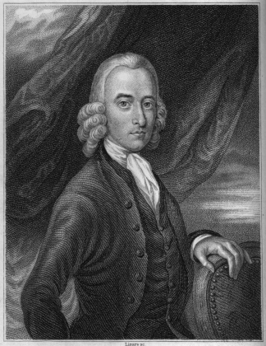
Robert Sandeman 1718-1771
American Influence
1760 – Letters On Theron And Aspasio Appear In Colonies
1763 – He Receives A Letter Urging A Visit To America
August 30, 1764 Sandeman Departs Scotland Arriving In Boston Harbor, Oct. 18, 1764
Glas/Sandemanian Churches Established In Connecticut, Rhode Island, Massachusetts, & Other New England States
Sandeman Died In Danbury, Connecticut, April 2, 1771 At 53 Years Of Age, Two Years Before Glas In Scotland

Slide 75
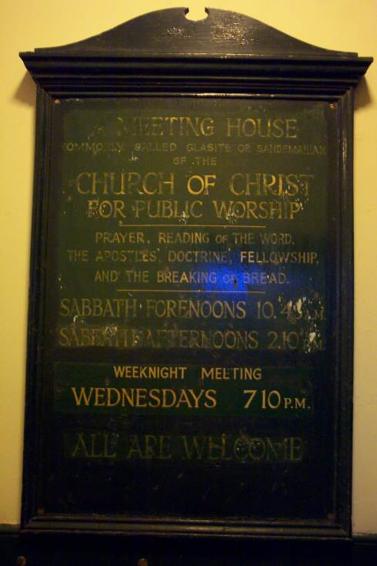

Slide 76
Family History From Family Bibles: Physical Births & Spiritual Rebirths
DENOMINATIONS = DEGREES OF REFORM
SACRAMENTAL/LITURGICAL TRADITIONALIST
ANTI-TRADITIONAL REVIVALISTS MOVEMENT
RATIONALISM + NATURALISM
PRE-RESTORATION SCOTLAND
PRE-RESTORATION AMERICA

Slide 77
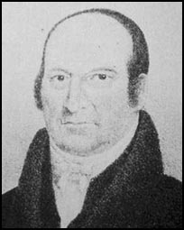
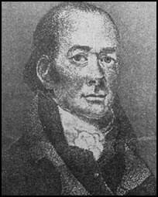
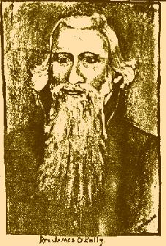
Earliest Restorers
Abner Jones
Elias Smith
1772-1841
1769-1846
John Wright
James O'Kelley
1738-1826
1785-1851

