Slide 1
CHURCH HISTORY AS FAMILY HISTORY
Family Tree: Restoration Movement Branch: Scottish Rationalism Branch: American Revivalism
By David Lee Burris

Slide 2
Family History From Family Bibles: Physical Births & Spiritual Rebirths
EVER OPENED UP someone else’s old photo album?
Grandparents, aunts, second cousins, old Ford Model Ts, big hats. Or boat cars and poodle skirts. People smiling into long-vanished sunsets and sunrises. At first, it seems confusing. Maybe you can pick out an era, but these aren’t your grandparents and your second cousins, your stories, or your inside jokes.
But then you talk to the people who own the photo album. You listen to their stories and the photos come alive. You learn what it meant to be part of that family in all its struggles and heartaches and joys. What it meant to live at that moment in history.
What does this photo album teach the rest of us? Things we already knew, but things it is good to remember. The centrality of the Bible. The centrality of the body of Christ. How American culture and the Christian message influenced each other.
And how difficult it is to be “simply Christian.” Even when you go whole hog. Traditions and human constructions can turn out to be, in the end, inescapable. But also inescapable, in the end, is the grace of God. Thanks be to God, who redeems all constructions. – Editoral Notes Christian History Special Issue Stone-Campbell Movement

Slide 3
Family History From Family Bibles: Physical Births & Spiritual Rebirths
DENOMINATIONS = DEGREES OF REFORM
SACRAMENTAL/LITURGICAL TRADITIONALIST
ANTI-TRADITIONAL REVIVALISTS MOVEMENT
RATIONALISM + NATURALISM
PRE-RESTORATION SCOTLAND
PRE-RESTORATION AMERICA

Slide 4
An Indiana Movement
John Wright Was A Member Of A German Free-Will Baptist Group
Known As “Dunkers” – German For “Immersers”
Began Comparing Baptist Doctrine To Baptist Doctrine And Found Discrepancies
When Comparing Baptist Doctrine To Scripture, Found Discrepancies
Taught That The Bible Was All-Sufficient For Faith & Practice
The Lord’s Supper Should Be Taken On The 1st Day Of Every Week
Thought Baptism Was Essential To Eternal Salvation, But Not For Forgiveness Of Sins – Later Changed This Belief
His Actions: Took 16 Baptist Churches Away From Baptists Near Salem, Indiana
In All This He Had Never Heard Of Alexander Campbell
John Wright
1785-1851

Slide 5
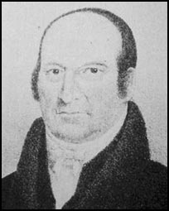
New England
Moved From Mass. When He Was 8 Yrs. Old To Vermont
1793 Baptized Into Baptist Church, Woodstock, VT
Began To Preach 1801, Age 29
Began Planning At 21
Studied His Bible On His Own
Found Baptist To Be Unauthorized Name
Should Be A Christian Only
Organized 1st Free Christian Church In New England
Denied Calvinism And Branded As Heretic By Free-Will Baptists
Abner Jones
1772-1841
Studied And Practiced Medicine For Many Years
Mastered Hebrew, Latin & Greek Grammars
Started Christian Churches In Vermont, New Hampshire & Salem, Massachusetts

Slide 6
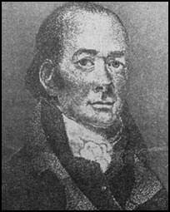
New England
Elias Smith
Broke With Sandamanian Congregationalists In New England
1789 Immersed A Baptist
Early Leanings Toward Universalism
Gave It Up By 1826
1802 – Taught That We Should Be Only Christians
1769-1846

Slide 7
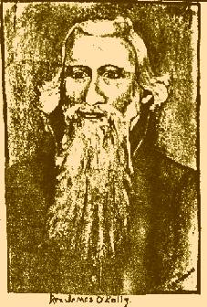
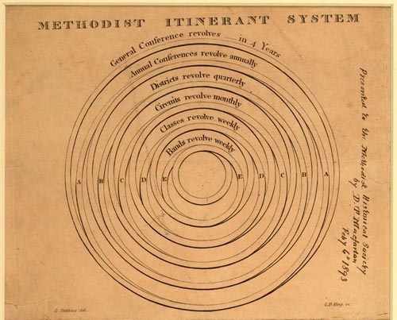
O’Kelley Leaves Methodism
O’Kelley’s Concerns
Didn’t Like One Man Being Placed Over The Church
Thought Circuit Riders Should Go Where They Felt The Need
By 1792 – Other Than Asbury, O’Kelley Was Probably The Most Influential Preacher Among Methodists
In 1789 – He Had Written Essays On Negro Slavery
He Was A Personal Friend To Thomas Jefferson
Had Addressed & Preached Before The U.S. Congress
December 24, 1792 – Awkward Conference Of Methodist – Made Two Suggestions
If Circuit Riders Did Not Like Their Assigned Circuit, They Could Appeal To The Conference For Change
Proposed That The Bible Be Taken As Final Authority In All Doctrinal Matters
Neither Were Accepted

Slide 8
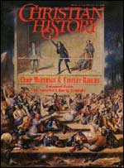
Changes Brought By Revivalism
Leveled Position Of Worship
Full Participation In Worship
Exercised Right Of Free Speech
Regular Leaders Stood Sidelined
Circuit Riders & Rotating Services
New Concepts Of Authority & Order
Audience Consent Not Old Institution
Public Address W/O Social Authority
Uneducated Pastors & Itinerant Preachers
Language Of Crowd Not Written Essay Reading
Emphasis: Saving Souls & Individual Importance

Slide 9
Family History From Family Bibles: Physical Births & Spiritual Rebirths
DENOMINATIONS = DEGREES OF REFORM
SACRAMENTAL/LITURGICAL TRADITIONALIST
ANTI-TRADITIONAL REVIVALISTS MOVEMENT
RATIONALISM + NATURALISM
PRE-RESTORATION SCOTLAND
PRE-RESTORATION AMERICA
THE FIRST GREAT AWAKENING

Slide 10
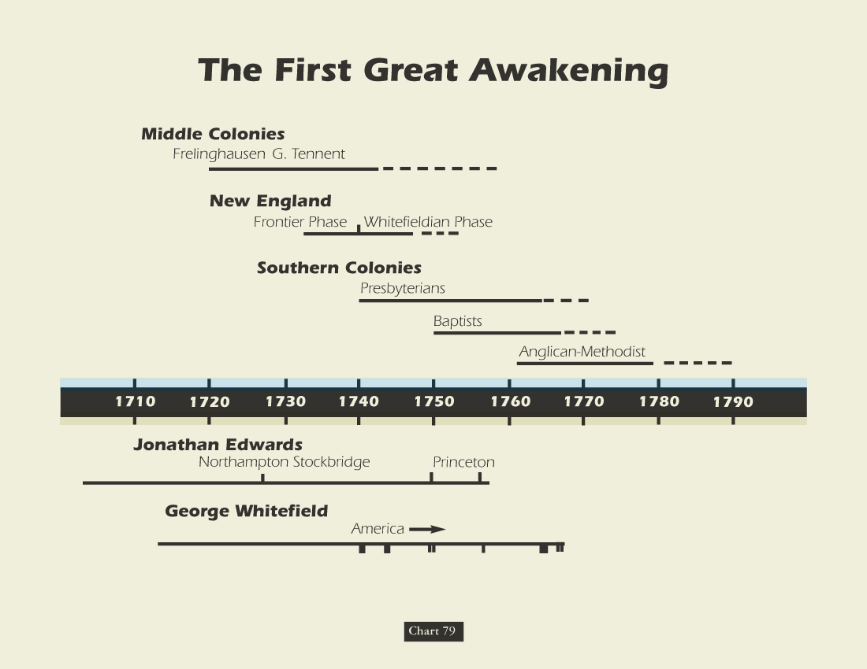

Slide 11
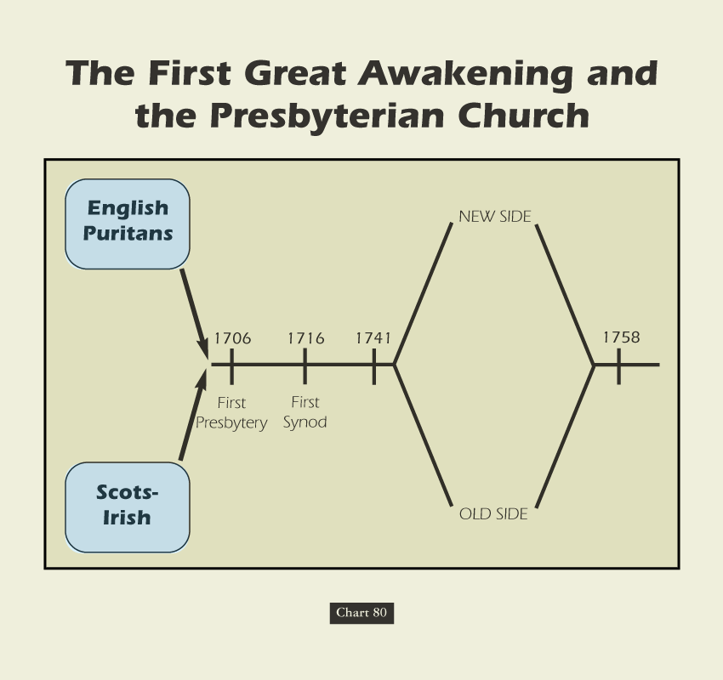

Slide 12
Sweet’s Story of American Religion: Presbyterians
“Of all the American churches at the opening of the national era, the Presbyterian was the most strategically located for an immediate advance into the West. The Scotch-Irish constituted the last great wave of emigration previous to the Revolution and by 1760 Scotch-Irish Presbyterian churches were to be found scattered along from ‘the frontiers of New England to the frontiers of South Carolina.’”

Slide 13
The Great Awakenings Compared
First Great Awakening | Second Great Awakening
Religious Revivals
Emotional, Fire & Brimstone Preaching
Calvinist Influence [Sinfulness Inherent] | Arminian Influence [Sinfulness a Choice]
Conversion Experience
Spread of Non-traditional Denominations
Promoted Democratic Ideals
American Revolution | Antebellum Reform

Slide 14
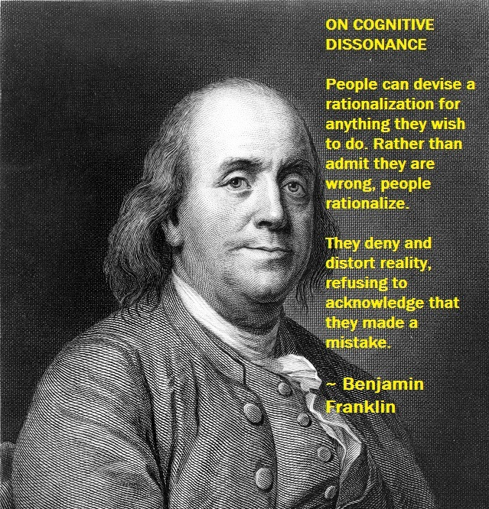
OVERVIEW: ANCIENT ORDER RESTORE POINT
1ST CENTURY RESTORATION: SEEKING THE ANCIENT ORDER
PIETISTS & ANABAPTISTS DO NOT HAVE A CHURCH HOME
FATALISM: AMERICA’S FRONTIER RELIGIOUS AWAKENINGS
HELD O/S ESTABLISHED STRUCTURES & W/O “PEW RENT”
18th Century 1ST AWAKENING @PRE-REVOLUTION AMERICA
NEW ENGLAND AREA: WRIGHT, JONES, SMITH & O’KELLY
19th Century 2ND AWAKENING @POST-REVOLUTION AMERICA
LOYALIST SUPPORT: ANGLICAN EPISCOPALIANS & WESLEYANS
REVOLUTION: BAPTIST, PRESBYTERIAN, & CONGREGATIONAL
BARTON STONE MAKES NEWS WITH CANE RIDGE REVIVAL
FRONTIER REVIVAL SPEAKERS: BAPTIST & PRESBYTERIAN
BARTON STONE: ONENESS, POSTMILLENNIAL, CHARISMATIC
OFFICIALLY STONE: NEW LIGHT/ SECEDER /PRESBYTERIAN
AFTER KENTUCKY REVIVAL HIS NEW LIGHT CHURCH WROTE:
“The Last Will & Testament of the Springfield Presbytery.”

Slide 15
But it’s Paine who is most singled out as America’s true philosophical founder. Paine’s Common Sense did put forth arguments for independence from Great Britain, but how did Paine argue his case? What were his sources? Did he follow deistic lines of argumentation similar to those of the French revolutionaries? “He constructed his arguments from materials that were familiar to the average colonist, favoring allusions to popular history, nature, and scripture rather than Montesquieu, Tacitus, and Cicero.” There is no hint of Deism in Common Sense.
A. J. Ayer remarks that “the first argument that Paine brings against the institution of kingship is scriptural.” Paine declared that “government by kings was first introduced into the world by the Heathens, from which the children of Israel copied the custom. . . . As the exalting of one man so greatly above the rest cannot be justified on the equal rights of nature, so neither can it be defended on the authority of scripture; for the will of the Almighty, as declared by Gideon and the prophet Samuel, expressly disapproves of government by kings. All anti-monarchical parts of scripture have been smoothly glossed over in monarchical governments, but they undoubtedly merit the attention of countries which have their governments yet to form. ‘Render unto Caesar the things which are Caesar’s’ is the scriptural doctrine of courts, yet it is no support of monarchical government, for the Jews at that time were without a king, and in a state of vassalage to the Romans.”

Slide 16
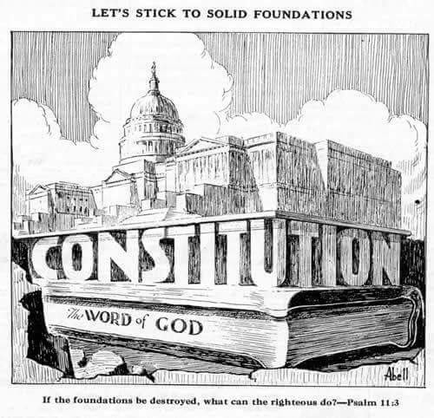
RESTORATION REGULATORY PRINCIPLE OF INTERPRETING HOLY SCRIPTURE MIRRORED STRICT CONSTRUCTIONIST CONSTITUTIONAL INTERPRET @FRAMERS ORIGINAL INTENT

Slide 17
The normative exceptions in historical observation
are what Nassim Nicholas Taleb calls Black Swans -
where as he says “History does not crawl, it jumps.”

Slide 18
These world class epic events include the
Wittenburg Hammer heard round the world
Lexington Bridge Shot heard round the world.

Slide 19
The Restoration Movement: An American Theology
“From the early to mid-1800’s, the Restoration Movement became the fastest growing religion on the American frontier & remained one of America’s largest indigenous religious movements. While many factors contributed to its success, one of the most important was a shift in the way Americans were coming to understand the nature of man and his relation to God. This new attitude is most succinctly put forward in the Declaration of Independence and helps explain the movement’s growth. Written only 25 years before the American Restoration Movement, the Declaration of Independence was a theological document as well as political.”

Slide 20
The Restoration Movement: An American Theology
“More than announcing separation from England, it offers a theological justification for rejecting the doctrine of the Divine Right of Kings. This was a theory that certain kings were chosen by God to rule & that they were accountable to no person except God. Rebellion against England’s King George meant that the American colonies would be arrayed against divinely appointed government. The American leaders, however, understood a different principle to be at work. America was a new continent. It was as if God had provided a new Eden and given humanity a fresh start. Accordingly, they appealed to Nature and a biblical understanding of creation whereby every person bears the image of God. In creation, all are equal & have inherited certain divine rights which no king can take away. If he does, he is a despot whose disobedience to God gives the people the right to depose him.” {Columbus Reported He Had Rediscovered Actual Eden}

Slide 21
The Restoration Movement: An American Theology
“This finds its way into the the Declaration of Independence in the statement: ‘We hold these truths to be self-evident, that all men are created equal & that they are endowed by their Creator with certain inalienable rights…’ The American political leaders rested their case for independence and democracy on this biblical foundation. The success of the American experiment worked to legitimize this new populist theology and move it beyond America and beyond politics. Now the church would have to wrestle with its implications. Twenty-five years after the U.S. Declaration of Independence, fourteen years after the Constitution was ratified, and ten years after the Bill of Rights, the Restoration movement began. It arose in an atmosphere of religious revivalism propelled by a heady idealism about the nature of man with earnest hopes for a utopian future.”

Slide 22
The Restoration Movement: An American Theology
The equal justice of God. “For the leaders of the American Restoration Movement, God is just & rules according to immutable laws. He is neither arbitrary, capricious, nor partial. Each human being has equal standing before Him & is equally amenable to His laws. Those laws are not hidden. They are revealed in a written and unchanging constitution: the New Testament. Moreover, they aren’t understood thru subjective human experience, but normal objective reasoning.”

Slide 23
The Restoration Movement: An American Theology
The sovereignty of the individual. “Since God is impartial and all humans are equal before Him, the Calvinist doctrine of election, whereby God chooses who will receive salvation, was rejected. Each person is free to participate in one’s own destiny, to accept or reject salvation!”

Slide 24
The Restoration Movement: An American Theology
The people’s government of the church. “Since God is no respecter of persons, but all have equal standing, there is no separate calling or class for clergy. All are ‘clergy’, and all are ‘laity.’ All Christians share the responsibility to promote the church & see to its good order. There is no divinely chosen hierarchy that stands over the church. The members of each congregation choose their leaders and select those who preach & teach for them. Thus, communion responsibility, preaching & prayers was placed in the hands of the common people.” – Carson Stephens

Slide 25
The Restoration Movement: An American Theology
Believer’s Baptism: Freedom Of The Will. “Once, while conducting a meeting at Slate Creek, Kentucky, a Methodist preacher was in a meeting across town. Smith attended a service by the side of the creek when the Methodist preacher applied water to a screaming infant. When ‘Racoon’ had a baptism the next day, the Methodist preacher was nearby standing on the bank. After the ceremony, Smith approached the preacher and began to pull him toward the creek. The Methodist preacher asked him what he was doing. ‘I am going to baptize you, Sir,’ replied Smith. ‘But I do not wish to be baptized.’ ‘Do you not believe?’ said Smith. ‘Certainly I do,’ stated the Methodist preacher. ‘Then come along, Sir,’ said Smith. ‘But,’ said the man, ‘I am not willing to go. It certainly would do me no good to be baptized against my will.’…”

Slide 26
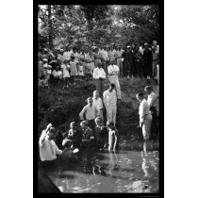
The Restoration Movement: An American Theology
Believer’s Baptism: Freedom Of The Will.
“… Racoon Then Stated, Did you not but yesterday baptize a helpless babe against its will? Did you get consent first, Sir? Come along with me, for you must be baptized.’ But the man protested and Smith released him.”
– Dabney Phillips

Slide 27
OVERVIEW: ANCIENT ORDER RESTORE POINT
1ST CENTURY RESTORATION: SEEKING THE ANCIENT ORDER
PIETISTS & ANABAPTISTS DO NOT HAVE A CHURCH HOME
FATALISM: AMERICA’S FRONTIER RELIGIOUS AWAKENINGS
HELD O/S ESTABLISHED STRUCTURES & W/O “PEW RENT”
18th Century 1ST AWAKENING @PRE-REVOLUTION AMERICA
NEW ENGLAND AREA: WRIGHT, JONES, SMITH & O’KELLY
19th Century 2ND AWAKENING @POST-REVOLUTION AMERICA
LOYALIST SUPPORT: ANGLICAN EPISCOPALIANS & WESLEYANS
REVOLUTION: BAPTIST, PRESBYTERIAN, & CONGREGATIONAL
BARTON STONE MAKES NEWS WITH CANE RIDGE REVIVAL
FRONTIER REVIVAL SPEAKERS: BAPTIST & PRESBYTERIAN
BARTON STONE: ONENESS, POSTMILLENNIAL, CHARISMATIC
OFFICIALLY STONE: NEW LIGHT/ SECEDER /PRESBYTERIAN
AFTER KENTUCKY REVIVAL HIS NEW LIGHT CHURCH WROTE:
“The Last Will & Testament of the Springfield Presbytery.”

Slide 28
The Church Across The Ages
of people, events
life and faith from
Glimpses
The Second Great Awakening
In August, 1801, Barton W. Stone led a revival in Cane Ridge, Kentucky that became the most famous camp meeting. The meeting lasted a week, and 23,000+ people came. The preaching was simple, lively, and persuasive, with preachers from different denominations sharing the platform. The strong emotional responses produced strange physical manifestations – some people fainted and fell to the ground or suffered uncontrollable shaking. There was dancing, running, and singing – all of which Stone said were manifestations of God’s presence. The noise of the meeting was so great some said “the noise was like the roar of Niagara.” Eastern revivalists were highly critical of the emotional excesses of the Cane Ridge camp meeting. One Presbyterian minister said the anarchy of the camp meetings must have had some connections with the French Revolution!

Slide 29
Family History From Family Bibles: Physical Births & Spiritual Rebirths
DENOMINATIONS = DEGREES OF REFORM
SACRAMENTAL/LITURGICAL TRADITIONALIST
ANTI-TRADITIONAL REVIVALISTS MOVEMENT
RATIONALISM + NATURALISM
PRE-RESTORATION SCOTLAND
PRE-RESTORATION AMERICA
THE FIRST GREAT AWAKENING
THE SECOND GREAT AWAKENING
BARTON STONE

Slide 30
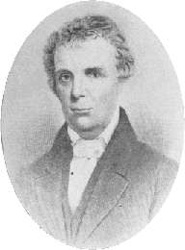
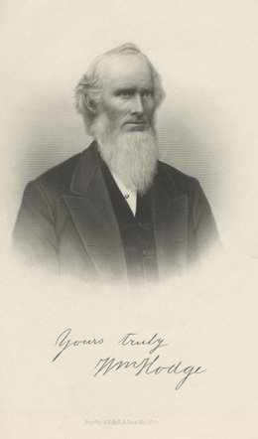
Barton Warren Stone
Studied The Languages – Believed That The Hebrew & Greek Languages Were The Choices Of God To Deliver His Message To Man, Therefore His Honor To Study
Got Religion
Upon Arrival, Not Interested In Religion, Just Wanted To Study Law
Just Before Arriving Most Of Student Body Had Been Converted To Presbyterianism At The Preaching Of William Hodge
1791, February — Heard James McGready, Who Left Him Cold And Religiously Detached
In The Spring, Got Religion At The Milder Preaching Of William Hodge, (Graduate of Caldwell’s School) At Hawfields Presbyterian Church - Sprinkled
William Hodge

Slide 31
Barton Warren Stone
After Graduation, Though Leaning To The Ministry, He Rejected It Initially Choosing To Visit His Brother In Washington, Georgia
Offered Teaching Position At Succoth Academy, In Washington, Georgia For One Year
Influenced By Principal, Hope Hull, A Methodist Influenced By O’Kelley In 1795
Was Professor Of Languages
His Notoriety As A Linguist Nearly Caused Him To Turn Away From Religion
1796 Return To N.C. Stone Was Licensed In The Orange Presbytery At Hawfields Church, To Preach
At Ordination William Hodge Took The Bible In Hand And Said Their Greatest Obligation Was To It
Stone Noted That Such Focus Was Not On The Confession Of Faith, But The Bible

Slide 32
Barton Warren Stone
Moved To Cane Ridge, Kentucky In 1797 Where He Accepted Positions Of Pastor For Concord & Cane Ridge Churches
Concerning His Ordination Into The Transylvania Presbytery, He Was To Swear Allegiance To The Westminster Confession Of Faith
Stone Said, “I Do In As Far As It Agrees With The Bible”
Heard Of And Visited The McGready Revival In Logan County, Fall, 1800
Returned To Cane Ridge And Preached A Lesson On John 3:16
July 2, 1801 – Married Elizabeth Campbell At Greenville, Ky.

Slide 33
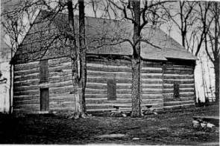
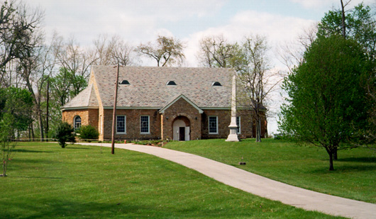
Cane Ridge Revival August 14-19, 1801
Area Settled In The Mid 1700s By Daniel Boone And Group From North Carolina
1791 – Built Largest One–Room Log Cabin In America
Between 15 & 25,000 People Gathered From All Denominations
Many Got Religion, Repented Of Sin And Confessed The Lord
Different Preachers Would Get Up On The Back Of Wagons And Speak To Groups In Their Area
People Left When Food Ran Out At The End Of Six Days

Slide 34
The Focus Of The Revival
Some Falsely Claim That The Focus Of The Cane Ridge Revival Was To Achieve A Religious Experience. See Stone’s Purpose In The Revival From His Autobiography
Bodily Functions Among Some In Attendance, Called “Exercises” Included Uncontrollable Dancing, Jerking, Running, Barking, Laughing, Etc.,
Stone Found Them Strange And Unexplainable. He Gave God The Praise And Pressed Forward With His Anti-Calvinistic Mission Of Preaching & Teaching The Gospel That Must Be Responded To In Order To Receive Its Blessings

Slide 37
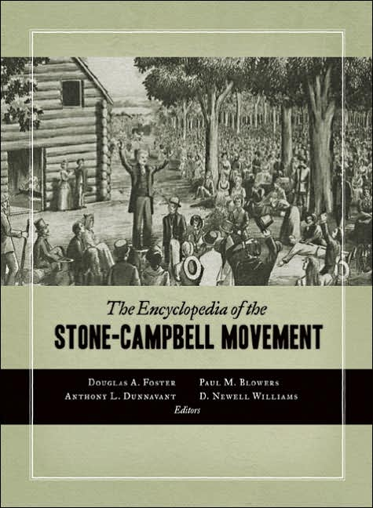
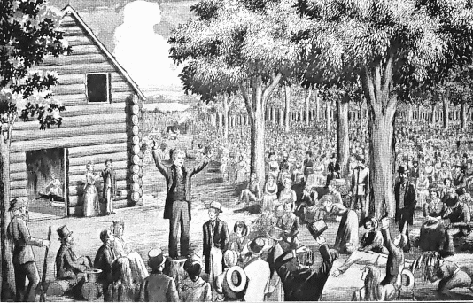
The Cane Ridge Revival
They Didn't Accept The Trinity
Barton Stone Taught Oneness
He Was Accused Of Arianism

Slide 38
Aftermath Of The Revival
10000 Expected; Over 25000 in Actual Attendance
3000 People “Got Religion” At The Revival
Preachers From The Methodist, Presbyterian, and Baptist All Spoke At Cane Ridge
This Brought Old Calvinistic Religion To A Crisis
The Baptists Divided Into Free-Will And Calvinists
The Presbyterians Divided Into New Lights and Old Lights
The Cumberland Presbyterian Church Began In 1810 As A New Light Congregation
This Was What Brought Barton Stone To A Crossroad In His Own Religion, And Caused Him To Begin Searching For New Testament Christianity

Slide 39
Resolutions from The Last Will Of The Springfield Presbytery
A Call To Take The Bible As The Only Sure Guide to Heaven
A Call To Reject The Westminster Confession Of Faith And All Document Designed By Man
That The church of Christ Resume Her native Right Of Internal Government
That The Title Of “Reverend” Be Forgotten, And Designated Only For The Lord.
At The Insistence Of Rice Haggard, The Name “Christian” Only Be Used
Notes:
The Last Will And Testimony Of The Springfield Presbytery
"THE PRESBYTERY OF SPRINGFIELD, sitting at Cane Ridge, in the county of Bourbon. Being, through a gracious providence, in more than ordinary bodily health, growing in strength and size daily; and in perfect soundness and composure of mind; but knowing that it is appointed for all delegated bodies once to die: and considering that the life of every such body is very uncertain, do make, and ordain this our last Will and Testament, in manner and following, viz:
Imprimis. We will, that this body die, be dissolved, and sink into union with the body of Christ at large, for there is but one body, and one spirit, even as we are called in one hope of our calling.
Item. We will, that our name of distinction, with its Reverend title, be forgotten, that there is but one Lord over God’s heritage and His name one.
Item. We will, that our power of making laws for the government of the church and executing them by delegated authority forever cease; that the people may have free course to the Bible, and adopt the law of the spirit of life in Christ Jesus.
Item. We will, that candidates for the Gospel ministry henceforth study the Holy Scriptures with fervent prayer, and obtain license from God to preach the simple Gospel, with the Holy Ghost sent down from Heaven, without any mixture of Philosophy, vein deceit, traditions of men or rudiments of the world- and let none henceforth take this honor to himself but he that is called of God, as was Aaron.
Item. We will, that the church of Christ resume her native right of internal government—try her candidates for the ministry as to the soundness of their faith, acquaintance with experimental religion, gravity, and aptness to teach; and admit no other proof of their authority but Christ speaking in them- We will, that the church of Christ lock to the Lord of the harvest to send forth laborers into His harvest; and she resume her primitive right of trying those who say they are apostles and are not.
Item. We will, that cacti particular church, ass body, actuated by the same spirit, choose their own preacher, and support him with a free will offering without a written call or subscription--admit members—remove offenses; and never henceforth delegate her right of government to any man or set of men whatsoever.
Item. We will, that people henceforth take the Bible as the only sure guide to Heaven; and as many as are offended with other books, which stand in competition with I, may cast them into the fire if they choose: for it is better to enter into Life having one Book, than having many to be cast into hell
Item. We will, that preachers and people, cultivate a spirit of mutual forbearance; pray more and dispute less; and while they behold the signs of the times, look up and confidently expect that redemption draweth nigh.
Item. We will, that our weak brethren, who may have been wishing to make the Presbytery of Springfield their king, and wot not what is now become of it. betake themselves to the Rock of Ages, and follow Jesus for the future.
Item. We will, that the Synod of Kentucky, examine each member, who may be suspected of having departed from the Confession of Faith, and suspend every such suspected heretic immediately, in order that the oppressed may go free, and taste the sweets of Gospel I body
Item. We will, that J --—, the author of two letters lately published in Lexington, be encouraged in his zeal to destroy partyism. We will, moreover, that our past conduct be examined into by all who have correct information; but let foreigners beware of speaking evil of things that they know not.
Item. Finally, we will, that all our sister bodies read their Bibles carefully, that they may see their fate there determined, and prepare for death before it is too late,
Springfield Presbytery, L. S., June 28, 1804
Witnesses:
Robert Marshall, John Dunlavy, Richard McNemar, B. W. Stone, John Thompson, David Purviance.
Writing in the Christian Messenger, Stone tells us about the forming of the Springfield arid its demise,
Under the name of Springfield Presbytery we went forward preaching, arid constituting churches: but we had not worn our name more than one year, before we saw that it savored of a party spirit With the man-made creeds we threw it overboard, and took the name CHRISTIAN—the name given to the disciples by divine appointment first at Antioch We published a pamphlet on this name, written by Elder Rice Haggard, who had just lately united with us. Having divested ourselves of all party creeds. And party names, and trusting alone in God; and in the Word of His grace. we became a by-word and Laughing stock to the sects around; all prophesying our speedy annihilation. Yet from this period I date the commencement of that reformation, which has progressed to this day.

Slide 40
Family History From Family Bibles: Physical Births & Spiritual Rebirths
DENOMINATIONS = DEGREES OF REFORM
SACRAMENTAL/LITURGICAL TRADITIONALIST
ANTI-TRADITIONAL REVIVALISTS MOVEMENT
RATIONALISM + NATURALISM
PRE-RESTORATION SCOTLAND
PRE-RESTORATION AMERICA
THE FIRST GREAT AWAKENING
THE SECOND GREAT AWAKENING
Campbell Family
Father & Son

Slide 41
David Lee Burris:
Calvinist Claim Of Arminian Position On Free Will As Slippery Slope To Secular Humanism & Popular Tyranny Was In America Proven Wrong; Intolerance Scourge Geographic Cured
Religious History Ends Where Church History Begins
Church History Setting In Summation Of Religious History:
While the Early Protestant Reform Movement could be conceived by Luther as a great duel between state & church and King & Pope
and Luther & Vatican – the Later Protestant Reform Movement could more accurately be characterized as that of the dualism of two
different mindsets in which great personalities took backstage to even greater presentations of principled position and the priority of
thoroughbred seedline trumpeted over the old prerogatives of bloodline.
Historically, the tilt back to the true faith was first noticed in the efforts of the scholar Jacob Arminius(1600) to initially assist the now
deceased Calvin who’s completed works he felt needed some cohesive fine-tuning of perceived theological weaknesses – adjustments
required to make them more Biblically sound and defensive; What developed in outcome was an hermeneutic separation amounting
to an competing theology - opposite in an optimistic comparison. Arminius did not meet his objective of finetuning Calvin - instead
he exceeded in accomplishing much more – ultimately even course correcting Christianity from his lifetime forward; Soon the process
theology that had recently moved from mere linearity to being an regression out of control began to baseline back to the first century.
Finally, the Rationalism of the 18th Century Scottish Reformation that both corresponded with & complemented Scottish Enlightenment -
began to architect argument, build theological frame, and brace scriptural structure around the Arminian groundwork of generations
past - from challenging the classic genetics of guilt inheritance they grew to question the epistemology of knowledge itself.
Although it was on the European stage that the sands of the ages were finally beginning to be removed from the eyes of men – both the
political and religious aspects of this enlightenment process could only completed in the better conditions and more pristine environment
of the New World – the land of freedom from fear & freedom of conscience! The Year Was 1807 - Our Story Begins – Scotland’s
Thomas Campbell Arrives In America!

Slide 42
OVERVIEW: ANCIENT ORDER RESTORE POINT
LOCALIZED RESTORATION PRELUDES: 2ND AWAKENING & REVIVALS
AFTER CANE RIDGE BARTON STONE CONGREGATION WRITES:
“The Last Will & Testament of the Springfield Presbytery.”
1809 – THOMAS CAMPBELL Composes “Declaration & Address”
Article 1: Holy Scripture is to be the Only Rule of Faith & Practice
Article 2: Sectarianism Evil & Lord’s Church Constitutionally One
Article 3: Religious Divisions Introduce Creature’s Innovations
Article 4: Human Experience or Tradition – No Place of Authority
THOMAS CAMPBELL: Silence Prohibitive – Not Prescriptive
THOMAS CAMPBELL: “The Thunderous Silence of God!”
RESTORATION WORSHIP FOCUS: GODLY & HUMAN RESPECT
WORSHIP MEMORIAL FOCUS: INNER WORTHY EXAMINATION
THOMAS CAMPBELL WRITES W/ FOCUS: DOUBLE TRUTH ISSUES
RESTORATION NAVIGATES TENSIONS BETWEEN AUTHORITY & UNITY
RESTORATION CLARIFIES CLAIMS OF ABSOLUTE – LICENSE v. LEGALISM

Slide 43
Living With Biblical Tensions by Klyne Snodgrass:
“Christians have always wrestled with the fact that our faith gives us two or more realities that stand in tension or seeming contradiction to each other. ‘Double-truth’ issues have dominated theological thinking throughout the church’s history. Throughout Christian history, heresy has resulted not from someone wanting to be evil or heretical but from someone taking a piece of truth to an extreme and not doing justice to other truths as well.”

Slide 44
Thomas Campbell’s Assessment: The Two Principles In Tension
David Lee Burris:
Thomas Confessed He Had Overlooked The Importance Of Baptism In His Efforts To Obtain Christian Unity!
“The authority of primitive Christianity and obligation of Christian unity should be cooperative and mutually corrective.”

Slide 45
The Principle Of Human Worth
The question of worthiness. By Luther’s lifetime, the phrase for the communion ceremony and host had been altered & with it a change of emphasis. The term Eucharistia, which means thanksgiving, had been replaced with Missa, which means the dismissal of the unworthy. Worthiness itself had metamorphosed in meaning from a subjective introspective responsibility to an objective meaning measured by works.
Catholic hierarchs determine individual worthiness.
Reform churches each establish closed communions as evidencing their determinations of individual worth.
Restoration churches teach human worth as God given intrinsic and in the memorial supper - inner examined.

Slide 46
Restoration
Closed Communion
Divergence

Slide 47
“Wrestling With God”

Slide 48
Father-Son Campbells’ Movement Focus: Son Alexander Campbell
David Lee Burris: Scottish Seceders Practiced Infant Baptism
Father Thomas Favored Soft Words & Hard Arguments Never Wishing To See Or Hear One Ironic Hint Or One Retaliative Retort;
Later Said Errett Of Son Alexander’s Technique: “But, unhappily, all this tended to whet a taste for controversy. Many learned to love it, to rejoice in its rxcitements and its triumphs, and to view the truth mainly in its controversial aspects.”
From Sermon On The Law – “The Patriarchs Had The Bud, The Jews Had The Blossom, & The Christian Has The Divine Mature Fruit Of Grace.”
They Felt Their Providential Mission To Hammer The Message Of Christian Simple Unity & Faith Not Based On Tests Or Laws.
They Felt No Man Or Group Of Men Had The Right To Judge Another’s Faith.
Felt Obedience Involved Three Things On Our Part – Believe, Repent, & Be Baptized.
Felt These Three Actions On Man’s Part Followed By Three Actions Of Deity - Forgiveness Of Sin – Bestowing Of The Holy Spirit – Granting Of Eternal Life
His Idea That Baptism Without Faith Is An Empty Gesture Becomes Labeled Heresy & He Is Asked To Defend His Position On This Issue In Public Debate.
Alexander Believes He Has Cause For Being Timid Toward The Debate Format – Initially Considering It An Unauthorized Method - Unapproved By God; He Felt Our Faith Is Not An Intellectual Exercise & Debate Being Such Was Distracting – Often Serving As Public Spectacle. However, His Wife Thought Strongly Otherwise & Was Sufficiently Persuasive. She Felt It An Authorized Expedient Needful In Focusing Serious Attention On That Same Gospel Faith.
He Debates Over Infant & Adult Believer’s Baptism & His Positions Over This Issue & That Of The Lord’s Supper Are Linked. He Is Accused On Both Occasions Of Not Examining For Worthiness – Of Which He Admits Guilt.
Year 1811, Dad & Him Form “Brush Run Church” & Until 1830, They Work At Reform Among Baptists.
He Is Expelled From First Baptist Association For Preaching That The Gospel Is Greater Than The Law – His Famous Dispensational “Sermon On The Law”
Notes:
In Debate With Catholic Bishop Purcell – He Got Him To Admit That There Had Been
50 Bad Popes Or One Of Four
Henry Clay Moderated His Last Debate With Major Figure Of Presbyterian Church
From That Debate: Two ladies were comparing the merits of their favorite debater.
One stated, “You can easily see that Mr. Rice is by far the most learned man, just see how many books he has on his table, while Mr. Campbell hardly has any.” The other lady replied, “But you do not appear to know that the books on Mr. Rice’s table were written by Mr. Campbell!”
At Home His Sermons Were One Hour & A Half In Length – When Away He Doubled Length.
Several Observed After Two To Three Hours It Had Seemed Like Thirty Minutes.
He Rarely Made A Gesture & There Was No Beating Of The Pulpit.
Concepts Of Religious Unity Propounded By The Campbells Can Be Summarized:
The Bible is the final court of appeals for God’s people and is inspired of God.
Congregations which follow the New Testament pattern will have the same organization, work, and worship.
It is unnecessary to trace the church back through the centuries in order to have the true church.
It is vital to have the New Testament and obey its contents.
When men follow the N. T. – the New Testament Church Will Be Restored.

Slide 49
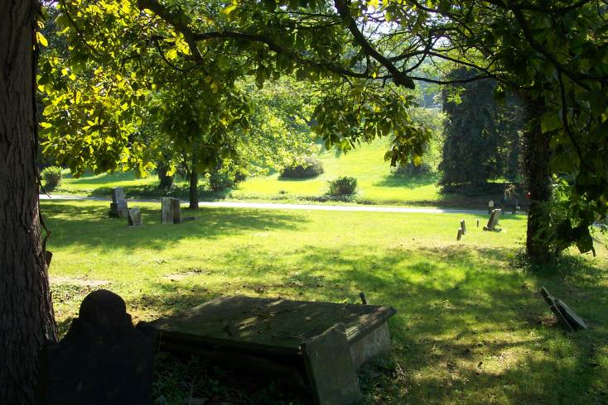
1816 Sermon On The Law
The “Sermon on the Law” is one of the most important historical documents of the Restoration Movement. It is important not as a mature statement of Campbell’s thought — that would evolve considerably over the next three decades - but rather as the point of origin of the separation from the Baptists and the development of a distinctive Restoration theology.
The sermon itself is quite long and the arguments are often rather complex. What follows is a very brief synopsis which focuses on the conclusions at the end of the sermon. The point of departure is Romans 8:3 & the sermon begins with the very Lockian sentence, “Words are signs of ideas or thoughts.” The word that Campbell is concerned with is “law.” Campbell is interested in demonstrating that “the law” signifies the Mosaic dispensation, a distinct and peculiar institution designed by God for a special people & for limited time. His method is made clear by this passage:
“ We would observe that there are two principles, commandments, or laws, that are never included in our observations respecting the law of Moses, nor are they ever in holy writ called the law of Moses; these are ‘Thou shalt love the Lord thy God with all thy heart, soul, mind, and strength; and thy neighbor as thyself.’ These our Great Prophet teaches us, are the basis of the law of Moses, and the Prophets.”

Slide 50
1816 Sermon On The Law
Campbell, therefore, judges the Mosaic Law by New Testament standards. In fact he states that all Jewish Law is but a modification of the two commandments handed down by Jesus. The principles found in both collections of law are rooted in universal and immutable obligation which God has engraved on the hearts of his creatures, angels and men, Christians and heathens. The law of Moses, then, can be swept away without weakening the moral obligations which they contain.
Once he has established what the law is, Campbell makes four additional points: 1) those things which the law could not accomplish; 2) the reason why the law failed to accomplish those objects; 3) how God has remedied those relative defects of the law; and 4) conclusions. The first conclusion is that “there is an essential difference between law and gospel - the Old Testament and the New. He minces no words about this opinion. The law is called “the letter;” “the ministration of death;” it is “abolished, and vanished away.” The New Testament is “the Spirit”; “the ministration of righteousness;” it “lives and is everlasting.”

Slide 51
1816 Sermon On The Law
Campbell concludes that since the law and the gospel are essentially different, there is no necessity for preaching the law in order to prepare men for receiving the gospel. This is an idea which was contrary to contemporary Baptist theology. In the fourth conclusion Campbell is more concrete and it is easier to see the revolutionary nature of his opinion. He rejects the idea that Old Testament practices can be integrated into Christianity. Therefore, infant baptism, tithes, holy days, fasting, national covenants, the establishment of religion, even the sanctification of the seventh day “...and all reasons and motives borrowed from the Jewish law, to excite the disciples of Christ to a compliance with or an imitation of Jewish customs, are inconclusive, repugnant to Christianity, and fall ineffectual to the ground; not being enjoined or countenanced by the authority of Jesus Christ.”

Slide 52
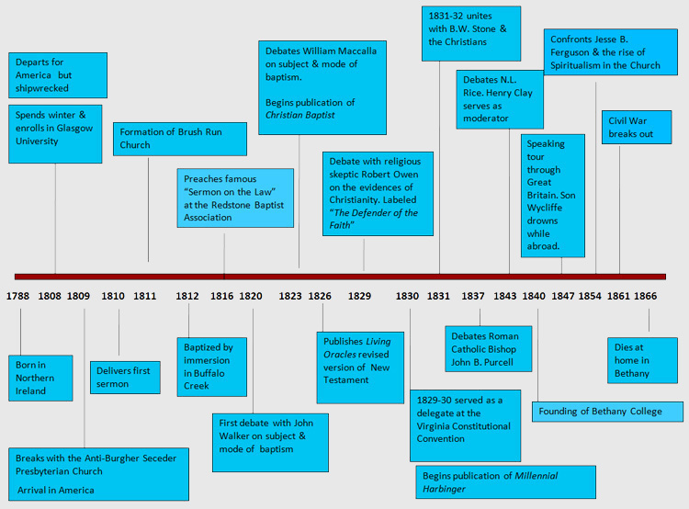

Slide 53
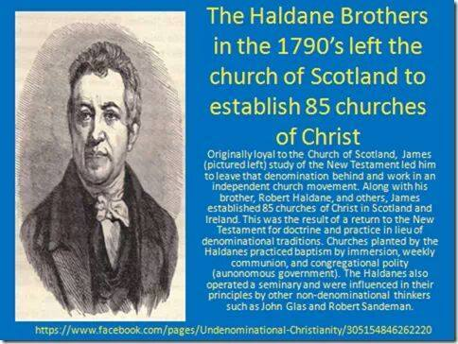
OVERVIEW: ANCIENT ORDER RESTORE POINT
RESTORATION NAVIGATES TENSIONS BETWEEN AUTHORITY & UNITY
RESTORATION CLARIFIES CLAIMS OF ABSOLUTE – LICENSE v. LEGALISM
BARTON STONE & CAMPBELLS DEDICATE TO UNITY “POLAR STAR”
“The Church is Essentially, Intentionally, & Constitutionally One.”
Scotland’s Haldane Viewpoint & American Caldwell Vision Lockstep
CAMPBELLS EJECTED FROM SECEDERS OVER CLOSED COMMUNION
THEY MERGE IN AFFLIATION WITH REGION BAPTIST ASSOCIATION
RESTORERS START @BAPTIST SECT AGREEING ON BAPTISM PRACTICE
ALEXANDER CAMPBELL SUBSTITUTE PREACHES ON DISPENSATIONS
ASSOCIATION EJECTS DUE TO PREACHING “THE GOSPEL IS GREATER”
RESTORERS END @BAPTIST SECT W/DISAGREE ON BAPTISM PURPOSE
2ND BAPTIST ASSOC. @Heresy: “Baptism W/O Faith Empty Gesture”
CAMPBELLS COME TO BELIEVE – CREEDS SECTARIAN LEGALISM
CAMPBELLS COME TO BELIEVE – CAREER CLERGY SELF-SERVING
CAMPBELLS COME TO BELIEVE - “REVEREND” TITLE IRREVERENT

Slide 57
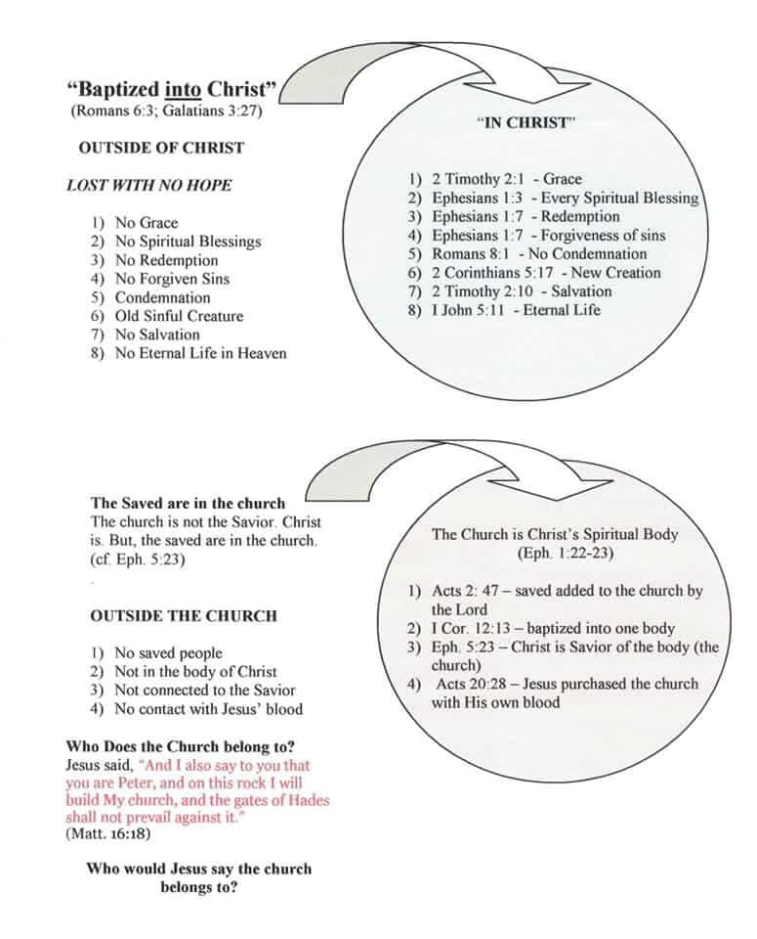

Slide 58
OVERVIEW: ANCIENT ORDER RESTORE POINT
2ND BAPTIST ASSOC. @Heresy “Baptism W/O Faith Empty Gesture”
CAMPBELLS COME TO BELIEVE – CREEDS SECTARIAN LEGALISM
CAMPBELLS COME TO BELIEVE – CAREER CLERGY SELF-SERVING
CAMPBELLS COME TO BELIEVE - “REVEREND” TITLE IRREVERENT
MRS. CAMPBELL CONVINCED DEBATE AN AUTHORIZED EXPEDIENT
ALEXANDER CAMPBELLS DEBATES LINK ON WORSHIP & SALVATION
ALEXANDER CAMPBELL DEBATES DEFEND NO WORTHINESS EXAM
3RD BAPTIST ASSOCIATION DECLARES RESTORATION “ANATHEMA”
FULL TILT RESTORE MOVEMENT: RETURN THE ORIGINAL PATTERN

Slide 62
Alexander Campbell Experiment: The Christian Baptist Interval
David Lee Burris: “15 Years Spent In Hope Of Starting Nothing New & Restoring The Old”
Both Campbells Accepted The Teaching Of The Baptist On The Form & Subject Of Baptism; Alexander Mentors John T. Johnson A Major In The War Of 1812 & Three Time US Congressman; One Of His Early Associates Was Signey Rigdon, Who Later Defected To The Mormons & Aided Joseph Smith In Translating The Old Spaulding Novel Manuscript Into The Book Of Mormon.
Identifies Brush Run Church W/ Baptist Redstone
They Liked The Dunker Vs. Presbyterian Debates
They Disliked Baptism For The Remission Of Sin
Mahoning Association Comes Out From Redstone
Campbell Mentors Walter Scott & Raccoon Smith * Scott formulated five-finger plan of salvation *
3rd Franklin Association Releases Statement of Anathema:
“They, the Reformers, maintain that there is no promise of salvation without baptism. That baptism should be administered to all who say they believe that Jesus Christ is the Son of God, without examination on any other point. That there is no direct operation of the Holy Spirit on the mind prior to baptism. That baptism procures the remission of sins and the gift of the Holy Spirit. That no creed is necessary for the church but the Scriptures as they stand…” (1829 Beaver Anathema)

Slide 63
Alexander Campbell Experiment: The Christian Baptist Interval
David Lee Burris: “15 Years Spent In Hope Of Starting Nothing New & Restoring The Old”
Both Campbells Accepted The Teaching Of The Baptist On The Form & Subject Of Baptism; Alexander Mentors John T. Johnson A Major In The War Of 1812 & Three Time US Congressman; One Of His Early Associates Was Signey Rigdon, Who Later Defected To The Mormons & Aided Joseph Smith In Translating The Old Spaulding Novel Manuscript Into The Book Of Mormon.
Fundamental differences with the Baptist Church:
The name ‘Baptist’ came about due to the belief and teaching that the church in the New Testament was a ‘Baptist Church,’ since it was established by John ‘the Baptist.’
John ‘the Baptist’ did not establish any church. In the New Testament, the only ‘Baptist,’ in any sense is ‘the Baptist,’ which was John. There is not a single instance in the New Testament where we find mention of ‘a Baptist.’ No. We only find ‘the Baptist,’ John the baptizer, the one who baptized people.

Slide 64
Alexander Campbell Experiment: The Christian Baptist Interval
David Lee Burris: “15 Years Spent In Hope Of Starting Nothing New & Restoring The Old”
Both Campbells Accepted The Teaching Of The Baptist On The Form & Subject Of Baptism; Alexander Mentors John T. Johnson A Major In The War Of 1812 & Three Time US Congressman; One Of His Early Associates Was Signey Rigdon, Who Later Defected To The Mormons & Aided Joseph Smith In Translating The Old Spaulding Novel Manuscript Into The Book Of Mormon.
Fundamental differences with the Baptist Church:
1st - John ‘the Baptist’ did not establish any church.
2nd – The baptism the Baptists practice is not for the same purpose as that of John, ‘the Baptist.’
Note what Mark says, ‘John did baptize in the wilderness, and preach the baptism of repentance for the forgiveness of sins.’ Note also – Acts 2: 38.
Those calling themselves Baptists today require baptism (immersion) in order to get into the Baptist Church, not in order to have sins forgiven. It is a matter of fact that the teachings of the Baptist Church contend that people can be saved, go to heaven, without baptism, but they just cannot enter the Baptist Church without baptism.

Slide 66
OVERVIEW: ANCIENT ORDER RESTORE POINT
PRESBYTERIAN & BAPTISTS DEBATE CHALLENGE SALVATION ORDER
RESTORATION INITIATES @WORSHIP: GODLY & HUMAN WORTH
CAMPBELL CONTROVERSY CLAIMS CENTER @ “ORDO SALUTIS”
ACCORDING TO ALEXANDER CAMPBELL – THREE THINGS OF MEN
PERSONAL BELIEF – CONVICTED REPENTANCE – BELIEVER BAPTISM
ACCORDING TO ALEXANDER CAMPBELL – THREE THINGS OF GOD
FORGIVE SIN – BESTOWING OF THE HOLY SPIRIT – GRANT HEAVEN
RESTORATION MOVEMENT: ADOPTS WALTER SCOTT 5-FINGER TOOL
5 STEPS: Believe – Repent – Baptism – Forgiven – Get the Holy Spirit

Slide 67
"Ordo Salutis"
“Latin, meaning ‘order of salvation,’ that is, succession of events in God’s salvific program. Although both the Catholic and Reformed traditions believe salvation comes only through Christ, they diverge dramatically regarding the ordo salutis.”
* Dictionary Of Theological Terms, Grenz & Guretzki

Slide 71
1820 Campbell Debates John Walker at Mt. Pleasant, Ohio On The Subject And Action Of Baptism
August 30—Mahoning Association Formed
1821 Adamson Bentley and Sidney Rigdon Visit Campbell At His Home, Remaining Two Days
They Embrace The Restoration Plea Through Campbell's Influence
Sidney Rigdon Becomes Preacher For The Church At Pittsburg

Slide 72
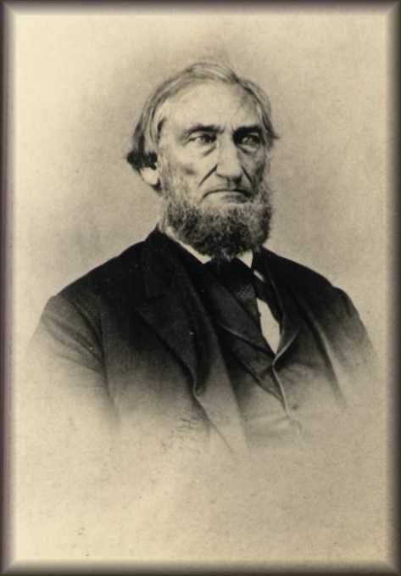
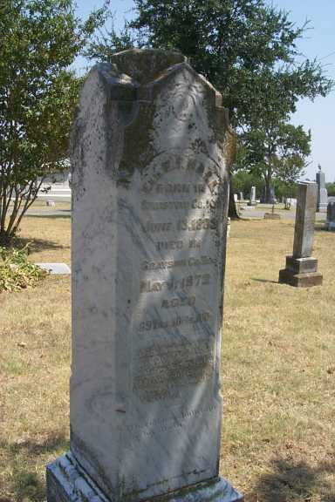
Influence Of The Campbell/McCalla Debate Of 1823
Buried At VanAlstyne, TX
His Stone Says:
He Was Ordained To The Ministry, May 1st, 1828 And Was The 1st In Ky. To Preach Salvation Through Obedience To The Gospel.
B.F. Hall
In The Discussion Campbell Argued That Baptism Was For The Remission Of Sin
Spring of 1826, B.F. Hall Found A Copy Of The Debate And Read It
In His Preaching Many Had Come To The Mourner’s Bench And Found No Relief
When Reading The Debate, He Noted Campbell’s Teaching On Baptism For Remission Of Sins, At Which Point, He Raised His Hands And Said, “Eureka! Eureka! I Found It! I Found It!
With This Discovery The Purpose Of Baptism Quickly Spread Throughout The Church

Slide 73
EPISODES & EVENTS: ALEXANDER CAMPBELL
1816 – Alexander Campbell @Baptist Redstone Congregation Delivers “Sermon on the Law”
NOTE: Thomas & Alexander Campbell Expelled for Teaching The Gospel Greater Than The Law.
1820 – Baptist Alexander Campbell Debates Presbyterian John Walker on the Topic of Infant Baptism.
1823 – Baptist Alexander Campbell Debates Presbyterian Will McCalla on the Topic of Infant Baptism.
1829 – Baptist Alexander Campbell Debates the Scotland Atheist Robert Owen on the Topic of “Religion the Cause Not the Answer to Social Problems.” (paraphrased)
NOTE: Alexander Campbell’s Argumentation was Nationwide Media Followed Representing Christian America
1830 – Unaffiliated Alexander Campbell Debates Presbyterian Obadiah Jennings on the Topic of “The Cult or Sect of Campbellism.”
1837 – (Christian Only) Alexander Campbell Debates Catholic Bishop John Purcell on the Topic of “Protestantism Versus Catholicism.”
1843 – (Christian Only) Alexander Campbell Debates Presbyterian Rice on the Topic of the “Operation of the Holy Spirit.”
1847 – Alexander Campbell Arrested During Scotland Tour Speaking on Slave Controversy.
1848 – Alexander Campbell Speaks Before U.S. Congress on the Subject of Carnal Warfare.
1849 – Alexander Campbell Accepts Presidency of American Christian Missionary Society.
1853 – Campbell Confronts Nashville’s Jesse Ferguson’s Last Chance Post-Mortem Gospel

Slide 74
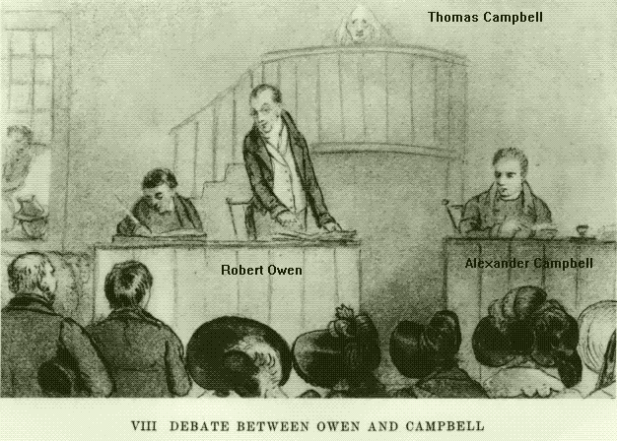
Alexander Campbell Accepts The Robert Owen Challenge to Debate:
‘All the religions of the world have been founded on the ignorance of mankind… and that they have been and are the real cause of vice, dissension and misery of every description.’

Slide 75
Campbell Accepts Owen Debate Challenge:
The Methodist Hall was chosen as the venue and by 9 a.m. on Monday the 13th of April over one thousand people had packed in, no doubt hoping for fireworks. Owen spoke gently and calmly, smiling charmingly at the audience. Campbell was made of sterner stuff. He punched relentlessly at Owen’s theories of human nature and his plans for utopian settlements, then he hammered home his message of the Gospel Truth, all backed up with a barrage of Bible references. The debate resumed next morning, and for six more days after that. At one point Campbell was on his feet for 12 hours. Even Owen had met his match. After the final points had been made, the audience – all 1,000 apparently still present – were invited to vote on whether they would continue in their Christian support: 997 of 1,000 went with Campbell. - p.177ff, Paradise, K. Rushby

Slide 76
1829 – Campbell / Owen Debate
April 13-21, Debate On Existence Of God Conducted In The Methodist Church At Cincinnati, Ohio
Campbell Spoke For 12 Hours
The Principles Of The Reformation Spread To England And Ireland.
Robert Owen
Notes:
In the Robert Owen debate, Mr. Campbell felt that he had met a worthy opponent. Mr. Owen was a Scotch freethinker, who came to America to establish a community in accordance with his social views; all religion was to be excluded. He preached a crusade against Christianity. He challenged any clergyman to meet him in debate, and was [449] about to sail for Europe announcing that no minister in the New World dared to meet him in debate. The challenge fell under the eye of Alexander Campbell, and he promptly accepted it. The debate was held at Cincinnati. Men went hundreds of miles to attend it. The debate was afterwards published. While it was preparing for publication, Mr. Owen was the guest of Mr. Campbell at Bethany. One day, while walking in the fields together, Mr. Owen turned and said to Mr. Campbell: "I have one advantage over the Christian." "What is that, sir?" "I am not afraid of death," responded Mr. Owen; "if I had a few business affairs arranged, I could lie down and die without a fear." "Have you any hope in death?" asked Mr. Campbell. "No, sir; I think that death is the end, and I am without hope or fear in death." "Do you see that ox?" said Mr. Campbell. "It has filled itself with the grass of the meadow, and now stands in the shade of the tree, without fear and without hope in death. Tell me, what does infidelity do to elevate a man above the beasts?"
During the debate Mr. Owen read his theses, nearly two hundred pages of folio. To this manuscript he adhered throughout the discussion. He laid down twelve laws of human nature, upon which he built a "Social System." Nothing Mr. Campbell could say could divert him from his manuscript, and his twelve laws of human nature. He had his say; the "gems" from "his casket" were shown for the eight days of this debate.
The debate seemed to be proceeding upon parallel lines which never would meet. When Mr. Owen had finished his manuscript, he sat down and gave the time to Mr. Campbell. He, without an opponent to reply, spoke for twelve hours on Christian evidences, the longest speech on record.
- Benjamin Lyon Smith, The Millennial Harbinger Abridged, (1902) pages 447-450

Slide 77
1830
“On their way to Missouri, Cowdery’s New Jerusalem party passed through northeastern Ohio, where Sidney Rigdon and over a hundred followers of his variety of Campbellite Restorationism converted to Mormonism, more than doubling the size of the Mormon church. Rigdon soon visited New York and quickly became Smith’s primary assistant.” - Wiki
Campbell Addresses
APOSTACY
Entire Rigdon Congregation Converts
MORMON

Slide 78
Notes:
Sidney Rigdon, a wolf in Campbellite preacher’s clothing, already had the Spaulding manuscript (future Book of Mormonism) in 1823 when he offered to ride 300 miles on horseback with Alexander Campbell to the Campbell-McCalla debates in Kentucky, where he also served as the debate’s “recorder”. He was a mole from the start. He wanted to pick Campbell’s brain! This explains many Restoration-themed similarities between the two great American religious movements of the time. He had already been hinting in his sermons to get ready for some exciting new “direct revelations” from God...

Slide 79
Presbyterian Seceders Intermediate Affliation
Baptists
AD 1830
Mahoning Association Expels Thomas & Alexander Campbell.
This was one of two historical marks that began the American Churches of Christ.
Churches of Christ

Slide 80
OVERVIEW: ANCIENT ORDER RESTORE POINT
RACOON SMITH ENVOY CAMPBELL DISCIPLES TO STONE FOLLOWERS
RACOON SMITH EXTENDS THE RIGHT HAND OF FELLOWSHIP(1832)
RIGHT HAND METAPHOR – OATH, POWER, STRENGTH, ALLEGIANCE
RESTORATION COMMITMENT: TO USE BIBLE WORDS IN BIBLE WAYS
1832 HANDSHAKE REPRESENTS: RATIONALISM JOINS REVIVALISM
DISCIPLES DEVELOP RESTORED AUTHORITY LEVEL DECISION TREE
LEVELS: COMMAND – EXAMPLE – NECESSARY IMPLICATION/INFERENCE

Slide 81
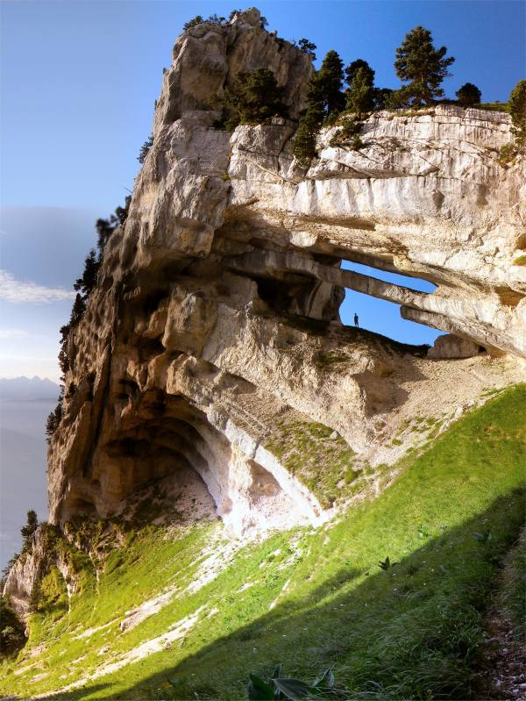
Raccoon Smith: Non-Essentials
Whatever opinions about these and similar subjects I may have reached in the course of my investigations, if I never distract the church of God with them or seek to impose them on my brethren, they will never do the world any harm. I have the more cheerfully resolved on this course because the gospel is a system of facts, commands, and promises; and no deduction or inference from them, however logical or true, forms any part of the gospel of Jesus Christ. No heaven is promised to those that hold them, and no hell is threatened against those who deny them. They do not constitute, singly or together, any item of the ancient and apostolic gospel.
While there is but one faith, there may be ten thousand opinions; and, hence, if Christians are ever to be one, they must be one in faith, and not in opinion!

Slide 82
After Famous 1824 Handshake Revivalism Meets Rationalism Similarities & Differences
Sola Scriptura Seen As Accepted Authority
Sectarianism Seen As Being Anti-Christian
Calvin Wrong On Pre-destination/Atonement
Refused Unscriptural Names & Titles
Rejected Denominational Organization & Structure
Name: Disciples (Stone) Christians (Campbell)
Baptism: Non-Essential (Stone) Essential (Campbell)
Lord’s Supper: Occasionally (Stone) Weekly (Campbell)
Faith Outwork: Emotion (Stone) Reason (Campbell)
Notes:
“Campbell and Stone differed in their methods of presenting the gospel. Stone was the evangelist, while Campbell was the teacher. Stone appealed to the head, while Campbell appealed to the heart. Campbell provided the light of information, while Stone was the man of exhortation.”

Slide 83
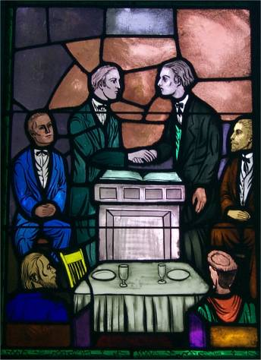

Slide 84
After Famous 1832 Handshake Revivalism Meets Rationalism Stone Reacts To Unity Address
“Controversies in the church sufficiently prove that Christians can never be one in their speculations upon these mysterious & sublime subjects, which, while they interest the Christian philosopher, can’t edify the church. After we have given up all creeds and taken the Bible, and the Bible alone, as our rule of faith and practice, we met with so much opposition that I was led to deliver some speculative discourses upon these subjects. But I never preached a sermon of that kind that really feasted my heart; I always felt a barrenness of soul afterwards. I perfectly accord with Brother Smith that these speculations should never be taken into the pulpit; and when compelled to speak of them at all, we should do so in the words of inspiration!”
Notes:
“Campbell and Stone differed in their methods of presenting the gospel. Stone was the evangelist, while Campbell was the teacher. Stone appealed to the head, while Campbell appealed to the heart. Campbell provided the light of information, while Stone was the man of exhortation.”

Slide 85
Faith & Logic Rehook
Wisdom Through Religion
- VERSUS -
Religion Through Wisdom

Slide 86
OVERVIEW: ANCIENT ORDER RESTORE POINT
RACOON SMITH ENVOY CAMPBELL DISCIPLES TO STONE FOLLOWERS
RACOON SMITH EXTENDS THE RIGHT HAND OF FELLOWSHIP(1832)
RIGHT HAND METAPHOR – OATH, POWER, STRENGTH, ALLEGIANCE
RESTORATION COMMITMENT: TO USE BIBLE WORDS IN BIBLE WAYS
1832 HANDSHAKE REPRESENTS: RATIONALISM JOINS REVIVALISM
DISCIPLES DEVELOP RESTORED AUTHORITY LEVEL DECISION TREE
LEVELS: COMMAND – EXAMPLE – NECESSARY IMPLICATION/INFERENCE

Slide 87
Family History From Family Bibles: Physical Births & Spiritual Rebirths
DENOMINATIONS = DEGREES OF REFORM
SACRAMENTAL/LITURGICAL TRADITIONALIST
ANTI-TRADITIONAL REVIVALISTS MOVEMENT
RATIONALISM + NATURALISM
PRE-RESTORATION SCOTLAND
PRE-RESTORATION AMERICA
THE FIRST GREAT AWAKENING
THE SECOND GREAT AWAKENING
1832: RATIONALISM + REVIVALISM

