Slide 1
OUR Lord & SAVIOR’S LAST WEEK On Earth
Edited From On-Line Free Source & Supplementations by David L. Burris

Slide 2
PRESENTATION OUTLINE
THE LAST DAYS OF JESUS
THE LAST HOURS OF JESUS
THREE EVENTS AT THE CROSS
WHO MOVED THE STONE?

Slide 4
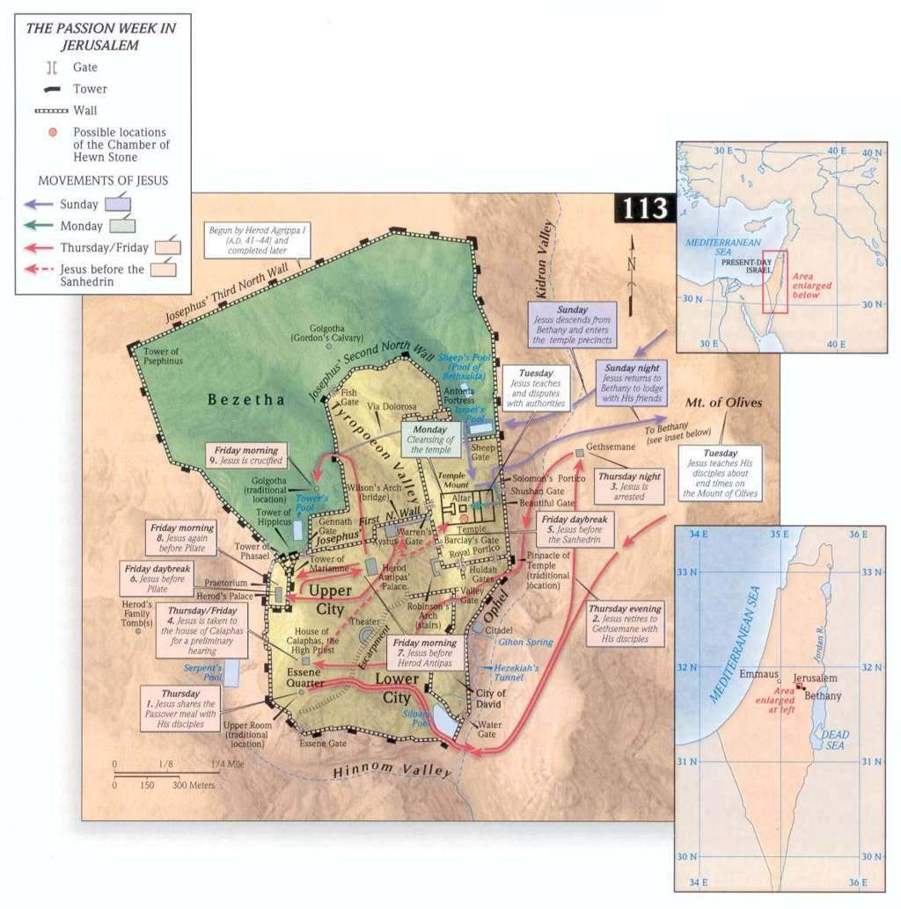

Slide 5
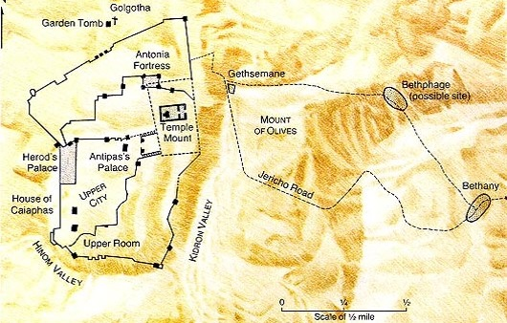
Jesus Travels – Friday/Sunday
Zacchaeus
Jericho
Luke 19
Jesus on Donkey
Mark 11

Slide 6
Outline of Last Week
Week(s) leading up
Lk 17:11, Travels in Samaria & Galilee to Jericho, then to Bethany
Lk 19:10, Seek and Save the Lost
10 lepers (Samaritan)
Advocate for Widow’s (Orphans)
Publican, Children, Zacchaeus, & Blind men
Notes:
Our purpose is to evaluate the events of Jesus last week and take lessons from the teachings.
Luke records detailed teaching and events of Jesus as he makes his way to Jerusalem for the final time. By doing this we can see the Holy Spirit giving us a picture and meaning deeper than the individual teachings as we often look at them. We see a summary of Jesus ministry here. Luke – Contrasted those Jesus accepted and rejected.

Slide 9
Jesus Travels – Sunday
Zacchaeus
Jericho
Luke 19
Jesus on Donkey
Mark 11
The King Enters Jerusalem

Slide 10
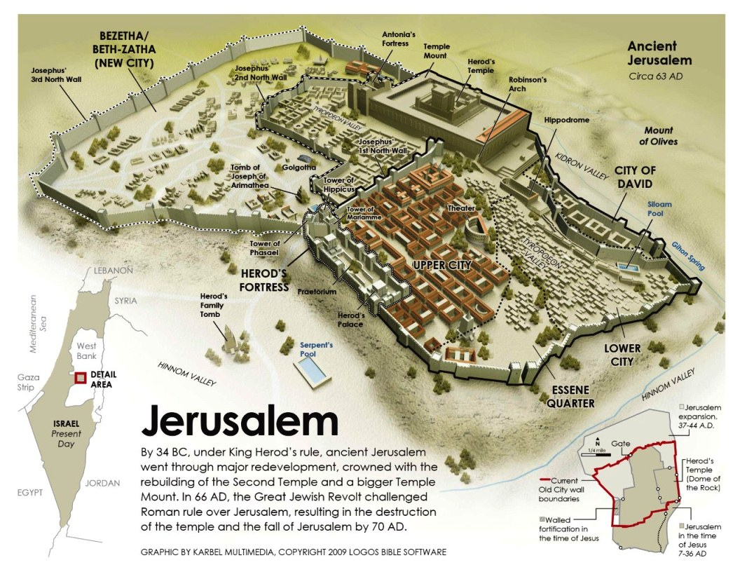

Slide 11
Jesus’ Last Week
Mk 11:1-11

Slide 12
Jesus’ Last Week A Day of Rejections
Lk 19:1-10, Zacchaeus
Mk 11:1-11, Jesus Triumphal
Notes:
Only Luke gives us the account of Zachaeus

Slide 13
Sunday
The Triumphal Entry
When Jesus came near Bethphage and Bethany, at a place called the Mount of Olives, he sent two disciples ahead of him to find a donkey and a colt that had never been ridden.
He instructed his disciples to untie the animals and bring them to him. He said if anyone asked they were to tell them, “The Lord needs it.”
(Matthew 21:1-3; Mark 11:1-3; Luke 19:28-31)
Notes:
Links on this slide will be activated in PowerPoint Show mode

Slide 14
Jesus’ Last Week
The King of the Jews Enters Jerusalem
Mk 11:7-11, On a Colt Donkey
Zech 9:9-10, Fulfilling Prophesy
This happens on Sunday
The beginning of the week he is crucified

Slide 15
Jesus’ Last Week
Significance of Donkey
Horse Symbol of War
Size
Strength
Speed
Chariots, Zech 9:10
Notes:
Prophecy fulfilled
Zech 9:10, And I will cut off the chariot from Ephraim, and the horse from Jerusalem, and the battle bow shall be cut off: and he shall speak peace unto the heathen: and his dominion shall be from sea even to sea, and from the river even to the ends of the earth.

Slide 16
Jesus’ Last Week
Significance of Donkey
Horse Symbol of War
Donkey Symbol of Peace
Jesus was not a conquering King taking his kingdom by Force
Jesus was a King seeking Peace, Zech 9:10
People to Volunteer obedience to the King
Notes:
Prophecy fulfilled
Zech 9:10, And I will cut off the chariot from Ephraim, and the horse from Jerusalem, and the battle bow shall be cut off: and he shall speak peace unto the heathen: and his dominion shall be from sea even to sea, and from the river even to the ends of the earth.

Slide 17
Jesus’ Last Week
The People Response
Mk 11:9, Called out Hosanna!
Save Us!

Slide 18
Jesus’ Last Week
The People Response
Mk 11:9, Blessed is he that cometh in the name of the Lord
Jesus had the Authority of God

Slide 19
Jesus’ Last Week
The People Response
Mk 11:10, Blessed be the kingdom of our father David
Mt 21:9, Hosanna to the Son of David
Lineage of David (Heir)
Right to the Throne
Fulfillment of promise to David
The King, Jn 12:13

Slide 20
Jesus’ Last Week
The People Response
Mk 11:10, Hosanna in the Highest!
God of Heaven Save Us!

Slide 22
Jesus’ Last Week
The People Response
Mk 11:9, Save Us!
Mk 11:9, with Authority of God
Mk 11:10, King
Mk 11:10, God of Heaven Save Us!

Slide 23
Jesus’ Last Week
Jesus the King
Jn 18:33-40, Not of this world
Riding a Donkey
Not a conquering King
Ask for followers
Of the Lineage of David
Bringing Salvation from God
Hosanna in the Highest

Slide 24
Jesus’ Last Week
Jesus The Slave King
Mt 20:20-28, James & John want Prominence
Lk 19:1-10, Zacchaeus
Thursday evening at the Last Supper/Passover
Jn 13:1-20, the King washes his disciples feet
Notes:
Jesus’ Disciples could not get their mind around the concept that Jesus was not here to establish a physical kingdom or a kingdom that looks anything like what they think of a kingdom.

Slide 25
Jesus’ Last Week
God in Heaven Save Us!
The Offer has been made

Slide 27
Jesus’ Last Week King Rejections
Mk 11:12-14
Mk 11:20-26

Slide 28
Jesus Travels – Monday
Jesus Christ
Spends Night
Matthew 21:17

Slide 29
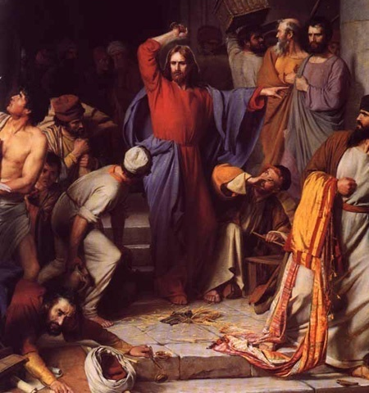
Monday
Jesus Cleanses the Temple
Jesus entered the Temple in Jerusalem and began to drive out the people who were selling things.
(Matthew 21:12; Mark 11:15; Luke 19:45; John 2:13-15)
Christ Cleansing the Temple, Carl Heinrich Bloch
Notes:
Links on this slide will be activated in PowerPoint Show mode

Slide 30
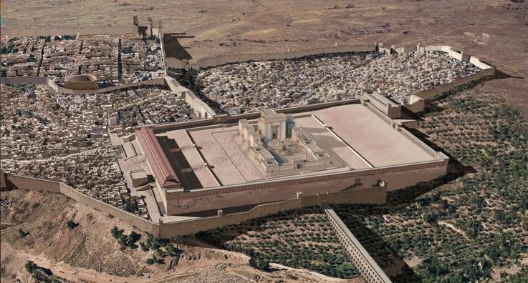
Temple Structure
Luke 19:41-44
Their View
Notes:
View from Mt Olives would have been at a higher elevation than the Temple
Also other places along the road(s) going to Jerusalem from the West.

Slide 31
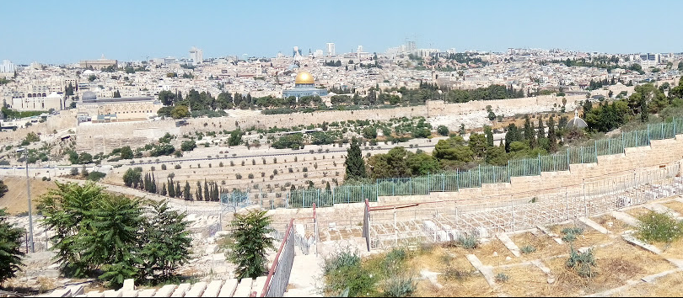
Temple Structure
Their View
Notes:
View from Mt Olives would have been at a higher elevation than the Temple
Also other places along the road(s) going to Jerusalem from the West.

Slide 32
A Day of Rejection
Lk 19:41-44
Wept – Strong’s to sob, wail aloud
Jn 11:35 “Jesus Wept” is rather to cry silently
Lamenting over Jerusalem

Slide 33
A Day of Rejection
Lk 19:41-44
Jesus has pity/shows empathy
Though rejected and about to carryout judgment against
Mt 23:37-39, the same day
Jas 1:20, For the wrath of man works not the righteousness of God
Lamenting over Jerusalem

Slide 34
A Day of Rejection
Mk 11:15-19
Large “market area”
Temple Cleansing
Notes:
Market Area likely displaced the Gentiles from the “temple”

Slide 35
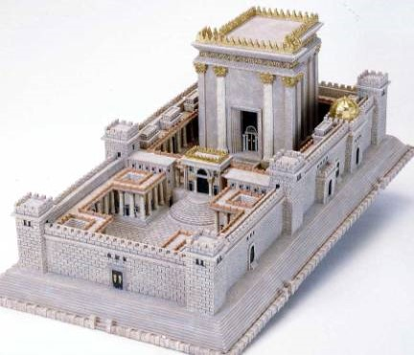
Temple Structure
Notes:
The Temple

Slide 36
Temple Structure
The Temple
Market Areas
Market Areas
Notes:
The entire “temple” area, including additional areas around the temple

Slide 37
A Day of Rejection
Mk 11:15-19
Jn 2:13-16, Similar event in first year of Jesus’ ministry
Jesus Clears the Floor
House of Merchandise
Den of Thieves
Temple Cleansing
Notes:
Would have been full of vendors in preparation of the Passover
Likely displaced Gentiles and others who would worship

Slide 38
A Day of Rejection
Mk 11:15-19
Temple Purpose Perverted
House of Prayer
II Sam 24:18-25, Sacrificing from ones own possessions
Temple Cleansing
Notes:
Would have been full of vendors in preparation of the Passover
Likely displaced Gentiles and others who would worship
Should have been bringing their best to offer, not leaving their best at home to purchase general stock from a pen like the stock yards.
The irony; only Jewish money was accepted for the temple tax but you could purchase your sacrifice

Slide 39
A Day of Rejection
Lessons
A Rebuke of the Religion of the Jews
Mk 7:1-13, Vain worship
Mt 7:21-24, depart from me workers of iniquity
Jews were doing their own thing
Ex 30:9, no strange incense
Ex 30:37-38, “God’s” incense was sacred
Lev 10:1-7, Nadab & Abihu
Lev 22:17-25, Free will offerings specified
Temple Cleansing
Notes:
The Temple was “built” for God and “belonged” to God
Owner determines purpose
Guidelines were very stringent when dealing with things that pertain to worshiping God; even a free will or voluntary offering had to be according to God’s pattern.

Slide 40
A Day of Rejection
Cleansing of the Temple
Opportunity had Past
Time of Judgment
But If you had Repented…
Fulfill God’s Purpose
In Ourselves
In Christ’s Church

Slide 41
Jesus Travels – Monday
?
Barren Fig Tree
?
Jesus Laments
Jesus Christ
Spends Night
Matthew 21:17

Slide 42
A Day of Rejection
Mk 11:12-14
Mt 21:19, Fig tree immediately withers
Similar to a Parable
Lk 13:1-9, unless you repent you shall likewise perish
Jesus’ last year of his Ministry
Given opportunity
This latter was not
The Barren Fig Tree
Rejected by the King

Slide 43
A Day of Rejection
Lesson
Time for repentance was past
Time for “judgment”
Mt 23:34-39
Application
God has a purpose for us
Lk 13, repent or we shall likewise perish
Patience and Effort
But one day…
The Barren Fig Tree
Rejected by the King

Slide 44
A Day of Rejection
Mk 11:20-24
The Next Day (Tuesday)
Vs. 20, The fig tree is Dried up
Have Faith in God
To Move Mountains
Disciple had a weak faith
Mt 17:14-21, healing of the son who had a devil
Lk 17:5-6, move trees
Dead Fig Tree
Notes:
We have skipped the cleaning of the temple, next weeks lesson.

Slide 45
A Day of Rejection
Mk 11:25-26
Forgive Others
Mt 11:4, Jesus’ Model Prayer
Mt 18:21-35, Parable of the Unforgiving Servant
Dead Fig Tree

Slide 46
A Kings Rejection
Barren Fig Tree
Opportunity had Past – Time of Judgment
Fulfill God’s Purpose
Bear Fruit – Or be Rejected
Have Faith
Forgive – Or be Rejected

Slide 47
Jesus Travels – Tuesday
Jesus Christ
Spends Night

Slide 48
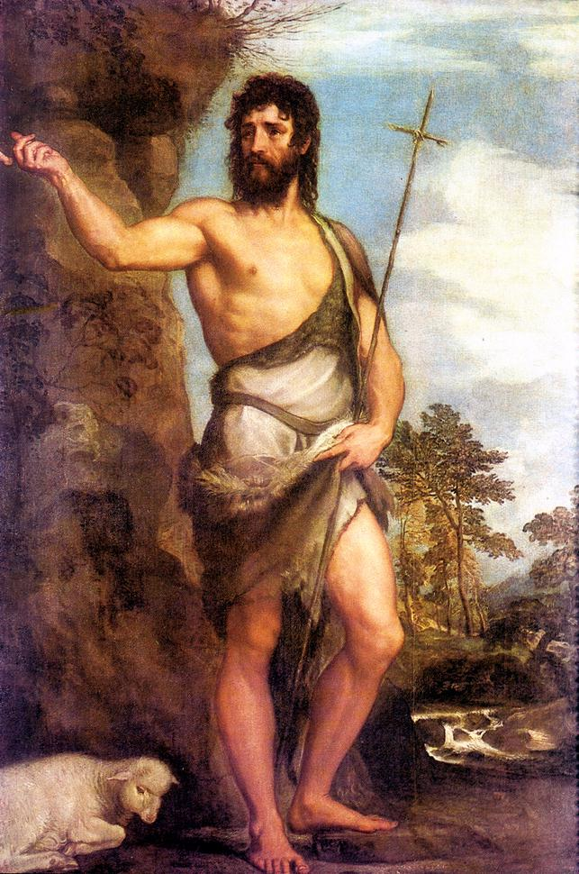
Tuesday
Jesus’ Authority is Questioned
The teachers of the law asked Jesus where he got his authority. Jesus responded by asking them whether John’s baptism came from heaven or from men.
(Matthew 21:23-25; Mark 11:27-30; Luke 20:1-4)
St. John the Baptist, Tiziano Vecellio (c. 1542)
Notes:
Links on this slide will be activated in PowerPoint Show mode

Slide 49
Jesus’ Last Week Attempts to Entangle
Tuesday
Authority Challenged
Mt 21:23-22:46
Notes:
Jesus’ disruption of the temple activities results in a confrontation with ALL the Jewish leadership – Jesus on “trail” for cleansing the Temple
Also take note we have referenced each of the Gospel writers along the way. Each one gives a little different perspective, maybe even a different purpose in their message. Here Matthew gives a detailed report of the Jew’s interaction with Jesus the day after he cleanses the temple. Previously Luke gave a detailed report of Jesus as he traveled to Jerusalem. That leaves us with a theme from each writer. Luke – Contrasted those Jesus accepted and rejected; Matthew – how Jesus dealt with his adversaries

Slide 50
Jesus Returns to the Cleansed Temple
Mt 21:23-27, By What Authority?
Lk 20:1, chief priests, scribes, and elders approach and challenge Jesus
Jesus answers with a question of his own
Baptism of John: Of heaven or men?
They “Reasoned”
Jesus Interrogated
Notes:
There are two questions that the Jews cannot answer. Jesus gives one here. The 2nd is at the end of his interrogation as Matthew records them
Their reasoning shows their lack of honesty in dealing with Jesus

Slide 51
Jesus Returns to the Cleansed Temple
Mt 21:28-32, Parable of the 2 Sons
One said would not go but did
Other said he would go but did not
Vs. 32, They did not believe John, nor did they repent
Analogous to the first condition except they did not repent
The publicans and the harlots believed John
Would they follow through on their belief or fail as the 2nd son did?
Jesus Teaches in Parables
Notes:
Condemnation of the Jews
The intention here is to review these parables at a surface level;
The Jews rejected and could have repented like the first son, but they did not.
Yet, the hated and shameful publicans and harlots are accepted.

Slide 52
Jesus Returns to the Cleansed Temple
Mt 21:33-46, Parable of the Wicked Manager
Owner turns vineyard over to a Manager
Jews
Servants sent to receive of harvest
They were beat, killed, and stoned
Prophets
His son is sent and killed also
Jesus
Jesus Teaches in Parables
Notes:
Condemnation of the Jews
Speaking of God’s prophets that were killed, Ref Mt 23:34-39
Kingdom taken from them and given to another

Slide 53
Jesus Returns to the Cleansed Temple
Mt 22:1-14, Marriage of Kings Son
Sends servants to invite the guest
Guest are the Jews
The servants are entreated spitefully and killed
Prophets of God
King then destroys the murderers and burned up their city
Jews & Jerusalem
Sends servants to invite all
Yet there were still conditions to be met
Gentiles are invited
Jesus Teaches in Parables
Notes:
Condemnation of the Jews
Destruction of Jerusalem alluded to here
Not all are accepted, must meet qualifications

Slide 54
Jesus Returns to the Cleansed Temple
Mt 21:28-32, Parable of the 2 Sons
Mt 21:33-46, Parable of the Wicked Manager
Mt 22:1-14, Marriage of Kings Son
Jesus Teaches in Parables

Slide 55
Jesus Returns to the Cleansed Temple
Jew’s Trick Questions
They solicit others to ask Jesus questions
Mt 22:16-22, Herodian’s ask about Roman Taxes
Mt 22:23-33, Sadducees on the Resurrection
Mt 22:34-40, Lawyer on the Greatest Command
Jesus Further Interrogated
Notes:
Jesus offered an unanswerable question; Jews try of their own to get Jesus to stumble.
Why the solicitation of others???
Are they protecting themselves? Saving face? Do they think they could not approach Jesus any more because they were known and called out already?
Is there any hint of sincerity in these that ask questions? Are they put up to it by the Leadership?

Slide 56
Jesus Returns to the Cleansed Temple
Jesus’ Second Question
Mt 22:41-46, Christ, How then doth David in spirit call him Lord
Jesus’ 2nd Question
Notes:
This Question by Jesus silences the Jews
It is truly a difficult questions and it get right at the Deity and authority of Jesus.

Slide 57
Jesus’ Last Week Teachings in The Temple
Tuesday
Woes of the Scribes and Pharisees
Mt 23:1-39

Slide 58
Teachings in the Temple
Mt 23:1-12, Warning of the Scribes & Pharisees
Be subject to their authority
They have position of authority
Only do not behave like them
They bind heavy and grievous burdens but do not bear them
Mt 5:19-20, Exceed behavior of the Scribes and Pharisees
Warning to Disciples

Slide 59
Teachings in the Temple
Mt 23:1-12, Warning of the Scribes & Pharisees
They loved human honors
Enlarge boarders of garments
Deut 6:8-9, Instructions in the law
Positions of honor
Called by great names
Lk 14, Seeking prominent seats
Jas 2:1-9, Early Church
Warning to Disciples

Slide 60
Teachings in the Temple
Mt 23:1-12, Warning of the Scribes & Pharisees
Be subject to their authority
They loved human honors
You be a humble servant
Warning to Disciples

Slide 61
Teachings in the Temple
Mt 23:13-36, Hypocrites
Vs. 13, Inhibited and Prohibited Access to the Kingdom
Their attitude toward
Widows vs. 14
Sick Jn 9
Sinners, Lk 15-16
Publicans, Lk 18, Mt 9:9-13
Jn 9:34, Blind man cast out
Jn 12:42, Pharisees would put out of the Synagogue
Mt 18:1-6, Jesus teaches his disciples who desired preeminence
Woes Pronounced
Notes:
There is a strong case to be made that this (and the next two woes) is at the root of why Jesus makes these bold scathing statements against the Scribes and Pharisees
Most heinous sin!

Slide 62
Teachings in the Temple
Mt 23:13-36, Hypocrites
Vs. 14, take from widows but make long prayers
Greater Condemnation!
Vs. 15, Corrupted converts
Make them worse than they are
Woes Pronounced
Notes:
Most heinous sin!

Slide 63
Teachings in the Temple
Jesus puts these 3 woe’s in a category of most the heinous sin
Vs. 13, Inhibited and Prohibited Access to the Kingdom
Vs. 14, take from widows but make long prayers
Vs. 15, Corrupted converts
Woes Pronounced
Notes:
Though likely a hyperbole, still they deserved what they were getting. The Sadducees, Herodian's, and other adversaries were not approached with these charges nor condemned with such explicit language

Slide 64
Teachings in the Temple
Mt 23:13-36, Hypocrites
Vs. 16-22, Dishonest
Deceit and Oath taking
Vs. 23-24, Majoring in Minors
They tithed the spices
Weightier matters
Justice, Mercy, and Faithfulness
They were weak yet would steal from the helpless (Widows & Orphans)
Woes Pronounced

Slide 65
Teachings in the Temple
Mt 23:13-36, Hypocrites
Vs. 25-26, Covetous
Robbers and lacked self control
Vs. 27-28, Hypocrites and sinners
Again, they had an outer appearance of righteousness
Ref. Mt 5&6
Woes Pronounced

Slide 66
Teachings in the Temple
Mt 23:13-36, Hypocrites
Vs. 29-36, Rejected and killed God’s messengers
Serpents
Mt 12:34
Blood on their hands
That Generation would receive punishment
Woes Pronounced

Slide 67
Teachings in the Temple
Mt 23:37-39
They rejected and tortured God’s messengers
Just like their “Fathers”
Lament over Jerusalem

Slide 68
Teachings in the Temple
Mt 23:37-39
Yet Jesus still Laments
Salvation was still available
Care like a mother hen
Lk 19:41-44, Jesus crying out over Jerusalem
Lk 15-16, Jesus teaches love for the lost
Lk 19:10, Jesus purpose - seek and save the lost
I Tim 2:4, Paul teaching Timothy about prayer in the Church
Lament over Jerusalem
Notes:
Keeping Proper Perspective
Jesus still shows and commands love
Not out of vengeance or spite
Even the worst enemy of Christ can be forgiven: Judas and the very Jews he is teaching here

Slide 69
Teachings in the Temple
Mt 23:37-39
But! House left desolate
Destruction
Key verse for the next teachings of Jesus
Lament over Jerusalem
Notes:
But their individual fate is not sealed, YET.

Slide 70
Jesus’ Teachings in the Temple
Summary
Vs. 1-12, Warning of the Scribes & Pharisees
Respect authorities
Do not mimic authorities
Binding heavy and grievous burdens
Love human honors
Be a humble servant

Slide 71
Jesus’ Teachings in the Temple
Summary
Vs. 13-36, Woes
Inhibited and Prohibited converts
Stole from Widows
Corrupted Converts
Dishonest
Majored in Minors
Robbers
Sinners
Rejected and Tortured God’s Messengers

Slide 72
Jesus’ Teachings in the Temple
Summary
Vs. 37-39, Lamenting over Jerusalem
Jesus still shows love and compassion
Fate of Jerusalem is set
Salvation is STILL available to them

Slide 73
Jesus’ Teachings in the Temple
Summary
Rarely does Jesus offer such rebuke
The Scribes and Pharisees
Inflicted much harm to Jesus and the Kingdom
Proud Boasters
Weak
Lacked a love for God and mankind

Slide 74
Jesus’ Teachings in the Temple
Lessons
A Place for greater criticism
It is possible to do more harm than good
Hypocrisy
Weightier Matters

Slide 75
Jesus’ Teachings in the Temple
Lessons
Follow Jesus
He will do with us as a hen does her chicks
Today is the Day of Salvation

Slide 76
Jesus Interrogated
The King has been Rejected
Dishonesty in the Jews in answering Question about John
Dishonesty in Jews trying to entrap Jesus
Jews could/would not answer either of Jesus’ Question
Notes:
This had to infuriate the Jews. They were the “wise” ones, the leaders, the righteous; and here Jesus is entangling them and leaving them speechless

Slide 77
Jesus Interrogated
The King has been Rejected
How Jesus Deals with confrontation
3 parables “Call Out” the Jews Leaders yet does so gently
Jesus answers their 3 trick questions
We see Jesus still trying to convince the Jews
This will change
Notes:
A good lesson on dealing with Adversaries and challenges; remember Jesus whaled over Jerusalem as he approached; Lk 19:41
Like Nathanial to David. Thou are the one!

Slide 78
Jesus Interrogated
The King has been Rejected
Jesus is beginning to aggressively and assertively challenge those who are rejecting him
Mt 23:38, House is left to you desolate

Slide 79
Jesus Interrogated
Lessons for Us
Be wise when we teach others
We can be assertive yet gentle in dealing with our adversaries and the lost
We must repent and do his will
We must produce fruit
All are invited
We must still meet expectations
Do you Call Jesus Lord?
Notes:
Parables
The 2 sons; we must repent and do his will;
Wicked manager; we must produce fruit
The marriage feast; guest not prepared
David called Jesus Lord Do YOU? Then we must do as the Lord says

Slide 80
Jesus’ Last Week Teachings on Mt Olive
Tuesday
Prophesies and parables
Mt 24-25

Slide 81
Jesus Travels – Tuesday

Slide 82
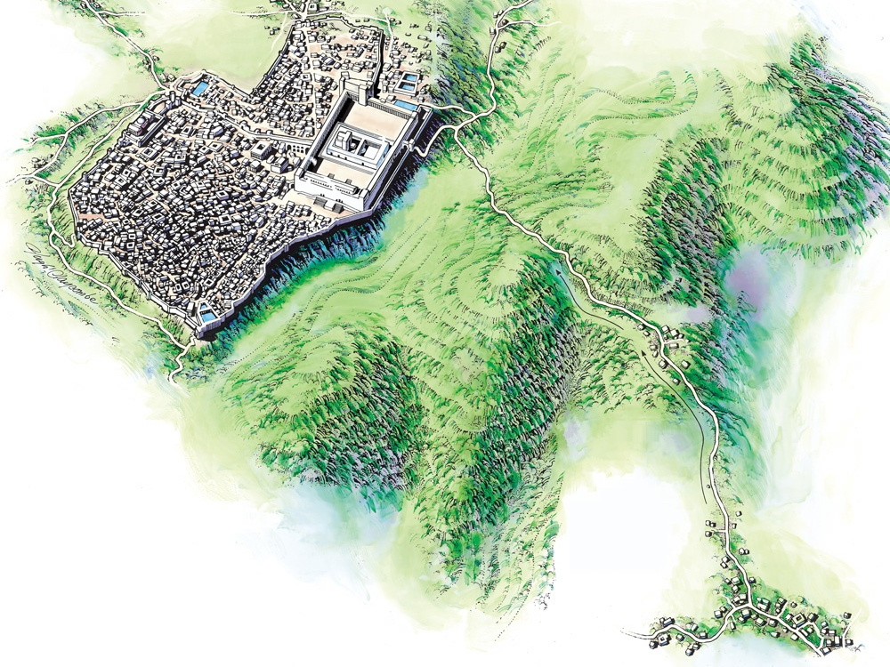
Mt. of Olives
Bethphage
Jerusalem
Bethany
Jesus Came to the Mount of Olives
Notes:
Links on this slide will be activated in PowerPoint Show mode

Slide 83
Teachings On Mt Olive
Mt 23:36, All these things shall come upon this generation
Mt 23:38, your house is left unto you desolate
Mt 23:39, Ye shall not see me henceforth, till ye shall say, Blessed is he that cometh in the name of the Lord
Preamble for Next Teachings

Slide 84
Teachings On Mt Olive
Mt 24:1-3
Jesus discusses the Temple with Disciples
On the way to Mt Olives
Likely looking back at Jerusalem in elevated position
Preamble for Next Teachings

Slide 85
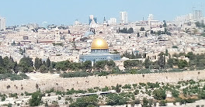
Temple Structure
Notes:
Muslim mosque sitting on the temple site!

Slide 86
Temple Structure
Their View
Notes:
View from Mt Olives would have been at a higher elevation than the Temple
Also other places along the road(s) going to Jerusalem from the West.

Slide 87
Teachings On Mt Olive
Mt 24:1-3, Jesus discusses the Temple with Disciples
Disciples Questions:
When will Temple be Destroyed
What are the signs of your coming
What are the signs of the end of the age
Mt 24&25 are His answers
Preamble for Next Teachings
Notes:
Note that the disciples still had man misconception about the nature of the kingdom. See Acts 1:6. in their mind, all 3 of these probably coincided with the same event, but Jesus teaches 2 distinct events.

Slide 88
Teachings On Mt Olive
Mt 24:4-35, Destruction of Jerusalem
Answering When
Mt 24:4-14, Events leading up to “The Day”
Signs the day is approaching
Vs. 9, that generation
Vs. 14, Gospel will be preached to all nations

Slide 89
Teachings On Mt Olive
Mt 24:4-35, Destruction of Jerusalem
Mt 24:15-22, Flee
Vs. 15-18, when you see… Then…
Matthew identifies the abomination of desolation that is prophesied by Daniel
Dan 9:26-27, 11:31-32, 12:11
Luke references the siege of Jerusalem
Lk 21:20-21
Both giving the same warning
Notes:
Luke possibly records from the gentile perspective; he does not mention the prophecy in Daniel which they may not be familiar with

Slide 90
Teachings On Mt Olive
Mt 24:4-35, Destruction of Jerusalem
Mt 24:15-22, Flee
Vs. 15-18, when you see… Then…
Vs. 19-22, Great tribulation

Slide 91
Teachings On Mt Olive
Mt 24:4-35, Destruction of Jerusalem
Mt 24:23-28, Warning of false prophets
Mt 24:29-35, Sign it is near
Vs. 32-33, parable of the Fig Tree
Know it is near
Vs. 34, it will be THIS generation

Slide 92
Teachings On Mt Olive
Mt 24:4-35, Destruction of Jerusalem
Mt 24:4-14, Be watchful for these events that lead up to “The Day”
Mt 24:15-22, Flee…
Mt 24:23-28, Warning of false prophets
Mt 24:29-35, Signs it is near

Slide 93
Teachings On Mt Olive
Mt 24:36-25:46, Final Judgment
Mt 24:36-41, Comparing Judgment with the Flood
Vs. 36, No man or angel knows the day or hour
Vs. 38-39, day will come WITHOUT warning
Emphasis has changed to be PREPARED because there will NOT be a sign
Notes:
A very distinct change in instructions here
Before: When you see…. Flee
Now: be prepared because there will be NO signs…

Slide 94
Teachings On Mt Olive
Mt 24:36-25:46, Final Judgment
Mt 24:42-44, Comparing Judgment with a Thief
Nobody knows when a thief comes, else we would be standing guard
No sign or indication of this event!
Be prepared because there will not be notice

Slide 95
Teachings On Mt Olive
Mt 24:36-25:46, Final Judgment
Mt 24:36-41, Comparing Judgment with the Flood
Mt 24:42-44, Comparing Judgment with a Thief
Mt 24:45-51, Parable of the Householder
Mt 25:1-13, Parable of the 10 Virgins
Mt 25:14-30, Parable of the Talents
Mt 25:31-46, Parable of the Sheep and Goats
Notes:
Time will be long
Example of Noah and Flood
Evil Servant said in his heart…, parable of the householder
After a long time… parable of the talents
Be ready for the final judgment for time will be no more

Slide 96
Teachings On Mt Olive
Mt 24:36-25:46, Final Judgment
Mt 24:45-51, Parable of the Householder
Vs. 45-47, blessed is the good householder who is found to be working
Vs. 48-51, the evil householder who is found to be idle will receive the wrath of God
Be prepared because there will not be notice
Man will think “my lord is delayed”
Same point with Noah and he flood
Notes:
When the cat’s away the mice will play
When the boss is away, the inmates run the asylum

Slide 97
Teachings On Mt Olive
Mt 24:36-25:46, Final Judgment
Mt 25:1-13, Parable of the 10 Virgins
All 10 were prepared
5 not prepared enough
Watch, You do not know the day or hour
Be prepared because there will not be notice
When event happens there will not be time to prepare

Slide 98
Teachings On Mt Olive
Mt 24:36-25:46, Final Judgment
Mt 25:14-30, Parable of the Talents
5, 2, & 1 Talent men
Vs. 19, They labored for a “long time”
1 talent man did not put forth any effort
Punishment – cast into outer darkness, weeping and gnashing of teeth
Must work according to abilities

Slide 99
Teachings On Mt Olive
Mt 24:36-25:46, Final Judgment
Mt 25:31-46, Parable of the Sheep and Goats
Jesus comes with his Angels
Sits on throne
Gathers all nations
Separate Sheep from Goats

Slide 100
Teachings On Mt Olive
Mt 24:36-25:46, Final Judgment
Mt 25:31-46, Parable of the Sheep and Goats
Sheep
Inherit kingdom prepared for you
Goats
Depart into everlasting fire with devil and his angels

Slide 101
Teachings On Mt Olive
Mt 24:36-25:46, Final Judgment
Mt 24:36-41, Comparing Judgment with the Flood
Mt 24:42-44, Comparing Judgment with a Thief
Mt 24:45-51, Parable of the Householder
Mt 25:1-13, Parable of the 10 Virgins
Mt 25:14-30, Parable of the Talents
Mt 25:31-46, Parable of the Sheep and Goats
Notes:
Time will be long
Example of Noah and Flood
Evil Servant said in his heart…, parable of the householder
After a long time… parable of the talents
Be ready for the final judgment for time will be no more

Slide 102
Jesus’ Teachings on Mt. Olive
Lessons
Mt 24:1-35, Jerusalem/Temple
Mt 24:36-25:46, Final Judgment
Be ready
It will be a long time
Temptation to be slothful
Tortious and the Hare

Slide 103
Jesus’ Teachings on Mt. Olive
Lessons
Mt 24:1-35, Jerusalem/Temple
Mt 24:36-25:46, Final Judgment
Be ready
It will be a long time
Mostly ready will not be enough
Being Idle is not enough
Generosity of the Faithful

Slide 104
Jesus’ Teachings on Mt. Olive
Lessons
Mt 10:22, And ye shall be hated of all men for my name's sake: but he that endures to the end shall be saved.
Labor
Endure
Persevere

Slide 105
Outline of the Last Week
Sunday
Mk 11:1-11, Rides Donkey into Jerusalem
Monday
Mk 11:12-26, Curses the Barren Fig Tree and Cleanses the Temple
Tuesday
Mt 21-25, Interrogation & Teaching in the Temple
Notes:
Our purpose is to evaluate the events of Jesus last week and take lessons from the teachings.

Slide 106
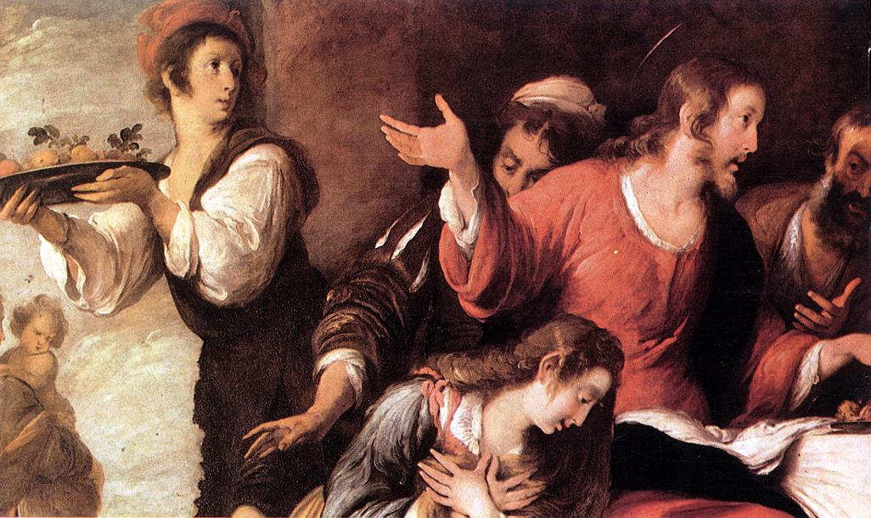
Wednesday
Banquet at the House of Simon (detail), Bernardo Strozzi (1629)
Notes:
Links on this slide will be activated in PowerPoint Show mode

Slide 107
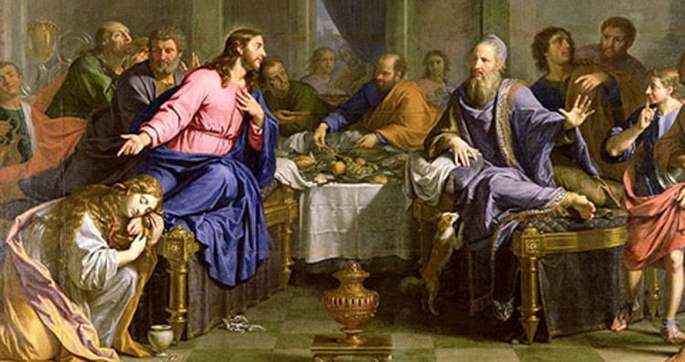

Slide 108
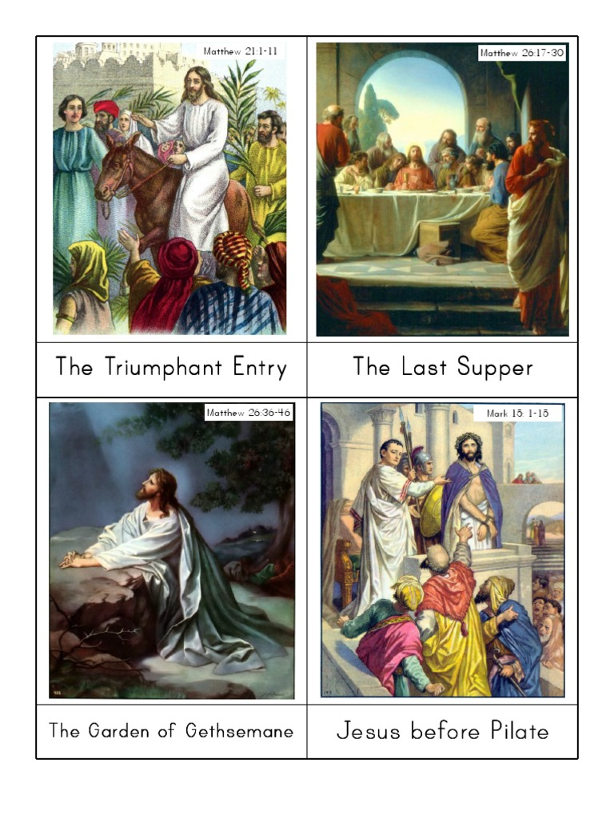

Slide 109
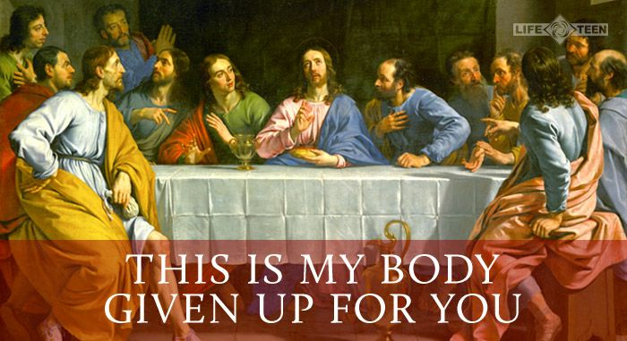

Slide 113
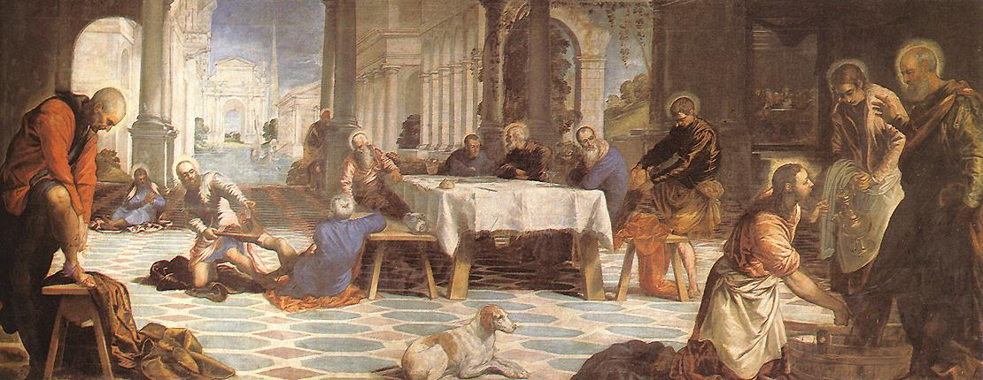
Thursday
Christ Washing the Feet of His Disciples, Tintoretto (c. 1547)
Notes:
Links on this slide will be activated in PowerPoint Show mode

Slide 115
Jesus Washes the Disciples Feet:
Verse 3-4: "Jesus, knowing that the Father had given all things into his hands, and that he had come from God and was going back to God, rose from supper. He laid aside his outer garments, and taking a towel, tied it around his waist."
For Jesus to Lay aside his outer garment means that He was wearing a tunic, (a shorter garment similar to a long undershirt, (the way slaves dressed to serve a meal), (Lk 12:37; 17:8). Jesus then tied a linen cloth around his waist, with which to dry their feet.
According to Jewish text, while Jewish bond slaves were not required to wash the feet of others, it was demanded of the Gentile slaves, (Ex 21:2).
Verse 5: "Then he poured water into a basin and began to wash the disciples’ feet and to wipe them with the towel that was wrapped around him."
Although a servant was generally given the task of washing the guests' feet, Jesus used this occasion to teach His disciples a lesson in humility and selfless service.

Slide 116
Thursday
Jesus Washes His Disciples’ Feet
Jesus told his disciples to wash each others’ feet as well. He said that the greatest must become like the youngest, and the leader must be like the one who serves.
A servant isn’t greater than his master.
If anyone receive the ones Jesus sends, then that one receives Jesus.
(Luke 22:24-30; John 13:11-20)
Notes:
Links on this slide will be activated in PowerPoint Show mode

Slide 117
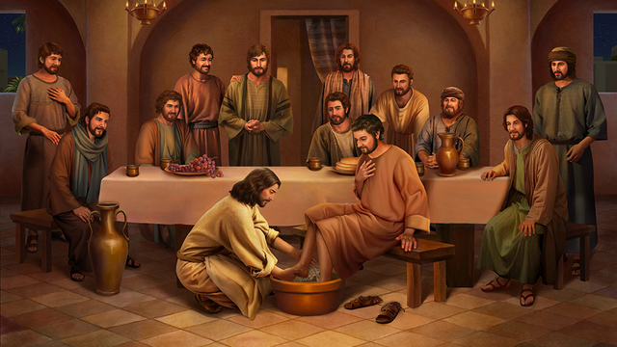

Slide 119
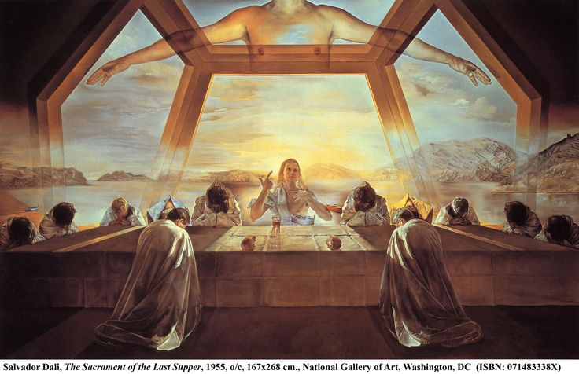
John 20 Verse 7: When Face Napkin Folded As Dinner Napkin Master Signaling “I’ll Be Back!”

Slide 120
Jesus’ Last Hours His Trial
Isa 53
Notes:
Speak to the nature of our society; I deserve… Justice

Slide 121
Jesus’ Last Hours
Jn 12-17, Jesus preparing the disciples for his death
Jn 14:27, …my peace I give unto you... Let not your heart be troubled, neither let it be afraid.
Jn 16:33, These things I have spoken unto you, that in me ye might have peace.
Mt 26:36-46, Jesus prays in Gethsemane
Vs. 46, Rise, let us be going: behold, he is at hand that doth betray me.
Time Line
(Our Thursday Night)
Notes:
Peter has cut off Malcus’ ear

Slide 122
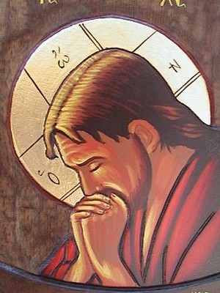
Our Lord: An Example Of Prayer Hebrews 5: 7 – Reviewed In Brief
“Who, in the days of his flesh, when he had offered up prayers and supplications, with strong crying and tears, unto him that was able to save him from death, and was heard in that he feared.”

Slide 123
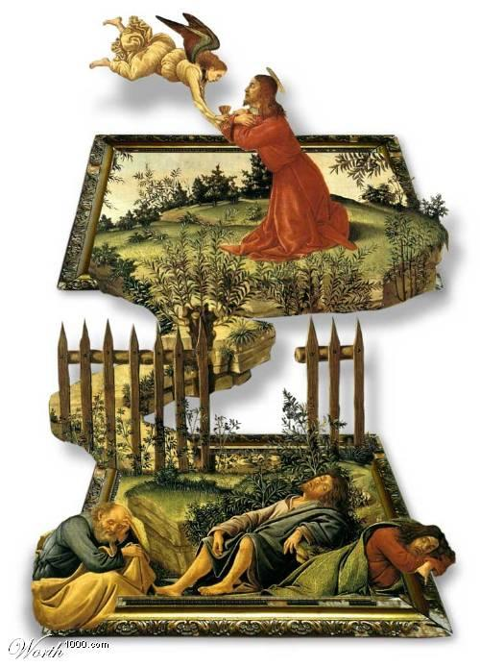

Slide 124
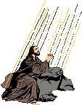
E. M. Bounds: Gethsemane Prayer
David Lee Burris: @ Jewish Theology – Righteous Forgiving Three Times Then They Reprobate
“We can pray against God’s will, as Moses did, to enter the promised land; as Paul did about the thorn in the flesh; as David did for his doomed child; as Hezekiah did to live. We must pray against God’s will three times when the stroke is the heaviest, the sorrow is the keenest, and the grief is the deepest. We may prostrate all night, as David did, through the hours of darkness. We may pray for hours, as Jesus did, and in the darkness of many nights, not measuring the hours by the clock, nor the nights by the calendar. It must all be, however, the prayer of submission … We are to be put into the crucible to be refined.”

Slide 125
Lord’s Prayer For His Apostles: Gospel Of John: Chapter 17
Prayer For Their Partners In The Divine Work
Prayer For Present Unity, Sanctification, & Their Keeping Unto Ultimate Glorification
Prays That They Keep From All Sin, From Sin In The Concrete & Sin In The Abstract
Prays That They Both Made Ready For Eternity & Equipped For Life On Earth
Prays That They Might Be Owned, Possessed, Filled, & All Guarded By God.
He Desired In Them A Holy Life & A Holy Work For God.
He Devoted Himself In Death In Order That They Might Be Devoted In Life To God.

Slide 126
No Room For Jesus
GETHSEMANE PLACE OF THE PRESS

Slide 127
Jesus’ Last Hours
Before Daylight
Jn 18:12-14, 19-24, Jesus Before Annas
Son-in-law to High Priest
Trial by the Jews

Slide 128
He Could Have Escaped By Three Routes

Slide 129
ICONIC IMAGE

Slide 133
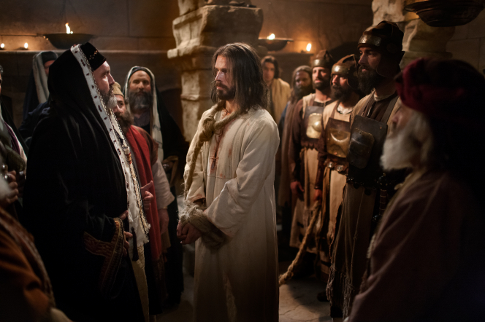

Slide 134
Jesus’ Last Hours
Before Daylight
Mt 26:57-68, Jesus Before Caiaphas
The High Priest
Solution looking for a Problem
False Witnesses could not agree
Blasphemy
Beginning of Physical Abuse
Spit in his face
Buffeted (Struck with Fist)
Struck with Palms
Trial by the Jews

Slide 135
Jesus’ Last Hours
At Daylight
Lk 22:66-23:1, Jesus Before the Sanhedrin
“Art thou the Christ?”
“Art thou then the Son of God?”
Trial by the Jews

Slide 138
Jesus’ Last Hours
Jn 18:28-38, Jesus Before Pilate
4xs asked for reason
King of Jews
Lk 23:2 adds
perverting the nation
forbidding to give tribute to Caesar
Trial by the Romans
Notes:
This section shows again the ploy, scheme by the Jew’s. Not looking for justice but to kill Jesus.

Slide 139
Jesus’ Last Hours
Lk 23:6-11, 14-15, Jesus Before Herod Antipas
No Fault Found
Jn 18:39-19:15, Jesus Returned to Pilate
Barabbas Released
Mocked
Scourged
Crown of thorns on his head
Smote him with their hands
Struck with Rod on the head, Mt 27:30
Trial by the Romans

Slide 140
Jesus’ Last Hours
Mockery of a Trail is now Completed
Justice Avoided
Jesus Tortured and Lead away to be Crucified
Trial by the Romans

Slide 141
Jesus’ Last Hours
Without Justice
Jew’s Early Morning Trials
They Feared the Jews
Mt 21:26, But if we shall say, Of men; we fear the people; for all hold John as a prophet.
Mt 21:46, But when they sought to lay hands on him, they feared the multitude, because they took him for a prophet
Mk 11:18, And the scribes and chief priests heard it, …for they feared him, because all the people…
Mk 12:12, And they sought to lay hold on him, but feared the people

Slide 142
Jesus’ Last Hours
Without Justice
Jew’s Early Morning Trials
Mt 26:59-60, False Witnesses could not agree
Finally charged:
Mt 26:63-64, Claiming to be the Son of God & Messiah
Mt 26:61, Destroying and Rebuilding the Temple prophecy (Jn 2:18-22)

Slide 143
Jesus’ Last Hours
Without justice
Trail Before Romans
Lk 23:2, Charges Changed
Perverting the Nation
Forbidding tribute to Caesar
Anointed King of Jews
Jn 18:1-19:15, Pilate could not find fault (8x)
Lk 23:13-16, Herod could not find fault
Mt 27:19, Pilate’s Wife said he was Just

Slide 144
Jesus’ Last Hours
mocked
Jn 19:1-15, Mt 27:26-30
Soldiers of the governor
Stripped him and put on him a scarlet robe
Put a crown of thorns upon his head
Put a reed in his right hand
Bowed the knee before him, and mocked him, saying, Hail, King of the Jews!

Slide 145
Jesus’ Last Hours
Physically abused
Jew’s Trail (Caiaphas), Mt 26:67
Spit in his face
Buffeted
Smote him with the palms of their hands
Roman Trail, Jn 19:1-3
Scourged
Crown of thorns
Smote him with their hands
Struck with rod on the head, Mt 27:30

Slide 146
Jesus’ Last Hours
The Beginning of Persecution
Trail Without Justice
Mocked
Physically Abused
Left him unable to bear his cross alone

Slide 148
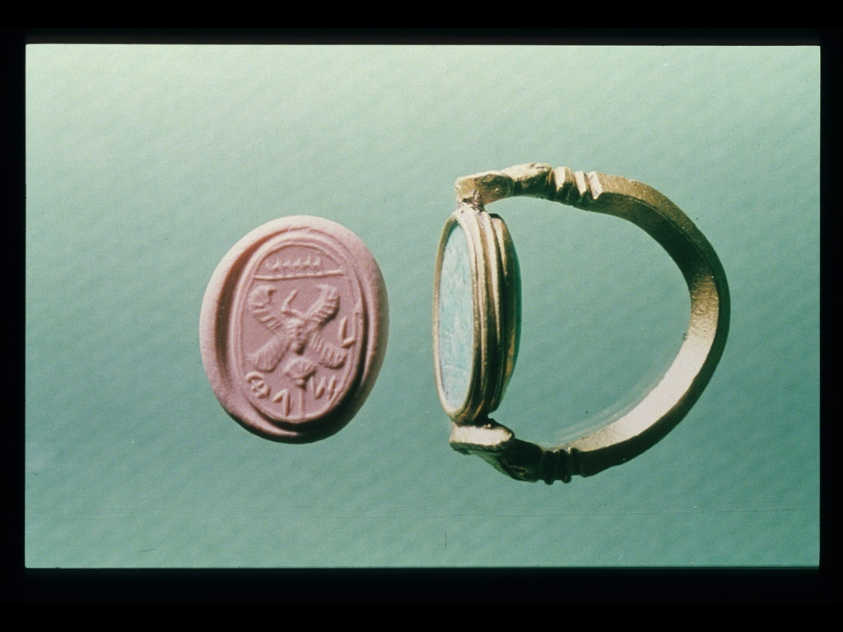
Jewish Judge's Signet Seal

Slide 149
High Priest Caiaphas
David Lee Burris:
Or Messiah Or Deliverer In Context Of Gamaliel @ Acts 5: 36, 37 & Rebels Period Taxing Census
Legal Question Dangerous Lunacy:
“Are You The Christ?”

Slide 151
Prefect Pontius Pilate
David Lee Burris:
John 19: 11 - Those That Handed Over Committed The Greater Sin!
Legal Question Harmless Lunacy:
“Are You The Jewish King?”

Slide 152
Rome’s Twelve Tables
David Lee Burris:
Earthly Rulers Do Not Jeopardize Themselves For Their Inferiors – Food Servants Taste Their Meals & Bodyguards Take Their Injuries;
Christ Could Command Angel Legions To Protect Him & Impose His Will
Non Compos Mentis
The Roman Insanity Defense:
“In the very concept of crime and punishment – crime being mens rea – there has to be the power within to frame the evil act.”
pilate

Slide 153
Jesus Christ
David Lee Burris:
Pilate & Jesus On Origin Of Power – Angels Would Have Saved In Both Temptation & Crucifixion Oriental Culture Of Baltic Rim Certified Lunacy & Protected It – i.e. Great Pyramid Legally Prohibited From Measure – Westerner Dressed In Pink Ballet Outfit – “Don’t Touch My TuTu”
Judicial Authorities Queried Accused Madmen As To Their Self-Identity & Thought Rationality
Crafted Answer Preventing Protection:
"You Say It!"
* John's Version Extended

Slide 154
Truth Does Not Count Legally. The Concern Of Law Is Proof.
Of God's Love
THE TREE
Christ’s Death On Calvary’s Tree
Is Proof Of Gods Love For Man

Slide 155
“What Is Truth?”
Messiah
Willingly
Obliged!

Slide 158
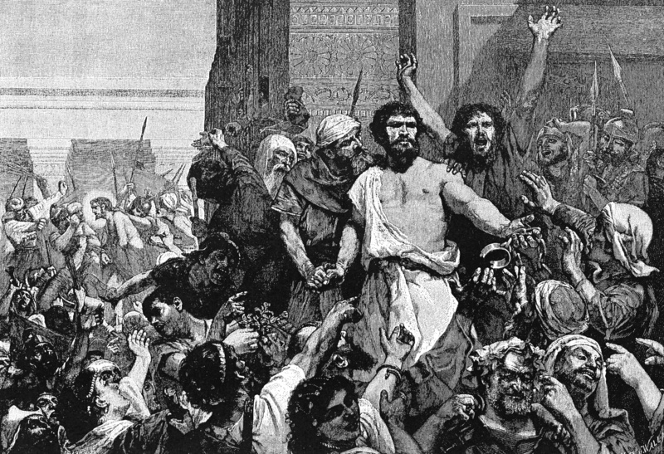
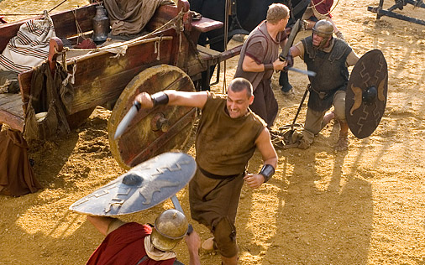
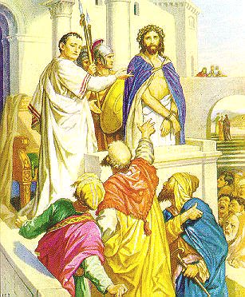
Case Of The Church-State Theocrat: Rebel Hero To Prince Of Peace
David Lee Burris: The Religion Of The Crutch & The Placebo Human Weakness Requires Religious Subordination? The Grand Inquisitor Says Of Jesus’ Temptation: “You made a mistake. You should have listened to what he said!”
Barabbas Matched Cultural Messiah Concept!

Slide 159
Jesus’ Last Hours His Crucifixion
I Cor 15:3

Slide 160
Jesus’ Last Hours
Sleep Deprived
Thursday after Dark
Partaking of the Passover & Institution of the Lord’s Supper, Lk 22:7-20
Teachings to Disciples, Jn 13-16
Late Thursday Night
Prayer in Gethsemane, Mt 26:36-46
Early Friday before Sun Rise
Betrayal and Arrest of Jesus, Jn 18:1-11
Suffering Prior to Crucifixion

Slide 161
Jesus’ Last Hours
Abuses During Trial
Mt 26:57-68, Jesus Before Caiaphas – The High Priest
spit in his face, and buffeted him; and others smote him with the palms of their hands,
Mt 27:26-30, Jesus before Pilate
Scourged
Crown of thorns, took a reed, and hit him on the head.
Suffering Prior to Crucifixion

Slide 164
Jesus’ Last Hours
Jn 19:16-17, Jesus Carries the Cross
Mt 27:32-33, Simon commissioned to help
Jesus unable to carry cross alone
To Golgotha, Calvary, “kranion”, a Skull
Crucifixion

Slide 165
Jesus’ Last Hours

Slide 166
Jesus’ Last Hours
Jn 19:18-27, Jesus Crucified
Mk 15:25, 3rd hour of Friday
Gospel writers omit the details of the process
It was horrendous
Scourged
Struck thorn crown on his head with a rod
Driving nails in hands and feet
Cross dropped into hole
It was a spectacle
not just to execute
torture, inflict pain, embarrassment
It Fulfilled Prophecy
Crucifixion

Slide 167
Jesus’ Last Hours
Sayings on the Cross
Lk 23:34, forgive them…
Lk 23:39-43, with Thief
Mt 27:46, My God, my God, why hast thou forsaken me
Jn 19:28, I thirst
Crucifixion

Slide 168
Jesus’ Last Hours
Jn 19:28-30, Death of Jesus
Mk 15:33-37, 9th hour
Mt 27:50-54, God’s Power on Display
Veil Torn in Temple between Holy & Most Holy
Earthquake & Rock’s torn
Graves Open
After Resurrection of Jesus
Many Believed
Jn 10:17-18, power to give and take life
Crucifixion

Slide 169
Jesus’ Last Hours
Jn 19:31-37, Jesus Side was Pierced
In accordance with prophecy
Crucifixion

Slide 170
Jesus’ Last Hours
Ps 22:1-21, Prophecies of Crucifixion
His forsaken cry, Ps 22:1 – Mt 27:46
Mocked, Ps 22:6-8 – Mt 27:27-31
People wag their heads, Ps 22:7 – Mt 27:39
Heartbroken, Ps 22:14 – Jn 19:34
Became very thirsty, Ps 22:15 – Jn 19:28
Hands and feet pierced, Ps 22:16 – Jn 20:24-28
People stared at Him, Ps 22:17 – Lk 23:35
Cloths divided and gambled for, Ps 22:18 – Jn 19:23-24
Notes:
Abundance of trivial details which could apply to many situations in life, all come together at Jesus’ crucifixion

Slide 171
Jesus’ Last Hours
Jn 19:18-27, Jesus Crucified
Jn 19:28-30, Death of Jesus
Jn 19:31-37, Jesus Side was Pierced
Ps 22, Fulfilled Prophecies
Crucifixion

Slide 172
Jesus’ Last Hours
Emphasis’ the cost of our salvation
Reveals the Humanity of Jesus
Reveals the Mercy of Jesus
Reveals the Forbearance of Jesus
Reveals the True Victory
Over Death & Satan
Ps 22:22-31
I Cor 15:54-57
Lessons from Jesus’ death

Slide 179
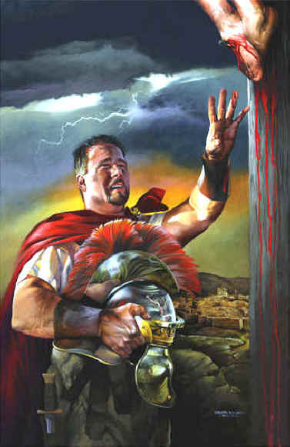

Slide 180
The Essential Jesus 3 Events During Jesus’ Crucifixion
The people passing by shouted abuse, shaking their heads in mockery. “So! You can destroy the Temple and build it again in three days, can you? Well then, if you are the Son of God, save yourself and come down from the cross!” . . .

Slide 181
The Essential Jesus 3 Events During Jesus’ Crucifixion
. . . The leading priests, the teachers of religious law, and the other leaders also mocked Jesus. “He saved others,” they scoffed, “but he can’t save himself! So he is the king of Israel, is he? Let him come down from the cross, and we will believe in him! He trusted God—let God show his approval by delivering him! For he said, ‘I am the Son of God.’” And the criminals who were crucified with him also shouted the same insults at him . . .

Slide 182
The Essential Jesus 3 Events During Jesus’ Crucifixion
DARKNESS AT MID-DAY
. . . At noon, darkness fell across the whole land until three o’clock.
Matthew 27:39-45

Slide 183
The Essential Jesus 3 Events During Jesus’ Crucifixion
DARKNESS AT MID-DAY
This was not a solar eclipse . . .
. . . & it was witnessed by people all over the Mediterranean Basin

Slide 184
The Essential Jesus 3 Events During Jesus’ Crucifixion
DARKNESS AT MID-DAY
“At the moment of Christ’s death, the light departed from the sun, and the land was darkened at noonday, which wonder is related in your own annals, and is preserved in your archives to this day.”
Tertullian, writing to non-Christian adversaries in the 2nd century

Slide 185
The Essential Jesus 3 Events During Jesus’ Crucifixion
DARKNESS AT MID-DAY
“In the fourth year of the 202nd Olympiad (33 AD), there was the greatest eclipse of the sun . . . It became night in the 6th hour of the day (noon) so that stars even appeared in the heavens.”
Phlegon, a non-Christian Greek author writing in 137 AD

Slide 186
The Essential Jesus 3 Events During Jesus’ Crucifixion
DARKNESS AT MID-DAY
MEANING: Jesus was under God’s judgment
The great day of the Lord is near . . . That day will be a day of wrath, a day of distress and anguish, a day of trouble and ruin, a day of darkness and gloom . . . I will bring distress on the people . . . because they have sinned against the Lord.
Zephaniah 1:14-17

Slide 187
The Essential Jesus 3 Events During Jesus’ Crucifixion
DARKNESS AT MID-DAY
MEANING: Jesus was under God’s judgment
“In that day,” declares the Lord, “I will make the sun go down at noon and darken the earth in broad daylight . . . I will make that time like mourning for an only son and the end of it like a bitter day.”
Amos 8:9,10

Slide 188
The Essential Jesus 3 Events During Jesus’ Crucifixion
DARKNESS AT MID-DAY
MEANING: Jesus was under God’s judgment
“Anyone who is hung from a tree is under God’s curse.”
Deuteronomy 21:23

Slide 189
The Essential Jesus 3 Events During Jesus’ Crucifixion
DARKNESS AT MID-DAY
MEANING: Jesus was under God’s judgment
At noon, darkness fell across the whole land until three o’clock. At about three o’clock, Jesus called out with a loud voice, “Eli, Eli, lema sabachthani?” which means, “My God, my God, why have you forsaken me?”
Matthew 27:45,46

Slide 190
The Essential Jesus 3 Events During Jesus’ Crucifixion
My God, my God! Why have you forsaken me? . . . Everyone who sees me mocks me. They sneer and shake their heads, saying, “Is this the one who relies on the Lord? Then let the Lord save him! If the Lord loves him so much, let the Lord rescue him!” . . . My life is poured out like water, and all my bones are out of joint. My heart is like wax, melting within me . . . You have laid me in the dust and left me for dead . . . They have pierced my hands and feet . . . They divide my clothes among themselves and throw dice for my garments. (Psalm 22:1-18)
DARKNESS AT MID-DAY
MEANING: Jesus was under God’s judgment

Slide 191
The Essential Jesus 3 Events During Jesus’ Crucifixion
DARKNESS AT MID-DAY
MEANING: Jesus was under God’s judgment
. . . But his crucifixion proved that he was the Messiah & was obeying God’s will

Slide 192
The Essential Jesus 3 Events During Jesus’ Crucifixion
THE TORN TEMPLE CURTAIN
Josephus, Tacitus & the Talmud refer to a catastrophe in the Temple at this time that implied its impending destruction
Then Jesus shouted out again, and he gave up his spirit. At that moment the curtain in the Temple was torn in two, from top to bottom. (Matthew 27:50,51)

Slide 193
The Essential Jesus 3 Events During Jesus’ Crucifixion
THE TORN TEMPLE CURTAIN
This curtain denied worshippers access into God’s presence in the “Holy of Holies”

Slide 194
The Essential Jesus 3 Events During Jesus’ Crucifixion
THE TORN TEMPLE CURTAIN
It symbolized our separation from God because of our sins

Slide 195
The Essential Jesus 3 Events During Jesus’ Crucifixion
THE TORN TEMPLE CURTAIN
Access to God was permitted only through the High Priest on the Day of Atonement

Slide 196
The Essential Jesus 3 Events During Jesus’ Crucifixion
THE TORN TEMPLE CURTAIN
The Temple & the Day of Atonement were only symbols of our dilemma with God & how God would one day solve it

Slide 197
The Essential Jesus 3 Events During Jesus’ Crucifixion
We thought his troubles were a punishment from God for his own sins! But he was wounded and crushed for our sins . . . All of us have strayed away like sheep. We have left God’s paths to follow our own. Yet the Lord laid on him the guilt and sins of us all . . . It was the Lord’s good plan to crush him and fill him with grief. Yet when his life is made an offering for (our) sin, he will he will be satisfied. And because of what he has experienced, my righteous Servant will make it possible for many to be counted righteous, for he will bear all their sins. (Isaiah 53:4-11)
THE TORN TEMPLE CURTAIN

Slide 198
The Essential Jesus 3 Events During Jesus’ Crucifixion
THE TORN TEMPLE CURTAIN
MEANING: Jesus’ death paid for humanity’s sins, so everyone can have personal access to God through faith in Jesus

Slide 199
The Essential Jesus 3 Events During Jesus’ Crucifixion
THE TORN TEMPLE CURTAIN
MEANING: Jesus’ death paid for humanity’s sins, so everyone can have personal access to God through faith in Jesus
Then Jesus shouted out again, and he gave up his spirit. At that moment the curtain in the Temple was torn in two, from top to bottom. (Matthew 27:50,51)

Slide 200
The Essential Jesus 3 Events During Jesus’ Crucifixion
THE TORN TEMPLE CURTAIN
MEANING: Jesus’ death paid for humanity’s sins, so everyone can have personal access to God through faith in Jesus
Jesus knew that everything was now finished, (so) he said, “Tetelestai!” Then he bowed his head and gave up his spirit. (John 19:28,30)

Slide 201
The Essential Jesus 3 Events During Jesus’ Crucifixion
THE TORN TEMPLE CURTAIN
Now we can boldly enter heaven’s Most Holy Place because of the blood of Jesus. This is the new, life-giving way that Christ has opened up for us through the sacred curtain, by means of his death for us. And since we have a great High Priest . . . let us go right into the presence of God, with true hearts fully trusting him.
Hebrews 10:19-22

Slide 202
The Essential Jesus 3 Events During Jesus’ Crucifixion
THE EARTHQUAKE & EMPTIED TOMBS
The earth shook, rocks split apart, and tombs opened. The bodies of many saints (believers) who had died were raised from the dead after Jesus’ resurrection. They left the cemetery, went into the holy city of Jerusalem, and appeared to many people.
Matthew 27:51-53

Slide 203
The Essential Jesus 3 Events During Jesus’ Crucifixion
THE EARTHQUAKE & EMPTIED TOMBS
At that time every one of your people whose name is written in the book will be rescued. Many of those whose bodies lie dead and buried will rise up, some to everlasting life . . .
Daniel 12:1,2

Slide 204
The Essential Jesus 3 Events During Jesus’ Crucifixion
THE EARTHQUAKE & EMPTIED TOMBS
“The time is coming when the dead in their graves will hear the voice of God’s Son, and they will rise again . . . to eternal life . . .”
John 5:28,29

Slide 205
The Essential Jesus 3 Events During Jesus’ Crucifixion
THE EARTHQUAKE & EMPTIED TOMBS
MEANING: Jesus is the Messiah & he has broken the power of death for all who entrust themselves to him

Slide 206
How will you respond to Jesus’ death on the cross?

Slide 207
Who Is Jesus?: The Deity of Christ

Slide 208
The Claims of Christ
Able to forgive sins (Mark 2:5–10)
A healer of disease (Mark 5:21-43)
Allows others to worship Him (Matt. 14:33, 28:9; cf also Acts 10:25–26; 14:12–15)

Slide 209
The Claims of Christ
Claims to be “other worldly” in origin and destiny (John 6:38)
Performs miracles over nature (Luke 9:16,17)
Claims He has absolute, moral purity (John 8:46; 2 Cor. 5:21)

Slide 210
The Claims of Christ
Claimed to be God, Messiah, and the way to God (Mark 14:61,62; John 8:58, 10:30; 14:6–9)
Claimed to be the fulfillment of all Messianic prophecies in the Old Testament (John 5:46–7; Luke 24:44)
Allowed others to call Him God and Messiah (John 20:27-29;Matt.16:15-17)

Slide 211
Considering the Options
One way to deal with the claims is to remove the historical material, which is offensive to us, which is what Thomas Jefferson did. The other option is to honestly accept the historical accuracy of the documents and come up with a plausible explanation. Our choices are reduced to one of four: He was either a Liar, a Lunatic, a Legend, or our Lord.

Slide 212
Liar
Everything that we know about Jesus discourages us from selecting this option. It is incomprehensible that the One who spoke of truth and righteousness was the greatest deceiver of history. He cannot be a great moral teacher and a liar at the same time.

Slide 213
Lunatic
In his interview with psychologist Gary Collins, Lee Strobel reports Collins listing a litany of Jesus characteristics that indicate his overall mental health including appropriate emotions, contact with reality, logical conversation, and deep and abiding relationships. All of these together in the same person would never be expected of one suffering from mental illness.
Lee Strobel, The Case for Christ, p. 144-154.

Slide 214
Lunatic
“He was loving but didn’t let his compassion immobilize him; he didn’t have a bloated ego, even though he was often surrounded by adoring crowds; he maintained balance despite an often demanding lifestyle; he always knew what he was doing and where he was going; he cared deeply about people, including women and children, who weren’t seen as being important back then; he was able to accept people while not winking at their sin; he responded to individuals based on where they were at and what they uniquely needed. . . . All in all, I just don’t see signs that Jesus was suffering from any known mental illness.”
Gary Collins in The Case for Christ, p. 147

Slide 215
Legend
The greatest difficulty with this option is the issue of time. Legends take time to develop. Yet most of the New Testament, including Matthew, Mark, Luke, Acts, and all of Paul’s Epistles were written by A.D. 68.
The creed in 1 Corinthians 15:3-8 dates to at least A.D. 51 and some trace back to as early as A.D.33-34.There simply is no time for a legend to develop.

Slide 217
Importance of Early Dating
Early dating shows eye witnesses were alive when gospels were circulating to attest to their accuracy.
The Apostles often appeal to the witness of the hostile crowd pointing to their knowledge of the facts as well (Acts 2:22, 26:26).
Also, the time is too short for legends to develop. Historians agree it takes about two generations for legendary accounts to establish themselves.

Slide 218
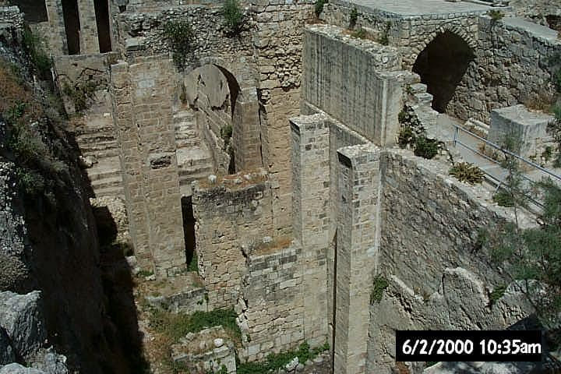
Archaeology and the Gospels
Gospel of John
Pool of Bethesda discovered in north east quarter of the Old Town Jerusalem
In 9:7 John mentions another long disputed site, the Pool of Siloam. However, this pool was also discovered in 1897, upholding the accuracy of John.

Slide 219
Archaeology and the Gospels
“A man whose accuracy can be demonstrated in matters where we are able to test it is likely to be accurate even where the means for testing him are not available. Accuracy is a habit of mind, and we know from happy experience that some people are habitually accurate just as others can be depended upon to be inaccurate. Luke’s record entitles him to be regarded as a writer of habitual accuracy.” F.F. Bruce
“Luke is a historian of first rank;…In short, this author should be placed along with the very greatest of historians.” William Ramsey

Slide 220
Archaeology and the Gospels
Luke is found to be a very accurate historian
Luke names 32 countries, 54 cities, and 9 islands without error
Luke’s accuracy is seen in the accuracy of titles used for government officials, proconsul, tetrach, etc… although some are strange are found to be accurate
In Luke's announcement of Jesus' public ministry (Luke 3:1), he mentions, "Lysanius tetrarch of Abilene."
In Acts 28:7, Luke gives Plubius, the chief man on the island of Malta, the title, "first man of the island."

Slide 221
Jewish Sources
The Talmud (Completed 300 AD) confirms a historical Jesus and attributes Jesus miracles to sorcery and magic
Affirm his death by Roman crucifixion and the healing ministry of five apostles named

Slide 222
Jewish Sources
Josephus confirms the following facts:
Characters mentioned in the gospels, the Herods, emperors Augustus, Tiberius, Claudius and Nero
High Priestly families of Caiaphas, Ananias, and Annas.
Events in the gospels are corroborated in Josephus
Gamiliel’s mention Judas the Galilean’s uprising in Acts 5:37 is mentioned in the Antiquities (18:1)
Acts 11:28 mentions a famine in the days of Claudius, mentioned in (Antiquities 17)
The sudden death of Agrippa in Acts 12 is recorded in Antiquities 19, agreeing with Luke’s outline.
John the Baptist and his death (Antiquities 18)
Death account of James the Brother of Jesus in Acts (Antiquities 18)

Slide 223
Roman Sources
Thallus wrote a work of history of Greece from the Trojan War to his present day in 52 AD
In his third book of his histories states that darkness covered the earth during the crucifixion of Jesus.

Slide 224
Roman Sources
“Nero fastened the guilt and inflicted the most exquisite tortures on a class hated for their abominations called Christians by the populace. Christus, from whom the name has its origin,suffered the extreme penalty during the reign of Tiberius at the hands of the procurators, Pontius Pilate, and a most mischievous superstition, thus checked for the moment, again broke out not only in Judea, the first source of evil, but even in Rome.”
Tacitus, a 1st Century Roman historian

Slide 225
Roman Sources
“They were in the habit of meeting on a certain fixed day before it was light, when they sang an anthem to Christ as God, and bound themselves by a solemn oath not to commit any wicked deed, but to abstain from all fraud, theft and adultery, never to break their word, or deny a trust when called upon to honor it; after which it was their custom to separate, and then meet again to partake of food, but ordinary and innocent kind.” (Pliny the Younger, From a letter to Emperor Trajan, A.D. 112)

Slide 226
Oral Tradition
Jewish culture stressed memorizations of the law.
Deuteronomy 6:4-9
It is a well known fact that the rabbis had the OT and much of the oral law committed to memory.
The Jews placed a high value on memorizing whatever writing reflected inspired scripture and the wisdom of God.
In a culture where this was practiced, their memorization skills were far advanced from ours today. New Testament scholar Darrell Bock states that the Jewish culture was “a culture of memory.”

Slide 227
Oral Tradition
Rainer Reisner presents six key reasons why oral tradition accurately preserved Jesus’ teachings.
Jesus used the OT prophets’ practice of proclaiming the word of God
Jesus would reinforce among his followers the need to preserve his words accurately.
90% of Jesus’ teachings and sayings use pneumonic methods

Slide 228
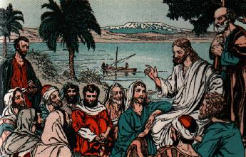
Oral Tradition
Jesus trained his disciples to teach his lessons even while he was on earth.
Jewish boys educated at least till twelve, so disciples knew how to read and write.
Finally, as was done by Jewish and Greek teachers who gathered disciples, they trained them to carry on the master’s teachings.

Slide 229
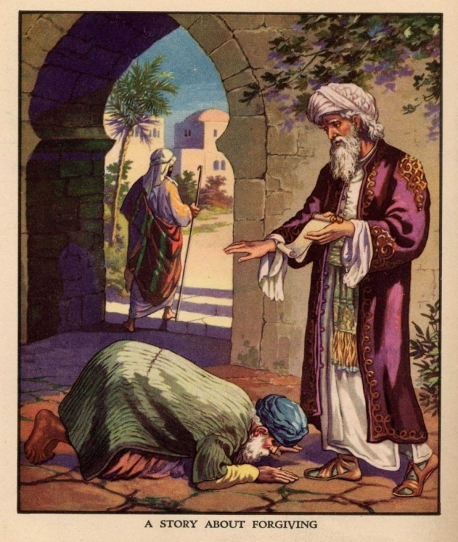
Oral Tradition
The teachings of Jesus and his illustrations are easy to memorize.
We also know that the church preserved the teachings of Christ in the forms of hymns which were easy to memorize.
Paul’s summary of the gospel in 1 Corinthians 15 is a good example of this.
We can have confidence that the oral tradition accurately preserved the teachings and the events of Jesus’ life till they were written down just a few years later.

Slide 230
Oral Tradition
The evidence shows that in oral cultures where memory has been trained for generations, oral memory can accurately preserve and pass on large amounts of information.

Slide 231
Who moved the stone?

Slide 233
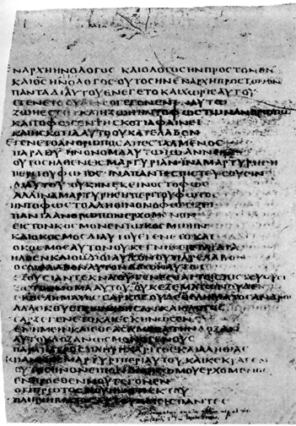
There is an interesting parenthetical in the Bezae manuscripts.
“And when He was laid there, he put against the tomb a stone which twenty men could not roll away.”
* Double Bound Spice-Soaked Body Wrap Weighed 75 lbs

Slide 234
Lord
In his book, Mere Christianity, C. S. Lewis said, “A man who was merely a man and said the sort of things Jesus said would not be a great moral teacher. He would either be a lunatic—on a level with the man who says he is a poached egg—or else he would be the Devil of Hell. You must make your choice. Either this man was, and is, the Son of God, or else a madman or something worse. . . .

Slide 235
Lord
You can shut Him up for a fool, you can spit at Him and kill Him as a demon, or you can fall at His feet and call Him Lord and God. But let us not come with any patronizing nonsense about His being a great moral teacher. He has not left that open to us. He did not intend to.”

Slide 236
The Resurrection of Jesus
Jesus clearly pointed to His bodily resurrection as the authenticating sign by which He would confirm His own unique claims. Later on, the Apostle Paul, in speaking of the importance of this event to the faith of a Christian would say, “If there is no resurrection of the dead, then not even Christ has been raised; and if Christ has not been raised, then our preaching is vain, your faith is also vain. . . if Christ has not been raised, your faith is worthless; you are still in your sins” (1 Cor. 15:13–17).

Slide 237
The Empty Tomb
The tomb of Jesus Christ was found empty on the third day.
From the beginning Christians have argued that the tomb was empty on the third day.
Even the opponents of Christianity believed that the tomb was empty.

Slide 238
The Empty Tomb
If the tomb had not been empty, it probably would have been treated as a shrine.
If the tomb was occupied, what would make the disciples of Jesus risk their lives by saying that it was empty?
The tomb of Jesus was empty because He had been resurrected from the dead.

Slide 239
The Empty Tomb
“In the face of the facts, they (critics) have been impotent to put Jesus body back in the tomb. They flounder, they struggle, they snatch at straws, they contradict themselves, they pursue desperate and extraordinary theories to try and account for the evidence. Yet each time, in the end, the tomb remains vacant. . . . ‘The empty tomb, then, forms a veritable rock on which all rationalistic theories of the resurrection dash themselves in vain.’” Lee Strobel, The Case for Christ, p. 223.

Slide 240
Jesus Rose from the Dead
Did the disciples steal the body?
Were the disciples deceived?
Did the Jewish leaders take it?

Slide 241
Jesus Rose from the Dead
Did Jesus really die?
Jesus was raised from the dead!

Slide 242
Jesus Rose from the Dead
Alternative explanations are inadequate, and eyewitnesses were put to death because they continued to maintain that Jesus had been raised from the dead. Christianity exists because these people truly believed in the resurrection, and their testimony continues to be the most reasonable explanation for the empty tomb of Jesus Christ.

Slide 243
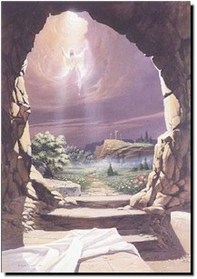
Jesus Rose from the Dead
“We did not follow cleverly invented stories when we told you about the power & coming of our Lord Jesus Christ, but we were eye-witnesses of his majesty.”
2 Peter 1:16

Slide 244
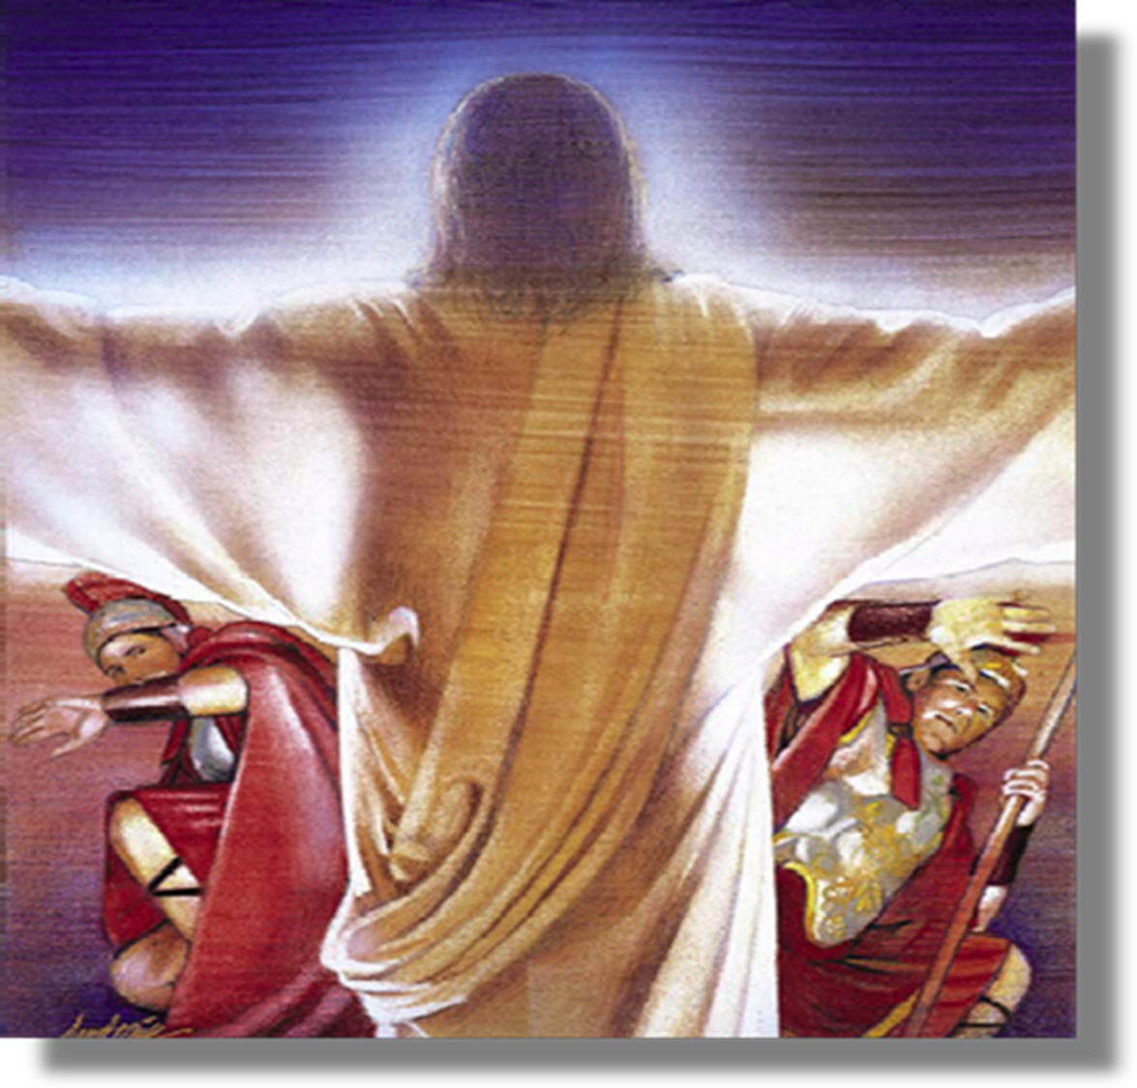
"To Tiberius Caesar, Emperor of Rome. Noble Sovereign, Greeting: The events of the last few days in my province have been of such a character that I will give the details in full as they occurred, ‘He said that about the beginning of the fourth watch they saw a soft and beautiful light over the sepulchre. He at first thought that the women had come to embalm the body of Jesus, as was their custom, but he could not see how they could have gotten through the guards. While these thoughts were passing through his mind, behold, the whole place was lighted up, and there seemed to be crowds of the dead in their grave clothes. All seemed to be shouting and filled with ecstasy, while all around and above was the most beautiful music he had ever heard; and the whole air seemed to be voices praising God’.” - p. pilate

Slide 245
Who Is Jesus?: The Deity of Christ!

Slide 246
The Resurrection Demonstrates the Truth of Christianity.
I am the bread of life; he who comes to me shall not hunger, and he who believes in me shall never thirst (John 6:35).
I am the light of the world; he who follows me shall not walk in the darkness, but shall have the light of life (John 8:12).
Truly, truly, I say to you, before Abraham was born, I AM [a claim to be God himself] (John 8:58).

Slide 247
The Resurrection Demonstrates the Truth of Christianity.
I am the door; if anyone enters through me, he shall be saved, and shall go in and out, and find pasture (John 10:9).
I am the good shepherd; the good shepherd lays down his life for the sheep (John 10:11).
I am the resurrection & the life; he who believes in me shall live even if he dies (John 11:25).
I am the way, and the truth, and the life; no one comes to the Father, but through me (John 14:6).

Slide 248
Jesus is the Lord of History
“But as many as received Him, to them He gave the right to become children of God, even to those who believe in His name.” John 1:12

