Slide 1
CHURCH HISTORY AS FAMILY HISTORY
Family Tree: Restoration Movement 1832 Handshake: Movement Marriage Post-Civil War: Uncivil Movement Divorce Second Separation: The Texas Family Feud
By David Lee Burris

Slide 2
Family History From Family Bibles: Physical Births & Spiritual Rebirths
EVER OPENED UP someone else’s old photo album?
Grandparents, aunts, second cousins, old Ford Model Ts, big hats. Or boat cars and poodle skirts. People smiling into long-vanished sunsets and sunrises. At first, it seems confusing. Maybe you can pick out an era, but these aren’t your grandparents and your second cousins, your stories, or your inside jokes.
But then you talk to the people who own the photo album. You listen to their stories and the photos come alive. You learn what it meant to be part of that family in all its struggles and heartaches and joys. What it meant to live at that moment in history.
What does this photo album teach the rest of us? Things we already knew, but things it is good to remember. The centrality of the Bible. The centrality of the body of Christ. How American culture and the Christian message influenced each other.
And how difficult it is to be “simply Christian.” Even when you go whole hog. Traditions and human constructions can turn out to be, in the end, inescapable. But also inescapable, in the end, is the grace of God. Thanks be to God, who redeems all constructions. – Editoral Notes Christian History Special Issue Stone-Campbell Movement

Slide 3
Excerpts of Religion & American Culture: Journal Of Interpretation, Vol. II, # 2 “The Apocalyptic Origins Of Churches Of Christ”
In 1906, the United States Bureau of the Census recognized for the first time a division in the ranks of the Stone-Campbell restoration tradition and listed two separate denominations: Churches Of Christ & Disciples of Christ. Until 1964, most historians rooted this division in a late nineteenth century dispute over missionary societies and instrumental music…However, in 1964, David Edwin Harrell took sharp exception in this interpretation and rooted the division in social forces related to the Civil War. Thus, he concluded, ‘the 20th century Churches of Christ are the spirited offspring of the religious rednecks of the postbellum South.”
There is considerable truth in both the traditional reading and in Harrell’s revisionist interpretation. At the same time, neither of these interpretations recognizes the pivotal role played by the separationist and apocalyptic tradition of Barton W. Stone in shaping Churches Of Christ, much less the cultural split that undergirded the differences between the Campbellite and the Stoneite perspectives…Alexander Campbell – a man who represented the “party of hope” as fully as any man of his age. Churches of Christ, ultimately descend, at least in part, from the separatist, anti-modern perspective of Barton W. Stone, who stood squarely in the “party of memory.”
Finally, the Stoneites were every bit as utopian and restorationist as Alexander Campbell, but for them, restoration had less to do with the forms and structures of the primitive church and more to do with lives of simple holiness.
That outlook, in turn, expressed itself in three specific ways: their insistence on a radical separation from the world; an eschatology that often manifested itself in premillennial terms, and their disdain for political involvement of any kind.
The Stoneites radical sense of separation from the world grew quite naturally from their apocalyptic orientation – an outlook that often gave expression to an explicitly premillennial eschatology. (some say postmill)
Indeed, millennial excitement was central to the Stone movement from its start at the 1801 Cane Ridge Revival.
While the Millerite excitement of the early 1840’s exacerbated Stone’s interest in this theme, his convictions regarding the premillennial kingdom of Christ predated those events by many years.
This is typical here of our man Barton Stone on this subject of Apocalyptic Origins & Millennial Orientation:
‘The 2nd coming of Christ is at the commencement of his millennial reign on earth – here on earth he will reign till the 1000 years be finished – nor will he cease to reign on earth till he has raised from death the wicked, & judged them according to their works.’

Slide 4
REVIEW: ANCIENT ORDER RESTORE POINT
RESTORATION MOVEMENT: ADOPTS THE FIVE STEPS TO SALVATION
5 STEPS: Believe – Repent – Baptism – Forgiven – Get the Holy Spirit
ALEXANDER CAMPBELLS DEBATES LINK ON WORSHIP & SALVATION:
ALEXANDER CAMPBELL DEBATES DEFEND NO WORTHINESS EXAM
RACOON SMITH ENVOY CAMPBELL DISCIPLES TO STONE FOLLOWERS
RACOON SMITH EXTENDS THE RIGHT HAND OF FELLOWSHIP(1832)
RIGHT HAND METAPHOR – OATH, POWER, STRENGTH, ALLEGIANCE
RESTORATION COMMITMENT: TO USE BIBLE WORDS IN BIBLE WAYS
1832 HANDSHAKE REPRESENTS: RATIONALISM JOINS REVIVALISM
DISCIPLES DEVELOP RESTORED AUTHORITY LEVEL DECISION TREE
LEVELS: COMMAND – EXAMPLE – NECESSARY IMPLICATION/INFERENCE
COUNTERING CORRUPTION META-NARRATIVE WITH MILLENNIAL

Slide 5
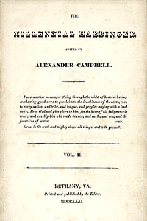
1830
January 4, Millennial Harbinger Begins
July 5, Last Issue Of The Christian Baptist

Slide 6
DISPENSATIONAL PREOCCUPATION
FATALISTIC ATTITUDE
Those who believe the Second Coming is immediate often adopt a fatalistic attitude & fall prey to a siege mentality:
“There’s nothing that can be done about the world’s problems. Don’t prepare for any future; just hunker down and wait.”

Slide 7
AN END TIMES MOVEMENT
Christadelphians – Prophesies and Pacifism
Christadelphians, a religious sect, was founded by Dr. John Thomas, son of a British Congregationalist minister. During Thomas’ immigration to the United States in 1832, the ship encountered several violent storms. Thomas vowed that he would devote his life to the study of religion if God would spare his life. Shortly after his arrival in the United States, Thomas briefly associated himself with the Campbellites, while sharing their belief that Jesus Christ would return to earth in 1866. But as he continued study with the Cambellites, he soon disagreed with their teachings, left the group disfellowshipped, and began his own religious sect called the “Brethren of Christ.”

Slide 8
Redeeming America: Road To War Curtis D. Johnson, 1993\Pages 164 & 184
“The Disciples of Christ, following the lead of Alexander Campbell, were generally in the postmillennial camp, as were the Baptists…
Millennialism continued to have an enormous influence over the United States on the eve of the Civil War. When the great conflict came, Americans spoke of the war using millennial language. Having been steeped in biblical prophecy and apocalyptic images for decades, it is not surprising that the Civil War generation described the conflict in Armageddon-like terms and tried to fit current events into a broader prophetic context and God’s role in history to make sense of the four years of carnage.”

Slide 9
Civil War: Brother Faces Brother From Flaws & Fissures To Faults
David Lee Burris:
Definition: Presentism - “Present-day standards of behavior are used to evaluate people who lived in the distant past – when such standards would have been unthinkable.”; James A. Garfield -
“If there is one thing on this earth that mankind love and admire better than another, it is a brave man; It is the man who dares to look the devil in the face and tell him he is a devil.”; On The Evil Of Slavery Was “Inclined To Believe That The Sin Of Slavery Is One Of Which It May Be Said That Without The Shedding Of Blood There Is No Remission.”
J. W. McGarvey -- “We will not take up arms against, fight and kill the brethren we have labored for twenty years to bring into the kingdom of God.”
“The Texas chaplain told of his friend, Alf Johnson, who when he saw wounded federal soldiers beg for medical help, instead ruthlessly shoot them… Graham asked Hall how he could feel this way toward his brethren in the North, and Hall replied that they were all infidels.”
The Hollywood Epic Length “Gods & Generals” Was Limited Still
Independence Declaration Ideals Constitutionally Compromised
Plus 100 Years: Concept Of National Sin Causes Regional Conflict
Causes Church Loss Of Moral Authority & Divisions North-South
Both Campbell’s & Barton Stone’s Sons Wore Confederate Grey {Campbell Family Slaveholders & After War Stand Stayed Same}
War & Conscience by Allen Isbell on page 189: “…(Future U. S. President) Garfield delivered recruiting speeches on the steps of many churches(of Christ) through the Western Reserve.”

Slide 10
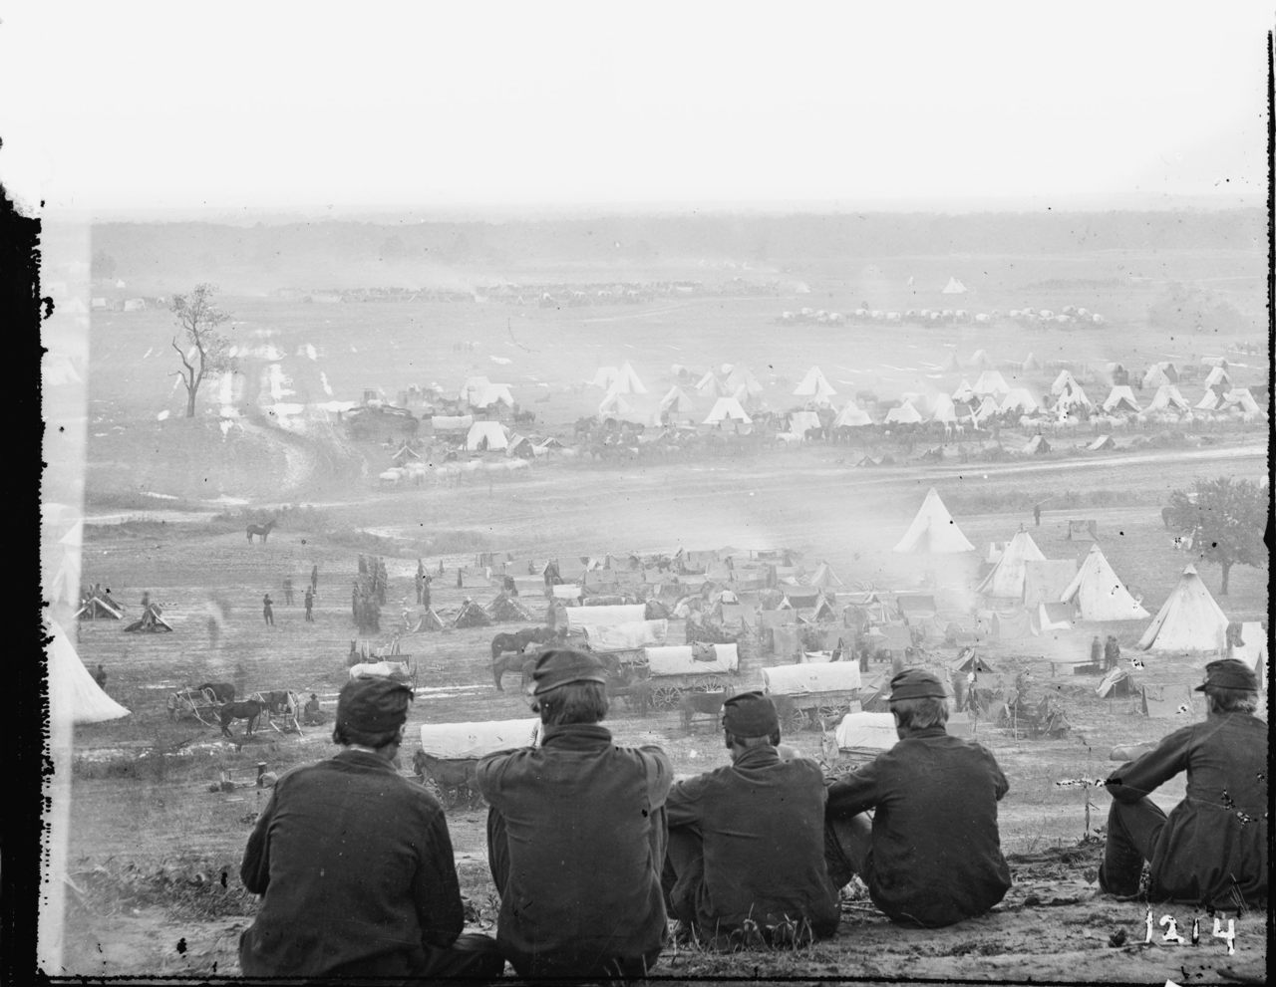
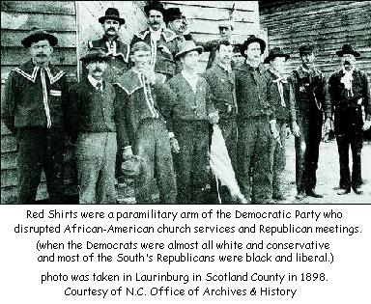
The Religious Landscape Changed Forever!

Slide 11
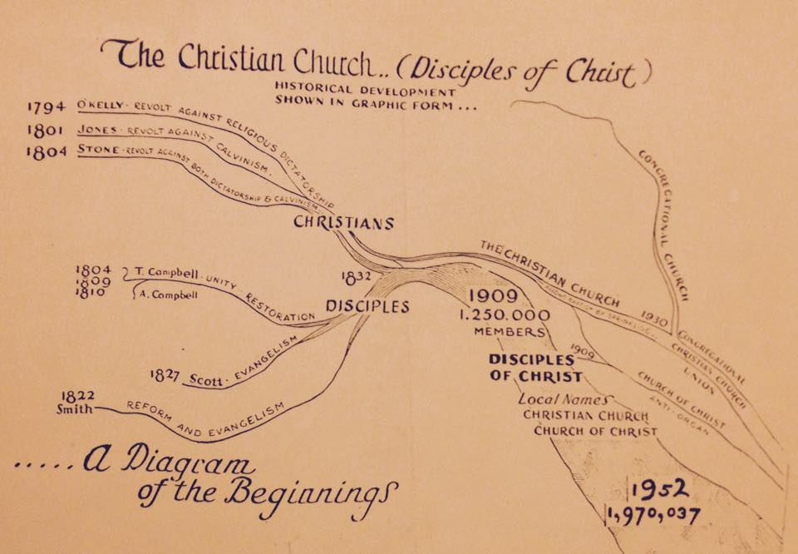
Beyond Annotations & Anecdotal Story: Court Records & Wartime Participation

Slide 12
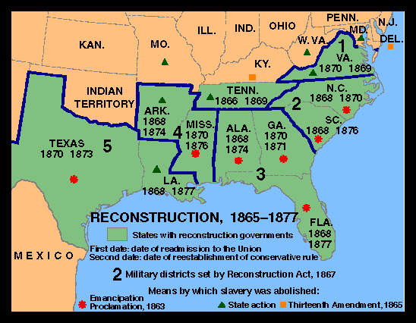
After The Great Awakening
The Great Disappointment

Slide 13
THE MILLENNIAL GLUE IS GONE!
NOTE: Correlation Isn’t Causation

Slide 14
After The Civil War: Testing Boundaries
Many Issues That Were Before The War Started Up Again
ACMS & The Instrument Of Music In Worship – Next 40 Years Takes Its Toll
Can Christians Fight In War Or Participate In Governmental Activities – e.g. President Garfield {His Freemason Affiliation Also Of Concern}
Alexander Campbell Dies March 4, 1866
1866 Christian Standard Begins With Isaac Errett As Editor – Devoted To A More Progressive Approach To Christianity
1866 The Gospel Advocate Restarts With Tolbert Fanning And A Young David Lipscomb As Co-Editors
1869 Henderson, Tennessee, Henderson Male & Female Institute Begins, Root School Out Of Which Would Later Come Freed-Hardeman University

Slide 15
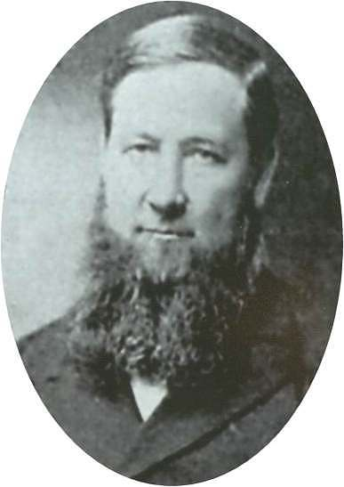
Breakdown Of Movement
Class | Conservatives | Liberals
Religious Authority | Faith/Testimony | Opinion/Inference
Church Government | Plurality Of Bishops | One-Man Pastorate
Preaching The Gospel | Through The Church | Through Missionary Society
Finances | Giving Through Simplicity | Fairs, Festivals & Begging
Music | Congregational Singing | Instrumental Music
Character of Members | Poor, pious, simple, humble, peace-loving, honest | Rich, shameless, arrogant, divisive, “usurpers of other men’s labors”

Slide 16
After The Civil War Cont.
1884 – Firm Foundation Begins In Austin, Texas, Austin McGary Editor
1891 – Nashville Bible School Begins, Later Lipscomb University
In The 1906 U.S. Census The Church of Christ And The Christian Church Was Recognized As Different Entities
*March 1917: Christian Church & Disciples Split @Hermeneutic

Slide 17
Beyond Annotations & Anecdotal Story: Family Migration/Frontier Resettlement

Slide 19
CONCLUSION: NON-DENOMINATIONAL MOVEMENT CREATES THREE CHURCHES
19TH CENTURY TEXAS CHURCHES OF CHRIST FOUNDED BEFORE REPUBLIC
19TH CENTURY TEXAS CHURCHES OF CHRIST - BARTON STONE FOLLOWERS
19TH CENTURY TEXAS CHURCHES OF CHRIST TRAVELED W/ DAVY CROCKETT

Slide 20
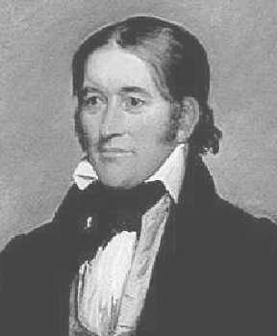
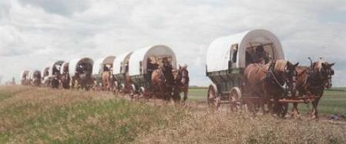
N.T. Christianity Comes To Texas
According To 1936 Document Prepared By Jewell Matthews, Descendant of Dr. Mansil Matthews, Cheap Land In Texas Prompted Nearly The Whole Town To Desire To Move To Texas*
The entire Church Left Waterloo, Alabama In 1835
It Was A Church On Foot, Wheels, & Horseback
Leading Them Was David Crockett
Slow Travel, With Sundays Set Aside For Worship, Crockett Left The Group At The Mississippi River
Crocket Passed Among The Campers, Greeting Each Man, Woman And Child; Left With Them An Affectionate Farewell, Mounted His Noble Bay Charger, Accoutered For Battle, And Waved His Cap, Halloed, ‘Hurrah For Texas,’ As He Galloped Away At The Head Of Some Sixty Volunteers For The Texas Army! Off They Went To The Alamo
David "Davy" Crockett (1786-1836)
* They Founded Waterloo, Texas
Later Renamed - Austin, Texas

Slide 21
Texas Restoration Movement: Barton Stone & Davy Crockett
“It seems that Benjamin Lynn, a minister for the Separate Baptist church, became interested in the Restoration work & preaching of Barton Stone, and sometime around 1805 came to Stone to be baptized. He then aligned himself with the Church of Christ. Benjamin Lynn had two daughters, one of whom, Rachel, married Marshall D’Spain. Benjamin Lynn died in 1814, but two years later, his daughter and son-in-law moved to Waterloo, Alabama where they established a church. The reason the Waterloo church disappeared from the Alabama records is because in 1835, the entire church moved to Texas.”

Slide 22
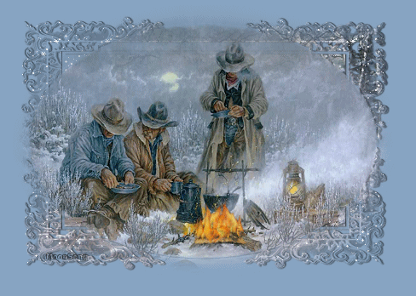

Slide 23
Texas Restoration Movement: Barton Stone & Davy Crockett
David Lee Burris:
Crockett was disillusioned from his congressional experience and highly disappointed & very critical of the Jackson administration’s expulsion of the Cherokee from the Georgia area in the “Trail of Tears.” He was actively looking for new lands and new frontiers of the mind!
“Practically, the whole Alabama community formed a company and started for Texas during the last half of the year 1835. The caravan, on its long and tiresome journey, did not travel on the Lord’s Day. The members spent the day in worship and rest. Almost the whole company was made up of Disciples. It was a Church on foot, on wheels, and on horseback. This ‘church on wheels’ was accompanied as far as Memphis, Tennessee, by Davy Crockett, the hero of the Alamo. At Memphis he departed to lead sixty volunteers to join the Texas army. When the church arrived at Ft. Clark, Texas, they settled there temporarily. After the war with Mexico ended, the members of the church scattered to settle in various parts of the state. The Restoration movement spread with them & churches were established throughout Texas. So it was that, in 1853, the church came to be established in a town in Texas that had also been named Waterloo. But by then, it had been renamed Austin and had become the state capital.”
- Theologia, Summer 2002

Slide 25
Sing W/ Instrument Accompany: Campbell Concert W/ Cowbell?
David Lee Burris: ORGAN ASSOCIATED WITH THE CIRCUS!
John Knox – The Organ a “chest of whistles!”
Fact: Early Church Fathers Comments Condemn
Fact: (666 AD) First Organ One Catholic Church
Fact: Erasmus (Desiderius) - “Theatrical Music”
Fact: Thomas Aquinas “ …not seem to Judaize.”
Fact: Martin Luther – “…an ensign of Baal.”
“Musical instruments in celebrating the praises of God would be no more suitable than the burning of incense, the lighting of lamps, & the restoration of the other shadows of the law… Men who are fond of outward pomp may delight in that noise; but the simplicity which God recommends to us by the apostles is far more pleasing to Him.” Calvin

Slide 26
Presbyterian Commentator Lyman Coleman
David Lee Burris:
A.D. 68: “[When his armies began to revolt] Nero went to the theatre and played with a new hydraulic-powered organ he owned. His behavior caused dismay among his supporters and a belief that the man was not entirely there.”
“It is generally admitted that the primitive Christians employed no instrumental music in their Christian worship. Neither Ambrose, nor Basil, nor Chrysostom, in the noble encomiums which they severally pronounce upon music, make any mention of instrumental music. Basil condemns it as ministering only to the depraved passion of men. (Water) organs were unknown in the church until the 8th century. Previous to this they had their place in theater rather than in the church. They were never regarded with favor in the Eastern Church and vehemently opposed in many places in the West.”

Slide 27
“In the earlier years of the present Reformation,
There was entire unanimity in the rejection of
instrumental music from the public worship.
It was declared unscriptural, inharmonious
with the Christian institution,
and a source of corruption.”
- J. W. McGarvey

Slide 28
Ben Franklin - Akron, Ohio - April, 1868:
“We have not been more tried in a long time. While it was going off, we reflected and turned the matter in every way possible. What was to be done? We never felt more unhappy. Are brethren determined, we involuntarily thought, to deteriorate the worship into music & compel us to endorse it? If we refuse to preach, it may, we further thought, create a lasting trouble, and some may blame us for it. We decided to preach, and did so, but with a heavy heart, in view of the worship having been degenerated before our face.”
This tendency toward the worship instrument was related to an extravagant trending in the construction of large, cathedral-like church buildings. Benjamin Franklin called them "temples," "a display of unchristian opulence," and an "appeal to the lust of the flesh and the pride of life" (Elder Ben Franklin: Eye of the Storm, Earl West, pp.290-292).

Slide 29
David Lipscomb\Gospel Advocate\Sept. 1873
“We do not think anyone has ever claimed authority from the Scriptures to use the organ in worship. They only claim it is not condemned… [But] the New Testament is at once the rule and limit of our faith and worship to God. This is the distinctive difference between us and other religious bodies. Others accept the NT as their rule, but do not make it the limit of their faith.”

Slide 30
“Worship Music” By J. Curwen In 1880:
“Men still living can remember the time when organs were very seldom found outside the Church of England. The Methodist, Independents, and Baptists rarely had them & by the Presbyterians were stoutly opposed. But since these bodies began to introduce organs, the adoption of them has been unchecked. Even the Presbyterians are giving away, & if we read the future by the past, we can hardly doubt that in a few years, unaccom- -panied singing will very seldom be heard.”

Slide 31
Incident At Thorpe Spring, Texas
The Instrument Of Music Began Entering Worships Assemblies Around 1860
1894, The Sons Of Clark Desired To Bring It In At Thorpe Spring Much To The Strong Reservations Of Joseph Clark
Tuesday Night, February 20, 1894, B.B. Sanders, A Minister Who Favored The Instrument Was Involved In A Gospel Meeting.
A Petition Was Signed By 139 Members Of The Congregation Saying They Did Not Want It, Even Having The List Read
Before Meeting Began Joseph Clark Stood And Prayed A Prayer For Unity
As Addison Clark, Directing The Worship, Said The Students Had Been Promised Instruments And They Were Going To Have Them, Turning He Looked At Miss Bertha Mason, The Pianist, And Said, “Play On, Miss Bertha!”
When It Was Introduced Brother Clark, Now In His 80s Departed The Assembly With 2/3 Of The Congregation
The Church Of Christ Was Re-established Across The Street.

Slide 32
BACKWARDS CHRISTIAN SOLDIERS
Post-War Doctrinal Division Along
Pre-War Lines of Sectional Split
1st – The Individuals Targeted
2nd – “The Issues” of Target
THE TEXAS SHARPSHOOTER FALLACY
This a logical fallacy, as described on Wikipedia, in which information that has no relationship is interpreted or manipulated until it appears to have meaning.
The name comes from a story about a Texan who fires several shots at the side of a barn, then paints a target centered on the hits and claims to be a sharpshooter.

Slide 35
Scripture Commands
INSTRUMENT
Ephesians 5: 19 “Speak In Song”
CANNOT
Colossians 3: 16 “Teach In Song”
CANNOT
Colossians 3: 16 “Admonish In Song”
CANNOT
1st Cor. 14: 15 “Sing Understanding”
CANNOT
Hebrews 2: 12 “Praise God”
CANNOT
Hebrews 13: 15 “Give Thanks”
CANNOT

Slide 36
CHRISTIAN DISUNITY & Restoration Divergence RELIGIOUS UNIFICATION MOVEMENT RESULTS IN THREE CHURCHES: CHRISTIAN CHURCH DISCIPLES OF CHRIST CHURCHES OF CHRIST

Slide 37
An Open Letter From Nadab and Abihu
Brethren,
It is with the utmost humility that we inform you of a change of worship practices in your normal sacrificing.
Be assured that we are bringing about this change only after much prayer and study.
We have recently concluded an in-depth study of the Law as delivered by our brother Moses that covered 400 days. (We might note that is ten times the length of time it took the Lord to impart this Law.)
We have decided to bring about a change in the type of fire used in worship.

Slide 38
An Open Letter From Nadab and Abihu
We are aware that there is a standing tradition of using only one source of fire, but we, as holy priests, do not feel obligated to blindly follow tradition.
Numerous polls of our worshipping clientele indicate the overwhelming opinion that they do not care where we get the fire used for their sacrifices as long as the service is conducted in a respectful and meaningful way.
We are in agreement with this growing majority, as we cannot see how a change in fire will affect anything in the least about our sacrifices.
The animal is still properly cooked, the incense burned.
We are of the mind that were we to secretly substitute a different fire it would be impossible for any of the worshippers to know a change had taken place.

Slide 39
An Open Letter From Nadab and Abihu
Besides all this, we became aware of the fact that nowhere in the Law does the Lord forbid the use of what some of our detractors have referred to as “strange fire.”
We feel that the lack of such a restriction was meant to give us freedom. For those who disagree, we would ask you to show us any place in the Law that tells us we cannot do something the Lord has not seen fit to condemn. We are simply asking, “Where does it say we cannot do this?”
We also wish to point out that the congregation of Israel is the only religious group in the known world that willingly limits itself to only one kind of fire.
We have become the laughingstock of the land of Canaan and have been ridiculed openly by many groups.
This “only-one-fire” self-righteous policy has alienated us from everyone else. We believe this change will open up many fellowship opportunities.

Slide 40
An Open Letter From Nadab and Abihu
Now, to set the minds of some of you at ease, we will continue to offer a traditional service using the old-fashion fire as well as this progressive service with the new fire.
As a matter of fact, we may occasionally use the old fire in our progressive service for special feast days.
In this way we hope that our older citizens are still comfortable even though they dogmatically insist on a worship style which is declining and we believe to be stunting our growth.
Consider the freedom this new practice affords us!
We will no longer have the expense of maintaining a constant fire in one location.
This will also make it possible to appeal to a younger audience as we discover more entertaining ways to “light the fire” of our assemblies. (We hope you caught the little play on words there!)

Slide 41
An Open Letter From Nadab and Abihu
For those that still oppose the use of new fire, we ask you not to be judgmental of new ideas.
We also hope you will not use this change as a excuse to divide our people or stir up trouble within the congregation.
We remind you that this has been well thought out and the majority of elders have signed on with us.
It is true we have not included our father Aaron in this deliberation; but we were well aware of his tradition-bound views and still plan to leave him in charge of doing the traditional service anyway.
We also have not consulted Moses, but his humility is well known and we are confident he will want to uphold the majority decision in this effort to improve our worship.
- David Brassfield, Forthright Magazine

Slide 42
PAST – PRESENT - FUTURE
PACIFISM REFERENCE: DAVID LIPSCOMB @Gospel Advocate
PENTECOSTAL REFERENCE: BOLES v. BOLL’S DISFELLOWSHIP
* Boll accomplished congregational departures @Rigdon Damage Level

Slide 43
PAST – PRESENT - FUTURE

Slide 44
Review of David Edwin Harrell’s “Emergence – ‘Church Of Christ’ – Denomination”
From Conservative & Exclusive Into Liberal & Tolerant Church
Worker Class & Fervent Faith Into Worldly Wealthy & Satisfied
Sect (The Truth/Thee Church) Into Denomination(Less Dogmatic)
Divergence - Different Christianities – Doctrinally Inconsequential
Census: Bifurcation Disciples & Christians Socio-Economic Status
With Each: Three Cycles Of Separation Started - Completed Since
Index: Liston Pope’s - 21 Item List - Transition Progress Criteria
“The New Testament is loaded with the sociological (sect-to-denomination process) message. Again and again Jesus said that His message was peculiarly
directed to the poor. James (2:5) clearly states the case: ‘Hearken, my beloved
brethren, Hath not God chosen the poor of this world rich in faith, and heirs of
the kingdom which he hath promised to them that love Him?” …
In 1st Corinthians 1:26 the Apostle Paul includes not only wealth but also success and sophistication as barriers to spiritual success: ‘For ye see your calling, brethren, how that not many wise men after the flesh, not many mighty, many noble, are called’.” 3rd paragraph, pg. 8

Slide 45
CONCLUSION: NON-DENOMINATIONAL MOVEMENT CREATES THREE CHURCHES
19TH CENTURY TEXAS CHURCHES OF CHRIST FOUNDED BEFORE REPUBLIC
19TH CENTURY TEXAS CHURCHES OF CHRIST - BARTON STONE FOLLOWERS
19TH CENTURY TEXAS CHURCHES OF CHRIST TRAVELED W/ DAVY CROCKETT
20TH CENTURY INSTITUTIONAL DIVIDE - TOTALLY FROM TEXAS OUTWARD
20TH CENTURY INSTITUTIONAL DIVIDE – ANTI’S MOVEMENT START EAST TX

Slide 46
Past & Present - Once & Future Church Workshop
David Lee Burris: FACTIONALISM WITHIN LORD’S CHURCH OR REMNANT SEPARATION?
Disciples-Christian & Churches Of Christ Separation Commonly Referred To As The 1906 Division Due To Query By US Census Director To David Lipscomb & His Famous Reply.
David Lee Burris:
Texas Branding Irons: The name calling & labeling of the late Fifties & early Sixties.
1-Three Streams Discussion:
Oral History From Older Generation Of Memories From Childhood Of The Difference & Similarity Between The Disciples, Independent Christians, & Churches Of Christ. When was the most contrast evident? To what do we attribute that 50 year long slow separation in comparison to the 5 yr quick & drastic divorce between 50’s churches of Christ ? Religious Collectivities: Of Unexplored Potential?
2 - Institutional Discussion:
Oral History From Following Generation Of The Sequence Of Events As They Were Actually Witnessed. Texas was in the forefront of this mutual separation. Highland Church was in Abilene and Roy Cogdill & Yater Tant were based in East Texas. These private discussions became public when Goodpasture of the Gospel Advocate advanced an agenda of quarantine. The editor agreed with one of the private participants that preachers should be fired, elders removed, & unruly brethren disciplined who did not go along with their change in evangelistic vision. Questions: Were the anti-extra institutional brethren just looking for “a horse to ride out on” as they were charged? Was the claim of those advancing the Herald of Truth in that “Where There Is No Pattern” there is authority actually the simple scraping of the restoration’s initial ideas of Christian unity for one more denominational and even ecumenical? Or as a third option – did all these brethren – left and right - not have the love for each other that would be expected – especially in comparison to the longsuffering shown in the three streams split? Moreover, in terms of third options, with preserving the brotherhood, not any institution, as most imperative, why did they not explore more seriously the third way presented to them – i.e. “box in the vestibule?”
In other words, why did all parties chose instead to destroy the fastest growing religious body in the whole world – doing almost as much irreparable damage to the Lord’s Church than was accomplished by the American Civil War?
Twenty Minute Maximum

Slide 47
What Were Considered The Defining Characteristics Of Churches Of Christ?
1) Commitment To Christian Unity
2) Commitment To Evangelism & Mission
3) New Testament Emphasis
4) Simple Confession Of Faith
5) Believer’s Baptism
6) Weekly Communion
7) Biblical Name
8) Congregational Authority
9) Lay Leadership
10) Unity In Diversity

Slide 48
Sixfold Influence - New Hermeneutic – Churches of Christ:
Changes in the Types of Music
Changes in the Role of Women
Changes in the Doctrine of Grace
Changes in the Elder’s Authority
Changes in the Memorial Supper
Changes in the Fellowship Circle
Optional Viewing: “The New Hermeneutic” Dave Miller Lessons; biblestudy@wvbs.org

Slide 49
1990’S: ARE THESE MUTUALLY EXCLUSIVE?
PREACH euangelizo |  | TEACH didasko
GOSPEL euangelion |  | DOCTRINE didaskalia
JUSTIFICATION (basis of fellowship) |  | SANCTIFICATION (unity in diversity)

Slide 50
CONCLUSION: NON-DENOMINATIONAL MOVEMENT CREATES THREE CHURCHES
19TH CENTURY TEXAS CHURCHES OF CHRIST FOUNDED BEFORE REPUBLIC
19TH CENTURY TEXAS CHURCHES OF CHRIST - BARTON STONE FOLLOWERS
19TH CENTURY TEXAS CHURCHES OF CHRIST TRAVELED W/ DAVY CROCKETT
20TH CENTURY INSTITUTIONAL DIVIDE - TOTALLY FROM TEXAS OUTWARD
20TH CENTURY INSTITUTIONAL DIVIDE – ANTI’S MOVEMENT START EAST TX
20TH & 21ST CENTURIES MODERN & POST-MODERN RESTORATION.
MAJORING IN MINORS: BIBLE AS TEXTBOOK NOT BOOK OF LIFE
MINORING IN MAJORS: NEGATIVE ISSUES NOT POSITIVE IDEALS

Slide 52
People of the Book
“You may have heard that tools are neutral things. And this is true in one aspect; for example, you can use a hammer to drive in a nail…or to bash in someone’s head. But tools are absolutely not neutral in the fact that the tools you choose to use and how you use them not only change things externally but mold you internally. The Jesuit priest and media scholar John Culkin put it this way: “We shape our tools, and thereafter they shape us.”

Slide 53
Preaching Style & Church Growth
48 Congregations Net Growth Rate
Negative Approach
Positive Approach
HIGH
2
14
1
MEDIUM
13
3
LOW
12
4
2
(1) Campbell Conversational Or Non-Manipulative Dialogue
(2) Information Transmission Or Manipulative Monologue
* Source: "Why Churches Grow" By - Flavil Yeakley

Slide 54
RENOVARE’ PERSPECTIVE @ JULY 2008
More Than A Textbook - - “Reading the Bible for interior transformation is a far different endeavor than reading the Bible for historical knowledge, literary appreciation, or religious instruction. In the latter case we learn head knowledge; in the former knowledge of the heart. To allow the Bible to infiltrate us with the Life God offers – piercing us like a two-edged sword dividing ‘soul from spirit, joints from marrow… {judging the thoughts and intentions of the heart}’ – we must bring to the Bible our whole selves, expectantly, attentively, and humbly.”

Slide 55
RELIGION OF HEAD
RELIGION OF HEART
RELIGION OF HANDS

Slide 56
A Fundamentalist
Is Someone
Who Hates Sin
More Than He
Loves Virtue.
John Schaar

Slide 57
Robert Harkrider On “Majoring In Minors”:
“Every Bible topic is important; none are ‘minor’ in the purest sense. But when brethren enforce their convictions to the point of splintering churches into factions with each regarding the other as 2nd rate citizens of the kingdom, something is out of balance.”

Slide 58
BASIS FOR UNITY
FUNDAMENTALS
A Person
Jesus Christ
A Principle
Restoration
A Privilege
Just Christians
A Platform
One Faith
A Plan
Simply Obey
A Power
The Gospel

Slide 59
Departure Principle: The Law Of Expediency
First Corinthians - Chapter Six - Verse Twelve:
“ALL THINGS ARE LAWFUL UNTO ME, BUT ALL THINGS ARE NOT EXPEDIENT: ALL THINGS ARE LAWFUL FOR ME, BUT I WILL NOT BE BROUGHT UNDER THE POWER OF ANY!”

Slide 60
Departure Principle: The Law Of Expediency
First Corinthians - Chapter Six - Verse Twelve:
Therefore, Two Principles Are Apparent: Expedients Cannot (a) Be an addition to the word of God - or – (b) be a substitution for God’s ways. A true expedience, therefore, neither adds to or changes the plan of God!

Slide 61
Departure Principle: The Law Of Expediency
First Corinthians Chapter Six & Verse Twelve States - The Lawful Expediency Must Meet Certain Criteria: Secondly, there cannot be an explicit statement found in the Bible. This is an evident conclusion from the first point. When God speaks, man is not left to use his judgment & reasoning ability to determine if he is going to act. When God speaks, obedience by faith must be forthcoming from man, and he cannot decide if he wants to do what God has commanded or not. Yet, with the area of thoughtful expediency, human wisdom can be utilized in that realm where God has left man free to use his own individual and collective judgment.

Slide 62
Departure Principle: The Law Of Expediency
First Corinthians Chapter Six & Verse Twelve States - The Lawful Expediency Must Meet Certain Criteria: Thirdly, to be an expedience, it must edify the church. Per 1st Corinthians 14: 26 - We can see that when matters of personal judgment pierce the Lord’s body, then we had better examine our Bibles & hearts for the correct answers!

Slide 63
Departure Principle: Primary Vs. Delegated Authority
Besides the generic and specific classification, there are two kinds of authority: primary and delegated. Primary authority is the original source of all power or authority. It is the authority that resides in the person by right of his relationship to those who are subject to his authority. All divine authority begins with God, the Father!

Slide 64
Departure Principle: Primary Vs. Delegated Authority
Besides the generic and specific classification, there are two kinds of authority: primary and delegated. Delegated authority is that which is given to another by the one who has the primary authority. All authority of God has been delegated to his Son, Jesus Christ, and not one single word has been delegated to mankind. In utilizing this authority delegated to the Son, Christ has delegated or granted certain power to others in administering his authority. The apostles received this power. All authority comes from the Son!

Slide 65
The Butterfly Effect Of Religious & Church History
Sensitive Dependence On Initial Conditions
Small variations in initial condition of a non-linear dynamical system may produce large variations in long term behavior of the system.
Each Iteration Amplifies The Initial Departure

Slide 66
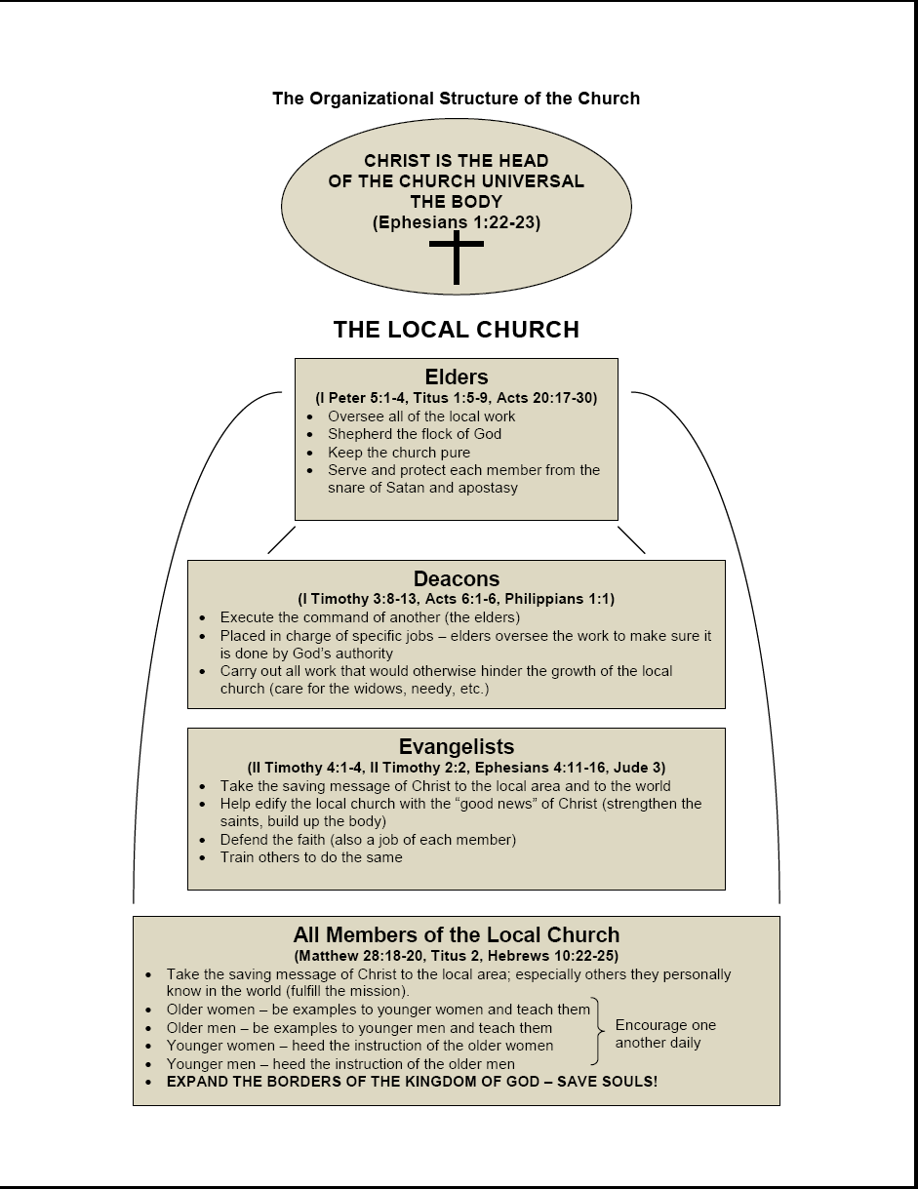

Slide 67
Guy Woods’ 1939 Quote @ ACC Lectures
“This writer has never been able to appreciate the logic of those who affect to see grave danger in Missionary Societies, but scruple not to form similar organizations for the purpose of caring for orphans and teaching men to be gospel preachers!”

Slide 68
“THAT WHICH SEEMS THE HEIGHT OF ABSURDITY IN ONE GENERATION OFTEN BECOMES THE HEIGHT OF WISDOM IN THE NEXT!”
- John Stewart Mill

Slide 69
Guy Woods On “The Issues” Of The 1960’s:
“This idea of trying to distinguish between Christian activity of the disciples and the church is an absurdity anyway!”
?
PLEASE
DISCUSS

Slide 70
Living With Biblical Tensions by Klyne Snodgrass:
“Christians have always wrestled with the fact that our faith gives us two or more realities that stand in tension or seeming contradiction to each other. ‘Double-truth’ issues have dominated theological thinking throughout the church’s history. Throughout Christian history, heresy has resulted not from someone wanting to be evil or heretical but from someone taking a piece of truth to an extreme and not doing justice to other truths as well.”

Slide 71
DOUBLE TRUTH DILEMMA:
Double Love of Double Truths
These Sources of Division Can Be Conquered By A Unified Single Hatred Of Wrongdoing & Love For A Lost Society.

Slide 72
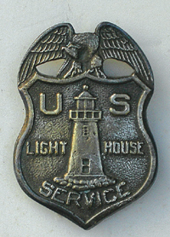
Loss Of Purpose Parable
Historic Cycles
Once upon a time, a group of concerned citizens decided to build a lighthouse in order to aid those in distress at sea. Through genuine caring interest, they would solve the problem.
Even more, this group decided not only to provide a beacon of light for those who were lost, but also to form rescue squads who would brave dangerous waters to save those imperiled by shipwrecks. They began to organize the work and create a structure to carry it out.

Slide 73
Loss Of Purpose Parable
Historic Cycles
In the beginning, the purpose of the group was clear; everyone who joined them knew that they would be trained to save people in distress. Yet, within a short time, some who organized the group began to question whether it was necessary to answer every distress signal. “Perhaps,” they said, “it would be acceptable only to have certain hours when they would be on duty.”
Next, they began to wonder if it were necessary for everyone to be part of the rescue mission. “Perhaps,” they thought, “only certain members should go out, while most just watched from shore.” They created titles and gave authority to a few, while most just wandered around the lighthouse or quit and went home.

Slide 74
Loss Of Purpose Parable
Historic Cycles
After a time, the rescue mission stopped altogether, and the group said, “Enough of this going out to sea. If people are lost, we’ve got a light on our house to guide them. They can simply follow the beacon.” Instead of rescue missions, they started holding meetings and talk only to each other.
Next, the group began to be more concerned about the comfort of the lighthouse and all the money it took to maintain it. They began to argue about who would control the light, the interior design and exterior decoration. Also, they decided they did not want wet and soggy people rescued from the sea, messing up their house.

Slide 75
Loss Of Purpose Parable
Historic Cycles
The more they argued the dimmer the light on the house became. One day the light went out and no one even noticed. They were too busy with work on the inside.
Finally, the group had a nice, comfortable house just the way they wanted it, and they changed its name from a lighthouse to a clubhouse.
A short time later, a group of concerned citizens decided to build a lighthouse so as to aid those in distress at sea. By way of a genuine caring interest, they would solve the problem…

Slide 76
A Great Truth Tom Wolfe
There are only 2 reasons people don’t become Christians
They’ve never seen a Christian
They have seen a Christian
A Narrow Demographic or Narrow-minded?

Slide 78
CONCLUSION: NON-DENOMINATIONAL MOVEMENT CREATES THREE CHURCHES
HISTORICAL RECORD: BETWEEN 2 TRUTHS UNITY THE CASUALTY
HISTORICAL RECORD: “The Narcissism of the Small Difference.”
FAIL #1: PLURAL EXEGESIS W/MULTIPLE NECESSARY IMPLICATIONS
FAIL #2: TWO RATIONALES – 2 VIEWS OF REGULATORY PRINCIPLE
FAIL #3: DEFINITION DEFAULT – 2 VIEWS OF EXPEDIENCY OPTION
FAIL #4: ABSOLUTIST DIVERGENCE IN THE HERMENEUTIC UTILITY
FAIL #5: HARD POSITIONING – NO ONE VALUES RECONCILIATION
FAIL #6: HARD POSTURING – BATTLING BROTHER PUBLICATIONS
FAIL #7: HARD PARTITIONING - NON-TRANSFERABLE MEMBERSHIP

Slide 79
Thomas Campbell’s Assessment: The Two Principles In Tension
David Lee Burris:
Thomas Confessed He Had Overlooked The Importance Of Baptism In His Efforts To Obtain Christian Unity!
“The authority of primitive Christianity and obligation of Christian unity should be cooperative and mutually corrective.”

Slide 80
David Lipscomb’s Approach: The Two Principles In Tension
“We will maintain the truth, press the truth upon him, compromise not one word or iota of that truth, yet forbear with the ignorance & weakness of our brother who is anxious but not yet able to see the truth. How do I know that the line beyond which ignorance damns, is behind me, not before him?”

Slide 81
Why do intercommunal relations became so vicious so fast - especially given the essential similarities?
But that in itself could well be the explanation. In numerous cases of ethnic conflict, the deepest hatreds are manifested between people who—to most outward appearances—exhibit few significant distinctions. It is one of the great contradictions of civilization and one of the great sources of its discontents, and Sigmund Freud even found a term for it: "the narcissism of the small difference." As he wrote, "It’s precisely the minor differences in people who otherwise are alike that form the basis of feelings of hostility between them."
?

Slide 82
“If they get you asking the wrong questions, they don’t have to worry about the answers.” Thomas Pynchon

Slide 83
Sherlock Holmes: “My Dear Watson”
“You see, my dear Watson, it is not really difficult to construct a series of inferences, each dependent upon its predecessor & each simple in itself. If, after doing so, one simply knocks out all the central inferences & presents one’s audience with the starting-point and the conclusion, one may produce a startling, though possibly a meretricious, effect.” The Dancing Men

Slide 84
One Body\Implication & Inference\Fall 1988:
“Some inferences are feasible, but not necessary. Conclusions which are not necessitated by logic, but are probable by logic, are in this class. They are made because they appear wise and expedient. Other inferences are merely arbitrary. Such an inference is but one out of a plurality of probable alternatives, any one of which may be held to the personal satisfaction of the student. One inference enjoys as much worth as another.”

Slide 85
Restoration
Regulative Principle
Divergence

Slide 86
Restoration Movement divide @ Regulative Principle:
DISCIPLES Of Christ - “We must not condemn what God has not!”
Churches Of Christ – “We must not add what God hasn’t authorized!”

Slide 87
NEW WINESKINS\MARCH 2002\PAGE 18
Ironic Trend. “The Restorationist Movement has often been very liberating because it frees converts from the restraints of dead tradition- -alism. Yet the regular pattern of such pietistic movements has been repeated for the followers of Stone and Campbell as well. The insights or practices that made possible the original liberation sometimes become a set of calcified standard procedures & automatically expected beliefs. The result for 2nd and 3rd generation Restorationists can be restriction of spontaneity and an end to real freedom.”

Slide 88
NEW WINESKINS\MARCH 2002\PAGE 18
Ironic Trend. “Restorationist movements are sometimes marked by considerable self-congratulation at having broken thru the stultifying bonds of human tradition. Yet when such reform groups proceed to establish the particular forms of their restoration as ‘traditionless traditions,’ they can become every bit as inflexible as the supposedly corrupt traditions that these movements came into existence to overcome.”

Slide 89
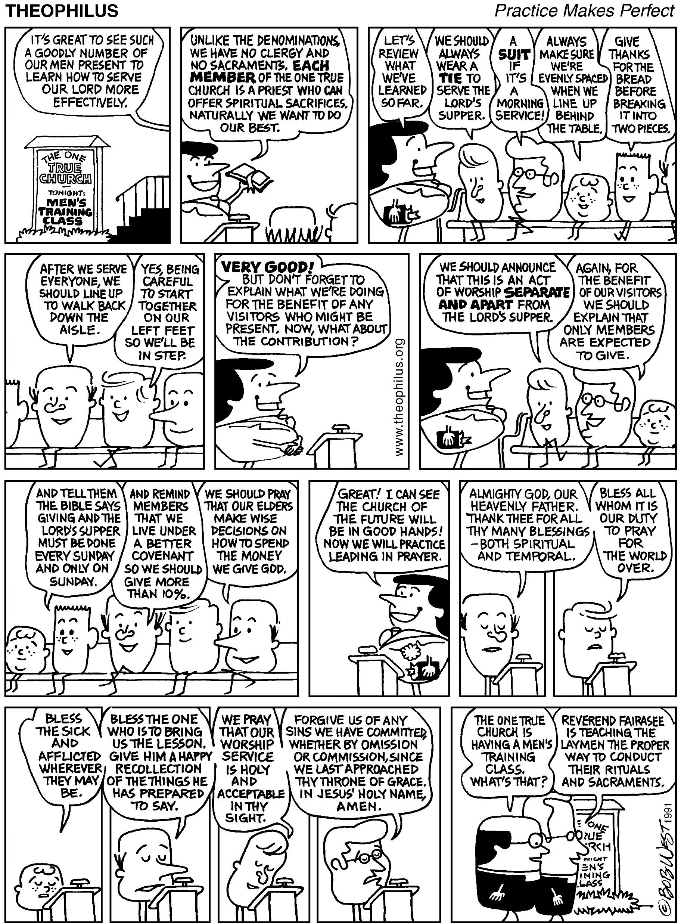
OUR OWN ROTE & RITUAL

Slide 90
Abundant Life\Institutional Mindset\Aug07:
Traditional Thinking. “When a whole body of proof-texts arise & are circulated generally – whether in written or unwritten form – they become a body of tradition, and reflect a sort of creed. The example of the Pharisee ought to warn us that you can be averse to the concept of human creeds & still embrace the reality in your zeal to build a hedge around the truth. Soon people begin to admire the hedge and are more committed to its maintenance than that of the truth behind it. The truth or falsity of the applications of the proof-texts is not the problem. The problem is that the applications of the Scripture begin to be raised to the status of Scripture itself, so that a generation arises that no longer reasons through the context. They merely outline its teaching with the stencil handed down to them by the fathers. Soon any other application of the proof-text is gazed at with an eye of suspicion because it doesn’t have the familiar ring of ‘orthodoxy.’ When that happens Christianity begins to wreak of that same odor of cedar shavings and mothballs that characterized the religion of the Pharisees. You see, one of the ‘institutions’ of ‘institutionalism’ is ‘tradition.’ ”
- Jason Moore

Slide 91
Tradition means giving a vote to the most obscure of all classes… our ancestors!
Gilbert Chesterton

Slide 92
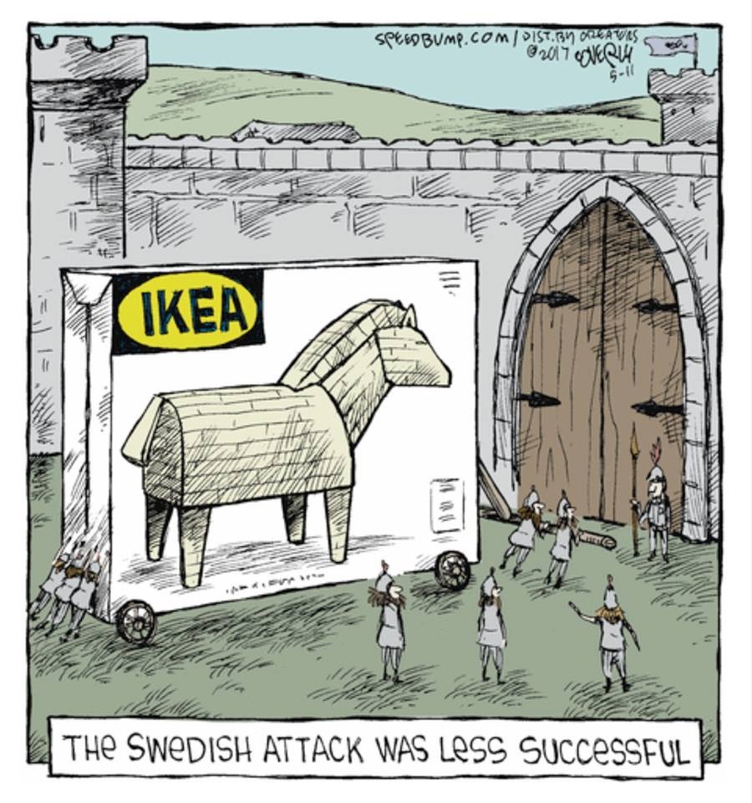
CONCLUSION: THREE CHURCHES SUBDIVIDE
UNITY & TRUTH ARE NO LONGER HELD OF AN EQUAL VALUE.
1960 – LIKE IN 1860 CHURCHES OF CHRIST FASTEST GROWING
RESTORE POINT SHORT LIVED & NEW REMNANT CYCLE BEGUN.
MATTER OF FACT CLASS TESTIMONY – 2 CENTURIES 2 DIVIDES
ILLUSTRATION: TASKING TOGETHER PERSONAL RESPONSIBILITY
ILLUSTRATION: TASKING BEYOND CONGREGATIONAL CAPACITY
MATTER OF FACT CLASS DISCUSSION – RECONCILIATION FAILS
ILLUSTRATION: MISSIONARY SOCIETY W/O SUPERORGANIZATION
ILLUSTRATION: ORPHAN HOME VESTIBULE CONTRIBUTION BOX
MATTER OF FACT CLASS DISCUSSION – TRADITIONLESS TRADITIONS
MATTER OF FACT CLASS DISCUSSION – WHAT IF THEY TIME LEAPED?
Could Restoration Notables Worship in Restoration Churches today?

Slide 94
1849 National Convention Meets In Cincinnati, Organizes The American Christian Missionary Society
Alexander Campbell Elected President Fills This Position For The Rest Of His Life
1848 – A. C. Spoke Before Congress on Carnal Warfare
1850 – A.C. Preached on John 3:16 to the U.S. Congress

Slide 96
Aphorism Attributed To Alexander Campbell As To Para-Church Actions & Organization:
“Whatever Is Good For The Church As A Whole Should Be Done By The Church As A Whole!”
?
PLEASE
DISCUSS

Slide 97
CONCLUSION: THREE CHURCHES SUBDIVIDE
Religious World calls belief system of churches of Christ – Campbellism.
Q - Could Alexander Campbell place membership in a church of Christ?
ILLUSTRATION: He was baptized by a denominational preacher.
ILLUSTRATION: He was an active participant in Ministerial Alliances.
ILLUSTRATION: He spoke in denominational pulpits w/o correction.
ILLUSTRATION: His five finger salvation steps different from today.
ILLUSTRATION: His five finger exercise includes indwelling of the Spirit.
ILLUSTRATION: He worked to “HARBINGER” Christ’s literal earthly reign.
Q - Would modern members Campbell or Stone be church disciplined?
Q – What is wrong in a corrective adjustment of a movement founder?

Slide 98
Integrity\Devil Is In The Details\Feb. 1996:
“We do, indeed, receive to our communion persons of other denominations who will take upon them the responsibility of their participa- -ting with us… All these persons, of so many and contradictory opinions, weekly meet around our Lord’s table… Our bond of union is faith in the slain Messiah, in his death for our sins, and his resurrection for our justification. Therefore, we acknowledge nothing among us but Christ, and him crucified.”
- Campbell In Debate With Rice

Slide 99
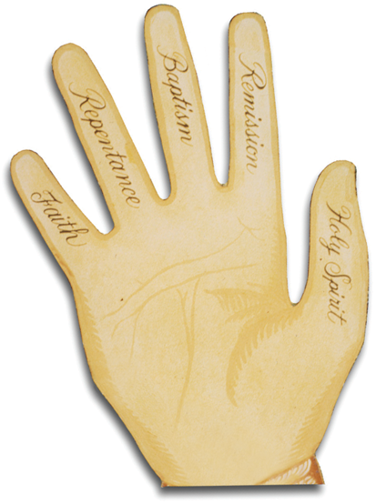
How Campbell Taught It

Slide 100
Could We Fellowship Campbell?
He is to our people what Luther is to the Lutherans or what Wesley is to the Methodists. Although we all know the drill associated with congregational identification – we still initially and instinctively wish to answer in the affirmative – but upon serious reflection we regretfully would say NO!
WHAT FOLLOWS HERE ARE SOME SEVEN REASONS
The truth is Alexander Campbell continually urged upon the brotherhood cooperative & associative endeavors.
Campbell accepted denominational status for the Restored Church when comparing as to “other denominations.”
He was a regular participant in ministerial joint efforts – i. e. “alliances - often meeting with “respectable ministers from all Protestant denominations.”
He often spoke at denominational churches - but “not to show them where they’re wrong” – which is the only justifiable reason a Church Of Christ preacher could do the same today.
Alexander Campbell believed there was a difference between gospel & doctrine and preaching & teaching. In terms of the local work, he also adhered to the concept of a plural ministry for the congregational eldership not our present normality of the located preacher.
Furthermore, he was never baptized “for the remission of sins,” as our churches today generally teach the concept. He was immersed by a Baptist preacher in 1812, simply upon his profession of faith that Jesus is the Christ, which was then as contrary to Baptist practice as it is today in the churches of Christ. He was never re-immersed as we would insist today. Moreover, in his Lunenburg letter he held that those who “habitually obey” Jesus are Christians even if they mistake the form of baptism and have not been immersed. This private letter runs contrary to his public statements in his debate with McCalla.
Most significantly, Campbell was a millennialist. His was a post-millennial view, Stone’s was a pre-millennial view, neither were of amillennialist viewpoint which has been made a test of fellowship. We would not have recognized either as brethren and driven them away - as was done to R. H. Bolls of Louisville, Ky. between the two world wars.

Slide 103
Excerpts of Religion & American Culture: Journal Of Interpretation, Vol. II, # 2 “The Apocalyptic Origins Of Churches Of Christ”
In 1906, the United States Bureau of the Census recognized for the first time a division in the ranks of the Stone-Campbell restoration tradition and listed two separate denominations: Churches Of Christ & Disciples of Christ. Until 1964, most historians rooted this division in a late nineteenth century dispute over missionary societies and instrumental music…However, in 1964, David Edwin Harrell took sharp exception in this interpretation and rooted the division in social forces related to the Civil War. Thus, he concluded, ‘the 20th century Churches of Christ are the spirited offspring of the religious rednecks of the postbellum South.”
There is considerable truth in both the traditional reading and in Harrell’s revisionist interpretation. At the same time, neither of these interpretations recognizes the pivotal role played by the separationist and apocalyptic tradition of Barton W. Stone in shaping Churches Of Christ, much less the cultural split that undergirded the differences between the Campbellite and the Stoneite perspectives…Alexander Campbell – a man who represented the “party of hope” as fully as any man of his age. Churches of Christ, ultimately descend, at least in part, from the separatist, anti-modern perspective of Barton W. Stone, who stood squarely in the “party of memory.”
Finally, the Stoneites were every bit as utopian and restorationist as Alexander Campbell, but for them, restoration had less to do with the forms and structures of the primitive church and more to do with lives of simple holiness.
That outlook, in turn, expressed itself in three specific ways: their insistence on a radical separation from the world; an eschatology that often manifested itself in premillennial terms, and their disdain for political involvement of any kind.
The Stoneites radical sense of separation from the world grew quite naturally from their apocalyptic orientation – an outlook that often gave expression to an explicitly premillennial eschatology. (some say postmill)
Indeed, millennial excitement was central to the Stone movement from its start at the 1801 Cane Ridge Revival.
While the Millerite excitement of the early 1840’s exacerbated Stone’s interest in this theme, his convictions regarding the premillennial kingdom of Christ predated those events by many years.
This is typical here of our man Barton Stone on this subject of Apocalyptic Origins & Millennial Orientation:
‘The 2nd coming of Christ is at the commencement of his millennial reign on earth – here on earth he will reign till the 1000 years be finished – nor will he cease to reign on earth till he has raised from death the wicked, & judged them according to their works.’

Slide 104
Kingdom Models
Historical Heritage
FUTURE
TERTULLIAN
INTERIOR
ORIGEN
EXEGETICAL ERROR:
REVERSING ORDER
TYPE & ANTITYPE
INSTITUTIONAL
AUGUSTINE
COUNTER-SYSTEM
MONASTIC
THEOCRATIC
CALVIN
UTOPIAN
ANA-BAPTIST

Slide 105
CHRIST & THE CHURCH
KINGDOM
BODY
Government
Unity
CHURCH
KINGDOM
HOUSEHOLD
BODY-CHRIST
Family
Ownership
HOUSEHOLD
CHRIST

