Slide 1
God Talk!
By David L. Burris

Slide 2
CONVERSATIONS WITH GOD
he is – “I am!”
three-in-one
questioning god
changing god’s mind
prayers petitioning god

Slide 3
He Is ~ “I am”

Slide 4
Where Did God Come From?

Slide 5
Was God Created?
If everything has to have a cause, does God?
Where did God come from?

Slide 6
God Always Existed
The concept of “eternal,” “everlasting” and “infinity” are difficult to grasp
God is “everlasting” in nature (Isa. 40:28; Ps. 90:2)
Hebrew word means “properly concealed, that is, the vanishing point; generally time out of mind, that is, eternity; perpetual, at any time, (beginning of the) world (+ without end)”
God is “eternal” (Deut. 33:27; Rom. 16:26; 1 Tim. 1:17).
Hebrew word means “the front of time (antiquity); often used adverbially (before, anciently); aforetime, eternal, everlasting”
The Greek word (αἰώνιος) means “perpetual (also used of past time, or past and future as well): eternal, for ever, everlasting, world (began).”
God has just always existed (Ex. 3:14)
God is Spirit, not confined by space and time…there is no need to be created!

Slide 7
God Never Changes
We can be assured that God’s nature does not change (Mal. 3:6; Jms. 1:17)
Because God does not change, we know that He currently exists as He always has…
And He will not change in the future!

Slide 8
God Will Always Exist
There is no end to God’s existence (Ps. 102:23-27)
He will be throughout known time, at the judgment and into eternity (Remember: He has no beginning and no end!)

Slide 9
We Will Experience Eternity
The bible is clear that we will experience eternity as well (Matt. 25:31-46)
Where we spend eternity is up to our own choices!

Slide 10
Our Challenge
Rightly divide the Word of Truth (2 Tim. 2:15)
To find all the things that pertain to life and godliness (2 Pt. 1:3)
And realize enough is revealed and some things may not be revealed (Deut. 29:29)

Slide 11
Lessons to Consider
God was not caused or created
Even if we cannot grasp the “eternal” characteristics, we can accept them by faith (2 Cor. 5:7)
We have a choice how we spend eternity (2 Ths. 1:8; Heb. 10:29-35)
We may not have all the answers, but we have enough (2 Pt. 1:3; Deut. 29:29)

Slide 12
Three-In-One

Slide 13
How Is God Part of a Godhead?

Slide 14
The Doctrine of the Godhead
Also called the Trinity…derived from the Latin word trinus (“three-fold”)
The term “Godhead” is found 3 times in the KJV (Acts 17:29; Rom. 1:20; Col. 2:9)
All three are mentioned in various passages (eg., 2 Cor. 13:14)

Slide 15
the
OneGod
Deuteronomy 4:35, 39
Deuteronomy 6:4
1 Kings 8:60
1 Chronicles 17:20
Isaiah 43:11
Zechariah 14:9
Galatians 3:20
James. 2:19

Slide 16
the
Divine
Three
Father
Son
spirit

Slide 17
Personal Distinctions:
Matthew 3:16-17
Matthew 28:19
Luke 1:35
John 14:26
2 Corinthians 13:14
Ephesians 2:18
Ephesians 4:4-6
1 Peter 1:2
Jude 20-21
Revelation 1:4-5
Father
Son
the
OneGod
(Eph. 1:3)
(Jn. 1:1,14;Heb. 1:8)
spirit
(Acts 5:3-4)

Slide 18
the
Divine
Three
IS NOT
Father
Mk. 13:32
Son
IS NOT
Gal. 4:6
Jn. 14:16
IS NOT
spirit

Slide 19
the
Divine
Three
Glorifies Father
(
Father
Son
Father
Son
spirit
spirit

Slide 20
Old Testament Evidence
“In the beginning, God (elohim) created…” (Gen. 1:1)
Multiple divine personalities allued to in other passages (Gen. 1:26, 3:22, 11:7; Is. 6:8; Eccl. 12:1)
Other passages reveal a distinction of personalities within the Godhead (Gen. 18:21 & 19:24; Is. 44:6 & Rev. 1:17; Zech. 11:12, 13; Ps. 110:1; Is. 53:6; Ps. 2:2, 3)

Slide 21
The Godhead @ Work
Creating the World (Gen. 1:1; Jn. 1:3,10; Col. 1:16)
Incarnation of the Son (Lk. 1:35)
Identifying the Messiah (Matt. 3:16-17)
Providing Redemption (Heb. 9:14; 1 Pt. 1:1-2)
Proclaiming Salvation (Heb. 2:3-4)
Sending the Spirit (Jn. 14:26, 15:26; Gal. 4:6)
Baptism of Believers (Matt. 28:19)
Providing Access to God (Eph. 2:18)
Blessing Believers (2 Cor. 13:14)
the
OneGod
the
OneGod
Father
Son
spirit

Slide 22
Lessons to Consider
The terms “Godhead” and “Trinity” are proper words for a biblical concept.
With faith we can be assured that there is one God who exhibits three personalities – regardless of how difficult it may be to understand
Each of the three personalities of the Godhead is eternal and equal in essence – though they may assume individual roles in their respective work
Misunderstanding of the Godhead, like many other doctrines, can seriously damage biblical teaching.

Slide 23
Questions

Slide 24
Should We Question God?

Slide 25
PRESUPPOSITIONS
Goes does exist
God is omniscient (“all-knowing”)
God is omnipresent (“always present”)
God is omnipotent (“all-powerful”)
God is omnibenevolent (“all-good”)
The Bible is the Word of God
God desires us to know Him

Slide 26
DOES IT MEAN WE DON’T TRUST HIM?
We must rely on God’s understanding (Prov. 3:5-6)
When we trust God, He will grant us peace and safety (Ps. 4:5-8, 9:9-10, 20:7-8, 25:105, 56:10-11)
Questioning God is not in itself wrong (Hab. 1:1-17; Ps. 10, 44, 74, 77)
Disobedience, hypocrisy, complaining, or insincerity can make questioning God wrong (1 Sam. 28:6, Job. 38:2)
We must ask with the right heart for it to be the right question…

Slide 27
MOSES
Moses questioned God on several occasions:
When God called him to lead Israel from bondage (Ex. 3:11)
When Israel was punished after Moses/Aaron first went to Pharaoh (Ex. 5:22-23)
When God wanted to destroy Israel for making the golden calf (Ex. 32:11-13)
Lesson: God will answer questions, but we better be ready to accept the answer!

Slide 28
GIDEON
Gideon had several questions about/for God when he was approached to deliver Israel (Jdg. 6:12-13)
He had a sincere desire to understand God
Lesson: God accepts sincere questions from those with righteous hearts

Slide 29
JOB
The entire book of Job contains questions to God
Ultimately, Job’s questions were answered by God…in a sense (Job 38:1-4)
God admonished and taught Job to keep proper perspective when questioning God
Lesson: We must keep a proper attitude toward God if we question Him!

Slide 30
CHRIST
As Christ hung in pain, he questioned God (Matt. 27:46)
Christ was human (like us) and perfect (unlike us); there cannot be anything sinful about asking God questions!
We are told to be like Christ (
Lesson: Even Christ questioned God…so we should be able to as well!

Slide 31
CONCLUSION
Nothing in the Bible indicates it is wrong to question God
We must be have the right attitude/heart
We must keep faith in him so we will be heard
We must be ready to accept whatever answer He gives (or has already given)

Slide 32
possibilities

Slide 33
Can We Really Change God’s Mind?

Slide 34
the
OneGod
Deuteronomy 4:35, 39
Deuteronomy 6:4
1 Kings 8:60
1 Chronicles 17:20
Isaiah 43:11
Zechariah 14:9
Galatians 3:20
James. 2:19

Slide 35
Understanding the Dilemma
God is omniscient (1 Jn. 3:20; Heb. 4:12-13; Ps. 139-1:24; Matt. 10:29-30)
God does not change (Ps. 7:11; Mal. 3:6; Num. 23:19; 1 Sam. 15:29; Is. 46:9-11; Ez. 24:14; Jms. 1:17)
God changed or repented in the past (Gen. 6:6-7; Ex. 32:14; Jonah 3:10)
Faithful prayers can make a difference (Jms. 5:16; 1 Pt. 3:10-12; Jn. 15:29; Phi. 1:4; 1 Ths. 5:17; Eph. 6:18; Lk. 2:37, 18:6-8)

Slide 36
Different Response?
Human attempts to explain God’s actions (not literal)
Change?...
…not a change if God already knows what He is going to do! (Is. 46:10-11)

Slide 37
“God’s decrees are not irrecovable, his will is not absolutely inflexible, and his judgments are not arbitrary. On the contrary, His actions exhibit love, concern and pity for man, and are designed to deal with him in a way commensurate with both justice and mercy.”
(Questions & Answers, Vol. 2; Guy N. Woods)

Slide 38
Conditional Warnings & Promises
The warnings and promises of God are often conditional and depend on actions of those to whom they apply:
Save a nation if they turns from evil (Jer. 18:7-10)
Save the cities if there were 10 righteous souls (Gen. 18:22-33)
Implied conditions are just as valid as specific ones!

Slide 39
God Does NOT Change…
God’s Character is Unchanged (Ps. 102:27; Mal. 3:6; Jms. 1:17)
God’s Nature is Unchanged (Heb. 1:12; Acts 17:31)
God’s Purpose is Unchanged (Heb. 6:17; Rom. 9:11; Job 23:13; Ps. 33:11; Is. 46:10)
God’s Promises are Unchanged (Num. 23:19; 1 Sam. 15:29; Rom. 11:29)

Slide 40
Why Should I Pray?
Prayer does not inform God, it involves God
Prayer does not change God, it changes us
Prayer does not get our will done in heaven, it gets God’s will done on earth
Prayer is not because God needs us, but because we need God!

Slide 41
Lessons to Consider
We can trust God and have confidence in all He does!
God does not need to change
We should pray
God is disappointed when we fail to follow his commands

Slide 42
petitioning

Slide 43
When God Does Not Hear!

Slide 44
God Does NOT Change…
God’s Character is Unchanged (Ps. 102:27; Mal. 3:6; Jms. 1:17)
God’s Nature is Unchanged (Heb. 1:12; Acts 17:31)
God’s Purpose is Unchanged (Heb. 6:17; Rom. 9:11; Job 23:13; Ps. 33:11; Is. 46:10)
God’s Promises are Unchanged (Num. 23:19; 1 Sam. 15:29; Rom. 11:29)

Slide 45
Why Should I Pray?
Prayer does not inform God, it involves God
Prayer does not change God, it changes us
Prayer does not get our will done in heaven, it gets God’s will done on earth
Prayer is not because God needs us, but because we need God!

Slide 46
Understanding the Dilemma
Things Which Negate
Though we have these precious revelations that God is concerned about us and willing to fill our needs, many prayers go unanswered because of things in our prayers and things in our lives which negate the prayer.

Slide 47
Seven Conditional Warnings & Promises
I. Lack of faith. Jesus commanded, “Therefore I say to you, all things for which you pray and ask, believe that you have received them, and they shall be granted you” (Mk. 11:24). That faith that God can and will give what we ask, if it be according to His will, is necessary for that prayer to be answered is also seen from this passage: “But if any of you lacks wisdom, let him ask of God, who gives to all men generously and without reproach, and it will be given to him. But let him ask in faith without doubting, for the one who doubts is like the surf of the sea driven and tossed by the wind. For let not that man expect that he will receive anything from the Lord, being a double-minded man, unstable in all his ways” (Jas. 1:5-8). The prayer that is offered without faith is not going to accomplish very much.

Slide 48
Seven Conditional Warnings & Promises
2. Asking amiss. James said, “Ye ask, and receive not, because ye ask amiss, that ye may consume it upon your lusts” (4:3). The word “amiss” is translated from kakos which means “with bad intent” or “for the wrong reason.” The context shows that some asked in prayer for things after which they had lusted and over which they had fought, although they did not want these things for the right reason. So frequently, our prayers are filled with requests designed to fill our inordinate desires for material things. We ask and do not receive and wonder why! We do not receive because we ask for the wrong reasons.

Slide 49
Seven Conditional Warnings & Promises
3. Self-righteousness. The parable of the prayers of the Pharisee and the publican demonstrates that a self-righteous attitude negates prayer (study Lk. 18:9-14). The Pharisee was a haughty man who acted as if his works justified him before God, failing to realize that all of us, no matter how righteous, are sinners before God (Rom. 3:23; Gal. 3:10). If we manifest a similar self-righteous attitude, our prayers will also be negated.

Slide 50
Seven Conditional Warnings & Promises
4. Failure to forgive others. The parable of the unmerciful slave (Mt. 18:21-35) shows that the man who refuses to forgive those who sin against him will not receive forgiveness from our merciful Father above. Jesus said, “But if you forgive men for their transgressions, your heavenly Father will also forgive you. But if you do not forgive men, then your Father will not forgive your transgressions” (Mt. 6:14-15). Regardless of how men have treated us, we must love our enemies (Mt. 5:44) and leave vengeance in the hands of our just God (Rom. 12:19-21).

Slide 51
Seven Conditional Warnings & Promises
5. Sinfulness. The Scriptures teach that God will not hear the prayer of the man who habitually refuses to sub= mit to God’s will. “He who turns away his ear from listening to the law, even his prayer is an abomination” (Prov. 28:9). “If I regard wickedness in my heart, the Lord will not hear” (Isa. 66:18). “Behold, the Lord’s hand is not so short that it cannot save; neither is his ear so dull it cannot hear. But your iniquities have made a separation between you and your God, and your sins have hid His face from you, so that He does not hear” (Isa. 59:1-2). The man who walks in darkness cannot enjoy fellowship with God (1 Jn. 1:5-10).

Slide 52
Seven Conditional Warnings & Promises
6. Praying for a show. Jesus said, “And when you pray, you are not to be as the hypocrites; for they love to stand and pray in the synagogues and on the street corners, in order to be seen by men. Truly I say to you, they have their reward in full” (Mt. 6:5). The word translated “have . . . in full” is apecho. The word was a technical term to refer to an account in business transactions which had been paid in full. What Jesus is saying is this: The man who prays to be seen by men has received full payment for what he has done when he hears mere men saying, “Brother-Piety surely can lead a beautiful prayer.” We must be careful that we offer our prayers because of our devotion to God rather than to be seen of men. Our personal, private devotions to God are a safeguard to worship for show (Mt. 6:6).

Slide 53
Seven Conditional Warnings & Promises
7. Vain repetition. Again, Jesus said, “And when you are praying, do not use meaningless repetition, as the Gentiles do, for they suppose that they will be heard for their many words” (Mt. 6:7). Jesus did not condemn repetition in prayer; indeed, He instructed us to be persistent in presenting our requests to the Lord (Lk. 18:1-8). What He condemned was meaningless or vain repetitions. We must be careful that some of the cliches which we use in prayer not become meaningless (for example, “Thank you Father, for this another beautiful Lord’s day,” “May the speaker have a ready recollection of what he has studied,” “Be with the sick the world over and especially those of the Household of faith,” etc.). Most of our cliches are scriptural things to pray for; we must be careful less they become mere meaningless repetition.

Slide 54
Faithless Petitions Flounder
A lack of faith can certainly hinder one’s prayers. James declares that we must pray “in faith, nothing doubting” (Jas. 1:6). He describes the doubter as being like the restless sea. He has two minds—one of faith and the other of doubt. Hence, shall not receive his requests from the Lord.
Elsewhere we read that true faith requires us to believe that God “is a rewarder of them that seek after him” (Heb. 11:6).
In a world of doubt and confusion, how can we have confidence that God is truly listening and responding to our prayers.
There are at least two reasons. First, since God is almighty (Gen. 17:1) and can do all things (Job 42:2) consistent with his nature and will, he is obviously able to answer prayer.
Second, we should be so glad to have a God who is, at his very nature, a loving God (1 Jn. 4:8). He is, to put it in our crass colloquialism, loaded rich in mercy (Eph. 2:4).
Because of his love and abundant mercy, he longs to answer his children’s requests in harmony with their genuine needs.

Slide 55
Ignorance Impedes Our Invocation
Another reason prayers may be weakened is because of our ignorance.
The disciples once approached Christ as he was praying. They asked: “Lord, teach us to pray, even as John also taught his disciples” (Lk. 11:1).
Doesn’t this reveal that there must be a correct way to pray that comes as a consequence of teaching? It is frequently the case that Christians “know not how to pray” as they ought (Rom. 8:26).
For instance, it may be that some saints do not know of God’s willingness to answer our prayers, hence, they have not because they ask not (Jas. 4:2; cf. Phil. 4:6). Ignorance concerning the purpose of prayer can hinder. For example, prayer should be according to God’s will in order to be heard (1 Jn. 5:24). But how can we pray effectively according to his will if we don’t know his will.
Here’s an example. It is not proper to pray for miracles, since those signs served a unique place in the divine plan (Mk. 16:17-20; Heb.2:2-4) and thus, have been terminated (1 Cor. 13:8-13; Eph. 4:8-16). (See: What Does the Bible Say About Miracles? )
And what about praying that God should save someone—someone we dearly love—but who remains in rebellion to the gospel plan of salvation (1 Jn. 5:16). The more we study and understand God’s will as revealed in his word, the more effectively we can pray.

Slide 56
Impurity Inhibits Intercession
If prayer is to reach the throne of grace, the supplicant must strive with deadly seriousness to conform his life to the holy will of the Lord God. The Bible is replete with instructions to this end.
Isaiah warned Israel of old that Jehovah would not hear them because of their sins (Isa. 59:2). The Savior solemnly taught that we must abide in him and allow his words to abide in us if we would have our petitions fully answered (Jn. 15:7).
Peter declared that “the eyes of the Lord are upon the righteous, and his ears unto their supplication” (1 Pet.3:12). Yes, the prayers of the righteous person avails much (Jas. 5:6).
But the requests of those who deliberately turn away from hearing the Creator’s will are abominable in his sight (Prov. 28:9).

Slide 57
Pride Prohibits Prayer
No one is qualified to approach the great God of the universe with a spirit of smugness.
He is the Lord, God Almighty (Gen. 17:1). We are but dust (Gen. 3:19). He is Creator. We, the created (Psa. 100:3). He is holy (Psa. 9:9), yet we are sinners (Rom. 3:9, 10).
Accordingly, prayer must ever be characterized by a spirit of lowliness.
This lesson is taught in one of the Lord’s parables. Two men went up to the temple to pray (Lk. 18:9ff). One was a Pharisee and the other was a publican. Pride made the difference as to whose prayer was heard.
When the Pharisee arrived at the temple, he struck a pose and eulogized himself. I thank thee, that I am not as the rest of men." He viewed himself as a self-made man, and he adored his creator! In stark relief, however, the publican contritely sought the Lord’s mercy as a sinner. He was justified rather than the other.
The lesson of the parable is this. Arrogance can negate prayer! Humility will bless it!

Slide 58
Unforgiving Attitudes Overthrow Prayer
One of the most utterly devasting things that the Christian can do to hinder, indeed, to virtually cancel the effect of his prayers is to harbor a surly, unforgiving attitude toward others he feels have sinned against him (whether is real or imagined).
Christ taught the disciples to pray: “Forgive us our debts, as we also have forgiven our debtors.” In conclusion he warned: But if ye forgive not men their trespasses, neither will your Father forgive your trespasses (Mt. 6:12, 15). Judgment is without mercy to him that shows no mercy (Jas. 2:13).
Peter once asked the Lord: “How oft shall my brother sin against me, and I forgive him? until seven times?”
The Jewish rabbis felt that three times to forgive was quite sufficient (cf. Barclay, 213). Likely, Peter assumed he was being generous, but the Lord cautioned that forgiveness was to be extended seventy times seven (i.e., limitless!).
Then in order to illustrate the gravity of having an unforgiving spirit, Jesus told the parable of the unmerciful servant. In this divine narrative, the king represents God. The first servant and his vast debt is you and me and the fact that our sins have put us head-over-heels in debt to God. It is debt that we can never pay off by acts of human merit. It must be a matter of forgiveness.
The second indebtedness calls attention to the trespasses others commit against us. How astounding it is that we, who have been given Heaven’s saving grace are sometimes so unwilling to forgive others. The Lord warns that we cannot receive his forgiveness unless we are willing, from the heart, to forgive each other.

Slide 59
The Sabotage of Selfish Prayers
Finally, some short-circuit their prayers due to their own selfishness. James says: “Ye ask, and receive not, because ye ask amiss, that ye may spend it in your pleasures” (Jas. 4:3).
The word for pleasures is hedone. Here it suggests the desire of one who is so wrapped up in the physical world that he has little interest in fulfilling his true purpose on earth (cf. Isa.43:7; Eccl. 12:13). Though “religious,” the individual here considered prays only out of a base spirit of selfishness.
Perhaps we need to analyze the motivation behind our prayers. When we petition for material things, is it that we might use them to the glory of God or that we might be more comfortable?
That the prayers of many members of the church to this end are selfish prayers is clearly evinced by the fact that most of their possessions are employed to accommodate themselves, while only a pittance is offered to the Lord. But if our petitions are directed to the end that we may effectively serve our Savior, God can open the windows of heaven and pour out blessings in abundance (Mal. 3:10; Prov. 3:9, 10; Lk. 6:38).

Slide 60
Don’t Forget To Be Thankful! When Paul wrote to Timothy (1st Timothy 2: 1), he told him that he should offer supplications, prayers, intercessions and giving of thanks for all men. “Supplications” are our requests regarding our needs. “Prayers” are any discourse with God, which would include petitions, praise and thanksgiving. “Intercessions” are our pleas to God on behalf of others. “Thanksgiving” obviously expresses our thanks for the multitude of blessings, both physical and spiritual, which we enjoy in this life. When we offer our prayers, we always want to remember to be thankful for the multitude of blessings God has bestowed upon us. Christians are saved by the grace of God, through the sacrifice of Jesus Christ, and through compliance with the terms and conditions set forth in the New Testament. Someone was concerned enough about us to tell us of the love of God and show us the things that we need to do to be saved. Certainly Christians are thankful for this blessing. But, we are also given great privileges, opportunities and comforts that are physical in their nature and it would be an act of utter ingratitude if we were not thankful for these physical blessings as well.

Slide 62
Hannah’s Prayer
Jabez’s Prayer
David’s Psalms
The Master Teacher
The Disciple’s Prayer
Four Fingers of Prayer
The Thumb is “Thanksgiving”

Slide 63
Hannah’s Prayer
Jabez’s Prayer
David’s Psalms
The Master Teacher
The Disciple’s Prayer
Four Fingers of Prayer
The Thumb is “Thanksgiving”

Slide 64
When God Does Not Answer!

Slide 65
God Does NOT Change…
God’s Character is Unchanged (Ps. 102:27; Mal. 3:6; Jms. 1:17)
God’s Nature is Unchanged (Heb. 1:12; Acts 17:31)
God’s Purpose is Unchanged (Heb. 6:17; Rom. 9:11; Job 23:13; Ps. 33:11; Is. 46:10)
God’s Promises are Unchanged (Num. 23:19; 1 Sam. 15:29; Rom. 11:29)

Slide 66
Why Should I Pray?
Prayer does not inform God, it involves God
Prayer does not change God, it changes us
Prayer does not get our will done in heaven, it gets God’s will done on earth
Prayer is not because God needs us, but because we need God!

Slide 68
Understanding the Dilemma
When we have prayed by Biblical Formula and in the Right Attitude but yet God Remains Silent. How is that to be understood?

Slide 69
Conditional Warnings & Promises
PERSISTENCE
The persistence of the petition is another factor that the Bible indicates has a bearing on the efficacy of prayer. In Luke 18:1, the gospel writer stated: “Then He [Jesus—KB] spoke a parable to them, that men always ought to pray and not lose heart” (emp. added). The parable Jesus told in this context was about a widow who made a request to an unjust judge. Her request was noble and right, but the unjust judge did not feel obligated to comply with her appeal. Due to her persistence, however, and her “continual coming” to the judge, he finally granted her petition. Jesus then commented that if an unjust judge can be swayed by persistence, how much more effective is the persistent prayer of a virtuous person when addressed to the righteous Judge of all the Earth.
Additionally, Jesus told of a man who visited his neighbor at midnight requesting bread to feed a guest. Initially, the neighbor refused the request, but eventually he complied. Jesus stated: “I say to you, though he will not rise and give to him because he is his friend, yet because of his persistence he will rise and give him as many as he needs” (emp. added). Jesus then coupled this parable with the instructions to be persistent in requests to God (vss. 9-13). In fact, throughout the Scriptures, persistence plays a prominent role in effective prayer (see Philippians 1:4; 1 Thessalonians 5:17; Ephesians 6:18; Luke 2:37).

Slide 70
David’s Unanswered Persistent Prayer
Chapters 11 and 12 of 2 Samuel are almost parenthetical, then, as they depict this exceptional period in David's life. This was a time when he was not a “man after God's heart.” And so we find chapter 11 beginning with a description of Israel going to battle, while David stays at home (11:1). We find verses 26-31 of chapter 12 reporting how David showed up for the war, and when it was won, all Israel returned home to Jerusalem. There is a sense of closure, of finality, here, which I think the author intended us to feel. In addition, we find that our text records the death of Bathsheba's first son, followed rather quickly by the account of the birth of the second, Solomon, who was to rule on the throne of his father, David.

Slide 71
David’s Unanswered Persistent Prayer
The tragic death of David’s son is a consequence of David's sin, but it is not the penalty David deserves for his sin. The penalty for adultery and murder is death, on each count. David deserves to die, on two counts: adultery and murder. But Nathan has made it very clear that David's sin has been “taken away.” The death of this child is a painful consequence of David's sin, but it is not punishment for his sin, per se. That punishment has been taken away, borne by the Lord Jesus Christ.

Slide 72
David’s Unanswered Persistent Prayer
God could not look the other way when David sinned, for his disobedience to God's commands was a matter of public knowledge. As his victories and triumphs were known among the Gentiles, so his sins would be widely known as well. By taking the life of this child, conceived in sin, God makes a statement to those looking on. If God does not deal with the sin of His saints, they might reason, then He will not be concerned with mine, either. Thus, they will mock God with the confidence that they can get away with their sin.

Slide 73
David’s Unanswered Persistent Prayer
David mourns as a sign of his repentance as he beseeches God to spare the life of his son.
Is it right for David to beseech God to spare the life of this child when He has already said that He is going to take the life of the child? I believe the answer is “Yes!” David knew that some prophecies were warnings of what God would do unless men repented. God sometimes foretold future judgment, which would come to pass if men did not repent. The hope for divine relenting in response to human repenting is set down in Jeremiah 18:5-8.

Slide 74
David’s Unanswered Persistent Prayer
Is it possible that David felt this child might be the heir to his throne? If this were the case, then David surely had reason to hope that God would spare the child's life.
David was certainly right in his assumption that the life of this child was in God's hands, and that his best course of action was to appeal to God to spare the child's life. David believed in the sovereignty of God, and thus he rested his case with God. David's prayers are not only the expression of his repentance, but the exercise of his faith. Believing in God's sovereignty did not keep David from taking action (fasting and praying); his faith prompted him to act.

Slide 75
David’s Unanswered Persistent Prayer
It is what happens from this point on that perplexes David's servants. While the child was ill they had not been able to get David up from the ground, nor to eat any food. They assumed it would only get worse once he knew the child was dead. Instead, David arose from the ground, washed and anointed himself, changed his clothes, and went into the house of the Lord, where he worshipped. When he had finished worshipping God, he came home and asked for food. When they set it before him, he ate it.

Slide 76
David’s Unanswered Persistent Prayer
The death of this child came as no surprise to David because it had already been foretold by Nathan. Through Nathan God had informed David that this son, the fruit of David's sinful union with Bathsheba, “Uriah’s widow,” would surely die. The death of this child was the revealed will of God. For David to mourn excessively would have been to express his regret over God's will. David's actions indicated that he had accepted the death of this child as God's will.

Slide 77
David’s Unanswered Persistent Prayer
Nathan had already explained the reason for death of this child to David. The purpose for the death of this child was not to punish David. The appropriate punishment for David's sins under the law would have been the death penalty. Nathan has not given David news of a reduced sentence, but of complete forgiveness, because the guilt and punishment for his sins had been “taken away” (12:13). The purpose for this child's death was instructive. It was meant to silence any blasphemy on the part of the “enemies of God.” Lest any might wrongly conclude that Israel's God was oblivious to David's sin in the breaking of God's law, God made it apparent that He would not wink at sin, even the sin of a man after His own heart. The death of David's son was an object lesson to the enemies of God.

Slide 78
David’s Unanswered Persistent Prayer
David's mourning during the child's sickness was an act of repentance, not the mourning of the loss of a loved one:
22 He said, “While the child was still alive, I fasted and wept; for I said, 'Who knows, the LORD may be gracious to me, that the child may live.' 23 “But now he has died; why should I fast? Can I bring him back again? I will go to him, but he will not return to me.”
The death of this child was accepted as God's final answer to David's petitions for the child's life. This is the substance of David's answer to the question posed by his servants. While the child was alive, David fasted, wept, and prayed. But now the child is dead. David has done all that he could. God has given David a clear and final answer: “No.” David sees death as the time to cease those activities which were only appropriate in life. Someone has said, “Where there's life, there's hope.” As far as David's hope for the healing of this child is concerned, God has indicated to David that he should cease his efforts to persuade God to relent concerning this child's death.

Slide 81
Conditional Warnings & Promises
PERSISTENCE
The persistence of the petition is another factor that the Bible indicates has a bearing on the efficacy of prayer. In Luke 18:1, the gospel writer stated: “Then He [Jesus—KB] spoke a parable to them, that men always ought to pray and not lose heart” (emp. added). The parable Jesus told in this context was about a widow who made a request to an unjust judge. Her request was noble and right, but the unjust judge did not feel obligated to comply with her appeal. Due to her persistence, however, and her “continual coming” to the judge, he finally granted her petition. Jesus then commented that if an unjust judge can be swayed by persistence, how much more effective is the persistent prayer of a virtuous person when addressed to the righteous Judge of all the Earth.
Additionally, Jesus told of a man who visited his neighbor at midnight requesting bread to feed a guest. Initially, the neighbor refused the request, but eventually he complied. Jesus stated: “I say to you, though he will not rise and give to him because he is his friend, yet because of his persistence he will rise and give him as many as he needs” (emp. added). Jesus then coupled this parable with the instructions to be persistent in requests to God (vss. 9-13). In fact, throughout the Scriptures, persistence plays a prominent role in effective prayer (see Philippians 1:4; 1 Thessalonians 5:17; Ephesians 6:18; Luke 2:37).

Slide 82
Paul’s Unanswered Persistent Prayer
2nd Corinthians 12: 8
In 2 Corinthians 12, Paul recounts being afflicted with that mysterious “thorn in the flesh,” because of the glorious revelation he’d experienced fourteen years earlier. He states that on three occasions he’d begged “the Lord” to remove it (2 Cor. 12:8).
Who was the Lord?
Let the context speak. The response to Paul’s prayers had been a firm “no” (implied) — with the extension, “My grace is sufficient for you.” The apostle then gloried in the fact that the “power of Christ” would be sufficient for him (2 Cor. 12:9).
Alford Plummer says that the term “besought” (parakaleo) is frequently used of those who asked of Christ’s help, but not when referring to the Father (Plummer, 353; see also Barnett, 571).

Slide 83
Paul’s Unanswered Persistent Prayer
WHAT WAS THE APOSTLE PAUL’S “THORN IN THE FLESH?”
No one knows for sure what Paul's thorn in the flesh was. There have been various theories offered, such as a chronic sickness and bad eyesight. We just don't know because the Bible does not tell us. It doesn't mean we can't offer some educated guesses, but first, let's take a look at the relevant Scripture. Paul said in 2 Corinthians 12:7-8, "Because of the surpassing greatness of the revelations, for this reason, to keep me from exalting myself, there was given me a thorn in the flesh, a messenger of Satan to torment me-to keep me from exalting myself! 8 Concerning this I implored the Lord three times that it might leave me." This problem may very well have been the same one he mentioned in Galatians 4:13-14, "but you know that it was because of a bodily illness that I preached the gospel to you the first time; 14 and that which was a trial to you in my bodily condition you did not despise or loathe, but you received me as an angel of God, as Christ Jesus Himself." Neither verse tells us what the issue was, but the affliction may have been painful as could be designated by the word "thorn." But then again, if it were an issue with his eyesight, that could be considered a thorn in the flesh that was not painful. Let's take a look at that option. In Acts 9:3 Paul says, "As he [Paul] was traveling, it happened that he was approaching Damascus, and suddenly a light from heaven flashed around him." Because of this light, Paul fell to the ground and was blinded for three days (Acts 9:8-9; 22:11). Also, Paul says something very interesting in Galatians 4:15, "Where then is that sense of blessing you had? For I bear you witness that, if possible, you would have plucked out your eyes and given them to me." Could it be that because of the encounter with Christ Paul had been blinded, and this is why the Galatians wanted to, so to speak, pluck their eyes out for him? It seems like a real possibility. At any rate, Paul had asked three times to be delivered of affliction, but God did not heal him. The reason is obvious, as is stated by Paul himself, that it was to keep him humble (2 Cor. 12:7). It is worth noting that our afflictions which are permitted by God are often for the same reason. We cannot see how pervasive sin really is in us, and sometimes we're humbled by our afflictions and return to God and trust him. This, of course, is a good thing. - C.A.R.M. Resources

Slide 84
Paul’s Unanswered Persistent Prayer
WHAT WAS THE APOSTLE PAUL’S “THORN IN THE FLESH?”
There are two other passages of Scripture that those who believe Paul’s thorn in the flesh was sickness have tried to use to verify that. One is Galatians 4:13-15. Here Paul says that he preached the Gospel to these Galatians through an infirmity of the flesh, and in verse 15, he makes reference to these people being willing to poke out their own eyes and give them to him. From this, many commentators have contended that Paul’s thorn was a rare, ancient disease which was characterized by runny, puffy eyes.
The next scripture used to say Paul’s thorn was bad eyes is also in Galatians, chapter 6, verse 11. It says, “Ye see how large a letter I have written unto you with mine own hand.” People have said Paul’s eyes were so bad that he had to write in large letters, and this is what he was making reference to.

Slide 85
Paul’s Unanswered Persistent Prayer
PAUL’S PRAYER NOT ANSWERED BECAUSE OF SIN BUT FOR A HIGHER PURPOSE
There were individuals who possessed faith, and yet were not healed of their ailments. The apostle Paul obviously had plenty of faith. He had an “infirmity” that was so painful that he called it “a thorn in the flesh” and “a messenger of Satan” (2 Corinthians 12:7-10). Yet his earnest prayers to God for relief did not result in his being healed. Timothy was a faithful and effective servant of the Lord. He had “frequent illnesses” and stomach trouble of such severity as to warrant Paul referring to it by inspiration. But rather than simply healing him, or telling him to “pray for healing,” Paul advised him to use a little wine as a tonic (1 Timothy 5:23). Another Christian worker and companion of Paul in his evangelistic travels, Trophimus (Acts 20:4: 21:29), had to be left at Miletus due to his sickness (2 Timothy 4:20). Epaphroditus was an extremely valuable worker in the kingdom of Christ, so much so that Paul referred to him as “my brother and fellow-worker and fellow-soldier…and minister to my need” (Philippians 2:25). When he became sick “nigh unto death” (Philippians 2:27,30)—likely due to his exhausting kingdom activity and service to Paul—Paul did not heal him. These examples demonstrate that personal faith was not prerequisite to the reception of a miracle in the first century. Miracles were inextricably bound to the authentication of the spoken Word of God.

Slide 86
What purposes do our "thorns" serve?
First, they serve as an antidote for pride. And pride, like fat, causes men to swell larger than they ought and is very painful to remove and keep removed.
Second, such thorns nurture our dependency upon God, humbling us and helping us recognize our need for God's help.
Third, these physical problems build strength. A person builds strength purposefully only when he recognizes his weakness. Strength and endurance come only at the price of some suffering. Ask any athlete.
Our suffering in the flesh develops character, temper control and better dispositions, to name just a few things. We must never forget that God's power is made perfect in our weakness. God is glorified most when our personal weakness is evident and his strength shines through in our life despite our personal impotency.
What is your thorn? Is it a sickness when you want to be well to serve the Lord? Or, might it be poverty, when you could wish to have money to help the Lord's cause? An unbelieving spouse? Limited education or abilities?
Remember, God's ways are not our ways. He has at times used the most unlikely men to accomplish his purposes. So, let us recognize that sometimes we may be praying for the removal of something from our lives for which God has a purpose. Taking the burden away may be our answer but God's answer may be giving us the strength to handle the burden, thus increasing our faith and that of others. – Truth Magazine

Slide 87
PRAYERS MUST ACCORD WITH GOD’S WILL
In Jesus’ instructions to His disciples regarding prayer, He explained that they should include in their prayers the idea that God’s will should be done (Matthew 6:10). The apostle John, who would have been well-aware of Jesus’ teaching on prayer, stated: “Now this is the confidence that we have in Him, that if we ask anything according to His will, He hears us. And if we know that He hears us, whatever we ask, we know that we have the petitions that we have asked of Him” (1 John 5:14-15, emp. added). Notice that if we do not include verse 14 of 1 John 5, we could make the passage say, “whatever we ask, we know that we have the petitions that we have asked of Him.” Yet to do that would be to leave off the important qualifying statement that the request should be in accordance with God’s will, and should be offered from a heart that is humble enough to accept God’s will—even if that means that the request is denied. When the skeptic pulls snippets of verses from the gospel accounts concerning prayer, he or she is guilty of leaving off just such important qualifying information.

Slide 88
When we consider the idea of praying “according to God’s will,” we can see how important this qualifier is. No requests will be granted that attempt to violate or circumvent God’s ultimate will. For instance, suppose a person were to pray: “God, please save my mother even though she does not believe in Jesus Christ and refuses to repent of her sins, please let her go to heaven anyway, in Jesus’ name, Amen.” Would God grant that petition? The Bible is clear that He certainly would not, because to do so would be to violate His ultimate will that salvation is through the name of Jesus (Acts 4:12).
Furthermore, certain events and actions in this physical world are required for God to accomplish His will on this Earth. For instance, if one of Jesus’ apostles had asked God to spare the life of Jesus and not let Him die on the cross, that request would not have been in accord with God’s ultimate will and would not have been answered in the affirmative. Mark 8:33 provides an excellent example of this when Peter rebuked Jesus for predicting His own death. Jesus responded to Peter, saying: “Get behind Me, Satan! For you are not mindful of the things of God, but the things of men.” Whereas Peter most likely thought his actions were in accord with God’s will, they were not. To further illustrate, the many events in the life of the Old Testament character Joseph may have seemed unfair at the time. No doubt Joseph prayed to be freed from slavery or to be released from jail. But at the end of Joseph’s life, we see that God’s will was to make him a great leader in Egypt and to save the Jewish nation through him. Joseph recognized this, and said to his brothers who had sold him into Egypt: “Do not be afraid, for am I in the place of God? But as for you, you meant evil against me; but God meant it for good, in order to bring it about as it’s this day, to save many people alive” (Genesis 50:20). Joseph’s slavery & incarceration were the vehicles by which God brought Joseph to power, accomplishing His will.

Slide 89
“Joseph in Prison” by Elton D. Higgs:
How far away the fields where grazed my father’s sheep, Where in my sleep the visions spoke,
Affirming that my special coat was well deserved; And in my youth I knew that God had favored me.
A willing instrument I was, rebuking in my father’s name.
My brother’s worldly ways. And then the pit, the chains, the foreign land –
No one then to listen to my dreams! But God was gracious to me still,
As Potiphar repaid the works of God in me, And I regained my virtuous pride.
In confidence I turned aside, The evil of my master’s wife,
Rebuked in righteous words her monstrous lust.
And for my trouble once again, I lie imprisoned and disgraced.
Has God seduced me too, and cast me off - For basking in His favor?
It seems but scant reward,To be the chief of those who languish in the dark.
How shall I deal with One who rips away, What He Himself bestowed?
My robe of innocence my brothers drenched in blood;
My robe of righteousness was snatched,To scandalize my name.
How shall I be clothed, my Lord, Lying naked to Your will?”

Slide 91
Conditional Warnings & Promises
“but the Spirit himself makes intercession for us”
The expression “Spirit himself” is emphatic; it expresses an activity of the Holy Spirit personally, rather than what he may accomplish through a representative medium (cf. John 4:2). While the pronoun auto (“itself” – KJV; “himself” – ASV) is a neuter form, it is more appropriate here to render it as a masculine, since the Holy Spirit is a person, not a thing. This has the precedent of Scripture itself (cf. John 14:26 where the masculine ekeinos is used of the “Spirit”—a neuter term).
“with groanings which cannot be uttered”
The term “groanings” (stenagmois) denotes a sigh or groan. It is used (in various forms) more than fifty times in the Greek version of the Old Testament, and it reflects a “human lament” which suffering people are powerless to remedy on their own (Balz and Schneider 1993, 272). For instance, it describes the anguish of the Israelite people under the burdens of Egypt (Exodus 2:23; cf. Acts 7:34).
The notion that the “groanings” refer to “speaking in tongues” is to be rejected totally. Stott comments: “These groans can hardly be glossolalia, since those ‘tongues’ or languages were expressed in words which some could understand and interpret” (1994, 245).
But whose groanings are these? Though some would attribute them to the Holy Spirit, the better view appears to be that they are the Christian’s groanings, which are conveyed on his behalf by the Spirit unto God. Clearly the term refers to the Christian’s plight a few verses earlier in this chapter (v. 23), though a different point of focus is in view.
The context seems to suggest that the groanings originate because “we know not how to pray as we ought” in a knowledgeable and articulate way. It would seem, therefore, more in harmony with the general tenor of the Bible as a whole, then, to conclude that it is the Christian who gives rise to these “mute sighs, the expression of which is suppressed by grief” (Thayer 1958, 25), rather than the groanings issuing from the omnipotent Spirit of God.
Hardeman Nichols observes: “Surely the Holy Spirit who has the ability to completely reveal the mind of God to man would have no difficulty in pleading man’s cause to God” (1980, 350).
It is not impossible, though, that there may be a blending of two thoughts. Some think that the groanings, though originating with the Christian, actually are “shared by the Holy Spirit and the believer” (McComiskey 1976, 424).
John Stott suggests that “the Holy Spirit identifies with our groans,” so that “we and he groan together” (245). One thing is certain: when the groanings reach God, they are perfectly clear to him.
It is imperative, though, that we emphasize this point: it must not be concluded that the Father could not know of our plight apart from the Spirit’s intercession; no, rather, it is the role of the Spirit as a companion in the Christian’s life that is being emphasized. His work has been divinely orchestrated, consistent with the planning of the entire Godhead.
H. Leo Boles wrote: “Since [the Holy Spirit] dwells in Christians, he helps them in the act of prayer. Prayer is to God the Father in the name of Christ, and by the help of the Holy Spirit. Hence, each member of the Godhead is included in acceptable prayer” (1983, 256).

Slide 92
Conditional Warnings & Promises
“and he who searches the hearts”
The heart-searcher of this passage is generally conceded to be God, the Father, mentioned subsequently in the verse. God is said to “search” the heart of man.
The word means to examine, to investigate. It is a form of the figure known as anthropomorphism (representing God with human traits), the design of which, in this text, is to emphasize the all-knowing aspect of deity (cf. 1st Chronicles 28:9; Psalms 7:9; Proverbs 17:3; 1 Thessalonians 2:4). Similar expressions are used both of Christ (Revelation 2:23) and of the Spirit (1st Corinthians 2:10).
The present tense form argues for the concept of a God who is ever aware of our needs. The “heart,” of course, is the soul or spirit of man, the rational, feeling aspect of the human being—that part made in the very image of God himself (Genesis 1:26-27; Daniel 7:15; 1 Corinthians 2:11; Romans 10:9-10).

Slide 93
Conditional Warnings & Promises
“knows what is the mind of the spirit”
Again the verb (oida), employed as a present tense (see above), reveals the fact that the Father and the Spirit are constantly in close communication with one another, if we may express ourselves in the same sort of accommodative language discussed just above. God is ever aware of the Spirit’s insights into our souls, hence can adequately respond to our needs.
Cottrell suggests that Paul’s argument here is one where the reasoning proceeds from the less likely to the more likely: “If God knows what is in the minds of created beings who are qualitatively different from him and relatively independent of him, then surely he knows what is in the mind of the Spirit himself, who is qualitatively equal with God and one in nature with him” (1996, 498).

Slide 94
Conditional Warnings & Promises
“because [that – ASV] he intercedes for the saints”
The present tense of the verb (“intercedes”) depicts the characteristic activity of the Spirit on behalf of the Christian. (For the meaning of “intercede,” see above.)
The term “saints,” as used in the New Testament, is a general term for those who are faithful to God. It is commonly used for the members of various congregations of the Lord’s people (cf. Romans 1:7; 1 Corinthians 1:2; Ephesians 1:1; Philippians 1:1). It is linguistically related to the words “holy” and “sanctified.” It refers to a person who, by virtue of his obedience to the gospel plan of salvation (cf. Ephesians 5:26) and his consecration of life has become “separated unto God” (cf. 1 Thessalonians 4:3-4, 7; Romans 6:19, 22; Hebrews 12:14).
The Holy Spirit is delighted to operate on behalf of a people dedicated to righteousness. The Roman Catholic concept of “sainthood” bears utterly no relationship to the New Testament Scriptures.

Slide 95
Conditional Warnings & Promises
“according to the will of God”
The Greek text simply says, “according to God.” The translators of both the King James Version and the American Standard Version have supplied the words “the will of” (as indicated by the italics) for clarification purposes. God the Father and the Holy Spirit operate in perfect unison in the interest of Christian people.
Perhaps it is not out of place at this point to remind ourselves that, unlike the so-called “gods” of the ancient pagan world, the members of the sacred Godhead are never at variance with one another. They function in absolute harmony.

Slide 97
Childish Prayers
Princely Privilege
Honesty & Humility
Focus on the Promises
The Turning of the Wills
Prayer Meant Transcendent
The Three Levels Life is Lived
Where Does the Time Go?
CONTENTMENT ALWAYS!

Slide 98
Childish Prayers
Princely Privilege
Honesty & Humility
Focus on the Promises
The Turning of the Wills
Prayer Meant Transcendent
The Three Levels Life is Lived
Where Does the Time Go?
CONTENTMENT ALWAYS!

Slide 102
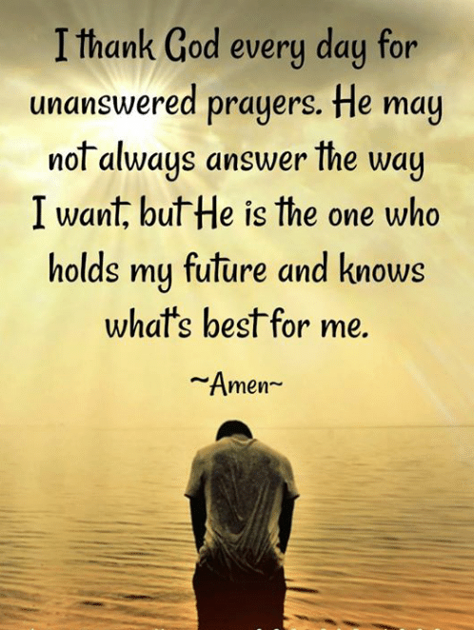

Slide 103
Unanswered Prayer Treated Poetically
He prayed for strength that he might achieve; He was made weak that he might obey.
He prayed for wealth that he might do greater things; He was given infirmity that he might do better things.
He prayed for riches that he might be happy; He was given poverty that he might be wise.
He prayed for power that he might have the praise of men; He was given infirmity that he might feel the need of God.
He prayed for all things that he might enjoy life; He was given life that he might enjoy all things.
He Had Received Nothing That He Asked For – All That He Hoped For; His Prayer Was Answered – He Was Most Blessed!

Slide 104
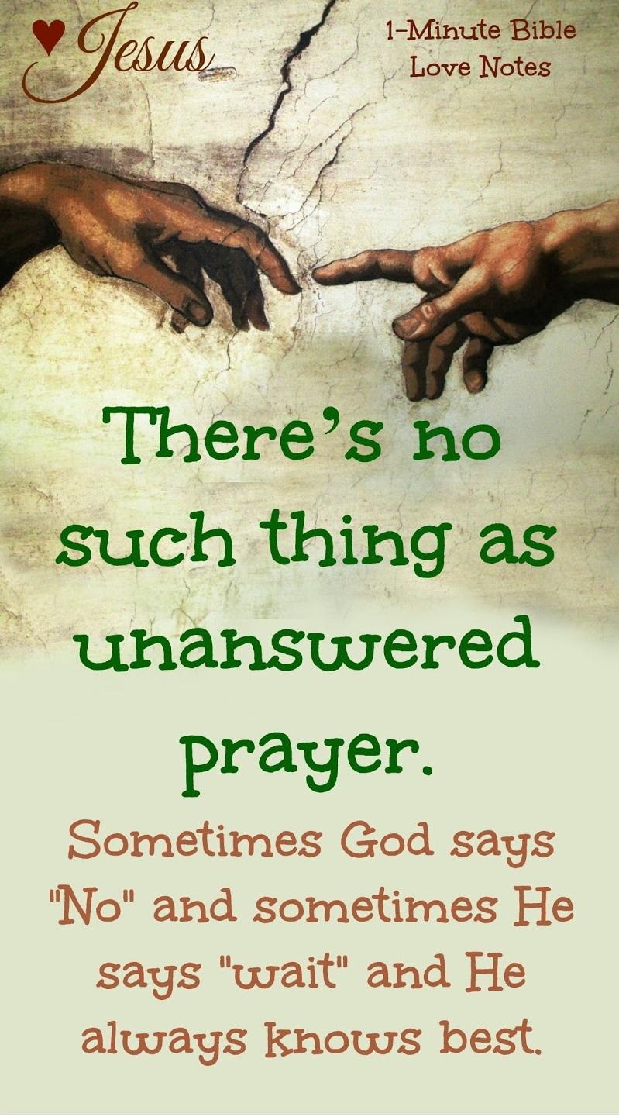

Slide 105
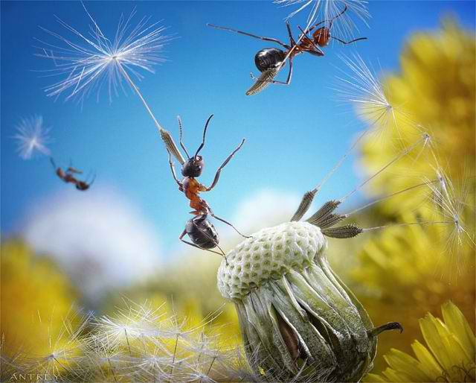
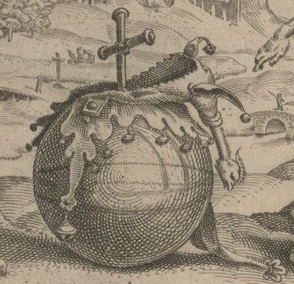
Proverbs 6.6
- & -
Hard
WORK
Fortune Is Related To Patience

Slide 106
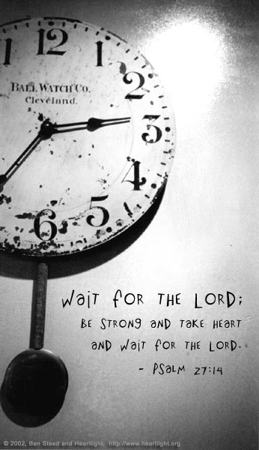

Slide 107
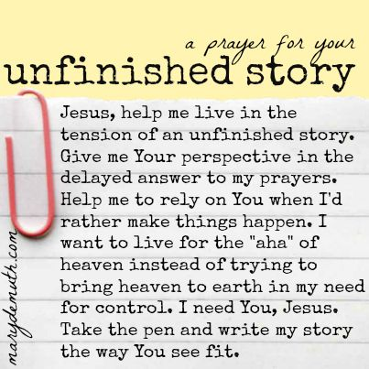

Slide 108
CONVERSATIONS WITH GOD
INTERNAL DOCUMENT HYPERLINKS

Slide 109
A Loss for Words
Notes:
Languages are dying every day, and experts predict that about half of the world’s tongues will be gone by the end of the 21st century. Will one of these fatalities be the language of prayer?
Manx. It’s the language of the Isle of Man, and on December 27, 1974, it was officially pronounced dead when its last native speaker died in the village of Cregneash at the age of 97. Words like coghal, meaning a large chunk of dead flesh in an open wound, or the word jouyl, meaning devil, are now lost and out of use. There are 6,800 spoken languages today, and experts believe that at least half will be dead by the end of the century. Nicholas Ostler is president of a foundation for endangered languages, and he is concerned about the large number of rare languages that are now in danger of becoming extinct. He points out that languages die for a number of reasons — war, genocide, disease, low birth rates, government policy. But globalization is probably posing the biggest threat of all. As the global village spreads and various economies become more intertwined, many people who speak minority languages will stop using them. For very practical reasons, they will switch to majority languages such as English, Chinese or Hindi—Urdu. Australia is a good example. English came to this continent through British colonization, just as it came to North America, and it became the language of government and commerce. As a result, 138 of Australia’s 261 native languages are now nearly extinct.

Slide 110
When it comes to prayer, are we at a loss for words?
Notes:
Yet, understandably, neither Ostler nor other experts point to another language that may be in danger of extinction: the language of prayer. Perhaps it’s not true. Who would admit that they don’t pray or believe in prayer? In fact, according to a George Barna survey, in 2001, 82 percent of adults said they pray at least once a week. And 89 percent believe there is a God who watches over us and who answers our prayers (see sidebar with more results of the survey). Yet, praying once a week hardly seems like a strong endorsement of the power of prayer. If we really believed that God answers prayer, and that prayer unleashes the power of God, would we pray just once a week? Come on! Perhaps it’s a case of people just mouthing the words, racing through the Prayer of Jabez or the Prayer of Jesus, thus relegating prayer to a minority language used by fewer and fewer people, leaving it with a cloudy and uncertain future. Have we allowed the dominant languages of government and commerce to take over our lives, edging out the lesser—known speech patterns that can connect us in a life—giving way to God? Have we pushed the language of prayer to the verge of extinction, making it a tongue that has just a handful of speakers, most of them elderly? In short, when it comes to prayer, are we at a loss for words? In Luke, the disciples of Jesus fear this very same future, so they ask him, “Lord, teach us to pray” (11:1). Jesus responds by instructing them to speak to God as they would speak to a member of their own family, calling God “Father” — an expression of intimacy and familiarity — and suggests that they make three requests. They should ask for bread, for forgiveness and for deliverance, and they should trust God to give them whatever they need.

Slide 111
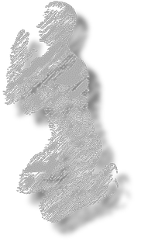
Jesus assures us that God will answer our prayers!
Notes:
Jesus goes on to encourage us to pray with persistence, using the language of prayer to plead for what we need (vv. 5—8). And then he assures us that God will hear our prayer and answer us, for if we human parents know how to give good gifts to our children, then “how much more will the heavenly Father give the Holy Spirit to those who ask him!” (v. 13). Jesus did not tell us what posture to assume when praying. Jurgen Moltmann, in his book The Source of Life: The Holy Spirit and the Theology of Life, observes that praying in the prone position denotes subservience, whereas the kneeling position — head bowed, eyes closed — speaks of an attitude of contrition and helplessness. Prayer while standing, with arms uplifted and outstretched, is a prayer of expectation in which the prayer—giver invites God to come into his life, indicating as well that the prayer—giver is ready to receive what God has to give. Finally, it is worth noting that this language of prayer, may not be a “language” at all — in the sense that it is spoken by a linguistic system, be it English, Spanish, French or something else. It may be a nonverbal language in which we speak to God by the manner in which we live. Ann and Barry Ulanov, in their book, Primary Speech: A Psychology of Prayer, note that “Prayer starts without words, and often ends without them.”

Slide 112
we will never be at a loss for words!
If we are in a close
Relationship with God,
Notes:
In any case, it is up to us to preserve this life—giving language, and keep it from extinction. Within the community of faith, we are challenged to create a healthy habitat for prayer, one in which we are not afraid to ask for the gifts we need for physical and spiritual health ... one in which we search diligently for the will of God among the many competing agendas of contemporary life ... one in which we knock again and again on the door to God’s kingdom, knock persistently through disciplined daily prayer, knock faithfully and forcefully with the full conviction that our Lord loves us and wants to meet our needs. With such an approach, the language of prayer will remain alive and active and off the endangered list. It will keep us in close communication with God ... and never at a loss for words. Source: Ostler, Nicholas. “A loss for words.” Foreign Policy. November—December 2003, 30—31.

Slide 114
Hannah’s Prayer

Slide 115
Human Barriers:
The Younger Son

Slide 116
Natural Barriers:
The Barren Woman

Slide 117
PRAYER IN IMITATION OF HANNAH
Has an important request to make
Has an important request to make
Has important purposes to affirm
Has important purposes to affirm
Has important work to pledge
Has important work to pledge
Has important confidence to express
Has important confidence to express
1st Samuel 1
Notes:
VI. Summary/Invitation
A. Who among us does not need to improve his prayer life?
1. Who among us does not need to have as an objective for this year to grow spiritually?
2. One way to accomplish both of these is to have spiritual growth through personal, private prayer.
B. As a practical model for effective prayer we have Hannah. To pray a prayer like Hannah’s prayer, we must:
1. Have an important request to make.
2. Have important purposes to affirm. We must show our commitment to use the results of that prayer in spiritual service.
3. Have some important work to pledge. We must commit to do our part in accomplishing the things we pray for.
4. Believe in results from prayer. To pray a prayer like Hannah’s prayer, we must have confidence in God’s capacity to answer our prayer.
5. May we increasingly strive to pray prayers like Hannah’s prayer.

Slide 118
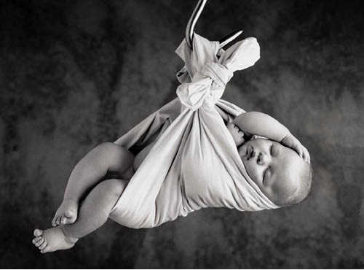
PRAYER IN IMITATION OF HANNAH
God Responds To Prayer!
Has an important request to make
1st Samuel 1
Notes:
VI. Summary/Invitation
A. Who among us does not need to improve his prayer life?
1. Who among us does not need to have as an objective for this year to grow spiritually?
2. One way to accomplish both of these is to have spiritual growth through personal, private prayer.
B. As a practical model for effective prayer we have Hannah. To pray a prayer like Hannah’s prayer, we must:
1. Have an important request to make.
2. Have important purposes to affirm. We must show our commitment to use the results of that prayer in spiritual service.
3. Have some important work to pledge. We must commit to do our part in accomplishing the things we pray for.
4. Believe in results from prayer. To pray a prayer like Hannah’s prayer, we must have confidence in God’s capacity to answer our prayer.
5. May we increasingly strive to pray prayers like Hannah’s prayer.

Slide 119
Jabez’s Prayer

Slide 120
The Prayer Of Jabez: What Wilkinson Is Really Teaching
That the verbatim repetition of an obscure Old Testament prayer should be the heart of the prayer life of the Christian.
That this obscure prayer is to set the pattern for our own prayer life – although the specific meaning of the prayer is unknown.
That this obscure prayer, which is never mentioned nor alluded to in the rest of Scripture, is the most important prayer in the Bible.
That proper exegesis of a passage of Scripture is not important.
That it is acceptable for the reader of Scripture to force any meaning they desire (eisegesis) upon the text.
That it is perfectly proper to apply any passage of Scripture to our own lives, even if that application is based upon a faulty interpretation.
That the ultimate proof of truth is not correct understanding of Scripture, but anecdotal and subjective testimony or personal experience.
That a prayer, any prayer, guarantees God’s favor and positive response.
That “selfish praying delights the heart of God.”
That the blessed life can be reduced to a formula, a gimmick, or a strategy.

Slide 121
David’s Psalms

Slide 122
David’s Psalms Of Communal Supplication: Literary Structure Of Hebrew Poetry
Synonymous Parallelism – is the most widely utilized. The two clauses are different in form but roughly identical in meaning. (Note: Psalm 38: 1 & 148: 1)
Antithetic Parallelism – occurs when the two clauses show an opposition or contrast of ideas. (Note: Psalm 1: 6 & 20: 8)
Synthetic Parallelism – occurs when the second clause completes the idea begun in the first clause - “as x, so y”. (See - Psalm 3: 4)
Two Synthetic Sub-genres – Cause & Effect Parallel (Psalm 126: 3) & Analogous Parallel (Psalm 125: 2)
Abundant Usage Of Metaphors & Personifications – Reference: 98: 8; 114: 4 & Example: Read 22nd Psalm
IMPRECATORY EXCEPTION

Slide 123
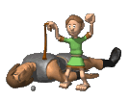
David Lee Burris:
WORDS ARE WEAPONS!

Slide 124
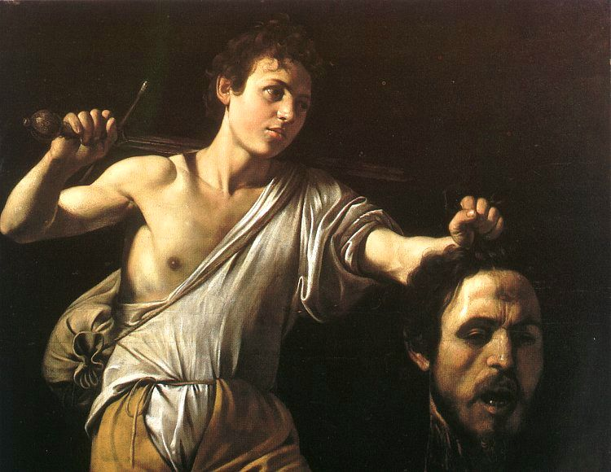
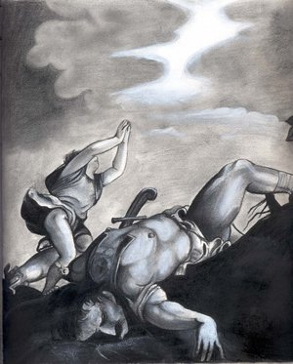

Slide 126
Psalm 23
The LORD is my Shepherd; I shall not want.
He makes me to lie down in green pastures; He leads me beside the still waters.
He restores my soul; He leads me in paths of righteousness for His name’s sake.
Yea, though I walk through the valley of the shadow of death, I will fear no evil; for You are with me;

Slide 127
Your rod and Your staff, they comfort me.
You prepare a table for me in the presence of my enemies;
You anoint my head with oil; my cup runs over.
Surely goodness and mercy shall follow me all the days of my life; and I shall dwell in the house of the LORD forever.

Slide 128
David’s Life Experience
This is a testimony Psalm. It is written by David in a distressed state most likely in exile in the forest of Hareth (1Sam.22:5)
Life was not a bed of Roses as David penned this psalm
David was a shepherd and he knew what a good shepherd did
He was experiencing God’s goodness in one of life’s darkest moments
David has moved experientially from the Lord being “a shepherd” to knowing him as “my shepherd”

Slide 129
Several Assumptions
We are all going to face situations in our lives for which nothing in our frame of reference can prepare us
Human strength and wisdom, while helpful, will at some point in our lives be inadequate or run out
Dependency on God is not a sign of weakness but an act of worship
God delights to show himself strong on behalf of his children especially in their time of weakness and need

Slide 130
Several Assumptions
God is willing and able to help us no matter how dire our situation He’s good for our good times as well as tough times
You have never been, currently are, or will be, in a situation where you heavenly Father is not greater
We tend to think comfort, God thinks character

Slide 131
Several Assumptions
We need to build our wall of defense in our time of peace so we have resources available in our time of storm
It’s not about the big “I”. God desires that He be glorified in you and I no matter what.

Slide 132
PSALM Chapter Twenty-three

Slide 133
Looking At Psalm 23
As a relational testimony
As a description of God’s character
As principles for daily living

Slide 134
Understanding the Text
hwhy yeh-ho-vaw,Jehovah, and her ra`ah raw-aw from the root Rohe Shepherd
There is no is in the original Hebrew.
It is a combination name; Jehovah-Shepherd
In the possessive it is Jehovah, my shepherd
It is to be seen and experienced relationally rather than didactically
David knew that because Jehovah, my shepherd was with him he had everything he needed

Slide 135
Looking At the Shepherd’s Psalm Relationally
Jehovah My Shepherd
When I have needs that are unmet…
When I need nourishment for my dry parched soul…
When trials and temptations seem more than I can bear…
When I have been beat up and hammered by life’s vicissitudes…
Jehovah My Shepherd
Jehovah My Shepherd
Jehovah My Shepherd

Slide 136
Looking At the Shepherd’s Psalm Relationally
Jehovah My Shepherd
When I am down, who lifts me up
When I am really hurting who understands and feels my pain
When I am troubled, who can give me peace
Jehovah My Shepherd
Jehovah My Shepherd

Slide 137
Looking At the Shepherd’s Psalm Relationally
Jehovah My Shepherd
When I face the scariest of circumstances…
When the enemies come in like a flood…
When this life is over and I die…
Jehovah My Shepherd
Jehovah My Shepherd

Slide 138
Psalm 23 Revised
The clock is my dictator, I shall not rest.
It makes me lie down only when exhausted.
It leads me into great depression, it hounds my soul.
It lead me in circles of frenzy, for activity sake.
Even though I run frantically from task to task, I’ll never get it all done.
For “my ideal” is with me; deadlines and need for approval, they drive me.

Slide 139
Psalm 23 Revised
They demand performance from me beyond the limits of my schedule.
They anoint my head with migraines, my in-basket overflows.
Surely fatigue and time pressure shall follow me all the days of my life.
And I will dwell in the bonds of frustration forever.

Slide 140
The Master Teacher

Slide 141
Our Lord: The Master Teacher
Prayer Assumes Its Normal Relation With God’s Person, God’s Moving, & Son
Accepting The Person Of Christ Is The Condition Of Prayer – John 14: 13, 14
Prayer One Of The Great Truths Christ Came Into The World To Teach – It Was Lowly Lesson Of Heavenly Vocation Mankind Has Been Adverse To Learn
Jesus Christ – Ours Now & Theirs Then - Divine School Master Of Spiritual Disciplines – By Precept & By Example
Epitome Covering Circle Of His Life & His Character – Jesus At Prayer
Suppliant Of All Suppliants & Intercessor Of All Intercessors
In Lowliest Form He Approached God & With Strongest Pleas He Prayed
He Teaches Us The Importance Of Prayer By His Urgency For His Disciples To Pray
In Addition, He Shows Us How Far Prayer Enters Into The Purposes Of God
Prayer Is The Spiritual Law World-Wide That Touches Eternity
Mosaic Prayer Altar Regulations Are No Longer In Effect – Old Law Types & Shadows Are Done Away With By New Dispensational Testament & Covenant
Not Any Prayer Isolated To Sacred Space & Special Time But Now All Attached To Any Ordinary Occasions & Set Of Circumstances
Prayer Regulations Now Spiritually Violated By Anger & Irreverence & Other Heart Disease

Slide 142
Our Lord: The Master Teacher
David Lee Burris:
Our Faith - By Definition - A Steering Wheel - Not A Spare Tire!
Sacrificial Incense Heavenly Ascending Now That Of Brotherly Love
He Has Put The Expanding Forces Of His Cause As Receptive To Our Prayers
Jesus Makes Prayer Out As All-Inclusive: It Has No Limitation As To Extent Or Subject
Gods Answer To Prayer Rules Over Forces Of Nature & Injustices Of Men In An Arranged Coincidence > Luke 18: 1 - 8
Christ Illustrates How Prayer Relates Both To God’s Spiritual Work & His Worldly Rule
Matthew 18: 19 – Power Of Prayer Related To Purity Of Church & Unity Of Spirit
He Bases Both The Possibilities & Necessities Of Prayer On The Relation Of Father & Child; The Child Crying For Bread & The Parent Giving That Which The Child Has Asked
Sterile Religion & Barren Unfruitful Cannot Pray; We Are To Pray For Church Growth & For The Harvest – Matthew 9: 38
When Within The Crucible – With God As First Mover Not As Last Resort -Mitigating Prayer Can Ameliorate Severity – Matthew 24: 20
Christ Teaches Prayer As Not The Rote Of Mere Rite But Request For Answers, Pleas For Gain, & The Seeking Of Great Good
He Instructs Humankind That Personal Prayer Is To Be Most Holy & Private Exercise

Slide 143
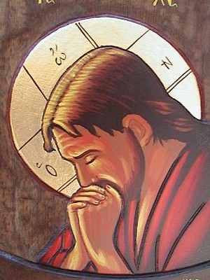
Our Lord: An Example Of Prayer Hebrews 5: 7 – Reviewed In Brief
“Who, in the days of his flesh, when he had offered up prayers and supplications, with strong crying and tears, unto him that was able to save him from death, and was heard in that he feared.”

Slide 144
First Timothy 2: Lesson On Prayer
David Lee Burris:
Colossians 4: 2 – 4 ~ Paul Urges Steadfastness In Prayer – Combines Watchfulness & Prayer – Unites Thanksgiving & Prayer – Combines Evangelism & Prayer
“Pray” Translated From 5 Greek Verbs & 4 Nouns
The verbs and their definitions are: (1) “Euchomai,” “To ask, beseech, to pray to God for something.” (2) “Proseuchomai,” “A comprehensive term in the New Testament denoting prayer in general.” (3) “Erotao,” “to ask request, entreat, beseech.” (4) “Deomai,” “to desire, ask, to pray, make supplication.” (5) “Parakaleo,” “to beg, entreat, beseech.”
The nouns and their definitions are: (1) “Euche,” “a prayer, wish.” (2) “Proseuche,” “prayer (generally).” (3) “Deesis,” “a need, asking, entreaty, supplication.” (4) “Enteuxis,” “a petition to a superior.”
In other words, prayer involves asking, supplication, requesting, & thanking.
The context of our passage demonstrates that prayer involves inclusively each of these meanings. The phrase “giving of thanks” in (1 Tim. 2: 1) translates “eucharistia,” which in this context means, “a prayer of thanksgiving.” In (1 Tim. 1: 12), the Apostle Paul states “…I thank Christ Jesus our Lord…” “Thank” translates “charis,” the root word found in “eucharistia.” In this text, Paul uses a term which expresses his gratitude to deity (Christ) and this gratefulness was shown by Paul to Christ in prayer - - (1 Timothy 1: 12 thru Chapter 2).

Slide 145
Disciple’s Prayer Checklist

Slide 146
LESSONS LEARNED: Disciples’ Prayer Checklist

Slide 147
David Lee Burris:
Balancing Act - Saints & Citizens!
Genre Of Biblical Prayer In Sojourner Motif
Serious Endeavor: Bridge Between Worlds
Prayer Life Is Oriented In Watchfulness
Prayer Life Part Of Righteous Obedience
Prayer Is Learning Experience & Service
Piety Includes Others & Petty Only Self
Partisan Pride & Social Superiority Mocks
Prayer Princely Privilege – Duty & Honor
Prayer Requires Reconciliation Horizontal Before Supplication Vertical
Prayer Requires Honest & Humble Approach
In Prayer We Match God’s Demands Of Justice With Our Intercession Requests For Mercy
Public Prayer Is For The Spiritually Matured

Slide 148
Prayer Is Talking To God
Jesus addressed this prayer to the Father, and in so doing shows that such is the main purpose of prayer. It is not to fulfill a religious exercise or to impress fellow creatures with our beautiful wording!

Slide 149
Prayer Is To Be Done With Reverence
After the salutation, the prayer continues with “hallowed be thy name.” This illustrates that reverence and respect are to be coupled with love and affection!

Slide 150
Spiritual Requests Are The First Things
While most men would start by asking God for personal favors and blessings, Jesus shows us in this prayer that the spiritual must come first. We seek first the kingdom of God and its righteousness!

Slide 151
Effective Prayer Requires Commitment
Jesus applied several expressions that not only were a request but would then involve those of a sincere heart to a life of service. “Thy will be done” would my submitting to God’s will. It would be hypocrisy to pray for such and then live in rebellion to God’s will. Prayer must be in accord with our lives, or rather, our lives must be in accord with our prayers!

Slide 152
Disciple’s Prayer Includes The Material
It has been a source of controversy, but most students of the Bible share in the opinion that the bread of life of which we express our thanks is broad in its application. It is inclusive of our daily bread that physically sustains us. Although our attitude of approach must be toward contentment in circumstance and our focus of prayer primarily spiritual and even though this is a minor point here in the Lord’s formula of prayer - we must keep this in mind. In other words, we must not take for granted either our spiritual nor our physical dependence upon the Almighty each and every day!

Slide 153
Prayer Should Be Constant & Continual
After the prayer’s distilled version ends in Luke chapter 11, verse 4, the teaching of Jesus continues through the chapter. The illustration of a man who would eventually answer a neighbor’s repeated request implies two things. One, that God will also answer our prayers: sometimes by saying yes, sometimes by saying no, sometimes by saying wait awhile. Yet, He hears and answers His child’s prayers. Two, That We Need To Be Prayerful Always & To Be A Prayerful People!
To Pray Only In Distress Is Mocking

Slide 154
Four Fingers of Prayer

Slide 155
PRAISE
Psalm 100: 4
1 John 1: 9
Matthew 7: 7
2nd Chr. 30: 8
REPENT
ASKING
YIELDED

Slide 156
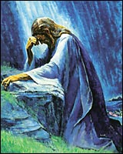
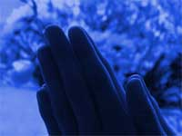
THE FOUR FINGERS OF PRAYER
ADORATION
CONFESSION
INTERCESSION
PETITION
Prayer 202: MODELED

Slide 157
Thanksgiving

Slide 158
The "T" In Thumb Is
For THANKSGIVING
Prayer 202: MODELED

Slide 159
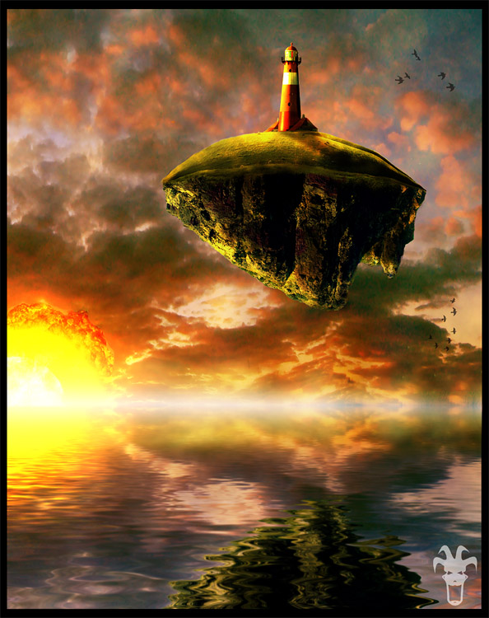

Slide 161
Thanksgiving Quotes
Most human beings have an almost infinite capacity for taking things for granted. Huxley

Slide 162
Thanksgiving Quotes
Life without thankfulness is devoid of love and passion. Hope without thankfulness is lacking in fine perception. Faith without thankfulness lacks strength and fortitude. Every virtue divorced from thankfulness is maimed and limps along the spiritual road. John Henry Jowett
In ordinary life we hardly realize that we receive a great deal more than we give, and it is only with gratitude that life becomes rich. Dietrich Bonhoeffer

Slide 163
Thanksgiving Quotes
Gratitude unlocks the fullness of life. It turns what we have into enough and more. It turns denial into acceptance, chaos to order, confusion to clarity. It can turn a meal into a feast, a house into a home, a stranger into a friend. Gratitude makes sense of our past, brings peace for today, a creates a vision for tomorrow. Melody Beattie

Slide 164
Interesting Research
From the research Project on Gratitude and Thanksgiving. Dr. Micheal McCollough of Southern Methodist University, and Dr. Robert Emmons of UC Davis presented.
Three groups of people kept daily diaries:
1st group recorded events of the day
2nd group recorded their unpleasant experiences
3rd group told to make a daily list of things for which they were grateful

Slide 165
Findings
Individuals Recording Gratitude Evidenced:
Higher levels of alertness, enthusiasm, determination, optimism and energy
Lower levels of depression and stress
More likely to volunteer assistance, were more healthy, and were making more progress towards their goals
Encouraged a positive cycle of reciprocal kindness and expression of loving feeling
More likely to be growing spiritually and developing a deeper spiritual awareness

Slide 166
If you have never experienced the horror of war, the solitude
of prison, the pain of torture, were not close to death from
starvation, then you are better off than 500 million people.

Slide 167
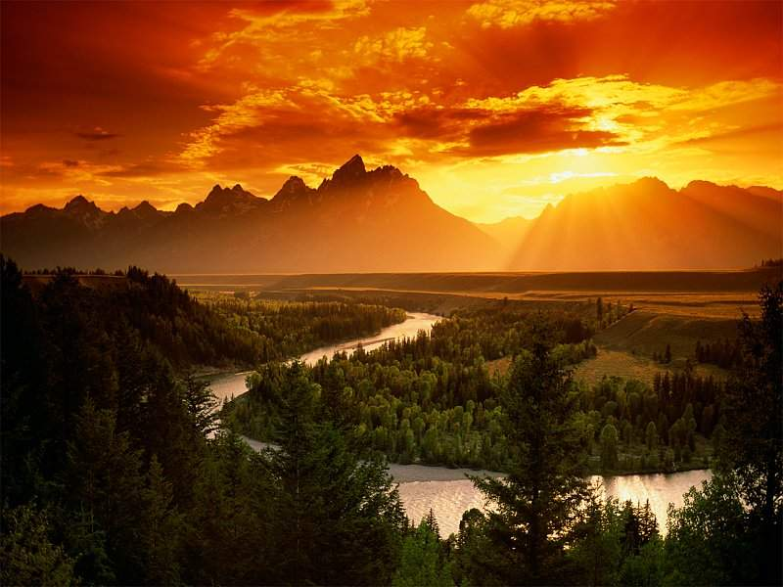
If you can go to your place of worship without fear that
Someone will assault or kill you, then you are luckier than
3 billion (that’s right) people.
If you have a full fridge, clothes on your back, a roof over your head and a place to sleep, you are wealthier than 75% of the world’s population.

Slide 168
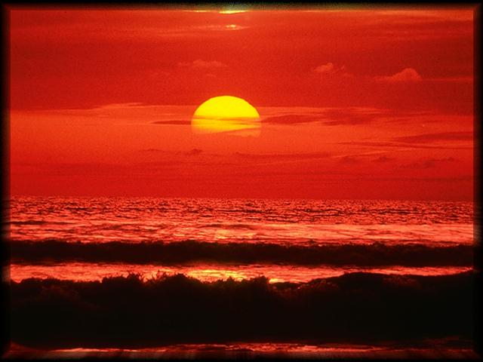
If you currently have money in the bank, in your wallet and a few coins in your purse, you are in the upper eight percent of the privileged few amongst the peoples of the world.

Slide 169
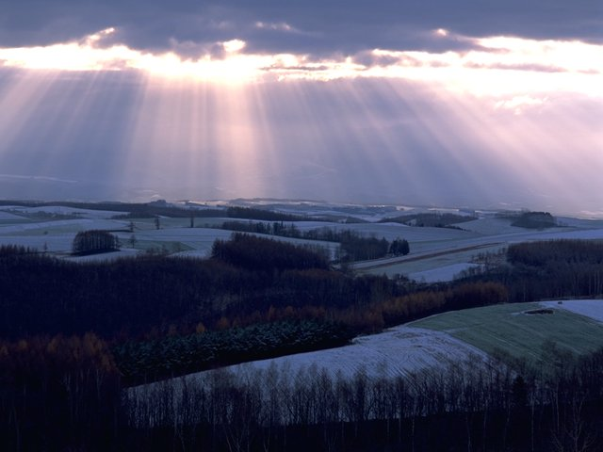
If you woke up this morning in good health, you have more luck than one million people, who won’t live through the week.

Slide 170
Childish Prayers

Slide 171
Successful Communication Requires “Putting Away Our Childish Ways”
David Lee Burris: ASEITY - God Is Not Limited To Anything External To Himself
– Being Himself The Limit Of Everything Else!
Discernment Produces Real Maturity & Noble Purpose Creates Fruitful Lives Of Lasting Happiness.
EVEN THRU THIS MEDIUM GOD STILL CANNOT:
Express Anything Other Than Perfect Love
Be Limited To The Natural World He Created
In Terms Of Space, Time, Matter, Or Energy
Yet, He Imposed Certain Limits Upon Himself!
Do Any Two Counter-Opposite & Mutually
Exclusive Things Both At The Same Time
Harm His Child. Maturity Discerns From Hurt
Be Our Comfortable Parent Or Leave Us Alone
Yet, He Is An Excellent Comforter!
Always Approve Us. Yet, Accepts & Accessible!

Slide 172
“Putting Away Our Childish Ways” This The Best Possible World
Planet Earth Result Of God’s Love Formula:
Human Maxim: “Never Create What You Cannot Control…”
Deity Maxim: “Let’s Make In Our Image”

Slide 173
“Putting Away Our Childish Ways” This The Best Possible World
Planet Earth Result Of God’s Love Formula:
It Is Relational – Compassion Requires Persons Mutually Influential & Capable Of Sympathetic Response
It Has Free Agency – Affections Are A Product Of The Will & Cannot Be Coerced
It Has Multiple Option – Human Choice Between Multiple Possibilities - Each & Every - Value-Laden

Slide 174
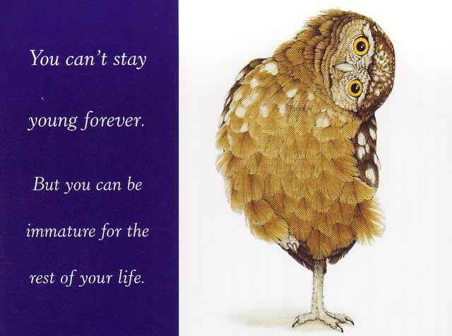
Successful Communication Requires “Putting Away Our Childish Ways”
David Lee Burris: ASEITY - God Is Not Limited To Anything External To Himself
– Being Himself The Limit Of Everything Else!
Discernment Produces Real Maturity & Noble Purpose Creates Fruitful Lives Of Lasting Happiness.
Purpose Driven Author Rick Warren On Life’s Purpose:
“God wants us to practice on earth what we will do forever in eternity.”
“We were made by God and for God, and until you figure that out, life isn’t going to make sense.”
“Life is a series of problems: Either you are in one now, you’re just coming out of one, or you’re getting ready to go into an other one.”
“The reason for this is that God is more interested in your character than your comfort.”
“God is more interested in making your life holy than He is in making your life happy!”

Slide 175
Princely Privilege

Slide 176
CHRISTIAN COUNSELING TODAY; VOLUME 11, NUMBER 4, PAGE 10:
1. Motive. Whenever the insist- -ence is on the point that God will answer prayer, we are off track. The meaning of prayer is that we get hold of God, not of the answer.

Slide 177
CHRISTIAN COUNSELING TODAY; VOLUME 11, NUMBER 4, PAGE 10:
1. Motive. Whenever the insist- -ence is on the point that God will answer prayer, we are off track. The meaning of prayer is that we get hold of God, not of the answer.
2. Method. Every time we pray our horizon is altered, our attitude to things is altered, not sometimes but every time, and the amazing thing is that we don’t pray more.

Slide 178
The prophet spoke of the privilege of entering into God’s presence in the 6th chapter of Isaiah & verse 1:
“Then said I, Woe is me! For I am undone; I am a man of unclean lips, and I dwell in the midst of a people of unclean lips: for mine eyes have seen the King, the Lord of hosts. Then flew one of the seraphim unto me, having a live coal in his hand, which he had taken with the tongs from off the altar and he laid it upon my mouth, and said, Lo, this has touched thy lips and thine iniquity is taken away, and thy sin purged.”

Slide 179
PRAYER: PRINCELY PRIVILEGE
Generally – It Is Devotional Linkage, Mutual
Communion With, & Enjoyed Access Of God
Romans 12:12 “Continuing Instant In Prayer”
Immediate & Confiding ~ Approach & Request
Prayer Enters Into All The Relations Of Our Life
Matt. 5: 23 - Reconciled Horizontal Before Vertical
Prayer Watchfulness Connected – Matthew 26: 41
1st Timothy 2: 1: Christian’s First Of First Things
Personal Prayer Is Cardinal Principle Of Piety
Not The Petty Interests One Person But All Men
Highly Intensive & Restricted Forms Of Prayer:
1) “Supplication” – Non-attenuated Supply Line
2) “Intercession” – For Others Included Answers
Beyond & Above Disciple Duty & Princely Privilege
Instrumental Also As God’s Avenue Of Assistance
Channels Good From God To Man & Men To Men
Belongs Both To The Schools Of Wisdom & Piety

Slide 180
Honesty & Humility

Slide 181
Honesty In Prayer

Slide 182
E. M. Bounds: Prayer & Humility
David Lee Burris: Personal Prayer Unobserved & Unheard Or Else Labeled Hypocritical
Maya Angelou – “When I Say… I Am A Christian…
Humility Is In Retirement From Public Attention
Humility Is In Disposition Given To Others Praise
Humility Is In Being Poor In Inner Spirit, Meek In Outer Behavior, & Lowly In Heart Before God
Parable Of Pharisee & Publican Is A Sermon In Brief On Improper Self-Praise & Proper Humility:
“The Pharisee seemed to be inured to prayer. He leaves business and business hours and walks with steady and fixed steps up to the house of prayer. The position and place are well chosen by him. There is the sacred place, the sacred hour, and the sacred name, each and all invoked by this seemingly praying man. But this praying ecclesiastic, though schooled in prayer, by training and by habit, prays not. Words are uttered by him, but words are not prayer. God hears his words only to condemn him… On the other hand, the publican…a sense of sin and a realization of utter unworthiness has fixed the roots of humility deep down in his soul, and has oppressed self and eye and heart, downward to the dust.”

Slide 183
David Lee Burris:
Because He Rose On Sunday
Early Christians
Stood In Prayer
Only On Sundays

Slide 184
With Arms Outstretched
As If On Christ's Cross

Slide 185
“One cannot imagine anything more absurd than wise, sublime and heavenly prayers, tagged onto a foolish worthless life where neither work nor leisure, time nor money, are under the direction of those same wise and heavenly prayers.” - William Law

Slide 186
Standing on the Promises

Slide 187
Isaiah 43:18-21
“Forget the former things;
do not dwell on the past.
See, I am doing a new thing! Now it springs up; do you not perceive it? I am making a way in the desert and streams in the wasteland.
The wild animals honor me, the jackals and the owls, because I provide water in the desert and streams in the wasteland, to give drink to my people, my chosen,
the people who I formed for myself that they may proclaim my praise.

Slide 188
The Context
Israel had been in both moral and spiritual decline for years
Their lifestyle was almost indistinguishable from their heathen contemporaries
Their worship (temple) attendance was in decline and it had become form without function, style with out substance

Slide 189
The Context
They had remembered what they were supposed to forget and forgot those things which they should have remembered
They had lost their sense of “why”. It’s was not about the me individually or the we corporately

Slide 190
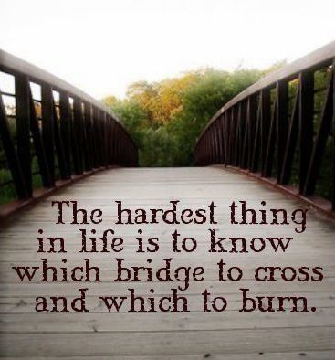

Slide 191
Realities (for them and us)
They and us are God’s chosen people
God does not deal with us based on our past but our potential
Our worthiness to receive blessings is not the issue, we never are worthy. All the worthiness we have is imputed. We are blessed because we are loved not because we are worthy

Slide 192
Realities (for them and us)
God can always do more than our resources or experience would predict. He doesn’t have our limitations
Our past performance is past. God deals with us based on the plans He has for us and the destiny He has in store for us
The text is clear “our best days are still to come”

Slide 193
The Exhortation
Do not remember the former things and do not consider the things of old. Don’t turn them into an idol
When things are not as they used to be our tendency is to:
Idealize the past and see its propagation or recreation as the best plan for the future
To live life looking in the rear view mirror
To focus on all our problems and forget all the promises

Slide 194
Where are your best days?
Past
Present
Future
Your
Heavenly Father
Experience
Resources
In What Or Who Are you Placing Your Trust?

Slide 195
Why Focus On The Promises Of God
God is creative. It’s His nature to give new mercies, new ideas, new hope “morning by morning new mercies I see”
God has a plan. Failing to change is saying that God is finished with us, that we’ve arrived, that His plan for us, in us, and through us is complete

Slide 196
Why Focus On The Promises Of God
The past is not all God wants to do for us. God sees potential “something good is about to happen something good is on its way”
When we lose site of His promises we live with complacency and get so wrapped up in ourselves that God has difficulty working in us
God wants to stretch us and change us and He knows its good for us

Slide 197
Why Focus On The Promises Of God
Growth and development in the kingdom of God is natural. Decline and decay is abnormal
Staying where we are, and doing what we’ve always done empties the gospel of its power “By your traditions you make of no effect the word of God”
Although the world has changed God already knew it was going to happen and already knows what we need to do about it. God isn’t caught by surprise, ever!

Slide 198
Begging the Question
What about the past, do we just forget it and move on?
This text and others urge us to “remember not the former things” “forgetting those things which are behind
The key word here is “things”

Slide 199
Understanding Things
Hebrew:”ree-shone” (185 times)
former (of time) (Our former when)
Ancestors (our former who)
former things, way of doing (our former how)
foremost (of location) (Our former where)
Greek
“opiso” (36 Times) back, behind, after, former
of place: things that are behind
of time
If we are clear on what it is we are to forget it will help us clarify what we are to remember

Slide 200
The Promise
God has a plan for us and He is sure it will happen; “For I know the plans I have for you,” says the LORD. “They are plans for good and not for disaster, to give you a future and a hope.” Jeremiah 29:11
God’s perspective on us is based on what He sees in us not on what we presently are or believe we are
The best days for all of us are still to come

Slide 201
As The Will Is Turned

Slide 202
Nero’s Tutor - Luccius Seneca – “On Providence”
David Lee Burris:
Philosopher Seneca & Apostle Paul Contemporaries – Who Were Aware Of Existence Of The Other
MIDDLE STOICS SUSPICIOUS OF WEALTH AS IT LEADS TO VICES
EXTERNAL GOODS CAN DRAIN VIRTUES IF GIVEN PREFERENCE
“Flee luxury, flee enfeebling good fortune, from which men’s minds grow sodden!”
“While all excesses are hurtful, the most dangerous is unlimited good fortune.” {Prov. 4. 9 – 10}

Slide 203
Nero’s Tutor - Luccius Seneca – “On Providence”
David Lee Burris:
Philosopher Seneca & Apostle Paul Contemporaries – Who Were Aware Of Existence Of The Other
MIDDLE STOICS PROFESSED A PERSONALISTIC & BENEVOLENT FATHER-FIGURE VIEW OF GOD
IN DEFENSE OF THIS POSITION SENECA RESPONDS TO THE PERENNIAL QUESTION AS TO WHY BAD THINGS HAPPEN TO GOOD MEN WHO ARE SUBJECT TO BENEVOLENT PROVIDENCE!

Slide 204
Nero’s Tutor - Luccius Seneca – “On Providence”
David Lee Burris:
Philosopher Seneca & Apostle Paul Contemporaries – Who Were Aware Of Existence Of The Other
(God) “does not make a spoiled pet out of a good man; he tests him, hardens him, and fits him for his service.”
1. Compares To Athletic Training
2. Contrasts To Mother’s Nurture
3. Correlates With Self-Discovery
* PROPER PERFORMANCE OF PIETY
Conformity Of The Inferior Personal Will
With The Better Purpose Of The Divine!

Slide 205
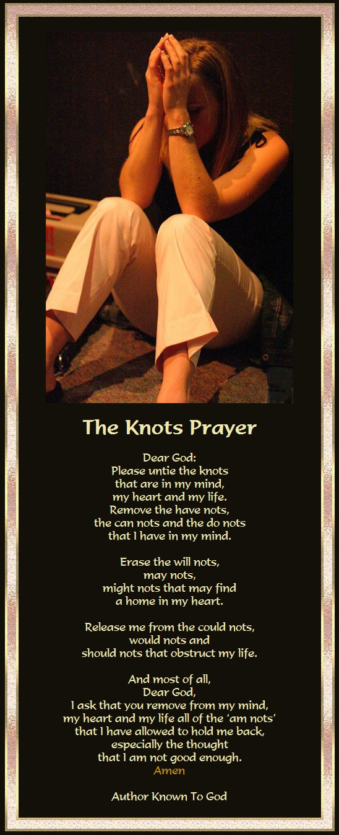

Slide 206
Providence & Prayer Intersect: Mergence Horizontal & Vertical
Three Wills Of Deity
Decreeative Will, or God As Sovereign.
Preceptive Will, or God’s Will That We React In A Certain Way Although We Are Free To Chose.
3) Dispositional Will, or That Which Pleases God.
.
God W/ Free-Will Man
1) God’s Intentional Will –
Would Be What God Prefers That Would Happen.
2) His Circumstantial Will -Would Be What God Does Due To The Circumstances Evolving He Did Not Intend.
Ultimate Will Of God –What God Can Achieve In Human Circumstances Due To Man’s Sinful Rebellion;
God Can Transform Simple
Evils Into Complex Goods!

Slide 207
King David’s Diagnostic-Confession Prayer Style Turning The Wheels Of The Wills
Psalms 6: 1-3 & 6,7 –
“Every night make I my bed to swim: I water my couch with
my tears.”
Psalms 38: 3 – 9 & 18 –
“My wounds are loathsome and corrupt, because of my
foolishness… Lord, all my desire is before thee; And my
groaning is not hid from thee. For I will declare mine iniquity;
I will be sorry for my sin.”
Psalm 51: 10 – 14 --
“Create in me a clean heart, O God; And renew a right spirit
within me… Restore unto me the joy of thy salvation… And
my tongue shall sing aloud of thy righteousness.”

Slide 208
Transcendent Prayer

Slide 209
David Lee Burris: Absolute Non-Reductive Ontology + Unconditional Non-Dependent Reality = Transcendent Value Noble Norms – Highest Principles - Absolute Standards Of Heavenly Origin & Of Almighty Decree
PRAYER IS TRANSCENDENT
Radical Others In Royal Paradox

Slide 210
Radical Others In Royal Paradox
Transcendence of Otherness. “What is God? Well, the non-spatial, non-temporal, non-causal, non-locatable, non-thing is an enigma wrapped in a puzzle. The side of the imponderable that I want us to focus on right now is this notion that God is radically other, radically transcendent, radically inaccessible to our eyes. In that sense, that sort of transcendence is reciprocal and symmetrical. If God is radically other to us, we are radically other to God. That is the very notion that is at the heart and core of the issue in Plato about how the world of forms, the world of ideas, and the world of appearances can meet and intermix. How can that which is beyond space, time, & causation and which is bound up in space, time, & causation meet? - Prayer! - James Hall, Philosophy of Religion

Slide 211
David Lee Burris: Absolute Non-Reductive Ontology + Unconditional Non-Dependent Reality = Transcendent Value Noble Norms – Highest Principles - Absolute Standards Of Heavenly Origin & Of Almighty Decree
PRAYER IS TRANSCENDENT
TO PRAY IS TRANSFORMATIVE

Slide 212
Level Life LIved

Slide 213
Levels of Life
A musical slideshow

Slide 214
The Levels At Which Our Life Is Lived
The sensual level. Controlled by the senses and what we feel see, hear, taste or smell
It is the normal opus operandi of our pre-Christ state
It is that which leads to carnality in our lives

Slide 215
The Levels At Which Our Life Is Lived
The lateral level is whereby human brain intellect & knowledge, emotional responses to faith and relationships, & the individual will are substituted for dependence on God
It is religion replacing a relationship with the living God
It’s the counterfeit to genuine Christianity
It is often emotionally controlled religion
You can be very religious at this level but have absolutely no relationship with the Lord

Slide 216
The Levels At Which Our Life Is Lived
The spiritual level is where the body is surrendered to God and the mind transformed by the Word of God
It is at this level the Apostle Paul to the Romans admonishes all men to live
It is at this standard of living that God is honored and lives are touched and we make a positive difference.

Slide 217
The Transformation Of The Mind
The world is seeking to shape your thinking
We have the power to nullify this molding by watching what we read, view, hear & with whom associate
The agent of transformation is the Word of God
It needs to become a settled issue for us. We love and trust His word and will obey it without question

Slide 218
How We Are Changed
We are changed Morally
We’re not conformed to the world.(Romans 12:2a)
The word means our outward form does not match the inward reality (suschematizo)
It implies that there is a difference that is visible
Rather than having our morals molded by the world we set the standard by which the world is judged
We do have power to choose what will shape and influence us
The internal pressure changing us is God’s Word!

Slide 219
How We Are Changed
We are changed Mentally
It is the renewal of the mind (2b)
The word used is metamorphoomai and is translated transformed
This word is used only 4 times
in the Bible Matthew 17:2,
Mark 9:2, 1 Corinthians 3:18
The battle ground is the mind

Slide 220
How We Are Changed
We are changed Motivationally (2c)
We will, by obedience experience that God does what He says He will do and is who He says He is (proof testing His metal)
We are never happier and more fulfilled as Christians when we’re doing God’s Will
We will see (Proved by that experience) that God’s will is good, acceptable, and perfect as we do it
The passion of our heart then changes to want nothing more than, and to do nothing else than, the will of God

Slide 221
By changing your thinking, You change your beliefs;
When you change your beliefs, You change your expectations;
When you change your expectations,
You change your attitude;
When you change your attitude, You change your behavior;
When you change your behavior, You change your performance;
When you change your performance; You change your life!

Slide 222
The levels at which our life is lived:
When you change your performance you change your life!

Slide 223
Carnally Minded
Spiritually Minded
Dominated by sinful thoughts
Dominated by The Spirit of God
Living after the flesh
Living thru the Spirit
Brings death
Brings life
Is God’s enemy
Is God’s Friend
Creates turmoil
Generates peace
Not willingly subject
Delights in obedience

Slide 224
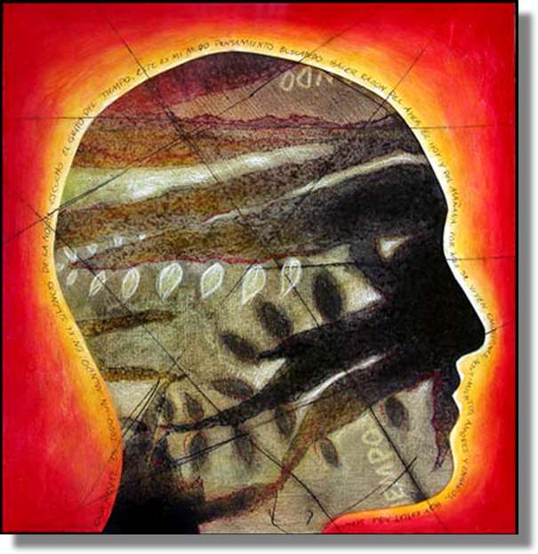
Renewing Your Mind
New Thinking
Leads to
New Doing

Slide 225
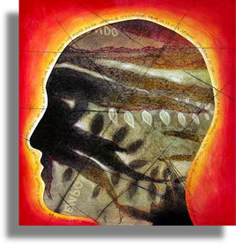
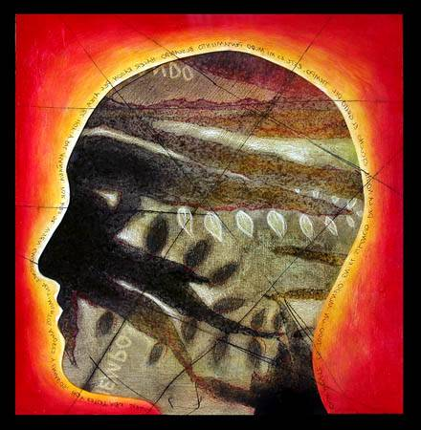
T h e m e
We’ll use Paul’s teachings in Romans
to motivate transformation of your inner values.

Slide 226
P r o p o s e
You’ll become as different from this wicked world…
as you make up your mind to be.

Slide 227
Transformation of the mind is proof of genuine repentance.
It is essential for nobler living.

Slide 228
P o I n t
Do you want your life to become like His?
Transform your thinking and values
so they are like His.

Slide 229
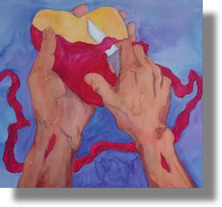
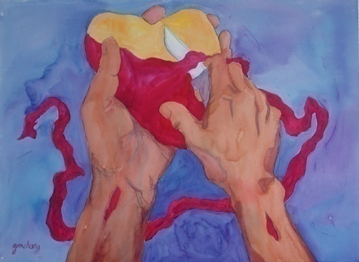
God Renewed Judah
Only a remnant
Three-step recovery:
1. Sit there and remember
2. Understand the damage
3. Hate themselves for it
A new heart from God:
I will give it
Make it yourselves

Slide 230
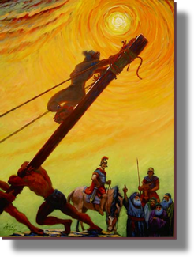
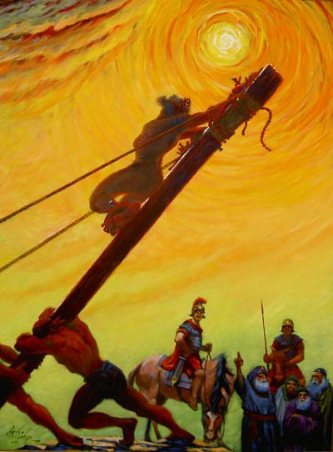
God’s Two Methods
Willing change:
Reflect on the cross
Soften the heart
Yields to God’s way of thinking
Grudging change:
External difficulties
Soften the heart
Yields

Slide 232
You have 3 choices:
You can willingly renew your thinking
You can force God to use harsh measures
You can resist change altogether

Slide 233
P o I n t
Do you want the gentlest route to heaven?
Do the work willingly
Determine to bring your mind-set
into harmony with His.

Slide 234
P r a y e r
The chorus to the 1970's hit song "Day By Day"
came from a prayer of the 13th century
Thanks be to Thee, my Lord Jesus Christ
For all the benefits Thou hast given me,
For all the pains and insults, Thou hast borne for me.

Slide 235
P r a y e r
The chorus to the 1970's hit song "Day By Day"
came from a prayer of the 13th century
O most merciful Redeemer, friend and brother,
May I know Thee more clearly,
Love Thee more dearly,
Follow Thee more nearly,
Day by day.

Slide 236
Where Goes The Time?

Slide 237
Where Does Our Time Go Money: January 2006
7.9 Hours sleeping
5.5 Hours Working
7 Minutes on Religious Practice
2.3 Hours watching TV
1 hour eating
49 minutes washing and grooming
10 minutes relaxing and thinking
47 minutes visiting (phone & in person)

Slide 238
Where Does Our Time Go Money: January 2006
7.9 Hours sleeping
5.5 Hours Working
WE MUST IMPROVE...
2.3 Hours watching TV
1 hour eating
49 minutes washing and grooming
10 minutes relaxing and thinking
47 minutes visiting (phone & in person)

Slide 239
Where Does Our Time Go Money: January 2006
7.9 Hours sleeping
5.5 Hours Working
Father's Business First
2.3 Hours watching TV
1 hour eating
49 minutes washing and grooming
10 minutes relaxing and thinking
47 minutes visiting (phone & in person)

Slide 240
The average number of minutes spent each time in prayer, by those who pray to God.
* Source: Absolute Confusion By George Barna

Slide 241
The average number of minutes spent each time in prayer, by those who pray to God.
* Source: Absolute Confusion By George Barna

Slide 242
We have all been told we should be content.
But there are some instances in which
being “good enough” is NOT good enough!
Name some other instances
where it’s not good to be satisfied.
The Bible tells us that Christians must
continue to grow into maturity.
Read these three passages of Scripture
to discover areas in which we must
resist the temptation to be satisfied:
Hebrews 5:11-14
Colossians 1:10
Colossians 1:11, 12

Slide 244
Contentment

Slide 245
“I’m not sure if life
is passing me by
or trying to
run me over.”

Slide 246
"In every joy that crowns my days,
In every pain I bear,
My heart shall find delight in praise,
Or seek relief in prayer.
"When gladness wings my favored hour,
Thy love my thoughts shall fill;
Resigned when storms of sorrow lower,
My soul shall meet thy will.
"My lifted eye, without a tear,
The gathering storm shall see;
My steadfast heart shall know no fear:
That heart shall rest on thee.”

Slide 247
Lord Jesus –
Settle dust, calm storms,
Quell the quaking.
Show the way, quiet hearts,
Still the shaking.
Pour Your Peace
Into troubled hearts;
Give Fresh Vision
For new starts!
- Sally Jadlow

Slide 248
Situation Faced
Action Taken
Happy Moment
Praise God!
Difficult Moment
Seek God!
Painful Moment
Trust God!
Quiet Moment
Worship God!
Public Moment
Let God!
Every Moment
Thank God!

Slide 250
We convince ourselves that life will be better once we are married, have a baby, then another.
Then we get frustrated because our children are not old enough, and that all will be well when they are older.
Then we are frustrated because they reach adolescence and we must deal with them. Surely we’ll be happier when they grow out of the teen years.
We tell ourselves our life will be better when our spouse gets his/her act together, when we have a nicer car, when we can take a vacation, when we finally retire.
The truth is that there is no better time to be happy than right now.
If not, then when?
Your life will always be full of challenges. It is better to admit as much and to decide to be happy in spite of it all.

Slide 251
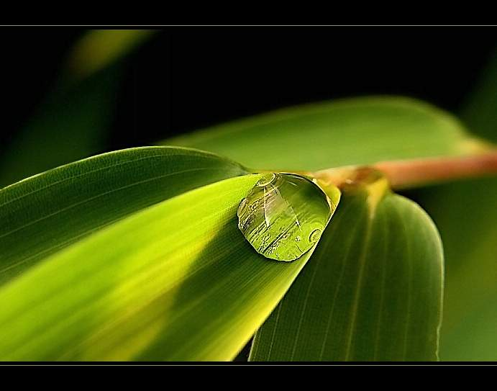
For the longest time, it seemed that life was about to start. Real life.
But there was always some obstacle along the way, an ordeal to get through, some work to be finished, some time to be given, a bill to be paid. Then life would start.
I finally came to understand that those obstacles were life.
That point of view helped me see that there isn’t any road to happiness.
Happiness IS the road.
So, enjoy every moment.
Stop waiting for school to end, for a return to school, to lose ten pounds, to gain ten pounds, for work to begin, to get married, for Friday evening, for Sunday morning, waiting for a new car, for your mortgage to be paid off, for spring, for summer, for fall, for winter, for the first or the fifteenth of the month, for your song to be played on the radio, to die, to be reborn… before deciding to be happy.

Slide 252
Happiness is a voyage, not a destination.
There is no better time to be happy than… NOW!
Live and enjoy the moment.
-Author unknown
Now, think and try to answer these questions: 1 – Name the 5 richest people in the world. 2 – Name the last 5 Miss Universe winners. 3 – Name the last 10 Nobel Prize winners. 4 – Name the last 10 winners of the Best Actor Oscar.

Slide 253
Can’t do it? Rather difficult, isn’t it?
Don’t worry, nobody remembers that.
Applause dies away!
Trophies gather dust!
Winners are soon forgotten.
Now answer these questions:
1 – Name 3 teachers who contributed to your education.
2 – Name 3 friends who helped you in your hour of need. 3 – Think of a few people who made you feel special. 4 – Name 5 people that you like to spend time with.
More manageable? It’s easier, isn’t it?
The people who mean something to your life are not rated “the best”, don’t have the most money, haven’t won the greatest prizes…
They are the ones who care about you, take care of you, those who, no matter what, stay close by.
Think about it for a moment.
Life is very short!
And you, in which list are you? Don’t know?

Slide 254
You are not among the most famous…
Some time ago, at the Seattle Olympics, nine athletes, all mentally or physically challenged, were standing on the start line for the 100 m race.
The gun fired and the race began. Not everyone was running, but everyone wanted to participate and win.
They ran in threes, a boy tripped and fell, did a few somersaults and started crying.
The other eight heard him crying.
They slowed down and looked behind them.
They stopped and came back… All of them…
A girl with Down’s Syndrome sat down next to him, hugged him and asked, “Feeling better now?” Then, all nine walked shoulder to shoulder to the finish line.
The whole crowd stood up and applauded. And the applause lasted a very long time…

Slide 255
People who witnessed this still talk about it.
Why?
Because deep down inside us, we all know that the most important thing in life is much more than winning for ourselves.
The most important thing in this life is to help others to win. Even if that means slowing down and changing our own race.
“A candle loses nothing if it is used to light another one.”

