Slide 1
The Mind of the Beast Vs. The Mind of Christ
By David L. Burris

Slide 2
The Sinful Versus Spiritual Mindset
Biblical Numerology: Two Opposed Mindsets
The Natural Man Versus The Enlightened Man
The People of the Lie Versus The People of God
Competing Worldviews: Secularist Versus Theistic
Comfortable Versus Transformative Discipleship
Expectant Hope for The Renewed Mind!

Slide 3
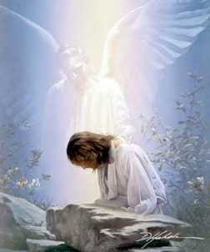
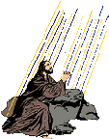
Nature Of This Temptation: Shortcut That Avoids Death

Slide 4

Flashback From Tempting Thought Satan Revisit In Matthew 16: 21
(22) “Far be it from You, Lord; this[crucifixion] shall not happen to You!”
(23) “Get behind Me, Satan! You are an offense to Me, for you are not mindful of the things of God, but the things of men.”

Slide 5
Flashback From Tempting Thought Satan Revisit In Matthew 16: 21
(23) “Get behind Me, Satan! You are an offense to Me, for you are not mindful of the things of God, but the things of men.”
“Peter is to get behind him, opiso mu, which means to follow, do not dictate, and so Peter’s proper position is to be with Jesus and follow where he is going, not to determine the conditions under which Jesus is going to be the Messiah!” - Tim Johnson

Slide 6

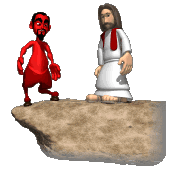
Luke 4: 6 – “I give it to whomever I wish.”
HOW?

Slide 7

The Prince Of This World
John 12: 31; 14: 30; 16: 11

Slide 8
“The God Of This World”
@ 2nd Corinthians 4: 4 - “…hath blinded the minds of them which believe not, lest the light of the glorious gospel of Christ… should shine unto them.”

Slide 9
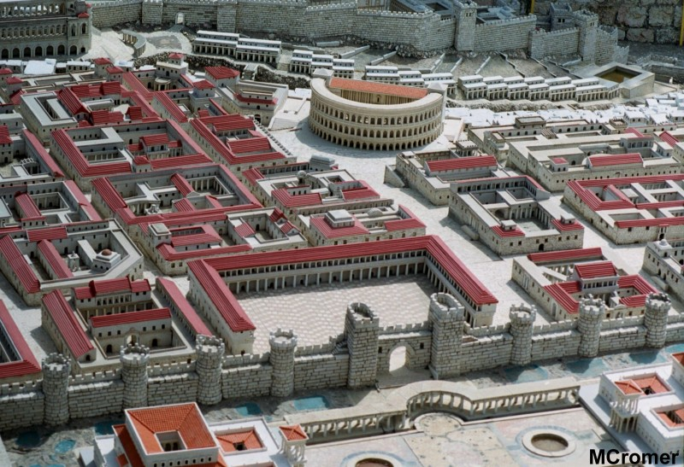
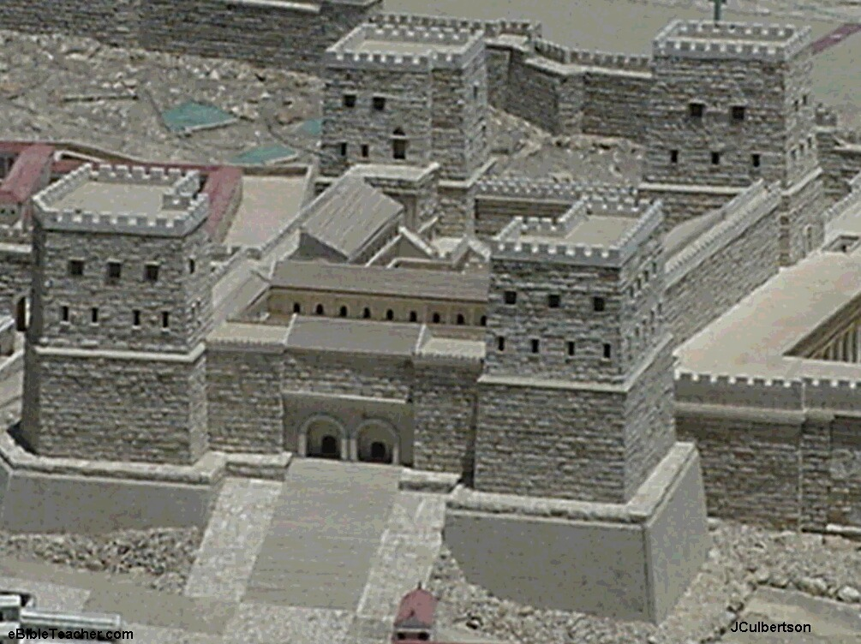
1^{st.} Obvious Outside & Alternative Agency

Slide 10
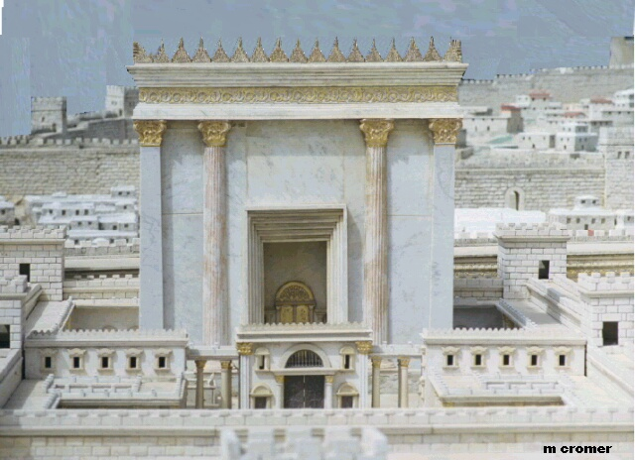
2^{nd.} God Would Allow Him Other Venue

Slide 11


To Take The Shortcut Would Short. Human Historical Consequences:
Relationship Regime Continuance:
Of Religion Ascribed Over Faith Consented
Of Shallow Shadow Over Spiritual Substance
Of Partiality Of Truth Over Purity Of Truth

Slide 12




Case Of The Church-State Theocrat: Being Better Judge Than Jesus
David Lee Burris: The Religion Of The Crutch & The Placebo Human Weakness Requires Religious Subordination? The Grand Inquisitor Says Of Jesus’ Temptation: “You made a mistake. You should have listened to what he said!”
Dostoevsky’s Grand Inquisitor To A Returned Christ:
“I awakened and would not serve madness. I turned back
and joined the ranks of those who have corrected thy work.”
Three Powers Accepted By Then “Universal Church”
Rejected In His Worldly Temptation By World Savior
The Power Over Three Forces Of Human Influence:
Force Of Magic, Mystic, Miracle
Force Of Ecclesiastic Hierarchy
Force Of Established Hegemony

Slide 13
The Sinful Versus Spiritual Mindset
THE CONCEPT OF DOUBLE APPLICATION: ONE IS SPECIFIC & ANOTHER’S GENERAL

Slide 14
APOCALYPTIC LITERATURE & BIBLICAL NUMEROLOGY – Ferrell Jenkins said it best concerning Apocalyptic Literature: “This literature was highly relevant to the historical situations of the day. Daniel and Ezekiel wrote during the Babylonian exile to comfort people in their faithfulness, and to prepare them for trials even down to the times of Antiochus Epiphanes, and finally to the Roman Empire. The Book of Revelation was written when God’s Saints were being severely tried in the crucible that was called Rome. It served to reveal God’s power to overcome all enemies and His disposition toward His afflicted ones. This book should serve as an encouragement to God’s people, whenever they are persecuted, down to the end of time. In literature like the Apocalypse, one expects a great use of visions and symbols…” CARM’s Matt Slick writes of Biblical Numerology in both Hebrew & Greek: “It seems quite obvious that the Bible uses numbers in pattern. One of the interesting features of Hebrew and Greek is that in both written languages there are no numeric characters, where we have numbers and letters [In English], they have only letters. So, in each language the letters are also used as numbers. When they are used, the context tells us which is which.

Slide 15
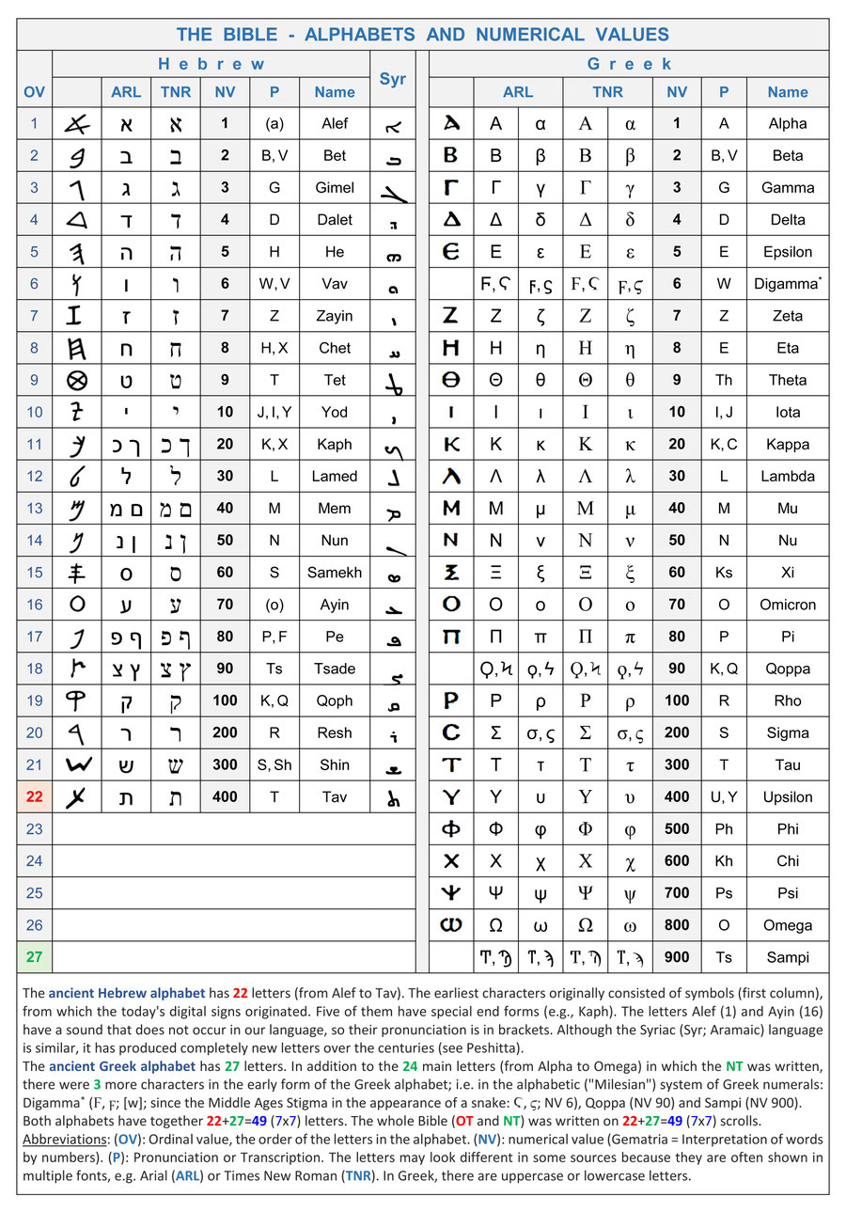

Slide 16
In his book The Avenging of the Apostles and Prophets, Brother Ogden makes a credible case for verse 18 as having application to a specific individual on the Throne of Imperial Rome: “This verse is intended to explain the significance of the preceding verse and to identify the specific administration in power at the time of the Apocalypse. The number of the beast ‘is Six hundred threescore and six.’ The reference is to an ancient practice of figuring the number of one’s name by adding up the assigned total for each letter in his name. Many ancient languages used alphabetical characters as numerical figures with specific values attached to the letters. The process is known as gematria. [The] number of the name Neron Caesar is 666 and identifies the specific emperor ruling Rome at the time of the Apocalypse. The explanation is simple, factual, and in perfect harmony with the subject material of the Apocalypse.” Similarly, the “Man of Sin” of 2nd Thessalonians 2: 3 – 10 corresponds in timeline. Both Thessalonian Letters were written by Paul while in Athens around 51 AD., Caesar Nero ruled the Roman Empire from 54 AD to 68 AD, and the Jewish Campaign began approximately year 64 AD. [However, a plausible argument for the Late Date & Roman Punishment of Biblical Proportion could be made based on the unnatural number and large magnitude of Volcanic Eruptions, Tectonic Plate Earthquake Shifting, and Tsunami Tidal Waves wiping out many major coastal population centers of the Roman Empire Late First Century.]

Slide 17
First Century Wisdom in Numerological Interpretation – Author Bruce Winter in his recent book Divine Honours for the Caesars: The First Christians Responses in Section II: Playing the Numbers Game to Identify the Beast addresses how the original reading audience would have interpreted the meaning of Revelation 13:18. He writes: “A greater challenge was issued that would test the skills of his readership to undertake a more complicated form for numerical calculation – ‘this calls for wisdom,’ ‘here is wisdom,’ a term used in Greek for skill in various disciplines of learning including music, poetry, medicine, and divination, and here the author of the letter uses it of gematria. He further defines the person possessing this skill as ‘the one having knowledge.’ This clue is in the use of the imperative when he writes that ‘he must calculate the number of the beast,’ and then explains, ‘for the number of the beast is a man and his number is 666’ (13:18). The actual text does not have the Greek letter for six repeated three times but, i.e. 600, 60, 6. This followed the Greek convention of spelling each of the letters that were represented numerically – ‘six hundred,’ sixty,’ and ‘six’.
What is the numerical value of the Greek letters for ‘beast’? It totals 247 (9,8,100,10,70,50). So he is not referring to a calculation of Greek letters of this term. However, ‘the same numerical technique was used in the Hebrew alphabet, and ‘beast’ in the Hebrew alphabet is 666 (400,200,10,6,50). The number of the beast is explicitly to coincide with another number. The writer explains, ‘For it is the number of a man’ and then discloses that number is ‘666’ (Revelation 13: 18). So, the total number for ‘beast’ and that for ‘man’ are the same. There is an official external evidence of the numerical value of the name of Nero in the Hebrew-Aramaic Script on an official deed of debt in A.D. 55 declared to be the second year of ‘Nero’.”

Slide 18
“666” The Number of a Man – [Referred to also as The Mark of the Beast @Revelation Chapter 13 Verses 15 – 18]. In my opinion, both Homer Hailey & Arthur Ogden present two strong arguments equally credible. In REVELATION: An Introduction and Commentary Brother Hailey writes: “I believe, however, that the number does not represent an individual such as Nero, Domitian, or others per se, but the sum of that which is human… When John adds, ‘It is the number of a man,’ he omits the definite article before ‘man,’ thereby indicating that he has no particular individual in mind. He is saying that the number represents that which is human; it is therefore a human number…Since the Apocalypse abounds in the symbolic use of numbers which express ideas rather than persons or literal quantities, the same principle should be followed in the interpretation of this number. Throughout the book, seven expresses the idea of perfect completeness: the seven churches, seven horns, seven eyes, seven spirits, and so forth. So, six, which falls below the sacred seven, can never be seven or reach perfection; therefore, it symbolizes the imperfect, that which is human and destined to fail. It is said that to the Jews the number six was an omen or symbol of dread and doom, so when it was tripled, 666, it represented the completeness of doom and failure.”

Slide 19

The Sinful Versus Spiritual Mindset
Biblical Numerology: Two Opposed Mindsets

Slide 20
The Mind of the Beast
“In Daniel chapter 4 verse 16, we read: “Let his mind be changed from that of a man and let him be given the mind of an animal, till seven times pass by for him.” Who was this man? Nebuchadnezzar, the great king and rebuilder of Babylon, was one of the most powerful men in ancient history. In the pages of the Bible there are two great rival cities. We first hear of Babylon under its Hebrew name Babel in the well known story of Genesis chapter 11. It becomes prominent later in Old Testament history. Jerusalem is first mentioned in the book of Joshua, but is not important till the time of King David. He captures it from the Jebusites and makes it his capital. From then on it is prominent throughout scripture, and is seldom long out of the news today. The book of Revelation ends with the destruction of Babylon and the new Jerusalem descending from heaven as a bride adorned for her husband. Egypt and Babylon were the two great empires of ancient times. Both are full of deep spiritual significance. The first great deliverance of scripture was from Egypt. The second was from Babylon. All God’s people Israel came out of Egypt. Only a minority of them returned from Babylon. What do these two countries represent? Every Bible reader knows the story of Moses and the exodus from Egypt, the ten plagues, the first Passover, the destruction of the Egyptians in the Red Sea and the bringing to birth of God’s people Israel. Everyone has at least a basic knowledge that Jesus is the new Passover Lamb who has brought us out of a spiritual Egypt and created us as a new spiritual people. The deliverance from Babylon is less familiar. Babylon was the great home of false religion. The essence of false religion is that it is based on man and man’s works. It has no real reference to God. It promotes and exalts man. Nebuchadnezzar was king of Babylon when the Jews were there in captivity. Chapter four of Daniel describes Nebuchadnezzar’s fall and restoration in his own words. His troubles began when he proudly said: “Is not this the great Babylon I have built as the royal residence, by my mighty power and for the glory of my majesty?” These words echo those of the first builders of Babel centuries before as they built their tower in total independence of and disregard for God. “Come, let us build ourselves a city,” they said, “with a tower that reaches to the heavens, so that we may make a name for ourselves and not be scattered over the face of the whole earth.” They also have the same spirit as the builders of countless spiritual babels from that day to this.”
“Their minds have been changed from 666 to 888.” – Per Internet Search

Slide 21
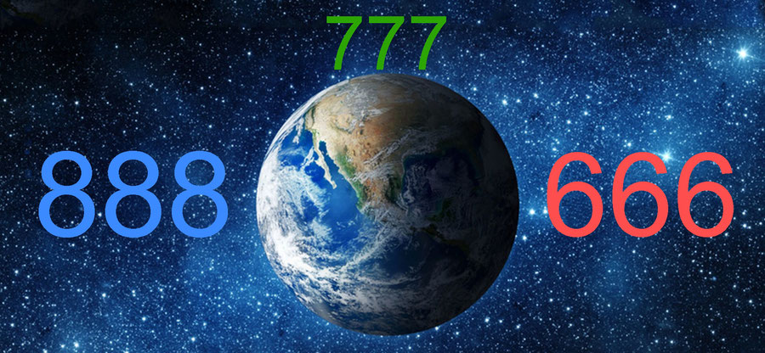
Genesis 1:1 and the numerical value 777 (God 86 + the heavens 395 + the earth 296)

Slide 25
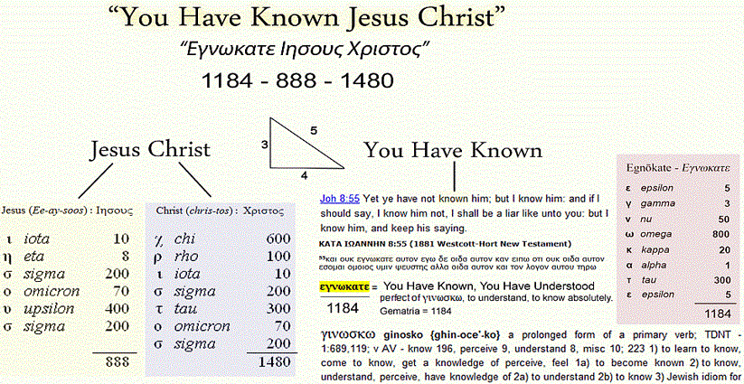

Slide 26
“An animal (a beast) can have no idea of God. Spiritual and moral values are of no meaning to it. The number six represents man without God. The number six six six means man man man, a system that’s totally man-centered and man-dominated. Everything is based on man’s thoughts and plans and schemes. There is no room for God in it. For seven years he lived as an animal and ate grass until his reason returned to him. His last recorded words have quite a different spirit: “Now I, Nebuchadnezzar, praise and exalt and glorify the King of heaven, because everything he does is right and all his ways are just. And those who walk in pride he is able to humble.” Nebuchadnezzar’s earlier career had been marked by the number 6. He built an image 60 cubits high & 6 cubits wide. We might have expected a number related to 13 rather than 6 to be the number of the beast, as 13 is more associated with Satan whereas 6 is the number of man. A well known incident from the gospels helps us understand. Peter had a wonderful moment of revelation when he said “You are the Messiah, the Son of the living God.” to Jesus, Jesus replied, “Blessed are you, Simon son of Jonah, for this was not revealed to you by man, but by my Father in heaven.” Very soon afterwards in the narrative, Peter gave Jesus some wise human advice about avoiding the way of the cross. Jesus turned and said to him, “Get behind me, Satan! You are a stumbling-block to me; you do not have in mind the things of God, but the things of men.” 666 represents man without God. The truth is that man without God is man with Satan. You cannot be neutral. You cannot opt to live with neither God nor Satan. Any system or any life that gives no place to God is actually controlled by Satan, because he is the prince of this world.” – Per Internet Search

Slide 27
The Sinful Versus Spiritual Mindset
Biblical Numerology: Two Opposed Mindsets
The Natural Man Versus The Enlightened Man

Slide 28
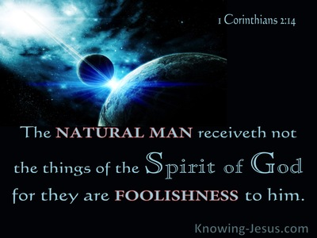
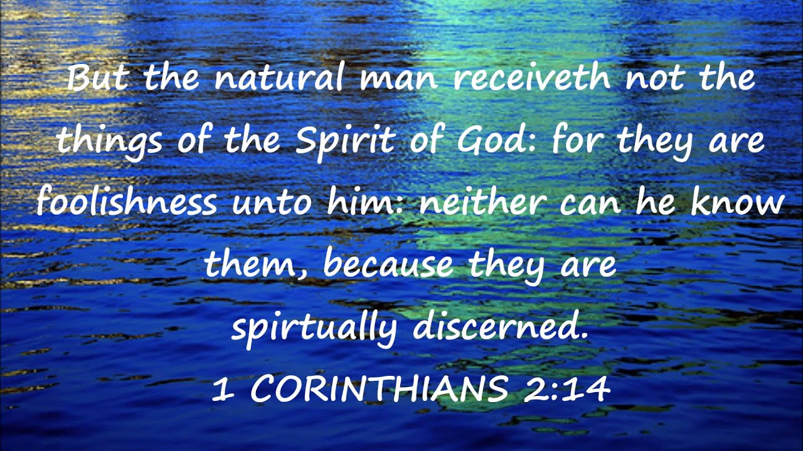

Slide 29
NATURAL LAW & NATURAL MAN
Paul’s Usage of the term Psuchikos Anthroopos
Biblically, in each of the five cases that “psuchikos” is used the term is contrasted with “pneumatikos” or with the spiritual. The contrast in 1st Corinthians 2: 14 is between a man inspired of God and one who has no such revelation (1Cor.2.12ff).
Paul seems to have adopted the Jewish understanding which denoted physical life as opposed to the supernatural life.

Slide 30
NATURAL LAW & NATURAL MAN
Paul’s Usage of the term Psuchikos Anthroopos
Paul seems to have adopted the Jewish understanding which denoted physical life as opposed to supernatural life.
The scriptural context of the Biblical term, “psuchikos anthroopos” is inspiration not salvation. The “natural man” tried to find, by his own wisdom, the “things” of God, but such must be revealed. Reference:
1st Corinthians Chapter Two & Verse Ten

Slide 31
1Corinthians 2:14 “But a natural man does not accept the things of the Spirit of God, for they are foolishness to him; and he cannot understand them, because they are spiritually appraised”
“Natural”: “Refers to one who obeys the promptings of his bodily nature, unspiritual or carnal” (Lenski p. 115). “He's the man who stands aloof from the wisdom of God and who depends on his foolish wisdom” (McGuiggan p. 46). “Does not accept”:“Rejects, refuses to accept” (Robertson p. 89). “The things of the Spirit of God”: The things that the Spirit revealed through the Apostles (2:11-13), the natural man rejects the gospel message. Many consider this "natural" man to be a non-Christian, and such a person would certainly qualify. Yet, the Corinthians were in danger to becoming this "natural" man, “for you are still fleshly” (1 Corinthians 3:1-3). Paul defines the "natural" man as anyone who rejects the teachings delivered by the Spirit, and some Christians did that in the First Century (14:37; 2 Thessalonians 3:6,14).
Therefore, the "natural" man is not a man so depraved that he cannot understand the gospel without the direct operation of the Holy Spirit. The phrase does not accept implies a choice, a conscious decision. He hears it, he understands what is being said, but he does not like it. The enemies of Jesus ("natural men") understood what He taught. (Matthew 21:45; 27:63). Those who rejected Paul's message, understood the concepts he was presenting (Acts 17:32; 22:22; 25:25 (Felix, a "natural" man, understood exactly what Paul was driving at). The Bible does not picture the sinner as “unable” to repent, but rather as “unwilling” to repent (Acts 13:46 “since you repudiate it”; Revelation 2:21 “She does not want to repent”).

Slide 32
1 Corinthians 2:14 “For they are foolishness to him”: Again note, the various unconverted Jews and Gentiles that had rejected Paul's preaching, "understood" that Paul was preaching a crucified Messiah, it's simply that they thought such a concept was ridiculous, “but we preach Christ crucified, to Jews a stumbling block and to Gentiles foolishness” (1 Corinthians 1:23). To this day people consider the message of the New Testament to be foolishness for various reasons. It's important to note that one's attitude toward's the gospel, reveals one's true self. Those that reject the gospel message are automatically labeled as "unspiritual". "People are revealed for who they are by their response to the cross" (Fee p. 117).
1 Corinthians 2:14 “And he cannot understand them”: In order to consider it "foolishness", he must know something about the gospel, if only what it claims. Paul has already stressed that man cannot know God apart from revelation (2:8-9; 1:21). Hence, the man or woman who has rejected the gospel message has just cut himself or herself off from the only true information that we have about God. “Because they are spiritually appraised”: “Appreciated by spiritual insight” (Wms); “because it takes spiritual insight to see its true value” (Gspd)
“Men access things differently according to their frames of reference. A fitness fanatic will (very often) have no appreciation at all for chess or sedentary pursuits. A man who has time only for making money frowns on holidays as a ‘waste of time’. The natural man judges everything by his worldly wisdom & spiritual things are ridiculed” (McGuiggan p. 46). How are things spiritually appraised? Clearly, by the Scriptures (Acts 17:11; 1 Thessalonians 5:21; Hebrews 5:14). Therefore, the person who has no appreciation for the revelation of the Spirit, is going to be wrong about many things. So why were the Corinthians enthralled with people who rejected God’s revelation? (Jeremiah 8:9 “Behold, they have rejected the word of the Lord, and what kind of wisdom do they have?”).

Slide 33
1 Corinthians 2:15 “But he who is spiritual appraises all things, yet he himself is appraised by no one.”
“Spiritual”: The person who accepts the revelation from the Spirit (1 Corinthians 14:37). “Appraises all things”: “Can find out the real value of everything” (Beck). “All things”:
All things that pertain to salvation, all things that are vital for his relationship with God. He is also able to properly evaluate the importance of many common things in everyday life, such as money, relationships, spouse, children, and so on (Hebrews 5:14; Psalm 119:99-105). The key to this ability, is not any inherent wisdom in the believer but his or her acceptance of the Word of God and the willingness to apply what it teaches to daily living. “Yet he himself”: The Christian. “Is appraised by no one”:“He is properly valued by none” (Ber) (Hebrews 11:38). The world does appraise the Christian, it does make a judgment about him. “That is, those who are not Christ's do not know how to understand him. The natural man regards him as an enigma, the spiritual man is marching to another drummer” (McGuiggan p. 47). The person who has rejected the gospel, has just labeled himself or herself as an unqualified assessor of "value". Why are we so concerned about human "approval", when these same people cannot even properly assess the value of God’s word?
“'The profane person cannot understand holiness; but the holy person can well understand the depths of evil” (Fee p. 118). The Christian is qualified to talk about the life of sin, but the non-Christian is not qualified to ridicule the life in Christ. So, to whom should we listen? If we are needing advice about an important decision in life, whose counsel should we seek?

Slide 34
1st Cor. 2: 16 “For who has known the mind of the Lord, that he will instruct Him? But we have the mind of Christ.”
“For”: This is a quotation from Isaiah 40:13, and is also quoted in Romans 11:34. “Who has known the mind of the Lord”: “Who is the person who wants to match wits with God?” (Fee p. 119). Read Job chapters 38-40, when you think you are ready. In order to properly judge Paul and other Christians, such men would have to know the mind of the Lord, and without revelation, that could only be accomplished if you had been the Lord's teacher! In this context, the only way that a person can know what God thinks about something, is to read God’s revelation through the apostles (1 Corinthians 2:9-13). Apart from such revelation, man is completely blind concerning spiritual truths and realties (Jeremiah 10:23; Isaiah 55:8-9). “We have the mind of Christ”: “The thoughts of Christ as they are revealed by the Spirit” (Fee p. 119). As already shown in verses 6-13 “We who are spiritual have the very thoughts of Christ!” (Phi)
Therefore, all those in the world who sit in judgment upon Christianity and faithful Christians, are manifesting a spirit, that Paul says is exactly the same as a person who would claim to be God's teacher. With the Scriptures, we have the very thoughts and mind of Christ, therefore we can properly judge and evaluate all things (Psalm 119:105).

Slide 35
Applications
Even Christians can fall into the trap of becoming a “natural man” (1 Corinthians 3:1-3). It is so easy to look at the Scriptures from a worldly perspective. For example, how many people read Matthew 7:12 “treat people the same way you want them to treat you”, and immediately think, “Yea, people need to be treating me the way I want to be treated”. That is a “natural man” interpretation of that verse. Instead of applying the verse immediately to themselves and their need to serve others, the natural man thinks only of him or herself.
“This is a difficult statement; who can listen to it” (John 6:60). “As a result of this many of His disciples withdrew and were not walking with Him anymore” (John 6:66). The natural man wants all the benefits of Christianity (peace, happiness, security, salvation, and so on), without the effort. The natural man is unwilling to spend the time and search the Scriptures to figure out what Jesus is expecting of him (6:56). The natural man wants to find a “short-cut” around a life of earnest faithfulness. The natural man does not want to wrestle with the Scriptures and bring his own will into line with God’s will. The natural man does not want to buffet his own body (1 Corinthians 9:27), but wants God to do all the work for him. There are too many people in this world, and even some in the church who are sitting around and waiting for some divine intervention to give them the help or motivation they need to do the right thing. The only intervention that we will receive is from the gospel message, “Behold, I stand at the door and knock” (Revelation 3:20); “He who has an ear, let him hear what the Spirit says to the churches” (3:22); (Luke 16:29,31). – Mark Dunagan

Slide 36

Nature's God: The Belly!

Slide 37
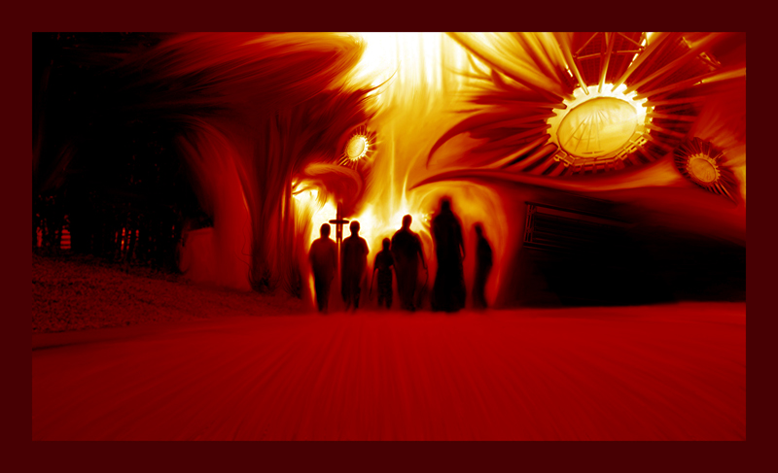
  THE NATURE OF EVIL

Slide 38
  THE NATURE OF EVIL:
  Chaos in the Moral Order

Slide 39
  THE NATURE OF EVIL:
  Evil as Part of Our Nature

Slide 40
Enlightenment Era
SOCIAL THEORIES OF THE GOOD & WISE

Slide 41

WHAT IS GOOD?
WHAT IS RIGHT?
WHAT IS WISE?

Slide 42
Western Practical Philosophy: Utility Theories Of The Good
Question: What Makes A Life A Good Life?
Paradigm Shift: Descriptive Not Normative.
Good Base Theory Of Derivative Hierarchy:
1. At the base are the things of genuine good value.
2. Actions are good in terms of whether they produce these things
of good category.
3. Actions motivated by attempt to produce the good are right acts.
4. Traits of character that result in right action are virtues.
Natural Law Majoritarian Jeremy Bentham;
Founder Equates “Desires” & “Oughts” In Utility:
“Nature has placed mankind under the governance of two sovereign
masters, pain and pleasure. It is for them alone to point out what
we ought to do, as well as to determine what we shall do…”

Slide 43
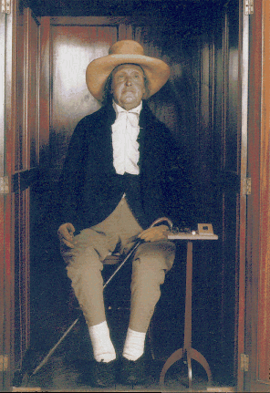
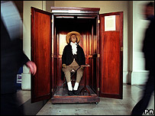

Happy Jeremy Today

Slide 44
Western Practical Philosophy: Category Theories Of The Right
Question: What Makes A Life A Moral Life?
Derivative Logic Or Ends Justification No Longer Appropriate Rationale For Injustice.
Positive Intent & Good Will & One’s Duty Are Recognized As Great & Noble Motives.
Instrumental Goods & Intrinsic Values – Prerequisite Values & Those Type Virtues Of A Higher Order – Properly Proportioned.
Kant’s Imperative Is The Rule Of Thumb; General Guide: Our Act Made Universal
Weakness: Real Result & Consequence.

Slide 45
Classic & Western Practical Philosophy: Debate Between Theory Good & Right
Question: How Do We Know Right From Wrong?
Relativist Skeptic Suggests Illusion & Dismisses As Special Language For Categories Of Situation.
Platonic Perceptions – Innate Infallible Conscience.
Euclidean Enlightened – Self-Evident Ethical Axiom
Ethical Knowledge – Not Analogous With Empirical.
Ethical Knowledge – Exams Evaluation Framework.
Ethical Knowledge – Tests For Internal Consistency
Ethical Knowledge - Test Modes Moral Experience.
John Rawl’s Reflective Equilibrium Guide Rule; We Judge Specific Cases In Terms Of General Principle But Also Judge General Principles In Terms Of A Specific Case.

Slide 46
Classic & Western Practical Philosophy: Debate Between Theory Good & Right
Question: How Do We Know Right From Wrong?
Divide The Debate Three Stage Staggered:
Descriptive Relativism: The claim that cultures differ according to their fundamental beliefs about value.
Ethical Relativism: Actions right & wrong alter along cultural context; universal truths and moral absolutes do not exist.
Prescriptive Relativism: It is wrong to condemn others or pass judgment on those with different cultural values.
The Three Positions Are A Process...
The Three Positions Are Progressive...
The Three Transition From Harmless To Alarming.
The Three Together Form Societal Slippery Slope.

Slide 47
Classic & Western Practical Philosophy: Debate Between Abstract & Concrete
David Lee Burris:
Task Most Difficult – Doing The Right Thing – In The Right Way – For The Right Reasons
Question: How Do We Know Right From Wrong?
Pragmatic Problems: Implicit Applied Explicit
Utilizer Viewpoint Weakness: Justice For All
Kantian Viewpoint Weakness: Consequential
Balancing Hypothesis Of Fragmented Value:
1st – Role & Duty: Institutional & Relational
2nd – Actions Constrained By Human Rights
3rd – Utility Welfare Effects: Macro & Micro
4th – Intrinsic Values To Perfectionist Ends

Slide 48
GOOD LIFE = MORAL WISDOM
David Lee Burris:
Wisdom Separates First & Primary Principles From Those Derivative & Secondary

Slide 49


Historic Cycle: Loss Of Moral Compass

Slide 50


Civilized Culture Index: Civic Virtues Compensate Vice
David Lee Burris:
“How Virtue Drives Out Vice” Poem By - Francis Of Assisi
Theories Of Right: Values Intrinsic Inspire
Concepts Of Utility: Neutral Orchestration
Order: “Selfishness… Greatest Motivator”
Basic: Established Power Corrective Force
Ideal: Watch Vulnerable & Victim Interest
Social Problem: Interceding Values Weak
Social Crisis: No Circumstantial Mitigation
Social Crisis: Not Any Situation Mediation

Slide 51
Civilized Culture Index: Civic Virtues Compensate Vice
Invisible Coordination: Cultural Inculcation
Invisible Coordination: Lone Internalization
Failure Indicator: Utility Value Wrong Acts
Social Gaming: Self-Interest Act Is To Evil
Signal: High Good Not Equal Order Of Evil
Vertical Virtuous Cannot Right Large Scale:
Horror Class Horizontal Human Exploitation
Horror Class Horizontal Human Oppression
Horror Class Horizontal Human Degradation

Slide 52
Civilized Culture Index: Comparative Calculus Changes
Church Arminians & Calvinists Disagree:
Disagree Against A Hopeless Fatalism
Disagree This World “Best Of Possible”
Framers Of Political Reformation Age: Royal Society Naturalism Split Resulted
Division: Man’s Nature & Natural Order

Slide 53
Civilized Culture Index: Comparative Calculus Changes
Secular: Reality Not Inevitably Geared Toward An Effortless Triumph Of Good
Renaissance Age & Enlightenment Era – European & American - Religious & Political – Reformers & Revolutionaries – Similarly Ranked Values & Disvalues
While Adversity Can Create Conditions For Dignified & Courageous Heroics – It Cannot Be Reasoned As Justification

Slide 54

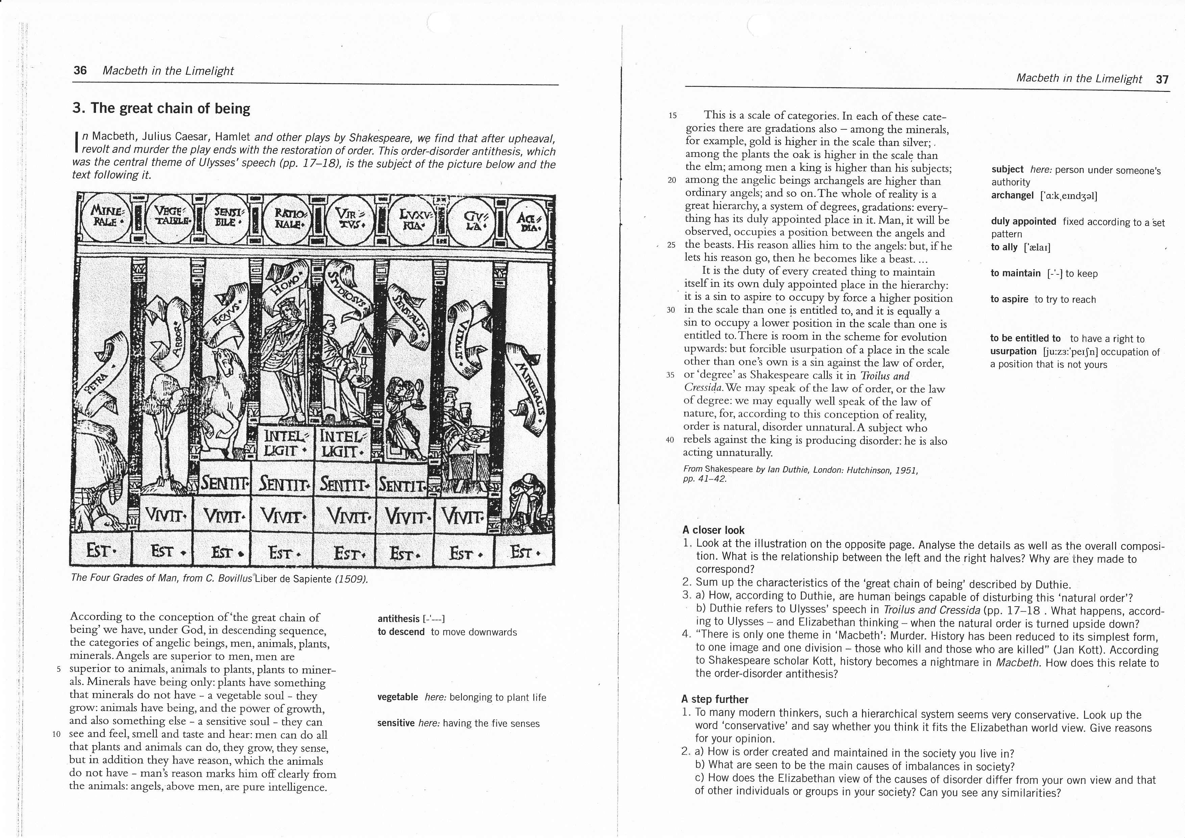
THE EUROPEAN CHAIN OF BEING

Slide 55
Calvin and (Thomas) Hobbes
Thomas Hobbes: Authored The Leviathan(1651)
Held the belief that people in a nutshell were stupid…
  Well intentioned, but stupid.
Citizens need a strong leader to tell them what to do.
  Given the chance, they will mess up society.
In nature…“no society; and which is worst of all, continual fear, and danger of violent death; and the life of man, solitary, poor, nasty, brutish, and short.”

Slide 56
A philosophical question…
What is man like in his “natural state?”
  This question fascinated thinkers around the late 17th century, the high point of the Scientific Revolution.
Without any society or laws or learned behaviors… how would people act?
  Do you believe it would be chaotic and warlike? Or would it be a society of people cooperating and aiming at common goals?

Slide 57
Premise of Leviathan
A. Men are generally equal (strength,
intelligence, etc.)
- No one can naturally beat everyone else… if fight happens, will be long
B. Man is selfish… competing for scarce
things leads to constant war in nature
- Food, land, water all limited… people constantly fight for them in natural state
C. All powerful Leviathan (ruler) needed to keep
peace for industry, security & social progress

Slide 58
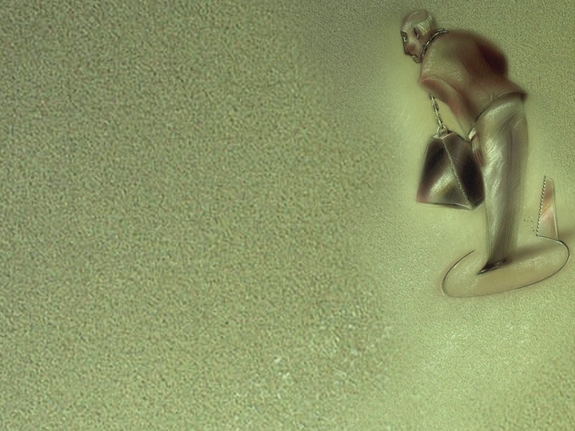
Fatal Fixation
Notes:
Target fixation and mental rigidity can lead to destruction, disaster and even death. Fortunately, Christ has released us from the grip of sin, so we can walk in newness of life.

Slide 59
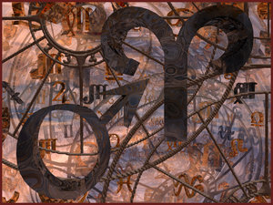
Czarina Catherine The Great Was Interested In Learning How Her Subjects Were Faring Under Her. She Was Instead The Innocent Prey For An Elaborate Ruse.
TILTING POINT

Slide 60
Her Lover - General Alexandovich –
Rather Than Burden Her With Real Visages Of Toiling Serfs - Ordered Construction Of Several Villages – Such That Her Eyes Were Greeted With Pictures Modern Prosperous & Of A Happy Waving Peasantry.
David Lee Burris:
FROM SYSTEMS EASY TO BE GOOD TO STRUCTURE DIFFICULT
TILTING POINT

Slide 61
Dostoevsky On Disproportion “Your Sympathy Does Not Justify My Suffering”
Karamazov Expresses Extremely:
First - Ivan Responds In Yielded Reason:
“I believe like a child that suffering will be made up for, that all the humiliating absurdity of human contradictions will vanish like a pitiful mirage… that in the world’s finale, at the moment of eternal harmony, something so precious will come to pass that it will suffice for all hearts, for the comforting of all resentments, for the atonement of all the crimes of humanity, of all the blood they’ve shed; that it will make it not only possible to forgive but to justify all that has happened with men…”

Slide 62
Wicked Reason Given Voice “If There Is No God Then All Things Are Permissible!”
David Lee Burris:
Gogol’s Dead Souls uses modern meanings for soul mixed with those of Imperial Russia. In Old Russia landowners owned their landbound serfs or souls and on paper - for ten year tax cycles – included some dead souls. The main character uses the Dead Souls to get a government loan.
Karamazov Expresses Extremely
Finally, Ivan’s Reaction In Indignation:
“I renounce the higher harmony altogether. It’s not worth the tears of that one tortured child who beat itself on the breast with its little fist and prayed in its stinking outhouse, with its unexpiated tears to ‘dear, kind God!’ It’s not worth it…”

Slide 63

Injustice: Christian Response Jesus Modeled A Third Way
Exposition Of Matthew 5: 39 – 42
Violent Resistance & Passive Acceptance Are Wrong
He Advocated Instead An Assertive Non-Violence
Turning The Other Cheek Central Illustration
Acting This Out Gets To The Point
You can be struck on the right cheek only by an overhand blow or with a backhand blow from the right hand.
But in that world people did not use the left hand to strike people. The left hand was ‘reserved’ for ‘unseemly use.’
Thus, being struck on the right cheek meant one had been backhanded with the right hand.
Given the social structure of the day a superior hit an inferior, whereas one fought social equals with fists.
This means the parable presupposes a setting in which a superior is beating a peasant.

Slide 64
Injustice: Christian Response Jesus Modeled A Third Way
Exposition Of Matthew 5: 39 – 42
Violent Resistance & Passive Acceptance Are Wrong
He Advocated Instead An Assertive Non-Violence
Turning The Other Cheek Central Illustration
Acting This Out Gets To The Point – Continued –
What Should The Peasant Do In Such Situation?
Verse 39 – “Turn To Him The Other Cheek”
What Would Be The Probable Outcome Of Following This Advice?
The only way the superior could continue the beating would be with an overhand blow with the fist – which would be treating the peasant as an equal.
Perhaps the beating would not have been stopped by this act but it would have been very disconcerting. He would only have continued the beating treating the peasant as a social peer!

Slide 65
Injustice: Christian Response Jesus Modeled A Third Way
David Lee Burris:
MLK – “In the end we will remember not the words of our enemies, but the silence of our friends.”
Exposition Of Matthew 5: 39 – 42
Violent Resistance & Passive Acceptance Are Wrong
He Advocated Instead An Assertive Non-Violence
Acting This Out Gets To The Point – Continued –
What Should The Peasant Do In Such Situation?
Verse 40 – “Let Him Have Your Cloak Also”
Under civil law a coat could be confiscated for non-payment of debt – there was not any bankruptcy protection back then.
For the poor, the coat then served as a blanket at night.
In that world, the only other garment typically worn by a peasant was an inner garment, a cloak.
In advising to give the cloak as well – Jesus is saying to strip naked!
In that world, nakedness was a shame to the person observing it.
These were potent methods to confound and expose social injustice.
In reality, this new way, was a radical approach to empowerment.

Slide 66
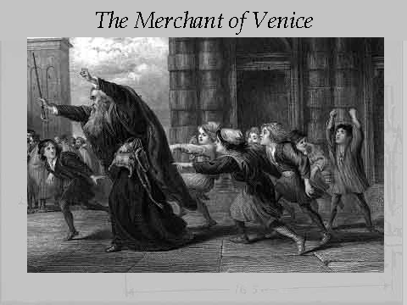
David Lee Burris:
Excessive legalism indicates a systems trending out-of-order!
Lessons Of Legalism: The Pound Of Flesh

Slide 67

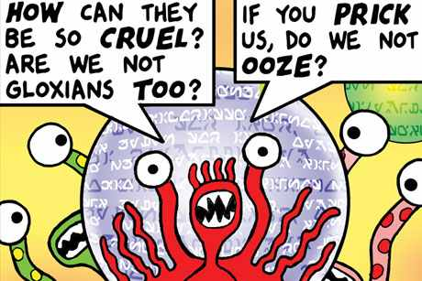
Perseveration is the tendency to continue in destructive behaviors.
Notes:
Perseveration is a brain dysfunction that causes people to persist in a task — to carry on in a completely illogical way, even when the chosen strategy is doomed and could lead to death. The Red Baron wasn’t born with this condition — in fact, for most of his career he was a careful fighter who achieved 80 kills, more than any other World War I pilot. But he suffered a traumatic brain injury in a dogfight nine months before his death, and researchers now believe that this caused his dysfunction to develop.
Today, the Air Force would have made him DNIF — Duties Not to Include Flying. But in 1918, his headaches, air sickness and fatigue were ignored. The Red Baron kept on flying, until that April day when he drove himself straight to his death.
Perseveration can be a problem for us as well, even without the dogfights — or cat-fights. Fatal fixations can pop up in our work, our parenting, our friendships, and our faith lives, causing us to pursue strategies that are doomed and even disastrous.

Slide 68
The Sinful Versus Spiritual Mindset
Biblical Numerology: Two Opposed Mindsets
The Natural Man Versus The Enlightened Man
The People of the Lie Versus The People of God

Slide 69

Satan’s Sin: Pit Of Pride
1st Timothy 3: 6 –
“…lest being puffed up with pride he fall into the same condemnation as the devil.”

Slide 70
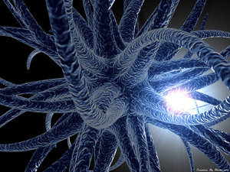
This Cancer Has Spread As An Efficient Killer!
PATHOGENIC

Slide 71
This Scourge Has Spread As A Virus That Hunts!
PANDEMIC

Slide 72

John 8: 44
“You are of your father the devil, and the desires of your father you want to do. He was a murderer from the beginning, and does not stand in the truth, because there is no truth in him…”

Slide 73

THE BIG LIE
“who exchanged the truth of God for the lie, and worshiped and served the creature rather than the Creator…”
Romans 1: 25

Slide 74
Humanistic Foundation For Our False Consciousness: The Big Lies Of The Devil
The Ego-Centric Lies Of The Garden: The Earth Belongs To The Living – T. Jefferson
Ego-Centric Lying In The Wilderness: Concept Of Self-Ownership & Self-Determination
The Lying Ego Of Eden’s Garden Was Exposed On The Cross!
The Lying Ego In The Wilderness Was Overcome By The Resurrection!

Slide 75
There Are Three Aspects To: Sharing Satan’s Sins & Believing Satan’s Lies
We Measure Ourselves By Ourselves - i.e. … 2nd Corinthians Chapter 10 & Verse 12
We Lie To Ourselves About Ourselves – i.e. … Proverbs 21: 2 Vs. “The Good Test” – As Per: An All-Covering Love – Long-suffering Love – A Love That Returns Good For Evil – Unselfishness Of Our Love – The Self-forgetting Love - Love That Doesn’t Change – The Honesty Of Our Love – The Humility Of Love – Undivided Love – The Purity Of Love
Network & Facilitate The Vision & Mission Of This World’s Prince Rather Than The Prince Of Peace!

Slide 76

“People Of The Lie” by M. Scott Peck, M.D.
“This willful failure of submission that characterizes malignant narcissism is depicted in the story of Satan. Satan refused to submit to God’s judgment that Christ was superior to him… For Satan to have accepted God’s judgment, he would have to accept his own imperfection. This he could not or would not do. It was unthinkable that he was imperfect. Consequently, submission was impossible and both the rebellion and fall inevitable.”

Slide 77
“People Of The Lie” by M. Scott Peck, M.D.
Q: “What is the cause of this overweening pride, this arrogant self-image?” A: ‘Malignant Narcissism’ type characterized by an unsubmitted will… (Erich Fromm) “In the conflict between their guilt & their will, it is the guilt that must go and the will that must win.”

Slide 78
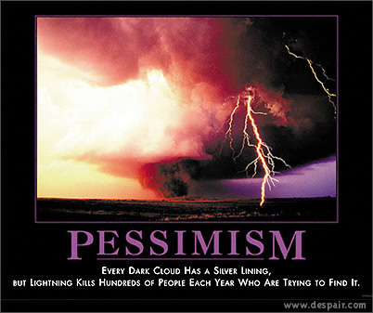


Slide 79
“People Of The Lie” by M. Scott Peck, M.D.
David Lee Burris: Charles Colson Citation – “[Mike] Wallace’s subsequent summation of Dinur’s terrible discovery – ‘Eichmann is in all of us’ – is a horrifying statement; but it indeed captures the central truth about man’s nature.”
“They are acutely sensitive to social norms and what others think of them… While they seem to lack any motivation to be good, they intensely desire to appear good. Their ‘goodness’ is all on a level of pretense. It is, in effect, a lie. This is why they are the ‘people of the lie.’ Actually, the lie is designed not so much to deceive others as to deceive themselves. They cannot or will not tolerate the pain of self-reproach.”

Slide 80
Men loved darkness
John 3:19-21 And this is the condemnation, that light is come into the world, and men loved darkness rather than light, because their deeds were evil. 20 For every one that doeth evil hateth the light, neither cometh to the light, lest his deeds should be reproved. 21 But he that doeth truth cometh to the light, that his deeds may be made manifest, that they are wrought in God.
Men made a choice
They Loved Darkness!
While others chose light!

Slide 81
A call from darkness to light
Rom 13:12-14 The night is far spent, the day is at hand: let us therefore cast off the works of darkness, and let us put on the armour of light. 13 Let us walk honestly, as in the day; not in rioting and drunkenness, not in chambering and wantonness, not in strife and envying. 14 But put ye on the Lord Jesus Christ, and make not provision for the flesh, to fulfil the lusts thereof.
Walk Honestly
Make No Provision
For The Flesh

Slide 82
Walk as children of light
Eph 5:6-8 Let no man deceive you with vain words: for because of these things cometh the wrath of God upon the children of disobedience. 7 Be not ye therefore partakers with them. 8 For ye were sometimes darkness, but now are ye light in the Lord: walk as children of light:
Eph 5:11 And have no fellowship with the unfruitful works of darkness, but rather reprove them.
We must make right choices!
No Fellowship With Darkness or we forfeit the crown!
Being deceived can be our demise!
Our choices determine our destiny!
God only gives us what we deserve!

Slide 83


Slide 84


Slide 85
Rom 8:3-8 For what the law could not do in that it was weak through the flesh, God did by sending His own Son in the likeness of sinful flesh, on account of sin: He condemned sin in the flesh, 4 that the righteous requirement of the law might be fulfilled in us who do not walk according to the flesh but according to the Spirit. 5 For those who live according to the flesh set their minds on the things of the flesh, but those who live according to the Spirit, the things of the Spirit. 6 For to be carnally minded is death, but to be spiritually minded is life and peace. 7 Because the carnal mind is enmity against God; for it is not subject to the law of God, nor indeed can be.

Slide 86
Two Kinds Of People in the World
Those who choose to walk after the flesh.
Those who choose to walk after the Spirit.

Slide 87
Those whose choice is the flesh
Flesh here denotes sinful, human nature apart from God
Rom 3:12-18 They have all turned aside; They have together become unprofitable; There is none who does good, no, not one.“ 13 "Their throat is an open tomb; With their tongues they have practiced deceit"; "The poison of asps is under their lips"; 14 "Whose mouth is full of cursing and bitterness." 15 "Their feet are swift to shed blood; 16 Destruction and misery are in their ways; 17 And the way of peace they have not known.“ 18 "There is no fear of God before their eyes."

Slide 88
Such do not have God's rightful expectation, the act of making us what we should justly be and what God originally created us to be
Rom 8:3-5 For what the law could not do in that it was weak through the flesh, God did by sending His own Son in the likeness of sinful flesh, on account of sin: He condemned sin in the flesh, 4 that the righteous requirement of the law might be fulfilled in us who do not walk according to the flesh but according to the Spirit.
Just obeying a law has been difficult for man all down through history. People feel that laws are made to be broken instead of obeyed. By God sending his only son we should be able to see this is more than just giving a law, God has invested himself in our Salvation through his son.

Slide 89
Paul elaborates on this change brought about through Christ
Rom 7:4-6 Therefore, my brethren, you also have become dead to the law through the body of Christ, that you may be married to another — to Him who was raised from the dead, that we should bear fruit to God. 5 For when we were in the flesh, the sinful passions which were aroused by the law were at work in our members to bear fruit to death. 6 But now we have been delivered from the law, having died to what we were held by, so that we should serve in the newness of the Spirit and not in the oldness of the letter.
No longer just a law but a way of life, we can start over fresh with a new life separate and apart from the struggles brought about by SIN. Christ offers us a freedom from the things that brought death in the past.

Slide 90
A distinctly different kind of life is offered to us all
Gal 5:16-21 I say then: Walk in the Spirit, and you shall not fulfill the lust of the flesh. 17 For the flesh lusts against the Spirit, and the Spirit against the flesh; and these are contrary to one another, so that you do not do the things that you wish. 18 But if you are led by the Spirit, you are not under the law.
19 Now the works of the flesh are evident, which are: adultery, fornication, uncleanness, lewdness, 20 idolatry, sorcery, hatred, contentions, jealousies, outbursts of wrath, selfish ambitions, dissensions, heresies, 21 envy, murders, drunkenness, revelries, and the like; of which I tell you beforehand, just as I also told you in time past, that those who practice such things will not inherit the kingdom of God.
Most act like sinners because they are sinners but you don’t have to make that choice, you can choose to be led by the Spirit and take a much safer path.

Slide 91
This is not about you just changing what you are doing but the very act of changing who you are
John 3:1-8 There was a man of the Pharisees named Nicodemus, a ruler of the Jews. 2 This man came to Jesus by night and said to Him, "Rabbi, we know that You are a teacher come from God; for no one can do these signs that You do unless God is with him.“ 3 Jesus answered and said to him, "Most assuredly, I say to you, unless one is born again, he cannot see the kingdom of God.“ 4 Nicodemus said to Him, "How can a man be born when he is old? Can he enter a second time into his mother's womb and be born?" 5 Jesus answered, "Most assuredly, I say to you, unless one is born of water and the Spirit, he cannot enter the kingdom of God. 6 That which is born of the flesh is flesh, and that which is born of the Spirit is spirit. 7 Do not marvel that I said to you, 'You must be born again.' 8 The wind blows where it wishes, and you hear the sound of it, but cannot tell where it comes from and where it goes. So is everyone who is born of the Spirit."
A change of who you are and how you think and live

Slide 92
Here John explains how it works
1 John 3:4-6 Whoever commits sin also commits lawlessness, and sin is lawlessness. 5 And you know that He was manifested to take away our sins, and in Him there is no sin. 6 Whoever abides in Him does not sin. Whoever sins has neither seen Him nor known Him.
7 Little children, let no one deceive you. He who practices righteousness is righteous, just as He is righteous. 8 He who sins is of the devil, for the devil has sinned from the beginning. For this purpose the Son of God was manifested, that He might destroy the works of the devil. 9 Whoever has been born of God does not sin, for His seed remains in him; and he cannot sin, because he has been born of God.

Slide 93
Others choose to walk in the Spirit
The ‘believer” made a choice at one point to turn their life around in a positive direction. There is no neutral walk so a person has to choose which path they will take.
The mindset of the believer confirms “ you are what you think”
Rom 8:6-8 For to be carnally minded is death, but to be spiritually minded is life and peace. 7 Because the carnal mind is enmity against God; for it is not subject to the law of God, nor indeed can be. 8 So then, those who are in the flesh cannot please God.

Slide 94
A good “rule of thumb to guide our thinking is this
Rom 12:3-4 For I say, through the grace given to me, to everyone who is among you, not to think of himself more highly than he ought to think, but to think soberly, as God has dealt to each one a measure of faith.
There is no conflict between what he does, where he goes, and what he thinks as there is no conflict between what he does and what he is.
If you are experiencing conflict, then you may need to -- “TAKE A LOOK AT WHO YOU HAVE BECOME”
The concern of unbelievers is not what they are, but how far they can go and get away with it. Gradification of the flesh is what is on their mind constantly.
The concern of the believer is pleasing God not self.

Slide 95
Mindset of the believer
Set on spiritual things
We become by choice, a partaker of God’s nature
We love the right things and hate the evil things just as God does
A person may claim to be saved, but if his lifestyle remains unchanged, his claim is false and deceptive.
1 Cor 6:9-11 Do you not know that the unrighteous will not inherit the kingdom of God? Do not be deceived. Neither fornicators, nor idolaters, nor adulterers, nor homosexuals, nor sodomites, 10 nor thieves, nor covetous, nor drunkards, nor revilers, nor extortioners will inherit the kingdom of God. 11 And such were some of you. But you were washed, but you were sanctified, but you were justified in the name of the Lord Jesus and by the Spirit of our God.

Slide 96
Their spirit is saved and sanctified because they have repented of their sin and turned to Jesus Christ for salvation. In their regenerated state, their mindset is not that of conformity to the flesh, in which sin never ceases to dwell, but opposition to sin and true repentance.
They have an aversion to yielding to the flesh. In order for this to come about, there must first be true repentance from sin.
Acts 2:38-39 Then Peter said to them, "Repent, and let every one of you be baptized in the name of Jesus Christ for the remission of sins; and you shall receive the gift of the Holy Spirit.

Slide 97

The Sinful Versus Spiritual Mindset
Biblical Numerology: Two Opposed Mindsets
The Natural Man Versus The Enlightened Man
The People of the Lie Versus The People of God
Competing Worldviews: Secularist Versus Theistic

Slide 98
Comparison of Worldviews

Slide 99

Questions which reveal one’s worldview
Why is there something rather than nothing?
How do you explain human nature?
How do you know that you know?
What happens to a person at death?
How do you determine what is right or wrong?
What is the meaning of history?

Slide 100
What are some worldview tests?
Reason – A worldview should be consistent and coherent
Experience – A worldview should match the facts of our experience
Explanation – A worldview should be comprehensive in scope and be able to explain the world around us.
Practice A worldview should be livable.
Notes:
The Bible is internally consistent
Buddhism gives a moral law with no reference point for its origin. There is no God. No coherence.
Naturalism cannot explain the origin of the first particle. Not comprehensive.
If pantheism suggests that physical reality is an illusion, then why not meditate on railroad tracks? Doesn’t match experience.

Slide 101
The test of explanatory power
“The explanatory power of theism is based . . . on the cumulative case one gets by reflecting on the existence of the universe, the order of the universe, and the facts of human rationality, moral consciousness, and religious experience.” -- Ronald Nash

Slide 102





Slide 103
A Quiz
Name that worldview!

Slide 104
Life without God?
Each of us will one day grow old, die, and our bodies disintegrate. What then?
“In the future, those who will be selected for, will be those who know there is no purpose in life, but will live as if there is.”
If the moral and the immoral eventually come to the same end, what does it matter how we live our lives?

Slide 105
Life Without God?
“No species, ours included, possesses a purpose beyond the imperatives created by its genetic history…we have no particular place to go.”
E. O. Wilson

Slide 106
Why is there something rather than nothing?
Everything had an impersonal beginning (spirit or energy).
Matter has always existed.
Everything had a personal beginning.

Slide 107


Slide 108
What is the ultimate source of knowledge?
Reason -- (Rationalism)
Experience -- (Empiricism)
Intuition -- (Mysticism)
Revelation

Slide 109
How do you explain human nature?
Blank slate
Inherently good
Socially constructed
Manifestation of “God”
Created image-bearer with a fallen nature

Slide 110
How do you determine what is right or wrong?
Everything is relative
Everything is determined
An “is” is an “ought”
Might makes right
Revealed absolutes

Slide 111
What is the meaning of human history?
History is determined as part of a mechanistic universe.
History is cyclical.
History is going forward, and it is meaningful.
History is decided by the historian.

Slide 112
History is both Linear & Meaningful
Rev. 1:8; 22:13
Gen. 1:1
Rev. 21-22
Rev. 1:4-8

Slide 113
What happens to a person at death?
People merely cease to exist.
People are reincarnated
Death is the gate to life with God or separation from God.
Whatever a person believes will happen is what matters.

Slide 114
THE BASIS OF OUR ETHICAL DECISIONS
* Source: Absolute Confusion By George Barna

Slide 115
THE BASIS OF OUR ETHICAL DECISIONS
* Source: Absolute Confusion By George Barna

Slide 116
The Moral Argument: Is There a Law Written on Our Hearts?
Moral laws imply a Moral Law Giver.
There is an objective moral law.
Therefore, there is a Moral Law Giver

Slide 117
Moral Laws Imply a Moral Lawgiver
Moral Laws are different from natural laws.
Moral laws describe what ought to be not what is.
“human beings all over the earth, have this curious idea that they ought to behave in a certain way, and cannot really get rid of it.” C. S. Lewis –Mere Christianity

Slide 118
There Is an Objective Moral Law
“If no set of moral ideas were truer or better than any other, there would be no sense in preferring civilised morality to savage morality, or Christian morality to Nazi morality. In fact, of course, we all do believe that some moralities are better than others. . . . The moment you say that one set of moral ideas can be better than another, you are, in fact, measuring them both by a standard . . .

Slide 119
There is an Objective Moral Law
“Comparing them both with some Real Morality, admitting that there is such a thing as a real right, independent of what people think, and that some people’s ideas get nearer to that real Right than others.”
C. S. Lewis, Mere Christianity

Slide 120
There is an Objective Moral Law
Is murder by cop wrong? For all people and all time?
But if there is such a universal, objective moral law, then there must be a Moral Law Giver.

Slide 121
Summary
Life without God is absurd.
The universe requires a sufficient Cause.
The design of the universe and living things implies a designer.
Our universal sense of right and wrong implies a Law Giver.
Therefore belief in God is reasonable.

Slide 122
Ancient Wisdom for Modern Life
Ecclesiastes
It’s all a matter of perspective!

Slide 123
TWO VIEWS OF THE WORLD
Secularist
World
View
Theistic
World
View

Slide 124

SECULARIST
WORLDVIEW
A World view without God
Autonomous man
Pursuit of the earthly

Slide 125
Four Realities
A transitory life
+ A meaningless earth cycle
+ An inability to know all
+ Generational discontinuity
Frustration & Hopelessness!

Slide 126


Slide 127
Four Realities
A transitory life
+ A meaningless earth cycle
+ An inability to know all
+ Generational discontinuity
+ God In The Equation
What Is The Outcome?

Slide 128
The Theistic
WORLDVIEW
A world under God’s control
A trusting relationship with the Creator
Pursuit of the spiritual purposes of God

Slide 129
Four Realities
A transitory life
+ A wise God in control
+ A sovereign purpose to fulfill
+ Wisdom to guide us
Satisfaction & hope!

Slide 130
TWO VIEWS OF THE WORLD
Secularist
World
View
Theistic
World
View
* The Great “Awokening” Vs. The Great “Awakening”

Slide 131



Different Perspective
NEW VISION

Slide 132
Lifeview & Worldview Change
Decision Of Pragmatism. Question: Does This Still Work?
Decision Of Propriety. Question: Proper For Problems?
Decision Of Process. Question: Given Enough Time?

Slide 133
Lifeview & Worldview Change
Organic Complex: Whole Value In No Relation To Parts
Positive Paradox: Tension Total Of Two Goods Better
Negative Paradox: Tension Total Of Two Evils Worse
Negative Complex: Complex Evil From Simple Goods
Positive Complex: Complex Good From Simple Evils

Slide 134
The Moral Change Process: Cognitional & Conceptual Developments
1st Level: Pre-Conventional Is Structured In Terms Of An Obedience To Tools & Rules.
2nd Level: Critical Reflection Of Rule Roles & Basic Conventions; Accepted Tool Of Social Relation & Maintenance Of Social Order.
3rd Level: Post-Conventional Individual & Minority Focus On Rights & Universal Principles - Natural Law & Analogic Method
Source: Kohlberg, Psychology Of Moral Development

Slide 135
The Moral Change Process: Cognitional & Conceptual Developments
Movement From Childhood Judgment According To The Results Perceived Personal.
Movement Unto Adulthood Judgment According To The Motives & Intents & Ideals.
Transitional From Concepts Utilitarian & Immediate Unto Concepts Universal & Eternal
Source: NYU Prof. Grim, Questions Of Value

Slide 136

WHAT CAN YOU
DO ABOUT IT

Slide 137

The words and actions of a person over a lifetime can be thought of in reference to a path that one treads – which we might think of as a two-dimensional graph. At any point a rational being can if he chooses – gauge the direction he is heading and decide one of three things:
Change Conceived Mathematic
1. Continue ~ Same Path & Current Direction
{Goals-Methods-Worldview - Remain Intact}
2. New Worldview – Actions & Agenda Same
3. Orthogonal Shift – Ninety Degree Diverge

Slide 138


Slide 139

The Lost have rejected both the natural order of general revelation & the special revelation of god’s own son!

Slide 140

Putting It All Together

Slide 141

What Was Designed Without Defect
Is Now Damaged Goods

Slide 142
Creatures Meant For The Good Life
Want Apart From Right Life

Slide 143
Creatures Meant For The Noble Life
Prioritize Lifestyle Enviable
Before Character Admirable

Slide 144
Eternal Creatures Purposed For Joy
Means-Ends Earthly & Worldly
Seeking Pleasure Of Temporal Nature
Happiness Measured Circumstantially

Slide 145
GOD
SEEKS
TO SAVE!

Slide 146
David Lee Burris:
Apologists Have Long Recognized That Rejections To The Gospel Message Are Morally Driven – Those That Object Seek To Justify Certain Behaviors – Over Time Their Sin Has Made Them Blind
SIN
SEPARATES
MAN

Slide 147
What Does This
MEAN TO YOU

Slide 148

David Lee Burris:
Like A Snake – But Like The Serpents Mentioned In Scripture – God Is In Control!
The Real Thorns Of Life Bite!

Slide 149
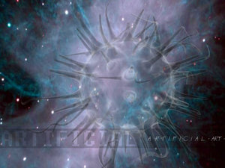
Jesus
Took The
Bite
Out Of
Reality!

Slide 150
Jesus
Took The
Sting
Out Of
Death!

Slide 151
THE HOPE HERMENEUTIC
Medical Practitioners are Professionally Trained to Facilitate the Patient Processing of Unpleasant Information:
GIVE THE GOOD NEWS FIRST!

Slide 152


Hope!
God makes life livable

Slide 153

Theme:
Three episodes in Jesus’ ministry…
filled people with hope

Slide 154

Hope…
Commonly → wish, desire
Sometimes → expectation
In Bible:
  Man’s desire
  Filled with expectation
Occasionally → confidence

Slide 155

Important?
Hope’s absence
has an amazing capacity to eat away at the whole structure of life

Slide 156
Important?
What oxygen is for the lungs,
such is hope for the meaning of human life

Slide 157
Important?
W/O hope → despair
Eph. 2¹²
  No hope
  Without God

Slide 158
Hope is critical to life
Anticipation drives us
Without hope…
nothing to live for!

Slide 159

Proposition:
God puts expectation into your desire…
and calls it hope

Slide 160


A Marvelous Catch
Setting:
  Multitudes came to listen
  Out in the boat
Put out…to catch
  No hope, but…
  Nets began to burst
Fear became commitment:
  Fishers of men

Slide 161

Calmed the Sea
Crossing over:
  Fierce gale
  Jesus sleeping
Don’t you care?
Hush, be still!
Have faith = trust Me

Slide 162

Walked on Water
They crossed over:
  Storm battered their little boat
  He came walking (after prayer)
It is I
Peter came:
  Panicked, but looked to Jesus
Jesus: “Why doubt?”
  Nature obeys Him!

Slide 163
Jesus’ control over our environment…
means we can expect good in our lives!

Slide 164

Point:
Do you want Him to fill your life with hope?
Be like Peter
Look to Him
Trust His love

Slide 165

Three Variations
Desire, accompanied by confident expectation
Thing hoped for or desired
One who is source or reason for hope

Slide 166

God, Our Hope
On His throne; in control
The hope of Spiritual Israel
  Healer
  Savior
  Source & object of praise

Slide 167

Born Again
Last week → He gives life
2 weeks → He overturns death
New life:
  Through resurrection
  Living hope!

Slide 168
We have hope because of God!
Who He is & how He feels toward us…
means we can expect good!

Slide 169
Point:
Do you want hope?
Look to God
Forget despair;
God is your source of blessings

Slide 170

My Life

Slide 171

The Big Questions
How can we personally discover a really meaningful existence?
What should our priorities be in order to be truly satisfied with life?
How can we live with what seem to be the arbitrary changes life forces upon us and still be joyous?

Slide 172

Make LIFESTYLE CHOICES that align us with God’s intentions.

Slide 173
The Sinful Versus Spiritual Mindset
Biblical Numerology: Two Opposed Mindsets
The Natural Man Versus The Enlightened Man
The People of the Lie Versus The People of God
Competing Worldviews: Secularist Versus Theistic
Comfortable Versus Transformative Discipleship

Slide 174
HOPE REQUIRES CHANGE!
My Life

Slide 175
The transformed disciple seeks to overcome evil with good.
Insight into the transformed life..
But How?

Slide 176


Slide 177

We Want Comfortable Discipleship
We want our discipleship compartmentalized
  Express faith Sunday fervent
  Restrict the spiritual to times & places of least discomfort
  Preside as Kings & Queens of mental castles with very many rooms & areas out of bounds

Slide 178
We Want Comfortable Discipleship
We consumerize our discipleship
  “What’s in it for me?” & “What have you done for me recently?” questions are always in mind.
  Unconsciously, we project continuously our cost calculating culture of benefit & burden analysis
  We seem to say: “Ask not what can we do for God but what can He do for us.” Each new day, by this attitude we reflect an inner corruption desirous of an inverted relationship with God.

Slide 179
We Want Comfortable Discipleship
We are complacent disciples
  We prefer to have events occur such that they cause minimal trouble and bother to our established patterns
  We assume that if it is God’s Will that something happens in our world He can do that thing without our taking part
  We presume our being contented is a goal accepted & destiny approved

Slide 180
We Want Comfortable Discipleship
We want our discipleship casual
  What would happen with our lives, our families, our neighborhood & employment, and especially to our churches, if we took God seriously
  Routine & regime “Christianity lite”
  The fear of being labeled fanatics prevents us being fans of God’s plan
  Avoidance of these images instead hinder integrity to professed faith

Slide 181
We Want Comfortable Discipleship
We’ve compromised our discipleship
  We claim to love God but still love sin
  We assume we are allowed some sin because we retain our human nature
  We excuse the actions of the flesh by pointing to it’s evident weakness
  We fail to understand or appreciate the significance of spiritual “being”

Slide 182
We Want Comfortable Discipleship
We become conceited disciples
  We believe we know better than God
  We equate either years in the faith or years in the church with maturity
  Our actions & words – our say and our do relate little with each other
  This arrogance amounts to an inner wall & low ceiling to further growth

Slide 183

We Want Comfortable Discipleship
We are conditional disciples
  We have assigned duty to God as if arranged in one-sided contract
  We keep that which we don’t want included out of the negotiations
  We attribute to God the role play of trapped tight “genie” in bottle

Slide 185


Slide 186


Slide 187
Spiritual Transformation:
Benchmark To Hallmark
Overcoming Evil With Good

Slide 188
The transformed disciple seeks to overcome evil with good.
Insight into the transformed life..
But How?

Slide 189


Slide 190


Slide 191
The Sinful Versus Spiritual Mindset
Biblical Numerology: Two Opposed Mindsets
The Natural Man Versus The Enlightened Man
The People of the Lie Versus The People of God
Competing Worldviews: Secularist Versus Theistic
Comfortable Versus Transformative Discipleship
Expectant Hope for The Renewed Mind!

Slide 192
Sanctification and the Subconscious Mind
If we are truly to be in the likeness of Christ, we must be in His likeness both on the conscious and subconscious levels of our personality. Thoughts, words, and actions take place on the conscious level, but they are expressions of our inner basic nature which exists on the subconscious level.
It is the design of sanctification to change our thoughts, words, and actions into the likeness of Christ and to so change our basic inner nature that these thoughts, words, and actions represent a real attitude of heart. Anything less than this fails to recognize the implications involved in the fact that man is personal. The view of redemption that makes man, in his highest dedication, a surrendered instrument or machine to be controlled by God, to the point that a Christian’s decisions are in no real sense his own, fails to understand what is meant to be changed into the image of Christ. Such a view fails to comprehend fully that man is a personal being.
The church has always been plagued with the idea that there is no real redemption of the personality in this life. Man is pictured by some as being so totally wrecked by sin that he is beyond repair in this life. Salvation becomes a divine towing service for the wrecked human being. Nothing can be done to restore him in this life. Everything will be made all right when we are finally towed into the heavenly garage, but that will be in the next life.
The best thing, according to this view, is for a person to dwell on the idea of his or her own nothingness and worthlessness. He is to believe that he is doing nothing and cannot do anything worthwhile. The best he can do is to keep from being a hindrance while God is towing His wrecked humanity into the heavenly garage. To despise himself would seem to be his highest virtue. To respect himself or to have anything like self-confidence is a sin.
  Forlines, F. L. (2011). . (J. M. Pinson, Ed.) (pp. 283284). Nashville, TN: Randall House.
Forlines, F. L. (2011). Classical Arminianism: A Theology of Salvation. (J. M. Pinson, Ed.) (pp. 283–284). Nashville, TN: Randall House.

Slide 193


Slide 194
Biblical Evidence for the Transformation of the Subconscious Mind
I appreciate the problems that many sincere Christians have that move them, to whatever extent, along the line of thought described above. However, the Bible clearly teaches that there is a basic change in the personality of redeemed people both on the conscious and subconscious levels that makes our actions in a real sense our own and a reflection of our inner nature.
In Romans 8:29, the word for “conformed” is the Greek word summorphos. Sanday and Headlam explain that this word “denotes inward and thorough and not merely superficial likeness.”
In 2 Corinthians 3:18, when Paul speaks about the process of being transformed into the image of the glory of the Lord, he uses a very interesting word. He uses a verb that is kin to the word used in Romans 8:29. It is the word metamorphoō. The word is made up of two words meaning “after” and “to form.” The noun which comes from the same root is the word morphē. R. C. Trench calls attention to an interesting contrast between morphē and another Greek word schēma. He explains that morphē “signifies the form as it is the utterance of the inner life.” Schēma refers to outward appearance or fashion and can be superficial. Suschēmatidzō is a verb which is made up of two words “with or together” and the verb form from the same root as schēma which means “to fashion.” Metamorphoō refers to an internal change rather than a mere external change. Suschēmatidzō refers to an outward, superficial change.
The choice of the word metamorphoō in 2 Corinthians 3:18 shows us that when Paul speaks of being changed into the image of the Lord, he is speaking about a deep, basic change in the inner nature of the Christian. It is a change of our personality on the subconscious level that manifests itself in conscious actions that are true reflections of the person.
In Romans 12:2 Paul says: “And do not be conformed to this world, but be transformed by the renewing of your mind.” The Greek word for conformed is suschēmatidzō. The Greek word for transformed is metamorphoō. Trench correctly explains: “ ‘Do not fall in,’ says the apostle, ‘with the fleeting fashions of this world, nor be yourselves fashioned to them (mēsuschēmatizesthe), but undergo a deep abiding change (alla metamorphousthe) by the renewing of your mind, such as the spirit of God alone can work in you’ (cf. 2 Corinthians 3:18).”
It is clear from the words used in Romans 8:29; 12:2; and 2 Corinthians 3:18 that Paul is referring to the fact that as Christians we experience a deep, basic, inner change. The life of the believer is brought into the likeness of the life of Christ. The outward life is to be a manifestation of an inner reality.
  Forlines, F. L. (2011). . (J. M. Pinson, Ed.) (pp. 284285). Nashville, TN: Randall House.
Forlines, F. L. (2011). Classical Arminianism: A Theology of Salvation. (J. M. Pinson, Ed.) (pp. 284–285). Nashville, TN: Randall House.

Slide 195
Sanctification and the Total Personality
The New Testament teaches that conformity to the image of Christ extends to each area of the personality. It affects the way we think, feel, and act. Romans 12:2 proves to be very interesting at this point. Paul speaks about a basic, inner change taking place “by the renewing of your mind.” Concerning the meaning of this expression, Barclay M. Newman and Eugene A. Nida explain: “The meaning is that the Christian confession demands that the entire bent of one’s mind be changed. The entire clause may be rendered as ‘permit God to change your inside by giving you a completely new mind’ or ‘by making your mind and your heart completely different.’ ”
As I understand it, the renewing of the mind is not a process that somehow stands outside the basic inner change that brings it about. Rather, it is involved in the change. The renewing of the mind is involved in the basic inner change.
The important question here is: What is the mind? In the English language, the word mind means: (1) that with which we think and reason, (2) the mind (in the limited sense just referred to) plus the heart and the will. It is this use of the word mind that is reflected in the statement: “I have made up my mind to serve the Lord.” We mean by this that our whole being—mind, heart, and will—is involved in the decision.
I believe the Greek word nous as Paul is using it embraces mind, heart, and will. Concerning the meaning of nous, J. H. Thayer gives as one of its meanings: “The mind, comprising alike the faculties of perceiving and understanding and those of feeling, judging, determining.” This use of the word mind is closely related to person or personality. We would be correct in saying that, in Romans 12:2 when Paul speaks of a change in our basic inner nature by the renewing of our mind, he was referring to a basic inner change in our total personality.
  Forlines, F. L. (2011). . (J. M. Pinson, Ed.) (pp. 285286). Nashville, TN: Randall House.
Forlines, F. L. (2011). Classical Arminianism: A Theology of Salvation. (J. M. Pinson, Ed.) (pp. 285–286). Nashville, TN: Randall House.

Slide 196
The Old and the New Person
Ephesians 4:17-19 Updated American Standard Version (UASV)
17 This, therefore, I say and bear witness to in the Lord, that you no longer walk as the Gentiles also walk, in the futility of their mind, 18 being darkened in their understanding, alienated from the life of God, because of the ignorance that is in them, because of the hardness of their heart; 19 who being past feeling gave themselves up to shameless conduct,104 for the practice of every uncleanness with greediness. 20 But you did not learn Christ in this way, 21 if indeed you have heard him and have been taught in him, just as truth is in Jesus, 22 that you take off, according to your former way of life, the old man, who is being destroyed according to deceitful desires, 23 and to be renewed in the spirit of your minds, 24 and put on the new man,105 the one created according to the likeness of God in righteousness and loyalty of the truth.
Satan is very crafty in using the natural desires that God gave us, which are now bent toward wrong, as a tool in his chest of weapons, in the battle for our minds. Yes, his battle for your mind, my mind, every true Christian mind carries on without letup. On Ephesians 4:17-19, Max Anders writes,
4:17. The Gentiles in Ephesus were particularly sinful. Ephesus was a leading city of commerce and culture in the Roman Empire, the home of the pagan temple of Diana, one of the seven wonders of the ancient world. Worship of Diana involved the worst immorality of degraded pagan religion. That influence made Ephesus a wretched hive of scum and villainy, a wicked place indeed. Temple prostitution, graft, crime, immorality, idolatry, and every conceivable form of sin abounded. Many of the Christians in Ephesus came out of that kind of background. In contrast with that evil background, Paul made his appeal, “Don’t live like that any longer!”
First, he says, it is futile to live like that. It leads to nothing.
4:18. Second, he says, it reflects darkened understanding, a result of having turned their backs on God. Their hearts are hard, and as a result, their mind is dark. Lives separated from God’s holiness are ignorant lives. This is hard for the sophisticated, educated people of Ephesus to accept. How dare someone call them ignorant. Paul did not contend they had no knowledge. He contended the knowledge did no good in leading them to a lifestyle that pleased God. Without such a lifestyle, their minds did not function properly.
4:19. Their hard heart, which yielded a darkened mind, led to an unholy life. Paul says they have given themselves over to sensuality, a life without concern for the consequences of their actions. Their desire for sensual pleasure overrode every other regard. No matter what they did, such desire was never satisfied. They always wanted more. Lust not love dominated their lives. Such Gentiles certainly did not serve as models for the church. They were not mature. They did not bring unity.¹⁰⁶
  Andrews, E. D. (2016). . Cambridge, OH: Christian Publishing Hous
Andrews, E. D. (2016). The battle for the christian mind: be transformed by the renewal of your mind. Cambridge, OH: Christian Publishing House.

Slide 197
How can We Renew Our Mind?
At the outset, we read the Apostle Paul’s words, “Do not be conformed to this world, but be transformed by the renewal of your mind, that by testing you may discern what is the will of God, what is good and acceptable and perfect.” How can we renew our mind? We have already said that the mind is the center of consciousness, which stores knowledge and can think, understand, and reason. Well, if it is the mindset of the world that can get us askew, we must take in knowledge from another source, creating a different mindset. Paul made this very clear to the Ephesians, when he gave them instructions for Christian living, how to build a new life. Paul said, ‘As a follower of the Lord, I order you to stop living like stupid, godless people. Their minds are in the dark, and they are stubborn and ignorant and have missed out on the life that comes from God. They no longer have any feelings about what is right, and they are so greedy that they do all kinds of indecent things.’ (Eph. 4:17-19, CEV) Because of their callused hearts, the god of this world blinds these, so that the truth cannot get through.
2 Corinthians 4:3-4 Updated American Standard Version (UASV)
3 And even if our gospel is veiled, it is veiled to those who are perishing. 4 In their case the god of this world has blinded the minds of the unbelievers,133 to keep them from seeing the light of the gospel of the glory of Christ, who is the image of God.
John MacArthur writes, “the god of this age (cf. Matt. 4:8; John 12:31; 14:30; 16:11; Eph. 2:2; 2 Tim. 2:26; 1 John 5:19)...has blinded. The current world mindset expressed by the ideals, opinions, goals, hopes, and views of the majority of people is Satan’s. It encompasses the world’s philosophies, education, and commerce… Satan blinds people to God’s truth through the world system he has created. Without a godly influence, man left to himself will follow that system, which deepens their moral darkness (cf. Matt. 13:19).
2Titus 3:3-8 Updated American Standard Version (UASV)
3 For we also once were foolish, disobedient, deceived, enslaved to various lusts and pleasures, spending our life in malice and envy, hateful, hating one another. 4 But when the kindness of God our Savior and his love for mankind appeared, 5 he saved us, not by deeds of righteousness that we have done, but because of his mercy, through the washing of regeneration and renewal by the Holy Spirit, 6 whom he poured out on us richly through Jesus Christ our Savior, 7 so that being justified by his grace we would be made heirs according to the hope of eternal life. 8 The saying is trustworthy, and I want you to insist on these things, so that those who have believed in God may be careful to devote themselves to good works. These things are excellent and profitable for men.
1. Natural man (3:3)
3:3. At one time we were not anything like the person described in verses 1 and 2. Paul made two points in remembering our past: it forms a basis for humility and compassion in the present, and it emphasizes the change that Christ has brought.
In the past, we too were foolish, disobedient, deceived. Paul included himself in this description. Without Christ all people follow this type of lifestyle and thinking. Like all people everywhere, we belonged to the fallen system and lived according to nature. Being foolish is obstinacy, a dig-in-your-heels refusal to admit the truth. The fool willfully goes his own, headstrong way. Being disobedient involves choice. It refers to a decision to reject God’s ways. As a person becomes seduced either by twisted Christian doctrines or man-made philosophies, he becomes deceived regarding the truth. This fuels both foolishness and disobedience, resulting in a life marked by sin: enslaved by all kinds of passions and pleasures.
Paul painted a picture of bondage. Having succumbed to the illusions of this world, unbelievers participate in unrestrained passions and pleasures. This leads to a loss of will. People eventually become prisoner to their urges. These may even be socially acceptable pursuits like materialism, or they may involve the lowest sorts of degradation. Either way, the heart is captivated.
Our relationships with others proved no better in the past as we lived in malice and envy, being hated and hating one another. It is common practice to destroy others in order to preserve one’s self. Without Christ we cannot understand ourselves, nor can we comprehend our place in the world. In an effort to make sense in a violent, threatening environment, people often protect themselves by striking out at others. Malice seeks to harm others; envy betrays our discontent and restlessness. Our self-protection results in hatred toward others, and they return the favor. It is a vicious cycle from which we need to be freed, but we remain enslaved, unable to cast off the shackles.
  Andrews, E. D. (2016). . Cambridge, OH: Christian Publishing House.
Andrews, E. D. (2016). The battle for the christian mind: be transformed by the renewal of your mind. Cambridge, OH: Christian Publishing House.

Slide 198
Paul told the Christians in Colossae,
Colossians 3:9-11 Updated American Standard Version (UASV)
9 Do not lie to one another, seeing that you have put off the old man181 with its practices 10 and have put on the new man182 who is being renewed through accurate knowledge183 according to the image of the one who created him, 11 where there is not Greek and Jew, circumcised and uncircumcised, barbarian, Scythian, slave, free; but Christ is all, and in all.
Science has indeed taken us a long way in our understanding of how the mind works, but it is only a grain of sand on the beach of sand in comparison to what we do not know. We have enough in these basics to understand some fundamental processes. When we open our eyes to the light of a new morning, it is altered into and electrical charge by the time it arrives at the gray matter of our brain’s cerebral cortex. As the sound of the morning birds reaches our gray matter, it comes as electrical impulses. The rest of our senses (smell, taste, and touch) arrive as electrical currents in the brain’s cortex as well. The white matter of our brain lies within the cortex of gray matter, used as a tool to send electrical messages to other cells in other parts of the gray matter. Thus, when anyone of our five senses detects danger, at the speed of light, a message is sent to the motor section, to prepare us for the needed action of either fight or flight.
Here lies the key to altering our way of thinking. Every single thought, whether it is conscious or subconscious makes an electrical path through the white matter of our brain, with a record of the thought and event. This holds true with our actions as well. If it is a repeated way of thinking or acting, it has no need to form a new path; it only digs a deeper, ingrained, established path.
  Andrews, E. D. (2016). . Cambridge, OH: Christian Publishing House.
The human baby starts with a blank slate, with a minimal amount of stable paths built in to survive those first few crucial years. As the boy grows into childhood, there is a flood of pathways established, more than all of the internet connections worldwide.
Our five senses are continuously adding to the maze. Ps. 139:14: “I will give thanks to you, for I am fearfully and wonderfully made. . . .” (NASB) So, it could never be overstated as to the importance of the foundational thinking and behavior that should be established in our children from infancy forward.
  Andrews, E. D. (2016). . Cambridge, OH: Christian Publishing House.
Andrews, E. D. (2016). The battle for the christian mind: be transformed by the renewal of your mind. Cambridge, OH: Christian Publishing House.

Slide 199
Keeping the Mind Renewed
Once we are transformed by the renewal of our mind, how do we keep it that way? Even the Apostle Paul wrote,
Romans 7:19-25 Updated American Standard Version (UASV)
19 For the good that I want, I do not do, but I practice the very evil that I do not want. 20 But if what I do not want to do, this I am doing, I am no longer the one doing it, but sin which dwells in me.
21 I find then the law in me that when I want to do right, that evil is present in me. 22 For I delight in the law of God according to the inner man, 23 but I see a different law in my members, warring against the law of my mind and taking me captive in the law of sin which is in my members. 24 Wretched man that I am! Who will deliver me from this body of death? 25 Thanks be to God through Jesus Christ our Lord! So then, I myself serve the law of God with my mind, but with my flesh, I serve the law of sin.
We have two laws mentioned here in verse 23, (1) the law of the mind (desire to obey God’s law) and (2) the law of sin that dwells in my members (the inner desire that wars against the law of the mind). A law is a rule of conduct that controls a person. [The law of the mind combined with the law of sin] is like inheriting one good trait and one bad trait. Whichever one is cultivated this one will control us. Therefore, we need to cultivate the law of the mind. This is not the old mind, but rather the renewed mind. In other words, we have come out of the world of humankind that is dominated by the mindset of Satan, into having the mind of Christ by way of knowledge. We have a new way of thinking, which controls the way we feel and believe, resulting in new behaviors. Our new mind is now what should control our new self. However, the conflict comes in because we now have a new mind in an old body and brain. We are in an imperfect state, and the law of sin is seeking to control our behavior, just as the law of the mind is doing the same. That is why there are times, when we fall victim to the law of sin, even though the law of the mind wanted no such thing.
Because we are ‘mentally bent’ toward the wickedness that dwells within us (Gen. 6:5; 8:21), there is an ongoing battle once we have renewed our mind. If we are to beat down these desires to the point of real self-control, we must feed our renewed mind continually with accurate knowledge from Scripture. (Col. 3:9-10) Head knowledge alone is not enough, we have to channel that head knowledge down into our figurative heart, the seat of motivation. In other words, we need to cultivate good mental habits, like telling the truth, as opposed to the bad habit of telling a lie. The habit of being honest instead of being dishonest is cultivated by repetition. This is the way we truly develop a law of the mind. We get to the point that as we contemplate a dishonest choice, a screaming internal alarm will go off, the conscience, telling us to abort.
Andrews, E. D. (2016). . Cambridge, OH: Christian Publishing House.
Andrews, E. D. (2016). The battle for the christian mind: be transformed by the renewal of your mind. Cambridge, OH: Christian Publishing House.

Slide 200


Slide 201
2 Timothy 3:8 Updated American Standard Version (UASV)
8 Just as Jannes and Jambres opposed Moses, so these men also oppose the truth, men corrupted in mind and disapproved in regard to the faith.
As we can see from the Apostle Paul, it is the truth of God’s Word that renews the mind, as well as keeping the mind renewed. However, if we start to doubt that truth because we deprive ourselves of constant replenishments, we can end up opposing the truth. This results in our being depraved and corrupted in mind, like a computer that is infected with a virus. Thus, our spiritual wellbeing, as well as our eternal life is wholly dependent on what we feed our mind on.
Romans 8:5-7 Updated American Standard Version (UASV)
5 For those who are according to the flesh set their minds on the things of the flesh, but those who are according to the Spirit, the things of the Spirit. 6 For setting the mind on the flesh is death, but setting the mind on the spirit is life and peace 7 because setting the mind on the flesh means enmity toward God, for it is not subjected to the law of God, for it is not even able to do so,
While it is perfectly fine to study what Bible critics have to say, or arguments that the atheist and agnostic might raise; it is not fine to do it without first preparing the mind to do battle. If we feed our minds with corruptive thinking, without having the ability to defend against it, we will end up with a depraved and corrupted mind.
Philippians 3:18-19 Updated American Standard Version (UASV)
18 For many walk, of whom I often told you, and now tell you even weeping, that they are enemies of the cross of Christ, 19 whose end is destruction, whose god is their belly, and whose glory is in their shame, and they have their minds on earthly things.
Satan uses many tools against the new Christian, or the Christian that is weak, or not prepared. One of these is the distortion of the truth. These can come from false Christianity, other religions, atheists, agnostics, and the like. Most of this distortion is designed to get you to call into question the heavenly truth that you learned, by getting your mind focused on earthly things. They replace the sovereignty of God, with the sovereignty of self.
Colossians 1:21 Updated American Standard Version (UASV)
21 And you, who once were alienated and enemies in your minds, doing evil works,
At one time, we were enemies of God, by way of our mind. At that time, our mindset, out attitude, our thinking was contrary to God. If we stumble by taking in distortions that we have not prepared ourselves to cope with, we can become hostile in mind once more, even to the point of being beyond repentance that is the desire to repent.
Ephesians 2:2-3 Updated American Standard Version (UASV)
2 in which you formerly walked according to the age of this world, according to the ruler of the authority of the air, the spirit now working in the sons of disobedience. 3 Among whom also we all formerly lived in the desires of our flesh, doing the desires of the flesh and of the thoughts, and were by nature children of wrath, even as the rest.
Before finding Christ, our minds were filled with ignorance. We had established certain things that we habitually fed our minds on, causing us to walk in the way of the world. After we renewed our mind, there lies the risk of becoming double-minded. Young prince Hezekiah wrote, “I hate the double-minded, but I love your law.” (Psa. 119:113, ESV) What does it mean to be double minded? This is one that tries to live a double life, one foot in the world and one foot in the faith. This will eventually lead to choosing the world over choosing the Word. You will undoubtedly become depraved and corrupted in mind. We owe God our whole heart, soul and mind.
  Andrews, E. D. (2016). . Cambridge, OH: Christian Publishing House.
Andrews, E. D. (2016). The battle for the christian mind: be transformed by the renewal of your mind. Cambridge, OH: Christian Publishing House.

Slide 202


Slide 203
Having the Right Heart
The term heart as it is commonly used in the Bible is very much related to this discussion. God is not interested in our outward appearances, but rather the inner man and woman. (1 Sam. 16:7) God’s Word tells its reader, “The refining pot is for silver and the furnace is for gold, and Jehovah tests hearts.” (Pro. 17:3) If we want to be clean in the eyes of the one who examines our heart; then, we must guard against what we take into our heart. Proverbs also says, “If you say, ‘Behold, we did not know this,’ does not he who weighs the heart perceive it? Does not he who keeps watch over your soul know it, and will he not repay man according to his work?” (Pro. 24:12) God can examine our hearts, and he can read our minds, as he knows our very thoughts, and he will know if we are indifferent toward him. The Scriptures also counsels, “Keep your heart [inner person] with all diligence, for out of it flow the springs of life.” (Pro. 4:23) The feelings of love, hate, and everything in between, flow from the human heart, which is the inner person, meaning it is about “life” and death. In other words, how we develop our heart, will be indicative of whether we receive eternal life or not.
The Bible also uses the word “heart” in such a context that it is referring to our mental power. Moses pressed the Israelites, “Lay it to your heart [your mind] that Jehovah is God.” In addition, later he told them, “Jehovah has not given you a heart [mind] to know.” (Deut. 4:39; 29:4) Whether we are talking about the Hebrew Old Testament or the Greek New Testament, the heart is associated with our intellect and thinking. Speaking to some of the scribes, “Jesus, knowing their thoughts, said, ‘Why do you think evil in your hearts?’” (Matt 9:4) We are told at Mark 2:6, “some of the scribes were sitting there and reasoning in their hearts.” Mark 6:52 says, “For they did not understand about the loaves, but their hearts were hardened.”
An overview of Scripture would reveal that God in the Old Testament was searching for right-hearted ones (Enoch, Noah, Abraham, Moses, Joshua, Daniel, Jeremiah, etc.), and in the New Testament he has his disciples searching for right-hearted ones, ones with a receptive heart (Cornelius, Lydia, Onesimus, etc.). He is very much interested in our intentions of the heart, love, reasons, steadfast-faith and affection. When we feed our minds on the Word of God, in serious personal Bible study, of the deeper things of God, as we are doing now, we are planting seeds in the soil of our heart (Matt 13:23). This strengthens us against our own imperfect flesh, the world that caters to that flesh, and against Satan and his horde of demons. When the Spirit inspired, inerrant Word of God grows in our heart, it develops the fruitage of the Spirit (Gal. 5:22-23). What may be grown in our hearts in personal Bible study will grow twentyfold if we are actively sharing Bible truths with others. Seeds of truth are reinforced and planted even deeper, so doubt cannot get at them (Jude 1:3, 22). The Psalmist tells us, “Be strong, and let your heart take courage, all you who hope in Jehovah.” (Psa. 31:24, ASV) Spiritual strength and maturity are not instantaneous, like being born again; rather they are based on our buying out the time to develop them.--Proverbs 2:1-6
Those who allow themselves to remain spiritual babes (Heb. 5:12-6:1) are (1) making themselves vulnerable to Satanic attacks, (2) deviation from the faith by way of human weaknesses, and (3) doubt, spiritual sickness. While it is true that “the god of this world has blinded the minds of the unbelievers,” he also has the ability to close the mind of believers (1 Pet. 5:8), if he is given entry through the wall that protects us, a wall of protection, which exists only through the Father, the Son, and the Holy Spirit. (Job 1:10-12) We ‘were once alienated and hostile in mind, doing evil deeds,’ have now been reconciled to God (Col. 1:21), “to present you holy and blameless and above reproach before him.” (Col. 1:22) Remember Adam and Eve, who were perfect in mind and body, and had the natural desire toward good…
  Andrews, E. D. (2016). . Cambridge, OH: Christian Publishing House.
Andrews, E. D. (2016). The battle for the christian mind: be transformed by the renewal of your mind. Cambridge, OH: Christian Publishing House.

Slide 205
Spiritual Metamorphosis
When a person who has reached the age of accountability sins by breaking God’s laws, he or she enters into a sad and tragic condition. The sinner is described in the Bible as being in spiritual darkness (Ephesians 5:8). He is like a pig wallowing in muck and mire, or a sick dog (2 Peter 2:22). He is spiritually blind (Romans 2:19). He is like a lost sheep (Luke 15:4). He is like a captive caught in a trap (2 Timothy 2:26). He is like a slave serving a master (Romans 6:16). He is like a sick person who has a disease (1 Corinthians 11:30). It’s as if he is asleep or even dead (1 Thessalonians 5:6; Colossians 2:13).
These thoughts of a person under the influence of sin and Satan are not pretty. If a person chooses to live his life doing bad things, and rejects God’s will for his life, he will spend the afterlife in torment away from God (Matthew 23:33).
So what should we do? What can people do to avoid being spiritually sick, lost, enslaved, asleep, or dead? What must the sinner do to regain a right relationship with God? Answer: A transformation must take place—a spiritual metamorphosis. This change begins when the non-Christian hears the Word of God. Hearing of God’s great love for every person, the sinner can choose to obey the gospel plan of salvation in order to be transformed by the blood of Christ into a New Testament Christian. To obey the Gospel, one must believe, repent of sin, confess Christ, and be immersed in water for the remission of sins. As Paul explained to the Colossians: “He has delivered us from the power of darkness and conveyed us into the kingdom of the Son of His love, in whom we have redemption through His blood, the forgiveness of sins” (1:13-14).
That spiritual metamorphosis then proceeds as the Christian daily makes the effort to become more like Christ. As Paul reminded the Romans: “And do not be conformed to this world, but be transformed (from the Greek word, metamorpousthe) by the renewing of your mind, that you may prove what is that good and acceptable and perfect will of God” (12:2). How’s your spiritual metamorphosis coming? – Dave Miller, Phd.

Slide 206
The Goal of Examination
Introspection, to be valid, must involve purpose. There scarcely is any profit in self-analysis, even honestly engaged and measured by divine truth, unless one purposes to mold his life to the mind of Christ (Phil. 2:5). There is a vast gulf between the theoretical and reality.
The Christian’s goal is to refrain from being “fashioned according to this world.” To the contrary, he aims to be “transformed” by the renewing of his mind (Rom. 12:1-2). This does not occur by means of some supernatural “zapping” of the Holy Spirit, but by diligent, daily application of the word of God to his life, with resulting adjustments. Simply speaking, it is called repentance.
Repentance has taken a hard hit in today’s world, and such has not left the church unaffected. Biblical repentance is not the cheap thing so often seen in our society, which ranges from the curt, “Sorry!,” that oozes sarcasm, to the genuine, “I am so sorry!,” that bares its anguish.
Nor is repentance a mere regret (such as characterized Judas – Mt. 27:3). Instead, repentance is genuine contrition, accompanied by a change of state or actions (or both). Metaphorically these components are designated as “fruit” (Mt. 3:8).
On July 2, 1893, J. W. McGarvey, the celebrated Restoration leader, delivered an address in Louisville, Kentucky. It was simply titled, “Repentance.” He began this marvelous discourse by saying, “The greatest obstacle to the salvation of men is the obstinacy of the human will.”
Subsequently, he pointed out that, comparatively speaking, it is not all that difficult to persuade multitudes of the divine nature of Jesus of Nazareth. An honest consideration of the evidence is tremendously compelling. Nor is it a rigorous task to lead folks to be immersed in water for the forgiveness of their sins, once they are convinced they are lost and without the hope of eternal life apart from obedience to Christ (2 Thes. 1:8-9; Heb. 5:9; 1 Pet. 4:17).
McGarvey forcefully emphasized that the most difficult obstacle in the path to genuine conversion “is to induce them to repent” (emphasis original).
Men want Christianity without conversion, forgiveness without forsaking. When there is no authentic purpose behind one’s actions, he subjects himself to mere ritual without substance.
Thus to these Corinthian saints the apostle will say they must “prove” their own selves if they would have Jesus Christ resident within them. Otherwise, they are reprobate, i.e., they have proved themselves disingenuous (13:5b). – Wayne Jackson

Slide 207
Subjective Faith
As noted above, the phrase “the faith,” is, on occasion, used subjectively, i.e., pertaining to an inner quality characteristic of someone.
Matthew 23 is one of the most incendiary chapters in the New Testament. Christ exposes the outrageous transgressions of the scribes and Pharisees. Among his indictments was the fact that while they prided themselves in the minutia of certain regulations (e.g., tithing), they left undone the weightier matters of the law—like justice, mercy, and “faith” (Greek “the faith”). The latter clearly suggests “faithfulness” (ESV).
In his epistle to the Romans, Paul speaks of the Jews who had been entrusted with “the oracles of God,” i.e., the Old Testament writings (Rom. 3:1-3). In spite of that, some of them “believed not.”
This question is then raised. Did their lack of belief nullify “the faith of God”? The expression here signifies “the faithfulness” of God. Irrespective of the fickleness of humanity, Jehovah always maintains his integrity.
Could then Christian faithfulness be the focus of the apostle’s rebuke? Kistemaker is adamant: “Paul is not referring to objective faith that is rooted in doctrine but to subjective trust in Jesus Christ” (1997, 450).
If this is the thrust of Paul’s argument, then it would be an admonition to personally focus on the common weaknesses which may disrupt the Christian life. This would involve strength over weakness that comes through learning, self-discipline, and the encouragement of others (cf. Romans 14:1ff; 15:1ff). It would be the faith that works through love (Gal. 5:6). It is that quality of faith that is depicted by James in the book that bears his name.
It is a faith accompanied by action (Jas. 2:14) and revealed in benevolence (Jas. 2:15-16). It is vibrant in spirit (Jas. 2:17) and visibly demonstrable (Jas. 2:18). It transcends mere demonic “faith” (Jas. 2:19). It is fruitful (Jas. 2:20) and obediently sacrificial (Jas. 2:21-23). It is the faithfulness that justifies (Jas. 2:24) and for which there is precedent in principle even from unexpected sources (Jas. 2:25). This faith stands in bold contrast to the “corpse” dogma that faith alone procures salvation (Jas. 2:26).
Faithfulness is the unswerving conviction that Jesus Christ is the Son of God combined with the disposition to trust one’s soul to him for salvation and care, undergirded by a determination to obey his commands without reservation (cf. Thayer 1958, 511). – Wayne Jackson

Slide 208
Feeding Our Minds
By Don Givens
What is the first commandment? “The Lord our God is one Lord; and thou shalt love the Lord thy God with all thy heart, and with all thy soul, and with all thy mind, and with all thy strength: this is the first commandment” (Mk. 12:29, 30). Can anything take priority over this? What comes before first?
The word “mind” in this passage is from the Greek dianoias which means, according to Thayer: “the mind as the faculty of understanding, feeling, desiring.” Harper’s Analytical Greek Lexicon says dianoids means: “thought, intention; the mind, intellect, understanding; insight, comprehension.”
We must love and serve God with full understanding. Our minds must be devoted to His service, and be pure minds anxious to learn His will and perform it. Be honest with yourself: how much of your mind is given to thoughts which pollute, degrade, and corrupt?
The mind of the Gentiles was corrupted because they did not devote themselves to God. “And even as they did not like to retain God in their knowledge, God gave them up to a reprobate mind, to do those things which are not fitting” (Rom. 1:28). A “reprobate mind” does those things that are entirely unfit and degrading in the sight of the Lord, even though it may be things that the world applauds and pursues. While guided by such a corrupt mind, it is impossible to please the Lord.
As one observes society in the eighties, seen on every hand are people with degraded, immoral, ungodly minds. One does not have to watch television, for example, very long before he will see much evidence of degraded minds and reprobate lives. The usual conversation of the worldly individual is filled with ungodly, immoral thoughts and speech. The filthy themes of a high percentage of modern rock, pop, and country and western songs are “adultery, whore-mongering, and drunkenness” (dressed up in more sophisticated speech, of course).
“For they that are after the flesh, do mind the things of the flesh; but they that are after the Spirit, the things of the Spirit. For to be carnally minded is death; but to be spiritually minded is life and peace” (Rom. 8:5,6). The one leads to death! The other to life and peace! What a contrast. How tragic it is that some who claim to be church members actually have carnal minds and are sadly lacking in real spirituality.
We can purify our minds by receiving and retaining the life-giving Word of God (Acts 17:11). This spiritual growth is demanded of every saint: “And be not conformed to this world, but be ye transformed by the renewing of your mind, that ye may prove what is that good, and acceptable, and perfect will of God” (Rom. 12:2). Our minds must be transformed; that is, changed. We disciples of Jesus are not to be squeezed into the mold of this carnal world. “And be renewed in the spirit of your mind” (Eph. 4:23).
As Jane McWhorter phrases it in her book Caterpillars or Butterflies, “The health department is not alone in inoculating people. It seems that sometimes the devil uses this same method. A small amount of injected smallpox germs will produce a light case of the dreaded disease and allow our bodies to develop a defense against a real attack. In the same way, new converts sometimes receive only a smattering of Christianity and somehow manage to build up a tremendous resistance to the real thing. Christ means nothing in our lives until He is everything…. Our trouble is this: we plant turnip seeds in our minds, allow dandelions to blow in and then wonder why we don’t have a rose garden. When we plant and cultivate the right seed, the right fruit will be produced. This is God’s answer to the transformation of a Christian’s mind.”
Our minds are truly the soil in which the seeds of our thoughts grow. About what are we thinking, and on what are we feeding?
Too many brethren take the Word of God just as they do bad-tasting medicine. They tolerate it when they have to do so just to get it over with and out of the way. Sadly, they have never known the delight that the psalmist experienced as he meditated on the law of God day and night (Psa. 1:2).
Are we taking delight in feeding our minds on the life-giving Words of God? Remember, eternity is getting closer with every breath you take.
Guardian of Truth XXIX: 21, p. 655
November 7, 1985

Slide 209
Mind Control
By David Holder
We hear much today about mind control. Such control is the power of the cults as well as the idea behind advertising. The inescapable fact is that something is going to control our thinking. And whatever it is that wields such control over our minds determines the kind of people we are. The writer of Proverbs observed, “For as he thinks within himself, so is he” (23:7). This should impress us with the fact that we must be concerned about our thinking. The reason that people do not do right and live right is that they do not think right. While mind control is the power of the cults and other such evils, it is also the power of the word of God. Paul teaches in Romans 12:2, “But be ye transformed by the renewing of your mind, that ye may prove what is the good and acceptable and perfect will of God.” Each Christian needs to do some serious thinking about thinking.
The Danger Of Wrong Thinking
The Bible is replete with examples of and warnings about wrong thinking and its consequences. In the days of Noah, “the Lord saw that the wickedness of man was great, and that every imagination of the thoughts of his heart was only evil continually” (Gen. 6:5). As a result, God destroyed mankind by the flood. In Isaiah 55:6-8 God called upon the unrighteous man to forsake his thoughts, “For,” God said, “my thoughts are not your thoughts.” Certainly God had not erred in His thoughts. It was the people whose thinking was not right.
There are several warnings in the New Testament regarding our thoughts, especially thoughts about ourselves. Paul speaks to all people in Romans 12:3 when he warns man ” . . . not to think of himself more highly than he ought to think.” 1 Corinthians 10:12 says, “let him who thinks he stands take heed lest he fall.” And Galatians 6:3 reads, “If a man thinks himself to be something when he is nothing, he deceives himself.” The summary of the matter is, whether we like to “think” it or not, man is capable of wrong thinking. We can think ourselves into or out of just about anything. “Free thinkers” have thought their way out of morals, religion, and belief in the existence of God, just to name a few. Some professed Christians have thought their way into pride, immorality, and sin of all kinds. This clearly shows that what we think is important because our thinking is a determining factor in the way we live our lives. Hence, it is necessary that our thinking be controlled by the right things.
Controlling Our Thinking
Our minds are controlled by one or more of four basic influences: our own will, the will of other people, things of the world, or the will of God. A good example of how such influences work is to study the mind of Pilate, the Roman procurator who sentenced Jesus to die. When Jesus first came before Pilate, the governor found the Son of Goo guilty of nothing and desired to release him. This was Pilate’s own will. Luke records in 23:23 that “the people were urgent with loud voices, asking that he might be crucified. And their voices prevailed.” Pilate was influenced by the will of others. Finally, the people said to Pilate, “If you release this man, you are not Caesar’s friend” (Jn. 19:12). They held before Pilate the power and prestige of his position. This greatly influenced the decision he made. Without doubt, there were definite influences in control of Pilate’s mind at various times which led him eventually to sentence Jesus to death. Such makes an interesting study, but what does this have to do with our thinking today?
The conclusion is that there are certain factors which can and will control our minds if we so allow them. If it is our desire, however, to be right and acceptable to God, then our minds must be controlled by the will of God alone. After all, who knows more about our minds than He? And who is more worthy of such control than God? Examine carefully what God’s word has to say about such matters:
(1) “Whatsoever things are true, honorable, just, pure, lovely, of good report; if there be any virtue, and if there be any praise, think on these things” (Phil. 4:8). How can we do right and think only of evil, immoral, and worldly things? Why is it that men sin and Christians forsake Christ and grow unfaithful? It is because their minds are dwelling on the wrong things. What the church and the world needs today is more people who think on such things as Paul lists in Philippians 4:8.
(2) “Bringing every thought into captivity to the obedience of Christ” (2 Cor. 10:5). Why would a man put his soul’s salvation into his own hand or into the hands of other people? Yet this is what so many people do through the thinking they are involved in. Their minds are controlled by some other will than God’s. The Bible teaches men to yield their will and thinking to the will of Christ. Paul exhorts, “Set your mind on the things that are above, not on things that are upon earth” (Col. 3:2).
The mind of man, without reservation, is the most complex thing on earth. If man could ever happen to figure out all things in the realms of science, technology, and medicine, never will he completely know his own mind. Probably the most difficult task we have as Christians is to control our own minds to the extent that we completely yield ourselves to the will of God. Rather than turning to cultism, agnosticism, or atheism as we search for peace and fulfillment in life, let us learn that true fulfillment and salvation come only from minds controlled by the will of God.
Guardian of Truth XXVII: 14, p. 436
July 21, 1983

Slide 210


Slide 211


Slide 212
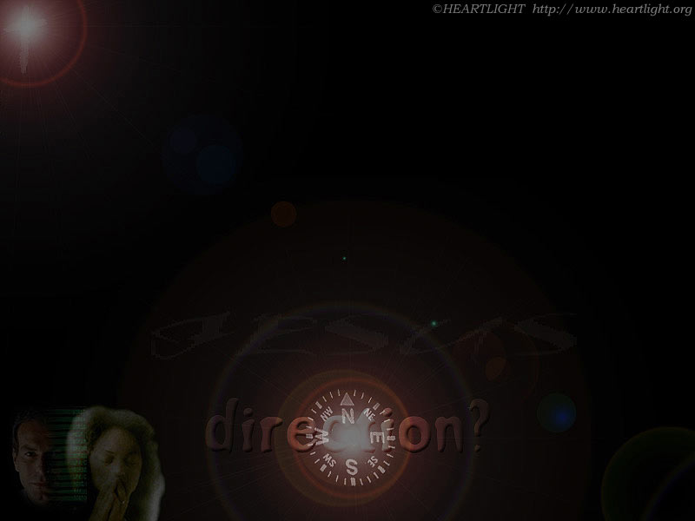

Where Are You Pointed?
Paradise?
Perdition?

Slide 213
JUDGEMENT PREPARED
FIVE STATES FIVE STEPS
Five States of the Soul:
EXEMPTION:
Ezekiel 18: 20; Matthew 18: 1 – 3
CONDEMNATION:
Galatians 3: 22
JUSTIFICATION:
Romans 5: 1, 2; 8: 1, 2
DAMNATION:
Matthew 23: 3; Mark 16: 16
GLORIFICATION:
Romans 8: 17, 30; II Thess. 1: 7 - 12

Slide 214


Slide 215
JUDGEMENT PREPARED
FIVE STATES FIVE STEPS
Five Steps for Saving:
HEARING:
Romans 10: 17; Matthew 7: 24 - 27
BELIEVING:
Hebrews 11: 6; Mark 16: 15, 16
REPENTING:
Acts 2: 38; 17: 30; Luke 13: 3
CONFESSING:
Matthew 10: 32, 33; Acts 8: 36, 37
BAPTISM:
Romans 6: 3 – 5; Acts 8: 36 - 38

