Slide 1

BIBLICAL DEMONOLOGY
THE OCCULT & SATANIC RITUAL
By David Lee Burris

Slide 2
1) Biblical Demonology
Study of Satan
Satan Worshipers
Bible DEMONOLOGY
THE OCCULT: ORIGINS
The Occult: Overview
THE OCCULT: God’s Word

Slide 3
INTRODUCTION:
@SUPERNATURAL

Slide 4
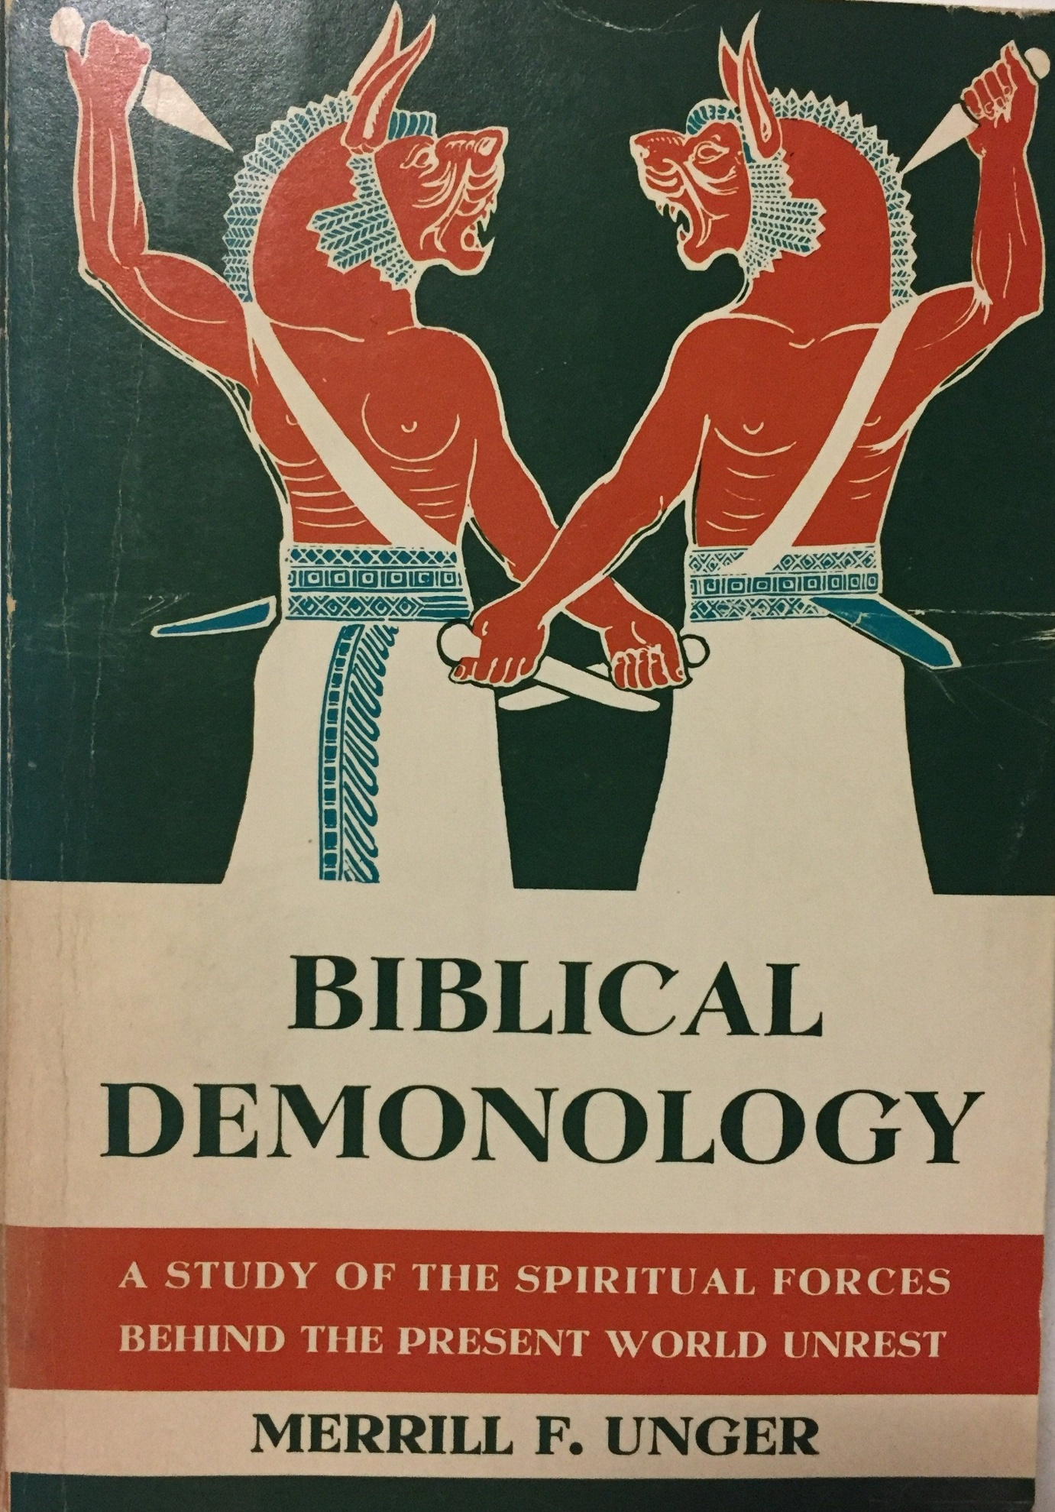

Slide 5
SUPERNATURALISM

Slide 6
The Biblical View of Evil Supernaturalism. In tracing the origin of evil supernaturalism, divine revelation is in sharp contrast to naturalistic theories, in that it goes far beyond them to original sources and ultimate realities. It expands horizons. It goes beyond the creation of man, and the introduction of sin into the human race, beyond even the creation of the angelic orders and the entrance of sin into the moral universe to the unfathomable eternity when God alone existed in sole sublime majesty. It alone conducts one to an eminence of altitude ample for furnishing sufficient sweep and perspective to see and comprehend the origin and nature of evil in the world. Sin itself began in heaven with "Lucifer, son of the morning," the highest and most exalted of heaven's created beings, who became Satan when he led a celestial revolt that spread to myriads of the angelic beings (Isa. 14:12-20). But Satan was not created evil. As Dr. Lewis Sperry Chafer points out, revelation concerning this eminent being begins with his sinless career, embracing the "dateless period" between the perfect creation of the heavens and the earth (Gen.1:1) and the catastrophic judgment upon this planet (Gen. 1:2; Jer. 4:23-26), which is, in all likelihood, to be connected with his fall. One passage, Ezekiel 28:11-19, despite contention to the contrary, obviously transcends reference to the "prince of Tyre," or to Adam in Eden, and embraces a splendid and detailed portrait of Satan's person in his primeval sinless glory.
Merrill F. Unger. Biblical Demonology: A Study of Spiritual Forces at Work Today (Kindle Locations 242-245). Kindle Edition.

Slide 7
The complete impotence of the naturalistic historian of religions in dealing with demonological facts is emphasized when the precise nature of those phenomena is analyzed. The sphere is that of evil supernaturalism. The phenomena may accordingly be described first as "supernatural," second as "evil." In this twofold characterization appears the double difficulty of the subject and the twin reason for the naturalistic historian's incompetence to handle the facts of the case. Knowledge of the supernatural can only come through supernatural revelation, since it is above and beyond natural law. Further, it is obvious that revealed truth can be understood only through faith in the revelation and hence in the Revealer. Faith implies humble realization of creaturely limitation, as well as clear apperception of God's infinite wisdom. Rejection of the supernatural is per se unbelief, which cuts off contact with God and shuts up the revelation.
Merrill F. Unger. Biblical Demonology: A Study of Spiritual Forces at Work Today (Kindle Location 157). Kindle Edition.

Slide 8
SATANOLOGY

Slide 9
SATANOLOGY

Slide 10
Then, too, the special heinous and destructive character of Satan and the demons is evident, not only in the facts of their wicked and lawless nature, but also in their aggressive activity in deceiving and harming others and in winning over as many deluded adherents as possible to their God-hating and God-opposing program. In this is evidenced their deadly nature. They are not passively wicked, as if they were in a state of sullen and peevish inaction, morosely sulking under the restraints of detested divine omnipotence. But, on the contrary, they are militantly malevolent, seemingly, completely obsessed with insane optimism and the blind delusion that eventually their cause must triumph and God's program be overturned.
Merrill F. Unger. Biblical Demonology: A Study of Spiritual Forces at Work Today (Kindle Locations 2624-2626). Kindle Edition.

Slide 11
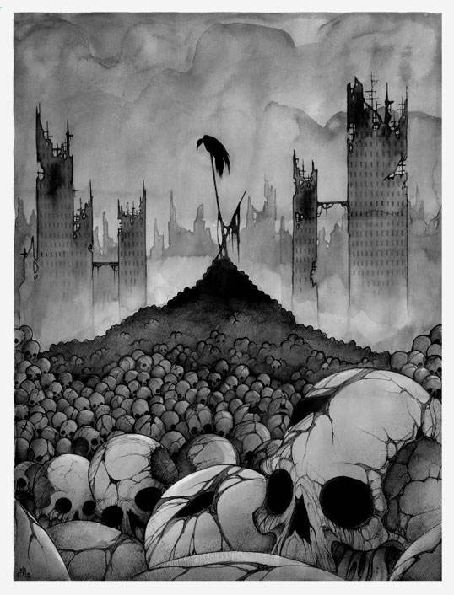
“On the practical level privatio boni is morally dangerous, because it belittles and trivializes Evil and thereby weakens the Good, because it deprives it of its necessary opposite…
If Evil is an illusion, Good is necessarily illusory too. That is the reason that I hold that privatio boni is illogical, irrational, and even non-sense. The moral opposites are an epistemological necessity and, when hypostasized, they produce an amoral Yahweh and a Lucifer and a Serpent and sinful Man and a Suffering Creation.” Carl Jung

Slide 12
EVIL AS FORCE. The Theodicy Triangle Argues Against God’s Existence. Natural Evil (Insurance Acts of God), Physical Evil (Bodily Pain & Emotional Suffering), & Moral Evil (Man’s Inhumanity to Man) all call into question the Arminian Argument equating God’s Genesis 1: 31 affirmation as meaning this (original) earth being the Best of Possible Worlds. The unbeliever points to the perfect quality of God’s characteristics of omnipotence (all powerful), omniscience (all knowing), omnipresence (all everywhere), and omnibenevolence (all good) in non-congruence with Natural, Physical, and Moral Evils. This mutual incompatibility is referred to in theological circles as the Theodicy Triangle. Augustine’s simple semantic solution to this exclusivity/inclusivity problem was in redefining evil as the absence of good. The Irenaean Solution to the puzzle of theodicy emphasized its cause-and-effect character-building instrumentality & in situations of seeming gratuitous outliers of these three type - the incomprehensible, intergenerational potentiality of simple (proximate) evils to create a complex (ultimate) good. In other words, these three evils are necessary to produce Secondary Virtues – Danger is prerequisite to Bravery; Hardship is prerequisite to Fortitude; & Neediness prerequisite to Generosity etc.

Slide 13
It was from the rind of one apple tasted, that the knowledge of good and evil, as two twins cleaving together, leaped forth into the world. And perhaps this is the doom which Adam fell into of knowing good and evil: that is to say, of knowing good by evil.
- JOHN MILTON

Slide 14
EVIL AS PERSON. God Is Love & Satan Is Hate - Monotheistic Religions generally portray Supranatural Powers Contrasted Regarding Humankind from Its Inception – Altruistic & Malevolent – The Figure of Evil Devil is always as Hateful Trickster.
As Heaven only becomes real to us in its contrast to Hell - Faith in God’s Existence and that of His Son Jesus Christ as Truth Personified - Lends Credibility to the Concept of the Dark Lord and His Demonic Minions as Liars and Evil Personified.
The Story of Satan is in The Tension Between God’s Perfect Vs. Permissive Will or What God Approves Versus What God Accepts. God’s Permissive Will is what God allows even though it is sin. Even with such allowance, God remains in control - His multi-generational purposes all the while being accomplished. The definitive feature of God’s Permissive Will is that it is never outside of His Perfect Will. God’s Perfect Decretive Eternal Will includes His Redemptive Plans for The Human Race, His Specific Plans for both Physical & Spiritual Israel and His Intermediate & Ultimate Plans for the Fallen Angels & their Leader – the Archangel Satan. These three threads of story line converge together in the first three verses of Revelation Chapter 20 – one at story start – one at mid-story – one at the end of their story.

Slide 15
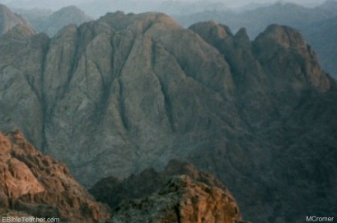
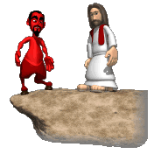

Slide 16
Consider the plight of Job on a worldwide scale. Were Satan to be unleashed without restriction upon the earth at any time, the results would be immediate worldwide devastation, destruction and Chaos the likes of which we could not even imagine.” [NOTE: Not the 2nd Coming Compared to Antediluvian World’s Inhumanity of Man to Man as described in Genesis 6: 1-13 & Luke 17: 26.]
World Power Was Satan’s To Offer – “After this perfect period of time Satan is allowed to operate in a more direct fashion on the earth than previously. Not without restriction by any means. During the temptation of Jesus by Satan, he made a statement to Jesus which has a direct bearing on this. “And the devil said to Him, ‘All this power will I give thee, and the glory of them: for that is delivered unto me; and to whomsoever I will I give it’.” (Luke 4: 6)
Satan Tempted Twice Face to Face – “Satan was able to come face to face and tempt Jesus directly. Satan does not do that now. And there is no record of him ever tempting anyone face to face beyond the garden. Satan had to get special permission from God to afflict Job in the way he did and there is no indication that Job ever met Satan face to face. In fact, it is evident from Job’s complaints that neither he or his companions knew Satan was directly involved in the matter. There is no indication that Job ever knew of the meeting between God and Satan concerning him.”

Slide 17
I. THE EXISTENCE OF SATAN
(Satan is the master deceiver. He has so deceived the world’s six billions of people that the majority of them do not believe that be exists. Many of those who do believe in his existence believe that he exists as a grotesque monster in a far-away hell or as a person to be studied in seminary classrooms and theological textbooks but not as a person to be feared in everyday life. All of these beliefs are contrary to the Biblical revelation concerning Satan.)
A. NEGATIVE
  1. Satan Is not a myth—Many people believe that Satan is a myth, a person existing only in the imagination of men and not in reality, but this is contrary to the Biblical revelation concerning Satan.
  2. Satan is not an invention—Some believe that Satan is an invention of priestcraft, that priests and preachers invented Satan (and hell) to scare their flocks and so hold them in subjection and obedience, but Biblically this is not true.
  3. Satan is not a superstition—Many believe that Satan is a superstition, a relic of the superstitious beliefs of the Middle Ages but this belief is contrary to Biblical teaching.
  4. Satan is not an abstract principle of evil—Some teach that God is the abstract principle of good and that God’s name should be spelled with two “o’s” (good) and that the devil is the abstract principle of evil and that the devil’s name should be spelled with no “d” (evil), but these beliefs are erroneous.
  5. Satan is not a bogie—He is not a hobgoblin, a specter, a person invented to scare children into obedience and goodness.
  6. Satan is not a grotesque monster—He is not, as he is pictured in paintings and on billboards, a grotesque monster, with horns, hoofs, a forked tail, a tight-fitting red asbestos suit, and a pitchfork. This description comes from “The Inferno,” a Middle-Ages’ poem written by the Italian poet Dante.
  7. Satan is not just a suitable subject for a good joke—Millions of persons use him in this way (but see Jude 9).
B. POSITIVE
  1. Satan is a person
  Persons are beings having intellect, sensibility, and will (the members of the godhead, the members of the angelic orders, and the members of the human family are persons.) In the Bible, Satan is pictured as possessing these three attributes. He thinks, he knows, he plots, he devises, he desires, he hates, he speaks, he tempts, he accuses, etc. All of these things are associated with a person and not with an abstract principle.
  2. Satan is a supernatural person
  He is a person not subject to the laws of nature for apparently he has an immaterial body, but he can make himself visible to men and can converse with them, Matt. 4:1–11.
  3. Satan is a normal person
  Nowhere in the Bible is Satan pictured as a weird, grotesque person but as a person meeting all the norms of personality.
    Gingrich, R. E. (2000). (pp. 45). Memphis, TN: Riverside Printing.
Gingrich, R. E. (2000). The History of Satan (pp. 4–5). Memphis, TN: Riverside Printing.

Slide 18
II. THE CREATION OF SATAN
A. THE FACT OF HIS CREATION (Ezek. 28:13, 15)
Most conservative Bible scholars agree that Isaiah, chapter 14, and Ezekiel, chapter 28, go far beyond the human kings (the King of Babylon and the King of Tyre) spoken of in these chapters and that certain of the passages of these chapters speak of Satan, of whom the human kings of these chapters are types. We believe this to be true and so we will use passages from these chapters to gather information concerning Satan.
Ezek. 28:13, 15 speaks of Satan and these verses tell us that Satan was created. Therefore he is not eternal.
B. THE AGENT OF HIS CREATION (1 Cor. 8:6)
He was created by God through Christ, 1 Cor. 8:6; Col. 1:16, 17.
C. THE HOLINESS OF HIS CREATION (Isa. 14:12)
Satan was created not as “Satan” (the opposer, the adversary) but as “Lucifer” (the day-star, the son of the morning). He later became “Satan” through his sin, through the misuse of the moral freedom given to him by God.
D. THE TIME OF HIS CREATION (Gen. 1:1)
The creation of Satan was a part of the original creation of God spoken of in Gen. 1:1, a creation which took place perhaps millions of years ago.
Many scholars believe (and the author of these notes believes) that there is a time gap of very long duration between Gen. 1:1 and Gen. 1:2.
E. THE ORDER OF HIS CREATION
Logic and certain Scriptures indicate that the creation took place in the following order:
  1. The third heaven (the heaven where God dwells) was created (Psa. 148:4, 5)—Before God created persons, He created a place for persons.
  2. The angel Lucifer (the person ordained to head the angelic creation) was created (Ezek. 28:13, 15)—No doubt the head of the angels, Ezek. 28:14, was created before the remainder of the angels were created.
  3. The angelic hosts were created (Col. 1:16)—These were all “good angels” until a part of them sinned, 2 Peter 2:4; Jude 6.
  Angels were created individually, so they are not a race (as are men) but are a company, Heb. 12:22.
  4. The second heaven and its starry hosts were created (Psa. 147:4; Psa. 148:3–5)
  5. The atmospheric heaven and the earth were created (Job 38:3–9; Rev. 10:6)—“The morning stars (the stars of second heaven) sang together and all the sons of God (the angelic sons of God) shouted for joy,”
  6. The human race was created (Gen. 1:27)—God created Adam and Eve, Gen. 1:27; 5:1, 2, and from Adam and Eve came the human race, Gen. 1:28. Acts 17:26. Man was the culmination of God’s creative program.
F. THE PLACE OF HIS CREATION
He was no doubt created in third heaven but was, after the creation of the earth, placed on the earth in the original Garden of Eden, a garden of precious stones, Ezek. 28:13, to head God’s angelic work on the earth.
  Gingrich, R. E. (2000). (pp. 56). Memphis, TN: Riverside Printing.
Gingrich, R. E. (2000). The History of Satan (pp. 5–6). Memphis, TN: Riverside Printing.

Slide 19
III. THE ORIGINAL STATE OF SATAN (the state of Lucifer before his fall)
A. HE WAS FULL OF WISDOM (Ezek. 28:12)
He was created full of finite, creature wisdom. Perhaps he was wiser than were Adam or Solomon (1 Kings 3:12; 4:29–34) when they later existed. His position of authority over the creation, Ezek. 28:14, called for this wisdom.
B. HE WAS PERFECT IN BEAUTY (Ezek. 28:12)
His beauty was perfect. He could not have been more beautiful (perhaps later Adam, also, was created with this perfection of beauty).
C. HE WAS ANOINTED WITH AUTHORITY (Ezek. 28:14)
From this verse, we learn that Lucifer was a cherub and that he was anointed (as a king) to be a covering (a ruler) over the rest of the creation. He, under God, was made to rule the creation (God gave him his office and his authority. “I have set thee so”).
He was placed upon “the holy mountain of God” (the place of divinely bestowed governmental authority) in the original Garden of Eden and he “walked up and down in the midst of the stones of fire” in this garden (as he went about in the exercise of his authority).
D. HE WAS SINLESS IN CONDUCT (Ezek. 28:15)
He was created a neutral moral being (morally inclined neither toward good nor evil), with a free will, a will capable of choosing good (obedience to God’s will) or evil (disobedience to God’s will). He for a time did choose the good (obedience to God’s will) until he finally made the opposite choice.
IV. THE FALL OF SATAN (the sin of Satan)
A. THE CAUSES OF HIS FALL
  1. The indirect cause—Pride (Ezek., 27:17; 1 Tim. 3:6)
    a. The cause of his pride—His beauty and his wisdom.
    Lucifer’s beauty and his wisdom caused him to be proud (he ceased to delight in the perfections of God and began to delight in his own perfections, given to him by God, and he became proud. Jesus did not do this, “He set the Lord always before Him,” Psa. 16:8).
    God condemns (1 Tim. 3:6) and resists (1 Peter 5:5) proud persons because proud persons detract from God’s glory (2 Cor. 10:5) and bring destruction upon themselves (Prov. 16:18).
    b. The results of his pride—Selfish ambition (Isa. 14:12–14)
    In Isa. 14:12–14, Satan speaks five “I wills” which reveal his selfish ambitions:
      (1) “I will ascend into heaven”—He purposed to ascend into third heaven to challenge the authority of God.
      (2) “I will exalt my throne above the stars of God”—He purposed to ascend into third heaven, defeat God, and establish his throne as the supreme throne over the angelic stars of God.
      (3) “I will sit upon the mount of the congregation, in the sides of the north”—He purposed to sit upon the mountain of authority over the universe.
      (4) “I will ascend above the heights of the clouds”—He purposed to reign as supreme over all.
      (5) “I will be like the most high”—The four previous “l wills” are summarized in this final “I will.” Satan purposed to “be like the Most High” (the possessor and ruler of heaven and earth, Gen. 14:19; Psa. 83:18). To “be like the Most High” is to possess and rule the heaven and the earth, receiving counsel from no one, needing help from no one, being hindered by no one, and giving account to no one, Dan. 4:35.
      In short, Lucifer purposed to dethrone the Most High and to replace Him with himself.
  2. The direct cause—Rebellion (“iniquity,” Ezek. 28:15; “sin,” Ezek. 28:16)
  Satan attempted to carry out his purposes (his five “I wills”). He rebelled against the authority of God and attempted to overthrow the kingdom of God (the Bible does not give us the details of this rebellion) but his rebellion was not successful. This rebellion is labeled “iniquity” (lawlessness), Ezek. 28:15, and “sin” (transgression of God’s law), Ezek. 28:16.
  In this rebellion, Satan inaugurated a kingdom to rival the kingdom of God. This kingdom yet exists and will exist until it is destroyed. Christ will put all of God’s enemies under His feet and then present the subdued creation to God, who will from henceforth rule over it in uncontested supremacy, 1 Cor. 15:24–28.
    Gingrich, R. E. (2000). (pp. 68). Memphis, TN: Riverside Printing.
Gingrich, R. E. (2000). The History of Satan (pp. 6–8). Memphis, TN: Riverside Printing.

Slide 20
B. THE RESULTS OF HIS FALL
1. Satan was no longer “Lucifer” (“day star”) but “Satan” (“adversary,” “opposer”)—He was no longer a reflector of God’s glory but an opposer of God’s will.
2. Satan was left with wisdom but it was corrupted (Ezek. 28:17)—His wisdom was henceforth used to promote evil and not good.
3. Satan was the first sinner—He was the first of God’s creatures to challenge the authority of God. He, being the first sinner, became the “father” of sinners, John 8:44.
4. Satan was the occasion for the fall of other angels—Through his evil example and evil influence, he occasioned the fall of one third of the other angels, 2 Peter 2:4; Jude 6; Rev. 12:4.
5. Satan was condemned and sentenced to be destroyed—Sin brings guilt, condemnation, and punishment. When Satan sinned, he was declared to be guilty, Ezek. 28:16, he was condemned, 1 Tim. 3:6, and he was sentenced to be destroyed, Isa. 14:12–17; Ezek. 28:16–19; Luke 10:18; Rev. 20:10 (and the lake of fire was prepared for him, Matt. 25:41). This sentence upon Satan will be executed. He will at that time be cast into the lake of fire, Rev. 20:10.
This sentence was delayed in its execution but it is certain to be carried out for no grace is provided for Satan and the angels who fell with him. The execution of the sentence is delayed: (1) that God might make a full display of His sovereignty over His creatures and (2) that God might provide opposition for His people for the development of their spiritual muscles.
6. Satan was cast forth from the mountain of God (Ezek. 28:16)—He was evicted from his office (of being “the anointed cherub that covereth”) and from his place of governmental authority over the creation, but he was permitted to retain his governmental authority over the fallen angels, Matt. 12:24.
Satan’s eviction from his exalted office does not mean that he no longer has access to heaven for he does have access to heaven, Job 1:6, 7; Rev. 12:7–9.
  Gingrich, R. E. (2000). (pp. 89). Memphis, TN: Riverside Printing.
Gingrich, R. E. (2000). The History of Satan (pp. 8–9). Memphis, TN: Riverside Printing.

Slide 21
V. THE EVIL CAREER OF SATAN
A. SATAN’S NAMES DURING HIS EVIL CAREER
  1. “Satan” (meaning hater, enemy, or adversary), Rev. 12:9
  He hates, is the enemy of, and is the adversary of: (1) the three persons of the godhead (especially of Christ), (2) the members of the God-family, and (3) the doctrines of the Bible (especially the doctrine of the cross of Christ, the doctrine that salvation cannot be earned but received as a gift through [obedient] faith in Christ and His substitutionary work in the sinner’s behalf).
  2. “The Devil” (meaning the accuser or the slanderer). Rev. 12:9
  He constantly accuses and slanders God (Gen. 3, 4) and man (Job 1:9; 2:4, 5; Rev. 12:10).
  3. “The Serpent” (meaning the cunning, subtle one), Rev. 12:9
  He, like an animal serpent, strikes suddenly and unexpectedly, Amos 5:19.
  4. “The Dragon” (meaning the ferocious and dangerous one), Rev. 12:7, 9
  He, like the legendary dragon, is to be faced with caution and fear.
  5. “Beelzebub” (meaning the prince of the demons), Matt. 12:24
  This title indicates that Satan has at his command the fallen angels to assist him in his evil work.
  6. “The wicked one” (this title [Greek, “ho poneros,”] means the wholly and totally vicious one).
  It has reference to Satan’s evil character. He constantly plots evil and not good.
  7. “Belial” (meaning the worthless, profitless one), 2 Cor. 6:15
  Satan is of no profit to anyone, including himself.
  8. “Abaddon-Apollyon” (meaning destroyer), Rev. 9:11
  Satan is the angel of the bottomless pit, Rev. 9:11.
  9. “The prince of the power of the air” (Eph. 2:2)
  Satan dwells in the atmospheric heavens and from this base he sends out an evil influence throughout the earth which motivates the children of disobedience (the unsaved) to perform evil works. Often Christians permit this spirit (this influence) to motivate them to evil works in spite of the fact that another spirit (the influence of the Holy Spirit) is constantly motivating them to good works, Phil. 2:13.
  10. “The prince of this world” (John 12:31; 14:30; 16:11)
  Although Jesus wrested the scepter of world authority from Satan in His death and resurrection, Rev. 1:18, Satan is yet permitted to rule this world as a usurper king. Satan’s claim to have power to deliver this world’s kingdoms to whomsoever he wills, Luke 4:6, 7, is yet valid and will be valid until this power is taken from him at the Lord’s Second Advent, Rev. 20:1–3.
  11. “The god of this world (age)” (2 Cor. 4:4)
  Satan is called “the god of this age” because he originates, directs, and inspires the great false religious systems of this age. Satan is behind all cults (false religions) and directly or indirectly is the object of their worship, Deut. 32:17; 1 Cor. 10:20.
    Gingrich, R. E. (2000). (pp. 910). Memphis, TN: Riverside Printing.
Gingrich, R. E. (2000). The History of Satan (pp. 9–10). Memphis, TN: Riverside Printing.

Slide 22
B. SATAN’S HOME DURING HIS EVIL CAREER
1. Negative—He does not dwell in hell, as is commonly believed. There is no Scripture to support the belief that he dwells there. This belief comes from Dante’s “Inferno.”
2. Positive
  a. He dwells in the atmospheric heavens—Eph. 2:2 implies that Satan dwells in the atmospheric heavens and that it is from this headquarters that he sends forth his influential power throughout all the earth. Eph. 6:12 tells us that the evil angelic host with whom we Christians wrestle is located in “heavenly places” (probably meaning the first heaven). This host includes their master, Satan.
  b. He has access to the third heaven (the heaven where God dwells)—He seemingly has free access to this realm, Job 1:6; 2:1; Rev. 12:10.
  c. He has access to the earth—See Job 1:7; 2:2; Matt. 4:4; 1 Peter 5:8.
C. SATAN’S POSSESSION OF THE SCEPTRE DURING HIS EVILCAREER
At the time of his fall, the sceptre of authority over God’s creation was taken from Satan, Ezek. 28:16, 17, but he retained governmental authority over the fallen angels, Matt. 12:24.
Much later, in the Garden of Eden, Satan, through subtlety and deceit, wrested the sceptre of world authority from Adam (when Adam obeyed Satan, he became a member of the kingdom which opposes God, a kingdom already having a head) and then ruled this world through right of conquest until the death and resurrection of Christ.
Through his death and resurrection, Christ took the sceptre of world authority from Satan, John 12:31; Col. 2:15; Heb. 2:14.
Satan, with divine permission, rules on during this age as a usurper king. Why has God left Satan on the throne of this world during the Inter-Advent period? For at least three reasons: (1) to give Christ time to choose out a queen (the church) to rule at his side, Acts 15:14; (2) to demonstrate the unfitness of Satan to rule; and (3) to provide opposition for the development of strong spiritual muscles in Church-age believers, Eph. 6:12.
At Christ’s Second Advent, He will remove Satan, the usurper king, from the throne of this world, Rev. 20:1–3.
Gingrich, R. E. (2000). (pp. 1011). Memphis, TN: Riverside Printing.
Gingrich, R. E. (2000). The History of Satan (pp. 10–11). Memphis, TN: Riverside Printing.

Slide 23
Your Adversary The Devil

Slide 24
There is a lot of misunderstanding about Satan

Slide 25
I. Names of Satan

Slide 26
Satan – this name literally means adversary
Acts 5:3
[3] But Peter said, Ananias, why hath Satan filled thine heart to lie to the Holy Ghost, and to keep back part of the price of the land?

Slide 27
The Devil – means one who engages in slander
Mt. 4:1 – here he is called “the devil”
The main object of his slander is God - he used this in the Garden of Eden and still uses it today

Slide 28
He is the tempter
Mt. 4:3 “and when the tempter came to him”
He cannot make one sin, but he can and does tempt
Js. 1:13-15

Slide 29
He is the serpent – he is very crafty
Rev. 12:9
[9] And the great dragon was cast out, that old serpent, called the Devil, and Satan, which deceiveth the whole world: he was cast out into the earth, and his angels were cast out with him.

Slide 30
He is the dragon
Re. 12:9
Intimidating and frightening

Slide 31
He is the murderer – He wants to destroy
Jn. 8:44
[44] Ye are of your father the devil, and the lusts of your father ye will do. He was a murderer from the beginning, and abode not in the truth, because there is no truth in him. When he speaketh a lie, he speaketh of his own: for he is a liar, and the father of it.

Slide 32
He is the liar
Jn. 8:44
He is dishonest and corrupt of speech
False teachers, the morally corrupt etc., are his children

Slide 33
He is the roaring lion – frightening, fierce, causing fear & dread
1 Pet. 5:8
[8] Be sober, be vigilant; because your adversary the devil, as a roaring lion, walketh about, seeking whom he may devour:

Slide 34
He is Beelzebul or Beelzebub
Mt. 12:24
[24] But when the Pharisees heard it, they said, This fellow doth not cast out devils, but by Beelzebub the prince of the devils.

Slide 35
The name means “lord of the flies” – refers to his corrupting nature
He is “ruler of the demons”

Slide 36
He is the evil one or wicked one
1 John 3:12
“Not as Cain, who was of that wicked one, and slew his brother. And wherefore slew he him? Because his own works were evil, and his brother's righteous.”
He is morally and socially worthless – wicked – evil – bad

Slide 37
The accuser of the brethren
Rev. 12:10
[10] And I heard a loud voice saying in heaven, Now is come salvation, and strength, and the kingdom of our God, and the power of his Christ: for the accuser of our brethren is cast down, which accused them before our God day and night.

Slide 38
The prince of this world
Eph. 2:2
² in which you once walked according to the course of this world, according to the prince of the power of the air, the spirit who now works in the sons of disobedience,

Slide 39
He has power in the earthly realm until the final overthrow at the second coming of Christ and the judgment
He has limited power to fight against Christ and His church

Slide 40
Ultimately he will fail
1 Jn. 5:4
[4] For whatsoever is born of God overcometh the world: and this is the victory that overcometh the world, even our faith.

Slide 41
III. Lessons for us

Slide 42
1. Satan, our enemy, is very clever
2 Cor. 11:13-14
[13] For such are false apostles, deceitful workers, transforming themselves into the apostles of Christ.
[14] And no marvel; for Satan himself is transformed into an angel of light.

Slide 43
2 Cor. 11:3 – he is beguiling (misleading, full of tricks)
3 But I fear, lest somehow, as the serpent deceived (beguiled) Eve by his craftiness, so your minds may be corrupted from the simplicity[a] that is in Christ.

Slide 44
1 Jn. 5:19 – he is very deceptive
[19] And we know that we are of God, and the whole world lieth in wickedness.

Slide 45
2. The devil is strong
Satan’s power has been limited by Christ’s death and resurrection – but he is still a powerful enemy
He opposes God’s people and the work they do
We must depend upon God for strength

Slide 46
1 Pet. 5:9
[9] Whom resist stedfast in the faith, knowing that the same afflictions are accomplished in your brethren that are in the world.

Slide 47
James 4:7-8
[7] Submit yourselves therefore to God. Resist the devil, and he will flee from you.
[8] Draw nigh to God, and he will draw nigh to you. Cleanse your hands, ye sinners; and purify your hearts, ye double minded.

Slide 48
3. This great enemy can be overcome
Eph. 6:10-18
[10] Finally, my brethren, be strong in the Lord, and in the power of his might.
[11] Put on the whole armour of God, that ye may be able to stand against the wiles of the devil.

Slide 49
[12] For we wrestle not against flesh and blood, but against principalities, against powers, against the rulers of the darkness of this world, against spiritual wickedness in high places.

Slide 50
[13] Wherefore take unto you the whole armour of God, that ye may be able to withstand in the evil day, and having done all, to stand.

Slide 51
[14] Stand therefore, having your loins girt about with truth, and having on the breastplate of righteousness;
[15] And your feet shod with the preparation of the gospel of peace;

Slide 52
[16] Above all, taking the shield of faith, wherewith ye shall be able to quench all the fiery darts of the wicked.
[17] And take the helmet of salvation, and the sword of the Spirit, which is the word of God:

Slide 53
[18] Praying always with all prayer and supplication in the Spirit, and watching thereunto with all perseverance and supplication for all saints;

Slide 54
We must be obedient to Christ and build a spiritual relationship with Him

Slide 55
1 Jn. 3:8 - Christ came to destroy the works of the devil
[8] He that committeth sin is of the devil; for the devil sinneth from the beginning. For this purpose the Son of God was manifested, that he might destroy the works of the devil.

Slide 56
Heb. 2:14 – Christ succeeded
[14] Forasmuch then as the children are partakers of flesh and blood, he also himself likewise took part of the same; that through death he might destroy him that had the power of death, that is, the devil;

Slide 57
Before you can put on the Christian armor, you must put on Christ
Gal. 3:26-28

Slide 58
Some points gleaned from “Your Adversary the Devil”, by Neal Pollard, Meeting Christ – Called unto heaven. 31st Annual Southwest Lectures, 2012

Slide 59
Satan –
His Nature

Slide 60
Introduction
“Some people think that if you believe in the devil, you never really graduated from childhood. Or as one put it, ‘Belief in a personal Satan is part of mankind’s nursery furniture.’” Allen Webster

Slide 61
Introduction
The Bible makes it clear that Satan is real
Jesus recognized the reality of the devil of spoke of him often

Slide 62
I. Satan Is A Slanderer
Devil = slanderer or accuser
Job 1:7-8
Ps. 109:6

Slide 63
I. Satan Is A Slanderer
When Satan accuses us today – remember that we have an Advocate in Heaven – Christ Jesus
1 Jn. 2:1-2

Slide 64
II. He Is A Counterfeiter Of God
2 Cor. 11:13-15

Slide 65
II. He Is A Counterfeit Of God
He has counterfeit: gods, religions, churches, Bibles,
He is content with men practicing idolatry or being involved in false religions

Slide 66
II. He Is A Counterfeit Of God
The only way to determine the genuine and the fake is by the word of God
1 Jn. 4:1
1 Th. 5:21

Slide 67
III. He Is Liar, Deceiver & Murderer
Since Eden he has been lying to mankind
Jn. 8:44

Slide 68
III. He Is Liar, Deceiver & Murderer
He introduced death into the world
2 Cor. 11:3

Slide 69
IV. He Is The Ruler Of This World
Jn. 12:31
2 Cor. 4:4

Slide 70
IV. He Is The Ruler Of This World
He has more followers presently than God does
Mt. 7:13-14

Slide 71
IV. He Is The Ruler Of This World
Eventually Satan will bow as will every one of his followers
Rom. 14:11

Slide 72
V. He Is Our Adversary
1 Pet. 5:8-9

Slide 73
V. He Is Our Adversary
The word Satan means adversary!
He is always nearby laying traps for us
2 Tim. 2:24
Eph. 6:11-12

Slide 74
VI. He Is A Destroyer
It is his goal to wreck every couple’s marriage, every person’s health, every minds sanity, etc.

Slide 75
VI. He Is A Destroyer
He wants to wreck every peaceful heart, every friendship, every good work, the unity in every congregation, every sermon’s effectiveness, and every souls destiny!

Slide 76
Conclusion
Mt. 25:41

Slide 77
References
Tract, “A Decent Devil?” by Allen Webster

Slide 78
Satan –
His Works

Slide 79
Introduction
1 Pet. 5:8
Be sober, be vigilant; because your adversary the devil, as a roaring lion, walketh about, seeking whom he may devour:

Slide 80
I. He Deceives
2 Cor. 2:11
2 Cor. 11:3
2 Cor. 11:14

Slide 81
2 Cor. 2:11
Lest Satan should get an advantage of us: for we are not ignorant of his devices

Slide 82
2 Cor. 11:3
But I fear, lest by any means, as the serpent beguiled Eve through his subtilty, so your minds should be corrupted from the simplicity that is in Christ.

Slide 83
2 Cor. 11:14
And no marvel; for Satan himself is transformed into an angel of light.

Slide 84
II. He Takes Away The Word Of God
Mt. 13:19
When any one heareth the word of the kingdom, and understandeth it not, then cometh the wicked one, and catcheth away that which was sown in his heart. This is he which received seed by the way side.

Slide 85
II. He Takes Away The Word Of God
He often does this by misusing Scripture
Mt. 4:6

Slide 86
Mt. 4:6
And saith unto him, If thou be the Son of God, cast thyself down: for it is written, He shall give his angels charge concerning thee: and in their hands they shall bear thee up, lest at any time thou dash thy foot against a stone.

Slide 87
III. He Wants To Control The Mind
Acts 5:3-4
But Peter said, Ananias, why hath Satan filled thine heart to lie to the Holy Ghost, and to keep back part of the price of the land? [4] Whiles it remained, was it not thine own? and after it was sold, was it not in thine own power? why hast thou conceived this thing in thine heart? thou hast not lied unto men, but unto God.

Slide 88
III. He Wants To Control The Mind
Books, magazines, radio, television, the Internet, conversation, etc.

Slide 89
IV. He Attacks Bodies & Destroys Possessions
Think about Job
Paul
2 Cor. 12:7

Slide 90
2 Cor. 12:7
And lest I should be exalted above measure through the abundance of the revelations, there was given to me a thorn in the flesh, the messenger of Satan to buffet me, lest I should be exalted above measure.

Slide 91
IV. He Attacks Bodies & Destroys Possessions
Satan uses illness and disaster to tempt us

Slide 92
V. He Seeks To Make Us Proud
1 Tim. 3:6
Proverbs 16:18

Slide 93
1 Tim. 3:6
Not a novice, lest being lifted up with pride he fall into the condemnation of the devil.

Slide 94
Proverbs 16:18
Pride goeth before destruction, and an haughty spirit before a fall.

Slide 95
VI. He Persecutes
Rev. 2:10
Fear none of those things which thou shalt suffer: behold, the devil shall cast some of you into prison, that ye may be tried; and ye shall have tribulation ten days: be thou faithful unto death, and I will give thee a crown of life.

Slide 96
VI. He Persecutes
-“God’s people are soldiers on the battlefield, but sometimes they are the battlefield” Allen Webster
- If we obey God only in the good times and fall under every trial then our faith is shallow

Slide 97
VI. He Persecutes
Faith that cannot withstand the test cannot be trusted
Js. 1:1-2
Js. 1:12
1 Pet. 1:3-9

Slide 98
Js. 1:2-3
My brethren, count it all joy when ye fall into divers temptations;
[3] Knowing this, that the trying of your faith worketh patience.

Slide 99
Js. 1:12
Blessed is the man that endureth temptation: for when he is tried, he shall receive the crown of life, which the Lord hath promised to them that love him.

Slide 100
VII. When We Sin He Accuses And Discourages
He never gives up
Lk. 4:13
And when the devil had ended all the temptation, he departed from him for a season.

Slide 101
What Satan Does & What We Must Do
1. He Deceives
Think
2. He Takes Away The Word Of God
Concentrate
3. He Wants To Control The Mind
Discern

Slide 102
What Satan Does & What We Must Do
4. He Attacks Bodies & Destroys Possessions
Endure
5. He Seeks To Make Us Proud
Resist

Slide 103
What Satan Does & What We Must Do
6. He Persecutes
Withstand
7. When We Sin He Accuses And Discourages
Press on. Trust in God!

Slide 104
References
“A Decent Devil” by Allen Webster

Slide 105
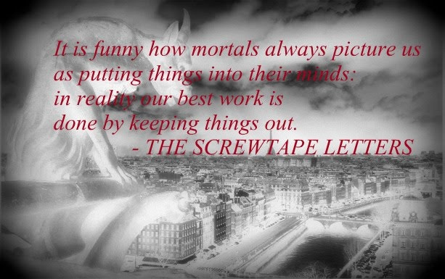

Slide 106
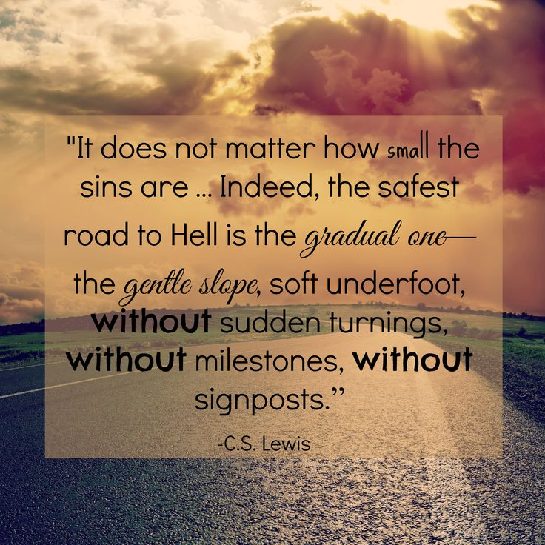

Slide 107
The deceit, the lie of the devil consists of this, that he wishes to make man believe that he can live without God's Word. Thus he dangles before man's fantasy a kingdom of faith, of power, and of peace, into which only he can enter who consents to the temptations; and conceals from men that he, as the devil, is the most unfortunate and unhappy of beings, since he is finally and eternally rejected by God.
Dietrich Bonhoeffer

Slide 108
The Armor of God
Ephesians 6:13-17
Use every piece of God’s armor to resist the enemy in the time of evil, so that after the battle you will still be standing firm.
Stand your ground, putting on the sturdy belt of truth and the body armor of God’s righteousness.
For shoes, put on the peace that comes from the Good News, so that you will be fully prepared.

Slide 109
In every battle you will need faith as your shield to stop the fiery arrows aimed at you by Satan.
Put on salvation as your helmet, and take the sword of the Spirit, which is the word of God.

Slide 110
Understanding The Text
Deliver us from evil (evil one)
  rhoumai rhoo'-om-ahee, middle voice (We can’t do it ourselves) deliver, deliverer
  poneros pon-ay-ros nominative case translated KJV as evil, wicked, bad but in this case the intent of Christ is to refer to Satan “the Evil One”. Satan is the personification of evil
Be our deliverer from the wicked/evil one

Slide 111
Deliver us from evil, (Evil One)
We are in a battle
It is a battle for which we are ill-equipped in the natural
Our battle is not against flesh & blood but against principalities & powers and against spiritual wickedness in high places. Satan is out to get us!

Slide 112
We need to know that the victory over the evil one is not won by us but has been won for us
Satan mounts an attack on all fronts
  The eye gate
  The ear gate
  The emotional gate
  The mind gate
  The will gate
  Any other gates he can get in. That’s what tempatation is about

Slide 113
We cannot defeat Satan by ourselves and do not have the strength for victory on our own
We are in a Spiritual Battle-Zone. Satan wants spiritually impotent Christians who are no threat to him.
The One who defeated Satan at Calvary can defeat Satan in our life if we will but ask

Slide 114
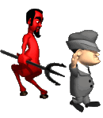
How Does Satan Work

Slide 115
God
1st Coming Of Christ
Nation
Disarm
Divert
Family
Distort
Fall
Discourage
Defeat
The Deadly D’s of the Devil
Destroy

Slide 116
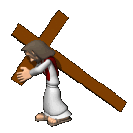
1st Coming
Of Christ
2nd Coming Of Christ
Church
Disarm
Divert
Distort
Discourage
Sending of
Holy Spirit
Defeat
The Deadly D’s of the Devil
Destroy

Slide 117
A Premise!
If God is for it, Satan is against it
If Satan is for it, God is against it

Slide 118
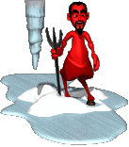
Satanic Strategies
Diverted Trust
Everything is relative (No absolute Truth)
Trust in human reason
Bending or compromising God’s Word to justify unethical behavior
Selfishness
Discredit your reputation
Negative attitudes
Fueling the Ego
Getting anger to rule your life

Slide 119


We need help

Slide 120

Why the Armor of God?
The problems we face are beyond our human strength or ability to conquer
The enemy is stronger than we are.
God’s desire is not our survival but victory
God knows what we need for victory and that’s what He’s given to us.
There is a modern world view which excludes biblical truth and will trap us in a morass of carnality. On our own we are destined to fail spiritually

Slide 121
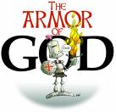
Protection
The weapons of our warfare can tear down strong holds.
2 Corinthians 10:4 For the weapons of our warfare are not carnal, but mighty through God to the pulling down of strong holds;

Slide 122
Protection
Without God’s help our lives are wide open to Satan’s tactics and antics
We need a hedge of protection around our minds, emotions, spirits and wills.

Slide 123
I Corinthians 10:12-13
If you think you are standing strong, be careful, for you, too, may fall into the same sin. But remember that the temptations that come into your life are no different from what others experience. And God is faithful. He will keep the temptation from becoming so strong that you can’t stand up against it. When you are tempted, he will show you a way out so that you will not give in to it.

Slide 124
What Is The Armor Of God?
It is God’s gift to us for our protection
Putting on the armor is putting on Christ.

Slide 125
Romans 13.12-14
The night is far spent; The day is at hand. Let is therefore take off the deeds of darkness, Let us put on the armor of light… … … … … …
Let us live honestly, as in the day, Not in reveling and drunkenness, Not in lust and licentiousness, Not in strife and jealousy;
But clothe yourselves with the Lord Jesus Christ, And make no provisions for your earthly nature and the gratification of its lusts.

Slide 126
What Is The Armor Of God
It is God’s gift to us for our protection
We need to put on daily the armor of God
Putting on the armor is putting on Christ.
God’s promise is victory in the midst of struggle not immunity from the struggle

Slide 127
1Peter 4
Do not think it strange, beloved, that a fiery ordeal has come to test you, as though some surprising thing had befallen you.
But be glad in the degree in which you share in the sufferings of Christ; so that when his glory shall be revealed, you too may be glad with triumphant gladness.

Slide 128
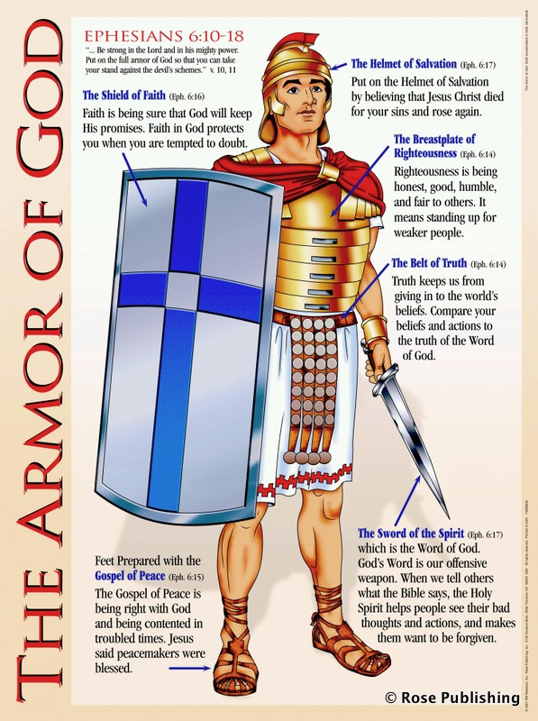
The Armor Of God

Slide 129
The Armor of God
The belt of truth to protect my emotions from being carnally governed. It assures me that He is truth and as I know Him and His will I will be protected from the enemies lies
We have all to some degree been influenced by the lies of world

Slide 130
The Armor of God
The breastplate of righteousness to assure me of my standing before God when accusations come. It allows me to see the truth about myself and that I have no standing before God apart from the the righteousness of Christ
Real assurance comes when I mentally accept the reality that - in addition to my own obedience – I’m beneficiary of the meritorious righteousness of Jesus Christ

Slide 131
The Armor of God
The Gospel of peace are my shoes so that where I walk peace will follow. I’m a minister of reconciliation. As I remain in Him I find myself with a calm in the midst of the storm, and as I follow him His peace reigns in my heart
You will keep him in perfect peace, the one whose mind focuses on you.
Isaiah 26:3

Slide 132
The Armor of God
The shield of faith so the enemies lies and deception will not penetrate my life. As I believe God and say “Amen” to His promises the lies and deception of the enemy are diverted away from me.
Faith is “a force” and stops the enemy in his tracks. Satan has no weapon that can nullify faith

Slide 133
The Armor of God
The helmet of salvation so that your mind is protected and renewed by the power of the gospel. My confidence is that He is my deliverer now, that He will never forsake me here and when the end comes I will be with Him forever
The battleground is the mind. Whatever we think about we become and do!
Victory comes through the renewal of the mind (Romans 12:1-2)

Slide 134
The Armor of God
The Sword of the Spirit which is God’s word is the weapon of choice for fighting the enemy. If God said it I can believe it. Hiding His word in your heart is a is the quickest way to respond to the attacks.
Knowing and using God’s word are not the same. It is “faithing” as we stand on his word when the attacks come

Slide 135
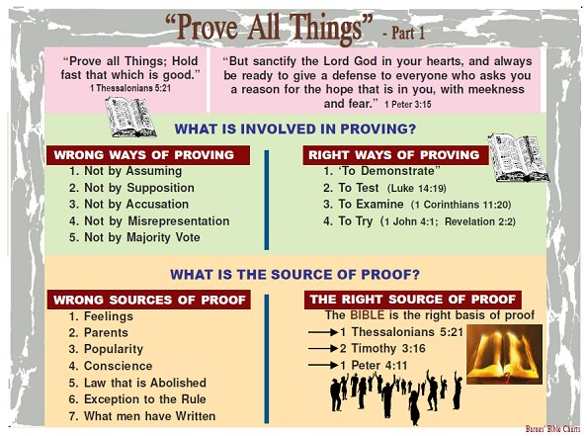

Slide 136
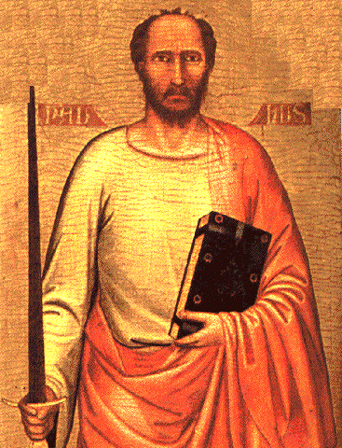
The Apostle Paul
THE SPIRITUAL SWORD

Slide 137
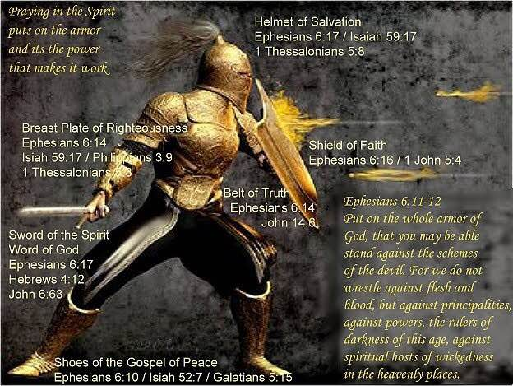

Slide 138

The Double-Edged Spiritual Sword
“For the word of God is living and powerful, and sharper than any two-edged sword, piercing even to the division of soul and spirit, and joints and marrow, and is a discerner of the thoughts and intents of the heart.”
- Hebrews 4: 12

Slide 139
The Double-Edged Spiritual Sword
INCLUDES the Word of God, the sword of the Spirit with double edge, one edge for convicting and converting some, and the other for condemning and destroying the unbelieving… sharper “more cutting” two-edged – sharpened at both edge and back. Its double power seems implied by its being “two-edged.” “It judges all that is in the heart, for there it passes through, at once punishing and searching…” [Chrysostom].
* Jamieson-Fausset-Brown On Hebrews 4:12

Slide 140
The Double-Edged Spiritual Sword
Philo similarly speaks of “God passing between the parts of Abraham’s sacrifices (Genesis 15: 17) where it is a burning lamp… which sword never ceases to divide all sensible things… {Paul’s audience was familiar with Philo}… even to dividing asunder of soul and spirit – i.e., reaching through to the separation of the animal soul, the lower part of man’s incorporeal nature, the seat of animal desires, which he has in common with the brutes… and of the joints and marrow-
* Jamieson-Fausset-Brown On Hebrews 4:12

Slide 141
The Double-Edged Spiritual Sword
As the knife of the Levitical priest reached to dividing parts, closely united as the joints of the limbs, and penetrated to the innermost parts, as the marrows; so the word of God divides the closely joined parts of man’s immaterial being, soul and spirit and penetrates to the innermost parts of the spirit. The Word’s dividing and far penetrating power has both a punitive and healing effect. discerner of the thoughts- “capable of judging the purposes.” intents- rather, “conceptions [Crellius]; “ideas” [Alford] refers to the intellect.
* Jamieson-Fausset-Brown On Hebrews 4:12

Slide 142


Slide 143

SATANIC CULTS

Slide 144


Slide 145
Occult Practices
A basic meaning of the word occult is “hidden”; so occultism deals with the hidden side of life. It has its root in the Latin word, occultus, which means to cover up or hide. It has the connotation of being something beyond man’s normal and natural experiences.
Kurt Koch, whose intense research and insightful writing of demonology had been a boon to those studying the subject, has written an in-depth book on occultic practices (Christian Counselling and Occultism) in which he classifies occult practices into three categories, namely, extrasensory perception, extrasensory influence, and extrasensory apparitions. He backs this up with various case studies. However, for our purposes, we will classify occult practices in a more practical manner, even though there might be quite a bit of overlapping between the categories. We will look at occultism under the headings of Occult Institutions, Spiritism, Occult Apparitions, and Entertainment Occult. We will look at how these become open doors to demonization, but will not deal with each of the items in great detail.
At this point we should note that there is a great interest in the occult and related subjects. One just needs to look at the lists of bestsellers in regular bookstores and publishers, and see the popularity of writers such as Anne Rice and J. K. Rowling. Then there is the spate of mystery and horror movies, with their either open or subtle undertones of the occult in them. In addition there is the growing interest in occult activities with witchcraft even being considered as an alternate way of faith. Are all of these indications of a Satanic swan song or a result of the spurt making the sinful living both acceptable and fashionable?
  Thompson, L. (2005). (pp. 8889). Joplin, MO: College Press Publishing Company.
Thompson, L. (2005). Demons (pp. 88–89). Joplin, MO: College Press Publishing Company.

Slide 146
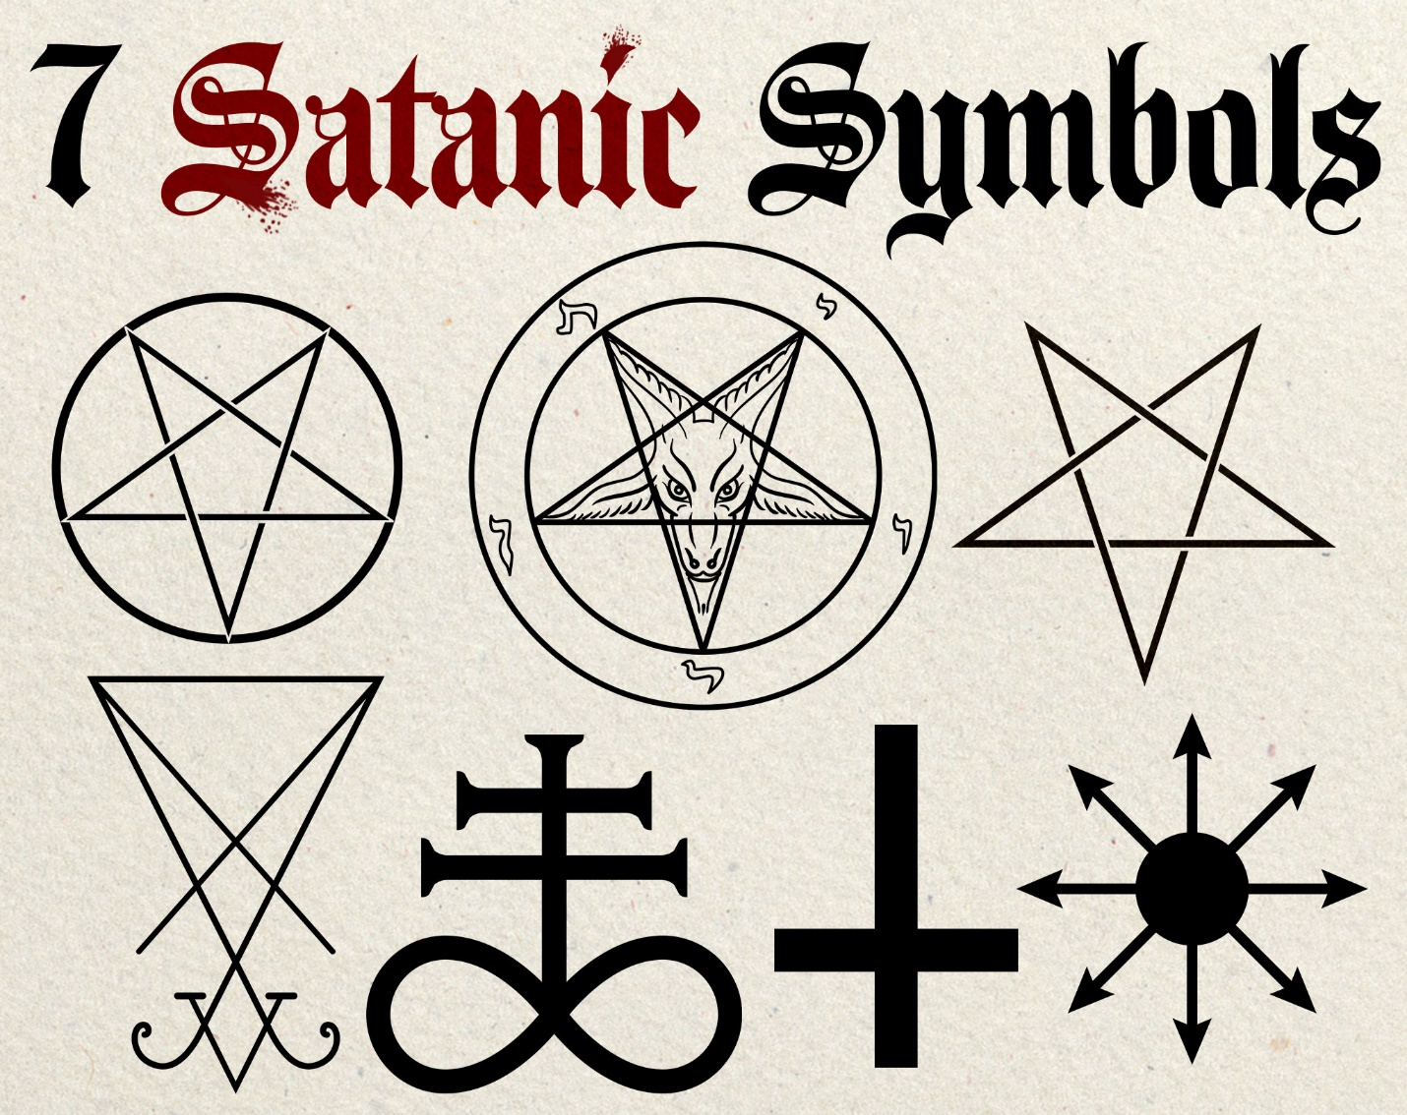

Slide 147
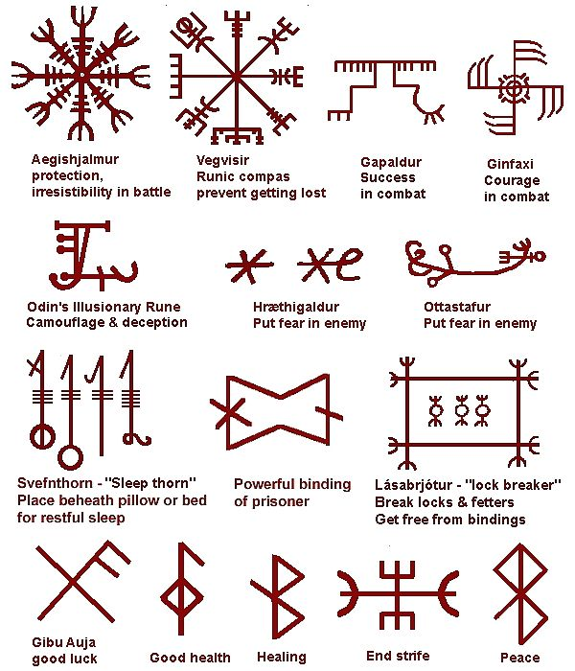

Slide 148
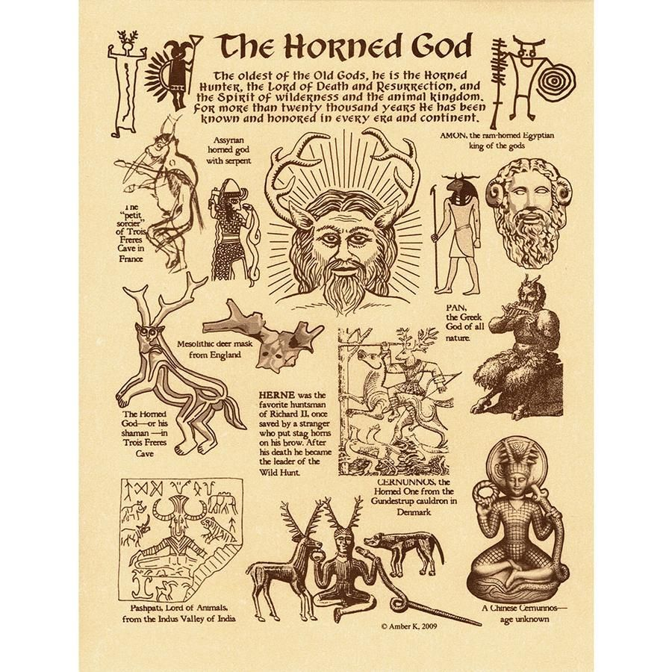

Slide 149
Date | Name | Description
February 2nd | Candlemas | In Catholicism this is the festival of the Blessed Virgin Mary. In other Christian religions it is the celebration of the presentation of Jesus in the Temple.
March 21st | Vernal Equinox
April 30th | Beltane | Also known as May eve. This is a major. Celtic festival marked by bonfires and fertility rites. In Christianity May 1st is Apostles Day.
June 22nd | Summer Solstice | Third highest satanic holiday.
July 31 to August 1st | Lammas | Feast of the Sun God. The beginning of autumn and the harvest season. The English festival of wheat harvest.
September 21st | Autumnal Equinox | Or Fall Day.
October 31st | Halloween | Or Samhain: First Highest Satanic holiday – Celebration of the beginning of the Celtic Year (Nov. 1st). In Catholicism, Nov. 1st is All Saints Day.
December 22nd | Yule or Winter Solstice | Fourth Highest satanic Holiday.

Slide 150
Types of Masses
Initiation: Where new members are accepted into the group. They will usually participate in the service acting as an acolyte. Once initiation is complete the neophyte is sworn to secrecy regarding all activities of the group.
Gnostic: A worship service sometimes open to outsiders who show a desire to join the group. Evil spirits are called upon and a desire of the group is expressed in hopes of it becoming a realization.
Mass of Angels: On the eve of the Mass a black rooster is killed and the heart, eyes and tongue are cut out. This mass is practiced to give the priest protection from demonic powers becoming too unruly.
Mass For the Dead: Used to call on God to free the celebrant from the fear of Hell and to make the demons obey. A lamb will be sacrificed, his throat cut and heart, eyes and tongue removed and ground into powder and then buried with the lamb.
Black Mass: The most bizarre of all rituals done only for evil purposes. Magicians can use powers, forces, spirits and demons. Evil medicine can be herbs or parts of animals or human beings. A mockery of the Catholic Mass is held. Blasphemy of the name of God and the trampling on or urination upon Christian artifacts is part of the service.
The Ritual
The steps taken before and during a ritual are described below. Keep in mind that each group may do things differently so this is merely an example of how one group conducts itself.
1. Preparation of the ritual area
2. Dress in garb and jewelry (if clothing is to be worn)
3. Ring bell to begin ritual
4. Light flame on the altar
5. Hold invocation
6. Celebrant drinks from chalice
7. Conjuring of demons begins
8. Execute desire
9. Extinguish flame
10. Ring bell to end ritual. utter closing, “So it is done.”
In most cases, rituals will be conducted within the circle to protect the celebrants from unruly demons. There are groups, however, who believe this to be unnecessary, feeling that they alone are in control of what happens during the rituals.

Slide 153
DEMONOLOGY

Slide 154
01.DEMONOLOGY

Slide 155
Biblical demonology, then, as it exists in its elemental essential form in the early chapters of Genesis, is the ultimate source and basis of all demonology-ethnic, later Biblical, Jewish, and Christian. Genesis as the book of beginnings catalogues the beginning of the earth and the human race, the beginning of human sin and death and the beginning of government and language. It also suggests the origin of demons. But inasmuch much as demons are certainly to be traced back to the fall of Satan and the angels, which the Book of Genesis assumes as background ground material in the same way it assumes the existence of God as background material (Gen. 1:1), it cannot validly be charged that there are no demons in the opening book of the Bible. In any event or upon any possible inference based on revealed facts, they are there, whether as fallen angels, or as [debated in the early church] the disembodied spirits of a pre-Adamite race (Genesis 1:2), or as [debated in the early church] the result of cohabitation of angelic beings with antediluvian women (Gen. 6:14). In the Book of Genesis the author assumes the existence of demons just as plainly as he assumes the existence of God or the fall of Satan and his angels.
Merrill F. Unger. Biblical Demonology: A Study of Spiritual Forces at Work Today (Kindle Locations 297-303). Kindle Edition.

Slide 156
A century later, Lactantius devoted considerable space to the fallen angels in the Second Book of his still worth reading Divine Institutes, in which he asserts that demons were: The inventors of astrology, and soothsaying, and divination, and those productions which are called oracles, and necromancy, and the art of magic, and whatever evil practices besides these men exercise, either openly or in secret.... These are they who taught men to make images and statues; who, in order that they might turn away the minds of man from the worship of the true God, caused the countenances of dead kings to be erected and consecrated, and assumed to themselves their names.
Merrill F. Unger. Biblical Demonology: A Study of Spiritual Forces at Work Today (Kindle Locations 28-32). Kindle Edition.

Slide 157
The Evidential Testimony

Slide 158
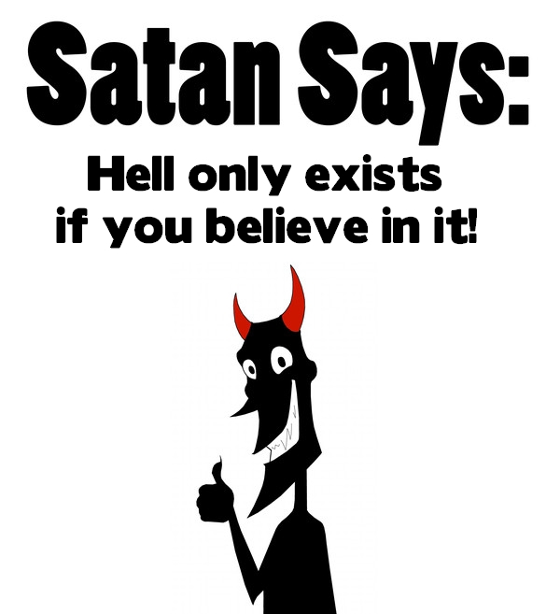
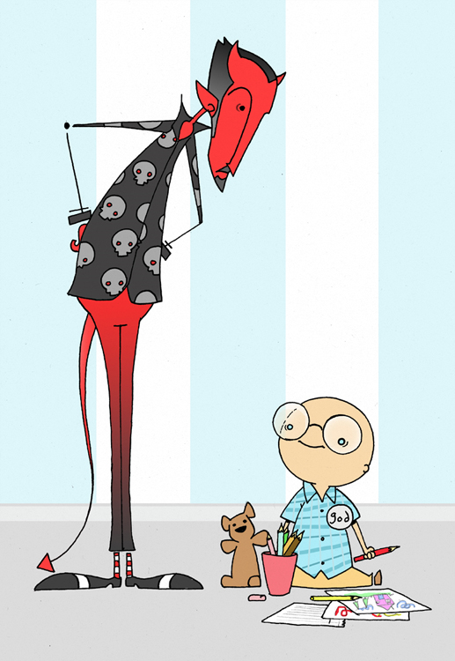

Slide 159
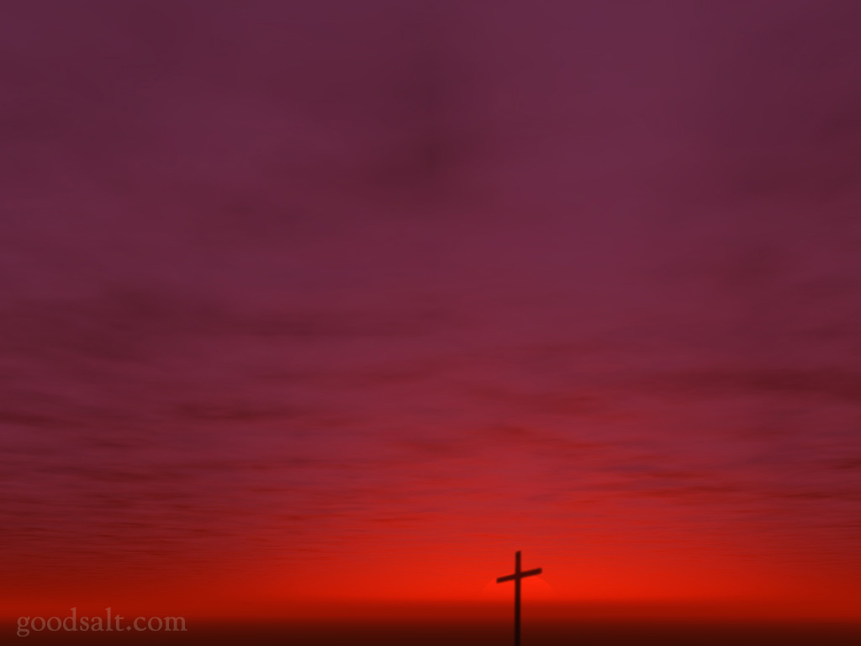
DEMON TESTIMONY: Truth From Hell About Truth Of Hell!
Etymology Of Term “Demon” Comes From Greek Root “To Know” Hence The Meaning Of “A Knowing One” (Vine)
Plato Wrote In Cratylus That The Term Derived From “Daemon” Signifying “Knowing” Or “Wise” (Page 92)
Ancient Greek Writers Suggested That The Genesis Of The Term Is To Be Found In The Fact That These Entities Were Considered “Intelligent Beings” (McClintock & Strong)
They Were Seen As Evil Spirits That Knew Certain Truths – “Somewhere Between The Human & The Divine” (Arndt, p. 168)
From Recorded Textual Testimony We Can Reasonably Conclude:
Demons were not atheists, they believed in God; Even further correct, they were not polytheists – they believed that God is “One” – James 2: 19.
Although, of admitted faith, it was not coupled with obedience; Disobedient, yet they did not try to justify themselves in their rebellion – James 2: 14 – 18.

Slide 160
DEMON TESTIMONY: Truth From Hell About Truth Of Hell!
Demons were not religious modernists. They did not subscribe to the notion that Jesus was a mere man. They acknowledged the Lord as “Holy One of God” – Mark 1: 24; In His proximity & presence they cried “…Thou art the Son of God” – Mark 3: 11.
Demons conceded the divine authority of Christ – a force of power they would be obliged to obey. On one occasion they entreated the Savior that He “would not command them to depart into the abyss” – Luke 8: 31.
The demons did not deny any personal responsibility. They once inquired of Jesus: “Are you come here to torment us before the time?” – Matthew 8: 29.
DEMONS DID NOT DENY HELL AS REAL!
They Knew Conscious Punishment Was Their Future (Matthew 8: 29) & At That Prospect - They Trembled (James 2: 19).

Slide 161
EVOLUTION OF MEANING OF THE TERM "DEMON" IN GREEK. Four principal meanings of the term daimon (demon) from the Homeric period to the time of the Septuagint may be traced in the course of the development of the term for its precise use in the Septuagint and in the New Testament. First, in the early history of the language, as in Homer, daimon was synonymous with "god" (theos). Ludwig Preller notes that the terms gods and daimones (demons) are employed for the same beings by Homer and the earlier poets, and contends that the former term expresses more definitely a god's personality, as this is defined by cults and mythology, while the latter expression has reference to his power and activity in manifestation in life and nature. Ramsay also is of the opinion that the daimon is the bearer of the divine power operative in nature and human life and that it has not been conceived and defined by mythology and the cultus as a god (theos). He also points out that hardly anywhere, except in the Iliad (111:420), is a special god called a daimon, and that there is a distinct tendency in Homer to attribute a bad influence to the daimon, especially in the Odyssey.
The view also finds expression that every man from his birth is accompanied by a special daimon. This daimon of the individual is evidently regarded as separable from the man himself, and not identifiable with his soul or spirit, as the daimonion of Socrates, who asked questions of it. Attic writers, especially, make reference to agathos daimon (a good demon). At this stage, "although the demons are regarded as being inferior to the gods, they do not appear to be conceived of as morally evil, unless, indeed, this may be inferred of some of them by contrast with the good demons ..."
Merrill F. Unger. Biblical Demonology: A Study of Spiritual Forces at Work Today (Kindle Locations 731-733). Kindle Edition.

Slide 162
A third stage of development in the term daimon came when the Greeks began to view demons as morally imperfect beings, like man, some good, some evil. This step in the gradual lowering of the concept of the word was the result of an effort to exalt the gods and to make their intermediary "demons" responsible for the passions and scandals attributed to them in the popular mythologies. While Plato endeavored to divest the gods of evils and scandals and to heighten the people's idea of them, his disciple Xenocrates sought to maintain his master's teaching on the subject of the sublime lime character of the gods by a development of his teacher's notions about demons, making these intermediary agents, whom he conceived as the departed souls of men, the real perpetrators of evil. "He introduced a new idea into philosophic theology in that he was the first to distinguish expressly between good and evil demons, and he emphasized their mediating position. They are now held to mediate the whole [social] intercourse between gods and men, particularly by means of oracles. They have superhuman power, but even the good demons have not perfect moral purity."
Xenocrates' distinction between good and evil demons was continued by later writers, especially by the Stoics and by Plutarch," who attributes to them degrees of virtue as in men. Posidonius, a Stoic philosopher of the first century before Christ, developed an elaborate theory of demons viewed as spirits of the departed and hence good and evil, the purer inhabitating the higher regions, the impure remaining nearer the earth.
Merrill F. Unger. Biblical Demonology: A Study of Spiritual Forces at Work Today (Kindle Locations 740-742). Kindle Edition.

Slide 163
THE OCCULT:
IT’S ORIGINS

Slide 164
THEORIES OF ORIGIN

Slide 165
THE CHARACTER OF RABBINIC DEMONOLOGY IN THE LIGHT OF DIVINE REVELATION. Little that is accurate and conformable to truth can be expected of ethnic demonology, unmoored and unanchored as it is to the divine revelation. Rabbinic demonology, however, having as it does, the chaste and elevated tone of Old Testament demonology as a background, might naturally be expected to be quite different. That such is not the case, but that rabbinic demonology betrays many of the features of contemporary ethnic thought, is not without out considerable significance in evaluating New Testament demonology.
RABBINIC DEMONOLOGY UNMISTAKABLY MIXED WITH ABJECT HEATHEN SUPERSTITIONS
The acme of extravagance is perhaps reached in the rabbinic formula for envisioning demons, which for indelicacy and sheer absurdity perhaps equals anything found anywhere in heathen folklore. But rabbinic demonology is not alone in its claim to direct verification. Rabbinic methods of managing demons, such as torchlight by night, ablutions, phylacteries, amulets, and magic formulae, bear the strong impress of ancient ethnic custom. Rabbinic modes of expelling demons, through the conviction that the demon could be reached through the avenues of sense, find numerous pagan parallels. Appeals to the sense of taste, by "hell-broths" and vile mixtures, through the sense of hearing, by curses or withering abuse, through the sense of smell, by fumigations, pleasant or odious, through sense of sight, by shocking or terrific exhibitions, through the sense of touch, by the infliction of manifold tortures, prove that between the Jewish and the ethnic doctrine of demons, there is substantial agreement.
Merrill F. Unger. Biblical Demonology: A Study of Spiritual Forces at Work Today (Kindle Locations 450-451). Kindle Edition.

Slide 166
THE SUPERIORITY OF THE BIBLICAL VIEW - - But little consideration is necessary to demonstrate how vastly superior any of the explanations of the origin of demons based on Scripture are to the mere naturalistic theories of man. Whereas the Bible, in tracing the course of Satan's apostasy and the introduction of sin into the universe, goes back to first causes and ultimate origins, man's speculations cannot get beyond effects rather than causes, and developments rather than origins.
Whereas, Scripture at once lifts the whole subject into the realm of supernatural natural reality from which diverse & bewildering demonological phenomena may be accurately appraised & discriminatingly evaluated, man's hypotheses but leave the whole field of inquiry sunk in indiscriminate confusion, wherein reliable criteria are lacking to differentiate reality from fancy and actual existence from pure imagination; and the whole is, as a result, promiscuously pronounced superstition. And, whereas the Scripture account of the origin and reality of evil supernaturalism offers a solid & substantial basis of explanation for the widespread persistence and manifestation of Satanic and demonological phenomena from the most ancient times to the present, naturalistic speculations can but inadequately attribute the facts to man's religiously superstitious mind, or to some similarly unsatisfactory basis.
Merrill F. Unger. Biblical Demonology: A Study of Spiritual Forces at Work Today (Kindle Locations 268-270). Kindle Edition.

Slide 167
Demons the Spirits of Wicked Men Deceased. This notion, apparently devoid of Scriptural support, seems to have developed from an ancient Greek rationalizing concept, which explained the origin of the gods as result of the fear of ghosts. Homeric gods, being but supernatural men, were but demons or spirits of good and great men deceased. As the intervening centuries lowered the concept of demons until they were thought of as evil, the idea that they were limited to the spirits of wicked men took root. Josephus seems persuaded of this view when he speaks of demons as "the spirits of the wicked that enter into men that are alive." This notion agrees well with his superstitious demonology, which is essentially that of contemporary Judaism, and not that of the Bible. The origin of demons is seldom accounted for in popular belief, although they are often thought of as coming down as elemental spirits. Their numbers, on the other hand, are regarded as continually augmented as the souls of the departed become regarded as malignant.
The oft-recorded fact that demons are continually seizing upon the bodies of men to try to use them as their own is taken as confirmatory evidence that demons are disembodied spirits, and that their intense desire for re-embodiment indicates that the intolerable condition of being unclothed, for which they were not created, is so overpowering that they will even enter the bodies of swine (Luke 8:32).
Merrill F. Unger. Biblical Demonology: A Study of Spiritual Forces at Work Today (Kindle Location 559). Kindle Edition.

Slide 168
THE OCCULT:
IN OVERVIEW

Slide 169
The term “occult” comes from the Latin word “occultus” and suggests the idea of things that are hidden, secret, and mysterious.

Slide 170
Dependent upon forces that are beyond human potential
Humans become empowered by extra-human forces
Capable of understanding the hidden facts of the universe

Slide 171
Any practice or belief that is used to reveal unknown facts through witch’s incantations, conversations with dead spirits, astrology, gazing into crystal balls, palm reading, tarot cards, reading tea leaves, etc.

Slide 172
ASTROLOGY (Deuteronomy 18:10; Isaiah 47:12, 13)
DIVINATION (Deuteronomy 18:9-14; Isaiah 44:25; Jeremiah 27:9)
ENCHANTMENTS (Deuteronomy 18:10-12; Isaiah 19:3)
MAGIC
MEDIUMS (Deuteronomy 18:10-12)

Slide 173
OMENS/SIGNS (Isaiah 44:25; Deuteronomy 18:10-12)
SORCERY (Exodus 7:11; Isaiah 47:9-15; Deuteronomy 18:10-12; Micah 5:12; Galatians 5:20; Revelation 21:8)
WITCHCRAFT (Deuteronomy 18:10-12; Micah 5:12; Galatians 5:20)

Slide 174
The Scriptures teach about it
Some things are not revealed (Deuteronomy 29:29).
Those who try to understand the unknowables of earthly life are placing themselves equal with Jehovah God (2 Kings 19:22).

Slide 175
There is no room for negotiation or compromise.
Deuteronomy 18:9-14; 2 Kings 21:6; Galatians 5:19, 20; Acts 12:6-12; Isaiah 8:19, 20; 44:25; 47:12, 13; Jeremiah 14:14; 27:9, 10; Ezekiel 13:9; Leviticus 19:26, 31; 20:6, 27; Micah 5:12; Revelation 21:8;
22:18-20; Exodus 22:18

Slide 176
The Bible condemns any attempt to divine future events.
Such an action destroys faith in God’s care.
Practice of the occult is an attempt of man to become the “god” of his life.
The occult seeks to replace God in our lives.

Slide 177
The Scriptures teach about it.
The Scriptures warn against it.

Slide 178
God warns us to avoid the occult because its practices are designed to use forces that are opposed to God to take advantage of those who are unprotected.

Slide 179
This divine opposition is illustrated in Acts 13:6-12
They are cooperating with Satan.
They are false prophets who cannot tell the Truth.
They seek to influence people to follow their evil course of life.
They attempt to prevent those seeking God’s Truth from learning it.
They deliberately divert those who want to follow God.

Slide 180
The Scriptures teach about it.
The Scriptures warn against it.
Many are involved in its practices.

Slide 181
Some place an absolute trust in various beliefs/practices and/or individuals who are reported to be able to reveal the mysteries of the future days and life.

Slide 182
Many are involved in its practices
Because of ignorance
Ignorance of the God of the Bible

Slide 183
This is a willful choice to ignore the simple truths (Romans 1:19, 20, 28).
Modern minds have redesigned the God of the Bible.
Fails to understand that God is personal, omnipotent, and good

Slide 184
Because of ignorance…
Ignorance of the God of the Bible
Ignorance of the teachings of the Bible

Slide 185
Man does not know the simple teaching of the Bible.
Many believe fantastic stories about the Bible, but they do not KNOW the Bible.
Some look upon the Bible as a magical charm, not as the inspired directions for godly living.
Most do not read the Bible to learn its Truth.

Slide 186
The Scriptures teach that occultic practices are sinful (Daniel 2:27, 28).

Slide 187
Many Christians profess a belief in the charm of “luck.”
These fail to understand that charmed luck exists in the occultic realm but not in the Scriptures.
Christians should view the random outcome of events from the prayerful perspective of God’s fortunate blessings and not so much as “good luck.”

Slide 188
The Bible teaches that God’s providence works every day to provide protection, positive provision, and the blessings of learning experiences for Believers.

Slide 189
THE DANGER OF IGNORANCE
Ignorance of the God of the Bible
Ignorance of the teachings of the Bible
Ignorance of the eternal destiny of mankind…

Slide 190
Life is recycled as the “life force” leaves the living at death…returns to the general mass and the physical body returns to its base elements.
This erases hope and purpose for living.
This instills a crippling fear.
This causes one to trust in absurd superstitions which seek the earth’s powers for protection.

Slide 191
Many are involved in its practices
Because of ignorance
Because of its promise of power
Emphasis is upon the power of “Nature” as a “force” in the world

Slide 192
Many trust more in natural powers than they do in the Almighty God.
This belief system is closed to the idea that any supernatural Being exists outside of the earth. It thus eliminates the biblical concept of God.
This is a clear contradiction of God’s charge to humans to have “dominion over the earth” (Genesis 1:26).

Slide 193
Because of its promise of power
Emphasis upon the power of “Nature” as a “force” in the world
A strong tendency to believe in HUMANISM

Slide 194
The humanist believes that within man there is the power to do anything.
We are told that within every human being there is the answer to every problem, illness, and issue.
This philosophy is a blatant lie! (Jeremiah 10:23)

Slide 195
Because of its promise of power
Emphasis upon the power of “Nature” as a “force” in the world
A strong tendency to believe in HUMANISM
A desire to be like God

Slide 196
Some want to…
Possess the power to control the future
Be able to control the actions of others
Know the “secrets of the universe”

Slide 197
Many are involved in its practices
Because of ignorance
Because of its promise of power
Because of curiosity

Slide 198
Curiosity about the promises of occultic matters

Slide 199
Many are involved in its practices
Because of ignorance
Because of its promise of power
Because of curiosity
Because of personal needs…

Slide 200
A need for hope
A need to escape present reality
A need for security

Slide 201
Remember to flee temptation.
Remember there’s nothing like “charmed luck”.
Remember that occultic arts may look appealing, but they are devilish.

Slide 202
THE OCCULT: GOD’S WORD

Slide 203
PROHIBITION

Slide 204
Spiritists have a pantheistic idea of deity and generally abrogate the idea of a personal God. They deny the foundation doctrine trine of the deity of Christ, making him only a "Master Medium," and His miraculous conception is to them "merely a fabulous tale." They reject the Bible doctrine of atonement, alleging that "one can see no justice in a vicarious sacrifice, nor in the God who could be placated by such means." They scoff at man's depravity, insisting "never was there any evidence of a fall." In their thinking, "Hell ... drops out altogether" as an "odious conception, so blasphemous in its view of the Creator" and "as a permanent place does not exist. "
Merrill F. Unger. Biblical Demonology: A Study of Spiritual Forces at Work Today (Kindle Locations 1971-1975). Kindle Edition.

Slide 205
The Opposition to the Revealed Word of God
The Holy Scripture identifies the following occultic practices:
Astrology (Deuteronomy 18:10)—sometimes referred to as “observing times” and includes the practice of horoscopes and predictions by the stars (Isaiah 47:12, 13).
Divination (Deuteronomy 18:9-14; Isaiah 44:25; Jeremiah 27:9)—the act of telling the fortunes of people. The Lord calls such a “lie” and deception (Jeremiah 14:14; Ezekiel 13:8) and commands Israel not to live with such people (Ezekiel 13:9; Leviticus 20:27). God says that such practices make one a “fool” (Isaiah 44:25).
Enchantments (Exodus 7:11)—are referred to as “incantations” in some translations. Sometimes these are called “spells” or “charming” (Deuteronomy 18:10-12; Isaiah 19:3, KJV).
Magic (Exodus 7:11)—are deceptions used to manipulate people to forsake God (Acts 13:6-12; Deuteronomy 18:10-12).
Mediums—called “spiritualism” or “necromancy.” It is the attempt to call dead spirits to offer knowledge and direction to the living (Deuteronomy 18:10-18; 2 Kings 21:6). This is usually different from “wizardry” which relies upon a “familiar spirit” for guidance. Use of mediums is called a “defilement” (Leviticus 19:31). We are told not to try to contact the spirits of the dead (Isaiah 8:19, 20).
Omens/Signs—are not to be sought for directing life’s choices (Isaiah 44:25). God wants His followers to make decisions based upon trust and study of the Bible, not signs! It is an abomination to seek signs (Deuteronomy 18:10-12).
Prognostication/Soothsaying/Clairvoyance—are practices that claim one is able to “see” into the dark future. Such were proven to be liars and faulty (Isaiah 47:13-15; Jeremiah 27:9, 10; Deuteronomy 18:10-12).
Sorcery—is the practice of cutting herbs and mixing tonics to bring about certain events. It was forbidden by God (Deuteronomy 18:10-12; Micah 5:12; Galatians 5:20; Revelation 21:8). It was required for Christians to give up such at conversion (Acts 19:19).
Witchcraft—is the practice of worshiping nature and believing that the god and goddess of Nature can help mankind. This is often mixed with other occultic practices. It is forbidden by God (Deuteronomy 18:10-12; Micah 5:12), It removes peace from the land (2 Kings 9:22). It is strictly condemned (Galatians 5:20).
Wizard—is one who has a “familiar spirit.” This was a spirit who had regular contact with the mortal. It is forbidden by God (Deut.18:10-12). Those who practice this have no truth in them (Isaiah 8:20)

Slide 206
The Bible offers mankind the answer to every question of life.
The occult offers knowledge and wisdom beyond earth.
Allegiance to both cannot be!

Slide 207
Opposition to True Knowledge
Adam and Eve were not satisfied with their knowledge (Genesis 3:4-6)
Many curious about unknown things of God (Deuteronomy 29:29)
Satan offers man unknown knowledge through the Occult.

Slide 208
Talking with unseen spirits/dead spirits
(Exodus 22:18; Leviticus 19:26, 31; 20:6; Deuteronomy 18:9-14).
Fortune-Telling
(Isaiah 8:19, 20; Jeremiah 27:9, 10).

Slide 209
These are “fleshly” and condemned by God (Galatians 5:19-21; Revelation 21:8; 22:14, 15).
Christians must repent of these acts (Acts 19:18).
These worship the creatures instead of the Creator (Romans 1:21-23).

Slide 210
The Occult offers the same temptation to modern mankind
as it did to Adam and Eve –
possess the power, knowledge, and prerogatives that belong ONLY to God.

Slide 211
Opposition to Divine Commands
Deuteronomy 18:9-14
Galatians 5:20
Acts 19:19

Slide 212
Opposition to the Almighty God
Acts 13:6-12
They are in league with Satan.
They are false teachers.
They seek to influence people with their teachings (verses 6, 7).

Slide 213
Opposition to the Almighty God
Acts 13:6-12
They attempt to prevent true seekers from finding God (verse 8).
They deliberately attempt to divert those who wish to be saved (verse 8).

Slide 214
Opposition to the Revealed
Word of God
Astrology (Deuteronomy 18:10)
Divination (Deuteronomy 18:9-14; Isaiah 44:25; Jeremiah 27:9)
Enchantments (Exodus 7:11)
Magic (Exodus 7:11)

Slide 215
Mediums (Deuteronomy 18:10-18;
2 Kings 21:6)
Omens/Signs (Isaiah 44:25; Deuteronomy 18:10-12)
Prognostication, Soothsaying or Clairvoyance (Isaiah 47:13-15)

Slide 216
Sorcery (Deuteronomy 18:10-12)
Witchcraft (Deuteronomy 18:10-12)
Wizard (Deuteronomy 18:10-12)

Slide 217
There is utter incompatibility in practicing both the Occult religion and Christianity!

Slide 218
There is an inescapable connection between the occultic arts and the Devil.
The occult is Satan’s most effective means of getting humanity to place their trust in something other than God.

Slide 219
These are deluded.
They are deceived and will be damned in hell
(2 Thessalonians 2:9ff)

Slide 220
Many Christians will practice some form of the occult and never realize that they are taking their trust away from God and placing it in Satan!

Slide 221
The Names of Satan
DEVIL (John 8:44)
“The accuser; slanderer”
Is able to persuade man to sin
Is tempted and drawn away from God
Is persuaded to forsake the Truth and accept error

Slide 222
The Names of Satan
SATAN (Matthew 12:26)
“The resistor or adversary”
Satan is the head of a government that is in violent opposition to our loving God.

Slide 223
The Names of Satan
TEMPTER (Matthew 4:3)
Is not content to accuse man or to reign in opposition to God
Is active in seeking to lead humanity to sin
Promising delights of pleasure, power, or knowledge
The three great categories described by John (1 John 2:16)
Is cleaver in detecting weakest point and attacking

Slide 224
The Names of Satan
FATHER OF LIES (John 8:44)
The tactics used to persuade
Is cleaver setting the lies to persuade
Is the “father of” lies
Stands opposite of God

Slide 225
The Names of Satan
LORD OF DEATH (Hebrews 2:14)
Has the power to kill for eternity
Is evident in the demise of our physical bodies; Is more serious from a spiritual perspective

Slide 226
The Names of Satan
BEELZEBUB (Mark 3:22, 23)
“Lord of the dunghill”/“Lord of the flies”
Corruption that destroys
Similar to the pagan god of Canaan
Extreme contempt

Slide 227
The Names of Satan
BELIAL (2 Corinthians 6:15)
Refers to a wicked person
Synonym for an enemy
“Worthless”
Absolutely nothing good in him at all

Slide 228
The Names of Satan
THE EVIL ONE (1 John 2:13)
The supreme evildoer

Slide 229
The Names of Satan
RULER OF THIS WORLD (John 14:30)
The leader of all opposition
Inspires opposition to God
Sphere of influence is the world

Slide 230
The Names of Satan
PRINCE OF THE POWER OF THE AIR (Ephesians 2:1, 2)
Influence isn’t restricted to just the earth

Slide 231
A personality that is thoroughly evil
Not one good thing about him
Purpose is to deceive and destroy
Offers blessings that are lies
Each title intensifies the corruption that he spreads.
Everything that is in Satan is corrupt and poisoned.
Satan hates all beings (human and spiritual).

Slide 232
The occultic practices lead one away from God and into the damnation that Satan will share.

Slide 233
He does exist (1 Peter 5:8)!

Slide 234
The reality of Satan
The Old Testament (Genesis 3:1ff;
1 Chronicles 21:2, 7; Job 2:1, 2; Zechariah 3:1-10)
The New Testament (Matthew
4:1-11; 12:27; Luke 22:31;
Ephesians 2:2; 2 Corinthians 11:15; 12:7; 1 John 3:8; 5:19)

Slide 235
Evident in his power to:
Author sin (John 3:8)
Cause sickness (Acts 10:38)
Introduce death (Hebrews 2:14)
Lead men/women astray
(2 Thessalonians 2:9, 10)

Slide 236
Satan is not deity
Satan was not created evil
Satan was created as an angel but rebelled

Slide 237
When did Satan become evil?
Psalm 148:2, 5; Job 38:6, 7;
2 Peter 2:4; Jude 6; Matthew 13:39

Slide 238
He has a career (1 Peter 5:8).
He has a strategy (James 1:14, 15).
2 Corinthians 2:11 – “devices”
Ephesians 6:11 – “wiles”
2 Thessalonians 2:10 – deceit not truth (2 Corinthians 4:4; 11:14, 15; Luke 8:12; Ephesians 4:14; 6:11).

Slide 239
He has a career (1 Peter 5:8).
He has a strategy (James 1:14, 15).
He has a destiny (Matthew 25:41; Revelation 20:10).
He has limited powers (Luke 4:6; 22:31; Job 1:12; 2:6).

Slide 240
Place suggestions into our minds (Matthew 4:1; Ephesians 6:11)
Pervert the Word of God
(Genesis 3:1-4)
Instigate false teaching
(1 Timothy 4:1-3)
Blind people to the Truth
(2 Corinthians 4:4)

Slide 241
Sow tares among God’s wheat (Matthew 13:24-30, 36-43).
Steal the Word of God from hearts (Matthew 13:19).
Lay snares for men (2 Timothy 2:26; 1 Timothy 3:7).
Afflict (Job 2:7; Luke 13:16; Acts 10:38; 2 Corinthians 12:7).
Deceive (Revelation 12:9; 20:8-10).

Slide 242
The Christian’s Awareness of Satan
Be aware of His existence!
(2 Corinthians 11:14, 15; 1 Peter 5:8)
Be aware of His motives!
Be aware of His methods!
(2 Thessalonians 2:9, 10; Revelation 12:9; John 8:44; Matthew 7:21ff)
Be aware of His limitations!(Matt.12:29; James 4:7; 1st Corinthians 10:13)

Slide 243
REMEMBER that...
Satan is always our adversary!
Satan is a liar!
The occultic arts lead us to Satan, not God!

Slide 244
2) Biblical Demonology
Occult Magick
Astrological signs
Witchcraft & curses
Soothsayers & seances
Demon Dead possession
Demon Doctrine: New Age
Complete & Forever Darkness

