Slide 1
Sermon on the Mount: The Blest Beatitudes
By David Lee Burris

Slide 3
THE EIGHT BE-ATTITUDES
PART ONE
Blessed Are The Poor In Spirit
Blessed Are Those Who Mourn
Blessed Are The Meek
Blessed Are Those Who Hunger & Thirst For Righteousness

Slide 5
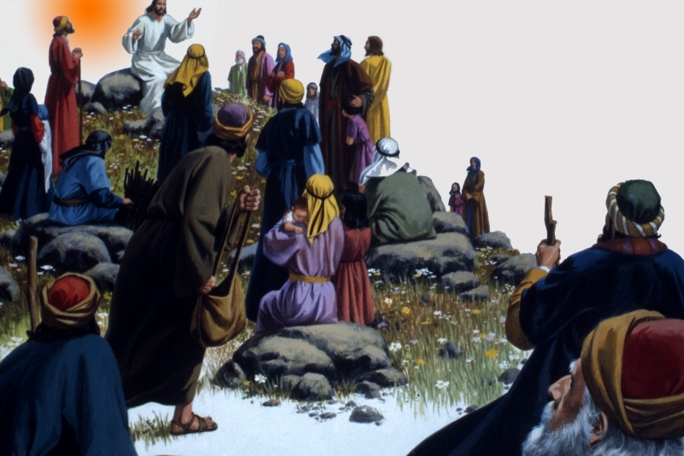

Slide 7
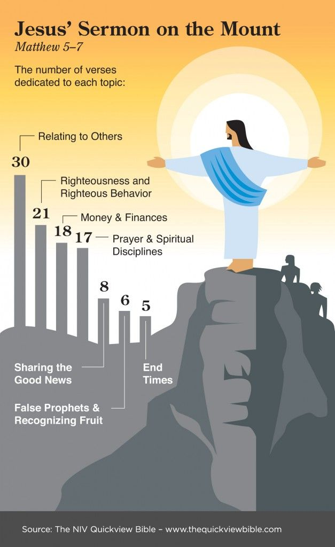

Slide 8
Summary Conclusion
In summary as we look at the Sermon on the Mount, we are taught who we must be like to be happy in the great beatitudes. We are also taught we are to be salt and the light in the midst of this world and a city that can be seen on a hill. We are taught to fulfill the law and the prophets as we are to bring it to the interior part of our hearts as Jesus is teaching. We are to be a people who do no violence to others, not to even to think about it. We are to be people that do not commit adultery, or even think about it. We are to be people who are honest in dealing with one another and letting our speech be ‘yes’ and ‘no.’ Jesus expects us to be people who are faithful in our marital relationship. We are to be non-retaliatory and non-resistant in the way we respond to others, even loving our enemies. We are to be people that give our alms not to be seen in an outward way by others, but seen by our heavenly Father. We are to pray, not by constant repetitiousness but in a simple way to our heavenly Father, worshipping him, pouring out our daily needs, forgiving others and praying that we would not be led into temptation by Satan. We are to fast in a way that is invisible to others, but visible to our Father in heaven. We are to store treasure in heaven by the way we give to others, but not have a greedy eye to gain material and money, lest our whole body be lead in a destructive way. We are not to live in anxiety, but casting all our care upon him for our daily needs. Whatever we do in word and deed, we must do in all in the name of the Lord Jesus. We are not to judge others in a negative, legalistic way; but rather, be persistent in our prayers, to enter through the narrow gate, and evaluate our life by our fruit. We are also to evaluate the lives of those who teach by the fruit of their lives. In doing these things, we build our lives upon the rock solid foundation of Christ’s teaching rather than self-reliant ignorance which would be to ignore Christ’s teaching and do the opposite. May we as believers always desire to build our lives first of all in Jesus, upon the salvation that he brings to us and in his atonement. Let us build upon the application growing out of the way he has taught us in the wonderful Sermon on the Mount.
Staats, G. (2013). . (D. Odegard, Ed.) (pp. 3738). Gary Staats.
Staats, G. (2013). The Teaching of Christ in the Sermon on the Mount: A Brief Christological Commentary of the Flow of Thought. (D. Odegard, Ed.) (pp. 37–38). Gary Staats.

Slide 12
Sermon on the Mount
The Citizens of the Kingdom (5:1-16)
The Righteousness of the Kingdom (5:17-48)
Sincere Devotion in the Kingdom (6:1-18)
Trusting God in the Kingdom (6:19-34)
Relating to Man in the Kingdom (7:1-12)
Entering the Kingdom (7:13-27)

Slide 13
Sermon on the Mount
Matthew 5-7
The Message
The Kingdom of God
Matt. 4:23 – preaching gospel of kingdom
“Kingdom” repeated throughout: (5:3, 10, 19, 20; 6:10; 33; 7:21)

Slide 14
Outline
Sermon on the Mount
Citizens of the Kingdom (5:2-16)
Characteristics [Beatitudes] (5:2-12)
Their influence on the world (5:13-16)
Righteousness of the Kingdom (5:17 - 7:12)
Harmonizes with the Old Testament (5:17-19)
Exceeds the righteousness of the Scribes & Pharisee (5:20-48)
Relationship to God (6)
Relationship to man (7:1-12)
Exhortation to Enter the Kingdom (7:13-27)
Enter the narrow gate that leads to life (7:13-14)
Don’t let false prophets turn you aside (7:15-20)
Only the obedient enter the kingdom (7:21-27)

Slide 15
The Citizens of the Kingdom
(Matt. 5:1-16)
Review
Characteristics of the Citizens (5:2-12)
The Influence of the Citizens on the World (5:13-16)
Sermon on the Mount

Slide 16
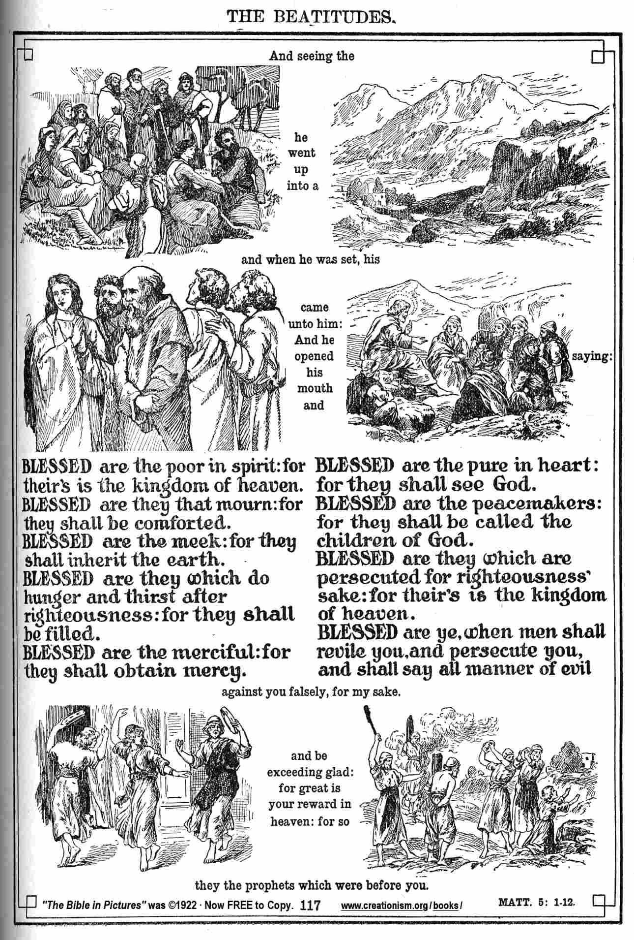

Slide 17
The solemn blessings
mark the opening of the
Sermon on the Mount
the very first of Our Lord’s sermons in Matthew.

Slide 18
BEATITUDES SERMON ON THE MOUNT Matthew 5:3-12
The Beatitudes
are at the heart of
Jesus' preaching.
They take up the promises made to the chosen people since Abraham.

Slide 19
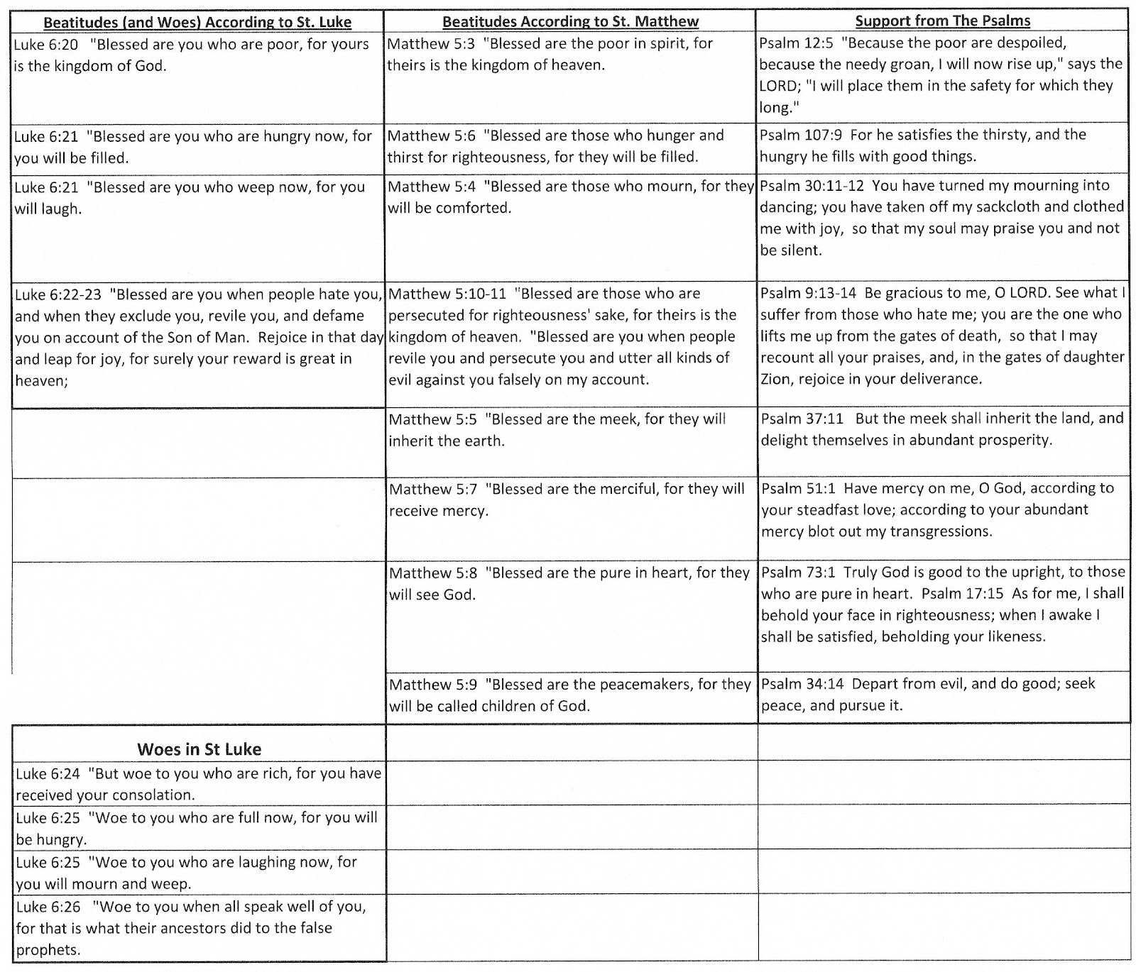

Slide 21
Introduction
The greatest desire of God is that man experience genuine happiness.
Man’s happiness is still God’s primary objective (John 14:26; Philippians 4:6-8; Revelation 7:16, 17)
God has revealed how happiness can be secured while living on earth.

Slide 22
“Blessed” (μαχάριος)
Incorporates the meaning of wholeness, joy, well-being, and, total peace/tranquility of spirit; an inner-satisfaction expressed by our Lord in John 14:27.

Slide 23
“This blessedness is broader and deeper than happiness…It lies not in outward circumstances, but in the inward life; not in what a man has, but in what he is.”

Slide 24
Introduction
The beatitudes of the Bible focus our attention upon the requirements necessary for one to find true happiness.
We do not have to wait until Heaven in order to find genuine happiness in our souls!

Slide 25
True happiness is found only when one follows God’s directions and finds true “blessedness.”
Those who are truly “blessed” will draw others to the Lord’s salvation.

Slide 26
“The Beatitudes may very well be the most unforgettable of all Christ’s teachings. They attract the child, and they confound the scholar, always pouring forth their true meaning to those who experience the wisdom of their insight in everyday life.”

Slide 27
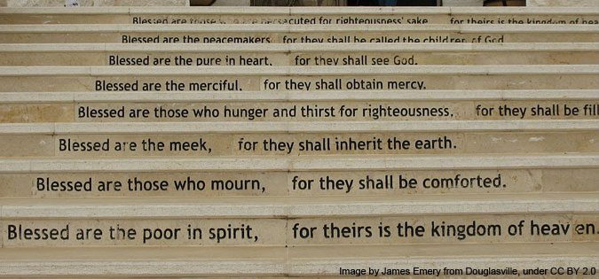

Slide 30
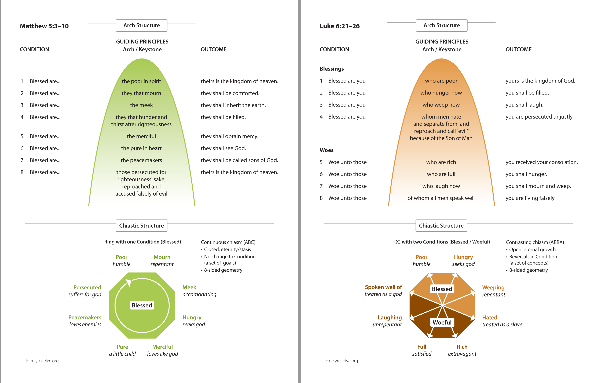

Slide 31
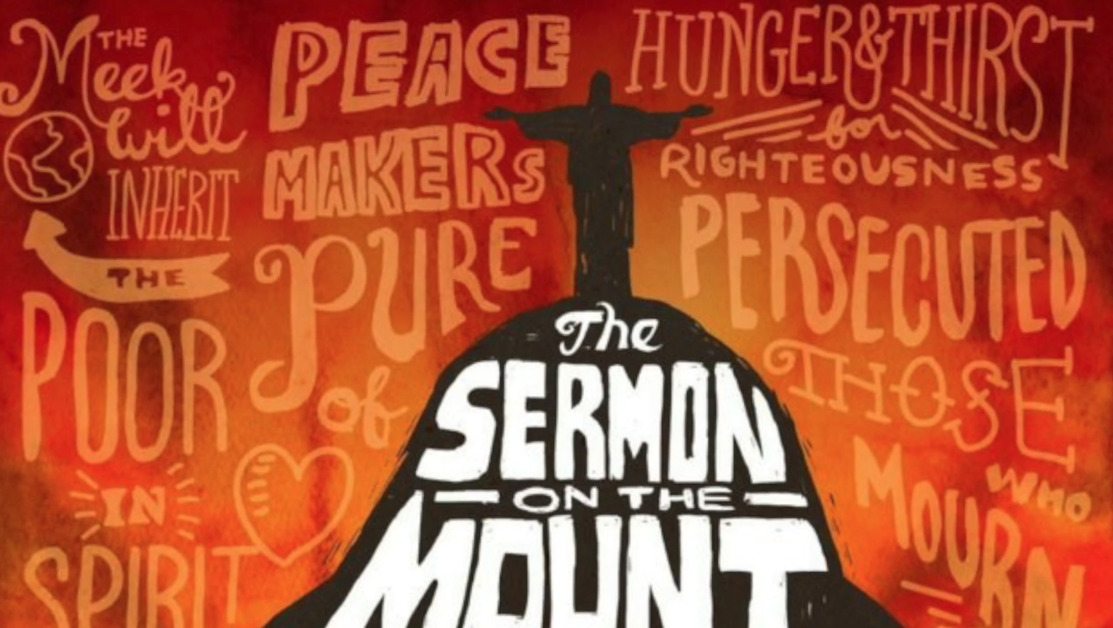

Slide 33
Matthew 5: 1-12

Slide 34
Matthew 5:1-4
And seeing the multitudes, He went up on a mountain, and when He was seated His disciples came to Him. Then He opened His mouth and taught them, saying: " Blessed are the poor in spirit, For theirs is the kingdom of heaven. Blessed are those who mourn, For they shall be comforted.

Slide 35
What are the Beatitudes?
They deal with the state of one’s heart.
Man puts much emphasis on the outward, Jesus on the inward.

Slide 36
The Term “Blessed”
It is deeper than happy, it includes peace and contentment.

Slide 37
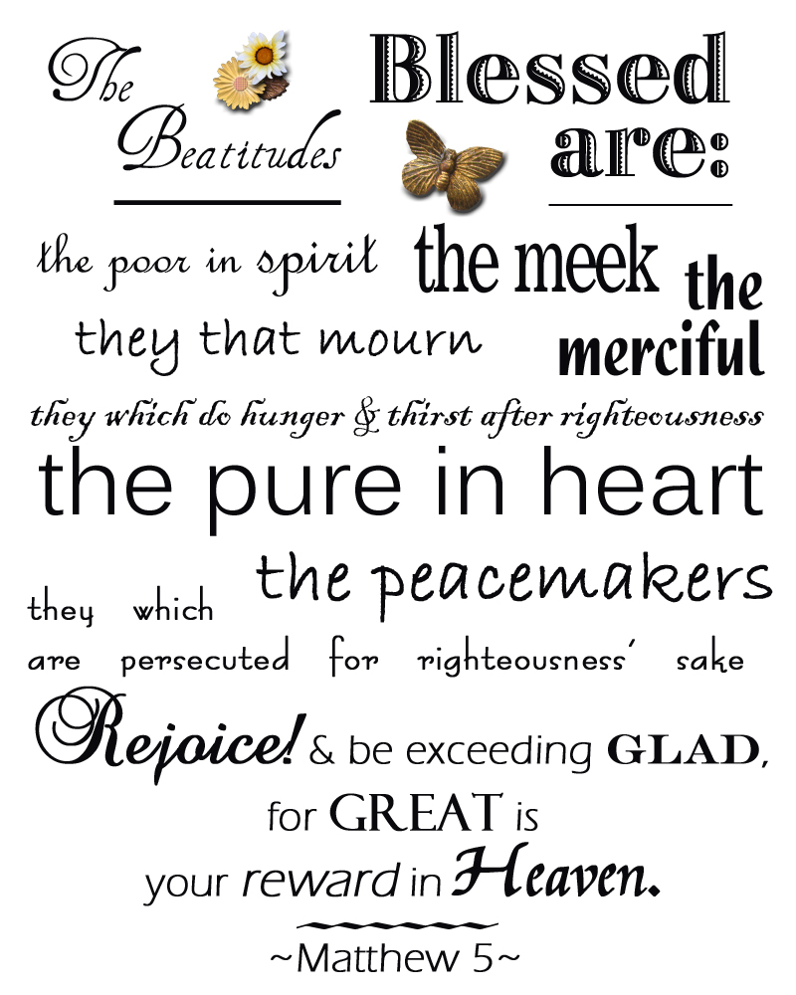

Slide 38
SERMON ON THE MOUNT
POOR OF SPIRIT
The Be-Attitudes: An Exposition of Matthew 5: 1 - 12

Slide 39
The Poor in Spirit

Slide 40
The Poor in Spirit
“Blessed are the poor in Spirit, for theirs is the kingdom of heaven.” – Matthew 5:5
The “poor in spirit” are those who recognize their need for God in all things.
Like the poor and destitute who depend on others, the poor in spirit know that only God can save and protect them.

Slide 41
The Poor in Spirit
What the World Says:
The world and every kind of human-made religion value the “spiritual master,” the guru, the great teacher.
If you know and do the right things, you can find your own spiritual salvation.
People have their own answers to their problems, if they could only recognize it.

Slide 42
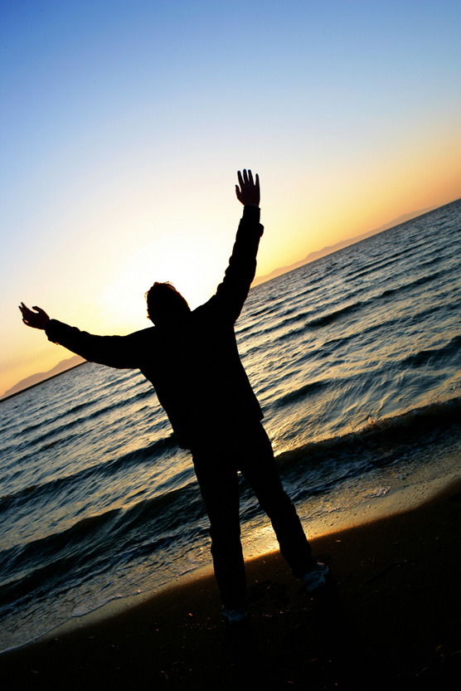
The Poor in Spirit
What Jesus Says:
Jesus tells us that the opposite is true: Genuinely happy people are those who recognize their spiritual bankruptcy before God.
Notes:
Image: ©Stephen Strathdee

Slide 43
The Poor in Spirit
What Jesus Says:
Their happiness consists in relying on God’s strength because they know he cannot fail.
They have certainty that in the kingdom of God, the Messiah will be fully in charge.
Notes:
Image: ©Stephen Strathdee

Slide 44
Matthew 5:3
" Blessed are the poor in spirit, For theirs is the kingdom of heaven.

Slide 45
Blessed are the poor in Spirit - v.3
These individuals know and understand their spiritual dependence upon God.

Slide 46
Blessed are the poor in Spirit - v.3
This is a faithful saying and worthy of all acceptance, that Christ Jesus came into the world to save sinners, of whom I am chief.
1 Timothy 1:15

Slide 47
Blessed are the poor in Spirit - v.3
Let us hold fast the confession of our hope without wavering, for He who promised is faithful.
Hebrews 10:23

Slide 48
Blessed are the poor in Spirit - v.3
These individuals know and understand their spiritual dependence upon God.
Their dependence upon Christ makes them poor or dependent in Spirit.

Slide 49
Blessed are the poor in Spirit - v.3
But Simon Peter answered Him, " Lord, to whom shall we go? You have the words of eternal life.
John 6:68

Slide 50
Blessed are the poor in Spirit - v.3
that you may love the Lord your God, that you may obey His voice, and that you may cling to Him, for He is your life and the length of your days; and that you may dwell in the land which the Lord swore to your fathers, to Abraham, Isaac, and Jacob, to give them.“
Deuteronomy 30:20

Slide 51
Blessed are the poor in Spirit - v.3
that you may love the Lord your God, that you may obey His voice, and that you may cling to Him, for He is your life and the length of your days; and that you may dwell in the land which the Lord swore to your fathers, to Abraham, Isaac, and Jacob, to give them.“
Deuteronomy 30:20

Slide 52
Blessed are the poor in Spirit - v.3
For God did not send His Son into the world to condemn the world, but that the world through Him might be saved.
John 3:17

Slide 53
Blessed are the poor in Spirit - v.3
These individuals know and understand their spiritual dependence upon God.
Their dependence upon Christ makes them poor or dependent in Spirit.
They will inherit the kingdom of Heaven.

Slide 54
Here are the very first words in the public ministry of Christ.
The first words are significant in that they point to a vital truth about the New Law of Christ – one must be “poor in spirit” in order to be a part of it!

Slide 55
“This is the first, because it is obviously, as I think we shall see, the key to all that follows. There is, beyond any question, a very definite order in these beatitudes. Our Lord does not place them in their respective positions haphazardly or accidentally.”

Slide 56
The cornerstone of the Kingdom of God.
From this will come all other essential traits.

Slide 57
It is NOT referring to material possessions.
It is NOT giving advantage to those in economic poverty.

Slide 58
It is NOT referring to material possessions.
It is NOT giving advantage to those in economic poverty.
It is NOT referring to those who are timid and fearful.

Slide 59
Illustrated in Luke 18:10ff
The fundamental “poverty” is the realization that we are nothing without God!
Condemns the proud as an unfit citizen for God’s Kingdom!
Until one admits that man does not have the ability or knowledge, he will not turn to God.

Slide 60
“Poor” is translated by two different Greek terms.
Those who lacked wealth
Those who literally had nothing
The “poor in spirit” are those who can offer God nothing.

Slide 61
Pride can masquerade as “humility.”
Pride masquerades as humility when one endeavors to escape God’s Truth and its demands saying they cannot really “know” or “presume” to judge issues of Truth.

Slide 62
Only the “poor in spirit” ARE appropriate citizens for God’s Kingdom!
Only those who are teachable; who sense their own unworthiness; who long for God’s forgiving mercy!
The Prodigal (Luke 15:18)
The Publican (Luke 18:13)
The Pentecostans (Acts 2:37)

Slide 63
It is fundamental to the Christian’s conduct.
It expresses the “emptying” that must precede the “filling” by the traits that follow. Until one can empty his heart of the evil, it will be impossible to fill it with the good.

Slide 64
Renouncing Self must occur before you can follow God (Luke 9:23).
Some have been “Christians” for many years, yet they have never been “poor in spirit.”
Fundamental Fact – before you can fill your heart with righteousness, before you can become a citizen in God’s Kingdom, you must become “poor in spirit.”

Slide 65
The Lord’s emphasis is upon those who are humble, totally dependent upon Him for success.
The world’s emphasis is upon the opposite – self-reliance, self-confidence, self-help!

Slide 66
This is not a popular beatitude today.
Seldom is appreciation shown for those who are “poor in spirit”

Slide 67
“How may I know when I am poor in spirit?”
When I am weaned from myself (Psalm 131:2).
When I am lost in the wonder of Christ (2 Corinthians 3:18; John 14:8; Psalm 17:5).
When I don’t complain or murmur.

Slide 68
“How may I know when I am poor in spirit?”
When I see good in others and behold my own faults (Matthew 7:1-5).
When I spend much time in prayer (Luke 11:15).
When I accept Christ on His terms.

Slide 69
“The Mount of Blessing in Matthew 5 stands in sharp contrast with the ‘Valley of Woes’ of Matthew 23. The blessings can be given to the poor in spirit but the woes come to the self-righteous for they are proud in spirit. Concerning our lives each one needs to ask:
Is it: Blessed am I? Or is it: Woe unto me?” (Bales, 3).

Slide 70
“The Beatitudes” by James M. Tolle Chapter Excerpt: “The Root Beatitude”
The Beatitude of poverty is the root from which the other Beatitudes grow. It is that spirit of deep humility that causes a person to recognize his frailties and weaknesses as a fallible human being, that make him aware of his spiritual needs and thus of his utter dependence on God.

Slide 71
“The Beatitudes” by James M. Tolle Chapter Excerpt: “The Root Beatitude”
David Brown observed, “This self-emptying conviction that ‘before God we are void of everything,’ lies at the foundation of all spiritual excellence, according to the teaching of Scripture. Without it we are inaccessible to the riches of Christ; with it we are in a fitting state of receiving all spiritual supplies.”
In discussing the approbation of God as an incentive to humility, A. R. Fausset wrote, “The tree, to grow upwards, must strike its roots downwards: so man to be exalted, must have his mind deep-rooted in humility.”

Slide 72
“The Beatitudes” by James M. Tolle Chapter Excerpt: “The Root Beatitude”
Poverty in spirit is the anti-thesis of pride. As humility is the basic virtue, so pride is the basic sin. Sixteen centuries ago Augustine wrote, “What could begin this evil will, but pride, that is the beginning of all sin.” Pride is the basic sin because it resists spiritual growth. It has been described as “the complete anti-God state of mind.” Gerhard noted: “Other sins flee from God: pride alone opposeth itself to God: therefore, God also in turn opposes Himself to the proud.”
Humility is the primary virtue because it possesses the attitude of receptivity which makes for spiritual growth. It is the complete pro-God state of Mind.

Slide 73
Those Who Mourn

Slide 74
SERMON ON THE MOUNT
THEY THAT MOURN
The Be-Attitudes: An Exposition of Matthew 5: 1 - 12

Slide 75
Those Who Mourn
“Blessed are those who mourn, for they will be comforted.” – Matthew 5:4
“Those who mourn” refers to people wishing God to send his Messiah, hoping God will set the world right.
Isaiah 61:2–3 tells of the coming Messiah who will “comfort all who mourn, and provide for those who grieve in Zion.”

Slide 76
Those Who Mourn
What the World Says:
“How can a mournful person be happy?”
The pursuit of happiness has become for us a goal above all goals.
We have become adept at hiding from pain and reality, pretending to be happy.

Slide 77
Those Who Mourn
What Jesus Says:
The way to true happiness must come through a radical shift in thought that first makes us see ourselves and the world as they really are.
Only after we recognize this sorrow can God comfort us.
Knowing that the Messiah has come offering redemption is the greatest comfort.

Slide 78
Those Who Mourn
Related Texts
“As a mother comforts her child, so will I comfort you.” – Isaiah 66:13
“I tell you the truth, you will weep and mourn while the world rejoices. You will grieve, but your grief will turn to joy.” – John 16:20

Slide 79
Matthew 5:4
Blessed are those who mourn, For they shall be comforted.

Slide 80
Blessed are those who mourn - v.4
Those who mourn over their sins and repent.

Slide 81
Blessed are those who mourn - v.4
I am weary with my groaning; All night I make my bed swim; I drench my couch with my tears.
Psalm 6:6

Slide 82
Blessed are those who mourn - v.4
Now I rejoice, not that you were made sorry, but that your sorrow led to repentance. For you were made sorry in a godly manner, that you might suffer loss from us in nothing. For godly sorrow produces repentance leading to salvation, not to be regretted; but the sorrow of the world produces death.
2 Corinthians 7:9-10

Slide 83
Blessed are those who mourn - v.4
Those who mourn over their sins and repent.
These are individuals who mourn because they have fallen short of the glory of God.

Slide 84
Blessed are those who mourn - v.4
for all have sinned and fall short of the glory of God,
Romans 3:23

Slide 85
Blessed are those who mourn - v.4
Those who mourn over their sins and repent.
These are individuals who mourn because they have fallen short of the glory of God.
Because of their mournful state over their sins-they will be comforted.

Slide 86
Blessed are those who mourn - v.4
And God will wipe away every tear from their eyes; there shall be no more death, nor sorrow, nor crying. There shall be no more pain, for the former things have passed away.“
Revelation 21:4

Slide 87
“This beatitude contradicts the view that is prevalent in our society…The philosophy of the world urges men to get all the pleasure they can out of life and to seek fun and entertainment, for this is real happiness as far as the world is concerned.”

Slide 88
A striking comparison is found in the parallel passage (Luke 6:25).
Some have decided that Christianity is a way of morbidity lived by those marked with a gloom and doom outlook and actions.

Slide 89
“He is not talking about the pessimist… nor the selfish person… nor the person who is bitter and rebellious over some loss. The first key to God’s Kingdom, ‘poverty of spirit,’ tells us we should be conscious of our lack of God. Now, the second key tells us we should be so grieved over our mortal and spiritual shortcomings that we cannot rest until we have found God, and our souls are satisfied.”

Slide 90
“If one wants to know something about a person’s character, find out what makes him laugh and what makes him weep.”

Slide 91
“Today we want God’s blessings without the pain of God’s purging. We want sermons on how to win friends, how to have peace of mind, and how to forget our fears. But we must remember that Christ came to make men good rather than merely to make men feel good.”

Slide 92
Better stated: “Blessed are they that CAN mourn”
It is critical that one be able to feel pain.
1 Timothy 4:2; Ephesians 4:19

Slide 93
Christ wept at Lazarus’ tomb, not because His friend was dead but because sin had entered the world and introduced death into life upsetting life and causing great unhappiness.

Slide 94
The mourning for others is an expression of our sensitivity to their plight.
The lack of this sensitivity is in Luke 6:21 – jovial laughter that ignores the danger; that says “Don’t dwell too much on these negative things!”

Slide 95
“Comfort” refers to a sense of consolation (Isaiah 61:1-2).
Those who mourn find a wonderful relief – their spiritual sensitivity leads them to great happiness.

Slide 96
In what ways will comfort come?
Through conversion to Christ
Acts 3:19
Through a daily devotion with Christ 1 John 1:7-10
Through the hope of heaven
2 Thessalonians 2:16

Slide 97
The Christian who is blessed because of “mourning”…
Is a sorrowful man, but he is not morose.
Is a sorrowful man, but he is not a miserable man.
Is a serious man, but he is not a solemn man.
Is a sober-minded man, but he is not a sullen man.

Slide 98
The Christian who is blessed because of “mourning”…
Is a grave man, but he is never cold or prohibitive.
Is a man who looks at life seriously; he contemplates it spiritually, and he sees in it sin and its effects.
Has ‘a joy unspeakable and is full of glory’.

Slide 99
“The Beatitudes” by James M. Tolle Chapter Excerpt: “Unblessed Mourners”
Unblessed: The Pessimists Who Always Whine & Murmur.
Unblessed: Those Who Mourn Because of Injured Pride.
Unblessed: Those Who Mourn Over Material Loss & Frustrated Ambition.
Unblessed: Those Who Mourn In View Of The Effects & Consequences Of Their Sin.

Slide 100
“The Beatitudes” by James M. Tolle Chapter Excerpt: “blessed Mourners”
The Blessed Mourner Mourns Over His Own Sins.
The Blessed Mourner Mourns Over The Sins Of Others.
The Blessed Mourner Mourns Over The Sadness & Suffering Of Others.

Slide 101
SERMON ON THE MOUNT
MEEK IS NOT WEAK!
The Be-Attitudes: An Exposition of Matthew 5: 1 - 12

Slide 102
The Meek

Slide 103
The Meek
“Blessed are the meek, for they will inherit the earth.” – Matthew 5:5
This beatitude alludes to Psalm 37:11: “But the meek will inherit the land.”
The Psalm is comparing the “evil” and “wicked” with the meek.
Psalm 37:3–5 defines what the psalmist means by the meek: “Trust in the Lord and do good.... Commit your way to the Lord; trust in him.”

Slide 104
The Meek
The prophet Zephaniah uses the same expression during a prophetic oracle of judgment: “Because I will remove from this city those who rejoice in their pride ... But I will leave within you the meek and humble, who trust in the name of the Lord” (Zephaniah 3:11–12).

Slide 105
The Meek
The word “meek” is an important adjective in the Bible used to describe Moses in Numbers 12:3, and usually translated as “humble.”
Jesus describes himself with the same word in Matthew 11:29, “I am gentle and humble in heart.”
Meekness is necessary to trust in God and do his will above our own.

Slide 106
The Meek
What the World Says:
Only the proud and mighty have the power to seize the prize of ruling the planet.
Only those who are clever and confident in themselves have any hope of holding on to authority and dominion.
Nice guys finish last; gentleness never gets you anywhere.

Slide 107
The Meek
What Jesus Says:
According to the values of this world meekness may be a disadvantage, but it is a wonderful thing in the values of God.
It is God’s invitation to trust in him, to have the certainty that his plans and work will accomplish what he promised.

Slide 108
The Meek
What Jesus Says:
Old Testament prophets communicated God’s promise to restore the land to Israel.
This promise was taken to be limited to the land that God originally promised to Abraham.
In the New Testament, the promise is extended to a new heaven and a new earth which the meek will inherit.
Notes:
Revelation 21:1

Slide 109
Blessed are the meek (v.5)
Meek or meekness can also be described as humble.

Slide 110
James 4:10
Humble yourselves in the sight of the Lord, and He will lift you up.

Slide 111
Blessed are the meek (v.5)
Meek or meekness can also be described as humble.
They are not concerned with the possessions of this world but only with pleasing God.

Slide 112
Luke 12:20
But God said to him, ' Fool! This night your soul will be required of you; then whose will those things be which you have provided? '

Slide 113
Matthew 6:33
But seek first the kingdom of God and His righteousness, and all these things shall be added to you.

Slide 114
Blessed are the meek (v.5)
Meek or meekness can also be described as humble.
They are not concerned with the possessions of this world be only with pleasing God.
With this attitude they inherit the earth.

Slide 115
The first three beatitudes deal with the Christian’s attitude toward God.
One sincerely humble (poor in spirit) having nothing to offer God
One expressing sorrow over sin’s presence (those who mourn)
One who is controlled by God’s will (meek)

Slide 116
“Meekness” is unappealing to our minds.
“Meekness” sounds as if we have surrendered, are weak, “spineless”

Slide 117
Synonyms –
patient, gentle, humble, modest, mild
Antonyms –
arrogant, proud, and haughty
Expresses how one reacts to another

Slide 118
Considered a virtue by the ancients
Used to describe a wild animal that had been tamed
“In other words, to be meek in the full meaning of the word is to be God-controlled and not self-controlled”

Slide 119
Ancient Greeks used “meekness” to explain “anger.” Aristotle defined “meekness” as being between excessive anger and non-anger.
The meek person is not passive; it is not apathetic.

Slide 120
“Meekness is the sanctification of anger…You can tell how close a person is to the Lord, and to what extent the Lord lives in him and self is dead, by noticing what he gets angry at and when. Anger betrays a great deal ... How blessed is the person who always gets angry at the right time, at the right things he should be angry at and never angry at the wrong time”

Slide 121
“Therefore the most ancient and basic meaning of this word PRAOTEES, ‘meekness,’ used in the third Beatitude, must include the idea that we are to stand up and be counted for the Lord Jesus Christ, passionately to rebuke what He is displeased with and to commend that which exalts Him”

Slide 122
It is a quality that ALL Christians MUST possess!
It is not being “laid-back.”
It is not being “nice.”
It is not a spirit of compromise.
It is not weakness.
It is demonstrated in the Christian’s attitudes.

Slide 123
“The Beatitudes” by James M. Tolle Chapter Excerpt: “Meek Indeed Earth Inherit”
In meekness only are we the inheritors of the earth. Meekness only makes the spiritual retina pure to receive God’s things as they are, mingling with them neither imperfection nor impurity of its own. To inherit the earth is to grow more alive to the presence in it and in all its parts, of Him who is the life of men.

Slide 124
“The Beatitudes” by James M. Tolle Chapter Excerpt: “Meek Indeed Earth Inherit”
Which is more possessor of the world - he who has a thousand homes, or he who, without one house to call his own, has ten in which his knock at the door would rouse instant jubilation?
Which is the richer, the man who, his large money spent, would have no refuge; or he for whose necessity a hundred would sacrifice comfort?

Slide 125
Matters of Meekness
Jesus expounded on His beatitude about meekness further in the sermon. For example, in the following passage:
“You have heard that it was said, ‘Eye for eye, and tooth for tooth.’ But I tell you, Do not resist an evil person. If someone strikes you on the right cheek, turn to him the other also. And if someone wants to sue you and take your tunic, let him have your cloak as well. If someone forces you to go one mile, go with him two miles. Give to the one who asks you, and do not turn away from the one who wants to borrow from you.
“You have heard that it was said, ‘Love your neighbor and hate your enemy.’ But I tell you: Love your enemies and pray for those who persecute you, that you may be sons of your Father in heaven. He causes his sun to rise on the evil and the good, and sends rain on the righteous and the unrighteous. If you love those who love you, what reward will you get? Are not even the tax collectors doing that? And if you greet only your brothers, what are you doing more than others? Do not even pagans do that? Be perfect, therefore, as your heavenly Father is perfect.”
—Matthew 5:38–48
As an aside, debate has always accompanied these verses. When to resist, when to give in. Jesus resisted at times, but never on His own behalf. Let me encourage you, for the sake of this lesson, not to get sidetracked into these discussions. Let’s just get to the heart of meekness.
In these opening verses, Jesus is describing a situation in which someone has power over you. We hate to feel powerless. It is very hard, in our flesh, to feel subject to another person. The first challenge to the flesh’s mastery is to submit to someone’s authority, especially if that person has evil motives. But remember these words: “You would have no power over me if it were not given to you from above” (John 19:11).
When we are in positions of powerlessness, such as Jesus described, the way of the flesh is to do what has to be done and nothing more, seething on the inside. “I’ll show you. You just wait. You’ll get yours,” go the flesh’s thoughts at such a time. The powerful person gains even more power over us because we are letting the poison of bitterness and hatred seep in and begin its destruction. When we respond in the pattern of our flesh, then we are really weak. We are indeed powerless.
But how would meekness meet the challenge? Imagine this scenario. You are powerless. Some evil person whose demands you must obey strikes you on the cheek, or compels you to give up your tunic, or forces you to go a mile with him. These, of course, are all cultural references. They represent the situations you encounter. The meek person is so strong that outward insults and demands that might humiliate a weak person, do not affect the meek person. The meek person does not have to chafe and boil on the inside, giving the offender more power over him. The meek person is so free from the tyranny of his outward circumstances that he is free to cheerfully perform more than duty. He performs ministry. Do you see the principle?
Love your enemy? Impossible for your flesh. Only through grace. Only by the indwelling, present Jesus operating through you. How first to love an enemy? Pray for him. Don’t pray that your enemy will change to suit you, or that your enemy will get what he deserves. Pray blessings on anyone who considers himself your enemy. You’ll soon find your heart following your prayers. It takes strength to be meek.
Dean, J. K. (2015). . Ashland, OH: New Hope Publishers.
Dean, J. K. (2015). Set apart: a 6-week study of the beatitudes. Ashland, OH: New Hope Publishers.

Slide 126
Injustice: Christian Response Jesus Modeled A Third Way
Exposition Of Matthew 5: 39 – 42
Violent Resistance & Passive Acceptance Are Wrong
He Advocated Instead An Assertive Non-Violence
Turning The Other Cheek Central Illustration
Acting This Out Gets To The Point
You can be struck on the right cheek only by an overhand blow or with a backhand blow from the right hand.
But in that world people did not use the left hand to strike people. The left hand was ‘reserved’ for ‘unseemly use.’
Thus, being struck on the right cheek meant one had been backhanded with the right hand.
Given the social structure of the day a superior hit an inferior, whereas one fought social equals with fists.
This means the parable presupposes a setting in which a superior is beating a peasant.

Slide 127
Injustice: Christian Response Jesus Modeled A Third Way
Exposition Of Matthew 5: 39 – 42
Violent Resistance & Passive Acceptance Are Wrong
He Advocated Instead An Assertive Non-Violence
Turning The Other Cheek Central Illustration
Acting This Out Gets To The Point – Continued –
What Should The Peasant Do In Such Situation?
Verse 39 – “Turn To Him The Other Cheek”
What Would Be The Probable Outcome Of Following This Advice?
The only way the superior could continue the beating would be with an overhand blow with the fist – which would be treating the peasant as an equal.
Perhaps the beating would not have been stopped by this act but it would have been very disconcerting. He would only have continued the beating treating the peasant as a social peer!

Slide 128
Injustice: Christian Response Jesus Modeled A Third Way
David Lee Burris:
MLK – “In the end we will remember not the words of our enemies, but the silence of our friends.”
Exposition Of Matthew 5: 39 – 42
Violent Resistance & Passive Acceptance Are Wrong
He Advocated Instead An Assertive Non-Violence
Acting This Out Gets To The Point – Continued –
What Should The Peasant Do In Such Situation?
Verse 40 – “Let Him Have Your Cloak Also”
Under civil law a coat could be confiscated for non-payment of debt – there was not any bankruptcy protection back then.
For the poor, the coat then served as a blanket at night.
In that world, the only other garment typically worn by a peasant was an inner garment, a cloak.
In advising to give the cloak as well – Jesus is saying to strip naked!
In that world, nakedness was a shame to the person observing it.
These were potent methods to confound and expose social injustice.
In reality, this new way, was a radical approach to empowerment.

Slide 129
THEY WILL INHERIT THE LAND
All the promises that accompany the Beatitudes are different ways of promising the kingdom. Your translation might say that the meek will inherit the earth, but the word is the land. In Hebrew thought, the land can only mean one thing: Canaan, the Promised Land. The land where all God’s power and provision are available. The meek inherit the land. Inherit is the word used in the Old Testament to describe Israel’s possession of Canaan. It means to take possession of. The root of the word means to take possession of property through a will or as an inheritance. Think about an inheritance. How does a person become an heir to an inheritance? By being born. The heir possesses his inheritance by virtue of relationship. He did not own it or earn it. It was given to him because of whose he is.
The meek will inherit the land. The kingdom is given to them because they are the King’s. “The land” in the Old Testament becomes “the kingdom” in the New Testament.
“The righteous will inherit the land and dwell in it forever” (Psalm 37:29). “Those the LORD blesses will inherit the land” (Psalm 37:22).
The Hebrew people knew that the land was the blessing. The land was where the abundance waited. The land was the place where rest was theirs. The land was ruled by the King’s rules.
‘“Follow my decrees and be careful to obey my laws, and you will live safely in the land. Then the land will yield its fruit, and you will eat your fill and live there in safety.’”
—Leviticus 25:18–19
The kingdom is the land. The dimension of our reality where heaven provides for earth’s needs.
Blessed are those who look only to the Lord and His strength and who have surrendered the strength of their flesh for the power of the Spirit. Blessed are those who are so anchored in the indwelling Christ that outward events do not distress them or give openings for bitterness to take root. They live in the land of abundant supply.
But blessed is the man who trusts in the LORD whose confidence is in him. He will be like a tree planted by the water that sends out its roots by the stream. It does not fear when heat comes; its leaves are always green. It has no worries in a year of drought and never fails to bear fruit.—Jeremiah 17:7–8
Blessed are the meek, for they will inherit the land.
Dean, J. K. (2015). . Ashland, OH: New Hope Publishers.
Dean, J. K. (2015). Set apart: a 6-week study of the beatitudes. Ashland, OH: New Hope Publishers.

Slide 130
SERMON ON THE MOUNT
HUNGRY THIRSTY
The Be-Attitudes: An Exposition of Matthew 5: 1 - 12

Slide 131
Those Who Hunger and Thirst for Righteousness

Slide 132
Those Who Hunger
“Blessed are those who hunger and thirst for righteousness for they will be filled.” – Matthew 5:6
Just as poverty leads to hunger, the recognition of one’s spiritual poverty leads to a hunger for righteousness—for God’s rule to bring justice.
It is a reign in which God will satisfy the hungry and thirsty for righteousness: “My servants will eat ... my servants will rejoice” (Isaiah 65:13).

Slide 133
Those Who Hunger
What Is Righteousness?
Righteousness in the Old Testament was a legal relational concept.
It was a relationship in terms of law, courts, judges (Psalm 9:4).
It meant ethical and fair behavior.
Notes:
Psalm 15; Isaiah 5:7; Ezekiel 18: 5–9, 25–32

Slide 134
Those Who Hunger
What Is Righteousness?
It also described a covenant relationship.
It is a description of God doing right toward his people, and the expected behavior of God’s people toward God.
Notes:
Psalm 15; Isaiah 5:7; Ezekiel 18: 5–9, 25–32

Slide 135
Those Who Hunger
What Is Righteousness?
The New Testament reflected the two-fold distinction in the Old Testament.
The Apostle Paul expanded the legal sense of the concept to apply it to Christ’s work.
Because of Jesus’ atoning death on the cross (he died in our place), God makes right (justifies) sinners (Romans 4:5).

Slide 136
Those Who Hunger
What Is Righteousness?
Paul did not mean that God makes people righteous in the sense that we can now only do what is right, but that God has applied Christ’s righteousness to us.
Thus, we become “legally” acquitted of the penalty of sin (death) because of Christ’s obedience and guiltlessness.

Slide 137
Those Who Hunger
What Is Righteousness?
In the Sermon on the Mount, Jesus was not using the legal sense of the concept, but the covenant relationship sense.
In the kingdom, relationships are restored:
Relationship between God and humanity;
Relationship between humanity and creation;
Relationships among humans.
Notes:
In the kingdom of heaven people do what is right in all relationships.

Slide 138
Those Who Hunger
What the World Says:
Hungering for things to be right is a fool’s game; nothing ever changes.
It’s fine to compromise and set aside honor when doing what’s right is inconvenient.
It’s all politics, so quit worrying about what is right, just go for what you need.
You gotta look out for number one!

Slide 139
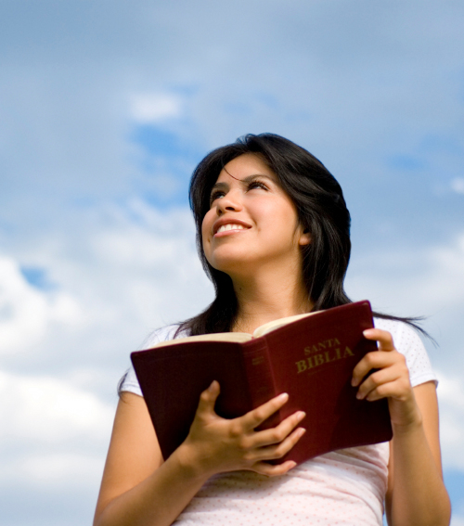
Those Who Hunger
What Jesus Says:
God’s kingdom is characterized by “righteousness, peace and joy in the Holy Spirit” (Romans 14:17).
Notes:
Isaiah 55:1–13; 65:13; John 6:48; Romans 14:17
Image: ©Aldo Murillo

Slide 140
Those Who Hunger
What Jesus Says:
Those who are starved for righteousness will be satisfied.
“If anyone is thirsty, let him come to me and drink.” – John 7:37
Notes:
Isaiah 55:1–13; 65:13; John 6:48; Romans 14:17
Image: ©Aldo Murillo

Slide 141
Matthew 5:6
Blessed are those who hunger and thirst for righteousness, For they shall be filled.

Slide 142
Blessed are those…(v.6)
“who hunger and thirst after righteousness”

Slide 143
Proverbs 1:2-5
To know wisdom and instruction, To perceive the words of understanding, To receive the instruction of wisdom, Justice, judgment, and equity; To give prudence to the simple, To the young man knowledge and discretion — A wise man will hear and increase learning, And a man of understanding will attain wise counsel,

Slide 144
2 Timothy 2:15
Be diligent to present yourself approved to God, a worker who does not need to be ashamed, rightly dividing the word of truth.

Slide 145
Blessed are those…(v.6)
“who hunger and thirst after righteousness”
They shall be filled.

Slide 146
Hebrews 5:14
But solid food belongs to those who are of full age, that is, those who by reason of use have their senses exercised to discern both good and evil.

Slide 147
In this fourth Beatitude we find a commandment that applies to all Christians and without this no one will ever find “blessedness.”

Slide 148
“This beatitude introduces a slight change into the whole approach. It is a little less negative and more positive. There is a negative element here, as we shall see, but there is a more positive element ... Here we begin to look for a solution, and thus there is a slight change in the emphasis... In this verse we have one of the most notable statements of the Christian gospel and everything it has to give us.”

Slide 149
Three great lessons
“Righteousness”
The key word in this Beatitude
Identifies the opposite of sin
Stands for all that God is (Jere 23:6)

Slide 150
“In the original Greek text, the definite article preceded the word dikaiosuneen, ‘righteousness.’ Literally translated, this Beatitude should read, ‘Blessed those hungering and thirsting after THE righteousness.”

Slide 151
How can we define this “righteousness”?
Not a peace on earth where no wars are fought.
Not the same as justification with God.
A fervent desire to be free from sin and to live in a right relationship with God.
The complete freedom from sin’s captivity!

Slide 152
Three great lessons
“Righteousness”
“Hunger and thirst”

Slide 153
The strongest drives in earthly life
Aptly state the goal of a person
These express an urgent
Need
Emotion
Situation

Slide 154
Spiritual hunger reveals a sense of
Emptiness
Satisfaction
Need
Completeness
Exclusion

Slide 155
Three great lessons
“Righteousness”
“Hunger and thirst”
“Be filled”

Slide 156
The true seeker of righteousness will never enjoy a once-and-for-all filling.

Slide 157
“You see the Christian is one who at one and the same time is hungering and thirsting, yet he is filled. And the more he is filled the more he hungers and thirsts. That is the blessedness of this Christian life. It goes on. You reach a certain stage in sanctification, but you do not rest upon that for the rest of your life.”

Slide 158
This filling is an individual obligation.
“God who made hunger a universal desire also made food universally available. But to appropriate it individually requires individual effort. All the food in the world is absolutely useless unless you take some of it and eat it.”

Slide 159
Each must act “starved for Christ” all of the time! A starving person will be present at the table when food is available – priorities will be set for Bible study, worship, fellowship, etc.!

Slide 160
This filling reveals more about your spiritual condition than you may wish be revealed!
Christians must be careful and watch their diet!

Slide 161
“The Beatitudes” by James M. Tolle Chapter Excerpt: “They Shall Be Filled!”
The Greek word for “filled” is chortazesthai. Originally it was used to describe the gorging and fattening of animals with fodder. In regard to men, it describes the filling of a person to the point of full and complete satisfaction. Paradoxically, the righteousness the Christian receives in Christ as a result of his spiritual hunger and thirst is of itself productive of higher hunger and thirst. The more the Christian receives from Christ, the more he wants from Christ: and the more he wants from Christ, the more he receives from Christ. (2nd Corinthians 3: 18)

Slide 162
BLESSED ARE THOSE WHO HUNGER AND THIRST FOR RIGHTEOUSNESS
The Greek word translated as “hunger and thirst” means “to avidly desire something as necessary to life.” This Greek word is likely interpreting the Hebrew word that means “an acute lack of food.” It can also be used for the exhaustion caused by a military campaign or a desert journey, according to Eerdmans Theological Dictionary of the New Testament.
Blessed are those who are famished and desperate and ravenous for righteousness. Blessed are those who are consumed with a desire for righteousness. Blessed are those who crave righteousness.
The desire for righteousness is compared to the body’s craving for food and drink. Why does the body crave food and drink? Because the body is created so that it requires food and drink to sustain life. Your body is fueled by food and drink, and in their absence it will quit functioning and die.
Why do God’s people hunger and thirst for righteousness? Because we are created to be righteous. The word righteous means “to be right.” It means to have everything functioning well. When we are righteous, then we are satisfied, and our deepest longings are fulfilled. Like everything else He gives, righteousness is not a gift apart from Himself. He gives us Himself—the law on the inside, grace, Christ in you—and in Him is everything. The longing for righteousness comes from Him. The gift of His righteousness comes from Him.
Jesus speaks of the one who hungers and thirsts for righteousness. The Scripture calls us to consider the Word of God as nourishment for our spirits in the same way that food is nourishment for our bodies. Could it be that feasting continually on the Word of God is the first step to experiencing the righteousness that Christ imparts within us?
The Scripture is God’s Word. Jesus is the Living Word, the Word embodied, and He lives in me. I think about it like this: Jesus, present with me and in me eternally, breaks the bread of the Word and feeds it to me, bite by bite. Like food in my body, it is digested and made available to my spirit, to my mind, to my emotions. I absorb it into my soul’s cells where it releases power and cleansing and nourishment and growth.
The Word of God does more than inform. It transforms. It renews the mind. It restores the soul. It energizes and motivates and corrects. Without a continual feeding on His Word, you will waste away.
The first step in satisfying that hunger for righteousness is to let the Word of God feed you and find that it increases your appetite.
Dean, J. K. (2015). . Ashland, OH: New Hope Publishers.
Dean, J. K. (2015). Set apart: a 6-week study of the beatitudes. Ashland, OH: New Hope Publishers.

Slide 163
Food You Know Not Of
Jesus spoke of the Father’s will as food. During His encounter with the woman at the well in Samaria (John 4:1–34), His disciples had left to get food for Him. They had been traveling, and the road they were traveling was arduous. He was at the well that day at that time because He was tired and hungry and thirsty. While His disciples were gone, He had this transforming encounter with the Samaritan woman, with whom He had a conversation about water.
There came a woman of Samaria to draw water. Jesus said to her, “Give Me a drink.”
For His disciples had gone away into the city to buy food.
Therefore the Samaritan woman said to Him, “How is it that You, being a Jew, ask me for a drink since I am Samaritan woman?” (For Jews have no dealings with Samaritans.)
Jesus answered and said to her, “If you knew the gift of God, and who it is who says to you, ‘Give Me a drink,’ you would have asked Him, and He would have given you living water.”
She said to Him, “Sir, You have nothing to draw with and the well is deep; where then do You get that living water? You are not greater than our father Jacob, are You, who gave us the well, and drank of it himself and his sons and his cattle?”
Jesus answered and said to her, “Everyone who drinks of this water will thirst again; but whoever drinks of the water that I will give him shall never thirst; but the water that I will give him will become in him a well of water springing up to eternal life.”
The woman said to Him, “Sir, give me this water, so I will not be thirsty nor come all the way here to draw.”
—John 4:7–15 (NASB)
How efficiently timed this was. Had the disciples been present, the woman may not have come, or at least she might not have been as open. But, as God’s perfect timing would have it, she was at the right place at the right time for a face-to-face encounter with Jesus.
His disciples returned with the food they had brought Him and encouraged Him to eat. Remember, before they left He had been hungry.
But he said to them, “I have food to eat that you know nothing about.”
Then his disciples said to each other, “Could someone have brought him food?”
“My food,” said Jesus, “is to do the will of him who sent me and to finish his work.
—John 4:32–34
He was so filled spiritually by His ministry to the woman He met at the well that His physical hunger disappeared. Doing His Father’s will filled and energized Him. “For the kingdom of God is not a matter of eating and drinking, but of righteousness, peace and joy in the Holy Spirit” (Romans 14:17–18).
Dean, J. K. (2015). . Ashland, OH: New Hope Publishers.
Dean, J. K. (2015). Set apart: a 6-week study of the beatitudes. Ashland, OH: New Hope Publishers.

Slide 164
THE EIGHT BE-ATTITUDES
PART ONE
Blessed Are The Poor In Spirit
Blessed Are Those Who Mourn
Blessed Are The Meek
Blessed Are Those Who Hunger & Thirst For Righteousness

Slide 167
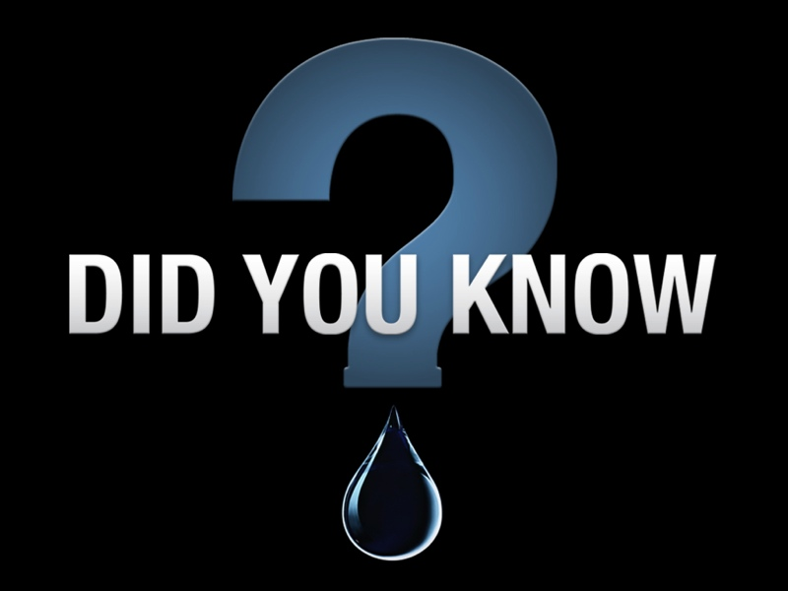

Slide 168
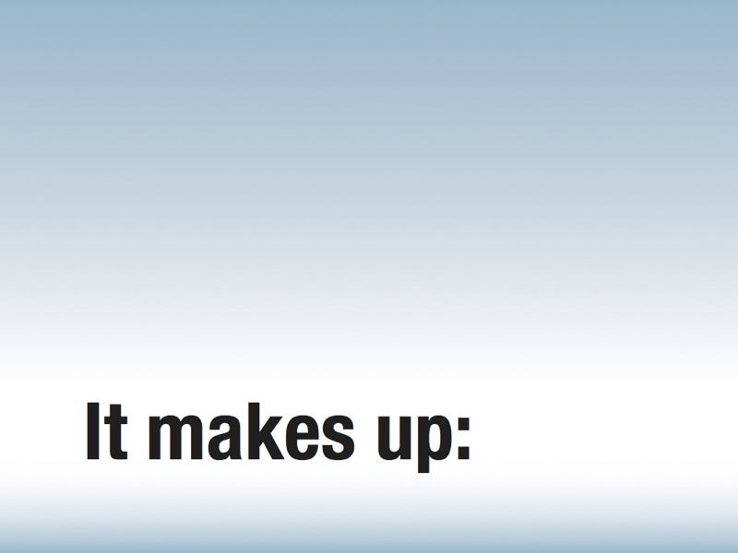

Slide 169
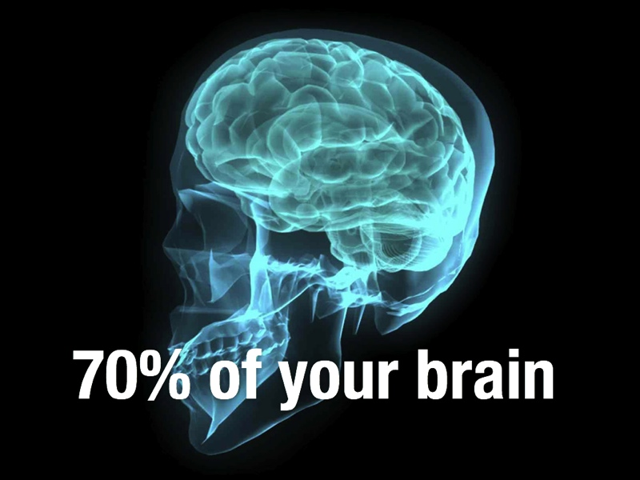

Slide 172
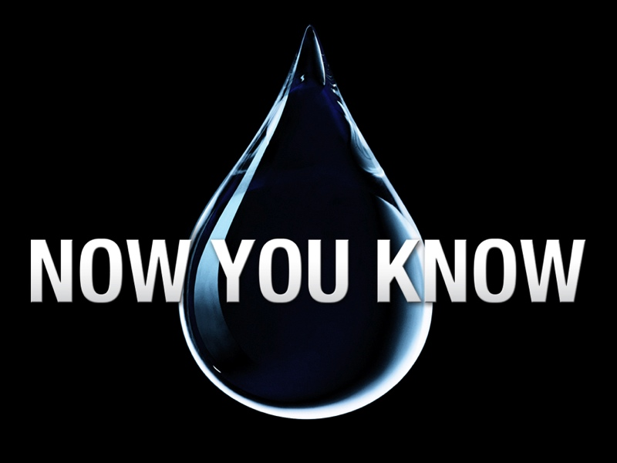

Slide 175
THE EIGHT BE-ATTITUDES
PART
TWO
Blessed Are The Merciful
Blessed Are The Poor In Heart
Blessed Are The Peacemakers
Blessed Are Those Who Are Persecuted For Righteousness Sake

