Slide 1
Sermon on the Mount: The Blest Beatitudes
By David Lee Burris

Slide 3
THE EIGHT BE-ATTITUDES
PART ONE
Blessed Are The Poor In Spirit
Blessed Are Those Who Mourn
Blessed Are The Meek
Blessed Are Those Who Hunger & Thirst For Righteousness

Slide 4
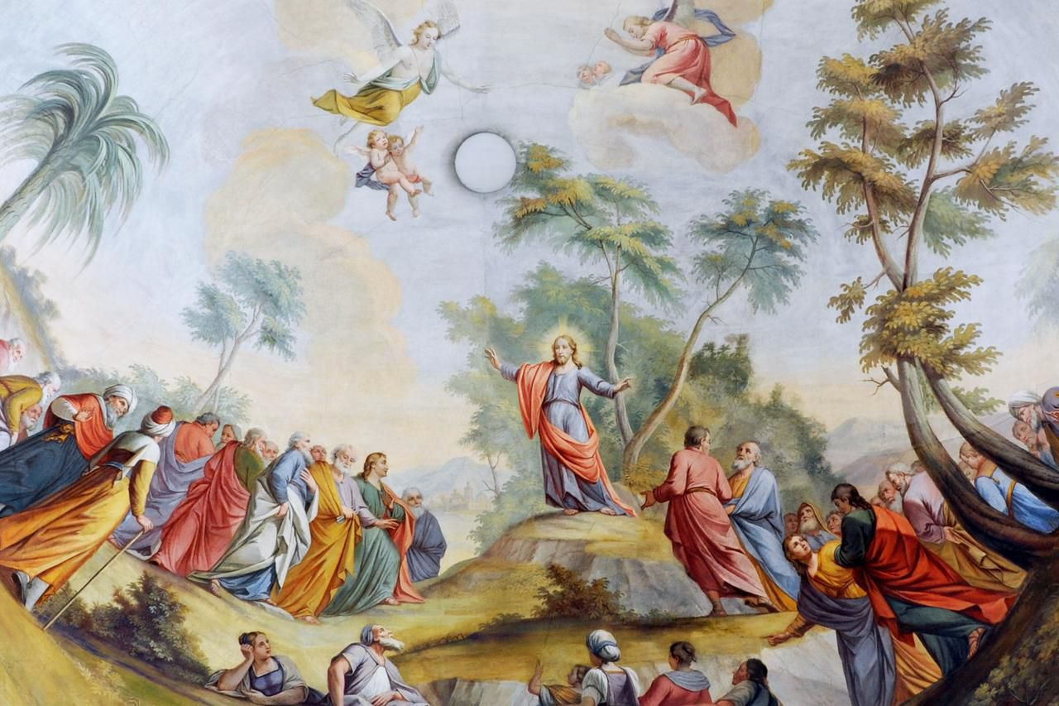

Slide 5
THE EIGHT BE-ATTITUDES
PART
TWO
Blessed Are The Merciful
Blessed Are The Poor In Heart
Blessed Are The Peacemakers
Blessed Are Those Who Are Persecuted For Righteousness Sake

Slide 7
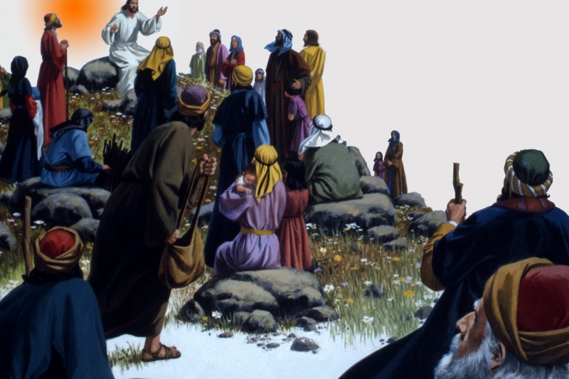

Slide 9
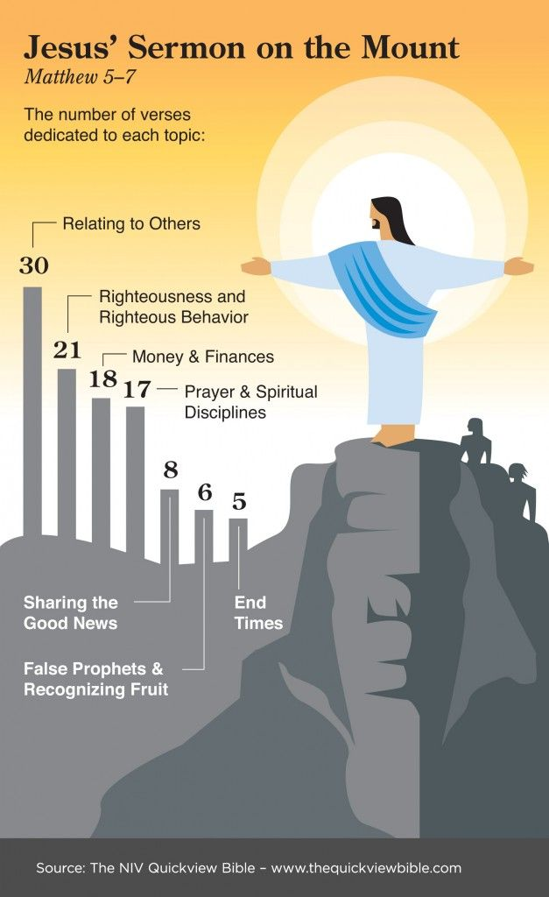

Slide 10
Summary Conclusion
In summary as we look at the Sermon on the Mount, we are taught who we must be like to be happy in the great beatitudes. We are also taught we are to be salt and the light in the midst of this world and a city that can be seen on a hill. We are taught to fulfill the law and the prophets as we are to bring it to the interior part of our hearts as Jesus is teaching. We are to be a people who do no violence to others, not to even to think about it. We are to be people that do not commit adultery, or even think about it. We are to be people who are honest in dealing with one another and letting our speech be ‘yes’ and ‘no.’ Jesus expects us to be people who are faithful in our marital relationship. We are to be non-retaliatory and non-resistant in the way we respond to others, even loving our enemies. We are to be people that give our alms not to be seen in an outward way by others, but seen by our heavenly Father. We are to pray, not by constant repetitiousness but in a simple way to our heavenly Father, worshipping him, pouring out our daily needs, forgiving others and praying that we would not be led into temptation by Satan. We are to fast in a way that is invisible to others, but visible to our Father in heaven. We are to store treasure in heaven by the way we give to others, but not have a greedy eye to gain material and money, lest our whole body be lead in a destructive way. We are not to live in anxiety, but casting all our care upon him for our daily needs. Whatever we do in word and deed, we must do in all in the name of the Lord Jesus. We are not to judge others in a negative, legalistic way; but rather, be persistent in our prayers, to enter through the narrow gate, and evaluate our life by our fruit. We are also to evaluate the lives of those who teach by the fruit of their lives. In doing these things, we build our lives upon the rock solid foundation of Christ’s teaching rather than self-reliant ignorance which would be to ignore Christ’s teaching and do the opposite. May we as believers always desire to build our lives first of all in Jesus, upon the salvation that he brings to us and in his atonement. Let us build upon the application growing out of the way he has taught us in the wonderful Sermon on the Mount.
Staats, G. (2013). . (D. Odegard, Ed.) (pp. 3738). Gary Staats.
Staats, G. (2013). The Teaching of Christ in the Sermon on the Mount: A Brief Christological Commentary of the Flow of Thought. (D. Odegard, Ed.) (pp. 37–38). Gary Staats.

Slide 14
Sermon on the Mount
The Citizens of the Kingdom (5:1-16)
The Righteousness of the Kingdom (5:17-48)
Sincere Devotion in the Kingdom (6:1-18)
Trusting God in the Kingdom (6:19-34)
Relating to Man in the Kingdom (7:1-12)
Entering the Kingdom (7:13-27)

Slide 15
Sermon on the Mount
Matthew 5-7
The Message
The Kingdom of God
Matt. 4:23 – preaching gospel of kingdom
“Kingdom” repeated throughout: (5:3, 10, 19, 20; 6:10; 33; 7:21)

Slide 16
Outline
Sermon on the Mount
Citizens of the Kingdom (5:2-16)
Characteristics [Beatitudes] (5:2-12)
Their influence on the world (5:13-16)
Righteousness of the Kingdom (5:17 - 7:12)
Harmonizes with the Old Testament (5:17-19)
Exceeds the righteousness of the Scribes & Pharisee (5:20-48)
Relationship to God (6)
Relationship to man (7:1-12)
Exhortation to Enter the Kingdom (7:13-27)
Enter the narrow gate that leads to life (7:13-14)
Don’t let false prophets turn you aside (7:15-20)
Only the obedient enter the kingdom (7:21-27)

Slide 17
The Citizens of the Kingdom
(Matt. 5:1-16)
Review
Characteristics of the Citizens (5:2-12)
The Influence of the Citizens on the World (5:13-16)
Sermon on the Mount

Slide 18
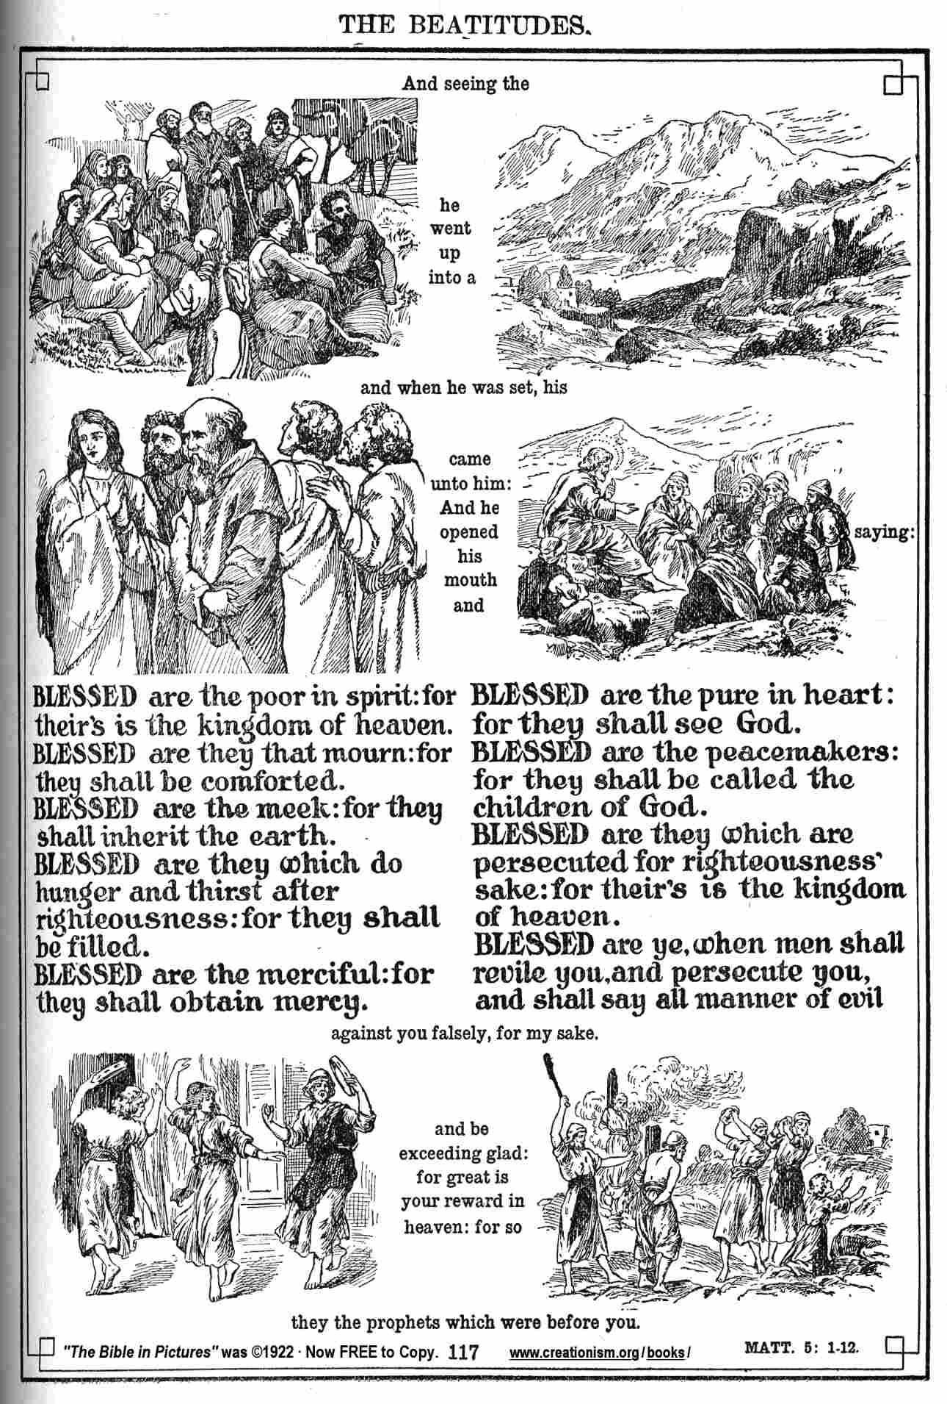

Slide 19
The solemn blessings
mark the opening of the
Sermon on the Mount
the very first of Our Lord’s sermons in Matthew.

Slide 20
BEATITUDES SERMON ON THE MOUNT Matthew 5:3-12
The Beatitudes
are at the heart of
Jesus' preaching.
They take up the promises made to the chosen people since Abraham.

Slide 21
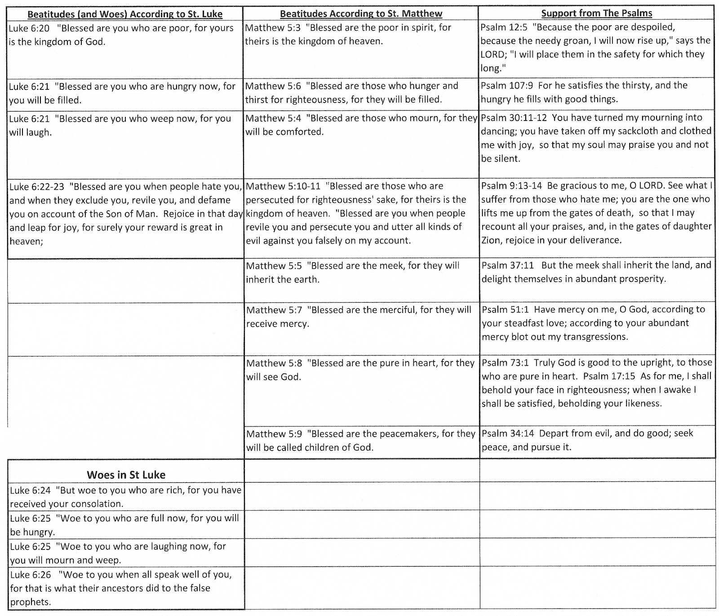

Slide 23
Introduction
The greatest desire of God is that man experience genuine happiness.
Man’s happiness is still God’s primary objective (John 14:26; Philippians 4:6-8; Revelation 7:16, 17)
God has revealed how happiness can be secured while living on earth.

Slide 24
“Blessed” (μαχάριος)
Incorporates the meaning of wholeness, joy, well-being, and, total peace/tranquility of spirit; an inner-satisfaction expressed by our Lord in John 14:27.

Slide 25
“This blessedness is broader and deeper than happiness…It lies not in outward circumstances, but in the inward life; not in what a man has, but in what he is.”

Slide 26
Introduction
The beatitudes of the Bible focus our attention upon the requirements necessary for one to find true happiness.
We do not have to wait until Heaven in order to find genuine happiness in our souls!

Slide 27
True happiness is found only when one follows God’s directions and finds true “blessedness.”
Those who are truly “blessed” will draw others to the Lord’s salvation.

Slide 28
“The Beatitudes may very well be the most unforgettable of all Christ’s teachings. They attract the child, and they confound the scholar, always pouring forth their true meaning to those who experience the wisdom of their insight in everyday life.”

Slide 29
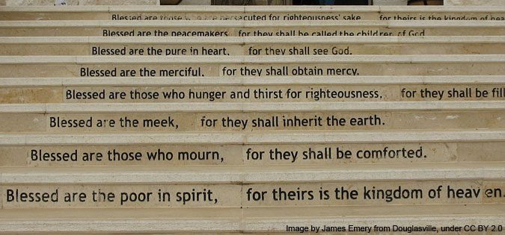

Slide 32
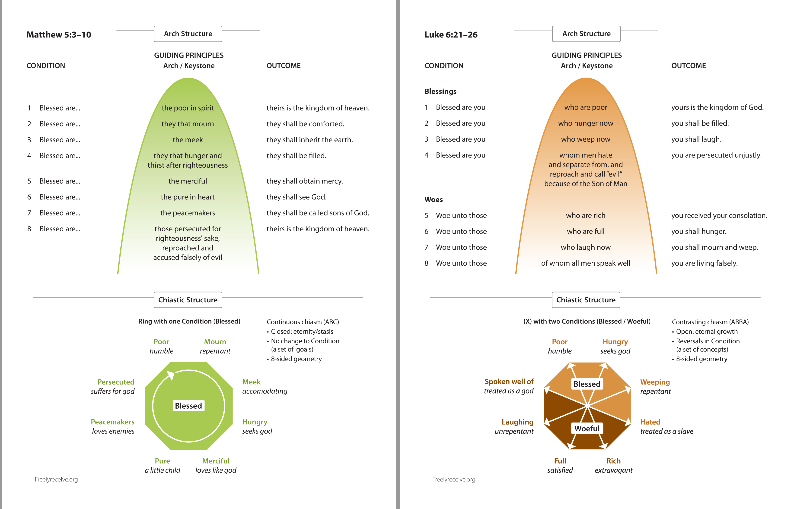

Slide 33
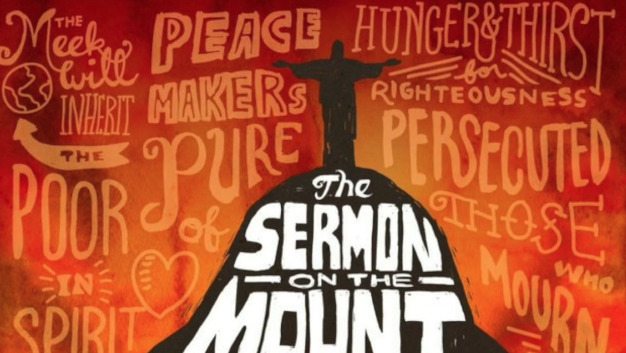

Slide 35
Matthew 5: 1-12

Slide 36
Matthew 5:1-4
And seeing the multitudes, He went up on a mountain, and when He was seated His disciples came to Him. Then He opened His mouth and taught them, saying: " Blessed are the poor in spirit, For theirs is the kingdom of heaven. Blessed are those who mourn, For they shall be comforted.

Slide 37
What are the Beatitudes?
They deal with the state of one’s heart.
Man puts much emphasis on the outward, Jesus on the inward.

Slide 38
The Term “Blessed”
It is deeper than happy, it includes peace and contentment.

Slide 39
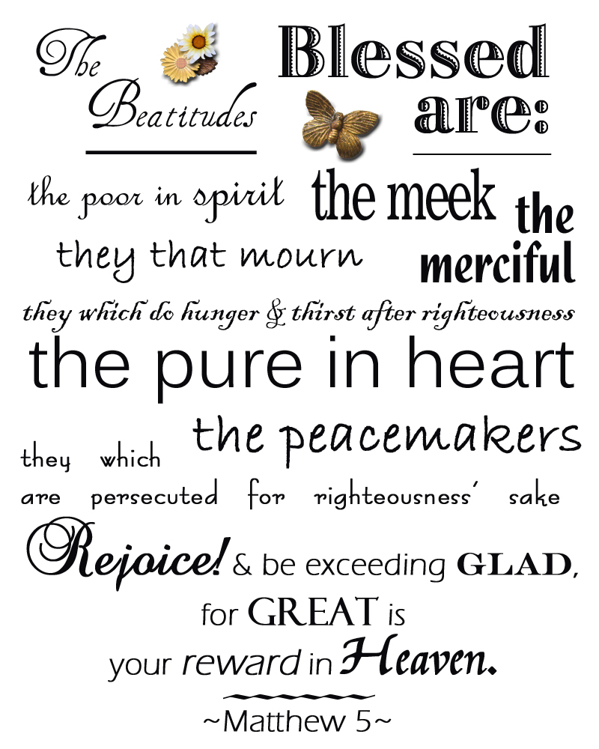

Slide 41
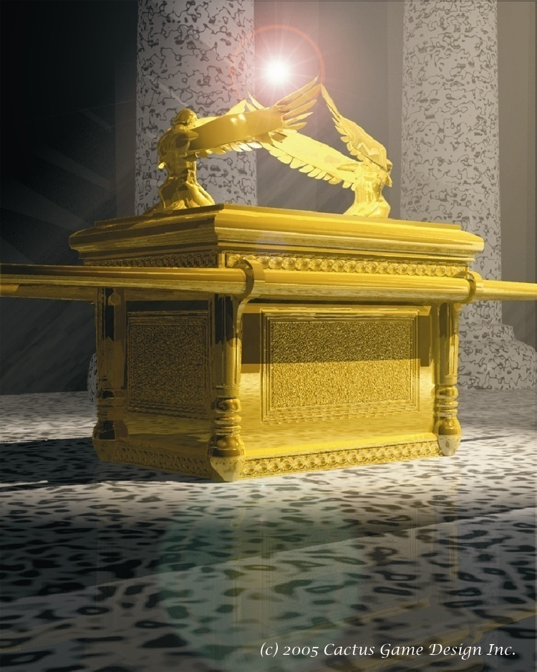

Slide 42
Once Per Year Animal Blood Sprinkled
On Ark Lid Between Cherubim

Slide 43
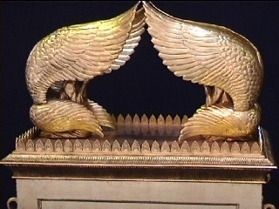
The Mercy Seat

Slide 44
The Defining Of Mercy
Forbearance to inflict harm under circumstances of provocation, when one has the power to inflict it; compassionate treatment of offender or adversary; BACON - Examples of justice must be made for terror to some; examples of mercy for comfort to others."
Compassionate treatment of the unfortunate and helpless; often, favor, beneficence. Luke 10. 37.
Disposition to exercise compassion or favor; pity; compassion; willingness to spare or to help.
Blessing regarded as a manifestation of compassion or favor. "The Father of mercies and the God of all comfort." 2 Corinthians. 1. 3

Slide 45
Specific To The Mercy Of God:
We are guilty, no question of it!
The basis of mercy is not found in the worthiness of the recipient.
The character of the mercy giver is shown in the giving of mercy to the benefit of those undeserving.
We have to exercise caution not to presume upon God’s mercy. We are neither worthy or deserving of it.

Slide 46
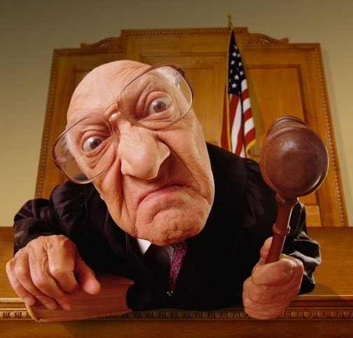

Slide 47
The Mercy Of God’s Ways Romans 11: 30-32
Three times the mercy of God is highlighted
To the Gentiles vs 30
To the Jews vs 31
To the whole world vs 32
All of us are in a prison of our own making vs 32
The emphasis is on ALL
Our disobedience was the reason
God’s mercy comes to the imprisoned

Slide 48
The Majesty of God’s Ways Romans Chap 11 & Vs 33-36
No act of human will or display of human strength can thwart His will
Nothing has happened or will happen that will catch Him by surprise or cause Him to be dumbfounded
What God has said He will do, can be considered done
Every goal God has will be achieved, on time, with no adjustments necessary
This God who is all powerful, and all wise, loves you and me and extends to us, who are undeserving, His mercy and grace

Slide 49
@ Grace - God’s Love - Hell’s Horror - Nexus
David Lee Burris:
Philosopher Seneca & Apostle Paul Contemporaries – Who Were Aware Of Existence Of The Other
Teacher Seneca To Student Nero Mercy Involves Reason Where Decision In Our Full Control;
Teacher Seneca To Student Nero Pity Is Akin To‘Wretchedness’ It Is Helplessly Succumbing At The Sight Of The Ill Of Others

Slide 50
@ Grace - God’s Love - Hell’s Horror - Nexus
MERCY: WHERE WE DO NOT GET WHAT WE DO REALLY DESERVE
GRACE: WHERE WE DO GET WHAT WE DO NOT REALLY DESERVE

Slide 51
SERMON ON THE MOUNT
SHOW MERCY
The Be-Attitudes: An Exposition of Matthew 5: 1 - 12

Slide 52
The Merciful

Slide 53
The Merciful
“Blessed are the merciful, for they will be shown mercy.” – Matthew 5:7
Mercy is part of God’s own nature: “…the compassionate and gracious God, slow to anger, abounding in love and faithfulness” (Exodus 34:6).

Slide 54
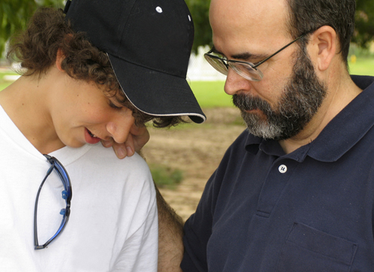
The Merciful
People who have experienced mercy and forgiveness are filled with gratitude, cultivating a merciful attitude in return.
God’s expects mercy from his people: “What does the Lord require of you? To act justly and to love mercy and to walk humbly with your God” (Micah 6:8).
Notes:
Image: ©Anitapatterson

Slide 55
The Merciful
What the World Says:
We want justice! Take no prisoners! We condemn others to make ourselves feel better.
Our world idolizes the arrogant and merciless in sports, in wealth, fame, and on the screen.
Mercy has become a liability—it is way too costly and will prevent the attainment of our goals.

Slide 56
The Merciful
What Jesus Says:
Jesus challenges the way the world thinks by lifting up mercy as an essential quality.
Mercy is what Jesus’ life was all about—God’s mercy to us.
We cannot buy God’s mercy by our own acts of mercy, but only those who know God’s mercy can be truly merciful and receive God’s most precious gift—eternal life.
Notes:
Matthew 6:12–15, 18:21–35

Slide 57
Matthew 5:7
Blessed are the merciful, For they shall obtain mercy.

Slide 58
Blessed…(v.7)
are the merciful

Slide 59
Matthew 6:12
And forgive us our debts, As we forgive our debtors.

Slide 60
Blessed…(v.7)
are the merciful
for they shall obtain mercy

Slide 61
“We have so far been looking at the Christian in terms of his need, of his consciousness of his need. But here there is a kind of turning-point. Now we are concerned more with his disposition, which results from everything that has gone before.”

Slide 62
“The Christian gospel places all its primary emphasis upon being, rather than doing. The gospel puts a greater weight upon our attitude than upon our actions...my Christianity controls me; I am to be dominated by the truth because I have been made a Christian...

Slide 63
“The Christian faith is not something on the surface of a man’s life, it is not merely a kind of coating or veneer. No, it is something that has been happening at the very centre of his personality. This is why the New Testament talks about rebirth and being born again, about a new creation and about receiving a new nature...

Slide 64
“That is why these Beatitudes are so searching... By the way we react we manifest our spirit... The whole of our life is an expression and a proclamation of what we really are.”

Slide 65
“Mercy”
Indicates an emotion of compassion for the unfortunate.
Refers to leniency of punishment toward one justly condemned
The Hebrew counterpart is CHESED — “loving-kindness”
Our idiom – “Before you condemn a man, first walk a mile in his shoes.”

Slide 66
“The idea today is that man should be absolutely free minded, that he has the right to do just what he likes. The merciful person, many people think, is one who smiles at transgression and law breaking. He says, ‘What does it matter? Let’s carry on.’ He is a flabby kind of person, easy-going, easy to get on with, to whom it does not matter whether laws are broken or not, who is not concerned about keeping them.”

Slide 67
Matthew 18:21-35
“To have a merciful spirit means the spirit that is displayed when you suddenly find yourself in the position of having in your power someone who has transgressed against you...This person is in your power; is there a vindictive spirit, or is there a spirit of pity and sorrow, a spirit, if you like, of kindness to your enemies in distress?”

Slide 68
Biblical “mercy” is distinguished by two factors:
The attitude that propels the action.
It is the ATTITUDE of mercy that is blessed. The gift of money, clothing, food, etc., is not as significant as the compassion and sympathy which prompts the action. The WHY we give is much more important than what we give!

Slide 69
Biblical “mercy” is distinguished by two factors:
The attitude that propels the action.
The consecration to God
Acts of mercy are beneficial ONLY to those performing the deed as a follower of God. Generic “humanitarian assistance” is not included with in the scope of this Beatitude.

Slide 70
This is a point seldom considered – merciful acts performed by groups other than the Lord’s Church, do not receive God’s commendation! They receive men’s commendation but not God’s! Many Christians spend much work in “mercy operations” that fail to give God the glory and thus they fail to express the true meaning of this Beatitude.

Slide 71
“The Beatitudes” by James M. Tolle Chapter Excerpt: “The Merciful”
A religious life that excludes justice and mercy is spiritually and morally empty, no matter how doctrinally sound it may be. The Jews of old who omitted the practice of justice and mercy from their lives thought they could receive God’s blessings by approaching Him with their sacrifices. How wrong they were! (Micah 6: 6 – 8)

Slide 72
“The Beatitudes” by James M. Tolle Chapter Excerpt: “The Merciful”
Religion without mercy, no matter how technically sound it may be, is hell oriented, not heaven oriented. No Christian can maintain a living, saving faith in Christ who excludes mercy from his life. Such a life can only lead to hell! (Matthew 25: 41 – 46)

Slide 73
The Hebrew word rachmani is the root of a word often translated “womb” (rechem). Mercy is pictured by the womb, cherishing the fetus. Protective, deeply loving, providing for every need. The strong defending the weak.
Mercy—compassion, pity—is often described in the context of a parent’s love for a child.
The kind of love that Jesus is describing when He says, “Blessed are the merciful,” is a love that takes responsibility for the plight of someone else. The merciful do not walk away from or close their ears to cries for help. The merciful feel the pain of others as their own.
Mercy always has redemption as its goal. What will redeem and restore and heal? That is the course mercy will take. Mercy never acts based on what another person deserves. “He does not treat us as our sins deserve or repay us according to our iniquities” (Psalm 103:10).
Grace gives us what we don’t deserve. Mercy withholds what we do deserve. Two parts of a whole that describe our compassionate Savior, whose heart is being formed in you.
Mercy in Motion
The Life Giver
As the leper struggled through the crowd, his bell announced his shame. “Unclean. Unclean.” All the clean ones moved away, avoiding his pain at all costs. The leper worked his way through the religious throng, desperate to find the presence of Jesus.
Jesus looked past his rotting flesh and saw the hope that sloughed away with every rejection, every head that turned away, every face that registered disgust and fear.
Jesus looked past the stench of decaying skin and saw the little spark of life crusted over with loneliness and hurt, almost extinguished.
He heard the anguished cry: “If you are willing, you can make me clean.” He restored the leper’s disease-ravaged body, but more than that, He restored his shame-ravaged soul. The fearless, compassionate touch of the Savior clothed the man in dignity. Jesus gave him more than a reprieve from death. Jesus gave him LIFE. (See Matthew 8:1–3.)
The Restorer
They hauled her through the streets, her guilt on display for all to see. No place for her to hide, no shelter from accusing glances and condemning words. She was a perfect target for their collective righteous outrage. A perfect target for the stones they itched to throw.
They dragged her into the presence of Jesus. Just how far would He carry His theme of mercy and compassion? Surely this woman would find mercy’s limits. Surely He would have no choice but to join them in their stone-throwing censure.
In Jesus’ presence, the stone-throwers discovered that His compassion never fails, His mercies never come to an end. He unmasked the surface righteousness of her accusers and set her free—FORGIVEN. (See John 8:2–11.)
Dean, J. K. (2015). . Ashland, OH: New Hope Publishers.
Dean, J. K. (2015). Set apart: a 6-week study of the beatitudes. Ashland, OH: New Hope Publishers.

Slide 74
BECOMING MERCIFUL
Remember, to live in a state of blessedness means to be so fully supplied by Christ in you that you are not captive to circumstances. The law has moved to the inside where it is transforming your heart and, so, conforming your behavior. The law is now the matrix in which your heart is at home.
The Beatitudes—the introduction to King Jesus’ inaugural address—are a description of the heart that produces the behaviors the law commands. The Beatitudes are the promise of what Jesus is willing to produce in you as you yield your heart to Him.
The great expositor D. Martyn Lloyd-Jones put it this way:
His Spirit controls me at the very centre of my life, controls the very spring of my being, the source of my every activity. You cannot read these Beatitudes without coming to that conclusion. The Christian faith is not something on the surface of a man’s life, it is not merely a kind of coating or veneer. No, it is something that has been happening in the very centre of his personality.
—Studies in the Sermon on the Mount
The mercy and compassion that are the defining qualities of Jesus’ character will be expressed through you. As you yield yourself ever more fully to Him, mercy becomes your natural response.
How does Jesus expound the concept of mercy in the Sermon on the Mount? Take a hint from the parallel speech patterns. “Blessed are the merciful, for they will be shown mercy.” Compare that to: “Do not judge, or you too will be judged. For in the same way you judge others, you will be judged, and with the measure you use, it will be measured to you” (Matthew 7:1–2). Jesus goes on, then, to elaborate.
“Why do you look at the speck of sawdust in your brother’s eye and pay no attention to the plank in your own eye? How can you say to your brother, ‘Let me take the speck out of your eye,’ when all the time there is a plank in your own eye? You hypocrite, first take the plank out of your own eye, and then you will see clearly to remove the speck from your brother’s eye.”
—Matthew 7:3–5
These statements would not have been new to the people. They are familiar rabbinic statements, as are many of Jesus’ sayings. Jesus is not throwing out the law, and in many cases, concurs with the rabbinical teachings on the law, called the Talmud.
Do not think that I have come to abolish the Law or the Prophets; I have not come to abolish them but to fulfill them. I tell you the truth, until heaven and earth disappear, not the smallest letter, not the least stroke of a pen, will by any means disappear from the Law until everything is accomplished. Anyone who breaks one of the least of these commandments and teaches others to do the same will be called least in the kingdom of heaven, but whoever practices and teaches these commands will be called great in the kingdom of heaven. For I tell you that unless your righteousness surpasses that of the Pharisees and the teachers of the law, you will certainly not enter the kingdom of heaven.
—Matthew 5:17–20
In this passage, Jesus is again using familiar rabbinical language. The rabbis had many parables and proverbs that indicated that neither the smallest Hebrew letter (yodh) nor even the small markings that accent letters (kotz) would ever be changed in Torah. This was a familiar way to express this reality. The Talmud has many quotations about the speck in one person’s eye and a beam in the other’s.
Rabbi Yochanan explained what is the meaning of the words, “And it came to pass, in the days when the judges judged . . .” (Ruth 1:1). It means that this was a generation in which the judges passed judgment upon each other. If the judge said to a person, “Take the splinter from between your teeth,” that person would respond, by saying, “Take the log out of your eye.” (b. Baha Batra 15 b).
—Brad H. Young, Meet the Rabbis
Dean, J. K. (2015). . Ashland, OH: New Hope Publishers.
Dean, J. K. (2015). Set apart: a 6-week study of the beatitudes. Ashland, OH: New Hope Publishers.

Slide 75
His statement—“Anyone who breaks one of the least of these commandments and teaches others to do the same will be called least in the kingdom of heaven, but whoever practices and teaches these commands will be called great in the kingdom of heaven”—was yet another common saying. The rabbis taught that “light” commandments were as binding as “heavy” commandments. Jesus, using the familiar Hebrew terms, was making a pun. “Anyone who teaches others to break a light commandment will be a lightweight in the kingdom.”
Again we see that He is not changing the content of the law, but the location of the law. “Unless your righteousness surpasses that of the Pharisees and the teachers of the law, you will certainly not enter the kingdom of heaven.” The Pharisees obeyed scrupulously the outward and ceremonial forms of the law, but their hearts were so unbowed that they did not recognize He to whom the law had always pointed.
Jesus stated that He had come to fulfill the law. Brad Young in Meet the Rabbis writes that Jesus likely used a typical Hebrew expression (kiyem) that means “to interpret the message accurately and to live out the meaning of the law in practice.” For a person’s righteousness to exceed that of the Pharisees and teachers of the law, that righteousness would have to be deeper. A righteousness of the heart. No one could outdo the Pharisees in the outward forms of religion.
Jesus, borrowing from familiar Talmudic sources, more fully defines mercy as forgoing the judgment that springs so naturally from our flesh. Don’t rush to judgment. Don’t judge the heart that you can’t see. Don’t immediately ascribe wrong motives. Give the best interpretation to another’s actions, not the worst.
He illustrates by saying, “Why do you look at the speck of sawdust in your brother’s eye and pay no attention to the plank in your own eye?” Think about it. What would it take to find the speck in someone’s eye? You would have to be looking for it. Looking carefully. You would have to be scrutinizing your brother, examining him, expecting to find something. All that time and energy watching your brother or sister for flaws would deflect your attention from your own sins.
What is a natural reaction to a person who is critical and accusing? If you are judgmental, others will likely be judgmental toward you as a form of self-preservation. But, if instead, you extend mercy, then others are likely to extend mercy to you. It seems that mercy begets mercy.
They Shall Be Shown Mercy
The disciple in whom Rabbi Jesus is producing holiness knows firsthand that she has been the recipient of mercy on a grand scale. Megamercy. Comprehensive, macro-level mercy. Big, big mercy. How can that person respond in any other way? Wouldn’t that person be so full of mercy poured in, that mercy would have to pour out? Mercy in, mercy out.
Mercy can be contagious. It usually is. A person who gives mercy, gets mercy. With the measure you use, it will be measured to you. In the kingdom, mercy flows. From the King to the inhabitants of the land. From person to person. In, through, around, between. Mercy floods the land.
Dean, J. K. (2015). . Ashland, OH: New Hope Publishers.
Dean, J. K. (2015). Set apart: a 6-week study of the beatitudes. Ashland, OH: New Hope Publishers.

Slide 76
In the Sermon on the
Mount, Jesus continues trying to “expand” our understanding of core
Old Testament commands, with the focus now being on the 5th and 7th
Commandments.

Slide 77
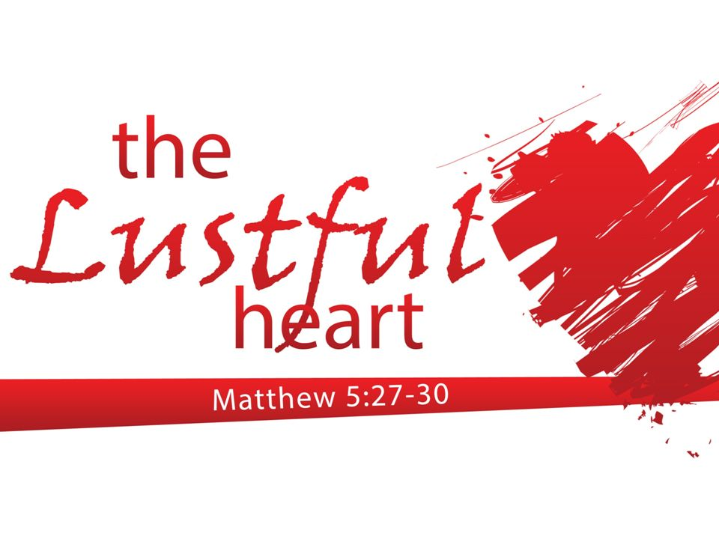

Slide 78
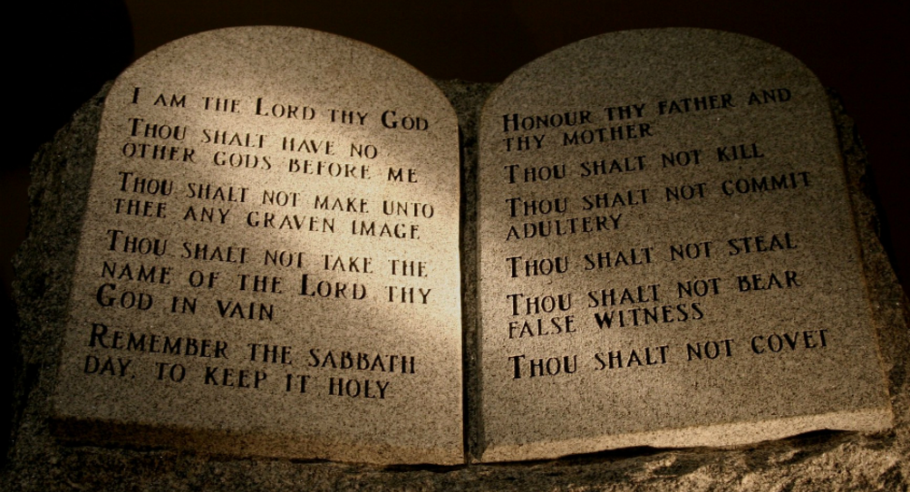
Exodus 20: 14 & 17
“You shall not
commit adultery.”
“You shall not covet your neighbor’s house. You shall not covet your neighbor’s wife, or his male or female servant, his ox or donkey, or anything that belongs to your neighbor.”
Leviticus 20:10
“If a man commits adultery with another man’s wife—with the wife of his neighbor—both the adulterer and the adulteress are to be put to death.”

Slide 79
Just as Jesus dealt with the “heart of the matter” behind murder last week (anger), this week He addresses the core issue behind adultery and coveting: Lust
As before, it is our thoughts that Jesus focuses on…wanting purity in heart & life.

Slide 80
2 of the 8
Beatitudes
deal with Lust

Slide 81
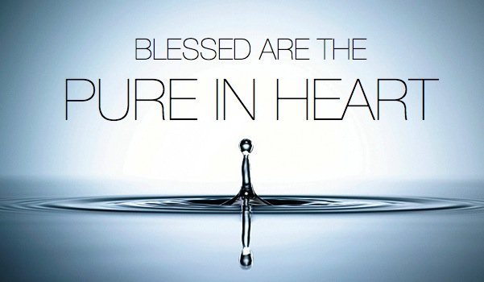
Hebrews 13:4
“Marriage should be honored by all,
and the marriage bed kept pure,
for God will judge the adulterer
and all the sexually immoral.”

Slide 82
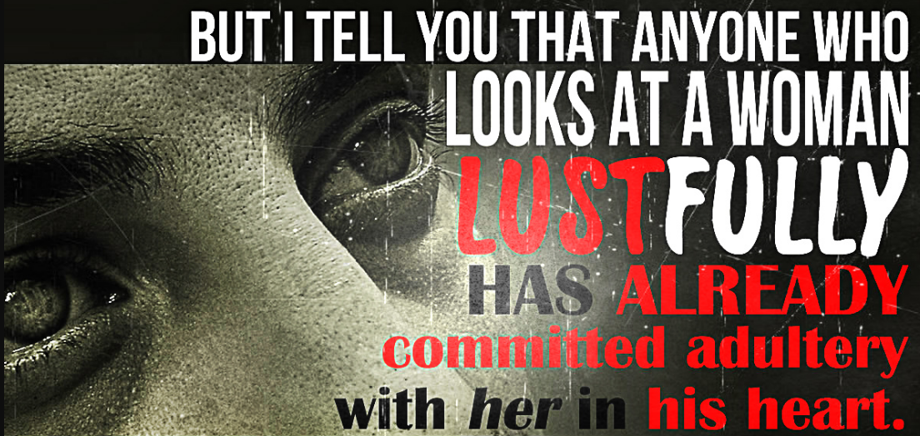
Jesus’ condemnation of “internal lust” as displeasing to God definitely raised the bar for the people of His time…who had many rigid rules about behaviors, but gave little thought to their lust problem.

Slide 83
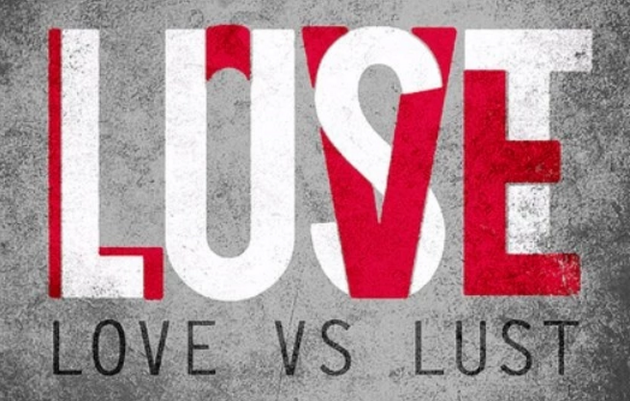

Slide 84
SERMON ON THE MOUNT
PURE OF HEART
The Be-Attitudes: An Exposition of Matthew 5: 1 - 12

Slide 85
The Pure in Heart

Slide 86
The Pure in Heart
“Blessed are the pure in heart for they will see God.” – Matthew 5:8
Seeing God is one of the greatest hopes of the believer, but only the pure in heart may receive this blessing.
Notes:
1 John 3:2–3

Slide 87
The Pure in Heart
What the World Says:
While our culture values things like pure air, pure water, and pure food, it seems to devalue the pure heart.
Some people insist on a “smoke-free” environment but do not mind a polluted heart.

Slide 88
The Pure in Heart
What Jesus Says:
True happiness begins in the presence of God.
It is a hope that sustains and inspires those living in the kingdom of heaven.
Notes:
Image: ©Peter Brutsch

Slide 89
The Pure in Heart
What Jesus Says:
One of Jesus’ constant criticisms of the Jewish leaders was their hypocrisy.
They desired to appear pure and holy, while being corrupted and impure inside.
Jesus came to fulfill the promise in Ezekiel 36:25–27: “I will sprinkle clean water on you, and you will be clean ... I will give you a new heart and put a new spirit in you.”

Slide 90
Matthew 5:8-10
Blessed are the pure in heart, For they shall see God. Blessed are the peacemakers, For they shall be called sons of God. Blessed are those who are persecuted for righteousness ' sake, For theirs is the kingdom of heaven.

Slide 91
Blessed are the…
The pure in heart

Slide 92
Blessed are the pure in heart
Finally, brethren, whatever things are true, whatever things are noble, whatever things are just, whatever things are pure, whatever things are lovely, whatever things are of good report, if there is any virtue and if there is anything praiseworthy — meditate on these things.
Philippians 4:8

Slide 93
Blessed are the…
The pure in heart
For they shall see God

Slide 94
For they shall see God
Bondservants, be obedient to those who are your masters according to the flesh, with fear and trembling, in sincerity of heart, as to Christ; not with eyeservice, as men- pleasers, but as bondservants of Christ, doing the will of God from the heart,
Ephesians 6:5-6

Slide 95
“We come now to what is undoubtedly one of the greatest utterances to be found anywhere in the whole realm of Holy Scripture. Anyone who realizes even something of the meaning of the words, ‘Blessed are the pure in heart: for they shall see God,’ can approach them only with a sense of awe and of complete inadequacy.”

Slide 96
This is the most widely known and beloved
Expresses the goal of the Gospel
Continues to show the Lord’s purpose

Slide 97
The first three Beatitudes announced the desperate condition of mankind and how that condition can be remedied by God’s grace.
The next three Beatitudes describe the results which come into the lives of those who have been filled.

Slide 98
Three questions help to analyze this Beatitude
“What Is the Heart?”
Christianity is a “heart-felt” religion! Christianity is not a “heart-directed” religion!
Jeremiah 31:33-34; Romans 6:17-18

Slide 99
Christianity is that force that changes our “hearts” so that our entire lives are changed (Matthew 12:34-36).
Unless one has a converted “heart” the act of immersion is useless
Romans 6:17

Slide 100
“Heart” is used in two senses in the Scriptures
The fleshly organ that pumps blood
The “organ” of the inward person that feels spiritual truths
The heart can be “pierced” (2 Samuel 18:14; Acts 2:37)
The “heart” of the inward man is changed in conversion and is the object of the Beatitude.

Slide 101
The “heart” that is the object of conversion and which must be “pure” is thus described:
That part of man called the “intellect”
Matthew 9:4; Mark 2:8; Matthew 13:15; Romans 10:10

Slide 102
The “heart” that is the object of conversion and which must be “pure” is thus described:
That part of man called “emotions”
2 Samuel 6:16; Romans 10:1; Matthew 22:37; Proverbs 3:5

Slide 103
The “heart” that is the object of conversion and which must be “pure” is thus described:
That quality of man called the “will”
1 Corinthians 7:37; Hebrews 4:12; Acts 11:23; Romans 6:17

Slide 104
The “heart” that is the object of conversion and which must be “pure” is thus described:
That faculty of man called the “conscience”
1 John 3:20, 21

Slide 105
In order for man to make his “heart” right with God, he must change his
intellect
emotions
will
conscience
to conform to God’s desires.

Slide 106
How does this complete change occur?
Intellect is changed by evidence (John 20:24-29,31; Romans 10:17).
Emotions are changed by faith in the testimony.
Will is changed by motivation from faith (Acts 22:10, 16).
Conscience is changed by faith having correctly obeyed (1 Peter 3:21).

Slide 107
Three questions help to analyze this Beatitude
“What Is the Heart?”
“What Is ‘Purity’ of Heart?”

Slide 108
“Without hypocrisy”
Matthew 6:22; Psalm 86:11
“Cleansed”
Revelation 21:27; 22:14

Slide 109
Think on the right things (Philippians 4:8).
Love the right things (Mark 12:30, 31; Colossians 3:1,2).
Purpose the right things (Daniel 1:8; Philippians 3:13, 14).

Slide 110
Three questions help to analyze this Beatitude
“What Is the Heart?”
“What Is ‘Purity’ of Heart?”
“What Blessings Come to the Pure in Heart?”

Slide 111
“What Blessings Come to the Pure in Heart?”
The desires of their heart
Their innocence
Their great love for God

Slide 112
Developing a “pure heart”
Begins in conversion (1 Peter 1:22)
Remains as we follow God’s will (Philippians 4:8; Colossians 3:1-2; 1 John 2:15-16)
Demonstrates loyalty to God (Deuteronomy 6:5; Matthew 22:37)
Results in peace (Ephesians 2:13ff)

Slide 113
“The Beatitudes” by James M. Tolle Chapter Excerpt: “Single Motive”
Getting back to the word katharos, we find that in its ordinary use in the Greek-speaking world it always denoted something without alloy, unmixed, single – like unmixed milk and unalloyed silver. So the pure in heart are those who have singleness of motive, whose hearts are attuned to God, who want to follow Him, please Him, and do His will without reservation and in full sincerity. Because of their single, unswerving devotion to God, their hearts are morally clean.

Slide 114
“The Beatitudes” by James M. Tolle Chapter Excerpt: “Single Motive”
Christians who are impure in heart are double-minded, lacking the singleness of purpose that would exalt Christ in their lives. To them the divine word directs the commandment, “Purify your hearts, ye double-minded.” (James 4: 8)

Slide 115
BLESSED ARE THE PURE IN HEART
Purity is all or nothing. While 99 percent pure might work for Ivory soap, it doesn’t work for the heart. Pure or impure—either/or. Almost pure is impure.
When Rabbi Jesus spoke of purity in His Jewish setting, the word had a singular meaning to His audience. It was not a nuanced word, but rather a word with a clear and precise meaning. Jesus probably referenced the Hebrew word tahor, meaning “ritually clean, set apart for use in worship.” In Israel’s parlance there was “clean” (pure) and “unclean” (impure). Other societies might declare things “good” or “bad,” but Israel declared things “clean” or “unclean”—“pure” or “impure.”
Tahor means to be declared pure because the proper rituals have been adhered to. It means to be recognized as pure and ready to be used by God for His purposes. Some purification rituals were preparatory—to make a person ready to encounter God. Other rituals were expiatory—to restore a person to a state of purity after the person had sinned or in some way been ritually defiled. In each case, the purification involved blood.
When Moses had proclaimed every commandment of the law to all the people, he took the blood of calves, together with water, scarlet wool and branches of hyssop, and sprinkled the scroll and all the people. He said, “This is the blood of the covenant, which God has commanded you to keep.” In the same way, he sprinkled with the blood both the tabernacle and everything used in its ceremonies. In fact, the law requires that nearly everything be cleansed with blood, and without the shedding of blood there is no forgiveness.
—Hebrews 9:19–22
Preparatory—Before its use, every article in the tabernacle had to be made pure by the sprinkling of blood. The concept was that blood would absorb the pollution that entered the tabernacle between ceremonies. Blood had (symbolically and ritually) the power to absorb sin. Blood, as God placed it in creation, perfectly mirrors its ritual use. Blood absorbs toxins and washes them away. (See my book, Power in the Blood of Christ, to learn more about this important topic)
Expiatory—Then, after those articles were purified for use, blood was offered on the altar, and once a year on the mercy seat, for the sins of the people. The blood of the sacrifices cleansed the people from their sins. “Because on this day atonement will be made for you, to cleanse you. Then, before the LORD, you will be clean from all your sins” (Leviticus 16:30).
People who had become ritually unclean by their own sin, through disease, or through any number of other ways, were cleansed through ceremonies that required the shedding of blood. Israelites well understood the power of blood to cleanse and purify. Other elements, like oil and water, were used as part of certain cleansing rituals, but blood was the constant.
The shed blood of the sacrificial offering was sprinkled on the person or on the instrument or on the article. By the blood of the pure and innocent life that had been offered for the sins of the people, the people were made ritually clean. Not really clean. Not heart-clean. But God accepted the ceremony until the reality was revealed.
The writer of the Book of Hebrews lays out how the symbolism of the Old Covenant has become the reality under Christ. For example:
Let us draw near to God with a sincere heart in full assurance of faith, having our hearts sprinkled to cleanse us from a guilty conscience and having our bodies washed with pure water.
—Hebrews 10:22
A clean heart will have to be sprinkled with the blood of the Eternal Sacrifice to cleanse it. A clean heart is not possible unless there is direct contact with blood. The blood of Christ, poured out for our sins, but poured in for our righteousness. It must have access to our hearts. It must flow—a living fountain opened in the heavenly realms to cleanse and purify the people of God.
A Clean Heart
Dean, J. K. (2015). . Ashland, OH: New Hope Publishers.
Dean, J. K. (2015). Set apart: a 6-week study of the beatitudes. Ashland, OH: New Hope Publishers.

Slide 116
A Clean Heart
The Hebrew language is picturesque. Each letter is a picture and when the pictures are combined, they tell a story. Each root word gives the underlying meaning to its derivatives. The Hebrew letters that make up the root word for “pure” picture a basket or container and a man. The root means “to contain a man,” according to Jeff Benner’s The Ancient Hebrew Lexicon of the Bible. It was commonly understood that God’s laws and instructions were for man’s good and for his protection. They were to “contain” his natural impulses and keep him from destroying himself. “I will walk about in freedom, for I have sought out your precepts” (Psalm 119:45).
Jesus’ audience was familiar with the Old Testament’s use of the word tahor to describe the heart that God desired. “Create in me a pure [clean] heart, O God, and renew a steadfast spirit within me” (Psalm 51:10, author’s insertion). God’s call for a pure heart connected with His audience. They knew that it was to their benefit to have a heart cleansed of any pollution.
The religious leaders of the day had lost sight of the clear teaching of the Scriptures they so revered, as well as the oral traditions of the rabbis and sages through the ages. They had fixated on the external ceremonies of cleansing—those things that could be measured and graded and displayed in public. Many of the more prominent leaders seemed to be more concerned about how they were viewed by others than whether or not their hearts were pure. They used the outward expressions of piety and holiness to protect their social position and their authority. They used their superior knowledge of the minutiae of the oral traditions to lord it over the common and uneducated.
Jesus rebuked them publicly, drawing their anger. A public challenge to their law-keeping did not go unnoticed by the people.
“Woe to you, teachers of the law and Pharisees, you hypocrites! You clean the outside of the cup and dish, but inside they are full of greed and self-indulgence. Blind Pharisee! First clean the inside of the cup and dish, and then the outside also will be clean.
“Woe to you, teachers of the law and Pharisees, you hypocrites! You are like whitewashed tombs, which look beautiful on the outside but on the inside are full of dead men’s bones and everything unclean. In the same way, on the outside you appear to people as righteous but on the inside you are full of hypocrisy and wickedness.”
—Matthew 23:25–28
Of course, we know this rebuke came later in His ministry. But the Beatitudes He laid out in His inaugural address were to be lived out and exemplified—fleshed out, you might say—in the rest of His ministry. In this sermon, He told His audience that their righteousness would have to exceed that of the scribes and Pharisees. It would have to go deeper. It would have to reach all the way to the heart.
He said that if the inside is clean, the outside will be clean also. Repeating His theme that when the law is moved to the inside, the outside naturally conforms. When the law transforms the heart, the heart transforms the behavior.
Dean, J. K. (2015). . Ashland, OH: New Hope Publishers.
Dean, J. K. (2015). Set apart: a 6-week study of the beatitudes. Ashland, OH: New Hope Publishers.

Slide 117
King of Hearts
In Hebrew, the heart is the inner man—intellect, emotions, and volition. It is the seat of his decision making. The picture created by the Hebrew letters in the word translated “heart” (lev) is developed from the first letter, which represents a staff (authority) and the second letter which represents a house or tent (within): the authority within, according to The Living Words—Volume One by Jeff Benner. We would better understand it by translating the word as “mind.”
The word for “pure” (tahor) is often used to describe the gold, silver, or other metals to be used in the tabernacle. In that sense, it has the meaning of “unalloyed” or “unmixed.”
This is the summation of the law. If the law were to be condensed to one thing, it would be to love the Lord with everything you are. Jesus said:
“‘Love the Lord your God with all your heart and with all your soul and with all your mind.’ This is the first and greatest commandment. And the second is like it: ‘Love your neighbor as yourself.’ All the Law and the Prophets hang on these two commandments.”
—Matthew 22:37–40
The first, the great commandment is to love the Lord your God with your whole self. The second flows from it. If you love the Lord fully with an undivided heart, then you will love your neighbor as He does. Without mixture of motive or focus, Christ in you will be reproducing His heart toward your neighbor. Rabbi Jesus, who calls you to a pure heart, creates a pure heart in you.
In David’s prayer from Psalm 51:10, as he prays for a clean heart, he also prays for a steadfast spirit. “Create in me a clean heart, O God, and renew a steadfast spirit within me” (Psalm 51:10). The spirit, when used of man’s spirit, refers to the inner man and could be a substitute word for “heart.”
The word translated “right” means to be steadfast, fixed, immoveable. The Hebrew letters tell the story of a seed opening (an open palm and a seed). The seed opens to put down roots and give the plant a foundation and a base (Jeff Benner’s The Ancient Hebrew Lexicon of the Bible). A pure heart, a steadfast spirit.
In Hebrew poetry it is typical to say the same thing twice, using different words for the same thought. How do these two lines say the same thing? Sum up the full thought put forth by the double statement.
“Create in me a clean heart, O God, and renew a steadfast spirit within me.”
—Psalm 51:10
Dean, J. K. (2015). . Ashland, OH: New Hope Publishers.
Dean, J. K. (2015). Set apart: a 6-week study of the beatitudes. Ashland, OH: New Hope Publishers.

Slide 118
HEART TO HEART
The Hebrew word David used in Psalm 51:10, which is translated “create,” is the same word used in Genesis 1:1: “In the beginning God created . . .” The word means to fashion, shape, or form. “Now the earth was formless and empty, darkness was over the surface of the deep, and the Spirit of God was hovering over the waters” (Genesis 1:2). The Holy Spirit is alluding to the beginning to define the work of God in our hearts.
Remember gezerah shavah (cut equally)? Let’s look at a statement that will immediately take the reader back to Genesis 1:2, when the earth was formless and empty. I borrow the basis of these thoughts from a brilliant sermon by Dr. Joseph Novenson called “Decreation and Recreation.”
I looked at the earth,
and it was formless and empty.
—Jeremiah 4:23
Do you see the gezarah shava? Formless and empty—the earth before God speaks order and light. Formless and empty—the hearts of His people when they leave the Word of God behind.
God, through Jeremiah, is reprimanding His rebellious people. He is telling them that their sin is distancing them from Him, and so is bringing into their lives the opposite of what His Word brings. When they are far from His Word, they remove themselves from what His Word provides. In Jeremiah, He is using the metaphor of the earth, but is using it to depict the empty, barren wasteland that their hearts have become. Formless and empty.
So, then, the remedy? Create, O God.
Once again, O God, hover over the emptiness that my heart has become and let there be order. Let there be life. Let there be righteousness and purity and steadfastness.
What God requires of you He provides for you. Purity comes from Him, transferring the law to the inside and being the law within you. Transforming wasteland into lush vineyard. Transforming formless emptiness into the image of His Son.
Look at the heart of Rabbi Jesus—the heart He promises to create in His disciples. What does a pure, unalloyed heart look like?
Dean, J. K. (2015). . Ashland, OH: New Hope Publishers.
Dean, J. K. (2015). Set apart: a 6-week study of the beatitudes. Ashland, OH: New Hope Publishers.

Slide 119
They Shall See God
The pure in heart will live in a state of blessedness, fully supplied and content, and that blessedness will be realized in seeing God. This is yet another way to say they will live in the kingdom.
To see God is not to see with the physical eyes, but with “the eyes of your heart” (Ephesians 1:18). Jesus used the language of seeing when He talked about how He recognized the Father’s activity while He was in the form of man.
Jesus gave them this answer: “I tell you the truth, the Son can do nothing by himself; he can do only what he sees his Father doing, because whatever the Father does the Son also does. For the Father loves the Son and shows him all he does.”
—John 5:19–20
Let’s go back to David’s Psalm 51. This psalm is probably the basis of Jesus’ words about the pure in heart. Let’s see what follows David’s plea for God to create in him a clean heart and renew a steadfast spirit.
Create in me a pure heart, O God, and renew a steadfast spirit within me.
Do not cast me from your presence or take your Holy Spirit from me.
—Psalm 51:10–11
David says, “Do not throw me out of Your presence—where I can see You.” The word translated “presence” in Hebrew refers to the face or the countenance. Don’t take your face away from me, David begged.
What did David believe would be the result of his impure heart? He would not see God. He would have to leave God’s face.
Rabbi Jesus reminds the people of what the Torah had always taught them. David said it long ago. The pure in heart will know the face of God.
Blessed are the pure in heart, for they shall see God.
Dean, J. K. (2015). . Ashland, OH: New Hope Publishers.
Dean, J. K. (2015). Set apart: a 6-week study of the beatitudes. Ashland, OH: New Hope Publishers.

Slide 120
Debate Begins With Aristotle: How Are People Changed Within?
“To Be Is To Do” - Or - “To Do Is To Be”
“Excellence is an art won by training and habituation. We do not act rightly because we have virtue or excellence, but rather we have those because we have acted rightly. We are what we repeatedly do… Excellence, then is not an act but a habit.”
* Disputing Human Nature!

Slide 122
COUNTERING THE COUNTERFACTUAL TEST
Bible Says You Are In Charge Of Your Own Heart
Jeremiah 4: 4 – “Remove the foreskin of your hearts”
Jeremiah 9: 13 – “Stubbornly followed their hearts”
Jeremiah 18: 11 – “Act according to his evil heart”
Ezekiel 18:31 – “Make Yourselves A New Heart & A New Spirit!”

Slide 123
Luther Critique’s Clairvaux: Spiritual Maturity & Progress
FIRST – Love Of Self For Your Own Sake.
SECOND – Love Of God For Your Own Sake.
THIRD – Love Of God For God’s Sake.
FOURTH – Love Of Self For God’s Sake.

Slide 124
Luther On The Gravity Of Sin: Mankind Is Incurvatus In Se
Humanity Has Curved In Upon Itself
With Meaning Twisted
& Our Ideals Warped
* Spiritual Physics Of Heavy Mass

Slide 125
SERMON ON THE MOUNT
DESIRE PEACE
The Be-Attitudes: An Exposition of Matthew 5: 1 - 12

Slide 126
The Peacemakers

Slide 127
The Peacemakers
“Blessed are the peacemakers for they will be called sons of God.” – Matthew 5:9
This beatitude brings together two Old Testament concepts: peace and sons of God.
Peace is a central characteristic of the kingdom of heaven.
“The wolf will live with the lamb, the leopard will lie down with the goat, the calf and the lion and the yearling together, and a little child will lead them.” – Isaiah 11:6

Slide 128
The Peacemakers
Those who would normally be at war with each other will be in harmony.
All things are made right and peace prevails.
The Old Testament applies the title of “son of God” to the Messiah (Psalm 2:7).
In the New Testament, Paul explains that when we are in Christ, we “receive the full rights of sons.” In other words, we are made adopted children of God (Galatians 4:5).

Slide 129
The Peacemakers
What Is Shalom?
Traditionally, the Hebrew word shalom is translated as “peace.”
When we think about peace, we tend to define it as absence of conflict, but shalom means much more than that.

Slide 130
The Peacemakers
What Is Shalom?
For example, in the Garden of Eden all things functioned according to the order and purpose that God assigned them.
There was order and harmony, balance and wholeness.
When Adam and Eve rebelled against God, this state of being was broken.

Slide 131
The Peacemakers
What Is Shalom?
The shalom of three relationships was broken:
Our relationship with God
Our relationship with Creation
Our relationship with each other

Slide 132
The Peacemakers
What Is Shalom?
Jesus brings peace in all these relationships, restoring shalom.
The kingdom of heaven is the context in which shalom prevails, where things work according to God’s original design.

Slide 133
The Peacemakers
What the World Says:
Peace at any price! Give peace a chance.
Peace—the cessation of all conflict—has become what a world in war is desperately looking for.
Many seek a personal peace through a variety of avenues— drugs, music, meditation, and others.

Slide 134
The Peacemakers
What Jesus Says:
The cessation of conflict the world seeks will not substitute for true peace, the kind of peace Jesus offers.
Jesus, before leaving this earth, promised his disciples, “Peace I leave with you; my peace I give you. I do not give to you as the world gives” (John 14:27).
Notes:
Ephesians 2:14; Galatians 4:5

Slide 135
The Peacemakers
What Jesus Says:
Jesus’ peace is a clear sign that the kingdom is in our midst.
Only Jesus makes this peace possible, and only in him we become adopted children.
Notes:
Ephesians 2:14; Galatians 4:5

Slide 136
Blessed are the…
Peacemakers

Slide 137
Blessed are the peacemakers
If it is possible, as much as depends on you, live peaceably with all men.
Romans 12:18
For a bishop must be blameless, as a steward of God, not self- willed, not quick- tempered, not given to wine, not violent, not greedy for money,
Titus 1:7

Slide 138
Blessed are the…
Peacemakers
For they shall be called sons of God

Slide 139
For they shall be called sons of God
for the Son of Man has come to seek and to save that which was lost.“
Luke 19:10

Slide 140
Six of these seven spiritual qualities can be set in pairs – three on each side of the central Beatitude that enjoins spiritual hunger and thirst. Humility and meekness go together ... Sorrow goes with purity of heart ... Meekness goes with peacemaking

Slide 141
These three Beatitudes, then, that follow the fourth Beatitude of hungering and thirsting after righteousness may be called the Beatitudes of the abundant life

Slide 142
This third beatitude of the abundant life provides the commodity desperately sought by the majority in the world – PEACE!

Slide 143
The world is filled with contentious people
Titus 3:9-11; 1 Timothy 6:4; 2 Timothy 2:24; Proverbs 6:19; 1 John 3:8

Slide 144
God’s punishment upon the wicked is the denial of peace and God’s blessing upon the righteous is the provision of peace
Isaiah 48:22; Psalm 29:11; John 14:27

Slide 145
Three sources of “peace”
One is secure in worldly possessions
One is surrounded by those of sympathy
One is secure with God

Slide 146
“Peace”
The Greek word basically means - “to join together”
The English is derived from the Latin PAX, “an agreement”
Not just an absence of strife

Slide 147
“Peacemakers”
A compound word meaning to “make peace and harmony”
“Peacemakers is preceded by the definite article, HOI, which is restrictive...The article here emphasizes that this is a particular class of individuals who are peacemakers distinguishing them from all other would-be peacemakers who ultimately and in reality are not lasting peacemakers”

Slide 148
The primary objective of the peacemaker is to establish harmony between God and man.
It is MORE than a “social gospel.”
They seek to establish peace between fallen man and the righteous God.

Slide 149
How can Christians conduct themselves so they will become known as a “peacemaker”?
By their example (1 Peter 3:1-2)
By the public teaching of God’s Word
Not by compromise of God’s Truths

Slide 150
To become a peacemaker does not mean we are to secure “peace at any price”!
True peace does not exist in a state of resignation to evil so that conflict does not occur.

Slide 151
This kind of behavior offers a “peace” that is deceptive.
Genuine peace does not result in making compromises of Truth
Compromise urges us to call for “Peace! Peace!” when there is no peace.
True peace may necessitate a WAR!

Slide 152
They find great happiness – “BLESSED.”
They are called “children of God.”

Slide 153
Being a “Peacemaker” is essential to citizenship in God’s Kingdom.

Slide 154
How can we make sure we are “Peacemakers”?
When we love others enough to proclaim to them the glorious message of salvation.
When we refuse to be provoked to do evil by others who taunt, jeer, and do unkind things to us.

Slide 155
How can we make sure we are “Peacemakers”?
When our attitudes and words toward those around us are guarded so we avoid unnecessary offenses.
When we are eager and willing to forgive those who sin against us.

Slide 156
“The Beatitudes” by James M. Tolle Chapter Excerpt: “A Divided World”
There are those in the church who accentuate the differences rather than the similarities between them and their brethren, who treat with contempt every brother who differs with them, who shut the door to honorable dialogue between conflicting ideas and concepts in the body of Christ. No matter how plausible their arguments may seem to justify their unbrotherly spirit, they are on the devil’s side!

Slide 157
BLESSED ARE THE PEACEMAKERS
“The fruit of righteousness will be peace; the effect of righteousness will be quietness and confidence forever” (Isaiah 32:17).
The fruit of a tree proves what kind of tree it is. Apple trees grow apples. Peach trees grow peaches. You can identify a tree by its fruit.
What is the fruit of righteousness? Peace.
Remember the Hebrew style of saying the same thing twice in different words. These two phrases are two ways of saying the same thing. “The fruit of righteousness will be peace” is another way of saying “the effect of righteousness will be quietness and confidence forever.” It helps us define the words. Fruit is the same as effect. Peace means essentially the same thing as quietness and confidence forever.
Let’s take a closer look at the words in this statement. The word translated here as “fruit” is a Hebrew word that means “workmanship, something created or fashioned.” The word is used in the Genesis creation account to describe the work of God’s hands in fashioning and forming that which He created.
When righteousness works, what does it fashion? What is its workmanship—the fruit of its labor? What is its masterpiece? Peace.
The word translated “effect” is a Hebrew word that usually means “work produced through servitude.” A derivative of the word is used to denote the work of the priests and Levites in service to God.
When righteousness forces a result, what is it? Quietness and trust forever. Peace.
Quietness means “tranquil, undisturbed and still.” Trust means “confident and untroubled.”
Rabbi Jesus declared that peacemakers would live in a state of blessedness. He was talking about people who actively worked to bring peace into relationships.
To make peace, a person must be at peace. A person who is filled with turmoil will inject that into relationships and situations. A person who is filled with peace will diffuse peace into relationships and situations.
To be a peacemaker, you have to be peaceful. But peace comes at a price.
Dean, J. K. (2015). . Ashland, OH: New Hope Publishers.
Dean, J. K. (2015). Set apart: a 6-week study of the beatitudes. Ashland, OH: New Hope Publishers.

Slide 158
Shalom
Shalom is the Hebrew word usually translated “peace,” but our English word peace does not capture it very well. Shalom means a state of completeness, wholeness, unity, fulfillment. It refers to emotional, physical, relational, and financial well-being, and even encompasses safety.
Shalom is the state in which God wants His people to live. In His shalom, you are not promised wealth, but you are promised provision. Blessedness is a state of shalom. In the introduction to Sabbath rest in Genesis 2:1, the Scripture uses a Hebrew word for finished that means “to be completed or to have brought to perfection and fullness.” The seventh day, Sabbath, is the day that all work is to be finished so that the people rest. The first Sabbath was the day on which God rested after having completed all His work. The number seven in Hebrew is the number that represents completeness and perfection. Sabbath is a day of shalom.
Paul writes, “We proclaim him, admonishing and teaching everyone with all wisdom, so that we may present everyone perfect in Christ. To this end I labor, struggling with all his energy, which so powerfully works in me” (Colossians 1:28–29, author’s emphasis). Paul likely has in mind the Hebrew concept of completeness and fullness, of shalom.
To see the original shalom that God has always meant for His people to experience, look at creation and see how He set things up in the beginning. Eden, before sin, was the perfect illustration of shalom.
Peace between God and His people. Intimacy, love, trust.
His people at peace with each other. Cooperation, respect, unity.
His people in a state of inner peace and rest. No worry. No anxiety. No anger or resentment or rebellion.
The Sabbath day would become a shadow and hint of the shalom of Eden. All the week’s work is completed. The day is given to rest and restoration. Nothing will detract from the enjoyment of fellowship with God.
Canaan, the land of rest, would be a shadow and hint of the shalom of Eden. Here, in the Promised Land, the buildings were already built, the crops were already planted. The abundance was provided. God intended rest from their enemies. The land was prepared for them, and they were to enjoy the land that God had given them.
The kingdom is what all the shadows of shalom had been leading up to. Eden, Sabbath, Canaan—all whispers of the kingdom. When you enter the kingdom, you enter shalom. In the kingdom, the King offers a shalom that begins in the heart, and radiates out to circumstances and relationships.
Dean, J. K. (2015). . Ashland, OH: New Hope Publishers.
Dean, J. K. (2015). Set apart: a 6-week study of the beatitudes. Ashland, OH: New Hope Publishers.

Slide 159
PEACE WITH GOD
“Since we have been justified through [obedient] faith, we have peace with God through our Lord Jesus Christ, through whom we have gained access by [obedient] faith into this grace in which we now stand.”
—Romans 5:1–2
In the Old Covenant, a series of sacrifices was established, each picturing the work that Jesus would accomplish on our behalf to bring us into relationship with God, from whom our sins had estranged us. The prescribed sin offering, which brought the sinner back into fellowship with God, required the sacrifice of an unblemished animal whose blood was poured on the altar. Before the animal was killed, the worshiper pressed his hand upon the animals head and confessed his sin, symbolically laying it on the animal. The body of the animal, once the blood was shed, was taken outside the encampment and burned.
The writer of Hebrews makes clear that this blood sacrifice was a shadow of Jesus’ sacrifice on the Cross.
The high priest carries the blood of animals into the Most Holy Place as a sin offering, but the bodies are burned outside the camp. And so Jesus also suffered outside the city gate to make the people holy through his own blood.
—Hebrews 13:11–12
As Paul states in Romans 5:1–2, quoted above, the peace we have with God is ours through our Lord Jesus Christ, who acted as our sin sacrifice and so brought us into relationship with the Father.
Peace with God came at a great price.
Peace Within
When Eden was disrupted by the entrance of sin, the effect was not only to bring disruption to the relationship between God and humans, but also to bring discord within the souls of humans themselves. Peace was no longer the state of the human’s soul. Instead, chaos began to reign. Anxiety, fear, anger, envy, lust . . . all invaded the human soul. Man was made for holiness, and sin brings disorder. Lost and searching for their moorings, humans apart from God are unsettled, formless, and void, longing for something they can’t even name. When Christ comes to indwell a restless soul, the peace of Christ takes up residence.
Paul describes the process this way:
Those who live according to the sinful nature have their minds set on what that nature desires; but those who live in accordance with the Spirit have their minds set on what the Spirit desires. The mind of sinful man is death, but the mind controlled by the Spirit is life and peace; the sinful mind is hostile to God. It does not submit to God’s law, nor can it do so. Those controlled by the sinful nature cannot please God. You, however, are controlled not by the sinful nature but by the Spirit, if the Spirit of God lives in you.
—Romans 8:5–9
Dean, J. K. (2015). . Ashland, OH: New Hope Publishers.
Dean, J. K. (2015). Set apart: a 6-week study of the beatitudes. Ashland, OH: New Hope Publishers.

Slide 160
Peace Between
For God was pleased to have all his fullness dwell in him, and through him to reconcile to himself all things, whether things on earth or things in heaven, by making peace through his blood, shed on the cross.
Once you were alienated from God and were enemies in your minds because of your evil behavior. But now he has reconciled you by Christ’s physical body through death to present you holy in his sight, without blemish and free from accusation.
—Colossians 1:19–22
Paul may well have been thinking about the peace offering of the sacrificial system when he penned these words, and alluding to it, knowing many in his audience would also pick up on the symbolism. Most rabbis, including Jesus, made heavy use of symbolism, allusion, and metaphor. Paul used the same style of teaching, one with which his Jewish audiences were familiar.
The peace offering was one of the blood sacrifices of the Old Testament. The purpose of the peace offering was not to make peace with God, but to celebrate the peace with God that had been established through the sin offering.
In the peace offering, the animal was slain at the tabernacle door and the priest sprinkled the blood on the altar. Then the animal was offered on the altar as a whole burnt offering, a pleasing aroma to the Lord. The person offering the sacrifice and the priest and the priest’s children all ate the meat of the sacrifice. The aroma of the whole burnt offering rose before the Lord, making God part of the meal.
The suggested symbolism was that all were consuming the body of the same sacrifice, and so partaking of one flesh, and so becoming one. Peace between God and the one offering the sacrifice, and between those consuming the sacrifice. All being unified through the flesh offered on the altar.
Reconciled to God and to each other through the Peace Offering. We become one with Him and so one with each other through Him.
For he himself is our peace, who has made the two one and has destroyed the barrier, the dividing wall of hostility, by abolishing in his flesh the law with its commandments and regulations. His purpose was to create in himself one new man out of the two, thus making peace, and in this one body to reconcile both of them to God through the cross, by which he put to death their hostility. He came and preached peace to you who were far away and peace to those who were near. For through him we both have access to the Father by one Spirit.
—Ephesians 2:14–18 (author’s emphasis)
Dean, J. K. (2015). . Ashland, OH: New Hope Publishers.
Dean, J. K. (2015). Set apart: a 6-week study of the beatitudes. Ashland, OH: New Hope Publishers.

Slide 161
Jesus gave a series of instructions, each framed in real-life settings. He used cultural references that were familiar to His audience, but that contained eternal truths, which can relate to any culture at any time. He was describing how a peacemaker would live, every day surrounded by humans with human failings and challenging circumstances. The call to live in the kingdom is not a call to live in a bubble. It is a call to live in the nitty-gritty, rubber-meets-the-road reality of planet earth.
Jesus clearly did not list every single possible scenario in which His disciples are to act in ways contrary to the ways of the world. His intention is not to lay out a new law for every potential situation. These statements follow immediately His declaration that He has come to fulfill the law, not to abolish it, and that His disciples must have a righteousness that exceeds that of the scribes and Pharisees. (Review Matthew 5:17–20).
Starting in verse 21, Jesus begins to list examples of how one’s righteousness would exceed the righteousness of the religious leaders. As we look at these instructions on how to live in ways that will make peace, even in contentious settings, look for a principle that these situations illustrate.
In each case, He is saying that the law goes beyond behavior. The law deals with the heart. Jesus makes demands that are impossible to obey. He is talking to an audience that is more accustomed to discussing behavioral rules than heart conditions. “Give me a rule to follow so I can be righteous! Give me a law to obey that will bring me eternal life!” is the more typical expectation.
Jesus is doing what He has been doing from the beginning of the sermon. He is laying out a law that cannot be kept from the outside, but can only be obeyed by Jesus living in you, transforming your heart, imparting His power and life.
Jesus takes it to the heart. When the law is filled to its fullness, then actions that don’t have heart obedience behind them don’t make the grade. Man looks at the outward appearance, but the Lord looks at the heart.
In kingdom peacemaking, the disciple takes the initiative. The disciple lays aside pride, risks rejection or ridicule. Peace, Jesus indicates, is more than absence of conflict. Peace is not passive. For example, if a person with the authority to do so, ordered you to go with him one mile, then going with him one mile would avoid conflict. But Jesus tells us to make peace. Create something out of nothing. Don’t be satisfied with keeping things on even keel. Make peace.
In order to go that second mile, the peace has to be in you. It is a peace that has grown out of meekness. A strong, settled, contented person, anchored to eternity’s realities, has the courage and the boldness to be outrageous in making peace. “The fruit of righteousness will be peace; the effect of righteousness will be quietness and confidence forever” (Isaiah 32:17).
Dean, J. K. (2015). . Ashland, OH: New Hope Publishers
Dean, J. K. (2015). Set apart: a 6-week study of the beatitudes. Ashland, OH: New Hope Publishers.

Slide 162
THEY WILL BE CALLED SONS OF GOD
“Blessed are the peacemakers, for they will be called sons of God” (Matthew 5:9).
Here the Greek word translated “sons” is the word for masculine offspring. Don’t worry. Women are not excluded. To be called a daughter in that ancient society would have little clout. But to be called a son—now that had heft. A son was the heir and the name-bearer. The son was to carry on the work of the father. The son was the exact replica of the father. Rabbi Jesus says to both men and women—you will be called sons.
They will be called sons of God. The word has many meanings. One is the obvious meaning that peacemakers will be known as sons of God. But let’s add some other layers, each legitimate inferences in the context and from the word used. It can mean “to invite or to call to oneself.” It is also the word used for the call of God—the appointment. It can refer to a summons. It can mean “to call out loud—to call to.”
Radical, outrageous peacemakers are known as sons of God. People who observe them can’t help but notice the likeness. God has invited them to Himself, called them out to set them apart. God has summoned them and called out loud, “Son! You are a peacemaker!”
How great is the love the Father has lavished on us, that we should be called children of God! And that is what we are!
—1 John 3:1
My Father’s Son
The peacemakers are like their Father in several ways. First, they reach out to make peace at cost to themselves. When the Father made peace with us, He did it like this:
You see, at just the right time, when we were still powerless, Christ died for the ungodly. Very rarely will anyone die for a righteous man, though for a good man someone might possibly dare to die. But God demonstrates his own love for us in this: While we were still sinners, Christ died for us.
—Romans 5:6–8
Second, they make peace. They create peace from scratch. When the situation is empty and formless, they turn it into peace.
In the beginning God created the heavens and the earth. Now the earth was formless and empty, darkness was over the surface of the deep, and the Spirit of God was hovering over the waters. And God said, “Let there be light,” and there was light.
—Genesis 1:1–3
Third, they find pleasure in creating peace where chaos had been. They know there is “joy for those who promote peace” (Proverbs 12:20).
God saw all that he had made, and it was very good.
—Genesis 1:31
Dean, J. K. (2015). . Ashland, OH: New Hope Publishers.
Dean, J. K. (2015). Set apart: a 6-week study of the beatitudes. Ashland, OH: New Hope Publishers.

Slide 163
SERMON ON THE MOUNT
SHARE IN THE CROSS!
The Be-Attitudes: An Exposition of Matthew 5: 1 - 12

Slide 164
Those Who Are Persecuted

Slide 165
Those Who Are Persecuted
“Blessed are those who are persecuted because of righteousness, for theirs is the kingdom of heaven.” – Matthew 5:10
Just like the kingdom of heaven belongs to the poor in spirit, it also belongs to the ones persecuted because of righteousness.

Slide 166
Those Who Are Persecuted
This verse is a reminder of God’s prophets in the Old Testament who encountered opposition, were mocked and harmed because they stood for what was right.
But their reward is great, for they truly enjoy the benefits of the kingdom of heaven.

Slide 167
Those Who Are Persecuted
What the World Says:
Principles are good, but not if they get you killed or cause you grief.
Righteousness has little foundation in our world today.
Standards for right and wrong are not defined by what God desires for our good.
People get away with what they can.

Slide 168
Those Who Are Persecuted
What Jesus Says:
Jesus made it clear to his disciples that persecution would occur: “If they persecuted me, they will persecute you also” (John 15:20).
Often doing what is right leads people to feel lonely, isolated, and persecuted.
Notes:
Image: ©ArtmannWitte

Slide 169
Those Who Are Persecuted
What Jesus Says:
Jesus promised that he would not leave these people alone, but send the Holy Spirit to guide and comfort.
Notes:
Image: ©ArtmannWitte

Slide 170
Those Who Are Persecuted
What Jesus Says:
Jesus promises that “Now is your time of grief, but I will see you again and you will rejoice, and no one will take away your joy” (John 16:22).

Slide 171
Blessed are those…
Who are persecuted for righteousness’ sake

Slide 172
Blessed are those who are persecuted for righteousness’ sake
Beloved, do not think it strange concerning the fiery trial which is to try you, as though some strange thing happened to you; but rejoice to the extent that you partake of Christ's sufferings, that when His glory is revealed, you may also be glad with exceeding joy. If you are reproached for the name of Christ, blessed are you, for the Spirit of glory and of God rests upon you. On their part He is blasphemed, but on your part He is glorified.

Slide 173
Blessed are those who are persecuted for righteousness’ sake
But let none of you suffer as a murderer, a thief, an evildoer, or as a busybody in other people's matters. Yet if anyone suffers as a Christian, let him not be ashamed, but let him glorify God in this matter.
1 Peter 4:12-16

Slide 174
Blessed are those who are persecuted for righteousness’ sake
Yes, and all who desire to live godly in Christ Jesus will suffer persecution.
2 Timothy 3:12

Slide 175
Blessed are those who are persecuted for righteousness’ sake
But you have carefully followed my doctrine, manner of life, purpose, faith, longsuffering, love, perseverance, persecutions, afflictions, which happened to me at Antioch, at Iconium, at Lystra — what persecutions I endured. And out of them all the Lord delivered me.
2 Timothy 3:10-11

Slide 176
Blessed are those…
Who are persecuted for righteousness’ sake
Theirs is the kingdom of God

Slide 177
Theirs is the kingdom of God
In this you greatly rejoice, though now for a little while, if need be, you have been grieved by various trials, that the genuineness of your faith, being much more precious than gold that perishes, though it is tested by fire, may be found to praise, honor, and glory at the revelation of Jesus Christ,
1 Peter 1:6-7

Slide 178
Those who seek to live with the characteristics described in the Beatitudes will definitely find themselves involved in bitter persecution.
2 Timothy 3:12; Romans 8:18-19

Slide 179
This Beatitude describes what happens to the Believer rather than describing some aspect of the Believer.
Christ has just described His followers as “peacemakers” but immediately states their peacemaking activities will result in bitter persecution.

Slide 180
This Beatitude forces the most critical evaluation of one’s devotion to God.
This Beatitude focuses upon a special group –
those persecuted for devotion to righteousness.

Slide 181
What this Beatitudes DOES NOT mean:
Not for those who are offensive and difficult.
Not for those who are fanatical.
Not for those who face religio-political reasons.
Not for those who strive to live a good, moral life.

Slide 182
When we live a life guided by “righteousness,” we discover many are opposed to us and seeking to discredit everything we do.
Galatians 4:16; John 15:18-20

Slide 183
Why this persecution arises:
He chooses to become poor in spirit
He mourns over sin
He has become “meek”
He hungers for God’s instructions
He is focused upon forgiveness
He seeks to live a pure life
He becomes an active “peacemaker”

Slide 184
“Finally, on the eighth rung of the ladder of Christian blessedness, we have the accumulation of the world’s reaction to the Christian. If you are characterized by all the conditions of blessedness, you cannot help but be the focal target for the enemies of the Gospel”

Slide 185
“Persecution” is a term meaning to persecute, to hasten, to run, to press on, to run after, to pursue, to strive for, to seek after
“This involves the world running after us to cause us suffering”
The devoted Christian is always a walking rebuke to those in the world (1 Peter 2:20)

Slide 186
“Actually the verse should read, ‘Blessed are ye whenever men shall...persecute you.’ It would be a recurring experience...Not constant persecution, but occasional outbursts of it, are sure to arise against the active peacemaker as he goes counter to the accepted philosophy of the world”

Slide 187
Different from those living by worldly values (John 15:19)
A constant rebuke to the unrighteous (Matthew 14:1ff)
Possess character the evil man envies (Genesis 4:1-8)
Interfere with the enjoyments of the worldling (Acts 16:16-24; 19:23ff)

Slide 188
A simple explanation – John 3:19-21.
NO possible way Christians can have peace with the world (2 Corinthians 6:14-18; Revelation 18:4-5).
Those who try to have “peace” with the world cannot have “peace” with God (James 4:4).

Slide 189
“Through the favor of the world and intimate intercourse with it we become too much involved in its sin. When Peter mixed with the people of the world in that night of Christ’s sufferings, and sat in the seat of the scornful, he denied his Lord.”

Slide 190
PERSECUTION
REVILE
Abuse in speech because they despise him
Name-calling; scoffs; innuendoes which cast doubt on integrity; taunts; or, a whispering campaign.
Intention is to destroy reputation and character

Slide 191
NEGATIVE responses
Do not retaliate; reply; strike back
Do not harbor resentment
Do not become depressed by such actions

Slide 192
POSITIVE responses
“Rejoice”
“Be exceeding glad”

Slide 193
Endure persecutions by
Committing to God
Realize that God has a purpose
Allow God to address the evil

Slide 194
“Jesus never promised ease to those who follow Him. Never did He put a carpet on the race track or a bed of roses on the battlefield. He talked about self-denial, about crosses, blood-splattered, death-dealing crosses. To enter the Kingdom of God may mean decisions that are hard, consecration that leads to persecution. But it can be no other way”

Slide 195
The comfort of God to His children who face persecutions is simply stated – “Fear not...”
Revelation 2:10

Slide 196
“To be poor in spirit means to give up our pride;
to mourn means to be penitent to the point of surrendering our sins;
meekness means that we must surrender our very selves to the plans and purposes of God;
our hunger for God means turning away from our ambitions for all things else;

Slide 197
to be merciful means to pay good for the evil we have received;
for purity we must give up all things impure;
to make peace is wholly to choose God.
Those are the seven ingredients of righteousness. They must be bought at a price. Blessed are those who pay the price, ‘for their’s is the kingdom of God.’”

Slide 198
“The real Christian is a man who is not praised by everybody. They did not praise our Lord, and they will never praise the man who is like Him. ‘Woe unto you, when all men shall speak well of you!’ That is what they did to the false prophets; they did not do that to Christ Himself”

Slide 199
“The Beatitudes” by James M. Tolle Chapter Excerpt: “Why Persecution?”
Those in the church who assume a martyr complex, who have a chip-on-the-shoulder attitude in their often morbid seeking after persecution, who are offensive to others in their manner of discussing religious matters, may earn persecution, but not for the sake of Christ.

Slide 200
“The Beatitudes” by James M. Tolle Chapter Excerpt: “Why Persecution?”
Boorish, unkind, inconsiderate, tactless preachers who speak the truth in hatred rather than love, often cry “foul” when they are criticized for their ungodly tactics. They would justify themselves by affirming that their critics cannot stand the truth. How mistaken they are! It is not the truth that has been offensive, but the speakers of the truth.

Slide 201
BLESSED ARE THOSE WHO ARE PERSECUTED BECAUSE OF RIGHTEOUSNESS
Those who suffer persecution because of their righteousness live in a state of blessedness. Notice, this does not include those who are disliked because of their self-righteousness, or because of their condescending attitude, or because of their hypercritical, judgmental approach. It does not include those who are unwelcome because of their religious demeanor.
This beatitude has many implications. For the purposes of this study, we will focus on one direction. I don’t want to seem to gloss over the kind of physical persecution that Christians have suffered and are now suffering for the sake of the gospel. Most of us will not know those experiences. I would be incapable of doing justice to a subject so holy and so outside the scope of my life experiences. How precious in the Lord’s sight are the sufferings His dear ones endure for His name’s sake. History is filled with these heroes, known and unknown. At this moment, all over the globe, Christians are suffering in physical ways because of their devotion to Christ. Many choose to put themselves in situations where their faith will make them targets, all for the sake of the gospel. How blessed are these courageous believers; their welfare should be a topic of our fervent prayers. However, this beatitude has other implications—some that will be more in line with what you and I are experiencing on a daily basis. I think this focus would lend itself best to this study.
Let’s look at how The Message translates this passage:
You’re blessed when your commitment to God provokes persecution. The persecution drives you even deeper into God’s kingdom.
Not only that—count yourselves blessed every time people put you down or throw you out or speak lies about you to discredit me. What it means is that the truth is too close for comfort and they are uncomfortable. You can be glad when that happens—give a cheer, even!—for though they don’t like it, I do! And all heaven applauds. And know that you are in good company. My prophets and witnesses have always gotten into this kind of trouble.
—Matthew 5:10–12 (The Message)
Persecution Lite
What kinds of persecution do most of us endure from the people around us? Do people sometimes belittle my beliefs and try to make me feel silly? Who cares! Do people perhaps talk behind my back about my fanaticism? So what! Do some people try to discredit me? Big deal! Do secular media or other secular institutions mock my beliefs? Who cares! May I be honest? I just can’t come up with any real persecution that I experience from people. Yet the Scripture makes this statement: “In fact, everyone who wants to live a godly life in Christ Jesus will be persecuted” (2 Timothy 3:12).
I can’t claim persecution from people, but my fight is not against flesh and blood.
War of the Worlds
The word translated “persecuted,” both the Greek word and the Hebrew word Jesus would likely have used, means “to be pursued.” Who might be pursuing me? “Your enemy the devil prowls around like a roaring lion looking for someone to devour” (1 Peter 5:8–9).
Dean, J. K. (2015). . Ashland, OH: New Hope Publishers.
Dean, J. K. (2015). Set apart: a 6-week study of the beatitudes. Ashland, OH: New Hope Publishers.

Slide 202
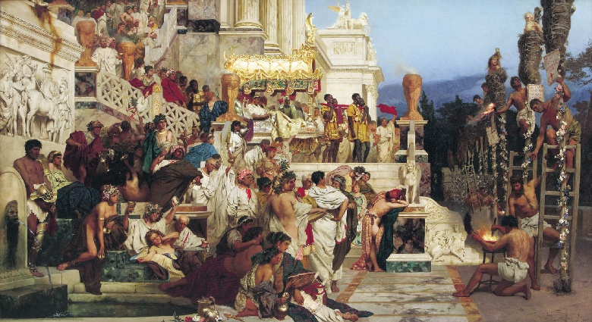
How Christ & Christians Were Viewed By Romans
From Page 344 The “Annals Of Tacitus”:
“Consequently, to get rid of the (fire) report, Nero fastened the guilt & inflicted the most exquisite tortures on a class hated for their abominations, called Christians by the populace. Christus, for whom the name had its origin, suffered the extreme penalty during Tiberius’ reign at the hands of one of our procurators, Pontius Pilatus, and a most mischievous superstition, thus checked for the moment, again broke out not only in Judaea, the first source of the evil, but even in Rome, where all things hideous and shameful from every part of the world find their centre and become popular. Accordingly, an arrest was first made of all who pleaded guilty; t hen upon their information, an immense multitude was convicted, not so much of the crime of firing the city, as of hatred against mankind.”
Nero’s RESCRIPT night lights

Slide 203
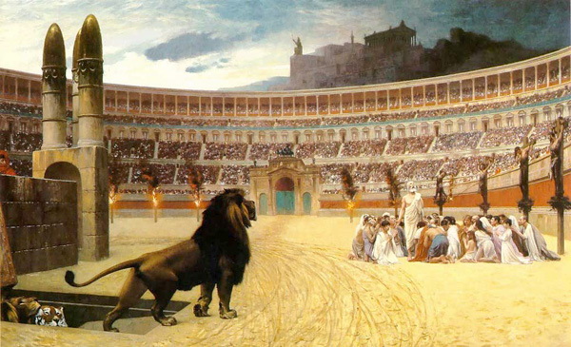
David Lee Burris: More On Marcus Aurelius: 177 @ Lyon, France For Holiday Entertainment Of Visiting Governor Torture Cheaper Than Valuable Gladiator Games Human BBQ On “The Hot Seat” More On Septimus Severus: Perpetua was educated Roman woman fluent in Latin & Greek and Felicitas was her slave girl. She would not surrender her faith even with her father’s pleading. She kept her modesty while the wild beasts brutalized her. Somehow the animals could not kill her off so trembling soldiers were sent in to finish the job – she guided their swords. Before dying she shouted to the anonymous Christians in the crowd – “You must all stand fast in the faith and love one another and do not be weakened by what we have gone through.” Two centuries later, Augustine pointed out the significance of the names of these two martyrs taken together – perpetua felicitas means “everlasting happiness” which is exactly what they received! More On Decius: Given certificate of sacrifice if did so – if not – executed on the spot. There were approximately 2 mill professed believers at that time. Some commentators suggest that most Christians recanted and offered sacrifice and that the number of faithful were reduced from millions to the thousands.
Socially Christianity Was Considered A Threat To The Organization Of Society
ROMAN PERSECUTION
Christianity Politically Intolerable Viewed As State Within A State
NATURE & EXTENT
Aurelius: 161-180
Christians Blamed For Natural Disasters
Septimus: 202-211
The Conversion To Christianity Forbidden
- ROMAN OUTLOOK -
Maximinus: 235-236
Clergy Executed That Supported Predecessor
Decius: 249-251
All Empire Total Terror Forced Emperor Worship
Valerian: 257-260
Property Confiscation No Right Of Assembly
Diocletian: 303-311
Churches & Bibles Burn; Compulsive Sacrificing

Slide 205
Tertullian 196 AD: Pagans Backlash
“The Christians are to blame for every disaster and every misfortune that befalls the people. If the Tiber rises to the walls, if the Nile fails to rise and flood the fields, if the sky withholds its rain, if there is earthquake or famine or plague, straightway the cry arises: ‘The Christians To The Lions!’”

Slide 206
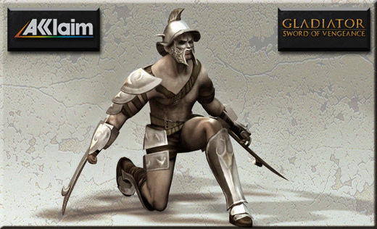
The Soul Conductor Opposite Dressed as Rhadamanthus, Judge of the Underworld.
Wearing tall dark boots, tunic, and raven’s mask, he claimed with each tap of mallet the now officially defunct gladiator souls.
Psychopompus Underworld Soul Conductor Stood on One Side in Black Dress with Red-Hot Caduceus Making Death Final

Slide 207
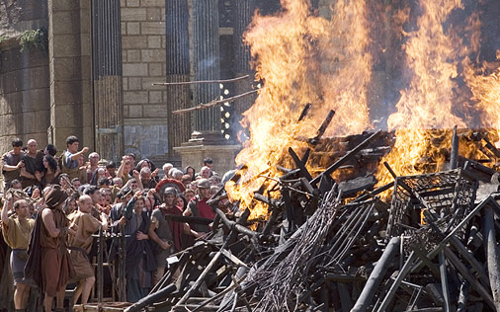
David Lee Burris:
More On Marcus Aurelius: 177 @ Lyon, France For Holiday Entertainment Of Visiting Governor Torture Cheaper Than Valuable Gladiator Games Human BBQ On “The Hot Seat”
More On Septimus Severus: Perpetua was educated Roman woman fluent in Latin & Greek and Felicitas was her slave girl. She would not surrender her faith even with her father’s pleading. She kept her modesty while the wild beasts brutalized her. Somehow the animals could not kill her off so trembling soldiers were sent in to finish the job – she guided their swords. Before dying she shouted to the anonymous Christians in the crowd – “You must all stand fast in the faith and love one another and do not be weakened by what we have gone through.” Two centuries later, Augustine pointed out the significance of the names of these two martyrs taken together – perpetua felicitas means “everlasting happiness” which is exactly what they received!
More On Maximus:
It began as an attempt to rid Cappadocia of Christians.
More On Decius: Given certificate of sacrifice if did so – if not – executed on the spot. There were approximately 2 mill professed believers at that time. Some commentators suggest that most Christians recanted and offered sacrifice and that the number of faithful were reduced from millions to the thousands.
More On Aurelia:
A whole legion of soldiers that professed Christianity were killed for not taking the Antichristian oath. In 274 AD, all 6,666 men were killed!
More on Diocletian:
It is related that 17,000 were slain in one month and in Egypt alone 144,000 died by the violence of their persecutors and 700,000 died through the fatigues of banishment or punishment.
Spiritual Law Of
Thermodynamics
ROMAN PERSECUTION
NATURE & EXTENT
Aurelius: 161-180
Christians Blamed For Natural Disasters
Septimus: 202-211
The Conversion To Christianity Forbidden
Killing The Catechumens
“Earlier persecutions had tended to focus on the leaders of the Christian community. Essentially pagan in their outllook, Roman authorities were used to facing religious institutions with a professional hierarchy of priests and a larger body of believers. If you take out the priests, they reasoned, the believers really have nowhere to go with their faith. They hadn’t reckoned on the essentially nonhierarchical nature of Christian spirituality. This time, Rome took a different tack. Severus decreed that it was converts who would be punished!”
Maximinus: 235-236
Clergy Executed That Supported Predecessor
Decius: 249-251
All Empire Total Terror Forced Emperor Worship
Valerian: 257-260
Property Confiscation No Right Of Assembly
Diocletian: 303-311
Churches & Bibles Burn; Compulsive Sacrificing

Slide 208
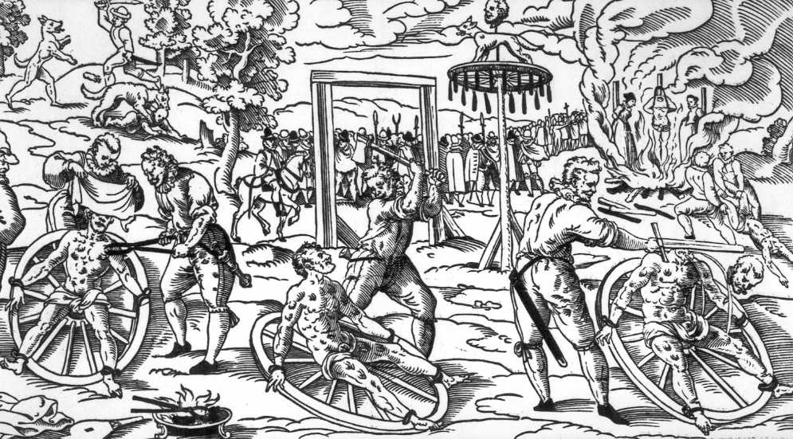
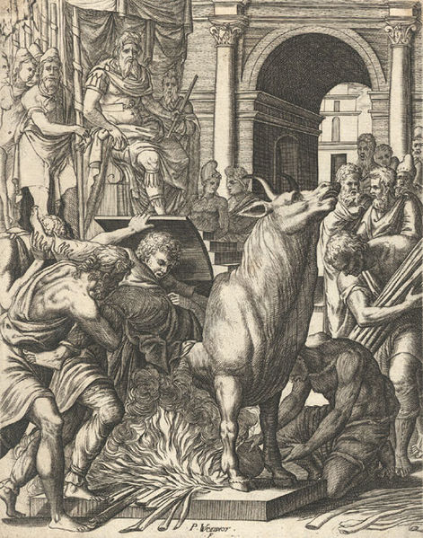
“Overt persecution is a sign of the failure of the persecutors. Failure to keep believers quiet leads to overt persecution – so overt persecution is an indication that believers have refused to be quiet! Overt persecution authenticates the faith within resistant cultures. Overt persecution gives faith value in the eyes of those who watch believers and marvel at their willingness to suffer and die in Jesus’ name.” – Nik Ripken

Slide 209
We have an enemy, an adversary in the spiritual realm. He is real. He is alert and watching for every opportunity to pursue us. His goal, now that he has lost us for eternity, is to keep us from the fullness of what Jesus has for us now. He has only one weapon—a weapon he wields with great skill. Lies. “When he lies, he speaks his native language, for he is a liar and the father of lies” (John 8:44).
Your enemy never ever tells the truth, “for there is no truth in him” (John 8:44). Yet he is so skilled at using lies that when he lies, it sounds like truth.
Your enemy hates you and has only one goal in his dealings with you: to steal, kill, and destroy anything that God has established in your life. The more you learn to live the surrendered life that Jesus describes in His inaugural address, the more your enemy will pursue you.
Nothing to fear here. Your enemy has a very limited reach into your life. In fact, he has no reach at all unless it is allowed by your Father. And your Father will allow no access to you except that which ultimately will be turned against the enemy and will accrue to your benefit.
The Battle Plan
Just like the Father uses people, relationships, and circumstances in your life to train you in the ways of the kingdom and to force your faith out of hiding, your enemy seeks to make use of those same people, relationships, and circumstances. Every situation that your enemy means to use against you, God means to use for your benefit.
Under God’s authority, your enemy can only bring difficulties into your life that have passed through the sieve of the Father’s great love for you and from which all the destructive force has been strained. What gets through is to be used for your good only.
Your enemy is on the lookout for the very places where your flesh is vulnerable. Soul wounds not quite healed. Areas where you are still trying to accomplish your own holiness—not surrendered to the indwelling power of Christ.
As we look for a moment at the enemy’s battle plan, remember that, although he uses people, relationships, and circumstances, your only enemy is in the spiritual realm. “For our struggle is not against flesh and blood, but against the rulers, against the authorities, against the powers of this dark world and against the spiritual forces of evil in the heavenly realms” (Ephesians 6:12).
When Satan uses people, that does not mean that the person is evil or is cooperating with Satan. Rather, it means that Satan sees how that person’s personality, or the words he speaks to you, or some imagined slight could be used to activate your weakness. Your enemy is persecuting you. Saying all manner of evil against you falsely. Working to divide you from another member of the body. Now, consider this. If the enemy is like a roaring lion looking for someone to devour, how does a lion get his prey in position? He isolates his prey from the herd. Cuts her off. Gets her alone. Do you see the process?
If your enemy were not feeling threatened by you, he would not work to distract you. The very incidents that he wants to use to weaken you, God wants to use to strengthen you. Your enemy’s clever manipulation only serves to identify places where your flesh is still active. This is to your advantage if you deliberately resist the lie and identify with the truth. When you do that, the flesh your enemy is able to target is surrendered to the life of Christ in you and when the enemy thinks he is taking on your flesh, he finds himself confronting Jesus Himself. Who’s the loser now?
Dean, J. K. (2015). . Ashland, OH: New Hope Publishers
Dean, J. K. (2015). Set apart: a 6-week study of the beatitudes. Ashland, OH: New Hope Publishers.

Slide 210
The New Testament Reframing of these Eight Old Testament Teachings are Known Together as the Beatitudes. These Eight Basic Be-Attitudes Outlined by Our Savior Are Transformative of Both Worldview & Life-view!

Slide 213
JUDGEMENT PREPARED
FIVE STATES FIVE STEPS
Five States of the Soul:
EXEMPTION:
Ezekiel 18: 20; Matthew 18: 1 – 3
CONDEMNATION:
Galatians 3: 22
JUSTIFICATION:
Romans 5: 1, 2; 8: 1, 2
DAMNATION:
Matthew 23: 3; Mark 16: 16
GLORIFICATION:
Romans 8: 17, 30; II Thess. 1: 7 - 12

Slide 214
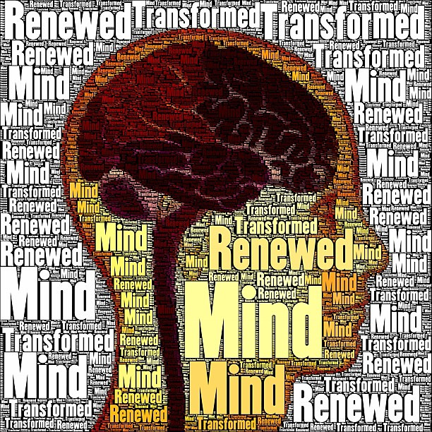

Slide 215
JUDGEMENT PREPARED
FIVE STATES FIVE STEPS
Five Steps for Saving:
HEARING:
Romans 10: 17; Matthew 7: 24 - 27
BELIEVING:
Hebrews 11: 6; Mark 16: 15, 16
REPENTING:
Acts 2: 38; 17: 30; Luke 13: 3
CONFESSING:
Matthew 10: 32, 33; Acts 8: 36, 37
BAPTISM:
Romans 6: 3 – 5; Acts 8: 36 - 38

