Slide 1
JOEL’S PROPHECY INTRODUCES THE Prophetic Book OF REVELATION: joel chapter two: Verses 28-32
By David Lee Burris

Slide 2
Joel’s Prophecy Of Double Application
THE mINOR Prophets
Joel’s Jerusalem Prophecy
Matthew’s olivet discourse
Book of Revelation Overview
Seven Churches of asia-minor
The Throne-The Book-The Lamb

Slide 3
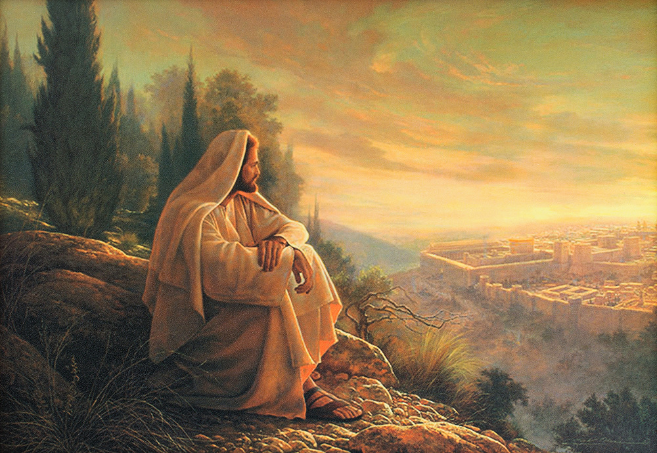
O’ Jerusalem, Jerusalem!

Slide 4
The Olivet Discourse

Slide 5
The Olivet Discourse
Millennialism Impacts Christian Watchfulness. The Olivet Discourse is easiest understood by observing that the Apostles were asking the typical ethno-centric question of the end of the world as they knew it (TEOTWAWKI) but truth be told - they were asking two questions – one of the destruction of the temple along with the city of Jerusalem - and the other as regards the end of the world. The fact that Christ gave His answer in two-part – the pivotal passage at Matthew 24: 34 – is of greatest illumination to our subject today. If we consider that Matthew 24: 3 – 34 parallels the events described in Revelation 20: 1, 2 to the End of that Age and Matthew 24: 35 – Matthew 25: 13 parallel events afterwards and until the End of Satan’s Story or End of the World - we can then observe the following contrasts: Events Local Versus Events Global; “This Generation” Versus “The Days of Your Fathers”; “That Day” Versus “Those Days”; and Signs Versus Suddenness.

Slide 6
The Olivet Discourse
Signs Versus Suddenness: Brother Larry Ray Hafley writes – “Jesus told of the signs preceding the destruction of Jerusalem; namely, ‘false Christs and false prophets,’ and wars and rumors of wars, famines and earthquakes – ‘all these are the beginnings of sorrows’ (Matthew 24: 6 – 8). Further He told them of ‘the abomination of desolation’ (Roman Eagle Standard), the Roman army (Matthew 24: 15; Luke 21: 20). ‘Then know that the desolation thereof is nigh’ (Luke 21: 20). They could ‘know’ the destruction of Jerusalem was ‘nigh,’ but the Coming of the Son of Man and the consequent Judgment were to be without warning (Matthew 24: 42, 43, 50; 25: 13). Compare ‘then know’ with ‘know not’ (Luke 21: 20; Matthew 24: 39). ‘So shall also the Coming of the Son of Man be.’

Slide 7
The Olivet Discourse
The desolation and annihilation of ‘the buildings of the temple’ were to be seen by signs. ‘When ye shall see these things, know it is near, even at the doors… But of that day and hour knoweth no man, no, not the angels of heaven, but My Father Only’ (Matthew 24: 33, 36).
At least three times, Jesus specifically indicated that He was giving tangible evidence of the destruction of Jerusalem (Matthew 24: 8, 25, 33) but the second coming and the judgment were to be sudden, unknown, as when a thief strikes (Matthew 24: 42, 44, 50; 25: 13; 1st Thessalonians 5: 2 – 4; 2nd Peter 3; 10).

Slide 8
The Olivet Discourse
Jesus spoke of ‘great tribulation, such as was not since the beginning of the world to this time, no nor ever shall be’ (Matt. 24: 21). This implies that time will continue after ‘this time,’ but there is no sense in saying, ‘nor shall ever be’ if the end of the world and the (final) judgment were being studied. The same argument can be made from the next verse (Matthew 24: 22). Those days evidently will ‘be shortened;’ they will end, and the elect shall be saved because of it. But if the end of the world were in view, the elect would be saved whether the days were shortened or not.

Slide 9
The Olivet Discourse
Finally, Matthew 25 supplements Matthew 24: 35 – 51. The judgment of Matthew 25 involves and includes ‘all nations’ (Matthew 25: 32). It is the final judgment (Matthew 25: 34, 41, 46). The ten virgins parable says, ‘be prepared,’ ‘watch.’ The parable of the talents stresses the necessity of diligence and faithfulness (Matthew 25: 21, 23, 26 linking @Matthew 24: 42–51).

Slide 10
2. THE FALL OF JERUSALEM SEPARATED JUDAISM FROM THE CHURCH
The fall of Jerusalem separated Judaism from Christianity.
Judaism was a God-ordained religion.
This made it possible for Judaizing teachers to deceive and confuse people as long as the temple existed.
It was one thing to appeal to people to give up paganism with its religion as it was never approved by God.
It was still another thing to call on the Jews to lay aside Judaism which was given by God and at one time acceptable to God.

Slide 11
It is easy to see how Judaizing teachers used this in opposing the church.
But when Jerusalem fell, the temple was destroyed, and they could no longer use this as a means of trying to confuse people.
While the temple stood, many thought of the church as only a sect of Judaism.
Christianity had its roots in Judaism.
The types and shadows of Judaism pointed to the church.
The prophecies of the Old Testament foretold of the establishment of another kingdom (Daniel 2, 7, 9; Isaiah 2:1-4).

Slide 12
The fact that Christianity had its roots in Judaism did not mean that it was a continuance of it, or just an advancement within it.
The gospel was an entirely different system from Judaism.
The sacrifice of Christ was not just another sacrifice, it was a different kind of sacrifice (Hebrews 9: & 10).
When Paul went to Rome, they asked to hear “concerning this sect that was everywhere spoken against,” (Acts 28:22).
This indicates that many considered the church as just another sect of Judaism like the Pharisees and the Sadducees.

Slide 13
When Jerusalem fell, it ended any thoughts of the church being only a sect of Judaism.
The fall of the nation left neither root nor branch: Malachi 4:1 ¶ For, behold, the day cometh, that shall burn as an oven; and all the proud, yea, and all that do wickedly, shall be stubble: and the day that cometh shall burn them up, saith the LORD of hosts, that it shall leave them neither root nor branch.
When Jerusalem fell, God pulled up Judaism by the roots and burned the branches.
Nothing was left but the ashes of Judaism.
One might as well expect to use the ashes of a house that has burned down to rebuild it as to expect to put life back into Judaism.

Slide 14
Thus, when Jerusalem fell, Judaism was plucked up by the roots and burned.
This left nothing but the church.
The fall of Jerusalem forever separated Judaism and the Lord’s Church.
Notice carefully these verses: Heb 12:27 And this word, Yet once more, signifieth the removing of those things that are shaken, as of things that are made, that those things which cannot be shaken may remain. 28 Wherefore we receiving a kingdom which cannot be moved, let us have grace, whereby we may serve God acceptably with reverence and godly fear: 29 For our God is a consuming fire.

Slide 15
When Jerusalem fell, Judaism went down to rise no more, leaving only the kingdom that Daniel saw remaining, and one that could not be moved.
The fall of Jerusalem closed the door of Judaism and left only the church remaining.

Slide 16
3. THE FALL OF JERUSALEM ANSWERS THE QUESTION OF THE PROMISE TO ABRAHAM
The fall of Jerusalem answers the question as to the meaning of God’s promise to Abraham.
In Genesis 12 God made 3 promises to Abraham:
“I will make of thee a great nation,” Gen. 12:2
“Unto thy seed will I give this land,” Gen. 12:7
“In thee shall all families of the earth be blessed,” Genesis 12:3
In order for a nation to develop from Abraham, they needed a land.
The nation and the land belonged together.

Slide 17
The reason back of the nation and the land was the spiritual promise – the Messiah, the Son of God, and the Saviour of the world.
The entire Old Testament from Genesis 12 through Malachi develops around the land of Canaan.
The birth, life, death, and resurrection of Christ are in the land of Canaan.
The church had its beginning in Jerusalem.
A careful reading of the book of Acts shows the shift from the city of Jerusalem.
The church was scattered out of Jerusalem (Acts 8:4).

Slide 18
The gospel was preached to Samaritans (Acts 8).
The conversion of Saul is recorded in Acts 9.
This is placed here because Saul was to be the apostle to the Gentile world.
In Acts 10 & 11 is recorded the conversion of Cornelius, the first Gentile.
The purpose is to show that the gospel is for the Gentiles as well as the Jews.
In the last part of Acts 11 is the beginning of the church in Antioch.
Here is the first Gentile congregation.
It is from here, not Jerusalem, that Paul goes on his missionary journey.

Slide 19
Antioch becomes the center from which the gospel radiates world-wide.
This is not by accident.
It is according to God’s purpose.
This change from Jerusalem to Antioch, as the center of the spread of the gospel, is in keeping with the change from national and fleshly Israel to the universal and spiritual church.
The church is now the Israel of God (Gal. 6:16).
The church is the nation, but it is spiritual, not fleshly (1 Peter 2:8-9).
When the nation went into Babylonian captivity, God brought it back to the land.

Slide 20
The Antiochene School Of Theology Practiced An Approach To Scriptural Interpretation With Literal Emphasis Rather Than Spiritual Meanings Not Immediately Evident From The Text
Antioch Center Of Christian Theology

Slide 21
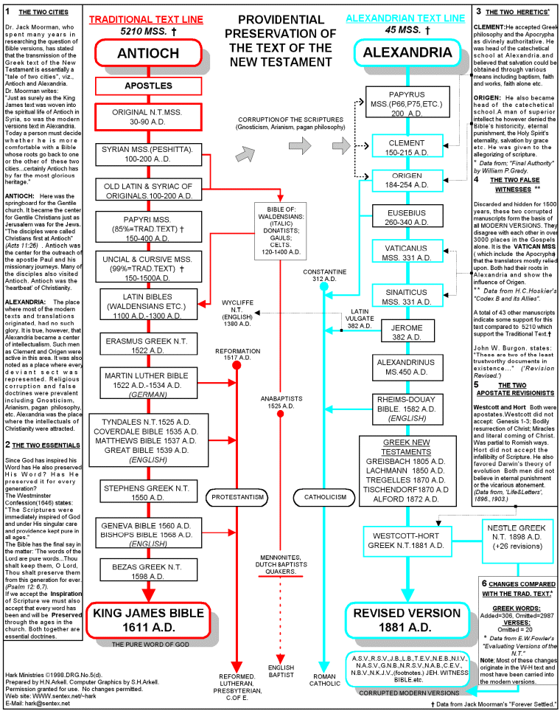

Slide 22
This was necessary for the spiritual promise to be fulfilled in Christ.
But Christ has come.
He has fulfilled the spiritual promise.
There is no more place for the mission of the nation.
Since the nation has fulfilled its mission in the coming of Christ, there is no further need for the land.
When Jerusalem fell, this was God’s way of saying that the promise to Abraham had found its fulfillment in Christ.
When Jerusalem fell, it left nothing but the spiritual promise and the gospel as man’s only hope.

Slide 23
Any future for the Jews will be found in the gospel and as an individual, not as a nation.
The fall of Jerusalem crowns the promise that God made to Abraham.
The fulfillment of the promise began at Pentecost.
When God brought judicial sentence on the nation in the fall of Jerusalem, it was His way of saying, “The gospel is the answer to the promise to Abraham.”
The only hope for Jews or Gentiles is to be found in the gospel of Christ.

Slide 24
The fall of Jerusalem is a warning to all man and for all times that God is through with the Jews as a nation.
The fall of Jerusalem is a warning to all man and for all times that their only hope is the gospel of Christ.

Slide 25
4. THE FALL OF JERUSALEM CLOSED THE QUESTION OF THE MESSIAH
The fall of Jerusalem closed the question of the promised Messiah.
In Matthew 24, verses 5 and 24, Christ points out that there would be false messiahs following His rejection and crucifixion.
Mt 24:5 For many shall come in my name, saying, I am Christ; and shall deceive many.
Mt 24:24 For there shall arise false Christs, and false prophets, and shall shew great signs and wonders; insomuch that, if it were possible, they shall deceive the very elect.

Slide 26
It is not strange that when the Jews rejected Christ, the promised Messiah, that there were false Messiahs who used the false expectation of the Jews to deceive them.
In rejecting Christ as the Messiah, the Jews would surely still look for one as long as the temple stood, which was the heart of Judaism.
There would be the means of deceiving the Jews about the Messiah.
It is of interest to note that until Christ came, there were no false Messiahs.
His coming and His rejection left the door open to blinded Jews to still look for one.

Slide 27
When Jerusalem fell, this forever closed the door on that question.
The temple and the records were destroyed.
The Messiah was the promised seed (Genesis 12:3; 22:18).
This promise was renewed to Isaac (26:4) and to Jacob (28:14)
In Genesis 49:10, it is limited to the tribe of Judah.
Gen 49:10 The sceptre shall not depart from Judah, nor a lawgiver from between his feet, until Shiloh come; and unto him shall the gathering of the people be.

Slide 28
Then in 2nd Samuel 7:10-13, it is limited in Judah to the house of David.
2nd Samuel 7:10 Moreover I will appoint a place for my people Israel, and will plant them, that they may dwell in a place of their own, and move no more; neither shall the children of wickedness afflict them any more, as beforetime, 11 And as since the time that I commanded judges to be over my people Israel, and have caused thee to rest from all thine enemies. Also the LORD telleth thee that he will make thee an house. 12 And when thy days be fulfilled, and thou shalt sleep with thy fathers, I will set up thy seed after thee, which shall proceed out of thy bowels, and I will establish his kingdom. 13 He shall build an house for my name, and I will stablish the throne of his kingdom for ever.

Slide 29
This accounts for Matthew’s introduction in Matthew 1:1:
Mt 1:1 ¶ The book of the generation of Jesus Christ, the son of David, the son of Abraham.
Abraham and David sum up the promised line.
Then Matthew gives the genealogy from Abraham through David to Christ.
If the babe born in Bethlehem is not the promised Messiah, then we can never know whether this promise will be fulfilled.
When the temple was destroyed, it took with it the record of the line of descendants from Abraham.
There is no way that a Jew can establish that he is of the line of Abraham and David.

Slide 30
If the Christ that was born in Bethlehem is not the Messiah, there will never be one.
God’s judgment on the Jewish Nation and the fall of Jerusalem closed the door on the question of the Messiah.
It is also well to remember that if Jesus is not the Messiah, the whole Bible collapses.
Christ, the Messiah, is the heart of both the Old and the New Testament.
If he has not come, it would be impossible to determine it since AD 70, and the promise of God is left hanging without ever being fulfilled.
But if God’s promise to Abraham falls, down goes the integrity of the entire Bible.

Slide 31
Is it any wonder that God closed the doors on the question of the Messiah when Jerusalem fell.
We either have the Messiah and the Bible stands firm, or we can forget about the Bible and walk in darkness forever.

Slide 32
5. SETTLED THE QUESTION OF SONS OF GOD
The fall of Jerusalem settled the question as to who are the sons of God.
The struggle between the Jews, Judaizing teachers, and the apostles, and especially the apostle Paul, runs through all the Epistles.
The attempt of Judaizing teachers to bind circumcision on the Gentiles and obligate them to keep the law is evident in the Galatian letter.
Chapters 3, 4, 5 of Galatians deal with this question.

Slide 33
In chapter 3 Paul shows that the promise to Abraham includes the Gentiles
Galatians 3:8 And the scripture, foreseeing that God would justify the heathen through faith, preached before the gospel unto Abraham, saying, In thee shall all nations be blessed.
And that the law was temporary: Galatians 3:19 ¶ Wherefore then serveth the law? It was added because of transgressions, until the seed should come to whom the promise was made; and it was ordained by angels in the hand of a mediator.

Slide 34
In chapter 3 Paul shows that the promise to Abraham includes the Gentiles (continued)
And that the law pointed to Christ. Ga 3:23 But before faith came, we were kept under the law, shut up unto the faith which should afterwards be revealed. 24 Wherefore the law was our school-master to bring us unto Christ, that we might be justified by faith. 25 But after that faith is come, we are no longer under a schoolmaster.
Then in verses 26 to 29 Paul draws his conclusion: “For ye are all the children of God by faith in Christ Jesus.” (v. 26)
Notice the word “all” – Jew and Gentile.
“By faith” – not flesh. “In Christ”- not in Abraham.

Slide 35
“For as many of you as have been baptized into Christ have put on Christ,” (Gal.3:27)
“As many” – that is , without distinction, whether Jew or Gentile.
Those “baptized into Christ” – not those baptized and then circumcised.
Thus, the one baptized into Christ, whether Jew or Greek, bond or free, male or female, were one in Christ and Abraham’s seed and heirs according to the promise (Gal. 3:28-29)
This shows the attempt of false teachers to try to maintain that in order for a Gentile to be a son of God, it was necessary for him not only to be baptized, but also to be circumcised and keep the law.

Slide 36
Of course, the apostles, and especially Paul, denied this claim, and this Epistle shows that it was false.
But God had one final argument in answer to these false teachers.
When Jerusalem fell, that was God’s way of saying, “I will show you once and for all who the sons of God are.”
Consider this passage, “Rev 10:7 But in the days of the voice of the seventh angel, when he shall begin to sound, the mystery of God should be finished, as he hath declared to his servants the prophets.

Slide 37
What was the mystery declared by the prophet?
Paul leaves no doubt about this.
Eph 3:3 How that by revelation he made known unto me the mystery; (as I wrote afore in few words, 4 Whereby, when ye read, ye may understand my knowledge in the mystery of Christ) 5 Which in other ages was not made known unto the sons of men, as it is now revealed unto his holy apostles and prophets by the Spirit; 6 That the Gentiles should be fellowheirs, and of the same body, partakers of his promise in Christ by the gospel:
The mystery was that Jew and Gentile would be heirs in Christ by the gospel.

Slide 38
John sees this question settled when Jerusalem fell.
Notice the connection between the mystery and the fall of Jerusalem in Romans 16.
In Romans 16:25 Paul ties together the gospel and the preaching of Jesus Christ. Then he states that it was “according to the revelation of the mystery, which was kept secret since the world began.”
Back in verse 20, Paul points to the fall of Jerusalem. Rom 16:20 And the God of peace shall bruise Satan under your feet shortly.
Is there no connection between his reference to the mystery and the fall of Jerusalem?

Slide 39
While the teaching of the New Testament makes plain that both Jew and Gentile stood on equality before God in one body, God had one last and final answer to settle the question.
When Jerusalem fell, the mystery had its concluding answer and proof that all baptized into Christ were sons of God whether Jews or Gentiles.
The outpouring of the Holy Spirit on Cornelius and his household was God’s first argument that he was no respecter of person.
The Epistles insist on this all the way through them.

Slide 40
The fall of Jerusalem clenches the argument once and for all, and, thus, the fall of Jerusalem answers another Bible question as to who are the sons of God.
The fall of Jerusalem and the end of Judaism was God’s way of saying, “sons of God are those who are obedient to the faith and are added to the church by the Lord.”

Slide 41
6. FALL OF JERUSALEM AND THE END OF THE MIRACULOUS AGE
Joel’s prophecy of the coming of the Spirit comprehends the beginning and the ending of the miraculous operation of the Spirit.
The miraculous age of the Spirit in Joel’s prophecy is placed between Pentecost and the fall of Jerusalem.
During this period, revelation was completed and confirmed.
During this period, the church grew from its infancy to its maturity.’

Slide 42
7. THE FALL OF JERUSALEM IS A SYMBOL OF THE FINAL JUDGMENT.
The fall of Jerusalem was God’s judicial sentence on the unbelief of the Jewish nation.
Peter refers to the fall of Jerusalem and uses the word “judgment” in reference to it: “For the time is come that JUDGMENT must begin at the house of God; and if it first begin at us, what shall the end be of them that obey not the gospel of God? And if the righteous scarcely be saved, where shall the ungodly and the sinner appear?” (1st Peter 4:17-18).

Slide 43
The fall of Jerusalem was God’s judgment on the nation for its rejection of Christ.
The fall of the nation under God’s sentence of judgment is a symbol of the final judgment on all who are not faithful Christians.
Will there be a final judgment?
Did God’s judgment fall on the Jewish nation?
The final judgment and the punishment of the wicked is as certain as Christ and the apostles’ announcement of judgment on Judaism that came to pass.
The fall of Jerusalem is warning to unbelievers and impenitents that they will just as certain face God in judgment and be lost forever.

Slide 46
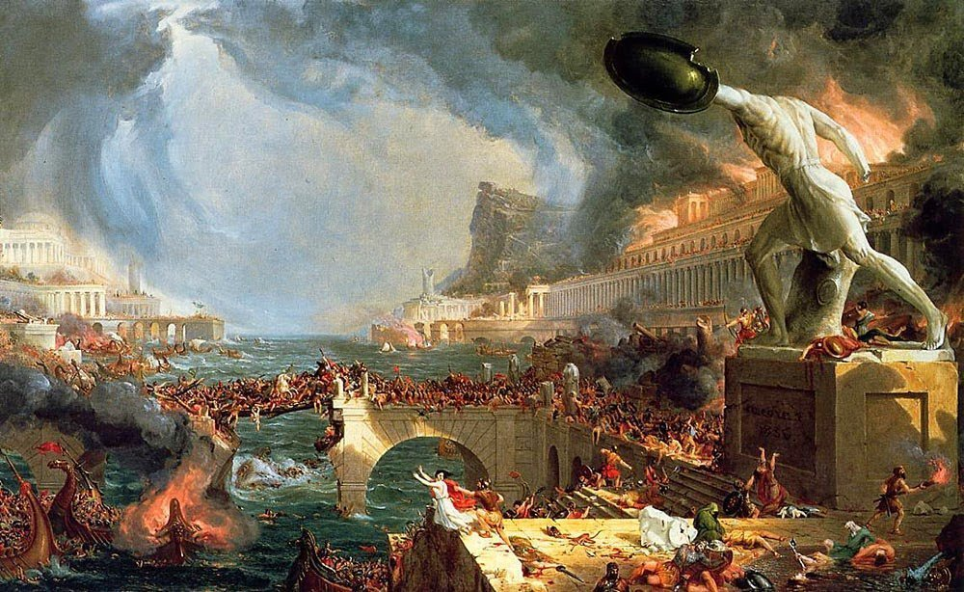

Slide 49
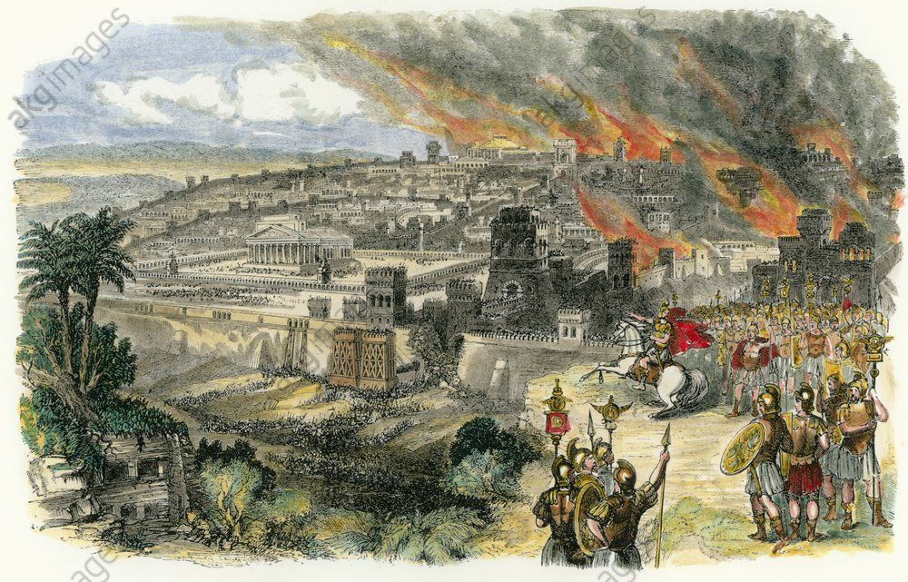

Slide 50
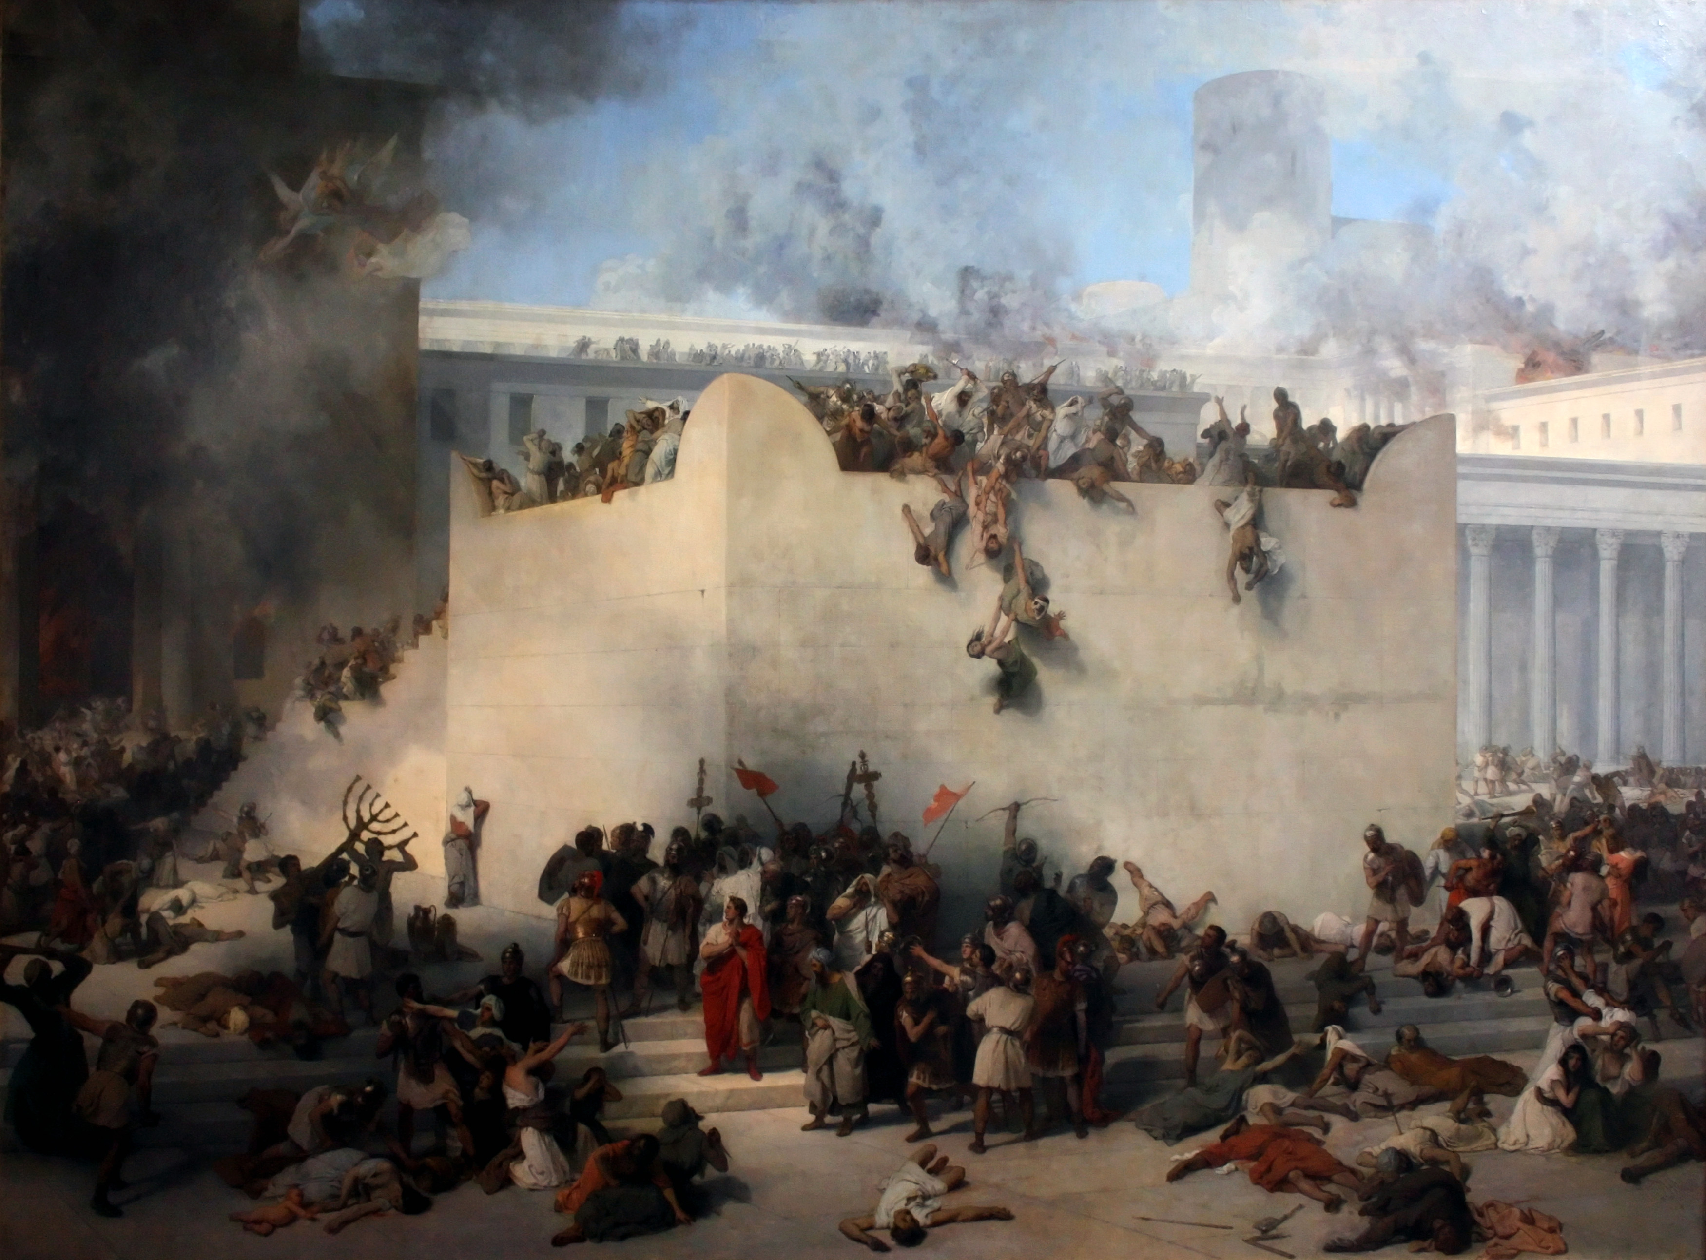

Slide 51
Revelation: Introduction

Slide 52
OVERVIEW
THE BOOK OF REVELATION

Slide 53
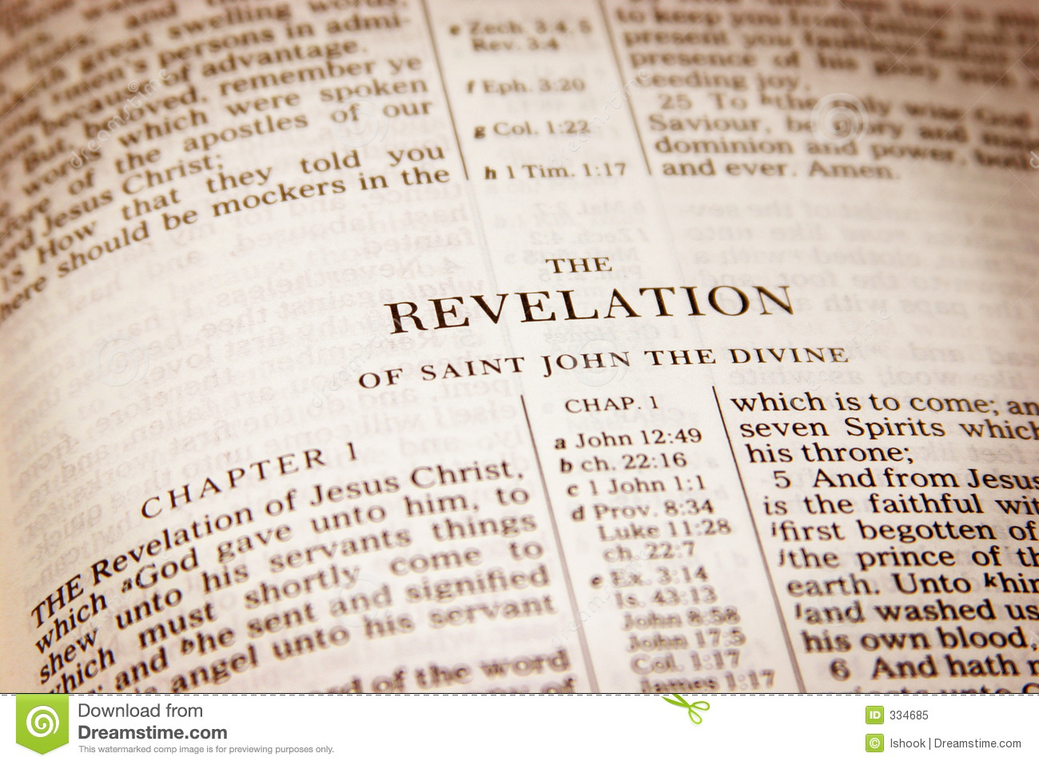
Symbol & Metaphor

Slide 54
Revelation Hermeneutic
The first thing to establish about any Bible passage is what it meant to the original readers; to see it in the light of contemporary history.
Revelation belongs to a particular type of literature – apocalyptic. It is both poetic and visionary, expressing its meaning through symbols and imagery. To take this picture-language literally, or treat the book as a logical treatise or time-table, is to go against the whole spirit of it.
Revelation is rooted in the Old Testament. This is where we find clues to the meaning of various symbols – comparing scripture with scripture.
Obscure passages must always be understood in light of comparable & clear passages – never the other way around.
This is a book of visions. The fact that John is not seriously concerned about harmonizing details makes it clear that it is the main thrust of each picture which is important. We should treat visions as we do parables, looking first at the whole picture to discover the main idea.
We are not necessarily meant to take John’s vision as an events sequence which follow on one after the other. The eastern mind is not as much preoccupied with chronology as we tend to be[time circular v. linear] - Eerdman’s Handbook to the Bible, pg. 645

Slide 55
THE NATURE OF THE BOOK
Apocalyptic Literature. This is the name given by Bible scholars to the writing style used by Daniel & Ezekiel. It was popularized by the BC 200 uninspired writers who were trying to resist the Greek influence.
Apocalyptic Literature Usually Produced During Persecution Period.
Apocalyptic Lit Was Written In Design To Encourage & Strengthen.
This uninspired literature had the following two trait characteristics:
An intense despair of the present circumstances and an equally intense hope for divine intervention in the future; by use of symbolic language, dreams, and visions.
By the introduction of celestial and demonic powers as messengers and agents in the progress of God’s purposes.
Why was this type of special literature even written?
The answer to such a question is seen in the fact that this literature was written in dangerous times. The personal safety of both writer and reader was endangered if the persecutors understood the true meaning of the book. For this reason the message of the apocalypse was written so to conceal & reveal – to conceal the message from the outsider, but reveal its message to the initiated.

Slide 56
An important piece of the background concerns the word ‘apocalypse’ itself. Today, the word conjures images of disaster & destruction, but the author of Revelation used it to mean ‘disclosure’; that is, an apocalypse is an act of disclosure. The original Greek word apokalypsis, the first word in the book, is translated into English as ‘revelation’ to convey the sense of giving insight into mystery. – Apocalypse Course Guidebook

Slide 57
The prophetic tradition eventually gave birth to the apocalyptic tradition, an important development that also lies behind the Book of Revelation. This tradition depicts the world as a place in which the forces of good and evil are in conflict and focuses on disclosing the nature of this conflict in order to give readers confidence that the just and righteous purposes of God will win out. – Course Guidebook, The Apocalypse

Slide 58
The Shift of Apocalypticism in Early Christianity.
The classic paradigm for Jewish apocalyptic thought consisted of two ages: the present age, in which the powers of sin, evil, and death are at work, and the age to come, which there will be only life & righteousness.
The classic scenario expects God to act in a definitive way to end the present age by defeating the powers of evil. The new age will begin with the resurrection of the dead. In this scenario, there is a direct movement from one age to the next. For early Christians, the legacy of Jesus redefined this paradigm.

Slide 59
The Shift of Apocalypticism in Early Christianity.
It was no longer a straightforward movement from present age into new age. Instead the new age began before the old age was fully gone, and Christians found themselves at the juncture of the two.
As they looked to the past, early Christians believed that Jesus’ Coming had (forever) changed the world. Yet when they looked at the present, these Christians realized that the powers of sin and death were still operative. Jesus had risen from the dead, but others had not - the resurrection remained a future hope.
Early Christians lived between these two realities: resurrection of Jesus, which had already happened, and the resurrection of others which was yet to occur.

Slide 60
Issues Facing Revelation’s First Readers:
Persecution. The cult of the Roman emperors was not so much imposed from the top as it was developed from the bottom up. It originated 100 years before the book was written when the people of Asia Minor requested and received permission to build a temple in honor of the Emperor Augustus. Additional later temples were built in honor of Tiberius(Smyrna) and Domitian(Ephesus). Also among the idol worshippers to the pagan gods Smyrna was famously known for her temple to the goddess Athena. In the early chapters of the text, Revelation clearly indicates that in this specific area of Asia Minor - persecution was local and sporadic.

Slide 61
Issues Facing Revelation’s First Readers:
Assimilation & Complacency. The issue of assimilation came up in connection with the practice of dining at temples to the Greek and Roman gods. In these hellenized communities, social gatherings were often held at temples. Most christians were invited as part of those communities and they would be conspicuous by their absence. Among the pagans, it was often looked upon as a near civic duty in that many of them believed these gods protected their city from natural and manmade disaster.

Slide 62
Issues Facing Revelation’s First Readers:
Assimilation & Complacency. The issue of complacency is most evident in Revelation in the message to the church of Laodicea.
John declares that the Christians there are tepid in their faith because of their wealth. Their material comfort had sapped away at the vitality of their faith. These particular Christians were well positioned to physically thrive in that region Roman-era economy.
Regional markets had expanded into international markets. In that cosmopolitan city - these people were not preoccupied with the shadow of Roman persecution or serious religion but instead with the brightness of their own situations and near future.

Slide 63
Short Study of Twelve Symbols
Description of Christ – Rev. 1:13-16/Dan. 10: 1-20
The Candlesticks – Rev. 1:20/Exod. 25:31;Zech. 4
The Throne of God – Rev. 4: 1-11/Isaiah 6: 1-10
The Living Creatures – Rev. 4: 6-8/Ezekiel 1: 5-11
The Lamb of God – Rev. 5:5;19:7/Gen. 49;Exo. 12
The Four Horsemen – Rev. 6:1/Zech. 6;Ezek. 4,5
The Sealing of the Saints – Rev. 7: 1-3/Ezek. 9:1
The Little Book – Rev. 10: 1-11/Jer. 15:16;Ezek.2,3
The Winepress – Revelation 14: 19-20/Isa. 63: 1-6
The Plagues – Revelation 15,16/Exodus 7,8,9,11,12
The Marriage of the Lamb – Rev. 19/Isa. 54;Jer. 2
The Books Were Opened – Rev. 20:12/Dan. 7:10

Slide 64
Images and Ideas
Are ideas more important than images, or are the two roughly equal in their expressive power? Is there something dangerous about an image without an idea? What about an idea without a corresponding image?

Slide 65
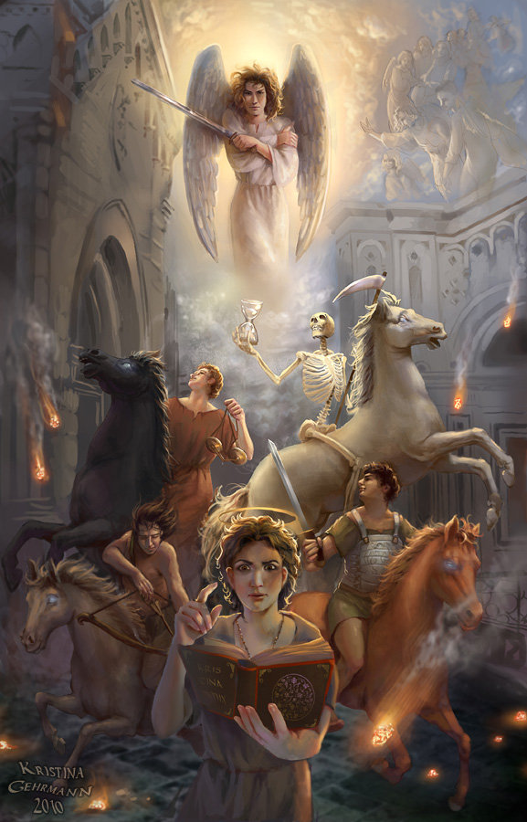
WORD PICTURES

Slide 66
Oh, I want to be in that number when the saints go marching in
Oh, when the saints go marching in
Oh, when the saints go marching in
Lord I want to be in that number
When the saints go marching in
Oh, when the drums begin to bang
Oh, when the drums begin to bang
I want to be in that number
When the saints go marching in
Oh, when the stars fall from the sky
Oh, when the stars fall from the sky
I want to be in that number
When the saints go marching in
Oh, when the moon turns red with blood
Oh, when the moon turns red with blood
I want to be in that number
When the saints go marching in
Oh, when the trumpet sounds its call
Oh, when the trumpet sounds its call
I want to be in that number
When the saints go marching in
Oh, when the fire begins to blaze
Oh, when the fire begins to blaze
I want to be in that number
When the saints go marching in
Oh, when the saints go marching in
Oh, when the saints go marching in
I want to be in that number
When the saints go marching in.

Slide 67
Forms & composition

Slide 68
Revelation consists of several different component elements – epistolary, prophetic, proverbial. Near the beginning of his work the seer addresses the seven churches in an epistolary fashion(1:4) and he concludes Revelation with an epistolary grace(22:21).
Throughout Revelation the seer employs prophetic forms – inaugural vision(1:12-20);
announcements of judgment or salvation(2:1-11); dirges(18:2,3) & interpretations by angels(7:13-17). Like the exiled Hebrew prophets – he structures language in the form of hymns(5:9,10), acclamations(16:7), doxologies(7:12), declarations of worthiness (4:11), and a thanksgiving(11:17,18). Revelation also contains proverbial forms such as aphorism (13:10), beatitude(22:7), lists of virtues and vices(22:15).
Among the compositional devices by which those smaller elements are ordered and subordinated to a larger, complex work, the most obvious is the sevenfold series.
Doublets also appear – (7:2 & 14:1), trumpets/bowls(c 8-9 & 16), (13:1 & 17:3), (14:8 & 18:2) and marked contrasts of weal and woe – (6:1-17 & 7:1 – 8:4), (18:1 & 19:1).

Slide 69
Narrative unity

Slide 70
Contrasting Units
Equivalence of Measure
Reversed Relationships
Accumulation of Images
Circularity –
Circularity refers to concentric development of a passage so that the ending reflects the beginning – chapter four door to door and chapter twelve character conflict - cosmic conflict – heaven’s battle.
Revelation 17:1 through 19:10 is enclosed by an antithetical ring.
Circularity consists of a concentric development of words, syntactical forms, or motifs. The seer tends to develop hismaterial concentrically into ever-widening rings – i.e. ‘Those that Conquer’.
The final section(22:6) circles back to the beginning three chapters.

Slide 71
Metaphoric unity

Slide 72
Similes & Metaphors
The Use of Irony
Puns and Word Plays –
The seer often creates puns and word plays on the different meanings of a word. Ephesians cannot bear, bearing up, their toil, & they have not grown weary. Sardis has a reputed name - but not one based in reality. Philadelphians assured because they kept – God will keep.
Verbal play can be seen in the reversals of the Ephesians and those at Thyatira: the Ephesians should do their first works(2:5), whereas the latter works of those at Thyatira exceed their first (2:19). Those at Laodicea must open the door(3:20), but Philadelphians have an open door set before them(3:8). Those at Smyrna are poor but rich(2:9), while those at Laodicea are rich but poor(3:17).

Slide 73
individual interpret matrix
STORYLINE
Figure History
Figure Future
Literal History
Literal Future
U N F O L D I N G T I M E L I N E

Slide 74
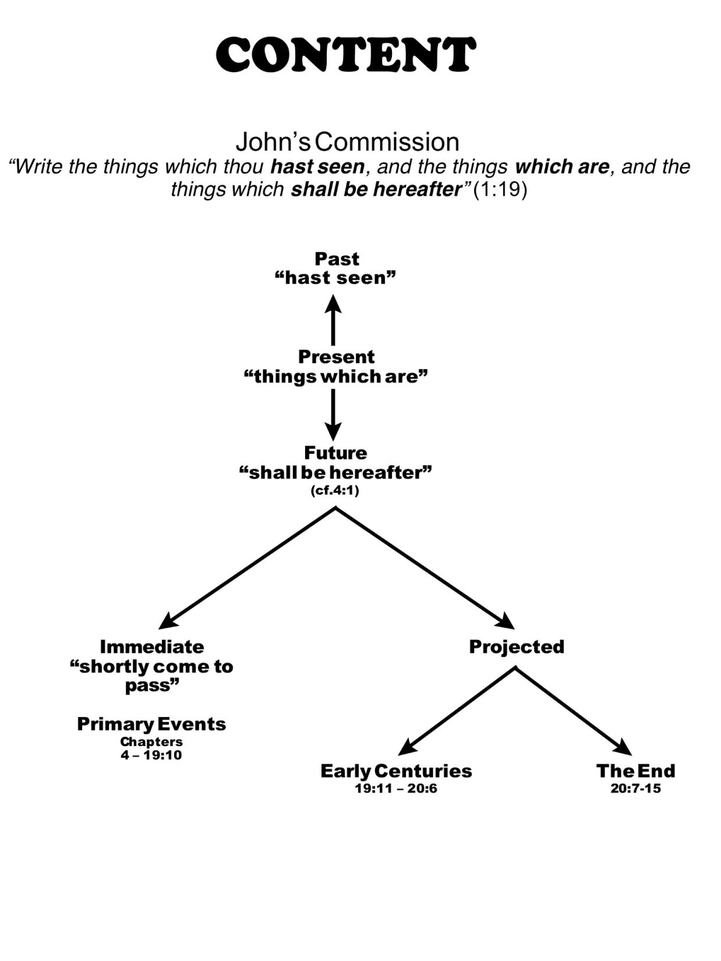

Slide 75
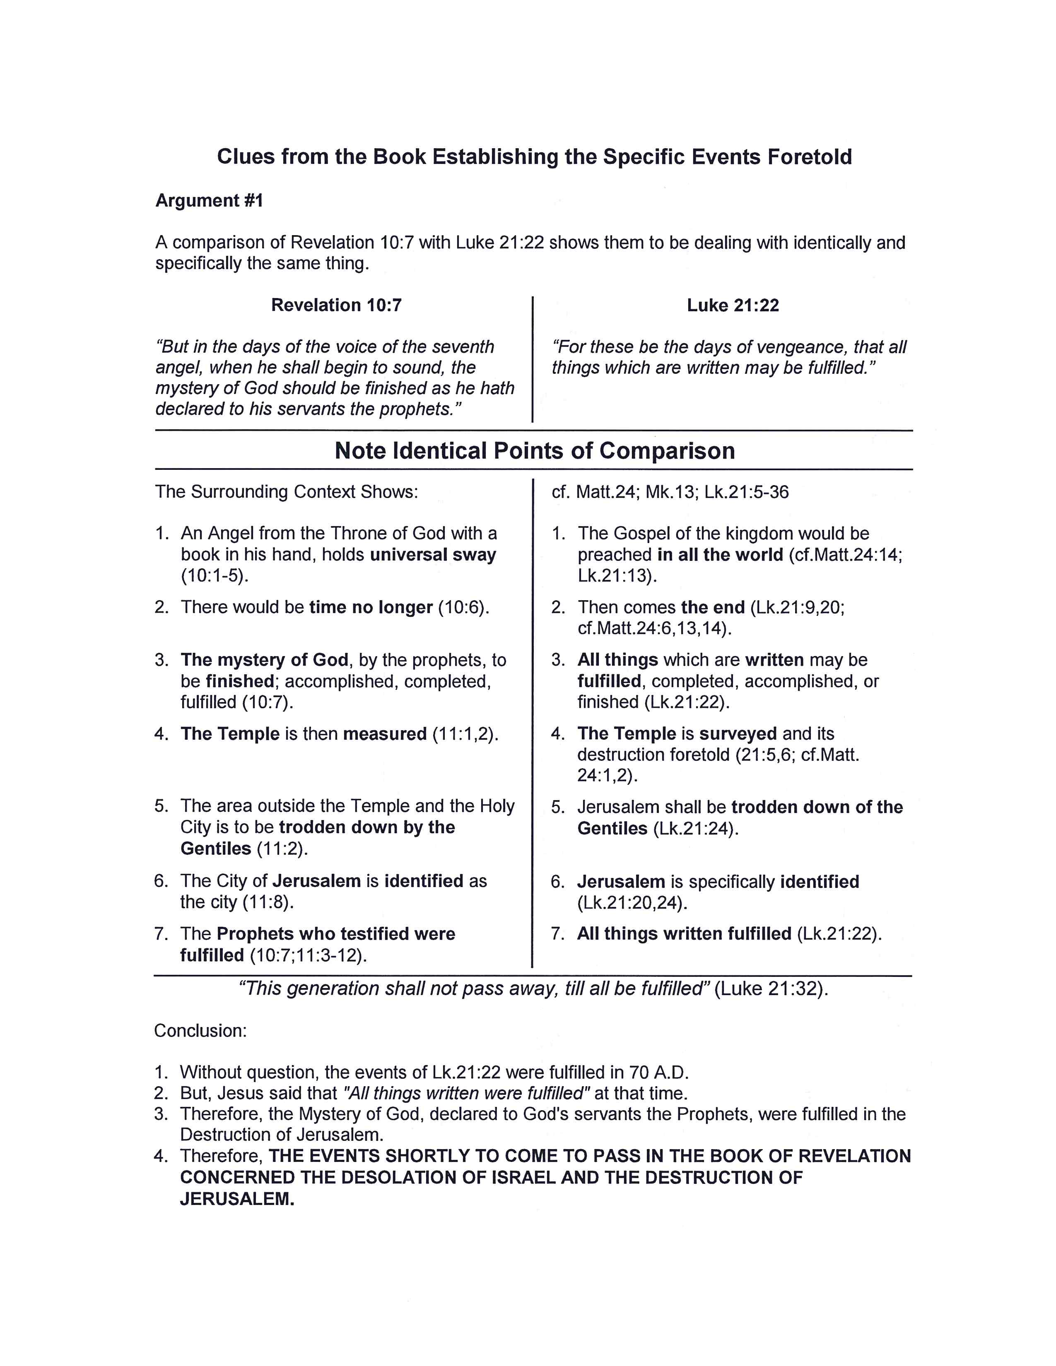

Slide 76
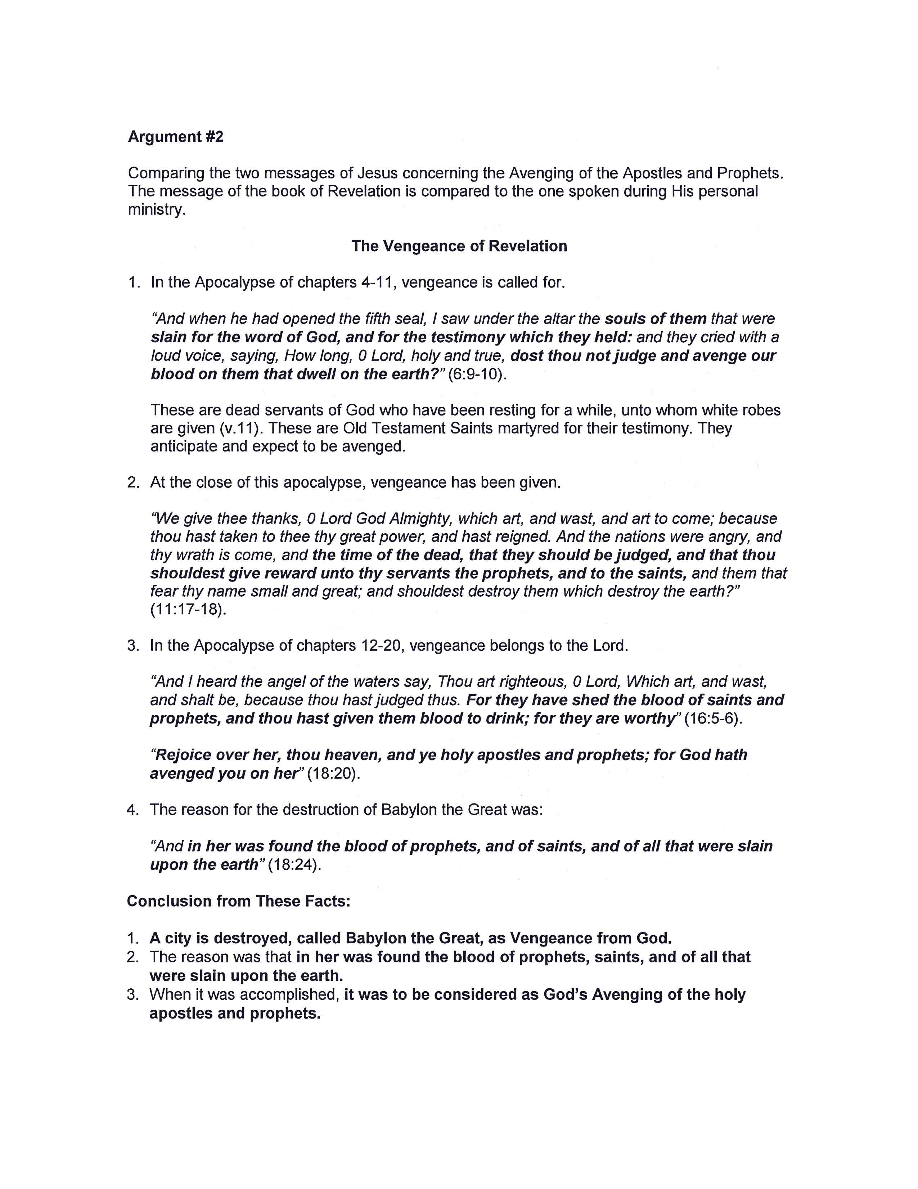

Slide 77
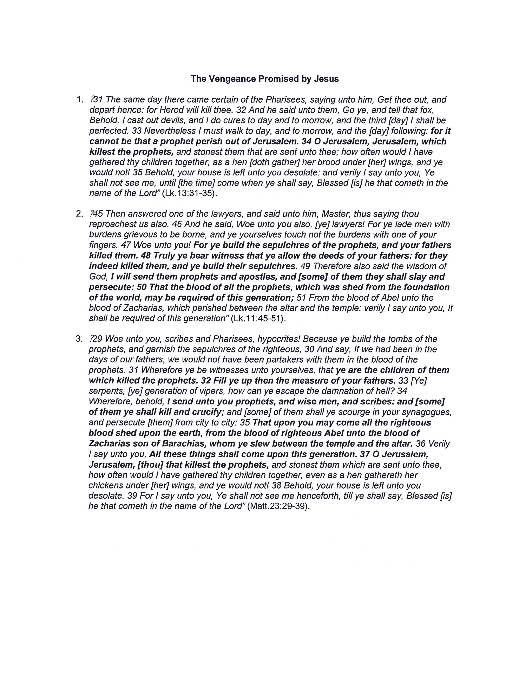

Slide 78
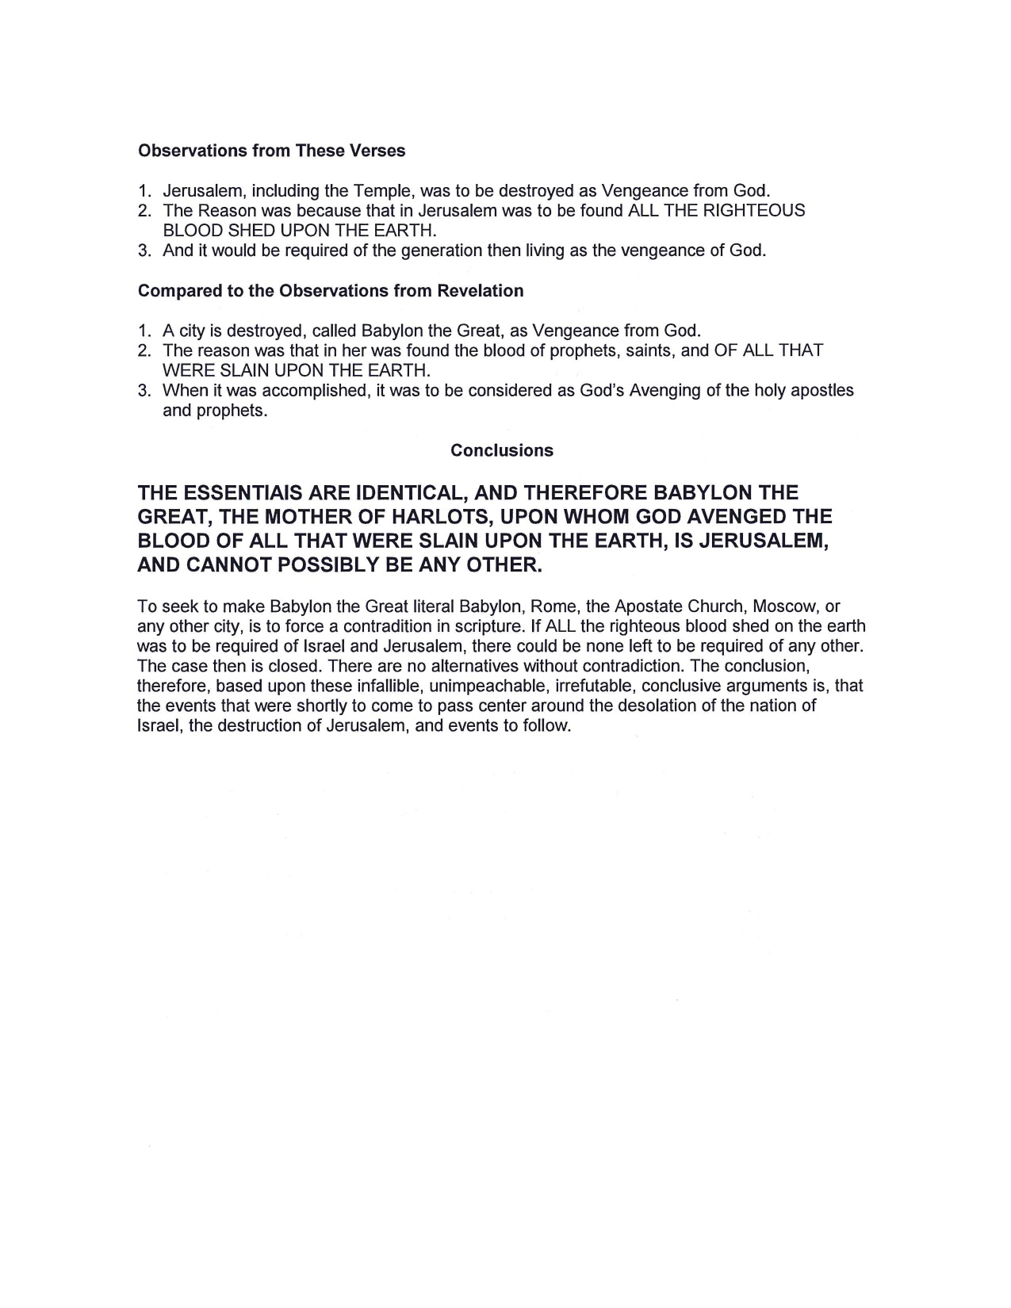

Slide 79
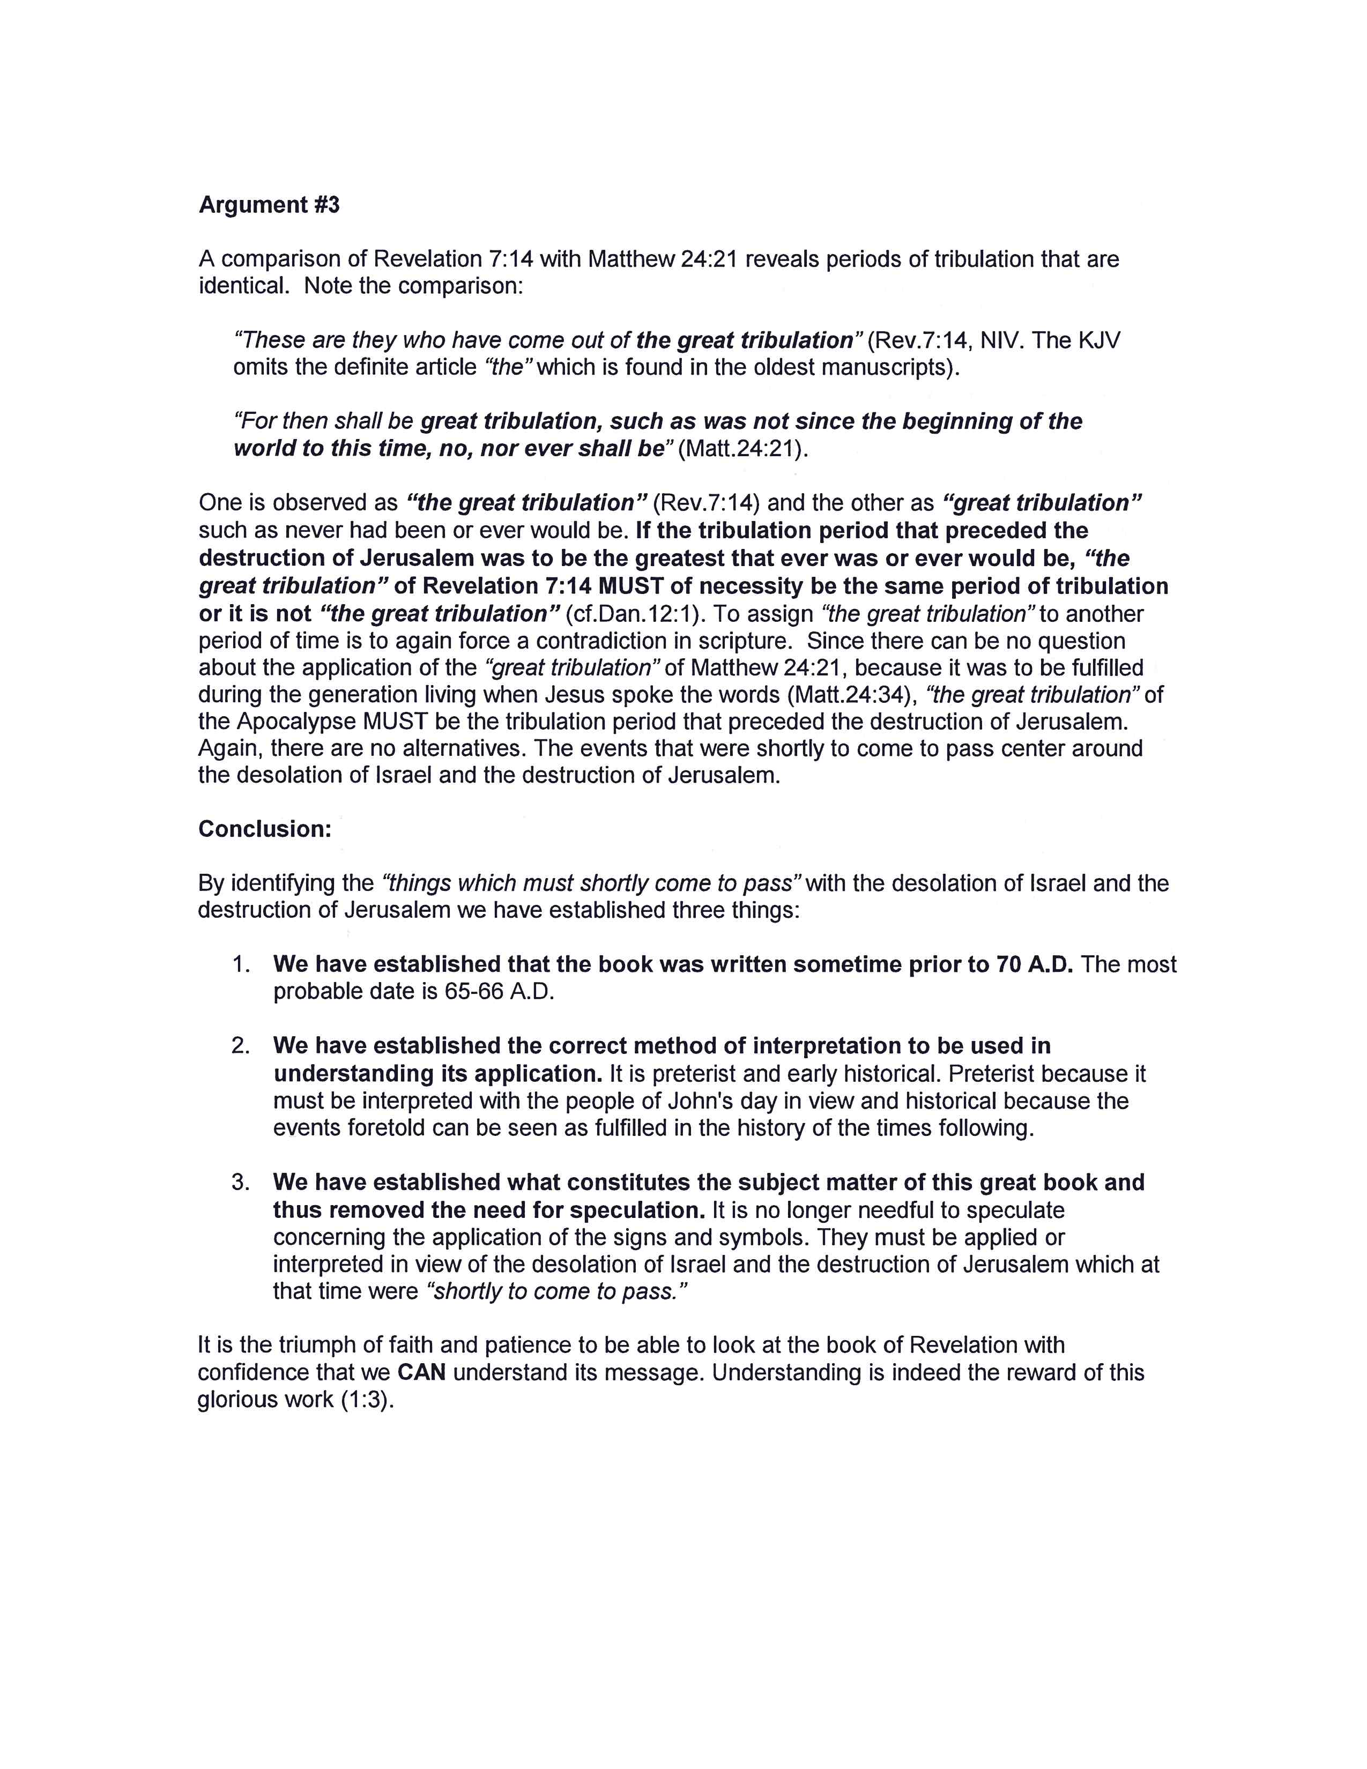

Slide 80
Four Divisions of the Book
1st Chapters 1-3 | 2nd Chapters 4-11 | 3rd Chapters 12-20 | 4th Chapters 21-22
CHRIST AMONG THE CHURCHES | The HEAVENLY APOCALYPSE | THE EARTHLY APOCALYPSE | THE NEW JERUSALEM
The clues to the understanding of the subject matter revealed in Revelation are found in the two middle sections, chapters 4-20. These clues may be divided into two parts: (1) those which reveal the primary and (2) secondary subject matter. Study the following passages in the Apocalypse which establish the primary subject
under consideration.

Slide 81
THE HEAVENLY APOCALYPSE Chapters 4-11
THE SEVEN SEALS Chapters 6-11
6:1-2 1ST ^{W} ^{H} ^{I} ^{T} ^{E} ^{H} ^{O} ^{R} ^{S} ^{E} | 6:3-4 2ND R E D H O R S E | 6:5-6 3RD B L A C K H O R S E | 6:7-8 4TH P A L E H O R S E | 6:9-11 5th S O U L S U N D E R A L T A R | 6:12-17 6TH G R E A T E A R T H Q U A K E | CHAPTER 7:1-17 Interlude Between 6th & 7th Seals 144,000 Sealed The Innumerable Multitude
The Throne of God
Chapter
4:1-11
O.T.
THRONE
SCENE
Chapter
5:1-14
N.T.
THRONE
SCENE

Slide 82
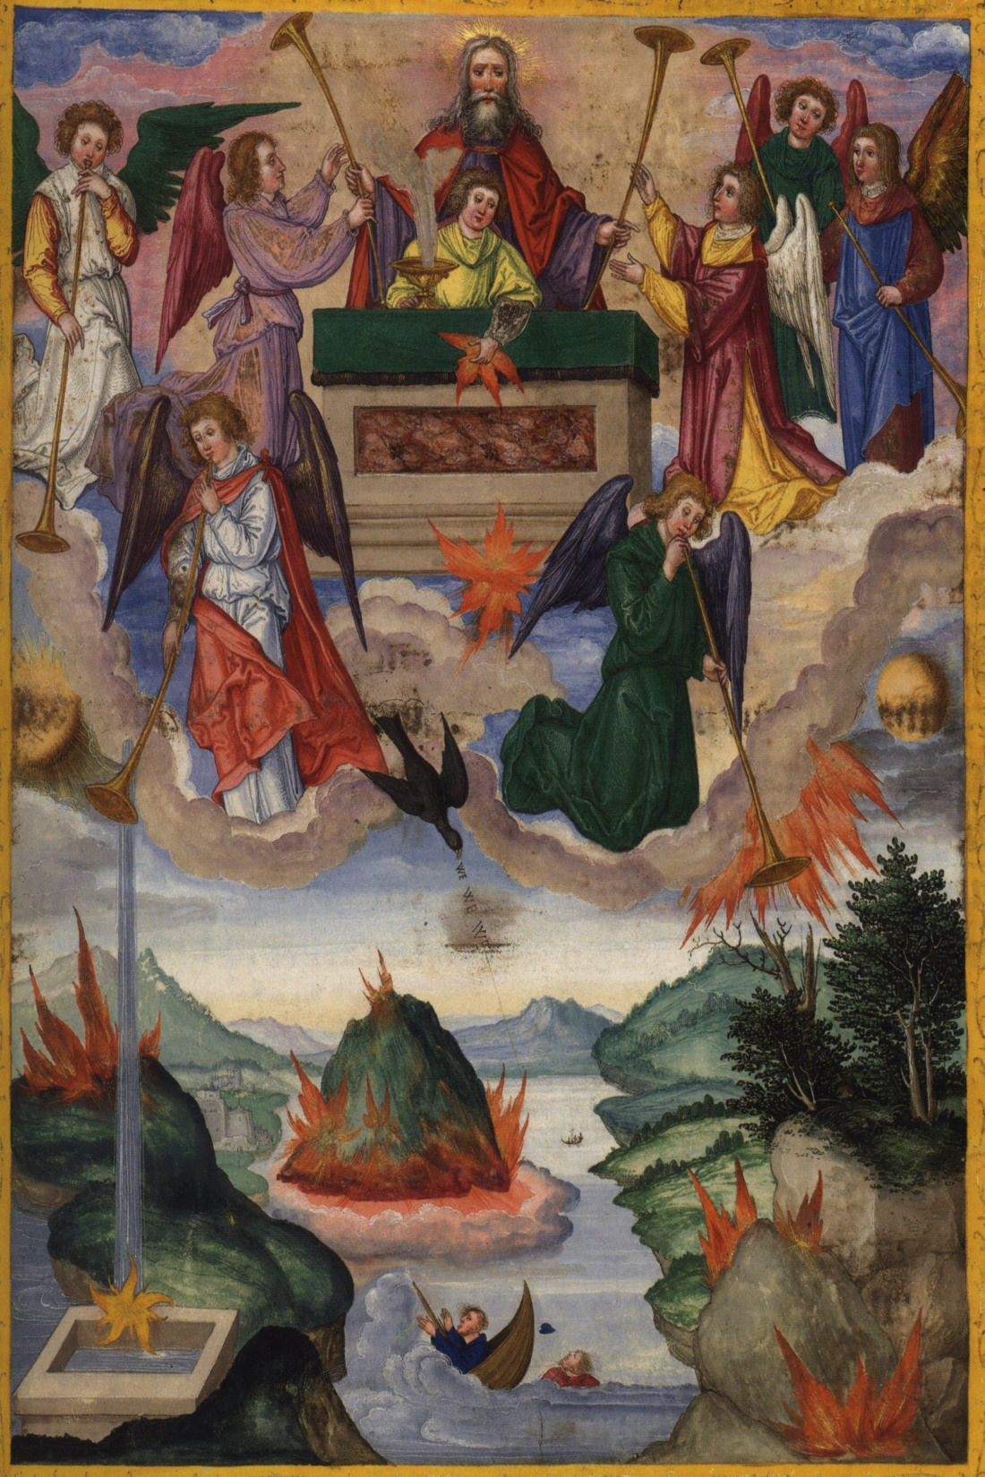
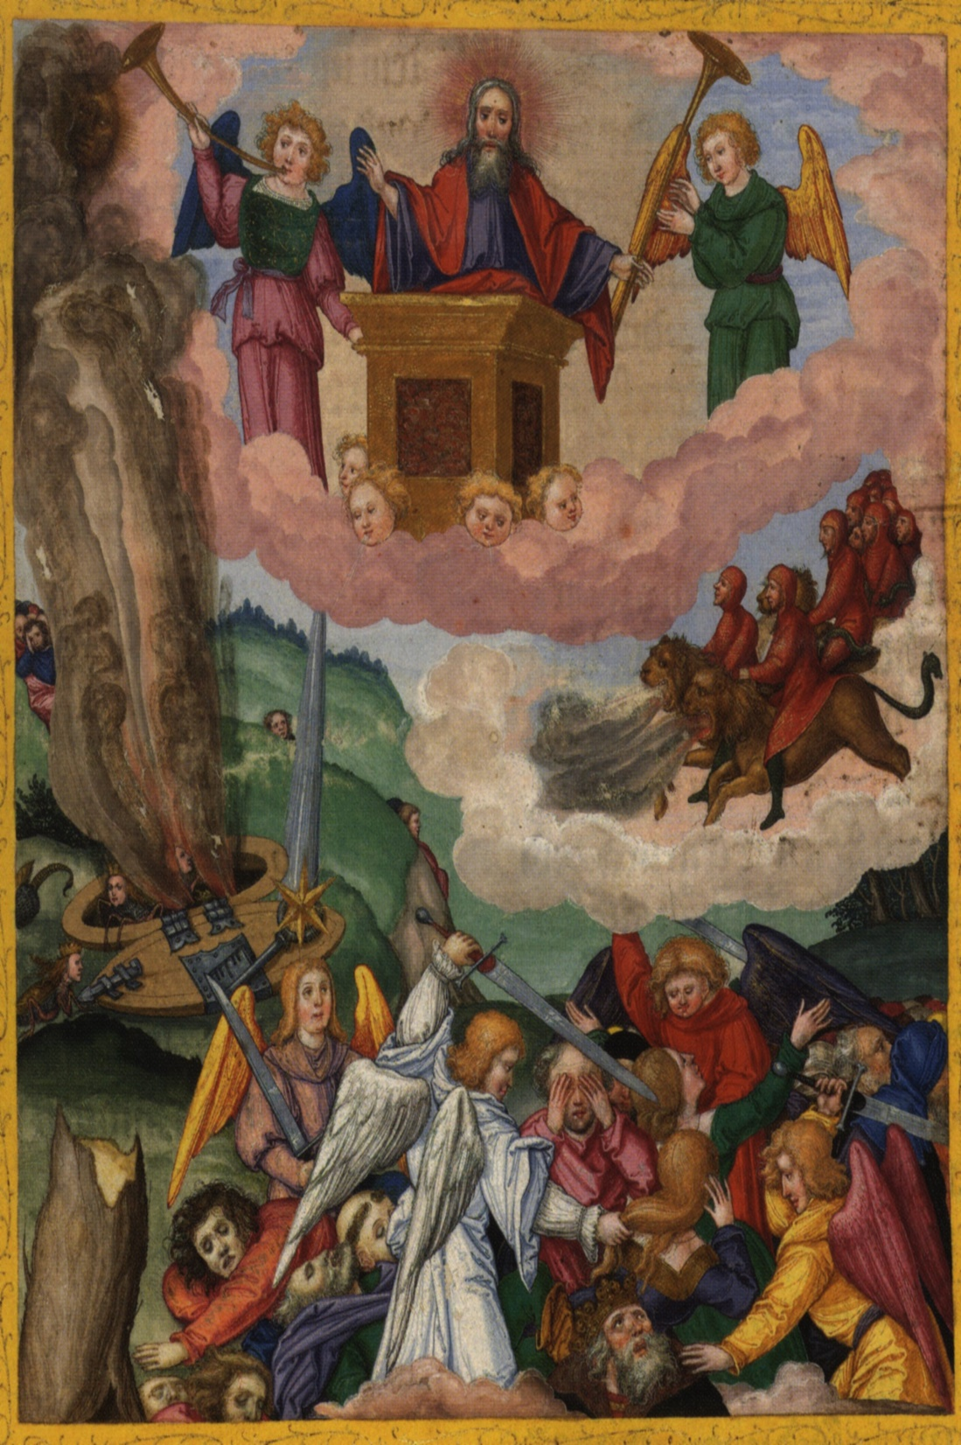

Slide 83
THE EARTHLY APOCALYPSE Chapters 12 - 20
12:1-17 The Underlying Conflict Between Christ & Satan Over Sin Is Developed | 13:1-18 SATAN’S HELPERS INTRODUCED THE ROMAN EMPIRE & PAGAN RELIGIONS THAT SERVED THE EMPIRE | 14:1-13 The LAMB WITH 144,000 INTRODUCED CHRISTIANITY’S THREE MESSAGES: The Gospel The Fall of Babylon Warning Against Worshiping the Empire | 14:14-16 THE REAPING OF THE GOOD HARVEST 14:17-20 THE REAPING OF THE VINE OF EARTH | 15:1-8 Victorious saints rejoice as the seven angels with the seven bowls of wrath are sent from God 1st 16:1-2 Earth 2nd 16:3 Sea 3rd 16:4-7 Rivers 4th 16:8-9 Sun 5th 16:10-11 Rome 6th 16:12-16 Euphrates 7th 16:17-21 Air
The Foes In This Conflict Introduced
The 7 Last Plagues or Bowls of Wrath Upon Babylon

Slide 84
CONTENT
John’s Commission
“WRITE THE THINGS WHICH THOU HAST SEEN, AND THE THINGS WHICH ARE, AND THE THINGS WHICH SHALL BE HEREAFTER” (1:19)
Past “hast seen” | Present “Things which are” | Future “shall be hereafter” (Ch.4:1)

Slide 85
Future Events (4:1) “things which shall be hereafter”
IMMEDIATE “shortly come to pass” PRIMARY EVENTS Chapters 4-19:10
PROJECTED
SECONDARY EVENTS
THE END
20:7-15
EARLY CENTURIES
19:11 – 20:6

Slide 86
Seven Angled Panoramic

Slide 87
Coded Biblical Numerology

Slide 88
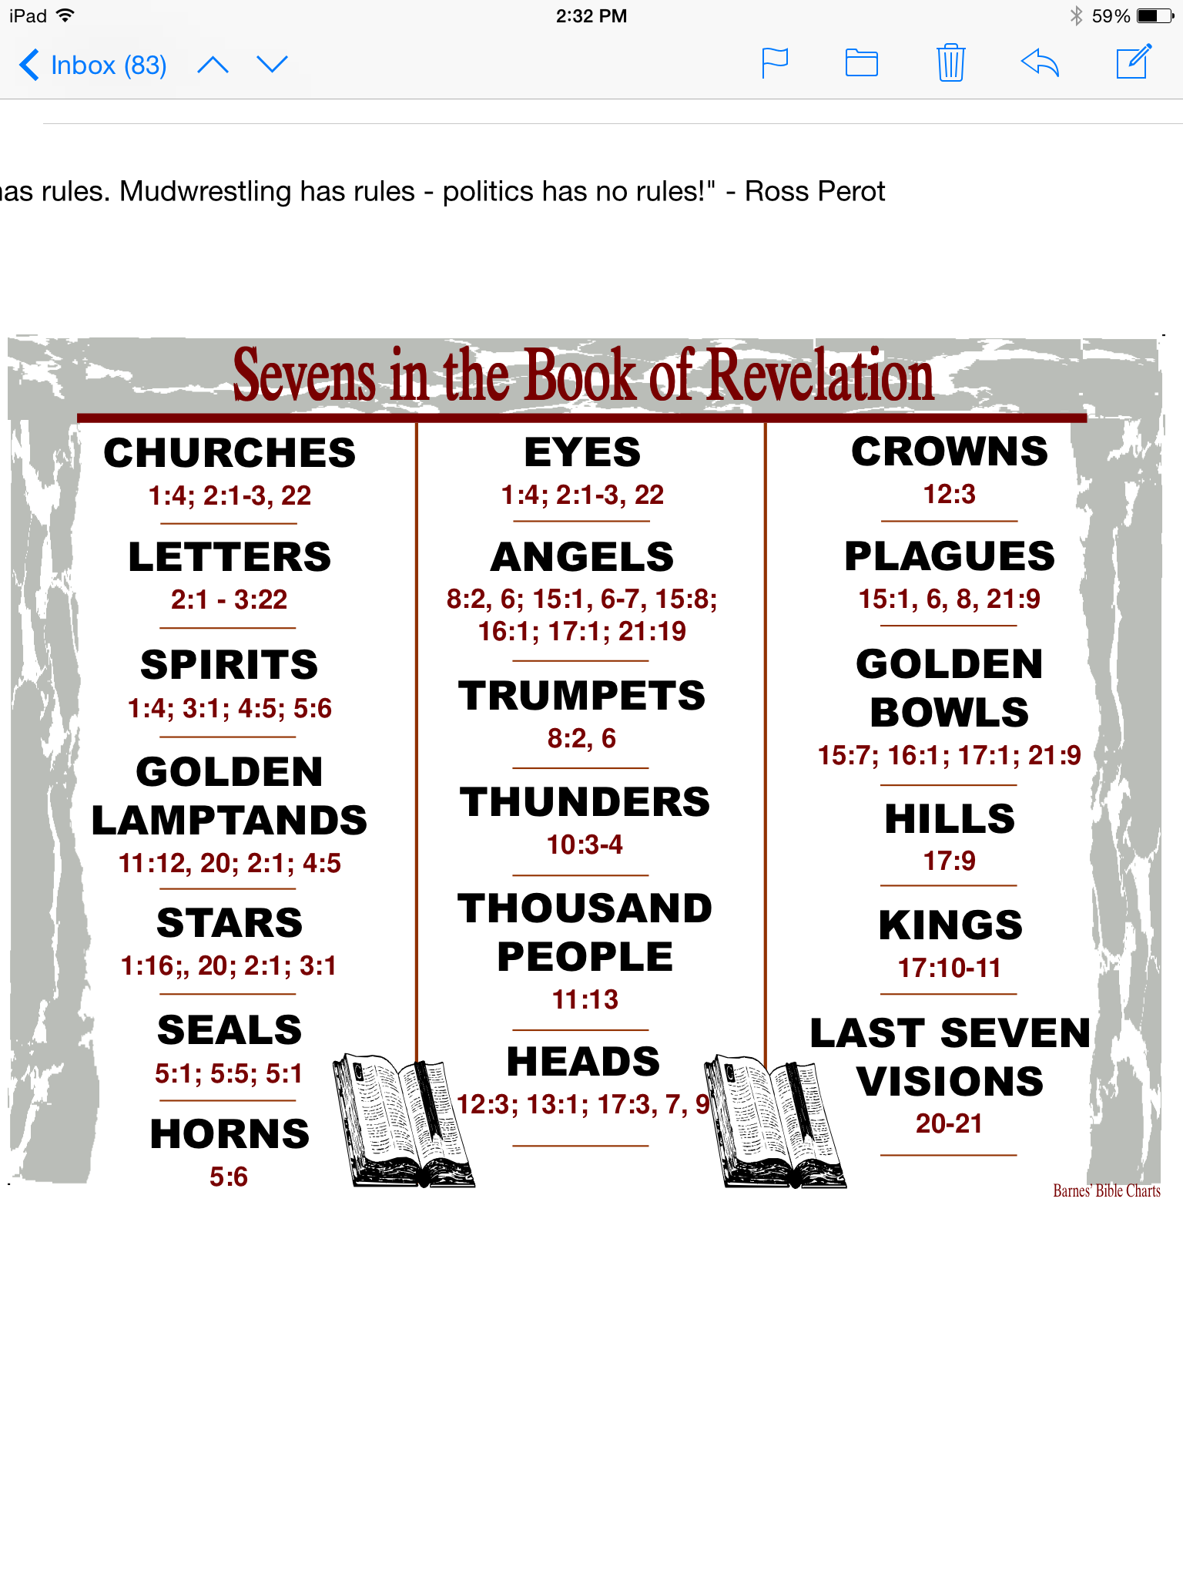

Slide 89
Seven symbolizes God's completed work
7 occurs …
more in Revelation than the rest of the NT
more in Revelation than in any OT book
7 symbolizes God finishing his work
Gen 2:1-3 WEB … On the seventh day God finished his work … and he rested on the seventh day ...

Slide 90
Revelation begins with a letter to 7 churches.
Rev 1:4 WEB John, to the seven assemblies ...
Rev 1:11 WEB ... “What you see, write in a book and send to the seven assemblies …”
Rev 1:20 WEB ... The seven lampstands are seven assemblies.
Ekklesiai is “churches” in other translations

Slide 91
The first vision features two sevens
The son of man is among 7 lampstands
Rev 1:20 WEB ... The seven lampstands are seven assemblies.
He is holding 7 stars
Rev 1:20 WEB ... The seven stars are the angels of the seven assemblies...

Slide 92
Before God's throne were 7 lamps
Rev 4:5 WEB ... There were seven lamps of fire burning before his throne, which are the seven Spirits of God.
These are seen elsewhere
Rev 1:4 WEB ... Grace to you and peace ... from the seven Spirits who are before his throne

Slide 93
A 7-sealed scroll was opened by a Lamb with 7 horns and 7 eyes
Rev 5:1-6 WEB I saw, in the right hand of him who sat on the throne, a book written inside and outside, sealed shut with seven seals … (6) I saw … a Lamb standing, as though it had been slain, having seven horns, and seven eyes …

Slide 94
God's judgments were announced by 7 angels with 7 trumpets.
Rev 8:2-6 WEB I saw the seven angels who stand before God, and seven trumpets were given to them … (6) The seven angels who had the seven trumpets prepared themselves to sound.

Slide 95
The dragon and sea beast each had 7 heads & the dragon had 7 crowns.
Rev 12:3 WEB … Behold, a great red dragon, having seven heads and ten horns, and … seven crowns.
Rev 13:1 WEB … I saw a beast coming up out of the sea, having ten horns and seven heads....

Slide 96
The prostitute in Rev 17 sits on a beast with 7 heads.
Rev 17:3 WEB ... I saw a woman sitting on a scarlet-colored animal … having seven heads and ten horns.
The heads correspond to 7 hills and 7 kings.
Rev 17:9-10 WEB … The seven heads are seven mountains, on which the woman sits. They are seven kings …

Slide 97
7 angels administer God's judgments
Rev 15:1 WEB I saw … seven angels having the seven last plagues, for in them God's wrath is finished.
Rev 15:6-8 WEB … One of the four living creatures gave to the seven angels seven golden bowls full of the wrath of God...

Slide 98
7 bowls of wrath were poured out on the earth.
Rev 16:1 WEB I heard a loud voice out of the temple, saying to the seven angels, “Go and pour out the seven bowls of the wrath of God on the earth!”

Slide 99
Seven beatitudes in Revelation
Rev 1:3 WEB Blessed is he who reads … those who hear … and keep the things that are written in it ...
Rev 14:13 WEB Blessed are the dead who die in the Lord from now on …
Rev 16:15 WEB “… Blessed is he who watches…”
Rev 19:9 WEB Blessed are those who are invited to the marriage supper of the Lamb.
Rev 20:6 WEB Blessed and holy is he who has part in the first resurrection ...
Rev 22:7 WEB Blessed is he who keeps the words of the prophecy of this book.
Rev 22:14 WEB Blessed are those who do his commandments …

Slide 100
Seven “I Am” sayings in Revelation
Rev 1:8 WEB “I am the Alpha and the Omega”
Rev 1:17-18 WEB “… I am the first and the last and the Living one. I was dead, and behold, I am alive forevermore...
Rev 2:23 WEB … I am he who searches the minds and hearts...
Rev 21:6 WEB “… I am the Alpha and the Omega, the Beginning and the End ...
Rev 22:13 WEB I am the Alpha and the Omega, the First and the Last, the Beginning and the End.
Rev 22:16 WEB … I am the root and the offspring of David; the Bright and Morning Star.

Slide 101
More Sevens in the Book of Revelation
7 kinds of men hide from God’s judgment
Rev 6:15-17 WEB The kings of the earth, the princes, the commanding officers, the rich, the strong, and every slave and free person, hid themselves in the caves and in the rocks of the mountains …
7 things the Lamb is worthy to receive
Rev 5:12 WEB ... “Worthy is the Lamb … to receive the power, wealth, wisdom, strength, honor, glory, and blessing!”
7 aspects of worship toward God
Rev 7:11-12 WEB All the angels … fell on their faces … and worshiped God … “Amen! Blessing, glory, wisdom, thanksgiving, honor, power, and might, be to our God forever and ever! Amen.”
7 represents that God will accomplish his purpose

Slide 102
revelation Lampstands

Slide 104
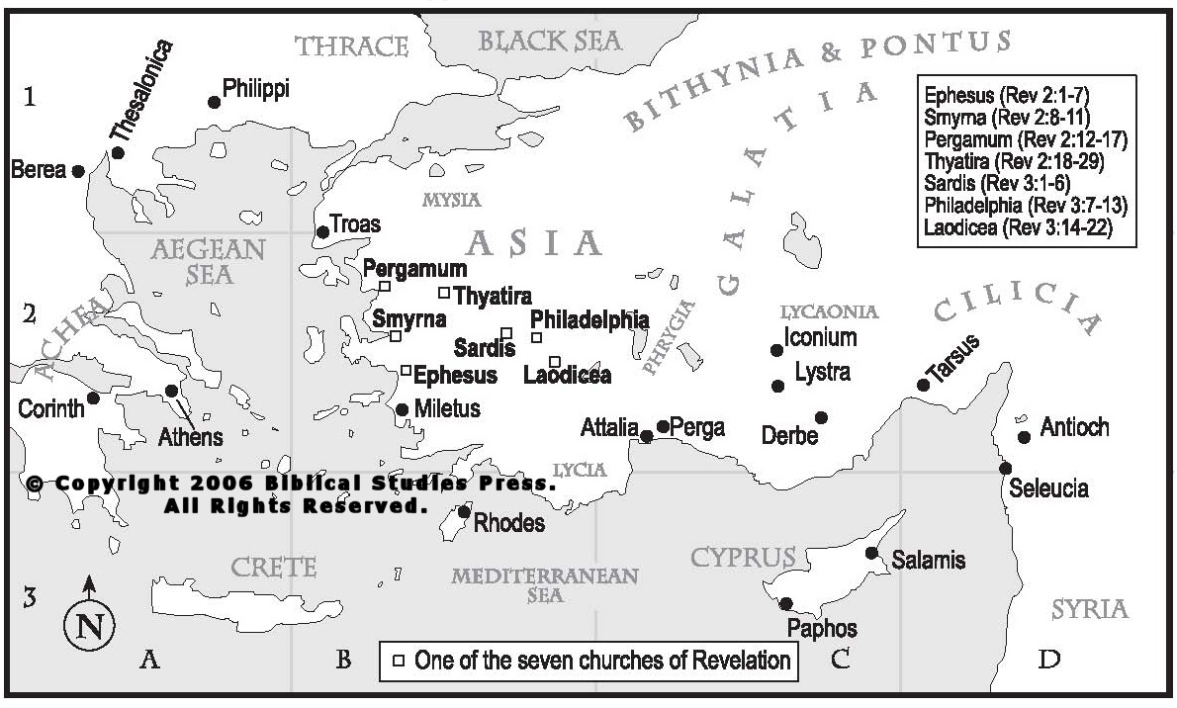

Slide 105
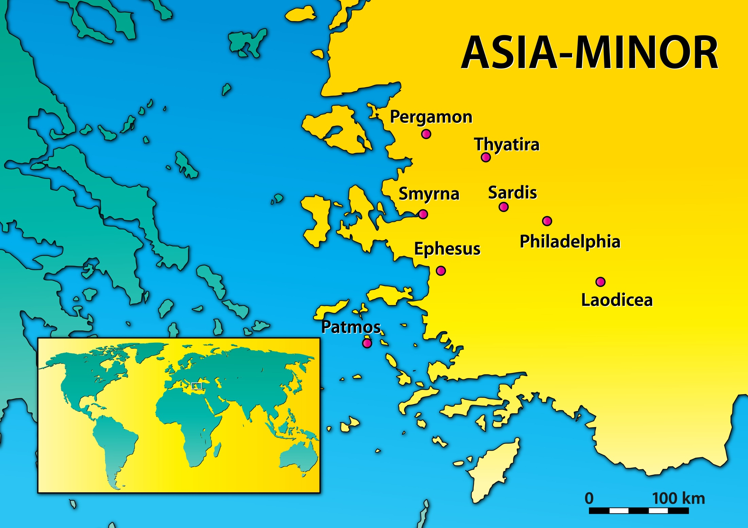
Order of Letter Sequence
The Salutation – Christ Identification Commendation – “I know your works”
Condemnation – “I know your works”
Counsel – Admonishing & Exhorting
Promise – “To him who overcomes…”

Slide 106
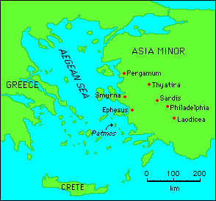
The Seven Churches of Asia
Notes:
Introduction: This presentation is to serve as an overview of the seven churches mentioned in Revelation chapters two and three.

Slide 107
The Seven Churches of Asia
“The letters to the seven churches are a distinct unit of seven within the book of Revelation. Other sevenfold units are the seven seals, the seven trumpets and the seven bowls of God's wrath. Because the number seven denotes divine completeness as a whole the seven letters form a whole unit which has a message to the church universal; there are more than seven churches in Asia, for example Colossi has been omitted. In 1:11 John is commanded to 'write on a scroll what you see and send it to the seven churches: to Ephesus, Smyrna, Pergamum, Thyatira, Sardis, Philadelphia and Laodicea‘….”

Slide 108
The Seven Churches of Asia
“…In verse 13 we see Christ among the lampstands, that is the seven churches, and in the letters we find out what he observed as he walks among the seven churches (2:1). Our Lord is one who walks among the churches and sees their deeds both good and bad. The seven churches represent the different imperfections that are likely to be found in individual churches in different localities and at different times. The churches give us a template against which we can measure our church in order to see our weaknesses and strengths, he also gives us the remedy for our deficiencies.”

Slide 109
The Seven Churches of Asia
Letters have a sevenfold pattern:
A greeting. “To the angel of the church” (cp. 2: 1).
A reference to Christ's self designation from Rev. 1:12-19.
A commendation. “I know your deeds...” (except in case of Smyrna and Pergamum, cp. 2: 2).
4. A rebuke if applicable (except in case of Smyrna and Philadelphia).
5. A charge to repent or a warning (cp. 2: 5).
6. A call to hear (2: 7).
7. A promise. The phrase “To him who overcomes” (cp. 2: 7).

Slide 110
The Seven Churches of Asia
Rewards for overcoming:
Will eat of the tree of life watered by the river of life whose source is Christ (2: 7).
Will receive the hidden manna (2: 17).
Will share in Christ's authority over the nations (2: 26).
Will walk with Christ dressed in white (3: 4).
Will write on him my new name (3: 12).
Will sit with Christ on his throne (3: 21).

Slide 111
The Seven Churches of Asia
Summary of conditions:
Commended with nothing against:
Smyrna: Materially poor but spiritually rich, enduring
affliction, slandered and persecuted.
Philadelphia: Open door, little strength, kept his word,
had not denied his name, endured patiently.

Slide 112
The Seven Churches of Asia
Summary of conditions:
2. Commended but with things against.
Ephesus: Hard work, perseverance, have not grown weary, cannot tolerate wicked men but had lost their love.
Pergamum: Live where Satan has his throne, Antipas was martyred, remain true to his name did not renounce their faith, but some hold to teaching of Balaam.
Thyatira: Have growing love and faith but tolerate the false teaching of Jezebel.

Slide 113
The Seven Churches of Asia
Summary of conditions:
3. Nothing to commend.
Sardis: Reputation of being alive but spiritually dead. Wake-up.
Laodicea: Lukewarm, materially rich but spiritually poor, blind and naked. About to be spewed out.

Slide 114
The Seven Churches of Asia
To which church may we be compared and what do we need to do in insure that we retain our lampstand as a church?
Conclusion:

Slide 115
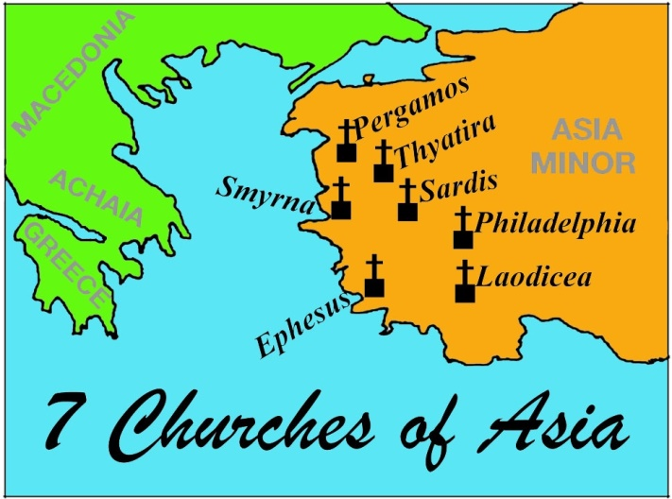
A Judgment Divinely Sanctioned: Christ center Of Congregation Lampstands

Slide 116
1st Six Seals Represent Revelation 1:19 Points Past - Present -Future

Slide 117
Short Study of Pre-Interlude Seals
The 1st Seal – Represents the development of the kingdom as foretold by Daniel through which the holy people (Israel) would be destroyed and scattered (Daniel 7, 8, 9, 12). The Roman Empire was the kingdom by which these things were accomplished. Daniel pictures the transformation from the Roman Republic to the Empire through the Caesars (Daniel 7).
The 2nd Seal – This horse and rider represent bloodshed & the Red Army of Rome which marched through the world killing foes and subduing nations.
The 3rd Seal – The rider’s scales represent indicate food shortage along with high prices for the little that was available. The Romans had the ability to create these conditions - besieging cities - cutting off incoming supplies. Such was the end to which Jerusalem came. The cry to ‘spare the oil and wine’ was designed to guarantee continued daily sacrifices in the temple.
The 4th Seal – The rider was named death to symbolize the powers by which death came to the Jews – sword, starvation, war plague, and theatre beasts.
The 5th Seal – The martyred under the altar are Old Testament worshipers.
The 6th Seal – References first question Jesus answered in Matthew 24 about those events preceding destruction of the religious capitol & O.T. Temple.

Slide 118
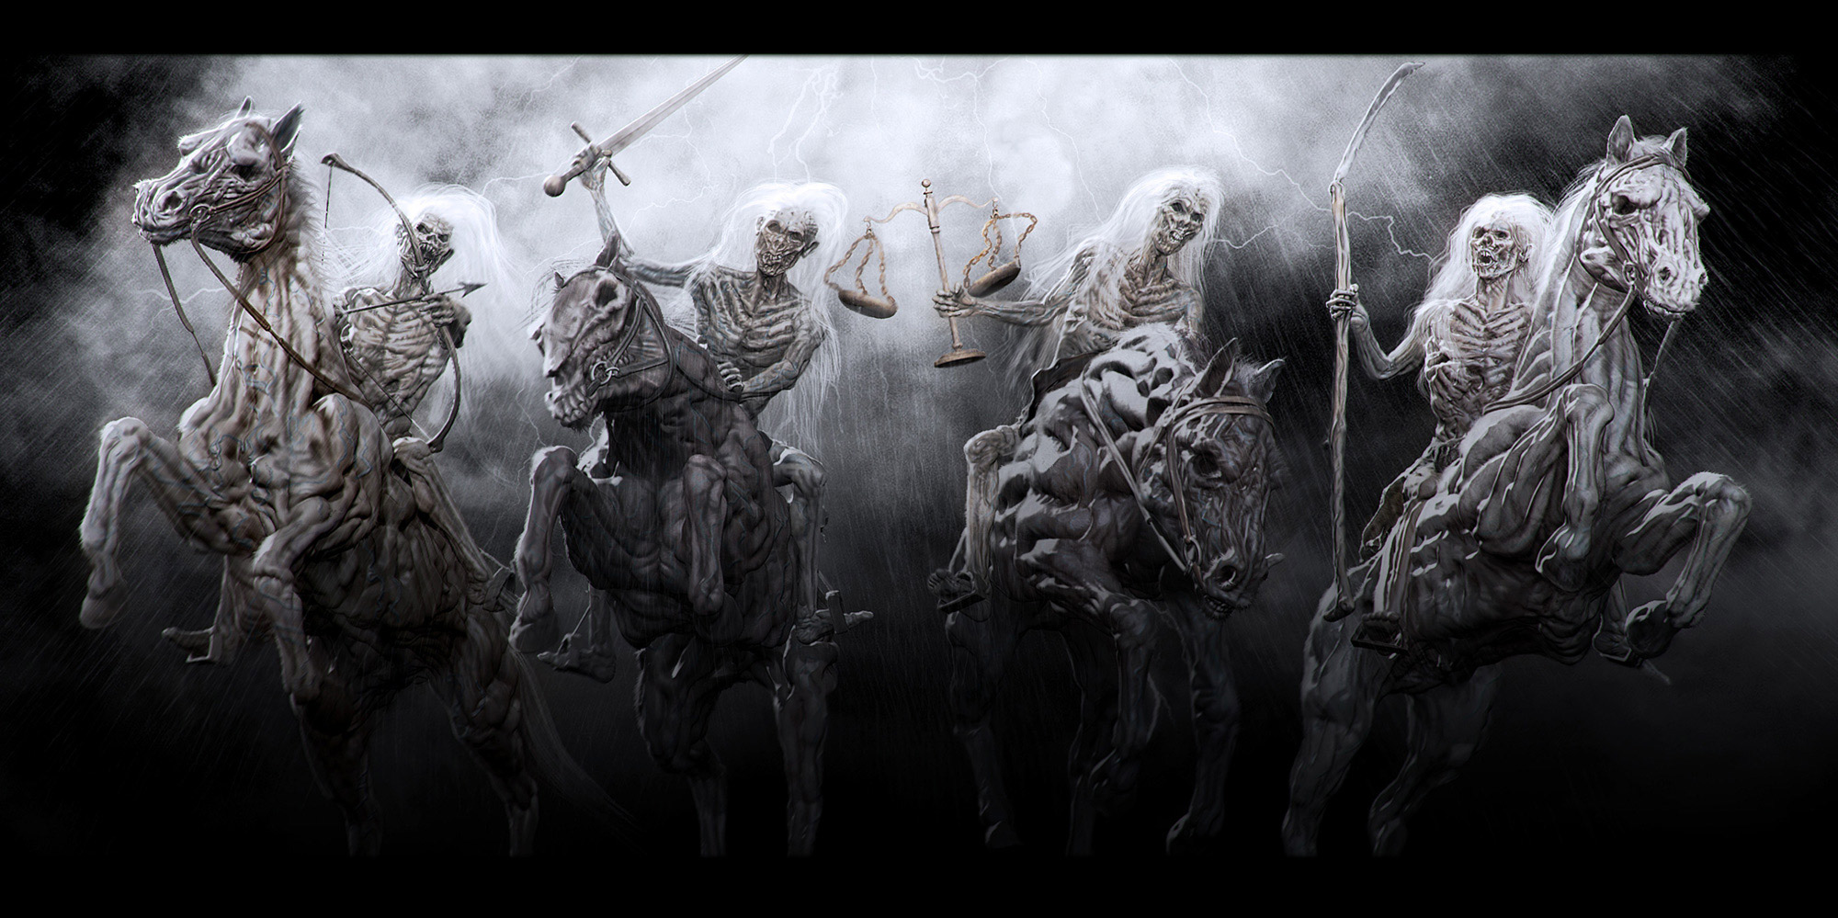
Beyond Malthus
WORLD HISTORY
60 AD | The Lycus valley and cities of Pergamum, Laodicea, and Collosse destroyed by earthquakes. ~ Tacitus, Annals, XIV, Xxvii
 | On the 5th of February, 63, the city of Pompeii was nearly engulfed by an earthquake. In 79 it would be completely buried by Vesuvius. ~ Tacitus, Annals, XV, xxii; Josephus, Ant., XX, vii, 2.
68 AD | A sudden eruption of the sea inundated Lycia, a port city in Turkey. ~ Dio Cassius, LXIII, xvii; Renen, Le Antichrist, IV, clxv
69 AD | Leading citizens ruined; whole communities devastated, providing for Vitellius’ banquets and sixty thousand soldiers in route to Rome. ~ Tacitus, Histories, II, lxii; lxxxvii
WORLD HISTORY
JERUSALEM IS DESTROYED BY THE ROMANS IN A.D. 70!

Slide 119
revelation The Throne Book & Lamb

Slide 120
THE THRONE ROOM OF GOD.
At the beginning of chapter four, John makes a visionary journey through heaven’s open door. John sees a majestic throne room, arranged in concentric circles. At the center of the vision is the throne of God.
The next circle is composed of four mysterious creatures surrounding the throne. Their faces resemble - lion, ox, human, and eagle. All of them have six wings and are covered with eyes.
This is a vision revealing the character of God and His throne. God is omniscient, omnipotent, omnipresent, righteous, eternal, holy, and just. The Almighty is also resolute, fierce, consuming. God must be both feared and reverenced.

Slide 121
THE THRONE ROOM OF GOD.
Here, John is giving us a vision of a rightly ordered universe, centered by the Creator.
At the beginning of chapter four, John makes a visionary journey through the open door of heaven. There, he sees a majestic throne room, arranged in concentric circles. At the center of the vision is the throne of God.
The next circle consists of 24 elders, their own thrones encircling that of God. Elder is and was terminology in Jewish and Christian communities that designated those servant leaders types that led by their wise counsel.

Slide 122
THE THRONE ROOM OF GOD.
The next circle consists of 24 elders, their own thrones encircling that of God. Elder is and was terminology in Jewish and Christian communities that designated those servant leader types that led by their wise counsel.
The elders in Revelation cast down their crowns before God, providing an example of true worship. The gesture of giving a golden crown to a figure on a throne did not come from the Hebrew prophets but from the political world of the Greeks and Romans.

Slide 123
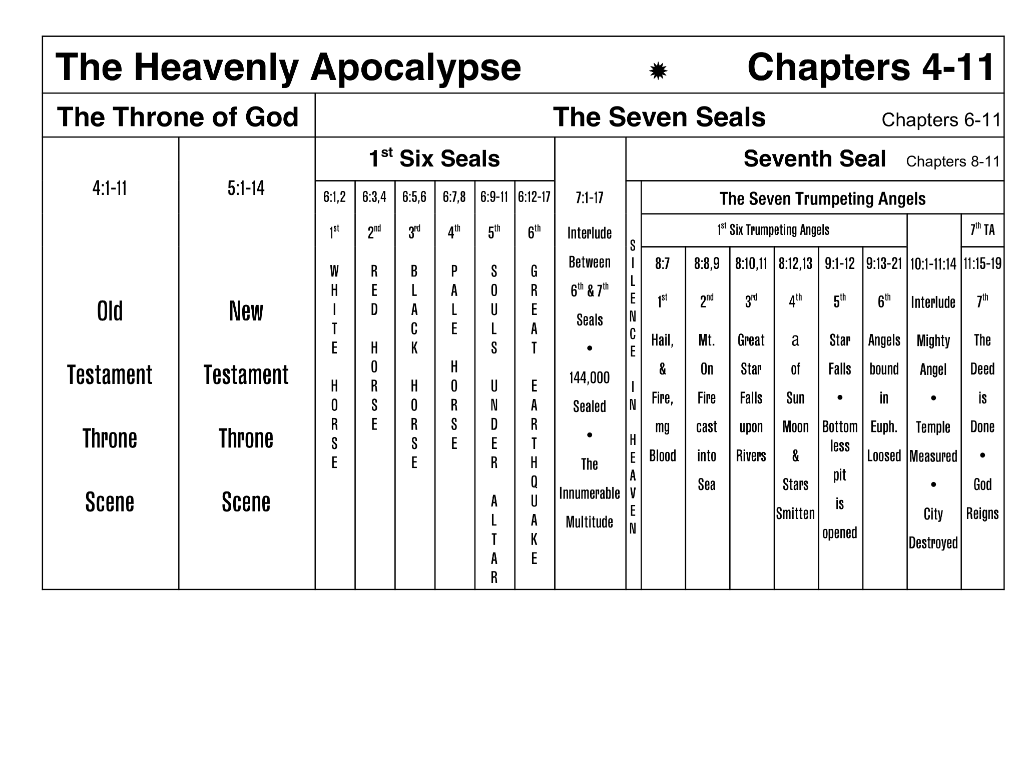
Throne Search for Only One Worthy To Open This Book
WORTHY IS THE LAMB!

