Slide 1
JOEL’S PROPHECY INTRODUCES THE Prophetic Book OF REVELATION: joel chapter two: Verses 28-32
By David Lee Burris

Slide 2
Joel’s Prophecy Of Double Application
THE mINOR Prophets
Joel’s Jerusalem Prophecy
Matthew’s olivet discourse
Book of Revelation Overview
Seven Churches of asia-minor
The Throne-The Book-The Lamb

Slide 3
The Prophet Joel Predicts

Slide 20
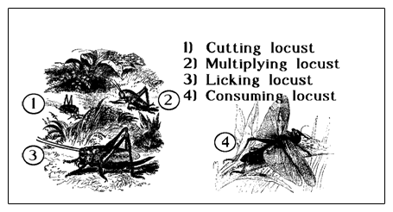

Slide 34
UNDERSTANDING JOEL’S PROPHECYas INTRO-TO-intro-to THE NEW TESTAMENT BOOK OF REVELATION

Slide 36
UNDERSTANDING REVELATION…
By - Understanding Joel’s Prophecy

Slide 39
Joel 2:28 ¶ And it shall come to pass afterward, that I will pour out my spirit upon all flesh; and your sons and your daughters shall prophesy, your old men shall dream dreams, your young men shall see visions: 29 And also upon the servants and upon the handmaids in those days will I pour out my spirit. 30 And I will shew wonders in the heavens and in the earth, blood, and fire, and pillars of smoke. 31 The sun shall be turned into darkness, and the moon into blood, before the great and the terrible day of the LORD come. 32 And it shall come to pass, that whosoever shall call on the name of the LORD shall be delivered: for in mount Zion and in Jerusalem shall be deliverance, as the LORD hath said, and in the remnant whom the LORD shall call.

Slide 40
Introduction:
Joel’s prophecy is the key to understanding what the new Testament teaches about the Holy Spirit and understanding about the Holy Spirit’s work is a key to understanding Revelation.
Due to the failure of the religious world to understand the purpose of the miraculous operation of the Holy Spirit, multiplied errors have develop around the subject.
The religious world makes no distinction between the miraculous operation of the Spirit and the Spirit working through the Word.

Slide 41
The miraculous operations of the Spirit are commonly applied to sinner and saint without any reference to the purpose and the temporary nature of these miraculous gifts.
While we have recognized, to some degree, the purpose of miraculous gifts and their duration, we have, at the same time, taken passages that deal with the miraculous and ignored the background, the context, and read into these passages a direct, but non-miraculous, operation.
This is what has caused the confusion we’re having today.

Slide 42
When passages that have to do with miraculous operation are interpreted to mean a non-miraculous indwelling, it results in a situation that none can explain.
It necessitates an operation apart from the Word.
Passages are quoted to sustain this position, but if called upon to explain how this operation works, no answer can be given.
Since miracles have ceased, no man can establish when this non-miraculous indwelling works.

Slide 43
But if it does something in addition to the Word, then people are searching for it, and the only thing left to rely on are feelings, moods, experiences, and similar things.
Feelings as evidence allow every man to decide how, what, and where the Spirit leads.
In spite of what its adherents say about the Spirit not leading contrary to the Word, the theory does not work out that way.

Slide 44
Joel’s prophecy is a summary of the miraculous operation of the Spirit by which the gospel was given and confirmed.
Joel’s prophecy is never out of sight when reference is made to the Holy Spirit in the New Testament.
There are two reasons that Joel’s prophecy is not understood:

Slide 45
Denominational people think Joel indicates that a direct and miraculous operation of the Spirit would continue after revelation was completed and confirmed. They miss the entire meaning and purpose of the prophecy and its fulfillment.
A second reason that Joel's prophecy is not understood, is that some in the church conclude that if it is allowed its full meaning, then miracles will have to continue today.
In an attempt to avoid what they think is a difficulty, passages are read and explained without any reference to Joel’s prophecy.

Slide 46
JOEL’S PROPHECY LIMITS THE BEGINNING AND THE END OF THE DIRECT MIRACULOUS OPERATION OF THE SPIRIT.
Joel’s prophecy is among the first of the prophets.
Some think that he may be the earliest.
Thus, his prophecy becomes the key to understanding what he other prophets say about the Spirit in the Christian Age.
There is no such thing as a prophecy of a non-miraculous, personal indwelling in the Old Testament.

Slide 47
Any prophet that refers to the Spirit and points to the Christian Age has reference to the same thing as Joel.
When one reads the other prophets and sees the non-miraculous, personal indwelling, he is simply reading into the prophets what is not there.
Acts 2 gives the beginning of the fulfillment of Joel’s prophecy: Acts 2:16 But this is that which was spoken by the prophet Joel.
There is no argument about its beginning.
Does Joel also indicate the ending of miraculous operation of the Spirit?

Slide 49
I think so.
The prophecy of Joel involves not only Pentecost, but also the fall of Jerusalem in A.D. 70; thus, his prophecy is placed between these two events.
I am conscious of the questions that will be raised by this statement, but let us weigh the evidence and see if there is proof to sustain the proposition.

Slide 51
Note that Jesus in discussing the destruction of Jerusalem quotes the language in Joel 2:30-31.
Joel 2:30 And I will shew wonders in the heavens and in the earth, blood, and fire, and pillars of smoke. 31 The sun shall be turned into darkness, and the moon into blood, before the great and the terrible day of the LORD come. 32 And it shall come to pass, that whosoever shall call on the name of the LORD shall be delivered: for in mount Zion and in Jerusalem shall be deliverance, as the LORD hath said, and in the remnant whom the LORD shall call.
Mt 24:29 Immediately after the tribulation of those days shall the sun be darkened, and the moon shall not give her light, and the stars shall fall from heaven, and the powers of the heavens shall be shaken:

Slide 52
Again In Marks account of Jesus and the end of Jerusalem.
Joel 2:30 And I will shew wonders in the heavens and in the earth, blood, and fire, and pillars of smoke. 31 The sun shall be turned into darkness, and the moon into blood, before the great and the terrible day of the LORD come. 32 And it shall come to pass, that whosoever shall call on the name of the LORD shall be delivered: for in mount Zion and in Jerusalem shall be deliverance, as the LORD hath said, and in the remnant whom the LORD shall call.
Mr 13:24 ¶ But in those days, after that tribulation, the sun shall be darkened, and the moon shall not give her light, 25 And the stars of heaven shall fall, and the powers that are in heaven shall be shaken.

Slide 54
Joel 2:30 And I will shew wonders in the heavens and in the earth, blood, and fire, and pillars of smoke. 31 The sun shall be turned into darkness, and the moon into blood, before the great and the terrible day of the LORD come. 32 And it shall come to pass, that whosoever shall call on the name of the LORD shall be delivered: for in mount Zion and in Jerusalem shall be deliverance, as the LORD hath said, and in the remnant whom the LORD shall call.
Luke 21:11 And great earthquakes shall be in divers places, and famines, and pestilences; and fearful sights and great signs shall there be from heaven.
The Quotation of these verses by Christ in Matthew 24:29, Mark 13:24 & Luke 21 is proof that Joel’s prophecy of the coming of the Holy Spirit also included the fall of Jerusalem.

Slide 55
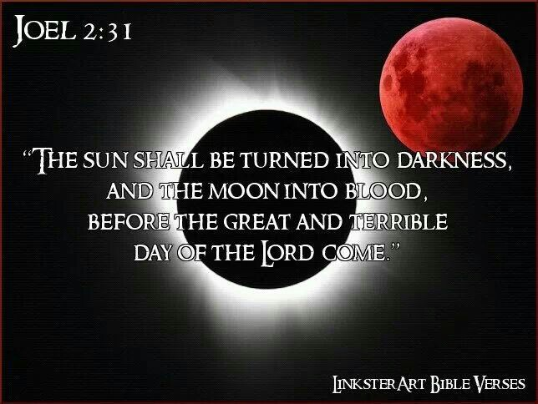

Slide 56
Matthew wrote especially for the Jews.
Mt 3:10 And now also the axe is laid unto the root of the trees: therefore every tree which bringeth not forth good fruit is hewn down, and cast into the fire. 11 I indeed baptize you with water unto repentance: but he that cometh after me is mightier than I, whose shoes I am not worthy to bear: he shall baptize you with the Holy Ghost, and with fire: 12 Whose fan is in his hand, and he will throughly purge his floor, and gather his wheat into the garner; but he will burn up chaff with unquenchable fire.
Verse 10 is a direct reference to the destruction of Jerusalem which happened in 70 AD.
Verse 11 points to Pentecost (Acts 2) “baptize you with…” Jews to be given 40 years as individuals to Repent.
Verse 12 passes into the final and eternal judgment.

Slide 58
JERUSALEM’S FALL PROPHESIED EARLY IN THE OLD TESTAMENT
The Old Testament points to the destruction of the City of Jerusalem.
It is referred to in several of the prophets: Zechariah 14; Malachi 3 & 4; as well as Joel and Daniel.
Note Daniel’s prophecy of the fall of Jerusalem.
Dan 9:20 ¶ And whiles I was speaking, and praying, and confessing my sin and the sin of my people Israel, and presenting my supplication before the LORD my God for the holy mountain of my God

Slide 59
Dan 9:21 Yea, whiles I was speaking in prayer, even the man Gabriel, whom I had seen in the vision at the beginning, being caused to fly swiftly, touched me about the time of the evening oblation. 22 And he informed me, and talked with me, and said, O Daniel, I am now come forth to give thee skill and understanding. 23 At the beginning of thy supplications the commandment came forth, and I am come to shew thee; for thou art greatly beloved: therefore understand the matter, and consider the vision. 24 Seventy weeks are determined upon thy people and upon thy holy city, to finish the transgression, and to make an end of sins, and to make reconciliation for iniquity, and to bring in everlasting righteousness, and to seal up the vision and prophecy, and to anoint the most Holy.

Slide 60
Dan 9:25 Know therefore and understand, that from the going forth of the commandment to restore and to build Jerusalem unto the Messiah the Prince shall be seven weeks, and threescore and two weeks: the street shall be built again, and the wall, even in troublous times. 26 And after threescore and two weeks shall Messiah be cut off, but not for himself: and the people of the prince that shall come shall destroy the city and the sanctuary; and the end thereof shall be with a flood, and unto the end of the war desolations are determined. 27 And he shall confirm the covenant with many for one week: and in the midst of the week he shall cause the sacrifice and the oblation to cease, and for the overspreading of abominations he shall make it desolate, even until the consummation, and that determined shall be poured upon the desolate.

Slide 61
Dan 9:25 Know therefore and understand, that from the going forth of the commandment to restore and to build Jerusalem unto the Messiah the Prince shall be seven weeks, and threescore and two weeks: the street shall be built again, and the wall, even in troublous times. 26 And after threescore and two weeks shall Messiah be cut off, but not for himself: and the people of the prince that shall come shall destroy the city and the sanctuary; and the end thereof shall be with a flood, and unto the end of the war desolations are determined. 27 And he shall confirm the covenant with many for one week: and in the midst of the week he shall cause the sacrifice and the oblation to cease, and for the overspreading of abominations he shall make it desolate, even until the consummation, and that determined shall be poured upon the desolate.

Slide 62
Whatever may be the difficulty in figuring the seventy weeks in relation to the fall of Jerusalem, there cannot be any doubt that it is included.
Christ settles this.
Matthew 24 is a prophecy concerning the fall of the City of Jerusalem.
In the midst of the prophecy, Christ said, “When ye therefore shall see the abomination of desolation spoken of by Daniel the prophet, stand in the holy place,” (Matthew 24:15)

Slide 63
Jesus identifies the prophecy of Daniel so as to include the fall of Jerusalem.
Luke 21:20 makes it clear that the reference is to the Roman army: “And when ye shall see Jerusalem compassed with armies, then know that the desolation thereof is nigh.”
If we can accept the words of Christ, Daniel, by inspiration, saw Jerusalem fall.
This takes on added significance when it is remembered that Daniel was in Babylonian captivity when this prophecy was made.

Slide 64
Jeremiah had prophesied of the Babylonian captivity and the return. (Jeremiah 25: 11,12; 29: 10)
Daniel 9:2 In the first year of his reign I Daniel understood by books the number of the years, whereof the word of the LORD came to Jeremiah the prophet, that he would accomplish seventy years in the desolations of Jerusalem.
Daniel knew the nation would return from captivity, yet he prophesied of a future fall of the nation and city in contrast with the return from Babylonian captivity.

Slide 66
The Olivet Discourse

Slide 67
The Olivet Discourse
Millennialism Impacts Christian Watchfulness. The Olivet Discourse is easiest understood by observing that the Apostles were asking the typical ethno-centric question of the end of the world as they knew it (TEOTWAWKI) but truth be told - they were asking two questions – one of the destruction of the temple along with the city of Jerusalem - and the other as regards the end of the world. The fact that Christ gave His answer in two-part – the pivotal passage at Matthew 24: 34 – is of greatest illumination to our subject today. If we consider that Matthew 24: 3 – 34 parallels the events described in Revelation 20: 1, 2 to the End of that Age and Matthew 24: 35 – Matthew 25: 13 parallel events afterwards and until the End of Satan’s Story or End of the World - we can then observe the following contrasts: Events Local Versus Events Global; “This Generation” Versus “The Days of Your Fathers”; “That Day” Versus “Those Days”; and Signs Versus Suddenness.

Slide 68
The Olivet Discourse
Signs Versus Suddenness: Brother Larry Ray Hafley writes – “Jesus told of the signs preceding the destruction of Jerusalem; namely, ‘false Christs and false prophets,’ and wars and rumors of wars, famines and earthquakes – ‘all these are the beginnings of sorrows’ (Matthew 24: 6 – 8). Further He told them of ‘the abomination of desolation’ (Roman Eagle Standard), the Roman army (Matthew 24: 15; Luke 21: 20). ‘Then know that the desolation thereof is nigh’ (Luke 21: 20). They could ‘know’ the destruction of Jerusalem was ‘nigh,’ but the Coming of the Son of Man and the consequent Judgment were to be without warning (Matthew 24: 42, 43, 50; 25: 13). Compare ‘then know’ with ‘know not’ (Luke 21: 20; Matthew 24: 39). ‘So shall also the Coming of the Son of Man be.’

Slide 69
The Olivet Discourse
The desolation and annihilation of ‘the buildings of the temple’ were to be seen by signs. ‘When ye shall see these things, know it is near, even at the doors… But of that day and hour knoweth no man, no, not the angels of heaven, but My Father Only’ (Matthew 24: 33, 36).
At least three times, Jesus specifically indicated that He was giving tangible evidence of the destruction of Jerusalem (Matthew 24: 8, 25, 33) but the second coming and the judgment were to be sudden, unknown, as when a thief strikes (Matthew 24: 42, 44, 50; 25: 13; 1st Thessalonians 5: 2 – 4; 2nd Peter 3; 10).

Slide 70
The Olivet Discourse
Jesus spoke of ‘great tribulation, such as was not since the beginning of the world to this time, no nor ever shall be’ (Matt. 24: 21). This implies that time will continue after ‘this time,’ but there is no sense in saying, ‘nor shall ever be’ if the end of the world and the (final) judgment were being studied. The same argument can be made from the next verse (Matthew 24: 22). Those days evidently will ‘be shortened;’ they will end, and the elect shall be saved because of it. But if the end of the world were in view, the elect would be saved whether the days were shortened or not.

Slide 71
The Olivet Discourse
Finally, Matthew 25 supplements Matthew 24: 35 – 51. The judgment of Matthew 25 involves and includes ‘all nations’ (Matthew 25: 32). It is the final judgment (Matthew 25: 34, 41, 46). The ten virgins parable says, ‘be prepared,’ ‘watch.’ The parable of the talents stresses the necessity of diligence and faithfulness (Matthew 25: 21, 23, 26 linking @Matthew 24: 42–51).

Slide 72
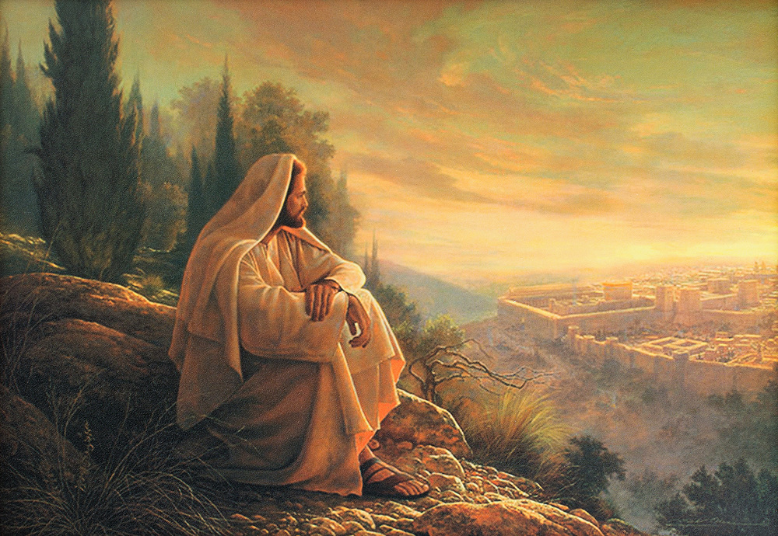
O’ Jerusalem, Jerusalem!

