Slide 1
THE MORMON ELDER KNOCKING AT YOUR DOOR
By David Lee Burris

Slide 2
PRESENTATION OUTLINE
Background on the Mormon Church
Background on the Mormon Scriptures
Background on the Mormon Missionary

Slide 3
THE MORMON CHURCH

Slide 4
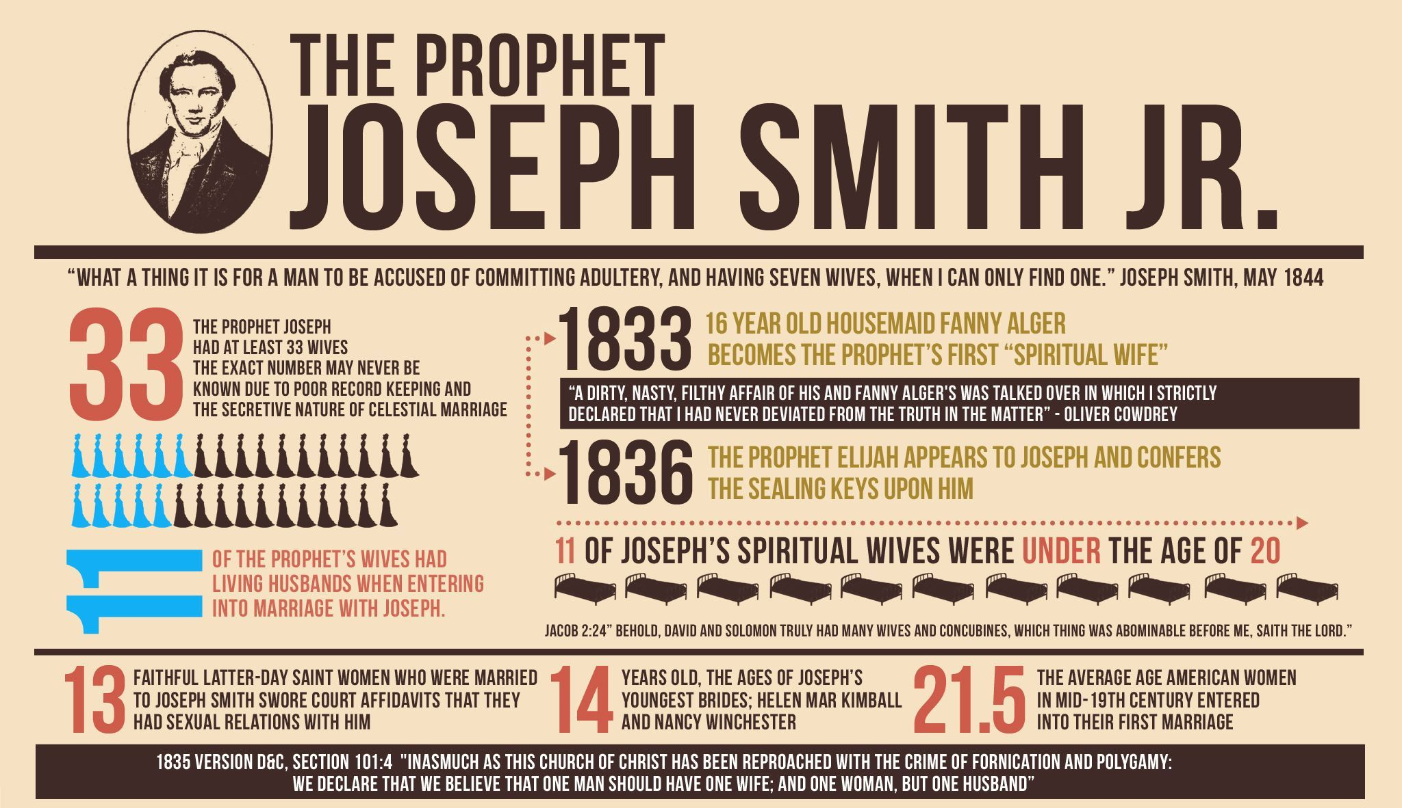

Slide 5
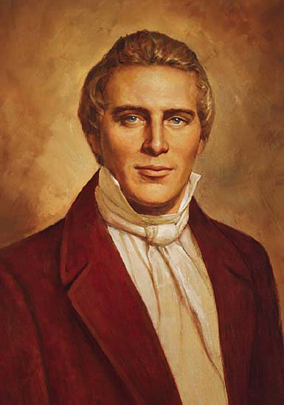
Was Joseph Smith A Prophet?
A. The claim – Prophet like Moses
“ But, behold, verily, verily I say unto thee, no one shall be appointed to receive commandments and revelations in this church, except my servant Joseph Smith, jun., for he receiveth them even as Moses” (Doctrine and Covenants 28:2)
“ Joseph Smith, through whom, by the gift and power of God, the ancient Scripture, known as THE BOOK OF MORMON, has been brought forth and translated into the English….” (Book of Mormon, Origin of THE BOOK OF MORMON)

Slide 6
Was Joseph Smith A Prophet?
A. The claim – Prophet like Moses
B. Evidence He Was Not A Prophet
1. The Bible is Complete - No Modern Day Revelations
a. Jude 3 – “once and for all” (Gingrich & Danker)
b. 2 Pet. 1:3 – all things that pertain to life & godliness
c. 2 Tim. 3:16 -17 - have all to be complete
d. John 16:12-13 – apostles guided into all truth
e. Rev. 22:18-19 – can’t add to or take away
f. Gal. 1:8-9 – even if an angel preach any other….

Slide 7
Was Joseph Smith A Prophet?
A. The claim – Prophet like Moses
B. Evidence He Was Not A Prophet
1. The Bible is Complete - No Modern Day Revelations
2. His Teaching Contradicts The Bible (Gal. 1:8-9)
3. Christ is the Prophet of the Last Days (Heb. 1:1-2)
4. No Promise in the N.T. of Another Prophet (cf. Deut. 18)
5. His Prophecies Failed (Deut. 18:21-22)
- Said place for Mormon temple would be Independence, MO (DC 57:1-3; 101:20; 124:51-52)
- It is: Salt Lake City, UT

Slide 8
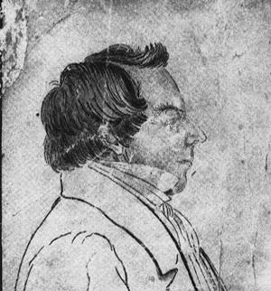
Joseph Smith
Diviner
Treasure Hunter
Religious Fraud

Slide 9
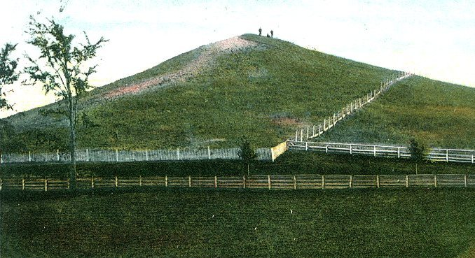
Early History
1823 A visit by the angel Moroni
  You will be given golden plates on the hill Cumorah
1827 Dug up golden plates. Written in “Reformed Egyptian.”
Used the “Urrim and the Thummim” with his head in a hat to translate the Book of Mormon.
Conveniently, God took the golden plates back to heaven.
The Hill Cumorah
Notes:
This had to infuriate the Jews. They were the “wise” ones, the leaders, the righteous; and here Jesus is entangling them and leaving them speechless

Slide 10
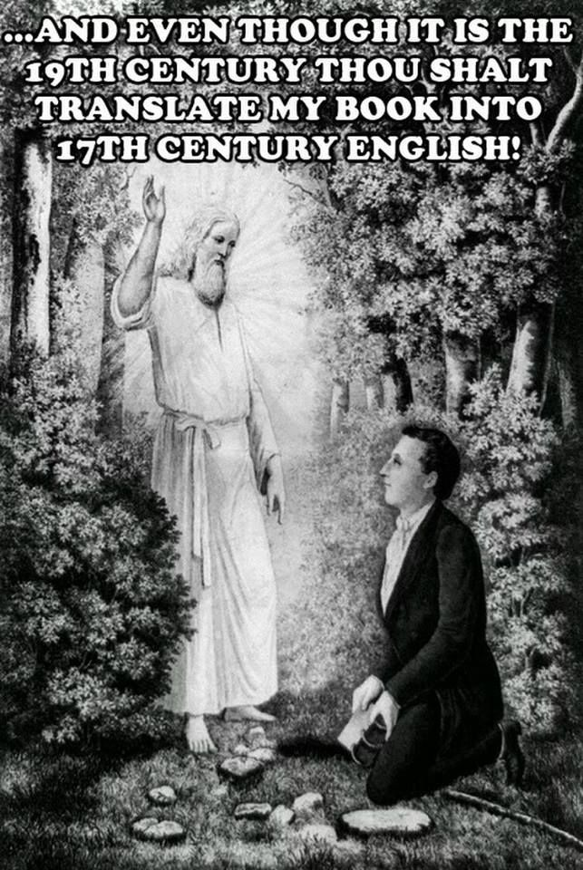

Slide 11
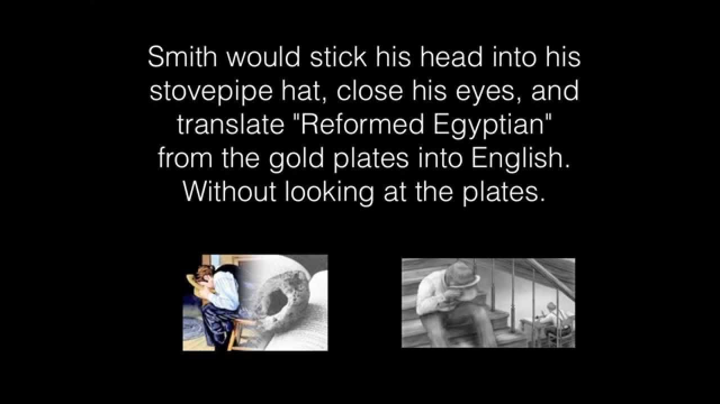

Slide 12
Mormons often refer to the witnesses of the Book of Mormon. Most of these men left the Church, but claims are also made that even though they did, they never denied that they had seen an angel who showed them "the plates of the Book of Mormon." However, in the Journal of Discourses, (7:164 ), Brigham Young stated that:
...witnesses of the Book of Mormon who handled the plates and conversed with the angels of God were afterwards left to doubt and to disbelieve that they had ever seen an angel.
Joseph Smith himself called these men wicked and liars, and by many other demeaning names. In the Journal of Discourses, 7: 114-115, George A. Smith lists those who have left the Church and mentions specifically, among others, "the witnesses of the Book of Mormon." Martin Harris later claimed that he had a better testimony of the "Shakers Book" than he ever had of the Book of Mormon. Reading about these witnesses, one is drawn to the conclusion that they were unstable men and easily convinced; for example, Martin Harris changed his religion at least eight times. Some of the others started their own religions later. – The Truth About Mormonism (Website)

Slide 13
WANDERING IN THE WILDERNESS
Palmyra, New York
Kirtland, Ohio
Independence, Missouri
Nauvoo, Illinois
Salt Lake Valley, Utah

Slide 14
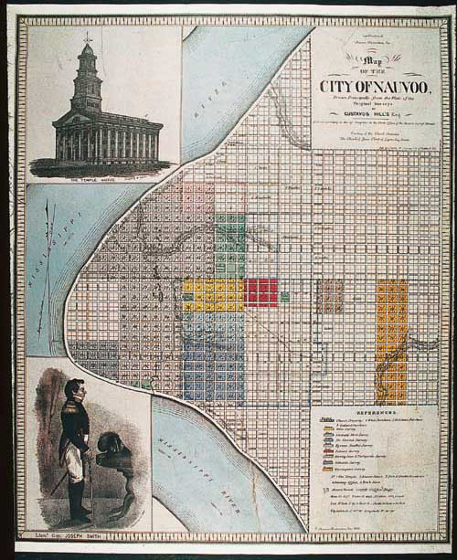
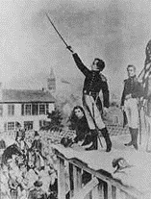
General Joseph Smith

Slide 15
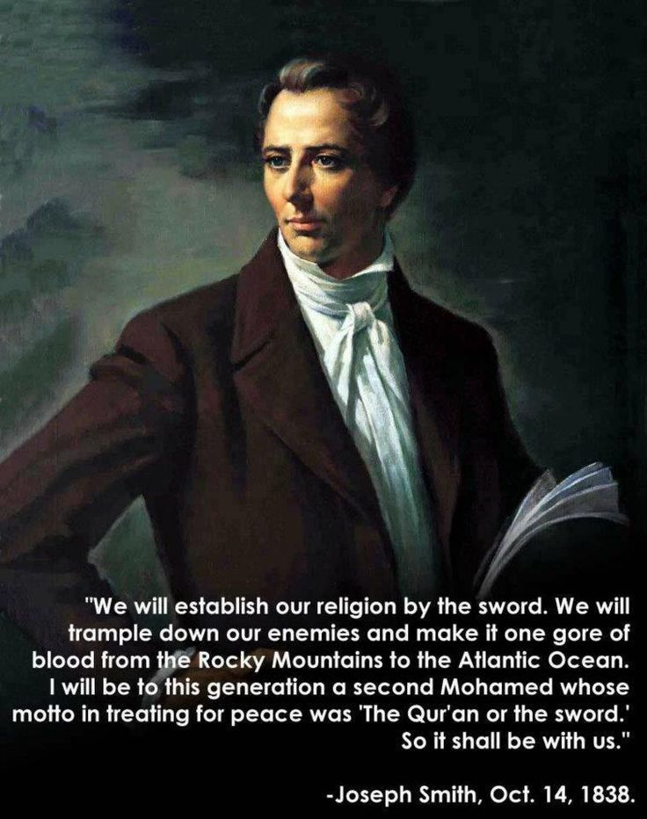

Slide 16
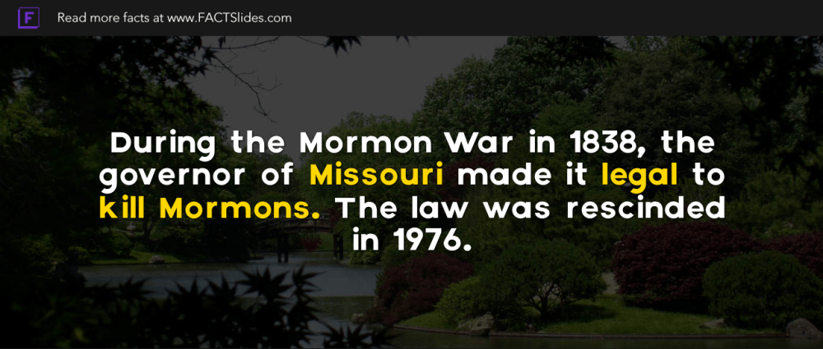

Slide 17
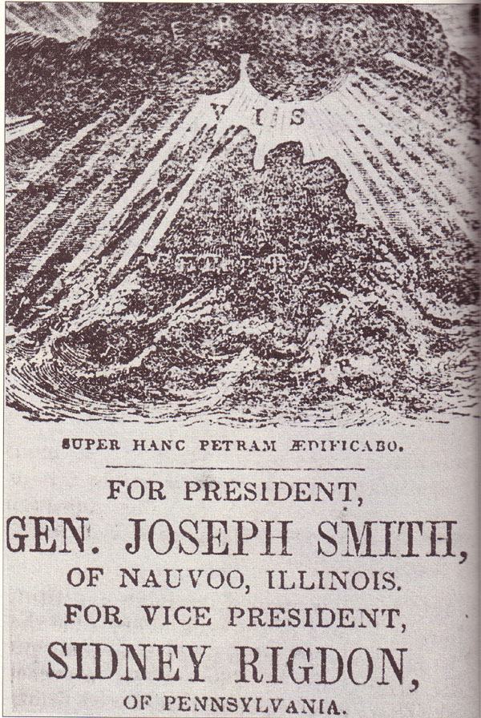
JOSEPH SMITH & SIDNEY RIGDON

Slide 18
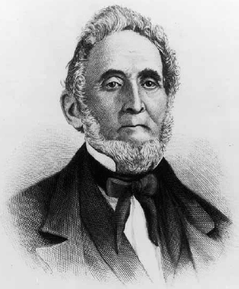
1830
“On their way to Missouri, Cowdery’s New Jerusalem party passed through northeastern Ohio, where Sidney Rigdon and over a hundred followers of his variety of Campbellite Restorationism converted to Mormonism, more than doubling the size of the Mormon church. Rigdon soon visited New York and quickly became Smith’s primary assistant.” - Wiki
Campbell Addresses
APOSTACY
Entire Rigdon Congregation Converts
MORMON

Slide 19

"MORMONISM -- The Means by which it stole the True Gospel.
"IT is well known that the Mormons preach the true gospel and plead for immediate obedience to it on the part of the hearers, as the advocates of original Christianity do. This was not an original measure of Mormonism; for, indeed, baptism for the remission of sins is a phrase not found in their book. A few of their leaders took it from Rigdon, at Euclid, on the Western Reserve, as may be learned from brother Jones' account of their first visit to Kirtland, published in a preceding volume of the Evangelist. Rigdon, we were perfectly aware, had possessed himself of our analysis of the gospel and the plea for obedience raised thereupon; but not, choosing to rely on my own recollection of the means by, and the times at, which they were imparted to him, we wrote to Mr. Bentley, who is his brother-in-law, for the necessary information. Mr. Bentley's letter shows not only whence he received his knowledge of the true gospel; but also that, coward that he was, he had not the independence necessary to preach it in his own vicinity after he had received it. Thus, knowledge of ordering and pleading the elements of the true gospel by that people, is seen to arise near the same time and from the same source as that of our own reformation.”

Slide 20
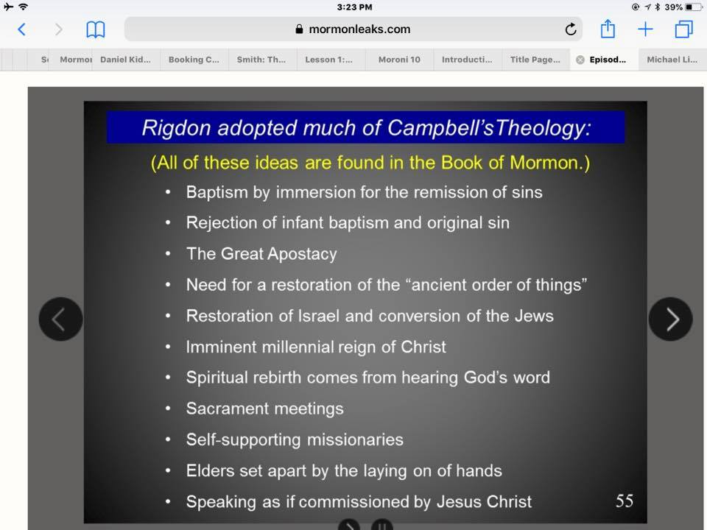
Notes:
Sidney Rigdon, a wolf in Campbellite preacher’s clothing, already had the Spaulding manuscript (future Book of Mormonism) in 1823 when he offered to ride 300 miles on horseback with Alexander Campbell to the Campbell-McCalla debates in Kentucky, where he also served as the debate’s “recorder”. He was a mole from the start. He wanted to pick Campbell’s brain!
This explains many Restoration-themed similarities between the two great American religious movements of the time. He had already been hinting in his sermons to get ready for some exciting new “direct revelations” from God...

Slide 21
Men remember what they hear, as well as what they see. Again, if men are said to "steal" what they see, may they not be said to "steal" what they hear? And if nothing short of seeing an action performed could explain this mystery, how comes the good Baptist Taylor to insert in his history of churches in Kentucky, writing about the time of the aforesaid conversation, the same views on this subject which are contained in the Book of Mormon? It is, therefore, no disparagement of these views of baptism that they are found in the Book of Mormon, more than that they are found in Taylor's History of Ten Baptist Churches in Kentucky, published three years before the Book of Mormon. But that Sidney Rigdon had a hand in the manufacture of the religious part of the Book of Mormon is clearly established from this fact, and from other expressions in that book, as certainly "stolen" from our brethren as that he once was amongst them. Our brother of the Evangelist seems on other occasions, as well as this, to draw conclusions.

Slide 22
1844 u.s. Presidential Candidate Joseph Smith the first assassinated U.S.A. potus candidate
“1844 presidential election was a very close race. Illinois could very well have held the balance of power in the electoral college to determine whether the Whigs or the Democrats won. It was a very close race in Illinois with a balance of power resting squarely in the hands of Joseph Smith and the Latter-day Saints.
There was friction between both major political parties and the Latter-day Saints. When Joseph Smith decided to run for the presidency, he did so primarily to make his views known and to bring the plight of the Latter-day Saints, particularly as to the state confiscation of the Saints property in Missouri, to the public spotlight.
Both the Democrats and the Whigs feared that he would sway the electoral votes in Illinois, and perhaps other states. Probably no one since Joseph Smith up until the candidacy of Ross Perot did any third-party candidate hold so much power.
All of that may be very interesting, but the bottom line is that Joseph Smith was, indeed, the first presidential candidate assassinated while running for office.”

Slide 23
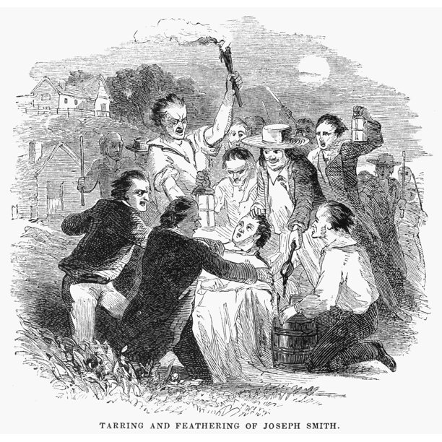

Slide 24
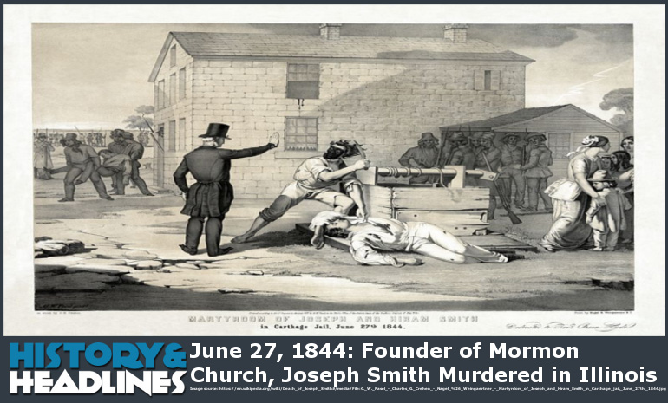

Slide 25
DEATH OF J. SMITH, THE MORMON IMPOSTOR.
JOSEPH SMITH and his brother HIRAM have been providentially cut off in the midst of their diabolical career. They were most lawlessly and mobocratically put to death. One of the antediluvian signs of the times was, that "the earth was filled with violence." From Boston and Philadelphia to New Orleans this land is filled with violence; and, analogically reasoning, some great catastrophe is coming upon the world. There is no law of sufficient authority in the hands of this government to preserve peace and safety in this country. The sword of the magistrate is worn in vain.
But the money-digger, the juggler, and the founder of the Golden Bible delusion, has been hurried away in the midst of his madness to his final account. 'He died not as a righteous man dieth.' The hand of the Lord was heavy upon him. An outlaw himself, God cut him off by outlaws. He requited him according to his works. He was not persecuted, unless to punish a traitor, a public plunderer, a marauder, be persecution! The killing of Robespierre was not murder. It was the outrages of the Mormons that brought upon the head of their leader the arm of justice. The phrenzy of a fanatic cannot make out of the affair persecution, Religion or religious opinions had nothing to do with it. It was neither more nor less than the assassination of one whose career was in open rebellion against God and man. Still the guilt of his death lies upon those who, in violation of the laws both of God and their country, dispatched him without even the form of a trial.
A. C.

Slide 26
SIDNEY RIGDON VS. BRIGHAM YOUNG
“Only five of the vigilantes were tried for Smith’s murder, and none were convicted. Smith’s First Counselor and Vice-Presidential running mate, Sidney Rigdon, tried to take control of the Mormon Church; then Brigham Young, a former carpenter who’d been ordained to an advisory council called the Quorum of the Twelve, made the more politic suggestion that the whole Quorum should oversee the Church, with Young as its president; the congregation agreed. (The Council later did excommunicate Sidney Rigdon, who later established a competing church, which condemned polygamy, in Pittsburgh.)” - The New Yorker Magazine

Slide 27
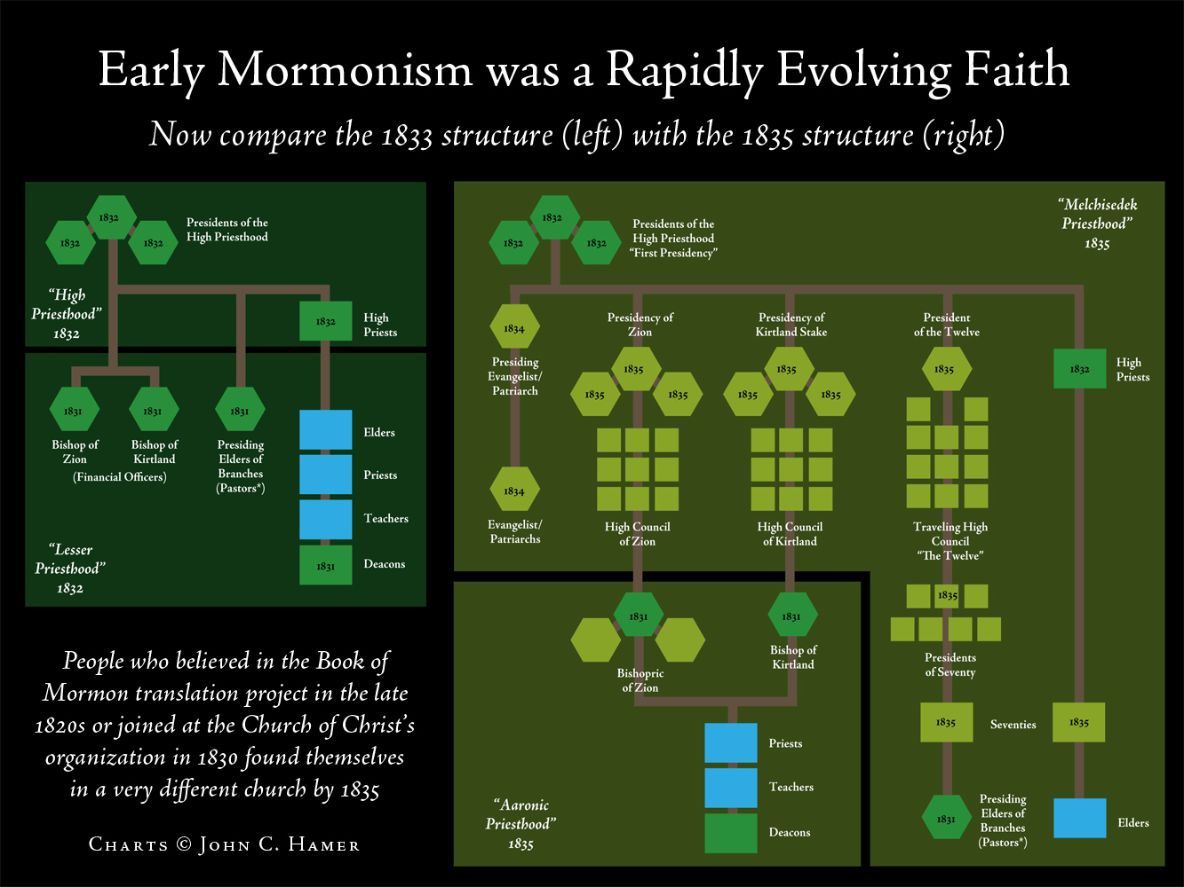

Slide 28
MORMON CHURCH EXTINCT.
The melancholy catastrophe of the murder of Joseph Smith, the presiding President, and Hyrum his brother, resulted in leaving one individual only known to the church as pointed out by repeated revelations, as Prophet, Seer, and Revelator for the Church -- viz. Sidney Rigdon. President Rigdon, who was then in Pittsburg, received instruction from the Lord to repair to this place, and present himself to the church for their acceptance or rejection; which actually did result in his rejection, and the appointment of the Twelve (by a large majority of the church) to the presidency of the whole church and its entire control. Verily believing as we do, that this was a vital departure from the order of Heaven, and a rejection of the only man who sustained the legal relation of a Revelator to the Church, and who was competent to reorganize the first Presidency, we dissented and lifted our voices against such proceedings, and manifested our adherence to President Rigdon.
In consequence of this rejection, President Rigdon has received a commandment to reorganize the church; and for this reason the Twelve and their adherents have assiduously studied and striven to misrepresent the character and designs of President Rigdon and his friends, and have not scrupled to ascribe to them motives and designs the most base and dishonorable. We do declare that President Rigdon is above all malevolent aspersions of his reputation, and is known to us as a worthy law-abiding citizen, and a gentleman of unblemished character.
We do, moreover, declare our sincere conviction, that, in rejecting Sidney Rigdon, the Church of Jesus Christ of Latter Day Saints does no longer exist, except in connexion with him; and that God has given no authority for an organization of the church, differing from that contained in the Book of Doctrine and Covenants. Heretofore the accused has had the privilege of a trial and an opportunity to reply to the charges brought against them; but on the memorable 8th of September, 1844, this privilege was denied in open and flagrant violation of all the laws and rules of the church; thus manifesting clearly that the course they pursued towards us is one unsanctioned by law and unallowed by justice.

Slide 29
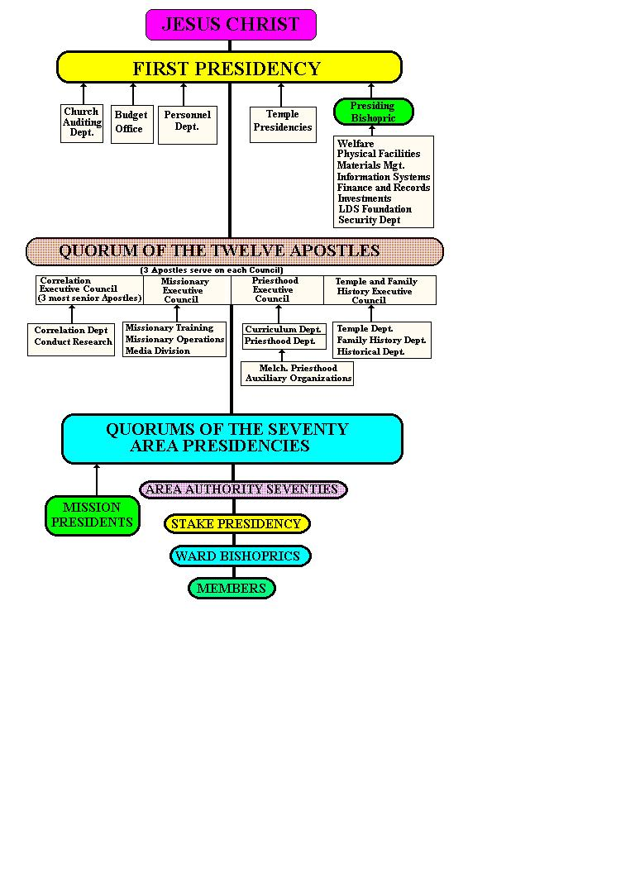

Slide 30
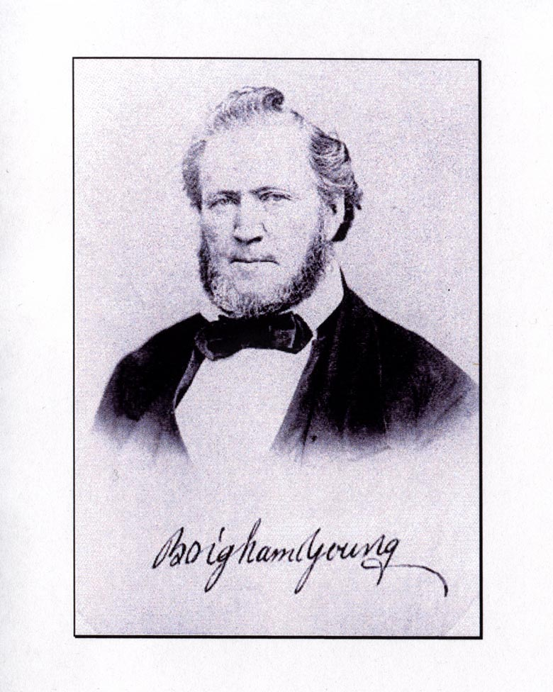
BRIGHAM YOUNG

Slide 31
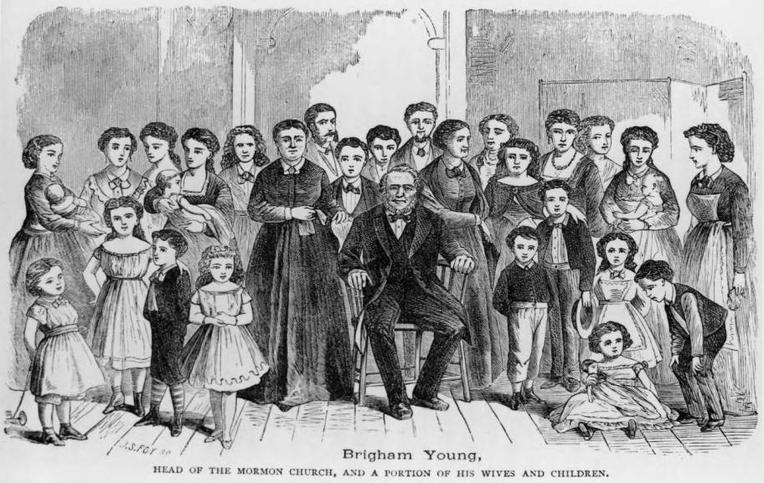
* There is anecdotal evidence that he had so many children he could not even remember their names.

Slide 32
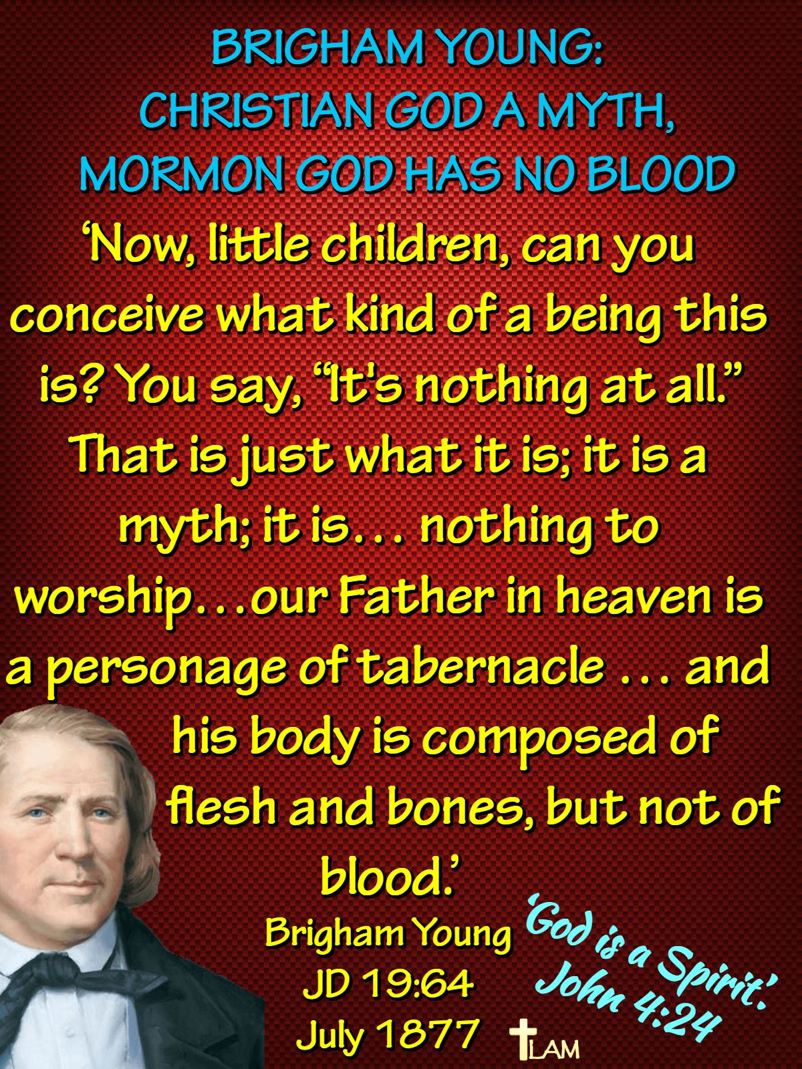

Slide 33
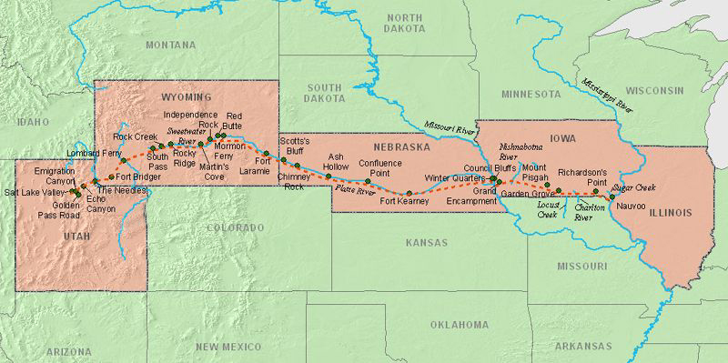

Slide 34
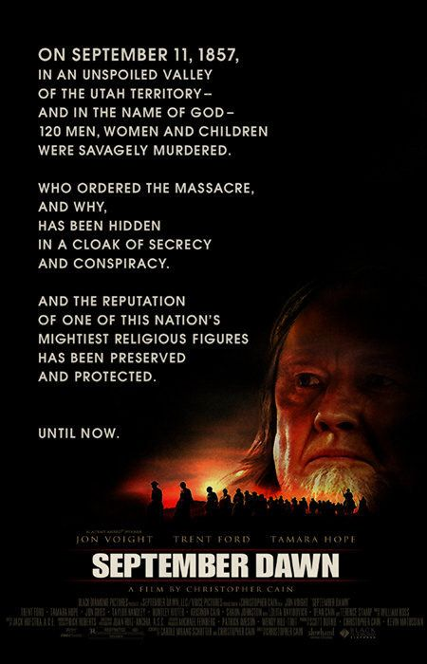
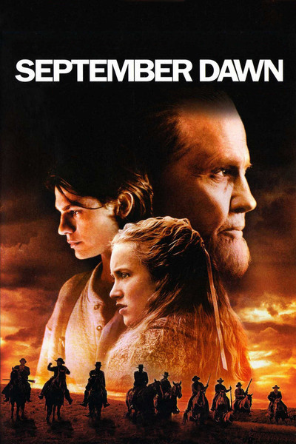

Slide 35
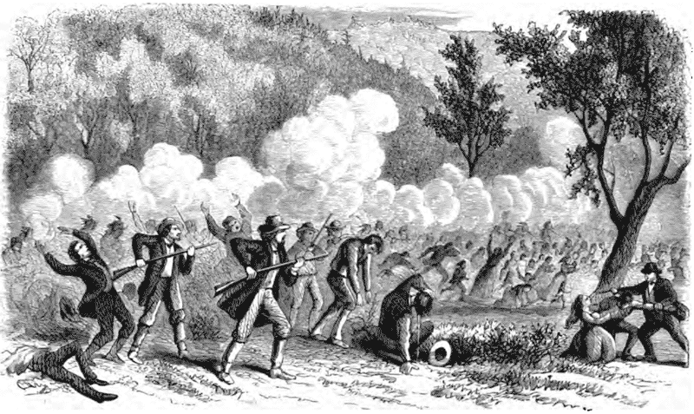
1857 Mormons Massacre wagon train moving through Utah territory

Slide 36
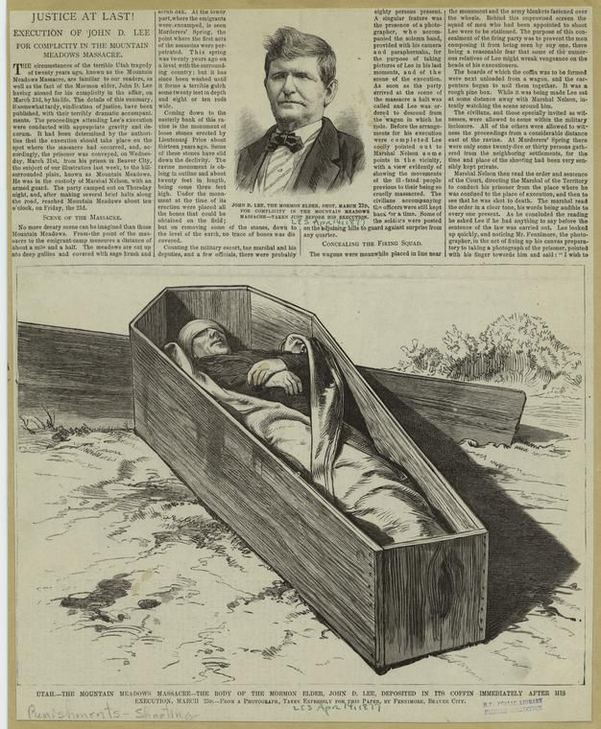

Slide 37
The Latter Day Saints
The original church completely fell away with the death of the original apostles. There was no legitimate church for about 1700 years.
“This is my testimony, Joseph Smith is a prophet and the Book of Mormon is the Word of God.”

Slide 38
THE MORMON HOLY BOOKS

Slide 39
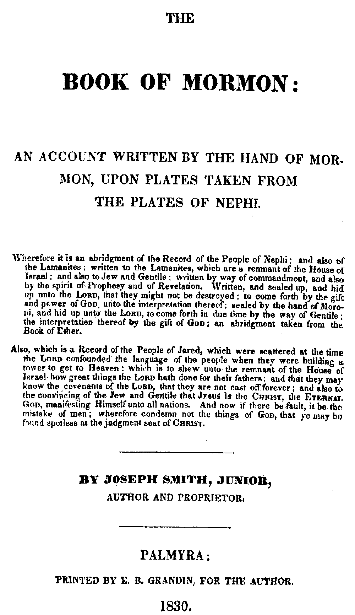
The Mormon Scripture
A grade B religious fantasy about the Jaredites and the Nephites.
The Pearl of Great Price with the Doctrine and the Covenants.
The Bible, “so long as it is correctly translated.”
Mormon 8:18 “Don’t demand to see the plates or you will be killed.”

Slide 40
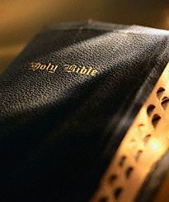
You’re A Fool If You Think The Bible Is All Of God’s Revelation!
“ And because my words shall hiss forth- many Gentiles shall say: A Bible! A Bible! We have got a Bible, and there cannot be any more Bibles….
“Thou fool, they shall say: A Bible, we have got a Bible, and we need no more Bible…
“Wherefore, because that ye have a Bible ye need not suppose that it contains all my words; neither need ye suppose that I have not caused more to be written”
(2 Nephi 29:3, 6, 10)

Slide 41
King James
Version
The Book of
Mormon
Copied
Isaiah 53
Mosiah 14
Acts 3:22-26
3 Nephi 20:23-16
Quotes Peter 500+ before Peter spoke.
2 Cor. 5:10
Mosiah 3:24
124 B.C. .
Matt. 7:7
2 Nephi 9:42
559 B.C. .
Quotes Italics and All

Slide 42
Book of Mormon
Bible
Priest from Lehi a decendant of Joseph (1 Nephi 5:14; 18:7; 2 Nephi 5:26 | Priest of the tribe of Levi (Num. 3:10; 18:1)
Name “Christian” used more than a 100 years before Acts 11:26 (Alma 46:14) | The name “Christian” used first at Antioch (Acts 11:26) about 40 AD
Jesus born in Jerusalem (Alma 7:10) | Jesus born in Bethlehem (Micah 5:2; Matt. 2:10
Church existed a about 73 B.C. (Alma 46:14) | Jesus said it would be built (Matt. 16:18)
Name “Jesus” announced 90 years before Mary (Alma 19:29) | Name “Jesus” announced to Mary (Luke 1:31; 2:21)

Slide 43
Book of Mormon
Bible
Melchisedec received his priesthood from ancestors (DC 84:14) | Melchisedec did not receive his priesthood from ancestors (Heb. 7:1-3)
3 Days of darkness at Crucifixion (1 Nephi 19:10; Helaman 14:20; 3 Nephi 8:3) | 3 Hours of darkness at crucifixion (Matt. 27:45; Mark 15:33)
Law of Moses written on plates of brass (1 Nephi 4:15-16) | Law of Moses written on tables of stone (Exo. 34:1)
God did not confound the language of the people (Ether 1:35-37) | God did confound the language of the people (Gen. 11:9)
We Cannot Believe Both!

Slide 44
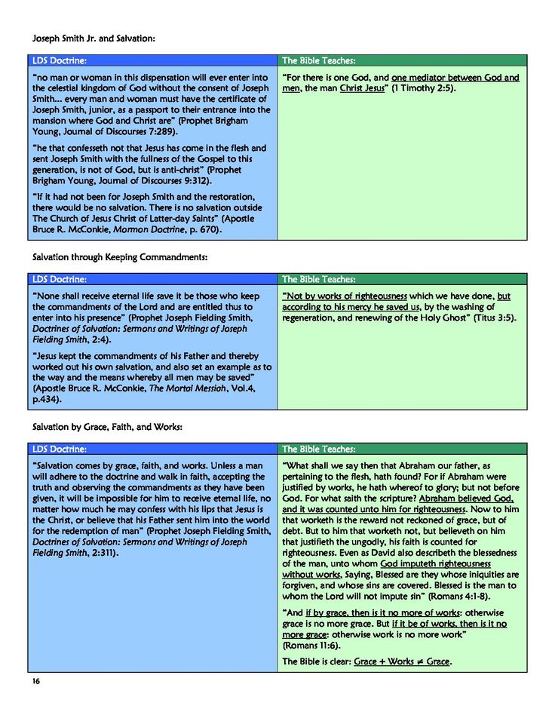

Slide 45
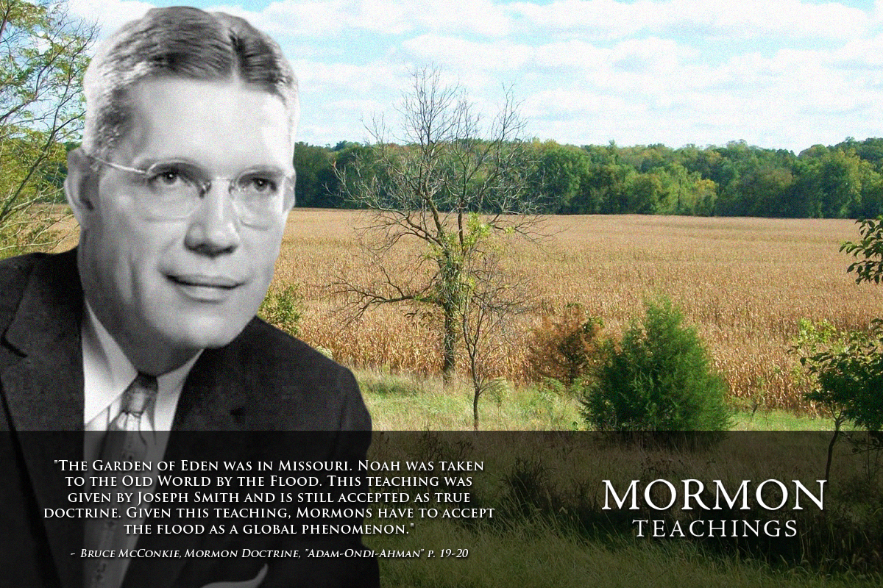

Slide 46
Doctrine About Christ
Born of Adam
  “He was not begotten by the Holy Ghost. And who is His Father? He is the first of the human family (Adam)…” (Brigham Young, Journal of Discourses, Vol. I, p. 50).
Married to Mary & Martha
  (“…there were several holy women that greatly ‘loved Jesus, such as Mary and Martha her sister, and Mary Magdalene; and Jesus greatly loved them… if all the acts were written, we, no doubt should learn that these beloved women were His wives” (Orson Hyde,The Seer, pp. 158-159)

Slide 47
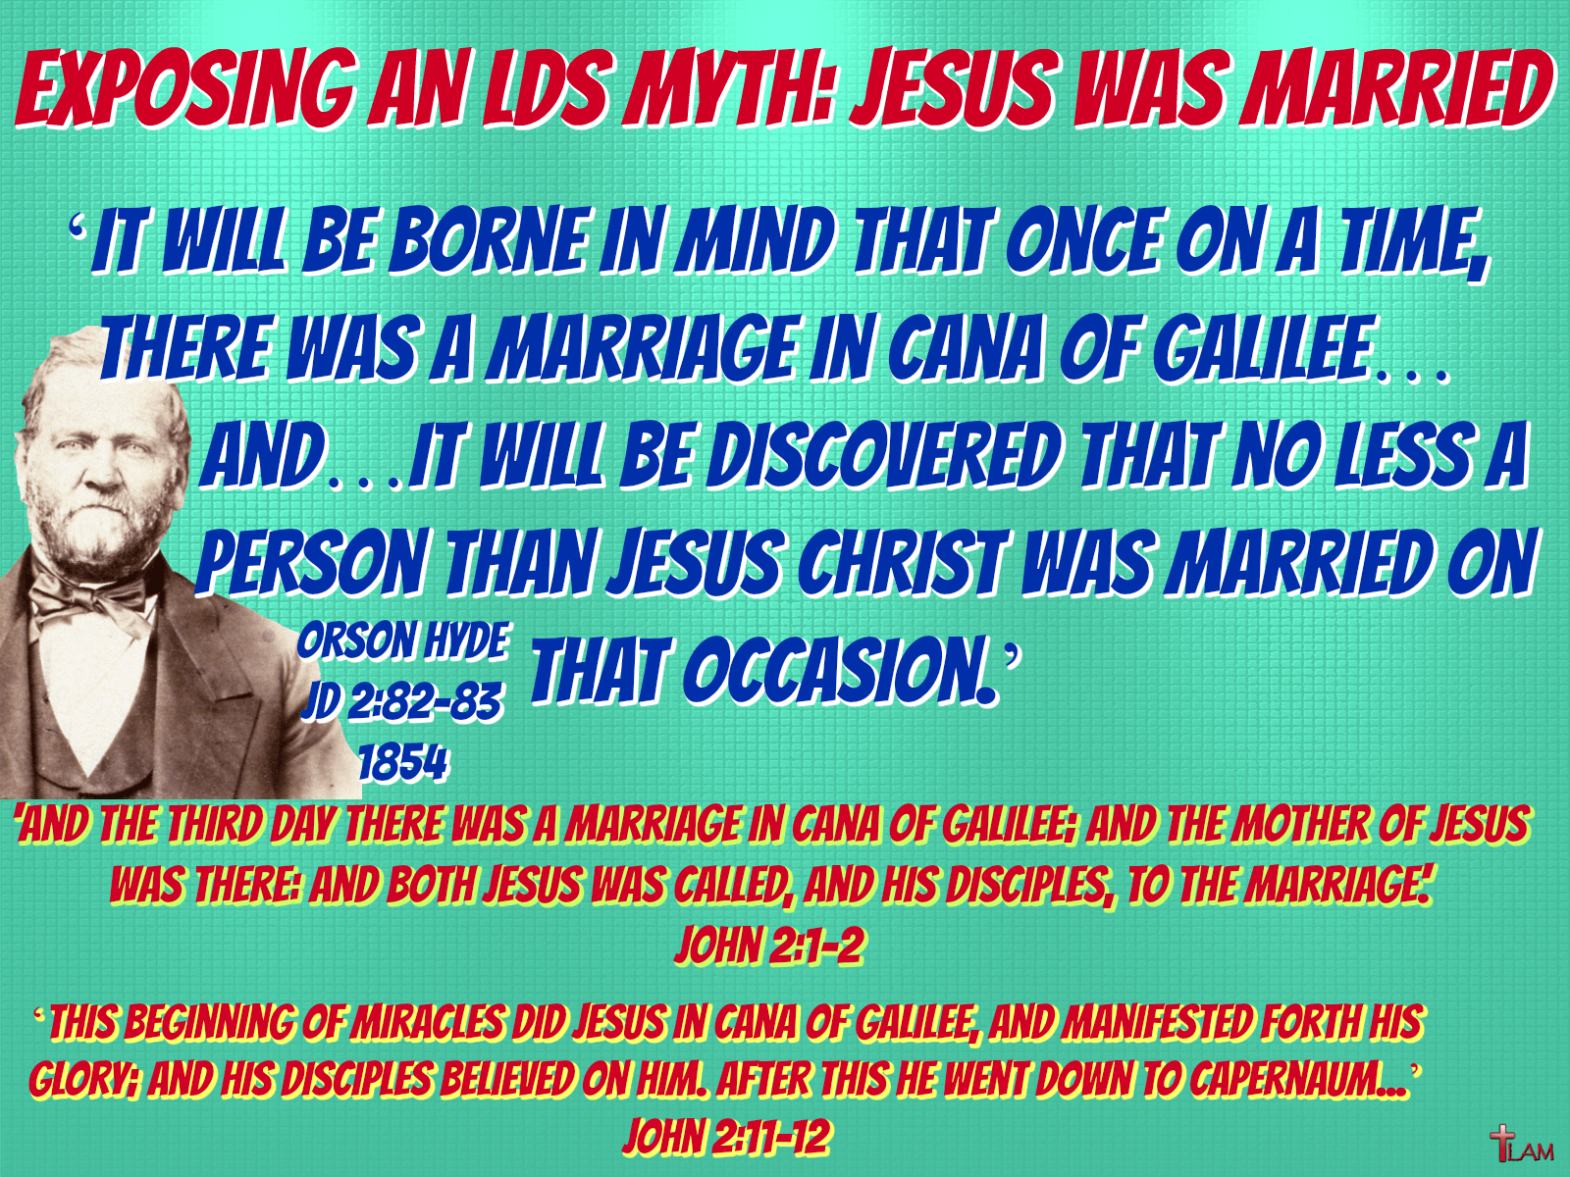

Slide 48
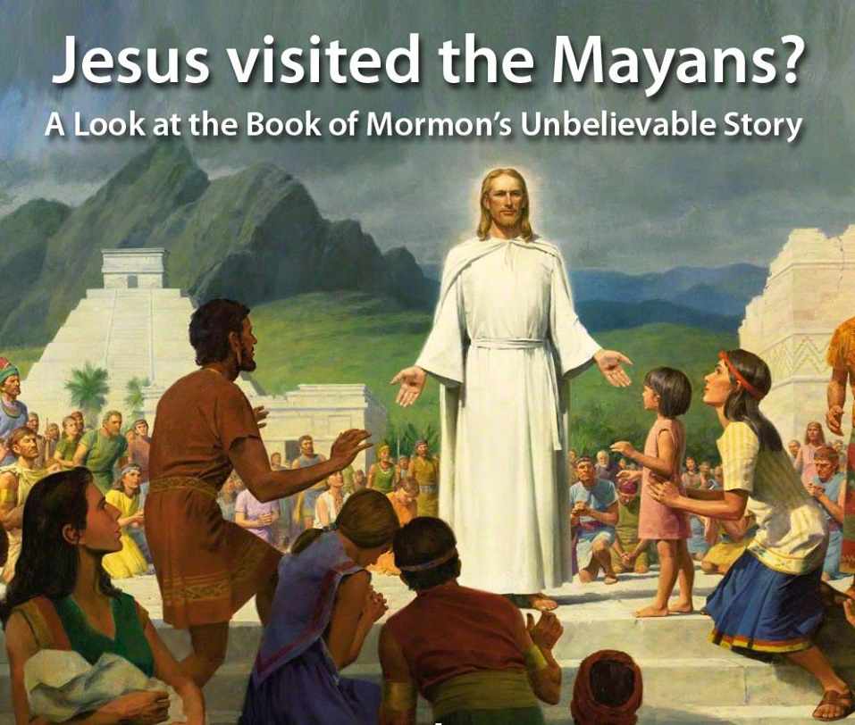

Slide 49
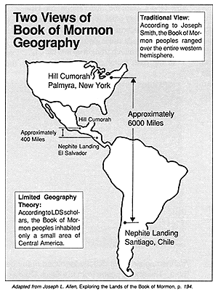
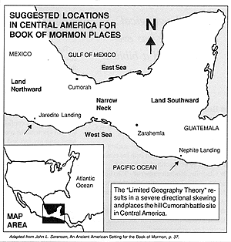

Slide 50
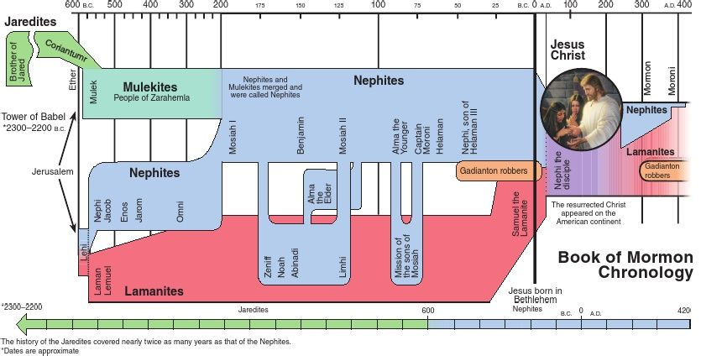

Slide 51
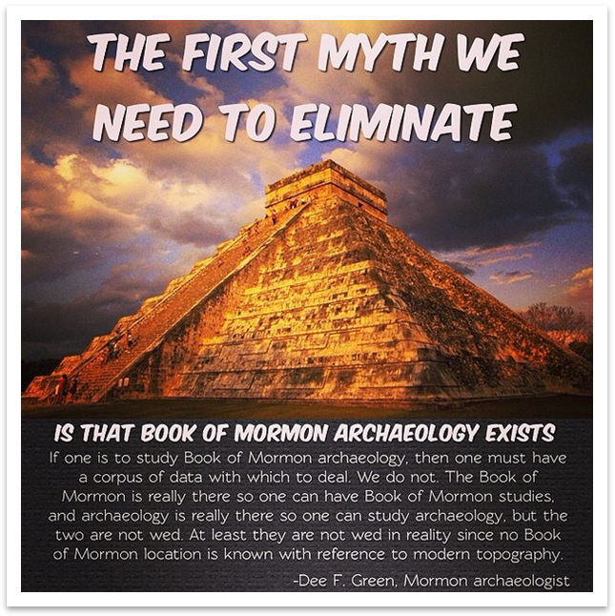
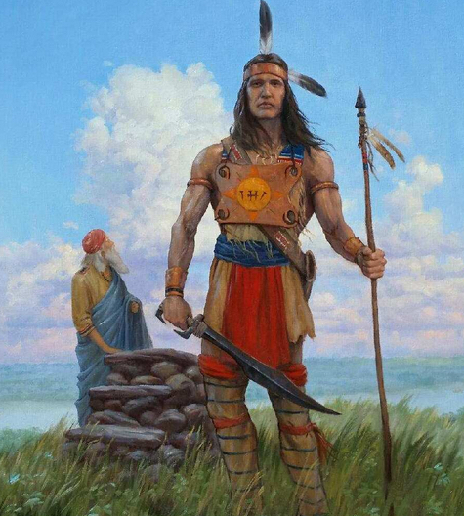

Slide 52
RESULTS OF SPOOFING
Although he had written a paper criticizing Book of Mormon archaeology, Tom Stuart Ferguson felt that it was generally best for those who doubted the faith to keep their "mouth shut." In a letter written Feb. 9,1976, he gave this advice:
"...Mormonism is probably the best conceived myth-fraternity to which one can belong... Joseph Smith tried so hard he put himself out on a limb with the Book of Abraham, and also with the Book of Mormon. He can be refuted--but why bother... It would be like wiping out placebos in medicine & that would make no sense when they do lots of good....
Perhaps you and I have been spoofed by Joseph Smith. Now that we have the inside dope--why not spoof a little back and stay aboard? Please consider this letter confidential -- for obvious reasons. I want to stay aboard the good ship, Mormonism…” Salt Lake City Messenger

Slide 53
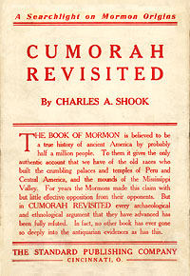
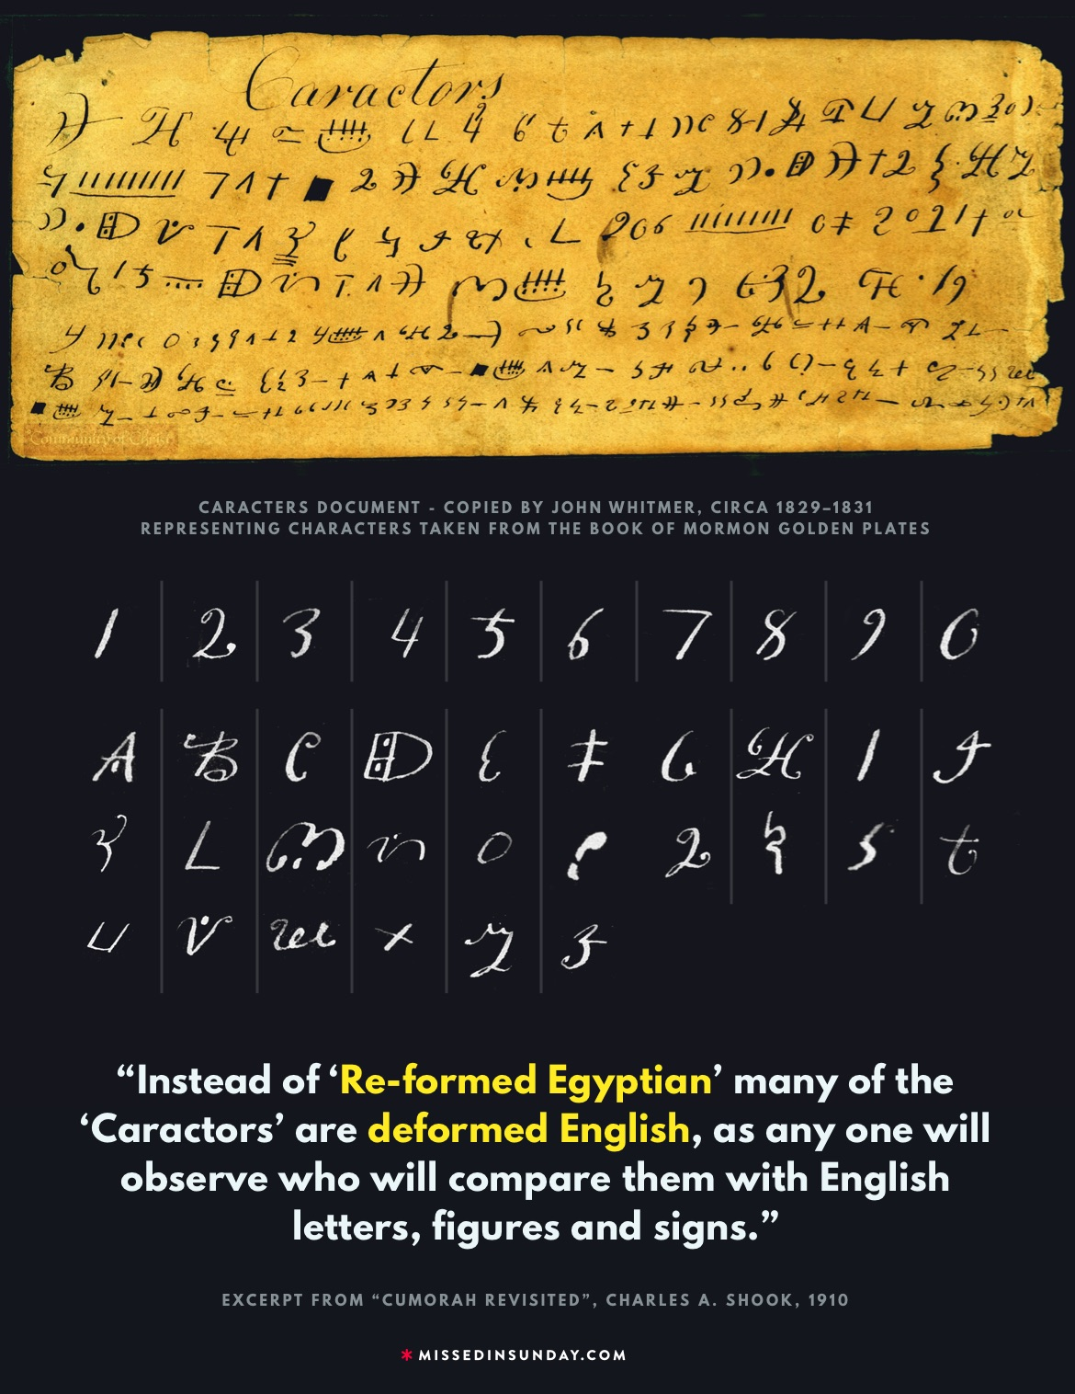

Slide 54
Statements by the Smithsonian Institution and the National Geographic Society:
"The Smithsonian Institution has never used the Book of Mormon in any way as a scientific guide. Smithsonian archaeologists see no connection between the archaeology of the New World and the subject matter of the Book." Official Statement, 1979
"Neither representatives of the Nat’l Geographic Society nor, to my knowledge, archaeologists connected with any other institution or equal prestige have ever used the Book of Mormon in locating historic ruins in Middle America or elsewhere."

Slide 55
MORMON TEACHINGS
The Latter Day Saints
Modern-day revelation
We are all gods
Polygamy
Racism
Baptism for the dead
Scriptures to bear in mind: Galatians 1:6-9, 2 Thessalonians 2:5-12, 1st John 2:18-23.

Slide 56
We are all gods.
The Father, Jesus Christ and the Holy Spirit are three separate gods.
Mormonism is polytheism.
  “I will preach on the plurality of gods. I have always declared God to be a distinct personage, Jesus Christ a separate and distinct personage from God the Father, and the Holy Ghost was a distinct personage and a Spirit: and these three constitute three distinct personages and three Gods.” Teachings of Joseph Smith, p. 370.
  From Joseph Smith’s most famous sermon: “God himself was once as we are now, and is an exalted man, and sits enthroned in yonder heavens!... I am going to tell you how God came to be God. We have imagined and supposed that God was God from eternity. I will refute that idea, and take away the veil so that you may see… He was once a man like us; yea that God himself, the Father of us all, dwelt on an earth, the same as Jesus Christ himself did.

Slide 57
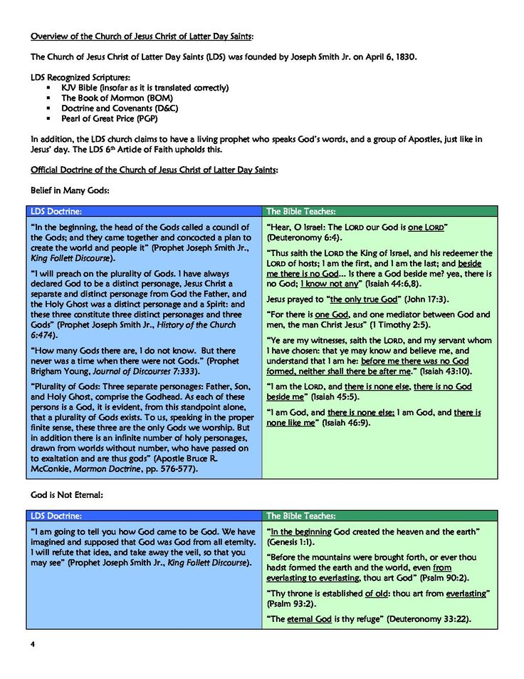

Slide 58
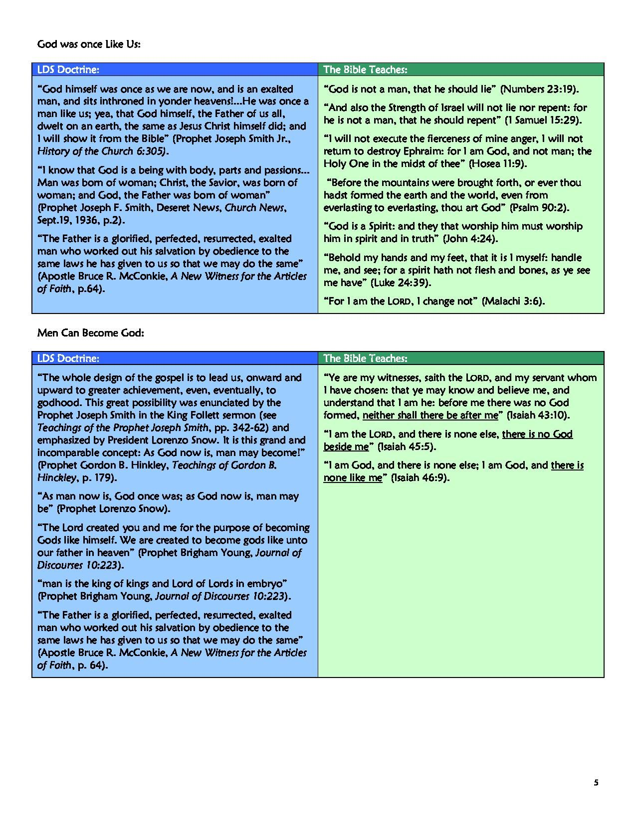

Slide 59
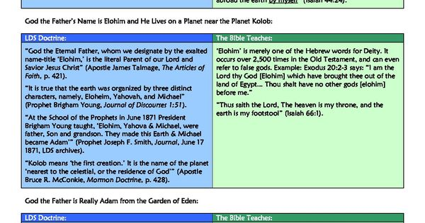

Slide 60
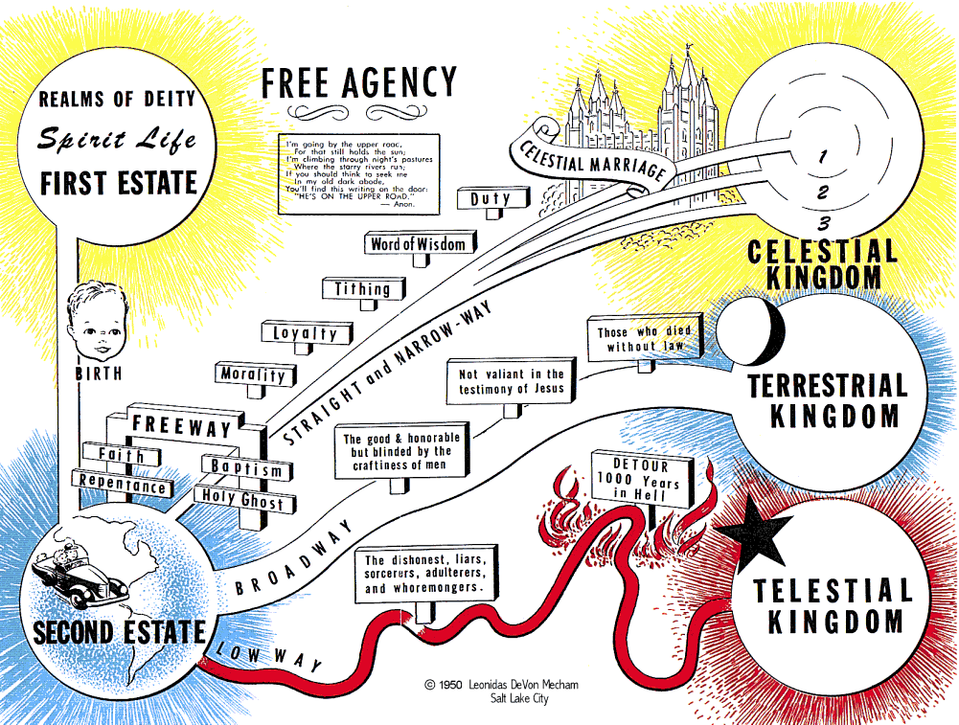

Slide 61
Marital Polygamy
A new revelation against polygamy by the Utah church 1890
Joseph Smith had at least 30 wives, some less than 15 yrs. old and took many other women as well.
Celestial marriages.
When our father Adam came into the garden of Eden, he came into it with a celestial body and brought Eve, one of his wives, with him. He helped to make and organize this world. He is Michael, the Ancient of Days! About whom holy men have written and spoken—He is our Father and our God, and the only God with whom we have to do.” Journal of Discourses vol 1, p 50.
“The grand reason why the Gentiles and philosophers of his school persecuted Jesus Christ, was because he had so many wives; there were Elizabeth, and Mary, and a host of others who followed him.”

Slide 62
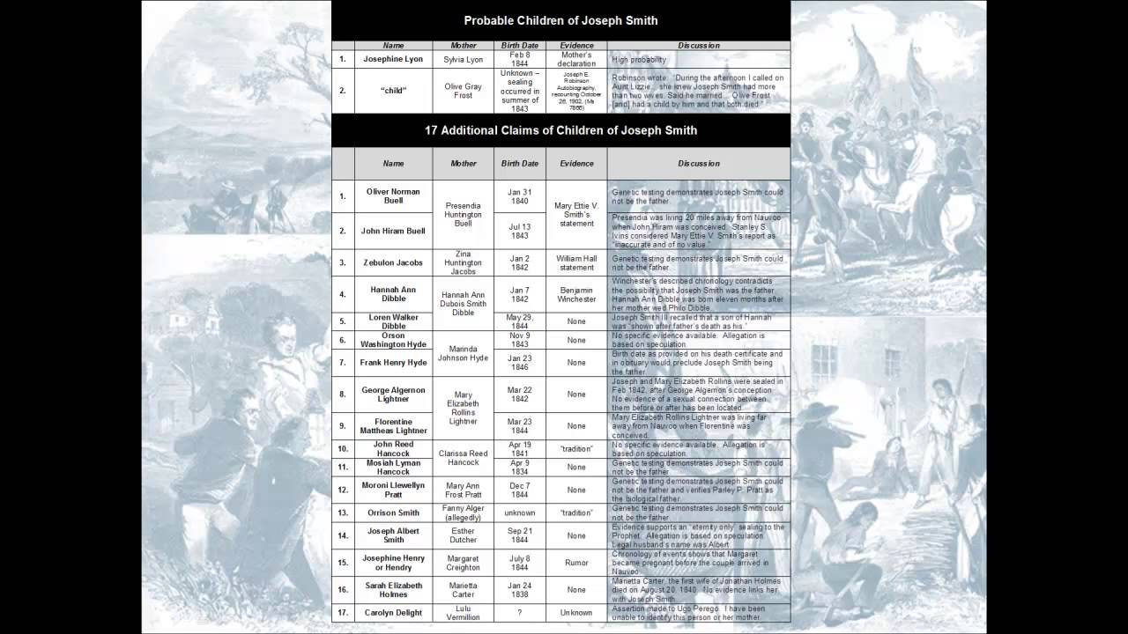

Slide 63
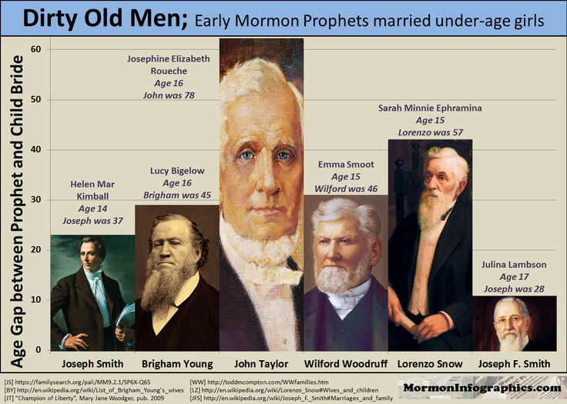

Slide 64
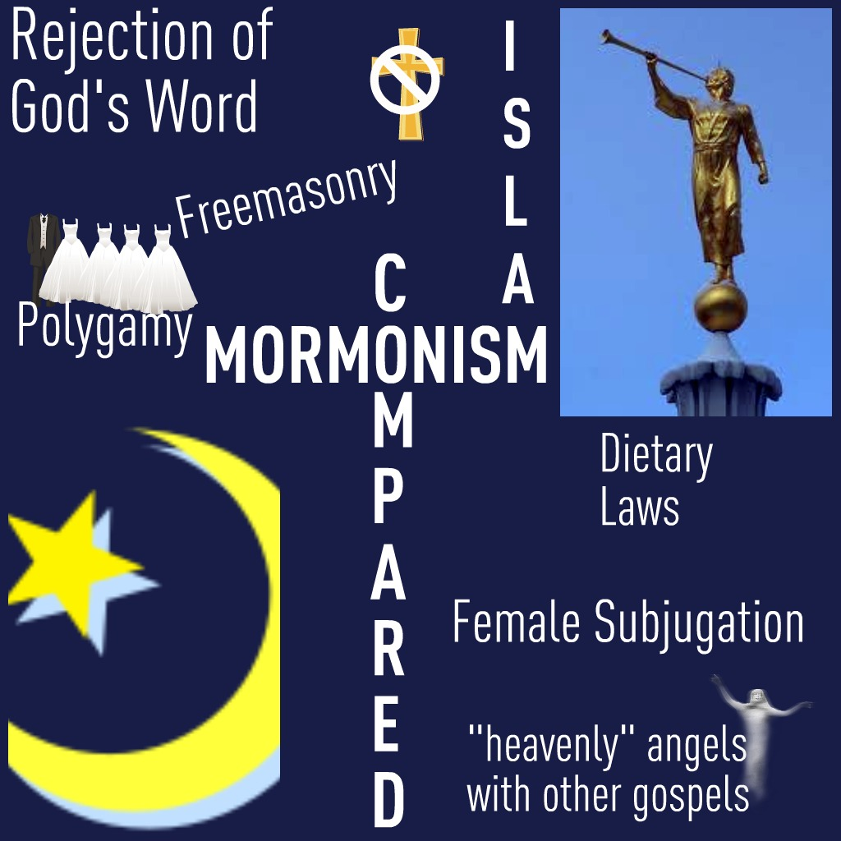

Slide 65
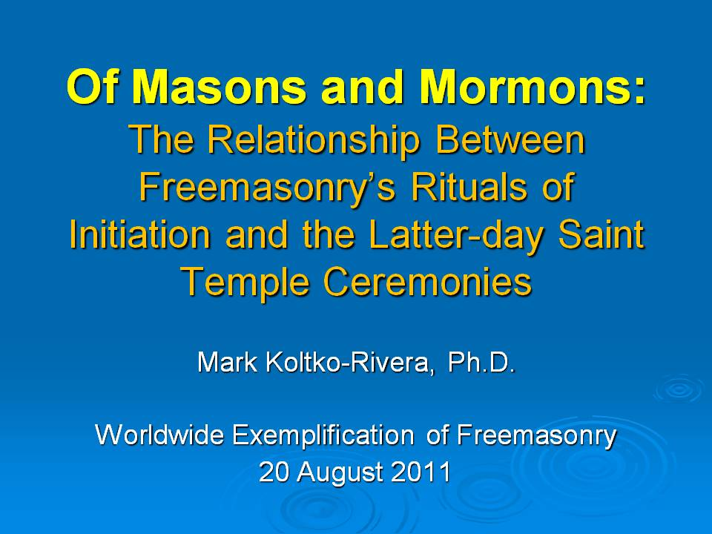

Slide 66
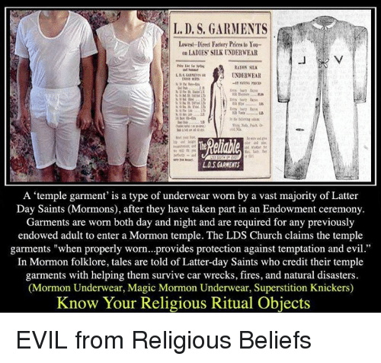

Slide 67
Racism
Mormons 5:15 “Indians are dark filthy and loathsome.”
1 Nephi 11:13 “dark people are sinful.”
2 Nephi 5:21 “Dark skin are loathsome. Those who marry dark skinned are cursed.”
Officially renounced by new revelation in 1978.

Slide 68
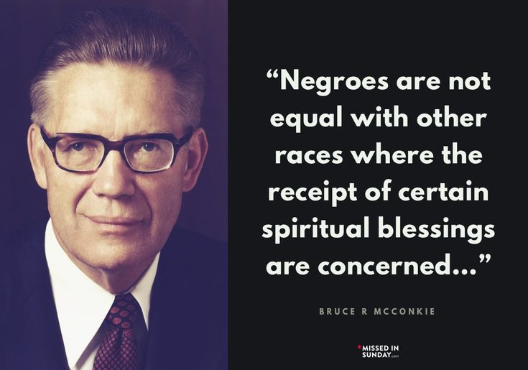

Slide 69
Other quite strange doctrines
Baptism for the dead
Modern-day priesthood of Melchizedek
Baptism in the name of Jesus preached to the Nephites several hundred years BC. A very confused idea of covenants.

Slide 70
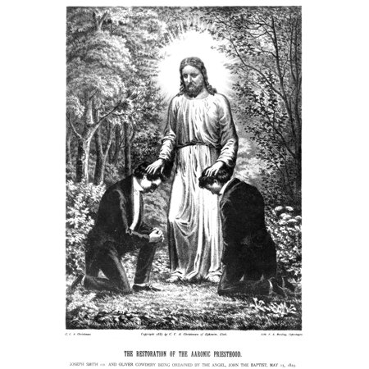

Slide 71
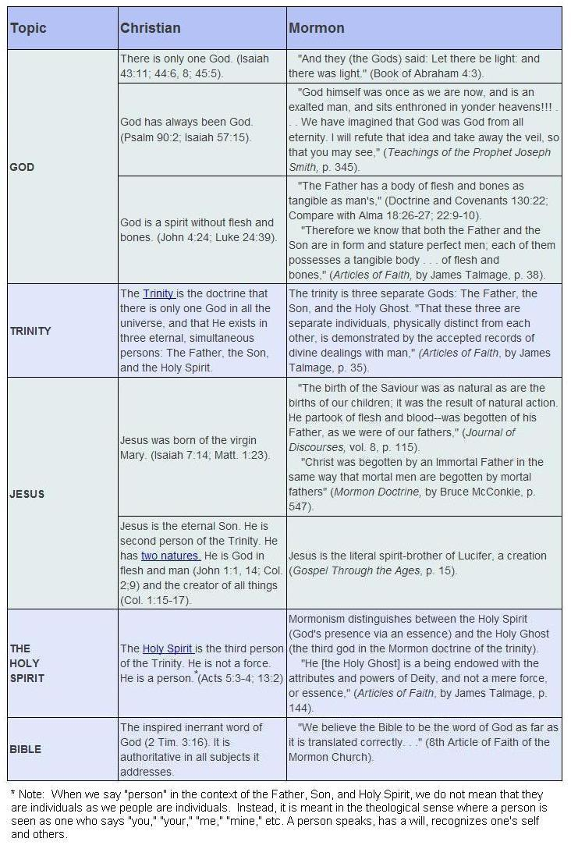

Slide 72


Slide 73


Slide 74


Slide 75

Alice laughed:
‘There’s no use trying,’ she said;
‘one can’t believe impossible things.’
‘I daresay you haven’t had much practice,’
Said the Queen. ‘When I was younger,
I always did it for half an hour a day.
Why, sometimes I’ve believed as many as
six impossible things before breakfast!’

Slide 76


Slide 77
THE MORMON YOUNG ELDER

Slide 78
1. Mormon missionaries are usually between the ages of 18 and 20. That’s pretty young. They’re barely out of high school. Many Mormon missionaries fund their mission from their own savings, sometimes with the help of their parents, sometimes with the help of the church as a whole. They save their whole lives to go on a mission. When other teens are saving money to buy clothes, a car, or for college, many Mormon teens are instead saving to go on a mission.
2. Missionaries are supposed to live on a fairly strict budget during their mission. With this money, they buy their own clothing and food, have a limited number of miles they can use if they have access to a car, and often have no money/miles at the end of the month for food. Mormon missionaries are only supposed to do work related to their mission except on “P-day” (once a week they have a preparation day where they can dress down a bit and do laundry, but they still have a lot of rules they’re following). They really can’t just sit down at a restaurant to go to lunch unless they’re teaching the gospel. They can’t go to movies or other entertainment.
3. Mormon missionaries aren’t supposed to talk to family and friends basically for the course of their entire mission of two years. That’s a long time for kids this age to go without family contact. They can email once a week only. And they get to Skype or make a phone call on Christmas and Mother’s Day. That’s it. They can be very lonely and crave some kind of positive human contact.
4. Mormon missionaries have VERY little training in theology or religion. Since they’re only high school graduates, you can imagine. Sure, they’ve been in Sunday school all their lives and they’ve taken a four-year course in high school called “Seminary.” They also spend a few weeks at a Missionary Training Center (MTC) where they are taught the basic lessons to offer investigators. They’re not interested in sparring with people about religious history or doctrine.
5. Hundreds of Mormon missionaries are watched over by a Mission President and his wife, kind of a mission “Mom” and “Dad,” who watch over them, call them to talk about problems, and enforce a lot of the strictest rules in hopes of preventing the biggest problems they see developing - like couples dating during this period.
6. No one physically forces someone to go on a mission, but there is a lot of cultural pressure to go. Young men who don’t go or go home early suffer stigmas for the rest of their lives.
7. Mormon missionaries are supposed to be with their companions. All the time. Every day. They can’t go anywhere without their companion. When they come home, it may take weeks to get used to the idea that they can go places on her own. (Abridged Internet Information)

Slide 79
REACHING OUT TO MORMONS
This is my testimony: Emotion vs. Reason.
Do not attack Joseph Smith personally
Friendship/family
Study on “Covenants” Joe Fields

Slide 80
“I’ve heard that the Mormon Church teaches… Is this what you believe?”
What to say if Mormon missionaries question your motives for talking to them:
When Mormon missionaries sense that you are strong in your Christian faith and that you are not going to convert to their beliefs, they may object to continuing their conversation with you by questioning your motives for talking to them. They may say something like this:
“I sense a spirit of contention here. You are not really interested in Mormonism, are you?
Why did you invite us to meet with you in the first place?
Are you trying to convert us to your beliefs?”
To answer this objection, we suggest that you reply with something like the following:
“You are right. I am comfortable in my faith and will likely not join the LDS Church. However, I invited you to talk to me because I want to learn more about what you believe. I have discovered that a person stops learning truth the moment he thinks he can’t learn anything from others. We both are learning from each other, aren’t we?”

Slide 81
CHALLENGE MORMONS WITH THE IMPOSSIBLE GOSPEL OF MORMONISM
You may be wondering: “What is the impossible Gospel of Mormonism?”
It is the emphasis that the LDS “Gospel Law” puts upon Mormons to do “all” (2 Nephi 25:23) they can do to prove themselves worthy of the highest level of heaven. Although the LDS Church teaches that Jesus Christ died to pay for Adam’s transgression and that because of Christ’s atonement, all people will be resurrected to one of three Kingdoms of Heaven, LDS Scripture states that before a person is able to receive the “grace” and “forgiveness” of Christ, he must first “repent” by removing “all ungodliness” from his life.

Slide 82
ASK THE MORMON:
  Do you believe that every person who claims to be a “prophet” is a true Prophet of God? Since the Bible warns about “false prophets,” how should we determine which prophets are of God and which ones are not? (Read Isaiah 8:20 and Deuteronomy 18:20-22.)
The following facts dispel the myths concerning Mormon Priesthood Authority. You can use these facts to prove that Mormon authority claims have no foundation in reality, but were merely the whimsical dreams of Joseph Smith and his cronies.
According to Mormon Scripture, the Apostle John never died (D&C 7:1-3 and 3 Nephi 28:6-7). So, according to LDS Scripture, Priesthood authority was never lost from the earth. Therefore it did not need to be restored. See “WAS A ‘RESTORATION’ OF THE GOSPEL NECESSARY?”
Mormon Priesthood descriptions do not concur with the Biblical descriptions of the Aaronic and Melchizedek Priesthoods. Therefore, these Priesthoods could not have been “restored” through Mormonism. See “WAS PRIESTHOOD AUTHORITY RESTORED THROUGH MORMONISM?”
Joseph Smith did not have LDS Priesthood Authority until a year to two years AFTER he organized the LDS Church. So, by Mormon standards, the LDS Church was organized without proper authority. See “DID JOSEPH SMITH POSSESS THE PROPER PRIESTHOOD AUTHORITY TO RESTORE CHRIST’S CHURCH IN 1830?”
Both the Bible and Mormon Scripture prove that neither Joseph Smith nor followers of Christ possess the qualifications to hold the Aaronic and Melchizedek Priesthoods (Numbers 3:3, 6, 10; Hebrews 7:1-4; 26; Genesis 41:45, 50-52;Abraham 1:21-22, 26-27). See “WHO HAS THE PROPER AUTHORITY TO ADMINISTER GOSPEL ORDINANCES? — 20 Questions for LDS on Priesthood Authority”
Jesus Christ was not qualified to hold the Aaronic Priesthood (Hebrews 7:5, 14), but He is the ONLY High Priest of the Melchizedek Priesthood (Hebrews 7:3-4, 24-26). True Christians are members of a completely separate Priesthood mentioned in the Bible called the “Royal Priesthood” (1 Peter 2:5, 9). The authority of this Priesthood is based completely upon the sacrifice of Christ’s blood and is the only authority given to Christians to act in God’s name. See “HIDDEN DOCTRINES OF MORMONISM – What the Mormon Church Will Not Tell You About Priesthood Authority”

Slide 83
ASK THE MORMON:
  Can you name a single Book of Mormon “precept” that Joseph Smith claimed would get a man “nearer to God” that is not found in the Bible? If Smith’s claim that “precepts” can be found in the Book of Mormon that are not found in “any other book” is true, why are you not able to find a single Gospel precept taught in the Book of Mormon that is missing from the Bible? Doesn’t the fact that all of the Gospel precepts in the Book of Mormon are also found in the Bible prove that the Bible is not missing “plain and precious” Gospel truths?
Since Jesus promised at Matthew 24:35 that His “Word” would “not pass away,” isn’t the Book of Mormon calling Jesus a liar by claiming that Jesus didn’t keep His promise to preserve His precious Gospel truths from being lost? Which should we believe? Jesus or the Book of Mormon?
  NOTE: No Mormon will want to tell you that Jesus is a liar. Yet, this is what he must believe if he accepts the testimony of the Book of Mormon concerning the words of Jesus being lost from the Bible. If the Mormon argues by saying that Jesus’ words about preserving His Word were not “translated correctly,” challenge the Mormon on why Joseph Smith did not correct these verses in his own Inspired Version of the Bible. If the Mormon claims that Smith never finished his translation of the Bible, correct his misunderstanding by showing him that Smith claimed to have finished his translation of the Scriptures in July of 1833, recorded in History of the Church, volume 1, pages 324 and 368. Also, Doctrine and Covenants revelations 94:10, 104:58, and 124:89 all state that God commanded Smith’s Bible translation to be printed. If Joseph Smith never finished his translation, why would God command it to be printed?

Slide 84
IS BIBLE SCRIPTURE INCOMPLETE?
A common accusation leveled by Mormons against the completeness of the Bible is the claim that there are “missing” or “lost” books of the Bible. To support this claim, Mormons often point to citations of book titles given in the text of the Bible that are not found in the canon (rule) of the Bible. Christians often respond to this accusation by pointing out that not every book mentioned in the Bible was considered Scripture. Often these books were referenced simply because they were well-known historical accounts of the nation of Israel (such as the book of the wars of the Lord mentioned at Numbers 21:14) or were the journals of the prophets (such as the book of Gad the Seer at 1 Chronicles 29:29). They are not included in the canon of the Bible today because the Jews never considered these books to be Scripture in the first place. Ironically, not only does the Bible cite unscriptural books in its text, but the Book of Mormon also cites no less than ten books that are not found in its canon of Scripture either. One can ask the Mormon, “Is the Book of Mormon also missing books?” No Mormon would agree to this claim in regard to the Book of Mormon; yet the “missing books” argument is hypocritically tossed around in Mormon circles as evidence that the Bible is incomplete. Mormons also accuse ambiguous statements in the Apostle Paul’s letters as evidence that some of his letters were lost from the text of Scripture.

Slide 85
ASK THE MORMON:
Since the Book of Mormon does not teach many of the unique doctrines of the LDS Church, how can a confirmation of its truthfulness prove the LDS Church is true? With over 100 splinter groups of Mormonism that all affirm the Book of Mormon as God’s Word, how can a prayer for the Book of Mormon determine which church I should join? They can’t all be right, can they?
When I read James 1:5 about asking for “wisdom” in prayer, I think about the fact that “wisdom” is through application of knowledge. So, if I haven’t read the Book of Mormon yet, how can I ask God for “wisdom” about a book I don’t have sufficient knowledge about? Don’t you think I should read and study the Book of Mormon first so that I can apply the “wisdom” God gives me when I pray? Along these same lines, I noticed that your Scripture at Doctrine and Covenants 9:8 says:
FALSE PREMISE: FAITH IS NOT FAITH IF IT HAS EVIDENCE.
Have you ever wondered why it is that you can present a significant amount of evidence against the beliefs and historical claims of Mormonism only to discover your LDS friend turning a deaf ear to your facts? Have you ever wondered why Mormon “feelings” about an alleged “testimony” of the Book of Mormon override rational thoughts and concerns? The reason is because Mormons have a faulty concept of what true Christian “faith” is. Since they believe that “faith” must be without evidence, they feel that the lack of evidence for their beliefs actually confirms that they have true “faith.” So, while you can ask difficult questions against the claims of Mormonism and present irrefutable evidence in support of your own Christian beliefs, if you never confront their false concept of “faith,” they will shut down their thinking capacities and refuse to consider what you present, rationalizing their behavior with the idea that “proof” and “evidence” prevents true “faith.” So, how does a Christian overcome this critical barrier to true communication, we suggest you discuss the difference between Biblical “faith” and “presumption.”

Slide 86
THE DIFFERENCE BETWEEN BIBLICAL FAITH AND PRESUMPTION:
Most people are familiar with the great definition of faith given in the Bible at Hebrews 11:1: “Now faith is the substance of things hoped for, the evidence of things not seen.” Yet, few understand the twisted way Mormons interpret this concept of faith. Mormons view the fact that “faith is …the evidence of things not seen” as a license to justify their trust in the Book of Mormon and other discrepancies within Mormonism that have failed the test of historical, archaeological, geographical, Biblical, and analytical studies. From a Biblical perspective, this type of “faith” in a fraudulent and unsubstantiated claim is nothing short of “presumption.”12. Yet, the Book of Mormon Prophet Alma justifies this faulty understanding of “faith” when he proclaims:
If “knowledge” or proof of a belief disqualifies it from being “faith,” we must ask: “What is the difference between this definition of ‘faith’ and the definition of ‘presumption’?” The word to “presume” means, “to suppose to be true without proof,”13. while the Greek word for “faith” (πίστις- pistis) used at Hebrews 11:1 means: “firm persuasion… assurance, firm conviction… ground of belief, guarantee.”14. Can you see the difference between these two words? While the Biblical view of “faith” is “conviction” based upon a “ground of belief, guarantee” or “assurance,” the Mormon view of “faith” fits the definition of “presumption” in that it is an assumption of something that does not have “proof.” Thus, according to Deuteronomy 18:20, “presumption” should be avoided and the advice of 1 Thessalonians 5:21 heeded: “Prove all things; hold fast that which is good.”
Since another word for “faith” is “trust,” faith is only as good as the object in whom it is placed. When we understand that true Biblical faith is a “conviction” based upon a “guarantee” of something that has been proved true and reliable in the past, we see immediately that “faith” at Hebrews 11:1 “is the substance of things hoped for,” based upon the “evidence” of the past that proves that the “things not seen” will indeed come to fruition. The key word in this passage of Hebrews 11:1 is “evidence.” It is “faith” (trust) in the past “evidence” of the faithfulness of God that allows a Christian to look forward to the future “things not seen” because God has proved dependable in the past.
This view of faith will be a new concept for your Mormon friends, but it is crucial that you explain these differences when they object to your views based upon their feelings and faith in Mormonism. By challenging them to explain to you the difference between faith and presumption, you will challenge their faulty presumptions so that your arguments based upon evidence will start to have an affect upon them.
If “knowledge” or proof of a belief disqualifies it from being “faith,” we must ask: “What is the difference between this definition of ‘faith’ and the definition of ‘presumption’?” The word to “presume” means, “to suppose to be true without proof,”13. while the Greek word for “faith” (πίστις- pistis) used at Hebrews 11:1 means: “firm persuasion… assurance, firm conviction… ground of belief, guarantee.”14. Can you see the difference between these two words? While the Biblical view of “faith” is “conviction” based upon a “ground of belief, guarantee” or “assurance,” the Mormon view of “faith” fits the definition of “presumption” in that it is an assumption of something that does not have “proof.” Thus, according to Deuteronomy 18:20, “presumption” should be avoided and the advice of 1 Thessalonians 5:21 heeded: “Prove all things; hold fast that which is good.”
Since another word for “faith” is “trust,” faith is only as good as the object in whom it is placed. When we understand that true Biblical faith is a “conviction” based upon a “guarantee” of something that has been proved true and reliable in the past, we see immediately that “faith” at Hebrews 11:1 “is the substance of things hoped for,” based upon the “evidence” of the past that proves that the “things not seen” will indeed come to fruition. The key word in this passage of Hebrews 11:1 is “evidence.” It is “faith” (trust) in the past “evidence” of the faithfulness of God that allows a Christian to look forward to the future “things not seen” because God has proved dependable in the past.
This view of faith will be a new concept for your Mormon friends, but it is crucial that you explain these differences when they object to your views based upon their feelings and faith in Mormonism. By challenging them to explain to you the difference between faith and presumption, you will challenge their faulty presumptions so that your arguments based upon evidence will start to have an affect upon them.

Slide 87
Study #1 The Word of God
What books are identified as the words of God? 2 Nephi 29:13
“…words of the Jews” (Old Testament)
“…words of the list tribes of Israel” (Lost book?)
“…words of the Nephites” (Book of Mormon)
What does “they both shall be established in one” mean? 1 Nephi 13:41
What are “the plain and precious things” that were taken from the Bible?
(1 Nephi 13:28) Please be specific.
Do the Bible and the Book of Mormon have to be in harmony with each other?
What are “the two sticks?” in Ezekiel 37:15-22?
What version of the Bible do you accept as the inspired word of God?
Does God’s word in the Book of Mormon ever contradict God’s word in the Bible?
Would there ever be any reason to reject the Bible as God’s word?

Slide 88
Study #2 Infinite/Eternal Atonement: Alma 34:14/Hebrews 10:1
Atonement Shadow Atonement Applied
Book of Mormon
Mosiah 16:14 (148 BC)
2 Nephi 25:24-27 (545 BC)
Alma 33:19-22 (74 BC)
Mosiah 12:31-13:28 (148 BC)
Alma 25:15 (77 BC)
Book of Mormon
Mosiah 4:2,3 (124 BC)
Jacob 4:11 (421 BC)
Jarom 1:11 (399 BC)
Jacob 7 (421 BC)
Alma 7:14 (83 BC)
The Old Testament
Genesis 12:3 (1500 BC)
Numbers 21:4-9 (1500 BC)
Isaiah 53:4-7 (701 BC)
Exodus 12:1 (1500 BC)
Leviticus 4 (1500 BC)
(Hebrews 10:1, Galatians 3:24)
The New Testament
Galatians 3:8 (AD 49)
John 3:14, 12:32 (AD 85-90)
1 Peter 2:21-25 (AD 64)
1 Corinthians 5:7 (AD 54)
Hebrews 9 (AD 60-69)
(Galatians 3:19,23, Colossians 2:14)

Slide 89
Study #2 (cont.) The Mystery
Ephesians 1:9,10 The mystery….to be put into effect when the times have reached their fulfillment
Ephesians 3:3-5 The mystery….which was not make known to men in other generations
Ephesians 3:6 The mystery….the gospel….the promise in Christ Jesus
Ephesians 3:9 The mystery, which for ages past was kept hidden in God.

Slide 90


Slide 91
Study #3 The Plan of Redemption
Atonement in Christ before foundation of the world
Law of Moses 1500-400 BC
Leviticus 16 Animal Sacrifices
Exodus 20:8 Keep the Sabbath
New Testament after AD 30
Hebrews 9:11-14 When Christ came
Colossians 2:14-16 Canceled the
written code
John 3:16 Belief in Christ
Romans 3:25 Atonement in Christ
Acts 2:38 Baptism into Christ
Acts 11:26 Becoming a Christian
Book of Mormon
Jarom 1:5,11 Law of Moses / Sabbath 399 BC
2 Nephi 25:24-27 Belief in Christ 545 BC
Mosiah 4:2 Atonement Applied 124 BC
Alma 7:14 Baptism to Remit Sins 83 BC
Alma 46:15 Christian 73 BC

Slide 92
JUDGEMENT PREPARED
FIVE STATES FIVE STEPS
Five States of the Soul:
EXEMPTION:
Ezekiel 18: 20; Matthew 18: 1 – 3
CONDEMNATION:
Galatians 3: 22
JUSTIFICATION:
Romans 5: 1, 2; 8: 1, 2
DAMNATION:
Matthew 23: 3; Mark 16: 16
GLORIFICATION:
Romans 8: 17, 30; II Thess. 1: 7 - 12

Slide 93
JUDGEMENT PREPARED
FIVE STATES FIVE STEPS
Five Steps for Saving:
HEARING:
Romans 10: 17; Matthew 7: 24 - 27
BELIEVING:
Hebrews 11: 6; Mark 16: 15, 16
REPENTING:
Acts 2: 38; 17: 30; Luke 13: 3
CONFESSING:
Matthew 10: 32, 33; Acts 8: 36, 37
BAPTISM:
Romans 6: 3 – 5; Acts 8: 36 - 38

Slide 94
finis

