Slide 1
Ancient Solomon still teaches today
By David Lee Burris

Slide 2


Slide 4


Slide 5
PART ONE
SOLOMON’S LIFE’S LESSONS
Bible Book Intro
Chapter One
Chapter Two
Chapter Three

Slide 6
iNTRODUCTION

Slide 7


Slide 8
Ancient Wisdom for Modern Life
Ecclesiastes
It’s all a matter of perspective!

Slide 9
TWO VIEWS OF THE WORLD
Secularist
World
View
Theistic
World
View

Slide 10

SECULARIST
WORLDVIEW
A World view without God
Autonomous man
Pursuit of the earthly

Slide 11
Four Realities
A transitory life
+ A meaningless earth cycle
+ An inability to know all
+ Generational discontinuity
Frustration & Hopelessness!

Slide 12
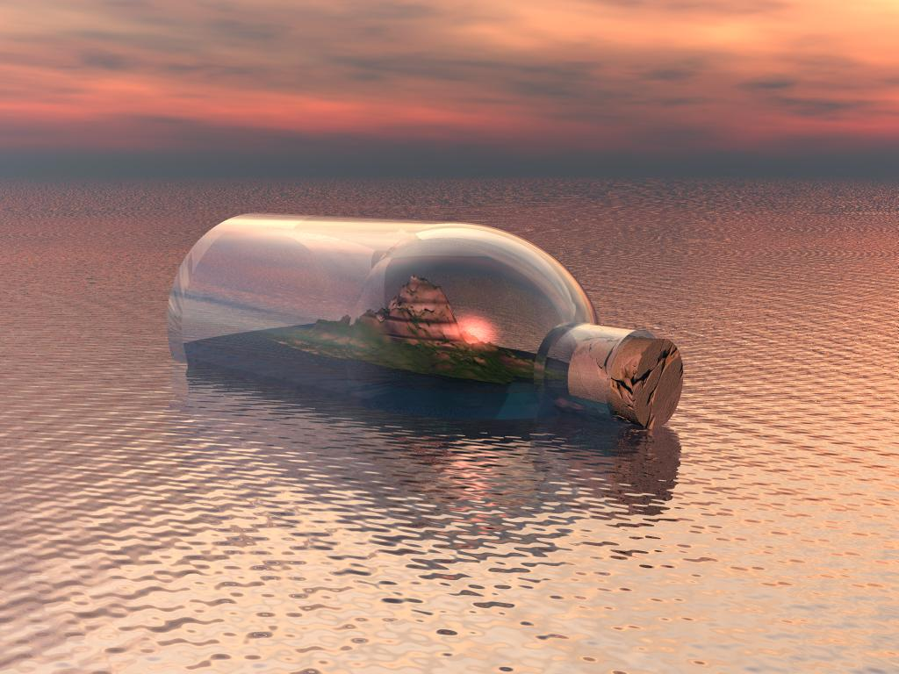

Slide 13
Four Realities
A transitory life
+ A meaningless earth cycle
+ An inability to know all
+ Generational discontinuity
+ God In The Equation
What Is The Outcome?

Slide 14
The Theistic
WORLDVIEW
A world under God’s control
A trusting relationship with the Creator
Pursuit of the spiritual purposes of God

Slide 15
Four Realities
A transitory life
+ A wise God in control
+ A sovereign purpose to fulfill
+ Wisdom to guide us
Satisfaction & hope!

Slide 16
TWO VIEWS OF THE WORLD
Secularist
World
View
Theistic
World
View

Slide 17
Ancient Wisdom for Modern Life
Ecclesiastes
It’s all a matter of perspective!

Slide 18


Slide 19


Slide 20
“Everything is Meaningless”
✤ The word “meaningless” occurs 35 times in the book
✤ The Hebrew word is “Hebel” which is sometimes translated “Vanity”.
✤ It means something that quickly passes, of no lasting value, emptiness, something that is like breath of wind or a puff of smoke that is briefly seen and disappears.

Slide 21


Slide 22
“Under the Sun”
✤ The key to understanding this book is the phrase “under the sun”.
✤ This phrase occurs 29 times.
✤ Ecclesiastes 1:14 (NIV84) “I have seen all things that are done under the sun; they are all meaningless, a chasing after the wind.”
✤ Ecclesiastes is realistic examination of life without the hope of Christ.

Slide 23
“The Teacher”
✤ 1:1 The words of the Teacher, son of David, king in Jerusalem:
✤ 1:12 “I, the Teacher, was king over Israel in Jerusalem.”
✤ Qoheleth = teacher, preacher
✤ Ecclesiastes is Latin for Teacher
✤ Solomon: the man who has done everything and has everything this world can offer and has found it all “meaningless”.

Slide 24
The Search for Meaning: Nature
✤ The natural world is filled with meaningless cycles that just go round and round.
✤ “The sun rises and the sun sets, and hurries back to where it rises. The wind blows to the south and turns to the north; round and round it goes, ever returning on its course. All streams flow to the sea, yet the sea is never full. To the place the streams come from, there they return again.” (Ecclesiastes 1:5–7, NIV84)
✤ “There is nothing new under the sun”.

Slide 25
The Search for Meaning:
Personal Constructions
✤ Great building projects
✤ Parks and irrigated gardens
✤ Beautiful cities and palaces
✤ “Yet when I surveyed all my hands had done and what I had toiled to achieve, everything was meaningless, a chasing after the wind; nothing was gained under the sun.” (Ecclesiastes 2:11, NIV)
✤ He knew that nothing he had built or achieved would last.

Slide 26
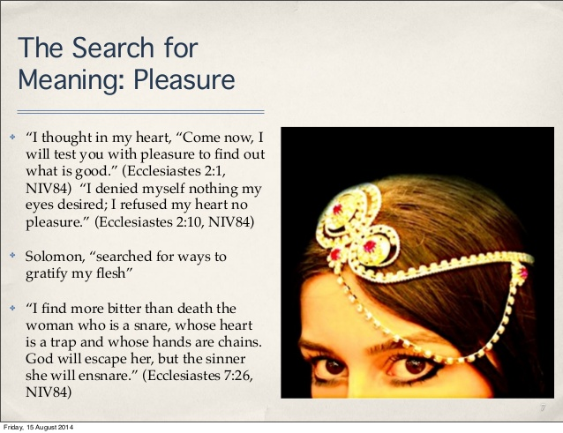

Slide 27
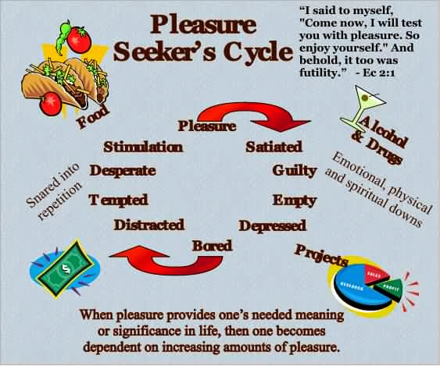

Slide 28
The Search for Meaning:
Wealth and Possessions
✤ Solomon was the wealthiest man in the world of his day.
“King Solomon was greater in riches and wisdom than all the other kings of the earth.”
(1 Kings 10:23, NIV84)
✤ “Whoever loves money never has money enough; whoever loves wealth is never satisfied with his income. This too is meaningless. (Ecclesiastes 5: 10)

Slide 29
The Inescapable Reality of Death
✤ The rich and poor both die.
✤ The fool and the wise both die
✤ The righteous & the wicked both die
✤ “In this meaningless life of mine I’ve seen both of these: a righteous man perishing in his righteousness, and a wicked man living long in his wickedness. Do not be over righteous, neither be over wise— why destroy yourself? Do not be over wicked, and do not be a fool— why die before your time? It is good to grasp the one and not let go of the other. The man who fears God will avoid all extremes.” (Ecclesiastes 7:15–18)

Slide 30
Inescapable Reality of Death – cont.
✤Death strips away any meaning or purpose if our focus is on this world alone. “Life under the sun”.
✤ Anyone who is among the living has hope-even a live dog is better off than a dead lion! For the living know that they will die, but the dead know nothing; they have no further reward, and even the memory of them is forgotten. Their love, hate and their jealousy have long since vanished; never again will they have a part in anything that happens under the sun.”
(Ecclesiastes 9:1–6, NIV84)

Slide 31
Teacher’s View of Life: Self-Centered
✤ “How may I enjoy life.” “How do I find meaning.” His view of life is completely self-centered.
✤ He believes in God, but God only lives on the outer edge of his life. God isn’t the center or focus of his life. This is why he finds all things in this life so meaningless in the end.
✤ “Now all has been heard; here is the conclusion of the matter: Fear God and keep his commandments, for this is the whole duty of man. For God will bring every deed into judgement, including every hidden thing, whether it is good or evil.” (Ecclesiastes 12:13–14, NIV84)

Slide 32
Balancing Our Lives
✤ How much of your life is spent dealing with things which from an eternal forever perspective are meaningless?
✤ What percentage of your life is spent investing in the things of eternal worth?
✤ What will still have meaning in one year’s time? Or 5 year’s time? Or 10 or 20?
✤ What will still have meaning at the hour of your death?
✤ When you depart from this world what will you leave behind that will have meaning for you in eternity?

Slide 33
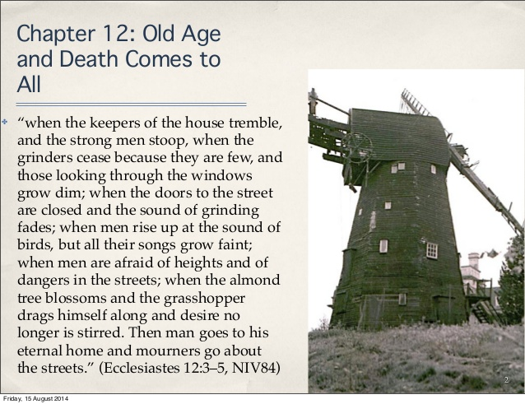

Slide 34


Slide 35
“God has put Eternity in their hearts”
✤ The heart of the problem for the Teacher is that in death “ no man knows whether love or hate awaits him.” (9:1)
✤ The Teacher knows God has created this world and has put an awareness of eternity in man’s heart. But he cannot understand why the world seems to have no meaning,
✤ “He has made everything beautiful in its time. He has also set eternity in the hearts of men; yet they cannot fathom what God has done from beginning to end. I know there is nothing better for men than to be happy and do good while they live. That everyone may eat and drink, and find satisfaction in all his toil—this is the gift of God.
(Ecclesiastes 3:11–14, NIV84)

Slide 36
Why God Sent His Son Jesus
✤ The Teacher lays bare the ultimate emptiness of this life and certainty of judgement.
✤ Life on earth, life under the sun, has no meaning without Jesus and the resurrection.
✤ Suffering, hardship, success, love and pleasures, even righteousness itself are pointless unless Jesus had opened the way to eternal life & salvation from judgement of sin.

Slide 37


Slide 38
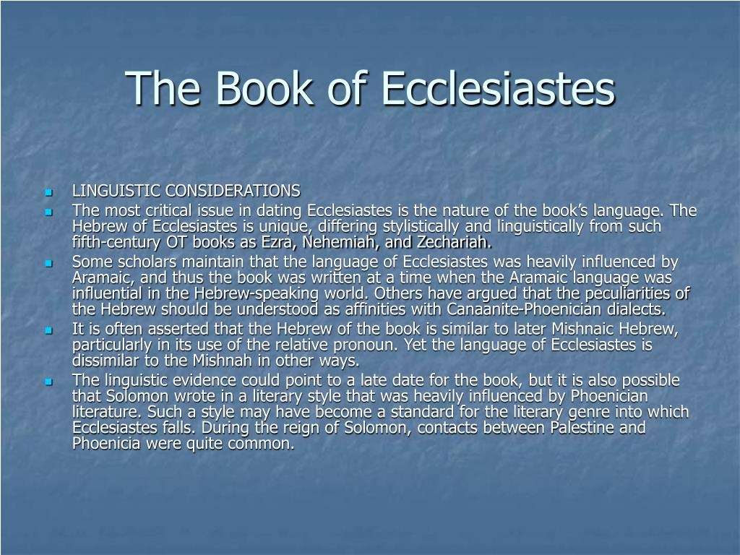

Slide 39
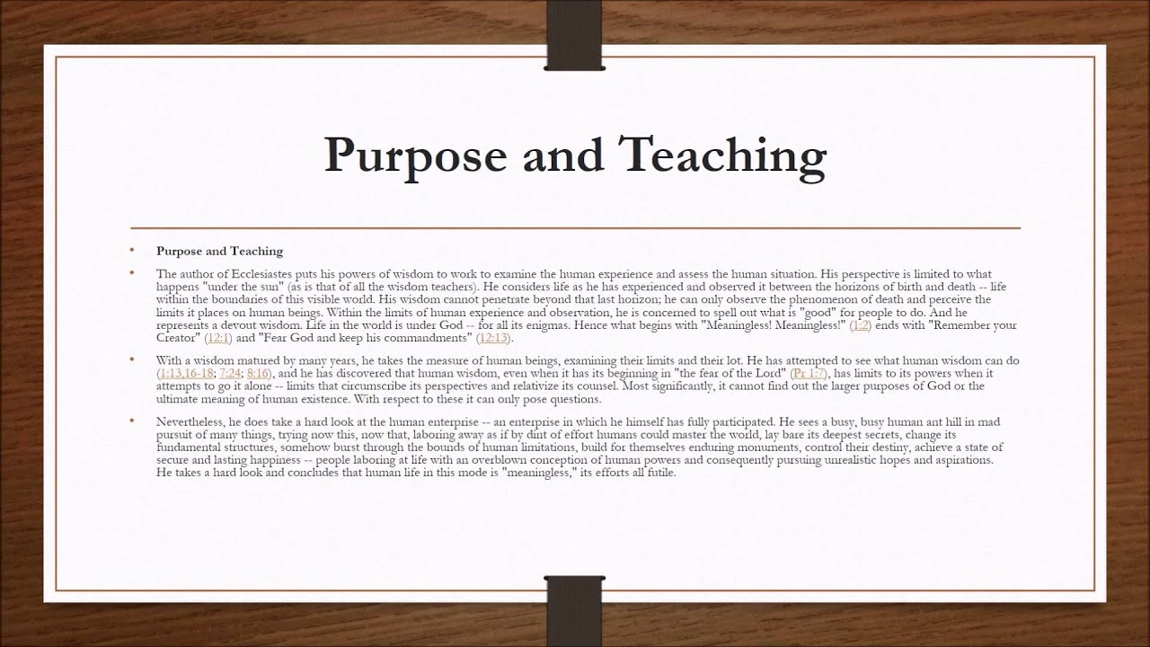

Slide 40
Characteristics
The book of Ecclesiastes has a number of characteristics that distinguish it from the other books of the Holy Scriptures: (A) its genre is wisdom literature, (B) it has a number of literary forms, (C) its theme is reflected in a number of key words.
A. Wisdom Literature—The book of Ecclesiastes is one of several books found in the Old Testament that is classified as “Wisdom Literature”. Also included in this list are the books of Job and Proverbs, with certain psalms (notably Ps 19; 37; 104; 107; 147; 148) as well as some non-canonical Apocrypha literature, such as Ecclesiasticus (Wisdom of Solomon).
B. Literary Forms—There are a number of literary forms and devices used by the author.
1. Aphorisms—Most prominent in literary forms in Ecclesiastes are aphorisms, which are short, pithy sayings, also called proverbs (7:1–8, 10:1–3, 8–15).
2. Didactic Narrative—We can find didactic narrative in Ecclesiastes, which is a short story with a moral (4:13–16, 5:13–17, 9:13–16).
3. Admonitions—We can find passages in Ecclesiastes that admonish the reader by using the imperative, or jussive, constructions within the text (5:1–4).
C. Key Words—The most frequently used words in a book of the Bible will reflect its theme. When we examine the book of Ecclesiastes, we find a number of words that do just that:
“good, better, well, pleasure, precious, joyful, merry” (S 2896) (52 uses),
“vanity” (S 1892) (38 uses),
“I perceived, I know, I discerned” (S 3045) (36 uses),
“under the sun” (29 uses),
“joy, mirth” or “rejoice” (8055 [8], 8057 [8]) (16 uses),
“profit” (S 3504) (10 uses),
“vexation of spirit” (9 uses), and
“I said in my heart” (5 uses).
Everett, G. H. (2011). (p. 14). Gary Everett.
Everett, G. H. (2011). The Book of Ecclesiastes (p. 14). Gary Everett.

Slide 41
Purpose
The purpose in writing the book of Ecclesiastes is to advise young men of the true meaning of life. We know that a young man is characterized by a passion for exploring and experiencing life. For example, he is inclined to equate true wisdom with a vast amount of knowledge experiences. Yet, Solomon had accumulated vast wisdom and found it not to be true. Or, perhaps the young man thought that life is most enjoyed when one is carefree and indulges in wine. But Solomon knew better by experience. Or, maybe some young men felt that life was given to accumulating wealth, or accomplishing great feats of renown. But again, Solomon had experienced this also and did not find satisfaction.
The Preacher attempts to tell his readers that serving the Lord and obeying His commandments is the true essence of life. The Preacher teaches us that we are to live our brief stay here on this earth with joy, and to do this he teaches us how to find purpose in our everyday tasks by walking daily in the fear of the Lord; for we are to acknowledge our gifts in this life of wisdom, mirth, labour and wealth, as blessings from God. The book of Ecclesiastes teaches us how little this world can satisfy the soul of man apart from serving God. It tells us that amidst the injustices, abnormalities and struggles of life that are beyond our control, there is a God who is intervening in the affairs of mankind. We can take comfort in the fact that there will be a day of reckoning for all of mankind. No book of the Holy Scriptures digs deeper into this truth than does Ecclesiastes.
  Everett, G. H. (2011). (pp. 1516). Gary Everett.
Everett, G. H. (2011). The Book of Ecclesiastes (pp. 15–16). Gary Everett.

Slide 42
A. Primary Theme (Foundational)—Poetry: How to Worship the Lord with all our Heart—The common underlying theme of the Hebrew poetry of the Scriptures is “How to Worship the Lord with all our Heart.” Poetry is primarily written to express the mood of man’s heart. When we read these books in the Old Testament, we are emotionally moved as we identify with the poet or psalmist. Although there are many poetic passages in the Scriptures, for the purposes of identifying thematic schemes, this division of the Old Testament includes Job, Psalms, Proverbs, Ecclesiastes, Song of Solomon, and Lamentations, although scholars group this biblical genre differently. The first book of Hebrew poetry we encounter as we read through the Old Testament is the book of Job, which opens with an account of this man worshipping God at an altar of sacrifice (Job 1:5). The Psalms of David show us how to worship the Lord during all seasons of life while the book of Job and Lamentations teaches us how to worship during the times of the greatest tragedies in life. As we journey through this life, we will have times of ecstasy when we are caught up in worship and we will have times of trials when we cry out to God for deliverance. However, most of our days are given to simple routines and decisions that determine our future well-being. We must then look to the book of Proverbs, Ecclesiastes, and Songs for a pattern of how to worship the Lord with our hearts during such uneventful days.
  Everett, G. H. (2011). (p. 16). Gary Everett.
Everett, G. H. (2011). The Book of Ecclesiastes (p. 16). Gary Everett.

Slide 43
B. Secondary Theme (Supportive and Structural)—We are Predestined to Reflect the Image of Christ as We Follow God’s Plan for our Lives (Body)—The secondary theme gives the book its structure, or outline. Mankind has been predestined to reflect the image of Christ by following the plan God has designed for his life. God initiates man’s spiritual journey on earth by subjecting him to vanities. It is God’s intent to burden every man with vanity and the sorrows of this world so that he will look unto God for direction in his life. Through life’s vanities, God appeals to our physical bodies to understand His ways.
  Everett, G. H. (2011). (p. 19). Gary Everett.
Everett, G. H. (2011). The Book of Ecclesiastes (p. 19). Gary Everett.

Slide 44
C. Third Theme (Imperative)—Fear God and Keep His Commandments—The third theme of Ecclesiastes supports its secondary theme by revealing the way in which man labours with the purpose of serving God, which is by the fear of the Lord. This theme is easily seen in Ecclesiastes, which declares that we are to fear God, and keep his commandments: for this is the whole duty of man. The third themes of Ecclesiastes and the book of Proverbs are the same, which is to fear the Lord.
  Everett, G. H. (2011). (p. 20). Gary Everett.
Everett, G. H. (2011). The Book of Ecclesiastes (p. 20). Gary Everett.

Slide 45
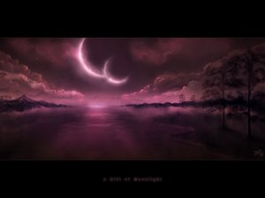
Book Of Ecclesiastes: The Preacher
General Providence: The Lot Of Man
GOD’S NATURAL & NORMAL LAW OF IMPARTIALITY
Total Vanity (Vapor) Or Ephemeral Emptiness Of Mankind’s Every Ambition & Pursuit
Determining Role Of Random Chance In Large Majority Of Human Success Stories & Failures Of Endeavor
No Denying That Luck & Time Happen To All Of Us & This Is Called “The Human Condition”
Nature Repeats Itself In Endless Cycles (Chapter 1) Or In Amoral Alternation Of Opposites (Chapter 3) – Always At Work But Nothing Is Achieved
Beasts Of Field Know No Difference But Humankind Requires Meaningful Objectives & Purposeful Existence
The Creatures Of Intelligence Throughout Human History Have Searched For Answers As To The Positively Purposed End To Man On Earth – Teleological Study Of History

Slide 46
Book Of Ecclesiastes: The Preacher
General Providence: The Lot Of Man
GOD’S NATURAL & NORMAL LAW OF IMPARTIALITY
Successive Generations Of Humans On The Earth Compare In Impact To That Of Goalless Nature
Aging Man Is Metaphorically Compared To An Old House
Then The Lone & Inevitable Certainty Of Each Man’s Death
We Will Not Even Be Remembered By Those That Survive Us
Thus, We Find In (12: 9 – 13) He States We Must Be Prepared To Go To Our Long Home
Chapters One Thru Eight Written In First Person – That Person Claimed As Being King Solomon
His Conclusion – Man Alone Is Not Merely A Number But Neither Are Men Together The Measure
After - Chapter 8: Verse 12 - Written In Third Person & Centers On Advice For Living In The Duration Or That Interval Between House & Home
Recommends “Seizing The Day” & Enjoying Small Pleasures Of This Life & The Three-Fold Chord Of Family.

Slide 47
LESSONS FROM WATER
Sometimes when you feel like your going would leave an unfillable hole,
Just follow this simple instruction and see how it humbles your soul.
Take a bucket and fill it with water, put your hand in it, up to the wrist;
Pull it out; and the hole that’s remaining, is a measure of how you’ll be missed.
You may splash all you please when you enter, you can stir up the water galore,
But stop and you’ll find in a minute, that it looks quite the same as before.
- UNKNOWN AUTHOR
Seasonal Distance From The Sun

Slide 48


Slide 49
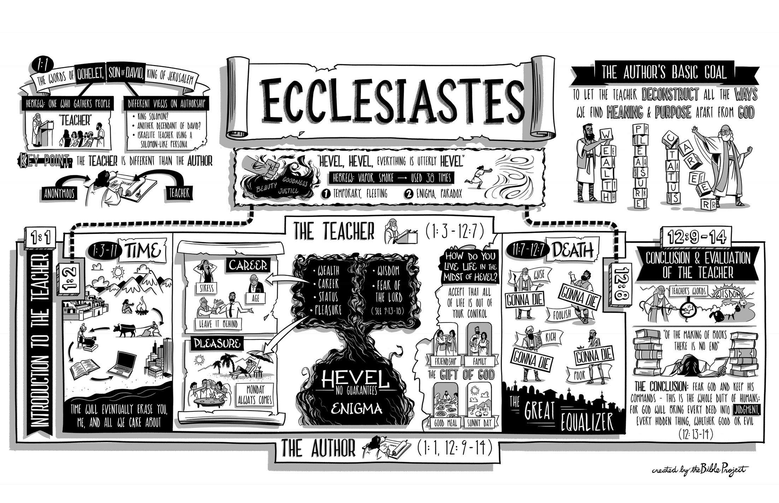

Slide 50
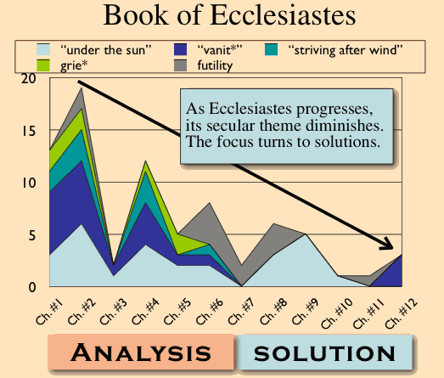

Slide 51
Outline of Ecclesiastes
1:1-3 | Solomon’s thesis statement
1:4-18 | The vanity of the world’s natural processes and pursuit of understanding
2 | The vanity of indulgence, human achievement, and materialism
3 | God’s organized way of life for human activity
4 | The vanity of human cruelty, toil, politics
5 | The vanity of careless worship and misused wealth
6 | The vanity of riches
7:1-11:8 | Wise insights in the midst of life’s vanity (mini-realities amid life’s conflicting differences)
11:9-12:7 | Onset of old age when the health and strength of youth passes
12:8-14 | Conclusion: life’s vanity can only be handled by devoting yourself to God

Slide 52
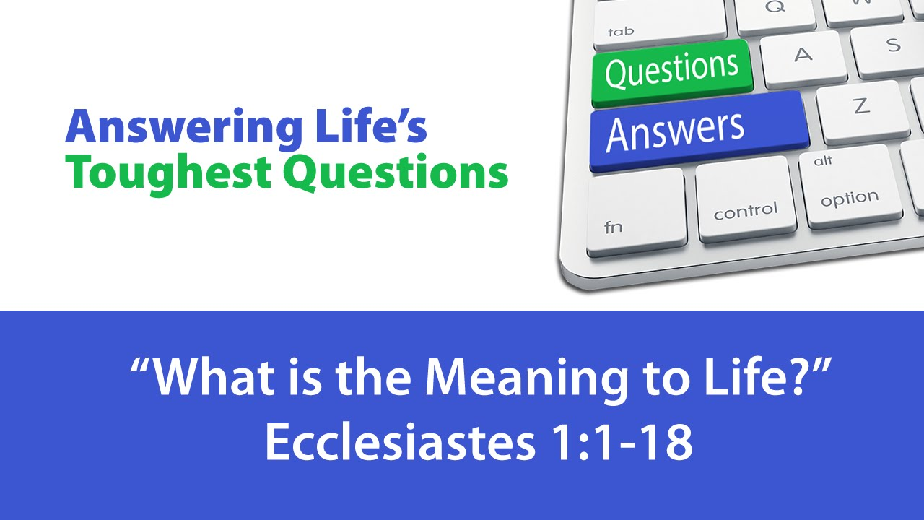

Slide 53

CHAPTER ONE

Slide 55
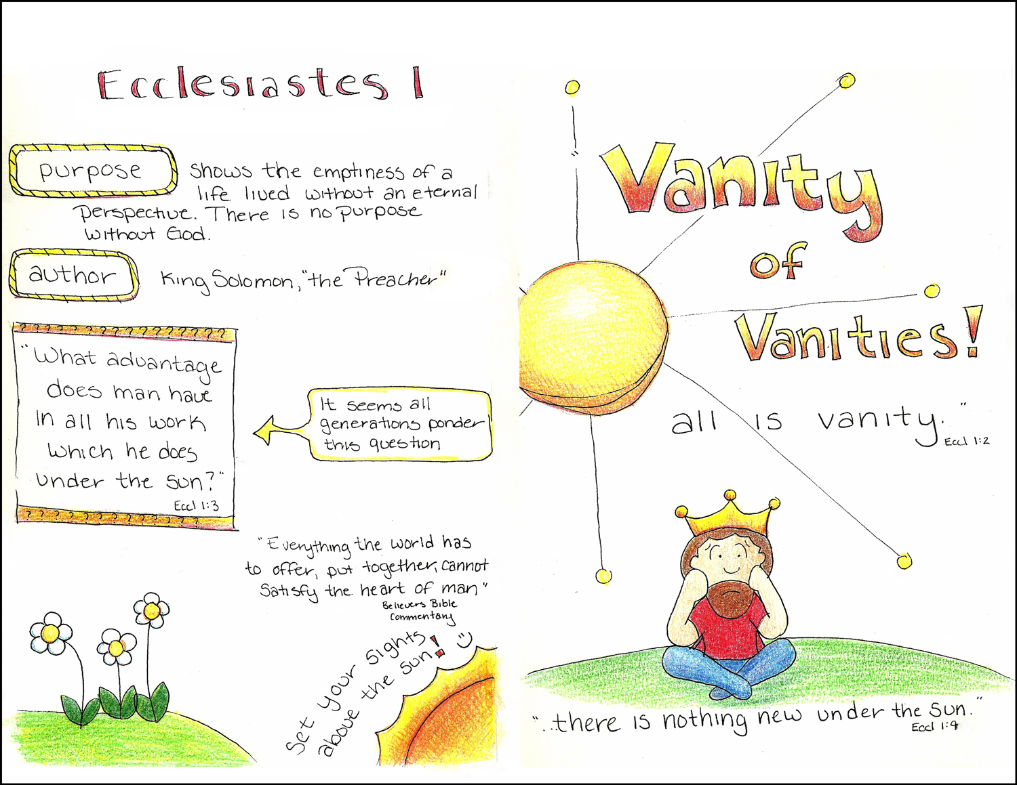

Slide 56
Ecclesiastes = Three Sections
Introduction – 1:1-15
Exploration – 2:1-6:9
Summary – 6:10-12:14

Slide 57
Background: Ecclesiastes
Ecclesiastes
– One who calls the Assembly
The “Preacher” is Solomon
Date: 925 BC
Theme: Ch 1:2

Slide 58
Main Outline
Introducing the Journey – 1:1-11

Slide 59
Main Outline
Introducing the Journey – 1:1-11
Pursing the Journey – 1:12-6:9
  1:12-18 – Wisdom
  2:1-11 – Pleasure
  2:12-17 – Wisdom/Folly
  2:18-3:22 – Work
  4:1-6:9 – Wealth & Power

Slide 60
Main Outline
Introducing the Journey – 1:1-11
Pursuing the Journey – 1:12-6:9
Reflection & Summary – 6:10-12:14

Slide 61
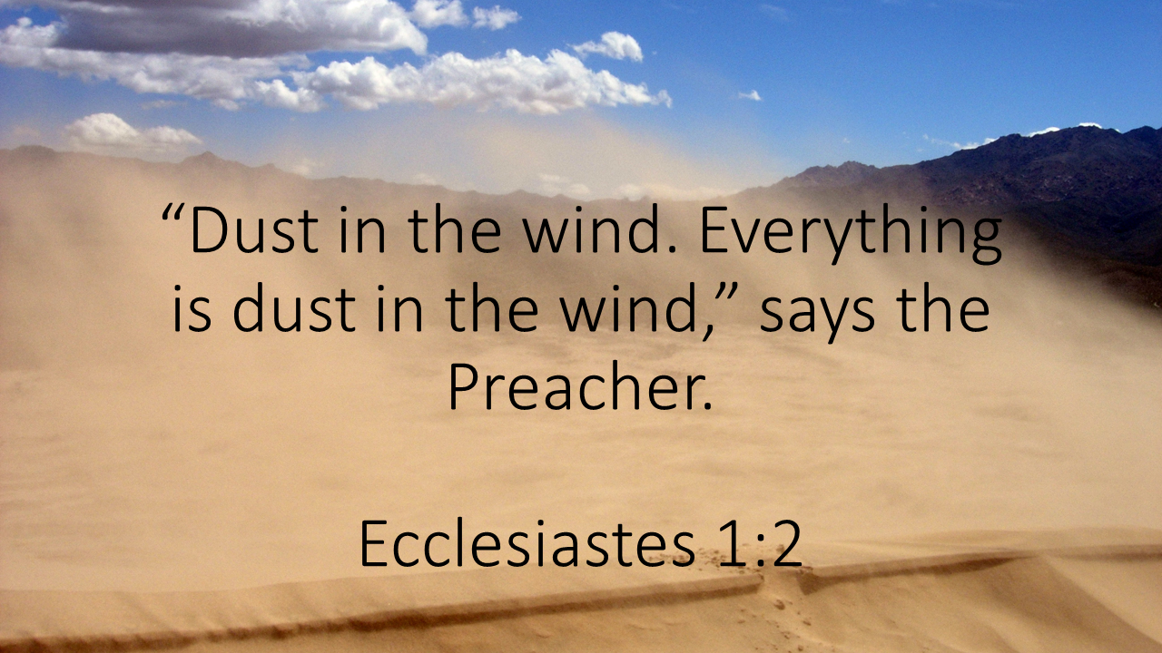

Slide 62


Slide 63
The words of the Preacher, the son of David, king in Jerusalem.
“Vanity of vanities,” says the Preacher,
“Vanity of vanities! All is vanity.”
What advantage does man have in all his work
Which he does under the sun?
- Ecc. 1:1-3

Slide 64
A generation goes and a generation comes,
But the earth remains forever.
- Ecc. 1:4

Slide 65
Q.
According to certain Bible critics, 2 Peter 3:10 contradicts Ecclesiastes 1:4. Whereas Peter wrote, “But the day of the Lord will come as a thief in the night, in which the heavens will pass away with a great noise, and the elements will melt with fervent heat; both the earth and the works that are in it will be burned up” (emp. added), Solomon declared in the book of Ecclesiastes, “One generation passes away, and another generation comes; but the earth abides forever” (emp. added). Is one of these two declarations an “erroneous statement” as skeptic David Miles contends (2007), or is there a logical explanation regarding why the “burned up” Earth is said to “abide forever”?
A.
The answer to this question actually is very simple: the Bible frequently uses the term “forever” (Hebrew olam) in a more limited sense, to mean “a long duration,” and not necessarily a literal eternal existence (see Olam, 1999). Consider a few examples:
Prior to the Israelites’ departure from Egypt, Moses instituted the Passover. He then added: “And you shall observe this thing as an ordinance for you and your sons forever” (Exodus 12:24, emp. added).
Under the Law of Moses, when a servant pledged allegiance to his master, the master would “take an awl and thrust it through” the servant’s ear to the door (Deuteronomy 15:17). This was a sign that the servant would work for his master “forever” (15:17).
After the Israelites visited King Rehoboam and petitioned him to lighten their burdens (2 Chronicles 10:3-4), the elders advised the king to be kind to the people and they would be his servants “forever” (10:7).

Slide 66
Also, the sun rises and the sun sets;
And hastening to its place it rises there again.
Blowing toward the south,
Then turning toward the north,
The wind continues swirling along;
And on its circular courses the wind returns.
- Ecc. 1:5-6

Slide 67
All the rivers flow into the sea,
Yet the sea is not full.
To the place where the rivers flow,
There they flow again.
All things are wearisome;
Man is not able to tell it.
- Ecc. 1:7-8a

Slide 68
The eye is not satisfied with seeing,
Nor is the ear filled with hearing.
- Ecc. 1:8b

Slide 69
That which has been is that which will be,
And that which has been done is that which will be done.
So there is nothing new under the sun.
Is there anything of which one might say,
“See this, it is new”?
Already it has existed for ages
Which were before us.
- Ecc. 1:9-10

Slide 70
There is no remembrance of earlier things;
And also of the later things which will occur,
There will be for them no remembrance
Among those who will come later still.
- Ecc. 1:11

Slide 71
Examples of Futility
Passing of Generations
Cycles of Nature
Curiosity of Man
Absence of Newness

Slide 72
For every universal, innate need of man there is an available and corresponding satisfaction
FOR EXAMPLE:
Hunger – Food
Sex – Sex Partner

Slide 73
Creatures are not born with desires unless satisfaction for those desires exists. A baby feels hunger: well, there is such a thing as food. A Ducking wants to swim: well, there is such a thing as water. Men feel sexual desire: well, there is such a thing as sex. If I find myself a desire which no experience in this world can satisfy, the most probable explanation is that I was made for another world. If none of my earthly pleasures satisfy it, that does not prove that the universe is a fraud. Probably earthly pleasures were never meant to satisfy it, but only to arouse it, to suggest the real thing.
“Surprised By Joy” – C.S. Lewis

Slide 74
I, the Preacher, have been king over Israel in Jerusalem. And I set my mind to seek and explore by wisdom concerning all that has been done under heaven.
- Ecc. 1:12-13a

Slide 75
It is a grievous task which God has given to the sons of men to be afflicted with.
- Ecc. 1:12-13b

Slide 76
MAIN LESSON
Some things cannot now, or will ever be found here on earth.

Slide 77
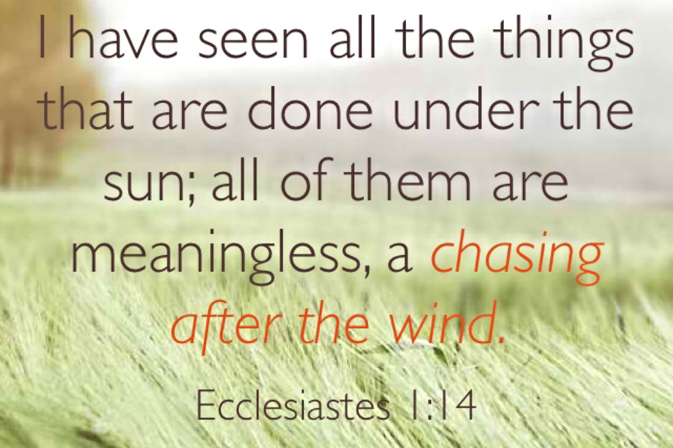
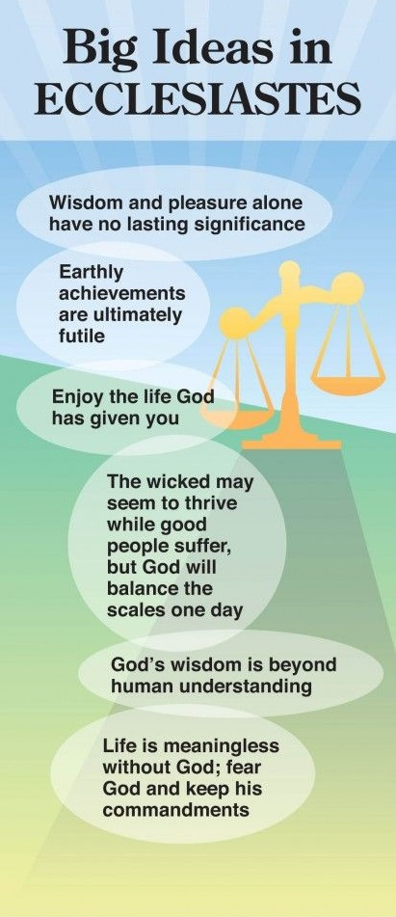

Slide 78
Chapter 2 to 4: Four Pursuits
Pleasure
Wisdom & Folly
Meaningful Work
Power & Wealth

Slide 79
CHAPTER TWO

Slide 80
I said to myself, “Come now, I will test you with pleasure.
- Ecc. 2:1a

Slide 81
So enjoy yourself.” And behold, it too was futility.
- Ecc. 2:1b

Slide 82
1. Laughter
I said of laughter, “It is madness,” and of pleasure, “What does it accomplish?”
- Ecc. 2:2

Slide 83
2. Consumption of Wine
I explored with my mind how to stimulate my body with wine while my mind was guiding me wisely, and how to take hold of folly, until I could see what good there is for the sons of men to do under heaven the few years of their lives.
- Ecc. 2:3

Slide 84
3. Building Projects
I enlarged my works: I built houses for myself, I planted vineyards for myself; I made gardens and parks for myself and I planted in them all kinds of fruit trees; I made ponds of water for myself from which to irrigate a forest of growing trees.
- Ecc. 2:4-6

Slide 85
4. Sensuality
I bought male and female slaves and I had homeborn slaves. Also I possessed flocks and herds larger than all who preceded me in Jerusalem. Also, I collected for myself silver and gold and the treasure of kings and provinces. I provided for myself male and female singers and the pleasures of men—many concubines.
- Ecc. 2:7-8

Slide 86
5. The Good Life
Then I became great and increased more than all who preceded me in Jerusalem. My wisdom also stood by me. All that my eyes desired I did not refuse them. I did not withhold my heart from any pleasure, for my heart was pleased because of all my labor and this was my reward for all my labor.
- Ecc. 2:9-10

Slide 87
Thus I considered all my activities which my hands had done and the labor which I had exerted, and behold all was vanity and striving after wind and there was no profit under the sun.
- Ecc. 2:11

Slide 88
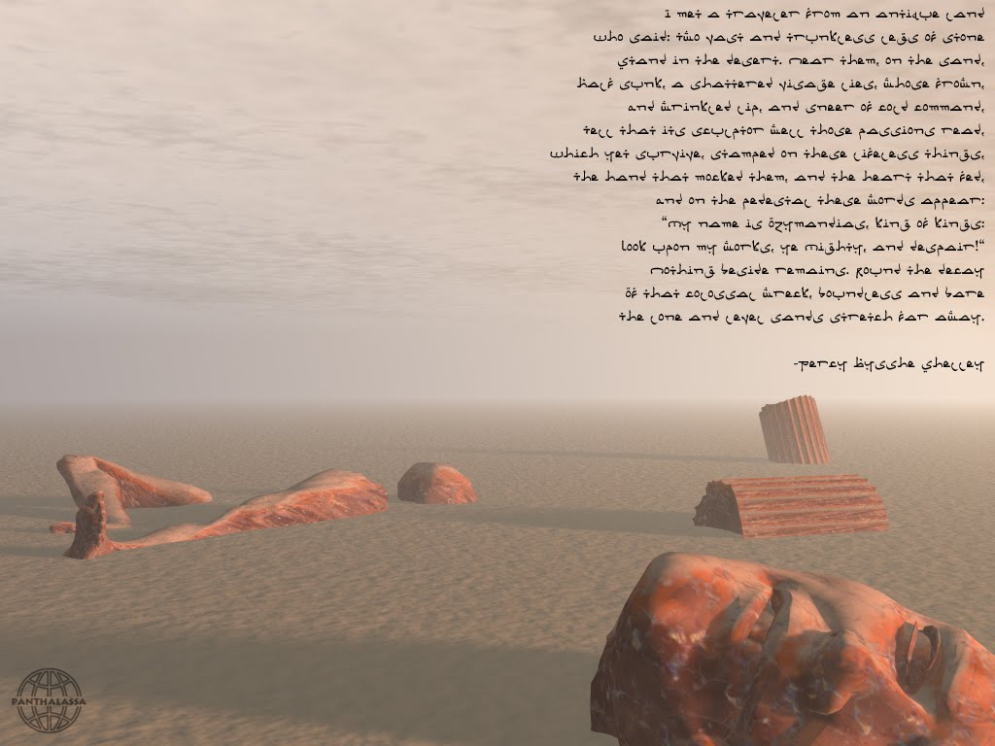

Slide 89
Sensual pleasures cannot be accumulated or stored

Slide 90
Legitimate Pleasure = Momentary
Illegitimate Pleasure = Guilt & Shame

Slide 91
No rats in the race for the “Crown of Life.”

Slide 92
Sensuality is a Dead-End:
Promises much, delivers little

Slide 93
Sensuality is a Dead-End:
Promises much, delivers little
Changes very little

Slide 94
Sensuality is a Dead-End:
Promises much, delivers little
Changes very little
Creates insatiable needs

Slide 95
Pleasure is not wrong, it simply is not the way to true meaning & contentment.

Slide 96
We Need to Pursue Things That:
Deliver what they promise
Makes us better people
Satisfy our basic needs

Slide 97
We Need to Pursue:
Faith & Obedience to God
Knowledge & relationship with Christ
Submission to the Holy Spirit

Slide 98
Sensual pleasure only
goes skin deep.
Only spiritual things can
satisfy spiritual needs.

Slide 99
Pleasure is pleasurable but also fleeting without lasting value.

Slide 100
So I turned to consider wisdom, madness and folly; for what will the man do who will come after the king except what has already been done? And I saw that wisdom excels folly as light excels darkness. The wise man’s eyes are in his head, but the fool walks in darkness.
- Ecc. 2:12-14a

Slide 101
And yet I know that one fate befalls them both. Then I said to myself, “As is the fate of the fool, it will also befall me. Why then have I been extremely wise?” So I said to myself, “This too is vanity.”
- Ecc. 2:14b-15

Slide 102
For there is no lasting remembrance of the wise man as with the fool, inasmuch as in the coming days all will be forgotten. And how the wise man and the fool alike die! So I hated life, for the work which had been done under the sun was grievous to me; because everything is futility and striving after wind.
- Ecc. 2:16-17

Slide 103
Thus I hated all the fruit of my labor for which I had labored under the sun, for I must leave it to the man who will come after me.
- Ecc. 2:18

Slide 104
And who knows whether he will be a wise man or a fool? Yet he will have control over all the fruit of my labor for which I have labored by acting wisely under the sun. This too is vanity.
- Ecc. 2:19

Slide 105
Therefore I completely despaired of all the fruit of my labor for which I had labored under the sun. When there is a man who has labored with wisdom, knowledge and skill, then he gives his legacy to one who has not labored with them. This too is vanity and a great evil.
- Ecc. 2:20-21

Slide 106
For what does a man get in all his labor and in his striving with which he labors under the sun? Because all his days his task is painful and grievous; even at night his mind does not rest. This too is vanity.
- Ecc. 2:22-23

Slide 107
There is nothing better for a man than to eat and drink and tell himself that his labor is good. This also I have seen that it is from the hand of God. For who can eat and who can have enjoyment without Him?
- Ecc. 2:24-25

Slide 108
Observation
The ability to experience joy is not related to what we do.

Slide 109
We experience the relationship
of joy in several ways:
- Salvation
- Hope
- Insight
- Love

Slide 110
Relationship with Christ
↓
Satisfaction
↓
Love, Joy, Peace

Slide 111
Solomon is saying that satisfaction, joy and peace work from the inside out!

Slide 112
For to a person who is good in His sight He has given wisdom and knowledge and joy, while to the sinner He has given the task of gathering and collecting so that he may give to one who is good in God’s sight. This too is vanity and striving after wind.
- Ecc. 2:26

Slide 113
The essence of one’s being is rooted in one’s relationship with God.

Slide 114
Solomon’s Point
Satisfaction is available to everyone irregardless of what they do as work.

Slide 115
Solomon’s Point
Joy and satisfaction are not a direct product of one’s work/skill, but must be found in one’s relationship with God.

Slide 116
Solomon’s Point
This relationship blesses our work, whatever we choose to do.

Slide 117
Review
A Life Examined:
  Pleasure
  Wisdom & Folly
  Work

Slide 118
Conclusions
Satisfaction is a gift from God
Righteousness is profitable
Work is carried out in “Time”

Slide 119
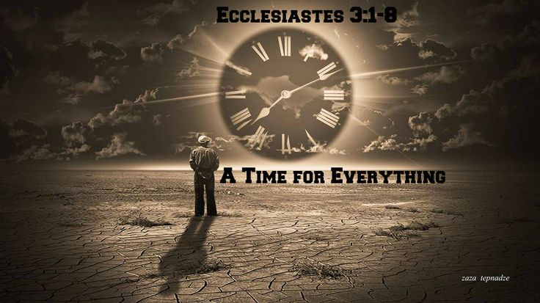

Slide 120
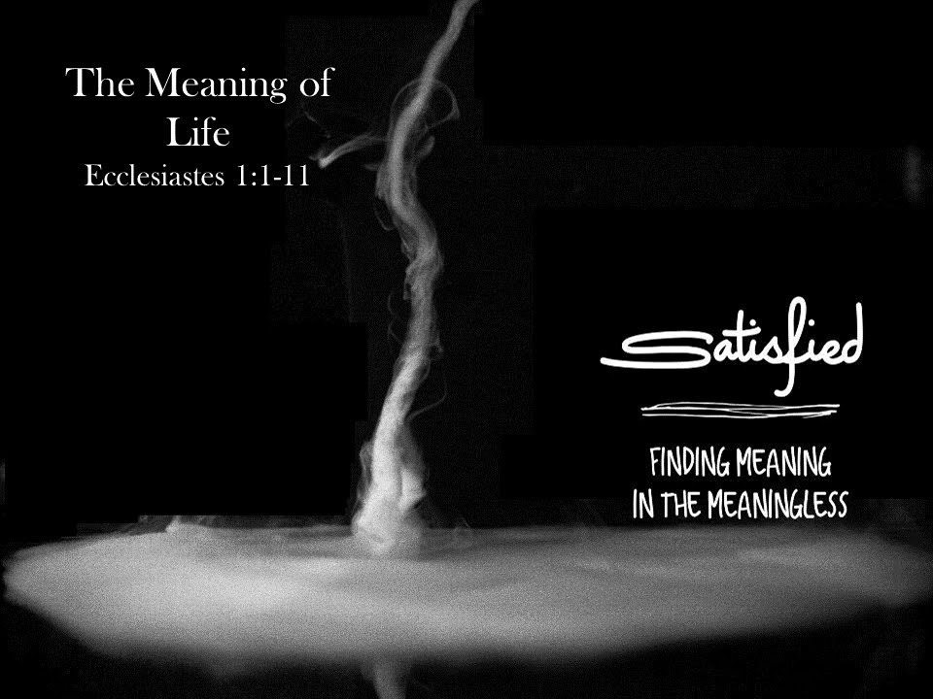
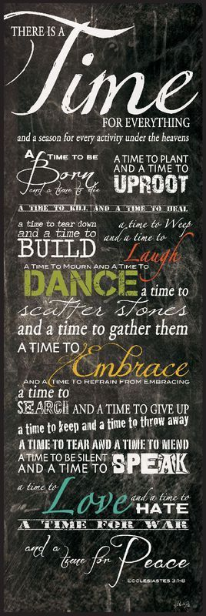

Slide 121
CHAPTER THREE

Slide 122


Slide 123
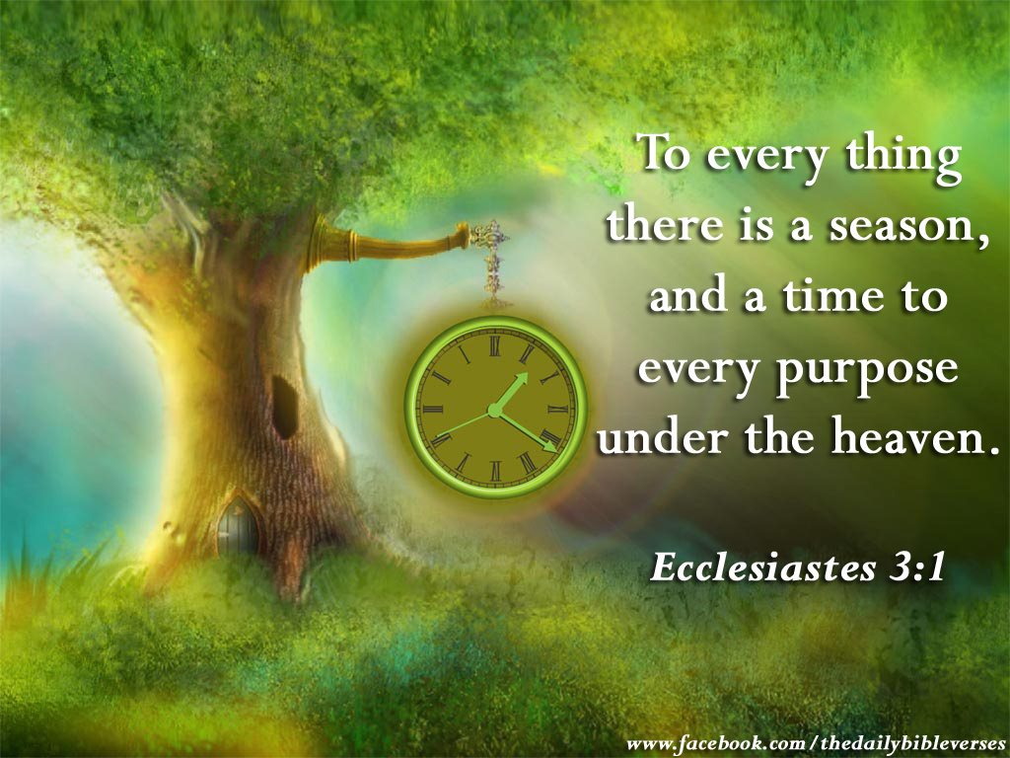

Slide 124
Definition
Time is a measurable period
during which events occur.

Slide 125
There is an appointed time for everything. And there is a time for every event under heaven—
- Ecc. 3:1

Slide 126
Opposites suggest the entire range of experiences
(Poetic device known as MERISM)

Slide 127
Jewish Numerology
3 = God
4 = World
7 = God + Creation
10 = Complete, Mature
1,000 = Completely Matured

Slide 128
1. Life & Death
A time to give birth and a time to die;
- Ecc. 3:2a

Slide 129
2. Renewal & Change
A time to plant and a time to uproot what is planted.
- Ecc. 3:2b

Slide 130
3. Destruction & Restoration
A time to kill and a time to heal;
- Ecc. 3:3a

Slide 131
4. Demolish & Rebuild
A time to tear down and a time to build up.
- Ecc. 3:3b

Slide 132
5. Sorrow & Joy
A time to weep and a time to laugh;
- Ecc. 3:4a

Slide 133
6. Mourn & Dance
A time to mourn and a time to dance.
- Ecc. 3:4b

Slide 134
7. Select & Reject
A time to throw stones and a time to gather stones;
- Ecc. 3:5a

Slide 135
8. Embrace & Confront
A time to embrace and a time to shun embracing.
- Ecc. 3:5b

Slide 136
9. Search & Abandon
A time to search and a time to give up as lost;
- Ecc. 3:6a

Slide 137
10. Keep & Discard
A time to keep and a time to throw away.
- Ecc. 3:6b

Slide 138
11. Grief & Resolution
A time to tear apart and a time to sew together;
- Ecc. 3:7a

Slide 139
12. Silence & Speaking Out
A time to be silent and a time to speak.
- Ecc. 3:7b

Slide 140
13. Love & Hate
A time to love and a time to hate;
- Ecc. 3:8a

Slide 141
14. War & Peace
A time for war and a time for peace.
- Ecc. 3:8b

Slide 142
What profit is there to the worker from that in which he toils?
- Ecc. 3:9

Slide 143
Question
What is the Profit?

Slide 144
I have seen the task which God has given the sons of men with which to occupy themselves. He has made everything appropriate in its time. He has also set eternity in their heart, yet so that man will not find out the work which God has done from the beginning even to the end.
- Ecc. 3:10-11

Slide 145
Conclusions
God has made everything appropriate in its Time.

Slide 146
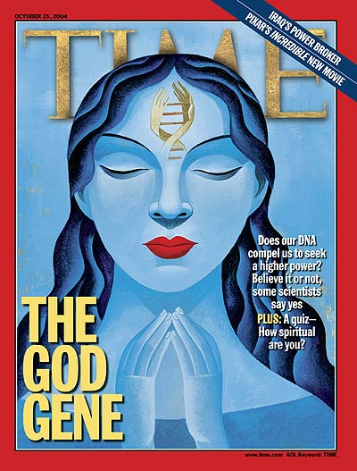
Conclusions
God has put eternity
into our hearts.

Slide 147
All the parts of life in time described, when put together do not equal something meaningful unless you add the part that is outside of time.

Slide 148
He is the image of the invisible God, the firstborn of all creation. For by Him all things were created, both in the heavens and on earth, visible and invisible, whether thrones or dominions or rulers or authorities—all things have been created through Him and for Him. He is before all things, and in Him all things hold together.
- Col. 1:15-17

Slide 149
Conclusions
We will never discover
God’s total work.

Slide 150
Solomon’s Search
Wisdom
Pleasure
Prudent/Foolish Life
Work
Life Events

Slide 151
Conclusion
Life is the Pits

Slide 152
Vertical View
God makes sense of chaos

Slide 153
He has made everything appropriate in its time. He has also set eternity in their heart, yet so that man will not find out the work which God has done from the beginning even to the end.
- Ecc. 3:11

Slide 154
The heavens are telling of the glory of God;
And their expanse is declaring the work of His hands.
- Ps. 19:1

Slide 155
Let everything that has breath praise the Lord.
Praise the Lord!
- Ps. 150:6

Slide 156
And we know that God causes all things to work together for good to those who love God, to those who are called according to His purpose.
- Rom. 8:28

Slide 157
Vertical View
God makes sense of chaos
God enables us to enjoy life

Slide 158


Slide 159
I know that there is nothing better for them than to rejoice and to do good in one’s lifetime; moreover, that every man who eats and drinks sees good in all his labor—it is the gift of God.
- Ecc. 3:12-13

Slide 160
Vertical View
God makes sense of chaos
God enables us to enjoy life
God provokes us to worship Him

Slide 161
I know that everything God does will remain forever; there is nothing to add to it and there is nothing to take from it, for God has so worked that men should fear Him. That which is has been already and that which will be has already been, for God seeks what has passed by.
- Ecc. 3:14-15

Slide 162
Horizontal View
Breeds Cynicism

Slide 163
Furthermore, I have seen under the sun that in the place of justice there is wickedness and in the place of righteousness there is wickedness.
- Ecc. 3:16

Slide 164
Then I looked again at all the acts of oppression which were being done under the sun. And behold I saw the tears of the oppressed and that they had no one to comfort them; and on the side of their oppressors was power, but they had no one to comfort them.
- Ecc. 4:1

Slide 165
So I congratulated the dead who are already dead more than the living who are still living. But better off than both of them is the one who has never existed, who has never seen the evil activity that is done under the sun.
- Ecc. 4:2-3

Slide 166
If you see oppression of the poor and denial of justice and righteousness in the province, do not be shocked at the sight; for one official watches over another official, and there are higher officials over them.
- Ecc. 5:8

Slide 167
All this I have seen and applied my mind to every deed that has been done under the sun wherein a man has exercised authority over another man to his hurt.
- Ecc. 8:9

Slide 168
Horizontal View
Solutions to Cynicism
  Injustice is Temporary

Slide 169
I said to myself, “God will judge both the righteous man and the wicked man,” for a time for every matter and for every deed is there.
- Ecc. 3:17

Slide 170
Horizontal View
Solutions to Cynicism
  Injustice is Temporary
  Injustice Condemns

Slide 171
I said to myself concerning the sons of men, “God has surely tested them in order for them to see that they are but beasts.” For the fate of the sons of men and the fate of beasts is the same. As one dies so dies the other; indeed, they all have the same breath and there is no advantage for man over beast, for all is vanity.
- Ecc. 3:18-19

Slide 172
All go to the same place. All came from the dust and all return to the dust. Who knows that the breath of man ascends upward and the breath of the beast descends downward to the earth?
- Ecc. 3:20-21

Slide 173
Horizontal View
Solutions to Cynicism
  Injustice is Temporary
  Injustice Condemns
  Hope Beyond Cynicism

Slide 174
I have seen that nothing is better than that man should be happy in his activities, for that is his lot. For who will bring him to see what will occur after him?
- Ecc. 3:22

Slide 175
Hopeful Realism
What is your unjust disadvantage?

Slide 176
Hopeful Realism
When do you plan to replace passive self-pity with active courage?

Slide 177
Hopeful Realism
How can God use you?

Slide 178
Changing our attitude will change our lives from cynicism to hope.

Slide 179
Providence and Its Apparent Problems
Although the term providence is not found in the Bible, it suggests that God’s foresight plays a part in guiding human destiny. But, on the one hand, any attempt to explain God’s control of the world faces serious problems. Wickedness seems to triumph over justice (Ecclesiastes 3:16). If God is in control, why does He allow this to happen? Also, life seems to be hopelessly swallowed up by death (3:19). Is this all there is to life? Moreover, the poor and weak are oppressed by the rich and powerful (4:1). If God answers prayer, why does He not respond to the outcry of human misery?
On the other hand, when one attempts to explain how God guides the lives of individuals on a day-today basis, he faces another set of problems. For one thing, if God desires that people work hard and succeed in life, why are others envious of their success (4:4)? Secondly, why are there so many lonely people in the world who are in desperate need of companionship (4:8)? Thirdly, why are success and popularity so short lived (4:13–16)? In the search for the meaning of life “under the sun,” the truth is “that the righteous and the wise, and their works, are in the hand of God; whether it be love or hatred, man knows not; all is before them” (9:1). Obviously, Ecclesiastes raises these questions concerning God’s providence to make us aware that man, left to himself, has no final solutions.
  Curry, M. (1989). . (D. Bowman, Ed.)Christianity Magazine, 6(7), 21.
Curry, M. (1989). The Providence of God in Ecclesiastes. (D. Bowman, Ed.)Christianity Magazine, 6(7), 21.

Slide 180
Creation, Providence, and Sin
Both the universe (1:5–7) and man (1:4; 7:9) were created by God and, despite the problems stated above, His providential hand may be seen in all things (3:1–8). God made His creation to be “very good” (Genesis 1:31), and He made man to live forever in Paradise; however, sin changed everything. Thus, when we look for God’s providence in a world where sin is present, we must understand that both creation and man are cursed as a consequence of sin, but that both continue under the watchful eye of God and will eventually be delivered from this curse. Indeed, God has provided every human being with the possibility of a new existence free from sin. We are warned, therefore, not to speak too hastily about things that we do not understand and that we cannot change (1:15; 5:2); rather, we must firmly believe that our Creator knows what He is doing (3:14).
Curry, M. (1989). . (D. Bowman, Ed.)Christianity Magazine, 6(7), 21.
Curry, M. (1989). The Providence of God in Ecclesiastes. (D. Bowman, Ed.)Christianity Magazine, 6(7), 21.

Slide 181
God’s Providence in Operation
Several aspects of God’s providence can be detected. In the first place, He keeps His creatures inquiringly ignorant of His activities in this world. This is why “He hath set eternity in their heart, yet so that man cannot find out the work that God hath done from the beginning even to the end” (3:11). Secondly, He makes it possible for men to be content in this life (2:24–26; 3:12; 5:18–19), but never satisfied with what they have (1:8; 5:10). Thirdly, He keeps injustice and oppression somewhat in check by means of civil authorities (5:8), and, more importantly, He holds all men accountable to Himself (3:17; 11:9; 12:14). Fourthly, He has permitted suffering and death to be the lot of all men (2:14–16); “time and chance happeneth to them all” (9:11–12). Ecclesiastes states that God has a purpose in all of this; He has placed prosperity and adversity each “side by side with the other, to the end that man should not find out any thing that should be after him” (7:14).
  Curry, M. (1989). . (D. Bowman, Ed.)Christianity Magazine, 6(7), 21.
Curry, M. (1989). The Providence of God in Ecclesiastes. (D. Bowman, Ed.)Christianity Magazine, 6(7), 21.

Slide 182
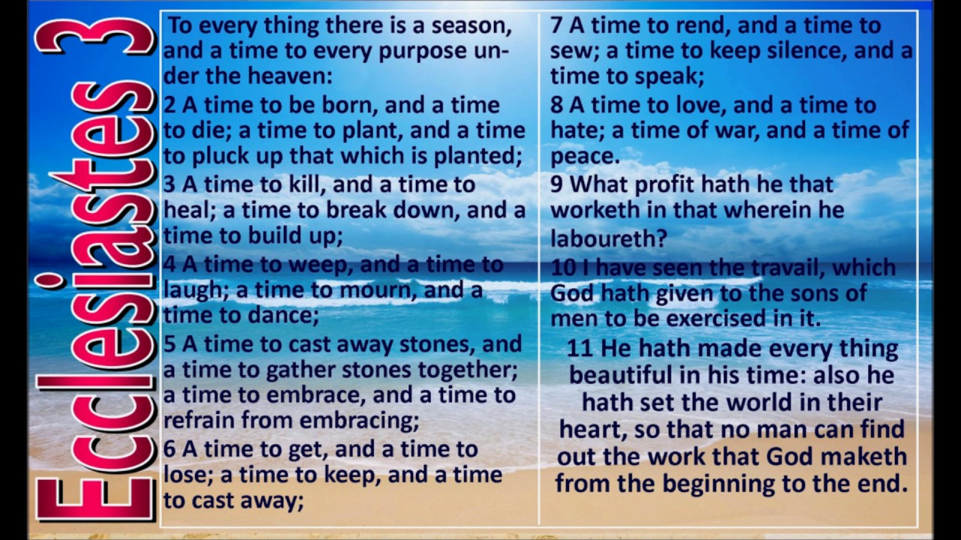

Slide 183


Slide 184
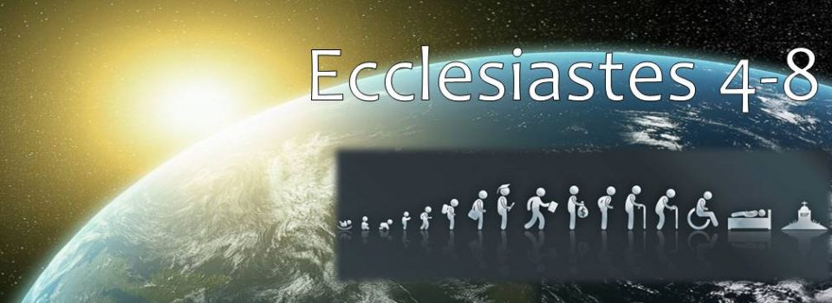

Slide 185
PARTTWO
SOLOMON’S LIFE’S LESSONS
Chapter four
Chapter five
Chapter six
Chapter Seven
Chapter Eight

