Slide 1
The Sect-to-Denomination Process
by David Lee Burris

Slide 2
Three Trends of Early Errors
Apostle Paul’s Convert Clement Is Received As If He Were An Apostle
Alexandria School Through Origen Defines Trinity Concept Sequential
Asia Minor School Thru Its Irenaeus Explains Mary By Contrasting To Eve
Organization Pattern
Doctrinal Pattern
Worshiping Pattern

Slide 3
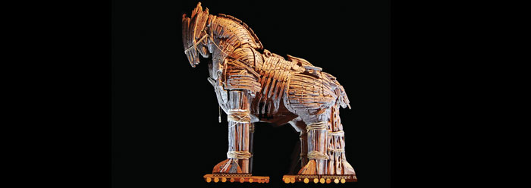
Historical Theology
Creeds – Catechisms – Confessions
Rules Of Faith & Council Decrees
Circulated Letters & Early Exegesis
Late Commentary & Interpretation

Slide 4
Historical Theology
Commentaries & Interpretation
Literaliter – historically meaningful.
Allegorice – events cautionary tale.
Tropologice – more & moral figure.
Anagogice – hereafter expressions.
* 12th Century - First Bible Commentary – Glossa Ordinaria

Slide 5
MAGISTERIUM
“Magisterium is used in a more limited sense to refer to the authoritative teaching body within the Roman Catholic Church, consisting of the bishops under the authority of the pope. The bishops fulfill ‘ordinary’ magisterium in an ongoing manner. The ‘extraordinary’ magisterium emerges when the bishops are assembled into a council or the pope proclaims new dogma(ex cathedra).”
* Dictionary Of Theological Terms, Grenz & Guretzki

Slide 7
From The Modern Scholar Course Guide: “One, Holy, Catholic, & Apostolic”
David Lee Burris:
The Curia is divided into nine congregations, three tribunals , and eleven councils. Each congregation meets in congress monthly and is headed by a powerful prefect.
FROM CANON LAW TO COURTS & CURIA!
“Canon law was appended and amended by new papal decretals, which were usually in response to court cases. These were added to the corpus. The pope was the only one who could offer dispensations from canonical norms. This brought floods of requests. Ecclesiastical courts were extremely busy. Appeals could be made all the way to Rome, which caused the expansion of the curia.” {Curia Number In Rome Equals All Other Priests}
LUKE 11: 46 & 52

Slide 8
DIFFERENT TRADITIONS

Slide 9
3 COUNCILS W/ 3 CREEDS
David Lee Burris:
Trials Of Belief; Synod = Court Of Jesus
@ NICAEA(325 a.d.) Arius Found Heretic
@ Constantinople (381 a.d.) East Evolve Triune Conventional
@ Chalcedon(451) Rome Second Class
Separate Christologies: Incarnate Terminology
Nicene Creed: Ancient Addition To Apostles; In 3 part for Godhead.
Formal Adoption Of Refined Creedal Of Athanasius Of Egypt.
Creed Further Formulated: Phrase “in two natures”; East word person=nature;
Start Point Church Split: Chalcedonian/Eutychian

Slide 11
Different Eastern Churches Accept Different Councils
THE GREEK ORTHODOX CHURCHES RECOGNIZE THE FIRST SEVEN
ARMENIAN ORTHODOX CHURCHES RECOGNIZE THE FIRST THREE
THE ETHIOPIAN COPTIC CHURCHES RECOGNIZE THE FIRST THREE
SCHISMATIC NESTORIAN CHURCHES RECOGNIZE THE FIRST TWO

Slide 12
726 ad
A War Against Spiritual Iconography:
Those who supported icons(iconodules) believes them to be a traditional part of their faith for over a century; icons had been around for a very long time, and those who attacked them were trying to innovate traditions.
Those who attacked icons, however, said they were a novel creation and not part of the tradition; people supporting icon worship were the true innovators.
Interestingly, from the perspective of history, the critics of iconic adoration had made the better case on that point.

Slide 13
From The Modern Scholar Course Guide: “One, Holy, Catholic, & Apostolic”
THE PHOTIAN SCHISM
“Pope Nicholas ridiculed the concept of a Roman emperor who could not even speak Latin and reminded him that the authority of the see of St. Peter existed before Constantinople was founded and would continue long after the emperors were gone. In 867, Constantinople’s Patriarch Photius excommunicated the pope on the basis of insertion of the Filioque Clause in the creed, which asserted that the Holy Spirit proceed from both the Father and the Son. This argument, that the pope was himself a heretic, would be used with increased regularity in the East.”

Slide 14
SACRAMENTALISM
“A term used pejoratively of persons or church traditions that see the essence of Christianity as participation in the sacraments rather than as inner transform- -ation and personal piety.”
* Dictionary Of Theological Terms, Grenz & Guretzki

Slide 15
SACERDOTALISM
“The emphasis in the Roman Catholic tradition, especially as proclaimed in the Middle Ages, on the powers of earthly priests as essential mediators between God and humankind.”
* Dictionary Of Theological Terms, Grenz & Guretzki

Slide 17
Systematic Theology
“The attempt to summarize religious truth or the belief system of a religious group through an organized system of thought carried out within a particular cultural and intellectual context.”
* Dictionary Of Theological Terms, Grenz & Guretzki

Slide 18
Analogy Of Faith
“Principle of interpretation that suggests that clearer passages of Scripture should be used to interpret obscure or difficult passages.”
* Dictionary Of Theological Terms, Grenz & Guretzki

Slide 19
Analogy Of Faith
“For Augustine the analogy of faith requires that scripture never be interpreted in such a way that it violates the church’s summary of Christian faith (i.e. the Apostle’s Creed.)”
* Dictionary Of Theological Terms, Grenz & Guretzki

Slide 20
Analogy Of Faith
“For Luther, Christ is the analogy of faith, so that scripture needs always to be interpreted as testifying to Christ.”
* Dictionary Of Theological Terms, Grenz & Guretzki

Slide 21
Analogy Of Faith
“For Calvin, the analogy of faith assumes because the Spirit oversaw its writing, Scripture and the Spirit together interpret other parts of Scripture.”
* Dictionary Of Theological Terms, Grenz & Guretzki

Slide 22
SOTERIOLOGY
“Literally, ‘the study of salvation.’ This topic within the corpus of systematic theology deals with the work of the triune God in bringing creation, and especially humans, to enjoy the divine purpose for existence; ‘objective’ soteriology speaks of the life, death, resurrection & exaltation of Christ in relation to human salvation; ‘subjective’ soteriology deals with the process whereby individuals are brought to God’s saving goals.”
* Dictionary Of Theological Terms, Grenz & Guretzki

Slide 23
Religious
Soteriological Exclusivity
Divergence

Slide 24
THE REFORMER IS ALWAYS RIGHT ABOUT WHAT IS WRONG. HE IS GENERALLY WRONG ABOUT WHAT IS RIGHT!
G. K. CHESTERTON

Slide 25
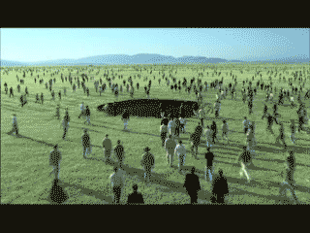
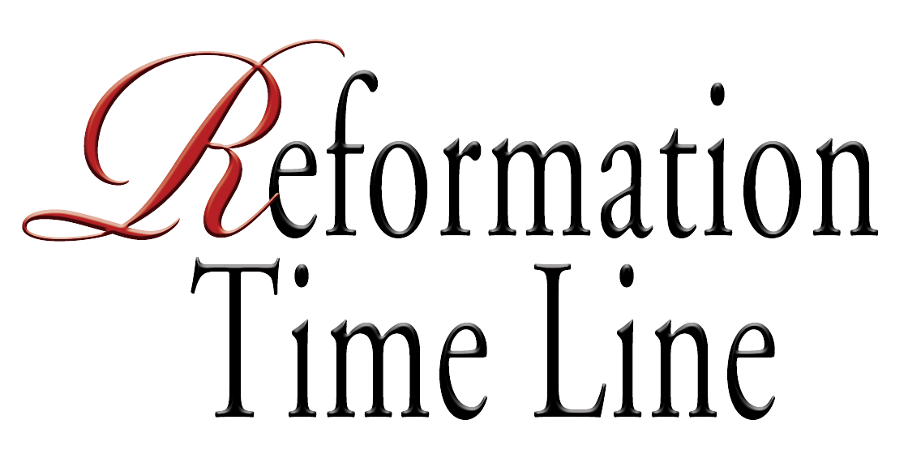
David Lee Burris:
Matters Of Ultimate Truth Taken Very Seriously
FROM DEBATE
UNTO DENOMINATIONS

Slide 26
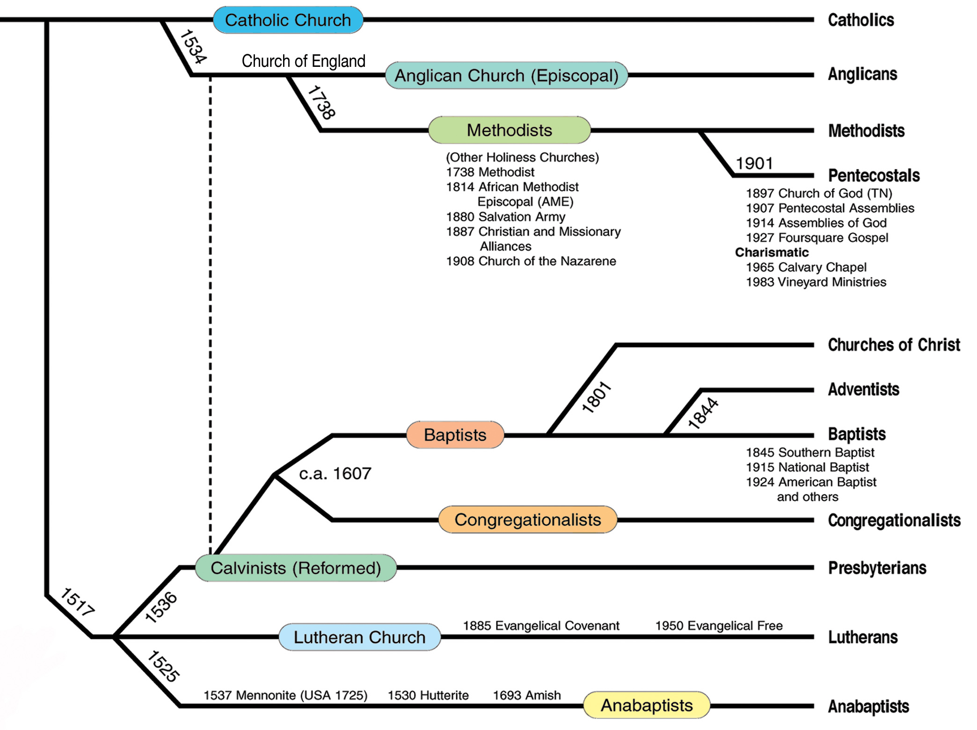

Slide 27
GERMAN
AD 1525
In 1525, Protestants in Zurich began the practice of baptizing believers (usually adults) only.
This marked the beginning of the Anabaptist movement.
Anabaptists

Slide 28
SACRAMENTAL
AD 1525
In 1525, Protestants in Zurich began the practice of baptizing believers (usually adults) only.
LITURGICAL

Slide 29
SWISS REFORM
AD 1536
Presbyterians
In 1536, John Calvin wrote Institutes of the Christian Religion.
This marked the beginning of the Calvinist (Presbyterian/Reformed) movement.

Slide 30
BELIEF SYSTEM:
EQUAL & LOCAL
Presbyterians
AD 1612
In 1612, John Smyth and other English Puritans formed the Baptist Church.
In his 1607 Principles & Inferences Concerning The Visible Church he wrote that there was no hierarchy & all officers were subject to the laity.
Baptists

Slide 31
BELIEF SYSTEM:
Lay Ministry
Anglicans
AD 1738
The 2nd Reformation!
In 1738, the conversion of John and Charles Wesley, already devout Anglican ministers, sparked the “Great Awakening,” a revival in England.
This marked the beginning of the Methodist Church and what has been labeled the second phase English Arminian Reformation.
Charles Westley himself remained in the Church of England Episcopal Church & Anglican Communion.
Methodists

Slide 32
First Awakening:
LEVELED CLERGY
Sacramental Religion
AD 1801
Charismatic Religion
Institutional Development FROM THE 2ND GREAT AMERICAN AWAKENING

Slide 33
Presbyterian Seceders Intermediate Affliation
Baptists
AD 1830
Mahoning Association Expels Thomas & Alexander Campbell.
This was one of two historical marks that began the American Churches of Christ.
Churches of Christ

Slide 34
Methodists
AD 1901
In 1901, Charles Fox Parham’s Kansas Bethel Bible College students spoke in tongues.
This marked the beginning of the Pentecostal movement.
Pentecostals

Slide 35
Pentecostals
AD 1901
In 1901, Charles Fox Parham’s Kansas Bethel Bible College students spoke in tongues.
This marked the beginning of the Pentecostal movement.
Health & Wealth

Slide 36
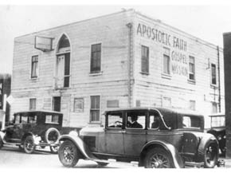
The Pentecostals
The Pentecostal movement spread, soon reaching the Azusa Street Apostolic Gospel Faith Mission in Los Angeles.
In 1914, several Pentecostal groups merged to form the Assemblies of God.
* Period Coincides with churches of Christ Congregational Level Boll’s Disfellowship
Azusa Street Mission

Slide 37
Multiple Branches Of One Vine?

Slide 38
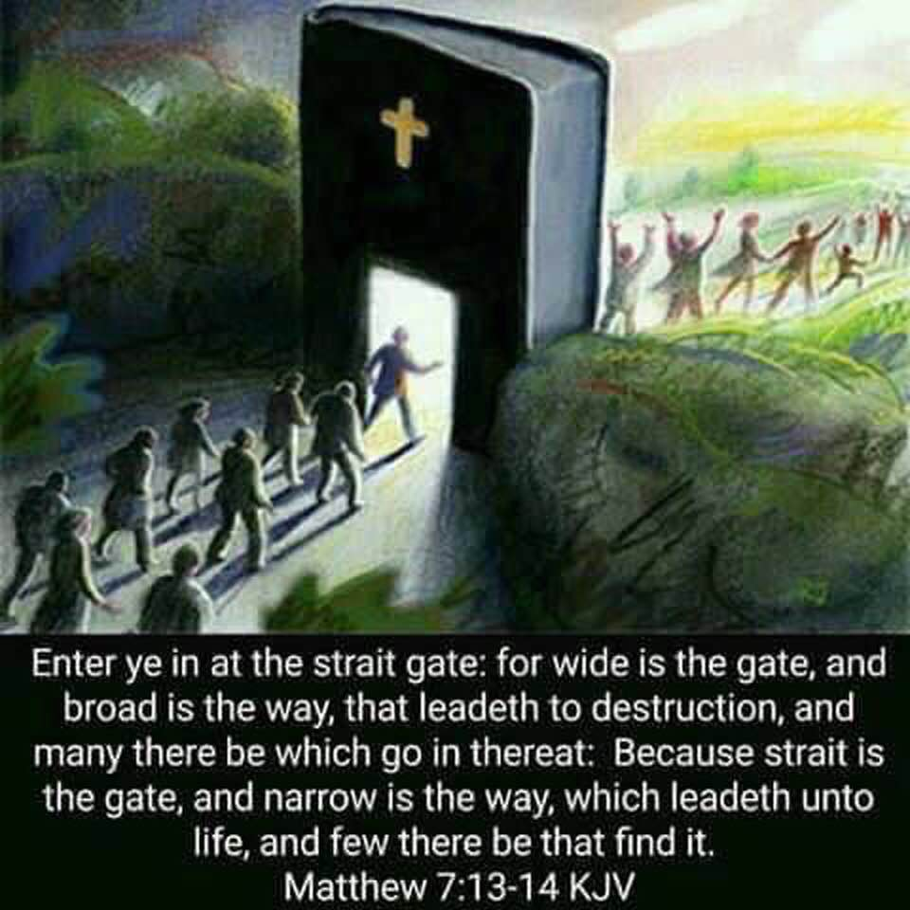

Slide 39
No Denominations At Lystra!
No Denominations At Corinth!

Slide 40
EXCLUSIVITY
“Just as there are as many ‘faiths’ or acceptable systems of belief through which a person living today can be saved as there are Gods – and there is only one: “One God and Father of all, who is above all, and through all, and in you all” (Eph. 4: 4). - just as there are as many bodies of saved people or churches as there are Gods in heaven. There is one and only one. The reason is because the same text affirms, ‘There is one body.’”
*
* Getwell Church Of Christ Bulletin 4-16-07

Slide 41
ONENESS LESSON
SCRIPTURE REFERENCE
“My Church”
Matthew 16: 18
“The Church”
Ephesians 1: 22
“One Body”
Ephesians 4: 4
“One Fold”
John 10: 16
“One Family”
1st Timothy 3: 15
“No Divisions”
1st Cor. 1: 10

Slide 44
CHRIST & THE CHURCH
KINGDOM
BODY
Government
Unity
CHURCH
KINGDOM
HOUSEHOLD
BODY-CHRIST
Family
Ownership
HOUSEHOLD
CHRIST

Slide 46
“Denominations Are Sinful”
by – Garland M. Robinson
“Since the words denomination & denominationalism are not found in the Bible, they must be defined from other sources. A denominational body is defined as ‘a part of a whole or one of a series of units.’ Webster defines denominationalism as: ‘devotion to denominational principles/interests. The emphasizing of denominational differences to the point of being narrowly exclusive.’ ‘An act of denominating, a value or size of a series of values or sizes (as of money), a religious organization whose congregations are united in their adherence to its beliefs and practices.’ ”
*
* “Seek The Old Paths” Newsletter April, 2009

Slide 47
“Denominations Are Sinful”
by – Garland M. Robinson
“A quarter is a denomination (a part ) of a dollar, but not the whole dollar. Each denominational church claims to be a part of the whole, but not the whole church. Many sincere and devoted people are involved in denominationalism. They are trying to go to Heaven and expect to get there in and through a denominational church.”
“A most appropriate question to ask is: are denominational churches just different ways of going to Heaven? No they are not. The Bible teaches that denominationalism is wrong and sinful. God’s word condemns denominationalism, which is division.”
*
* “Seek The Old Paths” Newsletter April, 2009

Slide 48
“Denominations Are Sinful”
by – Garland M. Robinson
“Denominationalism contradicts and condemns the Lord’s Prayer for unity. On the night in which Jesus was betrayed, He prayed for His apostles, saying… ‘ Neither pray I for these alone, but for them also which shall believe on me through their word; That they all may be one; as thou, Father, art in me, and I in thee, that they also may be one in us: that the world may believe that thou hast sent me. And the glory which thou gavest me I have given them; that they may be one, even as we are one: I in them, and thou in me, that they may be made perfect in one.” {JOHN 17: 20 – 23}
*
* “Seek The Old Paths” Newsletter April, 2009

Slide 49
BELIEFS RECEIVED & LEARNED RELIGION:
“If the source of our learning is corrupt, our learning will be no better! It’s not enough to be taught. We must concern ourselves with where and by whom we were taught – 2 Tim. 1:5. In order for one’s religion to be learned, there must be a process of teaching, learning, and knowing. Concerning Christianity – we are taught of God & learned of the Father – John 6: 44, 45. As Christians , we should ask ourselves why we believe as we do. Where did we learn it? We should be able to go to the scriptures and say, ‘Here is why I believe as I do. I learned it from the Bible!’” - - Marlin Kilpatrick

Slide 52
The Restoration Movement Rejects Dogmas & Revisits Received Doctrines.

Slide 53
SEDIMENTARY FORMATIONS
Deposited Traditions
Spiritual Sword Received Faiths

Slide 54
PUT AWAY Preconceived Predetermined PREJUDICE
David Lee Burris:
Humanity’s Utopistic Separation Over High Executive & Upper Management Policy
Wrestling With Scripture

Slide 55
Church Identifiers
Proof Texts
Founder/Foundation Jesus Christ
Matthew 16: 18
Member Profile Baptism Added
Acts 2: 41
Action Focus Save Souls
Phil 4: 14-18
Professed Doctrine The New Testament
Ephesians 2: 20
Organic Structure Local Congregation
Acts 14: 23
Physical Location All The Nations
Matt 28: 18-20

Slide 56
Respected
Reformed
Remixed-Remodeled
1st Cent Restored

