Slide 1
Paul’s Answer to the Philosophers
by David Lee Burris

Slide 2
Significant Differences
GREEK ANTHROPOMORPHIC FAITH VERSUS ROMAN NUMINA RELIGION
CITY GREEKS WERE XENOPHOBIC IMPERIAL ROMANS COSMOPOLITAN
GREEK ENTERTAIN BLOODLESSLY ROME HAD APPETITE FOR VIOLENCE
GREEK THOUGHT WAS WIDE & DEEP

Slide 3
Grecian Culture Everywhere

Slide 4
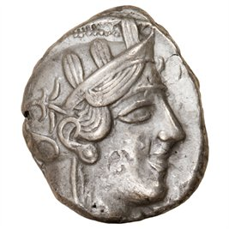
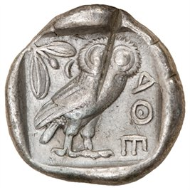
The Importance Of Thinking Rightly
Line 927 Of Aeschylus’ Agamemnon:
“And not to think wrongly is the greatest gift of God.”

Slide 5
Greek Classic Philosophers
Anaxagoras –
The first philosopher to reside in Athens, Anaxagoras rejected the four elements of Empedocles and posits a concept of seeds, elemental particles of every known quality.

Slide 6
Greek Classic Philosophers
Anaximander –
Possibly a student of Thales, he believed the primary source of all things was very indefinite. He made advances in astronomy by charting the paths of the Sun and Moon.

Slide 7
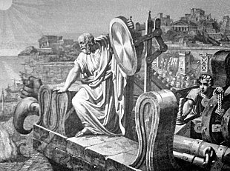
Greek Classic Philosophers
Anaximenes –
The youngest of the Milesian philosophers, Anaximenes believed that arche, the first principle or origin, of everything was air and not water, as Thales believed.

Slide 8
Greek Classic Philosophers
Democritus –
Democritus devised the first atomistic view of the world; he believed that the world was composed of only atoms & void.

Slide 9
Greek Classic Philosophers
Empedocles –
A pluralist, he believed that there are four root elements: fire, air, water, and earth. These four elements, governed by the two basic forces in the universe – love and strife – compose everything in existence.

Slide 10
Greek Classic Philosophers
Gorgias –
A rhetorician whose impressive oratorical style brought him influence in Athens. One of the first great Sophists, his work brought forth harsh criticism from Plato and from Aristotle.

Slide 11
Greek Classic Philosophers
Heraclitus –
The most radical of the pre-Socratics, he believed that nothing was stable or permanent. His enigmatic writing used contradictions to describe the world flux.

Slide 12
Greek Classic Philosophers
Hippias –
A very prominent early Sophist and self-described authority on all subjects, he lectured on poetry, grammar, history, politics, archaeology, mathematics, and astronomy.

Slide 13
Greek Classic Philosophers
Parmenides –
The pre-Socratic philosopher was the first of Western philosophy in focusing explicitly on questions of Being, A pure rationalist, he believed that the physical world we perceive is filled with change, multiplicity, and contradictions making it unreliable. As a result, he was the first philosopher to separate appearance from reality.

Slide 14
Greek Classic Philosophers
Philolaus –
A pre-Socratic philosopher, he was the first to publish the Pythagorean notion that this world is an orderly whole and constituted by numbers.

Slide 15
Greek Classic Philosophers
Prodicus –
A prominent Sophist, Prodicus taught pupils for both domestic and civic affairs. Unlike previous philosophers centered on rhetoric, he focused study on ethics as the concentration of his curriculum.

Slide 16
Greek Classic Philosophers
Protagoras –
He was not interested in nature, rather he believed that human beings were the center of all reality. Thus, Protagoras was the first Humanist in the West.

Slide 17
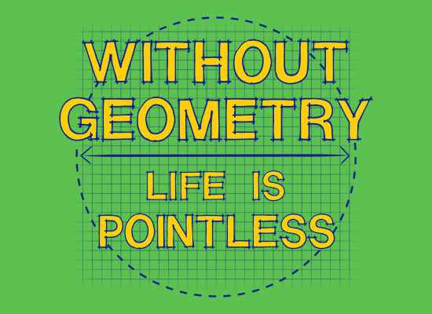
Greek Classic Philosophers
Pythagoras –
While none of his original writing has survived, there are nonetheless many indirect references to his work from the religious group, the Pythagoreans, which he initiated. Their belief system was formulated from his own general opinion of an universal harmony that is mathematically derived.

Slide 18
Greek Classic Philosophers
Thales –
Traditionally regarded as the very first Western philosopher, He was one of the legendary Seven Sages. He originated natural philosophy, utilizing rationality to explain nature. According to Herodotus, Thales even predicted the solar eclipse of 585 B.C.

Slide 19
Greek Classic Philosophers
Thrasymachus –
A Sophist who analyzed the role emotions played in persuasion, but is more well known for his famous discussion with Socrates in Plato’s Republic.

Slide 20
Greek Classic Philosophers
Xenophanes –
A religious thinker, he offered a basic & balanced critique of polytheism. This the initial monotheist amongst philosophers proclaimed that God is permanent & He does not move but enables everything else to both movement and motion.

Slide 21
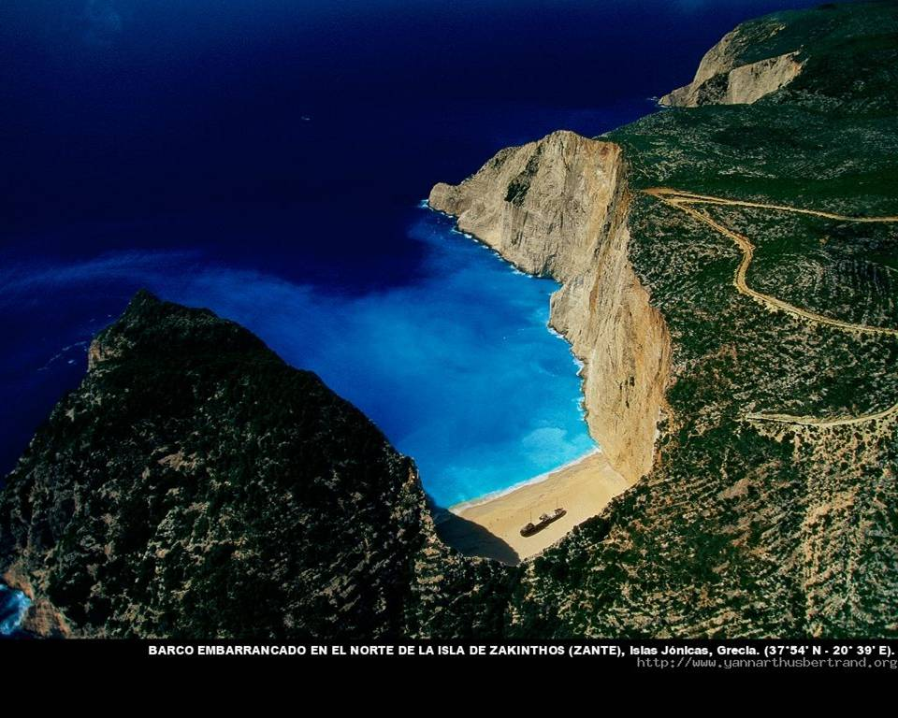
Ionian Islands, Greece

Slide 22
“they discovered the human mind” by professor marvin perry
“The first speculative philosophers in human history emerged in the sixth century B.C. in the Greek cities of Ionia. Curious about the essential composition of nature and dissatisfied with earlier creation legends, the Ionians sought physical, rather than mythico-religious explanations for natural occurrences. In the process, they arrived at a new concept of nature and a new method of inquiry. They maintained that nature was not manipulated by arbitrary and willful gods and that it was not governed by blind chance; rather, nature followed principles of order, general laws that were ascertained by the human mind.”

Slide 23
“they discovered the human mind” by professor marvin perry
“The Ionian cosmologists – Thales, Anaximander, Anaximenes – revolutionized thought when they attempted physical rather than mythico-religious explanations of natural occurrences. Their achievement made possible theoretical thought and the systemati- -zation of knowledge – as distinct from the mere observation and collection of data. What conditions enabled the Greeks to make the breakthrough? Perhaps the poets’ conception of human behavior subject to universal Destiny was extended into the philosophers’ belief that nature was governed by law. Perhaps the breakthrough was postured by the Greeks’ freedom from a priesthood & religious doctrines that limit thought. Perhaps Greek speculative thought was an offspring of the polis, because if law governed human affairs, providing balance & order, shouldn’t the universe also be regulated by principles of order?”

Slide 24
“they discovered the human mind” by professor marvin perry
“In their effort to understand the external world, the cosmologists had created the tools of reason. Greek thinkers then turned away from the world of nature and attempted a rational investigation of man and society. Exemplifying this shift in focus was the Sophists, who wandered from city to city teaching rhetoric, grammar, poetry, gymnastics, mathematics, and music. The Sophists insisted that it was futile to speculate about the first principles of the universe because such knowledge was beyond the grasp of the human mind; they urged instead that individuals improve themselves and their cities by applying reason to the task of citizenship. In applying reason to human affairs, the Sophists attacked the traditional religious and moral values of Athenian society. Some Sophists taught that speculation about the divine was useless; others went further and asserted that religion was just a human invention to ensure obedience to traditions and laws.”

Slide 25
“they discovered the human mind” by professor marvin perry
“Socrates was the pivotal figure in the development of Greek philosophy. Socrates felt that the Sophists taught skills, but that they had no insights into questions that really mattered: What is the purpose of life? What are the values by which man should live? How does man perfect his character? Here the Sophists failed, said Socrates; they taught the ambitious to succeed in politics, but persuasive oratory and clever reasoning do not instruct a man in the art of living. Socrates’ central concern was the perfection of individual character, the achievement of moral excellence. Moral values were attained when the individual regulated his life according to objective standards arrived at through rational reflection; that is, when reason became the formative, guiding and ruling agency of the soul. For Socrates, true education meant the shaping of character according to values discovered through the active and critical use of reason. Socrates believed that reason was the only proper guide to the most crucial problem of human existence – the question of good and evil.”

Slide 26
“they discovered the human mind” by professor marvin perry
“Dialectics affirmed that the acquisition of knowledge was a creative act. Dialogue implied that reason was meant to be used in relations between human beings & that they could learn from each other, help each other, teach each other, and improve each other. It implied further that the human mind could and should make rational choices. Through thought as dialogue, people could make ethical choices, impose rules on themselves & give form to their existence. For Socrates, the ethical way of life required conscious choice as a prerequisite!”

Slide 27
Greek Classic Philosophers
SOCRATES –
The first great Athenian philosopher, he had no positive teaching but excelled at refutation. His purposeful discourse & targeted questions often centered on social ethical and civic political values; these queries placed him on public trial on charges of neglecting the designated deities of the city and corrupting youth; his challenging of conventional wisdom cost him his life by required poisoning.

Slide 28
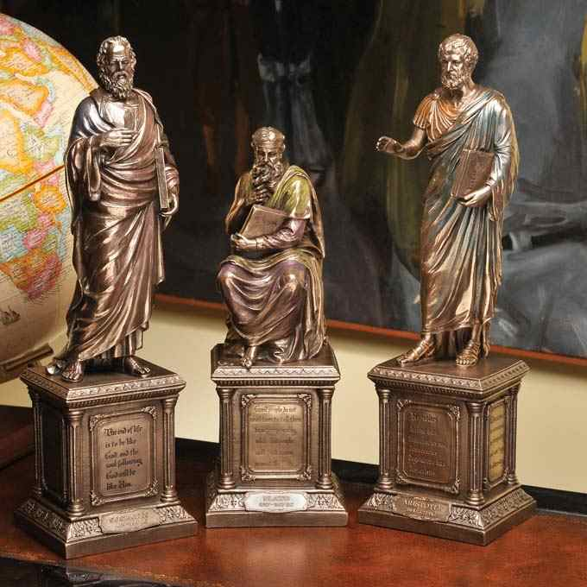
PLATO
Grecian Culture Everywhere

Slide 29
Greek Classic Philosophers
Plato –
A student of Socrates, he immortalized his teacher by using him as the protagonist in his incredibly influential writings. Plato is widely credited with starting a school of philosophy known as “The Academy.”

Slide 30
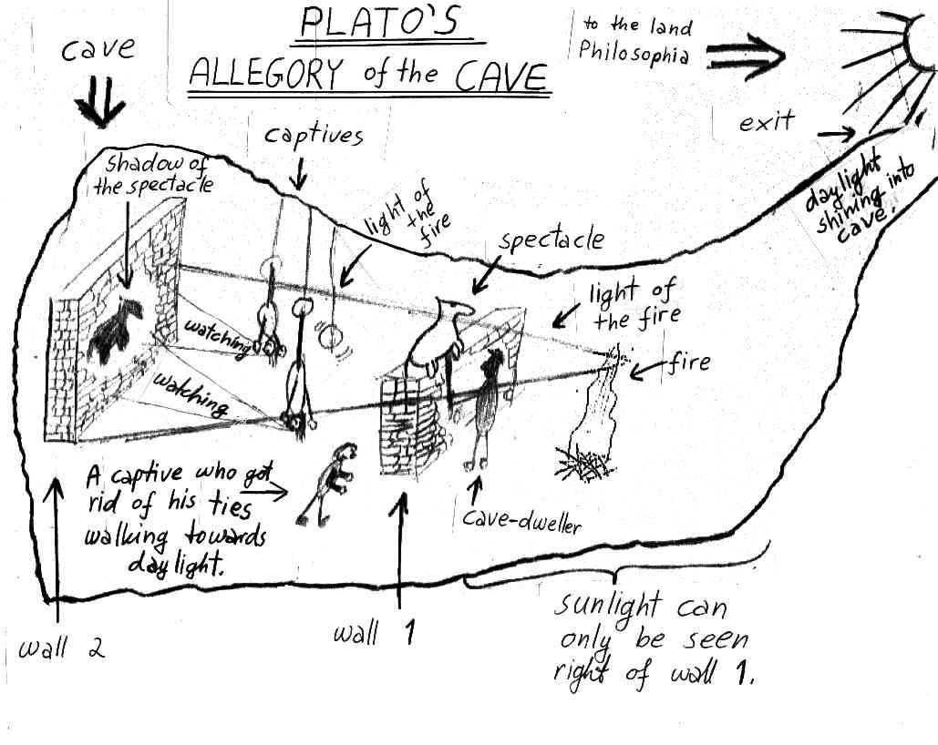
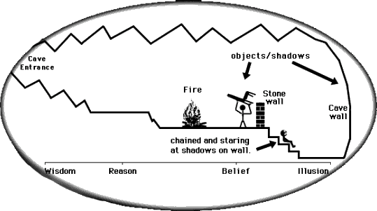
400 Years Before Jesus Christ THE PHILOSOPHER PLATO
Theory Of Forms:
- From “Socratic Dialogue” Unto Dogmatic Discipline
- Material Reality Shadows Of Ideal Forms
- Ideal World Soul Shapes & Sustains Physical Realm
World Soul Lower God That Created The Earth
Higher God existing above World Of Forms & Soul ultimate cause of the universe.
Our Bodies Temporary Containers For Immaterial & Eternal Soul.

Slide 31
"Ancient histories are but fables that have been agreed upon" - Voltaire

Slide 32
????????????

Slide 33
Stealth Strategy

Slide 36
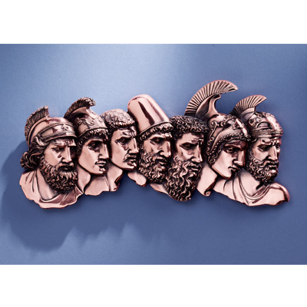
Stealth Strategy

Slide 37
Sinon’s Story… Construction Actually A Holy Offering To Benefit The Greeks & The Horse Built Huge So As Not To Be Brought Within The City Gates Benefiting The Trojans Instead.

Slide 38
The Trojan Response: They put wheels under it and break down a wall and, using ropes, haul the trophy inside the city, to the temple of the goddess it was dedicated.

Slide 39
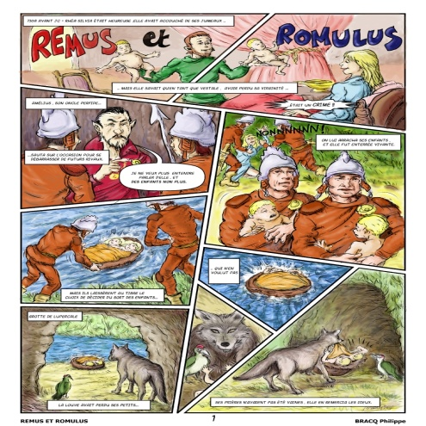
Classical Romans Trace Their Mythical Founding & Ancestry To The Trojan Prince Aeneas!

Slide 41
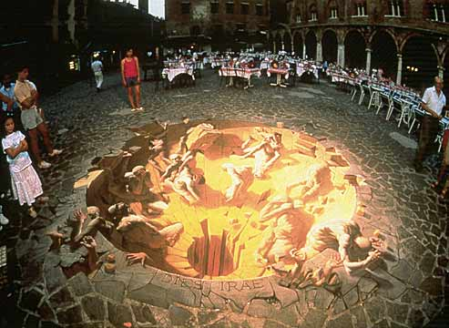
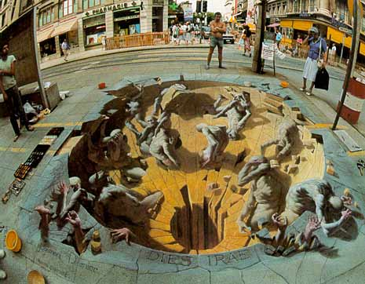
The Golden Mean!

Slide 42
SYNCRETISM
“The attempt to assimilate differing or opposite doctrines and practices, especially between philosophical and religious systems, resulting in a new system altogether in which the fundamental structure & tenets of each have been changed. Syncretism of the gospel occurs when its essential character is confused with elements from the culture.”
* Dictionary Of Theological Terms, Grenz & Guretzki

Slide 43
“Plato gave us platonic love;
Cynic philosophers gave us cynicism. What, pray, did the sophists bequeath? Sophistication.
With sophistication came obfuscation and empty rhetoric.”

Slide 44
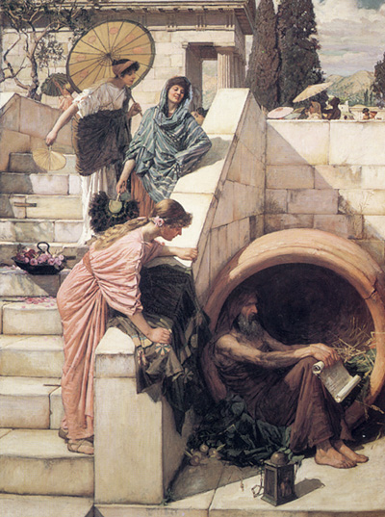
THE GREATEST OBSTACLE TO DISCOVERY IS NOT IGNORANCE – IT IS THE ILLUSION OF KNOWLEDGE!
DIOGENES
Daniel J. Boorstein

Slide 45
THE GREATEST OBSTACLE TO DISCOVERY IS NOT IGNORANCE – IT IS THE ILLUSION OF KNOWLEDGE!
“Most men are within a finger's breadth of being mad. Diogenes

Slide 46
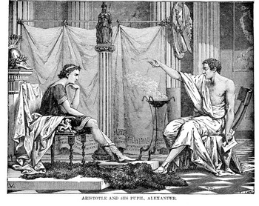
Greek Classic Philosophers
Aristotle –
A student of Plato, he was the first thinker to divide intellectual inquiry into distinct subjects such as biology, psycho-logy, political science, ethics, & physics. After tutoring Alexander the Great, he returned to Athens and opened his own school, the Lyceum.
* Aristotle Tutored Alexander @ Age 13

Slide 48
ARISTOTLE THRU THE AGES
Aristotle will always be significant to scholars as the most famous student of Plato.
His works on logic are among the classics. He basically believed existence is related to substance and that everything is caused by something else – uniform theory.
His practical philosophy proved more controversial. He states that our souls are formed by habits, skills, and virtues. These same virtues are like skills in that they are formed by practice – by working at it. The other way our souls are shaped is through perception.
Aristotle has remained an ageless figure and forever thought provoking as regards his postulation - in purely physical terms - of an “Unmoved Mover” – an irreducible final cause to the universe.

Slide 49
PLATO | ARISTOTLE
Idealism | Realism
Republic | Politics
The “Ideal” State | A Working Government
TRANSCEND Human Selfishness | ACKNOWLEDGE Human Selfishness
Social Unity | Balance

Slide 50
David Lee Burris:
Deep Damage - Both Hardware & Software Programs Of Correspondence & Communication;
Pagan Incorporations - Primitive Rites/Rituals, Feasts/Festivals, Customs/Celebrations & Female Deity/Myth Demigods
Church
WALLS
Greek
GIFTS

Slide 53
ATHENS WALKED IN 15 MINUTES

Slide 55
MODERN MAR’S HILL OF ATHENS

Slide 58
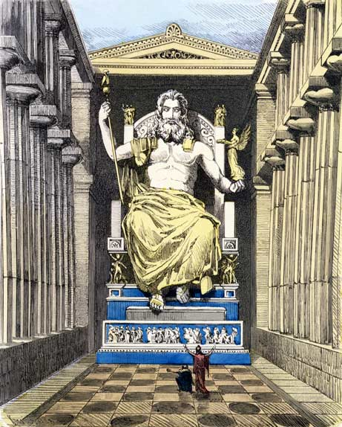

Slide 59
In Athens Paul Preaches Of Another Hill
D. L. Burris: 400 Years Religiously Evolved From Tribal Deities To Polytheistic Assimilation
Second Notation: The Point Of A Stoic Type Bridge To Early Christianity –
Earliest Christians Appealed W/I Philosophically Competitive Context W/ Center Stoic
Natural Inclinations = Stoic Affinities; Cosmos Order & Lawful Creation Rationale = Creative
Power Rational & Inexhaustible; Lawful Continuity Needs Continuous Agent Logos & Divine
Fire Constant Creative Dynamic Force; Reject Chaos By Obeying Principles Of Order
Conformance & Obedient Faith Conformance Configured To The Nomological Reasoning Of
The Stoical Cosmology.
David Lee Burris:
The Homeric Myth presupposes the viewpoint that humans are useful to the gods but are not objects of their affection!
Acts 17: 17 In The Marketplace Paul Preaches Both Jesus & His Resurrection
Acts 17: 18 Epicurean Materialists & The Stoic Practitioners (v 21) Wanted Paul For Themselves So They Brought Him To Mar’s Hill.
Mar’s Hill Was A Place For Honoring The City Gods Through Prayers & Sacrifice Although Neither Of These Groups Were Really Religious.
Gods Not Moral Beings Nor Demand Men To Be
Both Groups Had Accommodated These Practice Based Official Religions So As To Remain Public.
Oral Societies Considered The Written Word Disguise & Not Elastic Enough To Reveal Depth – Deep Truth Was To Be Discovered From Questioning An Original Source At A Forum.
Writings Were Either Transcripts Of These Deliberative Dialogues Or Doctrinal Defenses Using This Stylistic Form.
Following From Verse 22 Is An Actual Record.

Slide 60
GOLGOTHA

Slide 61
In Athens Paul Preaches Of Another Hill
David Lee Burris:
Religion Was A Communal Experience In The Pagan World; The Four Great Truths Of The Stoics: We are unhappy, anxious, and full of suffering – because of our passions – but we can attain peace of mind – by cultivating apatheia i.e. passionlessness or in modern terms “be cool”
Paul Probably Had A Mixed Audience Of Pagans & Philosophers Who Both Soon Thought He Was An Ancient Atheist As Antiquity Defined It.
This Would Be The Concern Of The Pagan Religionists Who Feared Offending The Designated Deities That Protect The City.
This Would Be To The Delight Of The Cognitive Elite Of Philosophical Thinkers.
Paul Proceeded – Like Socrates – To Show Himself Only Really Religious Person There.
Paul Exposed The Practice Based Ritual Religions Of The Pagans As Belief Systems Without Substance.
Paul Then Told - In Meta-Narrative Style - The Story Of - “The Meaning Of Life” - To The Philosophers.
God Create All Out Of Chaos Not Nothing!

Slide 63
In Athens Paul Preaches Of Another Hill
David Lee Burris:
“Great Thoughts Reduced To Practice Become Great Acts” - William Hazlit
Below Border Friezes Of Mythological Creation Stories He Told Not Of Gods In Human Form But Humans In Gods Form.
When He Told Of A God Who Would Be Man & Was Crucified For The Purpose Of Our Redemption – It Was Too Much For Them.
Most Of Both Groups Left Paul At Very Mention Of The Resurrection; Even For These “Lovers Of Wisdom” Accustomed To Hearing Of Strange Religions This Was Different – It Had A Demanding Worldview.
Belief In The Ideas Of This New Religion Had Consequence; It Was A Way Of Life That Required An Active Faith.
Satan Kept His Thumbprint On Most Here Who Kept Their False Consciousness Of Philosophical & Religious Relativism.

Slide 64
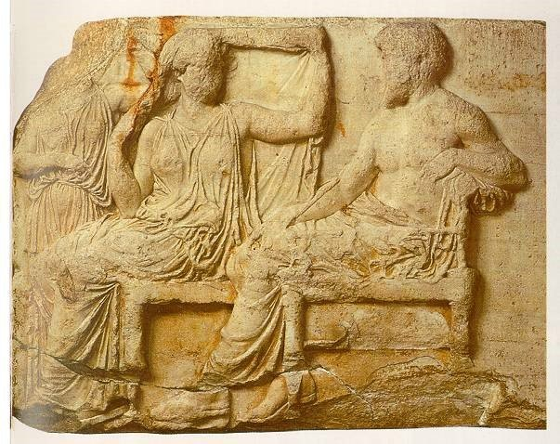
Left Side Building Frieze of First Couple

Slide 65
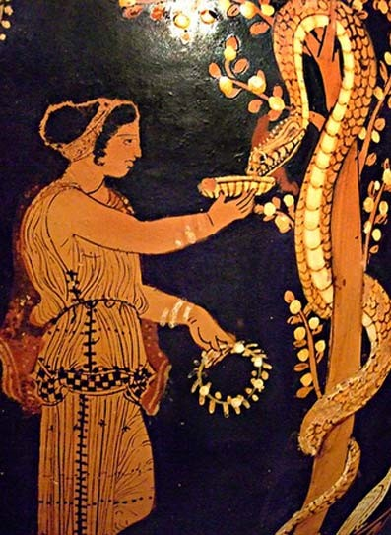
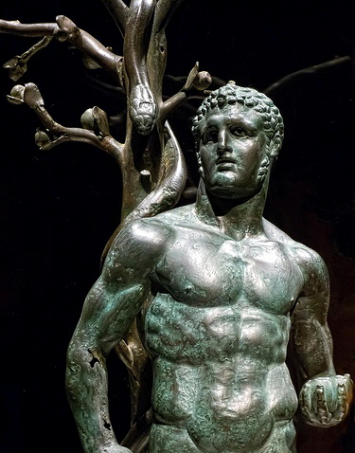
Ceramic & Statue of Eating From The Tree

Slide 66
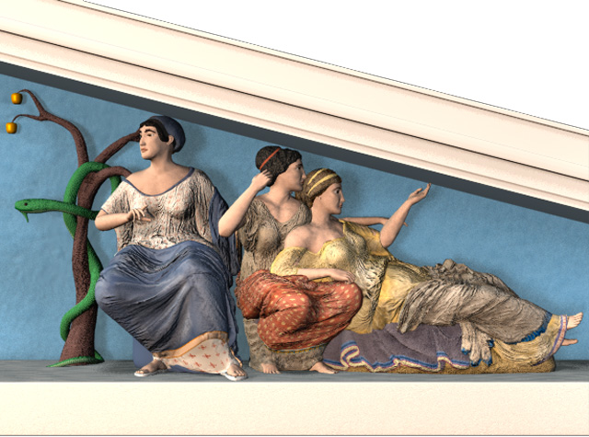

Slide 67
In Athens Paul Preaches Of Another Hill
Most Continued Then As They Continue Today Wrapped Tight In Their Ego-Centric World Where Man Is Not Responsible Before God Or Answerable For His Actions In This Life.
Most Continued Then As They Continue Today To Prefer Truth In Riddle Rather Than Revelation – Unsolved Mystery Over Message Clarity – Symbol Over Substance.
Most Continued Then As They Continue Today Avoiding Absolute Concepts & Total Commitment.
Most Continued Then As They Continue Today With An Intolerance For Pure Truth Preferring Its Administration As Medicine - In Small Doses & Sugarcoated!

Slide 68
In Athens Paul Preaches Of Another Hill
Most Were Then As Today Denying & Avoiding Absolute Concepts & Total Commitment.
Most Were Then As They Are Today Intolerant Of Pure Truth Preferring Its Administration As A Medicine - In Small Doses & Sugarcoated!
Thus Mortified Or In Mortal Fear Of Truthful Teachings –
They Then As Today –
LIED TO THEMSELVES!

Slide 69
In Athens Paul Preaches Of Another Hill
WHAT DOUBT DID THEY HAVE?
Three Type Combination:
Factual Doubts – Intellect
Emotional Doubts – Feeling
Volitional Doubts – Willing

Slide 70
In Athens Paul Preaches Of Another Hill
400 YRS: REFINED GOLD MEAN
TO DIALECTIC MATERIALISM
THESIS
SYNTHESIS
ANTI-THESIS

Slide 71
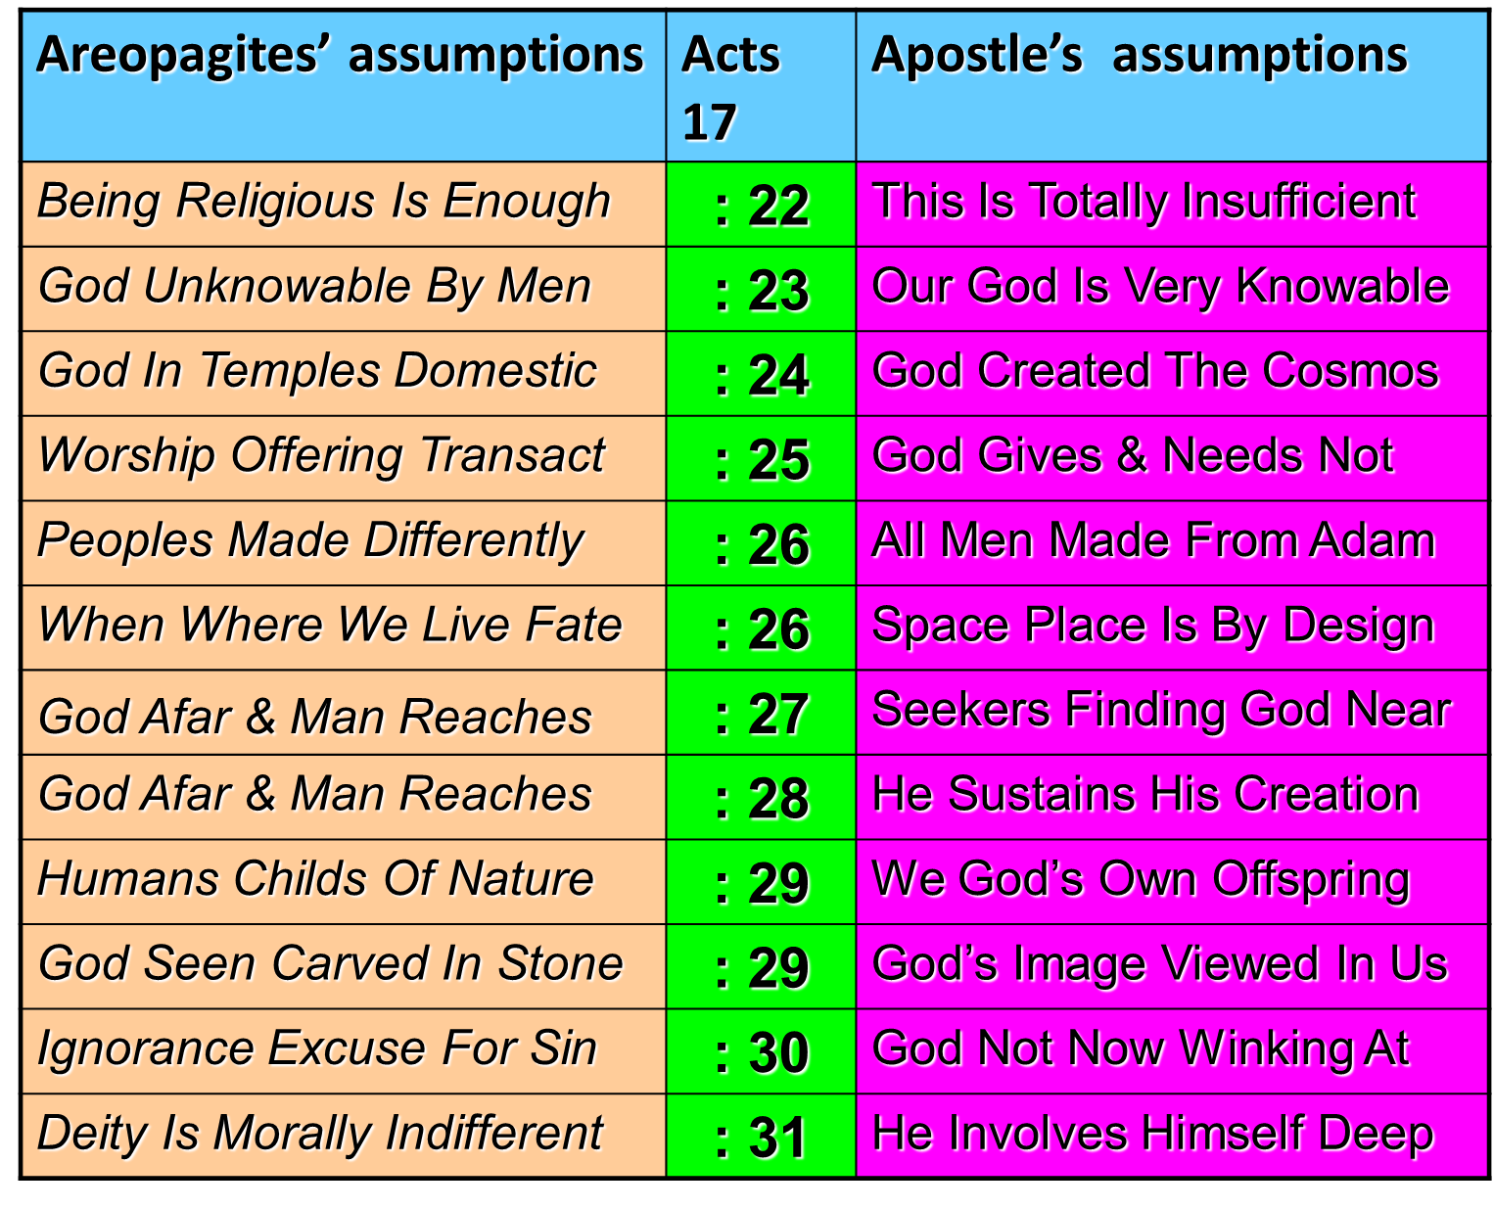

Slide 72
SYNCRETISM
“The attempt to assimilate differing or opposite doctrines and practices, especially between philosophical and religious systems, resulting in a new system altogether in which the fundamental structure & tenets of each have been changed. Syncretism of the gospel occurs when its essential character is confused with elements from the culture.”
* Dictionary Of Theological Terms, Grenz & Guretzki

Slide 73
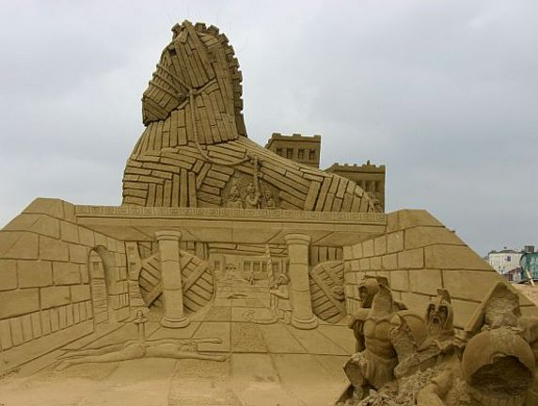

Slide 74
Deserted Fortress
DESERT FATHERS

Slide 75
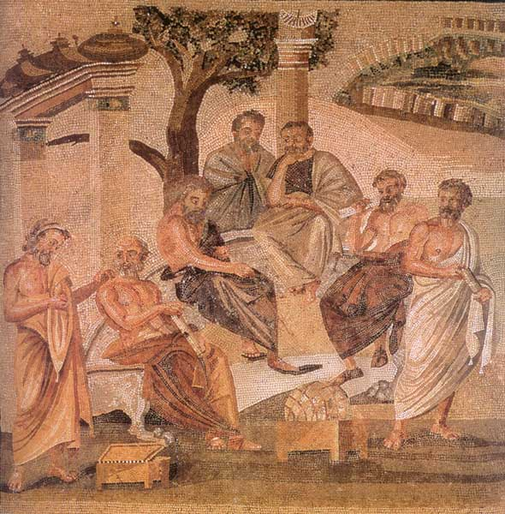
Post-Nicene Christian Thinkers Reopen Plato’s Greek Academy
Christians of the fourth century and beyond were attracted to this concept of “The One” equating it to “The Godhead” and incorporating “The Son” by renaming the World Soul “The Logos.” The same consensus seeming to reject the unqualified proposition of simple evil in single dimension as an absence of good – accepting instead a concept of complex evil and complicated suffering . The concept of graduated degrees or shades of good and evil has had a mixed reception over the generations among different Christian audiences; Completely rejected by dual determinists - acceptance seems to be correlated to an similar acceptance of the related doctrine of degreed reward & punishment.
As those personally familiar with the Apostles and those intimate with them in turn passed from the religious scene – the church transitioned from the Apologists to the Theologians – doctrine systematists and polemic writers that by the Dark Ages managed to so convolute and complicate the simple scripture as first received that Theology had become the “queen science” and Theologians regarded as the most learned of scholars. This next era witnessed within the field of theological science the shift from a scripture systemizing process of text to that of a synthesis process with philosophical tenet. Thus, with the move from apology to theology we have the marriage of Holy Scripture with Human Philosophy and the birth of Christian Platonism – the religious landscape would never be the same.

Slide 76
“What indeed does Athens to do with Jerusalem? What agreement is there between the Academy and the Church? What between heretics and Christians? Our instruction comes from ‘the porch of Solomon,’ who had himself taught ‘the Lord should be sought in simplicity of heart.’ Away with all these attempts to produce a mottled Christianity of Stoic, Platonic, and dialectic composition!”
TERTULLIAN

Slide 77
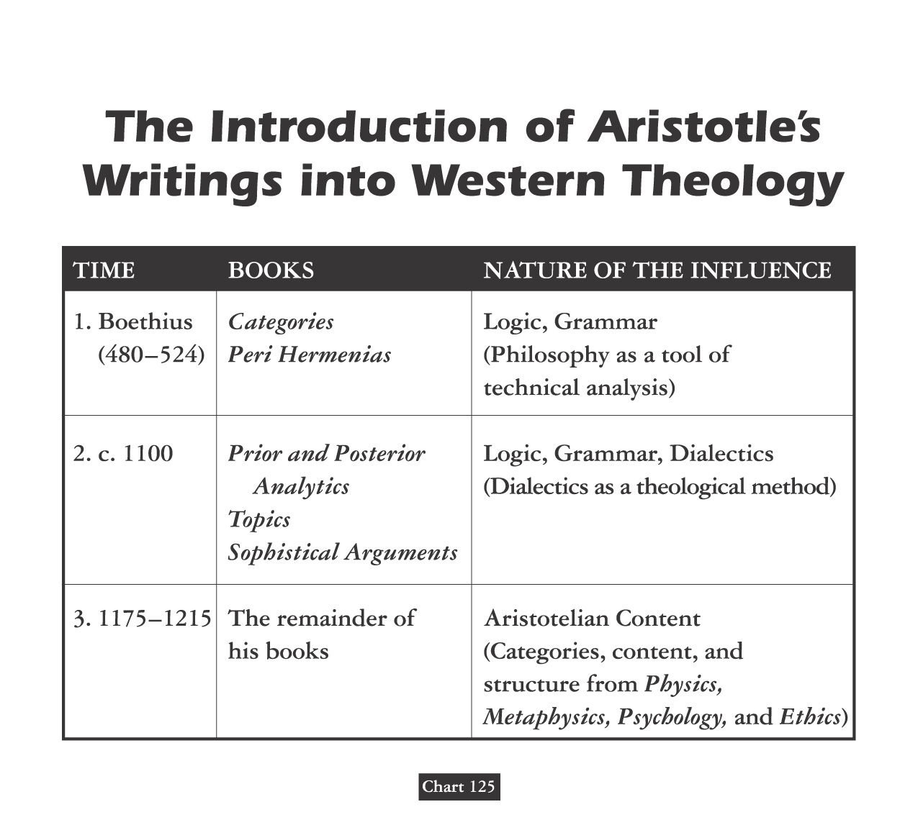

Slide 78
Debate Begins With Aristotle: How Are People Changed Within?
“To Be Is To Do” - Or - “To Do Is To Be”
“Excellence is an art won by training and habituation. We do not act rightly because we have virtue or excellence, but rather we have those because we have acted rightly. We are what we repeatedly do… Excellence, then is not an act but a habit.”
* Disputing Human Nature!

Slide 80
COUNTERING THE COUNTERFACTUAL TEST
Bible Says You Are In Charge Of Your Own Heart
Jeremiah 4: 4 – “Remove the foreskin of your hearts”
Jeremiah 9: 13 – “Stubbornly followed their hearts”
Jeremiah 18: 11 – “Act according to his evil heart”
Ezekiel 18:31 – “Make Yourselves A New Heart & A New Spirit!”

