Slide 1
BETWEEN THE TWO TESTAMENTS
Edited by David Lee Burris

Slide 2
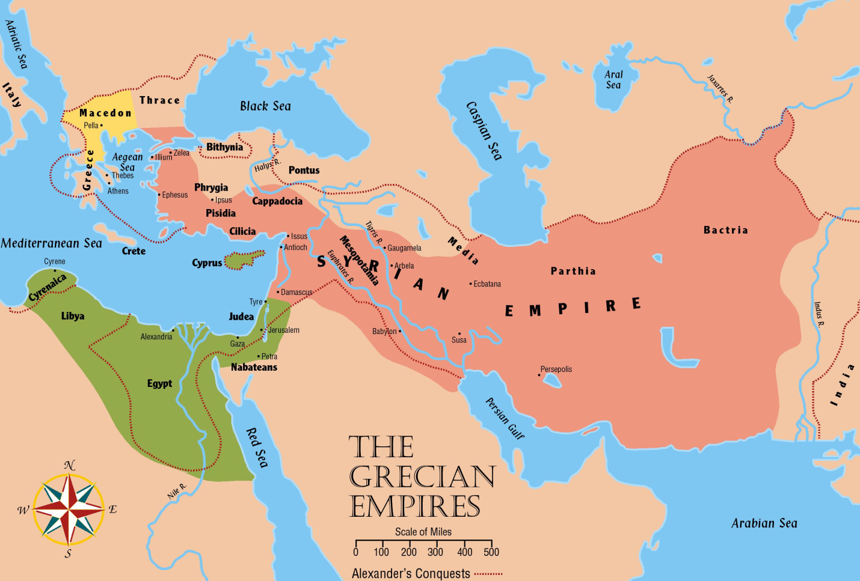
The Grecian Empire
Alexander’s army continued toward Persia
Met at Issus and Darius III was defeated there

Slide 3
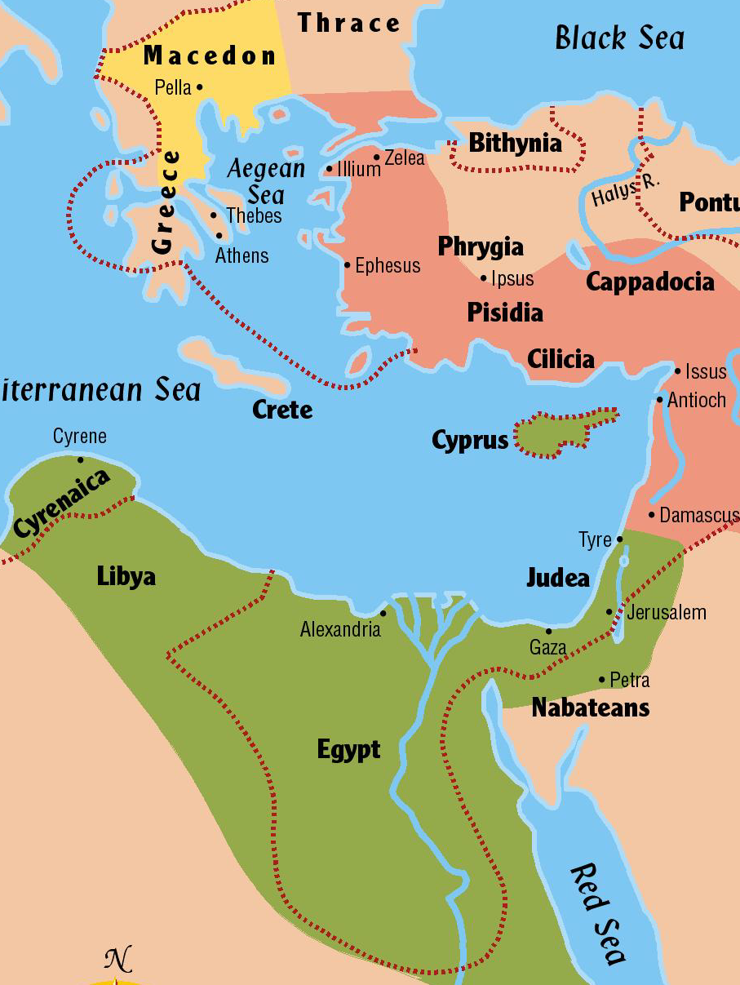
The Grecian Empire
Alexander’s army turned southward
Took Damascus, Gaza, Jerusalem and other cities
Some peacefully and others with battles
Island-fortress of Tyre also fell before him
Egypt welcomed the Greeks as liberators from the hated Persians

Slide 4
The Grecian Empire
Alexander’s army pushed eastward to complete the conquest of Persia
Carried him as far as the Indus River
Returned as far as Babylon in 323 BC
Died there of a fever at only 32 years of age
For the first time in all the centuries, we have an empire with its source far removed from the Mesopotamia Valley

Slide 5
The Grecian Empire
Alexander was educated by the famous Greek philosopher Aristotle
Thought the Greek or “Hellenistic” culture was the greatest the world had ever seen
As a result he established model Greek cities as he conquered a region
He did not live long enough to carry out his dreams
His kingdom fell into the hands of generals
Various men struggled for dominance
The territory of Palestine changed hands five times in the first 20 years after Alexander’s death

Slide 6
The Grecian Empire
Selucus Nicator shaped an empire
It included Thrace, Asia Minor, Syria, Babylon, Media, and on to India
He founded the city of Antioch in Syria and made it his capital
This began the new Syrian empire which was to remain in power until 64 BC
Ptolemy I was beginning a kingdom in Egypt
His dynasty lasted three centuries
Capital was Alexandria
This empire controlled Jerusalem and the area for approximately 100 years

Slide 7
The Grecian Empires

Slide 8
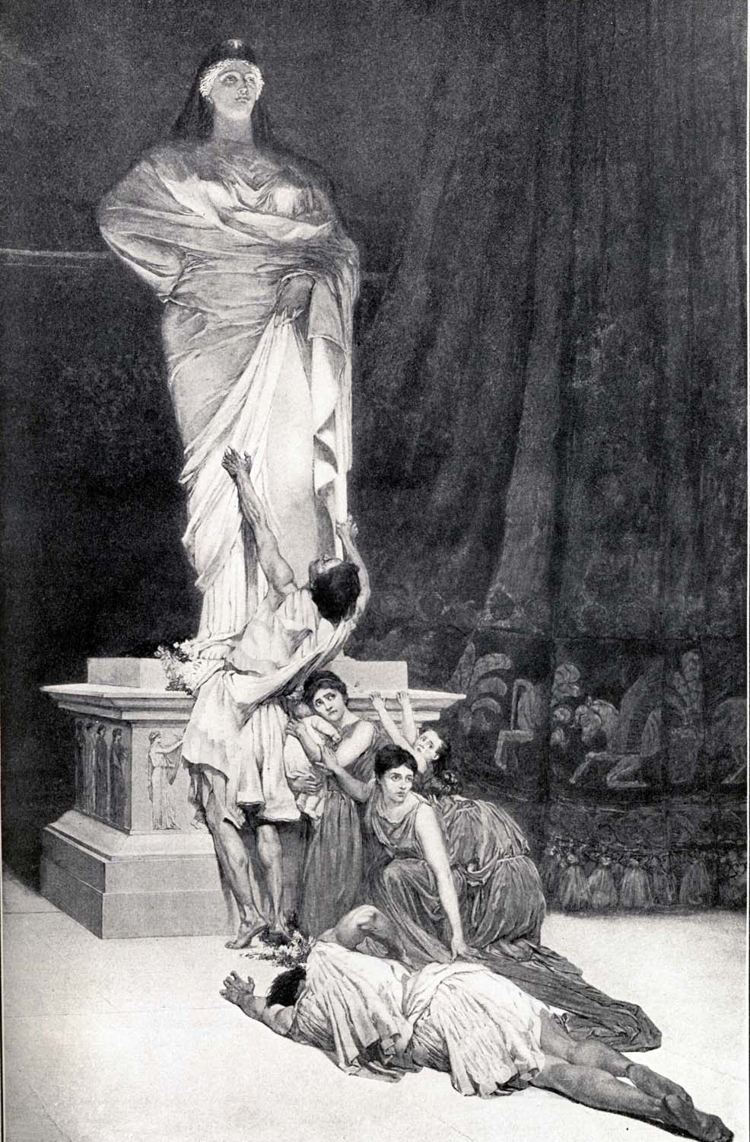
With Alexander the Great’s Greek World Empire
came Greek gods, Greek law, and Greek language.

Slide 9
God’s People In A Grecian Society
HELLENIZATION

Slide 10
God’s People In A Grecian Society
What was happening to God’s people during the fourth and fifth centuries before Christ – while the Greeks were rising in power?
No one knows for sure
Practically no records available from the period
Jerusalem began to prosper financially after the walls were rebuilt in Nehemiah’s day
Many legal and fiscal reforms to promote commerce were brought about by the Persians

Slide 11
God’s People In A Grecian Society
Jews and Samaritans relations worsened during these years
Samaritans looked at as a transported people
Tried to keep the Jews from building the walls
Samaritans’ religion made up of laws of God mixed with their own ancestral pagan rites
Does this sound familiar in many religions of today?
Samaritans built a temple of their own on Mt. Gerizim after the Jews would not let them share in the temple at Jerusalem

Slide 12
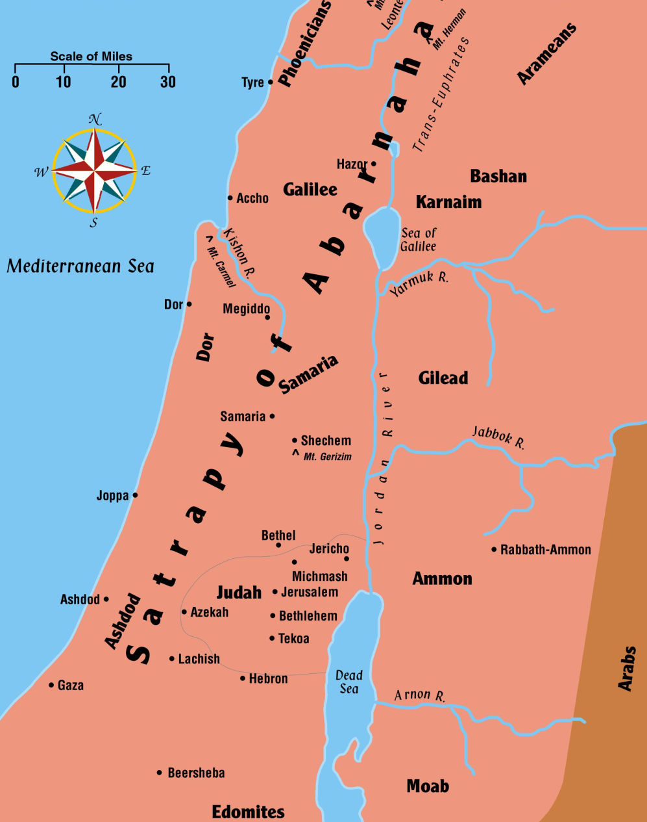
God’s People In A Grecian Society
Jews gradually filled the southern part of the land
Began to move to the north
Busy commercial centers arose
Section called Galilee since the Assyrians conquered northern Israel and made it their province

Slide 13
God’s People In A Grecian Society
Language
Aramaic language was the predominant language in the Fertile Crescent from the days of the Assyrian empire
During the days of Biblical silence, the Greek language became the official tongue of both the Syrian and Egyptian empires
Jews living in Palestine tended to resist the Grecian influence as much as possible
They continued speaking Aramaic in their daily lives as they had for many years

Slide 14
God’s People In A Grecian Society
Language
Jews were scattered everywhere during this time
Many migrated to Egypt during the Greek-Egyptian domination
Alexandria became one of the world centers for Judaism with an estimated million Jews living there
These Jews began to speak Greek more exclusively and had trouble reading their Hebrew scriptures
Under Ptolemy II the scriptures were translated into Greek
Called the Septuagint meaning “seventy” (280 BC)
First time that the Gentile could read the words of God

Slide 15
God’s People In A Grecian Society
Proselytes (convert from one religious belief to another)
Many Proselytes and God-fearers in the days of the New Testament
Proselyte Gentile converts committed themselves to the teachings of the Jews
Full fledged convert: Circumcised, Worshiped in the Jewish Temple, Observed all rituals & regulations, etc.
God-fearers accepted the God of the Jews but not all of the ceremonial rites of the law
These individuals were a rich mission field for the early church

Slide 16
God’s People In A Grecian Society
Jewish Individuality
Most Jews kept themselves separate from their neighbors no matter where they were living
Some Jews accepted the Hellenistic life-style
Others resisted strongly
By New Testament days there was a synagogue in every city where there were enough Jews
Ten Jewish men were required to have a synagogue
Gentiles
A term used by Jewish people to refer to foreigners or others not part of the Jewish race

Slide 17
God’s People In A Grecian Society
Religious Changes
Idolatry was the major threat to Jewish faithfulness
Traditions, not inspired by God, gradually were given greater honor than the scriptures themselves
Attitudes such as mercy, justice, honesty were abandoned by certain religious sects
Tried to keep ceremonial rites such as circumcision, the giving of a tenth, and keeping the Sabbath day holy

Slide 18
God’s People In A Grecian Society
Religious Sects
“Pious ones” or “Hasidim”
Early group of religious people strict in observance to the law and firm against anything that would corrupt the Jewish system of religion
Later known as the Pharisees
“Sadducees”
Very well to do people made up mainly of priests and aristocrats
Believed in God and the law – but rejected most of the traditions and interpretations of the Pharisees
Opposed Jesus – known for the denial of the bodily resurrection

Slide 19
God’s People In A Grecian Society
Religious Sects
“Essenes” (es SEENZ)
Sadducees considered the Pharisees too strict, the Essenes considered them too liberal
Known for their strict discipline and isolation from others who did not observe their way of life
Essenes believed souls were immortal and would be rewarded or punished after death
“Zealots” (ZELL uht)
Thought God would come to their aid militarily and usher in a Messianic kingdom in Jerusalem
Thought it was treason to pay tribute to the Roman emperor since God was Israel’s King

Slide 20
God’s People In A Grecian Society
Many other religious sects
These four were the major ones
All of them were looking for a Messiah
All of them wanted a glorious, independent kingdom which “all nations would flow unto” (Isaiah 2:1-5)
Each one had their own idea of what this kingdom would be like

Slide 21
The Grecian Civilization
Gave the world a universal language resulting in the Old Testament scriptures being translated and accessible to all.
The Jews were treated favorably and encouraged to settle in various centers through out the empire. Away from Jerusalem, from the sacrificial part of their worship, greater attention was given to the Law and the Prophets, and the result was that in the countries of their dispersion the expectation of the coming Messiah widely spread.
This version of the Old Testament is called the Septuagint and is known as LXX.

Slide 22
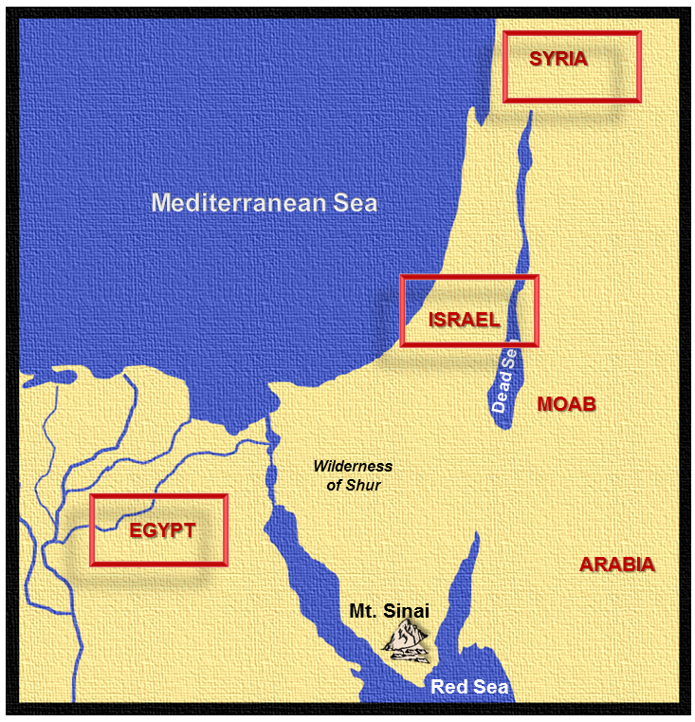
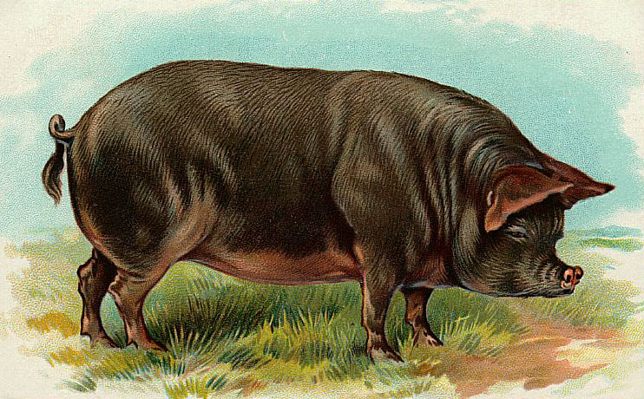
Then The Syrian Kingdom Arose, And The Jews Were Persecuted.
In the conflicts between Syria and Egypt Antiochus Epiphanes, King of Syria, seized Palestine and bitterly persecuted the Jews.
It was reported that Antiochus Epiphanes died in Egypt which caused the Jews to rejoice. But, it was a false report, and when he returned in 168 B.C. he slew 40,000 Jews and profaned the Temple by offering a sow on altar.
The Jews were forbidden to worship in the Temple and compelled to eat the flesh of swine.

Slide 23
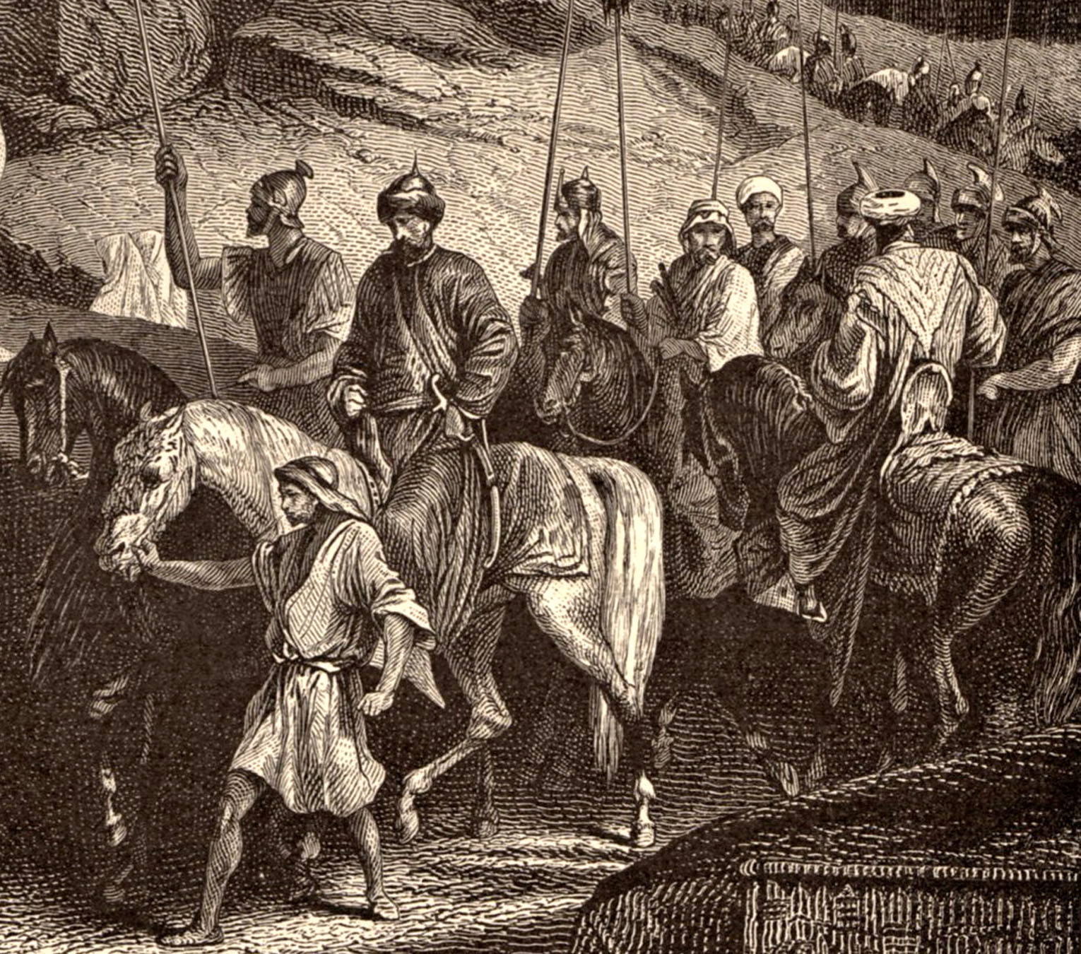
Maccabees (hammer)—
A name given to a Jewish family that had the courage to “hammer” their enemy. Matthias, the father, was a priest. He had 5 sons.
The cruelties of Antiochus Epiphanes, King of Syria, brought about a revolt of the Maccabees under the leadership of Matthias. The Maccabees aroused the patriotism of the Jews who rebelled.
The Temple was recaptured and sacrifices were resumed. The Maccabees served as both high priests and kings.

Slide 24
The Maccabean Revolt
THE HAMMER

Slide 25
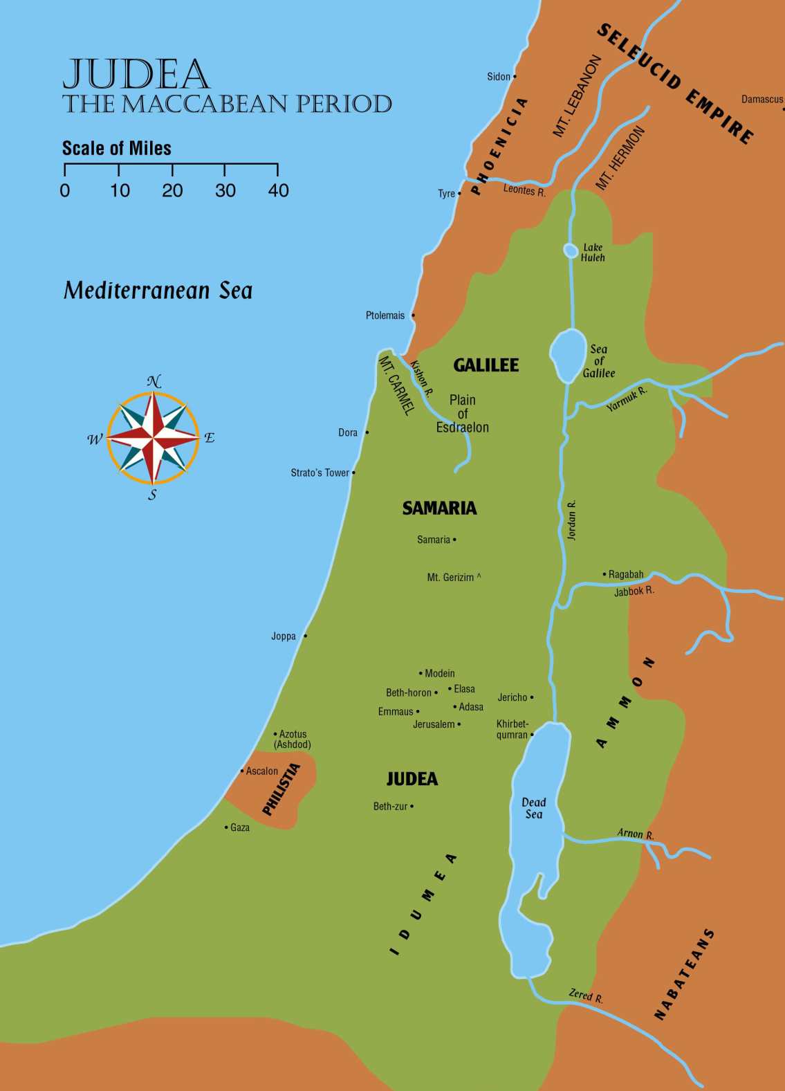
Territory controlled by the Hasmonian dynasty at its largest

Slide 26
The Maccabean Revolt
Syria defeated Egypt in 198 BC
Not the Syria of the Old Testament – a much more formidable foe, the Grecian-Syrian empire
Antiochus IV came to the throne in 175 BC
Rome, a new enemy, was growing on the horizon
Was demanding a crippling tax from Syria
Declared himself as the human manifestation of Zeus, the chief god of the Greeks
Tried to force everyone to accept the Greek way of life and to worship him as the Greek god

Slide 27
The Maccabean Revolt
Antiochus IV
His actions brought him in conflict with the Jews
To submit to his actions would mean apostasy from Jehovah
Succeeded in forcing the Samaritans to renounce their religion – then headed toward Jerusalem
Set up a high priest favorable to the Hellenistic way
Defiled the altar of burnt offering
Outlawed all Jewish ceremonies such as circumcision
Forbade the observance of the Sabbath or feast days
Burned copies of the law
Set up a cult to worship Zeus in the temple

Slide 28
The Maccabean Revolt
Idols of Zeus were set up in all public places throughout Judea
167 BC
All who would not obey the king’s decrees and display allegiance to the idol were publicly whipped and then killed!
This is real persecution

Slide 29
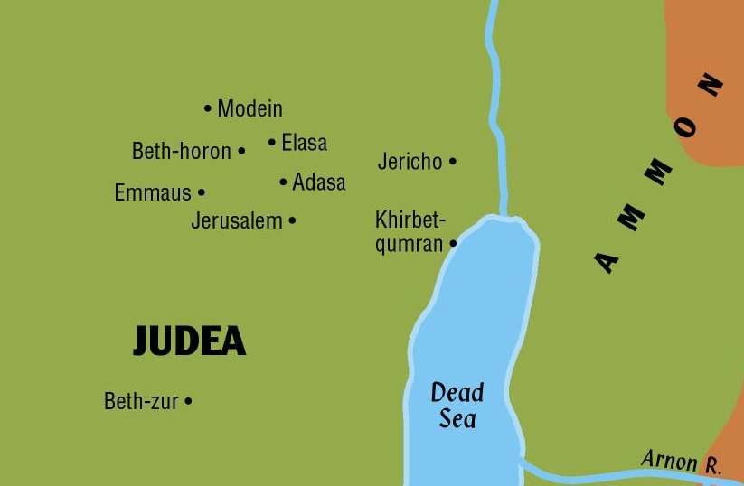
The Maccabean Revolt
Mattathias Hasmonean
A priest living in Modein, northwest of Jerusalem
First to have the courage to withstand a Syrian official
Refused Syrian’s demands and declared to live and die in the religion of his fathers
Killed the king’s officer

Slide 30
The Maccabean Revolt
Fled to Gophna Hills in Ephraim
Took his five sons – John, Simon, Judas, Eleazar, and Jonathan
Faithful Jews from all over the land rallied around them
Mattathias, realizing his great age, appointed his son Simon as counselor and father of the family
Named Judas as the military leader
The names “Maccabee” and “Hammer” were also some of the names that he was known by
Remembered in history as the “Hasmonean Dynasty”

Slide 31
The Maccabean Revolt
Judas and his followers
Began waging guerrilla type warfare immediately
Mingled with local villagers during the day and attacked Syrian army outposts at night
Local Jews approved of the Maccabean force
Kept Judas informed concerning enemy movement
Judas constantly was ambushing some vastly superior force and scattering it
Outnumbered, he met and defeated the royal forces in a series of victories

Slide 32
The Maccabean Revolt
Judas and his followers
Defeated a large army at Beth-zur
This paved the way for the re-taking of Jerusalem
Retook the city and the Temple Mount in 164 BC
Cleansed the sanctuary, re-lit the lamps in the temple

Slide 33
The Maccabean Revolt
Jews have celebrated the moment ever since with a feast in the New Testament called:
Today it is known as “Hanukkah”
Jesus Himself attended the feast as recorded in John 10:22-23
Feast of Dedication

Slide 34
The Maccabean Revolt
Syrians were having trouble in other parts of their empire as well
Rome was growing in power
Various heirs of the Seleucid throne struggled for power each time a ruler would die
Lysias, the new ruler of Syria offered a compromise peace with the Jews of Jerusalem
Would grant them religious freedom if they would return the military stronghold on the Temple Mount to the Syrians

Slide 35
The Maccabean Revolt
The death of Judas
With an army of 800 men, he fought off an army of thousands from morning until night
He and his men died surrounded by literally “heaps” of the enemy
Judas was succeeded by his brother Jonathan
Consolidated the power of the Maccabees by war as well as diplomacy
Widened the rebellion into a full-scale war
Gained independence
Led Judah to a considerable measure of glory

Slide 36
The Maccabean Revolt
John Hyrcanus later took over (135-105 BC)
Rome was quietly encouraging the efforts of the Jews to gain independence because it was weakening the Syrian empire
At the death of John Hyrcanus, the day of the great Maccabees was over
Decades that followed saw men and women with questionable motives struggle to gain power
The religious sects were fully developed by this time
Whoever was ruling at the time would favor one sect and then the other – bringing about civil war in the land

Slide 37
The Maccabean Revolt
Aristobulus – a son of John Hyrcanus
First to take the title King
Strictest of the Jews objected because he was not of the lineage of David
Others saw it as having independence and the beginning of a new day of glory for Israel
The land was full of unrest
It was ripe for plucking by the time the Roman legions approached Palestine
Practical independence was maintained until about 63 BC when Pompey invaded the country and brought it under Roman domination

Slide 38
The Maccabean Revolt
What the Maccabean rulers accomplished:
Complete subjugation of their ancient enemies
Samaria was conquered
Temple on Mt. Gerizim was destroyed
Old Edomites or Idumeans were conquered and forced to accept the Jewish religion
This point becomes important later because:
The Herods were Edomites who had become Jews in religion
Yet their religion was shallow since they had become such in order to avoid death

Slide 39
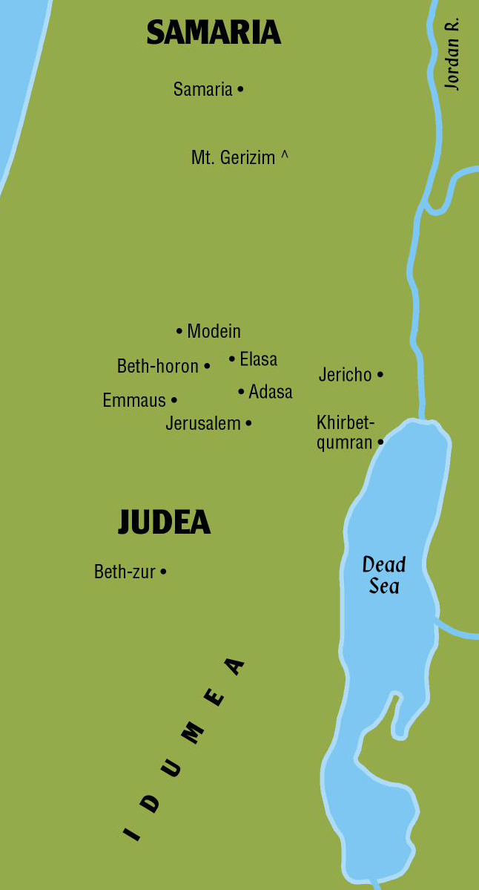
Key cities and areas
from the
Maccabean period

Slide 40
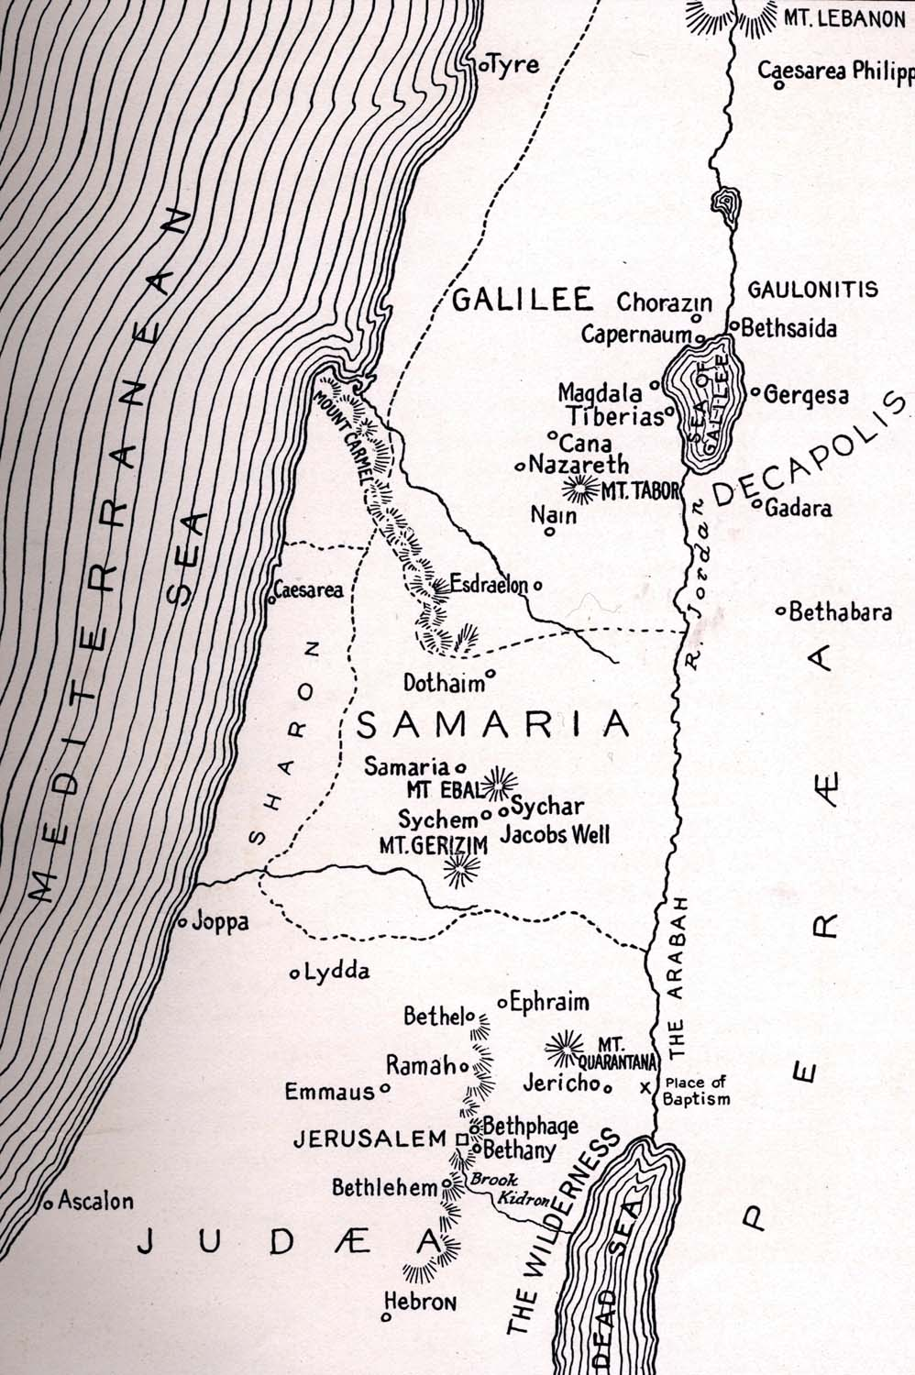
At the time of Syrian persecution the land was divided into
5 Provinces
with which the reader of the New Testament is familiar:
Judea, Samaria, Galilee, Perea, and Trachonitis .
Trachonitis

Slide 41
VOCABULARY FOR THE
400 Silent Years
Synagogue
Scribe
Samaritan
Sanhedrin
Pharisees
Sadducees
Essenes
Zealots
Herodians

Slide 42
The Hebrew term for synagogue is beit k'neset. It means "house of assembly" and thus approximates the Greek word ' synagoge' which also means "assembly." For centuries, the synagogue functioned primarily as the ancient world's idea of a "JCC," a place for Jews to assemble. These institutions dotted the Jewish landscape even while the Second Temple-shrine of ancient worship-stood.

Slide 43
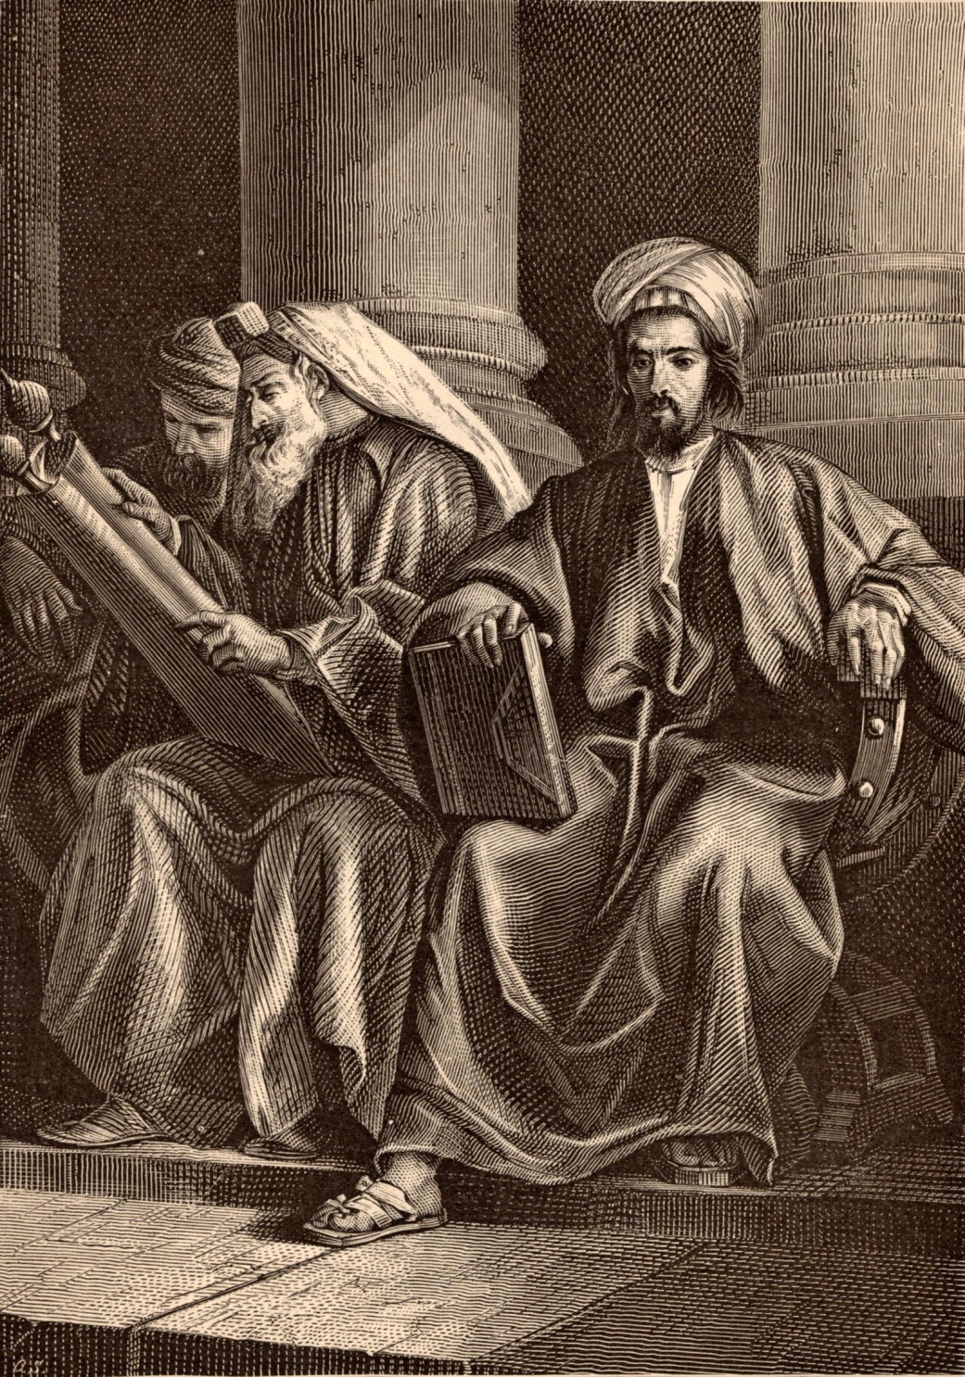
Synagogues—
As Jewish people spread through out the Grecian and then Roman Empires the synagogue became organized and depended upon.
Wherever ten Jewish families settled, a synagogue could be formed and weekly synagogue services were conducted.

Slide 44
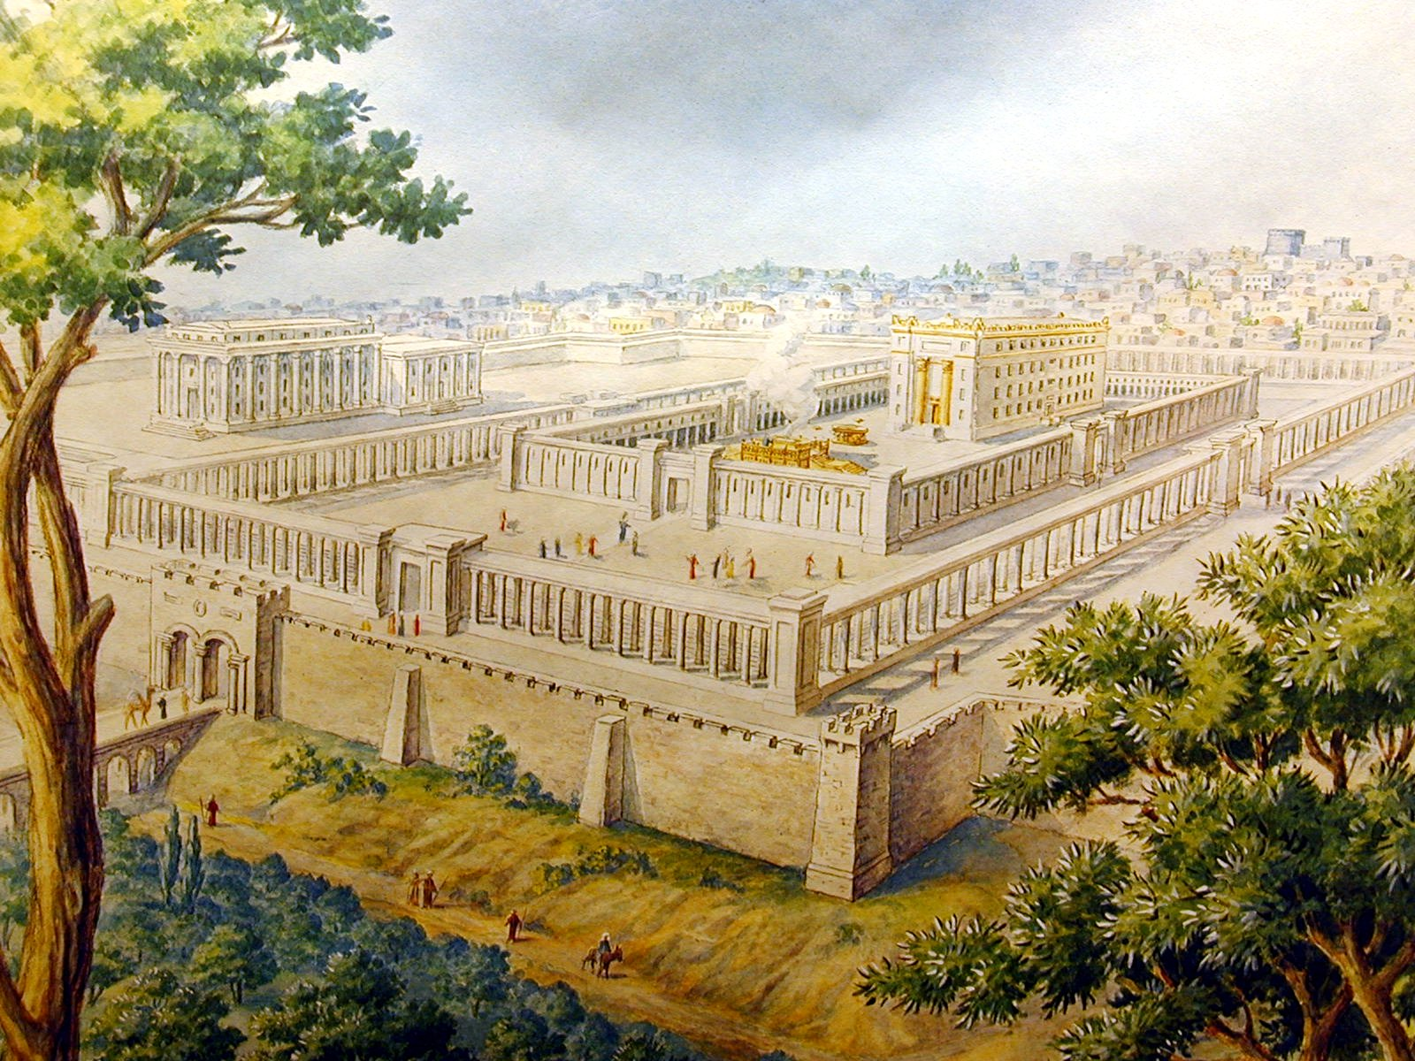
Of course Temple worship continued in Jerusalem.

Slide 45
VOCABULARY FOR THE
400 Silent Years
Synagogue
Scribe
Samaritan
Sanhedrin
Pharisees
Sadducees
Essenes
Zealots
Herodians

Slide 46
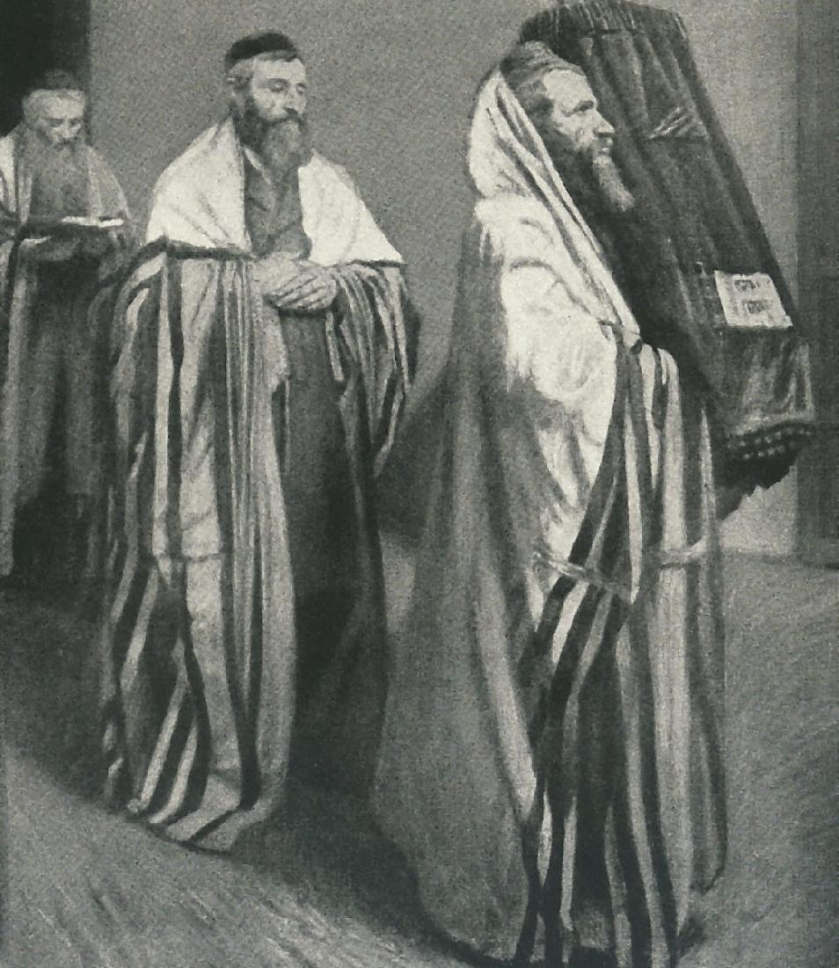
Scribe—
Jewish Scribes were a class of learned men who made the systematic study of the law their professional occupation.
They were not priests. They had secular jobs and did not receive money for their teaching.
They were also called:
Lawyers, Matthew 22:35
Doctors of the law, Luke 5:17
Rabbis, Matthew 23:8
To safeguard the sanctity of the law they developed a system of teaching known as “the tradition of the elders” (Matthew 15:2).

Slide 47
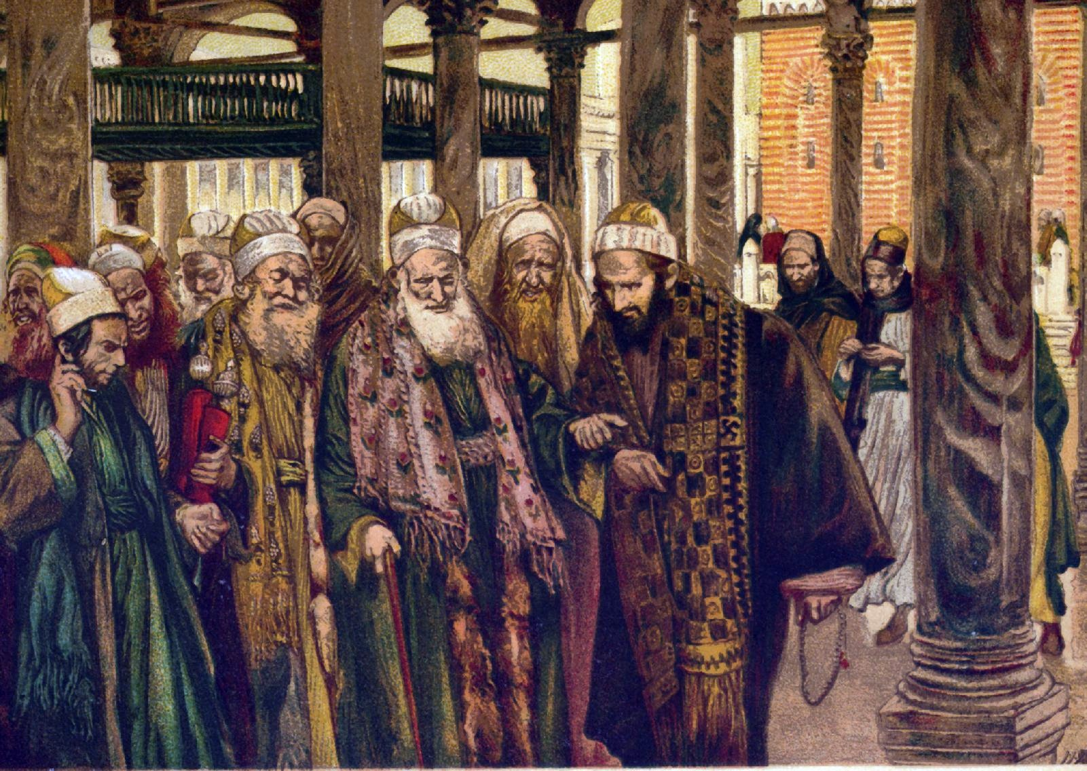
The scribes fiercely opposed Jesus and persecuted the early church.
Matthew 5:20
“For I say unto you, That except your righteousness shall exceed the righteousness of the scribes and Pharisees, ye shall in no case enter into the kingdom of heaven.”
Matthew 23:2-8
“The scribes and the Pharisees sit in Moses’ seat: ³All therefore whatsoever they bid you observe, that observe and do; but do not ye after their works: for they say, and do not. ⁴For they bind heavy burdens and grievous to be borne, and lay them on men’s shoulders; but they themselves will not move them with one of their fingers.”
Matthew 16:21
“From that time forth began Jesus to shew unto his disciples, how that he must go unto Jerusalem, and suffer many things of the elders and chief priests and scribes, and be killed, and be raised again the third day.”
Acts 6:12
“And they stirred up the people, and the elders, and the scribes, and came upon him, and caught him, and brought him to the council.”

Slide 48
VOCABULARY FOR THE
400 Silent Years
Synagogue
Scribe
Samaritan
Sanhedrin
Pharisees
Sadducees
Essenes
Zealots
Herodians

Slide 49
What is a Samaritan?
A people which derived their name from the region of Samaria. It was a term of contempt with the Jews because it was a person that was only part Jewish; a person that had inter-married.

Slide 50
VOCABULARY FOR THE
400 Silent Years
Synagogue
Scribe
Samaritan
Sanhedrin
Pharisees
Sadducees
Essenes
Zealots
Herodians

Slide 51
Who were the Sanhedrin?
The highest legal and administrative body among Jews in the Greek and Roman periods.
The origin of the Sanhedrin is unknown, and there is no historical evidence for its existence before the Greek period.
They were a council of 70 elders plus the president who was the High Priest.

Slide 52
VOCABULARY FOR THE
400 Silent Years
Synagogue
Scribe
Samaritan
Sanhedrin
Pharisees
Sadducees
Essenes
Zealots
Herodians

Slide 53
VOCABULARY FOR THE
400 Silent Years
Pharisees
Sadducees
Essenes
Zealots
Herodians
Sects or divisions of the Jews that came about during the inter-Testamental Period.

Slide 54
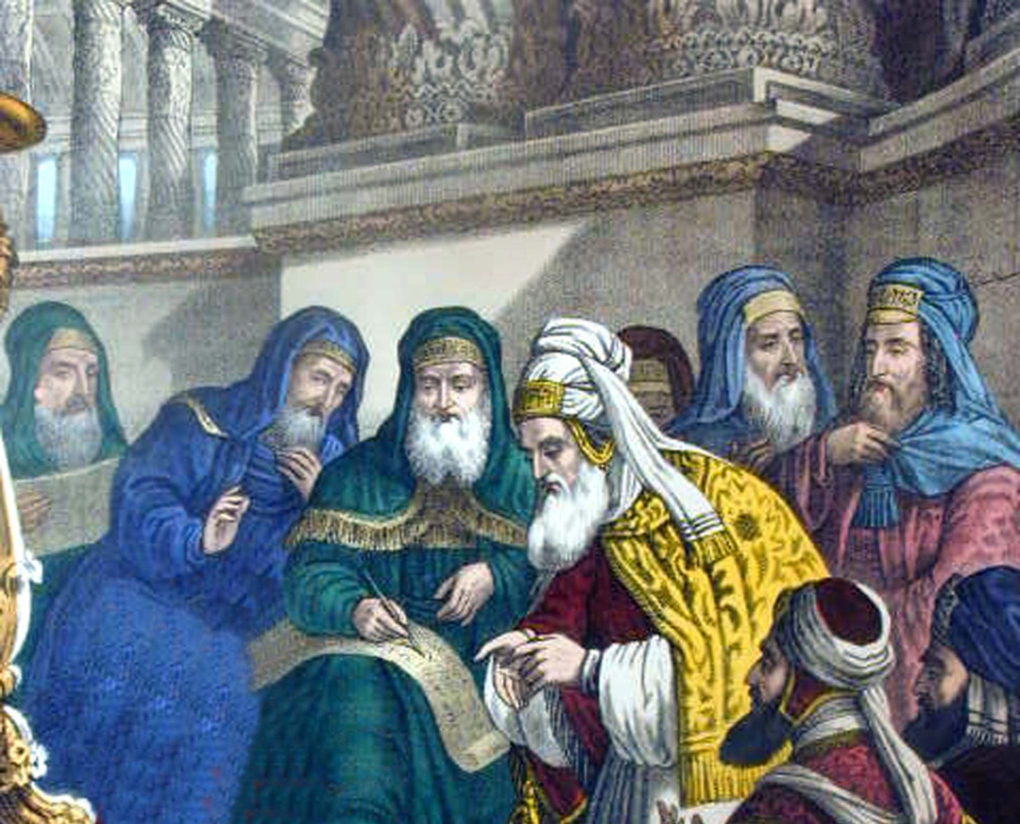
Pharisees:
Pharisee means separated ones.
It was the strictest sect of the Jews.
They were sticklers for ceremonial purity.
They wore distinguishing garb so as to be recognized.
They controlled the Temple and maintained the Synagogues.
They opposed Roman rule.
They taught predestination.
They were hypocritical.
They bitterly opposed Jesus.

Slide 55
VOCABULARY FOR THE
400 Silent Years
Pharisees
Sadducees
Essenes
Zealots
Herodians
Sects or divisions of the Jews that came about during the inter-Testamental Period.

Slide 56
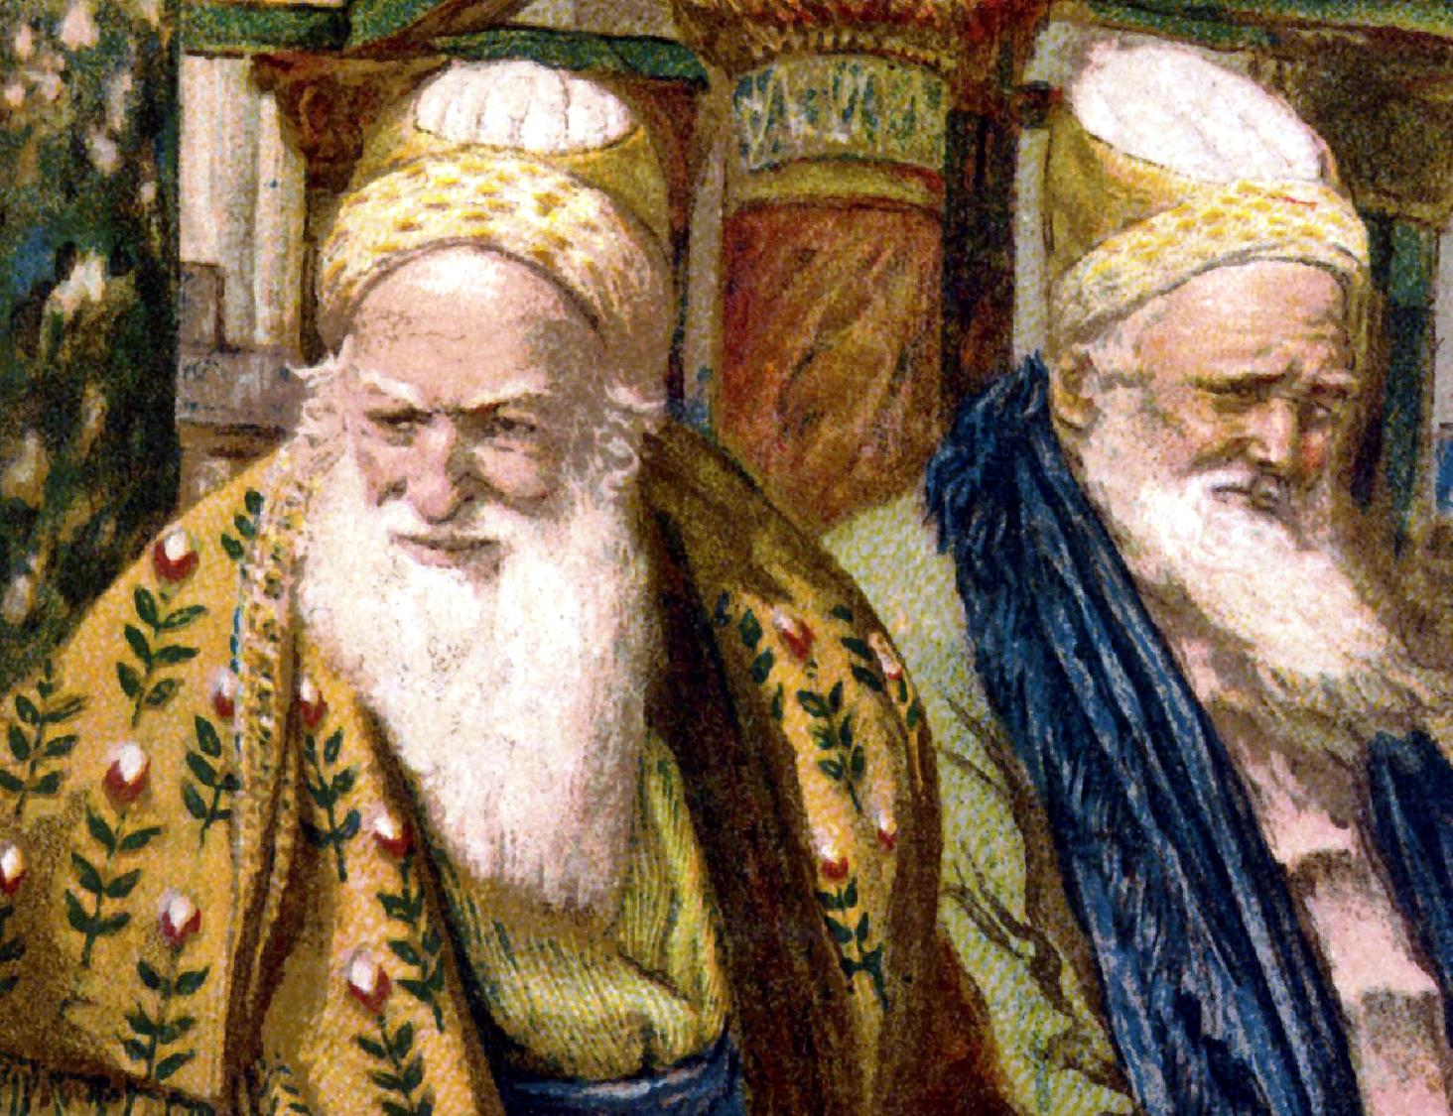
Sadducees:
The sect of the High Priesthood.
They rejected the Pharisee’s oral laws.
They did not believe in—
spirits, angels, or the resurrection which was very “Sad U see.”
They opposed John the Baptist, Christ, and the church.

Slide 57
VOCABULARY FOR THE
400 Silent Years
Pharisees
Sadducees
Essenes
Zealots
Herodians
Sects or divisions of the Jews that came about during the inter-Testamental Period.

Slide 58
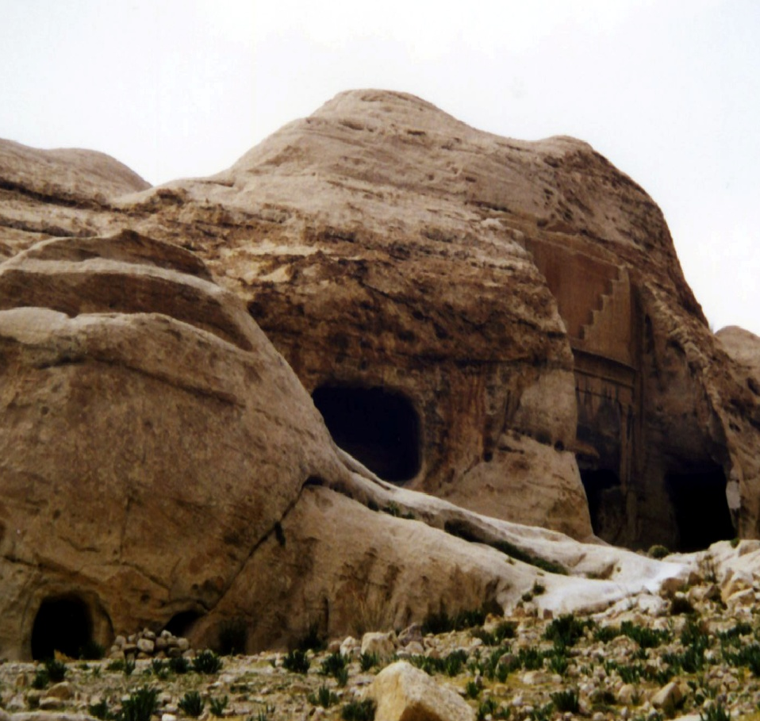
Essenes:
They lived apart in their own communities. Qumran was one such community where the Dead Sea scrolls were found.
They did not participate in Temple worship.
They did not believe in—
A bodily resurrection, slavery, or war and discouraged marriage.
Josephus and Pliny of the 1st Century tell us of the Essenes, but they are not mentioned in the Bible.

Slide 59
Pharisee, Sadducees, Essenes
Leaders of the Jewish Religion

Slide 60
Pharisee took dominance
They were the spiritual fathers of modern Judaism
They believed in an Oral Law that God gave to Moses at Sinai along with the Torah or written law
Think of the Torah much like the constitution of the United States
It was a series of laws they considered open to interpretation
The Oral law was the interpretation of what these laws meant

Slide 61
Thus you have a people in disobedience
The oral tradition was codified and written down roughly three centuries later and known as the Talmud
They also believed in the after life for both wicked and righteous
They believed in a messiah that would bring an era of world peace
They were like the blue collar Jews
They adhered mostly to tenets developed after the destruction of the temple, ind. prayer, assembling

Slide 62
The Sadducees were “Elitists”
They wanted to maintain the priestly caste, willing to incorporate Hellenism into their lives which the Pharisees opposed
The Hellenists were Greeks with a whole culture of influence on them
The Sadducees rejected the idea of the Oral Law and insisted on literal interpretation of the written law
They did not believe in the after life since it is not written in the Torah

Slide 63
The Sadducees cont.
The main focus of Sadducee life was rituals associated with the Temple
They disappeared around AD 70 after the destruction of the Temple. None of their writings survived
They denied the existence of a spiritual world made up of Angels and demons and such.
When you died you existence was finished

Slide 64
The Sanhedrin Council
These two parties served in the Great Sanhedrin, a kind of Jewish Supreme Court made up of 71 members whose responsibility was to interpret civil and religious laws
It was made up more of Sadducees than Pharisees but the masses were more loyal to the Pharisees and thus made it hard on the Sadducees to do as they pleased.
Sadducees wanted to get along with Rome

Slide 65
The Dead Sea Sect - Essenes
They emerged out of digust with the other two
They believed the other two sects had corrupted the city and the Temple
They moved out of Jerusalem and lived a monk like life in the desert
They had a strict dietary law and a life of celibacy.
Lived near the Dead Sea – 1947 they found scrolls in a cave near it

Slide 66
Differences
Sect | Sadducees | Pharisees | Essenes
Social Class | Priests, Aristocrats | Common People | Made up of both
Figures of Authority | Priests | Disciples of the Wise | Teacher of Righteous
Attitude Hellenism | For | Selective | Against
Attitude Hasmon-eans | Opposed Usurpation of Priesthood | Opposed Usurpation of Monarchy | Personally opposed to Jonathan

Slide 67
Hasmonean Kingdom of Israel
This was an independent Jewish State for 103 years under the leadership of Simon Maccabeaus
The Books of 1 and 2 Maccabees were about this period
Herod the Great even married a Maccabean princess to legitimate his power
Julius Ceasar, Pompey the Great, Mark Anthony and Octavian ended the Jewish Revolt and power

Slide 68
Differences
Theology Free Will Angels Afterlife | Sadduces Yes No None | Pharisee Mostly Yes Ress. | Essenes No ? Spiritual Survival
Attitude toward Bible | Literalist | Scholarly Interpret | Inspired Exegesis
Attitude to Oral Law | No such thing | Equal to written law | Inspired Exegesis

Slide 69
What does all this mean to us
It describes what man can do when he is trying to please himself
It is not about trying to do things to please God but to please man
None of these three got it right
None of them pleased God
None of them were ready for the messiah but they all fought each other but obtained nothing in return, just like men do today

Slide 70
The Jews Still Look For An Earthly Kingdom
It is sad that they never understood what God told them
It is sad they are looking in the wrong place
It is sad they have so much pride in themselves and their traditions to simply look to God and obey him
It is sad that at one time, God was their defender and sustainer but now God and his once faithful people are separated 70

Slide 71
VOCABULARY FOR THE
400 Silent Years
Pharisees
Sadducees
Essenes
Zealots
Herodians
Sects or divisions of the Jews that came about during the inter-Testamental Period.

Slide 72
In 63 B.C. Rome
gained possession of Palestine.
HOW ROMAN RULE EFFECTED THE JEWS—
Rome brought peace to the whole world.
Jews were allowed political liberty and self government.
As much as possible, Rome worked through local rules.
They were required to pay a yearly tax.
Rome constructed roads.

Slide 73
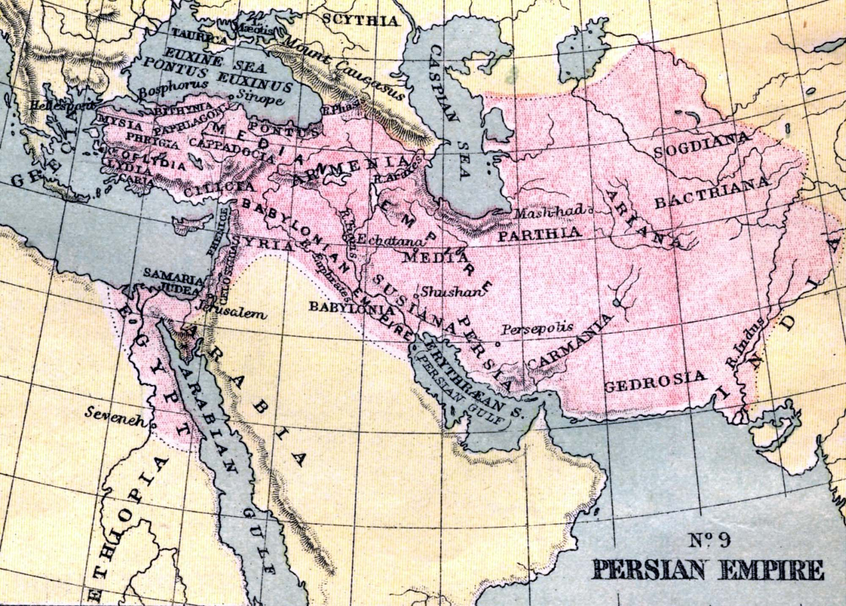
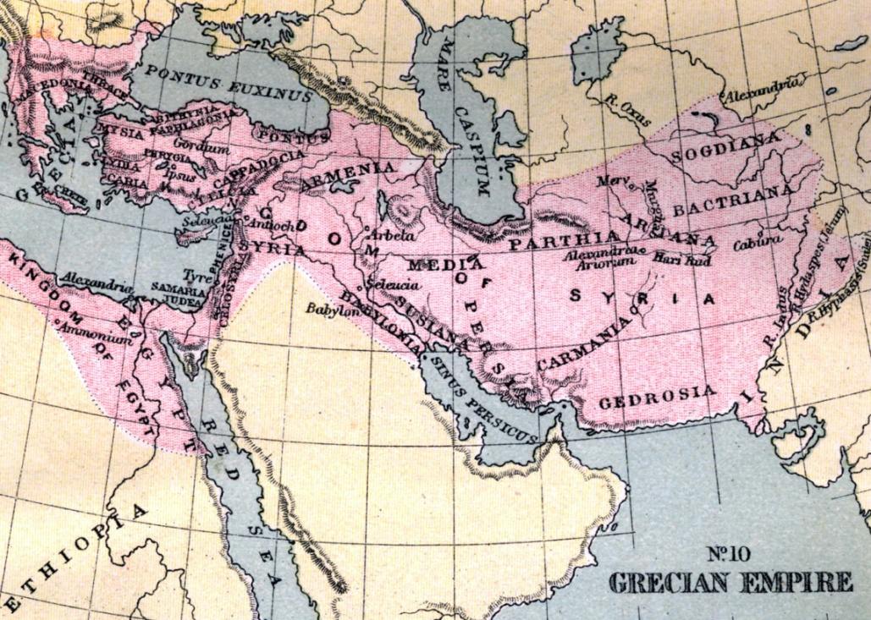
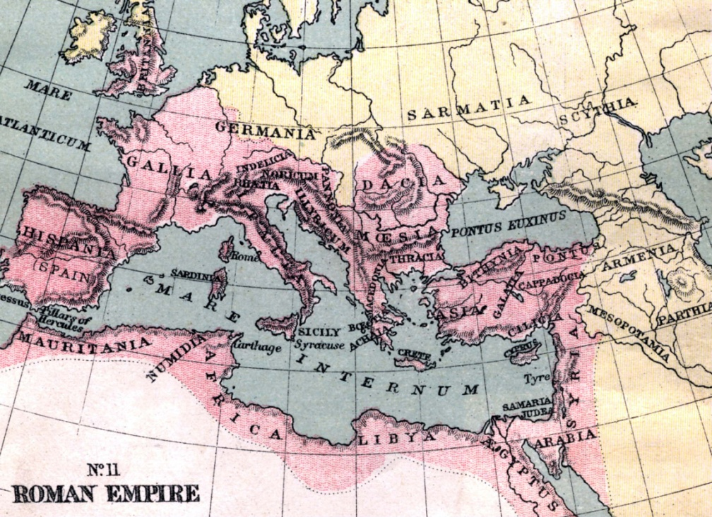
Notice how the land each empire dominated shifted toward Europe.

Slide 74
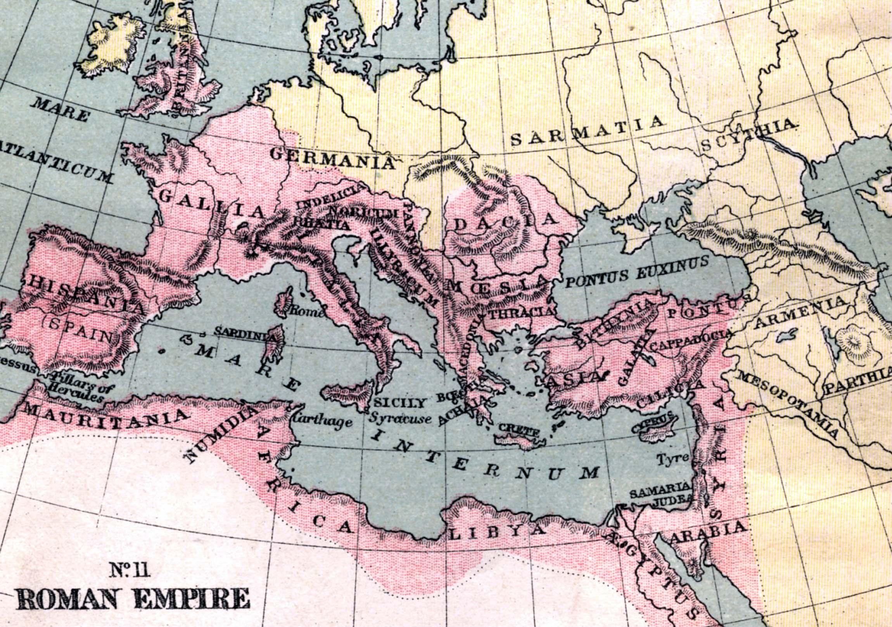

Slide 75
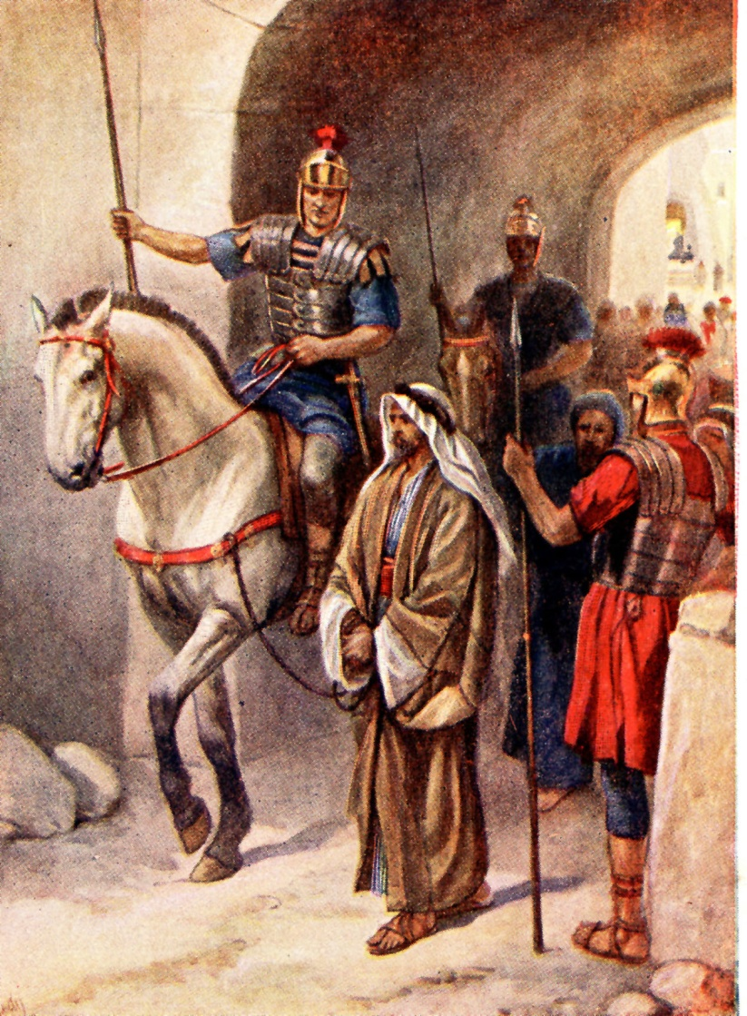
Zealots:
Roman rule was abhorrent to the Zealots. They refused to pay taxes and considered it a sin to acknowledge loyalty to Caesar.
The Zealots eventually won many followers and their defiance resulted in the destruction of Jerusalem in A.D. 70.
Simon the Zealot (Zelotes) was one of the 12 Apostles.

Slide 76
VOCABULARY FOR THE
400 Silent Years
Pharisees
Sadducees
Essenes
Zealots
Herodians
Sects or divisions of the Jews that came about during the inter-Testamental Period.

Slide 77
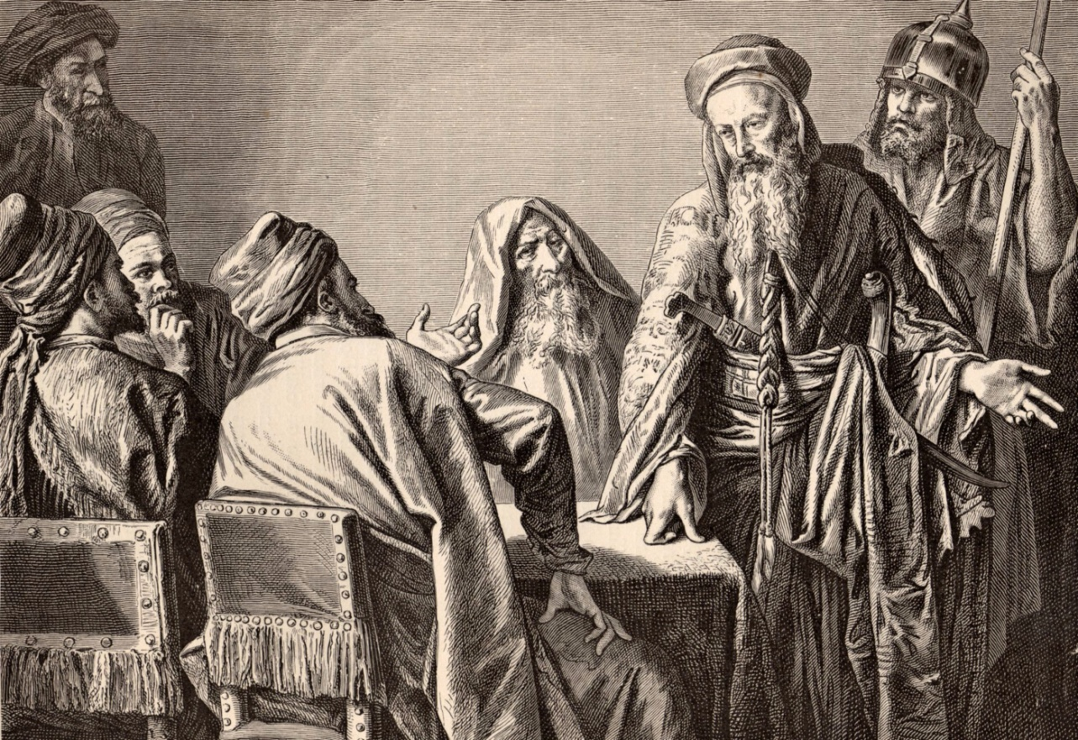
Herodians:
Jews who followed Herod.
Herod was governor over Galilee and king over the Jews. Julius Caesar had appointed him to his position.

Slide 78
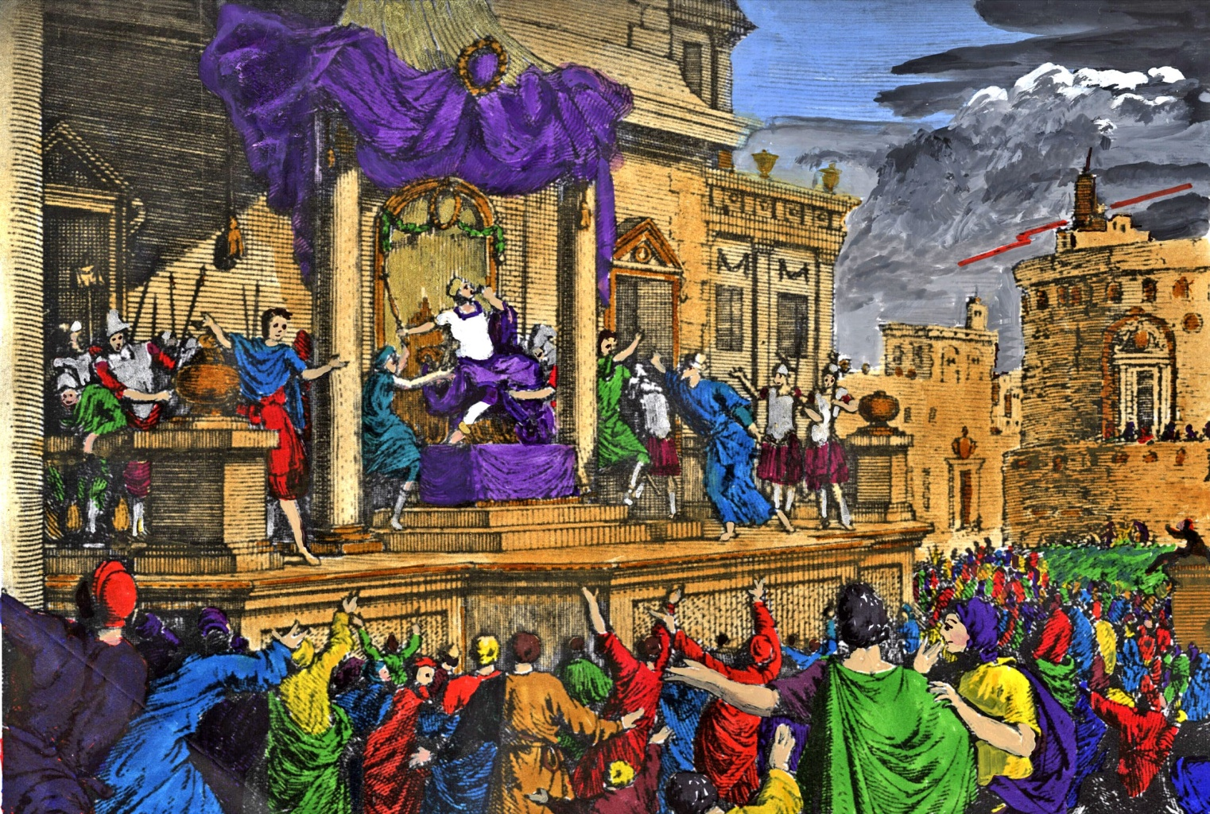
HEROD THE GREAT
1st Governor of Galilee and King of the Jews (37-4 B.C.)

Slide 79
The Herod Family
The Establishment Sect
“The name of several Roman rulers in the Palestine region during Jesus’ earthly ministry and the periods shortly before His birth and after His resurrection”
Herod the Great
Herod Archelaus
Herod Antipas
Herod Agrippa I
Herod Agrippa II
Characters
Main

Slide 80
Chronology
CAESARS
Augustus 31 BC – 14 AD
Tiberius 14 AD – 37 AD
Caligula 37 AD – 41 AD
Claudius 41 AD – 54 AD
Nero 54 AD – 68 AD
Vespasian 69 AD – 79 AD
Titus 79 AD – 81 AD
Domitian 81 AD – 96 AD
HERODS
The Great 37 BC – 4 BC
(Judea, then territory east of Palestine. At Christ’s birth was ruler of all Palestine. After death the province was divided)
Archelaus 4 BC – 6 AD
(Judea and Samaria)
Antipas 4 BC – 39 AD
(Galilee and Perea)
Philip 4 BC – 34 AD
(Country east of Galilee)
Agrippa I 37 AD – 44 AD
(King of the whole country)
Agrippa II 50 AD – 100 AD

Slide 81
The Wise Men
Came from the East
To worship the Christ child
Stopped at the palace of Herod the Great
Scribes determined that the child would be born in Bethlehem of Judea (Micah 5:2)
Warned to go home because Herod planned to harm the child
Herod furious so he ordered all babies of Bethlehem slain up to two years old

Slide 82
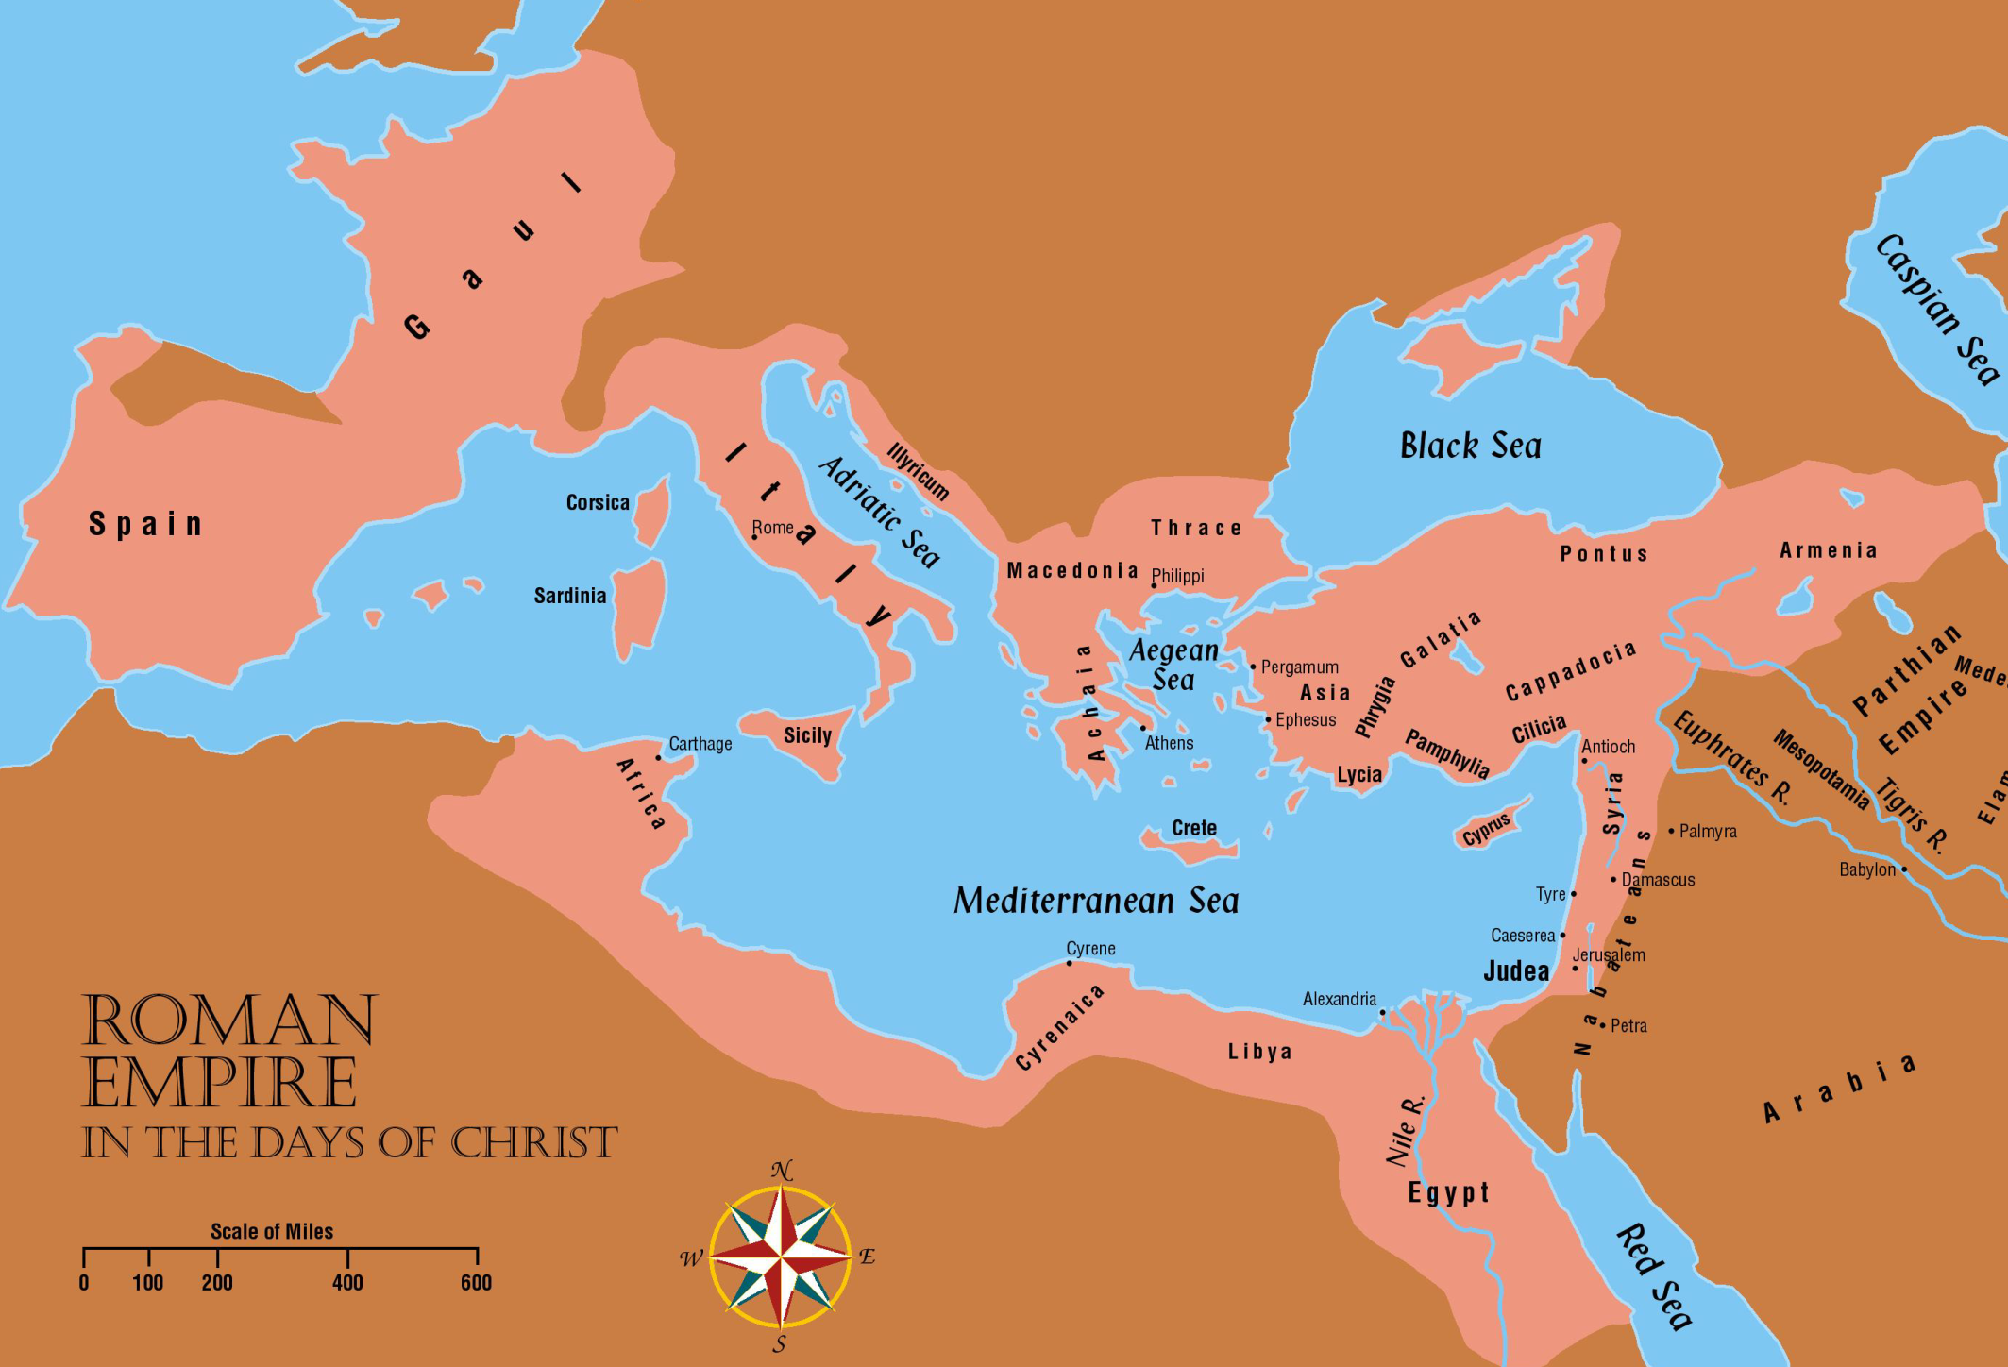
Wise men may have been astrologers from Media

Slide 83
Herod the Great
Obsessed with establishing his dynasty
Story of his life is strewn with the ghosts of people whom he suspected of treason or disloyalty
Ordered the death of 45 members of the Sanhedrin who had opposed him
What is the Sanhedrin?

Slide 84
Sanhedrin
Highest ruling body and court of justice among the Jewish people in the time of Jesus.
Made up of chief priests, elders, scribes
Headed by the high priest of Israel
Had 71 members – high priest was always the president of the Sanhedrin council
No power of capital punishment – reserved for Roman power
Handed Jesus over to Pilate after Jesus’ mock trial

Slide 85
Herod the Great
Anyone that grew in popularity would be killed – including his own family
Killed two brothers-in-law, 3 sons, and a wife
Killed last man in the Hasmonean dynasty
Felt threatened about the Jewish king
Jews hated Herod – Not a real Jew (Idumean)
Cruel and unjust
Professed to observe the law of Moses yet his life was a mockery to what it taught

Slide 86
Herod the Great
Good Points:
Renovated Jerusalem
Started rebuilding the temple as stated in John 2:20
Began in 19 BC and completed in 27 AD
Some work continued until AD 64
Temple was more beautiful than the one that Zerubbabel built in 530 B.C.
“Then the Jews said, "It has taken forty-six years to build this temple, and will You raise it up in three days?”

Slide 87
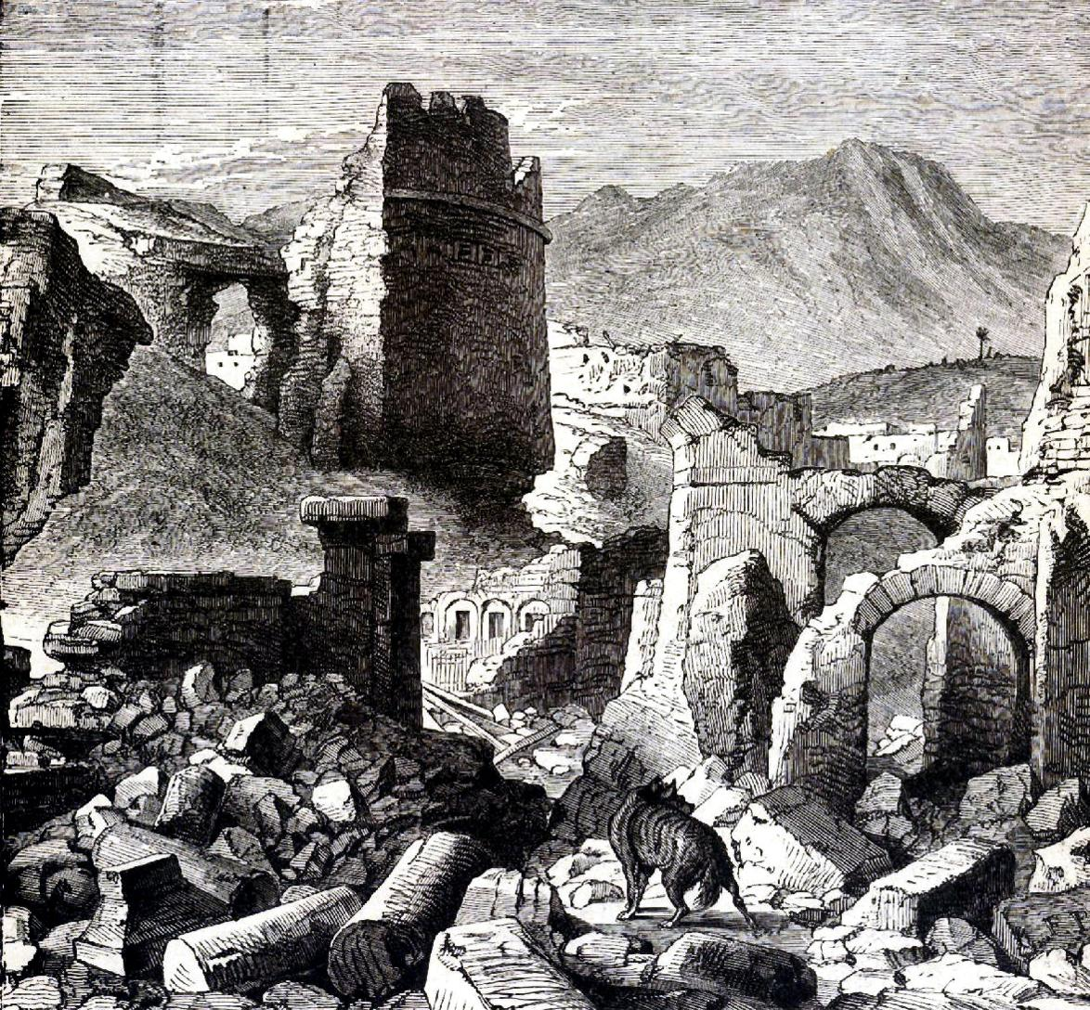
Solomon’s Temple was destroyed when Jerusalem was taken by the Babylonians.
Zerubabbel’s Temple was destroyed in A.D. 70 by the Romans.

Slide 88
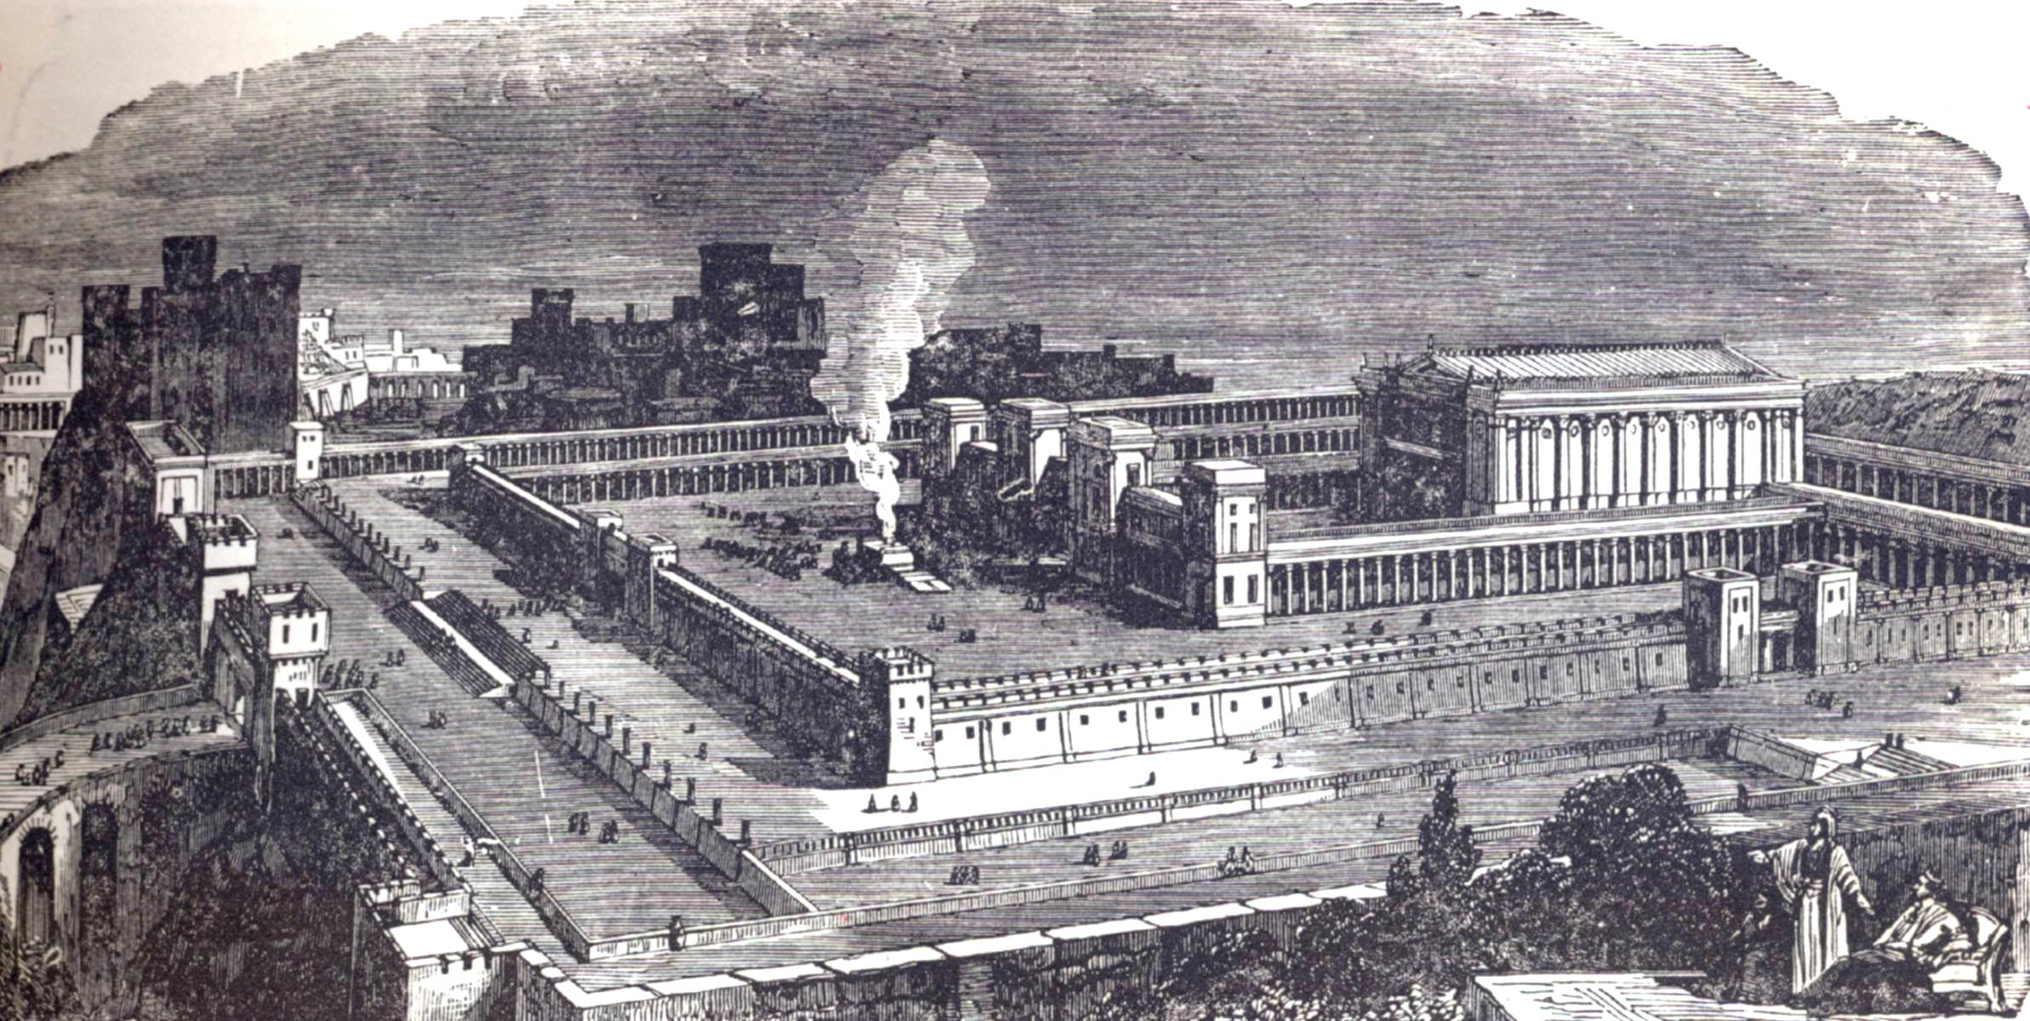
Herod sought to secure the good will of the Jews by funding renovations and improvements to “Zerubbabel’s” Temple which was over 500 years old, for it was the same temple the Jews built after their return from captivity. It had been looted and damaged by Antiochus King of Syria during the Maccabean revolt.
Herod’s work on the Temple continued for many years. Worship continued during the construction.

Slide 89
The JEWS during the days of the Herod’s
Had religious liberty
High priest recognized as religious head of all Jews
Allowed to pay the Temple tax
Rome usually allowed only her own tax
Allowed to observe the Sabbath day
Sanhedrin court allowed to continue
Came into being sometime during the years of Greek domination

Slide 90
The JEWS during the days of the Herod’s
Many cities were rebuilt or beautified by Herod
The city of Caesarea, in honor of Augustus Caesar was built
This city, plus other seaport cities that were enlarged gave the Jews ready access to sea trade
Jerusalem was renovated
The wall Pompey tore down was rebuilt

Slide 91
Herod the Great
37 BC - 4 BC
Ruled over most of Palestine
Divided the land into three main parts
Archelaus given Judea and Samaria
Antipas given Galilee and Perea
Philip given NE of the Sea of Galilee

Slide 92
Archelaus
4 BC - 6 AD
Ruled in Judea and Samaria (Matthew 2:19-23)
Proved to be almost as cruel as his father
After serious protest by the Jews he was finally deposed of after 10 years
Southern land was annexed and made into the Roman province of Judea (6AD)
Governed by “procurators”
Pontius Pilate was the 5th procurator to serve in Judea

Slide 93
Philip
Son of Herod the Great (Matthew 14:1-12)
Was disinherited because of disloyalty
Living in Rome with his wife Herodias
Antipas visited them and took Herodias away with him

Slide 94
Herod Antipas
6 AD - 39 AD
Jesus grew up in Galilee under the rule of Herod Antipas (Luke 23:5-12)
Was not as cruel as his father and Archelaus
Was in Jerusalem on the day of Jesus’ trial
Pilate sent Jesus to him when he learned that Jesus was from Galilee

Slide 95
Agrippa I
37 AD - 44 AD
After Christ returned to heaven, Herod Agrippa I was made ruler over most of the territory that Herod the Great had controlled
He was the brother to Herodias
He persecuted the early church to win the favor of the Jews
Killed the apostle James and imprisoned Peter – intending to kill him also
Died around 44 AD

Slide 96
Agrippa II
50 AD - 100 AD
After Agrippa I’s death the land was divided again
Judea was now comprised of what had been Judea, Samaria, Galilee, and Perea
Agrippa II was given the Northeastern section
Went to Caesarea to visit a new procurator named Festus

Slide 97
Agrippa II (continued)
50 AD - 100 AD
While at Caesarea he heard the case of the apostle Paul who had appealed his case to Caesar
Paul described him as being “expert in all customs and questions which are among the Jews”
Agrippa’s family outwardly observed the law of Moses (Acts 25:13ff)
“almost thou persuade me to be a Christian (Acts 26:28)

Slide 98
Worksheet of the Herod’s
Antipater
___________The first of the Herod family to have power in Palestine
___________Ordered John the Baptist killed
___________Killed the babies of Bethlehem
___________Jesus was tried before him
___________Killed James the apostle
___________Heard Paul’s defense
___________Herodias was his wife first
___________Joseph took the child Jesus to Nazareth when he heard this man was reigning in Judea
___________Rebuilt the temple
___________Imprisoned Peter
___________Jesus grew up in his territory
___________Built Caesarea
Antipas
Herod Great
Antipas
Agrippa I
Agrippa II
Herod Philip
Archelaus
Herod Great
Agrippa I
Antipas
Herod Great

Slide 99
Worksheet of the Herod’s
Of what nationality were the Herod’s?
Idumean (Edomites)
What was their religion?
Jewish (law of Moses) favorable toward Greek customs

Slide 100
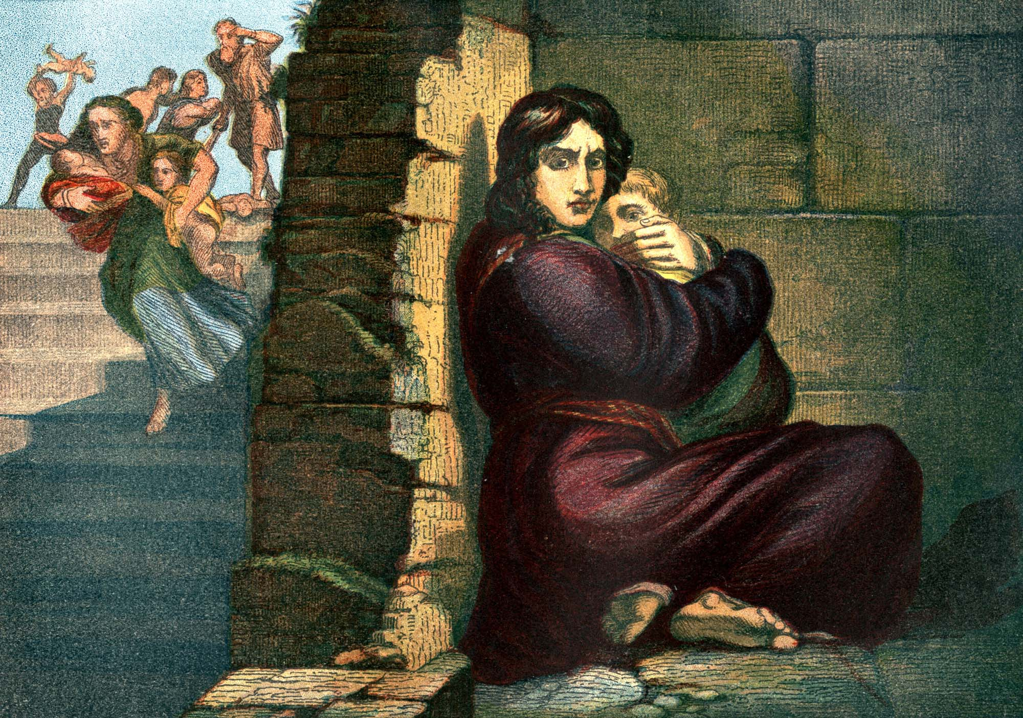
Herod was always fearful that his throne was not secure. When he heard that the King of the Jews was born [Jesus the Messiah] he ordered the slaying of all the infants.

Slide 101
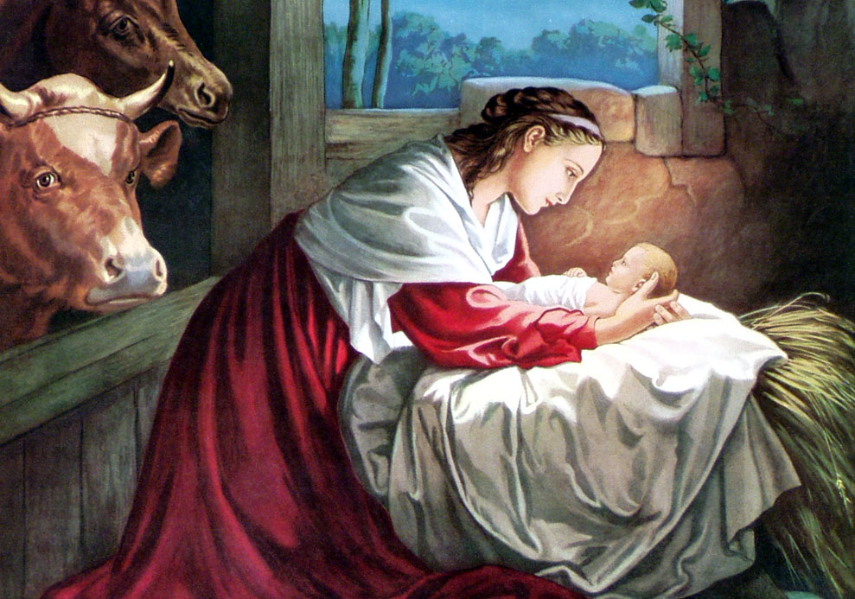
Matthew 1:21
“And she shall bring forth a son, and thou shalt call his name JESUS: for he shall save his people from their sins.”

Slide 102
THE END

