Slide 1
JUDGES ARE ANNOINTED TO PROMISE LAND GOVERNANCE
Edited by David Lee Burris

Slide 2
THE JEWS limit their horizons & settle for less than promised. Reversal of fortunes result from refusal to conquer complete!

Slide 3
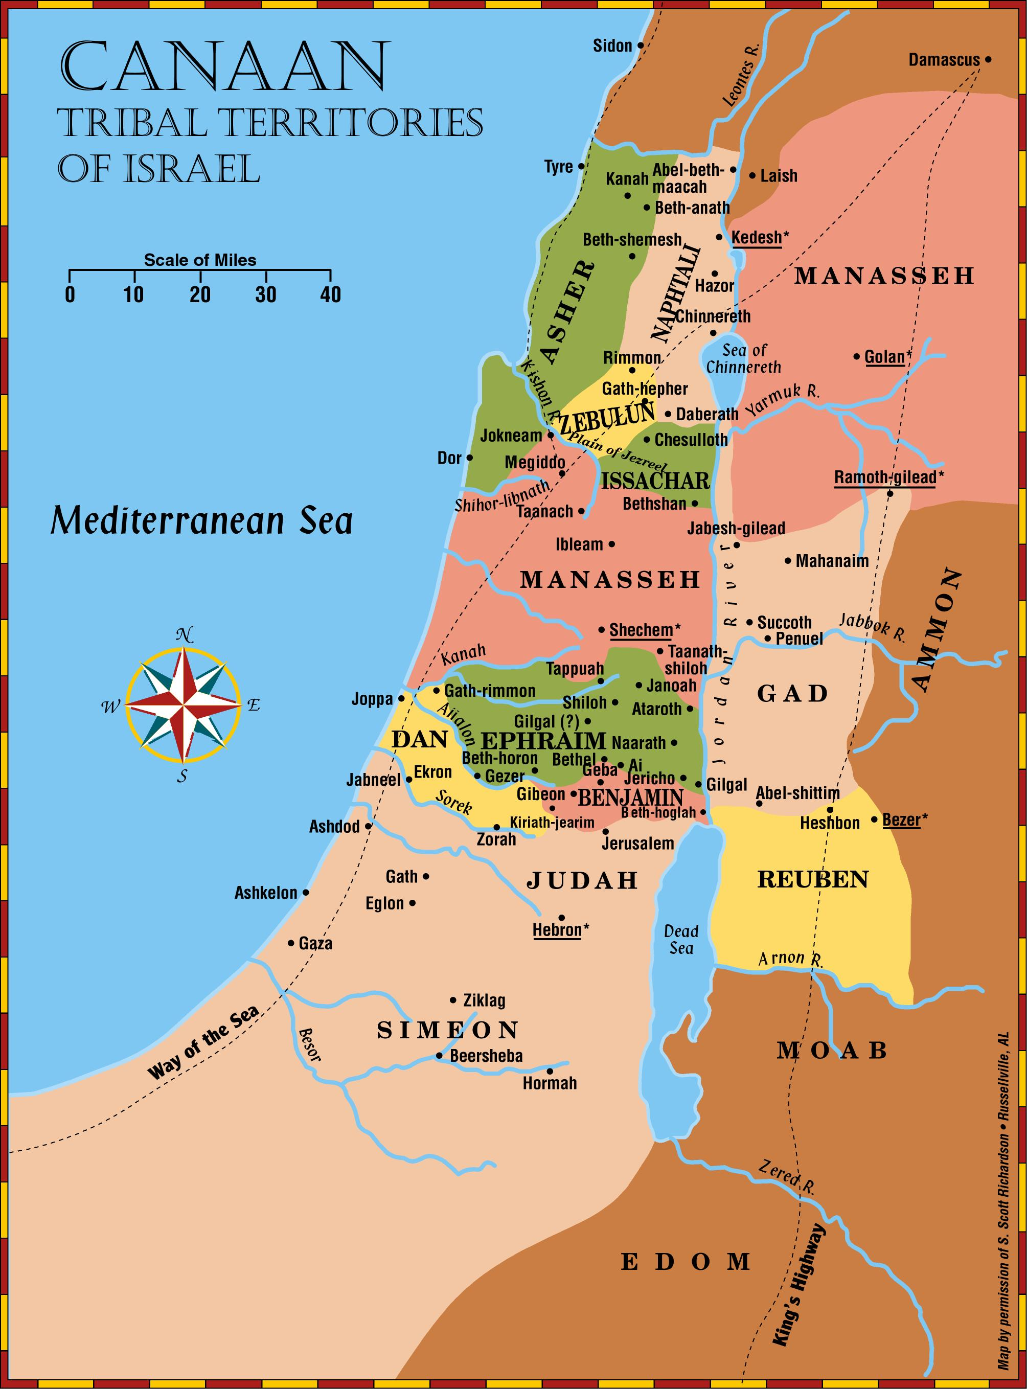
The Land Promise Fulfilled
Joshua 13-24

Slide 4
The Land Promise Fulfilled
The twelve sons of Jacob (Israel): Gen 35:23-26
Leah
Reuben Simeon Levi
Judah Issachar Zebulun
Rachel
Joseph Benjamin
Bilhah (Rachel’s Maidservant)
Dan Naphtali
Zilpah (Leah’s Maidservant)
Gad Asher

Slide 5
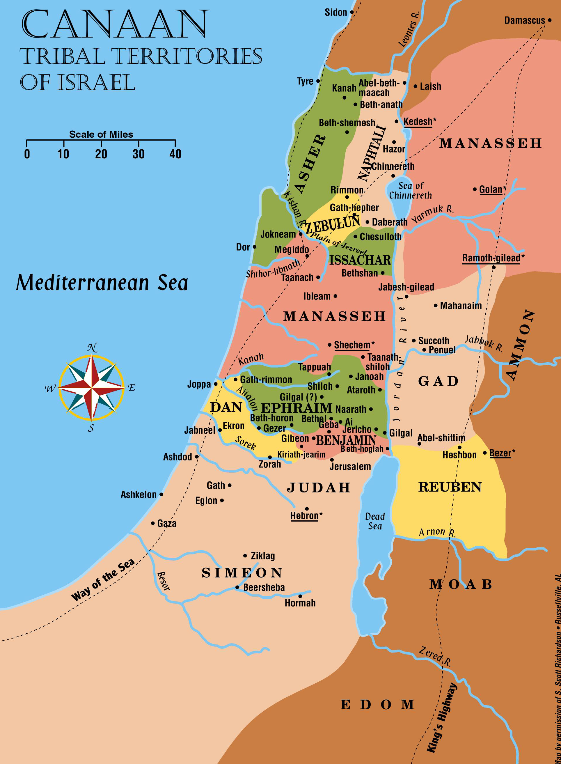
The Land Promise Fulfilled
Joshua 12 is a summary of all the cities Israel has conquered
Includes the territory on both sides of the Jordan
Joshua told to divide the land between the tribes
He would help each tribe finish the task of clearing its possession

Slide 6
The Land Promise Fulfilled
Joshua 13-19 describes the border lines of the tribal territories in detail
Can easily determine the general location of each tribe
Difficult to determine the exact border lines
Tribes asked for specific cities in particular sections of the country
Our faith rests on the fact that God kept His promise

Slide 7
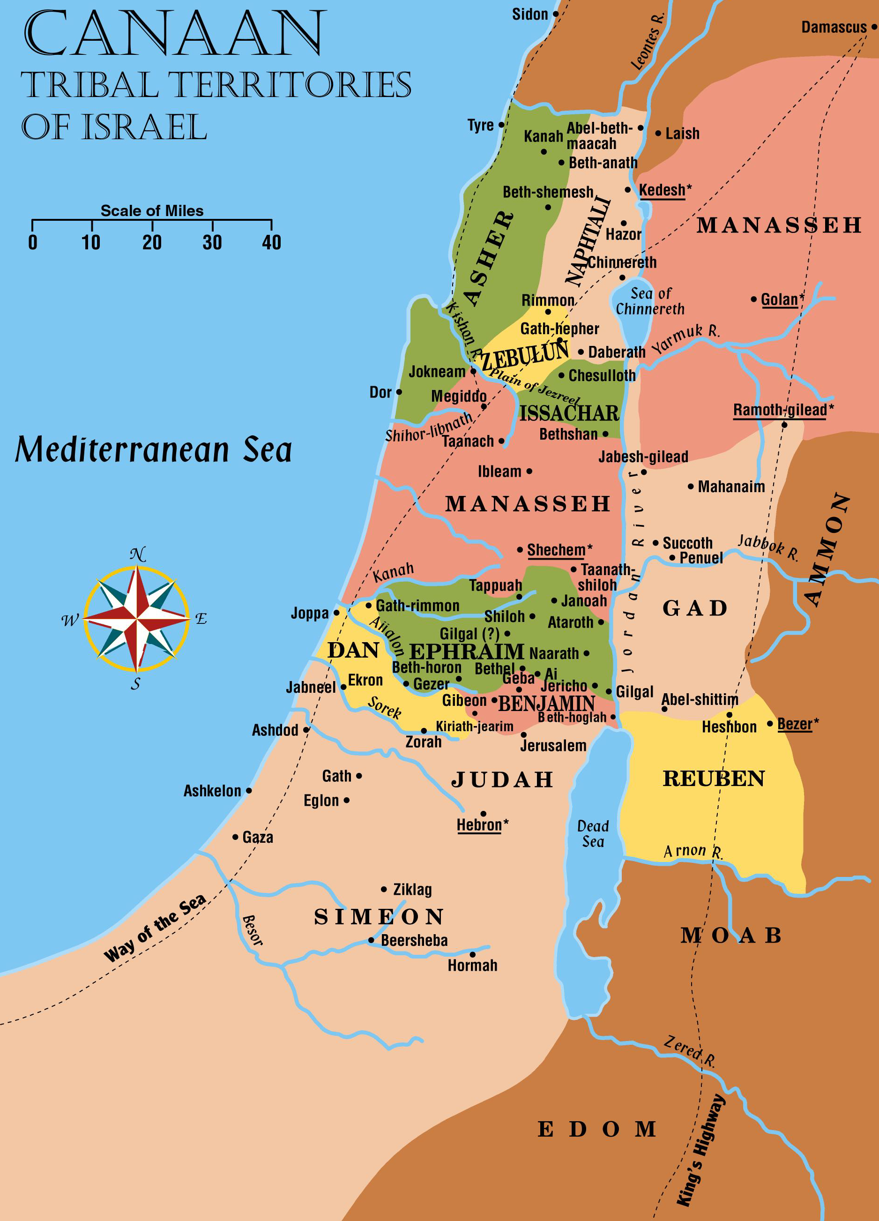
Identify the following places
Dead Sea | Manasseh
Med Sea | Simeon
Sea of Chinnereth | Judah
Jordan River | Benjamin
Zered River | Ephraim
Arnon River | Dan
Jabbok River | Issachar
Yarmuk River | Zebulun
Reuben | Asher
Gad | Naphtali

Slide 8
Tribal Territories East of Jordan
Reuben, Gad and half of the tribe of Manasseh asked for the territory east of the Jordan before Moses died
At first Moses thought they were afraid to take the land of Canaan
He was assured that they would help their brethren conquer Canaan before returning to their land
Reuben was given portion next to Moab
Gad received land taken from King Sihon
Manasseh received land taken from King Og

Slide 9
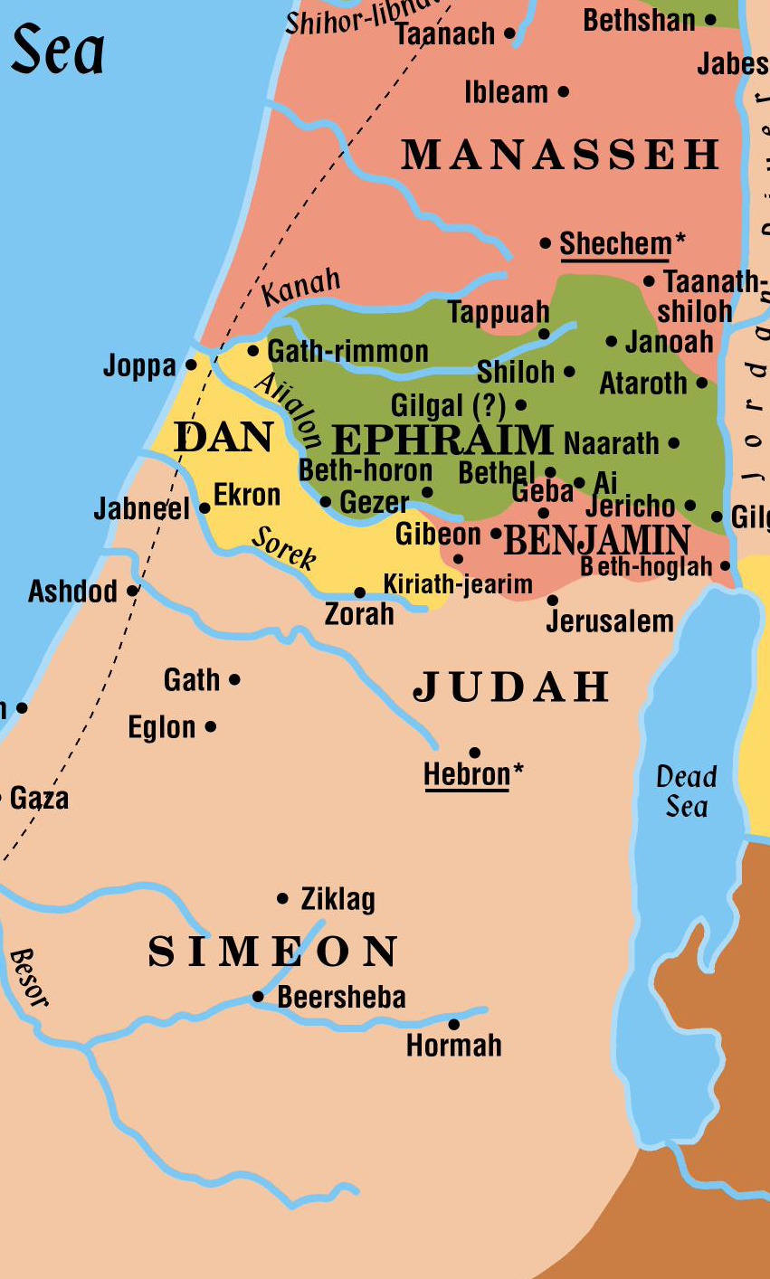
Tribal Territories West of Jordan
Judah was the first tribe to ask for territory west of the Jordan
Given all the land west of the Dead Sea south to the Negeb
City of Hebron was given specifically to Caleb
Ephraim and the remaining half tribe of Manasseh asked for the central portion of land
Joshua describes the borders of Ephraim (Josh 16:5-8)

Slide 10
Tribal Territories West of Jordan
The men reported that Judah’s portion was too large and it fell Simeon’s lot to share the territory
Dan and Benjamin were given territory between the tribes of Ephraim and Judah

Slide 11
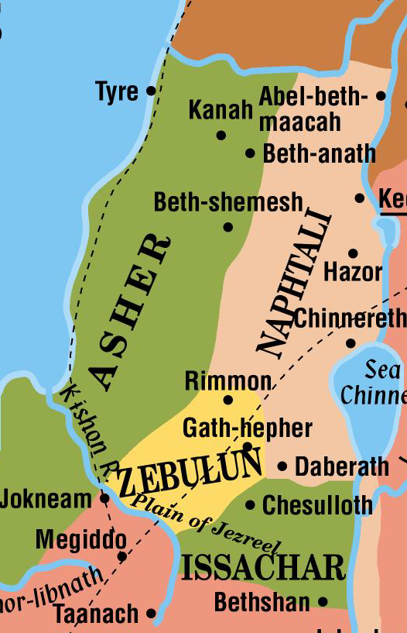
Tribal Territories West of Jordan
Asher was given the narrow coastal plain of the north
Naphtali received the lot lying farthest north along the banks of the upper Jordan
Zebulun and Issachar each received a healthy portion of the Jezreel Plain and of the hills and valleys of lower Galilee

Slide 12
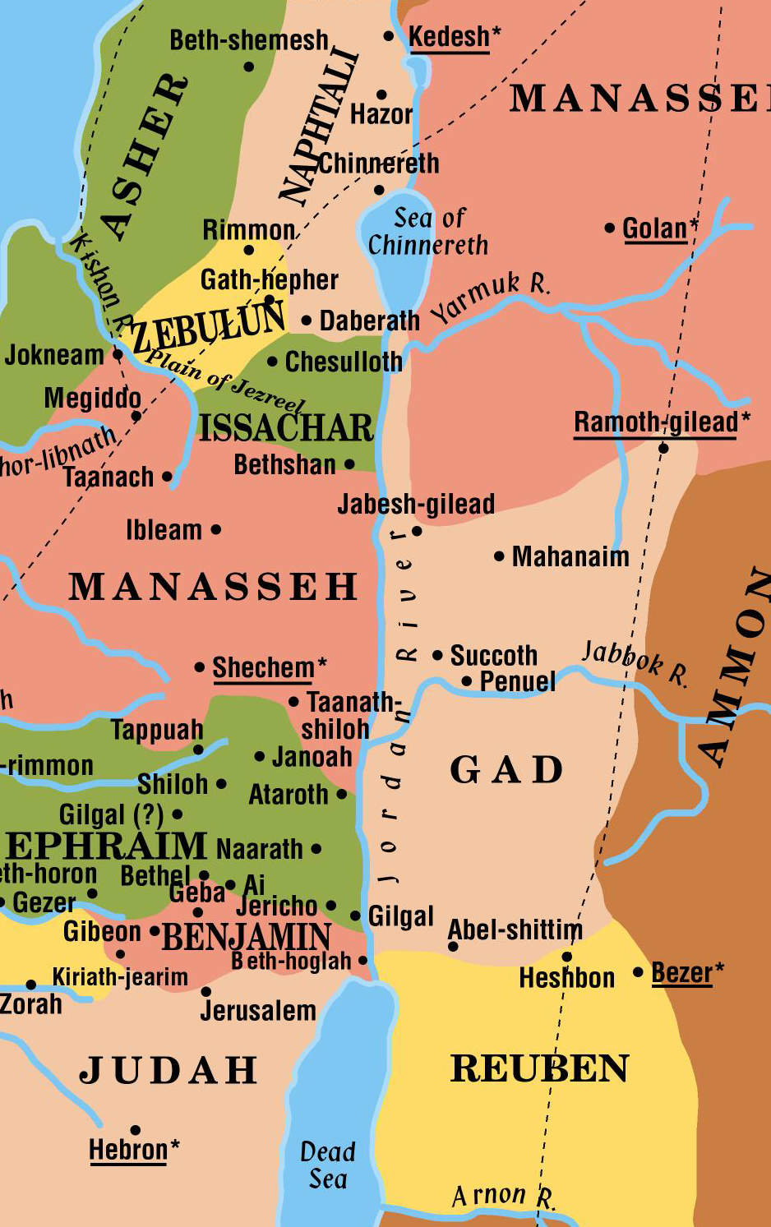
Tribe of Levi
Levi was selected by God to be His special ministers in the tabernacle worship
They were given 48 cities scattered throughout the land
Six of the 48 cities were called “cities of refuge” where one might flee in case of an accidental killing
Those cities were located so as to be a day’s journey from any point in the land

Slide 13
13 Tribes and only 12 Sons
How did that happen?
Jacob’s oldest son, Reuben sinned; and Jacob chose to give the birthright to Joseph, the oldest son of his favorite wife Rachel (1 Chron 5:1-2)
Instead of naming Joseph as one of the tribes, his two sons each inherited equally with the sons of Jacob, Joseph’s double portion
Manasseh and Ephraim

Slide 14
This is the land as God intended it to be
Canaanites were still living within each tribe’s land, but God has already promised to help His people finish driving them out!

Slide 15
Joshua Calls for Faithfulness!
Joshua called the people together before he died and urged them to be faithful. He told them that God had given them ALL the land that he had promised (Joshua 21:43-45; 23:14)
Two of the promises to Abraham are fulfilled by the end of the book of Joshua
His descendants are a distinct, separate nation
They are living in a land of their own – Canaan
The Jews do not need to inherit the land today to fulfill the promise to Abraham – that promise was made and kept over 1,000 years before Christ was born!

Slide 16
The Early Judges
Judges 1:1-10:5
1352 B.C.
The Old Testament
Books of Law:
Genesis, Exodus, Leviticus, Numbers, Deuteronomy
Books of History:
Joshua, Judges
Judges:
About 300 years (1350-1050 B.C.)

Slide 17
The Judges
Othniel (3:7-11)
Ehud (3:12-30)
Shamgar (3:31)
Deborah (4:1-5:31)
Gideon (6:1-8:35)
Abimelech (9:1-57)
Tola (10:1-2)
Jair (10:3-5)
Jephthah (10:6-12:7)
Ibzan (12:8-10)
Elon (12:11-12)
Abdon (12:13-15)
Samson (13:1-16:31)
Eli (1 Samuel 1:1-4:22)
Samuel (1 Samuel 7:3-25:1)

Slide 18
Introduction to The Early Judges
The Israelites that possessed the land of Canaan under the leadership of Joshua had good intentions of serving God all their lives – but humanity fails!
Review what Moses told them (Deut 7)
The land promise was fulfilled in Joshua’s day (Josh 11:15)
They entered the land and conquered every army that opposed them, however – it was the “little and little” that caused them to stumble
Review what Joshua told the people before his death concerning the consequences if they failed to finish the task that was set before them (Joshua 23)

Slide 19
Introduction to The Early Judges
If the Israelites had listened to the warnings and had destroyed the rest of the Canaanites their entire remaining history might have been different
Time passed and few additional Canaanites were destroyed
Some tribes complained about the Canaanites within their borders and Joshua urged them to join forces and destroy them, but they did not (Joshua 17:12-18)

Slide 20
Introduction to The Early Judges
Gradually over years, the Israelite families made friends with Canaanite families nearby
They first tolerated their neighbors’ idolatrous worship of Baal and then began experimenting with the idols themselves
Gradually all battles stopped
God was angry with the people because they had not obeyed Him

Slide 21
Introduction to The Early Judges
The day came when God said He would no longer help them drive out the remaining people in the land
They were left to prove whether Israel could be faithful in spite of the idolatrous worship of their surrounding neighbors (Judges 2:20-23)
For the next long period of history, the Israelites lived in their tribal territories with NO central government in the land

Slide 22
Introduction to The Early Judges
If they served God faithfully, all was well
If they turned to the idols of the Canaanites, God would allow an enemy to oppress them
When they asked God for help, He would raise a judge or deliverer to fight against the enemy
The cycle continued over and over!

Slide 23
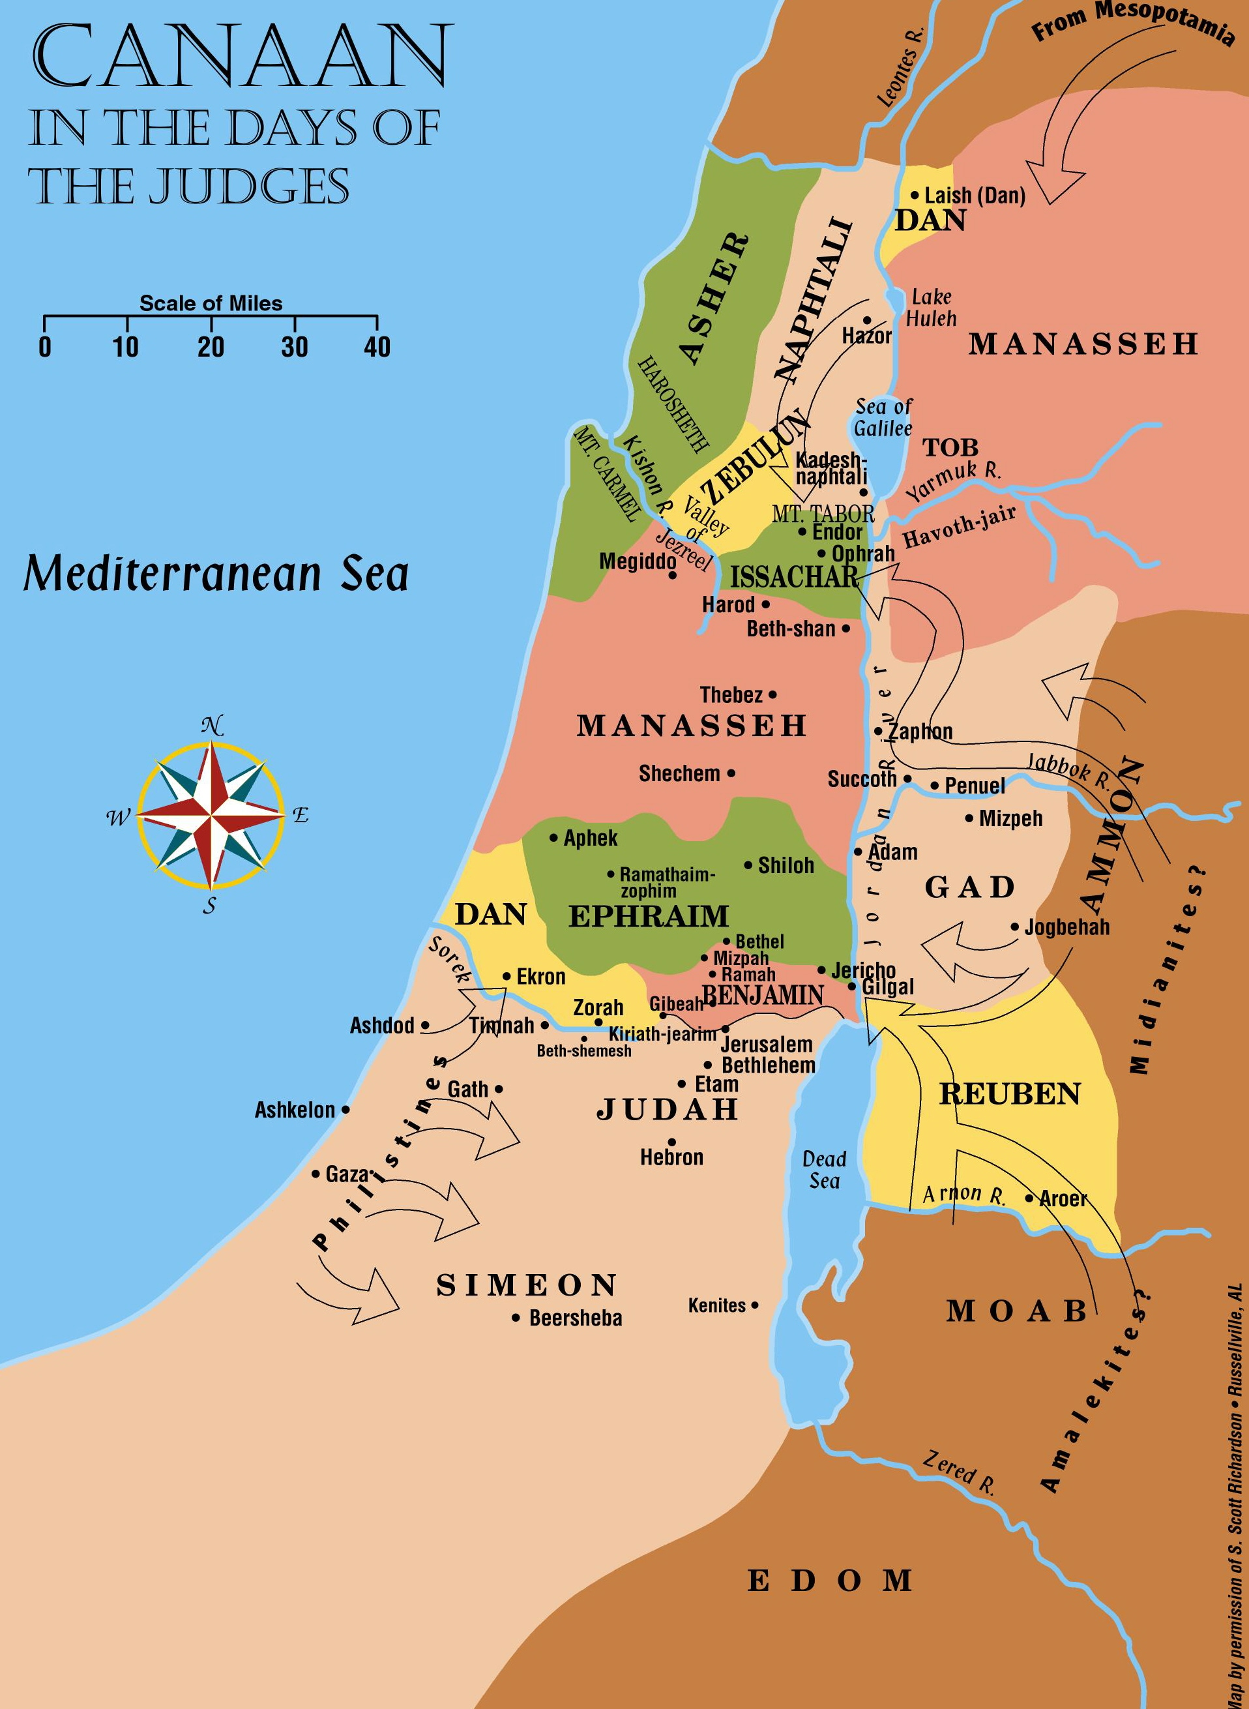
Early Judges
First oppression came from Mesopotamia
God helped Othniel throw off the oppression
Told no details of the battle
Othniel

Slide 24
Early Judges
Moabites, Ammonites and Amalekites joined forces to oppress Israel for 18 years
They took the city of Jericho
Ehud killed Eglon king of Moab and rallied the Israelites
He led the Israelites to victory and the land had rest for 80 years
Ehud

Slide 25
Early Judges
Gradually, the Canaanites remaining in the land gained enough strength to fight the Israelites again
They gained control of the rich valley of Jezreel and oppressed Israel for 20 years
The prophetess Deborah judged Israel at this time
Deborah

Slide 26
The Early Judges
Deborah lived between Ramah and Bethel in mount Ephraim
Sent for Barak of Kadesh to gather 10,000 men from the tribes of Naphtali and Zebulun to meet the Canaanites in battle at Mt Tabor
Barak did NOT have enough faith to go alone
He was told the honor would go to a woman
Barak’s army won a decisive victory
The captain of the Canaanites fled to Kadesh to the home of Heber the Kenite
He expected to find peace there but Heber’s wife Jael nailed him to the floor!

Slide 27
Early Judges
The Kenites’ home territory was in Judah
We notice the location of Hazor, the Valley of Jezreel, and Mt. Tabor
Why did Barak choose his army from these particular tribes?
Primarily for his own defense

Slide 28
Early Judges
Gideon would be the next judge or “deliverer” that God would use to stop the oppression of the Midianites and Amalekites
The Midianites and Amalekites joined forces with other people of the east to oppress Israel
Gideon

Slide 29
The Early Judges
Midianites were a nomadic people from the desert
All these nomadic tribes made their living by caravan trade up and down the trade routes
In this story, they came up the King’s Highway, crossed the Jordan at the ford near Jabbok and stole the crops from the tribes in the central portion of the land
This happened 7 years in a row until the Israelites were forced to hide their harvests in caves or any other place. This oppression went southwest to Gaza

Slide 30
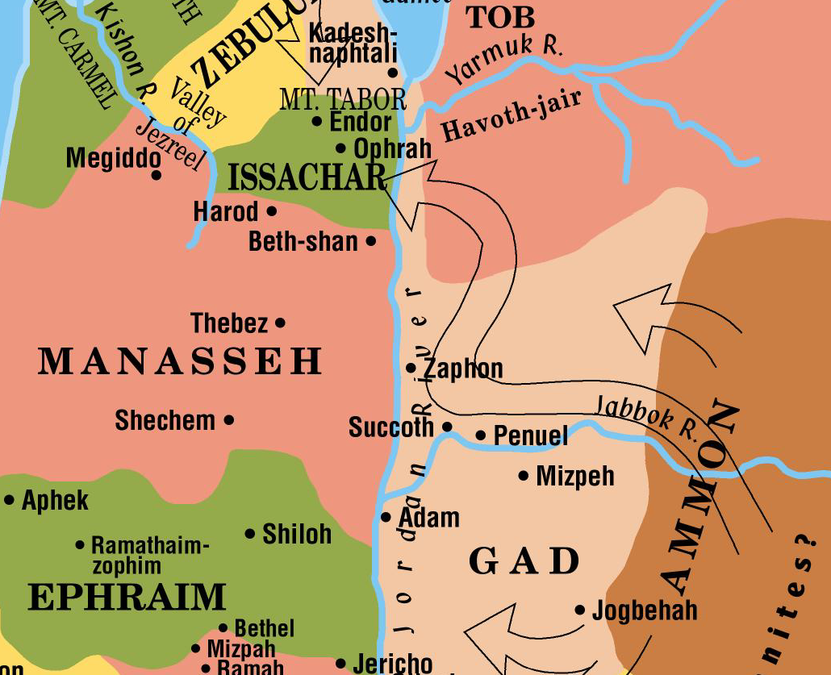
The Early Judges
Gideon was of the tribe of Manasseh
Midianites had camped in the Valley of Jezreel
Gideon called his army from the tribes of Asher, Zebulun, Manasseh and Naphtali
God, wanting all Israel to realize their total dependence on Him sent all but 300 of Gideon’s men home
They made a surprise attack on the enemy at night

Slide 31
The Early Judges
They fled toward the Jordan and turned south to the ford of the Jabbok
Men from Naphtali, Asher, Manasseh rejoined Gideon and were pursuing the enemy
Men from Ephraim stopped the enemy at the fords of the Jordan
Gideon and his army caught and destroyed the enemy and they took much spoil from them

Slide 32
The Early Judges
Abimelech
Although we usually name him as a judge, he was not a deliverer of any kind
He was a wicked son of Gideon who set himself up as king over the city of Shechem. When trouble arose he and the city succeeded in destroying each other!
Tola
Arose to defend Israel. Of the tribe of Isaachar
Judged Israel for 20 years
Jair
He and his sons judged 30 cities over 22 years

Slide 33
The Early Judges
Ibzan
From Bethlehem and judged Israel for 7 years
Elon
From the tribe of Zebulun and judged Israel for 10 yrs
Abdon
From Pirathon and judged Israel for 8 years
No enemy is ever mentioned in connection with any of the “lesser” judges
May have served during periods of peace when their duties involved handling local affairs and advisement

Slide 34
The Early Judges
The book of Judges is a summary of many years
In addition to the battles, there were long periods of peace
The oppressions and battles did not affect the entire country of Palestine
Moabites of Ehud’s day did not touch the northern tribes
Canaanites of Barak’s day did not touch the southern tribes

Slide 35
The Later Judges
Judges 10:6 - 1 Samuel 7:17

Slide 36
The Later Judges
A new wave of oppression begins because the Israelites became wicked again
They began worshiping the gods of Baalim, of Ashtaroth of Syria, of Zidon, and of the Moabites
Ammonites attacked the tribes on the eastern side of the Jordan
Philistines attacked the southern tribes in the west
Events in Jephthah’s story and in Samson’s story most likely overlapped in time

Slide 37
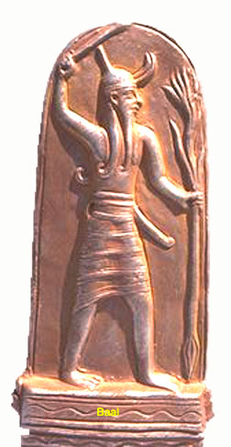
Pagan Gods
Baal: means “lord” or “master”
Became identified with various regional gods that were thought to provide fertility for crops and livestock
Ashtaroth: Another name for the goddesses called “the Asherah” (plural)
Her objects of worship were found up and down the land.
Considered the female counterpart to Baal (Judges 2:13). Like Baal, she is a god of fertility
Solomon compromised his faith by worshiping at the altar of Ashtaroth (1 Kings 11:5,33)

Slide 38
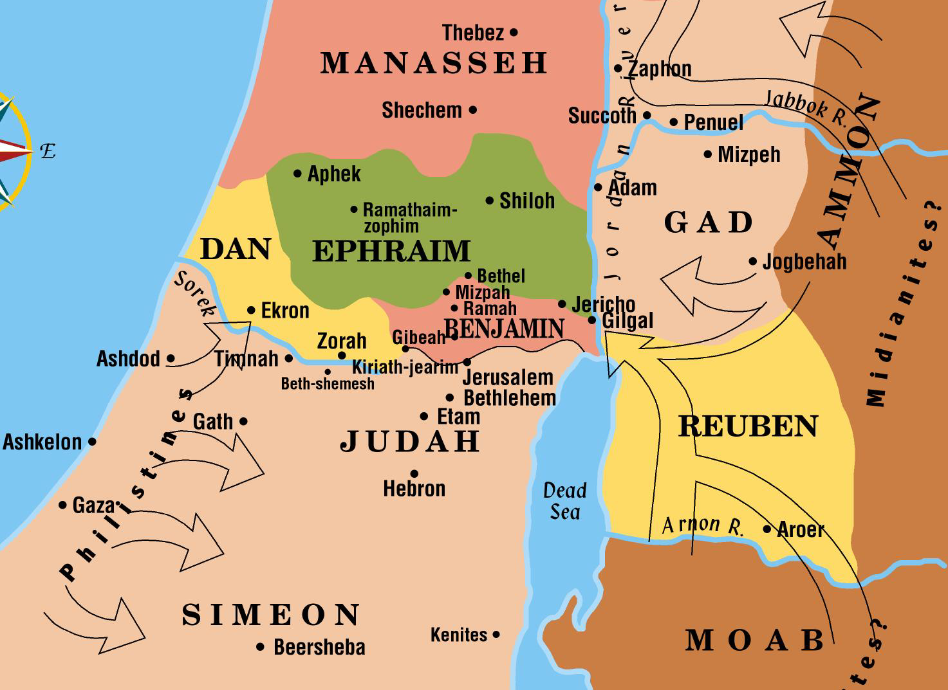
The Later Judges
Ammonites oppressed the Israelites living in Gilead for 18 years
Reuben, Gad, and the half tribe of Manasseh were involved in this oppression
They crossed the Jordan to fight against Judah, Benjamin and Ephraim
Ammonites

Slide 39
The Later Judges
Jephthah was called upon to help the Israelites in the battle
They agreed to make him their ruler in return
They battled the Ammonites and drove them back for awhile
During this time a very troublesome enemy moved in from the west

Slide 40
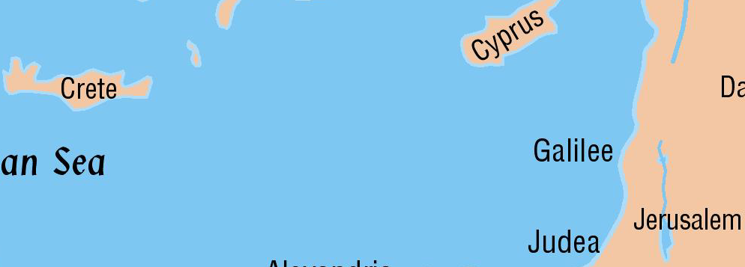
The Later Judges
The Philistines came to Palestine from the island of Crete
They brought with them the knowledge of iron smelting which neither the Canaanites nor the Israelites had
This gave them an advantage in their weaponry
Shamgar is the first Israelite named who fought the Philistines
He is briefly mentioned in Judges 3:31 as killing 600 of them with an ox goad

Slide 41
The Later Judges
More on the Philistines
Some were in the land as early as Abraham’s day
Genesis 21:34
They were no major threat at that time
Moses does not list them as one of the tribes to be conquered in his day
It appears from historical notes as well as scriptural facts, that a new wave of Philistines moved into the southern coastal plain about the time of the early Judges

Slide 42
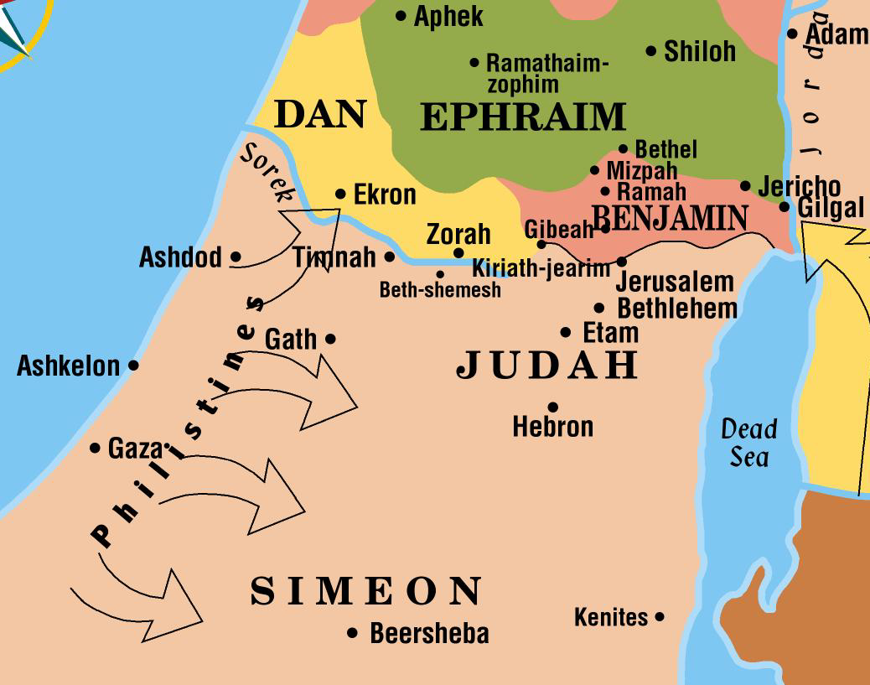
The Later Judges
Samson was of the tribe of Dan from the village of Zorah
God gave him miraculous strength to “begin to deliver Israel out of the hand of the Philistines”
His story is unusual in that he never led an army of any kind
All his conflicts with the Philistines were personal conflicts
He killed thousands of Philistines during his lifetime

Slide 43
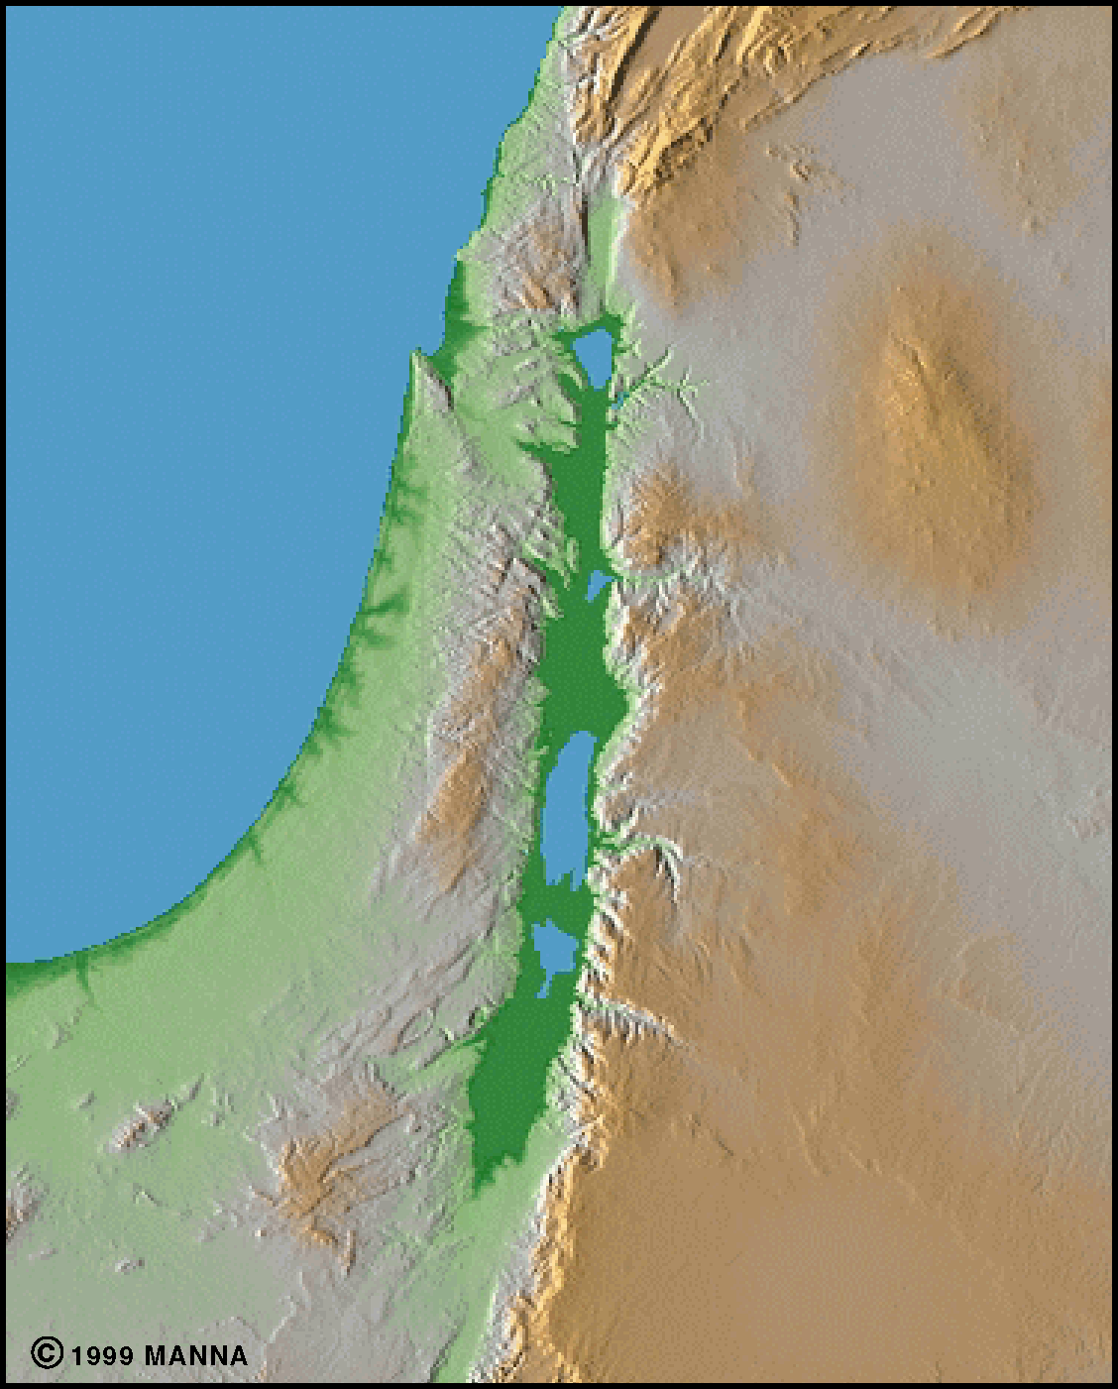
The Later Judges
Samson’s strength was displayed when he took the gates of the city of Gaza across to the hill before Hebron!
Hebron
Gaza
.
.

Slide 44
The Later Judges
Samson met his downfall in the valley of Sorek
They learned the secret of his strength through Delilah
They put out his eyes and forced him to be a slave
While mocking him in the house of their god Dagon in Gaza, he bowed himself on the pillars of the temple
He killed more in his death than he had in the rest of his life

Slide 45
The Later Judges
God was allowing His people to be oppressed at this time
They had become wicked
In addition to their idolatrous worship, the priests of God who were serving at the tabernacle at Shiloh were some of the most wicked men in the land
(1 Samuel 2:12-17)

Slide 46
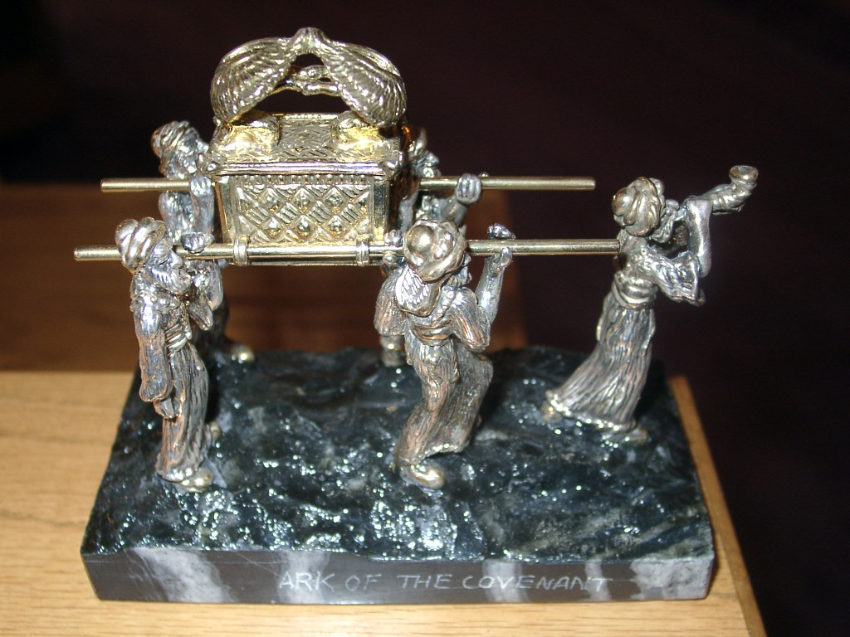
The Ark of the Covenant
The Philistine army gathered at Aphek to fight Israel after Samson’s last victory
God was not with His people
Israel was thoroughly defeated and the ark of the covenant was stolen!

Slide 47
The Ark of the Covenant
Sacred portable chest - along with the Mercy Seat and Cherubim – was the most sacred object of the Israelites during the wilderness
Contents: two stone tablets containing the ten commandments, golden pot of Manna, which God miraculously preserved, Aaron’s rod that budded
Nothing is known of what became of the ark. It disappeared when Nebuchadnezzar’s armies destroyed Jerusalem in 586 B.C. It was not available when the second and third temples were built

Slide 48
The Ark of the Covenant
God showed that He could take care of His ark even in the hands of the enemy
The Philistines took the ark to Ashdod, then to Gath, then to Ekron
A plague struck them at each place
They finally sent the ark back to Bethshemesh in Judah
The people there then sent it on to Kirjath Jearim where it stayed until the days of king David

Slide 49
The Ark of the Covenant

Slide 50
The Period of the Judges
The period of the judges is described as a time when there was no central government and:
“every man did that which was right in his own eyes” (Judges 21:25)
There was rivalry between the tribes
Ephraim felt insulted if they weren’t called to each battle
Benjamin refused to punish some wicked men for a crime committed and the other tribes nearly destroyed the whole tribe of Benjamin in revenge

Slide 51
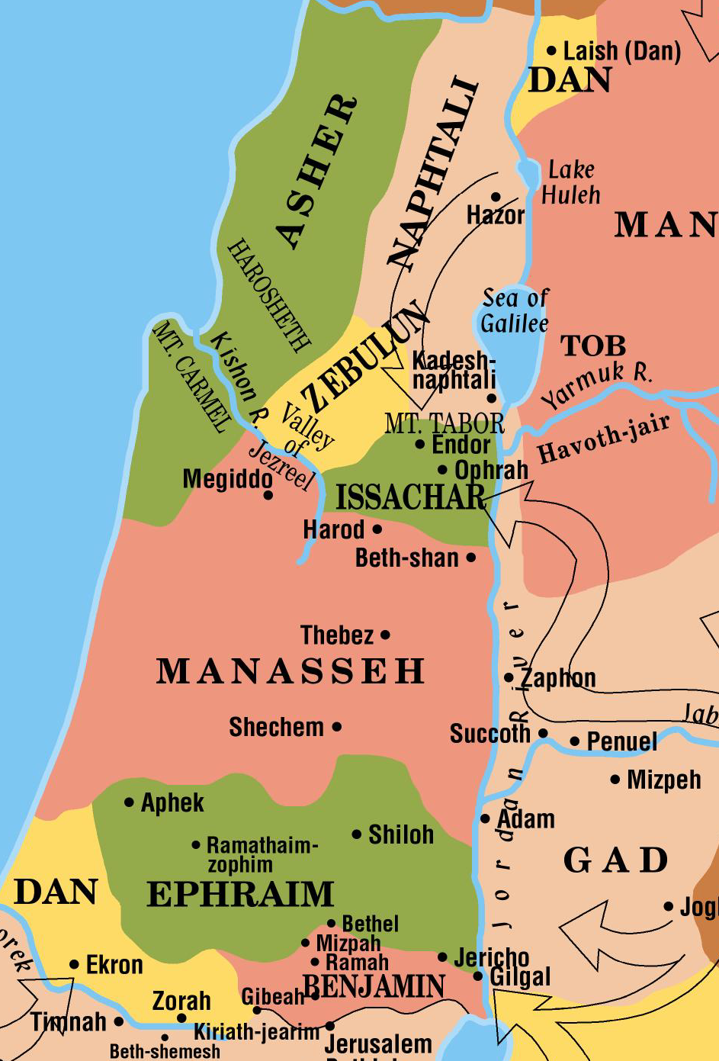
The Period of the Judges
The tribe of Dan felt crowded
They failed to take their allotted land from the Canaanites
Later the Philistines fought for their southern portion
Most of the tribe moved north and took the city of Laish near the source of the Jordan River
They renamed the city Dan in honor of the father of their tribe

Slide 52
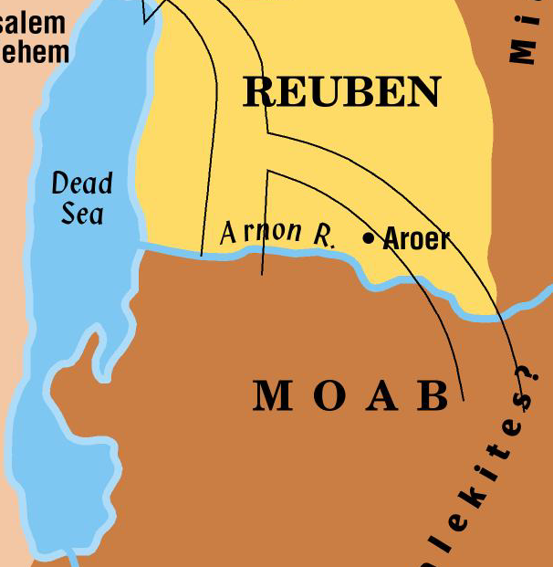
The Period of the Judges
During the period of oppression, battle and unrest, there were righteous people moving quietly about the affairs of life
During this period of time the story of Ruth unfolds
Ruth was a maiden from Moab – an ancestor of Christ
She came to Bethlehem with her mother-in-law Naomi
She married Boaz
Had a son named Obed
Who had a son named Jesse
Who had a son named David
Who had a descendent named Jesus!

Slide 53
Eli and Samuel
Hannah dedicated Samuel to the Lord (1 Sam 1:1-20)
Eli was both high priest and judge.
He judged for 40 years (1 Sam 4:18)
Samuel was the last judge of Israel
When he was old, he anointed Saul as the first king
Samuel was a judge, prophet, priest and the author of first and second Samuel

