Slide 1
Mental Health of Christians
Edited by David Burris

Slide 2
The Bible And Mental Health
Enemies Of The Mind
Lesson 1

Slide 3
Introduction
1. You wouldn’t think of knowingly allowing a thief into your home.
2. Consider the following enemies of the mind. We often allow these "thieves" to rob us of our mental health & happiness
Notes:
INTRODUCTION:
1. You wouldn’t think of knowingly allowing a thief into your home. Or would you?
2. Consider the following enemies of the mind. We often allow these "thieves" to rob us of our mental health.

Slide 4
Guilt- A Two-Edged Sword
Guilt = a feeling that one is deserving of blame on account of a wrong that was done
Guilt can be either good or bad
If God did not exist there would be no guilt
Notes:
I. Guilt – A Two-Edged Sword.
A. What is guilt?
1. A feeling of culpability (deserving of blame) on account of a wrong that was done.
2. One of the greatest emotional factors. Guilt can be either good or bad, depending on how man responds to this emotion.
B. If God did not exist, there would be no such thing as guilt.
1. Other forms of biological life (ex: pine tree, dog, etc.) do not experience guilt.
2. Man’s awareness of guilt (as reflected by his conscience) signals that there is moral cognizance within the soul, thus pointing to the ultimate moral source – God.
C. Guilt can be either subjective or objective.
1. Subjective guilt is guilt that a person feels but in fact has no basis. Ex: When a person commits suicide a surviving loved one may feel an unwarranted sense of guilt. A person may accidentally run over a toddler with his automobile and feel guilty, even though the accident may have been unavoidable.
2. Objective (actual) guilt is the result of violating God’s law. We ought to feel guilty as a consequence of doing wrong. Consider the response of many who heard Peter’s preaching on the day of Pentecost (Acts 2:37).
3. "Godly sorrow" is an especially valuable emotion (II Corinthians 7:10). When a person avails himself of the cure for this type of guilt (a proper relationship with God,) this guilt does not have to be devastating (Isaiah 1:18; Acts 3:19).
4. When we allow ourselves to linger in our guilt, guilt can rob us of our sleep at night and ruin our waking hours. Guilt can stalk us like a beast until we no longer enjoy living.
D. Unfortunately, rather than properly deal with his guilt, man often denies his responsibility.
1. Men deny the existence of sin.
2. Men call sin by less offensive names (ex: homosexuality becomes an "alternate" lifestyle or simply "gay").
3. Men rationalize their sin (ex: justifying themselves or claiming to be mere "products of their environment"). Men conceal their guilt or legalize their sin (ex: the murder of innocent, unborn children becomes the "right to choose").

Slide 5
Guilt- A Two-Edged Sword
We may feel guilt when we in fact we are not guilty
When we break God’s law we should feel guilt
Acts 2:37
2 Cor. 7:10
Is. 1:18
Acs 3:19
Notes:
I. Guilt – A Two-Edged Sword.
A. What is guilt?
1. A feeling of culpability (deserving of blame) on account of a wrong that was done.
2. One of the greatest emotional factors. Guilt can be either good or bad, depending on how man responds to this emotion.
B. If God did not exist, there would be no such thing as guilt.
1. Other forms of biological life (ex: pine tree, dog, etc.) do not experience guilt.
2. Man’s awareness of guilt (as reflected by his conscience) signals that there is moral cognizance within the soul, thus pointing to the ultimate moral source – God.
C. Guilt can be either subjective or objective.
1. Subjective guilt is guilt that a person feels but in fact has no basis. Ex: When a person commits suicide a surviving loved one may feel an unwarranted sense of guilt. A person may accidentally run over a toddler with his automobile and feel guilty, even though the accident may have been unavoidable.
2. Objective (actual) guilt is the result of violating God’s law. We ought to feel guilty as a consequence of doing wrong. Consider the response of many who heard Peter’s preaching on the day of Pentecost (Acts 2:37).
3. "Godly sorrow" is an especially valuable emotion (II Corinthians 7:10). When a person avails himself of the cure for this type of guilt (a proper relationship with God,) this guilt does not have to be devastating (Isaiah 1:18; Acts 3:19).
4. When we allow ourselves to linger in our guilt, guilt can rob us of our sleep at night and ruin our waking hours. Guilt can stalk us like a beast until we no longer enjoy living.
D. Unfortunately, rather than properly deal with his guilt, man often denies his responsibility.
1. Men deny the existence of sin.
2. Men call sin by less offensive names (ex: homosexuality becomes an "alternate" lifestyle or simply "gay").
3. Men rationalize their sin (ex: justifying themselves or claiming to be mere "products of their environment"). Men conceal their guilt or legalize their sin (ex: the murder of innocent, unborn children becomes the "right to choose").

Slide 6
Guilt- A Two-Edged Sword
Guilt that stays in our hearts can rob us of the joys of living
Men often deny their responsibility to God and try to justify their sins instead of admitting them
Notes:
I. Guilt – A Two-Edged Sword.
A. What is guilt?
1. A feeling of culpability (deserving of blame) on account of a wrong that was done.
2. One of the greatest emotional factors. Guilt can be either good or bad, depending on how man responds to this emotion.
B. If God did not exist, there would be no such thing as guilt.
1. Other forms of biological life (ex: pine tree, dog, etc.) do not experience guilt.
2. Man’s awareness of guilt (as reflected by his conscience) signals that there is moral cognizance within the soul, thus pointing to the ultimate moral source – God.
C. Guilt can be either subjective or objective.
1. Subjective guilt is guilt that a person feels but in fact has no basis. Ex: When a person commits suicide a surviving loved one may feel an unwarranted sense of guilt. A person may accidentally run over a toddler with his automobile and feel guilty, even though the accident may have been unavoidable.
2. Objective (actual) guilt is the result of violating God’s law. We ought to feel guilty as a consequence of doing wrong. Consider the response of many who heard Peter’s preaching on the day of Pentecost (Acts 2:37).
3. "Godly sorrow" is an especially valuable emotion (II Corinthians 7:10). When a person avails himself of the cure for this type of guilt (a proper relationship with God,) this guilt does not have to be devastating (Isaiah 1:18; Acts 3:19).
4. When we allow ourselves to linger in our guilt, guilt can rob us of our sleep at night and ruin our waking hours. Guilt can stalk us like a beast until we no longer enjoy living.
D. Unfortunately, rather than properly deal with his guilt, man often denies his responsibility.
1. Men deny the existence of sin.
2. Men call sin by less offensive names (ex: homosexuality becomes an "alternate" lifestyle or simply "gay").
3. Men rationalize their sin (ex: justifying themselves or claiming to be mere "products of their environment"). Men conceal their guilt or legalize their sin (ex: the murder of innocent, unborn children becomes the "right to choose").

Slide 7
MATRIX: NEXUS OF HUMAN LOVE & GUILT
 | Love High | Love Low
Guilt High
Guilt Low
Pleaser
Withholder
Controller
LOVER

Slide 8
Materialism
1 Tim. 6:9-10
Minded (ASV) = a person who is continually obsessed with obtaining “things” for his own use
These people are eventually caught in their own trap and destroyed
Notes:
II. The Many Sorrows of Materialism.
A. Notice Paul’s warning to Timothy in I Timothy 6:9-10: "For the love of money is the root of all evil." Consider the following:
1. "Minded" means to "purpose" or "will" and is in the present tense (progressive action), middle voice (self interest) form. Paul’s words describe a person who is continually obsessed with obtaining "things" for his own use.
2. The term "rich" is a present infinitive denoting an ambition for sustained prosperity.
3. "Fall" is a verb in the present tense and hints of the fate of those whose goal in life is the pursuit of things.
4. Those persons who are obsessed with making money or obtaining things are eventually caught in a trap and destroyed.
B. An infatuation with money can lead to a multitude of problems.
1. In the parable of the sower, Jesus warned against the deceitfulness of riches (Matthew 13:22).
2. Money promises much but cannot deliver. There is no security in material things.
C. Consider Jesus’ parable of the rich fool.
1. The man had laid up goods for many years.
2. But God said, "Thou fool, this night thy soul shall be required of thee" (Luke 12:20). The original language indicates, "This night they require your soul," suggesting that the man’s possessions were the very thing that did him

Slide 9
Materialism
Mt. 13:22
There is no security in money and material things
Lk. 12:20
Notes:
II. The Many Sorrows of Materialism.
A. Notice Paul’s warning to Timothy in I Timothy 6:9-10: "For the love of money is the root of all evil." Consider the following:
1. "Minded" means to "purpose" or "will" and is in the present tense (progressive action), middle voice (self interest) form. Paul’s words describe a person who is continually obsessed with obtaining "things" for his own use.
2. The term "rich" is a present infinitive denoting an ambition for sustained prosperity.
3. "Fall" is a verb in the present tense and hints of the fate of those whose goal in life is the pursuit of things.
4. Those persons who are obsessed with making money or obtaining things are eventually caught in a trap and destroyed.
B. An infatuation with money can lead to a multitude of problems.
1. In the parable of the sower, Jesus warned against the deceitfulness of riches (Matthew 13:22).
2. Money promises much but cannot deliver. There is no security in material things.
C. Consider Jesus’ parable of the rich fool.
1. The man had laid up goods for many years.
2. But God said, "Thou fool, this night thy soul shall be required of thee" (Luke 12:20). The original language indicates, "This night they require your soul," suggesting that the man’s possessions were the very thing that did him

Slide 10
Worry
Worry robs us of peace of mind and a peaceful life
Worry –stress- is a killer!
Mt. 6:25
Mt. 6:32
Notes:
III. Worry: The Thief of Tranquility.
A. Worry (stress) is a killer.
1. Dr. S. I. McMillen has discussed the differences between the "stress" glands of the lion and that of the crocodile.
2. The lion, in his jungle habitat, is constantly subjected to stress. Consequently, his life span is relatively brief. The crocodile’s glands are small and relatively inactive. He is not subjected to the constant "stress" of the lion and lives much longer.
3. Autopsies of humans have shown that the adrenal glands in those persons who have been exposed to great amounts of stress are larger than those who have not.
B. Jesus addressed the problem of worry in the Sermon on the Mount.
1. Jesus warned, "Take no thought (do not be constantly worried) for your (physical) life (Matthew 6:25). Jesus argued there is more to life than just the physical.
2. Jesus pointed out that if God takes care of his lesser creatures (the animals) he will surely provide for his people.
C. Jesus’ words point out the futility of worry.
1. No man can add years to his life by worrying.
2. Jesus also noted that worry is "paganish." Note: "For after all these things do the Gentiles seek" (Matthew 6:32). Those persons in the world may worry over physical matters, but Christians ought not.

Slide 11
Conclusion
1. Are you letting these enemies of your mind rob you of emotional health?
a) Guilt.
b) Materialism.
c) Worry.
Notes:
CONCLUSION:
1. Are you letting these enemies of your mind rob you of emotional health?
a) Guilt.
b) Materialism.
c) Worry.

Slide 12
The Bible And Mental Health
Enemies Of The Mind
Lesson 2

Slide 13
Introduction
God desires that we have peace in our lives
Phil. 4:7
Sometimes we do not have that peace in our lives and it is not because of any fault in God
Notes:
INTRODUCTION:
1. God desires that we have peace in our lives. Paul wrote, "And the peace of God, which passeth all understanding, shall keep your hearts and minds through Christ Jesus" (Philippians 4:7).
2. But sometimes we do not have that peace in our lives. Not because of any fault in God, but because of our own fault.
3. Consider some of the ways in which we deprive ourselves of the peace God desires that we have.

Slide 14
Introduction
Consider some of the ways we keep ourselves from knowing the true peace that God desires us to have
Notes:
INTRODUCTION:
1. God desires that we have peace in our lives. Paul wrote, "And the peace of God, which passeth all understanding, shall keep your hearts and minds through Christ Jesus" (Philippians 4:7).
2. But sometimes we do not have that peace in our lives. Not because of any fault in God, but because of our own fault.
3. Consider some of the ways in which we deprive ourselves of the peace God desires that we have.

Slide 15
Divided Allegiance
This is being drawn into opposite directions at the same time (called Dualism)
Mt. 6:24
Many people simply cannot make up their minds which direction they want to go
Notes:
I. Divided allegiance.
A. "Dualism" is the condition of being drawn into opposite directions at the same time. As in the case of the rubber band, something eventually has to snap.
B. Jesus recognized the problem of dualism when he said, "No man can serve two masters: for either he will hate the one, and love the other; or else he will hold to the one, and despise the other. Ye cannot serve God and mammon" (Matthew 6:24).
C. Many people are unhappy because they simply cannot make up their minds which direction they want to go.
1. Sometimes their bodies are in church while their hearts are in the world.
2. It is a pathetic thing to see someone who is afraid to go to hell, but does not really desire to go to heaven.
3. The prophet Elijah could ask many in our generation: "How long halt ye between two opinions" (I Kings 18:21).
4. Remember Jesus’ words to the church at Laodicea, recorded in Revelation 3:16 – So then because thou art lukewarm, and neither cold nor hot, I will spue thee out of my mouth."
D. James reminds us that a double-minded man is unstable in all his ways (James 1:8). James also reminds us, "Doth a fountain send forth at the same place sweet water and bitter" (James 3:11).
E. Sometimes "dualism" can develop into a very severe psychosis known as schizophrenia."
1. The word comes from two roots meaning, "to split" (schizo) and "the mind" (phrenia).
2. Schizophrenia, the most common form of insanity, accounts for about twenty percent of all those hospitalized for mental illness.
F. Christians should work to fortify our minds against distractions that draw us away from God. Consider Colossians 3:2-3. Also Matthew 22:37.

Slide 16
Divided Allegiance
Sometimes their bodies are in church while their hearts are in the world
1 Kings 18:21
Js. 1:8
Notes:
I. Divided allegiance.
A. "Dualism" is the condition of being drawn into opposite directions at the same time. As in the case of the rubber band, something eventually has to snap.
B. Jesus recognized the problem of dualism when he said, "No man can serve two masters: for either he will hate the one, and love the other; or else he will hold to the one, and despise the other. Ye cannot serve God and mammon" (Matthew 6:24).
C. Many people are unhappy because they simply cannot make up their minds which direction they want to go.
1. Sometimes their bodies are in church while their hearts are in the world.
2. It is a pathetic thing to see someone who is afraid to go to hell, but does not really desire to go to heaven.
3. The prophet Elijah could ask many in our generation: "How long halt ye between two opinions" (I Kings 18:21).
4. Remember Jesus’ words to the church at Laodicea, recorded in Revelation 3:16 – So then because thou art lukewarm, and neither cold nor hot, I will spue thee out of my mouth."
D. James reminds us that a double-minded man is unstable in all his ways (James 1:8). James also reminds us, "Doth a fountain send forth at the same place sweet water and bitter" (James 3:11).
E. Sometimes "dualism" can develop into a very severe psychosis known as schizophrenia."
1. The word comes from two roots meaning, "to split" (schizo) and "the mind" (phrenia).
2. Schizophrenia, the most common form of insanity, accounts for about twenty percent of all those hospitalized for mental illness.
F. Christians should work to fortify our minds against distractions that draw us away from God. Consider Colossians 3:2-3. Also Matthew 22:37.

Slide 17
Divided Allegiance
Dualism can sometimes lead into a condition known as schizophrenia
Christians should work to fortify our minds against things that draw us away from God
Col. 3:2-3
Notes:
I. Divided allegiance.
A. "Dualism" is the condition of being drawn into opposite directions at the same time. As in the case of the rubber band, something eventually has to snap.
B. Jesus recognized the problem of dualism when he said, "No man can serve two masters: for either he will hate the one, and love the other; or else he will hold to the one, and despise the other. Ye cannot serve God and mammon" (Matthew 6:24).
C. Many people are unhappy because they simply cannot make up their minds which direction they want to go.
1. Sometimes their bodies are in church while their hearts are in the world.
2. It is a pathetic thing to see someone who is afraid to go to hell, but does not really desire to go to heaven.
3. The prophet Elijah could ask many in our generation: "How long halt ye between two opinions" (I Kings 18:21).
4. Remember Jesus’ words to the church at Laodicea, recorded in Revelation 3:16 – So then because thou art lukewarm, and neither cold nor hot, I will spue thee out of my mouth."
D. James reminds us that a double-minded man is unstable in all his ways (James 1:8). James also reminds us, "Doth a fountain send forth at the same place sweet water and bitter" (James 3:11).
E. Sometimes "dualism" can develop into a very severe psychosis known as schizophrenia."
1. The word comes from two roots meaning, "to split" (schizo) and "the mind" (phrenia).
2. Schizophrenia, the most common form of insanity, accounts for about twenty percent of all those hospitalized for mental illness.
F. Christians should work to fortify our minds against distractions that draw us away from God. Consider Colossians 3:2-3. Also Matthew 22:37.

Slide 18
Self
Various views regarding self:
“Know yourself”
“Contain yourself”
“Enjoy yourself”
Jesus taught that true happiness comes from the one who “denied himself”
Lk. 9:23
Notes:
II. Self.
A. Consider the various views regarding self.
1. The Greek philosophers emphasized, "know yourself."
2. The ascetics emphasized, "contain yourself."
3. The hedonists emphasized, "enjoy yourself."
4. Jesus’ teaching is unique in that he taught true contentment could be had only by the one who "denied himself" (Luke 9:23).
5. Only revering our Creator, and keeping his commandments, will result in that "wholeness" for which we truly long (Ecclesiastes 12:13).
6. When a person dethrones God from his life and crowns himself instead, he is robbing himself of genuine contentment and happiness.
B. Self-centeredness manifests itself in a number of ways.
1. A person who is self-willed will not serve others and thus can never be truly happy.
2. When a person becomes self-righteous, his constant failures generate nothing but frustration.
3. Whenever a person develops an attitude of self-pity, he destroys his emotional tranquility. Consider the man in Psalm 73. When he observed the prosperity of the wicked, he lapsed into a state of despair.
4. Selfishness is one of the most unattractive character traits imaginable. Consider Acts 20:35.
5. Self-adulation, a person thinking of himself more highly than he ought, is also harmful (Romans 12:3). Someone has said that too many people are "self-made" individuals and are in love with their creator.

Slide 19
Self
Ecl. 12:13
Self-centered people can be identified in many ways:
Will not serve others
self-righteousness
self-pity
Notes:
II. Self.
A. Consider the various views regarding self.
1. The Greek philosophers emphasized, "know yourself."
2. The ascetics emphasized, "contain yourself."
3. The hedonists emphasized, "enjoy yourself."
4. Jesus’ teaching is unique in that he taught true contentment could be had only by the one who "denied himself" (Luke 9:23).
5. Only revering our Creator, and keeping his commandments, will result in that "wholeness" for which we truly long (Ecclesiastes 12:13).
6. When a person dethrones God from his life and crowns himself instead, he is robbing himself of genuine contentment and happiness.
B. Self-centeredness manifests itself in a number of ways.
1. A person who is self-willed will not serve others and thus can never be truly happy.
2. When a person becomes self-righteous, his constant failures generate nothing but frustration.
3. Whenever a person develops an attitude of self-pity, he destroys his emotional tranquility. Consider the man in Psalm 73. When he observed the prosperity of the wicked, he lapsed into a state of despair.
4. Selfishness is one of the most unattractive character traits imaginable. Consider Acts 20:35.
5. Self-adulation, a person thinking of himself more highly than he ought, is also harmful (Romans 12:3). Someone has said that too many people are "self-made" individuals and are in love with their creator.

Slide 20
Self
Ps. 73:2-3
Acts 20:35
Exalting self
Rom. 12:3
Notes:
II. Self.
A. Consider the various views regarding self.
1. The Greek philosophers emphasized, "know yourself."
2. The ascetics emphasized, "contain yourself."
3. The hedonists emphasized, "enjoy yourself."
4. Jesus’ teaching is unique in that he taught true contentment could be had only by the one who "denied himself" (Luke 9:23).
5. Only revering our Creator, and keeping his commandments, will result in that "wholeness" for which we truly long (Ecclesiastes 12:13).
6. When a person dethrones God from his life and crowns himself instead, he is robbing himself of genuine contentment and happiness.
B. Self-centeredness manifests itself in a number of ways.
1. A person who is self-willed will not serve others and thus can never be truly happy.
2. When a person becomes self-righteous, his constant failures generate nothing but frustration.
3. Whenever a person develops an attitude of self-pity, he destroys his emotional tranquility. Consider the man in Psalm 73. When he observed the prosperity of the wicked, he lapsed into a state of despair.
4. Selfishness is one of the most unattractive character traits imaginable. Consider Acts 20:35.
5. Self-adulation, a person thinking of himself more highly than he ought, is also harmful (Romans 12:3). Someone has said that too many people are "self-made" individuals and are in love with their creator.

Slide 21
Unforgiving Spirit
This is one of the greatest enemies of the mind
Mt. 18:15-17
Look at the parable of the unmerciful servant
Mt. 18: 21-35
Notes:
III. Unforgiving spirit.
A. One of the greatest enemies of peace of mind is a bitter spirit that nurses wounds (real or imagined) for months or even years, never letting go but always harboring the grievances of the past.
B. Jesus instructed us concerning how we are to resolve the issue when someone has sinned against us (Matthew 18:15-17).
1. First, we are to go to the offending party. If he listens, the matter should then be settled and we should forgive him.
2. If he refuses to listen, we are to go to him again, this time with two or three others.
3. If the offender still refuses to listen, we are to tell it to the church and then get on without lives. We accomplish nothing by letting the problem fester, constantly bringing it up to others, or always brooding about it.
C. Consider the parable of the unmerciful servant (Matthew 18:21-35).
1. One man owed his lord an enormous amount of money.
2. When he could not pay, his loving master had compassion on him and forgave the debt.
3. The forgiven man then encountered someone who owed him a small amount of money.
4. When this debtor pleaded for understanding, it was not given.
5. When the original master heard of this hateful attitude, he had the unforgiving servant thrown into prison.
6. Unless we forgive others from the heart, God will not forgive us.
D. When a person says, "I will forgive you, but I will not forget," he is simply saying, "I will not forgive you."
1. Someone has said, "When you bury the hatchet, forget where it is interred."
2. If we fail to forgive others, then we will not be able to receive the forgiveness we so desperately need.

Slide 22
Unforgiving Spirit
Unless we forgive others from the heart, God will not forgive us
Notes:
III. Unforgiving spirit.
A. One of the greatest enemies of peace of mind is a bitter spirit that nurses wounds (real or imagined) for months or even years, never letting go but always harboring the grievances of the past.
B. Jesus instructed us concerning how we are to resolve the issue when someone has sinned against us (Matthew 18:15-17).
1. First, we are to go to the offending party. If he listens, the matter should then be settled and we should forgive him.
2. If he refuses to listen, we are to go to him again, this time with two or three others.
3. If the offender still refuses to listen, we are to tell it to the church and then get on without lives. We accomplish nothing by letting the problem fester, constantly bringing it up to others, or always brooding about it.
C. Consider the parable of the unmerciful servant (Matthew 18:21-35).
1. One man owed his lord an enormous amount of money.
2. When he could not pay, his loving master had compassion on him and forgave the debt.
3. The forgiven man then encountered someone who owed him a small amount of money.
4. When this debtor pleaded for understanding, it was not given.
5. When the original master heard of this hateful attitude, he had the unforgiving servant thrown into prison.
6. Unless we forgive others from the heart, God will not forgive us.
D. When a person says, "I will forgive you, but I will not forget," he is simply saying, "I will not forgive you."
1. Someone has said, "When you bury the hatchet, forget where it is interred."
2. If we fail to forgive others, then we will not be able to receive the forgiveness we so desperately need.

Slide 23
Conclusion
Are you letting these enemies of your mind rob you of your mental health?
Divided allegiance
Self
Unforgiving spirit
Notes:
CONCLUSION:
1. Are you letting these enemies of your mind rob you of your mental health?
a) Divided allegiance.
b) Self.
c) Unforgiving spirit.

Slide 24
The Bible And Mental Health
Enemies Of The Mind
Lesson 3

Slide 25
Introduction
There are many methods of “wrong-thinking” that rob us of peace of mind

Slide 26
Perfectionism
Some people are not happy with anything less than perfect-in themselves and in others
Mt. 5:48

Slide 27
Perfectionism
However, we must realize that none of us will ever reach a state of perfection while here on earth
Ps. 78:39
There are no perfect people—your spouse—your children—church leaders—the preacher

Slide 28
Perfectionism
Being bothered by our own weakness will cause us to grow
1 Cor. 9:27
Try to improve
Work on your character
Don’t be overly demanding and have unrealistic expectations

Slide 29
Pessimism
This word comes from a Latin word meaning “the worst”
Usually this attitude expresses itself in two forms:

Slide 30
Pessimism
1. Life is too painful and there is so much evil that it is not worth living
2. The one who feels his life is of little value-nothing positive is accomplished

Slide 31
Pessimism
The Christian life’s the opposite of pessimism
Gen. 1:26
Heb. 12:2
Rom. 8:18
Phil. 4:4

Slide 32
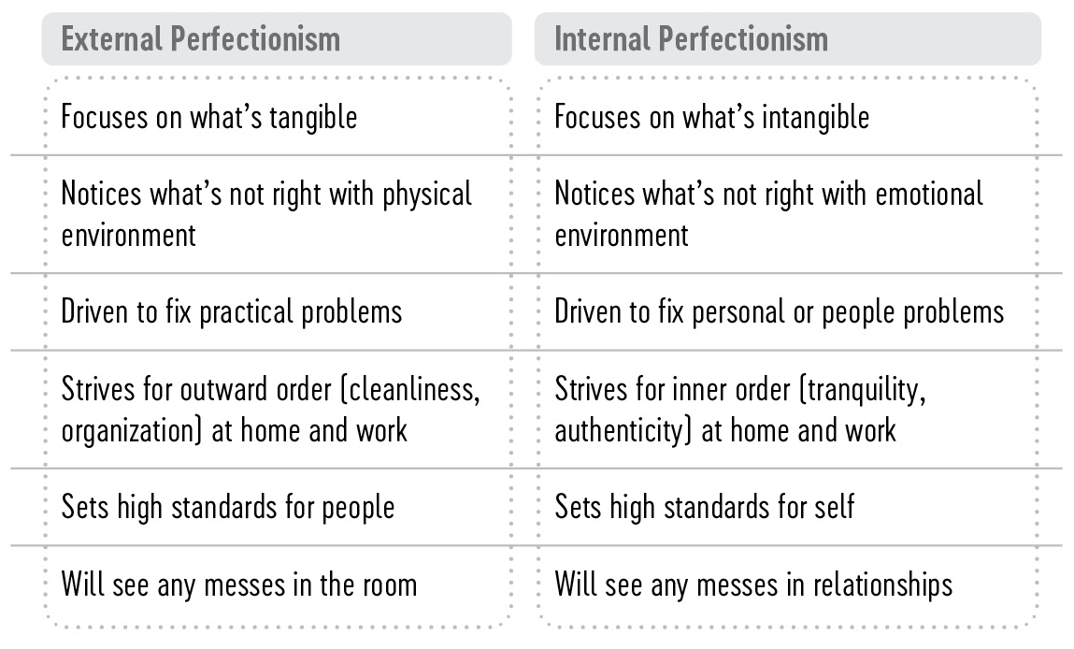
EXTREME INTROVERT

Slide 33
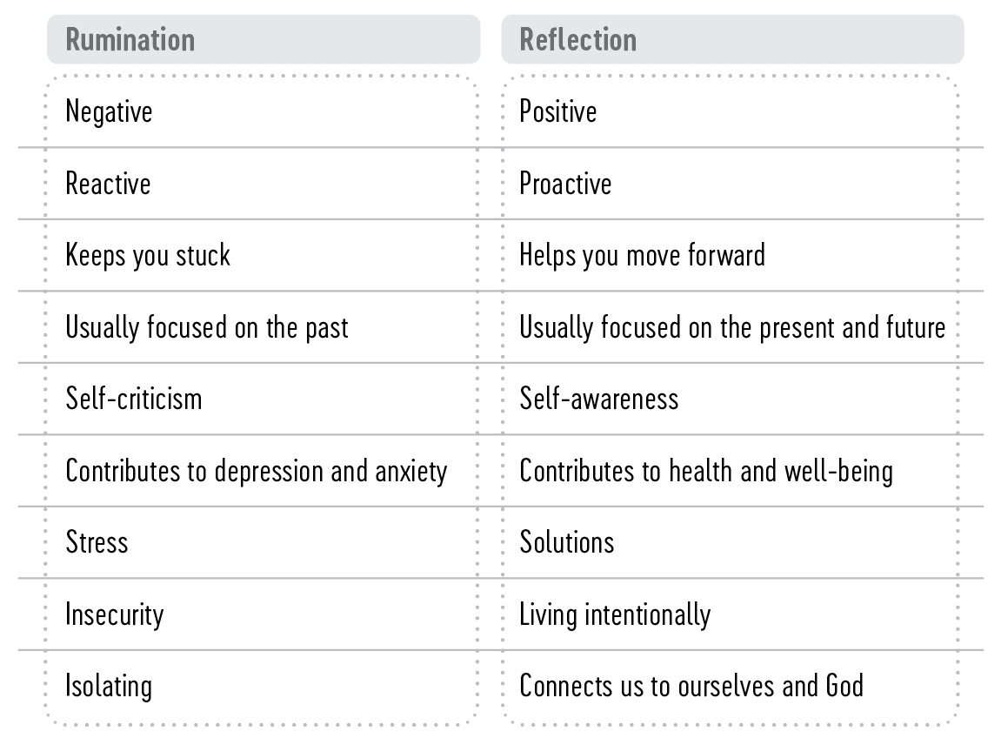
EXTREME INTROVERT

Slide 34
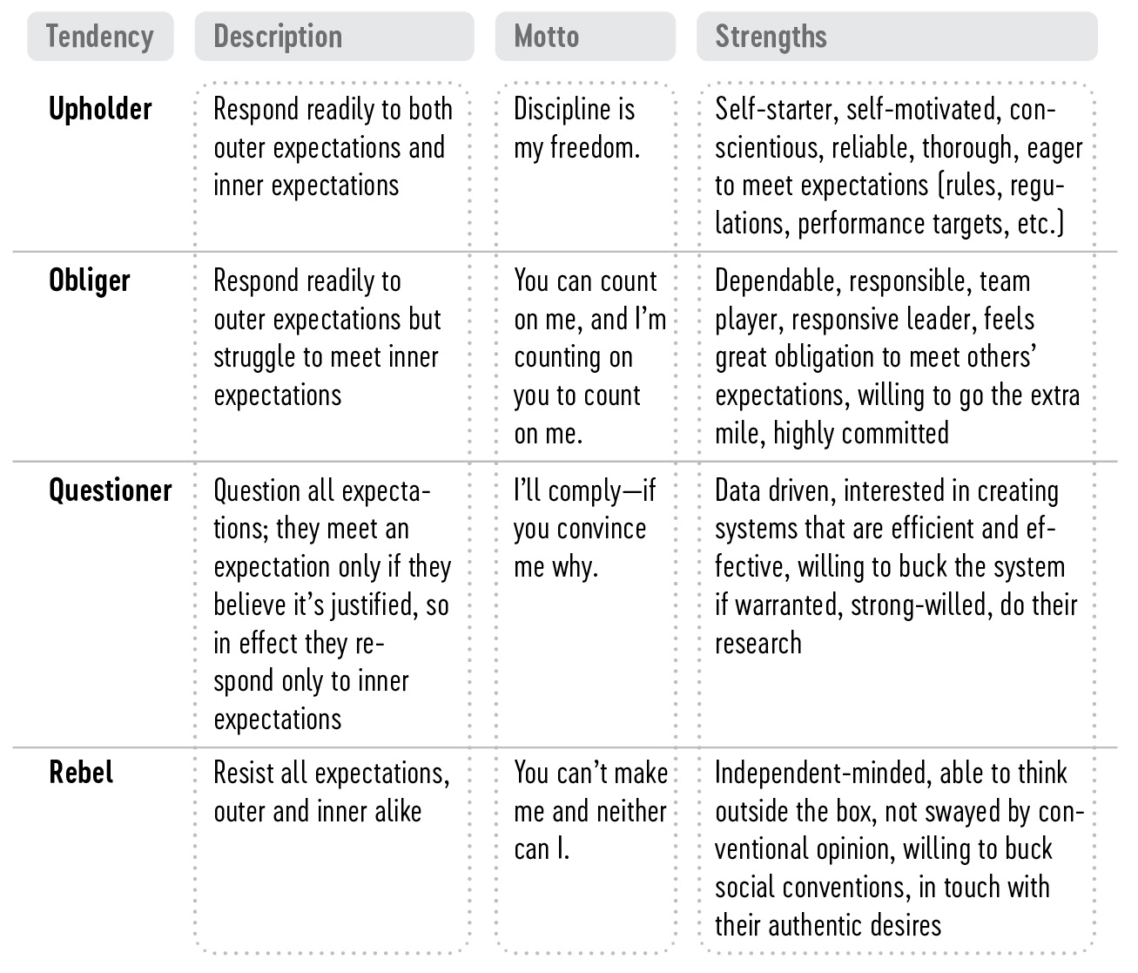
EXTREME INTROVERT

Slide 35
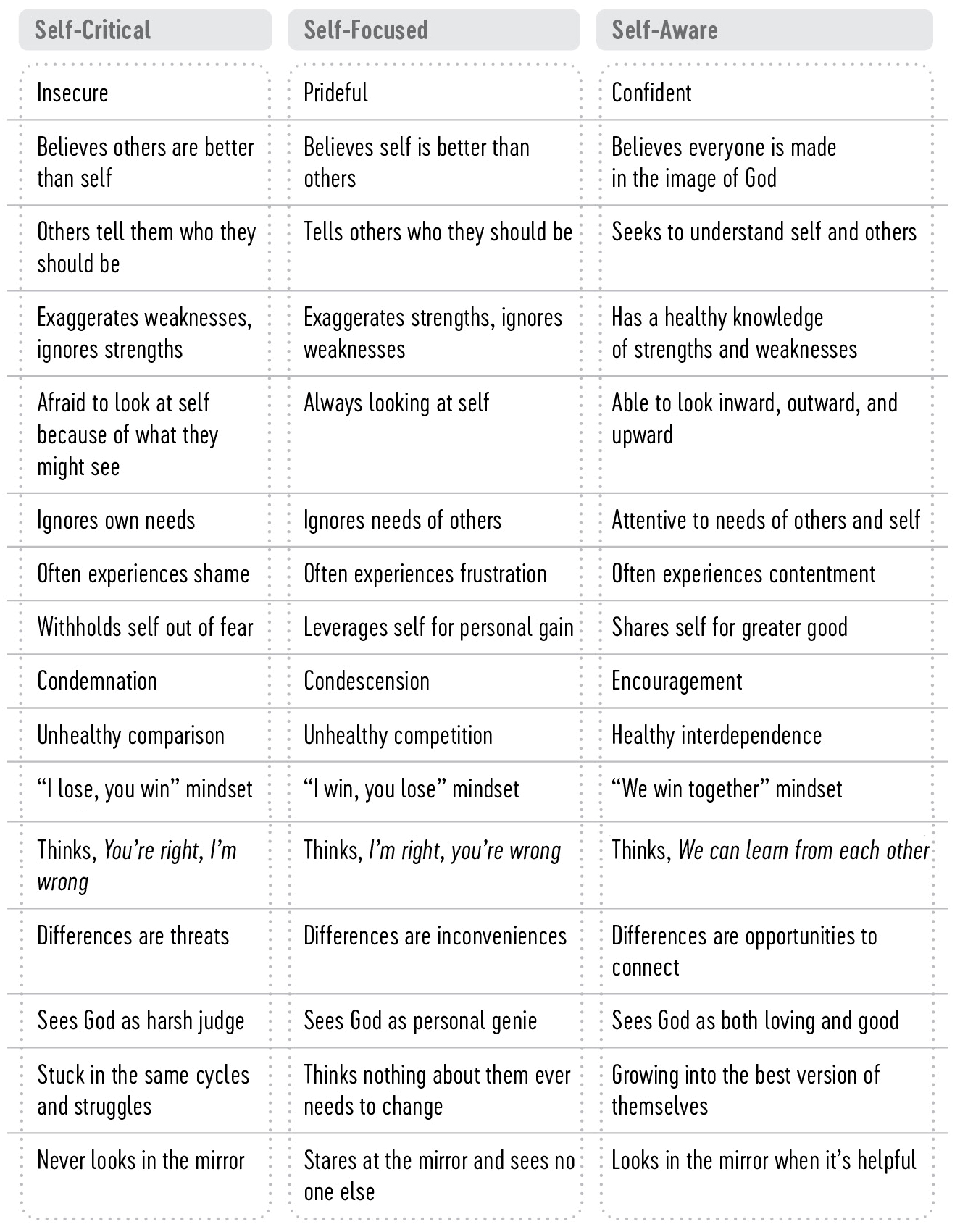
EXTREME INTROVERT

Slide 36
Anger
This is one of the most dangerous of all human emotions
It is a killer, both physically and emotionally

Slide 37
Anger
It is not always sinful to be angry
Ps. 7:11
Mk. 3:5
1 Pet. 2:22
Eph. 4:26

Slide 38
Conclusion
In order to enjoy peace of mind, we must learn to avoid perfectionism, pessimism, and anger

Slide 39
The Bible And Mental Health
Our World of Emotional Problems

Slide 40
Introduction
Mk. 5:15
A man possessed with demons
There is soundness of mind in being with the Son of God!
Notes:
1. Mark 5:1-15.
a) Christ and his disciples crossed to the eastern shore of the Sea of Galilee and found a man who was possessed with demons.
b) This man lived among the tombs. Men tried to bind him with chains but were unable to do so because he would break the chains. This possessed man roamed among the tombs and mountains, crying out and cutting himself with stones.
c) When Jesus met this man, Jesus cast out the unclean spirits (demons). All of the demons asked to be allowed to enter into a herd of swine feeding nearby. When the demons entered into the herd of swine, the herd ran down a steep hill into the sea and was choked.
d) The men who had been taking care of the swine went into town and told the people there what had happened. Naturally, the people were curious and went out to see what had happened.
e) The people found Jesus sitting with the man, who was now "in his right mind." Instead of being awed by the power of Jesus’ miracle, the people asked Jesus to leave. Many people today have foolishly deprived themselves of blessings by not allowing Jesus in their lives.
f) But we should not overlook an interesting point – when the demoniac found Jesus, he regained his sanity. There is soundness of mind in being with the Son of God!

Slide 41
Troublesome Times
Mental health is one of the major health problems in our society
1. Normal – have their share of problems-get tired-get angry-have ups and downs
Notes:
I. Troublesome times.
A. Mental illness is one of the major health problems in our society.
1. It has been estimated that at least half of those persons in hospital beds are there for no organic reason, but because they have emotional problems.
2. Dr. S. I. McMillen, author of "None of These Diseases," has made the statement that "medical science recognizes that emotions such as fear, sorrow, envy, resentment and hatred are responsible for the majority of our sickness. Estimates vary from 60 percent to nearly 100 percent."
3. The Yellow Pages of the telephone directory in any large city are filled with listing for psychiatrists and psychologists.
B. Psychologists suggest that, mentally, people fall into three general classes.
1. Normal – these people experience their share of daily problems, get tired, are angry on occasion, and have their ups and downs.
2. Neurotic – He is able to live in society and work around other people. However, these people often experience anxiety. These people may be hypochondriacs and imagine they are seriously ill.
3. Psychotic – this person has an emotional disorder that is so severe he requires custodial care. He has lost touch with reality and may be subject to delusions or hallucinations. He sometimes completely withdraws from society and does not respond to others around him. He tends to live in a world of his own.

Slide 42
Troublesome Times
2. Neurotic – able to live in society and be around other people- may have anxiety – may be hypochondriacs
Notes:
I. Troublesome times.
A. Mental illness is one of the major health problems in our society.
1. It has been estimated that at least half of those persons in hospital beds are there for no organic reason, but because they have emotional problems.
2. Dr. S. I. McMillen, author of "None of These Diseases," has made the statement that "medical science recognizes that emotions such as fear, sorrow, envy, resentment and hatred are responsible for the majority of our sickness. Estimates vary from 60 percent to nearly 100 percent."
3. The Yellow Pages of the telephone directory in any large city are filled with listing for psychiatrists and psychologists.
B. Psychologists suggest that, mentally, people fall into three general classes.
1. Normal – these people experience their share of daily problems, get tired, are angry on occasion, and have their ups and downs.
2. Neurotic – He is able to live in society and work around other people. However, these people often experience anxiety. These people may be hypochondriacs and imagine they are seriously ill.
3. Psychotic – this person has an emotional disorder that is so severe he requires custodial care. He has lost touch with reality and may be subject to delusions or hallucinations. He sometimes completely withdraws from society and does not respond to others around him. He tends to live in a world of his own.

Slide 43
Troublesome Times
3. Psychotic – may have an emotional disorder so severe that they require constant care – have lost touch with reality -
Notes:
I. Troublesome times.
A. Mental illness is one of the major health problems in our society.
1. It has been estimated that at least half of those persons in hospital beds are there for no organic reason, but because they have emotional problems.
2. Dr. S. I. McMillen, author of "None of These Diseases," has made the statement that "medical science recognizes that emotions such as fear, sorrow, envy, resentment and hatred are responsible for the majority of our sickness. Estimates vary from 60 percent to nearly 100 percent."
3. The Yellow Pages of the telephone directory in any large city are filled with listing for psychiatrists and psychologists.
B. Psychologists suggest that, mentally, people fall into three general classes.
1. Normal – these people experience their share of daily problems, get tired, are angry on occasion, and have their ups and downs.
2. Neurotic – He is able to live in society and work around other people. However, these people often experience anxiety. These people may be hypochondriacs and imagine they are seriously ill.
3. Psychotic – this person has an emotional disorder that is so severe he requires custodial care. He has lost touch with reality and may be subject to delusions or hallucinations. He sometimes completely withdraws from society and does not respond to others around him. He tends to live in a world of his own.

Slide 44
Causes Of Emotional Disturbance
May be organic – hormonal problems – chemical imbalance –requires medical care
Genetic defects – changes with aging – use of alcohol and drugs – need medical attention
Notes:
II. Causes of emotional disturbance.
A. Sometimes the origin of these disturbances is organic, hormonal, or chemical. Persons affected in this manner need medical attention.
B. Genetic defects, degenerative changes that accompany advanced age, the use of alcohol and other drugs can precipitate physical alterations in the brain that manifest themselves in emotional trauma. As with the first group, these people often require medical attention.
C. However, not all mental problems are genetic or organic in origin. People’s emotional problems are often times spiritual problems that have been allowed to go unresolved. They have been allowed to escalate to the point where these people simply cannot enjoy a happy, fulfilled life. These people become a misery to themselves and to those around them. Persons who suffer from emotional problems caused by spiritual problems do not need the advice of modern psychologists or psychiatrists nor do they need drug treatment.

Slide 45
PSYCHOSOMATIC SUFFERING
When the “nervous” patient is under a continuous strain of fear and anxiety for a long period of time, the tension may release itself through and into various parts of the body, causing physical symptoms and disease conditions, and sometimes death. In other words, so-called nervous conditions do not always remain in the mind as worry, but may produce physical symptoms and organic diseases—somatic diseases.
Therefore, when the emotional (psyche) state causes bodily (somatic) disturbances, we call such a condition “psychosomatic.”
Psychosomatic symptoms signify that the individual is having a war within himself. This warfare has created emotional tensions which can affect any part of the body (soma).
Notes:
D. Sin places an enormous emotional toll on those who sin. Consider the following:
1. Sin separates a person from a being of absolute purity, God (Isaiah 59:1-2). No one can enjoy true happiness as long as he is separated from his Creator.
2. Sin saddens. The prodigal son was in a state of depression until he "came to himself" and was reunited with his father (Luke 15:11ff.)
3. Sin scars. Even when a person knows he has been forgiven of his sin, he may continue to carry the burden of his sin. Long after his conversion, Paul referred to himself as the "chief of sinners" (I Timothy 1:15).
4. Sin sours. Carrying the burden of sin can cause a person to become negative and critical – "misdirected hostility."
5. Sin sickens. Sin can produce heart problems, ulcers, and emotional difficulties.
6. Sin sears. When sin is left uncorrected it allows the heart to become hardened. Paul spoke of those who were "past feeling" (Ephesians 4:19).

Slide 46
Causes Of Emotional Disturbance
Not all emotional problems are organic or genetic
They are often caused by spiritual problems that have not been resolved
Notes:
II. Causes of emotional disturbance.
A. Sometimes the origin of these disturbances is organic, hormonal, or chemical. Persons affected in this manner need medical attention.
B. Genetic defects, degenerative changes that accompany advanced age, the use of alcohol and other drugs can precipitate physical alterations in the brain that manifest themselves in emotional trauma. As with the first group, these people often require medical attention.
C. However, not all mental problems are genetic or organic in origin. People’s emotional problems are often times spiritual problems that have been allowed to go unresolved. They have been allowed to escalate to the point where these people simply cannot enjoy a happy, fulfilled life. These people become a misery to themselves and to those around them. Persons who suffer from emotional problems caused by spiritual problems do not need the advice of modern psychologists or psychiatrists nor do they need drug treatment.

Slide 47
Causes Of Emotional Disturbance
Sin takes a toll on those who sin:
1. Sin separates us from God
Is. 59:1-2
2. Sin makes us sad
Lk. 15:11 ff
Notes:
D. Sin places an enormous emotional toll on those who sin. Consider the following:
1. Sin separates a person from a being of absolute purity, God (Isaiah 59:1-2). No one can enjoy true happiness as long as he is separated from his Creator.
2. Sin saddens. The prodigal son was in a state of depression until he "came to himself" and was reunited with his father (Luke 15:11ff.)
3. Sin scars. Even when a person knows he has been forgiven of his sin, he may continue to carry the burden of his sin. Long after his conversion, Paul referred to himself as the "chief of sinners" (I Timothy 1:15).
4. Sin sours. Carrying the burden of sin can cause a person to become negative and critical – "misdirected hostility."
5. Sin sickens. Sin can produce heart problems, ulcers, and emotional difficulties.
6. Sin sears. When sin is left uncorrected it allows the heart to become hardened. Paul spoke of those who were "past feeling" (Ephesians 4:19).

Slide 48
Causes Of Emotional Disturbance
3. Sin leaves scars emotionally
1 Tim. 1:15
4. Sin sours
Carrying the burden of sin can cause a person to become negative and very critical—disagreeable--
Notes:
D. Sin places an enormous emotional toll on those who sin. Consider the following:
1. Sin separates a person from a being of absolute purity, God (Isaiah 59:1-2). No one can enjoy true happiness as long as he is separated from his Creator.
2. Sin saddens. The prodigal son was in a state of depression until he "came to himself" and was reunited with his father (Luke 15:11ff.)
3. Sin scars. Even when a person knows he has been forgiven of his sin, he may continue to carry the burden of his sin. Long after his conversion, Paul referred to himself as the "chief of sinners" (I Timothy 1:15).
4. Sin sours. Carrying the burden of sin can cause a person to become negative and critical – "misdirected hostility."
5. Sin sickens. Sin can produce heart problems, ulcers, and emotional difficulties.
6. Sin sears. When sin is left uncorrected it allows the heart to become hardened. Paul spoke of those who were "past feeling" (Ephesians 4:19).

Slide 49
Causes Of Emotional Disturbance
5. Sin sickens us
Sin can produce ulcers, heart problems and emotional difficulties
6. Sin sears our heart
Hardens the heart
Eph. 4:19
Notes:
D. Sin places an enormous emotional toll on those who sin. Consider the following:
1. Sin separates a person from a being of absolute purity, God (Isaiah 59:1-2). No one can enjoy true happiness as long as he is separated from his Creator.
2. Sin saddens. The prodigal son was in a state of depression until he "came to himself" and was reunited with his father (Luke 15:11ff.)
3. Sin scars. Even when a person knows he has been forgiven of his sin, he may continue to carry the burden of his sin. Long after his conversion, Paul referred to himself as the "chief of sinners" (I Timothy 1:15).
4. Sin sours. Carrying the burden of sin can cause a person to become negative and critical – "misdirected hostility."
5. Sin sickens. Sin can produce heart problems, ulcers, and emotional difficulties.
6. Sin sears. When sin is left uncorrected it allows the heart to become hardened. Paul spoke of those who were "past feeling" (Ephesians 4:19).

Slide 50
Spiritual Problems Have Spiritual Solutions
Modern psychiatry is often unable to deal with man’s problems
Modern psychiatry is often morally neutral-refusing to make judgments concerning moral values
Notes:
III. Spiritual problems have spiritual solutions.
A. Modern psychiatry is often unable to deal with man’s problems.
1. Modern psychiatry is often atheistic and thus humanistic, viewing man as a mere animal.
2. Modern psychiatry often strives to be morally neutral and refuses to make judgments concerning values.
B. There is only one solution to those emotional problems that are spiritually caused.
1. That solution is God’s word – II Peter 1:3.
2. The Bible is the best psychology textbook in the world. The Bible not only diagnoses humanity’s weaknesses, it also provides the cure.
CONCLUSION:
1. Just as Jesus restored (through the miraculous) soundness of mind to the demoniac, he can restore soundness of mind (through his word) to those who have emotional problems due to spiritual lapses.

Slide 51
Spiritual Problems Have Spiritual Solutions
There is only one solution to the emotional problems that are spiritually caused
That solution is God’s word
2 Pet. 1:3
The Bible is the best psychology textbook in the world
Notes:
III. Spiritual problems have spiritual solutions.
A. Modern psychiatry is often unable to deal with man’s problems.
1. Modern psychiatry is often atheistic and thus humanistic, viewing man as a mere animal.
2. Modern psychiatry often strives to be morally neutral and refuses to make judgments concerning values.
B. There is only one solution to those emotional problems that are spiritually caused.
1. That solution is God’s word – II Peter 1:3.
2. The Bible is the best psychology textbook in the world. The Bible not only diagnoses humanity’s weaknesses, it also provides the cure.
CONCLUSION:
1. Just as Jesus restored (through the miraculous) soundness of mind to the demoniac, he can restore soundness of mind (through his word) to those who have emotional problems due to spiritual lapses.

Slide 52
Spiritual Problems Have Spiritual Solutions
The Bible not only tells us the problem- it also tells us the cure
Notes:
III. Spiritual problems have spiritual solutions.
A. Modern psychiatry is often unable to deal with man’s problems.
1. Modern psychiatry is often atheistic and thus humanistic, viewing man as a mere animal.
2. Modern psychiatry often strives to be morally neutral and refuses to make judgments concerning values.
B. There is only one solution to those emotional problems that are spiritually caused.
1. That solution is God’s word – II Peter 1:3.
2. The Bible is the best psychology textbook in the world. The Bible not only diagnoses humanity’s weaknesses, it also provides the cure.
CONCLUSION:
1. Just as Jesus restored (through the miraculous) soundness of mind to the demoniac, he can restore soundness of mind (through his word) to those who have emotional problems due to spiritual lapses.

Slide 53
Conclusion
Just as Jesus restored (through the miraculous) soundness of mind to the demoniac, he can restore soundness of mind (through his word) to those who have emotional problems due to spiritual lapses.

Slide 54
The Bible And Mental Health
Depression

Slide 55
Introduction
a) Discouragement: a temporary feeling of disappointment or disheartenment …resulting from some event in ones life
Notes:
INTRODUCTION:
1. Distinction between discouragement and depression.
a) Discouragement: a temporary feeling of disappointment or disheartenment resulting from a disadvantageous turn of events – either material, social, emotional, or spiritual.
b) Depression: a protracted period of despondency that greatly curtails, or even destroys, one’s ability to function as a healthy and happy person.

Slide 56
Introduction
b) Depression: a longer period of despondency that makes one unable to function as a healthy and happy person.
Notes:
INTRODUCTION:
1. Distinction between discouragement and depression.
a) Discouragement: a temporary feeling of disappointment or disheartenment resulting from a disadvantageous turn of events – either material, social, emotional, or spiritual.
b) Depression: a protracted period of despondency that greatly curtails, or even destroys, one’s ability to function as a healthy and happy person.
Psychiatry. a condition of general emotional dejection and withdrawal; sadness greater and more prolonged than that warranted by any objective reason. Compare

Slide 57
Causes of Depression
Notes:
I. Causes of depression.

Slide 58
Physical Tragedy
Injury from accident
serious illness
Lk. 5:31
Ecl. 9:5
Rev. 14:13
Notes:
A. Physical tragedy (ex: injury from an automobile accident or development of a serious illness). Consider Luke 5:31 and Romans 5:12.

Slide 59
Not Having Material Things
Lose a job-house fire-loss of investments
Mt. 6:19-21
1 Tim. 6:7-8
“Hard work is the eraser of ‘hard luck’”
Mt. 6:11
Notes:
B. Deprivation of material substance. Re: Matthew 6:11; Matthew 6:21; I Timothy 6:7-8.

Slide 60
Forsaken By A Friend Or Someone You Love
Ps. 118:8
2 Tim. 4:16-17
Notes:
C. Social trauma (ex: forsaken by friend, unrequited love, etc.). Re: Psalm 118:8; II Timothy 4:16-17. Also consider the providence of God.

Slide 61
Death Of A Loved One
Gen. 25:8
2 Sam. 12:23
Heb. 9:27
Notes:
D. Death of a loved one (ex: spouse, parent, or child). Re: Genesis 25:8; II Samuel 12:23; Matthew 8:11; Matthew 17:3ff; Luke 16:9; Luke 16:16ff. We can be comforted by the fact that our creator is aware of our grief. Re: Psalm 56:8; Psalm 103:13; II Kings 20:5; II Corinthians 1:3; Psalm 55:22. Realize that all our heartaches will be removed in heaven. Re: Revelation 21:4.

Slide 62
Death Of A Loved One
God knows about our grief
Ps. 56:8
2 Kings 20:5
2 Cor. 1:3
Ps. 55:22

Slide 63
Death Of A Loved One
All of our heartaches will be removed in heaven
Rev. 21:4

Slide 64
Personal Guilt
Is. 57:20-21
Note David’s description of a life in which sin is allowed to linger
Ps. 6:2-7
One laboring under the guilt of sin has a way out
Notes:
E. Personal guilt. Re: Psalm 6:2-7; Isaiah 57:20-21.

Slide 65
MATRIX: NEXUS OF HUMAN LOVE & GUILT
 | Love High | Love Low
Guilt High
Guilt Low
Pleaser
Withholder
Controller
LOVER

Slide 66
Personal Guilt
Acts 2:38
Acts 22:16
The apostate child of God has a way of return also
Acts 8:22

Slide 67
Conclusion
We can be forgiven of sin and have the guilt removed
We many have to suffer the consequences the rest of our lives, but that should not cause us to be depressed or to turn from God

Slide 68
Conquering Depression

Slide 69
Do Not Become Self-centered
Lk. 23:34
Notes:
II. Conquering depression.
A. Refuse to be self-centered. Re: Luke 23:34.
B. Refuse to constantly focus on the negative. Re: Proverbs 16:24; Proverbs 23:7; Mark 7:21-23; Philippians 4:8.
C. Remain spiritually active. Re: Hebrews 10:25.

Slide 70
Refuse To Constantly Focus On The Negative
Prov. 16:24
Prov. 23:7
Mk. 7:21-23
Phil. 4:8
Notes:
II. Conquering depression.
A. Refuse to be self-centered. Re: Luke 23:34.
B. Refuse to constantly focus on the negative. Re: Proverbs 16:24; Proverbs 23:7; Mark 7:21-23; Philippians 4:8.
C. Remain spiritually active. Re: Hebrews 10:25.

Slide 71
Remain Spiritually Active
Heb. 10:25
I Cor. 15:58
Notes:
II. Conquering depression.
A. Refuse to be self-centered. Re: Luke 23:34.
B. Refuse to constantly focus on the negative. Re: Proverbs 16:24; Proverbs 23:7; Mark 7:21-23; Philippians 4:8.
C. Remain spiritually active. Re: Hebrews 10:25.

Slide 72
Find Friends Who Will Lift You Up
Those with similar problems may tend to bring you down
Notes:
D. Seeking out the companionship of those who will lift you up rather than those persons with similar problems (who may tend to bring you down).
E. Refuse to be constantly critical of others.
F. Be realistic; do not expect quick, magical solutions to your problems.
G. Remember that you possess more than just one trait.
H. Learn to trust God, no matter what the circumstances. Re: Proverbs 3:5-6.

Slide 73
Refuse To Be Constantly Critical Of Others
Mt. 7:12
Notes:
D. Seeking out the companionship of those who will lift you up rather than those persons with similar problems (who may tend to bring you down).
E. Refuse to be constantly critical of others.
F. Be realistic; do not expect quick, magical solutions to your problems.
G. Remember that you possess more than just one trait.
H. Learn to trust God, no matter what the circumstances. Re: Proverbs 3:5-6.

Slide 74
Do Not Expect Quick, Magical Solutions To Your Problem
We must be realistic-sometimes difficult situations take time to get better

Slide 75
Remember – You Have More Than One Good Quality About You
Gen. 1:26
Notes:
D. Seeking out the companionship of those who will lift you up rather than those persons with similar problems (who may tend to bring you down).
E. Refuse to be constantly critical of others.
F. Be realistic; do not expect quick, magical solutions to your problems.
G. Remember that you possess more than just one trait.
H. Learn to trust God, no matter what the circumstances. Re: Proverbs 3:5-6.

Slide 76
Learn To Trust In God – No Matter What Happens
Prov. 3:5-6
Notes:
D. Seeking out the companionship of those who will lift you up rather than those persons with similar problems (who may tend to bring you down).
E. Refuse to be constantly critical of others.
F. Be realistic; do not expect quick, magical solutions to your problems.
G. Remember that you possess more than just one trait.
H. Learn to trust God, no matter what the circumstances. Re: Proverbs 3:5-6.

Slide 77
What Must I do to be Saved?
Be
Baptized
S A L V A T I O N
Confess
Repent
Believe
Hear

