Slide 1
BETWEEN THE TWO TESTAMENTS
Edited by David Lee Burris

Slide 2
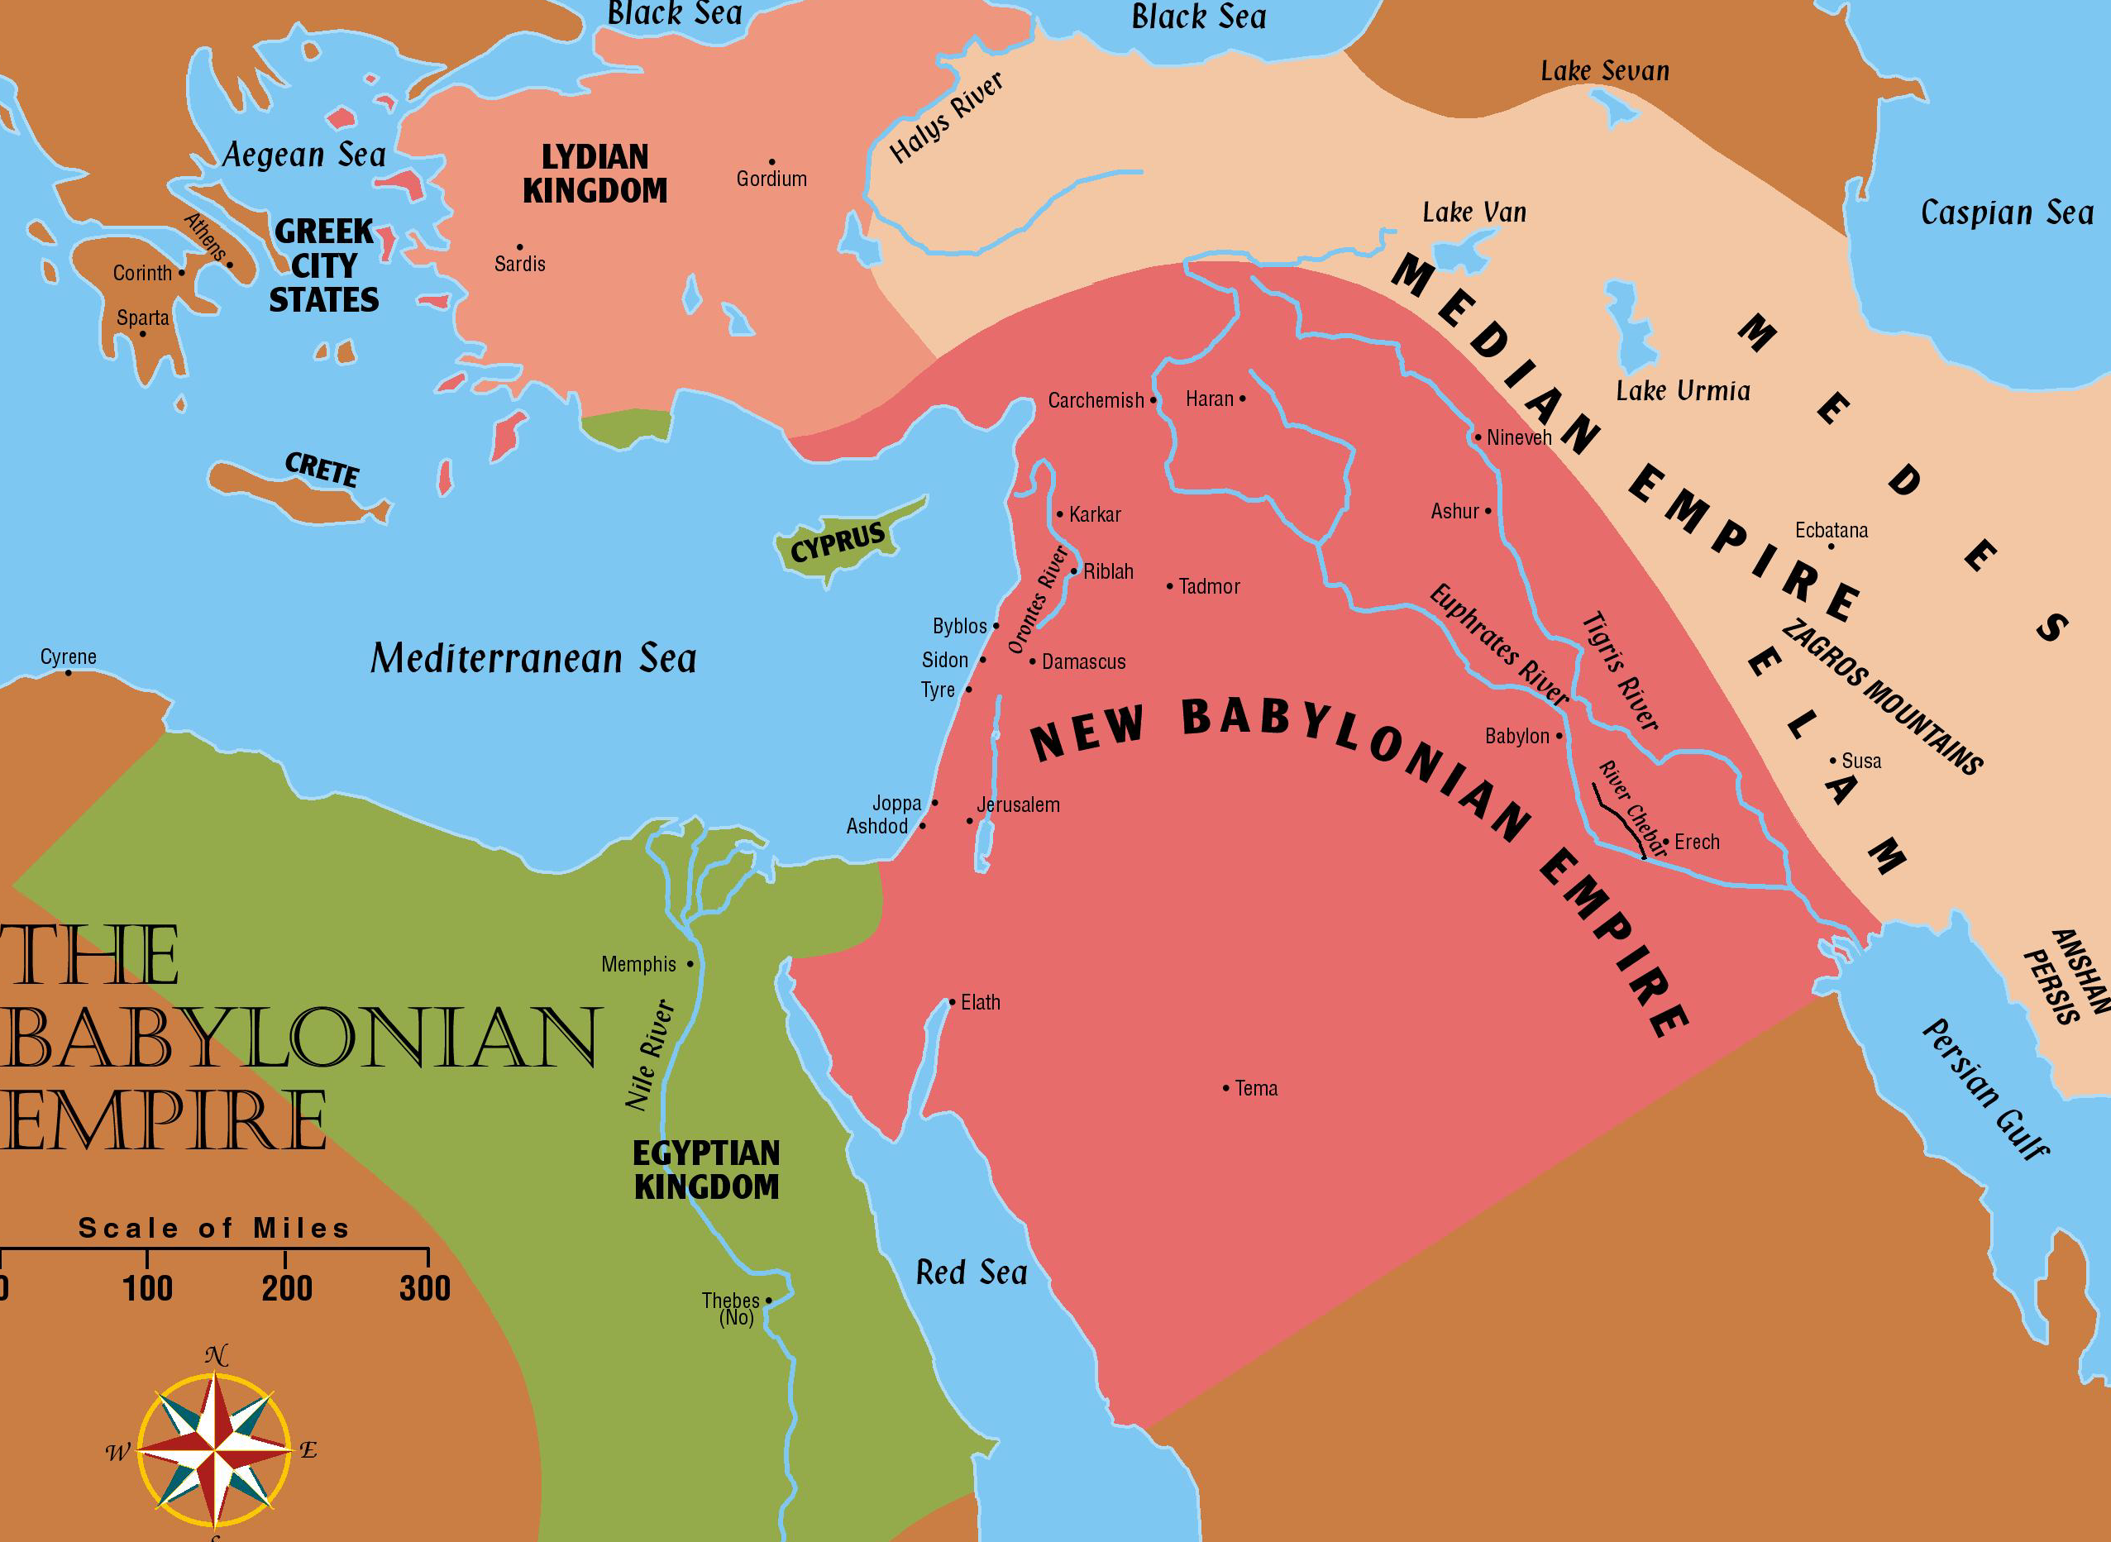
Judah’s Last Days
586 B.C.
2 Kings 18-25; 2 Chronicles 29-36

Slide 3
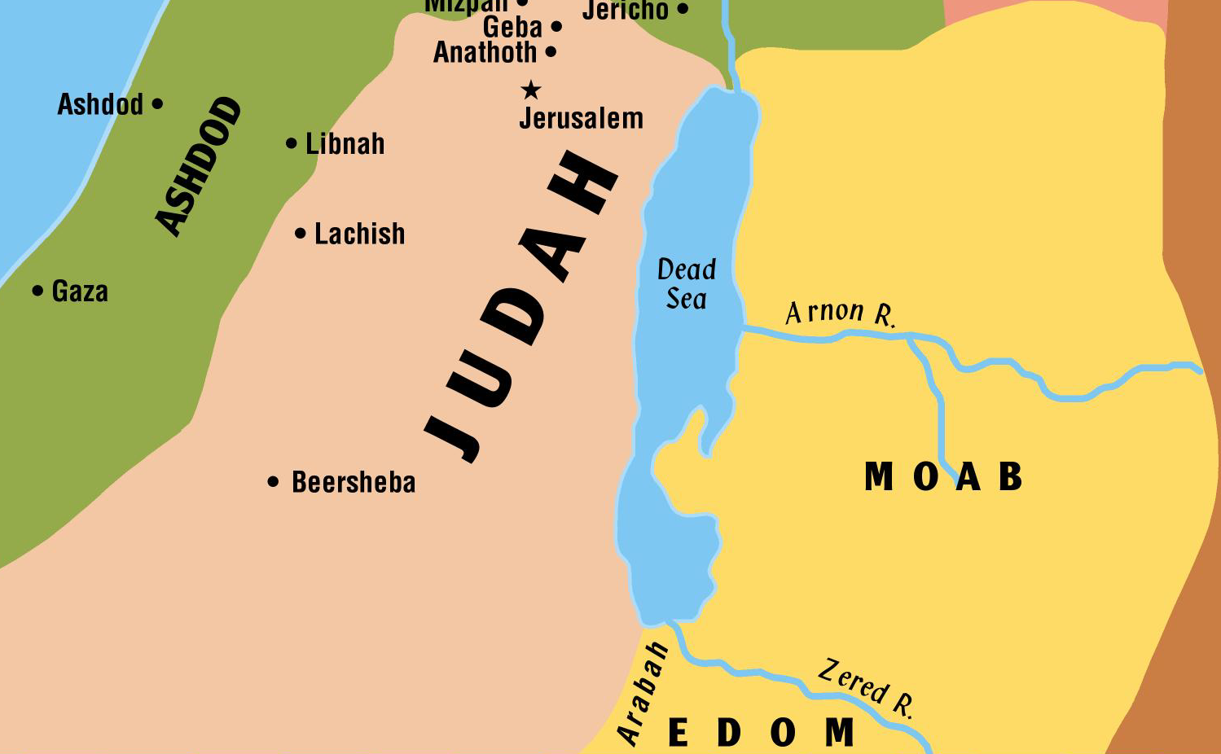
Judah’s Last Days
586 BC
Felt the heavy hand of Assyria
  Might have fallen soon after Israel if their kings had been as wicked as Ahaz – who appealed to Tiglath-pileser for help
Also troubled by raids from the Edomites and the Philistines

Slide 4
Judah’s Last Days
586 BC
Fortunately for Judah they had a good king (Hezekiah) who was as righteous as his father Ahaz was wicked
  He realized where their blessings came from
…our fathers have trespassed and done evil in the eyes of the LORD our God; they have forsaken Him….Therefore the wrath of the LORD fell upon Judah and Jerusalem, and He has given them up to trouble, to desolation, and to jeering….because of this our fathers have fallen by the sword; and our sons, our daughters, and our wives are in captivity. Now it is in my heart to make a covenant with the LORD God of Israel, that His fierce wrath may turn away from us….(2 Chron 29:3-11)

Slide 5
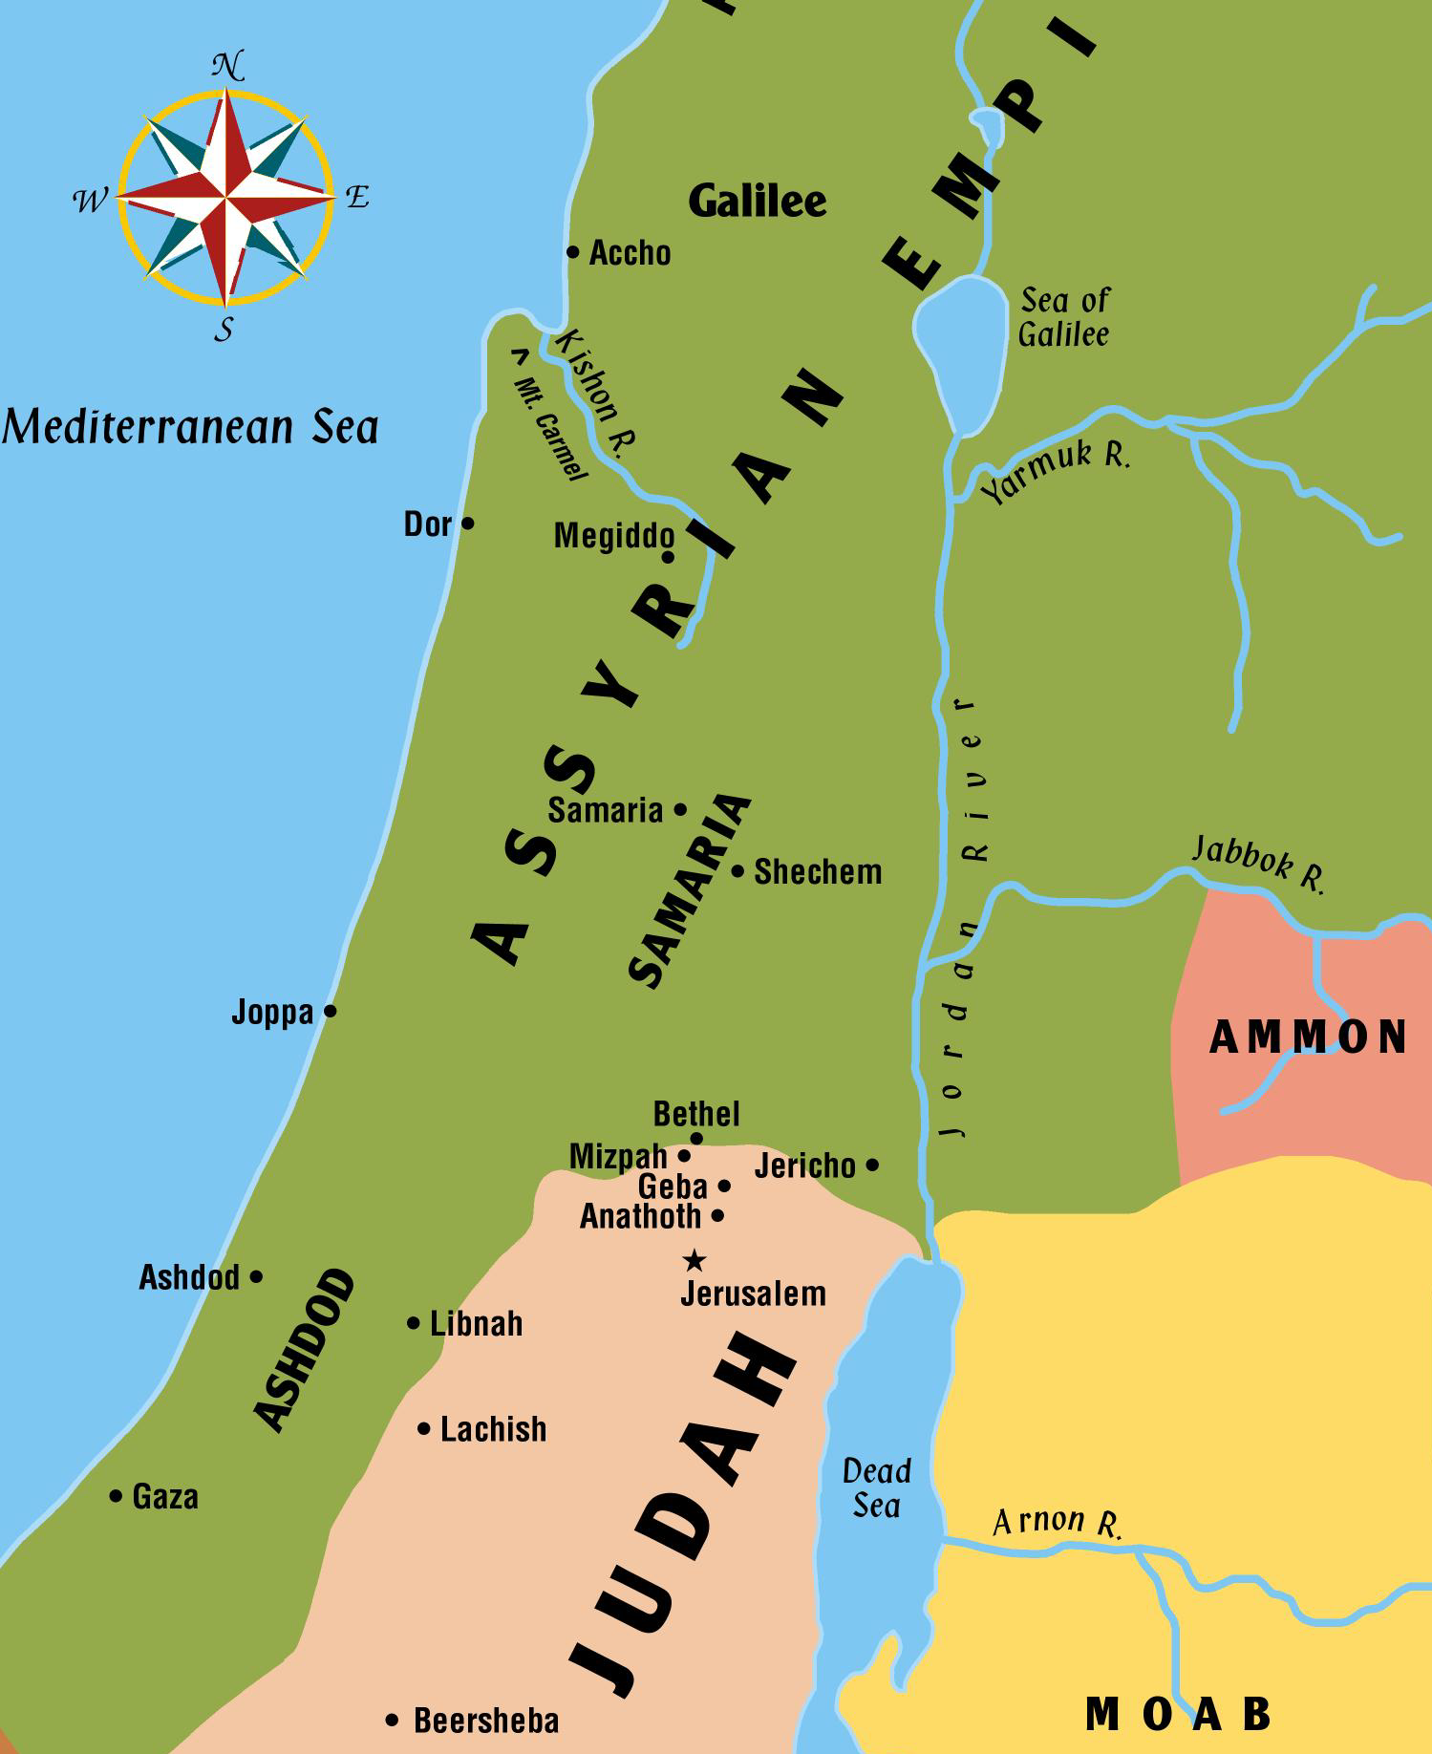
Judah’s Last Days
586 BC
Hezekiah cleansed the temple, restored the worship, destroyed idols in the land
  Invited all the people from Beersheba to Dan to celebrate the Passover
    People came from all parts of Israel
    None like it since days of David and Solomon

Slide 6
Judah’s Last Days
586 BC
Hezekiah’s reforms were taking place in Judah during the last few years before Israel’s fall
  Samaria fell in the sixth year of Hezekiah’s reign
At this point in history, all the little countries of Palestine had fallen completely to the Assyrians or were paying an enormous tribute
  Syria and Israel were gone
  Tyre stood, but most of Phoenicia was gone
  A few Philistine cities stood
  Moab, Ammon, Edom and Judah all continued with their own kings but were forced to pay tribute

Slide 7
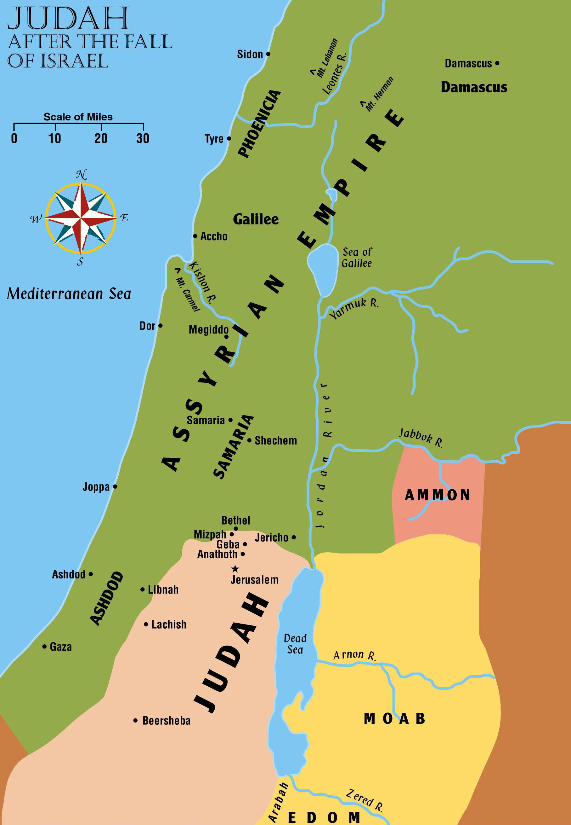
Judah’s Last Days
586 BC
Ashdod and Egypt made a coalition to go against Assyria
  Judah, Edom, and Moab seem to have given tentative support to this effort
    However, Ashdod and other towns fell under the scourge
  The area was made a new province of Assyria

Slide 8
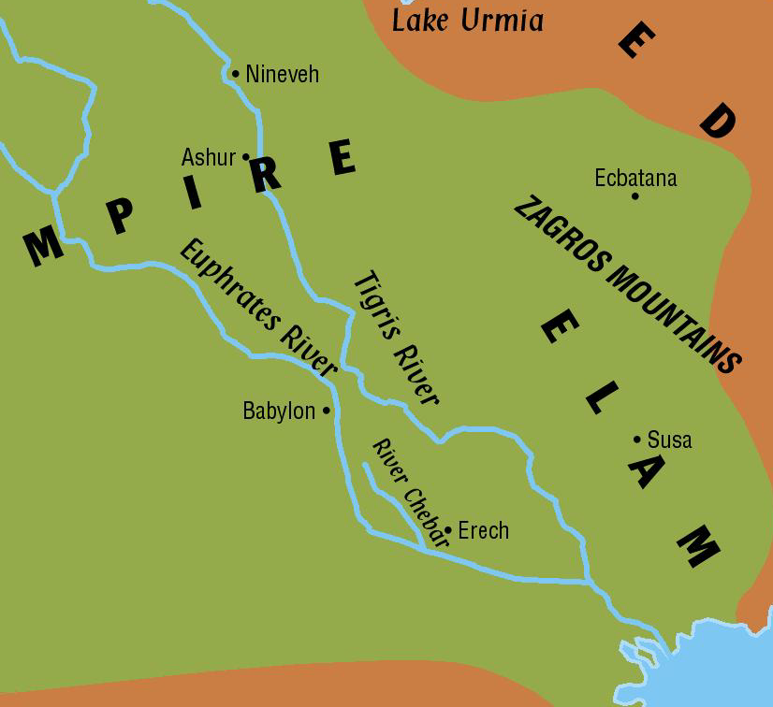
Judah’s Last Days
586 BC
At this same time King Sargon of Assyria was having trouble on the other end of his empire
  Babylon rebelled and set up an independent state
  Struggle between Nineveh and Babylon lasted about 12 years before Babylon was subdued

Slide 9
Judah’s Last Days
586 BC
During this time Egypt was reasserting its power
  Egypt wanted a buffer state between herself and Assyria
    Encouraged the little nations of Canaan to rebel
    Isaiah strongly urged King Hezekiah not to listen to Egypt
    But there was a strong pro-Egyptian party in the land
  Hezekiah withheld his tribute from Assyria
    Began making fortifications throughout his territory

Slide 10
Judah’s Last Days
586 BC
In the 14th year of Hezekiah’s reign:
  Armies came en masse – this time under King Sennacherib
    Destroyed the city of Tyre – then Joppa
    Met and defeated an Egyptian army along the way
    Laid siege to Judah’s walled cities
    They shut up Jerusalem “like a bird in a cage”
    Some of their armies devastated the countryside
  Realizing his danger, Hezekiah sent a huge tribute to the king camped at Lachish
    Stripped gold from the walls of the temple for resources
    It did not appease Sennacherib

Slide 11
Judah’s Last Days
586 BC
Judah was in serious trouble – All looked lost!
  Hezekiah went to Jehovah in prayer for help and God answered with a promise (Isa 37:33-35)
  As God promised, He struck down the Assyrian host with a plague
    Sennacherib awoke one morning to find 185,000 of his soldiers dead
    He withdrew from the land and did not return again
  Jerusalem was spared for another 100 years – but the toll had been high
    Sennacherib’s records boast of 46 walled cities and forts taken on the raid – much of the land was in ashes!

Slide 12
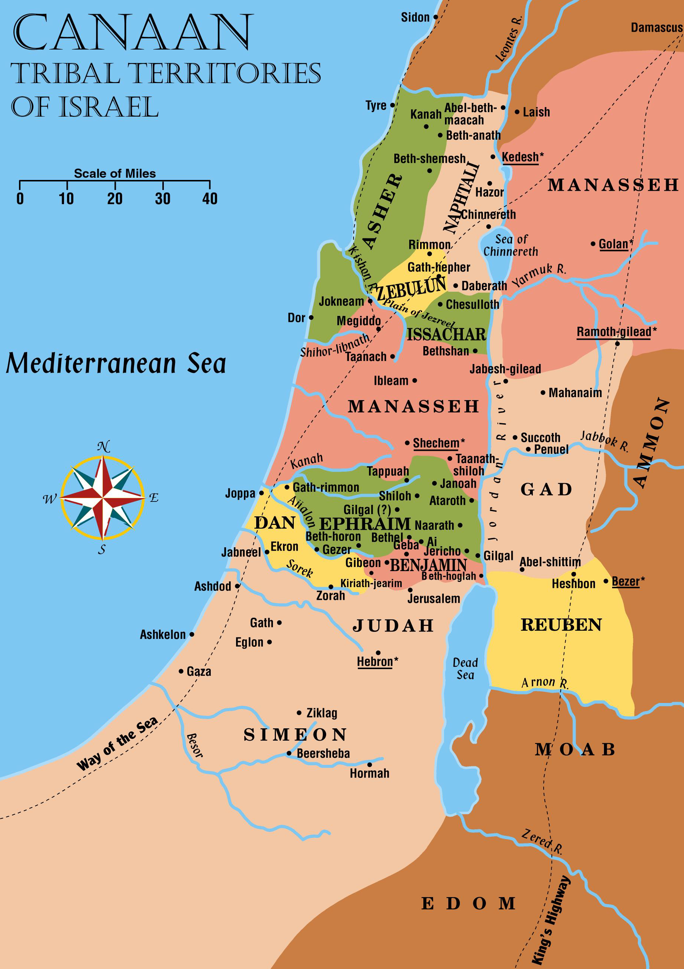
Judah’s Last Days
586 BC

Slide 13
Judah’s Last Days
586 BC
Aramaic Language
Israelite officials asked the Assyrians to speak in the Syrian or Aramaic language (2 Kings 18:26)
  This language was spoken by most of the people in northern Mesopotamia and Syria
  All this area that we have been studying was either captive of or subject to the Assyrians
    From this point on, the Aramaic language plays more of a part in the daily lives of the Israelites

Slide 14
Judah’s Last Days
586 BC
Jew
The name “Jew” began to be used about this time also. In the King James Version, the word is first used in 2 Kings 16:6:
In this passage it refers to the people of Judah
  Its use became more widespread as the years passed
At that time Rezin king of Syria recovered Elath to Syria, and drave the Jews from Elath: and the Syrians came to Elath, and dwelt there unto this day.

Slide 15
Judah’s Last Days
586 BC
Hezekiah was followed by his son Manasseh who reigned for 55 years
  He was the most wicked king Judah ever had!
    Revived idol worship
    Built altars to all kinds of idols INSIDE the temple grounds
    Sacrificed his own sons to Molech
    Practiced sorcery, witchcraft, and divination
    Cruel and unjust in all his dealings
      Filled Jerusalem with the blood of innocent people
  God declared he was worse than the Amorites that had been driven out of Canaan in Joshua’s day
    God would soon wipe Jerusalem clean!

Slide 16
Judah’s Last Days
586 BC
Manasseh remained loyal to Assyria
  He was later taken prisoner
    Had a hook put in his nose, bound in shackles and taken to Babylon
  While in Babylon he turned his heart to seek Jehovah
    God heard his prayer
    Later released and allowed to come back to his throne
  Spent the last few years of his life trying to destroy the idols he had set up and to undo the evil that he did
His son Amon came to the throne
  Wicked, reigned only two years and was killed

Slide 17
Judah’s Last Days
586 BC
Josiah
Came to the throne when only 8 years old and was determined to serve Jehovah
  Destroyed the idols throughout the land
  Gave orders that the temple be cleansed
    Huldah the prophetess told him that the law was correct
    God was angry – too late for punishment to be averted
      It would be postponed because of Josiah’s faithfulness
While cleaning the temple, the workers found an ancient copy of the law of Moses. Josiah was terrified when he heard it read.

Slide 18
Judah’s Last Days
586 BC
Josiah renewed his efforts to clean up his land
  Stopped the worship of Molech
  Went to the altar at Bethel and destroyed the sanctuary that had been built by Jeroboam I for his golden calves
  Burned the bones of false priests
  Destroyed the high places of false gods that Solomon had built for his wives nearly 300 years earlier
    BEST KING JUDAH EVER HAD!
Called the people together and led them in renewing their covenant with God!

Slide 19
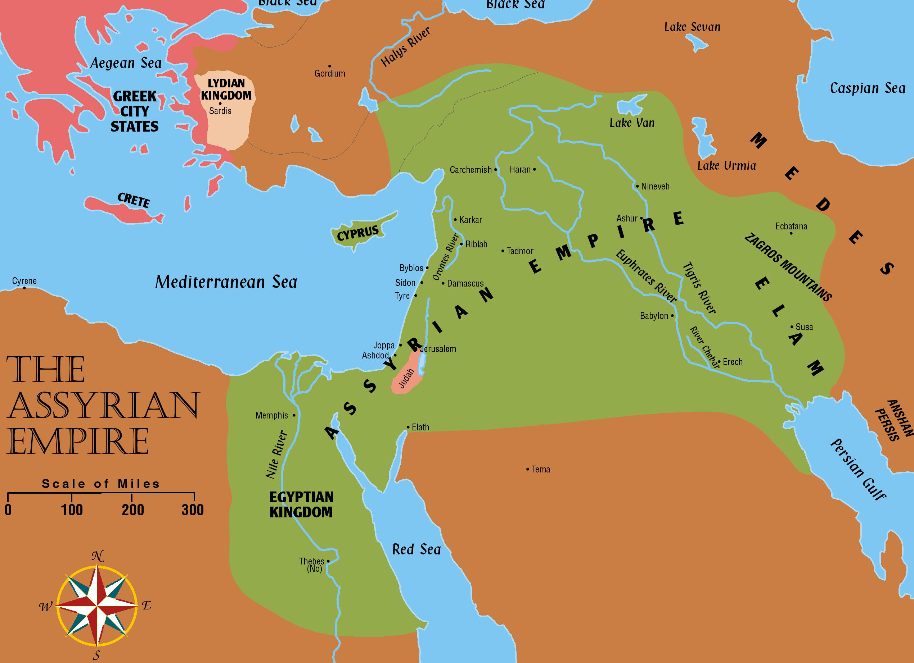
Judah’s Last Days
586 BC
Meanwhile – Assyria was having troubles of her own
  Egypt strove for independence
  Medes were growing in strength
  Rebellions from the city of Babylon
  Arab tribes plundered the lands of eastern Palestine and Syria
    Kings of Assyria could not hold the empire together much longer

Slide 20
Judah’s Last Days
586 BC
Revolts continued
  A Chaldean prince named Nabopolassar managed to gain independence for Babylon
    Joined forces with the Medes, and they laid siege to the city of Nineveh
      It fell after only three months – never to rise again (612 BC)
    A victorious battle at Carchemish marked Assyria’s end
Josiah was reigning in Judah during these last years of Assyria’s struggles
  Judah was relieved when Nineveh fell
  Book of Nahum is a prophetic expression of exultation over the fall of the city

Slide 21
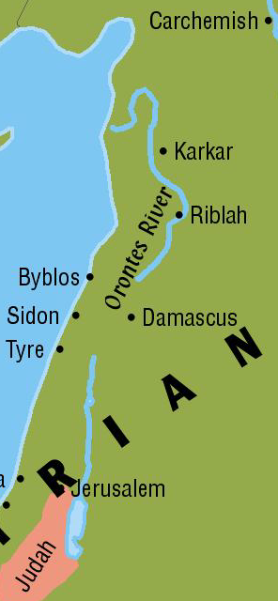
Judah’s Last Days
586 BC
Egypt also rejoiced over the fall of Assyria
  They saw an increasing danger in the rising Babylonians
    It would be to Egypt’s advantage if a weakened, but still existing Assyria remained between Egypt and Babylon
  Pharaoh-Necho of Egypt rushed along the Way of the Sea to help Assyria
Josiah was not as far-sighted as Necho – he did not want Assyria helped
  His army met Necho at Megiddo and Josiah was killed
    Necho failed to save the Assyrian Empire

Slide 22
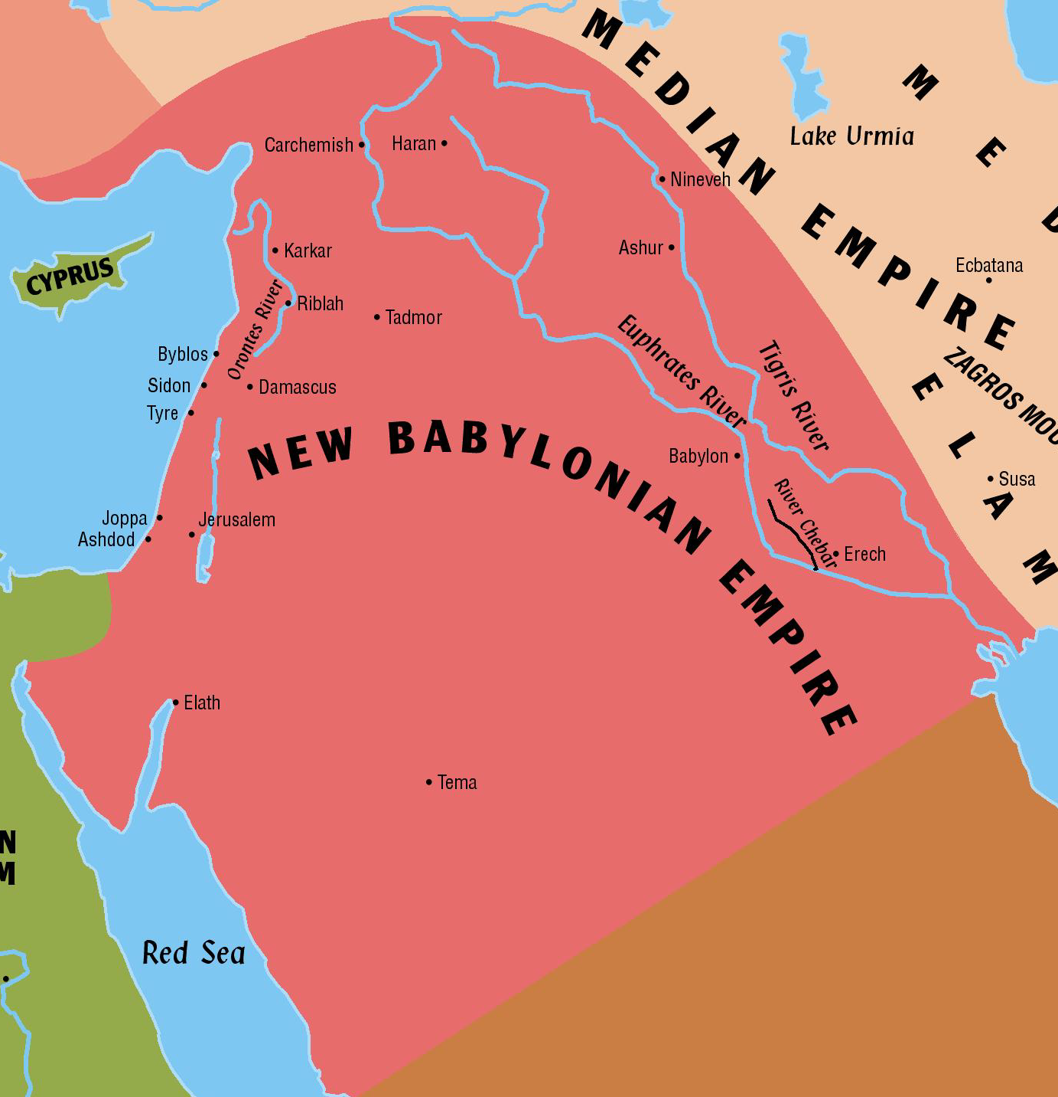
Judah’s Last Days
586 BC
Jews placed Josiah’s son Jehoahaz on the throne
  Three months later Necho put Jehoahaz’s brother Jehoiakim on the throne and took Jehoahaz as prisoner to Egypt
Babylon and Media agreed to co-exist
  Media laid claim to all the land north and east of Nineveh
  Babylon claimed all of Mesopotamia, Syria, Palestine, Arabia, and Egypt

Slide 23
Judah’s Last Days
586 BC
Nebuchadnezzar of Babylon was able to secure all land UNTIL he came to Egypt
  Egypt was formidable – Babylon was victorious but was weakened
Trouble was mounting in Judah
  Jehoahaz and Jehoiakim were terribly wicked
    Jehoiakim accepted Babylon’s rule when the armies first came – but thought he could rebel when weakened at Egypt
    Arameans, Chaldeans, Moabites, and Ammonites raided Judah – probably at Nebuchadnezzar’s instigation
    Babylonian forces came & took treasures from the temple
      Took captive young men from the royal family and nobility
      Daniel and his three friends were in this first group taken (606BC)

Slide 24
Judah’s Last Days
586 BC
Jehoiakim rebelled again and Nebuchadnezzar came back. Jehoiakim was bound and killed
Jehoiachin, his son, held out three months before surrendering to Babylon
  Babylonian army took away all the treasures from the temple and from the palace
  Gathered the officials and craftsmen of the city and took them away captive – leaving only the poor
Zedekiah, another son of Josiah, was set up as a puppet king over the remnant of Israel
Ezekiel taken captive

Slide 25
Judah’s Last Days
586 BC
Jeremiah was God’s spokesman during this time
  The Israelites would not listen to Jeremiah
Babylon came again in 586 BC and Jerusalem was leveled
  Gold was stripped from the walls of the temple
  Bronze pillars were broken and carried away
  Walls broken down and the gates burned
  Rest of the people were taken captive
    Nothing was left but a pile of rubbish!

Slide 26
Judah’s Last Days
586 BC
Gedaliah was set up as governor over the territory
  The poor left in the land rallied around him at Mizpah
  Other Jews who fled to Moab, Ammon, and Edom came back
  God was with this tiny group
King of the Ammonites hired a man named Ishmael to kill Gedaliah and all his officials
  This was the final blow to the little group that was left
  Jeremiah urged them to remain in the land but instead they went to Egypt
The land was left barren – Jerusalem was uninhabitable
  All of God’s people were in captivity spread from Egypt to the Persian Gulf – it remained idle for the next 50 years

Slide 27
The Rise of the
PERSIANS

Slide 28
Empire Review
Assyrians take Israel
Babylonians take Judah
Medo-Persians subdue Babylon
Jews return to Jerusalem
  Led by:
    Ancestor of Christ (Matt 1:12)
721 BC
586 BC
539 BC
536 BC
Zerubbabel

Slide 29
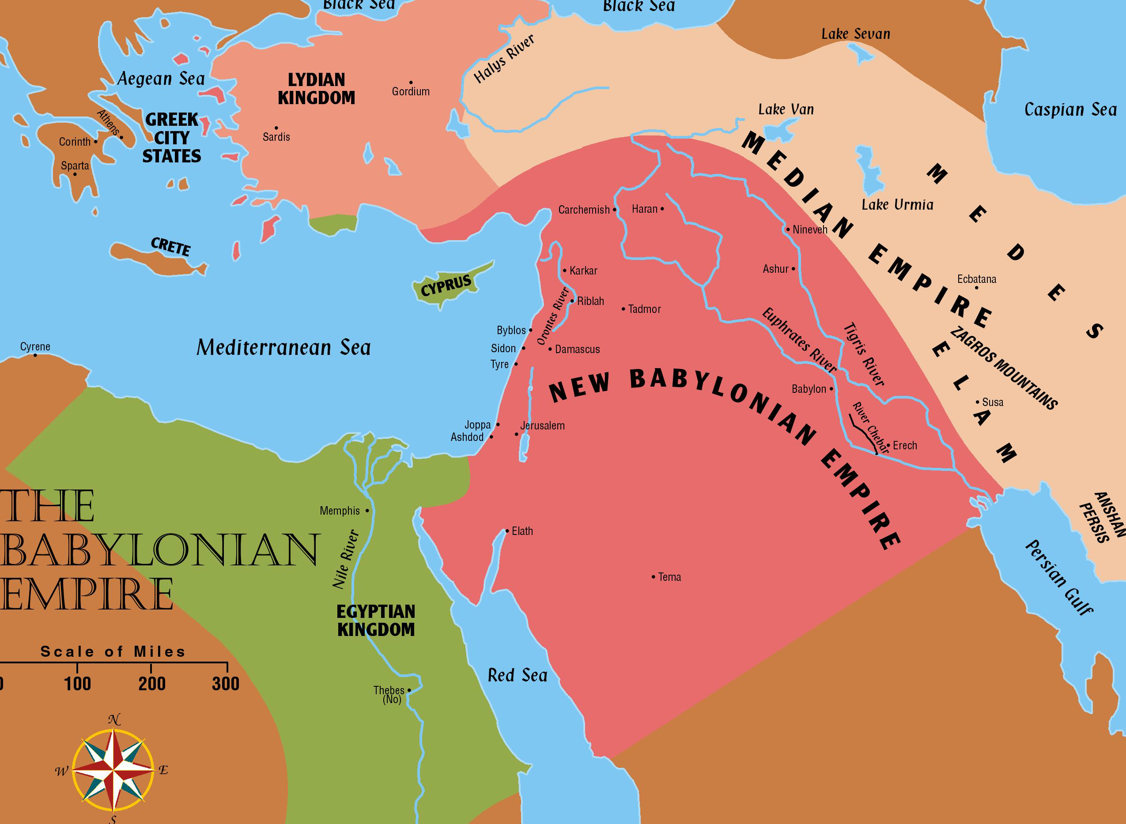
The Rise of the Persians
Media agreed to co-exist with the Babylonians originally
  Media was later taken by Cyrus of Persia, who in turn added the name of his tiny country to form the great Medo-Persian empire
  Originated in the highlands south of the Caspian Sea and east of the Zagros Mountains

Slide 30
The Rise of the Persians
They grew in strength until they became an extremely large empire

Slide 31
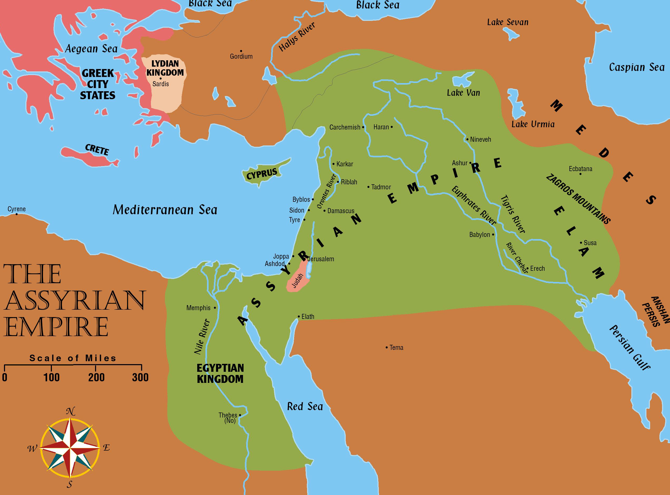
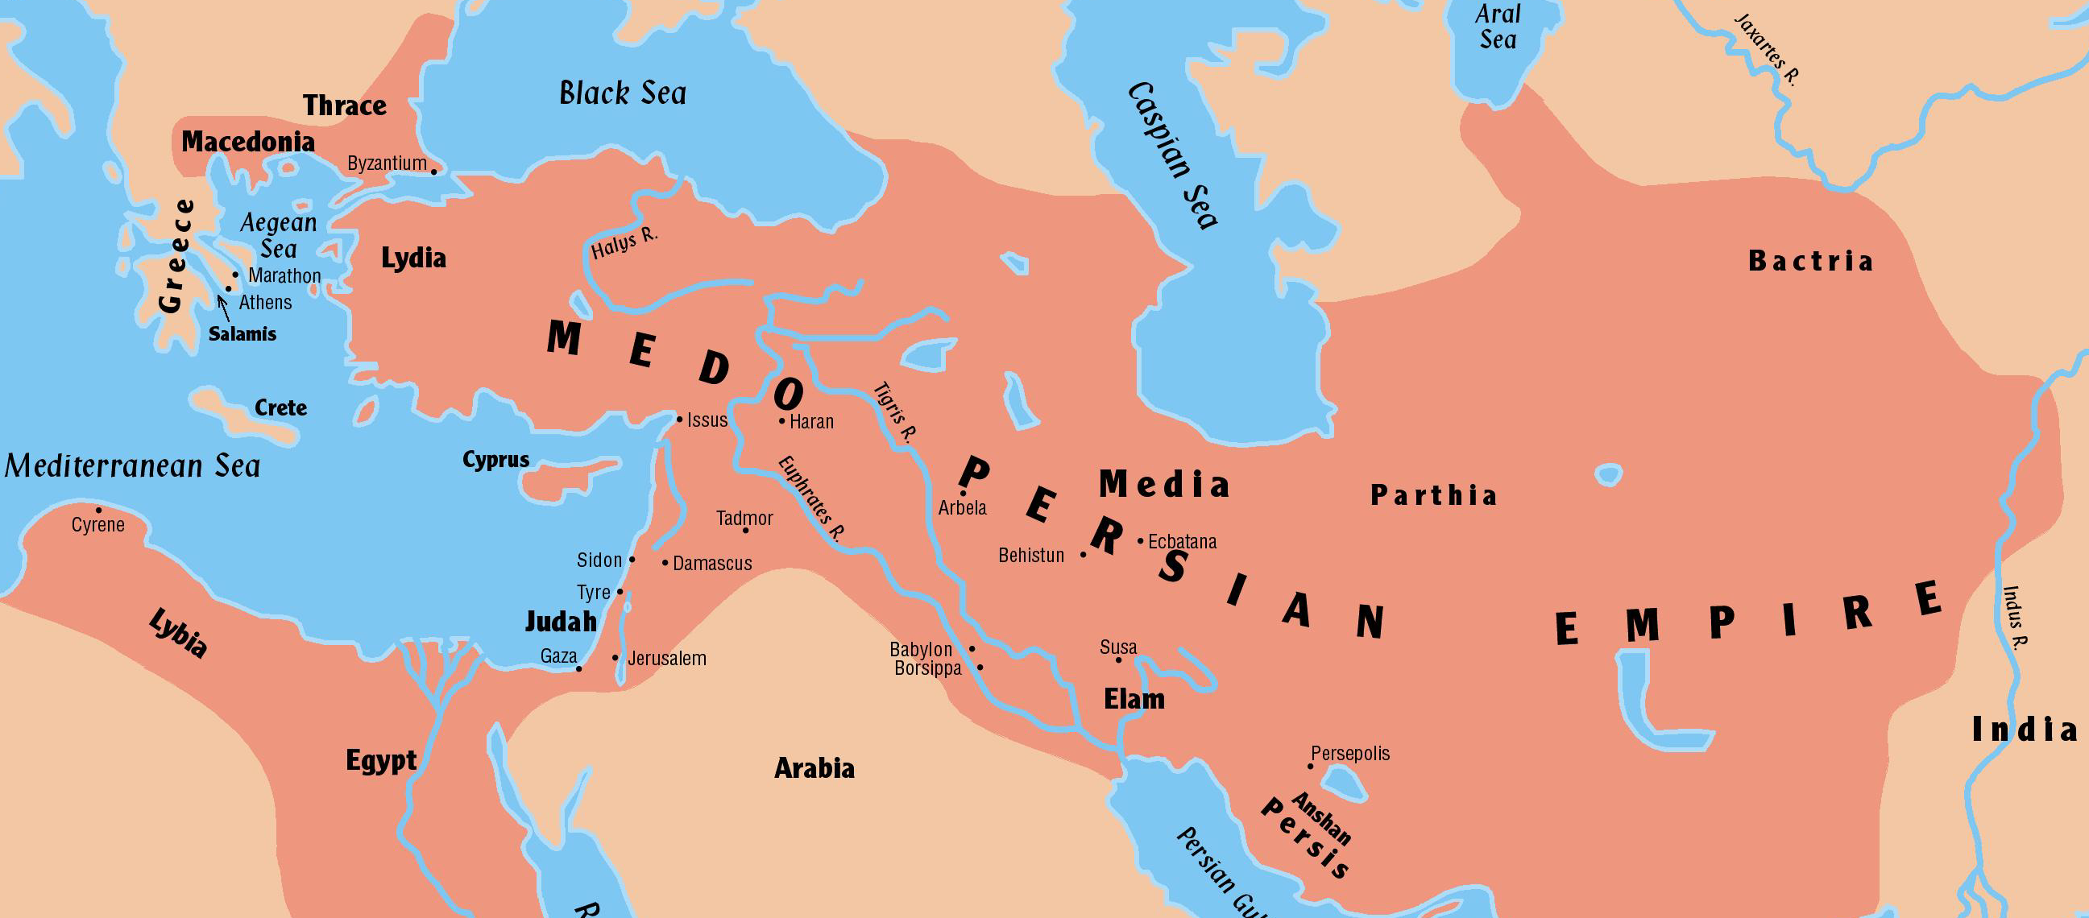
Comparing Kingdom Size
Assyrian
Babylonian
Persian

Slide 32
The Rise of the Persians
Cyrus comes to power
  From an obscure Persian province called Anshan
    His mother was the daughter of Astyages who was ruling over Media

Slide 33
The Rise of the Persians
Cyrus first defeats Astyages in a major battle
  Moved against the capital city of Ecbatana, conquering it in 550BC
    Proclaimed himself ruler over the already “large” Median empire
  Medes given positions of honor
  Many of their customs and laws were combined with those of Persia
    We now have the beginning of the Medo-Persian Kingdom which was to become the largest empire the world had yet seen

Slide 34
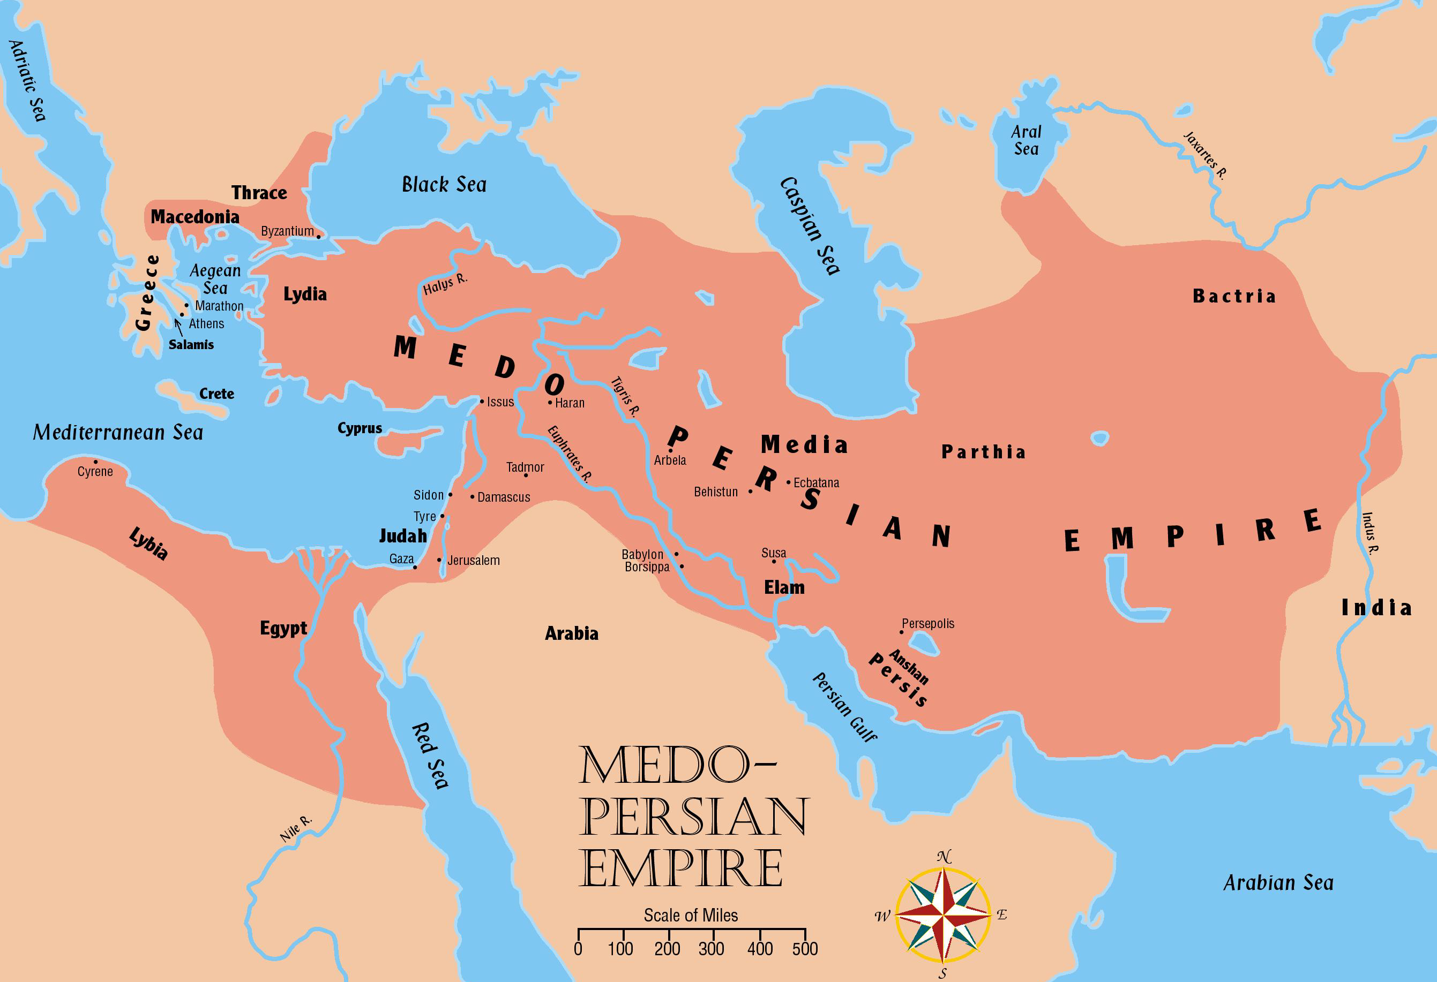
The Rise of the Persians

Slide 35
The Rise of the Persians
Cyrus turns his attention to Asia Minor to strengthen his power there
  Defeated Croesus and his kingdom of Lydia
Moved next against the Babylonian empire
  Began eating away at its hold on northern Mesopotamia
  He was soon ready to attack the city of Babylon
    Dug a great ditch outside the walls of the city
    Diverted the Euphrates into their ditch and entered the city under the walls on the dry river bed
    Babylon surrendered without a battle (539BC)

Slide 36
The Rise of the Persians
Cyrus was different than his predecessors
  No mass killings nor chained captives
    Men of prominence in the Babylonian kingdom were given positions in the new government
    Darius the Mede was set up as king over the new Persian province of Babylon
Jews in Babylon were pleased when Cyrus came to power
  Daniel knew the predicted 70 years of captivity were almost over
  God’s plan was still on schedule

Slide 37
Isaiah's Prophecy
200 years earlier the prophet Isaiah said Cyrus would give orders for Jerusalem and Judah to be rebuilt
  Jerusalem was still standing and prospering when Isaiah recorded these words:
“Who says of Cyrus, 'He is My shepherd, And he shall perform all My pleasure, Saying to Jerusalem, "You shall be built," And to the temple, "Your foundation shall be laid."‘ “Thus says the LORD to His anointed, To Cyrus, whose right hand I have held — To subdue nations before him And loose the armor of kings, To open before him the double doors, So that the gates will not be shut:” (Isaiah 44:28-45:1)

Slide 38
The Rise of the Persians
In keeping with God’s predictions:
  538 BC an edict went out over all Cyrus’ domain that all displaced persons could return to their homelands
  He returned idols to their original owners
  He gave money to rebuild places of worship
The 70 years of captivity have come to an end!

Slide 39
Place in Chronological Order
___ The Conquest of Canaan
___ The United Kingdom
___ Promises to Abraham
___ Wandering in the Wilderness
___ The Assyrian Empire
___ The Division of the land among the tribes
___ The Divided Kingdom
___ The Babylonian Empire
___ Fall of Israel
___ The Exodus from Egypt
___ The Rise of the Persians
___ Judges of Israel
___ Fall of Judah
___ The Babylonian Captivity
4
7
1
3
9
5
8
11
10
2
14
6
12
13

Slide 40
Jerusalem Is Rebuilt
Ezra, Nehemiah, Esther, Haggai, Zechariah, Malachi

Slide 41
Jerusalem Is Rebuilt
Permission to go home included all the tribes of the Israelites
  Israel (Northern tribes) was scattered throughout the Assyrian empire
  Judah (Southern tribes) was scattered in Babylon

Slide 42
Jerusalem Is Rebuilt
Persia now controls all the territories once held by Assyrian and Babylonian empires

Slide 43
Captives Free to Return
536 BC
Many Israelites stayed where they were
  It has been almost 200 years since the first captives have been taken from Israel
  The most recent captives have been gone 50 years
    They built homes and were content to stay
  It was their choice whether to return or not
Approximately 50,000 Jews gathered in Babylon to start home (Ezra 2:64-65)
  Sheshbazzar and Zerubbabel are named as leaders
    Unknown whether these were two different men or two names for the same man

Slide 44
Captives Free to Return
536 BC
No “gods” to return to the Jews, however:
  Many valuable vessels taken from the temple and palace in Nebuchadnezzar’s day are returned
    5,400 gold and silver vessels returned
  Jews who stayed behind helped their brethren with gifts to make their trip easier
It was a day of great joy as they began the trip
  However, the tasks ahead would not be easy

Slide 45
The People of Palestine
They profited from the Jews’ absence
  Samaritans had grown in power
    Claimed the territory around the ruins of Jerusalem
  Ammonites moved out of their near-desert territory into the fertile highlands of Gilead
  Edom moved out of the dry Negeb into land once belonging to Judah
    They took the city of Hebron
  Nomadic tribes moved nearer the fertile lands
    Established a more settled way of life

Slide 46
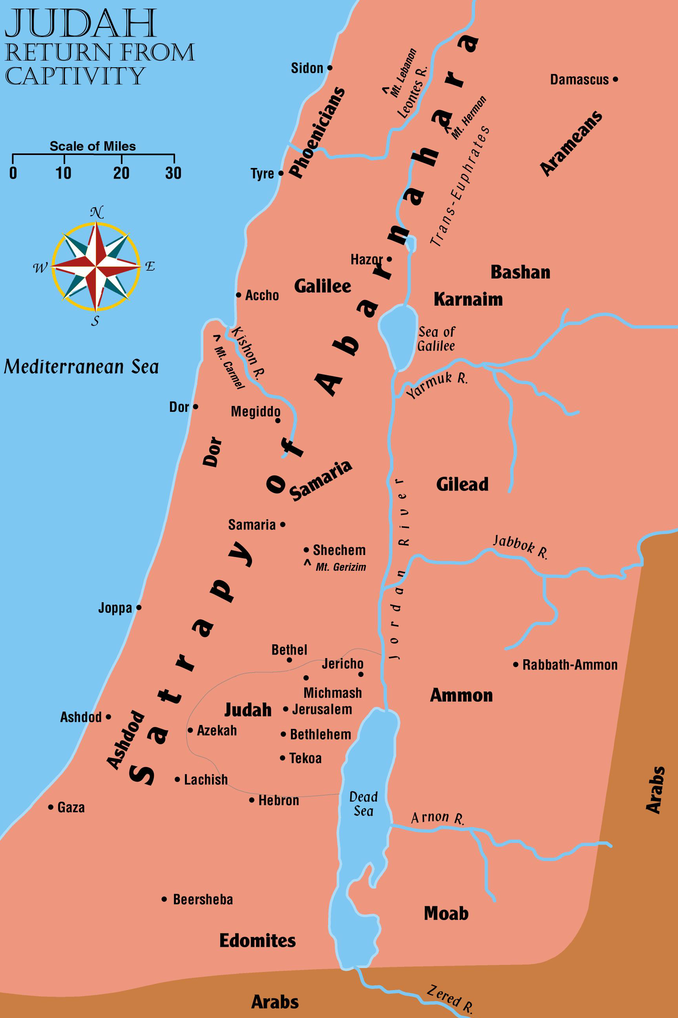
Judah
Return From
Captivity

Slide 47
Returns
3
Name the “three returns” in Ezra and Nehemiah:
  Jews return home under the leadership of Zerubbabel to build the temple
  Ezra returns with the Priests to start the spiritual reform
  Nehemiah returns to build the walls

Slide 48
Return Number ONE
Jews return to Palestine under Zerubbabel
  Begin to work on their temple as soon as they reach Jerusalem
  Rebuilt the altar of burnt offering and began their regular sacrifices
    Celebrated when the foundations of the temple were laid
  Praised God for His mercy
  Grief that day also
    Some present who could remember the splendor of the temple Nebuchadnezzar had burned
    This one would never compare to it!

Slide 49
Return Number ONE
Adversaries began trying to stop their work
  Wrote a letter to the new king Cambyses after Cyrus had died
    Called by the titles of Ahasuerus and Artaxerxes in letter
  Accused the Jews of treason
  Asked the king to check the records to see if Jerusalem had not always been rebellious
    Cambyses checked and he found that Jerusalem had been rebellious
    As a result, he had the work stopped and nothing more was accomplished for 16 years

Slide 50
Return Number ONE
Cambyses continued to push the borders of his kingdom outward
  Succeeded in taking Egypt and ended the reign of the Pharaohs forever
  Learned of problems at home
    Started back to secure his hold on the kingdom, but he died on the way
Darius the Great came to the throne
  Divided the empire into 20 satrapies with an officer over each one – answerable to him
    Each satrapy was subdivided into provinces with rulers

Slide 51
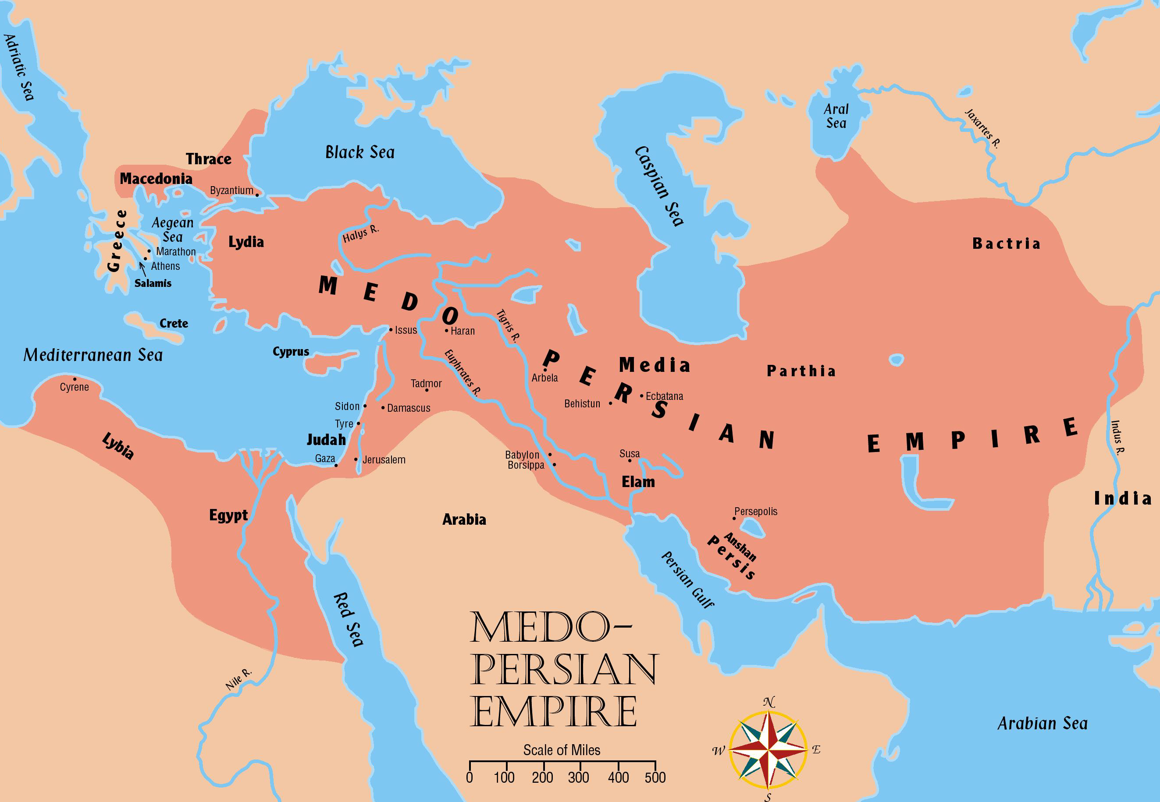
Return Number ONE

Slide 52
Return Number ONE
Darius conquered new territories
  A wise administrator
    Initiated many legal and fiscal reforms in the land to promote commerce
    Built roads
    Established an efficient postal system
    Built a canal connecting Gulf of Suez to the Mediterranean Sea

Slide 53
Return Number ONE
Judah was a tiny dependency in an empire of 2,000,000 square miles
  A Persian governor ruled the fifth Satrapy
  Extended from northern Syria down to the border of Egypt
    Called Abarnahara “the land beyond the Euphrates”

Slide 54
Return Number ONE
When king Darius came to power, Haggai & Zechariah urged the people to resume work
  The people really needed this encouragement
  A new letter is sent to the king telling the story of Jerusalem correctly (Ezra 5)
    Darius checked the records and found the original decree from Cyrus in the palace of Achmetha in Media
    He gave orders for the work to be finished and he forbade ANY opposition
  The temple was finished 20 years after it was begun
    A total of 4 years labor time (515 BC)

Slide 55
Esther
Takes place approximately between chapters 6 and 7 of the book of Ezra
  After king Darius I (521-486 BC)
  Xerxes comes to the throne (486-465 BC)
  Esther becomes queen to Xerxes
    Risks her life and spares her people from annihilation
    Her uncle Mordecai is raised to a highly responsible position in the kingdom – Jews treated with more respect
“For if you remain completely silent at this time, relief and deliverance will arise for the Jews from another place, but you and your father's house will perish. Yet who knows whether you have come to the kingdom for such a time as this?” (Esther 4:14)

Slide 56
Return Number TWO
In the 7th year of Artaxerxes, the son of Xerxes, he grants permission for Ezra to go to Jerusalem
  Ezra’s primary task was to inquire into the religious conditions in Judah and Jerusalem
    He was a teacher and a scribe
  He was authorized to purchase whatever he needed for the religious welfare of his people
  Nearly 2,000 people (mostly priests and Levites) returned with him
Ezra 7:10
“For Ezra had prepared his heart to seek the Law of the LORD, and to do it, and to teach statutes and ordinances in Israel.”

Slide 57
Return Number THREE
Nehemiah, the cupbearer to King Artaxerxes asked permission to return to Jerusalem to rebuild the city walls
  140 years since Jerusalem had been burned
  90 years since Cyrus gave permission to go home
  Plenty of time for the city to have become prosperous again
    However, the city was still a charred pile of rubble
    They had a temple, but nothing else
  Nehemiah was grieved over the situation

Slide 58
Return Number THREE
Jews were delighted
  With everyone’s help the entire wall was finished in 52 days!
    Completed in spite of severe opposition from the enemy
    Sanballat, Tobiah, and Geshem spearheaded the opposition
  Nehemiah and the people ignored their taunts and threats because they “had a mind to work.”
Why the delay in fixing up Jerusalem?
  People put their personal welfare ahead of their concern for God

Slide 59
Return Number THREE
Ezra and Nehemiah were distressed over conditions that they found among the Israelites
  People had intermarried with their pagan neighbors
  Some were speaking the language of Ashdod
    In accordance with God’s teaching, Ezra and Nehemiah demanded the foreign wives be put away!
  The Sabbath day was being ignored
    Merchants continued their business as they did the other 6
  Appropriate sacrifices not being accomplished
    Crippled and lame brought before God (Malachi 3:10)

Slide 60
Jerusalem Is Rebuilt
Nehemiah knew why Israel wasn’t being blessed
  He reviewed their history, remembering the many occasions God had spared them from destruction
  Told them God kept His promises
  Led them in renewing their covenant with God
God’s promises of prosperity are conditional
  If faithful, he would have blessed them (Mal 3:10)
  It was not God’s fault that Israel was not blessed
    They forsook Him and were determined to do what they wanted to do. Life is choice – they made wrong choices

Slide 61
Ezra's Prayer
“ And I said: "O my God, I am too ashamed and humiliated to lift up my face to You, my God; for our iniquities have risen higher than our heads, and our guilt has grown up to the heavens. Since the days of our fathers to this day we have been very guilty, and for our iniquities we, our kings, and our priests have been delivered into the hand of the kings of the lands, to the sword, to captivity, to plunder, and to humiliation, as it is this day. And now for a little while grace has been shown from the LORD our God, to leave us a remnant to escape, and to give us a peg in His holy place, that our God may enlighten our eyes and give us a measure of revival in our bondage……And now, O our God, what shall we say after this? For we have forsaken Your commandments, which You commanded by Your servants the prophets…..And after all that has come upon us for our evil deeds and for our great guilt, since You our God have punished us less than our iniquities deserve, and have given us such deliverance as this,
should we again break Your commandments…..Would You not be angry with us until You had consumed us, so that there would be no remnant or survivor? O LORD God of Israel, You are righteous, for we are left as a remnant, as it is this day. Here we are before You, in our guilt, though no one can stand before You because of this!” (Ezra 9:6-15)

Slide 62
World Affairs During The Years of Biblical Silence
In-between the Testaments

Slide 63
World Affairs During the Years of Biblical Silence
God became silent after the work of Ezra, Nehemiah, and Malachi
  Amos predicted:
    “Behold the days are come, saith the Lord God, that I will send a famine in the land, not a famine of bread, nor a thirst for water, but of hearing the words of the Lord” (Amos 8:11)
God’s plan is still on schedule
  He had already made all the necessary prophecies concerning His Son who would soon come
    It was now time to wait for the “fullness of time”

Slide 64
World Affairs During the Years of Biblical Silence
Many changes take place during the 400 yrs between Malachi and Matthew
  Old Testament closes with Judah a poverty-stricken dependency under the control of Persia
  New Testament opens with Jerusalem a prosperous city in the midst of a prosperous region ruled by a Roman emperor
    We have not yet studied a people called the Romans
    We need to touch on the 400 years of secular history to bring us up to the beginning of the New Testament

Slide 65
World Affairs During the Years of Biblical Silence
Religious conditions changed over the years
  In Nehemiah’s day, the Jews were negligent in observing their laws
    450 years later Christ found religious sects that were extremely careful to observe every detail (Matt 23:23)
  Nehemiah found them ignoring the Sabbath laws
    Jesus found the Pharisees so demanding in observing the Sabbath that they bitterly objected when He healed someone on the Sabbath (John 5)
      What brought about the changes?
  The Bible does not tell us these answers
    Must look at secular world history to find out

Slide 66
World Affairs During the Years of Biblical Silence
Persian empire remained in control for about a century after the Old Testament closes
  Continued to push their borders outward
  Finally met a foe they could not conquer
    The Greeks
  Cyrus, the first king wanted a foothold in Europe
  Darius, the third king actually attempted an invasion
    Took Thrace and Macedon, but the Greeks held out

Slide 67

Medo-Persian Empire

Slide 68
World Affairs During the Years of Biblical Silence
Darius’ son, Xerxes tried again
  Crossed the Hellespont and marched through Macedon
    Defeated the Spartans and occupied the city of Athens
  Greeks fled and rallied their forces on the island of Salamis
    The tide turned and Xerxes lost 1/3 of his fleet of ships
    He then was defeated twice more the same year at Plataea and Samos (479 BC)

Slide 69
Medo-Persian Empire
Hellespont

Slide 70

Medo-Persian Empire
Greek opposition continued
  All of Asia Minor west of the Halys River was granted freedom from Persian control
    Persia agreed not to enter the Aegean Sea
    Persia’s dominance was weakening

Slide 71
Medo-Persian Empire
The struggles mentioned occurred before the Old Testament closed
  Ezra, Nehemiah and Malachi were doing their work in Judah about the time Persia lost control of western Asia Minor
    Five Persian kings reigned during the next century
    None of them saw the glory the empire once possessed
  Egypt rebelled
  The rest of Asia Minor rebelled
    Kings were murdered

Slide 72

What terms refer to the time between the testaments?
The 400 silent years
Between The Testaments
The Inter-Testamental Period

Slide 73
Chronological
Order of the Prophets
Jonah
Joel
Amos
Hosea
Isaiah
Micah
Jeremiah
Zephaniah
Nahum
Habakkuk
Obadiah
Daniel
Ezekiel
Haggai
Zechariah
Malachi
From Malachi to the beginning of
New Testament Times no biblical prophet spoke or wrote.

Slide 74
THE APOCRYPHAL BOOKS
I Esdras Wisdom of Solomon Bel and the Dragon
II Esdras Ecclesiasticus Prayer of Manasseh
Tobit Baruch I Maccabees
Judith Song of 3 Holy Children II Maccabees
Esther additions History of Susanna
REMEMBER, THE JEWS had the oracles of God committed to them—
Romans 3:1-2
“¹What advantage then hath the Jew? . . . ²Much every way: chiefly,
because that unto them were committed the oracles of God.”
Apocrypha – “secret” or “hidden”
The 14 Apocrypha books
were written during the Inter-Testamental Period.
The content of them is Jewish history YET, the Jews never accepted them as inspired. The Jewish Bible consists of the 39 books we generally accept as the Old Testament.

Slide 75
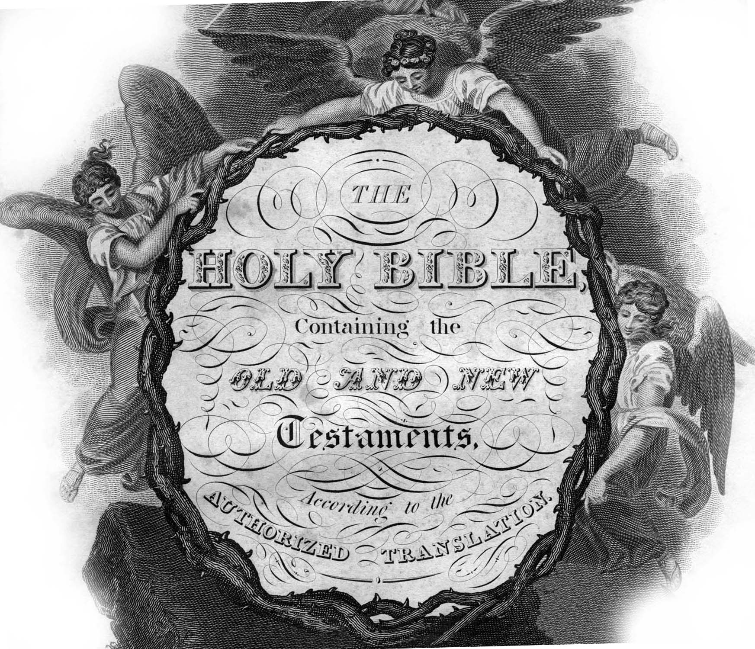
There are NO QUOTATIONS in the New Testament from the Apocrypha.
There are 250 express quotations in the New Testament from the Old Testament and the number goes over 1,000 when you include partial and indirect.

Slide 76
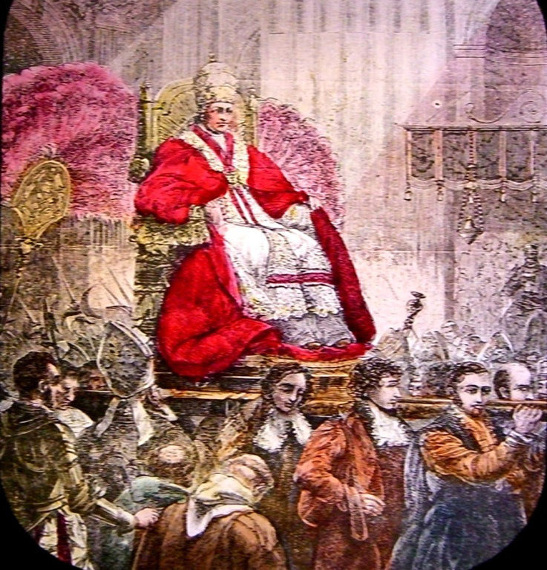
YET,
The Catholic Church
ACCEPTS THE APOCRYPHA
The Catholic “Council of Trent” in A.D. 1546
decided to include the Apocrypha in their Bible,
though even they assigned them a somewhat inferior rank.

Slide 77
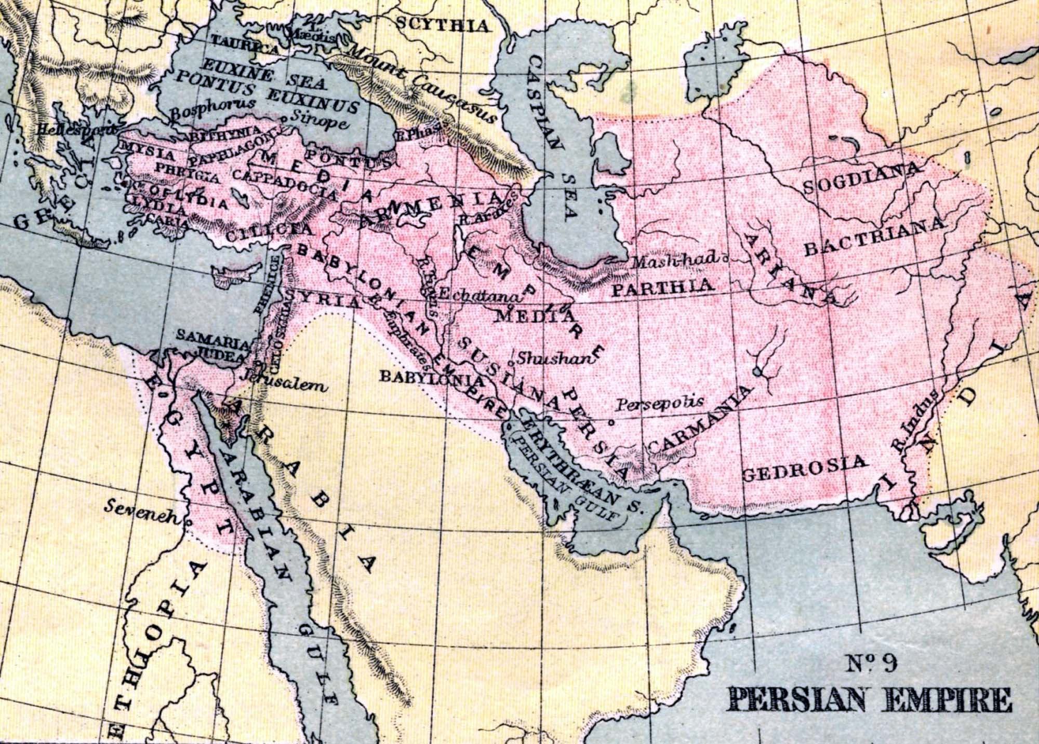
When the Old Testament Canon closed a remnant of the Jews had returned to Palestine. The Temple had been rebuilt, the walls around Jerusalem had been rebuilt, and the Persian Empire dominated the then known world.

Slide 78
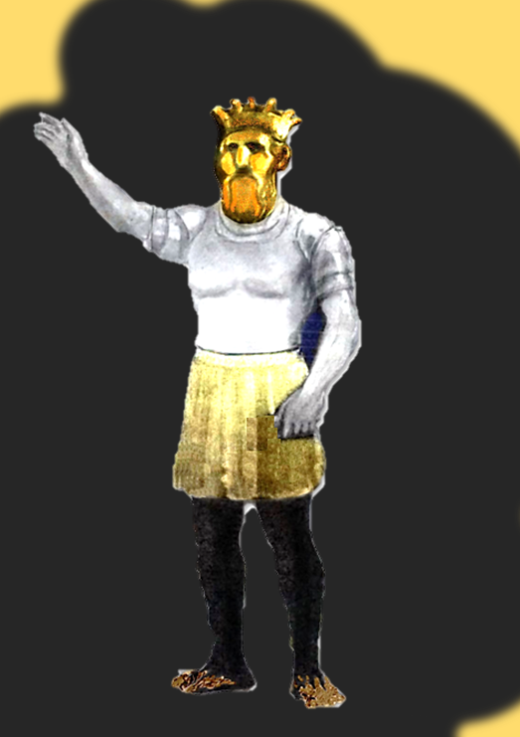
Babylon was conquered by Persia—Fulfilling part of Daniel’s prediction. Persian kings were tolerant of the Jewish people, eventually allowing them to return to their land. Persian rule lasted about 100 years.
END OF OLD TESTAMENT HISTORY
Alexander The Great conquered Persia—The 3rd world empire represented in Daniel’s vision by the body and thighs of brass.
Division of Alexander The Great’s Empire— Daniel predicted the empire of Alexander would separate into 4 parts , that the great horn would be broken and in its place would arise 4 horns. Following Alexander’s death his empire was divided between his 4 generals.

Slide 79
The Greeks
The Greeks began to grow in strength
  Philip rose to power in Macedon in 359 BC
    He was able to unite the Greek states under his control over the next 20 years
    Was elected commander of the allied Grecian forces
    Set out to take vengeance on Persia
  Appointed his son Alexander regent of Greece when he was only 16 years old
    Four years later his father was assassinated and he became an experienced ruler

