Slide 1
The NEW TESTAMENT BOOK OF ACTS
By David Lee Burris
Chapters 23 - 24 - 25 - 26

Slide 2
DOES THE NEW TESTAMENT IN PRACTICE ACTUALLY START WITH THE BOOK OF ACTS NOT THE GOSPELS?
“From the standpoint of the dispensations or the various economies by which God governs the world, the Old Testament Jewish economy actually continued through the gospels. Acts is a transitional book moving from the Old Testament economy into that of the new – the church age, the body of Christ.” (reference)

Slide 5
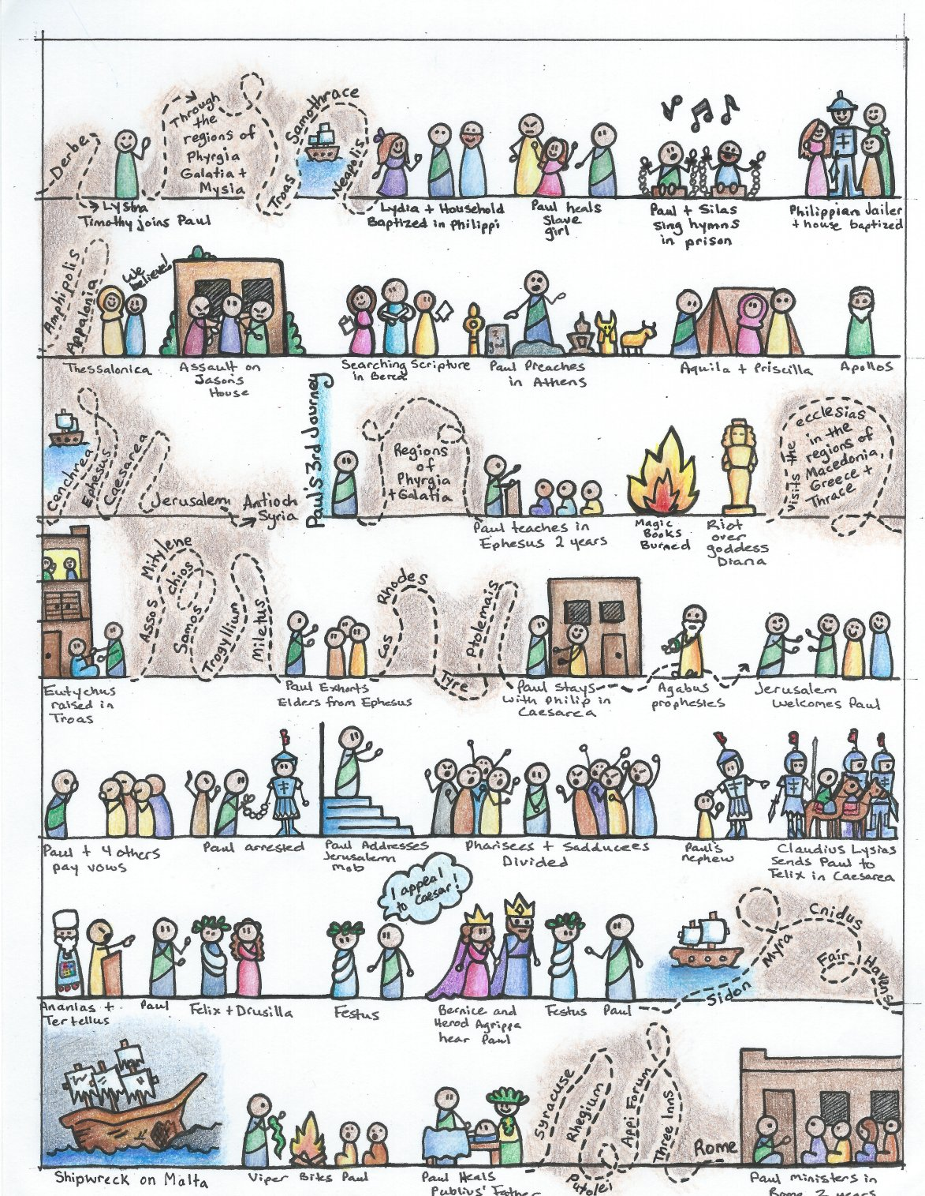

Slide 6
I. THE AUTHOR OF THE BOOK
From earliest times, Luke, “the beloved physician,” has been looked upon by conservative Bible scholars as being the author of The Book of Acts. Both internal and external evidence support this belief.
Luke was: (1) a Gentile (Col. 4:10–14); (2) the only Gentile author of a Bible book; (3) a physician (a medical doctor), Col. 4:14; (4) a “beloved” person, Col. 4:14; (5) a frequent missionary companion of Paul (the so-called “we sections” of The Book of Acts, 16:10–17; 20:5–21:18; 27:1–28:16, prove this assertion); and (6) the author of The Gospel of Luke as well as The Book of Acts.
II. THE ADDRESSEE OF THE BOOK
Luke addressed both The Gospel of Luke and The Book of Acts to Theophilus. Perhaps he had others in view as the ultimate readers of his two books.
We do not know the identity of Theophilus, nor do we know the place of his residence. He almost certainly was: (1) a friend of Luke and (2) a neophyte to Christianity (Luke wrote to Theophilus that he might know the certainty, the truthfulness, of the gospel truths wherein he had been instructed, Luke 1:1).
III. THE PLACE AND THE DATE OF THE WRITING OF THE BOOK
We do not know the place of writing but we can know the approximate date of writing. We know that it was written after the Spring of a.d. 63 for the book’s historical record extends to the Spring of that year and we know that the book was probably written before the Fall of a.d. 64 for the book makes no mention or allusion to the Neronian persecution which began in October of a.d. 64. We know that the book was almost certainly written before a.d. 70 for it makes no mention or allusion to the fall of Jerusalem and the destruction of its temple, events which occurred in a.d. 70 which greatly affected the early church and first-century Christianity (these events ended the Judaizers opposition to the gospel and the practice of preaching the gospel first to the Jews and then to the Gentiles).
IV. THE NAME OF THE BOOK
From the Second Century a.d., the common name for the book has been The Acts of the Apostles. This title is too comprehensive to be a correct one, for the book deals chiefly with the acts of only two apostles, Peter and Paul, and their acts are recorded only in part. A more apt title would be one of the following: (1) the Acts of the Risen Lord; (2) The Acts of the descended Holy Spirit; (3) Some of the Acts of Peter and Paul; (4) A Fragmentary History of the Early Church; (5) The First Chapter of Church History or (6) The only Inspired Chapter of Church History.
In the Greek manuscripts, the title is “Acts of Apostles.” This is a good and accurate title.
V. THE CLASSIFICATION OF THE BOOK
It is one of the five historical books of the New Testament. The New Testament has five historical books (Matthew through Acts), twenty-one doctrinal books (Romans through Jude) and one prophetical book (Revelation).
The 5 New Testament historical books are the New Testament’s “Pentateuch.”
Gingrich, R. E. (2002). (pp. 34). Memphis, TN: Riverside Printing.
Gingrich, R. E. (2002). The Book of Acts (pp. 3–4). Memphis, TN: Riverside Printing.

Slide 7
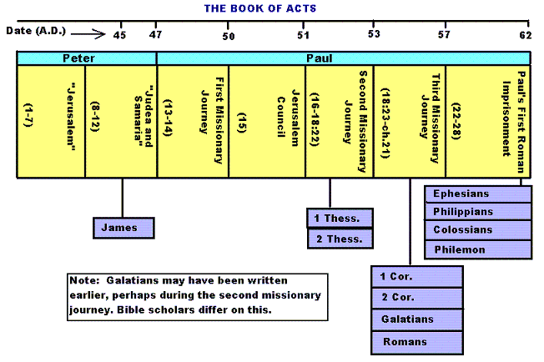

Slide 8
Historicity of Acts:
- the spread of Christianity from Jerusalem to Rome (“the ends of the earth”);
- The progress ... is mainly geographical:
- From Jerusalem ... to Samaria (8.5), Damascus (9.10), Antioch (11.26), Asia Minor (13.13), Europe (16.11), and finally Rome … itself;
- the northeastern corner of the Mediterranean;
- Maybe Spain But Nothing about North Africa, e.g., Alexandria and Cyrene.

Slide 10
1. Prologue and Ascension (1:1-11):
- Post-resurrection appearances … ;
- A ... visible ascension into heaven;
- Matthias chosen to replace Judas Iscariot (1.12-26);
- Luke’s understanding of an Apostle: see 1.21-22;
- Note: Saul (later Paul) meets those qualifications Acts 9 when Christ appeared to him while on the Damascus Road.

Slide 11
2. Founding of the Jerusalem Church - the role of the Holy Spirit (2.12-2.47):
- The Jerusalem Church increases in numbers by means of divine power;
- The work of the Holy Spirit, e.g., Glossolalia (2.1-24; see Joel 2.28-32);
- Peter’s speech interprets the meaning of Pentecost;
- The character of the Jerusalem Church (2.43-45; 4.32-35);

Slide 12
3. The Work of Peter and the other Apostles (3.1-5.42):
- Confrontation between the Apostles and the Jerusalem authorities (4.1-22);
- Luke’s attitude towards both the Sadducees and the Pharisees (4.8-11);

Slide 13
4. Persecution of the “Hellenists” (6.1-8.40):
- Stephen, a leading “Hellenist” or Greek-speaking Jew (6. 5, 8);
- Stephen is presented as the first Christian Martyr (7.60);
- subsequent persecution and the growth of the Church (8.1b-40);
the “new way” carried to such individuals as Simon the Magician (8.9) and an Ethiopian Eunuch (8.27);
the role of Philip in this work of evangelization (6.5; 8.4; 21,8).

Slide 14
5. Preparation for the Gentile Mission (9.1-12.25):
- The progress of Christianity …. as world adversary to pagan religion and human schools of philosophy;
- See, for example, the conversion of Saul of Tarsus (9.1-19) and Cornelius, the Roman centurion (Chs. 10-11);
- Peter is depicted as the one who first opens the door to Gentiles, that is, non-Jews;
Peter’s persuasion of the “circumcision party” (11.1-18);
See 10.44-48 and 11.15-18: the “Gentile Pentecost”;

Slide 15
5. Preparation for the Gentile Mission (9.1-12.25) (contd.):
- Gentiles flock to the Church at Antioch (11.19-26);
- The Jerusalem Church sends Barnabas... to report on the situation (11.22);
- Barnabas with the Apostle Paul at Antioch (11.25-30);
- Gospel preached “all over Judea and Samaria”;
- The first half concludes with an account of Herod Agrippa I’s persecution (41-44 CE) of the Jerusalem community;
- God is unhappy with Herod (12.20-23).

Slide 16
6. First Missionary Journey of Barnabas and Paul and the Jerusalem Conference (13.1-15.35):
- The rest of Acts is devoted mainly to the Missionary Journeys of the Apostle Paul and his fellow workers;
- the work of Paul and Barnabas in the various Hellenistic cities of Asia Minor;
- Dissension between Gentile and Jewish Christians over adherence to the Mosaic Torah (15.1-35);
- must Gentile Christians be circumcised and observe Jewish dietary laws?

Slide 17
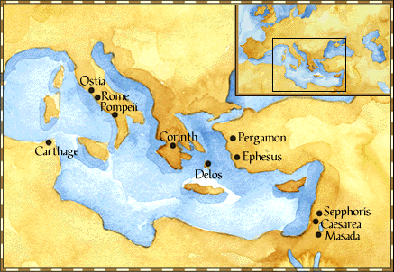
Paul: Map of His World.

Slide 18
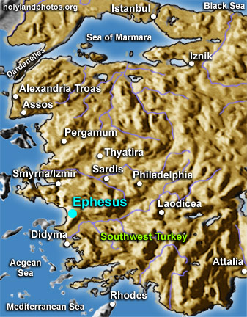

Slide 19
6. First Missionary Journey of Paul and Barnabas and the Jerusalem Conference (13.1-15.35) (contd.):
- The Jerusalem Conference held about A.D. 49 (Acts 15);
- Must a Gentile believer become a Jew ... to be a Christian?
- A division within the Church;
- The dispute settled in favor of uncircumcised Gentiles (15.28-29);
- The deciding voice is that of James (15.13-21).

Slide 20
6. First Missionary Journey of Paul and Barnabas and the Jerusalem Conference (13.1-15.35) (contd.):
- The Apostles and Elders required only limited Torah mandates of the Gentile Christians (15.13-21);
- requirements based on rules from Leviticus (Acts 15.13-21; Leviticus 17-18);
- Themes of unity and cooperation dominate … ;
- it is a unanimous decision and the “Whole Church” sends a delegation to Antioch to explain the Jerusalem Church’s decision (15.30-35);
- Actually, a decision of the Holy Spirit (15.22-29).

Slide 21
6. First Missionary Journey of Paul and Barnabas and the Jerusalem Conference (13.1-15.35) (contd.):
- Paul’s independence of the Apostolic Church (Gal 1.17, 18-19, 20; 2.1-10);
- Paul indicates that he was never under the jurisdiction of the Church’s leadership in Jerusalem (Gal 1.17, 18-19, 20; 2.1-10);
- See also 1 Cor 8.8; 10.27 relative to eating meat sacrificed to Greco-Roman gods.

Slide 22
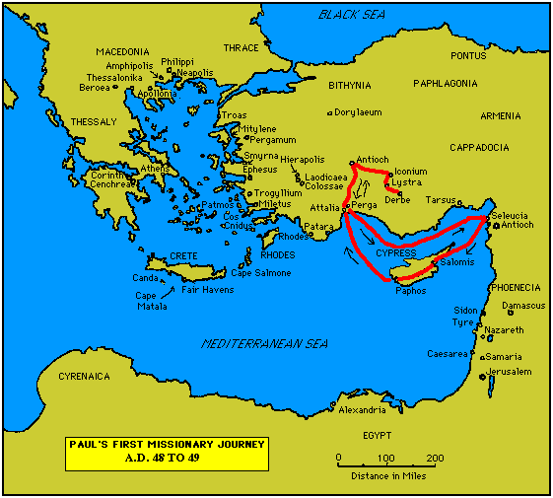

Slide 23
7. Paul’s Secondary Missionary Journey; Evangelizing Greece (16.1-18.21):
- Paul and Barnabas separate (15.39);
- Why the separation?
- Paul and Silas visit churches in Syria and Asia Minor (15.40-41);
- A vision directs Paul to Macedonia (15.40-16.10);
- Paul’s customary activity relative to the Jews and then being abused by them (16.11-17.15);

Slide 24
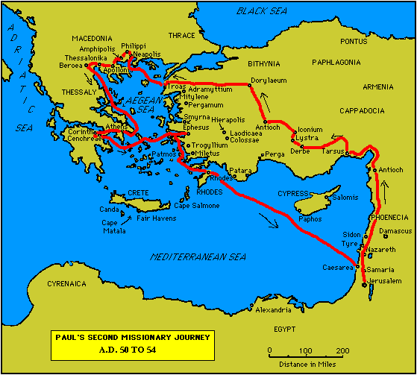

Slide 25
7. Paul’s Secondary Missionary Journey; Evangelizing Greece (16.1-18.21) (contd.):
- Paul in Philippi, Thessalonica, Beroea, and Athens;
- Paul speaks at the Areopagus in Athens (17.19-31);
- Paul at Corinth (18.1-17);

Slide 27
8. Paul’s Third Missionary Journey: Revisiting Asia Minor and Greece (18.22-20.38):
- Paul at Ephesus (18.19-21);
- Luke depicts Paul as determined to complete his last tour and head for the imperial capital, that is, Rome (19.21-22);
- Paul’s farewell speech at Miletus (20.17-38);
- See maps on the location of the major churches at the end of Paul’s ministry.

Slide 28
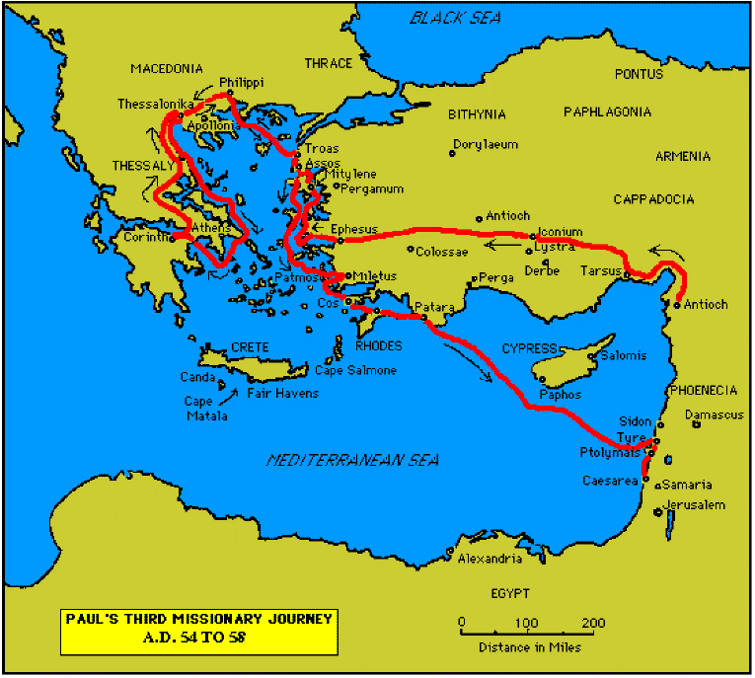

Slide 30
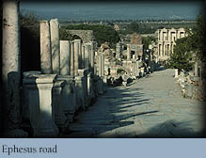

Slide 31
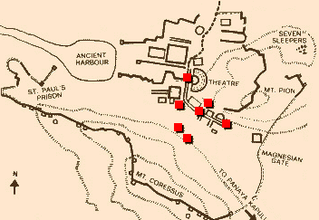
Ephesus: General View of the Ancient City.

Slide 32
9. Paul’s arrest in Jerusalem and imprisonment in Caesarea Maritime (21.1-26.32):
- Paul returns to Jerusalem (21.17) ... accused of blasphemy and profaning the Temple;
- When arrested, Paul claims that he is a Pharisee (21.27-23.10);
- Paul is imprisoned ... in Caesarea (23.33-26.32);
- he exercises his birthright as a Roman citizen (25.1-21);
- he defends himself (26.1-29);

Slide 33
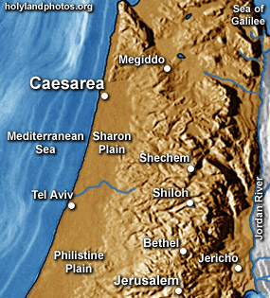

Slide 34
10. Paul’s Journey to Rome and His Preaching to Roman Jews (27.1-28.31):
- Paul’s sea journey to Rome... a shipwreck on the island of Malta (28.1 ) (see Map);
- the narrative in the first person plural, that is, “we”;
- Acts ends with Paul’s arrival in Rome (28.16);
- Paul is under house arrest but is free to preach (28.31);
- He continues to evangelize the Romans (28.23-31);
- We are not told of Paul’s fate.

Slide 35
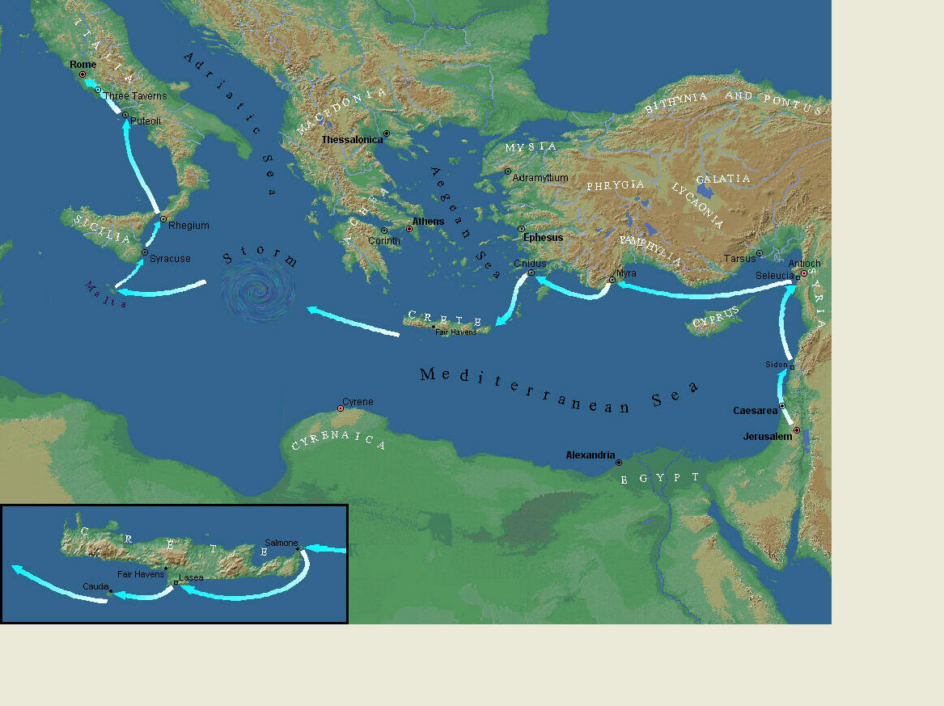
Paul’s Journey to Rome.

Slide 36
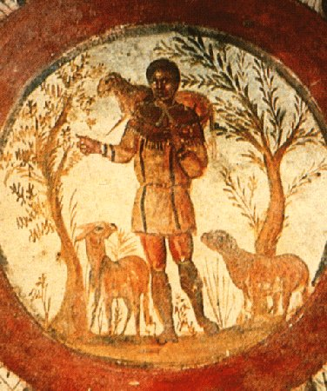
The Good Shepherd – in Catacombs of Rome.

Slide 37
10. Paul’s Journey to Rome and his Preaching to Roman Jews (27.1-28.31) (contd.):
- Luke has accomplished his task of tracing Christianity’s expansion from Jerusalem to “the ends of the earth” (1.8);
- Another theme emphasized: Paul and his successor evangelists will henceforth direct the Gospel primarily to Non-Jews, for “the Gentiles will listen” (28.28);
- Luke quotes from Isaiah 6 (see also Mark 4.10-13);
- Christianity’s future belongs to the Gentiles.

Slide 38
Basic Book Structure acts of the Apostles Centers around the great commission & Call To evangelize Then known world!

Slide 39
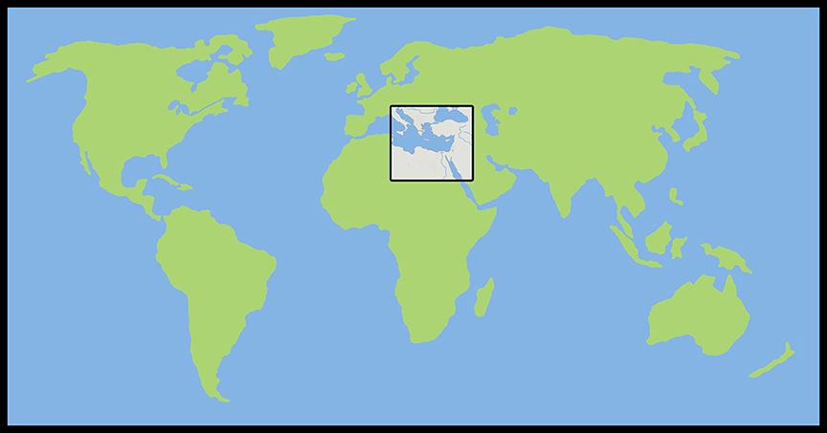
Where the Story takes Place

Slide 40
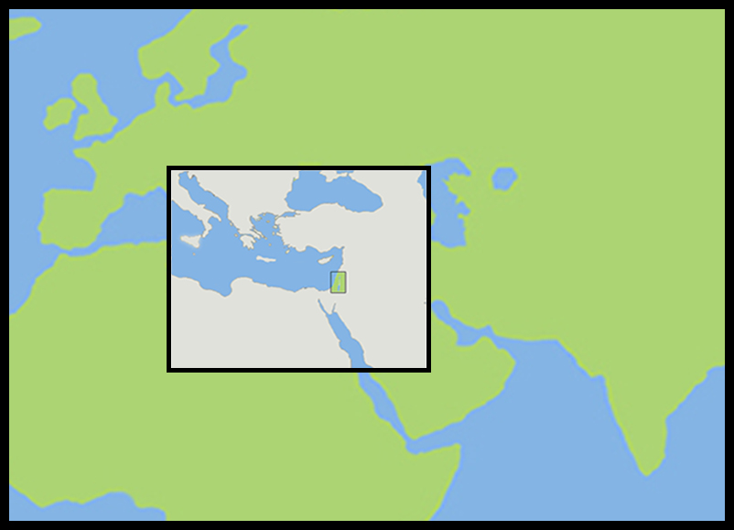
The Land of Canaan in the Near East

Slide 41
Acts 1:8 and the Great Commission
Acts 1:8 But ye shall receive power, after that the Holy Ghost is come upon you: and ye shall be witnesses unto me both in Jerusalem, and in all Judaea, and in Samaria, and unto the uttermost part of the earth.
Matthew 28:19-20 ¹⁹ Go ye therefore, and teach all nations, baptizing them in the name of the Father, and of the Son, and of the Holy Ghost: ²⁰ Teaching them to observe all things whatsoever I have commanded you: and, lo, I am with you alway, even unto the end of the world. Amen.
Mark 16:15 And he said unto them, Go ye into all the world, and preach the gospel to every creature.

Slide 42
Acts 1:8 and the Great Commission
Acts 1:8 But ye shall receive power, after that the Holy Ghost is come upon you: and ye shall be witnesses unto me both in Jerusalem, and in all Judaea, and in Samaria, and unto the uttermost part of the earth.
Matthew 28:19-20 ¹⁹ Go ye therefore, and teach all nations, baptizing them in the name of the Father, and of the Son, and of the Holy Ghost: ²⁰ Teaching them to observe all things whatsoever I have commanded you: and, lo, I am with you alway, even unto the end of the world. Amen.
Mark 16:15 And he said unto them, Go ye into all the world, and preach the gospel to every creature.

Slide 43
Acts 1:8 and the Great Commission
Acts 1:8 But ye shall receive power, after that the Holy Ghost is come upon you: and ye shall be witnesses unto me both in Jerusalem, and in all Judaea, and in Samaria, and unto the uttermost part of the earth.
Matthew 28:19-20 ¹⁹ Go ye therefore, and teach all nations, baptizing them in the name of the Father, and of the Son, and of the Holy Ghost: ²⁰ Teaching them to observe all things whatsoever I have commanded you: and, lo, I am with you alway, even unto the end of the world. Amen.
Mark 16:15 And he said unto them, Go ye into all the world, and preach the gospel to every creature.

Slide 44
Acts 1:8 and the Great Commission
Acts 1:8 But ye shall receive power, after that the Holy Ghost is come upon you: and ye shall be witnesses unto me both in Jerusalem, and in all Judaea, and in Samaria, and unto the uttermost part of the earth.
Matthew 28:19-20 ¹⁹ Go ye therefore, and teach all nations, baptizing them in the name of the Father, and of the Son, and of the Holy Ghost: ²⁰ Teaching them to observe all things whatsoever I have commanded you: and, lo, I am with you alway, even unto the end of the world. Amen.
Mark 16:15 And he said unto them, Go ye into all the world, and preach the gospel to every creature.

Slide 45
Acts 1:8 and the Structure of the Book
Acts 1:8 … ye shall be witnesses unto me both in Jerusalem, and in all Judaea, and in Samaria, and unto the uttermost part of the earth.
1. The witness in Jerusalem:
Chapters 1 to 7
2. The witness in Judaea and Samaria:
Chapters 8 to 12
3. The witness unto the uttermost parts of the earth:
Chapters 13 to 28

Slide 46
The Three Audiences
Part 1: The Jews
Part 2: The Samaritans
Part 3: The Gentiles

Slide 47
The Pillars of the Church
Part 1: Peter
Part 2: Peter and Paul (Saul of Tarsus)
Part 3: Paul

Slide 48
The Timeline
Part 1: 5 years (AD 30-35)
Part 2: 13 years (AD 35-48)
Part 3: 14 years (AD 48-62)
A total of 32 years, according to Nelson’s Complete Book of Bible Maps and Charts.

Slide 49
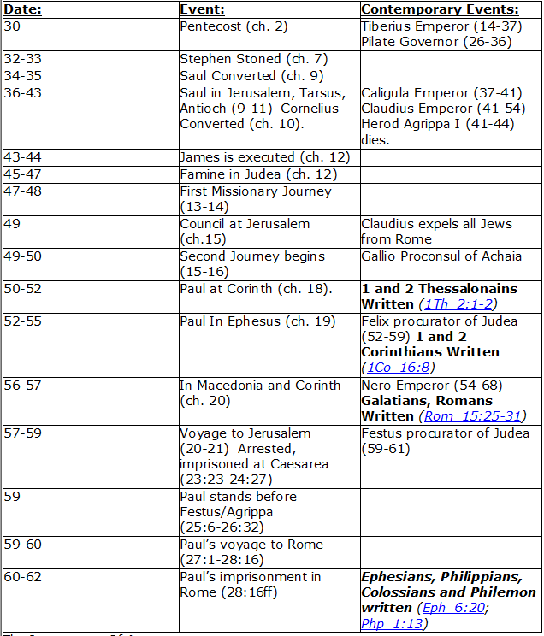
CHART BY
Mark Dunagan

Slide 50
PART ONE—The infancy of the church (the church in Jerusalem) (chapters 1–7)
(In this section, Jerusalem is the central city of Christianity and Peter is the most prominent person)
I. THE POST-RESURRECTION MINISTRY OF CHRIST (1:1–8)
II. THE ASCENSION OF CHRIST (1:9–11)
III. THE WAITING IN THE UPPER ROOM (1:12–26)
IV. THE ADVENT OF THE HOLY SPIRIT (2:1–41)
V. THE SNAPSHOT OF THE EARLY CHURCH (2:42–47)
VI. THE HEALING OF THE LAME MAN AND ITS CONSEQUENCES (3:1–4:31)
VII. THE DEATH OF ANANIAS AND SAPPHIRA AND ITS EFFECTS (4:32–5:42)
VIII. THE APPOINTMENT OF THE SEVEN (6:1–7)
IX. THE MINISTRY OF STEPHEN (6:8–7:60)
PART TWO—The adolescence of the church (the church in all Judea and In Samaria) (chapters 8–12)
(In this section, Jerusalem is gradually being replaced by Antioch as the central city of Christianity and Peter is gradually being replaced by Paul as the most prominent person)
I. THE FIRST MENTION OF PAUL (7:58; 8:1, 3)
II. THE PERSECUTION AND SCATTERING OF THE JERUSALEM CHURCH (8:1–4)
III. THE CONVERSION OF SAMARITANS (8:5–25)
IV. THE CONVERSION OF A JEWISH PROSELYTE (8:26–40)
V. THE CONVERSION OF SAUL (9:1–31)
VI. THE EXPANSION OF THE CHURCH IN WESTERN JUDEA (9:32–43)
VII. THE CONVERSION OF GENTILE GOD-FEARERS (chapter 10)
VIII. THE GROWING VISION OF THE JEWISH LEADERS (11:1–18)
IX. THE CONVERSION OF PAGAN GENTILES (11:19–26)
X. THE GROWING TIES BETWEEN JEWISH AND GENTILE CHRISTIANITY (11:27–30)
XI. THE COMPLETION OF THE TRANSITION (chapter 12)
PART THREE—The maturity of the church (the church in all the world) (chapters 13–28)
(In this section, Antioch is the central city of Christianity and Paul is the most prominent person)
I. PAUL’S CALL AT ANTIOCH TO HIS LIFE’S WORK (13:1–3)
II. PAUL’S FIRST MISSIONARY JOURNEY (13:4–14:27)
III. PAUL’S TWO YEARS BACK IN ANTIOCH (14:28–15:35)
IV. PAUL’S SECOND MISSIONARY JOURNEY (15:36–18:22)
V. PAUL’S THIRD MISSIONARY JOURNEY (18:23–21:16)
VI. PAUL’S ARREST AT JERUSALEM (21:17–23:35)
VII. PAUL’S TWO-YEARS’ IMPRISONMENT AT CAESAREA (chapters 24–26)
VIII. PAUL’S SHIPWRECK JOURNEY TO ROME (27:1–28:15)
IX. PAUL’S FIRST ROMAN IMPRISONMENT (28:16–31)
Gingrich, R. E. (2002). The Book of Acts (pp. 5–6). Memphis, TN: Riverside Printing.

Slide 51
L.D. CARY & SAM HOLT CATCH PHRASES
Chapter 19 – “10 + 9, Ephesus Time”
Chapter 20 – “Traveling A’Plenty”
Chapter 21 – “Confinement Begun”
Chapter 22 – “Before A Mob, Not A Few”
Chapter 23 – “Before The Council, You See”
Chapter 24 – “Felix Listens No More”
Chapter 25 – “Agrippa Arrives”
Chapter 26 – “Agrippa Realizes Paul’s Fix”
Chapter 27 – “Shipwreck & An Angel From Heaven”
Chapter 28 – “The End Of Our Wait”
“Before The Council, …You See”
Catch Phrase
Chapter Twenty-Three

Slide 52
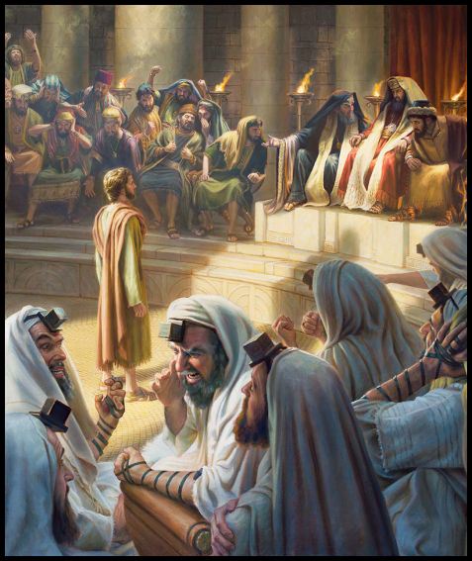
Acts 23:
¹ And Paul, earnestly beholding the council, said, Men and brethren, I have lived in all good conscience before God until this day.

Slide 53
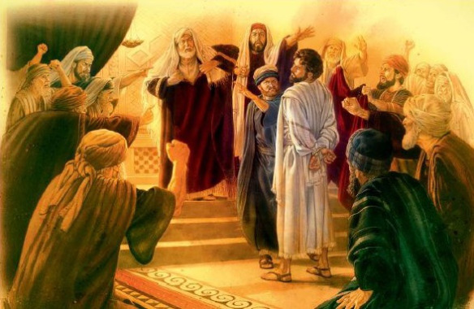
² And the high priest Ananias commanded them that stood by him to smite him on the mouth.

Slide 54
³ Then said Paul unto him, God shall smite thee, thou whited wall: for sittest thou to judge me after the law, and commandest me to be smitten contrary to the law?

Slide 55
³ Then said Paul unto him, God shall smite thee, thou whited wall: for sittest thou to judge me after the law, and commandest me to be smitten contrary to the law?
Matthew 23:27
Woe unto you, scribes and Pharisees, hypocrites! for ye are like unto whited sepulchres, which indeed appear beautiful outward, but are within full of dead men's bones, and of all uncleanness.

Slide 56
Exodus 22:28
Thou shalt not revile God, nor curse the ruler of thy people.
These are judges and magistrates.
1 Corinthians 8:5
For though there be that are so-called gods, whether in heaven or earth, (as there be many, and lords many.)
⁴ And they that stood by said, Revilest thou God's high priest?
⁵ Then said Paul, I wist not, brethren, that he was the high priest: for it is written, Thou shalt not speak evil of the ruler of thy people.

Slide 57
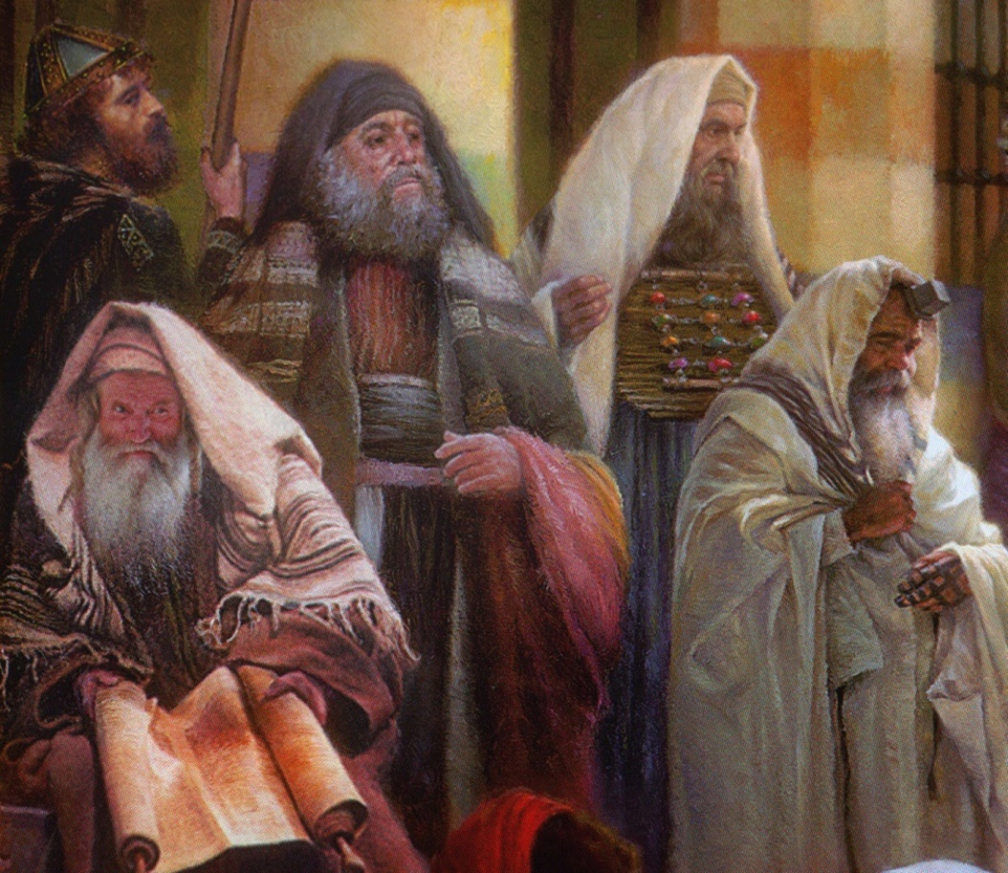
⁶ But when Paul perceived that the one part were Sadducees, and the other Pharisees, he cried out in the council, Men and brethren, I am a Pharisee, the son of a Pharisee: of the hope and resurrection of the dead I am called in question.
⁷ And when he had so said, there arose a dissension between the Pharisees and the Sadducees: and the multitude was divided.
⁸ For the Sadducees say that there is no resurrection, neither angel, nor spirit: but the Pharisees confess both.

Slide 58
⁹ And there arose a great cry: and the scribes that were of the Pharisees' part arose, and strove, saying, We find no evil in this man: but if a spirit or an angel hath spoken to him, let us not fight against God.
¹⁰ And when there arose a great dissension, the chief captain, fearing lest Paul should have been pulled in pieces of them, commanded the soldiers to go down, and to take him by force from among them, and to bring him into the castle.

Slide 59
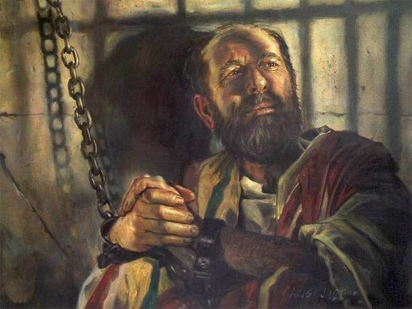
¹¹ And the night following the Lord stood by him, and said, Be of good cheer, Paul: for as thou hast testified of me in Jerusalem, so must thou bear witness also at Rome.

Slide 60
Did Paul disobey God by going to Jerusalem?
1) HIS INNER WITNESS
Acts 19:21
After these things were ended, Paul purposed in the spirit, when he had passed through Macedonia and Achaia, to go to Jerusalem, saying, After I have been there, I must also see Rome.
Acts 20:22-23
²² And now, behold, I go bound in the spirit unto Jerusalem, not knowing the things that shall befall me there:
²³ Save that the Holy Ghost witnesseth in every city, saying that bonds and afflictions abide me.

Slide 61
Did Paul disobey God by going to Jerusalem?
THE WITNESS OF OTHERS
Acts 21:11
And when he [Agabus] was come unto us, he took Paul's girdle, and bound his own hands and feet, and said, Thus saith the Holy Ghost, So shall the Jews at Jerusalem bind the man that owneth this girdle, and shall deliver him into the hands of the Gentiles.
Acts 21:12 and 14
¹² And when we [his friends and traveling companions] heard these things, both we, and they of that place, besought him not to go up to Jerusalem.
¹⁴ And when he would not be persuaded, we ceased [trying to dissuade him], saying, The will of the Lord be done.

Slide 62
Did Paul disobey God by going to Jerusalem?
THE WITNESS OF CHRIST
Acts 23:11 …Be of good cheer, Paul: for as thou hast testified of me in Jerusalem, so must thou bear witness also at Rome.
See how this agrees with Paul’s own witness:
Acts 19:21
…Paul purposed in the spirit …to go to Jerusalem, saying, After I have been there, I must also see Rome.
The Lord does not commend those who disobey him.

Slide 63
Did Paul disobey God by going to Jerusalem?
THE ONE “PROBLEM” VERSE
Acts 21:4-5
⁴ And finding disciples, we tarried there seven days: who said to Paul through the Spirit, that he should not go up to Jerusalem.
But it is not a problem when read in conjunction with the verse that follows:
⁵ And when we had accomplished those days [the seven days of tarrying], we departed and went our way...
This change in schedule put them in sync to rendezvous with Agabus

Slide 64
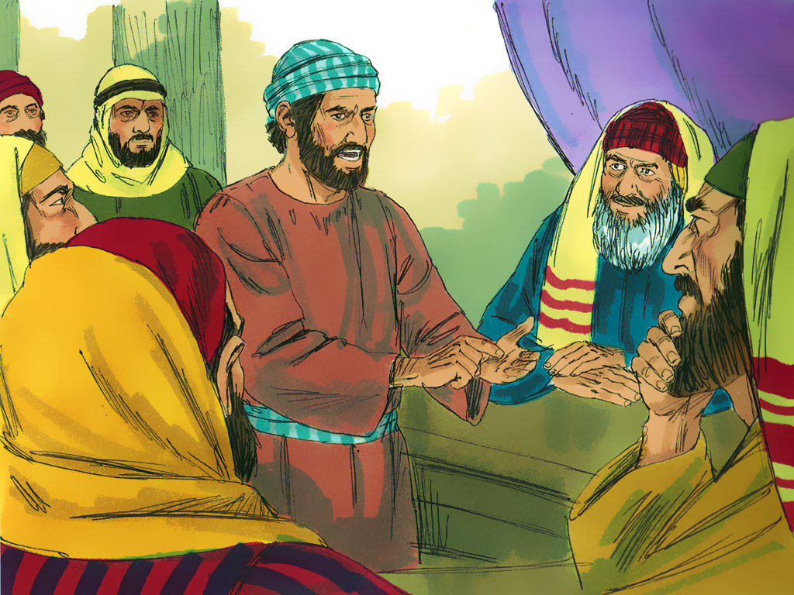
¹² And when it was day, certain of the Jews banded together, and bound themselves under a curse, saying that they would neither eat nor drink till they had killed Paul.
¹³ And they were more than forty which had made this conspiracy.

Slide 65
¹⁴ And they came to the chief priests and elders, and said, We have bound ourselves under a great curse, that we will eat nothing until we have slain Paul.
¹⁵ Now therefore ye with the council signify to the chief captain that he bring him down unto you to morrow, as though ye would enquire something more perfectly concerning him: and we, or ever he come near, are ready to kill him.

Slide 66
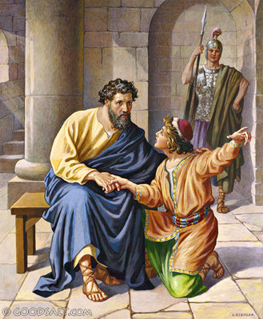
¹⁶ And when Paul's sister's son heard of their lying in wait, he went and entered into the castle, and told Paul.
¹⁷ Then Paul called one of the centurions unto him, and said, Bring this young man unto the chief captain: for he hath a certain thing to tell him.

Slide 67
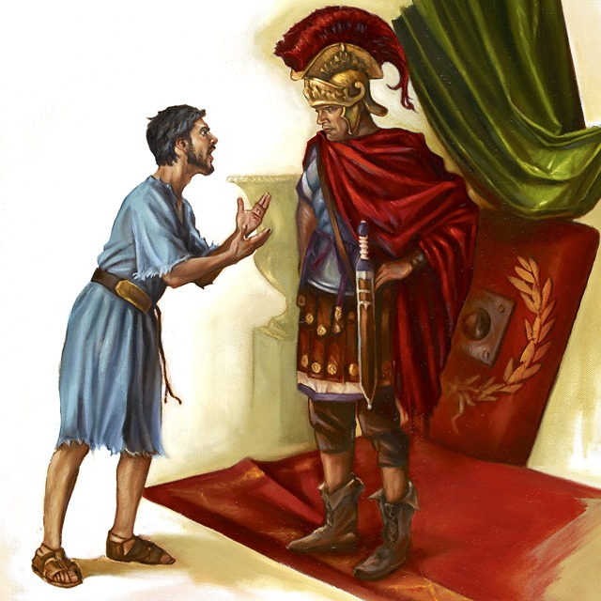
¹⁸ So he took him, and brought him to the chief captain, and said, Paul the prisoner called me unto him, and prayed me to bring this young man unto thee, who hath something to say unto thee.
¹⁹ Then the chief captain took him by the hand, and went with him aside privately, and asked him, What is that thou hast to tell me?
²⁰ And he said, The Jews have agreed to desire thee that thou wouldest bring down Paul to morrow into the council, as though they would enquire somewhat of him more perfectly.

Slide 68
²¹ But do not thou yield unto them: for there lie in wait for him of them more than forty men, which have bound themselves with an oath, that they will neither eat nor drink till they have killed him: and now are they ready, looking for a promise from thee.
²² So the chief captain then let the young man depart, and charged him, See thou tell no man that thou hast shewed these things to me.

Slide 69
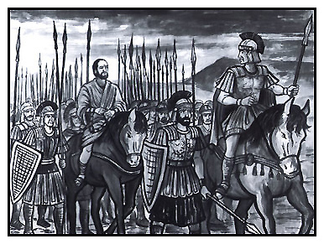
²³ And he called unto him two centurions, saying, Make ready two hundred soldiers to go to Caesarea, and horsemen threescore and ten, and spearmen two hundred, at the third hour of the night;
²⁴ And provide them beasts, that they may set Paul on, and bring him safe unto Felix the governor.
²⁵ And he wrote a letter after this manner:

Slide 70
²⁶ Claudius Lysias unto the most excellent governor Felix sendeth greeting.
²⁷ This man was taken of the Jews, and should have been killed of them: then came I with an army, and rescued him, having understood that he was a Roman. [This is not exactly true!]
²⁸ And when I would have known the cause wherefore they accused him, I brought him forth into their council:
²⁹ Whom I perceived to be accused of questions of their law, but to have nothing laid to his charge worthy of death or of bonds.
³⁰ And when it was told me how that the Jews laid wait for the man, I sent straightway to thee, and gave commandment to his accusers also to say before thee what they had against him. Farewell.

Slide 71
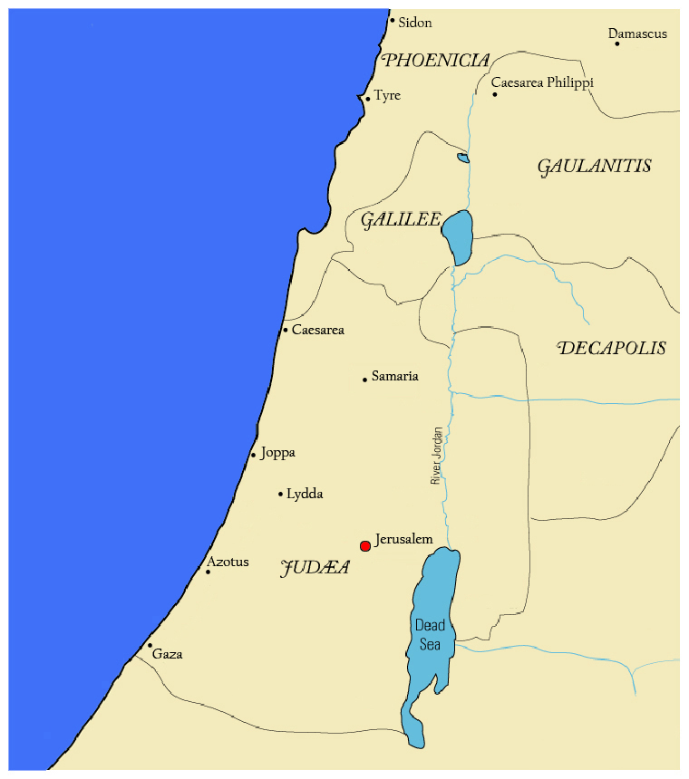
³¹ Then the soldiers, as it was commanded them, took Paul, and brought him by night to Antipatris.

Slide 72
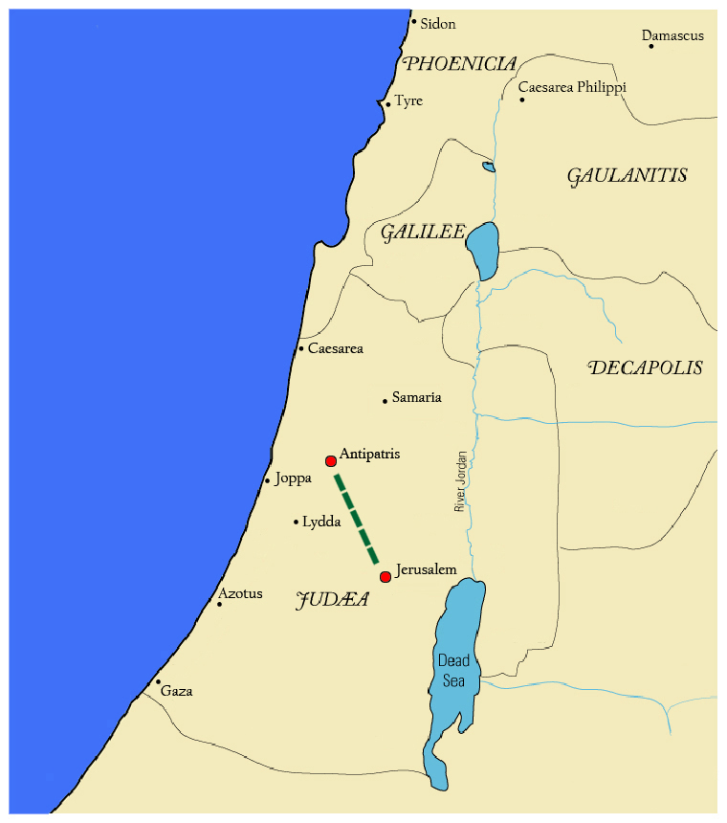
³¹ Then the soldiers, as it was commanded them, took Paul, and brought him by night to Antipatris.
³² On the morrow they left the horsemen to go with him, and returned to the castle:
³³ Who, when they came to Caesarea,

Slide 73
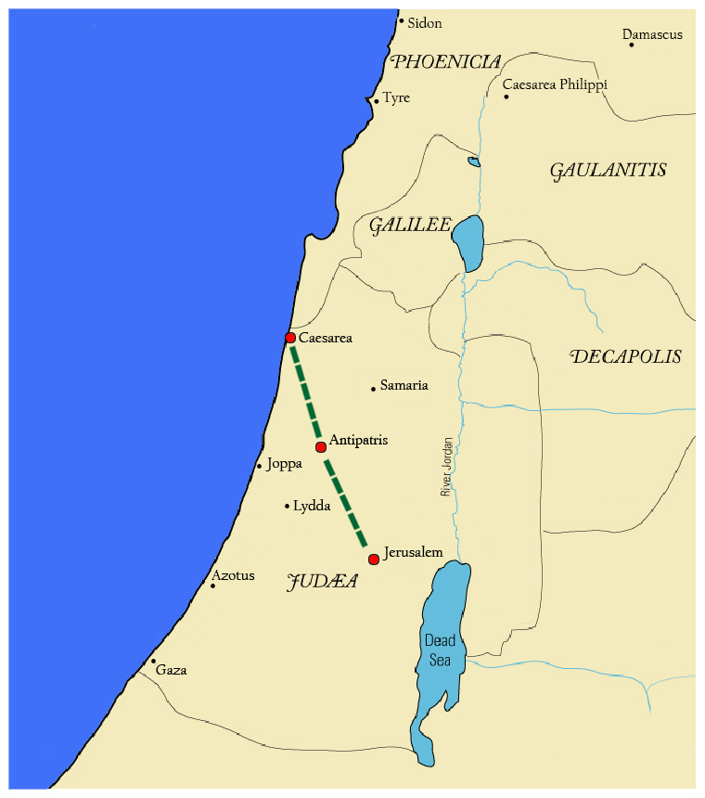
³¹ Then the soldiers, as it was commanded them, took Paul, and brought him by night to Antipatris.
³² On the morrow they left the horsemen to go with him, and returned to the castle:
³³ Who, when they came to Caesarea,
and delivered the epistle to the governor, presented Paul also before him.

Slide 75
In Caesarea

Slide 76
Acts 23:33 to 26:32

Slide 77
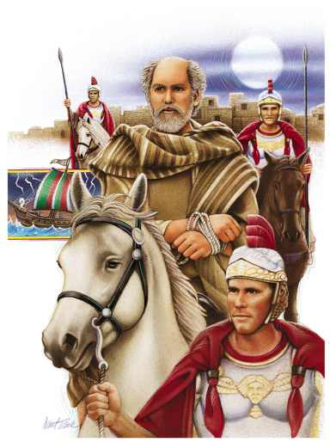
Acts 23
³¹ Then the soldiers, as it was commanded them, took Paul, and brought him by night to Antipatris.
³² On the morrow they left the horsemen to go with him, and returned to the castle:
³³ Who, when they came to Caesarea, and delivered the letter to the governor, presented Paul also before him.
Notes:
31: An ti PA tris or An-tip'-a-triss

Slide 78
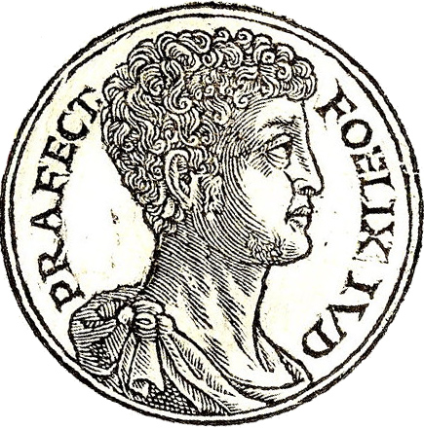
³⁴ And when the governor had read the letter, he asked of what province he was. And when he understood that he was of Cilicia;
³⁵ I will hear thee, said he, when thine accusers are also come.
And he commanded him to be kept in Herod's judgment hall.
Antonius Felix Claudius Caesar made him governor
of Judaea in AD 53.
Notes:
34: Ci LI shi a

Slide 79
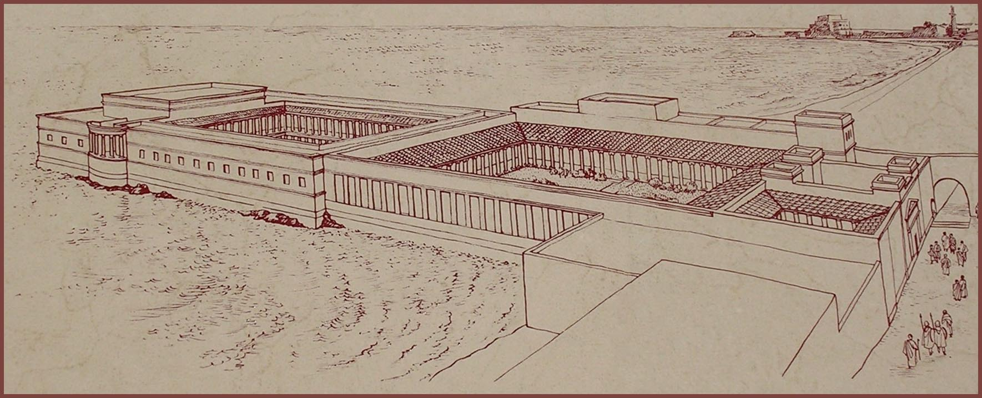
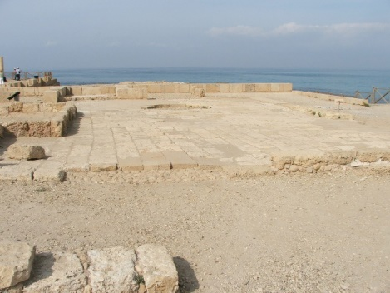
The Judgment Hall or Praetorium was the headquarters of the Roman military governor.
Notes:
pray TOR i um

Slide 80
L.D. CARY & SAM HOLT CATCH PHRASES
Chapter 19 – “10 + 9, Ephesus Time”
Chapter 20 – “Traveling A’Plenty”
Chapter 21 – “Confinement Begun”
Chapter 22 – “Before A Mob, Not A Few”
Chapter 23 – “Before The Council, You See”
Chapter 24 – “Felix Listens No More”
Chapter 25 – “Agrippa Arrives”
Chapter 26 – “Agrippa Realizes Paul’s Fix”
Chapter 27 – “Shipwreck & An Angel From Heaven”
Chapter 28 – “The End Of Our Wait”
“Felix Listens No More”
Catch Phrase
Chapter Twenty-Four

Slide 81
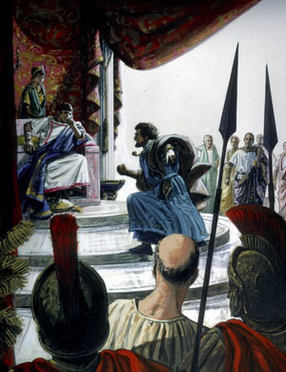
Acts 24
¹ And after five days Ananias the high priest descended with the elders, and with a certain orator named Tertullus, who informed the governor against Paul.
² And when he was called forth, Tertullus began to accuse him, saying,
Seeing that by thee we enjoy great quietness, and that very worthy deeds are done unto this nation by thy providence,
³ We accept it always, and in all places, most noble Felix, with all thankfulness.
⁴ Notwithstanding, that I be not further tedious unto thee, I pray thee that thou wouldest hear us of thy clemency a few words.
Notes:
1. Ter TUL lus

Slide 82
⁵ For we have found this man a pestilent fellow, and a mover of sedition among all the Jews throughout the world, and a ringleader of the sect of the Nazarenes:
Notes:
1. Ter TUL lus

Slide 83
⁵ For we have found this man a pestilent fellow, and a mover of sedition among all the Jews throughout the world, and a ringleader of the sect of the Nazarenes:
The Jews would not call them Christians as that was derived from the word for Messiah; so Tertullus was instructed to call them Nazarenes.
(Companion Bible)
Notes:
1. Ter TUL lus

Slide 84
⁵ For we have found this man a pestilent fellow, and a mover of sedition among all the Jews throughout the world, and a ringleader of the sect of the Nazarenes:
⁶ Who also hath gone about to profane the temple: whom we took, and would have judged according to our law.
⁷ But the chief captain Lysias came upon us, and with great violence took him away out of our hands,
⁸ Commanding his accusers to come unto thee: by examining of whom thyself mayest take knowledge of all these things, whereof we accuse him.
⁹ And the Jews also assented, saying that these things were so.
Notes:
1. Ter TUL lus

Slide 85
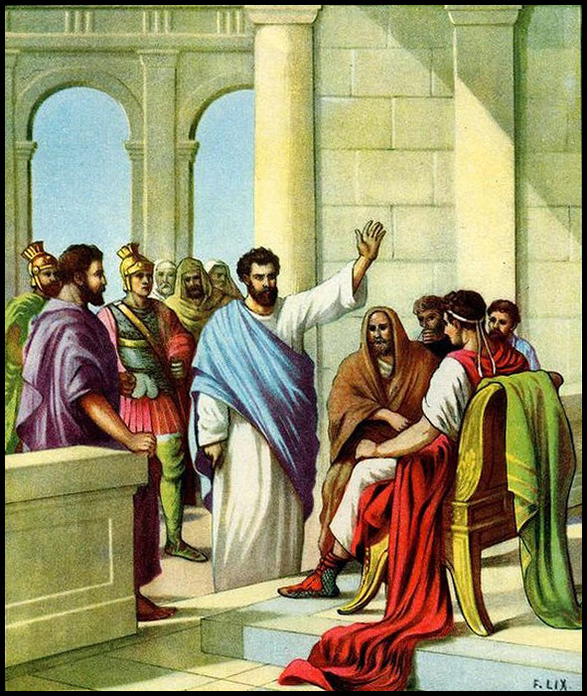
¹⁰ Then Paul, after that the governor had beckoned unto him to speak, answered,
Forasmuch as I know that thou hast been of many years a judge unto this nation, I do the more cheerfully answer for myself:
¹¹ Because that thou mayest understand, that there are yet but twelve days since I went up to Jerusalem for to worship.
¹² And they neither found me in the temple disputing with any man, neither raising up the people, neither in the synagogues, nor in the city:
¹³ Neither can they prove the things whereof they now accuse me.

Slide 86
¹⁴ But this I confess unto thee, that after the way which they call heresy, so worship I the God of my fathers, believing all things which are written in the law and in the prophets:
¹⁵ And have hope toward God, which they themselves also allow, that there shall be a resurrection of the dead, both of the just and unjust.
¹⁶ And herein do I exercise myself, to have always a conscience void of offence toward God, and toward men.

Slide 87
¹⁷ Now after many years I came to bring alms to my nation, and offerings.
¹⁸ Whereupon certain Jews from Asia found me purified in the temple, neither with multitude, nor with tumult.
¹⁹ Who ought to have been here before thee, and object, if they had ought against me.
²⁰ Or else let these same here say, if they have found any evil doing in me, while I stood before the council,
²¹ Except it be for this one voice, that I cried standing among them, Touching the resurrection of the dead I am called in question by you this day.

Slide 88
²² And when Felix heard these things, having more perfect knowledge of that way, he deferred them, and said,
When Lysias the chief captain shall come down, I will know the uttermost of your matter.
²³ And he commanded a centurion to keep Paul, and to let him have liberty, and that he should forbid none of his acquaintance to minister or come unto him.
Felix knew more about Christianity than they realized.
The Roman centurion Cornelius – who came to Christ through the ministry of Peter – also lived in Caesarea.
It is possible that from him and others Felix concluded that Christianity was not such an evil thing as was being told him.

Slide 89
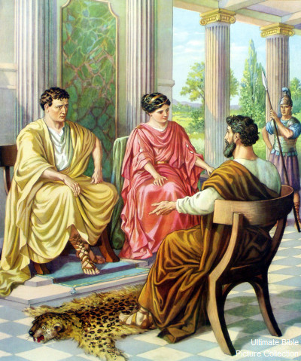
²⁴ And after certain days, when Felix came with his wife Drusilla, which was a Jewess, he sent for Paul, and heard him concerning the faith in Christ.

Slide 90
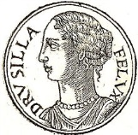
²⁴ And after certain days, when Felix came with his wife Drusilla, which was a Jewess, he sent for Paul, and heard him concerning the faith in Christ.
Drusilla was the daughter of Herod Agrippa.
She died in the eruption of Mount Vesuvius that destroyed Pompeii in AD 79.

Slide 91
²⁵ And as he reasoned of righteousness, temperance, and judgment to come, Felix trembled, and answered, Go thy way for this time; when I have a convenient season, I will call for thee.
²⁶ He hoped also that money should have been given him of Paul, that he might loose him: wherefore he sent for him the oftener, and communed with him.
²⁷ But after two years Porcius Festus succeeded Felix: and Felix, willing to shew the Jews a pleasure, left Paul bound.

Slide 92
L.D. CARY & SAM HOLT CATCH PHRASES
Chapter 19 – “10 + 9, Ephesus Time”
Chapter 20 – “Traveling A’Plenty”
Chapter 21 – “Confinement Begun”
Chapter 22 – “Before A Mob, Not A Few”
Chapter 23 – “Before The Council, You See”
Chapter 24 – “Felix Listens No More”
Chapter 25 – “Agrippa Arrives”
Chapter 26 – “Agrippa Realizes Paul’s Fix”
Chapter 27 – “Shipwreck & An Angel From Heaven”
Chapter 28 – “The End Of Our Wait”
“Agrippa Arrives”
Catch Phrase
Chapter Twenty-Five

Slide 93
Acts 25:
¹ Now when Festus was come into the province, after three days he ascended from Caesarea to Jerusalem.
² Then the high priest and the chief of the Jews informed him against Paul, and besought him,
³ And desired favour against him, that he would send for him to Jerusalem, laying wait in the way to kill him.
⁴ But Festus answered, that Paul should be kept at Caesarea, and that he himself would depart shortly thither.
⁵ Let them therefore, said he, which among you are able, go down with me, and accuse this man, if there be any wickedness in him.
⁶ And when he had tarried among them more than ten days, he went down unto Caesarea; and the next day sitting on the judgment seat commanded Paul to be brought.

Slide 94
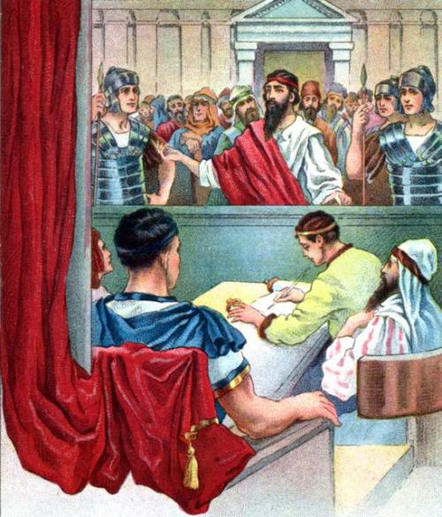
⁷ And when he was come, the Jews which came down from Jerusalem stood round about,
and laid many and grievous complaints against Paul, which they could not prove.
⁸ While he answered for himself, Neither against the law of the Jews, neither against the temple, nor yet against Caesar, have I offended any thing at all.
⁹ But Festus, willing to do the Jews a pleasure, answered Paul, and said, Wilt thou go up to Jerusalem, and there be judged of these things before me?

Slide 95
¹⁰ Then said Paul, I stand at Caesar's judgment seat, where I ought to be judged: to the Jews have I done no wrong, as thou very well knowest.
¹¹ For if I be an offender, or have committed anything worthy of death, I refuse not to die:
but if there be none of these things whereof these accuse me, no man may deliver me unto them.
I appeal unto Caesar.
¹² Then Festus, when he had conferred with the council, answered, Hast thou appealed unto Caesar? unto Caesar shalt thou go.

Slide 96
Paul's Arrest and Imprisonment - Part 2
Acts 23:12-25:12

Slide 97
Outline - Acts
II. The Ministry of Paul – Acts 13:1-28:31
Paul’s 1st Missionary Journey – Acts 13:1-15:35
Paul’s 2nd Missionary Journey – Acts 15:36-18:22
Paul’s 3rd Missionary Journey – Acts 18:23-21:14
Paul’s Arrest - 1 – Acts 21:15-23:11
Paul’s Arrest - 2 – Acts 23:12-25:12
Paul’s Arrest - 3 – Acts 25:13-26:32
Paul’s Journey to Rome – Acts 27:1-28:31

Slide 98
¹² When it was day, the Jews formed a conspiracy and bound themselves under an oath, saying that they would neither eat nor drink until they had killed Paul. ¹³ There were more than forty who formed this plot.
- Acts 23:12-13

Slide 99
¹⁴ They came to the chief priests and the elders and said, “We have bound ourselves under a solemn oath to taste nothing until we have killed Paul. ¹⁵ Now therefore, you and the Council notify the commander to bring him down to you, as though you were going to determine his case by a more thorough investigation; and we for our part are ready to slay him before he comes near the place.”
- Acts 23:14-15

Slide 100
CHAPTER 23 J. W. McGarvey’s Acts Commentary
VERSES 12 - 16
It is difficult for a conspiracy for this kind, requiring the consultation of so many persons, to be concocted and executed with perfect secrecy. Especially is it so when the intended victim is one about whom the whole community is, at the time, intensely excited. It is not at all surprising, therefore, that some of Paul’s many friends heard of it, and that his nephew undertook the dangerous task of communicating it to him. He at once saw, that, notwithstanding the assurance of safety given the night before, the danger of his situation was more alarming than ever. The chiliarch could not well refuse to grant so reasonable a request; and if it is granted, his doom is sealed. If the Pharisees who had befriended him in the Sanhedrim hadn’t become indifferent to his fate, they had rather been outwitted, so that the Sadducees were about to make the request in the name of the whole Sanhedrim without consulting them.
McGarvey, J. W. (1872). A commentary on Acts of Apostles (p. 268). Lexington, KY: Transylvania Printing and Publishing Co.

Slide 101
¹⁶ But the son of Paul’s sister heard of their ambush, and he came and entered the barracks and told Paul. ¹⁷ Paul called one of the centurions to him and said, “Lead this young man to the commander, for he has something to report to him.” ¹⁸ So he took him and led him to the commander and said, “Paul the prisoner called me to him and asked me to lead this young man to you since he has something to tell you.”
- Acts 23:16-18

Slide 102
¹⁹ The commander took him by the hand and stepping aside, began to inquire of him privately, “What is it that you have to report to me?” ²⁰ And he said, “The Jews have agreed to ask you to bring Paul down tomorrow to the Council, as though they were going to inquire somewhat more thoroughly about him.
- Acts 23:19-20

Slide 103
²¹ So do not listen to them, for more than forty of them are lying in wait for him who have bound themselves under a curse not to eat or drink until they slay him; and now they are ready and waiting for the promise from you.” ²² So the commander let the young man go, instructing him, “Tell no one that you have notified me of these things.”
- Acts 23:21-22

Slide 104
Paul was a Threat:
Appealed to all Jews

Slide 105
Paul was a Threat:
Appealed to all Jews
Good Debater

Slide 106
Paul was a Threat:
Appealed to all Jews
Good Debater
Well Known

Slide 107
Paul was a Threat:
Appealed to all Jews
Good Debater
Well Known
Holy Life, Spiritually Powerful

Slide 108
Paul was a Threat:
Appealed to all Jews
Good Debater
Well Known
Holy Life, Spiritually Powerful
Roman Citizen

Slide 109
Paul was a Threat:
Appealed to all Jews
Good Debater
Well Known
Holy Life, Spiritually Powerful
Roman Citizen
Accepted as an Apostle

Slide 110
Paul was a Threat:
Appealed to all Jews
Good Debater
Well Known
Holy Life, Spiritually Powerful
Roman Citizen
Accepted as an Apostle
He Appealed to Gentiles

Slide 111
There is neither Jew nor Greek, there is neither slave nor free man, there is neither male nor female; for you are all one in Christ Jesus.
- Galatians 3:28

Slide 112
And he called to him two of the centurions and said, “Get two hundred soldiers ready by the third hour of the night to proceed to Caesarea, with seventy horsemen and two hundred spearmen.”
- Acts 23:23

Slide 113
²⁴ They were also to provide mounts to put Paul on and bring him safely to Felix the governor. ²⁵ And he wrote a letter having this form:
- Acts 23:24-25

Slide 114
²⁶ “Claudius Lysias, to the most excellent governor Felix, greetings. ²⁷ “When this man was arrested by the Jews and was about to be slain by them, I came up to them with the troops and rescued him, having learned that he was a Roman.
- Acts 23:26-27

Slide 115
²⁸ “And wanting to ascertain the charge for which they were accusing him, I brought him down to their Council; ²⁹ and I found him to be accused over questions about their Law, but under no accusation deserving death or imprisonment.
- Acts 23:28-29

Slide 116
“When I was informed that there would be a plot against the man, I sent him to you at once, also instructing his accusers to bring charges against him before you.”
- Acts 23:30

Slide 117
CHAPTER 23 J. W. McGarvey’s Acts Commentary
VERSES 23 - 30
There were at least three lines of policy between which the chiliarch could have chosen. If he had been disposed to gratify the Jews, he might have given Paul up to their malice, without probability of being known to his superiors as accessory to the murder. If he had preferred to defy their power, and display his own, he might have sent him down to the Sanhedrim under a strong guard. Or if he desired to protect Paul, yet to avoid giving unnecessary offense to the Jews, he might send him away that night before their request was laid before him. It reflects credit upon his character that he chose the course which both justice and prudence dictated.
McGarvey, J. W. (1872). A commentary on Acts of Apostles (p. 269). Lexington, KY: Transylvania Printing and Publishing Co.

Slide 118
CHAPTER 23 J. W. McGarvey’s Acts Commentary
VERSES 23 - 30
But for one misrepresentation in this letter, there would be nothing discreditable to Lysias in this whole affair. He had acted like a just and prudent man in managing a difficult case; but in reporting to his superior, he so states the facts as to give himself credit to which he was not entitled. He states that his first rescue of Paul was prompted by the fact that he was a Roman citizen; whereas, in truth, he knew nothing of Paul’s citizenship till after he had seized him and had prepared to scourge him. Thus a motive was claimed which wasn’t real and a fault which he committed was suppressed. When we remember, however, that it is a common fault with military commanders to make the most favorable reports of their achievements, we are not disposed to give Lysias a low rank among his compeers for veracity.
McGarvey, J. W. (1872). A commentary on Acts of Apostles (pp. 269–270). Lexington, KY: Transylvania Printing and Publishing Co.

Slide 119
CHAPTER 23 J. W. McGarvey’s Acts Commentary
VERSES 23 - 30
The statement that he had commanded Paul’s accusers to say before Felix what they had against him, was not strictly true; for, at the time of writing, he had given no such command. But it was not intended to deceive the governor; for he intended to issue the order before the letter could be received. When this order was issued, the Jews were bitterly disappointed, and the forty conspirators had a prospect of a good long fast. They naturally felt some ill-will toward Lysias, as we shall see manifested hereafter, for snatching their victim out of their hands.
McGarvey, J. W. (1872). A commentary on Acts of Apostles (p. 270). Lexington, KY: Transylvania Printing and Publishing Co.

Slide 120
CHAPTER 23 J. W. McGarvey’s Acts Commentary
VERSES 23 - 30
The letter also shows, though Lysias could not understand the exact nature of the charges against Paul, he knew that they had reference to the Jewish law, and was satisfied that what they accused him of was not worthy either of death or of imprisonment. Under this conviction, if he had not been constrained to send him away because of safety, he would, probably, have released him.
McGarvey, J. W. (1872). A commentary on Acts of Apostles (p. 270). Lexington, KY: Transylvania Printing and Publishing Co.

Slide 121
³¹ So the soldiers, in accordance with their orders, took Paul and brought him by night to Antipatris. ³² But the next day, leaving the horsemen to go on with him, they returned to the barracks. ³³ When these had come to Caesarea and delivered the letter to the governor, they also presented Paul to him.
- Acts 23:31-33

Slide 122
CHAPTER 23 J. W. McGarvey’s Acts Commentary
VERSES 31 - 35
This incident in Paul’s history has been made to bear a part in the controversy as to whether military service is compatible with Christianity. It is urged that Paul could not consistently accept the services of an army of four hundred and seventy men to protect his life from a Jewish mob, unless he acknowledged the rightfulness of military service. But the facts in the case are not suitable to the argument. He did not, in the exercise of his freedom, voluntarily call for military interference; but the military had already interfered, without consulting his wishes, and taken violent possession of him; and his request was, that they should exercise the power which they had chosen to assume, for his safety rather than for his destruction. If a man were confined within the den of a gang of robbers, he might, with all propriety, request them to keep him out of the reach of another gang who were seeking his life. Such a request would be no more an indorsement of highway robbery than Paul’s request, expressed through his nephew, was an indorsement of military service. There is not an instance on record in which the apostles ever called for military interference in their times of suffering and persecution.
McGarvey, J. W. (1872). A commentary on Acts of Apostles (pp. 270–271). Lexington, KY: Transylvania Printing and Publishing Co.

Slide 123
³⁴ When he had read it, he asked from what province he was, and when he learned that he was from Cilicia, ³⁵ he said, “I will give you a hearing after your accusers arrive also,” giving orders for him to be kept in Herod’s Praetorium.
- Acts 23:34-35

Slide 124
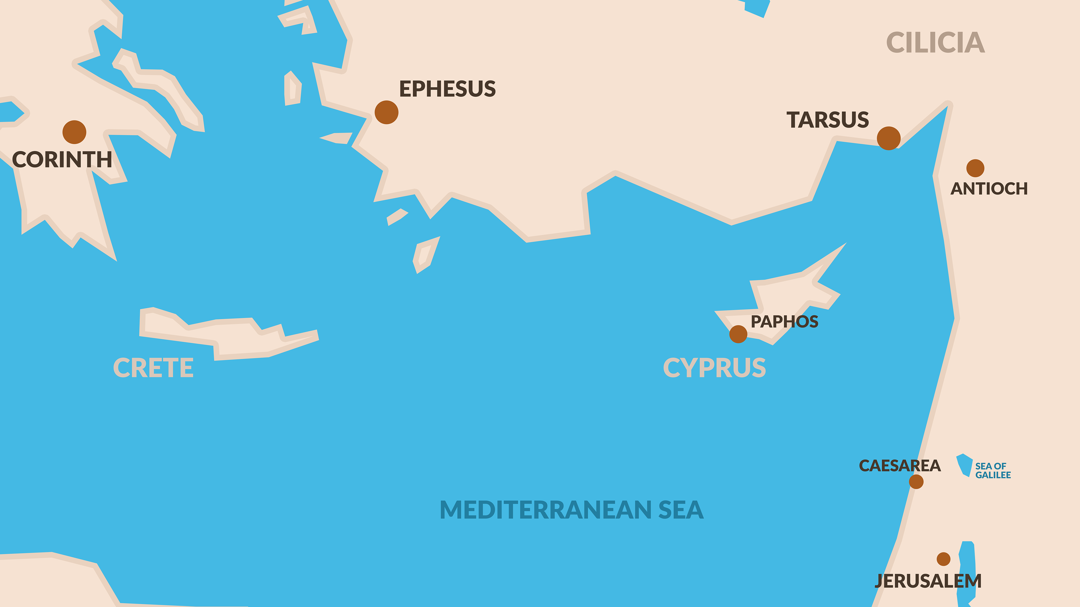

Slide 125
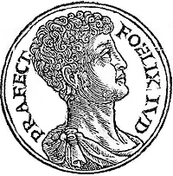
KING FELIX RULED 52-58AD

Slide 126
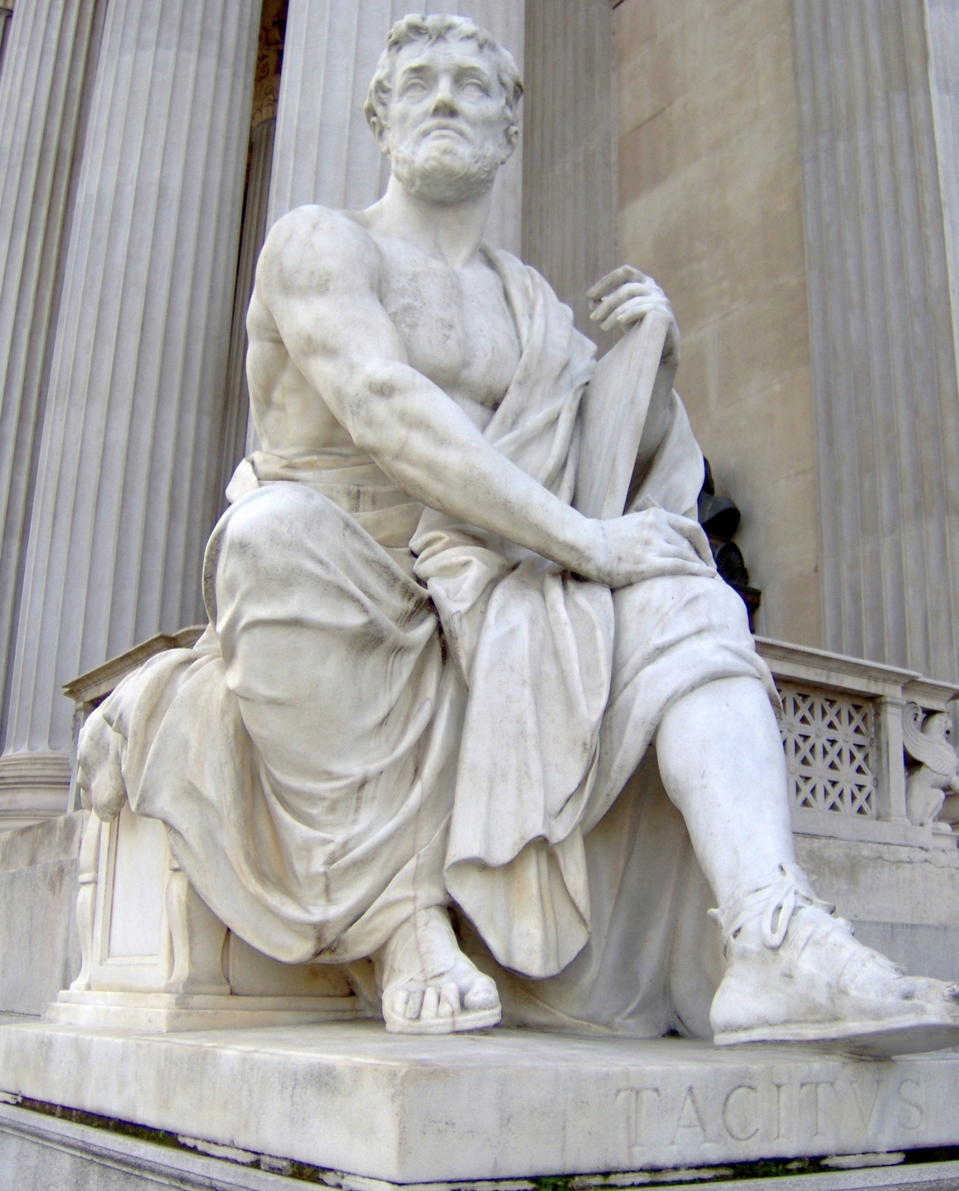
TACITUS ROMAN HISTORIAN

Slide 127
Three Charges Against Paul
Caused Dissention
Led a Renegade Sect
Desecrated the Temple

Slide 128
CHAPTER 24 J. W. McGarvey’s Acts Commentary
VERSES 2 - 9
The complimentary words with which this speech is introduced were not undeserved by Felix; for he had restored tranquility to the country, when it was disturbed, first by hordes of robbers; afterward by organized bands of Assassins, and more recently, by that Egyptian for whom Lysias at first mistook Paul. In suppressing all these disturbances, his administration had been prosperous.
The accusation against Paul, sustained by the testimony of the Jews, contained three specifications. It charged him, first, with exciting the Jews to sedition; second, with being the ringleader of the sect of Nazarenes; third, with profaning of the temple. Tertullus also took occasion to vent his indignation against Lysias, for interfering by violence, as he falsely alleged against him, with the judicial proceedings of the Sanhedrin. Finally, he asserts that Felix would be able, if he would examine Lysias, to gain from his lips a knowledge of all of which they were now informing him.
McGarvey, J. W. (1872). A commentary on Acts of Apostles (Ac 24:9). Lexington, KY: Transylvania Printing and Publishing Co.

Slide 129
Paul’s Response
Dissention
¹⁰ When the governor had nodded for him to speak, Paul responded: “Knowing that for many years you have been a judge to this nation, I cheerfully make my defense, ¹¹ since you can take note of the fact that no more than twelve days ago I went up to Jerusalem to worship. - Acts 24:10-11

Slide 130
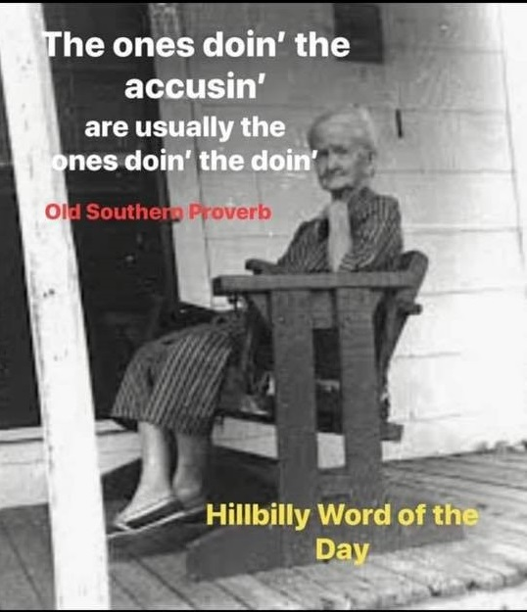
¹² Neither in the temple, nor in the synagogues, nor in the city itself did they find me carrying on a discussion with anyone or causing a riot. ¹³ Nor can they prove to you the charges of which they now accuse me.
- Acts 24:12-13

Slide 131
Paul’s Response
Leading a Renegade Sect
But this I admit to you, that according to the Way which they call a sect I do serve the God of our fathers, believing everything that is in accordance with the Law and that is written in the Prophets;
- Acts 24:14

Slide 133
¹⁵ having a hope in God, which these men cherish themselves, that there shall certainly be a resurrection of both the righteous and the wicked. ¹⁶ In view of this, I also do my best to maintain always a blameless conscience both before God and before men.
- Acts 24:15-16

Slide 134
Paul’s Response
Desecrating the Temple
¹⁷ Now after several years I came to bring alms to my nation and to present offerings; ¹⁸ in which they found me occupied in the temple, having been purified, without any crowd or uproar. But there were some Jews from Asia— ¹⁹ who ought to have been present before you and to make accusation, if they should have anything against me. - Acts 24:17-19

Slide 135
²⁰ Or else let these men themselves tell what misdeed they found when I stood before the Council, ²¹ other than for this one statement which I shouted out while standing among them, ‘For the resurrection of the dead I am on trial before you today.’”
- Acts 24:20-21

Slide 136
CHAPTER 24 J. W. McGarvey’s Acts Commentary
VERSES 10 - 21
This speech contains a distinct reply to each specification made by Tertullus. In answer to the charge of stirring up sedition, he shows first, that it had been only twelve days since he went up to Jerusalem. As it had now been five days since he left there, and he had been in prison one day previous to leaving, his previous stay there could have been only six days, which would have afforded no sufficient time for stirring up sedition. Moreover, they could not prove that he was engaged even in disputation with any one, in the temple, in the synagogues, or in any party of the city. As to being a ringleader of the sect of the Nazarenes, he frankly confesses that he belongs to what they call a sect: yet he believes all the law and the prophets, hopes for a resurrection of the dead, and is habitually struggling to lead a conscientious life. Finally, in reference to the charge of profaning the temple, implying disrespect for the Jewish people, he declares that the very object of his visit to Jerusalem was to bear alms to the people; and that when the Jews from Asia seized him in the temple, he was purified, and engaged about alms-giving, and the offerings of the temple. In conclusion, he notes the significant fact, that those who first seized him & knew what he was doing, were not there to testify; while he challenges those who were present to state a single act of his that was wrong, unless it were the very heinous offense of declaring he believed, with the great mass of the Jews, in the resurrection of the dead. The last point was made, and presented in the ironical form which it bears, in order to show Felix it was party jealousy which instigated his Sadducee prosecutors.
McGarvey, J. W. (1872). A commentary on Acts of Apostles (p. 272). Lexington, KY: Transylvania Printing and Publishing

Slide 138
²² But Felix, having a more exact knowledge about the Way, put them off, saying, “When Lysias the commander comes down, I will decide your case.” ²³ Then he gave orders to the centurion for him to be kept in custody and yet have some freedom, and not to prevent any of his friends from ministering to him.
- Acts 24:22-23

Slide 140
THOSE OUTSIDE THE MOVEMENT & THE UNLEARNED TYPICALLY REFERRED TO THE EARLY CHURCH & THE FIRST CHRISTIANS AS “PEOPLE OF THE WAY”

Slide 144
CHAPTER 24 J. W. McGarvey’s Acts Commentary
VERSE 23
When the Jews were dismissed, if Felix had possessed a strict regard for justice, he would have released Paul. As it was, he only relaxed the rigor of his previous confinement. (23) “And he commanded the centurion that Paul should be guarded, but have relaxation, and to forbid none of his friends to minister to him or visit him.” His confinement was now the least rigorous which was considered compatible with safe-keeping. He was under what was called the military custody, being placed in charge of a soldier, whose left arm was chained to Paul’s right, and who was responsible with his own life for the safety of his prisoner. The Apostle’s guards were relieved at regular intervals, and the “relaxation” allowed Paul was, probably, an occasional release from the chain.
McGarvey, J. W. (1872). A commentary on Acts of Apostles (p. 273). Lexington, KY: Transylvania Printing and Publishing Co.

Slide 145
²⁴ But some days later Felix arrived with Drusilla, his wife who was a Jewess, and sent for Paul and heard him speak about faith in Christ Jesus. ²⁵ But as he was discussing righteousness, self-control and the judgment to come, Felix became frightened and said, “Go away for the present, and when I find time I will summon you.”
- Acts 24:24-25

Slide 146
CHAPTER 24 J. W. McGarvey’s Acts Commentary
VERSE 24
Drusilla, according to Josephus, was a daughter of Herod Agrippa, whose persecutions of the apostles, and miserable death, we have considered in commenting on the twelfth chapter. She was a woman of remarkable beauty, the lawful wife of Azizus, king of Emesa, but was now living in adulterous intercourse with Felix. Concerning Felix, Tacitus testifies, that “with every kind of cruelty and lust, he exercised the authority of a king with the temper of a slave.”⁵
McGarvey, J. W. (1872). A commentary on Acts of Apostles (p. 273). Lexington, KY: Transylvania Printing and Publishing Co.

Slide 147
“We Believe”: Fides quae creditur
24:24–25a AV He sent for Paul, and heard him concerning the faith in Christ. And as he reasoned of [1] righteousness, [2] temperance, and [3] judgment to come.…
The present passage is a nice illustration of the textual problem. Is τῆς εἰς Χριστὸν Ἰησοῦν πίστεως, with the definite article in Greek, to be translated in English without the definite article (so RSV) as “faith in Christ Jesus,” therefore presumably as referring to fides qua creditur, or with the definite article (so AV) as “the faith in Christ Jesus,” referring to that faith which, in the company of the church through the ages, one believes and affirms about Jesus Christ (fides quae creditur), “that Jesus is the Son of God” (8:37 TPR AV) or “that Jesus Christ is Lord” (Phil. 2:11)? In “and the word of God increased; and the number of the disciples multiplied greatly in Jerusalem, and a great many of the priests were obedient to the faith” (6:7), both RSV and NRSV, and not only AV, do translate ὑπήκουον τῇ πίστει as “became/were obedient to the faith,” which in the context could mean the shared faith as content, fides quae creditur. The same is true in the description of Paul and Barnabas “strengthening the souls of the disciples, exhorting them to continue in the faith, and saying that through many tribulations we must enter the kingdom of God” (14:22).
A decision about which of the two meanings, “faith” or “the faith,” is at work in the present passage also affects the interpretation and even the translation of the words that immediately follow, as the text goes on to specify: “He discussed περὶ δικαιοσύνης καὶ ἐγκρατείας καὶ τοῦ κρίματος τοῦ μέλλοντος.” If he was discussing “the faith” as the faith that is believed and confessed by the church, then δικαιοσύνη can mean the righteousness that comes, according to Saint Paul, through justification by faith (→13:38–39); and it should not be translated, as it is in the NEB, with “morals,” which would, however, be acceptable if πίστις here means fides qua creditur, as the translators of the NEB have evidently understood it.
Pelikan, J. (2005). Acts (pp. 257–259). Grand Rapids, MI: Brazos Press.

Slide 149
CHAPTER 24 J. W. McGarvey’s Acts Commentary
VERSE 25
The common version, “Felix trembled,” may be true, but it is claiming more for the effect of Paul’s discourse than is asserted by Luke. He was “filled with fear,” which shows that Paul addressed him on these appropriate topics, not in a spirit of bravado, but in that earnest and solemn strain which alone can penetrate the heart. This feeling was the beginning necessary to a change of life; but lust and ambition smothered the kindling fires of conscience, and the common excuse of alarmed but impenitent sinners was urged to get rid of the too faithful monitor.
It is a sad warning to all who thus procrastinate, that to neither Felix nor Drusilla did the season ever come which they thought convenient to listen to such preaching. Felix was soon dismissed in disgrace from his office; and Drusilla, with a son by Felix, perished in that eruption of Mount Vesuvius which engulfed the cities of Pompeii and Herculaneum.
McGarvey, J. W. (1872). A commentary on Acts of Apostles (p. 273). Lexington, KY: Transylvania Printing and Publishing Co.

Slide 151
²⁶ At the same time too, he was hoping that money would be given him by Paul; therefore he also used to send for him quite often and converse with him. ²⁷ But after two years had passed, Felix was succeeded by Porcius Festus, and wishing to do the Jews a favor, Felix left Paul imprisoned.
- Acts 24:26-27

Slide 152
CHAPTER 24 J. W. McGarvey’s Acts Commentary
VERSES 26 & 27
Having learned, from Paul’s own lips, that he had been up to Jerusalem to bear alms from distant Churches to the poor, and knowing something, perhaps of the general liberality of the disciples toward one another, he could have no doubt, judging them according to the usage of the age, that they would be willing to purchase Paul’s freedom at a high price. That it was not done, shows that the disciples had too elevated a standard of morality to buy from a corrupt judge release from even unjust and protracted imprisonment.
These two years, if we judge from the silence of history, were the most inactive of Paul’s career. There are no epistles which bear this date & though his friends and brethren had free access to him, we have no recorded effects of their interviews with him. The only moments in which he emerges into our view, from the obscurity of his prison, are those in which he appeared before his judges. We shall, on this account, contemplate his conduct on these occasions with the deeper interest.
McGarvey, J. W. (1872). A commentary on Acts of Apostles (p. 274). Lexington, KY: Transylvania Printing and Publishing Co.

Slide 153
PORCIUS FESTUS COINS

Slide 154
CHAPTER 25 J. W. McGarvey’s Acts Commentary
VERSES 1 - 5
He further told them, as we learn from his speech to Agrippa, that it was contrary to Roman law to condemn a man to death before he had an opportunity for defense, face to face with his accusers. All this shows that Festus was, at this time, disposed to see justice done. He, of course, knew nothing of the plot to waylay Paul: for they kept this purpose concealed, while they professed another.
McGarvey, J. W. (1872). A commentary on Acts of Apostles (Ac 25:5). Lexington, KY: Transylvania Printing and Publishing Co.

Slide 155
⁶ After he had spent not more than eight or ten days among them, he went down to Caesarea, and on the next day he took his seat on the tribunal and ordered Paul to be brought. ⁷ After Paul arrived, the Jews who had come down from Jerusalem stood around him, bringing many and serious charges against him which they could not prove,
- Acts 25:6-7

Slide 156
⁸ while Paul said in his own defense, “I have committed no offense either against the Law of the Jews or against the temple or against Caesar.” ⁹ But Festus, wishing to do the Jews a favor, answered Paul and said, “Are you willing to go up to Jerusalem and stand trial before me on these charges?”
- Acts 25:8-9

Slide 157
The Law of Reason, the Law of Nations, the Law of God
25:8, 27 Paul said …, “Neither against the law of the Jews, nor against the temple, nor against Caesar have I offended at all.” … Festus said, … “It seems to me unreasonable, in sending a prisoner, not to indicate the charges against him.”
From the topics of all three loci communes in this twenty-fifth chapter it is evident that this is, in some respects, the most political chapter of the book of Acts, or at least the one in which there is the most attention to questions of politics and of law. Together with “wisdom” (σοφία, sapientia) (→7:22) and “justice” (δικαιοσύνη, iustitia) (→13:38–39), the concept of “law” (νόμος, lex, ius) (→10:15) occupied a dominant position both in the Jewish scheme of revelation and in the Greek and Roman worldviews. All three of these concepts, therefore, shaped the vocabulary of the Christian witness from the beginning. Each of them, moreover, stood in a special relation to another concept that was held in common by all these traditions, the concept of “reason” (λόγος, ratio). Juxtaposing these two statements this way from the opposite ends of this twenty-fifth chapter, the first reporting the words of Paul and the second reporting the words of Festus the Roman governor, calls attention, in the concept of law, to the complex interrelation between the law of reason, the law of nations, and the law of God: in biblical teaching these were not identical, nor were they mutually exclusive.
Already within Greco-Roman jurisprudence and philosophy, the possibility—indeed, the undeniable reality—of conflicts between the first two, the law of reason and the law of nations, was a serious issue. Traditional Greek and Roman law, whether traced to Solon among the Greeks or to the Law of the Twelve Tables among the Romans, had inherited a multitude of regulations and customs. It was manifestly impossible to find any philosophical justification for many of these, beyond the rational requirements of pragmatic necessity.

Slide 158
But unless the difference between the law of nations and the law of reason represented an outright contradiction, it was the counsel of philosopher-statesmen such as Cicero, most explicitly perhaps in De legibus (only portions of which have survived), to go along with the law even while recognizing that “the most foolish notion of all is the belief that everything is just which is found in the customs or laws of nations.” All of that became even more complicated with the introduction of the Hebrew notion of a—or, rather, the—revealed law of God (→5:29b) and then of the Christian reinterpretation of this revealed law (→3:25; →10:15).
As the Sixth Amendment in the Bill of Rights of the United States Constitution shows with its provision “in all criminal prosecutions, the accused shall enjoy the right … to be informed of the nature and cause of the accusation,” Festus might have said, “It seems to me unconstitutional, in sending a prisoner, not to indicate the charges against him,” for the origins of the Sixth Amendment can be traced to the Roman constitution and Roman law. The term “unconstitutional,” moreover, would make sense in a Roman context, even though the Roman “constitution” was not spelled out as explicitly as the American Constitution is.⁴
Invoking instead the criterion of what was “unreasonable” (ἄλογον) introduced the principle of the law of reason, not in the first instance as a source of positive law but as a test by which positive law could be judged and which it was obliged not to violate. The natural-law tradition in Christian thought has found support for this criterion in the apostle’s answer to the problem of good (which is in many ways more difficult and challenging than is the problem of evil): “When Gentiles who have not the law [of Moses] do by nature [φύσει] what the law requires, they are a law to themselves, even though they do not have the law. They show that what the law requires is written on their hearts” (Rom. 2:14–15).

Slide 159
Even so generous an estimate of the law of reason or natural law as these words of Paul to the Romans, however, has never been taken to preclude the necessity of positive law and the law of nations. Therefore, Paul insisted here that he had not “offended” “against Caesar at all.”
Paul’s defense against the charge of having “offended” “against Caesar” came after his earlier disclaimer of not having offended “against the law of the Jews, [or] against the temple.” This was of a piece with the attitude both toward “the law of the Jews” (→3:25) and toward “the temple” (→7:47–48) throughout the Acts of the Apostles, for what Paul here called “the law of the Jews” was in fact the law of God, the “living oracles” (λόγια ζῶντα) (7:38), “the law as delivered by angels” (7:53) as Stephen called it. As such, the moral law was eternal, and it had to be invoked both against the political authorities and against the religious hierarchy: “We must obey God rather than men” (→5:29b). Both in its confrontations with the concrete laws of many different nations during many periods of history and in its ordered philosophical and theological reflection on the nature of law and on the relation between the law of reason, the law of nations, and the law of God, Christian thought has shaped not only the conscience (→23:1) but the legal systems of many traditions. But the tension between these three species of “law” has also been responsible for some of the more radical expressions of Christian obedience—which have often entailed disobedience to a specific human authority in the name of the still higher authority of the law and the will of God (→14:22).
Pelikan, J. (2005). Acts (pp. 263–265). Grand Rapids, MI: Brazos Press.

Slide 160
¹⁰ But Paul said, “I am standing before Caesar’s tribunal, where I ought to be tried. I have done no wrong to the Jews, as you also very well know. ¹¹ If, then, I am a wrongdoer and have committed anything worthy of death, I do not refuse to die; but if none of those things is true of which these men accuse me, no one can hand me over to them. I appeal to Caesar.” ¹² Then when Festus had conferred with his council, he answered, “You have appealed to Caesar, to Caesar you shall go.”
- Acts 25:10-12

Slide 161
CHAPTER 25 J. W. McGarvey’s Acts Commentary
VERSES 10 & 11
The purpose of the Jews was well understood by Paul. He remembered the purpose of the similar request preferred before Claudius Lysias, and perceived his only safety was in frustrating their present attempt. Fortunately, the very imprisonment which exposed him to danger also furnished the means of his safety. This appeal every Roman citizen had the right to make, and it required a transfer of the case to the imperial court in Rome. The statement, “I stand at Cæsar’s judgment-seat,” was intended to justify him in refusing to be taken for any trial proceedings away from Cæsarea, which was the appointed capital of the province where the courts were properly held.
McGarvey, J. W. (1872). A commentary on Acts of Apostles (p. 275). Lexington, KY: Transylvania Printing and Publishing Co.

Slide 162
“Under Pontius Pilate”: “The Powers That Be”
25:11 I appeal to Caesar [Καίσαρα ἐπικαλοῦμαι].
The political metaphors of Christian language (→22:27; →27:24), such as the declaration of Paul that “our citizenship [ἡμῶν … τὸ πολίτευμα] is in heaven” (Phil. 3:20 NRSV), and, above all, the emphasis on the preaching of the “kingdom of God” (→28:23) led those same critics to accuse them of sedition. This accusation comes through, perhaps most explicitly anywhere in the New Testament, in the charge, “They are all acting against the decrees of Caesar, saying that there is another king, Jesus” (17:7); “the decrees of Caesar” did not countenance allegiance to another king, but only to Caesar as divine, while the “decrees” (δόγματα) (→16:4b) of Jesus did not countenance allegiance to any other god, including Caesar (→19:26). Further to the same point was the charge: “These men are Jews and they are disturbing our city. They advocate customs which it is not lawful for us Romans to accept or practice” (16:20–21).
The Christian defense against such accusations took several major forms, at least two of which figure prominently in Acts. The first, in elaboration of Paul’s exhortation, “the powers that be are ordained of God,” was to emphasize the Christian pledge of allegiance to legitimate government, including the government of Caesar, in which, as a matter of fact, Saint Paul held citizenship.

Slide 163
On that basis he claimed his civil rights to complain to the Roman magistrates: “They have beaten us publicly, uncondemned, men who are Roman citizens, and have thrown us into prison; and do they now cast us out secretly?” (16:37). And he could interrupt the centurion who, to make him tell the truth, was about to have him scourged: “Is it lawful for you to scourge a man who is a Roman citizen, and uncondemned?” (22:25). The rightness of that exercise of civic prerogative was acknowledged also by the letter of Claudius Lysias to the governor Felix: “This man was seized by the Jews, and was about to be killed by them, when I came upon them with the soldiers and rescued him, having learned that he was a Roman citizen” (23:27). This was a right to which, as a Roman citizen without political allegiance to some other earthly ruler, Saint Paul was fully entitled.
The other response was, while recognizing the legitimate claims of “the powers that be,” to reject any ultimate claims by any rulers, whether in the temporal or in the spiritual realm, as illegitimate, indeed as blasphemous (→5:29b). Such a twofold stance was taken to be an act of obedience to the command of Jesus: “Render therefore to Caesar the things that are Caesar’s, and to God the things that are God’s” (Matt. 22:21).
Pelikan, J. (2005). Acts (pp. 266–268). Grand Rapids, MI: Brazos Press.

Slide 164
Section Finish @ Paul’s Appeal to Imperial Rome & Caesar

Slide 165
L.D. CARY & SAM HOLT CATCH PHRASES
Chapter 19 – “10 + 9, Ephesus Time”
Chapter 20 – “Traveling A’Plenty”
Chapter 21 – “Confinement Begun”
Chapter 22 – “Before A Mob, Not A Few”
Chapter 23 – “Before The Council, You See”
Chapter 24 – “Felix Listens No More”
Chapter 25 – “Agrippa Arrives”
Chapter 26 – “Agrippa Realizes Paul’s Fix”
Chapter 27 – “Shipwreck & An Angel From Heaven”
Chapter 28 – “The End Of Our Wait”
“Agrippa Arrives”
Catch Phrase
Chapter Twenty-Five

Slide 166
Acts 25:
¹ Now when Festus was come into the province, after three days he ascended from Caesarea to Jerusalem.
² Then the high priest and the chief of the Jews informed him against Paul, and besought him,
³ And desired favour against him, that he would send for him to Jerusalem, laying wait in the way to kill him.
⁴ But Festus answered, that Paul should be kept at Caesarea, and that he himself would depart shortly thither.
⁵ Let them therefore, said he, which among you are able, go down with me, and accuse this man, if there be any wickedness in him.
⁶ And when he had tarried among them more than ten days, he went down unto Caesarea; and the next day sitting on the judgment seat commanded Paul to be brought.

Slide 167
⁷ And when he was come, the Jews which came down from Jerusalem stood round about,
and laid many and grievous complaints against Paul, which they could not prove.
⁸ While he answered for himself, Neither against the law of the Jews, neither against the temple, nor yet against Caesar, have I offended any thing at all.
⁹ But Festus, willing to do the Jews a pleasure, answered Paul, and said, Wilt thou go up to Jerusalem, and there be judged of these things before me?

Slide 168
¹⁰ Then said Paul, I stand at Caesar's judgment seat, where I ought to be judged: to the Jews have I done no wrong, as thou very well knowest.
¹¹ For if I be an offender, or have committed any thing worthy of death, I refuse not to die:
but if there be none of these things whereof these accuse me, no man may deliver me unto them.
I appeal unto Caesar.
¹² Then Festus, when he had conferred with the council, answered, Hast thou appealed unto Caesar? unto Caesar shalt thou go. . .

Slide 169
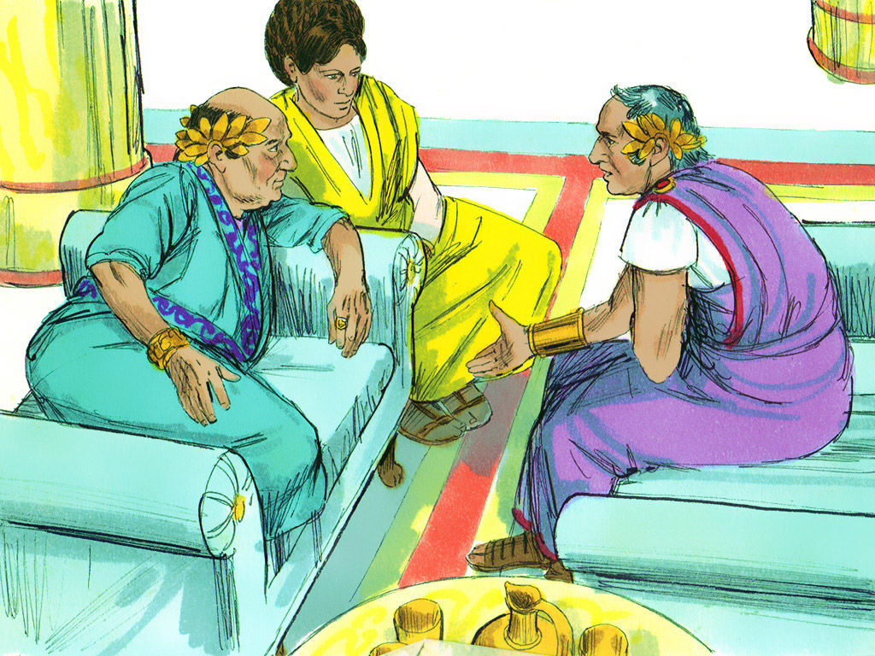
¹³ And after certain days king Agrippa and Bernice came unto Caesarea to salute Festus.

Slide 170
¹³ And after certain days king Agrippa and Bernice came unto Caesarea to salute Festus.
Herod Agrippa II was the last king of the Herodian dynasty that ruled from 40 BC to AD 92.

Slide 171
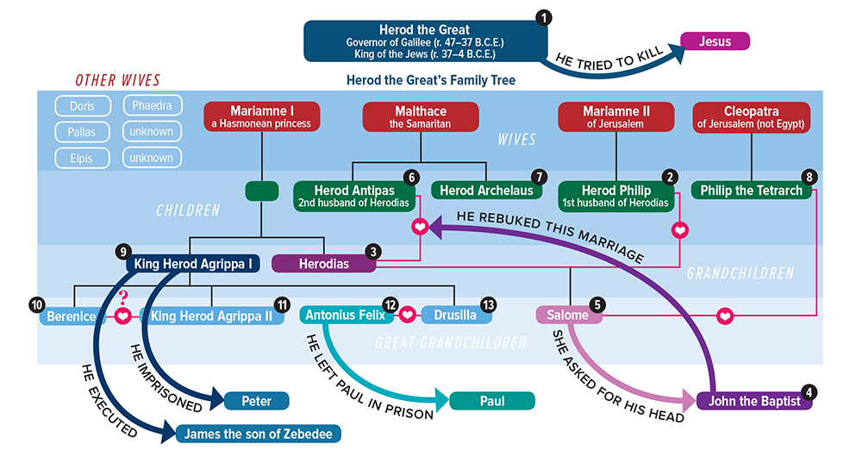
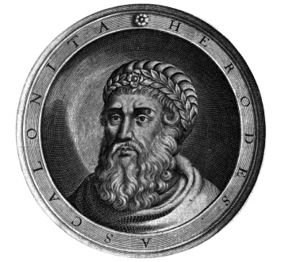
Herod the Great was the king of Judaea when Christ was born. It was he who committed the “Massacre of the Innocents.”
He was succeeded by his son Archelaus.
Notes:
(aar-chuh-LAL-uhs)

Slide 172
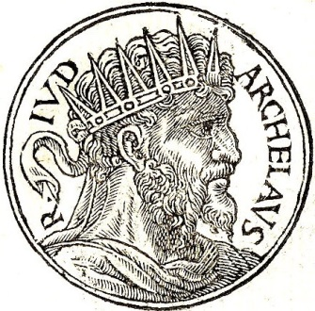
Matthew 2:22 But when [Joseph] heard that Archelaus did reign in Judaea in the room of his father Herod, he was afraid to go thither: notwithstanding, being warned of God in a dream, he turned aside into the parts of Galilee:
Notes:
Herod the Great was succeeded by his son Archelaus (aar-chuh-LAL-uhs)

Slide 173
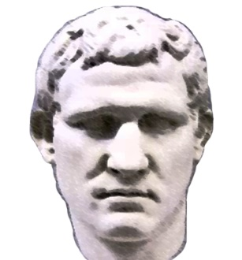
Herod Antipas was the tetrarch of Galilee during the time of Christ’s ministry on earth. He was married to his niece, Herodias, who had been the wife of his brother Philip.
This is the Herod who beheaded John the Baptist and mocked Jesus by putting him in “a gorgeous robe” (Lk 23).
Notes:
Herod the Great was succeeded by his son Archelaus (aar-chuh-LAL-uhs)

Slide 174
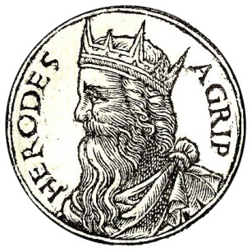
Agrippa I, the grandson of Herod the Great, killed James and imprisoned Peter. He died “because he gave not God the glory: and he was eaten of worms, and gave up the ghost” (Acts 12)
Notes:
Herod the Great was succeeded by his son Archelaus (aar-chuh-LAL-uhs)

Slide 175
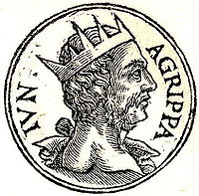
Agrippa II was the great-grandson of Herod the Great. His “wife” Bernice was actually his sister.
He is the king who heard Paul’s testimony in Caesarea. He was the last king of the Herodian dynasty.
Notes:
Herod the Great was succeeded by his son Archelaus (aar-chuh-LAL-uhs)

Slide 176
¹³ And after certain days king Agrippa and Bernice came unto Caesarea to salute Festus.
¹⁴ And when they had been there many days, Festus declared Paul's cause unto the king, saying,
There is a certain man left in bonds by Felix:
¹⁵ About whom, when I was at Jerusalem, the chief priests and the elders of the Jews informed me, desiring to have judgment against him.

Slide 177
¹⁸ Against whom when the accusers stood up, they brought none accusation of such things as I supposed:
¹⁹ But had certain questions against him of their own superstition, and of one Jesus, which was dead, whom Paul affirmed to be alive.
²⁰ And because I doubted of such manner of questions, I asked him whether he would go to Jerusalem, and there be judged of these matters.
¹⁶ To whom I answered, It is not the manner of the Romans to deliver any man to die, before that he which is accused have the accusers face to face, and have licence to answer for himself concerning the crime laid against him.
¹⁷ Therefore, when they were come hither, without any delay on the morrow I sat on the judgment seat, and commanded the man to be brought forth.

Slide 178
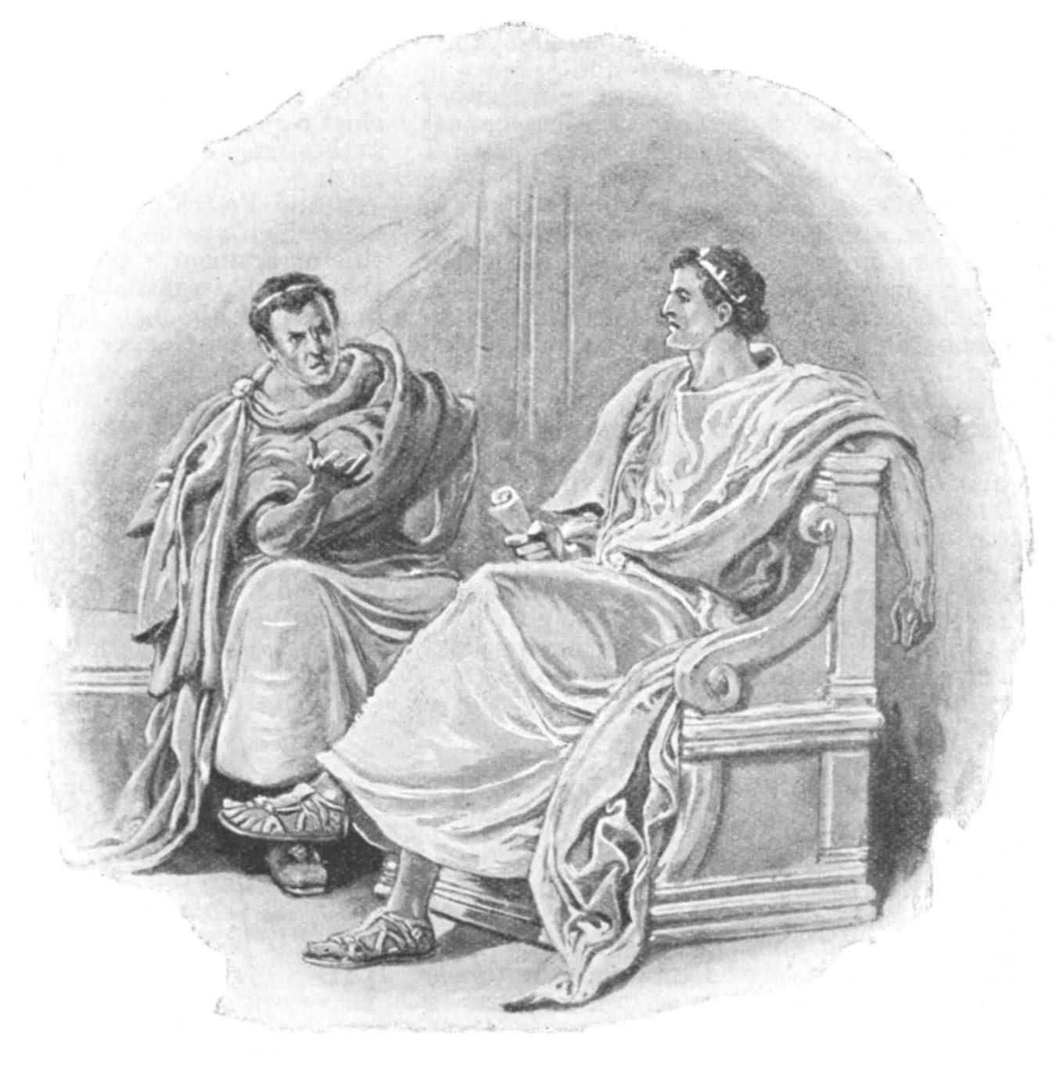
²¹ But when Paul had appealed to be reserved unto the hearing of Augustus, I commanded him to be kept till I might send him to Caesar.
²² Then Agrippa said unto Festus, I would also hear the man myself.
Tomorrow, said he, thou shalt hear him.

Slide 179
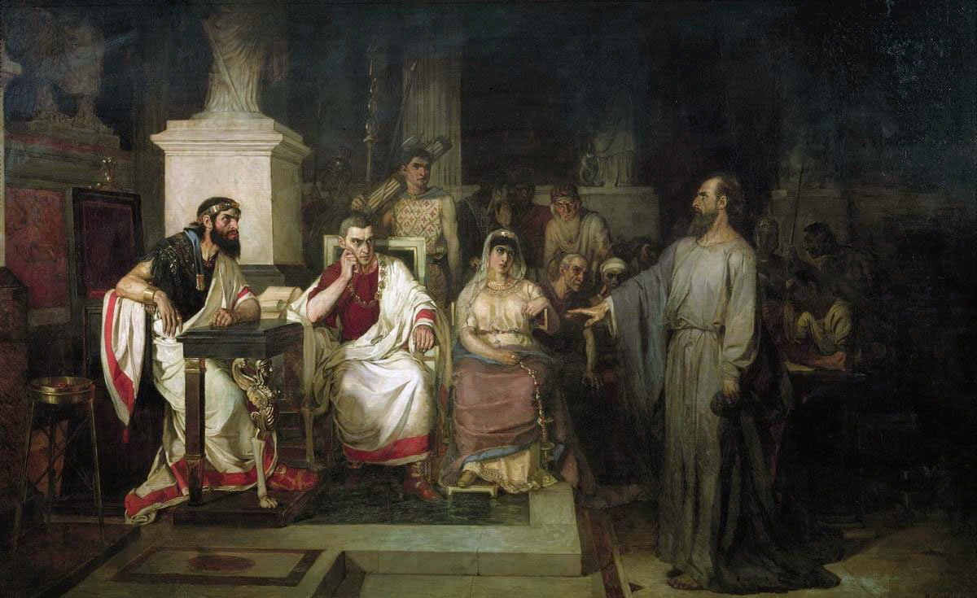
²³ And on the morrow, when Agrippa was come, and Bernice, with great pomp, and was entered into the place of hearing, with the chief captains, and principal men of the city, at Festus' commandment Paul was brought forth.

Slide 180
²⁴ And Festus said,
King Agrippa, and all men which are here present with us,
ye see this man,
about whom all the multitude of the Jews have dealt with me,
both at Jerusalem, and also here,
crying that he ought not to live any longer.
²⁵ But when I found that he had committed nothing worthy of death,
and that he himself hath appealed to Augustus,
I have determined to send him.
²⁶ Of whom I have no certain thing to write unto my lord.
Wherefore I have brought him forth before you,
and specially before thee, O king Agrippa,
that, after examination had, I might have somewhat to write.
²⁷ For it seemeth to me unreasonable to send a prisoner, and not withal to signify the crimes laid against him.

Slide 181
L.D. CARY & SAM HOLT CATCH PHRASES
Chapter 19 – “10 + 9, Ephesus Time”
Chapter 20 – “Traveling A’Plenty”
Chapter 21 – “Confinement Begun”
Chapter 22 – “Before A Mob, Not A Few”
Chapter 23 – “Before The Council, You See”
Chapter 24 – “Felix Listens No More”
Chapter 25 – “Agrippa Arrives”
Chapter 26 – “Agrippa Realizes Paul’s Fix”
Chapter 27 – “Shipwreck & An Angel From Heaven”
Chapter 28 – “The End Of Our Wait”
“Agrippa Realizes Paul’s Fix”
Catch Phrase
Chapter Twenty-Six

Slide 182
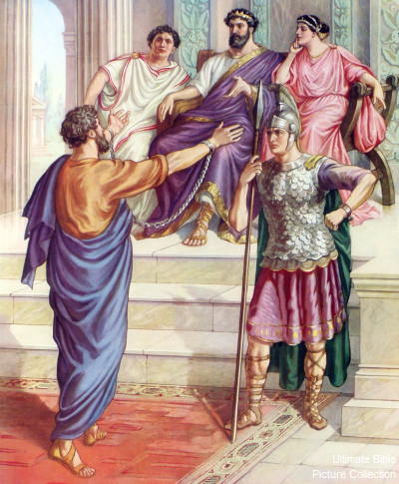
Acts 26:
¹ Then Agrippa said unto Paul, Thou art permitted to speak for thyself.
Then Paul stretched forth the hand, and answered for himself:
² I think myself happy, king Agrippa, because I shall answer for myself this day before thee touching all the things whereof I am accused of the Jews:
³ Especially because I know thee to be expert in all customs and questions which are among the Jews: wherefore I beseech thee to hear me patiently.

Slide 183
⁴ My manner of life from my youth, which was at the first among mine own nation at Jerusalem, know all the Jews;
⁵ Which knew me from the beginning, if they would testify, that after the most straitest sect of our religion I lived a Pharisee.

Slide 184
the most straitest
exceedingly exact
careful
sect
the same word as “heresy”
a body of men following their own tenets.
The Pharisees were the most precise and rigorous in interpreting the Mosaic law, and in observing even the more minute precepts of the law and tradition. (Thayer’s Greek Lexicon)
⁴ My manner of life from my youth, which was at the first among mine own nation at Jerusalem, know all the Jews;
⁵ Which knew me from the beginning, if they would testify, that after the most straitest sect of our religion I lived a Pharisee.

Slide 185
⁶ And now I stand and am judged for the hope of the promise made of God unto our fathers:
⁷ Unto which promise our twelve tribes, instantly serving God day and night,
hope to come.
For which hope's sake, king Agrippa, I am accused of the Jews.
⁸ Why should it be thought a thing incredible with you, that God should raise the dead?

Slide 186
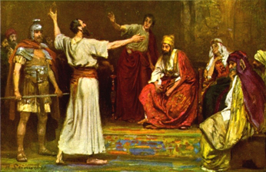
⁹ I verily thought with myself, that I ought to do many things contrary to the name of Jesus of Nazareth.
¹⁰ Which thing I also did in Jerusalem: and many of the saints did I shut up in prison, having received authority from the chief priests; and when they were put to death, I gave my voice against them.
¹¹ And I punished them oft in every synagogue, and compelled them to blaspheme; and being exceedingly mad against them, I persecuted them even unto strange cities.

Slide 187
¹² Whereupon as I went to Damascus with authority and commission from the chief priests,
¹³ At midday, O king, I saw in the way a light from heaven, above the brightness of the sun, shining round about me and them which journeyed with me.
¹⁴ And when we were all fallen to the earth, I heard a voice speaking unto me, and saying in the Hebrew tongue, Saul, Saul, why persecutest thou me? it is hard for thee to kick against the pricks.
¹⁵ And I said, Who art thou, Lord? And he said, I am Jesus whom thou persecutest.

Slide 188
¹⁶ But rise, and stand upon thy feet: for I have appeared unto thee for this purpose, to make thee a minister and a witness both of these things which thou hast seen, and of those things in the which I will appear unto thee;
¹⁷ Delivering thee from the people, and from the Gentiles, unto whom now I send thee,
¹⁸ To open their eyes, and to turn them from darkness to light, and from the power of Satan unto God, that they may receive forgiveness of sins, and inheritance among them which are sanctified by faith that is in me.

Slide 189
¹⁹ Whereupon, O king Agrippa, I was not disobedient unto the heavenly vision:
²⁰ But shewed first unto them of Damascus, and at Jerusalem, and throughout all the coasts of Judaea, and then to the Gentiles,
that they should repent and turn to God, and do works meet for repentance.
²¹ For these causes the Jews caught me in the temple, and went about to kill me.

Slide 190
²² Having therefore obtained help of God, I continue unto this day,
witnessing both to small and great,
saying none other things than those which the prophets and Moses did say should come:
²³ That Christ should suffer, and that he should be the first that should rise from the dead,
and should shew light unto the people, and to the Gentiles.

Slide 191
²⁴ And as he thus spake for himself, Festus said with a loud voice, Paul, thou art beside thyself; much learning doth make thee mad.
²⁵ But he said, I am not mad, most noble Festus; but speak forth the words of truth and soberness.
²⁶ For the king knoweth of these things, before whom also I speak freely: for I am persuaded that none of these things are hidden from him; for this thing was not done in a corner.
²⁷ King Agrippa, believest thou the prophets? I know that thou believest.

Slide 192
²⁸ Then Agrippa said unto Paul, Almost thou persuadest me to be a Christian.
²⁹ And Paul said, I would to God, that not only thou, but also all that hear me this day,
were both almost, and altogether such as I am, except these bonds.

Slide 193
³⁰ And when he had thus spoken, the king rose up, and the governor, and Bernice, and they that sat with them:
³¹ And when they were gone aside, they talked between themselves, saying, This man doeth nothing worthy of death or of bonds.
³² Then said Agrippa unto Festus, This man might have been set at liberty, if he had not appealed unto Caesar.

Slide 194
Paul's Arrest and Imprisonment - Part 3
Acts 25:13-26:32

Slide 195
Outline - Acts
II. The Ministry of Paul – Acts 13:1-28:31
Paul’s 1st Missionary Journey – Acts 13:1-15:35
Paul’s 2nd Missionary Journey – Acts 15:36-18:22
Paul’s 3rd Missionary Journey – Acts 18:23-21:14
Paul’s Arrest - 1 – Acts 21:15-23:11
Paul’s Arrest - 2 – Acts 23:12-25:12
Paul’s Arrest - 3 – Acts 25:13-26:32
Paul’s Journey to Rome – Acts 27:1-28:31

Slide 196
Now when several days had elapsed, King Agrippa and Bernice arrived at Caesarea and paid their respects to Festus.
- Acts 25:13

Slide 197
BERNICE AGRIPPA’S SISTER

Slide 198
CHAPTER 25 J. W. McGarvey’s Acts Commentary
VERSE 13
The custom of extending congratulations to men newly inducted into high office, which has prevailed in every age of the world, led to the next important incidents of Paul’s confinement in Cæsarea. This Agrippa was the son of the Herod who murdered the Apostle James. He was, at this time, king of Chalcis, but afterward of Galilee. Bernice was his sister. She had been married to her uncle, Herod, former king of Chalcis, but he had died, and she was still a widow. She afterward married Polemo, king of Cilicia. Like nearly all the Herod family, both male and female, she was licentious and ambitious. But she and Agrippa, being Jews by birth, were better able to understand Paul’s case than Festus.
McGarvey, J. W. (1872). A commentary on Acts of Apostles (p. 276). Lexington, KY: Transylvania Printing and Publishing Co.

Slide 200
AGRIPPA II

Slide 202
¹⁴ While they were spending many days there, Festus laid Paul’s case before the king, saying, “There is a man who was left as a prisoner by Felix; ¹⁵ and when I was at Jerusalem, the chief priests and the elders of the Jews brought charges against him, asking for a sentence of condemnation against him.
- Acts 25:14-15

Slide 203
¹⁶ I answered them that it is not the custom of the Romans to hand over any man before the accused meets his accusers face to face and has an opportunity to make his defense against the charges. ¹⁷ So after they had assembled here, I did not delay, but on the next day took my seat on the tribunal and ordered the man to be brought before me.
- Acts 25:16-17

Slide 204
“Due Process”
25:16 TPR I answered them that it was not the custom of the Romans to give up any one to destruction [εἰς ἀπώλειαν] before the accused met the accusers face to face, and had opportunity to make his defense concerning the charge laid against him.
The setting of these actions (→18:15; →23:25; →28:14; →28:31) in the context of a “court” and a “tribunal” (βῆμα) is a reminder of the prominence of law throughout the narrative of Acts, of Jewish law (→10:15) especially in the first half and of Roman law (→25:8) especially in the second. This emphasis on law implied that the narrative had to pay attention also to the concept of due process. Both of these ancient legal systems, the Jewish and the Roman, already had their own doctrines of due process and paid attention to these same four civil and legal rights, which were therefore an important feature also of the legal proceedings in Acts:
1. The need to prevent arbitrary government comes through in the message of the town clerk of Ephesus to “Demetrius and the craftsmen with him,” who found that their livelihood as goldsmiths and artisans of idols was being threatened by the monotheistic message of the apostles and who threatened to lynch the threatening intruders: “The courts are open, and there are proconsuls” (ἀγοραῖοι ἄγονται καὶ ἀνθύπατοί εἰσιν) (19:38). If these failed to give satisfaction, moreover, there was a prescribed appellate procedure: “But if you seek anything further, it shall be settled in the regular assembly” (19:39). Instead of following due process, however, the goldsmiths were running amok—“in confusion … for about two hours” (19:32, 34) through the streets—shouting “Great is Artemis of the Ephesians!” (→12:13–16). If this went on, the town clerk warned, “we are in danger of being charged with rioting today, there being no cause that we can give to justify this commotion” (19:40).

Slide 205
2. The obligation to avoid mistaken deprivations has often been the result of having made such mistakes in the past. Urging his colleagues to ponder the lessons of recent mistakes, Gamaliel the rabbi, who had once been the teacher of Saul in the Jewish law (22:3), took that lesson to be: “In the present case I tell you, keep away from these men and let them alone; for if this authority comes from human will, its power will fail; but if it is of God, you will not be able to overthrow them. You might even be found opposing God!” (5:38–39 TPR). Due process, therefore, was a protection not only of the accused but of the accusers from the consequences of their own folly.
3. The due process requirement to allow persons to know about and respond to charges against them was formulated in so many words by Festus when he explained to Agrippa how he had in turn explained to the chief priests and elders “that it was not the custom of the Romans [οὐκ ἔστιν ἔθος Ῥωμαίοις] to give up any one before the accused met the accusers face to face, and had opportunity to make his defense concerning the charge laid against him” (25:16). Indeed, it was, as the same chapter goes on to explain, “unreasonable, in sending a prisoner, not to indicate the charges against him” (25:27).
The duty of officials, by observing due process, to promote a sense of the legitimacy of official behavior was cited by Tertullus the ῥήτωρ in his advice to Felix the Roman governor: “By examining him yourself you will be able to learn from him about everything of which we accuse him” (24:8). But the supreme instance of reliance on due process that Luke documents was the trial of Jesus under Pontius Pilate (→25:11), where he seemed to be intent on establishing “the legitimacy of official behavior.” Therefore, Peter could speak to the Jewish people about “Jesus, whom you delivered up and denied in the presence of Pilate, when he had decided to release him” (3:13), even though he added, in partial exculpation, “that you acted in ignorance, as did also your rulers” (3:17). Because both Jewish law and Roman law had a doctrine of due process, both the legal process (Jewish and Roman) against Jesus and the subsequent action (also Jewish and Roman) against his disciples in their imitation of him (→7:59–60) must be judged in the light of that doctrine of jurisprudence.
Pelikan, J. (2005). Acts (pp. 268–269). Grand Rapids, MI: Brazos Press.

Slide 206
¹⁸ When the accusers stood up, they began bringing charges against him not of such crimes as I was expecting, ¹⁹ but they simply had some points of disagreement with him about their own religion and about a dead man, Jesus, whom Paul asserted to be alive. ²⁰ Being at a loss how to investigate such matters, I asked whether he was willing to go to Jerusalem and there stand trial on these matters.
- Acts 25:18-20

Slide 207
CHAPTER 25 J. W. McGarvey’s Acts Commentary
VERSES 14 - 21
Festus knew that the charges against Paul had reference to the Jewish law; but he still had not a sufficient understanding of the case to report it intelligibly to the emperor, as he now had to do, under Paul’s appeal. He determined, therefore, to obtain the benefit of Agrippa’s more familiar acquaintance with Jewish affairs. From this speech it appears that the perplexity of Festus was not so much in reference to the main issue between the Jews and Paul, as in reference to the bearing which the case had upon Roman law. He discovered that the main issue between the parties had reference to that “Jesus who had died, and whom Paul affirmed to be alive.”
McGarvey, J. W. (1872). A commentary on Acts of Apostles (p. 276). Lexington, KY: Transylvania Printing and Publishing Co.

Slide 208
²¹ But when Paul appealed to be held in custody for the Emperor’s decision, I ordered him to be kept in custody until I send him to Caesar.” ²² Then Agrippa said to Festus, “I also would like to hear the man myself.” “Tomorrow,” he said, “you shall hear him.”
- Acts 25:21-22

Slide 209
Festus’ Account
- Paul was left by Felix - Imprisoned to gain favor with Jewish leaders

Slide 210
Festus’ Account
- Could not determine charges - Kept in the hope of receiving a bribe

Slide 211
Festus’ Account
- Festus offered Paul a choice of trials - Could have set him free

Slide 212
So, on the next day when Agrippa came together with Bernice amid great pomp, and entered the auditorium accompanied by the commanders and the prominent men of the city, at the command of Festus, Paul was brought in.
- Acts 25:23

Slide 213
CHAPTER 25 J. W. McGarvey’s Acts Commentary
VERSES 23 - 27
Festus belonged to one peculiar class of men, who found it difficult to decide how to treat Christians. The bigoted Jews, whose national prejudices were assailed by the new preachers, were prompt to decide that “they ought not to live any longer.” The blind devotees of heathen worship, like those in Philippi and Ephesus, were of the same opinion; especially when the new doctrine came into conflict with their worldly interests. The firm friend of impartial justice, such as Gallio, could easily see that they were unjustly persecuted. But to the skeptical politician, like Festus, who regarded all religion as a mere superstitious homage paid to dead heroes, and who aimed to so administer government as to be popular with the most powerful class of his area subjects, it was a more difficult question. He saw clearly that Paul was guilty of nothing worthy of death or of bonds; therefore, he would not consent that the Jews should kill him; yet he was equally unwilling to offend them by releasing him. He was incapable, from his worldly & selfish nature, of appreciating Paul’s noble devotion to the good of humanity, and equally unable to understand the enmity of the Jews toward him. He must now, of necessity, send him to the emperor, but he confessed that he had no good reason to give the emperor for doing so, and was about to do an unreasonable act. In this predicament it was quite natural that he should call for the advice of Agrippa.
McGarvey, J. W. (1872). A commentary on Acts of Apostles (p. 277). Lexington, KY: Transylvania Printing and Publishing Co.

Slide 214
²⁴ Festus said, “King Agrippa, and all you gentlemen here present with us, you see this man about whom all the people of the Jews appealed to me, both at Jerusalem and here, loudly declaring that he ought not to live any longer. ²⁵ But I found that he had committed nothing worthy of death; and since he himself appealed to the Emperor, I decided to send him.
- Acts 25:24-25

Slide 215
²⁶ Yet I have nothing definite about him to write to my lord. Therefore I have brought him before you all and especially before you, King Agrippa, so that after the investigation has taken place, I may have something to write. ²⁷ For it seems absurd to me in sending a prisoner, not to indicate also the charges against him.”
- Acts 25:26-27

Slide 216
Festus’ Hearing
Creates an event to share responsibility with Agrippa

Slide 217
Festus’ Hearing
Omits his failure to free Paul according to Roman Law

Slide 218
Festus’ Hearing
Trades on Agrippa’s prestige at the Emperor’s court

Slide 219
Agrippa said to Paul, “You are permitted to speak for yourself.” Then Paul gesturing stretched out his hand and proceeded to make his defense:
- Acts 26:1

Slide 220
Son of The Agrippa Who “Stretched Forth His Hand” To Vex The Church

Slide 221
CHAPTER 26 J. W. McGarvey’s Acts Commentary
VERSES 1 - 3
It must have been his left hand which he stretched forth as he began this exordium, for his right was chained to the soldier who guarded him. The compliment to Agrippa for his close acquaintance with Jewish customs and controversies was not undeserved. It afforded Paul unfeigned gratification to know, that, after so many efforts to make himself understood by such men as Lysias, Felix & Festus, he was at length in the presence of one who could fully understand and appreciate his cause.
McGarvey, J. W. (1872). A commentary on Acts of Apostles (Ac 26:3). Lexington, KY: Transylvania Printing and Publishing Co.

Slide 222
² “In regard to all the things of which I am accused by the Jews, I consider myself fortunate, King Agrippa, that I am about to make my defense before you today; ³ especially because you are an expert in all customs and questions among the Jews; therefore I beg you to listen to me patiently.
- Acts 26:2-3

Slide 223
⁴ “So then, all Jews know my manner of life from my youth up, which from the beginning was spent among my own nation and at Jerusalem; ⁵ since they have known about me for a long time, if they are willing to testify, that I lived as a Pharisee according to the strictest sect of our religion.
- Acts 26:4-5

Slide 224
⁶ And now I am standing trial for the hope of the promise made by God to our fathers; ⁷ the promise to which our twelve tribes hope to attain, as they earnestly serve God night and day. And for this hope, O King, I am being accused by Jews. ⁸ Why is it considered incredible among you people if God does raise the dead?
- Acts 26:6-8

Slide 225
CHAPTER 26 J. W. McGarvey’s Acts Commentary
VERSES 4 - 8
The Pharisees were the least likely of all the Jewish sects to be unfaithful to Jewish institutions. It was, therefore, much in Paul’s favor that he was able to call even his enemies to witness that from his youth he had lived in the strict discipline of that sect. It was yet more so, to say that he was still a firm believer in the leading doctrine of the party, and to reiterate the assertion made on two former occasions, that it was on account of the hope of a resurrection he was accused. This wasn’t the avowed cause, but it was the real cause of their false accusations; for the assumptions that Christ had risen from the dead was the ground-work of all Jewish opposition and persecution. He interprets the promise made by God to the fathers, by which he doubtless means the promise, “In thee and in thy seed shall all the families of the earth be blessed,” as referring to the resurrection, because that’s the consummation of all the blessings of the gospel. He exposes the inconsistency of his enemies by observing, that it was even Jews who were accusing him of crime in demonstrating this great hope so cherished by the twelve tribes. Then, turning from Agrippa to the whole multitude. he asks, with an air of astonishment, if they really deem it an incredible thing that God should raise the dead. If not, why should he be accused of crime for declaring that it had been done?
McGarvey, J. W. (1872). A commentary on Acts of Apostles (p. 278). Lexington, KY: Transylvania Printing and Publishing Co.

Slide 226
⁹ “So then, I thought to myself that I had to do many things hostile to the name of Jesus of Nazareth. ¹⁰ And this is just what I did in Jerusalem; not only did I lock up many of the saints in prisons, having received authority from the chief priests, but also when they were being put to death I cast my vote against them.
- Acts 26:9-10

Slide 227
And as I punished them often in all the synagogues, I tried to force them to blaspheme; and being furiously enraged at them, I kept pursuing them even to foreign cities.
- Acts 26:11

Slide 228
CHAPTER 26 J. W. McGarvey’s Acts Commentary
VERSES 9 - 11
With such a record as this, there was no room to suspect him of any such bias as would render him an easy or a willing convert to Christ. On the contrary, it must have appeared to Agrippa, and the whole audience, most astonishing that such a change could take place. Their curiosity to know what produced the change must have been intense, and he proceeds to gratify it.
McGarvey, J. W. (1872). A commentary on Acts of Apostles (p. 278). Lexington, KY: Transylvania Printing and Publishing Co.

Slide 229
¹² “While so engaged as I was journeying to Damascus with the authority and commission of the chief priests, ¹³ at midday, O King, I saw on the way a light from heaven, brighter than the sun, shining all around me and those who were journeying with me.
- Acts 26:12-13

Slide 230
¹⁴ And when we had all fallen to the ground, I heard a voice saying to me in the Hebrew dialect, ‘Saul, Saul, why are you persecuting Me? It is hard for you to kick against the goads.’ ¹⁵ And I said, ‘Who are You, Lord?’ And the Lord said, ‘I am Jesus whom you are persecuting.
- Acts 26:14-15

Slide 231
But get up and stand on your feet; for this purpose I have appeared to you, to appoint you a minister and a witness not only to the things which you have seen, but also to the things in which I will appear to you;
- Acts 26:16

Slide 232
¹⁷ rescuing you from the Jewish people and from the Gentiles, to whom I am sending you, ¹⁸ to open their eyes so that they may turn from darkness to light and from the dominion of Satan to God, that they may receive forgiveness of sins and an inheritance among those who have been sanctified by faith in Me.’
- Acts 26:17-18

Slide 233
“It is hard for you to kick against the goads” “Why are you beating your head against the wall?”

Slide 234
Paul’s Future Service
Minister
Witness
Apostle
}
Jews and Gentiles

Slide 235
¹⁹ “So, King Agrippa, I did not prove disobedient to the heavenly vision, ²⁰ but kept declaring both to those of Damascus first, and also at Jerusalem and then throughout all the region of Judea, and even to the Gentiles, that they should repent and turn to God, performing deeds appropriate to repentance.
- Acts 26:19-20

Slide 236
²¹ For this reason some Jews seized me in the temple and tried to put me to death. ²² So, having obtained help from God, I stand to this day testifying both to small and great, stating nothing but what the Prophets and Moses said was going to take place; ²³ that the Christ was to suffer, and that by reason of His resurrection from the dead He would be the first to proclaim light both to the Jewish people and to the Gentiles.”
- Acts 26:21-23

Slide 237
CHAPTER 26 J. W. McGarvey’s Acts Commentary
VERSES 22 & 23
That the Jews had not succeeded, with all their mobs, and conspiracies, and corruption of rulers, in destroying his life, was a matter of astonishment, and Agrippa might well admit that it was owing to the protecting providence of God.
Here he assumes that, instead of dishonoring Moses, he and his brethren alone were teaching the things which both Moses and prophets had foretold; that it was required, by their writings, that the Messiah should suffer and rise from the dead.
McGarvey, J. W. (1872). A commentary on Acts of Apostles (p. 279). Lexington, KY: Transylvania Printing and Publishing Co.

Slide 238
CHAPTER 26 J. W. McGarvey’s Acts Commentary
VERSES 22 & 23
By the statement that Christ first showed light to the people and the Gentiles by his resurrection, he must mean that he was the first to bring the subject into clear light, by an actual resurrection to glory; for there had already been some light upon it, as is proved by the Apostle’s previous statement in reference to the hope to which the twelve tribes had been, in all their worship, seeking to attain.
McGarvey, J. W. (1872). A commentary on Acts of Apostles (p. 279). Lexington, KY: Transylvania Printing and Publishing Co.

Slide 239
²⁴ While Paul was saying this in his defense, Festus said in a loud voice, “Paul, you are out of your mind! Your great learning is driving you mad.” ²⁵ But Paul said, “I am not out of my mind, most excellent Festus, but I utter words of sober truth.
- Acts 26:24-25

Slide 240
CHAPTER 26 J. W. McGarvey’s Acts Commentary
VERSE 24
It presented to him a man who from his youth had lived in strict devotion to a religion whose chief characteristic was the hope of a resurrection from the dead; who had once persecuted to death his present friends, but had been induced to change his course by a vision from heaven; and who, from that moment, had been enduring stripes, and imprisonment, and constant exposure to death, in his efforts to inspire men with his own hope of a resurrection. Such a career he could not reconcile with those maxims of ease or of ambition which he regarded as the highest rule of life. Moreover, he saw this strange man, when called to answer to accusations of crime, appear to forget himself & attempt to convert his judges rather than to defend himself. There was a magnanimity of soul displayed in both the past and the present of his career, which was above the comprehension of the sensuous politician, and which he could not reconcile with sound reason. He seems to have forgotten where he was, and the decorum of the occasion, so deeply was he absorbed in listening to and thinking of Paul.
McGarvey, J. W. (1872). A commentary on Acts of Apostles (pp. 279–280). Lexington, KY: Transylvania Printing and Publishing Co.

Slide 241
CHAPTER 26 J. W. McGarvey’s Acts Commentary
VERSE 25
Paul saw at once, from the tone and manner of Festus, as well as from the admission of his great learning, that the charge of insanity wasn’t intended as an insult; but it was the sudden outburst of a conviction which had just seized the mind of the perplexed and the astonished governor. His answer, therefore, was most respectful. (25) “But he said, I am not mad, most noble Festus, but speak forth words of truth and soberness.” He saw, however, that Festus was beyond the reach of conviction; for a man who could see in the foregoing portion of this speech only the ravings of a madman, could not easily be reached by the argument, or touched by the pathos of the gospel.
McGarvey, J. W. (1872). A commentary on Acts of Apostles (p. 280). Lexington, KY: Transylvania Printing and Publishing Co.

Slide 242
²⁶ For the king knows about these matters, and I speak to him also with confidence, since I am persuaded that none of these things escape his notice; for this has not been done in a corner. ²⁷ King Agrippa, do you believe the Prophets? I know that you do.”
- Acts 26:26-27

Slide 243
Public Evidence for a Mystery?
26:26 This was not done in a corner.
In addition to, and sometimes in tension with, the primary sources of truth—the Old Testament revelation as this was being authoritatively interpreted (and reinterpreted) in normative Christian teaching (→8:30–31), the special revelation that had been granted in Christ and in his gospel (→1:2–3; →8:25), and the continuing private revelations through dreams, trances, and visions (→16:9), including those that came through the activity of Christian prophets (→21:9–10)—a prominent feature of the apologetics of Luke is his emphasis on the gospel as a public event. All of this adds up to the oxymoron that we have entitled “public evidence for a mystery,” which is in some respects the obverse side of interpreting the language of negation as the affirmation of transcendence (→17:23). It may be useful to review the three principal events that “these things” in “I am persuaded that none of these things has escaped his notice, for this was not done in a corner” included here in the immediate context of Paul’s address to King Agrippa: yet another iteration of his conversion story (26:9–19; →9:1–4); his missionary activity and its perils (26:20–21); and the death and the resurrection of Christ (26:22–23; →2:31). Not only about the second of these, which had clearly not been “done in a corner” at all, but by now had become a public nuisance to many, “turn[ing] the world upside down” and providing the occasion for controversy and even riots (17:6), but also about the third, which had provoked unbelieving ridicule from both Jews (4:2) and Gentiles (17:32), Paul seemed willing to lay claim to public verification of some kind or other. This claim was in keeping with the recitation of evidence from witnesses in Paul’s dissertation on the resurrection of Christ: “He appeared to Cephas, then to the twelve. Then he appeared to more than five hundred brethren at one time, most of whom are still alive, though some have fallen asleep. Then he appeared to James, then to all the apostles. Last of all, as to one untimely born, he appeared also to me” (1 Cor. 15:5–8).

Slide 244
In fact, “proof” is the very word that successive English translations have employed at the opening of the Acts account: “To them he presented himself alive after his passion by many proofs [τεκμηρίοις], appearing to them during forty days” (1:3). In his Pentecost sermon Peter spoke of Jesus as “a man attested to you by God” (ἄνδρα ἀποδεδειγμένον ἀπὸ τοῦ θεοῦ εἰς ὑμᾶς) and made a point of reminding his hearers that the “mighty works and wonders and signs which God did through him” (→6:8) had not been “done in a corner,” but “in your midst” (εἰς ὑμᾶς) (2:22); the same was said of Stephen’s “great wonders and signs among the people [ἐν τῷ λαῷ]” (6:8). When the members of the Jewish council are quoted as having said after the healing at the Beautiful Gate “that a notable sign has been performed through them is manifest to all the inhabitants of Jerusalem, and we cannot deny it” (4:16), they were being cited as nonbelievers who nevertheless found the evidence for this “notable sign” (γνωστὸν σημεῖον) (→6:8) too overwhelming to deny or refute.
The key passage about this within the Acts narrative is in the message of Peter to “Cornelius, a centurion, an upright and God-fearing man” (10:22), and his friends, where the kind of evidence that is provided by the “proofs” for the resurrection of Christ was specified in a very particular way: “God raised him on the third day and made him manifest; not to all the people but to us who were chosen by God as witnesses, who ate and drank with him after he rose from the dead” (10:40–41). “Witnesses” (μάρτυρες) here does have the dual meaning it still has in the courtroom: “eyewitnesses” (Luke 1:2) who have seen the event in question; and those who are called upon to bear witness and “testify that he is the one ordained by God to be judge of the living and the dead” (10:42).
Therefore, Paul could say of the risen Christ that “for many days he appeared [in the first sense of ‘witness’] to those who came up with him from Galilee to Jerusalem, who are now his witnesses [in the second sense] to the people” (13:31). In many respects, therefore, the idea of “public evidence for a mystery” can be said to be not only an oxymoron, but an argument in a circle.
Pelikan, J. (2005). Acts (pp. 275–278). Grand Rapids, MI: Brazos Press.

Slide 245
²⁸ Agrippa replied to Paul, “In a short time you will persuade me to become a Christian.” ²⁹ And Paul said, “I would wish to God, that whether in a short or long time, not only you, but also all who hear me this day, might become such as I am, except for these chains.”
- Acts 26:28-29

Slide 246
Cambridge Bible for Schools and Colleges
Acts 11:26. and the disciples were called Christians first in Antioch] It is most probable that this name was given them by the heathen in ridicule. The disciples of Jesus never give it to themselves, and as the use of it would imply that those who bore it were the followers of the Messiah, the Christ, it is certain it would not be given to them by the Jews.
The reason for a new distinctive term is apparent. When these new Gentile converts were joined to the Church of Antioch, none of the former distinctive appellations would embrace the whole body. They were no longer only of the Nazarenes or the Galilæans or Greek-Jews, and as to the people of Antioch they probably seemed a strange medley, they would not be unlikely to apply to them such a hybrid form as “Christian,” a Greek word with a Latin termination.
The name is probably used in mockery by Agrippa (Acts 26:28), “With but little persuasion thou wouldest fain make me a Christian,” but in the only other and later instance of the use of the name in the N. T. (1 Peter 4:16) we can see that what had been at first a taunt had soon come to be a name in which to glory, “If any man suffer as a Christian, let him not be ashamed.”

Slide 247
God’s Plan Of Salvation In The Book Of Acts

Slide 250
Mark 16:16 (NASB) ¹⁶ "He who has believed and has been baptized shall be saved; but he who has disbelieved shall be condemned.
GIFT PROMISED BY THE HOLY SPIRIT
Acts 2:21
Luke 24:47 (NASB) ⁴⁷ and that repentance for forgiveness of sins would be proclaimed in His name to all the nations, beginning from Jerusalem.
BELIEVE
REPENT
BE BAPTIZED
SALVATION
REMISSION OF SINS
Acts 2:21 (NASB) ²¹ 'AND IT SHALL BE THAT EVERYONE WHO CALLS ON THE NAME OF THE LORD WILL BE SAVED.'
AND
AND
FOR
Acts 2:39 (NASB) ³⁹ "For the promise is for you and your children and for all who are far off, as many as the Lord our God will call to Himself."
Acts 2:4 (NASB) 4 And they were all filled with the Holy Spirit and began to speak with other tongues, as the Spirit was giving them utterance.
Acts 2:37-38 (NASB) 37 Now when they heard this, they were pierced to the heart, and said to Peter and the rest of the apostles, " Brethren, what shall we do?" 38 And Peter said to them, " Repent, and let each of you be baptized in the name of Jesus Christ for the forgiveness of your sins; and you shall receive the gift of the Holy Spirit.
Acts 2:38 (NASB) ³⁸ Peter said to them, "Repent, and each of you be baptized in the name of Jesus Christ for the forgiveness of your sins; and you will receive the gift of the Holy Spirit.
Acts 2:41 (NASB) ⁴¹ So then, those who had received his word were baptized; and that day there were added about three thousand souls. Acts 2:47 (NASB) ⁴⁷ praising God and having favor with all the people. And the Lord was adding to their number day by day those who were being saved.
Romans 6:23 (NASB) ²³ For the wages of sin is death, but the free gift of God is eternal life in Christ Jesus our Lord.
Acts 3:19 (NASB) ¹⁹ "Therefore repent and return, so that your sins may be wiped away, in order that times of refreshing may come from the presence of the Lord;
1 John 2:25 (NASB) ²⁵ This is the promise which He Himself made to us: eternal life.
Notes:
Peter had taught them that Salvation would come to all those who call on the name of the Lord, 2:21
It is obvious they wanted to know how does one call on the name of the Lord to be saved so they ask “What shall we do?” 2:37
The gift is eternal life Rom 6:23
In the next chapter Peter answers with:

Slide 251
Greek Prepositions Chart 1
Acts 2:38 (NASB77) ³⁸ And Peter said to them, " Repent, and let each of you be baptized in the name of Jesus Christ for the forgiveness of your sins; and you shall receive the gift of the Holy Spirit.
Greek Prepositions Chart 2
forgiveness of your
sins
Repent and
be Baptized
Eis
(into)
For
(NASB)
Eis
(into)
For
(NASB)

Slide 252
Greek Prepositions Chart 1
Matthew 26:28 (NASB77) ²⁸ for this is My blood of the covenant, which is poured out for many for forgiveness of sins.
forgiveness of sins
Eis
For
into
My blood
Poured out
Acts 2:38 (NASB77) ³⁸ And Peter said to them, " Repent, and let each of you be baptized in the name of Jesus Christ for the forgiveness of your sins; and you shall receive the gift of the Holy Spirit.

Slide 253
Literal (word for word) English Translations
King James Version (1769 update)
American Standard Version (1901)
Revised Standard Version (1952)
New King James Version (1982 )
New American Standard Bible (1977)
English Standard Version (2001)

Slide 254
Thought for Thought English Translations (Dynamic Equivalence) Acts 2:38
New International Version (1984)
Holman Christian Standard Bible (2004)
God’s Word (1995)

Slide 255
Thought for Thought English Translations (Dynamic Equivalence) Acts 2:38
Contemporary English Version (1995)
The Living Bible (1971 paraphrase)
Today’s English Version (1976 ABS)

Slide 256
Thought for Thought English Translations (Dynamic Equivalence) New Living Translation (corrects error) Acts 2:38
New Living Translation 2nd Edition (2004)
New Living Translation 5th Edition (2015)
2:38 Peter replied, “Each of you must repent of your sins, turn to God, and be baptized in the name of Jesus Christ to show that you have received forgiveness for your sins. Then you will receive the gift of the Holy Spirit.
38 Peter replied, “Each of you must repent of your sins and turn to God, and be baptized in the name of Jesus Christ for the forgiveness of your sins. Then you will receive the gift of the Holy Spirit.

Slide 257
“WHAT MUST I DO TO BE SAVED?”
A. The answer to this question is critical: Acts 2:37; Acts 16:30
B. The answer: Acts 16:31
1. How can they believe? Ro 10:13-17; Ro 1:16; Acts 15:7
a. The word was preached, is Common to all belief in the book Acts: Acts 2:37; 8:5, 35; 10:33, 36; 16:13-14, 16:32
b. Preaching the Gospel includes the command to be baptized: Acts 2:37-38; Acts 8:5, 12, 35-36; Acts 16:14-15; 16:32-33
Romans 1:16 (NASB) ¹⁶ For I am not ashamed of the gospel, for it is the power of God for salvation to everyone who believes, to the Jew first and also to the Greek.
Acts 16:32-33 (NASB) (THE PHILIPPIAN JAILER - Gentile) ³² And they spoke the word of the Lord to him together with all who were in his house. ³³ And he took them that very hour of the night and washed their wounds, and immediately he was baptized, he and all his household.
Acts 16:14-15 (NASB) (LYDIA – Jewess and household) ¹⁴ A woman named Lydia, from the city of Thyatira, a seller of purple fabrics, a worshiper of God, was listening; and the Lord opened her heart to respond to the things spoken by Paul. ¹⁵ And when she and her household had been baptized, she urged us, saying, "If you have judged me to be faithful to the Lord, come into my house and stay." And she prevailed upon us.
Acts 8:35-36 (NASB) (THE ETHIOPIAN EUNUCH) ³⁵ Then Philip opened his mouth, and beginning from this Scripture he preached Jesus to him. ³⁶ As they went along the road they came to some water; and the eunuch *said, "Look! Water! What prevents me from being baptized?"
Acts 8:5 (NASB) (THE SAMARITANS – Jews and Proselytes) ⁵ Philip went down to the city of Samaria and began proclaiming Christ to them. Acts 8:12 (NASB) ¹² But when they believed Philip preaching the good news about the kingdom of God and the name of Jesus Christ, they were being baptized, men and women alike.
Acts 2:37-38 (NASB) (THE JEWS ON PENTECOST) ³⁷ Now when they heard this, they were pierced to the heart, and said to Peter and the rest of the apostles, "Brethren, what shall we do?" ³⁸ Peter said to them, "Repent, and each of you be baptized in the name of Jesus Christ for the forgiveness of your sins; and you will receive the gift of the Holy Spirit. (see verse 41)
Believe on the Lord Jesus
Acts 2:37 (NASB) (THE JEWS ON PENTECOST) ³⁷ Now when they heard this, they were pierced to the heart, and said to Peter and the rest of the apostles, "Brethren, what shall we do?"
Believe in the Lord Jesus, and you will be saved
Acts 16:31 (NASB) (THE PHILIPPIAN JAILER - GENTILE) ³¹ They said, "Believe in the Lord Jesus, and you will be saved, you and your household."
Acts 15:7 (NASB) (THE GENTILES) ⁷ After there had been much debate, Peter stood up and said to them, "Brethren, you know that in the early days God made a choice among you, that by my mouth the Gentiles would hear the word of the gospel and believe.
Romans 10:13-17 (NASB) ¹³ for "WHOEVER WILL CALL ON THE NAME OF THE LORD WILL BE SAVED." Joel 2:32 ¹⁴ How then will they call on Him in whom they have not believed? How will they believe in Him whom they have not heard? And how will they hear without a preacher?
Gospel preached
¹⁵ How will they preach unless they are sent? Just as it is written, "HOW BEAUTIFUL ARE THE FEET OF THOSE WHO BRING GOOD NEWS OF GOOD THINGS!" Isa 52:7 ¹⁶ However, they did not all heed the good news; for Isaiah says, "LORD, WHO HAS BELIEVED OUR REPORT?" Isa 53:1 ¹⁷ So faith comes from hearing, and hearing by the word of Christ.
Acts 16:13-14 (NASB) (JEWISH WOMEN AT RIVER - LYDIA) ¹³ And on the Sabbath day we went outside the gate to a riverside, where we were supposing that there would be a place of prayer; and we sat down and began speaking to the women who had assembled. ¹⁴ A woman named Lydia, from the city of Thyatira, a seller of purple fabrics, a worshiper of God, was listening; and the Lord opened her heart to respond to the things spoken by Paul.
Acts 8:5 (NASB) (THE SAMARITANS – hated Jewish sect of northern tribes) ⁵ Philip went down to the city of Samaria and began proclaiming Christ to them.
Acts 16:32 (NASB) (THE PHILIPPIAN JAILER - Gentile ) ³² And they spoke the word of the Lord to him together with all who were in his house.
Acts 2:37 (NASB) (THE JEWS ON PENTECOST) ³⁷ Now when they heard this, they were pierced to the heart, and said to Peter and the rest of the apostles, "Brethren, what shall we do?"
Acts 10:33, 36 (NASB) (CORNELIUS – FIRST GENTILES) ³³ "So I sent for you immediately, and you have been kind enough to come. Now then, we are all here present before God to hear all that you have been commanded by the Lord."
³⁶ "The word which He sent to the sons of Israel, preaching peace through Jesus Christ (He is Lord of all)—
Believers Baptized
Acts 8:35 (NASB) (THE ETHIOPIAN EUNUCH – Jew or Proselyte) ³⁵ Then Philip opened his mouth, and beginning from this Scripture he preached Jesus to him.
Acts 16:30 (NASB) (THE PHILIPPIAN JAILER - GENTILE) ³⁰ and after he brought them out, he said, "Sirs, what must I do to be saved?"

Slide 258
Acts 10:47-48 (NASB77) 47 " Surely no one can refuse the water for these to be baptized who have received the Holy Spirit just as we did, can he?" 48 And he ordered them to be baptized in the name of Jesus Christ. Then they asked him to stay on for a few days.
Acts 15:7-11 (NASB77) 7 And after there had been much debate, Peter stood up and said to them, "Brethren, you know that in the early days God made a choice among you, that by my mouth the Gentiles should hear the word of the gospel and believe. 8 "And God, who knows the heart, bore witness to them, giving them the Holy Spirit, just as He also did to us; 9 and He made no distinction between us and them, cleansing their hearts by faith. 10 "Now therefore why do you put God to the test by placing upon the neck of the disciples a yoke which neither our fathers nor we have been able to bear? 11 "But we believe that we are saved through the grace of the Lord Jesus, in the same way as they also are."
Heard
Heard
Acts 2:36-41 (NASB77) 36 "Therefore let all the house of Israel know for certain that God has made Him both Lord and Christ -- this Jesus whom you crucified." 37 Now when they heard this, they were pierced to the heart, and said to Peter and the rest of the apostles, " Brethren, what shall we do?" 38 And Peter said to them, " Repent, and let each of you be baptized in the name of Jesus Christ for the forgiveness of your sins; and you shall receive the gift of the Holy Spirit. 39 "For the promise is for you and your children, and for all who are far off, as many as the Lord our God shall call to Himself." 40 And with many other words he solemnly testified and kept on exhorting them, saying, " Be saved from this perverse generation!" 41 So then, those who had received his word were baptized; and there were added that day about three thousand souls.
Believed
Believed
Repented
Repented
Acts 11:18 (NASB77) 18 And when they heard this, they quieted down, and glorified God, saying, "Well then, God has granted to the Gentiles also the repentance that leads to life."
Acts 17:30 (NASB77) 30 "Therefore having overlooked the times of ignorance, God is now declaring to men that all everywhere should repent,
Acts 11:14 (NASB77) 14 and he shall speak words to you by which you will be saved, you and all your household.'
SAME GOSPEL TO BOTH JEW AND GENTILES
THE JEWS ON PENTECOST
THE GENTILES ACTS 10-11
Baptized
Baptized
Romans 1:16 (NASB77) 16 For I am not ashamed of the gospel, for it is the power of God for salvation to everyone who believes, to the Jew first and also to the Greek.
Forgiven of sins
Forgiven of sins
Added to saved
Added to saved

Slide 261
³⁰ The king stood up and the governor and Bernice, and those who were sitting with them, ³¹ and when they had gone aside, they began talking to one another, saying, “This man is not doing anything worthy of death or imprisonment.” ³² And Agrippa said to Festus, “This man might have been set free if he had not appealed to Caesar.”
- Acts 26:30-32

Slide 262
CHAPTER 26 J. W. McGarvey’s Acts Commentary
VERSES 30 - 32
The course of remark and the feeling of the audience had now reached that painful crisis in which it was necessary either to yield at once to the power of persuasion, or to break up the interview. Unfortunately for the audience, and especially for Agrippa, the latter alternative was chosen. The heart that beats beneath a royal robe is too deeply encased in worldly cares to often or seriously entertain the claims of such a religion as that of Jesus. A spurious religion, which shifts its demands to suit the rank of its devotees, has been acceptable to the great men of the nations, because it helps to soothe an aching conscience, and is often useful in controlling the ignorant masses; but men of rank and power are seldom willing to become altogether such as the Apostle Paul. They turn away from too close a pressure of the truth, as did Paul’s royal auditory.
McGarvey, J. W. (1872). A commentary on Acts of Apostles (p. 281). Lexington, KY: Transylvania Printing and Publishing Co.

Slide 263
CHAPTER 26 J. W. McGarvey’s Acts Commentary
VERSES 30 - 32
The decision that he had done nothing worthy of death or of bonds was the judgment of the whole company, while Agrippa went further, and said that he ought, by right, to be set at liberty. If Festus had decided thus honestly before Paul had made his appeal, he would have been released; but as the appeal had now been made, to Cæsar he must go. Whether Festus now knew any better than before what to write to Cæsar, Luke leaves to the imagination of the reader.
McGarvey, J. W. (1872). A commentary on Acts of Apostles (p. 281). Lexington, KY: Transylvania Printing and Publishing Co.

Slide 264
Chronology
CAESARS
Augustus 31 BC – 14 AD
Tiberius 14 AD – 37 AD
Caligula 37 AD – 41 AD
Claudius 41 AD – 54 AD
Nero 54 AD – 68 AD
Vespasian 69 AD – 79 AD
Titus 79 AD – 81 AD
Domitian 81 AD – 96 AD
HERODS
The Great 37 BC – 4 BC
(Judea, then territory east of Palestine. At Christ’s birth was ruler of all Palestine. After death the province was divided)
Archelaus 4 BC – 6 AD
(Judea and Samaria)
Antipas 4 BC – 39 AD
(Galilee and Perea)
Philip 4 BC – 34 AD
(Country east of Galilee)
Agrippa I 37 AD – 44 AD
(King of the whole country)
Agrippa II 50 AD – 100 AD

Slide 266
The NEW TESTAMENT BOOK OF ACTS

Slide 267
10/10

