Slide 1
The NEW TESTAMENT BOOK OF ACTS
By David Lee Burris
Chapters 27 & 28

Slide 2
DOES THE NEW TESTAMENT IN PRACTICE ACTUALLY START WITH THE BOOK OF ACTS NOT THE GOSPELS?
“From the standpoint of the dispensations or the various economies by which God governs the world, the Old Testament Jewish economy actually continued through the gospels. Acts is a transitional book moving from the Old Testament economy into that of the new – the church age, the body of Christ.” (reference)

Slide 5
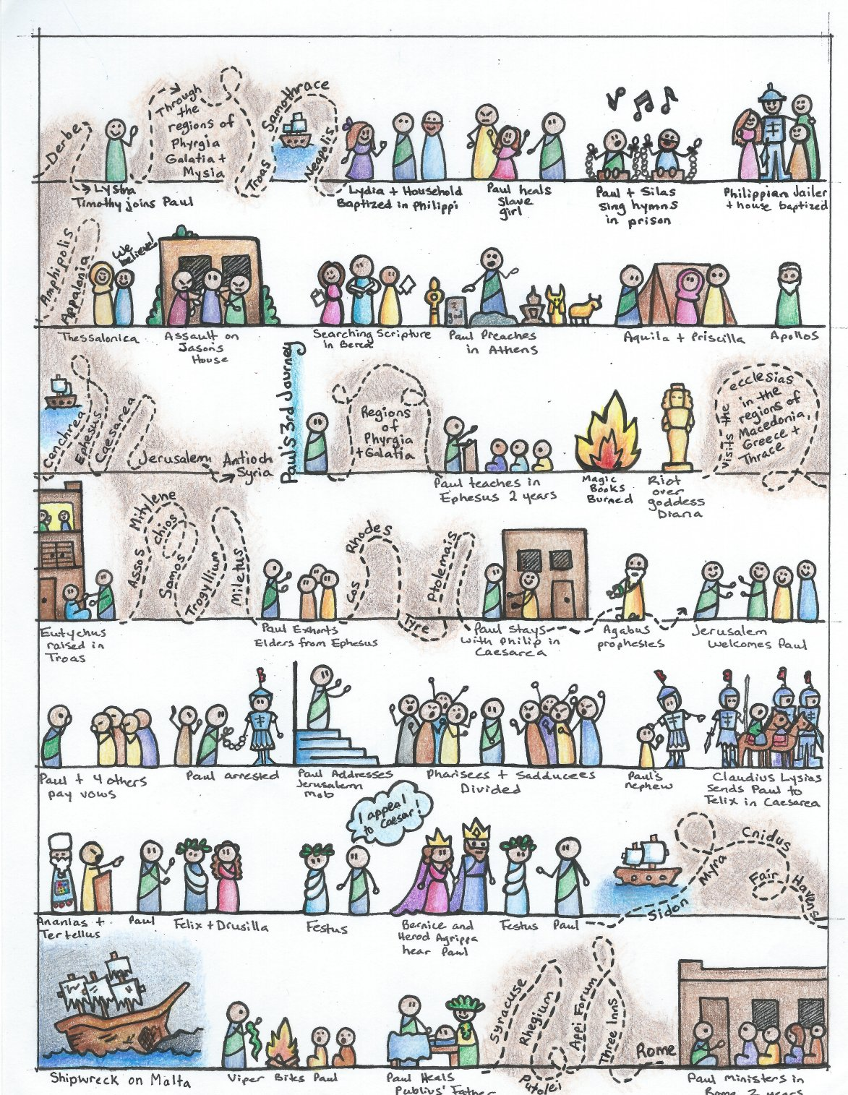

Slide 6
I. THE AUTHOR OF THE BOOK
From earliest times, Luke, “the beloved physician,” has been looked upon by conservative Bible scholars as being the author of The Book of Acts. Both internal and external evidence support this belief.
Luke was: (1) a Gentile (Col. 4:10–14); (2) the only Gentile author of a Bible book; (3) a physician (a medical doctor), Col. 4:14; (4) a “beloved” person, Col. 4:14; (5) a frequent missionary companion of Paul (the so-called “we sections” of The Book of Acts, 16:10–17; 20:5–21:18; 27:1–28:16, prove this assertion); and (6) the author of The Gospel of Luke as well as The Book of Acts.
II. THE ADDRESSEE OF THE BOOK
Luke addressed both The Gospel of Luke and The Book of Acts to Theophilus. Perhaps he had others in view as the ultimate readers of his two books.
We do not know the identity of Theophilus, nor do we know the place of his residence. He almost certainly was: (1) a friend of Luke and (2) a neophyte to Christianity (Luke wrote to Theophilus that he might know the certainty, the truthfulness, of the gospel truths wherein he had been instructed, Luke 1:1).
III. THE PLACE AND THE DATE OF THE WRITING OF THE BOOK
We do not know the place of writing but we can know the approximate date of writing. We know that it was written after the Spring of a.d. 63 for the book’s historical record extends to the Spring of that year and we know that the book was probably written before the Fall of a.d. 64 for the book makes no mention or allusion to the Neronian persecution which began in October of a.d. 64. We know that the book was almost certainly written before a.d. 70 for it makes no mention or allusion to the fall of Jerusalem and the destruction of its temple, events which occurred in a.d. 70 which greatly affected the early church and first-century Christianity (these events ended the Judaizers opposition to the gospel and the practice of preaching the gospel first to the Jews and then to the Gentiles).
IV. THE NAME OF THE BOOK
From the Second Century a.d., the common name for the book has been The Acts of the Apostles. This title is too comprehensive to be a correct one, for the book deals chiefly with the acts of only two apostles, Peter and Paul, and their acts are recorded only in part. A more apt title would be one of the following: (1) the Acts of the Risen Lord; (2) The Acts of the descended Holy Spirit; (3) Some of the Acts of Peter and Paul; (4) A Fragmentary History of the Early Church; (5) The First Chapter of Church History or (6) The only Inspired Chapter of Church History.
In the Greek manuscripts, the title is “Acts of Apostles.” This is a good and accurate title.
V. THE CLASSIFICATION OF THE BOOK
It is one of the five historical books of the New Testament. The New Testament has five historical books (Matthew through Acts), twenty-one doctrinal books (Romans through Jude) and one prophetical book (Revelation).
The 5 New Testament historical books are the New Testament’s “Pentateuch.”
Gingrich, R. E. (2002). (pp. 34). Memphis, TN: Riverside Printing.
Gingrich, R. E. (2002). The Book of Acts (pp. 3–4). Memphis, TN: Riverside Printing.

Slide 7
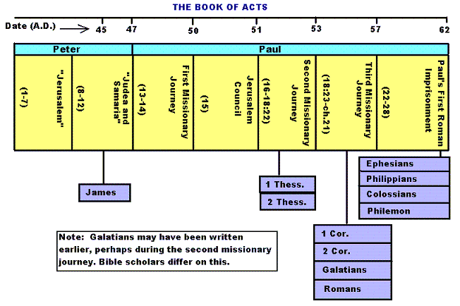

Slide 8
Historicity of Acts:
- the spread of Christianity from Jerusalem to Rome (“the ends of the earth”);
- The progress ... is mainly geographical:
- From Jerusalem ... to Samaria (8.5), Damascus (9.10), Antioch (11.26), Asia Minor (13.13), Europe (16.11), and finally Rome … itself;
- the northeastern corner of the Mediterranean;
- Maybe Spain But Nothing about North Africa, e.g., Alexandria and Cyrene.

Slide 10
1. Prologue and Ascension (1:1-11):
- Post-resurrection appearances … ;
- A ... visible ascension into heaven;
- Matthias chosen to replace Judas Iscariot (1.12-26);
- Luke’s understanding of an Apostle: see 1.21-22;
- Note: Saul (later Paul) meets those qualifications Acts 9 when Christ appeared to him while on the Damascus Road.

Slide 11
2. Founding of the Jerusalem Church - the role of the Holy Spirit (2.12-2.47):
- The Jerusalem Church increases in numbers by means of divine power;
- The work of the Holy Spirit, e.g., Glossolalia (2.1-24; see Joel 2.28-32);
- Peter’s speech interprets the meaning of Pentecost;
- The character of the Jerusalem Church (2.43-45; 4.32-35);

Slide 12
3. The Work of Peter and the other Apostles (3.1-5.42):
- Confrontation between the Apostles and the Jerusalem authorities (4.1-22);
- Luke’s attitude towards both the Sadducees and the Pharisees (4.8-11);

Slide 13
4. Persecution of the “Hellenists” (6.1-8.40):
- Stephen, a leading “Hellenist” or Greek-speaking Jew (6. 5, 8);
- Stephen is presented as the first Christian Martyr (7.60);
- subsequent persecution and the growth of the Church (8.1b-40);
the “new way” carried to such individuals as Simon the Magician (8.9) and an Ethiopian Eunuch (8.27);
the role of Philip in this work of evangelization (6.5; 8.4; 21,8).

Slide 14
5. Preparation for the Gentile Mission (9.1-12.25):
- The progress of Christianity …. as world adversary to pagan religion and human schools of philosophy;
- See, for example, the conversion of Saul of Tarsus (9.1-19) and Cornelius, the Roman centurion (Chs. 10-11);
- Peter is depicted as the one who first opens the door to Gentiles, that is, non-Jews;
Peter’s persuasion of the “circumcision party” (11.1-18);
See 10.44-48 and 11.15-18: the “Gentile Pentecost”;

Slide 15
5. Preparation for the Gentile Mission (9.1-12.25) (contd.):
- Gentiles flock to the Church at Antioch (11.19-26);
- The Jerusalem Church sends Barnabas... to report on the situation (11.22);
- Barnabas with the Apostle Paul at Antioch (11.25-30);
- Gospel preached “all over Judea and Samaria”;
- The first half concludes with an account of Herod Agrippa I’s persecution (41-44 CE) of the Jerusalem community;
- God is unhappy with Herod (12.20-23).

Slide 16
6. First Missionary Journey of Barnabas and Paul and the Jerusalem Conference (13.1-15.35):
- The rest of Acts is devoted mainly to the Missionary Journeys of the Apostle Paul and his fellow workers;
- the work of Paul and Barnabas in the various Hellenistic cities of Asia Minor;
- Dissension between Gentile and Jewish Christians over adherence to the Mosaic Torah (15.1-35);
- must Gentile Christians be circumcised and observe Jewish dietary laws?

Slide 17
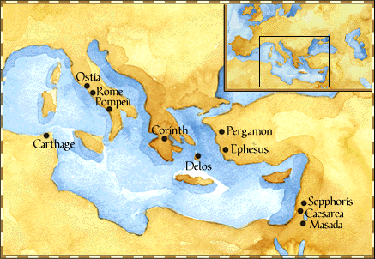
Paul: Map of His World.

Slide 18
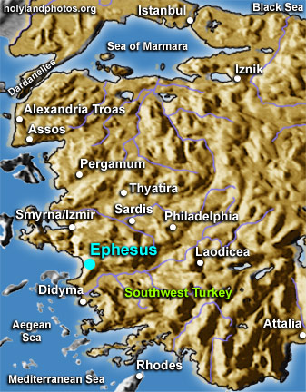

Slide 19
6. First Missionary Journey of Paul and Barnabas and the Jerusalem Conference (13.1-15.35) (contd.):
- The Jerusalem Conference held about A.D. 49 (Acts 15);
- Must a Gentile believer become a Jew ... to be a Christian?
- A division within the Church;
- The dispute settled in favor of uncircumcised Gentiles (15.28-29);
- The deciding voice is that of James (15.13-21).

Slide 20
6. First Missionary Journey of Paul and Barnabas and the Jerusalem Conference (13.1-15.35) (contd.):
- The Apostles and Elders required only limited Torah mandates of the Gentile Christians (15.13-21);
- requirements based on rules from Leviticus (Acts 15.13-21; Leviticus 17-18);
- Themes of unity and cooperation dominate … ;
- it is a unanimous decision and the “Whole Church” sends a delegation to Antioch to explain the Jerusalem Church’s decision (15.30-35);
- Actually, a decision of the Holy Spirit (15.22-29).

Slide 21
6. First Missionary Journey of Paul and Barnabas and the Jerusalem Conference (13.1-15.35) (contd.):
- Paul’s independence of the Apostolic Church (Gal 1.17, 18-19, 20; 2.1-10);
- Paul indicates that he was never under the jurisdiction of the Church’s leadership in Jerusalem (Gal 1.17, 18-19, 20; 2.1-10);
- See also 1 Cor 8.8; 10.27 relative to eating meat sacrificed to Greco-Roman gods.

Slide 22
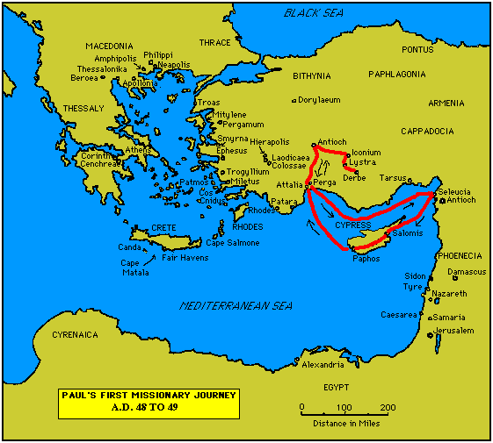

Slide 23
7. Paul’s Secondary Missionary Journey; Evangelizing Greece (16.1-18.21):
- Paul and Barnabas separate (15.39);
- Why the separation?
- Paul and Silas visit churches in Syria and Asia Minor (15.40-41);
- A vision directs Paul to Macedonia (15.40-16.10);
- Paul’s customary activity relative to the Jews and then being abused by them (16.11-17.15);

Slide 24
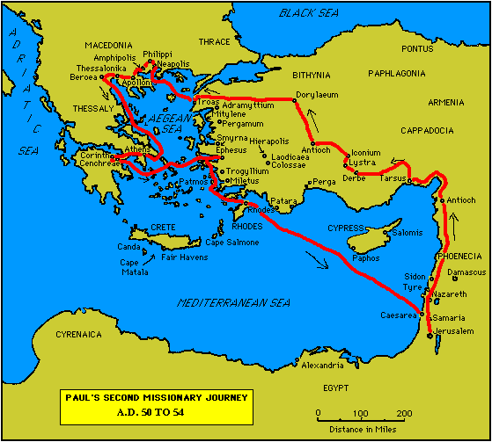

Slide 25
7. Paul’s Secondary Missionary Journey; Evangelizing Greece (16.1-18.21) (contd.):
- Paul in Philippi, Thessalonica, Beroea, and Athens;
- Paul speaks at the Areopagus in Athens (17.19-31);
- Paul at Corinth (18.1-17);

Slide 27
8. Paul’s Third Missionary Journey: Revisiting Asia Minor and Greece (18.22-20.38):
- Paul at Ephesus (18.19-21);
- Luke depicts Paul as determined to complete his last tour and head for the imperial capital, that is, Rome (19.21-22);
- Paul’s farewell speech at Miletus (20.17-38);
- See maps on the location of the major churches at the end of Paul’s ministry.

Slide 28
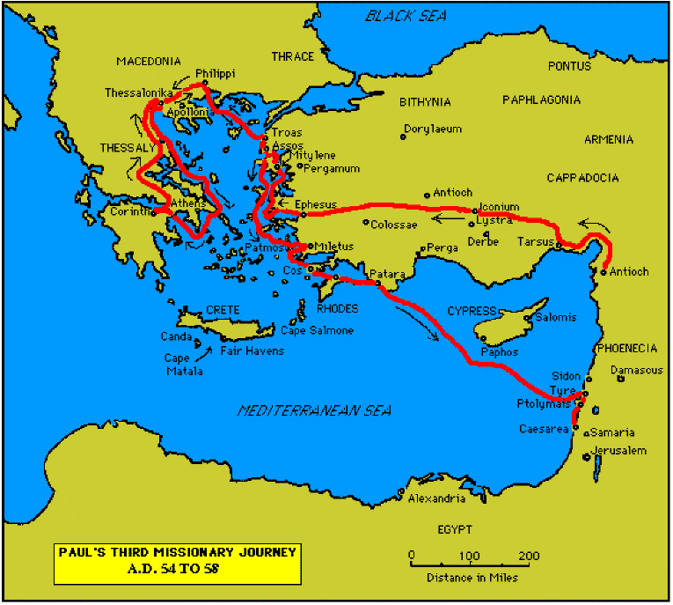

Slide 30
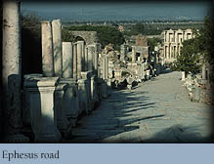

Slide 31
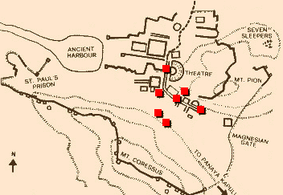
Ephesus: General View of the Ancient City.

Slide 32
9. Paul’s arrest in Jerusalem and imprisonment in Caesarea Maritime (21.1-26.32):
- Paul returns to Jerusalem (21.17) ... accused of blasphemy and profaning the Temple;
- When arrested, Paul claims that he is a Pharisee (21.27-23.10);
- Paul is imprisoned ... in Caesarea (23.33-26.32);
- he exercises his birthright as a Roman citizen (25.1-21);
- he defends himself (26.1-29);

Slide 33
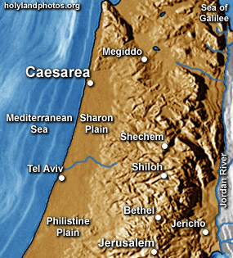

Slide 34
10. Paul’s Journey to Rome and His Preaching to Roman Jews (27.1-28.31):
- Paul’s sea journey to Rome... a shipwreck on the island of Malta (28.1 ) (see Map);
- the narrative in the first person plural, that is, “we”;
- Acts ends with Paul’s arrival in Rome (28.16);
- Paul is under house arrest but is free to preach (28.31);
- He continues to evangelize the Romans (28.23-31);
- We are not told of Paul’s fate.

Slide 35
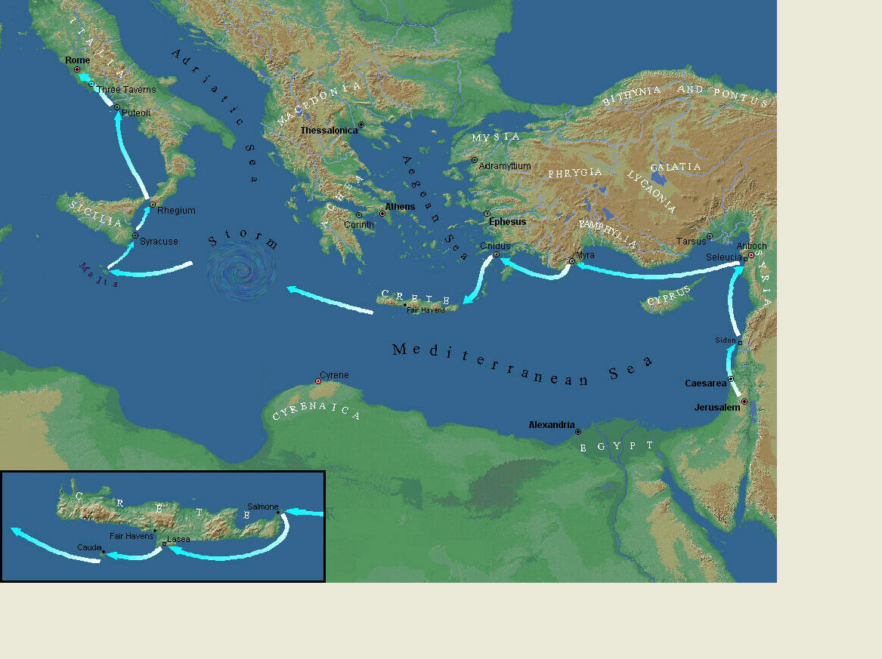
Paul’s Journey to Rome.

Slide 36
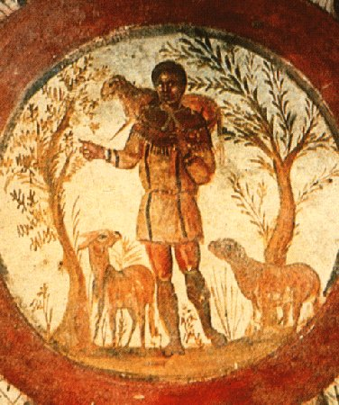
The Good Shepherd – in Catacombs of Rome.

Slide 37
10. Paul’s Journey to Rome and his Preaching to Roman Jews (27.1-28.31) (contd.):
- Luke has accomplished his task of tracing Christianity’s expansion from Jerusalem to “the ends of the earth” (1.8);
- Another theme emphasized: Paul and his successor evangelists will henceforth direct the Gospel primarily to Non-Jews, for “the Gentiles will listen” (28.28);
- Luke quotes from Isaiah 6 (see also Mark 4.10-13);
- Christianity’s future belongs to the Gentiles.

Slide 38
Basic Book Structure acts of the Apostles Centers around the great commission & Call To evangelize Then known world!

Slide 39
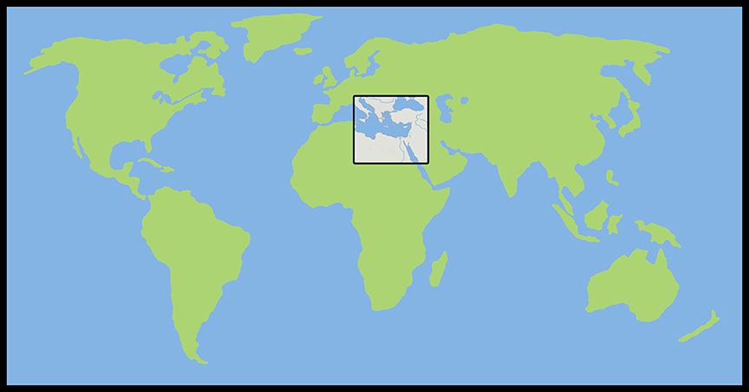
Where the Story takes Place

Slide 40
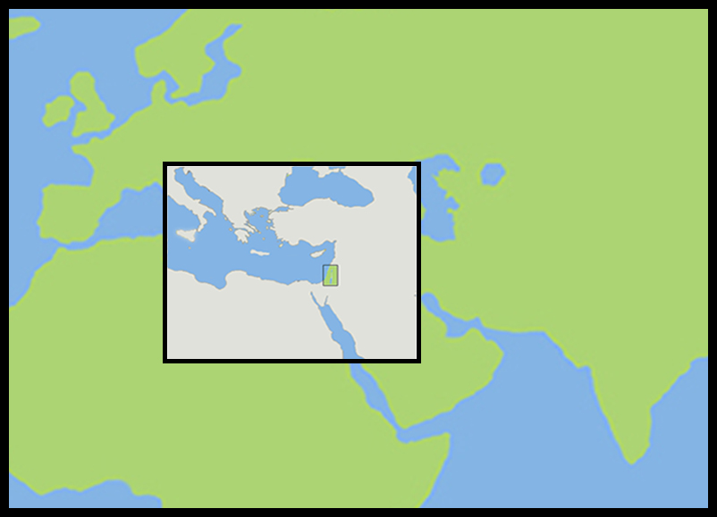
The Land of Canaan in the Near East

Slide 41
Acts 1:8 and the Great Commission
Acts 1:8 But ye shall receive power, after that the Holy Ghost is come upon you: and ye shall be witnesses unto me both in Jerusalem, and in all Judaea, and in Samaria, and unto the uttermost part of the earth.
Matthew 28:19-20 ¹⁹ Go ye therefore, and teach all nations, baptizing them in the name of the Father, and of the Son, and of the Holy Ghost: ²⁰ Teaching them to observe all things whatsoever I have commanded you: and, lo, I am with you alway, even unto the end of the world. Amen.
Mark 16:15 And he said unto them, Go ye into all the world, and preach the gospel to every creature.

Slide 42
Acts 1:8 and the Great Commission
Acts 1:8 But ye shall receive power, after that the Holy Ghost is come upon you: and ye shall be witnesses unto me both in Jerusalem, and in all Judaea, and in Samaria, and unto the uttermost part of the earth.
Matthew 28:19-20 ¹⁹ Go ye therefore, and teach all nations, baptizing them in the name of the Father, and of the Son, and of the Holy Ghost: ²⁰ Teaching them to observe all things whatsoever I have commanded you: and, lo, I am with you alway, even unto the end of the world. Amen.
Mark 16:15 And he said unto them, Go ye into all the world, and preach the gospel to every creature.

Slide 43
Acts 1:8 and the Great Commission
Acts 1:8 But ye shall receive power, after that the Holy Ghost is come upon you: and ye shall be witnesses unto me both in Jerusalem, and in all Judaea, and in Samaria, and unto the uttermost part of the earth.
Matthew 28:19-20 ¹⁹ Go ye therefore, and teach all nations, baptizing them in the name of the Father, and of the Son, and of the Holy Ghost: ²⁰ Teaching them to observe all things whatsoever I have commanded you: and, lo, I am with you alway, even unto the end of the world. Amen.
Mark 16:15 And he said unto them, Go ye into all the world, and preach the gospel to every creature.

Slide 44
Acts 1:8 and the Great Commission
Acts 1:8 But ye shall receive power, after that the Holy Ghost is come upon you: and ye shall be witnesses unto me both in Jerusalem, and in all Judaea, and in Samaria, and unto the uttermost part of the earth.
Matthew 28:19-20 ¹⁹ Go ye therefore, and teach all nations, baptizing them in the name of the Father, and of the Son, and of the Holy Ghost: ²⁰ Teaching them to observe all things whatsoever I have commanded you: and, lo, I am with you alway, even unto the end of the world. Amen.
Mark 16:15 And he said unto them, Go ye into all the world, and preach the gospel to every creature.

Slide 45
Acts 1:8 and the Structure of the Book
Acts 1:8 … ye shall be witnesses unto me both in Jerusalem, and in all Judaea, and in Samaria, and unto the uttermost part of the earth.
1. The witness in Jerusalem:
Chapters 1 to 7
2. The witness in Judaea and Samaria:
Chapters 8 to 12
3. The witness unto the uttermost parts of the earth:
Chapters 13 to 28

Slide 46
The Three Audiences
Part 1: The Jews
Part 2: The Samaritans
Part 3: The Gentiles

Slide 47
The Pillars of the Church
Part 1: Peter
Part 2: Peter and Paul (Saul of Tarsus)
Part 3: Paul

Slide 48
The Timeline
Part 1: 5 years (AD 30-35)
Part 2: 13 years (AD 35-48)
Part 3: 14 years (AD 48-62)
A total of 32 years, according to Nelson’s Complete Book of Bible Maps and Charts.

Slide 49
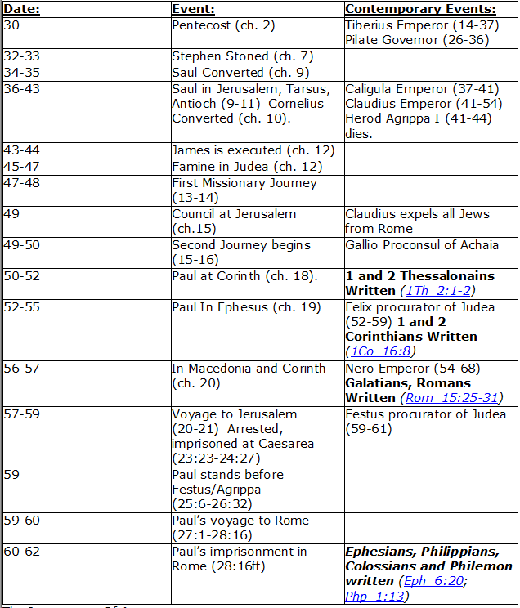
CHART BY
Mark Dunagan

Slide 50
PART ONE—The infancy of the church (the church in Jerusalem) (chapters 1–7)
(In this section, Jerusalem is the central city of Christianity and Peter is the most prominent person)
I. THE POST-RESURRECTION MINISTRY OF CHRIST (1:1–8)
II. THE ASCENSION OF CHRIST (1:9–11)
III. THE WAITING IN THE UPPER ROOM (1:12–26)
IV. THE ADVENT OF THE HOLY SPIRIT (2:1–41)
V. THE SNAPSHOT OF THE EARLY CHURCH (2:42–47)
VI. THE HEALING OF THE LAME MAN AND ITS CONSEQUENCES (3:1–4:31)
VII. THE DEATH OF ANANIAS AND SAPPHIRA AND ITS EFFECTS (4:32–5:42)
VIII. THE APPOINTMENT OF THE SEVEN (6:1–7)
IX. THE MINISTRY OF STEPHEN (6:8–7:60)
PART TWO—The adolescence of the church (the church in all Judea and In Samaria) (chapters 8–12)
(In this section, Jerusalem is gradually being replaced by Antioch as the central city of Christianity and Peter is gradually being replaced by Paul as the most prominent person)
I. THE FIRST MENTION OF PAUL (7:58; 8:1, 3)
II. THE PERSECUTION AND SCATTERING OF THE JERUSALEM CHURCH (8:1–4)
III. THE CONVERSION OF SAMARITANS (8:5–25)
IV. THE CONVERSION OF A JEWISH PROSELYTE (8:26–40)
V. THE CONVERSION OF SAUL (9:1–31)
VI. THE EXPANSION OF THE CHURCH IN WESTERN JUDEA (9:32–43)
VII. THE CONVERSION OF GENTILE GOD-FEARERS (chapter 10)
VIII. THE GROWING VISION OF THE JEWISH LEADERS (11:1–18)
IX. THE CONVERSION OF PAGAN GENTILES (11:19–26)
X. THE GROWING TIES BETWEEN JEWISH AND GENTILE CHRISTIANITY (11:27–30)
XI. THE COMPLETION OF THE TRANSITION (chapter 12)
PART THREE—The maturity of the church (the church in all the world) (chapters 13–28)
(In this section, Antioch is the central city of Christianity and Paul is the most prominent person)
I. PAUL’S CALL AT ANTIOCH TO HIS LIFE’S WORK (13:1–3)
II. PAUL’S FIRST MISSIONARY JOURNEY (13:4–14:27)
III. PAUL’S TWO YEARS BACK IN ANTIOCH (14:28–15:35)
IV. PAUL’S SECOND MISSIONARY JOURNEY (15:36–18:22)
V. PAUL’S THIRD MISSIONARY JOURNEY (18:23–21:16)
VI. PAUL’S ARREST AT JERUSALEM (21:17–23:35)
VII. PAUL’S TWO-YEARS’ IMPRISONMENT AT CAESAREA (chapters 24–26)
VIII. PAUL’S SHIPWRECK JOURNEY TO ROME (27:1–28:15)
IX. PAUL’S FIRST ROMAN IMPRISONMENT (28:16–31)
Gingrich, R. E. (2002). The Book of Acts (pp. 5–6). Memphis, TN: Riverside Printing.

Slide 51
Acts 27:1 to 28:31

Slide 52
L.D. CARY & SAM HOLT CATCH PHRASES
Chapter 19 – “10 + 9, Ephesus Time”
Chapter 20 – “Traveling A’Plenty”
Chapter 21 – “Confinement Begun”
Chapter 22 – “Before A Mob, Not A Few”
Chapter 23 – “Before The Council, You See”
Chapter 24 – “Felix Listens No More”
Chapter 25 – “Agrippa Arrives”
Chapter 26 – “Agrippa Realizes Paul’s Fix”
Chapter 27 – “Shipwreck & An Angel From Heaven”
Chapter 28 – “The End Of Our Wait”
“Shipwreck & An Angel From Heaven”
Catch Phrase
Chapter Twenty-Seven

Slide 54
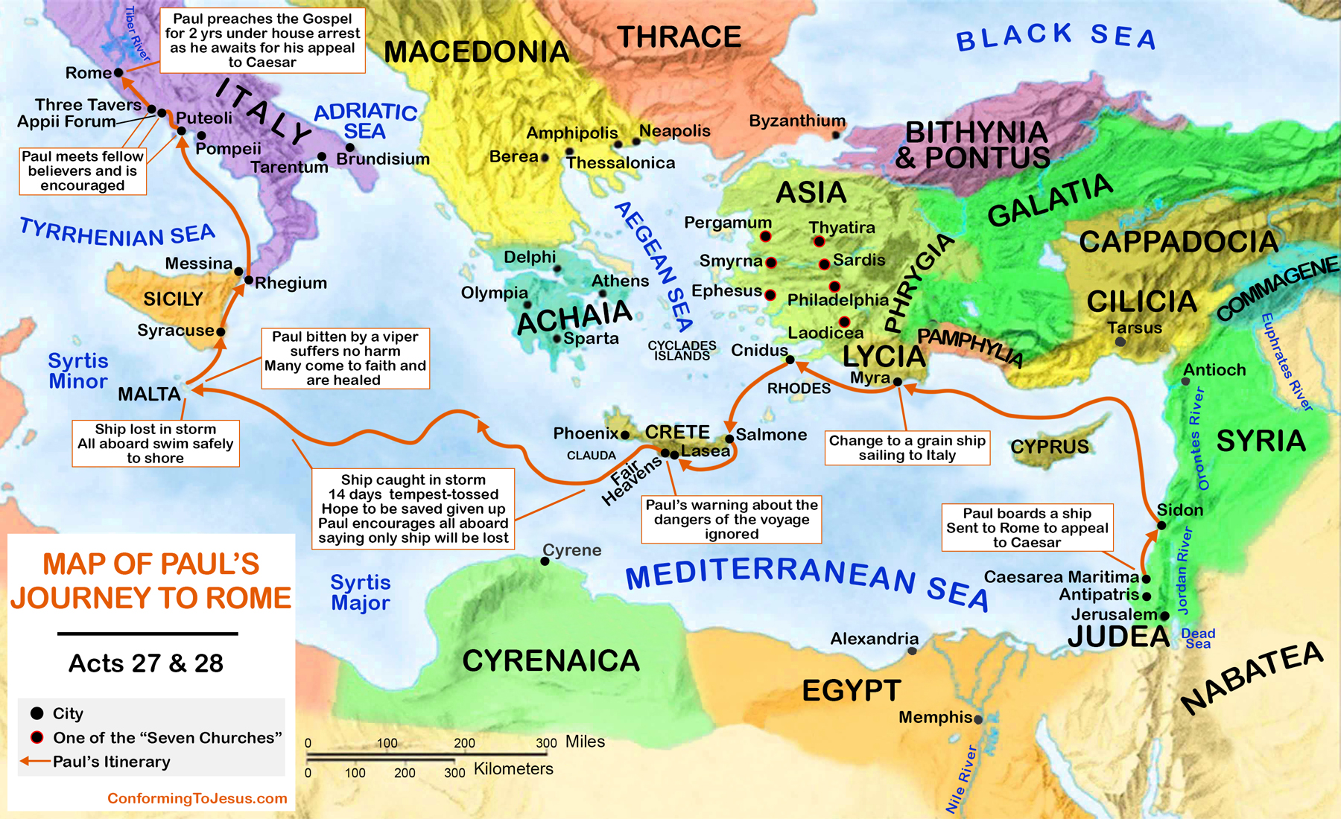

Slide 55
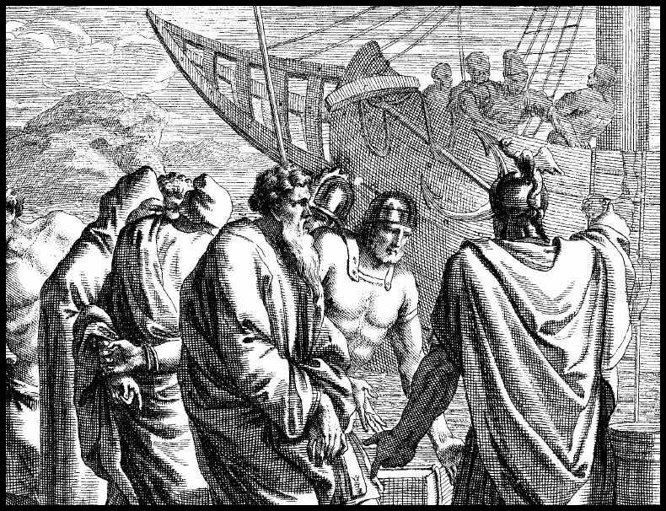
Acts 27:
¹ And when it was determined that we should sail into Italy, they delivered Paul and certain other prisoners unto one named Julius, a centurion of Augustus' band.

Slide 56
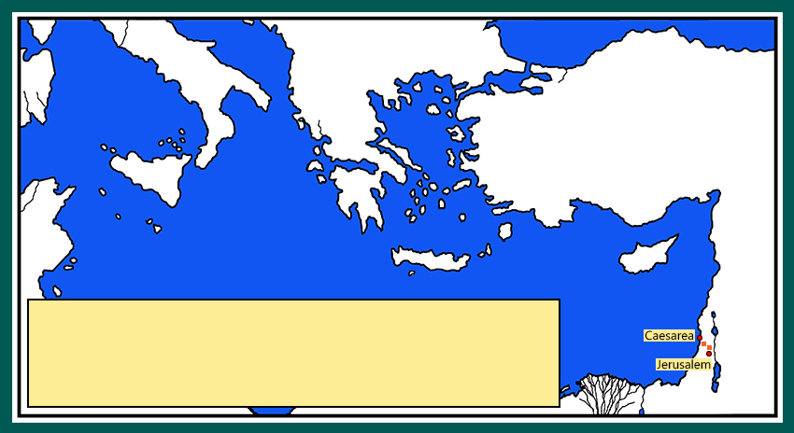
² And entering into a ship of Adramyttium,
² And entering into a ship of Adramyttium, we launched, meaning to sail by the coasts of Asia; one Aristarchus, a Macedonian of Thessalonica, being with us.
Notes:
Adramyttium – A’-dra-mit’-ee-oom
Aristarchus – Ar-iss-tar’-kuss
Thessalonica –Thess’-al-on-eye’-ka

Slide 57
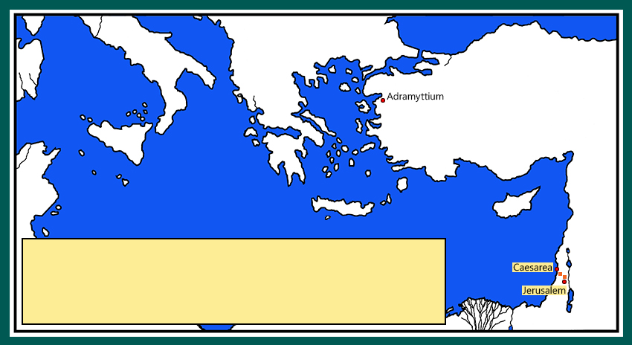
² And entering into a ship of Adramyttium,
we launched, meaning to sail by the coasts of Asia; one Aristarchus, a Macedonian of Thessalonica, being with us.
² And entering into a ship of Adramyttium, we launched, meaning to sail by the coasts of Asia; one Aristarchus, a Macedonian of Thessalonica, being with us.
Notes:
Adramyttium – A’-dra-mit’-ee-oom
Aristarchus – Ar-iss-tar’-kuss
Thessalonica –Thess’-al-on-eye’-ka

Slide 58
³ And the next day we touched at Sidon.
² And entering into a ship of Adramyttium, we launched, meaning to sail by the coasts of Asia; one Aristarchus, a Macedonian of Thessalonica, being with us.
Notes:
Sidon – Sigh’-don

Slide 59
³ And the next day we touched at Sidon.
And Julius courteously entreated Paul, and gave him liberty to go unto his friends to refresh himself.
² And entering into a ship of Adramyttium, we launched, meaning to sail by the coasts of Asia; one Aristarchus, a Macedonian of Thessalonica, being with us.

Slide 60
⁴ And when we had launched from thence, we sailed under Cyprus, because the winds were contrary.
² And entering into a ship of Adramyttium, we launched, meaning to sail by the coasts of Asia; one Aristarchus, a Macedonian of Thessalonica, being with us.

Slide 61
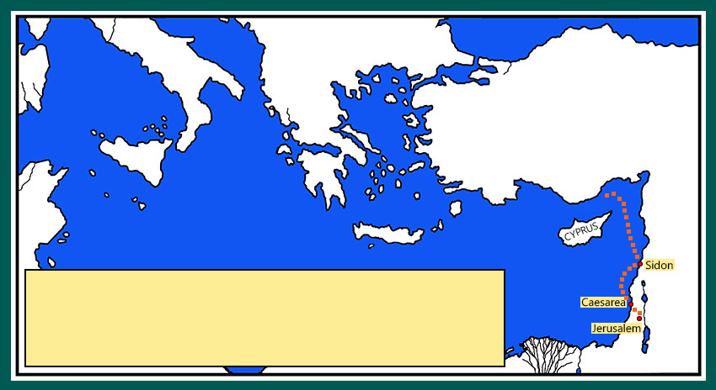
⁴ And when we had launched from thence, we sailed under Cyprus, because the winds were contrary.
² And entering into a ship of Adramyttium, we launched, meaning to sail by the coasts of Asia; one Aristarchus, a Macedonian of Thessalonica, being with us.

Slide 62
⁵ And when we had sailed over the sea of Cilicia and Pamphylia …
² And entering into a ship of Adramyttium, we launched, meaning to sail by the coasts of Asia; one Aristarchus, a Macedonian of Thessalonica, being with us.
Notes:
Cilicia –Sill-ish’-a
Pamphylia – Pam-fill’-i-a

Slide 63
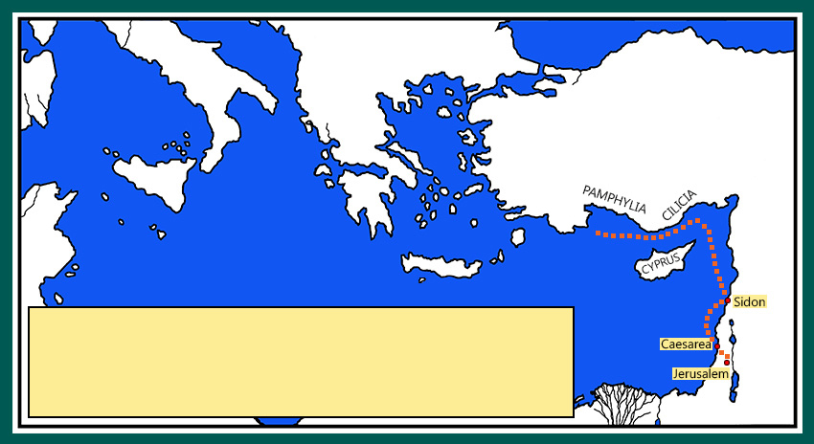
⁵ And when we had sailed over the sea of Cilicia and Pamphylia …
² And entering into a ship of Adramyttium, we launched, meaning to sail by the coasts of Asia; one Aristarchus, a Macedonian of Thessalonica, being with us.
Notes:
Cilicia –Sill-ish’-a
Pamphylia – Pam-fill’-i-a

Slide 64
…we came to Myra, a city of Lycia.
² And entering into a ship of Adramyttium, we launched, meaning to sail by the coasts of Asia; one Aristarchus, a Macedonian of Thessalonica, being with us.
Notes:
Myra – My’-ra
Lycia – Lee-shah

Slide 65
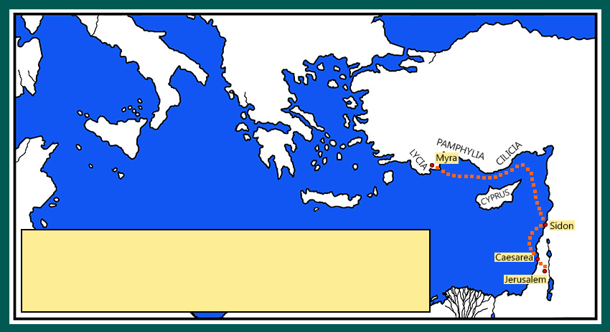
…we came to Myra, a city of Lycia.
² And entering into a ship of Adramyttium, we launched, meaning to sail by the coasts of Asia; one Aristarchus, a Macedonian of Thessalonica, being with us.

Slide 66
⁶ And there the centurion found a ship of Alexandria sailing into Italy; and he put us therein.
² And entering into a ship of Adramyttium, we launched, meaning to sail by the coasts of Asia; one Aristarchus, a Macedonian of Thessalonica, being with us.

Slide 67
⁶ And there the centurion found a ship of Alexandria sailing into Italy; and he put us therein.
² And entering into a ship of Adramyttium, we launched, meaning to sail by the coasts of Asia; one Aristarchus, a Macedonian of Thessalonica, being with us.

Slide 68
⁷ And when we had sailed slowly many days, and scarce were come over against Cnidus, the wind not suffering us,
² And entering into a ship of Adramyttium, we launched, meaning to sail by the coasts of Asia; one Aristarchus, a Macedonian of Thessalonica, being with us.
Notes:
Cnidus – Knigh’-dos

Slide 69
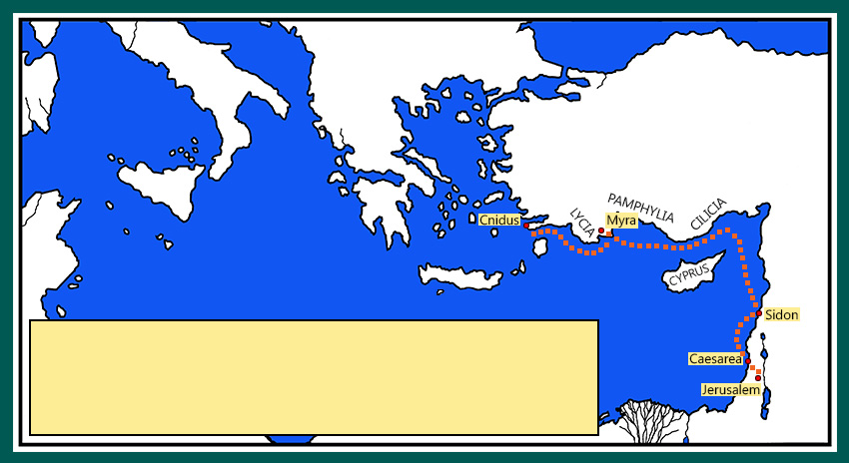
⁷ And when we had sailed slowly many days, and scarce were come over against Cnidus, the wind not suffering us,
we sailed under Crete, over against Salmone;
² And entering into a ship of Adramyttium, we launched, meaning to sail by the coasts of Asia; one Aristarchus, a Macedonian of Thessalonica, being with us.
Notes:
Salmone – Sal-moh’-ne

Slide 70
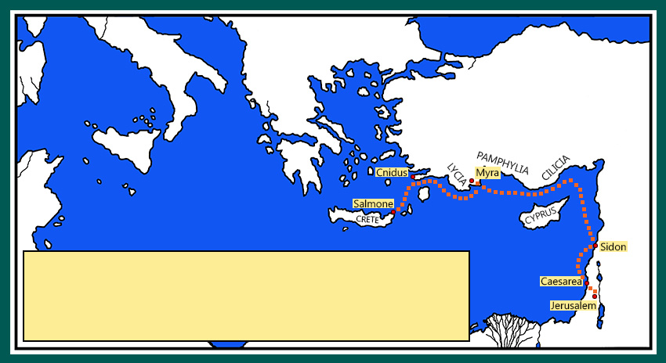
⁷ And when we had sailed slowly many days, and scarce were come over against Cnidus, the wind not suffering us,
we sailed under Crete, over against Salmone;
² And entering into a ship of Adramyttium, we launched, meaning to sail by the coasts of Asia; one Aristarchus, a Macedonian of Thessalonica, being with us.

Slide 71
⁸ And, hardly passing it, came unto a place which is called The fair havens; nigh whereunto was the city of Lasea.
² And entering into a ship of Adramyttium, we launched, meaning to sail by the coasts of Asia; one Aristarchus, a Macedonian of Thessalonica, being with us.
Notes:
Lasea – Las-e’-a

Slide 72
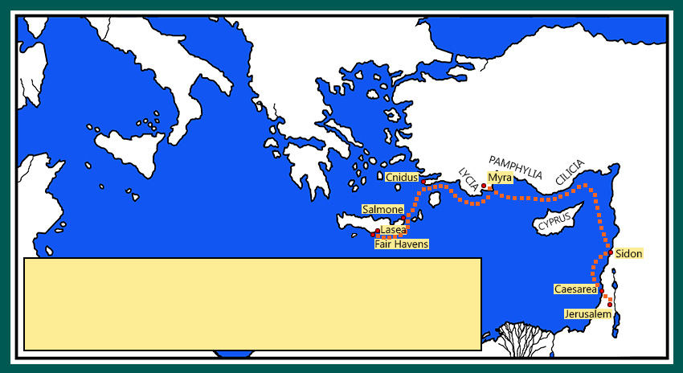
⁸ And, hardly passing it, came unto a place which is called The fair havens; nigh whereunto was the city of Lasea.
² And entering into a ship of Adramyttium, we launched, meaning to sail by the coasts of Asia; one Aristarchus, a Macedonian of Thessalonica, being with us.
Notes:
Lasea – Las-e’-a

Slide 73
⁹ Now when much time was spent, and when sailing was now dangerous, because the fast was now already past,
Paul admonished them,
¹⁰ And said unto them, Sirs, I perceive that this voyage will be with hurt and much damage, not only of the lading and ship, but also of our lives.
¹¹ Nevertheless the centurion believed the master and the owner of the ship, more than those things which were spoken by Paul.
This fast took place on the 10th day of the seventh month, the day of Atonement – about 1 October.
The winter storm months had arrived.

Slide 74
¹² And because the haven was not commodious to winter in, the more part advised to depart thence also, if by any means they might attain to Phenice, and there to winter;
² And entering into a ship of Adramyttium, we launched, meaning to sail by the coasts of Asia; one Aristarchus, a Macedonian of Thessalonica, being with us.
Notes:
Phenice – fe-ni'-se

Slide 75
¹² And because the haven was not commodious to winter in, the more part advised to depart thence also, if by any means they might attain to Phenice, and there to winter;
² And entering into a ship of Adramyttium, we launched, meaning to sail by the coasts of Asia; one Aristarchus, a Macedonian of Thessalonica, being with us.
Notes:
Phenice – fe-ni'-se

Slide 76
The harbor of Phenice opened toward the southwest and northwest.
…which is an haven of Crete, and lieth toward the south west and north west.
² And entering into a ship of Adramyttium, we launched, meaning to sail by the coasts of Asia; one Aristarchus, a Macedonian of Thessalonica, being with us.
Notes:
Phenice – fe-ni'-se

Slide 77
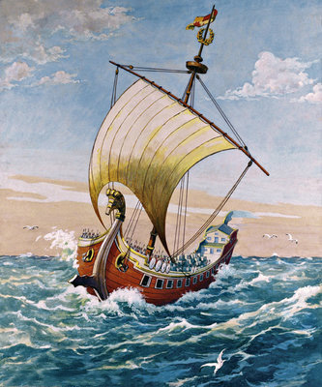
¹³ And when the south wind blew softly, supposing that they had obtained their purpose, loosing thence, they sailed close by Crete.

Slide 78
¹⁴ But not long after there arose against it a tempestuous wind, called Euroclydon.
Notes:
Euroclydon – Eur-okk’-lid-on

Slide 79
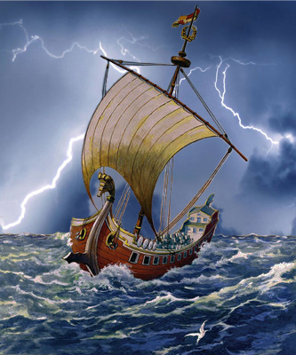
¹⁴ But not long after there arose against it a tempestuous wind, called Euroclydon.
Notes:
\

Slide 80
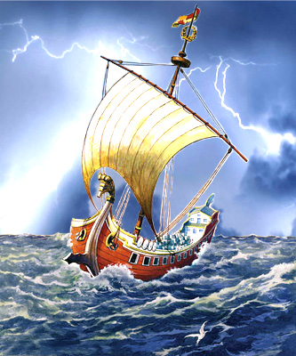
¹⁴ But not long after there arose against it a tempestuous wind, called Euroclydon.
Notes:
\

Slide 81
¹⁴ But not long after there arose against it a tempestuous wind, called Euroclydon.
The Euroclydon is a cyclonic northeast wind that blows in the Mediterranean in autumn and winter.
Notes:
\

Slide 82
¹⁴ But not long after there arose against it a tempestuous wind, called Euroclydon.
¹⁵ And when the ship was caught, and could not bear up into the wind, we let her drive.

Slide 83
¹⁶ And running under a certain island which is called Clauda, we had much work to come by the boat:
² And entering into a ship of Adramyttium, we launched, meaning to sail by the coasts of Asia; one Aristarchus, a Macedonian of Thessalonica, being with us.
Notes:
Clauda Klaw’-da

Slide 84
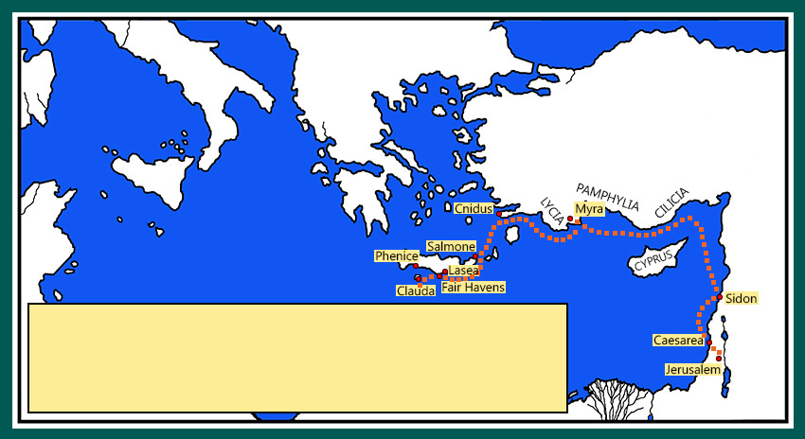
¹⁶ And running under a certain island which is called Clauda, we had much work to come by the boat:
² And entering into a ship of Adramyttium, we launched, meaning to sail by the coasts of Asia; one Aristarchus, a Macedonian of Thessalonica, being with us.

Slide 85
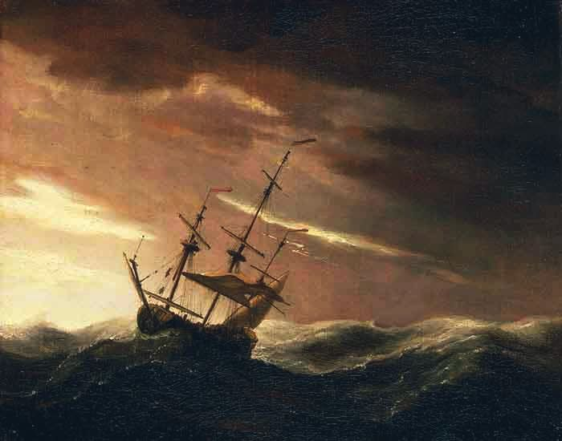
¹⁷ Which when they had taken up, they used helps, undergirding the ship; and, fearing lest they should fall into the quicksands, strake sail, and so were driven.
¹⁸ And we being exceedingly tossed with a tempest, the next day they lightened the ship;
¹⁹ And the third day we cast out with our own hands the tackling of the ship.
Notes:
Euroclydon – Eur-okk’-lid-on
Clauda

Slide 86
NIV translation of verses 14-19:
¹⁴ Before very long, a wind of hurricane force, called the "northeaster," swept down from the island.
¹⁵ The ship was caught by the storm and could not head into the wind; so we gave way to it and were driven along.
¹⁶ As we passed to the lee of a small island called Cauda, we were hardly able to make the lifeboat secure.
¹⁷ When the men had hoisted it aboard, they passed ropes under the ship itself to hold it together. Fearing that they would run aground on the sandbars of Syrtis, they lowered the sea anchor and let the ship be driven along.
¹⁸ We took such a violent battering from the storm that the next day they began to throw the cargo overboard.
¹⁹ On the third day, they threw the ship's tackle overboard with their own hands.
Notes:
Cauda – Kaw’-da
Syrtis – Sirr’-tiss

Slide 87
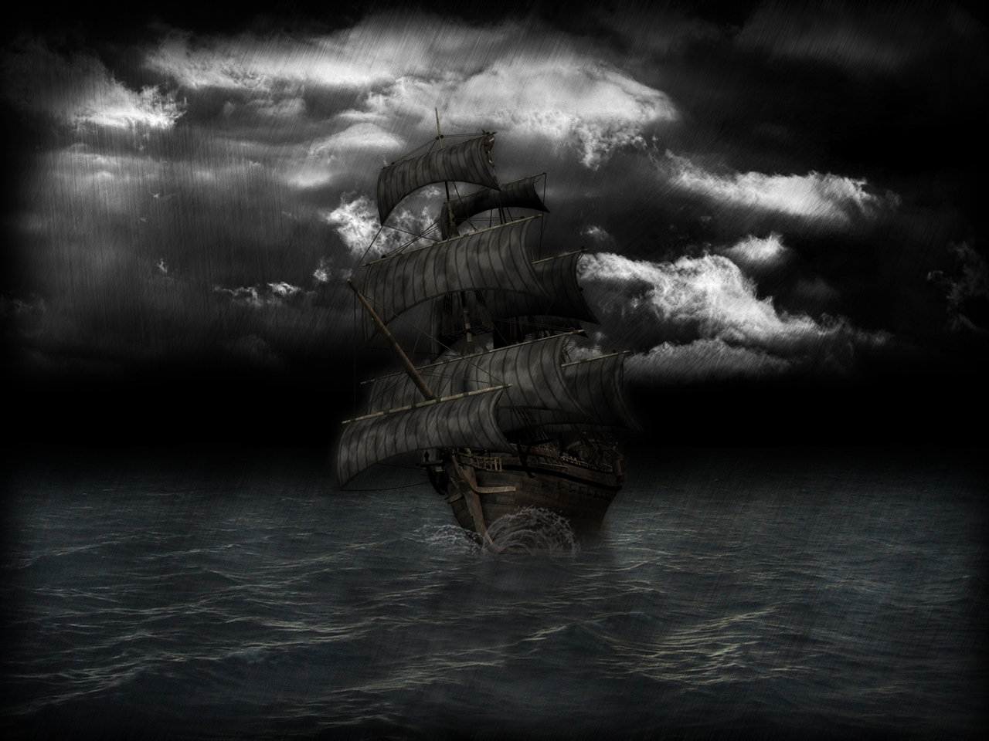
²⁰ And when neither sun nor stars in many days appeared, and no small tempest lay on us, all hope that we should be saved was then taken away.
Notes:
Euroclydon – Eur-okk’-lid-on
Clauda

Slide 88
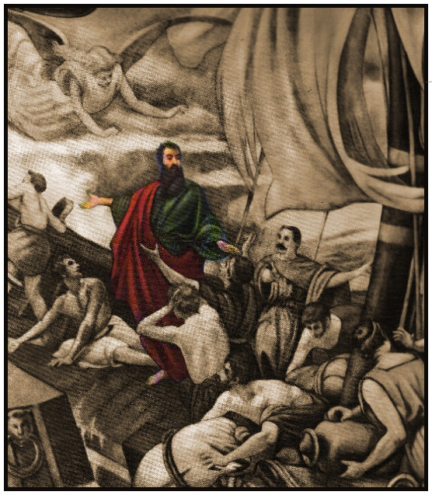
²¹ But after long abstinence Paul stood forth in the midst of them, and said,
Sirs, ye should have hearkened unto me, and not have loosed from Crete, and to have gained this harm and loss.
²² And now I exhort you to be of good cheer: for there shall be no loss of any man's life among you, but of the ship.
²³ For there stood by me this night the angel of God, whose I am, and whom I serve,
Notes:
Euroclydon – Eur-okk’-lid-on
Clauda

Slide 89
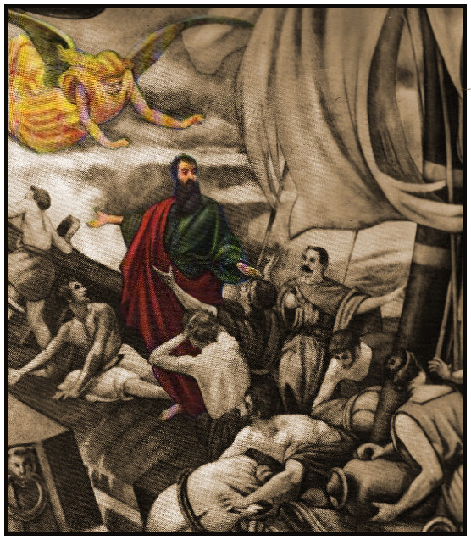
²⁴ Saying, Fear not, Paul; thou must be brought before Caesar: and, lo, God hath given thee all them that sail with thee.
²⁵ Wherefore, sirs, be of good cheer: for I believe God, that it shall be even as it was told me.
²⁶ Howbeit we must be cast upon a certain island.
Notes:
Euroclydon – Eur-okk’-lid-on
Clauda

Slide 90
In Paul’s day, the Adria included the part of the Mediterranean Sea lying south of Italy, east of Sicily, and west of Greece.
²⁷ But when the fourteenth night was come, as we were driven up and down in Adria, about midnight the shipmen deemed that they drew near to some country;
² And entering into a ship of Adramyttium, we launched, meaning to sail by the coasts of Asia; one Aristarchus, a Macedonian of Thessalonica, being with us.
Notes:
Adria Ah’dree-a

Slide 91
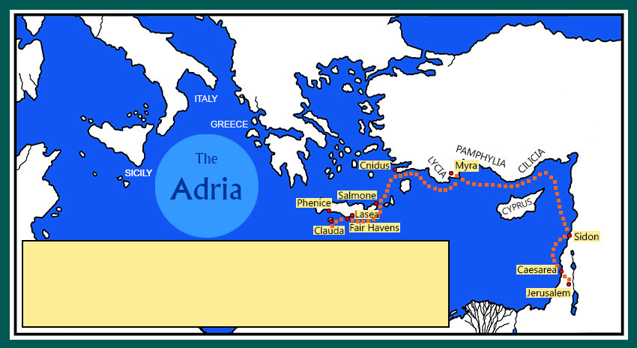
In Paul’s day the Adria included the part of the Mediterranean Sea lying south of Italy, east of Sicily, and west of Greece.
²⁷ But when the fourteenth night was come, as we were driven up and down in Adria, about midnight the shipmen deemed that they drew near to some country;
² And entering into a ship of Adramyttium, we launched, meaning to sail by the coasts of Asia; one Aristarchus, a Macedonian of Thessalonica, being with us.

Slide 92
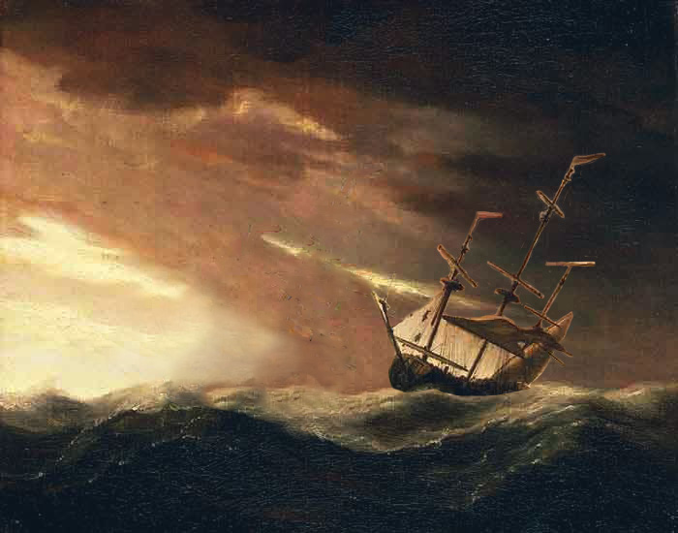
²⁸ And sounded, and found it twenty fathoms: and when they had gone a little further, they sounded again, and found it fifteen fathoms.
They let down their plummet, or sounding line, which was a line with a piece of lead attached to the end of it. They were trying to find out whether they were near land. They measured a depth of 120 feet, and then only 90 feet.

Slide 93
²⁹ Then fearing lest we should have fallen upon rocks, they cast four anchors out of the stern, and wished for the day.
³⁰ And as the shipmen were about to flee out of the ship, when they had let down the boat into the sea, under colour as though they would have cast anchors out of the foreship,

Slide 94
³¹ Paul said to the centurion and to the soldiers, Except these abide in the ship, ye cannot be saved.
³² Then the soldiers cut off the ropes of the boat, and let her fall off.

Slide 95
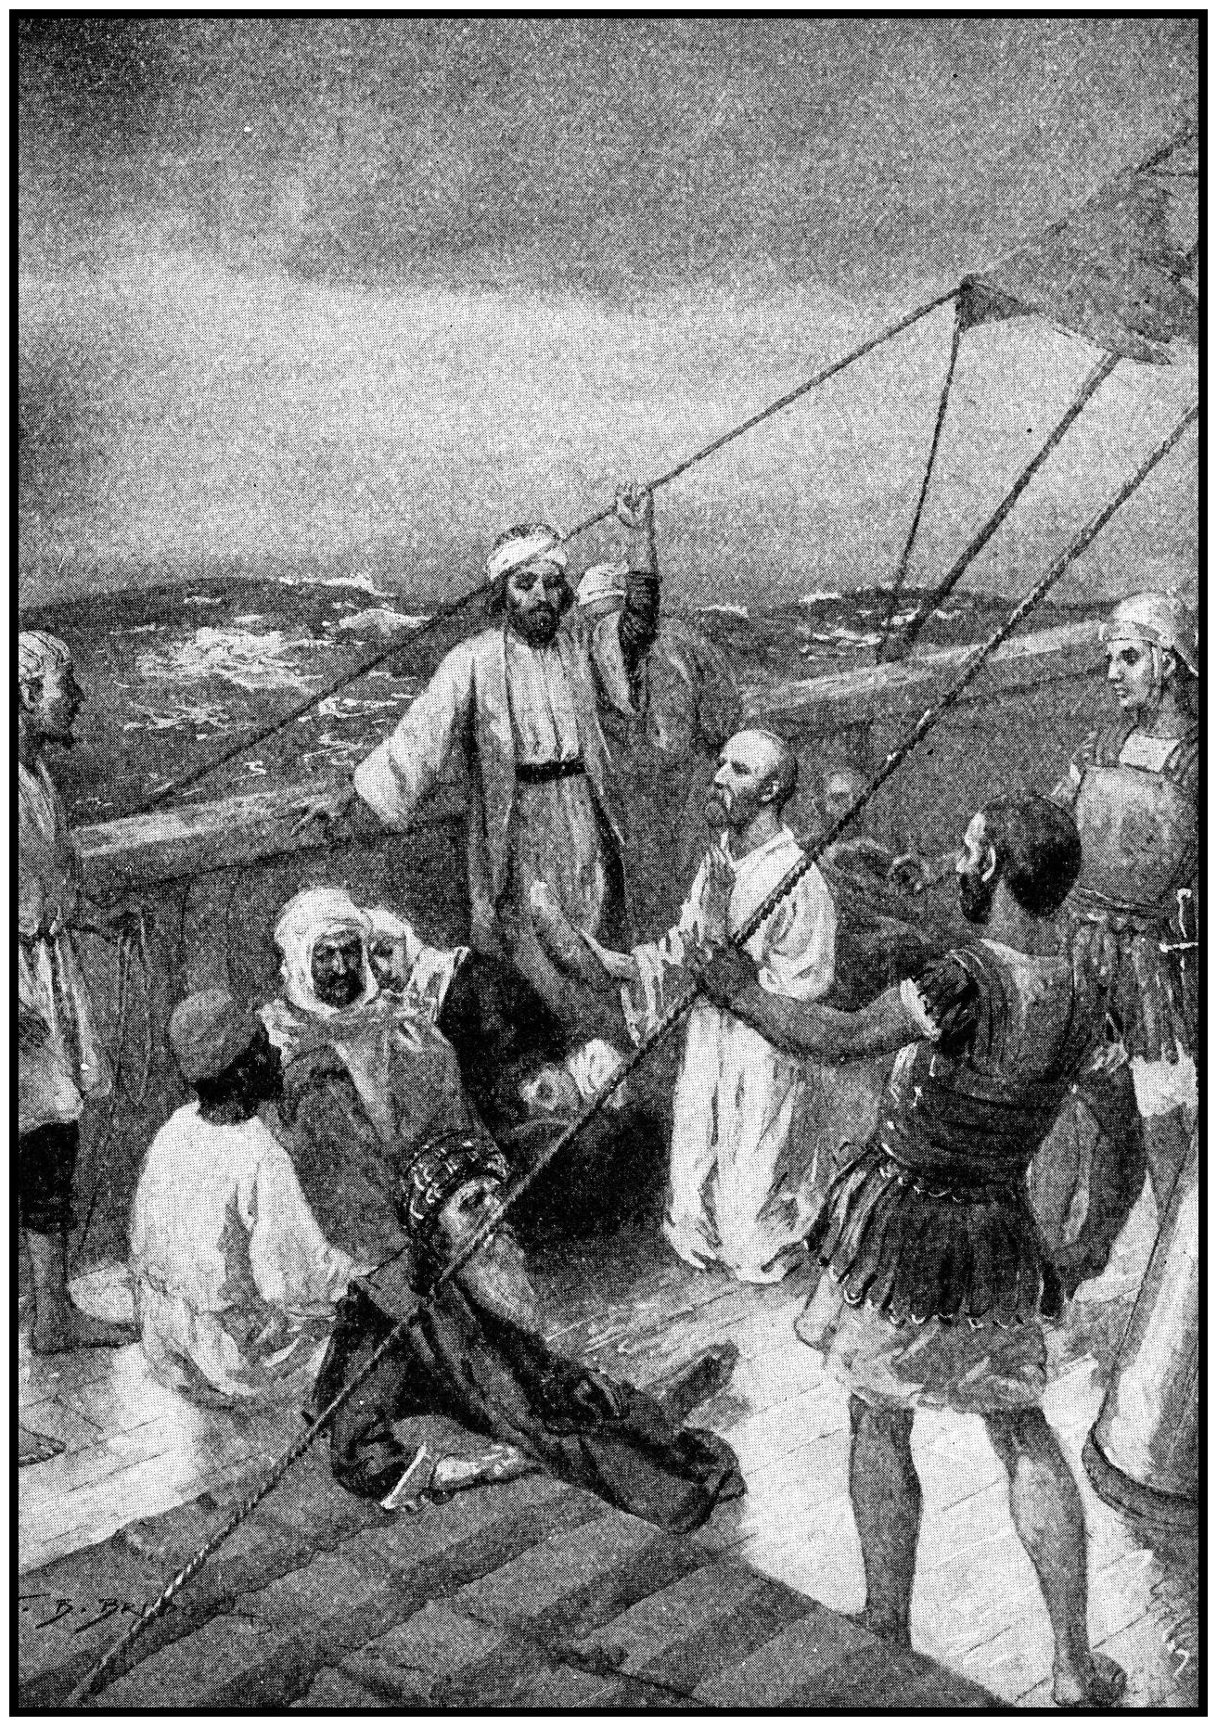
³³ And while the day was coming on, Paul besought them all to take meat, saying, This day is the fourteenth day that ye have tarried and continued fasting, having taken nothing.
³⁴ Wherefore I pray you to take some meat: for this is for your health: for there shall not an hair fall from the head of any of you.
³⁵ And when he had thus spoken, he took bread, and gave thanks to God in presence of them all: and when he had broken it, he began to eat.

Slide 96
³⁶ Then were they all of good cheer, and they also took some meat.
³⁷ And we were in all in the ship two hundred threescore and sixteen souls.
³⁸ And when they had eaten enough, they lightened the ship, and cast out the wheat into the sea.

Slide 97
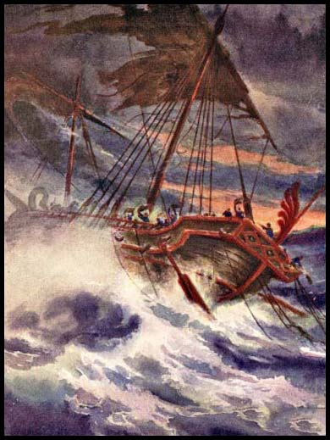
³⁹ And when it was day, they knew not the land: but they discovered a certain creek with a shore, into the which they were minded, if it were possible, to thrust in the ship.
⁴⁰ And when they had taken up the anchors, they committed themselves unto the sea, and loosed the rudder bands, and hoised up the mainsail to the wind, and made toward shore.

Slide 98
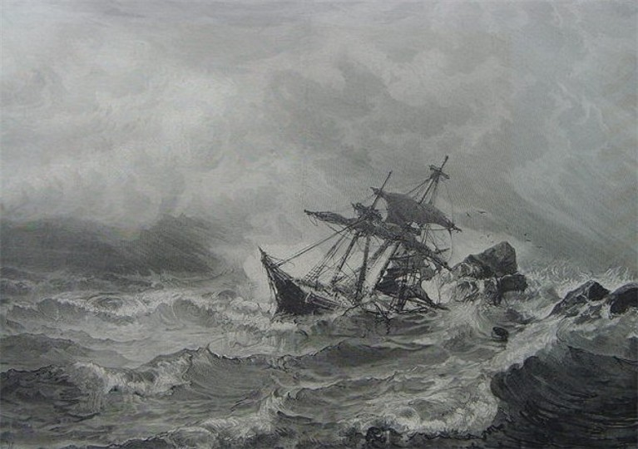
⁴¹ And falling into a place where two seas met,
[a sandbank formed by opposing currents]
they ran the ship aground;
and the forepart stuck fast, and remained unmoveable, but the hinder part was broken with the violence of the waves.

Slide 99
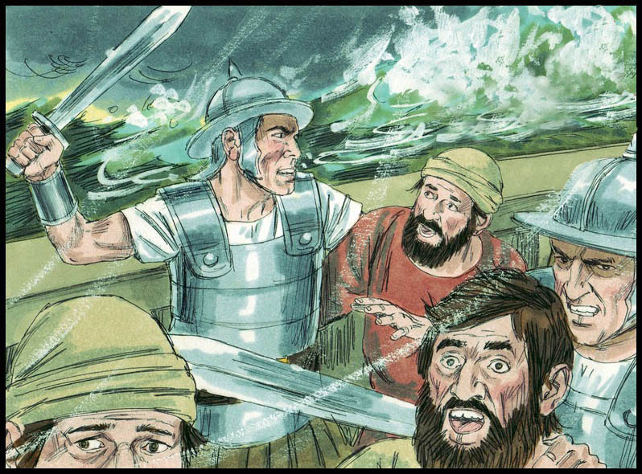
⁴² And the soldiers' counsel was to kill the prisoners, lest any of them should swim out, and escape.

Slide 100
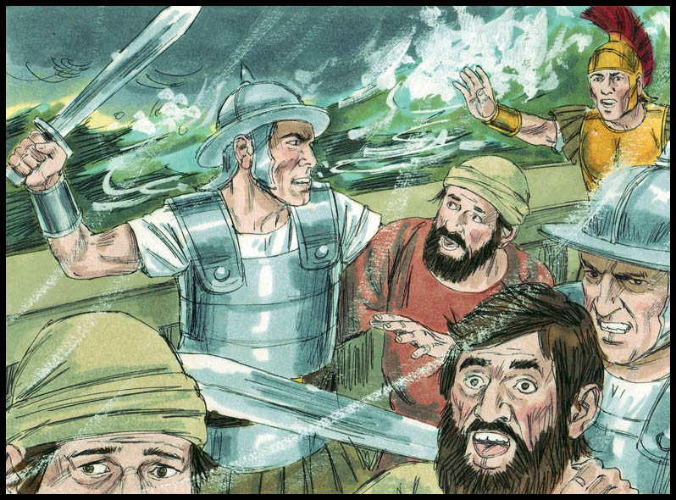
⁴² And the soldiers' counsel was to kill the prisoners, lest any of them should swim out, and escape.
⁴³ But the centurion, willing to save Paul, kept them from their purpose;
and commanded that they which could swim should cast themselves first into the sea, and get to land:
⁴⁴ And the rest, some on boards, and some on broken pieces of the ship.

Slide 101
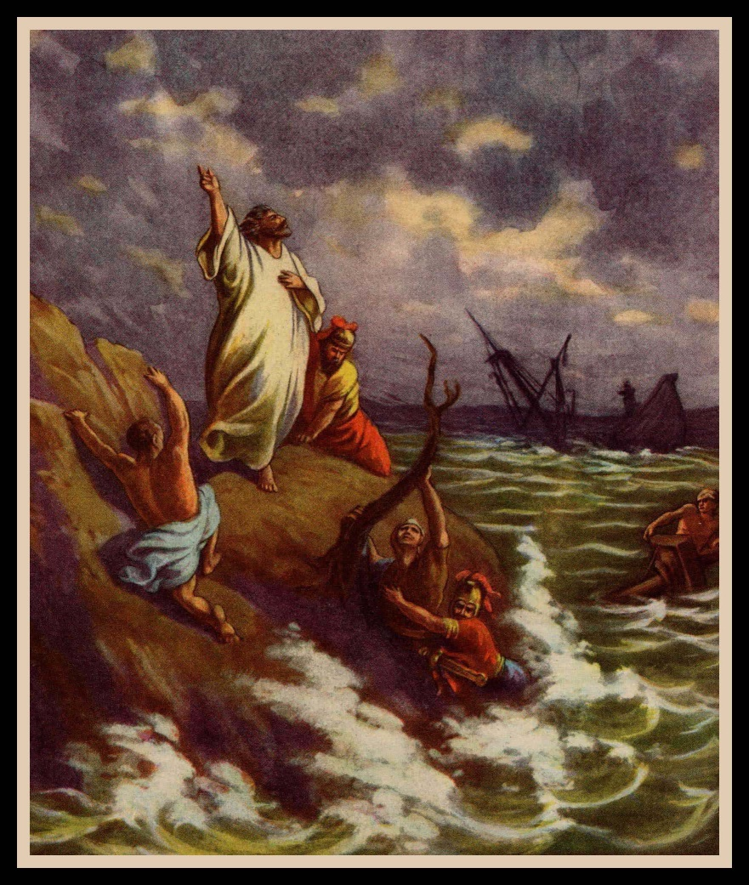
And so it came to pass, that they escaped all safe to land.

Slide 102
L.D. CARY & SAM HOLT CATCH PHRASES
Chapter 19 – “10 + 9, Ephesus Time”
Chapter 20 – “Traveling A’Plenty”
Chapter 21 – “Confinement Begun”
Chapter 22 – “Before A Mob, Not A Few”
Chapter 23 – “Before The Council, You See”
Chapter 24 – “Felix Listens No More”
Chapter 25 – “Agrippa Arrives”
Chapter 26 – “Agrippa Realizes Paul’s Fix”
Chapter 27 – “Shipwreck & An Angel From Heaven”
Chapter 28 – “The End Of Our Wait”
“The End Of Our Wait”
Catch Phrase
Chapter Twenty-Eight

Slide 103
Acts 28:
¹ And when they were escaped, then they knew that the island was called Melita.
² And entering into a ship of Adramyttium, we launched, meaning to sail by the coasts of Asia; one Aristarchus, a Macedonian of Thessalonica, being with us.
Notes:
Melita – mel-ee'-tay
Malta Mahl’-ta

Slide 104
Acts 28:
¹ And when they were escaped, then they knew that the island was called Melita.
² And entering into a ship of Adramyttium, we launched, meaning to sail by the coasts of Asia; one Aristarchus, a Macedonian of Thessalonica, being with us.

Slide 105
² And the barbarous people shewed us no little kindness: for they kindled a fire, and received us every one, because of the present rain, and because of the cold.
² And entering into a ship of Adramyttium, we launched, meaning to sail by the coasts of Asia; one Aristarchus, a Macedonian of Thessalonica, being with us.

Slide 106
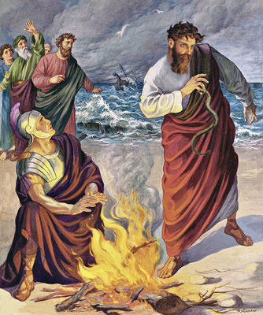
³ And when Paul had gathered a bundle of sticks, and laid them on the fire, there came a viper out of the heat, and fastened on his hand.
⁴ And when the barbarians saw the venomous beast hang on his hand, they said among themselves, No doubt this man is a murderer, whom, though he hath escaped the sea, yet vengeance suffereth not to live.

Slide 107
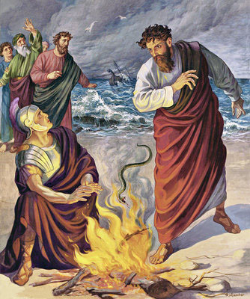
⁵ And he shook off the beast into the fire, and felt no harm.
⁶ Howbeit they looked when he should have swollen, or fallen down dead suddenly:
but after they had looked a great while, and saw no harm come to him, they changed their minds, and said that he was a god.

Slide 108
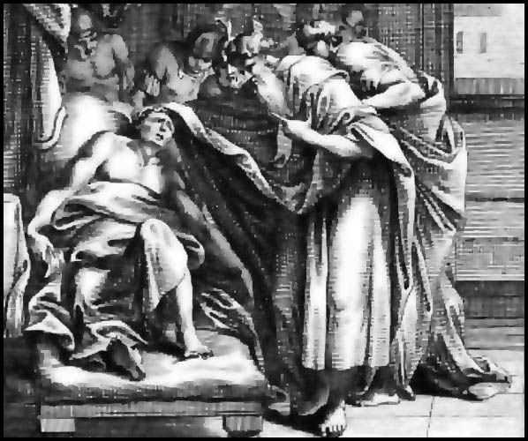
⁷ In the region was an estate of the chief man of the island, whose name was Publius; who received us, and lodged us three days courteously.
⁸ And it came to pass, that the father of Publius lay sick of a fever and of a bloody flux [dysentery]: to whom Paul entered in, and prayed, and laid his hands on him, and healed him.
Notes:
Publius – Poob’-lee-us

Slide 109
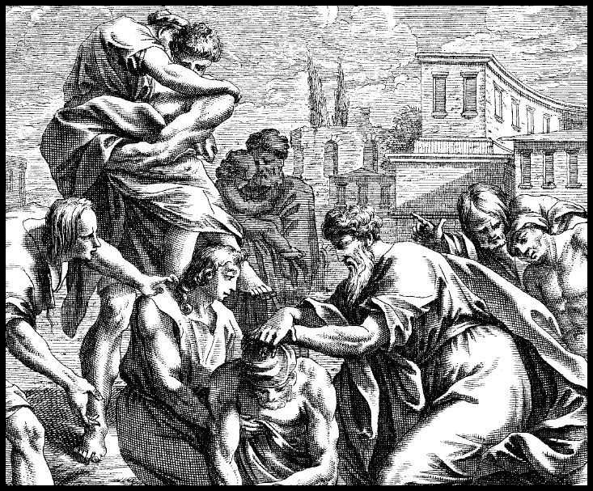
⁹ So when this was done, others also, which had diseases in the island, came, and were healed:
¹⁰ Who also honoured us with many honours; and when we departed, they laded us with such things as were necessary.

Slide 110
¹¹ And after three months we departed in a ship of Alexandria, which had wintered in the isle, whose sign was Castor and Pollux.
² And entering into a ship of Adramyttium, we launched, meaning to sail by the coasts of Asia; one Aristarchus, a Macedonian of Thessalonica, being with us.

Slide 111
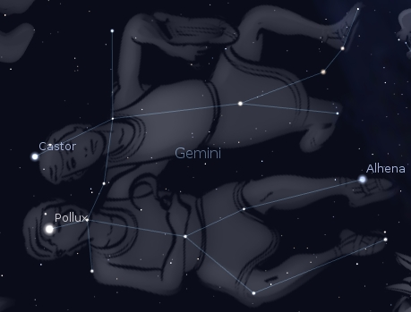
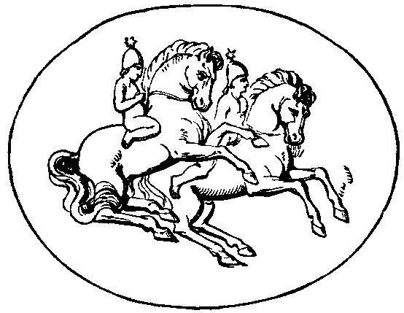
In Greek and Roman mythology, Castor and Pollux are the twin sons of Zeus and Leda.
Their names were given to the bright stars in the constellation Gemini.
Castor and Pollux were often depicted as helmeted horsemen carrying spears.

Slide 112
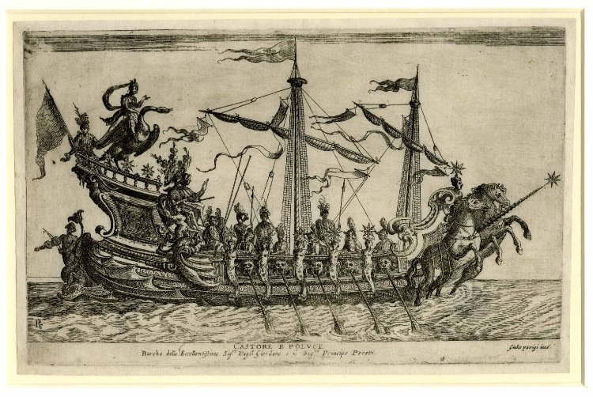
“whose sign was Castor and Pollux”
This sign was carried on the prow of the vessel, after the manner of a ship’s figurehead.
Castor and Pollux were regarded as the patron deities of sailors.

Slide 113
¹² And landing at Syracuse, we tarried there three days.
² And entering into a ship of Adramyttium, we launched, meaning to sail by the coasts of Asia; one Aristarchus, a Macedonian of Thessalonica, being with us.

Slide 114
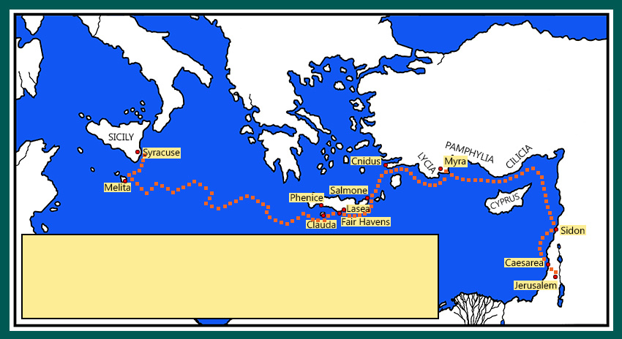
¹² And landing at Syracuse, we tarried there three days.
¹³ And from thence we fetched a compass, and came to Rhegium:
² And entering into a ship of Adramyttium, we launched, meaning to sail by the coasts of Asia; one Aristarchus, a Macedonian of Thessalonica, being with us.
Notes:
Regium – Rej’-ee-um

Slide 115
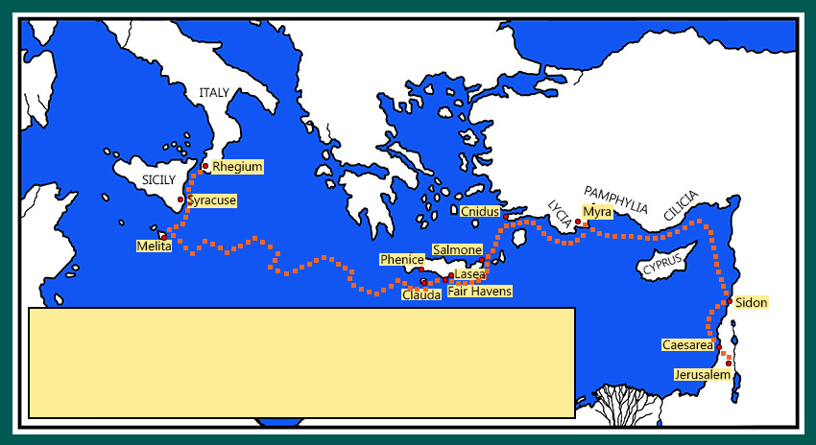
¹² And landing at Syracuse, we tarried there three days.
¹³ And from thence we fetched a compass, and came to Rhegium:
² And entering into a ship of Adramyttium, we launched, meaning to sail by the coasts of Asia; one Aristarchus, a Macedonian of Thessalonica, being with us.

Slide 116
To “fetch a compass” is to make a circuit; to take a circuitous route going to a place.
From Webster’s 1828 Dictionary:
FETCH – To make; to perform.
COMPASS – A passing round; a circular course; a circuit.
2 Samuel 5:23 And when David enquired of the LORD, he said, Thou shalt not go up; but fetch a compass behind them, and come upon them over against the mulberry trees.
2 Kings 3:9 So the king of Israel went, and the king of Judah, and the king of Edom: and they fetched a compass of seven days' journey: and there was no water for the host, and for the cattle that followed them.

Slide 117
…and after one day the south wind blew, and we came the next day to Puteoli:
² And entering into a ship of Adramyttium, we launched, meaning to sail by the coasts of Asia; one Aristarchus, a Macedonian of Thessalonica, being with us.
Notes:
Puteoli – Poo-tee’-o-lee

Slide 118
…and after one day the south wind blew, and we came the next day to Puteoli:
² And entering into a ship of Adramyttium, we launched, meaning to sail by the coasts of Asia; one Aristarchus, a Macedonian of Thessalonica, being with us.

Slide 119
¹⁴ Where we found brethren, and were desired to tarry with them seven days: and so we went toward Rome.
² And entering into a ship of Adramyttium, we launched, meaning to sail by the coasts of Asia; one Aristarchus, a Macedonian of Thessalonica, being with us.

Slide 120
¹⁵ And from thence, when the brethren heard of us, they came to meet us as far as Appii forum, and The three taverns:
² And entering into a ship of Adramyttium, we launched, meaning to sail by the coasts of Asia; one Aristarchus, a Macedonian of Thessalonica, being with us.
Notes:
Appii – A’-pee-eye

Slide 121
¹⁵ And from thence, when the brethren heard of us, they came to meet us as far as Appii forum, and The Three Inns:
² And entering into a ship of Adramyttium, we launched, meaning to sail by the coasts of Asia; one Aristarchus, a Macedonian of Thessalonica, being with us.

Slide 122
whom when Paul saw, he thanked God, and took courage.
² And entering into a ship of Adramyttium, we launched, meaning to sail by the coasts of Asia; one Aristarchus, a Macedonian of Thessalonica, being with us.

Slide 123
The Appii forum (the marketplace of Appius) was a well-known station on the Appian Way, one of the earliest and most important Roman roads of the ancient republic.
The three taverns was a village about ten miles near Rome.

Slide 124
¹⁶ And when we came to Rome,
² And entering into a ship of Adramyttium, we launched, meaning to sail by the coasts of Asia; one Aristarchus, a Macedonian of Thessalonica, being with us.

Slide 125
¹⁶ And when we came to Rome,
² And entering into a ship of Adramyttium, we launched, meaning to sail by the coasts of Asia; one Aristarchus, a Macedonian of Thessalonica, being with us.

Slide 126
…the centurion delivered the prisoners to the captain of the guard: but Paul was suffered to dwell by himself with a soldier that kept him.

Slide 127
¹⁷ And it came to pass, that after three days Paul called the chief of the Jews together:
and when they were come together, he said unto them,
Men and brethren, though I have committed nothing against the people, or customs of our fathers, yet was I delivered prisoner from Jerusalem into the hands of the Romans.
¹⁸ Who, when they had examined me, would have let me go, because there was no cause of death in me.
¹⁹ But when the Jews spake against it, I was constrained to appeal unto Caesar; not that I had ought to accuse my nation of.
²⁰ For this cause therefore have I called for you, to see you, and to speak with you: because that for the hope of Israel I am bound with this chain.

Slide 128
²¹ And they said unto him,
We neither received letters out of Judaea concerning thee, neither any of the brethren that came shewed or spake any harm of thee.
²² But we desire to hear of thee what thou thinkest:
for as concerning this sect, we know that every where it is spoken against.

Slide 129
²³ And when they had appointed him a day, there came many to him into his lodging; to whom he expounded and testified the kingdom of God, persuading them concerning Jesus, both out of the law of Moses, and out of the prophets, from morning till evening.
²⁴ And some believed the things which were spoken, and some believed not.
²⁵ And when they agreed not among themselves, they departed, after that Paul had spoken one word,

Slide 130
Well spake the Holy Ghost by Esaias the prophet unto our fathers,
²⁶ Saying, Go unto this people, and say, Hearing ye shall hear, and shall not understand; and seeing ye shall see, and not perceive:
²⁷ For the heart of this people is waxed gross, and their ears are dull of hearing, and their eyes have they closed;
lest they should see with their eyes, and hear with their ears, and understand with their heart, and should be converted, and I should heal them.

Slide 131
²⁸ Be it known therefore unto you, that the salvation of God is sent unto the Gentiles, and that they will hear it.
²⁹ And when he had said these words, the Jews departed, and had great reasoning among themselves.

Slide 132
³⁰ And Paul dwelt two whole years in his own hired house, and received all that came in unto him,
³¹ Preaching the kingdom of God, and teaching those things which concern the Lord Jesus Christ, with all confidence, no man forbidding him.

Slide 134
Paul's Journey to Rome
Acts 27:1-28:31

Slide 135
Outline - Acts
II. The Ministry of Paul – Acts 13:1-28:31
Paul’s 1st Missionary Journey – Acts 13:1-15:35
Paul’s 2nd Missionary Journey – Acts 15:36-18:22
Paul’s 3rd Missionary Journey – Acts 18:23-21:14
Paul’s Arrest - 1 – Acts 21:15-23:11
Paul’s Arrest - 2 – Acts 23:12-25:12
Paul’s Arrest - 3 – Acts 25:13-26:32
Paul’s Journey to Rome – Acts 27:1-28:31

Slide 136
CONSIDERED BY SOME BIBLE SCHOLARS PAUL’S FOURTH MISSIONARY JOURNEY

Slide 137
“PAX ROMANA” IS LATIN FOR “PEACE OF ROME” & REFERS TO THE PERIOD OF ROMAN HISTORY BETWEEN THE RISE OF AUGUSTUS CAESAR IN 27 B.C. & THE DEATH OF MARCUS AURELIUS IN THE YEAR 180 – 200 YEARS OF PEACE & PREDICTABILITY.
Pax Romana

Slide 138
¹ When it was decided that we would sail for Italy, they proceeded to deliver Paul and some other prisoners to a centurion of the Augustan cohort named Julius. ² And embarking in an Adramyttian ship, which was about to sail to the regions along the coast of Asia, we put out to sea accompanied by Aristarchus, a Macedonian of Thessalonica.
- Acts 27:1-2

Slide 139
CENTURION

Slide 140
CHAPTER 27 J. W. McGarvey’s Acts Commentary
VERSES 1 & 2
Not long after the interview with Agrippa, Paul saw an immediate prospect of departing upon his long-purposed voyage to Rome. The answer to his prayers was about to be realized, and the promise made him by night in the prison of Claudius Lysias that he should yet testify of Jesus Christ in Rome as he had done in Jerusalem, was about to be fulfilled. This was being accomplished, not by any sort of direct divine interference, but by a providential combination of circumstances. The machinations of the Jews, the corruption of Felix, the indecision of Festus, the prudence of Paul, and the Roman statute in behalf of citizens, had all most strangely, yet most naturally, combined to fulfill a promise of God made in answer to prayer.
McGarvey, J. W. (1872). A commentary on Acts of Apostles (p. 282). Lexington, KY: Transylvania Printing and Publishing Co.

Slide 141
CHAPTER 27 J. W. McGarvey’s Acts Commentary
VERSES 1 & 2
Here, again, we find the significant “we” of Luke, showing that he was again in Paul’s company. The last time we met with this term was upon the arrival of the apostolic company in Jerusalem. He had probably not been far from Paul during the two years of imprisonment in Cæsarea, and was now permitted to accompany him to Rome. Aristarchus was also a voluntary companion of the prisoner, as we infer from the manner in which his name is mentioned. There were, however, other prisoners on board. As the ship belonged to Adramyttium, which is on the coast of Mysia, it was now homeward bound, and was not expected to take the prisoners further than its own destination. But as they were about to touch at several “places along the coast of Asia,” they could calculate upon falling in with some vessel bound for Rome.
McGarvey, J. W. (1872). A commentary on Acts of Apostles (p. 282). Lexington, KY: Transylvania Printing and Publishing Co.

Slide 142
³ The next day we put in at Sidon; and Julius treated Paul with consideration and allowed him to go to his friends and receive care. ⁴ From there we put out to sea and sailed under the shelter of Cyprus because the winds were contrary.
- Acts 27:3-4

Slide 143
De amicitia: The Divine Gift of Friendship
27:3 TPR The centurion, being kindly disposed to Paul, permitted his friends to come to him and take care of him.
From the portrait of him in Acts as well as from his own epistles it is clear that as Saint Paul was prone to sudden and violent outbursts of anger (→21:13–14)—“God shall strike you, you whitewashed wall!” (23:3) he could shout at the high priest, and he could write to his congregation, “O foolish Galatians! Who has bewitched you?” (Gal. 3:1)—so he was capable both of expressing and of evoking deep and loyal friendship. This is nevertheless one of only two passages in Acts (the other being 19:31) where the actual word “friend” (φίλος) is used in connection with him. But because, to paraphrase the proverb, a friend is as a friend does, the theme of friendship, like the other “religious affections” (→21:13–14) that are portrayed here, comes through in the narratives of Acts primarily in concrete acts of friendship, from which it is possible to read off some of its characteristics:
1. Friendship is demonstrative, as Paul’s friends at Tyre manifested it to him and to his traveling companions, who evidently, from the use of the pronoun “we” (→27:1), included the author of Acts: “And when our days there were ended, we departed and went on our journey; and they all, with wives and children, brought us on our way till we were outside the city; and kneeling down on the beach we prayed and bade one another farewell” (21:5). The contrast could not be greater between this effusive demonstration of friendship and a proper and formally correct expression of official civility, whether personal or governmental.

Slide 144
2. Friendship outlasts even sharp disagreement, as Paul and Barnabas showed in their contention over Mark: “And after some days Paul said to Barnabas, ‘Come, let us return and visit the brethren in every city where we proclaimed the word of the Lord, and see how they are.’ And Barnabas wanted to take with them John called Mark. But Paul thought best not to take with them one who had withdrawn from them in Pamphylia, and had not gone with them to the work. And there arose a sharp contention, so that they separated from each other; Barnabas took Mark with him and sailed away to Cyprus” (15:36–39). Because the language of Acts describing how “the company of those who believed were of one heart and soul” (4:32) can all too easily be sentimentalized into an idealistic caricature of a community where there were no strong differences of opinion, this account is an important reminder that Christian fellowship and Christian friendship can coexist with such differences. One way to formulate this is to say that Christians can love one another even when they do not like one another very much. Instances from Christian history are numerous.
3. Friendship grieves over parting, as becomes evident above all in the farewell of Paul to the elders of Ephesus: “And they all wept and embraced Paul and kissed him, sorrowing most of all because the word he had spoken, that they should see his face no more. And they brought him to the ship” (20:37–38).
4. Friendship between believers is grounded in Christ the friend: “No longer do I call you servants [δούλους],” Jesus said in his closing discourses (John 15:15), “for the servant does not know what his master is doing; but I have called you friends [φίλους], for all that I have heard from my Father I have made known to you.” The title “Friend” did not make it into the catalog of official christological “titles of majesty” with “Lord,” “Son of God,” and “Logos.”
Friendship between believers is an imitation (→7:59–60) of the God who “used to speak to Moses face to face, as one speaks to his very own friend [πρὸς τὸν ἑαυτοῦ φίλον]” (Exod. 33:11 LXX). This is the God who described Abraham as “my friend” (Isa. 41:8). Just as it is God as Father from whom every human father derives that title (Eph. 3:14–15), rather than the other way around; so, too, the “friendship with mankind” (φιλανθρωπία) (Titus 3:4) of God is the pattern for his gift of the friendship that becomes possible between his creatures.
Pelikan, J. (2005). Acts (pp. 283–286). Grand Rapids, MI: Brazos Press.

Slide 145
CHAPTER 27 J. W. McGarvey’s Acts Commentary
VERSE 4
As the proper course of the ship was westward, the contrary wind must have come from that quarter. With a favorable wind she would have passed to the south of Cyprus; but in tacking to make headway against a contrary wind, they necessarily passed to the east and north-east of that island, leaving it on the left. An additional reason for taking this tack may have been a desire to take advantage of a current which flows westward along the southern shore of Asia Minor, as far as the Archipelago, and greatly favors the progress of westward-bound vessels.
McGarvey, J. W. (1872). A commentary on Acts of Apostles (p. 282). Lexington, KY: Transylvania Printing and Publishing Co.

Slide 146
⁵ When we had sailed through the sea along the coast of Cilicia and Pamphylia, we landed at Myra in Lycia. ⁶ There the centurion found an Alexandrian ship sailing for Italy, and he put us aboard it.
- Acts 27:5-6

Slide 147
CHAPTER 27 J. W. McGarvey’s Acts Commentary
VERSES 5 & 6
Thus, according to expectation, they fell in with a vessel bound for Italy, and left the ship of Adramyttium. Their new vessel was one of the many grain ships which supplied Rome with bread from the granaries of Egypt. She was a vessel of good size, accommodating, on this voyage, two hundred & seventy-six passengers. She had, probably, undertaken to sail direct from Alexandria to Rome; but the same contrary winds which had thus far retarded the progress of the other vessel had compelled her to sail far to the northward of the direct route.
McGarvey, J. W. (1872). A commentary on Acts of Apostles (p. 283). Lexington, KY: Transylvania Printing and Publishing Co.

Slide 148
⁷ When we had sailed slowly for a good many days, and with difficulty had arrived off Cnidus, since the wind did not permit us to go farther, we sailed under the shelter of Crete, off Salmone; ⁸ and with difficulty sailing past it we came to a place called Fair Havens, near which was the city of Lasea.
- Acts 27:7-8

Slide 150
When considerable time had passed and the voyage was now dangerous, since even the fast was already over, Paul began to admonish them,
- Acts 27:9

Slide 151
¹⁰ and said to them, “Men, I perceive that the voyage will certainly be with damage and great loss, not only of the cargo and the ship, but also of our lives.” ¹¹ But the centurion was more persuaded by the pilot and the captain of the ship than by what was being said by Paul.
- Acts 27:10-11

Slide 152
CHAPTER 27 J. W. McGarvey’s Acts Commentary
VERSES 9 - 12
Paul’s advice to the mariners was the beginning of an activity in behalf of the ship and crew which forms the chief matter of interest in the remainder of the voyage. We will yet see how nearly his prediction was fulfilled. He did not claim for it the authority of inspiration, and, therefore, we should not claim it for him; but he had some experience at sea, and expressed the result of his own judgment. It was quite natural, however, that the centurion, who seems to have had control of the matter, should put more confidence in the judgment of the owner and the master than in his. He had not yet learned to appreciate his prisoner as he did subsequently.
McGarvey, J. W. (1872). A commentary on Acts of Apostles (p. 283). Lexington, KY: Transylvania Printing and Publishing Co.

Slide 153
Because the harbor was not suitable for wintering, the majority reached a decision to put out to sea from there, if somehow they could reach Phoenix, a harbor of Crete, facing southwest and northwest, and spend the winter there.
- Acts 27:12

Slide 156
¹³ When a moderate south wind came up, supposing that they had attained their purpose, they weighed anchor and began sailing along Crete, close inshore. ¹⁴ But before very long there rushed down from the land a violent wind, called Euraquilo;
- Acts 27:13-14

Slide 157
¹⁵ and when the ship was caught in it and could not face the wind, we gave way to it and let ourselves be driven along. ¹⁶ Running under the shelter of a small island called Clauda, we were scarcely able to get the ship’s boat under control.
- Acts 27:15-16

Slide 158
¹⁷ After they had hoisted it up, they used supporting cables in undergirding the ship; and fearing that they might run aground on the shallows of Syrtis, they let down the sea anchor and in this way let themselves be driven along. ¹⁸ The next day as we were being violently storm-tossed, they began to jettison the cargo;
- Acts 27:17-18

Slide 159
CHAPTER 27 J. W. McGarvey’s Acts Commentary
VERSES 14 - 17
It was just as they were rounding Cape Matala, and expected to be borne by the southern wind directly to Phoenix, that they were whirled away by this tempest. The direction from Crete to Clauda is south-west; the wind, therefore, must have been from the north-east. This is indicated by the name Euroclydon, which Bloomfield translates “the wave-stirring easter.” Such a wind, varying from north-east to south-east, is said still to prevail in those seas.
While passing under the lee of Clauda, the island checked the violence of the storm, and enabled them to take some precautions which were impossible in the open sea. The first of these was to “secure the boat,” which had thus far drifted astern, and was likely to be dashed in pieces. The second was to undergird the ship, a process called frapping in modern style, which consists in passing heavy cables under the hull, and fastening them securely on the deck, to prevent the timbers from parting under the force of the waves. The third precaution was to lower the sails, so as to prevent the vessel being driven too rapidly before the wind.
McGarvey, J. W. (1872). A commentary on Acts of Apostles (p. 284). Lexington, KY: Transylvania Printing and Publishing Co.

Slide 160
¹⁹ and on the third day they threw the ship’s tackle overboard with their own hands. ²⁰ Since neither sun nor stars appeared for many days, and no small storm was assailing us, from then on all hope of our being saved was gradually abandoned.
- Acts 27:19-20

Slide 167
²¹ When they had gone a long time without food, then Paul stood up in their midst and said, “Men, you ought to have followed my advice and not to have set sail from Crete and incurred this damage and loss. ²² Yet now I urge you to keep up your courage, for there will be no loss of life among you, but only of the ship.
- Acts 27:21-22

Slide 169
²³ For this very night an angel of the God to whom I belong and whom I serve stood before me, ²⁴ saying, ‘Do not be afraid, Paul; you must stand before Caesar; and behold, God has granted you all those who are sailing with you.’ ²⁵ Therefore, keep up your courage, men, for I believe God that it will turn out exactly as I have been told. ²⁶ But we must run aground on a certain island.”
- Acts 27:23-26

Slide 170
CHAPTER 27 J. W. McGarvey’s Acts Commentary
VERSES 18 - 26
The sailors now began to realize the truth of Paul’s prediction about the character of the voyage, and they were prepared to listen to him with more respect when he addressed to them the following speech.
Paul’s former prediction was already fulfilled in part, and they all believed that it was about to be in full. His reference to it was designed both to rebuke them for not heeding it, and to remind them of its correctness. His present prediction conflicted with the former in reference to loss of life; but their lives had been so completely despaired of, that they were not disposed to find fault with the former prediction, even in this particular. The present, however, was certainly spoken upon divine authority; and if we suppose the former to have been also, then the security of their lives may be regarded as a boon granted to the Apostle Paul in answer to prayers offered subsequent to the first prediction. That their safety was in some sense owing to him, is evident from the words, “God has given to you all those who are sailing with you.”
McGarvey, J. W. (1872). A commentary on Acts of Apostles (p. 285). Lexington, KY: Transylvania Printing and Publishing Co.

Slide 171
Message From the Angel
Paul will go to Rome
All will be saved
The ship will be lost

Slide 173
CHAPTER 27 J. W. McGarvey’s Acts Commentary
VERSES 30 - 32
Under circumstances like these, both the nobler and the baser traits of human character have fair opportunity to exhibit themselves. The strong and skillful have often been known to save themselves without concern for the more helpless; while, at times, the utmost magnanimity has been displayed by the few. Both traits of character were exhibited here; one by the sailors, the other by Paul.
McGarvey, J. W. (1872). A commentary on Acts of Apostles (p. 285). Lexington, KY: Transylvania Printing and Publishing Co.

Slide 175
CHAPTER 27 J. W. McGarvey’s Acts Commentary
VERSES 30 - 32
Here we see that while the sailors, who alone could have any hope of steering the vessel safe to land, were selfishly leaving the passengers to their fate, and the soldiers were so paralyzed with fear as not to discover their design, Paul was perfectly self-possessed, and was watching for the safety of all. He had an assurance from God that no lives would be lost, yet he was just as watchful as though no such promise had been given; and he assured the soldiers that they would not be saved if the sailors were permitted to leave the vessel. We have here a happy illustration of the manner in which God’s decrees and human free agency harmonize to produce a given result. It was a decree of God that the passengers and crew should be saved, and it was certain to be accomplished; but the voluntarily watchfulness of Paul, and the desire of self-preservation on the part of the soldiers, were contingencies on which the result depended, and which contributed to it. In determining, therefore, that a thing shall be done, or declaring that it will be done, God anticipates the voluntary action of parties concerned, and only interferes, by miracles, where such action would fail of the contemplated result. In the matter of salvation, we should act as Paul did in this case: be as watchful and laborious as though God had promised us no assistance, yet as confident of divine assistance as though all were dependent on it alone.
McGarvey, J. W. (1872). A commentary on Acts of Apostles (pp. 285–286). Lexington, KY: Transylvania Printing and Publishing Co.

Slide 177
CHAPTER 27 J. W. McGarvey’s Acts Commentary
VERSES 33 - 36
In a time of extreme danger like the present, a man who is able to maintain complete self-possession has great control over those who are alarmed. Paul had already displayed his coolness & watchfulness to the soldiers, and had outgeneraled the sailors; consequently he became at once the leading spirit in the whole ship’s company. During the entire inactivity of the crew, while swinging at anchor and waiting for daylight, he endeavored to impart his own calmness to them all.
McGarvey, J. W. (1872). A commentary on Acts of Apostles (p. 286). Lexington, KY: Transylvania Printing and Publishing Co.

Slide 178
CHAPTER 27 J. W. McGarvey’s Acts Commentary
VERSES 33 - 36
The remark that they had taken no food for fourteen days must be interpreted in the light of the circumstances. It is not a remark of the Luke addressed to his readers, but one of Paul, addressed to his hearers. If they had taken any food at all during the time, which they certainly did, unless they were sustained by a miracle, they could but understand him as merely expressing, in strong terms, their severe abstinence. Such was undoubtedly his meaning. If Luke had been describing the fact in his own words instead of Paul’s, perhaps he would have stated it to us with some qualification. Here, again, the apostle assures them that no harm shall befall them, yet in the same breath urged them to eat heartily, as a precaution for their safety. Their safety, though certain, was still dependent upon their exertions, and, in order that they might have strength for the labor before them, it was necessary that they should break their long and exhausting fast.
McGarvey, J. W. (1872). A commentary on Acts of Apostles (p. 286). Lexington, KY: Transylvania

Slide 179
CHAPTER 27 J. W. McGarvey’s Acts Commentary
VERSES 37 & 38
The gathering of the whole ship’s company to partake of this meal seems to have suggested to the historian to mention, here, the number of persons on board. (37) “Now all the souls in the ships were two hundred and seventy-six. (38) And when they had eaten enough, they lightened the ship, casting the wheat into the sea.” This was all done between the time of eating and daylight, and was no inconsiderable labor. It was designed to lessen the draught of the vessel, so that when run ashore she might float into the shallow water.
McGarvey, J. W. (1872). A commentary on Acts of Apostles (pp. 286–287). Lexington, KY: Transylvania Printing and Publishing Co.

Slide 180
When day came, they could not recognize the land; but they did observe a bay with a beach, and they resolved to drive the ship onto it if they could.
- Acts 27:39

Slide 181
And casting off the anchors, they left them in the sea while at the same time they were loosening the ropes of the rudders; and hoisting the foresail to the wind, they were heading for the beach.
- Acts 27:40

Slide 182
⁴¹ But striking a reef where two seas met, they ran the vessel aground; and the prow stuck fast and remained immovable, but the stern began to be broken up by the force of the waves. ⁴² The soldiers’ plan was to kill the prisoners, so that none of them would swim away and escape;
- Acts 27:41-42

Slide 183
CHAPTER 27 J. W. McGarvey’s Acts Commentary
VERSES 39 - 41
At every point, except the one to which the vessel was steered, the shore was rocky; for this point was selected because it had a sandy shore. It required some seamanship to land where they did. While lying at anchor, the rudders, which were merely paddle-rudders, one at each side of the stern, had been lashed up, to prevent them from fouling with the four anchor-cables also astern. These were loosed to guide the vessel; and the foresail was unfurled to give the vessel impetus necessary to a successful use of the rudders. By a skillful use of both she was steered clear of the rocks, and stranded on the sandy beach. Here “two seas met;” that is, the waves from two different points met each other & spent their combined force upon the stern of the vessel, and she was rapidly going to pieces.
McGarvey, J. W. (1872). A commentary on Acts of Apostles (p. 287). Lexington, KY: Transylvania Printing and Publishing Co.

Slide 185
CHAPTER 27 J. W. McGarvey’s Acts Commentary
VERSES 43 & 44
But God had a purpose and a promise to fulfill, which did not admit of such a disposition of the prisoners, and the more cultivated nature of the centurion was the means of saving them. The incidents of the voyage had made an impression upon his mind most favorable to Paul, and he would not ignore the gratitude which he owed him.
McGarvey, J. W. (1872). A commentary on Acts of Apostles (p. 287). Lexington, KY: Transylvania Printing and Publishing Co.

Slide 186
⁴³ but the centurion, wanting to bring Paul safely through, kept them from their intention, and commanded that those who could swim should jump overboard first and get to land, ⁴⁴ and the rest should follow, some on planks, and others on various things from the ship. And so it happened that they all were brought safely to land.
- Acts 27:43-44

Slide 188
CHAPTER 28 J. W. McGarvey’s Acts Commentary
VERSES 1 & 2
In calling the islanders barbarians, Luke adopts the style of the Greeks, by whom all nations were styled barbarians except themselves. The term had not the same sense of reproach which it bears now; yet those to whom it was applied were regarded as comparatively uncivilized. Their kindness to shipwrecked strangers was true philanthropy, being prompted by the simple fact that they were men in distress. It was a most timely relief to the drenched and chilled and exhausted voyagers.
McGarvey, J. W. (1872). A commentary on Acts of Apostles (p. 288). Lexington, KY: Transylvania Printing and Publishing Co.

Slide 189
CHAPTER 28 J. W. McGarvey’s Acts Commentary
VERSES 3 - 6
This scene is like that at Lystra reversed. There the people first took Paul for a god, and afterward stoned him. Here they first suppose him to be a murderer, and then a god. Their bad opinion of him had not been based upon the mere fact that he was bitten by a serpent, for they knew that innocent men were liable to the same misfortune, but by the occurrence of this incident in so close connection with his safe escape from an almost hopeless shipwreck. The fact that he was a prisoner helped them to the conclusion that he had committed murder, and was now receiving a just retribution in a violent death. They attributed his punishment to the goddess of justice, using the Greek term Dike, the name of that goddess. When, after watching a long time, they found that the bite, so fatal to other men, had no effect on him, their heathen education led them irresistibly to the conclusion that he was god.
McGarvey, J. W. (1872). A commentary on Acts of Apostles (p. 288). Lexington, KY: Transylvania

Slide 192
Before his ascension back into heaven, Jesus commissioned his apostles to preach the gospel to the whole creation. In connection therewith, the Lord promised he would confirm the validity of their message by giving them the ability to perform different kinds of miracles.
One of these signs was: “[They] shall take up serpents” (Mark 16:18).
In another text Christ said: “I have given you authority to tread upon serpents and scorpions” (Luke 10:19)…
What many do not understand is this. Those miraculous signs were confined to the first century. They were temporary gifts, given as the New Testament documents were being prepared over a span of about fifty years.
Paul himself plainly taught that these miraculous signs would come to an end when the revelation process was made “complete” (see 1 Cor. 13:8-10). As the apostolic age faded, so did the supernatural gifts…
According to newspaper accounts, one fang of the snake pierced Brown’s finger. Within moments he toppled over. Why was he so affected? Because he did not have the “take-up-serpents” sign.
Interestingly, one of the first reactions of someone in the congregation was to call 911. Why did they not just pray for him, and heal the gentleman? Healing is listed in the same passage that mentions taking up serpents.
The answer is all too obvious. They did not have that power either.
Moreover, once Mr. Brown expired, why did not someone in the congregation raise him from the dead? Raising the dead was also a first-century sign (see Mt. 10:8; Acts 9:36-42; 20:9-10). They could not raise the victim from the dead!
As sad as this episode is, it illustrates how utterly deceived a person can be. Example after example of fatalities in connection with these snake-handling services can be cited, yet these poor people continue to practice this bizarre religion. Some folks, under the sway of religious dogma, appear to lose the basic ability to reason correctly. – Wayne Jackson

Slide 193
PENTECOSTAL PREACHERS

Slide 194
CHAPTER 28 J. W. McGarvey’s Acts Commentary
VERSES 8 - 10
The voyagers had lost every thing in the shipwreck, yet, through the services of Paul, they had lacked nothing during their stay on the island, and were now about to leave it with all the necessaries for the remainder of the voyage, supplied free of cost. At the beginning of the voyage Paul was one of the most unobserved of all the passengers; but he had gradually become the chief dependence of the whole company, and had acquired an ascendency over every mind. Much of this was due to his inspiration; yet native force of character and superior talent, place them where you will, will elevate their possessor to distinction and authority. Especially will this be true in times of danger and difficulty.
McGarvey, J. W. (1872). A commentary on Acts of Apostles (p. 289). Lexington, KY: Transylvania Printing and Publishing Co.

Slide 195
¹¹ At the end of three months we set sail on an Alexandrian ship which had wintered at the island, and which had the Twin Brothers for its figurehead. ¹² After we put in at Syracuse, we stayed there for three days.
- Acts 28:11-12

Slide 197
¹³ From there we sailed around and arrived at Rhegium, and a day later a south wind sprang up, and on the second day we came to Puteoli. ¹⁴ There we found some brethren, and were invited to stay with them for seven days; and thus we came to Rome.
- Acts 28:13-14

Slide 198
CHAPTER 28 J. W. McGarvey’s Acts Commentary
VERSES 11 - 14
It was, doubtless, an unexpected pleasure to Paul to find brethren in Puteoli, and equally unexpected to them to have the great apostle to the Gentiles in their midst. The request that he should remain with them 7 days indicates a desire to have him present at their Lord’s-day meeting. It is suggestive of a season of religious intercourse, terminated by the day on which the disciples came together to break the loaf. The ship had reached her final port; for Puteoli, situated on the northern side of the Bay of Naples, was the chief landing-place for vessels engaged in the trade between Rome and Egypt. The remainder of the journey was to be performed on foot, and there was nothing to prevent Paul’s delay with the brethren, except the will of the centurion, who was under too great obligations to him to refuse any reasonable request.
McGarvey, J. W. (1872). A commentary on Acts of Apostles (pp. 289–290). Lexington, KY: Transylvania Printing and Publishing Co.

Slide 199
¹⁵ And the brethren, when they heard about us, came from there as far as the Market of Appius and Three Inns to meet us; and when Paul saw them, he thanked God and took courage. ¹⁶ When we entered Rome, the centurion delivered the prisoners to the Praetorian Prefect; but Paul was allowed to dwell by himself, with the soldier who was guarding him.
- Acts 28:15-16

Slide 200
CHAPTER 28 J. W. McGarvey’s Acts Commentary
VERSE 15
The two places here mentioned were about ten miles apart, and it was doubtless two different companies who met them, having left Rome at different times. One party had come about forty miles, to Appii Forum, and the other about thirty, to the places called Tres Tabernæ, or Three Taverns. Such a mark of respect extended to him in his bonds was highly gratifying, and no wonder that he “thanked God and took courage.”
McGarvey, J. W. (1872). A commentary on Acts of Apostles (p. 290). Lexington, KY: Transylvania Printing and Publishing Co.

Slide 202
CHAPTER 28 J. W. McGarvey’s Acts Commentary
VERSE 16
The Prætorian Prefect was commander of the imperial guards, and had custody of all persons to be tried before the emperor. It was probably the influence of Julius, the centurion, in his favor, which obtained for Paul the distinguished privilege of living in his own rented house, with only a single guard.
McGarvey, J. W. (1872). A commentary on Acts of Apostles (p. 290). Lexington, KY: Transylvania Printing and Publishing Co.

Slide 203
“Sextus Burrus, one of the ‘good’ praetorian prefects, spent eight years trying to keep the government on an even keel – meanwhile compensating for and covering up the vicious habits of young Emperor Nero.
At length, despite his position, Burrus knuckled under to Nero’s lethal demands.”
Head of Nero

Slide 204
CHAPTER 28 J. W. McGarvey’s Acts Commentary
VERSE 16
Paul had now accomplished a journey which he had contemplated for many years, and had met with some of the brethren whom he had called upon two years and a half ago, to strive together with him in prayer to God that he might come to them with joy, by the will of God, and with them to be refreshed. God had twice promised him that he should visit Rome, and now the promise was fulfilled, and his prayers were answered. But how different his entrance into the imperial city from what he had fondly hoped! Instead of coming in a free man, to appear in the synagogue, and in the forum, for the name of Jesus, he is marched in between files of soldiers, reported to the authorities as a prisoner sent up for trial, and kept night and day under a military guard. How poor his prospect for evangelizing the vast population! If Paul the tent-maker, a penniless stranger, had commenced his labors in the commercial emporium of Greece, “in weakness, and in fear and in much trembling,” how shall Paul the prisoner, with all the suspicion of crime which attaches to such a situation, begin the work of salvation in the capital of the whole world? The prospect was sufficiently disheartening; but he had one consolation which he did not enjoy in Corinth. He was not a stranger here; but was well known to all the brethren, who had heard his Epistle to the Romans read in the Lord’s-day meetings, and who were eager to form his personal acquaintance. He had already thanked God and taken courage, when some of them had met him on the way, and now he was emboldened, by their sympathy, to send forth even from his prison-walls a voice of warning to the vast multitudes around him.
McGarvey, J. W. (1872). A commentary on Acts of Apostles (p. 290). Lexington, KY: Transylvania Printing and Publishing Co.

Slide 205
CHAPTER 28 J. W. McGarvey’s Acts Commentary
VERSES 17 - 20
The propriety of this interview, and of the individual statements in the speech, is quite obvious. It might have been supposed, from the fact that he was accused by the Jews, that he had been guilty of some crime; and from his appeal to Cæsar, he intended to prefer charges against his accusers. The fact that the Romans would have released him but for the opposition of the Jews, was much in his favor on the first point; and on the latter, his own disavowal was sufficient. His closing remark, that it was for the hope of Israel that he was bound with a chain, was well calculated to enlist their sympathies; for it was no uncommon thing for Jews to be persecuted.
McGarvey, J. W. (1872). A commentary on Acts of Apostles (p. 291). Lexington, KY: Transylvania Printing and Publishing Co.

Slide 206
CHAPTER 28 J. W. McGarvey’s Acts Commentary
VERSES 21 & 22
It is rather surprising that they had heard nothing of the exciting scenes of Paul’s life in the last two years; but it often thus happens that events pass almost unnoticed by a living generation, which are destined, in subsequent ages, to figure as the leading events of history. By hearing nothing, however, they had heard nothing prejudicial to him, except the sect of which he was an advocate had a bad reputation. If they had acted on the principle which often governs predominant religious parties, this would have been sufficient to turn away their ears. Doubtless, they had acted somewhat on this principle toward the preachers of the gospel who had preceded Paul in Rome; but the direct personal appeal which he made to them, and the conciliatory manner and matter of his address, induced them to think proper to hear what he thought. In these words, they gave good expression to an important rule of conduct; for, however a party who attempts to show us the truth may be spoken against, it’s always proper to hear them before pronouncing sentence against them.
McGarvey, J. W. (1872). A commentary on Acts of Apostles (p. 291). Lexington, KY: Transylvania Printing

Slide 208
When they had set a day for Paul, they came to him at his lodging in large numbers; and he was explaining to them by solemnly testifying about the kingdom of God and trying to persuade them concerning Jesus, from both the Law of Moses and from the Prophets, from morning until evening.
- Acts 28:23

Slide 209
“His Kingdom Will Have No End” - - 28:23 Testifying to God’s kingdom.
Among the theological topics or loci communes that span most of the text of the book of Acts from beginning to end, such as baptism (→22:16) or the angels (→12:7), instead of being concentrated in only one place, none comes as close to both ends of the book as does the doctrine of the kingdom of God, from the third verse of the first chapter to the final verse of the final chapter. There are, in all, eight references to the “kingdom of God” in Acts; these may conveniently be grouped under five headings:
1. “So, when they had come together, they asked him, ‘Lord, is it at this time that you will bring about the restoration, and when will the kingdom of Israel be?’ He said to them, ‘No one can know the time or season which the Father has fixed by his own authority. But you shall receive power when the Holy Spirit has come upon you’ ” (1:6–8 TPR). Attaching his narrative here in Acts to the narrative at the close of his Gospel, Luke summarized that message: “appearing to them during forty days, and speaking of the kingdom of God” (1:3). And yet only a few verses after that summary, Luke attributed to the graduates of Christ’s post-resurrection seminar this shocking naïveté about the kingdom of God and attributed to Christ the kind of reproof that would have seemed more appropriate at a far earlier stage of their education.
2. “But when they believed Philip as he preached good news about the kingdom of God and the name of Jesus Christ, they were baptized, both men and women” (8:12). The two themes of that preaching that are explicitly identified here are “[1] the kingdom of God and [2] the name of Jesus Christ.” The second of these, “the name,” both because “there is no other name under heaven given among men by which we must be saved” (4:12) and because it had an unmistakable connection with baptism in the name of Christ (→22:16).

Slide 210
3. “Strengthening the souls of the disciples, [Paul and Barnabas were] exhorting them to continue in the faith, and saying that through many tribulations we must enter the kingdom of God” (14:22). Although there is no direct indication in the preceding reference, does seem to carry such a content, for to “enter the kingdom of God” or “to inherit the kingdom” was a term for the attainment of the eschatological hope of life eternal (Luke 18:18); it was used that way in the miniature apocalypse with which Jesus closed his teaching to the disciples before the Last Supper (Matt. 25:34).
4. Two of the references to the kingdom of God in the preaching of Paul here in Acts had as their context his special relation to the church at Ephesus (→21:13–14). At Ephesus, as described in the narrative, “he entered the synagogue and for three months spoke boldly, arguing and pleading about the kingdom of God” (19:8). Because of the particular emphasis (→3:25) that the apostolic message took in the setting of the synagogue or other Jewish “place[s] of prayer” (16:13, 16), this “arguing and pleading about the kingdom of God” at Ephesus seems to refer to stating the Christian case for the “spiritual sense” of Scripture (→8:30–31), which for the doctrine of the kingdom of God consisted in showing that the promises of God about an everlasting kingdom did not refer in the first instance to a place on the map (→7:47–48) or to a political government (→25:11), as though the messianic “King Jesus” had come as a replacement for Caesar (17:7).
5. As with reference to Ephesus, so with reference to Rome in this concluding chapter of the Acts of the Apostles, there are two mentions of “the kingdom of God” in Saint Paul’s message—which is twice as many as in his entire Epistle to the Romans (Rom. 14:17). Once again, it appeared as a central theme (or even the central theme) of his preaching, as in his communication to his fellow Israelites he was “from morning till evening, testifying to the kingdom of God” (28:23), but also “preaching the kingdom of God and teaching about the Lord Jesus Christ” not to Jews alone but to “all who came to him,” both Jews and Gentiles (28:30–31).
Pelikan, J. (2005). Acts (pp. 292–295). Grand Rapids, MI: Brazos Press.

Slide 211
²⁴ Some were being persuaded by the things spoken, but others would not believe. ²⁵ And when they did not agree with one another, they began leaving after Paul had spoken one parting word, “The Holy Spirit rightly spoke through Isaiah the prophet to your fathers,
- Acts 28:24-25

Slide 212
CHAPTER 28 J. W. McGarvey’s Acts Commentary
VERSES 25 - 28
This was precisely the experience of the party who believed. They had themselves once been gross of heart and dull of hearing, and had closed their eyes against the truth as presented by previous preachers in Rome; but now they opened their eyes to what Paul presented & the consequence was, they turned to the Lord. We conclude, therefore, that the power of the gospel is sufficient for the conversion of all who will see and hear. For this reason, it is sent to all in the same words; all who hear enjoy the same divine influence, and those only are lost who willfully refuse to hear the truth, or obstinately resist it. In this arrangement there is no respect of persons with God, nor can any man attribute his final ruin to a withholding of saving influences on the part of the Holy Spirit.
McGarvey, J. W. (1872). A commentary on Acts of Apostles (p. 292). Lexington, KY: Transylvania Printing and Publishing Co.

Slide 213
saying,
‘Go to this people and say, “You will keep on hearing, but will not understand; And you will keep on seeing, but will not perceive;
For the heart of this people has become dull, And with their ears they scarcely hear,
- Acts 28:26

Slide 214
And they have closed their eyes; Otherwise they might see with their eyes, And hear with their ears, And understand with their heart and return, And I would heal them.”’
Therefore let it be known to you that this salvation of God has been sent to the Gentiles; they will also listen.”
- Acts 28:27-28

Slide 215
[When he had spoken these words, the Jews departed, having a great dispute among themselves.]
- Acts 28:29

Slide 216
³⁰ And he stayed two full years in his own rented quarters and was welcoming all who came to him, ³¹ preaching the kingdom of God and teaching concerning the Lord Jesus Christ with all openness, unhindered.
- Acts 28:30-31

Slide 217
CHAPTER 28 J. W. McGarvey’s Acts Commentary
VERSES 30 & 31
Here, again, Luke observes the distinction between preaching and teaching. Originating in the apostolic commission, which was the starting point of Acts, it has been preserved throughout the narrative, and now appears at its close.
The liberty granted Paul, of living in a rented house with the soldier who guarded him, enabled him to pursue these labors to the utmost advantage possible for one in military confinement. The brethren needed no invitation to visit him and hear his teaching; while their influence, actively exerted, was sufficient to bring in a large number of persons to hear his preaching.
The results of these efforts Luke does not see fit to enumerate; nor does he gratify the natural curiosity of the reader by continuing to its final close the biography of Paul. He leaves him at the end of two years’ imprisonment, without even informing us whether he was released. True, the remark that he “remained in his own hired house two whole years, and received those who came to him,” seems to imply a change after that time; but it might have been a change to closer confinement, so far as is indicated by this remark.
It is probable that the narrative was brought to a close here, partly because the composition of it was concluded at this time. The two years of comparative inactivity which Luke enjoyed while a companion of the prisoner Paul afforded a good opportunity for writing it, and it is quite certain that the last paragraph was not written till the close of this period.
McGarvey, J. W. (1872). A commentary on Acts of Apostles (p. 293). Lexington, KY: Transylvania Printing and Publishing Co.

Slide 218
CHAPTER 28 J. W. McGarvey’s Acts Commentary
VERSES 30 & 31
But, independent of this consideration, the leading purpose of the narrative itself rendered this a most fitting point at which to bring it to a close. Having started out to show the manner in which the apostles and evangelism executed their commission, he had now led his readers from Jerusalem through Judea, Samaria, the provinces of Asia Minor, the islands of the Mediterranean, Macedonia, and Achaia, to the imperial city of Rome; and leaving the principal laborer here, still engaged in “preaching the kingdom of God, and teaching the things concerning the Lord Jesus Christ,” his purpose is accomplished, and the narrative closes.
McGarvey, J. W. (1872). A commentary on Acts of Apostles (p. 293). Lexington, KY: Transylvania Printing and Publishing Co.

Slide 219
From Prison:
Jews and Gentiles converted
Roman guards and Caesar’s household converted
Epistles written

Slide 220
Paul’s Years of Imprisonment
Acts 21:17-28:13

Slide 221
Paul’s Years of Imprisonment
When Paul came to Jerusalem the brethren received him and his companions gladly
The Elders told Paul that some of the believing Jews were uncertain of his teaching on the law of Moses
Four men were defiled while under a Nazirite vow
Elders suggested Paul be “at charges” for these men to show the Jews that, though he strongly opposed the Gentiles being required to keep the law, he did not object to the Jews doing so as a matter of social custom
Paul agreed and started the seven days of purification for the men
The time was almost over when predicted trouble arose

Slide 222
Paul’s Years of Imprisonment
Some unbelieving Jews from Asia recognized the apostle Paul
Accused him of taking a Gentile into the temple grounds where only Jews were allowed to go
Jerusalem Jews were already suspicious of Paul
Therefore it did not take them long to get stirred up
Paul was grabbed by a mob of Jews
Roman military tribune intervened, keeping him from being killed
He offered a defense and the next day was carried before the Sanhedrin for a trial

Slide 223
Paul’s Years of Imprisonment
Jews were not going to give him a fair hearing
God assured Paul that he would live to bear witness of God in Rome (23:11)
Chief captain determined to send Paul to the governor (procurator) in Caesarea
He could not be kept safe in Jerusalem
470 soldiers left Jerusalem in the middle of the night to escort Paul to Caesarea

Slide 224
Paul’s Years of Imprisonment
Felix was the governor at the time
He listened to the testimony against Paul
He had some knowledge about the church
He ordered Paul to be kept safely and treated kindly
Paul’s friends could visit him when they wished
He listened to Paul often and “trembled” at his message
He kept Paul a prisoner for two years (58-60 A.D.)
He hoped to be given a bribe for Paul’s release (24:26)

Slide 225
Paul’s Years of Imprisonment
Festus became the new governor of Judea
He went to Jerusalem to greet the Jewish officials and learned about the prisoner Paul
In order to please the Jews, Festus asked Paul to go to Jerusalem to stand trial
Paul could not find justice at the hands of Festus
Therefore, according to his right as a Roman citizen, he appealed his case to Caesar
Festus has a problem: He has a prisoner who must be sent to Caesar
Too late to release him quietly
The problem: There were no logical charges against Paul!

Slide 226
Paul’s Years of Imprisonment
Herod Agrippa II came to pay his respects to Festus, the new governor
Agrippa was a Jew by religion
Festus decided he would have a better understanding of the Jews’ charges against Paul
Paul made his defense before Agrippa
After listening to the apostle, Agrippa said:
Paul is then sent on his way to Caesar in Rome
“You almost persuade me to become a Christian.”
Acts 26:28

Slide 227
Paul’s Journey to Rome
Acts 27:1-28:15
Years: 60-63 A.D.

Slide 228
Paul and other prisoners delivered to Julius
Entered a ship
276 people on board – more people for Paul to teach
Aristarchus of Thessalonica and Luke were with Paul
From Caesarea to Sidon

Slide 229
From Sidon to Myra
Sailed past Cyprus because the winds were bad (27:4)
They boarded a ship sailing for Italy (27:6)
Sailed by Cnidus, by Crete, by Salmone

Slide 230
Arrived at Fair Havens
Good sailing season was past
Paul warned them of danger if they sailed on
Centurion believed the ship master rather than Paul

Slide 231
Fair Havens
Most shipping stopped from early November until early March
Paul urged the centurion and master of the ship to remain at Fair Havens for the winter
Since it was still early in the season, they thought they had time to travel to the other side of the island to a better harbor at Phoenix
One day the wind was gentle and they thought they could continue on

Slide 232
Sailing became very difficult
They desired to reach Phoenix, a haven of Crete
Sailed by Crete and then a strong wind began
Sailed close to Clauda and had to give attention to the ship

Slide 233
The storm and the shipwreck (Acts 27)
Paul said that although the ship would be lost, all lives would be spared (Acts 27:21-26)
Angel of the Lord informed Paul as to what would happen
The ship wrecks (Acts 27:27-44)
Lost in storm at sea

Slide 234
Paul and his group shipwrecked on the island of Malta
People were friendly – spent the winter on the island
Paul bitten by a snake – did not die
Paul heals several on the island
Stayed three months
Lost in storm at sea

Slide 235
Caught a ship from Alexandria in early Spring
Sailed and landed at Syracuse for three days
On to Rhegium and the next day to Puteoli
Stayed with the brethren for seven days (28:14)

Slide 236
Rome, Italy – Paul’s first Roman Imprisonment
Population approximately 1,000,000 people
1,790 palaces, government buildings, sports complex

Slide 237
Paul in Rome
Paul was kept in prison in Rome two years before his case was heard
He was treated kindly
He was allowed to live in his own hired house
Visitors were permitted to come and go as they chose
Luke closes the account at this point
The rest of Paul’s life can only be pieced together by details given in the later epistles

Slide 238
Paul in Rome
Luke accompanied Paul
On the last trip to Jerusalem (20:5)
On the dangerous voyage to Rome (27:1-2)
Most of the book of Acts is thought to have been written while Paul was in prison at Caesarea
Paul was in prison in Rome from 61-63 A.D.
Nero was emperor of Rome from 54-68 A.D.
Nero was the one who would have heard his case

Slide 239
Paul in Rome
Paul was busy in Rome in spite of being a prisoner
Preached to all who would come and hear
Epaphras visited Paul from the congregation at Colosse
Paul wrote a letter in return and sent it by the hands of Tychicus and Onesimus
They also carried the book of Ephesians to the church at Ephesus
These two books (Colossians and Ephesians) are companion lessons. Colossians stresses the Deity of Christ, the fullness of deity. Ephesians stresses the church as the fullness of Christ

Slide 240
Paul in Rome
Onesimus
A runaway slave who had been put in prison
Paul converted him and sent him back to Philemon
Philemon was a personal friend of Paul’s, a faithful Christian in the congregation at Colossae
Paul wrote the book of Philemon to him to ask him to receive Onesimus again as a servant – AND as a brother in Christ as well (Col 4:7-18; Philemon)
Epaphroditus
Brought Paul a gift from the church at Philippi (63 AD)
Paul sent a return letter to the brethren expressing thanks for the gift and for all the brethren there

Slide 241
Paul wrote letters from Rome
Colossians
Ephesians
Philemon
Philippians
Prison
Epistles
Tychicus and Onesimus carried the Colossian letter and the Ephesian letter back to the respective congregations.
Onesimus carried the letter to Philemon.
Epaphroditus carried the letter to the Philippians

Slide 242
Paul in Rome
Bible does not reveal anything about the trial
It does seem that Paul was released from prison for awhile
The only evidence we have of any of his work during that time comes from the epistles of 1 Timothy and Titus
These books were written at this time
There is evidence that Paul worked in Ephesus, Macedonia, and Crete during that period
He left a cloak at Troas (2 Tim 4:13)
Told the Romans he hoped to go to Spain someday (Romans 15:24), but no evidence that he ever did

Slide 243
Paul in Rome
Large portion of Rome burned in 64 A.D.
Nero blamed the Christians
He was a cruel, unscrupulous man who killed Christians in his arena as a form of sport
Paul was arrested again
Wrote 2 Timothy
He was beheaded rather than facing the inhumane arena or the cross
He faced death as a time to gain the crown that was awaiting him in heaven
He was a great man, apostle, and servant of God!

Slide 244
2 Timothy
Paul’s last letter was written to his beloved son in the gospel, Timothy
He mentions in chapter four, verse 21: “do your utmost to come to me before winter.”
Earlier in verses 6-8 he pens these beautiful words:
“For I am already being poured out as a drink offering, and the time of my departure is at hand. I have fought the good fight, I have finished the race, I have kept the faith. Finally, there is laid up for me the crown of righteousness, which the Lord, the righteous Judge, will give to me on that Day, and not to me only but also to all who have loved His appearing.” (2 Timothy 4:6-8)

Slide 245
Paul’s Journey’s Reviewed
_____ 12 Men were “re-baptized”
_____ Visited the city of Salamis
_____ Luke joined Paul at Troas
_____ Bereans “searched the scriptures”
_____ Luke joined Paul at Philippi
_____ Paul calls for the elders at Miletus
_____ Acts 15-18
_____ Mark leaves Paul at Perga
_____ Aquila and Priscilla go to Ephesus
_____ Paul shipwrecked on Malta
_____ Brethren tell Paul not to go to Jerusalem
_____ Eutychus falls asleep and falls dead
_____ Paul was stoned and left for dead
_____ Covered 600 miles
_____ Letter from Jerusalem delivered
_____ Timothy joins Paul at Derbe and Lystra
3
1
2
2
3
3
2
1
2
4
3
3
1
1
2
2

Slide 247
CHAPTER 28 J. W. McGarvey’s Acts Commentary
J. W. McGarvey’s Final Comments
A commentary on Acts, strictly confined to the subject-matter of the text, would here be brought to a close. But as it has been a part of our purpose to give somewhat more fullness to the biography of Paul, by introducing information derived from other inspired sources, we have yet a few paragraphs to pen. Fortunately, the intense curiosity that was awakened by the closing chapters in reference to the further career of the apostle may, in some degree, be gratified. This curiosity directs itself chiefly to two questions suggested by the later portion of the history: first, what were the results to the cause of his long-wished-for visit to Rome? second, what was the result of his appeal to Cæsar?
McGarvey, J. W. (1872). A commentary on Acts of Apostles (pp. 293–294). Lexington, KY: Transylvania Printing and Publishing Co.

Slide 248
CHAPTER 28 J. W. McGarvey’s Acts Commentary
J. W. McGarvey’s Final Comments
Eventually, in answer to these prayers, a door of utterance was thrown open far wider than he had reason to expect. In the Epistle to the Philippians, written at a later period, when he was expecting his trial and release, he says: “I wish you to understand, brethren, that the things which have happened to me have fallen out rather to the furtherance of the gospel, so that my bonds in Christ are made manifest in all the palace, and in all other places, and many brethren in the Lord, growing confident by my bonds, are much more bold to speak the word without fear.” From his prison, the Lord had opened a door of utterance into the imperial palace itself; so that Paul the prisoner had an audience whose ears would have been wholly inaccessible to Paul the unfettered apostle. His discourse before the emperor, if we may judge by that before Agrippa, must have awakened new thoughts and emotions in the Roman court; and what awakened new interest there could not be long in spreading to “all other places.” The Lord had led him by a strange method to Rome, and surrounded him with many discouragements; but his purpose was now unfolded, and Paul saw in the result, as it affected both the disciples and the community at large, a wisdom which before had been inscrutable. He had now demonstrated what he had once written to the Romans, that he was not ashamed of the gospel of Christ, and was ready to preach it even in Rome; for he had preached it to both the proudest and the poorest of the population, and that with a chain upon his arm.
McGarvey, J. W. (1872). A commentary on Acts of Apostles (pp. 294–295). Lexington, KY: Transylvania

Slide 249
CHAPTER 28 J. W. McGarvey’s Acts Commentary
J. W. McGarvey’s Final Comments
The question as to the result of Paul’s appeal to Cæsar is not settled by direct scriptural evidence, yet it is determined, to the satisfaction of nearly all the commentators, that he was released at the end of the two years mentioned by Luke. The evidence on which this conclusion is based consists partly in the unanimous testimony of the earliest Christian writers after the apostles, and partly in the difficulty of fixing a date for the epistles to Timothy and Titus without this supposition. There are events mentioned in these epistles, for which no place can be found in the preceding history; such as leaving Timothy in Ephesus, to counteract the influence of false teachers, while he went into Macedonia; his leaving Titus in Crete, to set in order things that were wanting there, and to ordain elders; his visit to Miletus, when he left Trophimus there sick; and to Nicopolis, where he spent the winter.
McGarvey, J. W. (1872). A commentary on Acts of Apostles (p. 295). Lexington, KY: Transylvania Printing and Publishing Co.

Slide 250
CHAPTER 28 J. W. McGarvey’s Acts Commentary
J. W. McGarvey’s Final Comments
On the supposition of his release, the subsequent known facts are best arranged as follows: He first fulfilled the purpose so confidently expressed of the Philippians of visiting them again; and next took advantage of the lodging which he had directed Philemon to prepare for him at Colosse. While in Asia, he would scarcely pass by the city of Ephesus; but it is after a short visit to Spain, that we locate that visit, at the conclusion of which he left Timothy there and went into Macedonia. It was contrary to the expectation once entertained by Paul, that he was once more greeted by the brethren in Ephesus; for he had bidden them farewell four years ago with the conviction that they would see his face no more. Leaving Timothy in Ephesus, and going to Macedonia, he wrote back to him the First Epistle to Timothy, in which he expressed a hope of rejoining him soon at Ephesus. This he most likely did, as he soon after visited Crete, in company with Titus; and the most usual route from Macedonia to this island was by way of Ephesus. Having made a short visit in Crete, he left Titus there, to “set in order the things which were wanting, and ordain elders in every city.” Shortly after leaving the island, he wrote the Titus Epistle. He was then on his way to Nicopolis, a city of Epirus, where he expected to spend the winter. On the way he had passed through Miletus, where he left Trophimus sick; and Corinth, where he left Erastus. Whether he spent the whole winter in Nicopolis, or was imprisoned again before spring, is not certainly known; but the next that we know of him, he was a prisoner in Rome the second time, as is indicated in his Second Epistle to Timothy. From this epistle we learn several interesting particulars of his imprisonment, and of the beginning of his final trial. His situation was more alarming, and he was attended by fewer friends than before. Demas forsook him, through the love of this world, and went to Thessalonica; Crescens, for some reason unexplained, went to Galatia, and Titus to Dalmatia. Tychicus he had sent to Ephesus. Luke, alone, of all his former fellow-laborers, was with him, though he was expecting Timothy to soon rejoin him, and bring Mark with him.⁴⁰
McGarvey, J. W. (1872). A commentary on Acts of Apostles (p. 296). Lexington, KY: Transylvania Printing and Publishing

Slide 252
CHAPTER 28 J. W. McGarvey’s Acts Commentary
J. W. McGarvey’s Final Comments
At the time of writing, he had passed through the first stages of his trial, and was awaiting the second. The want of human sympathy which he had felt in his prison was realized still more intensely during his trial. He says: “At my first answer, no man stood with me, but all forsook me. I pray God that it may not be laid to their charge.” Even Luke, who dared to visit him while in his prison, and remain with him when others fled, shrunk from the fearful position of standing by his side in the presence of Nero. But the venerable man of God, though deserted in his most trying hour by human friends, was able to say, “Notwithstanding, the Lord stood with me, and strengthened me, that by me the preaching might be fully known, and that all the Gentiles might hear; and I was delivered out of the mouth of the lion.” Thus again had he fearlessly and fully vindicated his preaching in the presence of the imperial court, and passed, a second time, thru the fiery ordeal, without personal injury. The declaration that he was delivered out of the mouth of the lion is an allusion to the case of Daniel, of which his own reminded him.
McGarvey, J. W. (1872). A commentary on Acts of Apostles (pp. 296–297). Lexington, KY: Transylvania

Slide 253
Head of God Nero

Slide 258
How Christ & Christians Were Viewed By Romans
From Page 344 The “Annals Of Tacitus”:
“Consequently, to get rid of the (fire) report, Nero fastened the guilt & inflicted the most exquisite tortures on a class hated for their abominations, called Christians by the populace. Christus, for whom the name had its origin, suffered the extreme penalty during Tiberius’ reign at the hands of one of our procurators, Pontius Pilatus, and a most mischievous superstition, thus checked for the moment, again broke out not only in Judaea, the first source of the evil, but even in Rome, where all things hideous and shameful from every part of the world find their centre and become popular. Accordingly, an arrest was first made of all who pleaded guilty; t hen upon their information, an immense multitude was convicted, not so much of the crime of firing the city, as of hatred against mankind.”
Nero’s RESCRIPT night lights

Slide 260
APOCALYPTIC LITERATURE & BIBLICAL NUMEROLOGY – Ferrell Jenkins said it best concerning Apocalyptic Literature: “This literature was highly relevant to the historical situations of the day. Daniel and Ezekiel wrote during the Babylonian exile to comfort people in their faithfulness, and to prepare them for trials even down to the times of Antiochus Epiphanes, and finally to the Roman Empire. The Book of Revelation was written when God’s Saints were being severely tried in the crucible that was called Rome. It served to reveal God’s power to overcome all enemies and His disposition toward His afflicted ones. This book should serve as an encouragement to God’s people, whenever they are persecuted, down to the end of time. In literature like the Apocalypse, one expects a great use of visions and symbols…” CARM’s Matt Slick writes of Biblical Numerology in both Hebrew & Greek: “It seems quite obvious that the Bible uses numbers in pattern. One of the interesting features of Hebrew and Greek is that in both written languages there are no numeric characters, where we have numbers and letters [In English], they have only letters. So, in each language the letters are also used as numbers. When they are used, the context tells us which is which.

Slide 262
In his book The Avenging of the Apostles and Prophets, Brother Ogden makes a credible case for verse 18 as having application to a specific individual on the Throne of Imperial Rome: “This verse is intended to explain the significance of the preceding verse and to identify the specific administration in power at the time of the Apocalypse. The number of the beast ‘is Six hundred threescore and six.’ The reference is to an ancient practice of figuring the number of one’s name by adding up the assigned total for each letter in his name. Many ancient languages used alphabetical characters as numerical figures with specific values attached to the letters. The process is known as gematria. [The] number of the name Neron Caesar is 666 and identifies the specific emperor ruling Rome at the time of the Apocalypse. The explanation is simple, factual, and in perfect harmony with the subject material of the Apocalypse.” Similarly, the “Man of Sin” of 2nd Thessalonians 2: 3 – 10 corresponds in timeline. Both Thessalonian Letters were written by Paul while in Athens around 51 AD., Caesar Nero ruled the Roman Empire from 54 AD to 68 AD, and the Jewish Campaign began approximately year 64 AD. [However, a plausible argument for the Late Date & Roman Punishment of Biblical Proportion could be made based on the unnatural number and large magnitude of Volcanic Eruptions, Tectonic Plate Earthquake Shifting, and Tsunami Tidal Waves wiping out many major coastal population centers of the Roman Empire Late First Century.]

Slide 263
First Century Wisdom in Numerological Interpretation – Author Bruce Winter in his recent book Divine Honours for the Caesars: The First Christians Responses in Section II: Playing the Numbers Game to Identify the Beast addresses how the original reading audience would have interpreted the meaning of Revelation 13:18. He writes: “A greater challenge was issued that would test the skills of his readership to undertake a more complicated form for numerical calculation – ‘this calls for wisdom,’ ‘here is wisdom,’ a term used in Greek for skill in various disciplines of learning including music, poetry, medicine, and divination, and here the author of the letter uses it of gematria. He further defines the person possessing this skill as ‘the one having knowledge.’ This clue is in the use of the imperative when he writes that ‘he must calculate the number of the beast,’ and then explains, ‘for the number of the beast is a man and his number is 666’ (13:18). The actual text does not have the Greek letter for six repeated three times but, i.e. 600, 60, 6. This followed the Greek convention of spelling each of the letters that were represented numerically – ‘six hundred,’ sixty,’ and ‘six’.
What is the numerical value of the Greek letters for ‘beast’? It totals 247 (9,8,100,10,70,50). So he is not referring to a calculation of Greek letters of this term. However, ‘the same numerical technique was used in the Hebrew alphabet, and ‘beast’ in the Hebrew alphabet is 666 (400,200,10,6,50). The number of the beast is explicitly to coincide with another number. The writer explains, ‘For it is the number of a man’ and then discloses that number is ‘666’ (Revelation 13: 18). So, the total number for ‘beast’ and that for ‘man’ are the same. There is an official external evidence of the numerical value of the name of Nero in the Hebrew-Aramaic Script on an official deed of debt in A.D. 55 declared to be the second year of ‘Nero’.”

Slide 264
“666” The Number of a Man – [Referred to also as The Mark of the Beast @Revelation Chapter 13 Verses 15 – 18]. In my opinion, both Homer Hailey & Arthur Ogden present two strong arguments equally credible. In REVELATION: An Introduction and Commentary Brother Hailey writes: “I believe, however, that the number does not represent an individual such as Nero, Domitian, or others per se, but the sum of that which is human… When John adds, ‘It is the number of a man,’ he omits the definite article before ‘man,’ thereby indicating that he has no particular individual in mind. He is saying that the number represents that which is human; it is therefore a human number…Since the Apocalypse abounds in the symbolic use of numbers which express ideas rather than persons or literal quantities, the same principle should be followed in the interpretation of this number. Throughout the book, seven expresses the idea of perfect completeness: the seven churches, seven horns, seven eyes, seven spirits, and so forth. So, six, which falls below the sacred seven, can never be seven or reach perfection; therefore, it symbolizes the imperfect, that which is human and destined to fail. It is said that to the Jews the number six was an omen or symbol of dread and doom, so when it was tripled, 666, it represented the completeness of doom and failure.”

Slide 265
CHAPTER 28 J. W. McGarvey’s Acts Commentary
J. W. McGarvey’s Final Comments
But there was another stage of his trial yet before him, and from this he had reason to anticipate the most fatal results. From all the indications in view, he was induced to write to Timothy, “I am now ready to be offered, and the time of my departure is at hand.” He had some years before declared, “I hold not my life dear to myself, so that I may finish my course with joy, and the ministry which I have received of the Lord Jesus, to testify the gospel of the favor of God.” Now, he was about to yield up his life, and upon looking back over the course he had run & the ministry with which he had been entrusted, the conditions specified were completely fulfilled. With all confidence he is able to say, “I have fought a good fight, I have finished my course, I have kept the faith.” All who have followed his course with us in these pages can bear the testimony to this declaration & after glancing back with him over the long series of stripes, imprisonment, and exhausting toil through which he had passed, can enter into the feeling of relief and joy with which he looked forward and exclaimed, “Henceforth there is laid up for me a crown of righteousness, which the Lord, the righteous judge, will give to me at that day; and not to me only, but to all them also who love his appearing.” Like a mariner on a long voyage, whose bark had been tossed by many waves, and shrouded in the gloom of many a storm, his soul was cheered, at last, by a view of the desired haven close at hand. He is still, however, beaten by the storm, and one more dark billow is yet to roll over him, ere he rests upon the calm waters within the haven. Here the curtain of inspired history closes over him, and the last sound we hear is his shout of triumph as he braces himself for the last struggle. It only remains for the earliest uninspired history of the Church to confirm his own anticipations, by testifying that his trial finally resulted in a sentence of death, and that he was beheaded outside the gates of Rome, in the last year of the reign of Nero, a.d. 68.
McGarvey, J. W. (1872). A commentary on Acts of Apostles (p. 297). Lexington, KY: Transylvania Printing and Publishing

Slide 266
The Emperor Nero had two compulsions; he loved chariot racing, and he hated Christians. His participation in chariot racing was initially limited to silly board games which he designed, but eventually that did not prove enough to satisfy Nero. He soon began practicing chariot driving in his garden, in front of a forced audience, his slaves. Even that, however, did not prove enough – Nero wanted nothing less than to win the chariot races at the Greek Olympiad.
So Nero went to Greece, where he entered his ten-horse chariot in the tethrippon event in the Olympiad, which was a dream come true for Nero. There was the minor problem that the teams were supposed to consist of four horses rather than ten, but Nero overcame that issue, most likely through bribery. During the race Nero was thrown off of his chariot, was helped back on by spectators, and was subsequently thrown again. Unable to continue the race after the second fall, Nero nevertheless was proclaimed the victor! The duly bribed judges decided that Nero deserved to be declared the victor, because he certainly would have won if he would have finished the race!
During that short period of time (AD 67–68) between Nero’s "victory" in an unfinished race & his inglorious death, he was widely considered a buffoon. As the victory memorials went up around the city of Rome, and Nero’s self-composed songs about his exploits were performed, the common people were just as aware as Galba and others that his victory was false. One can imagine the parodies, graffiti, and jokes which circulated throughout Rome, ridiculing the "hero" Nero.
Into this scene enters the Apostle Paul. Paul had been arrested in Jerusalem for “disturbing the peace.” Fearing for his life, he had appealed for an audience before the highest Roman Civil Authority. Unfortunately for Paul, the Caesar to whom he had appealed was Nero.

Slide 268
The timeline of Paul’s life is a little fuzzy; some scholars place his death as early as AD 60, and others as late as AD 68. In the later death scenario, Paul was put to death by Nero in spring AD 68, after Nero’s "victorious" return to Rome and shortly before Nero’s own death through suicide that summer.
During this imprisonment in Rome, whenever it was, Paul wrote his last epistle, which was his second to Timothy. Shortly thereafter, the Saint was put to death. While held in Rome by Nero, Paul wrote (2 Timothy 4:7–8):
"I have fought the good fight, I have finished the race, I have kept the faith. Henceforth there is laid up for me the crown of righteousness, which the Lord, the righteous judge, will award to me on that Day, and not only to me but also to all who have loved his appearing."
Note the sous entendu meaning – "I, unlike Nero, have finished the race, in completing the course I have kept the faith. Henceforth there is laid up for me the crown of righteousness rather than a cheater’s crown, which the Lord, the righteous and incorruptible judge, will award to me …" [all text in italics added by me]
Was this Paul’s intent? Did he really mean to poke Nero in the eye? Paul was certainly aware of all the anti-Nero talk and activity going on around him. The contents of his prison letters surely were reviewed by the emperor’s officials; could he have unintentionally penned his words that carelessly? As a Christian, I believe Paul’s choice of words was intentional and God-honoring; God’s Word is inspired, not a word of it was written by accident.
Assuming the late timeline is correct, the only conclusion I can make is that the Apostle Paul, for whatever reason, and through the inspiration of the Holy Spirit, intentionally penned these inflammatory words, which very likely contributed to his condemnation. The fact is, a few short weeks later Saint Paul was dead, martyred by Nero. – Greg Heller

Slide 274
MATTHEW 24:14 – “And this gospel of the kingdom will be preached in all the world as a witness to all the nations, and then the End will come.”

Slide 275
THE END OF DAYS REFERENCED IN MATTHEW 24:3-34 AND ACTS 1:20 IS THE ELIMINATION OF PHYSICAL ISRAEL ALONG WITH JERUSALEM AS RELIGIOUS CAPITOL & CENTER OF MOSAIC SYSTEM OBSERVANCE

Slide 277
- END FOLLOWED BY NEW BEGINNING –
ACTS 1:21 – “And it shall come to pass That whosoever shall call upon the name of the LORD Shall be saved.”
-- Links to Christ’s Call -
Acts 1:8c - “Witnesses to Me … To the End of the Earth.”

Slide 278
Acts 1:8 and the Structure of the Book
Acts 1:8 … ye shall be witnesses unto me both in Jerusalem, and in all Judaea, and in Samaria, and unto the uttermost part of the earth.
1. The witness in Jerusalem:
Chapters 1 to 7
2. The witness in Judaea and Samaria:
Chapters 8 to 12
3. The witness unto the uttermost parts of the earth:
Chapters 13 to 28

Slide 279
The NEW TESTAMENT BOOK OF ACTS

Slide 280
finis

