Slide 1
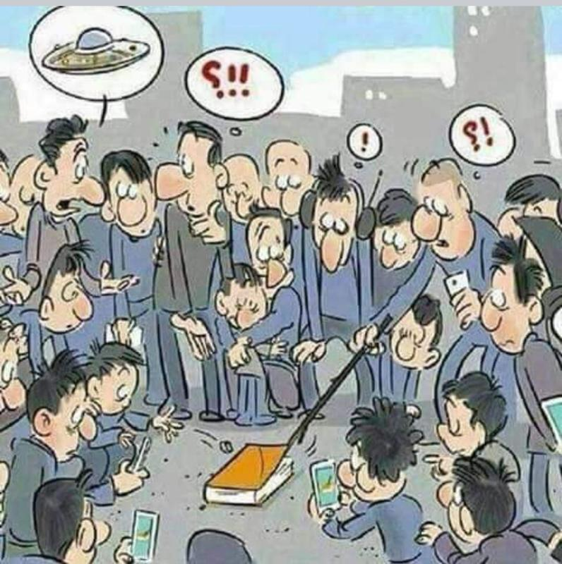
The NEW TESTAMENT BOOK OF ACTS
By David Lee Burris
Chapters 1 & 2

Slide 2
DOES THE NEW TESTAMENT IN PRACTICE ACTUALLY START WITH THE BOOK OF ACTS NOT THE GOSPELS?
“From the standpoint of the dispensations or the various economies by which God governs the world, the Old Testament Jewish economy actually continued through the gospels. Acts is a transitional book moving from the Old Testament economy into that of the new – the church age, the body of Christ.” (reference)

Slide 4
NOT EXACTLY

Slide 6
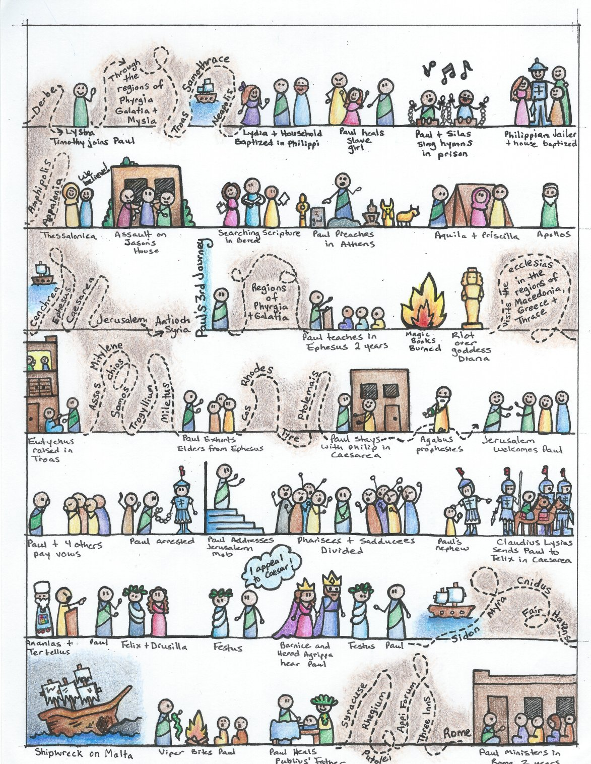

Slide 7
I. THE AUTHOR OF THE BOOK
From earliest times, Luke, “the beloved physician,” has been looked upon by conservative Bible scholars as being the author of The Book of Acts. Both internal and external evidence support this belief.
Luke was: (1) a Gentile (Col. 4:10–14); (2) the only Gentile author of a Bible book; (3) a physician (a medical doctor), Col. 4:14; (4) a “beloved” person, Col. 4:14; (5) a frequent missionary companion of Paul (the so-called “we sections” of The Book of Acts, 16:10–17; 20:5–21:18; 27:1–28:16, prove this assertion); and (6) the author of The Gospel of Luke as well as The Book of Acts.
II. THE ADDRESSEE OF THE BOOK
Luke addressed both The Gospel of Luke and The Book of Acts to Theophilus. Perhaps he had others in view as the ultimate readers of his two books.
We do not know the identity of Theophilus, nor do we know the place of his residence. He almost certainly was: (1) a friend of Luke and (2) a neophyte to Christianity (Luke wrote to Theophilus that he might know the certainty, the truthfulness, of the gospel truths wherein he had been instructed, Luke 1:1).
III. THE PLACE AND THE DATE OF THE WRITING OF THE BOOK
We do not know the place of writing but we can know the approximate date of writing. We know that it was written after the Spring of a.d. 63 for the book’s historical record extends to the Spring of that year and we know that the book was probably written before the Fall of a.d. 64 for the book makes no mention or allusion to the Neronian persecution which began in October of a.d. 64. We know that the book was almost certainly written before a.d. 70 for it makes no mention or allusion to the fall of Jerusalem and the destruction of its temple, events which occurred in a.d. 70 which greatly affected the early church and first-century Christianity (these events ended the Judaizers opposition to the gospel and the practice of preaching the gospel first to the Jews and then to the Gentiles).
IV. THE NAME OF THE BOOK
From the Second Century a.d., the common name for the book has been The Acts of the Apostles. This title is too comprehensive to be a correct one, for the book deals chiefly with the acts of only two apostles, Peter and Paul, and their acts are recorded only in part. A more apt title would be one of the following: (1) the Acts of the Risen Lord; (2) The Acts of the descended Holy Spirit; (3) Some of the Acts of Peter and Paul; (4) A Fragmentary History of the Early Church; (5) The First Chapter of Church History or (6) The only Inspired Chapter of Church History.
In the Greek manuscripts, the title is “Acts of Apostles.” This is a good and accurate title.
V. THE CLASSIFICATION OF THE BOOK
It is one of the five historical books of the New Testament. The New Testament has five historical books (Matthew through Acts), twenty-one doctrinal books (Romans through Jude) and one prophetical book (Revelation).
The 5 New Testament historical books are the New Testament’s “Pentateuch.”
Gingrich, R. E. (2002). (pp. 34). Memphis, TN: Riverside Printing.
Gingrich, R. E. (2002). The Book of Acts (pp. 3–4). Memphis, TN: Riverside Printing.

Slide 8
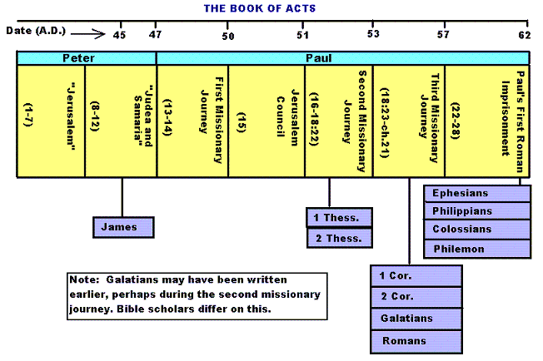

Slide 9
Historicity of Acts:
- the spread of Christianity from Jerusalem to Rome (“the ends of the earth”);
- The progress ... is mainly geographical:
- From Jerusalem ... to Samaria (8.5), Damascus (9.10), Antioch (11.26), Asia Minor (13.13), Europe (16.11), and finally Rome … itself;
- the northeastern corner of the Mediterranean;
- Maybe Spain But Nothing about North Africa, e.g., Alexandria and Cyrene.

Slide 11
1. Prologue and Ascension (1:1-11):
- Post-resurrection appearances … ;
- A ... visible ascension into heaven;
- Matthias chosen to replace Judas Iscariot (1.12-26);
- Luke’s understanding of an Apostle: see 1.21-22;
- Note: Saul (later Paul) meets those qualifications Acts 9 when Christ appeared to him while on the Damascus Road.

Slide 12
2. Founding of the Jerusalem Church - the role of the Holy Spirit (2.12-2.47):
- The Jerusalem Church increases in numbers by means of divine power;
- The work of the Holy Spirit, e.g., Glossolalia (2.1-24; see Joel 2.28-32);
- Peter’s speech interprets the meaning of Pentecost;
- The character of the Jerusalem Church (2.43-45; 4.32-35);

Slide 13
3. The Work of Peter and the other Apostles (3.1-5.42):
- Confrontation between the Apostles and the Jerusalem authorities (4.1-22);
- Luke’s attitude towards both the Sadducees and the Pharisees (4.8-11);

Slide 14
4. Persecution of the “Hellenists” (6.1-8.40):
- Stephen, a leading “Hellenist” or Greek-speaking Jew (6. 5, 8);
- Stephen is presented as the first Christian Martyr (7.60);
- subsequent persecution and the growth of the Church (8.1b-40);
the “new way” carried to such individuals as Simon the Magician (8.9) and an Ethiopian Eunuch (8.27);
the role of Philip in this work of evangelization (6.5; 8.4; 21,8).

Slide 15
5. Preparation for the Gentile Mission (9.1-12.25):
- The progress of Christianity …. as world adversary to pagan religion and human schools of philosophy;
- See, for example, the conversion of Saul of Tarsus (9.1-19) and Cornelius, the Roman centurion (Chs. 10-11);
- Peter is depicted as the one who first opens the door to Gentiles, that is, non-Jews;
Peter’s persuasion of the “circumcision party” (11.1-18);
See 10.44-48 and 11.15-18: the “Gentile Pentecost”;

Slide 16
5. Preparation for the Gentile Mission (9.1-12.25) (contd.):
- Gentiles flock to the Church at Antioch (11.19-26);
- The Jerusalem Church sends Barnabas... to report on the situation (11.22);
- Barnabas with the Apostle Paul at Antioch (11.25-30);
- Gospel preached “all over Judea and Samaria”;
- The first half concludes with an account of Herod Agrippa I’s persecution (41-44 CE) of the Jerusalem community;
- God is unhappy with Herod (12.20-23).

Slide 17
6. First Missionary Journey of Barnabas and Paul and the Jerusalem Conference (13.1-15.35):
- The rest of Acts is devoted mainly to the Missionary Journeys of the Apostle Paul and his fellow workers;
- the work of Paul and Barnabas in the various Hellenistic cities of Asia Minor;
- Dissension between Gentile and Jewish Christians over adherence to the Mosaic Torah (15.1-35);
- must Gentile Christians be circumcised and observe Jewish dietary laws?

Slide 18
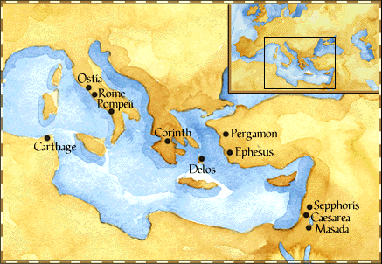
Paul: Map of His World.

Slide 19
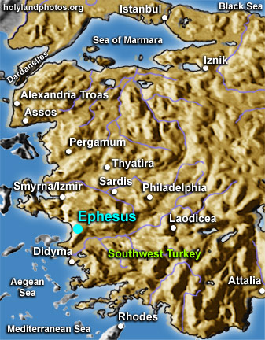

Slide 20
6. First Missionary Journey of Paul and Barnabas and the Jerusalem Conference (13.1-15.35) (contd.):
- The Jerusalem Conference held about A.D. 49 (Acts 15);
- Must a Gentile believer become a Jew ... to be a Christian?
- A division within the Church;
- The dispute settled in favor of uncircumcised Gentiles (15.28-29);
- The deciding voice is that of James (15.13-21).

Slide 21
6. First Missionary Journey of Paul and Barnabas and the Jerusalem Conference (13.1-15.35) (contd.):
- The Apostles and Elders required only limited Torah mandates of the Gentile Christians (15.13-21);
- requirements based on rules from Leviticus (Acts 15.13-21; Leviticus 17-18);
- Themes of unity and cooperation dominate … ;
- it is a unanimous decision and the “Whole Church” sends a delegation to Antioch to explain the Jerusalem Church’s decision (15.30-35);
- Actually, a decision of the Holy Spirit (15.22-29).

Slide 22
6. First Missionary Journey of Paul and Barnabas and the Jerusalem Conference (13.1-15.35) (contd.):
- Paul’s independence of the Apostolic Church (Gal 1.17, 18-19, 20; 2.1-10);
- Paul indicates that he was never under the jurisdiction of the Church’s leadership in Jerusalem (Gal 1.17, 18-19, 20; 2.1-10);
- See also 1 Cor 8.8; 10.27 relative to eating meat sacrificed to Greco-Roman gods.

Slide 23
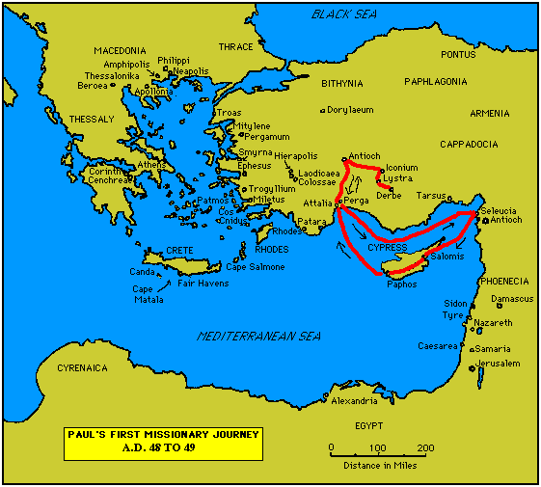

Slide 24
7. Paul’s Secondary Missionary Journey; Evangelizing Greece (16.1-18.21):
- Paul and Barnabas separate (15.39);
- Why the separation?
- Paul and Silas visit churches in Syria and Asia Minor (15.40-41);
- A vision directs Paul to Macedonia (15.40-16.10);
- Paul’s customary activity relative to the Jews and then being abused by them (16.11-17.15);

Slide 25
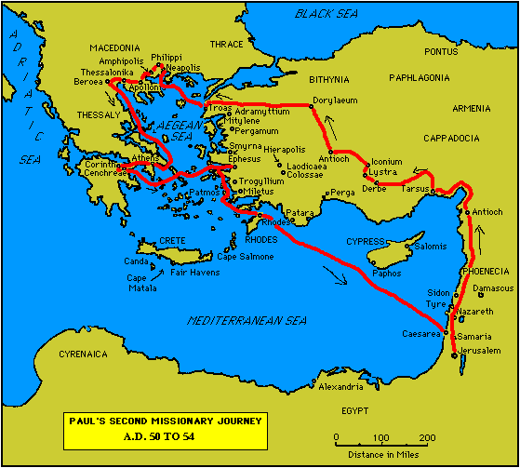

Slide 26
7. Paul’s Secondary Missionary Journey; Evangelizing Greece (16.1-18.21) (contd.):
- Paul in Philippi, Thessalonica, Beroea, and Athens;
- Paul speaks at the Areopagus in Athens (17.19-31);
- Paul at Corinth (18.1-17);

Slide 28
8. Paul’s Third Missionary Journey: Revisiting Asia Minor and Greece (18.22-20.38):
- Paul at Ephesus (18.19-21);
- Luke depicts Paul as determined to complete his last tour and head for the imperial capital, that is, Rome (19.21-22);
- Paul’s farewell speech at Miletus (20.17-38);
- See maps on the location of the major churches at the end of Paul’s ministry.

Slide 29
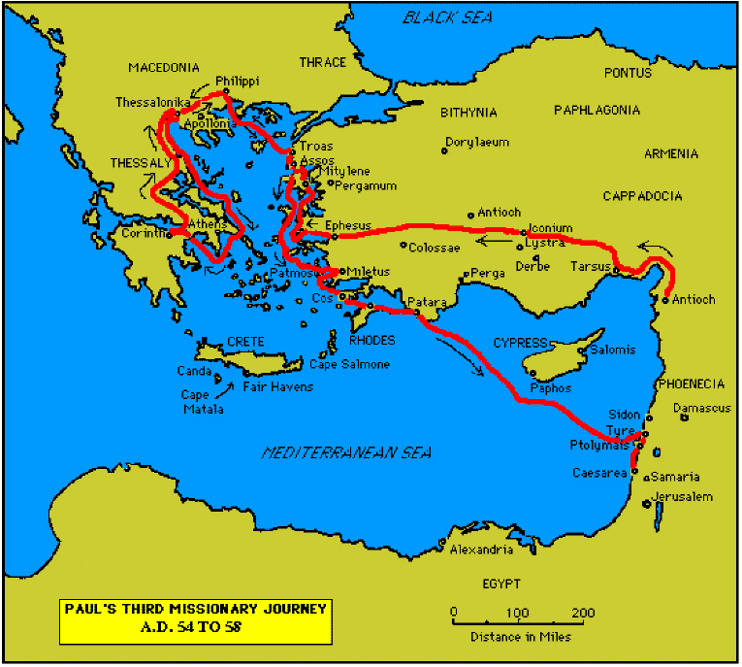

Slide 31
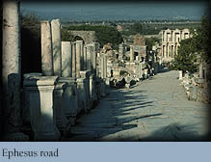

Slide 32
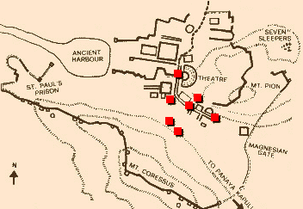
Ephesus: General View of the Ancient City.

Slide 33
9. Paul’s arrest in Jerusalem and imprisonment in Caesarea Maritime (21.1-26.32):
- Paul returns to Jerusalem (21.17) ... accused of blasphemy and profaning the Temple;
- When arrested, Paul claims that he is a Pharisee (21.27-23.10);
- Paul is imprisoned ... in Caesarea (23.33-26.32);
- he exercises his birthright as a Roman citizen (25.1-21);
- he defends himself (26.1-29);

Slide 34
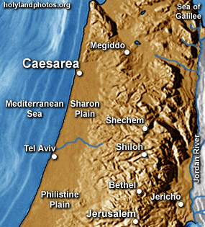

Slide 35
10. Paul’s Journey to Rome and His Preaching to Roman Jews (27.1-28.31):
- Paul’s sea journey to Rome... a shipwreck on the island of Malta (28.1 ) (see Map);
- the narrative in the first person plural, that is, “we”;
- Acts ends with Paul’s arrival in Rome (28.16);
- Paul is under house arrest but is free to preach (28.31);
- He continues to evangelize the Romans (28.23-31);
- We are not told of Paul’s fate.

Slide 36
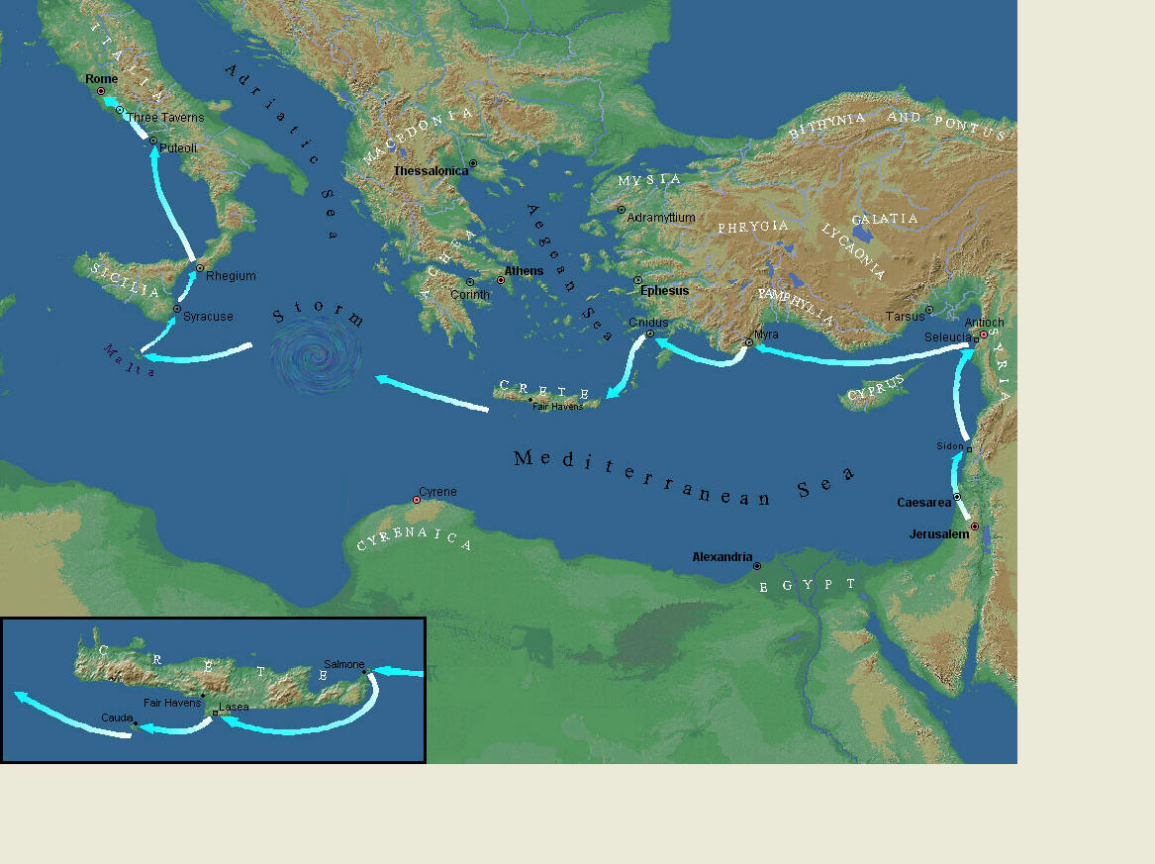
Paul’s Journey to Rome.

Slide 37
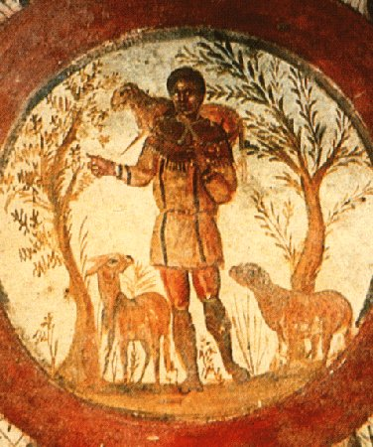
The Good Shepherd – in Catacombs of Rome.

Slide 38
10. Paul’s Journey to Rome and his Preaching to Roman Jews (27.1-28.31) (contd.):
- Luke has accomplished his task of tracing Christianity’s expansion from Jerusalem to “the ends of the earth” (1.8);
- Another theme emphasized: Paul and his successor evangelists will henceforth direct the Gospel primarily to Non-Jews, for “the Gentiles will listen” (28.28);
- Luke quotes from Isaiah 6 (see also Mark 4.10-13);
- Christianity’s future belongs to the Gentiles.

Slide 39
Basic Book Structure acts of the Apostles Centers around the great commission & Call To evangelize Then known world!

Slide 40
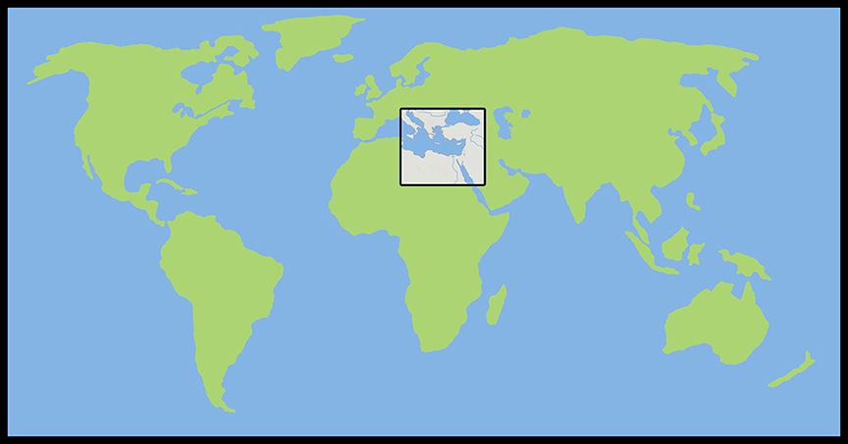
Where the Story takes Place

Slide 41
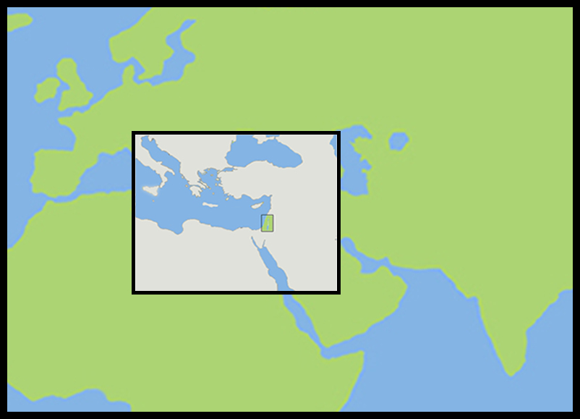
The Land of Canaan in the Near East

Slide 42
Acts 1:8 and the Great Commission
Acts 1:8 But ye shall receive power, after that the Holy Ghost is come upon you: and ye shall be witnesses unto me both in Jerusalem, and in all Judaea, and in Samaria, and unto the uttermost part of the earth.
Matthew 28:19-20 ¹⁹ Go ye therefore, and teach all nations, baptizing them in the name of the Father, and of the Son, and of the Holy Ghost: ²⁰ Teaching them to observe all things whatsoever I have commanded you: and, lo, I am with you alway, even unto the end of the world. Amen.
Mark 16:15 And he said unto them, Go ye into all the world, and preach the gospel to every creature.

Slide 43
Acts 1:8 and the Great Commission
Acts 1:8 But ye shall receive power, after that the Holy Ghost is come upon you: and ye shall be witnesses unto me both in Jerusalem, and in all Judaea, and in Samaria, and unto the uttermost part of the earth.
Matthew 28:19-20 ¹⁹ Go ye therefore, and teach all nations, baptizing them in the name of the Father, and of the Son, and of the Holy Ghost: ²⁰ Teaching them to observe all things whatsoever I have commanded you: and, lo, I am with you alway, even unto the end of the world. Amen.
Mark 16:15 And he said unto them, Go ye into all the world, and preach the gospel to every creature.

Slide 44
Acts 1:8 and the Great Commission
Acts 1:8 But ye shall receive power, after that the Holy Ghost is come upon you: and ye shall be witnesses unto me both in Jerusalem, and in all Judaea, and in Samaria, and unto the uttermost part of the earth.
Matthew 28:19-20 ¹⁹ Go ye therefore, and teach all nations, baptizing them in the name of the Father, and of the Son, and of the Holy Ghost: ²⁰ Teaching them to observe all things whatsoever I have commanded you: and, lo, I am with you alway, even unto the end of the world. Amen.
Mark 16:15 And he said unto them, Go ye into all the world, and preach the gospel to every creature.

Slide 45
Acts 1:8 and the Great Commission
Acts 1:8 But ye shall receive power, after that the Holy Ghost is come upon you: and ye shall be witnesses unto me both in Jerusalem, and in all Judaea, and in Samaria, and unto the uttermost part of the earth.
Matthew 28:19-20 ¹⁹ Go ye therefore, and teach all nations, baptizing them in the name of the Father, and of the Son, and of the Holy Ghost: ²⁰ Teaching them to observe all things whatsoever I have commanded you: and, lo, I am with you alway, even unto the end of the world. Amen.
Mark 16:15 And he said unto them, Go ye into all the world, and preach the gospel to every creature.

Slide 46
Acts 1:8 and the Structure of the Book
Acts 1:8 … ye shall be witnesses unto me both in Jerusalem, and in all Judaea, and in Samaria, and unto the uttermost part of the earth.
1. The witness in Jerusalem:
Chapters 1 to 7
2. The witness in Judaea and Samaria:
Chapters 8 to 12
3. The witness unto the uttermost parts of the earth:
Chapters 13 to 28

Slide 47
The Three Audiences
Part 1: The Jews
Part 2: The Samaritans
Part 3: The Gentiles

Slide 48
The Pillars of the Church
Part 1: Peter
Part 2: Peter and Paul (Saul of Tarsus)
Part 3: Paul

Slide 49
The Timeline
Part 1: 5 years (AD 30-35)
Part 2: 13 years (AD 35-48)
Part 3: 14 years (AD 48-62)
A total of 32 years, according to Nelson’s Complete Book of Bible Maps and Charts.

Slide 50
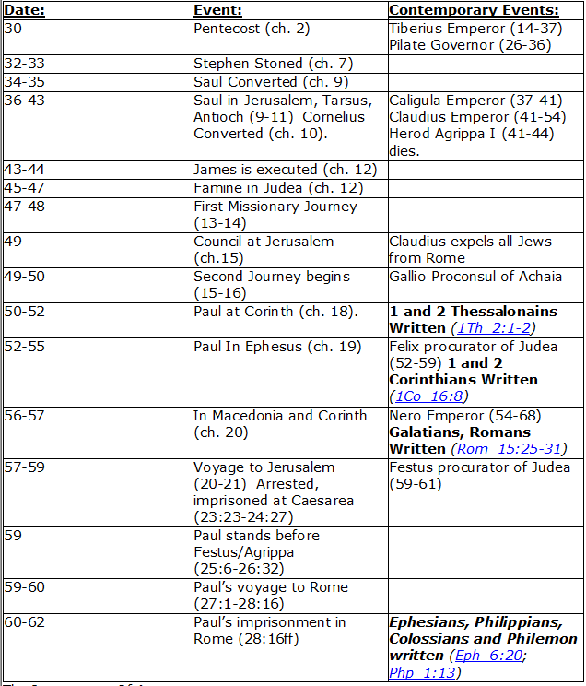
CHART BY
Mark Dunagan

Slide 51
PART ONE—The infancy of the church (the church in Jerusalem) (chapters 1–7)
(In this section, Jerusalem is the central city of Christianity and Peter is the most prominent person)
I. THE POST-RESURRECTION MINISTRY OF CHRIST (1:1–8)
II. THE ASCENSION OF CHRIST (1:9–11)
III. THE WAITING IN THE UPPER ROOM (1:12–26)
IV. THE ADVENT OF THE HOLY SPIRIT (2:1–41)
V. THE SNAPSHOT OF THE EARLY CHURCH (2:42–47)
VI. THE HEALING OF THE LAME MAN AND ITS CONSEQUENCES (3:1–4:31)
VII. THE DEATH OF ANANIAS AND SAPPHIRA AND ITS EFFECTS (4:32–5:42)
VIII. THE APPOINTMENT OF THE SEVEN (6:1–7)
IX. THE MINISTRY OF STEPHEN (6:8–7:60)
PART TWO—The adolescence of the church (the church in all Judea and In Samaria) (chapters 8–12)
(In this section, Jerusalem is gradually being replaced by Antioch as the central city of Christianity and Peter is gradually being replaced by Paul as the most prominent person)
I. THE FIRST MENTION OF PAUL (7:58; 8:1, 3)
II. THE PERSECUTION AND SCATTERING OF THE JERUSALEM CHURCH (8:1–4)
III. THE CONVERSION OF SAMARITANS (8:5–25)
IV. THE CONVERSION OF A JEWISH PROSELYTE (8:26–40)
V. THE CONVERSION OF SAUL (9:1–31)
VI. THE EXPANSION OF THE CHURCH IN WESTERN JUDEA (9:32–43)
VII. THE CONVERSION OF GENTILE GOD-FEARERS (chapter 10)
VIII. THE GROWING VISION OF THE JEWISH LEADERS (11:1–18)
IX. THE CONVERSION OF PAGAN GENTILES (11:19–26)
X. THE GROWING TIES BETWEEN JEWISH AND GENTILE CHRISTIANITY (11:27–30)
XI. THE COMPLETION OF THE TRANSITION (chapter 12)
PART THREE—The maturity of the church (the church in all the world) (chapters 13–28)
(In this section, Antioch is the central city of Christianity and Paul is the most prominent person)
I. PAUL’S CALL AT ANTIOCH TO HIS LIFE’S WORK (13:1–3)
II. PAUL’S FIRST MISSIONARY JOURNEY (13:4–14:27)
III. PAUL’S TWO YEARS BACK IN ANTIOCH (14:28–15:35)
IV. PAUL’S SECOND MISSIONARY JOURNEY (15:36–18:22)
V. PAUL’S THIRD MISSIONARY JOURNEY (18:23–21:16)
VI. PAUL’S ARREST AT JERUSALEM (21:17–23:35)
VII. PAUL’S TWO-YEARS’ IMPRISONMENT AT CAESAREA (chapters 24–26)
VIII. PAUL’S SHIPWRECK JOURNEY TO ROME (27:1–28:15)
IX. PAUL’S FIRST ROMAN IMPRISONMENT (28:16–31)
Gingrich, R. E. (2002). The Book of Acts (pp. 5–6). Memphis, TN: Riverside Printing.

Slide 52
L.D. CARY & SAM HOLT CATCH PHRASES
Chapter 1 – “Jesus’ Work On Earth Is Done”
Chapter 2 – “Peter Baptizes A Crew”
Chapter 3 – “A Beggar’s Plea”
Chapter 4 – “A Jailhouse Door”
Chapter 5 – “Ananias & Sapphira Don’t Survive”
Chapter 6 – “The Widow’s Fix”
Chapter 8 – “Stephen Looks Into Heaven”
Chapter 9 – “Saul Struck Blind”
“Jesus’ Work On Earth Is Done”
Catch Phrase
Chapter One

Slide 53
Acts of the Apostles Chapter 1

Slide 54
I. At the conclusion of the Gospels Jesus ascends into the heavens leaving the apostles behind. What if that were the end? Lk 24:44-52
A. The Gospel would never have been preached to anyone but Jews and they would have kept the law of Moses. Acts 10:28; Acts 11:19
Luke 24:44-52 (NASB) ⁴⁴ Now He said to them, "These are My words which I spoke to you while I was still with you, that all things which are written about Me in the Law of Moses and the Prophets and the Psalms must be fulfilled." ⁴⁵ Then He opened their minds to understand the Scriptures, ⁴⁶ and He said to them, "Thus it is written, that the Christ would suffer and rise again from the dead the third day, ⁴⁷ and that repentance for forgiveness of sins would be proclaimed in His name to all the nations, beginning from Jerusalem. ⁴⁸ "You are witnesses of these things. ⁴⁹ "And behold, I am sending forth the promise of My Father upon you; but you are to stay in the city until you are clothed with power from on high." ⁵⁰ And He led them out as far as Bethany, and He lifted up His hands and blessed them. ⁵¹ While He was blessing them, He parted from them and was carried up into heaven. ⁵² And they, after worshiping Him, returned to Jerusalem with great joy,
Acts 10:28 (NASB) ²⁸ And he said to them, "You yourselves know how unlawful it is for a man who is a Jew to associate with a foreigner or to visit him; and yet God has shown me that I should not call any man unholy or unclean. Acts 11:19 (NASB) ¹⁹ So then those who were scattered because of the persecution that occurred in connection with Stephen made their way to Phoenicia and Cyprus and Antioch, speaking the word to no one except to Jews alone.

Slide 55
Acts 1:1-2 (NASB) ¹ The first account I composed, Theophilus, about all that Jesus began to do and teach, ² until the day when He was taken up to heaven, after He had by the Holy Spirit given orders to the apostles whom He had chosen.
A. Concerning Luke who accompanied Paul in his travels: Act 16:10-18; 20:5-7; 13-15; Acts 21:1-8, 15-18; 27:2-27; 28:1-16; Col 4:14; 2Tim 4:11; Philemon 1:24;
1. “Luke” is a Latin (Roman) name. He appears to be an early convert and to have heard the apostles preach. Maybe he was a Jewish proselyte or Jew with a Roman name? Acts 2:8-10
B. Luke refers to his first letter to Theophilus (God Lover): Lk 1:1-4
1. The Gospel of Luke contains all that Jesus began to do and teach until he was taken up.
2. After this he gave orders through the Holy Spirit to the apostles: Jn 14:25-26; 15:26-27; Jn 16:12-15
3. Apostles whom he had chosen: Jn 6:70; 13:18; 15:16, 19; Acts 10:39-42
4. During his personal ministry he forbid the apostles from teaching all: Mt 16:20; 17:9
John 16:7-15 (NASB) ¹² "I have many more things to say to you, but you cannot bear them now. ¹³ "But when He, the Spirit of truth, comes, He will guide you into all the truth; for He will not speak on His own initiative, but whatever He hears, He will speak; and He will disclose to you what is to come. ¹⁴ "He will glorify Me, for He will take of Mine and will disclose it to you. ¹⁵ "All things that the Father has are Mine; therefore I said that He takes of Mine and will disclose it to you.
John 6:70 (NASB) ⁷⁰ Jesus answered them, "Did I Myself not choose you, the twelve, and yet one of you is a devil?"
John 13:18 (NASB) ¹⁸ "I do not speak of all of you. I know the ones I have chosen; but it is that the Scripture may be fulfilled, 'HE WHO EATS MY BREAD HAS LIFTED UP HIS HEEL AGAINST ME.'
John 15:16 (NASB) ¹⁶ "You did not choose Me but I chose you, and appointed you that you would go and bear fruit, and that your fruit would remain, so that whatever you ask of the Father in My name He may give to you. John 15:19 (NASB) ¹⁹ "If you were of the world, the world would love its own; but because you are not of the world, but I chose you out of the world, because of this the world hates you.
Acts 10:39-42 (NASB) ³⁹ "We are witnesses of all the things He did both in the land of the Jews and in Jerusalem. They also put Him to death by hanging Him on a cross. ⁴⁰ "God raised Him up on the third day and granted that He become visible, ⁴¹ not to all the people, but to witnesses who were chosen beforehand by God, that is, to us who ate and drank with Him after He arose from the dead. ⁴² "And He ordered us to preach to the people, and solemnly to testify that this is the One who has been appointed by God as Judge of the living and the dead.
Matthew 16:20 (NASB) ²⁰ Then He warned the disciples that they should tell no one that He was the Christ. Matthew 17:9 (NASB) ⁹ As they were coming down from the mountain, Jesus commanded them, saying, "Tell the vision to no one until the Son of Man has risen from the dead."
John 14:25-26 (NASB) ²⁵ "These things I have spoken to you while abiding with you. ²⁶ "But the Helper, the Holy Spirit, whom the Father will send in My name, He will teach you all things, and bring to your remembrance all that I said to you.
John 15:26-27 (NASB) ²⁶ "When the Helper comes, whom I will send to you from the Father, that is the Spirit of truth who proceeds from the Father, He will testify about Me, ²⁷ and you will testify also, because you have been with Me from the beginning.
Acts 28:11-16 (NASB) ¹¹ At the end of three months we set sail on an Alexandrian ship which had wintered at the island, and which had the Twin Brothers for its figurehead. ¹² After we put in at Syracuse, we stayed there for three days. ¹³ From there we sailed around and arrived at Rhegium, and a day later a south wind sprang up, and on the second day we came to Puteoli. ¹⁴ There we found some brethren, and were invited to stay with them for seven days; and thus we came to Rome. ¹⁵ And the brethren, when they heard about us, came from there as far as the Market of Appius and Three Inns to meet us; and when Paul saw them, he thanked God and took courage. ¹⁶ When we entered Rome, Paul was allowed to stay by himself, with the soldier who was guarding him.
Acts 16:10-12 (NASB) ¹⁰ When he had seen the vision, immediately we sought to go into Macedonia, concluding that God had called us to preach the gospel to them. ¹¹ So putting out to sea from Troas, we ran a straight course to Samothrace, and on the day following to Neapolis; ¹² and from there to Philippi, which is a leading city of the district of Macedonia, a Roman colony; and we were staying in this city for some days.
Colossians 4:14 (NASB) ¹⁴ Luke, the beloved physician, sends you his greetings, and also Demas.
2 Timothy 4:11 (NASB) ¹¹ Only Luke is with me. Pick up Mark and bring him with you, for he is useful to me for service.
Philemon 1:24 (NASB) ²⁴ as do Mark, Aristarchus, Demas, Luke, my fellow workers.
Acts 2:8-10 (NASB) ⁸ "And how is it that we each hear them in our own language to which we were born? ⁹ "Parthians and Medes and Elamites, and residents of Mesopotamia, Judea and Cappadocia, Pontus and Asia, ¹⁰ Phrygia and Pamphylia, Egypt and the districts of Libya around Cyrene, and visitors from Rome, both Jews and proselytes,
Luke 1:1-4 (NASB) ¹ Inasmuch as many have undertaken to compile an account of the things accomplished among us, ² just as they were handed down to us by those who from the beginning were eyewitnesses and servants of the word, ³ it seemed fitting for me as well, having investigated everything carefully from the beginning, to write it out for you in consecutive order, most excellent Theophilus; ⁴ so that you may know the exact truth about the things you have been taught.
Notes:
1. Luke is a Roman/Gentile name but that does mean he was not a Jew or proselyte.
B. Luke says that what Jesus did in his life was accomplished “among us”. There is no doubt that what Jesus did he did among the Jewish people.

Slide 56
Acts 1:3-5 (NASB) ³ To these He also presented Himself alive after His suffering, by many convincing proofs, appearing to them over a period of forty days and speaking of the things concerning the kingdom of God. ⁴ Gathering them together, He commanded them not to leave Jerusalem, but to wait for what the Father had promised, "Which," He said, "you heard of from Me; ⁵ for John baptized with water, but you will be baptized with the Holy Spirit not many days from now."
A. He presented himself alive: 1Cor 15:5-7; Jn 20:26-31
1. The Kingdom of God: Isa 2:1-4; Dan 2:44-45; Jer 31:31-34;
B. Wait in Jerusalem for what the Father promised which they heard from Jesus: Lk 24:44-49
1. This teaching was first taught by John the Baptist: Mt 3:11; Mk 1:8; Jn 1:33-34
2. Jesus informs the apostles that he will baptize them in the Holy Spirit in a few days. This will be evidence from heaven that Jesus is the one John foretold.
Isaiah 2:1-4 (NASB) ¹ The word which Isaiah the son of Amoz saw concerning Judah and Jerusalem. ² Now it will come about that In the last days The mountain of the house of the LORD Will be established as the chief of the mountains, And will be raised above the hills; And all the nations will stream to it. ³ And many peoples will come and say, "Come, let us go up to the mountain of the LORD, To the house of the God of Jacob; That He may teach us concerning His ways And that we may walk in His paths." For the law will go forth from Zion And the word of the LORD from Jerusalem. ⁴ And He will judge between the nations, And will render decisions for many peoples; And they will hammer their swords into plowshares and their spears into pruning hooks. Nation will not lift up sword against nation, And never again will they learn war.
Luke 24:44-49 (NASB) ⁴⁴ Now He said to them, "These are My words which I spoke to you while I was still with you, that all things which are written about Me in the Law of Moses and the Prophets and the Psalms must be fulfilled." ⁴⁵ Then He opened their minds to understand the Scriptures, ⁴⁶ and He said to them, "Thus it is written, that the Christ would suffer and rise again from the dead the third day, ⁴⁷ and that repentance for forgiveness of sins would be proclaimed in His name to all the nations, beginning from Jerusalem. ⁴⁸ "You are witnesses of these things. ⁴⁹ "And behold, I am sending forth the promise of My Father upon you; but you are to stay in the city until you are clothed with power from on high."
John 20:26-31 (NASB) ²⁶ After eight days His disciples were again inside, and Thomas with them. Jesus *came, the doors having been shut, and stood in their midst and said, "Peace be with you." ²⁷ Then He *said to Thomas, "Reach here with your finger, and see My hands; and reach here your hand and put it into My side; and do not be unbelieving, but believing." ²⁸ Thomas answered and said to Him, "My Lord and my God!" ²⁹ Jesus *said to him, "Because you have seen Me, have you believed? Blessed are they who did not see, and yet believed." ³⁰ Therefore many other signs Jesus also performed in the presence of the disciples, which are not written in this book; ³¹ but these have been written so that you may believe that Jesus is the Christ, the Son of God; and that believing you may have life in His name.
Jeremiah 31:31-34 (NASB) ³¹ "Behold, days are coming," declares the LORD, "when I will make a new covenant with the house of Israel and with the house of Judah, ³² not like the covenant which I made with their fathers in the day I took them by the hand to bring them out of the land of Egypt, My covenant which they broke, although I was a husband to them," declares the LORD. ³³ "But this is the covenant which I will make with the house of Israel after those days," declares the LORD, "I will put My law within them and on their heart I will write it; and I will be their God, and they shall be My people. ³⁴ "They will not teach again, each man his neighbor and each man his brother, saying, 'Know the LORD,' for they will all know Me, from the least of them to the greatest of them," declares the LORD, "for I will forgive their iniquity, and their sin I will remember no more."
Daniel 2:44-45 (NASB) ⁴⁴ "In the days of those kings the God of heaven will set up a kingdom which will never be destroyed, and that kingdom will not be left for another people; it will crush and put an end to all these kingdoms, but it will itself endure forever. ⁴⁵ "Inasmuch as you saw that a stone was cut out of the mountain without hands and that it crushed the iron, the bronze, the clay, the silver and the gold, the great God has made known to the king what will take place in the future; so the dream is true and its interpretation is trustworthy."
John 1:33-34 (NASB) ³³ "I did not recognize Him, but He who sent me to baptize in water said to me, 'He upon whom you see the Spirit descending and remaining upon Him, this is the One who baptizes in the Holy Spirit.' ³⁴ "I myself have seen, and have testified that this is the Son of God."
1 Corinthians 15:5-7 (NASB) ⁵ and that He appeared to Cephas, then to the twelve. ⁶ After that He appeared to more than five hundred brethren at one time, most of whom remain until now, but some have fallen asleep; ⁷ then He appeared to James, then to all the apostles;
Matthew 3:11 (NASB) ¹¹ "As for me, I baptize you with water for repentance, but He who is coming after me is mightier than I, and I am not fit to remove His sandals; He will baptize you with the Holy Spirit and fire.
Mark 1:8 (NASB) ⁸ "I baptized you with water; but He will baptize you with the Holy Spirit."
Notes:
10/16

Slide 57
Acts 1:6-8 (NASB) ⁶ So when they had come together, they were asking Him, saying, "Lord, is it at this time You are restoring the kingdom to Israel?" ⁷ He said to them, "It is not for you to know times or epochs which the Father has fixed by His own authority; ⁸ but you will receive power when the Holy Spirit has come upon you; and you shall be My witnesses both in Jerusalem, and in all Judea and Samaria, and even to the remotest part of the earth."
A. They had come to believe that the Kingdom had been taken out of the hands of the leaders of Israel and that Jesus would restore the Kingdom to Israel? The apostles had been well instructed by Jesus and their question had not been one of ignorance. Acts 1:3; Lk 24:45 See chart
1. The restoration of the Kingdom to Israel was a process which began on Pentecost and was completed on 70 A.D., this is the times and epochs Jesus refers to. The Father had never revealed the year or day that Jerusalem would fall and the Temple be destroyed. Mt 24:36
2. After the Holy Spirit would come they would begin to witness. Once the Gospel is preached to the whole world. Then Jerusalem would fall, the Temple destroyed. Jn 15:26-27; Mt 24:14
John 15:26-27 (NASB) ²⁶ "When the Helper comes, whom I will send to you from the Father, that is the Spirit of truth who proceeds from the Father, He will testify about Me, ²⁷ and you will testify also, because you have been with Me from the beginning.
Matthew 24:14 (NASB) ¹⁴ "This gospel of the kingdom shall be preached in the whole world as a testimony to all the nations, and then the end will come.
Acts 1:3 (NASB) ³ To these He also presented Himself alive after His suffering, by many convincing proofs, appearing to them over a period of forty days and speaking of the things concerning the kingdom of God.
Luke 24:45 (NASB) ⁴⁵ Then He opened their minds to understand the Scriptures,
Matthew 24:36 (NASB) ³⁶ "But of that day and hour no one knows, not even the angels of heaven, nor the Son, but the Father alone.
Notes:
Only the father knew when:

Slide 58
Acts 1:9-11 (NASB) ⁹ And after He had said these things, He was lifted up while they were looking on, and a cloud received Him out of their sight. ¹⁰ And as they were gazing intently into the sky while He was going, behold, two men in white clothing stood beside them. ¹¹ They also said, "Men of Galilee, why do you stand looking into the sky? This Jesus, who has been taken up from you into heaven, will come in just the same way as you have watched Him go into heaven."
A. Jesus is lifted up into the heavens right before their eyes: Mk 16:19; Lk 24:50-53;
1. A cloud received him out of their sight: Dan 7:13-14; Acts 7:56
2. Two men (angels) in white clothing: Mt 28:1-3; Mk 16:5: Lk 24:4
3. The angels address the Apostles as men of Galilee: Note the context since verse 2, to whom do the pronouns refer to?
a. Jesus will appear visibly in the same way that his departure was visible.
Matthew 28:1-3 (NASB) ¹ Now after the Sabbath, as it began to dawn toward the first day of the week, Mary Magdalene and the other Mary came to look at the grave. ² And behold, a severe earthquake had occurred, for an angel of the Lord descended from heaven and came and rolled away the stone and sat upon it. ³ And his appearance was like lightning, and his clothing as white as snow.
Mark 16:19 (NASB) ¹⁹ So then, when the Lord Jesus had spoken to them, He was received up into heaven and sat down at the right hand of God.
Luke 24:50-53 (NASB) ⁵⁰ And He led them out as far as Bethany, and He lifted up His hands and blessed them. ⁵¹ While He was blessing them, He parted from them and was carried up into heaven. ⁵² And they, after worshiping Him, returned to Jerusalem with great joy, ⁵³ and were continually in the temple praising God.
Daniel 7:13-14 (NASB) ¹³ "I kept looking in the night visions, And behold, with the clouds of heaven One like a Son of Man was coming, And He came up to the Ancient of Days And was presented before Him. ¹⁴ "And to Him was given dominion, Glory and a kingdom, That all the peoples, nations and men of every language Might serve Him. His dominion is an everlasting dominion Which will not pass away; And His kingdom is one Which will not be destroyed.
Acts 7:56 (NASB) ⁵⁶ and he said, "Behold, I see the heavens opened up and the Son of Man standing at the right hand of God."
Mark 16:5 (NASB) ⁵ Entering the tomb, they saw a young man sitting at the right, wearing a white robe; and they ` were amazed.
Luke 24:4 (NASB) ⁴ While they were perplexed about this, behold, two men suddenly stood near them in dazzling clothing;

Slide 59
Acts 1:12-14 (NASB) ¹² Then they returned to Jerusalem from the mount called Olivet, which is near Jerusalem, a Sabbath day's journey away. ¹³ When they had entered the city, they went up to the upper room where they were staying; that is, Peter and John and James and Andrew, Philip and Thomas, Bartholomew and Matthew, James the son of Alphaeus, and Simon the Zealot, and Judas the son of James. ¹⁴ These all with one mind were continually devoting themselves to prayer, along with the women, and Mary the mother of Jesus, and with His brothers.
A. Jerusalem and Mt. Olivet: Map
1. Sabbath Days Journey: 7/10th of a mile
B. They (the apostles) entered into a upper room of the Temple: Lk 24:50-53
1. The apostles (men of Galilee) were in this temple room along with some women, Mary Jesus mother and Jesus brothers: Jn 19:25-27; Jn 7:1-7 (some think brother is used loosely and does not refer to Joseph and or Mary children)
John 19:25-27 (NASB) ²⁵ Therefore the soldiers did these things. But standing by the cross of Jesus were His mother, and His mother's sister, Mary the wife of Clopas, and Mary Magdalene. ²⁶ When Jesus then saw His mother, and the disciple whom He loved standing nearby, He *said to His mother, "Woman, behold, your son!" ²⁷ Then He *said to the disciple, "Behold, your mother!" From that hour the disciple took her into his own household.
John 7:1-7 (NASB) ¹ After these things Jesus was walking in Galilee, for He was unwilling to walk in Judea because the Jews were seeking to kill Him. ² Now the feast of the Jews, the Feast of Booths, was near. ³ Therefore His brothers said to Him, "Leave here and go into Judea, so that Your disciples also may see Your works which You are doing. ⁴ "For no one does anything in secret when he himself seeks to be known publicly. If You do these things, show Yourself to the world." ⁵ For not even His brothers were believing in Him. ⁶ So Jesus *said to them, "My time is not yet here, but your time is always opportune. ⁷ "The world cannot hate you, but it hates Me because I testify of it, that its deeds are evil.
Luke 24:50-53 (NASB) ⁵⁰ And He led them out as far as Bethany, and He lifted up His hands and blessed them. ⁵¹ While He was blessing them, He parted from them and was carried up into heaven. ⁵² And they, after worshiping Him, returned to Jerusalem with great joy, ⁵³ and were continually in the temple praising God.
Notes:
11/6/16 B. 1.

Slide 60
Acts 1:15-19 (NASB) ¹⁵ At this time Peter stood up in the midst of the brethren (a gathering of about one hundred and twenty persons was there together), and said, ¹⁶ "Brethren, the Scripture had to be fulfilled, which the Holy Spirit foretold by the mouth of David concerning Judas, who became a guide to those who arrested Jesus. ¹⁷ "For he was counted among us and received his share in this ministry." ¹⁸ (Now this man acquired a field with the price of his wickedness, and falling headlong, he burst open in the middle and all his intestines gushed out. ¹⁹ And it became known to all who were living in Jerusalem; so that in their own language that field was called Hakeldama, that is, Field of Blood.)
A. David foretold the apostasy and replacement of Judas to complete the number Jesus had prophesied: Psa 41:9; Jn 13:18-19; 17:12; Mt 19:28
1. How did Peter know it was right to replace Judas since they had not yet received the Holy Spirit? Lk 24:44-45; Acts 1:3
2. Judas purchased a field in which he hung himself: It would seem that the Priests purchased this for Judas with the money they paid him to betray Jesus. Mt 27:3-10
Luke 24:44-45 (NASB) ⁴⁴ Now He said to them, "These are My words which I spoke to you while I was still with you, that all things which are written about Me in the Law of Moses and the Prophets and the Psalms must be fulfilled." ⁴⁵ Then He opened their minds to understand the Scriptures,
Acts 1:3 (NASB) ³ To these He also presented Himself alive after His suffering, by many convincing proofs, appearing to them over a period of forty days and speaking of the things concerning the kingdom of God.
Matthew 27:3-10 (NASB) ³ Then when Judas, who had betrayed Him, saw that He had been condemned, he felt remorse and returned the thirty pieces of silver to the chief priests and elders, ⁴ saying, "I have sinned by betraying innocent blood." But they said, "What is that to us? See to that yourself!" ⁵ And he threw the pieces of silver into the temple sanctuary and departed; and he went away and hanged himself. ⁶ The chief priests took the pieces of silver and said, "It is not lawful to put them into the temple treasury, since it is the price of blood." ⁷ And they conferred together and with the money bought the Potter's Field as a burial place for strangers. ⁸ For this reason that field has been called the Field of Blood to this day. ⁹ Then that which was spoken through Jeremiah the prophet was fulfilled: "AND THEY TOOK THE THIRTY PIECES OF SILVER, THE PRICE OF THE ONE WHOSE PRICE HAD BEEN SET by the sons of Israel; ¹⁰ AND THEY GAVE THEM FOR THE POTTER'S FIELD, AS THE LORD DIRECTED ME.“
Zechariah 11:12-13 (NASB) ¹² I said to them, "If it is good in your sight, give me my wages; but if not, never mind!" So they weighed out thirty shekels of silver as my wages. ¹³ Then the LORD said to me, "Throw it to the potter, that magnificent price at which I was valued by them." So I took the thirty shekels of silver and threw them to the potter in the house of the LORD.
(When the inspired writer, Matthew says that Jeremiah said this, it must be by inspiration that Matthew attributes to Jeremiah a prophecy that was also spoke by another prophet (Zechariah). Jeremiah’s prophecy concerning this event is not contained in his existing writings)
John 13:18-19 (NASB) ¹⁸ "I do not speak of all of you. I know the ones I have chosen; but it is that the Scripture may be fulfilled, 'HE WHO EATS MY BREAD HAS LIFTED UP HIS HEEL AGAINST ME.' ¹⁹ "From now on I am telling you before it comes to pass, so that when it does occur, you may believe that I am He.
John 17:12 (NASB) ¹² "While I was with them, I was keeping them in Your name which You have given Me; and I guarded them and not one of them perished but the son of perdition, so that the Scripture would be fulfilled.
Psalm 41:9 (NASB) ⁹ Even my close friend in whom I trusted, Who ate my bread, Has lifted up his heel against me.
Matthew 19:28 (NASB) ²⁸ And Jesus said to them, "Truly I say to you, that you who have followed Me, in the regeneration when the Son of Man will sit on His glorious throne, you also shall sit upon twelve thrones, judging the twelve tribes of Israel.

Slide 61
Acts 1:20-22 (NASB) ²⁰ "For it is written in the book of Psalms, 'LET HIS HOMESTEAD BE MADE DESOLATE, AND LET NO ONE DWELL IN IT'; and, 'LET ANOTHER MAN TAKE HIS OFFICE.' ²¹ "Therefore it is necessary that of the men who have accompanied us all the time that the Lord Jesus went in and out among us— ²² beginning with the baptism of John until the day that He was taken up from us—one of these must become a witness with us of His resurrection."
A. David’s prophecy appears to be Psalms addressed to evil men but in particular this most evil man is specifically spoken of: Psa 69:25; 109:8
1. Jesus had opened their minds to understand the Psalms that related to the death of Christ. This would include the Psalms referring to Judas who betrayed him.
B. The qualifications that the one who fill Judas’ office are laid out:
1. He had to be with the apostles from the baptism of Jesus by John until the day Jesus ascended from the apostles into the heavens. Acts 10:36-42; 1Cor 15:3-9
2. The number of the Apostles being completed it is now time for the twelve to bear witness.
1 Corinthians 15:3-9 (NASB) ³ For I delivered to you as of first importance what I also received, that Christ died for our sins according to the Scriptures, ⁴ and that He was buried, and that He was raised on the third day according to the Scriptures, ⁵ and that He appeared to Cephas, then to the twelve. ⁶ After that He appeared to more than five hundred brethren at one time, most of whom remain until now, but some have fallen asleep; ⁷ then He appeared to James, then to all the apostles; ⁸ and last of all, as to one untimely born, He appeared to me also. ⁹ For I am the least of the apostles, and not fit to be called an apostle, because I persecuted the church of God.
Acts 10:36-42 (NASB) ³⁶ "The word which He sent to the sons of Israel, preaching peace through Jesus Christ (He is Lord of all)— ³⁷ you yourselves know the thing which took place throughout all Judea, starting from Galilee, after the baptism which John proclaimed. ³⁸ "You know of Jesus of Nazareth, how God anointed Him with the Holy Spirit and with power, and how He went about doing good and healing all who were oppressed by the devil, for God was with Him. ³⁹ "We are witnesses of all the things He did both in the land of the Jews and in Jerusalem. They also put Him to death by hanging Him on a cross. ⁴⁰ "God raised Him up on the third day and granted that He become visible, ⁴¹ not to all the people, but to witnesses who were chosen beforehand by God, that is, to us who ate and drank with Him after He arose from the dead. ⁴² "And He ordered us to preach to the people, and solemnly to testify that this is the One who has been appointed by God as Judge of the living and the dead.
Psalm 69:25 (NASB) ²⁵ May their camp be desolate; May none dwell in their tents.
Psalm 109:8 (NASB) ⁸ Let his days be few; Let another take his office.

Slide 62
Acts 1:23-26 (NASB) ²³ So they put forward two men, Joseph called Barsabbas (who was also called Justus), and Matthias. ²⁴ And they prayed and said, "You, Lord, who know the hearts of all men, show which one of these two You have chosen ²⁵ to occupy this ministry and apostleship from which Judas turned aside to go to his own place." ²⁶ And they drew lots for them, and the lot fell to Matthias; and he was added to the eleven apostles.
A. Two men were met these qualifications. They did not limit the number of men so it is apparent that only two could be found. 1. Joseph 2. Matthias
1. They pray to God and ask Him to choose through the drawing of lots: Pro 16:33; Lev 16:7-10
2. Their number is now complete so that they may fulfill the prophecy of Jesus: Mt 19:28
Leviticus 16:7-10 (NASB) ⁷ "He shall take the two goats and present them before the LORD at the doorway of the tent of meeting. ⁸ "Aaron shall cast lots for the two goats, one lot for the LORD and the other lot for the scapegoat. ⁹ "Then Aaron shall offer the goat on which the lot for the LORD fell, and make it a sin offering. ¹⁰ "But the goat on which the lot for the scapegoat fell shall be presented alive before the LORD, to make atonement upon it, to send it into the wilderness as the scapegoat.
Matthew 19:28 (NASB) ²⁸ And Jesus said to them, "Truly I say to you, that you who have followed Me, in the regeneration when the Son of Man will sit on His glorious throne, you also shall sit upon twelve thrones, judging the twelve tribes of Israel.
Proverbs 16:33 (NASB) ³³ The lot is cast into the lap, But its every decision is from the LORD.
Notes:
A. They were not told to put forward only 2 men. They were what the criteria was and they only put 2 forward that met the criteria.
2. Jesus was sitting on his throne. And the message of regeneration (being born again) forgiven of sins was about to be preached. Jesus had selected the twelve to give Israel God’s judgements. All Israel would be judged by the message they were about to preach.

Slide 63
Acts 21:17-26 (NASB) ¹⁷ After we arrived in Jerusalem, the brethren received us gladly. ¹⁸ And the following day Paul went in with us to James, and all the elders were present. ¹⁹ After he had greeted them, he began to relate one by one the things which God had done among the Gentiles through his ministry. ²⁰ And when they heard it they began glorifying God; and they said to him, "You see, brother, how many thousands there are among the Jews of those who have believed, and they are all zealous for the Law; ²¹ and they have been told about you, that you are teaching all the Jews who are among the Gentiles to forsake Moses, telling them not to circumcise their children nor to walk according to the customs.
While Jesus lived the Kingdom was under the oversight of Jerusalem and its leaders of Israel
²² "What, then, is to be done? They will certainly hear that you have come. ²³ "Therefore do this that we tell you. We have four men who are under a vow; ²⁴ take them and purify yourself along with them, and pay their expenses so that they may shave their heads; and all will know that there is nothing to the things which they have been told about you, but that you yourself also walk orderly, keeping the Law. ²⁵ "But concerning the Gentiles who have believed, we wrote, having decided that they should abstain from meat sacrificed to idols and from blood and from what is strangled and from fornication." ²⁶ Then Paul took the men, and the next day, purifying himself along with them, went into the temple giving notice of the completion of the days of purification, until the sacrifice was offered for each one of them.
Mt 21:33-46
Galatians 5:2-6 (NASB) ² Behold I, Paul, say to you that if you receive circumcision, Christ will be of no benefit to you. ³ And I testify again to every man who receives circumcision, that he is under obligation to keep the whole Law. ⁴ You have been severed from Christ, you who are seeking to be justified by law; you have fallen from grace. ⁵ For we through the Spirit, by faith, are waiting for the hope of righteousness. ⁶ For in Christ Jesus neither circumcision nor uncircumcision means anything, but faith working through love.
Matthew 21:33-46 (NASB) ³³ "Listen to another parable. There was a landowner who PLANTED A VINEYARD AND PUT A WALL AROUND IT AND DUG A WINE PRESS IN IT, AND BUILT A TOWER, and rented it out to vine-growers and went on a journey. ³⁴ "When the harvest time approached, he sent his slaves to the vine-growers to receive his produce. ³⁵ "The vine-growers took his slaves and beat one, and killed another, and stoned a third. ³⁶ "Again he sent another group of slaves larger than the first; and they did the same thing to them. ³⁷ "But afterward he sent his son to them, saying, 'They will respect my son.'
⁴³ "Therefore I say to you, the kingdom of God will be taken away from you and given to a people, producing the fruit of it. ⁴⁴ "And he who falls on this stone will be broken to pieces; but on whomever it falls, it will scatter him like dust." ⁴⁵ When the chief priests and the Pharisees heard His parables, they understood that He was speaking about them. ⁴⁶ When they sought to seize Him, they feared the people, because they considered Him to be a prophet.
³⁸ "But when the vine-growers saw the son, they said among themselves, 'This is the heir; come, let us kill him and seize his inheritance.' ³⁹ "They took him, and threw him out of the vineyard and killed him. ⁴⁰ "Therefore when the owner of the vineyard comes, what will he do to those vine-growers?" ⁴¹ They *said to Him, "He will bring those wretches to a wretched end, and will rent out the vineyard to other vine-growers who will pay him the proceeds at the proper seasons.“ ⁴² Jesus *said to them, "Did you never read in the Scriptures, 'THE STONE WHICH THE BUILDERS REJECTED, THIS BECAME THE CHIEF CORNER stone; THIS CAME ABOUT FROM THE LORD, AND IT IS MARVELOUS IN OUR EYES'?
At the cross the Kingdom was removed. But a New Jerusalem was Restored under Jesus and his apostles
Acts 15:10-11 (NASB) ¹⁰ "Now therefore why do you put God to the test by placing upon the neck of the disciples a yoke which neither our fathers nor we have been able to bear? ¹¹ "But we believe that we are saved through the grace of the Lord Jesus, in the same way as they also are."
Jn 19:28-30; Dan 7:13-14; Eph 2:19-20; He 7:11-12, He 7:17-18; 8:6-7; Gal 4:24-31
Hebrews 7:11-12 (NASB) ¹¹ Now if perfection was through the Levitical priesthood (for on the basis of it the people received the Law), what further need was there for another priest to arise according to the order of Melchizedek, and not be designated according to the order of Aaron? ¹² For when the priesthood is changed, of necessity there takes place a change of law also.
Galatians 4:24-31 (NASB) ²⁴ This is allegorically speaking, for these women are two covenants: one proceeding from Mount Sinai bearing children who are to be slaves; she is Hagar. ²⁵ Now this Hagar is Mount Sinai in Arabia and corresponds to the present Jerusalem, for she is in slavery with her children. ²⁶ But the Jerusalem above is free; she is our mother.
Daniel 7:13-14 (NASB) ¹³ "I kept looking in the night visions, And behold, with the clouds of heaven One like a Son of Man was coming, And He came up to the Ancient of Days And was presented before Him. ¹⁴ "And to Him was given dominion, Glory and a kingdom, That all the peoples, nations and men of every language Might serve Him. His dominion is an everlasting dominion Which will not pass away; And His kingdom is one Which will not be destroyed.
Ephesians 2:19-20 (NASB) ¹⁹ So then you are no longer strangers and aliens, but you are fellow citizens with the saints, and are of God's household, ²⁰ having been built on the foundation of the apostles and prophets, Christ Jesus Himself being the corner stone,
Hebrews 7:17-18 (NASB) ¹⁷ For it is attested of Him, "YOU ARE A PRIEST FOREVER ACCORDING TO THE ORDER OF MELCHIZEDEK." ¹⁸ For, on the one hand, there is a setting aside of a former commandment because of its weakness and uselessness
John 19:28-30 (NASB) ²⁸ After this, Jesus, knowing that all things had already been accomplished, to fulfill the Scripture, *said, "I am thirsty." ²⁹ A jar full of sour wine was standing there; so they put a sponge full of the sour wine upon a branch of hyssop and brought it up to His mouth. ³⁰ Therefore when Jesus had received the sour wine, He said, "It is finished!" And He bowed His head and gave up His spirit.
Hebrews 8:6-7 (NASB) ⁶ But now He has obtained a more excellent ministry, by as much as He is also the mediator of a better covenant, which has been enacted on better promises. ⁷ For if that first covenant had been faultless, there would have been no occasion sought for a second.
Hebrews 8:13 (NASB) ¹³ When He said, "A new covenant," He has made the first obsolete. But whatever is becoming obsolete and growing old is ready to disappear.
²⁹ But as at that time he who was born according to the flesh persecuted him who was born according to the Spirit, so it is now also. ³⁰ But what does the Scripture say? "CAST OUT THE BONDWOMAN AND HER SON, FOR THE SON OF THE BONDWOMAN SHALL NOT BE AN HEIR WITH THE SON OF THE FREE WOMAN."
²⁷ For it is written, "REJOICE, BARREN WOMAN WHO DOES NOT BEAR; BREAK FORTH AND SHOUT, YOU WHO ARE NOT IN LABOR; FOR MORE NUMEROUS ARE THE CHILDREN OF THE DESOLATE THAN OF THE ONE WHO HAS A HUSBAND." ²⁸ And you brethren, like Isaac, are children of promise.
³¹ So then, brethren, we are not children of a bondwoman, but of the free woman.
A New Covenant was in Force. God allowed Temple Worship until 70 A.D.
Acts 21:17-26; 15:10-11; Gal 5:2-6; Heb 8:13
Notes:
10/23/16 – New Covenant 70 AD
Jn 19:28-30; Dan 7:13-14; Eph 2:19-20; new priest new covenant Heb 7:11-12, 17-18; 8:6-7
The complete end of the Law system of worship took 40 years. This 40 years was times and seasons Jesus said was not for the apostles to know. They never knew the year and day Jerusalem would fall.

Slide 64
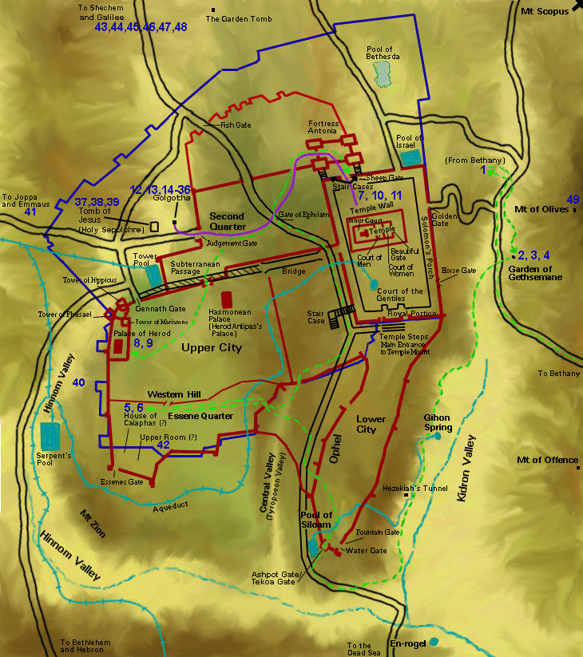
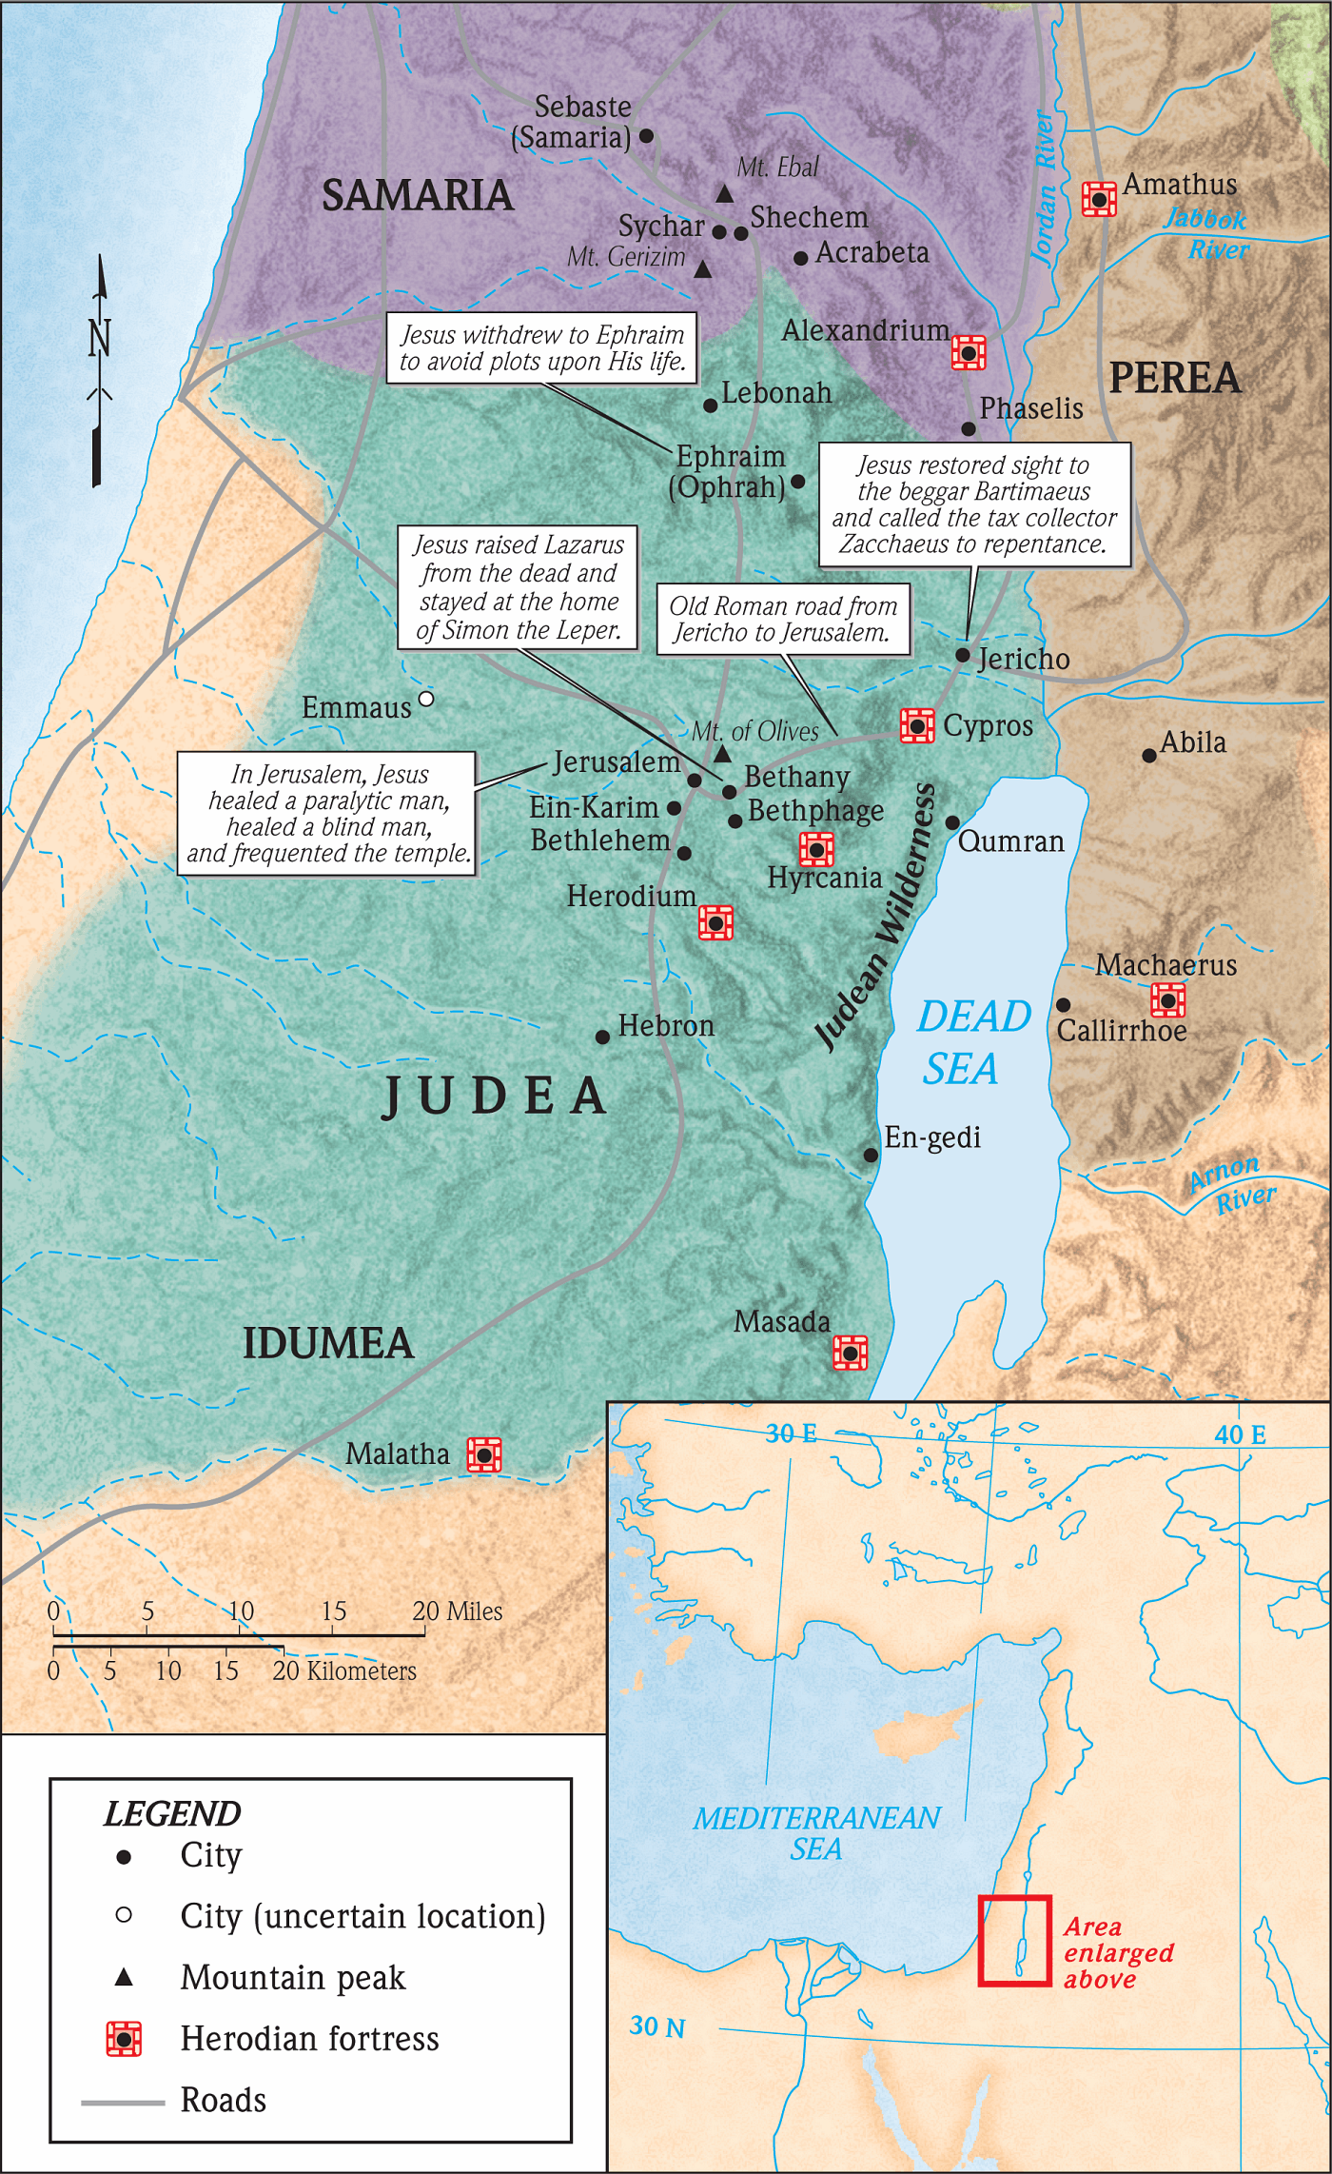

Slide 65
Filling the Office Vacated by Judas Iscariot
Acts 1:15-17 ¹⁵ And in those days Peter stood up in the midst of the disciples, and said, (the number of names together were about an hundred and twenty,)
¹⁶ Men and brethren, this scripture must needs have been fulfilled, which the Holy Ghost by the mouth of David spake before concerning Judas, which was guide to them that took Jesus.
¹⁷ For he was numbered with us, and had obtained part of this ministry.

Slide 66
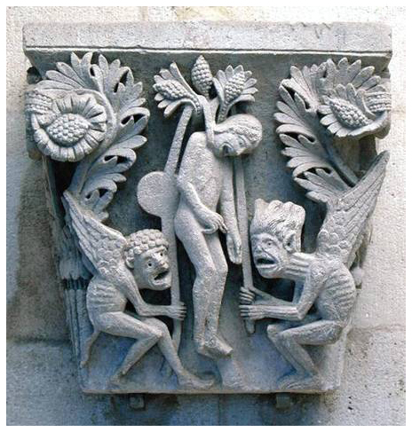
Recounting his death
Acts 1:18-19 ¹⁸ Now this man purchased a field with the reward of iniquity; and falling headlong, he burst asunder in the midst, and all his bowels gushed out.
¹⁹ And it was known unto all the dwellers at Jerusalem; insomuch as that field is called in their proper tongue, Aceldama, that is to say, The field of blood.
Notes:
The Death of Judas, Cathedral Museum of St. Lazare, Autun, Burgundy, France

Slide 67
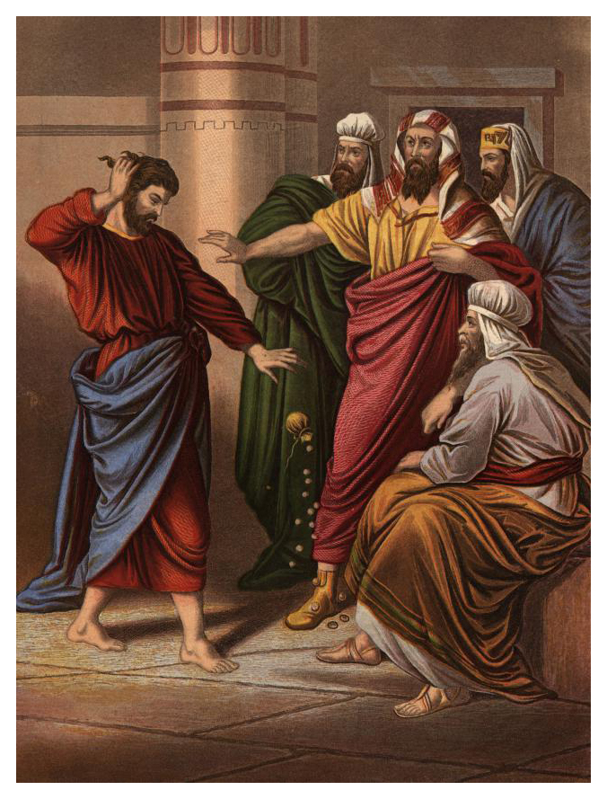
Matthew 27:
³ Then Judas, which had betrayed him, when he saw that he was condemned, repented himself, and brought again the thirty pieces of silver to the chief priests and elders,
⁴ Saying, I have sinned in that I have betrayed the innocent blood. And they said, What is that to us? see thou to that.

Slide 68
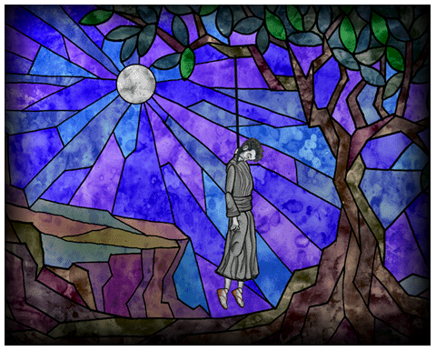
⁵ And he cast down the pieces of silver in the temple, and departed, and went and hanged himself.
⁶ And the chief priests took the silver pieces, and said, It is not lawful for to put them into the treasury, because it is the price of blood.
⁷ And they took counsel, and bought with them the potter's field, to bury strangers in.
⁸ Wherefore that field was called, The field of blood, unto this day.

Slide 69
The Condemnation of Judas Iscariot
Acts 1:20 For it is written in the book of Psalms, Let his habitation be desolate, and let no man dwell therein: and his office let another take.
Psalm 69:25 and 28 ²⁵ Let their habitation be desolate; and let none dwell in their tents. ²⁸ Let them be blotted out of the book of the living, and not be written with the righteous.
Psalm 109:6-9 ⁶ Set thou a wicked man over him: and let Satan stand at his right hand. ⁷ When he shall be judged, let him be condemned: and let his prayer become sin. ⁸ Let his days be few; and let another take his office. ⁹ Let his children be fatherless, and his wife a widow.

Slide 70
Qualifying the New Apostle
Acts 1:21-22 ²¹ Wherefore of these men which have companied with us all the time that the Lord Jesus went in and out among us,
²² Beginning from the baptism of John, unto that same day that he was taken up from us, must one be ordained to be a witness with us of his resurrection.

Slide 71
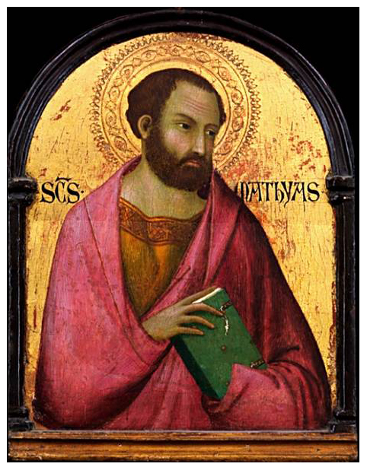
The Ordination of Matthias
Acts 1:23-26 ²³ And they appointed two, Joseph called Barsabas, who was surnamed Justus, and Matthias.
²⁴ And they prayed, and said, Thou, Lord, which knowest the hearts of all men, shew whether of these two thou hast chosen,
²⁵ That he may take part of this ministry and apostleship, from which Judas by transgression fell, that he might go to his own place.
²⁶ And they gave forth their lots; and the lot fell upon Matthias; and he was numbered with the eleven apostles.
Notes:
Saint Matthias from the workshop of Simone Martini

Slide 72
The Acts of the Apostles Chapter 1

Slide 73
Acts – A Study of Revelation
“In the beginning God …” totally miraculous
God spoke unto the fathers directly
God spoke through Moses
God started speaking through the scriptures
God spoke through judges and prophets
Periods of silence that scriptures should have covered
God spoke through His Son (while on earth)
The Son spoke through the Holy Spirit
While in heaven (confirming truth with miracles)
Inspiring apostles/prophets to complete scriptures
Today: total dependence on scriptures
References: Heb. 1&2, and 1 Cor 13

Slide 74
Luke 24:44-48 Jesus to Apostles
44 And he said unto them, These are my words which I spake unto you, while I was yet with you, that all things must needs be fulfilled, which are written in the law of Moses, and the prophets, and the psalms, concerning me.
45 Then opened he their mind, that they might understand the scriptures;
46 and he said unto them, Thus it is written, that the Christ should suffer, and rise again from the dead the third day;
47 and that repentance and remission of sins should be preached in his name unto all the nations, beginning from Jerusalem.
48 Ye are witnesses of these things.

Slide 75
Luke 24:48-53
48 Ye are witnesses of these things.
49 And behold, I send forth the promise of my Father upon you: but tarry ye in the city, until ye be clothed with power from on high.
50 And he led them out until (they were) over against Bethany: and he lifted up his hands, and blessed them.
51 And it came to pass, while he blessed them, he parted from them, and was carried up into heaven.
52 And they worshipped him, and returned to Jerusalem with great joy:
53 and were continually in the temple, blessing God.

Slide 76
Acts 1:1-4 Introduction
What did the former treatise cover? (1-2)
Who were the commandments to? (2)
Apostles
What was the last commandment? (2, 4)
Why “through the Holy Spirit?” (2)
Who is the “whom” in verse? (3)
How long had he appeared to them? (3)
What was the subject of his teaching?
Kingdom of God
Why not depart from Jerusalem? (4)
"Out of Zion shall go forth the law, and the word of the Lord from Jerusalem" (Isa 2:3)

Slide 77
Acts 1:4-5 The Promise
What did he charge them to do? (4)
What were they to wait for? (4)
Promise
Who made the promise?
Who had they heard this promise from? (4)
Jn. 14:16; 15:26; 16:7-13
What was the promise? (5)
Baptism in the Holy Spirit
Who also made the statement of vs. 5?
Mt. 3:11; John 1:33 (John the Baptist)

Slide 78
Matt 3:11-12
Matt 3:11-12
11 I indeed baptize you in water unto repentance: but he that cometh after me is mightier than I, whose shoes I am not worthy to bear: he shall baptize you in the Holy Spirit and (in) fire:
12 whose fan is in his hand, and he will thoroughly cleanse his threshing-floor; and he will gather his wheat into the garner, but the chaff he will burn up with unquenchable fire.
This is both a promise and a threat.
If “you” includes all Christians, then we will all be baptized in fire as well as the Holy Spirit.

Slide 79
Jesus in John 16:7-8; 12-13
John 16:7-8; 12-13 Jesus speaking to Apostles:
⁷ Nevertheless I tell you the truth: It is expedient for you that I go away; for if I go not away, the Comforter will not come unto you; but if I go, I will send him unto you.
⁸ And he, when he is come, will convict the world in respect of sin, and of righteousness, and of judgment: …
¹² I have yet many things to say unto you, but ye cannot bear them now.
¹³ Howbeit when he, the Spirit of truth, is come, he shall guide you into all the truth: for he shall not speak from himself; but what things soever he shall hear, (these) shall he speak: and he shall declare unto you the things that are to come.

Slide 80
John the Baptist
John 1:33
33 And I knew him not: but he that sent me to baptize in water, he said unto me, Upon whomsoever thou shalt see the Spirit descending, and abiding upon him, the same is he that baptizeth in the Holy Spirit.
Can men baptize in the Holy Spirit?
Was baptism in the Holy Spirit ever commanded?
What was commanded in Acts 1:4 in regard to it?

Slide 81
Acts 1:6-8 Unanswered Question
How does this question validate Jesus?
Are some things better not known? (7)
One reason for the silence of the scriptures
What would they think if Jesus said:
Yes
No
How Did Jesus Answer? (8)
Not for you to know … BUT
Ye shall receive power …
Ye shall be witnesses … to all men everywhere
Who were to be the Witnesses?
What was/is the Power? (Rom. 1:16)

Slide 82
The Power of God Unto Salvation
Promise
Of
Father
Jesus
Baptizes
Apostles in
Holy
Spirit
Apostles
Preach
the Word
Rom 1:16

Slide 83
Acts 1:9-11 Ascension
Evidential difference – Res & Asc? (9)
Should they continue wondering? (11)
Did they need comfort? … the Comforter
Will Jesus come back? (11)
In what manner? (11)
What if Jesus had Stayed on Earth?
John 16:7 Nevertheless I tell you the truth: It is expedient for you that I go away; for if I go not away, the Comforter will not come unto you; but if I go, I will send him unto you.
ESSENTIAL for (them and us) to experience
Death, Burial, Resurrection, Ascension
Recognize: Jesus rules from heaven
Need to depend on the Holy Spirit

Slide 84
Acts 1:12-14 Apostles Return
Where did they return to? (12)
Why Name the Apostles? (13)
The word “apostle” (used in vs. 2)
Official, formal meaning: the “the 12”
General meaning of the word: “one sent”
Who were with the Apostles? (14)
Women, his mother
His brothers

Slide 85
Acts 1:15-26 Judas’ Replacement
Who took the lead at this point? (15)
What was Judas’ fate? (18-19)
Mt. 27:5, 10 (Probably Luke’s parenthetical)
What was Peter’s reasoning? (20)
Ps. 69:5; 109:8 – Inference from scripture
What were the qualifications? (21-22)
Eye Witnesses (are there any today?)
Who selected the two? (23; 15)
What did they do before appointment? (24-5)
How did they resolve the selection? (26)

Slide 86
L.D. CARY & SAM HOLT CATCH PHRASES
Chapter 1 – “Jesus’ Work On Earth Is Done”
Chapter 2 – “Peter Baptizes A Crew”
Chapter 3 – “A Beggar’s Plea”
Chapter 4 – “A Jailhouse Door”
Chapter 5 – “Ananias & Sapphira Don’t Survive”
Chapter 6 – “The Widow’s Fix”
Chapter 8 – “Stephen Looks Into Heaven”
Chapter 9 – “Saul Struck Blind”
“Peter Baptizes A Crew”
Catch Phrase
Chapter Two

Slide 87
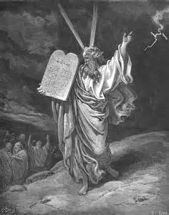
The Feasts of Israel
Exodus 23:14-17
¹⁴ Three times thou shalt keep a feast unto me in the year.
¹⁵ Thou shalt keep the feast of unleavened bread: (thou shalt eat unleavened bread seven days, as I commanded thee, in the time appointed of the month Abib; for in it thou camest out from Egypt: and none shall appear before me empty:)
¹⁶ And the feast of harvest, the firstfruits of thy labours, which thou hast sown in the field: and the feast of ingathering, which is in the end of the year, when thou hast gathered in thy labours out of the field.
¹⁷ Three times in the year all thy males shall appear before the Lord GOD.

Slide 88
The Feasts of Israel
Exodus 23:14-17
¹⁴ Three times thou shalt keep a feast unto me in the year.
¹⁵ Thou shalt keep the feast of unleavened bread: (thou shalt eat unleavened bread seven days, as I commanded thee, in the time appointed of the month Abib; for in it thou camest out from Egypt: and none shall appear before me empty:)
¹⁶ And the feast of harvest, the firstfruits of thy labours, which thou hast sown in the field: and the feast of ingathering, which is in the end of the year, when thou hast gathered in thy labours out of the field.
¹⁷ Three times in the year all thy males shall appear before the Lord GOD.

Slide 89
The Feasts of Israel
Exodus 23:14-17
¹⁴ Three times thou shalt keep a feast unto me in the year.
¹⁵ Thou shalt keep the feast of unleavened bread: (thou shalt eat unleavened bread seven days, as I commanded thee, in the time appointed of the month Abib; for in it thou camest out from Egypt: and none shall appear before me empty:)
¹⁶ And the feast of harvest, the firstfruits of thy labours, which thou hast sown in the field: and the feast of ingathering, which is in the end of the year, when thou hast gathered in thy labours out of the field.
¹⁷ Three times in the year all thy males shall appear before the Lord GOD.

Slide 90
The Feasts of Israel
Exodus 23:14-17
¹⁴ Three times thou shalt keep a feast unto me in the year.
¹⁵ Thou shalt keep the feast of unleavened bread: (thou shalt eat unleavened bread seven days, as I commanded thee, in the time appointed of the month Abib; for in it thou camest out from Egypt: and none shall appear before me empty:)
¹⁶ And the feast of harvest, the firstfruits of thy labours, which thou hast sown in the field: and the feast of ingathering, which is in the end of the year, when thou hast gathered in thy labours out of the field.
¹⁷ Three times in the year all thy males shall appear before the Lord GOD.

Slide 91
The Feast of Unleavened Bread was held in the month of Abib. The name Abib was later changed to Nisan.
Exodus 23:15 Thou shalt keep the feast of unleavened bread … in the time appointed of the month Abib …
Deuteronomy 16:1 Observe the month of Abib, and keep the passover unto the LORD thy God …
Numbers 28:16 And in the fourteenth day of the first month is the passover of the LORD.
Esther 3:7 In the first month, that is, the month Nisan …

Slide 92
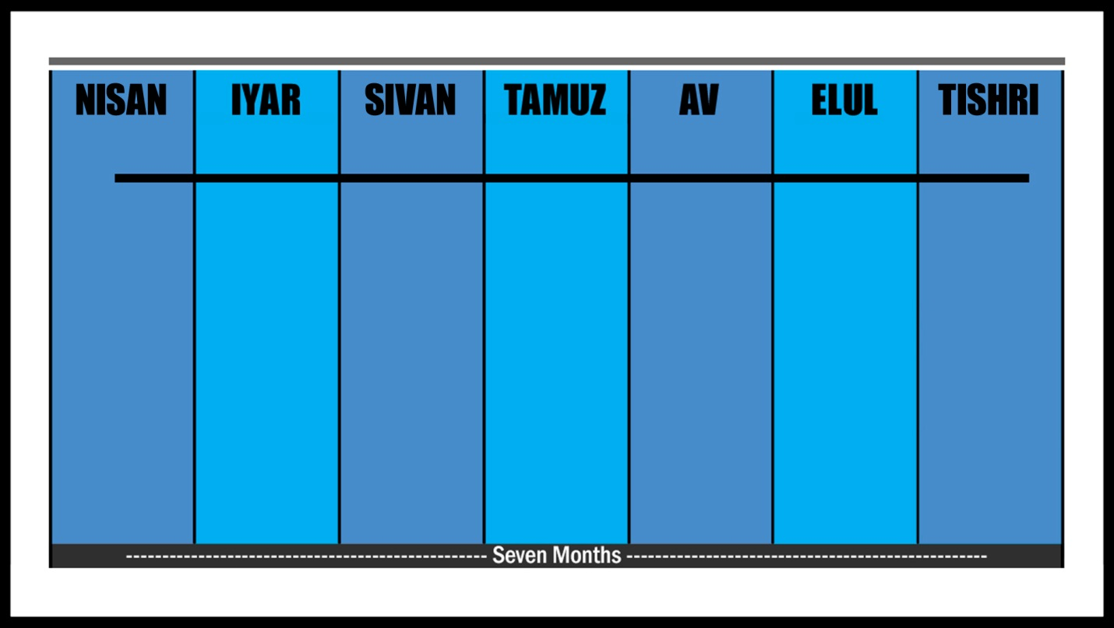
The feasts occurred over a period of 7 months:

Slide 93
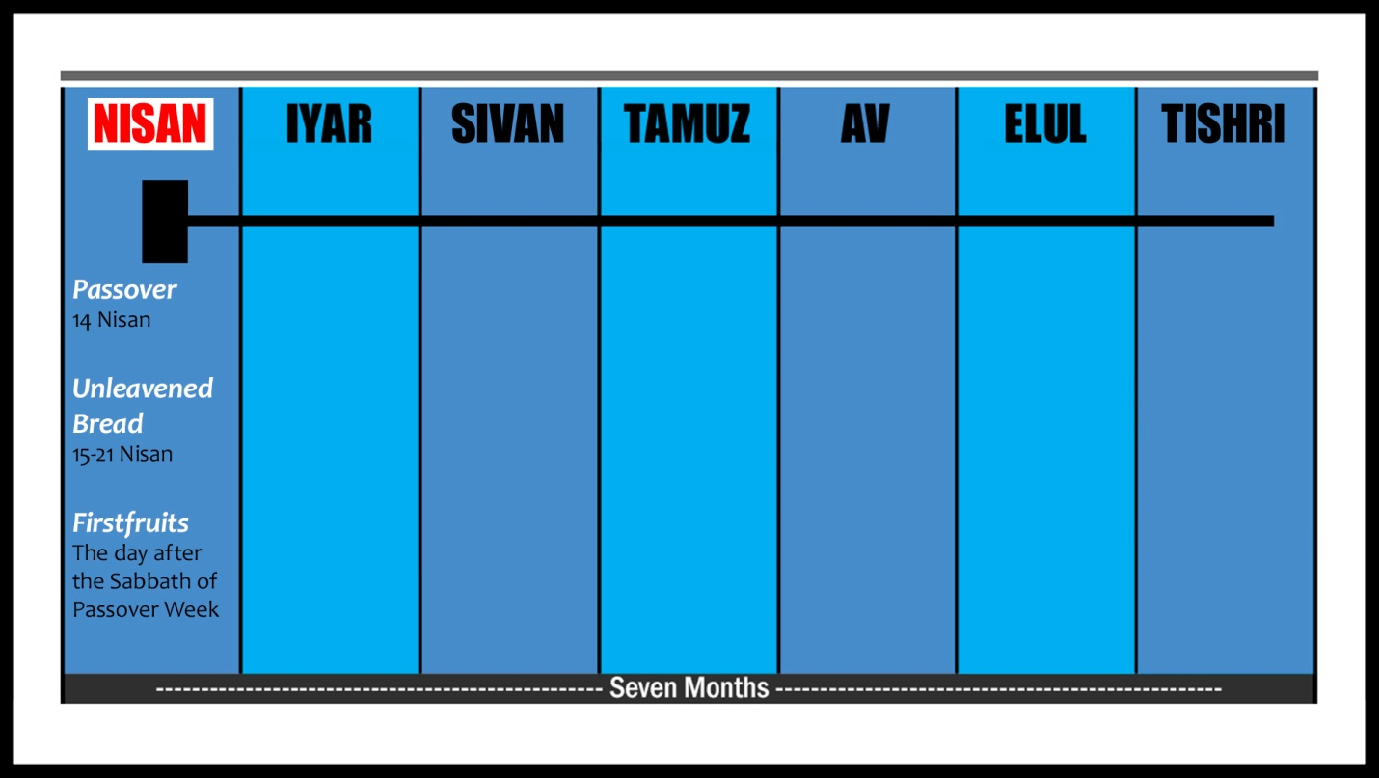
The Feasts of Passover, Unleavened Bread, and Firstfruits were in the springtime month of Nisan.
They were known collectively as the Feast of Unleavened Bread.

Slide 94
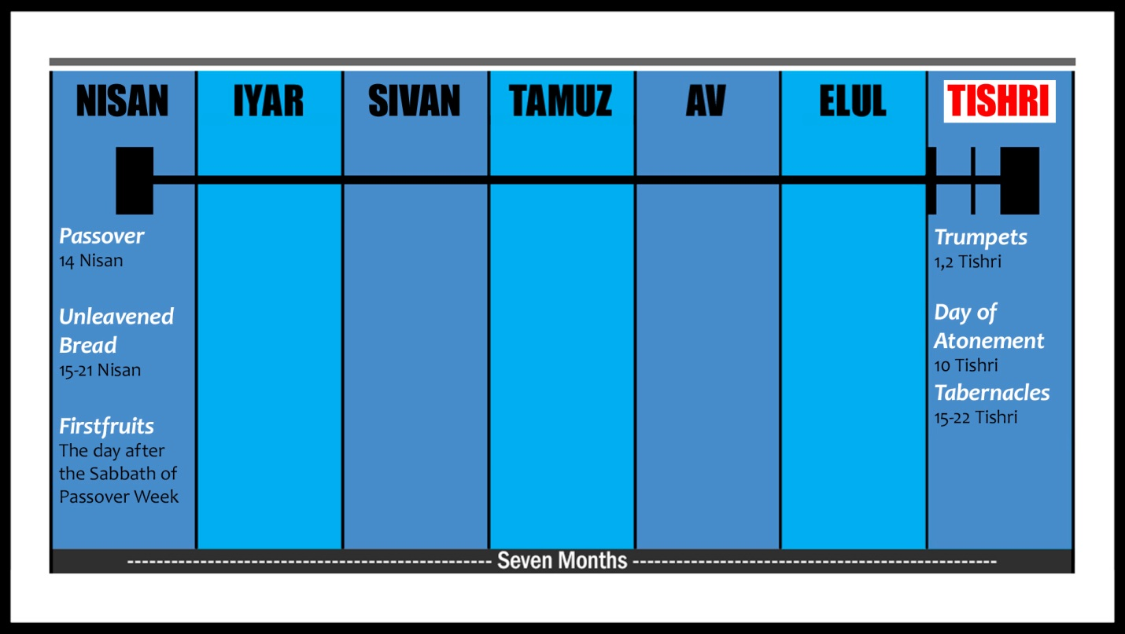
The Feast of Trumpets, the Day of Atonement, and the Feast of Tabernacles were in the Autumn month of Tishri.
These three were together called the Feast of Ingathering.

Slide 95
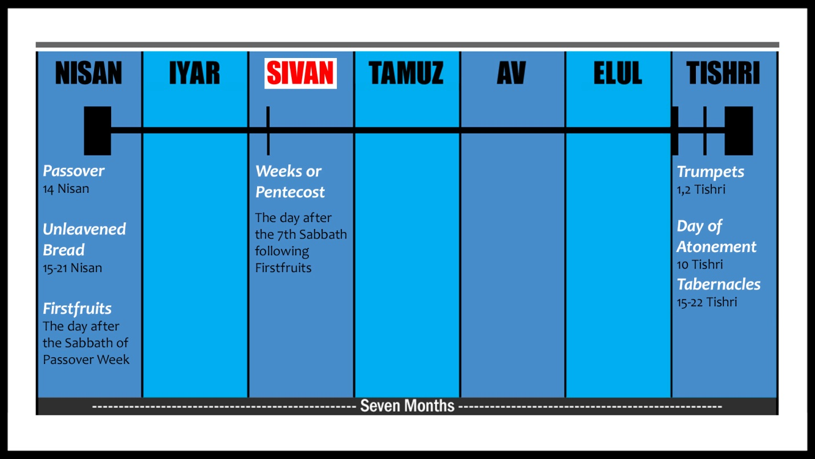
The Feast of Weeks was held in the summer month of Sivan.

Slide 96
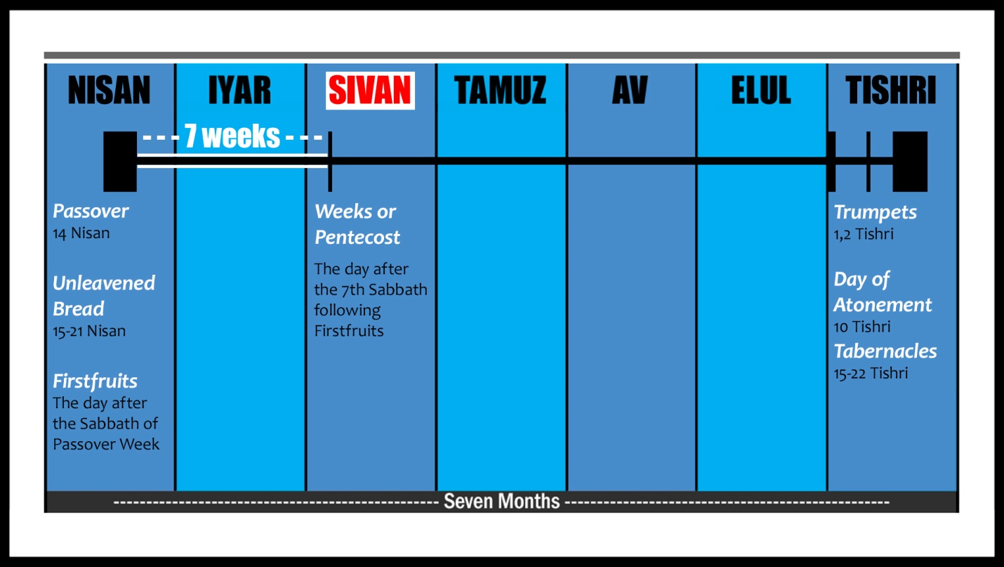
It was also called Pentecost because it came 50 days after the Passover Sabbath. Pente means 50.

Slide 97
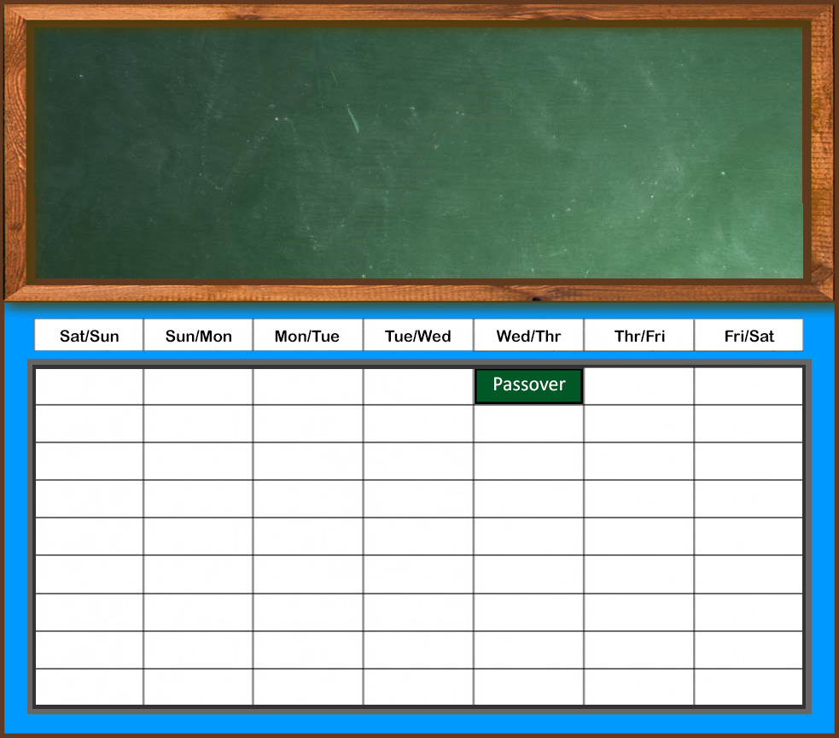
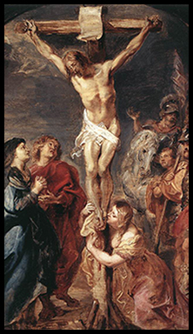
The Lamb of God was sacrificed for our sins on the Passover.
John 1:29 :
The next day John seeth Jesus coming unto him, and saith, Behold the Lamb of God, which taketh away the sin of the world.
1 Corinthians 5:7b:
For even Christ our passover is sacrificed for us:

Slide 98
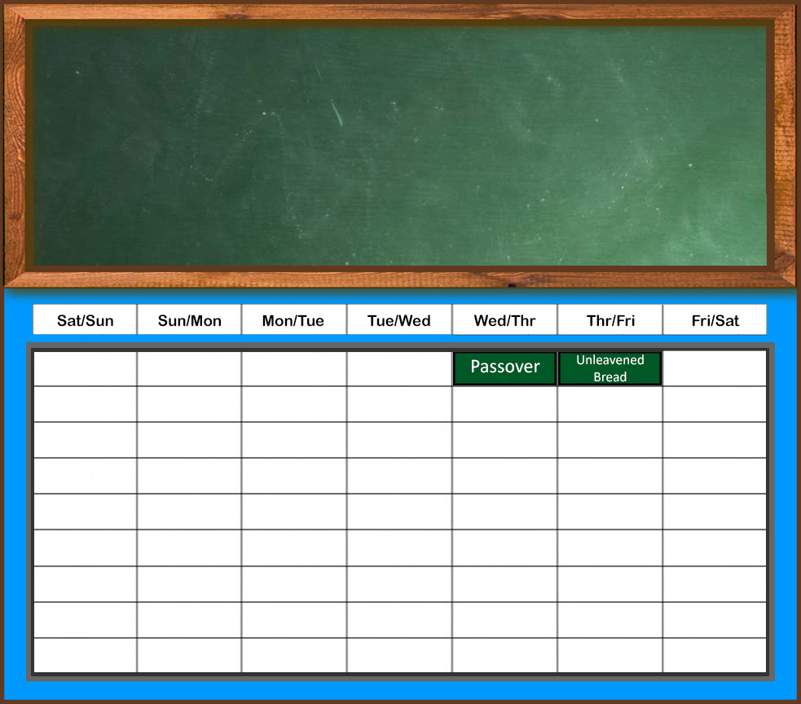
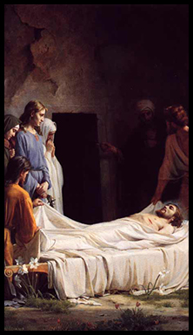
He was buried on the Feast of Unleavened Bread.
Mark 15:42-43, 46:
⁴² And now when the even was come, because it was the preparation, that is, the day before the sabbath,
⁴³ Joseph of Arimathaea, an honourable counsellor, which also waited for the kingdom of God, came, and went in boldly unto Pilate, and craved the body of Jesus.

Slide 99
He was buried on the Feast of Unleavened Bread.
⁴⁶ And he bought fine linen, and took him down, and wrapped him in the linen, and laid him in a sepulchre which was hewn out of a rock, and rolled a stone unto the door of the sepulchre.

Slide 100
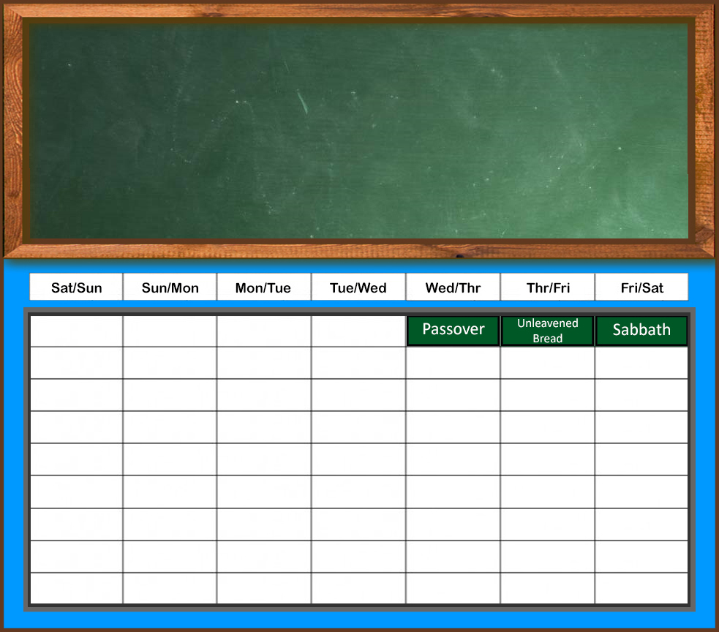
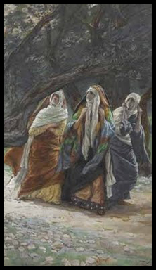
The next day was the weekly Sabbath.
Mark 16:1: And when the sabbath was past, Mary Magdalene, and Mary the mother of James, and Salome, had bought sweet spices, that they might come and anoint him.

Slide 101
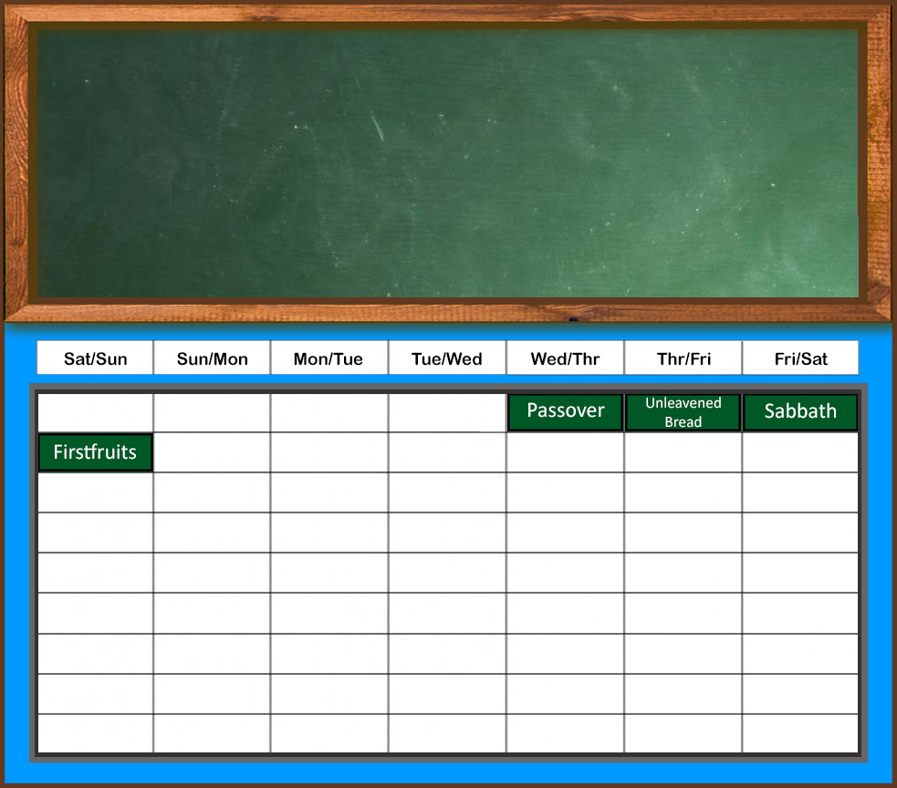
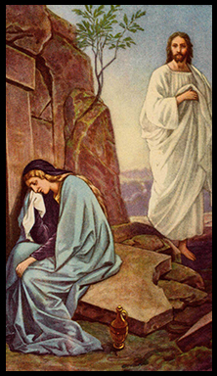
Jesus rose from the dead on the Feast of Firstfruits.
Mark 16:9: Now when Jesus was risen early the first day of the week, he appeared first to Mary Magdalene, out of whom he had cast seven devils.
1 Corinthians 15:20: But now is Christ risen from the dead, and become the firstfruits of them that slept.

Slide 102
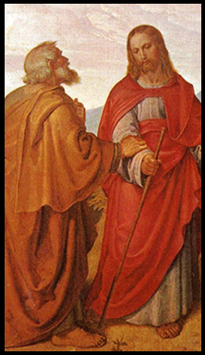
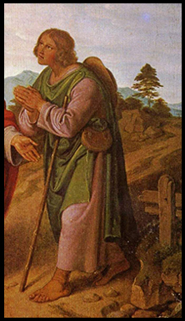
For 40 days, Jesus taught his disciples in his resurrected body.

Slide 103
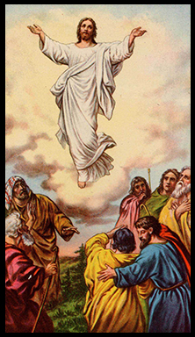
On the fortieth day, he ascended into heaven.
Mark 16:19: So then after the Lord had spoken unto them, he was received up into heaven, and sat on the right hand of God.

Slide 104
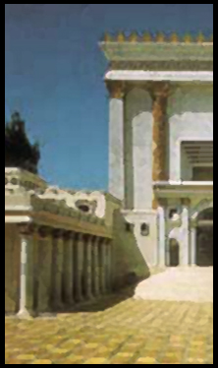
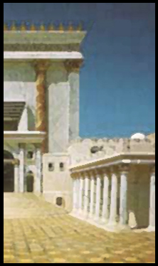
The disciples waited in Jerusalem for the fulfillment of the promise of the Father.

Slide 105
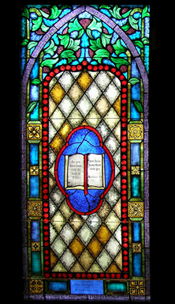
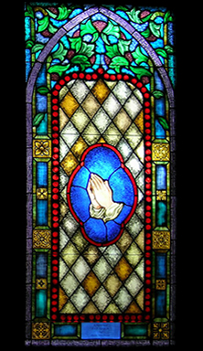
Seven weeks – 49 days – had passed since the Passover Sabbath.

Slide 106
The next day – the 50th day – was Pentecost.

Slide 108
HUB OF THE BIBLE. If someone were to ask you where the middle of the Bible is, what would you say? Some might say that Psalm118:8 is the middle of the Bible. Others might say the blank page between Malachi and Matthew is the middle of the Bible. But a better answer might be to say that Acts 2 is the middle of the Bible. Here’s why. We mean that this chapter is really at the heart of the Bible story. Everything prior to Acts 2 is pointing to the events found here. Many of the events that take place after Acts 2 point back to this chapter. While Acts 2 is not the geographic center of the Bible, it is at the center of God’s plan for man. It comes as a surprise to many folks that many - if not all - of the Old Testament books of the prophets pointed to the events of this day. Even Jesus, in all four gospels pointed to what would happen in Acts 2. This tells us that this chapter is critically important to the Bible story. A lot of people are familiar with some of the passages from Acts 2, particularly verse 38, but most folks do not know how everything in this chapter fits with respect to the whole Bible story. There are a lot of questions that people might have about this chapter. For example: Why was this day called the day of Pentecost? Who were the people gathered to hear Peter preach on that day? Who was it that received Holy Spirit baptism? Is Holy Spirit baptism for us today? What was the speaking in tongues that we read about in this chapter? Why did some of the people in Jerusalem think the apostles were drunk? Why was Peter the spokesman for the whole group of apostles? Why did he quote from the Prophet Joel? The answers to these, and dozens of other questions, are significant when it comes to understanding God’s plan. If people mis-understand the answers to these questions, they’re sure to make lots of mistakes on other things in God’s plan for saving us. This should be enough to make it clear to us that just knowing about Acts 2:38 is not enough. If all we know is just to quote that verse, we will certainly know more than most people, but we will not know what God wants us to know about this chapter. – Max Dawson’s Acts 2 Workbook

Slide 109
The Jews Had Three Annual Feasts
Passover (a.k.a. “The Feast of Unleavened Bread”)
Commemorated God’s deliverance from Egyptian bondage
Pentecost (a.k.a. “The Feast of Harvest”)
Celebrated the beginning of the harvest
The Jews also observed it as the giving of the law at Mt. Sinai
Feast of Tabernacles (a.k.a. “The Feast of Ingathering”)
Commemorated the sojourn in the wilderness
These feasts were ordained by the Lord through Moses
Ex. 23:14-17; cf. 34:18-23; Deut. 16:16
All Jewish males were to gather in Jerusalem for these occasions (Deut. 16:16-17)

Slide 110
The Day of Pentecost
It had various names in the Old Testament
The Feast of Weeks (Ex. 34:22; Deut. 16:10)
The Feast of Harvest (Ex. 23:16)
The Feast of Firstfruits (Ex. 23:16; Lev. 23:17; Num. 28:26)
“Pentecost” was the Greek name given to the feast
“Pentecost” means “fiftieth”
Pentecost always came 50 days after Passover (Lev. 23:15-16)
The day of Pentecost was a special day to the Jews
All Jewish males were to gather in Jerusalem (Deut. 16:16)
They were to make a freewill offering (Deut. 16:10, 16-17; Prov. 3:9)
A day of “holy convocation” with “no customary work” (Num. 28:26)
Special to this day was the wave offering (Lev. 23:15-20)

Slide 111
“When the day of Pentecost had fully come”
“Had fully come” literally means “was being fulfilled.”
This day of Pentecost was special and intentional.
History was finally arriving at a point in time.
God made this Pentecost the focal point of history (cf. Gal. 4:4).
There were large crowds gathered in Jerusalem for this special day.
Pentecost was one of the three annual feasts which Jewish males were required to attend (Deut. 16:16).
“There were dwelling in Jerusalem Jews, devout men, from every nation under heaven” (Acts 2:5).
It was the perfect day, time and setting for God to fulfill His grand purpose (cf. Eph. 3:10-11)

Slide 112
“When the day of Pentecost had fully come”
Pentecost was always the first day of the week (Lev. 23:15-16)
Sunday took on and sustains a special meaning to Christians
Christ was raised from the dead (John 20:1).
The Lord established His church in Acts 2.
The early Christians always assembled (Acts 20:7).
The Lord had specifically and intentionally chosen this day!
No longer was the Sabbath a holy day (Col. 2:14-17)
Interesting parallels between Jewish Pentecost & Christianity
The full harvest of Christ’s work as the Lamb of God came about
The new law/covenant was given and proclaimed
The first “in-gathering” of the gospel harvest occurred
It was a day of joy and gladness

Slide 113
“When the day of Pentecost had fully come”
Peter referred to Pentecost as “the beginning” (11:15):
The promise of the power of the Holy Spirit to the apostles (John 14:26; 15:27; 16:13).
The Great Commission becoming effective (Matt. 28:19-20; Mark 16:15-16; Luke 24:47).
The new covenant (Heb. 8:6-8; 9:15-17; 10:9; 1:1-2).
The preaching of the fullness of the gospel (Acts 2:22-36; 1 Cor. 15:1-4), including the resurrection and deity of Jesus.
Salvation through Jesus Christ according to His conditions (Acts 2:36-41; 4:12; 8:12-13; John 3:3-5).
The church (Acts 2:41, 47; Matt. 16:18-19; Eph. 1:3-23; 2:13-22; Col. 1:13-14).

Slide 114
Pentecost Was a Day of Great Things
A Great Day (2:1)
A Great Audience (2:5-11)
Great Preachers (2:14, 42)
A Great Sermon (2:22-36)
A Great Question (2:37)
A Great Answer (2:38)
A Great Response (2:40-46)
A Great Result (2:47)

Slide 115
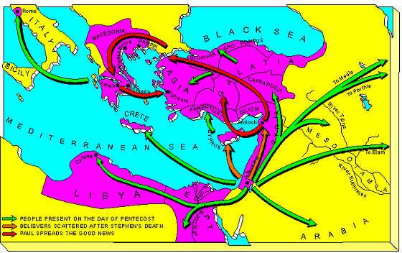

Slide 116
The Global Scattering
The words were prophetic.
After the kingdom divided, there was a great scattering of the Jews from their homeland.
Jeremiah 50:17
Israel is a scattered sheep; the lions have driven him away:
first the king of Assyria hath devoured him;

Slide 117
The northern kingdom of Israel was first to fall.
Jeremiah 50:17
Israel is a scattered sheep; the lions have driven him away:
first the king of Assyria hath devoured him;

Slide 118
The northern kingdom of Israel was first to fall.
Jeremiah 50:17
Israel is a scattered sheep; the lions have driven him away:
first the king of Assyria hath devoured him;

Slide 119
The northern kingdom of Israel was first to fall.
The southern kingdom of Judah fell not long after.
Jeremiah 50:17
Israel is a scattered sheep; the lions have driven him away:
first the king of Assyria hath devoured him;
and last this Nebuchadrezzar king of Babylon hath broken his bones.

Slide 120
The northern kingdom of Israel was first to fall.
The southern kingdom of Judah fell not long after.
Jeremiah 50:17
Israel is a scattered sheep; the lions have driven him away:
first the king of Assyria hath devoured him;
and last this Nebuchadrezzar king of Babylon hath broken his bones.

Slide 121
Some of the Jews did resettle the homeland, but now they were subject to foreign overlords:
The Babylonians,
Persians,
Greeks,
and Romans.
Jeremiah 50:17
Israel is a scattered sheep; the lions have driven him away:
first the king of Assyria hath devoured him;
and last this Nebuchadrezzar king of Babylon hath broken his bones.

Slide 122
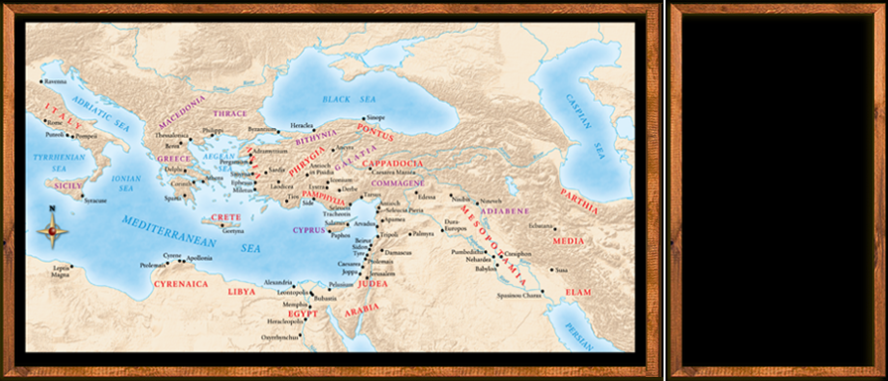
The Nations of Pentecost (Acts 2:9-11)
⁹ Parthians,
and Medes,
and Elamites,
and the dwellers in Mesopotamia,
and in Judaea,
and Cappadocia,
in Pontus,
and Asia,

Slide 123
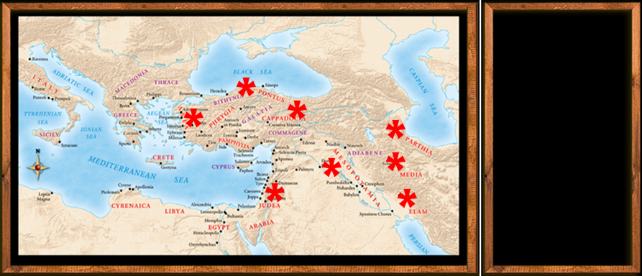
The Nations of Pentecost (Acts 2:9-11)
¹⁰ Phrygia,
and Pamphylia,
in Egypt,
and in the parts of Libya
about Cyrene,
and strangers of Rome, Jews and proselytes,

Slide 124
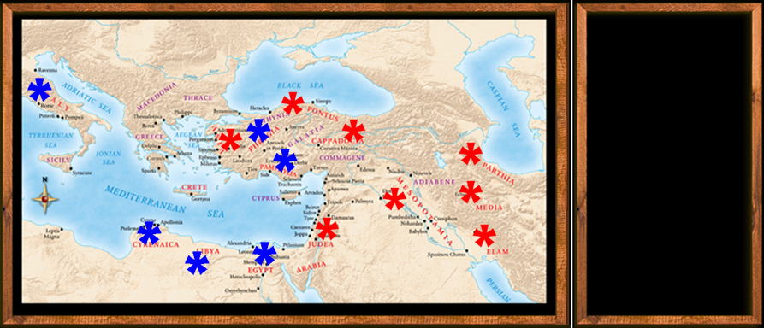
The Nations of Pentecost (Acts 2:9-11)
¹¹ Cretes
and Arabians,
we do hear them speak in our tongues the wonderful works of God.

Slide 125
Acts of the Apostles Chapter 2
The Coming Of The Holy Spirit
Gospel Preached
Three Thousand Obey The Gospel
The First Church Is Formed
The Jerusalem Church

Slide 126
Acts 2:1 (NASB) ¹ When the day of Pentecost had come, they were all together in one place.
A. Jesus had prepared the Apostles for this event:
B. Pentecost:
1. 50th day after the Passover (The first day of the week)
2. Jesus was with the Apostles 40 Days after his resurrection Acts 1:1-3
3. Many suggest that it was 10 days after Jesus ascended till Pentecost?
C. They the Apostles were all together in one place: This is a different time than when Matthias was chosen to take the place of Judas. The personal pronoun refers back to the expression “eleven apostles.” (Acts 1:26) This will become more apparent as the account progresses.
Acts 1:1-3 (NASB) ¹ The first account I composed, Theophilus, about all that Jesus began to do and teach, ² until the day when He was taken up to heaven, after He had by the Holy Spirit given orders to the apostles whom He had chosen. ³ To these He also presented Himself alive after His suffering, by many convincing proofs, appearing to them over a period of forty days and speaking of the things concerning the kingdom of God.
Acts 1:26 (NASB) ²⁶ And they drew lots for them, and the lot fell to Matthias; and he was added to the eleven apostles.

Slide 127
Acts 2:2-4 (NASB) ² And suddenly there came from heaven a noise like a violent rushing wind, and it filled the whole house where they were sitting. ³ And there appeared to them tongues as of fire distributing themselves, and they rested on each one of them. ⁴ And they were all filled with the Holy Spirit and began to speak with other tongues, as the Spirit was giving them utterance.
A. A noise of a violent rushing wind came from heaven: The fact that there was no wind but just the sound that filled one house (chamber) in Jerusalem.
1. Josephus calls the 30 spacious rooms around the temple court “houses,” using this same Greek word that occurs here in Acts. This certainly fits best with what is about to happen. Lk 24:52-53; Acts 1:13-15
2. Then appeared (i.e. visible) Tongues as of fire resting on each of the Apostles: A visible endorsement from heaven setting the apostles aside from all others.
3. They are filled with (baptism) the Holy Spirit: Mt 3:11; Act 1:5; 2:33
4. Speak in other tongues - Spirit gives them utterance: Mt 10:19-20; Jn 15:26-27; Act 2:14, 37
Acts 1:13-15 (NASB) ¹³ When they had entered the city, they went up to the upper room where they were staying; that is, Peter and John and James and Andrew, Philip and Thomas, Bartholomew and Matthew, James the son of Alphaeus, and Simon the Zealot, and Judas the son of James. ¹⁴ These all with one mind were continually devoting themselves to prayer, along with the women, and Mary the mother of Jesus, and with His brothers. ¹⁵ At this time Peter stood up in the midst of the brethren (a gathering of about one hundred and twenty persons was there together), and said,
Matthew 3:11 (NASB) ¹¹ "As for me, I baptize you with water for repentance, but He who is coming after me is mightier than I, and I am not fit to remove His sandals; He will baptize you with the Holy Spirit and fire.
Acts 1:5 (NASB) ⁵ for John baptized with water, but you will be baptized with the Holy Spirit not many days from now."
Acts 2:33 (NASB) ³³ "Therefore having been exalted to the right hand of God, and having received from the Father the promise of the Holy Spirit, He has poured forth this which you both see and hear.
Acts 2:14 (NASB) ¹⁴ But Peter, taking his stand with the eleven, raised his voice and declared to them: "Men of Judea and all you who live in Jerusalem, let this be known to you and give heed to my words. Acts 2:37 (NASB) ³⁷ Now when they heard this, they were pierced to the heart, and said to Peter and the rest of the apostles, "Brethren, what shall we do?"
Matthew 10:19-20 (NASB) ¹⁹ "But when they hand you over, do not worry about how or what you are to say; for it will be given you in that hour what you are to say. ²⁰ "For it is not you who speak, but it is the Spirit of your Father who speaks in you.
John 15:26-27 (NASB) ²⁶ "When the Helper comes, whom I will send to you from the Father, that is the Spirit of truth who proceeds from the Father, He will testify about Me, (Acts 2:4) ²⁷ and you will testify also, because you have been with Me from the beginning.
Luke 24:52-53 (NASB) ⁵² And they, after worshiping Him, returned to Jerusalem with great joy, ⁵³ and were continually in the temple praising God.

Slide 128
Acts 2:5-7 (NASB) ⁵ Now there were Jews living in Jerusalem, devout men from every nation under heaven. ⁶ And when this sound occurred, the crowd came together, and were bewildered because each one of them was hearing them speak in his own language. ⁷ They were amazed and astonished, saying, "Why, are not all these who are speaking Galileans?
A. Jews were living in Jerusalem (50 days) because of the Pentecost feast:
1. They had come from every nation under heaven (Roman Empire).
2. Each one heard them speak in his own language:
a. This is an obvious miracle to those hearing the rushing wind when there is no wind. Hearing in their own language.
b. What makes this even more incredible the ones speaking are all Galileans. An uneducated people in Palestine. But again we find more evidence that it is only the Apostles speaking. Acts 1:9-13
Acts 1:9-13 (NASB) ⁹ And after He had said these things, He was lifted up while they were looking on, and a cloud received Him out of their sight. ¹⁰ And as they were gazing intently into the sky while He was going, behold, two men in white clothing stood beside them. ¹¹ They also said, "Men of Galilee, why do you stand looking into the sky? This Jesus, who has been taken up from you into heaven, will come in just the same way as you have watched Him go into heaven." ¹² Then they returned to Jerusalem from the mount called Olivet, which is near Jerusalem, a Sabbath day's journey away. ¹³ When they had entered the city, they went up to the upper room where they were staying; that is, Peter and John and James and Andrew, Philip and Thomas, Bartholomew and Matthew, James the son of Alphaeus, and Simon the Zealot, and Judas the son of James.
Notes:
Tongue speaking is presented as a speaker talking in a language he has never learned, in the language of men. Did God split the language in the air so that the words came to the ears of the hearer in their own language. Such would not be impossible for the Spirit to do. It was a miracle worked through the Apostles and not on the ears of the hearer.

Slide 129
Acts 2:8-12 (NASB) ⁸ "And how is it that we each hear them in our own language to which we were born? ⁹ "Parthians and Medes and Elamites, and residents of Mesopotamia, Judea and Cappadocia, Pontus and Asia, ¹⁰ Phrygia and Pamphylia, Egypt and the districts of Libya around Cyrene, and visitors from Rome, both Jews and proselytes, ¹¹ Cretans and Arabs—we hear them in our own tongues speaking of the mighty deeds of God." ¹² And they all continued in amazement and great perplexity, saying to one another, "What does this mean?"
A. When the apostles received the Holy Spirit they were beginning their witness: Acts 1:8
1. The fact that they were Galileans clearly reinforced the fact that a miracle was taking place: Acts 2:7
2. Languages represent 15 regions in the Roman world: Tower of Babel - reversal
a) Tongues in this context are languages of men (v. 11 our own tongues): 1Cor 13:1; 14:27-28
3. Amazed and greatly perplexed – What does this mean?
Amazement:
The feeling that accompanies something extremely surprising.
(great) Perplexity:
1. Trouble or confusion resulting from complexity.
1 Corinthians 14:27-28 (NASB) ²⁷ If anyone speaks in a tongue, it should be by two or at the most three, and each in turn, and one must interpret; ²⁸ but if there is no interpreter, he must keep silent in the church; and let him speak to himself and to God.
1 Corinthians 13:1 (NASB) ¹ If I speak with the tongues of men and of angels, but do not have love, I have become a noisy gong or a clanging cymbal.
Acts 1:8 (NASB) ⁸ but you will receive power when the Holy Spirit has come upon you; and you shall be My witnesses both in Jerusalem, and in all Judea and Samaria, and even to the remotest part of the earth."
Acts 2:7 (NASB) ⁷ They were amazed and astonished, saying, "Why, are not all these who are speaking Galileans?
Notes:
3. Amazement = the feeling that accompanies something extremely surprising. Perplexity = trouble or confusion resulting from complexity. They cannot deny what the ears hear and their eyes see yet this just isn’t possible.
This is the question of the day – What does this mean?

Slide 130
Acts 2:13-15 (NASB) ¹³ But others were mocking and saying, "They are full of sweet wine." ¹⁴ But Peter, taking his stand with the eleven, raised his voice and declared to them: "Men of Judea and all you who live in Jerusalem, let this be known to you and give heed to my words. ¹⁵ "For these men are not drunk, as you suppose, for it is only the third hour of the day;
A. “What does this mean? (v 12), They are full of sweet wine: Mocking, joking, ridiculing
1. full of sweet new wine or grape juice:
2. Peter call out to the crowd to get their attention (standing with the eleven – apostles):
3. He answers the accusation of the mockers: It is too early in the morning (9:00 a.m.) for the twelve of us to have acquired enough New Wine, drank it and become drunk.
GREEK – ENGLISH LEXICON
G1098
γλεῦκος, εος ( Dor. gen. γλεύκιος GDI 4993 ( Gortyn )), τό, sweet new wine, Arist. Mete. 380b32, Nic. Al. 184, 299, PPetr. 3p.149 (iii B. C.), Act.Rev_2:13, Dsc. 5.6; οἴνου γλεύκους PGrenf. 2.24.12 (ii B. C.), PFlor. 65.8 (vi A. D.) .
2. grape-juice, Gal. 6.575. II sweetness, Arist. Pr. 931a18 .
(Act 2:13 But others were laughing and joking and ridiculing them, saying, "They are full of sweet wine and are drunk!" AMPlFIED BIBLE)
Notes:
It would be pretty much impossible to get drunk on grape juice. Even if it is grape juice which has begun to ferment it would be very unlikely that a man could get drunk on it by 9:00 a.m. in the morning.

Slide 131
Acts 2:16-21 (NASB) ¹⁶ but this is what was spoken of through the prophet Joel: ¹⁷ 'AND IT SHALL BE IN THE LAST DAYS,' God says, 'THAT I WILL POUR FORTH OF MY SPIRIT ON ALL MANKIND; AND YOUR SONS AND YOUR DAUGHTERS SHALL PROPHESY, AND YOUR YOUNG MEN SHALL SEE VISIONS, AND YOUR OLD MEN SHALL DREAM DREAMS; ¹⁸ EVEN ON MY BONDSLAVES, BOTH MEN AND WOMEN, I WILL IN THOSE DAYS POUR FORTH OF MY SPIRIT And they shall prophesy. ¹⁹ 'AND I WILL GRANT WONDERS IN THE SKY ABOVE AND SIGNS ON THE EARTH BELOW, BLOOD, AND FIRE, AND VAPOR OF SMOKE. ²⁰ 'THE SUN WILL BE TURNED INTO DARKNESS AND THE MOON INTO BLOOD, BEFORE THE GREAT AND GLORIOUS DAY OF THE LORD SHALL COME. ²¹ 'AND IT SHALL BE THAT EVERYONE WHO CALLS ON THE NAME OF THE LORD WILL BE SAVED.'
A. Peter now begins to answer the question “What does this mean?” verse 12. This is what was spoken through the prophet Joel: Joel 2:28-32
1. Last days Last days of what? Isa 2:1-4; Micah 4:1-3; Heb 1:1-2; Lk 24:45-49; Act 1:4-5, 8
Isaiah 2:1-4 (NASB77) ¹ The word which Isaiah the son of Amoz saw concerning Judah and Jerusalem. ² Now it will come about that In the last days, The mountain of the house of the LORD Will be established as the chief of the mountains, And will be raised above the hills; And all the nations will stream to it. ³ And many peoples will come and say, "Come, let us go up to the mountain of the LORD, To the house of the God of Jacob; That He may teach us concerning His ways, And that we may walk in His paths." For the law will go forth from Zion, And the word of the LORD from Jerusalem. ⁴ And He will judge between the nations, And will render decisions for many peoples; And they will hammer their swords into plowshares, and their spears into pruning hooks. Nation will not lift up sword against nation, And never again will they learn war.
Micah 4:1-3 (NASB77) ¹ And it will come about in the last days That the mountain of the house of the LORD Will be established as the chief of the mountains. It will be raised above the hills, And the peoples will stream to it. ² And many nations will come and say, " Come and let us go up to the mountain of the LORD And to the house of the God of Jacob, That He may teach us about His ways And that we may walk in His paths." For from Zion will go forth the law, Even the word of the LORD from Jerusalem. ³ And He will judge between many peoples And render decisions for mighty, distant nations. Then they will hammer their swords into plowshares And their spears into pruning hooks; Nation will not lift up sword against nation, And never again will they train for war.
Hebrews 1:1-2 (NASB77) ¹ God, after He spoke long ago to the fathers in the prophets in many portions and in many ways, ² in these last days has spoken to us in His Son, whom He appointed heir of all things, through whom also He made the world.
Luke 24:45-49 (NASB77) ⁴⁵ Then He opened their minds to understand the Scriptures, ⁴⁶ and He said to them, " Thus it is written, that the Christ should suffer and rise again from the dead the third day; ⁴⁷ and that repentance for forgiveness of sins should be proclaimed in His name to all the nations, beginning from Jerusalem. ⁴⁸ "You are witnesses of these things. ⁴⁹ "And behold, I am sending forth the promise of My Father upon you; but you are to stay in the city until you are clothed with power from on high."
Acts 1:4-5 (NASB77) ⁴ And gathering them together, He commanded them not to leave Jerusalem, but to wait for what the Father had promised, "Which," He said, "you heard of from Me; ⁵ for John baptized with water, but you shall be baptized with the Holy Spirit not many days from now." Acts 1:8 (NASB77) ⁸ but you shall receive power when the Holy Spirit has come upon you; and you shall be My witnesses both in Jerusalem, and in all Judea and Samaria, and even to the remotest part of the earth."
Notes:
It would seen logical that the Last days of the Jewish system which were beginning on this very day and would end in 70 AD at the destruction of Jerusalem. All that is contained in this prophecy did not happen on this day but it began to happen. Note it says Last days indicating that they would see all of this happen.

Slide 132
Acts 11:27-28 (NASB) ²⁷ Now at this time some prophets came down from Jerusalem to Antioch. ²⁸ One of them named Agabus stood up and began to indicate by the Spirit that there would certainly be a great famine all over the world. And this took place in the reign of Claudius.
Acts 21:8-9 (NASB77) ⁸ And on the next day we departed and came to Caesarea; and entering the house of Philip the evangelist, who was one of the seven, we stayed with him. ⁹ Now this man had four virgin daughters who were prophetesses.
Acts 21:10 (NASB77) ¹⁰ And as we were staying there for some days, a certain prophet named Agabus came down from Judea.
Acts 2:16-18 (NASB) ¹⁶ but this is what was spoken of through the prophet Joel: ¹⁷ 'AND IT SHALL BE IN THE LAST DAYS,' God says, 'THAT I WILL POUR FORTH OF MY SPIRIT ON ALL MANKIND; AND YOUR SONS AND YOUR DAUGHTERS SHALL PROPHESY, AND YOUR YOUNG MEN SHALL SEE VISIONS, AND YOUR OLD MEN SHALL DREAM DREAMS; ¹⁸ EVEN ON MY BONDSLAVES, BOTH MEN AND WOMEN, I WILL IN THOSE DAYS POUR FORTH OF MY SPIRIT And they shall prophesy.
A. Pour out my spirit on all mankind (lit. Flesh): God poured out His Spirit on the apostles who as Jews represented Jews. Mt 3:11-12; Acts 1:4-5; 2:32-33
1. Therefore only the circumcised were baptized, natural Jew or Proselyte were admitted into the church: Acts 6:1; 11:19
2. Then God poured forth his Spirit on the Gentiles: Acts 10:44-45; 11:15-18; 15:7-11; 10:47-48
3. The apostles had the power to lay hands on fellow Christians and impart gifts but only Jesus in heaven could baptize into the Spirit: Acts 8:14-19; Ro 1:11-12; 2Cor 12:12-13; Heb 2:1-4
B. Daughters, young men, old men see visions, prophecy: Acts 9:10-12; 11:27-28; 21:8-9; 21:10
Acts 15:7-11 (NASB77) ⁷ And after there had been much debate, Peter stood up and said to them, "Brethren, you know that in the early days God made a choice among you, that by my mouth the Gentiles should hear the word of the gospel and believe. ⁸ "And God, who knows the heart, bore witness to them, giving them the Holy Spirit, just as He also did to us; ⁹ and He made no distinction between us and them, cleansing their hearts by faith. ¹⁰ "Now therefore why do you put God to the test by placing upon the neck of the disciples a yoke which neither our fathers nor we have been able to bear? ¹¹ "But we believe that we are saved through the grace of the Lord Jesus, in the same way as they also are."
Acts 8:14-19 (NASB77) ¹⁴ Now when the apostles in Jerusalem heard that Samaria had received the word of God, they sent them Peter and John, ¹⁵ who came down and prayed for them, that they might receive the Holy Spirit. ¹⁶ For He had not yet fallen upon any of them; they had simply been baptized in the name of the Lord Jesus. ¹⁷ Then they began laying their hands on them, and they were receiving the Holy Spirit. ¹⁸ Now when Simon saw that the Spirit was bestowed through the laying on of the apostles' hands, he offered them money, ¹⁹ saying, "Give this authority to me as well, so that everyone on whom I lay my hands may receive the Holy Spirit."
Acts 10:44-45 (NASB77) ⁴⁴ While Peter was still speaking these words, the Holy Spirit fell upon all those who were listening to the message. ⁴⁵ And all the circumcised believers who had come with Peter were amazed, because the gift of the Holy Spirit had been poured out upon the Gentiles also.
Hebrews 2:1-4 (NASB77) ¹ For this reason we must pay much closer attention to what we have heard, lest we drift away from it. ² For if the word spoken through angels proved unalterable, and every transgression and disobedience received a just recompense, ³ how shall we escape if we neglect so great a salvation? After it was at the first spoken through the Lord, it was confirmed to us by those who heard, ⁴ God also bearing witness with them, both by signs and wonders and by various miracles and by gifts of the Holy Spirit according to His own will.
Acts 11:15-18 (NASB77) ¹⁵ "And as I began to speak, the Holy Spirit fell upon them, just as He did upon us at the beginning. ¹⁶ "And I remembered the word of the Lord, how He used to say, ' John baptized with water, but you shall be baptized with the Holy Spirit.' ¹⁷ "If God therefore gave to them the same gift as He gave to us also after believing in the Lord Jesus Christ, who was I that I could stand in God's way?" ¹⁸ And when they heard this, they quieted down, and glorified God, saying, "Well then, God has granted to the Gentiles also the repentance that leads to life."
Romans 1:11-12 (NASB77) ¹¹ For I long to see you in order that I may impart some spiritual gift to you, that you may be established; ¹² that is, that I may be encouraged together with you while among you, each of us by the other's faith, both yours and mine.
2 Corinthians 12:12-13 (NASB77) ¹² The signs of a true apostle were performed among you with all perseverance, by signs and wonders and miracles. ¹³ For in what respect were you treated as inferior to the rest of the churches, except that I myself did not become a burden to you? Forgive me this wrong!
Acts 9:10-12 (NASB) ¹⁰ Now there was a disciple at Damascus named Ananias; and the Lord said to him in a vision, "Ananias." And he said, "Here I am, Lord." ¹¹ And the Lord said to him, "Get up and go to the street called Straight, and inquire at the house of Judas for a man from Tarsus named Saul, for he is praying, ¹² and he has seen in a vision a man named Ananias come in and lay his hands on him, so that he might regain his sight."
Acts 2:32-33 (NASB77) ³² "This Jesus God raised up again, to which we are all witnesses. ³³ "Therefore having been exalted to the right hand of God, and having received from the Father the promise of the Holy Spirit, He has poured forth this which you both see and hear.
Matthew 3:11-12 (NASB77) ¹¹ "As for me, I baptize you with water for repentance, but He who is coming after me is mightier than I, and I am not fit to remove His sandals; He will baptize you with the Holy Spirit and fire. ¹² "And His winnowing fork is in His hand, and He will thoroughly clear His threshing floor; and He will gather His wheat into the barn, but He will burn up the chaff with unquenchable fire."
Acts 1:4-5 (NASB77) ⁴ And gathering them together, He commanded them not to leave Jerusalem, but to wait for what the Father had promised, "Which," He said, "you heard of from Me; ⁵ for John baptized with water, but you shall be baptized with the Holy Spirit not many days from now."
Acts 6:1 (NASB) ¹ Now at this time while the disciples were increasing in number, a complaint arose on the part of the Hellenistic Jews against the native Hebrews, because their widows were being overlooked in the daily serving of food. (Hellenistic Jews = Jewish Proselytes)
Acts 11:19 (NASB) ¹⁹ So then those who were scattered because of the persecution that occurred in connection with Stephen made their way to Phoenicia and Cyprus and Antioch, speaking the word to no one except to Jews alone.
Acts 10:47-48 (NASB77) ⁴⁷ " Surely no one can refuse the water for these to be baptized who have received the Holy Spirit just as we did, can he?" ⁴⁸ And he ordered them to be baptized in the name of Jesus Christ. Then they asked him to stay on for a few days.
Notes:
NOTE: The pouring forth of the Holy Spirit would only take place during the Last Days of Israel and its temple worship. At the fall in 70 AD the last days would end and so would the pouring forth of God’s spirit. After the last day the message of salvation would go forth and every soul of the Jews would be saved if they called on the Lord’s name through belief in the Gospel good news about Christ. There would be no more signs or miracles. The time of God’s patience would be over concerning Israel.
It would seem logical that the Last days of the Jewish system which were beginning on this very day and would end in 70 AD at the destruction of Jerusalem. All that is contained in this prophecy did not happen on this day but it began to happen. Note it says Last days indicating that they would see all of this happen.

Slide 133
Acts 2:19-21 (NASB) ¹⁹ 'AND I WILL GRANT WONDERS IN THE SKY ABOVE AND SIGNS ON THE EARTH BELOW, BLOOD, AND FIRE, AND VAPOR OF SMOKE. ²⁰ 'THE SUN WILL BE TURNED INTO DARKNESS AND THE MOON INTO BLOOD, BEFORE THE GREAT AND GLORIOUS DAY OF THE LORD SHALL COME. ²¹ 'AND IT SHALL BE THAT EVERYONE WHO CALLS ON THE NAME OF THE LORD WILL BE SAVED.'
A. The expression “Day of the Lord” is a common reference to God’s judgment on a nation: Ezk 30:3; Obad 1:15; Amos 5:18-20
1. The astronomical cataclysmic events are figures of speech which reinforce the idea of a nations destruction: Babylon Isa 13:1, 9-11; Edom Isa 34:4-5; Samaria Amos 8:9; Egypt Ezk 32:2, 7-8; Judah Jer 4:3-4, 23-24, 27-28; Jerusalem Mt 24:1-2, 29, 34
2. Joel was prophesying about the last days of Jerusalem even as Jesus did in Mt 24.
a. The judgment Joel is talking about is against Zion which is Jerusalem. And there will be a remnant of the Jews who would escape. These were the Jewish Christians.
Isaiah 13:1 (NASB) ¹ The oracle concerning Babylon which Isaiah the son of Amoz saw. Isaiah 13:9-11 (NASB) ⁹ Behold, the day of the LORD is coming, Cruel, with fury and burning anger, To make the land a desolation; And He will exterminate its sinners from it. ¹⁰ For the stars of heaven and their constellations Will not flash forth their light; The sun will be dark when it rises And the moon will not shed its light. ¹¹ Thus I will punish the world for its evil And the wicked for their iniquity; I will also put an end to the arrogance of the proud And abase the haughtiness of the ruthless.
Ezekiel 32:2 (NASB) ² "Son of man, take up a lamentation over Pharaoh king of Egypt and say to him, 'You compared yourself to a young lion of the nations, Yet you are like the monster in the seas; And you burst forth in your rivers And muddied the waters with your feet And fouled their rivers.'" Ezekiel 32:7-8 (NASB) ⁷ "And when I extinguish you, I will cover the heavens and darken their stars; I will cover the sun with a cloud And the moon will not give its light. ⁸ "All the shining lights in the heavens I will darken over you And will set darkness on your land," Declares the Lord GOD.
Jeremiah 4:3-4 (NASB) ³ For thus says the LORD to the men of Judah and to Jerusalem, "Break up your fallow ground, And do not sow among thorns. ⁴ "Circumcise yourselves to the LORD And remove the foreskins of your heart, Men of Judah and inhabitants of Jerusalem, Or else My wrath will go forth like fire And burn with none to quench it, Because of the evil of your deeds." Jeremiah 4:23-24 (NASB) ²³ I looked on the earth, and behold, it was formless and void; And to the heavens, and they had no light. ²⁴ I looked on the mountains, and behold, they were quaking, And all the hills moved to and fro. Jeremiah 4:27-28 (NASB) ²⁷ For thus says the LORD, "The whole land shall be a desolation, Yet I will not execute a complete destruction. ²⁸ "For this the earth shall mourn And the heavens above be dark, Because I have spoken, I have purposed, And I will not change My mind, nor will I turn from it."
Matthew 24:1-2 (NASB) ¹ Jesus came out from the temple and was going away when His disciples came up to point out the temple buildings to Him. ² And He said to them, "Do you not see all these things? Truly I say to you, not one stone here will be left upon another, which will not be torn down."
Matthew 24:29 (NASB) ²⁹ "But immediately after the tribulation of those days THE SUN WILL BE DARKENED, AND THE MOON WILL NOT GIVE ITS LIGHT, AND THE STARS WILL FALL from the sky, and the powers of the heavens will be shaken.
Matthew 24:34 (NASB) ³⁴ "Truly I say to you, this generation will not pass away until all these things take place.
Obadiah 1:15 (NASB) ¹⁵ "For the day of the LORD draws near on all the nations. As you have done, it will be done to you. Your dealings will return on your own head.
Amos 5:18-20 (NASB) ¹⁸ Alas, you who are longing for the day of the LORD, For what purpose will the day of the LORD be to you? It will be darkness and not light; ¹⁹ As when a man flees from a lion And a bear meets him, Or goes home, leans his hand against the wall And a snake bites him. ²⁰ Will not the day of the LORD be darkness instead of light, Even gloom with no brightness in it?
Ezekiel 30:3 (NASB) ³ "For the day is near, Even the day of the LORD is near; It will be a day of clouds, A time of doom for the nations.
Isaiah 34:4-5 (NASB) ⁴ And all the host of heaven will wear away, And the sky will be rolled up like a scroll; All their hosts will also wither away As a leaf withers from the vine, Or as one withers from the fig tree. ⁵ For My sword is satiated in heaven, Behold it shall descend for judgment upon Edom And upon the people whom I have devoted to destruction.
Amos 8:9 (NASB) ⁹ "It will come about in that day," declares the Lord GOD, "That I will make the sun go down at noon And make the earth dark in broad daylight.
Notes:
Also as verse 20 clearly indicates that before that glorious day would come the outpouring of the spirit would take place in the church. This did occur before the great day of Jerusalem Destructionc occurred. After which there would be the continual call by the lost to be saved. Such a call with any expectation of salvation will be useless at the end of time when all men will be judged for the life they lived with no more opportunity to be saved.
It would seen logical that the Last days of the Jewish system which were beginning on this very day and would end in 70 AD at the destruction of Jerusalem. All that is contained in this prophecy did not happen on this day but it began to happen. Note it says Last days indicating that they would see all of this happen. See the complete statement made by Joel in 2:32
Astronomical events may also be a figurative way of saying heaven is judging you.
Also as verse 20 clearly indicates that before that glorious day would come the outpouring of the spirit would take place in the church. This did occur before the great day of Jerusalem Destructionc occurred. After which there would be the continual call by the lost to be saved. Such a call with any expectation of salvation will be useless at the end of time when all men will be judged for the life they lived with no more opportunity to be saved.
The future respect of verse 21 clearly tells us that men and women would be calling on the name of the Lord to be saved after the great and glorious day in which God brings an end to the Old Testament system of things. A dark day for those who rejected Jesus but a great and glorious day for those who proclaim the good news to a lost and dying world. Peters sermon is designed to call these Jews out of a dying nation and system of serving God into the glorious light of Jesus. Acts 2:40

Slide 134
Acts 2:22-23 (NASB) ²² "Men of Israel, listen to these words: Jesus the Nazarene, a man attested to you by God with miracles and wonders and signs which God performed through Him in your midst, just as you yourselves know— ²³ this Man, delivered over by the predetermined plan and foreknowledge of God, you nailed to a cross by the hands of godless men and put Him to death.
A. Men of Israel listen to these words: Peter now addresses his nation having revealed by Joel that The Last Days have begun. The Day of the Lord against Israel will complete these days.
1. Jesus the Nazarene: Mk 10:46-48; Mk 14:67; Lk 24:19
2. Attested to you by God: Lk 7:20-23; Jn 3:1-2; 5:36; 6:14; 7:31; 11:47; 14:10-11; 15:24
B. by a predetermined plan and foreknowledge of God: Eph 1:4-5, 3:11
1. you nailed to a cross: Jn 19:7-13, 19
2. By the hand of Godless men: Eph 2:11-12
3. put Him to death: Jn 19:28-30, 32-34; Mt 27:24-25;
John 19:28-30, 32-34 (NASB) ²⁸ After this, Jesus, knowing that all things had already been accomplished, to fulfill the Scripture, *said, "I am thirsty." ²⁹ A jar full of sour wine was standing there; so they put a sponge full of the sour wine upon a branch of hyssop and brought it up to His mouth. ³⁰ Therefore when Jesus had received the sour wine, He said, "It is finished!" And He bowed His head and gave up His spirit.
³² So the soldiers came, and broke the legs of the first man and of the other who was crucified with Him; ³³ but coming to Jesus, when they saw that He was already dead, they did not break His legs. ³⁴ But one of the soldiers pierced His side with a spear, and immediately blood and water came out.
John 19:7-13 (NASB) ⁷ The Jews answered him, "We have a law, and by that law He ought to die because He made Himself out to be the Son of God." ⁸ Therefore when Pilate heard this statement, he was even more afraid; ⁹ and he entered into the Praetorium again and *said to Jesus, "Where are You from?" But Jesus gave him no answer. ¹⁰ So Pilate *said to Him, "You do not speak to me? Do You not know that I have authority to release You, and I have authority to crucify You?" ¹¹ Jesus answered, "You would have no authority over Me, unless it had been given you from above; for this reason he who delivered Me to you has the greater sin." ¹² As a result of this Pilate made efforts to release Him, but the Jews cried out saying, "If you release this Man, you are no friend of Caesar; everyone who makes himself out to be a king opposes Caesar." ¹³ Therefore when Pilate heard these words, he brought Jesus out, and sat down on the judgment seat at a place called The Pavement, but in Hebrew, Gabbatha.
Predetermined: Greek NASB Number: 3724
Definition: to mark off by boundaries, to determine:--
List of English Words and Number of Times Used appointed (2), declared (1), determined (3), fixes (1), predetermined (1)
New American Standard Exhaustive Concordance of the Bible
Foreknowledge:
Greek NASB Number: 4268
Greek Word: πρόγνωσις
Transliterated Word: prognôsis Root: from 4267;
Definition: foreknowledge
List of English Words and Number of Times Used foreknowledge (2).
New American Standard Exhaustive Concordance of the Bible
A prognosis is a prediction about how something will develop. Sage Dictionary
Ephesians 1:4-5 (NASB) ⁴ just as He chose us in Him before the foundation of the world, that we would be holy and blameless before Him. In love ⁵ He predestined us to adoption as sons through Jesus Christ to Himself, according to the kind intention of His will,
Ephesians 2:11-12 (NASB) ¹¹ Therefore remember that formerly you, the Gentiles in the flesh, who are called "Uncircumcision" by the so-called "Circumcision," which is performed in the flesh by human hands— ¹² remember that you were at that time separate from Christ, excluded from the commonwealth of Israel, and strangers to the covenants of promise, having no hope and without God in the world.
Matthew 27:24-25 (NASB) ²⁴ When Pilate saw that he was accomplishing nothing, but rather that a riot was starting, he took water and washed his hands in front of the crowd, saying, "I am innocent of this Man's blood; see to that yourselves." ²⁵ And all the people said, "His blood shall be on us and on our children!“
Mark 10:46-48 (NASB) ⁴⁶ Then they *came to Jericho. And as He was leaving Jericho with His disciples and a large crowd, a blind beggar named Bartimaeus, the son of Timaeus, was sitting by the road. ⁴⁷ When he heard that it was Jesus the Nazarene, he began to cry out and say, "Jesus, Son of David, have mercy on me!" ⁴⁸ Many were sternly telling him to be quiet, but he kept crying out all the more, "Son of David, have mercy on me!"
Mark 14:67 (NASB) ⁶⁷ and seeing Peter warming himself, she looked at him and *said, "You also were with Jesus the Nazarene."
Luke 24:19 (NASB) ¹⁹ And He said to them, "What things?" And they said to Him, "The things about Jesus the Nazarene, who was a prophet mighty in deed and word in the sight of God and all the people,
John 11:47 (NASB) ⁴⁷ Therefore the chief priests and the Pharisees convened a council, and were saying, "What are we doing? For this man is performing many signs.
John 14:10-11 (NASB) ¹⁰ "Do you not believe that I am in the Father, and the Father is in Me? The words that I say to you I do not speak on My own initiative, but the Father abiding in Me does His works. ¹¹ "Believe Me that I am in the Father and the Father is in Me; otherwise believe because of the works themselves.
Luke 7:20-23 (NASB) ²⁰ When the men came to Him, they said, "John the Baptist has sent us to You, to ask, 'Are You the Expected One, or do we look for someone else?'" ²¹ At that very time He cured many people of diseases and afflictions and evil spirits; and He gave sight to many who were blind.
John 3:1-2 (NASB) ¹ Now there was a man of the Pharisees, named Nicodemus, a ruler of the Jews; ² this man came to Jesus by night and said to Him, "Rabbi, we know that You have come from God as a teacher; for no one can do these signs that You do unless God is with him."
John 5:36 (NASB) ³⁶ "But the testimony which I have is greater than the testimony of John; for the works which the Father has given Me to accomplish—the very works that I do—testify about Me, that the Father has sent Me.
John 6:14 (NASB) ¹⁴ Therefore when the people saw the sign which He had performed, they said, "This is truly the Prophet who is to come into the world."
John 7:31 (NASB) ³¹ But many of the crowd believed in Him; and they were saying, "When the Christ comes, He will not perform more signs than those which this man has, will He?"
John 15:24 (NASB) ²⁴ "If I had not done among them the works which no one else did, they would not have sin; but now they have both seen and hated Me and My Father as well.
²² And He answered and said to them, "Go and report to John what you have seen and heard: the BLIND RECEIVE SIGHT, the lame walk, the lepers are cleansed, and the deaf hear, the dead are raised up, the POOR HAVE THE GOSPEL PREACHED TO THEM. ²³ "Blessed is he who does not take offense at Me.“
Ephesians 3:11 (NASB) ¹¹ This was in accordance with the eternal purpose which He carried out in Christ Jesus our Lord,
John 19:19 (NASB) ¹⁹ Pilate also wrote an inscription and put it on the cross. It was written, "JESUS THE NAZARENE, THE KING OF THE JEWS."
Notes:
12/18/16
B. Predetermined plan foreknowledge: This is what Peter must prove to them. The miracles needed no proving for Israel saw them.
By the hands of Godless men is a reference to the Gentiles: Eph 2:11-12

Slide 135
Acts 2:24-28 (NASB) ²⁴ "But God raised Him up again, putting an end to the agony of death, since it was impossible for Him to be held in its power.
A. God raised him up again: it was common knowledge that the body of Jesus disappeared about 47 days ago. You killed him God raised him becomes the master facts of the Sermons in Acts. 3:15; 4:10; 5:30; 10:39-40; 13:28-30
1. God put an end to the agony of death: is simply to say God resurrected Jesus.
2. It was impossible for Him to be held in its power: It was not possible since this was a subject of prophecy. It is impossible for God to lie. God had preplanned and foresaw that Jesus would suffer for man and be raised. Isa 55:9-11; Heb 6:13-18
3. Peter then offers the Jews prophetic proof the resurrection was foretold in scripture. Psa 16:25-27
Isaiah 55:9-11 (NASB) ⁹ "For as the heavens are higher than the earth, So are My ways higher than your ways And My thoughts than your thoughts. ¹⁰ "For as the rain and the snow come down from heaven, And do not return there without watering the earth And making it bear and sprout, And furnishing seed to the sower and bread to the eater; ¹¹ So will My word be which goes forth from My mouth; It will not return to Me empty, Without accomplishing what I desire, And without succeeding in the matter for which I sent it.
Hebrews 6:13-18 (NASB) ¹³ For when God made the promise to Abraham, since He could swear by no one greater, He swore by Himself, ¹⁴ saying, "I WILL SURELY BLESS YOU AND I WILL SURELY MULTIPLY YOU." ¹⁵ And so, having patiently waited, he obtained the promise. ¹⁶ For men swear by one greater than themselves, and with them an oath given as confirmation is an end of every dispute. ¹⁷ In the same way God, desiring even more to show to the heirs of the promise the unchangeableness of His purpose, interposed with an oath, ¹⁸ so that by two unchangeable things in which it is impossible for God to lie, we who have taken refuge would have strong encouragement to take hold of the hope set before us.
Peter’s Seven Propositions to the Jews
1. That Jesus had been approved by God among them, by miracles and wonders and signs which God had done by him.
2. That they, themselves, knew this to be so.
3. That it was not from impotence on his part, but in accordance with the purpose and foreknowledge of God, that he was yielded up to them. (must be proved)
4. That when thus yielded up they had put him to death, by the torture of crucifixion.
5. That they had done this with wicked hands.
6. That God had raised him from the dead. (must be proved)
7. That it was not possible that death should hold him. (must be proved)
Psalm 16:8-11 (NASB) ⁸ I have set the LORD continually before me; Because He is at my right hand, I will not be shaken. ⁹ Therefore my heart is glad and my glory rejoices; My flesh also will dwell securely. ¹⁰ For You will not abandon my soul to Sheol; Nor will You allow Your Holy One to undergo decay. ¹¹ You will make known to me the path of life; In Your presence is fullness of joy; In Your right hand there are pleasures forever.
Acts 3:15 (NASB) ¹⁵ but put to death the Prince of life, the one whom God raised from the dead, a fact to which we are witnesses.
Acts 4:10 (NASB) ¹⁰ let it be known to all of you and to all the people of Israel, that by the name of Jesus Christ the Nazarene, whom you crucified, whom God raised from the dead—by this name this man stands here before you in good health.
Acts 5:30 (NASB) ³⁰ "The God of our fathers raised up Jesus, whom you had put to death by hanging Him on a cross.
Acts 10:39-40 (NASB) ³⁹ "We are witnesses of all the things He did both in the land of the Jews and in Jerusalem. They also put Him to death by hanging Him on a cross. ⁴⁰ "God raised Him up on the third day and granted that He become visible,
Acts 13:28-30 (NASB) ²⁸ "And though they found no ground for putting Him to death, they asked Pilate that He be executed. ²⁹ "When they had carried out all that was written concerning Him, they took Him down from the cross and laid Him in a tomb. ³⁰ "But God raised Him from the dead;

Slide 136
Acts 2:25-28 (NASB) ²⁵ "For David says of Him, 'I SAW THE LORD ALWAYS IN MY PRESENCE; FOR HE IS AT MY RIGHT HAND, SO THAT I WILL NOT BE SHAKEN. ²⁶ 'THEREFORE MY HEART WAS GLAD AND MY TONGUE EXULTED; MOREOVER MY FLESH ALSO WILL LIVE IN HOPE; ²⁷ BECAUSE YOU WILL NOT ABANDON MY SOUL TO HADES, NOR ALLOW YOUR HOLY ONE TO UNDERGO DECAY. ²⁸ 'YOU HAVE MADE KNOWN TO ME THE WAYS OF LIFE; YOU WILL MAKE ME FULL OF GLADNESS WITH YOUR PRESENCE.'
A. David wrote Psa 16:25-11. Peter is arguing that David could not be talking about himself but Jesus the promised descendant. This is Peter’s proof that God had planned long ago what the Jews fulfilled when they had Jesus crucified. Gal 3:15-17
1. David writes that he was glad and exulted because he flesh lived in hope.
a. His soul would not be abandoned to Hades:
b. Nor would he (his flesh) undergo decay:
2. He would receive life and stand glad in God’s presence: Heb 12:2 see chart
Galatians 3:15-17 (NASB) ¹⁵ Brethren, I speak in terms of human relations: even though it is only a man's covenant, yet when it has been ratified, no one sets it aside or adds conditions to it. ¹⁶ Now the promises were spoken to Abraham and to his seed. He does not say, "And to seeds," as referring to many, but rather to one, "And to your seed," that is, Christ. ¹⁷ What I am saying is this: the Law, which came four hundred and thirty years later, does not invalidate a covenant previously ratified by God, so as to nullify the promise.
Hebrews 12:2 (NASB) ² fixing our eyes on Jesus, the author and perfecter of faith, who for the joy set before Him endured the cross, despising the shame, and has sat down at the right hand of the throne of God.
Matthew 10:28 (NASB) ²⁸ "Do not fear those who kill the body but are unable to kill the soul; but rather fear Him who is able to destroy both soul and body in hell.
James 2:26 (NASB) ²⁶ For just as the body without the spirit is dead, so also faith without works is dead.
Ecclesiastes 12:7 (NASB) ⁷ then the dust will return to the earth as it was, and the spirit will return to God who gave it.
Eccl 12:7
Ja 2:26; Mt 10:28

Slide 137
Acts 2:29-32 (NASB) ²⁹ "Brethren, I may confidently say to you regarding the patriarch David that he both died and was buried, and his tomb is with us to this day. ³⁰ "And so, because he was a prophet and knew that GOD HAD SWORN TO HIM WITH AN OATH TO SEAT one OF HIS DESCENDANTS ON HIS THRONE, ³¹ he looked ahead and spoke of the resurrection of the Christ, that HE WAS NEITHER ABANDONED TO HADES, NOR DID His flesh SUFFER DECAY. ³² "This Jesus God raised up again, to which we are all witnesses.
A. God had sworn to David that one of his descendants will sit on his throne forever: Psa 89:3-4; 1Kgs 2:12; 1Chron 29:23; Psa 11:4
B. David was not talking about himself in Psa 16:8-11 because he was not raised but went to the realm of the dead. His body did see corruption and decay. His tomb is still present.
C. We are all witnesses that God raised him: The power of their witness is clearly stated in the context. Acts 2:1-7 see chart
Acts 2:1-7 (NASB) ¹ When the day of Pentecost had come, they were all together in one place. ² And suddenly there came from heaven a noise like a violent rushing wind, and it filled the whole house where they were sitting. ³ And there appeared to them tongues as of fire distributing themselves, and they rested on each one of them. ⁴ And they were all filled with the Holy Spirit and began to speak with other tongues, as the Spirit was giving them utterance. ⁵ Now there were Jews living in Jerusalem, devout men from every nation under heaven. ⁶ And when this sound occurred, the crowd came together, and were bewildered because each one of them was hearing them speak in his own language. ⁷ They were amazed and astonished, saying, "Why, are not all these who are speaking Galileans?
1 Kings 2:12 (NASB) ¹² And Solomon sat on the throne of David his father, and his kingdom was firmly established.
Psalm 89:3-4 (NASB) ³ "I have made a covenant with My chosen; I have sworn to David My servant, ⁴ I will establish your seed forever And build up your throne to all generations." Selah.
1 Chronicles 29:23 (NASB) ²³ Then Solomon sat on the throne of the LORD as king instead of David his father; and he prospered, and all Israel obeyed him.
Psalm 11:4 (NASB) ⁴ The LORD is in His holy temple; the LORD'S throne is in heaven; His eyes behold, His eyelids test the sons of men.

Slide 138
Summarizing Peter’s Arguments To This Point
Psalm 16:8-11 (NASB) ⁸ I have set the LORD continually before me; Because He is at my right hand, I will not be shaken. ⁹ Therefore my heart is glad and my glory rejoices; My flesh also will dwell securely. ¹⁰ For You will not abandon my soul to Sheol; Nor will You allow Your Holy One to undergo decay. ¹¹ You will make known to me the path of life; In Your presence is fullness of joy; In Your right hand there are pleasures forever.
Acts 2:22-32 (NASB) ²² "Men of Israel, listen to these words: Jesus the Nazarene, a man attested to you by God with miracles and wonders and signs which God performed through Him in your midst, just as you yourselves know— ²³ this Man, delivered over by the predetermined plan and foreknowledge of God, you nailed to a cross by the hands of godless men and put Him to death. ²⁴ "But God raised Him up again, putting an end to the agony of death, since it was impossible for Him to be held in its power.
OUR AUTHORITY (Acts 2:16-21)
The miracles you see and hear are the fulfillment of: Joel 2:28-32
Our Nation has entered its last days. The Lord will save those who call on his name.
QUESTION
Who is the Lord that we may call on his name?
²⁵ "For David says of Him, 'I SAW THE LORD ALWAYS IN MY PRESENCE; FOR HE IS AT MY RIGHT HAND, SO THAT I WILL NOT BE SHAKEN. ²⁶ 'THEREFORE MY HEART WAS GLAD AND MY TONGUE EXULTED; MOREOVER MY FLESH ALSO WILL LIVE IN HOPE; ²⁷ BECAUSE YOU WILL NOT ABANDON MY SOUL TO HADES, NOR ALLOW YOUR HOLY ONE TO UNDERGO DECAY. ²⁸ 'YOU HAVE MADE KNOWN TO ME THE WAYS OF LIFE; YOU WILL MAKE ME FULL OF GLADNESS WITH YOUR PRESENCE.'
²⁹ "Brethren, I may confidently say to you regarding the patriarch David that he both died and was buried, and his tomb is with us to this day. ³⁰ "And so, because he was a prophet and knew that GOD HAD SWORN TO HIM WITH AN OATH TO SEAT one OF HIS DESCENDANTS ON HIS THRONE, ³¹ he looked ahead and spoke of the resurrection of the Christ, that HE WAS NEITHER ABANDONED TO HADES, NOR DID His flesh SUFFER DECAY. ³² "This Jesus God raised up again, to which we are all witnesses.
Acts 2:16-21 (NASB) ¹⁶ but this is what was spoken of through the prophet Joel: ¹⁷ 'AND IT SHALL BE IN THE LAST DAYS,' God says, 'THAT I WILL POUR FORTH OF MY SPIRIT ON ALL MANKIND; AND YOUR SONS AND YOUR DAUGHTERS SHALL PROPHESY, AND YOUR YOUNG MEN SHALL SEE VISIONS, AND YOUR OLD MEN SHALL DREAM DREAMS; ¹⁸ EVEN ON MY BONDSLAVES, BOTH MEN AND WOMEN, I WILL IN THOSE DAYS POUR FORTH OF MY SPIRIT And they shall prophesy. ¹⁹ 'AND I WILL GRANT WONDERS IN THE SKY ABOVE AND SIGNS ON THE EARTH BELOW, BLOOD, AND FIRE, AND VAPOR OF SMOKE.
Joel 2:28-32 (NASB) ²⁸ "It will come about after this That I will pour out My Spirit on all mankind; And your sons and daughters will prophesy, Your old men will dream dreams, Your young men will see visions. ²⁹ "Even on the male and female servants I will pour out My Spirit in those days. ³⁰ "I will display wonders in the sky and on the earth, Blood, fire and columns of smoke. ³¹ "The sun will be turned into darkness And the moon into blood Before the great and awesome day of the LORD comes. ³² "And it will come about that whoever calls on the name of the LORD Will be delivered; For on Mount Zion and in Jerusalem There will be those who escape, As the LORD has said, Even among the survivors whom the LORD calls.
²⁰ 'THE SUN WILL BE TURNED INTO DARKNESS AND THE MOON INTO BLOOD, BEFORE THE GREAT AND GLORIOUS DAY OF THE LORD SHALL COME. ²¹ 'AND IT SHALL BE THAT EVERYONE WHO CALLS ON THE NAME OF THE LORD WILL BE SAVED.‘
His tomb is empty because he was raised. He now is in the heavens seated on David’s Throne. As foretold by the prophet David in: Psa 16:8-11
JESUS OF NAZARETH (Acts 2:22-32)
God has proven this to you through miracles, fulfilled prophecy and our witness.
Peter sums up the meaning of the evidence that they had seen and heard.

Slide 139
Acts 2:33-36 (NASB) ³³ "Therefore having been exalted to the right hand of God, and having received from the Father the promise of the Holy Spirit, He has poured forth this which you both see and hear. ³⁴ "For it was not David who ascended into heaven, but he himself says: 'THE LORD SAID TO MY LORD, "SIT AT MY RIGHT HAND, ³⁵ UNTIL I MAKE YOUR ENEMIES A FOOTSTOOL FOR YOUR FEET."' ³⁶ "Therefore let all the house of Israel know for certain that God has made Him both Lord and Christ—this Jesus whom you crucified."
A. David was not raised to the heavens. His tomb is still here. But Jesus was raised to sit on David’s throne in Heaven. And He has poured forth what you see and hear as proof. 2:29-31
1. Verified by the prophet David for he wrote of the Messiah in: Psa 110:1; Mt 22:41-46
2. Know for certain: the conclusion is unavoidable, Jesus is both the Lord and Christ who God asked to sit on David’s throne, which is in the heavens. Psa 89:3-4; 1Kgs 2:12; 1Chron 29:23; Psa 11:4
3. Whom you crucified!
Matthew 22:41-46 (NASB) ⁴¹ Now while the Pharisees were gathered together, Jesus asked them a question: ⁴² "What do you think about the Christ, whose son is He?" They *said to Him, "The son of David." ⁴³ He *said to them, "Then how does David in the Spirit call Him 'Lord,' saying, ⁴⁴ 'THE LORD SAID TO MY LORD, "SIT AT MY RIGHT HAND, UNTIL I PUT YOUR ENEMIES BENEATH YOUR FEET"'? ⁴⁵ "If David then calls Him 'Lord,' how is He his son?" ⁴⁶ No one was able to answer Him a word, nor did anyone dare from that day on to ask Him another question.
Psalm 89:3-4 (NASB) ³ "I have made a covenant with My chosen; I have sworn to David My servant, ⁴ I will establish your seed forever And build up your throne to all generations." Selah.
1 Kings 2:12 (NASB) ¹² And Solomon sat on the throne of David his father, and his kingdom was firmly established.
1 Chronicles 29:23 (NASB) ²³ Then Solomon sat on the throne of the LORD as king instead of David his father; and he prospered, and all Israel obeyed him.
Psalm 11:4 (NASB) ⁴ The LORD is in His holy temple; the LORD'S throne is in heaven; His eyes behold, His eyelids test the sons of men.
Acts 2:29-31 (NASB) ²⁹ "Brethren, I may confidently say to you regarding the patriarch David that he both died and was buried, and his tomb is with us to this day. ³⁰ "And so, because he was a prophet and knew that GOD HAD SWORN TO HIM WITH AN OATH TO SEAT one OF HIS DESCENDANTS ON HIS THRONE, ³¹ he looked ahead and spoke of the resurrection of the Christ, that HE WAS NEITHER ABANDONED TO HADES, NOR DID His flesh SUFFER DECAY.
Psalm 110:1 (NASB) ¹ The LORD says to my Lord: "Sit at My right hand Until I make Your enemies a footstool for Your feet."
Notes:
1/8/2017

Slide 140
Acts 2:37-39 (NASB) ³⁷ Now when they heard this, they were pierced to the heart, and said to Peter and the rest of the apostles, "Brethren, what shall we do?" ³⁸ Peter said to them, "Repent, and each of you be baptized in the name of Jesus Christ for the forgiveness of your sins; and you will receive the gift of the Holy Spirit. ³⁹ "For the promise is for you and your children and for all who are far off, as many as the Lord our God will call to Himself."
A. When they heard this: Rom 1:16; 10:17; Acts 15:7
1. pierced to the heart: This describes an intense conviction of conscience. The anguish in their hearts was caused by the words. The prophecies that were fulfilled proved to their satisfaction that Jesus is the Christ. They had murdered the Messiah.
2. what shall we do? The question demonstrates their belief and desire to respond to God’s will.
3. Repent and be baptized:
4. The promise: is salvation
Romans 1:16 (NASB) ¹⁶ For I am not ashamed of the gospel, for it is the power of God for salvation to everyone who believes, to the Jew first and also to the Greek.
Romans 10:17 (NASB) ¹⁷ So faith comes from hearing, and hearing by the word of Christ.
Acts 15:7 (NASB) ⁷ After there had been much debate, Peter stood up and said to them, "Brethren, you know that in the early days God made a choice among you, that by my mouth the Gentiles would hear the word of the gospel and believe.
Word Studies:
This verb is related to the noun katanuxis (2629), “stupor, slumber,” and indicates a violent “pricking” or “piercing” action. Because of the violence associated with it the word could be used to describe strong emotion (“anxiety, grief”), as it is in Acts 2:37, its only occurrence in the New Testament: “Now when they heard this, they were pricked in their heart” (compare NIV: “cut to the heart”). Here it is used figuratively and conveys the idea, “they were deeply convicted.”
Complete Biblical Library Greek-English Dictionary
Notes:
1/22/2017
Second zoom slide on “For the forgiveness of sins”

Slide 141
Acts 2:40-41 (NASB) ⁴⁰ And with many other words he solemnly testified and kept on exhorting them, saying, "Be saved from this perverse generation!" ⁴¹ So then, those who had received his word were baptized; and that day there were added about three thousand souls.
A. Not all of Peter’s words are recorded. Many other words are omitted from the text but the purpose of these words is clear. Exhorting his people to be saved from the judgment.
1. Testified: intense, earnest testimony or protest
2. Exhorting: lit. to call beside or exhort
3. Be saved (save yourselves –ASV, ESV, RSV): Their salvation would require a personal response. God saves those who respond to his call. The response if up to the recipient.
4. Perverse generation: Crooked (Grk. Scolias – Crooked spine Scoliosis) Phil 2:15
5. Salvation requires the correct response: believing, repentant and baptized
a. added: Acts 2:47
Acts 2:47 (NASB77) ⁴⁷ praising God, and having favor with all the people. And the Lord was adding to their number day by day those who were being saved.
Philippians 2:15 (NASB77) ¹⁵ that you may prove yourselves to be blameless and innocent, children of God above reproach in the midst of a crooked and perverse generation, among whom you appear as lights in the world,
Notes:
3. Save yourselves ASV:
5. They had asked the question what they must do? Peter understood then to ask what they must do to be saved which is clearly understood in his response Verse 38. The 3000 that responded appropriately (he would save those who call upon his name – verse 21 (see Acts 22:16)

Slide 142
Acts 2:42 (NASB) ⁴² They were continually devoting themselves to the apostles' teaching and to fellowship, to the breaking of bread and to prayer.
A. The saved were continually devoting themselves:
1. Apostles teaching: Jn 6:66-69; Jn 17:20; Mt 28:16-20; Acts 1:8; 10:40-42; 1Jn 1:1-5; 1Cor 14:37; Eph 3:4-5; 2:19-20; 2Pet 3:1-2; Jude 1:17; 2Cor 5:19 – 6:1
a. To whom did the early church turn? To the apostles because they had the words of Christ.
2. Fellowship: my opinion is that this is the collection. It is distinct from teaching, breaking bread and prayer, all of which are forms of fellowship.
3. Breaking of bread:
4. Prayer: communication with our God has always been a part of his peoples relationship. Psa 34:15-19; Pro 15:29; 28:9; Psa 5:3; 143:1; 1Tim 2:5; Rom 8:26-27; Jn 14:13-14; 15:16; Jn 16:23-27; 1Jn 5:14-15;
1. Wicked person’s Prayer is abomination but not the seekers prayer: Dt 18:15, 19; Prov 28:9; Mt 7:7-8; Acts 10:1-4
Proverbs 15:29 (NASB77) ²⁹ The LORD is far from the wicked, But He hears the prayer of the righteous. Proverbs 28:9 (NASB77) ⁹ He who turns away his ear from listening to the law, Even his prayer is an abomination.
Psalm 34:15-19 (NASB77) ¹⁵ The eyes of the LORD are toward the righteous, And His ears are open to their cry. ¹⁶ The face of the LORD is against evildoers, To cut off the memory of them from the earth. ¹⁷ The righteous cry and the LORD hears, And delivers them out of all their troubles. ¹⁸ The LORD is near to the brokenhearted, And saves those who are crushed in spirit. ¹⁹ Many are the afflictions of the righteous; But the LORD delivers him out of them all.
Psalm 5:3 (NASB) ³ In the morning, O LORD, You will hear my voice; In the morning I will order my prayer to You and eagerly watch.
Psalm 143:1 (NASB) ¹ Hear my prayer, O LORD, Give ear to my supplications! Answer me in Your faithfulness, in Your righteousness!
1 Timothy 2:5 (NASB) ⁵ For there is one God, and one mediator also between God and men, the man Christ Jesus,
Romans 8:26-27 (NASB) ²⁶ In the same way the Spirit also helps our weakness; for we do not know how to pray as we should, but the Spirit Himself intercedes for us with groanings too deep for words; ²⁷ and He who searches the hearts knows what the mind of the Spirit is, because He intercedes for the saints according to the will of God.
John 14:13-14 (NASB) ¹³ "Whatever you ask in My name, that will I do, so that the Father may be glorified in the Son. ¹⁴ "If you ask Me anything in My name, I will do it.
John 15:16 (NASB) ¹⁶ "You did not choose Me but I chose you, and appointed you that you would go and bear fruit, and that your fruit would remain, so that whatever you ask of the Father in My name He may give to you.
1 John 5:14-15 (NASB) ¹⁴ This is the confidence which we have before Him, that, if we ask anything according to His will, He hears us. ¹⁵ And if we know that He hears us in whatever we ask, we know that we have the requests which we have asked from Him.
Acts 10:1-4 (NASB) ¹ Now there was a man at Caesarea named Cornelius, a centurion of what was called the Italian cohort, ² a devout man and one who feared God with all his household, and gave many alms to the Jewish people and prayed to God continually. ³ About the ninth hour of the day he clearly saw in a vision an angel of God who had just come in and said to him, "Cornelius!" ⁴ And fixing his gaze on him and being much alarmed, he said, "What is it, Lord?" And he said to him, "Your prayers and alms have ascended as a memorial before God.
Deuteronomy 18:15, 19 (NASB) ¹⁵ "The LORD your God will raise up for you a prophet like me from among you, from your countrymen, you shall listen to him. ¹⁹ 'It shall come about that whoever will not listen to My words which he shall speak in My name, I Myself will require it of him.
Continually Devoting
Greek NASB Number: 4342
Definition: to attend constantly:--
List of English Words and Number of Times Used continually devoting themselves (2), continued (1), continuing (1), devote ourselves (1), devote yourselves (1), devoted (1), devoting themselves (1), personal attendants (1), stand ready (1)
New American Standard Exhaustive Concordance of the Bible
Proverbs 28:9 (NASB) ⁹ He who turns away his ear from listening to the law, Even his prayer is an abomination.
John 16:23-27 (NASB) ²³ "In that day you will not question Me about anything. Truly, truly, I say to you, if you ask the Father for anything in My name, He will give it to you. ²⁴ "Until now you have asked for nothing in My name; ask and you will receive, so that your joy may be made full. ²⁵ "These things I have spoken to you in figurative language; an hour is coming when I will no longer speak to you in figurative language, but will tell you plainly of the Father. ²⁶ "In that day you will ask in My name, and I do not say to you that I will request of the Father on your behalf; ²⁷ for the Father Himself loves you, because you have loved Me and have believed that I came forth from the Father.
Matthew 7:7-8 (NASB) ⁷ "Ask, and it will be given to you; seek, and you will find; knock, and it will be opened to you. ⁸ "For everyone who asks receives, and he who seeks finds, and to him who knocks it will be opened.
Matthew 28:16-20 (NASB) ¹⁶ But the eleven disciples proceeded to Galilee, to the mountain which Jesus had designated. ¹⁷ When they saw Him, they worshiped Him; but some were doubtful. ¹⁸ And Jesus came up and spoke to them, saying, "All authority has been given to Me in heaven and on earth. ¹⁹ "Go therefore and make disciples of all the nations, baptizing them in the name of the Father and the Son and the Holy Spirit, ²⁰ teaching them to observe all that I commanded you; and lo, I am with you always, even to the end of the age."
1 Corinthians 14:37 (NASB) ³⁷ If anyone thinks he is a prophet or spiritual, let him recognize that the things which I write to you are the Lord's commandment.
Acts 10:40-42 (NASB) ⁴⁰ "God raised Him up on the third day and granted that He become visible, ⁴¹ not to all the people, but to witnesses who were chosen beforehand by God, that is, to us who ate and drank with Him after He arose from the dead. ⁴² "And He ordered us to preach to the people, and solemnly to testify that this is the One who has been appointed by God as Judge of the living and the dead.
1 John 1:1-5 (NASB) ¹ What was from the beginning, what we have heard, what we have seen with our eyes, what we have looked at and touched with our hands, concerning the Word of Life— ² and the life was manifested, and we have seen and testify and proclaim to you the eternal life, which was with the Father and was manifested to us— ³ what we have seen and heard we proclaim to you also, so that you too may have fellowship with us; and indeed our fellowship is with the Father, and with His Son Jesus Christ. ⁴ These things we write, so that our joy may be made complete. ⁵ This is the message we have heard from Him and announce to you, that God is Light, and in Him there is no darkness at all.
2 Peter 3:1-2 (NASB) ¹ This is now, beloved, the second letter I am writing to you in which I am stirring up your sincere mind by way of reminder, ² that you should remember the words spoken beforehand by the holy prophets and the commandment of the Lord and Savior spoken by your apostles.
Jude 1:17 (NASB) ¹⁷ But you, beloved, ought to remember the words that were spoken beforehand by the apostles of our Lord Jesus Christ,
2 Corinthians 5:19-6:1 (NASB) ¹⁹ namely, that God was in Christ reconciling the world to Himself, not counting their trespasses against them, and He has committed to us the word of reconciliation. ²⁰ Therefore, we are ambassadors for Christ, as though God were making an appeal through us; we beg you on behalf of Christ, be reconciled to God. ²¹ He made Him who knew no sin to be sin on our behalf, so that we might become the righteousness of God in Him. ¹ And working together with Him, we also urge you not to receive the grace of God in vain—
John 6:66-69 (NASB) ⁶⁶ As a result of this many of His disciples withdrew and were not walking with Him anymore. ⁶⁷ So Jesus said to the twelve, "You do not want to go away also, do you?" ⁶⁸ Simon Peter answered Him, "Lord, to whom shall we go? You have words of eternal life. ⁶⁹ "We have believed and have come to know that You are the Holy One of God."
John 17:20 (NASB) ²⁰ "I do not ask on behalf of these alone, but for those also who believe in Me through their word;
Ephesians 2:19-20 (NASB) ¹⁹ So then you are no longer strangers and aliens, but you are fellow citizens with the saints, and are of God's household, ²⁰ having been built on the foundation of the apostles and prophets, Christ Jesus Himself being the corner stone,
Acts 1:8 (NASB) ⁸ but you will receive power when the Holy Spirit has come upon you; and you shall be My witnesses both in Jerusalem, and in all Judea and Samaria, and even to the remotest part of the earth."
Ephesians 3:4-5 (NASB) ⁴ By referring to this, when you read you can understand my insight into the mystery of Christ, ⁵ which in other generations was not made known to the sons of men, as it has now been revealed to His holy apostles and prophets in the Spirit;
Fellowship
Strong's Number: <G2842>
Usage Notes: (a) "communion, fellowship, sharing in common" (from koinos, "common"), is translated "communion" it is most frequently translated "fellowship;"
(b) "that which is the outcome of fellowship, a contribution,"
Vine's Expository Dictionary of Old Testament and New Testament Words
Notes:
2/12/17 prayer – add that though God does not hear the prayer of the ones who refuses to accept his truth, He does hear the prayer of the honest searcher who follows what truth he is aware of. Prov 28:9; Acts 10 Cornelius
1. Apostles teaching: The apostles correctly that the only one who had the words of life was Jesus. Now in Acts 2 Jesus is in the heavens and the people no longer have him available. This is why Jesus chose the Apostles to be witnesses and to teach the world the teachings of Christ. The church had no one to turn to but the Apostles because they had the words of life.
4. Prayer: Prayer was unique to Christianity in this sense. The followers of the Christ prayed in his name. God had promised to hear their prayers as his children.

Slide 143
Acts 2:44-47 (NASB) ⁴³ Everyone kept feeling a sense of awe; and many wonders and signs were taking place through the apostles. ⁴⁴ And all those who had believed were together and had all things in common; ⁴⁵ and they began selling their property and possessions and were sharing them with all, as anyone might have need. ⁴⁶ Day by day continuing with one mind in the temple, and breaking bread from house to house, they were taking their meals together with gladness and sincerity of heart, ⁴⁷ praising God and having favor with all the people. And the Lord was adding to their number day by day those who were being saved.
A. Apostolic power: Acts 4:33; 5:12; 8:18-19
1. Sense of awe, wonders, signs: Lit. Fear; Wonders = the effect on the mind; Signs = God was showing the people the way.
B. The members of the church took care of each other selling their property: Acts 4:32-35
C. God was adding the saved to their number day by day: Acts 4:4
Acts 8:18-19 (NASB77) ¹⁸ Now when Simon saw that the Spirit was bestowed through the laying on of the apostles' hands, he offered them money, ¹⁹ saying, "Give this authority to me as well, so that everyone on whom I lay my hands may receive the Holy Spirit.“
Acts 4:32-35 (NASB77) ³² And the congregation of those who believed were of one heart and soul; and not one of them claimed that anything belonging to him was his own; but all things were common property to them. ³³ And with great power the apostles were giving witness to the resurrection of the Lord Jesus, and abundant grace was upon them all. ³⁴ For there was not a needy person among them, for all who were owners of land or houses would sell them and bring the proceeds of the sales, ³⁵ and lay them at the apostles' feet; and they would be distributed to each, as any had need.
Acts 4:33 (NASB77) ³³ And with great power the apostles were giving witness to the resurrection of the Lord Jesus, and abundant grace was upon them all. Acts 5:12 (NASB77) ¹² And at the hands of the apostles many signs and wonders were taking place among the people; and they were all with one accord in Solomon's portico.
Acts 4:4 (NASB77) ⁴ But many of those who had heard the message believed; and the number of the men came to be about five thousand.

Slide 144
CHART BY
Mark Dunagan

Slide 145
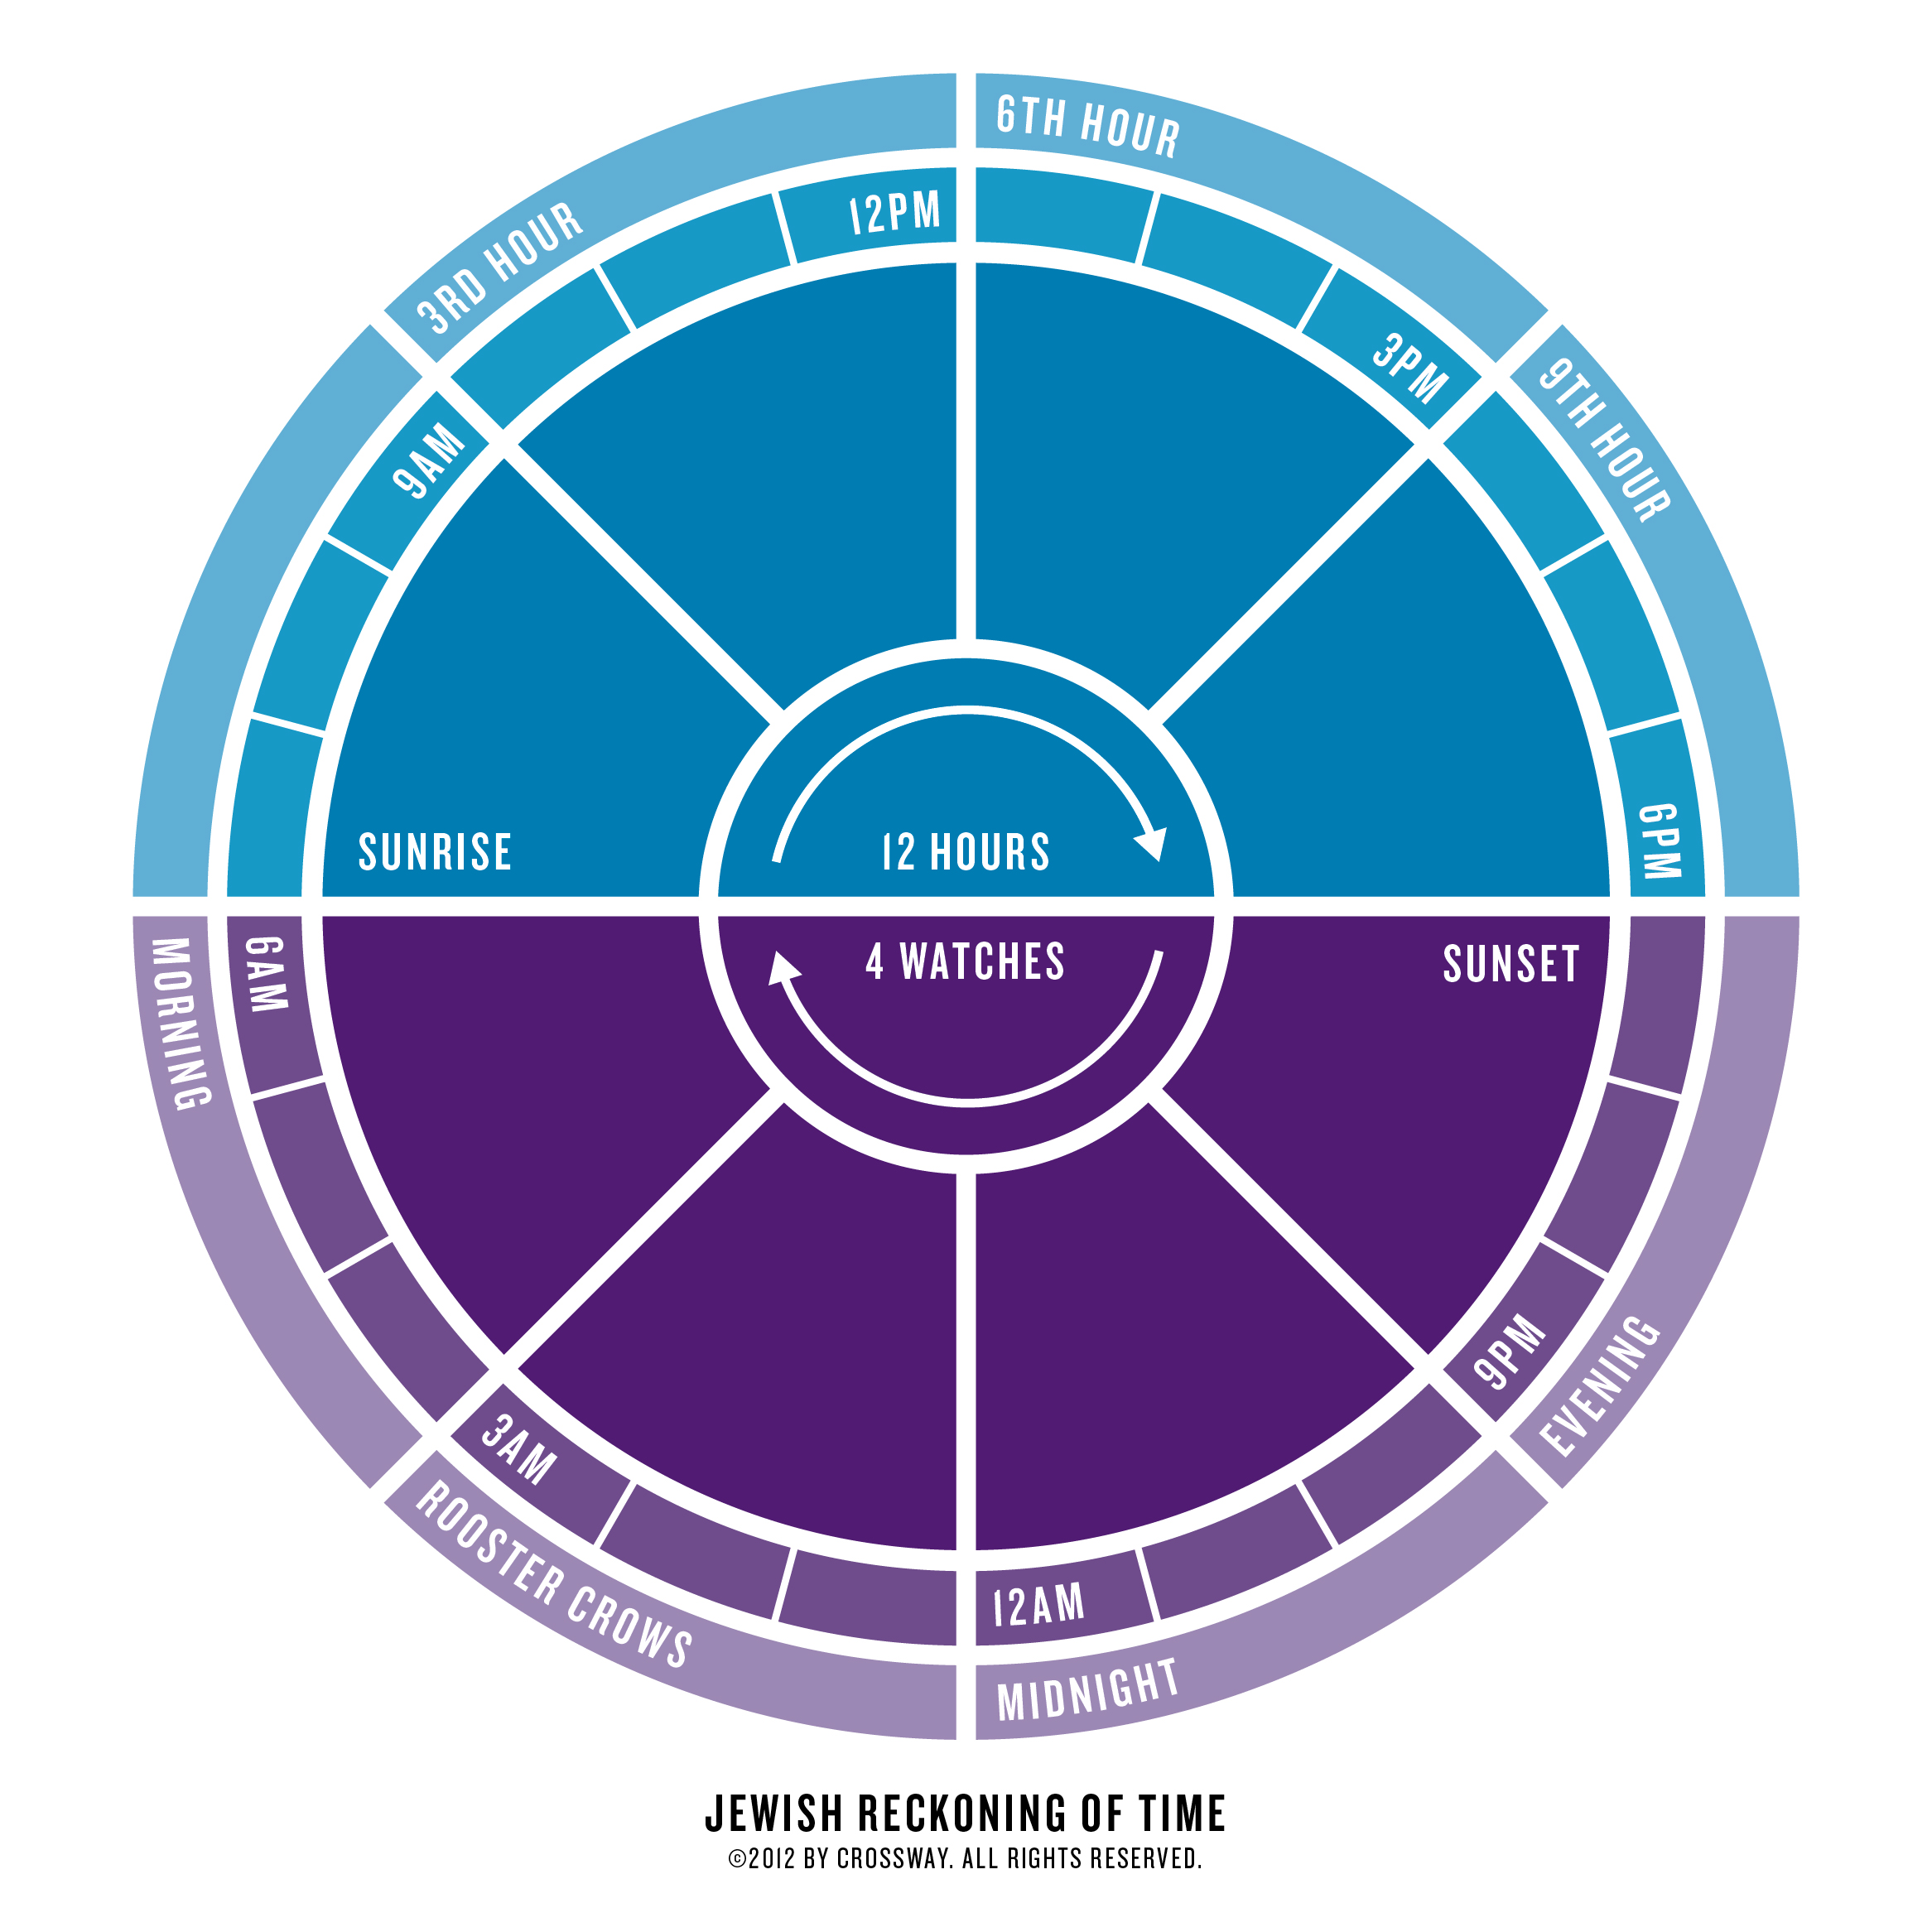

Slide 146
Acts 1:4-5 (NASB) ⁴ Gathering them together, He commanded them not to leave Jerusalem, but to wait for what the Father had promised, "Which," He said, "you heard of from Me; ⁵ for John baptized with water, but you will be baptized with the Holy Spirit not many days from now." Acts 1:8 (NASB) ⁸ but you will receive power when the Holy Spirit has come upon you; and you shall be My witnesses both in Jerusalem, and in all Judea and Samaria, and even to the remotest part of the earth."
John 15:26-27 (ASV) ²⁶ But when the Comforter is come, whom I will send unto you from the Father, even the Spirit of truth, which proceedeth from the Father, he shall bear witness of me: ²⁷ and ye also bear witness, because ye have been with me from the beginning.
Luke 24:46-49 (NASB) ⁴⁶ and He said to them, "Thus it is written, that the Christ would suffer and rise again from the dead the third day, ⁴⁷ and that repentance for forgiveness of sins would be proclaimed in His name to all the nations, beginning from Jerusalem. ⁴⁸ "You are witnesses of these things. ⁴⁹ "And behold, I am sending forth the promise of My Father upon you; but you are to stay in the city until you are clothed with power from on high."
APOSTLOLIC WITNESSES
Stay in Jerusalem
Power from on high
You will receive Power
when the Holy Spirit
is come upon you

Slide 147
Leviticus 23:15-16 (NASB) ¹⁵ 'You shall also count for yourselves from the day after the sabbath, from the day when you brought in the sheaf of the wave offering; there shall be seven complete sabbaths. ¹⁶ 'You shall count fifty days to the day after the seventh sabbath; then you shall present a new grain offering to the LORD.
1. The count is started the day after the Days of unleavened bread (Sunday).
2. Then 7 complete Sabbaths are counted (49 days).
3. The day after the 49th day, 50th day (Sunday), is the day of Pentecost:

Slide 148
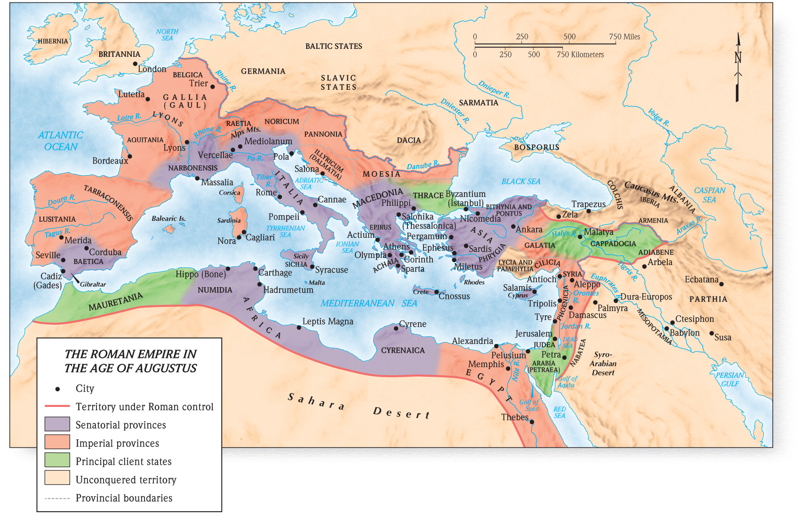
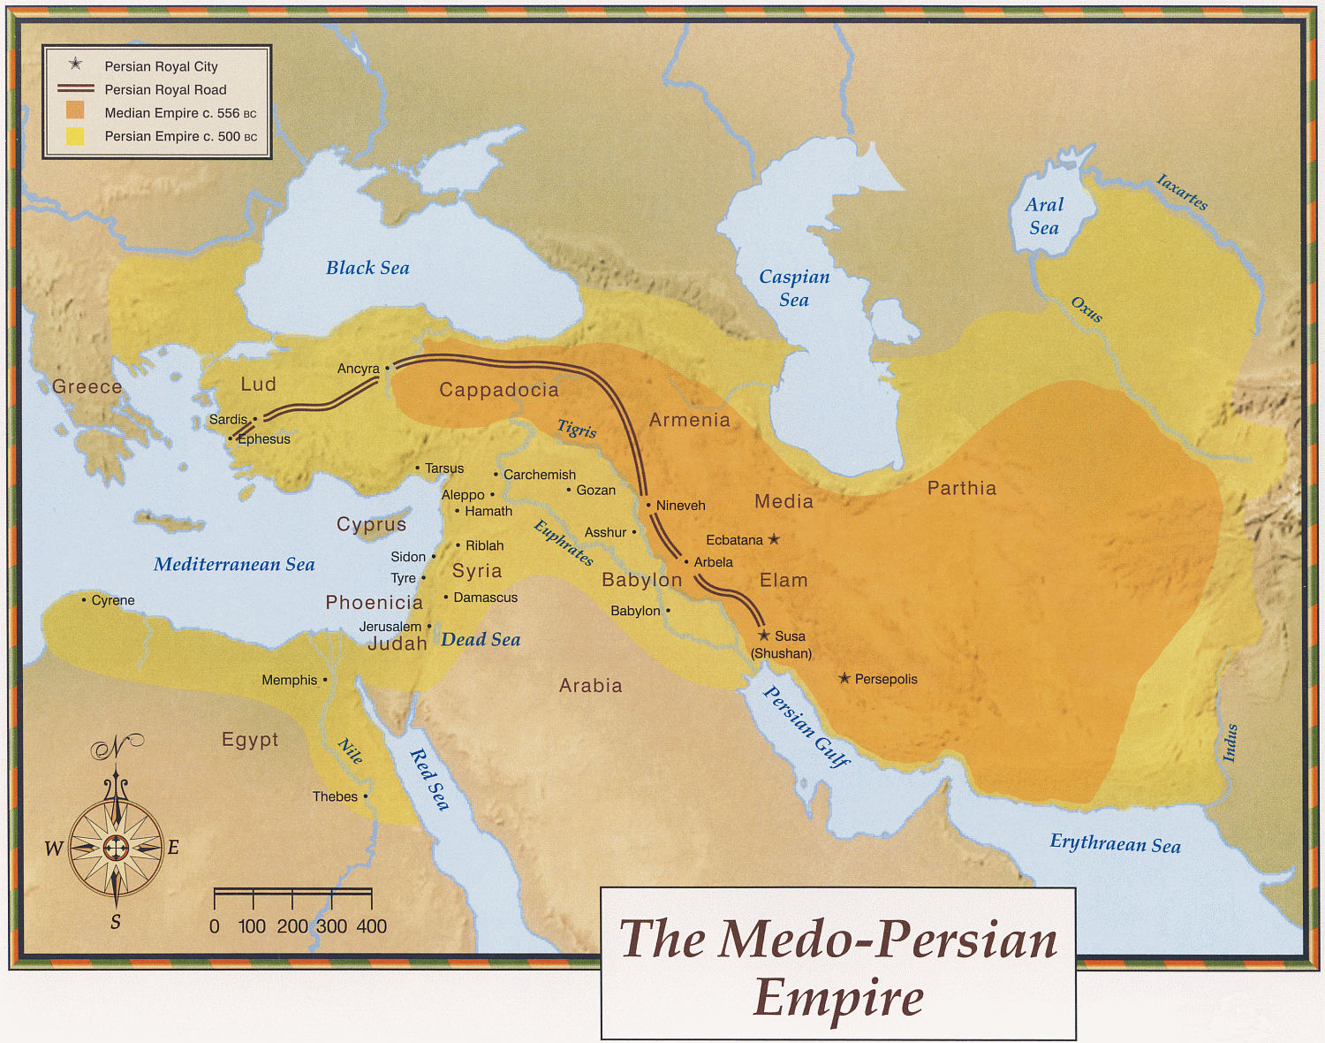
Acts 2:9-11 (NASB) ⁹ "Parthians and Medes and Elamites, and residents of Mesopotamia, Judea and Cappadocia, Pontus and Asia, ¹⁰ Phrygia and Pamphylia, Egypt and the districts of Libya around Cyrene, and visitors from Rome, both Jews and proselytes, ¹¹ Cretans and Arabs—we hear them in our own tongues speaking of the mighty deeds of God."

Slide 149
ACTS 2:16-21
¹⁷ …'THAT I WILL POUR FORTH OF MY SPIRIT ON ALL MANKIND; AND YOUR SONS AND YOUR DAUGHTERS SHALL PROPHESY, AND YOUR YOUNG MEN SHALL SEE VISIONS, AND YOUR OLD MEN SHALL DREAM DREAMS; ¹⁸ EVEN ON MY BONDSLAVES, BOTH MEN AND WOMEN, I WILL IN THOSE DAYS POUR FORTH OF MY SPIRIT And they shall prophesy.
L
A
S
T
D
A
Y
S
Acts 2:21 (NASB) ²¹ 'AND IT SHALL BE THAT EVERYONE WHO CALLS ON THE NAME OF THE LORD WILL BE SAVED.'
And it shall be in the last days, God says,
Joel 2:32 (NASB) ³² "And it will come about that whoever calls on the name of the LORD Will be delivered; For on Mount Zion and in Jerusalem There will be those who escape, As the LORD has said, Even among the survivors whom the LORD calls.
¹⁹ 'AND I WILL GRANT WONDERS IN THE SKY ABOVE AND SIGNS ON THE EARTH BELOW, BLOOD, AND FIRE, AND VAPOR OF SMOKE. ²⁰ 'THE SUN WILL BE TURNED INTO DARKNESS AND THE MOON INTO BLOOD, BEFORE THE GREAT AND GLORIOUS DAY OF THE LORD SHALL COME.
L
A
S
T
D
A
Y
FALL OF JERUSALEM

Slide 150
INVITATION
1. The Lord is calling: Jn 6:44-45
2. What shall they be taught to draw them to Christ? 2Thess 2:14
3. Will you come? Acts 2:37-41; 22:16
John 6:44-45 (NASB) ⁴⁴ "No one can come to Me unless the Father who sent Me draws him; and I will raise him up on the last day. ⁴⁵ "It is written in the prophets, 'AND THEY SHALL ALL BE TAUGHT OF GOD.' Everyone who has heard and learned from the Father, comes to Me.
2 Thessalonians 2:14 (NASB) ¹⁴ It was for this He called you through our gospel, that you may gain the glory of our Lord Jesus Christ.
Acts 22:16 (NASB) ¹⁶ 'Now why do you delay? Get up and be baptized, and wash away your sins, calling on His name.'
Acts 2:37-41 (NASB) ³⁷ Now when they heard this, they were pierced to the heart, and said to Peter and the rest of the apostles, "Brethren, what shall we do?" ³⁸ Peter said to them, "Repent, and each of you be baptized in the name of Jesus Christ for the forgiveness of your sins; and you will receive the gift of the Holy Spirit. ³⁹ "For the promise is for you and your children and for all who are far off, as many as the Lord our God will call to Himself." ⁴⁰ And with many other words he solemnly testified and kept on exhorting them, saying, "Be saved from this perverse generation!" ⁴¹ So then, those who had received his word were baptized; and that day there were added about three thousand souls.

Slide 151
Peter’s Argument
Acts 2:22-28 – Psa 16:8-11
YOU WILL NOT ABANDON MY SOUL TO HADES,
Not true of David
MY FLESH ALSO WILL LIVE IN HOPE
BECAUSE
NOR
ALLOW YOUR HOLY ONE TO UNDERGO DECAY
Tomb of David
Acts 2:29 (NASB) ²⁹ "Brethren, I may confidently say to you regarding the patriarch David that he both died and was buried, and his tomb is with us to this day.
In 30 A.D., the decayed bones of David were actually in the tomb of David
Notes:
A. Peter quotes scripture to prove that the prophet David foretold that the Christ would die and rise from the dead. Acts 2:24-28; Psa 16:8-11
B. When Peter spoke the words of Acts 2:29 he could confidently say that David was buried and his body decayed because everyone could actually visit the Tomb of David and see for themselves. The audience was very much aware of this fact.
C. The natural question then is “who was David writing about?”

Slide 152
YOU WILL NOT ABANDON MY SOUL TO HADES,
True of Jesus
MY FLESH ALSO WILL LIVE IN HOPE
BECAUSE
NOR
ALLOW YOUR HOLY ONE TO UNDERGO DECAY
Acts 2:33 (NASB) ³³ "Therefore having been exalted to the right hand of God, and having received from the Father the promise of the Holy Spirit, He has poured forth this which you both see and hear.
Hebrews 2:3-4 (NASB) ³ how will we escape if we neglect so great a salvation? After it was at the first spoken through the Lord, it was confirmed to us by those who heard, ⁴ God also testifying with them, both by signs and wonders and by various miracles and by gifts of the Holy Spirit according to His own will.
Acts 2:34-36 (NASB) ³⁴ "For it was not David who ascended into heaven, but he himself says: 'THE LORD SAID TO MY LORD, "SIT AT MY RIGHT HAND, ³⁵ UNTIL I MAKE YOUR ENEMIES A FOOTSTOOL FOR YOUR FEET."' ³⁶ "Therefore let all the house of Israel know for certain that God has made Him both Lord and Christ—this Jesus whom you crucified."
Acts 2:30-32 (NASB) ³⁰ "And so, because he was a prophet and knew that GOD HAD SWORN TO HIM WITH AN OATH TO SEAT one OF HIS DESCENDANTS ON HIS THRONE, ³¹ he looked ahead and spoke of the resurrection of the Christ, that HE WAS NEITHER ABANDONED TO HADES, NOR DID His flesh SUFFER DECAY. ³² "This Jesus God raised up again, to which we are all witnesses.
John 15:26-27 (NASB) ²⁶ "When the Helper comes, whom I will send to you from the Father, that is the Spirit of truth who proceeds from the Father, He will testify about Me, ²⁷ and you will testify also, because you have been with Me from the beginning.
Tomb of Jesus
In 30 A.D., on the day of Pentecost the tomb of Jesus had been empty for about 47 days ago
Notes:
A. Jesus tomb is missing and there is a suspicious story being passed around by guards which should have been put to death for failing at their mission of keeping the body from being stolen.
B. Jesus was believed to be the messiah and claimed to be. The fact that the missing tomb could account for where he is and proves he possibly is the messiah.
C. The witness of the Apostles: Jesus ascended to heaven not David. He has poured forth what you both see and hear. Hear – mighty rushing wind but no wind; Apostles speaking in the languages of everyone in the audience; fire above each of the twelve that had the appearance of tongues
C. But now Peter has presented evidence from the scripture plus the testimony of the Holy Spirit that is taking place before the audiences eyes. An honest person will not be able to dismiss what Peter is teaching.

Slide 153
Acts 2:33 (NASB) ³³ "Therefore having been exalted to the right hand of God, and having received from the Father the promise of the Holy Spirit, He has poured forth this which you both see and hear.
Acts 2:34-35 (NASB) ³⁴ "For it was not David who ascended into heaven, but he himself says: 'THE LORD SAID TO MY LORD, "SIT AT MY RIGHT HAND, ³⁵ UNTIL I MAKE YOUR ENEMIES A FOOTSTOOL FOR YOUR FEET."'
Notes:
The promise of the Holy spirit is the not the Holy Spirit. It is the throne of David that the Holy Spirit promised to David. Having received this promise and being seated in the heavens on David’s throne (Lord’s Throne) Jesus has sent the Holy Spirit as proof that he is in the heavens ruling.

Slide 154
Mark 16:16 (NASB) ¹⁶ "He who has believed and has been baptized shall be saved; but he who has disbelieved shall be condemned.
GIFT PROMISED BY THE HOLY SPIRIT
Acts 2:21
Luke 24:47 (NASB) ⁴⁷ and that repentance for forgiveness of sins would be proclaimed in His name to all the nations, beginning from Jerusalem.
REPENT
BE BAPTIZED
SALVATION
REMISSION OF SINS
Acts 2:21 (NASB) ²¹ 'AND IT SHALL BE THAT EVERYONE WHO CALLS ON THE NAME OF THE LORD WILL BE SAVED.'
AND
FOR
Acts 2:37 (NASB) ³⁷ Now when they heard this, they were pierced to the heart, and said to Peter and the rest of the apostles, "Brethren, what shall we do?"
Acts 2:38 (NASB) ³⁸ Peter said to them, "Repent, and each of you be baptized in the name of Jesus Christ for the forgiveness of your sins; and you will receive the gift of the Holy Spirit.
Acts 2:41 (NASB) ⁴¹ So then, those who had received his word were baptized; and that day there were added about three thousand souls. Acts 2:47 (NASB) ⁴⁷ praising God and having favor with all the people. And the Lord was adding to their number day by day those who were being saved.
Acts 2:39 (NASB) ³⁹ "For the promise is for you and your children and for all who are far off, as many as the Lord our God will call to Himself."
Acts 3:19 (NASB) ¹⁹ "Therefore repent and return, so that your sins may be wiped away, in order that times of refreshing may come from the presence of the Lord;
Romans 6:23 (NASB) ²³ For the wages of sin is death, but the free gift of God is eternal life in Christ Jesus our Lord.
1 John 2:25 (NASB) ²⁵ This is the promise which He Himself made to us: eternal life.
Notes:
Peter had taught them that Salvation would come to all those who call on the name of the Lord, 2:21
It is obvious they wanted to know how does one call on the name of the Lord to be saved so they ask “What shall we do?” 2:37
The gift is eternal life Rom 6:23
In the next chapter Peter answers with:

Slide 155
Greek Prepositions Chart 1
Acts 2:38 (NASB77) ³⁸ And Peter said to them, " Repent, and let each of you be baptized in the name of Jesus Christ for the forgiveness of your sins; and you shall receive the gift of the Holy Spirit.
Greek Prepositions Chart 2
the forgiveness of your
sins
Repent and
be Baptized
Eis
(into)
For
(NASB)
Eis
(into)
For
(NASB)

Slide 156
Greek Prepositions Chart 1
Matthew 26:28 (NASB77) ²⁸ for this is My blood of the covenant, which is poured out for many for forgiveness of sins.
forgiveness of sins
Eis
For
into
My blood
Poured out
Acts 2:38 (NASB77) ³⁸ And Peter said to them, " Repent, and let each of you be baptized in the name of Jesus Christ for the forgiveness of your sins; and you shall receive the gift of the Holy Spirit.

Slide 157
Literal (word for word) Translations

Slide 158
Thought for Thought (Dynamic Equivalence) Acts 2:38

Slide 159
Fellowship in the Scriptures Acts 2:42 Noun - Black underlined – Verb - Red
Galatians 2:8-9 (NASB) ⁸ (for He who effectually worked for Peter in his apostleship to the circumcised effectually worked for me also to the Gentiles), ⁹ and recognizing the grace that had been given to me, James and Cephas and John, who were reputed to be pillars, gave to me and Barnabas the right hand of fellowship, so that we might go to the Gentiles and they to the circumcised.
1 John 1:3 (NASB) ³ what we have seen and heard we proclaim to you also, so that you too may have fellowship with us; and indeed our fellowship is with the Father, and with His Son Jesus Christ.
1 John 1:7 (NASB) ⁷ but if we walk in the Light as He Himself is in the Light, we have fellowship with one another, and the blood of Jesus His Son cleanses us from all sin.
Romans 15:26 (NASB) ²⁶ For Macedonia and Achaia have been pleased to make a contribution for the poor among the saints in Jerusalem.
2 Corinthians 8:3-4 (NASB) ³ For I testify that according to their ability, and beyond their ability, they gave of their own accord, ⁴ begging us with much urging for the favor of participation in the support of the saints,
2 Corinthians 9:13 (NASB) ¹³ Because of the proof given by this ministry, they will glorify God for your obedience to your confession of the gospel of Christ and for the liberality of your contribution to them and to all,
1 Corinthians 10:16-17 (NASB) ¹⁶ Is not the cup of blessing which we bless a sharing in the blood of Christ? Is not the bread which we break a sharing in the body of Christ? ¹⁷ Since there is one bread, we who are many are one body; for we all partake of the one bread.
Philippians 1:5 (NASB) ⁵ in view of your participation in the gospel from the first day until now.
Philippians 4:15-16 (NASB) ¹⁵ You yourselves also know, Philippians, that at the first preaching of the gospel, after I left Macedonia, no church shared with me in the matter of giving and receiving but you alone; ¹⁶ for even in Thessalonica you sent a gift more than once for my needs.
Hebrews 13:16 (NASB) ¹⁶ And do not neglect doing good and sharing, for with such sacrifices God is pleased.
With God and Christ
Romans 12:13 (NASB) ¹³ contributing to the needs of the saints, practicing hospitality. Galatians 6:6 (NASB) ⁶ The one who is taught the word is to share all good things with the one who teaches him.
1Jn 1:3; 6 (2:6); Phil 3:10; 1Cor 1:9; 10:16; 1Pet 4:13
1 Corinthians 1:9 (NASB) ⁹ God is faithful, through whom you were called into fellowship with His Son, Jesus Christ our Lord. 1 Corinthians 10:16 (NASB) ¹⁶ Is not the cup of blessing which we bless a sharing in the blood of Christ? Is not the bread which we break a sharing in the body of Christ?
Philippians 3:10 (NASB) ¹⁰ that I may know Him and the power of His resurrection and the fellowship of His sufferings, being conformed to His death;
1 Peter 4:13 (NASB) ¹³ but to the degree that you share the sufferings of Christ, keep on rejoicing, so that also at the revelation of His glory you may rejoice with exultation.
1 John 1:3 (NASB) ³ what we have seen and heard we proclaim to you also, so that you too may have fellowship with us; and indeed our fellowship is with the Father, and with His Son Jesus Christ. 1 John 1:6 (NASB) ⁶ If we say that we have fellowship with Him and yet walk in the darkness, we lie and do not practice the truth; 1 John 2:6 (NASB) ⁶ the one who says he abides in Him ought himself to walk in the same manner as He walked.
SAME
Of the spirit
Phil 2:1; 2Cor 13:14; Acts 7:51-53
Acts 7:51-53 (NASB) ⁵¹ "You men who are stiff-necked and uncircumcised in heart and ears are always resisting the Holy Spirit; you are doing just as your fathers did. ⁵² "Which one of the prophets did your fathers not persecute? They killed those who had previously announced the coming of the Righteous One, whose betrayers and murderers you have now become; ⁵³ you who received the law as ordained by angels, and yet did not keep it."
Philippians 2:1 (NASB) ¹ Therefore if there is any encouragement in Christ, if there is any consolation of love, if there is any fellowship of the Spirit, if any affection and compassion, 2 Corinthians 13:14 (NASB) ¹⁴ The grace of the Lord Jesus Christ, and the love of God, and the fellowship of the Holy Spirit, be with you all.
With others
Philemon 1:6; 1Jn 1:3, 7; Gal 2:8-9; 1Cor 10:16-17; 2Cor 6:14; Ro 15:27; 1Tim 5:22; Heb 2:14; 2Jn 1:11
Romans 15:27 (NASB) ²⁷ Yes, they were pleased to do so, and they are indebted to them. For if the Gentiles have shared in their spiritual things, they are indebted to minister to them also in material things.
Philemon 1:6 (NASB) ⁶ and I pray that the fellowship of your faith may become effective through the knowledge of every good thing which is in you for Christ's sake.
2 Corinthians 6:14 (NASB) ¹⁴ Do not be bound together with unbelievers; for what partnership have righteousness and lawlessness, or what fellowship has light with darkness?
1 Timothy 5:22 (NASB) ²² Do not lay hands upon anyone too hastily and thereby share responsibility for the sins of others; keep yourself free from sin.
Hebrews 2:14 (NASB) ¹⁴ Therefore, since the children share in flesh and blood, He Himself likewise also partook of the same, that through death He might render powerless him who had the power of death, that is, the devil,
2 John 1:11 (NASB) ¹¹ for the one who gives him a greeting participates in his evil deeds.
As a contribution
Ro 15:26; 2Cor 8:3-4; 9:13; Philip 1:5, 4:15-16; Heb 13:16; Rom 12:13; Gal 6:6
Notes:
In the chart
Acst 2:42 uses the noun Strongs #2842 which are underlined
Strongs #2841 is the verb form of the same word. Not underlined red

Slide 160
BREAKING OF BREAD
I. Breaking of bread was a reference to a common act that occurred during a regular meal. The loaf was literally broken and the pieces handed to others at the table. It appears to be so common that a meal would be spoken of as breaking bread. Lk 24:30-35; Act 2:46; 20:11
II. This also became the common term to refer to the Lords Supper in which the bread was the only food served along with fruit of the vine to drink. It would be very natural for Christian's to refer to the supper as breaking of the bread. Acts 2:42; 20:7-11; 1Cor 10:16-17
a. This breaking of bread was unique to Christians: 1Cor 10:16-17 “the bread which we break”
1. They came together as a church for the purpose of Breaking the Bread: Acts 20:7; 1Cor 11:17-20
2. Every week: 1Cor 16:1-2 (NASB) (ESV; RSV; NIV)
1 Corinthians 16:1-2 (NASB77) ¹ Now concerning the collection for the saints, as I directed the churches of Galatia, so do you also. ² On the first day of every week let each one of you put aside and save, as he may prosper, that no collections be made when I come.
1 Corinthians 11:17-20 (NASB77) ¹⁷ But in giving this instruction, I do not praise you, because you come together not for the better but for the worse. ¹⁸ For, in the first place, when you come together as a church, I hear that divisions exist among you; and in part, I believe it. ¹⁹ For there must also be factions among you, in order that those who are approved may have become evident among you. ²⁰ Therefore when you meet together, it is not to eat the Lord's Supper,
Acts 2:46 (NASB) ⁴⁶ Day by day continuing with one mind in the temple, and breaking bread from house to house, they were taking their meals together with gladness and sincerity of heart,
Luke 24:30-35 (NASB) ³⁰ When He had reclined at the table with them, He took the bread and blessed it, and breaking it, He began giving it to them. ³¹ Then their eyes were opened and they recognized Him; and He vanished from their sight. ³² They said to one another, "Were not our hearts burning within us while He was speaking to us on the road, while He was explaining the Scriptures to us?" ³³ And they got up that very hour and returned to Jerusalem, and found gathered together the eleven and those who were with them, ³⁴ saying, "The Lord has really risen and has appeared to Simon." ³⁵ They began to relate their experiences on the road and how He was recognized by them in the breaking of the bread.
Acts 20:11 (NASB77) ¹¹ And when he had gone back up, and had broken the bread and eaten, he talked with them a long while, until daybreak, and so departed.
1 Corinthians 10:16-17 (NASB77) ¹⁶ Is not the cup of blessing which we bless a sharing in the blood of Christ? Is not the bread which we break a sharing in the body of Christ? ¹⁷ Since there is one bread, we who are many are one body; for we all partake of the one bread.
Acts 20:7-11 (NASB77) ⁷ And on the first day of the week, when we were gathered together to break bread, Paul began talking to them, intending to depart the next day, and he prolonged his message until midnight. ⁸ And there were many lamps in the upper room where we were gathered together. ⁹ And there was a certain young man named Eutychus sitting on the window sill, sinking into a deep sleep; and as Paul kept on talking, he was overcome by sleep and fell down from the third floor, and was picked up dead. ¹⁰ But Paul went down and fell upon him and after embracing him, he said, " Do not be troubled, for his life is in him."
Acts 2:42 (NASB77) ⁴² And they were continually devoting themselves to the apostles' teaching and to fellowship, to the breaking of bread and to prayer.
¹¹ And when he had gone back up, and had broken the bread and eaten, he talked with them a long while, until daybreak, and so departed.
1 Corinthians 10:16-17 (NASB77) ¹⁶ Is not the cup of blessing which we bless a sharing in the blood of Christ? Is not the bread which we break a sharing in the body of Christ? ¹⁷ Since there is one bread, we who are many are one body; for we all partake of the one bread.
Acts 20:7 (NASB77) ⁷ And on the first day of the week, when we were gathered together to break bread, Paul began talking to them, intending to depart the next day, and he prolonged his message until midnight.

Slide 161
The Acts of the Apostles Chapter 2

Slide 162
Review: John the Baptist
John 1:33
33 And I knew him not: but he that sent me to baptize in water, he said unto me, Upon whomsoever thou shalt see the Spirit descending, and abiding upon him, the same is he that baptizeth in the Holy Spirit.
Who was to baptize in the Holy Spirit?
Can men baptize in the Holy Spirit?
What do men baptize in? (Acts 8:38)
Was baptism in the Holy Spirit ever commanded?
What was commanded in Acts 1:4 in regard to it?
If we were going to be baptized in the Holy Spirit would we need to do anything to bring it about?

Slide 163
Acts 2:1-3 Miracles Testify
Pentecost – feast, 50 days after Passover
How many days after ascension?
Who is the “they” in vs. 1?
Was it wind? Was it Fire? (2-3)
Who did the tongues like fire sit upon? (3)
What would this indicate to observers?
Who did the wind sound testify to? (6)
What was the effect?
Amazed and Marvelled:
Sound, but no wind
Appearance of fire, but no heat
Described by the word “tongue”

Slide 164
Acts 2:4-12 Tongues Testified
Who were filled with the Holy Spirit? (4)
Note “they were all” same as vs. 1 (also 14)
What did this cause them to do? (4)
What is “speaking in other tongues?”
How do we know it was understandable? (6,8)
The miracle itself conveyed the gospel
Revealed the truth
Confirmed its source – from God
Why mention all the nationalities? (5-11)
Was any one left out? (6 – “every man”)
What was the honest reaction? (12)
What did most of them ask? (12)
But, what did some others say? (13)

Slide 165
Acts 2:13-18 Joel’s Prophecy
Why did some mock? … don’t they still?
Mockery is never based on logic (ad hominem)
Who were speaking in tongues? (14)
Were they in the last days? Are we? (17)
What did God promise in vs. 17?
Pour forth the Holy Spirit upon all flesh
What does “all flesh” mean? (17)
Both genders (17)
All ages (17)
All economic classifications (18)
All nations and races (Great Commission)
What would this outpouring cause? (18 end)

Slide 166
Acts 2:19-21 Wonders
Are vss. 19-20 literal? (Mt. 24:29)
What are they generally figurative of?
Blood, fire, vapor – war or natural catastrophe
Sun to darkness – calamity
Moon to blood – smoke and flames … color
Have these things ever ceased?
The message: don’t expect them to cease
What is the “day of the Lord?” (20)
Obviously some future judgment
So how do we prepare for all these things? (21)
How do we “call on the name of the Lord?”
Hebraism (idiom):
appealing and submitting to His authority

Slide 167
Acts 2:22-27 Proof of Resurrection
What made Peter so bold (22-24)?
Is this the same Peter who denied Christ?
You saw the miracles (22); you crucified him! (23)
“…determined counsel and foreknowledge”? (23)
Did this excuse them?
Resurrection a fact; apostles could testify (24, 32)
Who raised Jesus up? (24)
Principles about preaching the gospel.
Is it necessary to convict people of their sins?
Is it necessary sometimes to get quite specific?
Should we expect success?
Should we expect resistance?

Slide 168
Review: The Promise of the Holy Spirit-1
Luke 24:49
And behold, I send forth the promise of my Father upon you: but tarry ye in the city, until ye be clothed with power from on high.
Who made the promise?
What was the promise?
Who was the promise to?

Slide 169
Review: The Promise of the Holy Spirit-2
Acts 1:4-5
… and, being assembled together with them, he charged them not to depart from Jerusalem, but to wait for the promise of the Father, which, (said he,) ye heard from me.:
⁵ For John indeed baptized with water; but ye shall be baptized in the Holy Spirit not many days hence.
.
Who made the promise?
What was the promise?
Who was the promise to?

Slide 170
Review: The Promise of the Holy Spirit-3
Acts 2:17 (Joel 2:28-32)
¹⁷ And it shall be in the last days, saith God, I will pour forth of my Spirit upon all flesh: And your sons and your daughters shall prophesy, And your young men shall see visions, And your old men shall dream dreams:
.
Who made the promise?
What was the promise?
Who was the promise to?

Slide 171
Review Up to Acts 2:23
Jesus Meeting with Apostles
God’s promise to them (Holy Spirit)
Their question to Jesus (Kingdom)
Return to Jerusalem; appointing of Matthias
Apostles baptism in the Holy Spirit
Miracles tongues like fire; noise like wind
Apostles “speaking in tongues” (clearly defined)
Peter quotes Joel to explain these events
Peter’s bold condemnation of the listeners
We will start at verse 24

Slide 172
Acts 2:25-31 Proof of Verse 24
How would Peter prove vs. 24? (25-31)
Why not just perform a miracle?
Inspired use of scripture – example for us
What made it “impossible?” (Ps. 16:8-11)
What is the key verse in argument? (27)
Acts 2:27 (from Psalms 16:10):
“For You will not leave my soul in Hades, Nor will You allow Your Holy One to see corruption.“
Why can’t vs 27 refer to David (29)?
.
Conclusion: all of Ps. 16:8-11 are words of Christ

Slide 173
Ps. 16:8-11 (Acts 2:25-28)
For David saith concerning him, I have set the LORD always before me; For he is on my right hand, that I should not be moved:
Therefore my heart was glad, and my tongue rejoiced; Moreover my flesh also shall dwell in hope:
Because thou wilt not leave my soul unto Hades, Neither wilt thou give thy Holy One to see corruption.
Thou madest known unto me the ways of life; Thou shalt make me full of gladness with thy countenance.

Slide 174
Acts 2:30-31 David’s Throne
What had God sworn to David (30)?
What did David foresee (31)?
Christ sitting upon David’s throne (30) [this]
The resurrection of Christ (31)
Jesus’ soul was not left in Hades (31)
Jesus’ flesh did not see corruption (31)
Since Christ is on David’s throne …
What does this say about the kingdom?
Was the kingdom still “at hand?”
Was the kingdom (of …) restored?
Was the prophecy fulfilled?

Slide 175
Acts 2:32-33 Preconditions for HS
Who were the witnesses? (32) not scripture
What did they witness? (32-33)
What two things had to precede the outpouring of the Holy Spirit? (33)
Jesus had to be in heaven on the throne
Jesus had to receive the promise of the HS
Who did Jesus receive the promise from?
John 15:26
²⁶ But when the Comforter is come, whom I will send unto you from the Father, (even) the Spirit of truth, which proceedeth from the Father, he shall bear witness of me: … (see also Luke 24:49)

Slide 176
Acts 2:34-35 Added Scriptural Proof
Why must Ps. 110:1 apply to Jesus? (34)
David did not ascend into heaven
“The LORD said unto my Lord …” (Ps. 110:1)
LORD == the name of God (Yahweh?)
My Lord == Adoniy (servant to master)
Jesus Christ – now on the throne of God
(Ps. 110:1 referenced in Mt. 22:42)
For what duration? (35)
Enemies put under foot – satisfactory time

Slide 177
Acts 2:36-37 Peter’s Conclusion
Who made Jesus Lord and Christ? (36)
What was the people’s response? (37)
What indicates their belief of the apostles?
Who did they ask for information? (37)
What was their question?
“What shall we do?”
Did they understand something is necessary?

Slide 178
Acts 2:38-39 – First Conversions
What commands were given? (38)
They had already heard and believed
Repent (of ALL of your sins)
Be Baptized
What was major purpose of baptism?
For/unto the remission of your sins (38)
Wash sins away (Acts 22:16)

Slide 179
Acts 2:38-39 – The Promise
What promise to the obedient? (38-9)
The gift of the Holy Spirit? (38)
Luke 11:3; John 14:6
Acts 5:32; 8:18-20; 10:44-45; 11:17; 19:2
When was the Holy Spirit promised?
Joel 2:28; Jn. 16:7-11; Lk. 24:49; Acts 1:4; 2:33

Slide 180
Compare Acts 2:39 and Joel 2:28
Acts 2:17 (Joel 2:28)
¹⁷ … I will pour forth of my Spirit upon all flesh: And your sons and your daughters shall prophesy, And your young men shall see visions, And your old men shall dream dreams:
.
Acts 2:39
³⁹ For to you is the promise, and to your children, and to all that are afar off, (even) as many as the Lord our God shall call unto him.

Slide 181
The Essence of the Holy Spirit
A Means, Not an End
End result is spiritual life leading to salvation
How does the Holy Spirit bring about salvation?
Action of the Holy Spirit
Revealing the truth
Confirming the truth
Man’s Part: Obeying the Truth; but …
Without the Holy Spirit …
Nothing to obey
No delivery or proof of the truth
No incentive to obey

Slide 182
Christ and the Holy Spirit in You
Did all converted on Pentecost …
Get baptized in the Holy Spirit?
Obtain the ability to perform miracles?
Yield themselves to what the Holy Spirit said?
Allow the Holy Spirit to change their lives?
Allow the Holy Spirit to enter into their hearts?
… change their attitudes and outlook on life
… change their desires
Allow the Holy Spirit to dwell in them?
1 Corinthians 6:19
Or know ye not that your body is a temple of the Holy Spirit which is in you, which ye have from God?

Slide 183
Natural Benefits of the Holy Spirit
Rom 8:9-11
⁹ But ye are not in the flesh but in the Spirit, if so be that the Spirit of God dwelleth in you. But if any man hath not the Spirit of Christ, he is none of his.
¹⁰ And if Christ is in you, the body is dead because of sin; but the spirit is life because of righteousness.
¹¹ But if the Spirit of him that raised up Jesus from the dead dwelleth in you, he that raised up Christ Jesus from the dead shall give life also to your mortal bodies through his Spirit that dwelleth in you.

Slide 184
Acts 2:40-41 “Save Yourselves …”
“Many other words” – ? significance
Can we save ourselves?
In one sense we can by obedience
In another sense we cannot (Eph. 2:8-9)
Specifically what command? (41)
How were they added? (Rom. 6:3)
An outward tangible action – baptism
Enabling us to recognize new converts
Enabling them to recognize their new life
What about those who refused baptism? (41)
How many were added? (41)

Slide 185
2:42-43 Continued Steadfastly
Continued steadfastly in what? (42)
Apostles’ teaching (from the Holy Spirit)
Apostles’ fellowship (sharing in all ways)
Breaking of bread (Lord’s Supper)
Prayers
Who were the miracles done through?
Did the converts speak in tongues? (43)
Why would this cause fear? (43)

Slide 186
2:44-45 – “all things common”
“And all that believed were together, and had all things common; and they sold their possessions and goods, and parted them to all, according as any man had need.”
How does this example apply today?
All approved apostolic examples are binding
Does this detail actions or attitudes?
But let’s not explain it away; very important
Does it explain HOW this was done?
Did all sell all? (answered in Acts 5)
Details in AA examples are not binding when there are alternative details in other AA examples; in this case:
Acts 5, 1 Tim. 6:17, 2 Thes. 3:10
Other case in point: “upper room” example

Slide 187
Acts 2:46-47 Day by Day
Where were the Apostles? (46)
Where did they commonly meet? (46)
Where did they eat their meals? (46)
Were they thankful for what they had?
How were they regarded by others? (47)
When were people baptized?
As needed day by day
Who added them? (47) Kurion (2:36)
To what were they added? (47)
“Them” autos – Nestle-Aland
“Church” ekklesia – Textus Receptus

Slide 188
PETER’S FIRST SERMON

Slide 193
Outline - Acts
I. The Ministry of Peter – Acts 1:1-12:19
Peter’s 1st Sermon – Acts 1:1-2:47
Peter’s Post Pentecost Ministry – Acts 3:1-4:37
Persecution of Peter & Apostles – Acts 5:1-42
Persecution of the Church - 1 – Acts 6:1-7:60
Persecution of the Church - 2 – Acts 8:1-9:43
Peter Preaches to the Gentiles – Acts 10:1-12:25

Slide 194
Outline - Acts
II. The Ministry of Paul – Acts 13:1-28:31
Paul’s 1st Missionary Journey – Acts 13:1-15:35
Paul’s 2nd Missionary Journey – Acts 15:36-18:22
Paul’s 3rd Missionary Journey – Acts 18:23-21:14
Paul’s Arrest - 1 – Acts 21:15-23:11
Paul’s Arrest - 2 – Acts 23:12-25:22
Paul’s Arrest - 3 – Acts 25:23-26:32
Paul’s Journey to Rome – Acts 27:1-28:31

Slide 195
The first account I composed, Theophilus,
- Acts 1:1a

Slide 196
^{1b} about all that Jesus began to do and teach, ² until the day when He was taken up to heaven, after He had by the Holy Spirit given orders to the apostles whom He had chosen. ³ To these He also presented Himself alive after His suffering, by many convincing proofs, appearing to them over a period of forty days and speaking of the things concerning the kingdom of God.
- Acts 1:1b-3

Slide 198
⁴ Gathering them together, He commanded them not to leave Jerusalem, but to wait for what the Father had promised, “Which,” He said, “you heard of from Me; ⁵ for John baptized with water, but you will be baptized with the Holy Spirit not many days from now.”
- Acts 1:4-5

Slide 199
CHAPTER 1 J. W. McGarvey’s Acts Commentary
VERSES 1 & 2
During the personal ministry of Jesus, he authorized no human being to announce his Messiahship. On the contrary, whenever he discovered a disposition to do so, he uniformly forbade it, and this not only to various recipients of his healing power, but to the apostles themselves. When Peter made the memorable confession, “Thou art the Christ, the Son of the living God,” we are told, at the close of the conversation, “he charged his disciples that they should tell no man that he was Jesus the Christ.” Such was his uniform injunction on similar occasions. Even when Peter, James, and John had witnessed his transfiguration, and heard God himself proclaim him his Son, as they came down from the mount, “Jesus charged them, saying, Tell the vision to no man, until the Son of man is risen from the dead.”²
This stern prohibition, quite surprising to most readers of the New Testament, may be accounted for, in part, by a desire to avoid that political ferment, which, in the existing state of the public mind, might have resulted from a general belief among the Jews he was their Messiah. But there’s a much more imperative reason for it, found in the mental and moral condition of the disciples themselves. Their crude conceptions of the Messiahship, their gross misconception of the nature of the expected Kingdom, their fundamental misunderstanding of much that he had taught them, and their imperfect remembrance of that which they had understood, rendered them incapable of presenting his claims truthfully, not to say infallibly, to the world. Moreover, their faith had not, as yet, acquired the strength necessary to the endurance of privations and persecutions. While laboring under these defects, they were most wisely prohibited from preaching that he was the Christ.
McGarvey, J. W. (1872). A commentary on Acts of Apostles (pp. 9–10). Lexington, KY: Transylvania Printing and Publishing Co.

Slide 200
CHAPTER 1 J. W. McGarvey’s Acts Commentary
VERSES 1 & 2
During the last night he spent on earth, Jesus at length informed them that this restriction would soon be removed & they should receive the qualifications necessary to be his witnesses. He says, “The Advocate, the Holy Spirit, whom the Father will send in my name, he shall teach you all things, and bring all things to your remembrance, whatsoever I have said to you.” “I have many things to say to you, but you can not bear them now; howbeit when he, the Spirit of truth, is come, he will guide you into all the truth.“ “He shall testify of me: and you also shall testify, because you have been with me from the beginning.” In these words they have a promise that they shall testify of Jesus, with the Holy Spirit for their guide; but the promise looks to the future for its fulfillment.
Finally, “in the day in which he was taken up,” he gives them the commandment which is to unseal their lips, and authorizes them to preach the glad tidings to every creature. Without this commandment, they could not have dared to tell any many that he was the Christ; with it, they are authorized to begin the labors which our historian is about to narrate. But even yet there is one restriction laid upon them; for they have not yet received the promised qualifications. “He commanded them that they should not depart from Jerusalem; but await the promise of the Father, which you have heard from me.”
McGarvey, J. W. (1872). A commentary on Acts of Apostles (p. 10). Lexington, KY: Transylvania Printing and Publishing Co.

Slide 202
Baptism with the Holy Spirit
Empower – Power to perform tasks

Slide 203
¹ Now the Lord spoke to Moses, saying, ² “See, I have called by name Bezalel, the son of Uri, the son of Hur, of the tribe of Judah. ³ I have filled him with the Spirit of God in wisdom, in understanding, in knowledge, and in all kinds of craftsmanship,
- Exodus 31:1-3

Slide 204
⁴ to make artistic designs for work in gold, in silver, and in bronze, ⁵ and in the cutting of stones for settings, and in the carving of wood, that he may work in all kinds of craftsmanship.
- Exodus 31:4-5

Slide 205
¹ Now the Spirit of God came on Azariah the son of Oded, ² and he went out to meet Asa and said to him, “Listen to me, Asa, and all Judah and Benjamin: the Lord is with you when you are with Him. And if you seek Him, He will let you find Him; but if you forsake Him, He will forsake you.
- II Chronicles 15:1-2

Slide 206
The Spirit of the Lord God is upon me, Because the Lord has anointed me To bring good news to the afflicted;
- Isaiah 61:1a

Slide 207
Then Samuel took the horn of oil and anointed him in the midst of his brothers; and the Spirit of the Lord came mightily upon David from that day forward. And Samuel arose and went to Ramah.
- I Samuel 16:13

Slide 208
Different Expressions for “Empowering”
Craftsmen “Filled him with the Spirit” – Exodus 31:5
Moses “Perform all the miracles I have given you the power to do” – Exodus 4:21

Slide 209
Different Expressions for “Empowering”
Azariah “The Spirit of God came upon” – II Chronicles 15:1
David “The Spirit of the Lord came upon David” – I Samuel 16:13

Slide 210
²⁸ “It will come about after this That I will pour out My Spirit on all mankind; And your sons and daughters will prophesy, Your old men will dream dreams, Your young men will see visions. ²⁹ “Even on the male and female servants I will pour out My Spirit in those days.
- Joel 2:28-29

Slide 211
Baptism with the Holy Spirit
Empower
Indwelling – Power to become Christlike

Slide 212
Different Expressions for “Indwelling”
“Receive the Holy Spirit”

Slide 213
And when He had said this, He breathed on them and said to them, “Receive the Holy Spirit.
- John 20:22

Slide 214
Different Expressions for “Indwelling”
“Receive the Holy Spirit”
“Receive the gift of the Holy Spirit”

Slide 215
for John baptized with water, but you will be baptized with the Holy Spirit not many days from now.”
- Acts 1:5

Slide 216
⁶ So when they had come together, they were asking Him, saying, “Lord, is it at this time You are restoring the kingdom to Israel?” ⁷ He said to them, “It is not for you to know times or epochs which the Father has fixed by His own authority;
- Acts 1:6-7

Slide 217
CHAPTER 1 J. W. McGarvey’s Acts Commentary
VERSES 6 - 8
The question, “Lord, wilt thou at this time restore the kingdom to Israel?” indicates two interesting facts: First, that the apostles still misconceived the nature of Christ’s kingdom; second, the kingdom was not yet established. Both these facts deserve some attention at our hands, especially the latter.
Their misconceptions consisted in the expectation that Christ would re-establish the earthly kingdom of Israel, and restore it to its ancient glory, under its own personal reign. In his reply, the Savior does not undertake to correct this misconception, but leaves it as a part of that work of enlightenment yet to be effected by the Holy Spirit.
McGarvey, J. W. (1872). A commentary on Acts of Apostles (p. 12). Lexington, KY: Transylvania Printing and Publishing Co.

Slide 218
Cultural Context: “Thy Kingdom Come”
It Is Essential To Keep In Mind That The Hebrew Language Emphasizes The Kind Of Action & Not The Time
In Later Hebrew, The Time Factor Became More Important, But The Emphasis Of The Petition Is Not Temporal
It Emphasizes Instead The Dynamic Force Of God’s Kingship Being Realized As His Will Is Done
Jesus’ Words Would Have Been In The Imperfect Tense, Which Indicates Incompleted Action – The Idea Is That A Process Is Taking Place.
Thus, This Statement Can Be Connected To The Growth Parables Of The Kingdom
It Is Linked Similarly To Matthew 12: 28 & Then In Turn To Exodus 8:19 & 31:18 – Conveying The Message Of Deliverance
The Mishnah Links The “Yoke Of The Kingdom” To The Ancient’s Affirmation Of Deuteronomy 6: 4
It Was Put Into Prayer Form & Was Known As The Shema Yisrael (“Hear, O Israel”) & Everyone Praying It Received As Similar The “Yoke Of The Kingdom”
Reciting This Prayer Of Acknowledgment Was Considered The First Step In The Spiritual Obedience To The Laws, Ordnances, and Commandments Of Ancient Israel

Slide 219
Cultural Context: “Thy Kingdom Come”
“Heaven” Was Often Substituted In Meaning For “God” Because Of The Special Sanctity Reserved For His Name. This Was Common In Jesus’ Day & Persons Accepting The Authority Of The Kingdom Of Heaven Were Said To Have Entered Into The Reign Of God.
The Mekilta, An Early Midrash, Comments On The Beginning Statement Of The Decalogue – “I Am The Lord Thy God” – Conditioning Ancient’s Acceptance Of The Kingdom Of Heaven With The Omnipresent (God) “Doing Good For Us” – These Remarks Link The Liberation Of God’s People With The Theme Of The Kingdom
Therefore, God - In This Sense - Reigns By His Mighty Redemptive Acts Of Liberation!
Jesus’ Challenging Call To Repent Was An Essential Aspect Of His Proclamation Of The Kingdom
Furthermore, Jesus’ Public Ministry Demonstrated Many Acts Of Redemption That Were The Dynamic Realization Of God’s Kingdom.
In The Hebrew Translation Of The Blessing Of Matthew 5: 3 The Last Part Reads “They Make Up The Kingdom.” This Proper Translation Indicates As Well How The Kingdom Will Continue To Be Established.

Slide 220
CHAPTER 1 J. W. McGarvey’s Acts Commentary
VERSES 6 - 8
Having now fixed the time at which the kingdom was inaugurated in heaven, we are prepared to inquire when it began to be administered on earth. It began, of course, with the first administrative act on earth, and this was the sending of the Holy Spirit upon the apostles on the day of Pentecost. On that occasion, Peter says, “This Jesus has God raised up, whereof we are witnesses. Therefore, being to the right hand of God exalted, and having received from the Father the promise of the Holy Spirit, he has shed forth this which you now see and hear.” “Therefore, let all the house of Israel know assuredly, that God has made that same Jesus whom you have crucified, both Lord and Christ.“ This event is here assumed as the proof of his exaltation, and the history shows it to be the first act of the newly-crowned King which took effect on earth. These facts are consistent with no other conclusion than that the kingdom of Christ was inaugurated on earth on the first Pentecost after his ascension.
McGarvey, J. W. (1872). A commentary on Acts of Apostles (p. 14). Lexington, KY: Transylvania Printing and Publishing

Slide 221
“The Meaning Of The Millennium” by Robert Clouse DOUBLE APPLICATION: “THY KINGDOM COME”
“Amillennialists believe that the kingdom of God was founded by Christ at the time of his sojourn on earth, is operative in history now and is destined to be revealed in its fullness in the life to come. They understand the kingdom of God to be the reign of God dynamically active in human history through Jesus Christ. Its purpose is to redeem God’s people from sin and from demonic powers, and finally to establish the new heavens and the new earth. The kingdom of God means nothing less than God’s reign in Christ over his entire created universe. The kingdom of God is therefore both a present reality and a future hope.”

Slide 222
“A Case For Amillennialism” by Kim Riddlebarger DOUBLE APPLICATION: “THY KINGDOM COME”
“In other words, when the kingdom came in the person
of Jesus, the ‘age to come’ also had arrived, at least
in some provisional sense. The consummation of that
kingdom, when Jesus Christ returns to judge the world,
raise the dead, and make all things new, coincides with
the arrival of the ‘age to come’ in all its fullness. …the
presence of Jesus’ spiritual kingdom,‘the rule of Christ,’
is a reality which guarantees the consummation of the
kingdom of God yet to come. This is further reflected
in the Lord’s Prayer when Jesus exhorted believers to
pray for the consummation of that same kingdom which
dawned in his own person during his messianic mission
(Matthew 6: 9 – 13).” -- PAGES 109 & 110

Slide 223
CHAPTER 1 J. W. McGarvey’s Acts Commentary
VERSES 6 - 8
We may pursue the same inquiry in an indirect method, by determining when the previous kingdom of God among the Jews terminated. As they both, with their conflicting peculiarities, could not be in formal existence among the same people at the same time, the new one could not begin till the old one terminated. That the law and prophets were until John, Jesus declares; but he does not declare they no longer continued. On the contrary, he was himself “a minister of the circumcision,” and kept the law till his death. The law and the prophets were, until John, the only revelation from God. Since then the gospel of the coming kingdom was preached in addition to it, and was designed to fulfill the law and the prophets by preparing the people for a “better covenant.” Even the sacrifices of the altar, however, continued, with the sanction of Jesus, up to the very moment he expired on the cross. Then “the vail of the temple was rent in two from the top to the bottom,” indicating the end of that dispensation. All the sacrifices being then fulfilled in him, and a new and living way being consecrated for us, not under the vail, as the high priest had gone, but through the vail—that is to say, his flesh—he put an end to the priesthood of Aaron, and took out of the way the handwriting of ordinances, nailing it to his cross. At the death of Christ, therefore, the old kingdom came to its legal end, and on the next Pentecost the new kingdom began.
McGarvey, J. W. (1872). A commentary on Acts of Apostles (p. 16). Lexington, KY: Transylvania Printing

Slide 224
but you will receive power when the Holy Spirit has come upon you; and you shall be My witnesses both in Jerusalem, and in all Judea and Samaria, and even to the remotest part of the earth.”
- Acts 1:8

Slide 225
CHAPTER 1 J. W. McGarvey’s Acts Commentary
VERSES 6 - 8
But it was all-important that they should receive the necessary power: hence Jesus adds, “But you shall receive power when the Holy Spirit comes upon you.” The power promised isn’t authority, for this he had given them in the commission; but it is miraculous power to know all the truth, and work miracles in proof of their mission, which he had promised them before his death. He says to them, virtually, It is not for you to know the time at which I will establish my kingdom, but you shall receive power to inaugurate it on earth when the Holy Spirit comes upon you. This is an additional proof that the kingdom was inaugurated on the day of Pentecost.
McGarvey, J. W. (1872). A commentary on Acts of Apostles (p. 16). Lexington, KY: Transylvania Printing and Publishing Co.

Slide 226
CHAPTER 1 J. W. McGarvey’s Acts Commentary
VERSES 6 - 8
While promising them the requisite power, Jesus takes occasion to mark out their successive fields of labor: first “in Jerusalem,” next, “in all Judea,” then “in Samaria,” and finally, “to the uttermost part of the earth.” It is not to be imagined that this arrangement of their labors was dictated by partiality for the Jews, or was merely designed to fulfill prophesy. It was rather foretold through the prophets, because there were good reasons why it should be so. One reason, suggested by commentators generally, for beginning in Jerusalem, was the propriety of first vindicating the claims of Jesus in the same city in which he was condemned. But the controlling reason was doubtless this: the most devout portion of the Jewish people, that portion who had been most influenced by the preparatory preaching of John & of Jesus, were always collected at the great annual festivals, and hence the most successful beginning could there be made. Next to these, the inhabitants of the rural districts of Judea were best prepared, by the same influences, for the gospel; then the Samaritans, who had seen some of the miracles of Jesus; and, last of all, the Gentiles. Thus the rule of success was made their guide from place to place, and it became the custom of the apostles, even in heathen lands, to preach the gospel “first to the Jew” and “then to the Gentile.” The result fully justified the rule; for the most signal triumph of the gospel was in Judea, and the most successful approach to the Gentiles of every region was through the Jewish synagogue.
McGarvey, J. W. (1872). A commentary on Acts of Apostles (pp. 16–17). Lexington, KY: Transylvania Printing and Publishing Co.

Slide 228
⁹ And after He had said these things, He was lifted up while they were looking on, and a cloud received Him out of their sight. ¹⁰ And as they were gazing intently into the sky while He was going, behold, two men in white clothing stood beside them.
- Acts 1:9-10

Slide 229
They also said, “Men of Galilee, why do you stand looking into the sky? This Jesus, who has been taken up from you into heaven, will come in just the same way as you have watched Him go into heaven.”
- Acts 1:11

Slide 230
Upper Room
Devoted Themselves to Prayer
Peter Takes the Lead
Choose Matthias as Apostle

Slide 231
¹ When the day of Pentecost had come, they were all together in one place. ² And suddenly there came from heaven a noise like a violent rushing wind, and it filled the whole house where they were sitting. ³ And there appeared to them tongues as of fire distributing themselves, and they rested on each one of them.
- Acts 2:1-3

Slide 232
CHAPTER 2 J. W. McGarvey’s Acts Commentary
VERSE 1
It is important to determine who are the parties declared by Luke to be “all with one accord in one place;” for upon this depends the question whether the whole hundred and twenty disciples, or only the twelve apostles, were filled with the Holy Spirit. The words are almost uniformly referred, by commentators, to the hundred and twenty. Any who will read the first four verses of this chapter, noticing the connection of the pronoun “they,” which occurs in each of them, will see, at a glance, that it has, throughout, the same antecedent, and, therefore, all the parties said in the first verse to be together in one place, are said in the fourth to be filled with the Holy Spirit & to speak in other tongues. The question, then, Who were filled with the Holy Spirit? depends upon the reference of the pronoun in the statement, “They were all together in one place.” Those who suppose that the whole hundred and twenty are referred to, have to go back to the fifteenth verse of the preceding chapter to find the antecedent. But, if we obliterate the unfortunate separation between the first and second chapters, and take the last verse of the former into its connection with the latter, we will find the true and obvious antecedent much nearer at hand. It would read thus: “The lot fell upon Matthias, and he was numbered together with the eleven apostles. And when the day of Pentecost was fully come, they were all with one accord in one place.”
It is indisputable that the antecedent to they is the term apostles; and it is merely the division of the text into chapters, severing the close grammatical connection of the words, which has hid this most obvious fact from commentators and readers. The apostles alone, therefore, are said to have been filled with the Holy Spirit. This conclusion isn’t only evident from the context, but it is required by the very terms of the promise concerning the Holy Spirit. It was to the apostles alone, on the night of the betrayal, that Jesus had promised the miraculous aid of the Spirit, and to them alone he had said, on the day of ascension, “You shall be immersed in the Holy Spirit.” It involves both a perversion of the text, and a misconception of the design of the event, to suppose that the immersion in the Holy Spirit was shared by the whole hundred and twenty.
McGarvey, J. W. (1872). A commentary on Acts of Apostles (pp. 24–25). Lexington, KY: Transylvania Printing and Publishing

Slide 233
⁴ And they were all filled with the Holy Spirit and began to speak with other tongues, as the Spirit was giving them utterance. ⁵ Now there were Jews living in Jerusalem, devout men from every nation under heaven. ⁶ And when this sound occurred, the crowd came together, and were bewildered because each one of them was hearing them speak in his own language.
- Acts 2:4-6

Slide 235
⁷ They were amazed and astonished, saying, “Why, are not all these who are speaking Galileans? ⁸ And how is it that we each hear them in our own language to which we were born?
- Acts 2:7-8

Slide 236
Speaking in Tongues
Grammar – Tongue – “Glossa” – A Human Language
Context – 12 Languages Listed

Slide 237
In the Law it is written, “By men of strange tongues and by the lips of strangers I will speak to this people, and even so they will not listen to Me,” says the Lord.
- I Corinthians 14:21

Slide 238
But others were mocking and saying, “They are full of sweet wine.”
- Acts 2:13

Slide 239
Peter’s Sermon
Witness of the Holy Spirit – 2:14-21

Slide 241
CHAPTER 2 J. W. McGarvey’s Acts Commentary
VERSES 16 - 18
From this passage it is evident that the immediate effects of the outpouring of the Spirit, so far as the recipients are concerning, are mental, and not moral effects. The prophesy contemplates, not a miraculous elevation of the moral nature, but an inspiration of the mind, by which prophesy, and prophetic dreams and visions would be experienced. If the entrance of the Holy Spirit into men, to operate by an abstract exertion of divine power, which is certainly the nature of the operation here contemplated, was designed to take effect immediately upon the heart, it is certainly most unaccountable, that neither by the prophet foretelling the event, not by Luke describing it, is one word said in reference to such an effect. On the contrary, the only effects foretold by the prophet are dreams, visions, and prophesy, and the only one described by the historian is that species of prophesy which consists in speaking in unknown tongues. We desire to note such observations as this, wherever the text suggests them, in order to correct prevailing errors upon this subject. It will be found the uniform testimony of recorded facts, that the power of the Holy Spirit took immediate effect upon the intellectual faculties, leaving the moral nature of inspired men to the effect of the ideas revealed, in precisely the same manner that the hearts of their hearers were affected by the same ideas when uttered by inspired lips.
McGarvey, J. W. (1872). A commentary on Acts of Apostles (pp. 28–29). Lexington, KY: Transylvania Printing and Publishing

Slide 242
CHAPTER 2 J. W. McGarvey’s Acts Commentary
VERSES 16 - 18
We further remark, that there was no literal pouring in the case; for the Holy Spirit is not a liquid, that it might be literally poured. The term pour, here, is used metaphorically. In our vague conception of the nature of Spirit, there is such an analogy between it and a subtle fluid, that the action, which, in the plain style of the Savior, is called a coming of the Spirit, may, in the highly figurative style of the prophet Joel, be properly styled an outpouring of the Spirit. The analogy, therefore, which justifies the use of the word pour, is not that between baptism and the act of pouring, but that between a subtle fluid and our inadequate conceptions of spirit.
We now proceed to consider the propriety of styling the effect in question an immersion. When Jesus said, “John baptized in water, but you shall be baptized in the Holy Spirit,” his words suggested analogy between John’s baptism and that of the Spirit. But they could not have so far mistaken this analogy as to suppose that their bodies were to be subjects of the Spirit baptism, for this is forbidden by the very nature of the case. But they would naturally expect that their spirits would be the subjects of the baptism in the Spirit, as their bodies had been of the baptism in water. The event corresponded to this expectation; for they were “filled with the Holy Spirit;” he pervaded and possessed all their mental powers, so that, as Jesus had promised, it was not they that spoke, but the Spirit of their Father that spoke in them. Their spirits were as literally and completely immersed in the Holy Spirit, as their bodies had been in the waters of Jordan.
McGarvey, J. W. (1872). A commentary on Acts of Apostles (pp. 29–30). Lexington, KY: Transylvania Printing and Publishing Co.

Slide 244
Peter’s Sermon
Witness of the Holy Spirit – 2:13-21
Witness of the Gospel – Acts 2:22-40

Slide 245
“Men of Israel, listen to these words: Jesus the Nazarene, a man attested to you by God with miracles and wonders and signs which God performed through Him in your midst, just as you yourselves know,
- Acts 2:22

Slide 246
²³ this Man, delivered over by the predetermined plan and foreknowledge of God, you nailed to a cross by the hands of godless men and put Him to death. ²⁴ But God raised Him up again, putting an end to the agony of death, since it was impossible for Him to be held in its power.
- Acts 2:23-24

Slide 247
“Brethren, I may confidently say to you regarding the patriarch David that he both died and was buried, and his tomb is with us to this day.
- Acts 2:29

Slide 248
³⁰ And so, because he was a prophet and knew that God had sworn to him with an oath to seat one of his descendants on his throne, ³¹ he looked ahead and spoke of the resurrection of the Christ, that He was neither abandoned to Hades, nor did His flesh suffer decay.
- Acts 2:30-31

Slide 249
³² This Jesus God raised up again, to which we are all witnesses. ³³ Therefore having been exalted to the right hand of God, and having received from the Father the promise of the Holy Spirit, He has poured forth this which you both see and hear. ³⁴ For it was not David who ascended into heaven, but he himself says: ‘The Lord said to my Lord, “Sit at My right hand,
- Acts 2:32-34

Slide 250
³⁵ “Until I make Your enemies a footstool for Your feet.”’ ³⁶ Therefore let all the house of Israel know for certain that God has made Him both Lord and Christ—this Jesus whom you crucified.”
- Acts 2:35-36

Slide 251
³⁷ Now when they heard this, they were pierced to the heart, and said to Peter and the rest of the apostles, “Brethren, what shall we do?” ³⁸ Peter said to them, “Repent, and each of you be baptized in the name of Jesus Christ for the forgiveness of your sins; and you will receive the gift of the Holy Spirit.
- Acts 2:37-38

Slide 254
CHAPTER 2 J. W. McGarvey’s Acts Commentary
VERSE 37
Let it be observed, however, that what they had heard concerning Christ, they had heard not as the words of the mere man Peter; for, previous to introducing the name of Jesus, he had clearly demonstrated the inspiration of himself and the other apostles. This being established beyond the possibility of rational doubt, from the moment that he began to speak of Jesus they were listening to him as an inspired man. But the Jews had long since learned to ascribe to the words of inspired men all the authority of the Spirit who spoke through them; hence this audience realized that all the power to convince and to move, that the authority of God himself could impart to words, belonged to the words of Peter. If they could believe God, they must believe the oracles of God which find utterance through Peter’s lips. They do believe, and they believe because the words they hear are recognized as the words of God. Faith, then, comes by hearing the word of God; and he who hears the admitted word of God, must believe, or deny that God speaks the truth. This is true, whether the word is heard from the lips of the inspired men who originally gave it utterance, or is received through other authentic channels. The power by which the word of God produces faith is all derived from the fact that it is the word of God.
McGarvey, J. W. (1872). A commentary on Acts of Apostles (p. 38). Lexington, KY: Transylvania Printing and Publishing Co.

Slide 256
CHAPTER 2 J. W. McGarvey’s Acts Commentary
VERSE 37
No words, whether of men or of God, can effect moral changes in the feelings of the hearer, unless they are believed; nor can they when believed, unless they announce truths or facts calculated to produce such change. In the present instance, the facts announced placed the hearers in the awful attitude of the murderers of the Son of God, who was now not only alive again, but seated on the throne of God, with all power in his hands, both on earth and in heaven. The belief of these facts necessarily filled them then with the most intense realization of guilt, and the most fearful anticipation of punishment. The former of these emotions is expressed by the words of Luke, “They were pierced to the heart;” the latter, in their own words, “Brethren, what shall we do?” They had just heard Peter, in the language of Joel, speak of a possible salvation; and the question, What shall we do? unquestionably means, What shall we do to be saved?
McGarvey, J. W. (1872). A commentary on Acts of Apostles (pp. 38–39). Lexington, KY: Transylvania Printing and Publishing Co.

Slide 258
Peter said to them, “Repent, and each of you be baptized in the name of Jesus Christ for the forgiveness of your sins; and you will receive the gift of the Holy Spirit.
- Acts 2:38

Slide 262
CHAPTER 2 J. W. McGarvey’s Acts Commentary
VERSE 38
The careful reader will have observed that in stating the conditions of remission of sins to the multitude, Peter says nothing about the necessity of faith. This omission isn’t sufficiently accounted for by the fact that faith is implied in the command to repent and be immersed; for the parties now addressed were listening to the terms for the first time, and might fail to perceive this implication. But the fact is, that they did already believe, and it was a result of their faith, that they were pierced to the heart, and made to cry out, What shall we do? This Peter perceived, and therefore it would have been but little less than mockery to command them to believe.
It will be observed, throughout the course of apostolic preaching, that they never commanded men to do what they had already done, but took them as they found them, and enjoined upon them only that which they yet lacked of complete obedience. In the case before us, Peter was not laying down a complete formula for the conditions of pardon; but was simply informing the parties before him what they must do in order to the remission of their sins. Being believers already, they must add to their faith repentance and immersion.
McGarvey, J. W. (1872). A commentary on Acts of Apostles (pp. 43–44). Lexington, KY: Transylvania Printing and Publishing Co.

Slide 264
³⁹ For the promise is for you and your children and for all who are far off, as many as the Lord our God will call to Himself.” ⁴⁰ And with many other words he solemnly testified and kept on exhorting them, saying, “Be saved from this perverse generation!” ⁴¹ So then, those who had received his word were baptized; and that day there were added about three thousand souls.
- Acts 2:39-41

Slide 265
CHAPTER 2 J. W. McGarvey’s Acts Commentary
VERSE 41
Times without number the objection has been urged, and as often refuted, that three thousand men could not have been immersed in so short a time & with the inadequate supply of water afforded in Jerusalem. As to the quantity of available water, Dr. J. T. Barclay, in his work entitled “The City of the Great King,” written during a residence of three years and a half in Jerusalem, as a missionary, shows that Jerusalem was anciently better supplied with water than any other city known to history not permeated by living streams. Even to the present day, though most of the public reservoirs are now dry, such as the supposed pool of Bethesda, 365 feet long by 131 in breadth, and the lower pool of Gihon, 600 long by 260 in breadth, there are still in existence bodies of water, such as the pool of Siloam, and the pool of Hezekiah, affording most ample facilities for immersing any number of persons.
As to the want of time for the immersion of so many, any one who will make the mathematical calculation, without which it is folly to offer the objection, will find that there was the greatest abundance of time. Allowing that Peter’s speech commenced at nine o’clock, as he himself states in verse 15, and that the exercises at the temple closed at noon, we have left six hours till sunset. To immerse sixty men in an hour would be very deliberate work for one administrator. But there were twelve administrators, hence, each hour there were not less than seven hundred and twenty persons immersed. At this rate, in less than four and one-fourth hours the whole multitude would be immersed, leaving the sun nearly two hours high when the last candidate emerged from the water. In view of this simple calculation, which a child could make, it is truly astonishing that so many grave critics and preachers should urge this objection. It strikingly illustrates the blinding effects of partisan zeal.
McGarvey, J. W. (1872). A commentary on Acts of Apostles (pp. 45–46). Lexington, KY: Transylvania Printing and Publishing Co.

Slide 266
¹⁸ And Jesus came up and spoke to them, saying, “All authority has been given to Me in heaven and on earth. ¹⁹ Go therefore and make disciples of all the nations, baptizing them in the name of the Father and the Son and the Holy Spirit,
- Matthew 28:18-19

Slide 267
¹⁵ And He said to them, “Go into all the world & preach the gospel to all creation. ¹⁶ He who has believed and has been baptized shall be saved; but he who has disbelieved shall be condemned.
- Mark 16:15-16

Slide 268
Peter’s Sermon
Witness of the Holy Spirit – 2:13-21
Witness of the Gospel – Acts 2:22-40
Witness of the Church – Acts 2:42-47

Slide 269
⁴² They were continually devoting themselves to the apostles’ teaching and to fellowship, to the breaking of bread and to prayer. ⁴³ Everyone kept feeling a sense of awe; and many wonders and signs were taking place through the apostles.
- Acts 2:42-43

Slide 271
⁴⁴ And all those who had believed were together and had all things in common; ⁴⁵ and they began selling their property and possessions and were sharing them with all, as anyone might have need.
- Acts 2:44-45

Slide 272
⁴⁶ Day by day continuing with one mind in the temple, and breaking bread from house to house, they were taking their meals together with gladness & sincerity of heart, ^{47a} praising God and having favor with all the people.
- Acts 2:46-47a

Slide 273
Biblical Ministries
Evangelism – Acts 2:14-41
Education – Acts 2:42a
Fellowship – Acts 2:42b
Worship – Acts 2:42c
Service – Acts 2:43-47a

Slide 274
And the Lord was adding to their number day by day those who were being saved.
- Acts 2:47b

Slide 276
CHAPTER 2 J. W. McGarvey’s Acts Commentary
VERSES 46 & 47
Primarily, the term save means simply to make safe. In the religious sense, it means to make safe from the consequences of sin. If men had never sinned, they could not be saved, seeing they would be already safe. But having sinned, they are saved when they are made safe from the consequences of their sins. This is done when their sins are forgiven. At the moment a penitent sinner obtains pardon, he is, so far as the past is concerned, completely saved. It is in this sense that the parties in this case added to the Church are called “the saved.” Paul uses the term in the same sense when he says of God, “According to his mercy he saved us, by the laver of regeneration, and the renewing of the Holy Spirit.”
The fact that the Lord added the saved, or pardoned, to the Church, justifies two conclusions: first, That men are entitled to membership in the Church the moment that they are pardoned; second, That men should join the Church, not as a means of obtaining pardon, but because they have already obtained it. The former conclusion shows that it is unscriptural to admit, as some parties do, that certain persons are pardoned, and yet refuse them Church-fellowship. The latter condemns the practice observed by others, of received persons to membership “as a means of grace;” i. e., as a means of obtaining pardon.
McGarvey, J. W. (1872). A commentary on Acts of Apostles (p. 50). Lexington, KY: Transylvania Printing and Publishing Co.

Slide 279
-Glossolalia & Xenolalia
Glossolalia: In general application, coming from the Greek, "glossolalia" can refer to 1) speaking in either a variety of different languages or rather 2) speaking in incomprehensible sounds/ gibberish/non-real life languages. Specifically, "glossolalia" in common English properly refers to 1) making noises, including bodily noises, sighs, moans… or 2) speaking in gibberish/non-real languages.
Xenolalia: "xenolalia" refers to speaking in many real languages. In apostolic times, this would always refer to having an infused gift/learning of a language/number of languages (see Acts 2). In current times, "xenolalia" refers to the ability to learn foreign languages; some individuals learn non-native languages with ease while others struggle/find it impossible. Those who find it relatively easy/accessible are said to have the gift of "xenolalia." It can be considered a subcategory of the general term "glossolalia," but for the sake of specific usage, "glossolalia" and "xenolalia" denote two different things.
St. Paul did not have this distinction, so interpretation of the passages in which he refers to speaking in tongues must use surrounding context, both textual & Christian, to determine which type of tongues he speaks about. wiktionary.org

Slide 281
Empirical and experimental studies of glossolalia
Empirical study of glossolalia begins with the assumption that glossolalia is a kind of loud utterance that can be registered, tape-recorded and analyzed. According to the study glossolalia is automatic speech and production of sounds; the intonation pattern is repetitive, rhythmic and melodic. Vocalization occurs in the state of dissociation, which trance-like represents a neuropsychological correlate of a dream. That speech is not productive, it is non-communicative in a formal sense, since it does not transmit any message. In order to form a real language out of the speaking, the language should be formed in the system of resonant symbols organized into patterns of systematic series of vowels & consonants arbitrarily related to outer world, and with the main function to exchange the information. In glossolalia there are rudimentary language-like structures, but there is no constant relation between the words and there is no meaning for common listeners. In other words, there might be a phonological structure, which is considered the real language by the speaker, but in fact it is not any known or extinct language, although it can be similar to some of them. It happens mostly because the speaker unconsciously imitates his basic language. It is mainly praising the Lord, and therefore it need not to be interpreted. It is about angelic languages, which originate from God, i.e. it is un-notional prayer, an array of sounds with no meaning to us, but transmitting the message directly to Lord. Among the listeners there is usually a person with the gift of interpreting the language and he/she interprets the message or the prayer that were said. The interpreter intuitively knows what was said, although they do not understand it. In fact, he/she interprets the emotional content of the message. The phonetic inventory varies somewhat from group to group, but is stereotyped & rigid within the group. Glossolalists’ behavior depends on social expectations of their community. Some have convulsions, or lose consciousness; others dramatically fall into a trance, or have amnesia of speaking. There is also a possibility of group induction in a kind of domino effect. – Research Abstract

Slide 283
“Certainly, there is weighty evidence that modern tongues-speaking isn’t a gift of the Holy Spirit and has nothing to do with the speaking in tongues mentioned in the Bible. As such, it must be admitted to be a delusion or deception, and it cannot be considered to be harmless. It is absolutely not wrong to test the spirits, and, in fact, we are commanded to do so (1 John 4:1) and the implication is that we are to reject what is not from God. If today’s speaking in tongues is not from God, and I believe that both biblical and non-biblical evidence shows that it is not, then it must be rejected. Those who ignore this do so at the peril of opening themselves up to even greater deception.” – Peter Ditzel

Slide 285
The NEW TESTAMENT BOOK OF ACTS

Slide 286
2/10

