Slide 1

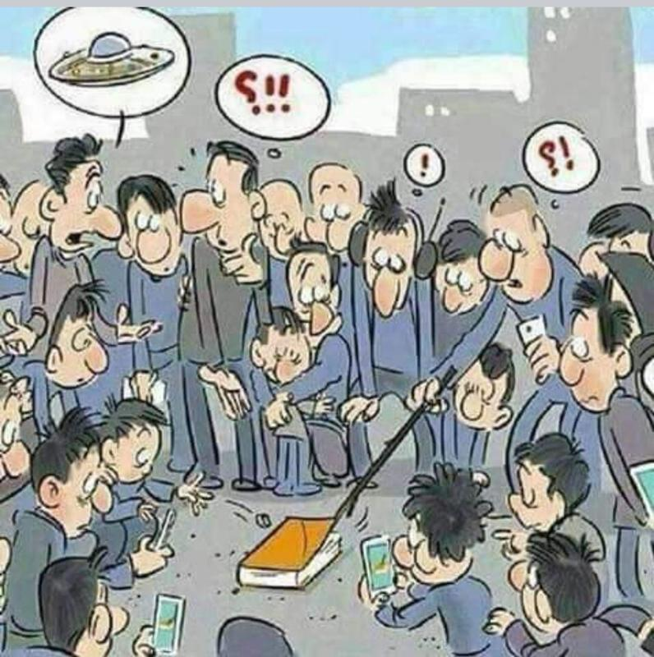
The NEW TESTAMENT BOOK OF ACTS
By David Lee Burris
Chapters 3 & 4

Slide 2
DOES THE NEW TESTAMENT IN PRACTICE ACTUALLY
START WITH THE BOOK OF ACTS NOT THE GOSPELS?
“From the standpoint of the dispensations or the various economies by which God governs the world, the Old Testament Jewish economy actually continued through the gospels. Acts is a transitional book moving from the Old Testament economy into that of the new – the church age, the body of Christ.” (reference)

Slide 3
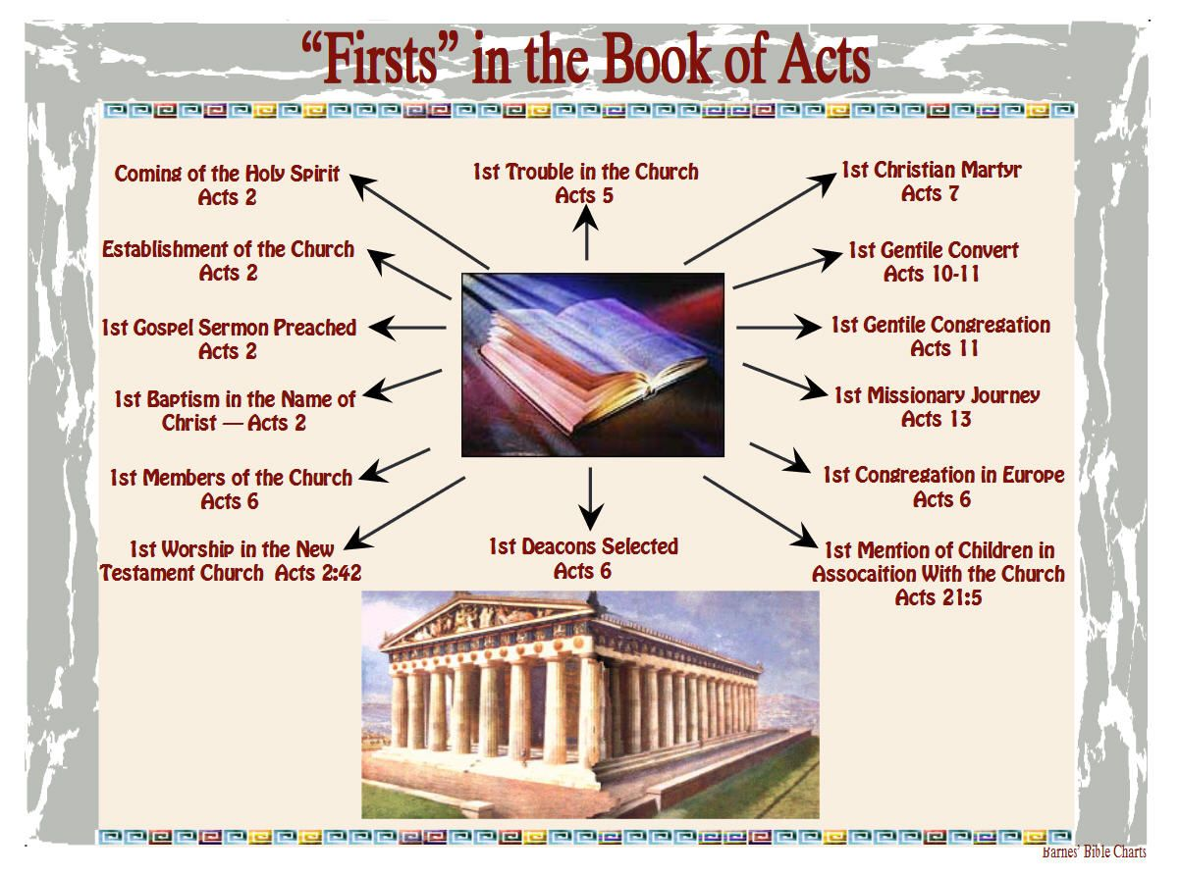

Slide 4
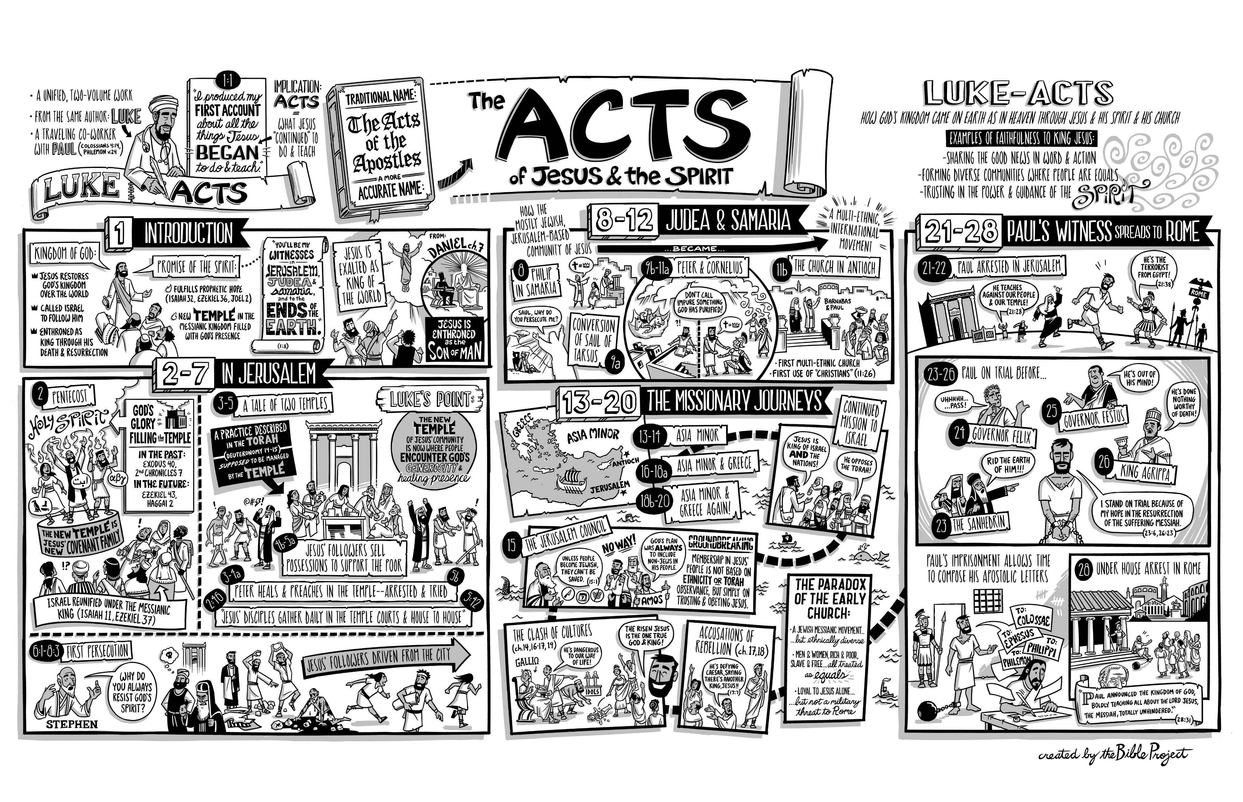

Slide 5
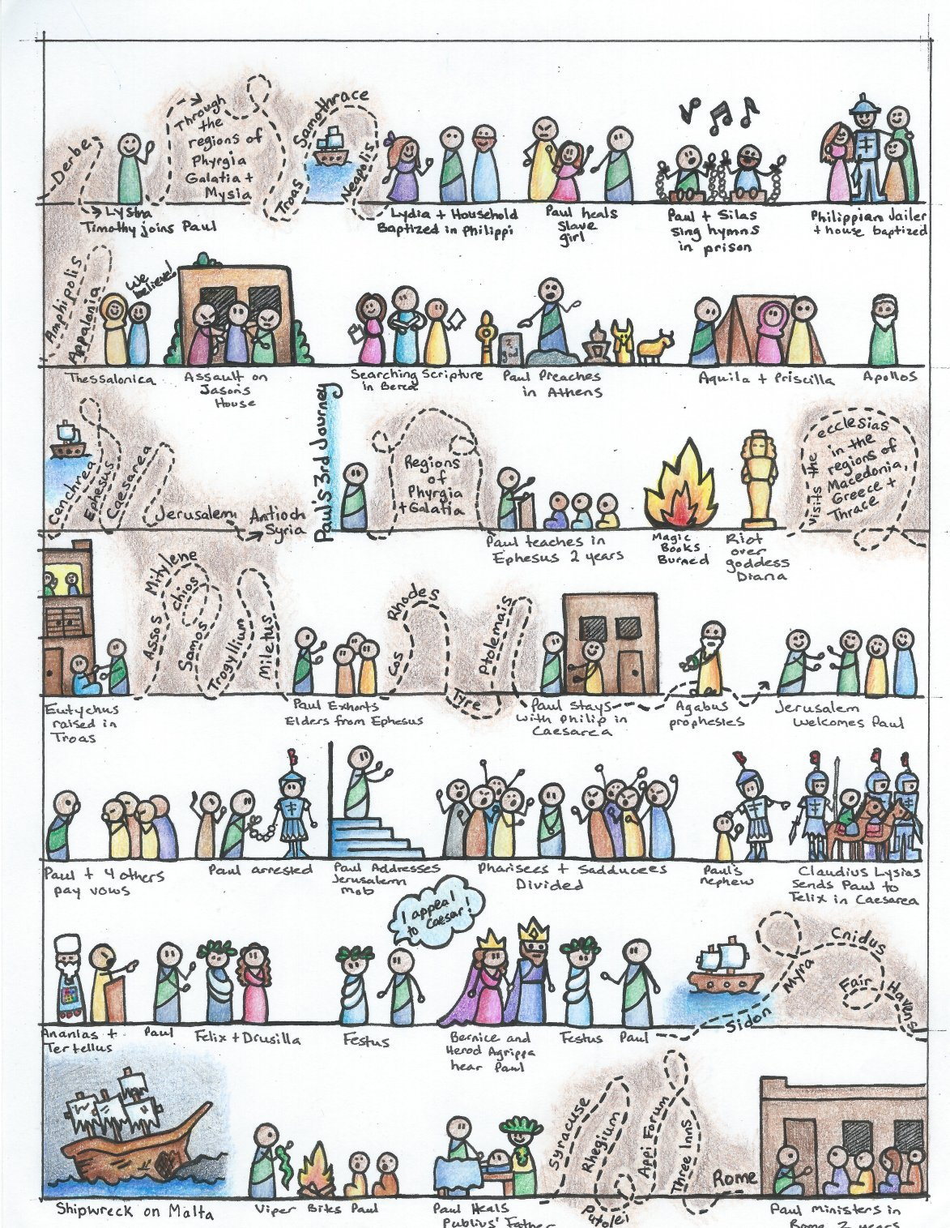

Slide 6
I. THE AUTHOR OF THE BOOK
From earliest times, Luke, “the beloved physician,” has been looked upon by conservative Bible scholars as being the author of The Book of Acts. Both internal and external evidence support this belief.
Luke was: (1) a Gentile (Col. 4:10–14); (2) the only Gentile author of a Bible book; (3) a physician (a medical doctor), Col. 4:14; (4) a “beloved” person, Col. 4:14; (5) a frequent missionary companion of Paul (the so-called “we sections” of The Book of Acts, 16:10–17; 20:5–21:18; 27:1–28:16, prove this assertion); and (6) the author of The Gospel of Luke as well as The Book of Acts.
II. THE ADDRESSEE OF THE BOOK
Luke addressed both The Gospel of Luke and The Book of Acts to Theophilus. Perhaps he had others in view as the ultimate readers of his two books.
We do not know the identity of Theophilus, nor do we know the place of his residence. He almost certainly was: (1) a friend of Luke and (2) a neophyte to Christianity (Luke wrote to Theophilus that he might know the certainty, the truthfulness, of the gospel truths wherein he had been instructed, Luke 1:1).
III. THE PLACE AND THE DATE OF THE WRITING OF THE BOOK
We do not know the place of writing but we can know the approximate date of writing. We know that it was written after the Spring of a.d. 63 for the book’s historical record extends to the Spring of that year and we know that the book was probably written before the Fall of a.d. 64 for the book makes no mention or allusion to the Neronian persecution which began in October of a.d. 64. We know that the book was almost certainly written before a.d. 70 for it makes no mention or allusion to the fall of Jerusalem and the destruction of its temple, events which occurred in a.d. 70 which greatly affected the early church and first-century Christianity (these events ended the Judaizers opposition to the gospel and the practice of preaching the gospel first to the Jews and then to the Gentiles).
IV. THE NAME OF THE BOOK
From the Second Century a.d., the common name for the book has been The Acts of the Apostles. This title is too comprehensive to be a correct one, for the book deals chiefly with the acts of only two apostles, Peter and Paul, and their acts are recorded only in part. A more apt title would be one of the following: (1) the Acts of the Risen Lord; (2) The Acts of the descended Holy Spirit; (3) Some of the Acts of Peter and Paul; (4) A Fragmentary History of the Early Church; (5) The First Chapter of Church History or (6) The only Inspired Chapter of Church History.
In the Greek manuscripts, the title is “Acts of Apostles.” This is a good and accurate title.
V. THE CLASSIFICATION OF THE BOOK
It is one of the five historical books of the New Testament. The New Testament has five historical books (Matthew through Acts), twenty-one doctrinal books (Romans through Jude) and one prophetical book (Revelation).
The 5 New Testament historical books are the New Testament’s “Pentateuch.”
Gingrich, R. E. (2002). (pp. 34). Memphis, TN: Riverside Printing.
Gingrich, R. E. (2002). The Book of Acts (pp. 3–4). Memphis, TN: Riverside Printing.

Slide 7
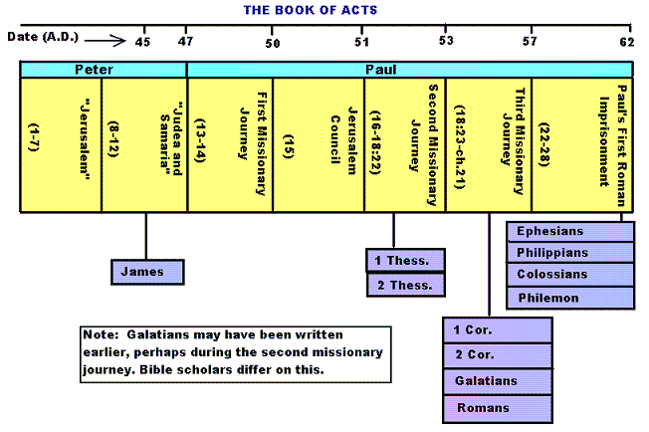

Slide 8
Historicity of Acts:
- the spread of Christianity from Jerusalem to Rome (“the ends of the earth”);
- The progress ... is mainly geographical:
- From Jerusalem ... to Samaria (8.5), Damascus (9.10), Antioch (11.26), Asia Minor (13.13), Europe (16.11), and finally Rome … itself;
- the northeastern corner of the Mediterranean;
- Maybe Spain But Nothing about North Africa, e.g., Alexandria and Cyrene.

Slide 9
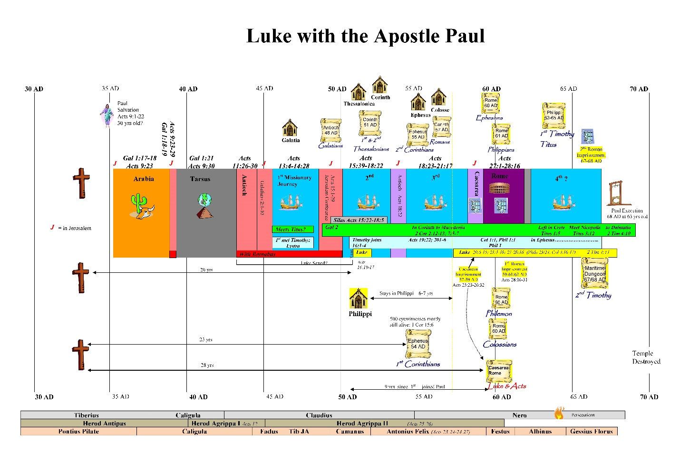

Slide 10
1. Prologue and Ascension (1:1-11):
- Post-resurrection appearances … ;
- A ... visible ascension into heaven;
- Matthias chosen to replace Judas Iscariot (1.12-26);
- Luke’s understanding of an Apostle: see 1.21-22;
- Note: Saul (later Paul) meets those qualifications Acts 9 when Christ appeared to him while on the Damascus Road.

Slide 11
2. Founding of the Jerusalem Church - the role of the Holy Spirit (2.12-2.47):
- The Jerusalem Church increases in numbers by means of divine power;
- The work of the Holy Spirit, e.g., Glossolalia (2.1-24; see Joel 2.28-32);
- Peter’s speech interprets the meaning of Pentecost;
- The character of the Jerusalem Church (2.43-45; 4.32-35);

Slide 12
3. The Work of Peter and the other Apostles (3.1-5.42):
- Confrontation between the Apostles and the Jerusalem authorities (4.1-22);
- Luke’s attitude towards both the Sadducees and the Pharisees (4.8-11);

Slide 13
4. Persecution of the “Hellenists” (6.1-8.40):
- Stephen, a leading “Hellenist” or Greek-speaking Jew (6. 5, 8);
- Stephen is presented as the first Christian Martyr (7.60);
- subsequent persecution and the growth of the Church (8.1b-40);
the “new way” carried to such individuals as Simon the Magician (8.9) and an Ethiopian Eunuch (8.27);
the role of Philip in this work of evangelization (6.5; 8.4; 21,8).

Slide 14
5. Preparation for the Gentile Mission (9.1-12.25):
- The progress of Christianity …. as world adversary to pagan religion and human schools of philosophy;
- See, for example, the conversion of Saul of Tarsus (9.1-19) and Cornelius, the Roman centurion (Chs. 10-11);
- Peter is depicted as the one who first opens the door to Gentiles, that is, non-Jews;
Peter’s persuasion of the “circumcision party” (11.1-18);
See 10.44-48 and 11.15-18: the “Gentile Pentecost”;

Slide 15
5. Preparation for the Gentile Mission (9.1-12.25) (contd.):
- Gentiles flock to the Church at Antioch (11.19-26);
- The Jerusalem Church sends Barnabas... to report on the situation (11.22);
- Barnabas with the Apostle Paul at Antioch (11.25-30);
- Gospel preached “all over Judea and Samaria”;
- The first half concludes with an account of Herod Agrippa I’s persecution (41-44 CE) of the Jerusalem community;
- God is unhappy with Herod (12.20-23).

Slide 16
6. First Missionary Journey of Barnabas and Paul and the Jerusalem Conference (13.1-15.35):
- The rest of Acts is devoted mainly to the Missionary Journeys of the Apostle Paul and his fellow workers;
- the work of Paul and Barnabas in the various Hellenistic cities of Asia Minor;
- Dissension between Gentile and Jewish Christians over adherence to the Mosaic Torah (15.1-35);
- must Gentile Christians be circumcised and observe Jewish dietary laws?

Slide 17
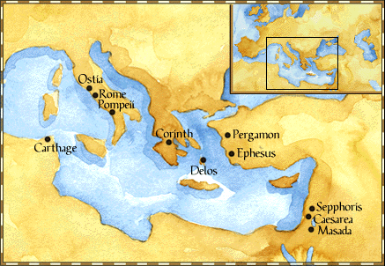
Paul: Map of His World.

Slide 18
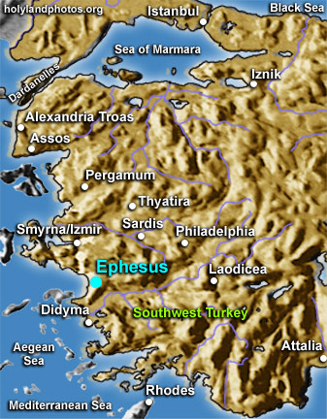

Slide 19
6. First Missionary Journey of Paul and Barnabas and the Jerusalem Conference (13.1-15.35) (contd.):
- The Jerusalem Conference held about A.D. 49 (Acts 15);
- Must a Gentile believer become a Jew ... to be a Christian?
- A division within the Church;
- The dispute settled in favor of uncircumcised Gentiles (15.28-29);
- The deciding voice is that of James (15.13-21).

Slide 20
6. First Missionary Journey of Paul and Barnabas and the Jerusalem Conference (13.1-15.35) (contd.):
- The Apostles and Elders required only limited Torah mandates of the Gentile Christians (15.13-21);
- requirements based on rules from Leviticus (Acts 15.13-21; Leviticus 17-18);
- Themes of unity and cooperation dominate … ;
- it is a unanimous decision and the “Whole Church” sends a delegation to Antioch to explain the Jerusalem Church’s decision (15.30-35);
- Actually, a decision of the Holy Spirit (15.22-29).

Slide 21
6. First Missionary Journey of Paul and Barnabas and the Jerusalem Conference (13.1-15.35) (contd.):
- Paul’s independence of the Apostolic Church (Gal 1.17, 18-19, 20; 2.1-10);
- Paul indicates that he was never under the jurisdiction of the Church’s leadership in Jerusalem (Gal 1.17, 18-19, 20; 2.1-10);
- See also 1 Cor 8.8; 10.27 relative to eating meat sacrificed to Greco-Roman gods.

Slide 22
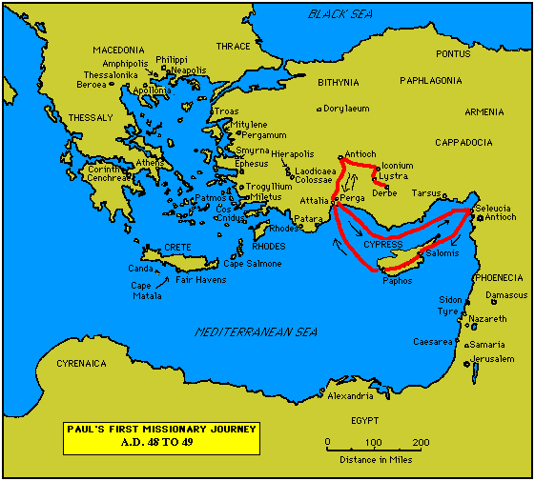

Slide 23
7. Paul’s Secondary Missionary Journey; Evangelizing Greece (16.1-18.21):
- Paul and Barnabas separate (15.39);
- Why the separation?
- Paul and Silas visit churches in Syria and Asia Minor (15.40-41);
- A vision directs Paul to Macedonia (15.40-16.10);
- Paul’s customary activity relative to the Jews and then being abused by them (16.11-17.15);

Slide 24
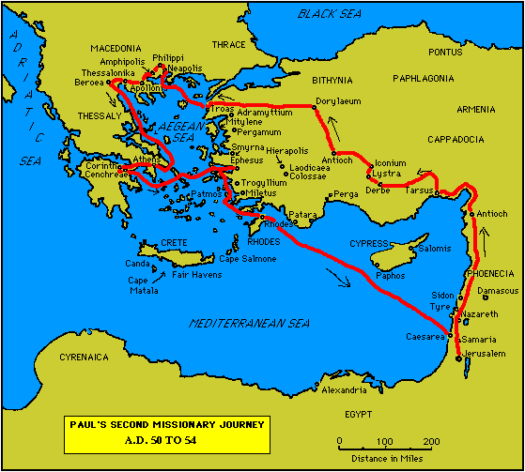

Slide 25
7. Paul’s Secondary Missionary Journey; Evangelizing Greece (16.1-18.21) (contd.):
- Paul in Philippi, Thessalonica, Beroea, and Athens;
- Paul speaks at the Areopagus in Athens (17.19-31);
- Paul at Corinth (18.1-17);

Slide 27
8. Paul’s Third Missionary Journey: Revisiting Asia Minor and Greece (18.22-20.38):
- Paul at Ephesus (18.19-21);
- Luke depicts Paul as determined to complete his last tour and head for the imperial capital, that is, Rome (19.21-22);
- Paul’s farewell speech at Miletus (20.17-38);
- See maps on the location of the major churches at the end of Paul’s ministry.

Slide 28
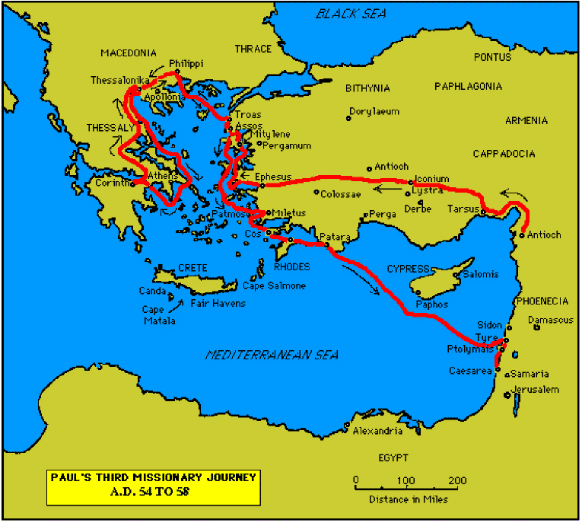

Slide 30
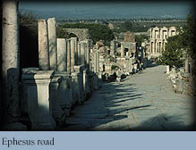

Slide 31
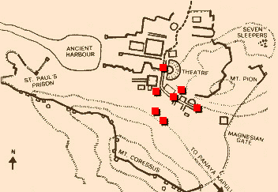
Ephesus: General View of the Ancient City.

Slide 32
9. Paul’s arrest in Jerusalem and imprisonment in Caesarea Maritime (21.1-26.32):
- Paul returns to Jerusalem (21.17) ... accused of blasphemy and profaning the Temple;
- When arrested, Paul claims that he is a Pharisee (21.27-23.10);
- Paul is imprisoned ... in Caesarea (23.33-26.32);
- he exercises his birthright as a Roman citizen (25.1-21);
- he defends himself (26.1-29);

Slide 33
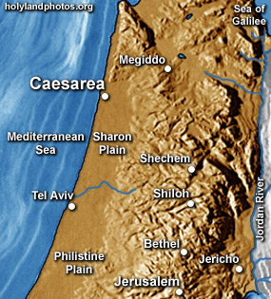

Slide 34
10. Paul’s Journey to Rome and His Preaching to Roman Jews (27.1-28.31):
- Paul’s sea journey to Rome... a shipwreck on the island of Malta (28.1 ) (see Map);
- the narrative in the first person plural, that is, “we”;
- Acts ends with Paul’s arrival in Rome (28.16);
- Paul is under house arrest but is free to preach (28.31);
- He continues to evangelize the Romans (28.23-31);
- We are not told of Paul’s fate.

Slide 35
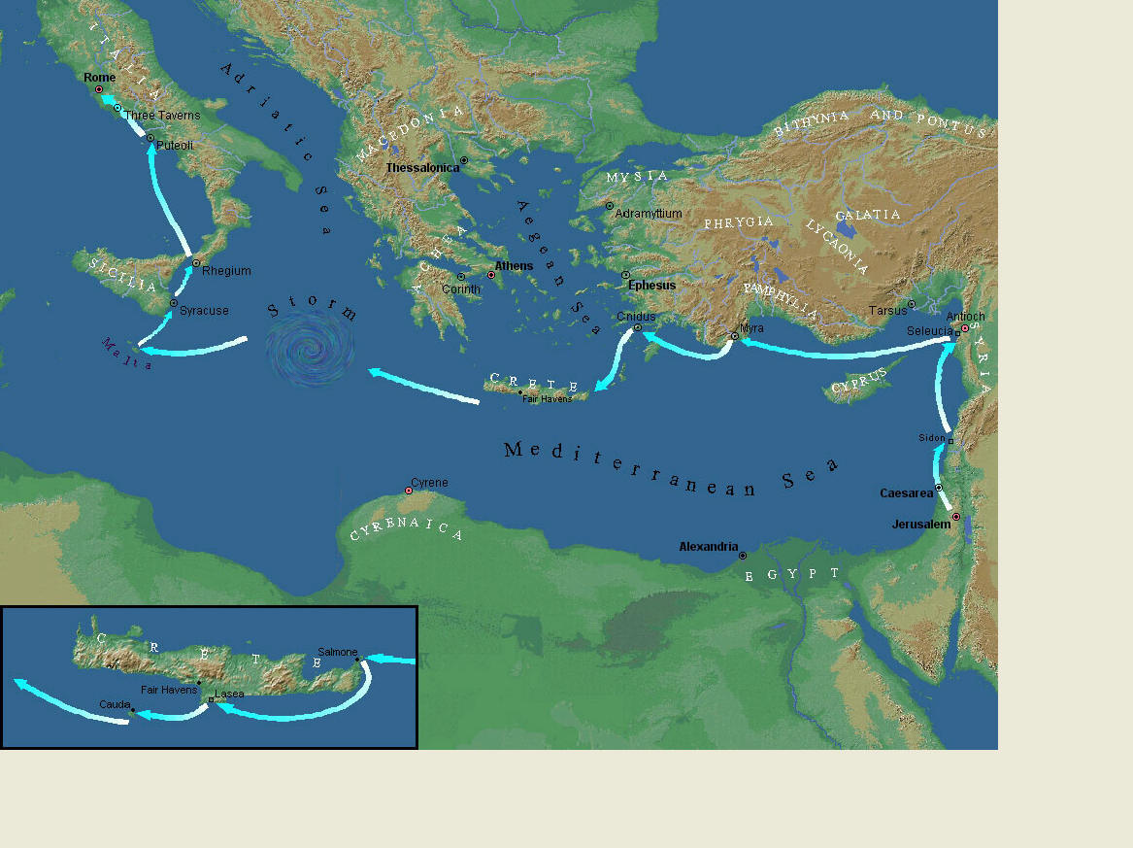
Paul’s Journey to Rome.

Slide 36
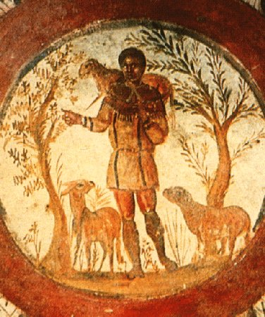
The Good Shepherd – in Catacombs of Rome.

Slide 37
10. Paul’s Journey to Rome and his Preaching to Roman Jews (27.1-28.31) (contd.):
- Luke has accomplished his task of tracing Christianity’s expansion from Jerusalem to “the ends of the earth” (1.8);
- Another theme emphasized: Paul and his successor evangelists will henceforth direct the Gospel primarily to Non-Jews, for “the Gentiles will listen” (28.28);
- Luke quotes from Isaiah 6 (see also Mark 4.10-13);
- Christianity’s future belongs to the Gentiles.

Slide 38
Basic Book Structure acts of the Apostles Centers around the great commission & Call To evangelize Then known world!

Slide 39
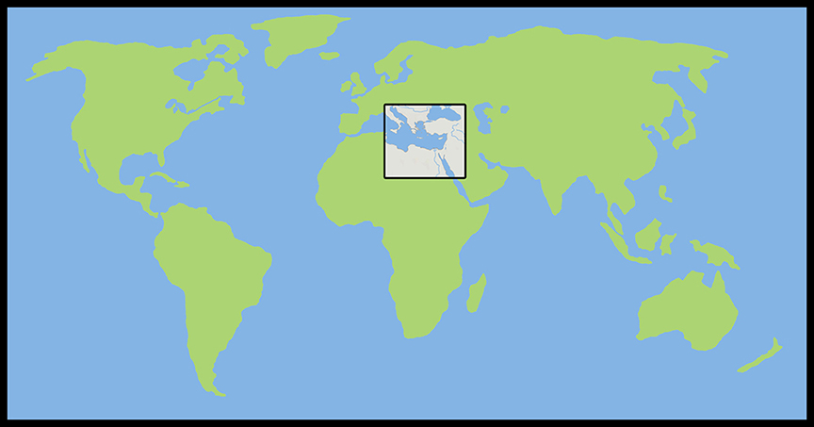
Where the Story takes Place

Slide 40
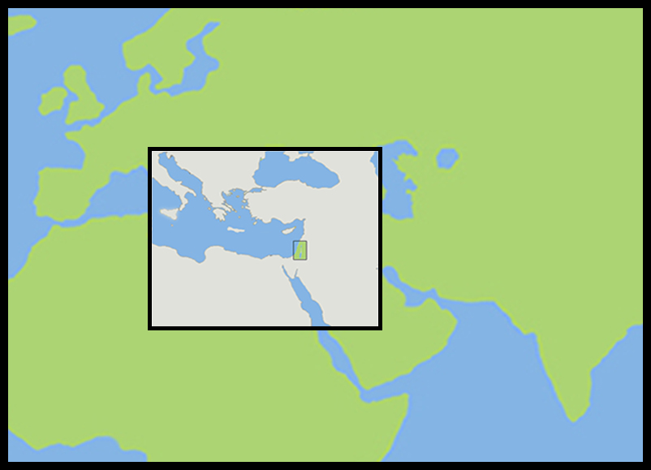
The Land of Canaan in the Near East

Slide 41
Acts 1:8 and the Great Commission
Acts 1:8
But ye shall receive power, after that the Holy Ghost is come upon you: and ye shall be witnesses unto me both in Jerusalem, and in all Judaea, and in Samaria, and unto the uttermost part of the earth.
Matthew 28:19-20
¹⁹ Go ye therefore, and teach all nations, baptizing them in the name of the Father, and of the Son, and of the Holy Ghost:
²⁰ Teaching them to observe all things whatsoever I have commanded you: and, lo, I am with you alway, even unto the end of the world. Amen.
Mark 16:15
And he said unto them, Go ye into all the world, and preach the gospel to every creature.

Slide 42
Acts 1:8 and the Great Commission
Acts 1:8
But ye shall receive power, after that the Holy Ghost is come upon you: and ye shall be witnesses unto me both in Jerusalem, and in all Judaea, and in Samaria, and unto the uttermost part of the earth.
Matthew 28:19-20
¹⁹ Go ye therefore, and teach all nations, baptizing them in the name of the Father, and of the Son, and of the Holy Ghost:
²⁰ Teaching them to observe all things whatsoever I have commanded you: and, lo, I am with you alway, even unto the end of the world. Amen.
Mark 16:15
And he said unto them, Go ye into all the world, and preach the gospel to every creature.

Slide 43
Acts 1:8 and the Great Commission
Acts 1:8
But ye shall receive power, after that the Holy Ghost is come upon you: and ye shall be witnesses unto me both in Jerusalem, and in all Judaea, and in Samaria, and unto the uttermost part of the earth.
Matthew 28:19-20
¹⁹ Go ye therefore, and teach all nations, baptizing them in the name of the Father, and of the Son, and of the Holy Ghost:
²⁰ Teaching them to observe all things whatsoever I have commanded you: and, lo, I am with you alway, even unto the end of the world. Amen.
Mark 16:15
And he said unto them, Go ye into all the world, and preach the gospel to every creature.

Slide 44
Acts 1:8 and the Great Commission
Acts 1:8
But ye shall receive power, after that the Holy Ghost is come upon you: and ye shall be witnesses unto me both in Jerusalem, and in all Judaea, and in Samaria, and unto the uttermost part of the earth.
Matthew 28:19-20
¹⁹ Go ye therefore, and teach all nations, baptizing them in the name of the Father, and of the Son, and of the Holy Ghost:
²⁰ Teaching them to observe all things whatsoever I have commanded you: and, lo, I am with you alway, even unto the end of the world. Amen.
Mark 16:15
And he said unto them, Go ye into all the world, and preach the gospel to every creature.

Slide 45
Acts 1:8 and the Structure of the Book
Acts 1:8
… ye shall be witnesses unto me both in Jerusalem, and in all Judaea, and in Samaria, and unto the uttermost part of the earth.
1. The witness in Jerusalem:
    Chapters 1 to 7
2. The witness in Judaea and Samaria:
    Chapters 8 to 12
3. The witness unto the uttermost parts of the earth:
    Chapters 13 to 28

Slide 46
The Three Audiences
Part 1: The Jews
Part 2: The Samaritans
Part 3: The Gentiles

Slide 47
The Pillars of the Church
Part 1: Peter
Part 2: Peter and Paul (Saul of Tarsus)
Part 3: Paul

Slide 48
The Timeline
Part 1: 5 years (AD 30-35)
Part 2: 13 years (AD 35-48)
Part 3: 14 years (AD 48-62)
          A total of 32 years, according to Nelson’s Complete Book of Bible Maps and Charts.

Slide 49
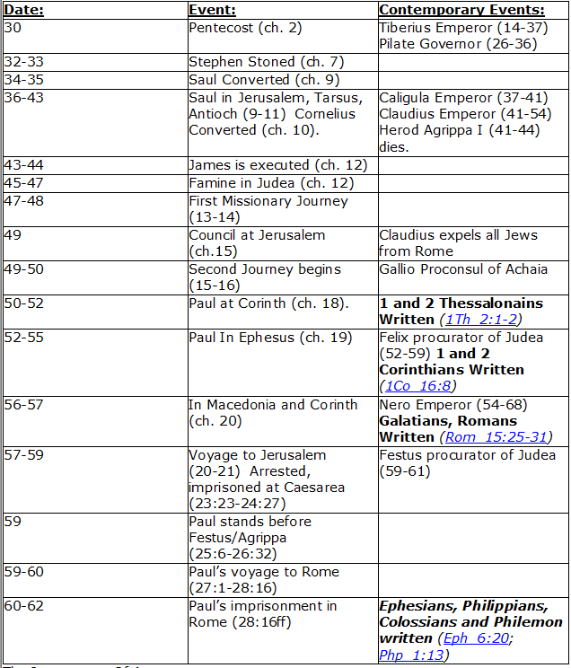
CHART BY
Mark Dunagan

Slide 50
PART ONE—The infancy of the church (the church in Jerusalem) (chapters 1–7)
(In this section, Jerusalem is the central city of Christianity and Peter is the most prominent person)
I. THE POST-RESURRECTION MINISTRY OF CHRIST (1:1–8)
II. THE ASCENSION OF CHRIST (1:9–11)
III. THE WAITING IN THE UPPER ROOM (1:12–26)
IV. THE ADVENT OF THE HOLY SPIRIT (2:1–41)
V. THE SNAPSHOT OF THE EARLY CHURCH (2:42–47)
VI. THE HEALING OF THE LAME MAN AND ITS CONSEQUENCES (3:1–4:31)
VII. THE DEATH OF ANANIAS AND SAPPHIRA AND ITS EFFECTS (4:32–5:42)
VIII. THE APPOINTMENT OF THE SEVEN (6:1–7)
IX. THE MINISTRY OF STEPHEN (6:8–7:60)
PART TWO—The adolescence of the church (the church in all Judea and In Samaria) (chapters 8–12)
(In this section, Jerusalem is gradually being replaced by Antioch as the central city of Christianity and Peter is gradually being replaced by Paul as the most prominent person)
I. THE FIRST MENTION OF PAUL (7:58; 8:1, 3)
II. THE PERSECUTION AND SCATTERING OF THE JERUSALEM CHURCH (8:1–4)
III. THE CONVERSION OF SAMARITANS (8:5–25)
IV. THE CONVERSION OF A JEWISH PROSELYTE (8:26–40)
V. THE CONVERSION OF SAUL (9:1–31)
VI. THE EXPANSION OF THE CHURCH IN WESTERN JUDEA (9:32–43)
VII. THE CONVERSION OF GENTILE GOD-FEARERS (chapter 10)
VIII. THE GROWING VISION OF THE JEWISH LEADERS (11:1–18)
IX. THE CONVERSION OF PAGAN GENTILES (11:19–26)
X. THE GROWING TIES BETWEEN JEWISH AND GENTILE CHRISTIANITY (11:27–30)
XI. THE COMPLETION OF THE TRANSITION (chapter 12)
PART THREE—The maturity of the church (the church in all the world) (chapters 13–28)
(In this section, Antioch is the central city of Christianity and Paul is the most prominent person)
I. PAUL’S CALL AT ANTIOCH TO HIS LIFE’S WORK (13:1–3)
II. PAUL’S FIRST MISSIONARY JOURNEY (13:4–14:27)
III. PAUL’S TWO YEARS BACK IN ANTIOCH (14:28–15:35)
IV. PAUL’S SECOND MISSIONARY JOURNEY (15:36–18:22)
V. PAUL’S THIRD MISSIONARY JOURNEY (18:23–21:16)
VI. PAUL’S ARREST AT JERUSALEM (21:17–23:35)
VII. PAUL’S TWO-YEARS’ IMPRISONMENT AT CAESAREA (chapters 24–26)
VIII. PAUL’S SHIPWRECK JOURNEY TO ROME (27:1–28:15)
IX. PAUL’S FIRST ROMAN IMPRISONMENT (28:16–31)
Gingrich, R. E. (2002). The Book of Acts (pp. 5–6). Memphis, TN: Riverside Printing.

Slide 51
L.D. CARY & SAM HOLT CATCH PHRASES
Chapter 1 – “Jesus’ Work On Earth Is Done”
Chapter 2 – “Peter Baptizes A Crew”
Chapter 3 – “A Beggar’s Plea”
Chapter 4 – “A Jailhouse Door”
Chapter 5 – “Ananias & Sapphira Don’t Survive”
Chapter 6 – “The Widow’s Fix”
Chapter 8 – “Stephen Looks Into Heaven”
Chapter 9 – “Saul Struck Blind”
“A Beggar’s Plea”
Catch Phrase
Chapter Three

Slide 52
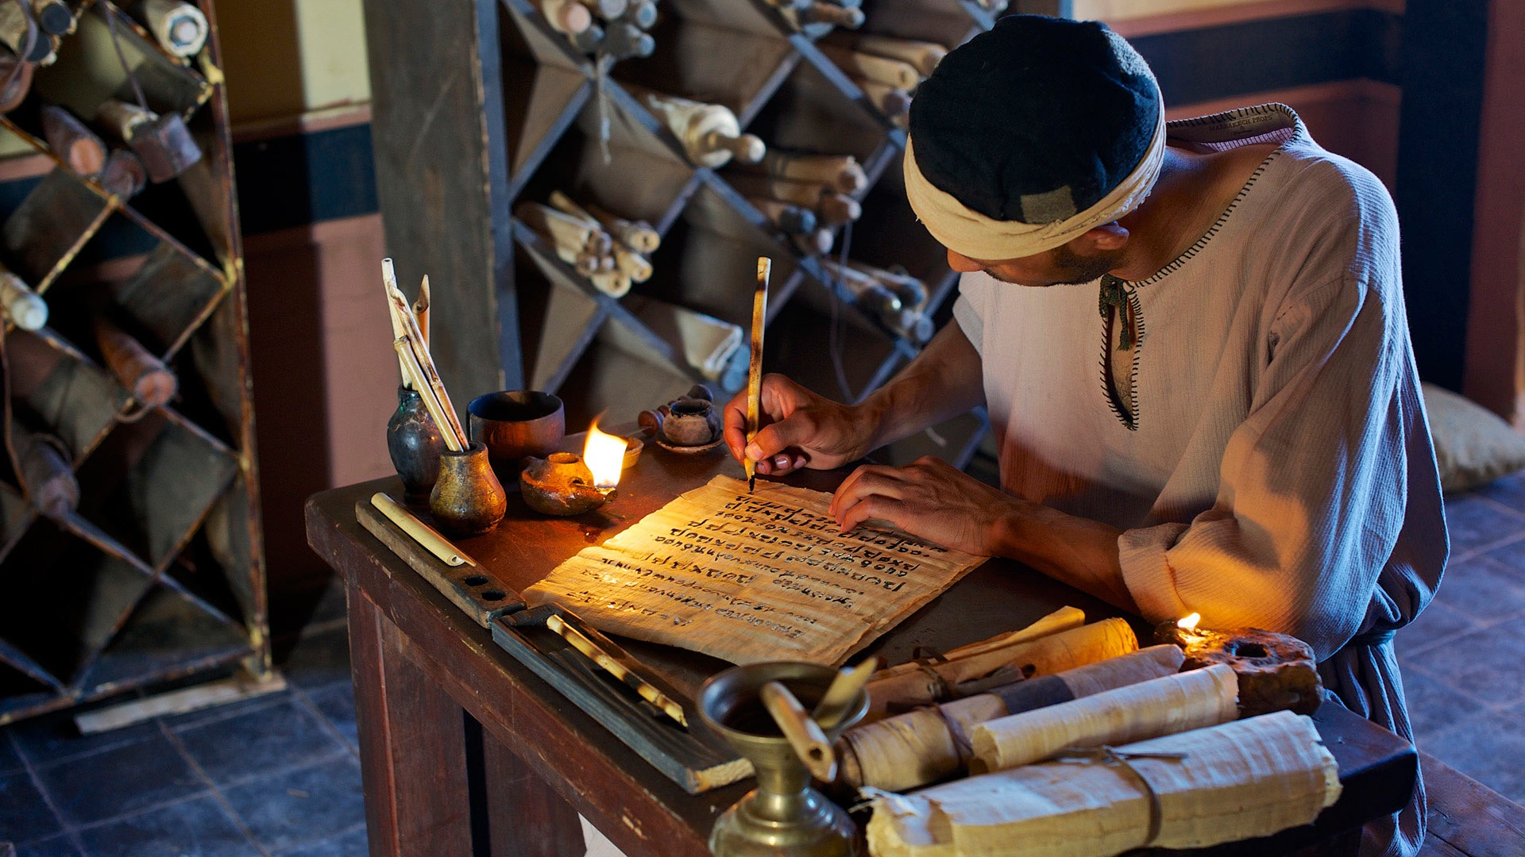
Acts of the Apostles
Chapter 3
Peter’s Second Sermon In The Temple Courtyard

Slide 53
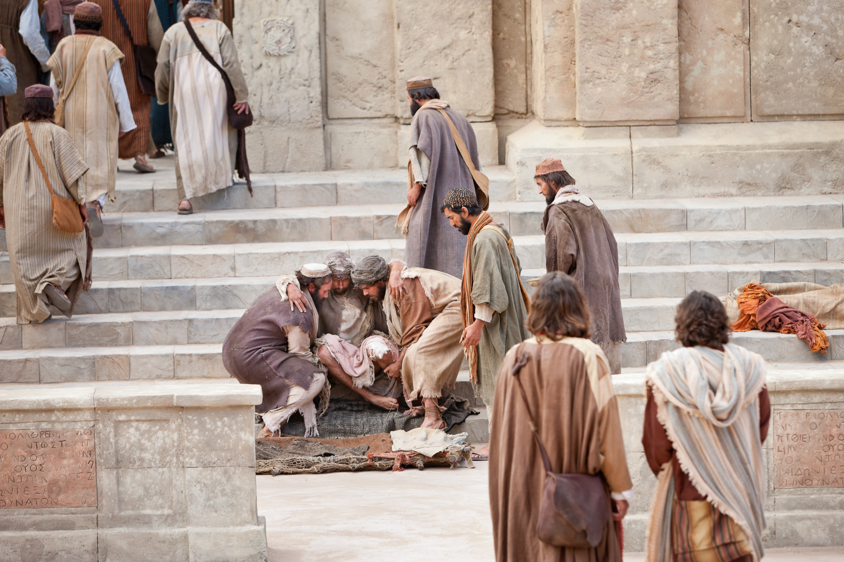
Acts 3:1-2 (NASB)
¹ Now Peter and John were going up to the temple at the ninth hour, the hour of prayer.
² And a man who had been lame from his mother's womb was being carried along, whom they used to set down every day at the gate of the temple which is called Beautiful, in order to beg alms of those who were entering the temple.

Slide 54
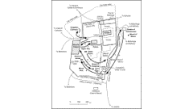

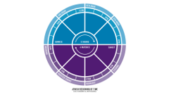

Acts 3:1-3 (NASB)
¹ Now Peter and John were going up to the temple at the ninth hour, the hour of prayer.
² And a man who had been lame from his mother's womb was being carried along, whom they used to set down every day at the gate of the temple which is called Beautiful, in order to beg alms of those who were entering the temple.
A. Up to the Temple: the temple was located on what was known as the Temple Mount.
1. The early church used the Temple as a place to congregate. It appears they met at the customary times that the Jewish people would gather. Acts 2:46
2. Ninth Hour (3:00 p.m.): one of the hours of prayer in a Jewish day.
B. A man born lame who was set at the gate of the Temple every day: No fraud here, his condition was well known by all who regularly entered the temple. He was not a stranger.
1. To beg alms: Dt 15:7-9; 15:11; 24:14-15; 10:18
Deuteronomy 15:7-9 (NASB)
⁷ "If there is a poor man with you, one of your brothers, in any of your towns in your land which the LORD your God is giving you, you shall not harden your heart, nor close your hand from your poor brother;
⁸ but you shall freely open your hand to him, and shall generously lend him sufficient for his need in whatever he lacks.
⁹ "Beware that there is no base thought in your heart, saying, 'The seventh year, the year of remission, is near,' and your eye is hostile toward your poor brother, and you give him nothing; then he may cry to the LORD against you, and it will be a sin in you.
Deuteronomy 24:14-15 (NASB)
¹⁴ "You shall not oppress a hired servant who is poor and needy, whether he is one of your countrymen or one of your aliens who is in your land in your towns.
¹⁵ "You shall give him his wages on his day before the sun sets, for he is poor and sets his heart on it; so that he will not cry against you to the LORD and it become sin in you.
Acts 2:46 (NASB)
⁴⁶ Day by day continuing with one mind in the temple, and breaking bread from house to house, they were taking their meals together with gladness and sincerity of heart,
Deuteronomy 10:18 (NASB)
¹⁸ "He executes justice for the orphan and the widow, and shows His love for the alien by giving him food and clothing.
Deuteronomy 15:11 (NASB)
¹¹ "For the poor will never cease to be in the land; therefore I command you, saying, 'You shall freely open your hand to your brother, to your needy and poor in your land.'

Slide 55
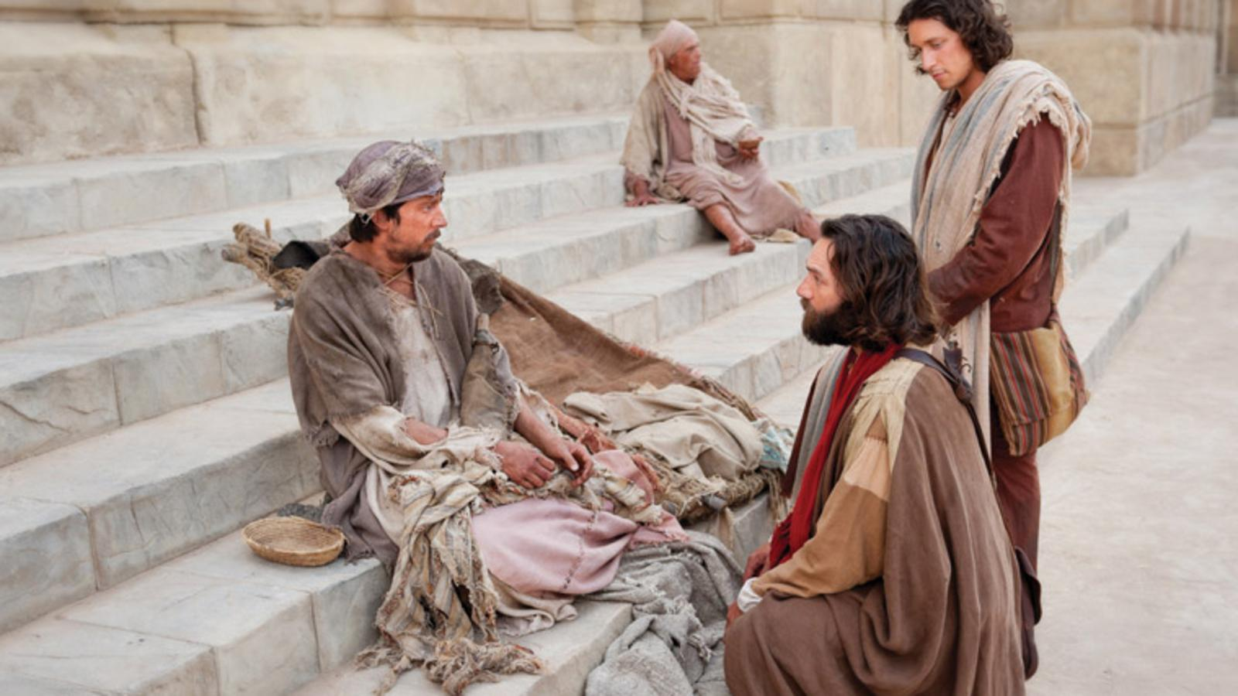
Acts 3:3 (NASB)
³ When he saw Peter and John about to go into the temple, he began asking to receive alms.
⁴ But Peter, along with John, fixed his gaze on him and said, "Look at us!"
⁵ And he began to give them his attention, expecting to receive something from them.

Slide 56
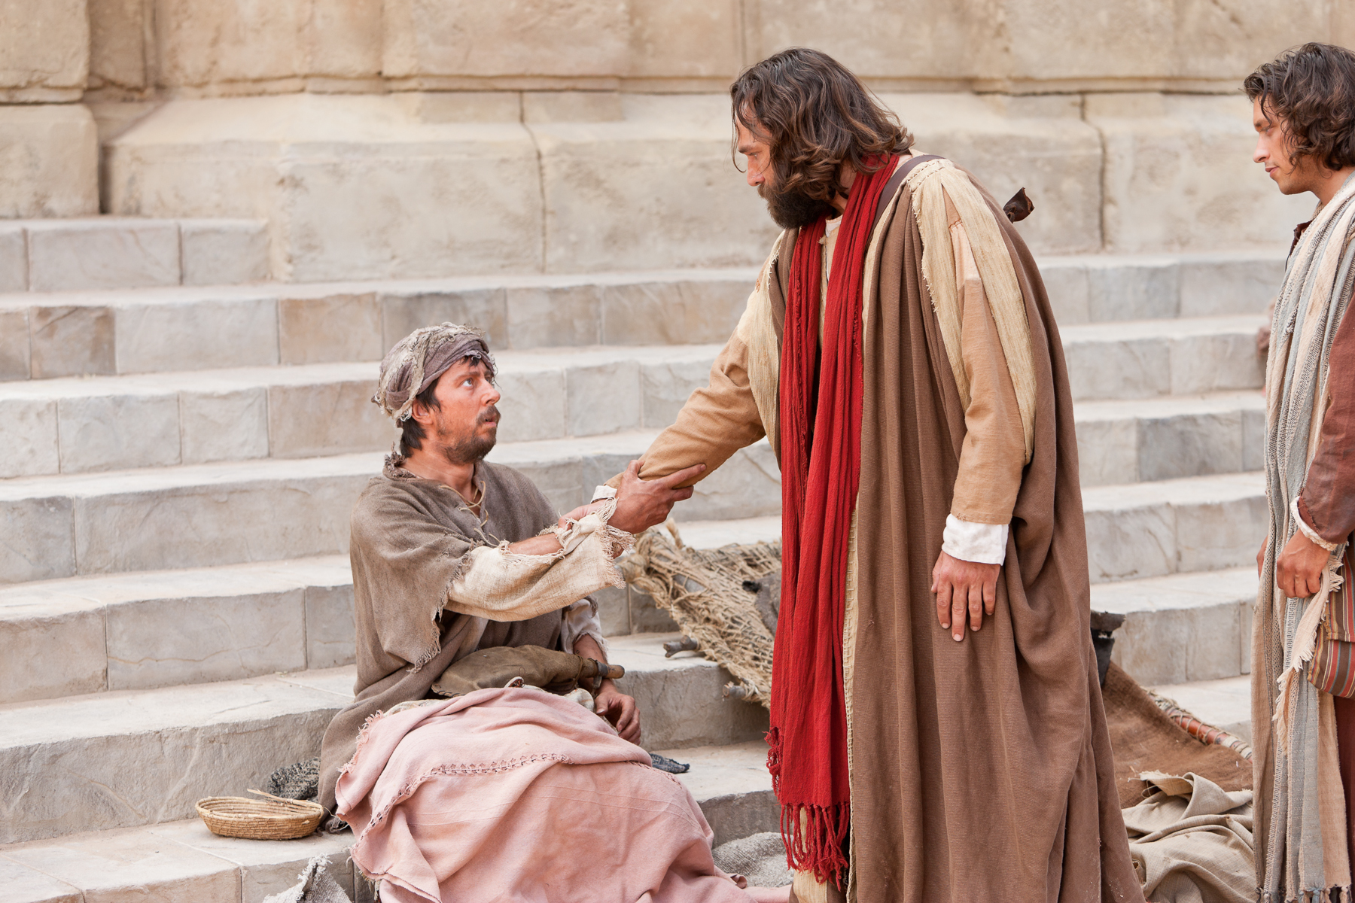
Acts 3:6-7 (NASB)
⁶ But Peter said, "I do not possess silver and gold, but what I do have I give to you: In the name of Jesus Christ the Nazarene—walk!"
⁷ And seizing him by the right hand, he raised him up; and immediately his feet and his ankles were strengthened.

Slide 57
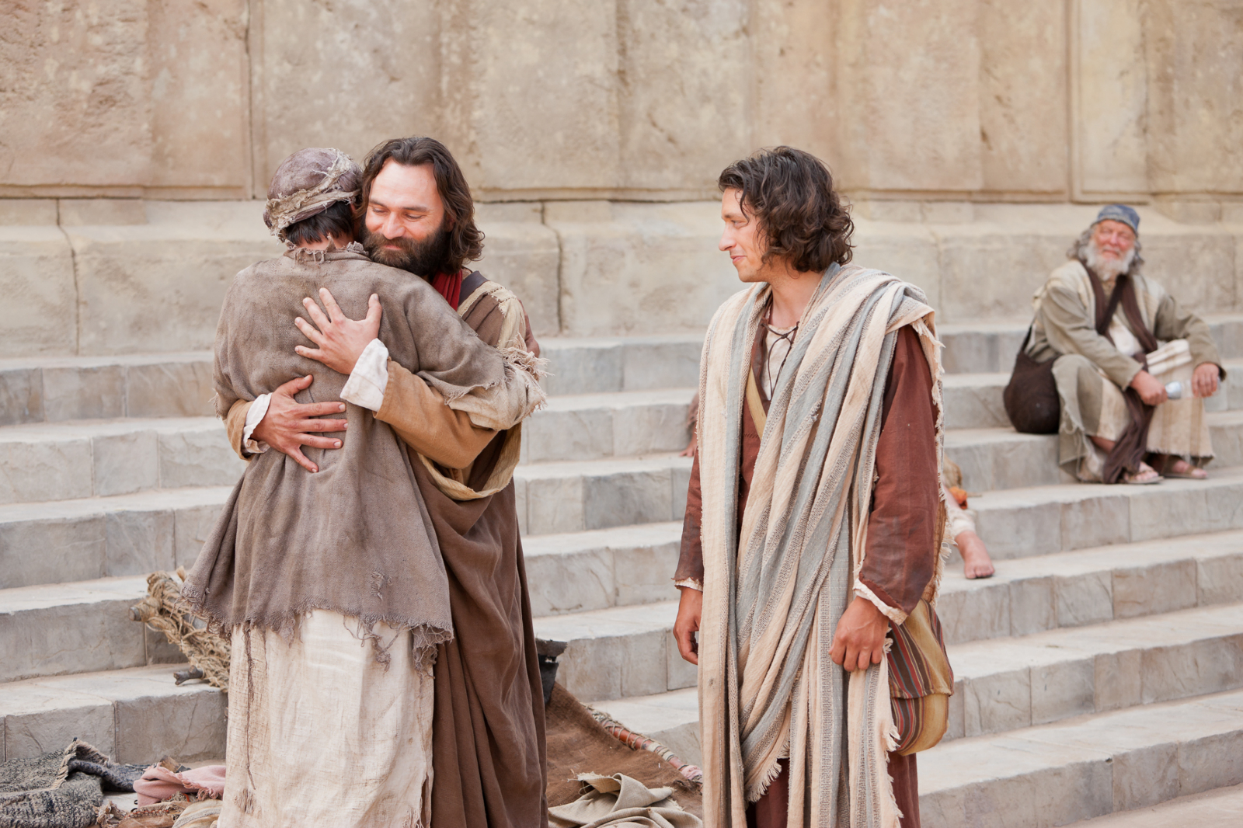
Acts 3:8 (NASB)
⁸ With a leap he stood upright and began to walk; and he entered the temple with them, walking and leaping and praising God.

Slide 58
Acts 3:4-8 (NASB)
³ When he saw Peter and John about to go into the temple, he began asking to receive alms.
⁴ But Peter, along with John, fixed his gaze on him and said, "Look at us!"
⁵ And he began to give them his attention, expecting to receive something from them.
⁶ But Peter said, "I do not possess silver and gold, but what I do have I give to you: In the name of Jesus Christ the Nazarene—walk!"
⁷ And seizing him by the right hand, he raised him up; and immediately his feet and his ankles were strengthened.
⁸ With a leap he stood upright and began to walk; and he entered the temple with them, walking and leaping and praising God.
A. Observations:
1. The lame man expected Peter and John to give him alms.
2. Peter had no silver or gold, which indicates what kind of alms were expected.
3. Peter offers what he does possess, which is to heal him of his crippled condition. Mt 10:7-8
4. The man does not respond so Peter seizes his right hand and raised him up.
5. The healing was instantaneous and though he had never walked before, he now could.
Matthew 10:7-8 (NASB)
⁷ "And as you go, preach, saying, 'The kingdom of heaven is at hand.'
⁸ "Heal the sick, raise the dead, cleanse the lepers, cast out demons. Freely you received, freely give.

Slide 59
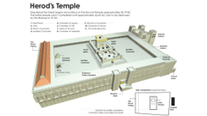

Acts 3:9-11 (NASB)
⁹ And all the people saw him walking and praising God;
¹⁰ and they were taking note of him as being the one who used to sit at the Beautiful Gate of the temple to beg alms, and they were filled with wonder and amazement at what had happened to him.
¹¹ While he was clinging to Peter and John, all the people ran together to them at the so-called portico of Solomon, full of amazement.
A. Obviously, the people recognized the man born lame who was set daily at the Beautiful Gate seeking alms. Skepticism is natural when the facts are not known.
1. Literally filled to the full with Wonder and Amazement:
a. This is God’s intended effect of miracles:
B. The crowd seeing the healed lame man clinging to Peter and John while walking and praising God conclude that Peter and John were responsible for the healing. The crowds run and gather around them in full amazement.
WONDER
Greek Strong's Number: 2285 - Greek Word: θάμβος
Part of Speech: n m/n
Usage Notes - English Words used in KJV:
be amazed + <G1096> 1 be astonished + <G4023> 1 wonder 1 [Total Count: 3]
akin to an obsolete tapho (to dumbfound); stupefaction (by surprise), i.e. astonishment :- × amazed, + astonished, wonder.
Strong's Talking Greek & Hebrew Dictionary
Amazement
Part Of Speech: Noun
Strong's Number: <G1611>
Original Word: ἔκστασις, ekstasis
Usage Notes: is, lit., "a standing out" (ek, "out of," stasis, "a standing"). Eng. "ecstasy" is a transliteration. It is translated "amazement" in Acts 3:10. It was said of any displacement, and especially, with reference to the mind, of that alteration of the normal condition by which the person is thrown into a state of surprise or fear, or both; or again, in which a person is so transported out of his natural state that he falls into a trance, Acts 10:10; Acts 11:5; Acts 22:17. As to the other meaning, the RV has "amazement" in Mark 5:42; Luke 5:26, but "astonishment" in Mark 16:8. See TRANCE.
Vine's Expository Dictionary of Old Testament and New Testament Words

Slide 60
Acts 3:12-15 (NASB)
¹² But when Peter saw this, he replied to the people, "Men of Israel, why are you amazed at this, or why do you gaze at us, as if by our own power or piety we had made him walk?
¹³ "The God of Abraham, Isaac and Jacob, the God of our fathers, has glorified His servant Jesus, the one whom you delivered and disowned in the presence of Pilate, when he had decided to release Him.
¹⁴ "But you disowned the Holy and Righteous One and asked for a murderer to be granted to you,
¹⁵ but put to death the Prince of life, the one whom God raised from the dead, a fact to which we are witnesses.
A. Peter refuses to take the credit for what has happened and tells the crowd that the miracle is God’s testimony that Jesus is His Holy One. Acts 2:22; Acts 14:8-18
1. You disowned the Holy and righteous one when Pilate tried to release him, asking for a murder: Lk 23:13-23
2. Prince of life: Jn 1:4; 5:21-26
3. God raised him – we, Peter and John are witnesses: Acts 2:24, 32; 10:34-43
Prince:
Strong's Number: <G747>
Original Word: ἀρχηγός, archēgos
Usage Notes: translated "Prince" in Acts 3:15 (marg., "Author") and Acts 5:31……………. the word suggest a combination of the meaning of leader with that of the source from whence a thing proceeds. That Christ is the Prince of life signifies, as Chrysostom says, that "the life He had was not from another; the Prince or Author of life must be He who has life from Himself." But the word does not necessarily combine the idea of the source or originating cause with that of leader. …………………………………
Vine's Expository Dictionary of Old Testament and New Testament Words
John 1:4 (NASB)
⁴ In Him was life, and the life was the Light of men.
John 5:21-26 (NASB)
²¹ "For just as the Father raises the dead and gives them life, even so the Son also gives life to whom He wishes.
²² "For not even the Father judges anyone, but He has given all judgment to the Son,
²³ so that all will honor the Son even as they honor the Father. He who does not honor the Son does not honor the Father who sent Him.
²⁴ "Truly, truly, I say to you, he who hears My word, and believes Him who sent Me, has eternal life, and does not come into judgment, but has passed out of death into life.
²⁵ "Truly, truly, I say to you, an hour is coming and now is, when the dead will hear the voice of the Son of God, and those who hear will live.
²⁶ "For just as the Father has life in Himself, even so He gave to the Son also to have life in Himself;
Acts 14:8-18 (NASB)
⁸ At Lystra a man was sitting who had no strength in his feet, lame from his mother's womb, who had never walked.
⁹ This man was listening to Paul as he spoke, who, when he had fixed his gaze on him and had seen that he had faith to be made well,
¹⁰ said with a loud voice, "Stand upright on your feet." And he leaped up and began to walk.
¹¹ When the crowds saw what Paul had done, they raised their voice, saying in the Lycaonian language, "The gods have become like men and have come down to us."
¹² And they began calling Barnabas, Zeus, and Paul, Hermes, because he was the chief speaker.
Luke 23:13-23 (NASB)
¹³ Pilate summoned the chief priests and the rulers and the people,
¹⁴ and said to them, "You brought this man to me as one who incites the people to rebellion, and behold, having examined Him before you, I have found no guilt in this man regarding the charges which you make against Him.
¹⁵ "No, nor has Herod, for he sent Him back to us; and behold, nothing deserving death has been done by Him.
¹⁶ "Therefore I will punish Him and release Him."
¹⁷ [Now he was obliged to release to them at the feast one prisoner.]
¹⁸ But they cried out all together, saying, "Away with this man, and release for us Barabbas!"
¹⁹ (He was one who had been thrown into prison for an insurrection made in the city, and for murder.)
²⁰ Pilate, wanting to release Jesus, addressed them again,
²¹ but they kept on calling out, saying, "Crucify, crucify Him!"
²² And he said to them the third time, "Why, what evil has this man done? I have found in Him no guilt demanding death; therefore I will punish Him and release Him."
²³ But they were insistent, with loud voices asking that He be crucified. And their voices began to prevail.
Acts 10:34-43 (NASB)
³⁴ Opening his mouth, Peter said: "I most certainly understand now that God is not one to show partiality,
³⁵ but in every nation the man who fears Him and does what is right is welcome to Him.
³⁶ "The word which He sent to the sons of Israel, preaching peace through Jesus Christ (He is Lord of all)—
³⁷ you yourselves know the thing which took place throughout all Judea, starting from Galilee, after the baptism which John proclaimed.
³⁸ "You know of Jesus of Nazareth, how God anointed Him with the Holy Spirit and with power, and how He went about doing good and healing all who were oppressed by the devil, for God was with Him.
¹³ The priest of Zeus, whose temple was just outside the city, brought oxen and garlands to the gates, and wanted to offer sacrifice with the crowds.
¹⁴ But when the apostles Barnabas and Paul heard of it, they tore their robes and rushed out into the crowd, crying out
¹⁵ and saying, "Men, why are you doing these things? We are also men of the same nature as you, and preach the gospel to you that you should turn from these vain things to a living God, WHO MADE THE HEAVEN AND THE EARTH AND THE SEA AND ALL THAT IS IN THEM.
¹⁶ "In the generations gone by He permitted all the nations to go their own ways;
¹⁷ and yet He did not leave Himself without witness, in that He did good and gave you rains from heaven and fruitful seasons, satisfying your hearts with food and gladness."
¹⁸ Even saying these things, with difficulty they restrained the crowds from offering sacrifice to them.
³⁹ "We are witnesses of all the things He did both in the land of the Jews and in Jerusalem. They also put Him to death by hanging Him on a cross.
⁴⁰ "God raised Him up on the third day and granted that He become visible,
⁴¹ not to all the people, but to witnesses who were chosen beforehand by God, that is, to us who ate and drank with Him after He arose from the dead.
⁴² "And He ordered us to preach to the people, and solemnly to testify that this is the One who has been appointed by God as Judge of the living and the dead.
⁴³ "Of Him all the prophets bear witness that through His name everyone who believes in Him receives forgiveness of sins.“
Acts 2:24 (NASB)
²⁴ "But God raised Him up again, putting an end to the agony of death, since it was impossible for Him to be held in its power.
Acts 2:32 (NASB)
³² "This Jesus God raised up again, to which we are all witnesses.
Acts 2:22 (NASB)
²² "Men of Israel, listen to these words: Jesus the Nazarene, a man attested to you by God with miracles and wonders and signs which God performed through Him in your midst, just as you yourselves know—

Slide 61

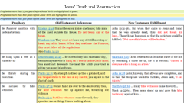
Acts 3:16-18 (NASB)
¹⁶ "And on the basis of faith in His name, it is the name of Jesus which has strengthened this man whom you see and know; and the faith which comes through Him has given him this perfect health in the presence of you all.
¹⁷ "And now, brethren, I know that you acted in ignorance, just as your rulers did also.
¹⁸ "But the things which God announced beforehand by the mouth of all the prophets, that His Christ would suffer, He has thus fulfilled.
A. This healing that causes you to marvel has come through the power of Jesus. Yes, the very one you killed. 1Pet 4:11
1. You and your rulers acted in ignorance: 1Cor 2:6-8; Eph 3:1-5
B. All the prophets predicted the suffering of the messiah: Acts 2:23
Ephesians 3:1-5 (NASB)
¹ For this reason I, Paul, the prisoner of Christ Jesus for the sake of you Gentiles—
² if indeed you have heard of the stewardship of God's grace which was given to me for you;
³ that by revelation there was made known to me the mystery, as I wrote before in brief.
⁴ By referring to this, when you read you can understand my insight into the mystery of Christ,
⁵ which in other generations was not made known to the sons of men, as it has now been revealed to His holy apostles and prophets in the Spirit;
1 Peter 4:11 (NASB)
¹¹ Whoever speaks, is to do so as one who is speaking the utterances of God; whoever serves is to do so as one who is serving by the strength which God supplies; so that in all things God may be glorified through Jesus Christ, to whom belongs the glory and dominion forever and ever. Amen.
1 Corinthians 2:6-8 (NASB)
⁶ Yet we do speak wisdom among those who are mature; a wisdom, however, not of this age nor of the rulers of this age, who are passing away;
⁷ but we speak God's wisdom in a mystery, the hidden wisdom which God predestined before the ages to our glory;
⁸ the wisdom which none of the rulers of this age has understood; for if they had understood it they would not have crucified the Lord of glory;
Acts 2:23 (NASB)
²³ this Man, delivered over by the predetermined plan and foreknowledge of God, you nailed to a cross by the hands of godless men and put Him to death.
Notes:
3/26/17

Slide 62

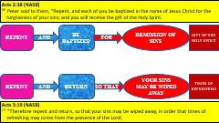
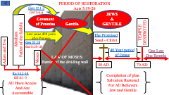
Acts 3:19-23 (NASB)
¹⁹ "Therefore repent and return, so that your sins may be wiped away, in order that times of refreshing may come from the presence of the Lord;
²⁰ and that He may send Jesus, the Christ appointed for you,
²¹ whom heaven must receive until the period of restoration of all things about which God spoke by the mouth of His holy prophets from ancient time.
²² "Moses said, 'THE LORD GOD WILL RAISE UP FOR YOU A PROPHET LIKE ME FROM YOUR BRETHREN; TO HIM YOU SHALL GIVE HEED to everything He says to you.
²³ 'And it will be that every soul that does not heed that prophet shall be utterly destroyed from among the people.'
A. Repent and Return so that your sins may be wiped out:
B. That he may send Jesus, the Christ appointed for you: references a future coming to Jews
1. Whom the heaven must receive until the restoration of all things:
a. Moses said: Dt 18:15-19
Deuteronomy 18:15-19 (NASB)
¹⁵ "The LORD your God will raise up for you a prophet like me from among you, from your countrymen, you shall listen to him.
¹⁶ "This is according to all that you asked of the LORD your God in Horeb on the day of the assembly, saying, 'Let me not hear again the voice of the LORD my God, let me not see this great fire anymore, or I will die.'
¹⁷ "The LORD said to me, 'They have spoken well.
¹⁸ 'I will raise up a prophet from among their countrymen like you, and I will put My words in his mouth, and he shall speak to them all that I command him.
¹⁹ 'It shall come about that whoever will not listen to My words which he shall speak in My name, I Myself will require it of him.
Notes:
Just as Peter had done is Acts 2 when he quoted Joel 2 which basically tells us who was under this coming judgment. Joel 2:32 leaves no doubt.
First sending of Christ to the Jews: Heb 1:1-2; jn 14
(Mt 17:9-13; Mt 19:28; Titus 3:5; Eph 5:25-27)

Slide 63
Acts 3:24-26 (NASB)
²⁴ "And likewise, all the prophets who have spoken, from Samuel and his successors onward, also announced these days.
²⁵ "It is you who are the sons of the prophets and of the covenant which God made with your fathers, saying to Abraham, 'AND IN YOUR SEED ALL THE FAMILIES OF THE EARTH SHALL BE BLESSED.'
²⁶ "For you first, God raised up His Servant and sent Him to bless you by turning every one of you from your wicked ways."
A. You are the sons of the prophets and of the covenant that God made with your fathers:
1. It is to your father Abraham that God spoke making the promise, “In your seed all the families of the earth shall be blessed.” Gen 22:18
2. God had raised up Jesus and first sent him to the Jews first. On Pentecost and on this very day. Hence the expression “to the Jew first”: Ro 1:16
Genesis 22:18 (NASB)
¹⁸ "In your seed all the nations of the earth shall be blessed, because you have obeyed My voice."
Romans 1:16 (NASB)
¹⁶ For I am not ashamed of the gospel, for it is the power of God for salvation to everyone who believes, to the Jew first and also to the Greek.

Slide 64
CHART BY
Mark Dunagan

Slide 65
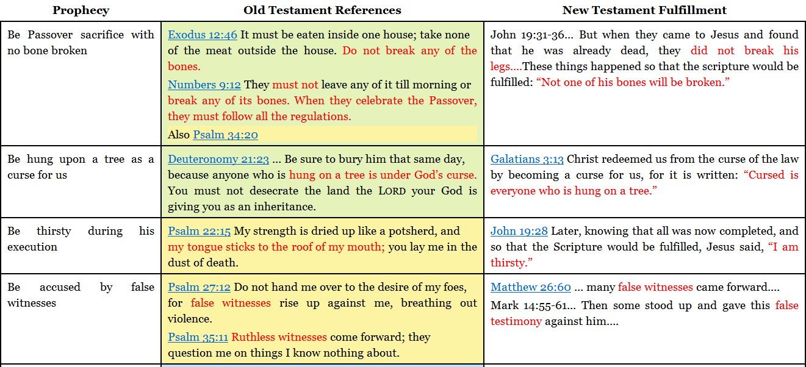
Jesus’ Death and Resurrection

Slide 66
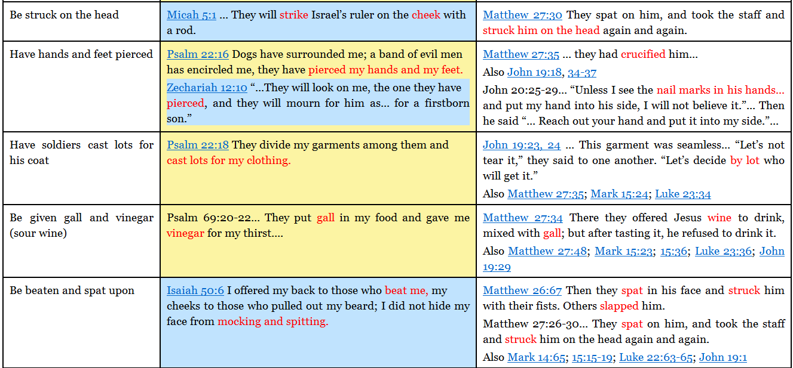
Jesus’ Death and Resurrection

Slide 67
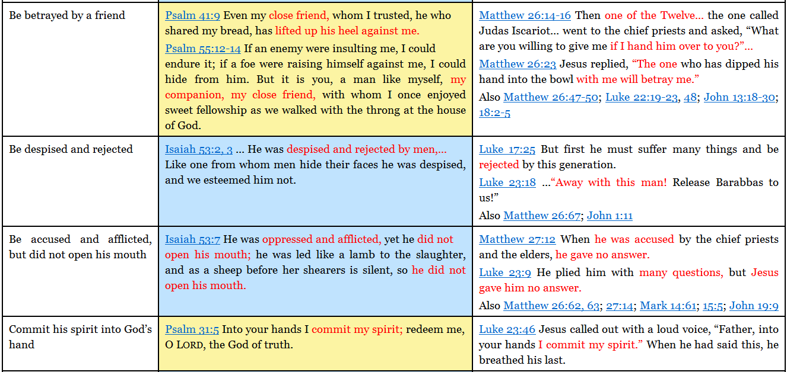
Jesus’ Death and Resurrection

Slide 68
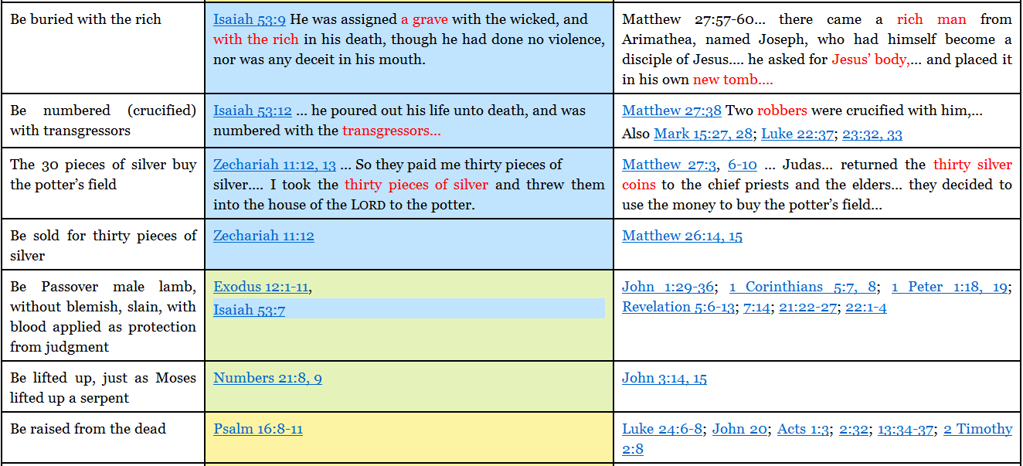
Jesus’ Death and Resurrection

Slide 69
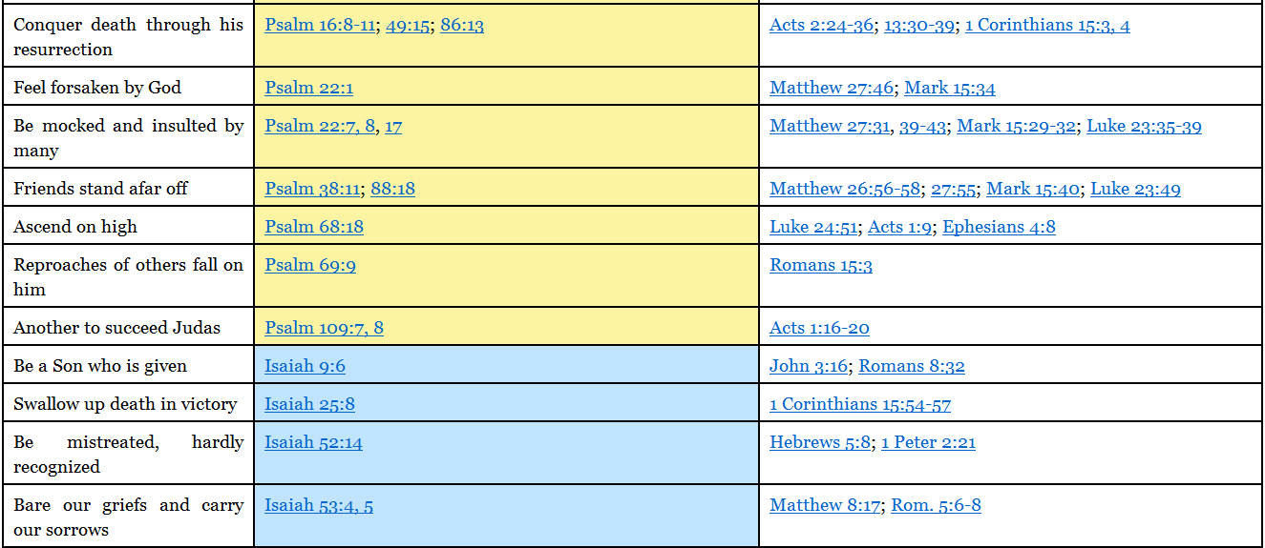
Jesus’ Death and Resurrection

Slide 70
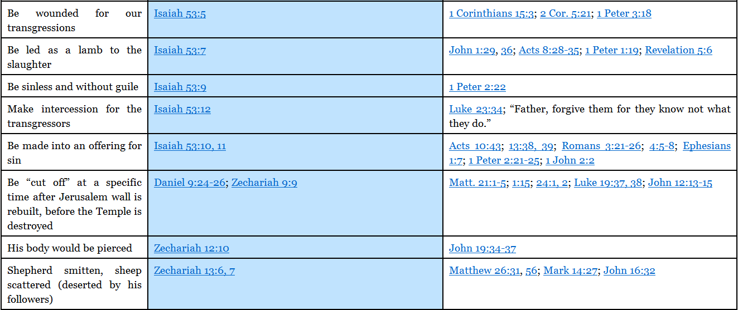
Jesus’ Death and Resurrection

Slide 71
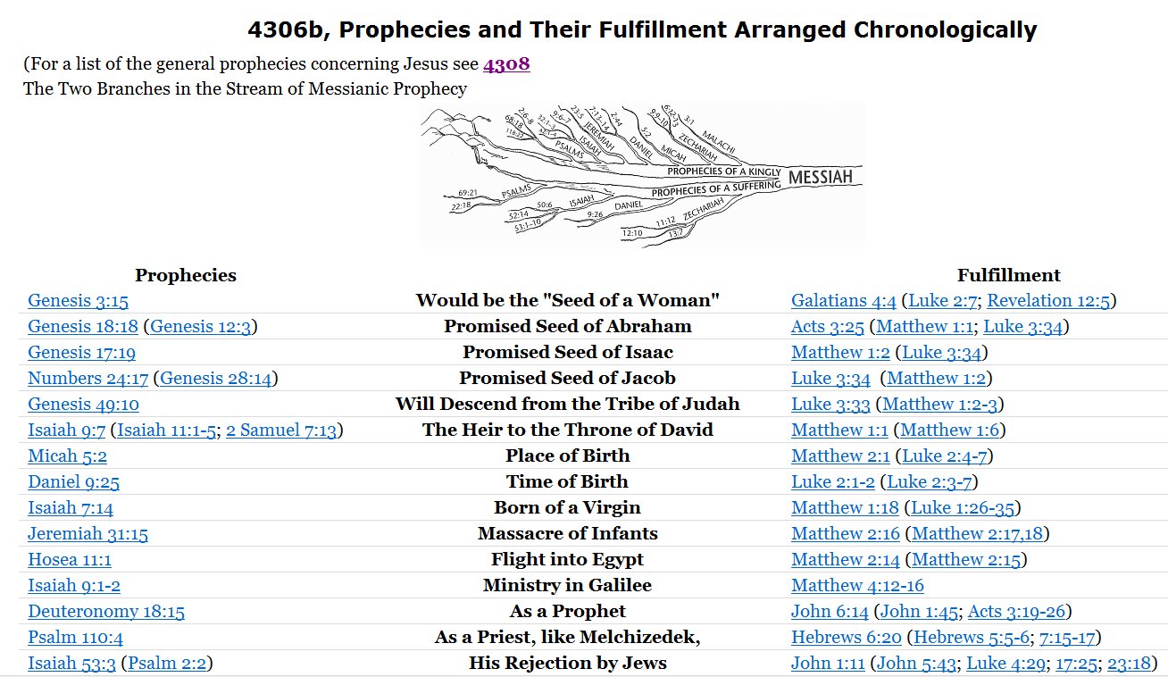


Slide 72
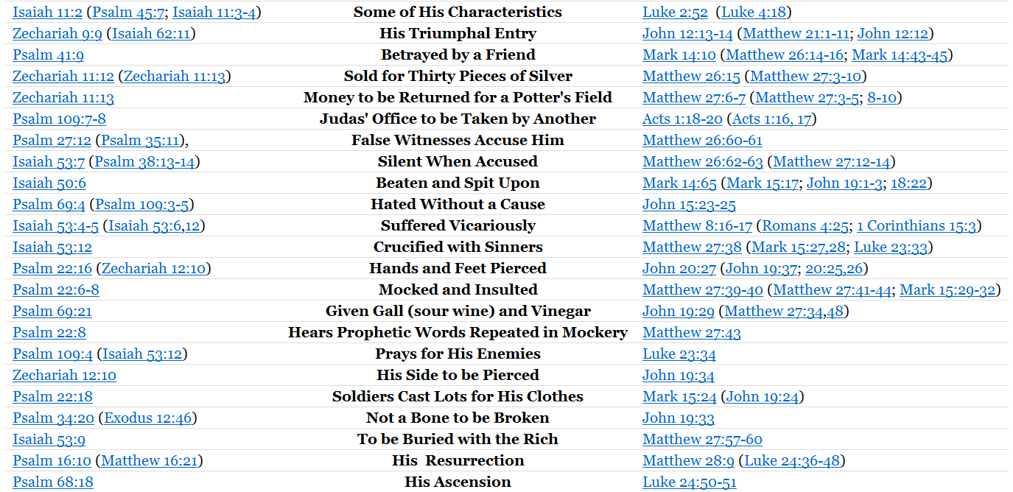

Slide 73

Strong's Number: <G5290>
Original Word: ὑποστρέφω, hypostrephō
Usage Notes: "to turn behind," or "back" (hypo, "under"), is translated "to return" ….. in Luke 1:56; Luke 2:20, 43; Luke 2:45, RV (AV, "turned back again"); Luke 4:1, 14; Luke 7:10; Luke 8:37; Luke 10:17; Luke 11:24, AV (RV, "I will turn back"); Luke 17:18; Luke 19:12; Luke 23:48, 56; Acts 1:12; Acts 12:25; Acts 13:13; Acts 13:34; Acts 20:3; Acts 21:6; Acts 22:17, RV (AV, "was come again"); Acts 23:32; Gal. 1:17; Heb. 7:1. See TURN (back).
Vine's Expository Dictionary of Old Testament and New Testament Words
(As can be seen in the cross references this word refers to an actual action - NAN)
Acts 2:38 (NASB)
³⁸ Peter said to them, "Repent, and each of you be baptized in the name of Jesus Christ for the forgiveness of your sins; and you will receive the gift of the Holy Spirit.
Greek NASB Number: 3340
Greek Word: μετανοέω
Transliterated Word: metanoeô
Root: from 3326 and 3539;
Definition: to change one's mind or purpose:--
List of English Words and Number of Times Used
repent (26), repented (5), repents (3).
New American Standard Exhaustive Concordance of the Bible
New Testament Usage
The most extensive repentance is a thoroughgoing change in one’s thinking, attitudes, and purpose. This is the deep-seated repentance spoken of in passages like Matthew 3:2 and Acts 3:19 where a thorough change of mind is urged. ……….. This repentance is stronger than remorse or emotional regret. Metanoeō portrays a change of mind so effective that Luke 15:7,10 assumes salvation for a sinner who has “repented.”
This “repentance” is required for entrance into the kingdom of heaven and is a subject of the apostolic preaching in Acts. ……..
Complete Biblical Library Greek-English Dictionary
Greek NASB Number: 1813
Greek Word: ἐξαλείφω
Transliterated Word: exaleiphô
Definition: to wipe out, erase, obliterate:--
List of English Words and Number of Times Used
canceled (1), erase (1), wipe (1), wipe away (1), wiped away (1).
New American Standard Exhaustive Concordance of the Bible
(all instances in the N.T. refer to forgiveness of sins - NAN)
401. ἀνάψυξις anapsuxis noun
Refreshing, relief, rest
Word Studies:
Anapsuxis is a medical term for treatment of a wound by exposure to air for cooling and drying (e.g., Hippocrates De Fracturis 25). In Exodus 8:15 in the Septuagint it translates rewāchâh which means “respite,” “relief,” or literally “room to breathe.” It came to mean “relief” or “refreshing” for either body or spirit. In Acts 3:19 (verse 20 in some translations), the only New Testament use, it refers to the times of refreshing promised those whose sins are forgiven.
Complete Biblical Library Greek-English Dictionary
Strong's Number: <G5290>
Original Word: ὑποστρέφω, hypostrephō
Usage Notes: "to turn behind," or "back" (hypo, "under"), is translated "to return" ….. in Luke 1:56; Luke 2:20, 43; Luke 2:45, RV (AV, "turned back again"); Luke 4:1, 14; Luke 7:10; Luke 8:37; Luke 10:17; Luke 11:24, AV (RV, "I will turn back"); Luke 17:18; Luke 19:12; Luke 23:48, 56; Acts 1:12; Acts 12:25; Acts 13:13; Acts 13:34; Acts 20:3; Acts 21:6; Acts 22:17, RV (AV, "was come again"); Acts 23:32; Gal. 1:17; Heb. 7:1. See TURN (back).
Vine's Expository Dictionary of Old Testament and New Testament Words
(As can be seen in the cross references this word refers to an actual action - NAN)
Matthew 3:2 (NASB)
² "Repent, for the kingdom of heaven is at hand."
REPENT
BE BAPTIZED
REMISSION OF SINS
GIFT OF THE HOLY SPIRIT
Luke 2:20 (NASB)
²⁰ The shepherds went back, glorifying and praising God for all that they had heard and seen, just as had been told them.
Luke 7:10 (NASB)
¹⁰ When those who had been sent returned to the house, they found the slave in good health.
AND
FOR
Luke 15:7, 10 (NASB)
⁷ "I tell you that in the same way, there will be more joy in heaven over one sinner who repents than over ninety-nine righteous persons who need no repentance.
¹⁰ "In the same way, I tell you, there is joy in the presence of the angels of God over one sinner who repents."
Exodus 8:15 (NASB)
¹⁵ But when Pharaoh saw that there was relief, he hardened his heart and did not listen to them, as the LORD had said. (from the plague of frogs - NAN)
Acts 1:12 (NASB)
¹² Then they returned to Jerusalem from the mount called Olivet, which is near Jerusalem, a Sabbath day's journey away.
Acts 26:20 (NASB)
²⁰ but kept declaring both to those of Damascus first, and also at Jerusalem and then throughout all the region of Judea, and even to the Gentiles, that they should repent and turn to God, performing deeds appropriate to repentance. (same Greek words used in Acts 3:19 – NAN)
Acts 2:41 (NASB)
⁴¹ So then, those who had received his word were baptized; and that day there were added about three thousand souls. (Baptism is the point of action when one returns - NAN)
Hebrews 7:1 (NASB)
¹ For this Melchizedek, king of Salem, priest of the Most High God, who met Abraham as he was returning from the slaughter of the kings and blessed him,
Matthew 3:8 (NASB)
⁸ "Therefore bear fruit in keeping with repentance;
REPENT
RETURN
YOUR SINS MAY BE WIPED AWAY
TIMES OF REFRESHING
AND
SO THAT
Acts 3:19 (NASB)
¹⁹ "Therefore repent and return, so that your sins may be wiped away, in order that times of refreshing may come from the presence of the Lord;
Notes:
Times of refreshing: if you replace sin with the frogs God destroyed from the land of Egypt and consider the great relief it was for Pharaoh, you can understand the relief that comes to the inner being of man when his sins are destroyed, blotted out, wiped away. RELIEF
Acts 2:38
Peter had taught them that Salvation would come to all those who call on the name of the Lord, 2:21
It is obvious they wanted to know how does one call on the name of the Lord to be saved so they ask “What shall we do?” 2:37
The gift is eternal life Rom 6:23

Slide 74
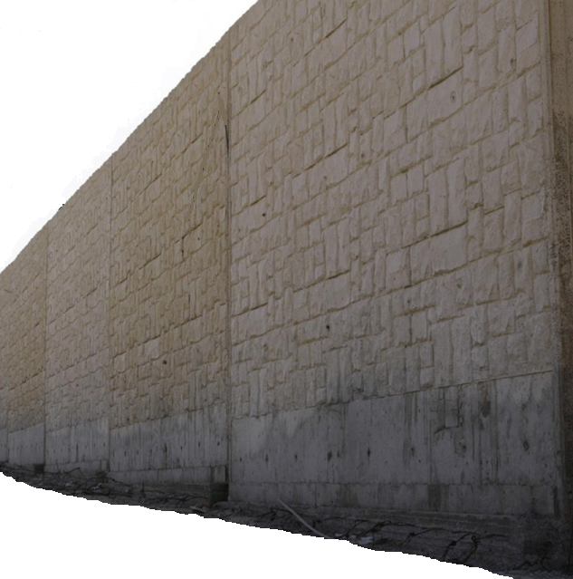
PERIOD OF RESTORATION
Acts 3:19-26
Gen 12:1-3
Gal 3:6-9
JEWS
&
GENTILE
Covenant of Promise
Gentile
JEWS
Law came 430 years after Promise
TEMPLE DESTROYED
The Promised Seed - Christ
Abraham
Father of the faithful
Gen 22:18
Gal 3:15-18
Adam and Eve
40 Year period of Grace
One Law
One Temple
Moses
LAW OF MOSES
Barrier of the dividing wall
Slide 28
30 AD
70 AD
Ro 5:12-14 GE 6:1-3
Completion of plan
Salvation Restored
For All Believers
Jew and Gentile
All Have Access And Are Accountable
Notes:
Acts 3:19-21; Eph 2:11-ff; Acts 15:13-18; Heb 9:8; Gen 22:15-18 – Gal 3:15-18 Gen 12:1-3 –Gal 3:6-9
Acts 3:19-21; Eph 2:11-ff; Acts 15:13-18; Heb 9:8; Gen 22:15-18 – Gal 3:15-18 Gen 12:1-3 –Gal 3:6-9- Col 2:14-17; Heb 8:13; 2Cor 3:12-18; Mt 10:23 – Mt 24:3, 29-31; Gal 2:7-10; 1Cor 9:20-21

Slide 75

Romans 5:12-14 (NASB)
¹² Therefore, just as through one man sin entered into the world, and death through sin, and so death spread to all men, because all sinned—
¹³ for until the Law sin was in the world, but sin is not imputed when there is no law.
¹⁴ Nevertheless death reigned from Adam until Moses, even over those who had not sinned in the likeness of the offense of Adam, who is a type of Him who was to come.
Genesis 6:1-3 (NASB)
¹ Now it came about, when men began to multiply on the face of the land, and daughters were born to them,
² that the sons of God saw that the daughters of men were beautiful; and they took wives for themselves, whomever they chose.
³ Then the LORD said, "My Spirit shall not strive with man forever, because he also is flesh; nevertheless his days shall be one hundred and twenty years."

Slide 76
Genesis 12:1-3 (NASB)
¹ Now the LORD said to Abram, "Go forth from your country, And from your relatives And from your father's house, To the land which I will show you;
² And I will make you a great nation, And I will bless you, And make your name great; And so you shall be a blessing;
³ And I will bless those who bless you, And the one who curses you I will curse. And in you all the families of the earth will be blessed."
Galatians 3:6-9 (NASB)
⁶ Even so Abraham BELIEVED GOD, AND IT WAS RECKONED TO HIM AS RIGHTEOUSNESS.
⁷ Therefore, be sure that it is those who are of faith who are sons of Abraham.
⁸ The Scripture, foreseeing that God would justify the Gentiles by faith, preached the gospel beforehand to Abraham, saying, "ALL THE NATIONS WILL BE BLESSED IN YOU."
⁹ So then those who are of faith are blessed with Abraham, the believer.

Slide 77
Genesis 22:18 (NASB)
¹⁸ "In your seed all the nations of the earth shall be blessed, because you have obeyed My voice."
Galatians 3:15-18 (NASB)
¹⁵ Brethren, I speak in terms of human relations: even though it is only a man's covenant, yet when it has been ratified, no one sets it aside or adds conditions to it.
¹⁶ Now the promises were spoken to Abraham and to his seed. He does not say, "And to seeds," as referring to many, but rather to one, "And to your seed," that is, Christ.
¹⁷ What I am saying is this: the Law, which came four hundred and thirty years later, does not invalidate a covenant previously ratified by God, so as to nullify the promise.
¹⁸ For if the inheritance is based on law, it is no longer based on a promise; but God has granted it to Abraham by means of a promise.

Slide 78
Hebrews 7:19 (NASB)
¹⁹ (for the Law made nothing perfect), and on the other hand there is a bringing in of a better hope, through which we draw near to God.
Galatians 3:19-22 (NASB)
¹⁹ Why the Law then? It was added because of transgressions, having been ordained through angels by the agency of a mediator, until the seed would come to whom the promise had been made.
²⁰ Now a mediator is not for one party only; whereas God is only one.
²¹ Is the Law then contrary to the promises of God? May it never be! For if a law had been given which was able to impart life, then righteousness would indeed have been based on law.
²² But the Scripture has shut up everyone under sin, so that the promise by faith in Jesus Christ might be given to those who believe.
Hebrews 8:7 (NASB)
7 For if that first covenant had been faultless, there would have been no occasion sought for a second.
Galatians 2:16 (NASB)
¹⁶ nevertheless knowing that a man is not justified by the works of the Law but through faith in Christ Jesus, even we have believed in Christ Jesus, so that we may be justified by faith in Christ and not by the works of the Law; since by the works of the Law no flesh will be justified.
Romans 3:20 (NASB)
²⁰ because by the works of the Law no flesh will be justified in His sight; for through the Law comes the knowledge of sin.

Slide 79
Galatians 3:23-29 (NASB)
²³ But before faith came, we were kept in custody under the law, being shut up to the faith which was later to be revealed.
²⁴ Therefore the Law has become our tutor to lead us to Christ, so that we may be justified by faith.
²⁵ But now that faith has come, we are no longer under a tutor.
²⁶ For you are all sons of God through faith in Christ Jesus.
²⁷ For all of you who were baptized into Christ have clothed yourselves with Christ.
²⁸ There is neither Jew nor Greek, there is neither slave nor free man, there is neither male nor f emale; for you are all one in Christ Jesus.
²⁹ And if you belong to Christ, then you are Abraham's descendants, heirs according to promise.
Ephesians 2:11-22 (NASB)
¹¹ Therefore remember that formerly you, the Gentiles in the flesh, who are called "Uncircumcision" by the so-called "Circumcision," which is performed in the flesh by human hands—
¹² remember that you were at that time separate from Christ, excluded from the commonwealth of Israel, and strangers to the covenants of promise, having no hope and without God in the world.
¹³ But now in Christ Jesus you who formerly were far off have been brought near by the blood of Christ.
¹⁴ For He Himself is our peace, who made both groups into one and broke down the barrier of the dividing wall,
¹⁵ by abolishing in His flesh the enmity, which is the Law of commandments contained in ordinances, so that in Himself He might make the two into one new man, thus establishing peace,
¹⁶ and might reconcile them both in one body to God through the cross, by it having put to death the enmity.
Acts 15:14-18 (NASB)
¹⁴ "Simeon has related how God first concerned Himself about taking from among the Gentiles a people for His name.
¹⁵ "With this the words of the Prophets agree, just as it is written,
¹⁶ 'AFTER THESE THINGS I will return, AND I WILL REBUILD THE TABERNACLE OF DAVID WHICH HAS FALLEN, AND I WILL REBUILD ITS RUINS, AND I WILL RESTORE IT,
¹⁷ SO THAT THE REST OF MANKIND MAY SEEK THE LORD, AND ALL THE GENTILES WHO ARE CALLED BY MY NAME,'
¹⁸ SAYS THE LORD, WHO MAKES THESE THINGS KNOWN FROM LONG AGO.
¹⁷ AND HE CAME AND PREACHED PEACE TO YOU WHO WERE FAR AWAY, AND PEACE TO THOSE WHO WERE NEAR;
¹⁸ for through Him we both have our access in one Spirit to the Father.
¹⁹ So then you are no longer strangers and aliens, but you are fellow citizens with the saints, and are of God's household,
(note: all the families of the earth blessed as one people – The Promise Gen 12:1-3)
²⁰ having been built on the foundation of the apostles and prophets, Christ Jesus Himself being the corner stone,
²¹ in whom the whole building, being fitted together, is growing into a holy temple in the Lord,
²² in whom you also are being built together into a dwelling of God in the Spirit.
(note: Jesus ultimately removed the Temple of old so that only one Temple of God exists. The church!)

Slide 80
Matthew 10:23 (NASB)
²³ "But whenever they persecute you in one city, flee to the next; for truly I say to you, you will not finish going through the cities of Israel until the Son of Man comes.
Acts 3:20-23 (NASB)
²⁰ and that He may send Jesus, the Christ appointed for you,
²¹ whom heaven must receive until the period of restoration of all things about which God spoke by the mouth of His holy prophets from ancient time.
²² "Moses said, 'THE LORD GOD WILL RAISE UP FOR YOU A PROPHET LIKE ME FROM YOUR BRETHREN; TO HIM YOU SHALL GIVE HEED to everything He says to you.
²³ 'And it will be that every soul that does not heed that prophet shall be utterly destroyed from among the people.'
Matthew 24:3 (NASB)
³ As He was sitting on the Mount of Olives, the disciples came to Him privately, saying, "Tell us, when will these things happen, and what will be the sign of Your coming, and of the end of the age?"
Matthew 24:29-31 (NASB)
²⁹ "But immediately after the tribulation of those days THE SUN WILL BE DARKENED, AND THE MOON WILL NOT GIVE ITS LIGHT, AND THE STARS WILL FALL from the sky, and the powers of the heavens will be shaken.
³⁰ "And then the sign of the Son of Man will appear in the sky, and then all the tribes of the earth will mourn, and they will see the SON OF MAN COMING ON THE CLOUDS OF THE SKY with power and great glory.
³¹ "And He will send forth His angels with A GREAT TRUMPET and THEY WILL GATHER TOGETHER His elect from the four winds, from one end of the sky to the other.
Hebrews 8:13 (NASB)
¹³ When He said, "A new covenant," He has made the first obsolete. But whatever is becoming obsolete and growing old is ready to disappear.
Hebrews 9:8 (NASB)
⁸ The Holy Spirit is signifying this, that the way into the holy place has not yet been disclosed while the outer tabernacle is still standing,

Slide 81
Ephesians 2:19-22 (NASB)
¹⁹ So then you are no longer strangers and aliens, but you are fellow citizens with the saints, and are of God's household,
²⁰ having been built on the foundation of the apostles and prophets, Christ Jesus Himself being the corner stone,
²¹ in whom the whole building, being fitted together, is growing into a holy temple in the Lord,
²² in whom you also are being built together into a dwelling of God in the Spirit.
Acts 3:22-23 (NASB)
²² "Moses said, 'THE LORD GOD WILL RAISE UP FOR YOU A PROPHET LIKE ME FROM YOUR BRETHREN; TO HIM YOU SHALL GIVE HEED to everything He says to you.
²³ 'And it will be that every soul that does not heed that prophet shall be utterly destroyed from among the people.'
1 Corinthians 9:20-21 (NASB)
²⁰ To the Jews I became as a Jew, so that I might win Jews; to those who are under the Law, as under the Law though not being myself under the Law, so that I might win those who are under the Law;
²¹ to those who are without law, as without law, though not being without the law of God but under the law of Christ, so that I might win those who are without law.
Romans 10:1-8 (NASB)
¹ Brethren, my heart's desire and my prayer to God for them is for their salvation.
² For I testify about them that they have a zeal for God, but not in accordance with knowledge.
³ For not knowing about God's righteousness and seeking to establish their own, they did not subject themselves to the righteousness of God.
⁴ For Christ is the end of the law for righteousness to everyone who believes.
⁵ For Moses writes that the man who practices the righteousness which is based on law shall live by that righteousness.
⁶ But the righteousness based on faith speaks as follows: "DO NOT SAY IN YOUR HEART, 'WHO WILL ASCEND INTO HEAVEN?' (that is, to bring Christ down),
⁷ or 'WHO WILL DESCEND INTO THE ABYSS?' (that is, to bring Christ up from the dead)."
⁸ But what does it say? "THE WORD IS NEAR YOU, IN YOUR MOUTH AND IN YOUR HEART"—that is, the word of faith which we are preaching,
Galatians 6:2 (NASB)
² Bear one another's burdens, and thereby fulfill the law of Christ.

Slide 82
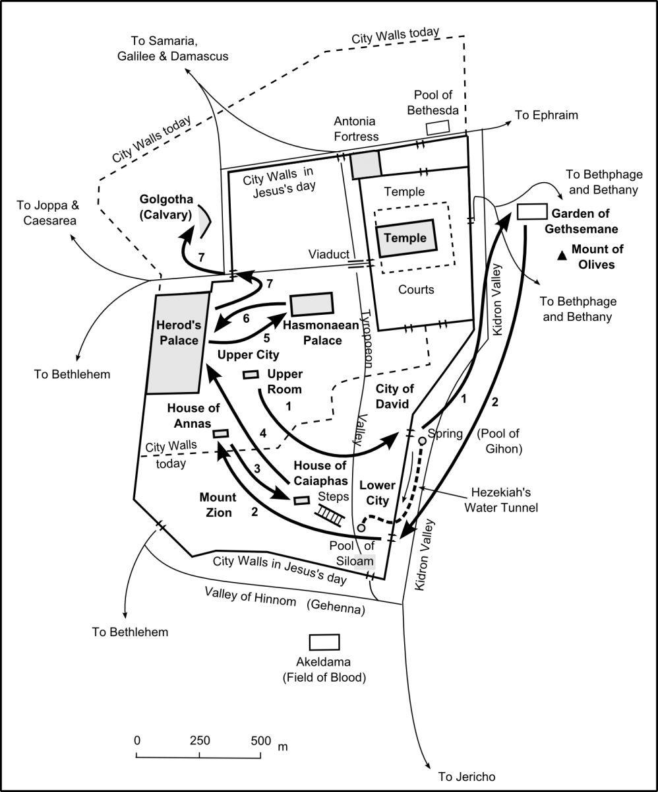

Slide 83
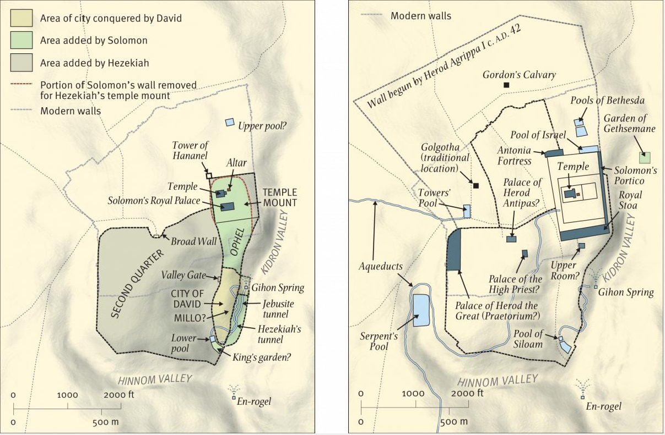

Slide 84
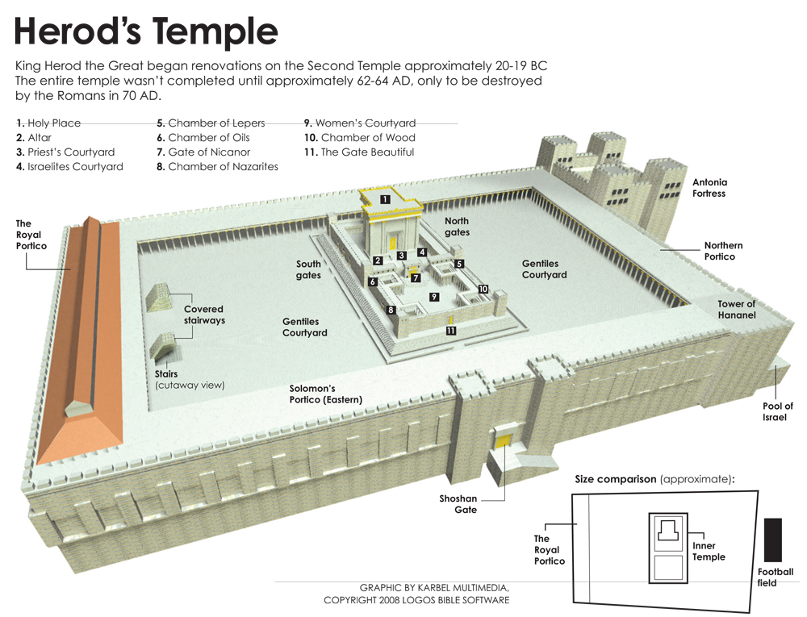

Slide 85
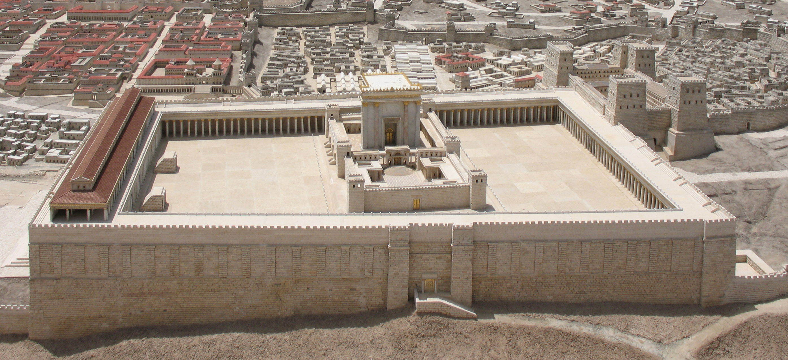

Slide 86
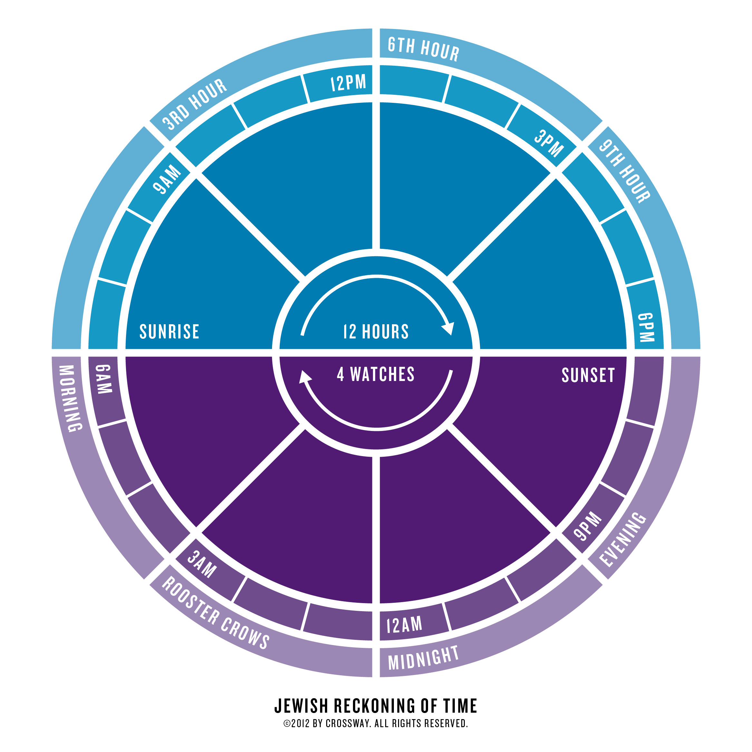

Slide 87
Acts Chapter Three

Slide 88

Acts 3:
¹ Now Peter and John went up together into the temple at the hour of prayer, being the ninth hour.
As this chapter begins, we do not know how long it had been since Pentecost.
The end of Chapter Two shows the passing of time.
Acts 2:46
And they, continuing daily with one accord in the temple, and breaking bread from house to house, did eat their meat with gladness and singleness of heart …

Slide 89
Acts 3:
¹ Now Peter and John went up together into the temple at the hour of prayer, being the ninth hour.
The Jews had three hours of prayer:
9 AM (the 3rd hour),
12 Noon (the 6th hour),
3 PM (the 9th hour).
The temple they attended was the second temple, known historically as Herod’s Temple.

Slide 90

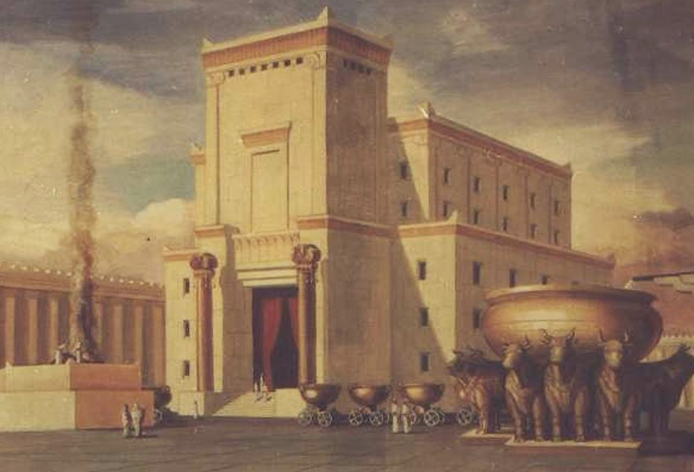
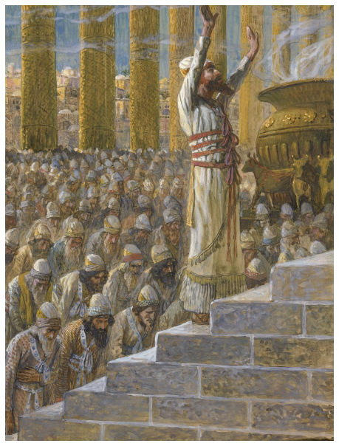
The first temple was designed by God, revealed to David, and built by Solomon.
Construction began in 967 BC.
Seven years later, Solomon dedicated it to the LORD.

Slide 91
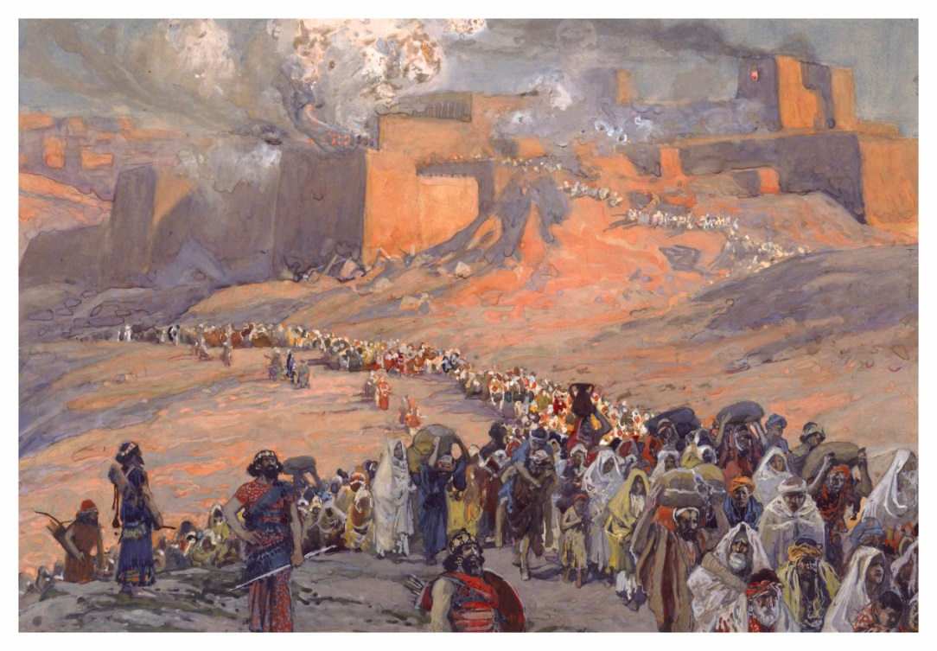
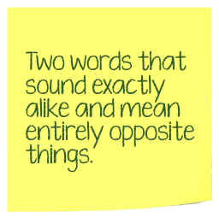
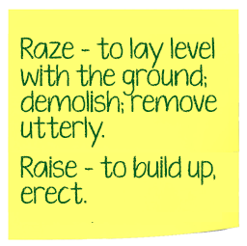
That temple was destroyed by the Babylonians
in 586 BC.
They razed Jerusalem and took the Jews into captivity.

Slide 92
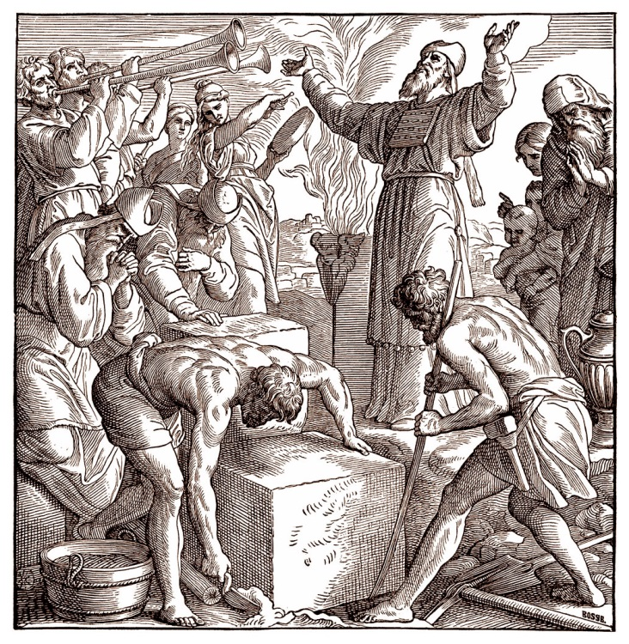

The Persian emperor Cyrus the Great decreed that a second temple be built.
The construction lasted from 536 to 516 BC.
The story is told in the books of Ezra and Nehemiah.
Born circa 600 BC; died 530 BC

Slide 93


Some 400 years later, King Herod the Great rebuilt the temple down to its foundation stones.

Slide 94
The work began in 19 BC and was finished in 64 AD.
This was the temple of Christ’s day.

Slide 95

The Holy Place was situated within a much larger complex called the Temple Mount.

Slide 96

The Temple Mount sat atop
Mt. Zion in the City of David.

Slide 97

Each level was tiered; each tier led to an area more restricted to the public.

Slide 98

This area was a public marketplace.
Matthew 21:12-13
¹² And Jesus went into the temple of God, and cast out all them that sold and bought in the temple, and overthrew the tables of the moneychangers, and the seats of them that sold doves,
¹³ And said unto them, It is written, My house shall be called the house of prayer; but ye have made it a den of thieves.

Slide 99

Any Gentile who passed this barricade could be put to death.
Ephesians 2:14:
For he is our peace, who hath made both one, and hath broken down the middle wall of partition between us;

Slide 100

"The Beautiful Gate" of Herod's temple was the outer one, made of Corinthian brass, surpassing in costliness even nine others of the outer court, which were covered with gold and silver. It was so heavy that twenty men were required to close it …”
Fausset’s Bible Dictionary

Slide 101

This is where Jesus honored the widow who put her last two mites into the treasury.
Mark 12:44
For all they did cast in of their abundance; but she of her want did cast in all that she had, even all her living.

Slide 102

The men of Israel who were not priests could observe the rites from here, but go no further.

Slide 103

This area was reserved for the temple priests.

Slide 104

Jesus never stepped foot inside this place.
Hebrews 9:24:
For Christ is not entered into the holy places made with hands, which are the figures of the true; but into heaven itself, now to appear in the presence of God for us:

Slide 105

This was a beautiful column-lined walkway located on the east side of the temple area.

Slide 106

“… a portion of the temple which according to Josephus remained from Solomon's time. It rose from a great depth, occupying part of the valley, and supported by a wall 400 cubits high, formed of immense stones, some 20 cubits long. The Chaldaeans spared it, perhaps for its strength and beauty.”
Fausett’s Bible Dictionary

Slide 107


John 10:23-24
²³ And Jesus walked in the temple in Solomon's porch.
²⁴ Then came the Jews round about him, and said unto him, How long dost thou make us to doubt? If thou be the Christ, tell us plainly.

Slide 108


Slide 109

Herod’s temple was more than twice the size of Solomon’s.

Slide 110

It was destroyed by the Romans in 70 AD, just 6 years after it was completed.

Slide 111

Mark 13:1-2
¹ And as he went out of the temple, one of his disciples saith unto him, Master, see what manner of stones and what buildings are here!
² And Jesus answering said unto him, Seest thou these great buildings? there shall not be left one stone upon another, that shall not be thrown down.

Slide 112

All that remains are the stones in the lowest section of the walls around the Temple Mount.
The Western Wall is also known as the Wailing Wall .

Slide 113

All that remains are the stones in the lowest section of the walls around the Temple Mount.
The Western Wall is also known as the Wailing Wall .

Slide 114

Back to Chapter 3:
¹ Now Peter and John went up together into the temple at the hour of prayer, being the ninth hour.
² And a certain man lame from his mother's womb was carried, whom they laid daily at the gate of the temple which is called Beautiful, to ask alms of them that entered into the temple;
³ Who seeing Peter and John about to go into the temple asked an alms.

Slide 115
⁴ And Peter, fastening his eyes upon him with John, said, Look on us.
⁵ And he gave heed unto them, expecting to receive something of them.
⁶ Then Peter said, Silver and gold have I none; but such as I have give I thee:
In the name of Jesus Christ of Nazareth rise up and walk.

Slide 116


Slide 117

⁷ And he took him by the right hand, and lifted him up: and immediately his feet and ankle bones received strength.
⁸ And he leaping up stood, and walked, and entered with them into the temple, walking, and leaping, and praising God.
⁹ And all the people saw him walking and praising God:
¹⁰ And they knew that it was he which sat for alms at the Beautiful gate of the temple: and they were filled with wonder and amazement at that which had happened unto him.
¹¹ And as the lame man which was healed held Peter and John, all the people ran together unto them in the porch that is called Solomon's, greatly wondering.
Here Peter begins his second recorded sermon:

Slide 118

¹² And when Peter saw it, he answered unto the people, Ye men of Israel, why marvel ye at this? or why look ye so earnestly on us, as though by our own power or holiness we had made this man to walk?
¹³ The God of Abraham, and of Isaac,
and of Jacob, the God of our fathers, hath glorified his Son Jesus; whom ye delivered up, and denied him in the presence of Pilate, when he was determined to let him go.
Christianity is not about our power or holiness. It is about the power and holiness of Christ.
For the second time, Peter charged the Jews with complicity in the death of Christ.

Slide 119
¹⁴ But ye denied the Holy One
and the Just, and desired a murderer to be granted unto you;
¹⁵ And killed the Prince of life,
whom God hath raised from the dead; whereof we are witnesses.
Mark 15:7-13: And there was one named Barabbas, which lay bound with them that had made insurrection with him, who had committed murder in the insurrection.
⁸ And the multitude crying aloud began to desire him to do as he had ever done unto them.
⁹ But Pilate answered them, saying, Will ye that I release unto you the King of the Jews?
¹⁰ For he knew that the chief priests had delivered him for envy.
¹¹ But the chief priests moved the people, that he should rather release Barabbas unto them.
¹² And Pilate answered and said again unto them, What will ye then that I shall do unto him whom ye call the King of the Jews?
¹³ And they cried out again, Crucify him.

Slide 120
¹⁶ And his name through faith in his name hath made this man strong, whom ye see and know: yea, the faith which is by him hath given him this perfect soundness in the presence of you all.
This was not the first healing done by Peter and John. But this was the first done in the name of Jesus Christ!
This was not an entirely new thing.
Deuteronomy 18:7: Then he shall minister in the name of the LORD his God, as all his brethren the Levites do, which stand there before the LORD.
1 Samuel 17:45: Then said David to the Philistine, Thou comest to me with a sword, and with a spear, and with a shield: but I come to thee in the name of the LORD of hosts, the God of the armies of Israel, whom thou hast defied.
To act in the name of Jesus is to act in the name of the LORD.

Slide 121
¹⁷ And now, brethren, I know that through ignorance ye did it, as did also your rulers.
¹⁸ But those things, which God before had shewed by the mouth of all his prophets, that Christ should suffer, he hath so fulfilled.
¹⁹ Repent ye therefore, and be converted, that your sins may be blotted out, when the times of refreshing shall come from the presence of the Lord;
A main theme in this sermon is that Christ is the Messiah of prophecy.
Acts 2:38 Then Peter said unto them, Repent, and be baptized every one of you in the name of Jesus Christ for the remission of sins, and ye shall receive the gift of the Holy Ghost.
To preach forgiveness without preaching repentance gives license to sin.
To preach repentance without preaching forgiveness leads to legalism.

Slide 122
²⁰ And he shall send Jesus Christ, which before was preached unto you:
²¹ Whom the heaven must receive until the times of restitution of all things, which God hath spoken by the mouth of all his holy prophets since the world began.

Slide 123
²² For Moses truly said unto the fathers, A prophet shall the Lord your God raise up unto you of your brethren, like unto me; him shall ye hear in all things whatsoever he shall say unto you.
²³ And it shall come to pass, that every soul, which will not hear that prophet, shall be destroyed from among the people.
²⁴ Yea, and all the prophets from Samuel and those that follow after, as many as have spoken, have likewise foretold of these days.
Deuteronomy 18:15
The LORD thy God will raise up unto thee a Prophet from the midst of thee, of thy brethren, like unto me; unto him ye shall hearken;
Deuteronomy 18:19
And it shall come to pass, that whosoever will not hearken unto my words which he shall speak in my name, I will require it of him.

Slide 124
²⁵ Ye are the children of the prophets, and of the covenant which God made with our fathers, saying unto Abraham, And in thy seed shall all the kindreds of the earth be blessed.
Genesis 12:3 And I will bless them that bless thee, and curse him that curseth thee: and in thee shall all families of the earth be blessed.
The covenants God had made with Abraham, Isaac, and Jacob defined the Jews as a people, and established their relationship with God.
They were the men of Israel – Israel being a MAN, not a PLACE.
Not all of Israel (the place) are of Israel (the man).
Romans 9:6 Not as though the word of God hath taken none effect. For they are not all Israel, which are of Israel:

Slide 125

Abraham had two sons.

Slide 126

Abraham had two sons.
The Covenant included only Isaac.

Slide 127

Abraham had two sons.
The Covenant included only Isaac.
Genesis 17:19
And God said, Sarah thy wife shall bear thee a son indeed; and thou shalt call his name Isaac: and I will establish my covenant with him for an everlasting covenant, and with his seed after him.

Slide 128
Isaac had two sons.

Slide 129

Isaac had two sons:
The Covenant included only Jacob.

Slide 130

Isaac had two sons.
The Covenant included only Jacob.
Genesis 35:10-12
¹¹ And God said unto him, I am God Almighty: be fruitful and multiply; a nation and a company of nations shall be of thee, and kings shall come out of thy loins;
¹² And the land which I gave Abraham and Isaac, to thee I will give it, and to thy seed after thee will I give the land.

Slide 131
God changed Jacob’s name to Israel, and made him the patriarch of the twelve tribes.

Slide 132

God changed Jacob’s name to Israel, and made him the patriarch of the twelve tribes.
Genesis 35:10-12
And God said unto him, Thy name is Jacob: thy name shall not be called any more Jacob, but Israel shall be thy name: and he called his name Israel.

Slide 133
When God appeared to Moses, he said, “I AM the God of thy father, the God of Abraham, the God of Isaac, and the God of Jacob” (Exodus 3:6).
The LORD God is the God of Abraham, Isaac, and Jacob.
The Children of Israel are the children of the covenant.

Slide 134
Here is the finale to Peter’s sermon:
²⁵ Ye are the children of the prophets, and of the covenant which God made with our fathers, saying unto Abraham, And in thy seed shall all the kindreds of the earth be blessed.
²⁶ Unto you first God, having raised up his Son Jesus, sent him to bless you, in turning away every one of you from his iniquities.
If Peter thought about it, he might have wondered why he didn’t say, “unto you ONLY.”
But the Gospel of Jesus always was, and always will be “to the Jew first.”

Slide 135
The Acts of the Apostles
Chapter 3

Slide 136
Acts 3:1-5 The Lame Man
“Hour of prayer,” a church ordinance? (1)
  Note: 2:46 … can we use the temple today?
  Jewish “hour of prayer” (Lk. 1:10; Dan. 6:10)
  Many Jewish traditions kept at this time
How did lame man get to the temple? (2)
What did Peter and John first command? (4)
What did he expect from this? (5)
What is the significance …
  “In the name of Jesus Christ of Nazareth …” (6)
  Let’s hold of until vs. 16

Slide 137
Acts 3:7-11 Nature of Bible Miracles
How many hands did Peter use? (7)
  How long did it take? (7)
  Did he require rehab?
How public was this event? (9)
  Were they familiar with the man? (10)
  What were there responses? (10)
  Did they just let it go at that? (11)
Note 2:43 – this is just one such miracle
  Probably noted because of what follows …

Slide 138
Acts 3:12-16 Peter’s 2nd Recorded
Would they generally have heard …
  Of Pentecost?
  Of Jesus in general?
What was the purpose of the miracle? (12)
Who did Peter give the credit to? (12)
Who did he blame? (13-14)
Who were the witnesses? (15)
What role did faith play? (16)
  Who had faith?
  Who was “his name?”
  Acting by Jesus authority (John 16:23)

Slide 139
Acts 3:17-19 Peter’s Admonition
John 16:23
Whatsoever ye shall ask the Father in my name, He will give it you.
Was ignorance an excuse? (17-18)
  Why not, especially in their case? (18)
  Mitigated by their misunderstanding
So what did Peter command? (19)
  Is this the total solution, as in Acts 2:38?
  Or was it part of his initial remarks?

Slide 140
Acts 3:19-21 The Promises
What was promised if they obeyed?
  Sins blotted out (19)
  “Seasons of refreshing” (19) Mt. 11:28-30
  “Send the Christ” (20)
What delays the return of Christ? (21)
  Heaven must receive (Jn. 16:7)
  Restoration, restitution …
    … whereof God spoke by whom? (21)
    Compare with Acts 2:35:
.
Till I make thine enemies the footstool of thy feet.

Slide 141
Acts 3:22-26 (Dt. 18:15-19)
How was Jesus like Moses? (22)
What was Moses’ command? (22)
What consequences of disobedience? (23)
  Examples from the Old Testament?
  Examples in Acts? (Acts 5)
  Was this absolutely applied to everyone?
  Is this absolute in the spiritual sense?
Who told of “these days?” (24)
Should they be familiar with this? (25)
What covenant did he remind them? (25)
Who was to be blessed first? (26)
  What does this imply? … others next?

Slide 142
L.D. CARY & SAM HOLT CATCH PHRASES
Chapter 1 – “Jesus’ Work On Earth Is Done”
Chapter 2 – “Peter Baptizes A Crew”
Chapter 3 – “A Beggar’s Plea”
Chapter 4 – “A Jailhouse Door”
Chapter 5 – “Ananias & Sapphira Don’t Survive”
Chapter 6 – “The Widow’s Fix”
Chapter 8 – “Stephen Looks Into Heaven”
Chapter 9 – “Saul Struck Blind”
“A Jailhouse Door”
Catch Phrase
Chapter Four

Slide 143

ACTS 4
Jesus’ Primary Religious Opponents – Pharisees
Apostle’s Primary Religious Opponents - Sadducees
HEROD’S TEMPLE

Slide 144
CHART BY
Mark Dunagan

Slide 145

Acts 4:1-4 (NASB)
¹ As they were speaking to the people, the priests and the captain of the temple guard and the Sadducees came up to them,
² being greatly disturbed because they were teaching the people and proclaiming in Jesus the resurrection from the dead.
³ And they laid hands on them and put them in jail until the next day, for it was already evening.
⁴ But many of those who had heard the message believed; and the number of the men came to be about five thousand.
A. The Priests were of the Sadducee party. The Temple guard (sagan) was of the Priests family and was considered a stepping stone office leading to High Priest.
1. The Sadducees did not accept Oral Traditions as authoritative. They maintained that only the scriptures were authoritative. Mt 16:6-12
2. Up until this point, Jewish Christians had no resistance from Jewish leaders or the people. Acts 2:47
Matthew 16:6-12 (NASB)
6 And Jesus said to them, "Watch out and beware of the leaven of the Pharisees and Sadducees."
7 They began to discuss this among themselves, saying, "He said that because we did not bring any bread."
8 But Jesus, aware of this, said, "You men of little faith, why do you discuss among yourselves that you have no bread?
9 "Do you not yet understand or remember the five loaves of the five thousand, and how many baskets full you picked up?
10 "Or the seven loaves of the four thousand, and how many large baskets full you picked up?
11 "How is it that you do not understand that I did not speak to you concerning bread? But beware of the leaven of the Pharisees and Sadducees."
12 Then they understood that He did not say to beware of the leaven of bread, but of the teaching of the Pharisees and Sadducees.
Acts 2:47 (NASB)
⁴⁷ praising God and having favor with all the people. And the Lord was adding to their number day by day those who were being saved.
Notes:
1. This is the beginning of Jewish resistance against the early church. The first of two arrests of the Apostles.

Slide 146
Acts 4:1-4 (NASB)
¹ As they were speaking to the people, the priests and the captain of the temple guard and the Sadducees came up to them,
² being greatly disturbed because they were teaching the people and proclaiming in Jesus the resurrection from the dead.
³ And they laid hands on them and put them in jail until the next day, for it was already evening.
⁴ But many of those who had heard the message believed; and the number of the men came to be about five thousand.
3. The outcome of this days preaching was spiritually profitable for the church. Acts 4:4
4. It was the doctrines being taught that alarmed the Sadducees. Acts 23:6-9
Acts 23:6-9 (NASB)
⁶ But perceiving that one group were Sadducees and the other Pharisees, Paul began crying out in the Council, "Brethren, I am a Pharisee, a son of Pharisees; I am on trial for the hope and resurrection of the dead!"
⁷ As he said this, there occurred a dissension between the Pharisees and Sadducees, and the assembly was divided.
⁸ For the Sadducees say that there is no resurrection, nor an angel, nor a spirit, but the Pharisees acknowledge them all.
⁹ And there occurred a great uproar; and some of the scribes of the Pharisaic party stood up and began to argue heatedly, saying, "We find nothing wrong with this man; suppose a spirit or an angel has spoken to him?"
Acts 4:4 (NASB)
⁴ But many of those who had heard the message believed; and the number of the men came to be about five thousand.
Notes:
1. This is the beginning of Jewish resistance against the early church. The first of two arrests of the Apostles.

Slide 147


Acts 4:5-7 (NASB)
⁵ On the next day, their rulers and elders and scribes were gathered together in Jerusalem;
⁶ and Annas the high priest was there, and Caiaphas and John and Alexander, and all who were of high-priestly descent.
⁷ When they had placed them in the center, they began to inquire, "By what power, or in what name, have you done this?"
A. Verses 5-6 - rulers, elders, and scribes. Annas the High Priest, Caiaphas and those of priestly decent: The Sanhedrin is the Roman authorized authority over the Jewish people in religious matters, with certain limitations. Mt 5:22;
Jn 18:12-13; Lk 22:66-67; (two slides); Jn 18:28-31;
Matthew 5:22 (NASB)
²² "But I say to you that everyone who is angry with his brother shall be guilty before the court; and whoever says to his brother, 'You good-for-nothing,' shall
be guilty before the supreme court; and whoever says, 'You fool,' shall be guilty enough to go into the fiery hell.
John 18:12-13 (NASB77)
12 So the Roman cohort and the commander, and the officers of the Jews, arrested Jesus and bound Him,
13 and led Him to Annas first; for he was father-in-law of Caiaphas, who was high priest that year.
Luke 22:66-67 (NASB)
⁶⁶ When it was day, the Council of elders of the people assembled, both chief priests and scribes, and they led Him away to their council chamber, saying,
⁶⁷ "If You are the Christ, tell us." But He said to them, "If I tell you, you will not believe;
John 18:28-31 (NASB77)
28 They •led Jesus therefore from Caiaphas into the Praetorium, and it was early; and they themselves did not enter into the Praetorium in order that they might not be defiled, but might eat the Passover.
29 Pilate therefore went out to them, and •said, "What accusation do you bring against this Man?"
30 They answered and said to him, "If this Man were not an evildoer, we would not have delivered Him up to you."
31 Pilate therefore said to them, "Take Him yourselves, and judge Him according to your law." The Jews said to him, "We are not permitted to put anyone to death," (this is a Roman limitation to the Sanhedrin’s rule)
Notes:
A. Annas the former High Priest, is Caiaphas’ father in law. Caiaphas is High Priest at this time, and as such, he is the leader of the Sanhedrin

Slide 148
Acts 4:8-10 (NASB)
⁸ Then Peter, filled with the Holy Spirit, said to them, "Rulers and elders of the people,
⁹ if we are on trial today for a benefit done to a sick man, as to how this man has been made well,
¹⁰ let it be known to all of you and to all the people of Israel, that by the name of Jesus Christ the Nazarene, whom you crucified, whom God raised from the dead—by this name this man stands here before you in good health.
B. Peter and John did not need to plan their defense: Lk 12:11-12; 21:14-15
1. The Holy Spirit does not use tact but gets right to the truth of the matter: Act 2:22-23; Acts 3:12-15
Acts 3:12-15 (NASB)
¹² But when Peter saw this, he replied to the people, "Men of Israel, why are you amazed at this, or why do you gaze at us, as if by our own power or piety we had made him walk?
¹³ "The God of Abraham, Isaac and Jacob, the God of our fathers, has glorified His servant Jesus, the one whom you delivered and disowned in the presence of Pilate, when he had decided to release Him.
Acts 2:22-23 (NASB)
²² "Men of Israel, listen to these words: Jesus the Nazarene, a man attested to you by God with miracles and wonders and signs which God performed through Him in your midst, just as you yourselves know—
²³ this Man, delivered over by the predetermined plan and foreknowledge of God, you nailed to a cross by the hands of godless men and put Him to death.
¹⁴ "But you disowned the Holy and Righteous One and asked for a murderer to be granted to you,
¹⁵ but put to death the Prince of life, the one whom God raised from the dead, a fact to which we are witnesses.
Luke 12:11-12 (NASB)
¹¹ "When they bring you before the synagogues and the rulers and the authorities, do not worry about how or what you are to speak in your defense, or what you are to say;
¹² for the Holy Spirit will teach you in that very hour what you ought to say."
Luke 21:14-15 (NASB)
¹⁴ "So make up your minds not to prepare beforehand to defend yourselves;
¹⁵ for I will give you utterance and wisdom which none of your opponents will be able to resist or refute.
Notes:
A. Annas the former High Priest, is Caiaphas’ father in law. Caiaphas is High Priest at this time ; John and Alexander are unknown except this mention in the scripture.
1. He gives the credit for the miracle which they cannot deny because he is standing right in front of them to Jesus. The same Jesus that they rejected as being the Messiah and killed. The Holy Spirit does not use tact when addressing those who took part in the killing of Jesus. They needed to own up to what they had done. There is no way to sugar coat this.

Slide 149
Acts 4:11-14 (NASB)
¹¹ "He is the STONE WHICH WAS REJECTED by you, THE BUILDERS, but WHICH BECAME THE CHIEF CORNER stone.
¹² "And there is salvation in no one else; for there is no other name under heaven that has been given among men by which we must be saved."
¹³ Now as they observed the confidence of Peter and John and understood that they were uneducated and untrained men, they were amazed, and began to recognize them as having been with Jesus.
¹⁴ And seeing the man who had been healed standing with them, they had nothing to say in reply.
A. The Holy Spirit’s use of prophecy is reminiscent to our Lords use of this same prophecy: Psa 118:22; Isa 28:16;
1. The Jews applied this to David, in the Targum.
Psalm 118:22 (NASB)
²² The stone which the builders rejected Has become the chief corner stone.
COMPARE
Isaiah 28:16 (NASB)
¹⁶ Therefore thus says the Lord GOD, "Behold, I am laying in Zion a stone, a tested stone, A costly cornerstone for the foundation, firmly placed. He who believes in it will not be disturbed.
Notes:
Tar·gum
ˈtärˌɡo͝om,-ˌɡo͞om/
noun
an ancient Aramaic paraphrase or interpretation of the Hebrew Bible, of a type made from about the 1st century AD when Hebrew was declining as a spoken language.

Slide 150
Acts 4:11-14 (NASB)
¹¹ "He is the STONE WHICH WAS REJECTED by you, THE BUILDERS, but WHICH BECAME THE CHIEF CORNER stone.
¹² "And there is salvation in no one else; for there is no other name under heaven that has been given among men by which we must be saved."
¹³ Now as they observed the confidence of Peter and John and understood that they were uneducated and untrained men, they were amazed, and began to recognize them as having been with Jesus.
¹⁴ And seeing the man who had been healed standing with them, they had nothing to say in reply.
2. But Jesus applied it to himself and so did Peter and Paul through the Holy Spirit: Mt 21:42-45; 1Pet 2:6-8; Ro 9:30-33; Eph 2:19-22
3. The Sanhedrin observed them to be ignorant men, who crafted an eloquent argument with undeniable proof that pressed them into a corner from which there was no escape.
1 Peter 2:4-8 (NASB)
⁴ And coming to Him as to a living stone which has been rejected by men, but is choice and precious in the sight of God,
⁵ you also, as living stones, are being built up as a spiritual house for a holy priesthood, to offer up spiritual sacrifices acceptable to God through Jesus Christ.
⁶ For this is contained in Scripture: "BEHOLD, I LAY IN ZION A CHOICE STONE, A PRECIOUS CORNER stone, AND HE WHO BELIEVES IN HIM WILL NOT BE DISAPPOINTED."
Ephesians 2:19-22 (NASB)
¹⁹ So then you are no longer strangers and aliens, but you are fellow citizens with the saints, and are of God's household,
²⁰ having been built on the foundation of the apostles and prophets, Christ Jesus Himself being the corner stone,
²¹ in whom the whole building, being fitted together, is growing into a holy temple in the Lord,
²² in whom you also are being built together into a dwelling of God in the Spirit.
Matthew 21:42-45 (NASB)
⁴² Jesus *said to them, "Did you never read in the Scriptures, 'THE STONE WHICH THE BUILDERS REJECTED, THIS BECAME THE CHIEF CORNER stone; THIS CAME ABOUT FROM THE LORD, AND IT IS MARVELOUS IN OUR EYES'?
⁴³ "Therefore I say to you, the kingdom of God will be taken away from you and given to a people, producing the fruit of it.
⁴⁴ "And he who falls on this stone will be broken to pieces; but on whomever it falls, it will scatter him like dust."
Romans 9:30-33 (NASB)
³⁰ What shall we say then? That Gentiles, who did not pursue righteousness, attained righteousness, even the righteousness which is by faith;
³¹ but Israel, pursuing a law of righteousness, did not arrive at that law.
³² Why? Because they did not pursue it by faith, but as though it were by works. They stumbled over the stumbling stone,
³³ just as it is written, "BEHOLD, I LAY IN ZION A STONE OF STUMBLING AND A ROCK OF OFFENSE, AND HE WHO BELIEVES IN HIM WILL NOT BE DISAPPOINTED."
⁴⁵ When the chief priests and the Pharisees heard His parables, they understood that He was speaking about them.
⁷ This precious value, then, is for you who believe; but for those who disbelieve, "THE STONE WHICH THE BUILDERS REJECTED, THIS BECAME THE VERY CORNER stone,"
⁸ and, "A STONE OF STUMBLING AND A ROCK OF OFFENSE"; for they stumble because they are disobedient to the word, and to this doom they were also appointed.

Slide 151
Acts 4:15-20 (NASB)
¹⁵ But when they had ordered them to leave the Council, they began to confer with one another,
¹⁶ saying, "What shall we do with these men? For the fact that a noteworthy miracle has taken place through them is apparent to all who live in Jerusalem, and we cannot deny it.
¹⁷ "But so that it will not spread any further among the people, let us warn them to speak no longer to any man in this name."
¹⁸ And when they had summoned them, they commanded them not to speak or teach at all in the name of Jesus.
¹⁹ But Peter and John answered and said to them, "Whether it is right in the sight of God to give heed to you rather than to God, you be the judge;
²⁰ for we cannot stop speaking about what we have seen and heard."
A. No matter what men may do - God must be obeyed: Mt 10:26-28;
Mt 5:11-16; Heb 13:6-7;
Matthew 10:26-28 (NASB)
²⁶ "Therefore do not fear them, for there is nothing concealed that will not be revealed, or hidden that will not be known.
²⁷ "What I tell you in the darkness, speak in the light; and what you hear whispered in your ear, proclaim upon the housetops.
²⁸ "Do not fear those who kill the body but are unable to kill the soul; but rather fear Him who is able to destroy both soul and body in hell.
Matthew 5:11-16 (NASB)
¹¹ "Blessed are you when people insult you and persecute you, and falsely say all kinds of evil against you because of Me.
¹² "Rejoice and be glad, for your reward in heaven is great; for in the same way they persecuted the prophets who were before you.
¹³ "You are the salt of the earth; but if the salt has become tasteless, how can it be made salty again? It is no longer good for anything, except to be thrown out and trampled under foot by men.
¹⁴ "You are the light of the world. A city set on a hill cannot be hidden;
¹⁵ nor does anyone light a lamp and put it under a basket, but on the lampstand, and it gives light to all who are in the house.
¹⁶ "Let your light shine before men in such a way that they may see your good works, and glorify your Father who is in heaven.
Hebrews 13:6-7 (NASB)
⁶ so that we confidently say, "THE LORD IS MY HELPER, I WILL NOT BE AFRAID. WHAT WILL MAN DO TO ME?"
⁷ Remember those who led you, who spoke the word of God to you; and considering the result of their conduct, imitate their faith.
Notes:
5/7/17

Slide 152
Acts 4:21-22 (NASB)
²¹ When they had threatened them further, they let them go (finding no basis on which to punish them) on account of the people, because they were all glorifying God for what had happened;
²² for the man was more than forty years old on whom this miracle of healing had been performed.
1. Evidence, an undeniable miracle prevented punishment and confirmed the word they spoke: Mk 16:20; Heb 2:1-4
Mark 16:20 (NASB)
²⁰ And they went out and preached everywhere, while the Lord worked with them, and confirmed the word by the signs that followed.
Hebrews 2:1-4 (NASB)
¹ For this reason we must pay much closer attention to what we have heard, so that we do not drift away from it.
² For if the word spoken through angels proved unalterable, and every transgression and disobedience received a just penalty,
³ how will we escape if we neglect so great a salvation? After it was at the first spoken through the Lord, it was confirmed to us by those who heard,
⁴ God also testifying with them, both by signs and wonders and by various miracles and by gifts of the Holy Spirit according to His own will.
Notes:
5/7/17

Slide 153
Acts 4:23-24 (NASB)
²³ When they had been released, they went to their own companions and reported all that the chief priests and the elders had said to them.
²⁴ And when they heard this, they lifted their voices to God with one accord and said, "O Lord, it is You who MADE THE HEAVEN AND THE EARTH AND THE SEA, AND ALL THAT IS IN THEM,
A. Their prayer (lifted their voiced). They recognize God as having authority over those who forbid them to speak in Jesus name: Psa 146:6
1. The Key idea of their prayer is - Even the enemies of Christ must submit to
His rule and cannot withstand Him.
Psalm 146:6 (NASB)
⁶ Who made heaven and earth, The sea and all that is in them; Who keeps faith forever;
Notes:
Verse 24: A different Greek word is used for Lord here. It is not Kurios which carries with it the idea of master = owner. This words primary idea is right of authority.

Slide 154
Acts 4:25-26 (NASB)
²⁵ who by the Holy Spirit, through the mouth of our father David Your servant, said, 'WHY DID THE GENTILES RAGE, AND THE PEOPLES DEVISE FUTILE THINGS?
²⁶ 'THE KINGS OF THE EARTH TOOK THEIR STAND, AND THE RULERS WERE GATHERED TOGETHER AGAINST THE LORD AND AGAINST HIS CHRIST.’
A. David is clearly seen as an inspired prophet. David foresaw the rise of the enemies of the Gospel, trying to prevent its being preached: Psa 2:1-12
Psalm 2:1-2 (NASB)
¹ Why are the nations in an uproar And the peoples devising a vain thing?
² The kings of the earth take their stand And the rulers take counsel together Against the LORD and against His Anointed, saying,
3 "Let us tear their fetters apart, And cast away their cords from us!"
4 He who sits in the heavens laughs, The Lord scoffs at them.
10 Now therefore, O kings, show discernment; Take warning, O judges of the earth.
11 Worship the LORD with reverence, And rejoice with trembling.
12 Do homage to the Son, lest He become angry, and you perish in the way, For His wrath may soon be kindled. How blessed are all who take refuge in Him!
5 Then He will speak to them in His anger And terrify them in His fury:
6 "But as for Me, I have installed My King Upon Zion, My holy mountain."
7 "I will surely tell of the decree of the LORD: He said to Me, 'Thou art My Son, Today I have begotten Thee.
8 'Ask of Me, and I will surely give the nations as Thine inheritance, And the very ends of the earth as Thy possession.
9 'Thou shalt break them with a rod of iron, Thou shalt shatter them like earthenware.'"
Notes:
Verse 24: A different Greek word is used for Lord here. It is not Kurios which carries with it the idea of master = owner. This words primary idea is right of authority.

Slide 155
Acts 4:27-31 (NASB)
²⁷ "For truly in this city there were gathered together against Your holy servant Jesus, whom You anointed, both Herod and Pontius Pilate, along with the Gentiles and the peoples of Israel,
²⁸ to do whatever Your hand and Your purpose predestined to occur.
²⁹ "And now, Lord, take note of their threats, and grant that Your bond-servants may speak Your word with all confidence,
³⁰ while You extend Your hand to heal, and signs and wonders take place through the name of Your holy servant Jesus."
³¹ And when they had prayed, the place where they had gathered together was shaken, and they were all filled with the Holy Spirit and began to speak the word of God with boldness.
A. Their prayer continues as they look back at the crucifixion and point out that even when the enemies thought they were gaining victory over Jesus by killing him, they only ended up fulfilling God’s plan. Acts 2:22; 3:18
Acts 2:22 (NASB)
²² "Men of Israel, listen to these words: Jesus the Nazarene, a man attested to you by God with miracles and wonders and signs which God performed through Him in your midst, just as you yourselves know—
Acts 3:18 (NASB)
¹⁸ "But the things which God announced beforehand by the mouth of all the prophets, that His Christ would suffer, He has thus fulfilled.

Slide 156
Acts 4:27-31 (NASB)
²⁷ "For truly in this city there were gathered together against Your holy servant Jesus, whom You anointed, both Herod and Pontius Pilate, along with the Gentiles and the peoples of Israel,
²⁸ to do whatever Your hand and Your purpose predestined to occur.
²⁹ "And now, Lord, take note of their threats, and grant that Your bond-servants may speak Your word with all confidence,
³⁰ while You extend Your hand to heal, and signs and wonders take place through the name of Your holy servant Jesus."
³¹ And when they had prayed, the place where they had gathered together was shaken, and they were all filled with the Holy Spirit and began to speak the word of God with boldness.
B. Now Lord continues to confirm by miracles, the Apostolic message. They defied the Sanhedrin’s command to stop preaching in Jesus’ name.
1. God responds miraculously, encouraging the Apostles to be bold. Verse 33
Acts 4:33 (NASB)
³³ And with great power the apostles were giving testimony to the resurrection of the Lord Jesus, and abundant grace was upon them all.

Slide 157
Acts 4:32-35 (NASB)
³² And the congregation of those who believed were of one heart and soul; and not one of them claimed that anything belonging to him was his own, but all things were common property to them.
³³ And with great power the apostles were giving testimony to the resurrection of the Lord Jesus, and abundant grace was upon them all.
³⁴ For there was not a needy person among them, for all who were owners of land or houses would sell them and bring the proceeds of the sales
³⁵ and lay them at the apostles' feet, and they would be distributed to each as any had need.
A. Matter of unity demonstrated by freely sharing their possessions as families do: Eph 2:19-22; 1Cor 12:25-26; 1Jn 5:1-3
1. The church possessed a common treasury since Acts 2: Acts 2:44-46
B. Answer to the Apostles prayer (4:29-31): Acts 1:8; 2:43; 4:33; 5:12; Heb 2:1-4
Hebrews 2:1-4 (NASB)
¹ For this reason we must pay much closer attention to what we have heard, so that we do not drift away from it.
² For if the word spoken through angels proved unalterable, and every transgression and disobedience received a just penalty,
³ how will we escape if we neglect so great a salvation? After it was at the first spoken through the Lord, it was confirmed to us by those who heard,
⁴ God also testifying with them, both by signs and wonders and by various miracles and by gifts of the Holy Spirit according to His own will.
Acts 1:8 (NASB)
⁸ but you will receive power when the Holy Spirit has come upon you; and you shall be My witnesses both in Jerusalem, and in all Judea and Samaria, and even to the remotest part of the earth.“ (“YOU” refers to the Apostles)
Acts 2:43 (NASB)
⁴³ Everyone kept feeling a sense of awe; and many wonders and signs were taking place through the apostles.
Acts 4:33 (NASB77)
33 And with great power the apostles were giving witness to the resurrection of the Lord Jesus, and abundant grace was upon them all.
Acts 5:12 (NASB)
¹² At the hands of the apostles many signs and wonders were taking place among the people; and they were all with one accord in Solomon's portico.
Acts 2:44-46 (NASB)
⁴⁴ And all those who had believed were together and had all things in common;
⁴⁵ and they began selling their property and possessions and were sharing them with all, as anyone might have need.
⁴⁶ Day by day continuing with one mind in the temple, and breaking bread from house to house, they were taking their meals together with gladness and sincerity of heart,
Ephesians 2:19-22 (NASB)
¹⁹ So then you are no longer strangers and aliens, but you are fellow citizens with the saints, and are of God's household,
²⁰ having been built on the foundation of the apostles and prophets, Christ Jesus Himself being the corner stone,
²¹ in whom the whole building, being fitted together, is growing into a holy temple in the Lord,
²² in whom you also are being built together into a dwelling of God in the Spirit.
1 Corinthians 12:25-26 (NASB)
²⁵ so that there may be no division in the body, but that the members may have the same care for one another.
²⁶ And if one member suffers, all the members suffer with it; if one member is honored, all the members rejoice with it.
1 John 5:1-3 (NASB)
¹ Whoever believes that Jesus is the Christ is born of God, and whoever loves the Father loves the child born of Him.
² By this we know that we love the children of God, when we love God and observe His commandments.
³ For this is the love of God, that we keep His commandments; and His commandments are not burdensome.
Acts 4:29-31 (NASB)
²⁹ "And now, Lord, take note of their threats, and grant that Your bond-servants may speak Your word with all confidence,
³⁰ while You extend Your hand to heal, and signs and wonders take place through the name of Your holy servant Jesus."
³¹ And when they had prayed, the place where they had gathered together was shaken, and they were all filled with the Holy Spirit and began to speak the word of God with boldness.
Notes:
5/14/17

Slide 158
Acts 4:36-37 (NASB)
³⁶ Now Joseph, a Levite of Cyprian birth, who was also called Barnabas by the apostles (which translated means Son of Encouragement),
³⁷ and who owned a tract of land, sold it and brought the money and laid it at the apostles' feet.
2. Joseph (Barnabas) a Levite, is an example of the selfless sharing: Acts 2:44-46
Acts 2:44-46 (NASB)
⁴⁴ And all those who had believed were together and had all things in common;
⁴⁵ and they began selling their property and possessions and were sharing them with all, as anyone might have need.
⁴⁶ Day by day continuing with one mind in the temple, and breaking bread from house to house, they were taking their meals together with gladness and sincerity of heart,
Notes:
The fact that Joseph is a Levite and owns land is clear evidence that the land of Israel is under Roman Rule and anyone who possesses means may own land.

Slide 159

Plan of the Herodian Temple and its Courts
By Leen and Kathleen Ritmeyer
Meeting place of the Sanhedrin
Notes:
This locates the place where the Temple guard would have brought Peter and John for interrogation

Slide 160

Chamber of Hewn Stone
Meeting place of the Sanhedrin

Slide 161
Acts Chapter Four

Slide 162

Acts 4:
¹ And as they spake unto the people, the priests, and the captain of the temple, and the Sadducees, came upon them,
² Being grieved that they taught the people, and preached through Jesus the resurrection from the dead.
³ And they laid hands on them, and put them in hold unto the next day: for it was now eventide.
Who were the Sadducees?
How did they differ from the Pharisees?
What gave them the authority to arrest Peter and John?

Slide 163


The Sadducees were a family of priests who claimed to be descendants of Zadok, the high priest during the reigns of David and Solomon.

Slide 164


  1 Kings 1:39:
  And Zadok the priest took an horn of oil out of the tabernacle, and anointed Solomon. And they blew the trumpet; and all the people said, God save king Solomon.

Slide 165


  George Frideric Handel composed the anthem “Zadok the Priest” for the coronation of King George II in 1727.
  It has been sung at every British coronation since then.
  “Zadok the Priest,
  and Nathan the Prophet
  anointed Solomon King.
  And all the people rejoiced, and said:
  God save the King!
  Long live the King!
  May the King live for ever,
  Amen, Allelujah.”

Slide 166

  Ezekiel 44:15-16:
  ¹⁵ But the priests the Levites, the sons of Zadok, that kept the charge of my sanctuary when the children of Israel went astray from me, they shall come near to me to minister unto me, and they shall stand before me to offer unto me the fat and the blood, saith the Lord GOD:
  ¹⁶ They shall enter into my sanctuary, and they shall come near to my table, to minister unto me, and they shall keep my charge.
In the days of Ezekiel, the sons of Zadok were entrusted with the ministry of the Temple.

Slide 167

As a result, the Sadducees had authority over everything to do with the temple, including the selection of the high priest, and command of the temple guard.
This continued throughout the existence of the second temple.

Slide 168

The Sadducees held the majority of seats in the Sanhedrin, the Jewish high court of justice.
This court was made up of 71 men, led by the high priest.
It could pronounce judgments and mete out punishments.
In the Gospels and Acts, the Sanhedrin is always referred to as “the council.”
Matthew 26:59: Now the chief priests, and elders, and all the council, sought false witness against Jesus, to put him to death;

Slide 169
Luke 22:52-53:
⁵² Then Jesus said unto the chief priests, and captains of the temple, and the elders, which were come to him, Be ye come out, as against a thief, with swords and staves?
⁵³ When I was daily with you in the temple, ye stretched forth no hands against me: but this is your hour, and the power of darkness.
In the Gospels and in Acts, the Sadducees are the chief priests.

Slide 170

Over the years, the aspirations of the Sadducees went from spiritual to political.

Slide 171
John 19:14-15:
¹⁴ And it was the preparation of the passover, and about the sixth hour: and he [Pilate] saith unto the Jews, Behold your King!
¹⁵ But they cried out, Away with him, away with him, crucify him. Pilate saith unto them, Shall I crucify your King? The chief priests answered, We have no king but Caesar.
They became wealthy aristocrats who protected their social position by acting as menpleasers first to the Greeks and then to Rome.

Slide 172



How did the Sadducees differ from the Pharisees?

Slide 173
The Sadducees
The Pharisees
Belonged to the privileged minority.
Had the power of the law on their side.
Kept good relations with the Gentile overlords, and used those connec-tions to increase their wealth.
Ruled in the Temple.
Recognized the authority of the five books of Moses only.
Represented the working-class.
Had the power of the people on their side.
Criticized the wealth of the Sadducees and their friendliness to foreign rule.
Ruled in the synagogues.
Recognized all the writings of the Old Testament, but gave even more weight to oral tradition.

Slide 174

The SCRIBES and LAWYERS were a branch of the Pharisees.
They were theologians and scholars who considered themselves the only true interpreters of Jewish laws and customs.
Jesus chastised them for honoring tradition more than they honored God.

Slide 175
Mark 7:5-9
⁵ Then the Pharisees and scribes asked him, Why walk not thy disciples according to the tradition of the elders, but eat bread with unwashen hands?
⁶ He answered and said unto them,
Well hath Esaias prophesied of you hypocrites, as it is written, This people honoureth me with their lips, but their heart is far from me.
⁷ Howbeit in vain do they worship me, teaching for doctrines the command-ments of men.

Slide 176
⁸ For laying aside the commandment of God, ye hold the tradition of men, as the washing of pots and cups: and many other such like things ye do.
⁹ And he said unto them, Full well ye reject the commandment of God, that ye may keep your own tradition.

Slide 177
Back to Acts 4:
¹ And as they spake unto the people, the priests, and the captain of the temple, and the Sadducees, came upon them,
² Being grieved that they taught the people, and preached through Jesus the resurrection from the dead.
The Sadducees were offended by Peter and John for two reasons:
That these unschooled fishermen would present themselves as teachers of the Scriptures.
That they preached the resurrection of the dead.

Slide 178
The fact that the Sadducees did not believe in the resurrection of the dead is stated 4 times in the Bible:
Matthew 22:23
Mark 12:18
Luke 20:27
Acts 23:8
Acts 23:8:
For the Sadducees say that there is no resurrection, neither angel, nor spirit: but the Pharisees confess both.

Slide 179


⁵ And it came to pass on the morrow, that their rulers, and elders, and scribes,
⁶ And Annas the high priest, and Caiaphas, and John, and Alexander, and as many as were of the kindred of the high priest, were gathered together at Jerusalem.
⁷ And when they had set them in the midst, they asked, By what power, or by what name, have ye done this?

Slide 180
⁸ Then Peter, filled with the Holy Ghost, said unto them…
The phrases God said or thus saith the LORD are not found in the Book of Acts.
The Lord said is only used in Paul’s vision of Christ,
(the one exception being the LORD said to my Lord in Acts 2:34).
In Acts, we read of men being moved by the Holy Spirit, speaking as the oracles of God.
1 Peter 4:11a:
If any man speak, let him speak as the oracles of God…

Slide 181

⁸ Then Peter, filled with the Holy Ghost, said unto them, Ye rulers of the people, and elders of Israel,
⁹ If we this day be examined of the good deed done to the impotent man, by what means he is made whole;
¹⁰ Be it known unto you all, and to all the people of Israel, that by the name of Jesus Christ of Nazareth, whom ye crucified, whom God raised from the dead, even by him doth this man stand here before you whole.

Slide 182

Psalm 118:22:
The stone which the builders refused is become the head stone of the corner.
¹¹ This is the stone which was set at nought of you builders, which is become the head of the corner.
¹² Neither is there salvation in any other: for there is none other name under heaven given among men, whereby we must be saved.

Slide 183

¹³ Now when they saw the boldness of Peter and John, and perceived that they were unlearned and ignorant men, they marvelled; and they took knowledge of them, that they had been with Jesus.
¹⁴ And beholding the man which was healed standing with them, they could say nothing against it.

Slide 184

¹⁵ But when they had commanded them to go aside out of the council, they conferred among themselves,
¹⁶ Saying, What shall we do to these men? for that indeed a notable miracle hath been done by them is manifest to all them that dwell in Jerusalem; and we cannot deny it.
¹⁷ But that it spread no further among the people, let us straitly threaten them, that they speak henceforth to no man in this name.
¹⁸ And they called them, and commanded them not to speak at all nor teach in the name of Jesus.

Slide 185
¹⁹ But Peter and John answered and said unto them, Whether it be right in the sight of God to hearken unto you more than unto God, judge ye.
²⁰ For we cannot but speak the things which we have seen and heard.
²¹ So when they had further threatened them, they let them go, finding nothing how they might punish them, because of the people: for all men glorified God for that which was done.
²² For the man was above forty years old, on whom this miracle of healing was shewed.
²³ And being let go, they went to their own company, and reported all that the chief priests and elders had said unto them.

Slide 186
²⁴ And when they heard that, they lifted up their voice to God with one accord, and said…
This is the second prayer in Acts.
In the first prayer, they asked God to show them who should replace Judas.
This is the first prayer after Pentecost.

Slide 187
Psalm 2:1-5:
¹ Why do the heathen rage, and the people imagine a vain thing?
² The kings of the earth set themselves, and the rulers take counsel together, against the LORD, and against his anointed,
saying,
³ Let us break their bands asunder, and cast away their cords from us.
⁴ He that sitteth in the heavens shall laugh: the Lord shall have them in derision.
⁵ Then shall he speak unto them in his wrath, and vex them in his sore displeasure.
²⁴ And when they heard that, they lifted up their voice to God with one accord, and said, Lord, thou art God, which hast made heaven, and earth, and the sea, and all that in them is:
²⁵ Who by the mouth of thy servant David hast said, Why did the heathen rage, and the people imagine vain things?
²⁶ The kings of the earth stood up, and the rulers were gathered together against the Lord, and against his Christ.

Slide 188
²⁷ For of a truth against thy holy servant Jesus, whom thou hast anointed, both Herod, and Pontius Pilate, with the Gentiles, and the people of Israel, were gathered together,
²⁸ For to do whatsoever thy hand and thy counsel determined before to be done.
²⁹ And now, Lord, behold their threatenings: and grant unto thy servants, that with all boldness they may speak thy word,
³⁰ By stretching forth thine hand to heal; and that signs and wonders may be done by the name of thy holy servant Jesus.
³¹ And when they had prayed, the place was shaken where they were assembled together; and they were all filled with the Holy Ghost, and they spake the word of God with boldness.

Slide 189
³² And the multitude of them that believed were of one heart and of one soul: neither said any of them that ought of the things which he possessed was his own; but they had all things common.
³³ And with great power gave the apostles witness of the resurrection of the Lord Jesus: and great grace was upon them all.
³⁴ Neither was there any among them that lacked: for as many as were possessors of lands or houses sold them, and brought the prices of the things that were sold,
³⁵ And laid them down at the apostles' feet: and distribution was made unto every man according as he had need.

Slide 190

³⁶ And Joses, who by the apostles was surnamed Barnabas, (which is, being interpreted, The son of consolation,) a Levite, and of the country of Cyprus,
³⁷ Having land, sold it, and brought the money, and laid it at the apostles' feet.
(End of Chapter 4)
The uprightness and generosity of Barnabas is set in sharp contrast to the scheming couple we read about next:

Slide 191
The Acts of the Apostles
Chapter 4

Slide 192
Acts 4:1-6 Trial
What was the Sadducees issue? (2)
What did they do to Peter and John? (3)
What was effect of Peter’s Sermon? (4)
Who heard their case? (5-6)
  Rulers, elders, scribes
  Caiaphas – previous high priest (John 18:13)
  Annas – high priest, father in law to Caiaphas
  Several others of the Council

Slide 193
Acts 4:7-12 Filled with Holy Spirit
What was the question to the apostles?
  What happened to the resurrection issue? (7)
“Filled with the Holy Spirit …”
  … did what? (8) Lk. 1:15, 41, 67; Acts 2:4 …
  Does this imply miraculous gifts? Eph 5:18
    Example: John the Baptist (John 10:41)
    Anything that Peter did not already know?
What question was Peter answering? (7)
  How did Peter respond (power, name)? (10)
    “in the name” == “in him” (Jesus)
  What was Jesus? (11 - Ps. 118:22)
  By whose authority are men saved? (12)

Slide 194
Acts 4:13-17 Reaction
What was their rationalization? (13)
  Under the influence of Jesus
  Similarly today with critics of the bible
Why could then not object? (14)
So what did they do? (15)
Did they accept the miracle? (16)
  When had a similar thing happened? (John 11)
  What did they propose? (17)

Slide 195
Acts 4:18-22 God or Men?
What did they charge them? (18)
What was their reaction? (19-20)
Why didn’t they punish them? (21)
How old was the healed man (22)
Note: the protection from the masses will only be temporary.

Slide 196
Acts 4:23-28 Prayer of Faith
Where did they go? (23)
Who did they pray to? (24)
  God: Theon (indicating Diety, Divinity)
  Lord: Despota (indicating their subjection)
  Context indicates to the Father (esp 27)
Did they quote scripture in prayer? (26)
  Psalms 2:1-2; Why? (Note inspiration of David.)
  What was the application? (26-28)

Slide 197
Acts 4:29-31 Their Request
What was the application of Ps. 2:1-2?
What was their prayer? (29-30)
  Boldness, miracles
What was God’s response? (31)
Filled with the Holy Spirit and …” (31)
  … they did what?
  Was this necessarily miraculous?
(Temporarily skip over vs. 32)
Who used power to witness? (33)

Slide 198
Acts 4:32-37 Barnabas
Did the first Christians share? (32)
  What is vs. 32 repeating? (Acts 2:44-45)
  Perhaps a contrast with the Jews???
  The question: how does this apply?
Were all Christians cared for? (34-35)
  What was the selling in response to?
What did Joseph do? (36)
  What did the apostles name Joseph?
  Had Barnabas been a faithful Jew?
  What race/country was he?
  Was what he did noteable?

Slide 199
Peter’s Post-Pentecost Ministry
Acts 3:1-4:37

Slide 200
Outline - Acts
I. The Ministry of Peter – Acts 1:1-12:19
Peter’s 1st Sermon – Acts 1:1-2:47
Peter’s Post Pentecost Ministry – Acts 3:1-4:37
Persecution of Peter & Apostles – Acts 5:1-42
Persecution of the Church - 1 – Acts 6:1-7:60
Persecution of the Church - 2 – Acts 8:1-9:43
Peter Preaches to the Gentiles – Acts 10:1-12:25

Slide 201
¹ Now Peter and John were going up to the temple at the ninth hour, the hour of prayer. ² And a man who had been lame from his mother’s womb was being carried along, whom they used to set down every day at the gate of the temple which is called Beautiful, in order to beg alms of those who were entering the temple.
- Acts 3:1-2

Slide 202
³ When he saw Peter and John about to go into the temple, he began asking to receive alms. ⁴ But Peter, along with John, fixed his gaze on him and said, “Look at us!” ⁵ And he began to give them his attention, expecting to receive something from them.
- Acts 3:3-5

Slide 203
⁶ But Peter said, “I do not possess silver and gold, but what I do have I give to you: In the name of Jesus Christ the Nazarene—walk!” ⁷ And seizing him by the right hand, he raised him up; and immediately his feet and his ankles were strengthened.
- Acts 3:6-7

Slide 204
⁸ With a leap he stood upright and began to walk; and he entered the temple with them, walking and leaping and praising God.
⁹ And all the people saw him walking and praising God; ¹⁰ and they were taking note of him as being the one who used to sit at the Beautiful Gate of the temple to beg alms, and they were filled with wonder and amazement at what had happened to him.
- Acts 3:8-10

Slide 205
Healing the Beggar
Beggar was well known
Infirmed from birth
Immediately healed
Well known
Legitimate healing

Slide 206
⁴³ Everyone kept feeling a sense of awe; and many wonders and signs were taking place through the apostles. ⁴⁴ And all those who had believed were together and had all things in common; ⁴⁵ and they began selling their property and possessions and were sharing them with all, as anyone might have need.
- Acts 2:43-45

Slide 207
⁴⁶ Day by day continuing with one mind in the temple, and breaking bread from house to house, they were taking their meals together with gladness and sincerity of heart, ⁴⁷ praising God and having favor with all the people. And the Lord was adding to their number day by day those who were being saved.
- Acts 2:46-47

Slide 208
¹¹ While he was clinging to Peter and John, all the people ran together to them at the so-called portico of Solomon, full of amazement. ¹² But when Peter saw this, he replied to the people, “Men of Israel, why are you amazed at this, or why do you gaze at us, as if by our own power or piety we had made him walk?
- Acts 3:11-12

Slide 209
¹³ The God of Abraham, Isaac and Jacob, the God of our fathers, has glorified His servant Jesus, the one whom you delivered and disowned in the presence of Pilate, when he had decided to release Him. ¹⁴ But you disowned the Holy and Righteous One and asked for a murderer to be granted to you,
- Acts 3:13-14

Slide 210
¹⁵ but put to death the Prince of life, the one whom God raised from the dead, a fact to which we are witnesses. ¹⁶ And on the basis of faith in His name, it is the name of Jesus which has strengthened this man whom you see and know; and the faith which comes through Him has given him this perfect health in the presence of you all.
- Acts 3:15-16

Slide 211

CHAPTER 3 J. W. McGarvey’s Acts Commentary
VERSE 16
Perhaps the formula employed by Peter in the act of healing, “In the name of Jesus of Nazareth, rise up and walk,” suggested to him the phraseology, “his name, through faith in his name, has made this man strong.” But lest the superstitious audience might imagine that there was some charm in the mere name of Jesus, a mistake which was afterwards made by certain Jews in Ephesus, he adds, “The faith which is through him has given him this perfect soundness.” The faith was not that of the cripple; for it is clear, from the description, that he had no faith. When Peter said to him, “Look on us,” the man looked up, expecting to receive alms. And even when Peter told him, in the name of Jesus, to rise up and walk, he did not attempt to move till Peter “took him by the right hand, and lifted him up.” He exhibited no faith, either in Jesus, or in Peter’s healing power, till after he found himself able to stand and walk. We must locate the faith, therefore, in the apostles; and in this we are sustained by the fact that the exercise of miraculous power, by those possessing spiritual gifts, was always dependent upon their faith; Peter was empowered to walk upon water; but, when his faith wavered, he began to sink, and Jesus said, “O thou of little faith, wherefore didst thou doubt?” Nine of the apostles, once, having failed to cast out a demon, asked Jesus, “Why could we not cast him out?” He replied, “Because of your unbelief.” In answer to their prayers, also, many miracles were wrought, but it was only “the prayer of faith” which could heal the sick.
It must be here observed that faith was necessary to the exercise of spiritual gifts, already imparted, and that no faith, however strong, ever enabled the uninspired to work miracles. The notion, therefore, which has existed in some minds, from time to time, ever since the apostolic period, that if our faith were strong enough, we, too, could work miracles, has as little foundation in scripture as it has in experiment.
McGarvey, J. W. (1872). A commentary on Acts of Apostles (pp. 52–53). Lexington, KY: Transylvania Printing and Publishing Co.

Slide 212


Slide 213
MIRACLES CONFIRM THE WORD
PASSAGE | MESSAGE | CONFIRMATION | RESPONSE
Acts 4:29-32 | “Speak Your Word with all boldness” | “by stretching out Your hand to heal and that signs and wonders may be done” | “those who believed were of one heart and soul”
Acts 8:5-12 | “the things spoken by Philip;” “Philip…preached Christ” | “hearing and seeing the miracles which he did” | “they believed Philip as he preached the things…and were baptized”
Acts 13:7-12 | “sought to hear the word of God” | “You shall be blind, not seeing” | “the proconsul believed…being astonished at the doctrine of the Lord”
Acts 14:2-3 | “speaking boldly in the Lord” | “The Lord…was bearing witness to the word…granting signs/wonders to be done” | “a great multitude…believed”
Romans 15:18-19 | “I have fully preached the gospel of Christ” | “in mighty signs and wonders, by the power of the Spirit of God” | “to make the Gentiles obedient”
1 Corinthians 2:4-5 | “my speech and my preaching” | “in demonstration of the Spirit and of power” | “that your faith should not be in the wisdom of men but in the power of God”
1 Thessalonians 1:5-6 | “our gospel did not come to you in word only” | “but also in power, and in the Holy Spirit and in much assurance” | “you became followers of us and the Lord, having received the word”
Hebrews 2:1-4 | “so great a salvation, which at the first began to be spoken by the Lord” | “God also bearing witness both with signs and wonders, with various miracles, and gifts of the Holy Spirit” | “give the more earnest heed”
Mark 16:15-20 | “preach the gospel…they went out and preached…the word” | “the Lord working with them and confirming the word through the accompanying signs” | “he who believes and is baptized will be saved”
John 2:22 | “He had said this...the Scripture and the word which Jesus had said” | “when he had risen from the dead” | “they believed”
John 2:23 | “in His name” | “they saw the signs which He did” | “many believed”

Slide 214
THE TEMPORARY NATURE OF MIRACLES IN CORINTH AND EPHESUS
1 Corinthians 12-14 | Ephesians 4
“Gifts” (12:4,9, 28,30,31) | “Gifts” (4:7-8)
“no schism in the body” (12:25) | “joined and knit together” (4:16)
“one body, many members” (12:12,14,18-20,27) | “whole body, every part” (4:16)
“apostles, prophets, teachers” (12:29) | “apostles, prophets, pastor-teachers” (4:11)
“prophecies, knowledge” (13:8) | “prophets, evangelists, pastor-teachers” (4:11)
“fail, cease, vanish, done away” (13:8-10) | “until” (4:13) “we come to the unity of the faith” (4:13)
“when perfect comes” (13:10) | “the knowledge/the fullness of Christ” (4:13)
“shall know” (13:12) | “the knowledge/the fullness of Christ” (4:13)
“child” (13:11) | “children” (4:14)
“man” (13:11) | “man” (4:13)
“put away childish things” (13:11) | “grow up” (4:15)
“love” (13:1-8) | “love” (4:15-16)
“edification of the church” (14:3-5,12,17) | “edifying the body of Christ” (4:12)

Slide 217
¹⁷ “And now, brethren, I know that you acted in ignorance, just as your rulers did also. ¹⁸ But the things which God announced beforehand by the mouth of all the prophets, that His Christ would suffer, He has thus fulfilled.
- Acts 3:17-18

Slide 218
CHAPTER 3 J. W. McGarvey’s Acts Commentary
VERSES 17 & 18
In connection, with this assertion of their criminality, he states another fact hard to be reconciled with it in the philosophy of man, that, in the commission of this crime, God was fulfilling what he had declared through his prophets should be done. Once before, in speaking of this same event, Peter had brought these two apparently conflicting facts, the sovereignty of God, and the free agency of man, into juxtaposition, when he said, “Him, being delivered by the determined purpose and foreknowledge of God, you have taken, and with wicked hands have crucified and slain.” That God had predetermined the death of Jesus can not be denied without contradicting both the prophets and the apostles; and that they acted wickedly in doing what God had determined should be done, Peter affirms & three thousand of them on Pentecost, with many more on this occasion, admitted it. If any man can frame a theory by which to philosophically reconcile these two facts, we will assent to it, if we can understand it; but unless both facts, unaltered have a place in the theory, we must reject it. We reject every man who denies either of the facts; but while he admits them both, we will not dispute with him about the theory upon which he attempts to reconcile them. This much, fidelity to the word of God on the one hand, and brotherly kindness on the other hand, demand of us. In the mean time, it is better to follow Peter’s example. He lays the two facts side by side, appealing to the prophets for the proof of one, and to the consciences of men for the proof of the other, and there he leaves them, seeming not to realize that he had involved himself in the slightest difficulty. It is folly to attempt to climb where we are certain of a fall.
  McGarvey, J. W. (1872). A commentary on Acts of Apostles (pp. 53–54). Lexington, KY: Transylvania Printing and Publishing Co.

Slide 219
Therefore repent and return, so that your sins may be wiped away, in order that times of refreshing may come from the presence of the Lord;
- Acts 3:19

Slide 220
²⁰ and that He may send Jesus, the Christ appointed for you, ²¹ whom heaven must receive until the period of restoration of all things about which God spoke by the mouth of His holy prophets from ancient time. ²² Moses said, ‘The Lord God will raise up for you a prophet like me from your brethren; to Him you shall give heed to everything He says to you.
- Acts 3:20-22

Slide 221
CHAPTER 3 J. W. McGarvey’s Acts Commentary
VERSES 19 - 21
Here, as in his former statement of the conditions of pardon, the apostle makes no mention of faith. But, having labored, from the beginning of his discourse, to convince his hearers, they necessarily understood that his command, based as it was, upon what he had said, implied the assumption that they believed it. A command based upon an argument, or upon testimony, always implies the sufficiency of the proof, and assume that the hearer is convinced. Moreover, Peter knew very well that none would repent at his command who did not believe what he had said; hence, in every view of the case, he proceeded, naturally and safely, in omitting mention of faith.
In the command, “Repent and turn,” the word “turn” expresses something to be done subsequent to repentance. There’s no way to avoid this conclusion, unless we suppose that turn is equivalent to repent; but this is inadmissible, because there could be no propriety in adding the command turn, if what it means had been already expressed in the command repent. We may observe, that the term reform, which some critics would employ instead of repent, would involve the passage in a repetition not less objectionable. To reform and to turn to the Lord are equivalent expressions, hence it would be a useless repetition to command men, Reform, and turn.
McGarvey, J. W. (1872). A commentary on Acts of Apostles (p. 54). Lexington, KY: Transylvania Printing and Publishing Co.

Slide 222
CHAPTER 3 J. W. McGarvey’s Acts Commentary
VERSES 19 - 21
In order to a proper understanding of this passage, it is necessary to determine the exact scriptural import of the term repent. The most popular conception of its meaning is “godly sorrow for sin.” But, according to Paul, “godly sorrow works repentance in order to salvation.” Instead of being identical with repentance, therefore, it is the immediate case which leads to repentance. Paul says to the Corinthians, in the same connection, “Now I rejoice, not that you were made sorry, but that you sorrowed to repentance.” This remark shows that it is sorrow which brings men to repentance, is also implies that there may be sorrow for sin without repentance. That there is a distinction between these two states of mind, and that sorrow for sin may exist without repentance, is also implied in commanding those on Pentecost who were already pierced to the heart, to repent. It is also evident from the case of Judas, who experienced the most intense sorrow for sin, but was not brought to repentance. His feeling is expressed by a different term in the original, which is never used to express the change which the gospel requires, and is equivalent to regret, though sometimes, as in his case, it expresses the idea of remorse.
  McGarvey, J. W. (1872). A commentary on Acts of Apostles (pp. 54–55). Lexington, KY: Transylvania Printing and Publishing Co.

Slide 223
CHAPTER 3 J. W. McGarvey’s Acts Commentary
VERSES 19 - 21
In thus tracing the distinction between “godly sorrow” and “repentance,” we have ascertained the fact that repentance is produced by sorrow for sin, and this must constitute one element in the definition of the term. Whatever it is, it is produced by sorrow for sin. Is it not, then, reformation? Reformation is certainly produced by sorrow for sin; but, as we have already observed, turning, which is equivalent to reforming, is distinguished, in the text before us, from repenting. The same distinction is elsewhere apparent. John the Immerser, in requiring the people to “bring forth fruits meet for repentance,” clearly distinguishes between repentance and those deeds of a reformed life which he styles fruits meet for repentance. With him, reformation is the fruit of repentance, not its equivalent. The distinction is that between fruit and the tree which bears it. When Jesus speaks of repenting seven times a day, he certainly means something different from reformation; for that would require more time. Likewise, when Peter required those on Pentecost to repent and be immersed, if by the term repent he had meant reform, he would certainly have given them time to reform before they were immersed, instead of immersing them immediately. Finally, the original term is sometimes used in connection with such prepositions as are not suitable to the idea of reformation. As a general rule it is followed by apo, or ek, which are suitable to either idea; but in 2 Cor. xii: 21, it is followed by epi with the dative: “Many have not repented, epi, of the uncleanness, and fornication, and lasciviousness which they have committed.” Now men do not reform of their evil deeds, neither will the preposition, in this case, bear a rendering which would suit the term reform. Reform, then, does not express the same idea as repent, but, as we have seen above, reformation is the fruit or result of repentance.
  McGarvey, J. W. (1872). A commentary on Acts of Apostles (p. 55). Lexington, KY: Transylvania Printing and Publishing Co.

Slide 224
CHAPTER 3 J. W. McGarvey’s Acts Commentary
VERSES 19 - 21
Seeing now that repentance is produced by sorrow for sin, and results in reformation, we can have no further difficulty in ascertaining exactly what it is; for the only result of sorrow for sin which leads to reformation, is a change of the will in reference to sin. The etymological meaning of metanoia is a change of mind; but the particular element of the mind which undergoes this change is the will. Strictly defined, therefore, repentance is a change of the will, produced by sorrow for sin, and leading to reformation. If the change of will is not produced by sorrow for sin, it is not repentance, in the religious sense, though it may be metanoia, in the classic sense. Thus, Esau “found no place for metanoias, a change of mind, though he sought it carefully with tears.” Here the word designates a change in the mind of Isaac in reference to the blessing which he had already given to Jacob; but this change did not depend upon sorrow for sin, hence it was not repentance, and should not be so translated. Again, if the change of will, though produced by sorrow for sin, is one which does not lead to reformation, it is not repentance; for there was a change in the will of Judas, produced by sorrow for sin, yet Judas did not repent. The change in his case led to suicide, not to reformation; it is, therefore, not expressed by metanoeo, but by metamelomai. Our definition, therefore, is complete, without redundancy.
McGarvey, J. W. (1872). A commentary on Acts of Apostles (pp. 55–56). Lexington, KY: Transylvania Printing and Publishing Co.

Slide 225
CHAPTER 3 J. W. McGarvey’s Acts Commentary
VERSES 19 - 21
We can now perceive, still more clearly than before, that in the command, “Repent and turn,” the terms repent, and turn, express two distinct changes, which take place in the order of the words. Their relative meaning is well expressed by Dr. Bloomfield, who says that the former denotes “a change of mind,” the latter “a change of conduct.” Mr. Barnes also well and truly remarks: “This expression (’be converted,’) conveys an idea not at all to be found in the original. It conveys the idea of passivity—BE converted, as if they were to yield to some foreign influence that they were now resisting. But the idea of being passive in this is not conveyed by the original word. The word properly means to turn—to return to a path from which one has gone astray; and then to turn away from sins, or to forsake them.” That turn, rather than be converted, is the correct rendering of the term, is not disputed by any competent authority; we shall assume, therefore, that it is correct, and proceed to inquire what Peter intended to designate by this term.
McGarvey, J. W. (1872). A commentary on Acts of Apostles (p. 56). Lexington, KY: Transylvania Printing and Publishing Co.

Slide 226
CHAPTER 3 J. W. McGarvey’s Acts Commentary
VERSES 19 - 21
As already observed, it designates a change in the conduct. A change of conduct, however, must, from the very necessity of the case, have a beginning; and that beginning consists in the first act of the better life. The command to turn is obeyed when this first act is performed. Previous to that, the man has not turned; subsequent to it he has turned; and the act itself is the turning act. If, in turning to the Lord, any one of a number of actions might be the first that the penitent performed, the command to turn would not specially designate any of these, but might be obeyed by the performance of either. But the fact is that one single act was uniformly enjoined upon the penitent, as the first overt act of obedience to Christ, and that was to be immersed. This Peter’s present hearers understood. They had heard him say to parties like themselves, “Repent and be immersed;” and the first act they saw performed by those who signified their repentance, was to be immersed. When, now, he commands them to repent and turn, they could but understand that they were to turn as their predecessors had done, by being immersed. The commands turn, and be immersed, are equivalent, not because the words have the same meaning, but because the command, “Turn to the Lord” was uniformly obeyed by the specific act of being immersed. Previous to immersion, men repented, but did not turn; after immersion, they had turned, and immersion was the turning act.
  McGarvey, J. W. (1872). A commentary on Acts of Apostles (p. 56). Lexington, KY: Transylvania Printing and Publishing Co.

Slide 227
CHAPTER 3 J. W. McGarvey’s Acts Commentary
VERSES 19 - 21
Not less worthy of observation is the fact, that while the change called conversion is popularly attributed to a divine power, as the only power capable of effecting it, and it is considered scarcely less than blasphemy to speak of a man converting another, or converting himself, yet the original word never does refer either to God, or Christ, or the Holy Spirit, as its agent. On the contrary, in five of its nineteen occurrences in the sense of a change from evil to good, it is employed of a human agent, as of John the Immerser, Paul, or some brother in the Church; and in the remaining fourteen instances, the agent is the person who is the subject of the change.
Thus, men may be properly said to turn their fellows, yet the subjects of this act are never said to be turned, but to turn to the Lord. The term invariably expresses something that the sinner is to do. These observations show how immeasurably the term convert has departed, in popular usage, from the sense of the original which it so falsely represents, and how imperious the necessity for displacing it from our English Bibles. The word turn corresponds to the original in meaning, in usage, in inflections, and translates it unambiguously in every instance.
  McGarvey, J. W. (1872). A commentary on Acts of Apostles (pp. 57–58). Lexington, KY: Transylvania Printing and Publishing Co.

Slide 228
²³ And it will be that every soul that does not heed that prophet shall be utterly destroyed from among the people.’
²⁴ And likewise, all the prophets who have spoken, from Samuel and his successors onward, also announced these days.
- Acts 3:23-24

Slide 229
It is you who are the sons of the prophets and of the covenant which God made with your fathers, saying to Abraham, ‘And in your seed all the families of the earth shall be blessed.’
- Acts 3:25

Slide 230
For you first, God raised up His Servant and sent Him to bless you by turning every one of you from your wicked ways.”
- Acts 3:26

Slide 231
¹ As they were speaking to the people, the priests and the captain of the temple guard and the Sadducees came up to them,
² being greatly disturbed because they were teaching the people and proclaiming in Jesus the resurrection from the dead.
³ And they laid hands on them and put them in jail until the next day, for it was already evening.
- Acts 4:1-3

Slide 232
CHAPTER 4 J. W. McGarvey’s Acts Commentary
VERSES 1 - 3
With the apostles the relations of these parties were as naturally reversed. Instead of assaulting, in detail, the doctrinal tenets of any party, they confined their labors, at first, to testimony concerning the resurrection & glorification of Jesus. This confirmed the chief distinctive doctrine of the Pharisees, who believed in a resurrection, and it left their other tenets, for the time being, unnoticed. But the whole force of this preaching was leveled against Sadduceean infidelity in reference to the resurrection, and it therefore aroused this party to an activity never exhibited before. They rushed in and arrested Peter and John, “being indignant that they taught the people, and preached, through Jesus, the resurrection from the dead.” They were seconded in this violent movement by the priests who were at the time officiating in the temple, and who were either identified with the Sadducees, or were enraged because the apostles, in the very midst of the temple, were drawing away the people from waiting upon their services. The “captain of the temple,” with his guard, was doubtless subject to the orders of the chief of the officiating priests, and executed the arrest.
McGarvey, J. W. (1872). A commentary on Acts of Apostles (p. 61). Lexington, KY: Transylvania Printing and Publishing Co.

Slide 233


Slide 234


Slide 235
The Sadducees were “Elitists”
They wanted to maintain the priestly caste, willing to incorporate Hellenism into their lives which the Pharisees opposed
The Hellenists were Greeks with a whole culture of influence on them
The Sadducees rejected the idea of the Oral Law and insisted on literal interpretation of the written law
They did not believe in the after life since it is not written in the Torah

Slide 236
The Sadducees cont.
The main focus of Sadducee life was rituals associated with the Temple
They disappeared around AD 70 after the destruction of the Temple. None of their writings survived
They denied the existence of a spiritual world made up of Angels and demons and such.
When you died you existence was finished

Slide 237


Slide 238
Peter and John Arrested by:
Priests

Slide 239
⁸ Now it happened that while he was performing his priestly service before God in the appointed order of his division, ⁹ according to the custom of the priestly office, he was chosen by lot to enter the temple of the Lord and burn incense.
- Luke 1:8-9

Slide 240
Peter and John Arrested by:
Priests
Captain of the Temple Guard
Sadducees

Slide 241
But many of those who had heard the message believed; and the number of the men came to be about five thousand.
- Acts 4:4

Slide 242
⁵ On the next day, their rulers and elders and scribes were gathered together in Jerusalem; ⁶ and Annas the high priest was there, and Caiaphas and John and Alexander, and all who were of high-priestly descent.
- Acts 4:5-6

Slide 243
⁷ When they had placed them in the center, they began to inquire, “By what power, or in what name, have you done this?” ⁸ Then Peter, filled with the Holy Spirit, said to them, “Rulers and elders of the people,
- Acts 4:7-8

Slide 244
CHAPTER 4 J. W. McGarvey’s Acts Commentary
VERSE 7
The prisoners had been arrested without a formal charge being preferred against them, and the court was now dependent upon what might be extorted from them, for the ground of their accusation. The question propounded to them is remarkable for its vagueness. By what power, or, in what name, have you done this? Done what? might have been the answer. Done this preaching? or this miracle? or what? The question specified nothing. There was no one particular thing done by Peter, on which they dared fix attention; but they frame an indefinite question, in attempting to answer which they evidently hoped he would say something on which they might condemn him.
  McGarvey, J. W. (1872). A commentary on Acts of Apostles (p. 63). Lexington, KY: Transylvania Printing and Publishing Co.

Slide 245
⁹ if we are on trial today for a benefit done to a sick man, as to how this man has been made well, ¹⁰ let it be known to all of you and to all the people of Israel, that by the name of Jesus Christ the Nazarene, whom you crucified, whom God raised from the dead—by this name this man stands here before you in good health.
- Acts 4:9-10

Slide 246
¹¹ He is the stone which was rejected by you, the builders, but which became the chief corner stone. ¹² And there is salvation in no one else; for there is no other name under heaven that has been given among men by which we must be saved.”
- Acts 4:11-12

Slide 247
¹¹ When they bring you before the synagogues and the rulers and the authorities, do not worry about how or what you are to speak in your defense, or what you are to say; ¹² for the Holy Spirit will teach you in that very hour what you ought to say.”
- Luke 12:11-12

Slide 248
Peter’s Sermon Points
Miracle by Jesus’ power and authority
Rulers responsible for Jesus’ death
God raised Jesus from the dead
His rejection spoken of by prophets
Salvation only possible through Jesus

Slide 249
¹³ Now as they observed the confidence of Peter and John and understood that they were uneducated and untrained men, they were amazed, and began to recognize them as having been with Jesus. ¹⁴ And seeing the man who had been healed standing with them, they had nothing to say in reply.
- Acts 4:13-14

Slide 250
¹⁵ But when they had ordered them to leave the Council, they began to confer with one another, ¹⁶ saying, “What shall we do with these men? For the fact that a noteworthy miracle has taken place through them is apparent to all who live in Jerusalem, and we cannot deny it.
- Acts 4:15-16

Slide 251
¹⁷ But so that it will not spread any further among the people, let us warn them to speak no longer to any man in this name.” ¹⁸ And when they had summoned them, they commanded them not to speak or teach at all in the name of Jesus.
- Acts 4:17-18

Slide 252
CHAPTER 4 J. W. McGarvey’s Acts Commentary
VERSE 17
The real motive which controlled them, and under the influence of which they kept each other in countenance, was an unconquerable desire to maintain their old influence with the people. This is manifested in the conclusion to which they came. (17) “But, that it may be spread no further among the people, let us strictly threaten them, that they speak, henceforth, to no man in this name.” The man who made this proposition no doubt thought that he had most satisfactorily solved a difficult problem, and the majority were too well pleased to find some means of escape from their present awkward predicament, to look very shrewdly into the probable success of the measure proposed. It was a safe course, if not a very bold one, and as there was no obstacle in the way but conscience, the could find no difficulty in pursuing it.
  McGarvey, J. W. (1872). A commentary on Acts of Apostles (p. 64). Lexington, KY: Transylvania Printing and Publishing Co.

Slide 253
CHAPTER 4 J. W. McGarvey’s Acts Commentary
VERSE 18
The resolution was no sooner formed than acted upon. (18) “And they called them, and commanded them not to speak at all, nor teach in the name of Jesus.” How Luke learned the particulars of the secret consultation which resulted in this injunction, we are not informed, though it is not difficult to imagine. Gamaliel, Saul’s teacher, and perhaps Saul himself, was present as a member of the Sanhedrim; and a great company of the priests themselves afterward became obedient to the faith. These and other conversions from the ranks of the enemy opened up channels for such information in abundance.
  McGarvey, J. W. (1872). A commentary on Acts of Apostles (p. 64). Lexington, KY: Transylvania Printing and Publishing Co.

Slide 254
¹⁹ But Peter and John answered and said to them, “Whether it is right in the sight of God to give heed to you rather than to God, you be the judge; ²⁰ for we cannot stop speaking about what we have seen and heard.”
- Acts 4:19-20

Slide 255
CHAPTER 4 J. W. McGarvey’s Acts Commentary
VERSES 19 & 20
The apostles, if at all anxious concerning their personal safety, might have received this stern command in silence, and retired respectfully from the assembly. (19) “But, Peter and John answered and said to them, Whether it is right, in the sight of God, to hearken to you rather than to God, do you judge. (20) For we can not but speak the things which we have seen and heard.” This was an open defiance of their power, with a direct appeal to their own consciences for a vindication of it. The apostles weren’t willing that their silence should be construed into even a momentary acquiescence in such a command, and they spoke in such a manner as to be distinctly understood.
  McGarvey, J. W. (1872). A commentary on Acts of Apostles (pp. 64–65). Lexington, KY: Transylvania Printing and Publishing Co.

Slide 256
²¹ When they had threatened them further, they let them go (finding no basis on which to punish them) on account of the people, because they were all glorifying God for what had happened; ²² for the man was more than forty years old on whom this miracle of healing had been performed.
- Acts 4:21-22

Slide 257
CHAPTER 4 J. W. McGarvey’s Acts Commentary
VERSES 21 & 22
It was a sore trial to the haughty spirits of the Sanhedrim to brook such defiance; but a desire to conciliate the people, mingled, no doubt, with a secret fear of the consequences of putting to death men who had exercised such power, restrained their wrath. (21) “And when they had further threatened them, they let them go, not finding how they might punish them, because of the people; for all glorified God for what was done. (22) For the man on whom this miracle of healing was wrought was more than forty years of age.“
  McGarvey, J. W. (1872). A commentary on Acts of Apostles (p. 65). Lexington, KY: Transylvania Printing and Publishing Co.

Slide 258
Leaders Cannot Punish Apostles
Could not deny sermon

Slide 259
Leaders Cannot Punish Apostles
Could not deny sermon
Could not deny miracle

Slide 260
Leaders Cannot Punish Apostles
Could not deny sermon
Could not deny miracle
Could not deny the Apostles their freedom

Slide 261
CHAPTER 4 J. W. McGarvey’s Acts Commentary
VERSES 23 - 30
In all the prayers of the apostles, we observe strict appropriateness, in the ascription to God with which they open and a remarkable simplicity in presenting the exact petition, and no more, which the occasion demands. On a former occasion, they had set before him two men, that he might choose one for the apostolic office, and they addressed him as the “heart-knower;” now they desire his protecting power, and now they style him the “Sovereign God who made heaven and earth, and the sea, and all that is in them.” They remind him that, according to his own words by David, kings and rulers, in the persons of Herod and Pilate, had risen up against his anointed while the people and the Gentiles were imagining vain things; and they pray him to “behold the threatening,” and grant to his servants boldness to speak the word in defiance of all opposition.
  McGarvey, J. W. (1872). A commentary on Acts of Apostles (p. 65). Lexington, KY: Transylvania Printing and Publishing Co.

Slide 262
CHAPTER 4 J. W. McGarvey’s Acts Commentary
VERSE 23 - 30
In these days of passion and war, in which it is common for prayers to be filled with earnest entreaties for victory over our enemies & sometimes with terrible maledictions against those who are waging war against our supposed rights, it is quite refreshing to observe the tone of this apostolic prayer. These men were not in danger of losing some mere political power or privilege, but the dearest and most indisputable right they had on earth was denied them, and they were threatened with death if they did not relinquish it; yet, in their prayers, they manifest no vindictive nor resentful spirit; but, in reference to their enemies they simply pray, Lord, behold their threatenings. Their gentle spirits never could have conceived that unblushing impiety which now so often brings men upon their knees for the very purpose of pouring out in the ears of God those violent and destructive passions which he has forbidden us to allow a place even within our hearts. By such prayers men seek to make God a partisan in every angry contention among men, as though he were nothing more than themselves. Much needs to be said upon this unhappy theme, but it can not be said here.
McGarvey, J. W. (1872). A commentary on Acts of Apostles (pp. 65–66). Lexington, KY: Transylvania Printing and Publishing Co.
Please Note That McGarvey Actually Composed This Commentary at the Height of The American Civil War Approximately 1862 – 1863.

Slide 263
And when they had prayed, the place where they had gathered together was shaken, and they were all filled with the Holy Spirit and began to speak the word of God with boldness.
- Acts 4:31

Slide 264
CHAPTER 4 J. W. McGarvey’s Acts Commentary
VERSE 32 - 35
Considering the immense numbers of this congregation, and that they were so suddenly drawn together from every class of society, it is certainly remarkable, and well worthy of a place in this record, that they were “of one heart and of one mind.” But the most signal proof of the power of the gospel among them was the almost entire subsidence of selfishness. Among the heathen nations of antiquity, systematic provision of the wants of the poor was unknown; and even among the Jews, whose law was watchful for the welfare of the poor in many respects, those who became insolvent were sold into temporary bondage to pay their debts. It was, therefore, a new thing under the sun, to see a large community selling houses and lands to supply the wants of the poor. It could but give additional weight to all that was said by the apostles, and for this reason Luke breaks the thread of his statements concerning it, to throw in the remark, that “With great power the apostles gave testimony concerning the resurrection of the Lord Jesus, and great favor was among all.” This remark does not mean that the testimony of the apostles was more distinct or positive, or that it was sustained by more signal miracles than before; for neither of these is possible. But it means that their testimony had more power with the people; and this is attributed to the harmony observed within the Church, together with their unheard- of benevolence, which combined to give them “great favor” with the people.
  McGarvey, J. W. (1872). A commentary on Acts of Apostles (pp. 66–67). Lexington, KY: Transylvania Printing and Publishing Co.

Slide 265
CHAPTER 4 J. W. McGarvey’s Acts Commentary
VERSE 32 - 35
The fact that distribution was made to each as he had need, shows that it was only the needy who received any thing, and that there was no equalization of property. The sale of property and consecration of the proceeds was voluntary with each individual, and not an established law of the Church. This is evident from the question of Peter to Ananias, below: “While it remained, was it not your own? And after it was sold, was it not in your own control?”
  McGarvey, J. W. (1872). A commentary on Acts of Apostles (p. 67). Lexington, KY: Transylvania Printing and Publishing Co.

Slide 266
CHAPTER 4 J. W. McGarvey’s Acts Commentary
VERSE 36 & 37 - BARNABAS IS INTRODUCED!
After stating that many brethren who had property sold it, and gave up the proceeds, Luke now gives an individual instance of this liberality, introduced, no doubt, on account of the subsequent celebrity of the individual. (36) “Now Joses, who was surnamed Barnabas by the apostles, (which is, when translated, son of exhortation,) a Levite, a Cyprian by birth, (37) having land, sold it, and brought the money, and laid it at the feet of the apostles.” This surname was given to Joses on account of his excellence in horatory address, and not on account of the consolation which he afforded by his liberality. The original term paraklesis, rendered consolation in the common version, is a verbal noun used to express both the act of the verb parakalein and the effect produced by it. We have no one word in English to represent it in these two senses; but exhortation expresses the act, and consolation the effect. We have, therefore, exhortation eight times in the common version, when the paraklesis is connected with the agent, but then always consolation when the reference is to the recipient. As Barnabas is contemplated at the agent, in this case, it should be exhortation, not consolation. This criticism is confirmed by the history of Barnabas. When the Church in Jerusalem heard that a congregation was planted in Antioch, they sent Barnabas thither, who “exhorted them all, that with purpose of heart they should cleave to the Lord.” This exhorting being the object for which he was sent, his selection for the mission indicates his superiority in that kind of talent. Perhaps it was chiefly on account of this talent, in which Paul was deficient, that Barnabas became the traveling companion of this apostle. It’s a talent much more rare than mere logical power, and has always been highly prized by the Churches.
  McGarvey, J. W. (1872). A commentary on Acts of Apostles (p. 67). Lexington, KY: Transylvania Printing and Publishing Co.

Slide 267
The NEW TESTAMENT BOOK OF ACTS

Slide 268
3/10

