Slide 1
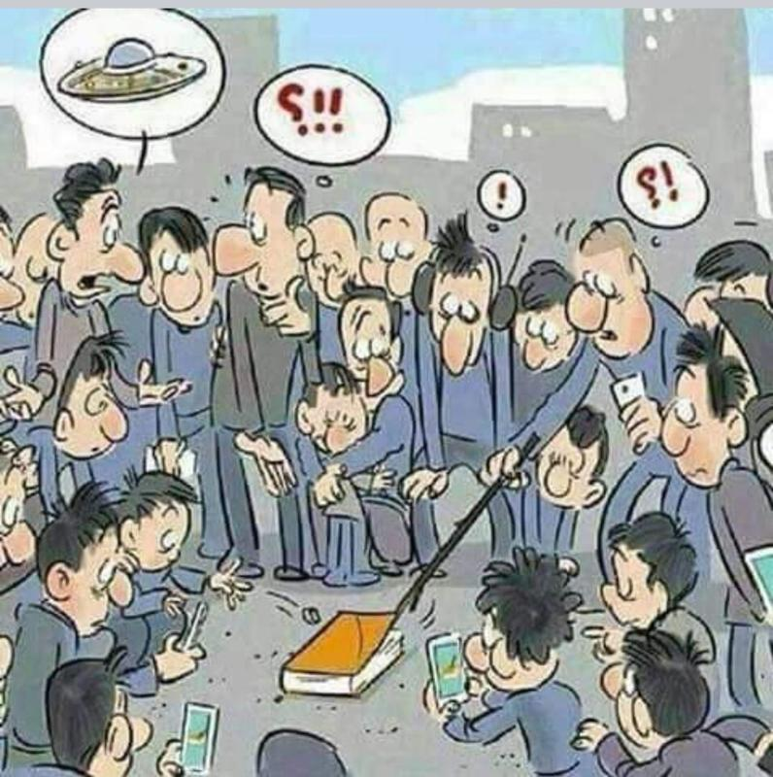
The NEW TESTAMENT BOOK OF ACTS
By David Lee Burris
Chapters 5 - 6 - 7

Slide 2
DOES THE NEW TESTAMENT IN PRACTICE ACTUALLY START WITH THE BOOK OF ACTS NOT THE GOSPELS?
“From the standpoint of the dispensations or the various economies by which God governs the world, the Old Testament Jewish economy actually continued through the gospels. Acts is a transitional book moving from the Old Testament economy into that of the new – the church age, the body of Christ.” (reference)

Slide 5
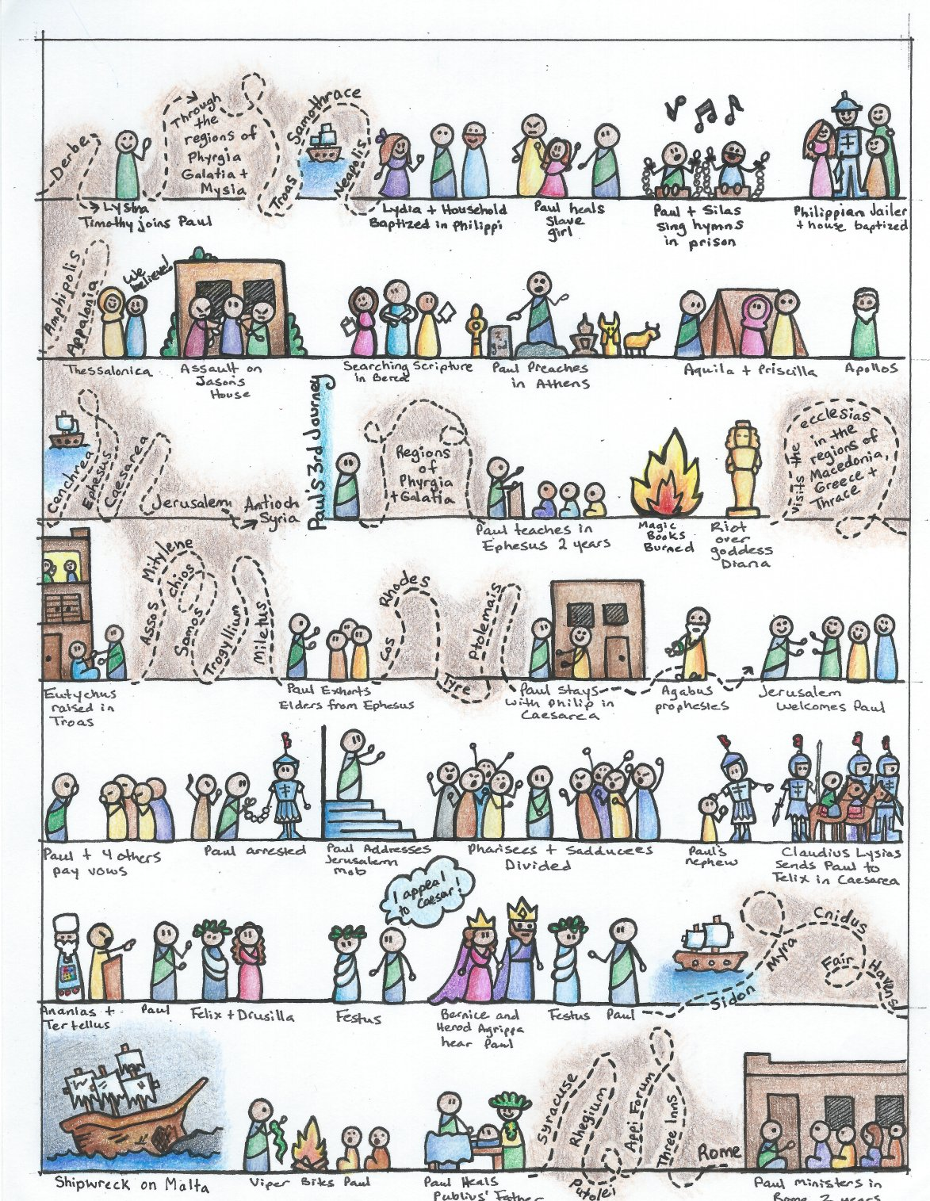

Slide 6
I. THE AUTHOR OF THE BOOK
From earliest times, Luke, “the beloved physician,” has been looked upon by conservative Bible scholars as being the author of The Book of Acts. Both internal and external evidence support this belief.
Luke was: (1) a Gentile (Col. 4:10–14); (2) the only Gentile author of a Bible book; (3) a physician (a medical doctor), Col. 4:14; (4) a “beloved” person, Col. 4:14; (5) a frequent missionary companion of Paul (the so-called “we sections” of The Book of Acts, 16:10–17; 20:5–21:18; 27:1–28:16, prove this assertion); and (6) the author of The Gospel of Luke as well as The Book of Acts.
II. THE ADDRESSEE OF THE BOOK
Luke addressed both The Gospel of Luke and The Book of Acts to Theophilus. Perhaps he had others in view as the ultimate readers of his two books.
We do not know the identity of Theophilus, nor do we know the place of his residence. He almost certainly was: (1) a friend of Luke and (2) a neophyte to Christianity (Luke wrote to Theophilus that he might know the certainty, the truthfulness, of the gospel truths wherein he had been instructed, Luke 1:1).
III. THE PLACE AND THE DATE OF THE WRITING OF THE BOOK
We do not know the place of writing but we can know the approximate date of writing. We know that it was written after the Spring of a.d. 63 for the book’s historical record extends to the Spring of that year and we know that the book was probably written before the Fall of a.d. 64 for the book makes no mention or allusion to the Neronian persecution which began in October of a.d. 64. We know that the book was almost certainly written before a.d. 70 for it makes no mention or allusion to the fall of Jerusalem and the destruction of its temple, events which occurred in a.d. 70 which greatly affected the early church and first-century Christianity (these events ended the Judaizers opposition to the gospel and the practice of preaching the gospel first to the Jews and then to the Gentiles).
IV. THE NAME OF THE BOOK
From the Second Century a.d., the common name for the book has been The Acts of the Apostles. This title is too comprehensive to be a correct one, for the book deals chiefly with the acts of only two apostles, Peter and Paul, and their acts are recorded only in part. A more apt title would be one of the following: (1) the Acts of the Risen Lord; (2) The Acts of the descended Holy Spirit; (3) Some of the Acts of Peter and Paul; (4) A Fragmentary History of the Early Church; (5) The First Chapter of Church History or (6) The only Inspired Chapter of Church History.
In the Greek manuscripts, the title is “Acts of Apostles.” This is a good and accurate title.
V. THE CLASSIFICATION OF THE BOOK
It is one of the five historical books of the New Testament. The New Testament has five historical books (Matthew through Acts), twenty-one doctrinal books (Romans through Jude) and one prophetical book (Revelation).
The 5 New Testament historical books are the New Testament’s “Pentateuch.”
Gingrich, R. E. (2002). (pp. 34). Memphis, TN: Riverside Printing.
Gingrich, R. E. (2002). The Book of Acts (pp. 3–4). Memphis, TN: Riverside Printing.

Slide 7
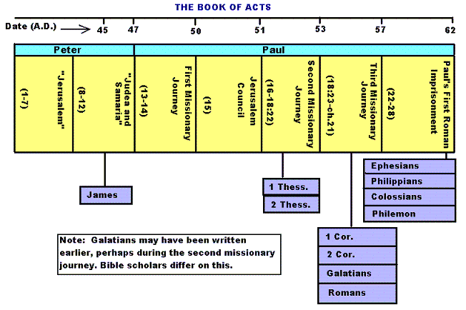

Slide 8
Historicity of Acts:
- the spread of Christianity from Jerusalem to Rome (“the ends of the earth”);
- The progress ... is mainly geographical:
- From Jerusalem ... to Samaria (8.5), Damascus (9.10), Antioch (11.26), Asia Minor (13.13), Europe (16.11), and finally Rome … itself;
- the northeastern corner of the Mediterranean;
- Maybe Spain But Nothing about North Africa, e.g., Alexandria and Cyrene.

Slide 10
1. Prologue and Ascension (1:1-11):
- Post-resurrection appearances … ;
- A ... visible ascension into heaven;
- Matthias chosen to replace Judas Iscariot (1.12-26);
- Luke’s understanding of an Apostle: see 1.21-22;
- Note: Saul (later Paul) meets those qualifications Acts 9 when Christ appeared to him while on the Damascus Road.

Slide 11
2. Founding of the Jerusalem Church - the role of the Holy Spirit (2.12-2.47):
- The Jerusalem Church increases in numbers by means of divine power;
- The work of the Holy Spirit, e.g., Glossolalia (2.1-24; see Joel 2.28-32);
- Peter’s speech interprets the meaning of Pentecost;
- The character of the Jerusalem Church (2.43-45; 4.32-35);

Slide 12
3. The Work of Peter and the other Apostles (3.1-5.42):
- Confrontation between the Apostles and the Jerusalem authorities (4.1-22);
- Luke’s attitude towards both the Sadducees and the Pharisees (4.8-11);

Slide 13
4. Persecution of the “Hellenists” (6.1-8.40):
- Stephen, a leading “Hellenist” or Greek-speaking Jew (6. 5, 8);
- Stephen is presented as the first Christian Martyr (7.60);
- subsequent persecution and the growth of the Church (8.1b-40);
the “new way” carried to such individuals as Simon the Magician (8.9) and an Ethiopian Eunuch (8.27);
the role of Philip in this work of evangelization (6.5; 8.4; 21,8).

Slide 14
5. Preparation for the Gentile Mission (9.1-12.25):
- The progress of Christianity …. as world adversary to pagan religion and human schools of philosophy;
- See, for example, the conversion of Saul of Tarsus (9.1-19) and Cornelius, the Roman centurion (Chs. 10-11);
- Peter is depicted as the one who first opens the door to Gentiles, that is, non-Jews;
Peter’s persuasion of the “circumcision party” (11.1-18);
See 10.44-48 and 11.15-18: the “Gentile Pentecost”;

Slide 15
5. Preparation for the Gentile Mission (9.1-12.25) (contd.):
- Gentiles flock to the Church at Antioch (11.19-26);
- The Jerusalem Church sends Barnabas... to report on the situation (11.22);
- Barnabas with the Apostle Paul at Antioch (11.25-30);
- Gospel preached “all over Judea and Samaria”;
- The first half concludes with an account of Herod Agrippa I’s persecution (41-44 CE) of the Jerusalem community;
- God is unhappy with Herod (12.20-23).

Slide 16
6. First Missionary Journey of Barnabas and Paul and the Jerusalem Conference (13.1-15.35):
- The rest of Acts is devoted mainly to the Missionary Journeys of the Apostle Paul and his fellow workers;
- the work of Paul and Barnabas in the various Hellenistic cities of Asia Minor;
- Dissension between Gentile and Jewish Christians over adherence to the Mosaic Torah (15.1-35);
- must Gentile Christians be circumcised and observe Jewish dietary laws?

Slide 17
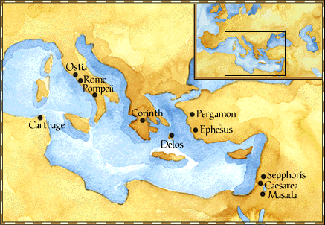
Paul: Map of His World.

Slide 18
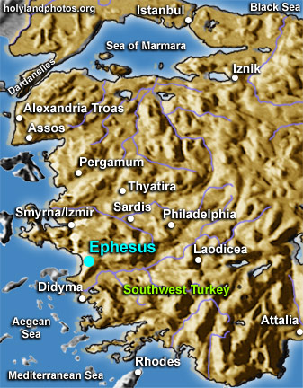

Slide 19
6. First Missionary Journey of Paul and Barnabas and the Jerusalem Conference (13.1-15.35) (contd.):
- The Jerusalem Conference held about A.D. 49 (Acts 15);
- Must a Gentile believer become a Jew ... to be a Christian?
- A division within the Church;
- The dispute settled in favor of uncircumcised Gentiles (15.28-29);
- The deciding voice is that of James (15.13-21).

Slide 20
6. First Missionary Journey of Paul and Barnabas and the Jerusalem Conference (13.1-15.35) (contd.):
- The Apostles and Elders required only limited Torah mandates of the Gentile Christians (15.13-21);
- requirements based on rules from Leviticus (Acts 15.13-21; Leviticus 17-18);
- Themes of unity and cooperation dominate … ;
- it is a unanimous decision and the “Whole Church” sends a delegation to Antioch to explain the Jerusalem Church’s decision (15.30-35);
- Actually, a decision of the Holy Spirit (15.22-29).

Slide 21
6. First Missionary Journey of Paul and Barnabas and the Jerusalem Conference (13.1-15.35) (contd.):
- Paul’s independence of the Apostolic Church (Gal 1.17, 18-19, 20; 2.1-10);
- Paul indicates that he was never under the jurisdiction of the Church’s leadership in Jerusalem (Gal 1.17, 18-19, 20; 2.1-10);
- See also 1 Cor 8.8; 10.27 relative to eating meat sacrificed to Greco-Roman gods.

Slide 22
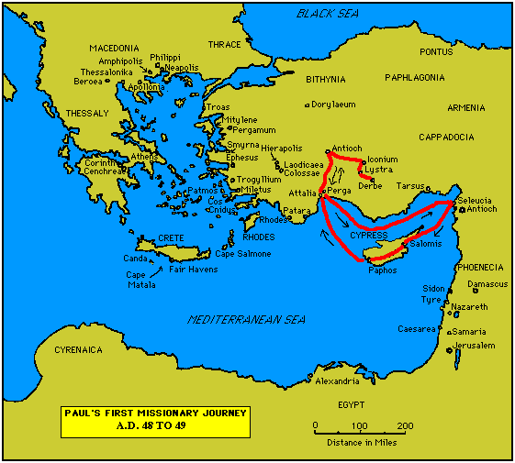

Slide 23
7. Paul’s Secondary Missionary Journey; Evangelizing Greece (16.1-18.21):
- Paul and Barnabas separate (15.39);
- Why the separation?
- Paul and Silas visit churches in Syria and Asia Minor (15.40-41);
- A vision directs Paul to Macedonia (15.40-16.10);
- Paul’s customary activity relative to the Jews and then being abused by them (16.11-17.15);

Slide 24
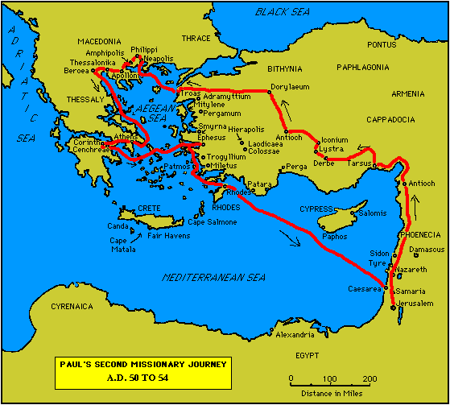

Slide 25
7. Paul’s Secondary Missionary Journey; Evangelizing Greece (16.1-18.21) (contd.):
- Paul in Philippi, Thessalonica, Beroea, and Athens;
- Paul speaks at the Areopagus in Athens (17.19-31);
- Paul at Corinth (18.1-17);

Slide 27
8. Paul’s Third Missionary Journey: Revisiting Asia Minor and Greece (18.22-20.38):
- Paul at Ephesus (18.19-21);
- Luke depicts Paul as determined to complete his last tour and head for the imperial capital, that is, Rome (19.21-22);
- Paul’s farewell speech at Miletus (20.17-38);
- See maps on the location of the major churches at the end of Paul’s ministry.

Slide 28
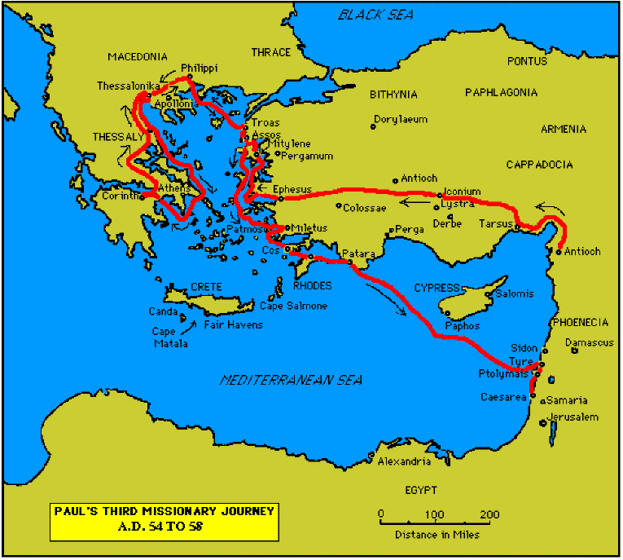

Slide 30
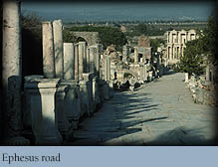

Slide 31
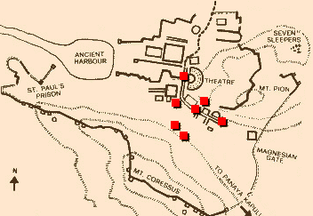
Ephesus: General View of the Ancient City.

Slide 32
9. Paul’s arrest in Jerusalem and imprisonment in Caesarea Maritime (21.1-26.32):
- Paul returns to Jerusalem (21.17) ... accused of blasphemy and profaning the Temple;
- When arrested, Paul claims that he is a Pharisee (21.27-23.10);
- Paul is imprisoned ... in Caesarea (23.33-26.32);
- he exercises his birthright as a Roman citizen (25.1-21);
- he defends himself (26.1-29);

Slide 33
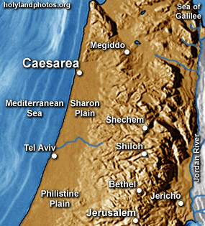

Slide 34
10. Paul’s Journey to Rome and His Preaching to Roman Jews (27.1-28.31):
- Paul’s sea journey to Rome... a shipwreck on the island of Malta (28.1 ) (see Map);
- the narrative in the first person plural, that is, “we”;
- Acts ends with Paul’s arrival in Rome (28.16);
- Paul is under house arrest but is free to preach (28.31);
- He continues to evangelize the Romans (28.23-31);
- We are not told of Paul’s fate.

Slide 35
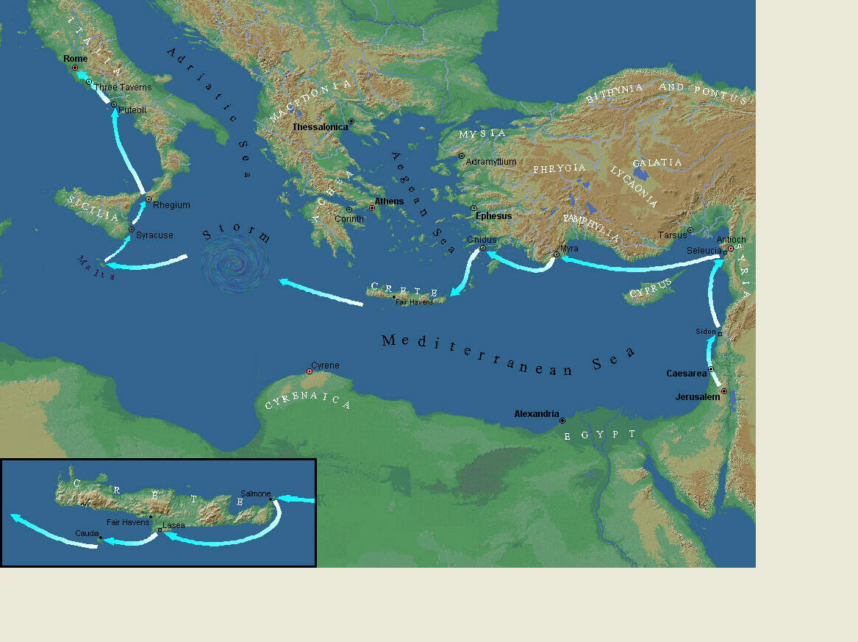
Paul’s Journey to Rome.

Slide 36
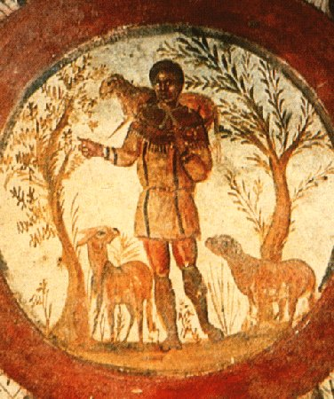
The Good Shepherd – in Catacombs of Rome.

Slide 37
10. Paul’s Journey to Rome and his Preaching to Roman Jews (27.1-28.31) (contd.):
- Luke has accomplished his task of tracing Christianity’s expansion from Jerusalem to “the ends of the earth” (1.8);
- Another theme emphasized: Paul and his successor evangelists will henceforth direct the Gospel primarily to Non-Jews, for “the Gentiles will listen” (28.28);
- Luke quotes from Isaiah 6 (see also Mark 4.10-13);
- Christianity’s future belongs to the Gentiles.

Slide 38
Basic Book Structure acts of the Apostles Centers around the great commission & Call To evangelize Then known world!

Slide 39
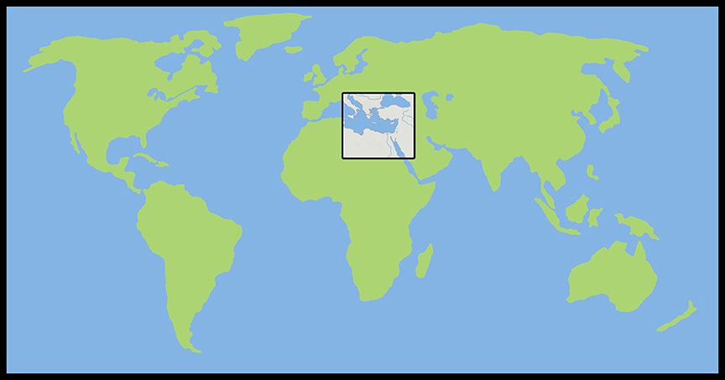
Where the Story takes Place

Slide 40
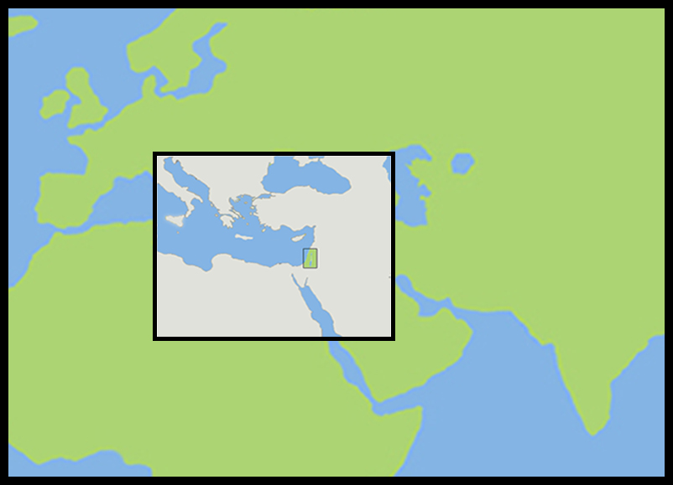
The Land of Canaan in the Near East

Slide 41
Acts 1:8 and the Great Commission
Acts 1:8 But ye shall receive power, after that the Holy Ghost is come upon you: and ye shall be witnesses unto me both in Jerusalem, and in all Judaea, and in Samaria, and unto the uttermost part of the earth.
Matthew 28:19-20 ¹⁹ Go ye therefore, and teach all nations, baptizing them in the name of the Father, and of the Son, and of the Holy Ghost: ²⁰ Teaching them to observe all things whatsoever I have commanded you: and, lo, I am with you alway, even unto the end of the world. Amen.
Mark 16:15 And he said unto them, Go ye into all the world, and preach the gospel to every creature.

Slide 42
Acts 1:8 and the Great Commission
Acts 1:8 But ye shall receive power, after that the Holy Ghost is come upon you: and ye shall be witnesses unto me both in Jerusalem, and in all Judaea, and in Samaria, and unto the uttermost part of the earth.
Matthew 28:19-20 ¹⁹ Go ye therefore, and teach all nations, baptizing them in the name of the Father, and of the Son, and of the Holy Ghost: ²⁰ Teaching them to observe all things whatsoever I have commanded you: and, lo, I am with you alway, even unto the end of the world. Amen.
Mark 16:15 And he said unto them, Go ye into all the world, and preach the gospel to every creature.

Slide 43
Acts 1:8 and the Great Commission
Acts 1:8 But ye shall receive power, after that the Holy Ghost is come upon you: and ye shall be witnesses unto me both in Jerusalem, and in all Judaea, and in Samaria, and unto the uttermost part of the earth.
Matthew 28:19-20 ¹⁹ Go ye therefore, and teach all nations, baptizing them in the name of the Father, and of the Son, and of the Holy Ghost: ²⁰ Teaching them to observe all things whatsoever I have commanded you: and, lo, I am with you alway, even unto the end of the world. Amen.
Mark 16:15 And he said unto them, Go ye into all the world, and preach the gospel to every creature.

Slide 44
Acts 1:8 and the Great Commission
Acts 1:8 But ye shall receive power, after that the Holy Ghost is come upon you: and ye shall be witnesses unto me both in Jerusalem, and in all Judaea, and in Samaria, and unto the uttermost part of the earth.
Matthew 28:19-20 ¹⁹ Go ye therefore, and teach all nations, baptizing them in the name of the Father, and of the Son, and of the Holy Ghost: ²⁰ Teaching them to observe all things whatsoever I have commanded you: and, lo, I am with you alway, even unto the end of the world. Amen.
Mark 16:15 And he said unto them, Go ye into all the world, and preach the gospel to every creature.

Slide 45
Acts 1:8 and the Structure of the Book
Acts 1:8 … ye shall be witnesses unto me both in Jerusalem, and in all Judaea, and in Samaria, and unto the uttermost part of the earth.
1. The witness in Jerusalem:
Chapters 1 to 7
2. The witness in Judaea and Samaria:
Chapters 8 to 12
3. The witness unto the uttermost parts of the earth:
Chapters 13 to 28

Slide 46
The Three Audiences
Part 1: The Jews
Part 2: The Samaritans
Part 3: The Gentiles

Slide 47
The Pillars of the Church
Part 1: Peter
Part 2: Peter and Paul (Saul of Tarsus)
Part 3: Paul

Slide 48
The Timeline
Part 1: 5 years (AD 30-35)
Part 2: 13 years (AD 35-48)
Part 3: 14 years (AD 48-62)
A total of 32 years, according to Nelson’s Complete Book of Bible Maps and Charts.

Slide 49
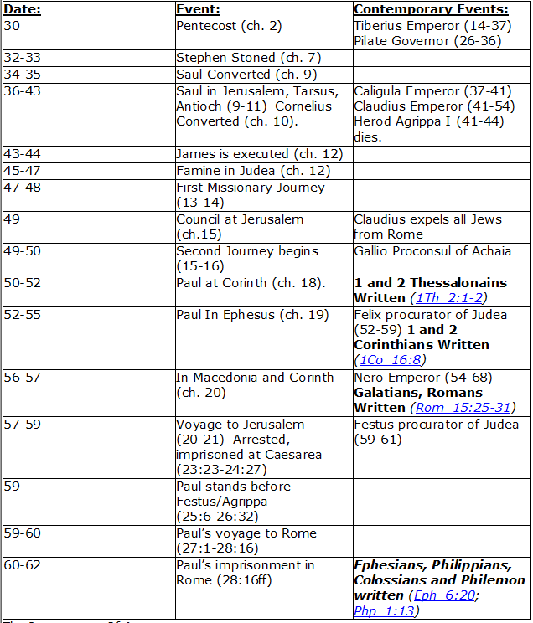
CHART BY
Mark Dunagan

Slide 50
PART ONE—The infancy of the church (the church in Jerusalem) (chapters 1–7)
(In this section, Jerusalem is the central city of Christianity and Peter is the most prominent person)
I. THE POST-RESURRECTION MINISTRY OF CHRIST (1:1–8)
II. THE ASCENSION OF CHRIST (1:9–11)
III. THE WAITING IN THE UPPER ROOM (1:12–26)
IV. THE ADVENT OF THE HOLY SPIRIT (2:1–41)
V. THE SNAPSHOT OF THE EARLY CHURCH (2:42–47)
VI. THE HEALING OF THE LAME MAN AND ITS CONSEQUENCES (3:1–4:31)
VII. THE DEATH OF ANANIAS AND SAPPHIRA AND ITS EFFECTS (4:32–5:42)
VIII. THE APPOINTMENT OF THE SEVEN (6:1–7)
IX. THE MINISTRY OF STEPHEN (6:8–7:60)
PART TWO—The adolescence of the church (the church in all Judea and In Samaria) (chapters 8–12)
(In this section, Jerusalem is gradually being replaced by Antioch as the central city of Christianity and Peter is gradually being replaced by Paul as the most prominent person)
I. THE FIRST MENTION OF PAUL (7:58; 8:1, 3)
II. THE PERSECUTION AND SCATTERING OF THE JERUSALEM CHURCH (8:1–4)
III. THE CONVERSION OF SAMARITANS (8:5–25)
IV. THE CONVERSION OF A JEWISH PROSELYTE (8:26–40)
V. THE CONVERSION OF SAUL (9:1–31)
VI. THE EXPANSION OF THE CHURCH IN WESTERN JUDEA (9:32–43)
VII. THE CONVERSION OF GENTILE GOD-FEARERS (chapter 10)
VIII. THE GROWING VISION OF THE JEWISH LEADERS (11:1–18)
IX. THE CONVERSION OF PAGAN GENTILES (11:19–26)
X. THE GROWING TIES BETWEEN JEWISH AND GENTILE CHRISTIANITY (11:27–30)
XI. THE COMPLETION OF THE TRANSITION (chapter 12)
PART THREE—The maturity of the church (the church in all the world) (chapters 13–28)
(In this section, Antioch is the central city of Christianity and Paul is the most prominent person)
I. PAUL’S CALL AT ANTIOCH TO HIS LIFE’S WORK (13:1–3)
II. PAUL’S FIRST MISSIONARY JOURNEY (13:4–14:27)
III. PAUL’S TWO YEARS BACK IN ANTIOCH (14:28–15:35)
IV. PAUL’S SECOND MISSIONARY JOURNEY (15:36–18:22)
V. PAUL’S THIRD MISSIONARY JOURNEY (18:23–21:16)
VI. PAUL’S ARREST AT JERUSALEM (21:17–23:35)
VII. PAUL’S TWO-YEARS’ IMPRISONMENT AT CAESAREA (chapters 24–26)
VIII. PAUL’S SHIPWRECK JOURNEY TO ROME (27:1–28:15)
IX. PAUL’S FIRST ROMAN IMPRISONMENT (28:16–31)
Gingrich, R. E. (2002). The Book of Acts (pp. 5–6). Memphis, TN: Riverside Printing.

Slide 51
L.D. CARY & SAM HOLT CATCH PHRASES
Chapter 1 – “Jesus’ Work On Earth Is Done”
Chapter 2 – “Peter Baptizes A Crew”
Chapter 3 – “A Beggar’s Plea”
Chapter 4 – “A Jailhouse Door”
Chapter 5 – “Ananias & Sapphira Don’t Survive”
Chapter 6 – “The Widow’s Fix”
Chapter 8 – “Stephen Looks Into Heaven”
Chapter 9 – “Saul Struck Blind”
“Ananias and Sapphira Do Not Survive”
Catch Phrase
Chapter Five

Slide 52
ACTS 5
HEROD’S TEMPLE

Slide 53
1 Corinthians 5:6-8 (NASB) ⁶ Your boasting is not good. Do you not know that a little leaven leavens the whole lump of dough? ⁷ Clean out the old leaven so that you may be a new lump, just as you are in fact unleavened. For Christ our Passover also has been sacrificed. ⁸ Therefore let us celebrate the feast, not with old leaven, nor with the leaven of malice and wickedness, but with the unleavened bread of sincerity and truth.
Luke 22:3 (NASB) ³ And Satan entered into Judas who was called Iscariot, belonging to the number of the twelve.
Luke 22:31 (NASB) ³¹ "Simon, Simon, behold, Satan has demanded permission to sift you like wheat;
1 Peter 5:8-9 (NASB) ⁸ Be of sober spirit, be on the alert. Your adversary, the devil, prowls around like a roaring lion, seeking someone to devour. ⁹ But resist him, firm in your faith, knowing that the same experiences of suffering are being accomplished by your brethren who are in the world.
Acts 4:34-37 (NASB) ³⁴ For there was not a needy person among them, for all who were owners of land or houses would sell them and bring the proceeds of the sales ³⁵ and lay them at the apostles' feet, and they would be distributed to each as any had need. ³⁶ Now Joseph, a Levite of Cyprian birth, who was also called Barnabas by the apostles (which translated means Son of Encouragement), ³⁷ and who owned a tract of land, sold it and brought the money and laid it at the apostles' feet.
Acts 5:1-6 (NASB) ¹ But a man named Ananias, with his wife Sapphira, sold a piece of property, ² and kept back some of the price for himself, with his wife's full knowledge, and bringing a portion of it, he laid it at the apostles' feet. ³ But Peter said, "Ananias, why has Satan filled your heart to lie to the Holy Spirit and to keep back some of the price of the land? ⁴ "While it remained unsold, did it not remain your own? And after it was sold, was it not under your control? Why is it that you have conceived this deed in your heart? You have not lied to men but to God." ⁵ And as he heard these words, Ananias fell down and breathed his last; and great fear came over all who heard of it. ⁶ The young men got up and covered him up, and after carrying him out, they buried him.
A. Ananias and Sapphira’s, benevolent giving – to be contrasted with Acts 4:34-37
1. If they succeeded in deceiving the Apostle then the power of God might be doubted. The faith of the fragile church was endangered. This would not have remained hidden. 1Cor 5:6-8
2. The influence of Satan and the free agency of the tempted: Lk 22:3, 31; 1Pt 5:8-9; 1Cor 10:12-13; Ja 1:12-15; 2Cor 2:10-11; 1Thess 3:5
2 Corinthians 2:10-11 (NASB) 10 But one whom you forgive anything, I forgive also; for indeed what I have forgiven, if I have forgiven anything, I did it for your sakes in the presence of Christ, 11 so that no advantage would be taken of us by Satan, for we are not ignorant of his schemes.
1 Thessalonians 3:5 (NASB) 5 For this reason, when I could endure it no longer, I also sent to find out about your faith, for fear that the tempter might have tempted you, and our labor would be in vain.
1 Corinthians 10:12-13 (NASB) ¹² Therefore let him who thinks he stands take heed that he does not fall. ¹³ No temptation has overtaken you but such as is common to man; and God is faithful, who will not allow you to be tempted beyond what you are able, but with the temptation will provide the way of escape also, so that you will be able to endure it.
James 1:12-15 (NASB) ¹² Blessed is a man who perseveres under trial; for once he has been approved, he will receive the crown of life which the Lord has promised to those who love Him. ¹³ Let no one say when he is tempted, "I am being tempted by God"; for God cannot be tempted by evil, and He Himself does not tempt anyone. ¹⁴ But each one is tempted when he is carried away and enticed by his own lust. ¹⁵ Then when lust has conceived, it gives birth to sin; and when sin is accomplished, it brings forth death.
Notes:
Here Peter brings together the influence of Satan, and the free agency of the tempted, just as he had, in former discourses, the free agency of men, and the purposes of God. He demands of Ananias, “Why has Satan filled thy heart to lie to the Holy Spirit,” and, in the same breath, “Why hast thou put this thing in thy heart?” The existence and agency of the tempter are distinctly recognized, yet it is not Satan, but Ananias who is rebuked; and he is rebuked for doing the very thing that Satan had done, showing that he is as guilty as though Satan had no existence. Indeed, he is rebuked for what Satan had done. The justice of this is manifest from the fact that Satan had no power to fill his heart with evil, without his co-operation. That he had rendered this co-operation, threw the responsibility upon himself.
Peter's knowledge of the deception was the result not of human information, but of the insight imparted to him by the Holy Spirit. This is necessary to the significance of the entire incident, as well as to the purport of Peter's own words.
A Commentary on Acts of Apostles, with a Revised Version of the Text.

Slide 54
Acts 5:7-10 (NASB) ⁷ Now there elapsed an interval of about three hours, and his wife came in, not knowing what had happened. ⁸ And Peter responded to her, "Tell me whether you sold the land for such and such a price?" And she said, "Yes, that was the price." ⁹ Then Peter said to her, "Why is it that you have agreed together to put the Spirit of the Lord to the test? Behold, the feet of those who have buried your husband are at the door, and they will carry you out as well." ¹⁰ And immediately she fell at his feet and breathed her last, and the young men came in and found her dead, and they carried her out and buried her beside her husband.
A. Because she is lying to an apostle, one filled with the Spirit, it would reflect negatively upon the power of the Spirit that guided the apostles. Today this exact situation is not even possible.
1. An Apostles power was considerable. 2Cor 1:21; 1Cor 4:21; 2Cor 13:1-3, 12:12; 10:8-11; 1Cor 14:37; Jn 13:20 Acts 13:6-12
2 Corinthians 10:8-11 (NASB) 8 For even if I boast somewhat further about our authority, which the Lord gave for building you up and not for destroying you, I will not be put to shame, 9 for I do not wish to seem as if I would terrify you by my letters. 10 For they say, "His letters are weighty and strong, but his personal presence is unimpressive and his speech contemptible." 11 Let such a person consider this, that what we are in word by letters when absent, such persons we are also in deed when present.
2 Corinthians 13:10 (NASB) 10 For this reason I am writing these things while absent, so that when present I need not use severity, in accordance with the authority which the Lord gave me for building up and not for tearing down.
1 Corinthians 4:21 (NASB) 21 What do you desire? Shall I come to you with a rod, or with love and a spirit of gentleness? 2 Corinthians 13:1-3 (NASB) 1 This is the third time I am coming to you. EVERY FACT IS TO BE CONFIRMED BY THE TESTIMONY OF TWO OR THREE WITNESSES. 2 I have previously said when present the second time, and though now absent I say in advance to those who have sinned in the past and to all the rest as well, that if I come again I will not spare anyone, 3 since you are seeking for proof of the Christ who speaks in me, and who is not weak toward you, but mighty in you.
Acts 13:6-12 (NASB) 6 When they had gone through the whole island as far as Paphos, they found a magician, a Jewish false prophet whose name was Bar-Jesus, 7 who was with the proconsul, Sergius Paulus, a man of intelligence. This man summoned Barnabas and Saul and sought to hear the word of God. 8 But Elymas the magician (for so his name is translated) was opposing them, seeking to turn the proconsul away from the faith. 9 But Saul, who was also known as Paul, filled with the Holy Spirit, fixed his gaze on him, 10 and said, "You who are full of all deceit and fraud, you son of the devil, you enemy of all righteousness, will you not cease to make crooked the straight ways of the Lord? 11 "Now, behold, the hand of the Lord is upon you, and you will be blind and not see the sun for a time." And immediately a mist and a darkness fell upon him, and he went about seeking those who would lead him by the hand. 12 Then the proconsul believed when he saw what had happened, being amazed at the teaching of the Lord.
John 13:20 (NASB) 20 "Truly, truly, I say to you, he who receives whomever I send receives Me; and he who receives Me receives Him who sent Me."
1 Corinthians 14:37 (NASB) 37 If anyone thinks he is a prophet or spiritual, let him recognize that the things which I write to you are the Lord's commandment.
2 Corinthians 12:12 (NASB) 12 The signs of a true apostle were performed among you with all perseverance, by signs and wonders and miracles.
2 Corinthians 1:21 (NASB) 21 Now He who establishes us with you in Christ and anointed us is God,
Notes:
5/21/17 Power of the Apostles
The same argument can be made for Stephen that was made for the apostles. Once someone was known to have the gift of the Spirit, it would reflect badly on the Spirit if he could be deceived. The Spirit could not allow this. Acts 7:51-60; 6:3-6; 8:14-18

Slide 55
Acts 5:11-13 (NASB) ¹¹ And great fear came over the whole church, and over all who heard of these things. ¹² At the hands of the apostles many signs and wonders were taking place among the people; and they were all with one accord in Solomon's portico. ¹³ But none of the rest dared to associate with them; however, the people held them in high esteem.
A. Fear came over the whole church: this was the intention of God but must be understood in light of God’s purpose. His harshness was to prevent others from developing this same covetous, dishonest faith. He 10:26-27, 30-31; 1Cor 5:6-7; Lev 10:1-3; 1Cor 10:5-12; Lk 5:3-8
B. They (the apostles) met at Solomon’s portico: Jn 10:23-24; Acts 3:11
1. None of the rest of the brethren and unbelievers dared associate (glued) to the apostles as they met at Solomon’s portico. God has clearly set them apart as ambassadors of the Savior. To lie them in any way is precarious in light of Ananias and Sapphira: Acts 9:26
2. Yet the people (unconverted) did highly esteem these powerful messengers of God through whom miraculous healings were taking place. Many were converted: Acts 2:47
Leviticus 10:1-3 (NASB) 1 Now Nadab and Abihu, the sons of Aaron, took their respective firepans, and after putting fire in them, placed incense on it and offered strange fire before the LORD, which He had not commanded them. 2 And fire came out from the presence of the LORD and consumed them, and they died before the LORD. 3 Then Moses said to Aaron, "It is what the LORD spoke, saying, 'By those who come near Me I will be treated as holy, And before all the people I will be honored.'" So Aaron, therefore, kept silent.
1 Corinthians 10:5-12 (NASB) 5 Nevertheless, with most of them God was not well-pleased; for they were laid low in the wilderness. 6 Now these things happened as examples for us, so that we would not crave evil things as they also craved. 7 Do not be idolaters, as some of them were; as it is written, "THE PEOPLE SAT DOWN TO EAT AND DRINK, AND STOOD UP TO PLAY." 8 Nor let us act immorally, as some of them did, and twenty-three thousand fell in one day.
Luke 5:3-8 (NASB) 3 And He got into one of the boats, which was Simon's, and asked him to put out a little way from the land. And He sat down and began teaching the people from the boat. 4 When He had finished speaking, He said to Simon, "Put out into the deep water and let down your nets for a catch." 5 Simon answered and said, "Master, we worked hard all night and caught nothing, but I will do as You say and let down the nets."
1 Corinthians 5:6-7 (NASB) 6 Your boasting is not good. Do you not know that a little leaven leavens the whole lump of dough? 7 Clean out the old leaven so that you may be a new lump, just as you are in fact unleavened. For Christ our Passover also has been sacrificed.
Original Word: φόβος, phobos
Usage Notes: first had the meaning of "flight," that which is caused by being scared; then, "that which may cause flight,"
Vine's Expository Dictionary of Old Testament and New Testament Words
Hebrews 10:26-27 (NASB) 26 For if we go on sinning willfully after receiving the knowledge of the truth, there no longer remains a sacrifice for sins, 27 but a terrifying expectation of judgment and THE FURY OF A FIRE WHICH WILL CONSUME THE ADVERSARIES.
Hebrews 10:30-31 (NASB) 30 For we know Him who said, "VENGEANCE IS MINE, I WILL REPAY." And again, "THE LORD WILL JUDGE HIS PEOPLE." 31 It is a terrifying thing to fall into the hands of the living God.
9 Nor let us try the Lord, as some of them did, and were destroyed by the serpents. 10 Nor grumble, as some of them did, and were destroyed by the destroyer. 11 Now these things happened to them as an example, and they were written for our instruction, upon whom the ends of the ages have come. 12 Therefore let him who thinks he stands take heed that he does not fall.
6 When they had done this, they enclosed a great quantity of fish, and their nets began to break; 7 so they signaled to their partners in the other boat for them to come and help them. And they came and filled both of the boats, so that they began to sink. 8 But when Simon Peter saw that, he fell down at Jesus' feet, saying, "Go away from me Lord, for I am a sinful man!"
John 10:23-24 (NASB) 23 it was winter, and Jesus was walking in the temple in the portico of Solomon. 24 The Jews then gathered around Him, and were saying to Him, "How long will You keep us in suspense? If You are the Christ, tell us plainly."
Acts 3:11 (NASB) 11 While he was clinging to Peter and John, all the people ran together to them at the so-called portico of Solomon, full of amazement.
Acts 2:47 (NASB) 47 praising God and having favor with all the people. And the Lord was adding to their number day by day those who were being saved.
Acts 9:26 (NASB) 26 When he came to Jerusalem, he was trying to associate with the disciples; but they were all afraid of him, not believing that he was a disciple.
Notes:
Verse 13: The rest seems to mean both members of the church and the people who heard of Ananias and Sapphira were willing to take a chance on getting too comfortable around the apostles for fear that their weakness and sins would become known. Still many wanted salvation and this did not deter them. In a way it purified who would respond to the Gospel. Only those with true faith.

Slide 56
Acts 5:11-16 (NASB) ¹⁴ And all the more believers in the Lord, multitudes of men and women, were constantly added to their number, ¹⁵ to such an extent that they even carried the sick out into the streets and laid them on cots and pallets, so that when Peter came by at least his shadow might fall on any one of them. ¹⁶ Also the people from the cities in the vicinity of Jerusalem were coming together, bringing people who were sick or afflicted with unclean spirits, and they were all being healed.
A. Verse 14 - The Jerusalem church continues to grow in large number: Acts 2:41, 47; 4:4
1. Though some of people of the community feared the Apostles others held them in higher esteem. They recognized the authority and power that God worked through them to heal. This must of added to their fondness toward them and their teachings. Jn 3:1-2
a. Special miracles worked, if Peters shadow might fall on them. Acts 19:11-12
b. The news spread to nearby cities and they too came to be healed and they ALL were healed. Acts 28:7-9
Acts 28:7-9 (NASB) 7 Now in the neighborhood of that place were lands belonging to the leading man of the island, named Publius, who welcomed us and entertained us courteously three days. 8 And it happened that the father of Publius was lying in bed afflicted with recurrent fever and dysentery; and Paul went in to see him and after he had prayed, he laid his hands on him and healed him. 9 After this had happened, the rest of the people on the island who had diseases were coming to him and getting cured.
Acts 2:41 (NASB) 41 So then, those who had received his word were baptized; and that day there were added about three thousand souls.
Acts 2:47 (NASB) 47 praising God and having favor with all the people. And the Lord was adding to their number day by day those who were being saved.
Acts 4:4 (NASB) 4 But many of those who had heard the message believed; and the number of the men came to be about five thousand.
John 3:1-2 (NASB) 1 Now there was a man of the Pharisees, named Nicodemus, a ruler of the Jews; 2 this man came to Jesus by night and said to Him, "Rabbi, we know that You have come from God as a teacher; for no one can do these signs that You do unless God is with him."
Acts 19:11-12 (NASB) 11 God was performing extraordinary miracles by the hands of Paul, 12 so that handkerchiefs or aprons were even carried from his body to the sick, and the diseases left them and the evil spirits went out.
Notes:
6/4/17

Slide 57
Acts 5:17-21 (NASB) ¹⁷ But the high priest rose up, along with all his associates (that is the sect of the Sadducees), and they were filled with jealousy. ¹⁸ They laid hands on the apostles and put them in a public jail. ¹⁹ But during the night an angel of the Lord opened the gates of the prison, and taking them out he said, ²⁰ "Go, stand and speak to the people in the temple the whole message of this Life." ²¹ Upon hearing this, they entered into the temple about daybreak and began to teach. Now when the high priest and his associates came, they called the Council together, even all the Senate of the sons of Israel, and sent orders to the prison house for them to be brought.
A. Filled with jealousy: jealous of losing their power to the apostles who had openly defied them. They had feared Jesus for the same reason. Jn 11:47-48; Mt 27:17-18; Acts 4:17-18
1. Arrest confirmed that their teachings were convincing: Ro 1:16; He 4:12-13
2. The Sadducees did not believe in angels but that doesn’t stop angels from overriding the authority of the Sanhedrin. Acts 23:8; 8:26; 12:7-10, 23
3. Preach the message of this life in the Temple: Jn 6:68; Jn 1:4; 2Tim 1:10; Jn 14:6;
Hebrews 4:12-13 (NASB) 12 For the word of God is living and active and sharper than any two-edged sword, and piercing as far as the division of soul and spirit, of both joints and marrow, and able to judge the thoughts and intentions of the heart. 13 And there is no creature hidden from His sight, but all things are open and laid bare to the eyes of Him with whom we have to do.
Acts 12:7-10 (NASB) 7 And behold, an angel of the Lord suddenly appeared and a light shone in the cell; and he struck Peter's side and woke him up, saying, "Get up quickly." And his chains fell off his hands. 8 And the angel said to him, "Gird yourself and put on your sandals." And he did so. And he *said to him, "Wrap your cloak around you and follow me." 9 And he went out and continued to follow, and he did not know that what was being done by the angel was real, but thought he was seeing a vision. 10 When they had passed the first and second guard, they came to the iron gate that leads into the city, which opened for them by itself; and they went out and went along one street, and immediately the angel departed from him.
Acts 12:23 (NASB) 23 And immediately an angel of the Lord struck him because he did not give God the glory, and he was eaten by worms and died.
Acts 8:26 (NASB) 26 But an angel of the Lord spoke to Philip saying, "Get up and go south to the road that descends from Jerusalem to Gaza." (This is a desert road.)
John 6:68 (NASB) 68 Simon Peter answered Him, "Lord, to whom shall we go? You have words of eternal life. John 1:4 (NASB) 4 In Him was life, and the life was the Light of men.
2 Timothy 1:10 (NASB) 10 but now has been revealed by the appearing of our Savior Christ Jesus, who abolished death and brought life and immortality to light through the gospel,
John 14:6 (NASB) 6 Jesus *said to him, "I am the way, and the truth, and the life; no one comes to the Father but through Me.
Acts 23:8 (NASB) 8 For the Sadducees say that there is no resurrection, nor an angel, nor a spirit, but the Pharisees acknowledge them all.
Acts 4:17-18 (NASB) 17 "But so that it will not spread any further among the people, let us warn them to speak no longer to any man in this name." 18 And when they had summoned them, they commanded them not to speak or teach at all in the name of Jesus.
John 11:47-48 (NASB) 47 Therefore the chief priests and the Pharisees convened a council, and were saying, "What are we doing? For this man is performing many signs. 48 "If we let Him go on like this, all men will believe in Him, and the Romans will come and take away both our place and our nation."
Matthew 27:17-18 (NASB) 17 So when the people gathered together, Pilate said to them, "Whom do you want me to release for you? Barabbas, or Jesus who is called Christ?" 18 For he knew that because of envy they had handed Him over.
Romans 1:16 (NASB) 16 For I am not ashamed of the gospel, for it is the power of God for salvation to everyone who believes, to the Jew first and also to the Greek.

Slide 58
Acts 5:22-27 (NASB) ²² But the officers who came did not find them in the prison; and they returned and reported back, ²³ saying, "We found the prison house locked quite securely and the guards standing at the doors; but when we had opened up, we found no one inside." ²⁴ Now when the captain of the temple guard and the chief priests heard these words, they were greatly perplexed about them as to what would come of this. ²⁵ But someone came and reported to them, "The men whom you put in prison are standing in the temple and teaching the people!" ²⁶ Then the captain went along with the officers and proceeded to bring them back without violence (for they were afraid of the people, that they might be stoned). ²⁷ When they had brought them, they stood them before the Council. The high priest questioned them,

Slide 59
Acts 4:16 (NASB) 16 saying, "What shall we do with these men? For the fact that a noteworthy miracle has taken place through them is apparent to all who live in Jerusalem, and we cannot deny it. Acts 4:21-22 (NASB) 21 When they had threatened them further, they let them go (finding no basis on which to punish them) on account of the people, because they were all glorifying God for what had happened; 22 for the man was more than forty years old on whom this miracle of healing had been performed.
Acts 5:28-32 (NASB) ²⁸ saying, "We gave you strict orders not to continue teaching in this name, and yet, you have filled Jerusalem with your teaching and intend to bring this man's blood upon us." ²⁹ But Peter and the apostles answered, "We must obey God rather than men. ³⁰ "The God of our fathers raised up Jesus, whom you had put to death by hanging Him on a cross. ³¹ "He is the one whom God exalted to His right hand as a Prince and a Savior, to grant repentance to Israel, and forgiveness of sins. ³² "And we are witnesses of these things; and so is the Holy Spirit, whom God has given to those who obey Him."
A. The apostles refused to obey the lesser authority. Their prayers are answered: Acts 4:27-29; Mt 23:29-35; 27:24-25;
1. Jesus is the proper ruler over Israel and through him the Sanhedrin might yet gain their forgiveness and salvation. Acts 4:17-19
2. There is a subtle truth boldly presented to the Sanhedrin. God gives the Holy Spirit to those who obey him. The evidence that the Apostles not the Sanhedrin had obeyed God had stood before the Sanhedrin not many days ago: Acts 4:16, 21-22
Acts 4:17-19 (NASB) 17 "But so that it will not spread any further among the people, let us warn them to speak no longer to any man in this name." 18 And when they had summoned them, they commanded them not to speak or teach at all in the name of Jesus. 19 But Peter and John answered and said to them, "Whether it is right in the sight of God to give heed to you rather than to God, you be the judge;
Matthew 23:29-35 (NASB) 29 "Woe to you, scribes and Pharisees, hypocrites! For you build the tombs of the prophets and adorn the monuments of the righteous, 30 and say, 'If we had been living in the days of our fathers, we would not have been partners with them in shedding the blood of the prophets.' 31 "So you testify against yourselves, that you are sons of those who murdered the prophets. 32 "Fill up, then, the measure of the guilt of your fathers. 33 "You serpents, you brood of vipers, how will you escape the sentence of hell?
34 "Therefore, behold, I am sending you prophets and wise men and scribes; some of them you will kill and crucify, and some of them you will scourge in your synagogues, and persecute from city to city, 35 so that upon you may fall the guilt of all the righteous blood shed on earth, from the blood of righteous Abel to the blood of Zechariah, the son of Berechiah, whom you murdered between the temple and the altar.
Acts 4:27-29 (NASB) 27 "For truly in this city there were gathered together against Your holy servant Jesus, whom You anointed, both Herod and Pontius Pilate, along with the Gentiles and the peoples of Israel, 28 to do whatever Your hand and Your purpose predestined to occur. 29 "And now, Lord, take note of their threats, and grant that Your bond-servants may speak Your word with all confidence,
Matthew 27:24-25 (NASB) 24 When Pilate saw that he was accomplishing nothing, but rather that a riot was starting, he took water and washed his hands in front of the crowd, saying, "I am innocent of this Man’s blood; see to that yourselves." 25 And all the people said, "His blood shall be on us and on our children!"

Slide 60
Acts 5:33-37 (NASB) ³³ But when they heard this, they were cut to the quick and intended to kill them. ³⁴ But a Pharisee named Gamaliel, a teacher of the Law, respected by all the people, stood up in the Council and gave orders to put the men outside for a short time. ³⁵ And he said to them, "Men of Israel, take care what you propose to do with these men. ³⁶ "For some time ago Theudas rose up, claiming to be somebody, and a group of about four hundred men joined up with him. But he was killed, and all who followed him were dispersed and came to nothing. ³⁷ "After this man, Judas of Galilee rose up in the days of the census and drew away some people after him; he too perished, and all those who followed him were scattered.
A. The implication of Peter’s words was not lost to the Sanhedrin. It cut to the heart, literally says “sawing asunder”. It was actively cutting them to the heart and infuriating their souls. Acts 7:54-60
B. Gamaliel a teacher of the law: Acts 22:3
1. Many have come claiming to be something and time revealed they were all false. And their movements failed and we retained our authority.
Acts 7:54-60 (NASB) 54 Now when they heard this, they were cut to the quick, and they began gnashing their teeth at him. 55 But being full of the Holy Spirit, he gazed intently into heaven and saw the glory of God, and Jesus standing at the right hand of God; 56 and he said, "Behold, I see the heavens opened up and the Son of Man standing at the right hand of God." 57 But they cried out with a loud voice, and covered their ears and rushed at him with one impulse.
58 When they had driven him out of the city, they began stoning him; and the witnesses laid aside their robes at the feet of a young man named Saul. 59 They went on stoning Stephen as he called on the Lord and said, "Lord Jesus, receive my spirit!" 60 Then falling on his knees, he cried out with a loud voice, "Lord, do not hold this sin against them!" Having said this, he fell asleep.
Acts 22:3 (NASB) 3 "I am a Jew, born in Tarsus of Cilicia, but brought up in this city, educated under Gamaliel, strictly according to the law of our fathers, being zealous for God just as you all are today.
Notes:
6/11/17
The fact of Gamaliel was listened to is very interesting since Paul was taught as a Pharisee not a Sadducee.

Slide 61
Acts 5:38-42 (NASB) ³⁸ "So in the present case, I say to you, stay away from these men and let them alone, for if this plan or action is of men, it will be overthrown; ³⁹ but if it is of God, you will not be able to overthrow them; or else you may even be found fighting against God." ⁴⁰ They took his advice; and after calling the apostles in, they flogged them and ordered them not to speak in the name of Jesus, and then released them. ⁴¹ So they went on their way from the presence of the Council, rejoicing that they had been considered worthy to suffer shame for His name. ⁴² And every day, in the temple and from house to house, they kept right on teaching and preaching Jesus as the Christ.
A. If it is of men, which is what they believed, then it cannot stand. If it is truly from God you will be fighting a war you cannot win.
1. They beat the apostles, ordered them not to speak in Jesus name and let them go.
2. They rejoiced to be treated on an equality as their master and they continued to preach. Mt 5:10-12; Jn 15:18-21; 1Pet 4:14-16; Col 1:24; Gal 2:20
3. They kept right on teaching and ignoring the commands to stop.
Matthew 5:10-12 (NASB) 10 "Blessed are those who have been persecuted for the sake of righteousness, for theirs is the kingdom of heaven. 11 "Blessed are you when people insult you and persecute you, and falsely say all kinds of evil against you because of Me. 12 "Rejoice and be glad, for your reward in heaven is great; for in the same way they persecuted the prophets who were before you.
John 15:18-21 (NASB) 18 "If the world hates you, you know that it has hated Me before it hated you. 19 "If you were of the world, the world would love its own; but because you are not of the world, but I chose you out of the world, because of this the world hates you. 20 "Remember the word that I said to you, 'A slave is not greater than his master.' If they persecuted Me, they will also persecute you; if they kept My word, they will keep yours also. 21 "But all these things they will do to you for My name's sake, because they do not know the One who sent Me.
1 Peter 4:14-16 (NASB) 14 If you are reviled for the name of Christ, you are blessed, because the Spirit of glory and of God rests on you. 15 Make sure that none of you suffers as a murderer, or thief, or evildoer, or a troublesome meddler; 16 but if anyone suffers as a Christian, he is not to be ashamed, but is to glorify God in this name.
Colossians 1:24 (NASB) 24 Now I rejoice in my sufferings for your sake, and in my flesh I do my share on behalf of His body, which is the church, in filling up what is lacking in Christ's afflictions.
Galatians 2:20 (NASB) 20 "I have been crucified with Christ; and it is no longer I who live, but Christ lives in me; and the life which I now live in the flesh I live by faith in the Son of God, who loved me and gave Himself up for me.
Notes:
During the first trial in Acts 4, they dared not punish the apostles for fear of the people. But they see their authority and integrity failing and the escalate to violence.

Slide 62
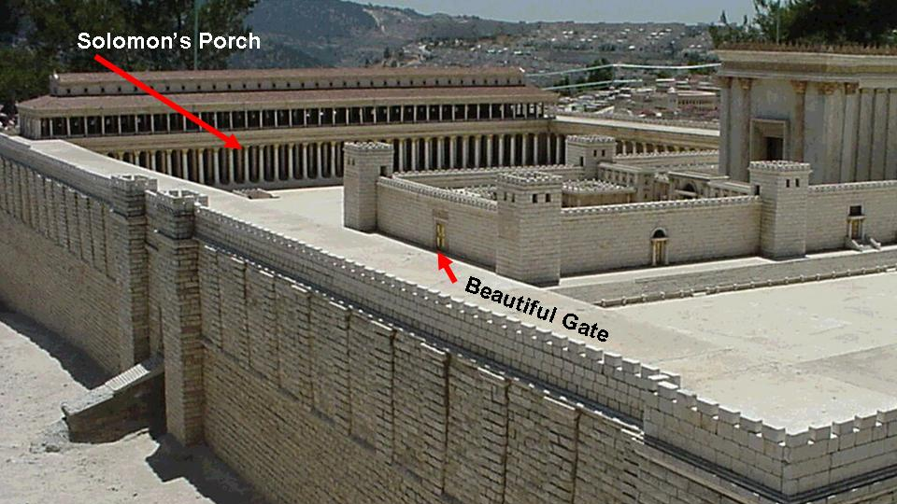

Slide 63
Acts Chapter Five

Slide 64
Acts 5:
¹ But a certain man named Ananias, with Sapphira his wife, sold a possession,
² And kept back part of the price, his wife also being privy to it, and brought a certain part, and laid it at the apostles' feet.
³ But Peter said, Ananias, why hath Satan filled thine heart to lie to the Holy Ghost, and to keep back part of the price of the land?
⁴ Whiles it remained, was it not thine own? and after it was sold, was it not in thine own power? why hast thou conceived this thing in thine heart? thou hast not lied unto men, but unto God.
Unlike Eve, this woman was not deceived.
Their sin was not in the money they kept for themselves.
It was in their premeditated deceit.
Matthew 25:40:
And the King shall answer and say unto them, Verily I say unto you, Inasmuch as ye have done it unto one of the least of these my brethren, ye have done it unto me.

Slide 65
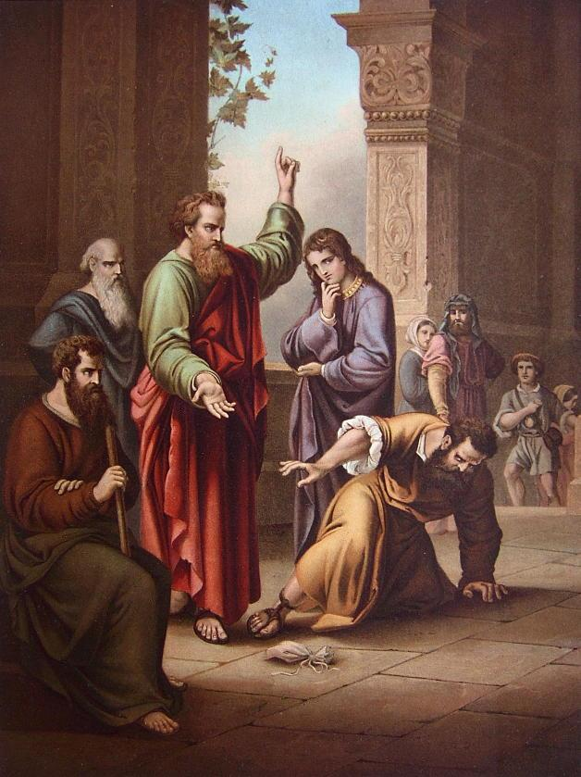
⁵ And Ananias hearing these words fell down, and gave up the ghost: and great fear came on all them that heard these things.
⁶ And the young men arose, wound him up, and carried him out, and buried him.
⁷ And it was about the space of three hours after, when his wife, not knowing what was done, came in.
⁸ And Peter answered unto her, Tell me whether ye sold the land for so much? And she said, Yea, for so much.

Slide 66
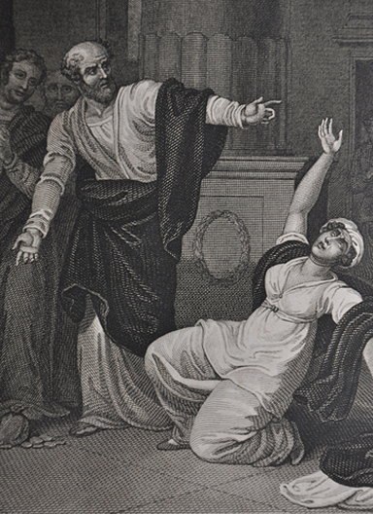
⁹ Then Peter said unto her, How is it that ye have agreed together to tempt the Spirit of the Lord? behold, the feet of them which have buried thy husband are at the door, and shall carry thee out.
¹⁰ Then fell she down straightway at his feet, and yielded up the ghost: and the young men came in, and found her dead, and, carrying her forth, buried her by her husband.
¹¹ And great fear came upon all the church, and upon as many as heard these things.

Slide 67
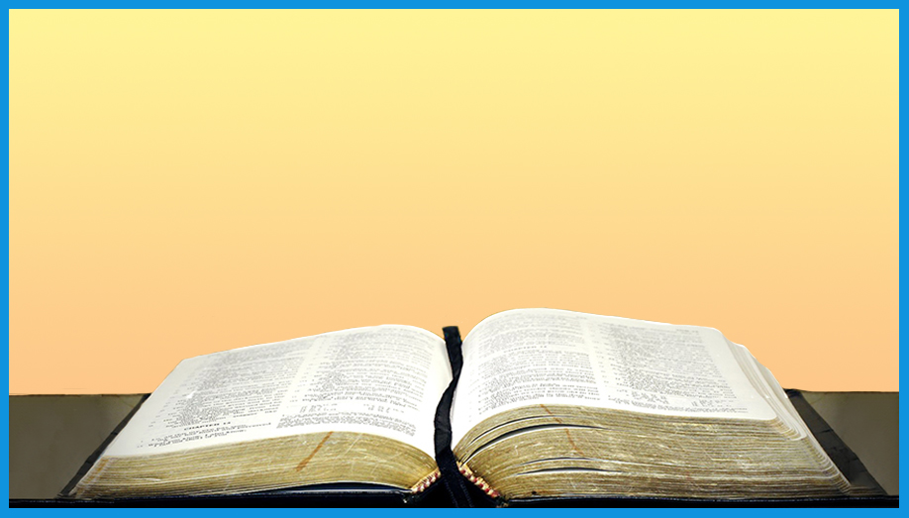
¹² And by the hands of the apostles were many signs and wonders wrought among the people; (and they were all with one accord in Solomon's porch.
¹³ And of the rest durst no man join himself to them: but the people magnified them.
¹⁴ And believers were the more added to the Lord, multitudes both of men and women.)

Slide 68
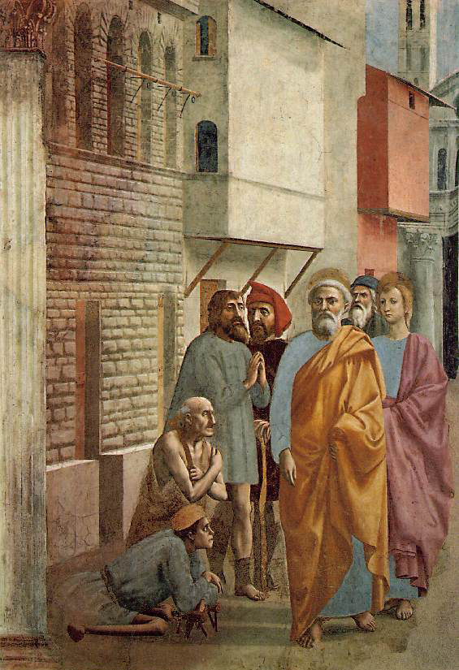
¹⁵ Insomuch that they brought forth the sick into the streets, and laid them on beds and couches, that at the least the shadow of Peter passing by might overshadow some of them.
¹⁶ There came also a multitude out of the cities round about unto Jerusalem, bringing sick folks, and them which were vexed with unclean spirits: and they were healed every one.

Slide 69
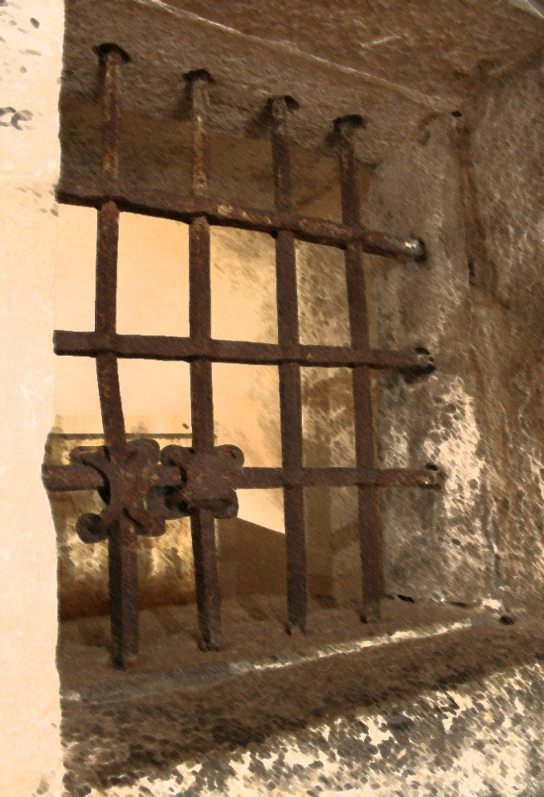
Acts 5:
¹⁷ Then the high priest rose up, and all they that were with him, (which is the sect of the Sadducees,) and were filled with indignation,
¹⁸ And laid their hands on the apostles, and put them in the common prison.

Slide 70
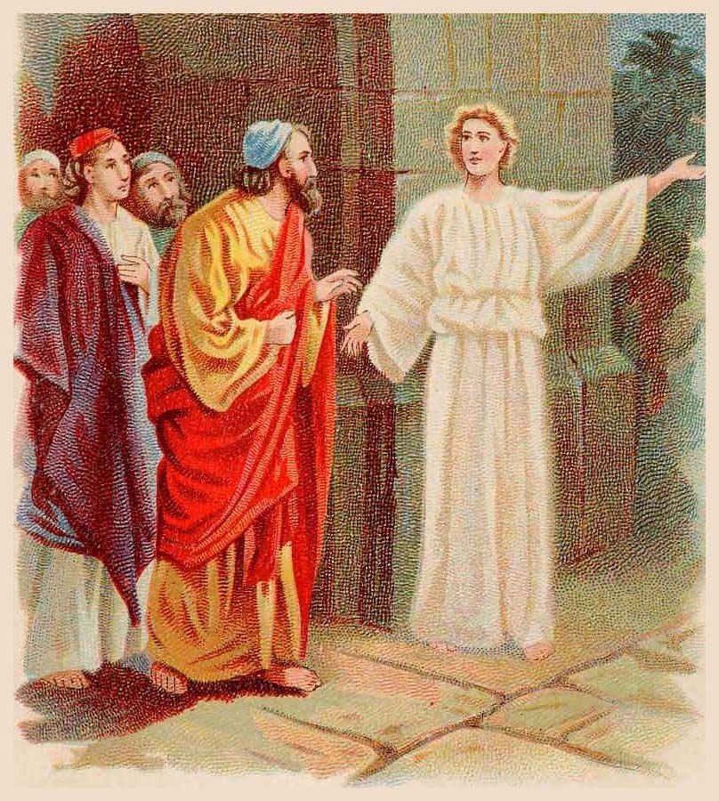
¹⁹ But the angel of the Lord by night opened the prison doors, and brought them forth, and said,
²⁰ Go, stand and speak in the temple to the people all the words of this life.

Slide 71
How ironic that the apostles were set free by an angel, when the Sadducees did not believe in angels!

Slide 72
And how it is strange that the Sadducees did not believe in angels, when the angels of God appear so many times in the five books of Moses (which they revered), and throughout the Word of God.

Slide 73
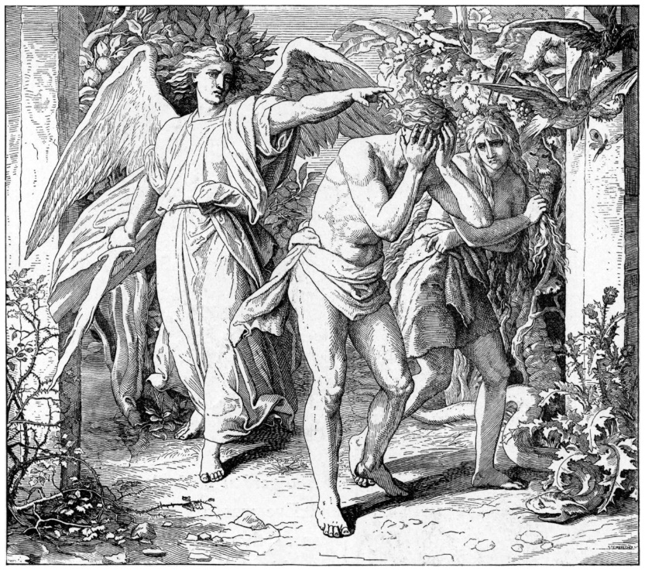
God put angels called Cherubim in the garden of Eden to guard the tree of life.
Genesis 3:24:
So he drove out the man; and he placed at the east of the garden of Eden Cherubims, and a flaming sword which turned every way, to keep the way of the tree of life.

Slide 74
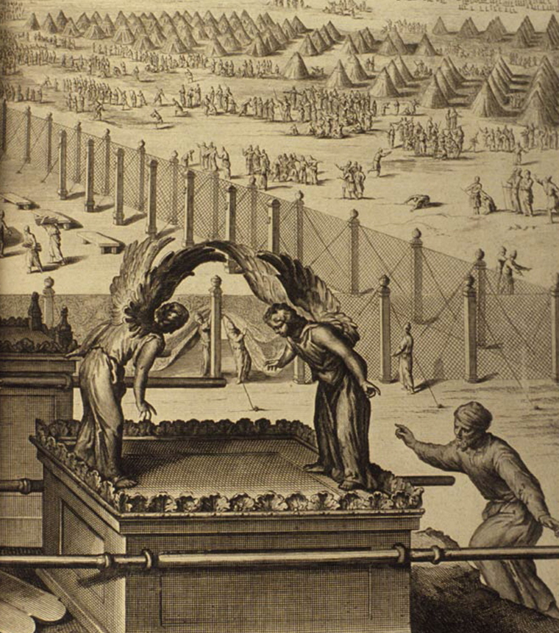
The figures of two cherubs sat on the mercy seat in the Ark of the Covenant.
Exodus 25:19-20
¹⁹ And make one cherub on the one end, and the other cherub on the other end: even of the mercy seat shall ye make the cherubims on the two ends thereof.
²⁰ And the cherubims shall stretch forth their wings on high, covering the mercy seat with their wings, and their faces shall look one to another; toward the mercy seat shall the faces of the cherubims be.

Slide 75
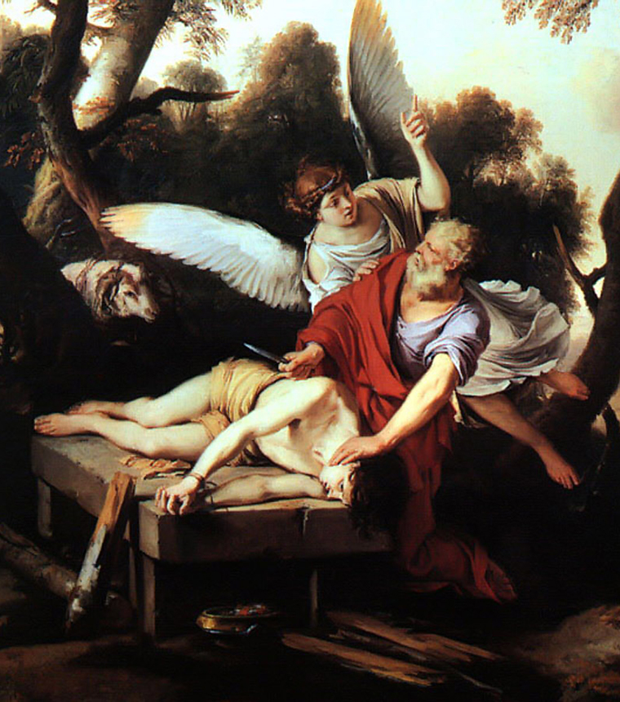
The angel of the Lord stopped Abraham from sacrificing Isaac.
Genesis 22:11-12:
¹¹ And the angel of the LORD called unto him out of heaven, and said, Abraham, Abraham: and he said, Here am I.
¹² And he said, Lay not thine hand upon the lad, neither do thou any thing unto him: for now I know that thou fearest God, seeing thou hast not withheld thy son, thine only son from me.

Slide 76
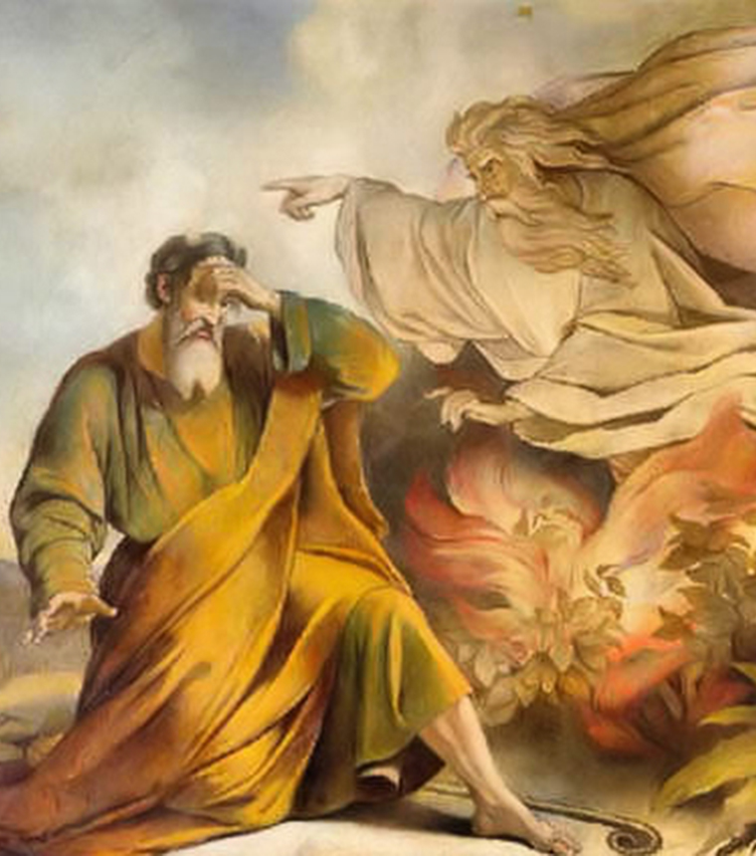
The angel of God spoke to Moses from a fiery bush.
Exodus 3:2: And the angel of the LORD appeared unto him in a flame of fire out of the midst of a bush: and he looked, and, behold, the bush burned with fire, and the bush was not consumed.

Slide 77
Isaiah saw a vision of the holy seraphim:
Isaiah 6:1-7:
¹ In the year that king Uzziah died I saw also the Lord sitting upon a throne, high and lifted up, and his train filled the temple.
² Above it stood the seraphims: each one had six wings; with twain he covered his face, and with twain he covered his feet, and with twain he did fly.

Slide 78
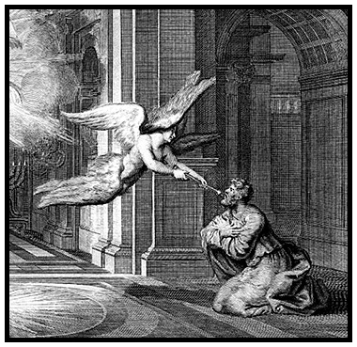
³ And one cried unto another, and said, Holy, holy, holy, is the LORD of hosts: the whole earth is full of his glory.
⁴ And the posts of the door moved at the voice of him that cried, and the house was filled with smoke.
⁵ Then said I, Woe is me! for I am undone; because I am a man of unclean lips, and I dwell in the midst of a people of unclean lips: for mine eyes have seen the King, the LORD of hosts.

Slide 79
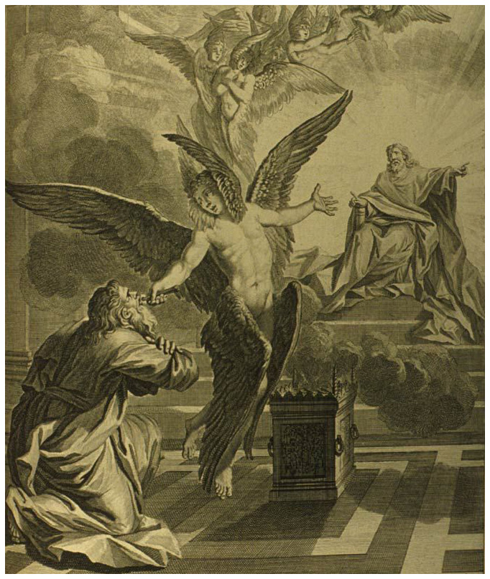
⁶ Then flew one of the seraphims unto me, having a live coal in his hand, which he had taken with the tongs from off the altar:
⁷ And he laid it upon my mouth, and said, Lo, this hath touched thy lips; and thine iniquity is taken away, and thy sin purged.

Slide 80
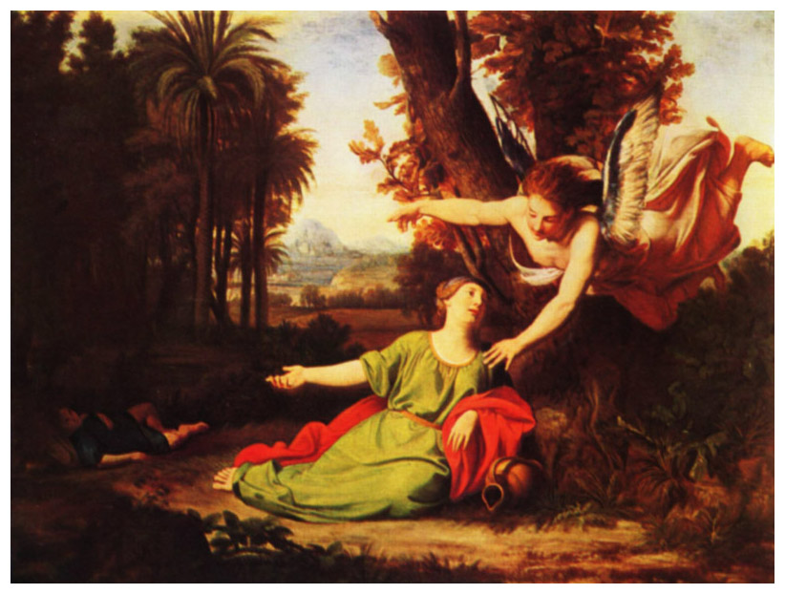
And what shall I more say? For the time would fail me to tell of …
Hagar

Slide 81
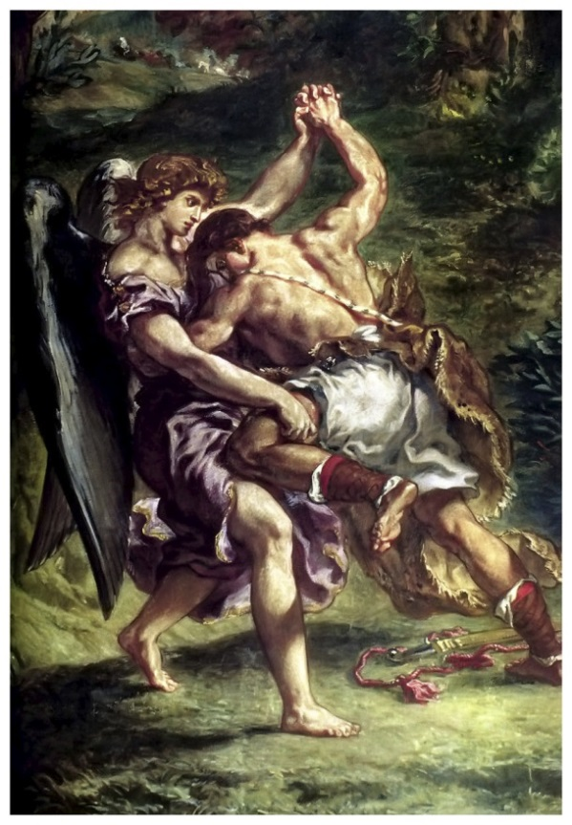
And what shall I more say? For the time would fail me to tell of …
Hagar
Jacob

Slide 82
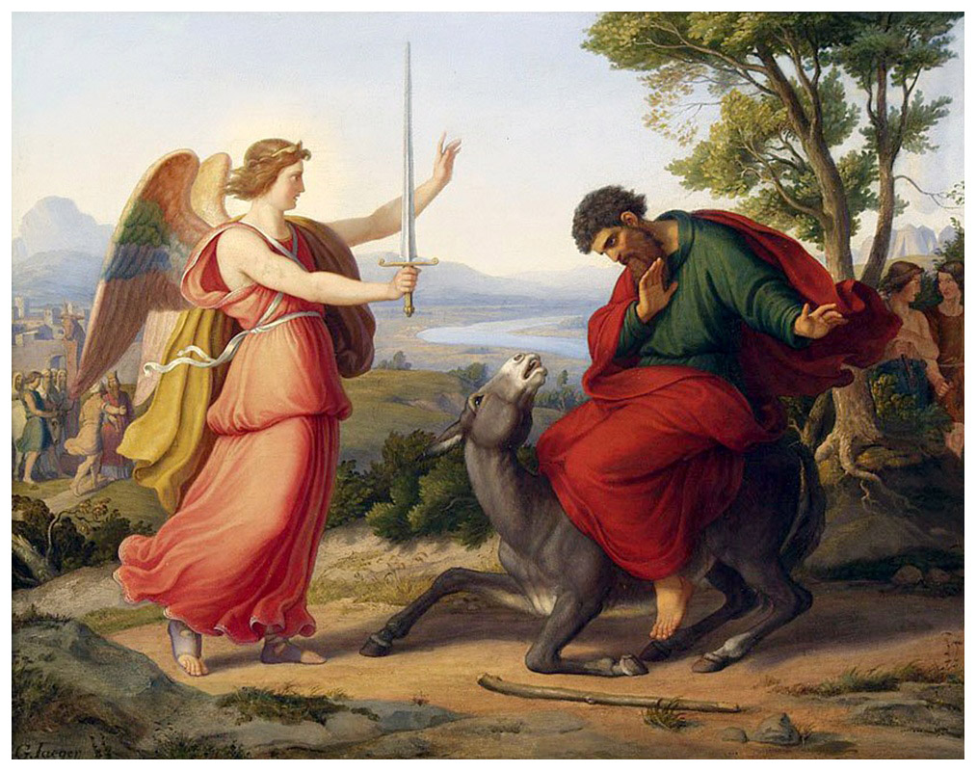
And what shall I more say? For the time would fail me to tell of …
Hagar
Jacob
Balaam

Slide 83
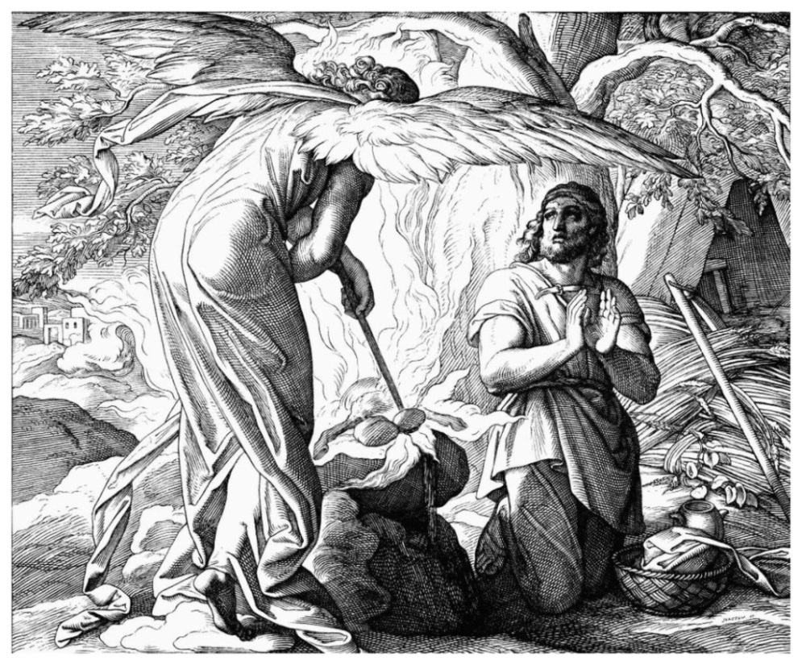
And what shall I more say? For the time would fail me to tell of …
Hagar
Jacob
Balaam
Gideon

Slide 84
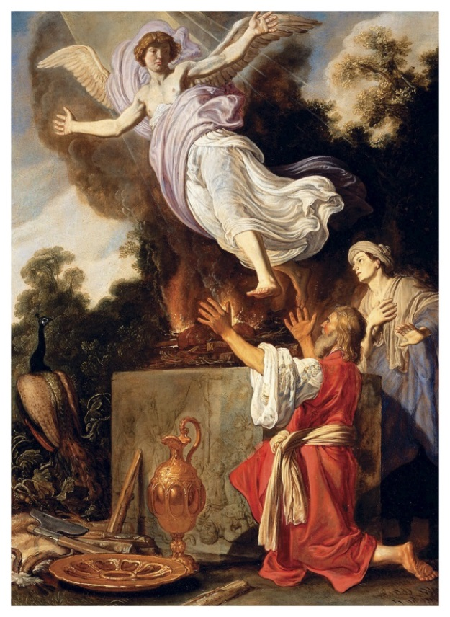
And what shall I more say? For the time would fail me to tell of …
Hagar
Jacob
Balaam
Gideon
the parents of Samson

Slide 85
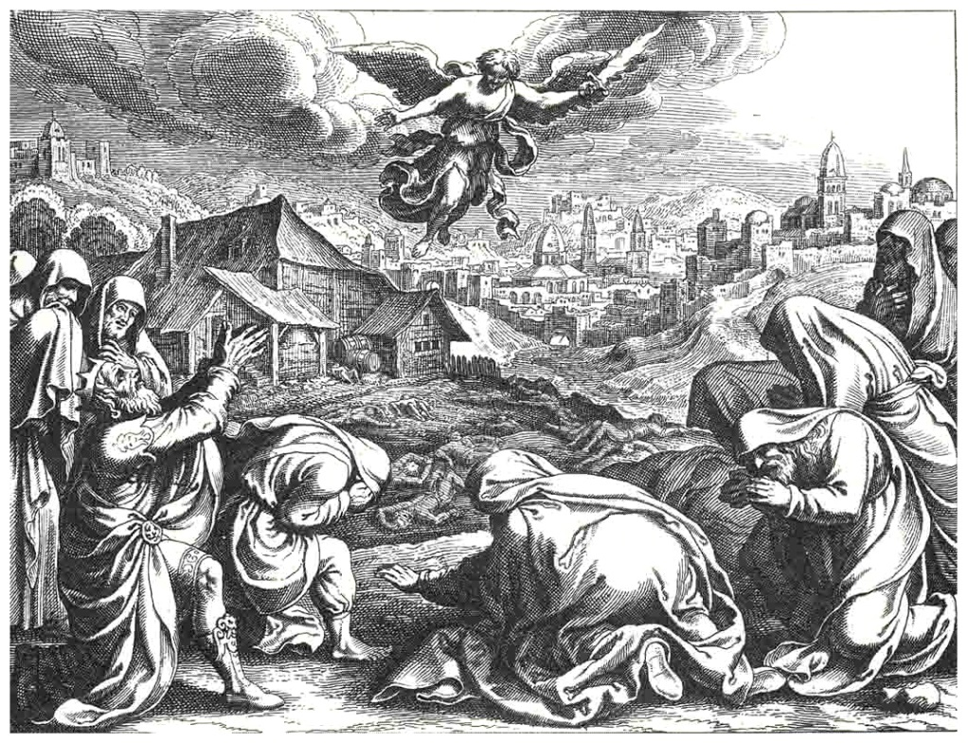
And what shall I more say? For the time would fail me to tell of …
Hagar
Jacob
Balaam
Gideon
the parents of Samson
King David

Slide 86
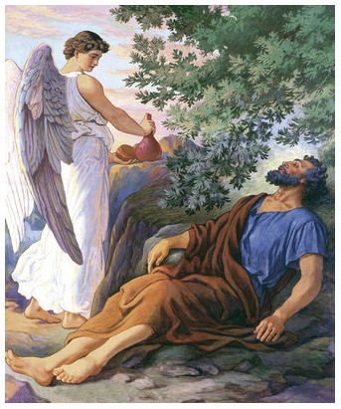
And what shall I more say? For the time would fail me to tell of …
Hagar
Jacob
Balaam
Gideon
the parents of Samson
King David
Elijah

Slide 87
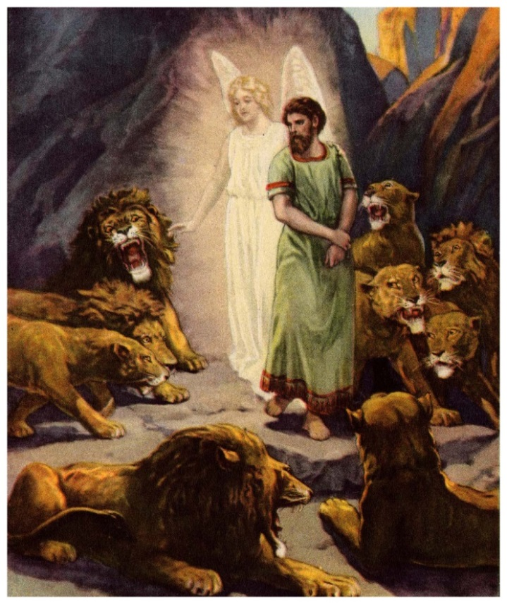
And what shall I more say? For the time would fail me to tell of …
Hagar
Jacob
Balaam
Gideon
the parents of Samson
King David
Elijah
Daniel

Slide 88
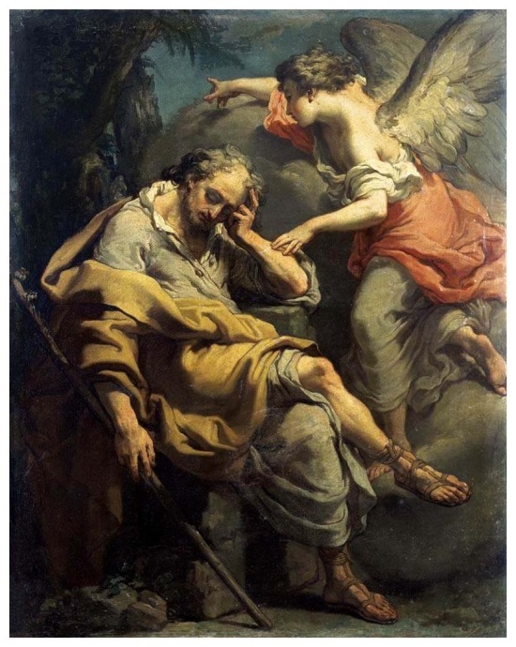
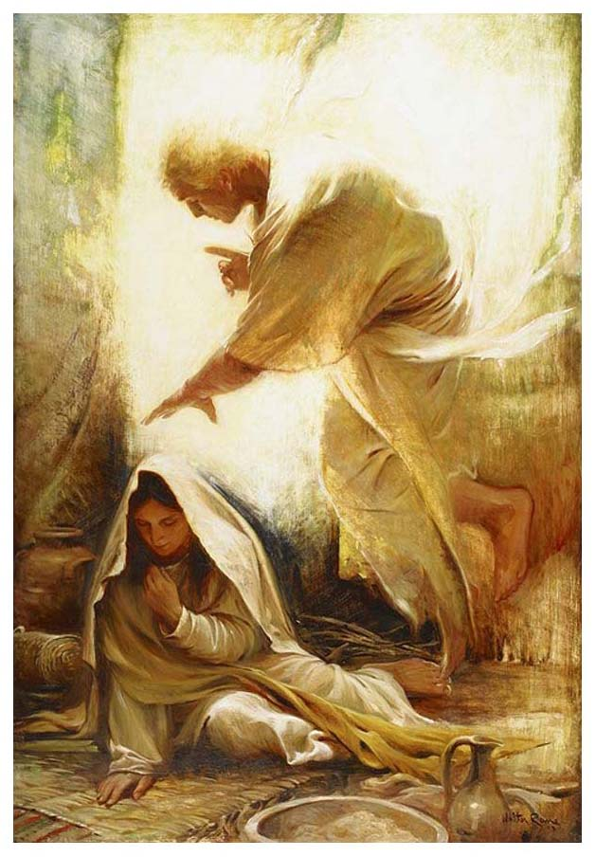
And what shall I more say? For the time would fail me to tell of …
Hagar
Jacob
Balaam
Gideon
the parents of Samson
King David
Elijah
Daniel
Joseph and Mary

Slide 89
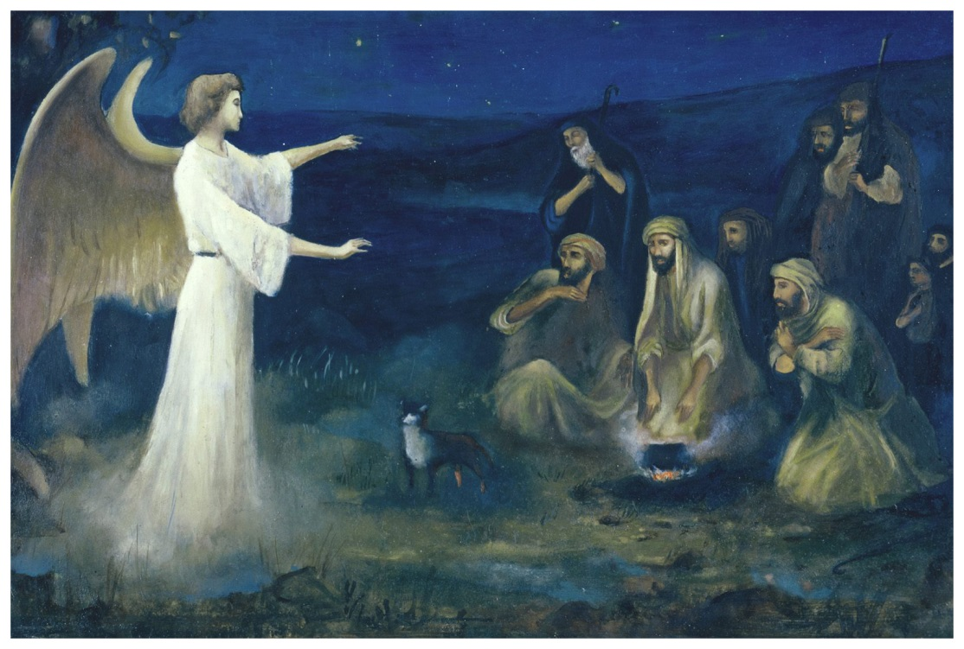
And what shall I more say? For the time would fail me to tell of …
Hagar
Jacob
Balaam
Gideon
the parents of Samson
King David
Elijah
Daniel
Joseph and Mary
the shepherds in the field

Slide 90
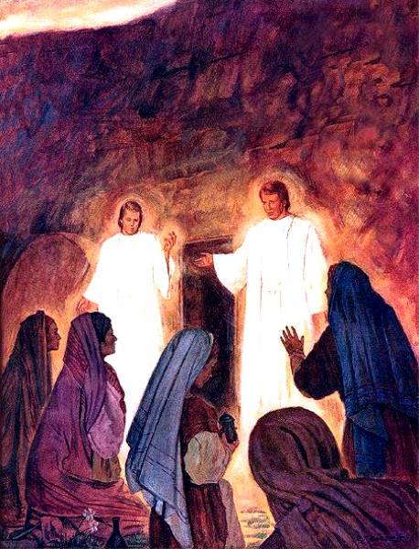
And what shall I more say? For the time would fail me to tell of …
Hagar
Jacob
Balaam
Gideon
the parents of Samson
King David
Elijah
Daniel
Joseph and Mary
the shepherds in the field
the women at the tomb
… all who had a remark-able experience with an angel of the Lord!

Slide 91
“Go, stand and speak in the temple to the people all the words of this life.”
Next:

Slide 92
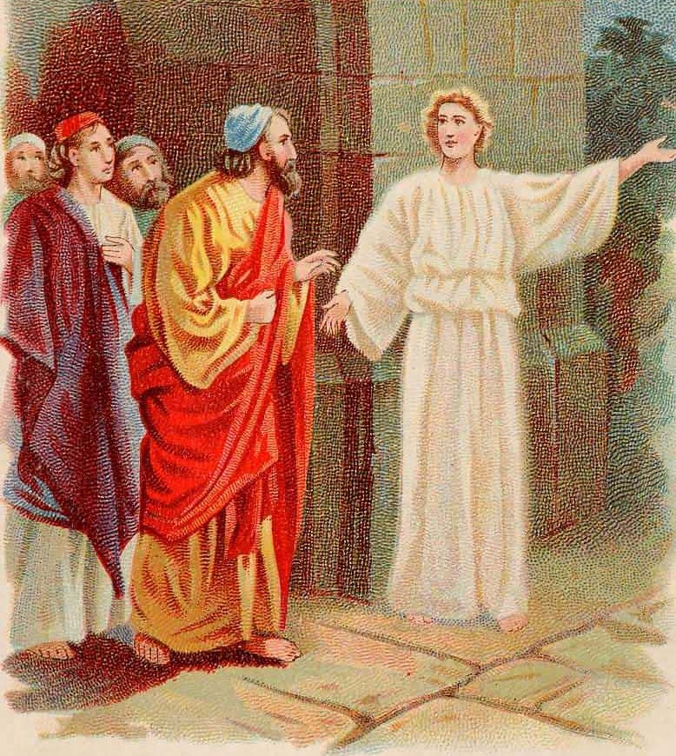
Acts 5:
¹⁹ But the angel of the Lord by night opened the prison doors, and brought them forth, and said,
²⁰ Go, stand and speak in the temple to the people all the words of this life.
²¹ And when they heard that, they entered into the temple early in the morning, and taught. But the high priest came, and they that were with him, and called the council together, and all the senate of the children of Israel, and sent to the prison to have them brought.

Slide 93
²² But when the officers came, and found them not in the prison, they returned, and told,
²³ Saying, The prison truly found we shut with all safety, and the keepers standing without before the doors: but when we had opened, we found no man within.
²⁴ Now when the high priest and the captain of the temple and the chief priests heard these things, they wondered what the outcome would be.

Slide 94
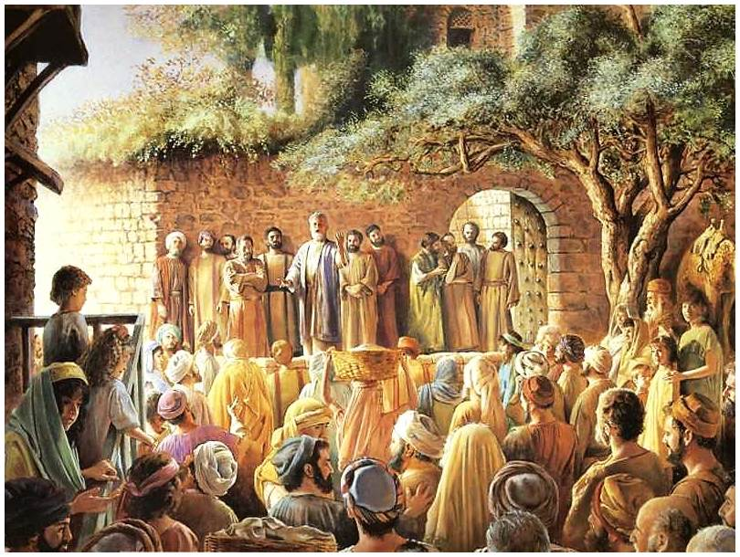
²⁵ Then came one and told them, saying, Behold, the men whom ye put in prison are standing in the temple, and teaching the people.

Slide 95
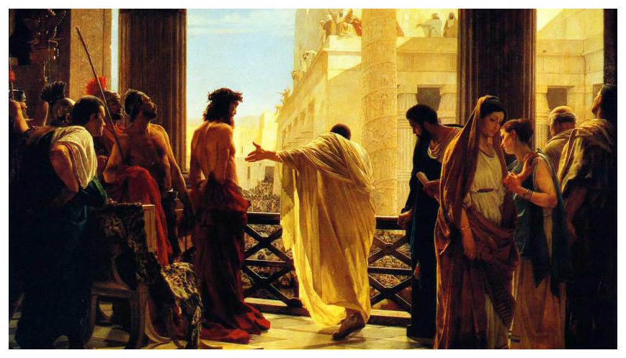
²⁶ Then went the captain with the officers, and brought them without violence: for they feared the people, lest they should have been stoned.
²⁷ And when they had brought them, they set them before the council: and the high priest asked them,
²⁸ Saying, Didn’t we straitly command you that ye should not teach in this name? and, behold, ye have filled Jerusalem with your doctrine, and intend to bring this man's blood upon us.
Matthew 27:24-25:
²⁴ When Pilate saw that he could prevail nothing, but that rather a tumult was made, he took water, and washed his hands before the multitude, saying, I am innocent of the blood of this just person: see ye to it.
²⁵ Then answered all the people, and said, His blood be on us, and on our children.

Slide 96
²⁹ Then Peter and the other apostles answered and said, We ought to obey God rather than men.
³⁰ The God of our fathers raised up Jesus, whom ye slew and hanged on a tree.
³¹ Him hath God exalted with his right hand to be a Prince and a Saviour, for to give repentance to Israel, and forgiveness of sins.
1 Samuel 15:22b: …Behold, to obey is better than sacrifice, and to hearken than the fat of rams.

Slide 97
³² And we are his witnesses of these things; and so is also the Holy Ghost, whom God hath given to them that obey him.
³³ When they heard that, they were cut to the heart, and took counsel to slay them.
Such a contrast to the men on the Day of Pentecost!
Acts 2:37: Now when they heard this, they were pricked in their heart, and said unto Peter and to the rest of the apostles, Men and brethren, what shall we do?

Slide 98
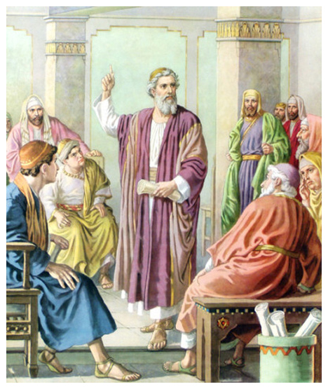
³⁴ Then stood there up one in the council, a Pharisee, named Gamaliel, a doctor of the law, had in reputation among all the people, and commanded to put the apostles forth a little space;
³⁵ And said unto them, Ye men of Israel, take heed to yourselves what ye intend to do as touching these men.

Slide 99
³⁶ For before these days rose up Theudas, boasting himself to be somebody; to whom a number of men, about four hundred, joined themselves: who was slain; and all, as many as obeyed him, were scattered, and brought to nought.
³⁷ After this man rose up Judas of Galilee in the days of the taxing, and drew away much people after him: he also perished; and all, even as many as obeyed him, were dispersed.

Slide 100
³⁸ And now I say unto you, Refrain from these men, and let them alone: for if this counsel or this work be of men, it will come to nought:
³⁹ But if it be of God, ye cannot overthrow it; lest haply ye be found even to fight against God.

Slide 101
⁴⁰ And to him they agreed: and when they had called the apostles, and beaten them, they commanded that they should not speak in the name of Jesus, and let them go.
⁴¹ And they departed from the presence of the council, rejoicing that they were counted worthy to suffer shame for his name.
⁴² And daily in the temple, and in every house, they ceased not to teach and preach Jesus Christ.
Philippians 3:10:
That I may know him, and the power of his resurrection, and the fellowship of his sufferings, being made conformable unto his death;
“There are no crown bearers in heaven that were not cross bearers on earth” – C H Spurgeon

Slide 102
The Acts of the Apostles Chapter 5

Slide 103
Acts 5:1-11 A&S
BUT – what is the contrast here? (1)
Did A&S make a large contribution? (2)
What was their sin? (3)
Did they have to give it all? (4)
What was the punishment? (5)
Was it miraculous, or did Peter cause it?
Why was the punishment so harsh?
It has to do with motive; not action …
Using the church for their self aggrandizement
Was Sapphira any less guilty? (6-10)
What was the effect of this? (11)

Slide 104
Acts 5:12-16 Miracles
Who performed miracles? (12)
Did anyone else at this point?
Where did they meet? (upper room?)
Who are the “rest?” (13)
Contrasting them with “the people” vs. 13
Why would they not join to them?
Would self-serving people be inclined …?
In general, were the believers well regarded?
Did this fear hurt their numbers? (14)
What helped the effort? (15)
Were any in need not healed? (16)

Slide 105
Acts 5:17-21 Persecution
What was their motivation? (17)
What did they do? (18)
“But” – what is the contrast? (19)
What did the angel command? (20)
In what was the power unto salvation?
Were they commanded to perform miracles?
Did the apostles obey immediately? (21)

Slide 106
Acts 5:21-29 Accusation
What did the Jewish leaders do? (21)
What did the officers find? (22-23)
Note the nature of this miracle.
What were the leaders perplexed at? (24)
What were the apostles reported doing? (25)
What did the persecutors do then? (26)
Why no violence? (26)
Was their accusation true? (27-28)
What major principle in verse 29?
When must we obey our authorities? (Rom. 13)
What is the only exception

Slide 107
Acts 5:30-32 Brief Defense
Who was Peter accusing here? (30)
Are we not all guilty?
What special guilt did they have at this point?
How does this contrast with Acts 3:17?
What is summarized in vs. 31?
Resurrection and coronation of Christ
Repentance, forgiveness – plan of salvation
Who has God given the obedient? (32)
Does this imply miraculous spiritual gifts?
What blessing does He bestow? (Witness)
Is this not more important than miracles?

Slide 108
Acts 5:33-42 Their Responses
How did the accusers respond? (33)
Why was this different from Acts 2:37?
Were the words any different?
Who was the voice of reason? (34)
How did he reason? (35-37)
What was his advice? (38-39)
Was it taken? (40) … God’s providence?
Did the apostles resent the dishonor? (41)
Where did they preach? (42)
What was a major tenet of their teaching? (42)
Why was this so significant? (… ceased not …)

Slide 109
Persecution of Peter and the Apostles
Acts 5:1-42

Slide 110
Outline - Acts
I. The Ministry of Peter – Acts 1:1-12:19
Peter’s 1st Sermon – Acts 1:1-2:47
Peter’s Post Pentecost Ministry – Acts 3:1-4:37
Persecution of Peter & Apostles – Acts 5:1-42
Persecution of the Church - 1 – Acts 6:1-7:60
Persecution of the Church - 2 – Acts 8:1-9:43
Peter Preaches to the Gentiles – Acts 10:1-12:25

Slide 111
³⁶ Now Joseph, a Levite of Cyprian birth, who was also called Barnabas by the apostles (which translated means Son of Encouragement), ³⁷ and who owned a tract of land, sold it and brought the money and laid it at the apostles’ feet.
- Acts 4:36-37

Slide 112
¹ But a man named Ananias, with his wife Sapphira, sold a piece of property, ² and kept back some of the price for himself, with his wife’s full knowledge, and bringing a portion of it, he laid it at the apostles’ feet. ³ But Peter said, “Ananias, why has Satan filled your heart to lie to the Holy Spirit and to keep back some of the price of the land?
- Acts 5:1-3

Slide 113
CHAPTER 5 J. W. McGarvey’s Acts Commentary
VERSES 3 & 4
“But Peter said, Ananias, why has Satan filled thy heart, to lie to the Holy Spirit, and to keep back part of the price of the land? (4) While it remained, was it not your own? And after it was sold, was it not in your own control? Why hast thou put this thing in thy heart? Thou hast not lied to men, but to God. Here Peter brings together the influence of Satan, and the free agency of the tempted, just as he had, in former discourses, the free agency of men, and the purposes of God. He demands of Ananias, “Why has Satan filled thy heart to lie to the Holy Spirit,” and, in the same breath, “Why hast thou put this thing in thy heart?” The existence and agency of the tempter are distinctly recognized, yet it is not Satan, but Ananias who is rebuked; and he is rebuked for doing the very thing that Satan had done, showing that he is as guilty as though Satan had no existence. Indeed, he is rebuked for what Satan had done. The justice of this is manifest from the fact that Satan had no power to fill his heart with evil, without his co-operation. That he had rendered this co-operation, threw the responsibility upon himself.
Peter’s knowledge of the deception was the result not of human information, but of the insight imparted to him by the Holy Spirit. This is necessary to the significance of the entire incident, as well as to the purport of Peter’s own words.
McGarvey, J. W. (1872). A commentary on Acts of Apostles (Ac 5:4). Lexington, KY: Transylvania Printing and Publishing Co.

Slide 114
⁴ While it remained unsold, did it not remain your own? And after it was sold, was it not under your control? Why is it that you have conceived this deed in your heart? You have not lied to men but to God.” ⁵ And as he heard these words, Ananias fell down and breathed his last; and great fear came over all who heard of it. ⁶ The young men got up and covered him up, and after carrying him out, they buried him.
- Acts 5:4-6

Slide 115
CHAPTER 5 J. W. McGarvey’s Acts Commentary
VERSE 5
The exposure of Ananias was very surprising, but neither the audience, nor perhaps Peter, was prepared by it for the event which immediately followed. (5) “And Ananias, hearing these words, fell down and expired. And great fear came upon all who heard these things.” There is no evidence that Peter had any will of his own in this matter; but it was an act of divine power exerted independent of the apostolic agency. The responsibility, therefore, attached not to Peter as an officer of the Church, but to God as the moral governor of the world. The propriety of the deed may be appreciated best by supposing that Ananias had succeeded in his undertaking. His success would not only have turned the most praiseworthy feature of the new Church into a source of corruption and hypocrisy, but it would have brought discredit upon the inspiration of the apostles, by showing that the Spirit within them could be deceived. Thus the whole fabric of apostolic authority, which was based upon their inspiration, would have fallen, and precipitated the entire cause into hopeless ruin. The attempt, therefore, presented a crisis of vital importance, and demanded some such vindication of their inspiration as could neither be mistaken nor forgotten. The immediate effect of the event was just the effect desired: “great fear came upon all who heard these things.”
McGarvey, J. W. (1872). A commentary on Acts of Apostles (p. 69). Lexington, KY: Transylvania Printing and Publishing Co.

Slide 116
There sin was creating a lie to inflate their generosity.

Slide 117
The seriousness of their sin was that the lie was directed at God.

Slide 118
⁷ Now there elapsed an interval of about three hours, and his wife came in, not knowing what had happened. ⁸ And Peter responded to her, “Tell me whether you sold the land for such and such a price?” And she said, “Yes, that was the price.”
- Acts 5:7-8

Slide 119
CHAPTER 5 J. W. McGarvey’s Acts Commentary
VERSE 7
Sapphira was not present. (7) “And it was about the space of three hours after, when his wife, not knowing what was done, came in.” How she remained so long ignorant of the fate of her husband, we are not informed, though it is a most extraordinary circumstance. He had died suddenly, in a manner which had excited everybody; had been buried; and three hours had passed; yet his wife, who must have been in the vicinity, has no intimation of it, but comes into the very assembly where it had occurred, without a word reaching her ear upon the subject. There is no way to account for this, but by the supposition that there was a concerted determination on the part of the whole multitude to conceal the facts from her. This was a most unnatural determination, and one difficult of execution, except on the further supposition that Peter commanded the multitude to restrain their natural impulses, and let her know nothing until he himself was ready to reveal it to her. This course was necessary in order to effectually expose her.
McGarvey, J. W. (1872). A commentary on Acts of Apostles (p. 69). Lexington, KY: Transylvania Printing

Slide 120
Then Peter said to her, “Why is it that you have agreed together to put the Spirit of the Lord to the test? Behold, the feet of those who have buried your husband are at the door, and they will carry you out as well.”
- Acts 5:9

Slide 121
¹⁰ And immediately she fell at his feet and breathed her last, and the young men came in and found her dead, and they carried her out and buried her beside her husband. ¹¹ And great fear came over the whole church, and over all who heard of these things.
- Acts 5:10-11

Slide 122
CHAPTER 5 J. W. McGarvey’s Acts Commentary
VERSE 11
The failure of the plot proved as propitious to the cause of truth as its success would have been disastrous. (11) “And great fear came upon all the Church, and upon all who had heard these things.” This fear was excited, not only by the sudden and awful fate of the guilty pair, but also by the fearful nature of that spirit-searching knowledge imparted to the apostles. The disciples were now filled with more just conceptions than before of the nature of inspiration, and the unbelieving masses who heard of the event were awed into respect and reverence.
McGarvey, J. W. (1872). A commentary on Acts of Apostles (p. 70). Lexington, KY: Transylvania Printing and Publishing Co.

Slide 124
Definition
"Blapto" & "Phemi"
Hurt & Speak
Hence to "speak to hurt"
This sin is committed
with the"Tongue"

Slide 125
It happened to some
1 Tim 1:19-20 Holding faith, and a good conscience; which some having put away concerning faith have made shipwreck:
20 Of whom is Hymenaeus and Alexander; whom I have delivered unto Satan, that they may learn not to blaspheme.
blasphemers

Slide 126
When we go to passages which speak of God’s willingness to forgive, we find that God is willing and that the failure is with man. (Exodus 33:7-20; Matthew 23:36-37). Observe on Matt. 23:36-37 that this statement would include any who had blasphemed the Holy Spirit, for some in Jerusalem did. (2nd Peter 3:9). Since no passage says that the sin against the Spirit will not be forgiven because God is not willing to forgive, should we really say it? Is not the fault entirely with man? – J. D. Bales

Slide 129
¹² At the hands of the apostles many signs and wonders were taking place among the people; and they were all with one accord in Solomon’s portico. ¹³ But none of the rest dared to associate with them; however, the people held them in high esteem.
- Acts 5:12-13

Slide 130
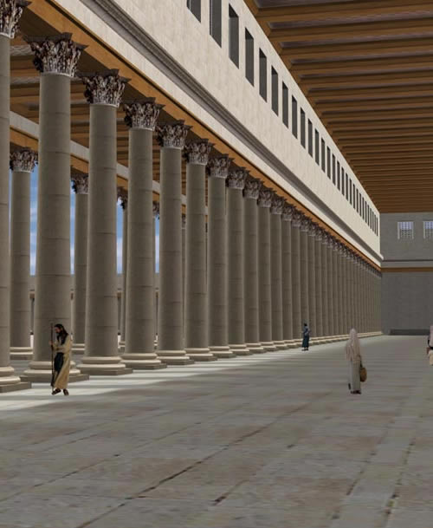

Slide 131
¹⁴ And all the more believers in the Lord, multitudes of men and women, were constantly added to their number, ¹⁵ to such an extent that they even carried the sick out into the streets and laid them on cots and pallets, so that when Peter came by at least his shadow might fall on any one of them.
- Acts 5:14-15

Slide 132
CHAPTER 5 J. W. McGarvey’s Acts Commentary
VERSE 14
The statement just made, that “of the rest no man dared to join himself to them,” can not mean that persons dared not join the Church, for the reverse is now stated. (14) “And believers were the more added to the Lord, multitudes both of men and women.” The increased awe in the presence of the apostles, with which the people were inspired, made them listen with increased respect to their testimony concerning Jesus, and brought them in greater numbers to obedience.
McGarvey, J. W. (1872). A commentary on Acts of Apostles (p. 70). Lexington, KY: Transylvania Printing and Publishing Co.

Slide 133
Also the people from the cities in the vicinity of Jerusalem were coming together, bringing people who were sick or afflicted with unclean spirits, and they were all being healed.
- Acts 5:16

Slide 134
¹⁷ But the high priest rose up, along with all his associates (that is the sect of the Sadducees), and they were filled with jealousy. ¹⁸ They laid hands on the apostles and put them in a public jail. ¹⁹ But during the night an angel of the Lord opened the gates of the prison, and taking them out he said, ²⁰ “Go, stand and speak to the people in the temple the whole message of this Life.”
- Acts 5:17-20

Slide 136
²¹ Upon hearing this, they entered into the temple about daybreak and began to teach. Now when the high priest and his associates came, they called the Council together, even all the Senate of the sons of Israel, and sent orders to the prison house for them to be brought. ²² But the officers who came did not find them in the prison; and they returned and reported back,
- Acts 5:21-22

Slide 137
²³ saying, “We found the prison house locked quite securely and the guards standing at the doors; but when we had opened up, we found no one inside.” ²⁴ Now when the captain of the temple guard and the chief priests heard these words, they were greatly perplexed about them as to what would come of this.
- Acts 5:23-24

Slide 138
But someone came and reported to them, “The men whom you put in prison are standing in the temple and teaching the people!”
- Acts 5:25

Slide 139
²⁶ Then the captain went along with the officers and proceeded to bring them back without violence (for they were afraid of the people, that they might be stoned). ²⁷ When they had brought them, they stood them before the Council. The high priest questioned them,
- Acts 5:26-27

Slide 140
²⁸ saying, “We gave you strict orders not to continue teaching in this name, and yet, you have filled Jerusalem with your teaching and intend to bring this man’s blood upon us.” ²⁹ But Peter and the apostles answered, “We must obey God rather than men.
- Acts 5:28-29

Slide 141
³⁰ The God of our fathers raised up Jesus, whom you had put to death by hanging Him on a cross. ³¹ He is the one whom God exalted to His right hand as a Prince and a Savior, to grant repentance to Israel, and forgiveness of sins. ³² And we are witnesses of these things; and so is the Holy Spirit, whom God has given to those who obey Him.”
- Acts 5:30-32

Slide 142
CHAPTER 5 J. W. McGarvey’s Acts Commentary
VERSES 29 - 32
To these charges the apostles candidly and fearlessly respond. (29) “Then Peter and the other apostles answered and said, We ought to obey God rather than men.” This answers the first charge. They plead guilty, but justify themselves by the authority of God. Peter and John had left the Sanhedrim before, with the words, “Whether it is right in the sight of God to hearken to men more than to God, do you judge.” Now, as if that question was decided, they declare, “We ought to obey God rather than men.” They then answer the second charge by a restatement of the facts: (30) “The God of our fathers had raised up Jesus, whom ye slew, having hung him on a tree. (31) This man has God exalted to his own right hand, a Prince and a Savior, to grant repentance to Israel, and remission of sins. (32) And we are his witnesses of these things, and so is the Holy Spirit whom God has given to those who obey him.” This was repeating, with terrible emphasis, the very thing which was charged against them as a crime.
McGarvey, J. W. (1872). A commentary on Acts of Apostles (p. 72). Lexington, KY: Transylvania

Slide 143
CHAPTER 5 J. W. McGarvey’s Acts Commentary
VERSES 29 - 32
In the declaration that Jesus had been exalted a Prince and a Savior, “to grant repentance to Israel and remission of sins,” it is implied that repentance, as well as remission of sins, is in some sense granted to me. But to grant repentance can not mean to bestow it upon men without an exercise of their own will; for repentance is enjoined upon men as a duty to be performed by them. How, then, can that which is a duty to be performed, be said to be granted to us? We will readily perceive the answer to this question, by remembering that repentance is produced by sorrow for sin, and that it belongs to God to furnish men with the facts which will awaken this sorrow. Without revelation, men would never be made to feel that sorrow for sin which works repentance; but in the revelation of Jesus Christ we are furnished with the chief of these motives, and because of this, he is said to grant repentance.
McGarvey, J. W. (1872). A commentary on Acts of Apostles (p. 72). Lexington, KY: Transylvania

Slide 144
First Arrest
By Jesus’ authority
Whom you crucified
That God raised
He is the Messiah
He is the only Savior

Slide 145
First Arrest
Third Arrest
By Jesus’ authority
Whom you crucified
That God raised
He is the Messiah
He is the only Savior
Healing + Teaching from God
Leaders crucified Jesus
Jesus is in heaven
Only He can forgive them
Apostles are spirit filled
Spirit dwells in all believers

Slide 146
³³ But when they heard this, they were cut to the quick and intended to kill them. ³⁴ But a Pharisee named Gamaliel, a teacher of the Law, respected by all the people, stood up in the Council and gave orders to put the men outside for a short time.
- Acts 5:33-34

Slide 147
³⁵ And he said to them, “Men of Israel, take care what you propose to do with these men. ³⁶ For some time ago Theudas rose up, claiming to be somebody, and a group of about four hundred men joined up with him. But he was killed, and all who followed him were dispersed and came to nothing.
- Acts 5:35-36

Slide 148
³⁷ After this man, Judas of Galilee rose up in the days of the census and drew away some people after him; he too perished, and all those who followed him were scattered. ³⁸ So in the present case, I say to you, stay away from these men and let them alone, for if this plan or action is of men, it will be overthrown; ³⁹ but if it is of God, you will not be able to overthrow them; or else you may even be found fighting against God.”
- Acts 5:37-39

Slide 149
CHAPTER 5 J. W. McGarvey’s Acts Commentary
VERSES 34 - 39
At this crisis the madness of the Sadducees was suddenly checked by the prudent counsel of one of the opposite party. The Pharisees were less exasperated, because their leading dogma was sustained by the apostles, and they saw that any imprudent proceedings were likely to involve the whole Sanhedrim in trouble, without regard to party; therefore, Gamaliel interposes his advice…
A question has been raised as to whether Luke is not guilty of an anachronism in this report of Gamaliel’s speech, by making him refer to a Theudas, who is mentioned by Josephus, and who flourished many years later, under the reign of Claudius Cæsar. Such a reference then could not possibly be made by Gamaliel & if it was made by Luke, he’s not only guilty of the anachronism, but, what is far worse, of giving a false report of Gamaliel’s speech. Rather than admit such a hypothesis involving these consequences in reference to a historian of unimpeached veracity, we must suppose that some impostor by the name of Theudas did flourish at the time here alluded to by Gamaliel. Judas the Galilean is also mentioned by Josephus, whose account of him agrees with this given by Gamaliel.
McGarvey, J. W. (1872). A commentary on Acts of Apostles (p. 73). Lexington, KY: Transylvania Printing and Publishing Co.

Slide 150
CHAPTER 5 J. W. McGarvey’s Acts Commentary
VERSES 34 - 39
The moral merits of this advice may be differently estimated, according to the point of view from which he contemplate it. If we regard it as a general rule of procedure in reference to religious movements, it must be regarded as a mere time-serving policy. Instead of waiting to see whether such a movement is going to prove successful or not, before we take ground in reference to it, the lover of truth will promptly investigate and decide its merits without regard to public opinion. But if we regard Gamaliel as only giving a reason why men should not persecute a cause which they are not prepared to accept, it was certainly most judicious advice. When we have decided against a cause, we should render a reason for our decision, and then leave it to the developments of Providence, well assured that whatever is not from God will come to nothing without any violent agency on our part. We should also be afraid to resist with violence or passion any thing bearing a semblance to truth, lest we fight against God, and be ourselves overthrown.
McGarvey, J. W. (1872). A commentary on Acts of Apostles (pp. 73–74). Lexington, KY: Transylvania

Slide 151
⁴⁰ They took his advice; and after calling the apostles in, they flogged them and ordered them not to speak in the name of Jesus, and then released them. ⁴¹ So they went on their way from the presence of the Council, rejoicing that they had been considered worthy to suffer shame for His name.
- Acts 5:40-41

Slide 152
CHAPTER 5 J. W. McGarvey’s Acts Commentary
VERSE 40
There was no opposition to Gamaliel’s advice. (40) “And they obeyed him; and having called the apostles, and scourged them, they commanded them not to speak in the name of Jesus, and let them go.” Scourging was so common in the Roman empire, even of men untried and uncondemned, and was so common a fate of Christians at the time Luke was writing, he mentions it here rather as a matter of course. It is the first time, however, that it was experienced by the apostles, and was, probably, harder to endure than it ever was afterward.
McGarvey, J. W. (1872). A commentary on Acts of Apostles (p. 74). Lexington, KY: Transylvania Printing and Publishing Co.

Slide 153
And every day, in the temple and from house to house, they kept right on teaching and preaching Jesus as the Christ.
- Acts 5:42

Slide 154
CHAPTER 5 J. W. McGarvey’s Acts Commentary
VERSES 41 & 42
The Sanhedrin had now tried both threats and scourging upon the apostles without checking their activity, and as there was nothing further for them to try but death, which they were not yet prepared to inflict, they relinquished for awhile their efforts. In this first contest, therefore, the apostles were completely victorious, and compelled their adversaries to abandon the field.
The apostles taught and preached not only publicly in the temple, but “from house to house.” In this they give an example to the ministry of all ages, which is well worthy of imitation. Private instruction and admonition bring the teacher and the taught into closer contact, and secure an individuality of effect not attainable in a public assembly. It can not, therefore, be well dispensed with; but he who employs it most diligently will, other things being equal, employ his energies most successfully.
McGarvey, J. W. (1872). A commentary on Acts of Apostles (p. 74). Lexington, KY: Transylvania Printing and Publishing Co.

Slide 155
Their Torture Proved:
Sincere faithfulness
Sureness of Jesus’ word

Slide 156
¹⁶ “Behold, I send you out as sheep in the midst of wolves; so be shrewd as serpents and innocent as doves. ¹⁷ But beware of men, for they will hand you over to the courts and scourge you in their synagogues; ¹⁸ and you will even be brought before governors and kings for My sake, as a testimony to them and to the Gentiles.
- Matthew 10:16-18

Slide 157
¹⁹ But when they hand you over, do not worry about how or what you are to say; for it will be given you in that hour what you are to say. ²⁰ For it is not you who speak, but it is the Spirit of your Father who speaks in you.
- Matthew 10:19-20

Slide 158
Their Torture Proved:
Sincere faithfulness
Sureness of Jesus’ word
Their weakness of the opposition
They were worthy to share Christ’s suffering

Slide 159
Taught from House to House
Congregation becoming too large
Avoid interference from Jewish leaders

Slide 160
Battle lines
Jewish Leadership
Tradition
Roman Empire
Pagan World
12 Apostles
Young Church

Slide 161
You are from God, little children, and have overcome them; because greater is He who is in you than he who is in the world.
- I John 4:4

Slide 162
L.D. CARY & SAM HOLT CATCH PHRASES
Chapter 1 – “Jesus’ Work On Earth Is Done”
Chapter 2 – “Peter Baptizes A Crew”
Chapter 3 – “A Beggar’s Plea”
Chapter 4 – “A Jailhouse Door”
Chapter 5 – “Ananias & Sapphira Don’t Survive”
Chapter 6 – “The Widow’s Fix”
Chapter 8 – “Stephen Looks Into Heaven”
Chapter 9 – “Saul Struck Blind”
“The Widow’s Fix”
Catch Phrase
Chapter Six

Slide 163
Acts of the Apostles Chapter 6
Overlooking the Widows of the Hellenistic Jews
Apostolic Solution to the problem
Selection of 7 men to see to the needs of Greek Widows
Sects of the Jews dispute with Stephen over the Gospel
Stephen put on trial before the Sanhedrin

Slide 164
Acts 8:1-4 (NASB) 1 Saul was in hearty agreement with putting him to death. And on that day a great persecution began against the church in Jerusalem, and they were all scattered throughout the regions of Judea and Samaria, except the apostles. 2 Some devout men buried Stephen, and made loud lamentation over him. 3 But Saul began ravaging the church, entering house after house, and dragging off men and women, he would put them in prison. 4 Therefore, those who had been scattered went about preaching the word.
2 Timothy 2:1-2 (NASB) 1 You therefore, my son, be strong in the grace that is in Christ Jesus. 2 The things which you have heard from me in the presence of many witnesses, entrust these to faithful men who will be able to teach others also.
1 Timothy 3:8-13 (NASB) 8 Deacons likewise must be men of dignity, not double-tongued, or addicted to much wine or fond of sordid gain, 9 but holding to the mystery of the faith with a clear conscience. 10 These men must also first be tested; then let them serve as deacons if they are beyond reproach. 11 Women must likewise be dignified, not malicious gossips, but temperate, faithful in all things. 12 Deacons must be husbands of only one wife, and good managers of their children and their own households. 13 For those who have served well as deacons obtain for themselves a high standing and great confidence in the faith that is in Christ Jesus.
Acts 6:1-3 (NASB)
1 Now at this time while the disciples were increasing in number, a complaint arose on the part of the Hellenistic Jews against the native Hebrews, because their widows were being overlooked in the daily serving of food. 2 So the twelve summoned the congregation of the disciples and said, "It is not desirable for us to neglect the word of God in order to serve tables. 3 "Therefore, brethren, select from among you seven men of good reputation, full of the Spirit and of wisdom, whom we may put in charge of this task.
A. Church is Hebrew speaking Jews, Greek speaking Jews and Proselytes: Acts 2:5-11; 6:5
1. Widows neglected: Ex 22:22; Dt 10:18; 14:29 Psa 146:9; 1Tim 5:3-5, 16; Ja 1:27
B. The apostles could not neglect the command given to them by Jesus. The apostles were inspired by the Holy Spirit to teach, not to serve tables: Mt 28:16-20; Mk 16:14-15; Act 1:8
1. Apostolic teaching prepared others to teach: Acts 8:1-4; 2Tim 2:1-2
2. Select 7 men, (lit.“we may appoint upon this need”): Deacons? Phil 1:1; 1Tim 3:8-13
3. Full of the spirit: miraculous? Acts 2:4; 4:8, 31; 6:8, natural? Jn 6:63; Gal 5:16-24; Eph 5:18
Matthew 28:16-20 (NASB) 16 But the eleven disciples proceeded to Galilee, to the mountain which Jesus had designated. 17 When they saw Him, they worshiped Him; but some were doubtful. 18 And Jesus came up and spoke to them, saying, "All authority has been given to Me in heaven and on earth. 19 "Go therefore and make disciples of all the nations, baptizing them in the name of the Father and the Son and the Holy Spirit, 20 teaching them to observe all that I commanded you; and lo, I am with you always, even to the end of the age."
Greek Strong's Number: 1247
Greek Word: διακονέω
Root: from <G1249> noun: minister, servant, deacon
Part of Speech: verb
English Words used in KJV:
minister unto 15 serve 10 minister 7 miscellaneous translations 5 [Total Count: 37]
from <G1249> (diakonos); to be an attendant, i.e. wait upon (menially or as a host, friend or [figurative] teacher); techn. to act as a Christian deacon: (ad-) minister (unto), serve, use the office of a deacon.
Strong's Talking Greek & Hebrew Dictionary
Galatians 5:16-24 (NASB) 16 But I say, walk by the Spirit, and you will not carry out the desire of the flesh. 17 For the flesh sets its desire against the Spirit, and the Spirit against the flesh; for these are in opposition to one another, so that you may not do the things that you please. 18 But if you are led by the Spirit, you are not under the Law. 19 Now the deeds of the flesh are evident, which are: immorality, impurity, sensuality, 20 idolatry, sorcery, enmities, strife, jealousy, outbursts of anger, disputes, dissensions, factions,
Acts 2:4 (NASB) 4 And they were all filled with the Holy Spirit and began to speak with other tongues, as the Spirit was giving them utterance.
Acts 4:8 (NASB) 8 Then Peter, filled with the Holy Spirit, said to them, "Rulers and elders of the people,
Acts 4:31 (NASB) 31 And when they had prayed, the place where they had gathered together was shaken, and they were all filled with the Holy Spirit and began to speak the word of God with boldness.
Ephesians 5:18-19 (NASB) 18 And do not get drunk with wine, for that is dissipation, but be filled with the Spirit, 19 speaking to one another in psalms and hymns and spiritual songs, singing and making melody with your heart to the Lord;
Acts 6:8 (NASB) 8 And Stephen, full of grace and power, was performing great wonders and signs among the people.
John 6:63 (NASB) 63 "It is the Spirit who gives life; the flesh profits nothing; the words that I have spoken to you are spirit and are life.
Philippians 1:1 (NASB) 1 Paul and Timothy, bond-servants of Christ Jesus, To all the saints in Christ Jesus who are in Philippi, including the overseers and deacons:
21 envying, drunkenness, carousing, and things like these, of which I forewarn you, just as I have forewarned you, that those who practice such things will not inherit the kingdom of God. 22 But the fruit of the Spirit is love, joy, peace, patience, kindness, goodness, faithfulness, 23 gentleness, self-control; against such things there is no law. 24 Now those who belong to Christ Jesus have crucified the flesh with its passions and desires.
Acts 2:5-11 (NASB) 5 Now there were Jews living in Jerusalem, devout men from every nation under heaven. 6 And when this sound occurred, the crowd came together, and were bewildered because each one of them was hearing them speak in his own language. 7 They were amazed and astonished, saying, "Why, are not all these who are speaking Galileans? 8 "And how is it that we each hear them in our own language to which we were born?
Acts 6:5 (NASB) 5 The statement found approval with the whole congregation; and they chose Stephen, a man full of faith and of the Holy Spirit, and Philip, Prochorus, Nicanor, Timon, Parmenas and Nicolas, a proselyte from Antioch.
9 "Parthians and Medes and Elamites, and residents of Mesopotamia, Judea and Cappadocia, Pontus and Asia, 10 Phrygia and Pamphylia, Egypt and the districts of Libya around Cyrene, and visitors from Rome, both Jews and proselytes, 11 Cretans and Arabs—we hear them in our own tongues speaking of the mighty deeds of God."
James 1:27 (NASB) 27 Pure and undefiled religion in the sight of our God and Father is this: to visit orphans and widows in their distress, and to keep oneself unstained by the world.
Deuteronomy 10:18 (NASB) 18 "He executes justice for the orphan and the widow, and shows His love for the alien by giving him food and clothing.
Deuteronomy 14:29 (NASB) 29 "The Levite, because he has no portion or inheritance among you, and the alien, the orphan and the widow who are in your town, shall come and eat and be satisfied, in order that the LORD your God may bless you in all the work of your hand which you do.
Psalm 146:9 (NASB) 9 The LORD protects the strangers; He supports the fatherless and the widow, But He thwarts the way of the wicked.
1 Timothy 5:3-5, 16 (NASB) 3 Honor widows who are widows indeed; 4 but if any widow has children or grandchildren, they must first learn to practice piety in regard to their own family and to make some return to their parents; for this is acceptable in the sight of God. 5 Now she who is a widow indeed and who has been left alone, has fixed her hope on God and continues in entreaties and prayers night and day.
Exodus 22:22 (NASB) 22 "You shall not afflict any widow or orphan.
16 If any woman who is a believer has dependent widows, she must assist them and the church must not be burdened, so that it may assist those who are widows indeed.
Mark 16:14-15 (NASB) 14 Afterward He appeared to the eleven themselves as they were reclining at the table; and He reproached them for their unbelief and hardness of heart, because they had not believed those who had seen Him after He had risen. 15 And He said to them, "Go into all the world and preach the gospel to all creation.
Acts 1:8 (NASB) 8 but you will receive power when the Holy Spirit has come upon you; and you shall be My witnesses both in Jerusalem, and in all Judea and Samaria, and even to the remotest part of the earth."
Notes:
6/18/17
1 - In these days while the disciples were increasing (5000 men). Anytime the numbers increase in any group of people the potential for problems increase. Often times these problems are due to human weakness or inconsideration. This seems to be the case here. The Hebrew Jews were Palestinian and as natural residents, those serving tables saw to it that their own were taken care of but inconsiderately did not take care of the Grecianized Jews.
2 - Hellenistic Jews verses the Native Hebrew Jews. Here we have a conclusive statement that the early church was made up of Jews. Hellenistic Jews were Greek speaking Jews. Amongst the Jewish people many Jews had been so long away from Palestine that they no longer spoke the Hebrew language. In the history of the Jewish people these Jews used the Septuagint version of the Bible rather than the Hebrew, which they could no longer read. Whereas their Hebrew counterpart were those Jews who still spoke and read Hebrew language, generally Palestinian Jews but not exclusively since many Jews spoke both Hebrew and Greek, including Palestinian Jews. Acts 2:5-11 There does appear to have been a prejudice, even a social order among Jewish people based on this difference among Jews. Similar to the difference between a proselyte and a descendant of Abraham amongst those of Jewish religion.
4 - Verse 3 – The word deacon does not appear in the context but there is no other official work that would fit this identification. It may be that this is a single work appointed for these these men and they were never assigned any other. We are never told but we do see these Philip leaving Jerusalem and ultimately settling in Caesarea. Acts 8:40; 21:8-9;
All seven men have Grecian names and therefore it is their widows that were overlooked. Wisdom in appointing men close to the problem to deal with the problem.
Qualifications: good reputation; full of the spirit having wisdom.

Slide 165
Acts 6:4-6 (NASB) 4 "But we will devote ourselves to prayer and to the ministry of the word." 5 The statement found approval with the whole congregation; and they chose Stephen, a man full of faith and of the Holy Spirit, and Philip, Prochorus, Nicanor, Timon, Parmenas and Nicolas, a proselyte from Antioch. 6 And these they brought before the apostles; and after praying, they laid their hands on them.
A. The apostles are resolved to fulfill the commands given to them by the Lord.
B. The 7 men chosen to look over this work had Greek names. There is great wisdom in the congregation selecting men of the same background as the neglected Grecian Widows. Not only would this resolve the problem but would develop trust and unity in the church. Acts 6:1; Eph 4:1-3
C. The apostles laid hands on them. Obviously this would be the customary method of setting someone over a work. But it was also a way by which gifts of the spirit were imparted. Nu 8:9-11; 27:15-18;Acts 13:1-3 -- Acts 8:14-18; 19:6; Ro 1:11; 2Tim 1:6
Numbers 8:9-11 (NASB) 9 "So you shall present the Levites before the tent of meeting. You shall also assemble the whole congregation of the sons of Israel, 10 and present the Levites before the LORD; and the sons of Israel shall lay their hands on the Levites. 11 "Aaron then shall present the Levites before the LORD as a wave offering from the sons of Israel, that they may qualify to perform the service of the LORD.
Acts 13:1-3 (NASB) 1 Now there were at Antioch, in the church that was there, prophets and teachers: Barnabas, and Simeon who was called Niger, and Lucius of Cyrene, and Manaen who had been brought up with Herod the tetrarch, and Saul. 2 While they were ministering to the Lord and fasting, the Holy Spirit said, "Set apart for Me Barnabas and Saul for the work to which I have called them." 3 Then, when they had fasted and prayed and laid their hands on them, they sent them away.
Acts 8:14-18 (NASB) 14 Now when the apostles in Jerusalem heard that Samaria had received the word of God, they sent them Peter and John, 15 who came down and prayed for them that they might receive the Holy Spirit. 16 For He had not yet fallen upon any of them; they had simply been baptized in the name of the Lord Jesus. 17 Then they began laying their hands on them, and they were receiving the Holy Spirit. 18 Now when Simon saw that the Spirit was bestowed through the laying on of the apostles’ hands, he offered them money,
Numbers 27:15-18 (NASB) 15 Then Moses spoke to the LORD, saying, 16 "May the LORD, the God of the spirits of all flesh, appoint a man over the congregation, 17 who will go out and come in before them, and who will lead them out and bring them in, so that the congregation of the LORD will not be like sheep which have no shepherd." 18 So the LORD said to Moses, "Take Joshua the son of Nun, a man in whom is the Spirit, and lay your hand on him;
Acts 6:1 (NASB) 1 Now at this time while the disciples were increasing in number, a complaint arose on the part of the Hellenistic Jews against the native Hebrews, because their widows were being overlooked in the daily serving of food.
Ephesians 4:1-3 (NASB) 1 Therefore I, the prisoner of the Lord, implore you to walk in a manner worthy of the calling with which you have been called, 2 with all humility and gentleness, with patience, showing tolerance for one another in love, 3 being diligent to preserve the unity of the Spirit in the bond of peace.
2 Timothy 1:6 (NASB) 6 For this reason I remind you to kindle afresh the gift of God which is in you through the laying on of my hands.
Romans 1:11 (NASB) 11 For I long to see you so that I may impart some spiritual gift to you, that you may be established;
Acts 19:6 (NASB) 6 And when Paul had laid his hands upon them, the Holy Spirit came on them, and they began speaking with tongues and prophesying.
Notes:
7/1/17

Slide 166
Hebrews 3:7-11 (NASB) 7 Therefore, just as the Holy Spirit says, "TODAY IF YOU HEAR HIS VOICE, 8 DO NOT HARDEN YOUR HEARTS AS WHEN THEY PROVOKED ME, AS IN THE DAY OF TRIAL IN THE WILDERNESS, 9 WHERE YOUR FATHERS TRIED Me BY TESTING Me, AND SAW MY WORKS FOR FORTY YEARS. 10 "THEREFORE I WAS ANGRY WITH THIS GENERATION, AND SAID, 'THEY ALWAYS GO ASTRAY IN THEIR HEART, AND THEY DID NOT KNOW MY WAYS'; 11 AS I SWORE IN MY WRATH, 'THEY SHALL NOT ENTER MY REST.’” Hebrews 3:16-19 (NASB) 16 For who provoked Him when they had heard? Indeed, did not all those who came out of Egypt led by Moses? 17 And with whom was He angry for forty years? Was it not with those who sinned, whose bodies fell in the wilderness? 18 And to whom did He swear that they would not enter His rest, but to those who were disobedient? 19 So we see that they were not able to enter because of unbelief.
James 2:17-18 (NASB) 17 Even so faith, if it has no works, is dead, being by itself. 18 But someone may well say, "You have faith and I have works; show me your faith without the works, and I will show you my faith by my works."
James 2:21-22 (NASB) 21 Was not Abraham our father justified by works when he offered up Isaac his son on the altar? 22 You see that faith was working with his works, and as a result of the works, faith was perfected;
James 2:26 (NASB) 26 For just as the body without the spirit is dead, so also faith without works is dead.
Acts 6:7-10 (NASB) 7 The word of God kept on spreading; and the number of the disciples continued to increase greatly in Jerusalem, and a great many of the priests were becoming obedient to the faith. 8 And Stephen, full of grace and power, was performing great wonders and signs among the people. 9 But some men from what was called the Synagogue of the Freedmen, including both Cyrenians and Alexandrians, and some from Cilicia and Asia, rose up and argued with Stephen. 10 But they were unable to cope with the wisdom and the Spirit with which he was speaking.
A. The church problem was resolved, the apostles preaching and performing miracles caused the church to grow and even the priests are being obedient to the faith. Heb 3:7-11, 16-19; Ja 2:17-18, 21-22, 26; Rom 1:5; Gal 5:6; 2Thess 1:8; Act 2:37-38, 41; 19:1-5; 1Cor 1:13
1. This can only lead to further escalation in resistance of the Sanhedrin and their followers against the church. They will finally turn to murder.
B. Stephen, one of the seven who had the laying on of the apostles hands was also preaching and performing miracles.
1. Stephen’s adversaries are incapable of defeating the Holy Spirit in debate: Acts 7:51-53
Acts 19:1-5 (NASB) 1 It happened that while Apollos was at Corinth, Paul passed through the upper country and came to Ephesus, and found some disciples. 2 He said to them, "Did you receive the Holy Spirit when you believed?" And they said to him, "No, we have not even heard whether there is a Holy Spirit." 3 And he said, "Into what then were you baptized?" And they said, "Into John's baptism." 4 Paul said, "John baptized with the baptism of repentance, telling the people to believe in Him who was coming after him, that is, in Jesus." 5 When they heard this, they were baptized in the name of the Lord Jesus.
Acts 7:51-53 (NASB) 51 "You men who are stiff-necked and uncircumcised in heart and ears are always resisting the Holy Spirit; you are doing just as your fathers did. 52 "Which one of the prophets did your fathers not persecute? They killed those who had previously announced the coming of the Righteous One, whose betrayers and murderers you have now become; 53 you who received the law as ordained by angels, and yet did not keep it.“
Romans 1:5 (NASB) 5 through whom we have received grace and apostleship to bring about the obedience of faith among all the Gentiles for His name's sake, Galatians 5:6 (NASB) 6 For in Christ Jesus neither circumcision nor uncircumcision means anything, but faith working through love.
2 Thessalonians 1:8 (NASB) 8 dealing out retribution to those who do not know God and to those who do not obey the gospel of our Lord Jesus.
Acts 2:41 (NASB) 41 So then, those who had received his word were baptized; and that day there were added about three thousand souls.
Acts 2:37-38 (NASB) 37 Now when they heard this, they were pierced to the heart, and said to Peter and the rest of the apostles, "Brethren, what shall we do?" 38 Peter said to them, "Repent, and each of you be baptized in the name of Jesus Christ for the forgiveness of your sins; and you will receive the gift of the Holy Spirit.
1 Corinthians 1:13 (NASB) 13 Has Christ been divided? Paul was not crucified for you, was he? Or were you baptized in the name of Paul?

Slide 167
Acts 6:11-15 (NASB) 11 Then they secretly induced men to say, "We have heard him speak blasphemous words against Moses and against God." 12 And they stirred up the people, the elders and the scribes, and they came up to him and dragged him away and brought him before the Council. 13 They put forward false witnesses who said, "This man incessantly speaks against this holy place and the Law; 14 for we have heard him say that this Nazarene, Jesus, will destroy this place and alter the customs which Moses handed down to us." 15 And fixing their gaze on him, all who were sitting in the Council saw his face like the face of an angel.
A. They secretly induce men: they gave Jesus the same kind of injustice - Mt 26:59-61
1. At no time did Stephen or any Christian blaspheme God or Moses! They did teach that no man could be saved by the Law and that Jesus would come and destroy the Temple: Ro 3:20; Gal 2:16; Mt 5:17-19; Lk 24:44; Mt 24:1-3, 30
2. The face of an angel: innocence and complete faith and trust in Jesus – 2Tim 1:12
Verb: suborn –
1 Induce to commit perjury or give false testimony
The President tried to suborn false witnesses
2 Procure false testimony or perjury
3 Incite to commit a crime or an evil deed
He suborned his butler to cover up the murder of his wife
Galatians 2:16 (NASB) 16 nevertheless knowing that a man is not justified by the works of the Law but through faith in Christ Jesus, even we have believed in Christ Jesus, so that we may be justified by faith in Christ and not by the works of the Law; since by the works of the Law no flesh will be justified.
Matthew 26:59-61 (NASB) 59 Now the chief priests and the whole Council kept trying to obtain false testimony against Jesus, so that they might put Him to death. 60 They did not find any, even though many false witnesses came forward. But later on two came forward, 61 and said, "This man stated, 'I am able to destroy the temple of God and to rebuild it in three days.’”
Matthew 24:1-3 (NASB) 1 Jesus came out from the temple and was going away when His disciples came up to point out the temple buildings to Him. 2 And He said to them, "Do you not see all these things? Truly I say to you, not one stone here will be left upon another, which will not be torn down." 3 As He was sitting on the Mount of Olives, the disciples came to Him privately, saying, "Tell us, when will these things happen, and what will be the sign of Your coming, and of the end of the age?" Matthew 24:30 (NASB) 30 "And then the sign of the Son of Man will appear in the sky, and then all the tribes of the earth will mourn, and they will see the SON OF MAN COMING ON THE CLOUDS OF THE SKY with power and great glory.
Matthew 5:17-19 (NASB) 17 "Do not think that I came to abolish the Law or the Prophets; I did not come to abolish but to fulfill. 18 "For truly I say to you, until heaven and earth pass away, not the smallest letter or stroke shall pass from the Law until all is accomplished. 19 "Whoever then annuls one of the least of these commandments, and teaches others to do the same, shall be called least in the kingdom of heaven; but whoever keeps and teaches them, he shall be called great in the kingdom of heaven.
Luke 24:44 (NASB) 44 Now He said to them, "These are My words which I spoke to you while I was still with you, that all things which are written about Me in the Law of Moses and the Prophets and the Psalms must be fulfilled."
2 Timothy 1:12 (NASB) 12 For this reason I also suffer these things, but I am not ashamed; for I know whom I have believed and I am convinced that He is able to guard what I have entrusted to Him until that day.
Greek Strong's Number: 5260
English Words used in KJV: suborn 1 [Total Count: 1]
from <G5259> (hupo) and <G906> (ballo); to throw in stealthily, i.e. introduce by collusion :- suborn.
Strong's Talking Greek & Hebrew Dictionary
Romans 3:20 (NASB) 20 because by the works of the Law no flesh will be justified in His sight; for through the Law comes the knowledge of sin.
Notes:
7/9/2017

Slide 168
Acts Chapter 6

Slide 169
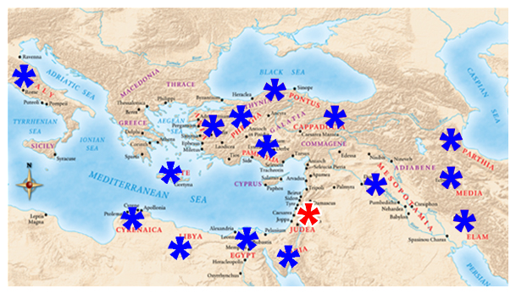
Persecution draws Christians together. Murmurings tear the church apart.
Now there were two camps:
the Greek-speaking Jews from outside Judea, and the Palestinian Jews.
Acts 6:
¹ And in those days, when the number of the disciples was multiplied, there arose a murmuring of the Grecians against the Hebrews, because their widows were neglected in the daily ministration.

Slide 170
Up to this time, the collection and distribution of goods was managed by the apostles.
Acts 4:34-35:
³⁴ Neither was there any among them that lacked: for as many as were possessors of lands or houses sold them, and brought the prices of the things that were sold,
³⁵ And laid them down at the apostles' feet: and distribution was made unto every man according as he had need.
Acts 6:
¹ And in those days, when the number of the disciples was multiplied, there arose a murmuring of the Grecians against the Hebrews, because their widows were neglected in the daily ministration.

Slide 171
From these servers of tables, we get the term deacon.
These were seven men – Phoebe is the only titled “deaconess” ever named according to some translations. Her mention was not in relationship of an officeholder. Most translations simply categorize her descriptively as servant.
Romans 16:1-2:
¹ I commend unto you Phebe our sister, which is a servant of the church which is at Cenchrea:
² That ye receive her in the Lord, as becometh saints, and that ye assist her in whatsoever business she hath need of you: for she hath been a succourer of many, and of myself also.
² Then the twelve called the multitude of the disciples unto them, and said, It is not reason that we should leave the word of God, and serve tables.
³ Wherefore, brethren, look ye out among you seven men of honest report, full of the Holy Ghost and wisdom, whom we may appoint over this business.
⁴ But we will give ourselves continually to prayer, and to the ministry of the word.

Slide 172
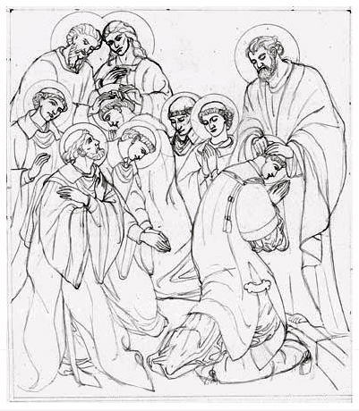
⁵ And the saying pleased the whole multitude: and they chose Stephen, a man full of faith and of the Holy Ghost, and Philip, and Prochorus, and Nicanor, and Timon, and Parmenas, and Nicolas a proselyte of Antioch:
⁶ Whom they set before the apostles: and when they had prayed, they laid their hands on them.
⁷ And the word of God increased; and the number of the disciples multiplied in Jerusalem greatly; and a great company of the priests were obedient to the faith.
These are all Greek names, evidence of the apostles’ wisdom and diplomacy.

Slide 173
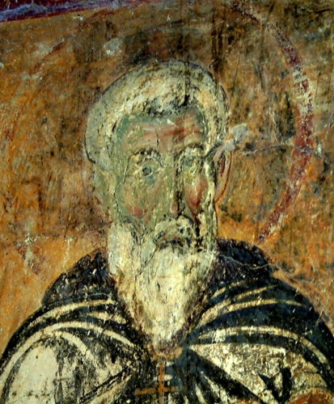
⁸ And Stephen, full of faith and power, did great wonders and miracles among the people.
⁹ Then there arose certain of the synagogue, which is called the synagogue of the Freedmen, and Cyrenians, and Alexandrians, and of them of Cilicia and of Asia, disputing with Stephen.

Slide 174
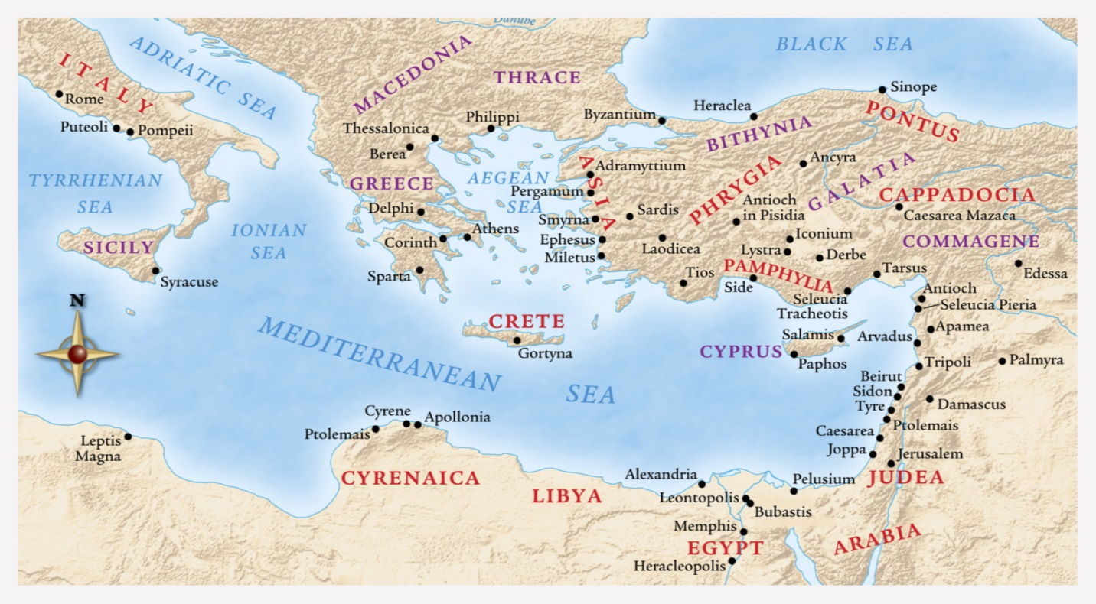
Cyrenians,
Alexandrians,
of Cilicia,
of Asia.

Slide 175
“The Synagogue of the Freedmen was an assembly of Hellenistic Jews, ‘the Freedmen’ from Rome who were descendants of the Jews enslaved by Pompey after his conquest of Judaea in 63 BC. These returned Jews, called by some Libertines, instead of being liberalized by their residence abroad, were more tenacious of Judaism, and more bitter against Stephen than those who had never left Judaea.”
(1911 Encyclopedia Britannica)
It is likely that Saul of Tarsus was a member of this synagogue. He was of Cilicia, and free born.
Acts 21:39a: But Paul said, I am a man which am a Jew of Tarsus, a city in Cilicia ...
Acts 22:27-28: ²⁷ Then the chief captain came, and said unto him, Tell me, art thou a Roman? He said, Yea.
²⁸ And the chief captain answered, With a great sum obtained I this freedom. And Paul said, But I was free born.

Slide 176
¹⁰ And they were not able to resist the wisdom and the spirit by which he spake.
¹¹ Then they suborned men, which said, We have heard him speak blasphemous words against Moses, and against God.
¹² And they stirred up the people, and the elders, and the scribes, and came upon him, and caught him, and brought him to the council,

Slide 177
¹³ And set up false witnesses, which said, This man ceaseth not to speak blasphemous words against this holy place, and the law:
¹⁴ For we have heard him say, that this Jesus of Nazareth shall destroy this place, and shall change the customs which Moses delivered us.
¹⁵ And all that sat in the council, looking stedfastly on him, saw his face as it had been the face of an angel.
(End of Chapter 6)

Slide 178
The Acts of the Apostles Chapter 6

Slide 179
Acts 6:1-4 First Church Problem
What was the “daily ministration?” (1)
Was there an racial/ethnic aspect? (1)
Was this just an accusation or a fact?
What did the apostles do … ? (2-4)
Why didn’t the apostles just monitor this? (2)
What is the principle here for us?
So, what action was commanded? (3)
What is the principle here? (Delegation)
What is the difference: selecting – appointing?
What does “appoint” (3) demonstrate? (Official)
What were the qualifications? (3)

Slide 180
Acts 6:5-7 First Church Solution
Full of the Spirit and Wisdom (3)
Should such a process please us? (5)
What was the significance of naming … (6)
Stephen? What is said about him?
Philip?
Nicolaus?
What accompanied the appointment? (6)
How is vs. 7 an effect of vss. 1-6 (1-7)
Number multiplied … WHERE?
Were all Jewish officials antagonistic?
Did they have a rightful place in the church?

Slide 181
Acts 6:8-9 Stephen
Did non-apostles perform miracles? (8)
Is this the first case of such?
How was this ability imparted? (Acts 8:18)
Were there exceptions to this rule?
Who disputed with Stephen? (9)
Synagogues? (about 480 in Jerusalem - Lightfoot, et al)
Analogous to denominations
Also the temple clergy infrastructure
Seemed not to be native Jews
? Implication – not as versed in the OT (?)
Not “main line” Jews

Slide 182
Acts 6:10-15 Persecution
Why not just perform a miracle? (10)
“… wisdom and the [Holy] Spirit by which he spake.”
Why did they suborn others? (11)
What was the accusation at this point? (11)
Would the Romans care about this?
How about the Jewish “establishment?”
What did the antagonists do next? (12)
What was the accusation now? (13)
What verbal evidence is cited? (14)
What part of this evidence was true?
What does face of an angel imply? (15)

Slide 183
L.D. CARY & SAM HOLT CATCH PHRASES
Chapter 1 – “Jesus’ Work On Earth Is Done”
Chapter 2 – “Peter Baptizes A Crew”
Chapter 3 – “A Beggar’s Plea”
Chapter 4 – “A Jailhouse Door”
Chapter 5 – “Ananias & Sapphira Don’t Survive”
Chapter 6 – “The Widow’s Fix”
Chapter 8 – “Stephen Looks Into Heaven”
Chapter 9 – “Saul Struck Blind”
“Stephen Looks Into Heaven”
Catch Phrase
Chapter Seven

Slide 184
ACTS 7
Stephen’s Defense

Slide 185
Acts 7:1 (NASB) 1 The high priest said, "Are these things so?"
I. Stephen was arrested on the charges of treason against Israel: Acts 6:11-14
1. Speaking against this Holy place by teaching that Jesus would destroy the Temple.
2. Speaking against Moses, his God and the Law.
II. Stephens Defense:
A. A detailed history of the nation of Israel. The Covenant agreed upon and the blessings and honor God bestowed upon Israel.
1. Included in this history is the ungrateful and rebelliousness response of the people toward God and the Covenant of blessing.
2. God never actually dwelt in the Temple. God had not asked for a Temple.
B. Stephen exposes the Jews of his day as being just like their fathers persecuting God’s prophets and killing God’s son.
Acts 6:11-14 (NASB) 11 Then they secretly induced men to say, "We have heard him speak blasphemous words against Moses and against God." 12 And they stirred up the people, the elders and the scribes, and they came up to him and dragged him away and brought him before the Council. 13 They put forward false witnesses who said, "This man incessantly speaks against this holy place and the Law; 14 for we have heard him say that this Nazarene, Jesus, will destroy this place and alter the customs which Moses handed down to us."

Slide 186
Acts 7:2-4 (NASB) 2 And he said, "Hear me, brethren and fathers! The God of glory appeared to our father Abraham when he was in Mesopotamia, before he lived in Haran, 3 and said to him, 'LEAVE YOUR COUNTRY AND YOUR RELATIVES, AND COME INTO THE LAND THAT I WILL SHOW YOU.' 4 "Then he left the land of the Chaldeans and settled in Haran. From there, after his father died, God had him move to this country in which you are now living.
A. God appeared to Abraham in Mesopotamia: Gen 11:31; 12:1-6

Slide 187
Acts 7:5-8 (NASB) 5 "But He gave him no inheritance in it, not even a foot of ground, and yet, even when he had no child, He promised that HE WOULD GIVE IT TO HIM AS A POSSESSION, AND TO HIS DESCENDANTS AFTER HIM. 6 "But God spoke to this effect, that his DESCENDANTS WOULD BE ALIENS IN A FOREIGN LAND, AND THAT THEY WOULD BE ENSLAVED AND MISTREATED FOR FOUR HUNDRED YEARS. 7 " 'AND WHATEVER NATION TO WHICH THEY WILL BE IN BONDAGE I MYSELF WILL JUDGE,' said God, 'AND AFTER THAT THEY WILL COME OUT AND SERVE ME IN THIS PLACE.’ 8 "And He gave him the covenant of circumcision; and so Abraham became the father of Isaac, and circumcised him on the eighth day; and Isaac became the father of Jacob, and Jacob of the twelve patriarchs.
A. God gave Abraham no inheritance but Abraham purchased some land: Gen 23:3-18
B. God did promise the land of Palestine to his descendants after 400 years:
C. The covenant of circumcision: Gen 17:7-12
Genesis 23:3-18 (NASB) 3 Then Abraham rose from before his dead, and spoke to the sons of Heth, saying, 4 "I am a stranger and a sojourner among you; give me a burial site among you that I may bury my dead out of my sight." 5 The sons of Heth answered Abraham, saying to him, 6 "Hear us, my lord, you are a mighty prince among us; bury your dead in the choicest of our graves; none of us will refuse you his grave for burying your dead." 7 So Abraham rose and bowed to the people of the land, the sons of Heth. 8 And he spoke with them, saying, "If it is your wish for me to bury my dead out of my sight, hear me, and approach Ephron the son of Zohar for me, 9 that he may give me the cave of Machpelah which he owns, which is at the end of his field; for the full price let him give it to me in your presence for a burial site."
Genesis 17:7-14 (NASB) 7 "I will establish My covenant between Me and you and your descendants after you throughout their generations for an everlasting covenant, to be God to you and to your descendants after you. 8 "I will give to you and to your descendants after you, the land of your sojournings, all the land of Canaan, for an everlasting possession; and I will be their God." 9 God said further to Abraham, "Now as for you, you shall keep My covenant, you and your descendants after you throughout their generations. 10 "This is My covenant, which you shall keep, between Me and you and your descendants after you: every male among you shall be circumcised. 11 "And you shall be circumcised in the flesh of your foreskin, and it shall be the sign of the covenant between Me and you. 12 "And every male among you who is eight days old shall be circumcised throughout your generations, a servant who is born in the house or who is bought with money from any foreigner, who is not of your descendants.
16 Abraham listened to Ephron; and Abraham weighed out for Ephron the silver which he had named in the hearing of the sons of Heth, four hundred shekels of silver, commercial standard. 17 So Ephron's field, which was in Machpelah, which faced Mamre, the field and cave which was in it, and all the trees which were in the field, that were within all the confines of its border, were deeded over 18 to Abraham for a possession in the presence of the sons of Heth, before all who went in at the gate of his city.
10 Now Ephron was sitting among the sons of Heth; and Ephron the Hittite answered Abraham in the hearing of the sons of Heth; even of all who went in at the gate of his city, saying, 11 "No, my lord, hear me; I give you the field, and I give you the cave that is in it. In the presence of the sons of my people I give it to you; bury your dead." 12 And Abraham bowed before the people of the land. 13 He spoke to Ephron in the hearing of the people of the land, saying, "If you will only please listen to me; I will give the price of the field, accept it from me that I may bury my dead there." 14 Then Ephron answered Abraham, saying to him, 15 "My lord, listen to me; a piece of land worth four hundred shekels of silver, what is that between me and you? So bury your dead."
Notes:
7/16/17

Slide 188
Genesis 46:26-27 (NASB) 26 All the persons belonging to Jacob, who came to Egypt, his direct descendants, not including the wives of Jacob's sons, were sixty-six persons in all, 27 and the sons of Joseph, who were born to him in Egypt were two; all the persons of the house of Jacob, who came to Egypt, were seventy.
Exodus 1:5 (NASB) 5 All the persons who came from the loins of Jacob were seventy in number, but Joseph was already in Egypt.
Deuteronomy 10:22 (NASB) 22 "Your fathers went down to Egypt seventy persons in all, and now the LORD your God has made you as numerous as the stars of heaven.
Genesis 23:16-20 (NASB) 16 Abraham listened to Ephron; and Abraham weighed out for Ephron the silver which he had named in the hearing of the sons of Heth, four hundred shekels of silver, commercial standard. 17 So Ephron's field, which was in Machpelah, which faced Mamre, the field and cave which was in it, and all the trees which were in the field, that were within all the confines of its border, were deeded over 18 to Abraham for a possession in the presence of the sons of Heth, before all who went in at the gate of his city. 19 After this, Abraham buried Sarah his wife in the cave of the field at Machpelah facing Mamre (that is, Hebron) in the land of Canaan. 20 So the field and the cave that is in it, were deeded over to Abraham for a burial site by the sons of Heth.
Genesis 47:27-31 (NASB) 27 Now Israel lived in the land of Egypt, in Goshen, and they acquired property in it and were fruitful and became very numerous. 28 Jacob lived in the land of Egypt seventeen years; so the length of Jacob's life was one hundred and forty-seven years. 29 When the time for Israel to die drew near, he called his son Joseph and said to him, "Please, if I have found favor in your sight, place now your hand under my thigh and deal with me in kindness and faithfulness. Please do not bury me in Egypt, 30 but when I lie down with my fathers, you shall carry me out of Egypt and bury me in their burial place." And he said, "I will do as you have said." 31 He said, "Swear to me." So he swore to him. Then Israel bowed in worship at the head of the bed.
Acts 7:9-16 (NASB) 9 "The patriarchs became jealous of Joseph and sold him into Egypt. Yet God was with him, 10 and rescued him from all his afflictions, and granted him favor and wisdom in the sight of Pharaoh, king of Egypt, and he made him governor over Egypt and all his household. 11 "Now a famine came over all Egypt and Canaan, and great affliction with it, and our fathers could find no food. 12 "But when Jacob heard that there was grain in Egypt, he sent our fathers there the first time. 13 "On the second visit Joseph made himself known to his brothers, and Joseph's family was disclosed to Pharaoh. 14 "Then Joseph sent word and invited Jacob his father and all his relatives to come to him, seventy-five persons in all. 15 "And Jacob went down to Egypt and there he and our fathers died. 16 "From there they were removed to Shechem and laid in the tomb which Abraham had purchased for a sum of money from the sons of Hamor in Shechem.
A. 14 Jacob’s family - 75 persons went to Egypt: Gen 46:26-27; Ex 1:5; Dt 10:22;
B. 15-16 Jacob had requested to be buried on the land Abraham purchased: Gen 23:16-20; Gen 47:27-31; 50:12-14
Septuagint
Gen 46:20 Brenton
20 And there were sons born to Joseph in the land of Egypt, whom Aseneth, the daughter of Petephres, priest of Heliopolis, bore to him, even Manasses and Ephraim. And there were sons born to Manasses, which the Syrian concubine bore to him, even Machir. And Machir begot Galaad. And the sons of Ephraim, the brother of Manasses; Sutalaam, and Taam. And the sons of Sutalaam; Edom.
Gen 46:26-27 Brenton
26 And all the souls that came with Jacob into Egypt, who came out of his loins, besides the wives of the sons of Jacob, even all the souls were sixty-six. 27 And the sons of Joseph, who were born to him in the land of Egypt, were nine souls; all the souls of the house of Jacob who came with Joseph into Egypt, were seventy-five souls.
Genesis 50:12-14 (NASB) 12 Thus his sons did for him as he had charged them; 13 for his sons carried him to the land of Canaan and buried him in the cave of the field of Machpelah before Mamre, which Abraham had bought along with the field for a burial site from Ephron the Hittite. 14 After he had buried his father, Joseph returned to Egypt, he and his brothers, and all who had gone up with him to bury his father.
Notes:
Gen 46:26-27 The number 66 does not include Jacob, Joseph and his 2 sons and Manasseh and Ephraim.
1. Stephen is quoting the Septuagint which says 75 souls. To get the number 75 instead of 70 you must add the 5 sons of Ephraim and Manasseh. The difference of five resulted from the Septuagint’s addition of two sons of Manasseh, two of Ephraim, and one grandson of Ephraim. This is how Stephen came up with his count. Gen 46:20
B.

Slide 189
Exodus 1:6-9 (NASB) 6 Joseph died, and all his brothers and all that generation. 7 But the sons of Israel were fruitful and increased greatly, and multiplied, and became exceedingly mighty, so that the land was filled with them. 8 Now a new king arose over Egypt, who did not know Joseph. 9 He said to his people, "Behold, the people of the sons of Israel are more and mightier than we.
Exodus 1:15-16 (NASB) 15 Then the king of Egypt spoke to the Hebrew midwives, one of whom was named Shiphrah and the other was named Puah; 16 and he said, "When you are helping the Hebrew women to give birth and see them upon the birthstool, if it is a son, then you shall put him to death; but if it is a daughter, then she shall live."
Exodus 2:7-10 (NASB) 7 Then his sister said to Pharaoh's daughter, "Shall I go and call a nurse for you from the Hebrew women that she may nurse the child for you?" 8 Pharaoh's daughter said to her, "Go ahead." So the girl went and called the child's mother. 9 Then Pharaoh's daughter said to her, "Take this child away and nurse him for me and I will give you your wages." So the woman took the child and nursed him. 10 The child grew, and she brought him to Pharaoh's daughter and he became her son. And she named him Moses, and said, "Because I drew him out of the water."
Exodus 1:22 (NASB) 22 Then Pharaoh commanded all his people, saying, "Every son who is born you are to cast into the Nile, and every daughter you are to keep alive."
Acts 7:17-22 (NASB) 17 "But as the time of the promise was approaching which God had assured to Abraham, the people increased and multiplied in Egypt, 18 until THERE AROSE ANOTHER KING OVER EGYPT WHO KNEW NOTHING ABOUT JOSEPH. 19 "It was he who took shrewd advantage of our race and mistreated our fathers so that they would expose their infants and they would not survive. 20 "It was at this time that Moses was born; and he was lovely in the sight of God, and he was nurtured three months in his father's home. 21 "And after he had been set outside, Pharaoh's daughter took him away and nurtured him as her own son. 22 "Moses was educated in all the learning of the Egyptians, and he was a man of power in words and deeds.
A. Israel loses favor with the Pharaoh and are commanded to kill their male children in an attempt to control the population of the Hebrews in Egypt: Ex 1:6-9; 15-16; 22
B. The birth of Moses: Ex 2:1-6; Ex 2:7-10; Heb 11:23
Exodus 2:1-6 (NASB) 1 Now a man from the house of Levi went and married a daughter of Levi. 2 The woman conceived and bore a son; and when she saw that he was beautiful, she hid him for three months. 3 But when she could hide him no longer, she got him a wicker basket and covered it over with tar and pitch. Then she put the child into it and set it among the reeds by the bank of the Nile. 4 His sister stood at a distance to find out what would happen to him. 5 The daughter of Pharaoh came down to bathe at the Nile, with her maidens walking alongside the Nile; and she saw the basket among the reeds and sent her maid, and she brought it to her. 6 When she opened it, she saw the child, and behold, the boy was crying. And she had pity on him and said, "This is one of the Hebrews' children."
Hebrews 11:23 (NASB) 23 By faith Moses, when he was born, was hidden for three months by his parents, because they saw he was a beautiful child; and they were not afraid of the king's edict.
Notes:
Birth of Moses: 7/23/17 go back to slide 4 and deal with the 400 verses 430 years of bondage.
The thing we should keep in mind as this history is presented by Stephen is that Israel's forefathers had found favor with God long before the Temple was built. If it is God’s plan to destroy the Temple through the Messiah, God will still take care of His people and worship will be able to offered to God without a Temple made of Stone.

Slide 190
Acts 7:23-29 (NASB) 23 "But when he was approaching the age of forty, it entered his mind to visit his brethren, the sons of Israel. 24 "And when he saw one of them being treated unjustly, he defended him and took vengeance for the oppressed by striking down the Egyptian. 25 "And he supposed that his brethren understood that God was granting them deliverance through him, but they did not understand. 26 "On the following day he appeared to them as they were fighting together, and he tried to reconcile them in peace, saying, 'Men, you are brethren, why do you injure one another?' 27 "But the one who was injuring his neighbor pushed him away, saying, 'WHO MADE YOU A RULER AND JUDGE OVER US? 28 'YOU DO NOT MEAN TO KILL ME AS YOU KILLED THE EGYPTIAN YESTERDAY, DO YOU?' 29 "At this remark, MOSES FLED AND BECAME AN ALIEN IN THE LAND OF MIDIAN, where he became the father of two sons.
A. Moses supposed his brethren understood that God was granting them deliverance through him. Indicating that his mother had taught him this. Ex 2:11-15; Heb 11:25-27
Exodus 2:11-15 (NASB) 11 Now it came about in those days, when Moses had grown up, that he went out to his brethren and looked on their hard labors; and he saw an Egyptian beating a Hebrew, one of his brethren. 12 So he looked this way and that, and when he saw there was no one around, he struck down the Egyptian and hid him in the sand. 13 He went out the next day, and behold, two Hebrews were fighting with each other; and he said to the offender, "Why are you striking your companion?" 14 But he said, "Who made you a prince or a judge over us? Are you intending to kill me as you killed the Egyptian?" Then Moses was afraid and said, "Surely the matter has become known." 15 When Pharaoh heard of this matter, he tried to kill Moses. But Moses fled from the presence of Pharaoh and settled in the land of Midian, and he sat down by a well.
Hebrews 11:24-27 (NASB) 24 By faith Moses, when he had grown up, refused to be called the son of Pharaoh's daughter, 25 choosing rather to endure ill-treatment with the people of God than to enjoy the passing pleasures of sin, 26 considering the reproach of Christ greater riches than the treasures of Egypt; for he was looking to the reward. 27 By faith he left Egypt, not fearing the wrath of the king; for he endured, as seeing Him who is unseen.

Slide 191
Exodus 3:1-10 (NASB) 1 Now Moses was pasturing the flock of Jethro his father-in-law, the priest of Midian; and he led the flock to the west side of the wilderness and came to Horeb, the mountain of God. 2 The angel of the LORD appeared to him in a blazing fire from the midst of a bush; and he looked, and behold, the bush was burning with fire, yet the bush was not consumed. 3 So Moses said, "I must turn aside now and see this marvelous sight, why the bush is not burned up." 4 When the LORD saw that he turned aside to look, God called to him from the midst of the bush and said, "Moses, Moses!" And he said, "Here I am." 5 Then He said, "Do not come near here; remove your sandals from your feet, for the place on which you are standing is holy ground." 6 He said also, "I am the God of your father, the God of Abraham, the God of Isaac, and the God of Jacob." Then Moses hid his face, for he was afraid to look at God. 7 The LORD said, "I have surely seen the affliction of My people who are in Egypt, and have given heed to their cry because of their taskmasters, for I am aware of their sufferings.
Acts 7:30-34 (NASB) 30 "After forty years had passed, AN ANGEL APPEARED TO HIM IN THE WILDERNESS OF MOUNT Sinai, IN THE FLAME OF A BURNING THORN BUSH. 31 "When Moses saw it, he marveled at the sight; and as he approached to look more closely, there came the voice of the Lord: 32 'I AM THE GOD OF YOUR FATHERS, THE GOD OF ABRAHAM AND ISAAC AND JACOB.' Moses shook with fear and would not venture to look. 33 "BUT THE LORD SAID TO HIM, 'TAKE OFF THE SANDALS FROM YOUR FEET, FOR THE PLACE ON WHICH YOU ARE STANDING IS HOLY GROUND. 34 'I HAVE CERTAINLY SEEN THE OPPRESSION OF MY PEOPLE IN EGYPT AND HAVE HEARD THEIR GROANS, AND I HAVE COME DOWN TO RESCUE THEM; COME NOW, AND I WILL SEND YOU TO EGYPT.’
A. When Moses was 80 the angel of the Lord appeared to him in the burning bush: EX 3:1-10
8 "So I have come down to deliver them from the power of the Egyptians, and to bring them up from that land to a good and spacious land, to a land flowing with milk and honey, to the place of the Canaanite and the Hittite and the Amorite and the Perizzite and the Hivite and the Jebusite. 9 "Now, behold, the cry of the sons of Israel has come to Me; furthermore, I have seen the oppression with which the Egyptians are oppressing them. 10 "Therefore, come now, and I will send you to Pharaoh, so that you may bring My people, the sons of Israel, out of Egypt.“
Notes:
7/30/17

Slide 192
Exodus 24:12-15 (NASB) (Moses goes into the mountain a second time) 12 Now the LORD said to Moses, "Come up to Me on the mountain and remain there, and I will give you the stone tablets with the law and the commandment which I have written for their instruction." 13 So Moses arose with Joshua his servant, and Moses went up to the mountain of God. 14 But to the elders he said, "Wait here for us until we return to you. And behold, Aaron and Hur are with you; whoever has a legal matter, let him approach them." 15 Then Moses went up to the mountain, and the cloud covered the mountain.
Acts 7:35-38 (NASB) 35 "This Moses whom they disowned, saying, 'WHO MADE YOU A RULER AND A JUDGE?’ is the one whom God sent to be both a ruler and a deliverer with the help of the angel who appeared to him in the thorn bush. 36 "This man led them out, performing wonders and signs in the land of Egypt and in the Red Sea and in the wilderness for forty years. 37 "This is the Moses who said to the sons of Israel, 'GOD WILL RAISE UP FOR YOU A PROPHET LIKE ME FROM YOUR BRETHREN.' 38 "This is the one who was in the congregation in the wilderness together with the angel who was speaking to him on Mount Sinai, and who was with our fathers; and he received living oracles to pass on to you.
A. Through Moses, God had promised the people another prophet like Moses. The Christians taught that Jesus was this prophet: Acts 3:22-26; Dt 18:15-18; Jn 12:48-50; He 1:1
B. God gave Moses the commandments which the fathers promised to obey: Ex 19:17; 24:1-4; Dt 32:47; Ex 24:12-15;
Exodus 19:17 (NASB) 17 And Moses brought the people out of the camp to meet God, and they stood at the foot of the mountain.
Exodus 24:1-4 (NASB) 1 Then He said to Moses, "Come up to the LORD, you and Aaron, Nadab and Abihu and seventy of the elders of Israel, and you shall worship at a distance. 2 "Moses alone, however, shall come near to the LORD, but they shall not come near, nor shall the people come up with him." 3 Then Moses came and recounted to the people all the words of the LORD and all the ordinances; and all the people answered with one voice and said, "All the words which the LORD has spoken we will do!" 4 Moses wrote down all the words of the LORD. Then he arose early in the morning, and built an altar at the foot of the mountain with twelve pillars for the twelve tribes of Israel.
Deuteronomy 32:47 (NASB) 47 "For it is not an idle word for you; indeed it is your life. And by this word you will prolong your days in the land, which you are about to cross the Jordan to possess."
Deuteronomy 18:15-18 (NASB) 15 "The LORD your God will raise up for you a prophet like me from among you, from your countrymen, you shall listen to him. 16 "This is according to all that you asked of the LORD your God in Horeb on the day of the assembly, saying, 'Let me not hear again the voice of the LORD my God, let me not see this great fire anymore, or I will die.' 17 "The LORD said to me, 'They have spoken well. 18 'I will raise up a prophet from among their countrymen like you, and I will put My words in his mouth, and he shall speak to them all that I command him.
Acts 3:22-26 (NASB) 22 "Moses said, 'THE LORD GOD WILL RAISE UP FOR YOU A PROPHET LIKE ME FROM YOUR BRETHREN; TO HIM YOU SHALL GIVE HEED to everything He says to you. 23 'And it will be that every soul that does not heed that prophet shall be utterly destroyed from among the people.' 24 "And likewise, all the prophets who have spoken, from Samuel and his successors onward, also announced these days. 25 "It is you who are the sons of the prophets and of the covenant which God made with your fathers, saying to Abraham, 'AND IN YOUR SEED ALL THE FAMILIES OF THE EARTH SHALL BE BLESSED.' 26 "For you first, God raised up His Servant and sent Him to bless you by turning every one of you from your wicked ways."
John 12:48-50 (NASB) 48 "He who rejects Me and does not receive My sayings, has one who judges him; the word I spoke is what will judge him at the last day. 49 "For I did not speak on My own initiative, but the Father Himself who sent Me has given Me a commandment as to what to say and what to speak. 50 "I know that His commandment is eternal life; therefore the things I speak, I speak just as the Father has told Me."
Hebrews 1:1-2 (NASB) 1 God, after He spoke long ago to the fathers in the prophets in many portions and in many ways, 2 in these last days has spoken to us in His Son, whom He appointed heir of all things, through whom also He made the world.
Notes:
As Israel of old had initially rejected Moses so the Israel of Stephens day had rejected the one that Moses said God would raise up to them. Add some scriptures about Moses bringing the commandments down from the mount and that the people said they would obey it and live. In Chapters 20 – 24 God gives Moses all the commands that the people were to obey and when they heard it they said they would obey it. Ex 24:1-4; Moses went a second time into the mount and God wrote the 10 commandments on stone tablets and gave him all the details for building the Tabernacle. The Tabernacle is a very important part of Stephens argumentation. Ex 24:12-15;

Slide 193
Acts 7:39-41 (NASB) 39 "Our fathers were unwilling to be obedient to him, but repudiated him and in their hearts turned back to Egypt, 40 SAYING TO AARON, 'MAKE FOR US GODS WHO WILL GO BEFORE US; FOR THIS MOSES WHO LED US OUT OF THE LAND OF EGYPT—WE DO NOT KNOW WHAT HAPPENED TO HIM.' 41 "At that time they made a calf and brought a sacrifice to the idol, and were rejoicing in the works of their hands.
A. But the fathers betrayed God and refused to obey the ordinances that Moses delivered to the people: Nu 14:3-4; Ex 32:1-6, 15-21
1. God writes a second set of commandments on stone for Moses to bring down to the people: Ex 34:1-7; 29-32
Exodus 32:15-21 (NASB) 15 Then Moses turned and went down from the mountain with the two tablets of the testimony in his hand, tablets which were written on both sides; they were written on one side and the other. 16 The tablets were God's work, and the writing was God's writing engraved on the tablets. 17 Now when Joshua heard the sound of the people as they shouted, he said to Moses, "There is a sound of war in the camp." 18 But he said, "It is not the sound of the cry of triumph, Nor is it the sound of the cry of defeat; But the sound of singing I hear." 19 It came about, as soon as Moses came near the camp, that he saw the calf and the dancing; and Moses' anger burned, and he threw the tablets from his hands and shattered them at the foot of the mountain. 20 He took the calf which they had made and burned it with fire, and ground it to powder, and scattered it over the surface of the water and made the sons of Israel drink it. 21 Then Moses said to Aaron, "What did this people do to you, that you have brought such great sin upon them?"
Exodus 32:1-6 (NASB) 1 Now when the people saw that Moses delayed to come down from the mountain, the people assembled about Aaron and said to him, "Come, make us a god who will go before us; as for this Moses, the man who brought us up from the land of Egypt, we do not know what has become of him." 2 Aaron said to them, "Tear off the gold rings which are in the ears of your wives, your sons, and your daughters, and bring them to me." 3 Then all the people tore off the gold rings which were in their ears and brought them to Aaron. 4 He took this from their hand, and fashioned it with a graving tool and made it into a molten calf; and they said, "This is your god, O Israel, who brought you up from the land of Egypt." 5 Now when Aaron saw this, he built an altar before it; and Aaron made a proclamation and said, "Tomorrow shall be a feast to the LORD." 6 So the next day they rose early and offered burnt offerings, and brought peace offerings; and the people sat down to eat and to drink, and rose up to play.
Numbers 14:3-4 (NASB) 3 "Why is the LORD bringing us into this land, to fall by the sword? Our wives and our little ones will become plunder; would it not be better for us to return to Egypt?" 4 So they said to one another, "Let us appoint a leader and return to Egypt."
Exodus 34:1-7 (NASB) 1 Now the LORD said to Moses, "Cut out for yourself two stone tablets like the former ones, and I will write on the tablets the words that were on the former tablets which you shattered. 2 "So be ready by morning, and come up in the morning to Mount Sinai, and present yourself there to Me on the top of the mountain. 3 "No man is to come up with you, nor let any man be seen anywhere on the mountain; even the flocks and the herds may not graze in front of that mountain." 4 So he cut out two stone tablets like the former ones, and Moses rose up early in the morning and went up to Mount Sinai, as the LORD had commanded him, and he took two stone tablets in his hand. 5 The LORD descended in the cloud and stood there with him as he called upon the name of the LORD. 6 Then the LORD passed by in front of him and proclaimed, "The LORD, the LORD God, compassionate and gracious, slow to anger, and abounding in lovingkindness and truth; 7 who keeps lovingkindness for thousands, who forgives iniquity, transgression and sin; yet He will by no means leave the guilty unpunished, visiting the iniquity of fathers on the children and on the grandchildren to the third and fourth generations."
Exodus 34:29-32 (NASB) 29 It came about when Moses was coming down from Mount Sinai (and the two tablets of the testimony were in Moses' hand as he was coming down from the mountain), that Moses did not know that the skin of his face shone because of his speaking with Him. 30 So when Aaron and all the sons of Israel saw Moses, behold, the skin of his face shone, and they were afraid to come near him. 31 Then Moses called to them, and Aaron and all the rulers in the congregation returned to him; and Moses spoke to them. 32 Afterward all the sons of Israel came near, and he commanded them to do everything that the LORD had spoken to him on Mount Sinai.
Notes:
As Israel of old had initially rejected Moses so the Israel of Stephens day had rejected the one that Moses said God would raise up to them.

Slide 194
Acts 7:42-45 (NASB) 42 "But God turned away and delivered them up to serve the host of heaven; as it is written in the book of the prophets, 'IT WAS NOT TO ME THAT YOU OFFERED VICTIMS AND SACRIFICES FORTY YEARS IN THE WILDERNESS, WAS IT, O HOUSE OF ISRAEL? 43 'YOU ALSO TOOK ALONG THE TABERNACLE OF MOLOCH AND THE STAR OF THE GOD ROMPHA, THE IMAGES WHICH YOU MADE TO WORSHIP. I ALSO WILL REMOVE YOU BEYOND BABYLON.' 44 "Our fathers had the tabernacle of testimony in the wilderness, just as He who spoke to Moses directed him to make it according to the pattern which he had seen. 45 "And having received it in their turn, our fathers brought it in with Joshua upon dispossessing the nations whom God drove out before our fathers, until the time of David.
A. God turned away and delivered them to serve the host of heaven: Josh 24:20; Isa 63:10; Jere 19:13; Ezk 20:39
1. Stephen quotes Amos (42-43) who prophesied after the history of (44-45): Amos 5:25-27
B. They had the Tabernacle/Temple and still were unholy. God punished the nation of Israel and destroyed their Temple. Just as Jesus would do: Ex 25:8-9, 40; Josh 18:1; Acts 6:13-14
Joshua 24:20 (NASB) 20 "If you forsake the LORD and serve foreign gods, then He will turn and do you harm and consume you after He has done good to you."
Isaiah 63:10 (NASB) 10 But they rebelled And grieved His Holy Spirit; Therefore He turned Himself to become their enemy, He fought against them.
Jeremiah 19:13 (NASB) 13 "The houses of Jerusalem and the houses of the kings of Judah will be defiled like the place Topheth, because of all the houses on whose rooftops they burned sacrifices to all the heavenly host and poured out drink offerings to other gods.“’”
Ezekiel 20:39 (NASB) 39 "As for you, O house of Israel," thus says the Lord GOD, "Go, serve everyone his idols; but later you will surely listen to Me, and My holy name you will profane no longer with your gifts and with your idols.
Amos 5:25-27 (NASB) 25 "Did you present Me with sacrifices and grain offerings in the wilderness for forty years, O house of Israel? 26 "You also carried along Sikkuth your king and Kiyyun, your images, the star of your gods which you made for yourselves. 27 "Therefore, I will make you go into exile beyond Damascus," says the LORD, whose name is the God of hosts.
Acts 6:13-14 (NASB) 13 They put forward false witnesses who said, "This man incessantly speaks against this holy place and the Law; 14 for we have heard him say that this Nazarene, Jesus, will destroy this place and alter the customs which Moses handed down to us."
Exodus 25:8-9 (NASB) 8 "Let them construct a sanctuary for Me, that I may dwell among them. 9 "According to all that I am going to show you, as the pattern of the tabernacle and the pattern of all its furniture, just so you shall construct it.
Exodus 25:40 (NASB) 40 "See that you make them after the pattern for them, which was shown to you on the mountain.
Joshua 18:1 (NASB) 1 Then the whole congregation of the sons of Israel assembled themselves at Shiloh, and set up the tent of meeting there; and the land was subdued before them.
Notes:
1. Amos prophesied approximately 787 BC before the fall of the 10 tribes to Assyria and after Solomon’s Temple had been built.
B. Remember the accusation made against Stephen which was based on the teachings of Jesus in Matthew 24 and Matt 5:17-19

Slide 195
Acts 7:46-50 (NASB) 46 "David found favor in God's sight, and asked that he might find a dwelling place for the God of Jacob. 47 "But it was Solomon who built a house for Him. 48 "However, the Most High does not dwell in houses made by human hands; as the prophet says: 49 'HEAVEN IS MY THRONE, AND EARTH IS THE FOOTSTOOL OF MY FEET; WHAT KIND OF HOUSE WILL YOU BUILD FOR ME?' says the Lord, 'OR WHAT PLACE IS THERE FOR MY REPOSE? 50 'WAS IT NOT MY HAND WHICH MADE ALL THESE THINGS?’
A. Then David found favor with God but was not allowed to build the Temple. But let it be understood that God did not dwell in the Temple and that righteousness is not based on the existence of the Temple or the Tabernacle. 2Sam 7:1-7, 12-13;
1. He does dwell in his people if they are obedient to Him. Righteousness is found in a humble obedient people. : Isa 66:1-2; Eph 2:19-22
2 Samuel 7:1-7, 12-13 (NASB) 1 Now it came about when the king lived in his house, and the LORD had given him rest on every side from all his enemies, 2 that the king said to Nathan the prophet, "See now, I dwell in a house of cedar, but the ark of God dwells within tent curtains." 3 Nathan said to the king, "Go, do all that is in your mind, for the LORD is with you." 4 But in the same night the word of the LORD came to Nathan, saying, 5 "Go and say to My servant David, 'Thus says the LORD, "Are you the one who should build Me a house to dwell in? 6 "For I have not dwelt in a house since the day I brought up the sons of Israel from Egypt, even to this day; but I have been moving about in a tent, even in a tabernacle. 7 "Wherever I have gone with all the sons of Israel, did I speak a word with one of the tribes of Israel, which I commanded to shepherd My people Israel, saying, 'Why have you not built Me a house of cedar?'“’ 12 "When your days are complete and you lie down with your fathers, I will raise up your descendant after you, who will come forth from you, and I will establish his kingdom. 13 "He shall build a house for My name, and I will establish the throne of his kingdom forever.
Isaiah 66:1-2 (NASB) 1 Thus says the LORD, "Heaven is My throne and the earth is My footstool. Where then is a house you could build for Me? And where is a place that I may rest? 2 "For My hand made all these things, Thus all these things came into being," declares the LORD. "But to this one I will look, To him who is humble and contrite of spirit, and who trembles at My word. Ephesians 2:19-22 (NASB) 19 So then you are no longer strangers and aliens, but you are fellow citizens with the saints, and are of God's household, 20 having been built on the foundation of the apostles and prophets, Christ Jesus Himself being the corner stone, 21 in whom the whole building, being fitted together, is growing into a holy temple in the Lord, 22 in whom you also are being built together into a dwelling of God in the Spirit.
Notes:
8/13/17
It is at this point that the people began to resist what Stephen was saying even though it was completely founded upon the scriptures. They understood that he was defending the things he was accused of teaching from the scriptures and they had heard enough. To suggest that God did not dwell in or need this Temple was leading to what he taught about Jesus coming to destroy this temple. Stephen in the next verses sees that they have stopped listening to him so he ends his teaching with a description of them being exactly like their forefathers who had attacked and resisted those they now call prophets. This rejection of God’s prophets led to the destruction of the Temple by Babylon. God will still be expecting humility from his people regardless of the existence of a Temple.

Slide 196
Acts 7:51-54 (NASB) 51 "You men who are stiff-necked and uncircumcised in heart and ears are always resisting the Holy Spirit; you are doing just as your fathers did. 52 "Which one of the prophets did your fathers not persecute? They killed those who had previously announced the coming of the Righteous One, whose betrayers and murderers you have now become; 53 you who received the law as ordained by angels, and yet did not keep it." 54 Now when they heard this, they were cut to the quick, and they began gnashing their teeth at him.
A. Stephen applies his teaching. They were exactly like their fathers. They defied God and killed his son and now were persecuting his messengers. The Temple will not save them anymore than it did their father. Temple worship will come to an end. Acts 6:13-16; Mt 23:29-39; 24:1-3
1. They defied God when they killed his son: Mt 27:50-51; Heb 9:3-8; Jn 14:1-6; Jn 19:30
a. With the changing of the Priesthood came an end of the Old Law: Heb 7:11-14; 8:4-9
Hebrews 9:3-8 (NASB) 3 Behind the second veil there was a tabernacle which is called the Holy of Holies, 4 having a golden altar of incense and the ark of the covenant covered on all sides with gold, in which was a golden jar holding the manna, and Aaron's rod which budded, and the tables of the covenant; 5 and above it were the cherubim of glory overshadowing the mercy seat; but of these things we cannot now speak in detail. 6 Now when these things have been so prepared, the priests are continually entering the outer tabernacle performing the divine worship, 7 but into the second, only the high priest enters once a year, not without taking blood, which he offers for himself and for the sins of the people committed in ignorance. 8 The Holy Spirit is signifying this, that the way into the holy place has not yet been disclosed while the outer tabernacle is still standing,
Acts 6:11, 13-15 (NASB) 11 Then they secretly induced men to say, "We have heard him speak blasphemous words against Moses and against God."
13 They put forward false witnesses who said, "This man incessantly speaks against this holy place and the Law; 14 for we have heard him say that this Nazarene, Jesus, will destroy this place and alter the customs which Moses handed down to us." 15 And fixing their gaze on him, all who were sitting in the Council saw his face like the face of an angel.
Hebrews 7:11-14 (NASB) 11 Now if perfection was through the Levitical priesthood (for on the basis of it the people received the Law), what further need was there for another priest to arise according to the order of Melchizedek, and not be designated according to the order of Aaron? 12 For when the priesthood is changed, of necessity there takes place a change of law also. 13 For the one concerning whom these things are spoken belongs to another tribe, from which no one has officiated at the altar. 14 For it is evident that our Lord was descended from Judah, a tribe with reference to which Moses spoke nothing concerning priests.
Matthew 24:1-3 (NASB) 1 Jesus came out from the temple and was going away when His disciples came up to point out the temple buildings to Him. 2 And He said to them, "Do you not see all these things? Truly I say to you, not one stone here will be left upon another, which will not be torn down." 3 As He was sitting on the Mount of Olives, the disciples came to Him privately, saying, "Tell us, when will these things happen, and what will be the sign of Your coming, and of the end of the age?"
Matthew 23:29-39 (NASB) 29 "Woe to you, scribes and Pharisees, hypocrites! For you build the tombs of the prophets and adorn the monuments of the righteous, 30 and say, 'If we had been living in the days of our fathers, we would not have been partners with them in shedding the blood of the prophets.' 31 "So you testify against yourselves, that you are sons of those who murdered the prophets. 32 "Fill up, then, the measure of the guilt of your fathers. 33 "You serpents, you brood of vipers, how will you escape the sentence of hell? 34 "Therefore, behold, I am sending you prophets and wise men and scribes; some of them you will kill and crucify, and some of them you will scourge in your synagogues, and persecute from city to city, 35 so that upon you may fall the guilt of all the righteous blood shed on earth, from the blood of righteous Abel to the blood of Zechariah, the son of Berechiah, whom you murdered between the temple and the altar. 36 "Truly I say to you, all these things will come upon this generation. 37 "Jerusalem, Jerusalem, who kills the prophets and stones those who are sent to her! How often I wanted to gather your children together, the way a hen gathers her chicks under her wings, and you were unwilling.
John 14:1-6 (NASB) 1 "Do not let your heart be troubled; believe in God, believe also in Me. 2 "In My Father's house are many dwelling places; if it were not so, I would have told you; for I go to prepare a place for you. 3 "If I go and prepare a place for you, I will come again and receive you to Myself, that where I am, there you may be also. 4 "And you know the way where I am going." 5 Thomas *said to Him, "Lord, we do not know where You are going, how do we know the way?" 6 Jesus *said to him, "I am the way, and the truth, and the life; no one comes to the Father but through Me.
Hebrews 8:4-9 (NASB) 4 Now if He were on earth, He would not be a priest at all, since there are those who offer the gifts according to the Law; 5 who serve a copy and shadow of the heavenly things, just as Moses was warned by God when he was about to erect the tabernacle; for, "SEE," He says, "THAT YOU MAKE all things ACCORDING TO THE PATTERN WHICH WAS SHOWN YOU ON THE MOUNTAIN." 6 But now He has obtained a more excellent ministry, by as much as He is also the mediator of a better covenant, which has been enacted on better promises. 7 For if that first covenant had been faultless, there would have been no occasion sought for a second. 8 For finding fault with them, He says, "BEHOLD, DAYS ARE COMING, SAYS THE LORD, WHEN I WILL EFFECT A NEW COVENANT WITH THE HOUSE OF ISRAEL AND WITH THE HOUSE OF JUDAH; 9 NOT LIKE THE COVENANT WHICH I MADE WITH THEIR FATHERS ON THE DAY WHEN I TOOK THEM BY THE HAND TO LEAD THEM OUT OF THE LAND OF EGYPT; FOR THEY DID NOT CONTINUE IN MY COVENANT, AND I DID NOT CARE FOR THEM, SAYS THE LORD.
38 "Behold, your house is being left to you desolate! 39 "For I say to you, from now on you will not see Me until you say, 'BLESSED IS HE WHO COMES IN THE NAME OF THE LORD!’”
Matthew 27:50-51 (NASB) 50 And Jesus cried out again with a loud voice, and yielded up His spirit. 51 And behold, the veil of the temple was torn in two from top to bottom; and the earth shook and the rocks were split.
John 19:30 (NASB) 30 Therefore when Jesus had received the sour wine, He said, "It is finished!" And He bowed His head and gave up His spirit.
Notes:
Matt 23:29-36; Mt 27:50-51; Jn 19:30
Resisting the Holy Spirit: Zech 7:12; Acts 7:55 Stephen was full of the Holy Spirit; 1Thess 5:19-20 (an unfortunate verse numbering here since 19-20 are referring to relationship between the Spirit who inspires the prophets)

Slide 197
Acts 7:55-60 (NASB) 55 But being full of the Holy Spirit, he gazed intently into heaven and saw the glory of God, and Jesus standing at the right hand of God; 56 and he said, "Behold, I see the heavens opened up and the Son of Man standing at the right hand of God." 57 But they cried out with a loud voice, and covered their ears and rushed at him with one impulse. 58 When they had driven him out of the city, they began stoning him; and the witnesses laid aside their robes at the feet of a young man named Saul. 59 They went on stoning Stephen as he called on the Lord and said, "Lord Jesus, receive my spirit!" 60 Then falling on his knees, he cried out with a loud voice, "Lord, do not hold this sin against them!" Having said this, he fell asleep.
A. The voice of truth is silenced by violence of men who had closed their ears: Jn 18:31; Lk 23:34
B. We are introduced to one of the greatest enemies of the church and the greatest defenders of the faith. His name is Saul of Tarsus.
John 18:31 (NASB) 31 So Pilate said to them, "Take Him yourselves, and judge Him according to your law." The Jews said to him, "We are not permitted to put anyone to death,"
Luke 23:34 (NASB) 34 But Jesus was saying, "Father, forgive them; for they do not know what they are doing." And they cast lots, dividing up His garments among themselves.

Slide 198
Genesis 11:31-32 (NASB) 31 Terah took Abram his son, and Lot the son of Haran, his grandson, and Sarai his daughter-in-law, his son Abram's wife; and they went out together from Ur of the Chaldeans in order to enter the land of Canaan; and they went as far as Haran, and settled there. 32 The days of Terah were two hundred and five years; and Terah died in Haran.
Genesis 12:1-6 (NASB) 1 Now the LORD said to Abram, "Go forth from your country, And from your relatives And from your father's house, To the land which I will show you; 2 And I will make you a great nation, And I will bless you, And make your name great; And so you shall be a blessing; 3 And I will bless those who bless you, And the one who curses you I will curse. And in you all the families of the earth will be blessed." 4 So Abram went forth as the LORD had spoken to him; and Lot went with him. Now Abram was seventy-five years old when he departed from Haran. 5 Abram took Sarai his wife and Lot his nephew, and all their possessions which they had accumulated, and the persons which they had acquired in Haran, and they set out for the land of Canaan; thus they came to the land of Canaan. 6 Abram passed through the land as far as the site of Shechem, to the oak of Moreh. Now the Canaanite was then in the land.

Slide 199
TIME ISRAEL SPENT IN EGYPT
Genesis 15:13 (NASB) 13 God said to Abram, "Know for certain that your descendants will be strangers in a land that is not theirs, where they will be enslaved and oppressed four hundred years.
Joseph dies at 110 80 years after he stood before Pharaoh 53 years after Jacobs death It has been 70 years since Israel came to Egypt
The generation that knew Joseph dies Israel has been in Egypt about 100 years when the persecution starts
Jacob comes to Egypt (70 or 75 souls) (Jacob is 130 years old Joseph is 40)
Manasseh and Ephraim born
Joseph before Pharaoh (30 years old)
Jacob dies at 147 Joseph is now 57
Acts 7:6 (NASB) 6 "But God spoke to this effect, that his DESCENDANTS WOULD BE ALIENS IN A FOREIGN LAND, AND THAT THEY WOULD BE ENSLAVED AND MISTREATED FOR FOUR HUNDRED YEARS.
7 years of plenty
7 years of famine
100 YEARS
Genesis 41:1 (NASB) 1 Now it happened at the end of two full years that Pharaoh had a dream, and behold, he was standing by the Nile.
(Joseph was in prison for 2 years before he stood before Pharaoh - 28 year old)
Exodus 1:6-8 (NASB) 6 Joseph died, and all his brothers and all that generation. 7 But the sons of Israel were fruitful and increased greatly, and multiplied, and became exceedingly mighty, so that the land was filled with them. 8 Now a new king arose over Egypt, who did not know Joseph.
(if the death of Josephs family took 30 years to die)
Genesis 50:22-26 (NASB) 24 Joseph said to his brothers, "I am about to die, but God will surely take care of you and bring you up from this land to the land which He promised on oath to Abraham, to Isaac and to Jacob." 25 Then Joseph made the sons of Israel swear, saying, "God will surely take care of you, and you shall carry my bones up from here." 26 So Joseph died at the age of one hundred and ten years; and he was embalmed and placed in a coffin in Egypt.
Genesis 47:7-9 (NASB) 7 Then Joseph brought his father Jacob and presented him to Pharaoh; and Jacob blessed Pharaoh. 8 Pharaoh said to Jacob, "How many years have you lived?" 9 So Jacob said to Pharaoh, "The years of my sojourning are one hundred and thirty; few and unpleasant have been the years of my life, nor have they attained the years that my fathers lived during the days of their sojourning."
Genesis 47:28 (NASB) 28 Jacob lived in the land of Egypt seventeen years; so the length of Jacob's life was one hundred and forty-seven years.
Genesis 41:46 (NASB) 46 Now Joseph was thirty years old when he stood before Pharaoh, king of Egypt. And Joseph went out from the presence of Pharaoh and went through all the land of Egypt.
Genesis 41:50-53 (NASB) 50 Now before the year of famine came, two sons were born to Joseph, whom Asenath, the daughter of Potiphera priest of On, bore to him. 51 Joseph named the firstborn Manasseh, "For," he said, "God has made me forget all my trouble and all my father's household." 52 He named the second Ephraim, "For," he said, "God has made me fruitful in the land of my affliction." 53 When the seven years of plenty which had been in the land of Egypt came to an end,
330 YEARS OF PERSECUTION
430 Years
Exodus 12:40 (NASB) 40 Now the time that the sons of Israel lived in Egypt was four hundred and thirty years.
Galatians 3:17 (NASB) 17 What I am saying is this: the Law, which came four hundred and thirty years later, does not invalidate a covenant previously ratified by God, so as to nullify the promise.
Notes:
Moses told us that it was exactly 430 years and he was inspired. The answer for the 30 year discrepancy is that God was not giving an exact number but rather the rounded off number. This is common among almost all cultures including the Hebrews.
In Acts 7:6 Stephen is merely quoting the rounded off number of Gen 15:13 text
Paul is quoting the exact number of Ex 12:40 in Gal 3:17

Slide 200
The Acts of the Apostles
Stephen’s Answer

Slide 201
In Review:
Seven Hellenists were made the first deacons of the Christian church. One of them was named Stephen.
Having failed to win their debate, certain Jews from the synagogue of the Freedmen decided to turn the people against him:
Acts 6:12-14:
¹² And they stirred up the people, and the elders, and the scribes, and came upon him, and caught him, and brought him to the council,
¹³ And set up false witnesses, which said, This man ceaseth not to speak blasphemous words against this holy place, and the law:
¹⁴ For we have heard him say, that this Jesus of Nazareth shall destroy this place, and shall change the customs which Moses delivered us.

Slide 202
Acts Chapter 7

Slide 203
¹² Then said the high priest, Are these things so?

Slide 204
Stephen’s answer was a history lesson of the Chosen People from Abraham to Solomon – a period of about 1,000 years.

Slide 205
² And he said, Men, brethren, and fathers, hearken;
The God of glory appeared unto our father Abraham, when he was in Mesopotamia, before he dwelt in Charran,

Slide 206
² And he said, Men, brethren, and fathers, hearken;
The God of glory appeared unto our father Abraham, when he was in Mesopotamia, before he dwelt in Charran,
³ And said unto him, Get thee out of thy country, and from thy kindred, and come into the land which I shall shew thee.
Genesis 12:1 Now the LORD had said unto Abram, Get thee out of thy country, and from thy kindred, and from thy father's house, unto a land that I will shew thee:

Slide 207
This is where the story of Abraham takes place.
The green area is the Fertile Crescent.

Slide 208
⁴ Then came he out of the land of the Chaldaeans,

Slide 209
⁴ Then came he out of the land of the Chaldaeans,

Slide 210
⁴ Then came he out of the land of the Chaldaeans, and dwelt in Charran:
and from thence, when his father was dead, he removed him into this land, wherein ye now dwell.

Slide 211
⁴ Then came he out of the land of the Chaldaeans,
and dwelt in Charran:
and from thence, when his father was dead, he removed him into this land, wherein ye now dwell.
Genesis 12:5 And Abram took Sarai his wife, and Lot his brother's son, and all their substance that they had gathered, and the souls that they had gotten in Haran; and they went forth to go into the land of Canaan; and into the land of Canaan they came.

Slide 212
⁵ And he gave him none inheritance in it, no, not so much as to set his foot on: yet he promised that he would give it to him for a possession, and to his seed after him, when as yet he had no child.

Slide 213
⁶ And God spake on this wise, That his seed should sojourn in a strange land; and that they should bring them into bondage, and entreat them evil four hundred years.
⁷ And the nation to whom they shall be in bondage will I judge, said God: and after that shall they come forth, and serve me in this place.
Genesis 15:13-14 ¹⁴ And he said unto Abram, Know of a surety that thy seed shall be a stranger in a land that is not theirs, and shall serve them; and they shall afflict them four hundred years;
¹⁴ And also that nation, whom they shall serve, will I judge: and afterward shall they come out with great substance.

Slide 214
⁸ And he gave him the covenant of circumcision:
and so Abraham begat Isaac, and circumcised him the eighth day;

Slide 215
⁸ And he gave him the covenant of circumcision:
and so Abraham begat Isaac, and circumcised him the eighth day;
and Isaac begat Jacob;

Slide 216
⁸ And he gave him the covenant of circumcision:
and so Abraham begat Isaac, and circumcised him the eighth day;
and Isaac begat Jacob;
and Jacob begat the twelve patriarchs.

Slide 217
⁹ And the patriarchs, moved with envy, sold Joseph into Egypt: but God was with him,

Slide 218
¹⁰ And delivered him out of all his afflictions, and gave him favour and wisdom in the sight of Pharaoh king of Egypt; and he made him governor over Egypt and all his house.

Slide 219
¹¹ Now there came a dearth over all the land of Egypt and Chanaan, and great affliction: and our fathers found no sustenance.
¹² But when Jacob heard that there was corn in Egypt, he sent out our fathers first.

Slide 220
¹³ And at the second time Joseph was made known to his brethren; and Joseph's kindred was made known unto Pharaoh.
¹⁴ Then sent Joseph, and called his father Jacob to him, and all his kindred, threescore and fifteen souls.

Slide 221
¹⁵ So Jacob went down into Egypt,

Slide 222
¹⁵ So Jacob went down into Egypt,

Slide 223
¹⁵ So Jacob went down into Egypt, and died, he, and our fathers,
¹⁶ And were carried over into Sychem,

Slide 224
¹⁵ So Jacob went down into Egypt, and died, he, and our fathers,
¹⁶ And were carried over into Sychem,

Slide 225
¹⁵ So Jacob went down into Egypt, and died, he, and our fathers,
¹⁶ And were carried over into Sychem, and laid in the sepulchre that Abraham bought for a sum of money of the sons of Emmor the father of Sychem.

Slide 226
¹⁷ But when the time of the promise drew nigh, which God had sworn to Abraham, the people grew and multiplied in Egypt,
¹⁸ Till another king arose, which knew not Joseph.
¹⁹ The same dealt subtilly with our kindred, and evil entreated our fathers, so that they cast out their young children, to the end they might not live.

Slide 227
²⁰ In which time Moses was born, and was exceeding fair, and nourished up in his father's house three months:
²¹ And when he was cast out, Pharaoh's daughter took him up, and nourished him for her own son.
²² And Moses was learned in all the wisdom of the Egyptians, and was mighty in words and in deeds.

Slide 228
²³ And when he was full forty years old, it came into his heart to visit his brethren the children of Israel.
²⁴ And seeing one of them suffer wrong, he defended him, and avenged him that was oppressed, and smote the Egyptian:
²⁵ For he supposed his brethren would have understood how that God by his hand would deliver them: but they understood not.

Slide 229
²⁶ And the next day he shewed himself unto them as they strove, and would have set them at one again, saying, Sirs, ye are brethren; why do ye wrong one to another?
²⁷ But he that did his neighbour wrong thrust him away, saying, Who made thee a ruler and a judge over us?
²⁸ Wilt thou kill me, as thou didest the Egyptian yesterday?

Slide 230
²⁹ Then fled Moses at this saying, and was a stranger in the land of Midian, where he begat two sons.

Slide 231
²⁹ Then fled Moses at this saying, and was a stranger in the land of Midian, where he begat two sons.
1 Chronicles 23:15 The sons of Moses were, Gershom, and Eliezer.

Slide 232
³⁰ And when forty years were expired, there appeared to him in the wilderness of mount Sina an angel of the Lord in a flame of fire in a bush.
³¹ When Moses saw it, he wondered at the sight: and as he drew near to behold it, the voice of the Lord came unto him,
³² Saying, I am the God of thy fathers, the God of Abraham, and the God of Isaac, and the God of Jacob. Then Moses trembled, and durst not behold.

Slide 233
³³ Then said the Lord to him, Put off thy shoes from thy feet: for the place where thou standest is holy ground.
³⁴ I have seen, I have seen the affliction of my people which is in Egypt, and I have heard their groaning, and am come down to deliver them. And now come, I will send thee into Egypt.
³⁵ This Moses whom they refused, saying, Who made thee a ruler and a judge? the same did God send to be a ruler and a deliverer by the hand of the angel which appeared to him in the bush.

Slide 234
³⁶ He brought them out, after that he had shewed wonders and signs in the land of Egypt,

Slide 235
³⁶ He brought them out, after that he had shewed wonders and signs in the land of Egypt,
and in the Red sea,

Slide 236
³⁶ He brought them out, after that he had shewed wonders and signs in the land of Egypt,
and in the Red sea,
and in the wilderness forty years.

Slide 237
³⁷ This is that Moses, which said unto the children of Israel, A prophet shall the Lord your God raise up unto you of your brethren, like unto me; him shall ye hear.
³⁸ This is he, that was in the church in the wilderness with the angel which spake to him in the Mount Sinai, and with our fathers: who received the lively oracles to give unto us:

Slide 238
³⁹ To whom our fathers would not obey, but thrust him from them, and in their hearts turned back again into Egypt.
⁴⁰ Saying unto Aaron, Make us gods to go before us: for as for this Moses, which brought us out of the land of Egypt, we wot not what is become of him.

Slide 239
Exodus 32:1
And when the people saw that Moses delayed to come down out of the mount, the people gathered themselves together unto Aaron, and said unto him, Up, make us gods, which shall go before us; for as for this Moses, the man that brought us up out of the land of Egypt, we wot not what is become of him.
³⁹ To whom our fathers would not obey, but thrust him from them, and in their hearts turned back again into Egypt.
⁴⁰ Saying unto Aaron, Make us gods to go before us: for as for this Moses, which brought us out of the land of Egypt, we wot not what is become of him.

Slide 240
⁴¹ And they made a calf in those days, and offered sacrifice unto the idol, and rejoiced in the works of their own hands.

Slide 241
⁴² Then God turned, and gave them up to worship the host of heaven; as it is written in the book of the prophets, O ye house of Israel, have ye offered to me slain beasts and sacrifices by the space of forty years in the wilderness?
⁴³ Yea, ye took up the tabernacle of Moloch, and the star of your god Remphan, figures which ye made to worship them: and I will carry you away beyond Babylon.

Slide 242
⁴⁴ Our fathers had the tabernacle of witness in the wilderness, as he had appointed, speaking unto Moses, that he should make it according to the fashion that he had seen.

Slide 243
⁴⁵ Which also our fathers that came after brought in with Joshua into the possession of the Gentiles, whom God drave out before the face of our fathers, unto the days of David;

Slide 244
⁴⁶ Who found favour before God, and desired to find a tabernacle for the God of Jacob.
⁴⁷ But Solomon built him an house.

Slide 245
⁴⁸ Howbeit the most High dwelleth not in temples made with hands; as saith the prophet,
⁴⁹ Heaven is my throne, and earth is my footstool: what house will ye build me? saith the Lord: or what is the place of my rest?
⁵⁰ Hath not my hand made all these things?

Slide 246
Isaiah 66:1-2: ¹ Thus saith the LORD, The heaven is my throne, and the earth is my footstool: where is the house that ye build unto me? and where is the place of my rest?
² For all those things hath mine hand made, and all those things have been, saith the LORD: but to this man will I look, even to him that is poor and of a contrite spirit, and trembleth at my word.
⁴⁸ Howbeit the most High dwelleth not in temples made with hands; as saith the prophet,
⁴⁹ Heaven is my throne, and earth is my footstool: what house will ye build me? saith the Lord: or what is the place of my rest?
⁵⁰ Hath not my hand made all these things?

Slide 247
⁵¹ Ye stiffnecked and uncircumcised in heart and ears, ye do always resist the Holy Ghost: as your fathers did, so do ye.
⁵² Which of the prophets have not your fathers persecuted? and they have slain them which shewed before of the coming of the Just One; of whom ye have been now the betrayers and murderers:
⁵³ Who have received the law by the disposition of angels, and have not kept it.

Slide 248
⁵⁴ When they heard these things, they were cut to the heart, and they gnashed on him with their teeth.
⁵⁵ But he, being full of the Holy Ghost, looked up stedfastly into heaven, and saw the glory of God, and Jesus standing on the right hand of God,

Slide 249
⁵⁴ When they heard these things, they were cut to the heart, and they gnashed on him with their teeth.
⁵⁵ But he, being full of the Holy Ghost, looked up stedfastly into heaven, and saw the glory of God, and Jesus standing on the right hand of God,
⁵⁶ And said, Behold, I see the heavens opened, and the Son of man standing on the right hand of God.

Slide 250
⁵⁷ Then they cried out with a loud voice, and stopped their ears, and ran upon him with one accord,
⁵⁸ And cast him out of the city, and stoned him: and the witnesses laid down their clothes at a young man's feet, whose name was Saul.

Slide 251
⁵⁹ And they stoned Stephen, calling upon God, and saying, Lord Jesus, receive my spirit.
⁶⁰ And he kneeled down, and cried with a loud voice, Lord, lay not this sin to their charge.
And when he had said this, he fell asleep.

Slide 252
⁵⁹ And they stoned Stephen, calling upon God, and saying, Lord Jesus, receive my spirit.
⁶⁰ And he kneeled down, and cried with a loud voice, Lord, lay not this sin to their charge.
And when he had said this, he fell asleep.
End of Chapter 7

Slide 253
The Acts of the Apostles Chapter 7

Slide 254
Acts 7:1-19 Stephen’s Defense
What were Stephen’s 2 main objectives?
Show his total faith in the Old Testament
Demonstrate nothing new in this persecution
Could vs. 1 be answered with yes/no?
Where did Stephen start his defense? (2)
How far does he get in vs. 19?
What subtheme is emerging?
God’s chosen: persecuted or persecutors?
Could have gone back to Cain and Abel

Slide 255
Acts 7:20-35 History Continued
What history is given in vss. 20-28?
What was Moses motive in vs. 24? (25)
Did Moses understand God’s plan? (25)
Not something stated in the OT
What motivated his antagonist? (26-28)
What did this jealousy cause? (29)
How long was Moses in exile? (30)
What event rectified this? (30-33)
What injustice had God seen? (34)
Relationship to the current charge? (35)
Do you think they could see it at this point?

Slide 256
Acts 7:36-43 Moses’ Rejection
How did Stephen support vs 35? (36)
Of whom did Moses prophecy? (3:22; 37)
Deut. 18:15-18
What else did Moses do? (38)
Were the Israelites “called out?” ekklesia(ed)
Who had received the living oracles? (38)
What does Steven bring up again? (39)
What was the event this time? (40-41)
How was this like Stephen’s accusers?
What was God’s response to them? (42-43)
Where is this recorded? Amos 5:25-26
Would they see themselves as idolaters?

Slide 257
Acts 7:44-50 Temple Accusation
How does Stephen begin this defense?
How long was the tabernacle used? (45)
Who built the first temple? (46-47)
How was it a dwelling place of God? (48)
How did Stephen prove his statements?
1 Kings 8:27; Isa. 66:1-2
Are the assertions of verse 49 literal?
What is the major point? (50)

Slide 258
Acts 7:51-54 Stephens Rebuke
Were the listeners starting to “get it?”
Or, perhaps this is just a summary …
What did he charge them with? (51-53)
Stiffnecked (ox who will not be yoked)
Uncircumcised in heart and ears
Resist the Holy Spirit
Betrayers and murderers of the Righteous One
Received the law but kept it not
What was their response? (54)
What does the word gnash mean?

Slide 259
Acts 7:55-60 Stephen Martyred
What did Stephen see? (55)
…being full of the Holy Spirit … and ____ …
What did he say? (56)
What was their reaction to this? (57-58)
Was this a mob action?
What was Saul’s part in this? (58)
What did Stephen say while being stoned?
What were his final words? (60)

Slide 260
Persecution of the Church – Part 1
Acts 6:1-7:60

Slide 261
Outline - Acts
I. The Ministry of Peter – Acts 1:1-12:19
Peter’s 1st Sermon – Acts 1:1-2:47
Peter’s Post Pentecost Ministry – Acts 3:1-4:37
Persecution of Peter & Apostles – Acts 5:1-42
Persecution of the Church - 1 – Acts 6:1-7:60
Persecution of the Church - 2 – Acts 8:1-9:43
Peter Preaches to the Gentiles – Acts 10:1-12:25

Slide 262
Now at this time while the disciples were increasing in number, a complaint arose on the part of the Hellenistic Jews against the native Hebrews, because their widows were being overlooked in the daily serving of food.
- Acts 6:1

Slide 263
=
Hellenistic Jews
Jews born out of Israel

Slide 264
So the twelve summoned the congregation of the disciples and said, “It is not desirable for us to neglect the word of God in order to serve tables.
- Acts 6:2

Slide 265
³ Therefore, brethren, select from among you seven men of good reputation, full of the Spirit and of wisdom, whom we may put in charge of this task. ⁴ But we will devote ourselves to prayer and to the ministry of the word.”
- Acts 6:3-4

Slide 266
CHAPTER 6 J. W. McGarvey’s Acts Commentary
VERSES 2 - 4
They must also be men who were “full of the Holy Spirit.” Whether this means that they must be possessed of miraculous powers, or merely that they must exhibit abundantly the fruits of the Spirit, it is difficult to determine. The circumstances, that up to this time no miracles had been wrought, so far as we know, by any of the apostles, and that, immediately after the appointment of the seven, Stephen appears “doing great wonders and miracles among the people,” seem to indicate that they were merely full of the Holy Spirit in the ordinary way, but received miraculous powers when the hands of the apostles were laid upon them. On the other hand, the expression, “full of the Holy Spirit,” generally means possessed of the miraculous powers of the Spirit. Whatever may be the decision of this question, it is certain that when a disciple was “full of the Spirit” in either sense, the religious sentiments were in lively exercise, and this is all that can be required in a candidate for the same office at the present day.
McGarvey, J. W. (1872). A commentary on Acts of Apostles (p. 76). Lexington, KY: Transylvania Printing and Publishing Co.

Slide 268
⁵ The statement found approval with the whole congregation; and they chose Stephen, a man full of faith and of the Holy Spirit, and Philip, Prochorus, Nicanor, Timon, Parmenas and Nicolas, a proselyte from Antioch. ⁶ And these they brought before the apostles; and after praying, they laid their hands on them.
- Acts 6:5-6

Slide 269
CHAPTER 6 J. W. McGarvey’s Acts Commentary
VERSES 5 & 6
It is a remarkable proof of the generosity of the Church at large, that all these are Greek names, indicating they were selected from the very party whence the murmuring had proceeded. It was as if the Hebrews had said to the Hellenists, We have no selfish ends to accomplish, not any jealousy toward you who complain, therefore we give the whole business into your hands, and will fearlessly trust our poor widows to your care. So generous a trust could not be betrayed, except by the basest of men.
McGarvey, J. W. (1872). A commentary on Acts of Apostles (pp. 76–77). Lexington, KY: Transylvania Printing and Publishing Co.

Slide 270
The Process for Selection
The Apostles established qualifications:
Males only
Seven Men
Spiritually mature
Wise / experienced

Slide 271
The Process for Selection
The Apostles established qualifications
The church had to choose

Slide 272
The Process for Selection
The Apostles established qualifications
The church had to choose
The Apostles would authorize

Slide 273
The word of God kept on spreading; and the number of the disciples continued to increase greatly in Jerusalem, and a great many of the priests were becoming obedient to the faith.
- Acts 6:7

Slide 274
CHAPTER 6 J. W. McGarvey’s Acts Commentary
VERSE 7
The appointment of the seven over the business of daily ministration to the poor was intended to supply an existing deficiency in the organization of the Church. The more efficient organization gave greater efficiency to the labors of all. (7) “And the word of God increased, and the number of disciples in Jerusalem was greatly multiplied, and a great multitude of the priests became obedient to the faith.” This is the first intimation of the accession of any of the priests to the new faith. It was the most signal triumph yet achieved by the gospel, for the priests of the old religion were more interested in maintaining it than were any other class among the Jews. The peculiar relation which the priesthood sustain to any system of religion must always render them the chief conservators of obsolete forms, and the most formidable opponents to the introduction of new truth. When the priests of an opposing system begin to give way, it is ready to fall. No fact yet recorded by Luke shows so strikingly the effect of the gospel upon the popular mind in Jerusalem.
McGarvey, J. W. (1872). A commentary on Acts of Apostles (pp. 77–78). Lexington, KY: Transylvania

Slide 275
CHAPTER 6 J. W. McGarvey’s Acts Commentary
VERSE 7
The expression used concerning these priests, that they became “obedient to the faith,” is worthy of notice as implying that there is something in the faith to be obeyed. This obedience is not rendered in the act of believing; for that is to exercise the faith, not to obey it. But faith in Jesus as the Messiah requires obedience to him as Lord; hence obedience rendered to him is styled obedience to the faith. It begins with immersion, and continues with the duties of a religious life. Paul declares that the grand object of the favor and apostleship conferred upon him was “for obedience to the faith among all nations.” Without it, faith itself is of no avail, for all who “obey not the gospel,” whatever may be their faith, will be “destroyed from the presence of the Lord and the glory of his power.”
McGarvey, J. W. (1872). A commentary on Acts of Apostles (p. 78). Lexington, KY: Transylvania Printing and Publishing Co.

Slide 276
Persecution Begins
Stephen’s Arrest
⁸ And Stephen, full of grace and power, was performing great wonders and signs among the people. ⁹ But some men from what was called the Synagogue of the Freedmen, including both Cyrenians and Alexandrians, and some from Cilicia and Asia, rose up and argued with Stephen. - Acts 6:8-9

Slide 277
CHAPTER 6 J. W. McGarvey’s Acts Commentary
VERSE 8
The policy of the opposition is now changed. Having been deterred, by fear of the people, and by division of sentiment in their own ranks, from resorting to extreme violence, and finding that threats and scourging were unavailing, they now resort to discussion, expecting, by superior learning, to confound men who could not be forced into silence. The parties who entered the lists of debate were all foreign-born Jews. The Freedmen were Jews who had been set free from Roman slavery; the Cyrenians and Alexandrians were from the north of Africa; the Asians and Cilicians from the peninsula of Asia, the last-named being from the native country of Saul of Tarsus.
McGarvey, J. W. (1872). A commentary on Acts of Apostles (p. 79). Lexington, KY: Transylvania Printing and Publishing Co.

Slide 278
CHAPTER 6 J. W. McGarvey’s Acts Commentary
VERSES 9 & 10
This is the first time the disciples measured the strength of their cause in open discussion. Hitherto the young converts had enjoyed no opportunity to compare the arguments by which they had been convinced with those which learning and ingenuity might frame against them. But now they were to hear both sides of the great question presented, with the odds of number, learning, and social position all on the side of their opponents. It was an interesting crisis, and it needs no very vivid imagination to realize the palpitating anxiety with which the disciples resorted to the place of discussion. Their fondest hopes were realized; for it soon became evident that Stephen had all the facts and the statements of Scripture in his favor, so that “they were not able to resist the wisdom and the spirit by which he spoke.” By the “spirit by which he spoke,” I suppose Luke refers to the Holy Spirit, who supplied him with whatever knowledge and wisdom he may have lacked.
McGarvey, J. W. (1872). A commentary on Acts of Apostles (pp. 79–80). Lexington, KY: Transylvania Printing and Publishing Co.

Slide 279
¹⁰ But they were unable to cope with the wisdom and the Spirit with which he was speaking. ¹¹ Then they secretly induced men to say, “We have heard him speak blasphemous words against Moses and against God.” ¹² And they stirred up the people, the elders and the scribes, and they came up to him and dragged him away and brought him before the Council.
- Acts 6:10-12

Slide 280
Persecution Begins
Stephen’s Arrest
The Trial
They put forward false witnesses who said, “This man incessantly speaks against this holy place and the Law;
- Acts 6:13

Slide 281
CHAPTER 6 J. W. McGarvey’s Acts Commentary
VERSES 11 - 14
This is the first time that “the people” are represented as taking part against the disciples. During the first two persecutions the “fear of the people” had restrained the violence of the persecutors, which renders their present opposition the more remarkable. But the Sadducees, who had conducted those persecutions, had but little popular influence and had contented themselves merely asserting authority of the Sanhedrim, without the aid of any ingenious policy. Pharisees were more influential and more cunning. They put in circulation a slanderous report, which was cunningly directed against a single individual, and which their great popular influence enabled them to circulate with effect; and by this means they aroused a strong popular feeling in their own favor.
McGarvey, J. W. (1872). A commentary on Acts of Apostles (p. 80). Lexington, KY: Transylvania Printing and Publishing Co.

Slide 282
CHAPTER 6 J. W. McGarvey’s Acts Commentary
VERSES 11 - 14
The general charge against Stephen was speaking blasphemy “against Moses and God,” otherwise expressed, “against this holy place, and the law.” The change of phraseology arises from the fact that the temple and law were the visible representatives of Moses and of God. The specifications under this charge were these: “We have heard him saying that this Jesus will destroy this place, and change the customs which Moses delivered to us.” It is quite likely that Stephen was guilty of the specifications; but they fell very far short of the crime of blasphemy against Moses and against God. In thus teaching, he was really honoring Moses, by insisting upon the very termination which Moses himself had assigned to his own law, while he honored God by receiving him whom God had sent.
McGarvey, J. W. (1872). A commentary on Acts of Apostles (pp. 80–81). Lexington, KY: Transylvania Printing and Publishing Co.

Slide 283
¹⁴ for we have heard him say that this Nazarene, Jesus, will destroy this place and alter the customs which Moses handed down to us.” ¹⁵ And fixing their gaze on him, all who were sitting in the Council saw his face like the face of an angel.
- Acts 6:14-15

Slide 284
Persecution Begins
Stephen’s Arrest
The Trial
Stephen’s Response
The high priest said, “Are these things so?” - Acts 7:1

Slide 285
CHAPTER 7 J. W. McGarvey’s Acts Commentary
VERSE 1
There is great diversity of opinion among commentators, as to the logical bearing and connection of this discourse. We would naturally expect to find in it—if we regard it as properly a defense—a formal response to the charge which had been preferred. But it contains no direct answer to any of the specifications. He neither admits nor denies what was charged in reference to the destruction of the temple by Jesus and the changing of the customs delivered by Moses; though his silence may be regarded as an admission that the witnesses had spoken the truth on these points. Neither does he formally answer to the charge of blasphemy against Moses and against God, or against the holy temple and the law. The only thing in the discourse that has even an indirect bearing in this way, is his frequent reference to facts contained in the writings of Moses, which has been understood, by some commentators, as intended to indicate a degree of respect for Moses inconsistent with a disposition to speak blasphemy against him. But if such was his purpose, it is unaccountable that he should have pursued so indirect a course, instead of distinctly avowing the sentiments he intended to indicate. Again, this supposition can not account for the introduction of so many facts connected with the persecution of various individuals.
McGarvey, J. W. (1872). A commentary on Acts of Apostles (Ac 7:1). Lexington, KY: Transylvania Printing and Publishing Co.

Slide 286
CHAPTER 7 J. W. McGarvey’s Acts Commentary
VERSE 1
The best statement of the drift of the discourse, I think, is this: The charge against him was hypocritically preferred, and his judges had no intention to investigate it, but were using it merely as an excuse for his predetermined condemnation to death. They were now giving him somewhat the form for a trial, to keep up appearances before the people. Under such circumstances, Stephen knew that it would be useless to offer a formal defense; and, therefore, he does not undertake it. He sees, however, that his persecutors were identifying themselves, by their proceedings, with the unbelieving and persecuting portion of their forefathers, and he determines to make them stand forth to the people in this their true position. In prosecuting this purpose he selects his material from the writings of Moses & shows that his accusers are with the persecuting party, while his Master and himself are side by side with Moses and others whom they had persecuted: Thus he hurls back upon them, and fastens on them, effectually, the charge which they had falsely preferred against him.
McGarvey, J. W. (1872). A commentary on Acts of Apostles (p. 82). Lexington, KY: Transylvania Printing and Publishing Co.

Slide 287
² And he said, “Hear me, brethren and fathers! The God of glory appeared to our father Abraham when he was in Mesopotamia, before he lived in Haran, ³ and said to him, ‘Leave your country and your relatives, and come into the land that I will show you.’
- Acts 7:2-3

Slide 288
CHAPTER 7 J. W. McGarvey’s Acts Commentary
VERSES 17 - 29
In the rejection of Moses by his countrymen, when he was seeking to deliver them from bondage, according to the promise of God, Stephen has before the minds of the Sanhedrim another case bearing upon his final conclusion. It is true, that as yet they could not anticipate the use he intended to make of it, but the obscurity of his design awakened their curiosity, and rendered their mortification the more intense when at last it was suddenly developed. If they could have anticipated it, they would have stopped his mouth at the beginning.
McGarvey, J. W. (1872). A commentary on Acts of Apostles (p. 84). Lexington, KY: Transylvania Printing and Publishing Co.

Slide 289
Matthew Poole's Commentary
This they might have inferred, 1. From his extraordinary deliverance out of the Egyptians’ hands, and out of the river, when young. 2. From his readiness to defend them: it was wonderful, that such a one as he was, and might have been, should mind them. 3. From the drawing near of the time of their deliverance, which they could not, without negligence, be wholly ignorant of. By his hand; by his means and ministry. But they understood not: stupidity is frequently charged upon this people: they then did not receive Moses, as these now would not receive Christ. Gill's Exposition of the Entire Bible
For he supposed his brethren would have understood him,.... From his being an Hebrew in such high life; from his wonderful birth, and miraculous preservation in his infancy, and education in Pharaoh's court; and from the promise of God that he would visit them and save them:how that God by his hand would deliver them: wherefore he was the more emboldened to kill the Egyptian, believing that his brethren would make no advantage of it against him; but look upon it as a beginning and pledge of their deliverance by him:
but they understood not; or "him not", as the Ethiopic version reads; they did not understand that he was to be their deliverer, or that this action of his was a token of it.

Slide 290
CHAPTER 7 J. W. McGarvey’s Acts Commentary
VERSES 30 - 37
In this passage, the speaker hasn’t only presented, in a most emphatic manner, the contrast between the rejection of Moses by his brethren, and his appointment by God to the very office of ruler and deliverer, which they refused him, but has also made a further advance toward his final purpose, by introducing the prophesy uttered by this same Moses concerning the Messiah. This prophesy was still more apposite, because it refuted the charge that he had spoken blasphemy against Moses, in saying that Christ would change the customs appointed by him. If Moses himself foretold the coming of a successor who should supersede him, he alone pays proper respect to Moses who submits to his successor.
McGarvey, J. W. (1872). A commentary on Acts of Apostles (p. 84). Lexington, KY: Transylvania Printing and Publishing Co.

Slide 291
CHAPTER 7 J. W. McGarvey’s Acts Commentary
VERSES 38 - 40
This instance of their rejection of Moses was much more flagrant than the first, seeing it occurred immediately after the most splendid manifestations of God’s presence with him; and that, in the very words which they addressed to Aaron, they acknowledged that it was he who had brought them out of Egypt. These circumstances also render more striking the analogy which Stephen is about to develop between him and Jesus; for he also had been rejected, notwithstanding the admission, by his enemies, that he had wrought miracles.
McGarvey, J. W. (1872). A commentary on Acts of Apostles (p. 85). Lexington, KY: Transylvania Printing and Publishing Co.

Slide 292
CHAPTER 7 J. W. McGarvey’s Acts Commentary
VERSES 41 - 43
With this brief glance at the subsequent fate of people who had so often rejected their deliverers, covering a period of many centuries, and terminating with their captivity in Babylon, Stephen concludes his summary of facts; but, previous to the final application, which he saw would raise a storm in the Assembly, he has a few words in reference to the temple.
McGarvey, J. W. (1872). A commentary on Acts of Apostles (p. 85). Lexington, KY: Transylvania Printing and Publishing Co.

Slide 293
The Paradox of Sacred Space and Sacred Time
7:47–48 It was Solomon who built a house for him. Yet the Most High does not dwell in houses made with hands.
The sacred spaces and sacred times of Judaism included not only the great temple of Solomon and the Holy Land itself with all its memorials of the promises of God and of the history of the people of Israel, but designated times such as “the sixth hour” (10:9) and “the ninth hour” (3:1; 10:3) and designated places throughout the Diaspora, where observant Jews would go, in obedience to the commandment to “remember the sabbath day, to keep it holy” (Exod. 20:8 LXX). Much of the activity of the apostles was concentrated in the Diaspora synagogue; συναγωγή was a Greek name for a Jewish sacred space (9:20; 13:5, 14; 14:1; 17:10; 18:19, 26; 19:8). But in addition to synagogues Judaism had other sacred spaces. At Philippi, therefore, Paul and his companions, apparently including Luke himself (→27:1), “on the sabbath day went outside the gate to the riverside, where we supposed there was a place of prayer [προσευχή]” (16:13, 16), using both the sacred time of Jewish ritual and a sacred place of Jewish worship to preach the gospel of Christ, just as at Corinth “he argued in the synagogue every sabbath” (18:4). As Gerhard A. Krodel points out, “the temple in Luke-Acts is the house of Jesus’ Father (Luke 2:49), a house of worship and prayer (Luke 19:46), the place where Israel is called to worship God (Acts 7:7), the place where Jesus and the apostles prayed and taught (Luke 19:47; 21:37; Acts 3:1–26; 4:1; 5:20, 42), and it remains the place to which believers continued to go also after Stephen’s martyrdom (21:22–26; 22:17; 24:18).”

Slide 294
Stephen thus tells his Jewish audience that “the Most High does not dwell in houses made with hands” (7:48), which extended to every προσευχή and every synagogue—and even to the temple itself, which, with all its celebrated buildings (Matt. 24:1) and cherished ceremonial associations, remained a “house made with hands.” That was true in a special sense of idolatrous and polytheistic “holy places” such as “the temple of the great goddess Artemis … whom all Asia and the world worship” at Ephesus, said to contain “the sacred stone that fell from the sky” (19:27, 35). Therefore, using some of the same words, Paul repeated to the Greeks of Athens, and even reinforced, the statements of Stephen here to the Jews of Jerusalem: “The God who made the world and everything in it, being Lord of heaven and earth, does not live in shrines made by man” (17:24). Authentic worship (→4:24–30), consequently, could be offered to the true God anytime and anywhere—on a housetop near Joppa (10:9) or on a sand beach at Tyre (21:5)—which implied that the spaces and times became sacred spaces and sacred times because of the prayer rather than vice versa.
The particular times when sacred events of salvation history took place acquired a derivative sacredness from them, and they were observed, “Pentecost” (πεντηκοστή) having originally been the Jewish Feast of Weeks (20:16) but becoming eventually the Christian observance of the sending of the Holy Spirit.¹⁸ Instead of the Sabbath when Moses was customarily read aloud in the synagogues (15:21), now it was “on the first day of the week, when we were gathered together to break bread” for the memorial service (→20:7), in remembrance and observance of that “first day of the week, at early dawn” (Luke 24:1) and the sacred event of the resurrection of Christ (→2:31). “Yet the Most High does not dwell in houses made with hands,” not even in those made with Christian hands—“neither on this mountain nor in Jerusalem; … [for] God is spirit, and those who worship him must worship in spirit and truth” (John 4:21, 24).
Pelikan, J. (2005). Acts (pp. 104–106). Grand Rapids, MI: Brazos Press.

Slide 295
“You men who are stiff-necked and uncircumcised in heart and ears are always resisting the Holy Spirit; you are doing just as your fathers did.
- Acts 7:51

Slide 297
Which one of the prophets did your fathers not persecute? They killed those who had previously announced the coming of the Righteous One, whose betrayers and murderers you have now become;
- Acts 7:52

Slide 298
you who received the law as ordained by angels, and yet did not keep it.”
- Acts 7:53

Slide 299
Stephen’s Accusations
Stubborn, hardhearted, unspiritual
Disobedient
Like their evil ancestors
Killed both the prophets and the Messiah
Did not honor or keep the Law

Slide 300
Persecution Begins
Stephen’s Arrest
The Trial
Stephen’s Response
Stephen’s Death
Now when they heard this, they were cut to the quick, and they began gnashing their teeth at him.
- Acts 7:54

Slide 301
⁵⁵ But being full of the Holy Spirit, he gazed intently into heaven and saw the glory of God, and Jesus standing at the right hand of God; ⁵⁶ and he said, “Behold, I see the heavens opened up and the Son of Man standing at the right hand of God.”
- Acts 7:55-56

Slide 302
But they cried out with a loud voice, and covered their ears and rushed at him with one impulse.
- Acts 7:57

Slide 303
⁵⁸ When they had driven him out of the city, they began stoning him; and the witnesses laid aside their robes at the feet of a young man named Saul. ⁵⁹ They went on stoning Stephen as he called on the Lord and said, “Lord Jesus, receive my spirit!”
- Acts 7:58-59

Slide 304
Then falling on his knees, he cried out with a loud voice, “Lord, do not hold this sin against them!” Having said this, he fell asleep.
- Acts 7:60

Slide 305
Martyr Model
Don’t act like your executioners
Keep your eyes of faith on Jesus
Don’t compromise
Forgive those who are taking your life

Slide 306
The Church
At " Jerusalem "

Slide 307
Spiritual Signifiance
Site of the first Church – Jerusalem mentioned 811 times in Bible
Acts 2:5 And there were dwelling at Jerusalem Jews, devout men, out of every nation under heaven.
Acts 2:14 But Peter, standing up with the eleven, lifted up his voice, and said unto them, Ye men of Judaea, and all ye that dwell at Jerusalem, be this known unto you, and hearken to my words:

Slide 308
The response from the High Priest speaking about their teachings on Jesus
Acts 5:28 Saying, Did not we straitly command you that ye should not teach in this name? and, behold, ye have filled Jerusalem with your doctrine, and intend to bring this man's blood upon us.
Good results in Jerusalem
Acts 6:7 And the word of God increased; and the number of the disciples multiplied in Jerusalem greatly; and a great company of the priests were obedient to the faith.

Slide 309
The Church Under Persecution
Acts 8:1-3 And Saul was consenting unto his death. And at that time there was a great persecution against the church which was at Jerusalem; and they were all scattered abroad throughout the regions of Judaea and Samaria, except the apostles. 2 And devout men carried Stephen to his burial, and made great lamentation over him. 3 As for Saul, he made havock of the church, entering into every house, and haling men and women committed them to prison.

Slide 310
Jerusalem was the Center of Jewish Rule
Acts 9:1-2 And Saul, yet breathing out threatenings and slaughter against the disciples of the Lord, went unto the high priest, 2 And desired of him letters to Damascus to the synagogues, that if he found any of this way, whether they were men or women, he might bring them bound unto Jerusalem.

Slide 311
First church showed great faith
Acts 2:42-47 And they continued stedfastly in the apostles' doctrine and fellowship, and in breaking of bread, and in prayers. 43 And fear came upon every soul: and many wonders and signs were done by the apostles. 44 And all that believed were together, and had all things common; 45 And sold their possessions and goods, and parted them to all men, as every man had need. 46 And they, continuing daily with one accord in the temple, and breaking bread from house to house, did eat their meat with gladness and singleness of heart, 47 Praising God, and having favour with all the people. And the Lord added to the church daily such as should be saved.

Slide 312
Miracles were performed influencing people to trust in God
Acts 3:1-7 Now Peter and John went up together into the temple at the hour of prayer, being the ninth hour. 2 And a certain man lame from his mother's womb was carried, whom they laid daily at the gate of the temple which is called Beautiful, to ask alms of them that entered into the temple; 3 Who seeing Peter and John about to go into the temple asked an alms. 4 And Peter, fastening his eyes upon him with John, said, Look on us. 5 And he gave heed unto them, expecting to receive something of them. 6 Then Peter said, Silver and gold have I none; but such as I have give I thee: In the name of Jesus Christ of Nazareth rise up and walk. 7 And he took him by the right hand, and lifted him up: and immediately his feet and ankle bones received strength

Slide 313
Apostles faced prison time
Acts 4:1-10 And as they spake unto the people, the priests, and the captain of the temple, and the Sadducees, came upon them, 2 Being grieved that they taught the people, and preached through Jesus the resurrection from the dead. 3 And they laid hands on them, and put them in hold unto the next day: for it was now eventide. 4 Howbeit many of them which heard the word believed; and the number of the men was about five thousand. 7 And when they had set them in the midst, they asked, By what power, or by what name, have ye done this? 8 Then Peter, filled with the Holy Ghost, said unto them, Ye rulers of the people, and elders of Israel, 9 If we this day be examined of the good deed done to the impotent man, by what means he is made whole; 10 Be it known unto you all, and to all the people of Israel, that by the name of Jesus Christ of Nazareth, whom ye crucified, whom God raised from the dead, even by him doth this man stand here before you whole.

Slide 314
Evil sometimes crept in …
Acts 5:1-5 But a certain man named Ananias, with Sapphira his wife, sold a possession, 2 And kept back part of the price, his wife also being privy to it, and brought a certain part, and laid it at the apostles' feet. 3 But Peter said, Ananias, why hath Satan filled thine heart to lie to the Holy Ghost, and to keep back part of the price of the land? 4 Whiles it remained, was it not thine own? and after it was sold, was it not in thine own power? why hast thou conceived this thing in thine heart? thou hast not lied unto men, but unto God. 5 And Ananias hearing these words fell down, and gave up the ghost: and great fear came on all them that heard these things.

Slide 315
Their suffering made them stronger
Acts 4:31-35 And when they had prayed, the place was shaken where they were assembled together; and they were all filled with the Holy Ghost, and they spake the word of God with boldness. 32 And the multitude of them that believed were of one heart and of one soul: neither said any of them that ought of the things which he possessed was his own; but they had all things common. 33 And with great power gave the apostles witness of the resurrection of the Lord Jesus: and great grace was upon them all. 34 Neither was there any among them that lacked: for as many as were possessors of lands or houses sold them, and brought the prices of the things that were sold, 35 And laid them down at the apostles' feet: and distribution was made unto every man according as he had need.

Slide 316
The NEW TESTAMENT BOOK OF ACTS

Slide 317
4/10

