Slide 1
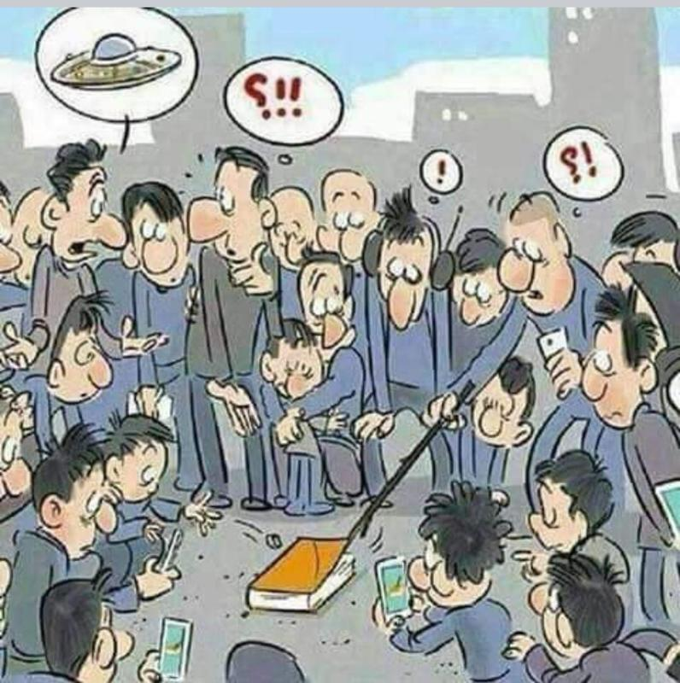
The NEW TESTAMENT BOOK OF ACTS
By David Lee Burris
Chapters 8 & 9

Slide 2
DOES THE NEW TESTAMENT IN PRACTICE ACTUALLY START WITH THE BOOK OF ACTS NOT THE GOSPELS?
“From the standpoint of the dispensations or the various economies by which God governs the world, the Old Testament Jewish economy actually continued through the gospels. Acts is a transitional book moving from the Old Testament economy into that of the new – the church age, the body of Christ.” (reference)

Slide 5
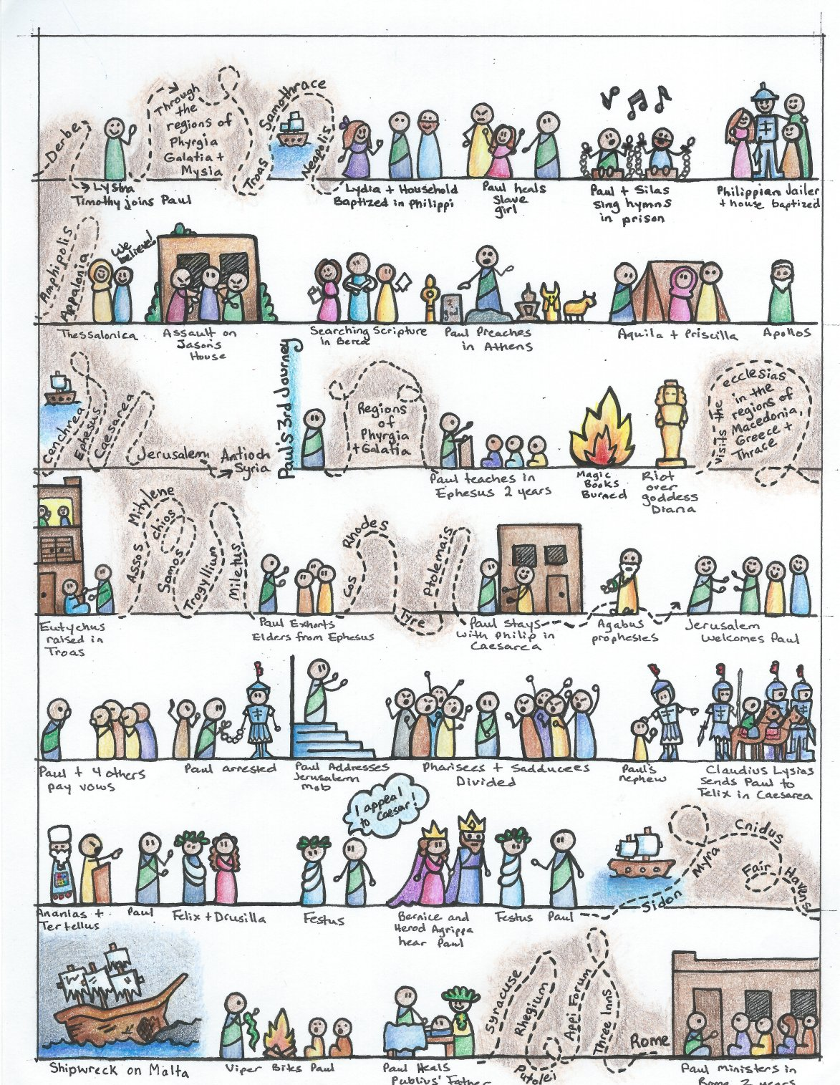

Slide 6
I. THE AUTHOR OF THE BOOK
From earliest times, Luke, “the beloved physician,” has been looked upon by conservative Bible scholars as being the author of The Book of Acts. Both internal and external evidence support this belief.
Luke was: (1) a Gentile (Col. 4:10–14); (2) the only Gentile author of a Bible book; (3) a physician (a medical doctor), Col. 4:14; (4) a “beloved” person, Col. 4:14; (5) a frequent missionary companion of Paul (the so-called “we sections” of The Book of Acts, 16:10–17; 20:5–21:18; 27:1–28:16, prove this assertion); and (6) the author of The Gospel of Luke as well as The Book of Acts.
II. THE ADDRESSEE OF THE BOOK
Luke addressed both The Gospel of Luke and The Book of Acts to Theophilus. Perhaps he had others in view as the ultimate readers of his two books.
We do not know the identity of Theophilus, nor do we know the place of his residence. He almost certainly was: (1) a friend of Luke and (2) a neophyte to Christianity (Luke wrote to Theophilus that he might know the certainty, the truthfulness, of the gospel truths wherein he had been instructed, Luke 1:1).
III. THE PLACE AND THE DATE OF THE WRITING OF THE BOOK
We do not know the place of writing but we can know the approximate date of writing. We know that it was written after the Spring of a.d. 63 for the book’s historical record extends to the Spring of that year and we know that the book was probably written before the Fall of a.d. 64 for the book makes no mention or allusion to the Neronian persecution which began in October of a.d. 64. We know that the book was almost certainly written before a.d. 70 for it makes no mention or allusion to the fall of Jerusalem and the destruction of its temple, events which occurred in a.d. 70 which greatly affected the early church and first-century Christianity (these events ended the Judaizers opposition to the gospel and the practice of preaching the gospel first to the Jews and then to the Gentiles).
IV. THE NAME OF THE BOOK
From the Second Century a.d., the common name for the book has been The Acts of the Apostles. This title is too comprehensive to be a correct one, for the book deals chiefly with the acts of only two apostles, Peter and Paul, and their acts are recorded only in part. A more apt title would be one of the following: (1) the Acts of the Risen Lord; (2) The Acts of the descended Holy Spirit; (3) Some of the Acts of Peter and Paul; (4) A Fragmentary History of the Early Church; (5) The First Chapter of Church History or (6) The only Inspired Chapter of Church History.
In the Greek manuscripts, the title is “Acts of Apostles.” This is a good and accurate title.
V. THE CLASSIFICATION OF THE BOOK
It is one of the five historical books of the New Testament. The New Testament has five historical books (Matthew through Acts), twenty-one doctrinal books (Romans through Jude) and one prophetical book (Revelation).
The 5 New Testament historical books are the New Testament’s “Pentateuch.”
Gingrich, R. E. (2002). (pp. 34). Memphis, TN: Riverside Printing.
Gingrich, R. E. (2002). The Book of Acts (pp. 3–4). Memphis, TN: Riverside Printing.

Slide 7
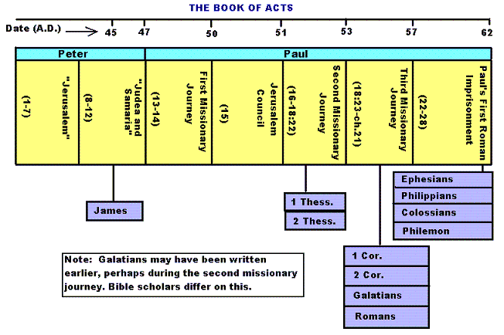

Slide 8
Historicity of Acts:
- the spread of Christianity from Jerusalem to Rome (“the ends of the earth”);
- The progress ... is mainly geographical:
- From Jerusalem ... to Samaria (8.5), Damascus (9.10), Antioch (11.26), Asia Minor (13.13), Europe (16.11), and finally Rome … itself;
- the northeastern corner of the Mediterranean;
- Maybe Spain But Nothing about North Africa, e.g., Alexandria and Cyrene.

Slide 10
1. Prologue and Ascension (1:1-11):
- Post-resurrection appearances … ;
- A ... visible ascension into heaven;
- Matthias chosen to replace Judas Iscariot (1.12-26);
- Luke’s understanding of an Apostle: see 1.21-22;
- Note: Saul (later Paul) meets those qualifications Acts 9 when Christ appeared to him while on the Damascus Road.

Slide 11
2. Founding of the Jerusalem Church - the role of the Holy Spirit (2.12-2.47):
- The Jerusalem Church increases in numbers by means of divine power;
- The work of the Holy Spirit, e.g., Glossolalia (2.1-24; see Joel 2.28-32);
- Peter’s speech interprets the meaning of Pentecost;
- The character of the Jerusalem Church (2.43-45; 4.32-35);

Slide 12
3. The Work of Peter and the other Apostles (3.1-5.42):
- Confrontation between the Apostles and the Jerusalem authorities (4.1-22);
- Luke’s attitude towards both the Sadducees and the Pharisees (4.8-11);

Slide 13
4. Persecution of the “Hellenists” (6.1-8.40):
- Stephen, a leading “Hellenist” or Greek-speaking Jew (6. 5, 8);
- Stephen is presented as the first Christian Martyr (7.60);
- subsequent persecution and the growth of the Church (8.1b-40);
the “new way” carried to such individuals as Simon the Magician (8.9) and an Ethiopian Eunuch (8.27);
the role of Philip in this work of evangelization (6.5; 8.4; 21,8).

Slide 14
5. Preparation for the Gentile Mission (9.1-12.25):
- The progress of Christianity …. as world adversary to pagan religion and human schools of philosophy;
- See, for example, the conversion of Saul of Tarsus (9.1-19) and Cornelius, the Roman centurion (Chs. 10-11);
- Peter is depicted as the one who first opens the door to Gentiles, that is, non-Jews;
Peter’s persuasion of the “circumcision party” (11.1-18);
See 10.44-48 and 11.15-18: the “Gentile Pentecost”;

Slide 15
5. Preparation for the Gentile Mission (9.1-12.25) (contd.):
- Gentiles flock to the Church at Antioch (11.19-26);
- The Jerusalem Church sends Barnabas... to report on the situation (11.22);
- Barnabas with the Apostle Paul at Antioch (11.25-30);
- Gospel preached “all over Judea and Samaria”;
- The first half concludes with an account of Herod Agrippa I’s persecution (41-44 CE) of the Jerusalem community;
- God is unhappy with Herod (12.20-23).

Slide 16
6. First Missionary Journey of Barnabas and Paul and the Jerusalem Conference (13.1-15.35):
- The rest of Acts is devoted mainly to the Missionary Journeys of the Apostle Paul and his fellow workers;
- the work of Paul and Barnabas in the various Hellenistic cities of Asia Minor;
- Dissension between Gentile and Jewish Christians over adherence to the Mosaic Torah (15.1-35);
- must Gentile Christians be circumcised and observe Jewish dietary laws?

Slide 17
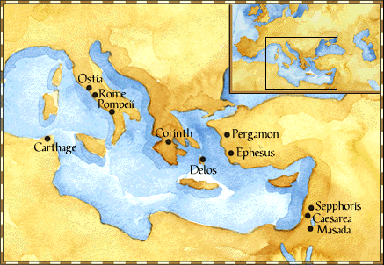
Paul: Map of His World.

Slide 18
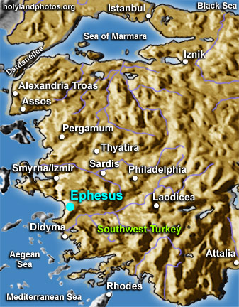

Slide 19
6. First Missionary Journey of Paul and Barnabas and the Jerusalem Conference (13.1-15.35) (contd.):
- The Jerusalem Conference held about A.D. 49 (Acts 15);
- Must a Gentile believer become a Jew ... to be a Christian?
- A division within the Church;
- The dispute settled in favor of uncircumcised Gentiles (15.28-29);
- The deciding voice is that of James (15.13-21).

Slide 20
6. First Missionary Journey of Paul and Barnabas and the Jerusalem Conference (13.1-15.35) (contd.):
- The Apostles and Elders required only limited Torah mandates of the Gentile Christians (15.13-21);
- requirements based on rules from Leviticus (Acts 15.13-21; Leviticus 17-18);
- Themes of unity and cooperation dominate … ;
- it is a unanimous decision and the “Whole Church” sends a delegation to Antioch to explain the Jerusalem Church’s decision (15.30-35);
- Actually, a decision of the Holy Spirit (15.22-29).

Slide 21
6. First Missionary Journey of Paul and Barnabas and the Jerusalem Conference (13.1-15.35) (contd.):
- Paul’s independence of the Apostolic Church (Gal 1.17, 18-19, 20; 2.1-10);
- Paul indicates that he was never under the jurisdiction of the Church’s leadership in Jerusalem (Gal 1.17, 18-19, 20; 2.1-10);
- See also 1 Cor 8.8; 10.27 relative to eating meat sacrificed to Greco-Roman gods.

Slide 22
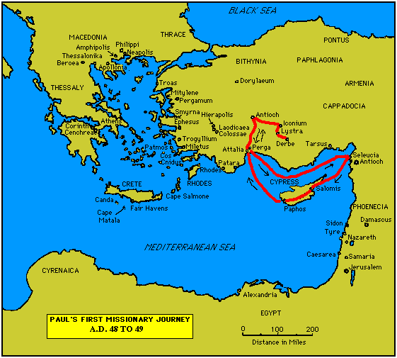

Slide 23
7. Paul’s Secondary Missionary Journey; Evangelizing Greece (16.1-18.21):
- Paul and Barnabas separate (15.39);
- Why the separation?
- Paul and Silas visit churches in Syria and Asia Minor (15.40-41);
- A vision directs Paul to Macedonia (15.40-16.10);
- Paul’s customary activity relative to the Jews and then being abused by them (16.11-17.15);

Slide 24
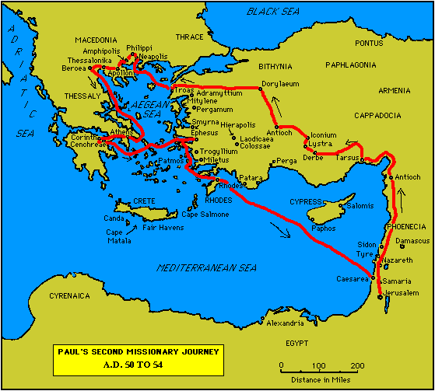

Slide 25
7. Paul’s Secondary Missionary Journey; Evangelizing Greece (16.1-18.21) (contd.):
- Paul in Philippi, Thessalonica, Beroea, and Athens;
- Paul speaks at the Areopagus in Athens (17.19-31);
- Paul at Corinth (18.1-17);

Slide 27
8. Paul’s Third Missionary Journey: Revisiting Asia Minor and Greece (18.22-20.38):
- Paul at Ephesus (18.19-21);
- Luke depicts Paul as determined to complete his last tour and head for the imperial capital, that is, Rome (19.21-22);
- Paul’s farewell speech at Miletus (20.17-38);
- See maps on the location of the major churches at the end of Paul’s ministry.

Slide 28
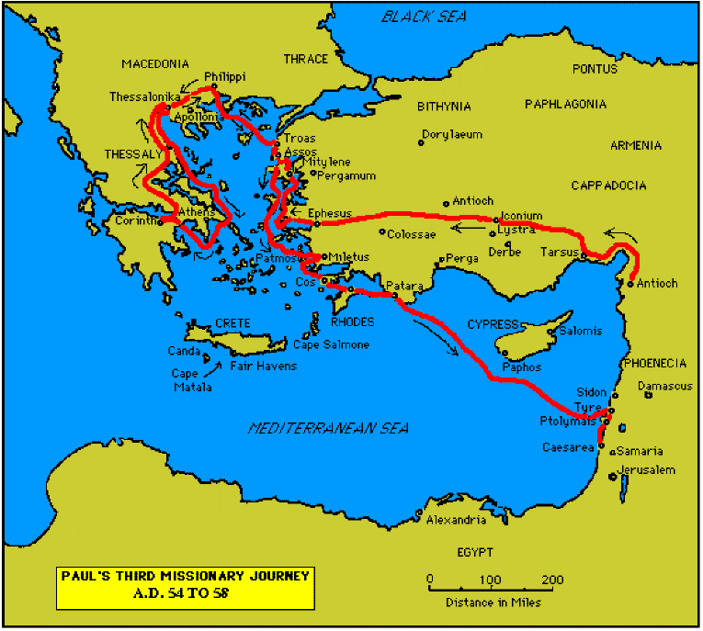

Slide 30
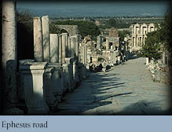

Slide 31
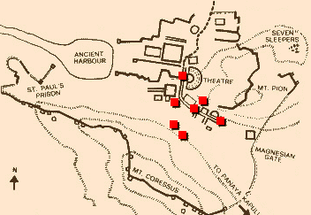
Ephesus: General View of the Ancient City.

Slide 32
9. Paul’s arrest in Jerusalem and imprisonment in Caesarea Maritime (21.1-26.32):
- Paul returns to Jerusalem (21.17) ... accused of blasphemy and profaning the Temple;
- When arrested, Paul claims that he is a Pharisee (21.27-23.10);
- Paul is imprisoned ... in Caesarea (23.33-26.32);
- he exercises his birthright as a Roman citizen (25.1-21);
- he defends himself (26.1-29);

Slide 33
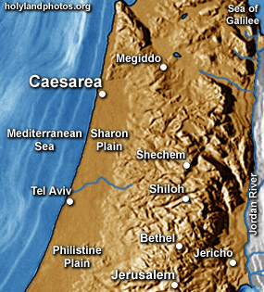

Slide 34
10. Paul’s Journey to Rome and His Preaching to Roman Jews (27.1-28.31):
- Paul’s sea journey to Rome... a shipwreck on the island of Malta (28.1 ) (see Map);
- the narrative in the first person plural, that is, “we”;
- Acts ends with Paul’s arrival in Rome (28.16);
- Paul is under house arrest but is free to preach (28.31);
- He continues to evangelize the Romans (28.23-31);
- We are not told of Paul’s fate.

Slide 35
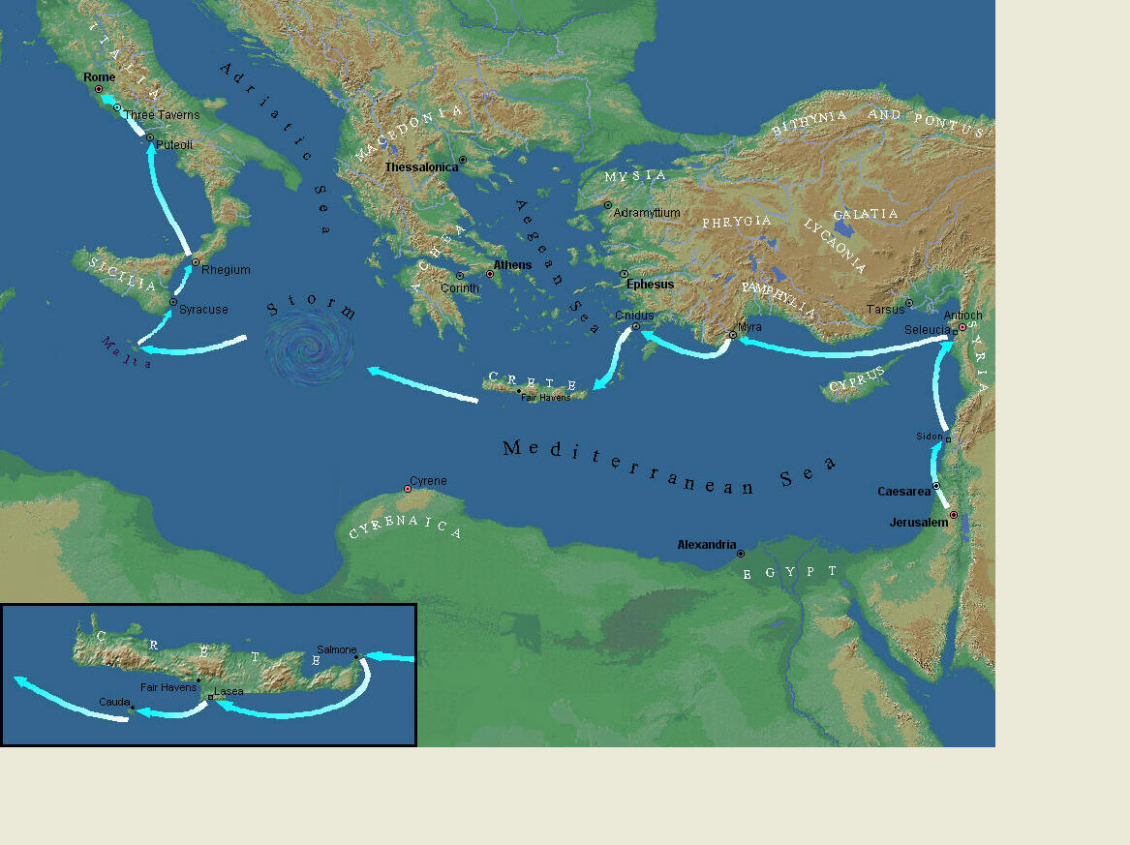
Paul’s Journey to Rome.

Slide 36
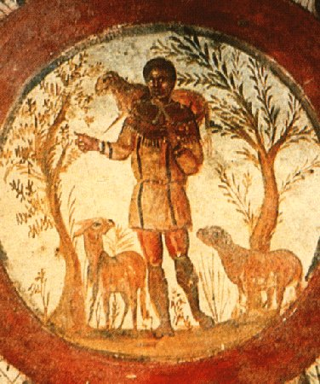
The Good Shepherd – in Catacombs of Rome.

Slide 37
10. Paul’s Journey to Rome and his Preaching to Roman Jews (27.1-28.31) (contd.):
- Luke has accomplished his task of tracing Christianity’s expansion from Jerusalem to “the ends of the earth” (1.8);
- Another theme emphasized: Paul and his successor evangelists will henceforth direct the Gospel primarily to Non-Jews, for “the Gentiles will listen” (28.28);
- Luke quotes from Isaiah 6 (see also Mark 4.10-13);
- Christianity’s future belongs to the Gentiles.

Slide 38
Basic Book Structure acts of the Apostles Centers around the great commission & Call To evangelize Then known world!

Slide 39
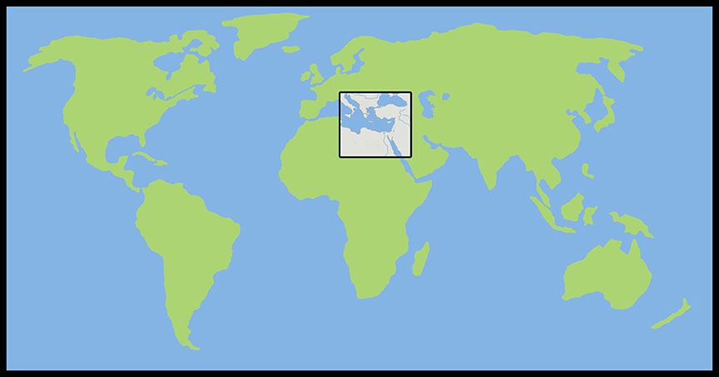
Where the Story takes Place

Slide 40
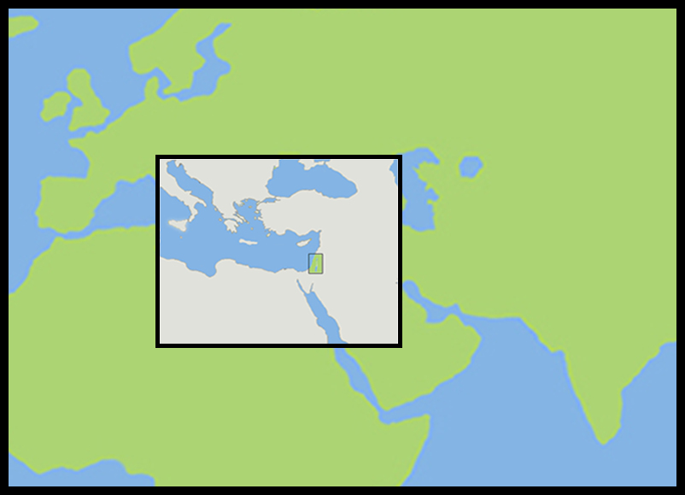
The Land of Canaan in the Near East

Slide 41
Acts 1:8 and the Great Commission
Acts 1:8 But ye shall receive power, after that the Holy Ghost is come upon you: and ye shall be witnesses unto me both in Jerusalem, and in all Judaea, and in Samaria, and unto the uttermost part of the earth.
Matthew 28:19-20 ¹⁹ Go ye therefore, and teach all nations, baptizing them in the name of the Father, and of the Son, and of the Holy Ghost: ²⁰ Teaching them to observe all things whatsoever I have commanded you: and, lo, I am with you alway, even unto the end of the world. Amen.
Mark 16:15 And he said unto them, Go ye into all the world, and preach the gospel to every creature.

Slide 42
Acts 1:8 and the Great Commission
Acts 1:8 But ye shall receive power, after that the Holy Ghost is come upon you: and ye shall be witnesses unto me both in Jerusalem, and in all Judaea, and in Samaria, and unto the uttermost part of the earth.
Matthew 28:19-20 ¹⁹ Go ye therefore, and teach all nations, baptizing them in the name of the Father, and of the Son, and of the Holy Ghost: ²⁰ Teaching them to observe all things whatsoever I have commanded you: and, lo, I am with you alway, even unto the end of the world. Amen.
Mark 16:15 And he said unto them, Go ye into all the world, and preach the gospel to every creature.

Slide 43
Acts 1:8 and the Great Commission
Acts 1:8 But ye shall receive power, after that the Holy Ghost is come upon you: and ye shall be witnesses unto me both in Jerusalem, and in all Judaea, and in Samaria, and unto the uttermost part of the earth.
Matthew 28:19-20 ¹⁹ Go ye therefore, and teach all nations, baptizing them in the name of the Father, and of the Son, and of the Holy Ghost: ²⁰ Teaching them to observe all things whatsoever I have commanded you: and, lo, I am with you alway, even unto the end of the world. Amen.
Mark 16:15 And he said unto them, Go ye into all the world, and preach the gospel to every creature.

Slide 44
Acts 1:8 and the Great Commission
Acts 1:8 But ye shall receive power, after that the Holy Ghost is come upon you: and ye shall be witnesses unto me both in Jerusalem, and in all Judaea, and in Samaria, and unto the uttermost part of the earth.
Matthew 28:19-20 ¹⁹ Go ye therefore, and teach all nations, baptizing them in the name of the Father, and of the Son, and of the Holy Ghost: ²⁰ Teaching them to observe all things whatsoever I have commanded you: and, lo, I am with you alway, even unto the end of the world. Amen.
Mark 16:15 And he said unto them, Go ye into all the world, and preach the gospel to every creature.

Slide 45
Acts 1:8 and the Structure of the Book
Acts 1:8 … ye shall be witnesses unto me both in Jerusalem, and in all Judaea, and in Samaria, and unto the uttermost part of the earth.
1. The witness in Jerusalem:
Chapters 1 to 7
2. The witness in Judaea and Samaria:
Chapters 8 to 12
3. The witness unto the uttermost parts of the earth:
Chapters 13 to 28

Slide 46
The Three Audiences
Part 1: The Jews
Part 2: The Samaritans
Part 3: The Gentiles

Slide 47
The Pillars of the Church
Part 1: Peter
Part 2: Peter and Paul (Saul of Tarsus)
Part 3: Paul

Slide 48
The Timeline
Part 1: 5 years (AD 30-35)
Part 2: 13 years (AD 35-48)
Part 3: 14 years (AD 48-62)
A total of 32 years, according to Nelson’s Complete Book of Bible Maps and Charts.

Slide 49
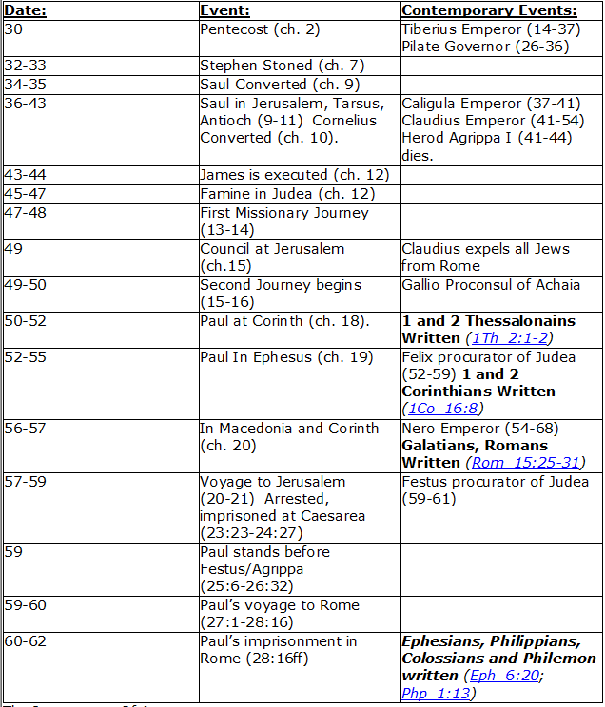
CHART BY
Mark Dunagan

Slide 50
PART ONE—The infancy of the church (the church in Jerusalem) (chapters 1–7)
(In this section, Jerusalem is the central city of Christianity and Peter is the most prominent person)
I. THE POST-RESURRECTION MINISTRY OF CHRIST (1:1–8)
II. THE ASCENSION OF CHRIST (1:9–11)
III. THE WAITING IN THE UPPER ROOM (1:12–26)
IV. THE ADVENT OF THE HOLY SPIRIT (2:1–41)
V. THE SNAPSHOT OF THE EARLY CHURCH (2:42–47)
VI. THE HEALING OF THE LAME MAN AND ITS CONSEQUENCES (3:1–4:31)
VII. THE DEATH OF ANANIAS AND SAPPHIRA AND ITS EFFECTS (4:32–5:42)
VIII. THE APPOINTMENT OF THE SEVEN (6:1–7)
IX. THE MINISTRY OF STEPHEN (6:8–7:60)
PART TWO—The adolescence of the church (the church in all Judea and In Samaria) (chapters 8–12)
(In this section, Jerusalem is gradually being replaced by Antioch as the central city of Christianity and Peter is gradually being replaced by Paul as the most prominent person)
I. THE FIRST MENTION OF PAUL (7:58; 8:1, 3)
II. THE PERSECUTION AND SCATTERING OF THE JERUSALEM CHURCH (8:1–4)
III. THE CONVERSION OF SAMARITANS (8:5–25)
IV. THE CONVERSION OF A JEWISH PROSELYTE (8:26–40)
V. THE CONVERSION OF SAUL (9:1–31)
VI. THE EXPANSION OF THE CHURCH IN WESTERN JUDEA (9:32–43)
VII. THE CONVERSION OF GENTILE GOD-FEARERS (chapter 10)
VIII. THE GROWING VISION OF THE JEWISH LEADERS (11:1–18)
IX. THE CONVERSION OF PAGAN GENTILES (11:19–26)
X. THE GROWING TIES BETWEEN JEWISH AND GENTILE CHRISTIANITY (11:27–30)
XI. THE COMPLETION OF THE TRANSITION (chapter 12)
PART THREE—The maturity of the church (the church in all the world) (chapters 13–28)
(In this section, Antioch is the central city of Christianity and Paul is the most prominent person)
I. PAUL’S CALL AT ANTIOCH TO HIS LIFE’S WORK (13:1–3)
II. PAUL’S FIRST MISSIONARY JOURNEY (13:4–14:27)
III. PAUL’S TWO YEARS BACK IN ANTIOCH (14:28–15:35)
IV. PAUL’S SECOND MISSIONARY JOURNEY (15:36–18:22)
V. PAUL’S THIRD MISSIONARY JOURNEY (18:23–21:16)
VI. PAUL’S ARREST AT JERUSALEM (21:17–23:35)
VII. PAUL’S TWO-YEARS’ IMPRISONMENT AT CAESAREA (chapters 24–26)
VIII. PAUL’S SHIPWRECK JOURNEY TO ROME (27:1–28:15)
IX. PAUL’S FIRST ROMAN IMPRISONMENT (28:16–31)
Gingrich, R. E. (2002). The Book of Acts (pp. 5–6). Memphis, TN: Riverside Printing.

Slide 51
L.D. CARY & SAM HOLT CATCH PHRASES
Chapter 1 – “Jesus’ Work On Earth Is Done”
Chapter 2 – “Peter Baptizes A Crew”
Chapter 3 – “A Beggar’s Plea”
Chapter 4 – “A Jailhouse Door”
Chapter 5 – “Ananias & Sapphira Don’t Survive”
Chapter 6 – “The Widow’s Fix”
Chapter 8 – “Stephen Looks Into Heaven”
Chapter 9 – “Saul Struck Blind”
“The Jewish Hate”
Catch Phrase
Chapter Eight

Slide 52
ACTS 8
The Gospel Begins To Spread Beyond Jerusalem

Slide 53
Acts 8:1-3 (NASB)
1 Saul was in hearty agreement with putting him to death. And on that day a great persecution began against the church in Jerusalem, and they were all scattered throughout the regions of Judea and Samaria, except the apostles. 2 Some devout men buried Stephen, and made loud lamentation over him. 3 But Saul began ravaging the church, entering house after house, and dragging off men and women, he would put them in prison.
A. The zeal with which Saul of Tarsus persecuted the church at Jerusalem resulted in the scattering of the church: Acts 22:20; 26:10
Acts 22:20 (NASB) 20 'And when the blood of Your witness Stephen was being shed, I also was standing by approving, and watching out for the coats of those who were slaying him.'
Acts 26:10 (NASB) 10 "And this is just what I did in Jerusalem; not only did I lock up many of the saints in prisons, having received authority from the chief priests, but also when they were being put to death I cast my vote against them.

Slide 54
Acts 8:4-8 (NASB)
4 Therefore, those who had been scattered went about preaching the word. 5 Philip went down to the city of Samaria and began proclaiming Christ to them. 6 The crowds with one accord were giving attention to what was said by Philip, as they heard and saw the signs which he was performing. 7 For in the case of many who had unclean spirits, they were coming out of them shouting with a loud voice; and many who had been paralyzed and lame were healed. 8 So there was much rejoicing in that city.
A. The scattered went about preaching the word: Mt 28:16-20; Acts 11:19; 2Tim 2:1-2
1. Philip went down to the city of Samaria: Acts 6:3-5
Matthew 28:16-20 (NASB) 16 But the eleven disciples proceeded to Galilee, to the mountain which Jesus had designated. 17 When they saw Him, they worshiped Him; but some were doubtful. 18 And Jesus came up and spoke to them, saying, "All authority has been given to Me in heaven and on earth. 19 "Go therefore and make disciples of all the nations, baptizing them in the name of the Father and the Son and the Holy Spirit,
Acts 6:3-5 (NASB) 3 "Therefore, brethren, select from among you seven men of good reputation, full of the Spirit and of wisdom, whom we may put in charge of this task. 4 "But we will devote ourselves to prayer and to the ministry of the word." 5 The statement found approval with the whole congregation; and they chose Stephen, a man full of faith and of the Holy Spirit, and Philip, Prochorus, Nicanor, Timon, Parmenas and Nicolas, a proselyte from Antioch.
20 teaching them to observe all that I commanded you; and lo, I am with you always, even to the end of the age.“
2 Timothy 2:1-2 (NASB) 1 You therefore, my son, be strong in the grace that is in Christ Jesus. 2 The things which you have heard from me in the presence of many witnesses, entrust these to faithful men who will be able to teach others also.
Acts 11:19 (NASB) 19 So then those who were scattered because of the persecution that occurred in connection with Stephen made their way to Phoenicia and Cyprus and Antioch, speaking the word to no one except to Jews alone.

Slide 55
Acts 8:4-8 (NASB)
4 Therefore, those who had been scattered went about preaching the word. 5 Philip went down to the city of Samaria and began proclaiming Christ to them. 6 The crowds with one accord were giving attention to what was said by Philip, as they heard and saw the signs which he was performing. 7 For in the case of many who had unclean spirits, they were coming out of them shouting with a loud voice; and many who had been paralyzed and lame were healed. 8 So there was much rejoicing in that city.
a. He proclaimed Christ in the city of Samaria: Acts 8:34-35
b. The crowds paid attention to what he taught and the signs that accompanied the gospel message: Mk 16:20; Jn 3:1-2; Heb 2:3-4
1) Casting out of Demons and healing the lame and paralyzed were miracles which accompanied the word: Mk 16:17-18; Mt 4:24
John 3:1-2 (NASB) 1 Now there was a man of the Pharisees, named Nicodemus, a ruler of the Jews; 2 this man came to Jesus by night and said to Him, "Rabbi, we know that You have come from God as a teacher; for no one can do these signs that You do unless God is with him."
Hebrews 2:3-4 (NASB) 3 how will we escape if we neglect so great a salvation? After it was at the first spoken through the Lord, it was confirmed to us by those who heard, 4 God also testifying with them, both by signs and wonders and by various miracles and by gifts of the Holy Spirit according to His own will.
Mark 16:17-18 (NASB) 17 "These signs will accompany those who have believed: in My name they will cast out demons, they will speak with new tongues; 18 they will pick up serpents, and if they drink any deadly poison, it will not hurt them; they will lay hands on the sick, and they will recover."
Acts 8:34-35 (NASB) 34 The eunuch answered Philip and said, "Please tell me, of whom does the prophet say this? Of himself or of someone else?" 35 Then Philip opened his mouth, and beginning from this Scripture he preached Jesus to him.
Matthew 4:24 (NASB) 24 The news about Him spread throughout all Syria; and they brought to Him all who were ill, those suffering with various diseases and pains, demoniacs, epileptics, paralytics; and He healed them.
Mark 16:20 (NASB) 20 And they went out and preached everywhere, while the Lord worked with them, and confirmed the word by the signs that followed.]

Slide 56
Acts 8:9-13 (NASB)
9 Now there was a man named Simon, who formerly was practicing magic in the city and astonishing the people of Samaria, claiming to be someone great; 10 and they all, from smallest to greatest, were giving attention to him, saying, "This man is what is called the Great Power of God." 11 And they were giving him attention because he had for a long time astonished them with his magic arts. 12 But when they believed Philip preaching the good news about the kingdom of God and the name of Jesus Christ, they were being baptized, men and women alike. 13 Even Simon himself believed; and after being baptized, he continued on with Philip, and as he observed signs and great miracles taking place, he was constantly amazed.
A. When the miracles of God were laid side by side with the magic of Simon, the people quickly and decisively saw the difference and abandoned Simon: Acts 8:5-8; 19:11-19
1. The people were believing and being baptized because of Philip’s preaching and miracles: Mt 28:18-20; Mk 16:15-16; Acts 2:38
2. Simon himself discerned the difference between his magic and Philip’s miracles and obeyed the Gospel by believing and being baptized: Acts 13:6
Acts 2:38 (NASB) ³⁸ Peter said to them, "Repent, and each of you be baptized in the name of Jesus Christ for the forgiveness of your sins; and you will receive the gift of the Holy Spirit.
Acts 8:5-8 (NASB) ⁵ Philip went down to the city of Samaria and began proclaiming Christ to them. ⁶ The crowds with one accord were giving attention to what was said by Philip, as they heard and saw the signs which he was performing. ⁷ For in the case of many who had unclean spirits, they were coming out of them shouting with a loud voice; and many who had been paralyzed and lame were healed. ⁸ So there was much rejoicing in that city.
Acts 19:11-19 (NASB) ¹¹ God was performing extraordinary miracles by the hands of Paul, ¹² so that handkerchiefs or aprons were even carried from his body to the sick, and the diseases left them and the evil spirits went out. ¹³ But also some of the Jewish exorcists, who went from place to place, attempted to name over those who had the evil spirits the name of the Lord Jesus, saying, "I adjure you by Jesus whom Paul preaches." ¹⁴ Seven sons of one Sceva, a Jewish chief priest, were doing this.
Mark 16:15-16 (NASB) ¹⁵ And He said to them, "Go into all the world and preach the gospel to all creation. ¹⁶ "He who has believed and has been baptized shall be saved; but he who has disbelieved shall be condemned.
Matthew 28:18-20 (NASB) ¹⁸ And Jesus came up and spoke to them, saying, "All authority has been given to Me in heaven and on earth. ¹⁹ "Go therefore and make disciples of all the nations, baptizing them in the name of the Father and the Son and the Holy Spirit, ²⁰ teaching them to observe all that I commanded you; and lo, I am with you always, even to the end of the age.“
¹⁵ And the evil spirit answered and said to them, "I recognize Jesus, and I know about Paul, but who are you?" ¹⁶ And the man, in whom was the evil spirit, leaped on them and subdued all of them and overpowered them, so that they fled out of that house naked and wounded. ¹⁷ This became known to all, both Jews and Greeks, who lived in Ephesus; and fear fell upon them all and the name of the Lord Jesus was being magnified.
¹⁸ Many also of those who had believed kept coming, confessing and disclosing their practices. ¹⁹ And many of those who practiced magic brought their books together and began burning them in the sight of everyone; and they counted up the price of them and found it fifty thousand pieces of silver.
Acts 13:6 (NASB) ⁶ When they had gone through the whole island as far as Paphos, they found a magician, a Jewish false prophet whose name was Bar-Jesus,
Notes:
Simon is a Hebrew name. He may have been a Jewish magician.

Slide 57
Acts 8:14-17 (NASB)
14 Now when the apostles in Jerusalem heard that Samaria had received the word of God, they sent them Peter and John, 15 who came down and prayed for them that they might receive the Holy Spirit. 16 For He had not yet fallen upon any of them; they had simply been baptized in the name of the Lord Jesus. 17 Then they began laying their hands on them, and they were receiving the Holy Spirit.
A. The Samaritans had received the word by believing and being baptized in the name of Jesus: Acts 2:38, 41; Acts 8:12-13; Mk 16:16
1. Baptism in the name of Jesus as taught by Philip was in water not the Holy Spirit: Acts 8:36-38
B. The apostles are sent so that the Samaritans could receive the Holy Spirit which only came through laying on of the apostles hands: Acts 8:5-7; 17-18
Acts 8:17-18 (NASB) 17 Then they began laying their hands on them, and they were receiving the Holy Spirit. 18 Now when Simon saw that the Spirit was bestowed through the laying on of the apostles’ hands, he offered them money,
Acts 8:5-7 (NASB) 5 Philip went down to the city of Samaria and began proclaiming Christ to them. 6 The crowds with one accord were giving attention to what was said by Philip, as they heard and saw the signs which he was performing. 7 For in the case of many who had unclean spirits, they were coming out of them shouting with a loud voice; and many who had been paralyzed and lame were healed.
Notes:
9/3/2017

Slide 58
Acts 8:18-24 (NASB)
18 Now when Simon saw that the Spirit was bestowed through the laying on of the apostles’ hands, he offered them money, 19 saying, "Give this authority to me as well, so that everyone on whom I lay my hands may receive the Holy Spirit." 20 But Peter said to him, "May your silver perish with you, because you thought you could obtain the gift of God with money! 21 "You have no part or portion in this matter, for your heart is not right before God. 22 "Therefore repent of this wickedness of yours, and pray the Lord that, if possible, the intention of your heart may be forgiven you. 23 "For I see that you are in the gall of bitterness and in the bondage of iniquity." 24 But Simon answered and said, "Pray to the Lord for me yourselves, so that nothing of what you have said may come upon me."
A. Apostles imparting the spirit: He 2:3-4; Acts 2:43; 4:33; Acts 19:1-7; Rom 1:11
B. When a disciple sins they must pray for forgiveness: Eph 4:5; Ja 5:16-18; Mt 6:9-15 1Thess 5:17-18; Eph 6:18
Acts 19:1-7 (NASB) 1 It happened that while Apollos was at Corinth, Paul passed through the upper country and came to Ephesus, and found some disciples. 2 He said to them, "Did you receive the Holy Spirit when you believed?" And they said to him, "No, we have not even heard whether there is a Holy Spirit." 3 And he said, "Into what then were you baptized?" And they said, "Into John's baptism." 4 Paul said, "John baptized with the baptism of repentance, telling the people to believe in Him who was coming after him, that is, in Jesus." 5 When they heard this, they were baptized in the name of the Lord Jesus. 6 And when Paul had laid his hands upon them, the Holy Spirit came on them, and they began speaking with tongues and prophesying. 7 There were in all about twelve men.
Romans 1:11 (NASB) 11 For I long to see you so that I may impart some spiritual gift to you, that you may be established;
Hebrews 2:3-4 (NASB) 3 how will we escape if we neglect so great a salvation? After it was at the first spoken through the Lord, it was confirmed to us by those who heard, 4 God also testifying with them, both by signs and wonders and by various miracles and by gifts of the Holy Spirit according to His own will.
Acts 2:43 (NASB) 43 Everyone kept feeling a sense of awe; and many wonders and signs were taking place through the apostles.
Acts 4:33 (NASB) 33 And with great power the apostles were giving testimony to the resurrection of the Lord Jesus, and abundant grace was upon them all.
John 3:3-7 (NASB) 3 Jesus answered and said to him, "Truly, truly, I say to you, unless one is born again he cannot see the kingdom of God." 4 Nicodemus *said to Him, "How can a man be born when he is old? He cannot enter a second time into his mother's womb and be born, can he?" 5 Jesus answered, "Truly, truly, I say to you, unless one is born of water and the Spirit he cannot enter into the kingdom of God. 6 "That which is born of the flesh is flesh, and that which is born of the Spirit is spirit. 7 "Do not be amazed that I said to you, 'You must be born again.'
Mark 16:16 (NASB) 16 "He who has believed and has been baptized shall be saved; but he who has disbelieved shall be condemned.
Ephesians 4:5 (NASB) 5 one Lord, one faith, one baptism,
Matthew 6:9-15 (NASB) 9 "Pray, then, in this way: 'Our Father who is in heaven, Hallowed be Your name. 10 'Your kingdom come. Your will be done, On earth as it is in heaven. 11 'Give us this day our daily bread. 12 'And forgive us our debts, as we also have forgiven our debtors. 13 'And do not lead us into temptation, but deliver us from evil. [For Yours is the kingdom and the power and the glory forever. Amen.'] 14 "For if you forgive others for their transgressions, your heavenly Father will also forgive you. 15 "But if you do not forgive others, then your Father will not forgive your transgressions.
James 5:16-18 (NASB) 16 Therefore, confess your sins to one another, and pray for one another so that you may be healed. The effective prayer of a righteous man can accomplish much. 17 Elijah was a man with a nature like ours, and he prayed earnestly that it would not rain, and it did not rain on the earth for three years and six months. 18 Then he prayed again, and the sky poured rain and the earth produced its fruit.
1 Thessalonians 5:17-18 (NASB) 17 pray without ceasing; 18 in everything give thanks; for this is God's will for you in Christ Jesus.
Ephesians 6:18 (NASB) 18 With all prayer and petition pray at all times in the Spirit, and with this in view, be on the alert with all perseverance and petition for all the saints,
Notes:
9/10/17 Simons forgiveness – did not need to be baptized again. There is only one birth and that is when you baptized. One baptism.
Peter says he must repent: the prayers of Peter would be of little value if Simon did not repent.
Gall of bitterness: it may be that Simon was bitter and jealous of the apostles power.
Bound to unrighteousness.

Slide 59
Acts 8:25-27 (NASB)
25 So, when they had solemnly testified and spoken the word of the Lord, they started back to Jerusalem, and were preaching the gospel to many villages of the Samaritans. 26 But an angel of the Lord spoke to Philip saying, "Get up and go south to the road that descends from Jerusalem to Gaza." (This is a desert road.) 27 So he got up and went; and there was an Ethiopian eunuch, a court official of Candace, queen of the Ethiopians, who was in charge of all her treasure; and he had come to Jerusalem to worship,
A. Peter and John preached while on their way back to Jerusalem: Acts 1:8
B. Philip directed by an angel goes to a road from Jerusalem to Gaza: 2 slides
C. Ethiopian Eunuch: It was so common to place Eunuchs over the treasury that the word Eunuch came to mean Treasurer. Mt 19:12; Dt 23:1; Isa 56:3-8
Matthew 19:12 (NASB) 12 "For there are eunuchs who were born that way from their mother's womb; and there are eunuchs who were made eunuchs by men; and there are also eunuchs who made themselves eunuchs for the sake of the kingdom of heaven. He who is able to accept this, let him accept it."
Isaiah 56:3-8 (NASB) 3 Let not the foreigner who has joined himself to the LORD say, "The LORD will surely separate me from His people." Nor let the eunuch say, "Behold, I am a dry tree." 4 For thus says the LORD, "To the eunuchs who keep My sabbaths, And choose what pleases Me, And hold fast My covenant, 5 To them I will give in My house and within My walls a memorial, And a name better than that of sons and daughters; I will give them an everlasting name which will not be cut off. 6 "Also the foreigners who join themselves to the LORD, To minister to Him, and to love the name of the LORD, To be His servants, every one who keeps from profaning the sabbath And holds fast My covenant; 7 Even those I will bring to My holy mountain And make them joyful in My house of prayer. Their burnt offerings and their sacrifices will be acceptable on My altar; For My house will be called a house of prayer for all the peoples." 8 The Lord GOD, who gathers the dispersed of Israel, declares, "Yet others I will gather to them, to those already gathered."
Acts 1:8 (NASB) 8 but you will receive power when the Holy Spirit has come upon you; and you shall be My witnesses both in Jerusalem, and in all Judea and Samaria, and even to the remotest part of the earth."
Deuteronomy 23:1 (NASB) 1 "No one who is emasculated or has his male organ cut off shall enter the assembly of the LORD.

Slide 60
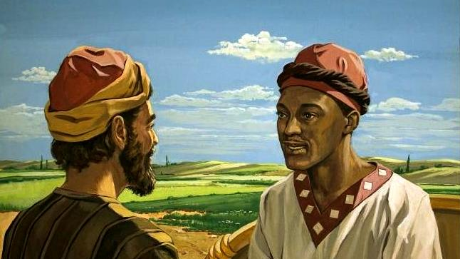
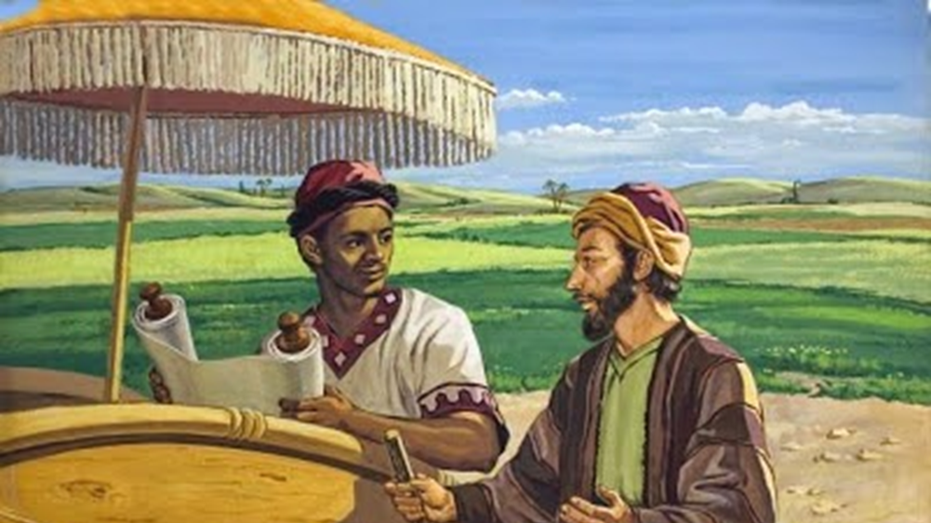
Acts 8:28-29 (NASB)
28 and he was returning and sitting in his chariot, and was reading the prophet Isaiah. 29 Then the Spirit said to Philip, "Go up and join this chariot."
A. The Eunuch was reading from the prophet Isaiah.
1. The Holy Spirit does not preach to this Eunuch. It is clear God wants human agency in the preaching.

Slide 61
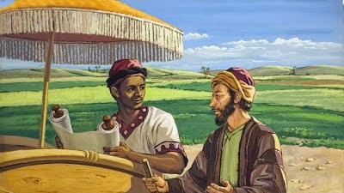
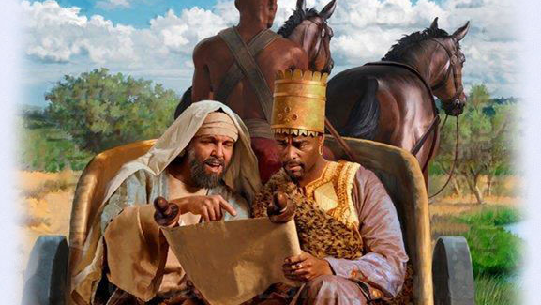
Acts 8:30-31 (NASB)
30 Philip ran up and heard him reading Isaiah the prophet, and said, "Do you understand what you are reading?" 31 And he said, "Well, how could I, unless someone guides me?" And he invited Philip to come up and sit with him.

Slide 62
Acts 8:32-34 (NASB)
32 Now the passage of Scripture which he was reading was this: "HE WAS LED AS A SHEEP TO SLAUGHTER; AND AS A LAMB BEFORE ITS SHEARER IS SILENT, SO HE DOES NOT OPEN HIS MOUTH. 33 "IN HUMILIATION HIS JUDGMENT WAS TAKEN AWAY; WHO WILL RELATE HIS GENERATION? FOR HIS LIFE IS REMOVED FROM THE EARTH." 34 The eunuch answered Philip and said, "Please tell me, of whom does the prophet say this? Of himself or of someone else?"
A. The passage of Isaiah that the Eunuch was reading is in the 53 chapter: Isa 53:1-8
1. The providence of God had provided this opportunity at this moment.
Isaiah 53:1-8 (NASB) 1 Who has believed our message? And to whom has the arm of the LORD been revealed? 2 For He grew up before Him like a tender shoot, And like a root out of parched ground; He has no stately form or majesty That we should look upon Him, Nor appearance that we should be attracted to Him. 3 He was despised and forsaken of men, A man of sorrows and acquainted with grief; And like one from whom men hide their face He was despised, and we did not esteem Him.
4 Surely our griefs He Himself bore, And our sorrows He carried; Yet we ourselves esteemed Him stricken, Smitten of God, and afflicted. 5 But He was pierced through for our transgressions, He was crushed for our iniquities; The chastening for our well-being fell upon Him, And by His scourging we are healed. 6 All of us like sheep have gone astray, Each of us has turned to his own way; But the LORD has caused the iniquity of us all To fall on Him.
7 He was oppressed and He was afflicted, Yet He did not open His mouth; Like a lamb that is led to slaughter, And like a sheep that is silent before its shearers, So He did not open His mouth. 8 By oppression and judgment He was taken away; And as for His generation, who considered That He was cut off out of the land of the living For the transgression of my people, to whom the stroke was due?

Slide 63
Acts 8:35-3 (NASB)
35 Then Philip opened his mouth, and beginning from this Scripture he preached Jesus to him. 36 As they went along the road they came to some water; and the eunuch *said, "Look! Water! What prevents me from being baptized?" 37 [And Philip said, "If you believe with all your heart, you may." And he answered and said, "I believe that Jesus Christ is the Son of God."] 38 And he ordered the chariot to stop; and they both went down into the water, Philip as well as the eunuch, and he baptized him. 39 When they came up out of the water, the Spirit of the Lord snatched Philip away; and the eunuch no longer saw him, but went on his way rejoicing. 40 But Philip found himself at Azotus, and as he passed through he kept preaching the gospel to all the cities until he came to Caesarea.
A. He preached Jesus: Matt 28:18-20; Mk 16:15-16; Acts 2:38
B. Spirit snatched Philip up leaving him at Azotus:
Matthew 28:18-20 (NASB) 18 And Jesus came up and spoke to them, saying, "All authority has been given to Me in heaven and on earth. 19 "Go therefore and make disciples of all the nations, baptizing them in the name of the Father and the Son and the Holy Spirit, 20 teaching them to observe all that I commanded you; and lo, I am with you always, even to the end of the age."
Mark 16:15-16 (NASB) 15 And He said to them, "Go into all the world and preach the gospel to all creation. 16 "He who has believed and has been baptized shall be saved; but he who has disbelieved shall be condemned.
Acts 2:38 (NASB) 38 Peter said to them, "Repent, and each of you be baptized in the name of Jesus Christ for the forgiveness of your sins; and you will receive the gift of the Holy Spirit.

Slide 64
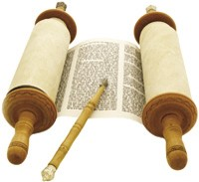
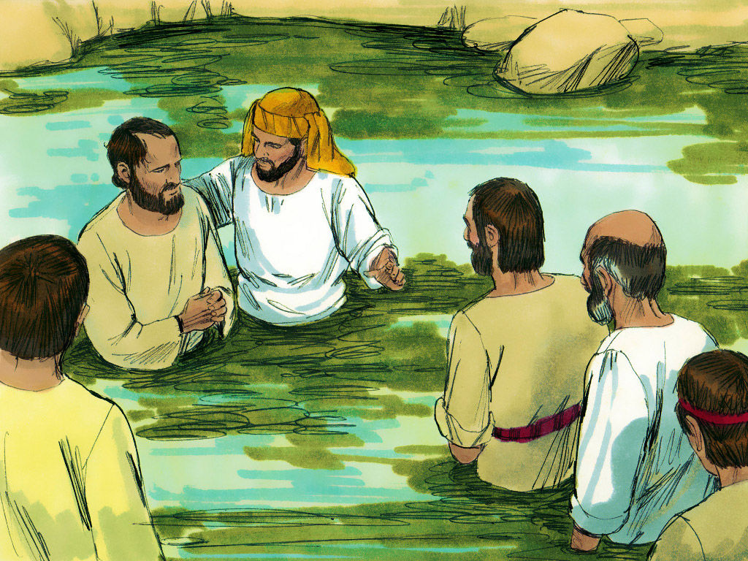
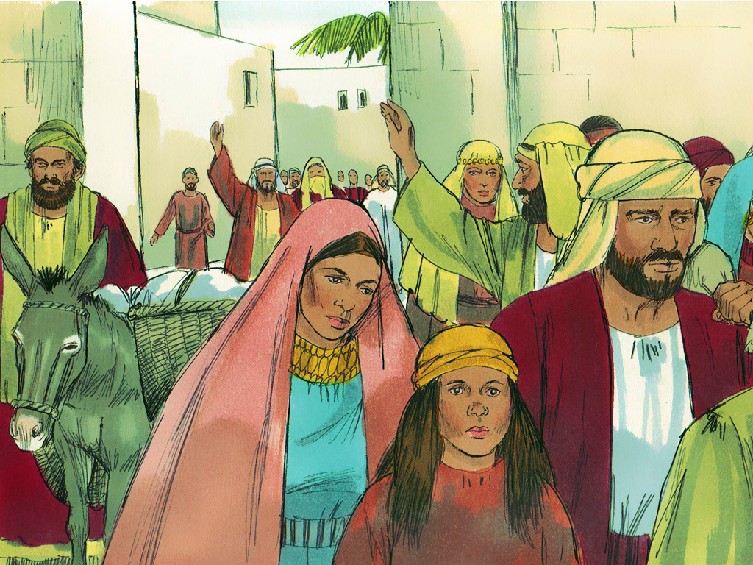
Acts 8:16 (NASB) 16 For He had not yet fallen upon any of them; they had simply been baptized in the name of the Lord Jesus.
Acts 8:12 (NASB) 12 But when they believed Philip preaching the good news about the kingdom of God and the name of Jesus Christ, they were being baptized, men and women alike.
THE WORD OF GOD
BAPTIZED IN THE NAME OF THE LORD JESUS
Acts 8:14 (NASB) 14 Now when the apostles in Jerusalem heard that Samaria had received the word of God, they sent them Peter and John,
Acts 8:35-36 (NASB) 35 Then Philip opened his mouth, and beginning from this Scripture he preached Jesus to him. 36 As they went along the road they came to some water; and the eunuch *said, "Look! Water! What prevents me from being baptized?"
Acts 2:38 (NASB) 38 Peter said to them, "Repent, and each of you be baptized in the name of Jesus Christ for the forgiveness of your sins; and you will receive the gift of the Holy Spirit.
Mark 16:16 (NASB) 16 "He who has believed and has been baptized shall be saved; but he who has disbelieved shall be condemned.
Acts 2:41 (NASB) 41 So then, those who had received his word were baptized; and that day there were added about three thousand souls.
SAMARIA HAD RECEIVED

Slide 66
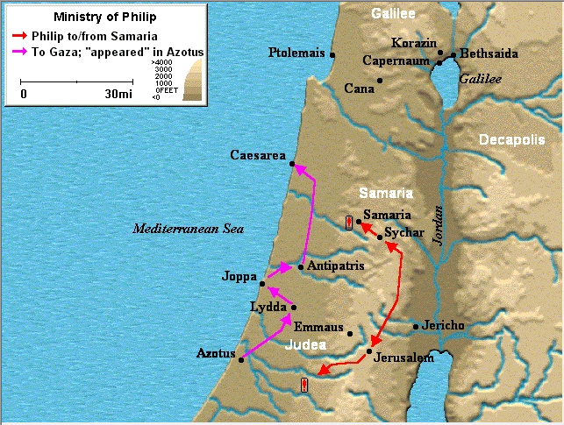
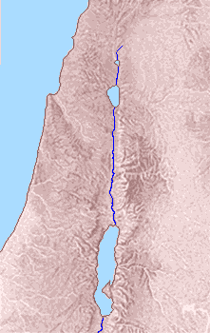
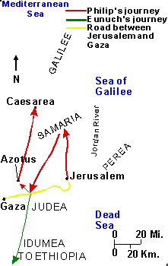

Slide 67
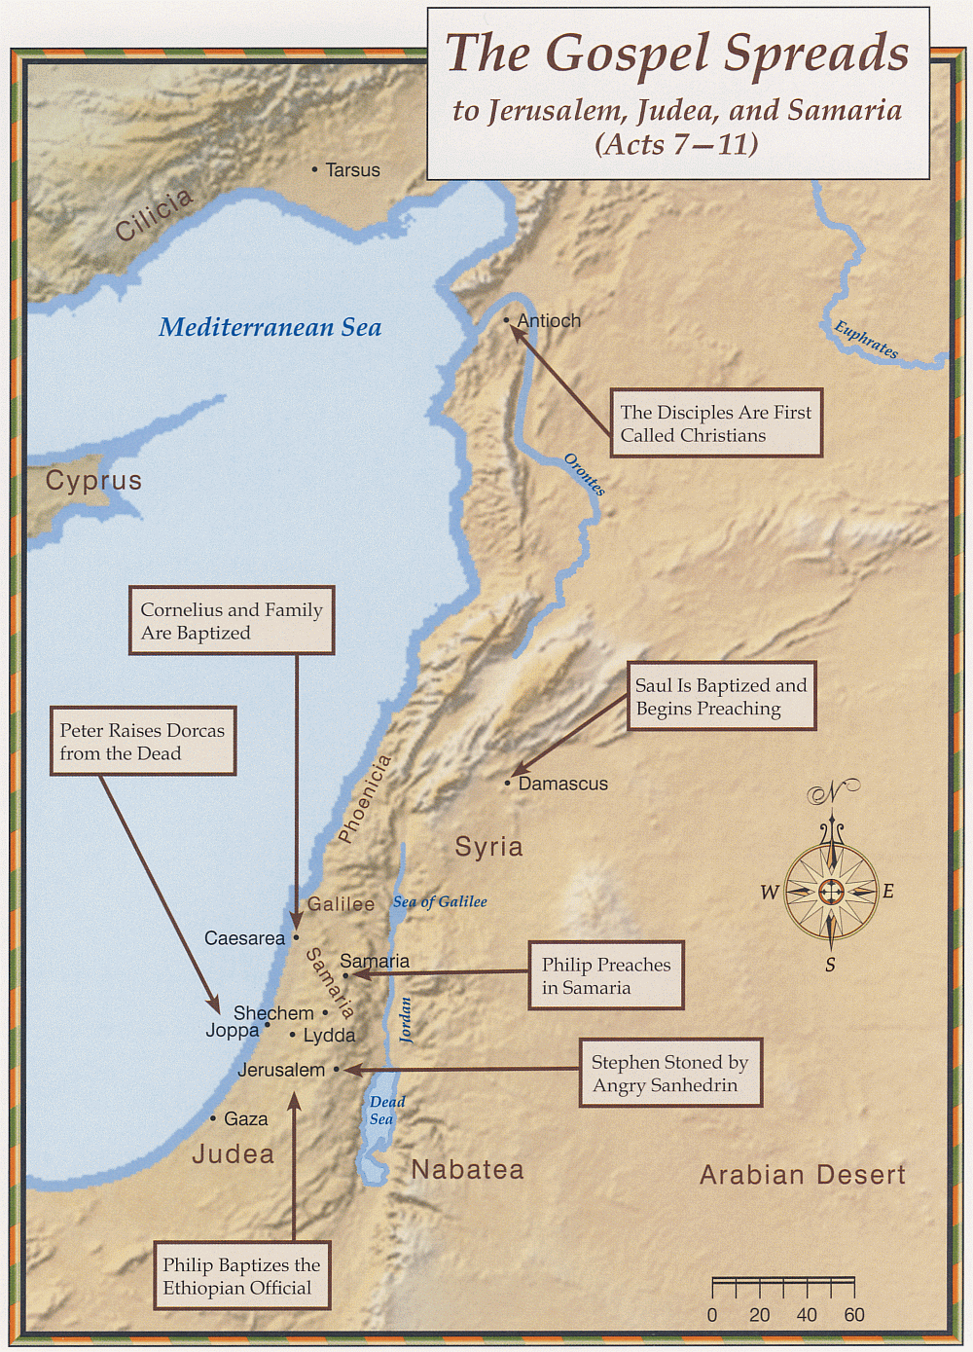
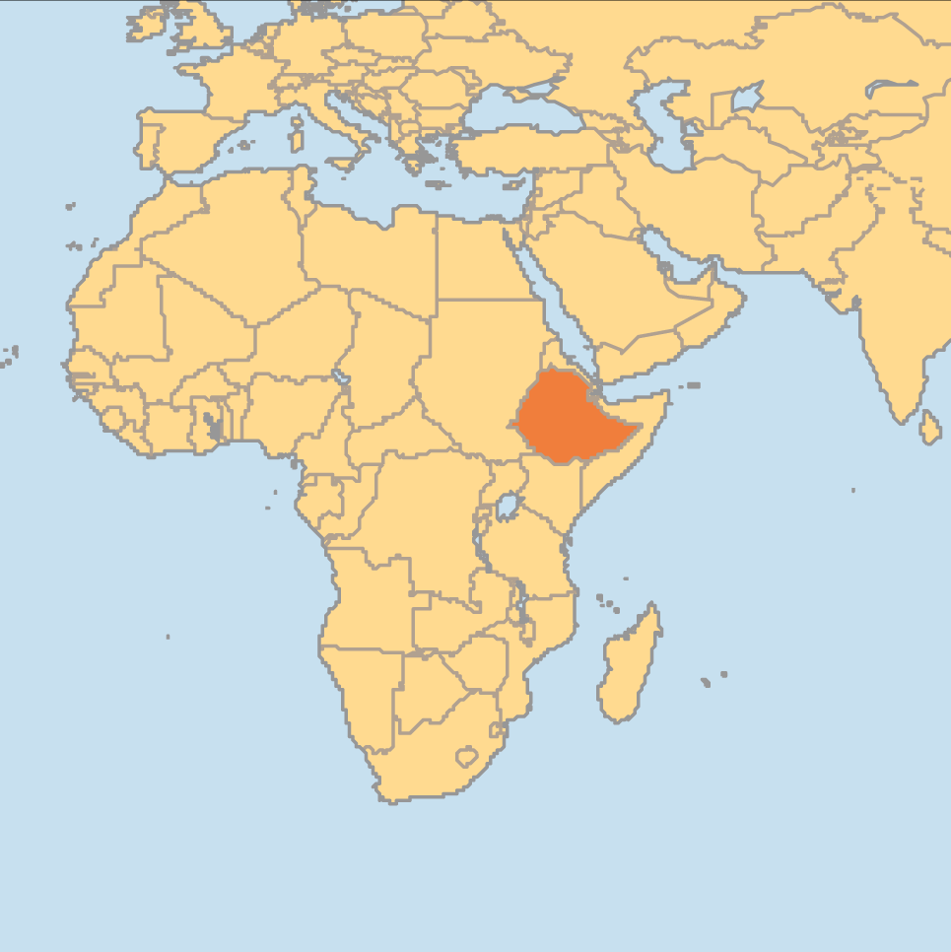

Slide 68
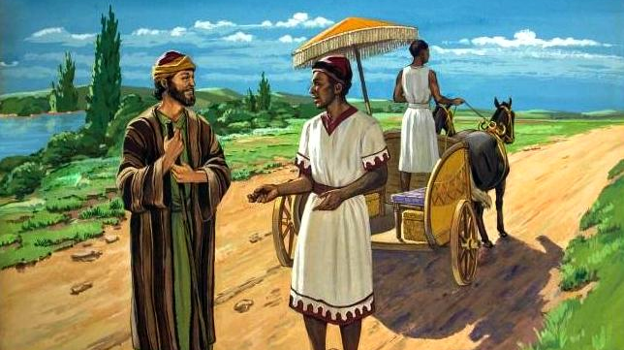

Slide 69
Chapter 8

Slide 70
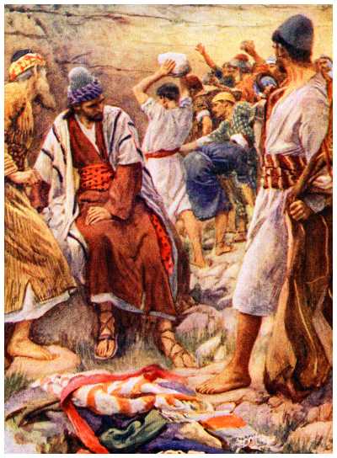
Acts 8: ¹ And Saul was consenting unto his [Stephen’s] death.
Acts 22:20 ²⁰ And when the blood of thy martyr Stephen was shed, I also was standing by, and consenting unto his death, and kept the raiment of them that slew him.

Slide 71
Acts 8: ¹ And Saul was consenting unto his [Stephen’s] death.
And at that time there was a great persecution against the church which was at Jerusalem; and they were all scattered abroad throughout the regions of Judaea and Samaria, except the apostles.

Slide 72
Previously, God scattered the Israelites because of their disobedience.
Nehemiah 1:8: Remember, I beseech thee, the word that thou commandedst thy servant Moses, saying, If ye transgress, I will scatter you abroad among the nations:
But now, “Christ would use the rage of his enemies in the spreading forth and enlarging of his kingdom.” (Geneva Bible Notes)
Acts 8: ¹ And Saul was consenting unto his death.
And at that time there was a great persecution against the church which was at Jerusalem; and they were all scattered abroad throughout the regions of Judaea and Samaria, except the apostles.

Slide 73
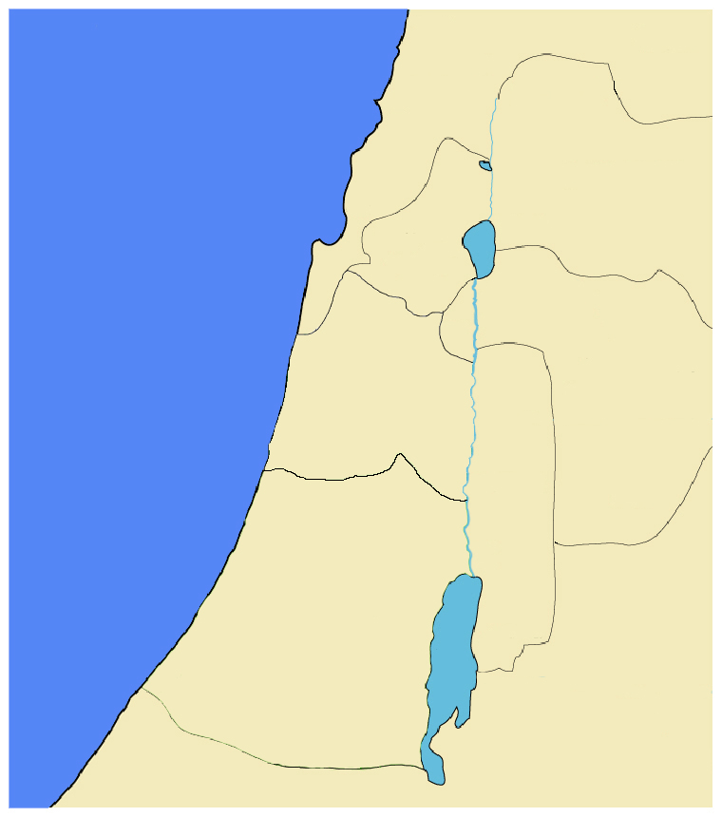
Acts 1:8 … ye shall be witnesses unto me both in Jerusalem, and in all Judaea, and in Samaria, and unto the uttermost part of the earth.

Slide 74
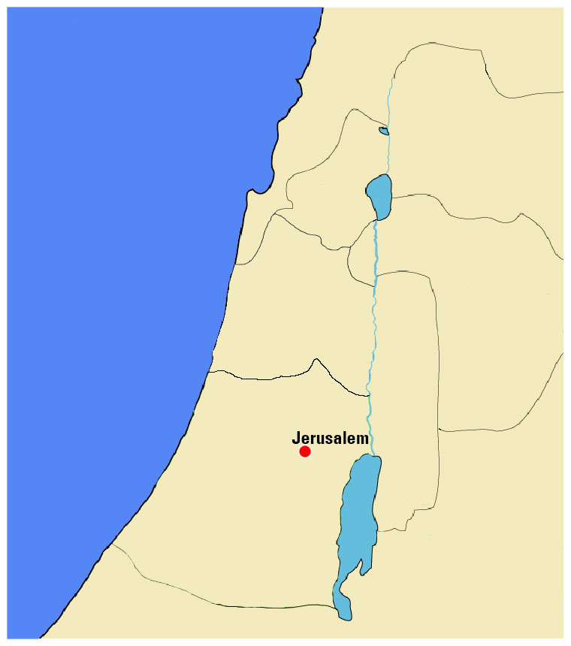
Acts 1:8 … ye shall be witnesses unto me both in Jerusalem, and in all Judaea, and in Samaria, and unto the uttermost part of the earth.
Part One: In Jerusalem
Chapters 1 to 7

Slide 75
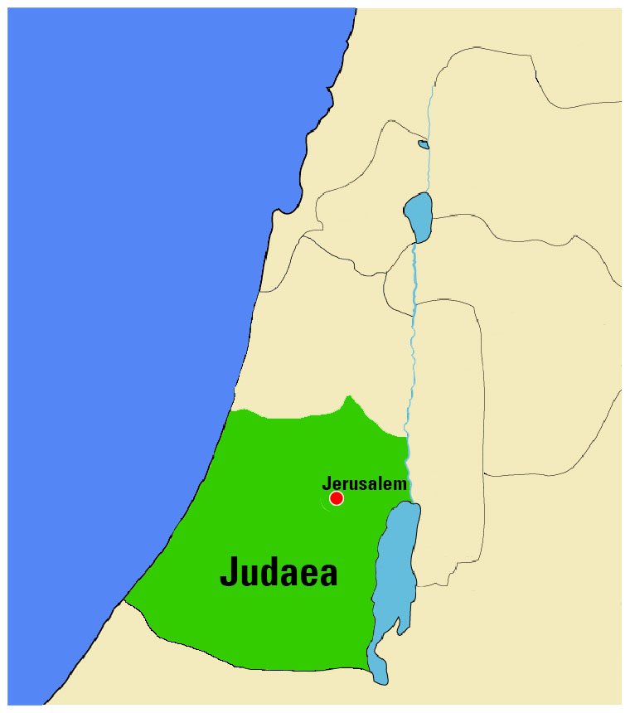
Acts 1:8 … ye shall be witnesses unto me both in Jerusalem, and in all Judaea, and in Samaria, and unto the uttermost part of the earth.
Part One: In Jerusalem
Chapters 1 to 7
Part Two: In Judaea

Slide 76
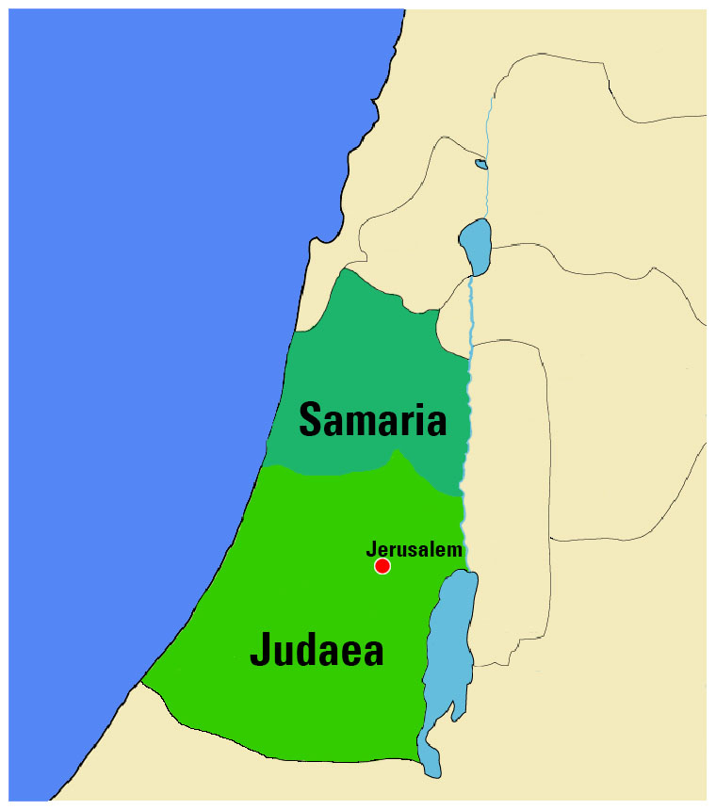
Acts 1:8 … ye shall be witnesses unto me both in Jerusalem, and in all Judaea, and in Samaria, and unto the uttermost part of the earth.
Part One: In Jerusalem
Chapters 1 to 7
Part Two: In Judaea
and in Samaria
Chapters 8 to 12

Slide 77
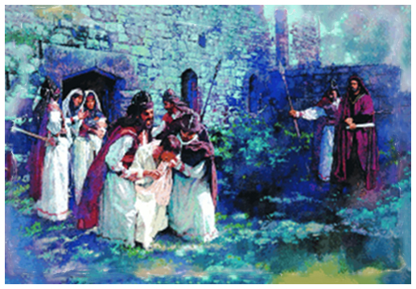
³ As for Saul, he made havock of the church, entering into every house, and haling men and women committed them to prison.
HAV•OCK (hăvˈək) n. Widespread destruction ; devastation. Disorder or chaos.
His own testimony shows the fury in his pursuit…

Slide 78
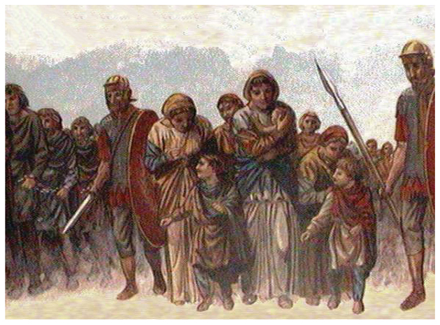
Acts 26:9-11 ⁹ I verily thought with myself, that I ought to do many things contrary to the name of Jesus of Nazareth.
¹⁰ Which thing I also did in Jerusalem: and many of the saints did I shut up in prison, having received authority from the chief priests; and when they were put to death, I gave my voice against them.
¹¹ And I punished them oft in every synagogue, and compelled them to blaspheme; and being exceedingly mad against them, I persecuted them even unto strange cities.

Slide 79
⁴ Therefore they that were scattered abroad ______________________.
Never mentioned the name of Christ again.
Demonstrated for free speech and human rights.
Retaliated against the priests and soldiers.

Slide 80
Remember this prayer from a previous chapter:
Acts 4:29-30 ²⁹ And now, Lord, behold their threatenings: and grant unto thy servants, that with all boldness they may speak thy word,
³⁰ By stretching forth thine hand to heal; and that signs and wonders may be done by the name of thy holy Servant Jesus.
⁴ Therefore they that were scattered abroad went every where preaching the word.

Slide 81
⁵ Then Philip went down to the city of Samaria,

Slide 82
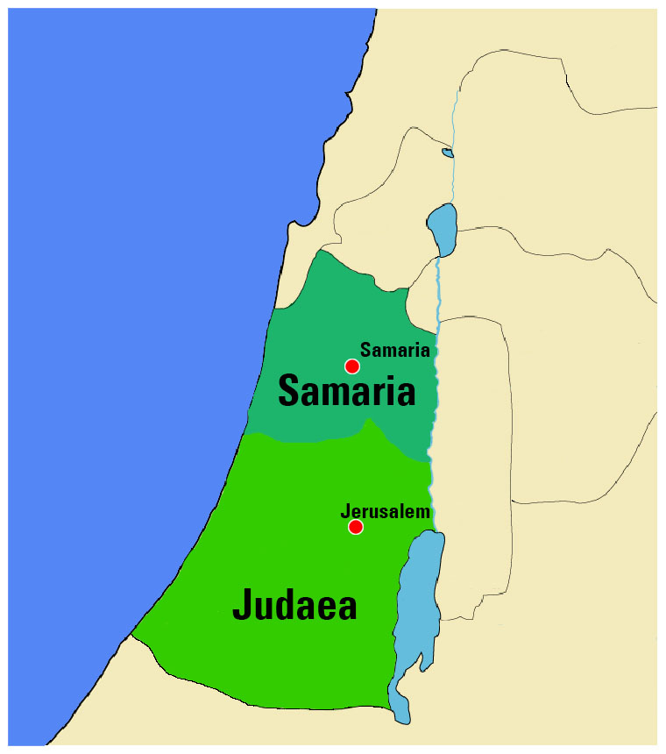
⁵ Then Philip went down to the city of Samaria,

Slide 83
⁵ Then Philip went down to the city of Samaria, and preached Christ unto them.

Slide 84
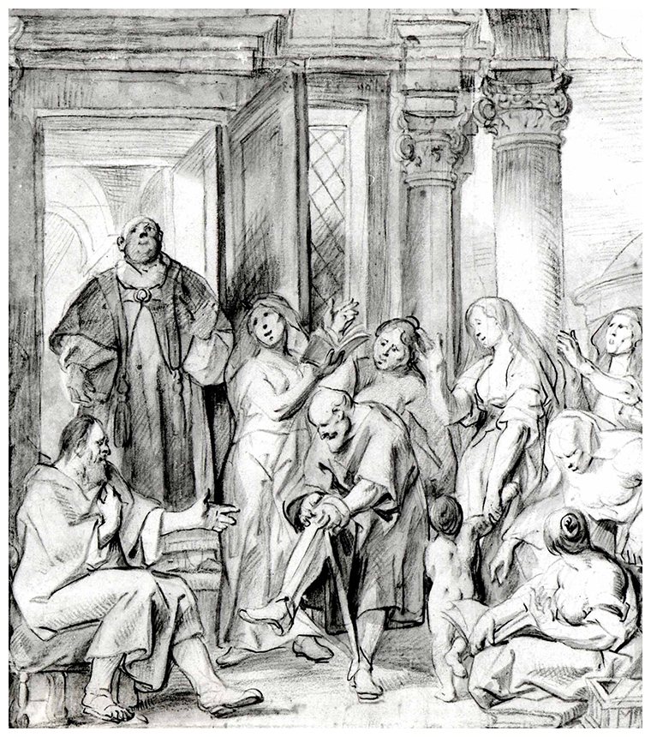
⁶ And the people with one accord gave heed unto those things which Philip spake, hearing and seeing the miracles which he did.
⁷ For unclean spirits, crying with loud voice, came out of many that were possessed with them: and many taken with palsies, and that were lame, were healed.
⁸ And there was great joy in that city.

Slide 85
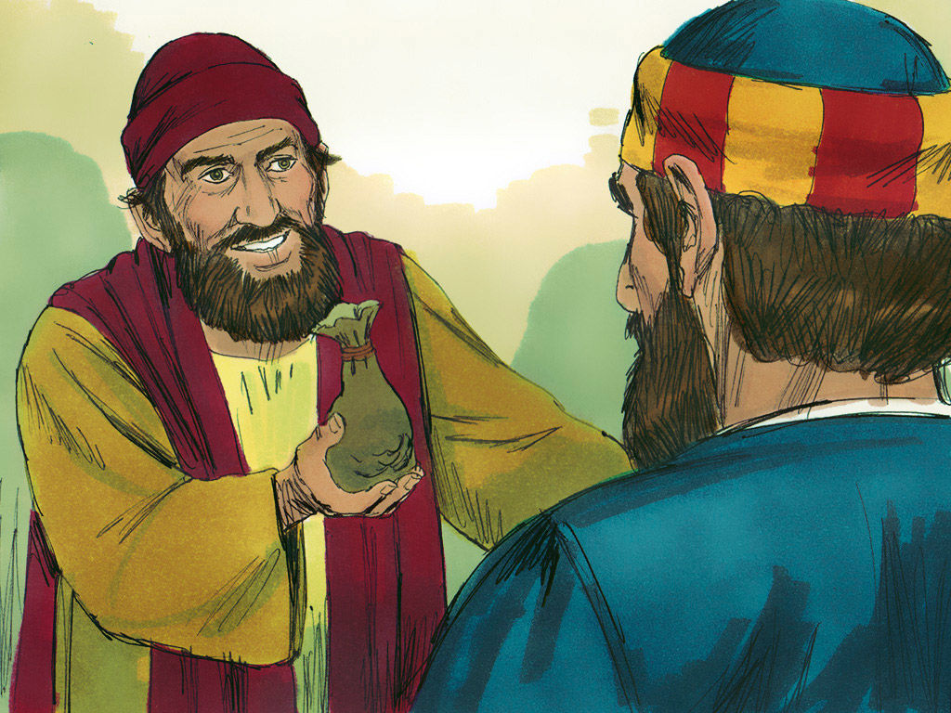
⁹ But there was a certain man, called Simon, which beforetime in the same city used sorcery, and bewitched the people of Samaria, giving out that himself was some great one:
¹⁰ To whom they all gave heed, from the least to the greatest, saying, This man is the great power of God.
¹¹ And to him they had regard, because that of long time he had bewitched them with sorceries.

Slide 86
⁹ But there was a certain man, called Simon, which beforetime in the same city used sorcery, and bewitched the people of Samaria, giving out that himself was some great one:
¹⁰ To whom they all gave heed, from the least to the greatest, saying, This man is the great power of God.
¹¹ And to him they had regard, because that of long time he had bewitched them with sorceries.
The religion of the Samaritans was a hybrid of Judaism and pagan religions.

Slide 87
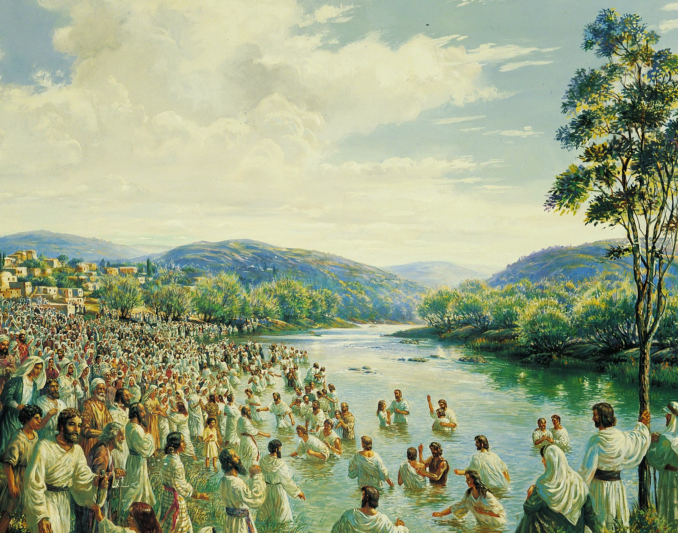
¹² But when they believed Philip preaching the things concerning the kingdom of God, and the name of Jesus Christ, they were baptized, both men and women.
¹³ Then Simon himself believed also: and when he was baptized, he continued with Philip, and wondered, beholding the miracles and signs which were done.

Slide 88
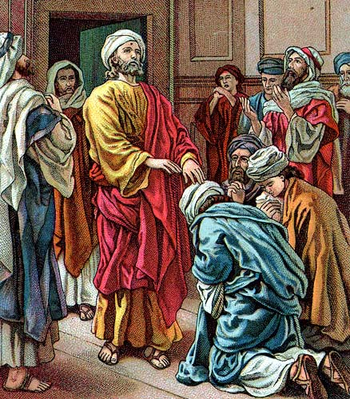
¹⁴ Now when the apostles which were at Jerusalem heard that Samaria had received the word of God, they sent unto them Peter and John:
¹⁵ Who, when they were come down, prayed for them, that they might receive the Holy Ghost:
¹⁶ (For as yet he was fallen upon none of them: only they were baptized in the name of the Lord Jesus.)

Slide 89
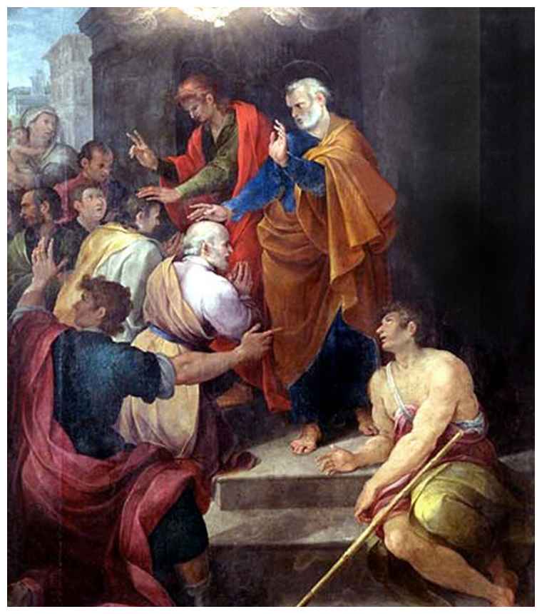
¹⁷ Then laid they their hands on them, and they received the Holy Ghost.
¹⁸ And when Simon saw that through laying on of the apostles' hands the Holy Ghost was given, he offered them money,

Slide 90
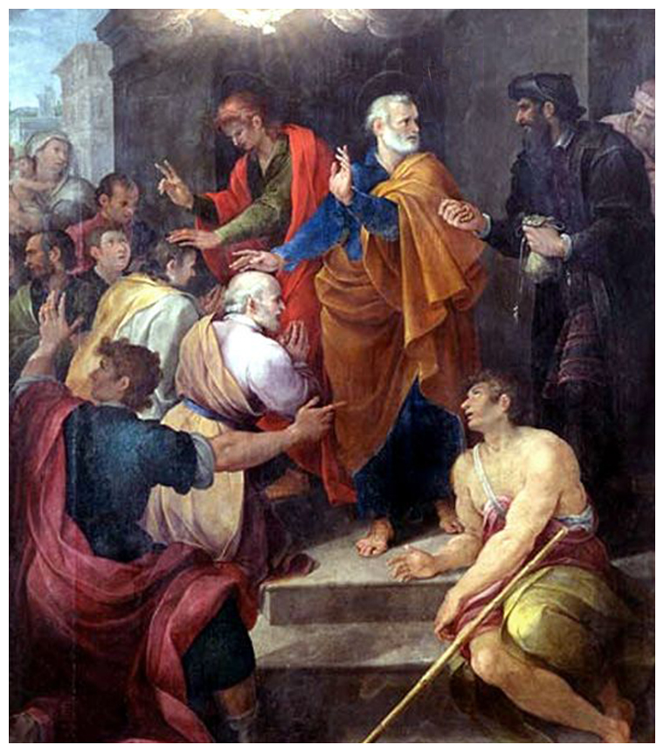
¹⁷ Then laid they their hands on them, and they received the Holy Ghost.
¹⁸ And when Simon saw that through laying on of the apostles' hands the Holy Ghost was given, he offered them money,
¹⁹ Saying, Give me also this power, that on whomsoever I lay hands, he may receive the Holy Ghost.

Slide 91
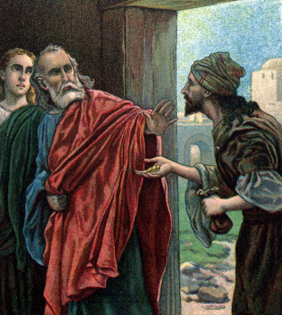
²⁰ But Peter said unto him, Thy money perish with thee, because thou hast thought that the gift of God may be purchased with money.
²² Repent therefore of this thy wickedness, and pray God, if perhaps the thought of thine heart may be forgiven thee.
²³ For I perceive that thou art in the gall of bitterness, and in the bond of iniquity.

Slide 92
Simony (sahy-muh-nee) n.
1. the making of profit out of sacred things.
2. the buying or selling of ecclesiastical preferments, benefices, etc.
²⁴ Then answered Simon, and said, Pray ye to the Lord for me, that none of these things which ye have spoken come upon me.

Slide 93
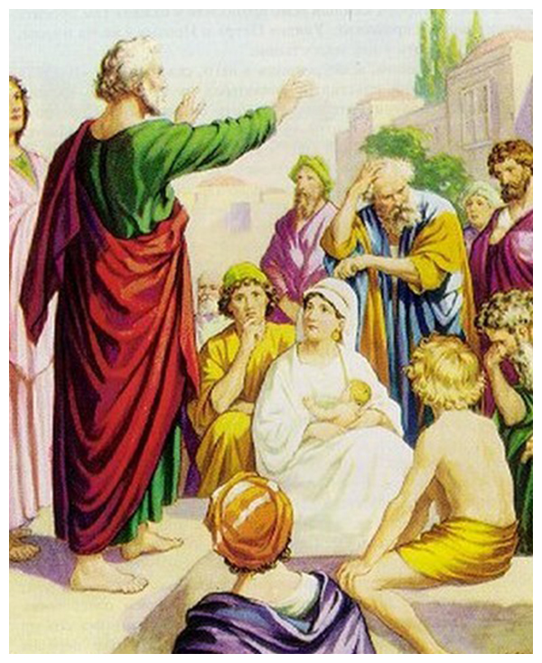
²⁵ And they, when they had testified and preached the word of the Lord, returned to Jerusalem, and preached the gospel in many villages of the Samaritans.

Slide 94
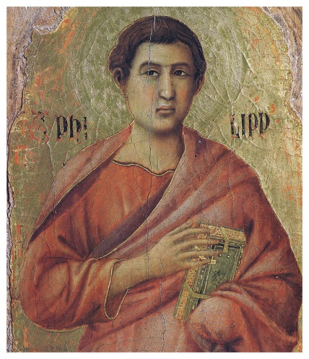
²⁶ And the angel of the Lord spake unto Philip, saying, Arise, and go toward the south unto the way that goeth down from Jerusalem unto Gaza, which is desert.

Slide 95
²⁶ And the angel of the Lord spake unto Philip, saying, Arise, and go toward the south unto the way that goeth down from Jerusalem unto Gaza, which is desert.

Slide 96
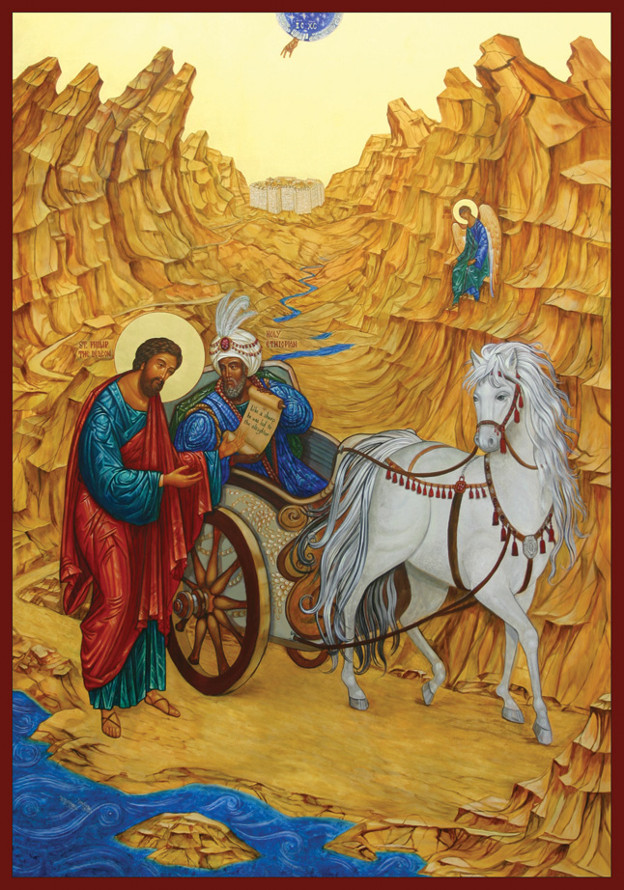
²⁷ And he arose and went: and, behold, a man of Ethiopia, an eunuch of great authority under Candace queen of the Ethiopians, who had the charge of all her treasure, and had come to Jerusalem for to worship,
²⁸ Was returning, and sitting in his chariot read Esaias the prophet.
²⁹ Then the Spirit said unto Philip, Go near, and join thyself to this chariot.

Slide 97
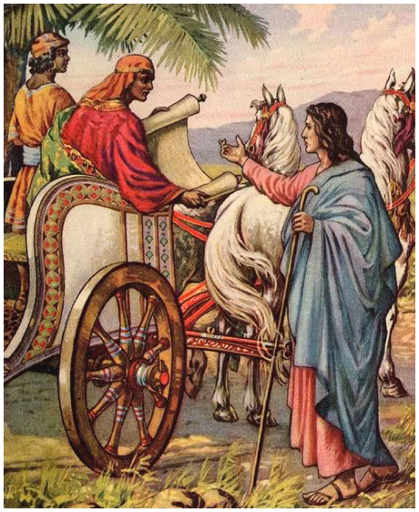
³⁰ And Philip ran thither to him, and heard him read the prophet Esaias, and said, Understandest thou what thou readest?
³¹ And he said, How can I, except some man should guide me?
And he desired Philip that he would come up and sit with him.

Slide 98
Isaiah 53:7-8
⁷ He was oppressed, and he was afflicted, yet he opened not his mouth: he is brought as a lamb to slaughter, and as a sheep before her shearers is dumb, so he openeth not his mouth.
⁸ He was taken from prison and from judgment: and who shall declare his generation? for he was cut off out of the land of the living: for the transgression of my people was he stricken.
³² The place of the scripture which he read was this,
He was led as a sheep to the slaughter; and like a lamb dumb before his shearer, so opened he not his mouth:
³³ In his humiliation his judgment was taken away: and who shall declare his generation? for his life is taken from the earth.

Slide 99
Isaiah 53:7-8
⁷ He was oppressed, and he was afflicted, yet he opened not his mouth: he is brought as a lamb to the slaughter, and as a sheep before her shearers is dumb, so he openeth not his mouth.
⁸ He was taken from prison and from judgment: and who shall declare his generation? for he was cut off out of the land of the living: for the transgression of my people was he stricken.
³² The place of the scripture which he read was this,
He was led as a sheep to the slaughter; and like a lamb dumb before his shearer, so opened he not his mouth:
³³ In his humiliation his judgment was taken away: and who shall declare his generation? for his life is taken from the earth.

Slide 100
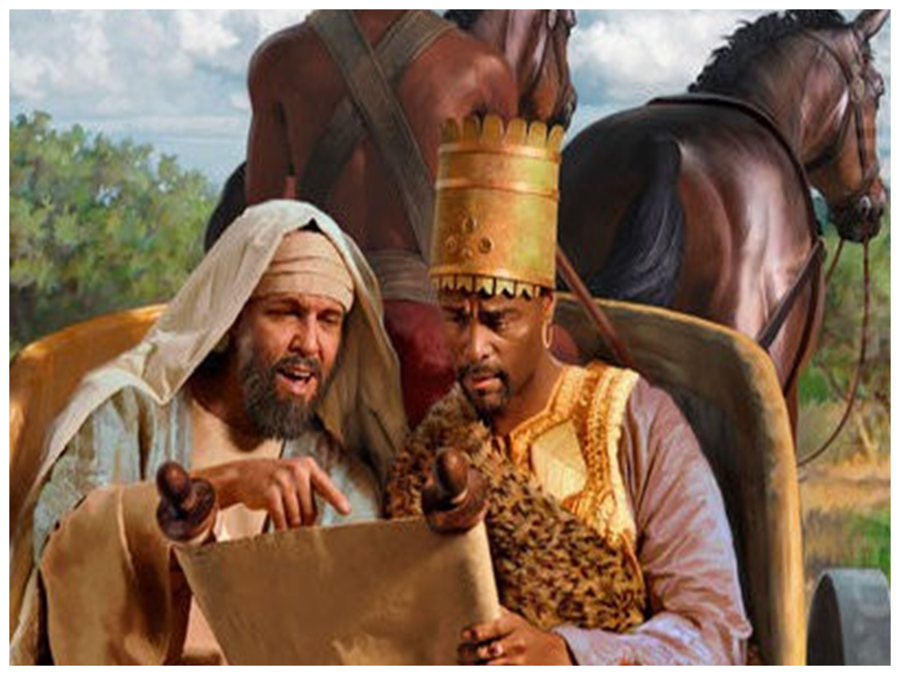
³⁴ And the eunuch answered Philip, and said, I pray thee, of whom speaketh the prophet this? of himself, or of some other man?
³⁵ Then Philip opened his mouth, and began at the same scripture, and preached unto him Jesus.

Slide 101
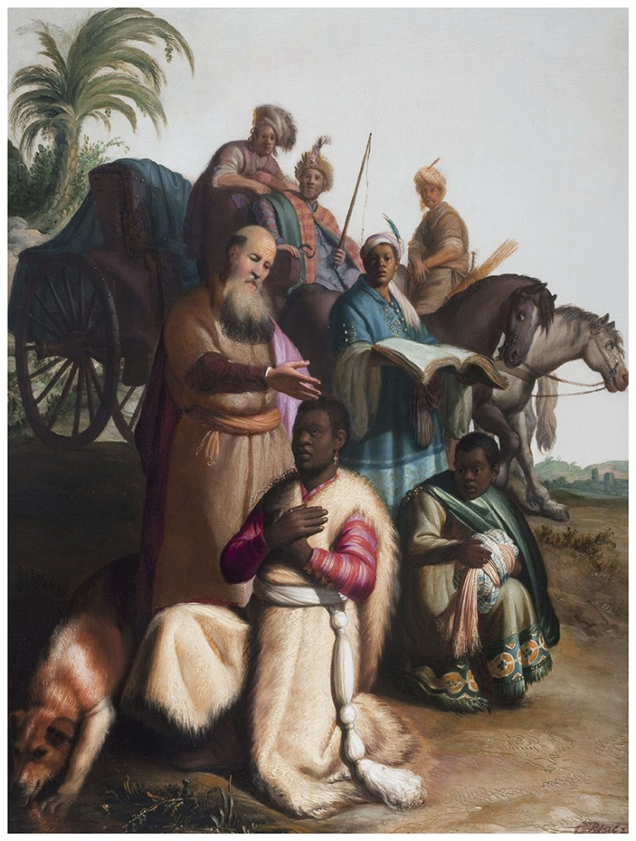
³⁶ And as they went on their way, they came unto a certain water: and the eunuch said, See, here is water; what doth hinder me to be baptized?
³⁷ And Philip said, If thou believest with all thine heart, thou mayest.
And he answered and said, I believe that Jesus Christ is the Son of God.

Slide 102
³⁸ And he commanded the chariot to stand still: and they went down both into the water, both Philip and the eunuch; and he baptized him.

Slide 103
³⁹ And when they were come up out of the water, the Spirit of the Lord caught away Philip, that the eunuch saw him no more:

Slide 104
³⁹ And when they were come up out of the water, the Spirit of the Lord caught away Philip, that the eunuch saw him no more: and he went on his way rejoicing.

Slide 105
⁴⁰ But Philip was found at Azotus:

Slide 106
⁴⁰ But Philip was found at Azotus:
and passing through he preached in all the cities, till he came to Caesarea.

Slide 107
⁴⁰ But Philip was found at Azotus:
and passing through he preached in all the cities, till he came to Caesarea.
End of Chapter 8

Slide 108
The Acts of the Apostles Chapter 8

Slide 109
Acts 8:1-3 Scattering
What is said about Saul? (1)
What resulted from Stephen’s death? (1)
Were there churches outside of Jerusalem?
Who were scattered? (1)
Who buried Stephen? (2)
Was it right to make lamentation over him?
Does this give us a general pattern to follow?
What is the contrast in verse 3?
What was the extent of Paul’s persecution? (3)

Slide 110
Acts 8:4-13 Positive Effects
What did the scattered Christians do? (4)
Where did Philip go? (5)
What did Philip have in common with Stephen?
What miracles did Philip perform? (6-7)
What did this cause? (8)
What is the contrast with the joy? (9)
What was Simon’s past? (9)
How was he regarded by the Samaritans? (11)
What act of obedience is recorded? (12)
Did Simon believe? (13)
Was Simon baptized? (13)
What amazed Simon? (13)

Slide 111
Acts 8:14-18 “Receive the HS”
Where were the apostles still? (14)
What did they do when they heard? (14)
Did they resent the Samaritans? (Jn. 4:9)
What did Peter and John do? (15, 17)
What does “receive the Holy Spirit” mean here?
Miraculous: 8:15, 17-19; 10:47; 19:2
What had they been baptized into? (16)
Did this give them miraculous gifts?
How was the miraculous imparted? (17-18)
Is “gift of the HS” always miraculous?
Not miraculous 2:37; 5:32; Rom. 5:5
Miraculous 8:18; 10:45; 11:17

Slide 112
Polyseme
A polyseme is a word or phrase with different, but related senses
For example the verb "to get" can mean "procure" (I‘ll get the nails), "becomes" (she gets scared), "have" (I've got three dollars), "understand" (I get it) etc.
The specific meaning is usually determined quite clearly by the context.

Slide 113
Acts 8:18-25 Simon’s Error
What motivated Simon? (18)
What did he want? (19)
How did he think he could obtain it?
What was Peter’s rebuke to him? (20)
What is the “gift of God” here?
What would be the fate of Simon … (23)
If he repented? What was the remedy?
If he failed to repent? (24)
What significance of many villages? (25)

Slide 114
Acts 8:26-31 Ethiopian
Who spoke to Philip? (26)
What did the angel tell him? Why?
What was different about this convert? (27)
Why does Luke include nationality?
Mt. 28:18 “… make disciples of all nations …”
What was the Ethiopian reading? (28)
What did the Spirit command Philip? (29)
What question did Philip ask? (30)
What was his response? (31)
How did he ask Philip to do? (31)

Slide 115
Acts 8:34-40 Plan of Salvation
What was his question? (34)
Why would this be an appropriate question?
What did Philip preach? (35)
What did this include? (36)
What type of baptism was this? (36)
[What was the condition of baptism? (37)]
[How did the Ethiopian respond? (37)]
The most detailed case of conversion
Hear, Believe, Repent, Confess, Baptism, Rejoice
What was the mode of baptism? (38-39)
What happened then? (39 and 40)

Slide 116
Isaiah 53:1-8
53 Who hath believed our message? and to whom hath the arm of Jehovah been revealed? ² For he grew up before him as a tender plant, and as a root out of a dry ground: he hath no form nor comeliness; and when we see him, there is no beauty that we should desire him. ³ He was despised, and rejected of men; a man of sorrows, and acquainted with grief: and as one from whom men hide their face he was despised; and we esteemed him not. ⁴ Surely he hath borne our griefs, and carried our sorrows; yet we did esteem him stricken, smitten of God, and afflicted. ⁵ But he was wounded for our transgressions, he was bruised for our iniquities; the chastisement of our peace was upon him; and with his stripes we are healed. ⁶ All we like sheep have gone astray; we have turned every one to his own way; and Jehovah hath laid on him the iniquity of us all. ⁷ He was oppressed, yet when he was afflicted he opened not his mouth; as a lamb that is led to the slaughter, and as a sheep that before its shearers is dumb, so he opened not his mouth. ⁸ By oppression and judgment he was taken away; and as for his generation, who (among them) considered that he was cut off out of the land of the living for the transgression of my people to whom the stroke (was due)?

Slide 117
L.D. CARY & SAM HOLT CATCH PHRASES
Chapter 1 – “Jesus’ Work On Earth Is Done”
Chapter 2 – “Peter Baptizes A Crew”
Chapter 3 – “A Beggar’s Plea”
Chapter 4 – “A Jailhouse Door”
Chapter 5 – “Ananias & Sapphira Don’t Survive”
Chapter 6 – “The Widow’s Fix”
Chapter 8 – “Stephen Looks Into Heaven”
Chapter 9 – “Saul Struck Blind”
“Saul Struck Blind”
Catch Phrase
Chapter Nine

Slide 118
Acts of the Apostles Chapter 9

Slide 119
Acts 8:1-3 (NASB) 1 Saul was in hearty agreement with putting him to death. And on that day a great persecution began against the church in Jerusalem, and they were all scattered throughout the regions of Judea and Samaria, except the apostles. 2 Some devout men buried Stephen, and made loud lamentation over him. 3 But Saul began ravaging the church, entering house after house, and dragging off men and women, he would put them in prison.
Acts 9:1-5 (NASB) ¹ Now Saul, still breathing threats and murder against the disciples of the Lord, went to the high priest, ² and asked for letters from him to the synagogues at Damascus, so that if he found any belonging to the Way, both men and women, he might bring them bound to Jerusalem. ³ As he was traveling, it happened that he was approaching Damascus, and suddenly a light from heaven flashed around him; ⁴ and he fell to the ground and heard a voice saying to him, "Saul, Saul, why are you persecuting Me?" ⁵ And he said, "Who are You, Lord?" And He said, "I am Jesus whom you are persecuting,
A. The persecution that Saul begins in chapter 8 continues to escalate: Phil 3:4-5; Acts 8:1-3; Acts 22:3-5; 26:9-12; Gal 1:13
1. Murder, emboldened by Stephen’s death: Jn 18:31; Mt 28:11-14; Ac 25:1-12
2. Asked for letters from the High Priest. His actions must be authorized:
3. Why are you persecuting me? Zech 2:8; Eph 1:22-23; 5:25-27
Ephesians 5:25-27 (NASB) 25 Husbands, love your wives, just as Christ also loved the church and gave Himself up for her, 26 so that He might sanctify her, having cleansed her by the washing of water with the word, 27 that He might present to Himself the church in all her glory, having no spot or wrinkle or any such thing; but that she would be holy and blameless.
Matthew 28:11-14 (NASB) 11 Now while they were on their way, some of the guard came into the city and reported to the chief priests all that had happened. 12 And when they had assembled with the elders and consulted together, they gave a large sum of money to the soldiers, 13 and said, "You are to say, 'His disciples came by night and stole Him away while we were asleep.' 14 "And if this should come to the governor's ears, we will win him over and keep you out of trouble."
Acts 26:9-12 (NASB) 9 "So then, I thought to myself that I had to do many things hostile to the name of Jesus of Nazareth. 10 "And this is just what I did in Jerusalem; not only did I lock up many of the saints in prisons, having received authority from the chief priests, but also when they were being put to death I cast my vote against them. 11 "And as I punished them often in all the synagogues, I tried to force them to blaspheme; and being furiously enraged at them, I kept pursuing them even to foreign cities. 12 "While so engaged as I was journeying to Damascus with the authority and commission of the chief priests,
Acts 22:3-5 (NASB) 3 "I am a Jew, born in Tarsus of Cilicia, but brought up in this city, educated under Gamaliel, strictly according to the law of our fathers, being zealous for God just as you all are today. 4 "I persecuted this Way to the death, binding and putting both men and women into prisons, 5 as also the high priest and all the Council of the elders can testify. From them I also received letters to the brethren, and started off for Damascus in order to bring even those who were there to Jerusalem as prisoners to be punished.
Acts 25:1-12 (NASB) 1 Festus then, having arrived in the province, three days later went up to Jerusalem from Caesarea. 2 And the chief priests and the leading men of the Jews brought charges against Paul, and they were urging him, 3 requesting a concession against Paul, that he might have him brought to Jerusalem (at the same time, setting an ambush to kill him on the way). 4 Festus then answered that Paul was being kept in custody at Caesarea and that he himself was about to leave shortly. 5 "Therefore," he *said, "let the influential men among you go there with me, and if there is anything wrong about the man, let them prosecute him."
6 After he had spent not more than eight or ten days among them, he went down to Caesarea, and on the next day he took his seat on the tribunal and ordered Paul to be brought. 7 After Paul arrived, the Jews who had come down from Jerusalem stood around him, bringing many and serious charges against him which they could not prove, 8 while Paul said in his own defense, "I have committed no offense either against the Law of the Jews or against the temple or against Caesar." 9 But Festus, wishing to do the Jews a favor, answered Paul and said, "Are you willing to go up to Jerusalem and stand trial before me on these charges?"
10 But Paul said, "I am standing before Caesar's tribunal, where I ought to be tried. I have done no wrong to the Jews, as you also very well know. 11 "If, then, I am a wrongdoer and have committed anything worthy of death, I do not refuse to die; but if none of those things is true of which these men accuse me, no one can hand me over to them. I appeal to Caesar." 12 Then when Festus had conferred with his council, he answered, "You have appealed to Caesar, to Caesar you shall go.“
Ephesians 1:22-23 (NASB) 22 And He put all things in subjection under His feet, and gave Him as head over all things to the church, 23 which is His body, the fullness of Him who fills all in all.
Zechariah 2:8 (NASB) 8 For thus says the LORD of hosts, "After glory He has sent me against the nations which plunder you, for he who touches you, touches the apple of His eye.
Philippians 3:4-5 (NASB) 4 although I myself might have confidence even in the flesh. If anyone else has a mind to put confidence in the flesh, I far more: 5 circumcised the eighth day, of the nation of Israel, of the tribe of Benjamin, a Hebrew of Hebrews; as to the Law, a Pharisee;
Galatians 1:13 (NASB) 13 For you have heard of my former manner of life in Judaism, how I used to persecute the church of God beyond measure and tried to destroy it;
John 18:31 (NASB) 31 So Pilate said to them, "Take Him yourselves, and judge Him according to your law." The Jews said to him, "We are not permitted to put anyone to death,"

Slide 120
Acts 9:6-9 (NASB) ⁶ but get up and enter the city, and it will be told you what you must do." ⁷ The men who traveled with him stood speechless, hearing the voice but seeing no one. ⁸ Saul got up from the ground, and though his eyes were open, he could see nothing; and leading him by the hand, they brought him into Damascus. ⁹ And he was three days without sight, and neither ate nor drank.
A. Paul must enter the city of Damascus and wait to learn what he must do:
B. Paul’s traveling companions heard the voice but not seeing anyone: Acts 22:9; Acts 26:14; Jn 12:28-30
1. Paul is blinded and his companions lead him by the hand to Damascus:
2. Paul was wrong about the Jewish Christians and Jesus who raised from the dead and is the Christ: Acts 2:36; Mt 27:62-64;
C. His repentance had caused him to pray and fast, neither eating or drinking: Acts 9:11
Matthew 27:62-64 (NASB) ⁶² Now on the next day, the day after the preparation, the chief priests and the Pharisees gathered together with Pilate, ⁶³ and said, "Sir, we remember that when He was still alive that deceiver said, 'After three days I am to rise again.' ⁶⁴ "Therefore, give orders for the grave to be made secure until the third day, otherwise His disciples may come and steal Him away and say to the people, ‘He has risen from the dead,' and the last deception will be worse than the first."
Acts 9:11 (NASB) 11 And the Lord said to him, "Get up and go to the street called Straight, and inquire at the house of Judas for a man from Tarsus named Saul, for he is praying,
Acts 2:36 (NASB) ³⁶ "Therefore let all the house of Israel know for certain that God has made Him both Lord and Christ—this Jesus whom you crucified."
John 12:28-30 (NASB) 28 "Father, glorify Your name." Then a voice came out of heaven: "I have both glorified it, and will glorify it again." 29 So the crowd of people who stood by and heard it were saying that it had thundered; others were saying, "An angel has spoken to Him." 30 Jesus answered and said, "This voice has not come for My sake, but for your sakes.
Acts 22:9 (NASB) 9 "And those who were with me saw the light, to be sure, but did not understand the voice of the One who was speaking to me.
Acts 26:14 (NASB) 14 "And when we had all fallen to the ground, I heard a voice saying to me in the Hebrew dialect, 'Saul, Saul, why are you persecuting Me? It is hard for you to kick against the goads.'
Notes:
Now Paul knew the very truth that had caused those he persecuted to believe. He now knew that the tomb of Jesus was empty because he did raise from the dead.

Slide 121
Acts 9:10 (NASB) ¹⁰ Now there was a disciple at Damascus named Ananias; and the Lord said to him in a vision, "Ananias." And he said, "Here I am, Lord."
Acts 9:12 (NASB) ¹² and he has seen in a vision a man named Ananias come in and lay his hands on him, so that he might regain his sight."
Acts 9:10-12 (NASB) ¹⁰ Now there was a disciple at Damascus named Ananias; and the Lord said to him in a vision, "Ananias." And he said, "Here I am, Lord." ¹¹ And the Lord said to him, "Get up and go to the street called Straight, and inquire at the house of Judas for a man from Tarsus named Saul, for he is praying, ¹² and he has seen in a vision a man named Ananias come in and lay his hands on him, so that he might regain his sight."
A. In the city of Damascus, on a street named Straight, in the house of Judas was a man from Tarsus named Saul:
B. In a vision: Visions have been frequently used by God in the conversion of Saul. Visions appear to be God’s means of showing realities which would otherwise be invisible to men, while they are awake. These waking dreams may be figures or illustrations of divine truth. Act 2:17; 9:10, 12; 26:19
…….. Tarsus received the position of an independent and duty-free state (civitas libera et immunis) and became for some time Antony's place of residence. This privileged status was confirmed by Augustus after the victory of Actium had made him sole master of the Roman Empire (31 BC). It did not by itself bestow Roman citizenship on the Tarsinas, but doubtless there were many natives of the city to whom Pompey, Caesar, Antony and Augustus granted that honor for themselves and, as a consequence, for their descendants……… On what occasion and for what service Roman civitas had been conferred on one of Paul's ancestors we cannot say; this only we know, that before his birth his father had possessed the coveted privilege (Acts 22:28).
The International Standard Bible Encyclopedia
Acts 2:17 (NASB) ¹⁷ 'AND IT SHALL BE IN THE LAST DAYS,' God says, 'THAT I WILL POUR FORTH OF MY SPIRIT ON ALL MANKIND; AND YOUR SONS AND YOUR DAUGHTERS SHALL PROPHESY, AND YOUR YOUNG MEN SHALL SEE VISIONS, AND YOUR OLD MEN SHALL DREAM DREAMS;
Acts 22:28 (NASB) ²⁸ The commander answered, "I acquired this citizenship with a large sum of money." And Paul said, "But I was actually born a citizen."
Acts 26:19 (NASB) ¹⁹ "So, King Agrippa, I did not prove disobedient to the heavenly vision,

Slide 122
Acts 9:13-16 (NASB) ¹³ But Ananias answered, "Lord, I have heard from many about this man, how much harm he did to Your saints at Jerusalem; ¹⁴ and here he has authority from the chief priests to bind all who call on Your name." ¹⁵ But the Lord said to him, "Go, for he is a chosen instrument of Mine, to bear My name before the Gentiles and kings and the sons of Israel; ¹⁶ for I will show him how much he must suffer for My name's sake."
A. Ananias tries to inform the Lord about Paul but to no avail. The Lord already knows.
B. Paul is a chosen container of the Lords who will bear the Lord’s name:
1. before the Gentiles: but not until Acts 10 (Acts 11:18-19)
2. before Kings: Acts 26:1-2
3. before the sons of Israel: Which Paul immediately does at Damascus
4. The Lord would show him how much he must suffer for His name: 2Cor 11:23-28
CHOSEN: Greek NASB Number: 1589
Greek Word: ἐκλογή
Definition: a (divine) selection:--
List of English Words and Number of Times Used choice (4), choosing (1), chosen (1), those who were chosen (1)
New American Standard Exhaustive Concordance of the Bible
INSTRUMENT: Greek NASB Number: 4632
Greek Word: σκεῦος
Definition: a vessel, implement, pl. goods:--
List of English Words and Number of Times Used article (2), container (1), goods (1), instrument (1), jar (1), merchandise (1), object (3), property (2), sea anchor (1), someone (1), vessel (3), vessels (6).
New American Standard Exhaustive Concordance of the Bible
Acts 11:18-19 (NASB) ¹⁸ When they heard this, they quieted down and glorified God, saying, "Well then, God has granted to the Gentiles also the repentance that leads to life." ¹⁹ So then those who were scattered because of the persecution that occurred in connection with Stephen made their way to Phoenicia and Cyprus and Antioch, speaking the word to no one except to Jews alone.
2 Corinthians 11:23-28 (NASB) ²³ Are they servants of Christ?—I speak as if insane—I more so; in far more labors, in far more imprisonments, beaten times without number, often in danger of death. ²⁴ Five times I received from the Jews thirty-nine lashes. ²⁵ Three times I was beaten with rods, once I was stoned, three times I was shipwrecked, a night and a day I have spent in the deep. ²⁶ I have been on frequent journeys, in dangers from rivers, dangers from robbers, dangers from my countrymen, dangers from the Gentiles, dangers in the city, dangers in the wilderness, dangers on the sea, dangers among false brethren; ²⁷ I have been in labor and hardship, through many sleepless nights, in hunger and thirst, often without food, in cold and exposure. ²⁸ Apart from such external things, there is the daily pressure on me of concern for all the churches.
Acts 26:1-2 (NASB) ¹ Agrippa said to Paul, "You are permitted to speak for yourself." Then Paul stretched out his hand and proceeded to make his defense: ² "In regard to all the things of which I am accused by the Jews, I consider myself fortunate, King Agrippa, that I am about to make my defense before you today;

Slide 123
Acts 9:17-19 (NASB) ¹⁷ So Ananias departed and entered the house, and after laying his hands on him said, "Brother Saul, the Lord Jesus, who appeared to you on the road by which you were coming, has sent me so that you may regain your sight and be filled with the Holy Spirit." ¹⁸ And immediately there fell from his eyes something like scales, and he regained his sight, and he got up and was baptized; ¹⁹ and he took food and was strengthened. Now for several days he was with the disciples who were at Damascus,
A. Paul was told to go into the city of Damascus and it would be told what he must do: Acts 9:6
1. He had seen Ananias in a vision come to him so he might regain his sight: Acts 9:12
2. Ananias informs him that he will be filled with the Holy Spirit. Obviously after he obeys the command of baptism. Acts 22:12-16
Acts 22:12-16 (NASB) ¹² "A certain Ananias, a man who was devout by the standard of the Law, and well spoken of by all the Jews who lived there, ¹³ came to me, and standing near said to me, 'Brother Saul, receive your sight!' And at that very time I looked up at him. ¹⁴ "And he said, 'The God of our fathers has appointed you to know His will and to see the Righteous One and to hear an utterance from His mouth. ¹⁵ 'For you will be a witness for Him to all men of what you have seen and heard. ¹⁶ 'Now why do you delay? Get up and be baptized, and wash away your sins, calling on His name.’
Acts 9:6 (NASB) ⁶ but get up and enter the city, and it will be told you what you must do."
Acts 9:12 (NASB) ¹² and he has seen in a vision a man named Ananias come in and lay his hands on him, so that he might regain his sight."
Notes:
10/8/17

Slide 124
Ephesians 6:18-20 (NASB) ¹⁸ With all prayer and petition pray at all times in the Spirit, and with this in view, be on the alert with all perseverance and petition for all the saints, ¹⁹ and pray on my behalf, that utterance may be given to me in the opening of my mouth, to make known with boldness the mystery of the gospel, ²⁰ for which I am an ambassador in chains; that in proclaiming it I may speak boldly, as I ought to speak.
Acts 18:5 (NASB) ⁵ But when Silas and Timothy came down from Macedonia, Paul began devoting himself completely to the word, solemnly testifying to the Jews that Jesus was the Christ.
Con-found’
v. t. [imp. & p. p. Confounded; p. pr. & vb. n. Confounding.] [F. confondre, fr. L. confundere, -fusum, to pour together; con- + fundere to pour. See Fuse to melt, and cf. Confuse.]
1. To mingle and blend, so that different elements can not be distinguished; to confuse.
2. To mistake for another; to identify falsely.
3. To throw into confusion or disorder; to perplex; to strike with amazement; to dismay.
4. To destroy; to ruin; to waste. [Obs.]
Syn.—To abash; confuse; baffle; dismay; astonish; defeat; terrify; mix; blend; intermingle. See Abash.
Webster's 1913 Unabridged English Dictionary
1 Corinthians 14:30-32 (NASB) ³⁰ But if a revelation is made to another who is seated, the first one must keep silent. ³¹ For you can all prophesy one by one, so that all may learn and all may be exhorted; ³² and the spirits of prophets are subject to prophets;
1 Peter 1:10-12 (NASB) ¹⁰ As to this salvation, the prophets who prophesied of the grace that would come to you made careful searches and inquiries, ¹¹ seeking to know what person or time the Spirit of Christ within them was indicating as He predicted the sufferings of Christ and the glories to follow. ¹² It was revealed to them that they were not serving themselves, but you, in these things which now have been announced to you through those who preached the gospel to you by the Holy Spirit sent from heaven—things into which angels long to look.
Acts 9:20-22 (NASB) ²⁰ and immediately he began to proclaim Jesus in the synagogues, saying, "He is the Son of God." ²¹ All those hearing him continued to be amazed, and were saying, "Is this not he who in Jerusalem destroyed those who called on this name, and who had come here for the purpose of bringing them bound before the chief priests?" ²² But Saul kept increasing in strength and confounding the Jews who lived at Damascus by proving that this Jesus is the Christ.
A. Immediately proclaim Jesus is the Son of God: Gal 1:11-17; Jn 10:31-39; Psa 2:7, 12
1. Paul’s mission was well known among the Jews which at first, would have given him access to the synagogues that no others would have:
B. As Paul’s spiritual strength (boldness) increased he confounded the Jews of Damascus: Eph 6:18-20; Acts 18:5; 1Cor 14:30-32
1. Proving that Jesus is the Christ: 1Pet 1:10-12
PROVING: Greek NASB Number: 4822
Greek Word: συμβιβάζω
Definition: to join together, hence to consider, by ext. to teach:--
List of English Words and Number of Times Used concluded (1), concluding (1), held (1), held together (1), instruct (1), knit together (1), proving (1), together* (1).
New American Standard Exhaustive Concordance of the Bible
Psalm 2:7, 12 (NASB) ⁷ "I will surely tell of the decree of the LORD: He said to Me, 'You are My Son, Today I have begotten You. ¹² Do homage to the Son, that He not become angry, and you perish in the way, For His wrath may soon be kindled. How blessed are all who take refuge in Him!
Galatians 1:11-17 (NASB) ¹¹ For I would have you know, brethren, that the gospel which was preached by me is not according to man. ¹² For I neither received it from man, nor was I taught it, but I received it through a revelation of Jesus Christ. ¹³ For you have heard of my former manner of life in Judaism, how I used to persecute the church of God beyond measure and tried to destroy it;
John 10:31-39 (NASB) ³¹ The Jews picked up stones again to stone Him. ³² Jesus answered them, "I showed you many good works from the Father; for which of them are you stoning Me?" ³³ The Jews answered Him, "For a good work we do not stone You, but for blasphemy; and because You, being a man, make Yourself out to be God."
¹⁴ and I was advancing in Judaism beyond many of my contemporaries among my countrymen, being more extremely zealous for my ancestral traditions. ¹⁵ But when God, who had set me apart even from my mother's womb and called me through His grace, was pleased ¹⁶ to reveal His Son in me so that I might preach Him among the Gentiles, I did not immediately consult with flesh and blood,
³⁸ but if I do them, though you do not believe Me, believe the works, so that you may know and understand that the Father is in Me, and I in the Father." ³⁹ Therefore they were seeking again to seize Him, and He eluded their grasp.
¹⁷ nor did I go up to Jerusalem to those who were apostles before me; but I went away to Arabia, and returned once more to Damascus.
³⁴ Jesus answered them, "Has it not been written in your Law, 'I SAID, YOU ARE GODS'? ³⁵ "If he called them gods, to whom the word of God came (and the Scripture cannot be broken), ³⁶ do you say of Him, whom the Father sanctified and sent into the world, 'You are blaspheming,' because I said, 'I am the Son of God'? ³⁷ "If I do not do the works of My Father, do not believe Me;

Slide 125
Proverbs 4:14-17 (NASB) ¹⁴ Do not enter the path of the wicked And do not proceed in the way of evil men. ¹⁵ Avoid it, do not pass by it; Turn away from it and pass on. ¹⁶ For they cannot sleep unless they do evil; And they are robbed of sleep unless they make someone stumble. ¹⁷ For they eat the bread of wickedness And drink the wine of violence.
Acts 9:23-25 (NASB) ²³ When many days had elapsed, the Jews plotted together to do away with him, ²⁴ but their plot became known to Saul. They were also watching the gates day and night so that they might put him to death; ²⁵ but his disciples took him by night and let him down through an opening in the wall, lowering him in a large basket.
A. The Jews plotted to kill Paul according to the pattern they established with Jesus and Stephen. When they could not stand before their teachings they turned to violence: Acts 20:3, 19; 23:12, 30; 25:3; Pro 2:12-15; 4:14-17
1. The plot became known to Saul.
2. The disciples saved Paul by lowering him in a basket over the wall:
Proverbs 2:12-15 (NASB) ¹² To deliver you from the way of evil, From the man who speaks perverse things; ¹³ From those who leave the paths of uprightness To walk in the ways of darkness; ¹⁴ Who delight in doing evil And rejoice in the perversity of evil; ¹⁵ Whose paths are crooked, And who are devious in their ways;
Acts 20:3 (NASB) ³ And there he spent three months, and when a plot was formed against him by the Jews as he was about to set sail for Syria, he decided to return through Macedonia.
Acts 20:19 (NASB) ¹⁹ serving the Lord with all humility and with tears and with trials which came upon me through the plots of the Jews;
Acts 23:12 (NASB) ¹² When it was day, the Jews formed a conspiracy and bound themselves under an oath, saying that they would neither eat nor drink until they had killed Paul.
Acts 23:30 (NASB) ³⁰ "When I was informed that there would be a plot against the man, I sent him to you at once, also instructing his accusers to bring charges against him before you."
Acts 25:3 (NASB) ³ requesting a concession against Paul, that he might have him brought to Jerusalem (at the same time, setting an ambush to kill him on the way).

Slide 126
ETHNARCH
Greek NASB Number: 1481
Greek Word: ἐθνάρχης
Transliterated Word: ethnarchês Root: from 1484 and 757; Definition: an ethnarch, a governor (not king) of a province:--
New American Standard Exhaustive Concordance of the Bible
2 Corinthians 11:30-33 (NASB) ³⁰ If I have to boast, I will boast of what pertains to my weakness. ³¹ The God and Father of the Lord Jesus, He who is blessed forever, knows that I am not lying. ³² In Damascus the ethnarch under Aretas the king was guarding the city of the Damascenes in order to seize me, ³³ and I was let down in a basket through a window in the wall, and so escaped his hands.

Slide 127
Acts 9:26-28 (NASB) ²⁶ When he came to Jerusalem, he was trying to associate with the disciples; but they were all afraid of him, not believing that he was a disciple. ²⁷ But Barnabas took hold of him and brought him to the apostles and described to them how he had seen the Lord on the road, and that He had talked to him, and how at Damascus he had spoken out boldly in the name of Jesus. ²⁸ And he was with them, moving about freely in Jerusalem, speaking out boldly in the name of the Lord.
A. The disciples will not associate with Saul: A reputation is hard to live down. Pro 22:1
1. Barnabas brought Paul before the apostles Peter and James: Gal 1:18-24; Acts 4:36; 15:38-39
2. Why hadn’t they heard of Paul’s conversion? It has been 3 years.
Galatians 1:18-24 (NASB) ¹⁸ Then three years later I went up to Jerusalem to become acquainted with Cephas, and stayed with him fifteen days. ¹⁹ But I did not see any other of the apostles except James, the Lord's brother. ²⁰ (Now in what I am writing to you, I assure you before God that I am not lying.) ²¹ Then I went into the regions of Syria and Cilicia. ²² I was still unknown by sight to the churches of Judea which were in Christ; ²³ but only, they kept hearing, "He who once persecuted us is now preaching the faith which he once tried to destroy." ²⁴ And they were glorifying God because of me.
Proverbs 22:1 (NASB) ¹ A good name is to be more desired than great wealth, Favor is better than silver and gold.
Acts 15:38-39 (NASB) ³⁸ But Paul kept insisting that they should not take him along who had deserted them in Pamphylia and had not gone with them to the work. ³⁹ And there occurred such a sharp disagreement that they separated from one another, and Barnabas took Mark with him and sailed away to Cyprus.
Acts 4:36 (NASB) ³⁶ Now Joseph, a Levite of Cyprian birth, who was also called Barnabas by the apostles (which translated means Son of Encouragement),
Notes:
Saul had started persecuting the church at Jerusalem before he went to Damascus. He cast his vote when Stephen was stoned. Distrust would be natural.
1. It is certain that intelligence did not travel speedily in those primitive times; there were few open roads, and no regular posts, except those between military stations.
2. Though Herod had married the daughter of Aretas, yet, as he had put her away, there were great animosities between the two courts, which at last broke out into an open war; this must have prevented all social and commercial intercourse.
3. The Christians were at that time greatly persecuted by the Jews, and therefore the few that dwelt at Damascus could have little connection, if any, with their brethren at Jerusalem.
4. It might be the interest of the Jews at Jerusalem, supposing they had heard of it, to keep the fact of Saul's conversion as quiet as possible, that the Christian cause might not gain credit by it.
5. They might have heard of his conversion; but either did not fully credit what they had heard
Adam Clarke's Commentary

Slide 128
Soon after Caligula's accession to the imperial dignity, the Jews at Alexandria suffered very much from the Egyptians in that city; and at length their oratories were all destroyed. In the third year of Caligula, A.D. 39, Petronius, who was made president of Syria in the place of Vitellius, was sent by the emperor to set up his statue in the temple at Jerusalem. This was a thunder-stroke to the Jews, and so occupied them that they had no time to think of any thing else; apprehending that their temple must be defiled, and the national religion destroyed, or themselves run the risk of being exterminated if they rebelled against the imperial decree.
The account given by Josephus will set this in a clear point of view. "Caligula sent Petronius to go with an army to Jerusalem, to set up his statues in the temple, enjoining him if the Jews opposed it, to put to death all that made resistance, and to make all the rest of the nation slaves. Petronius therefore marched from Antioch into Judea, with three legions, and a large body of auxiliaries raised in Syria. All were hereupon filled with consternation, the army being come as far as Ptolemais. The Jews, then, gathering together, went to the plain near Ptolemais, and entreated
Petronius in the first place for their laws, in the next place for themselves. Petronius was moved with their solicitations, and, leaving his army and the statues, went into Galilee, and called an assembly of the heads of the Jews at Tiberias; and, having exhorted them without effect to submit to the emperor's orders, said, 'Will ye then fight against Caesar?' They answered that they offered up sacrifices twice every day for the emperor and the Roman people; but that if he would set up the images, he ought first of all to sacrifice the whole Jewish nation; and that they were ready to submit themselves, their wives and children, to the slaughter." Philo gives a similar account of this transaction.
Adam Clarke's Commentary
Acts 9:1-2 (NASB) ¹ Now Saul, still breathing threats and murder against the disciples of the Lord, went to the high priest, ² and asked for letters from him to the synagogues at Damascus, so that if he found any belonging to the Way, both men and women, he might bring them bound to Jerusalem.
Acts 26:9-12 (NASB) ⁹ "So then, I thought to myself that I had to do many things hostile to the name of Jesus of Nazareth. ¹⁰ "And this is just what I did in Jerusalem; not only did I lock up many of the saints in prisons, having received authority from the chief priests, but also when they were being put to death I cast my vote against them. ¹¹ "And as I punished them often in all the synagogues, I tried to force them to blaspheme; and being furiously enraged at them, I kept pursuing them even to foreign cities. ¹² "While so engaged as I was journeying to Damascus with the authority and commission of the chief priests,
Acts 9:29-31 (NASB) ²⁹ And he was talking and arguing with the Hellenistic Jews; but they were attempting to put him to death. ³⁰ But when the brethren learned of it, they brought him down to Caesarea and sent him away to Tarsus. ³¹ So the church throughout all Judea and Galilee and Samaria enjoyed peace, being built up; and going on in the fear of the Lord and in the comfort of the Holy Spirit, it continued to increase.
A. Saul was arguing with the Hellenistic Jews who were planning to put him to death: Acts 6:9;
1. The brethren learn of the plot and send Paul away to Tarsus:
B. Note the condition of the church after Saul leaves and goes to Tarsus: Peace, built up, fearing the Lord, comfort of the holy spirit, increasing. Act 8:1-4; 9:1-2; 26:9-12
C. Alternate reason for the peace the saints enjoyed:
Acts 8:1-4 (NASB) ¹ Saul was in hearty agreement with putting him to death. And on that day a great persecution began against the church in Jerusalem, and they were all scattered throughout the regions of Judea and Samaria, except the apostles. ² Some devout men buried Stephen, and made loud lamentation over him. ³ But Saul began ravaging the church, entering house after house, and dragging off men and women, he would put them in prison. ⁴ Therefore, those who had been scattered went about preaching the word.
Acts 6:9 (NASB) ⁹ But some men from what was called the Synagogue of the Freedmen, including both Cyrenians and Alexandrians, and some from Cilicia and Asia, rose up and argued with Stephen.
Notes:
Those debating with Saul are Greek speaking Jews. Most likely similar group as those that killed Stephen. They did not live in Jerusalem so after committing murder they could flee to their homelands. Pretty secure in the fact that no one would hunt them.
They were afraid to even associate with Paul. They lived in fear of men.
Conclusion: Think about what one zealous Christian can accomplish and the effect they can have on the cause of Christ.

Slide 129
Acts 9:32-34 (NASB) 32 Now as Peter was traveling through all those regions, he came down also to the saints who lived at Lydda. 33 There he found a man named Aeneas, who had been bedridden eight years, for he was paralyzed. 34 Peter said to him, "Aeneas, Jesus Christ heals you; get up and make your bed." Immediately he got up.

Slide 130
Acts 9:35 (NASB) 35 And all who lived at Lydda and Sharon saw him, and they turned to the Lord.

Slide 131
Paralysis (Gk. paralutikos, “loosened,” Matthew 4:24; Matthew 9:2; etc.). Paralysis comes from several causes: (1) Inflammation of the brain or spinal cord. In the East this is specially common in infancy, and in many cases leads to partial paralysis, as of the shoulder, arm, one or both legs, and sometimes the nerve of speech or hearing, or both. (2) Injuries of the spinal column. These are more apt to occur in adult life. (3) Pressure from curvature of the spine, or from tumors or other cause. (4) Apoplexy. The paralysis from the latter cause is sometimes cured. That from the others is incurable. The cases brought to our Savior were undoubtedly of the incurable sort and probably involved at least the lower limbs.
The New Unger's Bible Dictionary
Acts 9:32-35 (NASB) ³² Now as Peter was traveling through all those regions, he came down also to the saints who lived at Lydda. ³³ There he found a man named Aeneas, who had been bedridden eight years, for he was paralyzed. ³⁴ Peter said to him, "Aeneas, Jesus Christ heals you; get up and make your bed." Immediately he got up. ³⁵ And all who lived at Lydda and Sharon saw him, and they turned to the Lord.
A. We last left Peter returning from Samaria to Jerusalem: Acts 8:25
B. Peter heals paralyzed man named Aeneas: Strokes caused such things in adults.
1. Note the details: paralyzed 8 years and everyone in two cities knew his condition. He was known, a neighbor, a friend etc.
2. The truth and power of the healing was convincing to entire cities of people. 1Cor 2:4-5
1 Corinthians 2:4-5 (NASB) 4 and my message and my preaching were not in persuasive words of wisdom, but in demonstration of the Spirit and of power, 5 so that your faith would not rest on the wisdom of men, but on the power of God.

Slide 132
Proverbs 31:12-20 (NASB) ¹² She does him good and not evil All the days of her life. ¹³ She looks for wool and flax And works with her hands in delight. ¹⁴ She is like merchant ships; She brings her food from afar. ¹⁵ She rises also while it is still night And gives food to her household And portions to her maidens. ¹⁶ She considers a field and buys it; From her earnings she plants a vineyard. ¹⁷ She girds herself with strength And makes her arms strong. ¹⁸ She senses that her gain is good; Her lamp does not go out at night. ¹⁹ She stretches out her hands to the distaff, And her hands grasp the spindle. ²⁰ She extends her hand to the poor, And she stretches out her hands to the needy.
Acts 9:36-39 (NASB) ³⁶ Now in Joppa there was a disciple named Tabitha (which translated in Greek is called Dorcas); this woman was abounding with deeds of kindness and charity which she continually did. ³⁷ And it happened at that time that she fell sick and died; and when they had washed her body, they laid it in an upper room. ³⁸ Since Lydda was near Joppa, the disciples, having heard that Peter was there, sent two men to him, imploring him, "Do not delay in coming to us." ³⁹ So Peter arose and went with them. When he arrived, they brought him into the upper room; and all the widows stood beside him, weeping and showing all the tunics and garments that Dorcas used to make while she was with them.
A. The raising from the dead of Tabitha:
1. Abounding in good deeds: Pro 31:12-20; 1Tim 5:5-10
2. She died, her body washed and laid in an upper room: No doubt she is dead
3. Showing the clothing she had made in life: remembering her through her works
1 Timothy 5:5, 9-10 (NASB) ⁵ Now she who is a widow indeed and who has been left alone, has fixed her hope on God and continues in entreaties and prayers night and day. ⁹ A widow is to be put on the list only if she is not less than sixty years old, having been the wife of one man, ¹⁰ having a reputation for good works; and if she has brought up children, if she has shown hospitality to strangers, if she has washed the saints' feet, if she has assisted those in distress, and if she has devoted herself to every good work.

Slide 133
Acts 4:13-18 (NASB) 13 Now as they observed the confidence of Peter and John and understood that they were uneducated and untrained men, they were amazed, and began to recognize them as having been with Jesus. 14 And seeing the man who had been healed standing with them, they had nothing to say in reply. 15 But when they had ordered them to leave the Council, they began to confer with one another, 16 saying, "What shall we do with these men? For the fact that a noteworthy miracle has taken place through them is apparent to all who live in Jerusalem, and we cannot deny it. 17 "But so that it will not spread any further among the people, let us warn them to speak no longer to any man in this name." 18 And when they had summoned them, they commanded them not to speak or teach at all in the name of Jesus.
Acts 9:40-43 (NASB) ⁴⁰ But Peter sent them all out and knelt down and prayed, and turning to the body, he said, "Tabitha, arise." And she opened her eyes, and when she saw Peter, she sat up. ⁴¹ And he gave her his hand and raised her up; and calling the saints and widows, he presented her alive. ⁴² It became known all over Joppa, and many believed in the Lord. ⁴³ And Peter stayed many days in Joppa with a tanner named Simon.
A. The resurrection of Tabitha (Dorcas), proved that Peter spoke for God and many honest people believed when they saw the proof of Peters Gospel: 1Cor 2:4-5; Mk 16:20; Heb 2:1-4
1. The result of Gospel preaching confirmed by God with miracles is belief. Honest people are not looking for a reason to disbelieve what they have seen. Acts 4:13-18
B. Peter stays in Joppa with a tanner named Simon: Tanning to elite Jews was a demeaning trade but there is no indication that it was against the Law of Moses. There were many uses for leather including the copying of the law on leather parchment.
1 Corinthians 2:4-5 (NASB) ⁴ and my message and my preaching were not in persuasive words of wisdom, but in demonstration of the Spirit and of power, ⁵ so that your faith would not rest on the wisdom of men, but on the power of God.
Hebrews 2:1-4 (NASB) ¹ For this reason we must pay much closer attention to what we have heard, so that we do not drift away from it. ² For if the word spoken through angels proved unalterable, and every transgression and disobedience received a just penalty,
Mark 16:20 (NASB) ²⁰ And they went out and preached everywhere, while the Lord worked with them, and confirmed the word by the signs that followed.
³ how will we escape if we neglect so great a salvation? After it was at the first spoken through the Lord, it was confirmed to us by those who heard, ⁴ God also testifying with them, both by signs and wonders and by various miracles and by gifts of the Holy Spirit according to His own will.
Notes:
A person could not be defiled because of Tanning leather. Still it carried a stigma in traditions of the Pharisees. Tanning is never mentioned by name in the Old Testament.

Slide 134
1. Paul begins searching for Jews who embraced and spread this new faith. Acts 8:1-3
2. Approximately 150 miles from Jerusalem to Damascus.

Slide 136
Acts 8:25 (NASB) ²⁵ So, when they had solemnly testified and spoken the word of the Lord, they started back to Jerusalem, and were preaching the gospel to many villages of the Samaritans.
Acts 9:32 (NASB) ³² Now as Peter was traveling through all those regions, he came down also to the saints who lived at Lydda.

Slide 137
Acts 9:38-39 (NASB) ³⁸ Since Lydda was near Joppa, the disciples, having heard that Peter was there, sent two men to him, imploring him, "Do not delay in coming to us." ³⁹ So Peter arose and went with them. When he arrived, they brought him into the upper room; and all the widows stood beside him, weeping and showing all the tunics and garments that Dorcas used to make while she was with them.

Slide 138
Acts 9: 1-43

Slide 139
Acts 9: ¹ And Saul, yet breathing out threatenings and slaughter against the disciples of the Lord,
went unto the high priest,
² And desired of him letters to Damascus to the synagogues, that if he found any of this way, whether they were men or women, he might bring them bound unto Jerusalem.

Slide 140
Acts 9: ¹ And Saul, yet breathing out threatenings and slaughter against the disciples of the Lord,
went unto the high priest,
² And desired of him letters to Damascus to the synagogues, that if he found any of this way, whether they were men or women, he might bring them bound unto Jerusalem.

Slide 141
Acts 9: ¹ And Saul, yet breathing out threatenings and slaughter against the disciples of the Lord,
went unto the high priest,
² And desired of him letters to Damascus to the synagogues, that if he found any of this way, whether they were men or women, he might bring them bound unto Jerusalem.
The distance from Jerusalem to Damascus is around 150 miles.

Slide 142
³ And as he journeyed, he came near Damascus: and suddenly there shined round about him a light from heaven:
⁴ And he fell to the earth, and heard a voice saying unto him, Saul, Saul, why persecutest thou me?

Slide 143
⁵ And he said, Who art thou, Lord?

Slide 144
⁵ And he said, Who art thou, Lord?
And the Lord said, I am Jesus whom thou persecutest:
it is hard for thee to kick against the pricks.

Slide 145
⁵ And he said, Who art thou, Lord?
And the Lord said, I am Jesus whom thou persecutest:
it is hard for thee to kick against the pricks.
Farmers used a sharply-pointed stick called a prick or goad to guide their plow animals.
When the beast resisted, it caused its own pain.

Slide 146
⁶ And he trembling and astonished said, Lord, what wilt thou have me to do?

Slide 147
⁶ And he trembling and astonished said, Lord, what wilt thou have me to do?
And the Lord said unto him, Arise, and go into the city, and it shall be told thee what thou must do.

Slide 148
⁷ And the men which journeyed with him stood speechless, hearing a voice, but seeing no man.

Slide 149
⁸ And Saul arose from the earth; and when his eyes were opened, he saw no man: but they led him by the hand, and brought him into Damascus.
⁹ And he was three days without sight, and neither did eat nor drink.

Slide 150
¹⁰ And there was a certain disciple at Damascus, named Ananias;
and to him said the Lord in a vision, Ananias. And he said, Behold, I am here, Lord.
Ananias was one of the Christians living in Damascus that Saul had come to arrest!

Slide 151
¹¹ And the Lord said unto him, Arise, and go into the street which is called Straight, and enquire in the house of Judas for one called Saul, of Tarsus:
The street called Straight was the Roman street Decumanus Maximus that ran from east to west in the old city of Damascus, Syria.

Slide 152
for, behold, he prayeth,
¹² And hath seen in a vision a man named Ananias coming in, and putting his hand on him, that he might receive his sight.

Slide 153
¹³ Then Ananias answered, Lord, I have heard by many of this man, how much evil he hath done to thy saints at Jerusalem:
¹⁴ And here he hath authority from the chief priests to bind all that call on thy name.

Slide 154
¹⁵ But the Lord said unto him, Go thy way: for he is a chosen vessel unto me, to bear my name before the Gentiles, and kings, and the children of Israel:
¹⁶ For I will shew him how great things he must suffer for my name's sake.

Slide 155
¹⁷ And Ananias went his way, and entered into the house; and putting his hands on him said,
Brother Saul, the Lord, even Jesus, that appeared unto thee in the way as thou camest, hath sent me, that thou mightest receive thy sight, and be filled with the Holy Ghost.
¹⁸ And immediately there fell from his eyes as it had been scales: and he received sight forthwith, and arose, and was baptized.

Slide 156
¹⁹ And when he had received meat, he was strengthened. Then was Saul certain days with the disciples which were at Damascus.
²⁰ And straightway he preached Christ in the synagogues, that he is the Son of God.

Slide 157
²¹ But all that heard him were amazed, and said; Is not this he that destroyed them which called on this name in Jerusalem, and came hither for that intent, that he might bring them bound unto the chief priests?
²² But Saul increased the more in strength, and confounded the Jews which dwelt at Damascus, proving that this is very Christ.

Slide 158
²³ And after that many days were fulfilled, the Jews took counsel to kill him:
This period of many days was in fact more than three years!
Paul testifies of the years following his conversion in Galatians 1:15-19.

Slide 159
Galatians 1:15-19: ¹⁵ But when it pleased God, who separated me from my mother's womb, and called me by his grace,
¹⁶ To reveal his Son in me, that I might preach him among the heathen; immediately I conferred not with flesh and blood:
¹⁷ Neither went I up to Jerusalem to them which were apostles before me;

Slide 160
… but I went into Arabia,
and returned again unto Damascus.
¹⁸ Then after three years I went up to Jerusalem to see Peter, and abode with him fifteen days.
¹⁹ But other of the apostles saw I none, save James the Lord's brother.

Slide 161
Back to Acts 9:
²³ And after that many days were fulfilled, the Jews took counsel to kill him:
The first of many plots against Paul’s life took place in Damascus.

Slide 162
²⁴ But their laying await was known of Saul. And they watched the gates day and night to kill him.

Slide 163
²⁴ But their laying await was known of Saul. And they watched the gates day and night to kill him.
²⁵ Then the disciples took him by night, and let him down by the wall in a basket.

Slide 164
²⁶ And when Saul was come to Jerusalem, he assayed to join himself to the disciples: but they were all afraid of him, and believed not that he was a disciple.

Slide 165
²⁶ And when Saul was come to Jerusalem, he assayed to join himself to the disciples: but they were all afraid of him, and believed not that he was a disciple.
²⁷ But Barnabas took him, and brought him to the apostles, and declared unto them how he had seen the Lord in the way, and that he had spoken to him, and how he had preached boldly at Damascus in the name of Jesus.

Slide 166
²⁸ And he was with them coming in and going out at Jerusalem.
²⁹ And he spake boldly in the name of the Lord Jesus, and disputed against the Grecians:
but they went about to slay him.

Slide 167
³⁰ Which when the brethren knew, they brought him down to Caesarea,

Slide 168
³⁰ Which when the brethren knew, they brought him down to Caesarea,
and sent him forth to Tarsus.

Slide 169
Galatians 1:21-24:
²¹ Afterwards I came into the regions of Syria and Cilicia;
²² And was unknown by face unto the churches of Judaea which were in Christ:
²³ But they had heard only, That he which persecuted us in times past now preacheth the faith which once he destroyed.
²⁴ And they glorified God in me.

Slide 170
³¹ Then had the churches rest throughout all Judaea

Slide 171
³¹ Then had the churches rest throughout all Judaea
and Galilee

Slide 172
³¹ Then had the churches rest throughout all Judaea
and Galilee
and Samaria,

Slide 173
³¹ Then had the churches rest throughout all Judaea
and Galilee
and Samaria,
and were edified;
and walking in the fear of the Lord,
and in the comfort of the Holy Ghost,
were multiplied.

Slide 174
Now the narrative shifts to Peter:
³² And it came to pass, as Peter passed throughout all quarters, he came down also to the saints which dwelt at Lydda.

Slide 175
³² And it came to pass, as Peter passed throughout all quarters, he came down also to the saints which dwelt at Lydda.
³³ And there he found a certain man named Aeneas, which had kept his bed eight years, and was sick of the palsy.

Slide 176
³⁴ And Peter said unto him, Aeneas, Jesus Christ maketh thee whole: arise, and make thy bed. And he arose immediately.
³⁵ And all that dwelt at Lydda & Saron saw him, and turned to the Lord.

Slide 177
³⁴ And Peter said unto him, Aeneas, Jesus Christ maketh thee whole: arise, and make thy bed. And he arose immediately.
³⁵ And all that dwelt at Lydda & Saron saw him, and turned to the Lord.
Saron (or Sharon) is the name of a fruitful country on the borders of the Mediterranean sea, between Joppa and Caesarea, beginning at Lydda.
Gill’s Exposition of the Entire Bible

Slide 178
Saron (or Sharon) is the name of a fruitful country on the borders of the Mediterranean sea, between Joppa and Caesarea, beginning at Lydda.
Gill’s Exposition of the Entire Bible
Song of Solomon 2:1 I am the rose of Sharon, and the lily of the valleys.

Slide 179
³⁶ Now there was at Joppa
a certain disciple named Tabitha, which by interpretation is called Dorcas:
this woman was full of good works and almsdeeds which she did.
³⁷ And it came to pass in those days, that she was sick, and died: whom when they had washed, they laid her in an upper chamber.

Slide 180
³⁸ And forasmuch as Lydda was nigh to Joppa, and the disciples had heard that Peter was there, they sent unto him two men, desiring him that he would not delay to come to them.

Slide 181
Jonah sailed from Joppa when he tried running from the Lord.
Jonah 1:3-4: ³ But Jonah rose up to flee unto Tarshish from the presence of the LORD, and went down to Joppa; and he found a ship going to Tarshish: so he paid the fare thereof, and went down into it, to go with them unto Tarshish from the presence of the LORD.
⁴ But the LORD sent out a great wind into the sea, and there was a mighty tempest in the sea, so that the ship was like to be broken.

Slide 182
³⁹ Then Peter arose and went with them.
When he was come, they brought him into the upper chamber:
and all the widows stood by him weeping, and showing the coats and garments which Dorcas made, while she was with them.

Slide 183
⁴⁰ But Peter put them all forth,

Slide 184
⁴⁰ But Peter put them all forth,

Slide 185
⁴⁰ But Peter put them all forth, and kneeled down, and prayed;

Slide 186
⁴⁰ But Peter put them all forth, and kneeled down, and prayed; and turning him to the body said, Tabitha, arise.

Slide 187
⁴⁰ But Peter put them all forth, and kneeled down, and prayed; and turning him to the body said, Tabitha, arise.
And she opened her eyes: and when she saw Peter, she sat up.

Slide 188
⁴⁰ But Peter put them all forth, and kneeled down, and prayed; and turning him to the body said, Tabitha, arise.
And she opened her eyes: and when she saw Peter, she sat up.
⁴¹ And he gave her his hand, and lifted her up,

Slide 189
… and when he had called the saints and widows, presented her alive.

Slide 190
… and when he had called the saints and widows, presented her alive.
⁴² And it was known throughout all Joppa; and many believed in the Lord.

Slide 191
⁴³ And it came to pass, that he tarried many days in Joppa with one Simon a tanner.
End of Chapter 9

Slide 192
The Acts of the Apostles Chapter 9

Slide 193
Acts 9:1-10 Saul of Tarsus
What did Saul ask for? (1-2)
Who were the letters to? (2) plural s______
What was “the Way?” …first occurrence in Acts
John 14:6 … emphasizing the life (2)
Where might Christians be “found?” (2?)
Saul on the road? (3-6)
What appeared? (3) Who’s voice? (5)
Was he converted? (?)
What was he told to do? (6)
What happened to Saul next? (8-9)
Who did Jesus call on to help Saul? (10)

Slide 194
Acts 9:11-16 Annias’ Instructions
Ananias’ instructions (11-12)
What was Saul doing at this time? (11)
What vision had Saul seen? (12)
What would Ananias do; to what effect? (12)
Does a vision necessarily indicate salvation?
What was Ananias’ objection? (13-14)
Was Ananias rebuked for questioning Jesus?
What was he told to do? (15)
What would Saul’s commission be? (15)
What is the significance of verse 16?
Saul went from causing suffering to enduring it
Persecuted in anger; suffered in love (blessed)

Slide 195
Acts 9:17-20 Saul’s Conversion
What did Ananias do then? (17)
What did he state his purpose was? (17)
Receive thy sight
Be filled with the Holy Spirit
What happened immediately? (18)
What command did he obey? (18)
Who did he have fellowship with? (19)
Was Saul baptized in the Holy Spirit now? (?)
Does this mean he never was?
What did Saul do immediately? (20)
How could he do this without instruction? Careful!
BREAK FOR THE CHRONOLOGY

Slide 196
Acts 9 Chronology - 1
20 And straightway in the synagogues [in Damascus] he proclaimed Jesus, that he is the Son of God. 21 And all that heard him were amazed, … 22 But Saul increased the more in strength, and confounded the Jews that dwelt at Damascus, proving that this is the Christ. 23 And when many days were fulfilled, the Jews took counsel together to kill him: 24 but their plot became known to Saul. And they watched the gates also day and night that they might kill him: 25 but his disciples took him by night, and let him down through the wall, lowering him in a basket.
.
Above + interim took three years – Gal. 1:18-19
.
26 And when he was come to Jerusalem, he assayed to join himself to the disciples: and they were all afraid of him, not believing that he was a disciple.

Slide 197
Gal. 1 Chronology - 2
Gal 1:11-17 maps to Acts 9:20-25
11 For I make known to you, brethren, as touching the gospel which was preached by me, that it is not after man. 12 For neither did I receive it from man, nor was I taught it, but (it came to me) through revelation of Jesus Christ. 13 For ye have heard of my manner of life … 15 But when it was the good pleasure of God, … 16 to reveal his Son in me, that I might preach him among the Gentiles; straightway I conferred not with flesh and blood: 17 neither went I up to Jerusalem to them that were apostles before me: but I went away into Arabia; and again I returned unto Damascus.
Gal 1:18-19 maps to the gap and Acts 9:26-30
18 Then after three years I went up to Jerusalem to visit Cephas, and tarried with him fifteen days. 19 But other of the apostles saw I none, save James the Lord's brother.
Acts 26-30 – In Jerusalem and escape to Tarsus

Slide 198
Acts 9 Chronology - 3
Gal 1:20-24 maps to time between 9:30 & 11:25
20 Now touching the things which I write unto you, behold, before God, I lie not. 21 Then I came unto the regions of Syria [Antioch] and Cilicia. 22 And I was still unknown by face unto the churches of Judaea which were in Christ: 23 but they only heard say, He that once persecuted us now preacheth the faith of which he once made havoc; 24 and they glorified God in me.
.
Gal 2:1-5 maps to Acts 11:27-30 or Acts 15
1 Then after the space of fourteen years I went up again to Jerusalem with Barnabas, taking Titus also with me. 2 And I went up by revelation; and I laid before them the gospel which I preach among the Gentiles but privately before them who were of repute, lest by any means I should be running, or had run, in vain. 3 But not even Titus who was with me, being a Greek, was compelled to be circumcised: 4 and that because of the false brethren privily brought in, who came in privily to spy out our liberty which we have in Christ Jesus, that they might bring us into bondage: 5 to whom we gave place in the way of subjection, no, not for an hour; that the truth of the gospel might continue with you.

Slide 199
Chronology (Yrs. After Pentecost)
Baptized in Damascus – Acts 9 (2-4)
Preached in/around Damascus – 9:20-22
Preached in Arabia and returned - Gal. 1:17
Damascus on edge of Arabia
Returned to Damascus …
After 3 yrs – Gal. 1:18 (7) … then …
15 day visit to Jerusalem/Peter-9:26 (7)
Sent forth to Tarsus – home - Acts 9:30 (7)
Then to regions of Syria and Cilicia – Gal 1:21
Tarsus and Antioch: centered between S & C
Barnabas brought him T to A - Acts 11:25
After 14 yrs. to Jerusalem – Gal 2:1 (21)
Either Acts 11:27-30 or Acts 15

Slide 200
Acts 9:20-25 Saul in Damascus
Where did Saul preach? Why? (20)
Why were his hearers’ amazed? (21)
Did Saul need to grow in strength? (22)
Do we KNOW he was an apostle at this point?
What was the Jews response? (23)
How much did they hate Saul? Why him?
What was their plot? (24)
How did the disciples help him? (25)?

Slide 201
Saul Between Acts 9:25 & 9:26
Where did Saul go? (Gal. 1:16-19)
…straightway I conferred not with flesh and blood: ¹⁷ neither went I up to Jerusalem to them that were apostles before me: but I went away into Arabia; and again I returned unto Damascus. ¹⁸ Then after three years I went up to Jerusalem to visit Cephas, and tarried with him fifteen days.
.
How many years from Paul’s conversion until Acts 9:26?

Slide 202
Acts 9:26-31 Saul in Jerusalem
What does vs. 26 confirm? (Gal. 1:22)
Who helped Saul? (27)
Did they have fellowship with Saul? (28)
Which race of Jews opposed Saul? (29)
How harsh was their animosity against him?
How did Saul escape this time? (30)
Where did he go? How long will be there?
Answer: until sought by Barnabas (Acts 11:26)
How was the church prospering? (31)
What positive things were occurring?

Slide 203
Persecution of the Church – Part 2
Acts 8:1-9:43

Slide 204
Outline - Acts
I. The Ministry of Peter – Acts 1:1-12:19
Peter’s 1st Sermon – Acts 1:1-2:47
Peter’s Post Pentecost Ministry – Acts 3:1-4:37
Persecution of Peter & Apostles – Acts 5:1-42
Persecution of the Church - 1 – Acts 6:1-7:60
Persecution of the Church - 2 – Acts 8:1-9:43
Peter Preaches to the Gentiles – Acts 10:1-12:25

Slide 205
Saul was in hearty agreement with putting him to death. And on that day a great persecution began against the church in Jerusalem, and they were all scattered throughout the regions of Judea and Samaria, except the apostles.
- Acts 8:1

Slide 206
² Some devout men buried Stephen, and made loud lamentation over him. ³ But Saul began ravaging the church, entering house after house, and dragging off men and women, he would put them in prison.
- Acts 8:2-3

Slide 207
Saul’s Persecution
Agreed with Stephen’s killing
Wanted to destroy the church
In charge of violent campaign

Slide 208
⁴ Therefore, those who had been scattered went about preaching the word. ⁵ Philip went down to the city of Samaria and began proclaiming Christ to them. ⁶ The crowds with one accord were giving attention to what was said by Philip, as they heard and saw the signs which he was performing.
- Acts 8:4-6

Slide 209
⁷ For in the case of many who had unclean spirits, they were coming out of them shouting with a loud voice; and many who had been paralyzed and lame were healed. ⁸ So there was much rejoicing in that city.
- Acts 8:7-8

Slide 210
Philip “empowered” through the laying on of hands by the Apostles. (Acts 6:6)

Slide 211
⁹ Now there was a man named Simon, who formerly was practicing magic in the city and astonishing the people of Samaria, claiming to be someone great; ¹⁰ and they all, from smallest to greatest, were giving attention to him, saying, “This man is what is called the Great Power of God.”
- Acts 8:9-10

Slide 212
¹¹ And they were giving him attention because he had for a long time astonished them with his magic arts. ¹² But when they believed Philip preaching the good news about the kingdom of God and the name of Jesus Christ, they were being baptized, men and women alike.
- Acts 8:11-12

Slide 213
Even Simon himself believed; and after being baptized, he continued on with Philip, and as he observed signs and great miracles taking place, he was constantly amazed.
- Acts 8:13

Slide 214
Magic and Occult: Practices
Enchantments – Magical Arts – Deut. 18:10-12
Witchcraft – Soothsaying – II Ch. 33:6
Sorcery – Witchcraft – Jer. 27:9
Divination – Fortune Telling – I Kings 17:17
Wizardry – Male Witch – Ex. 22:18

Slide 215
Magic and Occult: Practices
Necromancy – Séances/Communication w/ Dead – I Ch. 10:13-14
Charming – Casting Spells – Isa. 19:3
Stargazing – Astrology – Isa. 47:12-15
Imagery – Use of occult symbols and imagery for decoration and branding

Slide 216
¹⁴ Now when the apostles in Jerusalem heard that Samaria had received the word of God, they sent them Peter and John, ¹⁵ who came down and prayed for them that they might receive the Holy Spirit.
- Acts 8:14-15

Slide 218
CHAPTER 8 J. W. McGarvey’s Acts Commentary
VERSES 14 - 17
The statement that “as yet he had fallen on none of them, only they were immersed into the name of the Lord Jesus,” thrown in parenthetically in explanation of the mission of Peter and John, necessarily implies that there was no such connection between immersion into Christ and the miraculous gift of the Spirit, as that the latter might be inferred from the former. This gift, then, was not common to the disciples, but was enjoyed only by those to whom it was specifically imparted.
Seeing that this extraordinary gift of the Spirit was not necessary to the conversion and pardon of these parties, nor to the indwelling of the Spirit, it is proper to inquire for what purpose it was bestowed. We have already observed, in commenting on Acts 1: 8, that the design of bestowing it upon the apostles was to endow them, intellectually, with power to establish the kingdom, and to furnish miraculous attestation of their mission. In general, miracles were designed to indicate the divine sanction of the procedure with which they were connected; but when the miracle assumed a mental form, it was designed to qualify the party for some mental labor. The young Church in Samaria had hitherto been guided by the infallible teaching of Philip, and more recently, by that of Peter and John. But these brethren must, in executing their high commission, soon depart to other fields of labor. If, in doing so, they should leave the Church in the condition in which Peter and John found it, there would be no means left them of increasing their knowledge of the new institution, and none but their uncertain memories of retaining with accuracy what they had already learned. To supply this defect, chiefly, and secondarily, to leave among them the means of convincing unbelievers, the gift of inspiration was bestowed—not upon all the disciples, for this is not necessarily implied in the text, but upon a sufficient number of chosen individuals.
McGarvey, J. W. (1872). A commentary on Acts of Apostles (p. 93). Lexington, KY: Transylvania Printing and Publishing Co.

Slide 220
¹⁶ For He had not yet fallen upon any of them; they had simply been baptized in the name of the Lord Jesus. ¹⁷ Then they began laying their hands on them, and they were receiving the Holy Spirit.
- Acts 8:16-17

Slide 221
Speaking in Tongues
The ability to speak in a human language not previously known or studied by the speaker.

Slide 222
Holy Spirit
Indwelling
The Spirit dwells within a Christian (Acts 2:38)
Empowering
The Spirit gives you power to perform miracles, heal, speak in tongues.

Slide 223
Indwelling → Baptism Empowering → Laying on of hands by the Apostles

Slide 224
Indwelling Holy Spirit → Gospel → Disciples Empowering Holy Spirirt → Apostles → Disciples

Slide 225
¹⁸ Now when Simon saw that the Spirit was bestowed through the laying on of the apostles’ hands, he offered them money, ¹⁹ saying, “Give this authority to me as well, so that everyone on whom I lay my hands may receive the Holy Spirit.”
- Acts 8:18-19

Slide 226
CHAPTER 8 J. W. McGarvey’s Acts Commentary
VERSES 18 & 19
The form of this proposition shows that the Holy Spirit did not come upon these persons directly from heaven, as upon the apostles on the day of Pentecost, but that it was imparted through imposition of hands. This marks the difference between the immersion in the Holy Spirit, to which the event on Pentecost belongs, and the impartation of the Holy Spirit, to which we refer the present case. The latter was effected through human agency; the former without it.
McGarvey, J. W. (1872). A commentary on Acts of Apostles (p. 94). Lexington, KY: Transylvania Printing and Publishing Co.

Slide 227
²⁰ But Peter said to him, “May your silver perish with you, because you thought you could obtain the gift of God with money! ²¹ You have no part or portion in this matter, for your heart is not right before God. ²² Therefore repent of this wickedness of yours, and pray the Lord that, if possible, the intention of your heart may be forgiven you.
- Acts 8:20-22

Slide 228
CHAPTER 8 J. W. McGarvey’s Acts Commentary
VERSES 20 - 23
For aught that is affirmed of him, he may either have been influence by sinister motives in confessing his faith, or have been truly penitent at the time, and afterward, under the spur of temptation which the splendid gifts bestowed by Peter were the occasion of, have yielded to the sudden impulse of his ruling passion.
Whichever of these hypotheses we adopt, the case affords no objection to the immediate immersion of all who confess faith in Christ, and indicate a desire to obey him, no evidence of their insincerity being apparent. The inspired example of Philip is an authoritative guide for us, and if it appear that he occasionally immersed an unprepared subject, modern evangelists can not be censured for following his example, though they should occasionally meet with the same misfortune.
The supposition that Philip and Peter both, by the power of discerning spirits, knew from the beginning that Simon’s heart was not right, but, for wise reasons, withheld the announcement until his wickedness was developed before the people is entirely gratuitous. The gift of “discerning spirit,” mentioned in 1 Cor. xii: 10, was the power of testing the claims of those who professed to be inspired. There is no evidence that it was ever used by the apostles or others to detect the concealed thoughts and emotions of the soul. The detection of Ananias and Sapphira is not a case in point, for it was effected not by discerning their thoughts, but by a direct revelation to Peter that the story which they told was a lie.
McGarvey, J. W. (1872). A commentary on Acts of Apostles (p. 95). Lexington, KY: Transylvania Printing and Publishing Co.

Slide 229
²³ For I see that you are in the gall of bitterness and in the bondage of iniquity.” ²⁴ But Simon answered and said, “Pray to the Lord for me yourselves, so that nothing of what you have said may come upon me.”
- Acts 8:23-24

Slide 230
Gall of bitterness bondage of iniquity
Prisoner of your inward sin
=

Slide 234
CHAPTER 8 J. W. McGarvey’s Acts Commentary
VERSE 26
The statement “this is a desert” is correctly supposed, by best commentators, to be no part of the angel’s speech to Philip, but to have been added by Luke to note the singularity of a preacher being thus peremptorily sent away from a populous country into a desert. The term desert is not here to be understood in its stricter sense of a barren waste, but in its more general acceptation, of a place thinly inhabited. Such an interpretation is required by the geography of the country, and by the fact that water was found for the immersion of the eunuch. The only road from Jerusalem to Gaza, which passed through a level district suitable for wheeled vehicles, was that by Bethlehem to Hebron, and thence across a plain to Gaza. According to Dr. Hackett, this is “the desert” of Luke i: 80, in which John the Immerser grew up. Dr. S. T. Barclay, who traversed this entire route in May, 1853, says that he traveled, after leaving “the immediate vicinity of Hebron, over one of the very best roads (with slight exceptions) and one of the most fertile countries that I ever beheld.”
McGarvey, J. W. (1872). A commentary on Acts of Apostles (pp. 96–97). Lexington, KY: Transylvania

Slide 236
CHAPTER 8 J. W. McGarvey’s Acts Commentary
VERSES 31 - 35
We have now before us all the influences and agencies employed in this man’s conversion, and may restate them, as follows: He was reading a remarkable prophesy concerning Christ, and had paused upon it, with the inquiry, Of whom is this written? He could recollect nothing in the history of the prophet himself, or of any other man, to which it would apply. He was, therefore, unable to understand it; and if he learned to pray as David did, the prompt impulse of his heart was, “Open thou mine eyes, that I may behold wondrous things out of thy law.” In this frame of mind he was best prepared for the influences which God, who knows the secrets of all hearts, was preparing for him. If his eyes can be made to penetrate the darkness of that prophesy, and his heart to feel the power of the truth which lies there hid from his gaze, all will be well. But there is no human being being present to teach him, nor does any friend of Jesus know even of his existence. What, then, will be done? God employs his Spirit to open the eyes and touch the hearts of men; will he not, then, immediately distill a heavenly influence upon man’s soul, to enlighten him and save him? He does not do it. And if not in this case, where no human agent is at hand, who shall say that he does in any other? The word of God is silent in reference to any such abstract influence, and he who assumes its existence gets behind the curtain of revelation.
McGarvey, J. W. (1872). A commentary on Acts of Apostles (p. 98). Lexington, KY: Transylvania Printing and Publishing Co.

Slide 237
CHAPTER 8 J. W. McGarvey’s Acts Commentary
VERSES 31 - 35
But God employs angels in ministering to those who shall be heirs of salvation. In the absence of human agency, will not some angel be dispatched to the aid of this waiting subject for salvation? An angel is truly sent; but his mission is, to start a man in the direction of the chariot. When the man gets within sight of the chariot, the Holy Spirit begins to work; but he works by first bringing the man to the side of the chariot, and next, through his lips, speaking to the man in the chariot. Thus we see, that, though an angel from heaven has appeared, and the Holy Spirit has operated miraculously for the conversion of the sinner, there is still an insuperable necessity for the co-operation of a man, Unless that man does his part of the work, all that has been done by both the angel and the Spirit will prove unavailing. Not the slightest influence from either of the heavenly messengers reaches the sinner’s mind or heart, until the preacher begins to speak, and then it reaches him through the words which are spoken.
McGarvey, J. W. (1872). A commentary on Acts of Apostles (p. 98). Lexington, KY: Transylvania Printing and Publishing Co.

Slide 238
PROVIDENCE @WORK = PRAYING + DRAWING

Slide 239
CONVICTION: PREVENIENT GRACE
“The word ‘prevenient’ is based upon two Latin words which mean ‘to come before.’ Thus prevenient or preliminary grace refers to the operation of God’s grace before we turn to God. Implied is the concept that God’s drawing grace precedes the human response of faith.”

Slide 240
SEMI-PELAGIANISM
1. The God Who Draws
Calvinists believe that unregenerate people are so depraved that, left to themselves, they would never repent, believe and follow Jesus. And they are absolutely correct on that point. Jesus Christ said, ‘No man can come to Me unless the Father who sent me draws him’ [John 6: 44]
Contrary to what some Calvinist theologians try to tell us, however, the word draw doesn’t actually mean drag in the Greek language - per lexicon.

Slide 241
SEMI-PELAGIANISM
1. The God Who Draws
And if God ‘draws’ people, that clearly indicates that people have a say in the matter of whether or not they will yield to His drawing. Thus, Christ not only affirmed that our salvation requires the work of God’s grace from the very start, but He also affirmed that each person will use his or her God-given ability to either resist or not resist God’s gracious drawing.

Slide 242
SEMI-PELAGIANISM
1. The God Who Draws
As I’ve already stated, Calvinists believe that God draws only those whom He has allegedly predestined, and that He draws them so strongly that they can’t resist. He supposedly draws them ‘irresistibly.’
Non-Calvinists, on the other hand, believe that God could draw people irresistibly, but that He doesn’t. If He did, those who are irresistibly drawn, having no choice in the matter, would be virtual robots, and it could hardly be said they love God, as love is predicated on free choice. One wonders what God would desire with a group of robots. It could hardly be said that they have a relationship with them.

Slide 243
SEMI-PELAGIANISM
1. The God Who Draws
Non-Calvinists see the Bible as a book about people who resist God’s drawing. The Old Testament, in particular, is a story of people who resisted Him, and most of them, as descendants of Israel, were specifically chosen by Him. They were chosen by Him yet they resisted Him.
And when God sent His Son into the world ‘that it might be saved’ the majority whom He came to save rejected Him – even the Bible students. [John 1: 11]

Slide 244
SEMI-PELAGIANISM
1. The God Who Draws
Calvinists sometimes point out special people in the Bible, like the Apostle Paul, who certainly had a strong drawing from God the day he came to Christ. But because Saul(Paul) was struck down on the road to Damascus by a blinding light, does that prove his personal will had no part to play in his salvation? Could he have ignored his experience and continued his plan to persecute Christians? Of course he could. [See - Hebrews 13: 5; 1st Corinthians 9:27]

Slide 245
SEMI-PELAGIANISM
1. The God Who Draws
May I also point out that God’s very strong drawing of Paul is not typical, and so it can’t rightly serve as a typical example of how God generally deals with people. Moreover, God’s strong drawing of Paul was a manifestation of God’s drawing of you, me, and everyone else who ever heard Paul’s words quoted in the gospel. God did not strongly draw Paul just for Paul’s sake, but to draw you as well!

Slide 246
SEMI-PELAGIANISM
1. The God Who Draws
Moreover, Paul believed he was specially singled out by God because he was the foremost sinner, so that ‘Jesus Christ might demonstrate His perfect patience, as example for those who would believe in Him for eternal life’ (1st Timothy 1:16) That is, God wanted every sinner to have hope because of His great mercy towards Paul. Thus Paul’s special drawing does not buttress the idea of God’s alleged pre-selection of a few; rather, it affirms God’s universal love and mercy offered to every sinner.

Slide 247
³⁴ The eunuch answered Philip and said, “Please tell me, of whom does the prophet say this? Of himself or of someone else?” ³⁵ Then Philip opened his mouth, and beginning from this Scripture he preached Jesus to him. ³⁶ As they went along the road they came to some water; and the eunuch *said, “Look! Water! What prevents me from being baptized?”
- Acts 8:34-36

Slide 248
CHAPTER 8 J. W. McGarvey’s Acts Commentary
VERSE 36
“And as they went along the road, they came to certain water. And the eunuch said, What hinders me to be immersed?” The appearance of the water to which they had come suggested this question, but it could not have been done so unless the eunuch had been taught something concerning immersion as a religious ordinance. But he had enjoyed no opportunity for instruction on this subject, except through the teaching of Philip. Had Philip, then, preached him a sermon on immersion? No. Luke says Philip “preached to him Jesus.” How, then, had he, while hearing Jesus preached, obtained instruction in reference to immersion?
There is only one answer to this question. It is, that to preach Jesus, after the apostolic method, involves full instruction upon the subject of immersion. The prejudice, therefore, which exists at the present day against frequent introduction of this subject in discourses addressed to sinners, is altogether unscriptural; and those only preach Jesus correctly who give to it the same prominence which belongs to it in apostolic discourses. It was a part of Peter’s sermon on Pentecost, of Philip’s preaching to the Samaritans, and of his present discourse to the Ethiopian; and we will yet see, in the course of this commentary, that its always occupied a place in the preaching of inspired men on such occasions. Indeed, it would be impossible to preach Jesus fully without it. For the beginning of the gospel, historically, according to Mark, is the baptism by immersion of John, to which Jesus submitted, and near the conclusion of it is the commission given in the last words of Jesus on earth, commanding every believer to be immersed. Thus he who preaches Jesus has immersion in the beginning and in the end of his sermon.
McGarvey, J. W. (1872). A commentary on Acts of Apostles (p. 99). Lexington, KY: Transylvania Printing and Publishing Co.

Slide 249
³⁷ [And Philip said, “If you believe with all your heart, you may.” And he answered and said, “I believe Jesus Christ is the Son of God.”] ³⁸ And he ordered the chariot to stop; and they both went down into the water, Philip as well as the eunuch, and he baptized him.
- Acts 8:37-38

Slide 250
CHAPTER 8 J. W. McGarvey’s Acts Commentary
VERSE 37
We here have use for the interpolated verse now under consideration. The fact that it is interpolated does not prove that the eunuch did not make the confession. On the contrary, when rightly considered, it establishes the presumption that the passage, as it now reads, is a faithful account of the event. The interpolation is easily accounted for. The text read: “The eunuch said, See, here is water; what hinders me to be immersed? And he commanded the chariot to stand still, and they went down both into the water.” Now, the object of the interpolator was to fill up what appeared to be a historic blank, so that Philip shouldn’t appear to have led the man into the water too abruptly. In doing so, he, of course, inserted what he supposed to be the apostolic custom; and the fact that he inserted this confession shows that he believed that the apostles required candidates for immersion to make the confession. Furthermore, the interpolator would naturally be guided by the prevailing custom of his own day, so that his amendment might be received by his cotemporaries. In what age, therefore, the interpolation was made, it indicates both the custom of that age and the opinion then prevalent as to the apostolic custom. Whether these considerations have any force or not, depends upon the proximity of the age in question to the apostolic period. But this interpolation was known to Irenæus, a.d. 170, and this proves that the confession which the Scriptures show to have been universal in the days of the apostles was perpetuated into the latter part of the second century.
McGarvey, J. W. (1872). A commentary on Acts of Apostles (pp. 100–101). Lexington, KY: Transylvania Printing and Publishing Co.

Slide 251
CHAPTER 8 J. W. McGarvey’s Acts Commentary
VERSE 37
The kingdom of Christ is not limited to earth, but was designed to bind together, in one harmonious whole, God, angels, and men. God himself was the first to present himself for this great union. Over the bank of the Jordan he made the same confession which is required of us, and thereby not only bore testimony to the fact that Jesus was his Son, but, also, voluntarily placed himself before the universe in the attitude which the incipient mediatorship required him to occupy. By this formal confession he pledged himself to accept the mediation of Christ, just as we, by the same confession, pledge ourselves to accept the blessings which mediation procures for us. If God had never confessed Jesus, in this or some equivalent manner, we would have no direct assurance from him that he was in Christ reconciling the world to himself.
McGarvey, J. W. (1872). A commentary on Acts of Apostles (p. 102). Lexington, KY: Transylvania Printing and Publishing Co.

Slide 252
Kingdom Models
Historical Heritage
FUTURE
TERTULLIAN
INTERIOR
ORIGEN
EXEGETICAL ERROR:
REVERSING ORDER
TYPE & ANTITYPE
INSTITUTIONAL
AUGUSTINE
COUNTER-SYSTEM
MONASTIC
THEOCRATIC
CALVIN
UTOPIAN
ANA-BAPTIST

Slide 253
CHRIST & THE CHURCH
KINGDOM
BODY
Government
Unity
CHURCH
KINGDOM
HOUSEHOLD
BODY-CHRIST
Family
Ownership
HOUSEHOLD
CHRIST

Slide 256
CHAPTER 8 J. W. McGarvey’s Acts Commentary
VERSE 37
We have thus far argued upon the broadest assumption in reference to the inefficiency of the good confession in guarding the purity of the Church. We might retort upon the advocates of creeds and catechisms, by showing that these devices can not be, and haven’t been, any more efficient; but we prefer to show the real exclusiveness of the good confession. It is certainly exclusive enough to keep out the pagan, the Jew, the Mohammedan, the atheist, and the infidel; for none of these can honestly make the confession. It will exclude the Unitarian and the Universalist; for while they are willing to confess that Jesus is the Christ, in the next breath they deny him, by contradicting some of his most emphatic declarations. It will also exclude the wicked and impenitent; for it is offered only to penitent believers. If this is not considered sufficient, we may advance still further, and say that it will exclude the Roman Catholic, who persists in having other intercessors in heaven, besides “the high priest of our confession.“ It will exclude the devotee of the mourning bench, who waits for an operation of the Spirit before he comes to Christ. It will exclude the pedobaptist, who is satisfied with his sprinkling; for it requires an immediate immersion. None of these characters can scripturally make the good confession without some specific change in views or in character. Lest the tune of the objector should now be changed, and he should cry, “Your confession is too exclusive,” we add, that it receives all whom the apostles would receive, and excludes all whom they would exclude.
McGarvey, J. W. (1872). A commentary on Acts of Apostles (p. 105). Lexington, KY: Transylvania Printing and Publishing Co.

Slide 257
CHAPTER 8 J. W. McGarvey’s Acts Commentary
VERSES 38 & 39
This is one of the passages which the conflict of contending parties has rendered familiar to every reader of the New Testament. The questions in controversy are: First, Whether Philip and the eunuch went into the water, or only to it; Second, Whether the facts in the case afford any evidence that the eunuch was immersed.
The determination of the first question depends upon the exact force of the antithetical expression, katebesan eis to udor, and anebesan ek tou udatos. If the latter means, “they went up out of the water,” then the former necessarily means, “they went down into the water;” and vice versâ. There are two methods of inquiry, therefore, by which to determine whether they went into the water: First, The direct method, which depends upon the meaning of the words supposed to declare this fact; Second, The indirect method, which determines whether they went into the water, by determining whether they went out of it.
McGarvey, J. W. (1872). A commentary on Acts of Apostles (p. 105). Lexington, KY: Transylvania Printing and Publishing Co.

Slide 259
CHAPTER 8 J. W. McGarvey’s Acts Commentary
VERSES 38 & 39
One allusion from the Apostle Paul, and one from Peter, will suffice for our present purpose. Paul exhorts the brethren to draw near to God, “having our hearts sprinkled from an evil conscience & our bodies washed with pure water.” Here is an allusion to the sprinkled blood of Christ, as cleansing the heart from an evil conscience, and to baptism as a washing of the body. But this language is inconsistent with the idea of sprinkling or pouring a little water on the face, which could, by no propriety of speech, be styled a washing of the body. Nothing but immersion will meet the demands of the expression, for the words describe what takes in immersion, and in no other ordinance of the New Testament.
Peter’s allusion is quite similar to this. He says: “Baptism doth also now save us, not the putting away of the filth of the flesh, but the seeking of a good conscience toward God.” Now Peter could not have supplied the words, “Not the putting away of the filth of the flesh,” unless there was something in baptism which might possibly be mistaken for this. But it would be impossible for any one to so mistake sprinkling, while immersion might be readily mistaken for a cleansing of the flesh. Peter, then, knew that immersion, and not affusion, was baptism, and so indicates by this language.
McGarvey, J. W. (1872). A commentary on Acts of Apostles (p. 111). Lexington, KY: Transylvania Printing and Publishing Co.

Slide 260
But you are a chosen race, a royal priesthood, a holy nation, a people for God’s own possession, so that you may proclaim the excellencies of Him who has called you out of darkness into His marvelous light;
- I Peter 2:9

Slide 261
¹ Now Saul, still breathing threats and murder against the disciples of the Lord, went to the high priest, ² and asked for letters from him to the synagogues at Damascus, so that if he found any belonging to the Way, both men and women, he might bring them bound to Jerusalem.
- Acts 9:1-2

Slide 262
CHAPTER 9 J. W. McGarvey’s Acts Commentary
VERSES 1 & 2
The child [Saul] was being educated, under the eye of overruling Providence, for a future unthought of by either himself or by his parents. His residence in a city where the Greek language prevailed wasn’t the least important circumstance bearing upon his education. Like the children of foreigners in our country, though the ancestral tongue was the language of the fireside, on the streets and in all places of public resort he was compelled to employ the language of the adopted country. In this way he acquired that familiarity with the Greek, which enabled him, in after-life, to employ it with facility both in writing and speaking.
McGarvey, J. W. (1872). A commentary on Acts of Apostles (p. 113). Lexington, KY: Transylvania Printing and Publishing Co.

Slide 263
³ As he was traveling, it happened that he was approaching Damascus, and suddenly a light from heaven flashed around him; ⁴ and he fell to the ground and heard a voice saying to him, “Saul, Saul, why are you persecuting Me?”
- Acts 9:3-4

Slide 265
⁵ And he said, “Who are You, Lord?” And He said, “I am Jesus whom you are persecuting, ⁶ but get up and enter the city, and it will be told you what you must do.” ⁷ The men who traveled with him stood speechless, hearing the voice but seeing no one.
- Acts 9:5-7

Slide 268
CHAPTER 9 J. W. McGarvey’s Acts Commentary
VERSES 5 & 6
Since Jesus’ resurrection from the dead, and the appointment, by formal enactment, of the terms of pardon, there is no instance of this [individual] kind. Moreover, his refusal to tell Saul his appointed duty, or to pardon him on the spot, establishes the presumption that he will not do so in any case. If there ever was an occasion on which we would expect the glorified Savior to speak pardon, in person, to a sinner, it is here, when he is in actual conversation with the penitent, and the request is formally preferred. But he refuses to do so.
Those, therefore, who imagine themselves to have received a direct communication of pardon from Christ, either orally, or by an abstract spiritual agency, are deluded. They claim for themselves what was not accorded to Saul, and what is inconsistent with the order established in the kingdom of Christ. The reply to all inquirers, if Christ should now speak, would be, as it was then, Go to Damascus, and it shall be told you; Go to the apostles and evangelists of the New Covenant, and the answer will now be given you by Peter, Philip, Ananias, in the same words, and by the same authority, that it was then.
McGarvey, J. W. (1872). A commentary on Acts of Apostles (p. 118). Lexington, KY: Transylvania Printing and Publishing Co.

Slide 269
"Ordo Salutis"
“Latin, meaning ‘order of salvation,’ that is, succession of events in God’s salvific program. Although both the Catholic and Reformed traditions believe salvation comes only through Christ, they diverge dramatically regarding the ordo salutis.”
* Dictionary Of Theological Terms, Grenz & Guretzki

Slide 272
CHAPTER 9 J. W. McGarvey’s Acts Commentary
VERSES 5 & 6
To the question, What wilt thou have me to do? the Lord gave an answer which naturally divides itself in two parts. One part is given by Luke, in the verse before us, and by Paul, in his speech to the Jerusalem mob; the other, in the speech before Agrippa. The latter contains his commission as an apostle, and is expressed in these words: “I have appeared to thee for this purpose, to appoint thee a minister and a witness of the things which thou hast seen, and of those in which I will appear to thee, delivering thee from the people and the Gentiles, to whom I now send thee, to open their eyes, that they may turn from darkness to light, and from the authority of Satan to God, that they may receive remission of sins, and inheritance among the sanctified, by faith in me.” In this sentence, which we will notice more at length in its proper connection, Jesus states the object of his personal appearance to Saul, and gives him his commission as an apostle. The former was necessary to the latter; for an apostle must be a witness of the resurrection, and this he could not be without having seen him alive since his crucifixion. Having now seen him, not only alive, but glorified, his evidence was afterward classed with that of the original apostles and witnesses. If he had been converted without having seen the Lord, he would not have been an apostle, unless the Lord had afterward appeared to him to make him one. Instead of this, the Lord chose to appear to him in connection with his conversion. While this appearance was necessary to his apostleship, we may not assume that it was necessary to his conversion, unless we take the strange position that it was impossible for him to be convinced in any other way.
McGarvey, J. W. (1872). A commentary on Acts of Apostles (p. 117). Lexington, KY: Transylvania Printing and Publishing Co.

Slide 274
CHAPTER 9 J. W. McGarvey’s Acts Commentary
VERSE 7
This supposition helps to account for a well-known verbal discrepancy between these two accounts. Luke says they heard the voice; Paul says “they heard not the voice of him that spoke to me.” The discrepancy arises from the ambiguous use of the verb hear. There is nothing more common, among all nations, than for one who is listening to a speaker, but, either from his own confusion or the indistinctness of the speaker’s articulation, can only catch an occasional word, to exclaim “I don’t hear you;” although the sound of the voice reaches him continually. It is in this sense of the word hear, that the companions of Saul, in the confusion of their effort to escape from the scene, failed to hear the voice. They heard the sound, but did not understand the words.
McGarvey, J. W. (1872). A commentary on Acts of Apostles (pp. 118–119). Lexington, KY: Transylvania Printing and Publishing Co.

Slide 275
⁸ Saul got up from the ground, and though his eyes were open, he could see nothing; and leading him by the hand, they brought him into Damascus. ⁹ And he was three days without sight, and neither ate nor drank.
- Acts 9:8-9

Slide 276
¹⁰ Now there was a disciple at Damascus named Ananias; and the Lord said to him in a vision, “Ananias.” And he said, “Here I am, Lord.” ¹¹ And the Lord said to him, “Get up and go to the street called Straight, and inquire at the house of Judas for a man from Tarsus named Saul, for he is praying,
- Acts 9:10-11

Slide 277
CHAPTER 9 J. W. McGarvey’s Acts Commentary
VERSES 10 - 12
The necessity, in his case, differs from that of the eunuch, in that he needed not the man to preach Jesus to him; for this had already been done by Jesus himself. But there was something to be done before he obtained pardon, which a man must do & the sequel will show what that something is. In the mean time, let it be observed, that all these pretended conversions of present day, which are completely effected while the subject is in his bed at night, alone in the grove, or praying in some solitary place, lack this something of being scriptural conversions. No man was so converted in the days of the apostles.
McGarvey, J. W. (1872). A commentary on Acts of Apostles (p. 120). Lexington, KY: Transylvania Printing and Publishing Co.

Slide 278
¹² and he has seen in a vision a man named Ananias come in and lay his hands on him, so that he might regain his sight.” ¹³ But Ananias answered, “Lord, I have heard from many about this man, how much harm he did to Your saints at Jerusalem;
- Acts 9:12-13

Slide 279
¹⁴ and here he has authority from the chief priests to bind all who call on Your name.” ¹⁵ But the Lord said to him, “Go, for he is a chosen instrument of Mine, to bear My name before the Gentiles and kings and the sons of Israel;
- Acts 9:14-15

Slide 280
¹⁶ for I will show him how much he must suffer for My name’s sake.” ¹⁷ So Ananias departed and entered the house, and after laying his hands on him said, “Brother Saul, the Lord Jesus, who appeared to you on the road by which you were coming, has sent me so that you may regain your sight and be filled with the Holy Spirit.”
- Acts 9:16-17

Slide 281
¹⁸ And immediately there fell from his eyes something like scales, and he regained his sight, and he got up and was baptized; ¹⁹ and he took food and was strengthened.
- Acts 9:18-19

Slide 282
CHAPTER 9 J. W. McGarvey’s Acts Commentary
VERSES 17 - 19
It is quite common to assume that Ananias also conferred the Holy Spirit upon him, by imposition of hands. But this is neither stated nor implied in the text; nor is there any evidence that any besides the apostles ever exercised the power of imparting the Spirit. The fact that this power is not known to have been exercised by any other than the apostles, establishes a strong presumption that it was not exercised by Ananias. This presumption, in the entire absence of proof to the contrary, would alone be conclusive. We do not forget that Ananias says, “Jesus has sent me that you may be filled with the Holy Spirit.” This shows that his reception of the Spirit in some way depended upon the presence of Ananias, but does not imply that he received it by imposition of hands. All the other apostles received it direct from heaven, without human agency. They also received it after they had been immersed; for the fact that Jesus preached the immersion of John, and caused the twelve to administer it under his eye, is proof that they themselves had submitted to it. Moreover, in every other case in the New Testament, with the single exception of Cornelius, the gift of miraculous power followed immersion. These facts furnish a firm basis for the conclusion that Saul’s inspiration was awaiting his immersion; and that it depended upon the visit of Ananias, because he was sent to immerse him that he might receive pardon and be filled with the Holy Spirit. To conclude otherwise would be to make his case an exception to that of all the other apostles in reference to manner of receiving the Spirit, and to nearly all other disciples, including the apostles, in reference to the time of receiving it.
McGarvey, J. W. (1872). A commentary on Acts of Apostles (p. 121). Lexington, KY: Transylvania Printing and Publishing Co.

Slide 283
CHAPTER 9 J. W. McGarvey’s Acts Commentary
VERSES 17 - 19
It is a common assumption that Saul’s sins had been really forgiven before his immersion, and Ananias required him only to formally wash them away. But this is a mere combination of words to hide the absence of an idea. How can a man formally do a thing which has already been really done, unless it be by going through a form which is empty & deceptive? If Saul’s sins were already washed away, then he did not wash them away in immersion, and the language of Ananias was deceptive. But it is an indisputable fact, that at the time Ananias gave him this command he was still unhappy, and, therefore, unforgiven. Immediately after he was immersed, he was happy; and the change took place in the mean time, which connects it with his immersion. In precise accordance, therefore, with the commission, with Peter’s answer on Pentecost, and with the eunuch’s experience, his sins were forgiven when he was immersed.
McGarvey, J. W. (1872). A commentary on Acts of Apostles (p. 123). Lexington, KY: Transylvania Printing and Publishing Co.

Slide 286
Saul’s Conversion
Called – Miraculously
Taught – The Gospel
Baptized – To remove sin (Stephen + other killings)
Ministers – Too soon

Slide 287
Now for several days [3 yrs. Gal. 1:18] he was with the disciples who were at Damascus, and immediately he began to proclaim Jesus in the synagogues, saying, “He is the Son of God.”
- Acts 9:20

Slide 288
Here is a brief summary of the recorded details of the Jerusalem visits, set out for comparison:
(a) (i) Galatians 1: After his conversion Paul did not go up to Jerusalem, but to Arabia (verse 17). Three years after returning to Damascus he went to Jerusalem to ‘interview’ Cephas, and stayed fifteen days. He saw no other apostle save James, the Lord’s brother (verses 18, 19). He was then unknown by face to the churches of Judea (verse 22).
(ii) Acts 9: After his escape from Damascus Paul came to Jerusalem and tried to join the disciples, but they were afraid of him and did not believe he was a disciple. Barnabas brought him to the apostles, telling them of his conversion and his bold preaching in Damascus. He stayed ‘going in and out among them’, speaking boldly in the name of Jesus and debating with the Hellenists, but they sought to kill him, and the brethren took him down to Caesarea (verses 26–30).
The first visit involves sharper differences. In Galatians 1 Paul went to see Peter, and saw no other apostle except James; In Acts 9 Barnabas brought him to ‘the apostles’. In Galatians 1 he remained unknown by face to the churches of Judea, but In Acts 11 he apparently moved openly among the apostles, preached and debated boldly, and was finally conducted by Christians to Caesarea. Luke says Paul had apostolic contact: Paul tells us who he saw. The other matter goes deeper. Here we find at least one suggestive implication common to both accounts, that Paul’s introduction to the church was oddly limited and difficult. In the one case he met few individuals and was unknown to the church at large, in the other the church feared him and disbelieved his conversion. It seems very likely those two things go together. One of the tragedies of Christian missions in the Middle East today is that established Christians will reject converts from Islam whose sincerity is suspected though they may have lost everything through their conversion.

Slide 289
Paul first came to Jerusalem not to a welcome as a mighty evangelist of the future, but as a virtual outcast, rejected by both communities. Barnabas broke the ice, and representatives of the apostles responded, perhaps fearfully. Paul declared Christ in the synagogues, but the bulk of the church shunned contact with him.
I should see the real difficulty of my view elsewhere, in its chronology. If we make Galatians as early as has been suggested the question is raised whether there is enough time available to contain the primitive history of the Jerusalem church before the conversion of Paul and to accommodate the periods of three and fourteen years to which he refers (Galatians 1:18; 2:1). On one side this hinges on the uncertainty of the dating of the crucifixion and resurrection, on the other on the uncertain chronology of Paul’s conversion and subsequent activities.
The events in Jerusalem recorded In Acts 1–9 may well have happened within a space of months. The three and fourteen years are probably both to be reckoned from Paul’s conversion, concurrently rather than consecutively: ancient practice regularly reckoned fractions inclusively. The whole period from the crucifixion may have been no more than fourteen years of our reckoning. The Acts account need not be taken as rigidly chronological. Herod Agrippa I died in 44, but the famine-relief visit is likely to have happened in about 46 (cf. Josephus), even if the proclamation of Agabus and the preparation of assistance had occupied some considerable time. The crucifixion was perhaps in 30, or might be as late as 33.
There are many variables here, and no dogmatic chronology can be offered. It must be allowed that the dating would be very tight on some possible permutations of these data: but I suggest that on a variety of likely readings of them there is sufficient time to fit the reconstruction offered.
Hemer, C. J. (1977). Acts and Galatians Reconsidered. Themelios, 2(3), 85–88.

Slide 290
All those hearing him continued to be amazed, and were saying, “Is this not he who in Jerusalem destroyed those who called on this name, and who had come here for the purpose of bringing them bound before the chief priests?”
- Acts 9:21

Slide 291
CHAPTER 9 J. W. McGarvey’s Acts Commentary
VERSES 19 - 22
In addition to proofs employed by the other apostles and teachers, Saul stood up in synagogues as a new and independent witness of the resurrection, and glorification of Jesus. He had seen him alive, and arrayed in divine glory. He had conversed with him face to face. If any doubted the truth of his statements in reference to the vision, his traveling companions, who saw the same light, and heard the same voice, could testify with him. If any man, still incredulous, ventured the supposition that all of them were deceived by an optical illusion, or by some human trickster, the actual blindness which remained after the vision had passed away, and was witnessed by both believers and unbelievers, proved, indisputably, that it was a reality.
No illusion or deception could have produced this effect. If it were suspected that Saul and his companions had made up the story, in order to deceive, the suspicion was silenced by the fact that the blindness was real, and could not be feigned. Whether, therefore, they regarded him as honest and dishonest, such was the combination of facts that they could not find an excuse for doubting his testimony. No wonder that he “confounded the Jews who dwelt in Damascus.”
McGarvey, J. W. (1872). A commentary on Acts of Apostles (p. 124). Lexington, KY: Transylvania Printing and Publishing Co.

Slide 292
²² But Saul kept increasing in strength and confounding the Jews who lived at Damascus by proving that this Jesus is the Christ. ²³ When many days had elapsed, the Jews plotted together to do away with him,
- Acts 9:22-23

Slide 293
²⁴ but their plot became known to Saul. They were also watching the gates day and night so that they might put him to death; ²⁵ but his disciples took him by night and let him down through an opening in the wall, lowering him in a large basket.
- Acts 9:24-25

Slide 294
CHAPTER 9 J. W. McGarvey’s Acts Commentary
VERSES 23 - 25
Paul himself informs us that the governor of the city lent them his active co-operation. He says: “In Damascus, the governor under Aretas, the king, kept watch over the city with a garrison, desiring to apprehend me.” From the same passage in Second Corinthians, we learn that it was through a window in the wall that he was let down. Even to the present there are houses in Damascus built against the wall, with the upper stories projecting beyond the top of the wall, and containing windows which would answer admirably for such a mode of escape. The observations of modern travelers are constantly bringing to light topographical facts which accord most happily with the inspired narrative. Another such is the fact that there is yet a street in Damascus running in a straight line from the eastern gate for about a mile, to the palace of the Pasha, which can be no other than “the street called Straight,” on which Judas lived, and where Ananias found Saul.
McGarvey, J. W. (1872). A commentary on Acts of Apostles (p. 125). Lexington, KY: Transylvania Printing and Publishing Co.

Slide 295
When he came to Jerusalem, he was trying to associate with the disciples; but they were all afraid of him, not believing that he was a disciple.
- Acts 9:26

Slide 296
But Barnabas took hold of him and brought him to the apostles & described to them how he had seen the Lord on the road, and that He had talked to him, and how at Damascus he had spoken out boldly in the name of Jesus.
- Acts 9:27

Slide 297
²⁸ And he was with them, moving about freely in Jerusalem, speaking out boldly in the name of the Lord. ²⁹ And he was talking and arguing with the Hellenistic Jews; but they were attempting to put him to death.
- Acts 9:28-29

Slide 298
³⁰ But when the brethren learned of it, they brought him down to Caesarea and sent him away to Tarsus. ³¹ So the church throughout all Judea and Galilee and Samaria enjoyed peace, being built up; and going on in the fear of the Lord and in the comfort of the Holy Spirit, it continued to increase.
- Acts 9:30-31

Slide 301
Peter’s Ministry
Travelling throughout the region performing miracles and preaching the gospel
His miraculous power was unlimited
He was a shepherd/proclaimer not CEO/administrator

Slide 303
Peter
Simon, son of Jonah Cephas (“rock” or stone)
“BINDING & LOOSING” CONTEXTED
Matt 16:19 - An Apostle Audience Addressed: “Whatsoever ye shall bind on earth shall be bound in heaven and whatsoever ye shall loose on earth shall be loosed in heaven.” [KJV]
It does not at all indicate they had the freedom to bind (make laws) and loose (cancel laws) on earth and God would then bind and loose those same laws in heaven.
Even Jesus himself didn’t have that power – John 12:49.
Notes:
Links on this slide will be activated in PowerPoint Show mode

Slide 304
Peter
Simon, son of Jonah Cephas (“rock” or stone)
“BINDING & LOOSING” CONTEXTED
Even Jesus himself didn’t have that power – John 12:49
As Jesus spoke only that which the Father commanded, the Spirit spake only what He was given – John 16: 13.
Similarly, the apostles did not speak of their own wills but from that of God the Father. Refer – 1st Cor. 2: 13
Early Greek Text of Matthew 16: 19 Clearly Indicates
Contextual Greek: What the apostles “bound on earth” “had already been bound” in heaven & that which was “loosed” on earth “had already been loosed” in heaven.
Notes:
Links on this slide will be activated in PowerPoint Show mode

Slide 307
Lessons from Jewish Evangelism
All roads lead to Jesus
We all become Christians in the same way
3000 → Baptized
Samaritans → Baptized
Simon → Baptized
Eunuch → Baptized
Saul → Baptized

Slide 310
The cellular glue of life is cruciform

Slide 311
Dying to life: Three types
Molecular Level:
Death-In-Life By Daily Starvation
{Lord’s Supper}
Cellular Level:
Death-In-Life By Program Apoptosis
{Buried Baptism}
Tissue Level:
Death-In-Life By Healing Process
{Life Of Prayer}

Slide 313
Five States Of The Soul
EXEMPTION:
Ezekiel 18: 20; Matthew 18: 1 – 3
CONDEMNATION:
Galatians 3: 22
JUSTIFICATION:
Romans 5: 1, 2; 8: 1, 2
DAMNATION:
Matthew 23: 3; Mark 16: 16
GLORIFICATION:
Romans 8: 17, 30; II Thessalonians 1: 7 - 12

Slide 315
Five Steps to Salvation
HEARING:
Romans 10: 17; Matthew 7: 24 - 27
BELIEVING:
Hebrews 11: 6; Mark 16: 15, 16
REPENTING:
Acts 2: 38; 17: 30; Luke 13: 3
CONFESSING:
Matthew 10: 32, 33; Acts 8: 36, 37
BAPTISM:
Romans 6: 3 – 5; Acts 8: 36 - 38

Slide 317
The NEW TESTAMENT BOOK OF ACTS

Slide 318
5/10

