Slide 1

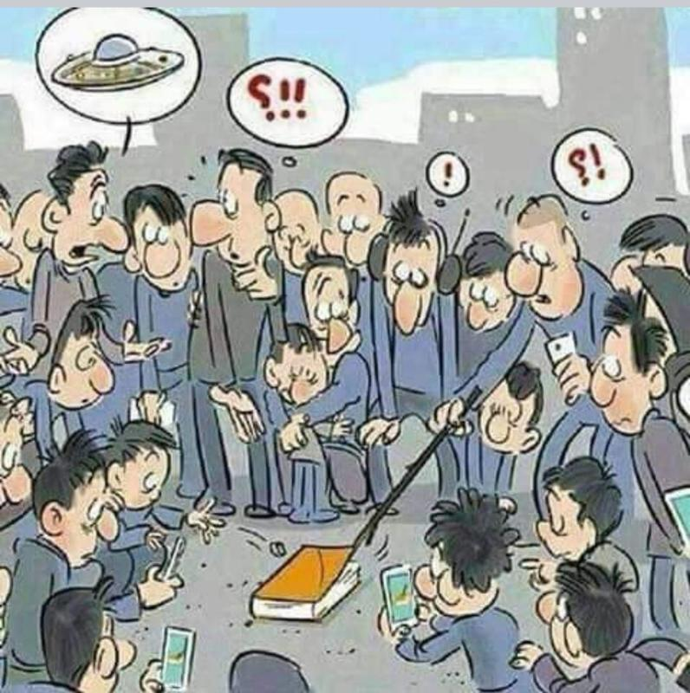
The NEW TESTAMENT BOOK OF ACTS
By David Lee Burris
Chapters 10 - 11 - 12

Slide 2
DOES THE NEW TESTAMENT IN PRACTICE ACTUALLY
START WITH THE BOOK OF ACTS NOT THE GOSPELS?
“From the standpoint of the dispensations or the various economies by which God governs the world, the Old Testament Jewish economy actually continued through the gospels. Acts is a transitional book moving from the Old Testament economy into that of the new – the church age, the body of Christ.” (reference)

Slide 3
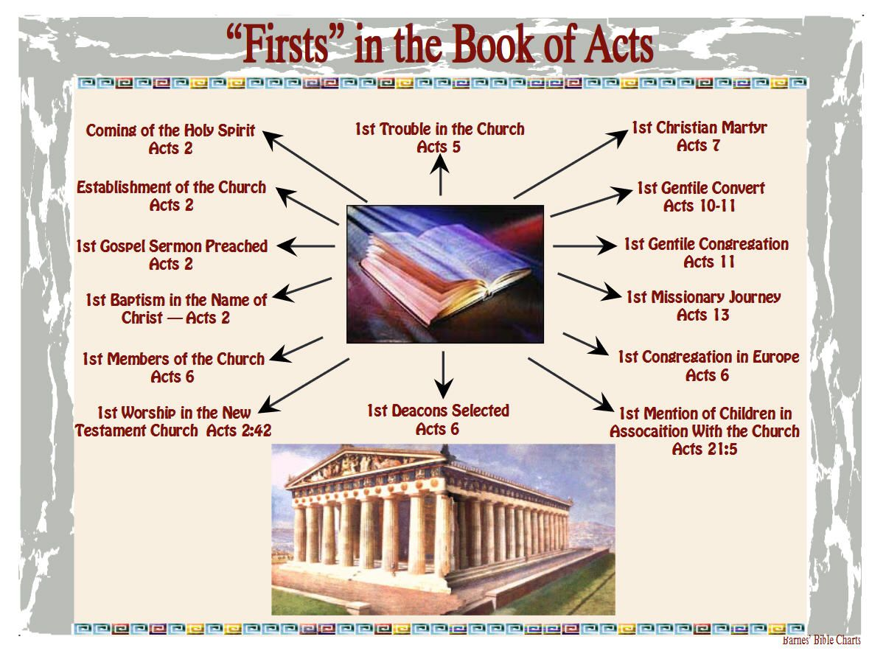

Slide 4
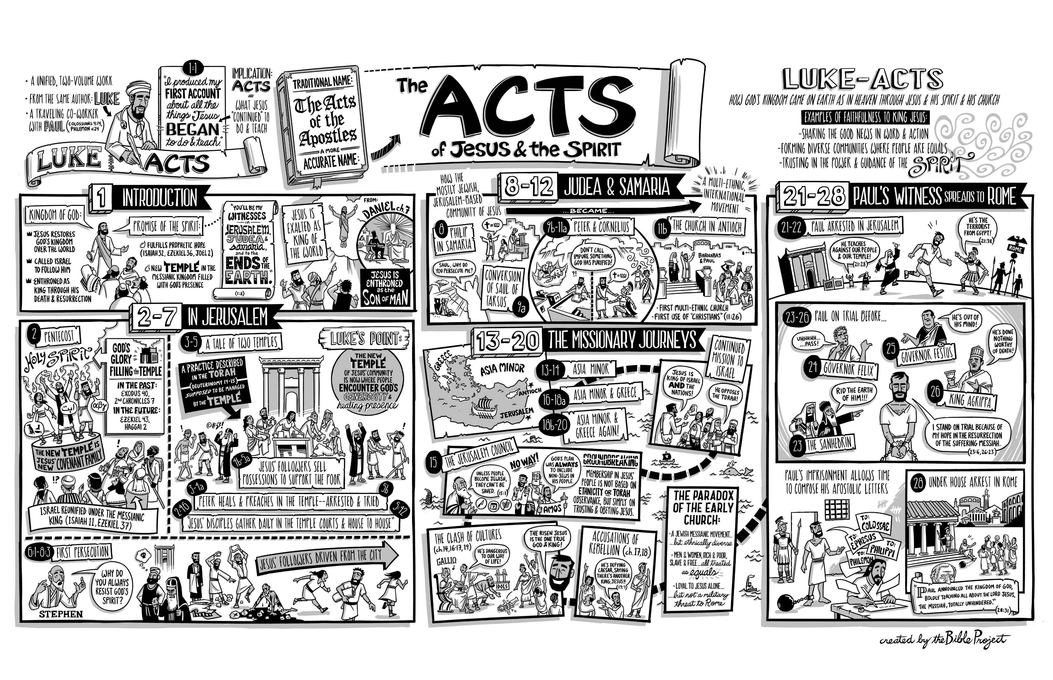

Slide 5
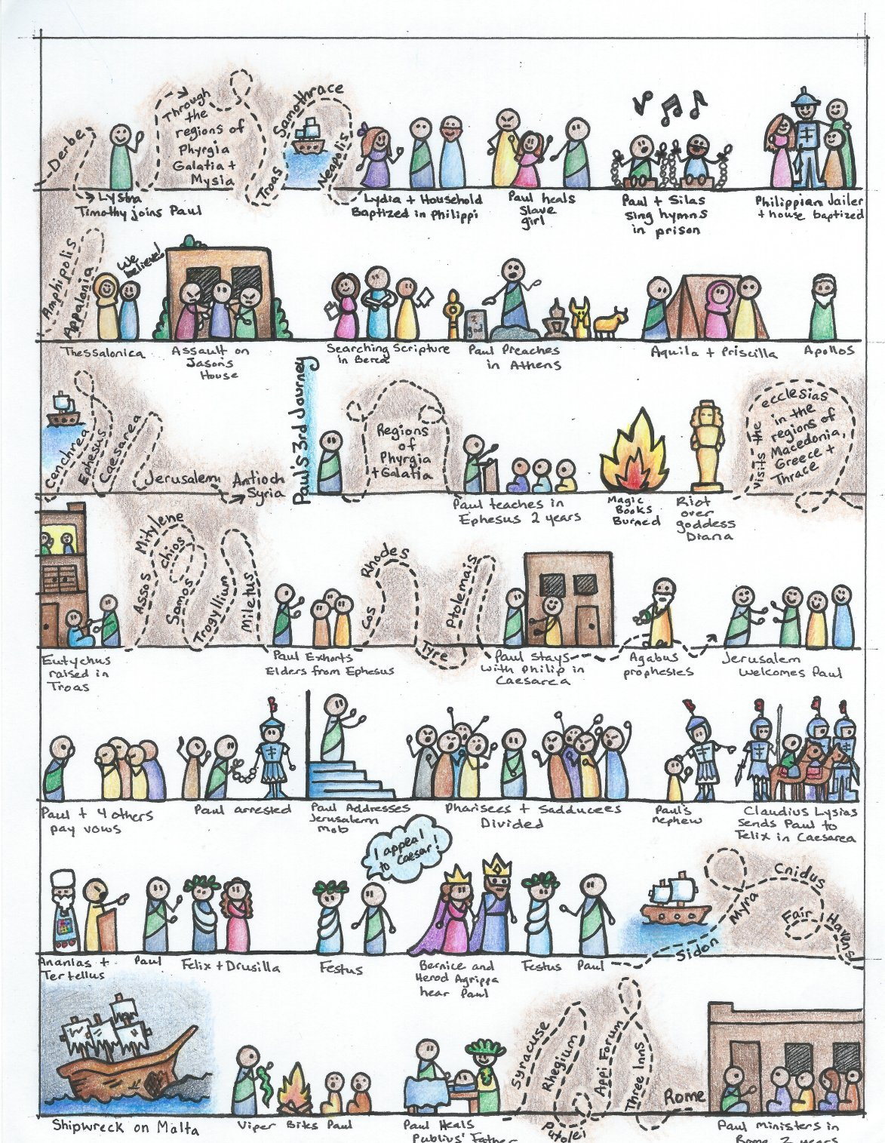

Slide 6
I. THE AUTHOR OF THE BOOK
From earliest times, Luke, “the beloved physician,” has been looked upon by conservative Bible scholars as being the author of The Book of Acts. Both internal and external evidence support this belief.
Luke was: (1) a Gentile (Col. 4:10–14); (2) the only Gentile author of a Bible book; (3) a physician (a medical doctor), Col. 4:14; (4) a “beloved” person, Col. 4:14; (5) a frequent missionary companion of Paul (the so-called “we sections” of The Book of Acts, 16:10–17; 20:5–21:18; 27:1–28:16, prove this assertion); and (6) the author of The Gospel of Luke as well as The Book of Acts.
II. THE ADDRESSEE OF THE BOOK
Luke addressed both The Gospel of Luke and The Book of Acts to Theophilus. Perhaps he had others in view as the ultimate readers of his two books.
We do not know the identity of Theophilus, nor do we know the place of his residence. He almost certainly was: (1) a friend of Luke and (2) a neophyte to Christianity (Luke wrote to Theophilus that he might know the certainty, the truthfulness, of the gospel truths wherein he had been instructed, Luke 1:1).
III. THE PLACE AND THE DATE OF THE WRITING OF THE BOOK
We do not know the place of writing but we can know the approximate date of writing. We know that it was written after the Spring of a.d. 63 for the book’s historical record extends to the Spring of that year and we know that the book was probably written before the Fall of a.d. 64 for the book makes no mention or allusion to the Neronian persecution which began in October of a.d. 64. We know that the book was almost certainly written before a.d. 70 for it makes no mention or allusion to the fall of Jerusalem and the destruction of its temple, events which occurred in a.d. 70 which greatly affected the early church and first-century Christianity (these events ended the Judaizers opposition to the gospel and the practice of preaching the gospel first to the Jews and then to the Gentiles).
IV. THE NAME OF THE BOOK
From the Second Century a.d., the common name for the book has been The Acts of the Apostles. This title is too comprehensive to be a correct one, for the book deals chiefly with the acts of only two apostles, Peter and Paul, and their acts are recorded only in part. A more apt title would be one of the following: (1) the Acts of the Risen Lord; (2) The Acts of the descended Holy Spirit; (3) Some of the Acts of Peter and Paul; (4) A Fragmentary History of the Early Church; (5) The First Chapter of Church History or (6) The only Inspired Chapter of Church History.
In the Greek manuscripts, the title is “Acts of Apostles.” This is a good and accurate title.
V. THE CLASSIFICATION OF THE BOOK
It is one of the five historical books of the New Testament. The New Testament has five historical books (Matthew through Acts), twenty-one doctrinal books (Romans through Jude) and one prophetical book (Revelation).
The 5 New Testament historical books are the New Testament’s “Pentateuch.”
Gingrich, R. E. (2002). (pp. 34). Memphis, TN: Riverside Printing.
Gingrich, R. E. (2002). The Book of Acts (pp. 3–4). Memphis, TN: Riverside Printing.

Slide 7
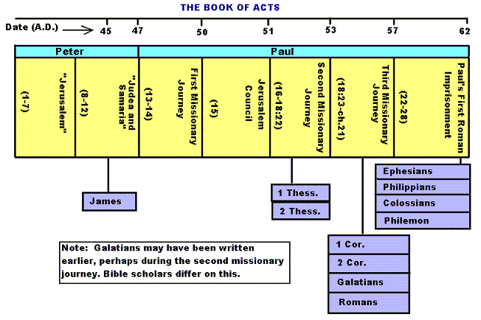

Slide 8
Historicity of Acts:
- the spread of Christianity from Jerusalem to Rome (“the ends of the earth”);
- The progress ... is mainly geographical:
- From Jerusalem ... to Samaria (8.5), Damascus (9.10), Antioch (11.26), Asia Minor (13.13), Europe (16.11), and finally Rome … itself;
- the northeastern corner of the Mediterranean;
- Maybe Spain But Nothing about North Africa, e.g., Alexandria and Cyrene.

Slide 9
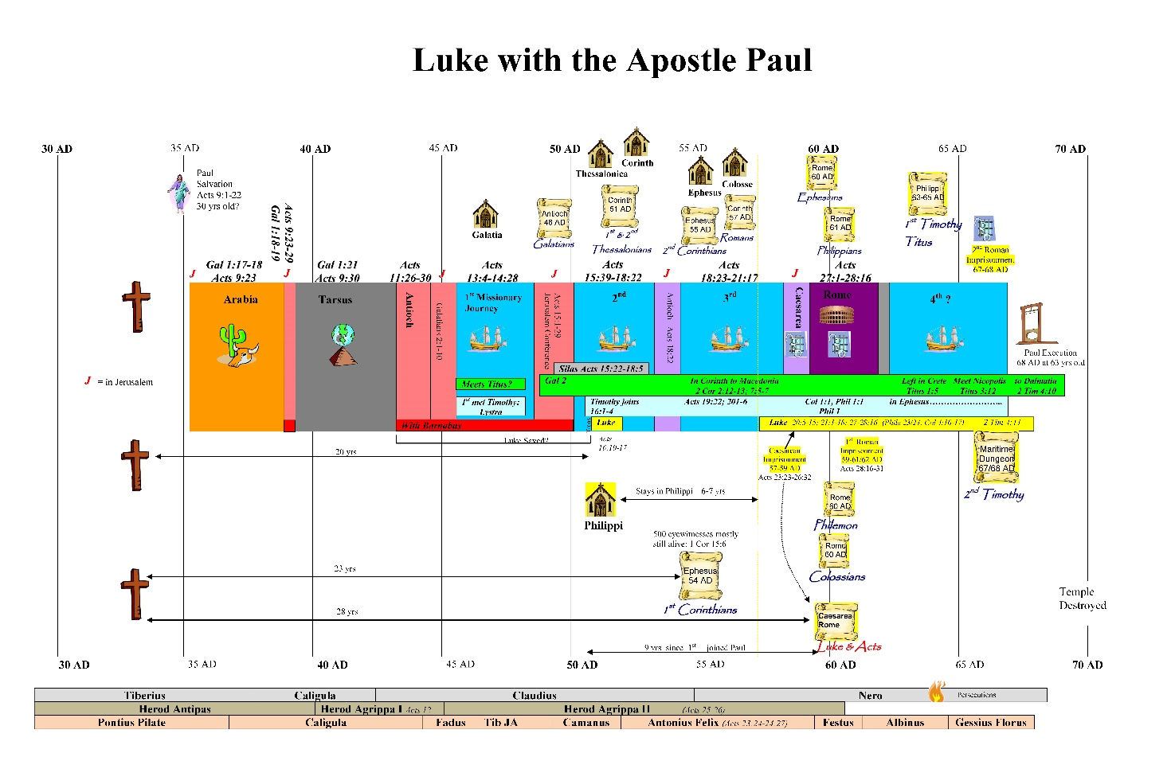

Slide 10
1. Prologue and Ascension (1:1-11):
- Post-resurrection appearances … ;
- A ... visible ascension into heaven;
- Matthias chosen to replace Judas Iscariot (1.12-26);
- Luke’s understanding of an Apostle: see 1.21-22;
- Note: Saul (later Paul) meets those qualifications Acts 9 when Christ appeared to him while on the Damascus Road.

Slide 11
2. Founding of the Jerusalem Church - the role of the Holy Spirit (2.12-2.47):
- The Jerusalem Church increases in numbers by means of divine power;
- The work of the Holy Spirit, e.g., Glossolalia (2.1-24; see Joel 2.28-32);
- Peter’s speech interprets the meaning of Pentecost;
- The character of the Jerusalem Church (2.43-45; 4.32-35);

Slide 12
3. The Work of Peter and the other Apostles (3.1-5.42):
- Confrontation between the Apostles and the Jerusalem authorities (4.1-22);
- Luke’s attitude towards both the Sadducees and the Pharisees (4.8-11);

Slide 13
4. Persecution of the “Hellenists” (6.1-8.40):
- Stephen, a leading “Hellenist” or Greek-speaking Jew (6. 5, 8);
- Stephen is presented as the first Christian Martyr (7.60);
- subsequent persecution and the growth of the Church (8.1b-40);
the “new way” carried to such individuals as Simon the Magician (8.9) and an Ethiopian Eunuch (8.27);
the role of Philip in this work of evangelization (6.5; 8.4; 21,8).

Slide 14
5. Preparation for the Gentile Mission (9.1-12.25):
- The progress of Christianity …. as world adversary to pagan religion and human schools of philosophy;
- See, for example, the conversion of Saul of Tarsus (9.1-19) and Cornelius, the Roman centurion (Chs. 10-11);
- Peter is depicted as the one who first opens the door to Gentiles, that is, non-Jews;
Peter’s persuasion of the “circumcision party” (11.1-18);
See 10.44-48 and 11.15-18: the “Gentile Pentecost”;

Slide 15
5. Preparation for the Gentile Mission (9.1-12.25) (contd.):
- Gentiles flock to the Church at Antioch (11.19-26);
- The Jerusalem Church sends Barnabas... to report on the situation (11.22);
- Barnabas with the Apostle Paul at Antioch (11.25-30);
- Gospel preached “all over Judea and Samaria”;
- The first half concludes with an account of Herod Agrippa I’s persecution (41-44 CE) of the Jerusalem community;
- God is unhappy with Herod (12.20-23).

Slide 16
6. First Missionary Journey of Barnabas and Paul and the Jerusalem Conference (13.1-15.35):
- The rest of Acts is devoted mainly to the Missionary Journeys of the Apostle Paul and his fellow workers;
- the work of Paul and Barnabas in the various Hellenistic cities of Asia Minor;
- Dissension between Gentile and Jewish Christians over adherence to the Mosaic Torah (15.1-35);
- must Gentile Christians be circumcised and observe Jewish dietary laws?

Slide 17
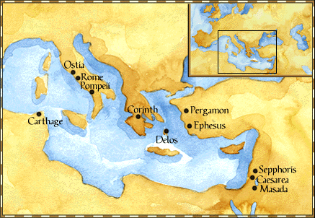
Paul: Map of His World.

Slide 18
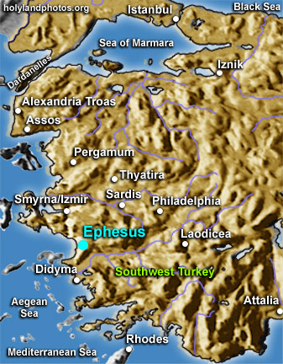

Slide 19
6. First Missionary Journey of Paul and Barnabas and the Jerusalem Conference (13.1-15.35) (contd.):
- The Jerusalem Conference held about A.D. 49 (Acts 15);
- Must a Gentile believer become a Jew ... to be a Christian?
- A division within the Church;
- The dispute settled in favor of uncircumcised Gentiles (15.28-29);
- The deciding voice is that of James (15.13-21).

Slide 20
6. First Missionary Journey of Paul and Barnabas and the Jerusalem Conference (13.1-15.35) (contd.):
- The Apostles and Elders required only limited Torah mandates of the Gentile Christians (15.13-21);
- requirements based on rules from Leviticus (Acts 15.13-21; Leviticus 17-18);
- Themes of unity and cooperation dominate … ;
- it is a unanimous decision and the “Whole Church” sends a delegation to Antioch to explain the Jerusalem Church’s decision (15.30-35);
- Actually, a decision of the Holy Spirit (15.22-29).

Slide 21
6. First Missionary Journey of Paul and Barnabas and the Jerusalem Conference (13.1-15.35) (contd.):
- Paul’s independence of the Apostolic Church (Gal 1.17, 18-19, 20; 2.1-10);
- Paul indicates that he was never under the jurisdiction of the Church’s leadership in Jerusalem (Gal 1.17, 18-19, 20; 2.1-10);
- See also 1 Cor 8.8; 10.27 relative to eating meat sacrificed to Greco-Roman gods.

Slide 22
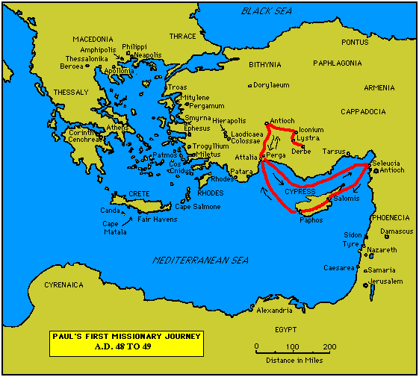

Slide 23
7. Paul’s Secondary Missionary Journey; Evangelizing Greece (16.1-18.21):
- Paul and Barnabas separate (15.39);
- Why the separation?
- Paul and Silas visit churches in Syria and Asia Minor (15.40-41);
- A vision directs Paul to Macedonia (15.40-16.10);
- Paul’s customary activity relative to the Jews and then being abused by them (16.11-17.15);

Slide 24
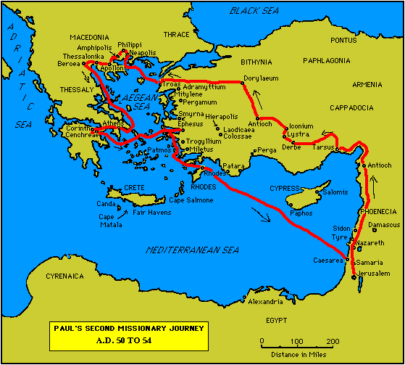

Slide 25
7. Paul’s Secondary Missionary Journey; Evangelizing Greece (16.1-18.21) (contd.):
- Paul in Philippi, Thessalonica, Beroea, and Athens;
- Paul speaks at the Areopagus in Athens (17.19-31);
- Paul at Corinth (18.1-17);

Slide 27
8. Paul’s Third Missionary Journey: Revisiting Asia Minor and Greece (18.22-20.38):
- Paul at Ephesus (18.19-21);
- Luke depicts Paul as determined to complete his last tour and head for the imperial capital, that is, Rome (19.21-22);
- Paul’s farewell speech at Miletus (20.17-38);
- See maps on the location of the major churches at the end of Paul’s ministry.

Slide 28
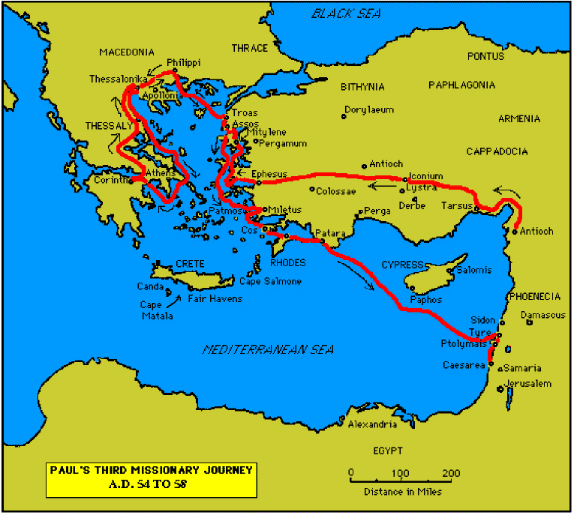

Slide 30
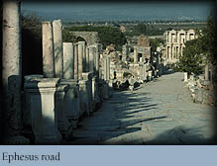

Slide 31
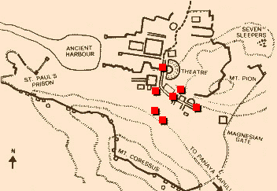
Ephesus: General View of the Ancient City.

Slide 32
9. Paul’s arrest in Jerusalem and imprisonment in Caesarea Maritime (21.1-26.32):
- Paul returns to Jerusalem (21.17) ... accused of blasphemy and profaning the Temple;
- When arrested, Paul claims that he is a Pharisee (21.27-23.10);
- Paul is imprisoned ... in Caesarea (23.33-26.32);
- he exercises his birthright as a Roman citizen (25.1-21);
- he defends himself (26.1-29);

Slide 33
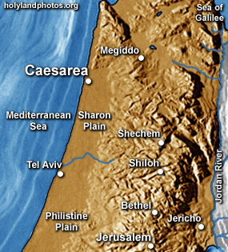

Slide 34
10. Paul’s Journey to Rome and His Preaching to Roman Jews (27.1-28.31):
- Paul’s sea journey to Rome... a shipwreck on the island of Malta (28.1 ) (see Map);
- the narrative in the first person plural, that is, “we”;
- Acts ends with Paul’s arrival in Rome (28.16);
- Paul is under house arrest but is free to preach (28.31);
- He continues to evangelize the Romans (28.23-31);
- We are not told of Paul’s fate.

Slide 35
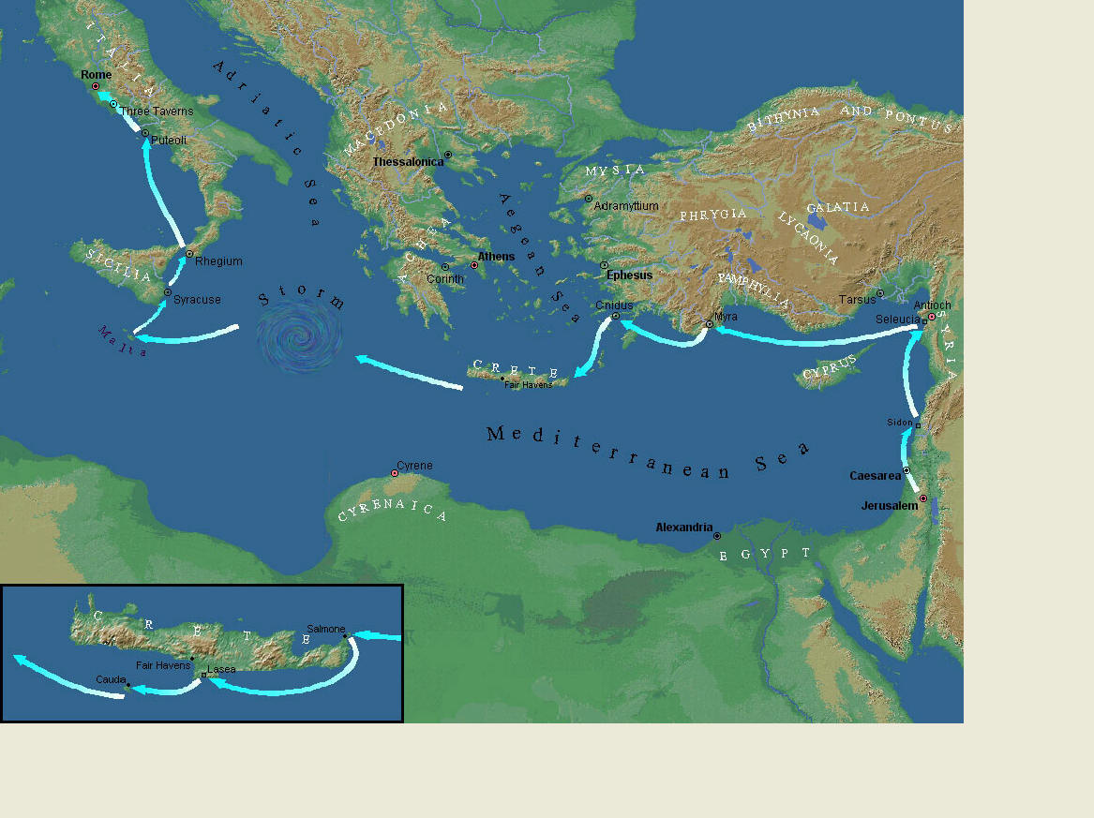
Paul’s Journey to Rome.

Slide 36
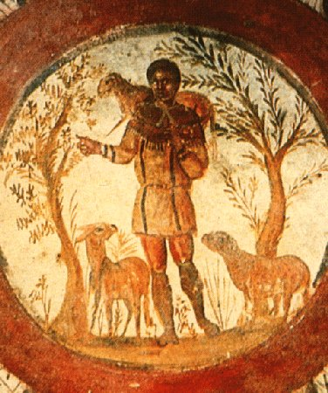
The Good Shepherd – in Catacombs of Rome.

Slide 37
10. Paul’s Journey to Rome and his Preaching to Roman Jews (27.1-28.31) (contd.):
- Luke has accomplished his task of tracing Christianity’s expansion from Jerusalem to “the ends of the earth” (1.8);
- Another theme emphasized: Paul and his successor evangelists will henceforth direct the Gospel primarily to Non-Jews, for “the Gentiles will listen” (28.28);
- Luke quotes from Isaiah 6 (see also Mark 4.10-13);
- Christianity’s future belongs to the Gentiles.

Slide 38
Basic Book Structure acts of the Apostles Centers around the great commission & Call To evangelize Then known world!

Slide 39
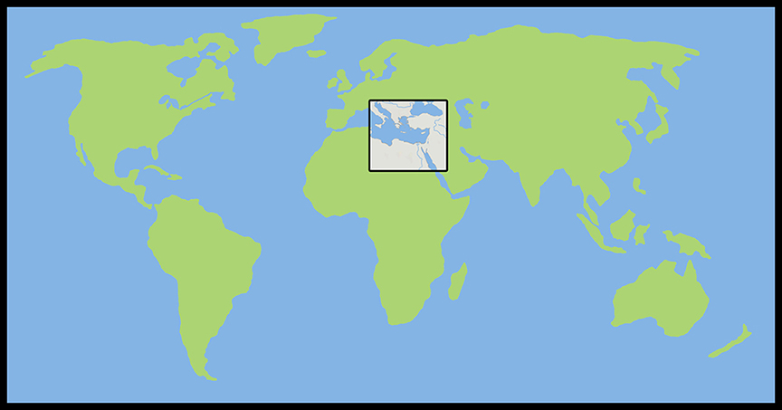
Where the Story takes Place

Slide 40
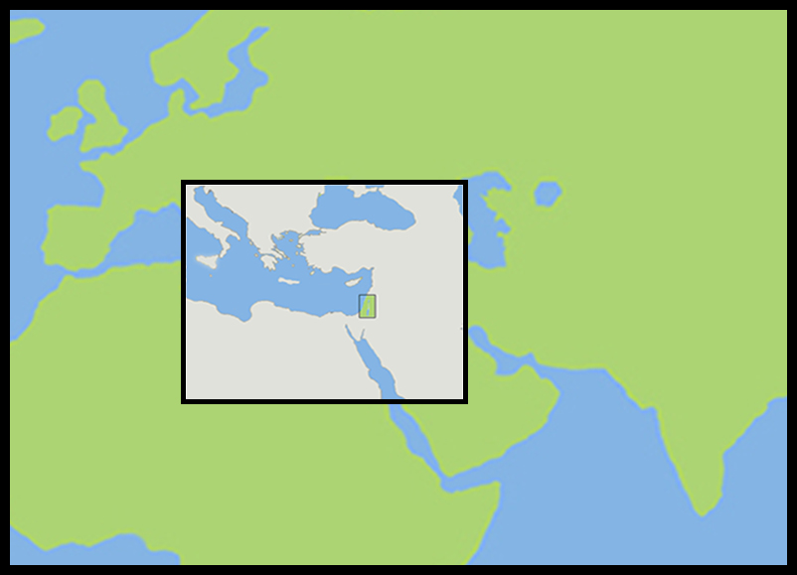
The Land of Canaan in the Near East

Slide 41
Acts 1:8 and the Great Commission
Acts 1:8
But ye shall receive power, after that the Holy Ghost is come upon you: and ye shall be witnesses unto me both in Jerusalem, and in all Judaea, and in Samaria, and unto the uttermost part of the earth.
Matthew 28:19-20
¹⁹ Go ye therefore, and teach all nations, baptizing them in the name of the Father, and of the Son, and of the Holy Ghost:
²⁰ Teaching them to observe all things whatsoever I have commanded you: and, lo, I am with you alway, even unto the end of the world. Amen.
Mark 16:15
And he said unto them, Go ye into all the world, and preach the gospel to every creature.

Slide 42
Acts 1:8 and the Great Commission
Acts 1:8
But ye shall receive power, after that the Holy Ghost is come upon you: and ye shall be witnesses unto me both in Jerusalem, and in all Judaea, and in Samaria, and unto the uttermost part of the earth.
Matthew 28:19-20
¹⁹ Go ye therefore, and teach all nations, baptizing them in the name of the Father, and of the Son, and of the Holy Ghost:
²⁰ Teaching them to observe all things whatsoever I have commanded you: and, lo, I am with you alway, even unto the end of the world. Amen.
Mark 16:15
And he said unto them, Go ye into all the world, and preach the gospel to every creature.

Slide 43
Acts 1:8 and the Great Commission
Acts 1:8
But ye shall receive power, after that the Holy Ghost is come upon you: and ye shall be witnesses unto me both in Jerusalem, and in all Judaea, and in Samaria, and unto the uttermost part of the earth.
Matthew 28:19-20
¹⁹ Go ye therefore, and teach all nations, baptizing them in the name of the Father, and of the Son, and of the Holy Ghost:
²⁰ Teaching them to observe all things whatsoever I have commanded you: and, lo, I am with you alway, even unto the end of the world. Amen.
Mark 16:15
And he said unto them, Go ye into all the world, and preach the gospel to every creature.

Slide 44
Acts 1:8 and the Great Commission
Acts 1:8
But ye shall receive power, after that the Holy Ghost is come upon you: and ye shall be witnesses unto me both in Jerusalem, and in all Judaea, and in Samaria, and unto the uttermost part of the earth.
Matthew 28:19-20
¹⁹ Go ye therefore, and teach all nations, baptizing them in the name of the Father, and of the Son, and of the Holy Ghost:
²⁰ Teaching them to observe all things whatsoever I have commanded you: and, lo, I am with you alway, even unto the end of the world. Amen.
Mark 16:15
And he said unto them, Go ye into all the world, and preach the gospel to every creature.

Slide 45
Acts 1:8 and the Structure of the Book
Acts 1:8
… ye shall be witnesses unto me both in Jerusalem, and in all Judaea, and in Samaria, and unto the uttermost part of the earth.
1. The witness in Jerusalem:
    Chapters 1 to 7
2. The witness in Judaea and Samaria:
    Chapters 8 to 12
3. The witness unto the uttermost parts of the earth:
    Chapters 13 to 28

Slide 46
The Three Audiences
Part 1: The Jews
Part 2: The Samaritans
Part 3: The Gentiles

Slide 47
The Pillars of the Church
Part 1: Peter
Part 2: Peter and Paul (Saul of Tarsus)
Part 3: Paul

Slide 48
The Timeline
Part 1: 5 years (AD 30-35)
Part 2: 13 years (AD 35-48)
Part 3: 14 years (AD 48-62)
          A total of 32 years, according to Nelson’s Complete Book of Bible Maps and Charts.

Slide 49
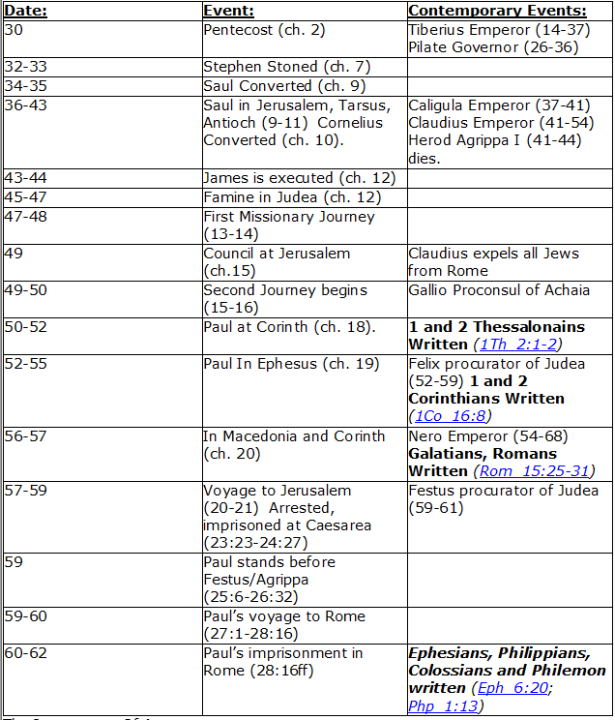
CHART BY
Mark Dunagan

Slide 50
PART ONE—The infancy of the church (the church in Jerusalem) (chapters 1–7)
(In this section, Jerusalem is the central city of Christianity and Peter is the most prominent person)
I. THE POST-RESURRECTION MINISTRY OF CHRIST (1:1–8)
II. THE ASCENSION OF CHRIST (1:9–11)
III. THE WAITING IN THE UPPER ROOM (1:12–26)
IV. THE ADVENT OF THE HOLY SPIRIT (2:1–41)
V. THE SNAPSHOT OF THE EARLY CHURCH (2:42–47)
VI. THE HEALING OF THE LAME MAN AND ITS CONSEQUENCES (3:1–4:31)
VII. THE DEATH OF ANANIAS AND SAPPHIRA AND ITS EFFECTS (4:32–5:42)
VIII. THE APPOINTMENT OF THE SEVEN (6:1–7)
IX. THE MINISTRY OF STEPHEN (6:8–7:60)
PART TWO—The adolescence of the church (the church in all Judea and In Samaria) (chapters 8–12)
(In this section, Jerusalem is gradually being replaced by Antioch as the central city of Christianity and Peter is gradually being replaced by Paul as the most prominent person)
I. THE FIRST MENTION OF PAUL (7:58; 8:1, 3)
II. THE PERSECUTION AND SCATTERING OF THE JERUSALEM CHURCH (8:1–4)
III. THE CONVERSION OF SAMARITANS (8:5–25)
IV. THE CONVERSION OF A JEWISH PROSELYTE (8:26–40)
V. THE CONVERSION OF SAUL (9:1–31)
VI. THE EXPANSION OF THE CHURCH IN WESTERN JUDEA (9:32–43)
VII. THE CONVERSION OF GENTILE GOD-FEARERS (chapter 10)
VIII. THE GROWING VISION OF THE JEWISH LEADERS (11:1–18)
IX. THE CONVERSION OF PAGAN GENTILES (11:19–26)
X. THE GROWING TIES BETWEEN JEWISH AND GENTILE CHRISTIANITY (11:27–30)
XI. THE COMPLETION OF THE TRANSITION (chapter 12)
PART THREE—The maturity of the church (the church in all the world) (chapters 13–28)
(In this section, Antioch is the central city of Christianity and Paul is the most prominent person)
I. PAUL’S CALL AT ANTIOCH TO HIS LIFE’S WORK (13:1–3)
II. PAUL’S FIRST MISSIONARY JOURNEY (13:4–14:27)
III. PAUL’S TWO YEARS BACK IN ANTIOCH (14:28–15:35)
IV. PAUL’S SECOND MISSIONARY JOURNEY (15:36–18:22)
V. PAUL’S THIRD MISSIONARY JOURNEY (18:23–21:16)
VI. PAUL’S ARREST AT JERUSALEM (21:17–23:35)
VII. PAUL’S TWO-YEARS’ IMPRISONMENT AT CAESAREA (chapters 24–26)
VIII. PAUL’S SHIPWRECK JOURNEY TO ROME (27:1–28:15)
IX. PAUL’S FIRST ROMAN IMPRISONMENT (28:16–31)
Gingrich, R. E. (2002). The Book of Acts (pp. 5–6). Memphis, TN: Riverside Printing.

Slide 51
L.D. CARY & SAM HOLT CATCH PHRASES
Chapter 10 – “The Gentiles Come In”
Chapter 11 – “10 + 1, Peter’s Rerun”
Chapter 12 – “10 + 2, Peter’s Rescue”
Chapter 13 – “10 + 3, First Preaching Spree”
Chapter 14 – “10 + 4, Preaching More”
Chapter 15 – “10 + 5, The Truth Survives”
Chapter 16 – “European Scene”
Chapter 17 – “10 + 7, One God In Heaven”
Chapter 18 – “10 + 8, The Corinth Wait”
“The Gentiles Come In”
Catch Phrase
Chapter Ten

Slide 52
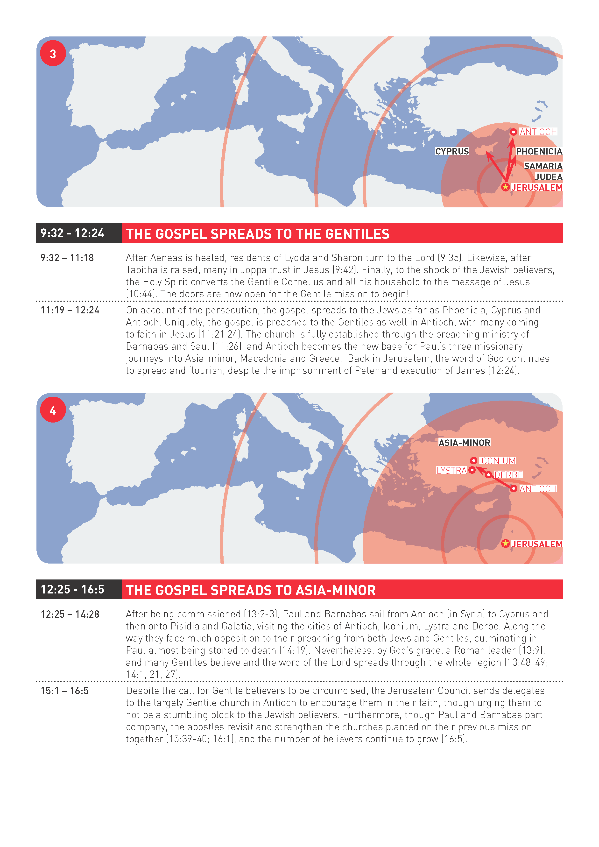

Slide 53
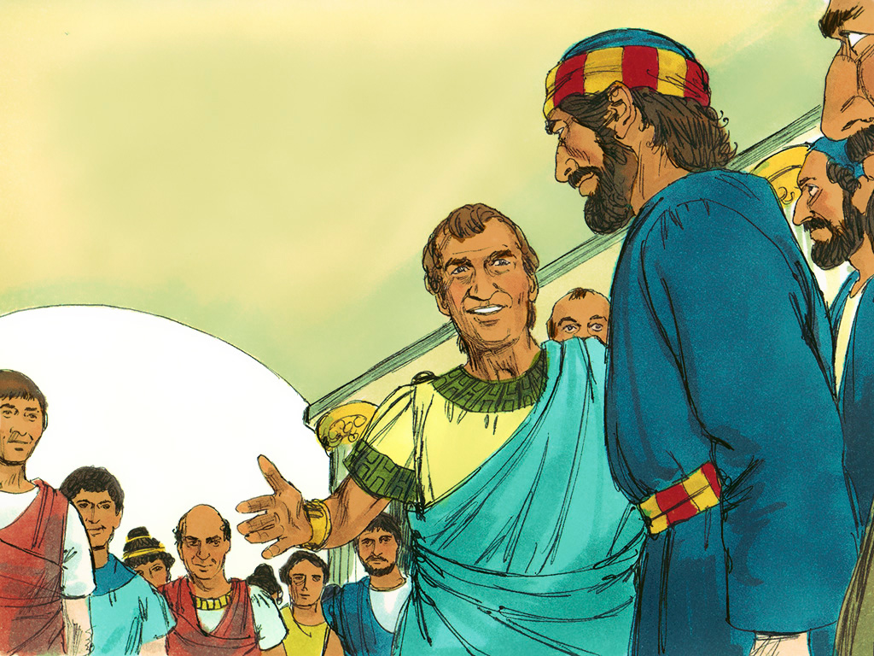
ACTS 10
Door is opened to preach the Gospel to the Gentiles

Slide 54

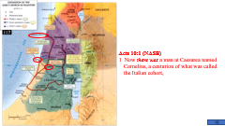
Acts 10:1-2 (NASB)
1 Now there was a man at Caesarea named Cornelius, a centurion of what was called the Italian cohort,
2 a devout man and one who feared God with all his household, and gave many alms to the Jewish people and prayed to God continually.
A. Caesarea:
1. Roman centurion called the Italian cohort: a commander of 100
2. Devout man who feared God: identifying him as devout and God fearing without the mention of idols tells us he worshipped the one true God of the Jews.
a. all his household: this indicates he was a good leader. His influence was such that his family turned to God also. 1Tim 3:1-7; Acts 10:22
3. Alms: gifts motivated by mercy and pity.
4. He prayed to God continually: Lk 18:1-8; 1Thess 5:17
1 Timothy 3:1-7 (NASB)
1 It is a trustworthy statement: if any man aspires to the office of overseer, it is a fine work he desires to do.
2 An overseer, then, must be above reproach, the husband of one wife, temperate, prudent, respectable, hospitable, able to teach,
3 not addicted to wine or pugnacious, but gentle, peaceable, free from the love of money.
4 He must be one who manages his own household well, keeping his children under control with all dignity
5 (but if a man does not know how to manage his own household, how will he take care of the church of God?),
Luke 18:1-8 (NASB)
1 Now He was telling them a parable to show that at all times they ought to pray and not to lose heart,
2 saying, "In a certain city there was a judge who did not fear God and did not respect man.
3 "There was a widow in that city, and she kept coming to him, saying, 'Give me legal protection from my opponent.'
4 "For a while he was unwilling; but afterward he said to himself, 'Even though I do not fear God nor respect man,
5 yet because this widow bothers me, I will give her legal protection, otherwise by continually coming she will wear me out.'"
6 And the Lord said, "Hear what the unrighteous judge *said;
7 now, will not God bring about justice for His elect who cry to Him day and night, and will He delay long over them?
8 "I tell you that He will bring about justice for them quickly. However, when the Son of Man comes, will He find faith on the earth?"
6 and not a new convert, so that he will not become conceited and fall into the condemnation incurred by the devil.
7 And he must have a good reputation with those outside the church, so that he will not fall into reproach and the snare of the devil.
1 Thessalonians 5:17 (NASB)
17 pray without ceasing;
Acts 10:22 (NASB)
22 They said, "Cornelius, a centurion, a righteous and God-fearing man well spoken of by the entire nation of the Jews, was divinely directed by a holy angel to send for you to come to his house and hear a message from you."
Notes:
A. Caesarea was located 30 miles North of Joppa. Rome considered it the capital of Palestine and was once called Strato’s Tower.
1. Roman centurion:
2. Devout comes from compound Greek word meaning “good worship” (Godly). God fearing, “to put to flight, to terrify, frighten”

Slide 55
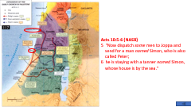
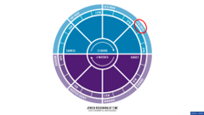

Acts 10:3-6 (NASB)
3 About the ninth hour of the day he clearly saw in a vision an angel of God who had just come in and said to him, "Cornelius!"
4 And fixing his gaze on him and being much alarmed, he said, "What is it, Lord?" And he said to him, "Your prayers and alms have ascended as a memorial before God.
5 "Now dispatch some men to Joppa and send for a man named Simon, who is also called Peter;
6 he is staying with a tanner named Simon, whose house is by the sea."
A. Ninth hour of the day – Jewish hour of prayer : It was 3:00 p.m. Acts 3:1
1. An angel of the Lord: The angel of the LORD indicates that the character of Cornelius is accurate.
2. His prayers and alms have caught the attention of God:
a. His prayers are going to be answered by Peter: Acts 11:13-14
b. We last left Peter with the tanner Simon: Acts 9:43
3. Send some men to Joppa, approximately 30 miles:
Acts 11:13-14 (NASB)
13 "And he reported to us how he had seen the angel standing in his house, and saying, 'Send to Joppa and have Simon, who is also called Peter, brought here;
14 and he will speak words to you by which you will be saved, you and all your household.’
Acts 3:1 (NASB)
1 Now Peter and John were going up to the temple at the ninth hour, the hour of prayer.
Acts 9:43 (NASB)
43 And Peter stayed many days in Joppa with a tanner named Simon.

Slide 56
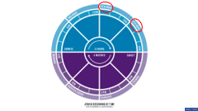

Acts 10:7-9 (NASB)
7 When the angel who was speaking to him had left, he summoned two of his servants and a devout soldier of those who were his personal attendants,
8 and after he had explained everything to them, he sent them to Joppa.
9 On the next day, as they were on their way and approaching the city, Peter went up on the housetop about the sixth hour to pray.
A. Cornelius sends his servants and they arrive by the next day after they were sent:
1. Cornelius had his vision at 3:00 P.M. (ninth hour): Acts 10:3
2. As his messengers were approaching the city of Joppa, Peter goes on the housetop to pray at noon (sixth hour):
Acts 10:3 (NASB)
3 About the ninth hour of the day he clearly saw in a vision an angel of God who had just come in and said to him, "Cornelius!"

Slide 57
Acts 10:10-16 (NASB)
10 But he became hungry and was desiring to eat; but while they were making preparations, he fell into a trance;
11 and he *saw the sky opened up, and an object like a great sheet coming down, lowered by four corners to the ground,
12 and there were in it all kinds of four-footed animals and crawling creatures of the earth and birds of the air.
13 A voice came to him, "Get up, Peter, kill and eat!"
14 But Peter said, "By no means, Lord, for I have never eaten anything unholy and unclean."
15 Again a voice came to him a second time, "What God has cleansed, no longer consider unholy."
16 This happened three times, and immediately the object was taken up into the sky.
A. Peter became hungry while he was praying and he fell into a trance: Acts 11:5-10
1. God emphasizes the message by repeating it three times:
a. Peter does not get the point since God corrects him three times - What God has cleansed, no longer consider unholy: 1Tim 4:1-4; 1Cor 10:25-26; Col 2:13-14, 16
Acts 11:5-10 (NASB)
5 "I was in the city of Joppa praying; and in a trance I saw a vision, an object coming down like a great sheet lowered by four corners from the sky; and it came right down to me,
6 and when I had fixed my gaze on it and was observing it I saw the four-footed animals of the earth and the wild beasts and the crawling creatures and the birds of the air.
7 "I also heard a voice saying to me, 'Get up, Peter; kill and eat.'
8 "But I said, 'By no means, Lord, for nothing unholy or unclean has ever entered my mouth.'
9 "But a voice from heaven answered a second time, 'What God has cleansed, no longer consider unholy.'
10 "This happened three times, and everything was drawn back up into the sky.
1 Timothy 4:1-4 (NASB)
1 But the Spirit explicitly says that in later times some will fall away from the faith, paying attention to deceitful spirits and doctrines of demons,
2 by means of the hypocrisy of liars seared in their own conscience as with a branding iron,
3 men who forbid marriage and advocate abstaining from foods which God has created to be gratefully shared in by those who believe and know the truth.
4 For everything created by God is good, and nothing is to be rejected if it is received with gratitude;
1 Corinthians 10:25-26 (NASB)
25 Eat anything that is sold in the meat market without asking questions for conscience' sake;
26 FOR THE EARTH IS THE LORD'S, AND ALL IT CONTAINS.
Colossians 2:13-16 (NASB)
13 When you were dead in your transgressions and the uncircumcision of your flesh, He made you alive together with Him, having forgiven us all our transgressions,
14 having canceled out the certificate of debt consisting of decrees against us, which was hostile to us; and He has taken it out of the way, having nailed it to the cross.
16 Therefore no one is to act as your judge in regard to food or drink or in respect to a festival or a new moon or a Sabbath day—
TRANCE Greek NASB Number: 1611
Definition: a displacement (of the mind), i.e. bewilderment, ecstasy:--
New American Standard Exhaustive Concordance of the Bible
VISION - Greek NASB Number: 3705
Definition: that which is seen:--
New American Standard Exhaustive Concordance of the Bible

Slide 58
Acts 10:17-21 (NASB)
17 Now while Peter was greatly perplexed in mind as to what the vision which he had seen might be, behold, the men who had been sent by Cornelius, having asked directions for Simon’s house, appeared at the gate;
18 and calling out, they were asking whether Simon, who was also called Peter, was staying there.
19 While Peter was reflecting on the vision, the Spirit said to him, "Behold, three men are looking for you.
20 "But get up, go downstairs and accompany them without misgivings, for I have sent them Myself."
21 Peter went down to the men and said, "Behold, I am the one you are looking for; what is the reason for which you have come?"
A. Peter is perplexed in mind not understanding the vision but at this very moment the Gentile men from Cornelius arrive:
1. God tells Peter to accompany these men because God has sent them:
2. Peter wants to why they have come:

Slide 59
Acts 10:22-26 (NASB)
22 They said, "Cornelius, a centurion, a righteous and God-fearing man well spoken of by the entire nation of the Jews, was divinely directed by a holy angel to send for you to come to his house and hear a message from you."
23 So he invited them in and gave them lodging. And on the next day he got up and went away with them, and some of the brethren from Joppa accompanied him.
24 On the following day he entered Caesarea. Now Cornelius was waiting for them and had called together his relatives and close friends.
25 When Peter entered, Cornelius met him, and fell at his feet and worshiped him.
26 But Peter raised him up, saying, "Stand up; I too am just a man."
A. He is to go to the house of a Roman Gentile man and speak words to him:
1. Words which God had commanded Peter to speak: Acts 10:33; 11:13-14
2. Peter by this time must be developing an understanding of the vision: Acts 10:28-29
3. Peter and six Jewish Christian brethren accompany him to Cornelius house: Acts 11:12
4. Cornelius fell down and worshipped Peter: Mt 4:8-10; Acts 14:12-15; Rev 19:10; 22:8-9
Acts 10:28-29 (NASB)
28 And he said to them, "You yourselves know how unlawful it is for a man who is a Jew to associate with a foreigner or to visit him; and yet God has shown me that I should not call any man unholy or unclean.
29 "That is why I came without even raising any objection when I was sent for. So I ask for what reason you have sent for me."
Acts 14:12-15 (NASB)
12 And they began calling Barnabas, Zeus, and Paul, Hermes, because he was the chief speaker.
13 The priest of Zeus, whose temple was just outside the city, brought oxen and garlands to the gates, and wanted to offer sacrifice with the crowds.
14 But when the apostles Barnabas and Paul heard of it, they tore their robes and rushed out into the crowd, crying out
15 and saying, "Men, why are you doing these things? We are also men of the same nature as you, and preach the gospel to you that you should turn from these vain things to a living God, WHO MADE THE HEAVEN AND THE EARTH AND THE SEA AND ALL THAT IS IN THEM.
Matthew 4:8-11 (NASB)
8 Again, the devil *took Him to a very high mountain and *showed Him all the kingdoms of the world and their glory;
9 and he said to Him, "All these things I will give You, if You fall down and worship me."
10 Then Jesus *said to him, "Go, Satan! For it is written, 'YOU SHALL WORSHIP THE LORD YOUR GOD, AND SERVE HIM ONLY.'"
Revelation 19:10 (NASB)
10 Then I fell at his feet to worship him. But he *said to me, "Do not do that; I am a fellow servant of yours and your brethren who hold the testimony of Jesus; worship God. For the testimony of Jesus is the spirit of prophecy."
Revelation 22:8-9 (NASB)
8 I, John, am the one who heard and saw these things. And when I heard and saw, I fell down to worship at the feet of the angel who showed me these things.
9 But he *said to me, "Do not do that. I am a fellow servant of yours and of your brethren the prophets and of those who heed the words of this book. Worship God."
Acts 11:12 (NASB)
12 "The Spirit told me to go with them without misgivings. These six brethren also went with me and we entered the man's house.
Acts 10:33 (NASB)
33 "So I sent for you immediately, and you have been kind enough to come. Now then, we are all here present before God to hear all that you have been commanded by the Lord."
Acts 11:13-14 (NASB)
13 "And he reported to us how he had seen the angel standing in his house, and saying, 'Send to Joppa and have Simon, who is also called Peter, brought here;
14 and he will speak words to you by which you will be saved, you and all your household.'
Notes:
1. Cornelius reveals that he completely understood that he was not saved when he sent for Peter.
2. Peter makes it clear in Acts 10:29 that the only reason he came was that he understood what God was saying to him in the vision of the sheets.

Slide 60


Acts 10:27-32 (NASB)
27 As he talked with him, he entered and *found many people assembled.
28 And he said to them, "You yourselves know how unlawful it is for a man who is a Jew to associate with a foreigner or to visit him; and yet God has shown me that I should not call any man unholy or unclean.
29 "That is why I came without even raising any objection when I was sent for. So I ask for what reason you have sent for me."
30 Cornelius said, "Four days ago to this hour, I was praying in my house during the ninth hour; and behold, a man stood before me in shining garments,
31 and he *said, 'Cornelius, your prayer has been heard and your alms have been remembered before God.
32 'Therefore send to Joppa and invite Simon, who is also called Peter, to come to you; he is staying at the house of Simon the tanner by the sea.’
A. Peter finished his journey from Joppa to Caesarea and entered Cornelius’s home: (3 slides)
B. The unlawfulness of a Jew or Jewish Christian from associating with a Gentiles: Eph 2:13-16; Gentile life - 1Pet 4:3 There are no more distinctions – Gal 3:26-29; Phil 3:3
C. Let us remember that Peter has 6 witnesses accompanying him: Acts 11:12
1 Peter 4:3 (NASB)
3 For the time already past is sufficient for you to have carried out the desire of the Gentiles, having pursued a course of sensuality, lusts, drunkenness, carousing, drinking parties and abominable idolatries.
Ephesians 2:13-16 (NASB)
13 But now in Christ Jesus you who formerly were far off have been brought near by the blood of Christ.
14 For He Himself is our peace, who made both groups into one and broke down the barrier of the dividing wall,
15 by abolishing in His flesh the enmity, which is the Law of commandments contained in ordinances, so that in Himself He might make the two into one new man, thus establishing peace,
16 and might reconcile them both in one body to God through the cross, by it having put to death the enmity.
Galatians 3:26-29 (NASB)
26 For you are all sons of God through faith in Christ Jesus.
27 For all of you who were baptized into Christ have clothed yourselves with Christ.
28 There is neither Jew nor Greek, there is neither slave nor free man, there is neither male nor female; for you are all one in Christ Jesus.
29 And if you belong to Christ, then you are Abraham's descendants, heirs according to promise.
Philippians 3:3 (NASB)
3 for we are the true circumcision, who worship in the Spirit of God and glory in Christ Jesus and put no confidence in the flesh,
Acts 11:12 (NASB)
12 "The Spirit told me to go with them without misgivings. These six brethren also went with me and we entered the man's house.
Notes:
B. Peter is saying to Cornelius, just as he would teach a fellow Jewish sinner the Gospel so he will teach a Gentile sinner the gospel because there is no difference. It was God who opened this door at this time.

Slide 61
Acts 10:33-38 (NASB)
33 "So I sent for you immediately, and you have been kind enough to come. Now then, we are all here present before God to hear all that you have been commanded by the Lord."
34 Opening his mouth, Peter said: "I most certainly understand now that God is not one to show partiality,
35 but in every nation the man who fears Him and does what is right is welcome to Him.
36 "The word which He sent to the sons of Israel, preaching peace through Jesus Christ (He is Lord of all)—
37 you yourselves know the thing which took place throughout all Judea, starting from Galilee, after the baptism which John proclaimed.
38 "You know of Jesus of Nazareth, how God anointed Him with the Holy Spirit and with power, and how He went about doing good and healing all who were oppressed by the devil, for God was with Him.
A. The commanded Peter to preach the message of salvation: Acts 11:13-14; Ro 1:16-17
B. Partiality, fears God and does right is welcome to Him: Ro 2:9-11; Col 3:25; Acts 10:28, 2
C. Peace through Jesus Christ who is Lord of all: Eph 2:13-17; Acts 2:22
Acts 11:13-14 (NASB)
13 "And he reported to us how he had seen the angel standing in his house, and saying, 'Send to Joppa and have Simon, who is also called Peter, brought here;
14 and he will speak words to you by which you will be saved, you and all your household.’
Romans 1:16-17 (NASB)
16 For I am not ashamed of the gospel, for it is the power of God for salvation to everyone who believes, to the Jew first and also to the Greek.
17 For in it the righteousness of God is revealed from faith to faith; as it is written, "BUT THE RIGHTEOUS man SHALL LIVE BY FAITH."
Romans 2:9-11 (NASB)
9 There will be tribulation and distress for every soul of man who does evil, of the Jew first and also of the Greek,
10 but glory and honor and peace to everyone who does good, to the Jew first and also to the Greek.
11 For there is no partiality with God.
Colossians 3:25 (NASB)
25 For he who does wrong will receive the consequences of the wrong which he has done, and that without partiality.
Acts 10:28 (NASB)
28 And he said to them, "You yourselves know how unlawful it is for a man who is a Jew to associate with a foreigner or to visit him; and yet God has shown me that I should not call any man unholy or unclean.
Acts 10:2 (NASB)
2 a devout man and one who feared God with all his household, and gave many alms to the Jewish people and prayed to God continually.
Ephesians 2:13-17 (NASB)
13 But now in Christ Jesus you who formerly were far off have been brought near by the blood of Christ.
14 For He Himself is our peace, who made both groups into one and broke down the barrier of the dividing wall,
15 by abolishing in His flesh the enmity, which is the Law of commandments contained in ordinances, so that in Himself He might make the two into one new man, thus establishing peace,
16 and might reconcile them both in one body to God through the cross, by it having put to death the enmity.
17 AND HE CAME AND PREACHED PEACE TO YOU WHO WERE FAR AWAY, AND PEACE TO THOSE WHO WERE NEAR;
Acts 2:22 (NASB)
22 "Men of Israel, listen to these words: Jesus the Nazarene, a man attested to you by God with miracles and wonders and signs which God performed through Him in your midst, just as you yourselves know—
Notes:
Acts 10:33 Cornelius encourages Peter to speak the words that God had commanded him to speak compare to Acts 11:

Slide 62
Acts 10:39-43 (NASB)
39 "We are witnesses of all the things He did both in the land of the Jews and in Jerusalem. They also put Him to death by hanging Him on a cross.
40 "God raised Him up on the third day and granted that He become visible,
41 not to all the people, but to witnesses who were chosen beforehand by God, that is, to us who ate and drank with Him after He arose from the dead.
42 "And He ordered us to preach to the people, and solemnly to testify that this is the One who has been appointed by God as Judge of the living and the dead.
43 "Of Him all the prophets bear witness that through His name everyone who believes in Him receives forgiveness of sins."
A. We are witnesses of His crucifixion - resurrection: Acts 1:2-3, 8, 21-22; 2:32;
1Cor 15:3-8
B. He appeared to chosen witnesses who ate and drank with him after he arose from the dead:
Jn 6:70; Lk 24:41-43; Acts 1:2-3
C. He ordered us to preach to the people: Mt 28:18-20; Mk 16:14-16
1. Testifying that Jesus has been appointed judge: Jn 5:22, 27; Acts 17:31; 2Ti 4:1
1 Corinthians 15:3-8 (NASB)
3 For I delivered to you as of first importance what I also received, that Christ died for our sins according to the Scriptures,
4 and that He was buried, and that He was raised on the third day according to the Scriptures,
5 and that He appeared to Cephas, then to the twelve.
6 After that He appeared to more than five hundred brethren at one time, most of whom remain until now, but some have fallen asleep;
7 then He appeared to James, then to all the apostles;
8 and last of all, as to one untimely born, He appeared to me also.
Acts 1:2-3, 8, 21-22 (NASB)
2 until the day when He was taken up to heaven, after He had by the Holy Spirit given orders to the apostles whom He had chosen.
3 To these He also presented Himself alive after His suffering, by many convincing proofs, appearing to them over a period of forty days and speaking of the things concerning the kingdom of God.
8 but you will receive power when the Holy Spirit has come upon you; and you shall be My witnesses both in Jerusalem, and in all Judea and Samaria, and even to the remotest part of the earth."
21 "Therefore it is necessary that of the men who have accompanied us all the time that the Lord Jesus went in and out among us—
22 beginning with the baptism of John until the day that He was taken up from us—one of these must become a witness with us of His resurrection."
Luke 24:41-43 (NASB)
41 While they still could not believe it because of their joy and amazement, He said to them, "Have you anything here to eat?"
42 They gave Him a piece of a broiled fish;
43 and He took it and ate it before them.
Acts 1:2-3 (NASB)
2 until the day when He was taken up to heaven, after He had by the Holy Spirit given orders to the apostles whom He had chosen.
3 To these He also presented Himself alive after His suffering, by many convincing proofs, appearing to them over a period of forty days and speaking of the things concerning the kingdom of God.
Matthew 28:18-20 (NASB)
18 And Jesus came up and spoke to them, saying, "All authority has been given to Me in heaven and on earth.
19 "Go therefore and make disciples of all the nations, baptizing them in the name of the Father and the Son and the Holy Spirit,
20 teaching them to observe all that I commanded you; and lo, I am with you always, even to the end of the age."
Mark 16:14-16 (NASB)
14 Afterward He appeared to the eleven themselves as they were reclining at the table; and He reproached them for their unbelief and hardness of heart, because they had not believed those who had seen Him after He had risen.
15 And He said to them, "Go into all the world and preach the gospel to all creation.
16 "He who has believed and has been baptized shall be saved; but he who has disbelieved shall be condemned.
John 5:22 (NASB)
22 "For not even the Father judges anyone, but He has given all judgment to the Son,
John 5:27 (NASB)
27 and He gave Him authority to execute judgment, because He is the Son of Man.
Acts 17:31 (NASB)
31 because He has fixed a day in which He will judge the world in righteousness through a Man whom He has appointed, having furnished proof to all men by raising Him from the dead."
2 Timothy 4:1 (NASB)
1 I solemnly charge you in the presence of God and of Christ Jesus, who is to judge the living and the dead, and by His appearing and His kingdom:
Acts 2:32 (NASB)
32 "This Jesus God raised up again, to which we are all witnesses.
John 6:70 (NASB)
70 Jesus answered them, "Did I Myself not choose you, the twelve, and yet one of you is a devil?"
Notes:
Peter is laying the groundwork as to why God sent him to preach to the gentiles.

Slide 63

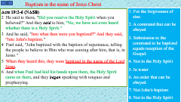
Acts 10:44-48 (NASB)
44 While Peter was still speaking these words, the Holy Spirit fell upon all those who were listening to the message.
45 All the circumcised believers who came with Peter were amazed, because the gift of the Holy Spirit had been poured out on the Gentiles also.
46 For they were hearing them speaking with tongues and exalting God. Then Peter answered,
47 "Surely no one can refuse the water for these to be baptized who have received the Holy Spirit just as we did, can he?"
48 And he ordered them to be baptized in the name of Jesus Christ. Then they asked him to stay on for a few days.
A. Having just begun to speak the message by which they would be saved: Acts 11:14-15
1. The six Jewish Christians that accompanied Paul are amazed at what God has done. Preaching to and baptizing Gentiles was not ever done until God testified through Peter and the Holy Spirit that it was His will: Acts 15:7-9; Ro 10:17
B. Peter concludes that water baptism cannot be withheld in light of God’s testimony. Verse 47
1. Water baptism is in the name of Jesus for the forgiveness of sins:
Acts 15:7-9 (NASB)
7 After there had been much debate, Peter stood up and said to them, "Brethren, you know that in the early days God made a choice among you, that by my mouth the Gentiles would hear the word of the gospel and believe.
8 "And God, who knows the heart, testified to them giving them the Holy Spirit, just as He also did to us;
9 and He made no distinction between us and them, cleansing their hearts by faith.
Acts 11:14-15 (NASB)
14 and he will speak words to you by which you will be saved, you and all your household.'
15 "And as I began to speak, the Holy Spirit fell upon them just as He did upon us at the beginning.
Romans 10:17 (NASB)
17 So faith comes from hearing, and hearing by the word of Christ.
Notes:
11/19/17

Slide 64
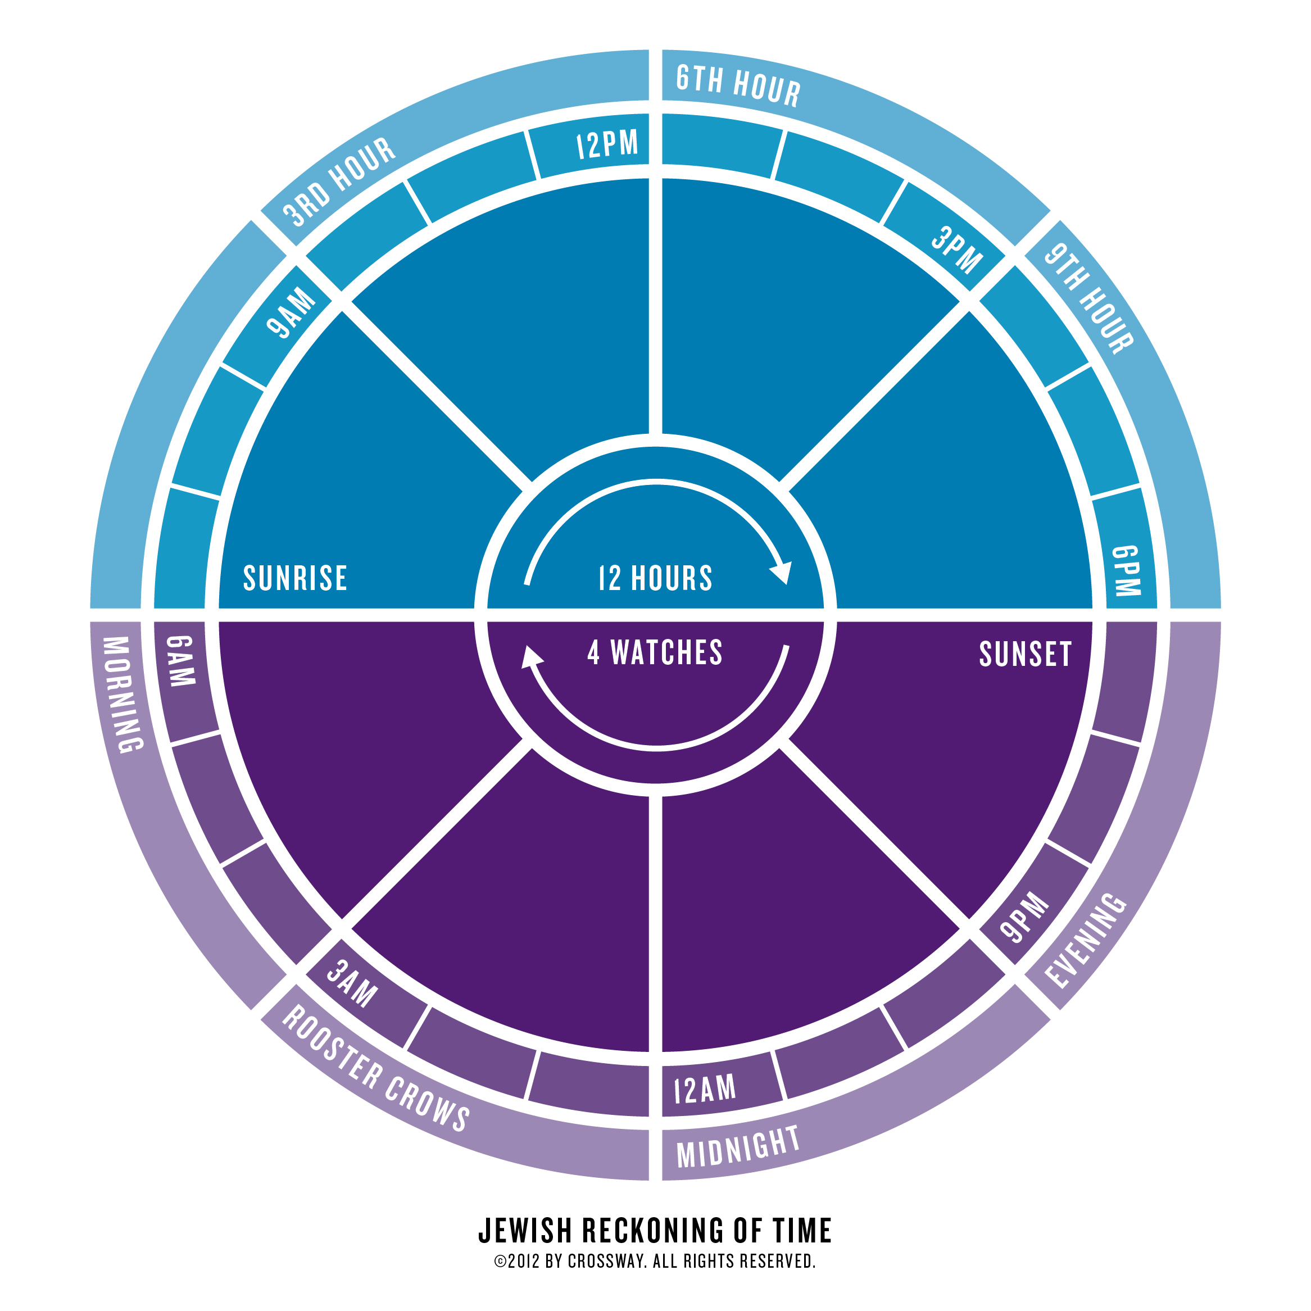

Slide 66
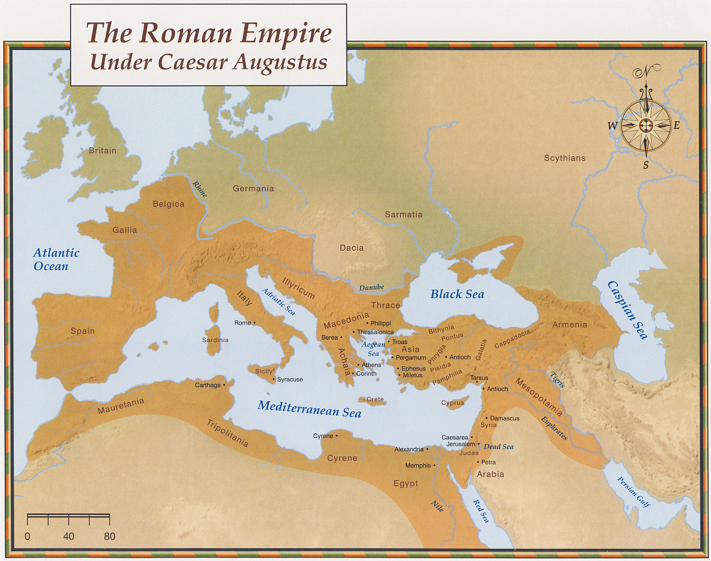

Slide 67
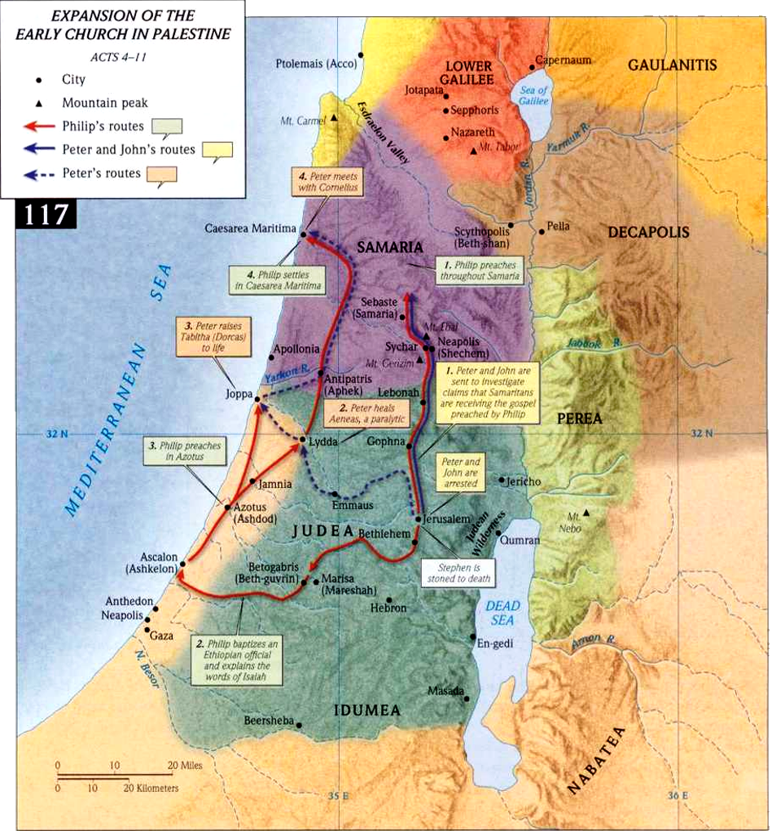
Acts 10:1 (NASB)
1 Now there was a man at Caesarea named Cornelius, a centurion of what was called the Italian cohort,

Slide 68
Acts 10:5-6 (NASB)
5 "Now dispatch some men to Joppa and send for a man named Simon, who is also called Peter;
6 he is staying with a tanner named Simon, whose house is by the sea."

Slide 69
Acts 10:5-6 (NASB)
5 "Now dispatch some men to Joppa and send for a man named Simon, who is also called Peter;
6 he is staying with a tanner named Simon, whose house is by the sea."

Slide 70
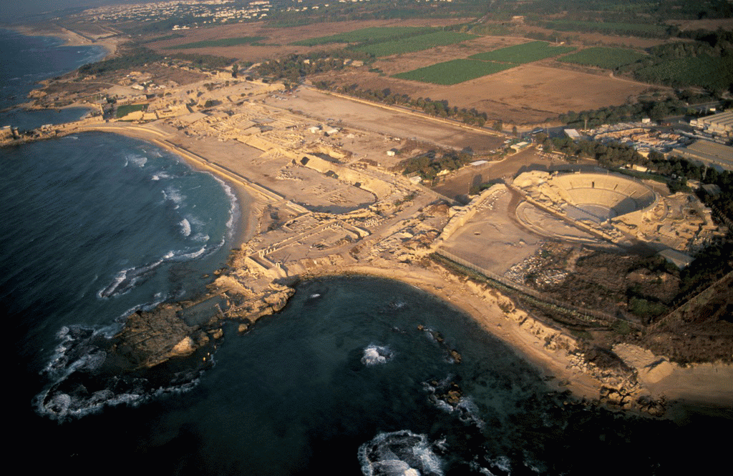
Coastal Plain: Caesarea, Plain of Sharon

Slide 71

Baptism in the name of Jesus Christ
Acts 19:2-6 (NASB)
2 He said to them, "Did you receive the Holy Spirit when you believed?" And they said to him, "No, we have not even heard whether there is a Holy Spirit."
3 And he said, "Into what then were you baptized?" And they said, "Into John's baptism."
4 Paul said, "John baptized with the baptism of repentance, telling the people to believe in Him who was coming after him, that is, in Jesus."
5 When they heard this, they were baptized in the name of the Lord Jesus.
6 And when Paul had laid his hands upon them, the Holy Spirit came on them, and they began speaking with tongues and prophesying.
1. For the forgiveness of sins.
2. A command that can be obeyed
3. Submission to the command to be baptized equals reception of the Gospel.
4. Not in the Holy Spirit
5. In water
6. An order that can be obeyed.
7. Not John’s baptism
8. Not in the Holy Spirit
Acts 8:12-16 (NASB)
12 But when they believed Philip preaching the good news about the kingdom of God and the name of Jesus Christ, they were being baptized, men and women alike.
13 Even Simon himself believed; and after being baptized, he continued on with Philip, and as he observed signs and great miracles taking place, he was constantly amazed.
14 Now when the apostles in Jerusalem heard that Samaria had received the word of God, they sent them Peter and John,
15 who came down and prayed for them that they might receive the Holy Spirit.
16 For He had not yet fallen upon any of them; they had simply been baptized in the name of the Lord Jesus.
Acts 2:38 (NASB)
38 Peter said to them, "Repent, and each of you be baptized in the name of Jesus Christ for the forgiveness of your sins; and you will receive the gift of the Holy Spirit.
Acts 2:41 (NASB)
41 So then, those who had received his word were baptized; and that day there were added about three thousand souls.
Acts 10:47-48 (NASB)
47 "Surely no one can refuse the water for these to be baptized who have received the Holy Spirit just as we did, can he?"
48 And he ordered them to be baptized in the name of Jesus Christ. Then they asked him to stay on for a few days.

Slide 72
Acts 10:1 to 10:48

Slide 73
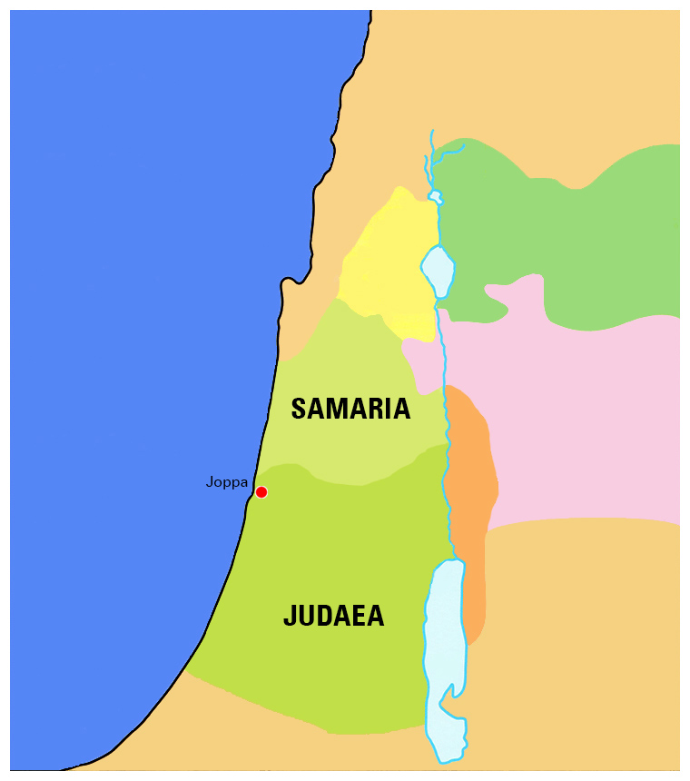
At the end of Acts 9:
…[Peter] tarried many days in Joppa with one Simon a tanner.
But at the same time…

Slide 74
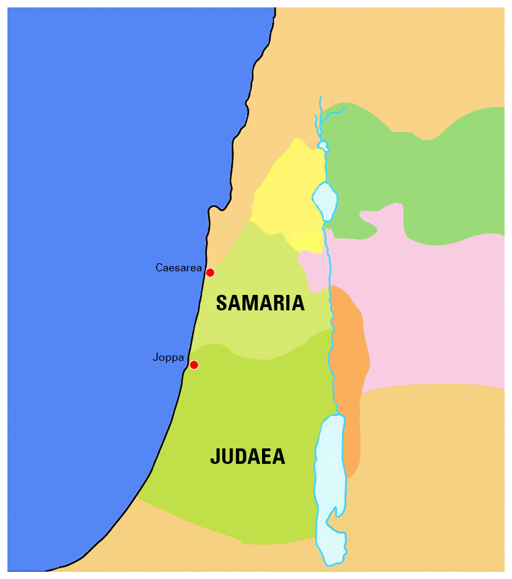
At the end of Acts 9:
…[Peter] tarried many days in Joppa with one Simon a tanner.
But at the same time…
Acts 10:1:
There was a certain man in Caesarea called Cornelius,

Slide 75
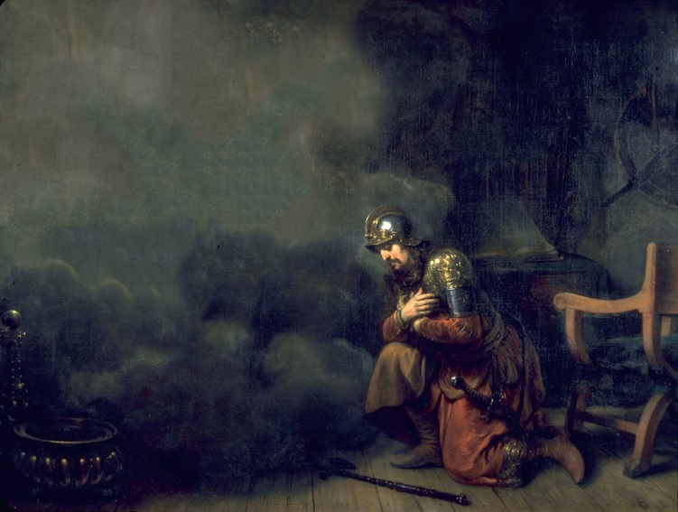
… a centurion of the band called the Italian band,
² A devout man, and one that feared God with all his house, which gave much alms to the people, and prayed to God alway.

Slide 76

³ He saw in a vision evidently about the ninth hour of the day an angel of God coming in to him, and saying unto him,

Slide 77
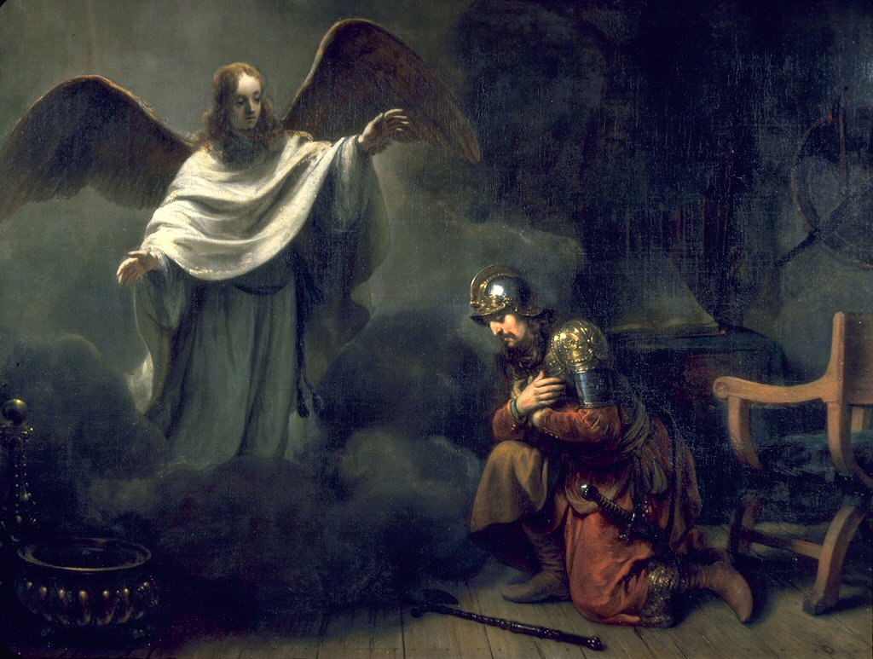

³ He saw in a vision evidently about the ninth hour of the day an angel of God coming in to him, and saying unto him,
⁴ And when he looked on him,
he was afraid, and said,
What is it, Lord?
And he said unto him, Thy prayers and thine alms are come up for a memorial before God.

Slide 78
⁵ And now send men to Joppa, and call for one Simon,
whose surname is Peter:
⁶ He lodgeth with one Simon a tanner, whose house is by the sea side:
he shall tell thee what thou oughtest to do.

Slide 79
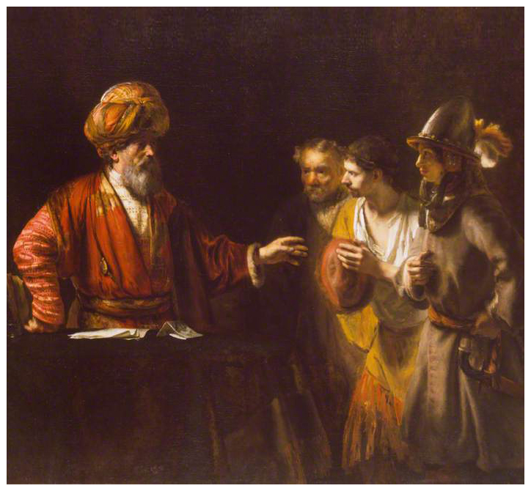
⁷ And when the angel which spake unto Cornelius was departed,
he called two of his household servants, and a devout soldier of them that waited on him continually;
⁸ And when he had declared all these things unto them, he sent them to Joppa.

Slide 80
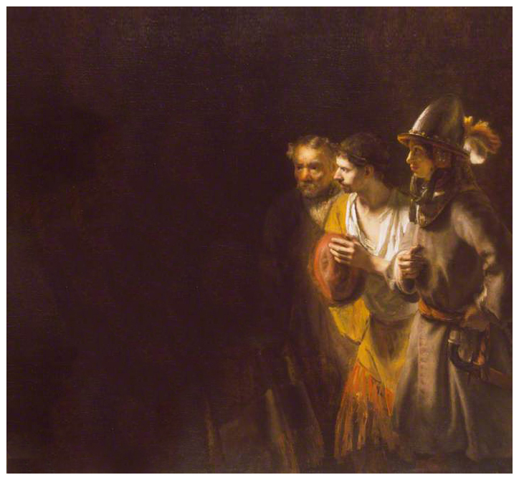
⁹ On the morrow, as they went on their journey, and drew nigh unto the city,

Slide 81
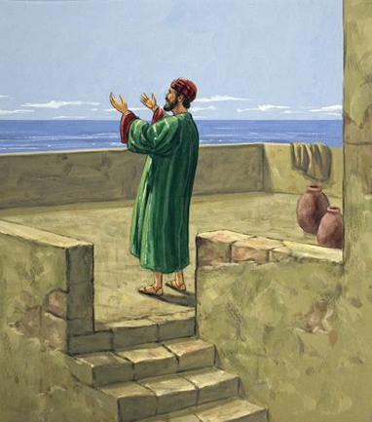
⁹ On the morrow, as they went on their journey, and drew nigh unto the city,
Peter went up upon the housetop to pray about the sixth hour:
¹⁰ And he became very hungry, and would have eaten:

Slide 82
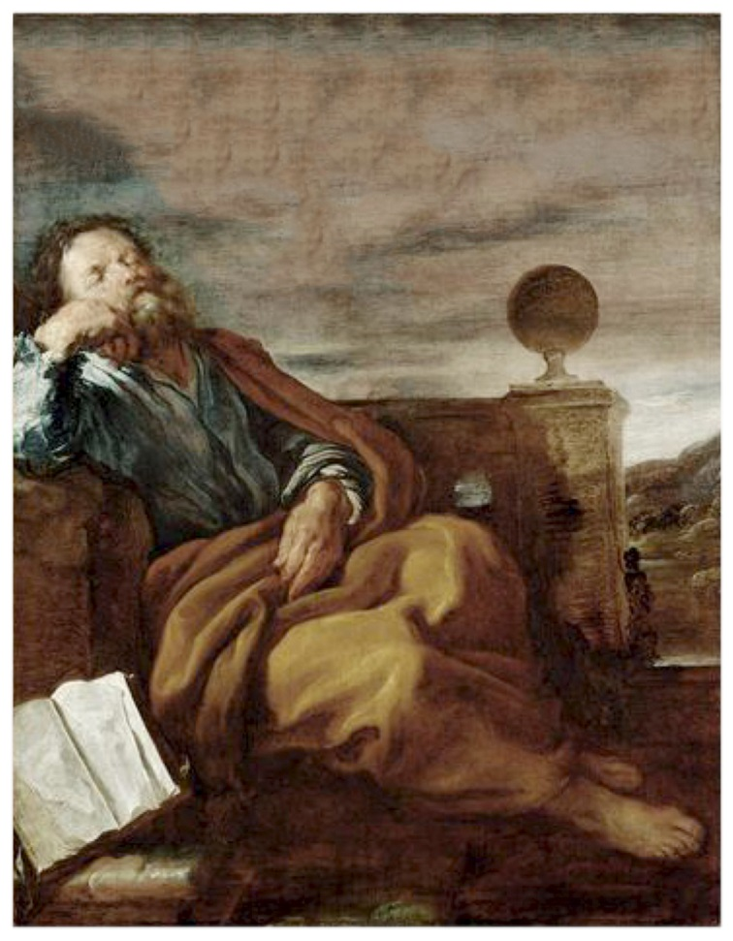
⁹ On the morrow, as they went on their journey, and drew nigh unto the city,
Peter went up upon the housetop to pray about the sixth hour:
¹⁰ And he became very hungry, and would have eaten:
but while they made ready,
he fell into a trance,

Slide 83
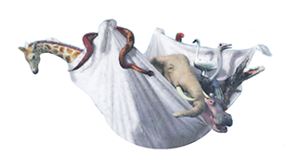


¹¹ And saw heaven opened, and a certain vessel descending unto him,
as it had been a great sheet knit at the four corners, and let down to the earth:
¹² Wherein were all manner of fourfooted beasts of the earth, and wild beasts, and creeping things, and fowls of the air.

Slide 84
Rise, Peter;
kill, and eat.
¹³ And there came a voice to him,

Slide 85
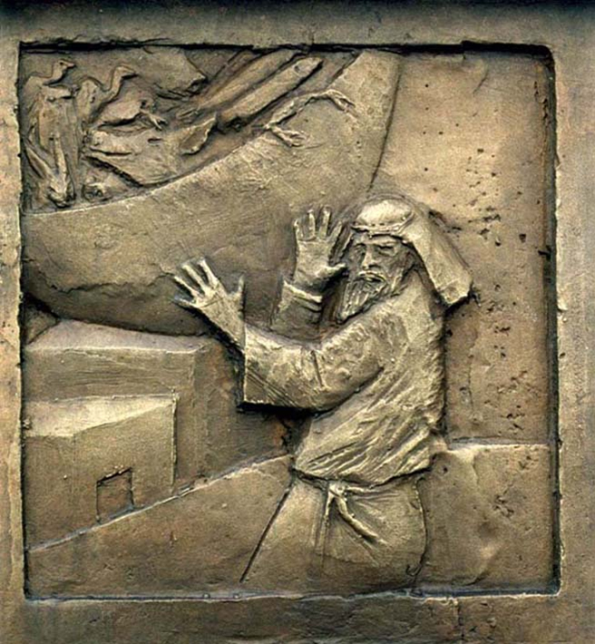
¹⁴ But Peter said, Not so, Lord;
for I have never eaten any thing that is common or unclean.

Slide 86
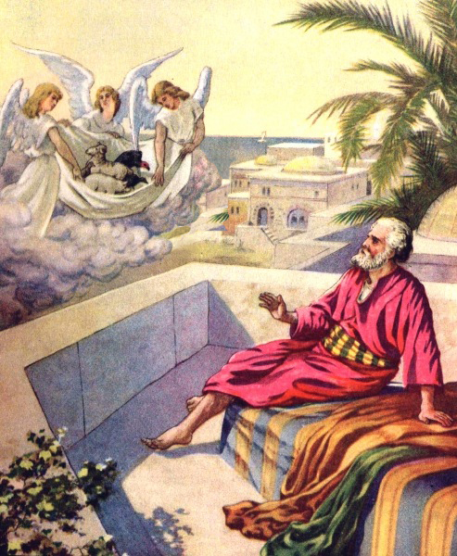
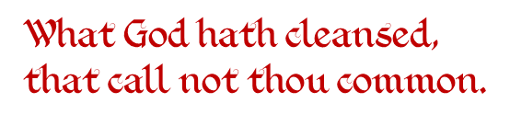
¹⁵ And the voice spake unto him again the second time,

Slide 87
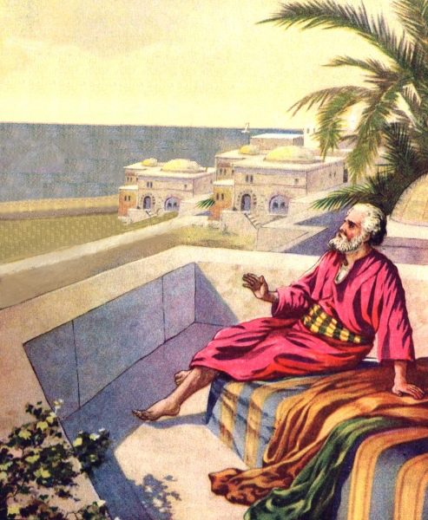
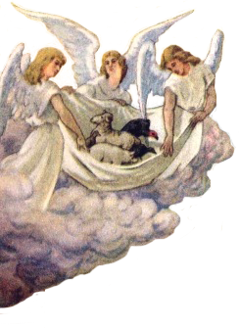
¹⁶ This was done thrice:
and the vessel was received up again into heaven.

Slide 88
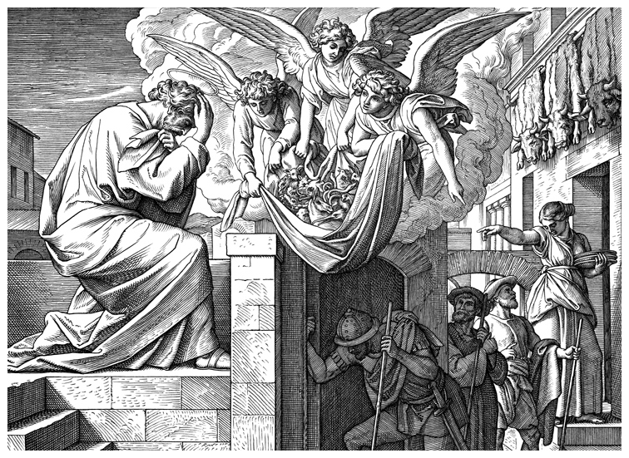
¹⁷ Now while Peter doubted in himself what this vision which he had seen should mean,
behold, the men which were sent from Cornelius had made enquiry for Simon's house, and stood before the gate,
¹⁸ And called, and asked whether Simon, which was surnamed Peter, were lodged there.

Slide 89
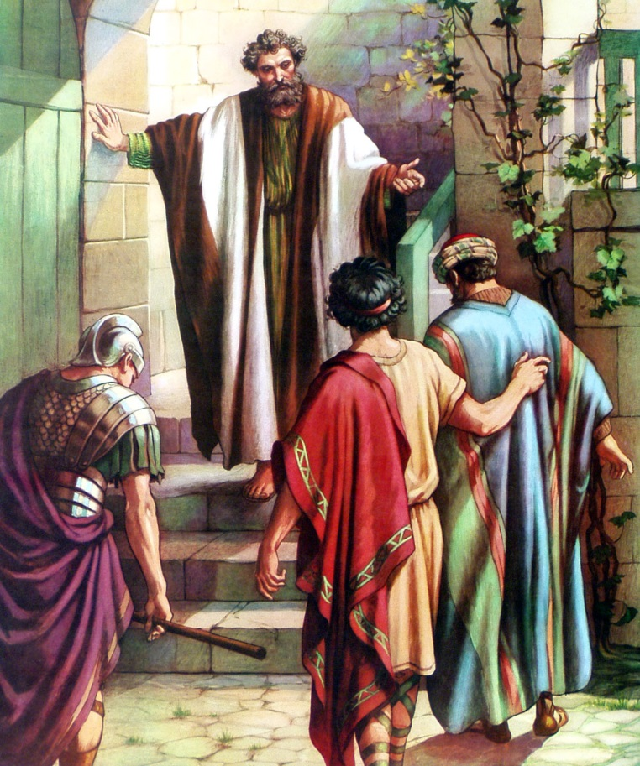
²¹ Then Peter went down to the men which were sent unto him from Cornelius; and said,
Behold, I am he whom ye seek:
what is the cause wherefore ye are come?

Slide 90
²² And they said,
Cornelius the centurion,
a just man,
and one that feareth God,
and of good report among all the nation of the Jews,
was warned from God by an holy angel to send for thee into his house,
and to hear words of thee.

Slide 91
²³ Then called he them in, and lodged them.
And on the morrow Peter went away with them, and certain brethren from Joppa accompanied him.

Slide 92
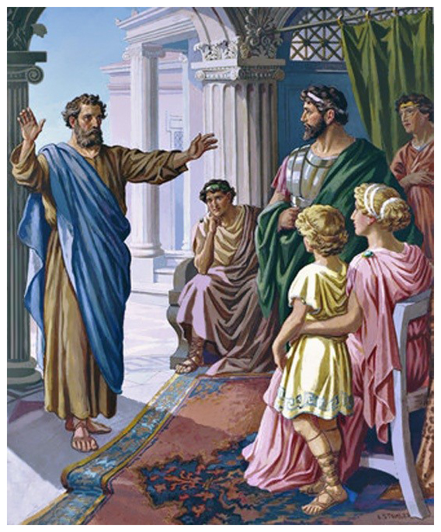
²³ Then called he them in, and lodged them.
And on the morrow Peter went away with them, and certain brethren from Joppa accompanied him.
²⁴ And the morrow after they entered into Caesarea. And Cornelius waited for them, and had called together his kinsmen and near friends.

Slide 93
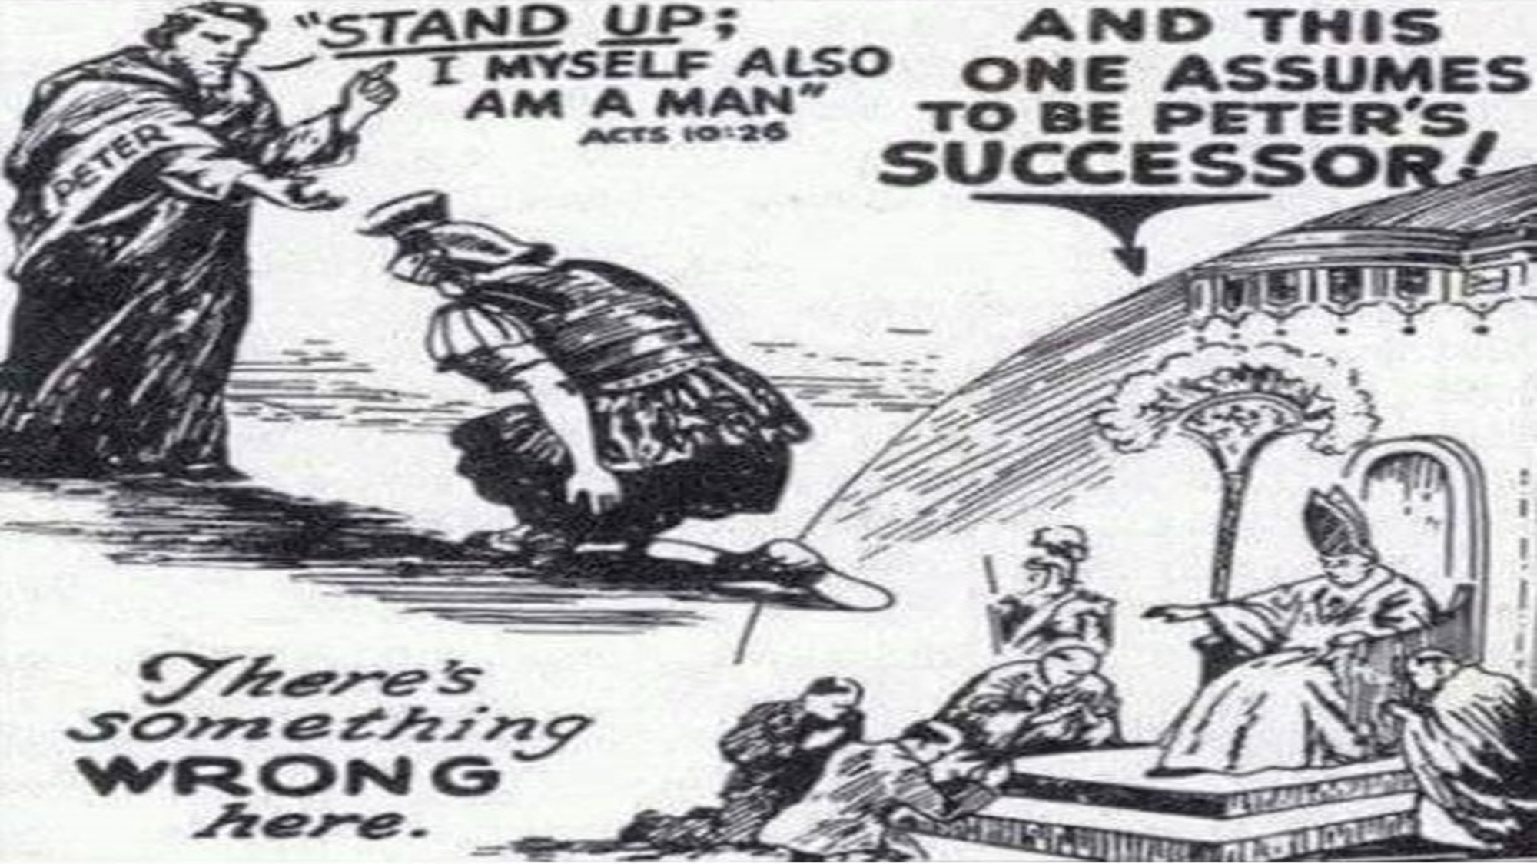
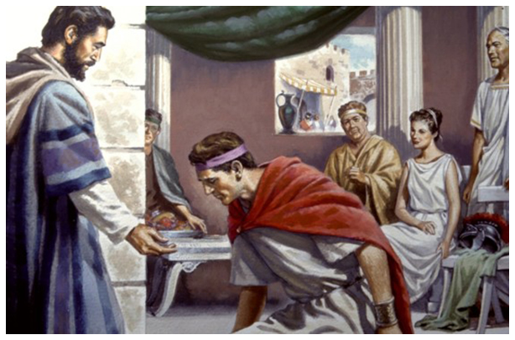
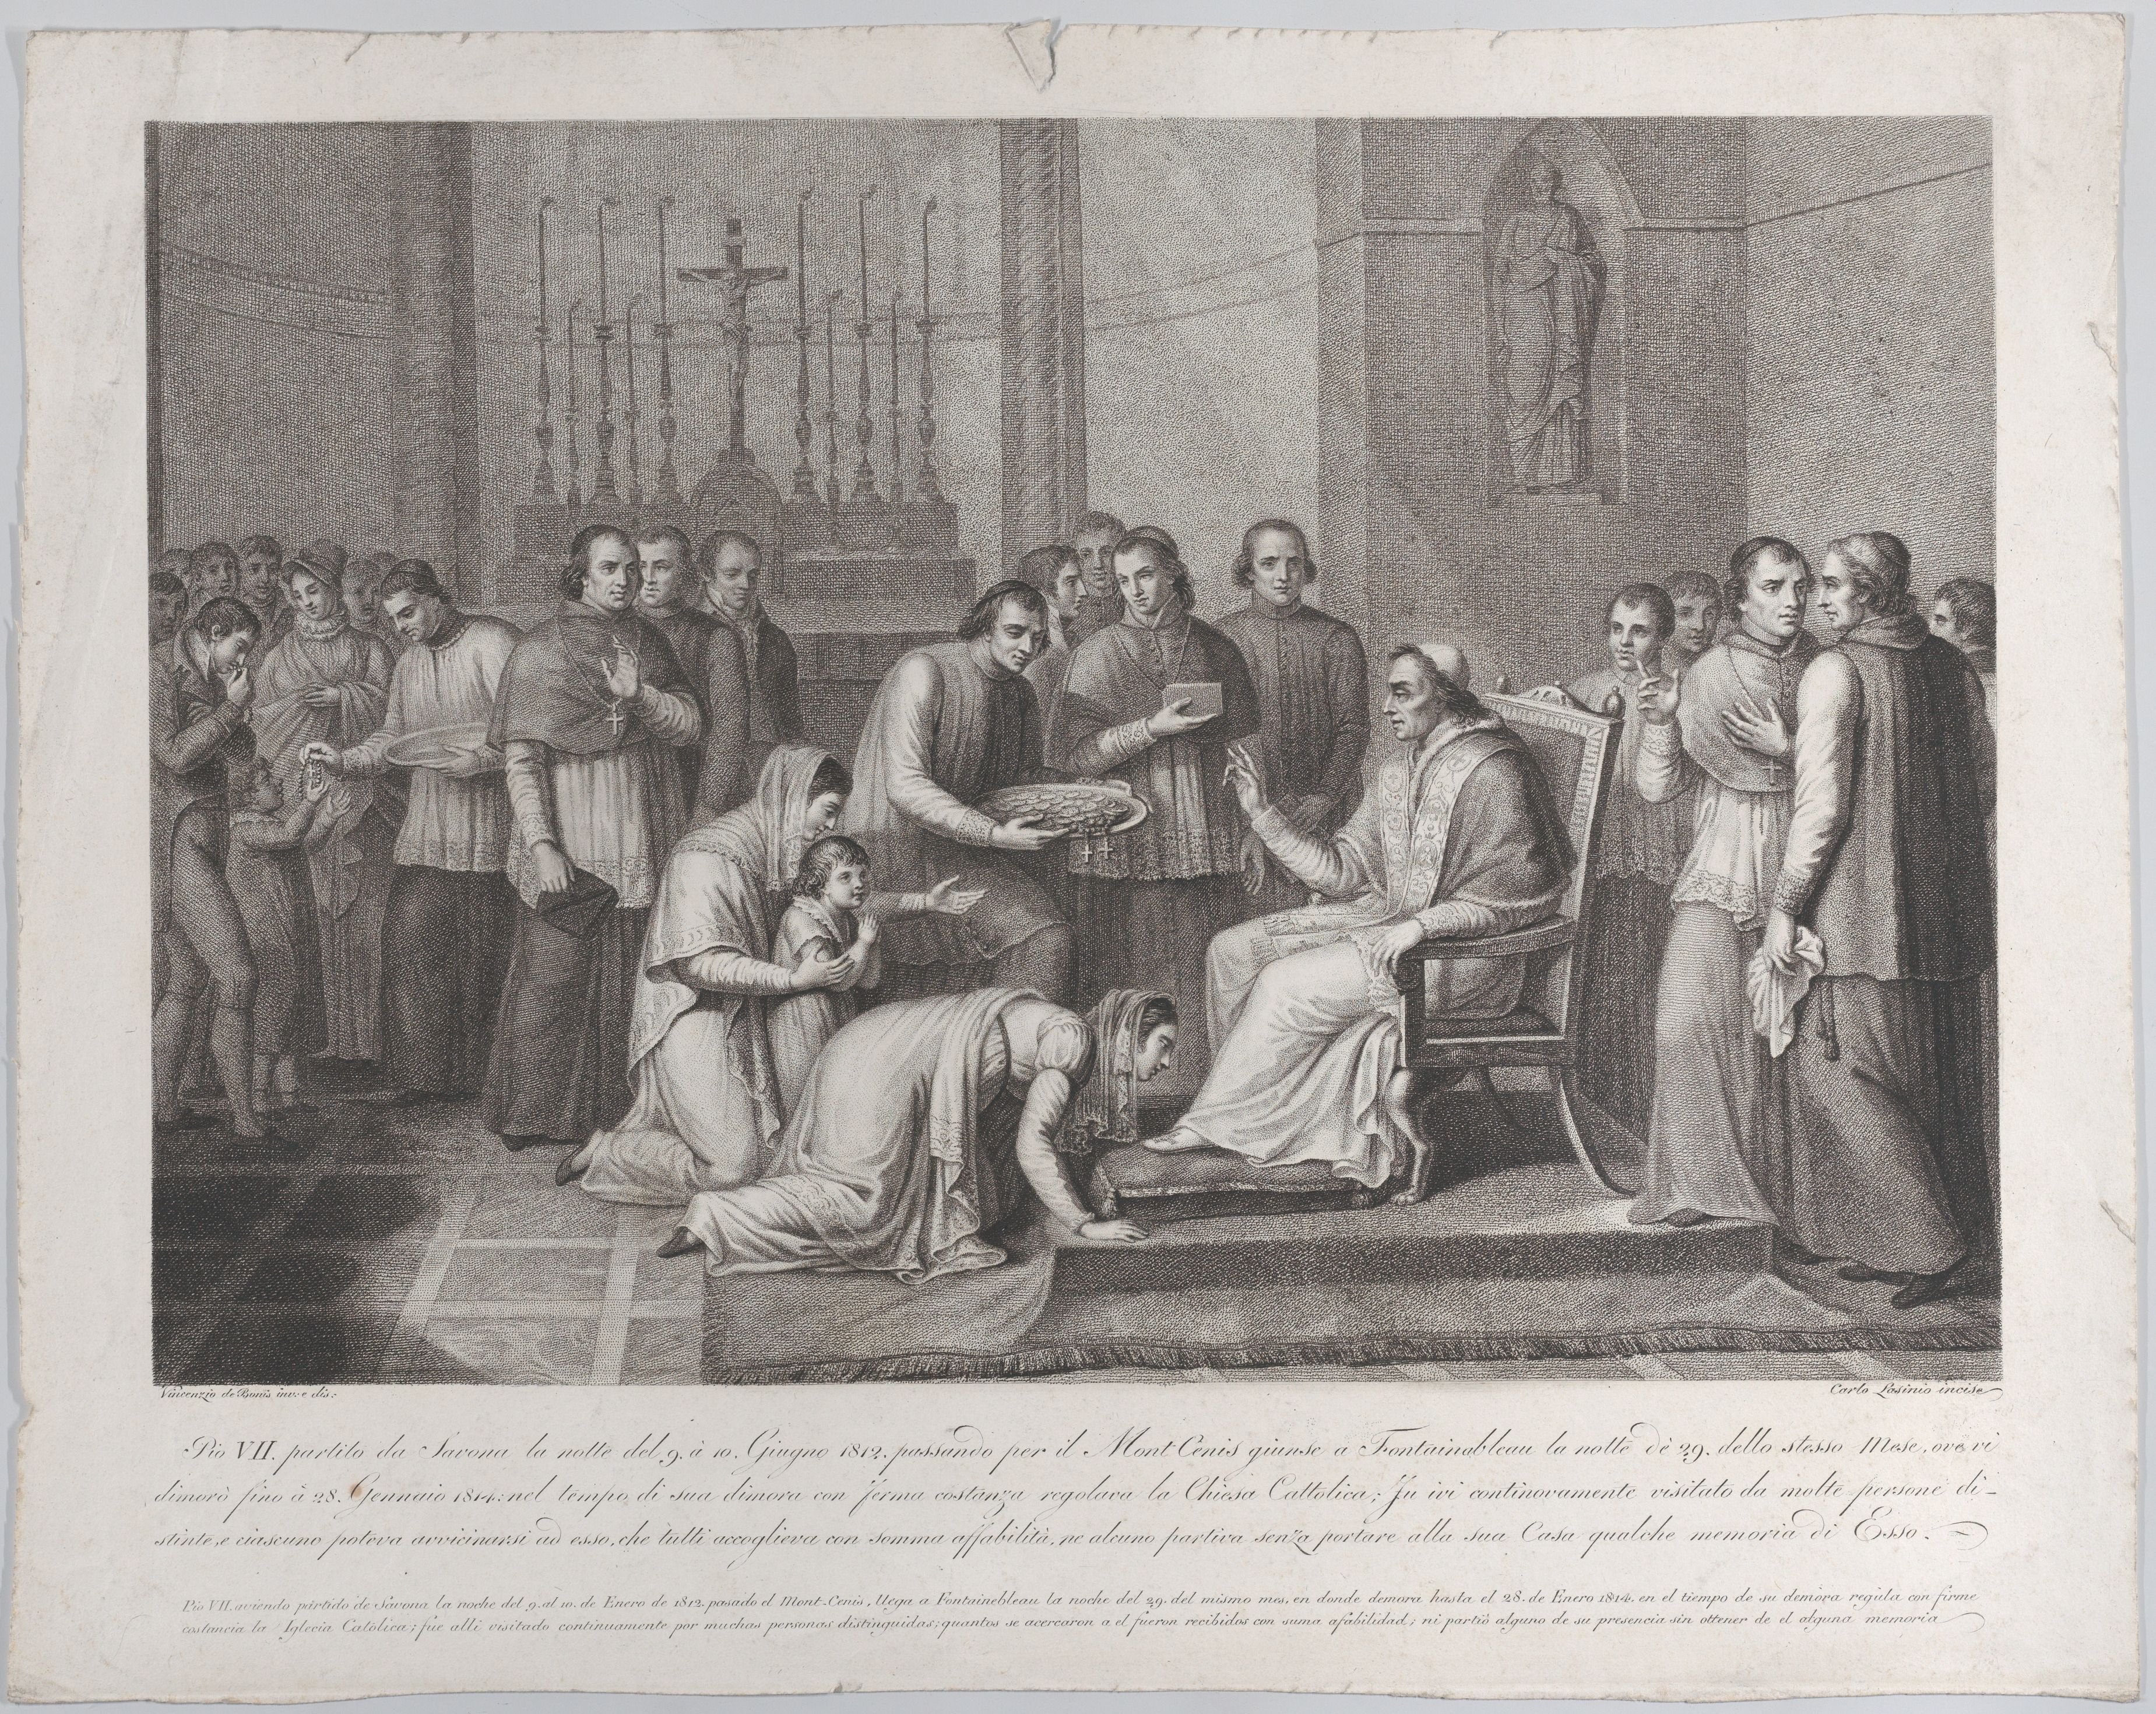
²⁵ And as Peter was coming in, Cornelius met him, and fell down at his feet, and worshipped him.
²⁶ But Peter took him up, saying, Stand up; I myself also am a man.
²⁷ And as he talked with him, he went in, and found many that were come together.
Those that claim to have authority passed down from Peter require the kissing of their feet.

Slide 94

²⁸ And he said unto them, Ye know how that it is an unlawful thing for a man that is a Jew to keep company, or come unto one of another nation;
but God hath shewed me that I should not call any man common or unclean.

Slide 95
²⁹ Therefore came I unto you without gainsaying, as soon as I was sent for:
I ask therefore
for what intent ye have sent for me?

Slide 96
³⁰ And Cornelius said, Four days ago I was fasting until this hour; and at the ninth hour I prayed in my house, and, behold, a man stood before me in bright clothing,
³¹ And said, Cornelius, thy prayer is heard, and thine alms are had in remembrance in the sight of God.
³² Send therefore to Joppa, and call hither Simon, whose surname is Peter;
he is lodged in the house of one Simon a tanner by the sea side: who, when he cometh, shall speak unto thee.
³³ Immediately therefore I sent to thee; and thou hast well done that thou art come. Now therefore are we all here present before God, to hear all things that are commanded thee of God.

Slide 97
³⁴ Then Peter opened his mouth, and said,
³⁵ But in every nation he that feareth him, and worketh righteousness, is accepted with him.
³⁶ The word which God sent unto the children of Israel, preaching peace by Jesus Christ: (he is Lord of all:)
³⁷ That word, I say, ye know, which was published throughout all Judaea, and began from Galilee, after the baptism which John preached;
³⁸ How God anointed Jesus of Nazareth with the Holy Ghost and with power:
who went about doing good, and healing all that were oppressed of the devil;
for God was with him.

Slide 98

⁴² And he commanded us to preach unto the people, and to testify that it is he which was ordained of God to be the Judge of quick and dead.
⁴³ To him give all the prophets witness, that through his name whosoever believeth in him shall receive remission of sins.

Slide 99

⁴⁴ While Peter yet spake these words, the Holy Ghost fell on all them which heard the word.
⁴⁵ And they of the circumcision which believed were astonished, as many as came with Peter, because that on the Gentiles also was poured out the gift of the Holy Ghost.
⁴⁶ For they heard them speak with tongues, and magnify God.

Slide 100

Then answered Peter,
⁴⁷ Can any man forbid water, that these should not be baptized,
which have received the Holy Ghost as well as we?
⁴⁸ And he commanded them to be baptized in the name of the Lord.
Then prayed they him to tarry certain days.
End of Chapter 10

Slide 101
The Acts of the Apostles
Chapter 10

Slide 102
Acts 10:1-8 Cornelius
What were Cornelius’ …
  nationality & job? (1)
  morality and righteousness? (2)
Cornelius’ vision … (3-7)
  Who spoke to Cornelius? (3)
  Where was Cornelius’ initial reaction? (4)
  Did God have respect for his prayers/alms (4)
  What was he commanded to do? (5-6)
  Why not just preach the gospel to him?
  How did Cornelius respond? (7-8)

Slide 103
Acts 10:9-22 Peter’s Vision
Why was Peter on the housetop? (9)
  What happened before the trance? (10)
    What were some others doing?
    What is a trance?
  What did he see (behold)? (11-12)
  What did the voice say? (13)
  Why did Peter refuse? (14)
  What was the response of the voice (15)
      Mark 7:19
  How many times? (16)
  Did Peter “get it?” (17)
  What did the Spirit say to Peter? (19-20)

Slide 104
Acts 10:17-23 Arrival of the Three
Who arrived at this point? (17-18)
  What did the Peter ask them? (21)
  What was their response (22)
  What is the implication: “warned of God?” (22)
  How did Peter treat these Gentiles?

Slide 105
Acts 10:24-29 Greetings
Who went with Peter? (23)
Who did Cornelius invite? (24)
  How did Cornelius greet Peter? (25)
  Did Peter allow this? By what principle? (26)
What did Peter state to them first? (28)
  Whose law is Peter citing? (28)
  Why did he break that law? (28) – Acts 5:29
    How did God show him this? NI
    What did Peter ask again? (29)

Slide 106
Acts 10:30-43 Cornelius’ Response
Cornelius re-tells the story. (30-33)
  “… thy prayer is heard … “
  What did Cornelius ask Peter to tell? (33)
What were Peter’s first words? (34)
  Who is acceptable to God? (35)
  What did Peter expect them to know? (36-38)
  How should they know God was with Jesus? (38)
Who were the witnesses? (39, 41)
  Who were not the witnesses (41)?
Who else bore witness of Jesus (43)
Is verse 43 the essence of the Gospel?

Slide 107
Acts 10:44-46 Baptism in HS
What happened at this point? (44)
  Did anyone expect it? Compare Acts 2
  What does it mean “of the circumcision?” (45)
    Acts 11:2; Gal. 2:12; Tit. 1:10 Judaizers
  Why were they amazed?
  What was “poured out?”
    Recall “poured out?” What chapter?
    Acts 2:17 (Joel) … “upon all flesh”
  What was evidence of the outpouring? (46)
Any scriptural evidence that this happened at any other time apart from the laying on of the apostles’ hands?

Slide 108
Acts 10:47-48 Baptism in Water
What was Peter’s argument? (47)
    Had some been forbidding the water?
    To whom? Why not to the proselytes?
    Meaning: “received the HS?” 8:15-19; 19:2
What was commanded? (48)
  What type of baptism was commanded?
  Would they be saved if they disobeyed?
  Did baptism in the HS indicate their salvation?
What honor did they show Peter? (48)

Slide 109
L.D. CARY & SAM HOLT CATCH PHRASES
Chapter 10 – “The Gentiles Come In”
Chapter 11 – “10 + 1, Peter’s Rerun”
Chapter 12 – “10 + 2, Peter’s Rescue”
Chapter 13 – “10 + 3, First Preaching Spree”
Chapter 14 – “10 + 4, Preaching More”
Chapter 15 – “10 + 5, The Truth Survives”
Chapter 16 – “European Scene”
Chapter 17 – “10 + 7, One God In Heaven”
Chapter 18 – “10 + 8, The Corinth Wait”
“10 + 1… Peter’s Rerun”
Catch Phrase
Chapter Eleven

Slide 110
ACTS
CHAPTER 11
Peter Defends Preaching To And Baptizing Gentiles

Slide 111

Acts 11:1-3 (NASB)
1 Now the apostles and the brethren who were throughout Judea heard that the Gentiles also had received the word of God.
2 And when Peter came up to Jerusalem, those who were circumcised took issue with him,
3 saying, "You went to uncircumcised men and ate with them."
A. Peter travels from Caesarea back to Jerusalem:
B. The apostles and brethren throughout Judea heard that Peter had preached to Gentiles. These circumcised Jewish Christians took issue with what Peter had done. Peter was of the same mind before Cornelius: Acts 10:28
1. Jesus himself set the parameters of who they were to preach to: Mt 10:5-6; 15:24
2. God decided when the gentiles would be allowed in and he had decided Peter would be the apostle used to open the two doors: Mt 16:17-19; Acts 2:14; 15:6-11
Matthew 16:17-19 (NASB)
17 And Jesus said to him, "Blessed are you, Simon Barjona, because flesh and blood did not reveal this to you, but My Father who is in heaven.
18 "I also say to you that you are Peter, and upon this rock I will build My church; and the gates of Hades will not overpower it.
19 "I will give you the keys of the kingdom of heaven; and whatever you bind on earth shall have been bound in heaven, and whatever you loose on earth shall have been loosed in heaven."
Acts 15:6-11 (NASB)
6 The apostles and the elders came together to look into this matter.
7 After there had been much debate, Peter stood up and said to them, "Brethren, you know that in the early days God made a choice among you, that by my mouth the Gentiles would hear the word of the gospel and believe.
8 "And God, who knows the heart, testified to them giving them the Holy Spirit, just as He also did to us;
9 and He made no distinction between us and them, cleansing their hearts by faith.
10 "Now therefore why do you put God to the test by placing upon the neck of the disciples a yoke which neither our fathers nor we have been able to bear?
11 "But we believe that we are saved through the grace of the Lord Jesus, in the same way as they also are."
Acts 10:28 (NASB)
28 And he said to them, "You yourselves know how unlawful it is for a man who is a Jew to associate with a foreigner or to visit him; and yet God has shown me that I should not call any man unholy or unclean.
Matthew 10:5-6 (NASB)
5 These twelve Jesus sent out after instructing them: "Do not go in the way of the Gentiles, and do not enter any city of the Samaritans;
6 but rather go to the lost sheep of the house of Israel.
Acts 2:14 (NASB)
14 But Peter, taking his stand with the eleven, raised his voice and declared to them: "Men of Judea and all you who live in Jerusalem, let this be known to you and give heed to my words.
Matthew 15:24 (NASB)
24 But He answered and said, "I was sent only to the lost sheep of the house of Israel."
Notes:
B. We need to note that God had approved of what was being done up to this time. The Lord had brought the gospel to the Jew first. He had sent the Holy Spirit to fall only upon Jews on the day of Pentecost. They knew it was approved of God to preach to the Jewish people. Though they knew the OT was no longer binding for salvation yet they did continue to keep the traditions and practices of the OT except in those areas which would have been now false. Meaning animal sacrifices for the remission of sins. Heb 10:1-4

Slide 112
Acts 11:4-10 (NASB)
4 But Peter began speaking and proceeded to explain to them in orderly sequence, saying,
5 "I was in the city of Joppa praying; and in a trance I saw a vision, an object coming down like a great sheet lowered by four corners from the sky; and it came right down to me,
6 and when I had fixed my gaze on it and was observing it I saw the four-footed animals of the earth and the wild beasts and the crawling creatures and the birds of the air.
7 "I also heard a voice saying to me, 'Get up, Peter; kill and eat.'
8 "But I said, 'By no means, Lord, for nothing unholy or unclean has ever entered my mouth.'
9 "But a voice from heaven answered a second time, 'What God has cleansed, no longer consider unholy.'
10 "This happened three times, and everything was drawn back up into the sky.
A. Peter explains the vision that God had shown him to the leaders of Jerusalem church. Verse 4
1. Great sheet with all kinds of unclean four footed animals, wild beasts, crawling creatures and birds. He is told to kill and eat. Verses 5-6
2. He refuses because they are unclean. Verses 7-8
3. What God has cleansed no longer consider unholy. Completion of vision. Verses 9-10

Slide 113
Acts 11:11-14 (NASB)
11 "And behold, at that moment three men appeared at the house in which we were staying, having been sent to me from Caesarea.
12 "The Spirit told me to go with them without misgivings. These six brethren also went with me and we entered the man's house.
13 "And he reported to us how he had seen the angel standing in his house, and saying, 'Send to Joppa and have Simon, who is also called Peter, brought here;
14 and he will speak words to you by which you will be saved, you and all your household.’
A. At the moment of the visions completion The three men sent by Cornelius arrive. Verse 11
1. The Holy Spirit tells Peter to go with these Gentile men without misgivings. Peter is accompanied by six of his Jewish Christian brethren. Verse 12
2. Arriving at Caesarea they entered the house of Cornelius. Cornelius explains that an Angel told him to send to Joppa for Peter. Verse 13
3. The Angel told Cornelius that Peter would speak words by which he and his household would be saved. Verse 14; Ro 1:16
Romans 1:16 (NASB)
16 For I am not ashamed of the gospel, for it is the power of God for salvation to everyone who believes, to the Jew first and also to the Greek.

Slide 114


Acts 11:15-18 (NASB)
15 "And as I began to speak, the Holy Spirit fell upon them just as He did upon us at the beginning.
16 "And I remembered the word of the Lord, how He used to say, 'John baptized with water, but you will be baptized with the Holy Spirit.'
17 "Therefore if God gave to them the same gift as He gave to us also after believing in the Lord Jesus Christ, who was I that I could stand in God's way?"
18 When they heard this, they quieted down and glorified God, saying, "Well then, God has granted to the Gentiles also the repentance that leads to life."
A. Peter had only begun to speak the Gospel message when the Holy Spirit fell upon Cornelius and his household just as he did upon the Apostles in the beginning. Acts 2:1-4
1. Peter remembered that Jesus used to say “John baptized with water but YOU will be baptized with the Holy Spirit.” Acts 1:4-5
2. Peters conclusion; if God gave the Gentiles (Cornelius and household) the Holy Spirit as He did the Jews (the Apostles), How could Peter stand in God’s way? Acts 15:7-11
B. Jews at Jerusalem concluded;
Acts 2:1-4 (ASV)
1 And when the day of Pentecost was now come, they were all together in one place.
2 And suddenly there came from heaven a sound as of the rushing of a mighty wind, and it filled all the house where they were sitting.
3 And there appeared unto them tongues parting asunder, like as of fire; and it sat upon each one of them.
4 And they were all filled with the Holy Spirit, and began to speak with other tongues, as the Spirit gave them utterance.
Acts 1:4-5 (ASV)
4 and, being assembled together with them, he charged them not to depart from Jerusalem, but to wait for the promise of the Father, which, said he, ye heard from me:
5 For John indeed baptized with water; but ye shall be baptized in the Holy Spirit not many days hence.
Acts 15:7-11 (ASV)
7 And when there had been much questioning, Peter rose up, and said unto them, Brethren, ye know that a good while ago God made choice among you, that by my mouth the Gentiles should hear the word of the gospel, and believe.
8 And God, who knoweth the heart, bare them witness, giving them the Holy Spirit, even as he did unto us;
9 and he made no distinction between us and them, cleansing their hearts by faith.
10 Now therefore why make ye trial of God, that ye should put a yoke upon the neck of the disciples which neither our fathers nor we were able to bear?
11 But we believe that we shall be saved through the grace of the Lord Jesus, in like manner as they.
Notes:
Jews and Gentiles are the same in God’s eyes just as all the animals were clean in Peter’s vision. No longer were they to call unholy or unclean what God has cleansed. God cleansed simply means that God has made the Gentiles acceptable candidates to hear the Gospel.

Slide 115
Acts 11:19-21 (NASB)
19 So then those who were scattered because of the persecution that occurred in connection with Stephen made their way to Phoenicia and Cyprus and Antioch, speaking the word to no one except to Jews alone.
20 But there were some of them, men of Cyprus and Cyrene, who came to Antioch and began speaking to the Greeks also, preaching the Lord Jesus.
21 And the hand of the Lord was with them, and a large number who believed turned to the Lord.
A. Before Cornelius they taught Jews alone. The news spread very quickly and some were now preaching to the Greeks (Gentiles).
1. We must stress at this point that there would have been no conversions except the Gospel was preached. People need to hear before they can believe and be saved. Acts 15:7; Ro 10:12-15;
1Cor 3:5-9
2. Large numbers of Gentiles believed and turned to the Lord. Turning is an expression meaning they returned to God. Heard, believed, repented and been baptized. Acts 2:36-38
Acts 2:36-38 (NASB)
36 "Therefore let all the house of Israel know for certain that God has made Him both Lord and Christ—this Jesus whom you crucified."
37 Now when they heard this, they were pierced to the heart, and said to Peter and the rest of the apostles, "Brethren, what shall we do?"
38 Peter said to them, "Repent, and each of you be baptized in the name of Jesus Christ for the forgiveness of your sins; and you will receive the gift of the Holy Spirit.
Romans 10:12-15 (NASB)
12 For there is no distinction between Jew and Greek; for the same Lord is Lord of all, abounding in riches for all who call on Him;
13 for "WHOEVER WILL CALL ON THE NAME OF THE LORD WILL BE SAVED."
14 How then will they call on Him in whom they have not believed? How will they believe in Him whom they have not heard? And how will they hear without a preacher?
15 How will they preach unless they are sent? Just as it is written, "HOW BEAUTIFUL ARE THE FEET OF THOSE WHO BRING GOOD NEWS OF GOOD THINGS!"
1 Corinthians 3:5-9 (NASB)
5 What then is Apollos? And what is Paul? Servants through whom you believed, even as the Lord gave opportunity to each one.
6 I planted, Apollos watered, but God was causing the growth.
7 So then neither the one who plants nor the one who waters is anything, but God who causes the growth.
8 Now he who plants and he who waters are one; but each will receive his own reward according to his own labor.
9 For we are God's fellow workers; you are God's field, God's building.
REPENT
Greek NASB Number: 3340
Greek Word: μετανοέω
Definition: to change one's mind or purpose:--
New American Standard Exhaustive Concordance of the Bible
Acts 15:7 (NASB)
7 After there had been much debate, Peter stood up and said to them, "Brethren, you know that in the early days God made a choice among you, that by my mouth the Gentiles would hear the word of the gospel and believe.

Slide 116



Acts 11:22-26 (NASB)
22 The news about them reached the ears of the church at Jerusalem, and they sent Barnabas off to Antioch.
23 Then when he arrived and witnessed the grace of God, he rejoiced and began to encourage them all with resolute heart to remain true to the Lord;
24 for he was a good man, and full of the Holy Spirit and of faith. And considerable numbers were brought to the Lord.
25 And he left for Tarsus to look for Saul;
26 and when he had found him, he brought him to Antioch. And for an entire year they met with the church and taught considerable numbers; and the disciples were first called Christians in Antioch.
A. Barnabas sent to Antioch: Acts 11:20-21;
B. He witnessed the grace of God, encouraging them: Acts 13:43; 20:24, 32; 4:36-37;
1. Good man, full of the Holy Spirit and faith: Lk 14:1; Acts 6:3; 7:55
C. Called Christians first at Antioch - Why: They were taught by knowledgeable faithful men – To conform to Christ’s image: Acts 20:20-21, 26-27; Ro 1:16-17
Acts 20:20-21 (NASB)
20 how I did not shrink from declaring to you anything that was profitable, and teaching you publicly and from house to house,
21 solemnly testifying to both Jews and Greeks of repentance toward God and faith in our Lord Jesus Christ.
Acts 20:26-27 (NASB)
26 "Therefore, I testify to you this day that I am innocent of the blood of all men.
27 "For I did not shrink from declaring to you the whole purpose of God.
Romans 1:16-17 (NASB)
16 For I am not ashamed of the gospel, for it is the power of God for salvation to everyone who believes, to the Jew first and also to the Greek.
17 For in it the righteousness of God is revealed from faith to faith; as it is written, "BUT THE RIGHTEOUS man SHALL LIVE BY FAITH."
Acts 13:43 (NASB)
43 Now when the meeting of the synagogue had broken up, many of the Jews and of the God- fearing proselytes followed Paul and Barnabas, who, speaking to them, were urging them to continue in the grace of God.
Acts 20:24 (NASB)
24 "But I do not consider my life of any account as dear to myself, so that I may finish my course and the ministry which I received from the Lord Jesus, to testify solemnly of the gospel of the grace of God.
Acts 20:32 (NASB)
32 "And now I commend you to God and to the word of His grace, which is able to build you up and to give you the inheritance among all those who are sanctified.
Luke 4:1 (NASB)
¹ Jesus, full of the Holy Spirit, returned from the Jordan and was led around by the Spirit in the wilderness
Acts 6:3 (NASB)
³ "Therefore, brethren, select from among you seven men of good reputation, full of the Spirit and of wisdom, whom we may put in charge of this task.
Acts 7:55 (NASB)
⁵⁵ But being full of the Holy Spirit, he gazed intently into heaven and saw the glory of God, and Jesus standing at the right hand of God;
Acts 11:20-21 (NASB)
²⁰ But there were some of them, men of Cyprus and Cyrene, who came to Antioch and began speaking to the Greeks also, preaching the Lord Jesus.
²¹ And the hand of the Lord was with them, and a large number who believed turned to the Lord.
Acts 4:36-37 (NASB)
36 Now Joseph, a Levite of Cyprian birth, who was also called Barnabas by the apostles (which translated means Son of Encouragement),
37 and who owned a tract of land, sold it and brought the money and laid it at the apostles' feet.
Notes:
12/10/2017
Barnabas was full of the Holy Spirit. Since he was also full of faith it would seem that the Spirit was actually helping him with his work. Just as Stephen, while he was dying, because he was full of the Holy Spirit was able to see Jesus. It is my opinion that since he was a member at Jerusalem where the apostles were that he had their hands laid on him at some point.

Slide 117

Acts 11:27-30 (NASB)
27 Now at this time some prophets came down from Jerusalem to Antioch.
28 One of them named Agabus stood up and began to indicate by the Spirit that there would certainly be a great famine all over the world. And this took place in the reign of Claudius.
29 And in the proportion that any of the disciples had means, each of them determined to send a contribution for the relief of the brethren living in Judea.
30 And this they did, sending it in charge of Barnabas and Saul to the elders.
A. The early church was a benevolent toward their brethren in need:
1. A famine came in the days of Claudius. This created the need in the church/churches in Judea. The Jerusalem church in particular would have had such a need because of the unique circumstances that existed there after Pentecost.
2. In proportion to their means the disciples determined to send relief. Each disciple, according to their ability, gave specifically for this need of benevolence. 2Cor 8:1-5, 11-15;
Ro 15:26-27; 1Cor 9:11
3. The funds were given to trusted members, Paul and Barnabas, who then took the funds and gave them to the elders of the church/churches in need.
2 Corinthians 8:11-15 (NASB)
11 But now finish doing it also, so that just as there was the readiness to desire it, so there may be also the completion of it by your ability.
12 For if the readiness is present, it is acceptable according to what a person has, not according to what he does not have.
13 For this is not for the ease of others and for your affliction, but by way of equality—
14 at this present time your abundance being a supply for their need, so that their abundance also may become a supply for your need, that there may be equality;
15 as it is written, "HE WHO gathered MUCH DID NOT HAVE TOO MUCH, AND HE WHO gathered LITTLE HAD NO LACK."
2 Corinthians 8:1-5 (NASB)
¹ Now, brethren, we wish to make known to you the grace of God which has been given in the churches of Macedonia,
² that in a great ordeal of affliction their abundance of joy and their deep poverty overflowed in the wealth of their liberality.
³ For I testify that according to their ability, and beyond their ability, they gave of their own accord,
⁴ begging us with much urging for the favor of participation in the support of the saints,
⁵ and this, not as we had expected, but they first gave themselves to the Lord and to us by the will of God.
Romans 15:26-27 (NASB)
²⁶ For Macedonia and Achaia have been pleased to make a contribution for the poor among the saints in Jerusalem.
²⁷ Yes, they were pleased to do so, and they are indebted to them. For if the Gentiles have shared in their spiritual things, they are indebted to minister to them also in material things.
1 Corinthians 9:11 (NASB)
¹¹ If we sowed spiritual things in you, is it too much if we reap material things from you?
Notes:
12/17/2017
Start 2

Slide 118

The Baptism of Holy Spirit
The Jews and The Gentiles
BAPTISM OF THE
HOLY SPIRIT
Day of Pentecost
Twelve Jewish Apostles Stood As Representatives Of The Circumcised
Acts 10:44-47 (NASB)
44 While Peter was still speaking these words, the Holy Spirit fell upon all those who were listening to the message.
45 All the circumcised believers who came with Peter were amazed, because the gift of the Holy Spirit had been poured out on the Gentiles also.
46 For they were hearing them speaking with tongues and exalting God. Then Peter answered,
47 "Surely no one can refuse the water for these to be baptized who have received the Holy Spirit just as we did, can he?"
Galatians 2:7-8 (NASB)
7 But on the contrary, seeing that I had been entrusted with the gospel to the uncircumcised, just as Peter had been to the circumcised
8 (for He who effectually worked for Peter in his apostleship to the circumcised effectually worked for me also to the Gentiles),
Acts 10:28 (NASB)
28 And he said to them, "You yourselves know how unlawful it is for a man who is a Jew to associate with a foreigner or to visit him; and yet God has shown me that I should not call any man unholy or unclean.
Acts 11:19 (NASB)
19 So then those who were scattered because of the persecution that occurred in connection with Stephen made their way to Phoenicia and Cyprus and Antioch, speaking the word to no one except to Jews alone.
Acts 15:7-9 (NASB)
7 After there had been much debate, Peter stood up and said to them, "Brethren, you know that in the early days God made a choice among you, that by my mouth the Gentiles would hear the word of the gospel and believe.
Cornelius And Household
Stood As Representatives
Of the Uncircumcised
Acts 11:15-17 (NASB)
15 "And as I began to speak, the Holy Spirit fell upon them just as He did upon us at the beginning.
16 "And I remembered the word of the Lord, how He used to say, 'John baptized with water, but you will be baptized with the Holy Spirit.'
17 "Therefore if God gave to them the same gift as He gave to us also after believing in the Lord Jesus Christ, who was I that I could stand in God's way?"
Acts 1:5 (NASB)
5 for John baptized with water, but you will be baptized with the Holy Spirit not many days from now."
Acts 2:1, 4 (NASB)
1 When the day of Pentecost had come, they were all together in one place.
4 And they were all filled with the Holy Spirit and began to speak with other tongues, as the Spirit was giving them utterance.
8 "And God, who knows the heart, testified to them giving them the Holy Spirit, just as He also did to us;
9 and He made no distinction between us and them, cleansing their hearts by faith.
Acts 11:18 (NASB)
18 When they heard this, they quieted down and glorified God, saying, "Well then, God has granted to the Gentiles also the repentance that leads to life."
The Gospel Is Only Preached To The Circumcised
The Gospel Is Preached
To The Uncircumcised

Slide 119

Purpose of Heart
Acts 11:23 (NASB)
²³ Then when he arrived and witnessed the grace of God, he rejoiced and began to encourage them all with resolute heart to remain true to the Lord;
Remain True To God By Bearing The Image Of Christ In Our Lives
The Mind (inner man) Purposes
What Does God Want Us To Purpose?
Ephesians 4:23-24 (NASB)
²³ and that you be renewed in the spirit of your mind,
²⁴ and put on the new self, which in the likeness of God has been created in righteousness and holiness of the truth.
Ephesians 1:11 (NASB)
¹¹ also we have obtained an inheritance, having been predestined according to His purpose who works all things after the counsel of His will,
God Wants The Purpose Of Our Heart - To Carry Out His Will And Be Like Him
Romans 8:28 (NASB)
²⁸ And we know that God causes all things to work together for good to those who love God, to those who are called according to His purpose.
Romans 8:29 (NASB)
²⁹ For those whom He foreknew, He also predestined to become conformed to the image of His Son, so that He would be the firstborn among many brethren;
Romans 12:2 (NASB)
² And do not be conformed to this world, but be transformed by the renewing of your mind, so that you may prove what the will of God is, that which is good and acceptable and perfect.
Galatians 2:20 (NASB)
²⁰ "I have been crucified with Christ; and it is no longer I who live, but Christ lives in me; and the life which I now live in the flesh I live by faith in the Son of God, who loved me and gave Himself up for me.

Slide 120


BENEVOLENCE IN ACTS 11:27-30
Josephus, in his annals refers to it:
Her arrival (Queen Helena of Adiabene) was very advantageous to the people of Jerusalem; for a famine oppressed them at that time, and many people died for want of money to procure food. Queen Helena sent some of her servants to Alexandria with money to buy a great quantity of grain, and others of them to Cyprus to bring back a cargo of dried figs. They quickly returned with the provisions, which she immediately distributed to those that need. She has thus left a most excellent memorial by the beneficence which she bestowed upon our nation. And when her son Izates was informed of this famine, he sent great sums of money to the principal men in Jerusalem.
Antiquities 20.2.5 49-53
WORLD
Famine in whole world (Roman Empire)
Famine in the days of Claudius 45 A.D.
Disciples send relief to the brethren
They chose two members of the Antioch church to carry their benevolence to the elders
Notes:
Claudius was emperor from 41 – 54 AD. Four famines occurred during the reign of Claudius. The first famine during this period was centered around the city of Rome in the years 41 and 42 A.D. The second famine known to have occurred during the reign of Claudius was in the fourth year of his office (45 A.D.), and was particularly centered in Judea. The third famine during the time of Claudius was centered in Greece in about A.D. 50. The fourth famine took place in 52 A.D. and once again, plagued the city of Rome.
Josephus mentions Queen Helena of Adiabene helping the Jews during this famine.

Slide 121
Acts 11:1-3 (NASB)
1 Now the apostles and the brethren who were throughout Judea heard that the Gentiles also had received the word of God.
2 And when Peter came up to Jerusalem, those who were circumcised took issue with him,
3 saying, "You went to uncircumcised men and ate with them."

Slide 122


Slide 123

Acts 11:1
And the apostles and brethren that were in Judaea heard that the Gentiles had also received the word of God.
² And when Peter was come up to Jerusalem, they that were of the circumcision contended with him,
³ Saying, Thou wentest in to men uncircumcised, and didst eat with them.
⁴ But Peter rehearsed the matter from the beginning, and expounded it by order unto them, saying,

Slide 124

⁵ I was in the city of Joppa praying: and in a trance I saw a vision,
A certain vessel descend, as it had been a great sheet, let down from heaven by four corners; and it came even to me:
⁶ Upon the which when I had fastened mine eyes, I considered, and saw fourfooted beasts of the earth, and wild beasts, and creeping things, and fowls of the air.

Slide 125
⁷ And I heard a voice saying unto me, Arise, Peter; slay and eat.
⁸ But I said, Not so, Lord: for nothing common or unclean hath at any time entered into my mouth.
⁹ But the voice answered me again from heaven, What God hath cleansed, that call not thou common.
¹⁰ And this was done three times: and all were drawn up again into heaven.

Slide 126

¹¹ And, behold, immediately there were three men already come unto the house where I was, sent from Caesarea unto me.
¹² And the Spirit bade me go with them, nothing doubting. Moreover these six brethren accompanied me, and we entered into the man's house:
¹³ And he shewed us how he had seen an angel in his house, which stood and said unto him,

Slide 127
Send men to Joppa, and call for Simon, whose surname is Peter;
¹⁴ Who shall tell thee words, whereby thou and all thy house shall be saved.
¹⁵ And as I began to speak, the Holy Ghost fell on them, as on us at the beginning.
¹⁶ Then remembered I the word of the Lord, how that he said, John indeed baptized with water; but ye shall be baptized with the Holy Ghost.

Slide 128

¹⁷ Forasmuch then as God gave them the like gift as he did unto us, who believed on the Lord Jesus Christ;
what was I, that I could withstand God?

Slide 129

¹⁸ When they heard these things,
they held their peace,
and glorified God, saying,
Then hath God also to the Gentiles granted repentance unto life.

Slide 130

¹⁹ Now they which were scattered abroad upon the persecution that arose about Stephen travelled as far as Phenice,
and Cyprus,
and Antioch,

Slide 131

¹⁹ Now they which were scattered abroad upon the persecution that arose about Stephen travelled as far as Phenice,
and Cyprus,
and Antioch,

Slide 132

¹⁹ Now they which were scattered abroad upon the persecution that arose about Stephen travelled as far as Phenice,
and Cyprus,
and Antioch,

Slide 133

¹⁹ Now they which were scattered abroad upon the persecution that arose about Stephen travelled as far as Phenice,
and Cyprus,
and Antioch,

Slide 134

²⁰ And some of them were men of Cyprus and Cyrene,
which, when they were come to Antioch,
spake unto the Grecians, preaching the Lord Jesus.
²¹ And the hand of the Lord was with them:
and a great number believed, and turned unto the Lord.

Slide 135

²² Then tidings of these things came unto the ears of the church which was in Jerusalem: and they sent forth Barnabas, that he should go as far as Antioch.
²³ Who, when he came, and had seen the grace of God, was glad, and exhorted them all, that with purpose of heart they would cleave unto the Lord.

Slide 136
²⁴ For he was a good man, and full of the Holy Ghost and of faith:
and much people was added unto the Lord.

Slide 137

²⁵ Then departed Barnabas to Tarsus, for to seek Saul:
²⁶ And when he had found him, he brought him unto Antioch.

Slide 138

And it came to pass, that a whole year they assembled themselves with the church, and taught much people.
And the disciples were called Christians first in Antioch.

Slide 139


Slide 140

²⁷ And in these days came prophets from Jerusalem unto Antioch.
²⁸ And there stood up one of them named Agabus, and signified by the Spirit that there should be great dearth throughout all the world: which came to pass in the days of Claudius Caesar.

Slide 141

Claudius (Tiberius Claudius Caesar Augustus Germanicus) was the emperor of Rome from 41 to 54 AD.
He is the only named Roman emperor in the Bible. The unnamed Caesar to whom Paul later made his appeal was Nero, the stepson of Claudius.

Slide 142

²⁹ Then the disciples, every man according to his ability, determined to send relief unto the brethren which dwelt in Judaea:
³⁰ Which also they did, and sent it to the elders by the hands of Barnabas and Saul.
This is the first mention of “elders” in the Christian churches.
End of Chapter 11

Slide 143
The Acts
of the Apostles
Chapter 11

Slide 144
Review
Acts 10:47-48 Baptism in Water
Think about Peter’s missionary journeys
  Acts 9:32
What was Peter’s argument? (47)
    Had some been forbidding the water?
    What is the meaning here:
    “received the HS?” 8:15-19; 19:2
What was commanded? (48)
  What type of baptism was commanded?
  Would they be saved if they disobeyed?
  Did baptism in the HS indicate their salvation?
What honor did they show Peter? (48)

Slide 145
Acts 11:1-3 Peter Challenged
Who heard about these events? (1)
Who contended with Peter? (2)
  Did this necessarily include any apostles?
  What was their complaint? (3)
  Was circumcision their only problem? Acts 15:5
  Was “of the circumcision” a sect in the church?

Slide 146
Acts 11:4-15 Peter’s Explanation
New information in the re-telling:
  How many went with Peter? (12)
    Were they with him now?
  What would Peter’s words produce? (14)
  How had the Holy Spirit fallen on them? (15)
    Had He fallen on others in other ways?
    When – what chapter?
    Acts 8:16 – thru laying on of apostles’ hands
    Did He fall on all Christians in these ways?

Slide 147
Acts 11:16-18 Baptism in the HS
Was this baptism in the Holy Spirit? (16)
  When was this quoted before in Acts?
  Was this what Peter was remembering? (1:5)
What is Peter’s argument? (17)
  Implication?
  What gift had God given them? (17)
What was the overall conclusion? (18)
  Did this resolve this issue for once and for all?

Slide 148
Acts 11:19-25 Evangelizing the Gentiles
Where did we read vs. 19 before?
Did some still only go to the Jews? (19)
What is the contrast here? (20)
  Who preached to Gentiles? Where? (20)
  Was this preaching effective in Antioch? (21)
Who did Jerusalem send to help? (22)
  What was Barnabas’ reaction? (23)
  What did he do at Antioch? (23)
  What accolades are written of him? (24)

Slide 149
Acts 11:26-30 Antioch Evangelism
Who did Barnabas get to help? (25)
  Where was Saul? (Reference: 9:30)
  Some say he was in Tarsus for about 5 years
How long were the two at Antioch? (26)
  What were the disciples first called there? (26)
  Who called them this? Other references:
    Acts 26:28; 1 Peter 4:16
Why might Luke think this is important?
Why is it significant that the focus is taken off of Jerusalem?

Slide 150
Acts 11:27-30 Agabas’ Prophecy
Who came down from Jerusalem? (27)
  Any mention of their bringing doctrine? (27)
  What prophecy did they bring? (28)
What was the Christian’s response? (29)
  Who determined to send relief?
  Was it an individual or collective action?
  Who did they send it to?
  Who carried it to Judea?
Days of Claudius (reign began 41 AD)
  Famine occurred from 4th to 7th year.
  Early: 46-33 = 13 years after Pentecost

Slide 151
L.D. CARY & SAM HOLT CATCH PHRASES
Chapter 10 – “The Gentiles Come In”
Chapter 11 – “10 + 1, Peter’s Rerun”
Chapter 12 – “10 + 2, Peter’s Rescue”
Chapter 13 – “10 + 3, First Preaching Spree”
Chapter 14 – “10 + 4, Preaching More”
Chapter 15 – “10 + 5, The Truth Survives”
Chapter 16 – “European Scene”
Chapter 17 – “10 + 7, One God In Heaven”
Chapter 18 – “10 + 8, The Corinth Wait”
“10 + 2 … Peter’s Rescue”
Catch Phrase
Chapter Twelve

Slide 152
ACTS
CHAPTER 12
The Killing of James
The Arrest of Peter
Peter Released by Divine Intervention
The Death of Herod
Church Growth And The Return To Antioch
Notes:
Herod had recently put to death James the apostle
He arrested Peter, put him in prison, intending to put him death after the Passover
An angel realeased Peter from the prison cell

Slide 153



Mark 14:1 (NASB)
¹ Now the Passover and Unleavened Bread were two days away; and the chief priests and the scribes were seeking how to seize Him by stealth and kill Him;
Mark 14:12 (NASB)
¹² On the first day of Unleavened Bread, when the Passover lamb was being sacrificed, His disciples *said to Him, "Where do You want us to go and prepare for You to eat the Passover?"
Leviticus 23:5-8 (NASB)
⁵ 'In the first month, on the fourteenth day of the month at twilight is the LORD'S Passover.
⁶ 'Then on the fifteenth day of the same month there is the Feast of Unleavened Bread to the LORD; for seven days you shall eat unleavened bread.
⁷ 'On the first day you shall have a holy convocation; you shall not do any laborious work.
⁸ 'But for seven days you shall present an offering by fire to the LORD. On the seventh day is a holy convocation; you shall not do any laborious work.’”
Acts 12:1-4 (NASB)
1 Now about that time Herod the king laid hands on some who belonged to the church in order to mistreat them.
2 And he had James the brother of John put to death with a sword.
3 When he saw that it pleased the Jews, he proceeded to arrest Peter also. Now it was during the days of Unleavened Bread.
4 When he had seized him, he put him in prison, delivering him to four squads of soldiers to guard him, intending after the Passover to bring him out before the people.
A. Herod (Agrippa I) the King (A.D. 42-44: (3 slides)
1. Good friends with Caius Caligula who appointed him as did Claudius Caesar, King of Galilee, Peraea, Gaulonitis, Traehonitis, Paneas, Abilene, Judea.
B. Apostle James son of Zebedee and brother of John: Mt 10:2; (Acts 8:1 in Jerusalem)
1. Seeing it pleased the Jews, he arrests Peter during the days of unleavened bread:
Lev 23:5-8; Dt 16:1-8; Mk 14:1, 12; Lk 22:1 (Jerusalem the chosen city for eating Passover)
2. Plans to kill Peter and appoints 16 soldiers (four squads) to guard him: Jn 19:23
Deuteronomy 16:3-8 (NASB)
³ "You shall not eat leavened bread with it; seven days you shall eat with it unleavened bread, the bread of affliction (for you came out of the land of Egypt in haste), so that you may remember all the days of your life the day when you came out of the land of Egypt.
⁴ "For seven days no leaven shall be seen with you in all your territory, and none of the flesh which you sacrifice on the evening of the first day shall remain overnight until morning.
⁵ "You are not allowed to sacrifice the Passover in any of your towns which the LORD your God is giving you;
⁶ but at the place where the LORD your God chooses to establish His name, you shall sacrifice the Passover in the evening at sunset, at the time that you came out of Egypt.
⁷ "You shall cook and eat it in the place which the LORD your God chooses. In the morning you are to return to your tents.
⁸ "Six days you shall eat unleavened bread, and on the seventh day there shall be a solemn assembly to the LORD your God; you shall do no work on it.
John 19:23 (NASB)
²³ Then the soldiers, when they had crucified Jesus, took His outer garments and made four parts, a part to every soldier and also the tunic; now the tunic was seamless, woven in one piece.
Matthew 10:2 (NASB)
² Now the names of the twelve apostles are these: The first, Simon, who is called Peter, and Andrew his brother; and James the son of Zebedee, and John his brother;
Acts 8:1 (NASB)
1 Saul was in hearty agreement with putting him to death. And on that day a great persecution began against the church in Jerusalem, and they were all scattered throughout the regions of Judea and Samaria, except the apostles.
Luke 22:1 (NASB)
¹ Now the Feast of Unleavened Bread, which is called the Passover, was approaching.
Notes:
12/24/17
1-2 He showed great favor to the Jews. Talked his friend Caius Caligula from setting up a divine Caesar Statue in Jerusalem. The events are taking place in Jerusalem during the Passover feasts days of unleavened bread. This is one of three feasts that requires the Jews presence in Jerusalem. Jerusalem was the church of the original 12 apostles Acts 8:1
Start 3-4: Note in verse 4 that it is called the Passover. He does not want to kill Peter until after Passover/unleavened bread. He wants the most political popularity possible among the Jews. It may offend the Jews if it was done during their holy feast or They will not pay any attention to what he does during the feast.
4 – A squad is composed of four soldiers. 16 soldiers to guard Peter in shifts. The four watches of the night.

Slide 154
Acts 12:5-9 (NASB)
5 So Peter was kept in the prison, but prayer for him was being made fervently by the church to God.
6 On the very night when Herod was about to bring him forward, Peter was sleeping between two soldiers, bound with two chains, and guards in front of the door were watching over the prison.
7 And behold, an angel of the Lord suddenly appeared and a light shone in the cell; and he struck Peter's side and woke him up, saying, "Get up quickly." And his chains fell off his hands.
8 And the angel said to him, "Gird yourself and put on your sandals." And he did so. And he *said to him, "Wrap your cloak around you and follow me."
9 And he went out and continued to follow, and he did not know that what was being done by the angel was real, but thought he was seeing a vision.
A. While Peter is in prison, the church is fervently praying in his behalf: 1Thes 5:17; Lk 18:1; Lk 22:41-44
B. Peter is released by an angel of God from his chains and prison: Peter was confused because visions are difficult to distinguish from reality. Acts 10:9-17
“Fervently” NASB
1604. ἐκτενής ektenēs adj
Eager, earnest, constant, intense, fervent.
Word Studies:
Ektenēs, “extended” or “strained,” is used in Acts 12:5 as an adverb to describe the manner in which the church prayed for Peter in prison.
Complete Biblical Library Greek-English Dictionary
Luke 22:41-44 (NASB)
⁴¹ And He withdrew from them about a stone's throw, and He knelt down and began to pray,
⁴² saying, "Father, if You are willing, remove this cup from Me; yet not My will, but Yours be done."
⁴³ Now an angel from heaven appeared to Him, strengthening Him.
⁴⁴ And being in agony He was praying very fervently; and His sweat became like drops of blood, falling down upon the ground.
Acts 10:9-17 (NASB)
⁹ On the next day, as they were on their way and approaching the city, Peter went up on the housetop about the sixth hour to pray.
¹⁰ But he became hungry and was desiring to eat; but while they were making preparations, he fell into a trance;
¹¹ and he *saw the sky opened up, and an object like a great sheet coming down, lowered by four corners to the ground,
¹² and there were in it all kinds of four-footed animals and crawling creatures of the earth and birds of the air.
¹³ A voice came to him, "Get up, Peter, kill and eat!"
¹⁴ But Peter said, "By no means, Lord, for I have never eaten anything unholy and unclean."
¹⁵ Again a voice came to him a second time, "What God has cleansed, no longer consider unholy."
¹⁶ This happened three times, and immediately the object was taken up into the sky.
¹⁷ Now while Peter was greatly perplexed in mind as to what the vision which he had seen might be, behold, the men who had been sent by Cornelius, having asked directions for Simon’s house, appeared at the gate;
1 Thessalonians 5:17 (NASB)
¹⁷ pray without ceasing;
Luke 18:1 (NASB)
¹ Now He was telling them a parable to show that at all times they ought to pray and not to lose heart,
Notes:
Note that in the vision of Acts 10, Peter is interacting with the voice he hears, he answers. This indicates that while in a visions one cannot discern that it is a vision. It is much more than a common day dream.

Slide 155
Acts 12:10-12 (NASB)
10 When they had passed the first and second guard, they came to the iron gate that leads into the city, which opened for them by itself; and they went out and went along one street, and immediately the angel departed from him.
11 When Peter came to himself, he said, "Now I know for sure that the Lord has sent forth His angel and rescued me from the hand of Herod and from all that the Jewish people were expecting."
12 And when he realized this, he went to the house of Mary, the mother of John who was also called Mark, where many were gathered together and were praying.
A. Rescued from Herod and the expectation of the Jewish people:
B. When he realized what had happened was real he went to the house of Mary where many were gathered in earnest prayer in his behalf: Acts 12:5
1. Mary the mother of John Mark and aunt of Barnabas: Acts 12:25; 13:13; 15:37-39;
Col 4:10
Acts 15:37-39 (NASB)
³⁷ Barnabas wanted to take John, called Mark, along with them also.
³⁸ But Paul kept insisting that they should not take him along who had deserted them in Pamphylia and had not gone with them to the work.
³⁹ And there occurred such a sharp disagreement that they separated from one another, and Barnabas took Mark with him and sailed away to Cyprus.
Acts 12:5 (NASB)
⁵ So Peter was kept in the prison, but prayer for him was being made fervently by the church to God.
Acts 12:25 (NASB)
²⁵ And Barnabas and Saul returned from Jerusalem when they had fulfilled their mission, taking along with them John, who was also called Mark.
Acts 13:13 (NASB)
¹³ Now Paul and his companions put out to sea from Paphos and came to Perga in Pamphylia; but John left them and returned to Jerusalem.
Colossians 4:10 (NASB)
¹⁰ Aristarchus, my fellow prisoner, sends you his greetings; and also Barnabas's cousin Mark (about whom you received instructions; if he comes to you, welcome him);

Slide 156
Hebrews 1:13-14 (NASB)
¹³ But to which of the angels has He ever said, "SIT AT MY RIGHT HAND, UNTIL I MAKE YOUR ENEMIES A FOOTSTOOL FOR YOUR FEET"?
¹⁴ Are they not all ministering spirits, sent out to render service for the sake of those who will inherit salvation?
Acts 12:13-17 (NASB)
13 When he knocked at the door of the gate, a servant-girl named Rhoda came to answer.
14 When she recognized Peter's voice, because of her joy she did not open the gate, but ran in and announced that Peter was standing in front of the gate.
15 They said to her, "You are out of your mind!" But she kept insisting that it was so. They kept saying, "It is his angel."
16 But Peter continued knocking; and when they had opened the door, they saw him and were amazed.
17 But motioning to them with his hand to be silent, he described to them how the Lord had led him out of the prison. And he said, "Report these things to James and the brethren." Then he left and went to another place.
A. Often when we pray it is limited by our own evaluation of what is possible. They did not expect Peter’s deliverance because Herod killed James. Ja 5:16-18
1. Rhoda insisted it was Peter, they decided it must be his angel. An ancient superstition that every person’s guardian angel can take their form: Mt 14:26; Lk 24:37; Mt 18:10; He 1:13^{ff}
B. “another place”: Peter left Jerusalem until Herod’s death this very year 44 A.D.: Acts 15:7
James 5:16-18 (NASB)
¹⁶ Therefore, confess your sins to one another, and pray for one another so that you may be healed. The effective prayer of a righteous man can accomplish much.
¹⁷ Elijah was a man with a nature like ours, and he prayed earnestly that it would not rain, and it did not rain on the earth for three years and six months.
¹⁸ Then he prayed again, and the sky poured rain and the earth produced its fruit.
Matthew 14:26 (NASB)
²⁶ When the disciples saw Him walking on the sea, they were terrified, and said, "It is a ghost!" And they cried out in fear.
Luke 24:37 (NASB)
³⁷ But they were startled and frightened and thought that they were seeing a spirit.
Matthew 18:10 (NASB)
¹⁰ "See that you do not despise one of these little ones, for I say to you that their angels in heaven continually see the face of My Father who is in heaven.
Acts 15:7 (NASB)
⁷ After there had been much debate, Peter stood up and said to them, "Brethren, you know that in the early days God made a choice among you, that by my mouth the Gentiles would hear the word of the gospel and believe.
Notes:
Where did Peter go “another place,”? We do not know where Peter went but see him next in Jerusalem in Acts 15:7. Herod died later this year (44 AD) so Peter would not have had to stay away very long before the search for him had ended. He had committed no crime nor was he accused of such. This was pure persecution of the church on the part of Herod. A policy that the next ruler did not continue.

Slide 157




Acts 12:18-19 (NASB) (44 A.D.)
18 Now when day came, there was no small disturbance among the soldiers as to what could have become of Peter.
19 When Herod had searched for him and had not found him, he examined the guards and ordered that they be led away to execution. Then he went down from Judea to Caesarea and was spending time there.
A. Further thoughts on the lineage of Herod. (2 slides)
B. Herod had searched for Peter and examined the guards: Acts 12:6-7; 10
1. Failure to fulfill your duty in guarding prisoner is death: Mt 28:11-15; Acts 16:26-27; Acts 27:42
2. A similar situation happened in Acts 5:17-20 (30 A.D.). Herod putting all 16 guards to death indicates unreasonable disregard of the facts of the case.
C. Herod left Judea and went down to Caesarea where he had a residence and throne. The throne simply refers to a place where the public could appear before him for official judgments:
Acts 12:6-7 (NASB)
6 On the very night when Herod was about to bring him forward, Peter was sleeping between two soldiers, bound with two chains, and guards in front of the door were watching over the prison.
7 And behold, an angel of the Lord suddenly appeared and a light shone in the cell; and he struck Peter's side and woke him up, saying, "Get up quickly." And his chains fell off his hands.
Acts 5:17-20 (NASB)
17 But the high priest rose up, along with all his associates (that is the sect of the Sadducees), and they were filled with jealousy.
18 They laid hands on the apostles and put them in a public jail.
19 But during the night an angel of the Lord opened the gates of the prison, and taking them out he said,
20 "Go, stand and speak to the people in the temple the whole message of this Life."
Matthew 28:11-15 (NASB)
¹¹ Now while they were on their way, some of the guard came into the city and reported to the chief priests all that had happened.
¹² And when they had assembled with the elders and consulted together, they gave a large sum of money to the soldiers,
¹³ and said, "You are to say, 'His disciples came by night and stole Him away while we were asleep.'
¹⁴ "And if this should come to the governor's ears, we will win him over and keep you out of trouble."
¹⁵ And they took the money and did as they had been instructed; and this story was widely spread among the Jews, and is to this day.
Acts 12:10 (NASB)
10 When they had passed the first and second guard, they came to the iron gate that leads into the city, which opened for them by itself; and they went out and went along one street, and immediately the angel departed from him.
Acts 16:26-27 (NASB)
²⁶ and suddenly there came a great earthquake, so that the foundations of the prison house were shaken; and immediately all the doors were opened and everyone's chains were unfastened.
²⁷ When the jailer awoke and saw the prison doors opened, he drew his sword and was about to kill himself, supposing that the prisoners had escaped.
Acts 27:42 (NASB)
⁴² The soldiers' plan was to kill the prisoners, so that none of them would swim away and escape;
Notes:
Start 1/7/2018
Note: Herod’s had no Jewish blood in his bloodline as I have suggested he might of. Further research shows that it was not the Herod family I was thinking of. Acts 24:24
B. 2. Herod had to disregard that the guards were still at their posts. Were they aware that Peter was gone they certainly would have fled or killed themselves. The stories of what happened while Pilate was still governor must have been known.

Slide 158


Acts 12:20-25 (NASB)
20 Now he was very angry with the people of Tyre and Sidon; and with one accord they came to him, and having won over Blastus the king's chamberlain, they were asking for peace, because their country was fed by the king's country.
21 On an appointed day Herod, having put on his royal apparel, took his seat on the rostrum and began delivering an address to them.
22 The people kept crying out, "The voice of a god and not of a man!"
23 And immediately an angel of the Lord struck him because he did not give God the glory, and he was eaten by worms and died.
A. Tyre and Sidon seek peace with Herod:
B. Josephus comments on Herod’s own view why he was dying:
1. According to Josephus Herod felt he was dying because the people called him God. He also felt he had lived a good life. Evil men rarely look at themselves as God does. He had killed the apostle James and would have killed Peter. But he did not see this as wrong because it made him politically popular with the Jews. Acts 12:1-4; Pro 30:20; Ro 1:24-32; Jer 17:9-10
Mt 15:16-20; 1Cor 2:11; Heb 4:13
Antiquities Book 19 Chapter 8 Section 2
A severe pain also arose in his belly, and began in a most violent manner. He therefore looked upon his friends, and said, "I, whom you call a god, am commanded presently to depart this life; while Providence thus reproves the lying words you just now said to me; and I, who was by you called immortal, am immediately to be hurried away by death. But I am bound to accept of what Providence allots, as it pleases God; for we have by no means lived ill, but in a splendid and happy manner." When he said this, his pain was become violent………………
And when he had been quite worn out by the pain in his belly for five days, he departed this life, being in the fifty-fourth year of his age
The Works of Flavius Josephus
Jeremiah 17:9-10 (NASB)
9 "The heart is more deceitful than all else And is desperately sick; Who can understand it?
10 "I, the LORD, search the heart, I test the mind, Even to give to each man according to his ways, According to the results of his deeds.
Acts 12:1-4 (NASB)
1 Now about that time Herod the king laid hands on some who belonged to the church in order to mistreat them.
2 And he had James the brother of John put to death with a sword.
3 When he saw that it pleased the Jews, he proceeded to arrest Peter also. Now it was during the days of Unleavened Bread.
4 When he had seized him, he put him in prison, delivering him to four squads of soldiers to guard him, intending after the Passover to bring him out before the people.
1 Corinthians 2:11 (NASB)
11 For who among men knows the thoughts of a man except the spirit of the man which is in him? Even so the thoughts of God no one knows except the Spirit of God.
YOU CAN KNOW YOUR HEART
Hebrews 4:13 (NASB)
13 And there is no creature hidden from His sight, but all things are open and laid bare to the eyes of Him with whom we have to do.
GOD KNOWS YOUR HEART
Antiquities Book 19 Chapter 8 Section 2
2. Now when Agrippa had reigned three years over all Judea, he came to the city Cesarea, which was formerly called Strato's Tower; and there he exhibited shows in honor of Caesar, upon his being informed that there was a certain festival celebrated to make vows for his safety. At which festival a great multitude was gotten together of the principal persons, and such as were of dignity through his province. On the second day of which shows he put on a garment made wholly of silver, and of a contexture truly wonderful, and came into the theater early in the morning; at which time the silver of his garment being illuminated by the fresh reflection of the sun's rays upon it, shone out after a surprising manner, and was so resplendent as to spread a horror over those that looked intently upon him; and presently his flatterers cried out, one from one place, and another from another, (though not for his good,) that he was a god; and they added, "Be thou merciful to us; for although we have hitherto reverenced thee only as a man, yet shall we henceforth own thee as superior to mortal nature." Upon this the king did neither rebuke them, nor reject their impious flattery.
The Works of Flavius Josephus
Romans 1:24-32 (NASB)
24 Therefore God gave them over in the lusts of their hearts to impurity, so that their bodies would be dishonored among them.
25 For they exchanged the truth of God for a lie, and worshiped and served the creature rather than the Creator, who is blessed forever. Amen.
26 For this reason God gave them over to degrading passions; for their women exchanged the natural function for that which is unnatural,
27 and in the same way also the men abandoned the natural function of the woman and burned in their desire toward one another, men with men committing indecent acts and receiving in their own persons the due penalty of their error.
Matthew 15:16-20 (NASB)
16 Jesus said, "Are you still lacking in understanding also?
17 "Do you not understand that everything that goes into the mouth passes into the stomach, and is eliminated?
18 "But the things that proceed out of the mouth come from the heart, and those defile the man.
19 "For out of the heart come evil thoughts, murders, adulteries, fornications, thefts, false witness, slanders.
20 "These are the things which defile the man; but to eat with unwashed hands does not defile the man."
29 being filled with all unrighteousness, wickedness, greed, evil; full of envy, murder, strife, deceit, malice; they are gossips,
30 slanderers, haters of God, insolent, arrogant, boastful, inventors of evil, disobedient to parents,
31 without understanding, untrustworthy, unloving, unmerciful;
32 and although they know the ordinance of God, that those who practice such things are worthy of death, they not only do the same, but also give hearty approval to those who practice them.
Proverbs 30:20 (NASB)
20 This is the way of an adulterous woman: She eats and wipes her mouth, And says, "I have done no wrong."

Slide 159
I. Repent and confess to your God that you are a sinner: Acts 17:30
II. Come to God as he has called you by being baptized: Acts 2:38
A. Baptism is that act of calling on God to forgive you: Acts 22:16
Acts 17:30 (NASB)
30 "Therefore having overlooked the times of ignorance, God is now declaring to men that all people everywhere should repent,
Acts 2:38 (NASB)
38 Peter said to them, "Repent, and each of you be baptized in the name of Jesus Christ for the forgiveness of your sins; and you will receive the gift of the Holy Spirit.
Acts 22:16 (NASB)
16 'Now why do you delay? Get up and be baptized, and wash away your sins, calling on His name.'

Slide 160
Acts 12:24-25 (NASB)
24 But the word of the Lord continued to grow and to be multiplied.
25 And Barnabas and Saul returned from Jerusalem when they had fulfilled their mission, taking along with them John, who was also called Mark.
A. Whatever the difficulties the church faced it continued to grow: Acts 2:41, 47; Acts 4:1-4; Acts 5:12-14; Acts 6:1; 7; Acts 9:31, 35; 42; Acts 11:20-21
1. Duty of evangelism: Acts 8:1-4; 5-6, 12-13; 15:7; Ro 10:13-15; 1Th 1:6-10
B. Returned from Jerusalem: This indicates that Jerusalem was the intended recipients of the help from Antioch. Acts 11:27-30
1. John Mark - a member of the Jerusalem church, related to Barnabas:
Acts 12:25; Col 4:10; Acts 13:13; 15:36-39;
b. Barnabas had been a member of the Jerusalem church: Acts 11:20-22
1) Barnabas and Paul: Acts 9:25-27; 11:23-26
Acts 15:36-39 (NASB)
36 After some days Paul said to Barnabas, "Let us return and visit the brethren in every city in which we proclaimed the word of the Lord, and see how they are."
37 Barnabas wanted to take John, called Mark, along with them also.
38 But Paul kept insisting that they should not take him along who had deserted them in Pamphylia and had not gone with them to the work.
39 And there occurred such a sharp disagreement that they separated from one another, and Barnabas took Mark with him and sailed away to Cyprus.
Colossians 4:10 (NASB)
10 Aristarchus, my fellow prisoner, sends you his greetings; and also Barnabas’s cousin Mark (about whom you received instructions; if he comes to you, welcome him);
Acts 12:11-12 (NASB)
11 When Peter came to himself, he said, "Now I know for sure that the Lord has sent forth His angel and rescued me from the hand of Herod and from all that the Jewish people were expecting."
12 And when he realized this, he went to the house of Mary, the mother of John who was also called Mark, where many were gathered together and were praying.
Acts 11:23-26 (NASB)
23 Then when he arrived and witnessed the grace of God, he rejoiced and began to encourage them all with resolute heart to remain true to the Lord;
24 for he was a good man, and full of the Holy Spirit and of faith. And considerable numbers were brought to the Lord.
25 And he left for Tarsus to look for Saul;
26 and when he had found him, he brought him to Antioch. And for an entire year they met with the church and taught considerable numbers; and the disciples were first called Christians in Antioch.
Acts 9:25-27 (NASB)
25 but his disciples took him by night and let him down through an opening in the wall, lowering him in a large basket.
26 When he came to Jerusalem, he was trying to associate with the disciples; but they were all afraid of him, not believing that he was a disciple.
27 But Barnabas took hold of him and brought him to the apostles and described to them how he had seen the Lord on the road, and that He had talked to him, and how at Damascus he had spoken out boldly in the name of Jesus.
Acts 11:20-22 (NASB)
20 But there were some of them, men of Cyprus and Cyrene, who came to Antioch and began speaking to the Greeks also, preaching the Lord Jesus.
21 And the hand of the Lord was with them, and a large number who believed turned to the Lord.
22 The news about them reached the ears of the church at Jerusalem, and they sent Barnabas off to Antioch.
Acts 9:31 (NASB)
31 So the church throughout all Judea and Galilee and Samaria enjoyed peace, being built up; and going on in the fear of the Lord and in the comfort of the Holy Spirit, it continued to increase.
Acts 9:35 (NASB)
35 And all who lived at Lydda and Sharon saw him, and they turned to the Lord.
Acts 9:42 (NASB)
42 It became known all over Joppa, and many believed in the Lord.
Acts 11:20-21 (NASB)
20 But there were some of them, men of Cyprus and Cyrene, who came to Antioch and began speaking to the Greeks also, preaching the Lord Jesus.
21 And the hand of the Lord was with them, and a large number who believed turned to the Lord.
Acts 2:41 (NASB)
41 So then, those who had received his word were baptized; and that day there were added about three thousand souls.
Acts 2:47 (NASB)
47 praising God and having favor with all the people. And the Lord was adding to their number day by day those who were being saved.
Acts 5:12-14 (NASB)
12 At the hands of the apostles many signs and wonders were taking place among the people; and they were all with one accord in Solomon's portico.
13 But none of the rest dared to associate with them; however, the people held them in high esteem.
14 And all the more believers in the Lord, multitudes of men and women, were constantly added to their number,
Acts 6:1 (NASB)
1 Now at this time while the disciples were increasing in number, a complaint arose on the part of the Hellenistic Jews against the native Hebrews, because their widows were being overlooked in the daily serving of food.
Acts 6:7 (NASB)
7 The word of God kept on spreading; and the number of the disciples continued to increase greatly in Jerusalem, and a great many of the priests were becoming obedient to the faith.
Acts 4:1-4 (NASB)
1 As they were speaking to the people, the priests and the captain of the temple guard and the Sadducees came up to them,
2 being greatly disturbed because they were teaching the people and proclaiming in Jesus the resurrection from the dead.
3 And they laid hands on them and put them in jail until the next day, for it was already evening.
4 But many of those who had heard the message believed; and the number of the men came to be about five thousand.
1 Thessalonians 1:6-10 (NASB)
6 You also became imitators of us and of the Lord, having received the word in much tribulation with the joy of the Holy Spirit,
7 so that you became an example to all the believers in Macedonia and in Achaia.
8 For the word of the Lord has sounded forth from you, not only in Macedonia and Achaia, but also in every place your faith toward God has gone forth, so that we have no need to say anything.
Acts 8:1-4 (NASB)
1 Saul was in hearty agreement with putting him to death. And on that day a great persecution began against the church in Jerusalem, and they were all scattered throughout the regions of Judea and Samaria, except the apostles.
2 Some devout men buried Stephen, and made loud lamentation over him.
3 But Saul began ravaging the church, entering house after house, and dragging off men and women, he would put them in prison.
4 Therefore, those who had been scattered went about preaching the word.
Romans 10:13-15 (NASB)
13 for "WHOEVER WILL CALL ON THE NAME OF THE LORD WILL BE SAVED."
14 How then will they call on Him in whom they have not believed? How will they believe in Him whom they have not heard? And how will they hear without a preacher?
Acts 8:5-6 (NASB)
5 Philip went down to the city of Samaria and began proclaiming Christ to them.
6 The crowds with one accord were giving attention to what was said by Philip, as they heard and saw the signs which he was performing.
Acts 8:12-13 (NASB)
12 But when they believed Philip preaching the good news about the kingdom of God and the name of Jesus Christ, they were being baptized, men and women alike.
13 Even Simon himself believed; and after being baptized, he continued on with Philip, and as he observed signs and great miracles taking place, he was constantly amazed.
Acts 15:7 (NASB)
7 After there had been much debate, Peter stood up and said to them, "Brethren, you know that in the early days God made a choice among you, that by my mouth the Gentiles would hear the word of the gospel and believe.
9 For they themselves report about us what kind of a reception we had with you, and how you turned to God from idols to serve a living and true God,
10 and to wait for His Son from heaven, whom He raised from the dead, that is Jesus, who rescues us from the wrath to come.
15 How will they preach unless they are sent? Just as it is written, "HOW BEAUTIFUL ARE THE FEET OF THOSE WHO BRING GOOD NEWS OF GOOD THINGS!“
Acts 11:27-30 (NASB)
27 Now at this time some prophets came down from Jerusalem to Antioch.
28 One of them named Agabus stood up and began to indicate by the Spirit that there would certainly be a great famine all over the world. And this took place in the reign of Claudius.
29 And in the proportion that any of the disciples had means, each of them determined to send a contribution for the relief of the brethren living in Judea.
30 And this they did, sending it in charge of Barnabas and Saul to the elders.
Acts 13:13 (NASB)
13 Now Paul and his companions put out to sea from Paphos and came to Perga in Pamphylia; but John left them and returned to Jerusalem.
Notes:
Acts 2:47 – Early Days of the Jerusalem church;
Acts 4:1-4 – After miraculous release from prison;
Acts 5:12-14 – After the death of Ananias and Sapphira;
Acts 6:1, 7 - After their second arrest and release and the first real internal church problem concerning the Grecian Widows;
Acts 8:6, 12 – after the Jerusalem church is dispersed due to persecution and the preaching of Philip;
Acts 9:31, 35, 41 - After the conversion of Saul and the great miracles performed by Peter in Lydda and Joppa;
Acts 11:20-21 – After the conversion of the Gentiles (Cornelius)

Slide 161
LET US SPREAD THE GOOD NEWS
1 Peter 3:15 (NASB)
15 but sanctify Christ as Lord in your hearts, always being ready to make a defense to everyone who asks you to give an account for the hope that is in you, yet with gentleness and reverence;
HAVE YOU HEARD THE GOSPEL CALL?
THEN COME
Acts 2:37-38 (NASB)
37 Now when they heard this, they were pierced to the heart, and said to Peter and the rest of the apostles, "Brethren, what shall we do?"
38 Peter said to them, "Repent, and each of you be baptized in the name of Jesus Christ for the forgiveness of your sins; and you will receive the gift of the Holy Spirit.

Slide 162
Hĕrʹod (heroic)
Herod the Great, tetrarch of Judea, b.c. 41; King of Judea, b.c. 41 - 4; liberal, yet tyrannical and cruel. Issued murderous edict against children of Bethlehem, Matt. 2:16.
Herod Antipas, son of former; tetrarch of Galilee and Perea, b.c. 4 - a.d. 39; murderer of John the Baptist, Matt. 14:1; Luke 3:19; 23:7-15; Acts 13:1.
Herod Philip, son of Herod the Great. Married Herodias, Matt. 14:3; Mark 6:17; Luke 3:19. Lived and died in private life.
Herod Philip II., son of Herod the Great, and tetrarch of Batanea, Ituræa, etc., b.c. 4 - a.d. 34, Luke 3:1.
Herod Agrippa I., grandson of Herod the Great; tetrarch of Galilee; king of his grandfather’s realm, a.d., 37 - 44, Acts 12:1-19.
Herod Agrippa II., son of former, and king of consolidated tetrarchies, a.d. 50 - 100,
Acts 25:13-27; 26:1-28.
Boyd's Bible Dictionary

Slide 163
THE HERODIAN RULERS
RULER | FAMILY RELATIONSHIP | REALM OF RESPONSIBILITY | DATES OF REIGN | BIBLICAL REFERENCE
Herod I (the Great) | Son of Antipater | King of Judea | 37-4 b.c. | Mt. 2:1-22; Lk 1:5
Herod Archelaus | Oldest son of Herod the Great | Ethanarch of Judea, Samaria, and Idumea | 4 b.c.-a.d. 6 | Mt. 2:22
Philip | Son of Herod the Great and Cleopatra of Jerusalem | Tetrarch of territories north and east of the Sea of Galilee | 4 b.c.-a.d. 34 | Lk 3:1
Herod Antipas | Youngest son of Herod the Great; second husband of Herodias | Tetrarch of Galilee and Perea | 4 b.c.-a.d. 39 | Mt 14:1-11; Mk 6:14-29; Lk 3:1, 19; 13:31-33; 23:7-12
Herod Agrippa I | Grandson of Herod the Great | King of Judea | a.d. 37-44 | Ac 12
Herod Agrippa II | Great-grandson of Herod the Great | Tetrarch and king of Chalcis | a.d. 44-100 (became king in a.d. 48) | Ac 25:13-26:32

Slide 164
The Herodian Family Tree
 |  | Antipas d. 78 bc
 |  | Antipater Proc. Judaea 47-43 bc
Phasael |  | Herod the Great (king of Judaea 37 bc ad 4 |  | Joseph |  |  | Pheroras |  |  | Salome
By Doris Antipater exec. 4 bc |  | By Mariamne Aristobulus (murdered 7 bc) Alexander (murdered 7 bc) |  | By Mariamne daughter of Simon Herod Philip (Mark 6:17) |  |  | By Malthace Antipas, d. ad 39 (tetr. of Gal.) Archelaus (ethn. Of Judaea 4 bc—ad 6) |  |  | By Cleopatra Herod Philip (tetr. of E. Jordan territory 4 bc—ad 34
Herod (king of Calchis) d. ad 48 |  | Herod Agrippa (king of Judaea) d. ad 44 |  | Herodias (Mark 6)
Herod Agrippa (king of Calchis) d. ad 100 |  | Bernice (Acts 25:23) |  | Drusilla (Acts 24:24)
Antipater was a convert to Judaism. A proselyte
Drusilla was a convert to Judaism. A proselyte
Notes:
Aristobulus married Bernice – Herod Agrippa I was the grandson of Herod the great through this marriage. Herod in 7 BC killed both Aristobulus and his brother Alexander in a jealous rage to keep his power.

Slide 165
THE HERODIAN RULERS
RULER | FAMILY RELATIONSHIP | REALM OF RESPONSIBILITY | DATES OF REIGN | BIBLICAL REFERENCE
Herod I (the Great) | Son of Antipater | King of Judea | 37-4 b.c. | Mt. 2:1-22; Lk 1:5
Herod Archelaus | Oldest son of Herod the Great | Ethanarch of Judea, Samaria, and Idumea | 4 b.c.-a.d. 6 | Mt. 2:22
Philip | Son of Herod the Great and Cleopatra of Jerusalem | Tetrarch of territories north and east of the Sea of Galilee | 4 b.c.-a.d. 34 | Lk 3:1
Herod Antipas | Youngest son of Herod the Great; second husband of Herodias | Tetrarch of Galilee and Perea | 4 b.c.-a.d. 39 | Mt 14:1-11; Mk 6:14-29; Lk 3:1, 19; 13:31-33; 23:7-12
Herod Agrippa I | Grandson of Herod the Great | King of Judea | a.d. 37-44 | Ac 12
Herod Agrippa II | Great-grandson of Herod the Great | Tetrarch and king of Chalcis | a.d. 44-100 (became king in a.d. 48) | Ac 25:13-26:32

Slide 166
The Herodian Family Tree
 |  | Antipas d. 78 bc
 |  | Antipater Proc. Judaea 47-43 bc
Phasael |  | Herod the Great (king of Judaea 37 bc ad 4 |  | Joseph |  |  | Pheroras |  |  | Salome
By Doris Antipater exec. 4 bc |  | By Mariamne Aristobulus (murdered 7 bc) Alexander (murdered 7 bc) |  | By Mariamne daughter of Simon Herod Philip (Mark 6:17) |  |  | By Malthace Antipas, d. ad 39 (tetr. of Gal.) Archelaus (ethn. Of Judaea 4 bc—ad 6) |  |  | By Cleopatra Herod Philip (tetr. of E. Jordan territory 4 bc—ad 34
Herod (king of Calchis) d. ad 48 |  | Herod Agrippa (king of Judaea) d. ad 44 |  | Herodias (Mark 6)
Herod Agrippa (king of Calchis) d. ad 100 |  | Bernice (Acts 25:23) |  | Drusilla (Acts 24:24)
Antipater was a convert to Judaism. A proselyte
Drusilla was a convert to Judaism. A proselyte
Notes:
Aristobulus married Bernice – Herod Agrippa I was the grandson of Herod the great through this marriage. Herod in 7 BC killed both Aristobulus and his brother Alexander in a jealous rage to keep his power.

Slide 167

The religious year begins with Nisan
The civil year begins with Tishri

Slide 168


Slide 169

Herod leaves Jerusalem and takes up residence in Caesarea.
Acts 12:19 (NASB)
19 When Herod had searched for him and had not found him, he examined the guards and ordered that they be led away to execution. Then he went down from Judea to Caesarea and was spending time there.
PALESTINE
1-70 A.D.
(WITH JERUSALEM CUTOUT)
(BLACK TEXT INDICATES ANCIENT PALESTINE)
(RED TEXT INDICATES PRESENT DAY)

Slide 170
PALESTINE
1-70 A.D.
(WITH JERUSALEM CUTOUT)
(BLACK TEXT INDICATES ANCIENT PALESTINE)
(RED TEXT INDICATES PRESENT DAY)

Slide 171
DISCIPLES OF JESUS
Matthew 10:2-4 | Mark 3:16-19 | Luke 6:13-16 | Acts 1:13-14
Simon Peter | Simon Peter | Simon Peter | Peter
Andrew | James son of Zebedee | Andrew | John
James son of Zebedee | John | James | James
John | Andrew | John | Andrew
Philip | Philip | Philip | Philip
Bartholomew | Bartholomew | Bartholomew | Thomas
Thomas | Matthew | Matthew | Bartholomew
Matthew the tax collector | Thomas | Thomas | Matthew
James son of Alphaeus | James son of Alphaeus | James son of Alphaeus | James son of Alphaeus
Thaddaeus | Thaddaeus the Zealot | Simon who was called | Simon the Zealot
Simon the Zealot | Simon the Zealot (compare John 14:22) | Judas son of James | Judas son of James
Judas Iscariot | Judas Iscariot | Judas Iscariot | (Judas Iscariot) Matthias (v. 26)

Slide 172
Acts 12:1-25

Slide 173

Acts 12:
¹ Now about that time Herod the king stretched forth his hands to vex certain of the church.
Herod Agrippa, aka Herod or Agrippa I
(11 BC – 44 AD), was the grandson of Herod the Great, the king who ordered the murder of Jewish infants around the time that Jesus was born.

Slide 174

Acts 12:
¹ Now about that time Herod the king stretched forth his hands to vex certain of the church.
Herod the Great died while Joseph, Mary, and Jesus were in exile in Egypt.

Slide 175
Matthew 2:19-21
¹⁹ But when Herod was dead, behold, an angel of the Lord appeareth in a dream to Joseph in Egypt,
²⁰ Saying, Arise, and take the young child and his mother, and go into the land of Israel: for they are dead which sought the young child's life.
²¹ And he arose, and took the young child and his mother, and came into the land of Israel.
Herod the Great died while Joseph, Mary, and Jesus were in exile in Egypt.

Slide 176

Back to Acts 12:
² And he [Herod Agrippa] killed James the brother of John with the sword.
James and John were among the Lord’s
first disciples.

Slide 177

Matthew 4:18-22:
¹⁸ And Jesus, walking by the sea of Galilee, saw two brethren, Simon called Peter, and Andrew his brother, casting a net into the sea: for they were fishers.
¹⁹ And he saith unto them, Follow me, and I will make you fishers of men.
²⁰ And they straightway left their nets, and followed him.
²¹ And going on from thence, he saw other two brethren, James the son of Zebedee, and John his brother, in a ship with Zebedee their father, mending their nets; and he called them.
²² And they immediately left the ship and their father, and followed him.

Slide 178

James was the first of the twelve apostles to die a martyr’s death –
and the only one whose death is recorded in the Bible.

Slide 179
³ And because he saw it pleased the Jews, he proceeded further to take Peter also. (Then were the days of unleavened bread.)
⁴ And when he had apprehended him, he put him in prison, and delivered him to four quaternions of soldiers to keep him …

Slide 180
A quaternion is a squad of four. Four quaternions of soldiers are 16 men.
“When therefore Herod, who adopted the Roman customs, is said to have delivered Peter to four quaternions of soldiers, it is to be understood that he was guarded by four men at a time, namely, two in the prison with him, and two before the doors, and that they were relieved every three hours by four others; making in all sixteen men.”
American Tract Society Bible Dictionary
³ And because he saw it pleased the Jews, he proceeded further to take Peter also. (Then were the days of unleavened bread.)
⁴ And when he had apprehended him, he put him in prison, and delivered him to four quaternions of soldiers to keep him … intending after Passover to bring him before the people.

Slide 181

⁵ Peter therefore was kept in prison: but prayer was made without ceasing of the church unto God for him.
⁶ And when Herod would have brought him forth, the same night Peter was sleeping between two soldiers, bound with two chains:
and the keepers before the door kept the prison.

Slide 182
⁷ And, behold, the angel of the Lord came upon him, and a light shined in the prison:

Slide 183

⁷ And, behold, the angel of the Lord came upon him, and a light shined in the prison:

Slide 184

⁷ And, behold, the angel of the Lord came upon him, and a light shined in the prison:
and he smote Peter on the side,
and raised him up, saying,
And his chains fell off from his hands.

Slide 185

⁸ And the angel said unto him,
Gird thyself, and bind on thy sandals. And so he did.
And he saith unto him,
Cast thy garment about thee, and follow me.

Slide 186

⁹ And he went out, and followed him; but he did not know it was real which was done by the angel; but thought he saw a vision.

Slide 187

¹⁰ When they were past the first and the second ward, they came unto the iron gate that leadeth unto the city; which opened to them of his own accord: and passed on through one street; and forthwith the angel departed from him.

Slide 188

¹⁰ When they were past the first and the second ward, they came unto the iron gate that leadeth unto the city; which opened to them of his own accord: and passed on through one street; and forthwith the angel departed from him.

Slide 189
¹¹ And when Peter was come to himself, he said, Now I know of a surety, that the Lord hath sent his angel, and hath delivered me out of the hand of Herod, and from all the expectation of the people of the Jews.

Slide 190

¹² And when he had considered the thing, he came to the house of Mary the mother of John, whose surname was Mark; where many were gathered together praying.
¹³ And as Peter knocked at the door of the gate, a damsel came to hearken, named Rhoda.

Slide 191

¹² And when he had considered the thing, he came to the house of Mary the mother of John, whose surname was Mark; where many were gathered together praying.
¹³ And as Peter knocked at the door of the gate, a damsel came to hearken, named Rhoda.
¹⁴ And when she knew Peter's voice, she opened not the gate for gladness, but ran in, and told how Peter stood before the gate.

Slide 192

¹⁵ And they said unto her, Thou art mad. But she constantly affirmed that it was even so. Then said they,
It is his angel.
¹⁶ But Peter continued knocking: and when they had opened the door, and saw him, they were astonished.

Slide 193

¹⁵ And they said unto her, Thou art mad. But she constantly affirmed that it was even so. Then said they,
It is his angel.
¹⁶ But Peter continued knocking: and when they had opened the door, and saw him, they were astonished.

Slide 194

¹⁷ But he, beckoning unto them with the hand to hold their peace, declared unto them how the Lord had brought him out of the prison.
And he said, Go tell these things unto James, and to the brethren.
And he departed, and went into another place.

Slide 195
¹⁷ But he, beckoning unto them with the hand to hold their peace, declared unto them how the Lord had brought him out of the prison.
And he said, Go tell these things unto James, and to the brethren.
And he departed, and went into another place.
Peter was referring to “James the Lord’s brother” (Gal. 1:19), one of the pillars of the primitive Christian church (Gal. 2:9), and the author of The Epistle of James.

Slide 196

¹⁸ Now as soon as it was day, there was no small stir among the soldiers, what was become of Peter.
¹⁹ And when Herod had sought for him, and found him not, he examined the keepers, and commanded that they should be put to death.

Slide 197
And he went down from Judaea to Caesarea, and there abode.
²⁰ And Herod was highly displeased with them of Tyre and Sidon:
but they came with one accord to him, and, having made Blastus the king's chamberlain their friend, desired peace; because their country was nourished by the king's country.

Slide 198

Tyre and Sidon were in the region of Phoenicia, in the Roman province of Syria.
Mark called this the Syrophenician nation.

Slide 199

Mark 7:24-31
²⁴ And from thence [Jesus] arose, and went into the borders of Tyre and Sidon, and entered into an house, and would have no man know it: but he could not be hid.
²⁵ For a certain woman, whose young daughter had an unclean spirit, heard of him, and came and fell at his feet:
²⁶ The woman was a Greek, a Syrophenician by nation; and she besought him that he would cast forth the devil out of her daughter.
²⁷ But Jesus said unto her, Let the children first be filled: for it is not meet to take the children's bread, and to cast it unto the dogs.
²⁸ And she answered and said unto him, Yes, Lord: yet the dogs under the table eat of the children's crumbs.

Slide 200
²⁹ And he said unto her, For this saying go thy way; the devil is gone out of thy daughter.
³⁰ And when she was come to her house, she found the devil gone out, and her daughter laid upon the bed.
³¹ And again, departing from the coasts of Tyre and Sidon, he came unto the sea of Galilee, through the midst of the coasts of Decapolis.

Slide 201

Matthew 15:22 refers to this same woman as “a woman of Canaan.”
The receptiveness of the Canaanite people of Tyre and Sidon to the Word of Christ was a sharp contrast to the indifference of the Jews in nearby Chorazin and Bethsaida.

Slide 202

Matthew 15:22 refers to this same woman as “a woman of Canaan.”
The receptiveness of the Canaanite people of Tyre and Sidon to the Word of Christ was a sharp contrast to the indifference of the Jews in nearby Chorazin and Bethsaida.

Slide 203
Matthew 11:21-22:
²¹ [Jesus said] Woe unto thee, Chorazin! woe unto thee, Bethsaida! for if the mighty works, which were done in you, had been done in Tyre and Sidon, they would have repented long ago in sackcloth and ashes.
²² But I say unto you, It shall be more tolerable for Tyre and Sidon at the day of judgment, than for you.

Slide 204

Back to Acts 12:
²¹ And upon a set day Herod, arrayed in royal apparel, sat upon his throne, and made an oration unto them.
²² And the people gave a shout, saying, It is the voice of a god, and not of a man.
²³ And immediately the angel of the Lord smote him, because he gave not God the glory: and he was eaten of worms, and gave up the ghost.

Slide 205

The Antiquities of the Jews,
Book 19, Chapter 8:
343. Now when Agrippa had reigned three years over all Judea, he came to the city Cesarea, which was formerly called Strato's Tower; and there he exhibited shows in honor of Caesar, upon his being informed that there was a certain festival celebrated to make vows for his safety.
At which festival a great multitude was gotten together of the principal persons, and such as were of dignity through his province.
344. On the second day of which shows he put on a garment made wholly of silver, and of a contexture truly wonderful, and came into the theater early in the morning;
at which time the silver of his garment being illuminated by the fresh reflection of the sun's rays upon it, shone out after a surprising manner,
Titus Flavius Josephus

Slide 206
and was so resplendent as to spread a horror over those that looked intently upon him;
345. and presently his flatterers cried out, one from one place, and another from another, (though not for his good,) that he was a god; and they added, "Be thou merciful to us; for although we have hitherto reverenced thee only as a man, yet shall we henceforth own thee as superior to mortal nature."
346. Upon this the king did neither rebuke them, nor reject their impious flattery.
But as he presently afterward looked up, he saw an owl sitting on a certain rope over his head, and immediately understood that this bird was the messenger of ill tidings, as it had once been the messenger of good tidings to him; and fell into the deepest sorrow.
A severe pain also arose in his belly, and began in a most violent manner.
347. He therefore looked upon his friends, and said, "I, whom you call a god, am commanded presently to depart this life; while Providence thus reproves the lying words you just now said to me; and I, who was by you called immortal, am immediately to be hurried away by death.
But I am bound to accept of what Providence allots, as it pleases God; for we have by no means lived ill, but in a splendid and happy manner."
350. And when he had been quite worn out by the pain in his belly for five days, he departed this life, being in the fifty-fourth year of his age, and in the seventh year of his reign;

Slide 207

²⁴ But the word of God grew and multiplied.
²⁵ And Barnabas and Saul returned from Jerusalem, when they had fulfilled their ministry, and took with them John, whose surname was Mark.

Slide 208
Barnabas and Saul had been in Judaea bringing relief to those suffering from the famine. They brought John Mark back to Antioch with them.
John Mark was nephew to Barnabas.
Colossians 4:10
Aristarchus my fellowprisoner saluteth you, and Marcus, sister's son to Barnabas…
End of Chapter 12

Slide 209


  Where we are at in this study:
  Part 1: The witness in Jerusalem
      Chapters 1 to 7
  Part 2: The witness in Judaea and Samaria
      Chapters 8 to 12
  Up next –
  Part 3: The witness unto the uttermost parts of the earth
      Chapters 13 to 28

Slide 210


Slide 211


Slide 212


Slide 213


Slide 214


Slide 215

COMING NEXT…

Slide 216


Slide 217
The Acts
of the Apostles
Chapter 12

Slide 218
Herod and the Herodians - 1
Of Idumean descent (Josephus, Ant. 14:1, section 3). [Edomites] The Idumeans were conquered and brought to Judaism by John Hyrcanus, 130 B.C. Thus the Herods, though aliens by birth, were Jews in faith. They made religion an engine of state policy. Eschewing Antiochus Epiphanes' design to Graecize Jerusalem by substituting the Greek worship and customs for the Jewish law, the Herod's, while professing to maintain the law, as effectively set at naught its spirit by making it a lever for elevating themselves and their secular kingdom. …

Slide 219
Herod and the Herodians - 2
… For this end Herod adorned gorgeously the temple with more than Solomonic splendor. Thus a descendant of Esau tried still to get from Jacob the forfeited blessing (Gen 27:29,40), in vain setting up an earthly kingdom on a professed Jewish basis, to rival Messiah's spiritual kingdom, as it was then being fore-announced by John Baptist. The "HERODIANS" probably cherished hopes of Herod's kingdom becoming ultimately, though at first necessarily leaning on Rome, an independent Judaic eastern empire.
-- from Fausett's Bible Dictionary

Slide 220
Acts 12:1-11 Herod’s Wickedness
What evil did Herod do? (1-2) Note: AD44
  What did he plan next? Why? (3)
  What prevented him? (4) [KJV different]
  What is the contrast made by Luke? (5)
    Did God hear their prayers?
Peter’s escape … “when Herod would have …”
  What was Peter doing? (6)
  How well was he secured? (4, 6)
  What enabled Peter to escape? (7-10)
  Any chance this could be a natural event?
  How did Peter reconcile this with reality? (11)
  What was the hope of the “Jews?” (11)

Slide 221
Acts 12:12-17 Rhoda
Where did he find himself? (12)
  What were they doing there? (12)
  Who responded to Peter’s knocking? (13)
  Why didn’t she open the gate? (14)
  What was the response when she told? (15)
    Was escape possible in their minds?
    Did they even expect Peter to survive?
    What is “It is his angel?” Fact or opinion?
So what did Peter do? (16)
  Who did he credit with his escape? (17)
  What instructions did he give them? (17)
  Is it acceptable to flee persecution?

Slide 222
Acts 12:18-23 Herod’s Reaction
Why would there be no small stir? (18)
  What was the standard punishment? (19)
  Was this a “cover up?”
  Is there evidence of fear on Herod’s part?
Why did T&S want peace with Herod? (20)
  How did he exploit this situation? (21)
  What was the people’s response? (22) Why?
  What was God’s reaction? (23)
  How did God kill Herod?
Compare with other punitive miracles.
  A&S in ch. 5. What do they have in common?

Slide 223
Acts 12:24-25 Another Contrast
Could there be any greater contrast? (24)
  Had God answered their prayers?
  What effect did this have on government actions?
  Any more such persecution recorded?
Who returned? What had they done? (25)
  Who did they bring with them? (25)
  Inference: had they experienced ch12 events?
  Would this impact their future efforts?

Slide 224
Peter Preaches to the Gentiles
Acts 10:1-12:25

Slide 225


Slide 226
Outline - Acts
I. The Ministry of Peter – Acts 1:1-12:19
Peter’s 1st Sermon – Acts 1:1-2:47
Peter’s Post Pentecost Ministry – Acts 3:1-4:37
Persecution of Peter & Apostles – Acts 5:1-42
Persecution of the Church - 1 – Acts 6:1-7:60
Persecution of the Church - 2 – Acts 8:1-9:43
Peter Preaches to the Gentiles – Acts 10:1-12:25

Slide 227
¹ Now there was a man at Caesarea named Cornelius, a centurion of what was called the Italian cohort, ² a devout man and one who feared God with all his household, and gave many alms to the Jewish people and prayed to God continually. ³ About the ninth hour of the day he clearly saw in a vision an angel of God who had just come in and said to him, “Cornelius!”
- Acts 10:1-3

Slide 228

CHAPTER 10 J. W. McGarvey’s Acts Commentary
VERSES 1 & 2
At first glance, it might appear strange that such a man should need conversion. There are many men, at the present day, in whose favor not so much can be said, who flatter themselves that their prospects for eternity are good. They are honest in their business, honorable in their intercourse with men, good husbands and fathers, generous to their neighbors, and benevolent to the poor; what have they to fear at the hands of a just and merciful God? They forget that their obligations to God are infinitely higher than those to men, even to the dearest friends on earth; and, therefore, it is the most inexcusable of all sins persistently refuse him the worship which is his due. This offense takes the hue of the blackest ingratitude, when we remember the blood which has been shed to touch our hearts, and to open up to us the way of pardon and eternal life. Of this crime every man is guilty who does not worship the living God, and submit to the ordinances of Jesus Christ. But Cornelius was a praying man, a devout worshiper of God, besides possessing every other virtue claimed by self-righteous sinners; yet it was necessary for even him to hear “words by which he might be saved.“ Until a man can claim for himself something more than is here said of him, he may not flatter himself with the hope of salvation.
  McGarvey, J. W. (1872). A commentary on Acts of Apostles (p. 130). Lexington, KY: Transylvania Printing and Publishing Co.

Slide 229
CHAPTER 10 J. W. McGarvey’s Acts Commentary
VERSES 1 & 2
Under the former dispensation, the piety and fidelity of Cornelius would have given him an honorable place among the holy men of God; but this alone could not suffice him now. Jesus the Christ had stepped in between God and man, and opened, through the rent vail of his flesh, the only access to God. All heaven had confessed his authority, and the holy disciples on earth had come to the Father by him. But Cornelius was still calling upon God, without the name of Christ, and seeking to approach him by the old, not by the new and living way. He was in the same condition with any pious but unbelieving Jew of that or of our age. It was necessary to his salvation that he should believe in Jesus and obey him. This would secure to him the pardon of his sins, which he had not and could not secure by worshiping according to the law.
  McGarvey, J. W. (1872). A commentary on Acts of Apostles (p. 130). Lexington, KY: Transylvania Printing and Publishing Co.

Slide 230
⁴ And fixing his gaze on him and being much alarmed, he said, “What is it, Lord?” And he said to him, “Your prayers and alms have ascended as a memorial before God.
⁵ Now dispatch some men to Joppa and send for a man named Simon, who is also called Peter; ⁶ he is staying with a tanner named Simon, whose house is by the sea.”
- Acts 10:4-6

Slide 231
CHAPTER 10 J. W. McGarvey’s Acts Commentary
VERSES 3 - 6
Here is an unconverted man praying, and his prayer is answered. But the circumstances of the man, the nature of the prayer, and the answer given, are all essentially different from those of unconverted men who are taught to pray by the Protestant sects of the present day. The man wasn’t instructed in a knowledge of the Redeemer, and the way of salvation, and of his own interest in the same, but neglecting his duty, as in the case with the modern sinner. Neither was he praying for pardon, while postponing obedience to the gospel, as in these cases; but his prayer was for a knowledge of his duty, and he had no one by to instruct him. The answer to his prayer was given, not, as is now so often pretended, by sending forth the Spirit into his heart to speak his sins forgiven, but by sending an angel to tell him where he can find a man who will guide him in the way of salvation.
  McGarvey, J. W. (1872). A commentary on Acts of Apostles (p. 131). Lexington, KY: Transylvania Printing and Publishing Co.

Slide 232
CHAPTER 10 J. W. McGarvey’s Acts Commentary
VERSES 3 - 6
In the case of the eunuch, an angel appeared to the preacher and sent him to the inquirer. In this case, the angel appears to the inquirer, and tells him to send for the preacher. In both cases, the only work of the angel was to bring the two men together, face to face. Thus, again, we seen an insuperable necessity, in case of a scriptural conversion, for the presence and co-operation of a human agent, showing that the divine influences, whatever, and however numerous they may be, reach the heart through the word of truth. The prayer of Cornelius was answered, like that of Saul, by referring him to inspired authorities within the Church. This shows how vain, at the present day, must be every prayer for direct answers from heaven, in reference to the pardon of sins. If a verbal answer to such prayers could be obtained, we are bound to conclude, from these precedents, that it would still be, “Go to Damascus and it shall be told you,” or “Send men to Joppa for Simon whose surname is Peter, and he will tell you what you ought to do.” Peter and Ananias are before us now, with the same instruction which they gave then, and it is useless for us to offer for what we have in hand, prayers which Saul & Cornelius offered for what had not yet been granted. The directions given by the two teachers, in these cases, and by other inspired men, is all that God granted to sinners then, and it is certainly all that we have a right to ask for now.
  McGarvey, J. W. (1872). A commentary on Acts of Apostles (p. 131). Lexington, KY: Transylvania Printing and Publishing Co.

Slide 233
CHAPTER 10 J. W. McGarvey’s Acts Commentary
VERSES 3 - 6
Before proceeding further in this case of conversion, we wish the reader to observe that enough has occurred already to secure Cornelius’ recognition as a genuine convert, by the prevailing Protestant parties of this day. Let any man come before the Church with such an experience as his, saying, “I have been for many years a devout man, worshiping God as well as I knew how, giving alms to the poor, praying continually & teaching all my family the fear of God. Yesterday afternoon, at three o’clock, I was praying, according to my custom, when suddenly a holy angel stood before me, and said, Thy prayers & thine alms have come up for a memorial before God.” Who would doubt that he was “powerfully converted,” or dare to insinuate that there was anything else necessary in this case? He would receive the right-hand of fellowship at once. Yet, so different was the apostolic procedure, the man was now only prepared to hear words by which he might be saved. How long will religious men allow their inventions and traditions to nullify the word of God?
  McGarvey, J. W. (1872). A commentary on Acts of Apostles (p. 132). Lexington, KY: Transylvania Printing and Publishing Co.

Slide 234
⁷ When the angel who was speaking to him had left, he summoned two of his servants and a devout soldier of those who were his personal attendants, ⁸ and after he had explained everything to them, he sent them to Joppa.
- Acts 10:7-8

Slide 235
2 Classes of Converts
Proselytes of the Gate
Proselytes of Righteousness

Slide 236
Cornelius
Devout/Pious
Feared God
Benevolent
Spiritually minded

Slide 237
⁹ On the next day, as they were on their way and approaching the city, Peter went up on the housetop about the sixth hour to pray. ¹⁰ But he became hungry and was desiring to eat; but while they were making preparations, he fell into a trance;
- Acts 10:9-10

Slide 238
¹¹ and he saw the sky opened up, and an object like a great sheet coming down, lowered by four corners to the ground, ¹² and there were in it all kinds of four-footed animals and crawling creatures of the earth and birds of the air. ¹³ A voice came to him, “Get up, Peter, kill and eat!”
- Acts 10:11-13

Slide 239
¹⁴ But Peter said, “By no means, Lord, for I have never eaten anything unholy and unclean.” ¹⁵ Again a voice came to him a second time, “What God has cleansed, no longer consider unholy.” ¹⁶ This happened three times, and immediately the object was taken up into the sky.
- Acts 10:14-16

Slide 240
CHAPTER 10 J. W. McGarvey’s Acts Commentary
VERSES 9 - 16
In order to fully appreciate the necessity for this vision, we must remember the prejudice of the Jews against uncircumcised Gentiles. Previous to the Babylonish captivity, they had too great an inclination to intimacy with their idolatrous neighbors; but that terrible affliction cured them of idolatry, and when they returned to their own land, they put away, at the instigation of Nehemiah, all the idolatrous wives among them. This was the beginning of a reaction toward the opposite extreme, and such a state of feeling was finally induced, that, in the traditions of the elders, it was regarded as a sin even to go into the house of one who was uncircumcised. The disciples of Jesus had been educated from their childhood to an intense degree of this prejudice, and there were facts in the history of Jesus calculated to foster rather than to eradicate it. They had heard him say, “I’m not sent save to the lost sheep of the house of Israel.” They had seen him work no miracle for a Gentile except under the protest, “It is not proper to take the children’s food and cast it to dogs.” And when he had sent them out on their first mission, he had commanded them, “Go not into the way of the Gentiles, and enter not into a city of the Samaritans; but go rather to the lost sheep of the house of Israel.” It is true, that in their final commission he had commanded them to disciple and immerse all nations; but they naturally interpreted this in the light of past experience, and concluded all nations were to be gradually absorbed into the Jewish commonwealth by circumcision, and afterward brought into the Church. They had not hesitated, therefore, to immerse proselytes, and even to give them office in the Church, though they still regarded it as a sin to enter the house of a Gentile who was uncircumcised.⁸
  McGarvey, J. W. (1872). A commentary on Acts of Apostles (p. 133). Lexington, KY: Transylvania Printing and Publishing Co.

Slide 241


Slide 242
Peter’s Vision
God had authority to establish or abolish laws
God was now amending food laws to include all food as “clean” or permissible

Slide 243
¹⁷ Now while Peter was greatly perplexed in mind as to what the vision which he had seen might be, behold, the men who had been sent by Cornelius, having asked directions for Simon’s house, appeared at the gate; ¹⁸ and calling out, they were asking whether Simon, who was also called Peter, was staying there.
- Acts 10:17-18

Slide 244
¹⁹ While Peter was reflecting on the vision, the Spirit said to him, “Behold, three men are looking for you. ²⁰ But get up, go downstairs and accompany them without misgivings, for I have sent them Myself.”
²¹ Peter went down to the men and said, “Behold, I am the one you are looking for; what is the reason for which you have come?”
- Acts 10:19-21

Slide 245
²² They said, “Cornelius, a centurion, a righteous and God-fearing man well spoken of by the entire nation of the Jews, was divinely directed by a holy angel to send for you to come to his house and hear a message from you.”
²³ So he invited them in and gave them lodging.
- Acts 10:22-23a

Slide 246
^{23b} And on the next day he got up and went away with them, and some of the brethren from Joppa accompanied him. ²⁴ On the following day he entered Caesarea. Now Cornelius was waiting for them and had called together his relatives and close friends.
- Acts 10:23b-24

Slide 247
CHAPTER 10 J. W. McGarvey’s Acts Commentary
VERSE 24
During the four days which had elapsed, Cornelius had made no secret of the vision he had witnessed, but had communicated it to such friends as were likely to take the same interest in it with himself. Having presumed, with all confidence, that Peter would come & knowing the time that the journey would require, all was in readiness for his arrival. (24) “On the next day they entered into Cæsarea. Cornelius was waiting for them, having called together his kinsmen and intimate friends.” These friends and relatives, it must be remembered, and not the mere family of Cornelius, were the chief part of the audience about to be addressed by Peter.
  McGarvey, J. W. (1872). A commentary on Acts of Apostles (p. 135). Lexington, KY: Transylvania Printing and Publishing Co.

Slide 248
²⁵ When Peter entered, Cornelius met him, and fell at his feet and worshiped him. ²⁶ But Peter raised him up, saying, “Stand up; I too am just a man.” ²⁷ As he talked with him, he entered and found many people assembled.
- Acts 10:25-27

Slide 249
²⁸ And he said to them, “You yourselves know how unlawful it is for a man who is a Jew to associate with a foreigner or to visit him; and yet God has shown me that I should not call any man unholy or unclean. ²⁹ That is why I came without even raising any objection when I was sent for. So I ask for what reason you have sent for me.”
- Acts 10:28-29

Slide 250
³⁰ Cornelius said, “Four days ago to this hour, I was praying in my house during the ninth hour; and behold, a man stood before me in shining garments, ³¹ and he said, ‘Cornelius, your prayer has been heard and your alms have been remembered before God.
- Acts 10:30-31

Slide 251
³² Therefore send to Joppa and invite Simon, who is also called Peter, to come to you; he is staying at the house of Simon the tanner by the sea.’ ³³ So I sent for you immediately, and you have been kind enough to come. Now then, we are all here present before God to hear all that you have been commanded by the Lord.”
- Acts 10:32-33

Slide 252
CHAPTER 10 J. W. McGarvey’s Acts Commentary
VERSES 34 & 35
The scene before Peter enlarges his conceptions of the purpose of God; for he now sees that his mission is designed not for the benefit of Cornelius alone, but for a large number of his Gentile friends; and if for all these, then, there is to be no further national limitation to the gospel message. He then gives utterance to this conception. (34) “Then Peter opened his mouth and said, In truth I perceive that God is not a respecter of persons; (35) but, in every nation, he that fears him and works righteousness is acceptable to him.” This expansive thought was sufficient to burst asunder all the exclusive bonds of the Mosaic institution, and should be sufficient now to explode the equally injurious theory of an arbitrary predestination of certain men and angels to their eternal destiny. It is a positive declaration that God respects not persons but character. To fear him, and to work righteousness, and not any other distinction between persons, is the ground of acceptability with him.
McGarvey, J. W. (1872). A commentary on Acts of Apostles (p. 136). Lexington, KY: Transylvania

Slide 253
³⁹ We are witnesses of all the things He did both in the land of the Jews and in Jerusalem. They also put Him to death by hanging Him on a cross. ⁴⁰ God raised Him up on the third day and granted that He become visible, ⁴¹ not to all the people, but to witnesses who were chosen beforehand by God, that is, to us who ate and drank with Him after He arose from the dead.
- Acts 10:39-41

Slide 254
⁴² And He ordered us to preach to the people, and solemnly to testify that this is the One who has been appointed by God as Judge of the living and the dead. ⁴³ Of Him all the prophets bear witness that through His name everyone who believes in Him receives forgiveness of sins.”
- Acts 10:42-43

Slide 255
CHAPTER 10 J. W. McGarvey’s Acts Commentary
VERSES 42 & 43
The declaration that every one who believes in him shall receive remission of sins has been construed as proof that remission of sins is dependent on faith only. But the fact that Peter is here stating what Jesus commanded the apostles to preach should prevent such a construction of his words; for, in the commission to which he refers, immersion is connected with faith, as a condition of pardon. His words must be construed consistent with this fact. There’s no difficulty in doing this, for it is a common apostolic usage to employ faith as equivalent for the conditions of pardon. To deny that immersion is for remission of sins, because, in a condensed statement like this, it is not specifically mentioned, is not less subversive of the truth than to deny that repentance is a condition because it is not mentioned. It is not sufficient to reply to this, that repentance was always implied in genuine faith; it certainly wasn’t more uniformly attendant upon faith than was immersion. It would be very difficult to find, in apostolic times, a penitent believer who was not immersed, without unnecessary delay, as a genuine believer who was not penitent. All believers who repented were invariably immersed. Of course, we exclude from this remark all cases which occurred previous to the date of the commission.
  McGarvey, J. W. (1872). A commentary on Acts of Apostles (pp. 137–138). Lexington, KY: Transylvania Printing and Publishing Co.

Slide 256
CHAPTER 10 J. W. McGarvey’s Acts Commentary
VERSES 42 & 43
It should be observed, further, that the statement in question is not absolutely “every one who believes in him shall receive remission of sins;” but that he shall receive it “through his name.” The expression, “through his name,” wasn’t thrown in here at random; for the inspired apostles never spoke at random. It has a well-defined meaning, and was intended to qualify the sentence of which it forms a part. What we receive through his name certainly can not reach us until we attain some connection with his name. But we are immersed into his name with that of the Father and the Holy Spirit; hence it is at the time of this immersion, that the believer receives remission of sins through his name.
  McGarvey, J. W. (1872). A commentary on Acts of Apostles (p. 138). Lexington, KY: Transylvania Printing and Publishing Co.

Slide 257
⁴⁴ While Peter was still speaking these words, the Holy Spirit fell upon all those who were listening to the message. ⁴⁵ All the circumcised believers who came with Peter were amazed, because the gift of the Holy Spirit had been poured out on the Gentiles also. ⁴⁶ For they were hearing them speaking with tongues and exalting God. Then Peter answered,
- Acts 10:44-46

Slide 258
CHAPTER 10 J. W. McGarvey’s Acts Commentary
VERSES 44 - 46
The matter of astonishment to the Jewish brethren was not merely that these men received the Spirit; for if Peter had gone on to finish his discourse, promising them the gift of the Holy Spirit as he did on Pentecost, and had then immersed them, these brethren would have understood, as a matter of course, that they received the Holy Spirit. And if, after this, he had laid hands on them, as he did the Samaritans, even miraculous manifestations of the Spirit could have created no surprise. The circumstances which caused the astonishment were: First, That the Holy Spirit was “poured out” upon them directly from God, as it had never been before on any but the apostles; Second, That this unusual gift was bestowed upon Gentiles.
  McGarvey, J. W. (1872). A commentary on Acts of Apostles (p. 138). Lexington, KY: Transylvania Printing and Publishing Co.

Slide 259
CHAPTER 10 J. W. McGarvey’s Acts Commentary
VERSES 44 - 46
In attempting to classify the manifestations of the Holy Spirit known in this history, we are compelled to distinguish the case before us from the gift of the Spirit enjoyed by all disciples in common, by the fact that these parties “spoke in tongues;” and from the gift of the Spirit bestowed on the Samaritans, by the fact that it was bestowed without prayer or imposition of hands. We have no like event with which to classify it except which occurred on Pentecost. That these two events constitute a class by themselves is further evident from the fact that these two parties alone are said to be “immersed in the Holy Spirit.” These two are the only instances of immersion in the Holy Spirit on record, and they are distinguished from other gifts of tongues, in that they alone were bestowed without human agency.
  McGarvey, J. W. (1872). A commentary on Acts of Apostles (p. 139). Lexington, KY: Transylvania

Slide 260
CHAPTER 10 J. W. McGarvey’s Acts Commentary
VERSES 44 - 46
There is only one passage of Scripture in even apparent conflict with this conclusion, which, from the interpretation frequently given to it, demands some notice in this connection. It is the statement of Paul: “By one Spirit we were all immersed into one body, whether Jews or Greeks, whether bond or free, and have all been made to drink of one Spirit.” If the apostle intends by this to assert that all the disciples “were immersed in the Holy Spirit,” then this immersion was not peculiar to the apostles and the house of Cornelius. The question turns upon the reference of the word immerse; whether it is to immersion in water or immersion in the Spirit. It is settled by the fact that the immersion here spoken of is that which introduces “into the one body.” We know by the commission that immersion in water brought its proper subjects “into the name of the Father, and of the Son, and of the Holy Spirit.” But when, and by whatever means, men were brought into the relation expressed in these words, it is indisputable that they were brought into the one body. It was immersion in water, therefore, by which “all were immersed into one body.” Moreover, the immersion in the Holy Spirit did not have this effect; for the apostles were in the one body before they were immersed in the Spirit, and Cornelius was immersed in the Spirit before he was immersed into the name of the Father, Son, and Holy Spirit. This makes it certain that the passage in question is not in conflict with our conclusion. As to Paul’s assertion that the immersion into one body was “by one Spirit,” the words “by one Spirit” are a declaration that the immersion had taken place under the direction of the one Spirit who was the author of all the gifts mentioned in the connection in which the passage occurs.
  McGarvey, J. W. (1872). A commentary on Acts of Apostles (p. 139). Lexington, KY: Transylvania Printing and Publishing Co.

Slide 261
Empowerment OR Indwelling?

Slide 262
Prophets foretold that the gospel would also be for the Gentiles.
Micah 4:2; Zechariah 8:22; Amos 9:12;
Jesus – Mark 13:10

Slide 263


Slide 264
⁴⁷ “Surely no one can refuse the water for these to be baptized who have received the Holy Spirit just as we did, can he?” ⁴⁸ And he ordered them to be baptized in the name of Jesus Christ. Then they asked him to stay on for a few days.
- Acts 10:47-48

Slide 265
CHAPTER 10 J. W. McGarvey’s Acts Commentary
VERSES 47 & 48
We would be glad to know more of the history of Cornelius, so as to determine how far, even in times of peace, the profession of arms is compatible with the faithful service of the Prince of Peace. He’s the only soldier of whose conversion we have an account in the New Testament, and of his subsequent career we know nothing. Whether, amid the scenes of blood and desolation not many years after most wickedly visited upon Judea by the army in which he was an officer, he resigned his office, or made shipwreck of the faith, we can’t know till the great day. Let it be noted, however, his is an instance of a soldier becoming a Christian, not of a Christian becoming a soldier. It furnishes a precedent for the former, but not for the latter. Whether Peter instructed him to resign his position in the army or not, is to be determined not by the historian’s silence in reference to it, but by first determining whether military service is compatible with the moral teachings of the New Testament. If Jesus and the apostles had been, for more than thirty years previous that Christians should not take the sword, it wasn’t at all necessary for Luke to say Peter so instructed Cornelius.
  McGarvey, J. W. (1872). A commentary on Acts of Apostles (pp. 141–142). Lexington, KY: Transylvania

Slide 266
Peter reports to the church in Jerusalem. (Acts 11:1-18)

Slide 267


Slide 268


Slide 269
So then those who were scattered because of the persecution that occurred in connection with Stephen made their way to Phoenicia and Cyprus and Antioch, speaking the word to no one except to Jews alone.
- Acts 11:19

Slide 270
²⁰ But there were some of them, men of Cyprus and Cyrene, who came to Antioch and began speaking to the Greeks also, preaching the Lord Jesus. ²¹ And the hand of the Lord was with them, and a large number who believed turned to the Lord.
²² The news about them reached the ears of the church at Jerusalem, and they sent Barnabas off to Antioch.
- Acts 11:20-22

Slide 271
²³ Then when he arrived and witnessed the grace of God, he rejoiced and began to encourage them all with resolute heart to remain true to the Lord; ²⁴ for he was a good man, and full of the Holy Spirit and of faith. And considerable numbers were brought to the Lord.
- Acts 11:23-24

Slide 272
²⁵ And he left for Tarsus to look for Saul; ²⁶ and when he had found him, he brought him to Antioch. And for an entire year they met with the church and taught considerable numbers; and the disciples were first called Christians in Antioch.
- Acts 11:25-26

Slide 273
CHAPTER 11 J. W. McGarvey’s Acts Commentary
VERSE 26
If the New Testament furnishes any names for the people of God, its authority in reference to their use is not less imperative than in reference to any other use of language. We can have no more right, in this case, to substitute other names for them, or to add others to them, than to do the same in reference to the names of the apostles, of the Holy Spirit, or of Christ.
Religious names are significant. They not only distinguish the bodies to which they belong, as do modern names of individuals, but they distinguish them by a condensed description of their peculiarities. All the peculiarities of a religious denomination are expressed by the denominational name in its current import. Hence, to call a Baptist by the name Methodist would be worse than to call a Smith by the name of Jones; for, besides miscalling him, it would be mis-representing his religious principles. It is true, that, in thus miscalling the Baptist, you have not changed him into a Methodist, for he remains the same by whatever name you call him. Still, you have miscalled him and done him injustice. Truth and justice, therefore, require us to use religious names with reference to their significance.
  McGarvey, J. W. (1872). A commentary on Acts of Apostles (p. 145). Lexington, KY: Transylvania Printing and Publishing Co.

Slide 274
CHAPTER 11 J. W. McGarvey’s Acts Commentary
VERSE 26
If denominational names are significant, those originally applied to the body of Christ are not less so. They distinguish the people of God by designating some of their peculiarities. These peculiarities were found either in the relations which they sustained, or in the character which they exhibited to the world. The first relation which attracted the attention of the world, as they followed Jesus from place to place, was that of teacher and pupils. This suggested the name disciples, or learners, by which they were first designated, and which is the most common designation in the gospel narratives. From the fact that there were disciples of John, with whom they might be confounded, they were, at first, styled “disciples of Jesus.” But when John had decreased, and Jesus had increased, the limiting words were dispensed with, and the term disciple was appropriated, so that, standing alone, it always meant a disciple of Jesus. In the four gospels the limiting words are commonly employed; but in Acts, where Luke is giving some of their history as a great people spreading through the earth, after once calling them “disciples of the Lord,” at the time Saul starts after them to Damascus, he drops the limiting words, and thence throughout the whole narrative he calls them simply the “disciples.”
  McGarvey, J. W. (1872). A commentary on Acts of Apostles (pp. 145–146). Lexington, KY: Transylvania Printing and Publishing Co.

Slide 275
CHAPTER 11 J. W. McGarvey’s Acts Commentary
VERSE 26
When the disciples assumed a new relation to their teacher, it necessarily brought them into a new relation to one another. From the nature of the moral lessons which they were learning, and which they were required to put into immediate practice, this relation became very intimate and very affectionate. It gave rise to their designation as “the brethren.” They were so styled first by Jesus, saying to them: “Be not called Rabbi; for one is your teacher, and all you are brethren.“ This term, however, as a distinctive appellation of the whole body, is used only once in the gospel narratives, where John says of the report that he wouldn’t die: “This saying went abroad among the brethren.“ In Acts it frequently occurs in this sense; but still more frequently in the Epistles. The latter being addressed to the brethren, and treating of their mutual obligations, this term most naturally takes precedence in them, and the term disciple, which is used in speaking of a brother rather than to him, is as naturally omitted. This accounts for the fact that the latter term is not once found in the Epistles.
  McGarvey, J. W. (1872). A commentary on Acts of Apostles (p. 146). Lexington, KY: Transylvania Printing and Publishing Co.

Slide 276
Roman Inquisitor’s Flawless Proof Of Christian Family:
APPLYING THE SAME CATEGORY OF EVIDENCE SINCE THE FIRST CENTURY
Persecutors Proved Who Christians Were By Testing Them With Idols:
To Separate Out True Belief Pliny The Younger Advised The Roman Emperor To Decorate Official Quarters With Roman Gods And Then Invite Individual Christians To Idol Sacrifice.
“Beginning in December, 249 everyone in the empire had to get a certificate from a government officer verifying that he or she had offered a sacrifice to the gods – an act that most Christians in good conscience could not do.” – Getting Certified

Slide 277
CHAPTER 11 J. W. McGarvey’s Acts Commentary
VERSES 26
This increasing currency of the term brethren in the later apostolic age is intimately associated with the introduction of another name which came into use in the same period. Jesus frequently called the disciples his own brethren, and taught them, in praying to say, “Our Father, who art in heaven;” but the title, “children of God,” which grew out of the relation thus indicated, was not applied to them during this early period. It is not so applied in any of the gospels but John’s, and in this only in two instances, where it is evident that he is using the phraseology of the time in which he writes rather than of the period of which he writes. This appellation, as a current & cotemporaneous title, is found only in the Epistles, being brought into use after the disciples had obtained more exalted conceptions of the blessed privileges and high honors which God had conferred upon them. It extorted an admiring comment from John, in his old age: “Behold, what manner of love the Father bestowed upon us, that we should be called the sons of God!“
  McGarvey, J. W. (1872). A commentary on Acts of Apostles (p. 146). Lexington, KY: Transylvania Printing and Publishing Co.

Slide 278
Could You Be Described As A Sanctified Child Of God?
One of the primary laws of human life is that you become like what you worship; what’s more, you reflect what you worship not outward to the world around. Those who worship money increasingly define themselves in terms of it and increasingly treat other people as creditors, debtors, partners, or customers rather than as human beings. Those who worship power define themselves in terms of it and treat other people as either collaborators, competitors, or pawns. These forms of idolatry combine damaging to the image-bearing quality of the people concerned and of those whose lives they touch. – Internet Search

Slide 279
CHAPTER 11 J. W. McGarvey’s Acts Commentary
VERSES 26
By this time the disciples exhibited to the world a well-defined character. It was such as identified them with those who, in the Old Testament, were called saints, and this suggested the use of this term as one of their appellations. The persecutions which they were enduring still further identified them with the holy “prophets who were before them.” This name occurs first on the lips of Ananias when he objected to approaching Saul of Tarsus. He says to the Lord, “I have heard by many of this man, how much evil he has done to thy saints in Jerusalem.” In the Epistles this name is used more frequently than any other.
  McGarvey, J. W. (1872). A commentary on Acts of Apostles (p. 146). Lexington, KY: Transylvania Printing and Publishing Co.

Slide 280
CHAPTER 11 J. W. McGarvey’s Acts Commentary
VERSE 26
There is another obligation involved in this name, arising from the fact that the brothers in one family stand on an equal footing in reference to authority, no one having supremacy over the others, but all subject to the father. Jesus makes use of this fact as the ground of a serious injunction. “Be not called Rabbi; for one is your teacher, and all you are brethren & call no man on earth your Father, for One who is in heaven is your Father; neither be called Leaders, for one is your Leader, the Christ.” The fact that we are brethren is thus made to bear directly against that thirsting for titles of distinction, and for rank and authority in the Church of Christ, which is invariably the offspring of an unholy ambition. The modern Leaders of sects—the ghostly Fathers of mystic Babylon, and the swelling titles by which Doctors of Divinity, and the Reverend and Right Reverend Bishops and Archbishops of the present age are distinguished, exhibit the most flagrant contempt for this solemn commandment of the Lord. A man who understands the meaning of the fact that he is one among many brethren, is guarded, by the humility of this title, from participation in a sin like this.
  McGarvey, J. W. (1872). A commentary on Acts of Apostles (p. 149). Lexington, KY: Transylvania Printing and Publishing Co.

Slide 281
CHAPTER 11 J. W. McGarvey’s Acts Commentary
VERSE 26
The constant and only influence of party names is to intensify mere partisan feelings. The man who wears the name Methodist feels called upon by the fact to simply act like a Methodist; and when that name is appealed to among those who honor it, it is only to exhort one another to diligence in which is peculiarly expected of a mere Methodist. So with all other party names. There is nothing in any of them to excite the longings of a sin-sick soul, and hence they are never appealed to when sinners are exhorted to repent. On the contrary, the most zealous partisans are often heard to assure sinners, “Our object is not to make Presbyterians of you, or Methodists, or Baptists; but we want you to become Christians.” How strange it is that men will pertinaciously cling to names which they are thus ashamed of in the presence of penitent sinners, when there are others at hand given by God himself, full of honor to the wearer, and of attraction to all who seek salvation!
  McGarvey, J. W. (1872). A commentary on Acts of Apostles (pp. 150–151). Lexington, KY: Transylvania Printing and Publishing Co.

Slide 282
“It appears that CHRISTIANS was the first GENERAL appellative of the followers of our blessed Lord; and there is presumptive evidence that this appellative came by DIVINE APPOINTMENT. How very few of those who profess this religion are satisfied with this title.” – Methodist Adam Clark
“God never made Protestant Episcopalians, nor Presbyterians, nor Congregationalists, nor any other sectarian name. He made Christians, and they chose to call themselves by less lovely names.” – Anglican Bishop Anderson
“I pray you leave my name alone, and call not yourselves Lutherans, but Christians. I have not been crucified for anyone. How then, does it befit me, a miserable bag of dust and ashes, to give my name to the children of God? Cease my dear friends, to cling to these party names and distinctions: away with all; and let us call ourselves only Christians.” – First Protestant Martin Luther

Slide 283
²⁷ Now at this time some prophets came down from Jerusalem to Antioch.
²⁸ One of them named Agabus stood up and began to indicate by the Spirit that there would certainly be a great famine all over the world. And this took place in the reign of Claudius.
- Acts 11:27-28

Slide 284
²⁹ And in the proportion that any of the disciples had means, each of them determined to send a contribution for the relief of the brethren living in Judea. ³⁰ And this they did, sending it in charge of Barnabas and Saul to the elders.
- Acts 11:29-30

Slide 285
CHAPTER 11 J. W. McGarvey’s Acts Commentary
VERSES 27 - 30
This benevolent supply was sent to the Elders, by whom, we are to understand, it was distributed to the final recipients. This is the first time elders, as a distinct class, are mentioned in connection with the congregations of disciples. They are mentioned, however, as a class of officials then well known, and, consequently, we must infer they had been appointed in the Churches at a still earlier period.
  McGarvey, J. W. (1872). A commentary on Acts of Apostles (p. 151). Lexington, KY: Transylvania Printing and Publishing Co.

Slide 286
¹ Now about that time Herod the king laid hands on some who belonged to the church in order to mistreat them. ² And he had James the brother of John put to death with a sword. ³ When he saw that it pleased the Jews, he proceeded to arrest Peter also. Now it was during the days of Unleavened Bread.
- Acts 12:1-3

Slide 287
Local Kings
Herod the Great – Ruled at Jesus’ Birth
Herod Antipas – Son of Herod the Great
Herod Agrippa – Grandson of Herod the Great

Slide 288
CHAPTER 12 J. W. McGarvey’s Acts Commentary
VERSES 1 & 2
The historian does not follow Barnabas and Saul in their tour through the districts in Judea, but, leaving them for awhile, introduces a very interesting episode concerning events that were then transpiring in Jerusalem. (1) “Now, about that time, Herod the king stretched forth his hand to afflict certain persons of the Church, (2) and killed James the brother of John with the sword.” The persecutions which we have hitherto noticed were conducted by religious partisans in Jerusalem, without any active assistance on the part of the civil authorities. We are now introduced to one in which the reigning prince is the leader, while the old enemies of the truth are working behind the curtain, if at all.
This Herod was a grandson of that Herod by whom the infants of Bethlehem were slaughtered, and a nephew of “Herod the Tetrarch,” by whom John the Immerser was beheaded. He grew up in Rome, where he wasted what fortune he had inherited in princely extravagance; but while doing so acquired an intimacy with Caius Cæsar, afterward the famous Caligula of history. When the latter ascended the throne, at the death of Tiberius, he elevated his friend Agrippa, as this Herod was most usually called, to a kingdom, which was subsequently enlarged by Claudius until it embraced all the territory ruled by his grandfather Herod the Great. He was now in the zenith of his power, and living in the utmost magnificence. Why he undertook this persecution it is difficult to tell, unless he was instigated to it by the old enemies of the Church. This appears most probable from Luke’s statement below, that he seized Peter because he saw that the death of James pleased the Jews.²
McGarvey, J. W. (1872). A commentary on Acts of Apostles (p. 152). Lexington, KY: Transylvania Printing and Publishing Co.

Slide 289
CHAPTER 12 J. W. McGarvey’s Acts Commentary
VERSES 1 & 2
A number of brethren suffered in this persecution, though James the brother of John is the only one who is said to have suffered death. He is designated as the “brother of John” to distinguish him from the other James, who is the author of the epistle bearing this name. He was the first of the apostles to suffer death, and his brother John was the last. In the death of both were fulfilled the words of Jesus, uttered on a memorable occasion, when they asked him for a seat, one at his right hand, and the other at his left. He asked them if they were able to undergo the immersion which he would undergo. They said, “We are able.” He replied, “You shall, indeed, drink of my cup, and be immersed in the immersion in which I am immersed; but to sit on my right hand and on my left is not mine to give, but to them for whom it is prepared by my Father.” As the sword of the executioner was made bare & the neck of James laid upon the block, he could but remember these words. He understood, too, far better than when he first made the request, what it is to sit at the right hand of Jesus.
  McGarvey, J. W. (1872). A commentary on Acts of Apostles (p. 152). Lexington, KY: Transylvania Printing

Slide 290
⁴ When he had seized him, he put him in prison, delivering him to four squads of soldiers to guard him, intending after the Passover to bring him out before the people. ⁵ So Peter was kept in the prison, but prayer for him was being made fervently by the church to God.
- Acts 12:4-5

Slide 291
CHAPTER 12 J. W. McGarvey’s Acts Commentary
VERSE 6
Time wore away in painful suspense until the Passover was gone by. (6) “And when Herod was about to bring him forth, in that night Peter was sleeping between two soldiers, bound with two chains, and the guards before the door were guarding the prison.” He was securely kept, according to the most ingenious method of the Roman army. Besides the prison-doors, and the guards without, his arms were pinioned by two chains, each to the arm of a soldier on the right and left, so that he couldn’t move without disturbing one or both. If Herod was actuated, in adopting these precautions, by a desire to prevent a rescue, he ought to have known that Peter’s brethren never fought with carnal weapons, even to save the life of a brother. Or if he were to fear a miraculous escape of his prisoner, and intended that the guards should kill him upon the first movement of that kind, he ought to have remembered that all the twelve had once walked out of a prison in that city without hindrance either from the iron doors or the armed soldiers. But wicked men are prone to forget the warnings of the past, and continue to repeat, in endless succession, the blunders of their predecessors.
McGarvey, J. W. (1872). A commentary on Acts of Apostles (p. 153). Lexington, KY: Transylvania Printing and Publishing Co.

Slide 292
CHAPTER 12 J. W. McGarvey’s Acts Commentary
VERSES 7 - 13
It is not at all strange that Peter thought, at first, that he was dreaming; for the deliverance was entirely unexpected & was effected in the most wonderful manner, and amid the bewilderment usual upon being suddenly aroused from deep sleep. When he then found himself alone in the street, and had collected his senses, he knew that it was a reality, and felt like one waking from a singular dream.
12. When the angel departed, he stood in the street for awhile, reflecting upon the incident and considering what he should do. In the house of Mary the sister of Barnabas, a number of disciples were at that very hour engaged in prayer in his behalf. He knew nothing of this, but, guided either by the proximity of the house, or the well-known character of its inmates, he turned in that direction.
13. Although the condition of Peter was the burden of the prayers of these disciples, they were by no means expecting his deliverance, and were most likely praying that he might be enabled to endure with fortitude a death which they regarded as inevitable.
  McGarvey, J. W. (1872). A commentary on Acts of Apostles (p. 154). Lexington, KY: Transylvania Printing and Publishing Co.

Slide 293
CHAPTER 12 J. W. McGarvey’s Acts Commentary
VERSES 18 & 19
The escape of Peter had been altogether unobserved by the soldiers who guarded him. The two who were chained to him in the prison slept on till day, and those guarding the outside changed their watches at the regular hours without suspecting anything wrong within. (18) “Now when it was day, there was no small stir among the soldiers, what was become of Peter. (19) And when Herod had sought for him and found him not, he examined the guards and commanded they should be put to death. And he went down from Judea to Cæsarea, and abode there.” The military law of the Romans required that guards who allowed the escape of a prisoner, and rendered no satisfactory account of it, should be put to death. But it’s impossible to believe that on this occasion Herod was governed by an honest sense of military duty. He must have known the escape of Peter was miraculous & the execution of the guards was an act of insane fury. A conscience stained by the blood of an apostle & of 16 faithful soldiers couldn’t find rest in the place where the deeds were done & doubtless this had much to do with removal of his residence to Cæsarea.
McGarvey, J. W. (1872). A commentary on Acts of Apostles (p. 155). Lexington, KY: Transylvania

Slide 294
CHAPTER 12 J. W. McGarvey’s Acts Commentary
VERSES 20 - 23
The historian pursues the history of this murderous prince a little further. (20) “Now Herod was enraged against the Tyrians and Sidonians. But they came to him with one accord, and having made Blastus the king’s chamberlain their friend, desired peace, because their country was nourished by that of the king. (21) And upon a set day King Herod, arrayed in royal apparel, sat upon his throne, and made an oration to them. (22) And the people cried out, The voice of a God, and not of a man. (23) And immediately an angel of the Lord smote him, because he gave not God the glory, and being eaten by worms, he expired.” Josephus says of the “royal apparel” in which he was arrayed, that it was woven wholly of silver threads, the glittering of which, in the early morning sun, suggested the idolatrous exclamation of the multitude. He also relates that Herod was seized with pains in the bowels, so violent that he had to be carried into the palace, and lingered five days in excruciating torments from the worms also mentioned by Luke. This historian mentions some circumstances of a superstitious character in connection with this terrible event, but his account agrees substantially with that of Luke. Thus was the righteous judgment of God, which is chiefly reserved for the future state, displayed even in the world, for the terror of wicked men and the encouragement of the righteous.
  McGarvey, J. W. (1872). A commentary on Acts of Apostles (pp. 155–156). Lexington, KY: Transylvania Printing and Publishing Co.

Slide 295

Worm Food For The Wasting
Bible Record As A Deadly Disease:
Man Job Said In Chapter 7 - Verse 5
“My flesh is clothed with maggots…”
Between Testaments In Apocrypha – 2ND Maccabees - Chapter 9 - Verse 8
Carried in an horse-litter showing forth unto all the manifest power of God. (9) So that the worms rose up out of the body of this wicked man and while he lived in sorrow and pain, his flesh fell away, and the filthiness of his smell was noisome to all in his army. (10) And the man, that thought a little afore he could reach to the stars of heaven, no man could endure to carry for his intolerable stink.”
The Acts Of The Apostles Chapter 12
“And immediately the angel of the Lord smote him, because he gave not God the glory: and he was eaten with worms, and gave up the ghost.”

Slide 296
²⁴ But the word of the Lord continued to grow and to be multiplied. ²⁵ And Barnabas and Saul returned from Jerusalem when they had fulfilled their mission, taking along with them John, who was also called Mark.
- Acts 12:24-25

Slide 297
CHAPTER 12 J. W. McGarvey’s Acts Commentary
VERSES 24
It was impossible that this providential and sudden death of Herod, occurring so soon after the murders which he had committed in Jerusalem, should not seriously affect the public mind. We aren’t surprised, therefore, that Luke adds: (24) “But the word of the Lord grew and multiplied.” Once more the efforts of men to crush the cause of Christ resulted in the extension of its triumphs.
  McGarvey, J. W. (1872). A commentary on Acts of Apostles (p. 156). Lexington, KY: Transylvania Printing and Publishing Co.

Slide 298
CHAPTER 12 J. W. McGarvey’s Acts Commentary
VERSES 25
This narrative concerning the death of James, the imprisonment of Peter, and the miserable death of Herod, is thrown in between the arrival of Paul and Barnabas on their mission to the poor saints, and their return to Antioch. It is most probable that they were in Jerusalem at the feast during which Peter lay in prison. (25) “Now Barnabas and Saul returned from Jerusalem, when they had fulfilled their ministry, and took with them John who was surnamed Mark.” This is the first appearance in public life told of the evangelist Mark, whose education in the house of Mary his mother, and whose subsequent familiarity, first with Barnabas and Saul, and afterward with Peter, very happily fitted him for the gospel narrative which we have from his pen. We will have more to say of him hereafter.
  McGarvey, J. W. (1872). A commentary on Acts of Apostles (p. 156). Lexington, KY: Transylvania Printing

Slide 299
Challenges Facing the Early Church
Rapid Growth
Demanding Needs
Famine
Persecution

Slide 301
The NEW TESTAMENT BOOK OF ACTS

Slide 302
6/10
I wish to thank Brother Nicholas Nelson Evangelist of the Quincy, Washington Church of Christ for his sharing of his detailed interactive presentations on the Book of Acts and allowing their incorporation into this study.

