Slide 1
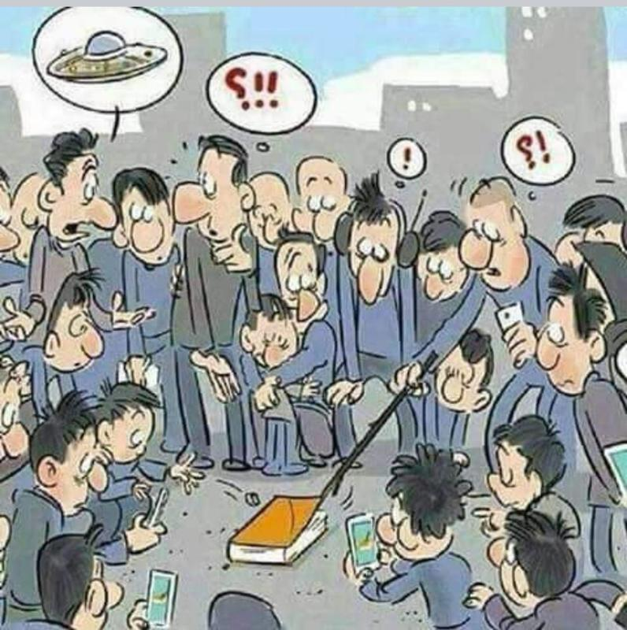
The NEW TESTAMENT BOOK OF ACTS
By David Lee Burris
Chapters 13 - 14 - 15

Slide 2
DOES THE NEW TESTAMENT IN PRACTICE ACTUALLY START WITH THE BOOK OF ACTS NOT THE GOSPELS?
“From the standpoint of the dispensations or the various economies by which God governs the world, the Old Testament Jewish economy actually continued through the gospels. Acts is a transitional book moving from the Old Testament economy into that of the new – the church age, the body of Christ.” (reference)

Slide 4
NOT EXACTLY

Slide 6
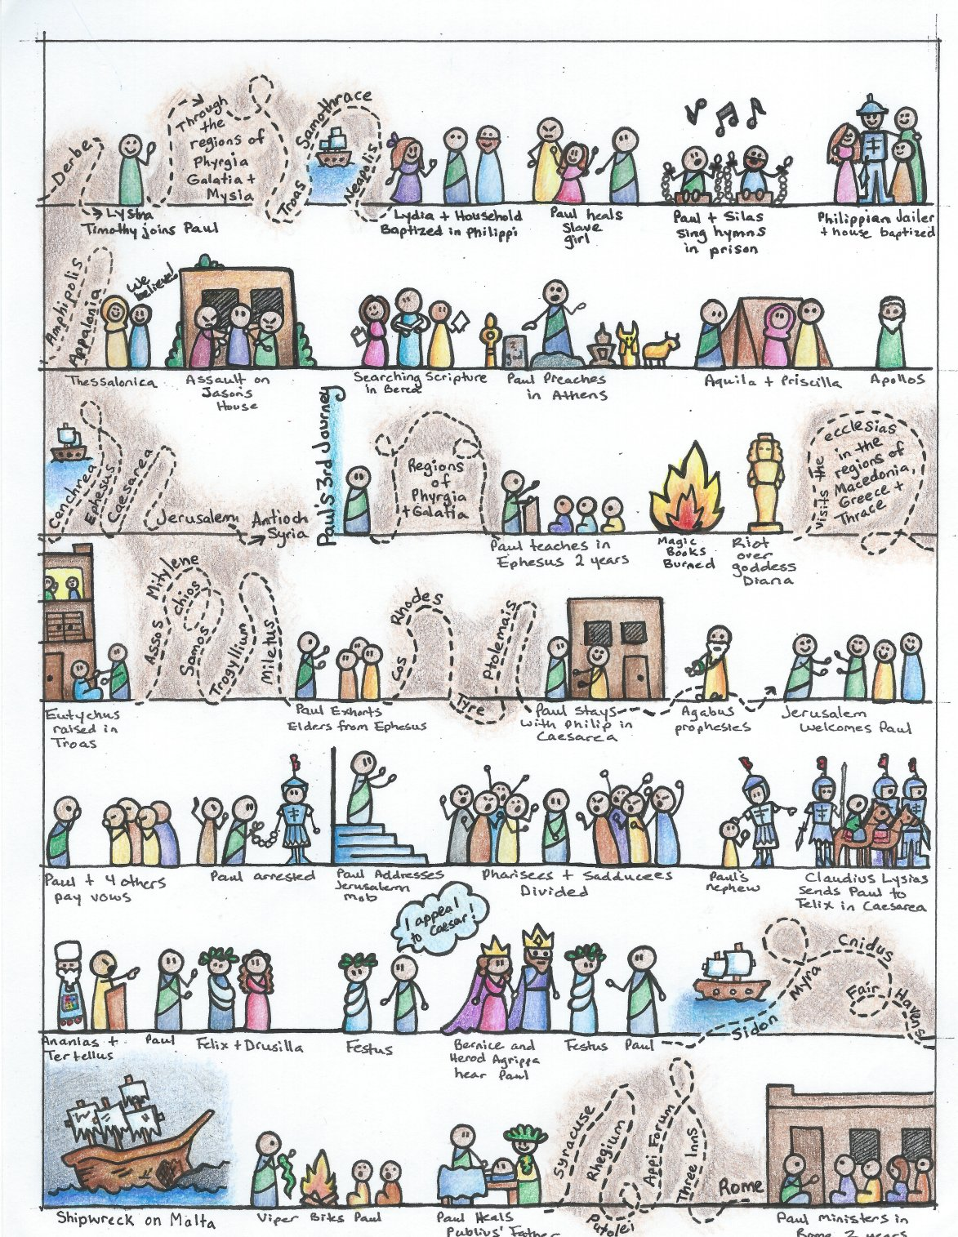

Slide 7
I. THE AUTHOR OF THE BOOK
From earliest times, Luke, “the beloved physician,” has been looked upon by conservative Bible scholars as being the author of The Book of Acts. Both internal and external evidence support this belief.
Luke was: (1) a Gentile (Col. 4:10–14); (2) the only Gentile author of a Bible book; (3) a physician (a medical doctor), Col. 4:14; (4) a “beloved” person, Col. 4:14; (5) a frequent missionary companion of Paul (the so-called “we sections” of The Book of Acts, 16:10–17; 20:5–21:18; 27:1–28:16, prove this assertion); and (6) the author of The Gospel of Luke as well as The Book of Acts.
II. THE ADDRESSEE OF THE BOOK
Luke addressed both The Gospel of Luke and The Book of Acts to Theophilus. Perhaps he had others in view as the ultimate readers of his two books.
We do not know the identity of Theophilus, nor do we know the place of his residence. He almost certainly was: (1) a friend of Luke and (2) a neophyte to Christianity (Luke wrote to Theophilus that he might know the certainty, the truthfulness, of the gospel truths wherein he had been instructed, Luke 1:1).
III. THE PLACE AND THE DATE OF THE WRITING OF THE BOOK
We do not know the place of writing but we can know the approximate date of writing. We know that it was written after the Spring of a.d. 63 for the book’s historical record extends to the Spring of that year and we know that the book was probably written before the Fall of a.d. 64 for the book makes no mention or allusion to the Neronian persecution which began in October of a.d. 64. We know that the book was almost certainly written before a.d. 70 for it makes no mention or allusion to the fall of Jerusalem and the destruction of its temple, events which occurred in a.d. 70 which greatly affected the early church and first-century Christianity (these events ended the Judaizers opposition to the gospel and the practice of preaching the gospel first to the Jews and then to the Gentiles).
IV. THE NAME OF THE BOOK
From the Second Century a.d., the common name for the book has been The Acts of the Apostles. This title is too comprehensive to be a correct one, for the book deals chiefly with the acts of only two apostles, Peter and Paul, and their acts are recorded only in part. A more apt title would be one of the following: (1) the Acts of the Risen Lord; (2) The Acts of the descended Holy Spirit; (3) Some of the Acts of Peter and Paul; (4) A Fragmentary History of the Early Church; (5) The First Chapter of Church History or (6) The only Inspired Chapter of Church History.
In the Greek manuscripts, the title is “Acts of Apostles.” This is a good and accurate title.
V. THE CLASSIFICATION OF THE BOOK
It is one of the five historical books of the New Testament. The New Testament has five historical books (Matthew through Acts), twenty-one doctrinal books (Romans through Jude) and one prophetical book (Revelation).
The 5 New Testament historical books are the New Testament’s “Pentateuch.”
Gingrich, R. E. (2002). (pp. 34). Memphis, TN: Riverside Printing.
Gingrich, R. E. (2002). The Book of Acts (pp. 3–4). Memphis, TN: Riverside Printing.

Slide 8
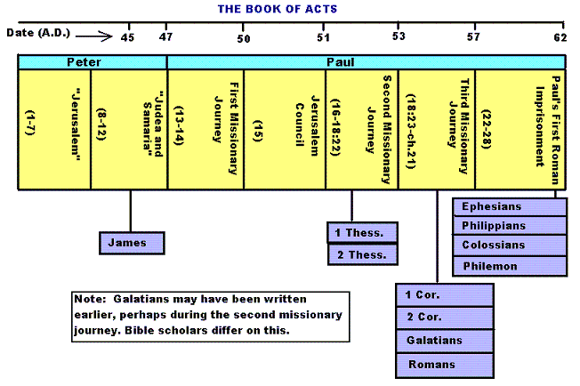

Slide 9
Historicity of Acts:
- the spread of Christianity from Jerusalem to Rome (“the ends of the earth”);
- The progress ... is mainly geographical:
- From Jerusalem ... to Samaria (8.5), Damascus (9.10), Antioch (11.26), Asia Minor (13.13), Europe (16.11), and finally Rome … itself;
- the northeastern corner of the Mediterranean;
- Maybe Spain But Nothing about North Africa, e.g., Alexandria and Cyrene.

Slide 11
1. Prologue and Ascension (1:1-11):
- Post-resurrection appearances … ;
- A ... visible ascension into heaven;
- Matthias chosen to replace Judas Iscariot (1.12-26);
- Luke’s understanding of an Apostle: see 1.21-22;
- Note: Saul (later Paul) meets those qualifications Acts 9 when Christ appeared to him while on the Damascus Road.

Slide 12
2. Founding of the Jerusalem Church - the role of the Holy Spirit (2.12-2.47):
- The Jerusalem Church increases in numbers by means of divine power;
- The work of the Holy Spirit, e.g., Glossolalia (2.1-24; see Joel 2.28-32);
- Peter’s speech interprets the meaning of Pentecost;
- The character of the Jerusalem Church (2.43-45; 4.32-35);

Slide 13
3. The Work of Peter and the other Apostles (3.1-5.42):
- Confrontation between the Apostles and the Jerusalem authorities (4.1-22);
- Luke’s attitude towards both the Sadducees and the Pharisees (4.8-11);

Slide 14
4. Persecution of the “Hellenists” (6.1-8.40):
- Stephen, a leading “Hellenist” or Greek-speaking Jew (6. 5, 8);
- Stephen is presented as the first Christian Martyr (7.60);
- subsequent persecution and the growth of the Church (8.1b-40);
the “new way” carried to such individuals as Simon the Magician (8.9) and an Ethiopian Eunuch (8.27);
the role of Philip in this work of evangelization (6.5; 8.4; 21,8).

Slide 15
5. Preparation for the Gentile Mission (9.1-12.25):
- The progress of Christianity …. as world adversary to pagan religion and human schools of philosophy;
- See, for example, the conversion of Saul of Tarsus (9.1-19) and Cornelius, the Roman centurion (Chs. 10-11);
- Peter is depicted as the one who first opens the door to Gentiles, that is, non-Jews;
Peter’s persuasion of the “circumcision party” (11.1-18);
See 10.44-48 and 11.15-18: the “Gentile Pentecost”;

Slide 16
5. Preparation for the Gentile Mission (9.1-12.25) (contd.):
- Gentiles flock to the Church at Antioch (11.19-26);
- The Jerusalem Church sends Barnabas... to report on the situation (11.22);
- Barnabas with the Apostle Paul at Antioch (11.25-30);
- Gospel preached “all over Judea and Samaria”;
- The first half concludes with an account of Herod Agrippa I’s persecution (41-44 CE) of the Jerusalem community;
- God is unhappy with Herod (12.20-23).

Slide 17
6. First Missionary Journey of Barnabas and Paul and the Jerusalem Conference (13.1-15.35):
- The rest of Acts is devoted mainly to the Missionary Journeys of the Apostle Paul and his fellow workers;
- the work of Paul and Barnabas in the various Hellenistic cities of Asia Minor;
- Dissension between Gentile and Jewish Christians over adherence to the Mosaic Torah (15.1-35);
- must Gentile Christians be circumcised and observe Jewish dietary laws?

Slide 18
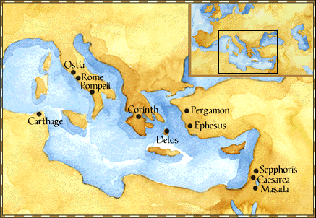
Paul: Map of His World.

Slide 19
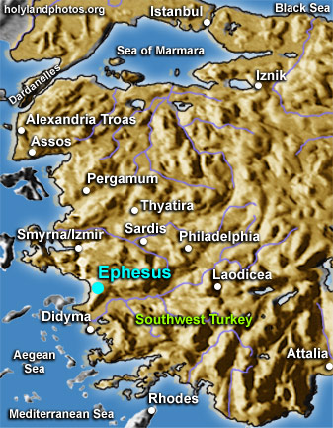

Slide 20
6. First Missionary Journey of Paul and Barnabas and the Jerusalem Conference (13.1-15.35) (contd.):
- The Jerusalem Conference held about A.D. 49 (Acts 15);
- Must a Gentile believer become a Jew ... to be a Christian?
- A division within the Church;
- The dispute settled in favor of uncircumcised Gentiles (15.28-29);
- The deciding voice is that of James (15.13-21).

Slide 21
6. First Missionary Journey of Paul and Barnabas and the Jerusalem Conference (13.1-15.35) (contd.):
- The Apostles and Elders required only limited Torah mandates of the Gentile Christians (15.13-21);
- requirements based on rules from Leviticus (Acts 15.13-21; Leviticus 17-18);
- Themes of unity and cooperation dominate … ;
- it is a unanimous decision and the “Whole Church” sends a delegation to Antioch to explain the Jerusalem Church’s decision (15.30-35);
- Actually, a decision of the Holy Spirit (15.22-29).

Slide 22
6. First Missionary Journey of Paul and Barnabas and the Jerusalem Conference (13.1-15.35) (contd.):
- Paul’s independence of the Apostolic Church (Gal 1.17, 18-19, 20; 2.1-10);
- Paul indicates that he was never under the jurisdiction of the Church’s leadership in Jerusalem (Gal 1.17, 18-19, 20; 2.1-10);
- See also 1 Cor 8.8; 10.27 relative to eating meat sacrificed to Greco-Roman gods.

Slide 23
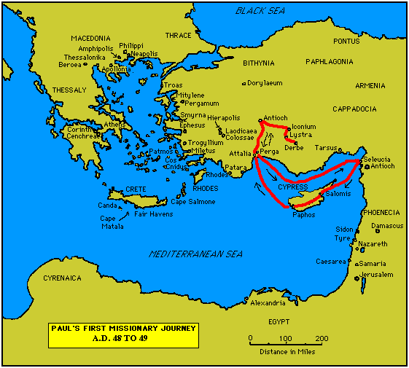

Slide 24
7. Paul’s Secondary Missionary Journey; Evangelizing Greece (16.1-18.21):
- Paul and Barnabas separate (15.39);
- Why the separation?
- Paul and Silas visit churches in Syria and Asia Minor (15.40-41);
- A vision directs Paul to Macedonia (15.40-16.10);
- Paul’s customary activity relative to the Jews and then being abused by them (16.11-17.15);

Slide 25
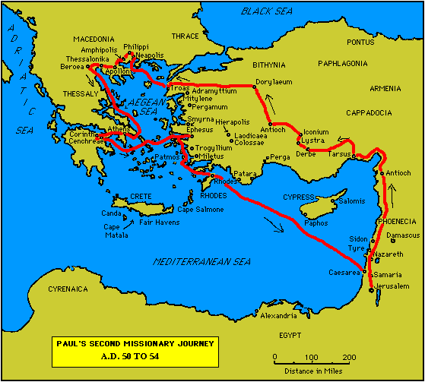

Slide 26
7. Paul’s Secondary Missionary Journey; Evangelizing Greece (16.1-18.21) (contd.):
- Paul in Philippi, Thessalonica, Beroea, and Athens;
- Paul speaks at the Areopagus in Athens (17.19-31);
- Paul at Corinth (18.1-17);

Slide 28
8. Paul’s Third Missionary Journey: Revisiting Asia Minor and Greece (18.22-20.38):
- Paul at Ephesus (18.19-21);
- Luke depicts Paul as determined to complete his last tour and head for the imperial capital, that is, Rome (19.21-22);
- Paul’s farewell speech at Miletus (20.17-38);
- See maps on the location of the major churches at the end of Paul’s ministry.

Slide 29
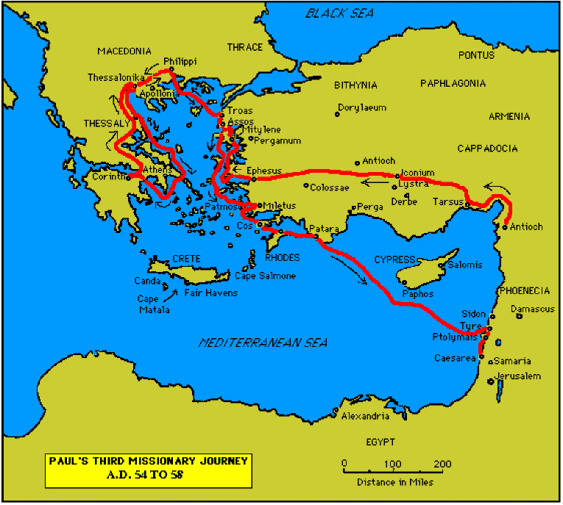

Slide 31
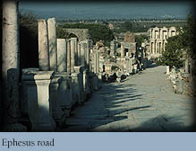

Slide 32
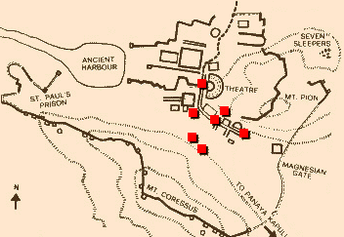
Ephesus: General View of the Ancient City.

Slide 33
9. Paul’s arrest in Jerusalem and imprisonment in Caesarea Maritime (21.1-26.32):
- Paul returns to Jerusalem (21.17) ... accused of blasphemy and profaning the Temple;
- When arrested, Paul claims that he is a Pharisee (21.27-23.10);
- Paul is imprisoned ... in Caesarea (23.33-26.32);
- he exercises his birthright as a Roman citizen (25.1-21);
- he defends himself (26.1-29);

Slide 34
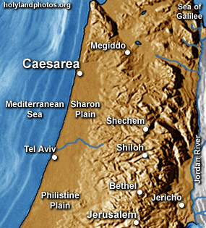

Slide 35
10. Paul’s Journey to Rome and His Preaching to Roman Jews (27.1-28.31):
- Paul’s sea journey to Rome... a shipwreck on the island of Malta (28.1 ) (see Map);
- the narrative in the first person plural, that is, “we”;
- Acts ends with Paul’s arrival in Rome (28.16);
- Paul is under house arrest but is free to preach (28.31);
- He continues to evangelize the Romans (28.23-31);
- We are not told of Paul’s fate.

Slide 36
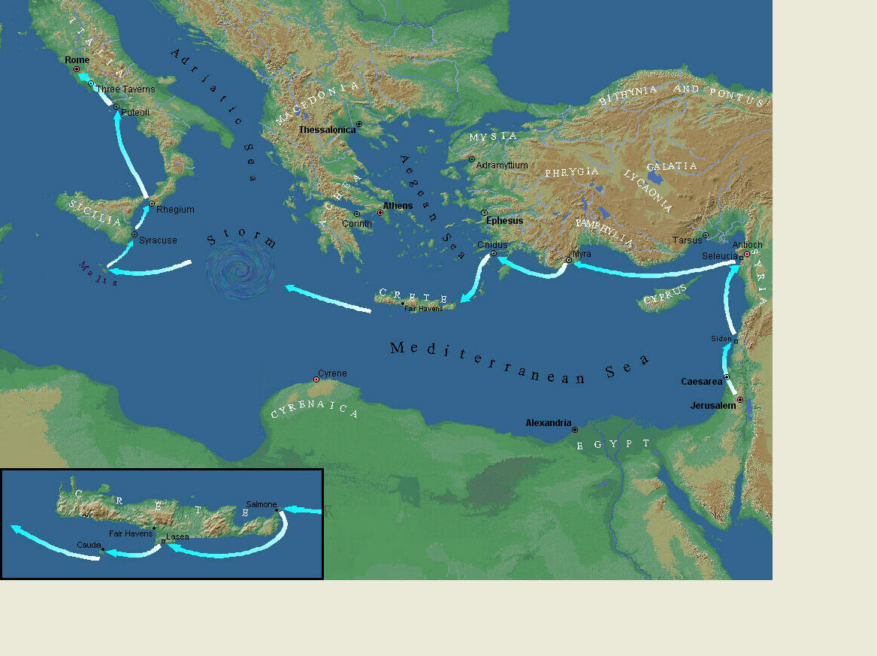
Paul’s Journey to Rome.

Slide 37
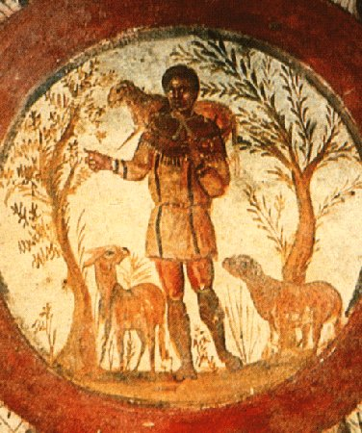
The Good Shepherd – in Catacombs of Rome.

Slide 38
10. Paul’s Journey to Rome and his Preaching to Roman Jews (27.1-28.31) (contd.):
- Luke has accomplished his task of tracing Christianity’s expansion from Jerusalem to “the ends of the earth” (1.8);
- Another theme emphasized: Paul and his successor evangelists will henceforth direct the Gospel primarily to Non-Jews, for “the Gentiles will listen” (28.28);
- Luke quotes from Isaiah 6 (see also Mark 4.10-13);
- Christianity’s future belongs to the Gentiles.

Slide 39
Basic Book Structure acts of the Apostles Centers around the great commission & Call To evangelize Then known world!

Slide 40
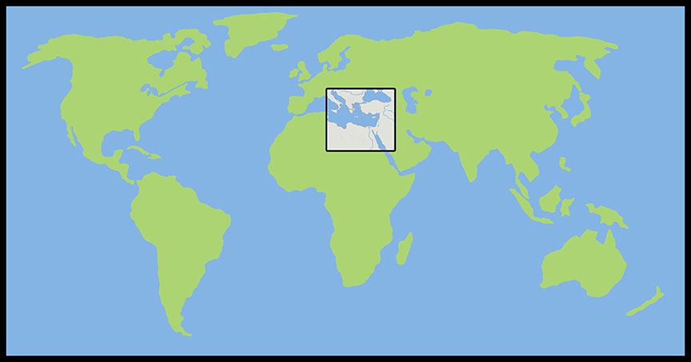
Where the Story takes Place

Slide 41
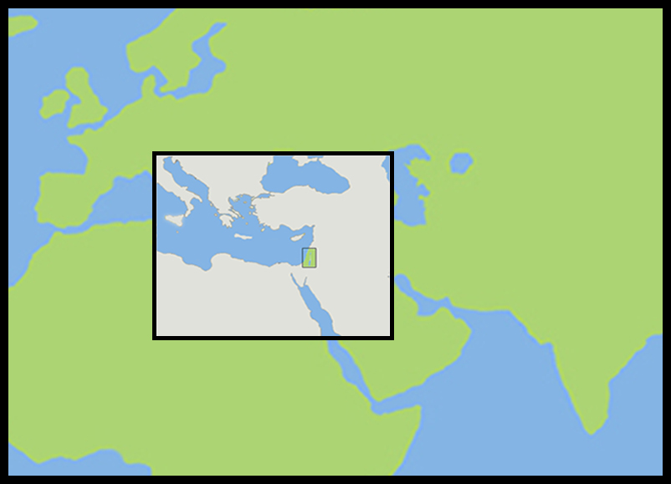
The Land of Canaan in the Near East

Slide 42
Acts 1:8 and the Great Commission
Acts 1:8 But ye shall receive power, after that the Holy Ghost is come upon you: and ye shall be witnesses unto me both in Jerusalem, and in all Judaea, and in Samaria, and unto the uttermost part of the earth.
Matthew 28:19-20 ¹⁹ Go ye therefore, and teach all nations, baptizing them in the name of the Father, and of the Son, and of the Holy Ghost: ²⁰ Teaching them to observe all things whatsoever I have commanded you: and, lo, I am with you alway, even unto the end of the world. Amen.
Mark 16:15 And he said unto them, Go ye into all the world, and preach the gospel to every creature.

Slide 43
Acts 1:8 and the Great Commission
Acts 1:8 But ye shall receive power, after that the Holy Ghost is come upon you: and ye shall be witnesses unto me both in Jerusalem, and in all Judaea, and in Samaria, and unto the uttermost part of the earth.
Matthew 28:19-20 ¹⁹ Go ye therefore, and teach all nations, baptizing them in the name of the Father, and of the Son, and of the Holy Ghost: ²⁰ Teaching them to observe all things whatsoever I have commanded you: and, lo, I am with you alway, even unto the end of the world. Amen.
Mark 16:15 And he said unto them, Go ye into all the world, and preach the gospel to every creature.

Slide 44
Acts 1:8 and the Great Commission
Acts 1:8 But ye shall receive power, after that the Holy Ghost is come upon you: and ye shall be witnesses unto me both in Jerusalem, and in all Judaea, and in Samaria, and unto the uttermost part of the earth.
Matthew 28:19-20 ¹⁹ Go ye therefore, and teach all nations, baptizing them in the name of the Father, and of the Son, and of the Holy Ghost: ²⁰ Teaching them to observe all things whatsoever I have commanded you: and, lo, I am with you alway, even unto the end of the world. Amen.
Mark 16:15 And he said unto them, Go ye into all the world, and preach the gospel to every creature.

Slide 45
Acts 1:8 and the Great Commission
Acts 1:8 But ye shall receive power, after that the Holy Ghost is come upon you: and ye shall be witnesses unto me both in Jerusalem, and in all Judaea, and in Samaria, and unto the uttermost part of the earth.
Matthew 28:19-20 ¹⁹ Go ye therefore, and teach all nations, baptizing them in the name of the Father, and of the Son, and of the Holy Ghost: ²⁰ Teaching them to observe all things whatsoever I have commanded you: and, lo, I am with you alway, even unto the end of the world. Amen.
Mark 16:15 And he said unto them, Go ye into all the world, and preach the gospel to every creature.

Slide 46
Acts 1:8 and the Structure of the Book
Acts 1:8 … ye shall be witnesses unto me both in Jerusalem, and in all Judaea, and in Samaria, and unto the uttermost part of the earth.
1. The witness in Jerusalem:
Chapters 1 to 7
2. The witness in Judaea and Samaria:
Chapters 8 to 12
3. The witness unto the uttermost parts of the earth:
Chapters 13 to 28

Slide 47
The Three Audiences
Part 1: The Jews
Part 2: The Samaritans
Part 3: The Gentiles

Slide 48
The Pillars of the Church
Part 1: Peter
Part 2: Peter and Paul (Saul of Tarsus)
Part 3: Paul

Slide 49
The Timeline
Part 1: 5 years (AD 30-35)
Part 2: 13 years (AD 35-48)
Part 3: 14 years (AD 48-62)
A total of 32 years, according to Nelson’s Complete Book of Bible Maps and Charts.

Slide 50
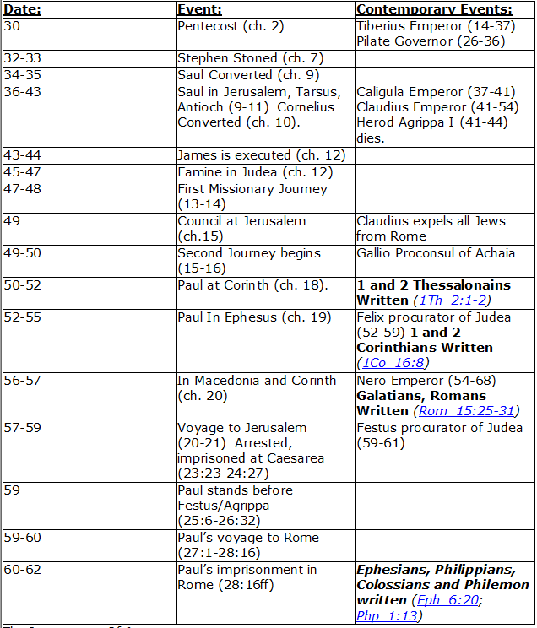
CHART BY
Mark Dunagan

Slide 51
PART ONE—The infancy of the church (the church in Jerusalem) (chapters 1–7)
(In this section, Jerusalem is the central city of Christianity and Peter is the most prominent person)
I. THE POST-RESURRECTION MINISTRY OF CHRIST (1:1–8)
II. THE ASCENSION OF CHRIST (1:9–11)
III. THE WAITING IN THE UPPER ROOM (1:12–26)
IV. THE ADVENT OF THE HOLY SPIRIT (2:1–41)
V. THE SNAPSHOT OF THE EARLY CHURCH (2:42–47)
VI. THE HEALING OF THE LAME MAN AND ITS CONSEQUENCES (3:1–4:31)
VII. THE DEATH OF ANANIAS AND SAPPHIRA AND ITS EFFECTS (4:32–5:42)
VIII. THE APPOINTMENT OF THE SEVEN (6:1–7)
IX. THE MINISTRY OF STEPHEN (6:8–7:60)
PART TWO—The adolescence of the church (the church in all Judea and In Samaria) (chapters 8–12)
(In this section, Jerusalem is gradually being replaced by Antioch as the central city of Christianity and Peter is gradually being replaced by Paul as the most prominent person)
I. THE FIRST MENTION OF PAUL (7:58; 8:1, 3)
II. THE PERSECUTION AND SCATTERING OF THE JERUSALEM CHURCH (8:1–4)
III. THE CONVERSION OF SAMARITANS (8:5–25)
IV. THE CONVERSION OF A JEWISH PROSELYTE (8:26–40)
V. THE CONVERSION OF SAUL (9:1–31)
VI. THE EXPANSION OF THE CHURCH IN WESTERN JUDEA (9:32–43)
VII. THE CONVERSION OF GENTILE GOD-FEARERS (chapter 10)
VIII. THE GROWING VISION OF THE JEWISH LEADERS (11:1–18)
IX. THE CONVERSION OF PAGAN GENTILES (11:19–26)
X. THE GROWING TIES BETWEEN JEWISH AND GENTILE CHRISTIANITY (11:27–30)
XI. THE COMPLETION OF THE TRANSITION (chapter 12)
PART THREE—The maturity of the church (the church in all the world) (chapters 13–28)
(In this section, Antioch is the central city of Christianity and Paul is the most prominent person)
I. PAUL’S CALL AT ANTIOCH TO HIS LIFE’S WORK (13:1–3)
II. PAUL’S FIRST MISSIONARY JOURNEY (13:4–14:27)
III. PAUL’S TWO YEARS BACK IN ANTIOCH (14:28–15:35)
IV. PAUL’S SECOND MISSIONARY JOURNEY (15:36–18:22)
V. PAUL’S THIRD MISSIONARY JOURNEY (18:23–21:16)
VI. PAUL’S ARREST AT JERUSALEM (21:17–23:35)
VII. PAUL’S TWO-YEARS’ IMPRISONMENT AT CAESAREA (chapters 24–26)
VIII. PAUL’S SHIPWRECK JOURNEY TO ROME (27:1–28:15)
IX. PAUL’S FIRST ROMAN IMPRISONMENT (28:16–31)
Gingrich, R. E. (2002). The Book of Acts (pp. 5–6). Memphis, TN: Riverside Printing.

Slide 52
L.D. CARY & SAM HOLT CATCH PHRASES
Chapter 10 – “The Gentiles Come In”
Chapter 11 – “10 + 1, Peter’s Rerun”
Chapter 12 – “10 + 2, Peter’s Rescue”
Chapter 13 – “10 + 3, First Preaching Spree”
Chapter 14 – “10 + 4, Preaching More”
Chapter 15 – “10 + 5, The Truth Survives”
Chapter 16 – “European Scene”
Chapter 17 – “10 + 7, One God In Heaven”
Chapter 18 – “10 + 8, The Corinth Wait”
“10 + 3 … 1st Preaching Spree”
Catch Phrase
Chapter Thirteen

Slide 53
ACTS 13 (Part 2 of Acts)
Barnabas and Paul’s First Missionary Journey

Slide 54
Acts 13:1-3 (NASB) 1 Now there were at Antioch, in the church that was there, prophets and teachers: Barnabas, and Simeon who was called Niger, and Lucius of Cyrene, and Manaen who had been brought up with Herod the tetrarch, and Saul. 2 While they were ministering to the Lord and fasting, the Holy Spirit said, "Set apart for Me Barnabas and Saul for the work to which I have called them." 3 Then, when they had fasted and prayed and laid their hands on them, they sent them away.
A. Church at Antioch:
B. Prophets and teachers:
1. Lucius of Cyrene appears to be one of the first to preach in Antioch. Acts 11:20; 2:10
C. Ministering to the Lord and fasting: 1Cor 15:58; Eph 4:11-12; Phil 2:12-13; Jn 9:4
D. The Holy Spirit had called them in the past for this work. They now need to get busy focusing their efforts on this work: Acts 11:22; 9:15-16; 26:15-18; Ro 1:1
1. Laid hands upon them: Acts 6:3-6;
Acts 26:15-18 (NASB) 15 "And I said, 'Who are You, Lord?' And the Lord said, 'I am Jesus whom you are persecuting. 16 'But get up and stand on your feet; for this purpose I have appeared to you, to appoint you a minister and a witness not only to the things which you have seen, but also to the things in which I will appear to you; 17 rescuing you from the Jewish people and from the Gentiles, to whom I am sending you, 18 to open their eyes so that they may turn from darkness to light and from the dominion of Satan to God, that they may receive forgiveness of sins and an inheritance among those who have been sanctified by faith in Me.’
Prophet
Original Word: προφήτης, prophētēs
Usage Notes: "one who speaks forth or openly" (see PROPHECY, A), "a proclaimer of a divine message," denoted among the Greeks an interpreter of the oracles of the gods. In the Sept. it is the translation of the word roeh, "a seer;" 1 Sam. 9:9, indicating that the "prophet" was one who had immediate intercourse with God. It also translates the word nabhi, meaning "either one in whom the message from God springs forth" or "one to whom anything is secretly communicated." Hence, in general, "the prophet" was one upon whom the Spirit of God rested, Num. 11:17-29, one, to whom and through whom God speaks, ………..
Vine's Expository Dictionary of Old Testament and New Testament Words
Acts 11:19-20 (NASB) 19 So then those who were scattered because of the persecution that occurred in connection with Stephen made their way to Phoenicia and Cyprus and Antioch, speaking the word to no one except to Jews alone. 20 But there were some of them, men of Cyprus and Cyrene, who came to Antioch and began speaking to the Greeks also, preaching the Lord Jesus.
Acts 6:3-6 (NASB) 3 "Therefore, brethren, select from among you seven men of good reputation, full of the Spirit and of wisdom, whom we may put in charge of this task. 4 "But we will devote ourselves to prayer and to the ministry of the word." 5 The statement found approval with the whole congregation; and they chose Stephen, a man full of faith and of the Holy Spirit, and Philip, Prochorus, Nicanor, Timon, Parmenas and Nicolas, a proselyte from Antioch. 6 And these they brought before the apostles; and after praying, they laid their hands on them.
Acts 11:22 (NASB) 22 The news about them reached the ears of the church at Jerusalem, and they sent Barnabas off to Antioch.
Acts 9:15-16 (NASB) 15 But the Lord said to him, "Go, for he is a chosen instrument of Mine, to bear My name before the Gentiles and kings and the sons of Israel; 16 for I will show him how much he must suffer for My name's sake.“
Acts 2:10 (NASB) 10 Phrygia and Pamphylia, Egypt and the districts of Libya around Cyrene, and visitors from Rome, both Jews and proselytes,
Philippians 2:12-13 (NASB) 12 So then, my beloved, just as you have always obeyed, not as in my presence only, but now much more in my absence, work out your salvation with fear and trembling; 13 for it is God who is at work in you, both to will and to work for His good pleasure.
John 9:4 (NASB) 4 "We must work the works of Him who sent Me as long as it is day; night is coming when no one can work.
1 Corinthians 15:58 (NASB) 58 Therefore, my beloved brethren, be steadfast, immovable, always abounding in the work of the Lord, knowing that your toil is not in vain in the Lord.
Ephesians 4:11-12 (NASB) 11 And He gave some as apostles, and some as prophets, and some as evangelists, and some as pastors and teachers, 12 for the equipping of the saints for the work of service, to the building up of the body of Christ;
Romans 1:1 (NASB) 1 Paul, a bond-servant of Christ Jesus, called as an apostle, set apart for the gospel of God,
Notes:
Add photos of ruins today as we journey through the map. Next week go through to slide 6
Note that the spirit said Barnabas and Saul placing him in a position of higher honor. This will change later in the chapter and rarely in Acts will Barnabas name be mentioned first.
Acts 6:3-6 – Essentially the other prophets and teachers tell Barnabas and Saul that they need to leave the work they are doing in Antioch and get busy doing the work the Holy Spirit made known to you some time ago.
Keep in mind that when Barnabas was sent by the church at Jerusalem to help in this work among the gentiles that he went to Tarsus to get Saul whom he knew was the Apostle to the Gentiles to help in Antioch. Acts 9:26-30

Slide 55
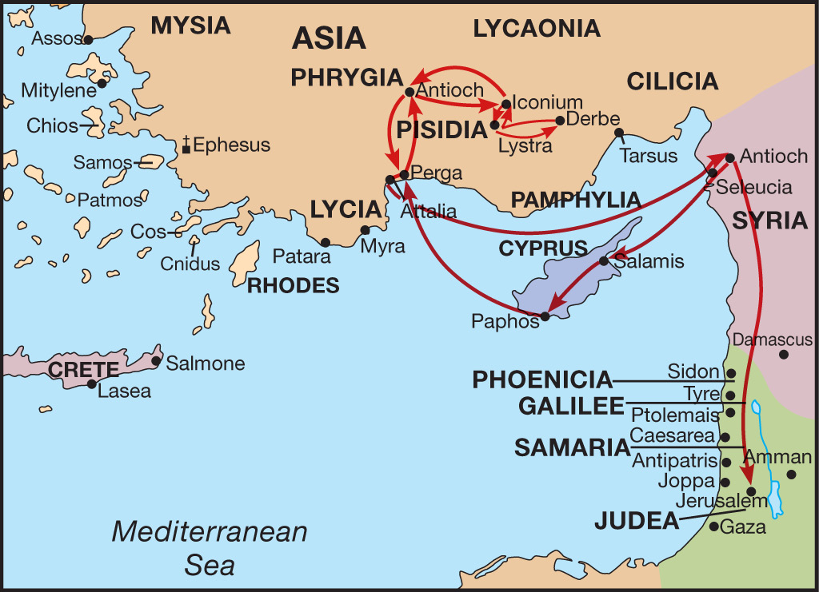
Barnabas and Paul’s First Missionary Journey
A.D. 47-49

Slide 56
Acts 13:4-7 (NASB) 4 So, being sent out by the Holy Spirit, they went down to Seleucia and from there they sailed to Cyprus. 5 When they reached Salamis, they began to proclaim the word of God in the synagogues of the Jews; and they also had John as their helper. 6 When they had gone through the whole island as far as Paphos, they found a magician, a Jewish false prophet whose name was Bar-Jesus, 7 who was with the proconsul, Sergius Paulus, a man of intelligence. This man summoned Barnabas and Saul and sought to hear the word of God.
A. Seleucia, Cyprus, Salamis: (4 slides)
1. Synagogues of Jews at Salamis: Ro 1:16
B. Paphos:
1. Jewish Magician – False Prophet: Acts 8:9-11; Mt 7:13-15; 24:11, 24; 2Pet 2:1-2;
2. Proconsul – Sergius Paulus:
a. Summoned Barnabas and Saul to hear the word of God: Acts 13:42-44; 17:10-12
Acts 8:9-11 (NASB) 9 Now there was a man named Simon, who formerly was practicing magic in the city and astonishing the people of Samaria, claiming to be someone great; 10 and they all, from smallest to greatest, were giving attention to him, saying, "This man is what is called the Great Power of God." 11 And they were giving him attention because he had for a long time astonished them with his magic arts.
Matthew 7:13-15 (NASB) 13 "Enter through the narrow gate; for the gate is wide and the way is broad that leads to destruction, and there are many who enter through it. 14 "For the gate is small and the way is narrow that leads to life, and there are few who find it. 15 "Beware of the false prophets, who come to you in sheep's clothing, but inwardly are ravenous wolves.
2 Peter 2:1-2 (NASB) 1 But false prophets also arose among the people, just as there will also be false teachers among you, who will secretly introduce destructive heresies, even denying the Master who bought them, bringing swift destruction upon themselves. 2 Many will follow their sensuality, and because of them the way of the truth will be maligned;
Proconsul
Usage Number: 1
Strong's Number: <G446>
Original Word: ἀνθύπατος, anthypatos
Usage Notes: from anti, "instead of," and hupatos, "supreme," denotes "a consul, one acting in place of a consul, a proconsul, the governor of a senatorial province" (i.e., one which had no standing army). ….. … Acts 19:38; …. Acts 13:7, 8, 12, ….. Acts 18:12 …….
Vine's Expository Dictionary of Old Testament and New Testament Words
Matthew 24:11 (NASB) 11 "Many false prophets will arise and will mislead many. Matthew 24:24 (NASB) 24 "For false Christs and false prophets will arise and will show great signs and wonders, so as to mislead, if possible, even the elect.
Acts 17:10-12 (NASB) 10 The brethren immediately sent Paul and Silas away by night to Berea, and when they arrived, they went into the synagogue of the Jews. 11 Now these were more noble-minded than those in Thessalonica, for they received the word with great eagerness, examining the Scriptures daily to see whether these things were so. 12 Therefore many of them believed, along with a number of prominent Greek women and men.
Acts 13:42-44 (NASB) 42 As Paul and Barnabas were going out, the people kept begging that these things might be spoken to them the next Sabbath. 43 Now when the meeting of the synagogue had broken up, many of the Jews and of the God-fearing proselytes followed Paul and Barnabas, who, speaking to them, were urging them to continue in the grace of God. 44 The next Sabbath nearly the whole city assembled to hear the word of the Lord.
Romans 1:16 (NASB) 16 For I am not ashamed of the gospel, for it is the power of God for salvation to everyone who believes, to the Jew first and also to the Greek.
Notes:
Bar-Jesus was a Jewish magician and so was Simon of Acts 8. Simon was converted before Cornelius Acts 10. They were only preaching the Gospel to Jews before Cornelius.

Slide 57
Acts 13:8-12 (NASB) 8 But Elymas the magician (for so his name is translated) was opposing them, seeking to turn the proconsul away from the faith. 9 But Saul, who was also known as Paul, filled with the Holy Spirit, fixed his gaze on him, 10 and said, "You who are full of all deceit and fraud, you son of the devil, you enemy of all righteousness, will you not cease to make crooked the straight ways of the Lord? 11 "Now, behold, the hand of the Lord is upon you, and you will be blind and not see the sun for a time." And immediately a mist and a darkness fell upon him, and he went about seeking those who would lead him by the hand. 12 Then the proconsul believed when he saw what had happened, being amazed at the teaching of the Lord.
A. Elymas (Bar-Jesus) the magician opposes the apostles teaching: 1Cor 4:18-21; 2Cor 12:12; 2Cor 10:8-11; 2Cor 13:1-3; Acts 13:11
1. Elymas opposed Saul’s use of the O. T. to prove Jesus is the Christ: Jn 5:37-39; Jn 8:42-47
2. The Proconsul believed: The miracle certainly made an impression but it was the teaching of the Lord that amazed him. - Ro 1:16
John 8:42-44 (NASB) 42 Jesus said to them, "If God were your Father, you would love Me, for I proceeded forth and have come from God, for I have not even come on My own initiative, but He sent Me. 43 "Why do you not understand what I am saying? It is because you cannot hear My word. 44 "You are of your father the devil, and you want to do the desires of your father. He was a murderer from the beginning, and does not stand in the truth because there is no truth in him. Whenever he speaks a lie, he speaks from his own nature, for he is a liar and the father of lies.
John 5:37-39 (NASB) 37 "And the Father who sent Me, He has testified of Me. You have neither heard His voice at any time nor seen His form. 38 "You do not have His word abiding in you, for you do not believe Him whom He sent. 39 "You search the Scriptures because you think that in them you have eternal life; it is these that testify about Me;
1 Corinthians 4:18-21 (NASB) 18 Now some have become arrogant, as though I were not coming to you. 19 But I will come to you soon, if the Lord wills, and I shall find out, not the words of those who are arrogant but their power. 20 For the kingdom of God does not consist in words but in power. 21 What do you desire? Shall I come to you with a rod, or with love and a spirit of gentleness?
2 Corinthians 13:1-3 (NASB) 1 This is the third time I am coming to you. EVERY FACT IS TO BE CONFIRMED BY THE TESTIMONY OF TWO OR THREE WITNESSES. 2 I have previously said when present the second time, and though now absent I say in advance to those who have sinned in the past and to all the rest as well, that if I come again I will not spare anyone, 3 since you are seeking for proof of the Christ who speaks in me, and who is not weak toward you, but mighty in you.
2 Corinthians 10:8-11 (NASB) 8 For even if I boast somewhat further about our authority, which the Lord gave for building you up and not for destroying you, I will not be put to shame, 9 for I do not wish to seem as if I would terrify you by my letters. 10 For they say, "His letters are weighty and strong, but his personal presence is unimpressive and his speech contemptible." 11 Let such a person consider this, that what we are in word by letters when absent, such persons we are also in deed when present.
45 "But because I speak the truth, you do not believe Me. 46 "Which one of you convicts Me of sin? If I speak truth, why do you not believe Me? 47 "He who is of God hears the words of God; for this reason you do not hear them, because you are not of God.“
Romans 1:16 (NASB) 16 For I am not ashamed of the gospel, for it is the power of God for salvation to everyone who believes, to the Jew first and also to the Greek.
Acts 13:11 (NASB) 11 "Now, behold, the hand of the Lord is upon you, and you will be blind and not see the sun for a time." And immediately a mist and a darkness fell upon him, and he went about seeking those who would lead him by the hand.
2 Corinthians 12:12 (NASB) 12 The signs of a true apostle were performed among you with all perseverance, by signs and wonders and miracles.

Slide 58
Barnabas and Paul’s First Missionary Journey
A.D. 47-49

Slide 59
Acts 13:13-15 (NASB) 13 Now Paul and his companions put out to sea from Paphos and came to Perga in Pamphylia; but John left them and returned to Jerusalem. 14 But going on from Perga, they arrived at Pisidian Antioch, and on the Sabbath day they went into the synagogue and sat down. 15 After the reading of the Law and the Prophets the synagogue officials sent to them, saying, "Brethren, if you have any word of exhortation for the people, say it."
A. At Perga John Mark left them and returned to the Jerusalem church: Acts 12:25; 13:2, 5
1. Perga was the capital city of Pamphylia, located in Asia Minor (Turkey):
B. Antioch of Pisidia located in Asia Minor (Turkey):
1. On the Sabbath they attend a gathering in the synagogue:
2. If you have any word of exhortation for the people, speak: Paul may have asked before the assembly if he might speak or out of courtesy they may have invited Paul to speak.
Acts 12:25 (NASB) 25 And Barnabas and Saul returned from Jerusalem when they had fulfilled their mission, taking along with them John, who was also called Mark.
Acts 13:2 (NASB) 2 While they were ministering to the Lord and fasting, the Holy Spirit said, "Set apart for Me Barnabas and Saul for the work to which I have called them."
Acts 13:5 (NASB) 5 When they reached Salamis, they began to proclaim the word of God in the synagogues of the Jews; and they also had John as their helper.

Slide 60
Acts 13:16-19 (NASB) 16 Paul stood up, and motioning with his hand said, "Men of Israel, and you who fear God, listen: 17 "The God of this people Israel chose our fathers and made the people great during their stay in the land of Egypt, and with an uplifted arm He led them out from it. 18 "For a period of about forty years He put up with them in the wilderness. 19 "When He had destroyed seven nations in the land of Canaan, He distributed their land as an inheritance—all of which took about four hundred and fifty years.
A. Preaching the Gospel: Beliefs they had in common
1. The audience is Jewish by faith both natural Jews and proselytes.
2. Paul begins with their history as the chosen people of God: Dt 7:6-8
3. As God’s chosen they were delivered out of Egyptian bondage and given land of Canaan when God destroyed their enemies. Josh 21:43-45
Deuteronomy 7:6-8 (NASB) 6 "For you are a holy people to the LORD your God; the LORD your God has chosen you to be a people for His own possession out of all the peoples who are on the face of the earth. 7 "The LORD did not set His love on you nor choose you because you were more in number than any of the peoples, for you were the fewest of all peoples, 8 but because the LORD loved you and kept the oath which He swore to your forefathers, the LORD brought you out by a mighty hand and redeemed you from the house of slavery, from the hand of Pharaoh king of Egypt.
Joshua 21:43-45 (NASB) 43 So the LORD gave Israel all the land which He had sworn to give to their fathers, and they possessed it and lived in it. 44 And the LORD gave them rest on every side, according to all that He had sworn to their fathers, and no one of all their enemies stood before them; the LORD gave all their enemies into their hand. 45 Not one of the good promises which the LORD had made to the house of Israel failed; all came to pass.

Slide 61
Acts 13:20-23 (NASB) 20 "After these things He gave them judges until Samuel the prophet. 21 "Then they asked for a king, and God gave them Saul the son of Kish, a man of the tribe of Benjamin, for forty years. 22 "After He had removed him, He raised up David to be their king, concerning whom He also testified and said, 'I HAVE FOUND DAVID the son of Jesse, A MAN AFTER MY HEART, who will do all My will.' 23 "From the descendants of this man, according to promise, God has brought to Israel a Savior, Jesus,
A. After these things came the period of Judges and the Prophet Samuel: Jdg 2:16-18; 1Sa 7:15
1. God gave them Saul son of Kish as the first King of Israel: 1Sam 9:15-17; 10:1; 1Sa 13:1
B. God gave them David as the second King of Israel: 1Sa 13:14; 16:6-13
1. According to God’s promise to David – He has brought Israel a savior - Jesus: Acts 2:30; Psa 89:35-37; Jer 33:15-17; Isa 9:6-7; Mt 1:1, 20-21; Lk 1:31-33
a. Jesus is the foundation point and the first point of controversy: Acts 28:21-22
Judges 2:16-17 (NASB) 16 Then the LORD raised up judges who delivered them from the hands of those who plundered them. 17 Yet they did not listen to their judges, for they played the harlot after other gods and bowed themselves down to them. They turned aside quickly from the way in which their fathers had walked in obeying the commandments of the LORD; they did not do as their fathers.
Isaiah 9:6-7 (NASB) 6 For a child will be born to us, a son will be given to us; And the government will rest on His shoulders; And His name will be called Wonderful Counselor, Mighty God, Eternal Father, Prince of Peace. 7 There will be no end to the increase of His government or of peace, On the throne of David and over his kingdom, To establish it and to uphold it with justice and righteousness From then on and forevermore. The zeal of the LORD of hosts will accomplish this.
Matthew 1:1 (NASB) 1 The record of the genealogy of Jesus the Messiah, the son of David, the son of Abraham:
Matthew 1:20-21 (NASB) 20 But when he had considered this, behold, an angel of the Lord appeared to him in a dream, saying, "Joseph, son of David, do not be afraid to take Mary as your wife; for the Child who has been conceived in her is of the Holy Spirit. 21 "She will bear a Son; and you shall call His name Jesus, for He will save His people from their sins."
1 Samuel 16:6-13 (NASB) 6 When they entered, he looked at Eliab and thought, "Surely the LORD'S anointed is before Him." 7 But the LORD said to Samuel, "Do not look at his appearance or at the height of his stature, because I have rejected him; for God sees not as man sees, for man looks at the outward appearance, but the LORD looks at the heart." 8 Then Jesse called Abinadab and made him pass before Samuel. And he said, "The LORD has not chosen this one either." 9 Next Jesse made Shammah pass by. And he said, "The LORD has not chosen this one either."
Luke 1:31-33 (NASB) 31 "And behold, you will conceive in your womb and bear a son, and you shall name Him Jesus. 32 "He will be great and will be called the Son of the Most High; and the Lord God will give Him the throne of His father David; 33 and He will reign over the house of Jacob forever, and His kingdom will have no end.“
Jeremiah 33:15-17 (NASB) 15 'In those days and at that time I will cause a righteous Branch of David to spring forth; and He shall execute justice and righteousness on the earth. 16 'In those days Judah will be saved and Jerusalem will dwell in safety; and this is the name by which she will be called: the LORD is our righteousness.' 17 "For thus says the LORD, 'David shall never lack a man to sit on the throne of the house of Israel;
1 Samuel 13:14 (NASB) (Samuel tells Saul he has been replaced) 14 "But now your kingdom shall not endure. The LORD has sought out for Himself a man after His own heart, and the LORD has appointed him as ruler over His people, because you have not kept what the LORD commanded you."
1 Samuel 9:15-17 (NASB) 15 Now a day before Saul's coming, the LORD had revealed this to Samuel saying, 16 "About this time tomorrow I will send you a man from the land of Benjamin, and you shall anoint him to be prince over My people Israel; and he will deliver My people from the hand of the Philistines. For I have regarded My people, because their cry has come to Me." 17 When Samuel saw Saul, the LORD said to him, "Behold, the man of whom I spoke to you! This one shall rule over My people."
10 Thus Jesse made seven of his sons pass before Samuel. But Samuel said to Jesse, "The LORD has not chosen these." 11 And Samuel said to Jesse, "Are these all the children?" And he said, "There remains yet the youngest, and behold, he is tending the sheep." Then Samuel said to Jesse, "Send and bring him; for we will not sit down until he comes here." 12 So he sent and brought him in. Now he was ruddy, with beautiful eyes and a handsome appearance. And the LORD said, "Arise, anoint him; for this is he." 13 Then Samuel took the horn of oil and anointed him in the midst of his brothers; and the Spirit of the LORD came mightily upon David from that day forward. And Samuel arose and went to Ramah.
Psalm 89:35-37 (NASB) 35 "Once I have sworn by My holiness; I will not lie to David. 36 "His descendants shall endure forever And his throne as the sun before Me. 37 "It shall be established forever like the moon, And the witness in the sky is faithful." Selah.
Acts 2:30 (NASB) 30 "And so, because he was a prophet and knew that GOD HAD SWORN TO HIM WITH AN OATH TO SEAT one OF HIS DESCENDANTS ON HIS THRONE,
Acts 28:21-22 (NASB) 21 They said to him, "We have neither received letters from Judea concerning you, nor have any of the brethren come here and reported or spoken anything bad about you. 22 "But we desire to hear from you what your views are; for concerning this sect, it is known to us that it is spoken against everywhere."
1 Samuel 7:15 (NASB) 15 Now Samuel judged Israel all the days of his life.
1 Samuel 10:1 (NASB) 1 Then Samuel took the flask of oil, poured it on his head, kissed him and said, "Has not the LORD anointed you a ruler over His inheritance?
1 Samuel 13:1 (NASB) 1 Saul was thirty years old when he began to reign, and he reigned forty two years over Israel.
Notes:
2/11/18
The year is 46-48 A.D., It has been 16 or 17 years since Jesus was crucified during the Passover/Days of unleavened bread. Among the members of this synagogue there is a high probability some were present.

Slide 62
Acts 13:24-26 (NASB) 24 after John had proclaimed before His coming a baptism of repentance to all the people of Israel. 25 "And while John was completing his course, he kept saying, 'What do you suppose that I am? I am not He. But behold, one is coming after me the sandals of whose feet I am not worthy to untie.' 26 "Brethren, sons of Abraham's family, and those among you who fear God, to us the message of this salvation has been sent.
A. John proclaiming his baptism and admitting that he is not Christ: Jn 1:22-33
B. To Paul and his audience the message of this salvation has been sent – but in a very special way to Saul of Tarsus (to you or to us?): Acts 3:26; Acts 10:37-42; Gal 1:11-12; 1Pet 1:10-12
Acts 10:37-42 (NASB) 37 you yourselves know the thing which took place throughout all Judea, starting from Galilee, after the baptism which John proclaimed. 38 "You know of Jesus of Nazareth, how God anointed Him with the Holy Spirit and with power, and how He went about doing good and healing all who were oppressed by the devil, for God was with Him. 39 "We are witnesses of all the things He did both in the land of the Jews and in Jerusalem. They also put Him to death by hanging Him on a cross.
1 Peter 1:10-12 (NASB) 10 As to this salvation, the prophets who prophesied of the grace that would come to you made careful searches and inquiries, 11 seeking to know what person or time the Spirit of Christ within them was indicating as He predicted the sufferings of Christ and the glories to follow. 12 It was revealed to them that they were not serving themselves, but you, in these things which now have been announced to you through those who preached the gospel to you by the Holy Spirit sent from heaven—things into which angels long to look.
John 1:22-33 (NASB) 22 Then they said to him, "Who are you, so that we may give an answer to those who sent us? What do you say about yourself?" 23 He said, "I am A VOICE OF ONE CRYING IN THE WILDERNESS, 'MAKE STRAIGHT THE WAY OF THE LORD,' as Isaiah the prophet said." 24 Now they had been sent from the Pharisees.
25 They asked him, and said to him, "Why then are you baptizing, if you are not the Christ, nor Elijah, nor the Prophet?" 26 John answered them saying, "I baptize in water, but among you stands One whom you do not know. 27 "It is He who comes after me, the thong of whose sandal I am not worthy to untie."
31 "I did not recognize Him, but so that He might be manifested to Israel, I came baptizing in water." 32 John testified saying, "I have seen the Spirit descending as a dove out of heaven, and He remained upon Him.
28 These things took place in Bethany beyond the Jordan, where John was baptizing. 29 The next day he *saw Jesus coming to him and *said, "Behold, the Lamb of God who takes away the sin of the world! 30 "This is He on behalf of whom I said, 'After me comes a Man who has a higher rank than I, for He existed before me.'
33 "I did not recognize Him, but He who sent me to baptize in water said to me, 'He upon whom you see the Spirit descending and remaining upon Him, this is the One who baptizes in the Holy Spirit.’
40 "God raised Him up on the third day and granted that He become visible, 41 not to all the people, but to witnesses who were chosen beforehand by God, that is, to us who ate and drank with Him after He arose from the dead. 42 "And He ordered us to preach to the people, and solemnly to testify that this is the One who has been appointed by God as Judge of the living and the dead.
Galatians 1:11-12 (NASB) 11 For I would have you know, brethren, that the gospel which was preached by me is not according to man. 12 For I neither received it from man, nor was I taught it, but I received it through a revelation of Jesus Christ.
Acts 3:26 (NASB) 26 "For you first, God raised up His Servant and sent Him to bless you by turning every one of you from your wicked ways."
Notes:
B. Paul claims guidance by the spirit of God to bring to this synagogue a message that the prophets have been fulfilled and Jesus is the messiah

Slide 63
Acts 1:10-14 (NASB) 10 And as they were gazing intently into the sky while He was going, behold, two men in white clothing stood beside them. 11 They also said, "Men of Galilee, why do you stand looking into the sky? This Jesus, who has been taken up from you into heaven, will come in just the same way as you have watched Him go into heaven." 12 Then they returned to Jerusalem from the mount called Olivet, which is near Jerusalem, a Sabbath day's journey away. 13 When they had entered the city, they went up to the upper room where they were staying; that is, Peter and John and James and Andrew, Philip and Thomas, Bartholomew and Matthew, James the son of Alphaeus, and Simon the Zealot, and Judas the son of James.
Acts 13:27-31 (NASB) 27 "For those who live in Jerusalem, and their rulers, recognizing neither Him nor the utterances of the prophets which are read every Sabbath, fulfilled these by condemning Him. 28 "And though they found no ground for putting Him to death, they asked Pilate that He be executed. 29 "When they had carried out all that was written concerning Him, they took Him down from the cross and laid Him in a tomb. 30 "But God raised Him from the dead; 31 and for many days He appeared to those who came up with Him from Galilee to Jerusalem, the very ones who are now His witnesses to the people.
A. The people and rulers of Jerusalem did not understand the prophets read every sabbath. Therefore unknowingly fulfilled the things the prophets foretold: Acts 3:17; 1Cor 2:8
B. They laid the body of Jesus in a tomb: Mt 27:62-66
C. But God raised him from the dead: Act 2:23-34; Ro 1:1-4
D. He appeared to those who came up with from Galilee: Acts 1:1-3, 10-13; 2:7; 10:39-42 (8 slides)
Acts 2:23-24 (NASB) 23 this Man, delivered over by the predetermined plan and foreknowledge of God, you nailed to a cross by the hands of godless men and put Him to death. 24 "But God raised Him up again, putting an end to the agony of death, since it was impossible for Him to be held in its power.
Acts 1:1-3 (NASB) 1 The first account I composed, Theophilus, about all that Jesus began to do and teach, 2 until the day when He was taken up to heaven, after He had by the Holy Spirit given orders to the apostles whom He had chosen. 3 To these He also presented Himself alive after His suffering, by many convincing proofs, appearing to them over a period of forty days and speaking of the things concerning the kingdom of God.
Matthew 27:62-66 (NASB) 62 Now on the next day, the day after the preparation, the chief priests and the Pharisees gathered together with Pilate, 63 and said, "Sir, we remember that when He was still alive that deceiver said, 'After three days I am to rise again.' 64 "Therefore, give orders for the grave to be made secure until the third day, otherwise His disciples may come and steal Him away and say to the people, ‘He has risen from the dead,' and the last deception will be worse than the first." 65 Pilate said to them, "You have a guard; go, make it as secure as you know how." 66 And they went and made the grave secure, and along with the guard they set a seal on the stone.
Acts 10:39-42 (NASB) 39 "We are witnesses of all the things He did both in the land of the Jews and in Jerusalem. They also put Him to death by hanging Him on a cross. 40 "God raised Him up on the third day and granted that He become visible, 41 not to all the people, but to witnesses who were chosen beforehand by God, that is, to us who ate and drank with Him after He arose from the dead. 42 "And He ordered us to preach to the people, and solemnly to testify that this is the One who has been appointed by God as Judge of the living and the dead.
Romans 1:1-4 (NASB) 1 Paul, a bond-servant of Christ Jesus, called as an apostle, set apart for the gospel of God, 2 which He promised beforehand through His prophets in the holy Scriptures, 3 concerning His Son, who was born of a descendant of David according to the flesh, 4 who was declared the Son of God with power by the resurrection from the dead, according to the Spirit of holiness, Jesus Christ our Lord,
Acts 2:7 (NASB) 7 They were amazed and astonished, saying, "Why, are not all these who are speaking Galileans?
1 Corinthians 2:8 (NASB) 8 the wisdom which none of the rulers of this age has understood; for if they had understood it they would not have crucified the Lord of glory;
Acts 3:17 (NASB) 17 "And now, brethren, I know that you acted in ignorance, just as your rulers did also.
Notes:
2/18/18
Note that verses 26-27 follows the line of thinking of 1Cor 2:1-13

Slide 64
Acts 13:32-37 (NASB) 32 "And we preach to you the good news of the promise made to the fathers, 33 that God has fulfilled this promise to our children in that He raised up Jesus, as it is also written in the second Psalm, 'YOU ARE MY SON; TODAY I HAVE BEGOTTEN YOU.' 34 "As for the fact that He raised Him up from the dead, no longer to return to decay, He has spoken in this way: 'I WILL GIVE YOU THE HOLY and SURE blessings OF DAVID.' 35 "Therefore He also says in another Psalm, 'YOU WILL NOT ALLOW YOUR HOLY ONE TO UNDERGO DECAY.' 36 "For David, after he had served the purpose of God in his own generation, fell asleep, and was laid among his fathers and underwent decay; 37 but He whom God raised did not undergo decay.
A. “We preach”, i.e. Paul and Barnabas - Paul is doing the speaking: Acts 13:16
1. The promise made to David was fulfilled when God raised Jesus: Acts 5:42; Psa 2:7; Jn 12:34; Lk 18:31-34; Acts 13:27
2. I will give you the holy, sure mercies of David: Isa 55:3; Heb 13:20; 1Pet 1:3-4;
3. David foretold one who’s flesh would not decay: Mt 10:16-20; (Psa 16:9-10)
Luke 18:31-34 (NASB) 31 Then He took the twelve aside and said to them, "Behold, we are going up to Jerusalem, and all things which are written through the prophets about the Son of Man will be accomplished. 32 "For He will be handed over to the Gentiles, and will be mocked and mistreated and spit upon, 33 and after they have scourged Him, they will kill Him; and the third day He will rise again." 34 But the disciples understood none of these things, and the meaning of this statement was hidden from them, and they did not comprehend the things that were said.
Matthew 10:16-20 (NASB) 16 "Behold, I send you out as sheep in the midst of wolves; so be shrewd as serpents and innocent as doves. 17 "But beware of men, for they will hand you over to the courts and scourge you in their synagogues; 18 and you will even be brought before governors and kings for My sake, as a testimony to them and to the Gentiles. 19 "But when they hand you over, do not worry about how or what you are to say; for it will be given you in that hour what you are to say. 20 "For it is not you who speak, but it is the Spirit of your Father who speaks in you.
Acts 13:2 (NASB) 2 While they were ministering to the Lord and fasting, the Holy Spirit said, "Set apart for Me Barnabas and Saul for the work to which I have called them."
Acts 13:27 (NASB) 27 "For those who live in Jerusalem, and their rulers, recognizing neither Him nor the utterances of the prophets which are read every Sabbath, fulfilled these by condemning Him.
1 Peter 1:3-4 (NASB) 3 Blessed be the God and Father of our Lord Jesus Christ, who according to His great mercy has caused us to be born again to a living hope through the resurrection of Jesus Christ from the dead, 4 to obtain an inheritance which is imperishable and undefiled and will not fade away, reserved in heaven for you,
John 12:34 (NASB) 34 The crowd then answered Him, "We have heard out of the Law that the Christ is to remain forever; and how can You say, 'The Son of Man must be lifted up’? Who is this Son of Man?"
Isaiah 55:3 (NASB) 3 "Incline your ear and come to Me. Listen, that you may live; And I will make an everlasting covenant with you, According to the faithful mercies shown to David.
Hebrews 13:20 (NASB) 20 Now the God of peace, who brought up from the dead the great Shepherd of the sheep through the blood of the eternal covenant, even Jesus our Lord,
Acts 13:16 (NASB) 16 Paul stood up, and motioning with his hand said, "Men of Israel, and you who fear God, listen:
Psalm 2:7 (NASB) 7 "I will surely tell of the decree of the LORD: He said to Me, 'You are My Son, Today I have begotten You.
Acts 5:42 (NASB) 42 And every day, in the temple and from house to house, they kept right on teaching and preaching Jesus as the Christ.
Notes:
David lived to be 70 years old. 1040 – 970 BC He ruled Israel 40 years. 1010 – 970 BC
Psalm 2 is a messiah prophecy: They knew it to be a messiah Psalm but did not understand. The idea of is that God will place his son on the throne. The son is not David but one who is born and seated. He was begotten (given life) and seated on the throne. The indication was very clear. This King would exist and yet be born again meaning he would die that he might receive life again.
Isa 55:3 speaks of living which is based on an everlasting covenant based on the mercies that would come through the descendant of David: eternal covenant indicates never ending promise eternal life
Psa 16:9-10: Note that Peter and Paul use the same approach to turn the hearts of the Jewish people to Jesus. The reason is obvious. It is the Holy Spirit giving them the words. No better approach can used than that of Divine inspiration.

Slide 65
Acts 13:38-41 (NASB) 38 "Therefore let it be known to you, brethren, that through Him forgiveness of sins is proclaimed to you, 39 and through Him everyone who believes is freed from all things, from which you could not be freed through the Law of Moses. 40 "Therefore take heed, so that the thing spoken of in the Prophets may not come upon you: 41 'BEHOLD, YOU SCOFFERS, AND MARVEL, AND PERISH; FOR I AM ACCOMPLISHING A WORK IN YOUR DAYS, A WORK WHICH YOU WILL NEVER BELIEVE, THOUGH SOMEONE SHOULD DESCRIBE IT TO YOU.’”
A. Through Jesus, forgiveness of sins is proclaimed:
1. And through Jesus believers will be freed from what the Law could not free you: 2 slides
B. Beware, lest you become like Israel when Habakkuk foretold the Babylonian captivity: Hab 1:5-6
1. Those in the Synagogue at Antioch find themselves in a similar situation. God has sent them His prophet who has revealed God’s will to them. As incredible as the Gospel is, honest souls know they must accept the message. Will they behave as the Jews did in Habakkuk’s day?
Habakkuk 1:5-6 (NASB) 5 "Look among the nations! Observe! Be astonished! Wonder! Because I am doing something in your days— You would not believe if you were told. 6 "For behold, I am raising up the Chaldeans, That fierce and impetuous people Who march throughout the earth To seize dwelling places which are not theirs.
Notes:
If you sit hear this morning, I ask have you responded to the Gospel of Jesus the Christ? Do you believe that Jesus is the son of God? Even the demons believed that. What will separate you from the Demons? Acts 2:37-38, 41

Slide 66
Acts 13:42-45 (NASB) 42 As Paul and Barnabas were going out, the people kept begging that these things might be spoken to them the next Sabbath. 43 Now when the meeting of the synagogue had broken up, many of the Jews and of the God- fearing proselytes followed Paul and Barnabas, who, speaking to them, were urging them to continue in the grace of God. 44 The next Sabbath nearly the whole city assembled to hear the word of the Lord. 45 But when the Jews saw the crowds, they were filled with jealousy and began contradicting the things spoken by Paul, and were blaspheming.
A. How did the people respond to the Gospel preached by Paul and Barnabas?
1. Some of both Jews and Gentile Proselytes were earnestly requesting, exhorting them to teach these things the next Sabbath: Acts 17:11; 1Pet 2:2
a. Continue in the Grace of God: This indicates they became Christians. Paul had told them what to do to enter the grace of God. Acts 13:20-23; Acts 2:37-38, 40-41; Acts 14:21-22
B. The majority of the Jews rejected the Gospel: Acts 5:17; 17:5; 1Thess 2:14-16; Mt 7:13-14
Acts 11:20-23 (NASB77) 20 But there were some of them, men of Cyprus and Cyrene, who came to Antioch and began speaking to the Greeks also, preaching the Lord Jesus. 21 And the hand of the Lord was with them, and a large number who believed turned to the Lord. 22 And the news about them reached the ears of the church at Jerusalem, and they sent Barnabas off to Antioch. 23 Then when he had come and witnessed the grace of God, he rejoiced and began to encourage them all with resolute heart to remain true to the Lord;
Acts 2:37-38 (NASB77) 37 Now when they heard this, they were pierced to the heart, and said to Peter and the rest of the apostles, " Brethren, what shall we do?" 38 And Peter said to them, " Repent, and let each of you be baptized in the name of Jesus Christ for the forgiveness of your sins; and you shall receive the gift of the Holy Spirit.
Acts 2:40-41 (NASB77) 40 And with many other words he solemnly testified and kept on exhorting them, saying, " Be saved from this perverse generation!" 41 So then, those who had received his word were baptized; and there were added that day about three thousand souls.
1 Thessalonians 2:14-16 (NASB77) 14 For you, brethren, became imitators of the churches of God in Christ Jesus that are in Judea, for you also endured the same sufferings at the hands of your own countrymen, even as they did from the Jews, 15 who both killed the Lord Jesus and the prophets, and drove us out. They are not pleasing to God, but hostile to all men, 16 hindering us from speaking to the Gentiles that they might be saved; with the result that they always fill up the measure of their sins. But wrath has come upon them to the utmost.
Acts 14:21-22 (NASB77) 21 And after they had preached the gospel to that city and had made many disciples, they returned to Lystra and to Iconium and to Antioch, 22 strengthening the souls of the disciples, encouraging them to continue in the faith, and saying, " Through many tribulations we must enter the kingdom of God." (To continue in the Grace of God = Continue in faith - NAN)
Acts 17:11 (NASB77) 11 Now these were more noble-minded than those in Thessalonica, for they received the word with great eagerness, examining the Scriptures daily, to see whether these things were so.
Acts 17:5 (NASB77) 5 But the Jews, becoming jealous and taking along some wicked men from the market place, formed a mob and set the city in an uproar; and coming upon the house of Jason, they were seeking to bring them out to the people.
Acts 5:17 (NASB77) 17 But the high priest rose up, along with all his associates (that is the sect of the Sadducees), and they were filled with jealousy;
Matthew 7:13-14 (NASB77) 13 " Enter by the narrow gate; for the gate is wide, and the way is broad that leads to destruction, and many are those who enter by it. 14 "For the gate is small, and the way is narrow that leads to life, and few are those who find it.
1 Peter 2:2 (NASB77) 2 like newborn babes, long for the pure milk of the word, that by it you may grow in respect to salvation,
Notes:
A., 1., a. - It is clear that we are not told everything Paul had taught them Just as in Acts 2 there are many words we are not given the details of: Acts 2:40
B. The Jews were jealous that the preaching of the Gospel could draw what their preaching of the Old Covenant could never draw. Nearly the Whole City of Antioch. Such was the power of the promise of eternal life through Jesus Christ.

Slide 67
Acts 13:46-48 (NASB) 46 Paul and Barnabas spoke out boldly and said, "It was necessary that the word of God be spoken to you first; since you repudiate it and judge yourselves unworthy of eternal life, behold, we are turning to the Gentiles. 47 "For so the Lord has commanded us, 'I HAVE PLACED YOU AS A LIGHT FOR THE GENTILES, THAT YOU MAY BRING SALVATION TO THE END OF THE EARTH.'" 48 When the Gentiles heard this, they began rejoicing and glorifying the word of the Lord; and as many as had been appointed to eternal life believed.
A. Necessary that the word of God be spoken to the Jews first: Heb 1:1-2; Mt 15:24; 10:5-6 Acts 3:26; Ro 1:16; Acts 14:1; 17:1-2, 10-11; 18:4, 19
1. The Jewish response: You Repudiate = Lit. Push away,
a. You Judge yourselves unworthy of eternal life: They chose – Acts 7:51-53
B. Behold, we are turning to the Gentiles: Ro 10:19-21; Isa 49:6
C. The response of the Gentiles: Glorified the word of Lord by believing/obeying the Gospel Acts 10:47-48; 16:30-34; Appointed –
Acts 7:51-53 (NASB77) 51 "You men who are stiff-necked and uncircumcised in heart and ears are always resisting the Holy Spirit; you are doing just as your fathers did. 52 " Which one of the prophets did your fathers not persecute? And they killed those who had previously announced the coming of the Righteous One, whose betrayers and murderers you have now become; 53 you who received the law as ordained by angels, and yet did not keep it."
Romans 10:19-21 (NASB77) 19 But I say, surely Israel did not know, did they? At the first Moses says, " I WILL MAKE YOU JEALOUS BY THAT WHICH IS NOT A NATION, BY A NATION WITHOUT UNDERSTANDING WILL I ANGER YOU." 20 And Isaiah is very bold and says, " I WAS FOUND BY THOSE WHO SOUGHT ME NOT, I BECAME MANIFEST TO THOSE WHO DID NOT ASK FOR ME." 21 But as for Israel He says, " ALL THE DAY LONG I HAVE STRETCHED OUT MY HANDS TO A DISOBEDIENT AND OBSTINATE PEOPLE."
Acts 16:30-34 (NASB77) 30 and after he brought them out, he said, "Sirs, what must I do to be saved?" 31 And they said, " Believe in the Lord Jesus, and you shall be saved, you and your household." 32 And they spoke the word of the Lord to him together with all who were in his house. 33 And he took them that very hour of the night and washed their wounds, and immediately he was baptized, he and all his household. 34 And he brought them into his house and set food before them, and rejoiced greatly, having believed in God with his whole household.
Acts 10:47-48 (NASB77) 47 " Surely no one can refuse the water for these to be baptized who have received the Holy Spirit just as we did, can he?" 48 And he ordered them to be baptized in the name of Jesus Christ. Then they asked him to stay on for a few days.
Isaiah 49:6 (NASB77) 6 He says, "It is too small a thing that You should be My Servant To raise up the tribes of Jacob, and to restore the preserved ones of Israel; I will also make You a light of the nations So that My salvation may reach to the end of the earth."
Hebrews 1:1-2 (NASB77) 1 God, after He spoke long ago to the fathers in the prophets in many portions and in many ways, 2 in these last days has spoken to us in His Son, whom He appointed heir of all things, through whom also He made the world.
Romans 1:16 (NASB77) 16 For I am not ashamed of the gospel, for it is the power of God for salvation to everyone who believes, to the Jew first and also to the Greek.
Acts 14:1 (NASB77) 1 And it came about that in Iconium they entered the synagogue of the Jews together, and spoke in such a manner that a great multitude believed, both of Jews and of Greeks.
Matthew 15:24 (NASB77) 24 But He answered and said, "I was sent only to the lost sheep of the house of Israel."
Matthew 10:5-6 (NASB77) 5 These twelve Jesus sent out after instructing them, saying, "Do not go in the way of the Gentiles, and do not enter any city of the Samaritans; 6 but rather go to the lost sheep of the house of Israel.
Acts 3:26 (NASB77) 26 "For you first, God raised up His Servant, and sent Him to bless you by turning every one of you from your wicked ways."
Acts 17:1-2 (NASB77) 1 Now when they had traveled through Amphipolis and Apollonia, they came to Thessalonica, where there was a synagogue of the Jews. 2 And according to Paul's custom, he went to them, and for three Sabbaths reasoned with them from the Scriptures,
Acts 17:10-11 (NASB77) 10 And the brethren immediately sent Paul and Silas away by night to Berea; and when they arrived, they went into the synagogue of the Jews. 11 Now these were more noble-minded than those in Thessalonica, for they received the word with great eagerness, examining the Scriptures daily, to see whether these things were so.
Acts 18:4 (NASB77) 4 And he was reasoning in the synagogue every Sabbath and trying to persuade Jews and Greeks.
Acts 18:19 (NASB77) 19 And they came to Ephesus, and he left them there. Now he himself entered the synagogue and reasoned with the Jews.
Notes:
Start on point B. 4/1/2018
The prophecy in verse 47 clearly indicates that the Lord foretold the Gentiles would see a light which refers to the Gospel would be preached to them in order that they might be saved. This is ordained, appointed by God as the means of salvation. Anyone who believes the Gospel becomes a part of God’s ordained plan to save them. Eph 3:8-11; Acts 15:7; Ro 1:16-17; 2Pet 3:9; 1Tim 2:4;

Slide 68
Acts 13:49-52 (NASB) 49 And the word of the Lord was being spread through the whole region. 50 But the Jews incited the devout women of prominence and the leading men of the city, and instigated a persecution against Paul and Barnabas, and drove them out of their district. 51 But they shook off the dust of their feet in protest against them and went to Iconium. 52 And the disciples were continually filled with joy and with the Holy Spirit.
A. They remained at Antioch of Pisidia preaching the word until it had spread throughout the region. To say that word was spread in the region is not saying the majority believed.
1. The unbelieving Jews seeing the power of the Gospel to convert both Jews and Gentiles instigate among the influential a persecution and drove Paul and Barnabas out of the district.
a. Shook the dust off their feet: Acts 18:5-6; 20:26-27; Matt 10:14; Mk 6:11
b. They went to Iconium:
B. Despite opposition the true church had been planted in Antioch and the disciples were filled with joy of salvation and the truth revealed by the Holy Spirit. Acts 7:51-52; 1Pet 1:12; Eph 5:17-20; Col 3:16
Acts 18:5-6 (NASB77) 5 But when Silas and Timothy came down from Macedonia, Paul began devoting himself completely to the word, solemnly testifying to the Jews that Jesus was the Christ. 6 And when they resisted and blasphemed, he shook out his garments and said to them, "Your blood be upon your own heads! I am clean. From now on I shall go to the Gentiles."
Ephesians 5:17-20 (NASB77) 17 So then do not be foolish, but understand what the will of the Lord is. 18 And do not get drunk with wine, for that is dissipation, but be filled with the Spirit, 19 speaking to one another in Psalms and hymns and spiritual songs, singing and making melody with your heart to the Lord; 20 always giving thanks for all things in the name of our Lord Jesus Christ to God, even the Father;
Acts 7:51-52 (NASB77) 51 "You men who are stiff-necked and uncircumcised in heart and ears are always resisting the Holy Spirit; you are doing just as your fathers did. 52 " Which one of the prophets did your fathers not persecute? And they killed those who had previously announced the coming of the Righteous One, whose betrayers and murderers you have now become;
Matthew 10:14 (NASB77) 14 "And whoever does not receive you, nor heed your words, as you go out of that house or that city, shake off the dust of your feet.
Mark 6:11 (NASB77) 11 "And any place that does not receive you or listen to you, as you go out from there, shake off the dust from the soles of your feet for a testimony against them."
1 Peter 1:12 (NASB77) 12 It was revealed to them that they were not serving themselves, but you, in these things which now have been announced to you through those who preached the gospel to you by the Holy Spirit sent from heaven-- things into which angels long to look.
Colossians 3:16 (NASB77) 16 Let the word of Christ richly dwell within you, with all wisdom teaching and admonishing one another with Psalms and hymns and spiritual songs, singing with thankfulness in your hearts to God.
Acts 20:26-27 (NASB77) 26 "Therefore I testify to you this day, that I am innocent of the blood of all men. 27 "For I did not shrink from declaring to you the whole purpose of God.

Slide 69
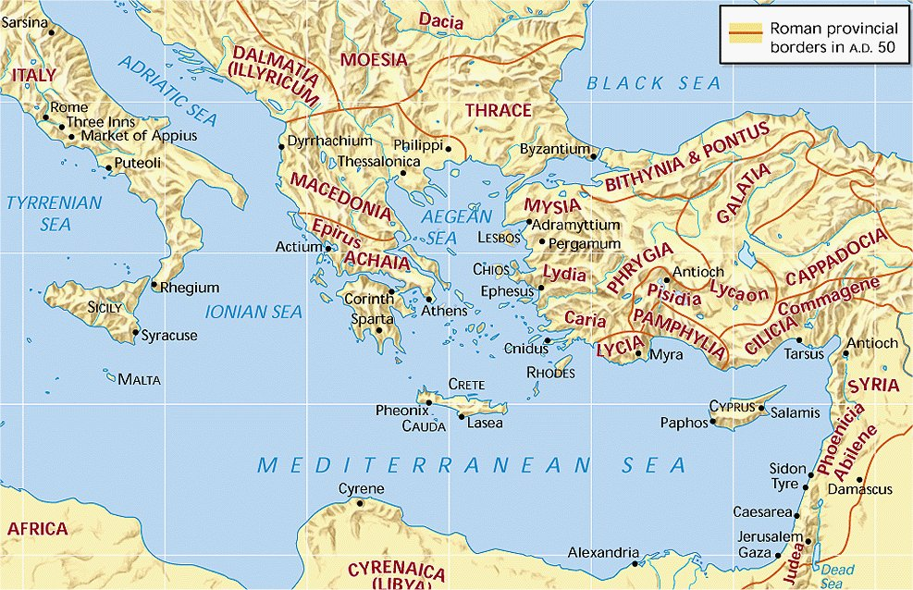
Acts 11:20-26 (NASB) 20 But there were some of them, men of Cyprus and Cyrene, who came to Antioch and began speaking to the Greeks also, preaching the Lord Jesus. 21 And the hand of the Lord was with them, and a large number who believed turned to the Lord. 22 The news about them reached the ears of the church at Jerusalem, and they sent Barnabas off to Antioch. 23 Then when he arrived and witnessed the grace of God, he rejoiced and began to encourage them all with resolute heart to remain true to the Lord;
Acts 11:27-30 (NASB) 27 Now at this time some prophets came down from Jerusalem to Antioch. 28 One of them named Agabus stood up and began to indicate by the Spirit that there would certainly be a great famine all over the world. And this took place in the reign of Claudius. 29 And in the proportion that any of the disciples had means, each of them determined to send a contribution for the relief of the brethren living in Judea. 30 And this they did, sending it in charge of Barnabas and Saul to the elders.
Acts 12:25 (NASB) 25 And Barnabas and Saul returned from Jerusalem when they had fulfilled their mission, taking along with them John, who was also called Mark.
24 for he was a good man, and full of the Holy Spirit and of faith. And considerable numbers were brought to the Lord. 25 And he left for Tarsus to look for Saul; 26 and when he had found him, he brought him to Antioch. And for an entire year they met with the church and taught considerable numbers; and the disciples were first called Christians in Antioch.
—"Antioch" was the capital of the Greek kingdom of Syria, and afterward became the residence of the Roman governor of the province. It was situated on the Orontes River, about sixteen miles from its mouth; its seaport was Seleucia. At Antioch was established the first church among the Gentiles, of which we have a record
Barnabas brings Saul to Antioch
Antioch sends Barnabas and Saul to Jerusalem
Barnabas, Saul and John Mark
Prophets come from Jerusalem to Antioch
Barnabas
Notes:
Use this map to go over 1. the history of the establishment of the church. Showing where the men of Cyprus and Cyrene came from. Review again how Barnabas and Saul came to work with Antioch. 2. How they were sent on a mission of Benevolence to Jerusalem, completed the mission and returned to Antioch with John Mark.
This young Gentile congregation received prophets from Jerusalem who informed then of a coming famine. They took up a collection sending help to Jerusalem the elders.Acts 11:27-30. They returned to Antioch bringing with them John Mark from Jerusalem. Acts 12:25

Slide 70
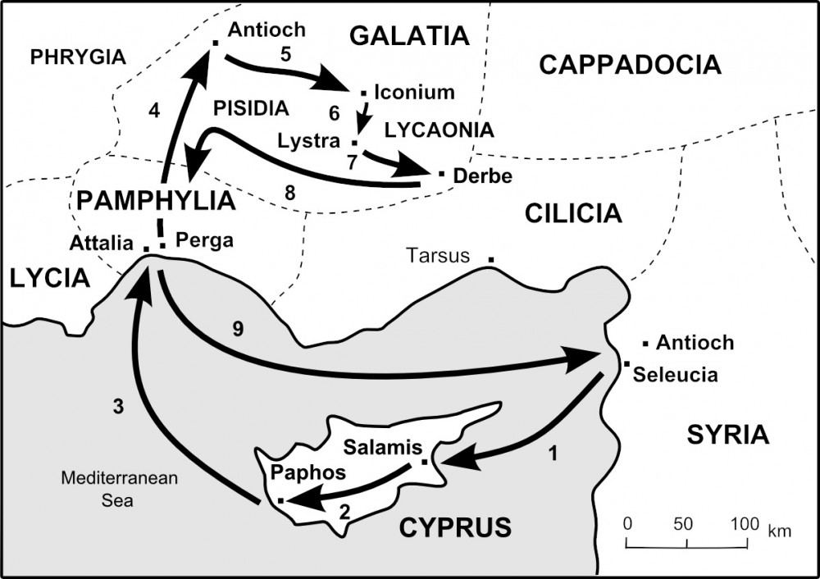
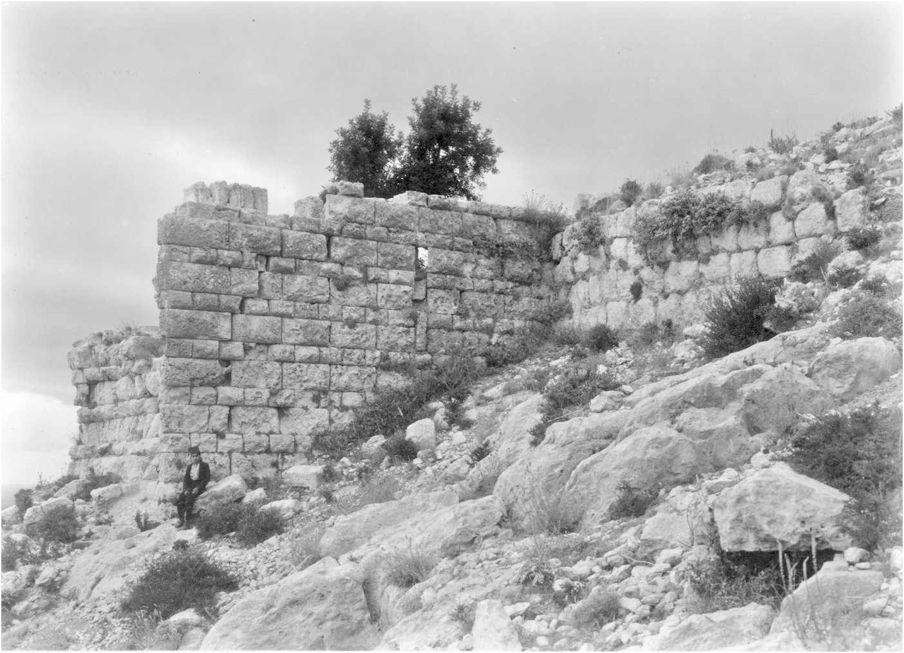
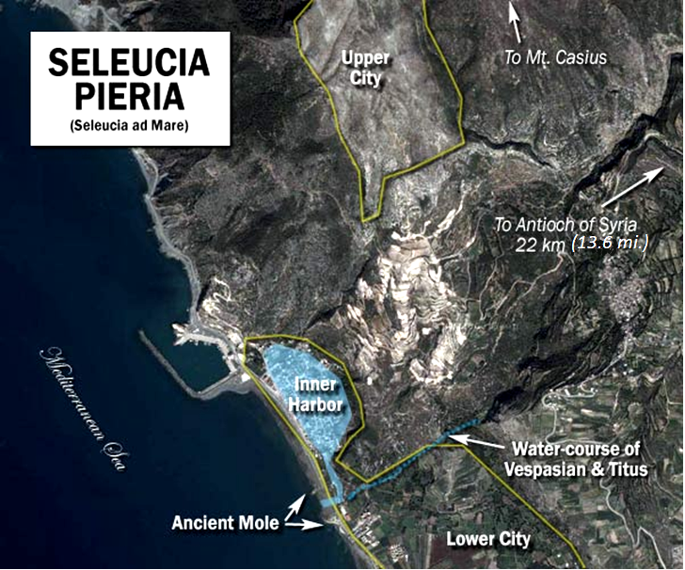
Slide 1
SELEUCIA
Seleucia (continued) The ancient city of Seleucia, was built on the rocky slope …Mt. Pierius…. The site was so favorable for a frontier fortress that Seleucia has been called a "Syrian Gibraltar." The city extended in a narrow strip up the mountain slope and was surrounded by a wall 6 km. (4 mi.) in perimeter. A natural moat was formed by two mountain torrents flowing outside the walls on the east and on the west.
SELEUCIA. sə-lōō'shi-ə, sə-lōō'shə [Gk. Seleukia]. The designation of perhaps ten cities named (or renamed) after the founder of the Seleucid dynasty……….
1. Seleucia on the Orontes (Seleucia Pieria). A port city and fortress 8 km. (5 mi.) inland from the Syrian coast on the Orontes River……. It served as the seaport for the city of Antioch, which lay about 26 km. (16 mi.) further upstream. It was from Seleucia that Paul and Barnabas set sail for Cyprus on their first missionary journey (Acts 13:4). ……
International Standard Bible Encyclopedia, Revised Edition
Pieria
Pieria
FIRST MISSIONARY JOURNEY
Ruins of wall that surrounded the upper City of Seleucia
FIRST MISSIONARY JOURNEY
Notes:
Ancient mole: A protective structure of stone or concrete extends from shore into the water to prevent a beach from washing away

Slide 71
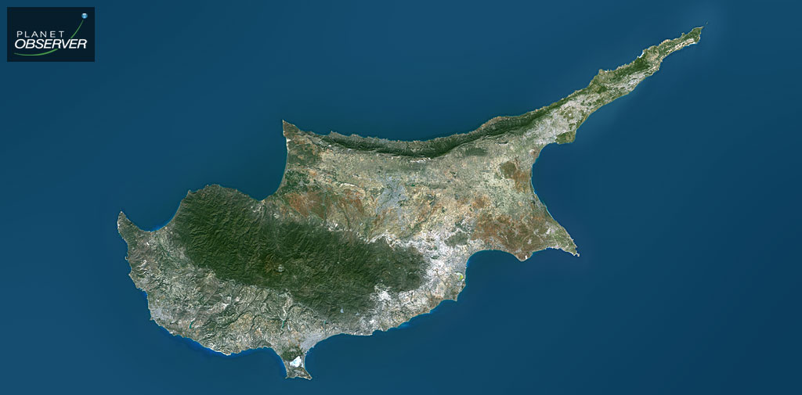
Slide 2
ISLAND OF CYPRUS
60 mi. Syrian coast
46 mi. Cilician coast
Occupies an Area 3584 sq. mi.
60 miles
140 miles

Slide 72
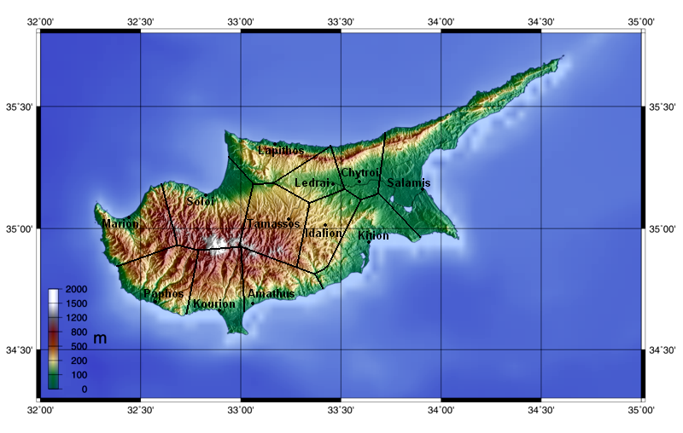
Acts 13:5 (NASB) 5 When they reached Salamis, they began to proclaim the word of God in the synagogues of the Jews; and they also had John as their helper.
Slide 3

Slide 73
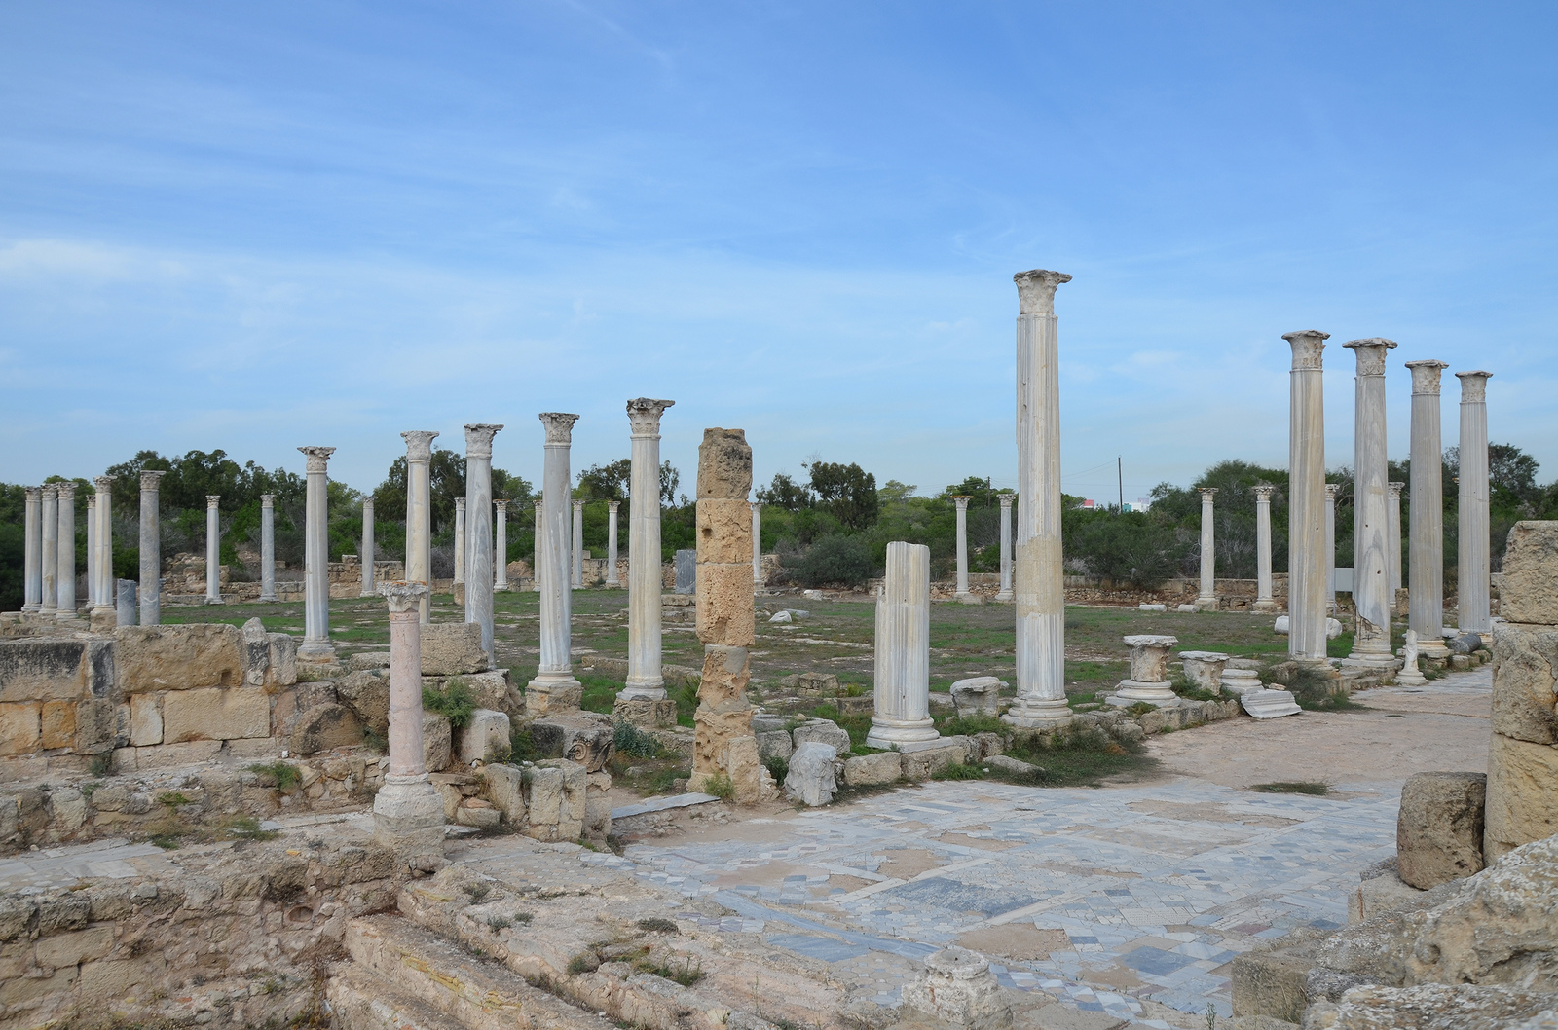
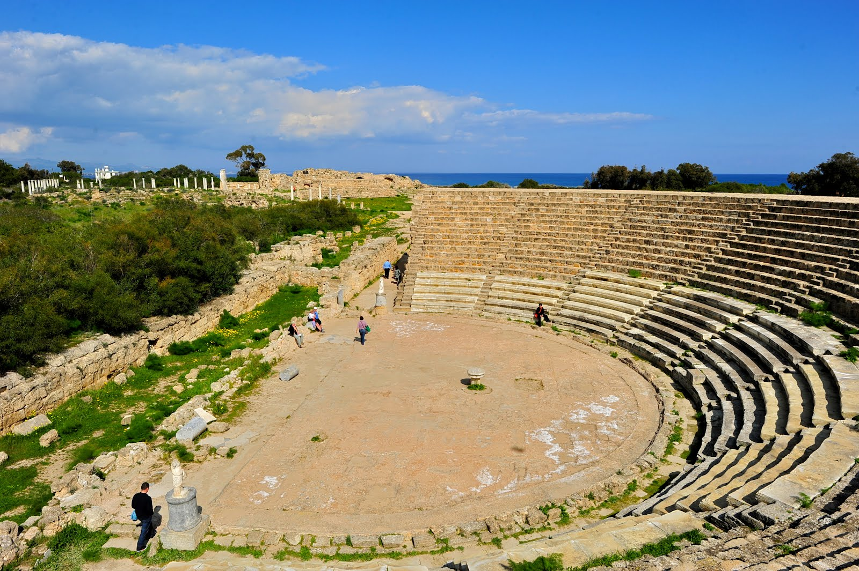
Slide 4
The Gymnasium with its columned palestra, Salamis
Ruins of Ancient Theater, Salamis of Cyprus
Notes:
Once a thriving port city on the island of Cyprus, the legendary birthplace of Aphrodite, Salamis offers a tantalizing glimpse into the vast history of the island. The ruins of the ancient city occupy an extensive area (one square mile) extending along the sea shore against the backdrop of sand dunes and a forest of acacias. Parts of the ruins date back before Barnabas and Paul departed on this first missionary journey. But the site was destroy by earthquakes measuring 10 or 11 on the Richter scale. It was rebuilt over and over again by the Romans only to fall to earthquakes.

Slide 74
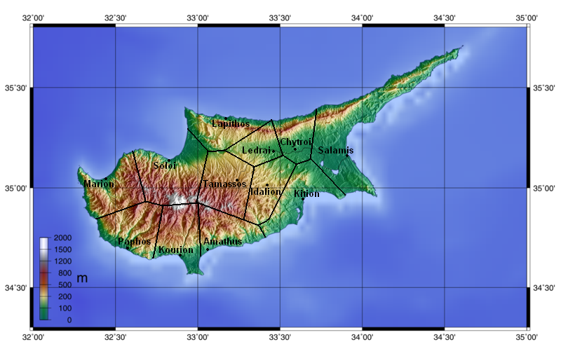
PAPHOS
Pieria
Acts 13:6 (NASB) 6 When they had gone through the whole island as far as Paphos, they found a magician, a Jewish false prophet whose name was Bar-Jesus,
FIRST MISSIONARY JOURNEY

Slide 75
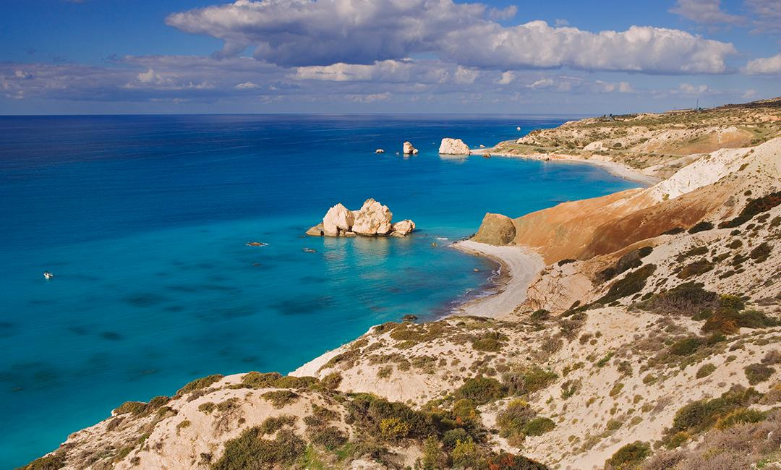
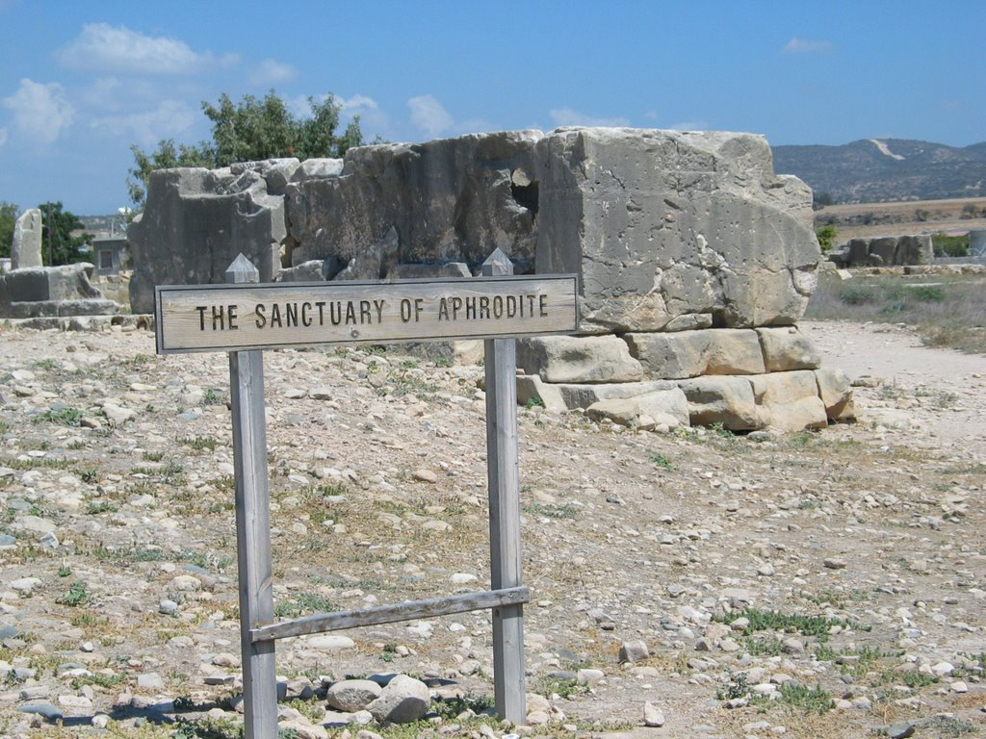
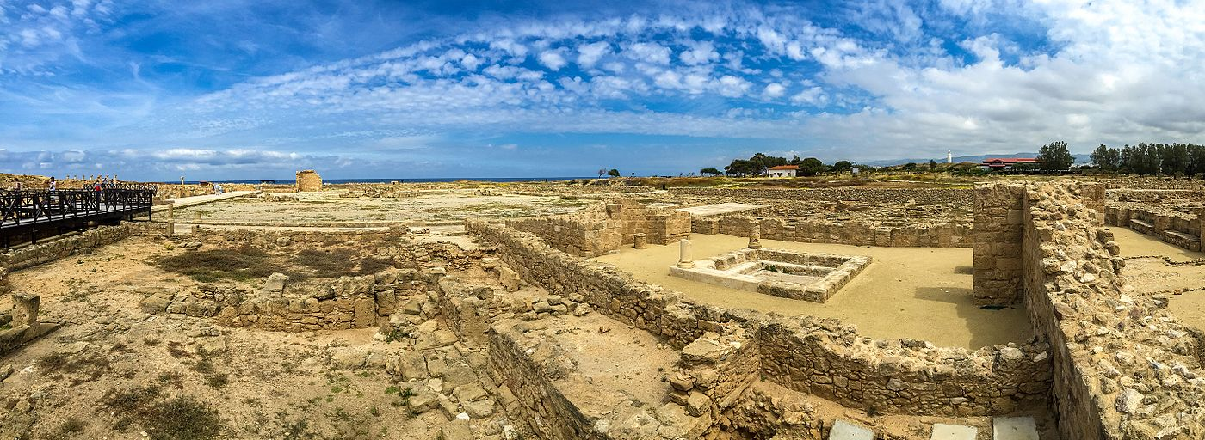
PAPHOS
Paphos Archaeological Park
PAPHOS - SHORELINE

Slide 76
LET US SPREAD THE GOOD NEWS
1 Peter 3:15 (NASB) 15 but sanctify Christ as Lord in your hearts, always being ready to make a defense to everyone who asks you to give an account for the hope that is in you, yet with gentleness and reverence;
HAVE YOU HEARD THE GOSPEL CALL?
THEN COME
Acts 2:37-38 (NASB) 37 Now when they heard this, they were pierced to the heart, and said to Peter and the rest of the apostles, "Brethren, what shall we do?" 38 Peter said to them, "Repent, and each of you be baptized in the name of Jesus Christ for the forgiveness of your sins; and you will receive the gift of the Holy Spirit.

Slide 77
THE PERSUASIVNESS OF THE GOSPEL MESSAGE AND MIRACLES
1. The miracles confirmed God’s word: Acts 2:22; Heb 2:3-4
a. The apostles always credit the Lord for the miracles performed not themselves. Acts 2:32-33; 3:11-13; 9:32-35;
2. The miraculous powers were never used by God as a coercive force of any kind. The Gospel message always allowed freedom to choose. It was the teaching that gave people the hope of eternal life. It is the Gospel that promised a Kingdom where there will be no injustice.
a. This appealed to many living in an oppressive society in which 50% of the population were slaves. This message caused a deep commitment for which they would die.
b. The Gospel was so widely received by the oppressed that Christians were perceived as a threat to the Empire and were persecuted.
3. The only logical explanation for the total commitment of the people is they were convinced that the promises were actually from God. The miracles helped to convince them the Gospel message was from a divine source. Eternal life is real.
Acts 2:22 (NASB) 22 "Men of Israel, listen to these words: Jesus the Nazarene, a man attested to you by God with miracles and wonders and signs which God performed through Him in your midst, just as you yourselves know— Hebrews 2:3-4 (NASB) 3 how will we escape if we neglect so great a salvation? After it was at the first spoken through the Lord, it was confirmed to us by those who heard, 4 God also testifying with them, both by signs and wonders and by various miracles and by gifts of the Holy Spirit according to His own will.
Acts 2:32-33 (NASB) 32 "This Jesus God raised up again, to which we are all witnesses. 33 "Therefore having been exalted to the right hand of God, and having received from the Father the promise of the Holy Spirit, He has poured forth this which you both see and hear.
Acts 3:11-13 (NASB) 11 While he was clinging to Peter and John, all the people ran together to them at the so-called portico of Solomon, full of amazement. 12 But when Peter saw this, he replied to the people, "Men of Israel, why are you amazed at this, or why do you gaze at us, as if by our own power or piety we had made him walk? 13 "The God of Abraham, Isaac and Jacob, the God of our fathers, has glorified His servant Jesus, the one whom you delivered and disowned in the presence of Pilate, when he had decided to release Him.
Acts 9:32-35 (NASB) 32 Now as Peter was traveling through all those regions, he came down also to the saints who lived at Lydda. 33 There he found a man named Aeneas, who had been bedridden eight years, for he was paralyzed. 34 Peter said to him, "Aeneas, Jesus Christ heals you; get up and make your bed." Immediately he got up. 35 And all who lived at Lydda and Sharon saw him, and they turned to the Lord.
Notes:
Next time someone tells you that the teachings of the bible are responsible for more hate and wars than any other cause. You tell them no that’s not true. You have never read the teachings of Jesus the Christ for if you had you would not make such an uniformed statement.

Slide 78
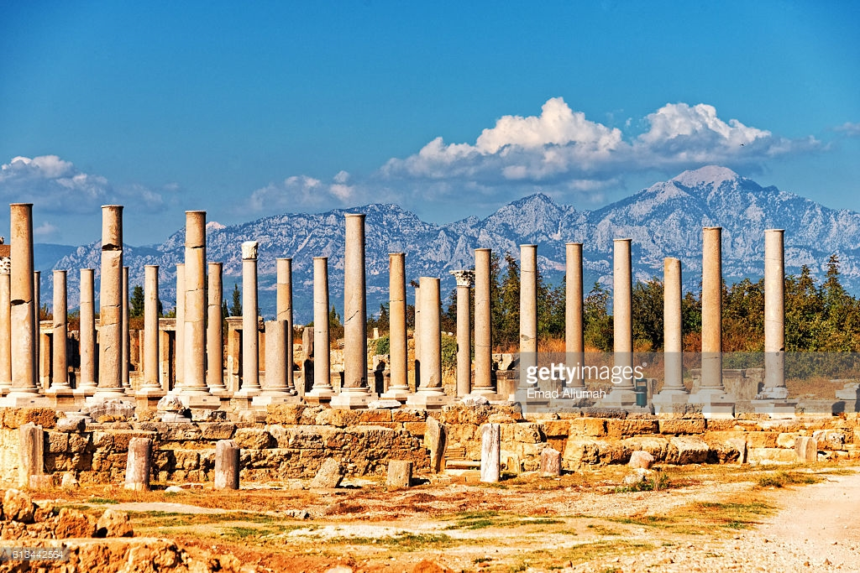
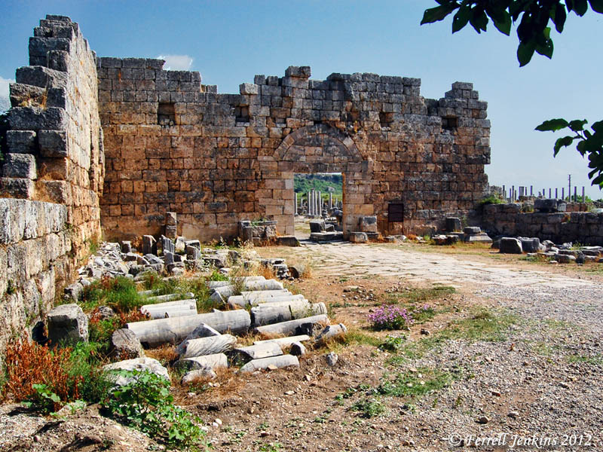
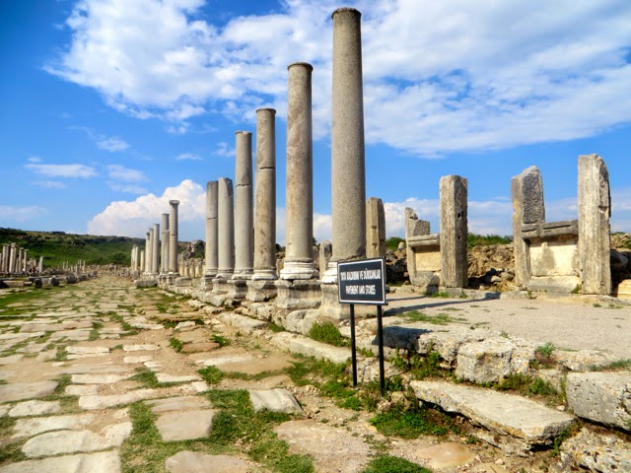
PERGA OF PAMPHYLIA
Acts 13:13
13 Now Paul and his companions put out to sea from Paphos and came to Perga in Pamphylia; but John left them and returned to Jerusalem.
Pieria
FIRST MISSIONARY JOURNEY
Ruins of Perga
Roman Gate into ruins of Perga

Slide 79
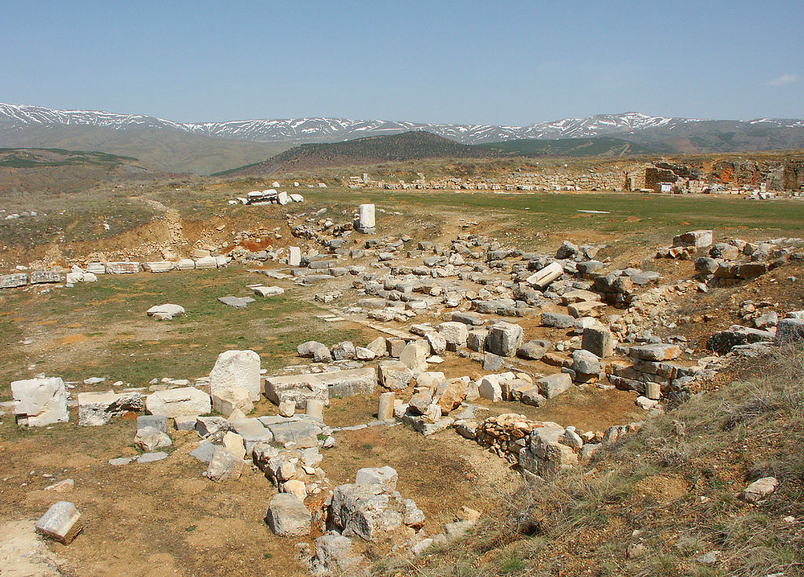
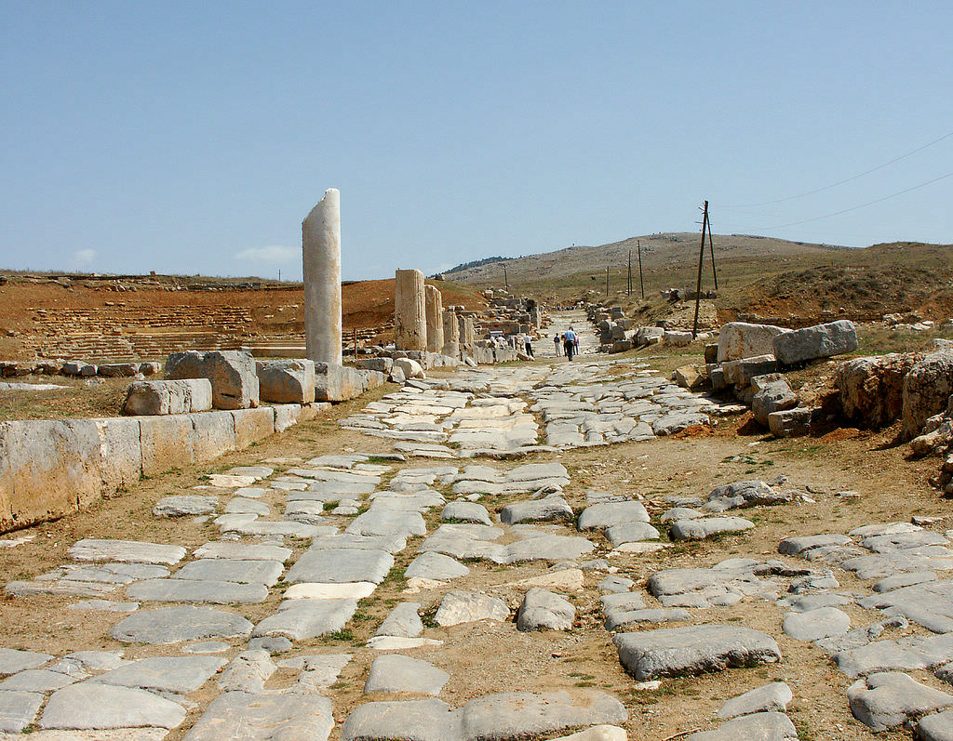
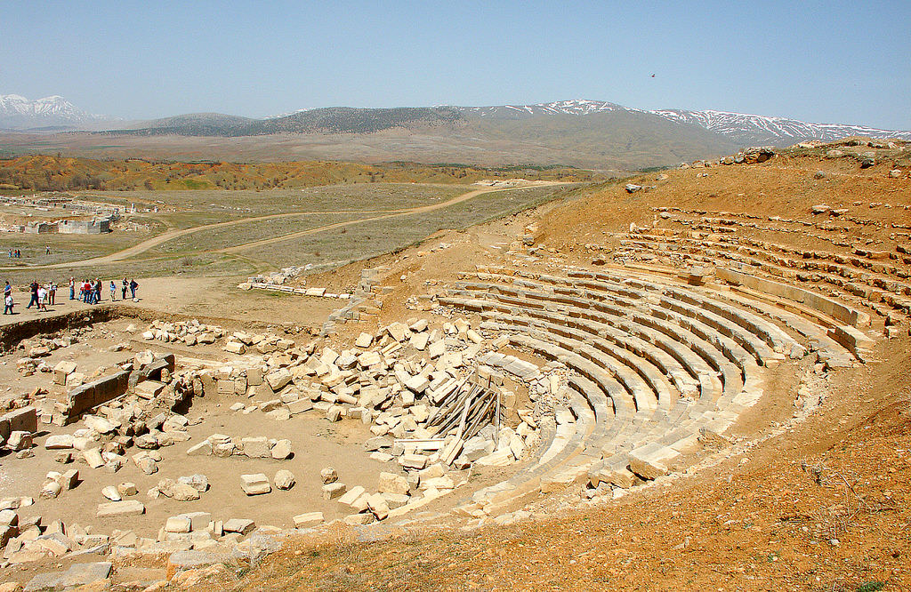
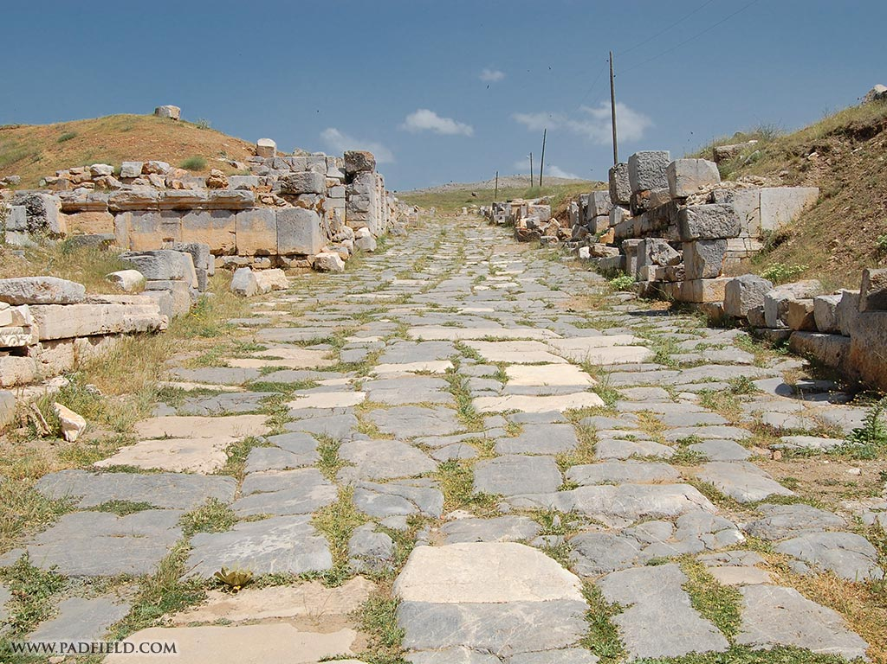
ANTIOCH OF PISIDIA
Acts 13:14
14 But going on from Perga, they arrived at Pisidian Antioch, and on the Sabbath day they went into the synagogue and sat down.
Pieria
FIRST MISSIONARY JOURNEY

Slide 80
SYNAGOGUE
Synagogue, Greek συναγωγή, sunagōgé, "gathering" (Acts 13:43), "gathering-place" (Luke 7:5), was the name applied to the Jewish place of worship in later Judaism in and outside of Palestine Proseuché, "a place of prayer“
Services: (1) Recitation of the "Shemaʿ". At least ten persons had to be present for regular worship. the recitation of the shēmaʿ, i.e. a confession of God's unity, consisting of the passages Deut. 6:4-9; Deut. 11:13-21; Numbers 15:37-41 ….
(2) Prayers. The most important prayers were the Shemōneh ʿesrēh, ….a cycle of eighteen prayers, ..Like the shēmaʿ they are very old. The prayers of the delegate were met with a response of Amen from the congregation.
(3) Reading of the Law and the Prophets.… the pārāshāh, i.e. the pericope from the Law for that Sabbath, was read, and the interpreter translated verse by verse into Aramaic (Meghillāh). The whole Pentateuch was divided into 154 pericopes, so that in the course of 3 years it was read through in order.
Luke 7:5 (NASB) 5 for he loves our nation and it was he who built us our synagogue."
Acts 13:43 (NASB) 43 Now when the meeting of the synagogue had broken up, many of the Jews and of the God-fearing proselytes followed Paul and Barnabas, who, speaking to them, were urging them to continue in the grace of God.
(4) The Sermon. After the reading from the Law and the Prophets followed the sermon... Anyone in the congregation might be asked by the ruler to preach, or might ask the ruler for permission to preach.
(5) The Benediction. After the sermon the benediction was pronounced (by a priest), and the congregation answered Amen (Berākhōth 5:4; Ṣōṭāh 7:2-3).
The International Standard Bible Encyclopedia
Deuteronomy 6:4-9 (NASB) 4 "Hear, O Israel! The LORD is our God, the LORD is one! 5 "You shall love the LORD your God with all your heart and with all your soul and with all your might. 6 "These words, which I am commanding you today, shall be on your heart. 7 "You shall teach them diligently to your sons and shall talk of them when you sit in your house and when you walk by the way and when you lie down and when you rise up.
Deuteronomy 11:13-21 (NASB) 13 "It shall come about, if you listen obediently to my commandments which I am commanding you today, to love the LORD your God and to serve Him with all your heart and all your soul, 14 that He will give the rain for your land in its season, the early and late rain, that you may gather in your grain and your new wine and your oil. 15 "He will give grass in your fields for your cattle, and you will eat and be satisfied.
Numbers 15:37-41 (NASB) 37 The LORD also spoke to Moses, saying, 38 "Speak to the sons of Israel, and tell them that they shall make for themselves tassels on the corners of their garments throughout their generations, and that they shall put on the tassel of each corner a cord of blue. 39 "It shall be a tassel for you to look at and remember all the commandments of the LORD, so as to do them and not follow after your own heart and your own eyes, after which you played the harlot,
8 "You shall bind them as a sign on your hand and they shall be as frontals on your forehead. 9 "You shall write them on the doorposts of your house and on your gates.
16 "Beware that your hearts are not deceived, and that you do not turn away and serve other gods and worship them. 17 "Or the anger of the LORD will be kindled against you, and He will shut up the heavens so that there will be no rain and the ground will not yield its fruit; and you will perish quickly from the good land which the LORD is giving you.
18 "You shall therefore impress these words of mine on your heart and on your soul; and you shall bind them as a sign on your hand, and they shall be as frontals on your forehead. 19 "You shall teach them to your sons, talking of them when you sit in your house and when you walk along the road and when you lie down and when you rise up. 20 "You shall write them on the doorposts of your house and on your gates,
21 so that your days and the days of your sons may be multiplied on the land which the LORD swore to your fathers to give them, as long as the heavens remain above the earth.
40 so that you may remember to do all My commandments and be holy to your God. 41 "I am the LORD your God who brought you out from the land of Egypt to be your God; I am the LORD your God.“

Slide 81
Lesson 24 HIS RESURRECTION – AND THE WITNESSES
“But now hath Christ been raised from the dead, the first-fruits of them that are asleep,” is the triumphant cry of the Apostle Paul (1Cor 15:20). This proposition is the keystone of the Christian’s faith. It is the support of his every hope. There is little use to argue about the rest of the miracles of the New Testament: if Christ be raised from the dead, the rest of the miracles are easy to accept; if He be not risen, the rest do not matter.
If the resurrection of Jesus Christ can be proved as a fact in history, then He is the Christ of God and the Bible is a special divine revelation. We believe the testimony is such that it is more reasonable to believe than not to believe.

Slide 82
I. THE QUESTION AND THE WITNESSES
1. The Question: Did Jesus raise from the dead? “By the leading skeptics it is now admitted; first, that Jesus actually died and was buried; second, it is admitted that on or before the third morning His body disappeared from the tomb; third, that the disciples came to believe firmly that He arose from the dead. The exact issue has reference to the last two facts, and may be stated by the two questions: Did the body disappear by a resurrection, or in some other way? And Did the belief of the disciples originate from the fact of the resurrection, or from some other cause?”
(J. W. McGarvey, Evidences of Christianity, Part III, pp. 117-118)
2. The Witnesses: “ To us the witnesses are a group of women, not less than five in number; the twelve older apostles, and the apostle Paul. The testimony of the women and the twelve is recorded in the four Gospels, in Acts, and in the Epistles of Peter and John, and in Revelation. That of Paul is found in Acts and his epistles.” (Ibid. p. 118)

Slide 83
II. THE APOSTLES AS WITNESSES TO THE RESURRECTION
“The force of human testimony depends on three things: first, the honesty of the witnesses; second, their competency; and third, their number”
(J. W. McGarvey, op. cit. p. 146).
1. Their honesty. “We ascertain whether they are honest by considering their general character and their motives in the particular case” (Ibid.).
a. Judged by all the testimony available, their character is good.
(a) Their tone. They tell their story in the dispassionate tone that belongs to truthful witnesses.
(b) Their candor in relating things to their own discredit. They show their honesty in relating things discreditable to themselves; Peter’s denial, the Apostles ambition, their failure to understand, etc.

Slide 84
(c) Their sufferings. The sincerity and honesty of the Apostles is proved by what they were willing to endure in consequence of the testimony they gave. They had no selfish advantage to gain.
b. “The motives which prompt men to false testimony are fear, avarice, and ambition; fear of some evil to themselves or others, which is to be averted by the testimony; desire of sordid gain; and ambition for some kind of distinction among men” (McGarvey, Ibid.). In this they are above suspicion.

Slide 85
2. Their competency. “Competency is determined by considering the opportunities of the witness to obtain knowledge of that to which he testifies, and his mental capacity to observe and remember the facts” (McGarvey, Ibid.).
a. Opportunity. The Apostles had been with Him from His baptism, and understood that their office was that of witnesses. Acts 1:21-22
b. Mentally competent. Note the character and occupation of at least three;
(a) Matthew was a tax gatherer, with a profound knowledge of Hebrew law, Roman law, and human nature. He shows no sign of hysteria or weakness.
(b) Peter, although impetuous, was not credulous.
(c) Nor was John credulous. He shows aptness at noting details, John 20:7 These men were not willing to believe just anything, Lk 24:25.
Acts 1:21-22 (NASB) 21 "Therefore it is necessary that of the men who have accompanied us all the time that the Lord Jesus went in and out among us— 22 beginning with the baptism of John until the day that He was taken up from us—one of these must become a witness with us of His resurrection."
Luke 24:25 (NASB) 25 And He said to them, "O foolish men and slow of heart to believe in all that the prophets have spoken!
John 20:7 (NASB) 7 and the face-cloth which had been on His head, not lying with the linen wrappings, but rolled up in a place by itself.

Slide 86
Mark 16:12-14 (NASB) 12 After that, He appeared in a different form to two of them while they were walking along on their way to the country. 13 They went away and reported it to the others, but they did not believe them either. 14 Afterward He appeared to the eleven themselves as they were reclining at the table; and He reproached them for their unbelief and hardness of heart, because they had not believed those who had seen Him after He had risen.
Matthew 16:21-22 (NASB) 21 From that time Jesus began to show His disciples that He must go to Jerusalem, and suffer many things from the elders and chief priests and scribes, and be killed, and be raised up on the third day. 22 Peter took Him aside and began to rebuke Him, saying, "God forbid it, Lord! This shall never happen to You."
Luke 22:33-34 (NASB) 33 But he said to Him, "Lord, with You I am ready to go both to prison and to death!" 34 And He said, "I say to you, Peter, the rooster will not crow today until you have denied three times that you know Me."
Luke 22:60-62 (NASB) 60 But Peter said, "Man, I do not know what you are talking about." Immediately, while he was still speaking, a rooster crowed. 61 The Lord turned and looked at Peter. And Peter remembered the word of the Lord, how He had told him, "Before a rooster crows today, you will deny Me three times." 62 And he went out and wept bitterly.
3. The number. “The requisite number varies with the degree of probability attached to the facts. The testimony of two honest and competent witnesses makes us feel more sure than of one; and that of three, than that of two; but a limit is soon reached beyond which those who are convinced feel the need of no more, and those who are not yet convinced realize that more would not convince them. When this number has testified in any case, the number is sufficient, and a greater number would be useless” (McGarvey, Ibid.).
III. THE EVIDENCE OF THE CHANGED DISCIPLES
1. Jesus repeatedly told His disciples He must be killed and raised from the dead on the third day, Mt 16:21-22
2. Peter betrayed Jesus due to fear: Lk 22:33-34; 60-62
3. This they did not understand, nor even believe after the resurrection, Lk 24:11, Lk 24:20-21; Mark 16:12-14.
Luke 24:20-21 (NASB) 20 and how the chief priests and our rulers delivered Him to the sentence of death, and crucified Him. 21 "But we were hoping that it was He who was going to redeem Israel. Indeed, besides all this, it is the third day since these things happened.
Luke 24:11 (NASB) 11 But these words appeared to them as nonsense, and they would not believe them.
Notes:
4/3/2015
III.

Slide 87
3. But after Jesus’ ascension and the coming of the Holy Spirit, behold the difference, Acts 2:22-24, 36
4. How is this change to be accounted for? No man can deny the zeal of the Apostles, for their message took the world, changed history, overturned existing systems. Peter’s explanation for his witness to the resurrection, 1Peter 1:3-5.
Acts 2:22-24 (NASB) 22 "Men of Israel, listen to these words: Jesus the Nazarene, a man attested to you by God with miracles and wonders and signs which God performed through Him in your midst, just as you yourselves know— 23 this Man, delivered over by the predetermined plan and foreknowledge of God, you nailed to a cross by the hands of godless men and put Him to death. 24 "But God raised Him up again, putting an end to the agony of death, since it was impossible for Him to be held in its power.
Acts 2:36 (NASB) 36 "Therefore let all the house of Israel know for certain that God has made Him both Lord and Christ—this Jesus whom you crucified."
1 Peter 1:3-5 (NASB) 3 Blessed be the God and Father of our Lord Jesus Christ, who according to His great mercy has caused us to be born again to a living hope through the resurrection of Jesus Christ from the dead, 4 to obtain an inheritance which is imperishable and undefiled and will not fade away, reserved in heaven for you, 5 who are protected by the power of God through faith for a salvation ready to be revealed in the last time.

Slide 88
THE EMPTY TOMB
I. It is easier to believe Peter’s explanation than to believe the explanations given by unbelievers in an effort to account for Jesus Christ and His influence.
1. Swoon theory, Jesus was not actually dead, revived and walked out of the tomb
2. The enemies of Jesus stole the body
3. The disciples stole the body
4. Hallucination theory, the disciples saw what they wanted to see and mistook a vision or dream for reality.
5. Jesus rose from the dead. This is the only explanation that explains why. Credible witnesses (1. truthful 2. competent 3. sufficient in number), were willing to give up everything receiving no profit in this life for their testimony.
Last slide

Slide 89
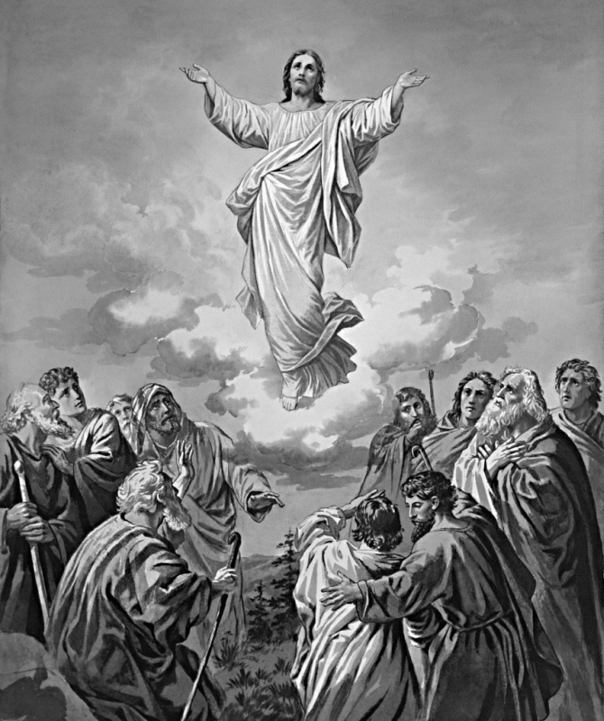
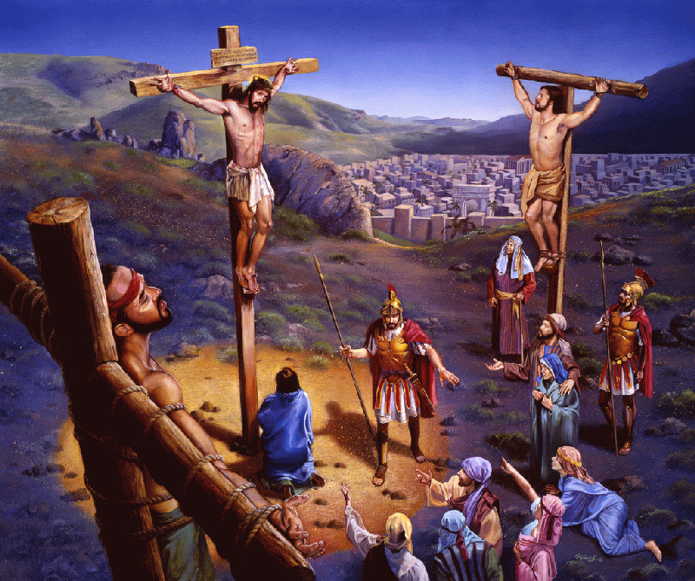
PAUL APPEALS TO O.T. PROPHETS AS PROOF THAT THE MESSIAH WOULD DIE AND RISE FROM THE DEAD
I. Prophecy foretold the Messiah’s death and resurrection: Psa 2:1-3; Ac 4:25-28; Jn 11:47-53; Mt 21:37-39; Psa 2:4-7; Acts 1:9-11; Dan 7:13-14; Acts 13:27
Daniel 7:13-14 (NASB) 13 "I kept looking in the night visions, And behold, with the clouds of heaven One like a Son of Man was coming, And He came up to the Ancient of Days And was presented before Him. 14 "And to Him was given dominion, Glory and a kingdom, That all the peoples, nations and men of every language Might serve Him. His dominion is an everlasting dominion Which will not pass away; And His kingdom is one Which will not be destroyed.
John 11:47-53 (NASB) 47 Therefore the chief priests and the Pharisees convened a council, and were saying, "What are we doing? For this man is performing many signs. 48 "If we let Him go on like this, all men will believe in Him, and the Romans will come and take away both our place and our nation." 49 But one of them, Caiaphas, who was high priest that year, said to them, "You know nothing at all, 50 nor do you take into account that it is expedient for you that one man die for the people, and that the whole nation not perish."
Acts 1:9-11 (NASB) 9 And after He had said these things, He was lifted up while they were looking on, and a cloud received Him out of their sight. 10 And as they were gazing intently into the sky while He was going, behold, two men in white clothing stood beside them. 11 They also said, "Men of Galilee, why do you stand looking into the sky? This Jesus, who has been taken up from you into heaven, will come in just the same way as you have watched Him go into heaven."
Psalm 2:4-7 (NASB) 4 He who sits in the heavens laughs, The Lord scoffs at them. 5 Then He will speak to them in His anger And terrify them in His fury, saying, 6 "But as for Me, I have installed My King Upon Zion, My holy mountain." 7 "I will surely tell of the decree of the LORD: He said to Me, 'You are My Son, Today I have begotten You.
Acts 4:25-28 (NASB) 25 who by the Holy Spirit, through the mouth of our father David Your servant, said, 'WHY DID THE GENTILES RAGE, AND THE PEOPLES DEVISE FUTILE THINGS? 26 'THE KINGS OF THE EARTH TOOK THEIR STAND, AND THE RULERS WERE GATHERED TOGETHER AGAINST THE LORD AND AGAINST HIS CHRIST.'
Matthew 21:37-39 (NASB) 37 "But afterward he sent his son to them, saying, 'They will respect my son.' 38 "But when the vine-growers saw the son, they said among themselves, 'This is the heir; come, let us kill him and seize his inheritance.' 39 "They took him, and threw him out of the vineyard and killed him.
Psalm 2:1-3 (NASB) 1 Why are the nations in an uproar And the peoples devising a vain thing? 2 The kings of the earth take their stand And the rulers take counsel together Against the LORD and against His Anointed, saying, 3 "Let us tear their fetters apart And cast away their cords from us!"
27 "For truly in this city there were gathered together against Your holy servant Jesus, whom You anointed, both Herod and Pontius Pilate, along with the Gentiles and the peoples of Israel, 28 to do whatever Your hand and Your purpose predestined to occur.
51 Now he did not say this on his own initiative, but being high priest that year, he prophesied that Jesus was going to die for the nation, 52 and not for the nation only, but in order that He might also gather together into one the children of God who are scattered abroad. 53 So from that day on they planned together to kill Him.
Acts 13:27 (NASB) 27 "For those who live in Jerusalem, and their rulers, recognizing neither Him nor the utterances of the prophets which are read every Sabbath, fulfilled these by condemning Him.
Notes:
David lived to be 70 years old. 1040 – 970 BC He ruled Israel 40 years. 1010 – 970 BC
Psalm 2 is a messiah prophecy: They knew it to be a messiah Psalm but did not understand. The idea is that God will place his son on the throne. The son is not David but one who is born and seated. He was begotten (given life) and seated on the throne. The indication was very clear. This King would exist and yet be born again meaning he would die that he might receive life again.
This is the context of the 2nd Psalm. It is known to be a Messiah prophecy but they did not understand it. Clearly Psalm 2 describes the nations, including the Jews attempt to keep power over the Kingdom and prevent the Messiah (son) for being enthroned over Gods people.
When the Christ comes will he do greater works than these (Jn 7:31)? Could it be that they know he is the Christ (Jn 7:26)?

Slide 90
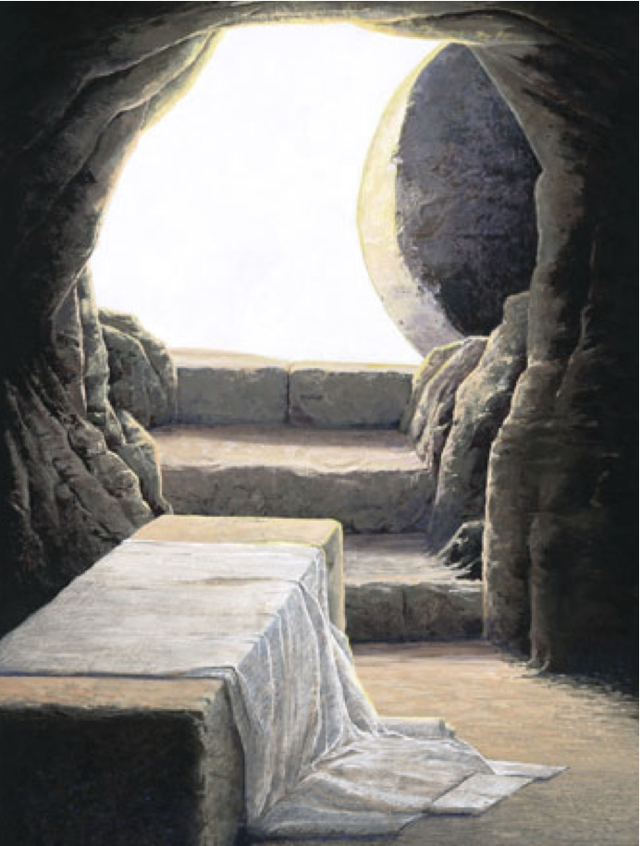
OLD TESTAMENT PROPHECY FORETOLD THE RESURRECTION OF THE MESSIAH
I. Prophecy foretold the Messiah’s death and resurrection before his body could begin to decay: Acts 13:34-37; Psa 16:8-11; Acts 2:29-31
David died and his body underwent decay.
The Messiah would be a descendant of David who would die but his body would not decay.
Jesus a descendant of David claimed to be the Messiah.
Jesus died and his body was placed in a tomb and it disappeared before it could decay.
David foretold this in Psa 16:10. Many witnesses saw Jesus alive after his body vanished.
Psalm 16:8-11 (David ruled Israel 1010 – 970 BC) 8 I have set the LORD continually before me; Because He is at my right hand, I will not be shaken. 9 Therefore my heart is glad and my glory rejoices; My flesh also will dwell securely. 10 For You will not abandon my soul to Sheol; Nor will You allow Your Holy One to undergo decay. 11 You will make known to me the path of life; In Your presence is fullness of joy; In Your right hand there are pleasures forever.
Acts 13:34-37 (NASB) 34 "As for the fact that He raised Him up from the dead, no longer to return to decay, He has spoken in this way: 'I WILL GIVE YOU THE HOLY and SURE blessings OF DAVID.' 35 "Therefore He also says in another Psalm, 'YOU WILL NOT ALLOW YOUR HOLY ONE TO UNDERGO DECAY.' 36 "For David, after he had served the purpose of God in his own generation, fell asleep, and was laid among his fathers and underwent decay; 37 but He whom God raised did not undergo decay.
Acts 2:29-31 (NASB) 29 "Brethren, I may confidently say to you regarding the patriarch David that he both died and was buried, and his tomb is with us to this day. 30 "And so, because he was a prophet and knew that GOD HAD SWORN TO HIM WITH AN OATH TO SEAT one OF HIS DESCENDANTS ON HIS THRONE, 31 he looked ahead and spoke of the resurrection of the Christ, that HE WAS NEITHER ABANDONED TO HADES, NOR DID His flesh SUFFER DECAY.
Notes:
He was raised to sit on the throne of David: Dan 7:13-14 But according to Psa 2:4-9 this is after he is killed and God laughs at men efforts to gain control over the kingdom by killing the heir. This why the term begotton is so important. What must have happened to Gods annointed in order to be begotten again and then set on the throne. All of this had to happen during the fourth Kingdom or the Roman empire. It either happened in those days and those kings or not at all.

Slide 91
What the Law Of Moses Could Not Do
Old Testament
Law was not given that could impart life!
Law was weak through the flesh of men
Galatians 5:19-21 (NASB) 19 Now the deeds of the flesh are evident, which are: immorality, impurity, sensuality, 20 idolatry, sorcery, enmities, strife, jealousy, outbursts of anger, disputes, dissensions, factions, 21 envying, drunkenness, carousing, and things like these, of which I forewarn you, just as I have forewarned you, that those who practice such things will not inherit the kingdom of God.
Galatians 3:10 (NASB) 10 For as many as are of the works of the Law are under a curse; for it is written, "CURSED IS EVERYONE WHO DOES NOT ABIDE BY ALL THINGS WRITTEN IN THE BOOK OF THE LAW, TO PERFORM THEM."
Many sacrifices never make men perfect
Year by year animal sacrifices remind of sin
Impossible for animal blood to take away sin
The Law of Moses
Jesus took away the OT to establish the NT
Hebrews 10:1-4 (NASB) 1 For the Law, since it has only a shadow of the good things to come and not the very form of things, can never, by the same sacrifices which they offer continually year by year, make perfect those who draw near.
Hebrews 10:11 (NASB) 11 Every priest stands daily ministering and offering time after time the same sacrifices, which can never take away sins;
2 Otherwise, would they not have ceased to be offered, because the worshipers, having once been cleansed, would no longer have had consciousness of sins? 3 But in those sacrifices there is a reminder of sins year by year. 4 For it is impossible for the blood of bulls and goats to take away sins.
Galatians 3:21 (NASB) 21 Is the Law then contrary to the promises of God? May it never be! For if a law had been given which was able to impart life, then righteousness would indeed have been based on law.
Romans 8:3 (NASB) 3 For what the Law could not do, weak as it was through the flesh, God did: sending His own Son in the likeness of sinful flesh and as an offering for sin, He condemned sin in the flesh,
Hebrews 10:9 (NASB) 9 then He said, "BEHOLD, I HAVE COME TO DO YOUR WILL." He takes away the first in order to establish the second.
Notes:
Rom 8:3; Heb 8:8; Heb 10:1-4 reminder of sins and day of atonement; 9:15; Gal 3:21; Heb 10:11

Slide 92
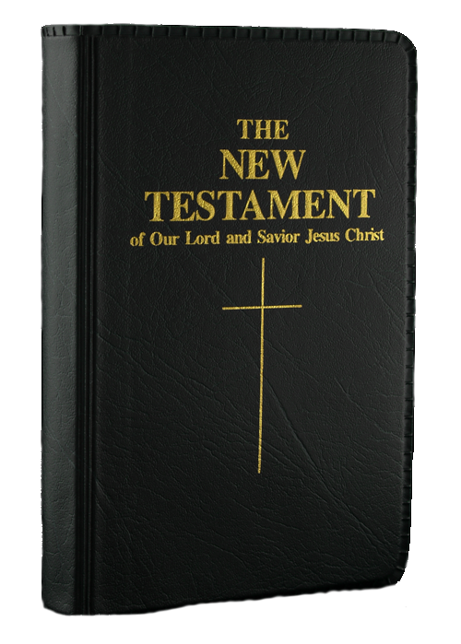
What the Law Of Moses Could Not Do
The New Covenant Of Jesus Christ Can Do
Last slide
In the NT of Christ eternal life is imparted
1 John 5:11-13 (NASB) 11 And the testimony is this, that God has given us eternal life, and this life is in His Son. 12 He who has the Son has the life; he who does not have the Son of God does not have the life. 13 These things I have written to you who believe in the name of the Son of God, so that you may know that you have eternal life.
2 Corinthians 3:6 (NASB) 6 who also made us adequate as servants of a new covenant, not of the letter but of the Spirit; for the letter kills, but the Spirit gives life.
Under Christ’s NT men are made perfect
1 Peter 5:10 (NASB) 10 After you have suffered for a little while, the God of all grace, who called you to His eternal glory in Christ, will Himself perfect, confirm, strengthen and establish you.
Hebrews 12:23 (NASB) 23 to the general assembly and church of the firstborn who are enrolled in heaven, and to God, the Judge of all, and to the spirits of the righteous made perfect,
One sacrifice which can take away sins
Hebrews 10:10-12 (NASB) 10 By this will we have been sanctified through the offering of the body of Jesus Christ once for all. 11 Every priest stands daily ministering and offering time after time the same sacrifices, which can never take away sins; 12 but He, having offered one sacrifice for sins for all time, SAT DOWN AT THE RIGHT HAND OF GOD,
Hebrews 9:24-26 (NASB) 24 For Christ did not enter a holy place made with hands, a mere copy of the true one, but into heaven itself, now to appear in the presence of God for us; 25 nor was it that He would offer Himself often, as the high priest enters the holy place year by year with blood that is not his own.
Under Christ’s NT our sin will not be remembered
26 Otherwise, He would have needed to suffer often since the foundation of the world; but now once at the consummation of the ages He has been manifested to put away sin by the sacrifice of Himself.
Hebrews 10:16-18 (NASB) 16 "THIS IS THE COVENANT THAT I WILL MAKE WITH THEM AFTER THOSE DAYS, SAYS THE LORD: I WILL PUT MY LAWS UPON THEIR HEART, AND ON THEIR MIND I WILL WRITE THEM," He then says, 17 "AND THEIR SINS AND THEIR LAWLESS DEEDS I WILL REMEMBER NO MORE."
18 Now where there is forgiveness of these things, there is no longer any offering for sin.
Notes:
Heb 12:23; 1Pet 5:10; 2Cor 3:6; Jn 5:11-13; Heb 10:5, 9-14;

Slide 93
AS MANY AS HAD BEEN APPOINTED TO ETERNAL LIFE BELIEVED
Ephesians 3:8-11 (NASB77) 8 To me, the very least of all saints, this grace was given, to preach to the Gentiles the unfathomable riches of Christ, 9 and to bring to light what is the administration of the mystery which for ages has been hidden in God, who created all things; 10 in order that the manifold wisdom of God might now be made known through the church to the rulers and the authorities in the heavenly places. 11 This was in accordance with the eternal purpose which He carried out in Christ Jesus our Lord,
Isaiah 49:6 (NASB77) 6 He says, "It is too small a thing that You should be My Servant To raise up the tribes of Jacob, and to restore the preserved ones of Israel; I will also make You a light of the nations So that My salvation may reach to the end of the earth."
God Commanded What He Had Appointed Through The Prophet Isaiah 739-686 B.C. Isa 49:6
COMMANED
APOSTLES
Acts 13:46 (NASB77) 46 And Paul and Barnabas spoke out boldly and said, "It was necessary that the word of God should be spoken to you first; since you repudiate it, and judge yourselves unworthy of eternal life, behold, we are turning to the Gentiles.
Acts 13:48 (NASB77) 48 And when the Gentiles heard this, they began rejoicing and glorifying the word of the Lord; and as many as had been appointed to eternal life believed.
Acts 13:47 (NKJV) 47 For so the Lord has commanded us: 'I have set you as a light to the Gentiles, That you should be for salvation to the ends of the earth.' "
1 Timothy 2:3-4 (NKJV) 3 For this is good and acceptable in the sight of God our Savior, 4 who desires all men to be saved and to come to the knowledge of the truth.
Acts 10:34-35 (NKJV) 34 Then Peter opened his mouth and said: "In truth I perceive that God shows no partiality. 35 But in every nation whoever fears Him and works righteousness is accepted by Him.
Notes:
Jesus is the light and the Apostles as his ambassadors speak for him. They are standing in the place of Jesus as Jesus completes his work through them. Acts 1:1; 2Cor 5:20; 1cor 14:37 In Jesus lifetime on earth he limited his mission to the Jews but he would continue his work being a light to the Gentiles through his official delegates.

Slide 94
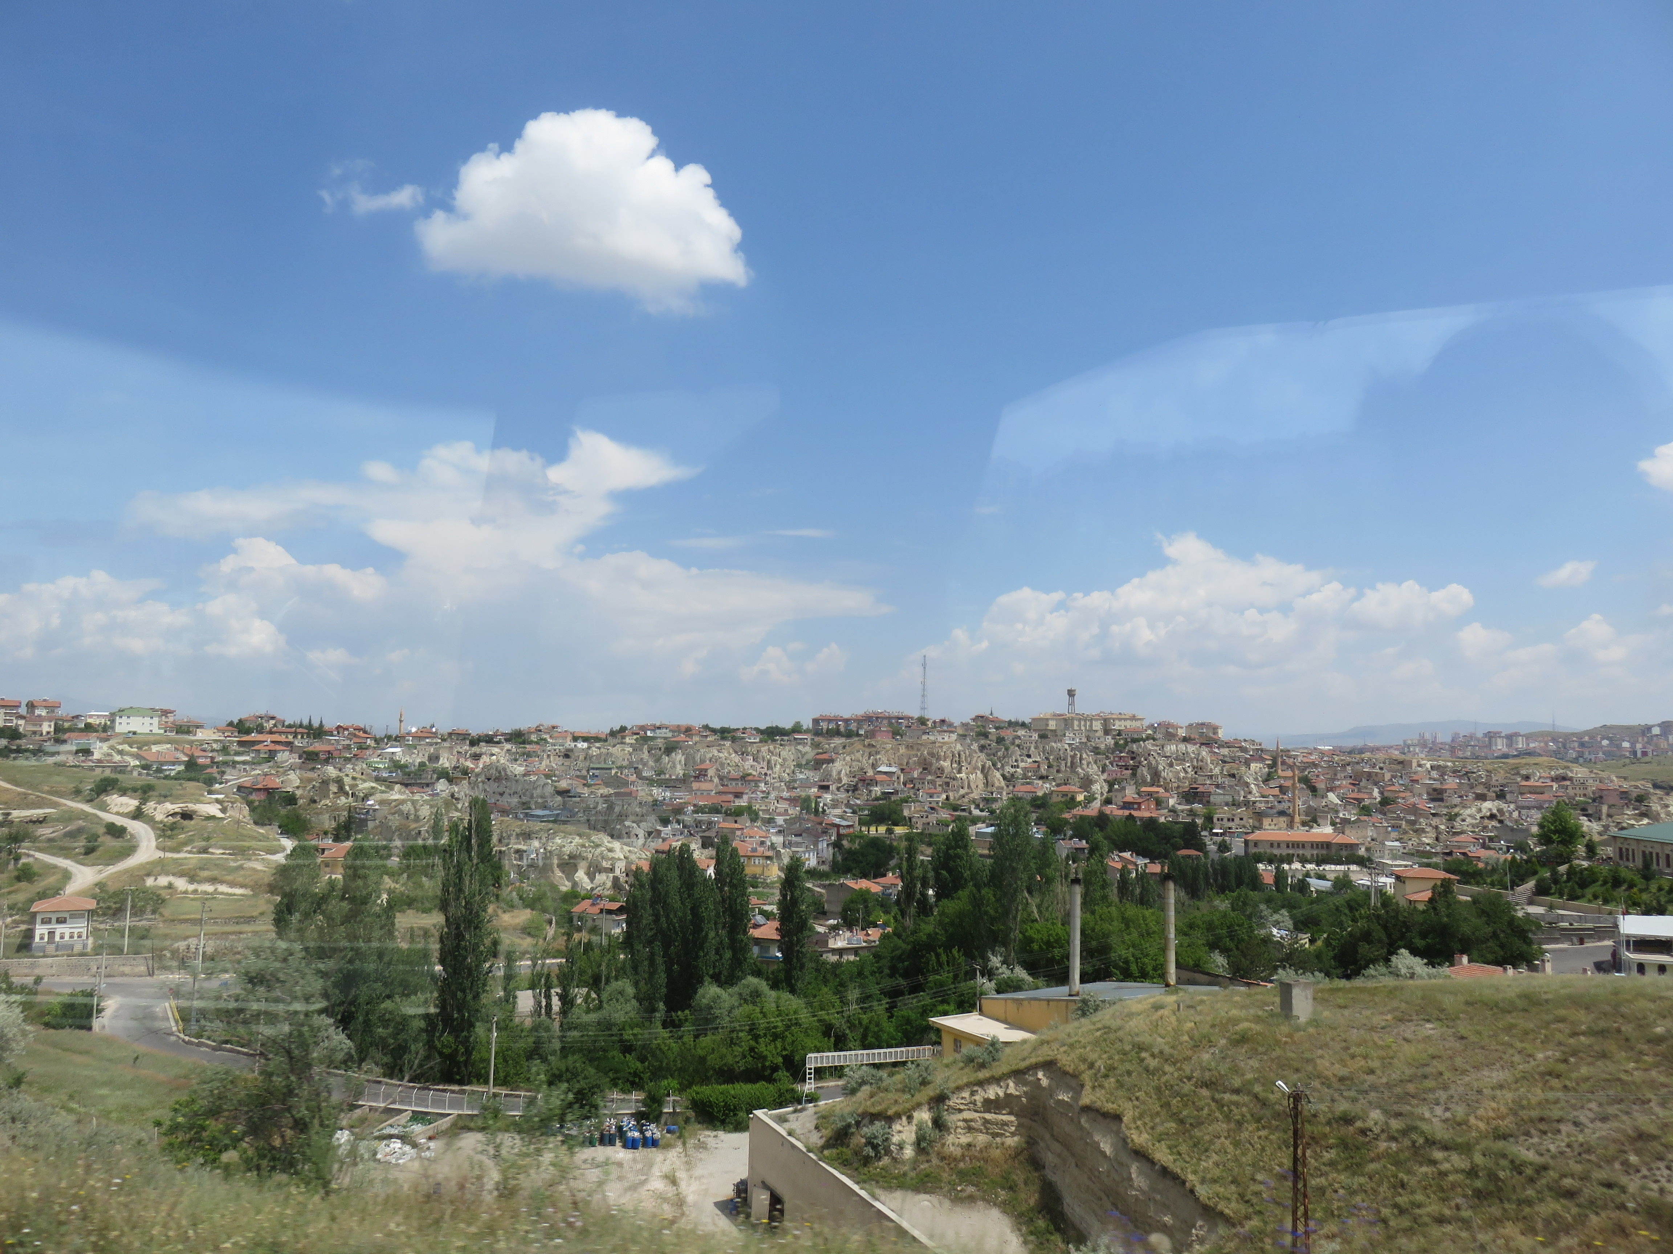
ICONIUM
Modern Day Konya
(Site of Ancient Iconium)
Acts 14:1 (NASB77) 1 And it came about that in Iconium they entered the synagogue of the Jews together, and spoke in such a manner that a great multitude believed, both of Jews and of Greeks.
Pieria
FIRST MISSIONARY JOURNEY
Notes:
There are not many archeological sites at Konya. There is a museum there with ancient statues and objects.

Slide 95
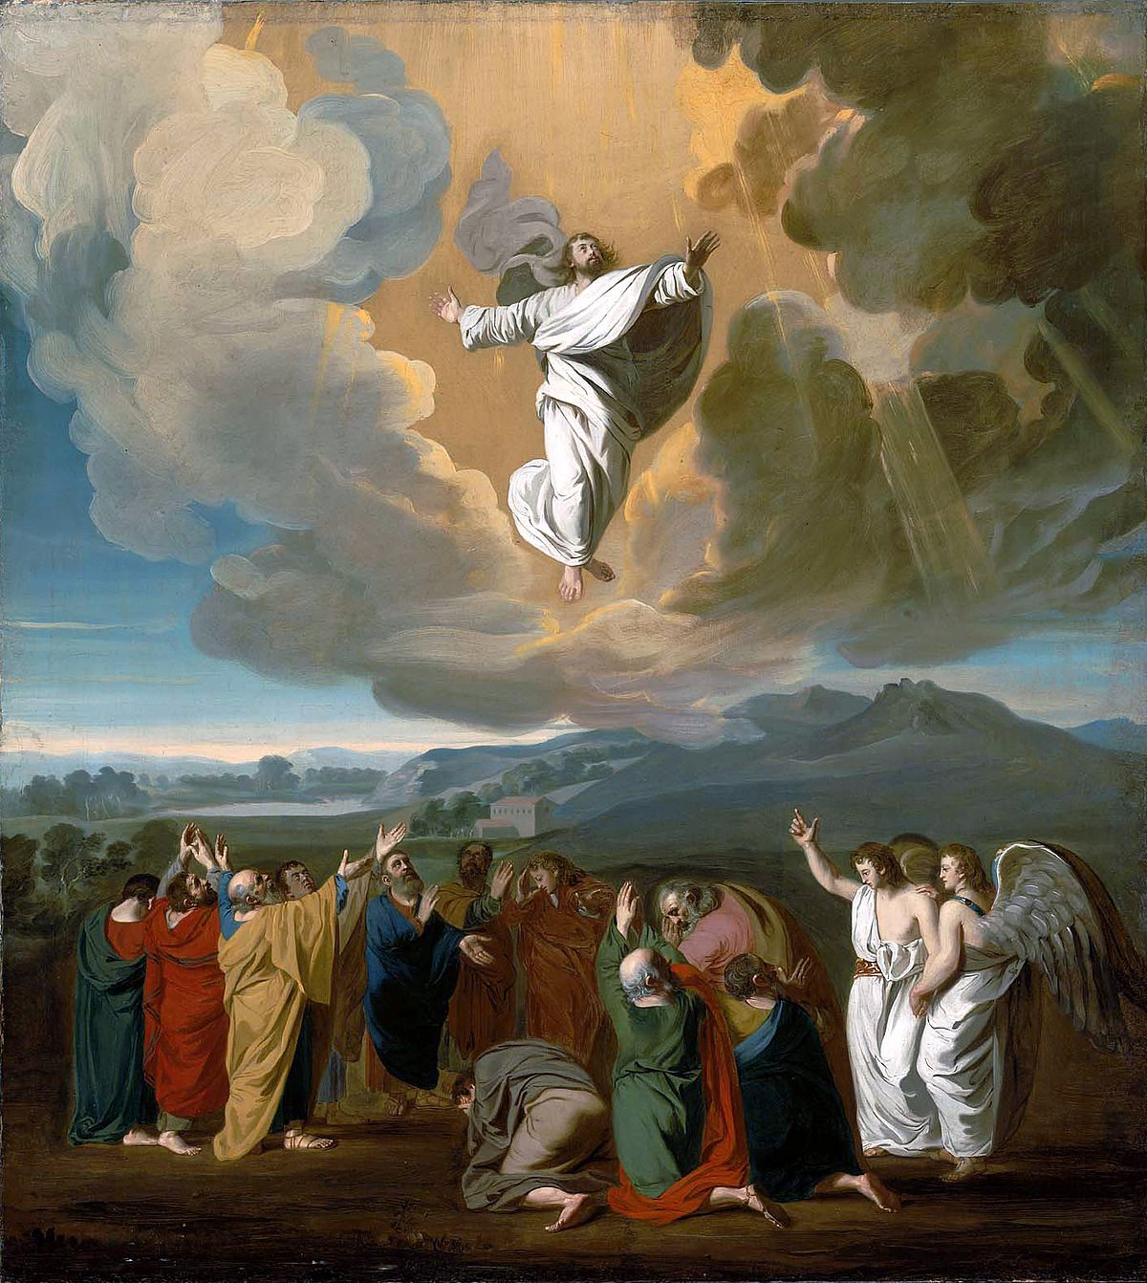
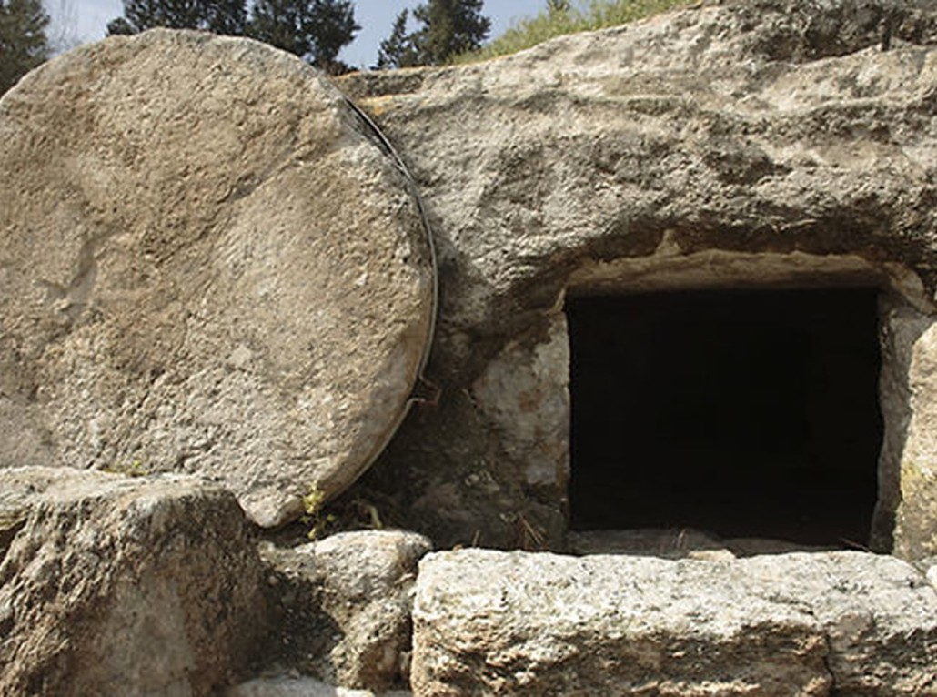
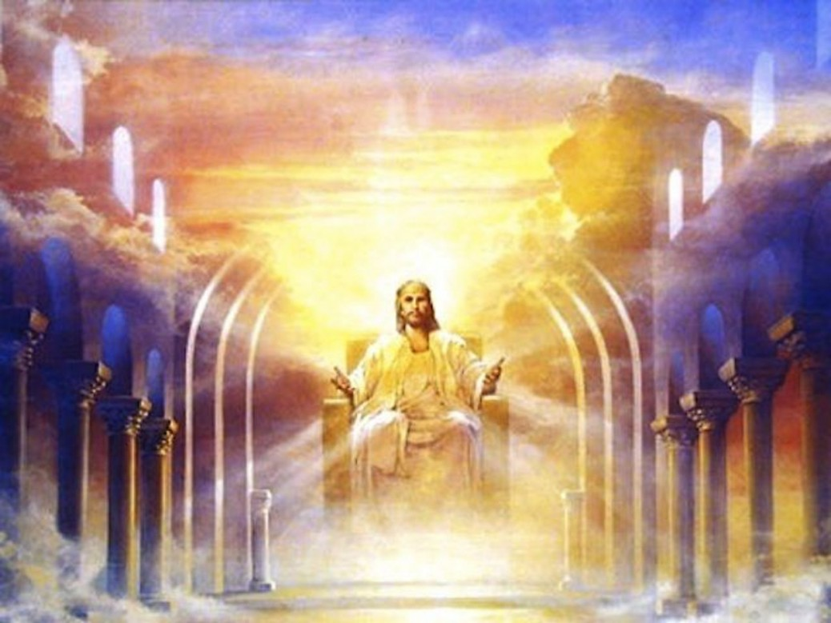
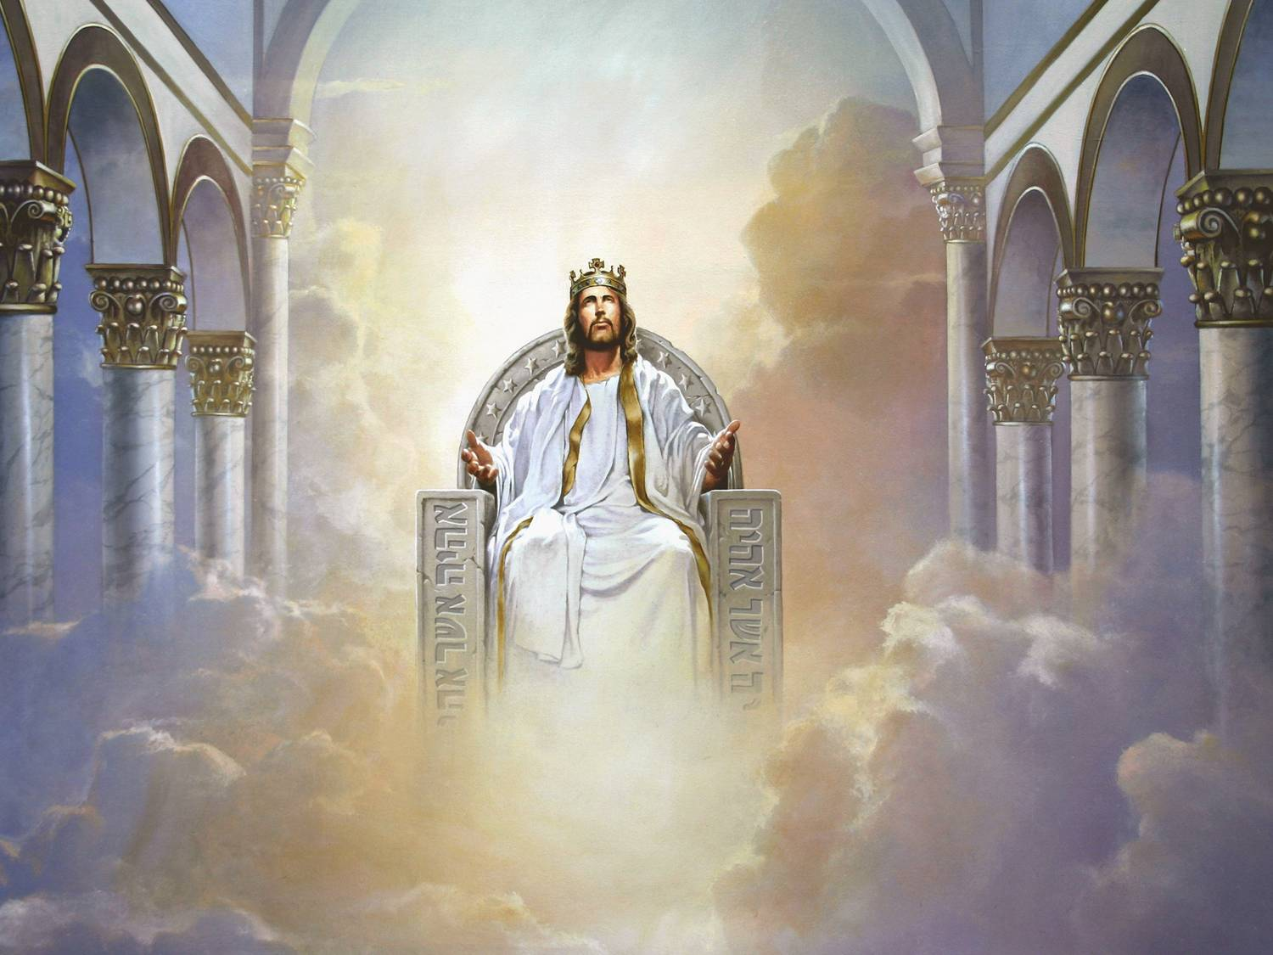

Slide 96
Notes:
1. City walls on the upper (acropolis) city of Seleusia.

Slide 97
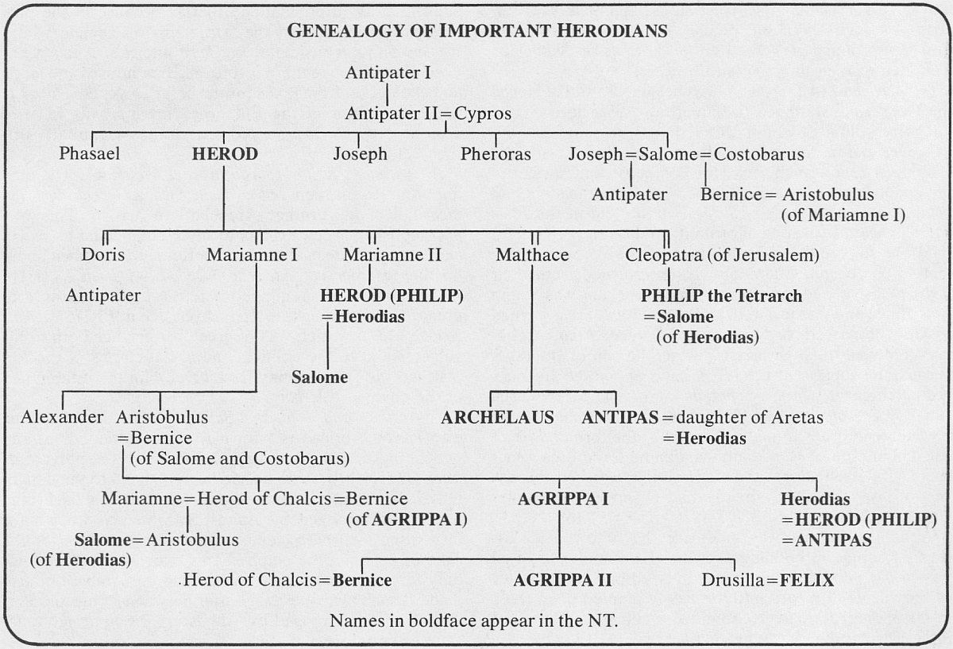

Slide 98
Acts 13:1 to 13:52

Slide 99
With this lesson we begin the third and final section of the Book of Acts:
the witness unto the uttermost part of the earth.

Slide 100
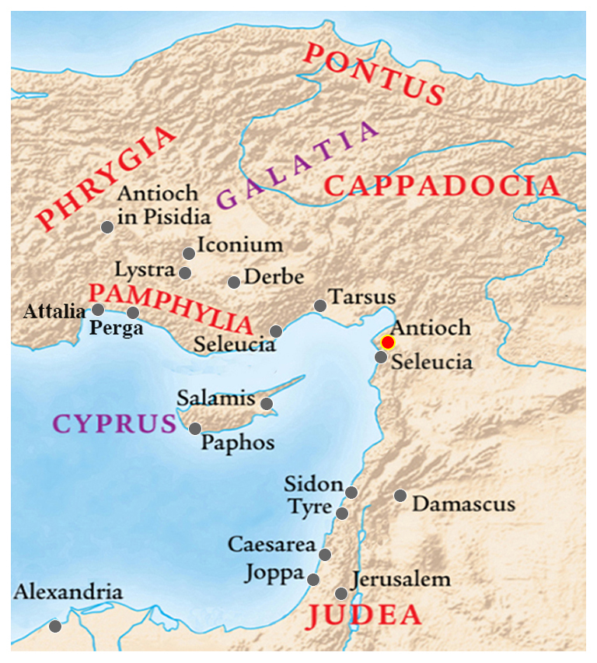
Acts 13: ¹ Now there were in the church that was at Antioch
certain prophets and teachers;
as Barnabas, and Simeon that was called Niger, and Lucius of Cyrene, and Manaen, which had been brought up with Herod the tetrarch, and Saul.

Slide 101
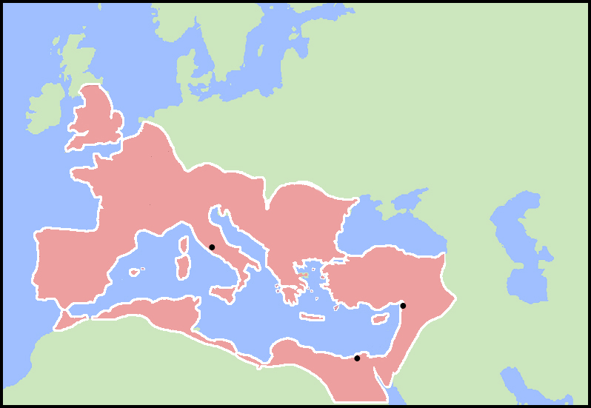
Antioch was the capital of the Roman province of Syria and the third biggest city in the Empire. Only Rome and Alexandria were larger.
ROME
ANTIOCH
ALEXANDRIA

Slide 102
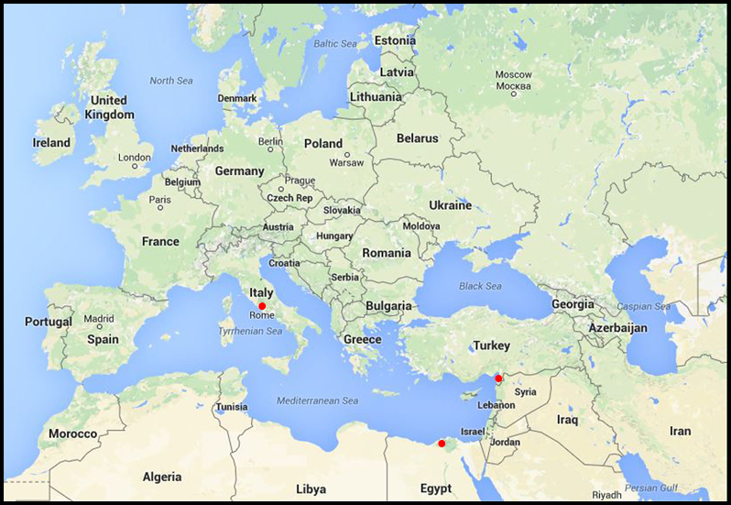
Antioch is now in southeast Turkey, west of Syria and north of Lebanon.

Slide 103
Acts 13: ¹ Now there were in the church that was at Antioch certain prophets and teachers; as Barnabas, and Simeon that was called Niger, and Lucius of Cyrene, and Manaen, which had been brought up with Herod the tetrarch, and Saul.
Barnabas and Saul (Paul) were now established among the prophets and teachers in Antioch.

Slide 104
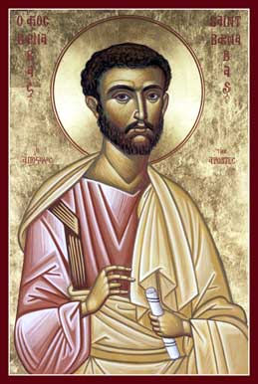
Simeon “was a Jew by birth, perhaps from an African-Jewish community.”
(Believer’s Bible Commentary)
“Niger” (nye-jer as in Nigeria) means black.
Again we see that the Gospel was in Africa before the first missionaries came from Europe.
Acts 13: ¹ Now there were in the church that was at Antioch certain prophets and teachers; as Barnabas, and Simeon that was called Niger, and Lucius of Cyrene, and Manaen, which had been brought up with Herod the tetrarch, and Saul.

Slide 105
Acts 13: ¹ Now there were in the church that was at Antioch certain prophets and teachers; as Barnabas, and Simeon that was called Niger, and Lucius of Cyrene, and Manaen, which had been brought up with Herod the tetrarch, and Saul.
Lucius of Cyrene was likely among the first group of Christians to preach in Antioch.
Acts 11:20: And some of them were men of Cyprus and Cyrene, which, when they were come to Antioch, spake unto the Grecians, preaching the Lord Jesus.
Cyrene was founded by the Greeks in 630 BC. It was once called “the Athens of Africa.” It is now Shahhat, Libya.

Slide 106
Acts 13: ¹ Now there were in the church that was at Antioch certain prophets and teachers; as Barnabas, and Simeon that was called Niger, and Lucius of Cyrene, and Manaen, which had been brought up with Herod the tetrarch, and Saul.
Manean was foster brother to Herod Antipas, the king who beheaded John the Baptist.
A tetrarch rules over one-fourth of a kingdom.
The four tetrarchs of Palestine are named in Luke 3:

Slide 107
Luke 3:1-2:
¹ Now in the fifteenth year of the reign of Tiberius Caesar,
Pontius Pilate being governor of Judaea,

Slide 108
Luke 3:1-2:
¹ Now in the fifteenth year of the reign of Tiberius Caesar, Pontius Pilate being governor of Judaea,
and Herod being tetrarch of Galilee,

Slide 109
Luke 3:1-2:
¹ Now in the fifteenth year of the reign of Tiberius Caesar, Pontius Pilate being governor of Judaea,
and Herod being tetrarch of Galilee,
and his brother Philip tetrarch of Ituraea and of the region of Trachonitis,

Slide 110
Luke 3:1-2:
¹ Now in the fifteenth year of the reign of Tiberius Caesar, Pontius Pilate being governor of Judaea,
and Herod being tetrarch of Galilee,
and his brother Philip tetrarch of Ituraea and of the region of Trachonitis,
and Lysanias the tetrarch of Abilene,

Slide 111
Luke 3:1-2:
¹ Now in the fifteenth year of the reign of Tiberius Caesar, Pontius Pilate being governor of Judaea,
and Herod being tetrarch of Galilee,
and his brother Philip tetrarch of Ituraea and of the region of Trachonitis,
and Lysanias the tetrarch of Abilene,
² Annas and Caiaphas being the high priests,
the word of God came unto John the son of Zacharias in the wilderness.

Slide 112
Back to Acts 13:
² As they ministered to the Lord, and fasted, the Holy Ghost said, Separate me Barnabas and Saul for the work whereunto I have called them.
³ And when they had fasted and prayed, and laid their hands on them, they sent them away.
⁴ So they, being sent forth by the Holy Ghost …

Slide 113
departed unto Seleucia;

Slide 114
departed unto Seleucia;
and from thence they sailed to Cyprus.
⁵ And when they were at Salamis,

Slide 115
departed unto Seleucia;
and from thence they sailed to Cyprus.
⁵ And when they were at Salamis,
they preached the word of God in the synagogues of the Jews: and they had also John to their minister.

Slide 116
⁶ And when they had gone through the isle unto Paphos,

Slide 117
⁶ And when they had gone through the isle unto Paphos,
they found a certain sorcerer, a false prophet, a Jew, whose name was Barjesus:
⁷ Which was with the deputy of the country, Sergius Paulus, a prudent man; who called for Barnabas and Saul, and desired to hear the word of God.

Slide 118
⁶ And when they had gone through the isle unto Paphos,
they found a certain sorcerer, a false prophet, a Jew, whose name was Barjesus:
⁷ Which was with the deputy of the country, Sergius Paulus, a prudent man; who called for Barnabas and Saul, and desired to hear the word of God.
In 1877 an inscription was found a short distance north of Paphos bearing Serguis Paulus’ name and title.

Slide 119
⁸ But Elymas the sorcerer (for so is his name by interpretation) withstood them, seeking to turn away the deputy from the faith.
⁹ Then Saul, (who also is called Paul,) filled with the Holy Ghost, set his eyes on him,
¹⁰ And said,

Slide 120
⁸ But Elymas the sorcerer (for so is his name by interpretation) withstood them, seeking to turn away the deputy from the faith.
⁹ Then Saul, (who also is called Paul,) filled with the Holy Ghost, set his eyes on him,
¹⁰ And said, O full of all subtilty and all mischief, thou child of the devil, thou enemy of all righteousness, wilt thou not cease to pervert the right ways of the Lord?

Slide 121
¹¹ And now, behold, the hand of the Lord is upon thee, and thou shalt be blind, not seeing the sun for a season.
And immediately there fell on him a mist and a darkness;

Slide 122
¹¹ And now, behold, the hand of the Lord is upon thee, and thou shalt be blind, not seeing the sun for a season.
And immediately there fell on him a mist and a darkness;
and he went about seeking some to lead him by the hand.

Slide 123
¹² Then the deputy, when he saw what was done, believed, being astonished at the doctrine of the Lord.

Slide 124
¹³ Now when Paul and his company loosed from Paphos, they came to Perga in Pamphylia:

Slide 125
¹³ Now when Paul and his company loosed from Paphos, they came to Perga in Pamphylia:
and John departing from them returned to Jerusalem.

Slide 126
¹⁴ But when they departed from Perga, they came to Antioch in Pisidia,

Slide 127
¹⁴ But when they departed from Perga, they came to Antioch in Pisidia,
and went into the synagogue on the sabbath day, and sat down.

Slide 128
¹⁵ And after the reading of the law and the prophets the rulers of the synagogue sent unto them, saying,
Ye men and brethren, if ye have any word of exhortation for the people, say on.

Slide 129
This is Paul’s first recorded sermon, given in a synagogue in Pisidia.
From this point forward he is called by his Greek name, Paulos, or Paul.
¹⁶ Then Paul stood up, and beckoning with his hand said,
Men of Israel, and ye that fear God, give audience.

Slide 130
The first part of Paul’s sermon spans a period of about 500 years from the Exodus to the reign of King David.
¹⁷ The God of this people of Israel chose our fathers, and exalted the people when they dwelt as strangers in the land of Egypt, and with an high arm brought he them out of it.
¹⁸ And about the time of forty years suffered he their manners in the wilderness.
¹⁹ And when he had destroyed seven nations in the land of Chanaan, he divided their land to them by lot.

Slide 131
The first part of Paul’s sermon spans a period of about 500 years from the Exodus to the reign of King David.
¹⁷ The God of this people of Israel chose our fathers, and exalted the people when they dwelt as strangers in the land of Egypt, and with an high arm brought he them out of it.
¹⁸ And about the time of forty years suffered he their manners in the wilderness.
¹⁹ And when he had destroyed seven nations in the land of Chanaan, he divided their land to them by lot.

Slide 132
The first part of Paul’s sermon spans a period of about 500 years from the Exodus to the reign of King David.
¹⁷ The God of this people of Israel chose our fathers, and exalted the people when they dwelt as strangers in the land of Egypt, and with an high arm brought he them out of it.
¹⁸ And about the time of forty years suffered he their manners in the wilderness.
¹⁹ And when he had destroyed seven nations in the land of Chanaan, he divided their land to them by lot.

Slide 133
The first part of Paul’s sermon spans a period of about 500 years from the Exodus to the reign of King David.
¹⁷ The God of this people of Israel chose our fathers, and exalted the people when they dwelt as strangers in the land of Egypt, and with an high arm brought he them out of it.
¹⁸ And about the time of forty years suffered he their manners in the wilderness.
¹⁹ And when he had destroyed seven nations in the land of Chanaan, he divided their land to them by lot.

Slide 134
The first part of Paul’s sermon spans a period of about 500 years from the Exodus to the reign of King David.
¹⁷ The God of this people of Israel chose our fathers, and exalted the people when they dwelt as strangers in the land of Egypt, and with an high arm brought he them out of it.
¹⁸ And about the time of forty years suffered he their manners in the wilderness.
¹⁹ And when he had destroyed seven nations in the land of Chanaan, he divided their land to them by lot.

Slide 135
The first part of Paul’s sermon spans a period of about 500 years from the Exodus to the reign of King David.
¹⁷ The God of this people of Israel chose our fathers, and exalted the people when they dwelt as strangers in the land of Egypt, and with an high arm brought he them out of it.
¹⁸ And about the time of forty years suffered he their manners in the wilderness.
¹⁹ And when he had destroyed seven nations in the land of Chanaan, he divided their land to them by lot.
Joshua 11:23: So Joshua took the whole land, according to all that the LORD said unto Moses; and Joshua gave it for an inheritance unto Israel according to their divisions by their tribes. And the land rested from war.

Slide 136
²⁰ And after that he gave unto them judges about the space of four hundred and fifty years, until Samuel the prophet.
The ministry of Samuel lasted from 1069 BC to 1015 BC

Slide 137
²⁰ And after that he gave unto them judges about the space of four hundred and fifty years, until Samuel the prophet.
The ministry of Samuel lasted from 1069 BC to 1015 BC

Slide 138
²⁰ And after that he gave unto them judges about the space of four hundred and fifty years, until Samuel the prophet.
The book of Judges takes place over 318 years, from the death of Joshua in 1368 BC t0 the start of Saul’s reign in 1050 BC. The about 450 years begins with Moses, the first judge.
Acts 7:35: This Moses whom they refused, saying, Who made thee a ruler and a judge? the same did God send to be a ruler and a deliverer by the hand of the angel which appeared to him in the bush.
There are 433 years from the Exodus to the end of Samuel’s rule.

Slide 139
²⁰ And after that he gave unto them judges about the space of four hundred and fifty years, until Samuel the prophet.
The book of Judges takes place over 318 years, from the death of Joshua in 1368 BC t0 the start of Saul’s reign in 1050 BC. The about 450 years begins with Moses, the first judge.
Acts 7:35: This Moses whom they refused, saying, Who made thee a ruler and a judge? the same did God send to be a ruler and a deliverer by the hand of the angel which appeared to him in the bush.
There are 433 years from the Exodus to the end of Samuel’s rule.

Slide 140
²¹ And afterward they desired a king: and God gave unto them Saul the son of Cis, a man of the tribe of Benjamin, by the space of forty years.

Slide 141
²¹ And afterward they desired a king: and God gave unto them Saul the son of Cis, a man of the tribe of Benjamin, by the space of forty years.
²² And when he had removed him, he raised up unto them David to be their king; to whom also he gave testimony, and said, I have found David the son of Jesse, a man after mine own heart, which shall fulfil all my will.

Slide 142
²¹ And afterward they desired a king: and God gave unto them Saul the son of Cis, a man of the tribe of Benjamin, by the space of forty years.
²² And when he had removed him, he raised up unto them David to be their king; to whom also he gave testimony, and said, I have found David the son of Jesse, a man after mine own heart, which shall fulfil all my will.

Slide 143
²¹ And afterward they desired a king: and God gave unto them Saul the son of Cis, a man of the tribe of Benjamin, by the space of forty years.
²² And when he had removed him, he raised up unto them David to be their king; to whom also he gave testimony, and said, I have found David the son of Jesse, a man after mine own heart, which shall fulfil all my will.
Now Paul moves forward almost 1,000 years to the time of Christ.
²³ Of this man's seed hath God according to his promise raised unto Israel a Saviour, Jesus:

Slide 144
²⁴ When John had first preached before his coming the baptism of repentance to all the people of Israel.
²⁵ And as John fulfilled his course, he said, Whom think ye that I am? I am not he. But, behold, there cometh one after me, whose shoes of his feet I am not worthy to loose.

Slide 145
²⁶ Men and brethren, children of the stock of Abraham, and whosoever among you feareth God, to you is the word of this salvation sent.
²⁷ For they that dwell at Jerusalem, and their rulers, because they knew him not, nor yet the voices of the prophets which are read every sabbath day, they have fulfilled them in condemning him.
²⁸ And though they found no cause of death in him, yet desired they Pilate that he should be slain.
²⁹ And when they had fulfilled all that was written of him, they took him down from the tree, and laid him in a sepulchre.

Slide 146
³⁰ But God raised him from the dead:
³¹ And he was seen many days of them which came up with him from Galilee to Jerusalem, who are his witnesses unto the people.
³² And we declare unto you glad tidings, how that the promise which was made unto the fathers,
³³ God hath fulfilled the same unto us their children, in that he hath raised up Jesus again; as it is also written in the second psalm,

Slide 147
³⁰ But God raised him from the dead:
³¹ And he was seen many days of them which came up with him from Galilee to Jerusalem, who are his witnesses unto the people.
³² And we declare unto you glad tidings, how that the promise which was made unto the fathers,
³³ God hath fulfilled the same unto us their children, in that he hath raised up Jesus again; as it is also written in the second psalm, Thou art my Son, this day have I begotten thee.

Slide 148
³⁰ But God raised him from the dead:
³¹ And he was seen many days of them which came up with him from Galilee to Jerusalem, who are his witnesses unto the people.
³² And we declare unto you glad tidings, how that the promise which was made unto the fathers,
³³ God hath fulfilled the same unto us their children, in that he hath raised up Jesus again; as it is also written in the second psalm, Thou art my Son, this day have I begotten thee. [Psa 2:7]
³⁴ And as concerning that he raised him up from the dead, now no more to return to corruption, he said on this wise,

Slide 149
³⁰ But God raised him from the dead:
³¹ And he was seen many days of them which came up with him from Galilee to Jerusalem, who are his witnesses unto the people.
³² And we declare unto you glad tidings, how that the promise which was made unto the fathers,
³³ God hath fulfilled the same unto us their children, in that he hath raised up Jesus again; as it is also written in the second psalm, Thou art my Son, this day have I begotten thee. [Psa 2:7]
³⁴ And as concerning that he raised him up from the dead, now no more to return to corruption, he said on this wise, I will give you the sure mercies of David.

Slide 150
³⁰ But God raised him from the dead:
³¹ And he was seen many days of them which came up with him from Galilee to Jerusalem, who are his witnesses unto the people.
³² And we declare unto you glad tidings, how that the promise which was made unto the fathers,
³³ God hath fulfilled the same unto us their children, in that he hath raised up Jesus again; as it is also written in the second psalm, Thou art my Son, this day have I begotten thee. [Psa 2:7]
³⁴ And as concerning that he raised him up from the dead, now no more to return to corruption, he said on this wise, I will give you the sure mercies of David. [Isa 55:3]
³⁵ Wherefore he saith also in another psalm,

Slide 151
³⁰ But God raised him from the dead:
³¹ And he was seen many days of them which came up with him from Galilee to Jerusalem, who are his witnesses unto the people.
³² And we declare unto you glad tidings, how that the promise which was made unto the fathers,
³³ God hath fulfilled the same unto us their children, in that he hath raised up Jesus again; as it is also written in the second psalm, Thou art my Son, this day have I begotten thee. [Psa 2:7]
³⁴ And as concerning that he raised him up from the dead, now no more to return to corruption, he said on this wise, I will give you the sure mercies of David. [Isa 55:3]
³⁵ Wherefore he saith also in another psalm, Thou shalt not suffer thine Holy One to see corruption.

Slide 152
³⁰ But God raised him from the dead:
³¹ And he was seen many days of them which came up with him from Galilee to Jerusalem, who are his witnesses unto the people.
³² And we declare unto you glad tidings, how that the promise which was made unto the fathers,
³³ God hath fulfilled the same unto us their children, in that he hath raised up Jesus again; as it is also written in the second psalm, Thou art my Son, this day have I begotten thee. [Psa 2:7]
³⁴ And as concerning that he raised him up from the dead, now no more to return to corruption, he said on this wise, I will give you the sure mercies of David. [Isa 55:3]
³⁵ Wherefore he saith also in another psalm, Thou shalt not suffer thine Holy One to see corruption. [Psa 16:10]

Slide 153
³⁶ For David, after he had served his own generation by the will of God, fell on sleep, and was laid unto his fathers, and saw corruption:
³⁷ But he, whom God raised again, saw no corruption.
³⁸ Be it known unto you therefore, men and brethren, that through this man is preached unto you the forgiveness of sins:
³⁹ And by him all that believe are justified from all things, from which ye could not be justified by the law of Moses.
⁴⁰ Beware therefore, lest that come upon you, which is spoken of in the prophets;
⁴¹ Behold, ye despisers, and wonder, and perish: for I work a work in your days, a work which ye shall in no wise believe, though a man declare it unto you.

Slide 154
³⁶ For David, after he had served his own generation by the will of God, fell on sleep, and was laid unto his fathers, and saw corruption:
³⁷ But he, whom God raised again, saw no corruption.
³⁸ Be it known unto you therefore, men and brethren, that through this man is preached unto you the forgiveness of sins:
³⁹ And by him all that believe are justified from all things, from which ye could not be justified by the law of Moses.
⁴⁰ Beware therefore, lest that come upon you, which is spoken of in the prophets;
⁴¹ Behold, ye despisers, and wonder, and perish: for I work a work in your days, a work which ye shall in no wise believe, though a man declare it unto you. [Hab 1:5]

Slide 155
⁴² And when the Jews were gone out of the synagogue, the Gentiles besought that these words might be preached to them the next sabbath.
⁴³ Now when the congregation was broken up, many of the Jews and religious proselytes followed Paul and Barnabas: who, speaking to them, persuaded them to continue in the grace of God.

Slide 156
⁴⁴ And the next sabbath day came almost the whole city together to hear the word of God.
⁴⁵ But when the Jews saw the multitudes, they were filled with envy, and spake against those things which were spoken by Paul, contradicting and blaspheming.

Slide 157
⁴⁶ Then Paul and Barnabas waxed bold, and said, It was necessary that the word of God should first have been spoken to you: but seeing ye put it from you, and judge yourselves unworthy of everlasting life, lo, we turn to the Gentiles.
⁴⁷ For so hath the Lord commanded us, saying, I have set thee to be a light of the Gentiles, that thou shouldest be for salvation unto the ends of the earth.

Slide 158
⁴⁸ And when the Gentiles heard this, they were glad, and glorified the word of the Lord: and as many as were ordained to eternal life believed.
⁴⁹ And the word of the Lord was published throughout all the region.

Slide 159
⁵⁰ But the Jews stirred up the devout and honorable women, and the chief men of the city, and raised persecution against Paul and Barnabas, and expelled them out of their coasts.
⁵¹ But they shook off the dust of their feet against them…

Slide 160
⁵⁰ But the Jews stirred up the devout and honorable women, and the chief men of the city, and raised persecution against Paul and Barnabas, and expelled them out of their coasts.
⁵¹ But they shook off the dust of their feet against them…
Mark 6:10-11:
¹⁰ And [Jesus] said unto them, In what place so ever ye enter into an house, there abide till ye depart from that place.
¹¹ And whosoever shall not receive you, nor hear you, when ye depart thence, shake off the dust under your feet for a testimony against them.
Verily I say unto you, It shall be more tolerable for Sodom and Gomorrha in the day of judgment, than for that city.

Slide 161
…and came unto Iconium.

Slide 162
…and came unto Iconium.
⁵² And the disciples were filled with joy, and with the Holy Ghost.
End of Chapter 13

Slide 163
The Acts of the Apostles Chapter 13
And a little look ahead
To Chapter 22

Slide 164
Acts 22:16-21 “I will send thee …”
Where was Saul baptized? (Acts 9)
How long before Jerusalem? (Gal. 1:18)
What happened to Paul there? (22:17)
How long did Paul stay? Why? (18)
Did Paul expect acceptance? (19-20)
Who was he expecting to reject him?
What is Jesus’ response? (21)
Had this occurred before Acts 13?
l

Slide 165
Acts 13:1-5 “Separate Me …” 46 AD
Was Antioch dependent on Jerusalem? (1)
Who is listed first? Who last? (1)
What did the Holy Spirit say? (2)
What did they do before sending them? (3)
Who is “they” in verse 3? (3)
Who were they sent forth by? (4)
Where did they sail to?
Whose home was there?
What city did they come to in Cyprus? (5)
Where did they preach in Salamis? (5)
Who was their attendant? (5)
l

Slide 166
Acts 13:
5-6
Salamis
Paphos

Slide 167
Acts 13:6-13 Bar-Jesus
What does the prefix “Bar” mean?
Who was Bar-jesus with? (6)
What did Sergius Paulus do? Why? (7)
What did Elymas do? Why? (8)
How did Paul respond to this? (9-11)
Was Sergius Paulus led by this to believe? (12)
What is the inference of verse 13?
Who is now in the lead role? (13)
Are we to know why John Mark departed? (13)
Does Paul now seem to be exercising much more leadership than prior to this?

Slide 168
Acts 13:
13-14
Perga
Antioch of
Pisidia

Slide 169
Acts 13:15-25 At Antioch of Pisidia
Who asked them to speak? (15)
Where does Paul start? (17)
After Egypt, 40 years where? (18)
How many nations conquered? (19)
Who ruled after the conquest? (20)
Who ruled after the Judges? (21)
Why the emphasis on time? (Heb. 1:1)
What was the relevance of David? (22-23)
1 Sam 13:14 “… after His own heart …”
Where did Peter reference this promise?
What did John the Baptist preach? (24-25)

Slide 170
Acts 13:26-36 “to you … salvation”
Paul’s Proof: Scripture Based
For they fulfilled _____ in condemning him (27)
Who did they request to slay Jesus? (28)
What did they do after all was fulfilled? (29)
Who raised Jesus from the dead? (30) Acts 2:23-24
Who were the witnesses? (31)
Does Paul claim to be a witness?
What specific good tidings is proclaimed? (32-33)
Who also used the non-corruption argument? (34-36)
Reference Acts 2:27

Slide 171
Acts 13:33-37 OT Scripture Review
(33) Psalm 2:7 Thou art my Son, this day have I begotten thee.
(34) Isa. 55:3 I will give you the holy and sure (blessings) of David.
(35) Psalm 16:10 Thou wilt not give Thy Holy One to see corruption.

Slide 172
At Antioch of Pisidia Acts 13:38-46 Plan of Salvation
What is proclaimed through Jesus? (38)
What is necessary to be justified? (39)
Was this possible by the law of Moses? (39)
What were they to beware of? (40-41)
Quotation: Habakkuk 1:5
Who urged them? to do what? (42-43)
How successful were they? (44)
What did this success cause? (45)
Does it appear that they were “uninvited?”
So, in what way would they …
… “turn to the Gentiles?” (46)

Slide 173
Acts 13:46-48 To the Gentiles
God’s will: Go to the Gentiles (Acts 10, 11)
How did Paul prove this to them? (47)
Isa. 49:6
What were the Gentiles reaction? (48)
Is there any difference? …
To believe
To be ordained unto eternal life
Which is man’s part? … God’s part?
Is vs. 48 for order?, or is it a truism?
What is the purpose of verse 48?
To affirm: God ordained the conversion of the Gentiles

Slide 174
Acts 13:49-52 Closure at Antioch
Were Paul and Barnabas successful? (49)
Who opposed them? (50)
Is this ALL the Jews?
What influence did the women have?
What did they do to Paul and Barnabas?
How did they show their displeasure? (51)
Could they have caused a major disruption?
What would that have resulted in?
How did their departure affect the work?
What accompanies being filled with the Holy Spirit? (52)

Slide 175
L.D. CARY & SAM HOLT CATCH PHRASES
Chapter 10 – “The Gentiles Come In”
Chapter 11 – “10 + 1, Peter’s Rerun”
Chapter 12 – “10 + 2, Peter’s Rescue”
Chapter 13 – “10 + 3, First Preaching Spree”
Chapter 14 – “10 + 4, Preaching More”
Chapter 15 – “10 + 5, The Truth Survives”
Chapter 16 – “European Scene”
Chapter 17 – “10 + 7, One God In Heaven”
Chapter 18 – “10 + 8, The Corinth Wait”
“10 + 4 … Preaching More”
Catch Phrase
Chapter Fourteen

Slide 176
ACTS 14
Paul and Barnabas 1st Missionary Journey
continued

Slide 177
Acts 14:1-3 (NASB) 1 In Iconium they entered the synagogue of the Jews together, and spoke in such a manner that a large number of people believed, both of Jews and of Greeks. 2 But the Jews who disbelieved stirred up the minds of the Gentiles and embittered them against the brethren. 3 Therefore they spent a long time there speaking boldly with reliance upon the Lord, who was testifying to the word of His grace, granting that signs and wonders be done by their hands.
A. Paul and Barnabas teach the gospel as they did at Antioch of Pisidia which results in a large number of Jews and Greeks believing and obeying. Ja 2:19-26
1. But the Jews who disbelieved were disobedient:
a. These disobedient Jews embittered the Gentile community in Iconium against their fellow citizens who had embraced the Gospel. The persecution was unsuccessful. Acts 13:50; Jn 19:12-16
B. They stayed and taught for a long time with the Lord testifying with their teaching by miracles: Mk 16:20; Acts 2:22; Heb 2:3-4
John 19:12-16 (NASB) ¹² As a result of this Pilate made efforts to release Him, but the Jews cried out saying, "If you release this Man, you are no friend of Caesar; everyone who makes himself out to be a king opposes Caesar." ¹³ Therefore when Pilate heard these words, he brought Jesus out, and sat down on the judgment seat at a place called The Pavement, but in Hebrew, Gabbatha. ¹⁴ Now it was the day of preparation for the Passover; it was about the sixth hour. And he *said to the Jews, "Behold, your King!" ¹⁵ So they cried out, "Away with Him, away with Him, crucify Him!" Pilate *said to them, "Shall I crucify your King?" The chief priests answered, "We have no king but Caesar." ¹⁶ So he then handed Him over to them to be crucified.
Evil Affected
Strong's Number: <G2559>
Original Word: κακόω, kakoō
Usage Notes: from kakos, "evil, to treat badly, to hurt," also means "to make evil affected, to embitter," Acts 14:2.
Vine's Expository Dictionary of Old Testament and New Testament Words
Mark 16:20 (NASB) ²⁰ And they went out and preached everywhere, while the Lord worked with them, and confirmed the word by the signs that followed.
Acts 2:22 (NASB) ²² "Men of Israel, listen to these words: Jesus the Nazarene, a man attested to you by God with miracles and wonders and signs which God performed through Him in your midst, just as you yourselves know—
Hebrews 2:3-4 (NASB) ³ how will we escape if we neglect so great a salvation? After it was at the first spoken through the Lord, it was confirmed to us by those who heard, ⁴ God also testifying with them, both by signs and wonders and by various miracles and by gifts of the Holy Spirit according to His own will.
James 2:19-26 (NASB) ¹⁹ You believe that God is one. You do well; the demons also believe, and shudder. ²⁰ But are you willing to recognize, you foolish fellow, that faith without works is useless? ²¹ Was not Abraham our father justified by works when he offered up Isaac his son on the altar? ²² You see that faith was working with his works, and as a result of the works, faith was perfected;
²³ and the Scripture was fulfilled which says, "AND ABRAHAM BELIEVED GOD, AND IT WAS RECKONED TO HIM AS RIGHTEOUSNESS," and he was called the friend of God. ²⁴ You see that a man is justified by works and not by faith alone. ²⁵ In the same way, was not Rahab the harlot also justified by works when she received the messengers and sent them out by another way? ²⁶ For just as the body without the spirit is dead, so also faith without works is dead.
Acts 13:50 (NASB) ⁵⁰ But the Jews incited the devout women of prominence and the leading men of the city, and instigated a persecution against Paul and Barnabas, and drove them out of their district.
Notes:
Use a darker blue on the chart the light blue does not show up
A. & 1. - Pisteuo, belief means more than having a family creed. It means to personally believe, be persuaded of the truth of your beliefs. To trust and rely upon those beliefs so that in your life the decisions you make are in harmony with those beliefs.
a. The Jews had no moral limitation on the extremes they would go to in order to manipulate the Gentiles in their opposition to the cause of Christ.
B. Miracles: The purpose of mircacles was always to confirm both the man and the words he spoke as being from God.

Slide 178
Acts 14:4-7 (NASB) 4 But the people of the city were divided; and some sided with the Jews, and some with the apostles. 5 And when an attempt was made by both the Gentiles and the Jews with their rulers, to mistreat and to stone them, 6 they became aware of it and fled to the cities of Lycaonia, Lystra and Derbe, and the surrounding region; 7 and there they continued to preach the gospel.
A. The success of the work is seen that the city is actually divided.
1. Jewish and Gentile pressure on the rulers and community to take action against this new religion whose teachings divided the community resulted in a plan to mistreat and stone (kill) them (Paul and Barnabas). Acts 25:1-6, 9-11;
2. Becoming aware of the plot they fled to the nearby cities of Lycaonia. Lystra and Derbe.
3. The persecution did not stop them from preaching. Mt 10:16-23, 27-28; Ro 8:31-39
Acts 25:9-11 (NASB77) 9 But Festus, wishing to do the Jews a favor, answered Paul and said, " Are you willing to go up to Jerusalem and stand trial before me on these charges?" 10 But Paul said, "I am standing before Caesar's tribunal, where I ought to be tried. I have done no wrong to the Jews, as you also very well know. 11 "If then I am a wrongdoer, and have committed anything worthy of death, I do not refuse to die; but if none of those things is true of which these men accuse me, no one can hand me over to them. I appeal to Caesar.“
Acts 25:1-6 (NASB77) 1 Festus therefore, having arrived in the province, three days later went up to Jerusalem from Caesarea. 2 And the chief priests and the leading men of the Jews brought charges against Paul; and they were urging him, 3 requesting a concession against Paul, that he might have him brought to Jerusalem (at the same time, setting an ambush to kill him on the way). 4 Festus then answered that Paul was being kept in custody at Caesarea and that he himself was about to leave shortly.
Matthew 10:16-23 (NASB77) 16 " Behold, I send you out as sheep in the midst of wolves; therefore be shrewd as serpents, and innocent as doves. 17 "But beware of men; for they will deliver you up to the courts, and scourge you in their synagogues; 18 and you shall even be brought before governors and kings for My sake, as a testimony to them and to the Gentiles. 19 " But when they deliver you up, do not become anxious about how or what you will speak; for it shall be given you in that hour what you are to speak. 20 "For it is not you who speak, but it is the Spirit of your Father who speaks in you. 21 " And brother will deliver up brother to death, and a father his child; and children will rise up against parents, and cause them to be put to death. 22 "And you will be hated by all on account of My name, but it is the one who has endured to the end who will be saved. 23 "But whenever they persecute you in this city, flee to the next; for truly I say to you, you shall not finish going through the cities of Israel, until the Son of Man comes.
Acts 7:58-59 (NASB77) 58 And when they had driven him out of the city, they began stoning him, and the witnesses laid aside their robes at the feet of a young man named Saul. 59 And they went on stoning Stephen as he called upon the Lord and said, "Lord Jesus, receive my spirit!"
Romans 8:31-39 (NASB77) 31 What then shall we say to these things? If God is for us, who is against us? 32 He who did not spare His own Son, but delivered Him up for us all, how will He not also with Him freely give us all things? 33 Who will bring a charge against God's elect? God is the one who justifies; 34 who is the one who condemns? Christ Jesus is He who died, yes, rather who was raised, who is at the right hand of God, who also intercedes for us. 35 Who shall separate us from the love of Christ? Shall tribulation, or distress, or persecution, or famine, or nakedness, or peril, or sword? 36 Just as it is written, " FOR THY SAKE WE ARE BEING PUT TO DEATH ALL DAY LONG; WE WERE CONSIDERED AS SHEEP TO BE SLAUGHTERED."
5 "Therefore," he •said, "let the influential men among you go there with me, and if there is anything wrong about the man, let them prosecute him." 6 And after he had spent not more than eight or ten days among them, he went down to Caesarea; and on the next day he took his seat on the tribunal and ordered Paul to be brought.
37 But in all these things we overwhelmingly conquer through Him who loved us. 38 For I am convinced that neither death, nor life, nor angels, nor principalities, nor things present, nor things to come, nor powers, 39 nor height, nor depth, nor any other created thing, shall be able to separate us from the love of God, which is in Christ Jesus our Lord.
STONE - NASB
Part Of Speech: Verb
Strong's Number: <G3036>
Original Word: λιθοβολέω, lithoboleō
Usage Notes: "to pelt with stones" (A, No. 1, and ballō, "to throw"), "to stone to death," occurs in Matt. 21:35; Matt. 23:37; Luke 13:34 …..: see No. 2); Acts 7:58- 59; Acts 14:5; Heb. 12:20
Vine's Expository Dictionary of Old Testament and New Testament Words
MISTREAT – NASB
Greek Strong's Number: 5195
Part of Speech: verb
English Words used in KJV:
entreat spitefully 2; reproach 1; use despitefully 1; shamefully entreat 1
from <G5196> (hubris); to exercise violence, i.e. abuse :- use despitefully, reproach, entreat shamefully (spitefully).
Strong's Greek & Hebrew Dictionary
Matthew 10:27-28 (NASB77) 27 " What I tell you in the darkness, speak in the light; and what you hear whispered in your ear, proclaim upon the housetops. 28 "And do not fear those who kill the body, but are unable to kill the soul; but rather fear Him who is able to destroy both soul and body in hell.
Notes:
Stoning was a Jewish death sentence. We can only imagine what kind of mistreatment they planned. Lev 20:27

Slide 179
Acts 14:8-10 (NASB) 8 At Lystra a man was sitting who had no strength in his feet, lame from his mother's womb, who had never walked. 9 This man was listening to Paul as he spoke, who, when he had fixed his gaze on him and had seen that he had faith to be made well, 10 said with a loud voice, "Stand upright on your feet." And he leaped up and began to walk.
A. There is no synagogue at Lystra. Note, true miracles verses modern claims of miracles:
1. The man was born lame and never walked in his life.
2. He had faith to be healed. Why would he believe healing was possible? See Acts 14:1-3
a. Miracles often occurred before preaching to capture the attention of the people: Acts 3:1-8
3. The difference from Peter’s lame man and Paul’s lame man is the response.
a. Peter’s lame man saw no previous miracles and only expected money. Peter had to pull him to his feet. The crowds all knew Peter’s lame man, no reason to doubt. Act 3:9-10
b. Paul’s lame man was listening and believed he could be made well, leaped up and walked.
Acts 3:1-8 (NASB77) 1 Now Peter and John were going up to the temple at the ninth hour, the hour of prayer. 2 And a certain man who had been lame from his mother's womb was being carried along, whom they used to set down every day at the gate of the temple which is called Beautiful, in order to beg alms of those who were entering the temple. 3 And when he saw Peter and John about to go into the temple, he began asking to receive alms. 4 And Peter, along with John, fixed his gaze upon him and said, "Look at us!"
5 And he began to give them his attention, expecting to receive something from them. 6 But Peter said, "I do not possess silver and gold, but what I do have I give to you: In the name of Jesus Christ the Nazarene-- walk!" 7 And seizing him by the right hand, he raised him up; and immediately his feet and his ankles were strengthened. 8 And with a leap, he stood upright and began to walk; and he entered the temple with them, walking and leaping and praising God.
Acts 3:9-10 (NASB77) 9 And all the people saw him walking and praising God; 10 and they were taking note of him as being the one who used to sit at the Beautiful Gate of the temple to beg alms, and they were filled with wonder and amazement at what had happened to him.
Acts 14:1-3 (NASB77) 1 And it came about that in Iconium they entered the synagogue of the Jews together, and spoke in such a manner that a great multitude believed, both of Jews and of Greeks. 2 But the Jews who disbelieved stirred up the minds of the Gentiles, and embittered them against the brethren.
3 Therefore they spent a long time there speaking boldly with reliance upon the Lord, who was bearing witness to the word of His grace, granting that signs and wonders be done by their hands.
Notes:
Healing was absolutely immediate unlike what I saw in Issaquah.

Slide 180
HERMES hûr'mēz [Gk. Hermēs].
1. A Greek god, son of Zeus and Maia, called "Mercury" by the Romans. In Greek mythology he functioned primarily as the attendant, herald, and interpreter of the gods. He was the god who conducted the souls of the dead to the underworld. Like his half brother Apollo, Hermes was celebrated as a skilled musician, being credited with the invention of the lyre and the pipes of Pan, and also as an athlete. He was popular as the patron of orators and the protector of travelers. Known as the god of gain— whether honest or dishonest—and renowned for his trickery, he was the patron of both merchants and thieves. His symbols were the caduceus, winged shoes, and purse. The caduceus was a golden rod he used as the shepherd-god who protected sheep and cattle. Though he played many roles in Greek mythology, in the cult he functioned primarily as a god of fertility, as is evidenced by the ithyphallic images erected to represent him.
International Standard Bible Encyclopedia, Revised Edition Volume Two
Acts 14:11-14 (NASB) 11 When the crowds saw what Paul had done, they raised their voice, saying in the Lycaonian language, "The gods have become like men and have come down to us." 12 And they began calling Barnabas, Zeus, and Paul, Hermes, because he was the chief speaker. 13 The priest of Zeus, whose temple was just outside the city, brought oxen and garlands to the gates, and wanted to offer sacrifice with the crowds.
B. This miracle had awed the crowd who became convinced that the Gods had come down among them. Paul appears to be preaching at the gates of the city outside of which is the Temple of Zeus. This would be a high traffic area, which is why Paul chose to preach at this location.
1. It is clear the man was well known to the people of Lystra. He was not a stranger who needed to testify of his condition to the crowds. They knew his condition and accepted the miracle.
2. Their conclusion was that Barnabas was Zeus and Paul Hermes because he was the speaker. A natural conclusion because of the Temple of Zeus located outside the gate.
a. The priest brought animals to the gates to sacrifice to Barnabas (Zeus) and Paul (Hermes).
(1) Oxen (plural) and garlands (plural): wreaths placed upon the oxen in honor of Zeus and Hermes who have come down and worked such a powerful sign among them.
The temple to Olympian Zeus built in the 2nd cent. b.c. beneath the acropolis at Athens. Originally surrounded by over one hundred Corinthian columns (Philip Gendreau, NY)
International Standard Bible Encyclopedia, Revised
ZEUS. zōōs [Gk. Zeus, genitive Dios] (Acts 14:12f.); AV, NEB, JUPITER. One of the principal deities in the Greco-Roman pantheon. To the Romans he was known as Jovis or Jupiter.
….. Zeus was originally associated with the sky and atmospheric phenomena. He was not the ancestor of gods or people, but as the supreme deity, ruler of gods and humanity…….. Identified as "Father," a term applied to kings in their role of concern for the needs of their subjects, Zeus served as the protector especially of the suppliant and the guest ……. Hesiod, recognizing Zeus as the protector of laws and morals, invoked him as a champion of justice (Opera et dies 213-285). From Zeus emanated all revelation.
International Standard BIble Encyclopedia, Revised Edition – Volume Four
Notes:
4/22/18
Not really a compliment to Barnabas or Paul from their point of view.
To the people of Lystra, to be a God demanded reverencing no matter what the God represented. Society saw no wrong in of these things. It all depended on circumstances.

Slide 181
Acts 14:15-18 (NASB) 14 But when the apostles Barnabas and Paul heard of it, they tore their robes and rushed out into the crowd, crying out 15 and saying, "Men, why are you doing these things? We are also men of the same nature as you, and preach the gospel to you that you should turn from these vain things to a living God, WHO MADE THE HEAVEN AND THE EARTH AND THE SEA AND ALL THAT IS IN THEM. 16 "In the generations gone by He permitted all the nations to go their own ways; 17 and yet He did not leave Himself without witness, in that He did good and gave you rains from heaven and fruitful seasons, satisfying your hearts with food and gladness." 18 Even saying these things, with difficulty they restrained the crowds from offering sacrifice to them.
A. Apostles Barnabas and Paul: Acts 14:4; 2Cor 8:23; Phil 2:25
B. Paul argues the design of this world points to only one God: Rom 1:18-20; Ps 19:1-4; 50:6
1. In the past God permitted the nations to go their own way as you are vainly trying to do.
2. Even during those days he left evidence of his existence:
Psalm 19:1-4 (NASB77) 1 The heavens are telling of the glory of God; And their expanse is declaring the work of His hands. 2 Day to day pours forth speech, And night to night reveals knowledge. 3 There is no speech, nor are there words; Their voice is not heard. 4 Their line has gone out through all the earth, And their utterances to the end of the world. In them He has placed a tent for the sun,
Psalm 50:6 (NASB77) 6 And the heavens declare His righteousness, For God Himself is judge. Selah.
Romans 1:18-20 (NASB77) 18 For the wrath of God is revealed from heaven against all ungodliness and unrighteousness of men, who suppress the truth in unrighteousness, 19 because that which is known about God is evident within them; for God made it evident to them. 20 For since the creation of the world His invisible attributes, His eternal power and divine nature, have been clearly seen, being understood through what has been made, so that they are without excuse.
Philippians 2:25 (NASB77) 25 But I thought it necessary to send to you Epaphroditus, my brother and fellow worker and fellow soldier, who is also your messenger and minister to my need;
Acts 14:4 (NASB77) 4 But the multitude of the city was divided; and some sided with the Jews, and some with the apostles.
2 Corinthians 8:23 (NASB77) 23 As for Titus, he is my partner and fellow worker among you; as for our brethren, they are messengers of the churches, a glory to Christ.
Notes:
The miracle that caused them such awe is also the testimony that what Paul and Barnabas were saying is true. This they cannot deny. The Gospel Paul preached to them was intended to turn them from idols to the one true God.
Here is the danger in what Paul is saying. His point was that this Priest from that Temple visible from the gates and the sacrifices he is offering are VAIN THINGS from which we are here to turn you away.

Slide 182
Acts 14:19-22 (NASB) 19 But Jews came from Antioch and Iconium, and having won over the crowds, they stoned Paul and dragged him out of the city, supposing him to be dead. 20 But while the disciples stood around him, he got up and entered the city. The next day he went away with Barnabas to Derbe. 21 After they had preached the gospel to that city and had made many disciples, they returned to Lystra and to Iconium and to Antioch, 22 strengthening the souls of the disciples, encouraging them to continue in the faith, and saying, "Through many tribulations we must enter the kingdom of God."
A. Jews from Antioch and Iconium win over the crowds to stone Paul:
1. At Antioch: Acts 13:45, 50
2. At Iconium: Acts 14:4-6
3. At Lystra: The crowds stoned Paul – Verse 19
a. Short time before they wanted to worship Paul thinking he was a God: Verses 11-13
B. Derbe and return trip of exhortation:
Acts 13:45 (NASB77) 45 But when the Jews saw the crowds, they were filled with jealousy, and began contradicting the things spoken by Paul, and were blaspheming.
Acts 13:50 (NASB77) 50 But the Jews aroused the devout women of prominence and the leading men of the city, and instigated a persecution against Paul and Barnabas, and drove them out of their district.
Acts 14:11-13 (NASB77) 11 And when the multitudes saw what Paul had done, they raised their voice, saying in the Lycaonian language, " The gods have become like men and have come down to us." 12 And they began calling Barnabas, Zeus, and Paul, Hermes, because he was the chief speaker. 13 And the priest of Zeus, whose temple was just outside the city, brought oxen and garlands to the gates, and wanted to offer sacrifice with the crowds.
Acts 14:4-6 (NASB77) 4 But the multitude of the city was divided; and some sided with the Jews, and some with the apostles. 5 And when an attempt was made by both the Gentiles and the Jews with their rulers, to mistreat and to stone them, 6 they became aware of it and fled to the cities of Lycaonia, Lystra and Derbe, and the surrounding region;
Notes:
4/29/18 Derbe
NOTE: The enemies of the truth cannot allow Christian thinking to go unchallenged. Expect the enemies of truth to be vigilant in their opposition to the truth. We see it in our own society. It is not going to get better. Where evil is not punished it increases and so does intolerance to biblical morality.

Slide 183
Acts 20:32 (NASB77) 32 "And now I commend you to God and to the word of His grace, which is able to build you up and to give you the inheritance among all those who are sanctified.
Acts 13:46-48 (NASB77) 46 And Paul and Barnabas spoke out boldly and said, "It was necessary that the word of God should be spoken to you first; since you repudiate it, and judge yourselves unworthy of eternal life, behold, we are turning to the Gentiles. 47 "For thus the Lord has commanded us, ' I HAVE PLACED YOU AS A LIGHT FOR THE GENTILES, THAT YOU SHOULD BRING SALVATION TO THE END OF THE EARTH.'" 48 And when the Gentiles heard this, they began rejoicing and glorifying the word of the Lord; and as many as had been appointed to eternal life believed.
Ephesians 4:13-14 (NASB) 13 until we all attain to the unity of the faith, and of the knowledge of the Son of God, to a mature man, to the measure of the stature which belongs to the fullness of Christ. 14 As a result, we are no longer to be children, tossed here and there by waves and carried about by every wind of doctrine, by the trickery of men, by craftiness in deceitful scheming;
Acts 14:23-28 (NASB) 23 When they had appointed elders for them in every church, having prayed with fasting, they commended them to the Lord in whom they had believed. 24 They passed through Pisidia and came into Pamphylia. 25 When they had spoken the word in Perga, they went down to Attalia. 26 From there they sailed to Antioch, from which they had been commended to the grace of God for the work that they had accomplished. 27 When they had arrived and gathered the church together, they began to report all things that God had done with them and how He had opened a door of faith to the Gentiles. 28 And they spent a long time with the disciples.
A. They appointed elders in every church: clearly a plurality of elders for each church was the gospel plan for the local congregations. Phil 1:1; Acts 20:17, 28 2 slides
B. Commended them to the Lord: always the apostles and early Christians turned people to the Lord. Never seeking their own glory. Acts 20:32; 1Cor 2:1-2; 4:16-17; 11:1; Eph 4:13-14
C. Spoken the word in Perga and Attalia: no mention of preaching – Acts 13:13-14
D. Return home: church gathered to hear how the mission among Gentiles went - Acts 13:46-48
Philippians 1:1 (NASB77) 1 Paul and Timothy, bond-servants of Christ Jesus, to all the saints in Christ Jesus who are in Philippi, including the overseers and deacons:
Acts 20:17 (NASB77) 17 And from Miletus he sent to Ephesus and called to him the elders of the church.
Acts 20:28 (NASB77) 28 "Be on guard for yourselves and for all the flock, among which the Holy Spirit has made you overseers, to shepherd the church of God which He purchased with His own blood. (Note the plurality in each scripture)
1 Corinthians 2:1-2 (NASB77) 1 And when I came to you, brethren, I did not come with superiority of speech or of wisdom, proclaiming to you the testimony of God. 2 For I determined to know nothing among you except Jesus Christ, and Him crucified.
1 Corinthians 4:16-17 (NASB77) 16 I exhort you therefore, be imitators of me. 17 For this reason I have sent to you Timothy, who is my beloved and faithful child in the Lord, and he will remind you of my ways which are in Christ, just as I teach everywhere in every church.
Acts 13:13-14 (NASB77) 13 Now Paul and his companions put out to sea from Paphos and came to Perga in Pamphylia; and John left them and returned to Jerusalem. 14 But going on from Perga, they arrived at Pisidian Antioch, and on the Sabbath day they went into the synagogue and sat down.
1 Corinthians 11:1 (NASB77) 1 Be imitators of me, just as I also am of Christ.
Notes:
A. Overseer (bishop), Elder, Shepherd (Pastor) all refer to the same office. Pastor is not a word used to refer to preachers.
B. Paul always qualifies the statement “imitate me” with “as I am of Christ” – Jesus is the standard.
D. The church has a special gathering to here Paul and Barnabas give a report to the church. Acts 13:46-48

Slide 184
AUTHORITY IN THE CHURCH
GOD THE FATHER AND CHRIST THE SON
Acts 14:23 (NASB77) 23 And when they had appointed elders for them in every church, having prayed with fasting, they commended them to the Lord in whom they had believed.
BIBLE
BIBLE
BIBLE
BIBLE
Elders SalamisChurch
BIBLE
BIBLE
Elders Derbe Church
BIBLE
Elders Paphos Church
Elders
Perga Church
Elders AntiochChurch
Elders Iconium Church
Elders Lystra Church

Slide 185
AUTHORITY IN THE CHURCH
GOD THE FATHER AND CHRIST THE SON
POPES
DANGER MAN MADE
If Error Taught Here
OVERSEEING ORGANIZATIONS
The Whole Is Corrupted
NOT FOUND IN THE BIBLE
SYNODS
COUNCILS
Sectarian
Churches
Sectarian Churches
DANGER MAN MADE
Sectarian Churches
Sectarian Churches
Sectarian Churches
Sectarian Churches
Sectarian Churches

Slide 186
Belief
Part Of Speech: Verb
Strong's Number: <G4100>
Original Word: πιστεύω, pisteuō
Usage Notes: "to believe," also "to be persuaded of," and hence, "to place confidence in, to trust," signifies, in this sense of the word, reliance upon, not mere credence. ………………
Notes: 1. The corresponding negative verb is “apisteō,” 2 Tim. 2:13, AV, "believe not" RV, "are faithless,"
Vine's Expository Dictionary of Old Testament and New Testament Words
Peithō / Apeitheō
OBEDIENCE / DISOBEDIENCE
Obedience
Part Of Speech: Verb
Strong's Number: <G3982>
Original Word: πείθω, peithō
Usage Notes: "to persuade, to win over," in the Passive and Middle Voices, "to be persuaded, to listen to, to obey," ………… The "obedience" suggested is not by submission to authority, but resulting from persuasion.
Disobedience
Part Of Speech: Verb
Strong's Number: <G544>
Original Word: ἀπειθέω, apeitheō
Usage Notes: akin to A, No. 1, and B, "to refuse to be persuaded, to refuse belief, to be disobedient," is translated "disobedient," or by the verb "to be disobedient,“…………..
Vine's Expository Dictionary of Old Testament and New Testament Words
"Peithō and pisteuō" 'to trust,' are closely related etymologically; the difference in meaning is that the former implies the obedience that is produced by the latter, cp. Heb. 3:18, 19, where the disobedience of the Israelites is said to be the evidence of their unbelief. Faith is of the heart, invisible to men; obedience is of the conduct and may be observed. When a man obeys God he gives the only possible evidence that in his heart he believes God. Of course it is persuasion of the truth that results in faith (we believe because we are persuaded that the thing is true, a thing does not become true because it is believed), but peithō, in NT suggests an actual and outward result of the inward persuasion and consequent faith." * [* From Notes on Thessalonians, by Hogg and Vine, pp. 254,255.]
Vine's Expository Dictionary of New Testament Words
Pisteuō / Apisteō
BELIEVE / FAITHLESS
Hebrews 3:18-19 (NASB) ¹⁸ And to whom did He swear that they would not enter His rest, but to those who were disobedient? ¹⁹ So we see that they were not able to enter because of unbelief.
Acts 14:1-2 (NASB) ¹ In Iconium they entered the synagogue of the Jews together, and spoke in such a manner that a large number of people believed, both of Jews and of Greeks. ² But the Jews who disbelieved stirred up the minds of the Gentiles and embittered them against the brethren.
Notes:
Pisteuo, belief means more than having a family creed. It means to personally believe, be persuaded of the truth of your beliefs. To trust, place confidence in and rely upon those beliefs so that in your life the decisions you make are in harmony with those beliefs.
In Greek the placing of an Alpha (letter - a) before the Greek word which means “obedience,” the meaning of the word becomes “disobedience”
The same is true when the Alpha (letter - a) is placed before the Greek word which means “faith or belief” the meaning of the word becomes “no faith or unbelief”

Slide 187
We also are men not Gods!
Psalm 115:3-8 (NASB77) 3 But our God is in the heavens; He does whatever He pleases. 4 Their idols are silver and gold, The work of man's hands. 5 They have mouths, but they cannot speak; They have eyes, but they cannot see; 6 They have ears, but they cannot hear; They have noses, but they cannot smell; 7 They have hands, but they cannot feel; They have feet, but they cannot walk; They cannot make a sound with their throat. 8 Those who make them will become like them, Everyone who trusts in them.
oxen and garlands to offer sacrifice
Why are you doing these things?
Isaiah 44:9-20 (NASB77) 9 Those who fashion a graven image are all of them futile, and their precious things are of no profit; even their own witnesses fail to see or know, so that they will be put to shame. 10 Who has fashioned a god or cast an idol to no profit? 11 Behold, all his companions will be put to shame, for the craftsmen themselves are mere men. Let them all assemble themselves, let them stand up, let them tremble, let them together be put to shame. 12 The man shapes iron into a cutting tool, and does his work over the coals, fashioning it with hammers, and working it with his strong arm. He also gets hungry and his strength fails; he drinks no water and becomes weary.
13 Another shapes wood, he extends a measuring line; he outlines it with red chalk. He works it with planes, and outlines it with a compass, and makes it like the form of a man, like the beauty of man, so that it may sit in a house. 14 Surely he cuts cedars for himself, and takes a cypress or an oak, and raises it for himself among the trees of the forest. He plants a fir, and the rain makes it grow. 15 Then it becomes something for a man to burn, so he takes one of them and warms himself; he also makes a fire to bake bread. He also makes a god and worships it; he makes it a graven image, and falls down before it. 16 Half of it he burns in the fire; over this half he eats meat as he roasts a roast, and is satisfied. He also warms himself and says, "Aha! I am warm, I have seen the fire."
17 But the rest of it he makes into a god, his graven image. He falls down before it and worships; he also prays to it and says, "Deliver me, for thou art my god." 18 They do not know, nor do they understand, for He has smeared over their eyes so that they cannot see and their hearts so that they cannot comprehend. 19 And no one recalls, nor is there knowledge or understanding to say, "I have burned half of it in the fire, and also have baked bread over its coals. I roast meat and eat it. Then I make the rest of it into an abomination, I fall down before a block of wood!" 20 He feeds on ashes; a deceived heart has turned him aside. And he cannot deliver himself, nor say, " Is there not a lie in my right hand?“
DEAD GODS
To turn you from these vain things
Priest and Temple of Zeus
We preach a Gospel
Matthew 26:65 (NASB77) 65 Then the high priest tore his robes, saying, "He has blasphemed! What further need do we have of witnesses? Behold, you have now heard the blasphemy;
3124. μάταιος mataios adj
Vain, useless, idle, empty, worthless, foolish.
Complete Biblical Library Greek-English Dictionary
Acts 14:13 (NASB77) 13 And the priest of Zeus, whose temple was just outside the city, brought oxen and garlands to the gates, and wanted to offer sacrifice with the crowds.
Acts 14:14 (NASB77) 14 But when the apostles, Barnabas and Paul, heard of it, they tore their robes and rushed out into the crowd, crying out
To a Living God
Acts 14:15 (NASB77) 15 and saying, "Men, why are you doing these things? We are also men of the same nature as you, and preach the gospel to you in order that you should turn from these vain things to a living God, WHO MADE THE HEAVEN AND THE EARTH AND THE SEA, AND ALL THAT IS IN THEM.

Slide 188
ICONIUM
Acts 14:1 (NASB77) 1 And it came about that in Iconium they entered the synagogue of the Jews together, and spoke in such a manner that a great multitude believed, both of Jews and of Greeks.
Pieria
FIRST MISSIONARY JOURNEY
Notes:
There are not many archeological sites at Konya. There is a museum there with ancient statues and objects.

Slide 189
Lystra and Derbe
Acts 14:6 (NASB77) 6 they became aware of it and fled to the cities of Lycaonia, Lystra and Derbe, and the surrounding region;
Pieria
FIRST MISSIONARY JOURNEY
Notes:
There are not many archeological sites at Konya. There is a museum there with ancient statues and objects.

Slide 190
Perga, Derbe and Antioch of Syria
Acts 14:25 (NASB77) 25 And when they had spoken the word in Perga, they went down to Attalia;
Pieria
FIRST MISSIONARY JOURNEY
Notes:
There are not many archeological sites at Konya. There is a museum there with ancient statues and objects.

Slide 192
Acts 14:1 to 14:28

Slide 193
Acts 14:
¹ And it came to pass in Iconium, that they went both together into the synagogue of the Jews, and so spake, that a great multitude both of the Jews and also of the Greeks believed.
² But the unbelieving Jews stirred up the Gentiles, and made their minds evil affected against the brethren.

Slide 194
³ Long time therefore abode they speaking boldly in the Lord, which gave testimony unto the word of his grace, and granted signs and wonders to be done by their hands.
⁴ But the multitude of the city was divided: and part held with the Jews, and part with the apostles.

Slide 195
⁵ And when there was an assault made both of the Gentiles, and also of the Jews with their rulers, to use them despitefully, and to stone them,
⁶ They were ware of it, and fled unto Lystra and Derbe, cities of Lycaonia, and unto the region that lieth round about:
⁷ And there they preached the gospel.

Slide 196
⁸ And there sat a certain man at Lystra,

Slide 197
⁸ And there sat a certain man at Lystra,

Slide 198
⁸ And there sat a certain man at Lystra, impotent in his feet, being a cripple from his mother's womb, who never had walked:

Slide 199
⁹ The same heard Paul speak:
who stedfastly beholding him, and perceiving that he had faith to be healed,
¹⁰ Said with a loud voice,

Slide 200
And he leaped and walked.

Slide 201
¹¹ And when the people saw what Paul had done, they lifted up their voices, saying in the speech of Lycaonia, The gods are come down to us in the likeness of men.
¹² And they called Barnabas, Jupiter; and Paul, Mercurius, because he was the chief speaker.

Slide 202
¹³ Then the priest of Jupiter, which was before their city, brought oxen and garlands unto the gates, and would have done sacrifice with the people.

Slide 203
¹⁴ Which when the apostles, Barnabas and Paul, heard of, they rent their clothes, and ran in among the people, crying out,
¹⁵ And saying, Sirs, why do ye these things? We also are men of like passions with you, and preach unto you that ye should turn from these vanities unto the living God, which made heaven, and earth, and the sea, and all things that are therein:
¹⁶ Who in times past suffered all nations to walk in their own ways.
¹⁷ Nevertheless he left not himself without witness, in that he did good, and gave us rain from heaven, and fruitful seasons, filling our hearts with food and gladness.
¹⁸ And with these sayings scarce restrained they the people, that they had not done sacrifice unto them.
Note the different tone of Paul’s words when he speaks to Gentiles.

Slide 204
¹⁹ And there came thither certain Jews from Antioch & Iconium, who persuaded the people, and, having stoned Paul, drew him out of the city, supposing he had been dead.
²⁰ Howbeit, as the disciples stood round about him, he rose up, and came into the city:

Slide 205
and the next day he departed with Barnabas to Derbe.

Slide 206
and the next day he departed with Barnabas to Derbe.
²¹ And when they had preached the gospel to that city, and had taught many, they returned again to Lystra, and to Iconium, and Antioch,

Slide 207
and the next day he departed with Barnabas to Derbe.
²¹ And when they had preached the gospel to that city, and had taught many, they returned again to Lystra, and to Iconium, and Antioch,

Slide 208
and the next day he departed with Barnabas to Derbe.
²¹ And when they had preached the gospel to that city, and had taught many, they returned again to Lystra, and to Iconium, and Antioch,

Slide 209
and the next day he departed with Barnabas to Derbe.
²¹ And when they had preached the gospel to that city, and had taught many, they returned again to Lystra, and to Iconium, and Antioch,

Slide 210
²³ And when they had ordained them elders in every church, and had prayed with fasting, they commended them to the Lord, on whom they believed.

Slide 211
²⁴ And after they had passed throughout Pisidia, they came to Pamphylia.

Slide 212
²⁴ And after they had passed throughout Pisidia, they came to Pamphylia.
²⁵ And when they had preached the word in Perga, they went down into Attalia:

Slide 213
²⁴ And after they had passed throughout Pisidia, they came to Pamphylia.
²⁵ And when they had preached the word in Perga, they went down into Attalia:

Slide 214
²⁶ And thence sailed to Antioch, from whence they had been recommended to the grace of God for the work which they fulfilled.

Slide 215
²⁶ And thence sailed to Antioch, from whence they had been recommended to the grace of God for the work which they fulfilled.

Slide 216
²⁷ And when they were come, and had gathered the church together, they rehearsed all that God had done with them, and how he had opened the door of faith unto the Gentiles.
²⁸ And there they abode long time with the disciples.
End of Chapter 14

Slide 217
The Acts of the Apostles Chapter 14

Slide 218
Acts 13:51
14:1
Iconium

Slide 219
Acts 14:1-7 Iconium
Where does Paul’s always go first? (1)
Were they successful at Iconium?
What did some influential Jews do? (2)
Discrediting truth to the Gentiles
How did the Lord help them thru this? (3)
Was the city united in their beliefs? (4)
What did this boil up into? (5)
So where did Paul and Barnabas go? (6)
What did they do there? (7)

Slide 220
Acts 14:6
Region:
Lycaonia
Cities:
Lystra
Derby

Slide 221
Acts 14:8-10 – Miraculous Healing
Who did they encounter at Lystra? (7-8)
What produced this man’s faith? (9, Rom. 10:17)
What did Paul recognized in this man? (9)
Contrast 10 & Acts 3:7 … Similarities? Differences?

Slide 222
Acts 14:11-18 – People’s Reaction
What conclusion did they draw? (11)
Did Paul know what they were saying?
Jupiter – chief god; Mercury – messenger (12)
Was the priest of Jupiter jealous? (13)
What does this show and validate?
The “apostles” response:
How did Paul and Barnabas object to this (14)
What were the good tidings to them? (15)
Does suffered mean compelled? (16)
What natural evidence does Paul cite? (17)
Similar to our arguments against evolution
Why were they so hard to restrain? (18)

Slide 223
Acts 14:19-26 – Amazing Reversal
Why would they turn so quickly? (19)
Did Jesus have this same problem?
Is religious fervor always a good thing?
Even when it supports the truth?
What if people’s expectations are not met?
How severe were Paul’s injuries? (19)
What miracle occurred? (20) 2 Cor. 11:25
Did anyone “perform” it?
Where to now? (21-26)

Slide 224
Acts 14:
21-26
Lystra
Derbe
Lystra
Iconium
Antioch
Pisidia*
Pamphilia*
Pergia
Attalia
Retruned
to
Antioch
of Syria

Slide 225
Acts 14:22-28 – Confirming
Why return to established churches? (22)
Of what did they warn the disciples? (22)
Hardships/tribulation: kingdom of God
What officials did they appoint? (23)
Did they select or appoint? (Recall Acts 6)
What did they do after appointing? (23)
What did they do at Antioch? (27)
Rehearsed all things (gave a report)
What special thing did they emphasize? (27)
How long did they stay at Antioch? (28)

Slide 226
L.D. CARY & SAM HOLT CATCH PHRASES
Chapter 10 – “The Gentiles Come In”
Chapter 11 – “10 + 1, Peter’s Rerun”
Chapter 12 – “10 + 2, Peter’s Rescue”
Chapter 13 – “10 + 3, First Preaching Spree”
Chapter 14 – “10 + 4, Preaching More”
Chapter 15 – “10 + 5, The Truth Survives”
Chapter 16 – “European Scene”
Chapter 17 – “10 + 7, One God In Heaven”
Chapter 18 – “10 + 8, The Corinth Wait”
“10 + 5 … The Truth Survives”
Catch Phrase
Chapter Fifteen

Slide 227
ACTS 15
The Jerusalem Church and doctrinal error
Circumcision and Keeping the Law

Slide 228
Acts 15:1-3 (NASB77) 1 And some men came down from Judea and began teaching the brethren, "Unless you are circumcised according to the custom of Moses, you cannot be saved." 2 And when Paul and Barnabas had great dissension and debate with them, the brethren determined that Paul and Barnabas and certain others of them should go up to Jerusalem to the apostles and elders concerning this issue. 3 Therefore, being sent on their way by the church, they were passing through both Phoenicia and Samaria, describing in detail the conversion of the Gentiles, and were bringing great joy to all the brethren.
A. Men came from Judea (Jerusalem): They are teaching a different Gospel than Paul and Barnabas. Is Jerusalem teaching a false gospel? Gal 1:6-9; 3:18-22; 5:3-4
1. The apostles stayed in Jerusalem during persecution: Acts 8:1
B. Paul and Barnabas are sent on their way by the church: “They” are apostles of the church at Antioch (Apostle means one sent forth as a representative).
Galatians 1:6-9 (NASB77) 6 I am amazed that you are so quickly deserting Him who called you by the grace of Christ, for a different gospel; 7 which is really not another; only there are some who are disturbing you, and want to distort the gospel of Christ. 8 But even though we, or an angel from heaven, should preach to you a gospel contrary to that which we have preached to you, let him be accursed. 9 As we have said before, so I say again now, if any man is preaching to you a gospel contrary to that which you received, let him be accursed.
Galatians 3:18-22 (NASB77) 18 For if the inheritance is based on law, it is no longer based on a promise; but God has granted it to Abraham by means of a promise. 19 Why the Law then? It was added because of transgressions, having been ordained through angels by the agency of a mediator, until the seed should come to whom the promise had been made. 20 Now a mediator is not for one party only; whereas God is only one.
Galatians 5:3-4 (NASB77) 3 And I testify again to every man who receives circumcision, that he is under obligation to keep the whole Law. 4 You have been severed from Christ, you who are seeking to be justified by law; you have fallen from grace.
Acts 8:1 (NASB77) 1 And Saul was in hearty agreement with putting him to death. And on that day a great persecution arose against the church in Jerusalem; and they were all scattered throughout the regions of Judea and Samaria, except the apostles.
21 Is the Law then contrary to the promises of God? May it never be! For if a law had been given which was able to impart life, then righteousness would indeed have been based on law. 22 But the Scripture has shut up all men under sin, that the promise by faith in Jesus Christ might be given to those who believe.
(The Law was never intended to impart eternal life)
Notes:
Note: Some claim that Jerusalem was a mother church over the rest of the local churches, but they totally miss the point of what is going on here.
A. This took place 14 years after Paul’s conversion in Acts 9. The real issue was not for Jerusalem to tell the followers what the truth was. Paul and Barnabas knew the truth and did not go to Jerusalem to discover some truth. They went to Jerusalem to find out if they really had departed from the truth. The Apostles and Elders in Jerusalem seemed unaware of the false doctrine among them until Paul and Barnabas arrived.
Just a side note: Paul and Barnabas will be referred to as Apostles and so they are Apostles of the church at Antioch. Yet, only Paul is an Apostle in the same manner as the twelve. My opinion, based on the evidence of my personal studies. Not all saints will agree.

Slide 229
Acts 15:4-6 (NASB77) 4 And when they arrived at Jerusalem, they were received by the church and the apostles and the elders, and they reported all that God had done with them. 5 But certain ones of the sect of the Pharisees who had believed, stood up, saying, "It is necessary to circumcise them, and to direct them to observe the Law of Moses." 6 And the apostles and the elders came together to look into this matter.
A. When they arrived at Jerusalem: Gal 2:1-2
1. The entire church including the apostles and elders listened to the report of the work among the Gentiles and the Gospel preached by Paul and Barnabas. Barnabas preached the same gospel Jerusalem did in the past. Acts 11:20-24
a. There were private meetings with those of great reputation, Apostles\Elders.
2. Certain ones of the sect of the Pharisees made themselves known: Gal 2:3-6
Acts 11:20-24 (NASB77) 20 But there were some of them, men of Cyprus and Cyrene, who came to Antioch and began speaking to the Greeks also, preaching the Lord Jesus. 21 And the hand of the Lord was with them, and a large number who believed turned to the Lord. 22 And the news about them reached the ears of the church at Jerusalem, and they sent Barnabas off to Antioch. 23 Then when he had come and witnessed the grace of God, he rejoiced and began to encourage them all with resolute heart to remain true to the Lord;
24 for he was a good man, and full of the Holy Spirit and of faith. And considerable numbers were brought to the Lord.
Galatians 2:3-6 (NASB77) 3 But not even Titus who was with me, though he was a Greek, was compelled to be circumcised. 4 But it was because of the false brethren who had sneaked in to spy out our liberty which we have in Christ Jesus, in order to bring us into bondage.
5 But we did not yield in subjection to them for even an hour, so that the truth of the gospel might remain with you. 6 But from those who were of high reputation (what they were makes no difference to me; God shows no partiality)-- well, those who were of reputation contributed nothing to me.
Galatians 2:1-2 (NASB77) 1 Then after an interval of fourteen years I went up again to Jerusalem with Barnabas, taking Titus along also. 2 And it was because of a revelation that I went up; and I submitted to them the gospel which I preach among the Gentiles, but I did so in private to those who were of reputation, for fear that I might be running, or had run, in vain.
Notes:
14 YEARS – Dated from Paul’s conversion in Acts 9
What was the revelation Paul received that caused him to go to Jerusalem? He did not go to see if Barnabas and he taught the true gospel. It appears God’s purpose was to use them to uncover the false brethren in the Jerusalem church and to publicly, in a very spectacular way end speculation about this issue once and for all.
The private meeting were not to hide anything but because they were not sure if the leaders were a part of the false teaching. They did not want the members hearing and seeing a divisive battle if it were not necessary.
Verse 5 – It is good to note that Barnabas had been sent by the Jerusalem church to the work in Antioch (Acts 11:22). He had taught the same Gospel in Antioch that Jerusalem once taught. It turns out that the leaders in Jerusalem still taught the same Gospel but had their eyes were opened concerning the false teaching silently believed and taught by some of its members. The false teachers and their followers made themselves known.

Slide 230
Acts 15:7-9 (NASB77) 7 And after there had been much debate, Peter stood up and said to them, "Brethren, you know that in the early days God made a choice among you, that by my mouth the Gentiles should hear the word of the gospel and believe. 8 "And God, who knows the heart, bore witness to them, giving them the Holy Spirit, just as He also did to us; 9 and He made no distinction between us and them, cleansing their hearts by faith.
A. During the meeting with the Apostles and Elders it becomes clear that Jerusalem’s leaders were not responsible for this false doctrine.
1. Peter’s testimony: years earlier Peter had already given an account of what he did among the Gentiles. Acts 11:1-4, 15-18
2. Exactly as the Jews on Pentecost obeyed the gospel so had the Gentiles. This Gospel said nothing about circumcision and keeping the Law.
Acts 11:15-18 (NASB77) 15 "And as I began to speak, the Holy Spirit fell upon them, just as He did upon us at the beginning. 16 "And I remembered the word of the Lord, how He used to say, ' John baptized with water, but you shall be baptized with the Holy Spirit.' 17 "If God therefore gave to them the same gift as He gave to us also after believing in the Lord Jesus Christ, who was I that I could stand in God's way?" 18 And when they heard this, they quieted down, and glorified God, saying, "Well then, God has granted to the Gentiles also the repentance that leads to life.“
Acts 11:1-4 (NASB77) 1 Now the apostles and the brethren who were throughout Judea heard that the Gentiles also had received the word of God. 2 And when Peter came up to Jerusalem, those who were circumcised took issue with him, 3 saying, " You went to uncircumcised men and ate with them." 4 But Peter began speaking and proceeded to explain to them in orderly sequence, saying,
Notes:
In Acts 11:15-18 Peter had to go all the way back to the beginning, (day of Pentecost), to find another incident comparable to how Jesus poured the Holy Spirit upon Cornelius and his household. The Apostles represented the Jews as a people on Pentecost. God had given his approval by pouring out the Holy Spirit upon twelve Jews. Cornelius and his family represent the Gentiles as a people.
Is that not what Peter says in Acts 15:7, he does not say Cornelius and his household. He says that event represented the entire Gentile peoples. Is that not the conclusion the Apostles and Elders at Jerusalem also came to in Acts 11:18. It is not Cornelius they speak of but the entire Gentile people now have the right to hear the Gospel and repent.

Slide 231
Acts 15:10-11 (NASB77) 10 "Now therefore why do you put God to the test by placing upon the neck of the disciples a yoke which neither our fathers nor we have been able to bear? 11 "But we believe that we are saved through the grace of the Lord Jesus, in the same way as they also are."
A. Why do you put God to the test: They were testing God’s method of saving men with one devised by Pharisaical Jews who had covertly entered the church in order to Judaize it.
1. Yoking the Gentiles with a law that the Jewish people could not bear: by altering the gospel with a law that was never intended to save men.
B. The Jews are saved through the grace of the Lord Jesus in exactly the same way as the Gentiles: “grace of the Lord Jesus,” is the forgiveness of sins offered men through his sacrifice upon the cross. The Jerusalem church had accepted forgiveness through Christ from the very beginning (Pentecost Acts 2).
Notes:
Note: Only Jews were baptized and added to the body of Christ until Acts 10. It might have been a logical assumption on the part of the Jews that circumcision and keeping the Law was a prerequisite to salvation. But after the conversion of the Gentiles this issue had been resolved. The Apostles had never taught such a doctrine since Peter explained the will of God to the church at Jerusalem in Acts 11.

Slide 232
Acts 15:12 (NASB77) 12 And all the multitude kept silent, and they were listening to Barnabas and Paul as they were relating what signs and wonders God had done through them among the Gentiles.
A. Paul and Barnabas tell of God’s testimony by miracles done among the Gentiles. God’s approval of a Gospel free of the Law of Moses: Mk 16:20; Heb 2:3-4
1. Jesus taught the people to keep the Law during his lifetime but always taught that forgiveness of sins would come through faith in Him. After Christ’s death and resurrection, the truth would be made known: Jn 8:24; Heb 10:1-10
a. Paul and Barnabas did not teach that Gentiles must be circumcised and keep the Law of Moses. They taught forgiveness through faith in Jesus:
Hebrews 10:1-10 (NASB) (Day of Atonement) 1 For the Law, since it has only a shadow of the good things to come and not the very form of things, can never, by the same sacrifices which they offer continually year by year, make perfect those who draw near. 2 Otherwise, would they not have ceased to be offered, because the worshipers, having once been cleansed, would no longer have had consciousness of sins? 3 But in those sacrifices there is a reminder of sins year by year.
4 For it is impossible for the blood of bulls and goats to take away sins. 5 Therefore, when He comes into the world, He says, "SACRIFICE AND OFFERING YOU HAVE NOT DESIRED, BUT A BODY YOU HAVE PREPARED FOR ME; 6 IN WHOLE BURNT OFFERINGS AND sacrifices FOR SIN YOU HAVE TAKEN NO PLEASURE.
7 "THEN I SAID, 'BEHOLD, I HAVE COME (IN THE SCROLL OF THE BOOK IT IS WRITTEN OF ME) TO DO YOUR WILL, O GOD.'" 8 After saying above, "SACRIFICES AND OFFERINGS AND WHOLE BURNT OFFERINGS AND sacrifices FOR SIN YOU HAVE NOT DESIRED, NOR HAVE YOU TAKEN PLEASURE in them", (which are offered according to the Law)
9 then He said, "BEHOLD, I HAVE COME TO DO YOUR WILL." He takes away the first in order to establish the second. 10 By this will we have been sanctified through the offering of the body of Jesus Christ once for all.
Mark 16:20 (NASB) 20 And they went out and preached everywhere, while the Lord worked with them, and confirmed the word by the signs that followed.
John 8:24 (NASB) 24 "Therefore I said to you that you will die in your sins; for unless you believe that I am He, you will die in your sins."
Hebrews 2:3-4 (NASB) 3 how will we escape if we neglect so great a salvation? After it was at the first spoken through the Lord, it was confirmed to us by those who heard, 4 God also testifying with them, both by signs and wonders and by various miracles and by gifts of the Holy Spirit according to His own will.

Slide 233
Acts 15:13-14 (NASB77) 13 And after they had stopped speaking, James answered, saying, "Brethren, listen to me. 14 " Simeon has related how God first concerned Himself about taking from among the Gentiles a people for His name.
A. James? There are several individuals whom may be James.
1. James is a respected leader in the Jerusalem church: Acts 12:17; Acts 21:18; Gal 2:9
B. Simeon (Peter) has told us how God used him to first take from the Gentiles a people for His name: (see Acts 15:7-11)
Galatians 2:9 (NASB) ⁹ and recognizing the grace that had been given to me, James and Cephas and John, who were reputed to be pillars, gave to me and Barnabas the right hand of fellowship, so that we might go to the Gentiles and they to the circumcised.
Acts 12:17 (NASB) ¹⁷ But motioning to them with his hand to be silent, he described to them how the Lord had led him out of the prison. And he said, "Report these things to James and the brethren." Then he left and went to another place.
Acts 21:18 (NASB) ¹⁸ And the following day Paul went in with us to James, and all the elders were present.
Notes:
5/27/18

Slide 234
Acts 15:15-18 (NASB77) 15 "And with this the words of the Prophets agree, just as it is written, 16 ' AFTER THESE THINGS I will return, AND I WILL REBUILD THE TABERNACLE OF DAVID WHICH HAS FALLEN, AND I WILL REBUILD ITS RUINS, AND I WILL RESTORE IT, 17 IN ORDER THAT THE REST OF MANKIND MAY SEEK THE LORD, AND ALL THE GENTILES WHO ARE CALLED BY MY NAME,' 18 SAYS THE LORD, WHO MAKES THESE THINGS KNOWN FROM OF OLD.
A. What Simeon (Peter) testified also agrees with what God foretold in the prophet Amos:
1. James argument that the rebuilding of the Tabernacle of David as foretold in Amos 9:11-12 was fulfilled in the resurrection of Christ. At the resurrection David’s royal family is restored in his descendent, the Messiah. Now the door is open to bring the Gentiles into the family of God.

Slide 235
Acts 15:20-21 (NASB77)
19 "Therefore it is my judgment that we do not trouble those who are turning to God from among the Gentiles,
20 but that we write to them that they abstain from things contaminated by idols and from fornication and from what is strangled and from blood. 21 "For Moses from ancient generations has in every city those who preach him, since he is read in the synagogues every Sabbath."
A. “Therefore” because Amos 9:11-12 says nothing about the Gentiles becoming Jewish proselytes, we will not trouble them with such unauthorized teachings.
B. “But,” we will charge them to keep universally true Laws imposed by God before there was a Law of Moses.
C. Law of Moses is taught and bound upon men every sabbath in the synagogues. The synagogues is where those who want the Law bound need to attend.

Slide 236
Acts 15:22-24 (NASB77) 22 Then it seemed good to the apostles and the elders, with the whole church, to choose men from among them to send to Antioch with Paul and Barnabas-- Judas called Barsabbas, and Silas, leading men among the brethren, 23 and they sent this letter by them, " The apostles and the brethren who are elders, to the brethren in Antioch and Syria and Cilicia who are from the Gentiles, greetings. 24 "Since we have heard that some of our number to whom we gave no instruction have disturbed you with their words, unsettling your souls,
A. The church leaders at Jerusalem agreed with James and sent out a letter which completely exonerated the Jerusalem church of teaching that one must be circumcised and keep the Law before becoming a Christian. Interestingly, before the conversion of Cornelius, this was the practice of the church.
1. Verse 24 “To whom we gave no instruction”
Notes:
6/10/18

Slide 237
Acts 15:25-29 (NASB77) 25 it seemed good to us, having become of one mind, to select men to send to you with our beloved Barnabas and Paul, 26 men who have risked their lives for the name of our Lord Jesus Christ. 27 "Therefore we have sent Judas and Silas, who themselves will also report the same things by word of mouth. 28 "For it seemed good to the Holy Spirit and to us to lay upon you no greater burden than these essentials: 29 that you abstain from things sacrificed to idols and from blood and from things strangled and from fornication; if you keep yourselves free from such things, you will do well. Farewell."
A. The letter was accompanied by representatives of the Jerusalem church to declare the letters validity.
1. Verse 28 not only did the church agree with Paul and Barnabas but the Holy Spirit sanctioned this letter.

Slide 238
Acts 15:30-34 (NASB77) 30 So, when they were sent away, they went down to Antioch; and having gathered the congregation together, they delivered the letter. 31 And when they had read it, they rejoiced because of its encouragement. 32 And Judas and Silas, also being prophets themselves, encouraged and strengthened the brethren with a lengthy message. 33 And after they had spent time there, they were sent away from the brethren in peace to those who had sent them out. 34 [ But it seemed good to Silas to remain there.]
A. The result was the church was again at peace walking in the truth and not being disturbed with the false teaching of circumcision and keeping the Law of Moses. Acts 15:1-2
1. All the men sent by the Jerusalem church returned to Jerusalem except Silas. He will have a continued role in the work among the Gentiles.
Acts 15:1-2 (NASB) ¹ Some men came down from Judea and began teaching the brethren, "Unless you are circumcised according to the custom of Moses, you cannot be saved." ² And when Paul and Barnabas had great dissension and debate with them, the brethren determined that Paul and Barnabas and some others of them should go up to Jerusalem to the apostles and elders concerning this issue.

Slide 239
Acts 15:35 (NASB77) 35 But Paul and Barnabas stayed in Antioch, teaching and preaching, with many others also, the word of the Lord.
A. Paul, Barnabas and many others continue teaching the word of the Lord to the church at Antioch. The early church believed that the word did not come from man but from God: Gal 1:11-12; 1Cor 14:37; 1Thess 2:13-16; 1Pet 1:22-25; Eph 6:17
B. It is during this time of prolonged teaching at Antioch that Peter made a visit a visit to Antioch: Gal 2:11-14
1. Paul rebukes Peter, Barnabas and any others that have behaved hypocritically in this matter of Jew/Gentile fellowship: Gal 2:15-21
Galatians 2:11-14 (NASB) ¹¹ But when Cephas came to Antioch, I opposed him to his face, because he stood condemned. ¹² For prior to the coming of certain men from James, he used to eat with the Gentiles; but when they came, he began to withdraw and hold himself aloof, fearing the party of the circumcision.
Galatians 2:15-21 (NASB) ¹⁵ "We are Jews by nature and not sinners from among the Gentiles; ¹⁶ nevertheless knowing that a man is not justified by the works of the Law but through faith in Christ Jesus, even we have believed in Christ Jesus, so that we may be justified by faith in Christ and not by the works of the Law; since by the works of the Law no flesh will be justified. ¹⁷ "But if, while seeking to be justified in Christ, we ourselves have also been found sinners, is Christ then a minister of sin? May it never be! ¹⁸ "For if I rebuild what I have once destroyed, I prove myself to be a transgressor. ¹⁹ "For through the Law I died to the Law, so that I might live to God.
1 Corinthians 14:37 (NASB) ³⁷ If anyone thinks he is a prophet or spiritual, let him recognize that the things which I write to you are the Lord's commandment.
¹³ The rest of the Jews joined him in hypocrisy, with the result that even Barnabas was carried away by their hypocrisy. ¹⁴ But when I saw that they were not straightforward about the truth of the gospel, I said to Cephas in the presence of all, "If you, being a Jew, live like the Gentiles and not like the Jews, how is it that you compel the Gentiles to live like Jews?
²⁰ "I have been crucified with Christ; and it is no longer I who live, but Christ lives in me; and the life which I now live in the flesh I live by faith in the Son of God, who loved me and gave Himself up for me. ²¹ "I do not nullify the grace of God, for if righteousness comes through the Law, then Christ died needlessly.“
1 Thessalonians 2:13-16 (NASB) ¹³ For this reason we also constantly thank God that when you received the word of God which you heard from us, you accepted it not as the word of men, but for what it really is, the word of God, which also performs its work in you who believe. ¹⁴ For you, brethren, became imitators of the churches of God in Christ Jesus that are in Judea, for you also endured the same sufferings at the hands of your own countrymen, even as they did from the Jews,
1 Peter 1:22-25 (NASB) ²² Since you have in obedience to the truth purified your souls for a sincere love of the brethren, fervently love one another from the heart, ²³ for you have been born again not of seed which is perishable but imperishable, that is, through the living and enduring word of God.
Ephesians 6:17 (NASB) ¹⁷ And take THE HELMET OF SALVATION, and the sword of the Spirit, which is the word of God.
Galatians 1:11-12 (NASB) ¹¹ For I would have you know, brethren, that the gospel which was preached by me is not according to man. ¹² For I neither received it from man, nor was I taught it, but I received it through a revelation of Jesus Christ.
¹⁵ who both killed the Lord Jesus and the prophets, and drove us out. They are not pleasing to God, but hostile to all men, ¹⁶ hindering us from speaking to the Gentiles so that they may be saved; with the result that they always fill up the measure of their sins. But wrath has come upon them to the utmost.
²⁴ For, "ALL FLESH IS LIKE GRASS, AND ALL ITS GLORY LIKE THE FLOWER OF GRASS. THE GRASS WITHERS, AND THE FLOWER FALLS OFF, ²⁵ BUT THE WORD OF THE LORD ENDURES FOREVER." And this is the word which was preached to you.

Slide 240
Acts 15:35-38 (NASB77) 36 And after some days Paul said to Barnabas, "Let us return and visit the brethren in every city in which we proclaimed the word of the Lord, and see how they are." 37 And Barnabas was desirous of taking John, called Mark, along with them also. 38 But Paul kept insisting that they should not take him along who had deserted them in Pamphylia and had not gone with them to the work.
A. Paul tells Barnabas that he wants them to return and visit the churches of their first missionary journey. He is concerned since they taught the Gospel to them under great persecution: Acts 14:21-22
1. Barnabas wants to take John (Mark) who during the first Missionary journey left them and returned to his home congregation of Jerusalem. Acts 13:13
2. Paul did not trust John Mark to finish the work, feeling he might abandon them again. Later Paul seems to change his mind about Mark. 2Tim 4:11
Acts 14:21-22 (NASB) ²¹ After they had preached the gospel to that city and had made many disciples, they returned to Lystra and to Iconium and to Antioch, ²² strengthening the souls of the disciples, encouraging them to continue in the faith, and saying, "Through many tribulations we must enter the kingdom of God."
2 Timothy 4:11 (NASB) ¹¹ Only Luke is with me. Pick up Mark and bring him with you, for he is useful to me for service.
Acts 13:13 (NASB) ¹³ Now Paul and his companions put out to sea from Paphos and came to Perga in Pamphylia; but John left them and returned to Jerusalem.
Notes:
6/17/18

Slide 241
Acts 15:39-41 (NASB77) 39 And there arose such a sharp disagreement that they separated from one another, and Barnabas took Mark with him and sailed away to Cyprus. 40 But Paul chose Silas and departed, being committed by the brethren to the grace of the Lord. 41 And he was traveling through Syria and Cilicia, strengthening the churches.
A. What should good brethren do when differences of opinion are so strong that they are unable to agree.
1. Paul and Barnabas have a serious disagreement over Mark. So much so that they choose to separate in different directions.
a. Their decision actually caused the Gospel to spread more quickly.

Slide 242
Acts 15:3 (NASB77) 3 Therefore, being sent on their way by the church, they were passing through both Phoenicia and Samaria, describing in detail the conversion of the Gentiles, and were bringing great joy to all the brethren.

Slide 243
Acts 10:47-48 (NASB77) 47 " Surely no one can refuse the water for these to be baptized who have received the Holy Spirit just as we did, can he?" 48 And he ordered them to be baptized in the name of Jesus Christ. Then they asked him to stay on for a few days.
Acts 15:7-11 (NASB77) 7 And after there had been much debate, Peter stood up and said to them, "Brethren, you know that in the early days God made a choice among you, that by my mouth the Gentiles should hear the word of the gospel and believe. 8 "And God, who knows the heart, bore witness to them, giving them the Holy Spirit, just as He also did to us; 9 and He made no distinction between us and them, cleansing their hearts by faith. 10 "Now therefore why do you put God to the test by placing upon the neck of the disciples a yoke which neither our fathers nor we have been able to bear? 11 "But we believe that we are saved through the grace of the Lord Jesus, in the same way as they also are."
Heard
Heard
Acts 2:36-41 (NASB77) 36 "Therefore let all the house of Israel know for certain that God has made Him both Lord and Christ -- this Jesus whom you crucified." 37 Now when they heard this, they were pierced to the heart, and said to Peter and the rest of the apostles, " Brethren, what shall we do?" 38 And Peter said to them, " Repent, and let each of you be baptized in the name of Jesus Christ for the forgiveness of your sins; and you shall receive the gift of the Holy Spirit. 39 "For the promise is for you and your children, and for all who are far off, as many as the Lord our God shall call to Himself." 40 And with many other words he solemnly testified and kept on exhorting them, saying, " Be saved from this perverse generation!" 41 So then, those who had received his word were baptized; and there were added that day about three thousand souls.
Believed
Believed
Repented
Repented
Acts 11:18 (NASB77) 18 And when they heard this, they quieted down, and glorified God, saying, "Well then, God has granted to the Gentiles also the repentance that leads to life."
Acts 17:30 (NASB77) 30 "Therefore having overlooked the times of ignorance, God is now declaring to men that all everywhere should repent,
Acts 11:14 (NASB77) 14 and he shall speak words to you by which you will be saved, you and all your household.'
SAME GOSPEL TO BOTH JEW AND GENTILES
THE JEWS ON PENTECOST
THE GENTILES ACTS 10-11
Baptized
Baptized
Romans 1:16 (NASB77) 16 For I am not ashamed of the gospel, for it is the power of God for salvation to everyone who believes, to the Jew first and also to the Greek.
Forgiven of sins
Forgiven of sins
Added to saved
Added to saved

Slide 244
Acts 1:13-14 (NASB77) 13 And when they had entered, they went up to the upper room, where they were staying; that is, Peter and John and James and Andrew, Philip and Thomas, Bartholomew and Matthew, James the son of Alphaeus, and Simon the Zealot, and Judas the son of James. 14 These all with one mind were continually devoting themselves to prayer, along with the women, and Mary the mother of Jesus, and with His brothers.
Acts 12:1-2 (NASB77) 1 Now about that time Herod the king laid hands on some who belonged to the church, in order to mistreat them. 2 And he had James the brother of John put to death with a sword.
Matthew 13:55 (NASB77) 55 "Is not this the carpenter's son? Is not His mother called Mary, and His brothers, James and Joseph and Simon and Judas?

Slide 245
Amos 9:11 (NASB) ¹¹ "In that day I will raise up the fallen booth of David, And wall up its breaches; I will also raise up its ruins And rebuild it as in the days of old;
By the time of Amos, David’s house had fallen.
But God predicted he would build it up again.
Family
How had David’s house fallen?
And
How would God rebuild it again?
Family
House of David
House of David

Slide 246
Amos 9:11 (NASB) ¹¹ "In that day I will raise up the fallen booth of David, And wall up its breaches; I will also raise up its ruins And rebuild it as in the days of old;
1 Kings 2:3-4 (NASB) (David speaking to Solomon)
3 "Keep the charge of the LORD your God, to walk in His ways, to keep His statutes, His commandments, His ordinances, and His testimonies, according to what is written in the Law of Moses, that you may succeed in all that you do and wherever you turn,
4 so that the LORD may carry out His promise which He spoke concerning me, saying, 'If your sons are careful of their way, to walk before Me in truth with all their heart and with all their soul, you shall not lack a man on the throne of Israel.'
2 Samuel 7:15-17 (NASB)
15 but My lovingkindness shall not depart from him, as I took it away from Saul, whom I removed from before you.
16 "Your house and your kingdom shall endure before Me forever; your throne shall be established forever."'"
17 In accordance with all these words and all this vision, so Nathan spoke to David.
Notes:
Jer 22:24-30; Mt 1:12
Lk 1:31-32; Acts 2:29-31

Slide 247
Amos 9:11 (NASB) ¹¹ "In that day I will raise up the fallen booth of David, And wall up its breaches; I will also raise up its ruins And rebuild it as in the days of old;
1 Corinthians 15:24-25 (NASB) ²⁴ then comes the end, when He hands over the kingdom to the God and Father, when He has abolished all rule and all authority and power. ²⁵ For He must reign until He has put all His enemies under His feet.
Hebrews 10:12-13 (NASB) ¹² but He, having offered one sacrifice for sins for all time, SAT DOWN AT THE RIGHT HAND OF GOD, ¹³ waiting from that time onward UNTIL HIS ENEMIES BE MADE A FOOTSTOOL FOR HIS FEET.
Daniel 7:13-14 (NASB) ¹³ "I kept looking in the night visions, And behold, with the clouds of heaven One like a Son of Man was coming, And He came up to the Ancient of Days And was presented before Him. ¹⁴ "And to Him was given dominion, Glory and a kingdom, That all the peoples, nations and men of every language Might serve Him. His dominion is an everlasting dominion Which will not pass away; And His kingdom is one Which will not be destroyed.
1 Chronicles 29:23 (NASB) ²³ Then Solomon sat on the throne of the LORD as king instead of David his father; and he prospered, and all Israel obeyed him. Psalm 11:4 (NASB) ⁴ The LORD is in His holy temple; the LORD’S throne is in heaven; His eyes behold, His eyelids test the sons of men.
Acts 2:29-31 (NASB) ²⁹ "Brethren, I may confidently say to you regarding the patriarch David that he both died and was buried, and his tomb is with us to this day. ³⁰ "And so, because he was a prophet and knew that GOD HAD SWORN TO HIM WITH AN OATH TO SEAT one OF HIS DESCENDANTS ON HIS THRONE, ³¹ he looked ahead and spoke of the resurrection of the Christ, that HE WAS NEITHER ABANDONED TO HADES, NOR DID His flesh SUFFER DECAY.
Kingdom
Luke 1:31-33 (NASB) ³¹ "And behold, you will conceive in your womb and bear a son, and you shall name Him Jesus. ³² "He will be great and will be called the Son of the Most High; and the Lord God will give Him the throne of His father David;
³³ and He will reign over the house of Jacob forever, and His kingdom will have no end."
House of Jacob (ISRAEL)
Notes:
Jer 22:24-30; Mt 1:12
Lk 1:31-32; Acts 2:29-31 (In Acts 2:25-28 Peter is quoting Psa 16:-11)
The earthly throne had lost the heavenly favor which gave the one who sat on it authority on earth from God. Jesus was a descendent of Jeconiah whom God specifically stated none of his descendants would ever sit on a throne in Jerusalem and rule. David’s throne’s authority and power were in the heavens which is where Jesus is seated right now. Dan 7:13-14;
Throne: 1Chro 29:23; Psa 11:4

Slide 248
Amos 9:11 (NASB) ¹¹ "In that day I will raise up the fallen booth of David, And wall up its breaches; I will also raise up its ruins And rebuild it as in the days of old;
Jeremiah 22:24-30 (NASB) ²⁴ "As I live," declares the LORD, "even though Coniah the son of Jehoiakim king of Judah were a signet ring on My right hand, yet I would pull you off; ²⁵ and I will give you over into the hand of those who are seeking your life, yes, into the hand of those whom you dread, even into the hand of Nebuchadnezzar king of Babylon and into the hand of the Chaldeans. ²⁶ "I will hurl you and your mother who bore you into another country where you were not born, and there you will die. ²⁷ "But as for the land to which they desire to return, they will not return to it.
1. JESUS WOULD NEVER SIT ON DAVID’S EARTHLY THRONE IN JERUSALEM AND RULE!
2. GOD HAD REMOVED HIS HEAVENLY AUTHORITY FROM DAVID’S EARTHLY THRONE RETURNING IT TO THE HEAVENS!
3. THIS IS WHERE DAVID SAW HIS DESCENDANT RAISED FROM THE DEAD TO BE SEATED FOREVER!
²⁸ "Is this man Coniah a despised, shattered jar? Or is he an undesirable vessel? Why have he and his descendants been hurled out And cast into a land that they had not known? ²⁹ "O land, land, land, Hear the word of the LORD! ³⁰ "Thus says the LORD, 'Write this man down childless, A man who will not prosper in his days; For no man of his descendants will prosper Sitting on the throne of David Or ruling again in Judah.’”
(Jesus as one of his descendants could never sit on a throne in Jerusalem. The power of David’s throne was God’s throne in heaven. And Jesus was raised from the dead to sit at God’s right hand in heaven, on the throne of David)
Matthew 1:11-12 (NASB) ¹¹ Josiah became the father of Jeconiah and his brothers, at the time of the deportation to Babylon. ¹² After the deportation to Babylon: Jeconiah became the father of Shealtiel, and Shealtiel the father of Zerubbabel.
(Jeconiah is Coniah of Jeremiah. None of his descendants would ever sit on the throne in Jerusalem)
Notes:
Jer 22:24-30; Mt 1:12
The earthly throne had lost the heavenly favor which gave the one who sat on it authority on earth from God. Jesus was a descendent of Jeconiah whom God specifically stated none of his descendants would ever sit on a throne in Jerusalem and rule. David’s throne’s authority and power were in the heavens which is where Jesus is seated right now.

Slide 249
Ephesians 2:11-15 (NASB) ¹¹ Therefore remember that formerly you, the Gentiles in the flesh, who are called "Uncircumcision" by the so-called "Circumcision," which is performed in the flesh by human hands— ¹² remember that you were at that time separate from Christ, excluded from the commonwealth of Israel, and strangers to the covenants of promise, having no hope and without God in the world. ¹³ But now in Christ Jesus you who formerly were far off have been brought near by the blood of Christ. ¹⁴ For He Himself is our peace, who made both groups into one and broke down the barrier of the dividing wall, ¹⁵ by abolishing in His flesh the enmity, which is the Law of commandments contained in ordinances, so that in Himself He might make the two into one new man, thus establishing peace,
Amos’s Prophecy Foretold David’s House Rebuilt - So Gentiles May Seek The Lord
Amos 9:11-12 (NASB) ¹¹ "In that day I will raise up the fallen booth of David, And wall up its breaches; I will also raise up its ruins And rebuild it as in the days of old; ¹² That they may possess the remnant of Edom And all the nations who are called by My name," Declares the LORD who does this.
Romans 15:12 (NASB) ¹² Again Isaiah says, "THERE SHALL COME THE ROOT OF JESSE, AND HE WHO ARISES TO RULE OVER THE GENTILES, IN HIM SHALL THE GENTILES HOPE."
Acts 15:15-18 (NASB) ¹⁵ "With this the words of the Prophets agree, just as it is written, ¹⁶ 'AFTER THESE THINGS I will return, AND I WILL REBUILD THE TABERNACLE OF DAVID WHICH HAS FALLEN, AND I WILL REBUILD ITS RUINS, AND I WILL RESTORE IT, ¹⁷ SO THAT THE REST OF MANKIND MAY SEEK THE LORD, AND ALL THE GENTILES WHO ARE CALLED BY MY NAME,' ¹⁸ SAYS THE LORD, WHO MAKES THESE THINGS KNOWN FROM LONG AGO.

Slide 250
THOSE THINGS THAT HAVE ALWAYS BEEN BOUND Acts 15:20, 29
Genesis 20:1-13 (NASB) (even among Gentiles moral right is recognized) ¹ Now Abraham journeyed from there toward the land of the Negev, and settled between Kadesh and Shur; then he sojourned in Gerar. ² Abraham said of Sarah his wife, "She is my sister." So Abimelech king of Gerar sent and took Sarah. ³ But God came to Abimelech in a dream of the night, and said to him, "Behold, you are a dead man because of the woman whom you have taken, for she is married." ⁴ Now Abimelech had not come near her; and he said, "Lord, will You slay a nation, even though blameless? ⁵ "Did he not himself say to me, 'She is my sister'? And she herself said, 'He is my brother.' In the integrity of my heart and the innocence of my hands I have done this."
Genesis 18:17-21 (NASB) ¹⁷ The LORD said, "Shall I hide from Abraham what I am about to do, ¹⁸ since Abraham will surely become a great and mighty nation, and in him all the nations of the earth will be blessed? ¹⁹ "For I have chosen him, so that he may command his children and his household after him to keep the way of the LORD by doing righteousness and justice, so that the LORD may bring upon Abraham what He has spoken about him."
1. Abstain from things contaminated by or sacrificed to idols – Gen 31:19; Ex 20:4; Dt 27:15; 1Cor 8:7-10
2. From blood – Gen 9:2-4
a. From things strangled – Things strangled still contained the blood
4. From Fornication – Gen 2:24; 20:1-13; 18:17-21; Jude 7; Gen 38:24
Genesis 38:24 (NASB) ²⁴ Now it was about three months later that Judah was informed, "Your daughter- in-law Tamar has played the harlot, and behold, she is also with child by harlotry." Then Judah said, "Bring her out and let her be burned!"
(Clearly, Judah was the unrighteous one and not Tamar. Judah recognizes this and confesses his wrong to Tamar. Harlotry was always immoral - NAN)
Wisdom From the Jerusalem Church
Acts 15:20 (NASB) (counsel from James) ²⁰ but that we write to them that they abstain from things contaminated by idols and from fornication and from what is strangled and from blood. Acts 15:29 (NASB) (The letter of clarification sent by the Jerusalem church) ²⁹ that you abstain from things sacrificed to idols and from blood and from things strangled and from fornication; if you keep yourselves free from such things, you will do well. Farewell."
⁶ Then God said to him in the dream, "Yes, I know that in the integrity of your heart you have done this, and I also kept you from sinning against Me; therefore I did not let you touch her. ⁷ "Now therefore, restore the man's wife, for he is a prophet, and he will pray for you and you will live. But if you do not restore her, know that you shall surely die, you and all who are yours." ⁸ So Abimelech arose early in the morning and called all his servants and told all these things in their hearing; and the men were greatly frightened. ⁹ Then Abimelech called Abraham and said to him, "What have you done to us? And how have I sinned against you, that you have brought on me and on my kingdom a great sin? You have done to me things that ought not to be done."
¹⁰ And Abimelech said to Abraham, "What have you encountered, that you have done this thing?" ¹¹ Abraham said, "Because I thought, surely there is no fear of God in this place, and they will kill me because of my wife. ¹² "Besides, she actually is my sister, the daughter of my father, but not the daughter of my mother, and she became my wife; ¹³ and it came about, when God caused me to wander from my father's house, that I said to her, 'This is the kindness which you will show to me: everywhere we go, say of me, "He is my brother.“’”
²⁰ And the LORD said, "The outcry of Sodom and Gomorrah is indeed great, and their sin is exceedingly grave. ²¹ "I will go down now, and see if they have done entirely according to its outcry, which has come to Me; and if not, I will know.“
1 Corinthians 8:7-10 (NASB) ⁷ However not all men have this knowledge; but some, being accustomed to the idol until now, eat food as if it were sacrificed to an idol; and their conscience being weak is defiled. ⁸ But food will not commend us to God; we are neither the worse if we do not eat, nor the better if we do eat. ⁹ But take care that this liberty of yours does not somehow become a stumbling block to the weak. ¹⁰ For if someone sees you, who have knowledge, dining in an idol's temple, will not his conscience, if he is weak, be strengthened to eat things sacrificed to idols?
Genesis 31:19 (NASB) (Idolatry existed early among God’s people) 19 When Laban had gone to shear his flock, then Rachel stole the household idols that were her father's.
Genesis 9:2-4 (NASB) ² "The fear of you and the terror of you will be on every beast of the earth and on every bird of the sky; with everything that creeps on the ground, and all the fish of the sea, into your hand they are given. ³ "Every moving thing that is alive shall be food for you; I give all to you, as I gave the green plant. ⁴ "Only you shall not eat flesh with its life, that is, its blood.
Exodus 20:4 (NASB) (The Ten Commandments) 4 "You shall not make for yourself an idol, or any likeness of what is in heaven above or on the earth beneath or in the water under the earth.
Deuteronomy 27:15 (NASB) 15 'Cursed is the man who makes an idol or a molten image, an abomination to the LORD, the work of the hands of the craftsman, and sets it up in secret.' And all the people shall answer and say, 'Amen.'
Jude 1:7 (NASB) ⁷ just as Sodom and Gomorrah and the cities around them, since they in the same way as these indulged in gross immorality and went after strange flesh, are exhibited as an example in undergoing the punishment of eternal fire.
Genesis 2:24 (NASB) (what God intended in intimate relations) ²⁴ For this reason a man shall leave his father and his mother, and be joined to his wife; and they shall become one flesh.

Slide 251
Acts 15:40
(NASB)
⁴⁰ But Paul chose Silas and left, being committed by the brethren to the grace of the Lord.
Acts 15:39 (NASB) ³⁹ And there occurred such a sharp disagreement that they separated from one another, and Barnabas took Mark with him and sailed away to Cyprus.
Paul & Silas
Pieria
Barnabas & Silas
FIRST MISSIONARY JOURNEY
Notes:
So, Paul and Silas begin the Second missionary journey by checking on the congregations established during the first missionary journey
There are not many archeological sites at Konya. There is a museum there with ancient statues and objects.

Slide 252
When Brethren Disagree Over Matters Of Opinion Concerning John Mark - Was Paul right? Was Barnabas right?
Do not violate the Law of Love
Ro 12:10;1Pet 1:22 1Jn 2:9-11; 1Jn 3:10-11
Eph 4:26-27
Never stop working for God
Gal 5:6-7; Ro 1:1-5 Ro 6:17-18; Ro 16:25-26 1Cor 15:58
Do all for the sake of the Gospel
1Cor 9:23; 2Tim 4:1-2
1Pet 3:15; Mt 28:18-20
Philip 1:12-18
Philippians 1:12-18 (NASB) ¹² Now I want you to know, brethren, that my circumstances have turned out for the greater progress of the gospel, ¹³ so that my imprisonment in the cause of Christ has become well known throughout the whole praetorian guard and to everyone else, ¹⁴ and that most of the brethren, trusting in the Lord because of my imprisonment, have far more courage to speak the word of God without fear.
1 Corinthians 15:58 (NASB) ⁵⁸ Therefore, my beloved brethren, be steadfast, immovable, always abounding in the work of the Lord, knowing that your toil is not in vain in the Lord.
1 Corinthians 9:23 (NASB) ²³ I do all things for the sake of the gospel, so that I may become a fellow partaker of it.
1 Peter 3:15 (NASB) ¹⁵ but sanctify Christ as Lord in your hearts, always being ready to make a defense to everyone who asks you to give an account for the hope that is in you, yet with gentleness and reverence;
Matthew 28:18-20 (NASB) ¹⁸ And Jesus came up and spoke to them, saying, "All authority has been given to Me in heaven and on earth. ¹⁹ "Go therefore and make disciples of all the nations, baptizing them in the name of the Father and the Son and the Holy Spirit, ²⁰ teaching them to observe all that I commanded you; and lo, I am with you always, even to the end of the age."
Galatians 5:6-7 (NASB) ⁶ For in Christ Jesus neither circumcision nor uncircumcision means anything, but faith working through love. ⁷ You were running well; who hindered you from obeying the truth?
Romans 1:1-5 (NASB) ¹ Paul, a bond-servant of Christ Jesus, called as an apostle, set apart for the gospel of God, ² which He promised beforehand through His prophets in the holy Scriptures, ³ concerning His Son, who was born of a descendant of David according to the flesh,
Romans 6:17-18 (NASB) ¹⁷ But thanks be to God that though you were slaves of sin, you became obedient from the heart to that form of teaching to which you were committed, ¹⁸ and having been freed from sin, you became slaves of righteousness.
2 Timothy 4:1-2 (NASB) ¹ I solemnly charge you in the presence of God and of Christ Jesus, who is to judge the living and the dead, and by His appearing and His kingdom: ² preach the word; be ready in season and out of season; reprove, rebuke, exhort, with great patience and instruction.
Romans 12:10 (NASB) ¹⁰ Be devoted to one another in brotherly love; give preference to one another in honor;
1 Peter 1:22 (NASB) ²² Since you have in obedience to the truth purified your souls for a sincere love of the brethren, fervently love one another from the heart,
1 John 2:9-11 (NASB) ⁹ The one who says he is in the Light and yet hates his brother is in the darkness until now. ¹⁰ The one who loves his brother abides in the Light and there is no cause for stumbling in him. ¹¹ But the one who hates his brother is in the darkness and walks in the darkness, and does not know where he is going because the darkness has blinded his eyes.
1 John 3:10-11 (NASB) ¹⁰ By this the children of God and the children of the devil are obvious: anyone who does not practice righteousness is not of God, nor the one who does not love his brother. ¹¹ For this is the message which you have heard from the beginning, that we should love one another;
Ephesians 4:26-27 (NASB) ²⁶ BE ANGRY, AND yet DO NOT SIN; do not let the sun go down on your anger, ²⁷ and do not give the devil an opportunity.
Romans 16:25-26 (NASB) ²⁵ Now to Him who is able to establish you according to my gospel and the preaching of Jesus Christ, according to the revelation of the mystery which has been kept secret for long ages past, ²⁶ but now is manifested, and by the Scriptures of the prophets, according to the commandment of the eternal God, has been made known to all the nations, leading to obedience of faith;
Paul and Barnabas still loved each other as Brothers in Christ
But they disagreed over an opinion about John Mark
They continued to work for the same cause
God continued to be glorified as they taught it to the world
¹⁸ What then? Only that in every way, whether in pretense or in truth, Christ is proclaimed; and in this I rejoice. Yes, and I will rejoice,
¹⁵ Some, to be sure, are preaching Christ even from envy and strife, but some also from good will; ¹⁶ the latter do it out of love, knowing that I am appointed for the defense of the gospel; ¹⁷ the former proclaim Christ out of selfish ambition rather than from pure motives, thinking to cause me distress in my imprisonment.
⁴ who was declared the Son of God with power by the resurrection from the dead, according to the Spirit of holiness, Jesus Christ our Lord, ⁵ through whom we have received grace and apostleship to bring about the obedience of faith among all the Gentiles for His name's sake,
Notes:
Whether together or not both men worked for the same goals. The strengthening of the church and the spread of the gospel.
Phil 1:12-18; 3-7; 4: 4:14-16; 1Thess 1:6-10
1Pet 1:22 – love of the brethren

Slide 253
The NEW TESTAMENT BOOK OF ACTS

Slide 254
6a > 6b

