Slide 1


The NEW TESTAMENT BOOK OF ACTS
By David Lee Burris
Chapters 13 - 14 - 15

Slide 2
L.D. CARY & SAM HOLT CATCH PHRASES
Chapter 10 – “The Gentiles Come In”
Chapter 11 – “10 + 1, Peter’s Rerun”
Chapter 12 – “10 + 2, Peter’s Rescue”
Chapter 13 – “10 + 3, First Preaching Spree”
Chapter 14 – “10 + 4, Preaching More”
Chapter 15 – “10 + 5, The Truth Survives”
Chapter 16 – “European Scene”
Chapter 17 – “10 + 7, One God In Heaven”
Chapter 18 – “10 + 8, The Corinth Wait”
“10 + 5 … The Truth Survives”
Catch Phrase
Chapter Fifteen

Slide 3
ACTS 15
The Jerusalem Church and doctrinal error
Circumcision and Keeping the Law

Slide 4



Acts 15:1-3 (NASB77)
1 And some men came down from Judea and began teaching the brethren, "Unless you are circumcised according to the custom of Moses, you cannot be saved."
2 And when Paul and Barnabas had great dissension and debate with them, the brethren determined that Paul and Barnabas and certain others of them should go up to Jerusalem to the apostles and elders concerning this issue.
3 Therefore, being sent on their way by the church, they were passing through both Phoenicia and Samaria, describing in detail the conversion of the Gentiles, and were bringing great joy to all the brethren.
A. Men came from Judea (Jerusalem): They are teaching a different Gospel than Paul and Barnabas. Is Jerusalem teaching a false gospel? Gal 1:6-9; 3:18-22; 5:3-4
1. The apostles stayed in Jerusalem during persecution: Acts 8:1
B. Paul and Barnabas are sent on their way by the church: “They” are apostles of the church at Antioch (Apostle means one sent forth as a representative).
Galatians 1:6-9 (NASB77)
6 I am amazed that you are so quickly deserting Him who called you by the grace of Christ, for a different gospel;
7 which is really not another; only there are some who are disturbing you, and want to distort the gospel of Christ.
8 But even though we, or an angel from heaven, should preach to you a gospel contrary to that which we have preached to you, let him be accursed.
9 As we have said before, so I say again now, if any man is preaching to you a gospel contrary to that which you received, let him be accursed.
Galatians 3:18-22 (NASB77)
18 For if the inheritance is based on law, it is no longer based on a promise; but God has granted it to Abraham by means of a promise.
19 Why the Law then? It was added because of transgressions, having been ordained through angels by the agency of a mediator, until the seed should come to whom the promise had been made.
20 Now a mediator is not for one party only; whereas God is only one.
Galatians 5:3-4 (NASB77)
3 And I testify again to every man who receives circumcision, that he is under obligation to keep the whole Law.
4 You have been severed from Christ, you who are seeking to be justified by
law; you have fallen from grace.
Acts 8:1 (NASB77)
1 And Saul was in hearty agreement with putting him to death. And on that day a great persecution arose against the church in Jerusalem; and they were all scattered throughout the regions of Judea and Samaria, except the apostles.
21 Is the Law then contrary to the promises of God? May it never be! For if a law had been given which was able to impart life, then righteousness would indeed have been based on law.
22 But the Scripture has shut up all men under sin, that the promise by faith in Jesus Christ might be given to those who believe.
(The Law was never intended to impart eternal life)
Notes:
Note: Some claim that Jerusalem was a mother church over the rest of the local churches, but they totally miss the point of what is going on here.
A. This took place 14 years after Paul’s conversion in Acts 9. The real issue was not for Jerusalem to tell the followers what the truth was. Paul and Barnabas knew the truth and did not go to Jerusalem to discover some truth. They went to Jerusalem to find out if they really had departed from the truth. The Apostles and Elders in Jerusalem seemed unaware of the false doctrine among them until Paul and Barnabas arrived.
Just a side note: Paul and Barnabas will be referred to as Apostles and so they are Apostles of the church at Antioch. Yet, only Paul is an Apostle in the same manner as the twelve. My opinion, based on the evidence of my personal studies. Not all saints will agree.

Slide 5
Acts 15:4-6 (NASB77)
4 And when they arrived at Jerusalem, they were received by the church and the apostles and the elders, and they reported all that God had done with them.
5 But certain ones of the sect of the Pharisees who had believed, stood up, saying, "It is necessary to circumcise them, and to direct them to observe the Law of Moses."
6 And the apostles and the elders came together to look into this matter.
A. When they arrived at Jerusalem: Gal 2:1-2
1. The entire church including the apostles and elders listened to the report of the work among the Gentiles and the Gospel preached by Paul and Barnabas. Barnabas preached the same gospel Jerusalem did in the past. Acts 11:20-24
a. There were private meetings with those of great reputation, Apostles\Elders.
2. Certain ones of the sect of the Pharisees made themselves known: Gal 2:3-6
Acts 11:20-24 (NASB77)
20 But there were some of them, men of Cyprus and Cyrene, who came to Antioch and began speaking to the Greeks also, preaching the Lord Jesus.
21 And the hand of the Lord was with them, and a large number who believed turned to the Lord.
22 And the news about them reached the ears of the church at Jerusalem, and they sent Barnabas off to Antioch.
23 Then when he had come and witnessed the grace of God, he rejoiced and began to encourage them all with resolute heart to remain true to the Lord;
24 for he was a good man, and full of the Holy Spirit and of faith. And considerable numbers were brought to the Lord.
Galatians 2:3-6 (NASB77)
3 But not even Titus who was with me, though he was a Greek, was compelled to be circumcised.
4 But it was because of the false brethren who had sneaked in to spy out our liberty which we have in Christ Jesus, in order to bring us into bondage.
5 But we did not yield in subjection to them for even an hour, so that the truth of the gospel might remain with you.
6 But from those who were of high reputation (what they were makes no difference to me; God shows no partiality)-- well, those who were of reputation contributed nothing to me.
Galatians 2:1-2 (NASB77)
1 Then after an interval of fourteen years I went up again to Jerusalem with Barnabas, taking Titus along also.
2 And it was because of a revelation that I went up; and I submitted to them the gospel which I preach among the Gentiles, but I did so in private to those who were of reputation, for fear that I might be running, or had run, in vain.
Notes:
14 YEARS – Dated from Paul’s conversion in Acts 9
What was the revelation Paul received that caused him to go to Jerusalem? He did not go to see if Barnabas and he taught the true gospel. It appears God’s purpose was to use them to uncover the false brethren in the Jerusalem church and to publicly, in a very spectacular way end speculation about this issue once and for all.
The private meeting were not to hide anything but because they were not sure if the leaders were a part of the false teaching. They did not want the members hearing and seeing a divisive battle if it were not necessary.
Verse 5 – It is good to note that Barnabas had been sent by the Jerusalem church to the work in Antioch (Acts 11:22). He had taught the same Gospel in Antioch that Jerusalem once taught. It turns out that the leaders in Jerusalem still taught the same Gospel but had their eyes were opened concerning the false teaching silently believed and taught by some of its members. The false teachers and their followers made themselves known.

Slide 6


Acts 15:7-9 (NASB77)
7 And after there had been much debate, Peter stood up and said to them, "Brethren, you know that in the early days God made a choice among you, that by my mouth the Gentiles should hear the word of the gospel and believe.
8 "And God, who knows the heart, bore witness to them, giving them the Holy Spirit, just as He also did to us;
9 and He made no distinction between us and them, cleansing their hearts by faith.
A. During the meeting with the Apostles and Elders it becomes clear that Jerusalem’s leaders were not responsible for this false doctrine.
1. Peter’s testimony: years earlier Peter had already given an account of what he did among the Gentiles. Acts 11:1-4, 15-18
2. Exactly as the Jews on Pentecost obeyed the gospel so had the Gentiles. This Gospel said nothing about circumcision and keeping the Law.
Acts 11:15-18 (NASB77)
15 "And as I began to speak, the Holy Spirit fell upon them, just as He did upon us at the beginning.
16 "And I remembered the word of the Lord, how He used to say, ' John baptized with water, but you shall be baptized with the Holy Spirit.'
17 "If God therefore gave to them the same gift as He gave to us also after believing in the Lord Jesus Christ, who was I that I could stand in God's way?"
18 And when they heard this, they quieted down, and glorified God, saying, "Well then, God has granted to the Gentiles also the repentance that leads to life.“
Acts 11:1-4 (NASB77)
1 Now the apostles and the brethren who were throughout Judea heard that the Gentiles also had received the word of God.
2 And when Peter came up to Jerusalem, those who were circumcised took issue with him,
3 saying, " You went to uncircumcised men and ate with them."
4 But Peter began speaking and proceeded to explain to them in orderly sequence, saying,
Notes:
In Acts 11:15-18 Peter had to go all the way back to the beginning, (day of Pentecost), to find another incident comparable to how Jesus poured the Holy Spirit upon Cornelius and his household. The Apostles represented the Jews as a people on Pentecost. God had given his approval by pouring out the Holy Spirit upon twelve Jews. Cornelius and his family represent the Gentiles as a people.
Is that not what Peter says in Acts 15:7, he does not say Cornelius and his household. He says that event represented the entire Gentile peoples. Is that not the conclusion the Apostles and Elders at Jerusalem also came to in Acts 11:18. It is not Cornelius they speak of but the entire Gentile people now have the right to hear the Gospel and repent.

Slide 7
Acts 15:10-11 (NASB77)
10 "Now therefore why do you put God to the test by placing upon the neck of the disciples a yoke which neither our fathers nor we have been able to bear?
11 "But we believe that we are saved through the grace of the Lord Jesus, in the same way as they also are."
A. Why do you put God to the test: They were testing God’s method of saving men with one devised by Pharisaical Jews who had covertly entered the church in order to Judaize it.
1. Yoking the Gentiles with a law that the Jewish people could not bear: by altering the gospel with a law that was never intended to save men.
B. The Jews are saved through the grace of the Lord Jesus in exactly the same way as the Gentiles: “grace of the Lord Jesus,” is the forgiveness of sins offered men through his sacrifice upon the cross. The Jerusalem church had accepted forgiveness through Christ from the very beginning (Pentecost Acts 2).
Notes:
Note: Only Jews were baptized and added to the body of Christ until Acts 10. It might have been a logical assumption on the part of the Jews that circumcision and keeping the Law was a prerequisite to salvation. But after the conversion of the Gentiles this issue had been resolved. The Apostles had never taught such a doctrine since Peter explained the will of God to the church at Jerusalem in Acts 11.

Slide 8
Acts 15:12 (NASB77)
12 And all the multitude kept silent, and they were listening to Barnabas and Paul as they were relating what signs and wonders God had done through them among the Gentiles.
A. Paul and Barnabas tell of God’s testimony by miracles done among the Gentiles. God’s approval of a Gospel free of the Law of Moses: Mk 16:20; Heb 2:3-4
1. Jesus taught the people to keep the Law during his lifetime but always taught that forgiveness of sins would come through faith in Him. After Christ’s death and resurrection, the truth would be made known: Jn 8:24; Heb 10:1-10
a. Paul and Barnabas did not teach that Gentiles must be circumcised and keep the Law of Moses. They taught forgiveness through faith in Jesus:
Hebrews 10:1-10 (NASB) (Day of Atonement)
1 For the Law, since it has only a shadow of the good things to come and not the very form of things, can never, by the same sacrifices which they offer continually year by year, make perfect those who draw near.
2 Otherwise, would they not have ceased to be offered, because the worshipers, having once been cleansed, would no longer have had consciousness of sins?
3 But in those sacrifices there is a reminder of sins year by year.
4 For it is impossible for the blood of bulls and goats to take away sins.
5 Therefore, when He comes into the world, He says, "SACRIFICE AND OFFERING YOU HAVE NOT DESIRED, BUT A BODY YOU HAVE PREPARED FOR ME;
6 IN WHOLE BURNT OFFERINGS AND sacrifices FOR SIN YOU HAVE TAKEN NO PLEASURE.
7 "THEN I SAID, 'BEHOLD, I HAVE COME (IN THE SCROLL OF THE BOOK IT IS WRITTEN OF ME) TO DO YOUR WILL, O GOD.'"
8 After saying above, "SACRIFICES AND OFFERINGS AND WHOLE BURNT OFFERINGS AND sacrifices FOR SIN YOU HAVE NOT DESIRED, NOR HAVE YOU TAKEN PLEASURE in them", (which are offered according to the Law)
9 then He said, "BEHOLD, I HAVE COME TO DO YOUR WILL." He takes away the first in order to establish the second.
10 By this will we have been sanctified through the offering of the body of Jesus Christ once for all.
Mark 16:20 (NASB)
20 And they went out and preached everywhere, while the Lord worked with them, and confirmed the word by the signs that followed.
John 8:24 (NASB)
24 "Therefore I said to you that you will die in your sins; for unless you believe that I am He, you will die in your sins."
Hebrews 2:3-4 (NASB)
3 how will we escape if we neglect so great a salvation? After it was at the first spoken through the Lord, it was confirmed to us by those who heard,
4 God also testifying with them, both by signs and wonders and by various miracles and by gifts of the Holy Spirit according to His own will.

Slide 9


Acts 15:13-14 (NASB77)
13 And after they had stopped speaking, James answered, saying, "Brethren, listen to me.
14 " Simeon has related how God first concerned Himself about taking from among the Gentiles a people for His name.
A. James? There are several individuals whom may be James.
1. James is a respected leader in the Jerusalem church: Acts 12:17; Acts 21:18; Gal 2:9
B. Simeon (Peter) has told us how God used him to first take from the Gentiles a people for His name: (see Acts 15:7-11)
Galatians 2:9 (NASB)
⁹ and recognizing the grace that had been given to me, James and Cephas and John, who were reputed to be pillars, gave to me and Barnabas the right hand of fellowship, so that we might go to the Gentiles and they to the circumcised.
Acts 12:17 (NASB)
¹⁷ But motioning to them with his hand to be silent, he described to them how the Lord had led him out of the prison. And he said, "Report these things to James and the brethren." Then he left and went to another place.
Acts 21:18 (NASB)
¹⁸ And the following day Paul went in with us to James, and all the elders were present.
Notes:
5/27/18

Slide 10


Acts 15:15-18 (NASB77)
15 "And with this the words of the Prophets agree, just as it is written,
16 ' AFTER THESE THINGS I will return, AND I WILL REBUILD THE TABERNACLE OF DAVID WHICH HAS FALLEN, AND I WILL REBUILD ITS RUINS, AND I WILL RESTORE IT,
17 IN ORDER THAT THE REST OF MANKIND MAY SEEK THE LORD, AND ALL THE GENTILES WHO ARE CALLED BY MY NAME,'
18 SAYS THE LORD, WHO MAKES THESE THINGS KNOWN FROM OF OLD.
A. What Simeon (Peter) testified also agrees with what God foretold in the prophet Amos:
1. James argument that the rebuilding of the Tabernacle of David as foretold in Amos 9:11-12 was fulfilled in the resurrection of Christ. At the resurrection David’s royal family is restored in his descendent, the Messiah. Now the door is open to bring the Gentiles into the family of God.

Slide 11

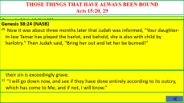
Acts 15:20-21 (NASB77)
19 "Therefore it is my judgment that we do not trouble those who are turning to God from among the Gentiles,
20 but that we write to them that they abstain from things contaminated by idols and from fornication and from what is strangled and from blood.
21 "For Moses from ancient generations has in every city those who preach him, since he is read in the synagogues every Sabbath."
A. “Therefore” because Amos 9:11-12 says nothing about the Gentiles becoming Jewish proselytes, we will not trouble them with such unauthorized teachings.
B. “But,” we will charge them to keep universally true Laws imposed by God before there was a Law of Moses.
C. Law of Moses is taught and bound upon men every sabbath in the synagogues. The synagogues is where those who want the Law bound need to attend.

Slide 12
Acts 15:22-24 (NASB77)
22 Then it seemed good to the apostles and the elders, with the whole church, to choose men from among them to send to Antioch with Paul and Barnabas-- Judas called Barsabbas, and Silas, leading men among the brethren,
23 and they sent this letter by them, " The apostles and the brethren who are elders, to the brethren in Antioch and Syria and Cilicia who are from the Gentiles, greetings.
24 "Since we have heard that some of our number to whom we gave no instruction have disturbed you with their words, unsettling your souls,
A. The church leaders at Jerusalem agreed with James and sent out a letter which completely exonerated the Jerusalem church of teaching that one must be circumcised and keep the Law before becoming a Christian. Interestingly, before the conversion of Cornelius, this was the practice of the church.
1. Verse 24 “To whom we gave no instruction”
Notes:
6/10/18

Slide 13
Acts 15:25-29 (NASB77)
25 it seemed good to us, having become of one mind, to select men to send to you with our beloved Barnabas and Paul,
26 men who have risked their lives for the name of our Lord Jesus Christ.
27 "Therefore we have sent Judas and Silas, who themselves will also report the same things by word of mouth.
28 "For it seemed good to the Holy Spirit and to us to lay upon you no greater burden than these essentials:
29 that you abstain from things sacrificed to idols and from blood and from things strangled and from fornication; if you keep yourselves free from such things, you will do well. Farewell."
A. The letter was accompanied by representatives of the Jerusalem church to declare the letters validity.
1. Verse 28 not only did the church agree with Paul and Barnabas but the Holy Spirit sanctioned this letter.

Slide 14
Acts 15:30-34 (NASB77)
30 So, when they were sent away, they went down to Antioch; and having gathered the congregation together, they delivered the letter.
31 And when they had read it, they rejoiced because of its encouragement.
32 And Judas and Silas, also being prophets themselves, encouraged and strengthened the brethren with a lengthy message.
33 And after they had spent time there, they were sent away from the brethren in peace to those who had sent them out.
34 [ But it seemed good to Silas to remain there.]
A. The result was the church was again at peace walking in the truth and not being disturbed with the false teaching of circumcision and keeping the Law of Moses.
Acts 15:1-2
1. All the men sent by the Jerusalem church returned to Jerusalem except Silas. He will have a continued role in the work among the Gentiles.
Acts 15:1-2 (NASB)
¹ Some men came down from Judea and began teaching the brethren, "Unless you are circumcised according to the custom of Moses, you cannot be saved."
² And when Paul and Barnabas had great dissension and debate with them, the brethren determined that Paul and Barnabas and some others of them should go up to Jerusalem to the apostles and elders concerning this issue.

Slide 15
Acts 15:35 (NASB77)
35 But Paul and Barnabas stayed in Antioch, teaching and preaching, with many others also, the word of the Lord.
A. Paul, Barnabas and many others continue teaching the word of the Lord to the church at Antioch. The early church believed that the word did not come from man but from God: Gal 1:11-12; 1Cor 14:37; 1Thess 2:13-16; 1Pet 1:22-25;
Eph 6:17
B. It is during this time of prolonged teaching at Antioch that Peter made a visit a visit to Antioch: Gal 2:11-14
1. Paul rebukes Peter, Barnabas and any others that have behaved hypocritically in this matter of Jew/Gentile fellowship: Gal 2:15-21
Galatians 2:11-14 (NASB)
¹¹ But when Cephas came to Antioch, I opposed him to his face, because he stood condemned.
¹² For prior to the coming of certain men from James, he used to eat with the Gentiles; but when they came, he began to withdraw and hold himself aloof, fearing the party of the circumcision.
Galatians 2:15-21 (NASB)
¹⁵ "We are Jews by nature and not sinners from among the Gentiles;
¹⁶ nevertheless knowing that a man is not justified by the works of the Law but through faith in Christ Jesus, even we have believed in Christ Jesus, so that we may be justified by faith in Christ and not by the works of the Law; since by the works of the Law no flesh will be justified.
¹⁷ "But if, while seeking to be justified in Christ, we ourselves have also been found sinners, is Christ then a minister of sin? May it never be!
¹⁸ "For if I rebuild what I have once destroyed, I prove myself to be a transgressor.
¹⁹ "For through the Law I died to the Law, so that I might live to God.
1 Corinthians 14:37 (NASB)
³⁷ If anyone thinks he is a prophet or spiritual, let him recognize that the things which I write to you are the Lord's commandment.
¹³ The rest of the Jews joined him in hypocrisy, with the result that even Barnabas was carried away by their hypocrisy.
¹⁴ But when I saw that they were not straightforward about the truth of the gospel, I said to Cephas in the presence of all, "If you, being a Jew, live like the Gentiles and not like the Jews, how is it that you compel the Gentiles to live like Jews?
²⁰ "I have been crucified with Christ; and it is no longer I who live, but Christ lives in me; and the life which I now live in the flesh I live by faith in the Son of God, who loved me and gave Himself up for me.
²¹ "I do not nullify the grace of God, for if righteousness comes through the Law, then Christ died needlessly.“
1 Thessalonians 2:13-16 (NASB)
¹³ For this reason we also constantly thank God that when you received the word of God which you heard from us, you accepted it not as the word of men, but for what it really is, the word of God, which also performs its work in you who believe.
¹⁴ For you, brethren, became imitators of the churches of God in Christ Jesus that are in Judea, for you also endured the same sufferings at the hands of your own countrymen, even as they did from the Jews,
1 Peter 1:22-25 (NASB)
²² Since you have in obedience to the truth purified your souls for a sincere love of the brethren, fervently love one another from the heart,
²³ for you have been born again not of seed which is perishable but imperishable, that is, through the living and enduring word of God.
Ephesians 6:17 (NASB)
¹⁷ And take THE HELMET OF SALVATION, and the sword of the Spirit, which is the word of God.
Galatians 1:11-12 (NASB)
¹¹ For I would have you know, brethren, that the gospel which was preached by me is not according to man.
¹² For I neither received it from man, nor was I taught it, but I received it through a revelation of Jesus Christ.
¹⁵ who both killed the Lord Jesus and the prophets, and drove us out. They are not pleasing to God, but hostile to all men,
¹⁶ hindering us from speaking to the Gentiles so that they may be saved; with the result that they always fill up the measure of their sins. But wrath has come upon them to the utmost.
²⁴ For, "ALL FLESH IS LIKE GRASS, AND ALL ITS GLORY LIKE THE FLOWER OF GRASS. THE GRASS WITHERS, AND THE FLOWER FALLS OFF,
²⁵ BUT THE WORD OF THE LORD ENDURES FOREVER." And this is the word which was preached to you.

Slide 16
Acts 15:35-38 (NASB77)
36 And after some days Paul said to Barnabas, "Let us return and visit the brethren in every city in which we proclaimed the word of the Lord, and see how they are."
37 And Barnabas was desirous of taking John, called Mark, along with them also.
38 But Paul kept insisting that they should not take him along who had deserted them in Pamphylia and had not gone with them to the work.
A. Paul tells Barnabas that he wants them to return and visit the churches of their first missionary journey. He is concerned since they taught the Gospel to them under great persecution: Acts 14:21-22
1. Barnabas wants to take John (Mark) who during the first Missionary journey left them and returned to his home congregation of Jerusalem. Acts 13:13
2. Paul did not trust John Mark to finish the work, feeling he might abandon them again. Later Paul seems to change his mind about Mark. 2Tim 4:11
Acts 14:21-22 (NASB)
²¹ After they had preached the gospel to that city and had made many disciples, they returned to Lystra and to Iconium and to Antioch,
²² strengthening the souls of the disciples, encouraging them to continue in the faith, and saying, "Through many tribulations we must enter the kingdom of God."
2 Timothy 4:11 (NASB)
¹¹ Only Luke is with me. Pick up Mark and bring him with you, for he is useful to me for service.
Acts 13:13 (NASB)
¹³ Now Paul and his companions put out to sea from Paphos and came to Perga in Pamphylia; but John left them and returned to Jerusalem.
Notes:
6/17/18

Slide 17



Acts 15:39-41 (NASB77)
39 And there arose such a sharp disagreement that they separated from one another, and Barnabas took Mark with him and sailed away to Cyprus.
40 But Paul chose Silas and departed, being committed by the brethren to the grace of the Lord.
41 And he was traveling through Syria and Cilicia, strengthening the churches.
A. What should good brethren do when differences of opinion are so strong that they are unable to agree.
1. Paul and Barnabas have a serious disagreement over Mark. So much so that they choose to separate in different directions.
a. Their decision actually caused the Gospel to spread more quickly.

Slide 18
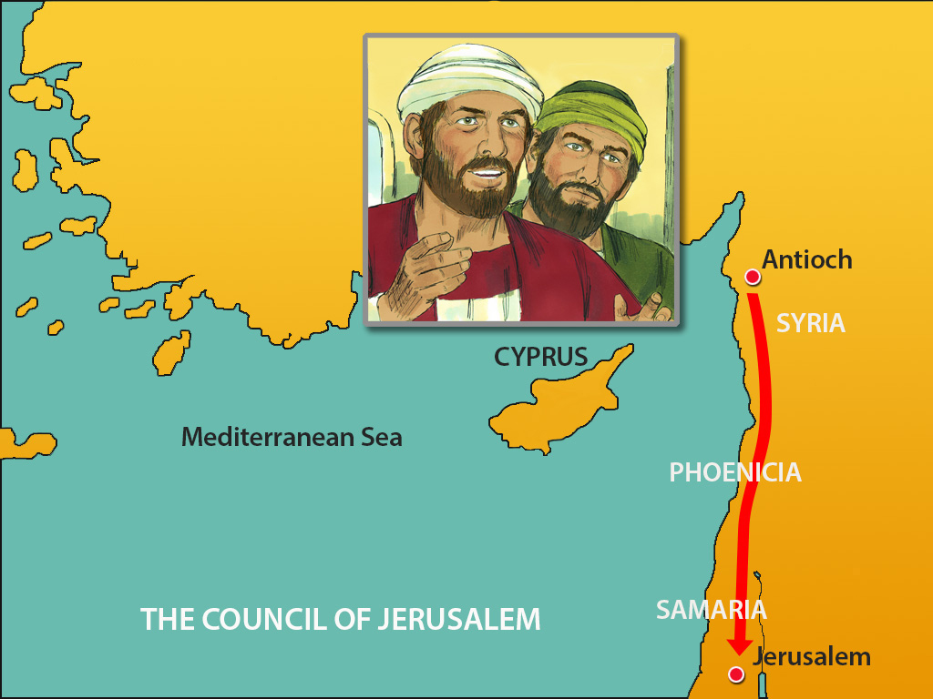
Acts 15:3 (NASB77)
3 Therefore, being sent on their way by the church, they were passing through both Phoenicia and Samaria, describing in detail the conversion of the Gentiles, and were bringing great joy to all the brethren.

Slide 19
Acts 10:47-48 (NASB77)
47 " Surely no one can refuse the water for these to be baptized who have received the Holy Spirit just as we did, can he?"
48 And he ordered them to be baptized in the name of Jesus Christ. Then they asked him to stay on for a few days.
Acts 15:7-11 (NASB77)
7 And after there had been much debate, Peter stood up and said to them, "Brethren, you know that in the early days God made a choice among you, that by my mouth the Gentiles should hear the word of the gospel and believe.
8 "And God, who knows the heart, bore witness to them, giving them the Holy Spirit, just as He also did to us;
9 and He made no distinction between us and them, cleansing their hearts by faith.
10 "Now therefore why do you put God to the test by placing upon the neck of the disciples a yoke which neither our fathers nor we have been able to bear?
11 "But we believe that we are saved through the grace of the Lord Jesus, in the same way as they also are."
Heard
Heard
Acts 2:36-41 (NASB77)
36 "Therefore let all the house of Israel know for certain that God has made Him both Lord and Christ -- this Jesus whom you crucified."
37 Now when they heard this, they were pierced to the heart, and said to Peter and the rest of the apostles, " Brethren, what shall we do?"
38 And Peter said to them, " Repent, and let each of you be baptized in the name of Jesus Christ for the forgiveness of your sins; and you shall receive the gift of the Holy Spirit.
39 "For the promise is for you and your children, and for all who are far off, as many as the Lord our God shall call to Himself."
40 And with many other words he solemnly testified and kept on exhorting them, saying, " Be saved from this perverse generation!"
41 So then, those who had received his word were baptized; and there were added that day about three thousand souls.
Believed
Believed
Repented
Repented
Acts 11:18 (NASB77)
18 And when they heard this, they quieted down, and glorified God, saying, "Well then, God has granted to the Gentiles also the repentance that leads to life."
Acts 17:30 (NASB77)
30 "Therefore having overlooked the times of ignorance, God is now declaring to men that all everywhere should repent,
Acts 11:14 (NASB77)
14 and he shall speak words to you by which you will be saved, you and all your household.'
SAME GOSPEL TO BOTH
JEW AND GENTILES
THE JEWS ON PENTECOST
THE GENTILES ACTS 10-11
Baptized
Baptized
Romans 1:16 (NASB77)
16 For I am not ashamed of the gospel, for it is the power of God for salvation to everyone who believes, to the Jew first and also to the Greek.
Forgiven of sins
Forgiven of sins
Added to saved
Added to saved

Slide 20
Acts 1:13-14 (NASB77)
13 And when they had entered, they went up to the upper room, where they were staying; that is, Peter and John and James and Andrew, Philip and Thomas, Bartholomew and Matthew, James the son of Alphaeus, and Simon the Zealot, and Judas the son of James.
14 These all with one mind were continually devoting themselves to prayer, along with the women, and Mary the mother of Jesus, and with His brothers.
Acts 12:1-2 (NASB77)
1 Now about that time Herod the king laid hands on some who belonged to the church, in order to mistreat them.
2 And he had James the brother of John put to death with a sword.
Matthew 13:55 (NASB77)
55 "Is not this the carpenter's son? Is not His mother called Mary, and His brothers, James and Joseph and Simon and Judas?

Slide 21
Amos 9:11 (NASB)
¹¹ "In that day I will raise up the fallen booth of David, And wall up its breaches; I will also raise up its ruins And rebuild it as in the days of old;
By the time of Amos, David’s house had fallen.
But God predicted he would build it up again.
Family
How had David’s house fallen?
And
How would God rebuild it again?
Family
House of David
House of David

Slide 22
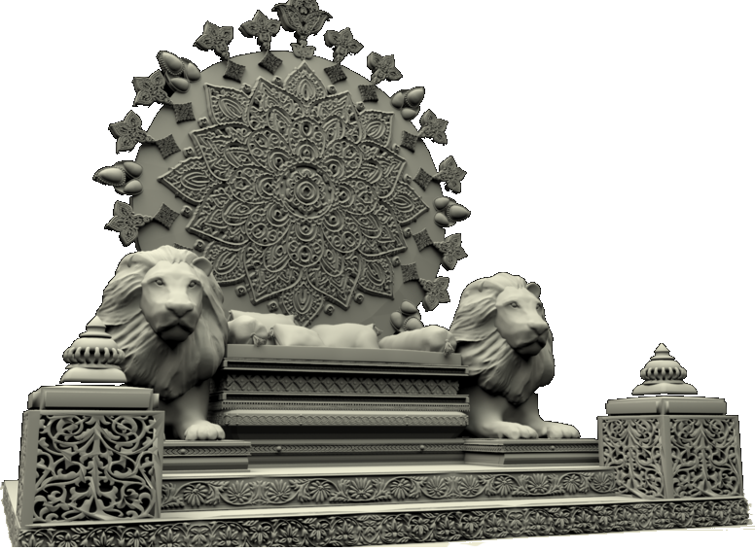
Amos 9:11 (NASB)
¹¹ "In that day I will raise up the fallen booth of David, And wall up its breaches; I will also raise up its ruins And rebuild it as in the days of old;
1 Kings 2:3-4 (NASB) (David speaking to Solomon)
3 "Keep the charge of the LORD your God, to walk in His ways, to keep His statutes, His commandments, His ordinances, and His testimonies, according to what is written in the Law of Moses, that you may succeed in all that you do and wherever you turn,
4 so that the LORD may carry out His promise which He spoke concerning me, saying, 'If your sons are careful of their way, to walk before Me in truth with all their heart and with all their soul, you shall not lack a man on the throne of Israel.'
2 Samuel 7:15-17 (NASB)
15 but My lovingkindness shall not depart from him, as I took it away from Saul, whom I removed from before you.
16 "Your house and your kingdom shall endure before Me forever; your throne shall be established forever."'"
17 In accordance with all these words and all this vision, so Nathan spoke to David.
Notes:
Jer 22:24-30; Mt 1:12
Lk 1:31-32; Acts 2:29-31

Slide 23
Amos 9:11 (NASB)
¹¹ "In that day I will raise up the fallen booth of David, And wall up its breaches; I will also raise up its ruins And rebuild it as in the days of old;
1 Corinthians 15:24-25 (NASB)
²⁴ then comes the end, when He hands over the kingdom to the God and Father, when He has abolished all rule and all authority and power.
²⁵ For He must reign until He has put all His enemies under His feet.
Hebrews 10:12-13 (NASB)
¹² but He, having offered one sacrifice for sins for all time, SAT DOWN AT THE RIGHT HAND OF GOD,
¹³ waiting from that time onward UNTIL HIS ENEMIES BE MADE A FOOTSTOOL FOR HIS FEET.
Daniel 7:13-14 (NASB)
¹³ "I kept looking in the night visions, And behold, with the clouds of heaven One like a Son of Man was coming, And He came up to the Ancient of Days And was presented before Him.
¹⁴ "And to Him was given dominion, Glory and a kingdom, That all the peoples, nations and men of every language Might serve Him. His dominion is an everlasting dominion Which will not pass away; And His kingdom is one Which will not be destroyed.
1 Chronicles 29:23 (NASB)
²³ Then Solomon sat on the throne of the LORD as king instead of David his father; and he prospered, and all Israel obeyed him.
Psalm 11:4 (NASB)
⁴ The LORD is in His holy temple; the LORD’S throne is in heaven; His eyes behold, His eyelids test the sons of men.
Acts 2:29-31 (NASB)
²⁹ "Brethren, I may confidently say to you regarding the patriarch David that he both died and was buried, and his tomb is with us to this day.
³⁰ "And so, because he was a prophet and knew that GOD HAD SWORN TO HIM WITH AN OATH TO SEAT one OF HIS DESCENDANTS ON HIS THRONE,
³¹ he looked ahead and spoke of the resurrection of the Christ, that HE WAS NEITHER ABANDONED TO HADES, NOR DID His flesh SUFFER DECAY.
Kingdom
Luke 1:31-33 (NASB)
³¹ "And behold, you will conceive in your womb and bear a son, and you shall name Him Jesus.
³² "He will be great and will be called the Son of the Most High; and the Lord God will give Him the throne of His father David;
³³ and He will reign over the house of Jacob forever, and His kingdom will have no end."
House of Jacob
(ISRAEL)
Notes:
Jer 22:24-30; Mt 1:12
Lk 1:31-32; Acts 2:29-31 (In Acts 2:25-28 Peter is quoting Psa 16:-11)
The earthly throne had lost the heavenly favor which gave the one who sat on it authority on earth from God. Jesus was a descendent of Jeconiah whom God specifically stated none of his descendants would ever sit on a throne in Jerusalem and rule. David’s throne’s authority and power were in the heavens which is where Jesus is seated right now. Dan 7:13-14;
Throne: 1Chro 29:23; Psa 11:4

Slide 24
Amos 9:11 (NASB)
¹¹ "In that day I will raise up the fallen booth of David, And wall up its breaches; I will also raise up its ruins And rebuild it as in the days of old;
Jeremiah 22:24-30 (NASB)
²⁴ "As I live," declares the LORD, "even though Coniah the son of Jehoiakim king of Judah were a signet ring on My right hand, yet I would pull you off;
²⁵ and I will give you over into the hand of those who are seeking your life, yes, into the hand of those whom you dread, even into the hand of Nebuchadnezzar king of Babylon and into the hand of the Chaldeans.
²⁶ "I will hurl you and your mother who bore you into another country where you were not born, and there you will die.
²⁷ "But as for the land to which they desire to return, they will not return to it.
1. JESUS WOULD NEVER SIT ON DAVID’S EARTHLY THRONE IN JERUSALEM AND RULE!
2. GOD HAD REMOVED HIS HEAVENLY AUTHORITY FROM DAVID’S EARTHLY THRONE RETURNING IT TO THE HEAVENS!
3. THIS IS WHERE DAVID SAW HIS DESCENDANT RAISED FROM THE DEAD TO BE SEATED FOREVER!
²⁸ "Is this man Coniah a despised, shattered jar? Or is he an undesirable vessel? Why have he and his descendants been hurled out And cast into a land that they had not known?
²⁹ "O land, land, land, Hear the word of the LORD!
³⁰ "Thus says the LORD, 'Write this man down childless, A man who will not prosper in his days; For no man of his descendants will prosper Sitting on the throne of David Or ruling again in Judah.’”
(Jesus as one of his descendants could never sit on a throne in Jerusalem. The power of David’s throne was God’s throne in heaven. And Jesus was raised from the dead to sit at God’s right hand in heaven, on the throne of David)
Matthew 1:11-12 (NASB)
¹¹ Josiah became the father of Jeconiah and his brothers, at the time of the deportation to Babylon.
¹² After the deportation to Babylon: Jeconiah became the father of Shealtiel, and Shealtiel the father of Zerubbabel.
(Jeconiah is Coniah of Jeremiah. None of his descendants would ever sit on the throne in Jerusalem)
Notes:
Jer 22:24-30; Mt 1:12
The earthly throne had lost the heavenly favor which gave the one who sat on it authority on earth from God. Jesus was a descendent of Jeconiah whom God specifically stated none of his descendants would ever sit on a throne in Jerusalem and rule. David’s throne’s authority and power were in the heavens which is where Jesus is seated right now.

Slide 25
Ephesians 2:11-15 (NASB)
¹¹ Therefore remember that formerly you, the Gentiles in the flesh, who are called "Uncircumcision" by the so-called "Circumcision," which is performed in the flesh by human hands—
¹² remember that you were at that time separate from Christ, excluded from the commonwealth of Israel, and strangers to the covenants of promise, having no hope and without God in the world.
¹³ But now in Christ Jesus you who formerly were far off have been brought near by the blood of Christ.
¹⁴ For He Himself is our peace, who made both groups into one and broke down the barrier of the dividing wall,
¹⁵ by abolishing in His flesh the enmity, which is the Law of commandments contained in ordinances, so that in Himself He might make the two into one new man, thus establishing peace,
Amos’s Prophecy Foretold David’s House Rebuilt - So Gentiles May Seek The Lord
Amos 9:11-12 (NASB)
¹¹ "In that day I will raise up the fallen booth of David, And wall up its breaches; I will also raise up its ruins And rebuild it as in the days of old;
¹² That they may possess the remnant of Edom And all the nations who are called by My name," Declares the LORD who does this.
Romans 15:12 (NASB)
¹² Again Isaiah says, "THERE SHALL COME THE ROOT OF JESSE, AND HE WHO ARISES TO RULE OVER THE GENTILES, IN HIM SHALL THE GENTILES HOPE."
Acts 15:15-18 (NASB)
¹⁵ "With this the words of the Prophets agree, just as it is written,
¹⁶ 'AFTER THESE THINGS I will return, AND I WILL REBUILD THE TABERNACLE OF DAVID WHICH HAS FALLEN, AND I WILL REBUILD ITS RUINS, AND I WILL RESTORE IT,
¹⁷ SO THAT THE REST OF MANKIND MAY SEEK THE LORD, AND ALL THE GENTILES WHO ARE CALLED BY MY NAME,'
¹⁸ SAYS THE LORD, WHO MAKES THESE THINGS KNOWN FROM LONG AGO.

Slide 26
THOSE THINGS THAT HAVE ALWAYS BEEN BOUND
Acts 15:20, 29
Genesis 20:1-13 (NASB) (even among Gentiles moral right is recognized)
¹ Now Abraham journeyed from there toward the land of the Negev, and settled between Kadesh and Shur; then he sojourned in Gerar.
² Abraham said of Sarah his wife, "She is my sister." So Abimelech king of Gerar sent and took Sarah.
³ But God came to Abimelech in a dream of the night, and said to him, "Behold, you are a dead man because of the woman whom you have taken, for she is married."
⁴ Now Abimelech had not come near her; and he said, "Lord, will You slay a nation, even though blameless?
⁵ "Did he not himself say to me, 'She is my sister'? And she herself said, 'He is my brother.' In the integrity of my heart and the innocence of my hands I have done this."
Genesis 18:17-21 (NASB)
¹⁷ The LORD said, "Shall I hide from Abraham what I am about to do,
¹⁸ since Abraham will surely become a great and mighty nation, and in him all the nations of the earth will be blessed?
¹⁹ "For I have chosen him, so that he may command his children and his household after him to keep the way of the LORD by doing righteousness and justice, so that the LORD may bring upon Abraham what He has spoken about him."
1. Abstain from things contaminated by or sacrificed to idols – Gen 31:19;
Ex 20:4; Dt 27:15; 1Cor 8:7-10
2. From blood – Gen 9:2-4
a. From things strangled – Things strangled still contained the blood
4. From Fornication – Gen 2:24; 20:1-13; 18:17-21; Jude 7; Gen 38:24
Genesis 38:24 (NASB)
²⁴ Now it was about three months later that Judah was informed, "Your daughter- in-law Tamar has played the harlot, and behold, she is also with child by harlotry." Then Judah said, "Bring her out and let her be burned!"
(Clearly, Judah was the unrighteous one and not Tamar. Judah recognizes this and confesses his wrong to Tamar. Harlotry was always immoral - NAN)
Wisdom From the Jerusalem Church
Acts 15:20 (NASB) (counsel from James)
²⁰ but that we write to them that they abstain from things contaminated by idols and from fornication and from what is strangled and from blood.
Acts 15:29 (NASB) (The letter of clarification sent by the Jerusalem church)
²⁹ that you abstain from things sacrificed to idols and from blood and from things strangled and from fornication; if you keep yourselves free from such things, you will do well. Farewell."
⁶ Then God said to him in the dream, "Yes, I know that in the integrity of your heart you have done this, and I also kept you from sinning against Me; therefore I did not let you touch her.
⁷ "Now therefore, restore the man's wife, for he is a prophet, and he will pray for you and you will live. But if you do not restore her, know that you shall surely die, you and all who are yours."
⁸ So Abimelech arose early in the morning and called all his servants and told all these things in their hearing; and the men were greatly frightened.
⁹ Then Abimelech called Abraham and said to him, "What have you done to us? And how have I sinned against you, that you have brought on me and on my kingdom a great sin? You have done to me things that ought not to be done."
¹⁰ And Abimelech said to Abraham, "What have you encountered, that you have done this thing?"
¹¹ Abraham said, "Because I thought, surely there is no fear of God in this place, and they will kill me because of my wife.
¹² "Besides, she actually is my sister, the daughter of my father, but not the daughter of my mother, and she became my wife;
¹³ and it came about, when God caused me to wander from my father's house, that I said to her, 'This is the kindness which you will show to me: everywhere we go, say of me, "He is my brother.“’”
²⁰ And the LORD said, "The outcry of Sodom and Gomorrah is indeed great, and their sin is exceedingly grave.
²¹ "I will go down now, and see if they have done entirely according to its outcry, which has come to Me; and if not, I will know.“
1 Corinthians 8:7-10 (NASB)
⁷ However not all men have this knowledge; but some, being accustomed to the idol until now, eat food as if it were sacrificed to an idol; and their conscience being weak is defiled.
⁸ But food will not commend us to God; we are neither the worse if we do not eat, nor the better if we do eat.
⁹ But take care that this liberty of yours does not somehow become a stumbling block to the weak.
¹⁰ For if someone sees you, who have knowledge, dining in an idol's temple, will not his conscience, if he is weak, be strengthened to eat things sacrificed to idols?
Genesis 31:19 (NASB) (Idolatry existed early among God’s people)
19 When Laban had gone to shear his flock, then Rachel stole the household idols that were her father's.
Genesis 9:2-4 (NASB)
² "The fear of you and the terror of you will be on every beast of the earth and on every bird of the sky; with everything that creeps on the ground, and all the fish of the sea, into your hand they are given.
³ "Every moving thing that is alive shall be food for you; I give all to you, as I gave the green plant.
⁴ "Only you shall not eat flesh with its life, that is, its blood.
Exodus 20:4 (NASB) (The Ten Commandments)
4 "You shall not make for yourself an idol, or any likeness of what is in heaven above or on the earth beneath or in the water under the earth.
Deuteronomy 27:15 (NASB)
15 'Cursed is the man who makes an idol or a molten image, an abomination to the LORD, the work of the hands of the craftsman, and sets it up in secret.' And all the people shall answer and say, 'Amen.'
Jude 1:7 (NASB)
⁷ just as Sodom and Gomorrah and the cities around them, since they in the same way as these indulged in gross immorality and went after strange flesh, are exhibited as an example in undergoing the punishment of eternal fire.
Genesis 2:24 (NASB) (what God intended in intimate relations)
²⁴ For this reason a man shall leave his father and his mother, and be joined to his wife; and they shall become one flesh.

Slide 27
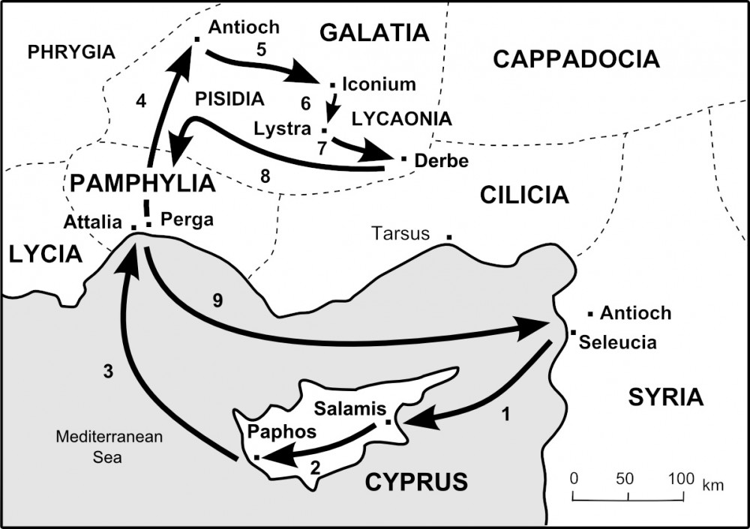
Acts 15:40
(NASB)
⁴⁰ But Paul chose Silas and left, being committed by the brethren to the grace of the Lord.
Acts 15:39 (NASB)
³⁹ And there occurred such a sharp disagreement that they separated from one another, and Barnabas took Mark with him and sailed away to Cyprus.
Paul & Silas
Pieria
Barnabas
&
Silas
FIRST MISSIONARY JOURNEY
Notes:
So, Paul and Silas begin the Second missionary journey by checking on the congregations established during the first missionary journey
There are not many archeological sites at Konya. There is a museum there with ancient statues and objects.

Slide 28
When Brethren Disagree Over Matters Of Opinion
Concerning John Mark - Was Paul right? Was Barnabas right?
Do not violate the Law of Love
Ro 12:10;1Pet 1:22
1Jn 2:9-11; 1Jn 3:10-11
Eph 4:26-27
Never stop working for God
Gal 5:6-7; Ro 1:1-5
Ro 6:17-18; Ro 16:25-26 1Cor 15:58
Do all for the sake of the Gospel
1Cor 9:23; 2Tim 4:1-2
1Pet 3:15; Mt 28:18-20
Philip 1:12-18
Philippians 1:12-18 (NASB)
¹² Now I want you to know, brethren, that my circumstances have turned out for the greater progress of the gospel,
¹³ so that my imprisonment in the cause of Christ has become well known throughout the whole praetorian guard and to everyone else,
¹⁴ and that most of the brethren, trusting in the Lord because of my imprisonment, have far more courage to speak the word of God without fear.
1 Corinthians 15:58 (NASB)
⁵⁸ Therefore, my beloved brethren, be steadfast, immovable, always abounding in the work of the Lord, knowing that your toil is not in vain in the Lord.
1 Corinthians 9:23 (NASB)
²³ I do all things for the sake of the gospel, so that I may become a fellow partaker of it.
1 Peter 3:15 (NASB)
¹⁵ but sanctify Christ as Lord in your hearts, always being ready to make a defense to everyone who asks you to give an account for the hope that is in you, yet with gentleness and reverence;
Matthew 28:18-20 (NASB)
¹⁸ And Jesus came up and spoke to them, saying, "All authority has been given to Me in heaven and on earth.
¹⁹ "Go therefore and make disciples of all the nations, baptizing them in the name of the Father and the Son and the Holy Spirit,
²⁰ teaching them to observe all that I commanded you; and lo, I am with you always, even to the end of the age."
Galatians 5:6-7 (NASB)
⁶ For in Christ Jesus neither circumcision nor uncircumcision means anything, but faith working through love.
⁷ You were running well; who hindered you from obeying the truth?
Romans 1:1-5 (NASB)
¹ Paul, a bond-servant of Christ Jesus, called as an apostle, set apart for the gospel of God,
² which He promised beforehand through His prophets in the holy Scriptures,
³ concerning His Son, who was born of a descendant of David according to the flesh,
Romans 6:17-18 (NASB)
¹⁷ But thanks be to God that though you were slaves of sin, you became obedient from the heart to that form of teaching to which you were committed,
¹⁸ and having been freed from sin, you became slaves of righteousness.
2 Timothy 4:1-2 (NASB)
¹ I solemnly charge you in the presence of God and of Christ Jesus, who is to judge the living and the dead, and by His appearing and His kingdom:
² preach the word; be ready in season and out of season; reprove, rebuke, exhort, with great patience and instruction.
Romans 12:10 (NASB)
¹⁰ Be devoted to one another in brotherly love; give preference to one another in honor;
1 Peter 1:22 (NASB)
²² Since you have in obedience to the truth purified your souls for a sincere love of the brethren, fervently love one another from the heart,
1 John 2:9-11 (NASB)
⁹ The one who says he is in the Light and yet hates his brother is in the darkness until now.
¹⁰ The one who loves his brother abides in the Light and there is no cause for stumbling in him.
¹¹ But the one who hates his brother is in the darkness and walks in the darkness, and does not know where he is going because the darkness has blinded his eyes.
1 John 3:10-11 (NASB)
¹⁰ By this the children of God and the children of the devil are obvious: anyone who does not practice righteousness is not of God, nor the one who does not love his brother.
¹¹ For this is the message which you have heard from the beginning, that we should love one another;
Ephesians 4:26-27 (NASB)
²⁶ BE ANGRY, AND yet DO NOT SIN; do not let the sun go down on your anger,
²⁷ and do not give the devil an opportunity.
Romans 16:25-26 (NASB)
²⁵ Now to Him who is able to establish you according to my gospel and the preaching of Jesus Christ, according to the revelation of the mystery which has been kept secret for long ages past,
²⁶ but now is manifested, and by the Scriptures of the prophets, according to the commandment of the eternal God, has been made known to all the nations, leading to obedience of faith;
Paul and Barnabas still loved each other as Brothers in Christ
But they disagreed over an opinion about John Mark
They continued to work for the same cause
God continued to be glorified as they taught it to the world
¹⁸ What then? Only that in every way, whether in pretense or in truth, Christ is proclaimed; and in this I rejoice. Yes, and I will rejoice,
¹⁵ Some, to be sure, are preaching Christ even from envy and strife, but some also from good will;
¹⁶ the latter do it out of love, knowing that I am appointed for the defense of the gospel;
¹⁷ the former proclaim Christ out of selfish ambition rather than from pure motives, thinking to cause me distress in my imprisonment.
⁴ who was declared the Son of God with power by the resurrection from the dead, according to the Spirit of holiness, Jesus Christ our Lord,
⁵ through whom we have received grace and apostleship to bring about the obedience of faith among all the Gentiles for His name's sake,
Notes:
Whether together or not both men worked for the same goals. The strengthening of the church and the spread of the gospel.
Phil 1:12-18; 3-7; 4: 4:14-16; 1Thess 1:6-10
1Pet 1:22 – love of the brethren

Slide 29
Acts 15:1-41

Slide 30
Acts 14:27-28:
²⁷ And when they were come, and had gathered the church together, they rehearsed all that God had done with them, and how he had opened the door of faith unto the Gentiles.
²⁸ And there they abode long time with the disciples.
At the end of Chapter 14, Paul and Barnabas were back in Antioch of Syria after a very successful mission.
From the Matthew Henry Commentary:
“If ever there was a heaven upon earth, surely it was in the church at Antioch at this time, when there were so many excellent ministers there, and blessed Paul among them, building up that church in her most holy faith.

Slide 31
Acts 15:
¹ And certain men which came down from Judaea taught the brethren, and said, Except ye be circumcised after the manner of Moses, ye cannot be saved.
But here we have their peace disturbed, and differences arising.
A new doctrine started among them, which occasioned this division, obliging the Gentile converts to submit to circumcision and the ceremonial law.
Those that are ever so well taught have need to stand upon their guard that they be not untaught again, or ill taught.”

Slide 32
The Jewish Christians still zealous for the law became known as Judaizers.
If what they were saying was true…
The Gentiles who had come to Christ by obedient faith were not truly saved.
Salvation was by rote and ritual.
All Christians were subject to the Law of Moses.
The Jewish Christian was a higher class of Christian than his Gentile brother.
Acts 15:
¹ And certain men which came down from Judaea taught the brethren, and said, Except ye be circumcised after the manner of Moses, ye cannot be saved.

Slide 33
Paul wrote of this trip to Jerusalem in his letter to the Galatians:
Galatians 2:1-2a:
¹ Then fourteen years after I went up again to Jerusalem with Barnabas, and took Titus with me also.
² And I went up by revelation, and communicated unto them that gospel which I preach among the Gentiles …
The journey was financed by the church in Antioch.
² When therefore Paul and Barnabas had no small dissension & disputation with them, they determined that Paul and Barnabas, and certain other of them, should go up to Jerusalem unto the apostles and elders about this question.

Slide 34
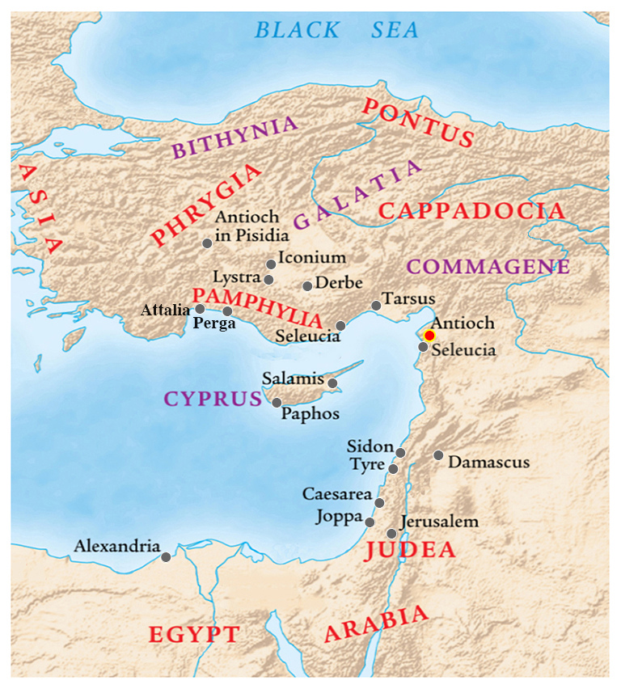
³ And being brought on their way by the church, they passed through Phenice and Samaria, declaring the conversion of the Gentiles: and they caused great joy unto all the brethren.

Slide 35

³ And being brought on their way by the church, they passed through Phenice and Samaria, declaring the conversion of the Gentiles: and they caused great joy unto all the brethren.

Slide 36
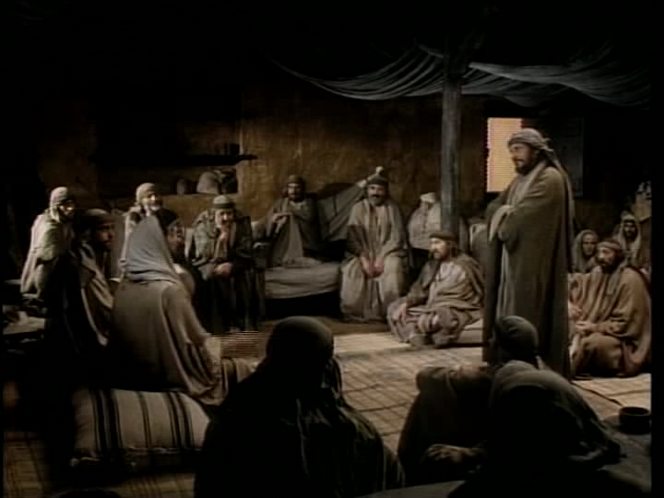
⁴ And when they were come to Jerusalem, they were received of the church, and of the apostles and elders, and they declared all things that God had done with them.

Slide 37
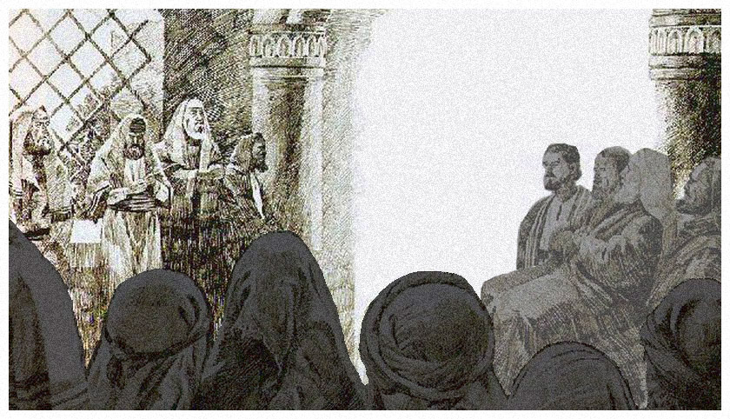
⁵ But there rose up certain of the sect of the Pharisees which believed, saying, That it was needful to circumcise them, and to command them to keep the law of Moses.

Slide 38
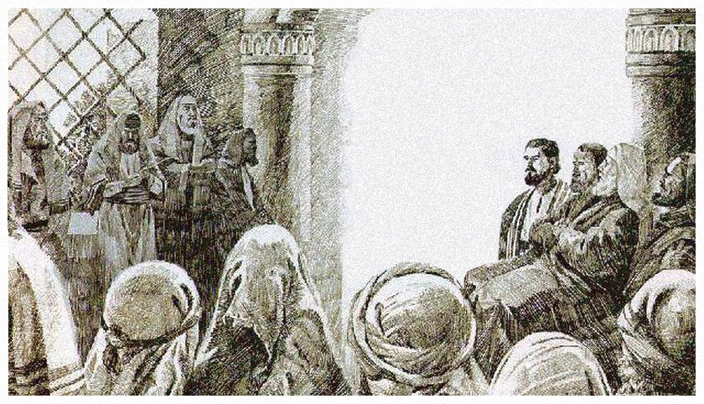
⁶ And the apostles and elders came together for to consider of this matter.
⁷ And when there had been much disputing, Peter rose up, and said unto them,

Slide 39
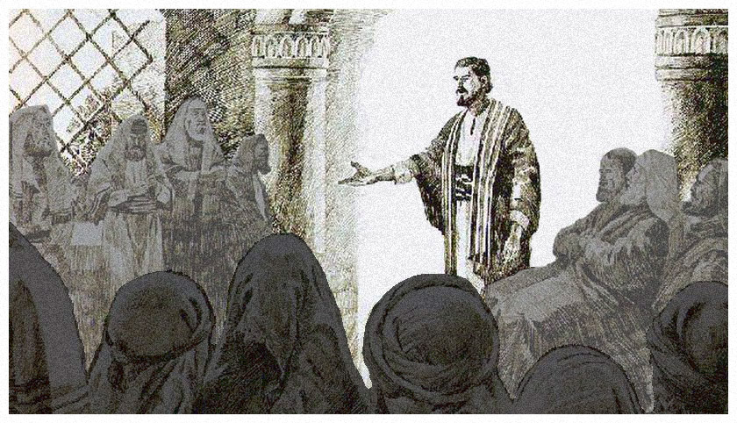
Men and brethren, ye know how that a good while ago God made choice among us, that the Gentiles by my mouth should hear the word of the gospel, and believe.

Slide 40
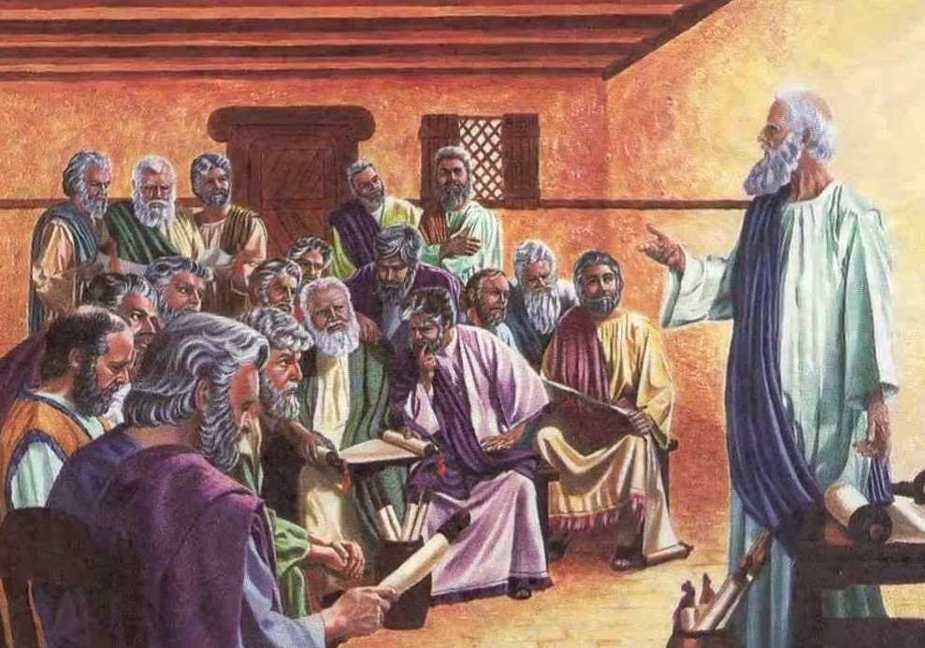
⁸ And God, which knoweth the hearts, bare them witness, giving them the Holy Ghost, even as he did unto us;
⁹ And put no difference between us and them, purifying their hearts by faith.

Slide 41
¹⁰ Now therefore why tempt ye God, to put a yoke upon the neck of the disciples, which neither our fathers nor we were able to bear?
¹¹ But we believe that through the grace of the Lord Jesus Christ we shall be saved, even as they.

Slide 42
¹² Then all the multitude kept silence, and gave audience to Barnabas and Paul, declaring what miracles and wonders God had wrought among the Gentiles by them.

Slide 43
¹³ And after they had held their peace, James answered, saying,
Men and brethren, hearken unto me:
¹⁴ Simeon hath declared how God at the first did visit the Gentiles, to take out of them a people for his name.
¹⁵ And to this agree the words of the prophets; as it is written,

Slide 44
¹⁶ After this I will return, and will build again the tabernacle of David, which is fallen down; and I will build again the ruins thereof, and I will set it up:
¹⁷ That the residue of men might seek after the Lord, and all the Gentiles, upon whom my name is called, saith the Lord, who doeth all these things.
Amos 9:11-12:
¹¹ In that day will I raise up the tabernacle of David that is fallen, and close up the breaches thereof; and I will raise up his ruins, and I will build it as in the days of old:
¹² That they may possess the remnant of Edom, and of all the heathen, which are called by my name, saith the LORD that doeth this.

Slide 45
¹⁸ Known unto God are all his works from the beginning of the world.
¹⁹ Wherefore my sentence is, that we trouble not them, which from among the Gentiles are turned to God:
²⁰ But that we write unto them, that they abstain from pollutions of idols, and from fornication, and from things strangled, and from blood.
pollutions of idols
fornication
things strangled
blood
James mentioned neither circumcision nor salvation.
Paul later confronted the doctrine of the Judaizers in his epistle to the Galatians.

Slide 46
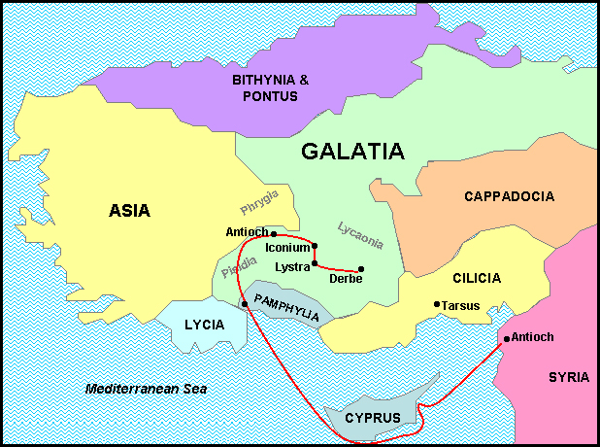
Galatians 5:2-4, 6:
² Behold, I Paul say unto you,
that if ye be circumcised,
Christ shall profit you nothing.
³ For I testify again to every man that is circumcised, that he is a debtor to do the whole law.
⁴ Christ is become of no effect unto you, whosoever of you are justified by the law; ye are fallen from grace.
⁶ For in Jesus Christ neither circumcision availeth any thing,
nor uncircumcision;
but faith which worketh by love.
Paul’s mission with Barnabas

Slide 47
Mark 12:29-31:
²⁹ And Jesus answered him, The first of all the commandments is, Hear, O Israel; The Lord our God is one Lord:
³⁰ And thou shalt love the Lord thy God with all thy heart, and with all thy soul, and with all thy mind, and with all thy strength: this is the first commandment.
³¹ And the second is like, namely this, Thou shalt love thy neighbour as thyself. There is none other commandment greater than these.
James addressed things the Gentile Christians were doing that violated the two great commandments.
The two eternal laws of God were cited by both James and Paul in their respective letters to the church.

Slide 48
Romans 13:9-10:
⁹ For this, Thou shalt not commit adultery, Thou shalt not kill, Thou shalt not steal, Thou shalt not bear false witness, Thou shalt not covet; and if there be any other commandment, it’s briefly comprehended in this saying, namely, Thou shalt love thy neighbour as thyself.
¹⁰ Love worketh no ill to his neighbour: therefore love is the fulfilling of the law.
James addressed things the Gentile Christians were doing that violated the two great commandments.
The “royal law” of God was cited by both James and Paul in their respective letters to the church.

Slide 49
James addressed things the Gentile Christians were doing that violated the two great commandments.
The “royal law” of God was cited by both James and Paul in their respective letters to the church.
Galatians 5:14:
For all the law is fulfilled in one word, even in this; Thou shalt love thy neighbour as thyself.

Slide 50
James addressed things the Gentile Christians were doing that violated the two great commandments.
The “royal law” of God was cited by both James and Paul in their respective letters to the church.
James 2:8:
If ye fulfil the royal law according to the scripture, Thou shalt love thy neighbour as thyself, ye do well:

Slide 51
Romans 1:22-24, 26-27:
²² Professing themselves to be wise, they became fools,
²³ And changed the glory of the uncorruptible God into an image made like to corruptible man, and to birds, and fourfooted beasts, and creeping things.
²⁴ Wherefore God also gave them up to uncleanness through the lusts of their own hearts, to dishonour their own bodies between themselves:
Before coming to Christ, the Gentiles lived according to the customs and manners of their pagan religions. Idolatry and sexual deviance were celebrated rather than condemned.
‘Vile affections’ follow a trail forged by idolatry.

Slide 52
²⁶ For this cause God gave them up unto vile affections: for even their women did change the natural use into that which is against nature:
²⁷ And likewise also the men, leaving the natural use of the woman, burned in their lust one toward another; men with men working which is unseemly, and receiving in themselves that recompence of their error which was meet.
Before coming to Christ, the Gentiles lived according to the customs and manners of their pagan religions. Idolatry and sexual deviance were celebrated rather than condemned.
‘Vile affections’ follow a trail forged by idolatry.

Slide 53
1 Corinthians 10:7-8:
⁷ Neither be ye idolaters, as were some of them; as it is written, The people sat down to eat and drink, and rose up to play.
⁸ Neither let us commit fornication, as some of them committed, and fell in one day three and twenty thousand.
In Paul’s letter to the Corinthians we again see the unholy union of idolatry and fornication .
Paul was referring to an event that took place in the days of Moses.

Slide 54
Numbers 25:1-3, 9:
¹ And Israel abode in Shittim, and the people began to commit whoredom with the daughters of Moab.
² And they called the people unto the sacrifices of their gods: and the people did eat, and bowed down to their gods.
³ And Israel joined themselves unto Baalpeor: and the anger of the LORD was kindled against Israel.
⁹ And those that died in the plague were twenty and four thousand.
In Paul’s letter to the Corinthians we again see the unholy union of idolatry and fornication .
Paul was referring to an event that took place in the days of Moses.

Slide 55
Concerning “things strangled, and from blood” Matthew Henry wrote:
Genesis 9:4:
⁴ But flesh with the life thereof, which is the blood thereof, shall ye not eat.
“Though not evil in themselves, as the other two, nor designed to be always abstained from, as those were, these had been forbidden by the precepts of Noah before the giving of the law of Moses.

Slide 56
1 Corinthians 8:8, 13:
⁸ But meat commendeth us not to God: for neither, if we eat, are we the better; neither, if we eat not, are we the worse.
¹³ Wherefore, if meat make my brother to offend, I will eat no flesh while the world standeth, lest I make my brother to offend.
The Jews had a great dislike to them and to all those that took a liberty to use them. Therefore, to avoid giving offence, the Gentile converts were advised to abridge themselves of their liberty herein. Thus we must become all things to all men.”

Slide 57
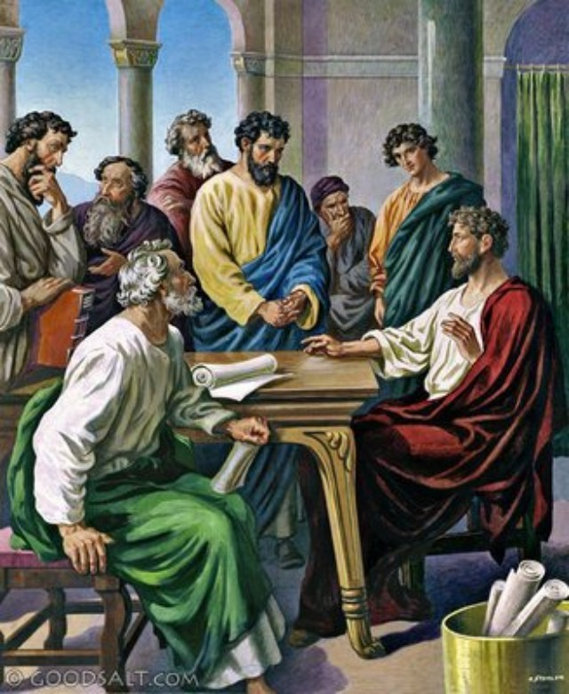
²² Then pleased it the apostles and elders, with the whole church, to send chosen men of their own company to Antioch with Paul and Barnabas; namely, Judas surnamed Barsabas, and Silas, chief men among the brethren:
²³ And they wrote letters by them after this manner…

Slide 58
The apostles and elders and brethren send greeting unto the brethren which are of the Gentiles in Antioch and Syria and Cilicia:
²⁴ Forasmuch as we have heard, that certain which went out from us have troubled you with words, subverting your souls, saying, Ye must be circum-cised, and keep the law: to whom we gave no such commandment:

Slide 59
²⁵ It seemed good unto us, being assembled with one accord, to send chosen men unto you with our beloved Barnabas and Paul,
²⁶ Men that have hazarded their lives for the name of our Lord Jesus Christ.
²⁷ We have sent therefore Judas and Silas, who shall also tell you the same things by mouth.

Slide 60
²⁸ For it seemed good to the Holy Ghost, and to us, to lay upon you no greater burden than these necessary things;
²⁹ That ye abstain from meats offered to idols, and from blood, and from things strangled, and from fornication: from which if ye keep yourselves, ye shall do well.
Fare ye well.

Slide 61
The Christian protocol concerning the eating of “meats offered to idols” was also set forth by Paul:
1 Corinthians 8:10-11:
¹⁰ For if any man see thee which hast knowledge sit at meat in the idol's temple, shall not the conscience of him which is weak be emboldened to eat those things which are offered to idols;
¹¹ And through thy knowledge shall the weak brother perish, for whom Christ died?
²⁸ For it seemed good to the Holy Ghost, and to us, to lay upon you no greater burden than these necessary things;
²⁹ That ye abstain from meats offered to idols, and from blood, and from things strangled, and from fornication: from which if ye keep yourselves, ye shall do well.
Fare ye well.

Slide 62
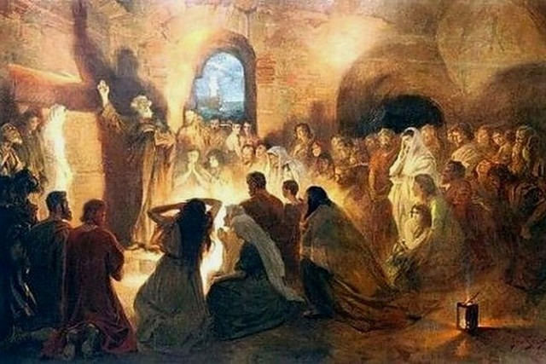
³⁰ So when they were dismissed, they came to Antioch: and when they had gathered the multitude together, they delivered the epistle:
³¹ Which when they had read, they rejoiced for the consolation.

Slide 63
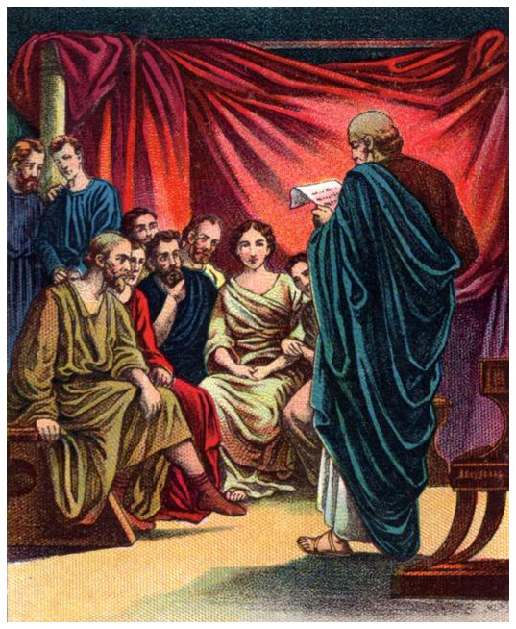
³² And Judas and Silas, being prophets also themselves, exhorted the brethren with many words, and confirmed them.
³³ And after they had tarried there a space, they were let go in peace from the brethren unto the apostles.

Slide 64
³⁴ Notwithstanding it pleased Silas to abide there still.
³⁵ Paul also and Barnabas continued in Antioch, teaching and preaching the word of the Lord, with many others also.

Slide 65
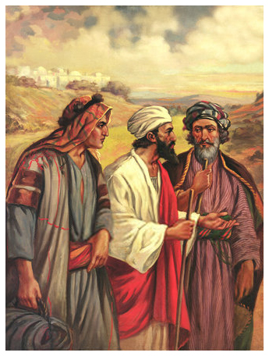
³⁶ And some days after Paul said unto Barnabas, Let us go again and visit our brethren in every city where we have preached the word of the Lord, and see how they do.
³⁷ And Barnabas determined to take with them John, whose surname was Mark.

Slide 66
³⁸ But Paul thought not good to take him with them, who departed from them from Pamphylia, and went not with them to the work.
⁴⁰ And Paul chose Silas,

Slide 67
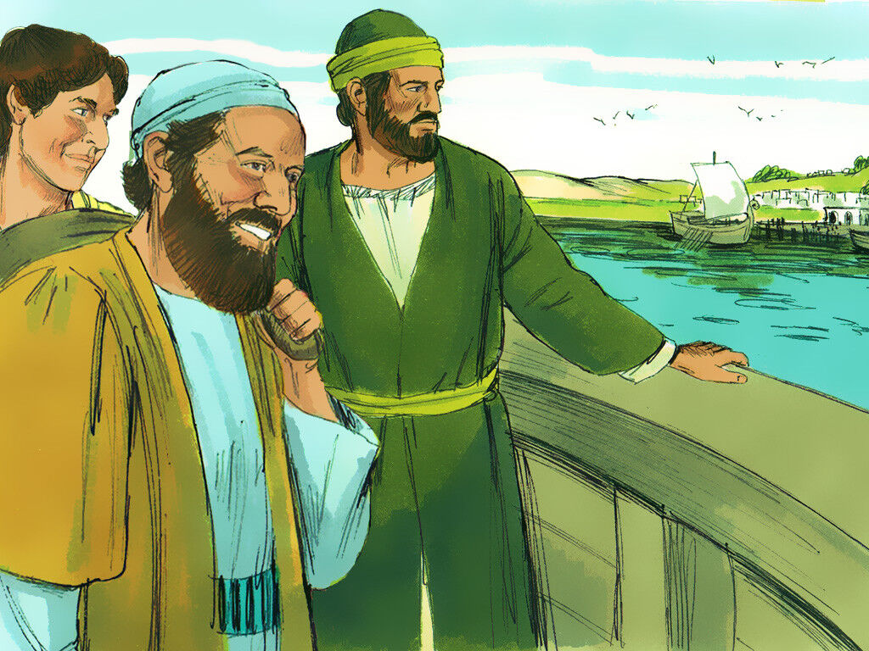
³⁸ But Paul thought not good to take him with them, who departed from them from Pamphylia, and went not with them to the work.
⁴⁰ And Paul chose Silas,
and departed, being recommended by the brethren unto the grace of God.
⁴¹ And he went through Syria and Cilicia, confirming the churches.

Slide 68
³⁸ But Paul thought not good to take him with them, who departed from them from Pamphylia, and went not with them to the work.
⁴⁰ And Paul chose Silas,
and departed, being recommended by the brethren unto the grace of God.
⁴¹ And he went through Syria and Cilicia, confirming the churches.
And here, joined by Silas, Paul begins his second missionary journey.
End of Chapter 15

Slide 69
The Acts
of the Apostles
Chapter 15

Slide 70
Acts 15:1-2 – Call for a Meeting
Where were the false teachers from? (1)
  Why would they teach such a thing?
  Was circumcision the only issue? (see 5)
What was Paul/Barnabas response?
  Did they need Jerusalem to resolve this? (2)
  Then why go to Jerusalem?
  Who went with them?
  What does this show on the part of P&B?

Slide 71
Acts 15:3-5 – On Way to Jerusalem
What did they do on the way? (3)
  What did they declare?
  What does this prove as far as authority?
  What did this produce with all the brethren?
Who received them? (4)
  What type of authority did they present? (4)
  Direct Command
    (Acts 13:1-2) “Separate me …”
Were the apostles in total control? (5)
  Were the Pharisees a sect within the church?
What were they teaching? (5)

Slide 72
Acts 15:6-10 – Evidence Presented
Supreme Court or a discussion? (6)
  Is this example of how we should resolve issues?
    Anything miraculous about it?
  Were the apostles in dictatorial control? (7)
What does Peter testify to? (7-10)
  Did Peter cite a direct command?
  Recall Acts 10-11; any direct command there?
  Peter acted on Necessary Inference
  Overall conclusion should have been based on:
    Approved apostolic example

Slide 73
Acts 15:11-18 – Evidence Presented
Who is the we in vs. 11? (11)
  Who is the we? Who is the they? Gal. 2:14
  What was Peter teaching about Jewish salvation?
Arguments of Barnabas and Paul? (12)
  Had they received a direct command?
    Acts 13:2; 22:21
  What validated their proper obedience to it?
  So, did the Holy Spirit agree with P&B?
What did James present? (16-18)
  Amos 9:8-12
  Does this speak directly to Gentiles’ baptism?
  Necessary Inference

Slide 74
Acts 15:19-22 – Conclusion
What was James’ opinion? (19)
  Would requiring circumcision “trouble” Gentiles?
  What did he suggest they require? (20)
    Forbid idolatry (for emphasis?)
    Forbid fornication (for emphasis?)
    Forbid eating strangled meats*
    Forbid consumption of blood*
  What was his rationale for this? (21)
  *Would these things especially “trouble” the Jews?
Who all concurred in this? (22)
  Who did they send? (22)
  Judas (Barsabas) and Silas (Silvanus)

Slide 75
Acts 15:23-29 – The Letter
Who from? Who to? (23)
Why were they writing to them? (24)
  Was the false doctrine just a technicality?
  Had the false teachers come from the apostles?
How did they regard Barnabas and Paul? (26)
  Why were Judas and Silas so important? (27)
  Should we ever resent such validation?
What role did the Holy Spirit play? (28)
  Who gave Peter the command to go to C? (Acts10)
  Who enabled Gentiles to speak in tongues? (Acts 10)
  Who sent out Barnabas and Saul? (Acts 13:2)
  Who validated what and who B/S taught?

Slide 76
Acts 15:30-39 – To Antioch
Was the letter well received? (30-31)
What gift did Judas and Silas have? (32)
Who stayed and who left? (33-35)
Just something to consider: Gal. 2:11-14
To what did Paul and Barnabas agree? (36)
  Who did Barnabas want to take? (37)
  Why did Paul not agree? (38)
Sharp Contention (39)
  Can we expect such in the church today? Why?
  Was this a matter of doctrine or judgment?
  Did each feel strongly about this issue?

Slide 77
Acts 15:39-41 – The Resolution
Was it resolved peacefully? (39)
  How is this an example to us?
  Would it be better if we knew who was right?
  Is there always a resolution to matters of judgment? Phil. 2:3
Where did Barnabas go next?
  Mentioned positively in 1 Cor. 9:6
Who went with Paul? Where? (40-41)
John Mark and Paul
  Col. 4:10 “if he come unto you, receive him.”
  2 Tim. 4:11 “… he is useful to me for ministering.”
  Philemon 1:24?; 1 Pet. 5:13?

Slide 78
Acts Chapters 1 – 12: To The Jews
Acts Chapters 13 – 28: To The Gentiles

Slide 79
Paul’s First Missionary Journey
Acts 13:1-15:35

Slide 80
Outline - Acts
II. The Ministry of Paul – Acts 13:1-28:31
Paul’s 1st Missionary Journey – Acts 13:1-15:35
Paul’s 2nd Missionary Journey – Acts 15:36-18:22
Paul’s 3rd Missionary Journey – Acts 18:23-21:14
Paul’s Arrest - 1 – Acts 21:15-23:11
Paul’s Arrest - 2 – Acts 23:12-25:12
Paul’s Arrest - 3 – Acts 25:13-26:32
Paul’s Journey to Rome – Acts 27:1-28:31

Slide 81
Now there were at Antioch, in the church that was there, prophets and teachers: Barnabas, and Simeon who was called Niger, and Lucius of Cyrene, and Manaen who had been brought up with Herod the tetrarch, and Saul.
- Acts 13:1

Slide 82

CHAPTER 13 J. W. McGarvey’s Acts Commentary
VERSE 1
We have already seen that Barnabas and Saul had labored one whole year together in the city of Antioch, and we now learn that at the close of this period there were other inspired teachers associated with them. (1) “Now there were in the Church in Antioch certain prophets and teachers, Barnabas and Simeon called Niger, and Lucius the Cyrenian, and Manaen, foster-brother of Herod the tetrarch, and Saul.” It will be observed that, in this catalogue of names, that of Barnabas stands first, and that of Saul last. As it was customary at that period to arrange names in the order of their notability at the time contemplated, we may infer that Barnabas still occupied a position of pre-eminence, while Saul was as yet comparatively undistinguished among the inspired teachers. Nothing more is known of Simeon, Lucius, and Manaen than is here stated; but this is enough to show that the future instruction of the congregation might be safely committed to their hands.
  McGarvey, J. W. (1872). A commentary on Acts of Apostles (Ac 13:1). Lexington, KY: Transylvania Printing and Publishing Co.

Slide 83
² While they were ministering to the Lord and fasting, the Holy Spirit said, “Set apart for Me Barnabas and Saul for the work to which I have called them.”
³ Then, when they had fasted and prayed and laid their hands on them, they sent them away.
- Acts 13:2-3

Slide 84
CHAPTER 13 J. W. McGarvey’s Acts Commentary
VERSES 2 & 3
The solemn simplicity of this apostolic ceremony stands in striking contrast with the pompous mummery which often characterizes “ordination” services in modern Churches. No less striking is the contrast between the humility of Saul and the ambitious spirit of many modern clergyman who are extremely exacting in reference to the punctilios of ecclesiastical rank. Though an apostle by special commission, he was “ordained” by his humble fellow-laborers in Antioch. This fact shows that the idea of superior rank and authority had not then begun the work of ruin which it has since accomplished, in filling the minds of preachers with the same lust of office and power which characterizes the intrigues of political partisans.
  McGarvey, J. W. (1872). A commentary on Acts of Apostles (p. 158). Lexington, KY: Transylvania Printing and Publishing Co.

Slide 85
A Call to Ministry
The Calling
  Desire
  Opportunity
  Feedback
  Need

Slide 86
A Call to Ministry
The Calling
Consecration
  Education
  Training

Slide 87
A Call to Ministry
The Calling
Consecration
Commendation
  No Self Appointment

Slide 88
CHAPTER 13 J. W. McGarvey’s Acts Commentary
VERSES 4 & 5
In choosing this island as the first point in the wide world to which they directed their steps, they were, doubtless, guided not by the natural partiality which Barnabas may have felt for it as his native land, but by that fixed principle in the apostolic labors which taught them to cultivate first those fields which promised the most abundant harvest. The fact that this was the native island of Barnabas gave him hope of a more ready access to many old associates. Besides, the gospel had already been proclaimed here with some success among the Jews, and in the city of Salamis, as we learn from the text just quoted, there was more than one Jewish synagogue.
  McGarvey, J. W. (1872). A commentary on Acts of Apostles (p. 158). Lexington, KY: Transylvania Printing and Publishing Co.

Slide 89
CHAPTER 13 J. W. McGarvey’s Acts Commentary
VERSES 4 & 5
What duties were performed by John, in his capacity as “an assistant,” can not be specifically determined with certainty. The term assistant would indicate that he performed, under their direction, a part of the same labor in which they were themselves engaged. The fact, however, that Saul was not in the habit of immersing his own converts, but imposed this duty on his assistants, renders it highly probable that this was at least one of the duties performed by John.
  McGarvey, J. W. (1872). A commentary on Acts of Apostles (p. 158). Lexington, KY: Transylvania Printing and Publishing Co.

Slide 90
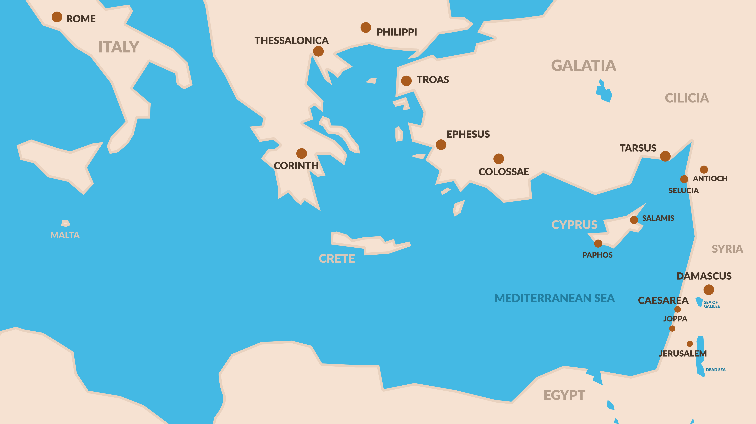

Slide 91
⁶ When they had gone through the whole island as far as Paphos, they found a magician, a Jewish false prophet whose name was Bar-Jesus, ⁷ who was with the proconsul, Sergius Paulus, a man of intelligence. This man summoned Barnabas and Saul and sought to hear the word of God.
- Acts 13:6-7

Slide 92
CHAPTER 13 J. W. McGarvey’s Acts Commentary
VERSES 6 & 7
Luke is entirely silent in reference to the effect of the apostolic preaching in Salamis, leaving us to suppose that it was not great. After stating that they preached in the synagogues of the Jews, he follows them in their further progress thru the island. (6) “And having passed through the whole island as far as Paphos, they found a certain magician, a false prophet, a Jew whose name was Bar-Jesus, (7) who was with Sergius Paulus the proconsul, a prudent man, who called for Barnabas and Saul, and desired to hear the word of God.” Every reader of ancient history has observed that statesmen and generals were in the habit of consulting oracles and auguries, and that they generally kept about them some one supposed to have the power of interpreting the signs of approaching good or evil. In this particular period, the educated Romans had become skeptical in reference to their heathen oracles, but Jewish pretenders still had access to their confidence on the credit of the ancient Jewish prophets. With a knowledge of the true God superior to that of even the greatest philosophers among the Greeks, because derived from the Jewish Scriptures, this Bar-Jesus very naturally gained the confidence of even the prudent Sergius Paulus. When, however, two other Jews appeared in Paphos, claiming to bring additional revelations from the God of Israel, the same prudence which had prompted the proconsul to reject the heathen oracles in favor of the Jewish pretender, now prompted him to send for Barnabas and Saul, that he might hear the word of God from them. Such a mind as his could not fail to hear with profit.
McGarvey, J. W. (1872). A commentary on Acts of Apostles (pp. 158–159). Lexington, KY: Transylvania Printing and Publishing Co.

Slide 93
⁸ But Elymas the magician (for so his name is translated) was opposing them, seeking to turn the proconsul away from the faith. ⁹ But Saul, who was also known as Paul, filled with the Holy Spirit, fixed his gaze on him,
- Acts 13:8-9

Slide 94
CHAPTER 13 J. W. McGarvey’s Acts Commentary
VERSES 8 - 12
This is the only miracle wrought by an apostle to the injury of any one’s person. It is to be accounted for, not by supposed resentment on the part of Saul, nor by a desire to make a special example of Bar-jesus. But the case was such some display of power over the person of the false prophet was the readiest way to convince the proconsul. When Moses went into Egypt he found it necessary to impose many personal inflictions upon the priests, in order to destroy Pharaoh’s confidence in them. The present case was similar to that. The conflict in the mind of Sergius Paulus was between the claim of Bar-jesus to prophetic powers, and that of the apostles.
The best way to settle this question was to denounce him in his true character as a son of the devil and an enemy of all righteousness, and then prove the justice of the denunciation, by exerting miraculous control over his person. As he groped about, calling upon one and another of the frightened bystanders to lead him by the hand, the falsity and iniquity if his pretensions stood confessed, and the divine mission of the apostles was demonstrated. The proconsul was fully convinced, and astonished at teaching which was attended by such power.
  McGarvey, J. W. (1872). A commentary on Acts of Apostles (p. 159). Lexington, KY: Transylvania Printing and Publishing Co.

Slide 95
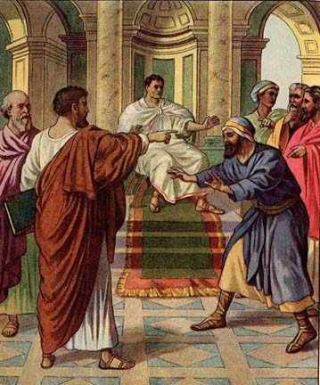

Slide 96
CHAPTER 13 J. W. McGarvey’s Acts Commentary
VERSES 8 - 12
This triumph over Bar-jesus, and the consequent conversion of Sergius Paulus, forms an epoch in the life of the Apostle Paul. Hitherto he has occupied a subordinate position, and his name has come last in the list of himself & his fellow-laborers. But hereafter he is to occupy the foreground of almost every scene in which he acts. Heretofore, Luke has written only “Barnabas and Saul;” hereafter he writes, “Paul and Barnabas.” He had been, up to this time, known by no other name than Saul, being so called not only by Luke, but by Jesus and Ananias. Luke, though writing long after this name had gone into disuse, remembering the custom which thus far prevailed, thus far retains it in his narrative. But, from this time forward he uses the name Paul exclusively; and that this was the universal custom, we infer from the fact that he is so called by all others who mention his name; by the Lord Jesus; by the mob in Jerusalem; by the centurion under Lysias; by his own nephew; by Lysias the chiliarch; by Festus; and by Peter.

Slide 97
CHAPTER 13 J. W. McGarvey’s Acts Commentary
VERSES 8 - 12
There are only two suppositions worthy of notice, by which to account for this change of name. First, that he had both the Hebrew name Saul, and the Latin name Paul, before this time & perhaps from his infancy; but the conversion of the proconsul Paulus led to the exclusive use of his Latin name thereafter. This supposition, however, can’t account for the entire absence of the name Paul previous to this event. Moreover, while it is true that many Jews of that day had both a Hebrew and a Latin or Greek name, there is no evidence that such had been the case with Saul.
  McGarvey, J. W. (1872). A commentary on Acts of Apostles (p. 160). Lexington, KY: Transylvania Printing and Publishing Co.

Slide 98
CHAPTER 13 J. W. McGarvey’s Acts Commentary
VERSES 8 - 12
The other supposition is, that he received this new name by common consent, in commemoration of the conversion of Paulus. This conversion was a signal triumph; it was accomplished by his intrumentality alone, and was the beginning of the pre-eminence which he afterward maintained over Barnabas and all subsequent follow-laborers. So bold and startling an incident, though it might have been regarded as common-place in his subsequent career, attracted attention now, because it was the first of the kind in his history, and because it secured a conversion of which even Barnabas, under the circumstances, might have despaired. Surprised by the event, and observing the extreme similarity between his name and that of his distinguished convert, which differed only in a single letter, and sounded very much alike, his friends very naturally conceived the idea of changing his name, as they did. It was in perfect harmony with a prevalent custom of the time. Its universal reception soon followed as a matter of course.
  McGarvey, J. W. (1872). A commentary on Acts of Apostles (p. 160). Lexington, KY: Transylvania Printing and Publishing Co.

Slide 99
and said, “You who are full of all deceit and fraud, you son of the devil, you enemy of all righteousness, will you not cease to make crooked the straight ways of the Lord?
- Acts 13:10

Slide 100
¹¹ Now, behold, the hand of the Lord is upon you, and you will be blind and not see the sun for a time.” And immediately a mist and a darkness fell upon him, and he went about seeking those who would lead him by the hand. ¹² Then the proconsul believed when he saw what had happened, being amazed at the teaching of the Lord.
- Acts 13:11-12

Slide 101
ELYMAS = THE EXPERT

Slide 102
Now Paul and his companions put out to sea from Paphos and came to Perga in Pamphylia; but John left them and returned to Jerusalem.
- Acts 13:13

Slide 103
CHAPTER 13 J. W. McGarvey’s Acts Commentary
VERSE 13
Why they chose the regions north of Pamphylia, in Asia Minor, as their next field of labor, we are not informed. Luke is equally silent in reference to the reason why John Mark, at this particular juncture, departed from them & returned to Jerusalem. He informs us, however, at a later period, that Paul censured him for so doing. It’s very plausibly suggested that he was influenced by fear of the dangers which lay in their way, the mountains before them being commonly infested with robbers. One reference states: “No population, through the midst of which he ever traveled, abounded more in those ’perils of robbers’ of which he himself speaks, than the wild and lawless clans of the Pisidian highlanders.”
  McGarvey, J. W. (1872). A commentary on Acts of Apostles (p. 161). Lexington, KY: Transylvania Printing and Publishing Co.

Slide 104
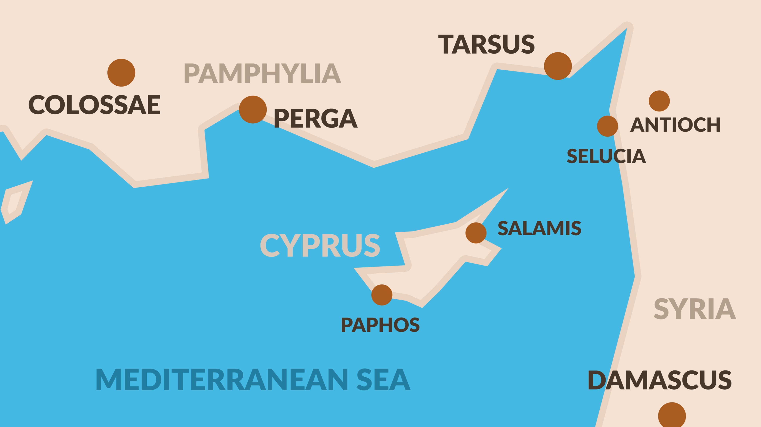
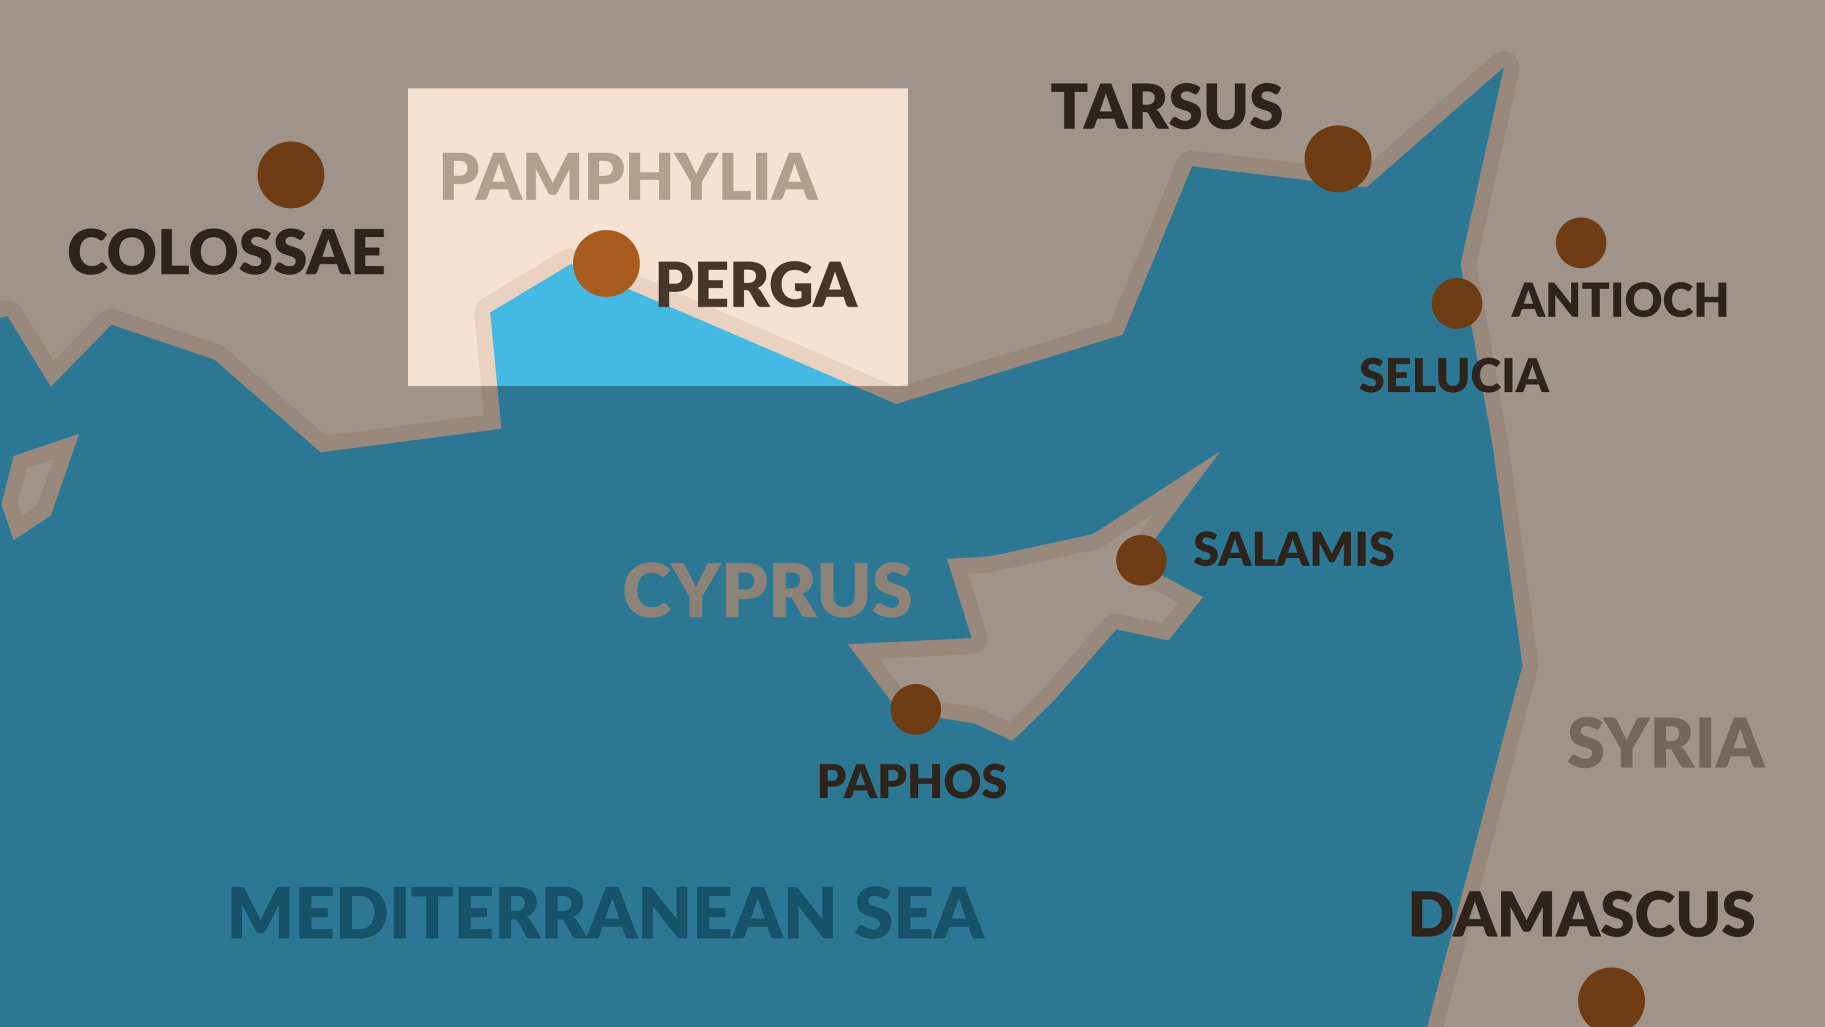

Slide 105
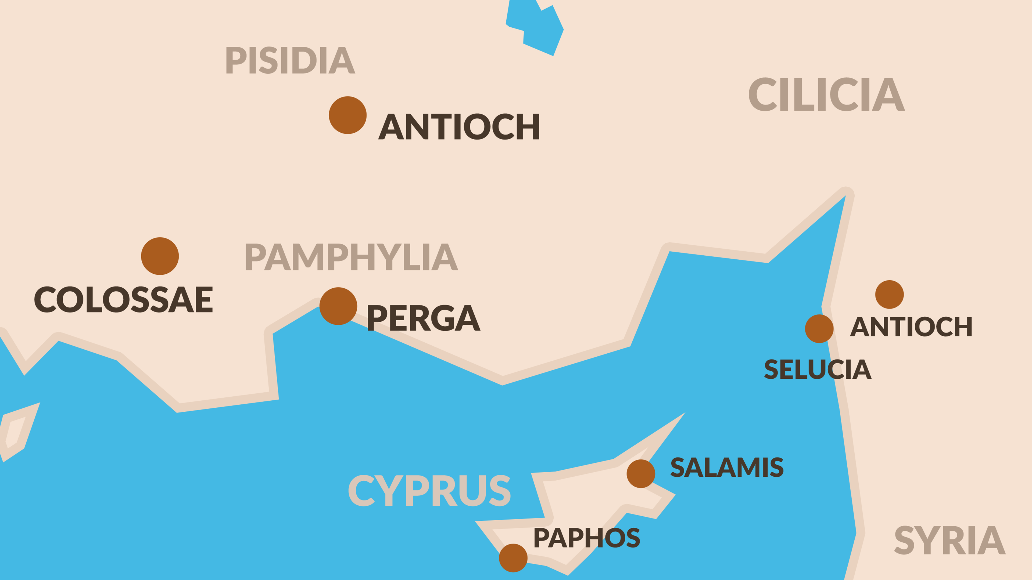
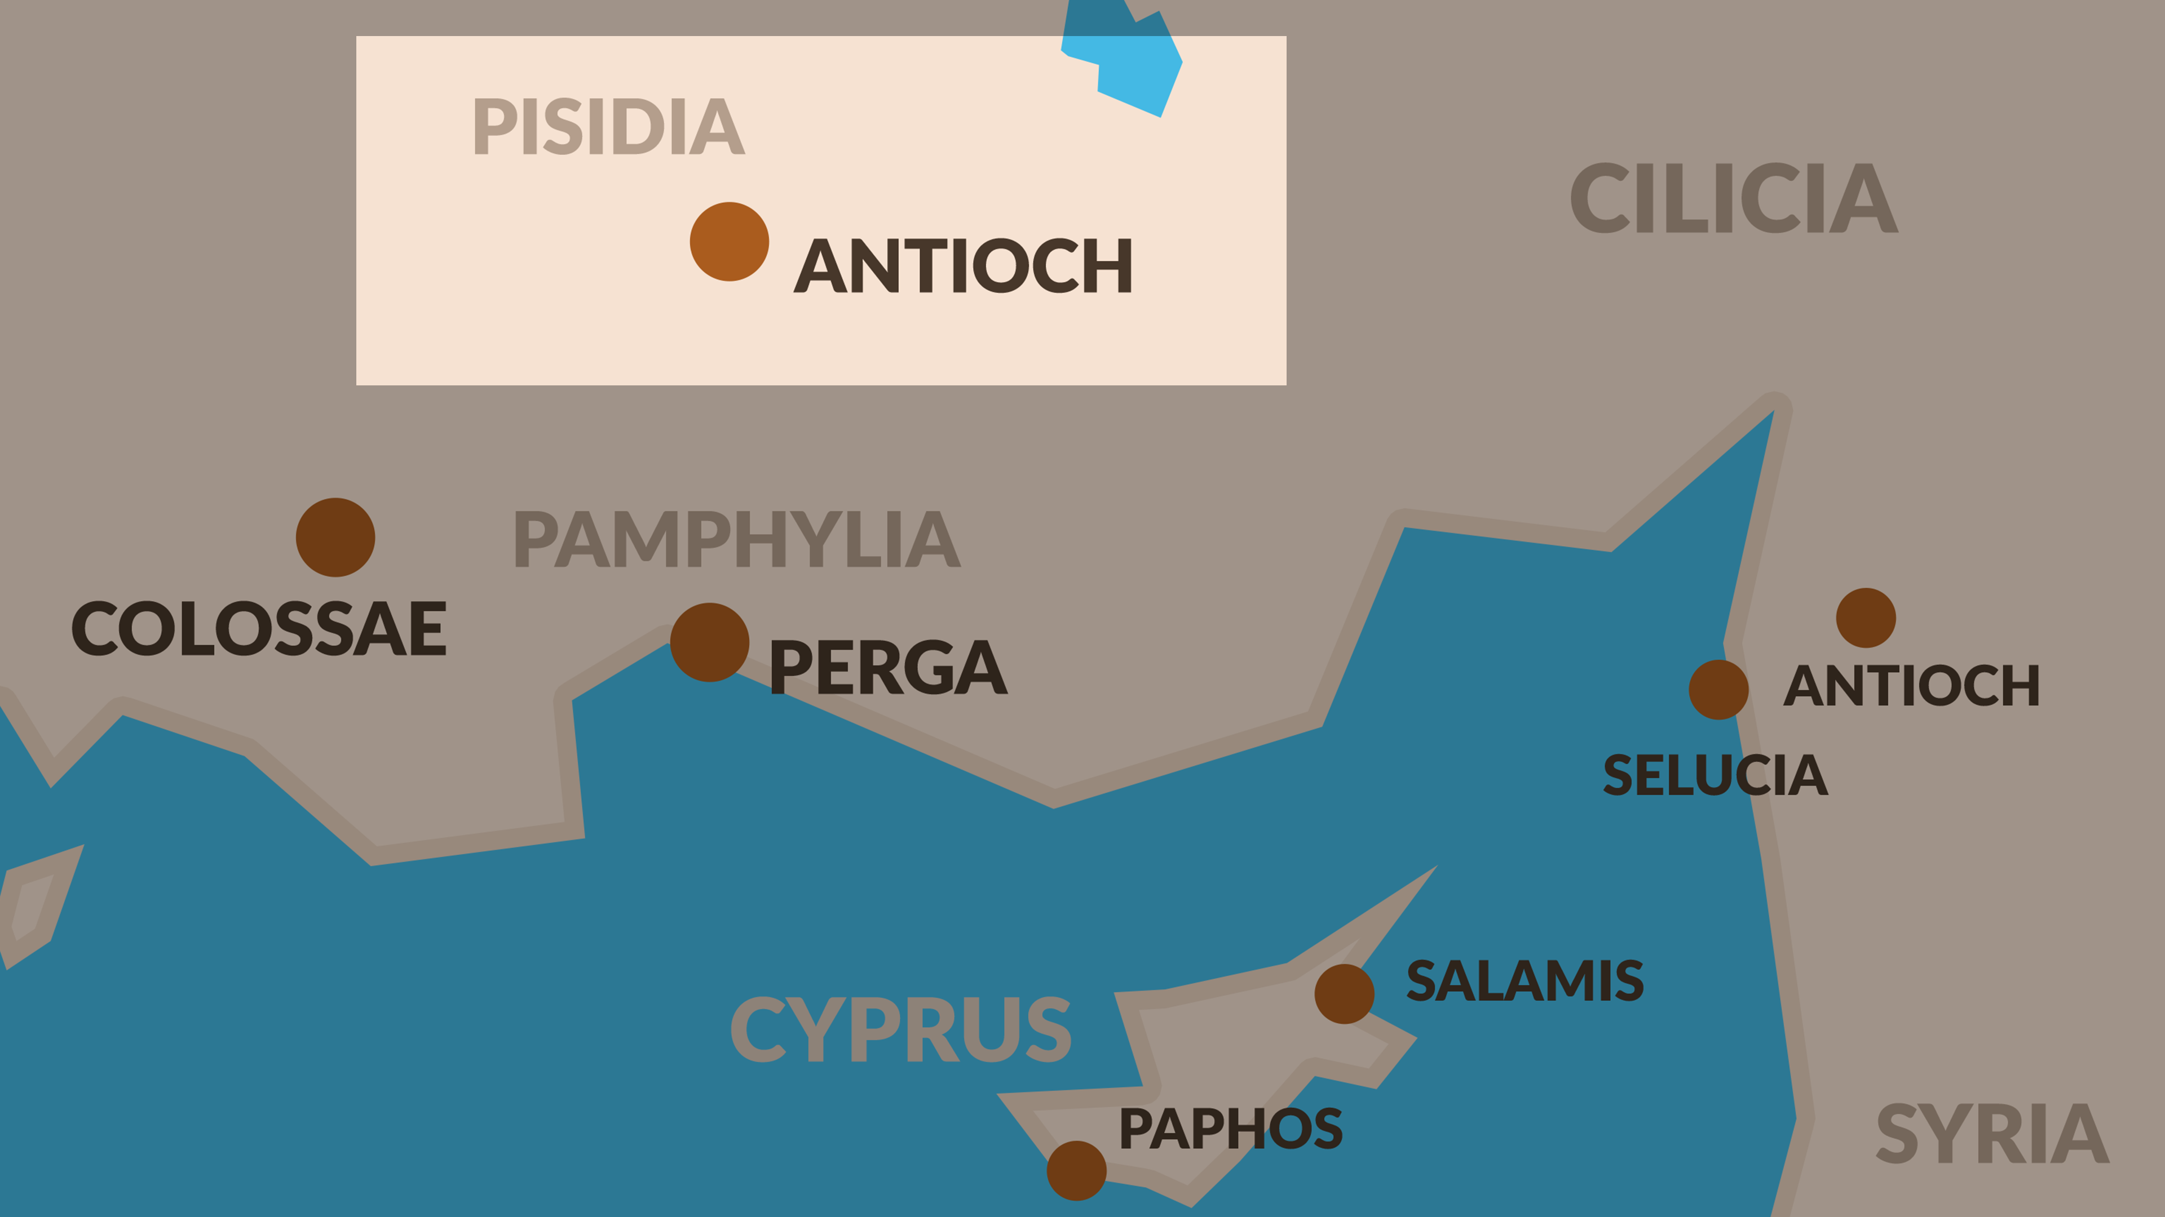

Slide 106
But going on from Perga, they arrived at Pisidian Antioch, and on the Sabbath day they went into the synagogue and sat down.
- Acts 13:14

Slide 107
¹⁵ After the reading of the Law and the Prophets the synagogue officials sent to them, saying, “Brethren, if you have any word of exhortation for the people, say it.” ¹⁶ Paul stood up, and motioning with his hand said,
- Acts 13:15-16

Slide 108
CHAPTER 13 J. W. McGarvey’s Acts Commentary
VERSE 16
To this invitation Paul responded, by immediately arising and addressing the audience. It need not be supposed, in order to account for the leadership which he now assumes, that he had laid formal claim to superiority over Barnabas; for when two men, of generous spirit, are co-operating together under trying circumstances, he who possesses the greater courage and promptness will eventually assume the foremost position, even without a special agreement to that effect. Such was the constant danger and embarrassment of the two missionaries, that the question was, who is willing to go forward, rather than, who has the right to be heard first.
Paul’s manner, in arising to open the gospel message among these strangers, was bold and commanding. It is thus described by Luke: (16) “Then Paul stood up, and beckoning with his hand, said, Men of Israel, and ye who fear God, give audience.” This gesture, described as beckoning with the hand, was characteristic of Paul’s manner, as well shall have occasion to observe frequently hereafter, and was well calculated to arrest the attention of an audience. It’s the manner of one who knows what he is about to say, and feels confident of its importance.
McGarvey, J. W. (1872). A commentary on Acts of Apostles (p. 161). Lexington, KY: Transylvania Printing and Publishing Co.

Slide 109
CHAPTER 13 J. W. McGarvey’s Acts Commentary
VERSE 16
Besides the Jewish audience present, Paul addressed a number of Gentiles, such as were in the habit of attending Jewish worship in almost every Gentile city, and many of whom, like Cornelius, had learned to worship the true God. He distinguishes the two classes, by addressing the former as “Men of Israel,” and the latter, as “Ye who fear God.”
  McGarvey, J. W. (1872). A commentary on Acts of Apostles (p. 162). Lexington, KY: Transylvania Printing and Publishing Co.

Slide 110
CHAPTER 13 J. W. McGarvey’s Acts Commentary
VERSES 17 - 24
The Jews had a glorious history, of which they were justly proud; and any happily expressed allusions to its leading facts always awakened in their hearts the most lively emotions. These incidents furnished the inspiration of their songs, the themes of their orators, the foundation of their national pride & their comfort in persecution. Whoever, of their own people, appeared most deeply touched by their memories, had the readiest access to their sympathies, and he who would treat them with indifference or contempt, incurred their utmost hatred. Before such an audience, if Paul had abruptly introduced the name and the new doctrine of Jesus, he might have appeared an apostate from the Jewish faith, seeking to supplant it by something entirely new and would therefore have kindled the resentment of his Jewish hearers all at once. But, beginning with a happy reference to the history of the chosen tribes, and the reign of their most glorious king, and catching up the promise made to David, on which their own most cherished hopes were based, he leads them, by almost imperceptible steps, to the favorable consideration of the fulfillment of that promise in the appearance of Jesus as a Savior to Israel. The reference to John, whom all the Jews now accredited as a prophet, served the same purpose, while it designated more specifically the period in which Jesus had first appeared as a Savior.
  McGarvey, J. W. (1872). A commentary on Acts of Apostles (p. 162). Lexington, KY: Transylvania Printing and Publishing Co.

Slide 111
Paul’s Lesson: “Israel’s Savior is Jesus”
Israel’s history leads to Jesus
And while John was completing his course, he kept saying, ‘What do you suppose that I am? I am not He. But behold, one is coming after me the sandals of whose feet I am not worthy to untie.’
- Acts 13:25

Slide 112
Paul’s Lesson: “Israel’s Savior is Jesus”
Israel’s history leads to Jesus
Israel rejected its Savior
When they had carried out all that was written concerning Him, they took Him down from the cross and laid Him in a tomb.
- Acts 13:29

Slide 113
Paul’s Lesson: “Israel’s Savior is Jesus”
Israel’s history leads to Jesus
Israel rejected its Savior
God raised Him from the Dead
³² And we preach to you the good news of the promise made to the fathers, ³³ that God has fulfilled this promise to our children in that He raised up Jesus, as it is also written in the second Psalm, ‘You are My Son; today I have begotten You.’
- Acts 13:32-33

Slide 114
CHAPTER 13 J. W. McGarvey’s Acts Commentary
VERSES 30 - 33
In Hebrews v: 5, Paul says: “Christ glorified not himself to be made a priest, but he who said to him, Thou art my son; to-day have I begotten thee.” Now, as Christ was not a priest until after he had died as a victim, and was prepared to enter heaven with his own blood, it is clear that these words are applied to his resurrection, at the time of which he entered upon his priestly office. So, likewise, in Hebrews i: 5, the question, “To which of the angels said he at any time, Thou art my son; to-day have I begotten thee?” is adduced as evidence of his superiority to angels, and can not, therefore, refer to the period when he was “made a little lower than the angels.” That the term rendered begotten may be properly referred to the resurrection is evident from the fact that he is called the “first begotten from the dead,” and the “first born from the dead,” in which two expressions the Greek words are the same. He was the “only begotten son of God,” by his birth of the Virgin Mary; but he became the “first born from the dead,” or the “first born of the whole creation,” when he was declared to be the Son of God with power by the resurrection from the dead. In applying the quotation from the second Psalm, therefore, to the resurrection, and endeavoring to cheer the Jews in Antioch, with the thought that a long-cherished & familiar promise was thereby fulfilled, Paul was giving his real understanding of the passage quoted, and it is one as much more cheering than that which many commentators have gathered from it, as the exaltation of Christ from the grave to his throne in the heavens was a more glorious birth than that which brought him into this sinful world.
  McGarvey, J. W. (1872). A commentary on Acts of Apostles (p. 164). Lexington, KY: Transylvania Printing and Publishing Co.

Slide 115
CHAPTER 13 J. W. McGarvey’s Acts Commentary
VERSES 34 - 37
The purpose of the quotation is to prove that God would raise the Messiah from the dead no more to return to corruption. He assumes, therefore, that the words quoted refer to the Messiah, and that his hearers would not dispute the reference. Whatever, therefore, might otherwise be our own understanding of the words, we must take this as their true reference. The promise is addressed not to the Messiah, but to the Jews; for the pronoun you (umin) is in the plural number. It is a promise, then, to give to the Jews the holy things faithfully promised to David, among which was the promise already referred to, “Thou wilt not suffer thy Holy One to see corruption.” It furnished, therefore, the required proof that the Messiah would rise, and not see corruption.
  McGarvey, J. W. (1872). A commentary on Acts of Apostles (p. 165). Lexington, KY: Transylvania Printing and Publishing Co.

Slide 116
CHAPTER 13 J. W. McGarvey’s Acts Commentary
VERSES 34 - 37
The only objection which his hearers would be likely to raise against the argument is, in the words, “Thou wilt not suffer thy Holy One to see corruption,” David spoke of himself. But this very objection is anticipated by the remark that David had fallen asleep and had seen corruption, whereas he, Jesus, whom God raised up, as was proved by the witnesses who saw him alive, didn’t see corruption; hence to him the words must refer. According, therefore, to the only possible application of David’s words, and to the admitted reference of the words quoted from Isaiah, they were bound to admit that Jesus was the Messiah.
  McGarvey, J. W. (1872). A commentary on Acts of Apostles (p. 165). Lexington, KY: Transylvania Printing and Publishing Co.

Slide 117
Paul’s Lesson: “Israel’s Savior is Jesus”
Israel’s history leads to Jesus
Israel rejected its Savior
God raised Him from the Dead
Forgiveness and Salvation are in Jesus
³⁸ Therefore let it be known to you, brethren, that through Him forgiveness of sins is proclaimed to you, ³⁹ and through Him everyone who believes is freed from all things, from which you could not be freed through the Law of Moses.
- Acts 13:38-39

Slide 118
CHAPTER 13 J. W. McGarvey’s Acts Commentary
VERSES 38 & 39
The expression en touto, in him, not by him as rendered in the common version, indicates that the parties to be justified must be in Christ, that is, in subjection to his authority; as the expression en to uomo, in the law, applies to those who were under the law & not to uncircumcised Gentiles who weren’t under it. The benefits of the Jewish law extended only to those who were born in, or properly initiated into the body of people to whom the law was given; and just so, the remission of sins is preached only to those who shall be in Christ by being properly initiated into his body.
  McGarvey, J. W. (1872). A commentary on Acts of Apostles (p. 165). Lexington, KY: Transylvania Printing and Publishing Co.

Slide 119
CHAPTER 13 J. W. McGarvey’s Acts Commentary
VERSES 38 & 39
Paul argues this assumption at length, in the ninth and tenth chapters of Hebrews. The only provisions in the law at all connected with remission of sins were its sacrifices; and he asserts of them, “It isn’t possible that the blood of bulls and goats should take away sins.” It can’t be rightly assumed that he contemplates these sacrifices as considered apart from their typical meaning; for he makes no such distinction. He takes them just as he finds them, with all that belongs to them when offered in good faith & makes the assertion that it is not possible for them to take away sins. In the preceding verses of the same chapter he presents a specific argument based upon this broad assertion: “The law, having a shadow of good things to come, and not the very image of those things, can never, by those sacrifices which they offer year by year continually, make the comers thereunto perfect.” He proves this proposition, and shows the particular in which they were still imperfect, by adding, “For then would they not have ceased to be offered? Because worshipers, once cleansed, would have no more conscience of sins.” If a man had once obtained remission of particular sins, he would, of course, as is here argued, no longer offer sacrifices for those sins, seeing his conscience would no longer annoy him in reference to them. But it is a fact, he argues further, that “In those sacrifices there is a remembrance of sins made every year.” The sins of the year, for which offerings had been made daily, were remembered again on the annual day of atonement & new sacrifices offered for them declaring to the worshiper that they were still remembered against him. As this continued, annually, throughout the life of the pious Jew, it left him in the same condition at the day of his death, and he was gathered to his fathers with his sins still unforgiven.
McGarvey, J. W. (1872). A commentary on Acts of Apostles (p. 166). Lexington, KY: Transylvania Printing and Publishing Co.

Slide 120
CHAPTER 13 J. W. McGarvey’s Acts Commentary
VERSES 38 & 39
There can not be less than a promise of pardon in the words quoted; and as it can’t be a promise fulfilled at the time, it must be a promise reserved to some future period for fulfillment. That the promise of pardon made to Jews & patriarch was reserved for fulfillment to the death of Christ, Paul affirms in these words: “On this account he is the mediator of the new covenant, that by means of death for the redemption of the transgressions that were under the first covenant, they who were called” (the ancient elect) “might receive the promise of eternal inheritance.“ Here the reception of the “promise of eternal inheritance,” by those who were under the first covenant, is made to depend upon the redemption of their transgressions. This redemption was not effected till the death of Jesus Christ; therefore, till his death their transgressions remained unforgiven. Though they had the promise of pardon, and rejoiced in the full assurance that it would yet be granted, they were compelled to regard it as blessing of the future and not of the present. Their enjoyment, as compared with that of the saints under the new covenant, was as that of one who has from God a promise of pardon, compared with him who has it already in possession. Their happiness, like ours, depended upon their faith in God’s word.
McGarvey, J. W. (1872). A commentary on Acts of Apostles (p. 167). Lexington, KY: Transylvania Printing and Publishing Co.

Slide 121
CHAPTER 13 J. W. McGarvey’s Acts Commentary
VERSES 38 & 39
By the antithesis here instituted between the law and gospel, Paul assumes that there was no remission of sins enjoyed by those under the law. For he asserts that there were some things “from which they could not be justified in the law of Moses;” and in the expression “justified from all from which you could not be justified in the law,” the true supplement after all is sins, taken from the preceding clause. He announces that remission of sins is preached through Jesus, and from these he assumes that under the law there was no justification. This point, indeed, would need no argument, even if the context did not settle it; for certainly, if there was any thing from which under the law couldn’t be justified, it was sin; and, on the other hand, in Christ we’re justified from nothing but sin. The assumption isn’t, that justification can’t be procured by works of law, for this is equally true under Christ; but that those under the law of Moses did not obtain remission of sins at all.
  McGarvey, J. W. (1872). A commentary on Acts of Apostles (pp. 165–166). Lexington, KY: Transylvania Printing and Publishing Co.

Slide 122
It was necessary that the word of God should be spoken to you first; but since you reject it, and judge yourselves unworthy of everlasting life, behold, we turn to the Gentiles.
Acts 13:46

Slide 123
For so the Lord has commanded us:
“I have set you as a light to the Gentiles, That you should be for salvation to the ends of the earth.”
Acts 13:47

Slide 124
CHAPTER 13 J. W. McGarvey’s Acts Commentary
VERSES 46 & 47
The remark that it was necessary that the word of God should first be spoken to them, before turning to the Gentiles, shows the apostles understood that the gospel was not only to begin in Jerusalem, but that, in every distinct community, it was to begin with the Jews. Hence the frequent occurrence, in Paul’s style, of the expression, “To the Jew first, and also to the Gentile.”
  McGarvey, J. W. (1872). A commentary on Acts of Apostles (p. 168). Lexington, KY: Transylvania Printing and Publishing Co.

Slide 125
CHAPTER 13 J. W. McGarvey’s Acts Commentary
VERSE 48
It now remains, in order to full eludication of the passage, that we account for the connection indicated between their being determined for everlasting life, and their believing. The former stands as a cause which led to the latter. Let it be noted that everlasting life is not contemplated as the object of their belief, for, if it was, they would have had to believe in it, before they could determine for it; so that the order of the two mental acts would be reversed. But, in common with the Jews, who had been their religious instructors, they already believed in a future state, and what they now learned to believe by Paul’s preaching was the gospel of Christ. Those of them who had, either through previous religious instruction, or through the influence of Paul’s preaching, heartily determined for eternal life, were in a better frame of mind to appreciate the evidence in favor of that Christ through whom alone it could be obtained, than the others who were so undetermined upon the subject that they appeared to judge themselves unworthy of such a destiny. Such was the difference between the two classes in the audience, and Luke’s object is to declare the result of the difference in the fact that the one class believed, and the other thrust the word of God from them. To say that the difference had been wrought in them exclusively by divine agency would be to rob them of responsibility. Or to say that the favorably-disposed party had become so exclusively by their self-determining energy would be to deny the influence of divine truth. Neither of these positions can be true; but, while it was an act of their own minds to determine for eternal life, it was God Almighy who had induced them to do so; at the same time, the other party determined against eternal life, in despite of the same divine influence exerted upon them.
  McGarvey, J. W. (1872). A commentary on Acts of Apostles (p. 171). Lexington, KY: Transylvania Printing and Publishing Co.

Slide 126
CHAPTER 13 J. W. McGarvey’s Acts Commentary
VERSES 49 - 52
The means by which this persecution was brought about serves to illustrate the relation which the Jews who settled in Gentile cities sustained to the surrounding society. They had no political power in their own hands, and dared not lay violent hands upon the apostles. But certain “honorable women,” wives of the “chief men of the city,” had come under their influence by attending the synagogue worship, and through them they gained access to their unbelieving husbands so as to induce them to expel Paul and Barnabas. It is a suggestive fact, that the women who were made instruments of a transaction so discreditable are then styled “devout women.” It shows that devotion in the worship of God, like zeal when not according to knowledge, may be made to do the devil’s own work. The more devout one’s feelings, while his mind is corrupted by false conceptions of duty, the greater mischief he is likely to do; so far is it from being true, that to make the heart right is to make the whole man right. No man is safe without a proper understanding of his duty, derived from the word of God.
  McGarvey, J. W. (1872). A commentary on Acts of Apostles (pp. 171–172). Lexington, KY: Transylvania Printing and Publishing Co.

Slide 127
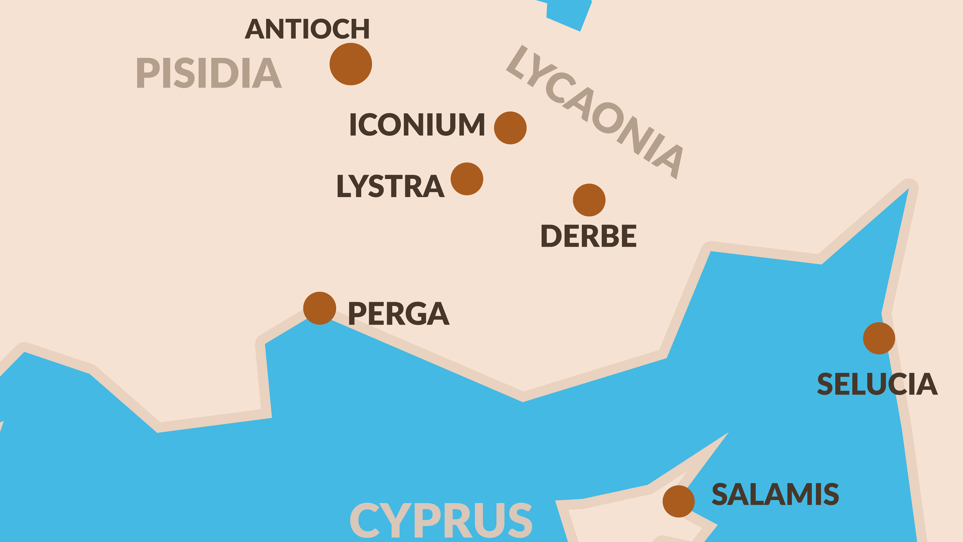

Slide 128
CHAPTER 14 J. W. McGarvey’s Acts Commentary
VERSES 1 & 2
It should not escape the notice of the reader, the conviction of these people is attributed distinctly to the force of what the apostles spoke. They “so spoke that a great multitude believed.” This is one among many incidental remarks of Luke, which indicate that he had no conception of the modern doctrine that faith is produced by an abstract operation of the Holy Spirit, and which confirm by historic facts the doctrine of Paul, that faith comes by hearing the word of God.
  McGarvey, J. W. (1872). A commentary on Acts of Apostles (Ac 14:2). Lexington, KY: Transylvania Printing and Publishing Co.

Slide 129
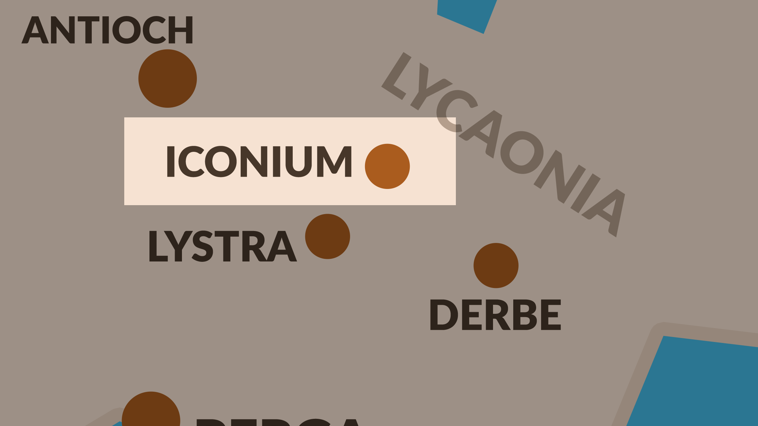

Slide 130
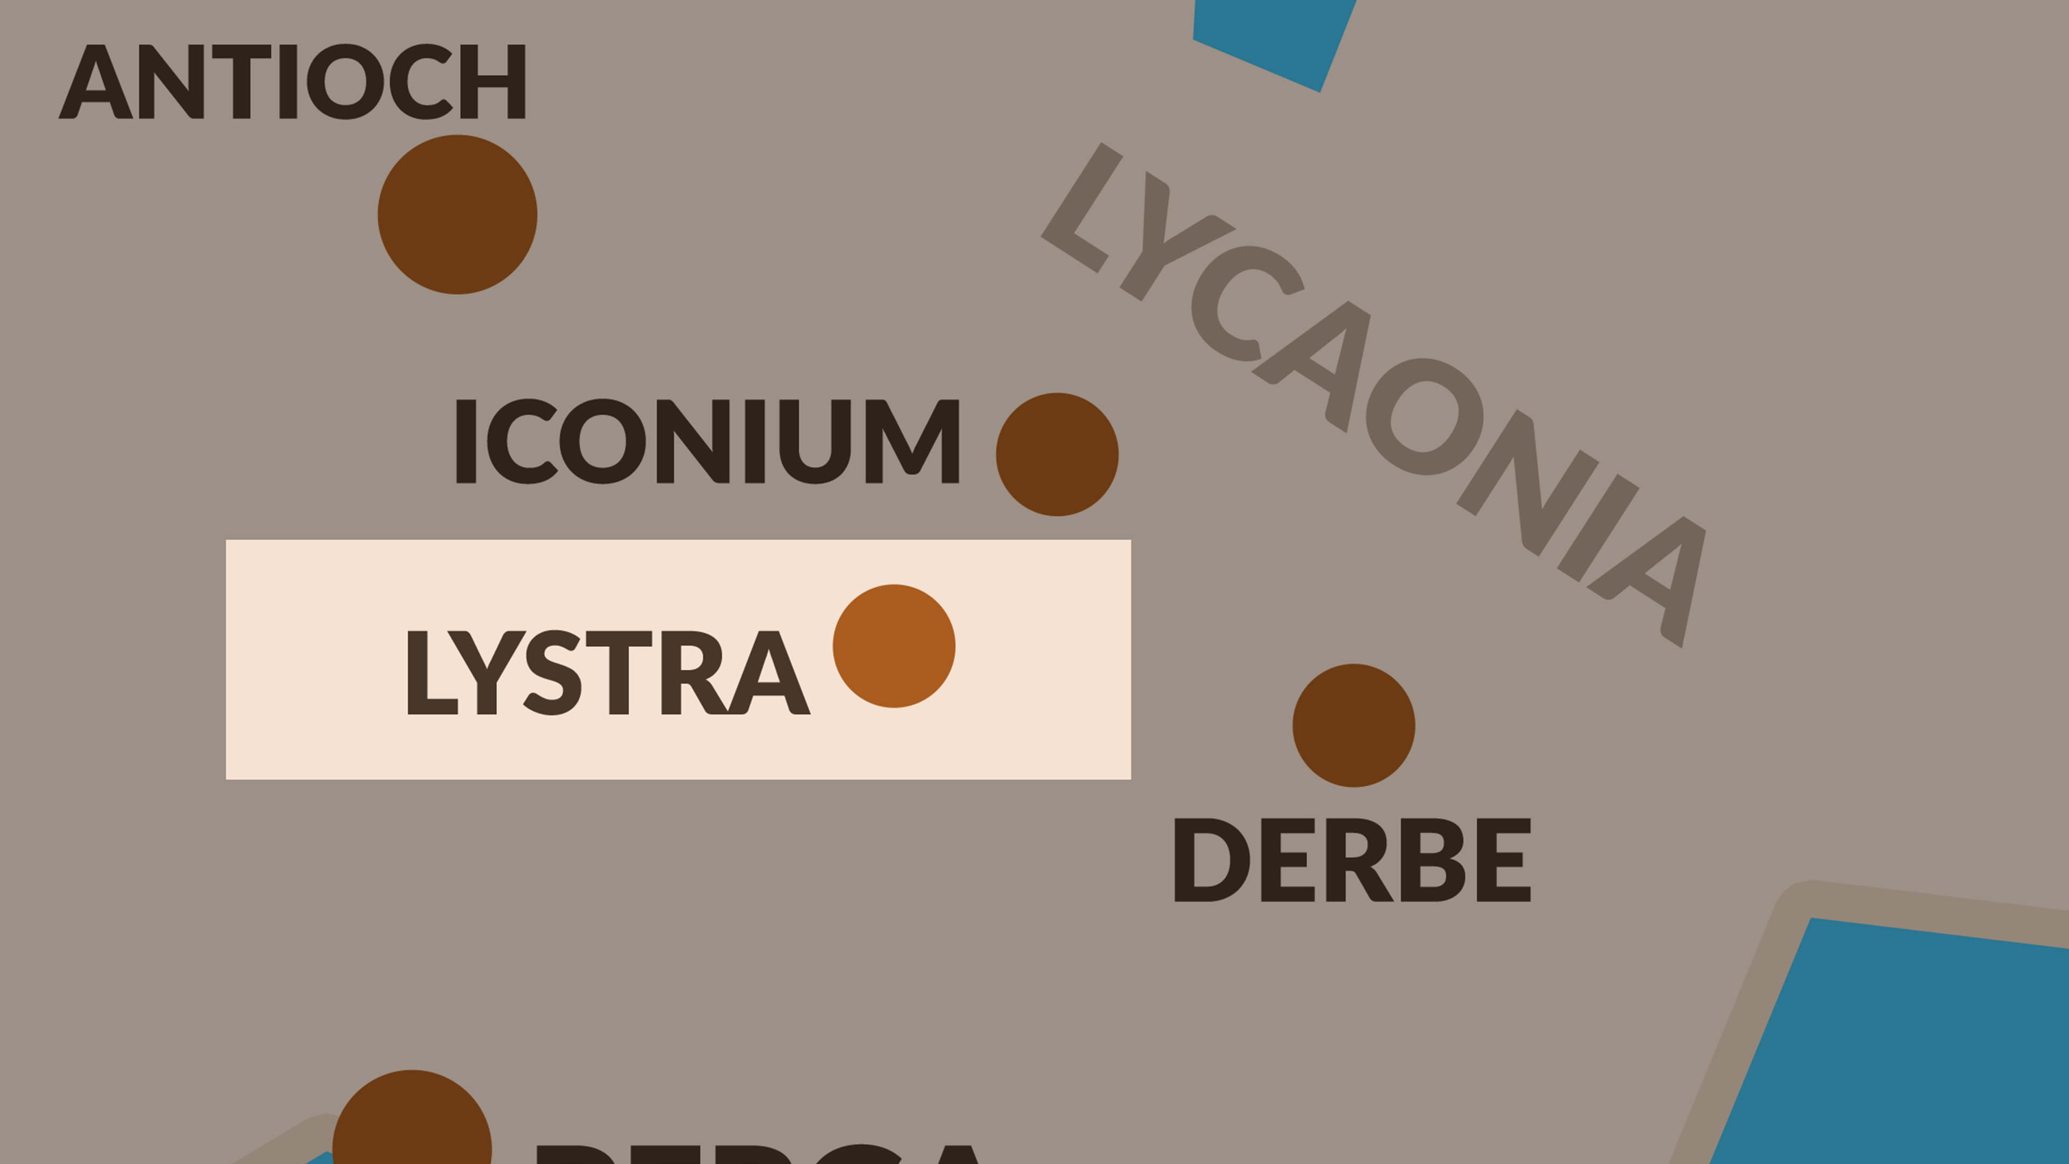

Slide 131
CHAPTER 14 J. W. McGarvey’s Acts Commentary
VERSES 8 - 12
Their conclusion as to which of the gods had appeared, was as natural and as instantaneous as their conviction that they were gods. They had a temple, or a statue, or perhaps both, in front of their city, as we learn below, to the honor of Jupiter; hence any god who might appear to them would be naturally taken for him. But when two gods appeared together, the one who acts as chief speaker could be no other than Mercury, the god of Eloquence & the constant attendant of Jupiter in his terrestrial visits. The remark of Luke that Paul was called Mercury “because he was the chief speaker,” shows that he was familiar with Greek mythology.
  McGarvey, J. W. (1872). A commentary on Acts of Apostles (p. 174). Lexington, KY: Transylvania Printing and Publishing Co.

Slide 132
¹⁴ But when the apostles Barnabas and Paul heard of it, they tore their robes and rushed out into the crowd, crying out ¹⁵ and saying, “Men, why are you doing these things? We are also men of the same nature as you, and preach the gospel to you that you should turn from these vain things to a living God, who made the heaven and the earth and the sea and all that is in them. ¹⁶ In the generations gone by He permitted all the nations to go their own ways;
- Acts 14:14-16

Slide 133
“The Love Which Moves the Sun and the Other Stars”
14:15–17 TPR A living God who made the heaven and the earth and the sea and all that is in them. In past generations he allowed each nation of men to walk in its own ways; yet he did not leave himself without witness, for he did good and gave you from heaven rains and fruitful seasons, satisfying your hearts with food and gladness.
Although Paul somewhat obliquely “praised the Athenians” by commenting “that in every way you are very religious” (17:22)—this translation of δεισιδαιμονεστέρους in the RSV apparently being preferable in this context to the “too superstitious” of the AV—and although he did speak there (17:23) of “what … you worship [εὐσεβεῖτε]” (→4:24–30) and not only of their philosophical systems (→17:18), his discourse at Athens was primarily an exercise in the rhetoric of convincing intellectually, which may also account for “the more secular style of this speech.” This discourse at Lystra came much closer to the rhetoric of persuading existentially (→9:1–4; →24:1–2) when it spoke about God as (reversing the original order) (1) “satisfying your hearts with … gladness” (εὐφροσύνης τὰς καρδίας ὑμῶν), (2) “filling you with food” (NRSV) (ἐμπιπλῶν τροφῆς), and (3) giving “you from heaven rains and fruitful seasons” (οὐρανόθεν ὑμῖν ὑετοὺς διδοὺς καὶ καιροὺς καρποφόρους).

Slide 134
This appeal to the testimony of the natural world in the rain and the seasons, which was at best only implicit in the Athenian discourse, came much closer to the reasoning in the cardinal text of Saint Paul for what has come to be called, more or less satisfactorily (and probably less rather than more), “the natural knowledge of God”: “The invisible things of him from the creation of the world [ἀπὸ κτίσεως κόσμου, meaning ‘ever since the creation’ chronologically or perhaps, by some interpretations, ‘on the basis of the creation’ logically] are clearly seen, being understood by [through] the things that are made, even his eternal power and Godhead” (Rom. 1:20 AV). Significantly, this passage in Rom. 1 in the context of the argument of the first two chapters was intended to show, by means of an alpha privative, that human beings are “without excuse” (ἀναπολογήτους), while this passage in Acts 14 was intended to show, by means of another alpha privative, that God was “not … without witness” (οὐκ ἀμάρτυρον)—which, to be sure, finally did come down to the same thing, because it meant also that human beings were “without excuse,” since they could not plead that they did not know the witness and the will of God when they were violating it.
By putting this positive connotation on the witness of creation and thus emphasizing the continuity between the love of God as Creator and the love of God as Redeemer, the Lystran apologetic reached backward and forward.
Pelikan, J. (2005). Acts (pp. 165–167). Grand Rapids, MI: Brazos Press.

Slide 135
¹⁷ and yet He did not leave Himself without witness, in that He did good and gave you rains from heaven and fruitful seasons, satisfying your hearts with food and gladness.” ¹⁸ Even saying these things, with difficulty they restrained the crowds from offering sacrifice to them.
- Acts 14:17-18

Slide 136
CHAPTER 14 J. W. McGarvey’s Acts Commentary
VERSES 14 - 18
The habit of rending one’s clothes under the influence of sudden passion, which Paul and Barnabas had inherited from their ancestors, and fell into on this occasion, appears very singular to the taste of western nations. The earliest historical traces of it are found in the family of Jacob, and the example of Job; and the latest in the instance before us, which is the only one recorded of the apostles. How so childish and destructive a custom could have originated, it is difficult to imagine; but when once introduced, it is easy to see how it might be transmitted by imitation, until the use of more costly garments would put a stop to it with the economical, or the the restraints of a more enlightened piety would mollify the passions of the religious. It was, certainly, very inconsistent with the calm self-possession inculcated by Christ and the apostles; but we can excuse Barnabas and Saul on this occasion, in consideration of their early habits, which often spring unexpectedly upon men in a moment of sudden excitement.
  McGarvey, J. W. (1872). A commentary on Acts of Apostles (p. 175). Lexington, KY: Transylvania Printing and Publishing Co.

Slide 137
CHAPTER 14 J. W. McGarvey’s Acts Commentary
VERSES 14 - 18
In describing their effort to restrain the idolatry of the multitude, Luke once more reverses their names, saying Barnabas and Saul, as he did before the conversion of Sergius Paulus. This is because Barnabas was called Jupiter, and was the chief figure in this scene. The care with which Luke changes the order of their names, according as one or the other is most prominent, confirms what we have said of the pre-eminence of Barnabas previous to the commencement of this missionary tour.
  McGarvey, J. W. (1872). A commentary on Acts of Apostles (p. 175). Lexington, KY: Transylvania Printing and Publishing Co.

Slide 138
¹⁹ But Jews came from Antioch and Iconium, and having won over the crowds, they stoned Paul and dragged him out of the city, supposing him to be dead. ^{20a} But while the disciples stood around him, he got up and entered the city.
- Acts 14:19-20a

Slide 139
CHAPTER 14 J. W. McGarvey’s Acts Commentary
VERSE 19
The readiness with which a people who had so recently offered divine honors to Paul were persuaded to stone him to death, though at first glance surprising, is but a natural result of all the circumstances. That portion of them who had been prominent in the idolatrous proceedings felt mortified at the discovery of their mistake, and were naturally inclined to excuse their own folly by throwing censure upon the innocent objects of it. The Jews stimulated this feeling by urging that Paul was an impostor, and that all the honorable women and chief men of Antioch and Iconium had united in driving him away from those cities. This enabled them to charge him with willful deception, and as their feelings were already keyed up to their utmost tension they were easily swayed to the opposite extreme, and at a nod from the Jews they were ready to dash him to pieces. That Paul, rather than Barnabas, was the victim of their wrath, resulted from the fact that both here and in the cities from which the Jews had come, he was the chief speaker. The same circumstance which had given him the inferior place in their idolatry, gave him, finally, the superior place in their hatred.
McGarvey, J. W. (1872). A commentary on Acts of Apostles (p. 176). Lexington, KY: Transylvania Printing and Publishing Co.

Slide 140
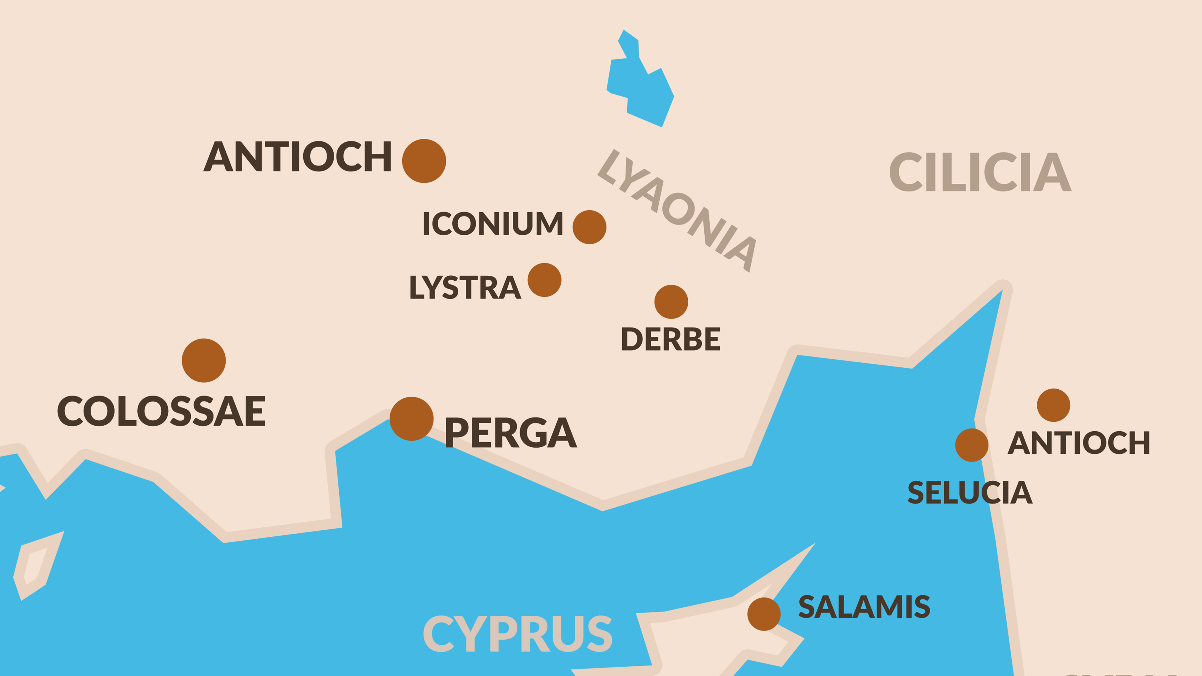

Slide 141
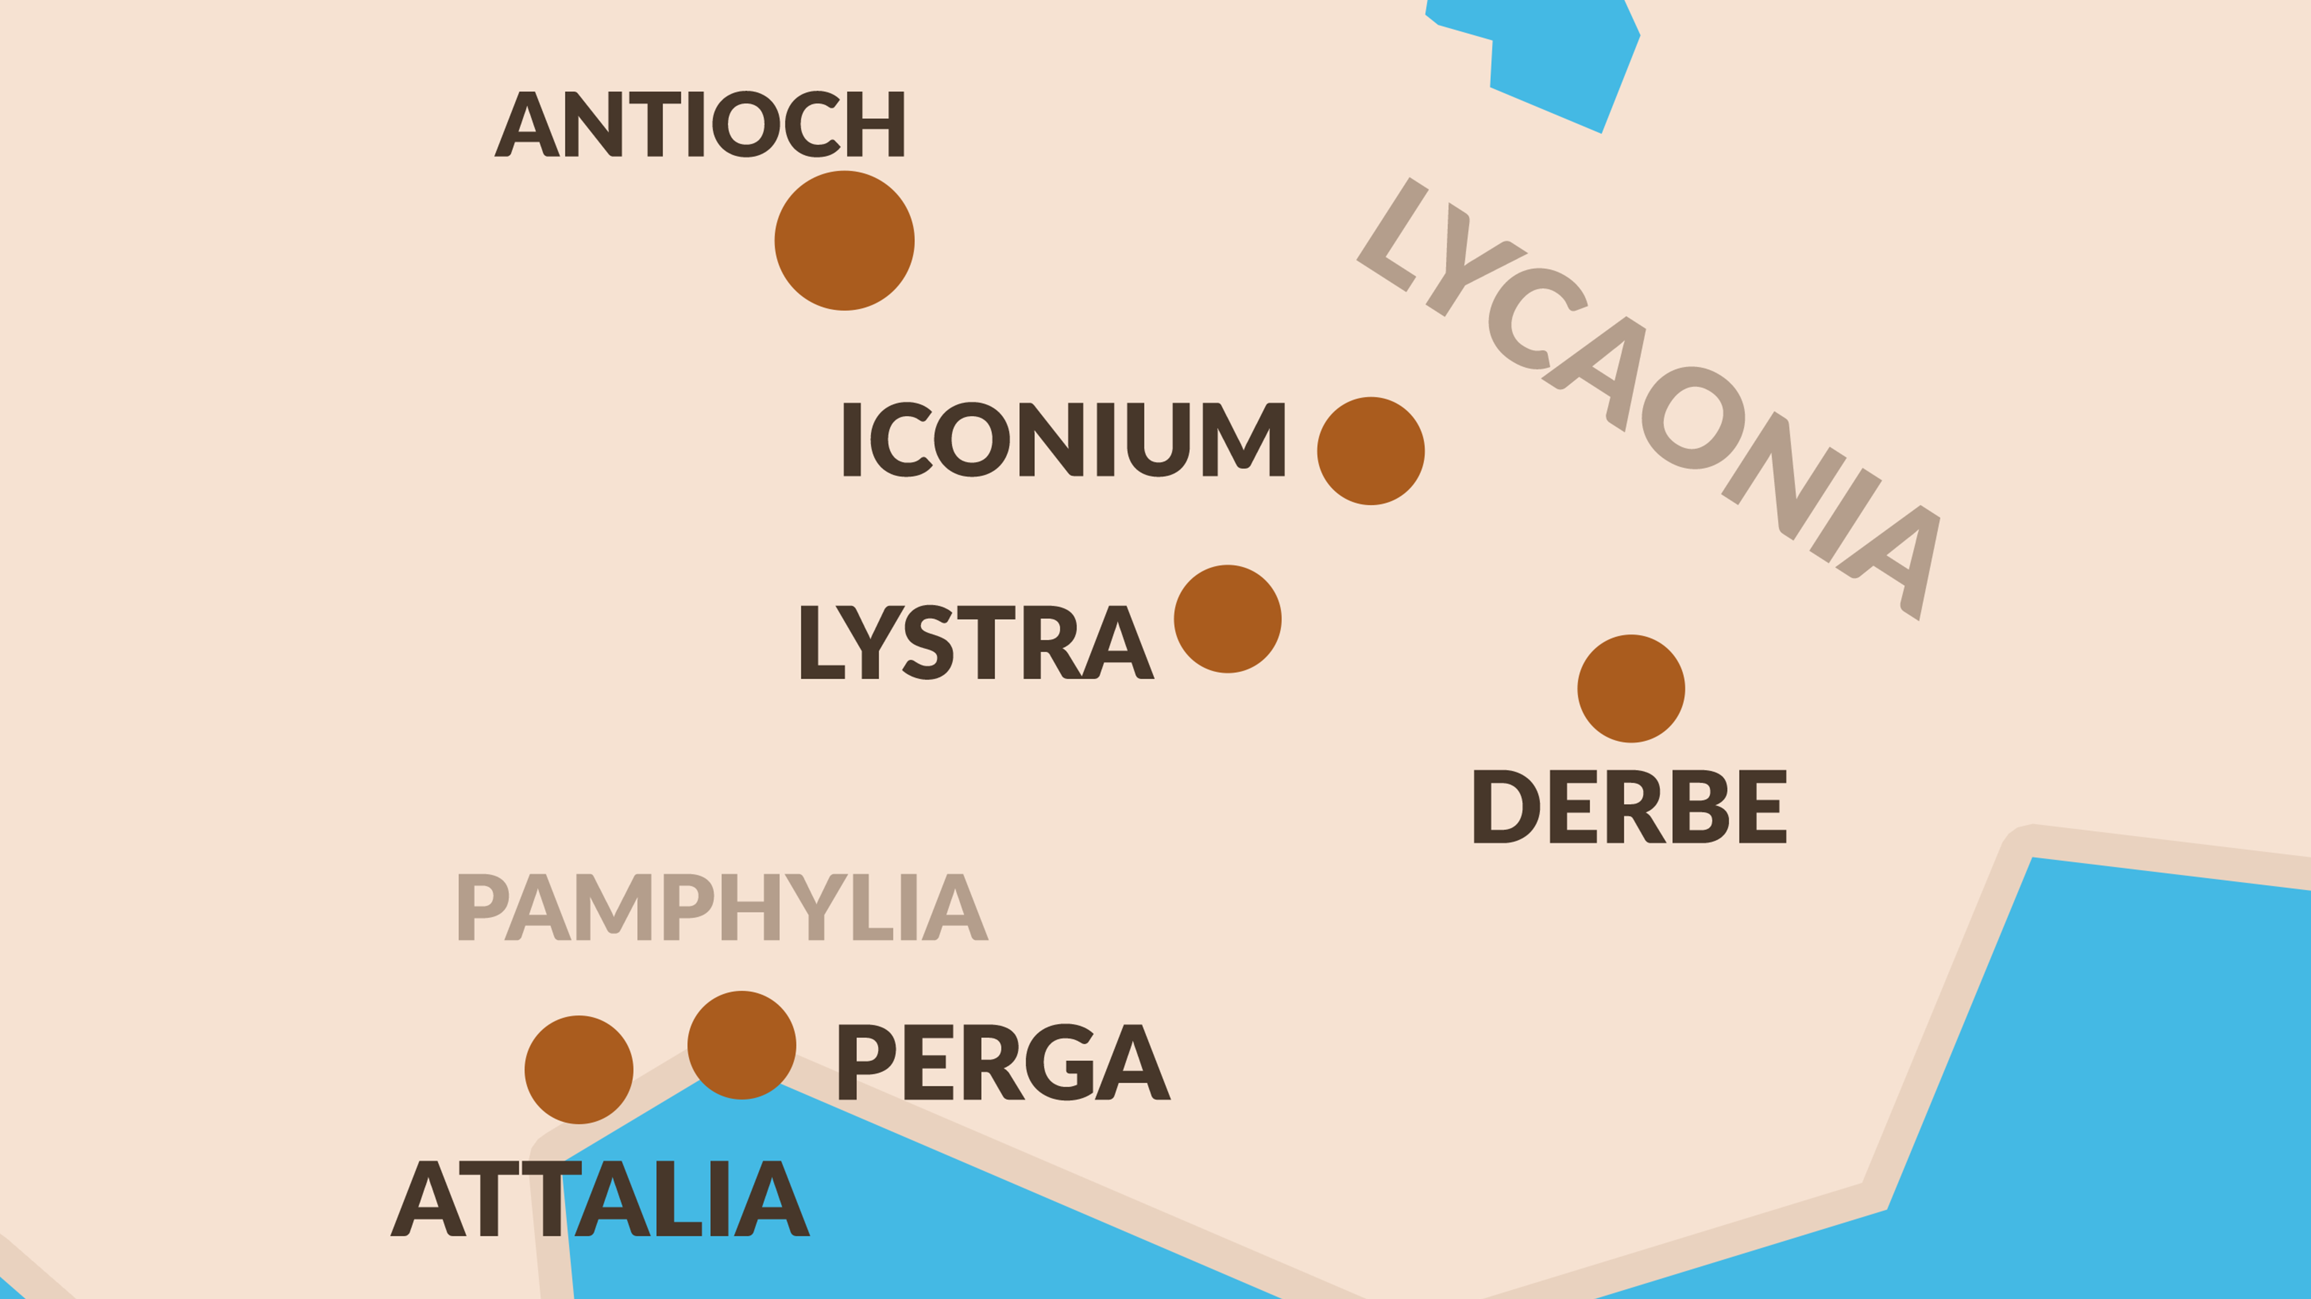

Slide 142
When they had appointed elders for them in every church, having prayed with fasting, they commended them to the Lord in whom they had believed.
- Acts 14:23

Slide 143
CHAPTER 14 J. W. McGarvey’s Acts Commentary
VERSES 23
As the office exercised by these elders, and the number of them in each congregation, have been made subjects of controversy, we will devote some space to grouping a few facts which bear upon these points. The passage before us contains earliest mention of the appointment of elders, yet these were by no means the first elders appointed. For Paul and Barnabas, when sent to Jerusalem with a contribution for the poor saints, delivered it to “the elders.” This shows that there were already elders in the Churches in Judea. Paul and Barnabas, on their present tour, appointed elders in every Church; Titus was left in Crete that he might set in order the things that were omitted, and appoint elders in every city; and James takes it for granted that every Church has elders, by directing, in his general epistle, that the sick should call for the elders of the Church, to pray for them and anoint them with oil, with a view to their recovery. In view of these facts, it can not be doubted that the office of elder was universal in the apostolic Churches.
McGarvey, J. W. (1872). A commentary on Acts of Apostles (p. 177). Lexington, KY: Transylvania Printing and Publishing Co.

Slide 144
CHAPTER 14 J. W. McGarvey’s Acts Commentary
VERSES 23
That the term elder is used as an official title, and not merely to indicate the older members of the Church, is sufficiently evident from the fact that men became elders by appointment, whereas an appointment can not make one an old man. The fact that these officers were called elders indicates that they were generally selected from the elderly class; still, it does not necessarily imply that, to be an elder officially, a man must be an elder in years. Terms which are appropriated as official titles do not always retain their original meanings. Whether advanced age is necessary to the elder’s office is to be determined, not by the official title, but by the qualifications prescribed. But, inasmuch as no such qualification is anywhere prescribed, we conclude that any brother who possesses the qualifications which are prescribed, may be made an elder, though he be not an old man.
  McGarvey, J. W. (1872). A commentary on Acts of Apostles (pp. 177–178). Lexington, KY: Transylvania Printing and Publishing Co.

Slide 145
CHAPTER 14 J. W. McGarvey’s Acts Commentary
VERSES 23
That there was a plurality of elders in each congregation could hardly be disputed by an unbiased reader of the New Testament. Two facts, alone, would seem sufficient to settle this question: first, the fact that Titus was to ordain elders, not an elder, in every city; second, that they were elders, and not an elder from the Church in Ephesus, who came to meet Paul at Miletus. The objection sometimes urged, that there may have been several Churches in each of these cities, and that the plurality of elders was made up of the single elders from the individual Churches, is based upon a conjecture utterly without historic foundation. But if the argument from these passages were waived, the issue is conclusively settled by the statement of our text, that Paul and Barnabas, “appointed elders in every Church.” A plurality of elders, therefore, and not a single one, were appointed for each Church.
  McGarvey, J. W. (1872). A commentary on Acts of Apostles (p. 178). Lexington, KY: Transylvania Printing and Publishing Co.

Slide 146
CHAPTER 14 J. W. McGarvey’s Acts Commentary
VERSES 23
This must be so, from the fact that the qualifications for the office, public speaking alone excepted, are more frequently found combined in three or four men, than in one, whether pastor, or class-leader, or whatever may be his title. The folly, therefore, of abandoning the apostolic eldership in favor of any other organization, is demonstrated by history; while its wickedness must be apparent to every one who esteems apostolic precedents above human expedients. To seek an escape from the condemnation due for this wickedness, by asserting that the apostles left no model of Church organization, is only to add to the original crime by perverting the Scriptures to excuse it. So long as it stands recorded that Paul and Barnabas “appointed for them elders in every Church,” and so long as the duties of these officers remain carefully prescribed in the apostolic epistles, so long will it be false to deny that the apostles left us a definite model of Church organization, and wicked in the sight of God to abandon it for any other.
  McGarvey, J. W. (1872). A commentary on Acts of Apostles (p. 179). Lexington, KY: Transylvania Printing

Slide 147
CHAPTER 14 J. W. McGarvey’s Acts Commentary
VERSES 27 & 28
In the statement that God had “opened a door of faith to the Gentiles,” this is an allusion both to the opening of that national inclosure which had hitherto having confined the gospel almost exclusively to the Jews, and then the introduction of the distant Gentiles through that door into the Church. Before this, faith had been to them inaccessible; for “how shall they believe on him of whom they had not heard?” But now that the preachers had been sent out to them, the door was open, and faith was accessible to all.
  McGarvey, J. W. (1872). A commentary on Acts of Apostles (p. 180). Lexington, KY: Transylvania Printing and Publishing Co.

Slide 148
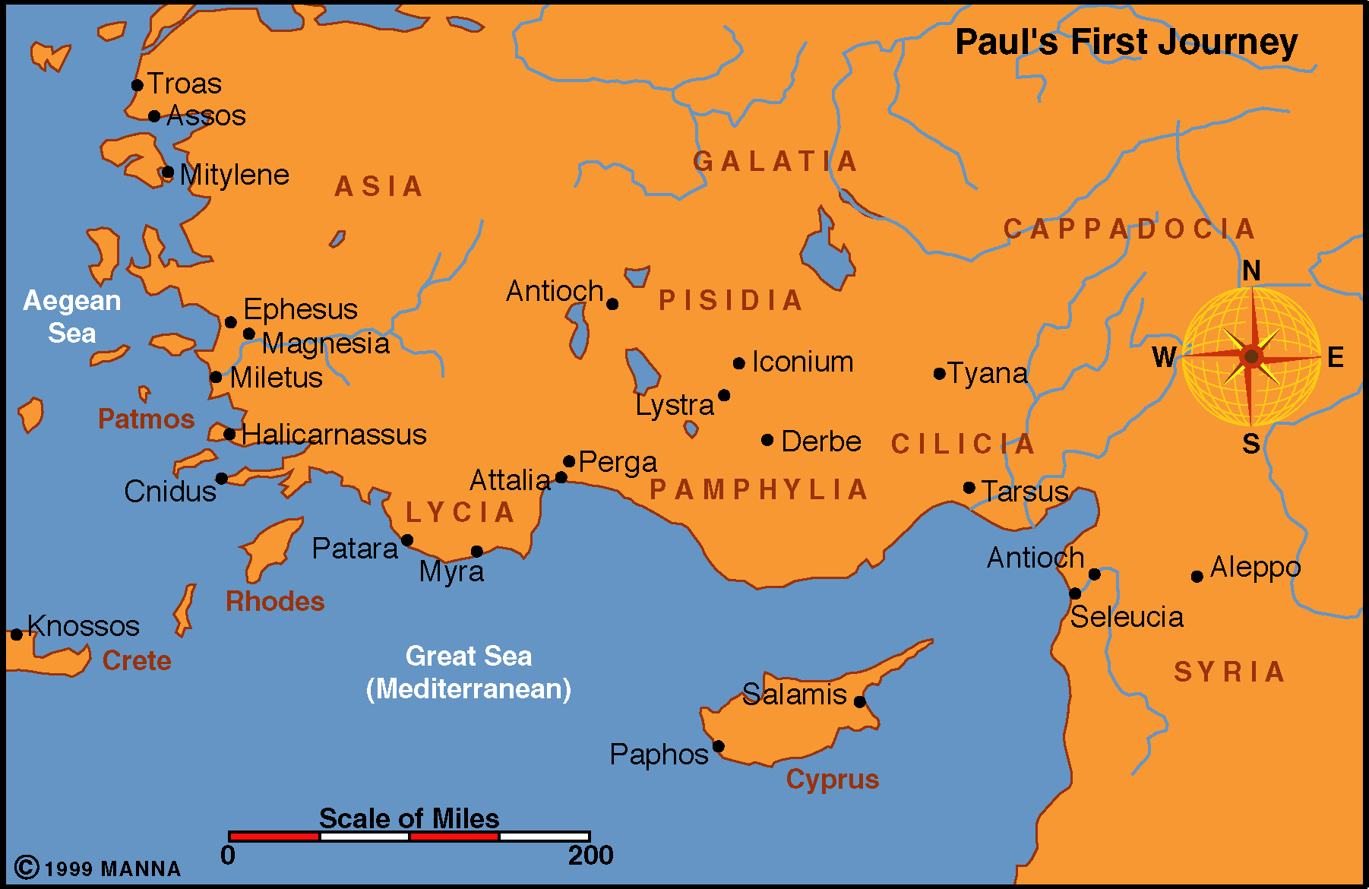
Antioch
Seleucia
CYPRUS
Salamis
Acts 13-14
Approx 2-3 Years
45-48 A.D.
Begins in Antioch
Seleucia
  Boarded a ship
  To Cyprus (90mi)
Salamis
  Preached to the Jews in Synagogue

Slide 149
Paphos
  150 mi from Salamis
    Other end of Cyprus
  Sergius Paulus desired to hear the word of God
  Elymas tries to turn him away from the faith - Acts 13:6-11
  Saul is referred to as Paul for the first time – Acts 13:9
  Now it is “Paul and Barnabas” not “Barnabas & Saul”
Antioch
Seleucia
CYPRUS
Salamis
Paphos

Slide 150
Antioch
Seleucia
CYPRUS
Salamis
Paphos
PAMPHYLIA
Perga
Perga
  12 miles inland
  150 mi from Paphos
  John Mark (writer of Mark) turned back and went to Jerusalem

Slide 151
Antioch (Pisidia)
  100 mi from Perga
  Paul preached at least two Sabbaths
    Acts 13:42
  Paul’s 1st recorded sermon – 13:16-41
  Sermons of Peter and Stephen had same line of thought
Antioch
Seleucia
CYPRUS
Salamis
Paphos
PAMPHYLIA
Perga
PISIDIA
Antioch

Slide 152
Paul’s Early Work
Antioch of Pisidia
  Paul invited to speak in the synagogue of the Jews
    Many Jews impressed with the messages as were Gentiles
    Asked permission to hear more about it the next week
    Nearly the whole city assembled the next week to hear him
  Jews saw the multitudes -- were filled with jealousy
    Gentiles listened readily -- the Jews stirred up trouble
    Expelled the men from their city
    This was the first noted severe persecution Paul and Barnabas encountered on this trip ---- from the Jews!

Slide 153
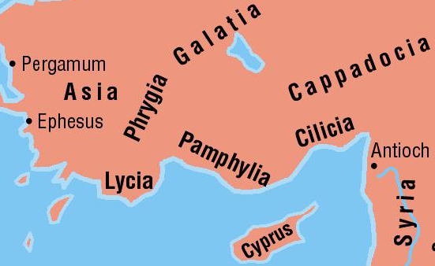
Paul’s Early Work
Region of Asia Minor
  2/3 the size of the state of Texas
  Under the control of Rome
  Broken into 9 provinces
  Broken down further into districts
  Example:
    Province of Asia
      Caria, Lydia, Mysia, Phrygia
    Province of Galatia
      Pisidia and Lycaonia
  Writers would refer to places by “province” or by the “districts” (more exact location)

Slide 154
Antioch
Seleucia
CYPRUS
Salamis
Paphos
PAMPHYLIA
Perga
PISIDIA
Antioch
LYCAONIA
Iconium
Iconium
  80 miles from Antioch.
  Departed from Antioch because of severe persecution
  Paul preached in the synagogue
  Jews & Gentiles converted
  Unbelievers tried to stone them

Slide 155
Antioch
Seleucia
CYPRUS
Salamis
Paphos
PAMPHYLIA
Perga
PISIDIA
Antioch
LYCAONIA
Iconium
Lystra
Lystra
  18 mi from Iconium
  Lame man healed
  People of city thought Paul & Barnabas were gods – Acts 14:12
  Jews from Antioch & Iconium came and stirred up trouble – Paul was stoned, left for dead

Slide 156
Antioch
Seleucia
CYPRUS
Salamis
Paphos
PAMPHYLIA
Perga
PISIDIA
Antioch
LYCAONIA
Iconium
Lystra
Derbe
Derbe
  30 mi from Lystra
  Many disciples added (14:20)
  Farthest point of travel on first missionary journey

Slide 157
Return Trip
Lystra
  Strengthened disciples
Iconium
  Exhorted them to continue in faith
Antioch (Pisidia)
  “appointed elders in every church”
Perga
  Preached word
Attalia
  Sailed home
Antioch
Seleucia
CYPRUS
Salamis
Paphos
PAMPHYLIA
Perga
PISIDIA
Antioch
LYCAONIA
Iconium
Lystra
Derbe
Lystra
Iconium
PISIDIA
Antioch
PAMPHYLIA
Perga
Attalia
Antioch

Slide 158
INFORMATION
1,200 Miles
480 miles by water
At least 7 cong established
Paul’s words to Timothy
  2 Timothy 3:10-12
Paul reported about the work at Antioch in Syria
  Acts 14:27-28
  Stayed approx two years in Antioch
Antioch
Seleucia
CYPRUS
Salamis
Paphos
PAMPHYLIA
Perga
PISIDIA
Antioch
LYCAONIA
Iconium
Lystra
Derbe
Lystra
Iconium
PISIDIA
Antioch
PAMPHYLIA
Perga
Attalia
Antioch

Slide 160
Some men came down from Judea and began teaching the brethren, “Unless you are circumcised according to the custom of Moses, you cannot be saved.”
- Acts 15:1

Slide 161
CHAPTER 15 J. W. McGarvey’s Acts Commentary
VERSE 1
At this point in the narrative our historian makes a sudden transition from the conflicts of the disciples with the unbelieving world to one almost as serious among themselves. There never was a national antipathy more intense than that felt by the Jews to the whole Gentile world. It was the more intense, from the fact that it was imbedded in their deepest religious sentiments, and was cultivated in all the devotions. In the hearts of the disciples this feeling had, by this time, been so far overcome, that they had admitted the propriety of receiving uncircumcised Gentiles into the Church. But they found it more difficult to convince themselves that Gentiles were to be admitted into social and domestic intimacy. Hence, when Peter returned from the house of Cornelius to Jerusalem, the chief objection urged against him was, not that he had immersed Gentiles, but “Thou didst go into the house of men uncircumcised, and didst eat with them.” This was the full extent to which the judaizing party in the Church were prepared, at that time, to push their objections. But when men take an unreasonable and obstinate stand against any cause, they frequently assume more extravagant ground as the cause they are opposing advances. While but a few Gentiles had come into the Church, the pharisaic party objected only to domestic association with them; but now that Paul and Barnabas had succeeded in opening a door of faith to the whole Gentile world, and it was likely that the Jews, who had hitherto constituted almost the whole body of the Church, were soon to become only a small element in its constituency, their fears were excited, and their demands became more exorbitant. Paul and Barnabas were still in Antioch. (1) “And certain men came down from Judea, and taught the brethren, Unless you are circumcised according to the law of Moses, you can not be saved.” As we learn from a subsequent part of this chapter, they were not content with merely enjoining circumcision, but also exacted the observance of all the law of Moses, to which circumcision was only preliminary. The success of this party would have perpetuated Judaism, and forever have neutralized those philanthropic principles of the gospel which the experience of the world and the wisdom of God alike had shown to be necessary to the moral renovation of the human race.
  McGarvey, J. W. (1872). A commentary on Acts of Apostles (p. 181). Lexington, KY: Transylvania Printing and Publishing Co.

Slide 162
This teaching was dangerous because it replaced a gospel of grace and faith with one of Law and works.

Slide 163
And when Paul and Barnabas had great dissension and debate with them, the brethren determined that Paul and Barnabas and some others of them should go up to Jerusalem to the apostles and elders concerning this issue.
- Acts 15:2

Slide 164
CHAPTER 15 J. W. McGarvey’s Acts Commentary
VERSE 5
This party is here identified as converts from the old sect of the Pharisees. We have had no account hitherto of any large accessions to the Church from this party; but this incidental remark shows that some of these obstinate opposers of the truth had yielded, and were now occupying positions of influence in the congregation. Paul now once more meets some of his companions in the persecution of the disciples, not to harmonize with them, nor to dispute with them in the synagogues concerning the claims of Christ; but to contend, within the Church itself, against that same disposition to perpetuate the law which had made them formerly fight against the gospel. He had a bad opinion of some of them, which must have been well-founded, or he would not have given the public utterance to it which he did at a subsequent period. He styles them, in the Epistle to the Galatians, “False brethren, unawares brought in, who came in privily to spy out our liberty which we have in Christ Jesus, that they might bring us into bondage.” Having witnessed a rapid increase of the congregations under the pressure of the persecutions and disputations to which they had formerly resorted, these wily enemies of the truth determined at length to corrupt and destroy, under the guise of friendship, a cause whose progress they could not impede by open enmity. They well knew, what some of the brethren had failed to discover, that the doctrine of Christ would be rendered powerless if it could only be hampered by bondage to the law.
  McGarvey, J. W. (1872). A commentary on Acts of Apostles (p. 182). Lexington, KY: Transylvania Printing and Publishing Co.

Slide 165
ROMANS & JEWS FROM CORRUPT TO CRAZY!

Slide 166
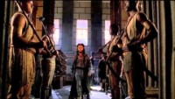

Slide 167
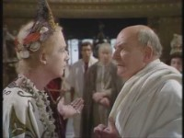

Slide 168
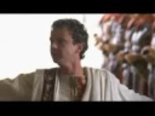

Slide 169
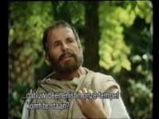

Slide 170
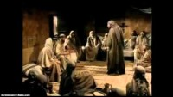

Slide 171
AFTER THE TEMPLE IS DESTROYED BOTH ISSUES BEFORE THE “COUNCIL” ARE SETTLED FOR ALL TIME & WITH JERUSALEM’S DESTRUCTION A SHIFT IN THE RELIGIOUS CENTER

Slide 172
CHAPTER 15 J. W. McGarvey’s Acts Commentary
VERSE 5
Even to this day the mass of religious teachers have failed to learn this lesson, though the experience of ages has demonstrated its truth. The essential issue between Paul and the Pharisees had reference to the perpetuation of the law of Moses in the Church of Christ, and the same issue has been in debate, under various aspects, from that day to this. Paul defeated the attempt of these Judaizers to fasten circumcision on the Church; but subsequent Judaizers imposed infant immersion and infant sprinkling as a substitute. What the early Pharisees failed to accomplish in the face of apostolic opposition, the later Pharisees did accomplish under a thin disguise. The unsuccessful attempt of those Pharisees to “spy out the liberty which disciples had in Christ Jesus & bring them into bondage” under the law, has been successfully accomplished by these, in teaching men that the Church of Christ originated in Abraham’s family & that the Jewish tribes and the Christian congregations constitute but one identical Church. The Roman apostasy perpetuates the pompous ritual and daily sacrifice of the old temple; religious zealots slaughter Canaanites in the form of modern heretics; professed Christians go to war under the old battle-cry of “The sword of the Lord and of Gideon;” the Latter-day Saints emulate the Turks in the multiplication of wives & for all these corruptions authority is found in the laws and customs of ancient Israel. The intelligent reader of the New Testament knows scarcely which of these errors is most repugnant to the truth; but must, like Paul, struggle with untiring energy and ceaseless vigilance to uproot them all from the minds of men.
  McGarvey, J. W. (1872). A commentary on Acts of Apostles (pp. 182–183). Lexington, KY: Transylvania Printing and Publishing

Slide 173
The Historical “Economies” of the Living God
15:8–9 And God who knows the heart bore witness to them, giving them the Holy Spirit just as he did to us; and he made no distinction between us and them, but cleansed their hearts by faith.
But just as the description of the historical economy of the past as “times of ignorance” led to the identification of the historical economy of the present as the καιρός of “but now,” so that identification in turn moved directly into the historical economy of the future: “But now he commands all men everywhere to repent, because he has fixed a day on which he will judge the world in righteousness by a man whom he has appointed, and of this he has given assurance to all men by raising him from the dead” (17:30–31). As the living “God who knows the heart,” God had promised and would accomplish an age of renewal, in fulfillment of ancient prophecy, in which, among other novelties, Gentiles, and not only Israelites, were said to be “called by my name” (Amos 9:11–12 LXX; Jer. 12:15 LXX; Isa. 45:21 LXX) (→13:48; →20:28a):
After this I will return, and I will rebuild the dwelling of David, which has fallen:
I will rebuild its ruins, and I will set it up, that the rest of men may seek the Lord,
and all the Gentiles who are called by my name, says the Lord. Known from of old is his work. (15:16–18)
“From of old” and “but now,” taken together, were a confession of all the historical economies of God, as they were comprehended in the affirmation of the psalmist: “My times [οἱ καιροί μου] are in thy hand” (Ps. 31:15).
Pelikan, J. (2005). Acts (pp. 172–175). Grand Rapids, MI: Brazos Press.

Slide 174
CHAPTER 15 J. W. McGarvey’s Acts Commentary
VERSES 7 - 11
The position of the Pharisees not only condemned the course of Paul and Barnabas, but also involved a censure of Peter, who was the first of all the apostles, as he here asserts, to preach the Word to Gentiles. When arraigned once before for his conduct in the case of Cornelius, he had vindicated his procedure by relating the miraculous evidences of God’s will which had been his guide & now, to accomplish the same end with these brethren, he adduces the most decisive of those miracles, the gift of the Holy Spirit to uncircumcised Gentiles. Having given to them the same gift as to the apostles on Pentecost, and having imposed upon them none of the purifying rites of the law, but simply purifying their hearts by faith, he assumes that God had made no difference between them and the Jewish brethren. Now, to attempt to impose the law upon them, in the face of these evidences of God’s will to the contrary, would be putting God to the proof of his determination to maintain his own authority. It would, moreover, be imposing a yoke which the Jews themselves had never been able to bear successfully. This yoke is not circumcision, for there is no difficulty in submitting to that; but it was the law, under whose provisions no man could live without incurring its condemnation. His concluding statement, “We believe that we shall be saved through the favor of the Lord Jesus, in the same manner as they,” involves two important conclusions: First, That it is not through the merit of obedience to the law that we are to be saved, but through the favor of the Lord Jesus Christ. This favor is extended in the pardon of sins. Second, That the Gentiles are saved in the same manner as the Jews. By using the plural we believe, instead of I believe, he doubtless intended to express not only the conviction of his own mind, but that of the party with whom he acted, including the other apostles. It was a decision of the inspired teachers against the Pharisees.
  McGarvey, J. W. (1872). A commentary on Acts of Apostles (p. 184). Lexington, KY: Transylvania Printing and Publishing Co.

Slide 175
¹⁰ Now therefore why do you put God to the test by placing upon the neck of the disciples a yoke which neither our fathers nor we have been able to bear? ¹¹ But we believe that we are saved through the grace of the Lord Jesus, in the same way as they also are.”
- Acts 15:10-11

Slide 176
¹⁴ Simeon has related how God first concerned Himself about taking from among the Gentiles a people for His name. ¹⁵ With this the words of the Prophets agree, just as it is written,
- Acts 15:14-15

Slide 177
So that the rest of mankind may seek the Lord,
And all the Gentiles who are called by My name,’
- Acts 15:17

Slide 178
CHAPTER 15 J. W. McGarvey’s Acts Commentary
VERSES 13 - 21
So far as recent indications of God’s will were concerned, the argument was now complete and unanswerable; but the Jewish mind was prone to an underestimate of passing events, while they looked back with superior reverence to the law and the prophets. The Apostle James, knowing that they would reject all possible cotemporaneous evidences, if they appeared to conflict with the written word, determined to close up this avenue of escape from the argument already presented by sustaining it with the authority of the prophets.
  McGarvey, J. W. (1872). A commentary on Acts of Apostles (p. 185). Lexington, KY: Transylvania Printing and Publishing Co.

Slide 179
CHAPTER 15 J. W. McGarvey’s Acts Commentary
VERSES 13 - 21
In this speech James shows that God, who knows from eternity what his own works would be, had foretold, through the prophet, the work which he was then performing through the labors of Peter, Barnabas, and Paul. He had said that he would rebuild the tabernacle of David, in order that the residue of men, who had not known the Lord before, “even all the Gentiles, upon whom his name is called,” should seek after the Lord; and now, he had, through these apostles, selected from among the Gentiles “a people for his name.” The prophesy clearly covered all the ground claimed for it & made the argument complete.
  McGarvey, J. W. (1872). A commentary on Acts of Apostles (p. 185). Lexington, KY: Transylvania Printing and Publishing Co.

Slide 180
CHAPTER 15 J. W. McGarvey’s Acts Commentary
VERSES 13 - 21
There was room for no other conclusion than the one which James deduced, that they should impose on the Gentiles, so far as the class of restrictions under consideration were concerned, only those necessary things which were necessary independent of the Mosaic law. Idolatry, with the pollution connected with it, was known to be sinful before the law of Moses was given; and so was fornication. The eating of blood, and, by implication, of strangled animals, whose blood was still in them, was forbidden to the whole world in the family of Noah. In the restrictions here proposed by James, therefore, there is not the slightest extension of the law of Moses, but a mere enforcement upon Gentiles of rules of conduct which had ever been binding & were to be perpetual. They are as binding to-day as they were then. To deny this would be to despise the combined authority of all the apostles, when enjoining upon the Gentile world, of which we form a part, restrictions which they pronounce necessary. One would be surprised that it was thought necessary to mention to Gentiles, who had turned to the Lord, the sinfulness of fornication, did we not know that among heathen nations of antiquity it was deemed innocent, and even sometimes virtuous.

Slide 181
CHAPTER 15 J. W. McGarvey’s Acts Commentary
VERSES 13 - 21
The whole argument turns upon the meaning of the expression “tabernacle of David.” If the metaphorical word tabernacle here means the Jewish Church, the argument would have force. But the Mosaic institution never sustained such a relation to David that it could, with propriety, be styled the “tabernacle of David.” If such had been the reference, the expression would undoubtedly have been, the tabernacle of Moses, which would have been unambiguous. But David was a king & had a promise from God, that his “throne should be established forever;” that there should not fail him a man on the throne of Israel. This promise God confirmed with an oath, saying, “I have made a covenant with my chosen, I have sworn to David my servant, Thy seed will I establish forever, and build up thy throne to all generations.” According to the apparent meaning of this promise, it had long since failed; for it had been many generations since a descendant of David had occupied his throne. It was during this period, in which the royal house of David was in ruins, that Amos uttered the prophesy, “I will return, and build again the tabernacle of David which is fallen down; I will build again the ruins thereof, and set it upright.” The term tabernacle, therefore, must be put for the family who dwell in the tabernacle, and the reconstruction of it the re-establishment of the royal dignity which the family had lost. Hence, when the birth of Jesus was announced to Mary, the angel said: “The Lord shall give to him the throne of his father David, and he shall reign over the house of Jacob forever, and of his kingdom there shall be no end.” Thus, the promise, when properly understood, is seen to refer neither to a continuous line of Jewish kings, descended from David, nor to a reconstruction of the Jewish Church, but to the perpetual reign of Jesus, the “seed of David according to the flesh.” When, therefore, Jesus sat down upon his throne in heaven, the tabernacle of David was rebuilt, and now, by the labors of Peter, Barnabas, and Paul, the remainder of the prophesy of Amos was being fulfilled, by the extension of his kingdom among the Gentiles.

Slide 182


Judaism was a vehicle designed by God to deliver Jesus to the world.

Slide 183
CHAPTER 15 J. W. McGarvey’s Acts Commentary
VERSES 22 - 31
By the construction of the Greek, we learn that it was Paul and Barnabas, and not Judas and Silas, who are commended in this letter as “men who have hazarded their lives for the name of the Lord Jesus.” The object of sending Judas and Silas with Paul and Barnabas was doubtless that they, having been entirely unconnected with the conversion of Gentiles, and above suspicion of undue partiality toward them, might use their personal influence with the Jewish brethren to induce them to accept the teaching of the epistle. Their journey, and the effect of the epistle, are thus stated: (30) “So, then, being sent away, they went to Antioch, and having assembled the multitude, they gave them the epistle. (31) When they read it, they rejoiced for the consolation.” The brethren residing in Antioch had not become partisans in the controversy, but had been distressed by the conflict between Paul and Barnabas and the Pharisees from Jerusalem & desired only a satisfactory settlement of the question. The epistle, therefore, afforded them “consolation,” and they cheerfully yielded to its requirements.
  McGarvey, J. W. (1872). A commentary on Acts of Apostles (p. 187). Lexington, KY: Transylvania Printing

Slide 184
CHAPTER 15 J. W. McGarvey’s Acts Commentary
VERSES 22 - 31
Before dismissing the subject of this appeal to the apostles and elders in Jerusalem, we must notice briefly the use that is made of it by the advocates of representative assemblies in the Church, for judicial and legislative purposes. Romanists, and the advocates of episcopacy generally, find in the assembly in Jerusalem the first “general council,” and have styled it “The Council of Jerusalem.” The Presbyterians find in it the first synod; and others still appeal to it in general terms, as authority for assemblies of brethren to decide questions of doctrine and discipline. In order that it may properly be used as a precedent for any of these assemblies, it must be made to appear analogous to them in its essential features. But its essential features are: First, That it was occasioned by an appeal from one congregation to certain parties in one other congregation, in reference to a disputed question which the first felt unable to decide. Second, That the parties to whom the appeal was made were inspired men, who could say of their decision, when made, “It seemed good to the Holy Spirit and us;” i. e., to the Holy Spirit as the divine arbiter, and to us as obedient subjects of his authority. It was the inspiration, and, consequently, the infallibility of the party appealed to, that suggested and that justified the appeal. In both these peculiarities all the councils & synods of Catholic and Protestant history are essentially deficient, for, instead of being called together at the request of some congregations, to decide some question presented, they consist of representatives from a number of congregations, or districts of country, assembled for the purpose of discussing and deciding whatever questions may come up among them; and instead of being infallible, their decisions are nothing but the fallible opinions of uninspired men, in reference to which it would be the height of profanity to say, “It seemed good to the Holy Spirit and us.” Not till we have an assembly under the guidance of inspired men can we allow them to authoritatively decide religious questions after the precedent of this assembly in Jerusalem. All the duties, responsibilities, and privileges of disciples have already been authoritatively propounded by inspired men; and for men now to meet together for the authoritative decision of such questions, is to assume a prerogative that belongs exclusively to inspired apostles and prophets, and, at the same time, is to assume that there are deficiencies in their infallible teachings to be supplied by uninspired men.
  McGarvey, J. W. (1872). A commentary on Acts of Apostles (pp. 187–188). Lexington, KY: Transylvania Printing and Publishing Co.

Slide 185
CHAPTER 15 J. W. McGarvey’s Acts Commentary
VERSES 32 - 34
The manner in which Luke connects the fact that these brethren were prophets, with the statement that they exhorted the brethren and confirmed them, shows that the chief work of the New Testament prophets was not to foretell the future, but to exhort and confirm the brethren. He says, “being also themselves prophets, they exhorted the brethren and confirmed them;” which form of expression makes the fact of being prophets account for their exhortations. They differed from the Old Testament prophets only in that the latter gave their chief attention to foretelling future events. Still, even the predictions of the old prophets were made to answer the purpose of exhortations to their contemporaries; so that the difference between the two is very slight.
  McGarvey, J. W. (1872). A commentary on Acts of Apostles (p. 189). Lexington, KY: Transylvania Printing and Publishing Co.

Slide 186
CHAPTER 15 J. W. McGarvey’s Acts Commentary
VERSES 32 - 34
It has been erroneously (?) supposed that Peter, in this affair, acted in direct conflict with the epistle which he had just united in addressing to the Gentile brethren. The harshness of this supposition has led some writers to conclude that his improper conduct must have occurred at a period antecedent to the issuing of that epistle. It is also urged in favor of an earlier date of the incident, that, if it had occurred subsequent to the publication of that epistle, Paul would naturally have appealed to it in the controversy with Peter, which he seems not to have done. Both of these suppositions [might] spring from a mistake as to the exact fault of which Peter was guilty. He did not insist that the Gentiles should be circumcised, or that they even should keep the law; which were the points discussed in the apostolic epistle. But, still admitting the right of the uncircumcised to membership and its privileges, his fault was in refusing to eat with them in their private circles, although he had himself been the first to do so in the family of Cornelius, and had done so, for a time, even since he came to Antioch. In opposing such conduct, it would not have answered Paul’s purpose to appeal to the epistle from Jerusalem; for it merely asserted the freedom of the Gentiles from the yoke of the law, without prescribing the intercourse that should exist between the circumcised and uncircumcised brethren. The course of argument which he did pursue was the only one available. He convicted Peter of inconsistency, saying, “If you, being a Jew, live like a Gentile, and not like a Jew, why do you require the Gentiles to live like Jews?” He had lived like a Gentile while eating with them; but now, by withdrawing from them, he was virtually saying to them, You must live like the Jews. This was inconsistent, and made it appear that either he was now a transgressor, while building up the Jewish prejudices, or had formerly been, while seeking to break them down. “For if I build again the things which I destroyed, I make myself a transgressor.”¹⁵
  McGarvey, J. W. (1872). A commentary on Acts of Apostles (pp. 189–190). Lexington, KY: Transylvania Printing and Publishing Co.

Slide 187
CHAPTER 15 J. W. McGarvey’s Acts Commentary
VERSES 32 - 34
But the proof of inconsistency in an opponent never settles a question of truth or duty. After you have proved your opponent inconsistent, you have still to prove that his present course differs from what truth requires, as well as from his former course. Moral inconsistency convicts a man as a transgressor, but whether a transgressor now, or formerly, is still an open question. Paul, therefore, proceeded to prove Peter’s present conduct improper, by stating as an undisputed fact, “I, through the law, am dead to the law, that I might live to God;” that is, by the limitation which the law prescribes to itself, it has ceased to bind me, and I have ceased to live under it. This fact was decisive, because the distinction assumed to exist between the circumcised and uncircumcised was based upon the supposition that the former, at least, were still under the law.
  McGarvey, J. W. (1872). A commentary on Acts of Apostles (p. 190). Lexington, KY: Transylvania Printing and Publishing Co.

Slide 188
CHAPTER 15 J. W. McGarvey’s Acts Commentary
VERSES 32 - 34
This is the last passage in Acts connected with the Apostle Peter. Before leaving it, we must notice one fact in connection with this unhappy incident in his life which far outweighs the dissimulation rebuked by Paul. It is the manner in which he received this rebuke. There is not the least evidence of any resentment on his part, either for the rebuke itself, or the subsequent publication of it to the Churches in Galatia. Most men become offended when thus rebuked by their equals, and would regard it as an unpardonable offense to give unnecessary publicity to a fault of this kind. But Paul knew so well the goodness of Peter’s heart, that he did not hesitate to speak of it to the world and to future generations. That he didn’t overestimate the meekness of Peter, is evident from the fact that the latter subsequently spoke most affectionately of Paul, with direct allusion to his epistles, and with a publicity equal to that which his own sin had received. This excellence of Peter’s character was known to other brethren besides Paul, as is evident from the freedom with which all the four evangelists speak of his denial of the Lord. They might have omitted this incident from their narratives, if they had been influenced by that pride and sensitiveness which prompt men to hide the faults of their leaders, or if they had thought that the publication of it would give serious offense to Peter. But they knew Peter, and, we must presume, they knew that he was willing for any fault of his, however discreditable, to be published to the world, if it would do any good. This is the spirit of self-sacrifice with which every servant of God should offer himself to the cause of Christ.
  McGarvey, J. W. (1872). A commentary on Acts of Apostles (p. 190). Lexington, KY: Transylvania Printing and Publishing Co.

Slide 189
CHAPTER 15 J. W. McGarvey’s Acts Commentary
VERSES 36 - 41
This incident shows the best of men may differ about matters of expediency, and that, in contending for their respective conclusions, they may be aroused to improper feelings. But the good man, under such circumstances, will always be distinguished by the readiness with which such feelings will be repressed, and by the absence of all subsequent malice. We know that Paul afterward felt very differently toward John; for, during his first imprisonment at Rome, he mentions him to Philemon as a fellow-laborer there present & to the Colossians as one who had been a comfort to him; and, during his second imprisonment, he writes to Timothy: “Take Mark & bring him with you; for he is profitable to me for the ministry.” The slight heat engendered between Barnabas and Paul also subsided in a short time; for Paul afterward speaks of him in most friendly terms, in the First Epistle to the Corinthians.²³
  McGarvey, J. W. (1872). A commentary on Acts of Apostles (p. 191). Lexington, KY: Transylvania Printing and Publishing Co.

Slide 190
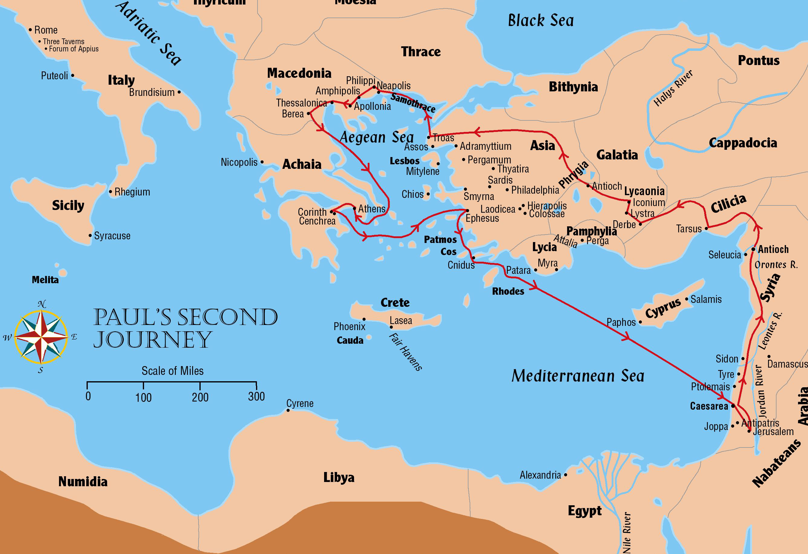
Paul’s Second Journey
Acts 15:1-18:22; 1 and 2 Thessalonians

Slide 191
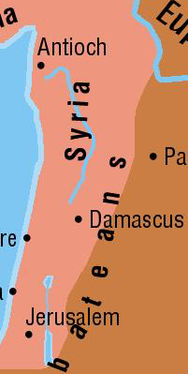
The Council in Jerusalem
Acts 15:1-31
300 Miles
49 or 50 A.D.

Slide 192
The Council in Jerusalem
Acts 15:1-31
Paul and Barnabas remained at Antioch after the first journey was completed
About 10 years has passed since the conversion of Cornelius
Judean brethren came to Antioch in Syria disputing and teaching that circumcision was necessary for salvation (v1)
  Paul, Barnabas, and others are sent to Jerusalem to confer with the apostles and elders – about 300 miles (v2)
  Titus was with them – this is Paul’s 3rd visit to Jerusalem since his conversion

Slide 193
The Council in Jerusalem
Acts 15:1-31
Conference at Jerusalem (Acts 15:6-21; Gal 2:1-10)
  Jerusalem church was center of Christianity among Jews
  Antioch church was center of Christianity among Gentiles
“Then after fourteen years I went up again to Jerusalem with Barnabas, and also took Titus with me. And I went up by revelation, and communicated to them that gospel which I preach among the Gentiles, but privately to those who were of reputation, lest by any means I might run, or had run, in vain.” Galatians 2:1-2
  Discussion of the circumcision of Titus (Acts 15:5; Gal 2:3-5)

Slide 194
The Council in Jerusalem
Acts 15:1-31
Circumcision of Titus
  A key point concerning Titus and this trip is that Titus was taken as a test case
    Titus was a Gentile Christian
  Yet he was NOT required to be circumcised
  Timothy was circumcised before he accompanied Paul – but that was because he had a Jewish mother and had been raised as a Jew
    In both cases, circumcision was not a requirement under the law of Christ in order to be saved

Slide 195
The Council in Jerusalem
Acts 15:1-31
The meeting of the council proper – Speeches given by:
  Peter (Acts 15:6-11 – Peter’s last recorded words in Acts)
  Paul (Acts 15:12)
  Barnabas (Acts 15:12)
  James (Acts 15:13-21)
Outcome of the meeting
  Brethren selected to report to the churches (Acts 15:22)
  Letter from the apostles and elders drafted for the churches (Acts 15:23-29)

Slide 196
The Council in Jerusalem
Acts 15:1-31
Return from Jerusalem to Antioch
  Apostolic letter read to the church at Antioch (Acts 15:30-31)
  Judas and Silas exhorted the brethren (Acts 15:32)
  Judas returns to Jerusalem, but Silas continues in Antioch (Acts 15:33-34)
  Paul and Barnabas, along with others, continued their teaching in Antioch (Acts 15:35)

Slide 197
The Book of Acts
is a Book of Conversions
An inspired commentary on the commission
Fulfillment of prophecy (i.e. Isaiah 2)
More teaching on conversion in this book that any other book
It tells us:
  Actual cases
  Type of people (common, high rank)
  Numbers (single conversion or thousands)
  What they were taught & what they did

Slide 198
Conversion
of the 3,000
Up till now – preached only in promise – now it is fact!
Called “The beginning” (Acts 11:15)
Called the “hub of the Bible”

Slide 199
Pentecost
One of three annual Jewish festivals
Observed on the 50th day (7 weeks) from Paschal Feast [7 Sabbaths + 1 day = 1st day]
Called “Feast of Harvest” (Exo. 23:16), “Feast of Weeks” (Num. 28:16; Lev. 23:17)
Fell in 3rd month (Sivan) = our late May

Slide 200
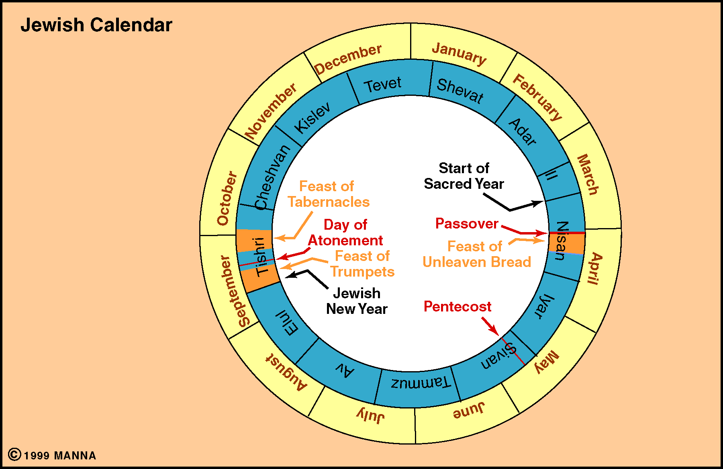
Jewish Calendar

Slide 201
Conversion
of the 3,000
I. The Account (Acts 2)
I. The Account (Acts 2)

Slide 202
Acts 2
“The Beginning”
I. The Reception Of The Holy Spirit (vv. 1-13)
II. Peter’s Sermon (vv. 14-36)
III. Response Of The Multitude (vv. 37-41)
IV. The Disciples Continued In The Apostles Doctrine (vv. 42-47)

Slide 203
I. The Reception Of The Holy Spirit (vv. 1-13)
  A. The apostles receive the Spirit and speak in tongues (vv. 1-4)
  B. The multitude is amazed (vv. 5-13)
The Audience:
In Sin
Think they are okay
Have some knowledge

Slide 204
Acts 2
“The Beginning”
I. The Reception Of The Holy Spirit (vv. 1-13)
II. Peter’s Sermon (vv. 14-36)
III. Response Of The Multitude (vv. 37-41)
IV. The Disciples Continued In The Apostles Doctrine (vv. 42-47)

Slide 205
II. Peter’s Sermon (vv. 14-36)
A. Explanation of the events (vv. 14-21)

Slide 206
17'And it shall come to pass in the last days, says God,
That I will pour out of My Spirit on all flesh;
Your sons and your daughters shall prophesy,
Your young men shall see visions,
Your old men shall dream dreams.
18 And on My menservants and on My maidservants
I will pour out My Spirit in those days;
And they shall prophesy.
19 I will show wonders in heaven above
And signs in the earth beneath:
Blood and fire and vapor of smoke.
20 The sun shall be turned into darkness,
And the moon into blood,
Before the coming of the great and awesome day of the LORD.
21 And it shall come to pass
That whoever calls on the name of the LORD
Shall be saved.'
Revelation
Confirmation
Salvation

Slide 207
II. Peter’s Sermon (vv. 14-36)
A. Explanation of the events (vv. 14-21)
B. Jesus is raised from the dead (vv. 22-36)
1. The one you crucified is raised (vv. 22-24)
2. David prophesied of this (vv. 25-31)
3. He is now exalted as both Lord & Christ (vv. 32-26)
What they heard:
Conviction of sin
Evidence of Res. of Christ

Slide 208
Acts 2
“The Beginning”
I. The Reception Of The Holy Spirit (vv. 1-13)
II. Peter’s Sermon (vv. 14-36)
III. Response Of The Multitude (vv. 37-41)
IV. The Disciples Continued In The Apostles Doctrine (vv. 42-47)

Slide 209
III. Response Of The Multitude (vv. 37-41)
A. They asked what to do (vv. 37-40)
1. The question (v. 37)
2. The answer (vv. 38-40)
a. Repent & be baptized for rem. (vv. 38-39)
b. Save yourself (v. 40)
B. They gladly received word & obeyed (v. 41)
What they were told:
Repent
Be Baptized

Slide 210
Great Commission
Hear (v. 22)
Know (v.36)
Repent
(v. 38)
Baptized (v.38)
Rem (v.38)
Acts 2

Slide 211
Acts 2
“The Beginning”
I. The Reception Of The Holy Spirit (vv. 1-13)
II. Peter’s Sermon (vv. 14-36)
III. Response Of The Multitude (vv. 37-41)
IV. The Disciples Continued In The Apostles Doctrine (vv. 42-47)

Slide 212
IV. The Disciples Continued In The Apostles Doctrine (vv. 42-47)
A. Followed apostles authority (v. 42)
B. Were steadfast (v. 42)
C. Worshiped (v. 42)
D. Feared (v. 43)
E. Took care of needy (vv. 44-45)
F. Served daily (v. 46)
G. Grew (v. 47)
What did they become?
Active Christians
Worshiped, Dedicated, Active

Slide 213
Conversion
of the 3,000
I. The Account (Acts 2)
I. The Account (Acts 2)
II. Summary
II. Summary

Slide 214
Summary of Their Conversion
They were in sin
Jesus was raised from dead
Must Repent & Be Baptized
What Were
They Told?
What Did They
Understand?
That they needed to be saved
That Jesus is Son of God
That they must repent & bapt.
How Did They
Respond?
Gladly, willingly obeyed

Slide 215

Cases of Conversion
3,000 on Pentecost (Acts 2)
Samaritans (Acts 8:4-12)
Simon (Acts 8:13-25)
Ethiopian Eunuch (Acts 8:26-40)
Saul of Tarsus (Acts 9, 22, 26)
Cornelius (Acts 10)
Lydia (Acts 16:13-15)
Philippian Jailor (Acts 16:25-34)
Corinthians (Acts 18)
Ephesians (Acts 19)
Saul of Tarsus (Acts 9, 22, 26)

Slide 216
Conversion of Saul
Acts 9:1-30 – The account of Conversion
Acts 22:1-21 – His defense when arrested – tells of his conversion
Acts 26:1-23 – Before King Agrippa – tells about his conversion

Slide 217
Conversion of Saul
Was
(From)
Became
(To)
Adversary
Advocate
Foe
Friend
Rejected
Accepted

Slide 218
The Conversion of Saul
I. Before
(Rejected by God & His People)

Slide 219
Before
(Rejected by God & His People)
Enemy - Persecutor
Acts 7:58 - An accomplice
Acts 8:1-3 - Havoc of church / prison
Acts 9:1-2 - Threats & murder
Acts 22:4-5 - Death

Slide 220
Before
(Rejected by God & His People)
Enemy - Persecutor
Religious
A Pharisee - Acts 23:6
A Hebrew of Hebrews - Phil. 3:5

Slide 221
Before
(Rejected by God & His People)
Enemy - Persecutor
Religious
Devout - Conscientious
Acts 22:3; 23:1; 24:16; 26:9
Phil. 3:6

Slide 222
Lessons
People can change!
The worse of people - prospects
Strong convictions / feelings against the truth - prospects
Can think your right - be wrong

Slide 223
The Conversion of Saul
I. Before
(Rejected by God & His People)
II. Conversion
(Invited by God & His People)

Slide 224
Conversion
(Invited by God & His People)
Lord Appeared to Saul

Slide 225
What happened:
Bright Light (9:3; 22:6; 26:13)
Voice (9:4-6; 22:7-10; 26:14-18)
“Why persecute me?”
“I am Jesus”
“Go city told what to do”
“Appeared to you -send to Gentles”
Blinded (9:7-9; 22:11)

Slide 226
What happened:
Not converted on the road:
If so - miserable (Acts 9:9)
If so - Ananias didn’t know it (Acts 22:16)
If so - saved without calling on the name of the Lord (Acts 22:16)
If so - still in his sins (Acts 22:16)

Slide 227
What happened:
Not converted on the road:
Purpose of appearance:
Qualified to be an apostle (Acts 1:22; 1 Cor. 9:1)
Sent him to Gentiles (Acts 9:15-16; 22:21; 26:16-18)

Slide 228
Conversion
(Invited by God & His People)
Lord Appeared to Saul
Sending the preacher: Ananias
Acts 9:10-19

Slide 229
Conversion
(Invited by God & His People)
Lord Appeared to Saul
Sending the preacher: Ananias
What he had to do
Not pray through (Acts 9:11; 22:16)
Believed in Christ (John 8:24)
Repented (Acts 17:30-31)
Baptized (Acts 22:16)

Slide 230
Lessons
Saved same way all are
Sacrifice to be a Christian
The Lord invites all - even enemies

Slide 231
The Conversion of Saul
I. Before
(Rejected by God & His People)
II. Conversion
(Invited by God & His People)
III. After
(Accepted by God & His People)

Slide 232
After
(Accepted by God & His People)
Forgiven (Acts 22:16)

Slide 233
After
(Accepted by God & His People)
Forgiven (Acts 22:16)
Taught (Acts 9:20-22; 26:20-23)

Slide 234
After
(Accepted by God & His People)
Forgiven (Acts 22:16)
Taught (Acts 9:20-22; 26:20-23)
Identified (9:26-28)
  Local church membership
  Church not accept – until knew
  Right / respon – maintain purity
  Active in the local church

Slide 235
Lessons
Forgave himself (Titus. 3:3-7)
Shared gospel with others
Churches can’t accept just anyone
Active in local church

Slide 236
The Conversion of Saul
I. Before
(Rejected by God & His People)
II. Conversion
(Invited by God & His People)
III. After
(Accepted by God & His People)

Slide 237
Lessons
All roads lead to Jesus
We all become Christians
in the same way
  3000 → Baptized
  Samaritans → Baptized
  Simon → Baptized
  Eunuch → Baptized
  Saul → Baptized

Slide 238
Cases of Conversion
3,000 on Pentecost (Acts 2)
Samaritans (Acts 8:4-12)
Simon (Acts 8:13-25)
Ethiopian Eunuch (Acts 8:26-40)
Saul of Tarsus (Acts 9, 22, 26)
Cornelius (Acts 10)
Lydia (Acts 16:13-15)
Philippian Jailor (Acts 16:25-34)
Corinthians (Acts 18)
Ephesians (Acts 19)
Cornelius (Acts 10, 11, 15)

Slide 239
Conversion of Cornelius
Acts 10, 11, 15
Acts 10:1-48 – The account of Conversion
Acts 11:1-18 – Peter retells events
Acts 15:7-9 – Peter relates it at Jerusalem

Slide 240
Conversion of Cornelius
Of particular interest – opens door to Gentiles
Converted without circumcision
7+ years gospel has been preached to Jews only

Slide 241
Conversion of Cornelius
Acts 10, 11, 15
Acts 10:1-48 – The account of Conversion
Acts 11:1-18 – Peter retells events
Acts 15:7-9 – Peter relates it at Jerusalem

Slide 242
Conversion of Cornelius
Acts 10, 11, 15
I. The Man Cornelius
I. The Man Cornelius

Slide 243
A. A Gentile
  First Gentile convert
  At time church mostly Jews – Today mostly Gentiles
  His conversion is used to prove Gentiles can be saved like Jews
I. The Man Cornelius

Slide 244
A. A Gentile
B. Military Man
  Centurion (over 100 soldiers)
  Of Italian Regiment (Cohort band of 500 to 1000 men)
  Man of power & authority
  Had same need of the lowest private
I. The Man Cornelius

Slide 245
A. A Gentile
B. Military Man
C. Moral Man
  Devout – Sincere (v. 2)
  Gave alms - good to others (v. 2)
  Just man – honorable, honest (v. 22)
  Good reputation (v. 22)
I. The Man Cornelius

Slide 246
A. A Gentile
B. Military Man
C. Moral Man
D. Religious Man
  Devout – Devoted to his religious service; active in religion (v. 2)
  Feared God (v. 2)
  Prayed (v. 2)
I. The Man Cornelius

Slide 247
A. A Gentile
B. Military Man
C. Moral Man
D. Religious Man
E. Desired to Know
  Admitted that needed to learn (v. 33)
  Wanted to know what God said (v. 33)
I. The Man Cornelius

Slide 248
A. A Gentile
B. Military Man
C. Moral Man
D. Religious Man
E. Desired to Know
F. Relation to God
  Not saved (11:14)
  Had not repented unto life (11:18)
  Even though: Moral & Religious!
I. The Man Cornelius

Slide 249
Conversion of Cornelius
Acts 10, 11, 15
I. The Man Cornelius
I. The Man Cornelius
II. Miracles Surrounding It
II. Miracles Surrounding It
Reason:
First Gentile Convert
To Bring Cornelius & Peter Together

Slide 250
A. Angel Appeared to Cornelius (10:3-8)
  Said prayers are heard (v. 4)
  Told Cornelius to send for Peter (vv. 5-6)
  Peter will tell you what do to (v. 6)
  He send 3 men for Peter (vv. 7-8)
  This had nothing to do with his salvation
    If it did – why not in all cases?
    When Angel left – no evidence that he yet believes in Christ
II. Miracles Surrounding It
Point: To Call For Peter

Slide 251
A. Angel Appeared to Cornelius (10:3-8)
B. Peter’s Vision (10:9-18)
  Sheet with animals told to eat (vv. 9- 16)
  Means: What Lord cleansed – not common or unclean
  Application: Gentiles acceptable
  Explanation (10:28-29)
II. Miracles Surrounding It
Point: Go to the Gentiles

Slide 252
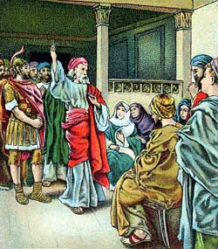
Peter Goes To Cornelius
Acts 10:24-33
1. Cornelius welcomes Peter (vv. 24-27)
a. Waiting with family & friends (vv. 24, 27)
b. Attempted to worship Peter (vv. 25-26)
2. Peter explains why he comes to Gentiles (vv. 28-29)
3. Cornelius explains his calling for Peter (vv. 30-33)
a. His vision (vv. 30-32)
b. Now ready to hear all things commanded (v. 33)

Slide 253
A. Angel Appeared to Cornelius (10:3-8)
B. Peter’s Vision (10:9-18)
C. Reception of the Holy Spirit (vv. 44-47)
  What did they receive?
Holy Spirit Baptism
Was like what the Apostles received (10:45, 47)
Reminded Peter of Holy Spirit Baptism (11:16)
Same gift (11:17)
Just as unto “us” (15:8)
II. Miracles Surrounding It

Slide 254
A. Angel Appeared to Cornelius (10:3-8)
B. Peter’s Vision (10:9-18)
C. Reception of the Holy Spirit (vv. 44-47)
  What did they receive?
  What did it prove?
II. Miracles Surrounding It
That the Gentiles are now Gospel subjects
(Acts 11:18)

Slide 255
A. Angel Appeared to Cornelius (10:3-8)
B. Peter’s Vision (10:9-18)
C. Reception of the Holy Spirit (vv. 44-47)
  What did they receive?
  What did it prove?
  What it does not prove
II. Miracles Surrounding It
1. Holy Spirit baptism For believers today
2. Saved before being baptized

Slide 256
If The Reception of the Holy Spirit Proves Salvation Before Baptism,
It Proves Salvation Before Faith
The Holy Spirit Fell As Peter Began To Speak
(Acts 11:15)
Began
“Past tense of begin” (58)
Begin: “…to enter upon
some action; to start…” (59)
Finished
Finish: “to bring or come
To an end; to complete.”
(242)
Peter’s Sermon
Beginning
Finished

Slide 257
Conversion of Cornelius
Acts 10, 11, 15
I. The Man Cornelius
I. The Man Cornelius
II. Miracles Surrounding It
II. Miracles Surrounding It
III. The Sermon
III. The Sermon

Slide 258
A. No Partiality (10:34-35)
  God does not respect persons
  Accepts those
    Fear God
    Work Righteousness
III. The Sermon

Slide 259
A. No Partiality (10:34-35)
B. Christ (10:36-43)
  Anointed with power - miracles (v. 38)
  Was killed – crucified (v. 39)
  Raised from dead (vv. 40-41)
  Judge of living & dead (v. 42)
  Fulfillment of prophecy (v. 43)
  Offers salvation (v. 43)
III. The Sermon

Slide 260
A. No Partiality (10:34-35)
B. Christ (10:36-43)
C. What he was told to do
  Hear (10:6; 11:14)
  Believe (10:43)
  Repent (11:15)
  Baptized (10:48)
III. The Sermon
Cornelius Obeyed
(Acts 15:7-9)

Slide 261
Conversion of Cornelius
Acts 10, 11, 15
I. The Man Cornelius
I. The Man Cornelius
II. Miracles Surrounding It
II. Miracles Surrounding It
III. The Sermon
III. The Sermon

Slide 262
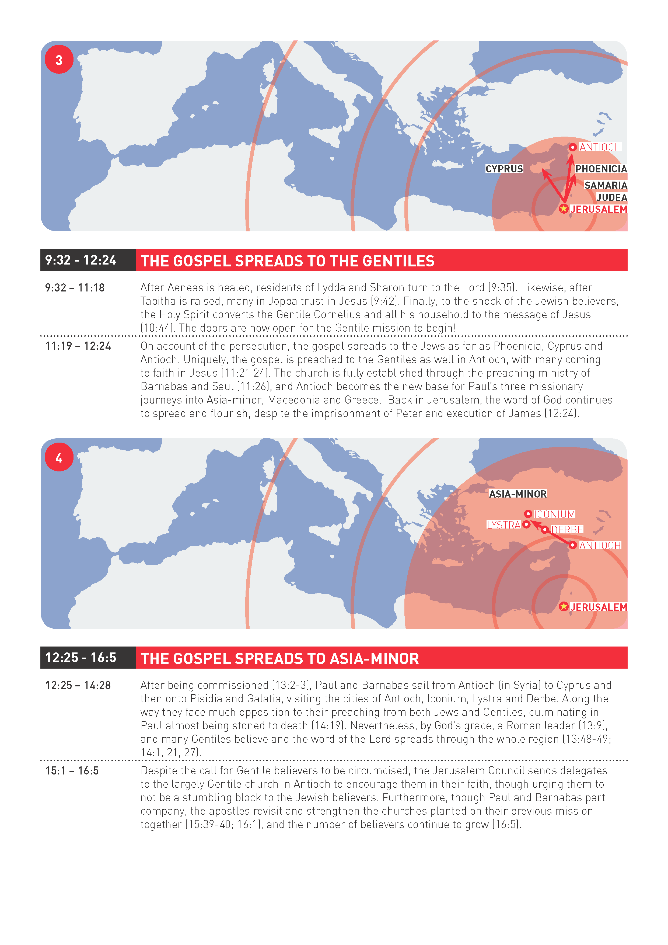

Slide 263
The NEW TESTAMENT BOOK OF ACTS

Slide 264
7/10

