Slide 1
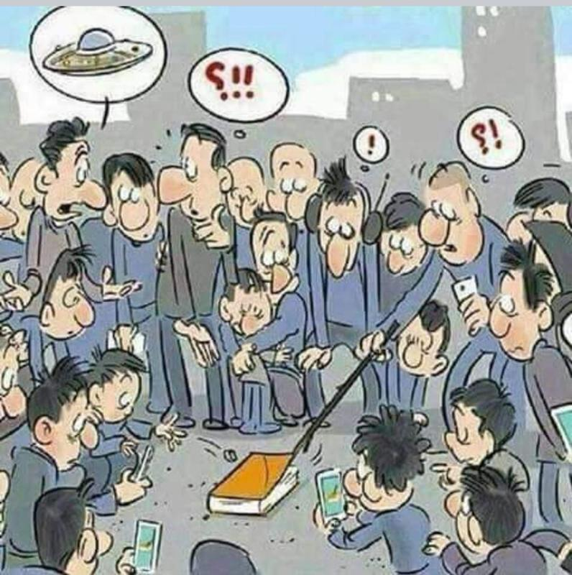
The NEW TESTAMENT BOOK OF ACTS
By David Lee Burris
Chapters 16 - 17 - 18

Slide 2
DOES THE NEW TESTAMENT IN PRACTICE ACTUALLY START WITH THE BOOK OF ACTS NOT THE GOSPELS?
“From the standpoint of the dispensations or the various economies by which God governs the world, the Old Testament Jewish economy actually continued through the gospels. Acts is a transitional book moving from the Old Testament economy into that of the new – the church age, the body of Christ.” (reference)

Slide 5
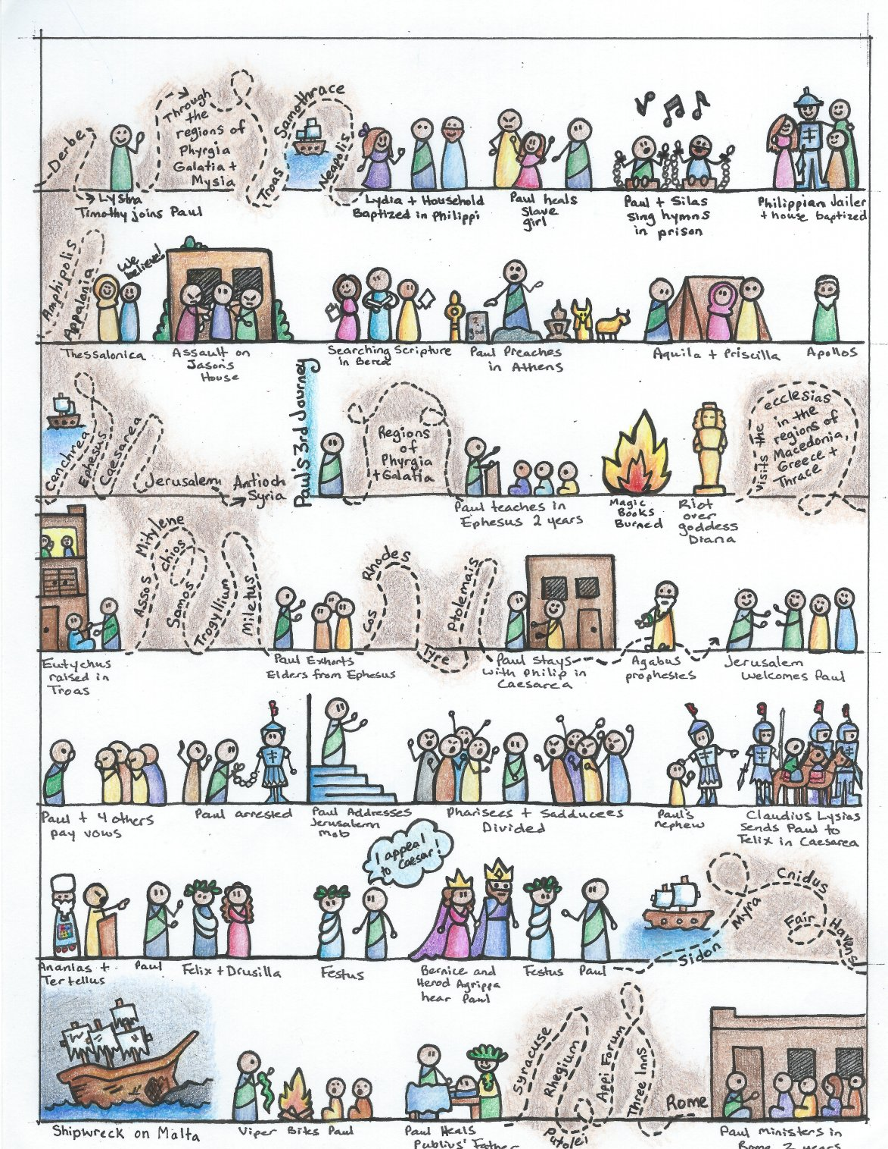

Slide 6
I. THE AUTHOR OF THE BOOK
From earliest times, Luke, “the beloved physician,” has been looked upon by conservative Bible scholars as being the author of The Book of Acts. Both internal and external evidence support this belief.
Luke was: (1) a Gentile (Col. 4:10–14); (2) the only Gentile author of a Bible book; (3) a physician (a medical doctor), Col. 4:14; (4) a “beloved” person, Col. 4:14; (5) a frequent missionary companion of Paul (the so-called “we sections” of The Book of Acts, 16:10–17; 20:5–21:18; 27:1–28:16, prove this assertion); and (6) the author of The Gospel of Luke as well as The Book of Acts.
II. THE ADDRESSEE OF THE BOOK
Luke addressed both The Gospel of Luke and The Book of Acts to Theophilus. Perhaps he had others in view as the ultimate readers of his two books.
We do not know the identity of Theophilus, nor do we know the place of his residence. He almost certainly was: (1) a friend of Luke and (2) a neophyte to Christianity (Luke wrote to Theophilus that he might know the certainty, the truthfulness, of the gospel truths wherein he had been instructed, Luke 1:1).
III. THE PLACE AND THE DATE OF THE WRITING OF THE BOOK
We do not know the place of writing but we can know the approximate date of writing. We know that it was written after the Spring of a.d. 63 for the book’s historical record extends to the Spring of that year and we know that the book was probably written before the Fall of a.d. 64 for the book makes no mention or allusion to the Neronian persecution which began in October of a.d. 64. We know that the book was almost certainly written before a.d. 70 for it makes no mention or allusion to the fall of Jerusalem and the destruction of its temple, events which occurred in a.d. 70 which greatly affected the early church and first-century Christianity (these events ended the Judaizers opposition to the gospel and the practice of preaching the gospel first to the Jews and then to the Gentiles).
IV. THE NAME OF THE BOOK
From the Second Century a.d., the common name for the book has been The Acts of the Apostles. This title is too comprehensive to be a correct one, for the book deals chiefly with the acts of only two apostles, Peter and Paul, and their acts are recorded only in part. A more apt title would be one of the following: (1) the Acts of the Risen Lord; (2) The Acts of the descended Holy Spirit; (3) Some of the Acts of Peter and Paul; (4) A Fragmentary History of the Early Church; (5) The First Chapter of Church History or (6) The only Inspired Chapter of Church History.
In the Greek manuscripts, the title is “Acts of Apostles.” This is a good and accurate title.
V. THE CLASSIFICATION OF THE BOOK
It is one of the five historical books of the New Testament. The New Testament has five historical books (Matthew through Acts), twenty-one doctrinal books (Romans through Jude) and one prophetical book (Revelation).
The 5 New Testament historical books are the New Testament’s “Pentateuch.”
Gingrich, R. E. (2002). (pp. 34). Memphis, TN: Riverside Printing.
Gingrich, R. E. (2002). The Book of Acts (pp. 3–4). Memphis, TN: Riverside Printing.

Slide 7
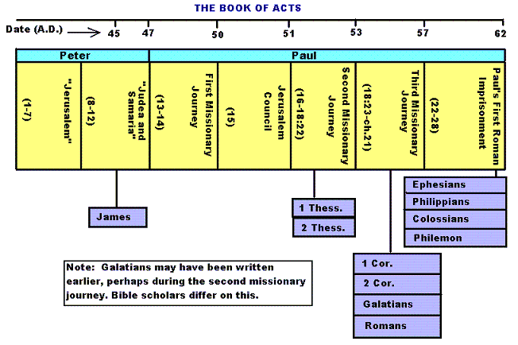

Slide 8
Historicity of Acts:
- the spread of Christianity from Jerusalem to Rome (“the ends of the earth”);
- The progress ... is mainly geographical:
- From Jerusalem ... to Samaria (8.5), Damascus (9.10), Antioch (11.26), Asia Minor (13.13), Europe (16.11), and finally Rome … itself;
- the northeastern corner of the Mediterranean;
- Maybe Spain But Nothing about North Africa, e.g., Alexandria and Cyrene.

Slide 10
1. Prologue and Ascension (1:1-11):
- Post-resurrection appearances … ;
- A ... visible ascension into heaven;
- Matthias chosen to replace Judas Iscariot (1.12-26);
- Luke’s understanding of an Apostle: see 1.21-22;
- Note: Saul (later Paul) meets those qualifications Acts 9 when Christ appeared to him while on the Damascus Road.

Slide 11
2. Founding of the Jerusalem Church - the role of the Holy Spirit (2.12-2.47):
- The Jerusalem Church increases in numbers by means of divine power;
- The work of the Holy Spirit, e.g., Glossolalia (2.1-24; see Joel 2.28-32);
- Peter’s speech interprets the meaning of Pentecost;
- The character of the Jerusalem Church (2.43-45; 4.32-35);

Slide 12
3. The Work of Peter and the other Apostles (3.1-5.42):
- Confrontation between the Apostles and the Jerusalem authorities (4.1-22);
- Luke’s attitude towards both the Sadducees and the Pharisees (4.8-11);

Slide 13
4. Persecution of the “Hellenists” (6.1-8.40):
- Stephen, a leading “Hellenist” or Greek-speaking Jew (6. 5, 8);
- Stephen is presented as the first Christian Martyr (7.60);
- subsequent persecution and the growth of the Church (8.1b-40);
the “new way” carried to such individuals as Simon the Magician (8.9) and an Ethiopian Eunuch (8.27);
the role of Philip in this work of evangelization (6.5; 8.4; 21,8).

Slide 14
5. Preparation for the Gentile Mission (9.1-12.25):
- The progress of Christianity …. as world adversary to pagan religion and human schools of philosophy;
- See, for example, the conversion of Saul of Tarsus (9.1-19) and Cornelius, the Roman centurion (Chs. 10-11);
- Peter is depicted as the one who first opens the door to Gentiles, that is, non-Jews;
Peter’s persuasion of the “circumcision party” (11.1-18);
See 10.44-48 and 11.15-18: the “Gentile Pentecost”;

Slide 15
5. Preparation for the Gentile Mission (9.1-12.25) (contd.):
- Gentiles flock to the Church at Antioch (11.19-26);
- The Jerusalem Church sends Barnabas... to report on the situation (11.22);
- Barnabas with the Apostle Paul at Antioch (11.25-30);
- Gospel preached “all over Judea and Samaria”;
- The first half concludes with an account of Herod Agrippa I’s persecution (41-44 CE) of the Jerusalem community;
- God is unhappy with Herod (12.20-23).

Slide 16
6. First Missionary Journey of Barnabas and Paul and the Jerusalem Conference (13.1-15.35):
- The rest of Acts is devoted mainly to the Missionary Journeys of the Apostle Paul and his fellow workers;
- the work of Paul and Barnabas in the various Hellenistic cities of Asia Minor;
- Dissension between Gentile and Jewish Christians over adherence to the Mosaic Torah (15.1-35);
- must Gentile Christians be circumcised and observe Jewish dietary laws?

Slide 17
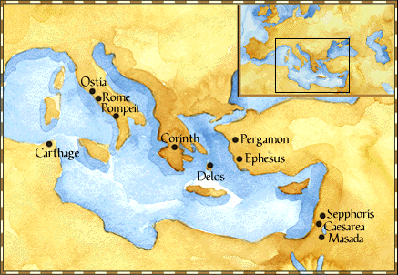
Paul: Map of His World.

Slide 18
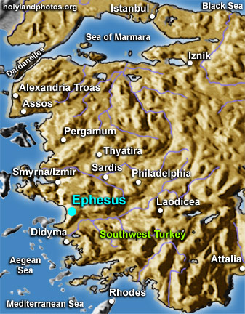

Slide 19
6. First Missionary Journey of Paul and Barnabas and the Jerusalem Conference (13.1-15.35) (contd.):
- The Jerusalem Conference held about A.D. 49 (Acts 15);
- Must a Gentile believer become a Jew ... to be a Christian?
- A division within the Church;
- The dispute settled in favor of uncircumcised Gentiles (15.28-29);
- The deciding voice is that of James (15.13-21).

Slide 20
6. First Missionary Journey of Paul and Barnabas and the Jerusalem Conference (13.1-15.35) (contd.):
- The Apostles and Elders required only limited Torah mandates of the Gentile Christians (15.13-21);
- requirements based on rules from Leviticus (Acts 15.13-21; Leviticus 17-18);
- Themes of unity and cooperation dominate … ;
- it is a unanimous decision and the “Whole Church” sends a delegation to Antioch to explain the Jerusalem Church’s decision (15.30-35);
- Actually, a decision of the Holy Spirit (15.22-29).

Slide 21
6. First Missionary Journey of Paul and Barnabas and the Jerusalem Conference (13.1-15.35) (contd.):
- Paul’s independence of the Apostolic Church (Gal 1.17, 18-19, 20; 2.1-10);
- Paul indicates that he was never under the jurisdiction of the Church’s leadership in Jerusalem (Gal 1.17, 18-19, 20; 2.1-10);
- See also 1 Cor 8.8; 10.27 relative to eating meat sacrificed to Greco-Roman gods.

Slide 22
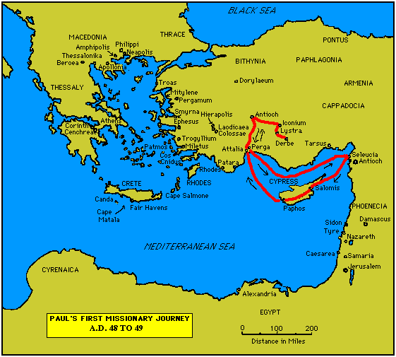

Slide 23
7. Paul’s Secondary Missionary Journey; Evangelizing Greece (16.1-18.21):
- Paul and Barnabas separate (15.39);
- Why the separation?
- Paul and Silas visit churches in Syria and Asia Minor (15.40-41);
- A vision directs Paul to Macedonia (15.40-16.10);
- Paul’s customary activity relative to the Jews and then being abused by them (16.11-17.15);

Slide 24
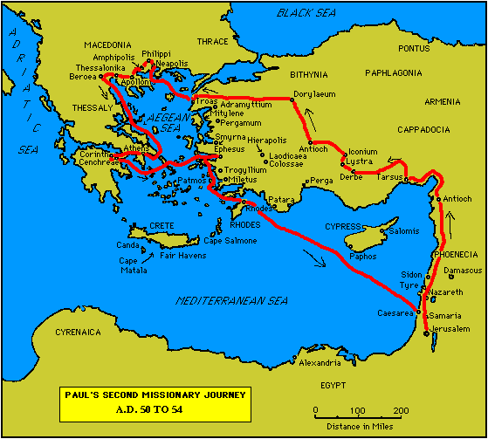

Slide 25
7. Paul’s Secondary Missionary Journey; Evangelizing Greece (16.1-18.21) (contd.):
- Paul in Philippi, Thessalonica, Beroea, and Athens;
- Paul speaks at the Areopagus in Athens (17.19-31);
- Paul at Corinth (18.1-17);

Slide 27
8. Paul’s Third Missionary Journey: Revisiting Asia Minor and Greece (18.22-20.38):
- Paul at Ephesus (18.19-21);
- Luke depicts Paul as determined to complete his last tour and head for the imperial capital, that is, Rome (19.21-22);
- Paul’s farewell speech at Miletus (20.17-38);
- See maps on the location of the major churches at the end of Paul’s ministry.

Slide 28
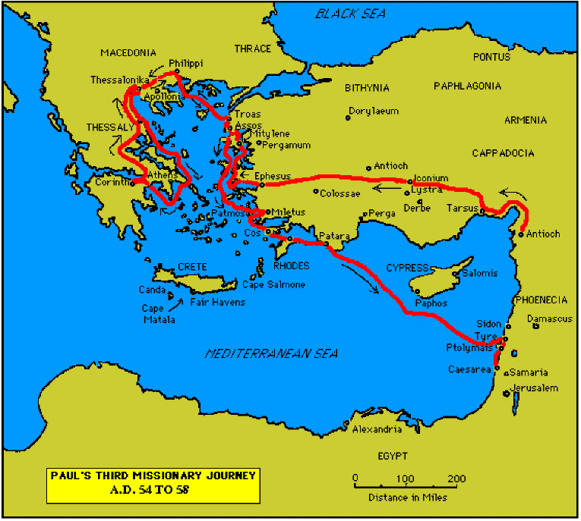

Slide 30
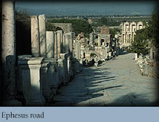

Slide 31
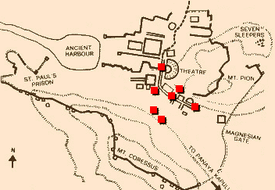
Ephesus: General View of the Ancient City.

Slide 32
9. Paul’s arrest in Jerusalem and imprisonment in Caesarea Maritime (21.1-26.32):
- Paul returns to Jerusalem (21.17) ... accused of blasphemy and profaning the Temple;
- When arrested, Paul claims that he is a Pharisee (21.27-23.10);
- Paul is imprisoned ... in Caesarea (23.33-26.32);
- he exercises his birthright as a Roman citizen (25.1-21);
- he defends himself (26.1-29);

Slide 33
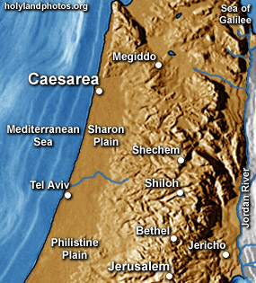

Slide 34
10. Paul’s Journey to Rome and His Preaching to Roman Jews (27.1-28.31):
- Paul’s sea journey to Rome... a shipwreck on the island of Malta (28.1 ) (see Map);
- the narrative in the first person plural, that is, “we”;
- Acts ends with Paul’s arrival in Rome (28.16);
- Paul is under house arrest but is free to preach (28.31);
- He continues to evangelize the Romans (28.23-31);
- We are not told of Paul’s fate.

Slide 35
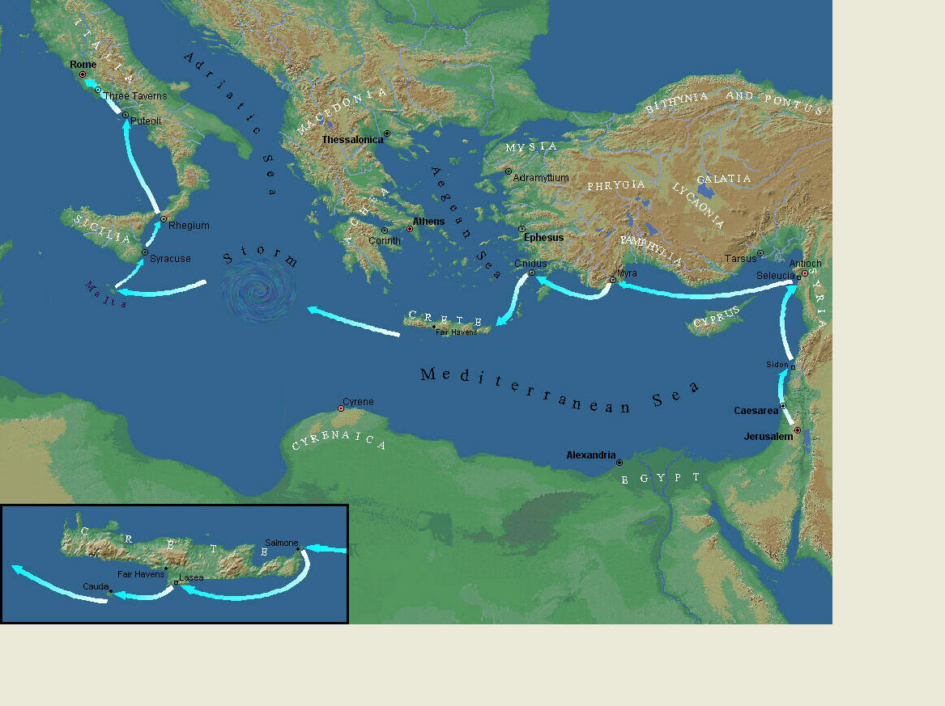
Paul’s Journey to Rome.

Slide 36
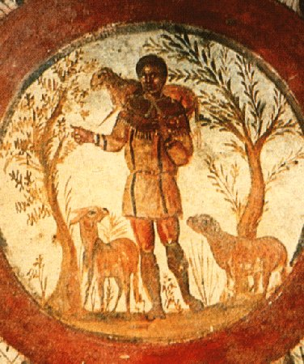
The Good Shepherd – in Catacombs of Rome.

Slide 37
10. Paul’s Journey to Rome and his Preaching to Roman Jews (27.1-28.31) (contd.):
- Luke has accomplished his task of tracing Christianity’s expansion from Jerusalem to “the ends of the earth” (1.8);
- Another theme emphasized: Paul and his successor evangelists will henceforth direct the Gospel primarily to Non-Jews, for “the Gentiles will listen” (28.28);
- Luke quotes from Isaiah 6 (see also Mark 4.10-13);
- Christianity’s future belongs to the Gentiles.

Slide 38
Basic Book Structure acts of the Apostles Centers around the great commission & Call To evangelize Then known world!

Slide 39
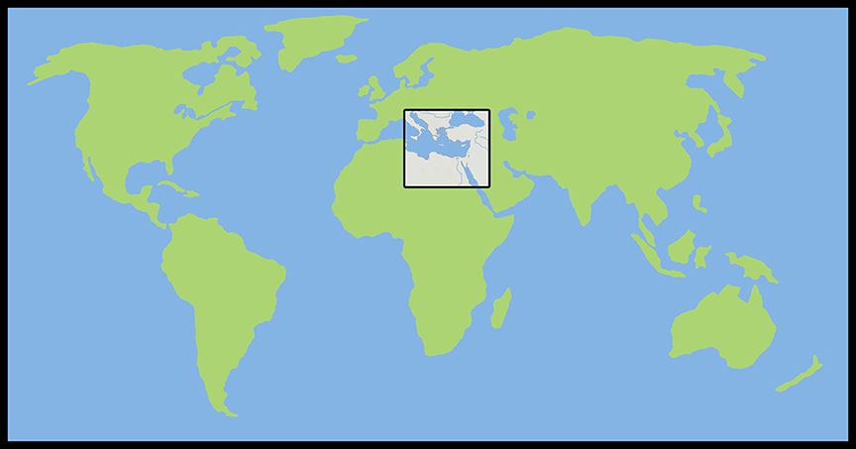
Where the Story takes Place

Slide 40
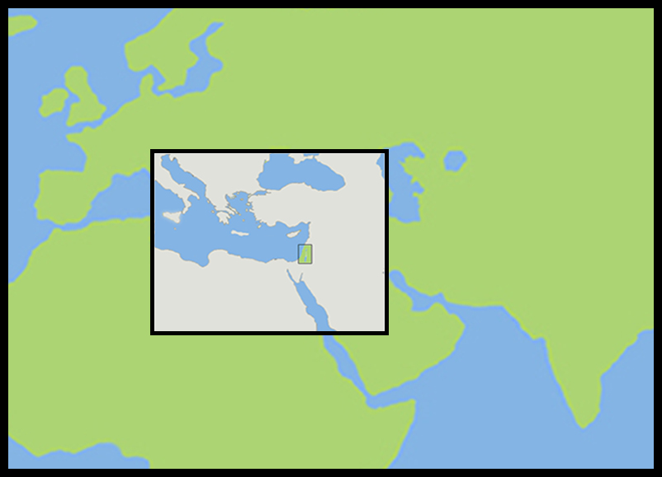
The Land of Canaan in the Near East

Slide 41
Acts 1:8 and the Great Commission
Acts 1:8 But ye shall receive power, after that the Holy Ghost is come upon you: and ye shall be witnesses unto me both in Jerusalem, and in all Judaea, and in Samaria, and unto the uttermost part of the earth.
Matthew 28:19-20 ¹⁹ Go ye therefore, and teach all nations, baptizing them in the name of the Father, and of the Son, and of the Holy Ghost: ²⁰ Teaching them to observe all things whatsoever I have commanded you: and, lo, I am with you alway, even unto the end of the world. Amen.
Mark 16:15 And he said unto them, Go ye into all the world, and preach the gospel to every creature.

Slide 42
Acts 1:8 and the Great Commission
Acts 1:8 But ye shall receive power, after that the Holy Ghost is come upon you: and ye shall be witnesses unto me both in Jerusalem, and in all Judaea, and in Samaria, and unto the uttermost part of the earth.
Matthew 28:19-20 ¹⁹ Go ye therefore, and teach all nations, baptizing them in the name of the Father, and of the Son, and of the Holy Ghost: ²⁰ Teaching them to observe all things whatsoever I have commanded you: and, lo, I am with you alway, even unto the end of the world. Amen.
Mark 16:15 And he said unto them, Go ye into all the world, and preach the gospel to every creature.

Slide 43
Acts 1:8 and the Great Commission
Acts 1:8 But ye shall receive power, after that the Holy Ghost is come upon you: and ye shall be witnesses unto me both in Jerusalem, and in all Judaea, and in Samaria, and unto the uttermost part of the earth.
Matthew 28:19-20 ¹⁹ Go ye therefore, and teach all nations, baptizing them in the name of the Father, and of the Son, and of the Holy Ghost: ²⁰ Teaching them to observe all things whatsoever I have commanded you: and, lo, I am with you alway, even unto the end of the world. Amen.
Mark 16:15 And he said unto them, Go ye into all the world, and preach the gospel to every creature.

Slide 44
Acts 1:8 and the Great Commission
Acts 1:8 But ye shall receive power, after that the Holy Ghost is come upon you: and ye shall be witnesses unto me both in Jerusalem, and in all Judaea, and in Samaria, and unto the uttermost part of the earth.
Matthew 28:19-20 ¹⁹ Go ye therefore, and teach all nations, baptizing them in the name of the Father, and of the Son, and of the Holy Ghost: ²⁰ Teaching them to observe all things whatsoever I have commanded you: and, lo, I am with you alway, even unto the end of the world. Amen.
Mark 16:15 And he said unto them, Go ye into all the world, and preach the gospel to every creature.

Slide 45
Acts 1:8 and the Structure of the Book
Acts 1:8 … ye shall be witnesses unto me both in Jerusalem, and in all Judaea, and in Samaria, and unto the uttermost part of the earth.
1. The witness in Jerusalem:
Chapters 1 to 7
2. The witness in Judaea and Samaria:
Chapters 8 to 12
3. The witness unto the uttermost parts of the earth:
Chapters 13 to 28

Slide 46
The Three Audiences
Part 1: The Jews
Part 2: The Samaritans
Part 3: The Gentiles

Slide 47
The Pillars of the Church
Part 1: Peter
Part 2: Peter and Paul (Saul of Tarsus)
Part 3: Paul

Slide 48
The Timeline
Part 1: 5 years (AD 30-35)
Part 2: 13 years (AD 35-48)
Part 3: 14 years (AD 48-62)
A total of 32 years, according to Nelson’s Complete Book of Bible Maps and Charts.

Slide 49
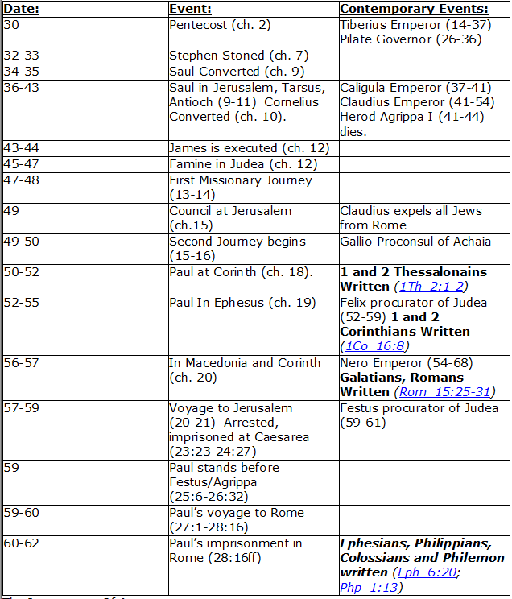
CHART BY
Mark Dunagan

Slide 50
PART ONE—The infancy of the church (the church in Jerusalem) (chapters 1–7)
(In this section, Jerusalem is the central city of Christianity and Peter is the most prominent person)
I. THE POST-RESURRECTION MINISTRY OF CHRIST (1:1–8)
II. THE ASCENSION OF CHRIST (1:9–11)
III. THE WAITING IN THE UPPER ROOM (1:12–26)
IV. THE ADVENT OF THE HOLY SPIRIT (2:1–41)
V. THE SNAPSHOT OF THE EARLY CHURCH (2:42–47)
VI. THE HEALING OF THE LAME MAN AND ITS CONSEQUENCES (3:1–4:31)
VII. THE DEATH OF ANANIAS AND SAPPHIRA AND ITS EFFECTS (4:32–5:42)
VIII. THE APPOINTMENT OF THE SEVEN (6:1–7)
IX. THE MINISTRY OF STEPHEN (6:8–7:60)
PART TWO—The adolescence of the church (the church in all Judea and In Samaria) (chapters 8–12)
(In this section, Jerusalem is gradually being replaced by Antioch as the central city of Christianity and Peter is gradually being replaced by Paul as the most prominent person)
I. THE FIRST MENTION OF PAUL (7:58; 8:1, 3)
II. THE PERSECUTION AND SCATTERING OF THE JERUSALEM CHURCH (8:1–4)
III. THE CONVERSION OF SAMARITANS (8:5–25)
IV. THE CONVERSION OF A JEWISH PROSELYTE (8:26–40)
V. THE CONVERSION OF SAUL (9:1–31)
VI. THE EXPANSION OF THE CHURCH IN WESTERN JUDEA (9:32–43)
VII. THE CONVERSION OF GENTILE GOD-FEARERS (chapter 10)
VIII. THE GROWING VISION OF THE JEWISH LEADERS (11:1–18)
IX. THE CONVERSION OF PAGAN GENTILES (11:19–26)
X. THE GROWING TIES BETWEEN JEWISH AND GENTILE CHRISTIANITY (11:27–30)
XI. THE COMPLETION OF THE TRANSITION (chapter 12)
PART THREE—The maturity of the church (the church in all the world) (chapters 13–28)
(In this section, Antioch is the central city of Christianity and Paul is the most prominent person)
I. PAUL’S CALL AT ANTIOCH TO HIS LIFE’S WORK (13:1–3)
II. PAUL’S FIRST MISSIONARY JOURNEY (13:4–14:27)
III. PAUL’S TWO YEARS BACK IN ANTIOCH (14:28–15:35)
IV. PAUL’S SECOND MISSIONARY JOURNEY (15:36–18:22)
V. PAUL’S THIRD MISSIONARY JOURNEY (18:23–21:16)
VI. PAUL’S ARREST AT JERUSALEM (21:17–23:35)
VII. PAUL’S TWO-YEARS’ IMPRISONMENT AT CAESAREA (chapters 24–26)
VIII. PAUL’S SHIPWRECK JOURNEY TO ROME (27:1–28:15)
IX. PAUL’S FIRST ROMAN IMPRISONMENT (28:16–31)
Gingrich, R. E. (2002). The Book of Acts (pp. 5–6). Memphis, TN: Riverside Printing.

Slide 51
L.D. CARY & SAM HOLT CATCH PHRASES
Chapter 10 – “The Gentiles Come In”
Chapter 11 – “10 + 1, Peter’s Rerun”
Chapter 12 – “10 + 2, Peter’s Rescue”
Chapter 13 – “10 + 3, First Preaching Spree”
Chapter 14 – “10 + 4, Preaching More”
Chapter 15 – “10 + 5, The Truth Survives”
Chapter 16 – “European Scene”
Chapter 17 – “10 + 7, One God In Heaven”
Chapter 18 – “10 + 8, The Corinth Wait”
“European Scene”
Catch Phrase
Chapter Sixteen

Slide 52
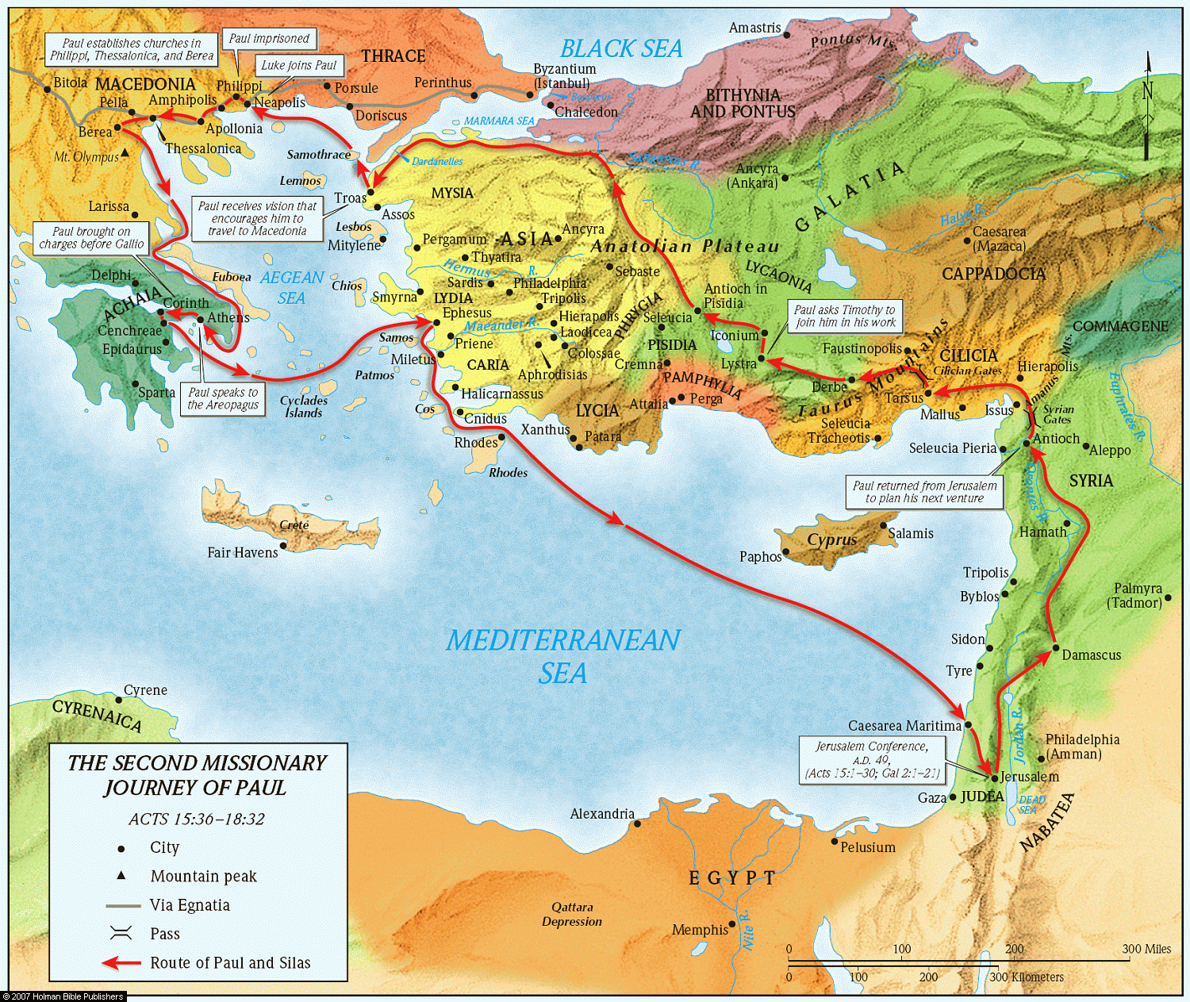
ACTS 16
PAUL’S
2ND MISSIONARY
JOURNEY

Slide 53
Acts 16:1-2 (NASB) ¹ Paul came also to Derbe and to Lystra. And a disciple was there, named Timothy, the son of a Jewish woman who was a believer, but his father was a Greek, ² and he was well spoken of by the brethren who were in Lystra and Iconium.
A. Derbe and Lystra:
B. Timothy:
1. Timothy’s reputation extended to both the Lystra and Iconium churches, it is believed he may already have been a public speaker, which is the work for which Paul used Timothy: 1Tim 4:12-13; 1Cor 16:10-11; Phil 2:19-22
2. Timothy’s mother is a Jewess who was converted by the teachings of Paul before Timothy was also converted by Paul. 2Tim 1:2-5; 2Tim 3:14-15; 1Tim 1:2, 18-19; 2Tim 3:10-12
2 Timothy 1:2-5 (NASB77) ² to Timothy, my beloved son: Grace, mercy and peace from God the Father and Christ Jesus our Lord. ³ I thank God, whom I serve with a clear conscience the way my forefathers did, as I constantly remember you in my prayers night and day, ⁴ longing to see you, even as I recall your tears, so that I may be filled with joy. ⁵ For I am mindful of the sincere faith within you, which first dwelt in your grandmother Lois, and your mother Eunice, and I am sure that it is in you as well.
2 Timothy 3:10-12 (NASB77) ¹⁰ But you followed my teaching, conduct, purpose, faith, patience, love, perseverance, ¹¹ persecutions, and sufferings, such as happened to me at Antioch, at Iconium and at Lystra; what persecutions I endured, and out of them all the Lord delivered me! ¹² And indeed, all who desire to live godly in Christ Jesus will be persecuted.
Acts 14:19 (NASB77) (At Lystra) ¹⁹ But Jews came from Antioch and Iconium, and having won over the multitudes, they stoned Paul and dragged him out of the city, supposing him to be dead.
2 Timothy 3:14-15 (NASB77) ¹⁴ You, however, continue in the things you have learned and become convinced of, knowing from whom you have learned them; ¹⁵ and that from childhood you have known the sacred writings which are able to give you the wisdom that leads to salvation through faith which is in Christ Jesus.
1 Timothy 1:18-19 (NASB77) ¹⁸ This command I entrust to you, Timothy, my son, in accordance with the prophecies previously made concerning you, that by them you may fight the good fight, ¹⁹ keeping faith and a good conscience, which some have rejected and suffered shipwreck in regard to their faith.
1 Timothy 1:2 (NASB77) ² to Timothy, my true child in the faith: Grace, mercy and peace from God the Father and Christ Jesus our Lord.
1 Timothy 4:12-13 (NASB77) ¹² Let no one look down on your youthfulness, but rather in speech, conduct, love, faith and purity, show yourself an example of those who believe. ¹³ Until I come, give attention to the public reading of Scripture, to exhortation and teaching.
1 Corinthians 16:10-11 (NASB77) ¹⁰ Now if Timothy comes, see that he is with you without cause to be afraid; for he is doing the Lord's work, as I also am. ¹¹ Let no one therefore despise him. But send him on his way in peace, so that he may come to me; for I expect him with the brethren.
Philippians 2:19-22 (NASB77) ¹⁹ But I hope in the Lord Jesus to send Timothy to you shortly, so that I also may be encouraged when I learn of your condition. ²⁰ For I have no one else of kindred spirit who will genuinely be concerned for your welfare.
²¹ For they all seek after their own interests, not those of Christ Jesus. ²² But you know of his proven worth that he served with me in the furtherance of the gospel like a child serving his father.
Notes:
Timothy appears to have been a personal convert of Paul. That his grandmother and mother were first converted and Timothy followed having been given a deep familiarity with the word of God as he grew up. This made him fertile soil when his heart heard the teachings of Paul. Timothy was with Paul during his 1st missionary journey as saw first-hand the sufferings of Paul at the hands of unbelievers including the stoning of Paul.

Slide 54
Acts 16:3 (NASB) ³ Paul wanted this man to go with him; and he took him and circumcised him because of the Jews who were in those parts, for they all knew that his father was a Greek.
A. Timothy and circumcision:
1. Because the Jewish community in that region knew Timothy’s mother was a Jewess and his father was a Greek, Paul circumcised him. 1Cor 9:20-22
1 Corinthians 9:20-22 (NASB77) ²⁰ And to the Jews I became as a Jew, that I might win Jews; to those who are under the Law, as under the Law, though not being myself under the Law, that I might win those who are under the Law; ²¹ to those who are without law, as without law, though not being without the law of God but under the law of Christ, that I might win those who are without law.
²² To the weak I became weak, that I might win the weak; I have become all things to all men, that I may by all means save some.
Notes:
Keep in mind that the Jews saw Jewish Christians as a part of a Jewish sect: Acts 28:21-22;
Paul became all things to all men in order that he might save some. His journey to save the lost is being recorded in the history recorded here in Acts. He was willing to pay a heavy personal cost in order to save some. This is the journey we are investigating.

Slide 55
Acts 16:4-5 (NASB) ⁴ Now while they were passing through the cities, they were delivering the decrees which had been decided upon by the apostles and elders who were in Jerusalem, for them to observe. ⁵ So the churches were being strengthened in the faith, and were increasing in number daily.
A. They were delivering the decrees in which the Jerusalem church declared they did not teach Gentiles must be circumcised and keep the Law of Moses in order to be saved (Acts 15:23-29).
1. The strengthening of the faithful was the intention of Paul when he proposed this missionary journey. Acts 15:36; 3Jn 1:2-4; Acts 20:32; Ro 10:17; 1Pet 1:5; Ro 1:16
2. Not only were the disciples strengthened but the churches continued to grow numerically. This made rejection bearable:
Acts 15:36 (NASB77) ³⁶ And after some days Paul said to Barnabas, "Let us return and visit the brethren in every city in which we proclaimed the word of the Lord, and see how they are."
3 John 1:2-4 (NASB77) ² Beloved, I pray that in all respects you may prosper and be in good health, just as your soul prospers. ³ For I was very glad when brethren came and bore witness to your truth, that is, how you are walking in truth. ⁴ I have no greater joy than this, to hear of my children walking in the truth.
Acts 20:32 (NASB77) ³² "And now I commend you to God and to the word of His grace, which is able to build you up and to give you the inheritance among all those who are sanctified.
1 Peter 1:5 (NASB77) ⁵ who are protected by the power of God through faith for a salvation ready to be revealed in the last time.
Romans 10:17 (NASB77) ¹⁷ So faith comes from hearing, and hearing by the word of Christ.
Romans 1:16 (NASB77) ¹⁶ For I am not ashamed of the gospel, for it is the power of God for salvation to everyone who believes, to the Jew first and also to the Greek.
Notes:
The efforts of Christians seeking the lost were filled with disappointment but when was worth it when souls were won to the Lord.

Slide 56
Acts 16:6-9 (NASB) ⁶ They passed through the Phrygian and Galatian region, having been forbidden by the Holy Spirit to speak the word in Asia; ⁷ and after they came to Mysia, they were trying to go into Bithynia, and the Spirit of Jesus did not permit them; ⁸ and passing by Mysia, they came down to Troas. ⁹ A vision appeared to Paul in the night: a man of Macedonia was standing and appealing to him, and saying, "Come over to Macedonia and help us."
A. Passing through the regions of Phrygian, Galatian, Mysia forbidden to speak in Asia and Bithynia, finally stopping at the city of Troas:
B. A vision at Troas: Visions appear to be a waking dream in which the person does not know it is a dream and interacts with the experience.

Slide 57
Acts 16:10-12 (NASB) ¹⁰ When he had seen the vision, immediately we sought to go into Macedonia, concluding that God had called us to preach the gospel to them. ¹¹ So putting out to sea from Troas, we ran a straight course to Samothrace, and on the day following to Neapolis; ¹² and from there to Philippi, which is a leading city of the district of Macedonia, a Roman colony; and we were staying in this city for some days.
A. God had called them to preach the gospel to them: Rom 1:16; 10:13-15; Acts 15:7
B. The trip from Troas to Philippi:
Romans 1:16 (NASB77) ¹⁶ For I am not ashamed of the gospel, for it is the power of God for salvation to everyone who believes, to the Jew first and also to the Greek.
Romans 10:13-15 (NASB77) ¹³ for " WHOEVER WILL CALL UPON THE NAME OF THE LORD WILL BE SAVED." ¹⁴ How then shall they call upon Him in whom they have not believed? And how shall they believe in Him whom they have not heard? And how shall they hear without a preacher?
Acts 15:7 (NASB77) ⁷ And after there had been much debate, Peter stood up and said to them, "Brethren, you know that in the early days God made a choice among you, that by my mouth the Gentiles should hear the word of the gospel and believe.
¹⁵ And how shall they preach unless they are sent? Just as it is written, " HOW BEAUTIFUL ARE THE FEET OF THOSE WHO BRING GLAD TIDINGS OF GOOD THINGS!"

Slide 58
Acts 16:13-15 (NASB) ¹³ And on the Sabbath day we went outside the gate to a riverside, where we were supposing that there would be a place of prayer; and we sat down and began speaking to the women who had assembled. ¹⁴ A woman named Lydia, from the city of Thyatira, a seller of purple fabrics, a worshiper of God, was listening; and the Lord opened her heart to respond to the things spoken by Paul. ¹⁵ And when she and her household had been baptized, she urged us, saying, "If you have judged me to be faithful to the Lord, come into my house and stay." And she prevailed upon us.
A. There was no synagogue in Philippi. There must be a minimum of 10 Jewish men to establish a synagogue. There was a place of prayer at the riverside.
1. A small group of (Jewish/Proselytes?) women met at the riverside to pray:
2. If you have judged me to be faithful: meaning because I believed and obeyed
Notes:
1/15/18

Slide 59
Acts 16:16-18 (NASB) ¹⁶ It happened that as we were going to the place of prayer, a slave-girl having a spirit of divination met us, who was bringing her masters much profit by fortune-telling. ¹⁷ Following after Paul and us, she kept crying out, saying, "These men are bond- servants of the Most High God, who are proclaiming to you the way of salvation." ¹⁸ She continued doing this for many days. But Paul was greatly annoyed, and turned and said to the spirit, "I command you in the name of Jesus Christ to come out of her!" And it came out at that very moment.
A. Slave girl having a spirit of divination:
1. The message she proclaimed was true but endorsed a lie. (Lit. a way of Salvation)
B. It is amazing that Paul tolerated this detestable Prophetess for many days:
1. She represented a false religion already accepted by the community. This would imply an alliance existed between Jesus, the Apostles, the Gospel and the religion of Apollos and demons. Mk 1:34; Lk 4:41
Mark 1:34 (NASB) ³⁴ And He healed many who were ill with various diseases, and cast out many demons; and He was not permitting the demons to speak, because they knew who He was.
Luke 4:41 (NASB) ⁴¹ Demons also were coming out of many, shouting, "You are the Son of God!" But rebuking them, He would not allow them to speak, because they knew Him to be the Christ.
(Jesus could not allow the influence of demons to taint His work. We must remember that Jesus enemies accused him of working with Satan in casting out demons. It might appear that the accusations were true, so Jesus shut the demons' mouths)

Slide 60
Acts 16:19-21 (NASB) ¹⁹ But when her masters saw that their hope of profit was gone, they seized Paul and Silas and dragged them into the market place before the authorities, ²⁰ and when they had brought them to the chief magistrates, they said, "These men are throwing our city into confusion, being Jews, ²¹ and are proclaiming customs which it is not lawful for us to accept or to observe, being Romans."
A. Her masters saw what Paul had done. There was no doubt that the power of the apostle was responsible for the casting out of the demon. Ro 15:19; 1Cor 2:1-5;
1. Their concern was not the servant girl now in her right mind but the loss of the money she profited them. Mt 6:20-24; Col 3:5
B. Accusations, “Throwing our city into confusion, being Jews”: Acts 19:38-41
1. Proclaiming customs not lawful for Romans: Jn 19:12-13; Acts 17:7
Matthew 6:20-24 (NASB) ²⁰ "But store up for yourselves treasures in heaven, where neither moth nor rust destroys, and where thieves do not break in or steal; ²¹ for where your treasure is, there your heart will be also. ²² "The eye is the lamp of the body; so then if your eye is clear, your whole body will be full of light. ²³ "But if your eye is bad, your whole body will be full of darkness. If then the light that is in you is darkness, how great is the darkness!
Acts 19:38-41 (NASB) ³⁸ "So then, if Demetrius and the craftsmen who are with him have a complaint against any man, the courts are in session and proconsuls are available; let them bring charges against one another. ³⁹ "But if you want anything beyond this, it shall be settled in the lawful assembly. ⁴⁰ "For indeed we are in danger of being accused of a riot in connection with today's events, since there is no real cause for it, and in this connection we will be unable to account for this disorderly gathering." ⁴¹ After saying this he dismissed the assembly.
(The preaching of the Gospel often caused anger and unrest. Jesus prepared his apostles for such an outcome. Mt 10:17-25, 34-36)
1 Corinthians 2:1-5 (NASB) ¹ And when I came to you, brethren, I did not come with superiority of speech or of wisdom, proclaiming to you the testimony of God. ² For I determined to know nothing among you except Jesus Christ, and Him crucified. ³ I was with you in weakness and in fear and in much trembling,
⁴ and my message and my preaching were not in persuasive words of wisdom, but in demonstration of the Spirit and of power, ⁵ so that your faith would not rest on the wisdom of men, but on the power of God.
²⁴ "No one can serve two masters; for either he will hate the one and love the other, or he will be devoted to one and despise the other. You cannot serve God and wealth.
Acts 17:7 (NASB) ⁷ and Jason has welcomed them, and they all act contrary to the decrees of Caesar, saying that there is another king, Jesus."
John 19:12-13 (NASB) ¹² As a result of this Pilate made efforts to release Him, but the Jews cried out saying, "If you release this Man, you are no friend of Caesar; everyone who makes himself out to be a king opposes Caesar." ¹³ Therefore when Pilate heard these words, he brought Jesus out, and sat down on the judgment seat at a place called The Pavement, but in Hebrew, Gabbatha.
Romans 15:19 (NASB) ¹⁹ in the power of signs and wonders, in the power of the Spirit; so that from Jerusalem and round about as far as Illyricum I have fully preached the gospel of Christ.
Colossians 3:5 (NASB) ⁵ Therefore consider the members of your earthly body as dead to immorality, impurity, passion, evil desire, and greed, which amounts to idolatry.
Notes:
A. Her masters do not bring up the real personal loss of profits as their reason for bringing Paul and Silas to the Magistrates.
B. The magistrates are responsible to Rome for maintaining peace in the community:
1. Rome was generally tolerant of Religion unless it involved a social or Political crime.

Slide 61
Acts 16:22-24 (NASB) ²² The crowd rose up together against them, and the chief magistrates tore their robes off them and proceeded to order them to be beaten with rods. ²³ When they had struck them with many blows, they threw them into prison, commanding the jailer to guard them securely; ²⁴ and he, having received such a command, threw them into the inner prison and fastened their feet in the stocks.
A. No actual trial takes place. The magistrates give in to the crowd (mob) and beat Silas and Paul with rods: 2Cor 11:25; 1Pet 1:6-7; 2:19-23; 3:8-14; 4:12-16; 2Ti 3:12
1. They threw them into prison commanding the jailer to guard them securely:
a. The Jailer took his duty seriously and put them into the inner prison putting their feet in stocks:
1 Peter 2:19-23 (NASB) ¹⁹ For this finds favor, if for the sake of conscience toward God a person bears up under sorrows when suffering unjustly. ²⁰ For what credit is there if, when you sin and are harshly treated, you endure it with patience? But if when you do what is right and suffer for it you patiently endure it, this finds favor with God.
1 Peter 3:8-14 (NASB) ⁸ To sum up, all of you be harmonious, sympathetic, brotherly, kindhearted, and humble in spirit; ⁹ not returning evil for evil or insult for insult, but giving a blessing instead; for you were called for the very purpose that you might inherit a blessing.
1 Peter 4:12-16 (NASB) ¹² Beloved, do not be surprised at the fiery ordeal among you, which comes upon you for your testing, as though some strange thing were happening to you; ¹³ but to the degree that you share the sufferings of Christ, keep on rejoicing, so that also at the revelation of His glory you may rejoice with exultation. ¹⁴ If you are reviled for the name of Christ, you are blessed, because the Spirit of glory and of God rests on you.
²¹ For you have been called for this purpose, since Christ also suffered for you, leaving you an example for you to follow in His steps, ²² WHO COMMITTED NO SIN, NOR WAS ANY DECEIT FOUND IN HIS MOUTH; ²³ and while being reviled, He did not revile in return; while suffering, He uttered no threats, but kept entrusting Himself to Him who judges righteously;
¹⁰ For, "THE ONE WHO DESIRES LIFE, TO LOVE AND SEE GOOD DAYS, MUST KEEP HIS TONGUE FROM EVIL AND HIS LIPS FROM SPEAKING DECEIT. ¹¹ "HE MUST TURN AWAY FROM EVIL AND DO GOOD; HE MUST SEEK PEACE AND PURSUE IT.
¹² "FOR THE EYES OF THE LORD ARE TOWARD THE RIGHTEOUS, AND HIS EARS ATTEND TO THEIR PRAYER, BUT THE FACE OF THE LORD IS AGAINST THOSE WHO DO EVIL." ¹³ Who is there to harm you if you prove zealous for what is good? ¹⁴ But even if you should suffer for the sake of righteousness, you are blessed. AND DO NOT FEAR THEIR INTIMIDATION, AND DO NOT BE TROUBLED,
¹⁵ Make sure that none of you suffers as a murderer, or thief, or evildoer, or a troublesome meddler; ¹⁶ but if anyone suffers as a Christian, he is not to be ashamed, but is to glorify God in this name.
1 Peter 1:6-7 (NASB) ⁶ In this you greatly rejoice, even though now for a little while, if necessary, you have been distressed by various trials, ⁷ so that the proof of your faith, being more precious than gold which is perishable, even though tested by fire, may be found to result in praise and glory and honor at the revelation of Jesus Christ;
2 Corinthians 11:25 (NASB) ²⁵ Three times I was beaten with rods, once I was stoned, three times I was shipwrecked, a night and a day I have spent in the deep.
2 Timothy 3:12 (NASB) ¹² Indeed, all who desire to live godly in Christ Jesus will be persecuted.
Notes:
8/5/2018 – Point 1

Slide 62
Acts 16:25-28 (NASB) ²⁵ But about midnight Paul and Silas were praying and singing hymns of praise to God, and the prisoners were listening to them; ²⁶ and suddenly there came a great earthquake, so that the foundations of the prison house were shaken; and immediately all the doors were opened and everyone’s chains were unfastened. ²⁷ When the jailer awoke and saw the prison doors opened, he drew his sword and was about to kill himself, supposing that the prisoners had escaped. ²⁸ But Paul cried out with a loud voice, saying, "Do not harm yourself, for we are all here!"
A. Praying and Singing hymns of praise to God: Eph 5:19; Col 3:16
B. An earthquake of such strength that the cell doors open and the chains fell loose from what they were attached.
C. Roman Penalty for allowing a prisoner to escape was death: Acts 12:19
Original Word: ὑμνέω, hymneō - Verb
Usage Notes: is used (a) transitively, Matt. 26:30; Mark 14:26, where the "hymn" was that part of the Hallel consisting of Psalms 113-118; (b) intransitively, where the verb itself is rendered "to sing praises" or "praise," Acts 16:25; Heb. 2:12. The Psalms are called, in general, "hymns," by Philo; Josephus calls them "songs and hymns.“
Vine's Expository Dictionary of Old Testament and New Testament Words
Noun hallel - /hɑˈleɪl/ 1. Hallel Judaism A chant of praise Psalms 113 through 118 used at Passover and Shabuoth and Sukkoth and Hanukkah and Rosh Hodesh
The Sage VII English Dictionary
Ephesians 5:19 (NASB) (the noun form of the verb in Acts 16:25 “singing hymns”) ¹⁹ speaking to one another in psalms and hymns and spiritual songs, singing and making melody with your heart to the Lord;
Colossians 3:16 (NASB) (the noun form of the verb in Acts 16:25 “singing hymns”) ¹⁶ Let the word of Christ richly dwell within you, with all wisdom teaching and admonishing one another with psalms and hymns and spiritual songs, singing with thankfulness in your hearts to God.
Acts 12:19 (NASB) ¹⁹ When Herod had searched for him and had not found him, he examined the guards and ordered that they be led away to execution. Then he went down from Judea to Caesarea and was spending time there.
Notes:
Verse 25 – Timothy and Luke were not with Paul when he was arrested. We are not told where they are.
“Singing, Hymns and Praise” all coming from one Greek word, Verb. Strong's Number: <G5214>
The Prisoners were listening: Literally the word “listening” means “intently listening”

Slide 63
Acts 16:29-31 (NASB) ²⁹ And he called for lights and rushed in, and trembling with fear he fell down before Paul and Silas, ³⁰ and after he brought them out, he said, "Sirs, what must I do to be saved?" ³¹ They said, "Believe in the Lord Jesus, and you will be saved, you and your household."
A. The Jailor is ecstatic at the knowledge that everyone is present. No one escaped. He understood why they were arrested and had listened to their prayers to God and fell asleep to their songs praising God:
1. Trembling with fear he fell before Paul and Silas: Lit. Terrified and quaking in fear.
2. “What must I do to be saved?”:

Slide 64
Acts 16:32-34 (NASB) ³² And they spoke the word of the Lord to him together with all who were in his house. ³³ And he took them that very hour of the night and washed their wounds, and immediately he was baptized, he and all his household. ³⁴ And he brought them into his house and set food before them, and rejoiced greatly, having believed in God with his whole household.
A. Having believed in God with his whole household: “having believed in God” includes believing Jesus is Lord and baptism. Jailer Vs 31-33, Lydia 14-15
Acts 16:31-33 (NASB) ³¹ They said, "Believe in the Lord Jesus, and you will be saved, you and your household." ³² And they spoke the word of the Lord to him together with all who were in his house. ³³ And he took them that very hour of the night and washed their wounds, and immediately he was baptized, he and all his household.
Acts 16:14-15 (NASB) (Lydia sees her obedience in baptism as faithfulness to God) ¹⁴ A woman named Lydia, from the city of Thyatira, a seller of purple fabrics, a worshiper of God, was listening; and the Lord opened her heart to respond to the things spoken by Paul. ¹⁵ And when she and her household had been baptized, she urged us, saying, "If you have judged me to be faithful to the Lord, come into my house and stay." And she prevailed upon us.
Notes:
What other grounds could Paul judge Lydia to be faithful to the Lord other than her response to the Gospel in baptism? Paul barely knows anything about her except how she responded to the Gospel.

Slide 65
Acts 16:35-37 (NASB) ³⁵ Now when day came, the chief magistrates sent their policemen, saying, "Release those men." ³⁶ And the jailer reported these words to Paul, saying, "The chief magistrates have sent to release you. Therefore come out now and go in peace." ³⁷ But Paul said to them, "They have beaten us in public without trial, men who are Romans, and have thrown us into prison; and now are they sending us away secretly? No indeed! But let them come themselves and bring us out."
A. Beaten without a trial: It was a capital offence to scourge a Roman citizen. The magistrates had publicly treated him like a criminal, thus bringing shame on his name. He could not allow his name to be blemished. Acts 22:25-29; Prov 22:1
1. Why was Paul born a Roman citizen? It is unknown. It could be that Paul’s family entertained and provided hospitality to some powerful Roman leader. Possibly the people of Tarsus showed loyalty to Rome at a difficult time. Acts 21:39; 22:3
Acts 22:25-29 (NASB) ²⁵ But when they stretched him out with thongs, Paul said to the centurion who was standing by, "Is it lawful for you to scourge a man who is a Roman and uncondemned?" ²⁶ When the centurion heard this, he went to the commander and told him, saying, "What are you about to do? For this man is a Roman." ²⁷ The commander came and said to him, "Tell me, are you a Roman?" And he said, "Yes."
Acts 21:39 (NASB) ³⁹ But Paul said, "I am a Jew of Tarsus in Cilicia, a citizen of no insignificant city; and I beg you, allow me to speak to the people." Acts 22:3 (NASB) ³ "I am a Jew, born in Tarsus of Cilicia, but brought up in this city, educated under Gamaliel, strictly according to the law of our fathers, being zealous for God just as you all are today.
²⁸ The commander answered, "I acquired this citizenship with a large sum of money." And Paul said, "But I was actually born a citizen." ²⁹ Therefore those who were about to examine him immediately let go of him; and the commander also was afraid when he found out that he was a Roman, and because he had put him in chains.
Proverbs 22:1 (NASB) ¹ A good name is to be more desired than great wealth, Favor is better than silver and gold.
Notes:
Paul could not allow this injustice to stand. If other communities where they would preach heard of it they would be emboldened to do the same. It would hinder the Gospel.

Slide 66
Acts 16:38-40 (NASB) ³⁸ The policemen reported these words to the chief magistrates. They were afraid when they heard that they were Romans, ³⁹ and they came and appealed to them, and when they had brought them out, they kept begging them to leave the city. ⁴⁰ They went out of the prison and entered the house of Lydia, and when they saw the brethren, they encouraged them and departed.
A. The magistrates were forced to publicly bring them out of the prison cell and begged (not command) them to leave the city. This would become known to all the nearby cities and would provide protection in the work of preaching the Gospel.
1. The brethren were gathered at Lydia’s house which may have become the place of meeting for the church at Philippi. Phil 4:1
Philippians 4:1 (NASB) ¹ Therefore, my beloved brethren whom I long to see, my joy and crown, in this way stand firm in the Lord, my beloved.

Slide 67
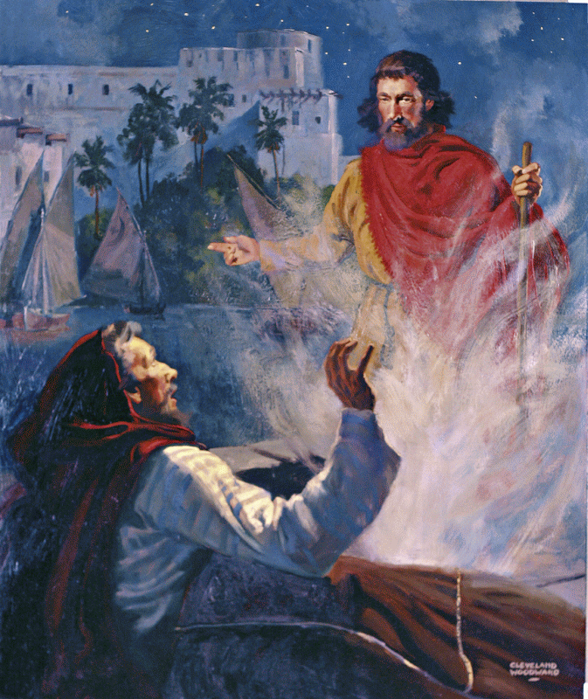
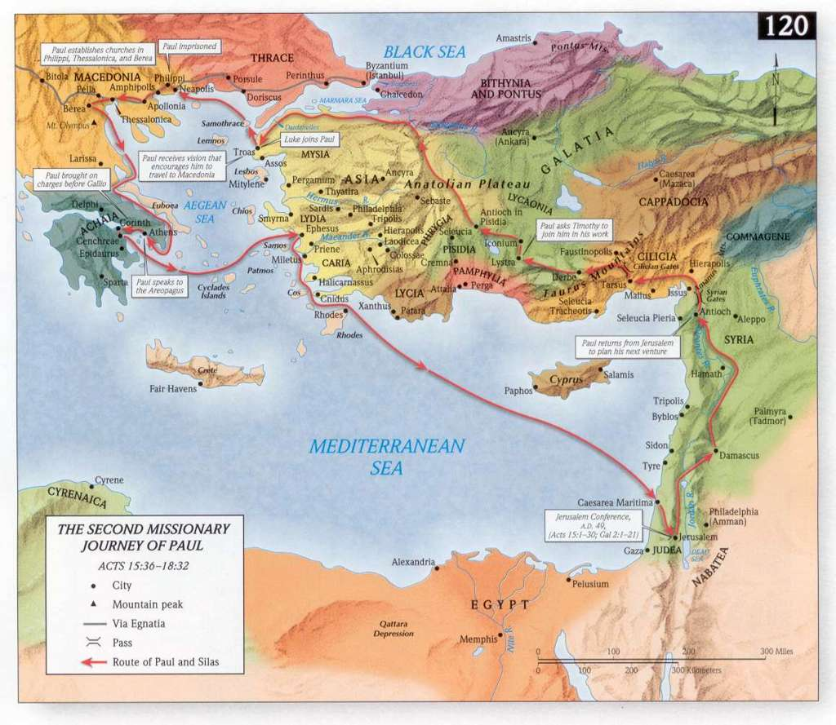
Acts 16:6-8 (NASB77) ⁶ And they passed through the Phrygian and Galatian region, having been forbidden by the Holy Spirit to speak the word in Asia; ⁷ and when they had come to Mysia, they were trying to go into Bithynia, and the Spirit of Jesus did not permit them; ⁸ and passing by Mysia, they came down to Troas.
Acts 16:9-10 (NASB77) ⁹ And a vision appeared to Paul in the night: a certain man of Macedonia was standing and appealing to him, and saying, "Come over to Macedonia and help us."
Notes:
TROAS: A large seaport city of Mysia in northwest Asia Minor, 10 mi. S of ancient Troy; in NT times it was the gateway from Asia to Macedonia and Thrace.
Troas was founded by Antigonus (a successor of Alexander the Great). In 133 b.c. the Romans gained control of the city. Augustus made Troas an independent Roman colony possessing Roman landholding privileges and immunities.

Slide 68
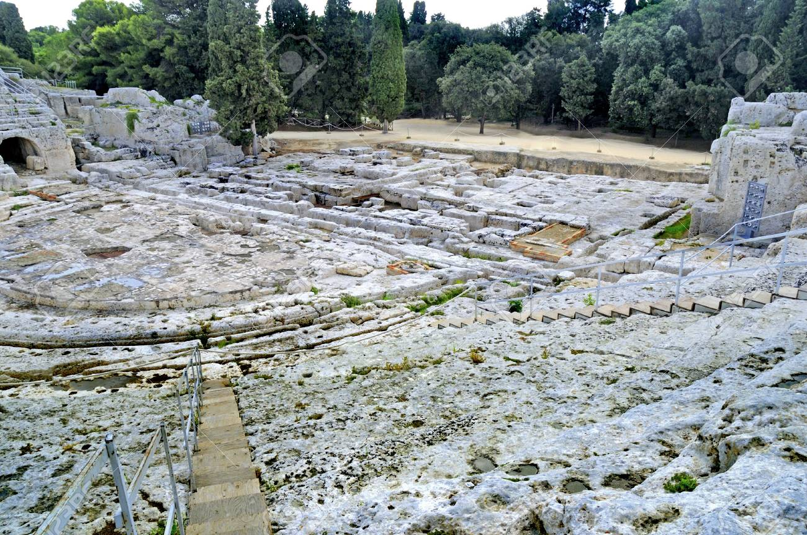
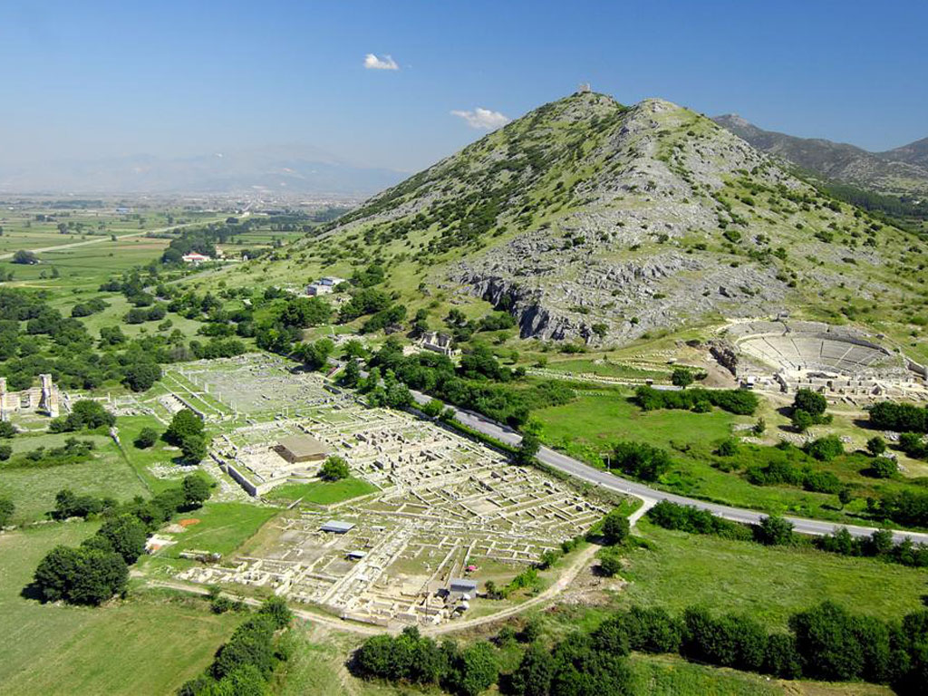
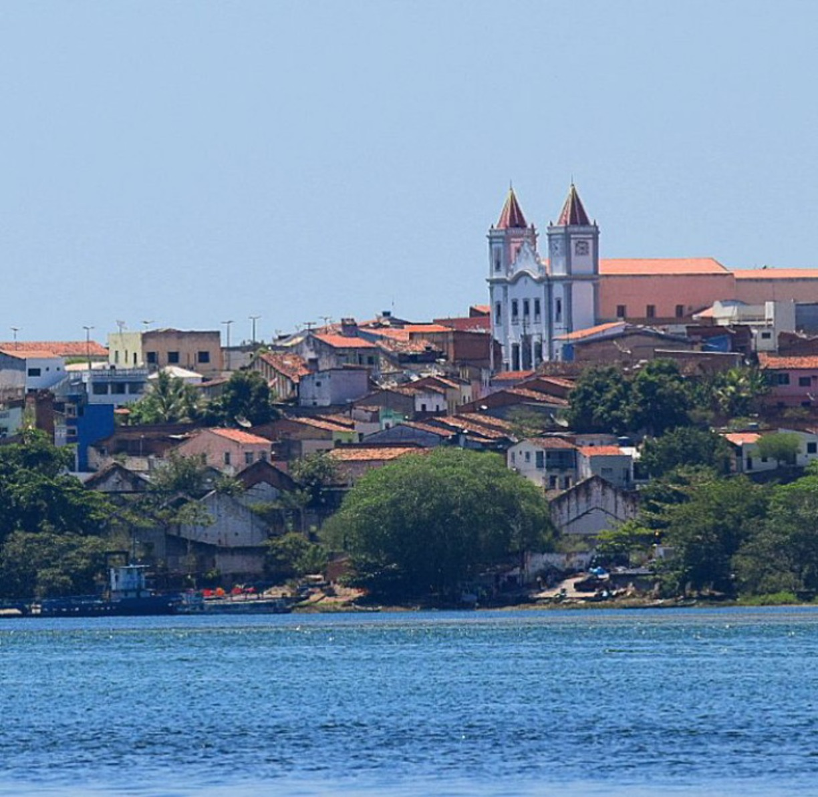
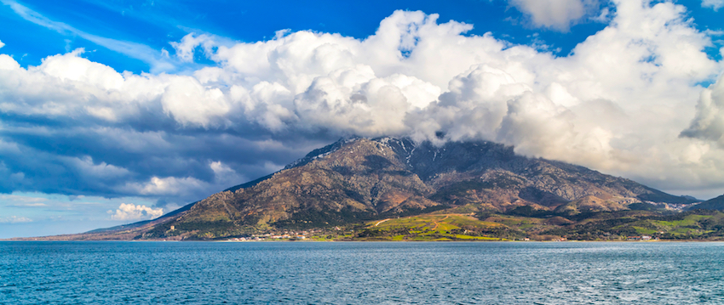
Island of Samothrace
Ancient Ruins At Neapolis
Neapolis
Ancient Ruins At Philippi
Acts 16:11-12 (NASB77) ¹¹ Therefore putting out to sea from Troas, we ran a straight course to Samothrace, and on the day following to Neapolis; ¹² and from there to Philippi, which is a leading city of the district of Macedonia, a Roman colony; and we were staying in this city for some days.
Notes:
Samothrace: A small island (only 176 sq. km., or 68 sq. mi.) in the northeast Aegean Sea. As the name indicates (see Samos), the island is mountainous, its highest peak rising to 1800 m. (5900 ft.), the highest point on any of the Aegean islands. The island had no harbor—only an unsafe anchorage on its north side
Neapolis: The seaport of the city of Philippi on the north coast of the Aegean Sea. Neapolis was about 10 mi. SE of Philippi and was beautifully situated on a natural rocky area that stretched out into the north Aegean. Neapolis at the time of Paul was part of the Roman province of Macedonia. As a result of the success of the gospel in the area, the town was known as "Christopolis" in the early centuries of the Christian era.
Philippi: Philippi was given the right to the Law of Italy together with many privileges and immunities—especially the immunity from taxation. As might be expected, the residents of Philippi became very conscious of their Roman heritage.

Slide 69
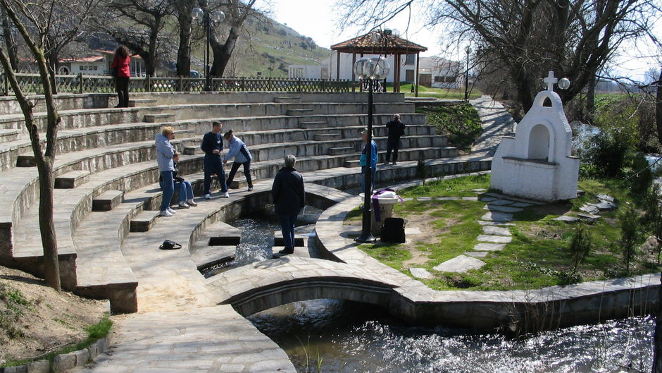
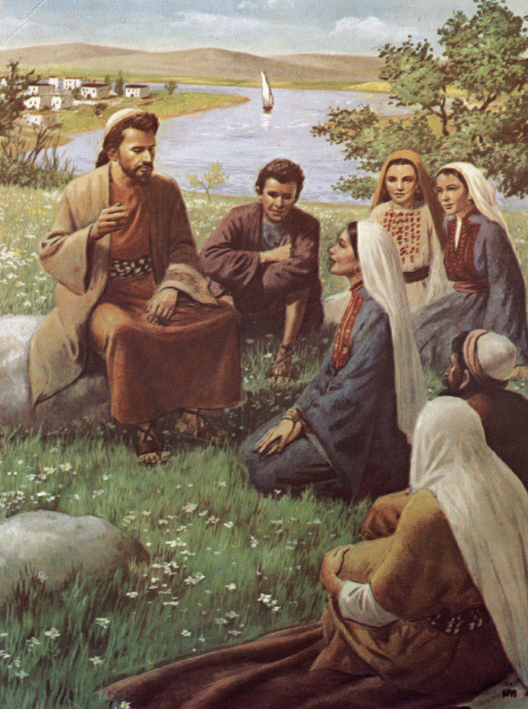
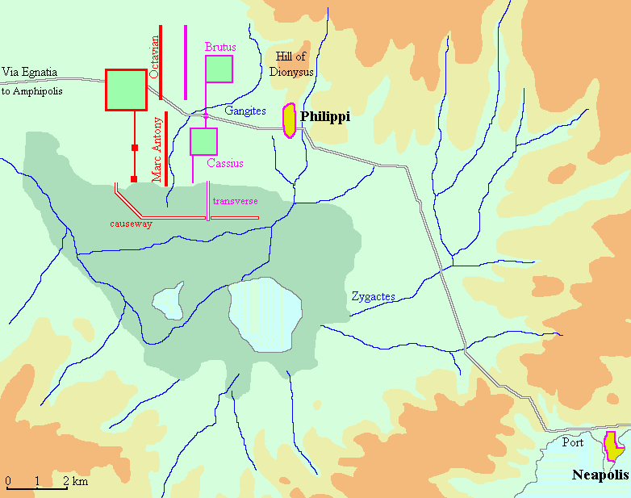
Acts 16:13-14 (NASB) ¹³ And on the Sabbath day we went outside the gate to a riverside, where we were supposing that there would be a place of prayer; and we sat down and began speaking to the women who had assembled.
¹⁴ A woman named Lydia, from the city of Thyatira, a seller of purple fabrics, a worshiper of God, was listening; and the Lord opened her heart to respond to the things spoken by Paul.
Notes:
It is possible that meeting by the river provided them with the water they would need for ceremonial cleansing.
Lydia was from Thyatira where there was a large Jewish community. She most likely was converted to Judaism while living there.

Slide 70
THE CONVERSION OF LYDIA AND HER HOUSEHOLD
I. Paul began speaking to the women: Acts 16:10; 1Cor 15:1-8
A. The Gospel is Facts to be believed
1. Lydia a worshipper of God was listening and the Lord opened her heart to respond. How did the Lord open her heart? By the Gospel message she was listening to: Heb 4:11-13; Acts 2:4, 37; 8:4-6; Acts 11:12-14; Acts 15:7; Acts 7:51-52; Ro 10:14-17; Ro 1:16
B. The Gospel is commands to be obeyed: Acts 6:7; Ro 2:8; 2Thess 1:8; 1Pet 4:17
1. Lydia obeyed the gospel in the waters of baptism: Acts 16:15; 2:37-38, 41; Acts 8:12, 35-38 continued obedience – Ro 1:1-5; Phil 2:12-14; 1Pet 1:14-16
C. The Gospel is promises to be received: Mk 16:16; Acts 2:38; Ro 6:23; Act 26:6-8; 1Jn 2:25
Acts 2:37-38 (NASB) ³⁷ Now when they heard this, they were pierced to the heart, and said to Peter and the rest of the apostles, "Brethren, what shall we do?" ³⁸ Peter said to them, "Repent, and each of you be baptized in the name of Jesus Christ for the forgiveness of your sins; and you will receive the gift of the Holy Spirit.
Acts 2:41 (NASB) ⁴¹ So then, those who had received his word were baptized; and that day there were added about three thousand souls.
1 John 2:25 (NASB) ²⁵ This is the promise which He Himself made to us: eternal life.
Acts 2:39 (NASB) 39 "For the promise is for you and your children and for all who are far off, as many as the Lord our God will call to Himself."
Acts 26:6-8 (NASB) ⁶ "And now I am standing trial for the hope of the promise made by God to our fathers; ⁷ the promise to which our twelve tribes hope to attain, as they earnestly serve God night and day. And for this hope, O King, I am being accused by Jews. ⁸ "Why is it considered incredible among you people if God does raise the dead?
Mark 16:16 (NASB) ¹⁶ "He who has believed and has been baptized shall be saved; but he who has disbelieved shall be condemned. Acts 2:38 (NASB) ³⁸ Peter said to them, "Repent, and each of you be baptized in the name of Jesus Christ for the forgiveness of your sins; and you will receive the gift of the Holy Spirit. Romans 6:23 (NASB) ²³ For the wages of sin is death, but the free gift of God is eternal life in Christ Jesus our Lord.
Acts 8:12 (NASB) ¹² But when they believed Philip preaching the good news about the kingdom of God and the name of Jesus Christ, they were being baptized, men and women alike.
Acts 8:35-38 (NASB) ³⁵ Then Philip opened his mouth, and beginning from this Scripture he preached Jesus to him. ³⁶ As they went along the road they came to some water; and the eunuch *said, "Look! Water! What prevents me from being baptized?" ³⁷ [And Philip said, "If you believe with all your heart, you may." And he answered and said, "I believe that Jesus Christ is the Son of God."] ³⁸ And he ordered the chariot to stop; and they both went down into the water, Philip as well as the eunuch, and he baptized him.
1 Peter 1:14-16 (NASB) ¹⁴ As obedient children, do not be conformed to the former lusts which were yours in your ignorance, ¹⁵ but like the Holy One who called you, be holy yourselves also in all your behavior; ¹⁶ because it is written, "YOU SHALL BE HOLY, FOR I AM HOLY.“
Philippians 2:12-14 (NASB) ¹² So then, my beloved, just as you have always obeyed, not as in my presence only, but now much more in my absence, work out your salvation with fear and trembling; ¹³ for it is God who is at work in you, both to will and to work for His good pleasure. ¹⁴ Do all things without grumbling or disputing;
Romans 1:1-5 (NASB) ¹ Paul, a bond-servant of Christ Jesus, called as an apostle, set apart for the gospel of God, ² which He promised beforehand through His prophets in the holy Scriptures, ³ concerning His Son, who was born of a descendant of David according to the flesh, ⁴ who was declared the Son of God with power by the resurrection from the dead, according to the Spirit of holiness, Jesus Christ our Lord, ⁵ through whom we have received grace and apostleship to bring about the obedience of faith among all the Gentiles for His name's sake,
1 Corinthians 15:1-8 (NASB) ¹ Now I make known to you, brethren, the gospel which I preached to you, which also you received, in which also you stand, ² by which also you are saved, if you hold fast the word which I preached to you, unless you believed in vain.
Acts 16:10 (NASB) ¹⁰ When he had seen the vision, immediately we sought to go into Macedonia, concluding that God had called us to preach the gospel to them.
⁵ and that He appeared to Cephas, then to the twelve. ⁶ After that He appeared to more than five hundred brethren at one time, most of whom remain until now, but some have fallen asleep; ⁷ then He appeared to James, then to all the apostles; ⁸ and last of all, as to one untimely born, He appeared to me also.
³ For I delivered to you as of first importance what I also received, that Christ died for our sins according to the Scriptures, ⁴ and that He was buried, and that He was raised on the third day according to the Scriptures,
Acts 11:12-14 (NASB) ¹² "The Spirit told me to go with them without misgivings. These six brethren also went with me and we entered the man's house. ¹³ "And he reported to us how he had seen the angel standing in his house, and saying, 'Send to Joppa and have Simon, who is also called Peter, brought here; ¹⁴ and he will speak words to you by which you will be saved, you and all your household.'
Acts 15:7 (NASB) ⁷ After there had been much debate, Peter stood up and said to them, "Brethren, you know that in the early days God made a choice among you, that by my mouth the Gentiles would hear the word of the gospel and believe.
Hebrews 4:11-13 (NASB) ¹¹ Therefore let us be diligent to enter that rest, so that no one will fall, through following the same example of disobedience. ¹² For the word of God is living and active and sharper than any two-edged sword, and piercing as far as the division of soul and spirit, of both joints and marrow, and able to judge the thoughts and intentions of the heart.
Acts 2:4 (NASB) ⁴ And they were all filled with the Holy Spirit and began to speak with other tongues, as the Spirit was giving them utterance.
Acts 2:37 (NASB) ³⁷ Now when they heard this, they were pierced to the heart, and said to Peter and the rest of the apostles, "Brethren, what shall we do?"
Acts 8:4-6 (NASB) ⁴ Therefore, those who had been scattered went about preaching the word. ⁵ Philip went down to the city of Samaria and began proclaiming Christ to them. ⁶ The crowds with one accord were giving attention to what was said by Philip, as they heard and saw the signs which he was performing.
Romans 10:14-17 (NASB) ¹⁴ How then will they call on Him in whom they have not believed? How will they believe in Him whom they have not heard? And how will they hear without a preacher? ¹⁵ How will they preach unless they are sent? Just as it is written, "HOW BEAUTIFUL ARE THE FEET OF THOSE WHO BRING GOOD NEWS OF GOOD THINGS!"
Romans 1:16 (NASB) ¹⁶ For I am not ashamed of the gospel, for it is the power of God for salvation to everyone who believes, to the Jew first and also to the Greek.
Acts 7:51-52 (NASB) ⁵¹ "You men who are stiff-necked and uncircumcised in heart and ears are always resisting the Holy Spirit; you are doing just as your fathers did. ⁵² "Which one of the prophets did your fathers not persecute? They killed those who had previously announced the coming of the Righteous One, whose betrayers and murderers you have now become;
Acts 16:13-14 (NASB) ¹³ And on the Sabbath day we went outside the gate to a riverside, where we were supposing that there would be a place of prayer; and we sat down and began speaking to the women who had assembled. ¹⁴ A woman named Lydia, from the city of Thyatira, a seller of purple fabrics, a worshiper of God, was listening; and the Lord opened her heart to respond to the things spoken by Paul.
¹³ And there is no creature hidden from His sight, but all things are open and laid bare to the eyes of Him with whom we have to do.
¹⁶ However, they did not all heed the good news; for Isaiah says, "LORD, WHO HAS BELIEVED OUR REPORT?" ¹⁷ So faith comes from hearing, and hearing by the word of Christ.
Acts 6:7 (NASB) ⁷ The word of God kept on spreading; and the number of the disciples continued to increase greatly in Jerusalem, and a great many of the priests were becoming obedient to the faith.
2 Thessalonians 1:8 (NASB) ⁸ dealing out retribution to those who do not know God and to those who do not obey the gospel of our Lord Jesus.
1 Peter 4:17 (NASB) ¹⁷ For it is time for judgment to begin with the household of God; and if it begins with us first, what will be the outcome for those who do not obey the gospel of God?
Romans 2:8 (NASB) ⁸ but to those who are selfishly ambitious and do not obey the truth, but obey unrighteousness, wrath and indignation.
Acts 16:15 (NASB) ¹⁵ And when she and her household had been baptized, she urged us, saying, "If you have judged me to be faithful to the Lord, come into my house and stay." And she prevailed upon us.
Notes:
7/22/18 – B.
The Lord had moved Lydia to respond to Paul’s words because they were in truth the words of the spirit of God reasoning with and thereby opening her heart.

Slide 71
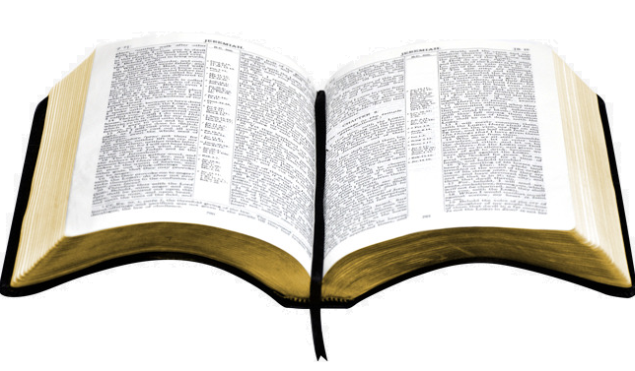
GOD DESIGNED THE GOSPEL
G O S P E L
1. FACTS TO BE BELIEVED
2. COMMANDS TO BE OBEYED
3. PROMISES TO RECEIVE
FAITH
ACTS OF FAITH
Romans 10:17 (NASB) ¹⁷ So faith comes from hearing, and hearing by the word of Christ.

Slide 72
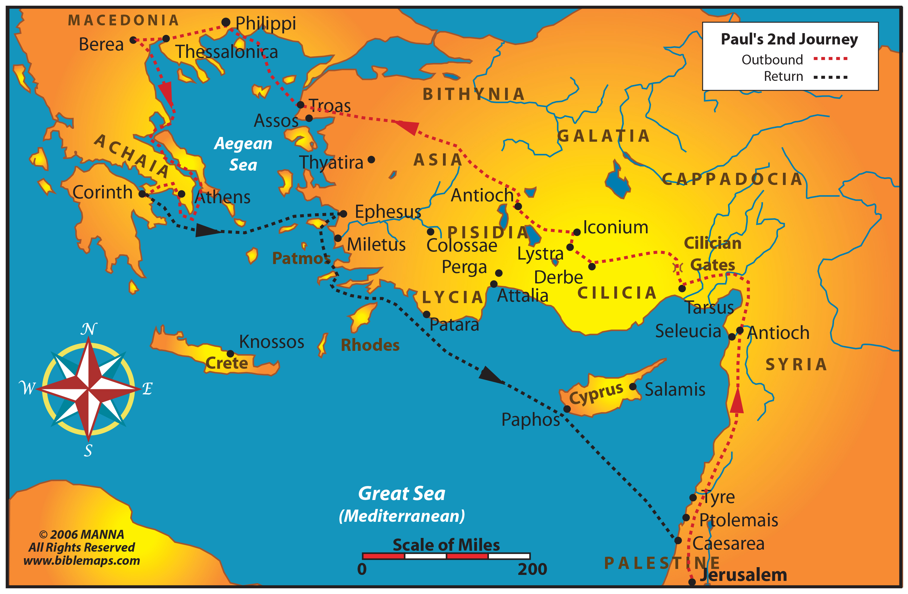
Timothy joins Paul

Slide 73
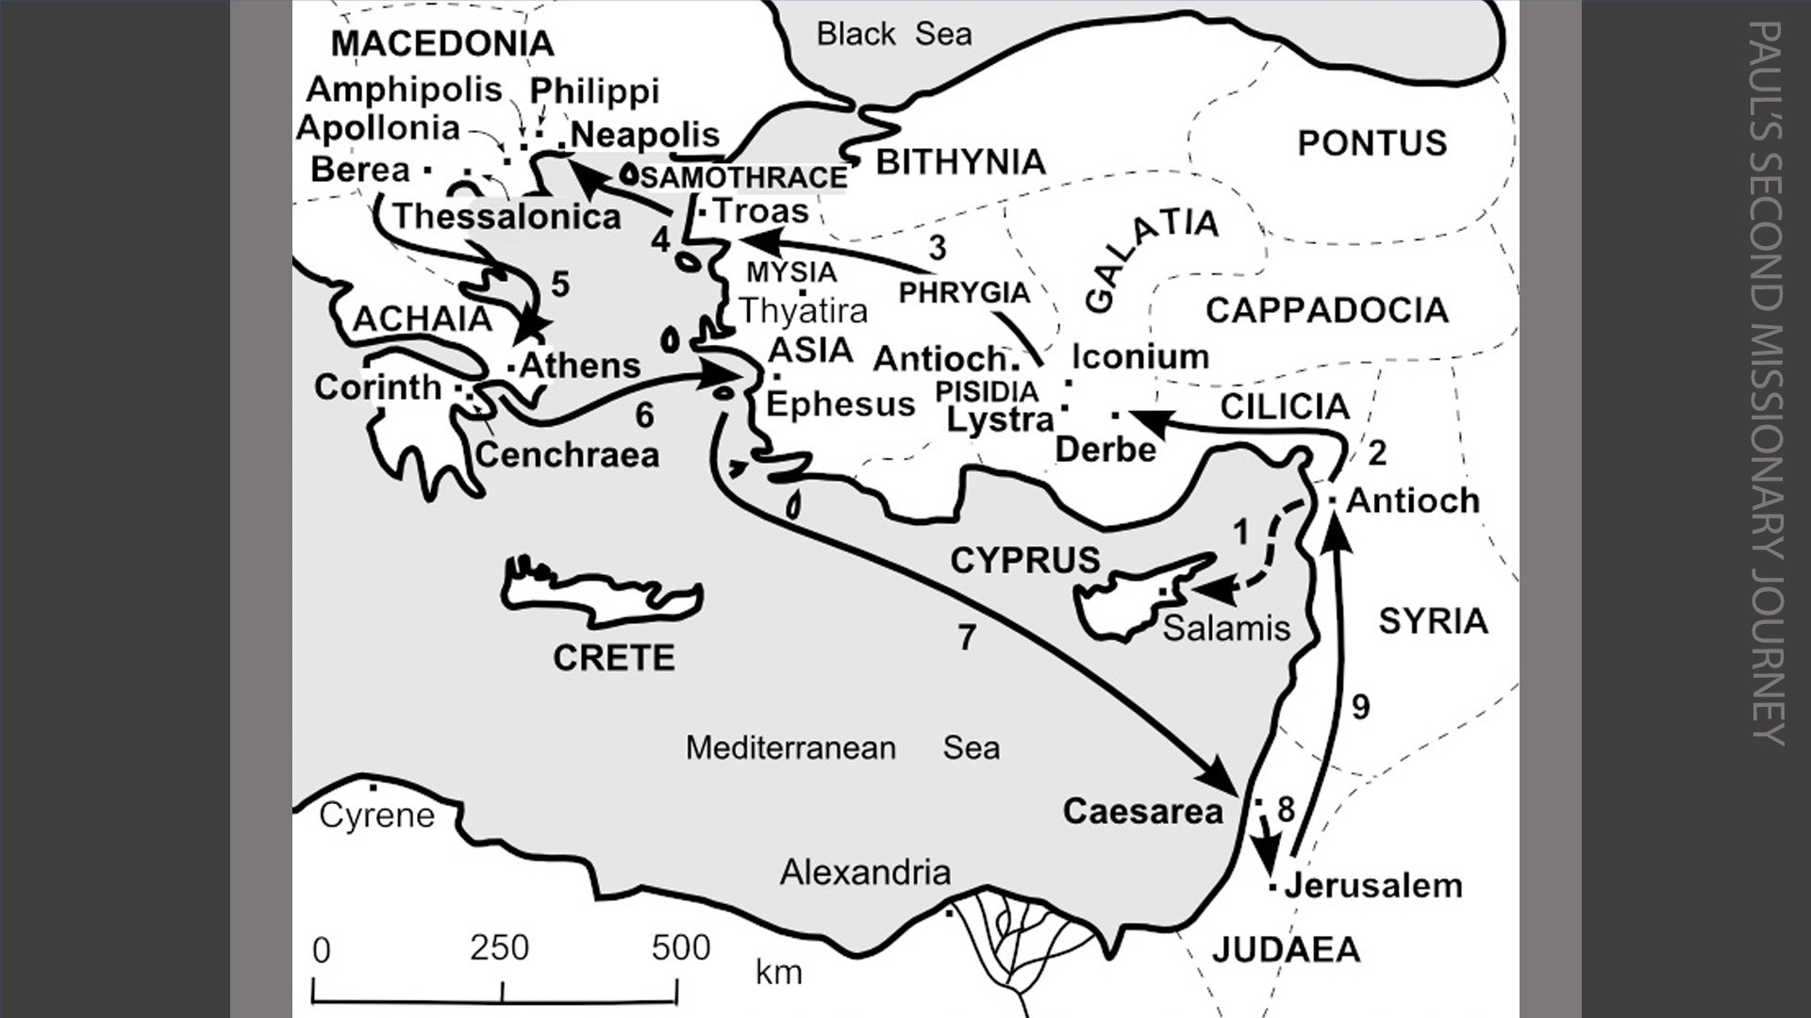
Timothy joins Paul

Slide 74
PREPARING THE SOIL OF A CHILDS MIND
I. The parable of the sower: Mt 13:3-8
A. Seeds are dependent upon the kind of soil in which they are planted.
II. Interpretation of the parable of the sower: Mt 13:18-23
B. The word of God is dependent upon the kind of mind in which it is planted.
III. It is the duty of parents to prepare the minds of their children to receive the word of God: Psa 127:1-5; Prov 22:6; Eph 6:4; Pro 6:20
A. The mind needs constant plowing and preparation in order to allow the seed of God’s word to produce fruit: Dt 4:8-10; Dt 6:4-8; Dt 11:16-21; Psa 119:9-16
B. To neglect parenting responsibility may lead to a mind which will not allow the seed of God’s word to grow: Jdgs 2:10; Eph 4:17-19
Deuteronomy 6:4-8 (NASB77) ⁴ " Hear, O Israel! The LORD is our God, the LORD is one! ⁵ "And you shall love the LORD your God with all your heart and with all your soul and with all your might. ⁶ "And these words, which I am commanding you today, shall be on your heart; ⁷ and you shall teach them diligently to your sons and shall talk of them when you sit in your house and when you walk by the way and when you lie down and when you rise up.
Deuteronomy 11:16-21 (NASB77) ¹⁶ " Beware, lest your hearts be deceived and you turn away and serve other gods and worship them. ¹⁷ "Or the anger of the LORD will be kindled against you, and He will shut up the heavens so that there will be no rain and the ground will not yield its fruit; and you will perish quickly from the good land which the LORD is giving you. ¹⁸ " You shall therefore impress these words of mine on your heart and on your soul; and you shall bind them as a sign on your hand, and they shall be as frontals on your forehead.
Psalm 119:9-16 (NASB77) ⁹ How can a young man keep his way pure? By keeping it according to Thy word. ¹⁰ With all my heart I have sought Thee; Do not let me wander from Thy commandments. ¹¹ Thy word I have treasured in my heart, That I may not sin against Thee. ¹² Blessed art Thou, O LORD; Teach me Thy statutes. ¹³ With my lips I have told of All the ordinances of Thy mouth. ¹⁴ I have rejoiced in the way of Thy testimonies, As much as in all riches.
Deuteronomy 4:8-10 (NASB77) ⁸ "Or what great nation is there that has statutes and judgments as righteous as this whole law which I am setting before you today? ⁹ "Only give heed to yourself and keep your soul diligently, lest you forget the things which your eyes have seen, and lest they depart from your heart all the days of your life; but make them known to your sons and your grandsons.
Ephesians 4:17-19 (NASB77) ¹⁷ This I say therefore, and affirm together with the Lord, that you walk no longer just as the Gentiles also walk, in the futility of their mind, ¹⁸ being darkened in their understanding, excluded from the life of God, because of the ignorance that is in them, because of the hardness of their heart; ¹⁹ and they, having become callous, have given themselves over to sensuality, for the practice of every kind of impurity with greediness.
¹⁹ " And you shall teach them to your sons, talking of them when you sit in your house and when you walk along the road and when you lie down and when you rise up. ²⁰ " And you shall write them on the doorposts of your house and on your gates, ²¹ so that your days and the days of your sons may be multiplied on the land which the LORD swore to your fathers to give them, as long as the heavens remain above the earth.
¹⁵ I will meditate on Thy precepts, And regard Thy ways. ¹⁶ I shall delight in Thy statutes; I shall not forget Thy word.
¹⁰ "Remember the day you stood before the LORD your God at Horeb, when the LORD said to me, 'Assemble the people to Me, that I may let them hear My words so they may learn to fear Me all the days they live on the earth, and that they may teach their children.’
⁸ " And you shall bind them as a sign on your hand and they shall be as frontals on your forehead.
Matthew 13:3-9 (NASB77) ³ And He spoke many things to them in parables, saying, "Behold, the sower went out to sow; ⁴ and as he sowed, some seeds fell beside the road, and the birds came and ate them up. ⁵ "And others fell upon the rocky places, where they did not have much soil; and immediately they sprang up, because they had no depth of soil. ⁶ "But when the sun had risen, they were scorched; and because they had no root, they withered away. ⁷ "And others fell among the thorns, and the thorns came up and choked them out. ⁸ "And others fell on the good soil, and •yielded a crop, some a hundredfold, some sixty, and some thirty.
Matthew 13:18-23 (NASB77) ¹⁸ " Hear then the parable of the sower. ¹⁹ "When anyone hears the word of the kingdom, and does not understand it, the evil one comes and snatches away what has been sown in his heart. This is the one on whom seed was sown beside the road. ²⁰ "And the one on whom seed was sown on the rocky places, this is the man who hears the word, and immediately receives it with joy; ²¹ yet he has no firm root in himself, but is only temporary, and when affliction or persecution arises because of the word, immediately he falls away.
²² "And the one on whom seed was sown among the thorns, this is the man who hears the word, and the worry of the world, and the deceitfulness of riches choke the word, and it becomes unfruitful. ²³ "And the one on whom seed was sown on the good soil, this is the man who hears the word and understands it; who indeed bears fruit, and brings forth, some a hundredfold, some sixty, and some thirty.“
Judges 2:10 (NASB77) ¹⁰ And all that generation also were gathered to their fathers; and there arose another generation after them who did not know the LORD, nor yet the work which He had done for Israel.
Proverbs 22:6 (NASB77) ⁶ Train up a child in the way he should go, Even when he is old he will not depart from it.
Ephesians 6:4 (NASB77) ⁴ And, fathers, do not provoke your children to anger; but bring them up in the discipline and instruction of the Lord.
Proverbs 6:20 (NASB77) ²⁰ My son, observe the commandment of your father, And do not forsake the teaching of your mother;
Psalm 127:1-5 (NASB77) ¹ Unless the LORD builds the house, They labor in vain who build it; Unless the LORD guards the city, The watchman keeps awake in vain. ² It is vain for you to rise up early, To retire late, To eat the bread of painful labors; For He gives to His beloved even in his sleep.
³ Behold, children are a gift of the LORD; The fruit of the womb is a reward. ⁴ Like arrows in the hand of a warrior, So are the children of one's youth. ⁵ How blessed is the man whose quiver is full of them; They shall not be ashamed, When they speak with their enemies in the gate.
Notes:
Preparing the soil for planting is a yearly task. You do not just do it once. A mind requires consistent regular preparation in removing the weeds, rocks and hardening of the mind. It is a constant diet of God’s word that prepares the mind to allow God’s word to produce fruit. One time preparation will not do.

Slide 75
PAUL AND THE CIRCUMCISION OF TIMOTHY The Problem
I. A short time before Paul circumcised Timothy the issue of circumcision and keeping the Law of Moses in order to be saved as a Christian caused a considerable stir in the church at Antioch and Jerusalem: Acts 15:1-2, 5-6
A. While in Jerusalem those who taught circumcision and the Law tried to pressure Paul and Barnabas to circumcise Titus: Gal 2:1-5; 6:12
B. Jerusalem denied authorizing anyone to teach this doctrine and sent a letter to to be delivered to the churches by the hands of Paul, Barnabas, Barsabbas and Silas: Acts 15:22-29
1. Paul taught that keeping circumcision and the Law of Moses to be saved would result in a Christian losing their salvation. 1Cor 7:18-20; Gal 5:6, 2-4
2. As he delivered to the churches the letter from Jerusalem, Paul circumcised Timothy: Act 16:3-4
Acts 15:22-29 (NASB) ²² Then it seemed good to the apostles and the elders, with the whole church, to choose men from among them to send to Antioch with Paul and Barnabas—Judas called Barsabbas, and Silas, leading men among the brethren, ²³ and they sent this letter by them, "The apostles and the brethren who are elders, to the brethren in Antioch and Syria and Cilicia who are from the Gentiles, greetings. ²⁴ "Since we have heard that some of our number to whom we gave no instruction have disturbed you with their words, unsettling your souls, ²⁵ it seemed good to us, having become of one mind, to select men to send to you with our beloved Barnabas and Paul, ²⁶ men who have risked their lives for the name of our Lord Jesus Christ.
Galatians 5:2-4 (NASB) ² Behold I, Paul, say to you that if you receive circumcision, Christ will be of no benefit to you. ³ And I testify again to every man who receives circumcision, that he is under obligation to keep the whole Law. ⁴ You have been severed from Christ, you who are seeking to be justified by law; you have fallen from grace.
Galatians 5:6 (NASB) ⁶ For in Christ Jesus neither circumcision nor uncircumcision means anything, but faith working through love.
1 Corinthians 7:18-20 (NASB) ¹⁸ Was any man called when he was already circumcised? He is not to become uncircumcised. Has anyone been called in uncircumcision? He is not to be circumcised. ¹⁹ Circumcision is nothing, and uncircumcision is nothing, but what matters is the keeping of the commandments of God. ²⁰ Each man must remain in that condition in which he was called.
Acts 16:3-4 (NASB) ³ Paul wanted this man to go with him; and he took him and circumcised him because of the Jews who were in those parts, for they all knew that his father was a Greek. ⁴ Now while they were passing through the cities, they were delivering the decrees which had been decided upon by the apostles and elders who were in Jerusalem, for them to observe.
²⁷ "Therefore we have sent Judas and Silas, who themselves will also report the same things by word of mouth. ²⁸ "For it seemed good to the Holy Spirit and to us to lay upon you no greater burden than these essentials: ²⁹ that you abstain from things sacrificed to idols and from blood and from things strangled and from fornication; if you keep yourselves free from such things, you will do well. Farewell.“
Acts 15:1-2 (NASB) ¹ Some men came down from Judea and began teaching the brethren, "Unless you are circumcised according to the custom of Moses, you cannot be saved." ² And when Paul and Barnabas had great dissension and debate with them, the brethren determined that Paul and Barnabas and some others of them should go up to Jerusalem to the apostles and elders concerning this issue.
Acts 15:5-6 (NASB) ⁵ But some of the sect of the Pharisees who had believed stood up, saying, "It is necessary to circumcise them and to direct them to observe the Law of Moses." ⁶ The apostles and the elders came together to look into this matter.
Galatians 2:1-5 (NASB) ¹ Then after an interval of fourteen years I went up again to Jerusalem with Barnabas, taking Titus along also. ² It was because of a revelation that I went up; and I submitted to them the gospel which I preach among the Gentiles, but I did so in private to those who were of reputation, for fear that I might be running, or had run, in vain. ³ But not even Titus, who was with me, though he was a Greek, was compelled to be circumcised.
Galatians 6:12 (NASB) ¹² Those who desire to make a good showing in the flesh try to compel you to be circumcised, simply so that they will not be persecuted for the cross of Christ.
⁴ But it was because of the false brethren secretly brought in, who had sneaked in to spy out our liberty which we have in Christ Jesus, in order to bring us into bondage. ⁵ But we did not yield in subjection to them for even an hour, so that the truth of the gospel would remain with you.
Notes:
Timothy was not circumcised when he became a Christian. He was taught by Paul who saw no reason to circumcise him at that time. It was not necessary to his salvation.

Slide 76
CIRCUMCISION
I. Originally circumcision was not a part of the Law of Moses but rather a part of the covenant of promise identifying one as Abrahams seed: Gen 17:9-14; Lev 12:1-3; Jn 7:22; Acts 7:8; Phil 3:5
A. The covenant of circumcision came 430 years before the Law of Moses: Gal 3:16-18; Gen 12:1-3; 22:15-18
1. Mandatory circumcision indicated people were still bound to keep the Law of Moses: Ro 2:25; Gal 5:2-3
2. God called Abraham to the land of Palestine and promised to bless all the nations through a future “seed” which is Jesus the Christ of promise. Once the promise came circumcision and the Law were no longer bound upon anyone as a condition of salvation. Gal 3:19-29
Galatians 3:19-29 (NASB) ¹⁹ Why the Law then? It was added because of transgressions, having been ordained through angels by the agency of a mediator, until the seed would come to whom the promise had been made. ²⁰ Now a mediator is not for one party only; whereas God is only one. ²¹ Is the Law then contrary to the promises of God? May it never be! For if a law had been given which was able to impart life, then righteousness would indeed have been based on law. ²² But the Scripture has shut up everyone under sin, so that the promise by faith in Jesus Christ might be given to those who believe. ²³ But before faith came, we were kept in custody under the law, being shut up to the faith which was later to be revealed.
²⁴ Therefore the Law has become our tutor to lead us to Christ, so that we may be justified by faith. ²⁵ But now that faith has come, we are no longer under a tutor. ²⁶ For you are all sons of God through faith in Christ Jesus. ²⁷ For all of you who were baptized into Christ have clothed yourselves with Christ. ²⁸ There is neither Jew nor Greek, there is neither slave nor free man, there is neither male nor female; for you are all one in Christ Jesus. ²⁹ And if you belong to Christ, then you are Abraham's descendants, heirs according to promise.
Genesis 17:9-14 (NASB) ⁹ God said further to Abraham, "Now as for you, you shall keep My covenant, you and your descendants after you throughout their generations. ¹⁰ "This is My covenant, which you shall keep, between Me and you and your descendants after you: every male among you shall be circumcised. ¹¹ "And you shall be circumcised in the flesh of your foreskin, and it shall be the sign of the covenant between Me and you. ¹² "And every male among you who is eight days old shall be circumcised throughout your generations, a servant who is born in the house or who is bought with money from any foreigner, who is not of your descendants.
Leviticus 12:1-3 (NASB) ¹ Then the LORD spoke to Moses, saying, ² "Speak to the sons of Israel, saying: 'When a woman gives birth and bears a male child, then she shall be unclean for seven days, as in the days of her menstruation she shall be unclean. ³ 'On the eighth day the flesh of his foreskin shall be circumcised.
John 7:22 (NASB) ²² "For this reason Moses has given you circumcision (not because it is from Moses, but from the fathers), and on the Sabbath you circumcise a man.
Acts 7:8 (NASB) ⁸ "And He gave him the covenant of circumcision; and so Abraham became the father of Isaac, and circumcised him on the eighth day; and Isaac became the father of Jacob, and Jacob of the twelve patriarchs.
Philippians 3:5 (NASB) ⁵ circumcised the eighth day, of the nation of Israel, of the tribe of Benjamin, a Hebrew of Hebrews; as to the Law, a Pharisee;
¹³ "A servant who is born in your house or who is bought with your money shall surely be circumcised; thus shall My covenant be in your flesh for an everlasting covenant. ¹⁴ "But an uncircumcised male who is not circumcised in the flesh of his foreskin, that person shall be cut off from his people; he has broken My covenant.“
Galatians 3:16-18 (NASB) ¹⁶ Now the promises were spoken to Abraham and to his seed. He does not say, "And to seeds," as referring to many, but rather to one, "And to your seed," that is, Christ. ¹⁷ What I am saying is this: the Law, which came four hundred and thirty years later, does not invalidate a covenant previously ratified by God, so as to nullify the promise. ¹⁸ For if the inheritance is based on law, it is no longer based on a promise; but God has granted it to Abraham by means of a promise.
Genesis 12:1-3 (NASB) ¹ Now the LORD said to Abram, "Go forth from your country, And from your relatives And from your father's house, To the land which I will show you; ² And I will make you a great nation, And I will bless you, And make your name great; And so you shall be a blessing; ³ And I will bless those who bless you, And the one who curses you I will curse. And in you all the families of the earth will be blessed."
Genesis 22:15-18 (NASB) ¹⁵ Then the angel of the LORD called to Abraham a second time from heaven, ¹⁶ and said, "By Myself I have sworn, declares the LORD, because you have done this thing and have not withheld your son, your only son, ¹⁷ indeed I will greatly bless you, and I will greatly multiply your seed as the stars of the heavens and as the sand which is on the seashore; and your seed shall possess the gate of their enemies. ¹⁸ "In your seed all the nations of the earth shall be blessed, because you have obeyed My voice."
Romans 2:25 (NASB) ²⁵ For indeed circumcision is of value if you practice the Law; but if you are a transgressor of the Law, your circumcision has become uncircumcision.
Galatians 5:2-3 (NASB) ² Behold I, Paul, say to you that if you receive circumcision, Christ will be of no benefit to you. ³ And I testify again to every man who receives circumcision, that he is under obligation to keep the whole Law.
Notes:
Jn 7:22 clearly teaches Lev 12:1-3 was not from Moses but from the fathers
Philip 3:5 shows circumcision had to do with being a Hebrew of the family of Abraham.

Slide 77
Acts 2:47 (NASB77) ⁴⁷ praising God, and having favor with all the people. And the Lord was adding to their number day by day those who were being saved.
Acts 4:4 (NASB77) ⁴ But many of those who had heard the message believed; and the number of the men came to be about five thousand.
Acts 5:14 (NASB77) ¹⁴ And all the more believers in the Lord, multitudes of men and women, were constantly added to their number;
Acts 6:1 (NASB77) ¹ Now at this time while the disciples were increasing in number, a complaint arose on the part of the Hellenistic Jews against the native Hebrews, because their widows were being overlooked in the daily serving of food.

Slide 78
Acts 6:7 (NASB77) ⁷ And the word of God kept on spreading; and the number of the disciples continued to increase greatly in Jerusalem, and a great many of the priests were becoming obedient to the faith. Acts 11:21 (NASB77) ²¹ And the hand of the Lord was with them, and a large number who believed turned to the Lord. Acts 14:1 (NASB77) ¹ And it came about that in Iconium they entered the synagogue of the Jews together, and spoke in such a manner that a great multitude believed, both of Jews and of Greeks.

Slide 79
SLAVE GIRL WITH A SPIRIT OF DIVINATION
A. She is possessed by a spirit (demon) of Divination: 1Cor 10:20-21; Lev 19:31 Lev 20:6, 27; Dt 18:10-12
1. Note Luke’s use of the word “US”. Luke (the author of Acts) is one of Paul’s traveling companions.
2. Her masters profited by her fortune-telling: It was believed that she was guided by and spoke for Apollo, she was considered an inspired Prophetess.
Leviticus 20:6 (NASB) ⁶ 'As for the person who turns to mediums and to spiritists, to play the harlot after them, I will also set My face against that person and will cut him off from among his people. Leviticus 20:27 (NASB) ²⁷ 'Now a man or a woman who is a medium or a spiritist shall surely be put to death. They shall be stoned with stones, their bloodguiltiness is upon them.'"
Leviticus 19:31 (NASB) ³¹ 'Do not turn to mediums or spiritists; do not seek them out to be defiled by them. I am the LORD your God.
4294. πύθων puthōn noun
Python, ventriloquist, soothsayer.
Complete Biblical Library Greek-English Dictionary
1 Corinthians 10:20-21 (NASB) ²⁰ No, but I say that the things which the Gentiles sacrifice, they sacrifice to demons and not to God; and I do not want you to become sharers in demons. ²¹ You cannot drink the cup of the Lord and the cup of demons; you cannot partake of the table of the Lord and the table of demons.
Deuteronomy 18:10-12 (NASB) ¹⁰ "There shall not be found among you anyone who makes his son or his daughter pass through the fire, one who uses divination, one who practices witchcraft, or one who interprets omens, or a sorcerer, ¹¹ or one who casts a spell, or a medium, or a spiritist, or one who calls up the dead. ¹² "For whoever does these things is detestable to the LORD; and because of these detestable things the LORD your God will drive them out before you.
Acts 16:16 (NASB) ¹⁶ It happened that as we were going to the place of prayer, a slave-girl having a spirit of divination met us, who was bringing her masters much profit by fortune- telling.
Notes:
A. According to Greek mythology, the Delphic Oracle was guarded by a great serpent (Python) which the God Apollos killed. Puthōn had also been the giver of oracles, a function that Apollo then assumed. In time women known as Pythia became the mouthpieces of Apollo. Later the word Python came to mean Divination.
1. Ventriloquist: The places of worship was often in caves which had an effect on the voice of the Pythia. It is said they became so expert in throwing their voices from the hollow of their stomach that they sounded as if the voice were in a cave. In the case of actual demon possession there would be a different voice coming from within the woman.

Slide 80
“WHAT MUST I DO TO BE SAVED?”
A. The answer to this question is critical: Acts 2:37
B. The answer: Acts 16:31
1. How can they believe? Acts 15:7; Ro 10:13-17; Ro 1:16
a. Common to all belief in Acts is the word was preached: Acts 2:37; 8:5, 35; 10:33, 36; 16:13-14, 16:32
b. Preaching Jesus includes the command to be baptized: Acts 2:37-38; Acts 8:5, 12, 35-36; Acts 16:14-15; 16:32-33; Acts 2:41
Acts 16:30 (NASB) ³⁰ and after he brought them out, he said, "Sirs, what must I do to be saved?"
Acts 2:37-38 (NASB) (God expects man to do what He commands) ³⁷ Now when they heard this, they were pierced to the heart, and said to Peter and the rest of the apostles, "Brethren, what shall we do?" ³⁸ Peter said to them, "Repent, and each of you be baptized in the name of Jesus Christ for the forgiveness of your sins; and you will receive the gift of the Holy Spirit.
(“forgiveness” and the “gift of the spirit” is what God does)
Acts 16:14-15 (NASB) ¹⁴ A woman named Lydia, from the city of Thyatira, a seller of purple fabrics, a worshiper of God, was listening; and the Lord opened her heart to respond to the things spoken by Paul. ¹⁵ And when she and her household had been baptized, she urged us, saying, "If you have judged me to be faithful to the Lord, come into my house and stay." And she prevailed upon us.
Acts 16:32-33 (NASB) ³² And they spoke the word of the Lord to him together with all who were in his house. ³³ And he took them that very hour of the night and washed their wounds, and immediately he was baptized, he and all his household.
Acts 8:35-36 (NASB) ³⁵ Then Philip opened his mouth, and beginning from this Scripture he preached Jesus to him. ³⁶ As they went along the road they came to some water; and the eunuch *said, "Look! Water! What prevents me from being baptized?"
Acts 8:5 (NASB) ⁵ Philip went down to the city of Samaria and began proclaiming Christ to them. Acts 8:12 (NASB) ¹² But when they believed Philip preaching the good news about the kingdom of God and the name of Jesus Christ, they were being baptized, men and women alike.
Believe on the Lord Jesus
Acts 2:37 (NASB) ³⁷ Now when they heard this, they were pierced to the heart, and said to Peter and the rest of the apostles, "Brethren, what shall we do?"
Acts 16:31 (NASB) ³¹ They said, "Believe in the Lord Jesus, and you will be saved, you and your household."
Acts 15:7 (NASB) ⁷ After there had been much debate, Peter stood up and said to them, "Brethren, you know that in the early days God made a choice among you, that by my mouth the Gentiles would hear the word of the gospel and believe.
Romans 10:13-17 (NASB) ¹³ for "WHOEVER WILL CALL ON THE NAME OF THE LORD WILL BE SAVED." ¹⁴ How then will they call on Him in whom they have not believed? How will they believe in Him whom they have not heard? And how will they hear without a preacher?
Romans 1:16 (NASB) ¹⁶ For I am not ashamed of the gospel, for it is the power of God for salvation to everyone who believes, to the Jew first and also to the Greek.
(the power of the Gospel to save is conditional upon the hearer’s belief)
Gospel preached
¹⁵ How will they preach unless they are sent? Just as it is written, "HOW BEAUTIFUL ARE THE FEET OF THOSE WHO BRING GOOD NEWS OF GOOD THINGS!" ¹⁶ However, they did not all heed the good news; for Isaiah says, "LORD, WHO HAS BELIEVED OUR REPORT?" ¹⁷ So faith comes from hearing, and hearing by the word of Christ.
Acts 8:5 (NASB) ⁵ Philip went down to the city of Samaria and began proclaiming Christ to them.
Acts 8:35 (NASB) ³⁵ Then Philip opened his mouth, and beginning from this Scripture he preached Jesus to him.
Acts 16:13-14 (NASB) ¹³ And on the Sabbath day we went outside the gate to a riverside, where we were supposing that there would be a place of prayer; and we sat down and began speaking to the women who had assembled. ¹⁴ A woman named Lydia, from the city of Thyatira, a seller of purple fabrics, a worshiper of God, was listening; and the Lord opened her heart to respond to the things spoken by Paul.
Acts 16:32 (NASB) ³² And they spoke the word of the Lord to him together with all who were in his house.
Acts 2:37 (NASB) ³⁷ Now when they heard this, they were pierced to the heart, and said to Peter and the rest of the apostles, "Brethren, what shall we do?"
Acts 10:33, 36 (NASB) ³³ "So I sent for you immediately, and you have been kind enough to come. Now then, we are all here present before God to hear all that you have been commanded by the Lord."
³⁶ "The word which He sent to the sons of Israel, preaching peace through Jesus Christ (He is Lord of all)—
Believers Baptized
Acts 2:41 (NASB) 41 So then, those who had received his word were baptized; and that day there were added about three thousand souls.
(The Word preached is not believed until it is received by being baptized)

Slide 81
Acts 16:1 - 40

Slide 82
When the Council in Jerusalem was over, Paul and Barnabas returned to Antioch. But this would be their last mission together. A disagreement over John Mark drove a wedge between them, and when it was time for the next mission …
…Barnabas took Mark, and sailed unto Cyprus;
And Paul chose Silas, and departed, being recommended by the brethren unto the grace of God.
And he went through Syria and Cilicia, confirming the churches.
This is how Acts 15 ended.

Slide 83
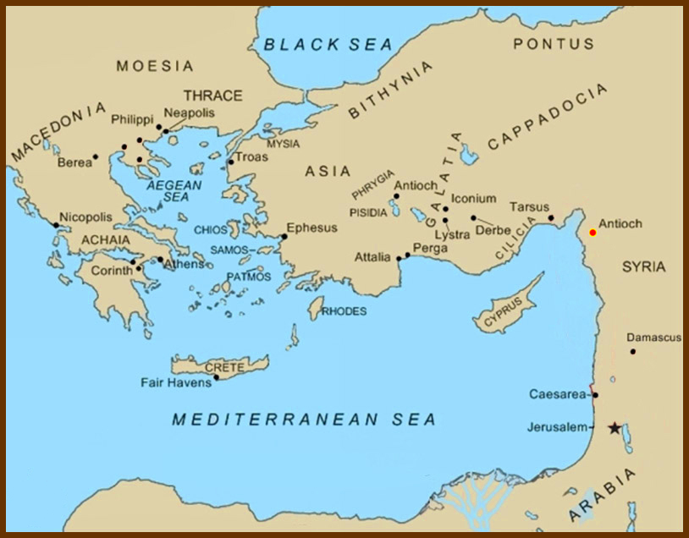
So once again starting out from Antioch,

Slide 84
So once again starting out from Antioch, Paul took Silas and traveled through Syria and Cilicia …

Slide 85
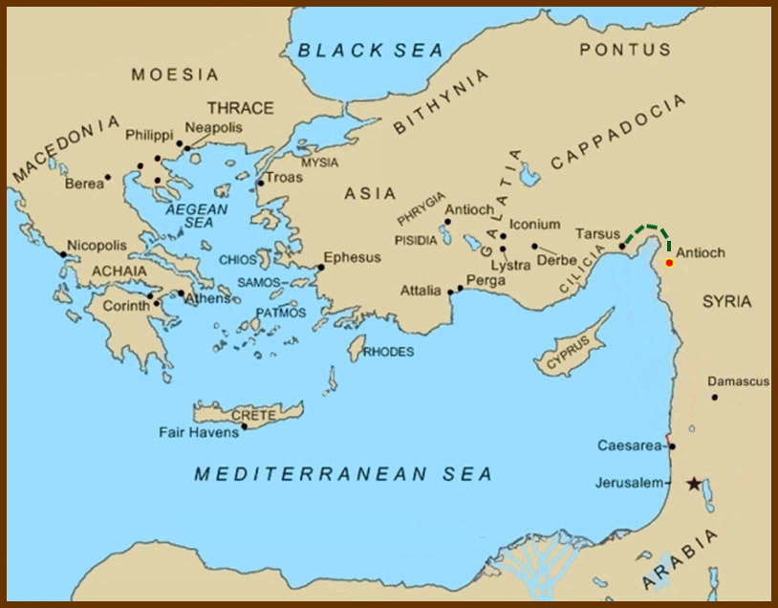
So once again starting out from Antioch, Paul took Silas and traveled through Syria and Cilicia …

Slide 86
Acts 16:
¹ Then came he to Derbe and Lystra:

Slide 87
Acts 16:
¹ Then came he to Derbe and Lystra:
and, behold, a certain disciple was there, named Timotheus,

Slide 88
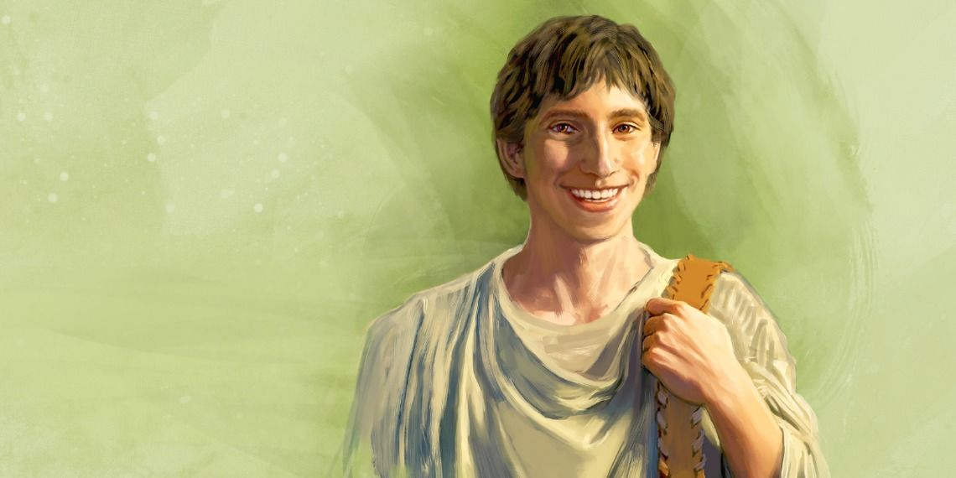
… the son of a certain woman, which was a Jewess, and believed; but his father was a Greek:
² Which was well reported of by the brethren that were at Lystra and Iconium.
³ Him would Paul have to go forth with him; and took and circumcised him because of the Jews which were in those quarters: for they knew all that his father was a Greek.

Slide 89
… the son of a certain woman, which was a Jewess, and believed; but his father was a Greek:
² Which was well reported of by the brethren that were at Lystra and Iconium.
³ Him would Paul have to go forth with him; and took and circumcised him because of the Jews which were in those quarters: for they knew all that his father was a Greek.
This might seem an odd thing to do, especially so soon after the Jerusalem Council’s ruling on circumcision. But this was not done for Timothy’s salvation. This was done so he could minister in the synagogues and temple of the Jews.
Ezekiel 44:9: Thus saith the Lord GOD; No stranger, uncircumcised in heart, nor uncircumcised in flesh, shall enter into my sanctuary, of any stranger that is among the children of Israel.

Slide 90
⁴ And as they went through the cities, they delivered them the decrees for to keep, that were ordained of the apostles and elders which were at Jerusalem.
⁵ And so were the churches established in the faith, and increased in number daily.

Slide 91
⁶ Now when they had gone throughout Phrygia and the region of Galatia,

Slide 92
⁶ Now when they had gone throughout Phrygia and the region of Galatia,

Slide 93
⁶ Now when they had gone throughout Phrygia and the region of Galatia, and were forbidden of the Holy Ghost to preach the word in Asia,

Slide 94
⁷ After they were come to Mysia,

Slide 95
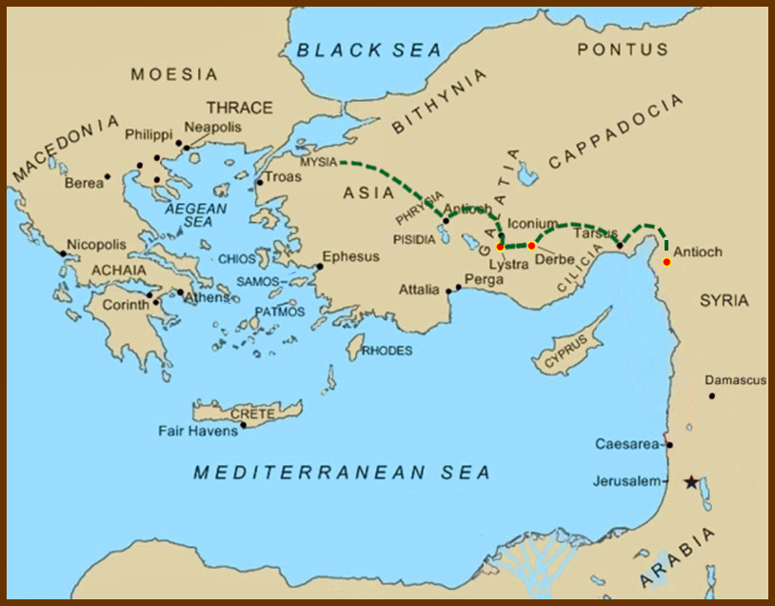
⁷ After they were come to Mysia,
they assayed to go into Bithynia: but the Spirit suffered them not.

Slide 96
Looking at the map we see that the Spirit forbid them to journey either to the north or to the south.

Slide 97
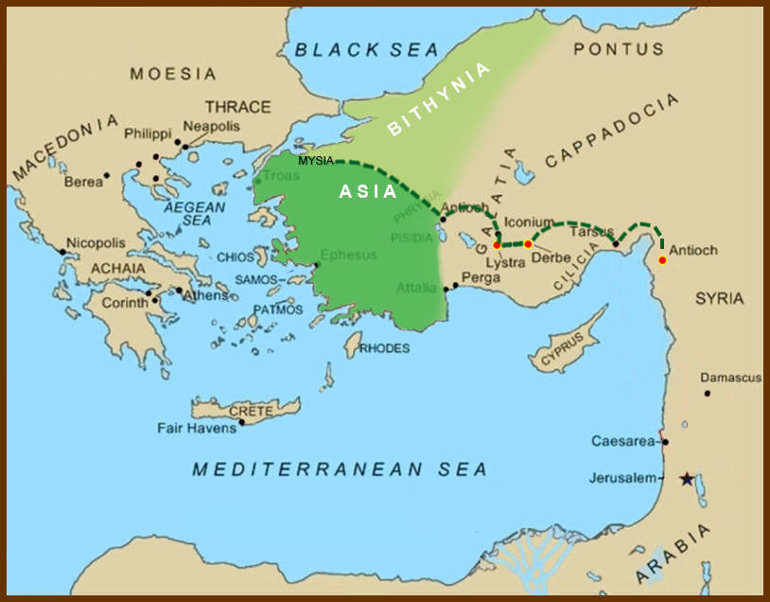
Looking at the map we see that the Spirit forbid them to journey either to the north or to the south.

Slide 98
Paul did not minister in places he wished to go when:
The Holy Spirit redirected him (as we just read), or
Satan hindered him.
1 Thessalonians 2:17-18:
¹⁷ But we, brethren, being taken from you for a short time in presence, not in heart, endeavoured the more abundantly to see your face with great desire.
¹⁸ Wherefore we would have come unto you, even I Paul, once and again; but Satan hindered us.
A successful missionary must discern the difference between his own thoughts, the urging of the Holy Spirt, and interference from Satan.
Looking at the map we see that the Spirit forbid them to journey either to the north or to the south.

Slide 99
⁸ And they passing by Mysia came down to Troas.

Slide 100
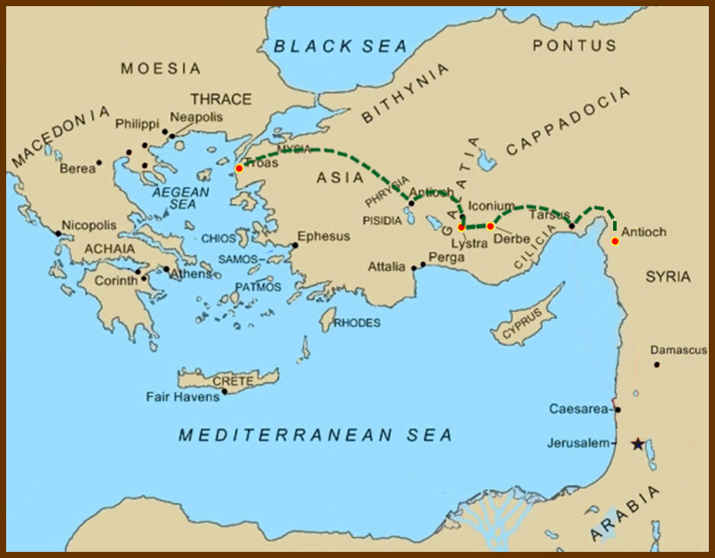
⁸ And they passing by Mysia came down to Troas.

Slide 101
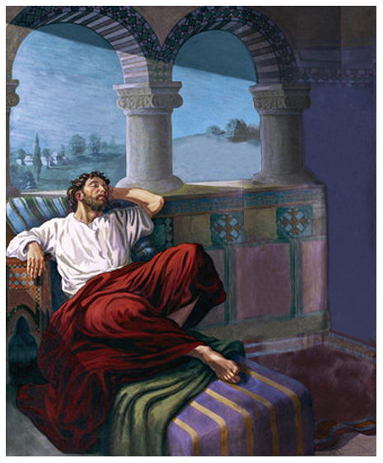
⁹ And a vision appeared to Paul in the night;
There stood a man of Macedonia, and prayed him, saying,

Slide 102
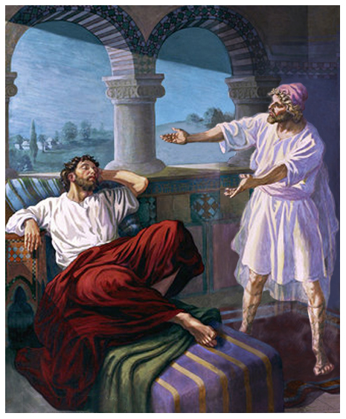
¹⁰ And after he had seen the vision, immediately we endeavoured to go into Macedonia, assuredly gathering that the Lord had called us for to preach the gospel unto them.

Slide 103
¹⁰ And after he had seen the vision, immediately we endeavoured to go into Macedonia, assuredly gathering that the Lord had called us for to preach the gospel unto them.
This is where Luke enters the story.

Slide 104
¹¹ Therefore loosing from Troas, we came with a straight course to Samothracia,

Slide 105
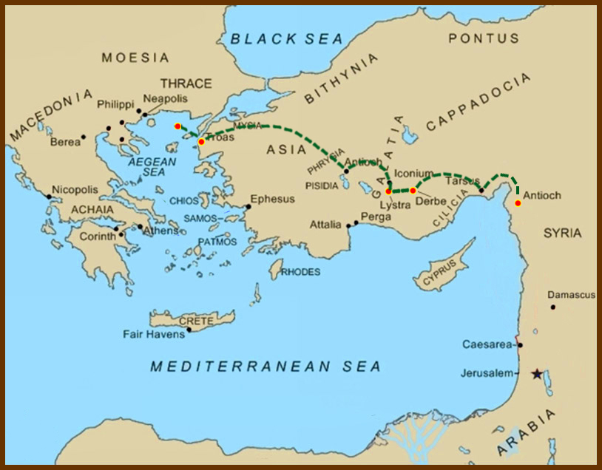
¹¹ Therefore loosing from Troas, we came with a straight course to Samothracia,
and the next day to Neapolis;

Slide 106
¹¹ Therefore loosing from Troas, we came with a straight course to Samothracia,
and the next day to Neapolis;

Slide 107
¹² And from thence to Philippi,

Slide 108
¹² And from thence to Philippi,
which is the chief city of that part of Macedonia, and a colony: and we were in that city abiding certain days.

Slide 109
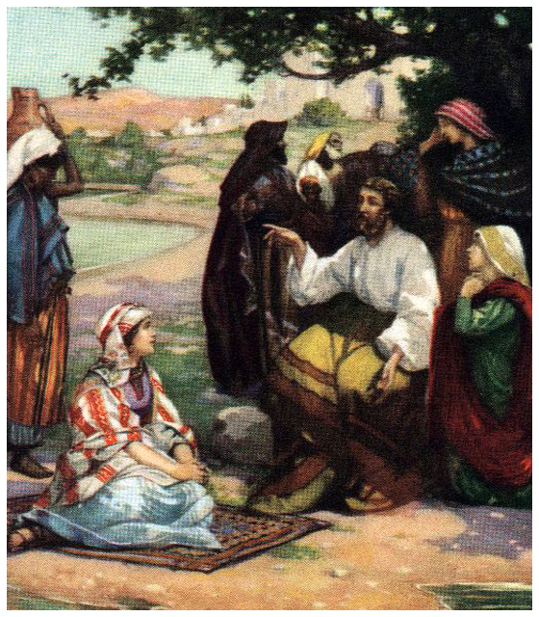
¹³ And on the sabbath we went out of the city by a river side, where prayer was wont to be made; and we sat down, and spake unto the women which resorted thither.
¹⁴ And a certain woman named Lydia, a seller of purple, of the city of Thyatira, which worshipped God, heard us: whose heart the Lord opened, that she attended unto the things which were spoken of Paul.

Slide 110
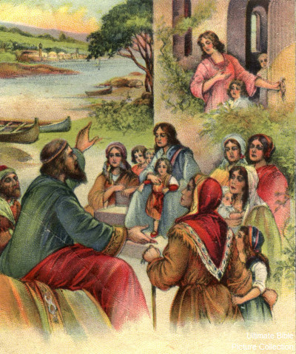
¹⁵ And when she was baptized, and her household, she besought us, saying, If ye have judged me to be faithful to the Lord, come into my house, and abide there. And she constrained us.

Slide 111
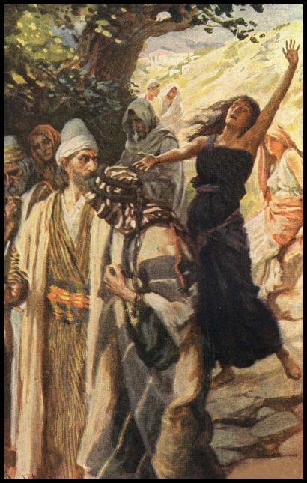
¹⁶ And it came to pass, as we went to prayer, a certain damsel possessed with a spirit of divination met us, which brought her masters much gain by soothsaying:
¹⁷ The same followed Paul and us, and cried, saying, These men are the servants of the most high God, which shew unto us the way of salvation.
¹⁸ And this did she many days.

Slide 112
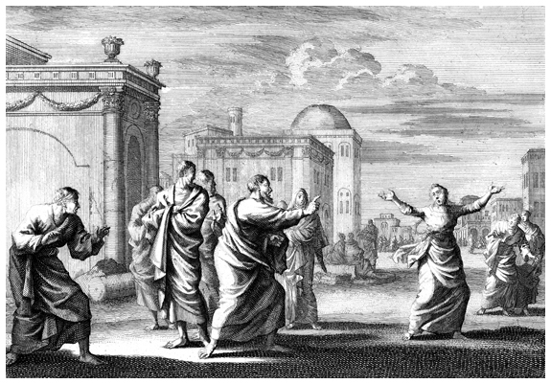
But Paul, being grieved, turned and said to the spirit,
I command thee in the name of Jesus Christ to come out of her.
And he came out the same hour.

Slide 113
But Paul, being grieved, turned and said to the spirit,
I command thee in the name of Jesus Christ to come out of her.
And he came out the same hour.

Slide 114
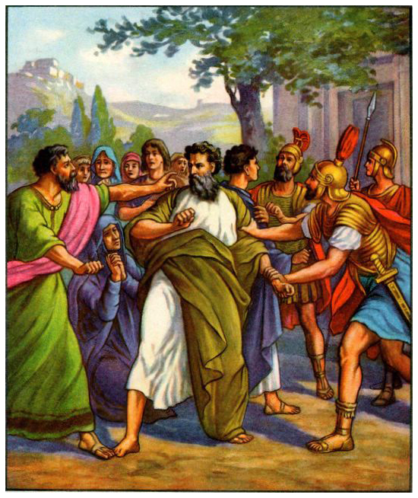
¹⁹ And when her masters saw that the hope of their gains was gone, they caught Paul and Silas, and drew them into the marketplace unto the rulers,
²⁰ And brought them to the magistrates, saying, These men, being Jews, do exceedingly trouble our city,
²¹ And teach customs, which are not lawful for us to receive, neither to observe, being Romans.
²² And the multitude rose up together against them: and the magistrates rent off their clothes, and commanded to beat them.

Slide 115
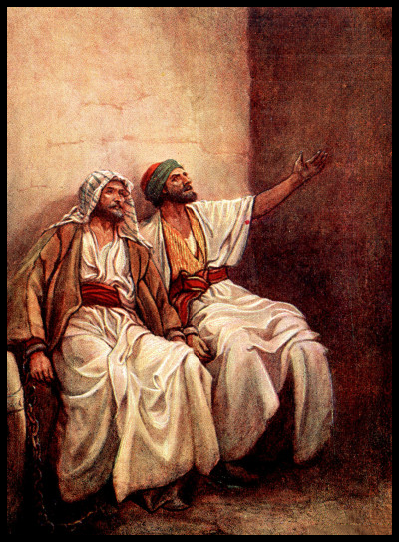
²³ And when they had laid many stripes upon them, they cast them into prison, charging the jailor to keep them safely:
²⁴ Who, having received such a charge, thrust them into the inner prison, and made their feet fast in the stocks.
²⁵ And at midnight Paul and Silas prayed, and sang praises unto God: and the prisoners heard them.

Slide 116
²⁶ And suddenly there was a great earthquake, so that the foundations of the prison were shaken: and immediately all the doors were opened, and every one's bands were loosed.

Slide 117
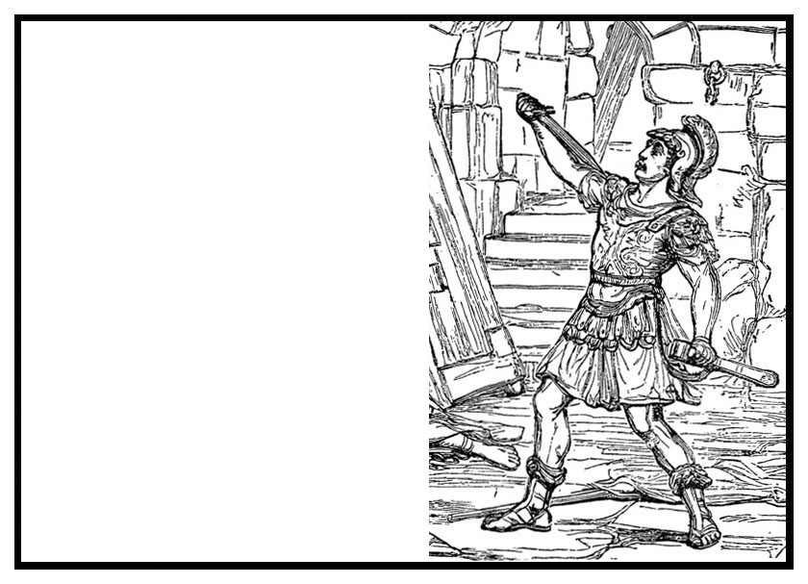
²⁷ And the keeper of the prison awaking out of his sleep, and seeing the prison doors open, he drew out his sword, and would have killed himself, supposing that the prisoners had been fled.

Slide 118
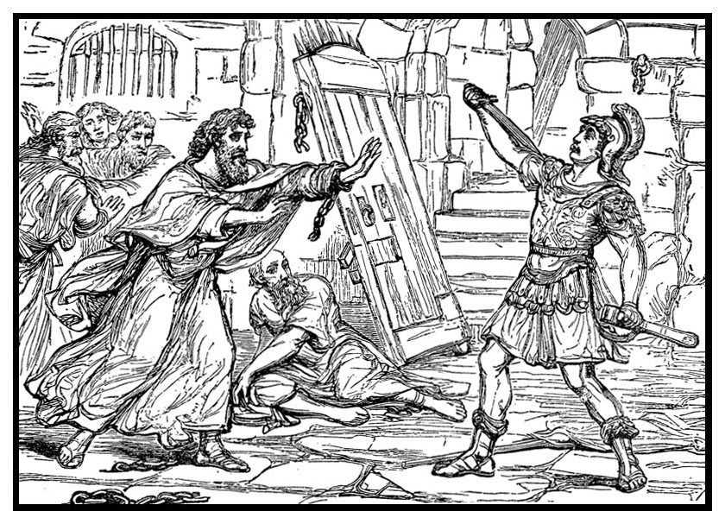
²⁸ But Paul cried with a loud voice, saying, Do thyself no harm: for we are all here.

Slide 119
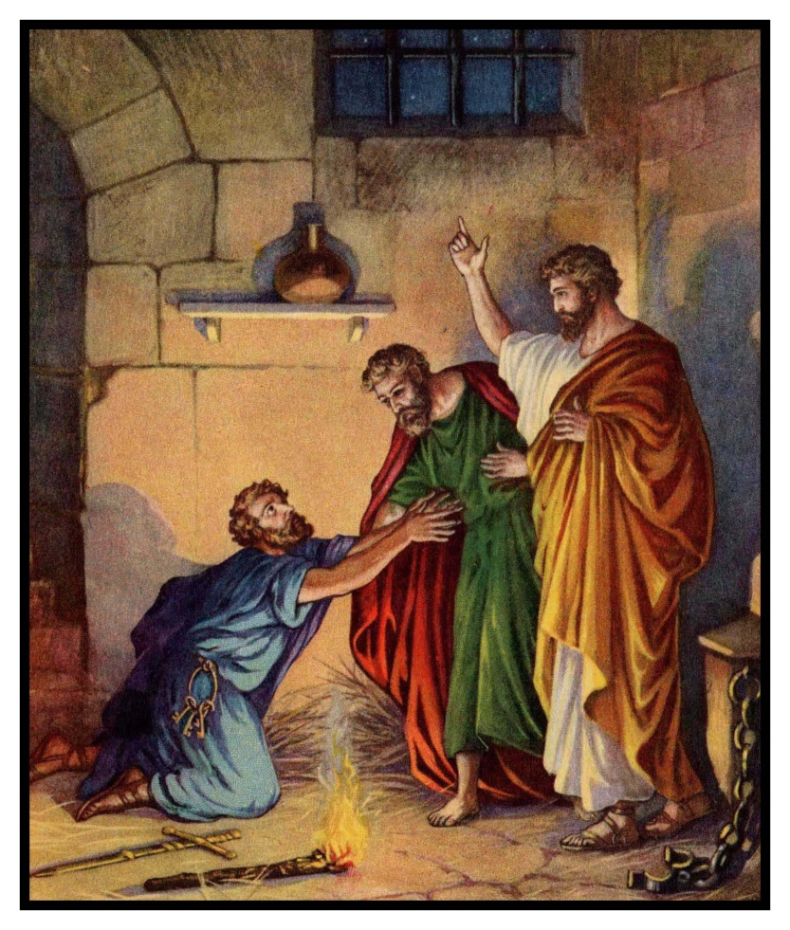
²⁹ Then he called for a light, and sprang in, and came trembling, and fell down before Paul and Silas,
³⁰ And brought them out, and said, Sirs, what must I do to be saved?
³¹ And they said, Believe on the Lord Jesus Christ, and thou shalt be saved, and thy house.
³² And they spake unto him the word of the Lord, and to all that were in his house.

Slide 120
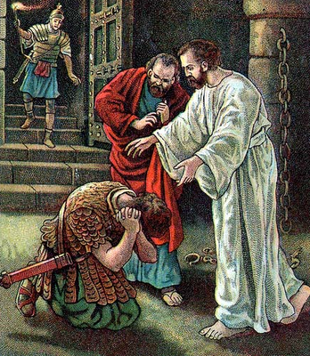
³³ And he took them the same hour of the night, and washed their stripes; and was baptized, he and all his, straightway.
³⁴ And when he had brought them into his house, he set meat before them, and rejoiced, believing in God with all his house.

Slide 121
³⁵ And when it was day, the magistrates sent the serjeants, saying, Let those men go.
³⁶ And the keeper of the prison told this saying to Paul, The magistrates have sent to let you go: now therefore depart, and go in peace.
³⁷ But Paul said unto them, They have beaten us openly uncondemned, being Romans, and have cast us into prison; and now do they thrust us out privily? nay verily; but let them come themselves and fetch us out.
³⁸ And the serjeants told these words unto the magistrates: and they feared, when they heard that they were Romans.
³⁹ And they came and besought them, and brought them out, and desired them to depart out of the city.
⁴⁰ And they went out of the prison, and entered into the house of Lydia: and when they had seen the brethren, they comforted them, and departed.
End of Chapter 16

Slide 123
Paul’s Second Mission, Part 2 (Thessalonica to Athens)

Slide 124
L.D. CARY & SAM HOLT CATCH PHRASES
Chapter 10 – “The Gentiles Come In”
Chapter 11 – “10 + 1, Peter’s Rerun”
Chapter 12 – “10 + 2, Peter’s Rescue”
Chapter 13 – “10 + 3, First Preaching Spree”
Chapter 14 – “10 + 4, Preaching More”
Chapter 15 – “10 + 5, The Truth Survives”
Chapter 16 – “European Scene”
Chapter 17 – “10 + 7, One God In Heaven”
Chapter 18 – “10 + 8, The Corinth Wait”
“10 + 7…One God In Heaven”
Catch Phrase
Chapter Seventeen

Slide 125
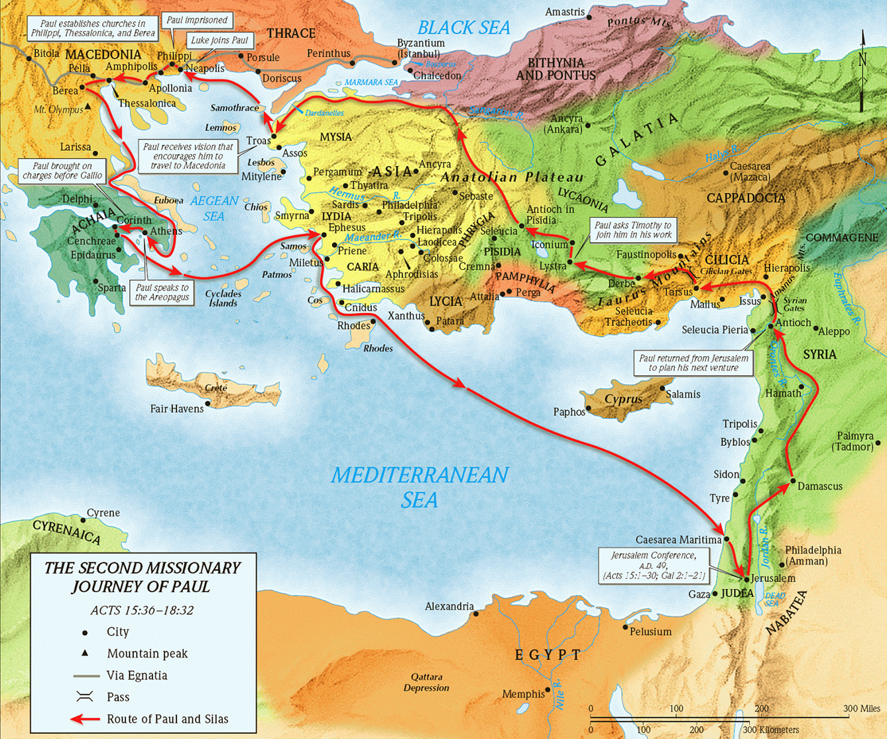
ACTS 17
PAUL’S
2ND MISSIONARY
JOURNEY
Thessalonica
Berea
Athens
Acts 15:36 – 18:22

Slide 126
Acts 17:1-3 (NASB) ¹ Now when they had traveled through Amphipolis and Apollonia, they came to Thessalonica, where there was a synagogue of the Jews. ² And according to Paul's custom, he went to them, and for three Sabbaths reasoned with them from the Scriptures, ³ explaining and giving evidence that the Christ had to suffer and rise again from the dead, and saying, "This Jesus whom I am proclaiming to you is the Christ."
A. Amphipolis, Apollonia and Thessalonica:
1. Synagogue of the Jews: Individuals or a group of Jews could build a synagogue and worship. Some prayers required a minimum assembly of 10.
2. Custom of teaching (reasoning) from the scriptures to the Jews first: Acts 2:42; 2Tim 3:14-17; 2Pet 3:15-16; Acts 20:32; Ro 1:16-17; 10:17
a. The goal of his reasoning from the scriptures is to give the mind evidence that Jesus is the Christ: Lk 24:44-47; Dt 18:18-19; Amos 9:11; Psa 16:8-10
2 Peter 3:15-16 (NASB) ¹⁵ and regard the patience of our Lord as salvation; just as also our beloved brother Paul, according to the wisdom given him, wrote to you, ¹⁶ as also in all his letters, speaking in them of these things, in which are some things hard to understand, which the untaught and unstable distort, as they do also the rest of the Scriptures, to their own destruction.
Romans 1:16-17 (NASB) ¹⁶ For I am not ashamed of the gospel, for it is the power of God for salvation to everyone who believes, to the Jew first and also to the Greek. ¹⁷ For in it the righteousness of God is revealed from faith to faith; as it is written, "BUT THE RIGHTEOUS man SHALL LIVE BY FAITH." Romans 10:17 (NASB) ¹⁷ So faith comes from hearing, and hearing by the word of Christ.
Luke 24:44-47 (NASB) ⁴⁴ Now He said to them, "These are My words which I spoke to you while I was still with you, that all things which are written about Me in the Law of Moses and the Prophets and the Psalms must be fulfilled." ⁴⁵ Then He opened their minds to understand the Scriptures, ⁴⁶ and He said to them, "Thus it is written, that the Christ would suffer and rise again from the dead the third day, ⁴⁷ and that repentance for forgiveness of sins would be proclaimed in His name to all the nations, beginning from Jerusalem.
2 Timothy 3:14-17 (NASB) ¹⁴ You, however, continue in the things you have learned and become convinced of, knowing from whom you have learned them, ¹⁵ and that from childhood you have known the sacred writings which are able to give you the wisdom that leads to salvation through faith which is in Christ Jesus. ¹⁶ All Scripture is inspired by God and profitable for teaching, for reproof, for correction, for training in righteousness; ¹⁷ so that the man of God may be adequate, equipped for every good work.
Psalm 16:8-10 (NASB) - Acts 2:25-27; 13:34-35 ⁸ I have set the LORD continually before me; Because He is at my right hand, I will not be shaken. ⁹ Therefore my heart is glad and my glory rejoices; My flesh also will dwell securely. ¹⁰ For You will not abandon my soul to Sheol; Nor will You allow Your Holy One to undergo decay.
Deuteronomy 18:18-19 (NASB) - Act 3:20-26 ¹⁸ 'I will raise up a prophet from among their countrymen like you, and I will put My words in his mouth, and he shall speak to them all that I command him. ¹⁹ 'It shall come about that whoever will not listen to My words which he shall speak in My name, I Myself will require it of him.
Acts 2:42 (NASB) ⁴² They were continually devoting themselves to the apostles' teaching and to fellowship, to the breaking of bread and to prayer.
Acts 20:32 (NASB) ³² "And now I commend you to God and to the word of His grace, which is able to build you up and to give you the inheritance among all those who are sanctified.
Amos 9:11 (NASB) - Acts 15:13-16 ¹¹ "In that day I will raise up the fallen booth of David, And wall up its breaches; I will also raise up its ruins And rebuild it as in the days of old;
Notes:
8/19/2018
Verse 2: reasoned with them NASB; The word reasoned has inherently within it the thought of a two way discussion and is rendered “argued or disputed”. It is at this point of the process that the Jewish leaders tried to meet Paul and Silas with counter arguments. The verb διαλέγομαι (dialegomai) gives the sense that Paul’s reasoning included teaching or discourse which may even have involved the method of question and answer. Perhaps the message of Paul made it impossible for the Jewish audience to keep silent.
The College Press NIV Commentary – Acts.
a. The goal of this two way discussion was to convince the people that Jesus is the Christ. Using “The Law, The Prophets, and the Psalms”

Slide 127
Acts 17:4-5 (NASB) ⁴ And some of them were persuaded and joined Paul and Silas, along with a large number of the God-fearing Greeks and a number of the leading women. ⁵ But the Jews, becoming jealous and taking along some wicked men from the market place, formed a mob and set the city in an uproar; and attacking the house of Jason, they were seeking to bring them out to the people.
A. Using the scriptures, they had won the arguments presented in the synagogue. They persuaded some Jews, and many God-fearing Gentiles and leading women: Acts 13:43
1. The leading women are those married to prominent Gentile men. Acts 13:50
B. Losing the debate had aroused the Jewish leaders to Jealousy and motivated them to form a mob and set the city in a noisy riotous uproar, attack the house of a believer named Jason seeking to bring Paul and Silas out by force. Christians never used coercion 2Cor 10:3-5; Ro 1:16; Eph 6:17; 2Tim 4:1-5
2 Corinthians 10:3-5 (NASB) ³ For though we walk in the flesh, we do not war according to the flesh, ⁴ for the weapons of our warfare are not of the flesh, but divinely powerful for the destruction of fortresses. ⁵ We are destroying speculations and every lofty thing raised up against the knowledge of God, and we are taking every thought captive to the obedience of Christ,
2 Timothy 4:1-5 (NASB) ¹ I solemnly charge you in the presence of God and of Christ Jesus, who is to judge the living and the dead, and by His appearing and His kingdom: ² preach the word; be ready in season and out of season; reprove, rebuke, exhort, with great patience and instruction. ³ For the time will come when they will not endure sound doctrine; but wanting to have their ears tickled, they will accumulate for themselves teachers in accordance to their own desires, ⁴ and will turn away their ears from the truth and will turn aside to myths. ⁵ But you, be sober in all things, endure hardship, do the work of an evangelist, fulfill your ministry.
Romans 1:16 (NASB) ¹⁶ For I am not ashamed of the gospel, for it is the power of God for salvation to everyone who believes, to the Jew first and also to the Greek.
Ephesians 6:17 (NASB) ¹⁷ And take THE HELMET OF SALVATION, and the sword of the Spirit, which is the word of God.
Acts 13:43 (NASB) ⁴³ Now when the meeting of the synagogue had broken up, many of the Jews and of the God-fearing proselytes followed Paul and Barnabas, who, speaking to them, were urging them to continue in the grace of God.
Acts 13:50 (NASB) ⁵⁰ But the Jews incited the devout women of prominence and the leading men of the city, and instigated a persecution against Paul and Barnabas, and drove them out of their district.

Slide 128
Acts 17:6-7 (NASB) ⁶ When they did not find them, they began dragging Jason and some brethren before the city authorities, shouting, "These men who have upset the world have come here also; ⁷ and Jason has welcomed them, and they all act contrary to the decrees of Caesar, saying that there is another king, Jesus."
A. They could not find Paul and Silas so the dragged Jason and some other brethren out of the house. This screaming mob drags them before the authorities.
1. They are seeking some kind legal order to prevent them from reasoning from the scriptures. They want to censure them. The accusations:
a. These men, who have upset the world elsewhere by their teachings are doing the same here. Mt 10:34
b. Jason is blamed since he invited them into his home. They teach contrary to Caesars laws, saying Jesus is another king. Acts 16:19-22; Jn 19:12
Acts 16:19-22 (NASB) ¹⁹ But when her masters saw that their hope of profit was gone, they seized Paul and Silas and dragged them into the market place before the authorities, ²⁰ and when they had brought them to the chief magistrates, they said, "These men are throwing our city into confusion, being Jews, ²¹ and are proclaiming customs which it is not lawful for us to accept or to observe, being Romans." ²² The crowd rose up together against them, and the chief magistrates tore their robes off them and proceeded to order them to be beaten with rods.
Matthew 10:34 (NASB) ³⁴ "Do not think that I came to bring peace on the earth; I did not come to bring peace, but a sword.
John 19:12 (NASB) ¹² As a result of this Pilate made efforts to release Him, but the Jews cried out saying, "If you release this Man, you are no friend of Caesar; everyone who makes himself out to be a king opposes Caesar."
Notes:
It is true that almost everywhere they went a Public commotion happened but that is not evidence that it is their fault. Those who actually embraced their teaching were good citizens and not troublesome at all except they believed and taught things that some found distasteful.

Slide 129
Acts 17:8-10 (NASB) ⁸ They stirred up the crowd and the city authorities who heard these things. ⁹ And when they had received a pledge from Jason and the others, they released them. ¹⁰ The brethren immediately sent Paul and Silas away by night to Berea, and when they arrived, they went into the synagogue of the Jews.
A. They stirred up the mob and the city officials to do something about the preaching of the Gospel.
1. The magistrates made Jason and other followers of the teachings of Paul and Silas pay a pledge. The pledge would be large sums of money or possibly their homes or businesses as proof that Paul and Silas would leave and there would be no more riots. (Philippian church supported Paul. Phil 4:15-16)
2. They send Paul and Silas away immediately to Berea. Where they found a synagogue and immediately got about the work of teaching the Gospel.
Philippians 4:15-16 (NASB) ¹⁵ You yourselves also know, Philippians, that at the first preaching of the gospel, after I left Macedonia, no church shared with me in the matter of giving and receiving but you alone; ¹⁶ for even in Thessalonica you sent a gift more than once for my needs.

Slide 130
Acts 17:11-12 (NASB) ¹¹ Now these were more noble-minded than those in Thessalonica, for they received the word with great eagerness, examining the Scriptures daily to see whether these things were so. ¹² Therefore many of them believed, along with a number of prominent Greek women and men.
A. The leaders of the synagogue and the people were more noble minded: 1Thes 5:21; 1Jn 4:1; Dt 13:1-5
1. Eagerly (readiness of mind) examining (investigating, interrogating) the scriptures (Old Testament prophecies concerning the Christ):
B. The end result of the preaching and the investigation: Many Jews believed plus a number of prominent Gentile women and men.
Deuteronomy 13:1-5 (NASB) ¹ "If a prophet or a dreamer of dreams arises among you and gives you a sign or a wonder, ² and the sign or the wonder comes true, concerning which he spoke to you, saying, 'Let us go after other gods (whom you have not known) and let us serve them,’
NOBLE-MINDED well born, i.e. (literal) high in rank, or (figurative) generous :- more noble, nobleman.
Strong's Greek & Hebrew Dictionary
Refers to the mind of one raised and educated in a higher class which makes them willing to investigate and gain knowledge before accepting or rejecting something as true or false. NAN
1 Thessalonians 5:21 (NASB) ²¹ But examine everything carefully; hold fast to that which is good;
1 John 4:1 (NASB) ¹ Beloved, do not believe every spirit, but test the spirits to see whether they are from God, because many false prophets have gone out into the world.
³ you shall not listen to the words of that prophet or that dreamer of dreams; for the LORD your God is testing you to find out if you love the LORD your God with all your heart and with all your soul. ⁴ "You shall follow the LORD your God and fear Him; and you shall keep His commandments, listen to His voice, serve Him, and cling to Him.
⁵ "But that prophet or that dreamer of dreams shall be put to death, because he has counseled rebellion against the LORD your God who brought you from the land of Egypt and redeemed you from the house of slavery, to seduce you from the way in which the LORD your God commanded you to walk. So you shall purge the evil from among you.
Notes:
Verse 11 They even “examined the Scriptures,” not once, but “every day to see if what Paul said was true.”
The College Press NIV Commentary – Acts.

Slide 131
Acts 17:13-15 (NASB) ¹³ But when the Jews of Thessalonica found out that the word of God had been proclaimed by Paul in Berea also, they came there as well, agitating and stirring up the crowds. ¹⁴ Then immediately the brethren sent Paul out to go as far as the sea; and Silas and Timothy remained there. ¹⁵ Now those who escorted Paul brought him as far as Athens; and receiving a command for Silas and Timothy to come to him as soon as possible, they left.
A. The Jews at Thessalonica heard that the word of God was being preached at Berea and came there stirring up the crowds in the same way they did at Thessalonica. (Antioch Acts 13:50; Iconium 14:5-6, Lystra 14:19; Berea 17:13)
1. Timothy and Silas stay at Berea while Paul is escorted to Athens:
2. Timothy and Silas were to come as soon as possible: 3 slides
Acts 14:5-6 (NASB) Iconium ⁵ And when an attempt was made by both the Gentiles and the Jews with their rulers, to mistreat and to stone them, ⁶ they became aware of it and fled to the cities of Lycaonia, Lystra and Derbe, and the surrounding region;
Acts 13:50 (NASB) Antioch ⁵⁰ But the Jews incited the devout women of prominence and the leading men of the city, and instigated a persecution against Paul and Barnabas, and drove them out of their district.
Acts 14:19 (NASB) Lystra ¹⁹ But Jews came from Antioch and Iconium, and having won over the crowds, they stoned Paul and dragged him out of the city, supposing him to be dead.

Slide 132
Acts 17:16-17 (NASB) ¹⁶ Now while Paul was waiting for them at Athens, his spirit was being provoked within him as he was observing the city full of idols. ¹⁷ So he was reasoning in the synagogue with the Jews and the God-fearing Gentiles, and in the market place every day with those who happened to be present.
A. Timothy and Silas did arrive while Paul was in Athens but out of deep concern he sent them to the church at Thessalonica: 1Thess 3:1-2
B. Provoked observing idols that filled Athens: Lit. sharpen – the idea that the presence of so many idols poked Paul’s spirit moving him to anger. Septuagint Dt 9:18; Psa 106:29
C. This anger motivated him to reason with the Jews and God fearing Gentiles in the synagogue and with the Athenian people in the market place: Acts 17:2; 18:4; 18:19; 19:8-9; 24:25
Deuteronomy 9:18 (NASB) ¹⁸ "I fell down before the LORD, as at the first, forty days and nights; I neither ate bread nor drank water, because of all your sin which you had committed in doing what was evil in the sight of the LORD to provoke Him to anger.
Psalm 106:29 (NASB) ²⁹ Thus they provoked Him to anger with their deeds, And the plague broke out among them.
Original Word: διαλέγομαι, dialegomai
Usage Notes: "to think different things with oneself, to ponder," then, "to dispute with others," is translated "to reason"
Vine's Expository Dictionary of Old Testament and New Testament Words
Acts 19:8-9 (NASB) ⁸ And he entered the synagogue and continued speaking out boldly for three months, reasoning and persuading them about the kingdom of God. ⁹ But when some were becoming hardened and disobedient, speaking evil of the Way before the people, he withdrew from them and took away the disciples, reasoning daily in the school of Tyrannus.
Acts 24:25 (NASB) ²⁵ But as he was discussing righteousness, self-control and the judgment to come, Felix became frightened and said, "Go away for the present, and when I find time I will summon you."
Acts 18:19 (NASB) ¹⁹ They came to Ephesus, and he left them there. Now he himself entered the synagogue and reasoned with the Jews.
Acts 17:2 (NASB) ² And according to Paul's custom, he went to them, and for three Sabbaths reasoned with them from the Scriptures,
Acts 18:4 (NASB) ⁴ And he was reasoning in the synagogue every Sabbath and trying to persuade Jews and Greeks.
1 Thessalonians 3:1-2 (NASB) ¹ Therefore when we could endure it no longer, we thought it best to be left behind at Athens alone, ² and we sent Timothy, our brother and God's fellow worker in the gospel of Christ, to strengthen and encourage you as to your faith,
Notes:
Verse 16 - Timothy and Silas did come from Berea to Paul at Athens but Paul being very concerned about what was happening at Thessalonica sent them to Thessalonica. 1Thess 3:1-2

Slide 133
Acts 17:18-20 (NASB) ¹⁸ And also some of the Epicurean and Stoic philosophers were conversing with him. Some were saying, "What would this idle babbler wish to say?" Others, "He seems to be a proclaimer of strange deities,"—because he was preaching Jesus and the resurrection. ¹⁹ And they took him and brought him to the Areopagus, saying, "May we know what this new teaching is which you are proclaiming? ²⁰ "For you are bringing some strange things to our ears; so we want to know what these things mean."
A. Epicurean and Stoic philosophers: Both believed man is the ruler of life
1. Some said Paul was a Babbler: lit. seed picker, one who picks up scraps of knowledge and passes it off as truth. This is not a compliment.
2. Strange deities, because he preached Jesus and the resurrection: lit. evil spirits or demons - 1Cor 15:1-4; Rom 1:4
a. Areopagus:
1 Corinthians 15:1-4 (NASB) ¹ Now I make known to you, brethren, the gospel which I preached to you, which also you received, in which also you stand, ² by which also you are saved, if you hold fast the word which I preached to you, unless you believed in vain. ³ For I delivered to you as of first importance what I also received, that Christ died for our sins according to the Scriptures, ⁴ and that He was buried, and that He was raised on the third day according to the Scriptures,
Romans 1:4 (NASB) ⁴ who was declared the Son of God with power by the resurrection from the dead, according to the Spirit of holiness, Jesus Christ our Lord,
Notes:
Verse 1 - The Epicureans descended from Epicurus (340-270 B.C.), they rejected any thought of life beyond this world. Though they did not deny the existence of the gods, they believed them to be uninvolved in this world. Epicurus taught that nature is the supreme teacher and provides sensations, feelings, and anticipations for the testing of truth. By feelings he meant pleasure and pain. These he said could be used to distinguish between good and evil. He also taught that the gods were incapable of wrath, indifferent to human weakness, and did not intervene or participate in human affairs. Thus, he denied the possibility of miracles, prophecy, and divine providence. In the beginning Epicurus meant "real happiness" by pleasure. At first, his followers merely sought a quiet life free from fear, pain, and anger. Later, some made sensual pleasures the goal of life (They were the original “if it feels good do it”).
Stoics came from a school of philosophy founded by Zeno (c. 340-265 B.C.). His meeting place was the στοά ποικίλη (stoa poikilē) (“painted colonnade”) in the marketplace of Athens, and from this meeting place the school took the name “Stoics.” The Stoics believed that the good life was obtained through resignation and the pursuit of what they thought was virtue, glorifying human reason and self-sufficiency, teaching that self-sufficiency and an acceptance of fate was essential. He encouraged his followers to accept the laws of nature and conscience and to be indifferent to pleasure, pain, joy, and grief (The original Spocks). They were pantheistic, believing that the spark of divinity was in all of the creation. Stoics were characterized by a high standard of ethics, and their belief that everyone had the spark of divinity led them to a sense of universal brotherhood, even for slaves.

Slide 134
I. HOW DOES ONE PRESENT THE GOSPEL TO:
1. Those who do not believe in the Bible nor the God the Bible?
a. Who believe that if there is a God he is indifferent to the wellbeing of mankind?
2. Who are steeped in superstitious beliefs such as nature is God, man is God?
a. Who believe that man is the ultimate source of truth and that man is making the world a more perfect place as his knowledge increases in passage of time?
3. We are going to examine Paul’s method of teaching such people.
Notes:
9/2/2018

Slide 135
Acts 17:21-23 (NASB) ²¹ (Now all the Athenians and the strangers visiting there used to spend their time in nothing other than telling or hearing something new.) ²² So Paul stood in the midst of the Areopagus and said, "Men of Athens, I observe that you are very religious in all respects. ²³ "For while I was passing through and examining the objects of your worship, I also found an altar with this inscription, 'TO AN UNKNOWN GOD.' Therefore what you worship in ignorance, this I proclaim to you.
A. Telling or hearing something new: 2Tim 3:6-7
B. The place where they went to hear speakers present some new thing is the Areopagus:
C. Paul observed they were a very superstitious people who even worshiped a God they did not know:
2 Timothy 3:6-7 (NASB) ⁶ For among them are those who enter into households and captivate weak women weighed down with sins, led on by various impulses, ⁷ always learning and never able to come to the knowledge of the truth.
Notes:
Athens
— the capital of Attica, the most celebrated city of the ancient world, the seat of Greek literature and art during the golden period of Grecian history. Its inhabitants were fond of novelty (Acts 17:21), and were remarkable for their zeal in the worship of the gods. It was a sarcastic saying of the Roman satirist that it was "easier to find a god at Athens than a man."
(Easton's Bible Dictionary, PC Study Bible)

Slide 136
Acts 17:24-25 (NASB) ²⁴ "The God who made the world and all things in it, since He is Lord of heaven and earth, does not dwell in temples made with hands; ²⁵ nor is He served by human hands, as though He needed anything, since He Himself gives to all people life and breath and all things;
A. The Athenians could accept the concept that there is a creator, a God of gods created all things:
1. Such a powerful creator has no needs which man provides since he created everything, including man. 1Kgs 8:27; Psa 50:8-13;
2. Man’s existence is entirely dependent upon God. God is never dependent upon man: Psa 104:27-30 (entire Psa);
Psalm 104:27-30 (NASB) ²⁷ They all wait for You To give them their food in due season. ²⁸ You give to them, they gather it up; You open Your hand, they are satisfied with good. ²⁹ You hide Your face, they are dismayed; You take away their spirit, they expire And return to their dust. ³⁰ You send forth Your Spirit, they are created; And You renew the face of the ground.
Psalm 50:8-13 (NASB) ⁸ "I do not reprove you for your sacrifices, And your burnt offerings are continually before Me. ⁹ "I shall take no young bull out of your house Nor male goats out of your folds. ¹⁰ "For every beast of the forest is Mine, The cattle on a thousand hills. ¹¹ "I know every bird of the mountains, And everything that moves in the field is Mine.
¹² "If I were hungry I would not tell you, For the world is Mine, and all it contains. ¹³ "Shall I eat the flesh of bulls Or drink the blood of male goats?
1 Kings 8:27 (NASB) ²⁷ "But will God indeed dwell on the earth? Behold, heaven and the highest heaven cannot contain You, how much less this house which I have built!

Slide 137
Acts 17:26-27 (NASB) ²⁶ and He made from one man every nation of mankind to live on all the face of the earth, having determined their appointed times and the boundaries of their habitation, ²⁷ that they would seek God, if perhaps they might grope for Him and find Him, though He is not far from each one of us;
A. That man and this world are product of an intelligent God who has designed the creation and set the boundaries of the various nations of men:
1. The divine purpose in the design of this world is that mankind might seek to find God: Mt 7:7-8; Ro 1:20; Acts 14:15-17
a. He made from one every nation of mankind and appointed times and boundaries: Gen 9:19; Dt 32:8; Gen 11:7-9; Job 12:23; Gen 15:13-16;
Acts 14:15-17 (NASB) ¹⁵ and saying, "Men, why are you doing these things? We are also men of the same nature as you, and preach the gospel to you that you should turn from these vain things to a living God, WHO MADE THE HEAVEN AND THE EARTH AND THE SEA AND ALL THAT IS IN THEM. ¹⁶ "In the generations gone by He permitted all the nations to go their own ways; ¹⁷ and yet He did not leave Himself without witness, in that He did good and gave you rains from heaven and fruitful seasons, satisfying your hearts with food and gladness."
Deuteronomy 32:8 (NASB) ⁸ "When the Most High gave the nations their inheritance, When He separated the sons of man, He set the boundaries of the peoples According to the number of the sons of Israel.
Genesis 15:13-16 (NASB) ¹³ God said to Abram, "Know for certain that your descendants will be strangers in a land that is not theirs, where they will be enslaved and oppressed four hundred years. ¹⁴ "But I will also judge the nation whom they will serve, and afterward they will come out with many possessions. ¹⁵ "As for you, you shall go to your fathers in peace; you will be buried at a good old age. ¹⁶ "Then in the fourth generation they will return here, for the iniquity of the Amorite is not yet complete." (Gal 3:16-17 a generation is approx. 100 years)
Matthew 7:7-8 (NASB) ⁷ "Ask, and it will be given to you; seek, and you will find; knock, and it will be opened to you. ⁸ "For everyone who asks receives, and he who seeks finds, and to him who knocks it will be opened.
Genesis 11:7-9 (NASB) ⁷ "Come, let Us go down and there confuse their language, so that they will not understand one another's speech." ⁸ So the LORD scattered them abroad from there over the face of the whole earth; and they stopped building the city. ⁹ Therefore its name was called Babel, because there the LORD confused the language of the whole earth; and from there the LORD scattered them abroad over the face of the whole earth.
Job 12:23 (NASB) ²³ "He makes the nations great, then destroys them; He enlarges the nations, then leads them away.
Genesis 9:19 (NASB) ¹⁹ These three were the sons of Noah, and from these the whole earth was populated.
Romans 1:20 (NASB) ²⁰ For since the creation of the world His invisible attributes, His eternal power and divine nature, have been clearly seen, being understood through what has been made, so that they are without excuse.
Notes:
From one: Gen 9:19; the proof of this fact is that all mankind can intermarry and produce children. They are one. It would seem that at the tower of Babel when God split the languages that he did so by race. They were all mankind but now separated by language which turned out to be by race. Language separated mankind not physical characteristics, yet it appears God used language to separate physical characteristics. Dt 32:8; Job 12:23; Gen 11:7-9; 15:13-16;
Acts 14:17; ro 1:20; Jere 23:23-25

Slide 138
Acts 17:28-29 (NASB) ²⁸ for in Him we live and move and exist, as even some of your own poets have said, 'For we also are His children.' ²⁹ "Being then the children of God, we ought not to think that the Divine Nature is like gold or silver or stone, an image formed by the art and thought of man.
A. We live, move and exist in Him. How silly it is to think you can build a Temple where he lives or that He needs anything from you.
1. Your idols could never really be Gods: Jer 10:1-5; Psa 115:3-8 (Isa 44:9-20)
Psalm 115:3-8 (NASB) ³ But our God is in the heavens; He does whatever He pleases. ⁴ Their idols are silver and gold, The work of man's hands. ⁵ They have mouths, but they cannot speak; They have eyes, but they cannot see; ⁶ They have ears, but they cannot hear; They have noses, but they cannot smell; ⁷ They have hands, but they cannot feel; They have feet, but they cannot walk; They cannot make a sound with their throat. ⁸ Those who make them will become like them, Everyone who trusts in them.
Jeremiah 10:1-5 (NASB) ¹ Hear the word which the LORD speaks to you, O house of Israel. ² Thus says the LORD, "Do not learn the way of the nations, And do not be terrified by the signs of the heavens Although the nations are terrified by them; ³ For the customs of the peoples are delusion; Because it is wood cut from the forest, The work of the hands of a craftsman with a cutting tool.
⁴ "They decorate it with silver and with gold; They fasten it with nails and with hammers So that it will not totter. ⁵ "Like a scarecrow in a cucumber field are they, And they cannot speak; They must be carried, Because they cannot walk! Do not fear them, For they can do no harm, Nor can they do any good."

Slide 139
Acts 17:30-31 (NASB) ³⁰ "Therefore having overlooked the times of ignorance, God is now declaring to men that all people everywhere should repent, ³¹ because He has fixed a day in which He will judge the world in righteousness through a Man whom He has appointed, having furnished proof to all men by raising Him from the dead."
A. The times of your lustful ignorance are over. God holds all men to account: Acts 14:16; Ro 1:28; 3:25; 1Pet 1:14-18; Acts 20:20-21; Titus 2:11-12
1. God has fixed a day in which he will judge all men through Jesus: Jn 5:22, 27; 2Cor 5:9-10;
2. Furnished proof by the resurrection: Ro 1:4; 1Pet 1:3; 1Cor 15:12-18
1 Corinthians 15:12-18 (NASB) ¹² Now if Christ is preached, that He has been raised from the dead, how do some among you say that there is no resurrection of the dead? ¹³ But if there is no resurrection of the dead, not even Christ has been raised; ¹⁴ and if Christ has not been raised, then our preaching is vain, your faith also is vain. ¹⁵ Moreover we are even found to be false witnesses of God, because we testified against God that He raised Christ, whom He did not raise, if in fact the dead are not raised. ¹⁶ For if the dead are not raised, not even Christ has been raised;
John 5:22 (NASB) ²² "For not even the Father judges anyone, but He has given all judgment to the Son, John 5:27 (NASB) ²⁷ and He gave Him authority to execute judgment, because He is the Son of Man.
2 Corinthians 5:9-10 (NASB) ⁹ Therefore we also have as our ambition, whether at home or absent, to be pleasing to Him. ¹⁰ For we must all appear before the judgment seat of Christ, so that each one may be recompensed for his deeds in the body, according to what he has done, whether good or bad.
¹⁷ and if Christ has not been raised, your faith is worthless; you are still in your sins. ¹⁸ Then those also who have fallen asleep in Christ have perished.
1 Peter 1:3 (NASB) ³ Blessed be the God and Father of our Lord Jesus Christ, who according to His great mercy has caused us to be born again to a living hope through the resurrection of Jesus Christ from the dead,
1 Peter 4:14-18 (NASB) ¹⁴ If you are reviled for the name of Christ, you are blessed, because the Spirit of glory and of God rests on you. ¹⁵ Make sure that none of you suffers as a murderer, or thief, or evildoer, or a troublesome meddler; ¹⁶ but if anyone suffers as a Christian, he is not to be ashamed, but is to glorify God in this name.
Acts 20:20-21 (NASB) ²⁰ how I did not shrink from declaring to you anything that was profitable, and teaching you publicly and from house to house, ²¹ solemnly testifying to both Jews and Greeks of repentance toward God and faith in our Lord Jesus Christ.
Titus 2:11-12 (NASB) ¹¹ For the grace of God has appeared, bringing salvation to all men, ¹² instructing us to deny ungodliness and worldly desires and to live sensibly, righteously and godly in the present age,
Acts 14:16 (NASB) ¹⁶ "In the generations gone by He permitted all the nations to go their own ways;
Romans 1:28 (NASB) ²⁸ And just as they did not see fit to acknowledge God any longer, God gave them over to a depraved mind, to do those things which are not proper,
Romans 3:25 (NASB) ²⁵ whom God displayed publicly as a propitiation in His blood through faith. This was to demonstrate His righteousness, because in the forbearance of God He passed over the sins previously committed;
¹⁷ For it is time for judgment to begin with the household of God; and if it begins with us first, what will be the outcome for those who do not obey the gospel of God? ¹⁸ AND IF IT IS WITH DIFFICULTY THAT THE RIGHTEOUS IS SAVED, WHAT WILL BECOME OF THE GODLESS MAN AND THE SINNER?
Romans 1:4 (NASB) ⁴ who was declared the Son of God with power by the resurrection from the dead, according to the Spirit of holiness, Jesus Christ our Lord,

Slide 140
Acts 17:30-31 (NASB) ³² Now when they heard of the resurrection of the dead, some began to sneer, but others said, "We shall hear you again concerning this." ³³ So Paul went out of their midst. ³⁴ But some men joined him and believed, among whom also were Dionysius the Areopagite and a woman named Damaris and others with them.
A. The Athenians stumbled at the Resurrection of Christ and the promise of Resurrection to all those who embrace him: Lk 2:34; 20:17-18; 1Pet 2:6-8
B. There is no mention of a church established in Athens or Paul returning to Athens.
1. Some “joined” Paul, meaning they attached themselves to Paul and his cause.
2. It would seem that Dionysius was in some way connected to the Areopagus but on his conversion this would no longer be so: (Acts 17:19, 22)
1 Peter 2:6-8 (NASB) ⁶ For this is contained in Scripture: "BEHOLD, I LAY IN ZION A CHOICE STONE, A PRECIOUS CORNER stone, AND HE WHO BELIEVES IN HIM WILL NOT BE DISAPPOINTED."
Luke 2:34 (NASB) ³⁴ And Simeon blessed them and said to Mary His mother, "Behold, this Child is appointed for the fall and rise of many in Israel, and for a sign to be opposed—
Luke 20:17-18 (NASB) ¹⁷ But Jesus looked at them and said, "What then is this that is written: 'THE STONE WHICH THE BUILDERS REJECTED, THIS BECAME THE CHIEF CORNER stone'? ¹⁸ "Everyone who falls on that stone will be broken to pieces; but on whomever it falls, it will scatter him like dust."
⁷ This precious value, then, is for you who believe; but for those who disbelieve, "THE STONE WHICH THE BUILDERS REJECTED, THIS BECAME THE VERY CORNER stone," ⁸ and, "A STONE OF STUMBLING AND A ROCK OF OFFENSE"; for they stumble because they are disobedient to the word, and to this doom they were also appointed.

Slide 141
II. The book of Acts is a history of God’s people and the role they play in bringing the Gospel to a world of unbelievers. 2Tim 4:1-5; 1Pet 3:15; Ro 1:16, 10:13-15
Romans 10:13-15 (NASB) ¹³ for "WHOEVER WILL CALL ON THE NAME OF THE LORD WILL BE SAVED." ¹⁴ How then will they call on Him in whom they have not believed? How will they believe in Him whom they have not heard? And how will they hear without a preacher? ¹⁵ How will they preach unless they are sent? Just as it is written, "HOW BEAUTIFUL ARE THE FEET OF THOSE WHO BRING GOOD NEWS OF GOOD THINGS!"
2 Timothy 4:1-5 (NASB) ¹ I solemnly charge you in the presence of God and of Christ Jesus, who is to judge the living and the dead, and by His appearing and His kingdom: ² preach the word; be ready in season and out of season; reprove, rebuke, exhort, with great patience and instruction. ³ For the time will come when they will not endure sound doctrine; but wanting to have their ears tickled, they will accumulate for themselves teachers in accordance to their own desires, ⁴ and will turn away their ears from the truth and will turn aside to myths. ⁵ But you, be sober in all things, endure hardship, do the work of an evangelist, fulfill your ministry.
Romans 1:16 (NASB) ¹⁶ For I am not ashamed of the gospel, for it is the power of God for salvation to everyone who believes, to the Jew first and also to the Greek.
1 Peter 3:15 (NASB) ¹⁵ but sanctify Christ as Lord in your hearts, always being ready to make a defense to everyone who asks you to give an account for the hope that is in you, yet with gentleness and reverence;

Slide 142
ACTS 17
Amphipolis
Apollonia
Thessalonica
Notes:
Thessalonica -- about 100 miles from Philippi. Thessalonica was established in 315 B.C., and named after the half-sister of Alexander the Great. It had become the second largest city in Greece with a population of about 200,000. When the Romans assumed dominance in 148 B.C., they made it the center of Roman administration in Macedonia. Later, Thessalonica was made a free city in 42 B.C. because of its loyalty to Octavian and Antony in the battle of Philippi.
The College Press NIV Commentary – Acts.

Slide 143
ACTS 17
Berea
Notes:
Berea -- Located about fifty miles from Thessalonica, this city at one time was the capital of one of the four divisions of Macedonia (from 167-148 B.C.). The journey to this populous city took about three days to walk The College Press NIV Commentary – Acts.

Slide 144
Timothy and Silas left at Berea
Paul waits at Athens for Timothy and Silas
ACTS 17
Athens
(3 slides)
Notes:
ATHENS --

Slide 145
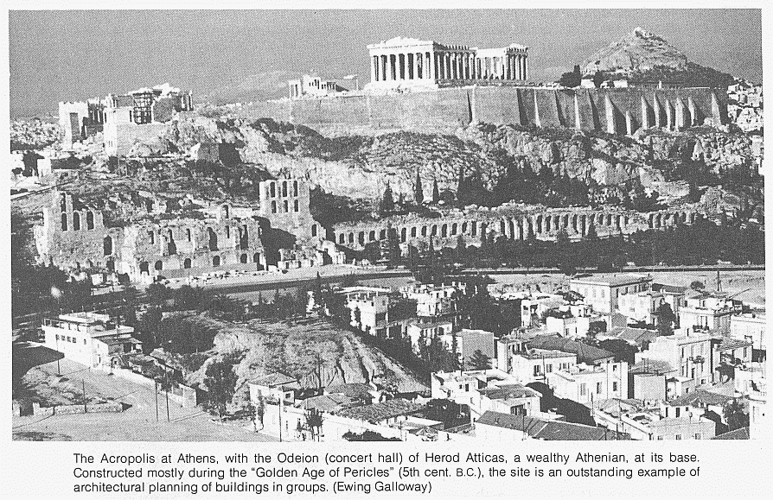

Slide 148
Acts 15:36 – 18:22
ACTS 17
Philippi
Thessalonica
Berea
Athens

Slide 149
Acts 17:1 – 34

Slide 150
Acts 17:
¹ Now when they had passed through Amphipolis and Apollonia, they came to Thessalonica, where was a synagogue of the Jews:

Slide 151
Acts 17:
¹ Now when they had passed through Amphipolis and Apollonia, they came to Thessalonica, where was a synagogue of the Jews:

Slide 152
Acts 17:
¹ Now when they had passed through Amphipolis and Apollonia, they came to Thessalonica, where was a synagogue of the Jews:

Slide 153
Acts 17:
¹ Now when they had passed through Amphipolis and Apollonia, they came to Thessalonica, where was a synagogue of the Jews:

Slide 154
² And Paul, as his manner was, went in unto them, and three sabbath days reasoned with them out of the scriptures,
³ Opening and alleging, that Christ must needs have suffered, and risen again from the dead; and that this Jesus, whom I preach unto you, is Christ.

Slide 155
⁴ And some of them believed, and consorted with Paul and Silas; and of the devout Greeks a great multitude, and of the chief women not a few.

Slide 156
⁴ And some of them believed, and consorted with Paul and Silas; and of the devout Greeks a great multitude, and of the chief women not a few.
⁵ But the Jews which believed not, moved with envy, took unto them certain lewd fellows of the baser sort, and gathered a company, and set all the city on an uproar, and assaulted the house of Jason, and sought to bring them out to the people.

Slide 157
⁴ And some of them believed, and consorted with Paul and Silas; and of the devout Greeks a great multitude, and of the chief women not a few.
⁵ But the Jews which believed not, moved with envy, took unto them certain lewd fellows of the baser sort, and gathered a company, and set all the city on an uproar, and assaulted the house of Jason, and sought to bring them out to the people.
⁶ And when they found them not, they drew Jason and certain brethren unto the rulers of the city, crying,

Slide 158
⁴ And some of them believed, and consorted with Paul and Silas; and of the devout Greeks a great multitude, and of the chief women not a few.
⁵ But the Jews which believed not, moved with envy, took unto them certain lewd fellows of the baser sort, and gathered a company, and set all the city on an uproar, and assaulted the house of Jason, and sought to bring them out to the people.
⁶ And when they found them not, they drew Jason and certain brethren unto the rulers of the city, crying,
These that have turned the world upside down are come hither also;

Slide 159
⁴ And some of them believed, and consorted with Paul and Silas; and of the devout Greeks a great multitude, and of the chief women not a few.
⁵ But the Jews which believed not, moved with envy, took unto them certain lewd fellows of the baser sort, and gathered a company, and set all the city on an uproar, and assaulted the house of Jason, and sought to bring them out to the people.
⁶ And when they found them not, they drew Jason and certain brethren unto the rulers of the city, crying,
These that have turned the world upside down are come hither also;
⁷ Whom Jason hath received: and these all do contrary to the decrees of Caesar, saying that there is another king, one Jesus.

Slide 160
⁴ And some of them believed, and consorted with Paul and Silas; and of the devout Greeks a great multitude, and of the chief women not a few.
⁵ But the Jews which believed not, moved with envy, took unto them certain lewd fellows of the baser sort, and gathered a company, and set all the city on an uproar, and assaulted the house of Jason, and sought to bring them out to the people.
⁶ And when they found them not, they drew Jason and certain brethren unto the rulers of the city, crying,
These that have turned the world upside down are come hither also;
⁷ Whom Jason hath received: and these all do contrary to the decrees of Caesar, saying that there is another king, one Jesus.
⁸ And they troubled the people and the rulers of the city, when they heard these things.

Slide 161
⁴ And some of them believed, and consorted with Paul and Silas; and of the devout Greeks a great multitude, and of the chief women not a few.
⁵ But the Jews which believed not, moved with envy, took unto them certain lewd fellows of the baser sort, and gathered a company, and set all the city on an uproar, and assaulted the house of Jason, and sought to bring them out to the people.
⁶ And when they found them not, they drew Jason and certain brethren unto the rulers of the city, crying,
These that have turned the world upside down are come hither also;
⁷ Whom Jason hath received: and these all do contrary to the decrees of Caesar, saying that there is another king, one Jesus.
⁸ And they troubled the people and the rulers of the city, when they heard these things.
⁹ And when they had taken security [bail money] of Jason, and of the other, they let them go.

Slide 162
¹⁰ And the brethren immediately sent away Paul and Silas by night unto Berea:

Slide 163
¹⁰ And the brethren immediately sent away Paul and Silas by night unto Berea:
who coming thither went into the synagogue of the Jews.

Slide 164
¹¹ These were more noble than those in Thessalonica, in that they received the word with all readiness of mind, and searched the scriptures daily, whether those things were so.
¹² Therefore many of them believed; also of honourable women which were Greeks, and of men, not a few.

Slide 165
¹³ But when the Jews of Thessalonica had knowledge that the word of God was preached of Paul at Berea, they came thither also, and stirred up the people.
¹⁴ And then immediately the brethren sent away Paul to decoy as it were to the sea: but Silas and Timotheus abode there still.

Slide 166
¹⁵ And they that conducted Paul brought him unto Athens:

Slide 167
¹⁵ And they that conducted Paul brought him unto Athens:
and receiving a commandment unto Silas and Timotheus for to come to him with all speed, they departed.
Note: It could have been a land route as well.

Slide 168
¹⁶ Now while Paul waited for them at Athens, his spirit was stirred in him, when he saw the city wholly given to idolatry.
¹⁷ Therefore disputed he in the synagogue with the Jews, and with the devout persons, and in the market daily with them that met with him.

Slide 169
¹⁸ Then certain philosophers of the Epicureans, and of the Stoicks, encountered him. And some said, What will this babbler say? other some, He seemeth to be a setter forth of strange gods: because he preached unto them Jesus, and the resurrection.

Slide 170
¹⁹ And they took him, and brought him unto Areopagus, saying, May we know what this new doctrine, whereof thou speakest, is?
²⁰ For thou bringest certain strange things to our ears: we would know therefore what these things mean.

Slide 171
²¹ (For all the Athenians and strangers which were there spent their time in nothing else, but either to tell, or to hear some new thing.)

Slide 172
²² Then Paul stood in the midst of Mars' hill, and said, Ye men of Athens, I perceive that in all things ye are too superstitious.

Slide 173
²² Then Paul stood in the midst of Mars' hill, and said, Ye men of Athens, I perceive that in all things ye are too superstitious.
²³ For as I passed by, and beheld your devotions, I found an altar with this inscription, TO THE UNKNOWN GOD. Whom therefore ye ignorantly worship, him declare I unto you.

Slide 174
²² Then Paul stood in the midst of Mars' hill, and said, Ye men of Athens, I perceive that in all things ye are too superstitious.
²³ For as I passed by, and beheld your devotions, I found an altar with this inscription, TO THE UNKNOWN GOD. Whom therefore ye ignorantly worship, him declare I unto you.
²⁴ God that made the world and all things therein, seeing that he is Lord of heaven and earth, dwelleth not in temples made with hands;

Slide 175
²² Then Paul stood in the midst of Mars' hill, and said, Ye men of Athens, I perceive that in all things ye are too superstitious.
²³ For as I passed by, and beheld your devotions, I found an altar with this inscription, TO THE UNKNOWN GOD. Whom therefore ye ignorantly worship, him declare I unto you.
²⁴ God that made the world and all things therein, seeing that he is Lord of heaven and earth, dwelleth not in temples made with hands;
²⁵ Neither is worshipped with men's hands, as though he needed any thing, seeing he giveth to all life, and breath, and all things;

Slide 176
²² Then Paul stood in the midst of Mars' hill, and said, Ye men of Athens, I perceive that in all things ye are too superstitious.
²³ For as I passed by, and beheld your devotions, I found an altar with this inscription, TO THE UNKNOWN GOD. Whom therefore ye ignorantly worship, him declare I unto you.
²⁴ God that made the world and all things therein, seeing that he is Lord of heaven and earth, dwelleth not in temples made with hands;
²⁵ Neither is worshipped with men's hands, as though he needed any thing, seeing he giveth to all life, and breath, and all things;
²⁶ And hath made of one blood all nations of men for to dwell on all the face of the earth, and hath determined the times before appointed, and the bounds of their habitation;

Slide 177
²² Then Paul stood in the midst of Mars' hill, and said, Ye men of Athens, I perceive that in all things ye are too superstitious.
²³ For as I passed by, and beheld your devotions, I found an altar with this inscription, TO THE UNKNOWN GOD. Whom therefore ye ignorantly worship, him declare I unto you.
²⁴ God that made the world and all things therein, seeing that he is Lord of heaven and earth, dwelleth not in temples made with hands;
²⁵ Neither is worshipped with men's hands, as though he needed any thing, seeing he giveth to all life, and breath, and all things;
²⁶ And hath made of one blood all nations of men for to dwell on all the face of the earth, and hath determined the times before appointed, and the bounds of their habitation;
²⁷ That they should seek the Lord, if haply they might feel after him, and find him, though he be not far from every one of us:

Slide 178
²⁸ For in him we live, and move, and have our being; as certain also of your own poets have said, For we are also his offspring.

Slide 179
²⁸ For in him we live, and move, and have our being; as certain also of your own poets have said, For we are also his offspring.
²⁹ Forasmuch then as we are the offspring of God, we ought not to think that the Godhead is like unto gold, or silver, or stone, graven by art and man's device.

Slide 180
²⁸ For in him we live, and move, and have our being; as certain also of your own poets have said, For we are also his offspring.
²⁹ Forasmuch then as we are the offspring of God, we ought not to think that the Godhead is like unto gold, or silver, or stone, graven by art and man's device.
³⁰ And the times of this ignorance God winked at; but now commandeth all men every where to repent:

Slide 181
²⁸ For in him we live, and move, and have our being; as certain also of your own poets have said, For we are also his offspring.
²⁹ Forasmuch then as we are the offspring of God, we ought not to think that the Godhead is like unto gold, or silver, or stone, graven by art and man's device.
³⁰ And the times of this ignorance God winked at; but now commandeth all men every where to repent:
³¹ Because he hath appointed a day, in the which he will judge the world in righteousness by that man whom he hath ordained; whereof he hath given assurance unto all men, in that he hath raised him from the dead.

Slide 182
³² And when they heard of the resurrection of the dead, some mocked: and others said, We will hear thee again of this matter.
³³ So Paul departed from among them.
³⁴ Howbeit certain men clave unto him, and believed: among the which was Dionysius the Areopagite, and a woman named Damaris, and others with them.
(End of Chapter 17)

Slide 183
Paul’s Second Mission, Part 3 (From Corinth back to Antioch)

Slide 184
Recapping the mission so far…

Slide 185
Paul and Silas left Antioch intending to “visit our brethren in every city where we have preached the word of the Lord, and see how they do” (Acts 15:36).

Slide 186
They traveled through Syria and Cilicia,

Slide 187
They traveled through Syria and Cilicia,

Slide 188
and revisited Derbe

Slide 189
and revisited Derbe
and Lystra,

Slide 190
and revisited Derbe and Lystra,

Slide 191
and revisited Derbe and Lystra, where
Timothy joined the mission team.

Slide 192
They continued through Phrygia and the region of Galatia,

Slide 193
They continued through Phrygia and the region of Galatia,
telling the churches about the council in Jerusalem.

Slide 194
Passing by Mysia, they came to Troas

Slide 195
Passing by Mysia, they came to Troas
where Paul had the vision known as the Macedonian Call.

Slide 196
They sailed across the Aegean Sea to the island of Samothracia,

Slide 197
They sailed across the Aegean Sea to the island of Samothracia,

Slide 198
and landed at the port city of Neapolis.

Slide 199
and landed at the port city of Neapolis.

Slide 200
From Neapolis they went to Philippi.

Slide 201
From Neapolis they went to Philippi.

Slide 202
From Neapolis they went to Philippi. The first European converts were Lydia and her household, and a prison guard and his family.

Slide 203
They continued through Amphipolis and Apollonia,

Slide 204
They continued through Amphipolis and Apollonia,

Slide 205
They continued through Amphipolis and Apollonia,

Slide 206
and came to Thessalonica.

Slide 207
and came to Thessalonica.

Slide 208
From Thessalonica
to Berea,

Slide 209
From Thessalonica
to Berea,

Slide 210
and Berea to
Athens.

Slide 211
and Berea to
Athens.
Note: It could have been a land route as well.

Slide 212
and Berea to
Athens.
Now we read the conclusion to Paul’s second mission.

Slide 213
L.D. CARY & SAM HOLT CATCH PHRASES
Chapter 10 – “The Gentiles Come In”
Chapter 11 – “10 + 1, Peter’s Rerun”
Chapter 12 – “10 + 2, Peter’s Rescue”
Chapter 13 – “10 + 3, First Preaching Spree”
Chapter 14 – “10 + 4, Preaching More”
Chapter 15 – “10 + 5, The Truth Survives”
Chapter 16 – “European Scene”
Chapter 17 – “10 + 7, One God In Heaven”
Chapter 18 – “10 + 8, The Corinth Wait”
“10 + 8 … The Corinth Wait”
Catch Phrase
Chapter Eighteen

Slide 214
ACTS 18
PAUL’S
2ND MISSIONARY
(Corinth, Cenchreae, Ephesus, Caesarea, Jerusalem, Antioch)
JOURNEY COMPLETED
Acts 15:36 – 18:22

Slide 215
Acts 18:1-3 (NASB) ¹ After these things he left Athens and went to Corinth. ² And he found a Jew named Aquila, a native of Pontus, having recently come from Italy with his wife Priscilla, because Claudius had commanded all the Jews to leave Rome. He came to them, ³ and because he was of the same trade, he stayed with them and they were working, for by trade they were tent-makers.
A. Corinth: Capital city of the Roman province of Achaia in NT times
1. Map and Photos: 7 slides
B. Jew named Aquila, a native of Pontus and his wife Priscilla:
1. Claudius expelled all Jews (Christian or non) in approximately 49 A.D.. Paul arrived in Corinth in the summer of 50 A.D.
C. Paul and Aquila were of the same trade: 1Thess 2:9; Phil 4:14-18; 2Thess 3:6-12; 1Cor 9:6-11, 14-15 2Cor 11:7-9
Julius Caesar decreed in 46 B.C. that it should be rebuilt. A Roman colony was founded on the site, which later became the capital of the province of Achaia. Its population was made up of local Greeks, Orientals including a large number of Jews, freedmen from Italy, and Roman government officials and businessmen. The city became a favorite spot of the Roman emperors.
In Roman times the city was notorious as a place of wealth and indulgence. “To live as a Corinthian” meant to live in luxury and immorality. …..The temple of Aphrodite on Acrocorinth was unique in Greece. Its priestesses were said to be more than a thousand ….. “sacred slaves,” who engaged in Prostitution…... Its wealth was derived from its commercial traffic by sea and by land…… At its height it probably had a population of 200,000 free men and 500,000 slaves.
The Zondervan Encyclopedia of the Bible
Suetonius, the Roman historian, refers to this expulsion as due to Jewish rioting in Rome 'at the instigation of Chrestus (impulsore Chresto)', and it is a plausible hypothesis that the trouble in the Jewish community in Rome was caused by the arrival of the gospel of Christus. ….. If Aquila and Priscilla were expelled in such circumstances, it is quite possible that they were Christians (i.e. Christian Jews) before they met Paul, and this may be implied by the absence of any reference to their conversion in Acts.
The Book of Acts in Its Ancient Literary Setting.
1 Corinthians 9:6-11 (NASB) ⁶ Or do only Barnabas and I not have a right to refrain from working? ⁷ Who at any time serves as a soldier at his own expense? Who plants a vineyard and does not eat the fruit of it? Or who tends a flock and does not use the milk of the flock? ⁸ I am not speaking these things according to human judgment, am I? Or does not the Law also say these things? ⁹ For it is written in the Law of Moses, "YOU SHALL NOT MUZZLE THE OX WHILE HE IS THRESHING." God is not concerned about oxen, is He? ¹⁰ Or is He speaking altogether for our sake? Yes, for our sake it was written, because the plowman ought to plow in hope, and the thresher to thresh in hope of sharing the crops.
Philippians 4:14-18 (NASB) ¹⁴ Nevertheless, you have done well to share with me in my affliction. ¹⁵ You yourselves also know, Philippians, that at the first preaching of the gospel, after I left Macedonia, no church shared with me in the matter of giving and receiving but you alone; ¹⁶ for even in Thessalonica you sent a gift more than once for my needs. ¹⁷ Not that I seek the gift itself, but I seek for the profit which increases to your account. ¹⁸ But I have received everything in full and have an abundance; I am amply supplied, having received from Epaphroditus what you have sent, a fragrant aroma, an acceptable sacrifice, well-pleasing to God.
2 Thessalonians 3:6-12 (NASB) ⁶ Now we command you, brethren, in the name of our Lord Jesus Christ, that you keep away from every brother who leads an unruly life and not according to the tradition which you received from us. ⁷ For you yourselves know how you ought to follow our example, because we did not act in an undisciplined manner among you, ⁸ nor did we eat anyone's bread without paying for it, but with labor and hardship we kept working night and day so that we would not be a burden to any of you; ⁹ not because we do not have the right to this, but in order to offer ourselves as a model for you, so that you would follow our example. ¹⁰ For even when we were with you, we used to give you this order: if anyone is not willing to work, then he is not to eat, either.
¹¹ If we sowed spiritual things in you, is it too much if we reap material things from you?
1 Corinthians 9:14-15 (NASB) ¹⁴ So also the Lord directed those who proclaim the gospel to get their living from the gospel. ¹⁵ But I have used none of these things. And I am not writing these things so that it will be done so in my case; for it would be better for me to die than have any man make my boast an empty one.
¹¹ For we hear that some among you are leading an undisciplined life, doing no work at all, but acting like busybodies. ¹² Now such persons we command and exhort in the Lord Jesus Christ to work in quiet fashion and eat their own bread.
1 Thessalonians 2:9 (NASB) ⁹ For you recall, brethren, our labor and hardship, how working night and day so as not to be a burden to any of you, we proclaimed to you the gospel of God.
2 Corinthians 11:7-9 (NASB) ⁷ Or did I commit a sin in humbling myself so that you might be exalted, because I preached the gospel of God to you without charge? ⁸ I robbed other churches by taking wages from them to serve you;
⁹ and when I was present with you and was in need, I was not a burden to anyone; for when the brethren came from Macedonia they fully supplied my need, and in everything I kept myself from being a burden to you, and will continue to do so.
Notes:
B. 1. We can imagine how this occurred. The arrival of the Gospel in the synagogues (Jew first then the Gentiles) caused the Jews to follow their usual patter only it backfired this time. When Paul first arrived in Corinth he tells us it was in weakness fear and trembling (1Cor 2:1-3)

Slide 216
Acts 18:4-6 (NASB) ⁴ And he was reasoning in the synagogue every Sabbath and trying to persuade Jews and Greeks. ⁵ But when Silas and Timothy came down from Macedonia, Paul began devoting himself completely to the word, solemnly testifying to the Jews that Jesus was the Christ. ⁶ But when they resisted and blasphemed, he shook out his garments and said to them, "Your blood be on your own heads! I am clean. From now on I will go to the Gentiles."
A. Paul reasoned in the synagogue with the Gospel message: Ro 1:16
1. Silas and Timothy arrive from Macedonia, Paul was fearful, less bold before their arrival: 1Thess 3:1-2; 1Cor 2:1-5; Acts 18:9-10; Eph 6:19-20
2. Jews reject the message of life, Paul turns to the Gentiles. Acts 13:46; 20:26-27
1 Thessalonians 3:1-2 (NASB) ¹ Therefore when we could endure it no longer, we thought it best to be left behind at Athens alone, ² and we sent Timothy, our brother and God's fellow worker in the gospel of Christ, to strengthen and encourage you as to your faith,
Acts 18:9-10 (NASB) ⁹ And the Lord said to Paul in the night by a vision, "Do not be afraid any longer, but go on speaking and do not be silent; ¹⁰ for I am with you, and no man will attack you in order to harm you, for I have many people in this city."
Ephesians 6:19-20 (NASB) ¹⁹ and pray on my behalf, that utterance may be given to me in the opening of my mouth, to make known with boldness the mystery of the gospel, ²⁰ for which I am an ambassador in chains; that in proclaiming it I may speak boldly, as I ought to speak.
1 Corinthians 2:1-5 (NASB) ¹ And when I came to you, brethren, I did not come with superiority of speech or of wisdom, proclaiming to you the testimony of God. ² For I determined to know nothing among you except Jesus Christ, and Him crucified. ³ I was with you in weakness and in fear and in much trembling, ⁴ and my message and my preaching were not in persuasive words of wisdom, but in demonstration of the Spirit and of power, ⁵ so that your faith would not rest on the wisdom of men, but on the power of God.
Acts 13:46 (NASB) ⁴⁶ Paul and Barnabas spoke out boldly and said, "It was necessary that the word of God be spoken to you first; since you repudiate it and judge yourselves unworthy of eternal life, behold, we are turning to the Gentiles. Acts 20:26-27 (NASB) ²⁶ "Therefore, I testify to you this day that I am innocent of the blood of all men. ²⁷ "For I did not shrink from declaring to you the whole purpose of God.
Romans 1:16 (NASB) ¹⁶ For I am not ashamed of the gospel, for it is the power of God for salvation to everyone who believes, to the Jew first and also to the Greek.
Notes:
9/16/2018

Slide 217
Acts 18:7-8 (NASB) ⁷ Then he left there and went to the house of a man named Titius Justus, a worshiper of God, whose house was next to the synagogue. ⁸ Crispus, the leader of the synagogue, believed in the Lord with all his household, and many of the Corinthians when they heard were believing and being baptized.
A. (Gaius?)Titius Justus is a Roman name. It seems from Luke’s description that he was either a proselyte or considering Judaism. His home becomes Paul’s base from which he could continue to teach. Acts 18:2-3; Ro 16:23; 1Co 1:14
B. Crispus, the leader of the synagogue and all his household believed in the Lord, as did many Gentiles: 1Cor 1:14
1. Heard: Acts 2:37; 4:4; 10:22, 33; 13:44; 15:7
2. believed: Jn 8:24
3. were baptized: Acts 2:37-38, 41; 8:12; 8:36-38; 16:14-15, 33-34; Lk 7:30
Luke 7:30 (NASB) ³⁰ But the Pharisees and the lawyers rejected God's purpose for themselves, not having been baptized by John.
Acts 16:14-15 (NASB) ¹⁴ A woman named Lydia, from the city of Thyatira, a seller of purple fabrics, a worshiper of God, was listening; and the Lord opened her heart to respond to the things spoken by Paul. ¹⁵ And when she and her household had been baptized, she urged us, saying, "If you have judged me to be faithful to the Lord, come into my house and stay." And she prevailed upon us.
Acts 16:33-34 (NASB) ³³ And he took them that very hour of the night and washed their wounds, and immediately he was baptized, he and all his household. ³⁴ And he brought them into his house and set food before them, and rejoiced greatly, having believed in God with his whole household.
Acts 2:37 (NASB) ³⁷ Now when they heard this, they were pierced to the heart, and said to Peter and the rest of the apostles, "Brethren, what shall we do?"
Acts 4:4 (NASB) ⁴ But many of those who had heard the message believed; and the number of the men came to be about five thousand.
Acts 10:22 (NASB) ²² They said, "Cornelius, a centurion, a righteous and God-fearing man well spoken of by the entire nation of the Jews, was divinely directed by a holy angel to send for you to come to his house and hear a message from you."
Acts 10:33 (NASB) ³³ "So I sent for you immediately, and you have been kind enough to come. Now then, we are all here present before God to hear all that you have been commanded by the Lord.“
Acts 13:44 (NASB) ⁴⁴ The next Sabbath nearly the whole city assembled to hear the word of the Lord.
Acts 15:7 (NASB) ⁷ After there had been much debate, Peter stood up and said to them, "Brethren, you know that in the early days God made a choice among you, that by my mouth the Gentiles would hear the word of the gospel and believe.
Acts 8:35-38 (NASB) ³⁵ Then Philip opened his mouth, and beginning from this Scripture he preached Jesus to him. ³⁶ As they went along the road they came to some water; and the eunuch *said, "Look! Water! What prevents me from being baptized?" ³⁷ [And Philip said, "If you believe with all your heart, you may." And he answered and said, "I believe that Jesus Christ is the Son of God."] ³⁸ And he ordered the chariot to stop; and they both went down into the water, Philip as well as the eunuch, and he baptized him.
John 8:24 (NASB) ²⁴ "Therefore I said to you that you will die in your sins; for unless you believe that I am He, you will die in your sins."
Acts 2:37-38, 41 (NASB) ³⁷ Now when they heard this, they were pierced to the heart, and said to Peter and the rest of the apostles, "Brethren, what shall we do?" ³⁸ Peter said to them, "Repent, and each of you be baptized in the name of Jesus Christ for the forgiveness of your sins; and you will receive the gift of the Holy Spirit.
⁴¹ So then, those who had received his word were baptized; and that day there were added about three thousand souls.
Acts 8:12 (NASB) ¹² But when they believed Philip preaching the good news about the kingdom of God and the name of Jesus Christ, they were being baptized, men and women alike.
Romans 16:23 (NASB) ²³ Gaius, host to me and to the whole church, greets you. Erastus, the city treasurer greets you, and Quartus, the brother.
Acts 18:2-3 (NASB) ² And he found a Jew named Aquila, a native of Pontus, having recently come from Italy with his wife Priscilla, because Claudius had commanded all the Jews to leave Rome. He came to them, ³ and because he was of the same trade, he stayed with them and they were working, for by trade they were tent-makers.
1 Corinthians 1:14 (NASB) ¹⁴ I thank God that I baptized none of you except Crispus and Gaius,
1 Corinthians 1:14 (NASB) ¹⁴ I thank God that I baptized none of you except Crispus and Gaius,

Slide 218
Acts 18:9-11 (NASB) ⁹ And the Lord said to Paul in the night by a vision, "Do not be afraid any longer, but go on speaking and do not be silent; ¹⁰ for I am with you, and no man will attack you in order to harm you, for I have many people in this city." ¹¹ And he settled there a year and six months, teaching the word of God among them.
A. The Lord encourages Paul so that he will let go of his fear and speak boldly: Acts 18:5; Eph 6:19-20
1. No one will attack you or hurt you: 2Cor 11:23-27; (Acts 14:19-20 stoned)
2. Encouraged by the Lord, he taught the word of God for a year and a half.
2 Corinthians 11:23-27 (NASB) ²³ Are they servants of Christ?—I speak as if insane—I more so; in far more labors, in far more imprisonments, beaten times without number, often in danger of death. ²⁴ Five times I received from the Jews thirty-nine lashes. ²⁵ Three times I was beaten with rods, once I was stoned, three times I was shipwrecked, a night and a day I have spent in the deep.
²⁶ I have been on frequent journeys, in dangers from rivers, dangers from robbers, dangers from my countrymen, dangers from the Gentiles, dangers in the city, dangers in the wilderness, dangers on the sea, dangers among false brethren; ²⁷ I have been in labor and hardship, through many sleepless nights, in hunger and thirst, often without food, in cold and exposure.
Acts 18:5 (NASB) ⁵ But when Silas and Timothy came down from Macedonia, Paul began devoting himself completely to the word, solemnly testifying to the Jews that Jesus was the Christ.
Ephesians 6:19-20 (NASB) ¹⁹ and pray on my behalf, that utterance may be given to me in the opening of my mouth, to make known with boldness the mystery of the gospel, ²⁰ for which I am an ambassador in chains; that in proclaiming it I may speak boldly, as I ought to speak.
Acts 14:19-20 (NASB) ¹⁹ But Jews came from Antioch and Iconium, and having won over the crowds, they stoned Paul and dragged him out of the city, supposing him to be dead. ²⁰ But while the disciples stood around him, he got up and entered the city. The next day he went away with Barnabas to Derbe.
Notes:
9/23/18

Slide 219
Acts 18:12-15 (NASB) ¹² But while Gallio was proconsul of Achaia, the Jews with one accord rose up against Paul and brought him before the judgment seat, ¹³ saying, "This man persuades men to worship God contrary to the law." ¹⁴ But when Paul was about to open his mouth, Gallio said to the Jews, "If it were a matter of wrong or of vicious crime, O Jews, it would be reasonable for me to put up with you; ¹⁵ but if there are questions about words and names and your own law, look after it yourselves; I am unwilling to be a judge of these matters."
A. Gallio proconsul of Achaia: Governor of Achaia from 52 – 53 A.D.. Later he was put to death by Nero.
B. The Jewish pattern of trying to silence Christians through the false use of Roman law: Acts 17:6-7; Jn 19:12-13
1. Gallio refuses to hear the case: Jn 18:28-31; Acts 5:33-35; Acts 23:24-29; Acts 25:14-19; 26:30-32
Acts 5:33-35 (NASB) ³³ But when they heard this, they were cut to the quick and intended to kill them. ³⁴ But a Pharisee named Gamaliel, a teacher of the Law, respected by all the people, stood up in the Council and gave orders to put the men outside for a short time. ³⁵ And he said to them, "Men of Israel, take care what you propose to do with these men.
Acts 23:24-29 (NASB) ²⁴ They were also to provide mounts to put Paul on and bring him safely to Felix the governor. ²⁵ And he wrote a letter having this form: ²⁶ "Claudius Lysias, to the most excellent governor Felix, greetings. ²⁷ "When this man was arrested by the Jews and was about to be slain by them, I came up to them with the troops and rescued him, having learned that he was a Roman. ²⁸ "And wanting to ascertain the charge for which they were accusing him, I brought him down to their Council; ²⁹ and I found him to be accused over questions about their Law, but under no accusation deserving death or imprisonment.
Acts 25:14-19 (NASB) ¹⁴ While they were spending many days there, Festus laid Paul's case before the king, saying, "There is a man who was left as a prisoner by Felix; ¹⁵ and when I was at Jerusalem, the chief priests and the elders of the Jews brought charges against him, asking for a sentence of condemnation against him. ¹⁶ "I answered them that it is not the custom of the Romans to hand over any man before the accused meets his accusers face to face and has an opportunity to make his defense against the charges. ¹⁷ "So after they had assembled here, I did not delay, but on the next day took my seat on the tribunal and ordered the man to be brought before me. ¹⁸ "When the accusers stood up, they began bringing charges against him not of such crimes as I was expecting, ¹⁹ but they simply had some points of disagreement with him about their own religion and about a dead man, Jesus, whom Paul asserted to be alive.
Acts 17:6-7 (NASB) ⁶ When they did not find them, they began dragging Jason and some brethren before the city authorities, shouting, "These men who have upset the world have come here also; ⁷ and Jason has welcomed them, and they all act contrary to the decrees of Caesar, saying that there is another king, Jesus.“
John 19:12-13 (NASB) ¹² As a result of this Pilate made efforts to release Him, but the Jews cried out saying, "If you release this Man, you are no friend of Caesar; everyone who makes himself out to be a king opposes Caesar." ¹³ Therefore when Pilate heard these words, he brought Jesus out, and sat down on the judgment seat at a place called The Pavement, but in Hebrew, Gabbatha.
John 18:28-31 (NASB) ²⁸ Then they *led Jesus from Caiaphas into the Praetorium, and it was early; and they themselves did not enter into the Praetorium so that they would not be defiled, but might eat the Passover. ²⁹ Therefore Pilate went out to them and *said, "What accusation do you bring against this Man?" ³⁰ They answered and said to him, "If this Man were not an evildoer, we would not have delivered Him to you." ³¹ So Pilate said to them, "Take Him yourselves, and judge Him according to your law." The Jews said to him, "We are not permitted to put anyone to death,"
Acts 26:30-32 (NASB) ³⁰ The king stood up and the governor and Bernice, and those who were sitting with them, ³¹ and when they had gone aside, they began talking to one another, saying, "This man is not doing anything worthy of death or imprisonment." ³² And Agrippa said to Festus, "This man might have been set free if he had not appealed to Caesar."

Slide 220
Acts 18:16-17 (NASB) ¹⁶ And he drove them away from the judgment seat. ¹⁷ And they all took hold of Sosthenes, the leader of the synagogue, and began beating him in front of the judgment seat. But Gallio was not concerned about any of these things.
A. Gallio’s opinion of the Jews is clearly demonstrated as he forcefully drives them away from his judgment seat.
1. Gallio set a legal precedence which would prevent the Jews of Corinth from ever using the Roman government or Roman power against Christians again.
B. The Gentiles taking advantage of Gallio’s attitude, grabbed Sosthenes and beat him in Gallio’s presence. Gallio was unmoved and did nothing about the beating.
1. Sosthenes, the new leader of the synagogue, was converted by Paul. He is with Paul in Ephesus, 56 A.D. 3rd missionary journey: Acts 18:8; 1Cor 1:1-2; 16:5-8
1 Corinthians 16:5-8 (NASB) ⁵ But I will come to you after I go through Macedonia, for I am going through Macedonia; ⁶ and perhaps I will stay with you, or even spend the winter, so that you may send me on my way wherever I may go. ⁷ For I do not wish to see you now just in passing; for I hope to remain with you for some time, if the Lord permits. ⁸ But I will remain in Ephesus until Pentecost;
1 Corinthians 1:1-2 (NASB) ¹ Paul, called as an apostle of Jesus Christ by the will of God, and Sosthenes our brother, ² To the church of God which is at Corinth, to those who have been sanctified in Christ Jesus, saints by calling, with all who in every place call on the name of our Lord Jesus Christ, their Lord and ours:
Acts 18:8 (NASB) ⁸ Crispus, the leader of the synagogue, believed in the Lord with all his household, and many of the Corinthians when they heard were believing and being baptized.
Notes:
1. Letter of 1st Corinthian written in 56 A.D. from Ephesus to the Corinthian church during Paul’s 3rd missionary journey.

Slide 221
Acts 18:18-20 (NASB) ¹⁸ Paul, having remained many days longer, took leave of the brethren and put out to sea for Syria, and with him were Priscilla and Aquila. In Cenchrea he had his hair cut, for he was keeping a vow. ¹⁹ They came to Ephesus, and he left them there. Now he himself entered the synagogue and reasoned with the Jews. ²⁰ When they asked him to stay for a longer time, he did not consent,
A. The riotous attempt failed to stop Paul from teaching the Gospel: Paul writes 2Thessalonians sometime during these many days.
1. Paul cut his hair as part of a vow: Dt 23:21-23; Mt 5:33-37; Nu 6:1-5, 18-21 Acts 21:21-26; 1Cor 9:19-23
B. Paul, Priscilla and Aquila arrive at Ephesus where Paul reasons with the Jews in the Synagogue. Paul refuses to stay at Ephesus, his plan is go to Syria (v. 18). It appears that he wants to finish his vow in Jerusalem before going to Syria.
Numbers 6:1-5 (NASB) ¹ Again the LORD spoke to Moses, saying, ² "Speak to the sons of Israel and say to them, 'When a man or woman makes a special vow, the vow of a Nazirite, to dedicate himself to the LORD, ³ he shall abstain from wine and strong drink; he shall drink no vinegar, whether made from wine or strong drink, nor shall he drink any grape juice nor eat fresh or dried grapes. ⁴ 'All the days of his separation he shall not eat anything that is produced by the grape vine, from the seeds even to the skin.
Numbers 6:18-21 (NASB) ¹⁸ 'The Nazirite shall then shave his dedicated head of hair at the doorway of the tent of meeting, and take the dedicated hair of his head and put it on the fire which is under the sacrifice of peace offerings. ¹⁹ 'The priest shall take the ram's shoulder when it has been boiled, and one unleavened cake out of the basket and one unleavened wafer, and shall put them on the hands of the Nazirite after he has shaved his dedicated hair.
Acts 21:21-26 (NASB) ²¹ and they have been told about you, that you are teaching all the Jews who are among the Gentiles to forsake Moses, telling them not to circumcise their children nor to walk according to the customs. ²² "What, then, is to be done? They will certainly hear that you have come. ²³ "Therefore do this that we tell you. We have four men who are under a vow; ²⁴ take them and purify yourself along with them, and pay their expenses so that they may shave their heads; and all will know that there is nothing to the things which they have been told about you, but that you yourself also walk orderly, keeping the Law.
1 Corinthians 9:19-23 (NASB) ¹⁹ For though I am free from all men, I have made myself a slave to all, so that I may win more. ²⁰ To the Jews I became as a Jew, so that I might win Jews; to those who are under the Law, as under the Law though not being myself under the Law, so that I might win those who are under the Law; ²¹ to those who are without law, as without law, though not being without the law of God but under the law of Christ, so that I might win those who are without law.
Matthew 5:33-37 (NASB) ³³ "Again, you have heard that the ancients were told, 'YOU SHALL NOT MAKE FALSE VOWS, BUT SHALL FULFILL YOUR VOWS TO THE LORD.' ³⁴ "But I say to you, make no oath at all, either by heaven, for it is the throne of God, ³⁵ or by the earth, for it is the footstool of His feet, or by Jerusalem, for it is THE CITY OF THE GREAT KING. ³⁶ "Nor shall you make an oath by your head, for you cannot make one hair white or black. ³⁷ "But let your statement be, 'Yes, yes' or 'No, no'; anything beyond these is of evil.
Deuteronomy 23:21-23 (NASB) ²¹ "When you make a vow to the LORD your God, you shall not delay to pay it, for it would be sin in you, and the LORD your God will surely require it of you. ²² "However, if you refrain from vowing, it would not be sin in you. ²³ "You shall be careful to perform what goes out from your lips, just as you have voluntarily vowed to the LORD your God, what you have promised.
⁵ 'All the days of his vow of separation no razor shall pass over his head. He shall be holy until the days are fulfilled for which he separated himself to the LORD; he shall let the locks of hair on his head grow long.
²² To the weak I became weak, that I might win the weak; I have become all things to all men, so that I may by all means save some. ²³ I do all things for the sake of the gospel, so that I may become a fellow partaker of it.
²⁰ 'Then the priest shall wave them for a wave offering before the LORD. It is holy for the priest, together with the breast offered by waving and the thigh offered by lifting up; and afterward the Nazirite may drink wine.' ²¹ "This is the law of the Nazirite who vows his offering to the LORD according to his separation, in addition to what else he can afford; according to his vow which he takes, so he shall do according to the law of his separation.“
²⁵ "But concerning the Gentiles who have believed, we wrote, having decided that they should abstain from meat sacrificed to idols and from blood and from what is strangled and from fornication." ²⁶ Then Paul took the men, and the next day, purifying himself along with them, went into the temple giving notice of the completion of the days of purification, until the sacrifice was offered for each one of them.
Notes:
9/30/18 Start at 1. Vow
1. At Cenchrea, the port of Corinth (9 miles east on the Saronic Gulf), Paul had his hair cut, for he had taken a vow, probably a modified Nazirite vow, to express total dedication to God and His will. The Complete Biblical Library – Acts.
It is clear that Jews living in other lands were allowed to take the Nazarite vow and could shave their heads elsewhere as long as they brought the hair to the Temple and offered the appropriate sacrifices within the allotted time period. This explains why Paul would not stay at Ephesus when asked.
NAZIRITE: Means “a consecrated one”, someone who has separated themselves to God for some special service. Instead of setting things owned to God they set themselves aside.
The objection that Paul could not have taken such a vow consistently with his position in reference to the law of Moses, is fallacious in two respects. First, It assumes a degree of freedom from legal observances on the part of Paul which his conduct on subsequent occasions shows that he had not attained.[428] Second, It assumes, without authority, that this vow was one peculiar to the law, which it would be improper for Christians to observe. The vow of the Nazarite would certainly be improper now, because it required the offering of sacrifices at its termination.[429] But this was not that vow, seeing the hair was sheared in Cenchrea; whereas the Nazarite's hair could be sheared only at the temple in Jerusalem.[430] What the exact nature of the vow was, we have now no means of determining.
A Commentary on Acts of Apostles, with a Revised Version of the Text.

Slide 222
Acts 18:21-22 (NASB) ²¹ but taking leave of them and saying, "I will return to you again if God wills," he set sail from Ephesus. ²² When he had landed at Caesarea, he went up and greeted the church, and went down to Antioch.
A. “I will return to you again if God wills,”: James 4:13-16; Acts 19:21; Ro 1:10; Ro 15:30-32; Heb 6:1-3
1. Paul finishes his 2nd missionary journey but goes down to Jerusalem first. He was in such a hurry that he could not stay at Ephesus. Why stop at Jerusalem which slowed down his return to Antioch of Syria? Maybe he wanted to stop at the Temple and complete his vow. Burning the hair he shaved off at Cenchreae on the altar at Jerusalem.
Acts 19:21 (NASB) ²¹ Now after these things were finished, Paul purposed in the Spirit to go to Jerusalem after he had passed through Macedonia and Achaia, saying, "After I have been there, I must also see Rome."
Romans 1:10 (NASB) ¹⁰ always in my prayers making request, if perhaps now at last by the will of God I may succeed in coming to you.
Romans 15:30-32 (NASB) ³⁰ Now I urge you, brethren, by our Lord Jesus Christ and by the love of the Spirit, to strive together with me in your prayers to God for me, ³¹ that I may be rescued from those who are disobedient in Judea, and that my service for Jerusalem may prove acceptable to the saints; ³² so that I may come to you in joy by the will of God and find refreshing rest in your company.
James 4:13-16 (NASB) ¹³ Come now, you who say, "Today or tomorrow we will go to such and such a city, and spend a year there and engage in business and make a profit." ¹⁴ Yet you do not know what your life will be like tomorrow. You are just a vapor that appears for a little while and then vanishes away. ¹⁵ Instead, you ought to say, "If the Lord wills, we will live and also do this or that." ¹⁶ But as it is, you boast in your arrogance; all such boasting is evil.
Hebrews 6:1-3 (NASB) ¹ Therefore leaving the elementary teaching about the Christ, let us press on to maturity, not laying again a foundation of repentance from dead works and of faith toward God, ² of instruction about washings and laying on of hands, and the resurrection of the dead and eternal judgment. ³ And this we will do, if God permits.

Slide 223
ACTS 18:23
PAUL’S
3rd MISSIONARY
JOURNEY BEGINS
Acts 18:23 -- 21:16

Slide 224
Acts 18:23 (NASB) ²³ And having spent some time there, he left and passed successively through the Galatian region and Phrygia, strengthening all the disciples.
A. We do not know how much time Paul spent at Antioch of Syria. He starts out his 3rd missionary journey much as he had started his second. Acts 15:36-41
Acts 15:36-41 (NASB) ³⁶ After some days Paul said to Barnabas, "Let us return and visit the brethren in every city in which we proclaimed the word of the Lord, and see how they are." ³⁷ Barnabas wanted to take John, called Mark, along with them also. ³⁸ But Paul kept insisting that they should not take him along who had deserted them in Pamphylia and had not gone with them to the work. ³⁹ And there occurred such a sharp disagreement that they separated from one another, and Barnabas took Mark with him and sailed away to Cyprus.
⁴⁰ But Paul chose Silas and left, being committed by the brethren to the grace of the Lord. ⁴¹ And he was traveling through Syria and Cilicia, strengthening the churches.
Notes:
10/14/2018

Slide 225
Acts 18:24-25 (NASB) ²⁴ Now a Jew named Apollos, an Alexandrian by birth, an eloquent man, came to Ephesus; and he was mighty in the Scriptures. ²⁵ This man had been instructed in the way of the Lord; and being fervent in spirit, he was speaking and teaching accurately the things concerning Jesus, being acquainted only with the baptism of John;
B. A Jew named Apollos:
1. Alexandrian by birth: (see map)
2. Eloquent and mighty in scriptures: Lit. Learned and mighty in scriptures
a. Instructed in the “way of the Lord”: Lk 3:10-18
b. fervent in spirit: simply that his inner man was zealous to serve God
c. teaching accurately things concerning Jesus: verse 26
d. lit. Knowing, understanding only the baptism of John: Mt 28:18; Ac 2:38
Luke 3:10-18 (NASB) ¹⁰ And the crowds were questioning him, saying, "Then what shall we do?" ¹¹ And he would answer and say to them, "The man who has two tunics is to share with him who has none; and he who has food is to do likewise." ¹² And some tax collectors also came to be baptized, and they said to him, "Teacher, what shall we do?" ¹³ And he said to them, "Collect no more than what you have been ordered to." ¹⁴ Some soldiers were questioning him, saying, "And what about us, what shall we do?" And he said to them, "Do not take money from anyone by force, or accuse anyone falsely, and be content with your wages."
¹⁵ Now while the people were in a state of expectation and all were wondering in their hearts about John, as to whether he was the Christ, ¹⁶ John answered and said to them all, "As for me, I baptize you with water; but One is coming who is mightier than I, and I am not fit to untie the thong of His sandals; He will baptize you with the Holy Spirit and fire. ¹⁷ "His winnowing fork is in His hand to thoroughly clear His threshing floor, and to gather the wheat into His barn; but He will burn up the chaff with unquenchable fire." ¹⁸ So with many other exhortations he preached the gospel to the people.
Matthew 28:18-20 (NASB) ¹⁸ And Jesus came up and spoke to them, saying, "All authority has been given to Me in heaven and on earth. ¹⁹ "Go therefore and make disciples of all the nations, baptizing them in the name of the Father and the Son and the Holy Spirit, ²⁰ teaching them to observe all that I commanded you; and lo, I am with you always, even to the end of the age."
Acts 2:38 (NASB) ³⁸ Peter said to them, "Repent, and each of you be baptized in the name of Jesus Christ for the forgiveness of your sins; and you will receive the gift of the Holy Spirit.
Acts 18:26 (NASB) ²⁶ and he began to speak out boldly in the synagogue. But when Priscilla and Aquila heard him, they took him aside and explained to him the way of God more accurately.
Notes:
Apollos was making disciples of John because he did not realize that the messiah John said was coming had come. Which indicates he was either converted by John and went back to Alexandria never realizing that John had pointed out Jesus as the messiah or that he was converted to John by one of John’s disciples who had come to Alexandria. Lk 7:29-30; Jn 3:25-30; Jn 4:1-2
Because He taught John’s baptism, He came to the attention of Aquilla and Pricilla.
John the baptist accurately taught about the Messiah before he knew it was Jesus. It is clear that this is the limitation of Apollos’s knowledge. He accurately understood and taught what John taught about the coming messiah. Mal 3:1; 4:6; lk 1:16, 76 Lk 3:4-6 – Isa 40:3-5; Lk 3:10-18

Slide 226
Acts 18:26-28 (NASB) ²⁶ and he began to speak out boldly in the synagogue. But when Priscilla and Aquila heard him, they took him aside and explained to him the way of God more accurately. ²⁷ And when he wanted to go across to Achaia, the brethren encouraged him and wrote to the disciples to welcome him; and when he had arrived, he greatly helped those who had believed through grace, ²⁸ for he powerfully refuted the Jews in public, demonstrating by the Scriptures that Jesus was the Christ.
A. Pricilla and Aquila continued to meet in the synagogue because they had not yet rejected listening to the gospel message: Acts 18:19-21
1. “Took him aside”: The idea of this expression is that they included him in their home where they could instruct him gently and privately.
B. Apollos’s great knowledge assisted him in refuting the Jews at Corinth showing Jesus to be the Christ of prophecy. 1Cor 3:6; 16:12
Acts 18:18-21 (NASB) ¹⁸ Paul, having remained many days longer, took leave of the brethren and put out to sea for Syria, and with him were Priscilla and Aquila. In Cenchrea he had his hair cut, for he was keeping a vow. ¹⁹ They came to Ephesus, and he left them there. Now he himself entered the synagogue and reasoned with the Jews. ²⁰ When they asked him to stay for a longer time, he did not consent, ²¹ but taking leave of them and saying, "I will return to you again if God wills," he set sail from Ephesus.
1 Corinthians 16:12 (NASB) ¹² But concerning Apollos our brother, I encouraged him greatly to come to you with the brethren; and it was not at all his desire to come now, but he will come when he has opportunity.
1 Corinthians 3:6 (NASB) ⁶ I planted, Apollos watered, but God was causing the
Notes:
Pricilla and Aquilla continued to meet in the synagogue regularly looking for Jews who might be converted to Jesus. This synagogue had not yet turned on the Jewish Christians and actually wanted Paul to stay and teach them.

Slide 227
END CHAPTER 18

Slide 228
Acts 18:23 (NASB) ²³ And having spent some time there, he left and passed successively through the Galatian region and Phrygia, strengthening all the disciples.
Acts 15:41 (NASB) ⁴¹ And he was traveling through Syria and Cilicia, strengthening the churches.
Acts 18:23 -- 21:16
Acts 18:23 -- 21:16

Slide 229
Acts 18:24 (NASB) 24 Now a Jew named Apollos, an Alexandrian by birth, an eloquent man, came to Ephesus; and he was mighty in the Scriptures.
Acts 18:23 -- 21:16
Acts 18:23 -- 21:16
Apollos’ birthplace

Slide 231
Corinthian Order columns in Corinth
Statues in the Archaeological Museum of Ancient Corinth
The walled gates of Acrocorinth
Pirene Fountain in Corinth
Street of Ancient Corinth
Temple of Apollo at Corinth
Notes:
1. Temple of Apollo - Apollo Temple has been built in Doric style on the ruins of earlier temple, being a good example of peripteral temple, supported by 38 columns, 7 of which are still in place.
Note the hill in the background. It is called AcroCorinth (Upper Corinth) see next picture
2. AcroCorinth, upper city rises to 1,886 ft. and was easily defended and was such an impregnable fortress that it was never taken by storm until the invention of gunpowder.
3. Pirene Fountain - Pirene or Peirene is the name of a fountain or spring in Greek mythology, physically located in Corinth. It was said to be a favored watering-hole of Pegasus, sacred to the Muses. Poets would travel there to drink and receive inspiration.
4. Museum statues.
5. Corinthian Order was a method of building with columns which was named after Corinth. Note the ornate capitol.
5. Corinthian Street

Slide 232
Notes:
Aquila was from Pontus, see map location

Slide 233
Acts 15:36 – 18:22
ACTS 18
ACHAIA (Southern Greece)
Corinth

Slide 235
Acts 18:18-19 (NASB) 18 Paul, having remained many days longer, took leave of the brethren and put out to sea for Syria, and with him were Priscilla and Aquila. In Cenchrea he had his hair cut, for he was keeping a vow. 19 They came to Ephesus, and he left them there. Now he himself entered the synagogue and reasoned with the Jews.

Slide 236
Acts 18:1-22

Slide 237
Acts 18:
¹ After these things Paul departed from Athens, and came to Corinth;

Slide 238
Acts 18:
¹ After these things Paul departed from Athens, and came to Corinth;

Slide 239
² And found a certain Jew named Aquila, born in Pontus, lately come from Italy, with his wife Priscilla; (because that Claudius had commanded all Jews to depart from Rome:) and came unto them.

Slide 240
Head of Claudius Caesar

Slide 241
The Roman historian Suetonius states that Emperor Claudius expelled all the Jews from Rome in 49 AD “because they were constantly rioting at the instigation of Chrestus.”
When Christianity was brought to Rome, there were approximately thirteen synagogues in the city; some were open to the teachings of the Christians regarding Jesus Christ (called “Chrestus” by Suetonius), while others fought against those teachings. This tension led to a clash between the synagogues that was so serious that Claudius responded by forcing all 40‑50,000 Jews to leave the city.
The Jews expelled by Claudius included not only practitioners of Judaism, but also Jewish Christians. The Jews were allowed to return to Rome five years later, at the beginning of Emperor Nero’s reign in 54 AD.
From Be Transformed: An Interactive Study of the Epistle to the Romans by J Barker

Slide 242
³ And because he was of the same craft, he abode with them, and wrought: for by their occupation they were tentmakers.

Slide 243
³ And because he was of the same craft, he abode with them, and wrought: for by their occupation they were tentmakers.
The Rabbis said, “Whosoever does not teach his son a trade is as if he brought him up to be a robber.”

Slide 244
“Though he was entitled to a maintenance from the churches he had planted, and from the people to whom he preached, yet he worked at his calling to get bread, which is more to his praise who did not ask for supplies than to theirs who did not supply him unasked, knowing what straits he was reduced to.
See how humble Paul was, and wonder that so great a man could stoop so low; but he had learned condescension of his Master, who came not to be ministered to, but to minister.
See how industrious he was, and how willing to take pains. He that had so much excellent work to do with his mind, yet, when there was occasion, did not think it below him to work with his hands. Even those that are redeemed from the curse of the law are not exempt from that sentence, In the sweat of thy face thou shalt eat bread.
See how careful Paul was to recommend his ministry, and to prevent prejudices against it, even the most unjust and unreasonable; he therefore maintained himself with his own labor that he might not make the gospel of Christ burdensome.”
Matthew Henry Commentary

Slide 245
⁴ And he reasoned in the synagogue every sabbath, and persuaded the Jews and the Greeks.
⁵ And when Silas and Timotheus were come from Macedonia, Paul was pressed in the spirit, and testified to the Jews that Jesus was Christ.

Slide 246
⁶ And when they opposed themselves, and blasphemed, he shook his raiment, and said unto them, Your blood be upon your own heads; I am clean: from henceforth I will go unto the Gentiles.

Slide 247
⁶ And when they opposed themselves, and blasphemed, he shook his raiment, and said unto them, Your blood be upon your own heads; I am clean: from henceforth I will go unto the Gentiles.
This was “an expressive act of shaking off the guilt of their condemnation. He shook his raiment to show that he was resolved henceforward to have nothing to do with them …”
Barnes Commentary

Slide 248
Ezekiel 3:18-19:
¹⁸ When I say unto the wicked, Thou shalt surely die; and thou givest him not warning, nor speakest to warn the wicked from his wicked way, to save his life; the same wicked man shall die in his iniquity; but his blood will I require at thine hand.
¹⁹ Yet if thou warn the wicked, and he turn not from his wickedness, nor from his wicked way, he shall die in his iniquity; but thou hast delivered thy soul.
⁶ And when they opposed themselves, and blasphemed, he shook his raiment, and said unto them, Your blood be upon your own heads; I am clean: from henceforth I will go unto the Gentiles.

Slide 249
⁷ And he departed thence, and entered into a certain man's house, named Justus, one that worshipped God, whose house joined hard to the synagogue.
⁸ And Crispus, the chief ruler of the synagogue, believed on the Lord with all his house; and many of the Corinthians hearing believed, and were baptized.

Slide 250
^{9-11:} Then spake the Lord to Paul in the night by a vision,
And he continued there a year and six months, teaching the word of God among them.

Slide 251
¹² And when Gallio was the deputy of Achaia, the Jews made insurrection with one accord against Paul, and brought him to the judgment seat,
¹³ Saying, This fellow persuadeth men to worship God contrary to the law.
¹⁴ And when Paul was now about to open his mouth, Gallio said unto the Jews,
If it were a matter of wrong or wicked lewdness, O ye Jews, reason would that I should bear with you:
¹⁵ But if it be a question of words and names, and of your law, look ye to it; for I will be no judge of such matters.
¹⁶ And he drave them from the judgment seat.
¹⁷ Then all the Greeks took Sosthenes, the chief ruler of the synagogue, and beat him before the judgment seat. And Gallio cared for none of those things.

Slide 252
“The judgment seat (Gr. bema) from which Gallio judged the affairs of Achaia and before which Paul stood was located in the market area. Paul uses this to teach graphically that all those who know Christ will stand before His judgment seat, His bema judgment.” (Nelson Study Bible)

Slide 253
2 Corinthians 5:10: For we must all appear before the judgment seat of Christ; that every one may receive the things done in his body, according to that he hath done, whether it be good or bad.

Slide 254
¹⁸ And Paul after this tarried there yet a good while,
and then took his leave of the brethren, and sailed thence into Syria, and with him Priscilla and Aquila;
having shorn his head in Cenchrea: for he had a vow.

Slide 255
¹⁸ And Paul after this tarried there yet a good while,
and then took his leave of the brethren, and sailed thence into Syria,
and with him Priscilla and Aquila; having shorn his head in Cenchrea: for he had a vow.

Slide 256
In our discussion of deacons in Acts 6, mention was made of Phebe, sometimes falsely categorized as a “deaconess.” She was from Cenchrea.
Romans 16:1: I commend unto you Phebe our sister, which is a servant of the church which is at Cenchrea:
Here is the superscript that ends the book of Romans, though it is not included in all Bibles:
Romans 16:27: To God only wise, be glory through Jesus Christ for ever. Amen. Written to the Romans from Corinthus, and sent by Phebe servant of the church at Cenchrea.
¹⁸ And Paul after this tarried there yet a good while,
and then took his leave of the brethren, and sailed thence into Syria,
and with him Priscilla and Aquila; having shorn his head in Cenchrea: for he had a vow.

Slide 257
¹⁸ And Paul after this tarried there yet a good while,
and then took his leave of the brethren, and sailed thence into Syria,
and with him Priscilla and Aquila; having shorn his head in Cenchrea: for he had a vow.

Slide 258
Knowing he was returning to Jerusalem, it is possible that Paul took the Nazarite vow to show the Jews there that he had not forgotten his people or their traditions.
Numbers 6:18-21:
¹⁸ And the Nazarite shall shave the head of his separation at the door of the tabernacle of the congregation, and shall take the hair of the head of his separation, and put it in the fire which is under the sacrifice of the peace offerings.
¹⁹ And the priest shall take the sodden shoulder of the ram, and one unleavened cake out of the basket, and one unleavened wafer, and shall put them upon the hands of the Nazarite, after the hair of his separation is shaven:
¹⁸ And Paul after this tarried there yet a good while,
and then took his leave of the brethren, and sailed thence into Syria,
and with him Priscilla and Aquila; having shorn his head in Cenchrea: for he had a vow.

Slide 259
¹⁸ And Paul after this tarried there yet a good while,
and then took his leave of the brethren, and sailed thence into Syria,
and with him Priscilla and Aquila; having shorn his head in Cenchrea: for he had a vow.
²⁰ And the priest shall wave them for a wave offering before the LORD: this is holy for the priest, with the wave breast and heave shoulder: and after that the Nazarite may drink new wine.
²¹ This is the law of the Nazarite who hath vowed, and of his offering unto the LORD for his separation, beside that that his hand shall get: according to the vow which he vowed, so he must do after the law of his separation.

Slide 261
¹⁹ And he came to Ephesus,

Slide 262
¹⁹ And he came to Ephesus,

Slide 263
¹⁹ And he came to Ephesus,
and left them there: [Priscilla and Aquila]
but he himself entered into the synagogue, and reasoned with the Jews.

Slide 264
²⁰ When they desired him to tarry longer time with them, he consented not;
²¹ But bade them farewell, saying, I must by all means keep this feast that cometh in Jerusalem: but I will return again unto you, if God will.
And he sailed from Ephesus.

Slide 265
²² And when he had landed at Caesarea,

Slide 266
²² And when he had landed at Caesarea,
and gone up, and saluted the church,

Slide 267
²² And when he had landed at Caesarea, and gone up, and saluted the church,
he went down to Antioch.

Slide 268
²² And when he had landed at Caesarea, and gone up, and saluted the church, he went down to Antioch.

Slide 269
This is not the end of Chapter 18, but this is where Paul’s second mission ends, back in Antioch where it began.
This entire mission lasted about 3 years, from 49 to 51 AD.

Slide 270
Luke’s testimony of Paul’s third mission begins in the next verse:
Acts 18:23: And after he had spent some time there, he departed…

Slide 271
21 years had passed since the Day of Pentecost.

Slide 272
21 years had passed since the Day of Pentecost.
13 years remain to the end of the story.

Slide 273
21 years had passed since the Day of Pentecost.
13 years remain to the end of the story.

Slide 274
The NEW TESTAMENT BOOK OF ACTS

Slide 275
7a>7b

