Slide 1
The NEW TESTAMENT BOOK OF ACTS
By David Lee Burris
Chapters 16 - 17 - 18

Slide 2
Paul’s Second Missionary Journey
Acts 15:36-18:22

Slide 3
Outline - Acts
II. The Ministry of Paul – Acts 13:1-28:31
Paul’s 1st Missionary Journey – Acts 13:1-15:35
Paul’s 2nd Missionary Journey – Acts 15:36-18:22
Paul’s 3rd Missionary Journey – Acts 18:23-21:14
Paul’s Arrest - 1 – Acts 21:15-23:11
Paul’s Arrest - 2 – Acts 23:12-25:12
Paul’s Arrest - 3 – Acts 25:13-26:32
Paul’s Journey to Rome – Acts 27:1-28:31

Slide 4
Acts 15:36-40 – Dispute

Slide 5
⁴¹ And he was traveling through Syria and Cilicia, strengthening the churches. ¹ Paul came also to Derbe and to Lystra. And a disciple was there, named Timothy, the son of a Jewish woman who was a believer, but his father was a Greek, ² and he was well spoken of by the brethren who were in Lystra and Iconium.
- Acts 15:41-16:2

Slide 6
CHAPTER 16 J. W. McGarvey’s Acts Commentary
VERSE 3
The real difficulty of the case is made apparent by putting into juxtaposition two of Paul’s statements, and two of his deeds. He says to the Corinthians, “Circumcision is nothing, and uncircumcision is nothing;” yet to the Galatians he writes: “Behold, I, Paul, say to you, that if you are circumcised, Christ shall profit you nothing.” When he was in Jerusalem upon the appeal of the Antioch Church, brethren urgently insisted that he should circumcise Titus, who was with him, but he sternly refused, and says, “I gave place to them by subjection, no, not for an hour.” Yet we see him in the case before us, circumcising Timothy with his own hand & “on account of certain Jews who were in those quarters.” In order to reconcile these apparently conflicting facts and statements, we must have all the leading facts concerning this rite before us.
McGarvey, J. W. (1872). A commentary on Acts of Apostles (p. 193). Lexington, KY: Transylvania Printing and Publishing Co.

Slide 7
CHAPTER 16 J. W. McGarvey’s Acts Commentary
VERSE 3
We observe, first, that in the language of Jesus, circumcision “is not of Moses, but of the fathers.” The obligation which the Jews were under to observe it was not originated by the law of Moses, or the covenant of Mount Sinai; but existed independent of that covenant and the law, having originated four hundred and thirty years before the law. The connection between the law and circumcision originated in the fact the law was given to a part of the circumcised descendants of Abraham. We say part of his descendants, because circumcision was enjoined upon his descendants through Ishmael, through the sons of Keturah & through Esau, as well as upon Jews. Since, then, the law did not originate the obligation to be circumcised, abrogation of the law couldn’t possibly annul that obligation. He shall be forced, therefore, to the conclusion, that it still continues since the law, unless we find it annulled by the apostles.
McGarvey, J. W. (1872). A commentary on Acts of Apostles (p. 193). Lexington, KY: Transylvania Printing and Publishing Co.

Slide 8
CHAPTER 16 J. W. McGarvey’s Acts Commentary
VERSE 3
It is, then, inconsistent with any gospel institution? Pedobaptists assume that it was a seal of righteousness, and a rite of initiation into the Church; and as baptism now occupies that position, it necessarily supplants circumcision. It is true, that Paul says: “Abraham received the sign of circumcision, a seal of the righteousness of the faith which he had while yet uncircumcised;” but what it was to Abraham, it never was not any of his offspring, seeing that the child eight days old could not possibly have any righteousness of faith while yet uncircumcised, of which circumcision could be the seal. Again: it was not to the Jew an initiatory rite. For, first, the law of God prescribing to Abraham the terms of the covenant says: “The uncircumcised man-child whose flesh of his foreskin is not circumcised, shall be cut off from his people; he has broken my covenant.” Now, no man can be cut off from a people who is not previously of them. Regarding the Jewish commonwealth, therefore, as a Church, the infant of 8 days was already in the Church by natural birth & circumcision, instead of bringing him into it, was a condition of his remaining in it. In the second place, this conclusion from the terms of the covenant is made indisputable by a prominent fact in Jewish history. While the 12 tribes were in the wilderness forty years, none of the children born were circumcised. The six hundred thousand men over twenty years of age who left Egypt all died in the wilderness, and an equal number were born in the same period; for the whole number of men at the end of the journey was the same as at the beginning. When they crossed the Jordan, therefore, there were six hundred thousand male Jews, some of them 40 years of age, who had not been circumcised, yet they had been entering the Jewish Church during a period of forty years. After crossing the Jordan Joshua commanded them to be circumcised, and it was done. This fact not only demonstrates that circumcision was not to the Jews an initiatory rite, but throws light upon its real design. The covenant of circumcision was ingrafted upon the promise to Abraham of an innumerable fleshly offspring, to keep them a distinct people & enable the world to identify them, thereby recognizing the fulfillment of the promise, and also the fulfillment of various prophesies concerning them. In accordance with this design, while they were in the wilderness, in no danger of intermingling with other nations, the institution was neglected. But, as soon as they enter the populous land of Canaan, where there is danger of such intermingling, the separating mark is put upon them.
McGarvey, J. W. (1872). A commentary on Acts of Apostles (pp. 194–195). Lexington, KY: Transylvania Printing and Publishing Co.

Slide 9
CHAPTER 16 J. W. McGarvey’s Acts Commentary
VERSE 3
From these two considerations, we see that there’s no inconsistency between circumcision and baptism, even if the latter is admitted to be a seal of faith righteousness, which language is nowhere applied to it in the Scriptures. Neither is there inconsistency between it and any thing in the gospel scheme; for Paul declares: “In Jesus Christ, neither circumcision availeth any thing, nor uncircumcision; but faith which works by love.” Thence, he enjoins: “Is any man called, being circumcised, let him not be uncircumcised; is any man called being in uncircumcision, let him not be circumcised.” So far as faith in Christ, and acceptability with him are concerned, circumcision makes a man neither better nor worse, and is, of course, not inconsistent with obedience of faith in any respect whatever.
McGarvey, J. W. (1872). A commentary on Acts of Apostles (pp. 194–195). Lexington, KY: Transylvania Printing

Slide 10
CHAPTER 16 J. W. McGarvey’s Acts Commentary
VERSE 3
If it was addressed to Jewish Christians, then it is certainly wrong for the institution to be perpetuated among them. But neither Paul nor any of the apostles so understood it. That Paul did not is proved by the fact that he circumcised Timothy; and that the other apostles did not, is proved conclusively by the conference which took place in Jerusalem upon Paul’s last visit to that place. James says to him, “You see, brother, how many thousands of Jews there are who believe, and they are all zealous of the law. And they are informed of you, that you teach all the Jews who are among the Gentiles to forsake Moses, saying that they ought not to circumcise their children, neither to walk after the customs. Do this, therefore, that we say to you. We have four men which have a vow on them. Take them, and purify yourself with them, and pay their expenses, in order that they may shave their heads, and all may know that the things of which they were informed concerning you are nothing, but that you yourself walk orderly, and keep the law.” This speech shows that James considered it slanderous to say that Paul taught the Jews not to circumcise their children; and Paul’s ready consent to the proposition made to him shows that he agreed with James. Yet this occurred after he had written the epistle to the Galatians, in which he says, “If you are circumcised, Christ shall profit you nothing.” There could not be clearer proof that this remark was not intended for Jewish Christians.
McGarvey, J. W. (1872). A commentary on Acts of Apostles (p. 195). Lexington, KY: Transylvania Printing and Publishing Co.

Slide 11
CHAPTER 16 J. W. McGarvey’s Acts Commentary
VERSE 3
It should be observed, that there never did arise among the disciples any difference of opinion as to the propriety of circumcising Jews. This was granted by all. But the controversy had exclusive reference to the Gentiles; and the fact the Judaizers based their plea for circumcising Gentiles upon the continued validity of the rite among the Jews, is one of the strongest proof that all the disciples considered it perpetual. If Paul, in disputing with them, could have said, that, by the introduction of the gospel, circumcision was abolished even among the Jews, he would have subverted, at once, the very foundation of their argument. But this fundamental assumption was admitted and acted upon by Paul himself, and no inspired man ever called it in question.
McGarvey, J. W. (1872). A commentary on Acts of Apostles (pp. 195–196). Lexington, KY: Transylvania Printing and Publishing Co.

Slide 12
CHAPTER 16 J. W. McGarvey’s Acts Commentary
VERSE 3
That it was the Gentiles alone who were forbidden to be circumcised, is further evident from the context of this prohibition in Galatians. This epistle was addressed to Gentiles, as is evident from the remark in the fourth chapter, “Howbeit, then, when you knew not God, you did service to them who by nature are no gods?” Circumcision of the Gentiles is not, however, considered apart from the purpose for which it was done. It is often the purpose alone which gives moral character to an action & in this case it gave to this action its chief moral turpitude. The purpose for which the Judaizers desired the Gentiles to be circumcised was that they might be brought under the law as a means of justification. Hence Paul adds to the declaration we’re considering: “I testify again to every man who submits to circumcision, that he is a debtor to do the whole law. You have ceased from Christ, whoever of you are being justified by the law, you have fallen away from favor.” This can not refer to Jews, for it would make Paul himself and all the Jewish Christians “debtors to do the whole law;” a conclusion in direct conflict with one of the main arguments of this epistle. It must, then, refer to Gentiles who were considering the propriety of circumcision as a condition of justification by the law.
McGarvey, J. W. (1872). A commentary on Acts of Apostles (p. 196). Lexington, KY: Transylvania Printing and Publishing Co.

Slide 13
CHAPTER 16 J. W. McGarvey’s Acts Commentary
VERSE 3
We can now account for Paul’s stern refusal to circumcise Titus. He was a Gentile, and could not with propriety be circumcised unless he desired to unite himself nationally with the Jewish people. But if, with Paul’s consent, he should do this, his example would be used as a precedent to justify all other Gentile disciples in doing the same; & thus, in a short time, circumcision would cease to be a distinguishing mark of the offspring of Abraham, and the original design of the rite would be subverted. Moreover, to have circumcised him under the demand that was made by the Pharisees, would have been a virtual admission that it was necessary to justification, which could not be admitted without abandoning the liberty of Christ for the bondage of the law.
McGarvey, J. W. (1872). A commentary on Acts of Apostles (p. 196). Lexington, KY: Transylvania Printing

Slide 14
CHAPTER 16 J. W. McGarvey’s Acts Commentary
VERSE 3
The case of Timothy was quite different. He was a half-blood Jew, and therefore belonged, in part, to the family of Abraham. He could be circumcised, not on the ground of its being necessary as a part of a system of justification by law, but because he was heir of the everlasting covenant with Abraham. This, however, was not the chief reason for which Paul circumcised him, for Luke says it was “on account of the Jews who dwelt in those quarters; for they knew his father was a Greek.” In this reason there are two considerations combined, the latter qualifying the former. The fact that his father was known to be a Greek is given to account for the fact that Paul yielded to the prejudices of the Jews. If his father & mother both had been Jews, Paul might have acted from the binding nature of the Abrahamic covenant. Or if the both had been Greeks, he would have disregarded the clamor of the Jews, as he did in the case of Titus. But the mixed parentage of Timothy made his case a peculiar one. The marriage of his mother to a Greek was contrary to the law of Moses. Whether the offspring from such a marriage should be circumcised, or not, the law did not determine. The Jewish rabbis taught that the mother should not circumcise the child without the consent of the father, which was to admit that his circumcision was not obligatory. Paul did not, then, feel bound by the Abrahamic covenant to circumcise him, but did so to conciliate the “Jews who dwelt in those quarters,” who had, doubtless, already objected to the prominent position assigned to one in Timothy’s anomalous condition. It was, as all the commentators agree, a matter of expediency; but not, as they also contend, because it was indifferent whether anyone were circumcised or not, but instead because it was indifferent whether one like Timothy were circumcised or not. It was an expediency that applied only to the case of a half-blood Jew with a Greek father; and it would, therefore, be most unwarrantable to extend it to the case of full-blooded Jews.
McGarvey, J. W. (1872). A commentary on Acts of Apostles (p. 197). Lexington, KY: Transylvania Printing and Publishing Co.

Slide 15
CHAPTER 16 J. W. McGarvey’s Acts Commentary
VERSE 3
If we have properly collated the apostolic teaching on this subject, the conclusion of the whole matter is this: that Christian Jews, Ishmaelites, or Edomites, are under the same obligation to circumcise their children that the twelve tribes were in Egypt, and that the descendants of Ishmael and Esau were during the period of the law of Moses. This being so, the pedobaptist conceit that baptism has taken the place of circumcision is shown to be absurd, by the fact that circumcision still occupies its own place. It is undeniable that during the whole apostolic period Jewish disciples observed both baptism and circumcision, and as both these could not occupy the same place at the same time, their proper places must be different. According to apostolic precedent, both should still continue among the Jews; neither one taking the place of the other, but one serving as a token of the fleshly covenant with Abraham, the other as an institution of the new covenant, and a condition, both to Jew and Gentile, of the remission of sins.
McGarvey, J. W. (1872). A commentary on Acts of Apostles (pp. 197–198). Lexington, KY: Transylvania Printing and Publishing Co.

Slide 16
Reason For Resistance To Re-Baptism Ana-Baptists: Light - End Of Tunnel – Oncoming Train Opposition Invested: Out On Far Limb - Good / Evil Decision Tree
Counter-Intuitive Doubting:
“The Philosophy Of One Century Is The Common Sense Of The Next.”
Henry Ward Beecher
Derailment Of Entrainment Thought:
“The low, almost imperceptible process, part biological, part
cognitive, by which people adapt
& eventually adopt, the prevailing
rhythms surrounding them.”
Ritual Rationale – An argument of attack was seldom made according to spiritual rescue – a regime cleansing from an inheritance of original sin. Rather more frequently a weaker defensive position was taken identical to that offered for the “benign custom” of arranged childhood marriage. Both were treated as legally valid although empty signs that were not rendered efficacious until respectively either confirmed or consummated. Another after marriage illustration of comparison noted that after being matched as children any incidents of infidelity and adultery could be straightened simply by way of a willingness to forgive and/or reconcile – it did not require contractual remarriage – because the childhood marriage was still valid according to law.
The Swiss Reformed specifically stated that infant baptism was a sign of future faith like was circumcision – an indication that the child will be raised in covenant community and loving family as a Christian and valid until the youth makes profession of faith which makes them also a member of the universal church. I speculate that this also is most probably that time period commencing the Roman Catholic practice of newborn Godparent selection. I do not believe there is any fixed date of doctrinal departure for this specific practice so this is only an educated guess on my part.
Boys Alone Circumcised!

Slide 17
³ Paul wanted this man to go with him; and he took him and circumcised him because of the Jews who were in those parts, for they all knew that his father was a Greek. ⁴ Now while they were passing through the cities, they were delivering the decrees which had been decided upon by the apostles and elders who were in Jerusalem, for them to observe. ⁵ So the churches were being strengthened in the faith, and were increasing in number daily.
- Acts 16:3-5

Slide 18
⁶ They passed through the Phrygian and Galatian region, having been forbidden by the Holy Spirit to speak the word in Asia; ⁷ and after they came to Mysia, they were trying to go into Bithynia, and the Spirit of Jesus did not permit them; ⁸ and passing by Mysia, they came down to Troas.
- Acts 16:6-8

Slide 19
CHAPTER 16 J. W. McGarvey’s Acts Commentary
VERSES 6 - 8
This statement does not mean merely that he was suffering in the flesh at the time; but the expression di asthenian indicates that the infirmity was the cause which led him to his preaching to them. The infirmity was evidently that “thorn in the flesh, the messenger of Satan to buffet him,” which he had prayed in vain to the Lord to take from him. For he says to them: “My temptation which was in my flesh you despised not, nor rejected, but received me as an angel of God, even as Christ Jesus.” It is probable that he had intended to pass through this region without stopping, but some unusual violence of the humiliating and irritating malady compelled him to forego the more distant journey, and make some stay where the Word was so gladly received by these brethren. Though Paul felt that strangers like these would be likely to despise him and reject him, on perceiving the malady with which he was afflicted, yet this people listened to his annunciation of eternal truth as if they heard an angel of God, or Jesus Christ Christ himself. His distress of mind and weakness of body were calculated to give a mellower tone to his preaching, and to awaken a livelier sympathy in truly generous hearts, and such was the effect on them. He says: “I bear you witness, that if it had been possible, you would have plucked out your own eyes and have given them to me.” Thus, out of the most unpropitious hour in which this faithful apostle every introduced the gospel to a strange community, the kind providence of God that brought forth the sweetest fruits of all his labors; for there are no other Churches of whose fondness for him he speaks in terms so touching. This serves to illustrate the meaning of the Lord’s answer, when Paul prayed that the thorn might depart from his flesh: “My favor is sufficient for you; for my strength is made perfect in weakness.” His weakest hour, wherein he expected to be despised and rejected, he found the strongest for the cause he was pleading, and the most soothing to his own troubled spirit. It was experience like this which enabled him, in later years, to exclaim, “Most gladly, therefore, will I rather glory in my infirmities, that the power of Christ may rest upon me. Therefore I take pleasure in infirmities, in reproaches, in necessities, in persecutions, in distresses for Christ’s sake; for when I am weak, then am I strong.”
McGarvey, J. W. (1872). A commentary on Acts of Apostles (p. 199). Lexington, KY: Transylvania Printing and Publishing Co.

Slide 20
⁹ A vision appeared to Paul in the night: a man of Macedonia was standing and appealing to him, and saying, “Come over to Macedonia and help us.” ¹⁰ When he had seen the vision, immediately we sought to go into Macedonia, concluding that God had called us to preach the gospel to them.
- Acts 16:9-10

Slide 21
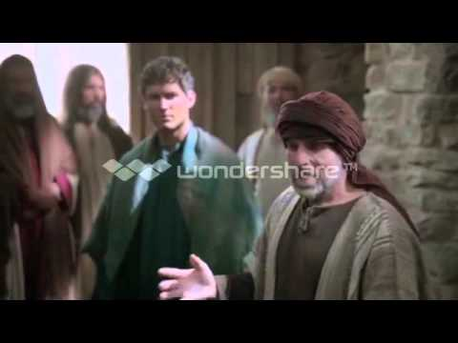

Slide 22
CHAPTER 16 J. W. McGarvey’s Acts Commentary
VERSES 9 & 10
We will yet see that, as in the cases of Philip and of Peter, the prayers of individuals ready to hear the gospel were connected with the divine interference by which Paul and Silas were now being directed.
Preachers of the present day have no authoritative visions by night to guide them, and the supposition indulged by some, that they are at times prompted by the Spirit as Paul was, is nothing more than the conceit of an enthusiast, while it is nothing less than a claim to inspiration. But Paul was often guided merely by the indications of Providence, and so may it be with us. If we are attentive to these indications, we shall be under the guidance of that same All-seeing Eye which chose the steps of Paul. If the way of our choosing is entirely blocked up, at times, or some stern necessity turns us aside from a settled purpose, we may regard it as but the firmer pressure of that hand which leads us, for the most part, unseen and unfelt.
McGarvey, J. W. (1872). A commentary on Acts of Apostles (p. 200). Lexington, KY: Transylvania

Slide 23
CHAPTER 16 J. W. McGarvey’s Acts Commentary
VERSES 11 & 12
The observant reader will here notice a change in style of the narrative, which indicates the presence of the writer among the companions of Paul. Hitherto he had spoken of them only by way of the third person; but when about to leave Troas, he uses the first person plural, saying, “we sought to go forth into Macedonia,” and “we ran to Samothrace,” etc. It is only by such a change in the pronoun employed, from the third to the first person, and from the first to the third that we can detect the presence or absence of Luke. From this indication we conclude that he first joined the company in the interior of Asia Minor, just previous to entering the city of Troas. The company with whom we are now traveling is composed of Paul and Silas, Timothy and Luke.
McGarvey, J. W. (1872). A commentary on Acts of Apostles (pp. 200–201). Lexington, KY: Transylvania Printing and Publishing Co.

Slide 24
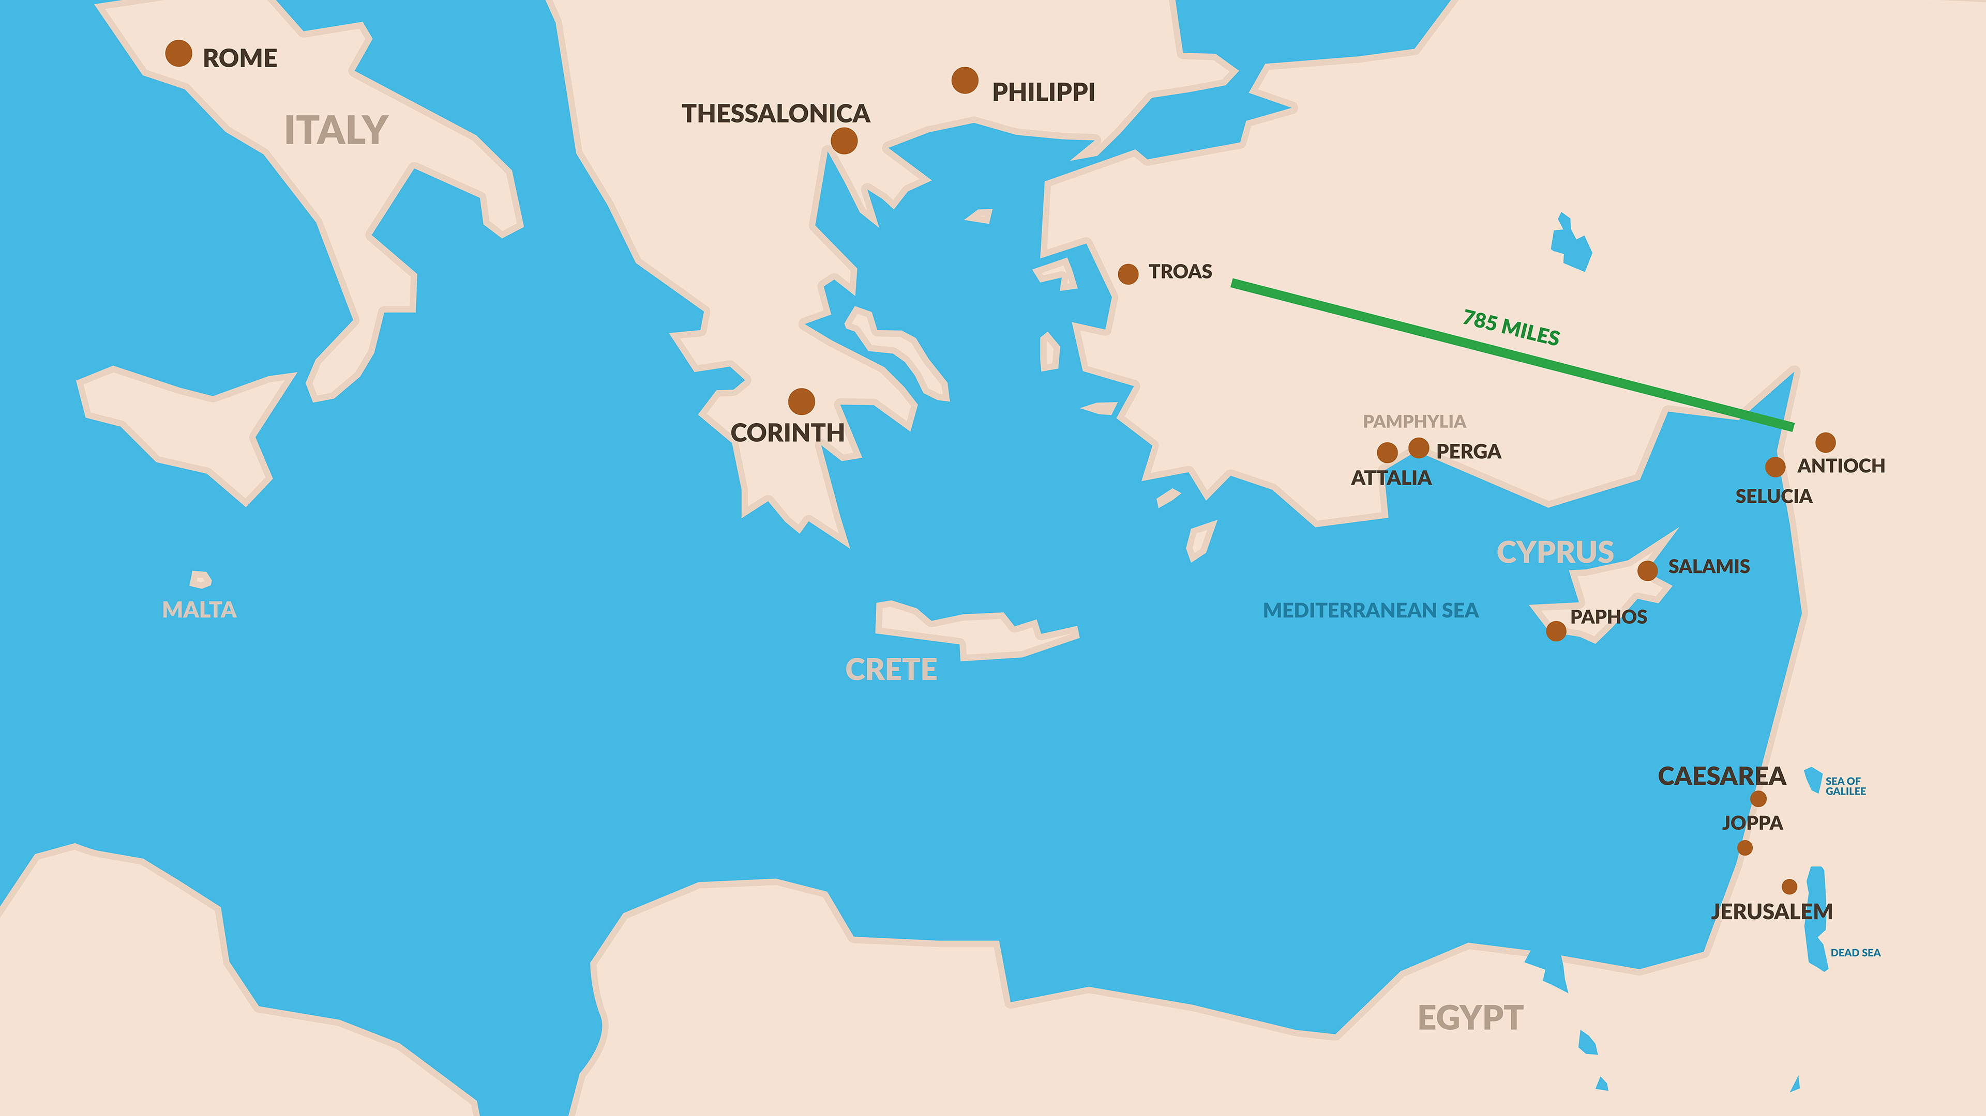

Slide 25
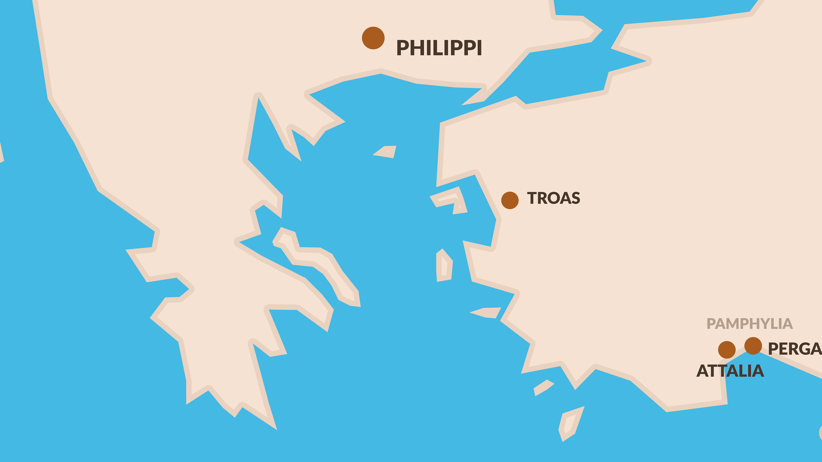

Slide 26
¹³ And on the Sabbath day we went outside the gate to a riverside, where we were supposing that there would be a place of prayer; and we sat down and began speaking to the women who had assembled. ¹⁴ A woman named Lydia, from the city of Thyatira, a seller of purple fabrics, a worshiper of God, was listening; and the Lord opened her heart to respond to the things spoken by Paul.
- Acts 16:13-14

Slide 27
And when she and her household had been baptized, she urged us, saying, “If you have judged me to be faithful to the Lord, come into my house and stay.” And she prevailed upon us.
- Acts 16:15

Slide 28
CHAPTER 16 J. W. McGarvey’s Acts Commentary
VERSES 13 - 15
The impulse awakened in Lydia’s heart was not such a disposition that she listened favorably to what Paul said, but, “that she attended to things” which he spoke. The facts, in the order in which they are stated, are as follows: 1st. “We spoke to the women.” 2d. Lydia “was listening.” 3d. God opened her heart. 4th. She attended to the things spoken. The fourth fact is declared to be the result of the third. It was after she “was listening” that God opened her heart, and after her heart was opened, and because of this opening, that she attended to what she had heard. What the exact result was, then, is to be determined by the meaning of the word “attended.” The term attend sometimes means to concentrate the mind upon a subject, and sometimes to practically observe what we are taught. The Greek term prosecho, here employed, has a similar usage. It is used in the former sense, in Acts viii: 6, where it is said the people, “attended to the things spoken by Philip, in hearing and seeing the miracles which he wrought.” It is used in the latter sense in 1 Tim. iv: 13, where Paul says, “Till I come, attend to reading, to exhortation, to teaching;” and in Heb. vii: 13, where to attend to the altar means to do the service at the altar. That the latter is the meaning in the case before us is clearly proved by the fact that she had already listened to what Paul spoke, or given mental attention to it, before God opened her heart so that she attended to the things she had heard. Now, in hearing the gospel, she learned that there were certain things which she was required to attend to, which were, to believe, to repent, and to be immersed. To attend to the things she heard, then, was to do these things. That immersion was included in the things which Luke refers to by this term is evident from the manner in which he introduces that circumstance. He says, “And when she was immersed,” etc., as if her immersion was already implied in the preceding remark. If such was not his meaning, he would not have used the adverb when, but would simply have stated, as an additional fact, that she was immersed.
McGarvey, J. W. (1872). A commentary on Acts of Apostles (p. 202). Lexington, KY: Transylvania Printing and Publishing Co.

Slide 29
CHAPTER 16 J. W. McGarvey’s Acts Commentary
VERSES 13 - 15
Having the facts of the case now before us, we inquire whether it is necessary to admit an immediate influence of the Spirit, in order to account for the opening of her heart. We must bear in mind, while prosecuting this inquiry, that the opening in question was such a change in her heart as to induce her to believe the gospel, to repent of her sins, and to be immersed, thereby devoting her life to the service of Christ. Her heart had been contracted by the narrowness of Jewish prejudices, which were obstacles, in some degree, to the reception of the gospel; but she was a “worshiper of God,” which inclined her to do whatever she might learn to be the will of God. In seeking to account for the change effected, we must also bear in mind the well-settled philosophical principle, that when an effect can be accounted for by causes which are known to be present, it is illogical to assume a cause which is not known to be present. Now, in Lydia’s case, it is not asserted that an immediate action of the Spirit took place in her heart; neither can it be known that such a cause was present, unless this is the only cause which could produce the effect. But it is known that all the power which can be exerted through the words of an inspired apostle preaching the gospel of Jesus Christ, was present. And it can not be denied, that when the gospel, thus presented, is listened to by one who is already a sincere worshiper of God, as Lydia was, the heart may be so expanded by it from the narrowness of Jewish prejudice as to admit faith, repentance & obedience. The assumption, therefore, that her heart was opened by an abstract influence of the Spirit, is entirely gratuitous and illogical, while the real cause is patent upon the face of the narrative in the preaching done by Paul.
McGarvey, J. W. (1872). A commentary on Acts of Apostles (pp. 202–203). Lexington, KY: Transylvania Printing and Publishing Co.

Slide 30
CHAPTER 16 J. W. McGarvey’s Acts Commentary
VERSES 13 - 15
If, in conclusion of this inquiry, we compare Lydia’s case with that of the eunuch, or of Cornelius, who were in similar states of mind previous to conversion, and needed a similar opening of the heart, we find that it was effected in the same way, through the power of miraculously attested truth, and that the only difference is in the phraseology in which Luke chooses to describe it. If, from these facts, we attempt a general conclusion, it is, that when any narrowness of heart, produced by improper education, or other, stands in the way of salvation, the Lord removes it, and opens the heart, by the expanding and ennobling influence of his truth. This is true of the saint as well as the sinner, as is well illustrated by the case of Peter and the other apostles in connection with the family of Cornelius.
McGarvey, J. W. (1872). A commentary on Acts of Apostles (p. 203). Lexington, KY: Transylvania Printing and Publishing Co.

Slide 31
CHAPTER 16 J. W. McGarvey’s Acts Commentary
VERSES 13 - 15
It is sufficient to say, that “the repeated mention of whole households as baptized” affords not the slightest evidence in favor of infant baptism, unless it can be proved that in at least one of these households there were infants. It there were infants in one, this would establish the presumption that there might be in some others. But until there is proof that there were infants in some of them, it may be inferred that the absence of infants was the very circumstance which led to the immersion of the whole family. Indeed, a fair induction of such cases fully justifies this inference in reference to Lydia’s case. There is positive proof that there were no infants in any other family whose immersion is mentioned in the New Testament. There were none in the household of Cornelius; for they all spoke in tongues, and believed. There were none in that of the jailer; for they all believed and rejoiced in the Lord. None in the household of Stephanas; for they “addicted themselves to the ministry of the saints.” Now, inasmuch as one of the peculiarities of all households who were immersed, of whom we know the facts, was the absence of infants, we are justified in the conclusion, no evidence to the contrary appearing, that this was also a peculiarity of Lydia’s household. The argument, therefore, as stated by Dr. Alexander, is not only inconclusive, but, when properly viewed, establishes a presumption quite the reverse..
McGarvey, J. W. (1872). A commentary on Acts of Apostles (p. 204). Lexington, KY: Transylvania Printing and Publishing Co.

Slide 32
CHAPTER 16 J. W. McGarvey’s Acts Commentary
VERSES 13 - 15
The mere absence of proof is not the worst feature of the pedobaptist assumptions in this case. For the assumption that infants were here baptized depends upon five other assumptions, the falsity of either of which would vitiate the whole argument. It is assumed, First, That some of the household were baptized without faith. Second, That Lydia was, or had been, a married woman. Third, That she had children. Fourth, That one or more of her children were infants. Fifth, That her infant children were so young as to necessarily be brought with her from Thyatira to Philippi. Now, so long as remains possible that all the parties baptized were believers; or Lydia was a maiden; or she was a married woman or widow without children; or her children were of a responsible age; or that her younger children were left at home in Thyatira when she came to Philippi to sell her purple cloths; so long as any one of these hypotheses can possibly be true, so long will it be impossible to prove an instance of infant baptism in her household.
McGarvey, J. W. (1872). A commentary on Acts of Apostles (p. 205). Lexington, KY: Transylvania Printing and Publishing Co.

Slide 33
Jamieson-Fausset-Brown Bible Commentary
16-18. as we went to prayer—The words imply that it was on their way to the usual place of public prayer, by the river-side, that this took place; therefore not on the same day with what had just occurred. a damsel — a female servant, and in this case a slave (Acts 16:19).
possessed of a spirit of divination—or, of Python, that is, a spirit supposed to be inspired by the Pythian Apollo, or of the same nature. The reality of this demoniacal possession is as undeniable as that of any other in the Gospel history.

Slide 34
MacLaren's Expositions THE RIOT AT PHILIPPI
Verse 19 - The accuracy of the charge may be measured by the ignorance of the accusers that Paul and his friends were in any way different from the run of Jews. No doubt they were supposed to be teaching Jewish practices, which were supposed to be inconsistent with Roman citizenship. But if the magistrates had said, ‘What customs?’ the charge would have collapsed. Thank God, the Gospel has a witness to bear against many ‘customs’; but it does not begin by attacking even these, much less by prescribing illegalities. Its errand was and is to the individual first. It sets the inner man right with God, and then the new life works itself out, and will war against evils which the old life deemed good; but the conception of Christianity as a code regulating actions is superficial, whether it is held by friends or foes. There is always a mob ready to follow any leader, especially if there is the prospect of hurting somebody. The lovers of tranquility showed how they loved it by dragging Paul and Silas into the forum, and bellowing untrue charges against them. The mob seconded them; ‘they rose up together [with the slave-owners] against Paul and Silas.’ The magistrates, knowing the ticklish material that they had to deal with, and seeing only a couple of Jews from nobody knew where, did not think it worth while to inquire or remonstrate. They were either cowed or indifferent; and so, to show how zealous they and the mob were for Roman law, they drove a coach-and-six clean through it, and without the show of investigation, scourged and threw into prison the silent Apostles. It was a specimen of what has happened too often since. How many saints have been martyred to keep popular feeling in good tune! And how many politicians will strain conscience to-day, because they are afraid of what Luke here unpolitely calls ‘the multitude,’ or as we might render it, ‘the mob,’ but which we now fit with a much more respectful appellation!

Slide 35
Does God Exist?\Oct90\Revolution Or Evolution?\Cecil Hook
David Lee Burris:
Notes On Roman Stylized Slavery: “Legally claiming personal bankruptcy opened the door for many to make their fortunes handling the affairs of the great houses of the prominent families of the cities. Slowly but surely these temporary slaves became essential to the maintenance of the household and then the dependency relationship would be reversed. Shortly thereafter these skilled individuals would buy out their contract and become manor caretakers – in other words – they went from self-enslavement to quoting their own salary in short order!” Myself
Was it sinful for christians to own slaves?
Would it have been proper to buy a slave?
What about one person enslaving another?
“Paul insists, ‘Do not become slaves of men?’ (1st Cor 7:23). If it is wrong for me to become a slave, it is wrong for me to enslave someone else. Through the working out of the Golden Rule, this great social change was to evolve…”

Slide 36
Does God Exist?\Oct90\Revolution Or Evolution?\Cecil Hook
David Lee Burris:
Notes On Roman Stylized Slavery: “Legally claiming personal bankruptcy opened the door for many to make their fortunes handling the affairs of the great houses of the prominent families of the cities. Slowly but surely these temporary slaves became essential to the maintenance of the household and then the dependency relationship would be reversed. Shortly thereafter these skilled individuals would buy out their contract and become manor caretakers – in other words – they went from self-enslavement to quoting their own salary in short order!” Myself
Was it sinful for christians to own slaves?
Would it have been proper to buy a slave?
What about one person enslaving another?
“Paul insists, ‘Do not become slaves of men?’ (1st Cor 7:23). If it is wrong for me to become a slave, it is wrong for me to enslave someone else. Through the working out of the Golden Rule, this great social change was to evolve…”
“God wants change in all individuals and societies. He does not, however, demand or expect that change to be an immediate leap from depravity to perfection. Conduct of a mature disciple is not demanded of a newborn in Christ; neither is infancy an acceptable standard for those who have had time and opportunity to grow toward the fullness of Christ!”

Slide 37
²⁵ But about midnight Paul and Silas were praying and singing hymns of praise to God, and the prisoners were listening to them.
- Acts 16:25

Slide 40
Scripture Commands
INSTRUMENT
Ephesians 5: 19 “Speak In Song”
CANNOT
Colossians 3: 16 “Teach In Song”
CANNOT
Colossians 3: 16 “Admonish In Song”
CANNOT
1st Cor. 14: 15 “Sing Understanding”
CANNOT
Hebrews 2: 12 “Praise God”
CANNOT
Hebrews 13: 15 “Give Thanks”
CANNOT

Slide 41
²⁵ But about midnight Paul and Silas were praying and singing hymns of praise to God, and the prisoners were listening to them.
- Acts 16:25

Slide 42
²⁵ But about midnight Paul and Silas were praying and singing hymns of praise to God, and the prisoners were listening to them.
- Acts 16:25

Slide 43
²⁵ But about midnight Paul and Silas were praying and singing hymns of praise to God, and the prisoners were listening to them; ²⁶ and suddenly there came a great earthquake, so that the foundations of the prison house were shaken; and immediately all the doors were opened and everyone’s chains were unfastened. ²⁷ When the jailer awoke and saw the prison doors opened, he drew his sword and was about to kill himself, supposing that the prisoners had escaped.
- Acts 16:25-27

Slide 44
PREACHING & TEACHING WAS A BYPRODUCT OF THEIR PRAISES!

Slide 45
²⁸ But Paul cried out with a loud voice, saying, “Do not harm yourself, for we are all here!” ²⁹ And he called for lights and rushed in, and trembling with fear he fell down before Paul and Silas, ³⁰ and after he brought them out, he said, “Sirs, what must I do to be saved?”
- Acts 16:28-30

Slide 46
CHAPTER 16 J. W. McGarvey’s Acts Commentary
VERSES 31 & 32
The conduct of the jailer in prostrating himself before Paul and Silas, and crying out, “What shall I do to be saved?” shows he already believed them to be messengers of God & understood that their message had reference to the salvation of men. But there is no evidence that his faith or his information extended beyond this. Having commanded him to believe on the Lord Jesus Christ, it was necessary to put within his reach the means of faith; and this Paul proceeds to do by preaching “the word of the Lord to him and to all who were in his house.”
McGarvey, J. W. (1872). A commentary on Acts of Apostles (p. 210). Lexington, KY: Transylvania Printing and Publishing Co.

Slide 47
³¹ They said, “Believe in the Lord Jesus, and you will be saved, you and your household.” ³² And they spoke the word of the Lord to him together with all who were in his house.
- Acts 16:31-32

Slide 48
CHAPTER 16 J. W. McGarvey’s Acts Commentary
VERSES 31 & 32
Now, the statement of Paul to the jailer is not, that if he would believe on the Lord Jesus Christ with a dead faith, or a faith so weak as to be overpowered by worldly motives, he should be saved; but he evidently contemplates a living faith—a faith which leads to immediate and hearty obedience. In this usage of the term it is true that not only the jailer, but every other believer may be promised, “Believe on the Lord Jesus, and thou shalt be saved.” Yet it is equally true that the salvation does not result from the faith only; and that it is not enjoyed until the faith brings forth the contemplated obedience. If faith without works is dead, then it remains dead as long as it remains without works. It thus remains until the believer is immersed, if he proceed according to apostolic example; therefore, faith without immersion is dead. Paul acted upon this principle in the case before us. For, after telling him, in the comprehensive sense of the term believe, that if he would believe on the Lord Jesus he should be saved, he immediately gives him more specific instruction, and immerses him the same hour of the night. Those who argue that the jailer obtained pardon by faith alone, leave the jail too soon. If they would remain one hour longer, they would see him immersed for the remission of his sins, and rejoicing in the knowledge of pardon after his immersion, not before it.
McGarvey, J. W. (1872). A commentary on Acts of Apostles (pp. 209–210). Lexington, KY: Transylvania Printing and Publishing Co.

Slide 49
³³ And he took them that very hour of the night and washed their wounds, and immediately he was baptized, he and all his household. ³⁴ And he brought them into his house and set food before them, and rejoiced greatly, having believed in God with his whole household.
- Acts 16:33-34

Slide 51
CHAPTER 16 J. W. McGarvey’s Acts Commentary
VERSES 31 & 32
The term is sometimes used abstractly, and sometimes to include the repentance and obedience which properly result from faith. Whatever is affirmed of faith only must necessarily contemplate it in the former sense. But in that sense it can not secure justification, as is proved by the force of those passages which treat of it in this sense. John, in his gospel, says this: “Among the chief rulers many believed on him; but because of the Pharisees they did not confess him, lest they should be put out of the synagogue: for they loved the praise of men more than the praise of God.” James also says: “As the body without the spirit is dead, so faith without works is dead also.” In those passages faith is considered separately from the works which should follow it, and is declared to be dead, or inoperative.
McGarvey, J. W. (1872). A commentary on Acts of Apostles (p. 209). Lexington, KY: Transylvania Printing and Publishing Co.

Slide 55
CHAPTER 16 J. W. McGarvey’s Acts Commentary
VERSES 33 - 34
It has been suggested that the party could not have passed through the gates of the city at this hour of the night; but there is no evidence that Philippi was a walled town. Again, it is sometimes objected, that the jailer had no right to take his prisoners outside the jail; and that Paul and Silas showed, by their conduct on the next morning, that they would not go out without the consent of the authorities. But this is to assume that the jailer would rather obey men than God, and that Paul and Silas were so punctilious about their personal dignity that they would refuse to immerse a penitent sinner thru fear of compromising it. Such assumptions are certainly too absurd to be entertained when once observed; but, even if we cling to them, they can not set aside the fact, so clearly established above, that the jailer did lead them out of the prison.
As for the assumption infants were baptized here, we have already observed, in commenting on Lydia’s conversion, that it is precluded by the fact that all the household believed. “He rejoiced, believing in God with all his house.” Moreover, Paul and Silas spoke the Word to “all who were in the house,” yet they certainly did not preach to infants. As there were no infants in the house while hearing, and none while subsequently believing and rejoicing, there could be none at the intermediate baptizing.
McGarvey, J. W. (1872). A commentary on Acts of Apostles (p. 211). Lexington, KY: Transylvania Printing and Publishing Co.

Slide 56
CHAPTER 16 J. W. McGarvey’s Acts Commentary
VERSES 33 & 34
Those pedobaptist writers who claim the example of the apostles in favor of affusion and infant baptism attempt to find support for these practices in this case of conversion. Their argument for affusion depends entirely upon the assumption that the baptism was performed within the prison. If this assumption were admitted, it would prove nothing in favor of affusion so long as it is possible that there were conveniences for immersion within the prison. But the assumption is in direct conflict with the facts in the case. The facts are briefly as follows: First, When the jailer was about to commit suicide, Paul saw him, which shows that he was then outside of his dungeon, in the more part of the prison. Second, Hearing Paul’s voice, the jailer sprang into the prison, and “led them out“—not dungeon, but out of the prison. Third, Being now out of the prison, “they spoke the word of the Lord to him and to all who were in his house.” While speaking, then, they were in the house, and not in the prison. Fourth, “He took them and washed their stripes, and was baptized.” The verb took, in this connection, implies the removal of the parties to some other spot for the washing and baptizing. Whether to some other part of the house, or out of the house, it does not determine. But, fifth, when the baptizing was concluded, “he led them into his house,” which shows that, before it was done, he had taken them out of the house. Between the moment at which he took them out of the house and the moment he brought them into it, the baptizing was done. But they would not, at this hour of the night, have gone out, unless there was some necessity for it, which the demands of affusion could not supply. The circumstances, though not in itself a proof of immersion, afford strong circumstantial evidence in its favor, and is suggestive of that river on the banks of which Lydia first heard the gospel, and in which she was immersed.
McGarvey, J. W. (1872). A commentary on Acts of Apostles (pp. 210–211). Lexington, KY: Transylvania Printing and Publishing Co.

Slide 58
CHAPTER 16 J. W. McGarvey’s Acts Commentary
VERSES 37 - 39
If the fact of their having been scourged and imprisoned should follow them to other cities, it would do them no harm, provided it were also known that the magistrates had acknowledged the injustice done them, by going in person to the prison, and giving them an honorable discharge.
As it was a capital crime, under the Roman law, to scourge a Roman citizen, and Paul & Silas both enjoyed rights of citizenship, they had the magistrates in their power, and could dictate terms to them. The terms were promptly complied with; for men who can be induced to pervert justice by the clamor of an unthinking mob will nearly always prove cowardly and sycophantic when their crimes are exposed, and justice is likely to overtake them.
McGarvey, J. W. (1872). A commentary on Acts of Apostles (p. 212). Lexington, KY: Transylvania Printing and Publishing Co.

Slide 59
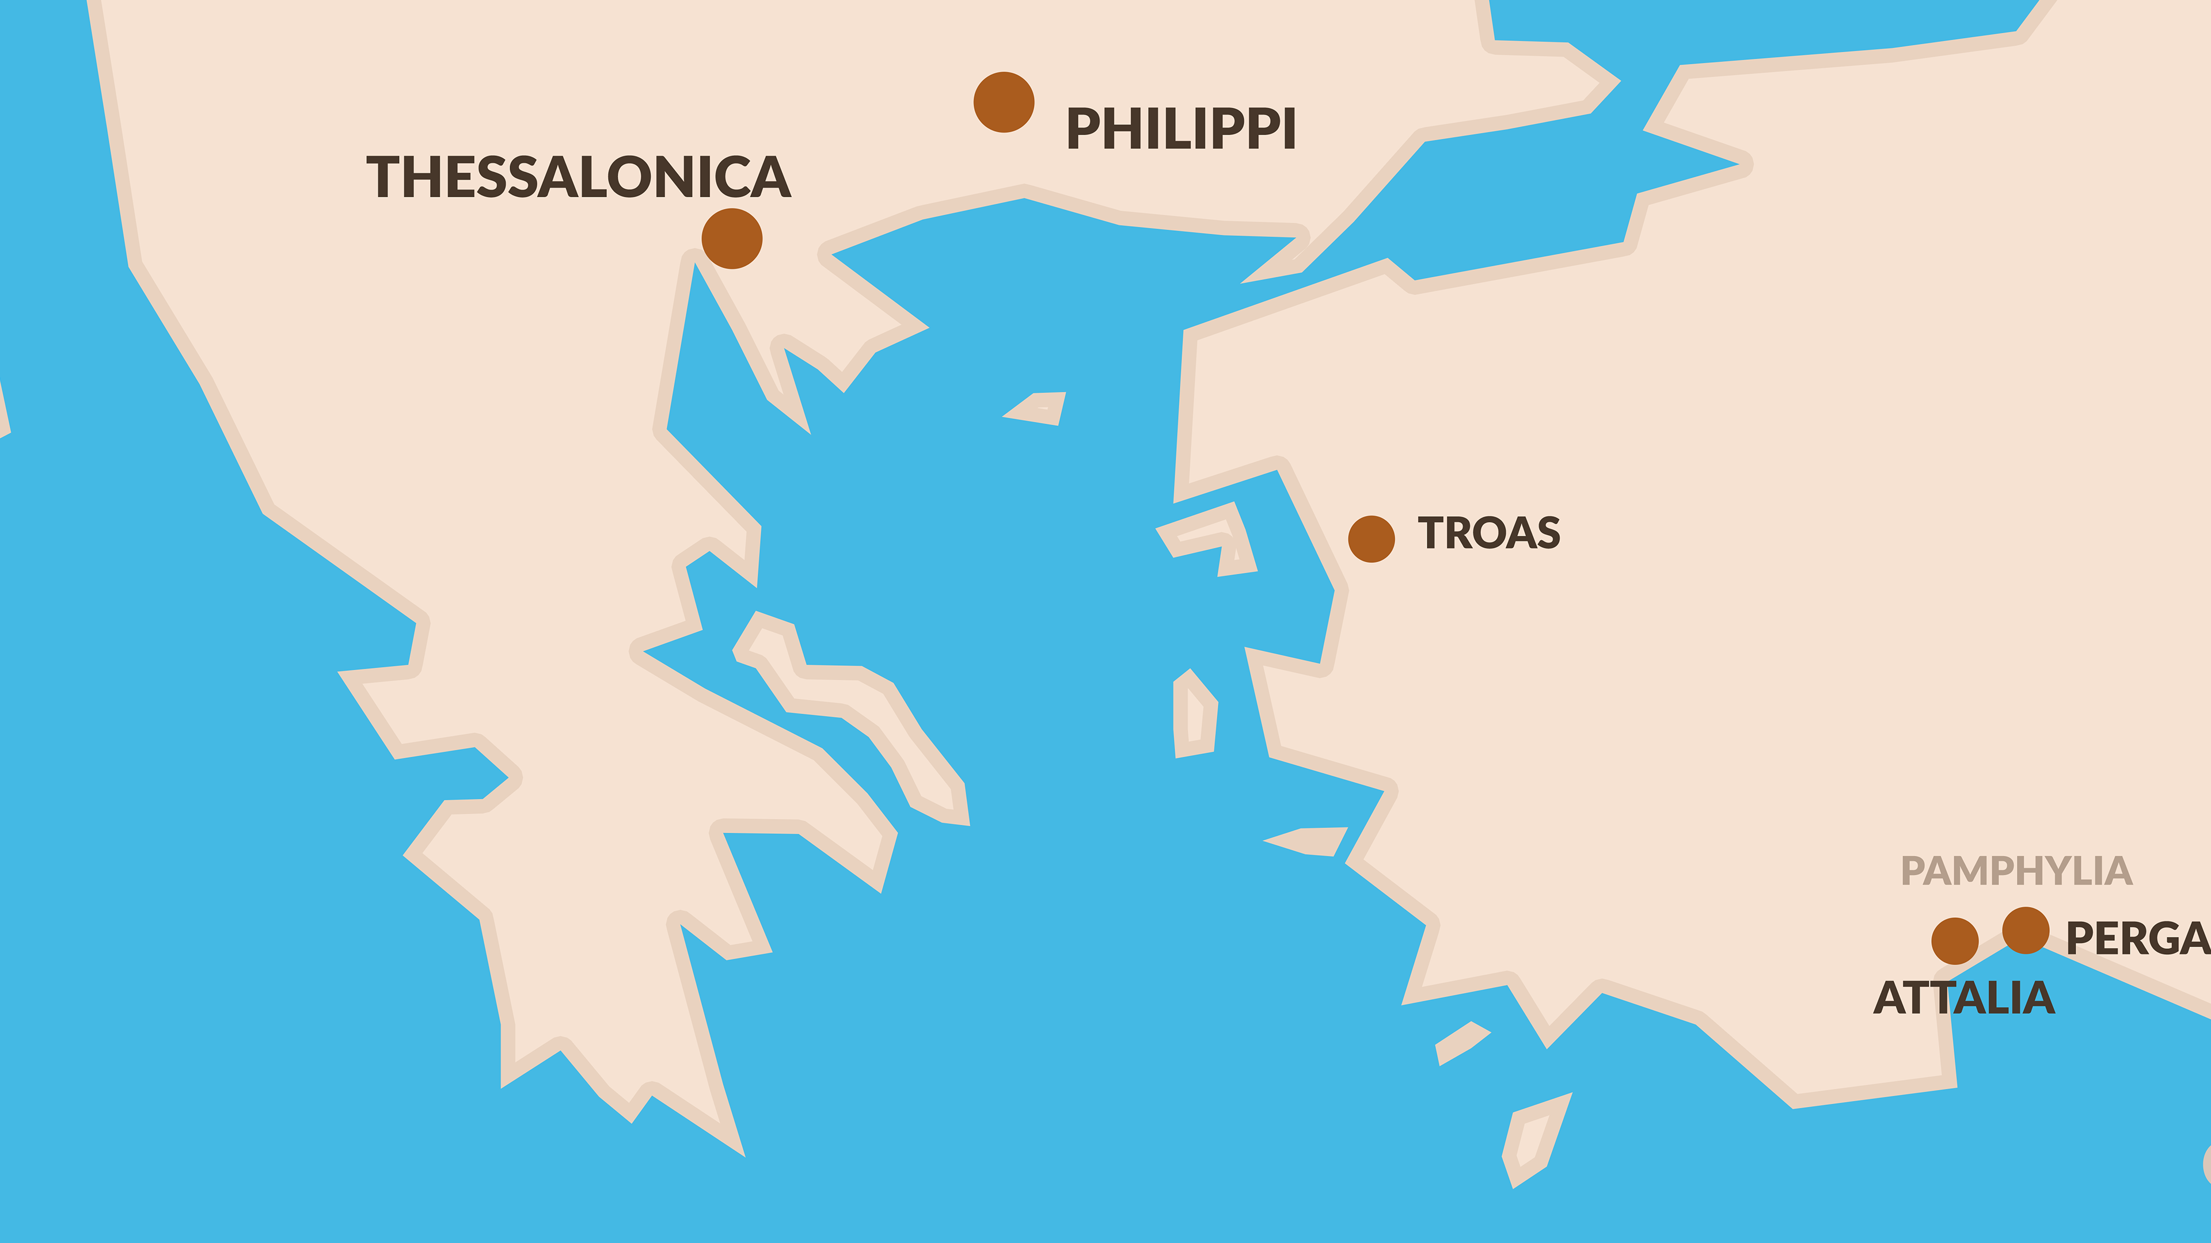

Slide 60
¹ Now when they had traveled through Amphipolis and Apollonia, they came to Thessalonica, where there was a synagogue of the Jews. ² And according to Paul’s custom, he went to them, and for three Sabbaths reasoned with them from the Scriptures,
- Acts 17:1-2

Slide 61
³ explaining and giving evidence that the Christ had to suffer and rise again from the dead, and saying, “This Jesus whom I am proclaiming to you is the Christ.” ⁴ And some of them were persuaded and joined Paul and Silas, along with a large number of the God-fearing Greeks and a number of the leading women.
- Acts 17:3-4

Slide 62
But the Jews, becoming jealous and taking along some wicked men from the market place, formed a mob and set the city in an uproar; and attacking the house of Jason, they were seeking to bring them out to the people.
- Acts 17:5

Slide 63
⁶ When they did not find them, they began dragging Jason and some brethren before the city authorities, shouting, “These men who have upset the world have come here also; ⁷ and Jason has welcomed them, and they all act contrary to the decrees of Caesar, saying that there is another king, Jesus.”
- Acts 17:6-7

Slide 66
⁸ They stirred up the crowd and the city authorities who heard these things. ⁹ And when they had received a pledge from Jason and the others, they released them.
- Acts 17:8-9

Slide 67
Paul’s Pattern
Preaches the gospel
Some believe
Disbelievers cause trouble
Paul moves on to another city

Slide 68
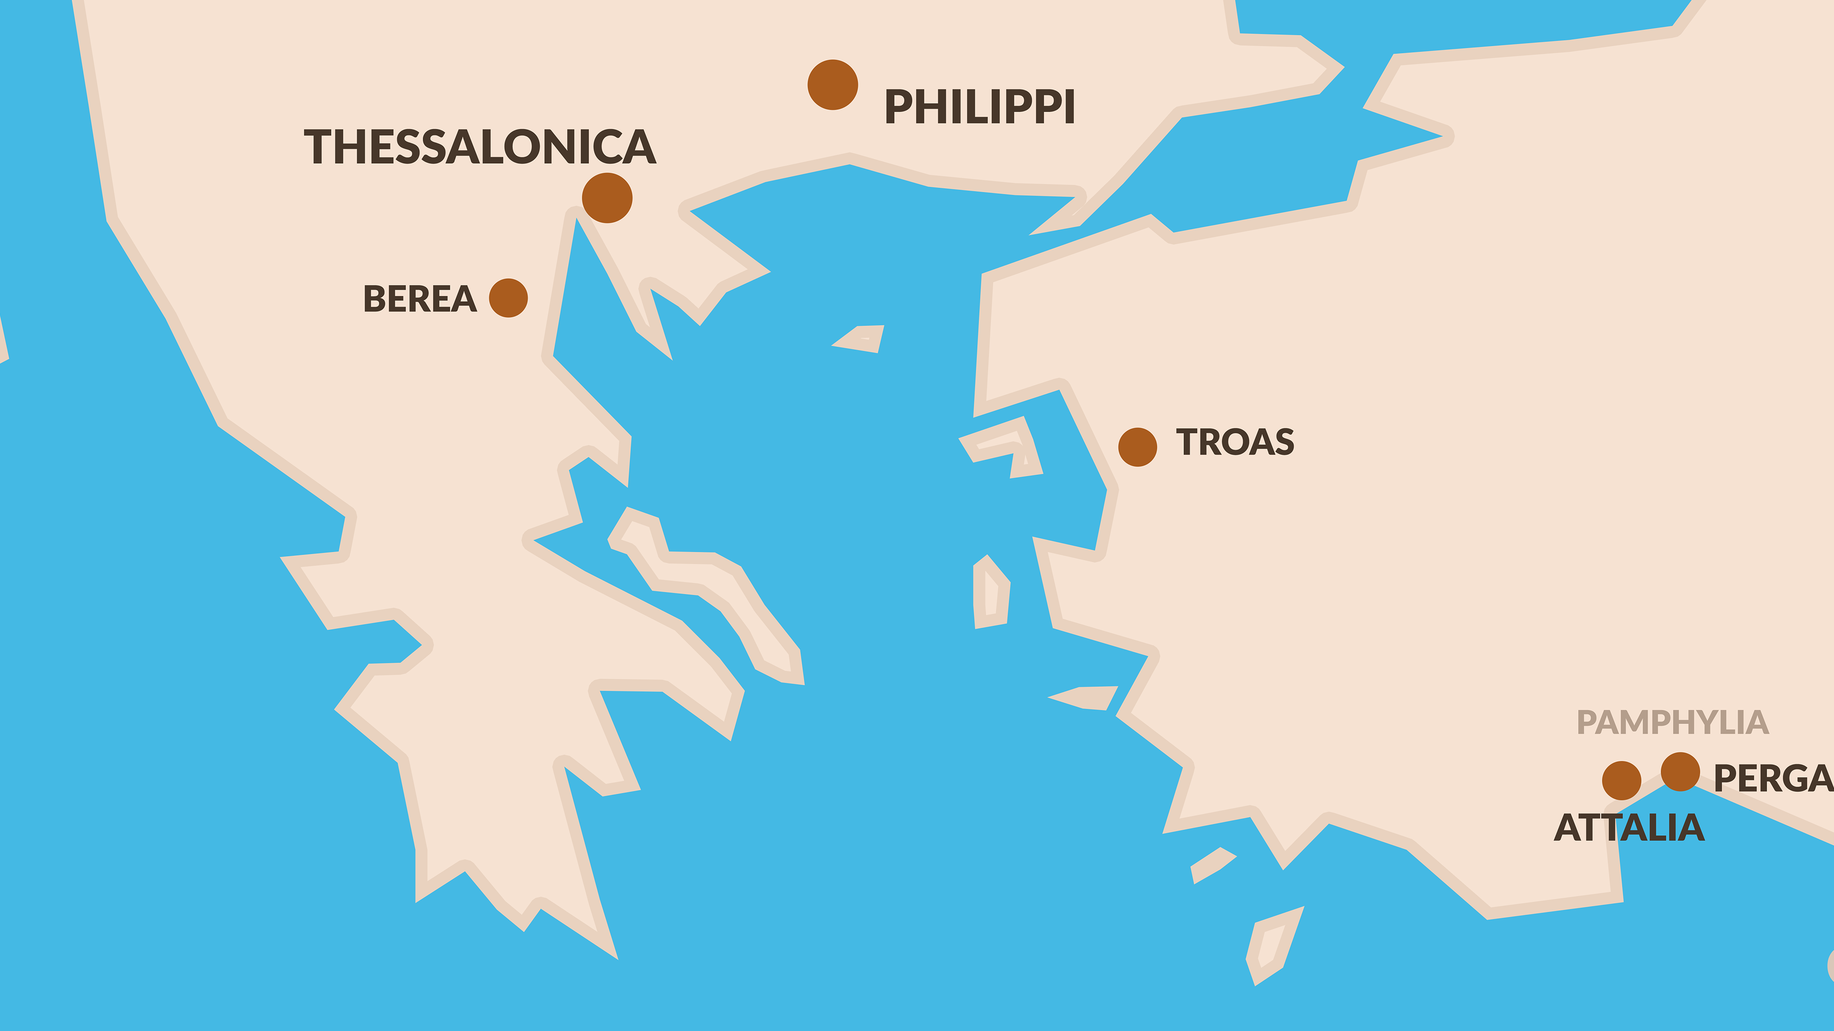

Slide 72
¹⁵ Now those who escorted Paul brought him as far as Athens; and receiving a command for Silas and Timothy to come to him as soon as possible, they left. ¹⁶ Now while Paul was waiting for them at Athens, his spirit was being provoked within him as he was observing the city full of idols.
- Acts 17:15-16

Slide 73
¹⁷ So he was reasoning in the synagogue with the Jews and the God-fearing Gentiles, and in the market place every day with those who happened to be present. ¹⁸ And also some of the Epicurean and Stoic philosophers were conversing with him. Some were saying, “What would this idle babbler wish to say?” Others, “He seems to be a proclaimer of strange deities,”—because he was preaching Jesus and the resurrection.
- Acts 17:17-18

Slide 74
CHAPTER 17 J. W. McGarvey’s Acts Commentary
VERSES 15 - 17
In the ancient world there were two distinct species of civilization, both of which had reached their highest excellence in the days of the apostles. One was the result of human philosophy; the other, of a divine revelation. The chief center of the former was the city of Athens; of the latter, the city of Jerusalem. If we compare them, either as respects the moral character of the people brought respectively under their influence, or with reference to their preparation for a perfect religion, we shall find the advantage in favor of the latter. Fifteen hundred years before, God had placed the Jews under the influence of revelation, and left the other nations of the earth to “walk in their own ways.” By a severe discipline, continued through many centuries, the former had been elevated above the idolatry in which they were sunk at the beginning, and which still prevailed over all other nations. They presented, therefore, a degree of purity in private morals which stands unrivaled in ancient history previous to the advent of Christ. On the other hand, the most elegant of the heathen nations were exhibiting, in their social life, a complete exhaustion of the catalogue of base and beastly things of which men and women could be guilty. In Athens, where flourished the most profound philosophy, the most glowing eloquence, the most fervid poetry, and the most refined art which the world has ever seen, there was the most complete and studied abandonment of every vice which passion could prompt or imagination invent.
McGarvey, J. W. (1872). A commentary on Acts of Apostles (pp. 217–218). Lexington, KY: Transylvania Printing and Publishing

Slide 75
ATHENS WALKED IN 15 MINUTES

Slide 76
¹⁹ And they took him and brought him to the Areopagus, saying, “May we know what this new teaching is which you are proclaiming? ²⁰ For you are bringing some strange things to our ears; so we want to know what these things mean.”
- Acts 17:19-20

Slide 77
(Now all the Athenians and the strangers visiting there used to spend their time in nothing other than telling or hearing something new.)
- Acts 17:21

Slide 79
CHAPTER 17 J. W. McGarvey’s Acts Commentary
VERSES 19 - 21
The Areopagus was a rocky eminence, ascended by a flight of stone steps cut in the solid rock, on the summit of which were seats in the open air, where the judges, called Areopagites, held court for the trial of criminals, and of grave religious questions. The informal character of the proceedings on this occasion shows that it was not this court which had summoned Paul, but that those who were interested in hearing him selected this as a suitable place for the purpose. This is further evident from the note of explanation here appended by Luke, that the Athenians and strangers dwelling there, spent their time in nothing else than telling and hearing something new. It was more from curiosity, therefore, that they desired to hear him, than because they really expected to be benefited by what they would hear.
McGarvey, J. W. (1872). A commentary on Acts of Apostles (p. 219). Lexington, KY: Transylvania Printing and Publishing Co.

Slide 80
MODERN MAR’S HILL OF ATHENS

Slide 82
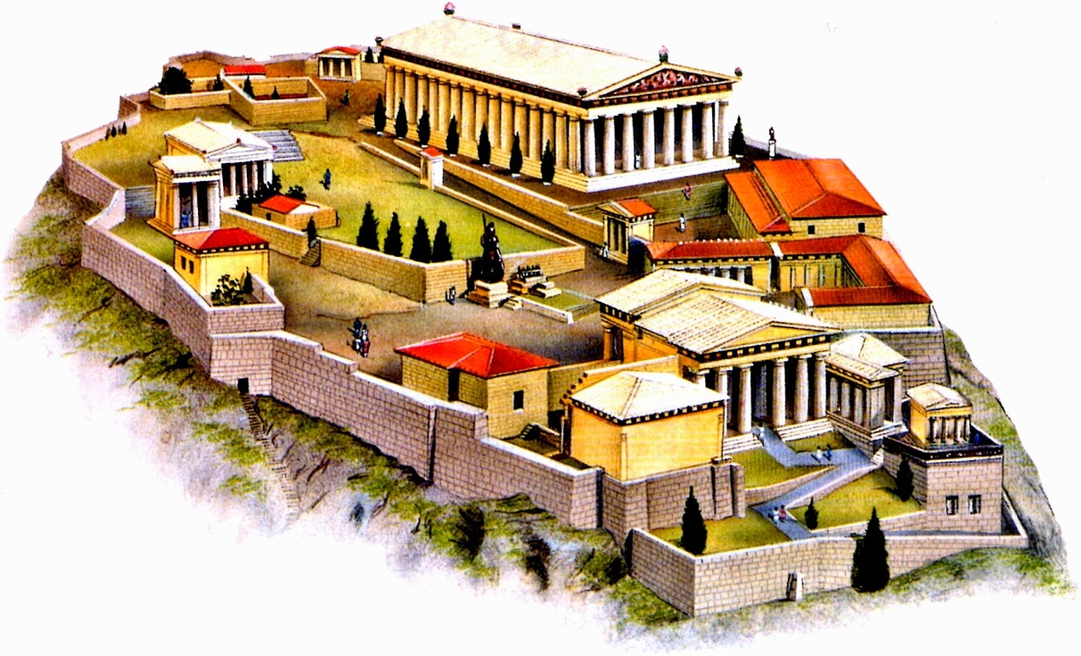

Slide 84
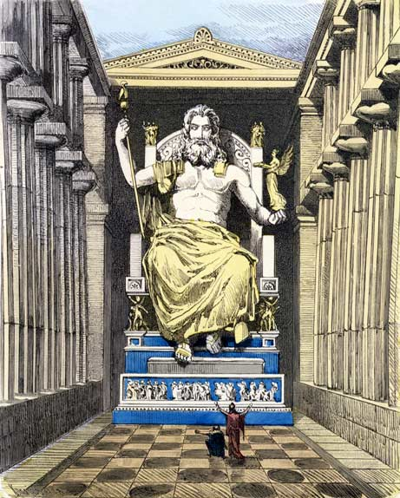

Slide 86
CHAPTER 17 J. W. McGarvey’s Acts Commentary
VERSES 22 - 31
After persevering, but necessarily disconnected “babbling” conversational efforts on the streets, Paul has now an audience assembled for the special purpose of hearing him & may present his theme in a more formal manner. He has now an audience of Jews and proselytes, but an assembly of demon-worshipers. He can’t, therefore, open the Scriptures, and begin by speaking of the long-expected Messiah. The Scriptures, and even the God who gave them, are to them, unknown. Before he can preach Jesus to them, as the Son of God, he must introduce to them a true conception of God himself. It was this consideration which made the following speech of Paul so different from all others recorded in Acts. We will first hear the whole discourse, and then examine the different parts in their connection with one another.
McGarvey, J. W. (1872). A commentary on Acts of Apostles (p. 219). Lexington, KY: Transylvania Printing and Publishing Co.

Slide 87
²² So Paul stood in the midst of the Areopagus and said, “Men of Athens, I observe that you are very religious in all respects. ²³ For while I was passing through and examining the objects of your worship, I also found an altar with this inscription, ‘TO AN UNKNOWN GOD.’ Therefore what you worship in ignorance, this I proclaim to you.
- Acts 17:22-23

Slide 88
In Athens Paul Preaches Of Another Hill
D. L. Burris: 400 Years Religiously Evolved From Tribal Deities To Polytheistic Assimilation
Second Notation: The Point Of A Stoic Type Bridge To Early Christianity –
Earliest Christians Appealed W/I Philosophically Competitive Context W/ Center Stoic
Natural Inclinations = Stoic Affinities; Cosmos Order & Lawful Creation Rationale = Creative
Power Rational & Inexhaustible; Lawful Continuity Needs Continuous Agent Logos & Divine
Fire Constant Creative Dynamic Force; Reject Chaos By Obeying Principles Of Order
Conformance & Obedient Faith Conformance Configured To The Nomological Reasoning Of
The Stoical Cosmology.
David Lee Burris:
The Homeric Myth presupposes the viewpoint that humans are useful to the gods but are not objects of their affection!
Acts 17: 17 In The Marketplace Paul Preaches Both Jesus & His Resurrection
Acts 17: 18 Epicurean Materialists & The Stoic Practitioners (v 21) Wanted Paul For Themselves So They Brought Him To Mar’s Hill.
Mar’s Hill Was A Place For Honoring The City Gods Through Prayers & Sacrifice Although Neither Of These Groups Were Really Religious.
Gods Not Moral Beings Nor Demand Men To Be
Both Groups Had Accommodated These Practice Based Official Religions So As To Remain Public.
Oral Societies Considered The Written Word Disguise & Not Elastic Enough To Reveal Depth – Deep Truth Was To Be Discovered From Questioning An Original Source At A Forum.
Writings Were Either Transcripts Of These Deliberative Dialogues Or Doctrinal Defenses Using This Stylistic Form.
Following From Verse 22 Is An Actual Record.

Slide 89
In Athens Paul Preaches Of Another Hill
David Lee Burris:
Religion Was A Communal Experience In The Pagan World; The Four Great Truths Of The Stoics: We are unhappy, anxious, and full of suffering – because of our passions – but we can attain peace of mind – by cultivating apatheia i.e. passionlessness or in modern terms “be cool”
Paul Probably Had A Mixed Audience Of Pagans & Philosophers Who Both Soon Thought He Was An Ancient Atheist As Antiquity Defined It.
This Would Be The Concern Of The Pagan Religionists Who Feared Offending The Designated Deities That Protect The City.
This Would Be To The Delight Of The Cognitive Elite Of Philosophical Thinkers.
Paul Proceeded – Like Socrates – To Show Himself Only Really Religious Person There.
Paul Exposed The Practice Based Ritual Religions Of The Pagans As Belief Systems Without Substance.
Paul Then Told - In Meta-Narrative Style - The Story Of - “The Meaning Of Life” - To The Philosophers.
God Create All Out Of Chaos Not Nothing!

Slide 90
In Athens Paul Preaches Of Another Hill
400 YRS: REFINED GOLD MEAN
TO DIALECTIC MATERIALISM
THESIS
SYNTHESIS
ANTI-THESIS

Slide 91
In Athens Paul Preaches Of Another Hill
David Lee Burris:
“Great Thoughts Reduced To Practice Become Great Acts” - William Hazlit
Below Border Friezes Of Mythological Creation Stories He Told Not Of Gods In Human Form But Humans In Gods Form.
When He Told Of A God Who Would Be Man & Was Crucified For The Purpose Of Our Redemption – It Was Too Much For Them.
Most Of Both Groups Left Paul At Very Mention Of The Resurrection; Even For These “Lovers Of Wisdom” Accustomed To Hearing Of Strange Religions This Was Different – It Had A Demanding Worldview.
Belief In The Ideas Of This New Religion Had Consequence; It Was A Way Of Life That Required An Active Faith.
Satan Kept His Thumbprint On Most Here Who Kept Their False Consciousness Of Philosophical & Religious Relativism.

Slide 92
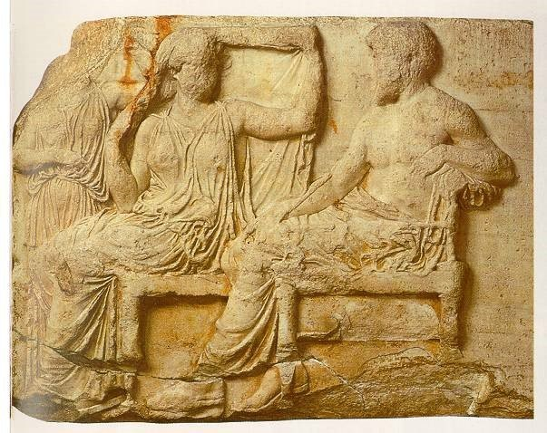
Left Side Building Frieze of First Couple

Slide 93
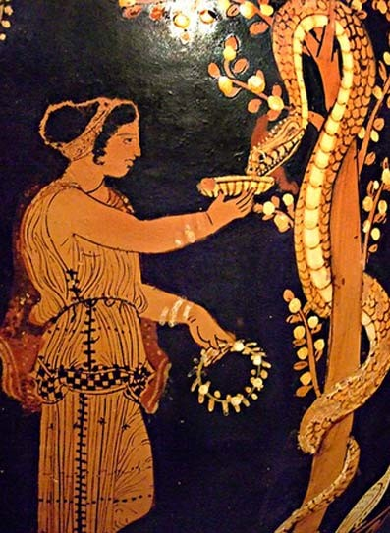
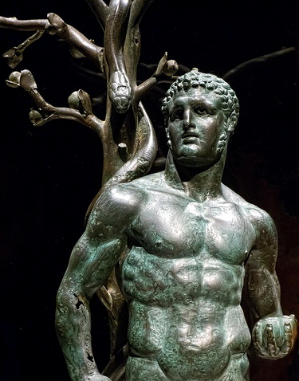
Ceramic & Statue of Eating From The Tree

Slide 94
²⁴ The God who made the world and all things in it, since He is Lord of heaven and earth, does not dwell in temples made with hands; ²⁵ nor is He served by human hands, as though He needed anything, since He Himself gives to all people life and breath and all things; ²⁶ and He made from one man every nation of mankind to live on all the face of the earth, having determined their appointed times and the boundaries of their habitation,
- Acts 17:24-26

Slide 95
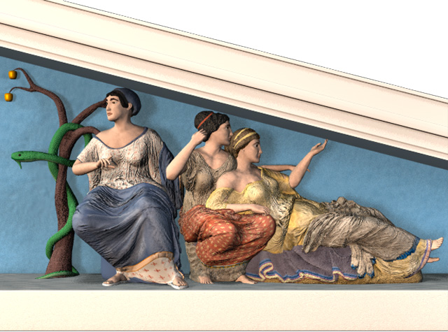

Slide 96
CHAPTER 17 J. W. McGarvey’s Acts Commentary
VERSES 22 - 31
He next introduces the God to whom he refers as the God who made the world, and all things in it, and who is Lord of both heaven and earth. That there was such a God, he assumes; but the assumption was granted by a part of his audience, the Stoics, and the Epicureans found it difficult to account to themselves for the fact that the world was made, without admitting there was a God who made it. He endeavors to give them a just conception of this God, by presenting several points of contrast between him and the gods with whom they were familiar. The first of these is, that, unlike them, “He does not dwell in temples made with hands.” All around the spot where he stood were temples in which the gods made their abode, and to which the people were compelled to resort in order to communicate with them. But that the God who made heaven and earth does not dwell in temples made by human hangs, he argued from the fact that he was “Lord of heaven and earth;” which implies that he could not be confined within limits so narrow. This was enough to establish his superiority to all other gods in power and majesty.
McGarvey, J. W. (1872). A commentary on Acts of Apostles (p. 221). Lexington, KY: Transylvania Printing and Publishing Co.

Slide 97
CHAPTER 17 J. W. McGarvey’s Acts Commentary
VERSES 22 - 31
The next point of contrast presented has reference to the services rendered the gods. His hearers had been in the habit of presenting meat offerings and drink offerings in the temples, under the superstitious belief that they were devoured by the gods. But Paul tells them the unknown God “is not served by the hands of men as though he needed any thing; for it is he who gives to all men life and breath, and all things, and has made from one blood all nations of men,” and appointed beforehand their periods, and the boundaries of their habitations. These facts demonstrate his entire independence of human ministrations, and exhibit, in a most striking manner, the dependence of men upon him. They not only sustain the point of contrast presented by Paul, but they involve an assumption of the special providence of God. By special providence, we mean providence in reference to individual persons and things. If God gives to all men life and breath and all things, he acts with reference to each individual man, to each individual breath that each man breathes, and to each particular thing going to make up all the things which he gives them. Again, if God appoints beforehand the “periods” of the nation (by which I understand all the great eras in their history,) and the “boundaries of their habitations,” he certainly directs the movements of individual men; for the movements of nations depend upon the movements of the individual men of whom they are composed. Sometimes, indeed, the movements of one man, as of Christopher Columbus, determine the settlement of continents, and the destiny of mighty nations. In view of these facts, we must admit the most special and minute providence of God in all the affairs of earth. It would never, perhaps, have been doubted, but for the philosophical difficulty of reconciling it with the free agency of men, and of discriminating between it and the working of miracles. This difficulty, however, affords no rational ground for such a doubt, for the method of God’s agency in human affairs is above human comprehension.
McGarvey, J. W. (1872). A commentary on Acts of Apostles (pp. 221–222). Lexington, KY: Transylvania Printing and Publishing Co.

Slide 98
CHAPTER 17 J. W. McGarvey’s Acts Commentary
VERSES 22 - 31
From this reference to the efforts of men to find God, a natural association of thought led the speaker to then assert the omni-presence of God: “Although he is not far from each one of us; for in him we live, and move, and have our being; as also some of your own poets have said, For we are also his offspring.” The connection of thought in this passage is basically this: If we are his offspring, as your own poets teach & this is sufficient proof that he is still about us; for he certainly would not abandon the offspring whom he has begotten.
McGarvey, J. W. (1872). A commentary on Acts of Apostles (p. 222). Lexington, KY: Transylvania Printing and Publishing Co.

Slide 99
²⁷ that they would seek God, if perhaps they might grope for Him and find Him, though He is not far from each one of us; ²⁸ for in Him we live and move and exist, as even some of your own poets have said, ‘For we also are His children.’ ²⁹ Being then the children of God, we ought not to think that the Divine Nature is like gold or silver or stone, an image formed by the art and thought of man.
- Acts 17:27-29

Slide 101
CHAPTER 17 J. W. McGarvey’s Acts Commentary
VERSES 22 - 31
From the conclusion that we are the offspring of God, Paul advances to the third point of contrast between him and the gods around him: “Being then, the offspring of God, we ought not to think that the Deity is similar to gold, or silver, or stone, graven by the art and device of man.” This was a strong appeal to the self-respect of his hearers. Acknowledging that they were the offspring of God, and at the same time admitting that he was similar to a carved piece of metal, or marble, was to degrade themselves by degrading their origin.
McGarvey, J. W. (1872). A commentary on Acts of Apostles (pp. 222–223). Lexington, KY: Transylvania Printing and Publishing Co.

Slide 102
³⁰ Therefore having overlooked the times of ignorance, God is now declaring to men that all people everywhere should repent, ³¹ because He has fixed a day in which He will judge the world in righteousness through a Man whom He has appointed, having furnished proof to all men by raising Him from the dead.”
- Acts 17:30-31

Slide 103
GOLGOTHA

Slide 104
CHAPTER 17 J. W. McGarvey’s Acts Commentary
VERSES 22 - 31
The argument by which he revealed to them the God who had been unknown is now completed. He has exhibited the uselessness of all the splendid temples around him, by showing that the true God dwells not in them, and that he is the God who made the earth & the heavens & all conceivable things. He has proved the folly of all their acts or worship, by showing that the real God had no need to any thing, but that all men are dependent on him for life and breath and all things. He has exhibited the foreknowledge; the providence, general & special; the omnipresence, and the universal parentage of this God; and has made them feel disgusted at the idea of worshiping, as their creator, any thing similar to metal or marble shaped by human hands. Thus their temples, their services, and their images are all degraded to their proper level, while the grandeur and glory and paternity of the true God are exalted before them.
McGarvey, J. W. (1872). A commentary on Acts of Apostles (p. 223). Lexington, KY: Transylvania Printing and Publishing Co.

Slide 105
CHAPTER 17 J. W. McGarvey’s Acts Commentary
VERSES 22 - 31
The speaker next advances to unfold to his hearers ears their most fearful responsibility to God now revealed to them. The times of ignorance, in which they had built these temples and carved these images, he tells them that God had overlooked; that is, to use his own language on another occasion, he had “suffered nations to walk in their own ways.” “But now, commands all men everywhere to repent; because he has appointed a day in which he will judge the world in righteousness, by a man whom he has appointed, of which he has given assurance to all by raising him from the dead.” This was evidently not designed for the concluding paragraph of the speech, but was a brief statement of the appointment of Jesus as judge of the living and the dead, preparatory to introducing him fully to the audience. But here his discourse was interrupted, and brought abruptly to a close.
McGarvey, J. W. (1872). A commentary on Acts of Apostles (p. 223). Lexington, KY: Transylvania Printing and Publishing Co.

Slide 106
If the thought of sharing the gospel with intellectuals intimidates you, then Paul’s sermon to the philosophers of Athens should both encourage and instruct you. He was at Athens, not by his plans, but because he had to flee persecution in Berea. He was waiting for Silas and Timothy to join him. As he strolled around the city, his spirit was provoked by the abundance of idols that he saw. One early observer said that you were more likely to meet a god in Athens than a man, and it was statistically true. It is estimated that there were about 30,000 idols in the city, but only 10,000 people when Paul visited there. The glory days of Athens had been four centuries earlier. But it was still an intellectual and cultural center, with two predominant rival schools of philosophy, the Epicureans and the Stoics…
To reach intellectuals for Christ, we must show them God’s supremacy and their own sin.
Paul exalts God and humbles proud man. He begins at the beginning: “The God who made the world and all things in it, since He is Lord of heaven and earth, does not dwell in temples made with hands, nor is He served by human hands, as though He needed anything, since He Himself gives to all people life and breath and all things” (17:24-25). Intellectuals need to learn a basic fact: God is God and they are not God! Invariably, intellectuals sit in judgment on God, as if He were an idea that they are free to bat around and leave on the table when they’re done. But Paul begins, as the Bible does, by declaring, “In the beginning, God created the heavens and the earth.” He is the inescapable fact!

Slide 108
Intellectuals need to be humbled by realizing that they have nothing to offer God. He is not served by human hands, as though He needed anything. He has gotten along just fine all of these centuries without their astute intellect, and He will do just fine in the centuries to come whether they offer Him their services or not! While He graciously gives His redeemed children the privilege of serving Him, He does not need any one of us to accomplish His purpose. The minute I start thinking that I am indispensable to God, I am in big trouble! God is able to raise up children for Himself from the very stones, if He wills (Luke 3:8).
Intellectuals also need to realize that God is sovereignly active in determining the rise and fall of individuals and of nations (17:26). Paul is here confronting the deism of the Epicureans, the view that God is not actively involved with His creation. He is also confronting the racism of the Greeks, who called everyone who could not speak Greek “barbarians.” No nation or race is superior, because God made us all from one common ancestor. Any form of racism stems from sinful pride. God in His sovereign wisdom determined the appointed times and boundaries of every nation’s habitation. He raises up world powers and He takes them down again, according to His purpose. No nation or ruler can boast that we are what we are because of our own intelligence or power. We are what we are only by the grace of God. If He plunges our nation into abject poverty and weakness, He has every right to do it.

Slide 109
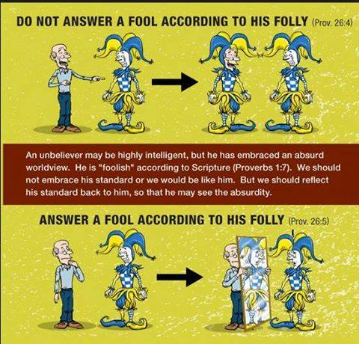

Slide 110
In verse 28, Paul cites the Cretan poet Epimenides, “in Him we live and move and exist.” Then he cites a Cilician poet, Aratus, “we also are His children.” Both of those lines were written in the context of Greek polytheism, which Paul was not in any way endorsing. Rather, he is taking a strand of thought from these pagan poets and showing how these thoughts lined up with the revelation of the one true God. The first quote supports what Paul has just said about all of us owing our very life and breath to God. The second quote supports Paul’s contention that God made all people and nations from one man, so that we all are His children by creation. So, Paul is using the debating tactic of quoting your opponents’ own writers in support of your point. Reason alone is not sufficient to bring men to salvation and the knowledge of God. We cannot reason an intellectual into the kingdom, because the heart of his problem is sin, not just wrong thinking.
The root sin of intellectuals is pride, which clearly shows itself here. Even before they heard Paul’s defense of the gospel, they sneered at him and called him an idle babbler (17:18). The Greek word is a “seed-picker.” It referred to birds that would flit around pecking at a seed here and a seed there. So it came to be used in mockery of a man who picked up a stray idea from one place, and another idea from another place, and went around promoting them as his own wisdom. But Luke, in a parenthetical comment (17:21), shows that the Athenians were the real babblers. They liked to pass their time with mind games and endless banter, attempting to prove the superiority of their intellects. - Steven J. Cole

Slide 111
Addressed Assumptions Like Sermon On The Mount
Areopagites’ Assumptions | Acts 17 | Apostle’s Assumptions
Being Religious Is Enough | : 22 | This Is Totally Insufficient
God Unknowable By Men | : 23 | Our God Is Very Knowable
God In Temples Domestic | : 24 | God Created The Cosmos
Worship Offering Transact | : 25 | God Gives & Needs Not
Peoples Made Differently | : 26 | All Men Made From Adam
When Where We Live Fate | : 26 | Space Place Is By Design
God Afar & Man Reaches | : 27 | Seekers Finding God Near
God Afar & Man Reaches | : 28 | He Sustains His Creation
Humans Childs Of Nature | : 29 | We God’s Own Offspring
God Seen Carved In Stone | : 29 | God’s Image Viewed In Us
Ignorance Excuse For Sin | : 30 | God Not Now Winking At
Deity Is Morally Indifferent | : 31 | He Involves Himself Deep

Slide 112
³² Now when they heard of the resurrection of the dead, some began to sneer, but others said, “We shall hear you again concerning this.” ³³ So Paul went out of their midst. ³⁴ But some men joined him and believed, among whom also were Dionysius the Areopagite and a woman named Damaris and others with them.
- Acts 17:32-34

Slide 116
In Athens Paul Preaches Of Another Hill
Most Continued Then As They Continue Today Wrapped Tight In Their Ego-Centric World Where Man Is Not Responsible Before God Or Answerable For His Actions In This Life.
Most Continued Then As They Continue Today To Prefer Truth In Riddle Rather Than Revelation – Unsolved Mystery Over Message Clarity – Symbol Over Substance.
Most Continued Then As They Continue Today Avoiding Absolute Concepts & Total Commitment.
Most Continued Then As They Continue Today With An Intolerance For Pure Truth Preferring Its Administration As Medicine - In Small Doses & Sugarcoated!

Slide 117
In Athens Paul Preaches Of Another Hill
Most Were Then As Today Denying & Avoiding Absolute Concepts & Total Commitment.
Most Were Then As They Are Today Intolerant Of Pure Truth Preferring Its Administration As A Medicine - In Small Doses & Sugarcoated!
Thus Mortified Or In Mortal Fear Of Truthful Teachings –
They Then As Today –
LIED TO THEMSELVES!

Slide 118
In Athens Paul Preaches Of Another Hill
WHAT DOUBT DID THEY HAVE?
Three Type Combination:
Factual Doubts – Intellect
Emotional Doubts – Feeling
Volitional Doubts – Willing

Slide 119
CHAPTER 17 J. W. McGarvey’s Acts Commentary
VERSE 34
Although his discourse terminated amid the mockery of a portion of his audience, the apostle’s effort was not altogether fruitless. (34) “But certain men followed him and believed; among whom were Dionysius the Areopagite, and a woman named Damaris, and others with them.” We find, however, no subsequent trace of a Church in Athens within the period of apostolic history & these names aren’t elsewhere mentioned. We are constrained, therefore, to the conclusion, that the philosophy & polished heathenism of this city had too far corrupted its inhabitants to admit of their turning to Christ, until some providential changes should prepare the way.
McGarvey, J. W. (1872). A commentary on Acts of Apostles (p. 224). Lexington, KY: Transylvania Printing and Publishing Co.

Slide 120
Comparison
Christianity
One God
All powerful
God creates man
God’s justice
Greek Religion
Many gods
Demi gods
Man creates gods
Man’s justice

Slide 121
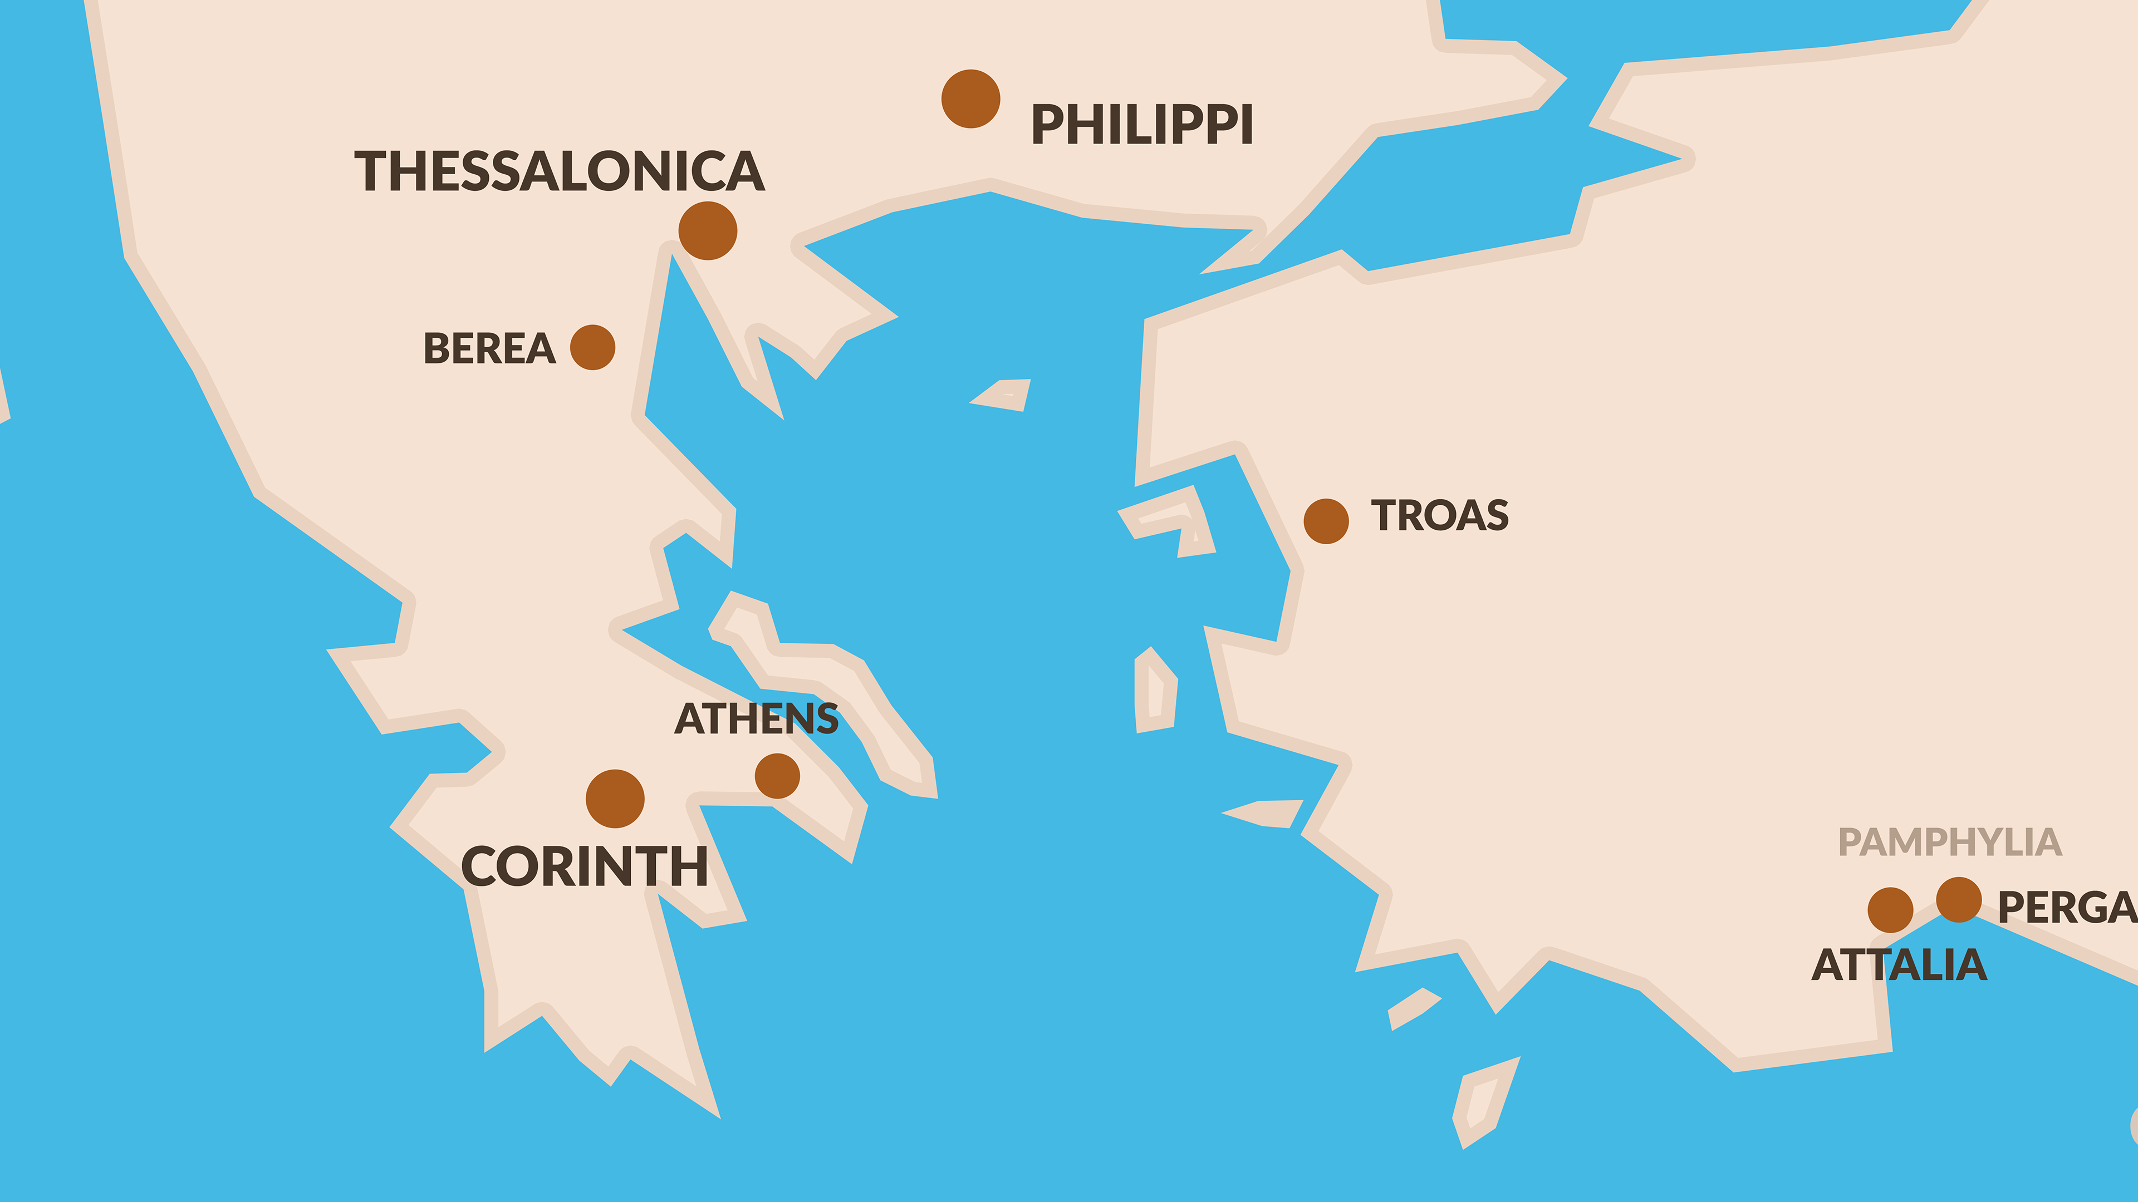

Slide 122
¹ After these things he left Athens and went to Corinth. ² And he found a Jew named Aquila, a native of Pontus, having recently come from Italy with his wife Priscilla, because Claudius had commanded all the Jews to leave Rome. He came to them,
- Acts 18:1-2

Slide 123
³ and because he was of the same trade, he stayed with them and they were working, for by trade they were tent-makers. ⁴ And he was reasoning in the synagogue every Sabbath and trying to persuade Jews and Greeks.
- Acts 18:3-4

Slide 124
CHAPTER 18 J. W. McGarvey’s Acts Commentary
VERSES 4 & 5
The arrival of Silas & Timothy brings us to a new period in the life of Paul, the period of his letter-writing. We have already made some use of his epistles to throw light upon the somewhat elliptical narrative before us; but we shall henceforth have them as cotemporary documents & will be able to fill up from them many blanks in Paul’s personal history. The First Epistle to the Thessalonians was written from Corinth soon after the arrival of Timothy, as is proved by the concurrence of the two facts, that, on the return of Silas and Timothy, as seen in the text, just quoted, they found Paul in Corinth, and that, in the epistle itself, Paul speaks of their arrival as having taken place at the time of writing. Several statements in this epistle throw additional light upon the state of Paul’s feelings during his first labors in Corinth. He was not only “pressed in spirit,” as stated by Luke, “in weakness, in fear, and in much trembling,” as he himself says to the Corinthians but he was racked with uncontrollable anxiety concerning the brethren in Thessalonica, for whom he would have been willing to sacrifice his own life, and who were now suffering the severest persecution. The good report brought from them by Silas and Timothy gave him much joy, but it was joy in the midst of distress. He says: “When Timothy came to us from you, and brought us good tidings of your faith and love, and that you have remembrance of us always, desiring greatly to see us, as we also to see you, therefore, brethren, we were comforted over you in all our affliction and distress by your faith: for now we live, if you stand fast in the Lord.” It was, therefore, with a zeal newly kindled from almost utter despair, by their good report from Thessalonica and the arrival of his fellow-laborers, that he now so “earnestly testified to the Jews that Jesus is the Christ.”
McGarvey, J. W. (1872). A commentary on Acts of Apostles (pp. 225–226). Lexington, KY: Transylvania Printing and Publishing

Slide 125
⁵ But when Silas and Timothy came down from Macedonia, Paul began devoting himself completely to the word, solemnly testifying to the Jews that Jesus was the Christ. ⁶ But when they resisted and blasphemed, he shook out his garments and said to them, “Your blood be on your own heads! I am clean. From now on I will go to the Gentiles.”
- Acts 18:5-6

Slide 126
⁷ Then he left there and went to the house of a man named Titius Justus, a worshiper of God, whose house was next to the synagogue. ⁸ Crispus, the leader of the synagogue, believed in the Lord with all his household, and many of the Corinthians when they heard were believing and being baptized. ⁹ And the Lord said to Paul in the night by a vision, “Do not be afraid any longer, but go on speaking and do not be silent;
- Acts 18:7-9

Slide 127
CHAPTER 18 J. W. McGarvey’s Acts Commentary
VERSES 9 & 10
In the declaration, “I have many people in this city,” the Lord called persons who were then unbelievers, and perhaps idolaters, his people. This would accord with the Calvinistic idea that God’s people are a certain definite number whom he has selected, many of whom are yet unconverted. But it can not prove this doctrine, because it admits of rational explanation upon another hypothesis. He knew that these people would yet believe and obey the gospel, and he could, therefore, with all propriety of speech, call them his by anticipation. Such is no doubt the true idea.
McGarvey, J. W. (1872). A commentary on Acts of Apostles (p. 227). Lexington, KY: Transylvania Printing and Publishing Co.

Slide 128
¹⁰ for I am with you, and no man will attack you in order to harm you, for I have many people in this city.” ¹¹ And he settled there a year and six months, teaching the word of God among them.
- Acts 18:10-11

Slide 129
CHAPTER 18 J. W. McGarvey’s Acts Commentary
VERSE 11
Instead of the more usual expression, “preaching the word of God,” we have here “teaching the word of God.” This change of phraseology is not without a purpose. It indicates that Paul’s labor, during this period, consisted not so much in proclaiming the great facts of the gospel, as rather in teaching his hearers the practical precepts of the Word. He was executing the latter part of the commission as recorded by Matthew: “Teaching them to observe and do all that I have commanded you.”
McGarvey, J. W. (1872). A commentary on Acts of Apostles (p. 227). Lexington, KY: Transylvania Printing and Publishing Co.

Slide 130
CHAPTER 18 J. W. McGarvey’s Acts Commentary
VERSES 14 - 16
In this case, however, they had to deal with a man of far different character from the magistrates of Philippi, or the city rulers of Thessalonica. Gallio was a brother of Seneca, the famous Roman moralist, who describes him as a man of admirable integrity, amiable, and popular. Such was the character which he exhibited on this occasion. Instead of yielding to popular clamor, as did so many provincial and municipal officers, before whom the apostles were arraigned, he examined carefully the accusation, and seeing that it had reference, not to any infraction of the Roman law, but to questions in regard to their own law, he determined at once to dismiss the case.
(14) “But when Paul was about to open his mouth, Gallio said to the Jews, If it were a matter of injustice or wicked recklessness, Jews, it would be reasonable that I should bear with you. (15) But since it is a question concerning a doctrine and words, and your own law, do you see to it; for I do not intend to be a judge of these matters. (16) And he drove them from the judgment-seat.” This is the only instance, in all the persecutions of Paul, in which his accusers were dealt with summarily and justly. The incident reflects great credit upon Gallio.
McGarvey, J. W. (1872). A commentary on Acts of Apostles (p. 228). Lexington, KY:Transylvania.

Slide 131
Theological “Bickering about Words and Names”
18:15 NEB If it is some bickering about words and names and your Jewish law, you may see to it yourselves; I have no mind to be a judge of these matters.
This is not the only instance in Acts of a political figure who was called in to adjudicate questions of Christian doctrine that he could not understand or even take seriously. In a later chapter, as part of an introduction that classical rhetoric (→24:1–2) prescribed in Latin as captatio benevolentiae, Paul appealed to King Agrippa as one who was “especially familiar with all customs and controversies of the Jews” (26:2–3). There was probably no “controversy of the Jews” mentioned in Acts that was more fundamental than that between the Pharisees and the Sadducees over immortality and resurrection: “For the Sadducees say that there is no resurrection, nor angel, nor spirit; but the Pharisees confess the existence of resurrection and angel and spirit” (23:8 TPR). Yet in addressing this same King Agrippa, Festus the Roman governor could describe such “bickering about words and names” this way: “When the accusers stood up, they brought no charges in his [Paul’s] case of such evils as I supposed, but they had certain points of dispute with him about their own superstition [ζητήματα … τινα περὶ τῆς ἰδίας δεισιδαιμονίας] and about one Jesus, who was dead, but whom Paul asserted to be alive. Being at a loss to investigate these questions, I asked whether he wished to go to Jerusalem and be tried there regarding them,” probably before a court of his Jewish peers who were the only ones who had the competency and theological expertise to adjudicate questions “about their own superstition” (25:17–27). In the event, Paul appealed instead to the tribunal of Caesar (→25:11). It is not necessary to share this—or any other—“superstition” to recognize that “mere bickering about words and names” is often not “mere” at all. It is difficult to avoid the generalization that differences over the meaning of terms tend to be vital to those to whom the issues involved are themselves vital, but that they are no more than “bickering about words and names” to those who, like Claudius Lysius (23:28–29) or Festus or Agrippa, stand outside “the hermeneutical circle.” The conclusion to be drawn is not that doctrine or doctrinal formulation is always tantamount to “bickering about words and names,” but that “divisions following upon divergent ways in expressing” rather than upon genuine and substantive divergence in doctrine do remain a clear and present danger.
Pelikan, J. (2005). Acts (pp. 200–202). Grand Rapids, MI: Brazos Press.

Slide 132
CHAPTER 18 J. W. McGarvey’s Acts Commentary
VERSE 17
For once, the heart of the unconverted multitude was with the apostle, and so indignant were they at the unprovoked attempt to injure him, that when it was fully exposed, they visited upon the head of the chief persecutor the very beating which he had laid up for Paul. Sosthenes was most probably the successor of Crispus, as chief ruler of the synagogue, and may have been selected for that position on account of his zeal in opposing the course which Crispus pursued. The beating which the Greeks gave him was a riotous proceeding, which Gallio, in the strict discharge of his duty, should have suppressed. That he did not do so, and that Luke says, “Gallio cared for none of these things,” has been generally understood to indicate an easy and yielding disposition, which was averse to the strict enforcement of the law. This, however, is inconsistent with the promptness of his vindication of Paul & his indignant dismissal of the accusers. I would rather understand it as indicating a secret delight at seeing the tables so handsomely turned upon the persecutors, prompting him to let pass unnoticed a riot, which, under any other such circumstances, he would have rebuked severely. The rage and disappointment of the Jews must have been intense; but the rough handling which their leaders experienced admonished them to keep quiet for a time.
McGarvey, J. W. (1872). A commentary on Acts of Apostles (p. 228). Lexington, KY: Transylvania Printing

Slide 133
¹⁸ Paul, having remained many days longer, took leave of the brethren and put out to sea for Syria, and with him were Priscilla and Aquila. In Cenchrea he had his hair cut, for he was keeping a vow. ¹⁹ They came to Ephesus, and he left them there. Now he himself entered the synagogue and reasoned with the Jews.
- Acts 18:18-19

Slide 134
CHAPTER 18 J. W. McGarvey’s Acts Commentary
VERSE 18
It is after the arraignment before Gallio, and previous to his departure from Corinth, that we best locate the date of the Second Epistle to the Thessalonians. That it was written in Corinth is determined chiefly by a comparison of its contents with those of the First Epistle. The congregation was still suffering from the same persecution mentioned in the First Epistle & there was still among them some improper excitement in reference to the second coming of the Lord. Both these circumstances indicate that it was written shortly after the first; as soon, perhaps, as Paul could hear from them after their reception of the first. That it was after the arraignment before Gallio, is sufficiently evident, I think, from the absence of those indications of distress in the mind of the writer, which abound in the First Epistle. He did not enjoy this comparative peace of mind until after the persecutions of the Jews culminated and terminated in the scene before Gallio’s judgment-seat. Many very eminent commentators have contended that it was Aquila, and not Paul, who sheared his head at Cenchrea.
McGarvey, J. W. (1872). A commentary on Acts of Apostles (p. 229). Lexington, KY: Transylvania Printing and Publishing Co.

Slide 135
CHAPTER 18 J. W. McGarvey’s Acts Commentary
VERSE 18
My own opinion is that it was Paul, and my chief reason for so thinking is this: the term Paul is the leading subject of the sentence, to which the verbs & participles must be referred, unless there’s some grammatical necessity for detaching one or more of them, and referring them to another subject. Priscilla & Aquila are subjects of the verb sailed (understood): “Paul sailed into Syria, and with him (sailed) Priscilla and Aquila.” But if it was intended also to refer the act of shearing to Aquila, the English would require the relative and verb instead of the participle: “with him Priscilla & Aquila who had sheared his head,” instead of “Priscilla and Aquila, having sheared his head.” The Greek, in order to express this idea, would also have required the article or relative after Aquila. In the absence of such a modification of the construction, we must refer the terms keiramenos, having shaved, and eike, had, to the leading subject of the sentence, with which agree all the other verbs, prosmeinas, tarried; apotaxamenos, took leave of; and exepei, sailed away. The objection that Paul could not have taken such a vow consistently with his position in reference to the law of Moses, is fallacious in two respects. First, It assumes a degree of freedom from legal observances on the part of Paul which his conduct on subsequent occasions shows that he had not attained. Second, It assumes, without authority, that this vow was one peculiar to the law, which it would be improper for Christians to observe. The vow of the Nazarite would certainly be improper now, because it required the offering of sacrifices at termination. But this was not that vow, seeing the hair was sheared in Cenchrea; whereas the Nazarite’s hair could be sheared only at the temple in Jerusalem. What the exact nature of the vow was, we have now no means of determining.
McGarvey, J. W. (1872). A commentary on Acts of Apostles (p. 230). Lexington, KY: Transylvania Printing and Publishing Co.

Slide 136
²⁰ When they asked him to stay for a longer time, he did not consent, ²¹ but taking leave of them and saying, “I will return to you again if God wills,” he set sail from Ephesus. ²² When he had landed at Caesarea, he went up and greeted the church, and went down to Antioch.
- Acts 18:20-22

Slide 137
¹¹ Now when Peter had come to Antioch, I withstood him to his face, because he was to be blamed; for before certain men came from James, he would eat with the Gentiles; but when they came, he withdrew and separated himself, fearing those who were of the circumcision. And the rest of the Jews also played the hypocrite with him, so that even Barnabas was carried away with their hypocrisy.
- Galatians 2:11

Slide 138
SEE ALSO: MCGARVEY’S COMMENTS ACTS CHAPTER 15 VERSES 32–34

Slide 139
Gill's Exposition of the Entire Bible
But when Peter was come to Antioch,.... Our apostle first takes notice of a visit he made him, three years after his conversion, Galatians 1:18, when his stay with him was but fifteen days, and, for what appears, there was then an entire harmony between them; fourteen years after he went up to Jerusalem again, and communicated his Gospel to Peter, and the rest, when they also were perfectly agreed; but now at Antioch there was a dissension between them, which is here related. However, the Papists greedily catch at this, to secure the infallibility of the bishops of Rome, who pretend to be the successors of Peter, lest, should the apostle appear blameworthy, and to be reproved and opposed, they could not, with any grace, assume a superior character to his: but that Peter the Apostle is here designed is so manifest, that some of their best writers are obliged to own it, and give up the other as a mere conceit. When Peter came to Antioch is not certain; some have thought it was before the council at Jerusalem concerning the necessity of circumcision to salvation, because it is thought that after the decree of that council Peter would never have behaved in such a manner as there related; though it should be observed, that that decree did not concern the Jews, and their freedom from the observance of the law, only the Gentiles; so that Peter and other Jews might, as it is certain they did, notwithstanding that, retain the rites and ceremonies of the law of Moses; and according to the series of things, and the order of the account, it seems to be after that council, when Paul and Barnabas returned to Antioch, and with others continued there for some time.

Slide 140
Cambridge Bible for Schools and Colleges
The conduct of Paul supplies a conclusive argument in favor of the equality of the Apostles and against the papal view of the supremacy of Peter. No pope would or could allow any Catholic bishop or archbishop to call him to an account and to talk to him in that style of manly independence. The conduct of Peter is also fatal to the claim of papal infallibility, as far as morals or discipline is concerned; for Peter acted here officially with all the power of his Apostolic example, and however correct in doctrine, he erred very seriously in practice, and endangered the great principle of Christian freedom, as the popes have done ever since. No wonder that the story was offensive to some of the Fathers and Roman commentators and gave rise to most unnatural explanations. We may add that the account of the Council in Jerusalem in Acts 15 likewise contradicts the Vatican system, which would have required a reference of the great controversy on circumcision to the Apostle Peter rather than to a council under the presidency of James.

Slide 141
Papacy: Did It Start With Peter?
That a place of primacy was assigned to one of the apostles of Christ is a supposition that is contrary to the whole tenor of Christ’s teaching. On more than one occasion the disciples fell into a discussion as to who would be greatest in the kingdom of heaven
And each time they were taught by the Lord that such a question was unworthy of their consideration.

Slide 142
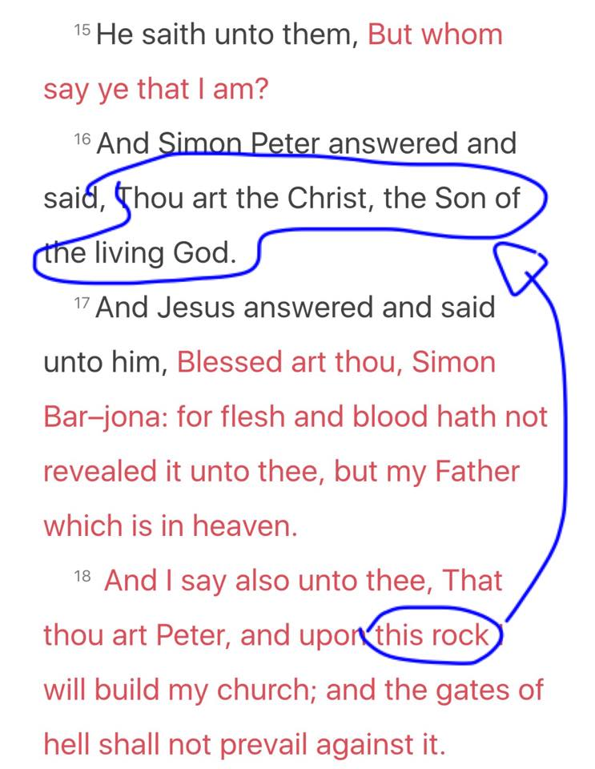

Slide 143
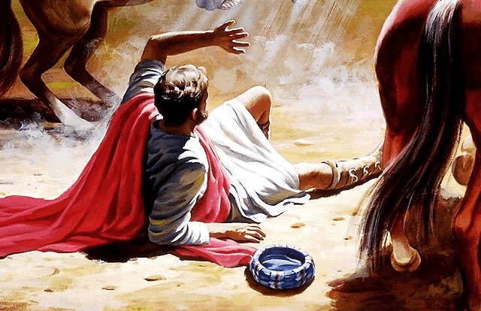
CLOSE ENCOUNTER OF THE FIRST KIND

Slide 144
Papacy: Did It Start With Peter?
A far better case could be made out for the Primacy of Paul than any Catholic can establish for Peter. Paul had the care of all churches upon him. (2 Cor. 11: 28) He labored more abundantly than the rest of the apostles. (1 Cor. 15: 9-11) He was not a whit behind the chiefest of the apostles. (2 Cor. 12: 11) He rebuked Peter to the face before them all when he did wrong. (Gal. 2: 11)

Slide 145
CHAPTER 18 J. W. McGarvey’s Acts Commentary
VERSES 24 - 26
His ignorance had reference to the points of distinction between John’s immersion & that of the apostles, which were chiefly these, that John did not promise the Holy Spirit to those who were immersed, and did not immerse into the name of the Father, and of the Son, and of the Holy Spirit. Whatever confusion of thought upon kindred topics is necessarily involved in ignorance of these two things, Apollos must also have been subject to; but we are not authorized to extend his ignorance any further than this. On these points he was instructed by Priscilla and Aquila, and was then able to teach the things concerning the Lord more accurately. There is no evidence whatever that he was re-immersed.
McGarvey, J. W. (1872). A commentary on Acts of Apostles (p. 232). Lexington, KY: Transylvania Printing and Publishing Co.

Slide 146
CHAPTER 18 J. W. McGarvey’s Acts Commentary
VERSES 27 & 28
This is the earliest mention of letters of commendation among the disciples. It shows that they were employed simply to make known the bearer to strange brethren, and commend him to their fellowship.
Apollos mightily convinced the Jews in Achaia; whereas Paul’s converts had been mostly among the Gentiles. This was, no doubt, owing to the peculiarity of his endowments, giving him access to some minds which were inaccessible to Paul. A variety of talents and acquirements among preachers is still necessary to the success of the gospel message among the immense variety of the minds & characters which make up human society.
McGarvey, J. W. (1872). A commentary on Acts of Apostles (p. 233). Lexington, KY: Transylvania Printing and Publishing Co.

Slide 147
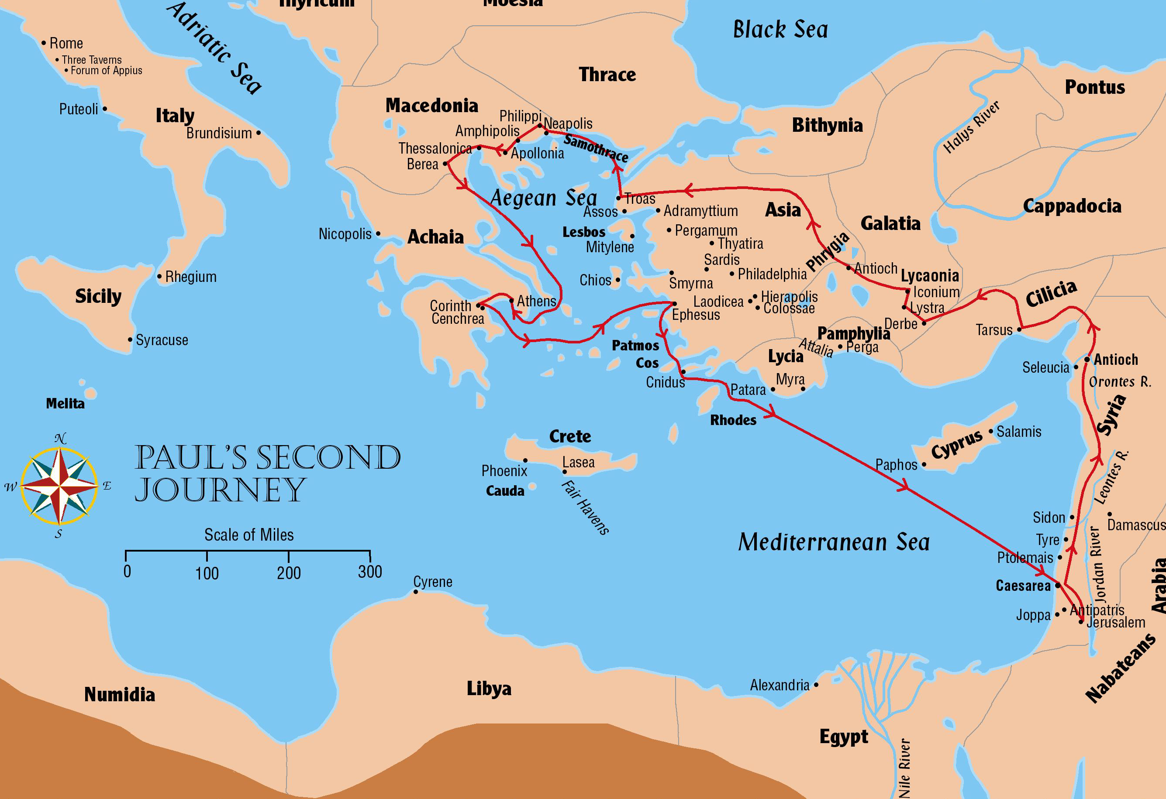
Paul’s Second Journey
Acts 15:1-18:22; 1 and 2 Thessalonians

Slide 148
The Council in Jerusalem Acts 15:1-31
300 Miles
49 or 50 A.D.

Slide 149
The Council in Jerusalem Acts 15:1-31
Paul and Barnabas remained at Antioch after the first journey was completed
About 10 years has passed since the conversion of Cornelius
Judean brethren came to Antioch in Syria disputing and teaching that circumcision was necessary for salvation (v1)
Paul, Barnabas, and others are sent to Jerusalem to confer with the apostles and elders – about 300 miles (v2)
Titus was with them – this is Paul’s 3rd visit to Jerusalem since his conversion

Slide 150
The Council in Jerusalem Acts 15:1-31
Conference at Jerusalem (Acts 15:6-21; Gal 2:1-10)
Jerusalem church was center of Christianity among Jews
Antioch church was center of Christianity among Gentiles
“Then after fourteen years I went up again to Jerusalem with Barnabas, and also took Titus with me. And I went up by revelation, and communicated to them that gospel which I preach among the Gentiles, but privately to those who were of reputation, lest by any means I might run, or had run, in vain.” Galatians 2:1-2
Discussion of the circumcision of Titus (Acts 15:5; Gal 2:3-5)

Slide 151
The Council in Jerusalem Acts 15:1-31
Circumcision of Titus
A key point concerning Titus and this trip is that Titus was taken as a test case
Titus was a Gentile Christian
Yet he was NOT required to be circumcised
Timothy was circumcised before he accompanied Paul – but that was because he had a Jewish mother and had been raised as a Jew
In both cases, circumcision was not a requirement under the law of Christ in order to be saved

Slide 152
The Council in Jerusalem Acts 15:1-31
The meeting of the council proper – Speeches given by:
Peter (Acts 15:6-11 – Peter’s last recorded words in Acts)
Paul (Acts 15:12)
Barnabas (Acts 15:12)
James (Acts 15:13-21)
Outcome of the meeting
Brethren selected to report to the churches (Acts 15:22)
Letter from the apostles and elders drafted for the churches (Acts 15:23-29)

Slide 153
The Council in Jerusalem Acts 15:1-31
Return from Jerusalem to Antioch
Apostolic letter read to the church at Antioch (Acts 15:30-31)
Judas and Silas exhorted the brethren (Acts 15:32)
Judas returns to Jerusalem, but Silas continues in Antioch (Acts 15:33-34)
Paul and Barnabas, along with others, continued their teaching in Antioch (Acts 15:35)

Slide 154
Paul’s Second Journey

Slide 155
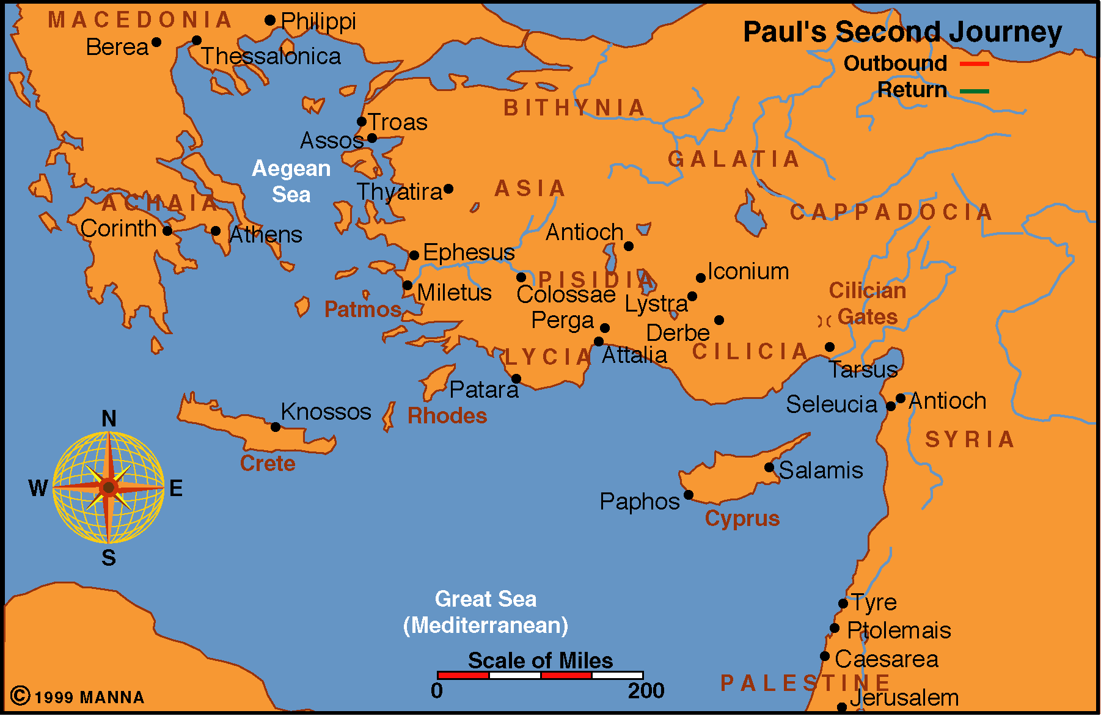
Neapolis
Acts 15:36-18:22
Approximately 3 Years
50-53 A.D.
Wrote 1 & 2 Thessalonians
from Corinth 52-53 A.D.

Slide 156
The primary cities of Paul’s Second Journey
Tarsus
Derbe
Lystra
Iconium
Antioch (Pisidia)
Troas
Neapolis
Philippi
Thessalonica
Berea
Athens
Corinth
Ephesus
Caesarea

Slide 157
Neapolis
Acts 15:36-18:22
Preparation for second journey
Paul decides to visit congregations he had helped to establish
Paul and Barnabas separate over Mark
Paul takes Silas – leave toward Tarsus
Barnabas takes Mark – toward Cyprus

Slide 158
Neapolis
Acts 15:36-18:22
To Derbe and Lystra
Timothy joins their work (16:1-3)
Through Phrygia and Galatia
Decrees from Jerusalem delivered
Paul attacked by sickness (Gal 4:13-14)
Forbidden to go into Asia (16:6)

Slide 159
Neapolis
Acts 15:36-18:22
To Troas
Paul received “Macedonian Call”
Luke joins Paul at Troas
Troas to Samothracia
To Neapolis

Slide 160
Neapolis
Acts 15:36-18:22
To Philippi
Conversion of Lydia (16:13-15)
Paul and Silas were put in prison (16:23)
Conversion of Jailer (16:25f)
Book of Philippians would later be written to these brethren

Slide 161
The Second Journey
Paul arrives in Philippi
Macedonia was once the home of Philip and his famous son Alexander the Great
Now a Roman colony – an extension of Rome
Paul and his companions had now moved into the heart of the Hellenistic influence in the empire
Perhaps only a few Jewish men were in Philippi because he did not find a synagogue there
Only needed 10 Jewish men to have a synagogue there
Seems all of the congregations were mostly Gentile
Macedonia was thoroughly Greek in its culture

Slide 162
Neapolis
Acts 15:36-18:22
To Thessalonica
Largest city in Macedonia
Reasoned in the Jewish synagogue
Paul’s life in danger – accused of treason (17:7)
Brethren sent Paul and Silas away
Epistles of 1 & 2 Thessalonians would later be written to these brethren

Slide 163
Neapolis
Acts 15:36-18:22
To Berea
Key scripture (17:11)
Jews from Thessalonica came to Berea to stir up trouble
Brethren sent Paul away by sea

Slide 164
Neapolis
Acts 15:36-18:22
To Athens
A city given over to idolatry (17:16)
Paul taught to all who would listen
Synagogues
Devout persons
Market places
Mars Hill

Slide 165
The Second Journey
Paul arrives in Athens
Paul seems to have been alone almost the whole time he was in Athens
Greeks considered Athens their first and foremost center for culture and learning (Acts 17:21)
The Athenians invited Paul to tell them his “new doctrine”
Scoffed in unbelief when he told of the resurrection of Christ

Slide 166
Neapolis
Acts 15:36-18:22
To Corinth
Terrible moral climate
Paul stayed 1 year, 6 months (18:11)
Preached in synagogue every Sabbath
Justus converted (18:7)
Crispus and his household converted

Slide 167
The Second Journey
Paul arrives in Corinth
The term “Corinthian” came to have the connotation of one totally dedicated to fulfilling the sensual desires of life
Was the capital of the Roman province of Achaia
Stayed with a couple named Aquila and Priscilla
Worked with them as tentmakers
Paul taught regularly in the synagogues
Timothy and Silas came and delivered good news from the churches of Macedonia
1 and 2 Thessalonians written from Corinth

Slide 168
Neapolis
Acts 15:36-18:22
To Ephesus
250 miles across the Aegean Sea
Temple of Diana
Preached in the synagogue
Left Priscilla and Aquila at Ephesus
Paul hurried on to Caesarea (likely to Jerusalem) – promising to return soon

Slide 169
Neapolis
Acts 15:36-18:22
To Jerusalem
Approximately one month sailing time

Slide 170
Neapolis
Acts 15:36-18:22
To Antioch of Syria
Spent some time before starting his 3rd journey

Slide 171
The Second Journey
Lasted 3 years
Visited large districts of Asia Minor and visited European cities
Jews violently resisted him in most every place
Congregations established in several places during this journey
2,700 miles (1,290 by sea/1,410 by land)

Slide 172
The NEW TESTAMENT BOOK OF ACTS

Slide 173
8/10
I wish to thank Brother Nicholas Nelson Evangelist of the Quincy, Washington Church of Christ for his sharing of his detailed interactive presentations on the Book of Acts and allowing their incorporation into this study.

