Slide 1


The NEW TESTAMENT BOOK OF ACTS
By David Lee Burris
Chaps 19 – 20 – 21– 22 – 23

Slide 2
DOES THE NEW TESTAMENT IN PRACTICE ACTUALLY
START WITH THE BOOK OF ACTS NOT THE GOSPELS?
“From the standpoint of the dispensations or the various economies by which God governs the world, the Old Testament Jewish economy actually continued through the gospels. Acts is a transitional book moving from the Old Testament economy into that of the new – the church age, the body of Christ.” (reference)

Slide 3
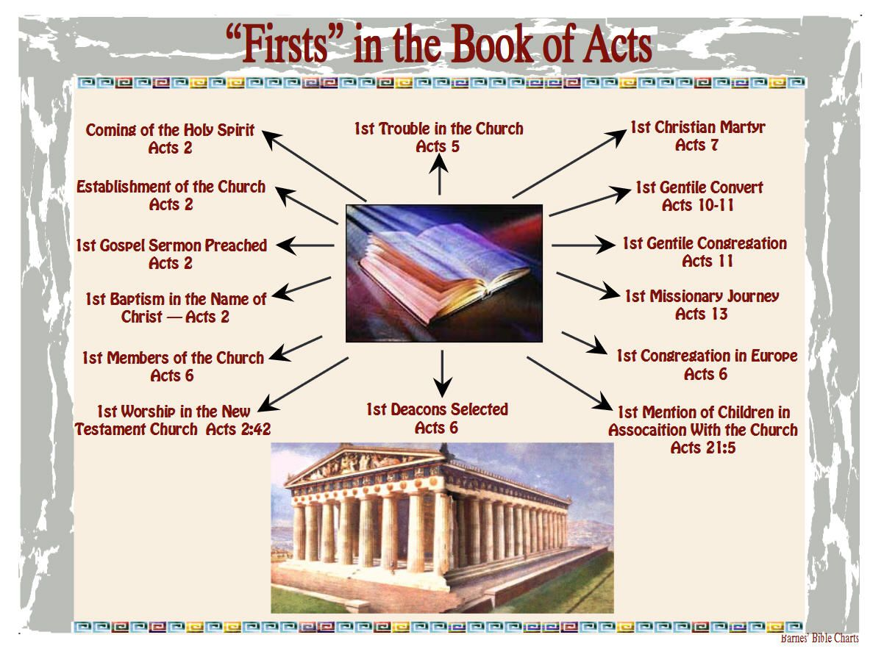

Slide 4
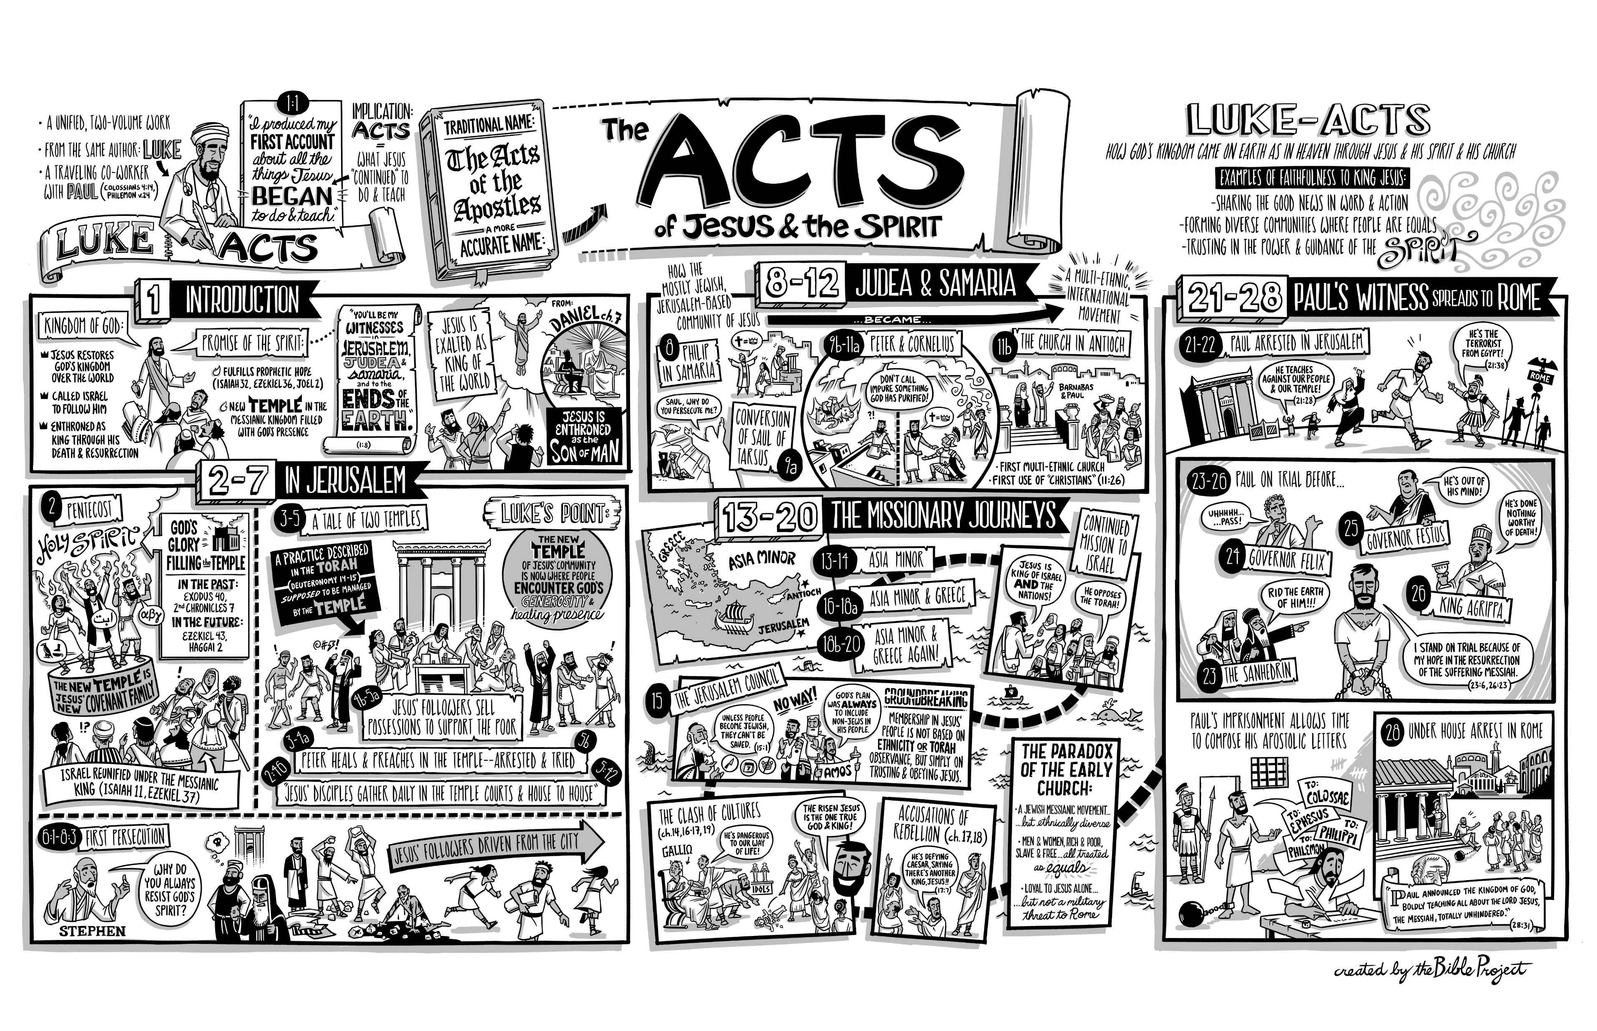

Slide 5
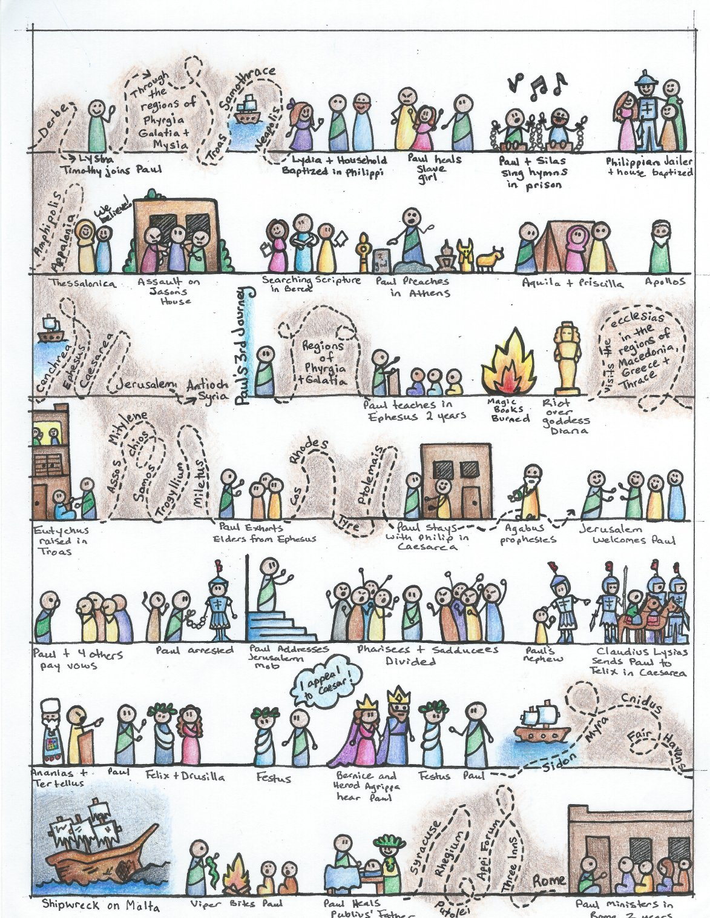

Slide 6
I. THE AUTHOR OF THE BOOK
From earliest times, Luke, “the beloved physician,” has been looked upon by conservative Bible scholars as being the author of The Book of Acts. Both internal and external evidence support this belief.
Luke was: (1) a Gentile (Col. 4:10–14); (2) the only Gentile author of a Bible book; (3) a physician (a medical doctor), Col. 4:14; (4) a “beloved” person, Col. 4:14; (5) a frequent missionary companion of Paul (the so-called “we sections” of The Book of Acts, 16:10–17; 20:5–21:18; 27:1–28:16, prove this assertion); and (6) the author of The Gospel of Luke as well as The Book of Acts.
II. THE ADDRESSEE OF THE BOOK
Luke addressed both The Gospel of Luke and The Book of Acts to Theophilus. Perhaps he had others in view as the ultimate readers of his two books.
We do not know the identity of Theophilus, nor do we know the place of his residence. He almost certainly was: (1) a friend of Luke and (2) a neophyte to Christianity (Luke wrote to Theophilus that he might know the certainty, the truthfulness, of the gospel truths wherein he had been instructed, Luke 1:1).
III. THE PLACE AND THE DATE OF THE WRITING OF THE BOOK
We do not know the place of writing but we can know the approximate date of writing. We know that it was written after the Spring of a.d. 63 for the book’s historical record extends to the Spring of that year and we know that the book was probably written before the Fall of a.d. 64 for the book makes no mention or allusion to the Neronian persecution which began in October of a.d. 64. We know that the book was almost certainly written before a.d. 70 for it makes no mention or allusion to the fall of Jerusalem and the destruction of its temple, events which occurred in a.d. 70 which greatly affected the early church and first-century Christianity (these events ended the Judaizers opposition to the gospel and the practice of preaching the gospel first to the Jews and then to the Gentiles).
IV. THE NAME OF THE BOOK
From the Second Century a.d., the common name for the book has been The Acts of the Apostles. This title is too comprehensive to be a correct one, for the book deals chiefly with the acts of only two apostles, Peter and Paul, and their acts are recorded only in part. A more apt title would be one of the following: (1) the Acts of the Risen Lord; (2) The Acts of the descended Holy Spirit; (3) Some of the Acts of Peter and Paul; (4) A Fragmentary History of the Early Church; (5) The First Chapter of Church History or (6) The only Inspired Chapter of Church History.
In the Greek manuscripts, the title is “Acts of Apostles.” This is a good and accurate title.
V. THE CLASSIFICATION OF THE BOOK
It is one of the five historical books of the New Testament. The New Testament has five historical books (Matthew through Acts), twenty-one doctrinal books (Romans through Jude) and one prophetical book (Revelation).
The 5 New Testament historical books are the New Testament’s “Pentateuch.”
Gingrich, R. E. (2002). (pp. 34). Memphis, TN: Riverside Printing.
Gingrich, R. E. (2002). The Book of Acts (pp. 3–4). Memphis, TN: Riverside Printing.

Slide 7
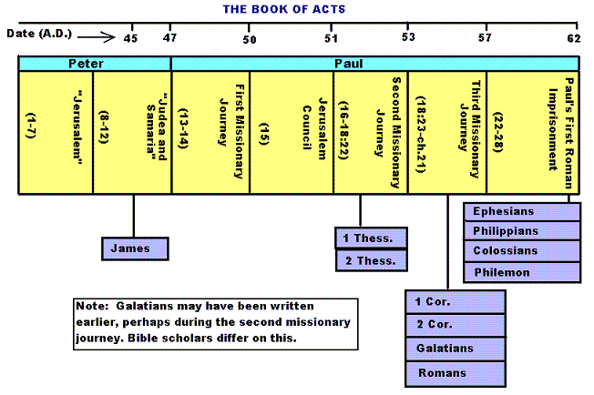

Slide 8
Historicity of Acts:
- the spread of Christianity from Jerusalem to Rome (“the ends of the earth”);
- The progress ... is mainly geographical:
- From Jerusalem ... to Samaria (8.5), Damascus (9.10), Antioch (11.26), Asia Minor (13.13), Europe (16.11), and finally Rome … itself;
- the northeastern corner of the Mediterranean;
- Maybe Spain But Nothing about North Africa, e.g., Alexandria and Cyrene.

Slide 9
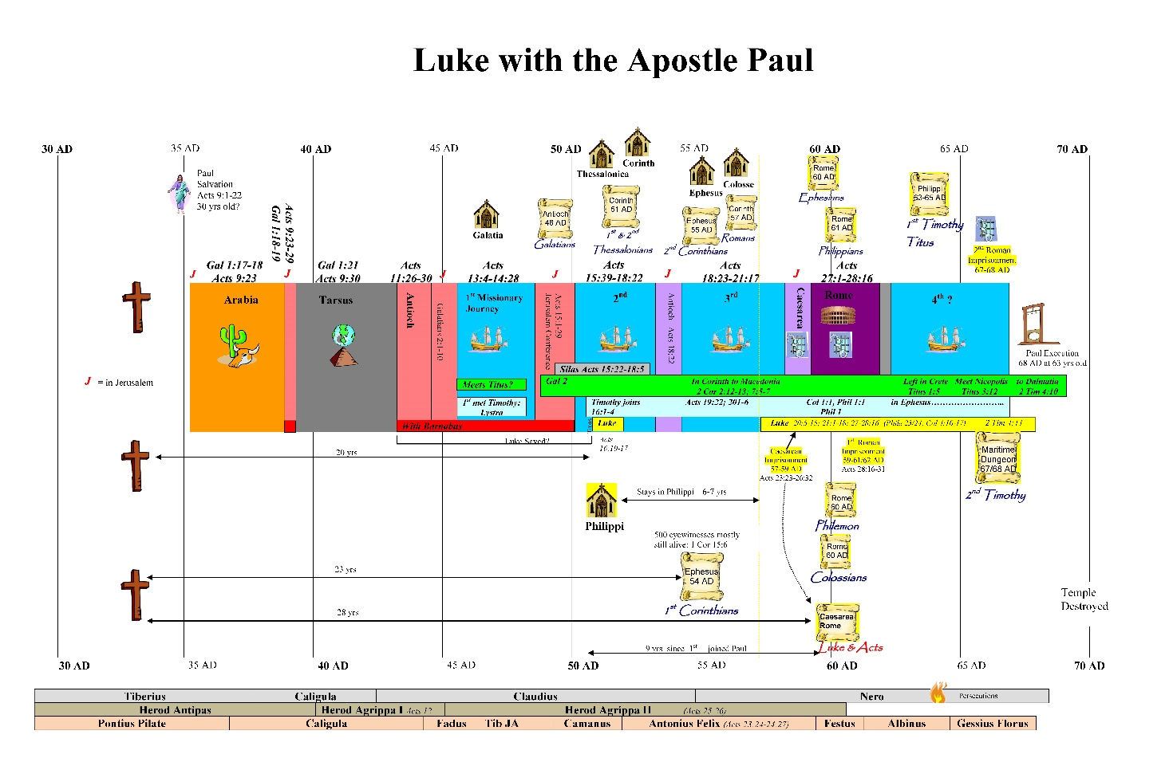

Slide 10
1. Prologue and Ascension (1:1-11):
- Post-resurrection appearances … ;
- A ... visible ascension into heaven;
- Matthias chosen to replace Judas Iscariot (1.12-26);
- Luke’s understanding of an Apostle: see 1.21-22;
- Note: Saul (later Paul) meets those qualifications Acts 9 when Christ appeared to him while on the Damascus Road.

Slide 11
2. Founding of the Jerusalem Church - the role of the Holy Spirit (2.12-2.47):
- The Jerusalem Church increases in numbers by means of divine power;
- The work of the Holy Spirit, e.g., Glossolalia (2.1-24; see Joel 2.28-32);
- Peter’s speech interprets the meaning of Pentecost;
- The character of the Jerusalem Church (2.43-45; 4.32-35);

Slide 12
3. The Work of Peter and the other Apostles (3.1-5.42):
- Confrontation between the Apostles and the Jerusalem authorities (4.1-22);
- Luke’s attitude towards both the Sadducees and the Pharisees (4.8-11);

Slide 13
4. Persecution of the “Hellenists” (6.1-8.40):
- Stephen, a leading “Hellenist” or Greek-speaking Jew (6. 5, 8);
- Stephen is presented as the first Christian Martyr (7.60);
- subsequent persecution and the growth of the Church (8.1b-40);
the “new way” carried to such individuals as Simon the Magician (8.9) and an Ethiopian Eunuch (8.27);
the role of Philip in this work of evangelization (6.5; 8.4; 21,8).

Slide 14
5. Preparation for the Gentile Mission (9.1-12.25):
- The progress of Christianity …. as world adversary to pagan religion and human schools of philosophy;
- See, for example, the conversion of Saul of Tarsus (9.1-19) and Cornelius, the Roman centurion (Chs. 10-11);
- Peter is depicted as the one who first opens the door to Gentiles, that is, non-Jews;
Peter’s persuasion of the “circumcision party” (11.1-18);
See 10.44-48 and 11.15-18: the “Gentile Pentecost”;

Slide 15
5. Preparation for the Gentile Mission (9.1-12.25) (contd.):
- Gentiles flock to the Church at Antioch (11.19-26);
- The Jerusalem Church sends Barnabas... to report on the situation (11.22);
- Barnabas with the Apostle Paul at Antioch (11.25-30);
- Gospel preached “all over Judea and Samaria”;
- The first half concludes with an account of Herod Agrippa I’s persecution (41-44 CE) of the Jerusalem community;
- God is unhappy with Herod (12.20-23).

Slide 16
6. First Missionary Journey of Barnabas and Paul and the Jerusalem Conference (13.1-15.35):
- The rest of Acts is devoted mainly to the Missionary Journeys of the Apostle Paul and his fellow workers;
- the work of Paul and Barnabas in the various Hellenistic cities of Asia Minor;
- Dissension between Gentile and Jewish Christians over adherence to the Mosaic Torah (15.1-35);
- must Gentile Christians be circumcised and observe Jewish dietary laws?

Slide 17
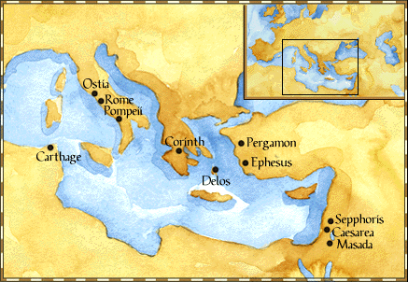
Paul: Map of His World.

Slide 18
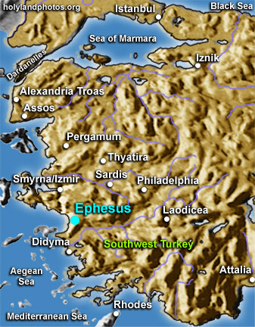

Slide 19
6. First Missionary Journey of Paul and Barnabas and the Jerusalem Conference (13.1-15.35) (contd.):
- The Jerusalem Conference held about A.D. 49 (Acts 15);
- Must a Gentile believer become a Jew ... to be a Christian?
- A division within the Church;
- The dispute settled in favor of uncircumcised Gentiles (15.28-29);
- The deciding voice is that of James (15.13-21).

Slide 20
6. First Missionary Journey of Paul and Barnabas and the Jerusalem Conference (13.1-15.35) (contd.):
- The Apostles and Elders required only limited Torah mandates of the Gentile Christians (15.13-21);
- requirements based on rules from Leviticus (Acts 15.13-21; Leviticus 17-18);
- Themes of unity and cooperation dominate … ;
- it is a unanimous decision and the “Whole Church” sends a delegation to Antioch to explain the Jerusalem Church’s decision (15.30-35);
- Actually, a decision of the Holy Spirit (15.22-29).

Slide 21
6. First Missionary Journey of Paul and Barnabas and the Jerusalem Conference (13.1-15.35) (contd.):
- Paul’s independence of the Apostolic Church (Gal 1.17, 18-19, 20; 2.1-10);
- Paul indicates that he was never under the jurisdiction of the Church’s leadership in Jerusalem (Gal 1.17, 18-19, 20; 2.1-10);
- See also 1 Cor 8.8; 10.27 relative to eating meat sacrificed to Greco-Roman gods.

Slide 22
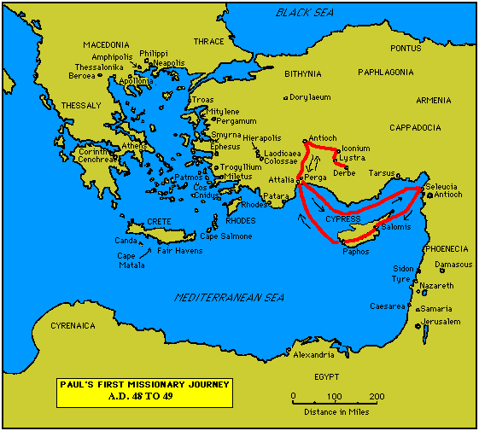

Slide 23
7. Paul’s Secondary Missionary Journey; Evangelizing Greece (16.1-18.21):
- Paul and Barnabas separate (15.39);
- Why the separation?
- Paul and Silas visit churches in Syria and Asia Minor (15.40-41);
- A vision directs Paul to Macedonia (15.40-16.10);
- Paul’s customary activity relative to the Jews and then being abused by them (16.11-17.15);

Slide 24
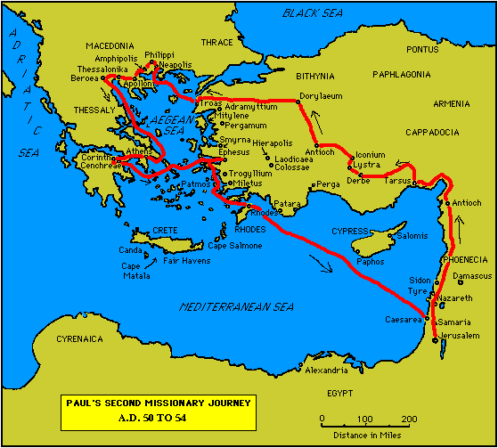

Slide 25
7. Paul’s Secondary Missionary Journey; Evangelizing Greece (16.1-18.21) (contd.):
- Paul in Philippi, Thessalonica, Beroea, and Athens;
- Paul speaks at the Areopagus in Athens (17.19-31);
- Paul at Corinth (18.1-17);

Slide 27
8. Paul’s Third Missionary Journey: Revisiting Asia Minor and Greece (18.22-20.38):
- Paul at Ephesus (18.19-21);
- Luke depicts Paul as determined to complete his last tour and head for the imperial capital, that is, Rome (19.21-22);
- Paul’s farewell speech at Miletus (20.17-38);
- See maps on the location of the major churches at the end of Paul’s ministry.

Slide 28
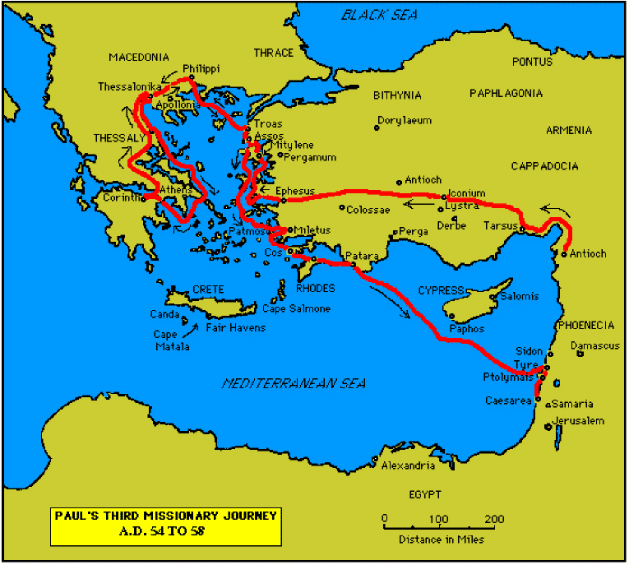

Slide 30
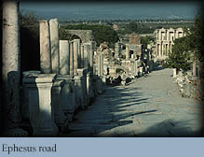

Slide 31
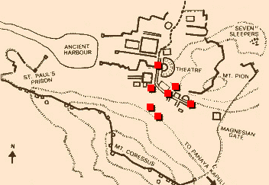
Ephesus: General View of the Ancient City.

Slide 32
9. Paul’s arrest in Jerusalem and imprisonment in Caesarea Maritime (21.1-26.32):
- Paul returns to Jerusalem (21.17) ... accused of blasphemy and profaning the Temple;
- When arrested, Paul claims that he is a Pharisee (21.27-23.10);
- Paul is imprisoned ... in Caesarea (23.33-26.32);
- he exercises his birthright as a Roman citizen (25.1-21);
- he defends himself (26.1-29);

Slide 33
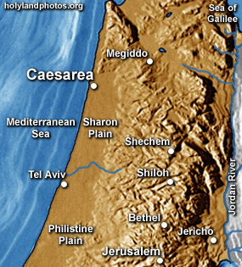

Slide 34
10. Paul’s Journey to Rome and His Preaching to Roman Jews (27.1-28.31):
- Paul’s sea journey to Rome... a shipwreck on the island of Malta (28.1 ) (see Map);
- the narrative in the first person plural, that is, “we”;
- Acts ends with Paul’s arrival in Rome (28.16);
- Paul is under house arrest but is free to preach (28.31);
- He continues to evangelize the Romans (28.23-31);
- We are not told of Paul’s fate.

Slide 35
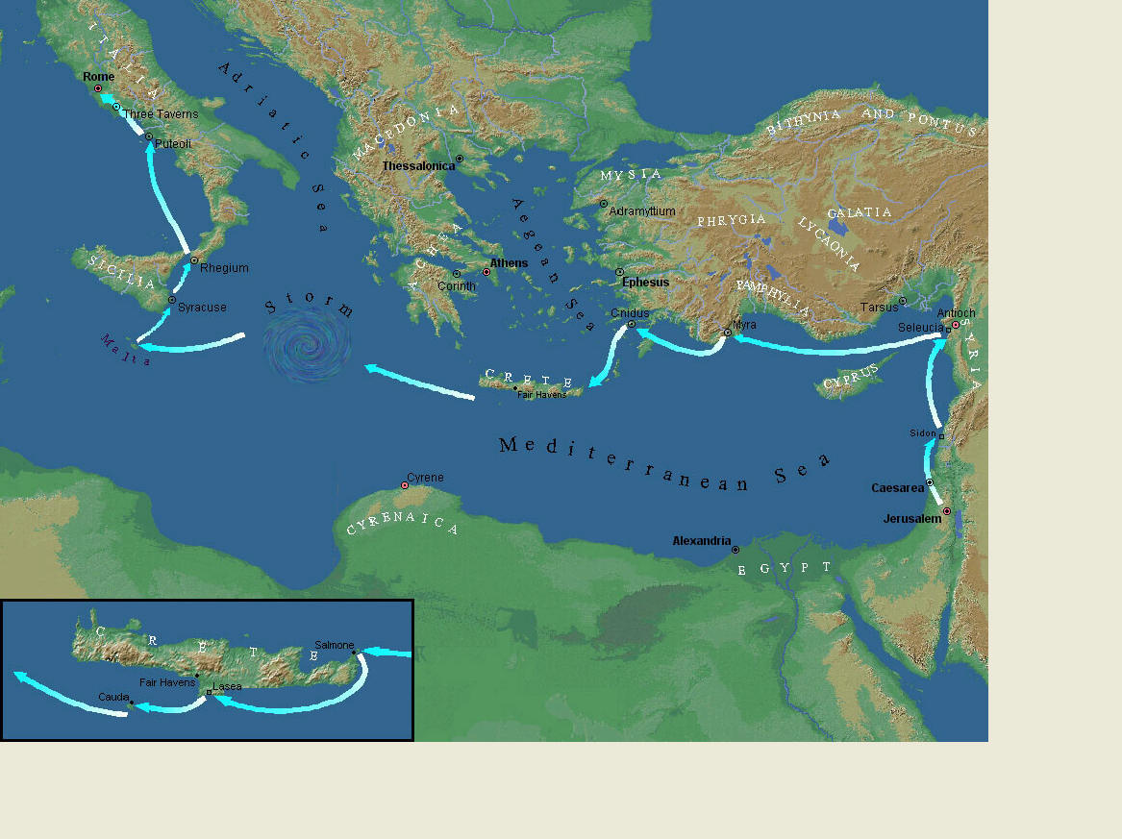
Paul’s Journey to Rome.

Slide 36
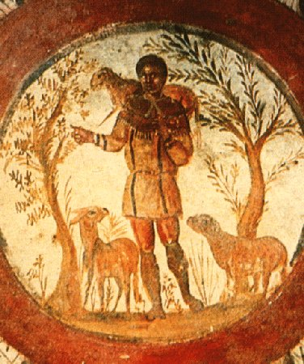
The Good Shepherd – in Catacombs of Rome.

Slide 37
10. Paul’s Journey to Rome and his Preaching to Roman Jews (27.1-28.31) (contd.):
- Luke has accomplished his task of tracing Christianity’s expansion from Jerusalem to “the ends of the earth” (1.8);
- Another theme emphasized: Paul and his successor evangelists will henceforth direct the Gospel primarily to Non-Jews, for “the Gentiles will listen” (28.28);
- Luke quotes from Isaiah 6 (see also Mark 4.10-13);
- Christianity’s future belongs to the Gentiles.

Slide 38
Basic Book Structure acts of the Apostles Centers around the great commission & Call To evangelize Then known world!

Slide 39
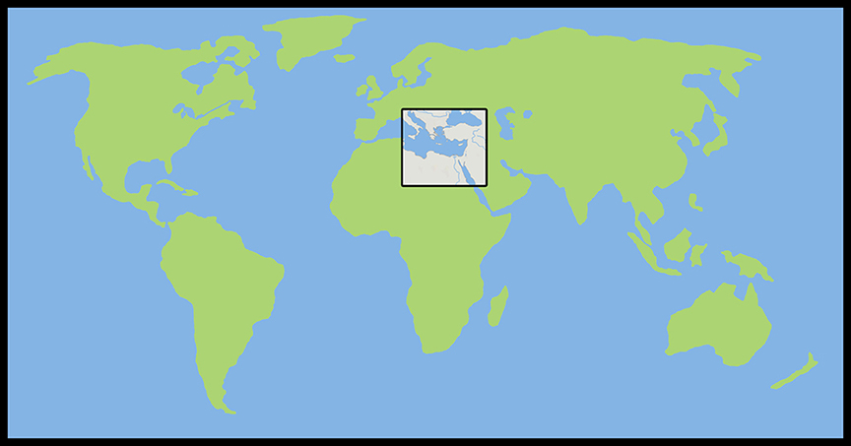
Where the Story takes Place

Slide 40
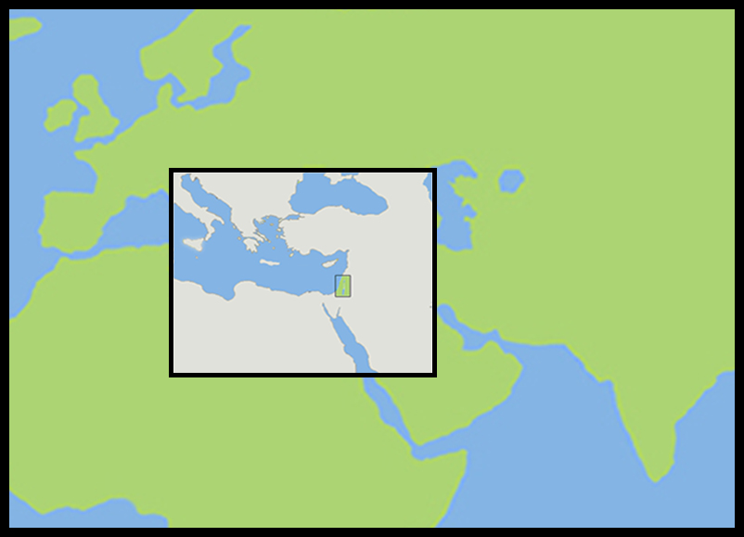
The Land of Canaan in the Near East

Slide 41
Acts 1:8 and the Great Commission
Acts 1:8
But ye shall receive power, after that the Holy Ghost is come upon you: and ye shall be witnesses unto me both in Jerusalem, and in all Judaea, and in Samaria, and unto the uttermost part of the earth.
Matthew 28:19-20
¹⁹ Go ye therefore, and teach all nations, baptizing them in the name of the Father, and of the Son, and of the Holy Ghost:
²⁰ Teaching them to observe all things whatsoever I have commanded you: and, lo, I am with you alway, even unto the end of the world. Amen.
Mark 16:15
And he said unto them, Go ye into all the world, and preach the gospel to every creature.

Slide 42
Acts 1:8 and the Great Commission
Acts 1:8
But ye shall receive power, after that the Holy Ghost is come upon you: and ye shall be witnesses unto me both in Jerusalem, and in all Judaea, and in Samaria, and unto the uttermost part of the earth.
Matthew 28:19-20
¹⁹ Go ye therefore, and teach all nations, baptizing them in the name of the Father, and of the Son, and of the Holy Ghost:
²⁰ Teaching them to observe all things whatsoever I have commanded you: and, lo, I am with you alway, even unto the end of the world. Amen.
Mark 16:15
And he said unto them, Go ye into all the world, and preach the gospel to every creature.

Slide 43
Acts 1:8 and the Great Commission
Acts 1:8
But ye shall receive power, after that the Holy Ghost is come upon you: and ye shall be witnesses unto me both in Jerusalem, and in all Judaea, and in Samaria, and unto the uttermost part of the earth.
Matthew 28:19-20
¹⁹ Go ye therefore, and teach all nations, baptizing them in the name of the Father, and of the Son, and of the Holy Ghost:
²⁰ Teaching them to observe all things whatsoever I have commanded you: and, lo, I am with you alway, even unto the end of the world. Amen.
Mark 16:15
And he said unto them, Go ye into all the world, and preach the gospel to every creature.

Slide 44
Acts 1:8 and the Great Commission
Acts 1:8
But ye shall receive power, after that the Holy Ghost is come upon you: and ye shall be witnesses unto me both in Jerusalem, and in all Judaea, and in Samaria, and unto the uttermost part of the earth.
Matthew 28:19-20
¹⁹ Go ye therefore, and teach all nations, baptizing them in the name of the Father, and of the Son, and of the Holy Ghost:
²⁰ Teaching them to observe all things whatsoever I have commanded you: and, lo, I am with you alway, even unto the end of the world. Amen.
Mark 16:15
And he said unto them, Go ye into all the world, and preach the gospel to every creature.

Slide 45
Acts 1:8 and the Structure of the Book
Acts 1:8
… ye shall be witnesses unto me both in Jerusalem, and in all Judaea, and in Samaria, and unto the uttermost part of the earth.
1. The witness in Jerusalem:
    Chapters 1 to 7
2. The witness in Judaea and Samaria:
    Chapters 8 to 12
3. The witness unto the uttermost parts of the earth:
    Chapters 13 to 28

Slide 46
The Three Audiences
Part 1: The Jews
Part 2: The Samaritans
Part 3: The Gentiles

Slide 47
The Pillars of the Church
Part 1: Peter
Part 2: Peter and Paul (Saul of Tarsus)
Part 3: Paul

Slide 48
The Timeline
Part 1: 5 years (AD 30-35)
Part 2: 13 years (AD 35-48)
Part 3: 14 years (AD 48-62)
          A total of 32 years, according to Nelson’s Complete Book of Bible Maps and Charts.

Slide 49
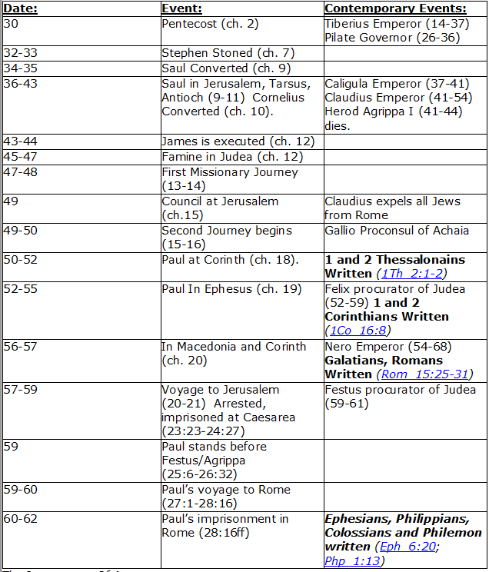
CHART BY
Mark Dunagan

Slide 50
PART ONE—The infancy of the church (the church in Jerusalem) (chapters 1–7)
(In this section, Jerusalem is the central city of Christianity and Peter is the most prominent person)
I. THE POST-RESURRECTION MINISTRY OF CHRIST (1:1–8)
II. THE ASCENSION OF CHRIST (1:9–11)
III. THE WAITING IN THE UPPER ROOM (1:12–26)
IV. THE ADVENT OF THE HOLY SPIRIT (2:1–41)
V. THE SNAPSHOT OF THE EARLY CHURCH (2:42–47)
VI. THE HEALING OF THE LAME MAN AND ITS CONSEQUENCES (3:1–4:31)
VII. THE DEATH OF ANANIAS AND SAPPHIRA AND ITS EFFECTS (4:32–5:42)
VIII. THE APPOINTMENT OF THE SEVEN (6:1–7)
IX. THE MINISTRY OF STEPHEN (6:8–7:60)
PART TWO—The adolescence of the church (the church in all Judea and In Samaria) (chapters 8–12)
(In this section, Jerusalem is gradually being replaced by Antioch as the central city of Christianity and Peter is gradually being replaced by Paul as the most prominent person)
I. THE FIRST MENTION OF PAUL (7:58; 8:1, 3)
II. THE PERSECUTION AND SCATTERING OF THE JERUSALEM CHURCH (8:1–4)
III. THE CONVERSION OF SAMARITANS (8:5–25)
IV. THE CONVERSION OF A JEWISH PROSELYTE (8:26–40)
V. THE CONVERSION OF SAUL (9:1–31)
VI. THE EXPANSION OF THE CHURCH IN WESTERN JUDEA (9:32–43)
VII. THE CONVERSION OF GENTILE GOD-FEARERS (chapter 10)
VIII. THE GROWING VISION OF THE JEWISH LEADERS (11:1–18)
IX. THE CONVERSION OF PAGAN GENTILES (11:19–26)
X. THE GROWING TIES BETWEEN JEWISH AND GENTILE CHRISTIANITY (11:27–30)
XI. THE COMPLETION OF THE TRANSITION (chapter 12)
PART THREE—The maturity of the church (the church in all the world) (chapters 13–28)
(In this section, Antioch is the central city of Christianity and Paul is the most prominent person)
I. PAUL’S CALL AT ANTIOCH TO HIS LIFE’S WORK (13:1–3)
II. PAUL’S FIRST MISSIONARY JOURNEY (13:4–14:27)
III. PAUL’S TWO YEARS BACK IN ANTIOCH (14:28–15:35)
IV. PAUL’S SECOND MISSIONARY JOURNEY (15:36–18:22)
V. PAUL’S THIRD MISSIONARY JOURNEY (18:23–21:16)
VI. PAUL’S ARREST AT JERUSALEM (21:17–23:35)
VII. PAUL’S TWO-YEARS’ IMPRISONMENT AT CAESAREA (chapters 24–26)
VIII. PAUL’S SHIPWRECK JOURNEY TO ROME (27:1–28:15)
IX. PAUL’S FIRST ROMAN IMPRISONMENT (28:16–31)
Gingrich, R. E. (2002). The Book of Acts (pp. 5–6). Memphis, TN: Riverside Printing.

Slide 52

Paul’s Third Mission

Slide 53
Acts 18:23 to 21:15

Slide 54
L.D. CARY & SAM HOLT CATCH PHRASES
Chapter 19 – “10 + 9, Ephesus Time”
Chapter 20 – “Traveling A’Plenty”
Chapter 21 – “Confinement Begun”
Chapter 22 – “Before A Mob, Not A Few”
Chapter 23 – “Before The Council, You See”
Chapter 24 – “Felix Listens No More”
Chapter 25 – “Agrippa Arrives”
Chapter 26 – “Agrippa Realizes Paul’s Fix”
Chapter 27 – “Shipwreck & An Angel From Heaven”
Chapter 28 – “The End Of Our Wait”
“10 + 9 … Ephesus Time”
Catch Phrase
Chapter Nineteen

Slide 55
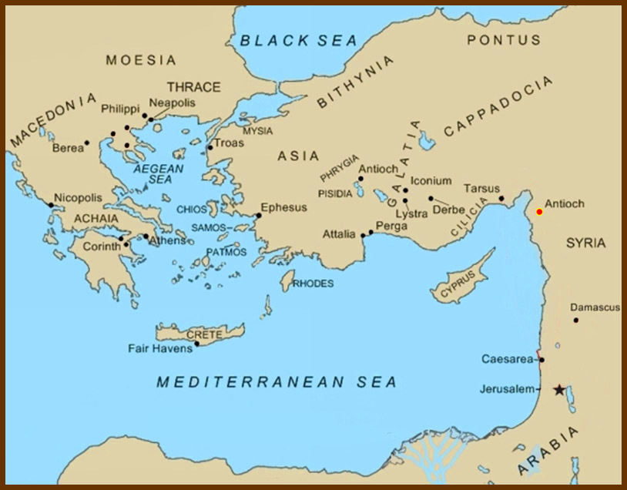
Paul’s second mission ended where it began, in Antioch of Syria.

Slide 56
Acts 18:
²³ And after he had spent some time there, he departed, and went over all the country of Galatia and Phrygia in order, strengthening all the disciples.

Slide 57
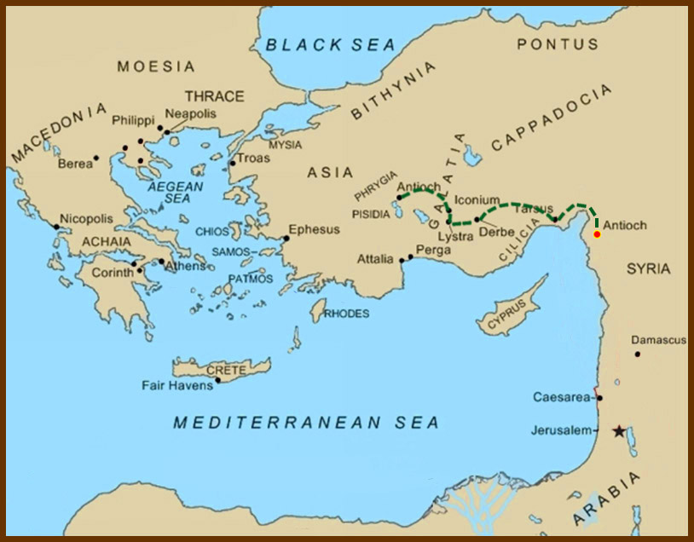
Acts 18:
²³ And after he had spent some time there, he departed, and went over all the country of Galatia and Phrygia in order, strengthening all the disciples.

Slide 58
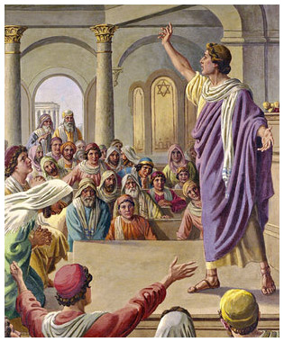
²⁴ And a certain Jew named Apollos, born at Alexandria, an eloquent man, and mighty in the scriptures, came to Ephesus.
²⁵ This man was instructed in the way of the Lord; and being fervent in the spirit, he spake and taught diligently the things of the Lord, knowing only the baptism of John.

Slide 59
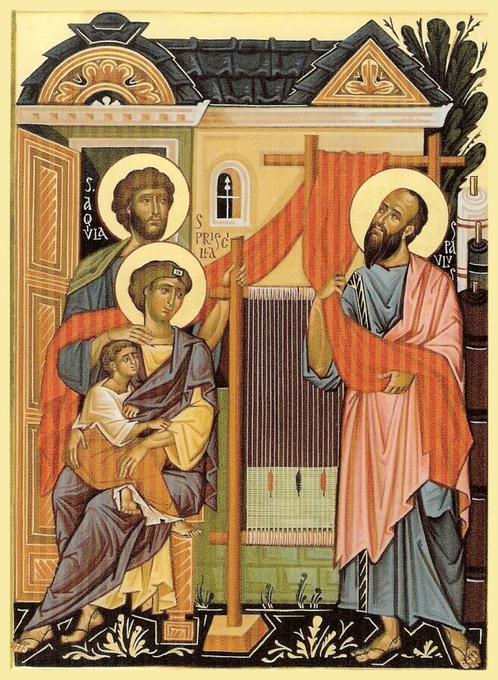
²⁶ And he began to speak boldly in the synagogue: whom when Aquila and Priscilla had heard, they took him unto them, and expounded unto him the way of God more perfectly.

Slide 60
²⁷ And when he [Apollos] was disposed to pass into Achaia…

Slide 61
…the brethren wrote, exhorting the disciples to receive him: who, when he was come, helped them much which had believed through grace:

Slide 62
²⁸ For he mightily convinced the Jews, and that publickly, shewing by the scriptures that Jesus was Christ.

Slide 63
Chapter 19:
¹ And it came to pass, that, while Apollos was at Corinth, Paul having passed through the upper coasts came to Ephesus …

Slide 64
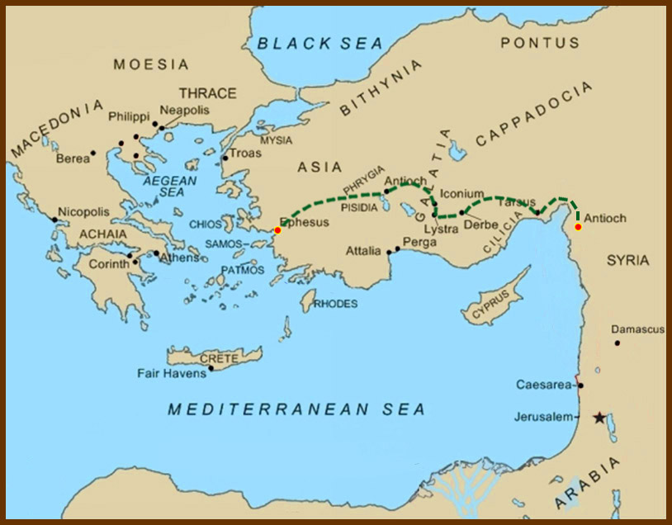
Chapter 19:
¹ And it came to pass, that, while Apollos was at Corinth, Paul having passed through the upper coasts came to Ephesus …

Slide 65
…and finding certain disciples,
² He said unto them, Have ye received the Holy Ghost since ye believed? And they said unto him, We have not so much as heard whether there be any Holy Ghost.
³ And he said unto them, Unto what then were ye baptized? And they said, Unto John's baptism.
⁴ Then said Paul, John verily baptized with the baptism of repentance, saying unto the people, that they should believe on him which should come after him, that is, on Christ Jesus.
⁵ When they heard this, they were baptized in the name of the Lord Jesus.

Slide 66
The difference in the baptism of John and baptism in the name of the Lord Jesus can be seen by comparing the ministries of John and Christ.
The baptism of John anticipated the coming ministry of the Lamb of God.
Baptism in the name of Jesus Christ acknowledges the finished work of Christ on the cross.

Slide 67
This is similar to what happened in Samaria:
Acts 8:14-17:
¹⁴ Now when the apostles which were at Jerusalem heard that Samaria had received the word of God, they sent unto them Peter and John:
¹⁵ Who, when they were come down, prayed for them, that they might receive the Holy Ghost:
¹⁶ (For as yet he was fallen upon none of them: only they were baptized in the name of the Lord Jesus.)
¹⁷ Then laid they their hands on them, and they received the Holy Ghost.
⁶ And when Paul had laid his hands upon them, the Holy Ghost came on them; and they spake with tongues, and prophesied.
⁷ And all the men were about twelve.

Slide 68
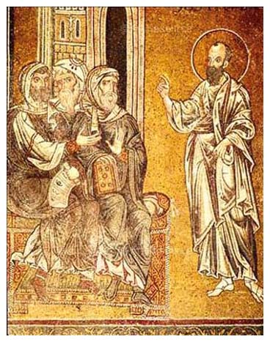
⁸ And he went into the synagogue, and spake boldly for the space of three months, disputing and persuading the things concerning the kingdom of God.
⁹ But when some were hardened, and believed not, but spake evil of that way before the multitude, he departed from them, and separated the disciples, disputing daily in the school of one Tyrannus.
¹⁰ And this continued by the space of two years; so that all they which dwelt in Asia heard the word of the Lord Jesus, both Jews and Greeks.

Slide 69
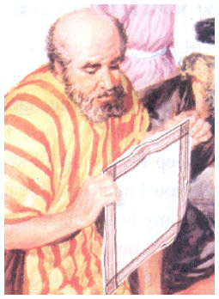
¹¹ And God wrought special miracles by the hands of Paul:
¹² So that from his body were brought unto the sick handkerchiefs or aprons, and the diseases departed from them, and the evil spirits went out of them.

Slide 70
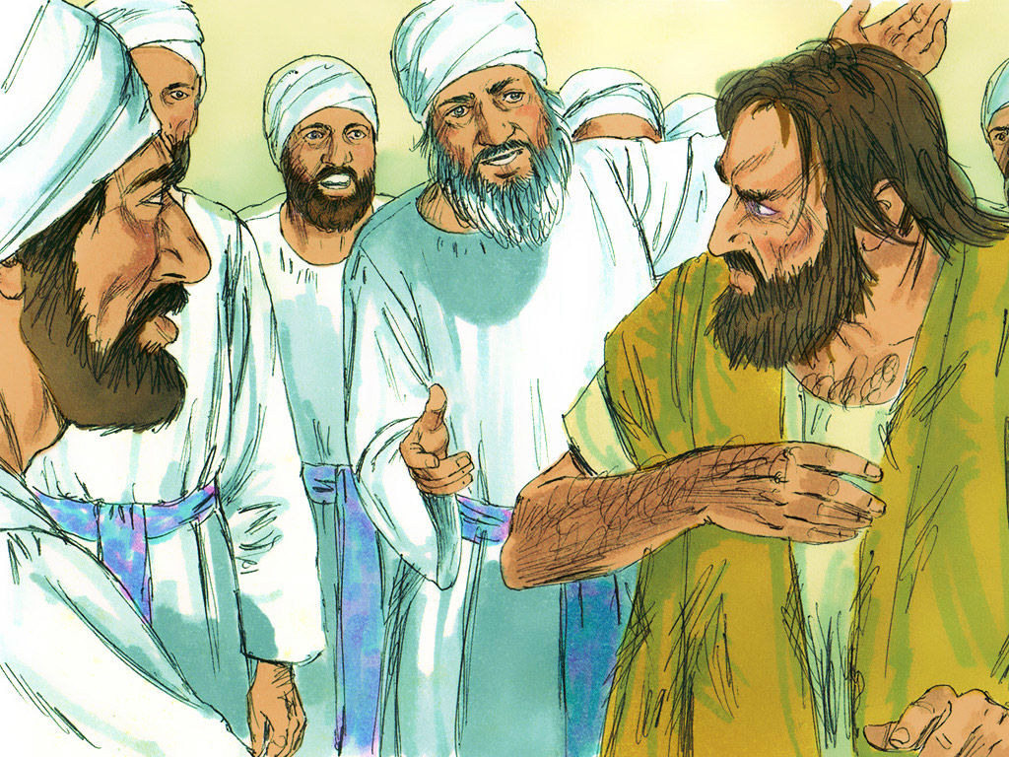
¹³ Then certain of the vagabond Jews, exorcists, took upon them to call over them which had evil spirits the name of the Lord Jesus, saying,
We adjure you by Jesus whom Paul preacheth.
¹⁴ And there were seven sons of one Sceva, a Jew, and chief of the priests, which did so.
¹⁵ And the evil spirit answered and said, Jesus I know, and Paul I know; but who are ye?

Slide 71
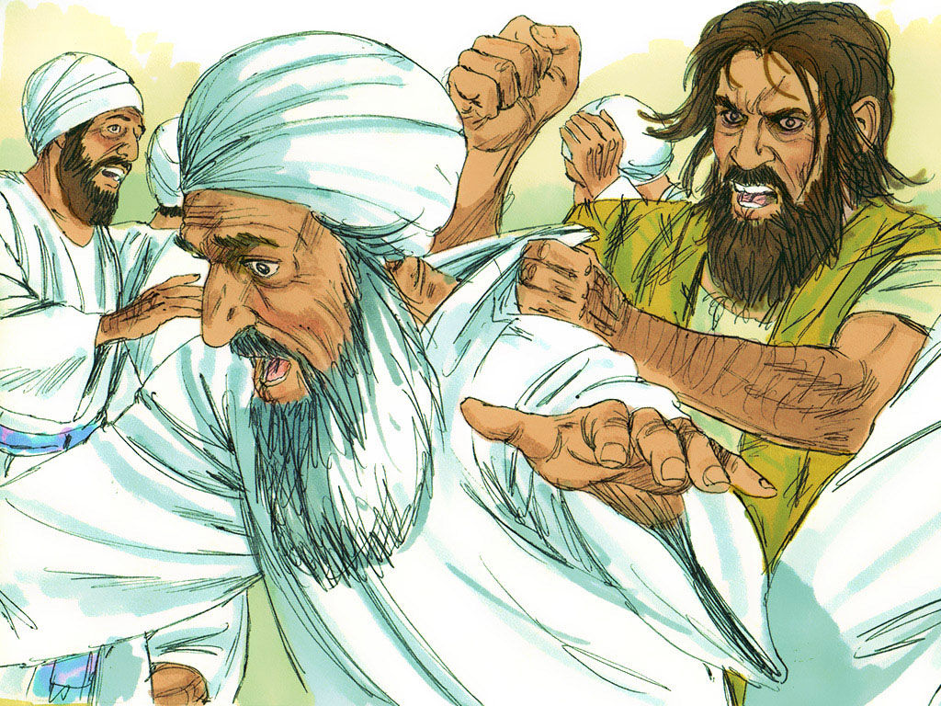
¹⁶ And the man in whom the evil spirit was leaped on them, and overcame them, and prevailed against them, so that they fled out of that house naked and wounded.
¹⁷ And this was known to all the Jews and Greeks also dwelling at Ephesus; and fear fell on them all, and the name of the Lord Jesus was magnified.

Slide 72
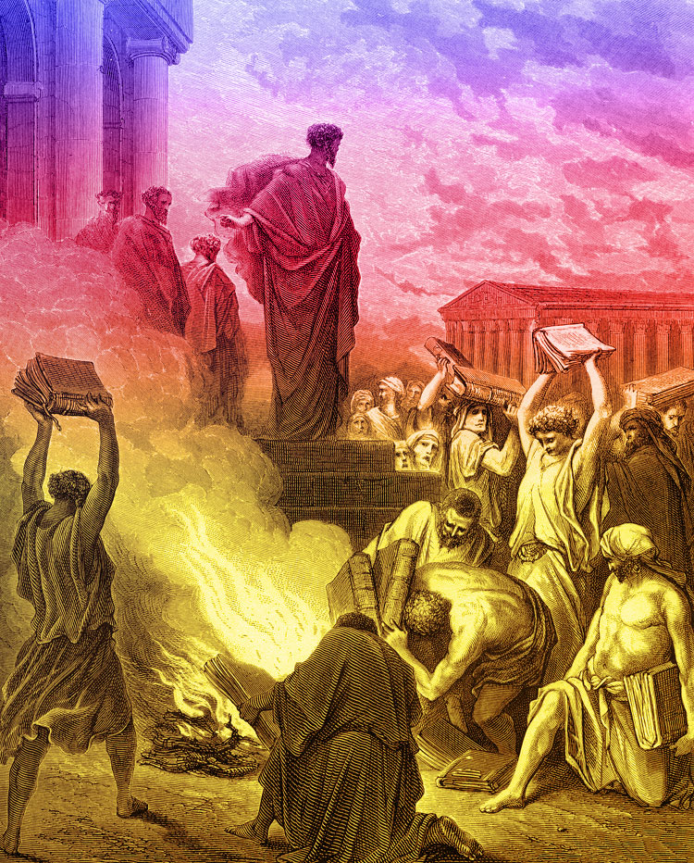
¹⁸ And many that believed came, and confessed, and shewed their deeds.
¹⁹ Many of them also which used curious arts brought their books together, and burned them before all men: and they counted the price of them, and found it fifty thousand pieces of silver.
²⁰ So mightily grew the word of God and prevailed.

Slide 73
²¹ After these things were ended, Paul purposed in the spirit, when he had passed through Macedonia and Achaia, to go to Jerusalem, saying, After I have been there, I must also see Rome.
²² So he sent into Macedonia two of them that ministered unto him, Timotheus and Erastus; but he himself stayed in Asia for a season.
Paul “purposed in the spirit” – he was firmly resolved in his heart.
Philippians 2:13
For it is God which worketh in you both to will and to do of his good pleasure.

Slide 74
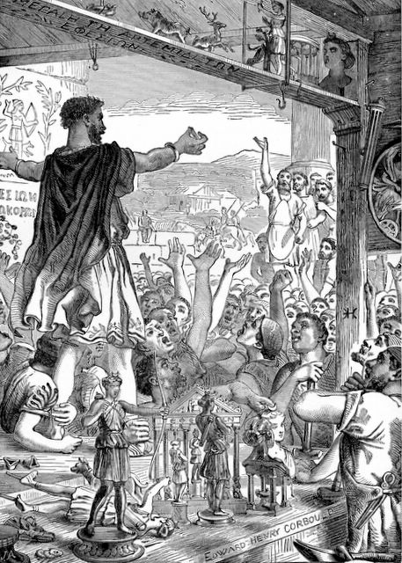
²³ And the same time there arose no small stir about that way.
²⁴ For a certain man named Demetrius, a silversmith, which made silver shrines for Diana, brought no small gain unto the craftsmen;
²⁵ Whom he called together with the workmen of like occupation, and said, Sirs, ye know that by this craft we have our wealth.
²⁶ Moreover ye see and hear, that not alone at Ephesus, but almost throughout all Asia, this Paul hath persuaded and turned away much people, saying that they be no gods, which are made with hands:

Slide 75
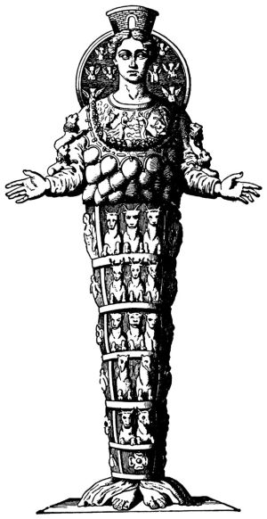
²⁷ So that not only this our craft is in danger to be set at nought; but also that the temple of the great goddess Diana should be despised, and her magnificence should be destroyed, whom all Asia and the world worshippeth.
²⁸ And when they heard these sayings, they were full of wrath, and cried out, saying, Great is Diana of the Ephesians.
²⁹ And the whole city was filled with confusion: and having caught Gaius and Aristarchus, men of Macedonia, Paul's companions in travel, they rushed with one accord into the theatre.

Slide 76
²⁹ And the whole city was filled with confusion:
and having caught Gaius and Aristarchus, men of Macedonia, Paul's companions in travel, they rushed with one accord into the theatre.

Slide 77
³⁰ And when Paul would have entered in unto the people, the disciples suffered him not.
³¹ And certain of the chief of Asia, which were his friends, sent unto him, desiring him that he would not adventure himself into the theatre.
³² Some therefore cried one thing, and some another: for the assembly was confused; and the more part knew not wherefore they were come together.
³³ And they drew Alexander out of the multitude, the Jews putting him forward.
And Alexander beckoned with the hand, and would have made his defence unto the people.
³⁴ But when they knew that he was a Jew, all with one voice about the space of two hours cried out, Great is Diana of the Ephesians.

Slide 78
³⁵ And when the townclerk had appeased the people, he said, Ye men of Ephesus, what man is there that knoweth not how that the city of the Ephesians is a worshipper of the great goddess Diana, and of the image which fell down from Jupiter?
³⁶ Seeing then that these things cannot be spoken against, ye ought to be quiet, and to do nothing rashly.
³⁷ For ye have brought hither these men, which are neither robbers of churches, nor yet blasphemers of your goddess.
³⁸ Wherefore if Demetrius, and the craftsmen which are with him, have a matter against any man, the law is open, and there are deputies: let them implead one another.
³⁹ But if ye enquire any thing concerning other matters, it shall be determined in a lawful assembly.
⁴⁰ For we are in danger to be called in question for this day's uproar, there being no cause whereby we may give an account of this concourse.
⁴¹ And when he had thus spoken, he dismissed the assembly.

Slide 80
L.D. CARY & SAM HOLT CATCH PHRASES
Chapter 19 – “10 + 9, Ephesus Time”
Chapter 20 – “Traveling A’Plenty”
Chapter 21 – “Confinement Begun”
Chapter 22 – “Before A Mob, Not A Few”
Chapter 23 – “Before The Council, You See”
Chapter 24 – “Felix Listens No More”
Chapter 25 – “Agrippa Arrives”
Chapter 26 – “Agrippa Realizes Paul’s Fix”
Chapter 27 – “Shipwreck & An Angel From Heaven”
Chapter 28 – “The End Of Our Wait”
“Traveling A’Plenty”
Catch Phrase
Chapter Twenty

Slide 81
Acts 20:
¹ And after the uproar was ceased, Paul called unto him the disciples, and embraced them, and departed for to go into Macedonia.

Slide 82
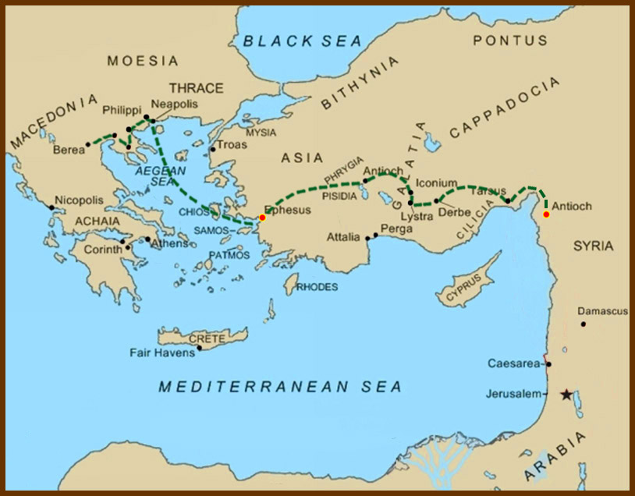
Acts 20:
¹ And after the uproar was ceased, Paul called unto him the disciples, and embraced them, and departed for to go into Macedonia.

Slide 83
² And when he had gone over those parts, and had given them much exhortation, he came into Greece,

Slide 84
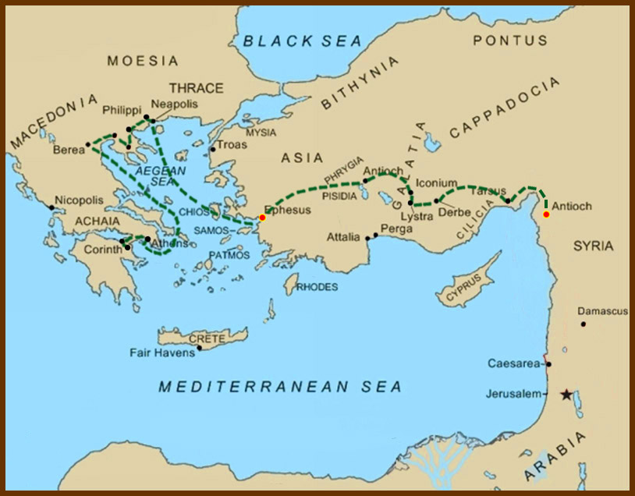
² And when he had gone over those parts, and had given them much exhortation, he came into Greece,
³ And there abode three months …

Slide 85
…And when the Jews laid wait for him, as he was about to sail into Syria, he purposed to return through Macedonia.

Slide 86

…And when the Jews laid wait for him, as he was about to sail into Syria, he purposed to return through Macedonia.

Slide 87
⁴ And there accompanied him into Asia Sopater of Berea;
and of the Thessalonians, Aristarchus and Secundus;
and Gaius of Derbe, and Timotheus;
and of Asia, Tychicus and Trophimus.
⁵ These going before tarried for us at Troas.

Slide 88
⁶ And we sailed away from Philippi after the days of unleavened bread,
and came unto them to Troas in five days; where we abode seven days.

Slide 89
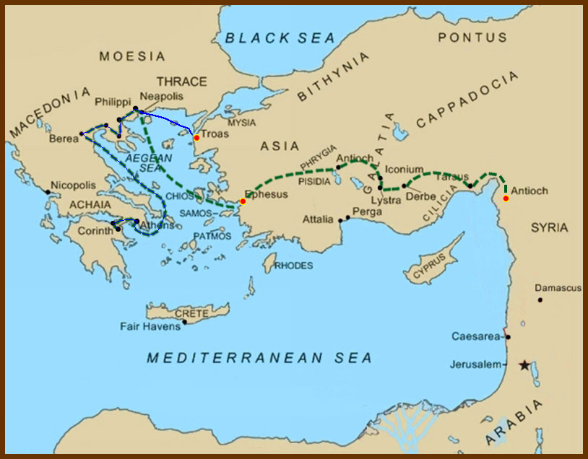
⁶ And we sailed away from Philippi after the days of unleavened bread,
and came unto them to Troas in five days; where we abode seven days.

Slide 90
⁷ And upon the first day of the week, when the disciples came together to break bread, Paul preached unto them, ready to depart on the morrow; and continued his speech until midnight.
⁸ And there were many lights in the upper chamber, where they were gathered together.
This is the first indication that the Christians met on Sundays and not on the Sabbath.

Slide 91
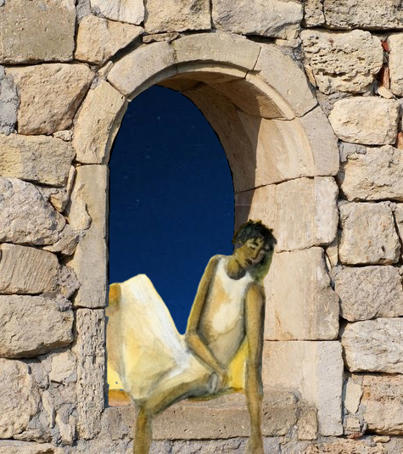
⁹ And there sat in a window a certain young man named Eutychus, being fallen into a deep sleep: and as Paul was long preaching, he sunk down with sleep, and fell down from the third loft, and was taken up dead.

Slide 92
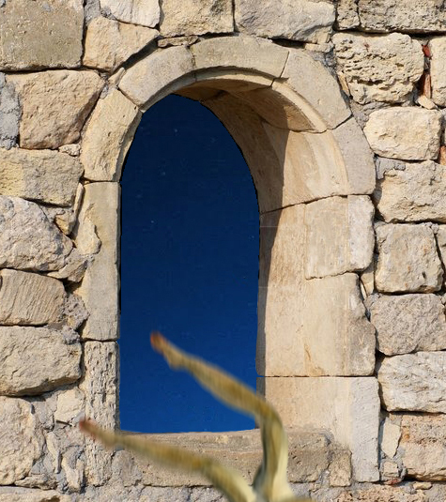
⁹ And there sat in a window a certain young man named Eutychus, being fallen into a deep sleep: and as Paul was long preaching, he sunk down with sleep, and fell down from the third loft, and was taken up dead.

Slide 93
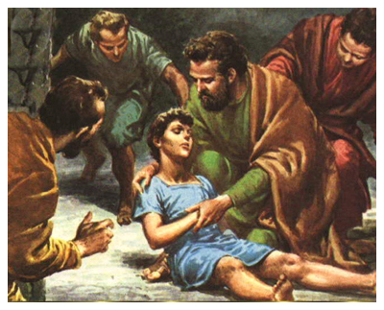
¹⁰ And Paul went down, and fell on him, and embracing him said, Trouble not yourselves; for his life is in him.
¹¹ When he therefore was come up again, and had broken bread, and eaten, and talked a long while, even till break of day, so he departed.
¹² And they brought the young man alive, and were not a little comforted.

Slide 94
¹³ And we went before to ship, and sailed unto Assos, there intending to take in Paul: for so had he appointed, minding himself to go afoot.

Slide 95

¹³ And we went before to ship, and sailed unto Assos, there intending to take in Paul: for so had he appointed, minding himself to go afoot.

Slide 96
¹⁴ And when he met with us at Assos, we took him in, and came to Mitylene.

Slide 97
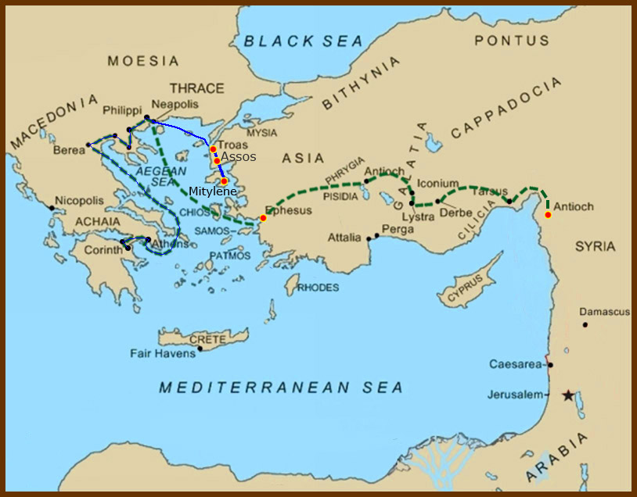
¹⁴ And when he met with us at Assos, we took him in, and came to Mitylene.

Slide 98
¹⁴ And when he met with us at Assos, we took him in, and came to Mitylene.
¹⁵ And we sailed thence, and came the next day over against Chios;

Slide 99

¹⁴ And when he met with us at Assos, we took him in, and came to Mitylene.
¹⁵ And we sailed thence, and came the next day over against Chios;

Slide 100
…and the next day we arrived at Samos, and tarried at Trogyllium;

Slide 101

…and the next day we arrived at Samos, and tarried at Trogyllium;
and the next day we came to Miletus.

Slide 102
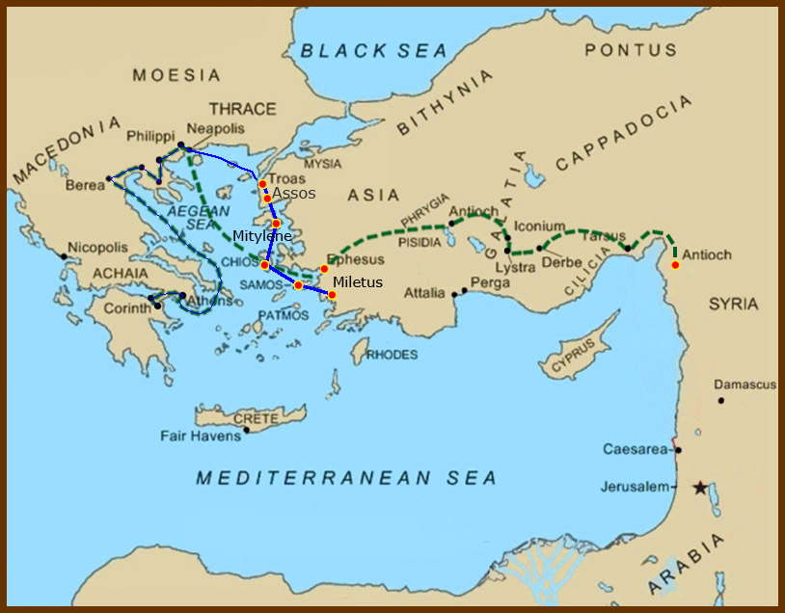
…and the next day we arrived at Samos, and tarried at Trogyllium;
and the next day we came to Miletus.

Slide 103
¹⁶ For Paul had determined to sail by Ephesus, because he would not spend the time in Asia: for he hasted, if it were possible for him, to be at Jerusalem the day of Pentecost.
¹⁷ And from Miletus he sent to Ephesus, and called the elders of the church.

Slide 104
¹⁸ And when they were come to him, he said unto them, Ye know, from the first day that I came into Asia, after what manner I have been with you at all seasons,
¹⁹ Serving the Lord with all humility of mind, and with many tears, and temptations,
which befell me by the lying in wait of the Jews:
²⁰ And how I kept back nothing that was profitable unto you, but have shewed you,
and have taught you publickly, and from house to house,
²¹ Testifying both to the Jews, and also to the Greeks, repentance toward God,
and faith toward our Lord Jesus Christ.

Slide 105
²² And now, behold, I go bound in the spirit unto Jerusalem, not knowing the things that shall befall me there:
²³ Save that the Holy Ghost witnesseth in every city, saying that bonds and afflictions abide me.
²⁴ But none of these things move me, neither count I my life dear unto myself, so that I might finish my course with joy, and the ministry, which I have received of the Lord Jesus, to testify the gospel of the grace of God.

Slide 106
²⁵ And now, behold, I know that ye all, among whom I have gone preaching the kingdom of God, shall see my face no more.
²⁶ Wherefore I take you to record this day, that I am pure from the blood of all men.
²⁷ For I have not shunned to declare unto you all the counsel of God.

Slide 107
²⁸ Take heed therefore unto yourselves, and to all the flock, over the which the Holy Ghost hath made you overseers, to feed the church of God, which he hath purchased with his own blood.
²⁹ For I know this, that after my departing shall grievous wolves enter in among you, not sparing the flock.
³⁰ Also of your own selves shall men arise, speaking perverse things, to draw away disciples after them.
³¹ Therefore watch, and remember, that by the space of three years I ceased not to warn every one night and day with tears.

Slide 108
³² And now, brethren, I commend you to God, and to the word of his grace, which is able to build you up, and to give you an inheritance among all them which are sanctified.
³³ I have coveted no man's silver, or gold, or apparel.
³⁴ Yea, ye yourselves know, that these hands have ministered unto my necessities, and to them that were with me.
³⁵ I have shewed you all things, how that so laboring ye ought to support the weak, and to remember the words of the Lord Jesus, how he said, It is more blessed to give than to receive.

Slide 109
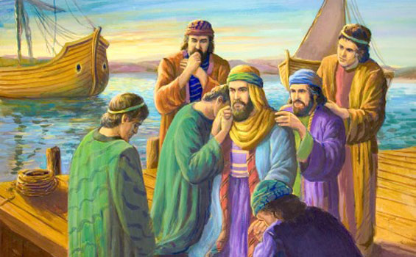
³⁶ And when he had thus spoken, he kneeled down, and prayed with them all.
³⁷ And they all wept sore, and fell on Paul's neck, and kissed him,
³⁸ Sorrowing most of all for the words which he spake, that they should see his face no more. And they accompanied him unto the ship.

Slide 110
L.D. CARY & SAM HOLT CATCH PHRASES
Chapter 19 – “10 + 9, Ephesus Time”
Chapter 20 – “Traveling A’Plenty”
Chapter 21 – “Confinement Begun”
Chapter 22 – “Before A Mob, Not A Few”
Chapter 23 – “Before The Council, You See”
Chapter 24 – “Felix Listens No More”
Chapter 25 – “Agrippa Arrives”
Chapter 26 – “Agrippa Realizes Paul’s Fix”
Chapter 27 – “Shipwreck & An Angel From Heaven”
Chapter 28 – “The End Of Our Wait”
“Confinement Begun”
Catch Phrase
Chapter Twenty-One

Slide 111
Acts 21:
¹ And it came to pass, that after we were gotten from them, and had launched, we came with a straight course unto Coos,

Slide 112
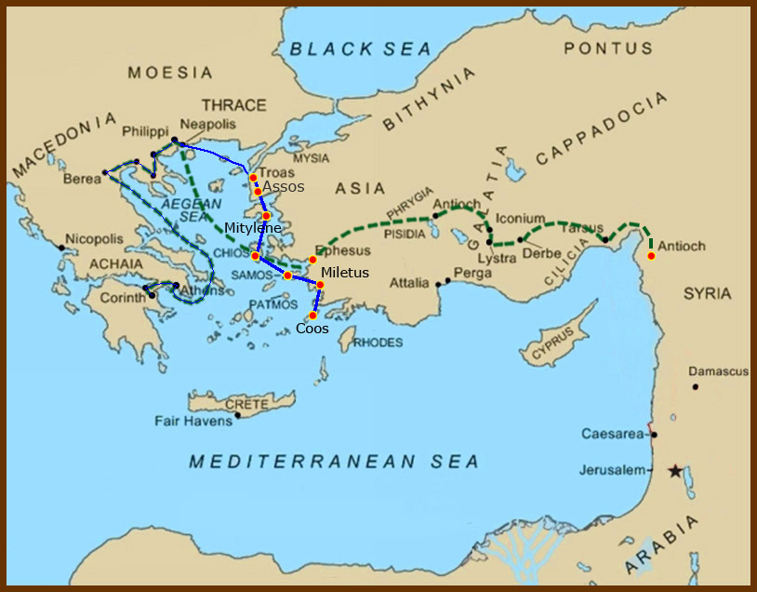
Acts 21:
¹ And it came to pass, that after we were gotten from them, and had launched, we came with a straight course unto Coos,
and the day following unto Rhodes,

Slide 113
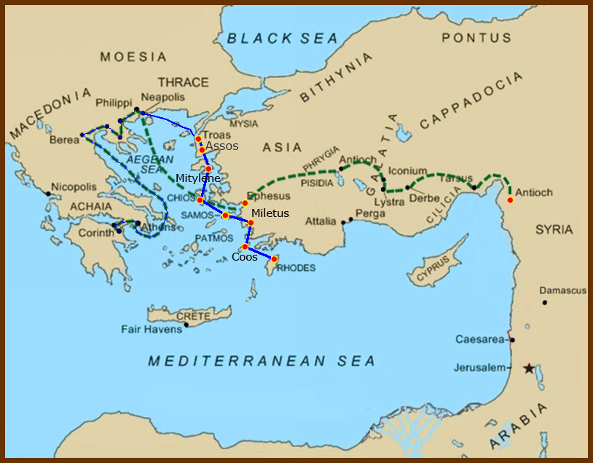
Acts 21:
¹ And it came to pass, that after we were gotten from them, and had launched, we came with a straight course unto Coos, and the day following unto Rhodes,
and from thence unto Patara:

Slide 114
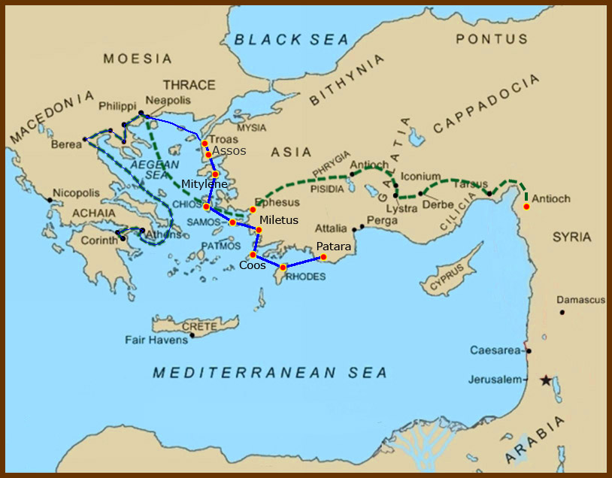
Acts 21:
¹ And it came to pass, that after we were gotten from them, and had launched, we came with a straight course unto Coos, and the day following unto Rhodes,
and from thence unto Patara:

Slide 115
² And finding a ship sailing over unto Phenicia, we went aboard, and set forth.
³ Now when we had discovered Cyprus,
we left it on the left hand, and sailed into Syria, and landed at Tyre: for there the ship was to unlade her burden.

Slide 116
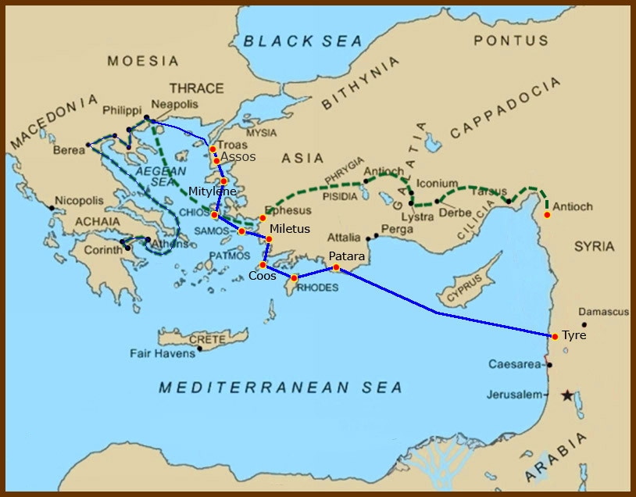
² And finding a ship sailing over unto Phenicia, we went aboard, and set forth.
³ Now when we had discovered Cyprus,
we left it on the left hand, and sailed into Syria, and landed at Tyre: for there the ship was to unlade her burden.

Slide 117
⁴ And finding disciples, we tarried there seven days: who said to Paul through the Spirit, that he should not go up to Jerusalem.
⁵ And when we had accomplished those days, we departed and went our way; and they all brought us on our way, with wives and children, till we were out of the city: and we kneeled down on the shore, and prayed.
⁶ And when we had taken our leave one of another, we took ship; and they returned home again.

Slide 118
⁷ And when we had finished our course from Tyre, we came to Ptolemais,
and saluted the brethren, and abode with them one day.

Slide 119
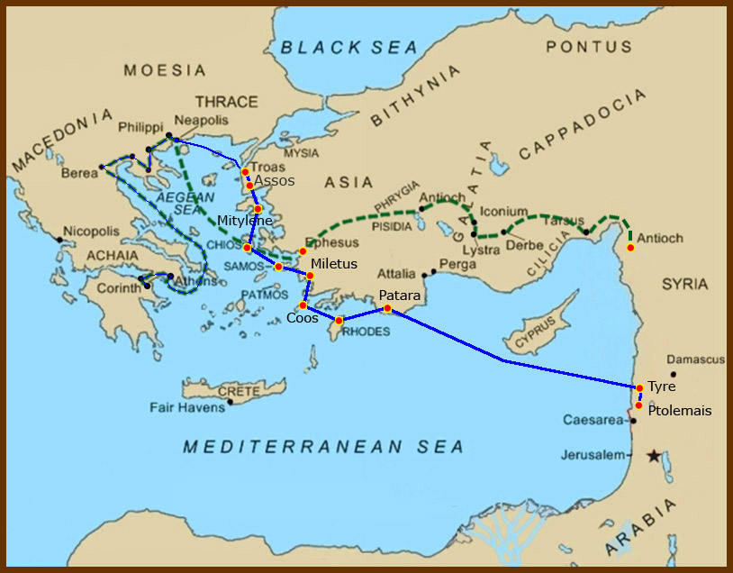
⁷ And when we had finished our course from Tyre, we came to Ptolemais,
and saluted the brethren, and abode with them one day.
⁸ And the next day we that were of Paul's company departed, and came unto Caesarea:

Slide 120

⁷ And when we had finished our course from Tyre, we came to Ptolemais,
and saluted the brethren, and abode with them one day.
⁸ And the next day we that were of Paul's company departed, and came unto Caesarea:

Slide 121
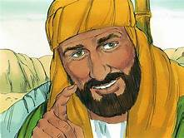
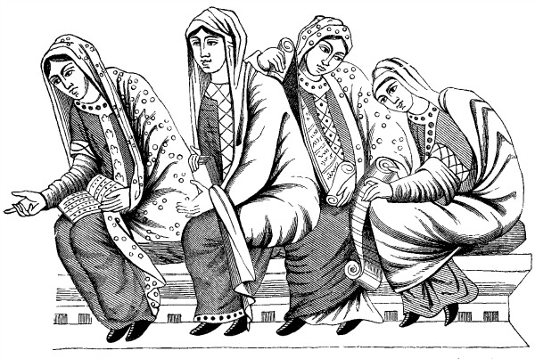
…and we entered into the house of Philip the evangelist, which was one of the seven; and abode with him.
⁹ And the same man had four daughters, virgins, which did prophesy.

Slide 122
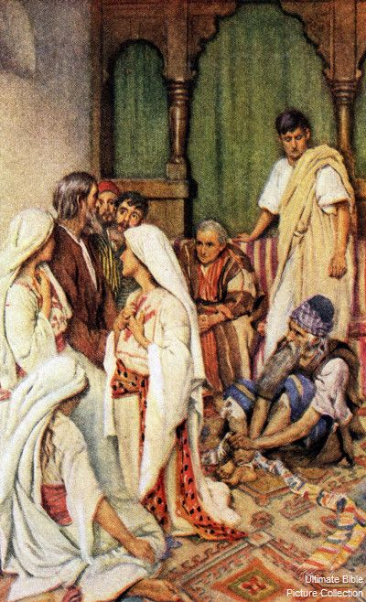
¹⁰ And as we tarried there many days,
there came down from Judaea a certain prophet, named Agabus.
¹¹ And when he was come unto us, he took Paul's girdle, and bound his own hands and feet, and said,
Thus saith the Holy Ghost, So shall the Jews at Jerusalem bind the man that owneth this girdle, and shall deliver him into the hands of the Gentiles.

Slide 123
¹² And when we heard these things, both we, and they of that place, besought him not to go up to Jerusalem.
¹³ Then Paul answered, What mean ye to weep and to break mine heart? for I am ready not to be bound only, but also to die at Jerusalem for the name of the Lord Jesus.
¹⁴ And when he would not be persuaded, we ceased, saying, The will of the Lord be done.

Slide 124
¹⁵ And after those days we took up our carriages, and went up to Jerusalem.

Slide 125

¹⁵ And after those days we took up our carriages, and went up to Jerusalem.
This is where Paul’s third mission trip ends.

Slide 126
Paul’s Third Missionary Journey
Acts 18:23-21:14

Slide 127
Outline - Acts
II. The Ministry of Paul – Acts 13:1-28:31
Paul’s 1st Missionary Journey – Acts 13:1-15:35
Paul’s 2nd Missionary Journey – Acts 15:36-18:22
Paul’s 3rd Missionary Journey – Acts 18:23-21:14
Paul’s Arrest - 1 – Acts 21:15-23:11
Paul’s Arrest - 2 – Acts 23:12-25:12
Paul’s Arrest - 3 – Acts 25:13-26:32
Paul’s Journey to Rome – Acts 27:1-28:31

Slide 128
And having spent some time there, he left and passed successively through the Galatian region and Phrygia, strengthening all the disciples.
- Acts 18:23

Slide 129
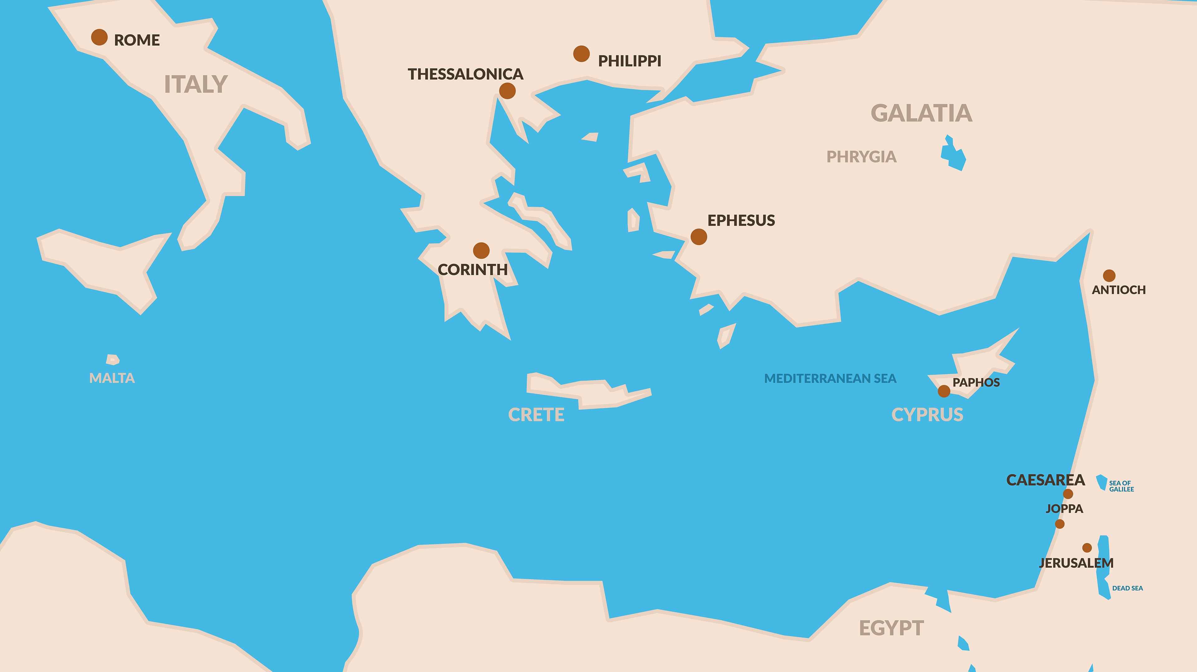

Slide 130
²⁴ Now a Jew named Apollos, an Alexandrian by birth, an eloquent man, came to Ephesus; and he was mighty in the Scriptures. ²⁵ This man had been instructed in the way of the Lord; and being fervent in spirit, he was speaking and teaching accurately the things concerning Jesus, being acquainted only with the baptism of John;
- Acts 18:24-25

Slide 131
and he began to speak out boldly in the synagogue. But when Priscilla and Aquila heard him, they took him aside and explained to him the way of God more accurately.
- Acts 18:26

Slide 132

CHAPTER 18 J. W. McGarvey’s Acts Commentary
VERSES 24 - 26
His ignorance had reference to the points of distinction between John’s immersion & that of the apostles, which were chiefly these, that John did not promise the Holy Spirit to those who were immersed, and did not immerse into the name of the Father, and of the Son, and of the Holy Spirit. Whatever confusion of thought upon kindred topics is necessarily involved in ignorance of these two things, Apollos must also have been subject to; but we are not authorized to extend his ignorance any further than this. On these points he was instructed by Priscilla and Aquila, and was then able to teach the things concerning the Lord more accurately. There is no evidence whatever that he was re-immersed.
  McGarvey, J. W. (1872). A commentary on Acts of Apostles (p. 232). Lexington, KY: Transylvania Printing and Publishing Co.

Slide 133
²⁷ And when he wanted to go across to Achaia, the brethren encouraged him and wrote to the disciples to welcome him; and when he had arrived, he greatly helped those who had believed through grace, ²⁸ for he powerfully refuted the Jews in public, demonstrating by the Scriptures that Jesus was the Christ.
- Acts 18:27-28

Slide 134
CHAPTER 18 J. W. McGarvey’s Acts Commentary
VERSES 27 & 28
This is the earliest mention of letters of commendation among the disciples. It shows that they were employed simply to make known the bearer to strange brethren, and commend him to their fellowship.
Apollos mightily convinced the Jews in Achaia; whereas Paul’s converts had been mostly among the Gentiles. This was, no doubt, owing to the peculiarity of his endowments, giving him access to some minds which were inaccessible to Paul. A variety of talents and acquirements among preachers is still necessary to the success of the gospel message among the immense variety of the minds & characters which make up human society.
  McGarvey, J. W. (1872). A commentary on Acts of Apostles (p. 233). Lexington, KY: Transylvania Printing and Publishing Co.

Slide 135
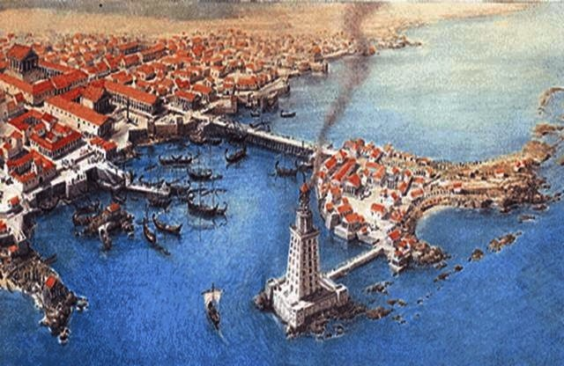

Slide 136
Apollos
Eloquent
Mighty in Scriptures
Not Fully Trained

Slide 137
P
E
N
T
E
C
O
S
T
John’s Baptism
- Disciples
- Apostles
- Apollos
Jesus’ Baptism
- New disciples
- Those baptized
into John after
Pentecost

Slide 138
¹ It happened that while Apollos was at Corinth, Paul passed through the upper country and came to Ephesus, and found some disciples.
² He said to them, “Did you receive the Holy Spirit when you believed?” And they said to him, “No, we have not even heard whether there is a Holy Spirit.” ³ And he said, “Into what then were you baptized?” And they said, “Into John’s baptism.”
- Acts 19:1-3

Slide 139
⁴ Paul said, “John baptized with the baptism of repentance, telling the people to believe in Him who was coming after him, that is, in Jesus.”
⁵ When they heard this, they were baptized in the name of the Lord Jesus. ⁶ And when Paul had laid his hands upon them, the Holy Spirit came on them, and they began speaking with tongues and prophesying. ⁷ There were in all about twelve men.
- Acts 19:4-7

Slide 140
CHAPTER 19 J. W. McGarvey’s Acts Commentary
VERSES 1 - 7
They are called disciples, and were known as such when Paul found them; for it is said “he found certain disciples.” They were disciples, not of John, but of Jesus; for the uniform currency of the term disciple, throughout Acts, requires us to so understand. This is further evident from Paul’s question, “Have you received the Holy Spirit since you believed?” The term believed evidently refers to Jesus as its object. They were known, then, as disciples of Jesus, and were so recognized by Paul.
  McGarvey, J. W. (1872). A commentary on Acts of Apostles (Ac 19:7). Lexington, KY: Transylvania Printing and Publishing Co.

Slide 141
CHAPTER 19 J. W. McGarvey’s Acts Commentary
VERSES 1 - 7
It is inconceivable that these disciples were ignorant of the existence of the Holy Spirit, hence a literal rendering of their reply, “We have not so much as heard that there is a Holy Spirit,” would convey a false idea. The supplement given is necessary to complete the sense, as it is in John vii: 39, where it is said, “The Holy Spirit was not yet, because Jesus was not yet risen.” The term given must be supplied, in the latter case, in order to avoid the denial of the existence of the Spirit previous to the resurrection & in the former, to avoid the declaration of an ignorance on the part of these men inconsistent with the fact that they were disciples.
  McGarvey, J. W. (1872). A commentary on Acts of Apostles (p. 234). Lexington, KY: Transylvania Printing and Publishing Co.

Slide 142
CHAPTER 19 J. W. McGarvey’s Acts Commentary
VERSES 1 - 7
This answer at once revealed to Paul that there was some irregularity in their religious history; for no one could be properly discipled without learning that the Holy Spirit was to be given. He at once perceived, too, that the irregularity must have been connected with their immersion; for he inquires, “Into what, then, were you immersed?” If the gift of the Spirit had no connection with immersion, this inquiry would have been inapposite, and Paul would not have propounded it. But the apostles taught as Peter did on the day of Pentecost, when he said, “Repent and be immersed, everyone of you, in the name of Jesus Christ, for the remission of sins, and you shall receive the gift of the Holy Spirit.” It is only on the supposition Paul knew this to be the universal teaching of rightly-informed brethren, that he inferred something wrong about their immersion, from their ignorance of the gift of the Holy Spirit. This supposition which is a necessary, not an optional one, makes the whole matter very plain. Paul’s first question had reference to the miraculous gift of the Spirit; but when they said they knew not that the Holy Spirit was given, he saw that they were ignorant of even the ordinary gift, which is promised to all who repent and are immersed, and that they were immersed without proper instruction.
  McGarvey, J. W. (1872). A commentary on Acts of Apostles (p. 234). Lexington, KY: Transylvania Printing and Publishing Co.

Slide 143
CHAPTER 19 J. W. McGarvey’s Acts Commentary
VERSES 1 - 7
Their reply, that they were immersed into John’s immersion, relieved the case of all obscurity, and Paul then understood it perfectly. He explained, that John’s immersion was one of repentance, to be followed by faith in the Messiah when he should come. Those immersed by him believed the Messiah was coming; but they did not, until after their immersion, believe that Jesus was the Messiah, nor did they have a promise of the Holy Spirit. They were not, therefore, immersed into the name of Jesus or that of the Holy Spirit. This is further evident from the fact that Paul commanded these twelve to be “immersed into the name of the Lord Jesus,” which the authority of the commission requires us to understand as equivalent to the expression, “into the name of the Father, and of the Son, and of the Holy Spirit.” These points of defect, however, were not peculiar to the immersion of the twelve, but attached also to that of the twelve apostles, the 120 disciples & the five hundred who saw Jesus together in Galilee after the resurrection, none of whom were reimmersed. What, then, led to the immersion of these parties? If their immersion had taken place, like that of all the others just named, while John’s immersion was still an existing institution, no reason could be given for their reimmersion. This then forces us to the conclusion that they had been immersed with John’s immersion after it had ceased to be administered by divine authority. Apollos had been recently preaching this obsolete immersion in Ephesus, and these persons may have been immersed by him. If so, they submitted to an institution which had been abrogated more than twenty years, and this was the defect that led to their reimmersion. The general conclusion, from all the premises, is this: that persons who were immersed with John’s immersion, while it was in lawful existence, were received into the Church of Christ without reimmersion. But persons who were thus immersed, after the introduction of apostolic immersion, were reimmersed. The reason why Apollos was not reimmersed as well as the twelve, was, doubtless, because, like the apostles and the other original disciples, he was immersed during the ministry of John.
  McGarvey, J. W. (1872). A commentary on Acts of Apostles (pp. 234–235). Lexington, KY: Transylvania Printing and Publishing Co.

Slide 144
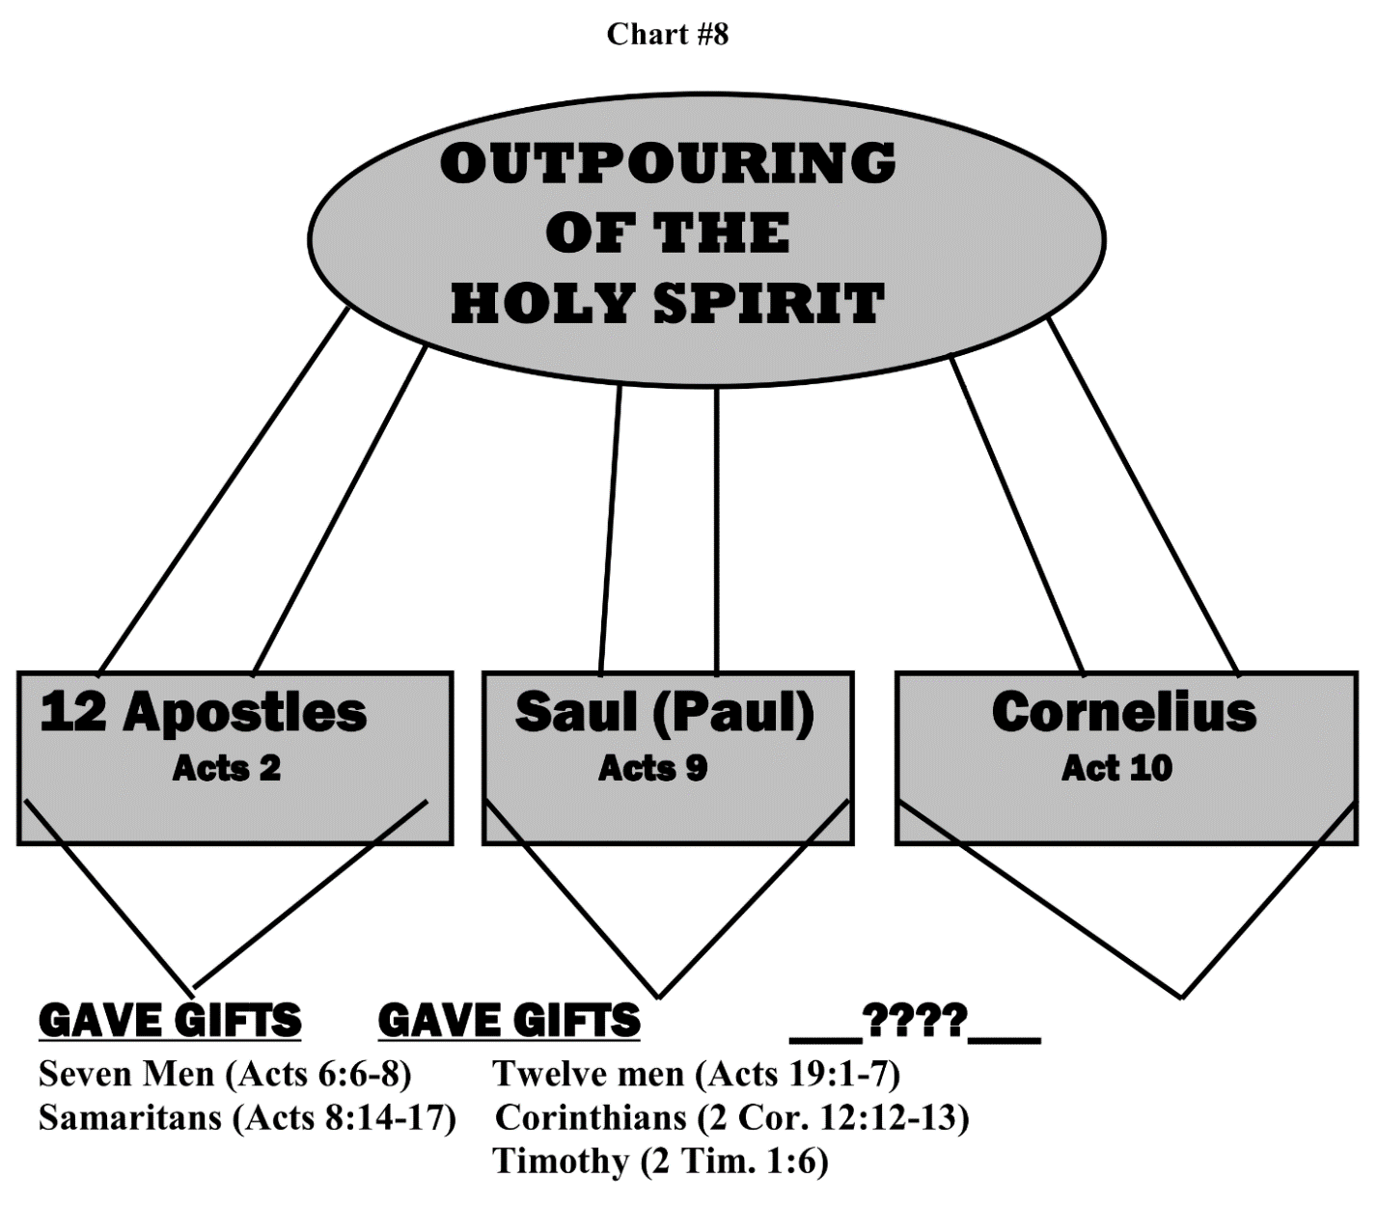

Slide 145
Jesus’ Baptism =
Forgiveness + Holy Spirit Indwelling
Apostle’s Laying on of Hands =
Holy Spirit Empowering

Slide 146


Slide 147


Slide 148


Slide 149
⁸ And he entered the synagogue and continued speaking out boldly for three months, reasoning and persuading them about the kingdom of God. ⁹ But when some were becoming hardened and disobedient, speaking evil of the Way before the people, he withdrew from them and took away the disciples, reasoning daily in the school of Tyrannus. ¹⁰ This took place for two years, so that all who lived in Asia heard the word of the Lord, both Jews and Greeks.
- Acts 19:8-10

Slide 150
CHAPTER 19 J. W. McGarvey’s Acts Commentary
VERSES 8 - 12
It is worthy of note that Paul commenced his labors in Ephesus by rectifying what he found wrong in the few disciples already there, before he undertook to add to their number. It is an example worthy of imitation to the full extent that may be found practicable. When he had accomplished this, he was prepared to grapple with the Jewish and pagan errors which pervaded the community.
  McGarvey, J. W. (1872). A commentary on Acts of Apostles (p. 235). Lexington, KY: Transylvania Printing and Publishing Co.

Slide 151
Barnes' Notes on the Bible
Verse 12 - So that from his body… That is, those handkerchiefs which had been applied to his body, which he had used, or which he had touched. An instance somewhat similar to this occurs in the case of the woman who was healed by touching the hem of the Savior's garment, Matthew 9:20-22.Unto the sick - The sick who were at a distance, and who were unable to go where he was. If it be asked why this was done, it may be observed:(1) That the working of miracles in that region would greatly contribute to the spread of the gospel.
(2) we are not to suppose that there was any efficacy in the aprons thus brought, or in the mere fact that they had touched the body of Paul, anymore than there was in the hem of the Savior's garment which the woman touched, or in the clay which he made use of to open the eyes of the blind man, John 8:6.
(3) in this instance, the fact that the miracles were performed in this manner by garments which had touched his body, was a mere sign, or an evidence to the persons concerned, that it was done by the instrumentality of Paul, as the fact that the Savior put his fingers into the ears of a deaf man, and spit and touched his tongue Mark 7:33, was an evidence to those who saw it that the power of healing came from him. The bearing of these aprons to the sick was, therefore, merely evidence to all concerned that miraculous power was given to Paul.
Handkerchiefs - The word used here σουδάρια soudaria is of Latin origin, and properly denotes "a piece of linen" with which sweat was wiped from the face; and then "any piece of linen used for tying up or containing anything." In Luke 19:20, it denotes the "napkin" in which the talent of the unprofitable servant was concealed; in John 11:44; John 20:7, the "napkin" which was used to bind up the face of the dead applied to Lazarus and to our Saviour.
Or aprons - σιμικίνθια simikinthia. This is also Latin word, and means literally a half girdle, or covering half the person a piece of cloth which was girded round the waist to preserve the clothes of those who were engaged in any kind of work. The word "aprons" expresses the idea. And the diseases departed - The sick were healed.

Slide 152
Modern-day use of prayer cloths has been tied to the Mormon church and the Pentecostal church. There are times when the cloths have the sweat of those who pray over it on the cloth. They also may be anointed with oil. Prayer cloths can be given to those you care about as a reminder that you are praying over them. Sometimes, groups of people will pray for a person holding onto the cloth. Some believe that the sweat will create a transfer that will allow God’s miracle power to enter the recipient of the prayers.
In recent decades, prayer cloths have shifted in their application and have been used to take advantage of believers. They have become a fund-raising method used by many prosperity gospel televangelists. These are the infomercials you’ve likely woken up to in the middle of the night. The program will encourage viewers to call in, and send their name, address and a short prayer request to a 1-800 number. Following submitting this information, you receive instructions on what should be done with the prayer cloth like “write your name on it” or “put it under your pillow,” along with a hefty donation to the ministry. It is particularly problematic when they are used exclusively for financial gain. – Internet Search

Slide 153

Televangelist Faith Healer’s Con-Artist Scam
Health & Wealth Prosperity Doctrine Not Supported By Scripture

Slide 154
Question:
I have a friend that asked me about "prayer blankets or cloths". I am aware of the Scripture she is referencing: Acts 19:11-12. I'm just unsure on how to help her understand scripturally why this is not necessary. Thank you for your time and scriptural truth; I really appreciate it.
Answer:
"Now God worked unusual miracles by the hands of Paul, so that even handkerchiefs or aprons were brought from his body to the sick, and the diseases left them and the evil spirits went out of them" (Acts 19:11-12).
Your friend wishes to claim that what God said was an unusual miracle showing that Paul was an apostle and inspired by God (Hebrews 2:3-4) is now a common place item.
But it really isn't the same thing at all. People were miraculously healed by clothes that Paul had touched. Notice that no mention of prayers is found in this verse. Prayers may have been said, but that is not where the emphasis lies.
God answers prayers, but people think they need something tangible instead of trusting God to hear. In a way, they are much like Thomas, "Jesus said to him, "Thomas, because you have seen Me, you have believed. Blessed are those who have not seen and yet have believed"" (John 20:29).
God never commanded the use of prayer cloths and there is no example of such being used (beyond pulling an event concerning Paul out of its context). What I've seen these days is hucksters offering mystical prayer cloths for a some of money. Even if someone realizes the cloths don't do anything beyond wiping up dust, they are told that it is because they lack faith. "For the time will come when they will not endure sound doctrine, but according to their own desires, because they have itching ears, they will heap up for themselves teachers; and they will turn their ears away from the truth, and be turned aside to fables" (II Timothy 4:3-4).

Slide 155
CHAPTER 19 J. W. McGarvey’s Acts Commentary
VERSES 13 - 17
Nothing is more mortifying, or better calculated to provoke the contempt of the community, than the unexpected exposure of mysterious pretensions such as were assumed by these exorcists. The spirit was enraged at their insulting pretensions, and doubtless enjoyed the joke of exposing them. The seven resisted until they were stripped and wounded, when they fled, presenting a very ludicrous aspect as they passed along the streets. While all Ephesus was laughing at them, it was remembered that the spirit had acknowledged the authority of Jesus, and of Paul, and that a licentious use of the name of Jesus was the cause of all their trouble. The mirth awakened by the event was soon changed to reverence for the name of Jesus, which they now saw was not, as the exorcists had pretended, a mere conjurer’s talisman.
  McGarvey, J. W. (1872). A commentary on Acts of Apostles (p. 236). Lexington, KY: Transylvania Printing and Publishing Co.

Slide 156
CHAPTER 19 J. W. McGarvey’s Acts Commentary
VERSES 18 - 20
The believers who “came and confessed and declared their practices,” had not, till now, realized the impropriety of those arts, which their heathen education had taught them to regard with reverence. That others, those who were not yet disciples, did the same thing, and even burned up their books, is a striking proof of the fear that fell upon them all. The pieces of silver in which the value of the books was computed were doubtless the Attic didrachma; for it was a Greek city, and this was the most common silver coin among the Greeks. It was worth fifteen cents of Federal money & the value of all the books was seven thousand five hundred dollars; a sufficient indication of the extent to which these arts prevailed, and of the number and value of the books written in explanation of them. This whole account is in full accordance with the profane history of Ephesus, which represents it as the chief center of magic arts in the whole Roman empire.
  McGarvey, J. W. (1872). A commentary on Acts of Apostles (pp. 236–237). Lexington, KY: Transylvania Printing and Publishing Co.

Slide 157
CHAPTER 19 J. W. McGarvey’s Acts Commentary
VERSES 21 & 22
The First Epistle to the Corinthians was written from Ephesus, as we learn from the remark, (chapter xvi: 8, 9,) “I will tarry in Ephesus until Pentecost; for a great and effectual door is opened to me, and there are many adversaries.” It was also during the present visit that it was written, for, during his first visit, he didn’t tarry at all. The exact date of the epistle is best fixed within the period covered by the words “he himself stayed in Asia for a season;” for it was then that “a great and effectual door” was first opened to him.
This is not really the first epistle Paul wrote to the Corinthians; for in it he speaks of another, which he had previously written, upon the subject of fornication. He says: “I wrote to you in an epistle not to keep company with fornicators.” This is all we know of the subject-matter of the epistle, which is lost; and perhaps it was for the reason that it treated of this subject alone, and in a less detailed method than does the epistle now called the first, that it was not preserved with the other two.
McGarvey, J. W. (1872). A commentary on Acts of Apostles (p. 237). Lexington, KY: Transylvania Printing

Slide 158
CHAPTER 19 J. W. McGarvey’s Acts Commentary
VERSES 21 & 22
Subsequent to the date of the lost epistle, some members of the household of Chloe had brought him information of great disorders and corruption in the Church in Corinth. He learned that the congregation was distracted by party strife; that fornication, and even incest were still tolerated by them; that some of them were engaged in litigation before the civil courts; that his own apostolic authority was called in question; that their women, contrary to the prevailing rules of modesty, took part in the worship with unvailed faces; that some confusion and strife had arisen in reference to the spiritual gifts among them; that some among them were even denying the resurrection; and that the Lord’s supper was profaned by feasting and drunkenness. Besides all this, he had received a letter from them calling for information in reference to marriage and divorce, and the eating of meats offered to idols.
To answer their questions, and to correct and rebuke these disorders, was the object of the epistle. The temper in which it is written appears calm and stern; yet it is not conceivable that Paul could hear of corruptions so gross in a Church which had cost him so much labor and anxiety, without intense pain. Though no such feeling was allowed to manifest itself in the epistle, he was constrained afterward, to confess it, and say to them, “Out of much affliction & anguish of heart, I wrote to you, with many tears.“ It was, therefore, with a heart full of anguish in reference to some results of his past labors, but buoyed up by the opening of a wide and effectual door in his present field, that he sent Timothy and Erastus into Macedonia, but remained himself in Asia for a season.
  McGarvey, J. W. (1872). A commentary on Acts of Apostles (p. 238). Lexington, KY: Transylvania Printing and Publishing Co.

Slide 159


Slide 160

© Ad Meskens

Slide 161

© Eoe gian

Slide 162


Slide 163


Slide 164
²³ About that time there occurred no small disturbance concerning the Way. ²⁴ For a man named Demetrius, a silversmith, who made silver shrines of Artemis, was bringing no little business to the craftsmen;
- Acts 19:23-24

Slide 165
²⁵ these he gathered together with the workmen of similar trades, and said, “Men, you know that our prosperity depends upon this business. ²⁶ You see and hear that not only in Ephesus, but in almost all of Asia, this Paul has persuaded and turned away a considerable number of people, saying that gods made with hands are no gods at all.
- Acts 19:25-26

Slide 166
Not only is there danger that this trade of ours fall into disrepute, but also that the temple of the great goddess Artemis be regarded as worthless and that she whom all of Asia and the world worship will even be dethroned from her magnificence.”
- Acts 19:27

Slide 167
CHAPTER 19 J. W. McGarvey’s Acts Commentary
VERSES 28 - 31
Not finding him, they seize his companions, and rushing into the theater, where criminals were sometimes exposed to wild beasts, they are about to take the part of the wild beasts themselves. What was the fate of Gaius and Aristarchus is not here stated, though both names occur afterward in the history, and probably designate the same individuals.
When Paul heard the tumult, and knew that his companions had been dragged within the theater, he could but suppose that they were torn to pieces. This thought alone was intensely harrowing to his feelings; but it was still more so to know that they were suffering in his stead. He could not endure to remain inactive at such a crisis, but resolved to die with them.
  McGarvey, J. W. (1872). A commentary on Acts of Apostles (p. 239). Lexington, KY: Transylvania Printing

Slide 168
CHAPTER 19 J. W. McGarvey’s Acts Commentary
VERSES 28 - 31
Giving up all hope of life, as he started toward the theater, and trusting in Him who raises the dead, when the tumult had subsided, and he was assured of safety, he felt much as if he had been raised from the dead. He therefore says, in the same connection, “Who delivered me from so grievous a death, and is delivering, in whom I trust that he will even yet deliver us: you also helping by prayer for us, that for the gift bestowed on us by means of many persons, thanks may be given by man on our behalf.”
  McGarvey, J. W. (1872). A commentary on Acts of Apostles (p. 239). Lexington, KY: Transylvania Printing and Publishing Co.

Slide 169
CHAPTER 19 J. W. McGarvey’s Acts Commentary
VERSES 32 - 34
The rage of an excited multitude, unless it find some new fuel to keep up the flame, will naturally subside in a few hours. While it is at its height, it becomes only the more furious the more it is opposed; but when it begins to subside, frequently a few well-chosen words are sufficient to restore quiet. Acting upon this principle, the city authorities had not, thus far, interfered with the mob; but when they were exhausted by long-continued vociferation, the following well-timed and well-worded speech was addressed to them.
This is evidently the speech of a man well skilled in the management of popular assemblies, and, doubtless, its happy adaptation to the circumstances is what suggested to Luke the propriety of preserving it. It is probable that the speaker, like the Asiarchs who interfered to keep Paul out of danger, was a friend to the apostle & a man of too much intelligence to receive with blind credulity the popular delusion in reference to the temple and image of Diana. The speech, indeed, has a ring of insincerity about it, indicating that the speaker was merely humoring the popular superstition for the special purpose before him. Upon this hypothesis the speech appears the more ingenious. The confident assumption that the divine honors bestowed on their goddess, and the belief that her image fell from heaven, were so well known that no man would call them in question, was soothing to their excited feelings, and the remark that the unquestionable certainty of these facts ought to make them feel entirely composed on the subject, brought them, by a happy turn of thought, to the very composure which he desired, and which they fancied was the result of a triumphant vindication of their cause. Advancing, then, to the case of the disciples, like a trained advocate, he ignores the real charge against them, that of denying that they are gods which are made with hands, and declares that they are neither temple robbers, nor revilers of their goddess. Then, as for the men who had excited them to this disturbance, the proconsular courts were the proper place for complaints like theirs, and they had no right to disturb the people with such matters. Finally, he gives them a gentle hint as to the unlawfulness of their assemblage, and the probability that they would be called to account for it by the Roman authorities. This last remark had special force with the majority, who, according to Luke, “knew not on what account they had come together;” and the whole speech was well aimed toward the result which followed, the dispersion of the mob. The city authorities had reason to congratulate themselves that so fierce a mob had been so successfully controlled, and the disciples could but be thankful to God that they had escaped so well.

Slide 170


Slide 171
CHAPTER 20 J. W. McGarvey’s Acts Commentary
VERSE 1
But the news brought by Titus was not all of a cheering kind. He told of the good effects of the former epistle; that the majority of the Church had repented of their evil practices; that they had excluded the incestuous man; and that they were forward in their preparation for a large contribution to the poor saints in Judea. But he also brought word that Paul had some bitter personal enemies in the Church, who were endeavoring to injure esteemed reputation in order to subvert his apostolic authority. For the purpose of counteracting the influence of these ministers of Satan, encouraging faithful brethren in their renewed zeal, and presenting to them many solemn and touching reflections suggested by his own afflictions, he addressed them the epistle known as the Second to the Corinthians, and dispatched it by the hand of Titus & two other brethren, whose names are not mentioned.
  McGarvey, J. W. (1872). A commentary on Acts of Apostles (p. 242). Lexington, KY: Transylvania Printing and Publishing Co.

Slide 172
CHAPTER 20 J. W. McGarvey’s Acts Commentary
VERSES 2 & 3
The circumstance which led to this result was the increasing alienation between the Jews and the Gentiles within the Church. The decree of the apostles and inspired brethren in Jerusalem, though it had given comfort to the Church in Antioch, where the controversy first became rife, and had done good everywhere that it was carried, had not succeeded in entirely quelling the pride and arrogance of the judaizing teachers. They had persisted in their schismatical efforts, until there was not a wide-spread disaffection between the parties, threatening to rend the whole Church into two hostile bodies. By this influence the Churches in Galatia had become almost entirely alienated from Paul, for whom they once would have been willing to pluck out their own eyes, and were rapidly led back under bondage to the law of Moses. The Church in Rome, at the opposite extremity of the evangelized territory, was also disturbed by factions, the Jews insisting that justification was by works of law, and that the distinctions of meats and holy days should be perpetuated. Such danger to the cause could but be to Paul a source of inexpressible anxiety; and while it was imminent he concentrated all his energies to its aversions.
McGarvey, J. W. (1872). A commentary on Acts of Apostles (p. 243). Lexington, KY: Transylvania Printing and Publishing Co.

Slide 173
CHAPTER 20 J. W. McGarvey’s Acts Commentary
VERSES 2 & 3
We have here the spectacle of a man who was regarded with suspicion, if not with positive dislike, by a large portion of his brethren, securing from others who were involved with him in the same reproach, a self-denying contribution for the temporal wants of the disaffected party; and, then, fearing lest their disaffection was so great as to lead them to reject the gift—a fear which would cause most men to withhold it entirely—he calls upon all the donors to unite in persistent prayer that it might not be rejected. The object of it all, too, was to gain no selfish ends, but to win back the alienated affections of brethren & to preserve the unity of the body of Christ. No nobler instance of disinterested benevolence can be found in human history. The prosecution of the enterprise as we will hereafter see, was in keeping with the magnanimity of its inception. But before we consider it further, we must briefly notice some kindred facts.
  McGarvey, J. W. (1872). A commentary on Acts of Apostles (p. 244). Lexington, KY: Transylvania Printing and Publishing Co.

Slide 174
⁷ On the first day of the week, when we were gathered together to break bread, Paul began talking to them, intending to leave the next day, and he prolonged his message until midnight. ⁸ There were many lamps in the upper room where we were gathered together.
- Acts 20:7-8

Slide 175
CHAPTER 20 J. W. McGarvey’s Acts Commentary
VERSE 7
The disciples came together on that day, even though Paul and Luke and Timothy, and all he brethren who had come from Greece, were present, not primarily to hear one or more of them discourse, but “to break the loaf.” Such is the distinct statement of the historian. That such was an established custom in the Churches is implied in a rebuke administered by Paul to the Church at Corinth, in which he says: “When you come together in one place, it is not to eat the Lord’s supper.” Now, for this they would not have deserved censure, had it not been that to eat the Lord’s supper was the proper object of their assemblage. These facts are sufficient to establish the conclusion that the main object of the Lord’s-day meeting was to break the loaf.
  McGarvey, J. W. (1872). A commentary on Acts of Apostles (p. 246). Lexington, KY: Transylvania Printing and Publishing Co.

Slide 176
CHAPTER 20 J. W. McGarvey’s Acts Commentary
VERSE 7
As a practical issue between the advocates of weekly communion and their opponents, the questions really has reference to the comparative weight of evidence in favor of this practice & of monthly, quarterly, or yearly communion. When it is thus presented, no one can long hesitate as to the conclusion; for in favor of either of the intervals last mentioned there is not the least evidence, either in the New Testament, or in the uninspired history of the Churches. On the other hand, it is the universal testimony of antiquity that the Churches of the second century broke the loaf every Lord’s day & considered it a custom of apostolic appointment. Now it can not be doubted that the apostolic Churches had some regular interval at which to celebrate this institution, and seeing that all the evidence there is in the case is in favor of a weekly celebration, there is no room for a reasonable doubt that this was the interval which they adopted.
  McGarvey, J. W. (1872). A commentary on Acts of Apostles (p. 247). Lexington, KY: Transylvania Printing and Publishing Co.

Slide 177
⁹ And there was a young man named Eutychus sitting on the window sill, sinking into a deep sleep; and as Paul kept on talking, he was overcome by sleep and fell down from the third floor and was picked up dead. ¹⁰ But Paul went down and fell upon him, and after embracing him, he said, “Do not be troubled, for his life is in him.”
- Acts 20:9-10

Slide 178
¹¹ When he had gone back up and had broken the bread and eaten, he talked with them a long while until daybreak, and then left. ¹² They took away the boy alive, and were greatly comforted.
- Acts 20:11-12

Slide 179
CHAPTER 20 J. W. McGarvey’s Acts Commentary
VERSE 11
It is a question of some curiosity whether it was at daybreak on Sunday morning or Monday morning, that this assembly was dismissed. They were assembled in the early part of the night, yet the time of their assembling was included in the “first day of the week.” If the brethren in Troas were accustomed to begin and close the day at midnight, according to the Greek custom, it must have been Sunday night when they met. But if they reckoned according to the Jewish method, which began and closed the day with sunset, then they must have met on what we call Saturday night; for in this case the whole of that night would belong to the first day of the week, and Sunday night to the second day. It is supposed, by many commentators, that the Greek method prevailed, and that they met Sunday night; but, I am constrained to the other opinion; a conclusive proof of which I find in the fact, that if the meeting was on Sunday night, then the loaf was broken on Monday morning; for it was broken after midnight. There can be no doubt of this fact, unless we understand the breaking of the loaf, mentioned in the eleventh verse, as referring to a common meal. But this is inadmissible; for, having stated, (verse 7,) that they came together to break the loaf and now stating, for the first time, that Paul did break the loaf, we must conclude that by the same expression, Luke means the same thing. To this objection that Paul alone is said to have broken and eaten the bread, I answer, that this would be a very natural expression to indicate that Paul officiated at the table; but, on the other hand, if it is a common meal, it would be strange that he alone should eat, especially to the exclusion of his traveling companions, who were going to start as early in the morning as he did. I conclude, therefore, that the brethren met on the night after the Jewish Sabbath, which was still observed as a day of rest by all of them who were Jews or Jewish proselytes, and considering this the beginning of the first day of the week, spent it in the manner above described. On Sunday morning Paul and his companions resumed their journey, being constrained, no doubt, by the movements of the ship, which had already been in the harbor of Troas seven days. His example does not justify traveling on the Lord’s day, except under similar constraint, and upon a mission as purely religious as that which was taking him to Jerusalem.
  McGarvey, J. W. (1872). A commentary on Acts of Apostles (pp. 248–249). Lexington, KY: Transylvania Printing and Publishing Co.

Slide 180


Slide 181
¹⁷ From Miletus he sent to Ephesus and called to him the elders of the church. ¹⁸ And when they had come to him, he said to them,
“You yourselves know, from the first day that I set foot in Asia, how I was with you the whole time,
- Acts 20:17-18

Slide 182
¹⁹ serving the Lord with all humility and with tears and with trials which came upon me through the plots of the Jews; ²⁰ how I did not shrink from declaring to you anything that was profitable, and teaching you publicly and from house to house,
²¹ solemnly testifying to both Jews and Greeks of repentance toward God and faith in our Lord Jesus Christ.
- Acts 20:19-21

Slide 183


Slide 184
CHAPTER 20 J. W. McGarvey’s Acts Commentary
VERSES 18 - 21
The order in which the terms repentance and faith occur in this last sentence, and in some other passages, has been urged as proof that repentance occurs before faith in the order of mental operations. But this is a most fallacious source of reasoning. From it we might argue that sanctification precedes faith, because Paul addresses the Thessalonians as having been chosen to salvation “through sanctification of spirit and the belief of the truth;” or that the confession precedes faith, because Paul says: “If thou shalt confess with thy mouth the Lord Jesus, and believe in thy heart that God has raised him from the dead, thou shalt be saved.” The order of the words describing two actions proves nothing in reference to the order of their occurrence, except when it is mad evident that it was the writer’s intention to indicate the order of occurrence. No such intention is manifest here.
  McGarvey, J. W. (1872). A commentary on Acts of Apostles (p. 251). Lexington, KY: Transylvania Printing and Publishing Co.

Slide 185
CHAPTER 20 J. W. McGarvey’s Acts Commentary
VERSES 18 - 21
The purpose of the sentence in question is to state the two leading topics on which he had testified among the Ephesians, and the order in which they are mentioned was suggested by the nature of the case. All the Jews in Ephesus & all the Gentiles who attended the synagogue worship already believed in God, before Paul preached to them concerning Jesus. It was also necessary that all the heathen should learn to believe in God, before hearing the gospel of the Son of God. Moreover, they might be induced to repent toward God, as they had all been taught that they must do, before they believed that Jesus was the Son of God. Repentance toward God, bringing men to an honest and candid state of mind, was a most excellent preparation for faith in Jesus Christ. This was the design of John’s ministry. He prepared them for the reception of Jesus Christ, by calling them to repentance before God. Paul also attempted to make known the true God to the Athenians & told them that God had “commanded all men everywhere to repent,” before he introduced to them the name of Jesus. This, however, is far from being proof of repentance before faith in the ordinary sense of the expression, which does not require any repentance toward God before faith in Christ, but repentance toward God before faith in God.
  McGarvey, J. W. (1872). A commentary on Acts of Apostles (p. 251). Lexington, KY: Transylvania Printing and Publishing Co.

Slide 186
CHAPTER 20 J. W. McGarvey’s Acts Commentary
VERSES 18 - 21
That a man can repent toward a God in whose existence he doesn’t believe, is not assumed by any party; but all grant that some degree or species of faith must precede repentance, while the prevailing Protestant parties that saving faith, as it is styled, must follow repentance. The mistake which they commit arises from a misconception of the nature of faith and repentance. Regarding repentance as simply sorrow for sin, and faith as a yielding up of the will to Christ, they very readily reach the conclusion that the former must precede the latter. But in this conception the sorrow for sin which produces repentance is mistaken for repentance itself; while the yielding up of the will to Christ, which is really repentance, is mistaken for faith. Repentance really covers all the ground usually assigned to both repentance and saving faith, leaving no room for faith to arise after it.
  McGarvey, J. W. (1872). A commentary on Acts of Apostles (pp. 251–252). Lexington, KY: Transylvania Printing and Publishing Co.

Slide 187
CHAPTER 20 J. W. McGarvey’s Acts Commentary
VERSES 18 - 21
A correct definition of faith is equally inconsistent with this conception. It is “confidence as to things hoped for, conviction as to things not seen.” It can exist, in this its fullest sense, only when its object is both unseen & a subject of hope. When the object is not a subject of hope, as in the faith the worlds were framed by the word of God, the faith is merely a conviction as to something not seen. But Jesus the Christ, the prime object of the Christian’s faith, is both unseen, and the being upon whom all our hopes depend. Faith in him, therefore, is both “confidence as to things hoped for, and conviction as to things not seen.” But it is impossible for me to repent of the sins which I have committed against Christ before I am convinced in reference to his Messiahship, and have confidence in reference to the things which he has promised. It is, therefore, impossible for repentance to precede faith, in reference to him. On the contrary, faith, or conviction that he is the Christ, and confidence in reference to what he has promised, is the chief means of leading men to repentance; although it is still true, that deists, such as modern Jews, and others who believe in God but reject Christ, might be induced to repent toward God before they believe in Christ.
McGarvey, J. W. (1872). A commentary on Acts of Apostles (pp. 251–252). Lexington, KY: Transylvania Printing and Publishing Co.
McGarvey, J. W. (1872). A commentary on Acts of Apostles (pp. 251–252). Lexington, KY: Transylvania Printing and Publishing Co.

Slide 188
CHAPTER 20 J. W. McGarvey’s Acts Commentary
VERSES 18 - 21
We may further remark, that, in the scriptural distribution of our conception of the divine nature, God is the proper object of repentance, and Jesus Christ of faith. To believe that Jesus is the Christ is the faith; but repentance is not thus limited; it has reference to God, independent of the distinction between Father and Son. It is this thought which suggested the connection of the term repentance with the name of God, and faith with that of Christ.
  McGarvey, J. W. (1872). A commentary on Acts of Apostles (p. 252). Lexington, KY: Transylvania Printing and Publishing Co.

Slide 189
²² And now, behold, bound by the Spirit, I am on my way to Jerusalem, not knowing what will happen to me there, ²³ except that the Holy Spirit solemnly testifies to me in every city, saying that bonds and afflictions await me.
- Acts 20:22-23

Slide 190
²⁴ But I do not consider my life of any account as dear to myself, so that I may finish my course and the ministry which I received from the Lord Jesus, to testify solemnly of the gospel of the grace of God. ²⁵ “And now, behold, I know that all of you, among whom I went about preaching the kingdom, will no longer see my face.
- Acts 20:24-25

Slide 191
²⁶ Therefore, I testify to you this day that I am innocent of the blood of all men. ²⁷ For I did not shrink from declaring to you the whole purpose of God.
- Acts 20:26-27

Slide 192
²⁸ Be on guard for yourselves and for all the flock, among which the Holy Spirit has made you overseers, to shepherd the church of God which He purchased with His own blood. ²⁹ I know that after my departure savage wolves will come in among you, not sparing the flock;
- Acts 20:28-29

Slide 193

David Lee Burris:
Special Days – Passover Continued With Judaizers -Celebrated Instead With Christ As The Passover Lamb – This Developed Into Easter – Then This Judaizing Accommodation As Precedent For Later Pagan Accommodation With Religious Holidays
MOSES SEATS
- & -
Sedia Gestatoria

Slide 194


Any Apostate Church Indicators?
David Lee Burris:
Predicted Departure From The Faith – Holy Spirit Predicted – From Truth Unto Fables Because They Could Not Endure Sound Doctrine – Speaking {Knowing} Lies In Hypocrisy – Their Consciences Over Time Become Without Feeling.
Vatican Built Upon Roman Racetrack & Circus & Next To Nero’s Gardens – Scenes Of Christian Persecution & Entertainment Execution!
To Proof Text Peter At Rome The Catholic Church Says 1st Peter 5: 13 Refers to Rome When Referencing Babylon & Clement Of Alexandria Makes The Same Application!
- - IMPROBABLE:
Fourth Kingdom of Daniel 2: 40, 41
Little Horn on Fourth Beast of Daniel 7: 8 – 25
Ten Horns on Dragon & Leopard of Revelation 12 & 13
Babylon – Mother & Daughters of Revelation 17 & 18
-- PROBABLE: Acts 20: 28 - 30: “grievous wolves among you”
Matthew 4: 1 – 3: “…in the latter times some will depart… giving heed to… doctrines of demons. … forbidding to marry and commanding to abstain from foods … created to be received with thanks

Slide 195



Any Apostate Church Indicators?
David Lee Burris:
Predicted Departure From The Faith – Holy Spirit Predicted – From Truth Unto Fables Because They Could Not Endure Sound Doctrine – Speaking {Knowing} Lies In Hypocrisy – Their Consciences Over Time Become Without Feeling.
Vatican Built Upon Roman Racetrack & Circus & Next To Nero’s Gardens – Scenes Of Christian Persecution & Entertainment Execution!
To Proof Text Peter At Rome The Catholic Church Says 1st Peter 5: 13 Refers to Rome When Referencing Babylon & Clement Of Alexandria Makes The Same Application!
- - IMPROBABLE:
Fourth Kingdom of Daniel 2: 40, 41
Little Horn on Fourth Beast of Daniel 7: 8 – 25
Ten Horns on Dragon & Leopard of Revelation 12 & 13
Babylon – Mother & Daughters of Revelation 17 & 18
Child Feral Abnormality
-- PROBABLE: Acts 20: 28 - 30: “grievous wolves among you”
Matthew 4: 1 – 3: “…in the latter times some will depart… giving heed to… doctrines of demons. … forbidding to marry and commanding to abstain from foods … created to be received with thanks

Slide 196

Pagan Rome Luperci Priesthood of the Wolf

Slide 197


Slide 198



Slide 199


Slide 200
³⁰ and from among your own selves men will arise, speaking perverse things, to draw away the disciples after them.
³¹ Therefore be on the alert, remembering that night and day for a period of three years I did not cease to admonish each one with tears.
- Acts 20:30-31

Slide 201


“so perish every one that shall leap over my wall!”

Slide 202




David Lee Burris:
Clipping The Wool From The Sheep’s Eyes – “This is a bad thing because a sheep with wool over his eyes doesn’t do good. He doesn’t see where he is going; he doesn’t find his food easily; he strays out from the rest and is more apt to be caught by a coyote.” - L. E. Lindsted
David Lee Burris:
Retained Imperial Titles & Terminology Such As Pontiff.
Roman Empire
ROMAN CHURCH

Slide 203


CHURCH HISTORY
THE STUDY OF RELIGIOUS IMPRINTING!

Slide 204

STILL GOOD ADVICE

Slide 205


Slide 206
And now I commend you to God and to the word of His grace, which is able to build you up and to give you the inheritance among all those who are sanctified.
- Acts 20:32

Slide 207
Biblical Leaders
Same Person:
vs. 17 – Elder/Presbyter = Mature/Older Man
vs. 28 – Overseer/Bishop = Guardian/Leader
vs. 28 – Shepherd/Pastor = Caregiver/Leader

Slide 208
Denominal Church Leaders
Pastor/Priest/Vicar = Local Church Leader
Bishop = Leader of Several Churches
Archbishop = Oversees other Bishops
Cardinal = Over a Geographic Area
Pope = Supreme Head of R.C. Church

Slide 209
New Testament Church
Each Local
Congregation
{
Elders
Deacons
Evangelists/Preachers
Teachers

Slide 210
And now I commend you to God and to the word of His grace, which is able to build you up and to give you the inheritance among all those who are sanctified.
- Acts 20:32

Slide 211
In everything I showed you that by working hard in this manner you must help the weak and remember the words of the Lord Jesus, that He Himself said, ‘It is more blessed to give than to receive.’”
- Acts 20:35

Slide 212


Slide 213
CHAPTER 21 J. W. McGarvey’s Acts Commentary
VERSE 4
Here Paul met a repetition of those prophetic warnings which had already cast a gloom over his feelings, and so much alarmed were the brethren at the prospects before him, that they entreated him to go no further. We are not to understand that these entreaties were dictated by the Spirit; for this would have made it Paul’s duty to desist from his purpose; but the statement means that they were enabled to advise him not to go, by knowing through the Spirit, what awaited him. The knowledge was supernatural; the advice was the result of their own judgment.
  McGarvey, J. W. (1872). A commentary on Acts of Apostles (Ac 21:4). Lexington, KY: Transylvania Printing and Publishing Co.

Slide 214
⁷ When we had finished the voyage from Tyre, we arrived at Ptolemais, and after greeting the brethren, we stayed with them for a day. ⁸ On the next day we left and came to Caesarea, and entering the house of Philip the evangelist, who was one of the seven, we stayed with him.
- Acts 21:7-8

Slide 215
CHAPTER 21 J. W. McGarvey’s Acts Commentary
VERSES 8 & 9
When we parted from Philip, after the immersion of the eunuch, he had prosecuted an evangelizing tour through Azotus and the intermediate cities, to Cæsarea. It was probably while he was engaged in this tour that Peter had come to Cæsarea, and immersed the family and friends of Cornelius. When Philip arrived, he found the nucleus of a Church, and here we still find him, after a lapse of more than twenty years. He seems never to have returned to Jerusalem, to resume his position as a deacon of that Church, but accepted the providential arrangement by which he was thrown out into a wider field of usefulness, and thenceforward was known as Philip the evangelist. That he had four maiden daughters, who had the gift of prophesy, indicates the strict religious training which he had given to his family.
  McGarvey, J. W. (1872). A commentary on Acts of Apostles (p. 256). Lexington, KY: Transylvania Printing and Publishing Co.

Slide 216
⁹ Now this man had four virgin daughters who were prophetesses.
¹⁰ As we were staying there for some days, a prophet named Agabus came down from Judea.
- Acts 21:9-10

Slide 217


Slide 218
¹¹ And coming to us, he took Paul’s belt and bound his own feet and hands, and said, “This is what the Holy Spirit says: ‘In this way the Jews at Jerusalem will bind the man who owns this belt and deliver him into the hands of the Gentiles.’” ¹² When we had heard this, we as well as the local residents began begging him not to go up to Jerusalem.
- Acts 21:11-12

Slide 219
¹³ Then Paul answered, “What are you doing, weeping and breaking my heart? For I am ready not only to be bound, but even to die at Jerusalem for the name of the Lord Jesus.” ¹⁴ And since he would not be persuaded, we fell silent, remarking, “The will of the Lord be done!”
- Acts 21:13-14

Slide 220
CHAPTER 21 J. W. McGarvey’s Acts Commentary
VERSES 10 - 14
Agabus was the same prophet who went from Jerusalem to Antioch, and announced the famine which caused the mission of Paul and Barnabas into Judea with a contribution for the poor. It was a singular coincidence that the same man should now meet him, after the lapse of so many years, when entering Judea on a similar mission, and warn him of his own personal danger. The dramatic manner in which his prophesy was delivered gave Paul a more distinct conception of the afflictions which awaited him. If his traveling companions had hitherto been silent when brethren were entreating him to desist from the journey, as is implied in the narrative, their courage now failed them, and they joined in the entreaties of the brethren in Cæsarea. The fearfulness of his prospects was a sufficient trial to his own courage, when he enjoyed at least the silent sympathy of his chosen companions; but when they deserted him, and threw the weight of their influence upon the weight already too heavy for him, the effect was crushing to his heart, though the steadfastness of his purpose was not shaken. The duty imposed upon him by the fearful condition of the Church at large was paramount to all personal considerations, and he felt willing to be bound and to die in his efforts to maintain the honor of the name of the Lord Jesus by preserving the unity of his body. Upon this declaration of his sublime self-devotion, the brethren felt unable to offer another objection, and gave expression to their reluctant resignation by the remark, “The will of the Lord be done.”
  McGarvey, J. W. (1872). A commentary on Acts of Apostles (p. 257). Lexington, KY: Transylvania Printing and Publishing Co.

Slide 221
CHAPTER 21 J. W. McGarvey’s Acts Commentary
VERSES 18 - 26
Thus far we have omitted special mention of one custom, because its importance demands for it a separate consideration. We refer to sacrifices. It is evident, from the transaction before us, as observed above, that James and the brethren in Jerusalem regarded the offering of sacrifices as at least innocent; for they approved the course of the four Nazarites, and urged Paul to join with them in the service, though it required them to offer sacrifices, and even sin-offerings. They could not, indeed, very well avoid this opinion, since they admitted the continued authority of the Mosaic law. Though disagreeing with them as to the ground of their opinion, as in reference to the other customs, Paul evidently admitted the opinion itself, for he adopted their advice, and paid the expense of the sacrifices which the four Nazarites offered.
  McGarvey, J. W. (1872). A commentary on Acts of Apostles (p. 259). Lexington, KY: Transylvania Printing and Publishing Co.

Slide 222
CHAPTER 21 J. W. McGarvey’s Acts Commentary
VERSES 18 - 26
Nazarites had no purification to perform except when they became unclean during their vow; and there was no period of seven days connected with their vow, except in the instance just mentioned. In this instance, as the head was to be sheared on the seventh day, and the offerings presented on the eighth, there were just seven whole days employed. Paul’s part was to give notice to the priest of the beginning of these days, and to pay the expenses of the offerings; but he had to purify himself before he went in for this purpose.
  McGarvey, J. W. (1872). A commentary on Acts of Apostles (pp. 261–262). Lexington, KY: Transylvania Printing and Publishing Co.

Slide 223
CHAPTER 21 J. W. McGarvey’s Acts Commentary
VERSES 18 - 26
Peter finally discovered that he was wrong in that matter, and Paul at length discovered that he was wrong, in his connection with the offerings of these Nazarites. Some years later, the whole question concerning the Aaronic priesthood and animal sacrifices was thrust more distinctly upon his mind, and the Holy Spirit made to him a more distinct revelation of the truth upon the subject, and caused him to develop it to the Churches, in Ephesians, Colossians, and especially in Hebrews. In the last-named Epistle, written during his imprisonment in Rome, he exhibited the utter inefficiency of animal sacrifices; the sacrifice of Christ, once for all, the only sufficient sin-offering; and the abrogation of the Aaronic priesthood by that of Christ, who was now the only high priest and mediator between God and man. After these developments, he could not, for any earthly consideration, have repeated the transaction with the Nazarites; for it would have been to insult the great High Priest over the house of God, by presenting, before a human priest, an offering which could not take away sin, and which would proclaim the insufficiency of the blood of the atonement. We conclude, therefore, that the procedure described in the text was inconsistent with the truth as finally developed by the apostles, but not with so much of it as was then understood by Paul. This conclusion presents but another proof that the Holy Spirit, in leading the apostles “into the truth,” did so by a gradual development running through a series of years.
  McGarvey, J. W. (1872). A commentary on Acts of Apostles (p. 260). Lexington, KY: Transylvania Printing and Publishing Co.

Slide 224
Did Judaizers Win?
David Lee Burris:
Special Days – Passover Continued With Judaizers -Celebrated Instead With Christ As The Passover Lamb – This Developed Into Easter – Then This Judaizing Accommodation As Precedent For Later Pagan Accommodation With Religious Holidays
MOSES SEATS
- & -
Sedia Gestatoria

Slide 225
CHAPTER 21 J. W. McGarvey’s Acts Commentary
VERSES 18 - 26
Then came in the necessity for the destruction of their temple & city, so that it should be impossible for them to longer offer sacrifices which had been superseded. The destruction of the temple was not the legal termination of the Mosaic ritual; for it ceased to be legal with the death of Christ; but this brought to an end its illegal continuance.
He had certainly taught the Jews that they were no longer under the law, and that “the customs” were no longer binding, and this was, in one sense, “apostasy from Moses.” But he had not, as he was charged, taught them to abandon the customs; for he had insisted that they were innocent; and, in reference to circumcision, he had given no ground of offense whatever. Hence the charge, as understood by those who preferred it, was false; and it was with the utmost propriety that Paul consented to disabuse their minds, though the means he adopted for that purpose was improper.
  McGarvey, J. W. (1872). A commentary on Acts of Apostles (p. 261). Lexington, KY: Transylvania Printing and Publishing Co.

Slide 226
The Root Problem Here Is That The Judaizing Christians & Even The Inspired Apostles Has But Incomplete Understanding of Matthew 24. The Olivet Discourse is easiest understood by observing that the Apostles were asking the typical ethno-centric question of the end of the world as they knew it (TEOTWAWKI) but truth be told - they were asking two questions – one of the destruction of the temple along with the city of Jerusalem - and the other as regards the end of the world. The fact that Christ gave His answer in two-part – the pivotal passage at Matthew 24: 35 – is of greatest illumination to our subject today. If we consider that Matthew 24: 3 – 34 parallels the events described in Revelation 20: 1, 2 to the End of that Age & Matthew 24: 35 – Matthew 25: 13 parallel events afterwards and until the End of Satan’s Story or End of the World - we can then observe the following contrasts: Events Local Versus Events Global; “This Generation” Versus “The Days of Your Fathers”; “That Day” Versus “Those Days”; and Signs Versus Suddenness.
Signs Versus Suddenness: Brother Larry Ray Hafley writes – “Jesus told of the signs preceding the destruction of Jerusalem; namely, ‘false Christs and false prophets,’ and wars and rumors of wars, famines and earthquakes – ‘all these are the beginnings of sorrows’ (Matthew 24: 6 – 8). Further He told them of ‘the abomination of desolation’ (Roman Eagle Standard), the Roman army (Matthew 24: 15; Luke 21: 20). ‘Then know that the desolation thereof is nigh’ (Luke 21: 20). They could ‘know’ the destruction of Jerusalem was ‘nigh,’ but the Coming of the Son of Man and the consequent Judgment were to be without warning (Matthew 24: 42, 43, 50; 25: 13). Compare ‘then know’ with ‘know not’ (Luke 21: 20; Matthew 24: 39). ‘So shall also the Coming of the Son of Man be.’
The desolation and annihilation of ‘the buildings of the temple’ were to be seen by signs. ‘When ye shall see these things, know it is near, even at the doors… But of that day and hour knoweth no man, no, not the angels of heaven, but My Father Only’ (Matthew 24: 33, 36).
At least three times, Jesus specifically indicated that He was giving tangible evidence of the destruction of Jerusalem (Matthew 24: 8, 25, 33) but the second coming and the judgment were to be sudden, unknown, as when a thief strikes (Matthew 24: 42, 44, 50; 25: 13; 1st Thessalonians 5: 2 – 4; 2nd Peter 3; 10).
Jesus spoke of ‘great tribulation, such as was not since the beginning of the world to this time, no nor ever shall be’ (Matthew 24: 21). This implies that time will continue after ‘this time,’ but there is no sense in saying, ‘nor shall ever be’ if the end of the world and the (final) judgment were being studied. The same argument can be made from the next verse (Matthew 24: 22). Those days evidently will ‘be shortened;’ they will end, and the elect shall be saved because of it. But if the end of the world were in view, the elect would be saved whether the days were shortened or not.
Finally, Matthew 25 supplements Matthew 24: 36 – 51. The judgment of Matthew 25 involves and includes ‘all nations’ (Matthew 25: 32). It is the final judgment (Matthew 25: 34, 41, 46). The ten virgins parable says, ‘be prepared,’ ‘watch.’ The parable of the talents stresses the necessity of diligence and faithfulness (Matthew 25: 21, 23, 26 linking @Matthew 24: 42 – 51).
– David Burris Satan Bounded Article This Same Site

Slide 227



Slide 228



jerusalem
TEMPLE

Slide 229


Slide 230


Slide 231


Slide 232


jerusalem
OLD TEMPLE
The New Temple

Slide 233
The NEW TESTAMENT BOOK OF ACTS

Slide 234
8a > 8b

