Slide 1
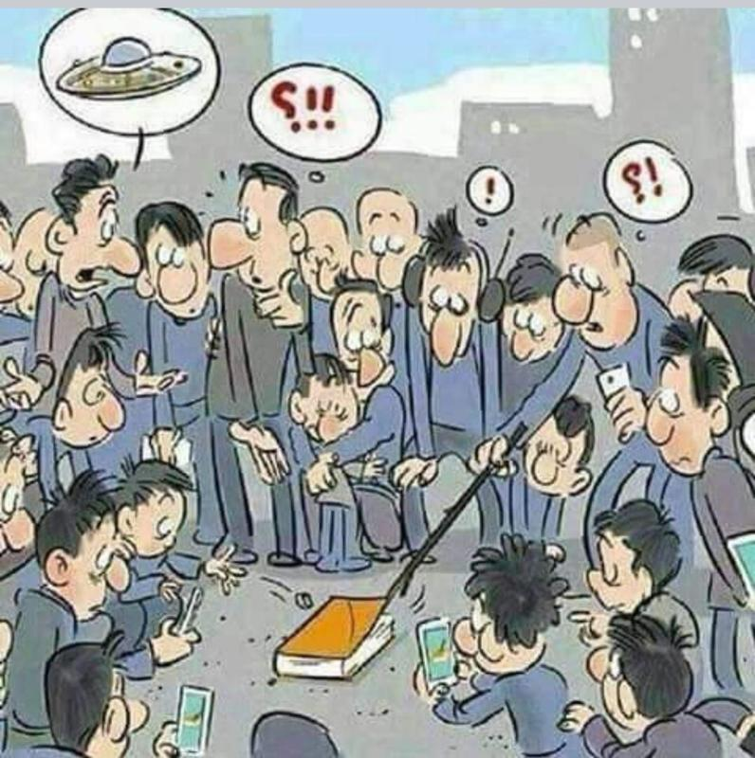
The NEW TESTAMENT BOOK OF ACTS
By David Lee Burris
Chaps 19 – 20 – 21– 22 -- 23

Slide 2
Empowerment OR Indwelling?

Slide 3
Baptism with the Holy Spirit
Empower
Indwelling – Power to become Christlike

Slide 4
Holy Spirit
Indwelling
The Spirit dwells within a Christian (Acts 2:38)
Empowering
The Spirit gives you power to perform miracles, heal, speak in tongues.

Slide 5
Indwelling → Baptism Empowering → Laying on of hands by the Apostles

Slide 6
Indwelling Holy Spirit → Gospel → Disciples Empowering Holy Spirirt → Apostles → Disciples

Slide 7
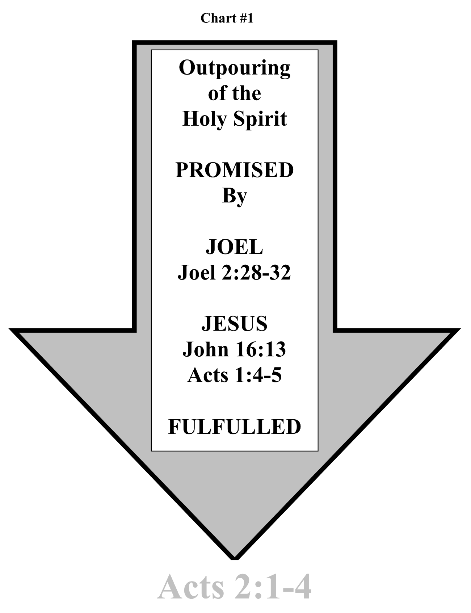

Slide 8
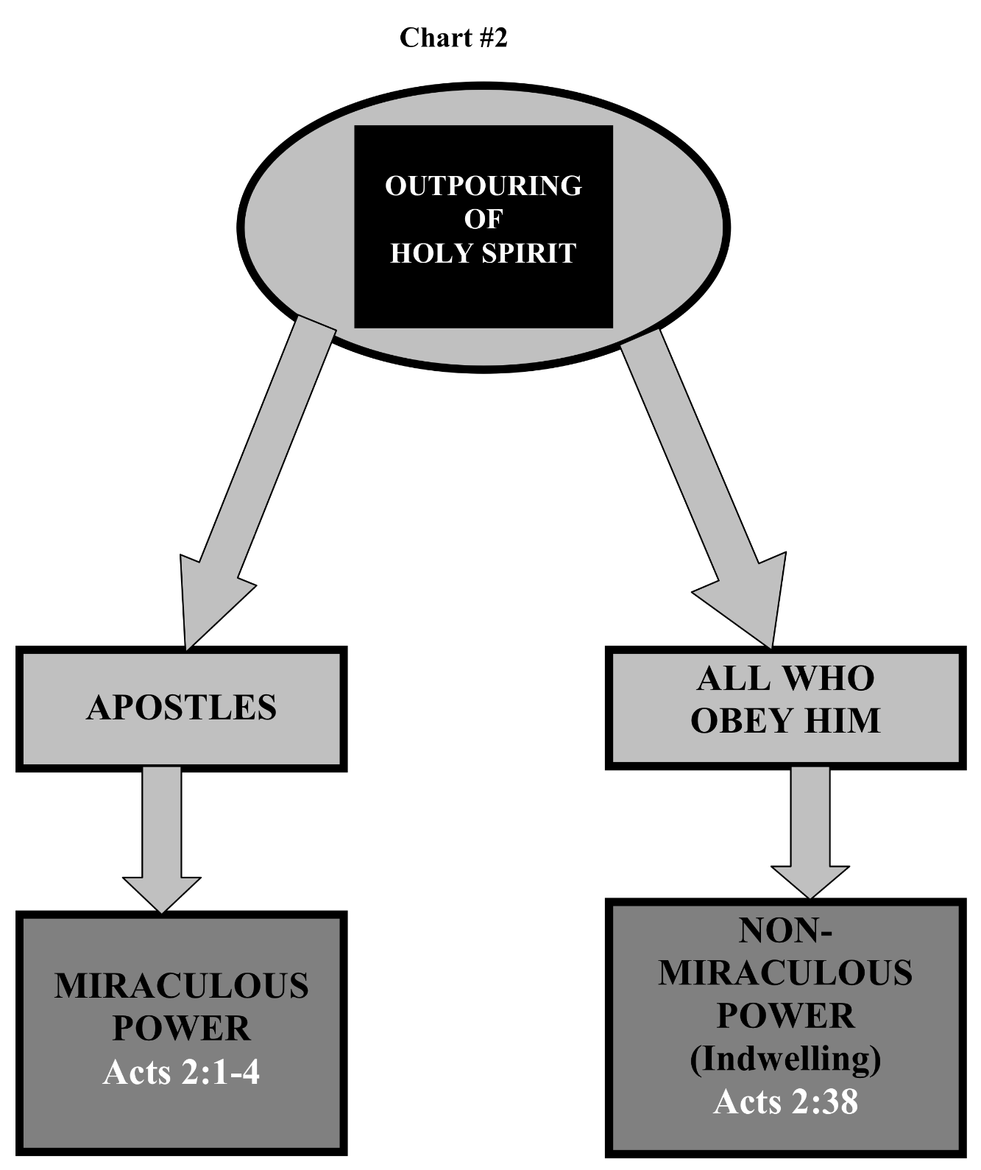

Slide 9
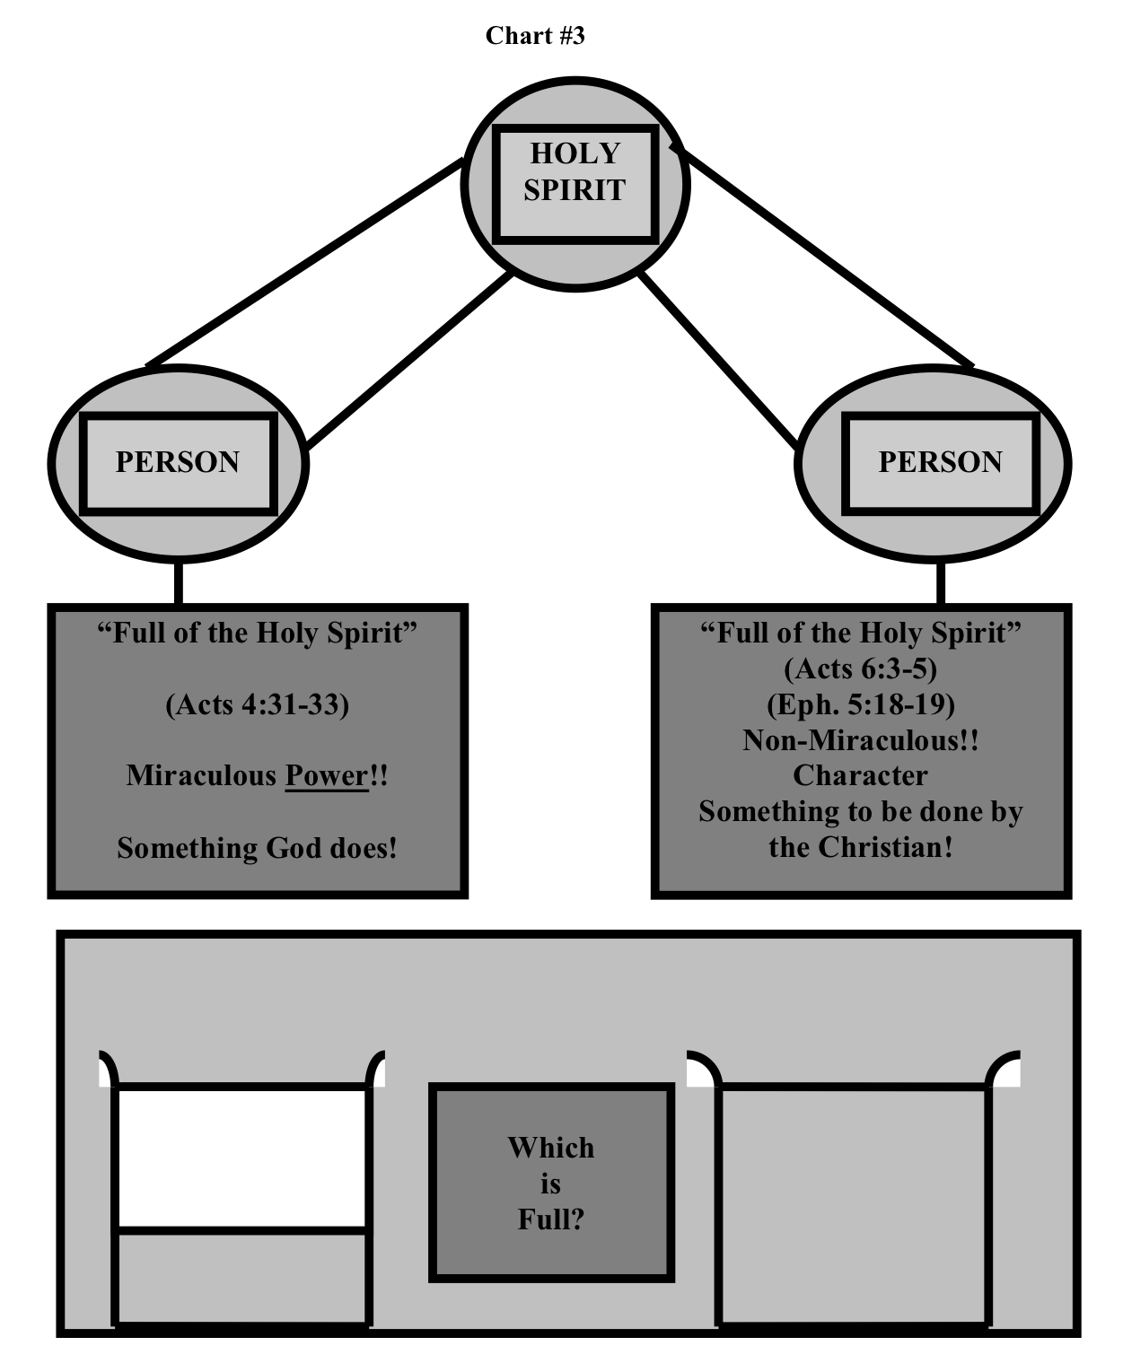

Slide 10
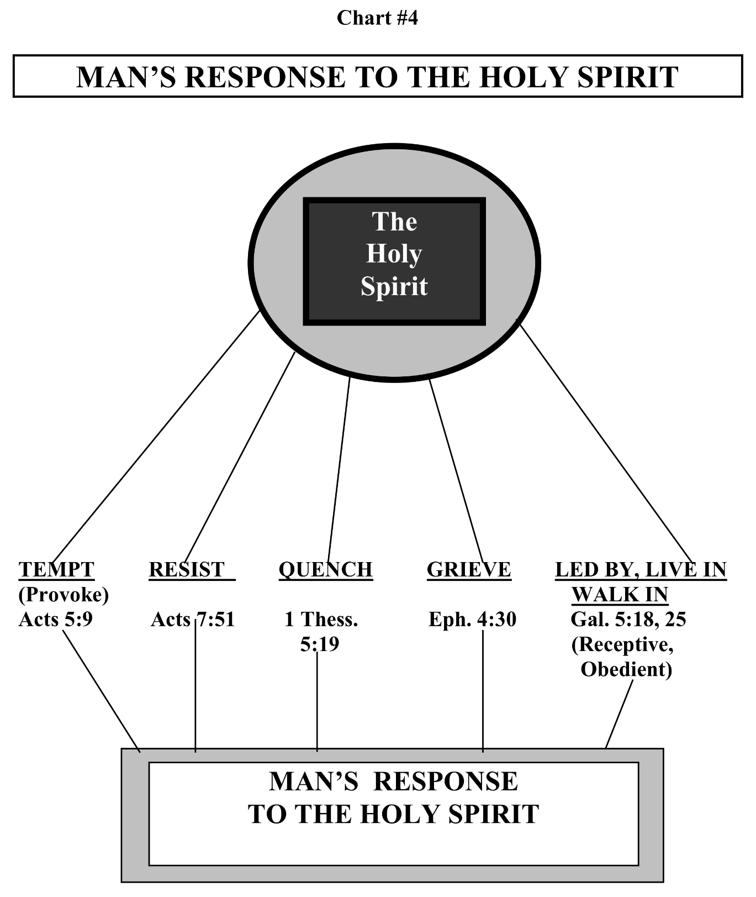

Slide 11
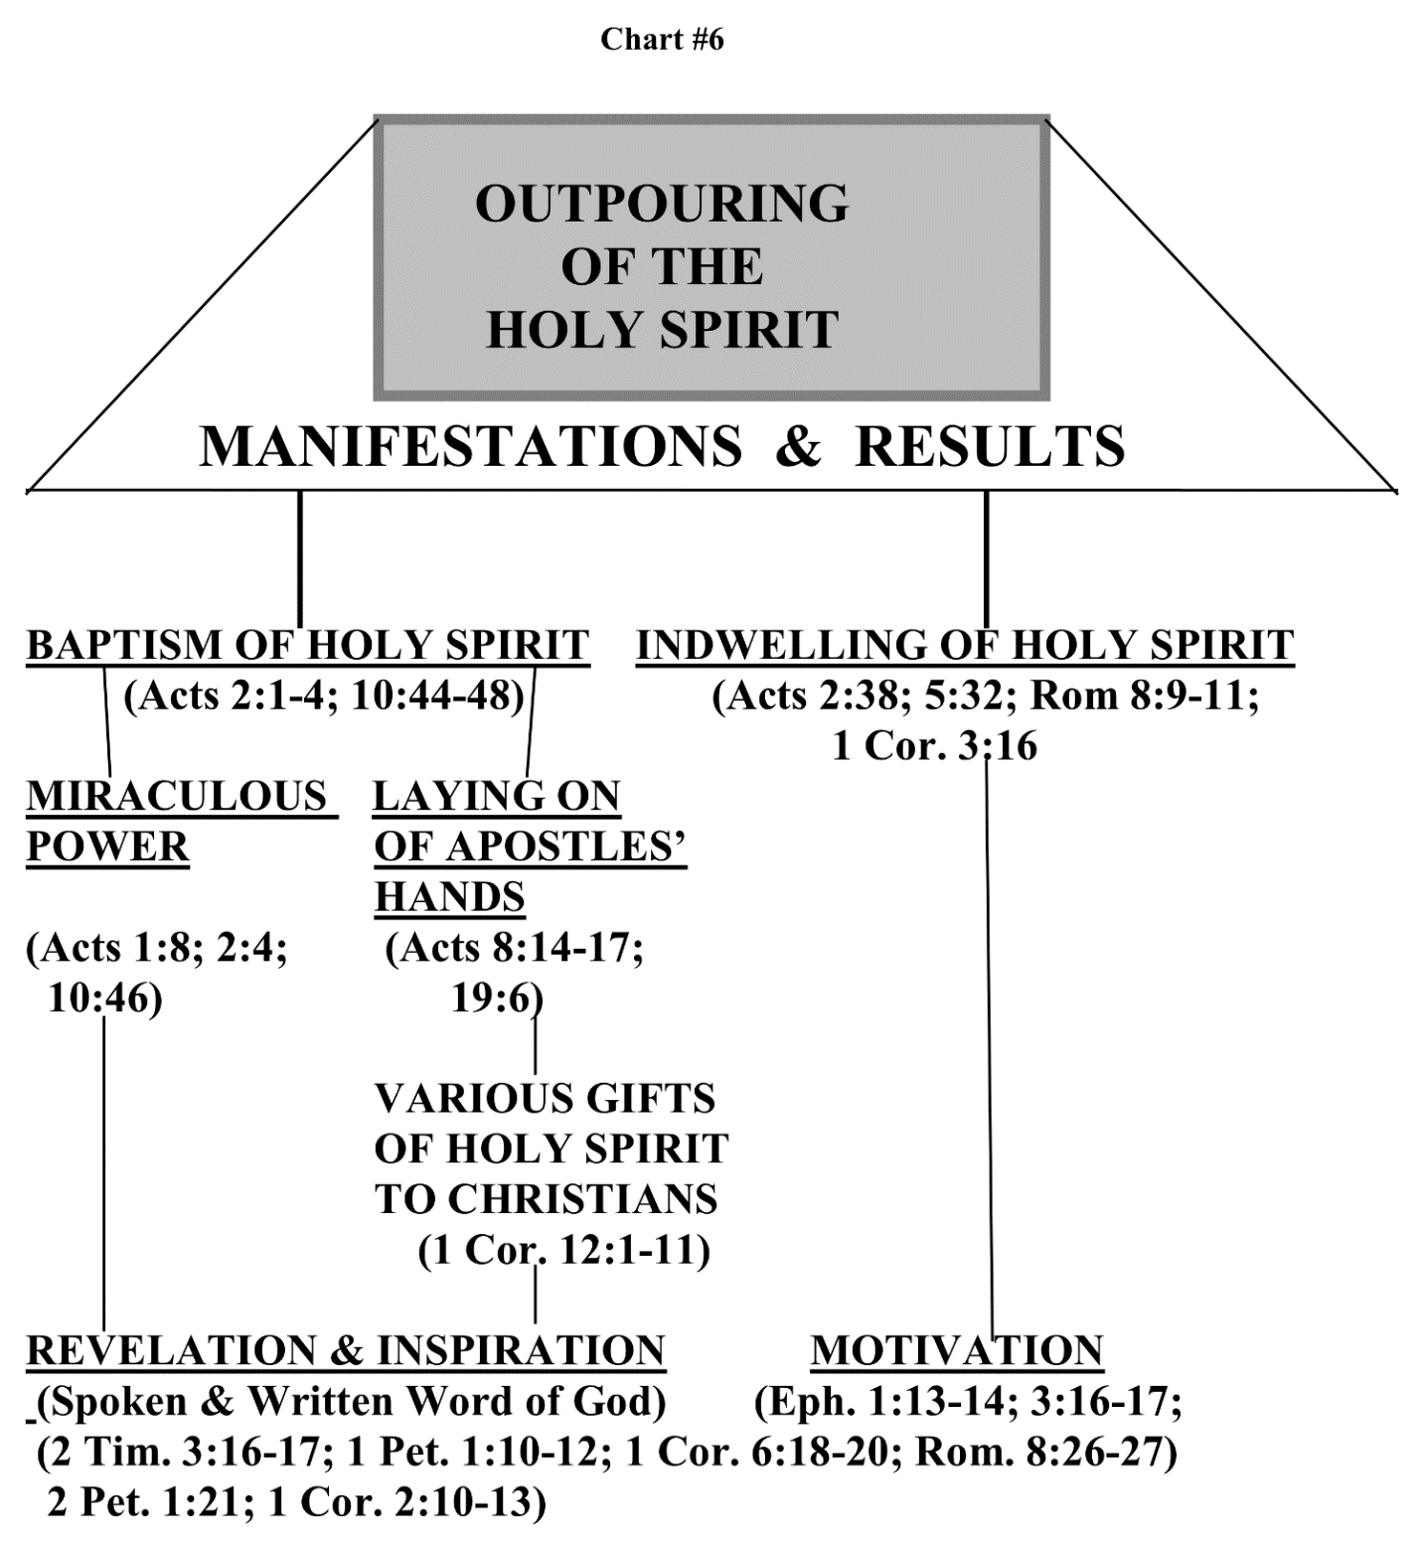

Slide 12
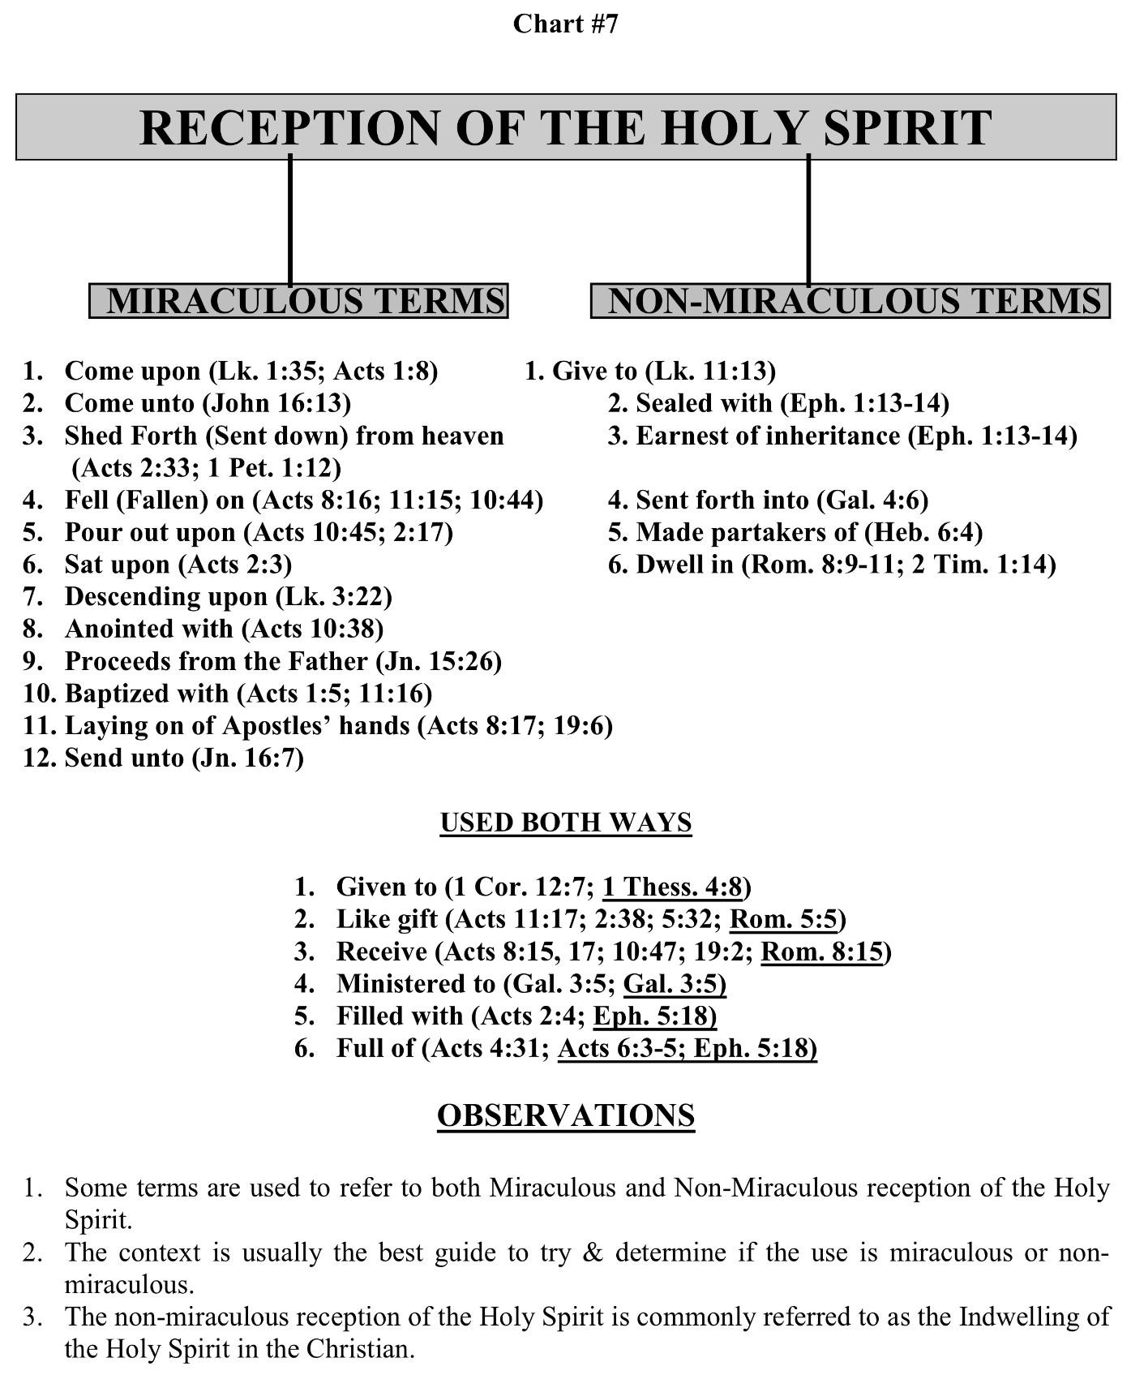

Slide 13
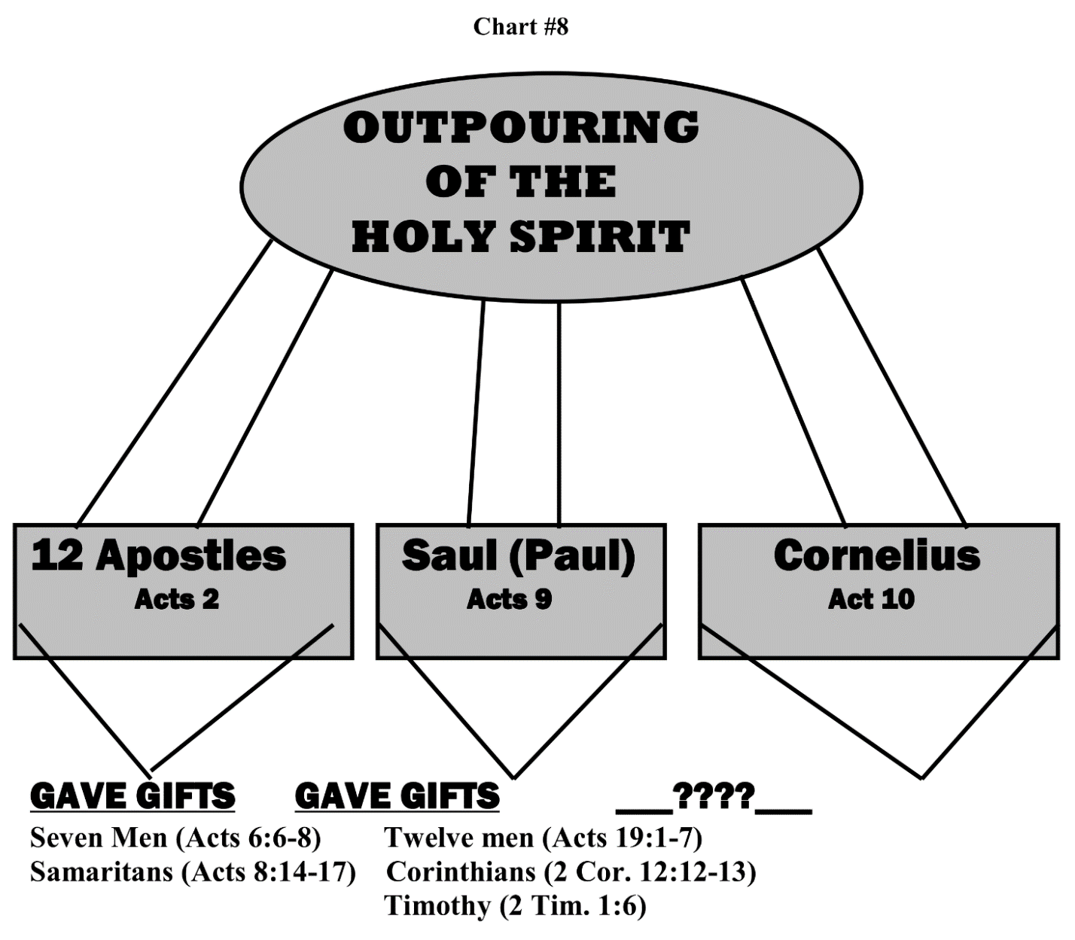

Slide 14
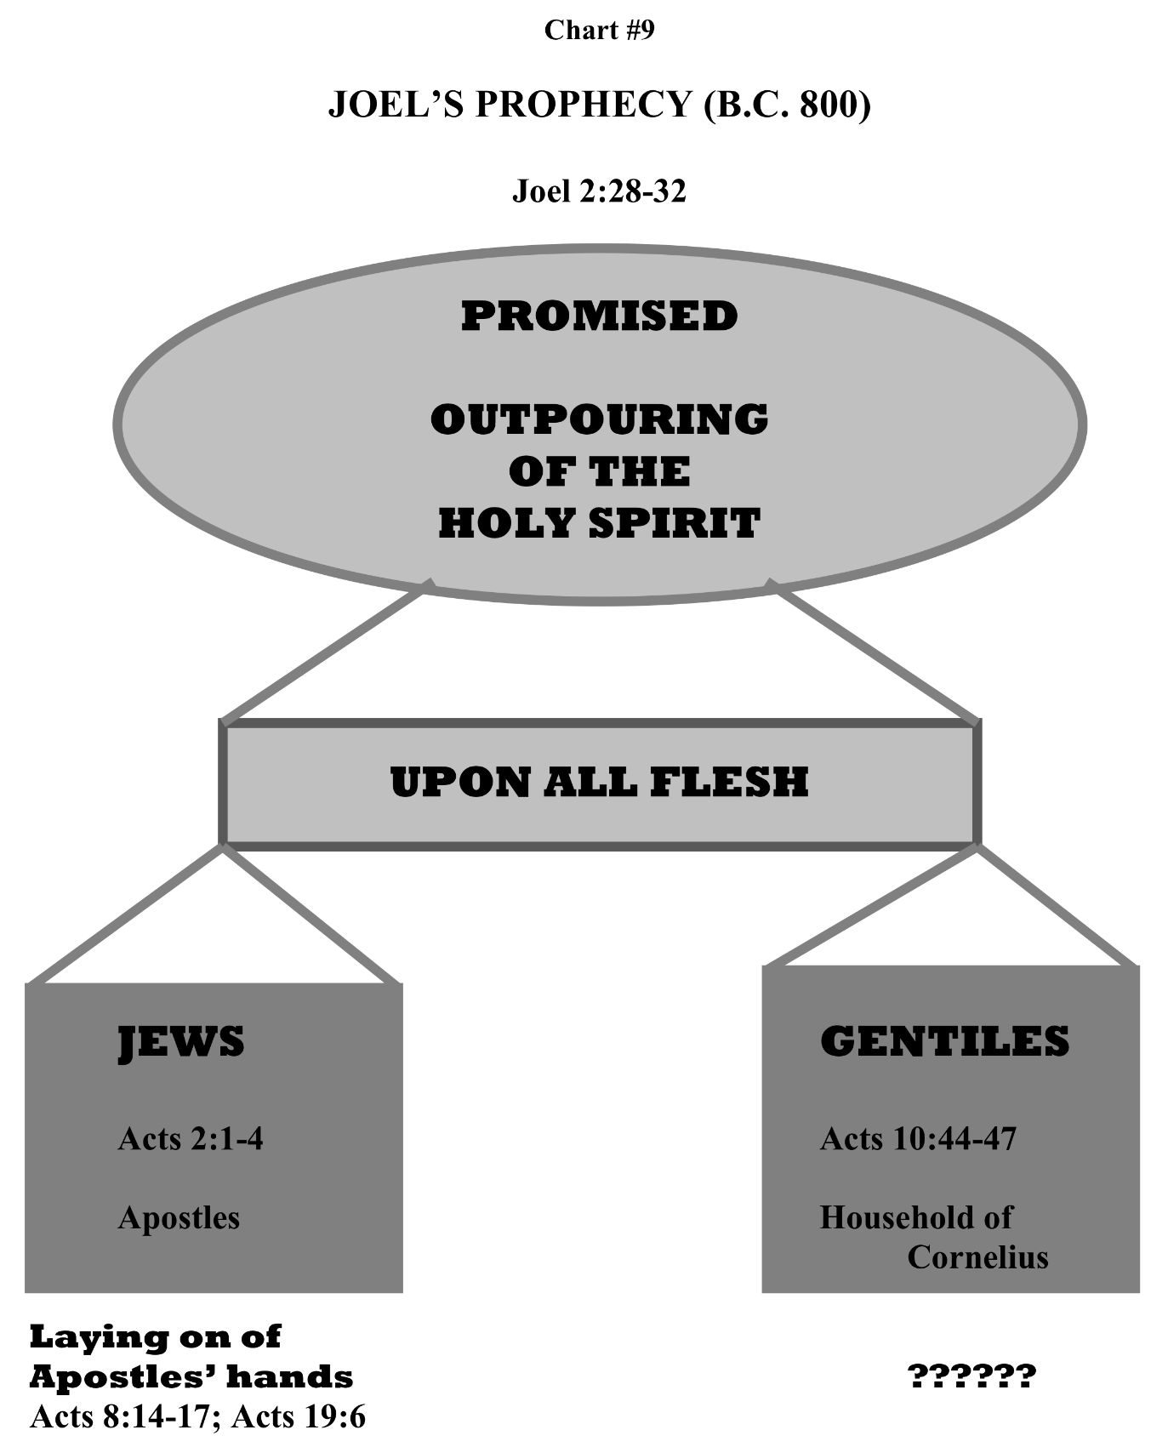

Slide 15
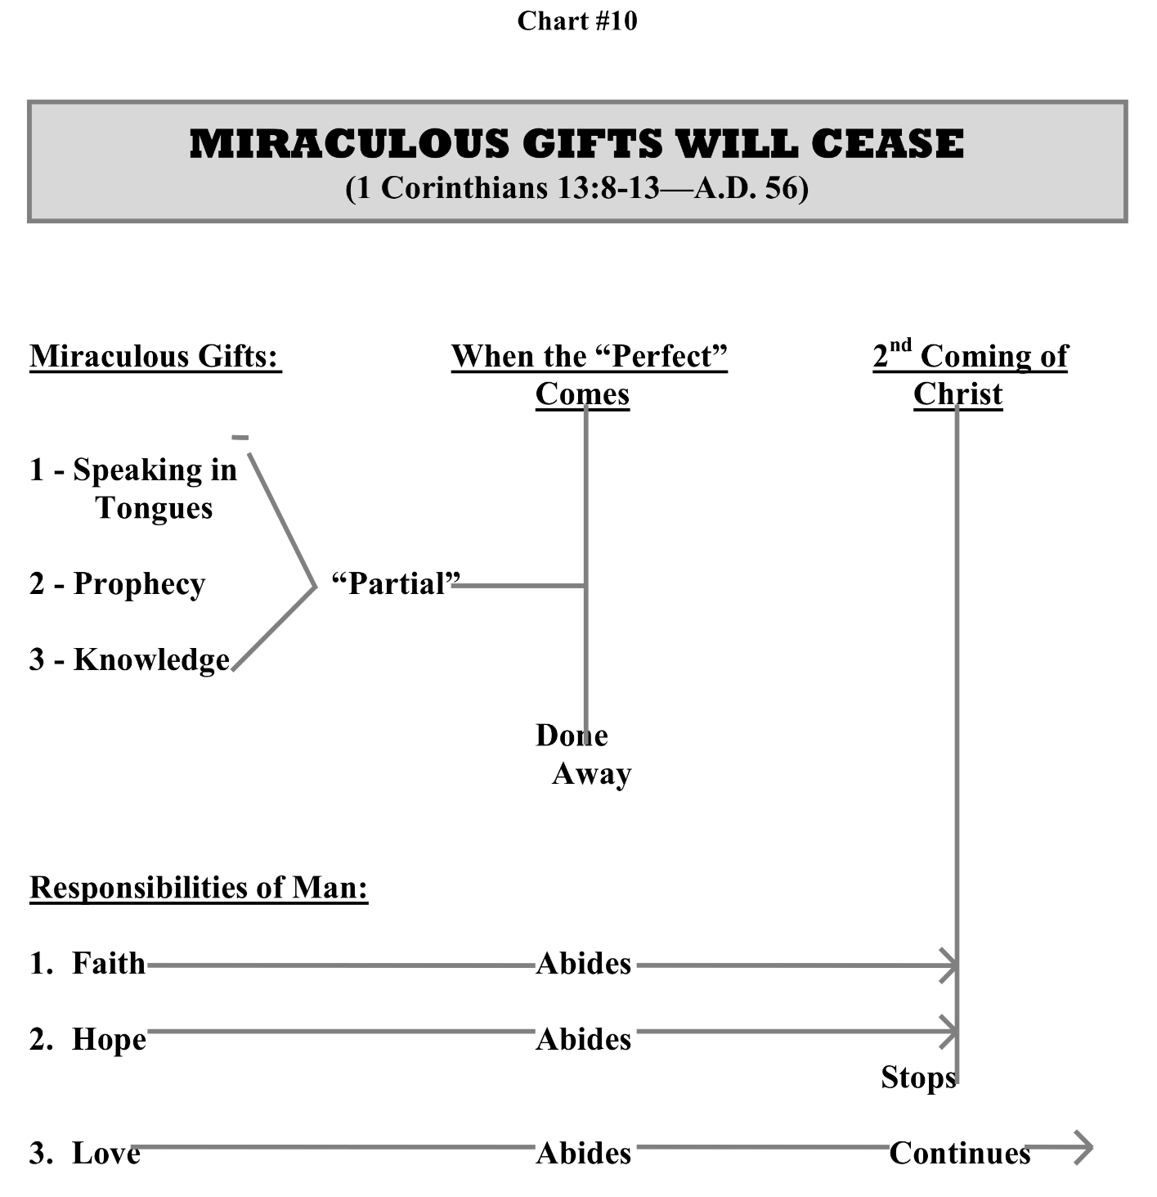

Slide 17
Jesus’ Baptism = Forgiveness + Holy Spirit Indwelling Apostle’s Laying on of Hands = Holy Spirit Empowering

Slide 20
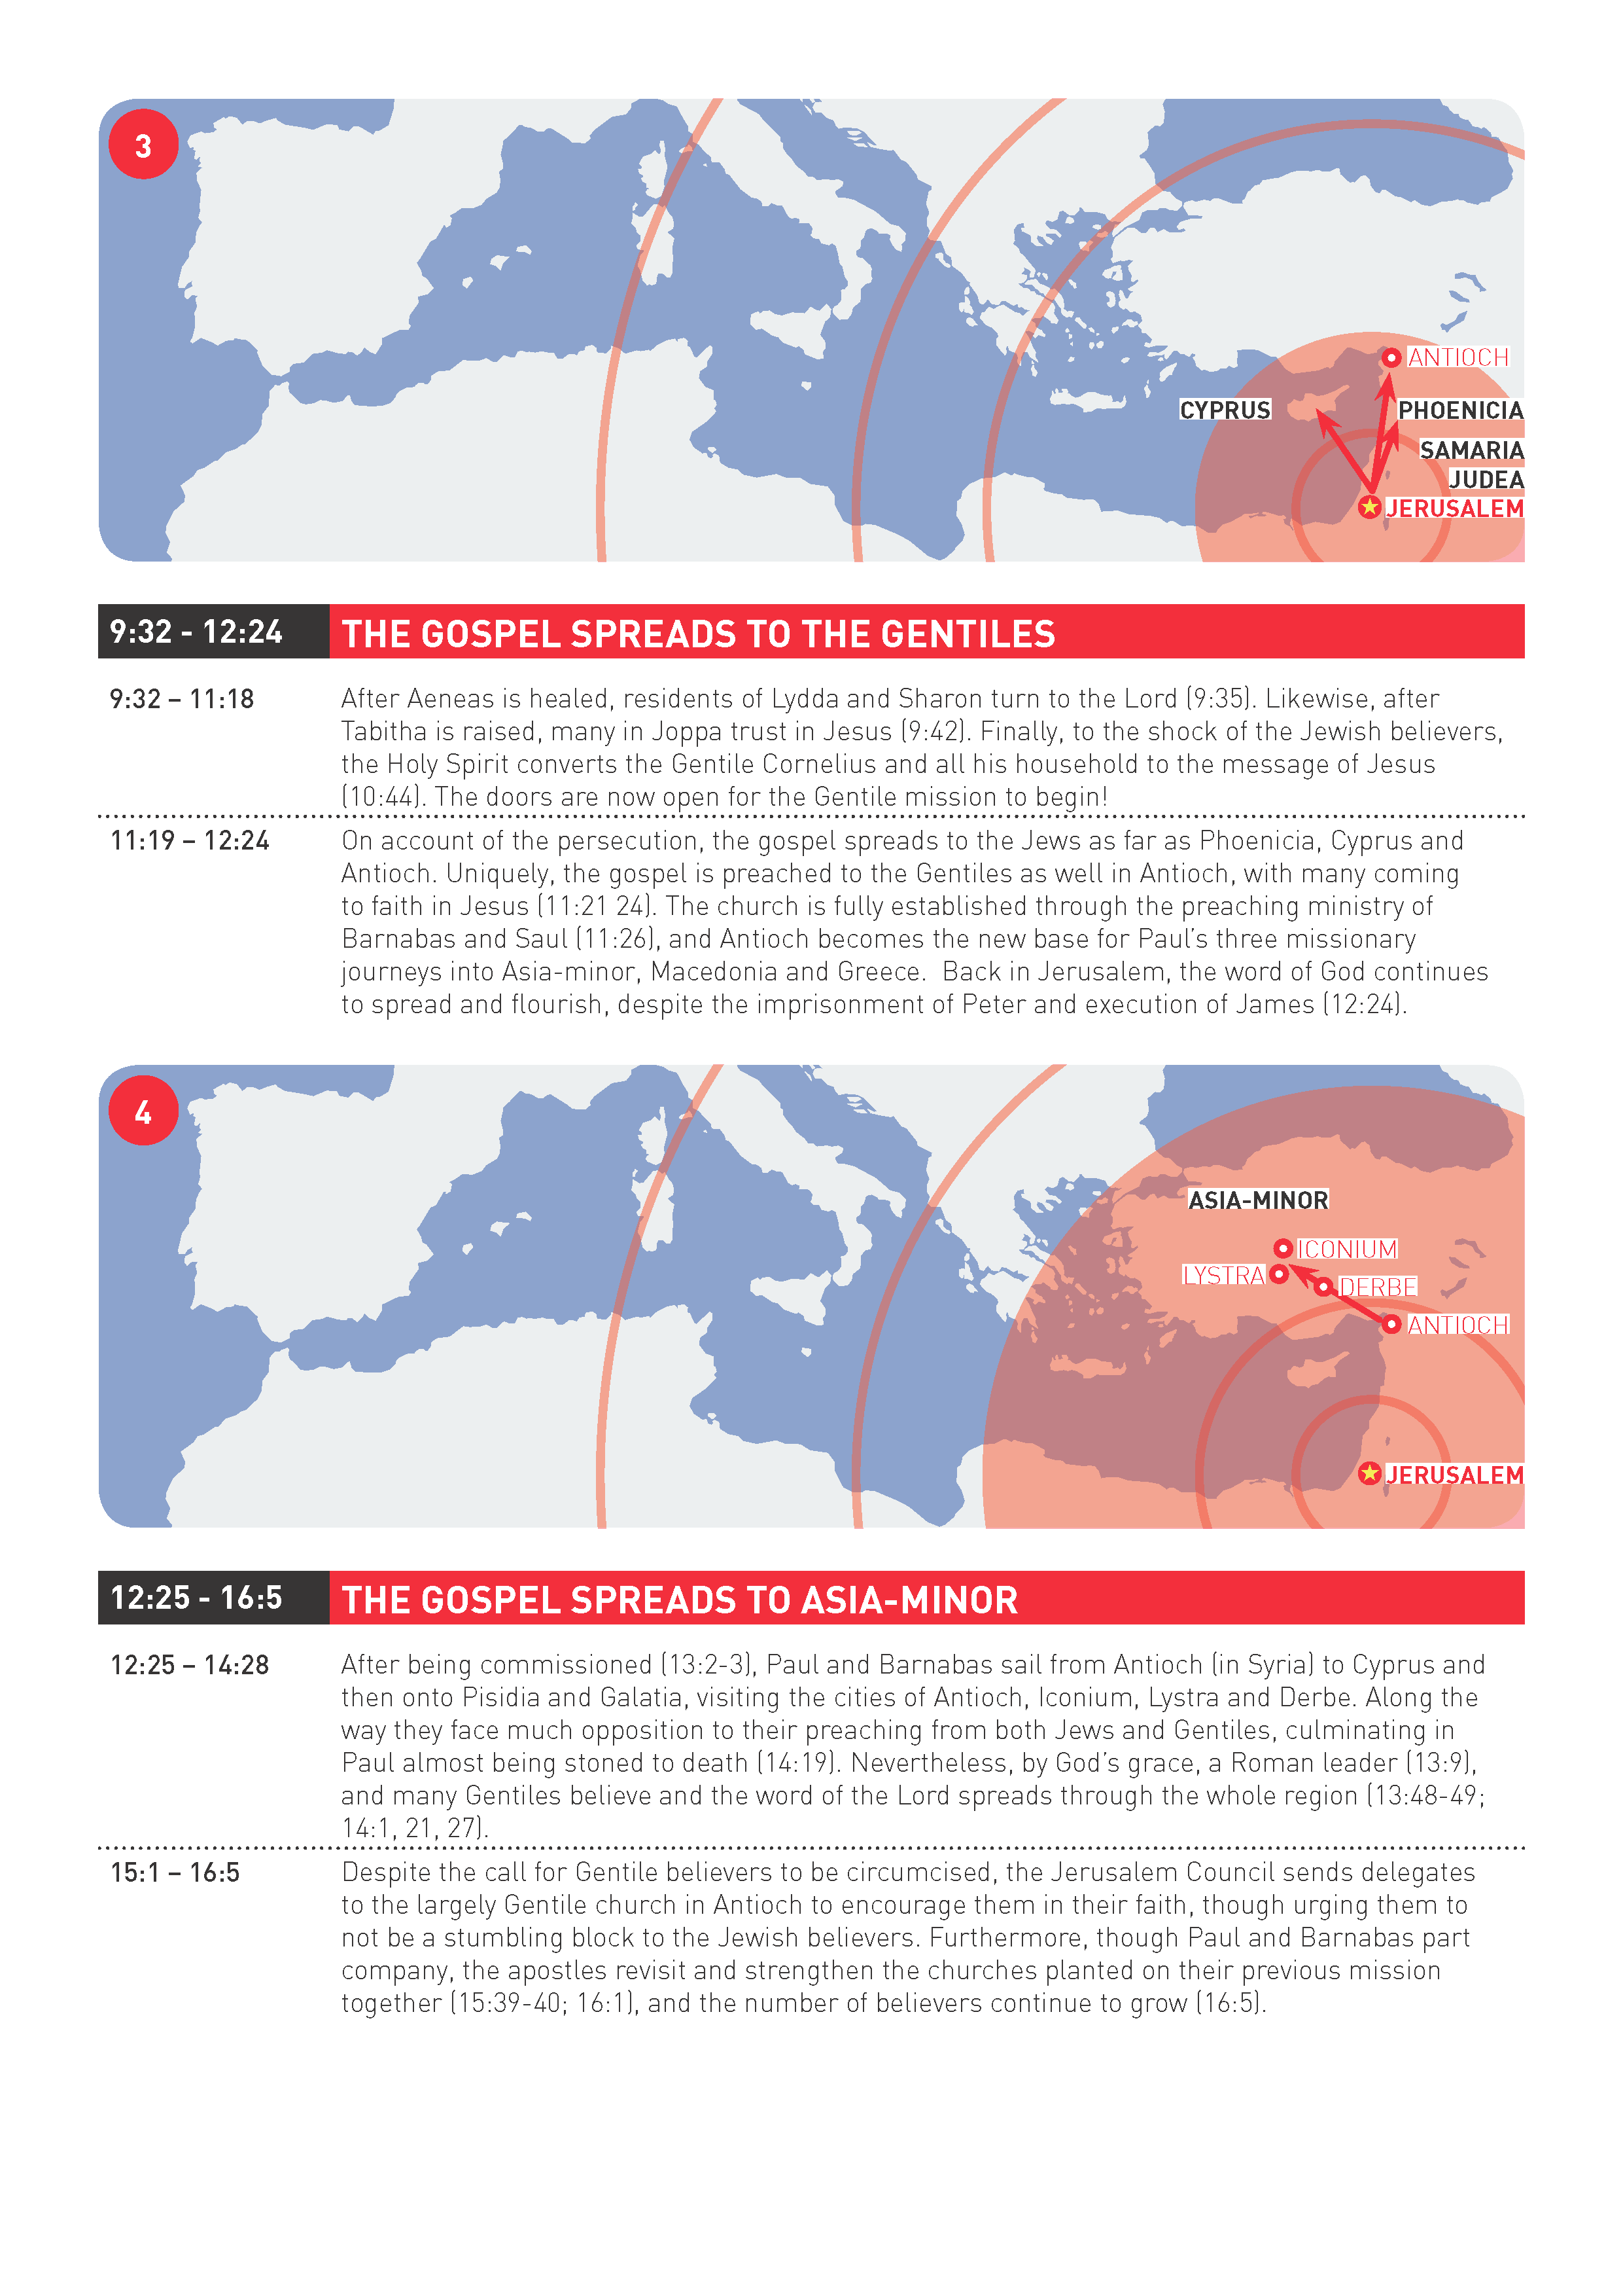

Slide 21
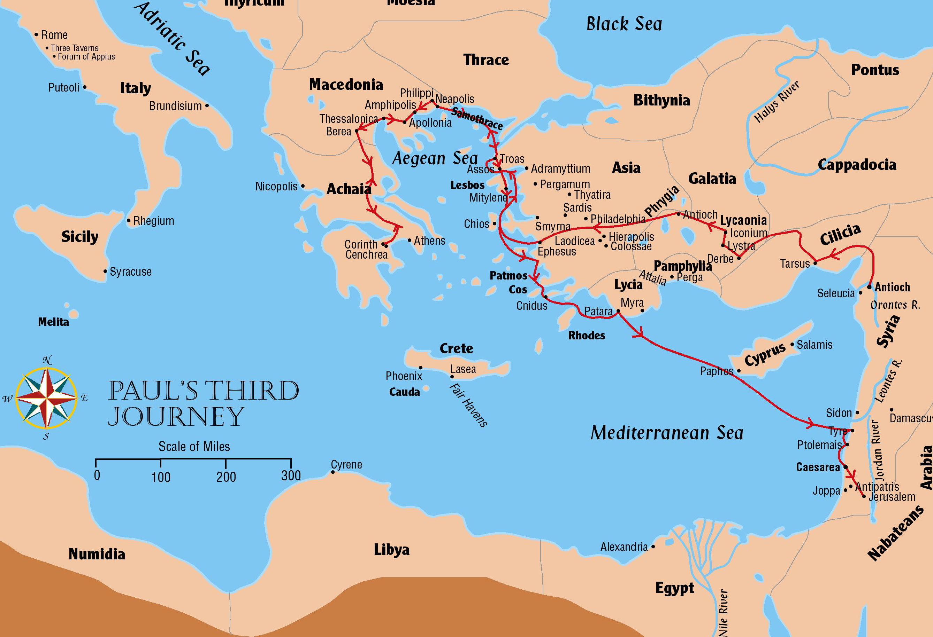
Paul’s Third Journey
Acts 18:23-21:16

Slide 22
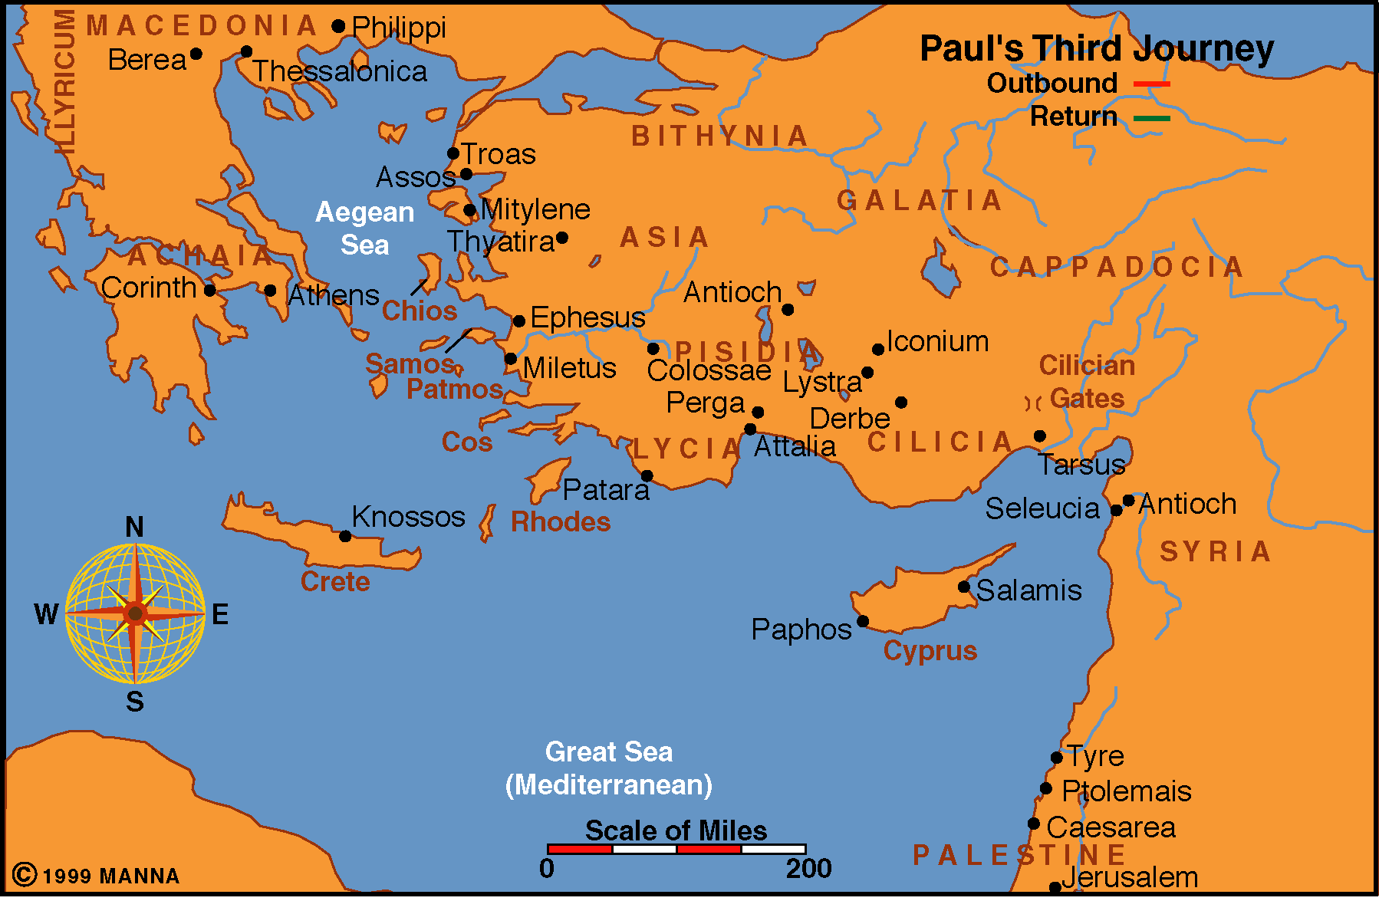
Acts 18:23-21:16
54-58 A.D.

Slide 23
Acts 18:23-21:16
Length: Approximately 4 Years
Years: 54-58 A.D.

Slide 24
Journey begins from Antioch in Syria
Paul does not have Barnabas or Silas with him
Travels through Galatia and Phrygia
Strengthens the disciples (18:22-23)

Slide 25
Ephesus
A Major city
One of the greatest cities of the eastern Mediterranean, along with Antioch of Syria and Alexandria of Egypt
Capital of the province of Asia
Major trade center
Religious cult grew up in Ephesus around a goddess named Artemis or Diana
Temple of Diana considered one of the wonders of the ancient world
One of the largest buildings in existence at that time
Cult brought much trade to the city as tourists made their trips to the temple
Demetrius and other silversmiths worried about their trade when Paul preached that Jehovah is the ONLY God

Slide 26
Travels to Ephesus
Apollos instructed in the Lord by Aquila and Priscilla
Apollos goes to Achaia
Paul later writes: “I planted, Apollos watered, but God gave the increase” (1 Cor 3:6)

Slide 27
Paul at Ephesus
12 men were “re-baptized” (19:1-7)
Preached in the synagogue for three months (19:8)
Reasoned daily in school of Tyrannus (19:9)
Remained at Ephesus for 2-3 years
All in Asia heard the word of God (19:10)
Performed miracles (19:11-12)

Slide 28
Paul at Ephesus
Books of magic burned publicly (19:19)
Sends Timothy to Macedonia
Paul writes 1 Corinthians in 57 A.D.
Paul writes Galatians in 57 A.D.
Sends Titus to Corinth to inquire concerning the effect of 1 Corinthians and to begin a collection for the poor in Jerusalem (2 Cor 12:17-18; 7:13-15)

Slide 29
Paul at Ephesus
Demetrius the silversmith, maker of shrines of Diana, caused an uproar (19:23-41)
Mob shouts “Great is Diana of the Ephesians” for two hours! (19:34)
Paul later writes the Ephesian letter to the brethren at Ephesus

Slide 30
Paul travels north to Troas
Hoped to find Titus bringing him news from Corinth
Titus did not arrive at the expected time
Paul could not use the door of opportunity open about Corinth’s reception of the first letter because Titus had not yet brought news from Corinth
He then heads across into Macedonia

Slide 31
Paul goes to Macedonia
Finds Titus with good news about the first letter
Writes 2 Corinthians in 57 AD to solve other problems
Paul travels to Greece
Stays for three months (20:3)
Jews plotted against Paul – he departs (20:3)
Tells of his visit to Greece in 2 Cor and Romans

Slide 32
It’s Paul’s 3rd visit to Corinth – he writes:
Romans in 58 A.D.
Paul returns to Macedonia and to Philippi
Luke rejoins Paul in Philippi

Slide 33
Paul travels on to Troas
Remained there for 7 days (20:6)
Met with the disciples on the first day of the week (20:7)
Preached until midnight
Eutychus falls asleep and fell from the third loft and was killed. Paul performed a miracle and brought him back to life (20:7-12)

Slide 34
Paul travels to Miletus
Calls for the elders of Ephesus to meet with him (20:17-38; Rom 15:30-32)
Miletus approximately 28 miles south of Ephesus by land
Four years have passed since Paul established the work at Ephesus
Admonishes them to teach the church properly; warns against false teachers (20:28-29)

Slide 35
Paul heads to Jerusalem
This concludes his 3rd missionary journey

Slide 36
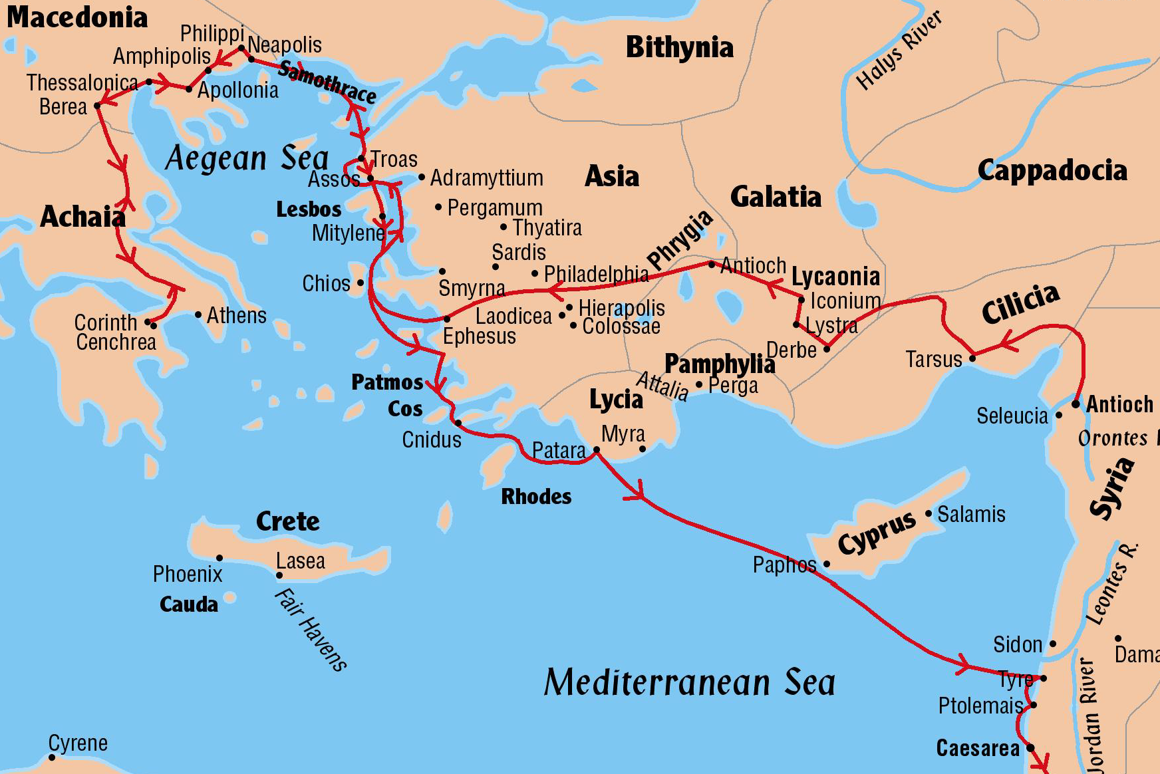
Key Cities and Areas
Antioch of Syria
Galatia
Phrygia
Ephesus
Troas
Macedonia
Corinth
Philippi
Miletus
Caesarea

Slide 37
Trouble in Jerusalem

Slide 38
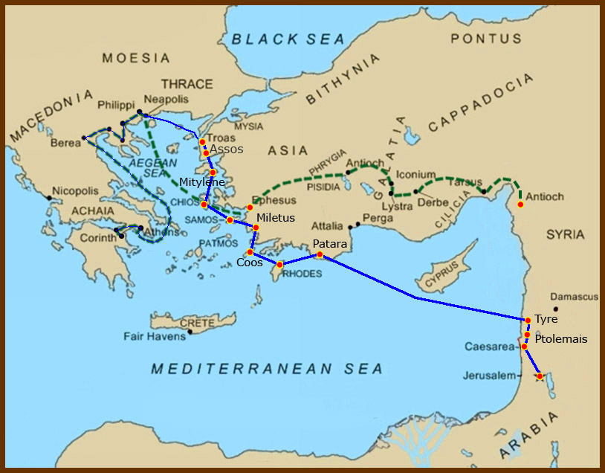
Acts 21:
¹⁵ And after those days we took up our carriages, and went up to Jerusalem.

Slide 39
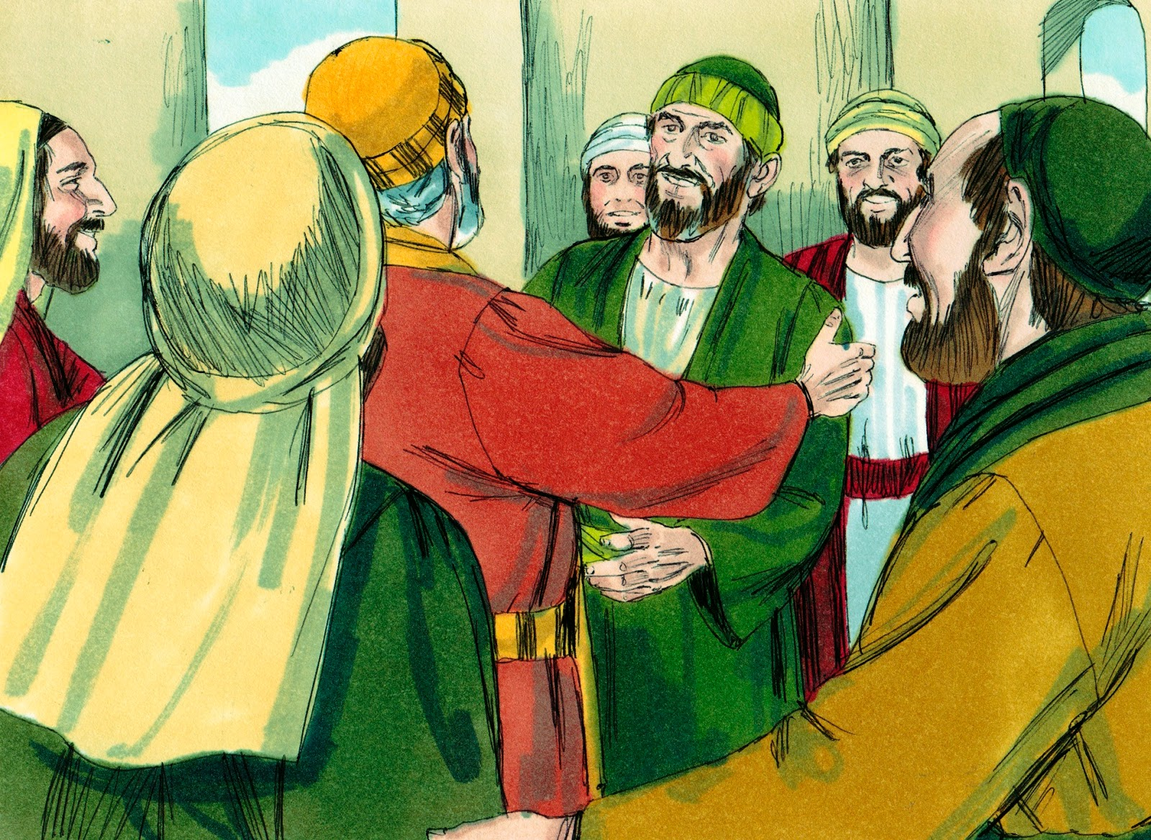
¹⁶ There went with us also certain of the disciples of Caesarea, and brought with them one Mnason of Cyprus, an old disciple, with whom we should lodge.
¹⁷ And when we were come to Jerusalem, the brethren received us gladly.

Slide 40
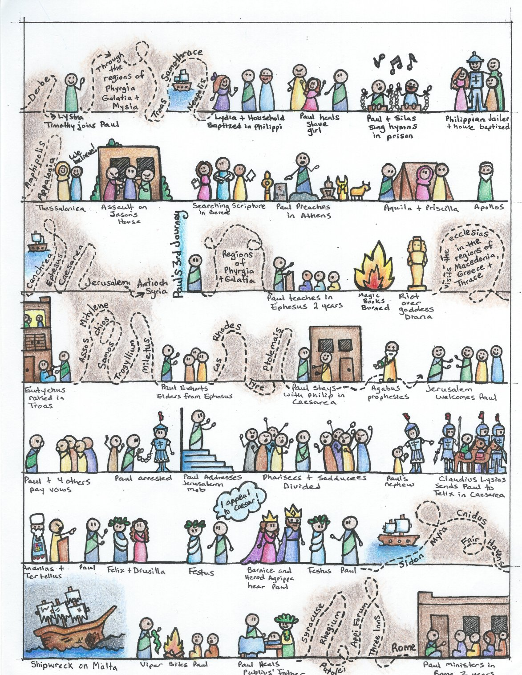

Slide 41
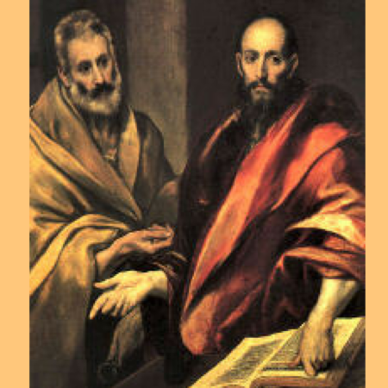
¹⁸ And the day following Paul went in with us unto James; and all the elders were present.
Although he surely attended this meeting, Peter is not mentioned by name in the book of Acts after the council at Jerusalem in chapter 15. Even then it was James, the half-brother of Jesus, who was the chief speaker.

Slide 42
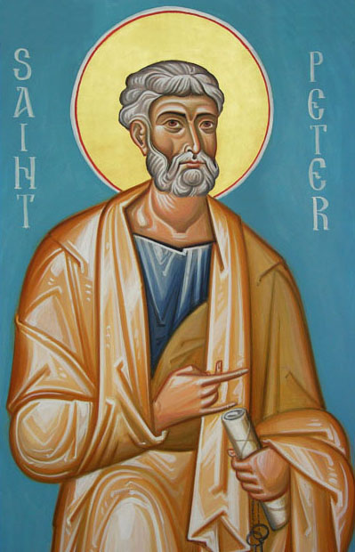
Paul speaks of Peter in his letter to the Galatians but not in an entirely favorable light. This incident took place after the Council at Jerusalem but before Barnabas and Paul split up:
Galatians 2:
¹¹ But when Peter was come to Antioch, I withstood him to the face, because he was to be blamed.
¹² For before that certain came from James, he did eat with the Gentiles: but when they were come, he withdrew and separated himself, fearing them which were of the circumcision.
¹³ And the other Jews dissembled likewise with him; insomuch that Barnabas also was carried away with their dissimulation [hypocrisy].
¹⁴ But when I saw that they walked not uprightly according to the truth of the gospel, I said unto Peter before them all, If thou, being a Jew, livest after the manner of Gentiles, and not as do the Jews, why compellest thou the Gentiles to live as do the Jews?
The Apostle Paul Obviously Did Not Regard The Apostle Peter As The “Chief Apostle”

Slide 43
Peter’s praise for Paul in his own epistle shows that there was no bad feelings between them.
2 Peter 3:
¹⁴ Wherefore, beloved, seeing that ye look for such things, be diligent that ye may be found of him in peace, without spot, and blameless.
¹⁵ And account that the longsuffering of our Lord is salvation; even as our beloved brother Paul also according to the wisdom given unto him hath written unto you;
The Apostle Paul Obviously Did Not Regard The Apostle Peter As The “Chief Apostle”

Slide 44
Was Peter the First Pope?
David Lee Burris:
Oldest Continuously Functioning Institution In World Still Can’t Trace Origins To Apostles!
This tradition that the Apostle Peter held the papal office from A.D. 42 to A.D. 67 started early in the third century.
26 church congregants are noted by their names in the first fifteen verses of Paul’s Letter to the Romans in chapter 16. Peter is not even casually mentioned although this point of time overlaps with that of his supposed service term there.
Acts 12 – Peter was held this period in prison in Jerusalem.
“But it is said on all sides , Was not St. Peter at Rome? Was he not crucified with his head down? Are not the pulpits in which he taught, the altars at which he said the mass, in this eternal city? St. Peter having been in Rome, my venerable brethren, rest only on tradition… Scaliger, one of the most learned of men, has not hesitated to say St. Peter’s episcopate and residence at Rome ought to be classed with ridiculous legends.” 1870 Vatican Council; Bishop Strossmayer

Slide 45
Back to Acts 21 –
¹⁸ And the day following Paul went in with us unto James; and all the elders were present.
¹⁹ And when he had saluted them, he declared particularly what things God had wrought among the Gentiles by his ministry.

Slide 46
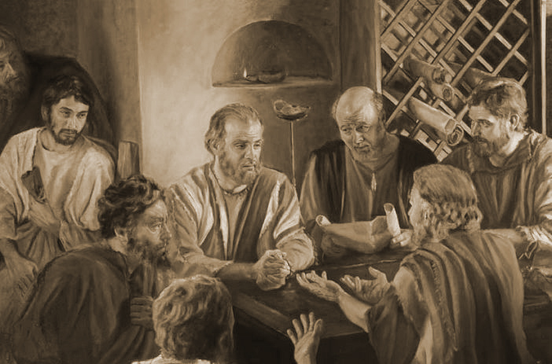
²⁰ And when they heard it, they glorified the Lord, and said unto him, Thou seest, brother, how many thousands of Jews there are which believe; and they are all zealous of the law:
²¹ And they were informed of thee, that thou teachest all the Jews which are among the Gentiles to forsake Moses, saying that they ought not to circumcise their children, neither to walk after the customs.

Slide 47
²² What is it therefore? the assembly must needs come together: for they will hear that thou art come.
²³ Do therefore this that we say to thee:

Slide 48
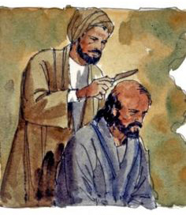
We have four men which have a vow on them;
²⁴ Them take, and purify thyself with them, and be at charges with them, that they may shave their heads:
and all may know that those things, whereof they were informed concerning thee, are nothing; but that thou thyself also walkest orderly, and keepest the law.

Slide 49
We have four men which have a vow on them;
²⁴ Them take, and purify thyself with them, and be at charges with them, that they may shave their heads:
and all may know that those things, whereof they were informed concerning thee, are nothing; but that thou thyself also walkest orderly, and keepest the law.
The elders advised Paul to join himself to four men who were also undergoing the Nazarite ritual of purification – something Paul had begun in Cenchrea when he shaved his head.
The word “Nazarite” comes from the Hebrew word nazir meaning consecrated or separated.
This is different from a Nazarene – someone from the city of Nazareth. Jesus of Nazareth was not a Nazarite.

Slide 50
We have four men which have a vow on them;
²⁴ Them take, and purify thyself with them, and be at charges with them, that they may shave their heads:
and all may know that those things, whereof they were informed concerning thee, are nothing; but that thou thyself also walkest orderly, and keepest the law.
The elders also advised Paul to cover the expense of the offerings that were required with the Nazarite vow.
These offerings are listed in Numbers 6:13-15:
a year-old ram for a burnt-offering
a year-old sheep for a sin-offering,
a ram for a thank-offering,
a basket of unleavened cakes,
a libation of wine (the pouring out of a drink as an offering).

Slide 51
We have four men which have a vow on them;
²⁴ Them take, and purify thyself with them, and be at charges with them, that they may shave their heads:
and all may know that those things, whereof they were informed concerning thee, are nothing; but that thou thyself also walkest orderly, and keepest the law.
Why did Paul agree to this ritual?
1 Corinthians 9:20
And unto the Jews I became as a Jew, that I might gain the Jews; to them that are under the law, as under the law, that I might gain them that are under the law;

Slide 52
The elders continued:
²⁵ As touching the Gentiles which believe, we have written and concluded that they observe no such thing, save only that they keep themselves from things offered to idols, and from blood, and from strangled, and from fornication.
They made it clear that they were not going to impose Jewish law on the Gentile believers.

Slide 53
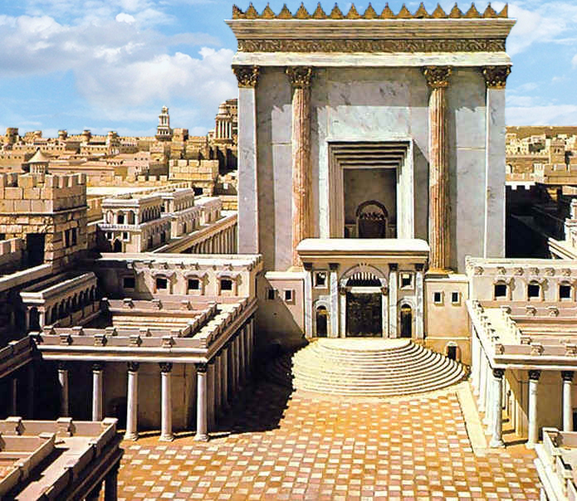
²⁶ Then Paul took the men, and the next day purifying himself with them entered into the temple, to signify the accomplishment of the days of purification, until that an offering should be offered for every one of them.

Slide 54
²⁷ And when the seven days were almost ended, the Jews which were of Asia, when they saw him in the temple, stirred up all the people, and laid hands on him,
²⁸ Crying out, Men of Israel, help: This is the man, that teacheth all men every where against the people, and the law, and this place: and further brought Greeks also into the temple, and hath polluted this holy place.
²⁹ (For they had seen before with him in the city Trophimus an Ephesian, whom they supposed that Paul had brought into the temple.)

Slide 55
²⁷ And when the seven days were almost ended, the Jews which were of Asia, when they saw him in the temple, stirred up all the people, and laid hands on him,
²⁸ Crying out, Men of Israel, help: This is the man, that teacheth all men every where against the people, and the law, and this place: and further brought Greeks also into the temple, and hath polluted this holy place.
²⁹ (For they had seen before with him in the city Trophimus an Ephesian, whom they supposed that Paul had brought into the temple.)
These Judaizers (Christians who expect their fellows to follow the law of Moses) made three accusations against Paul:
That he taught the people to forsake their heritage.
That he taught them to forsake the law of Moses.
That he defiled the temple by bringing in Gentiles with him.

Slide 56
²⁷ And when the seven days were almost ended, the Jews which were of Asia, when they saw him in the temple, stirred up all the people, and laid hands on him,
²⁸ Crying out, Men of Israel, help: This is the man, that teacheth all men every where against the people, and the law, and this place: and further brought Greeks also into the temple, and hath polluted this holy place.
²⁹ (For they had seen before with him in the city Trophimus an Ephesian, whom they supposed that Paul had brought into the temple.)
These Judaizers (Christians who expect their fellows to follow the law of Moses) made three accusations against Paul:
That he taught the people to forsake their heritage.
That he taught them to forsake the law of Moses.
That he defiled the temple by bringing in Gentiles with him.

Slide 57
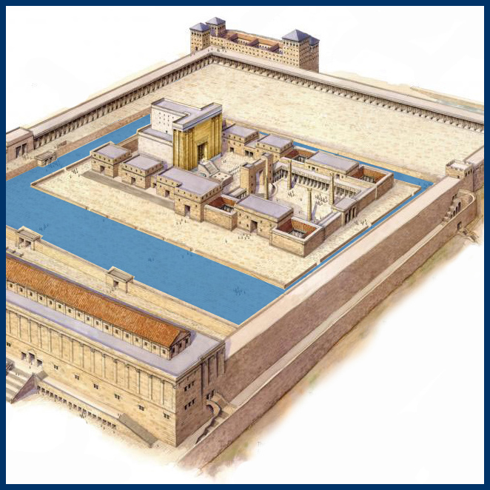
Remember that no Gentile was allowed beyond the “middle wall of partition” that separated the Court of the Gentiles from the inner court.
This notice was posted in plain view:
“No alien is to enter within the railing and enclosure around the temple. Whosoever is caught will be responsible to himself for his death which will ensue.”
The uproar against Paul must have taken place within the temple itself.
The Court of the Gentiles

Slide 58
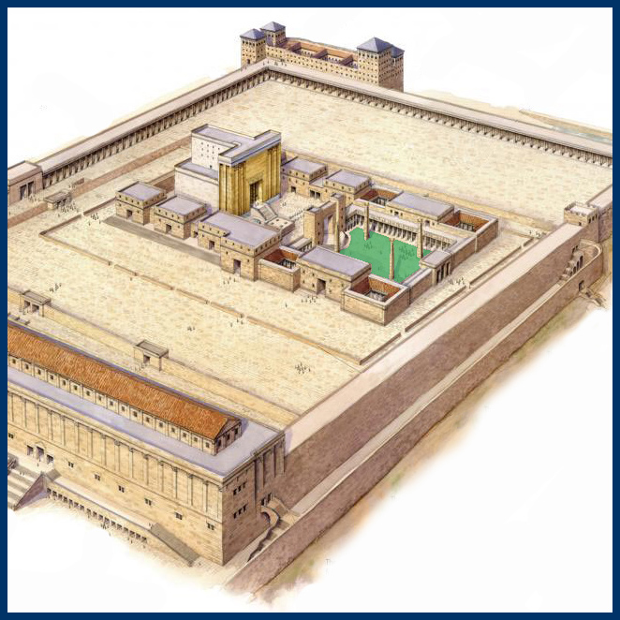
Remember that no Gentile was allowed beyond the “middle wall of partition” that separated the Court of the Gentiles from the inner court.
This notice was posted in plain view:
“No alien is to enter within the railing and enclosure around the temple. Whosoever is caught will be responsible to himself for his death which will ensue.”
The uproar against Paul must have taken place within the temple itself.
The Court of Women

Slide 59
³⁰ And all the city was moved, and the people ran together: and they took Paul, and drew him out of the temple: and forthwith the doors were shut.
The gate doors were shut by the temple guards because a death on the grounds would defile the temple. But no effort was made to rescue Paul from the crowd which was intent on beating him to death.
The Court of Women

Slide 60
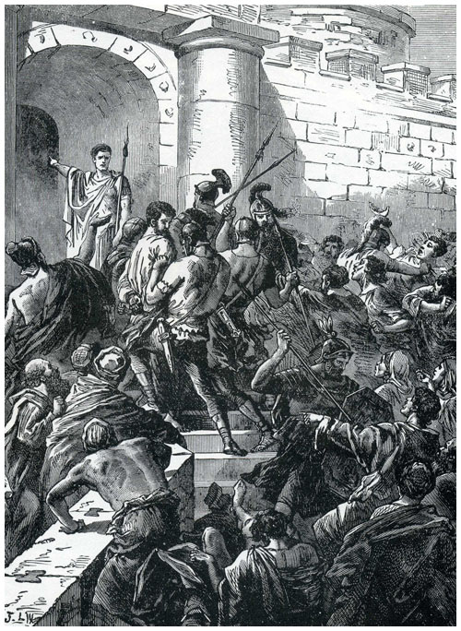
³¹ And as they went about to kill him, tidings came unto the chief captain of the band, that all Jerusalem was in an uproar.
³² Who immediately took soldiers and centurions, and ran down unto them: and when they saw the chief captain and the soldiers, they left beating of Paul.
³³ Then the chief captain came near, and took him, and commanded him to be bound with two chains; and demanded who he was, and what he had done.

Slide 61
³¹ And as they went about to kill him, tidings came unto the chief captain of the band, that all Jerusalem was in an uproar.
³² Who immediately took soldiers and centurions, and ran down unto them: and when they saw the chief captain and the soldiers, they left beating of Paul.
³³ Then the chief captain came near, and took him, and commanded him to be bound with two chains; and demanded who he was, and what he had done.
(Thus fulfilling the prophecy of Agabus.)

Slide 62
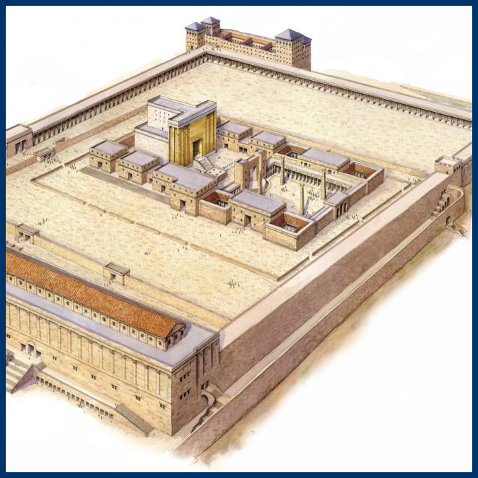
³⁴ And some cried one thing, some another, among the multitude:
and when he could not know the certainty for the tumult, he commanded him to be carried into the castle.
³⁵ And when he came upon the stairs, so it was, that he was borne of the soldiers for the violence of the people.
³⁶ For the multitude of the people followed after, crying, Away with him.
The Castle of Antonia was a military barracks named for Mark Antony.

Slide 63
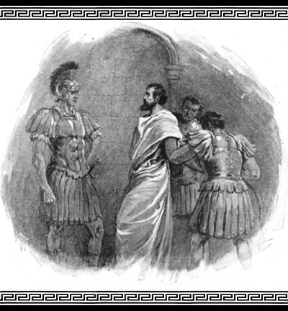
³⁷ And as Paul was to be led into the castle, he said unto the chief captain, May I speak unto thee?
Who said, Canst thou speak Greek?
³⁸ Art not thou that Egyptian, which before these days madest an uproar, and leddest out into the wilderness four thousand men that were murderers?

Slide 64
³⁹ But Paul said,
I am a man which am a Jew of Tarsus,
a city in Cilicia, a citizen of no mean [insignificant] city:
and, I beseech thee,
suffer me to speak unto the people.

Slide 65
L.D. CARY & SAM HOLT CATCH PHRASES
Chapter 19 – “10 + 9, Ephesus Time”
Chapter 20 – “Traveling A’Plenty”
Chapter 21 – “Confinement Begun”
Chapter 22 – “Before A Mob, Not A Few”
Chapter 23 – “Before The Council, You See”
Chapter 24 – “Felix Listens No More”
Chapter 25 – “Agrippa Arrives”
Chapter 26 – “Agrippa Realizes Paul’s Fix”
Chapter 27 – “Shipwreck & An Angel From Heaven”
Chapter 28 – “The End Of Our Wait”
“Before A Mob, Not A Few”
Catch Phrase
Chapter Twenty-Two

Slide 66
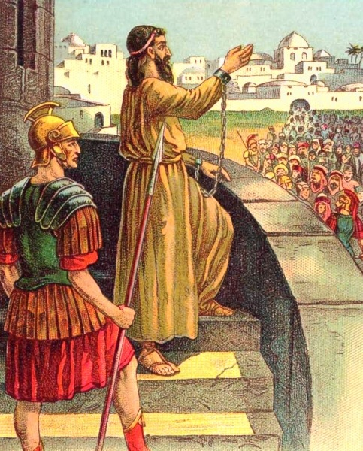
⁴⁰ And when he had given him licence, Paul stood on the stairs, and beckoned with the hand unto the people.
And when there was made a great silence, he spake unto them in the Hebrew tongue, saying,
Acts 22:
¹ Men, brethren, and fathers, hear ye my defence which I make now unto you.
² (And when they heard that he spake in the Hebrew tongue to them, they kept the more silence: and he saith,)

Slide 67
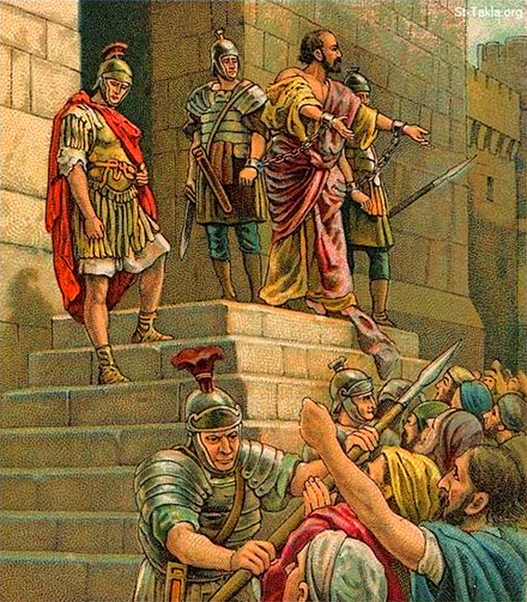
³ I am verily a man which am a Jew, born in Tarsus, a city in Cilicia, yet brought up in this city at the feet of Gamaliel, and taught according to the perfect manner of the law of the fathers, and was zealous toward God, as ye all are this day.

Slide 68
⁴ And I persecuted this way unto the death, binding and delivering into prisons both men and women.
⁵ As also the high priest doth bear me witness, and all the estate of the elders: from whom also I received letters unto the brethren, and went to Damascus, to bring them which were there bound unto Jerusalem, for to be punished.

Slide 69
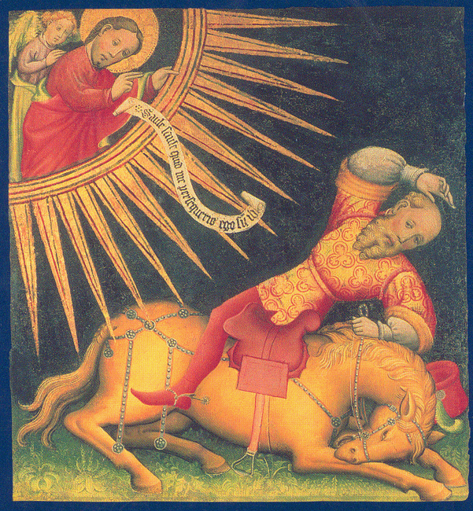
⁶ And it came to pass, that, as I made my journey, and was come nigh unto Damascus about noon, suddenly there shone from heaven a great light round about me.
⁷ And I fell unto the ground, and heard a voice saying unto me, Saul, Saul, why persecutest thou me?
⁸ And I answered, Who art thou, Lord?
And he said unto me, I am Jesus of Nazareth, whom thou persecutest.

Slide 70
⁹ And they that were with me saw indeed the light, and were afraid; but they heard not the voice of him that spake to me.
¹⁰ And I said, What shall I do, Lord?
And the Lord said unto me, Arise, and go into Damascus; and there it shall be told thee of all things which are appointed for thee to do.

Slide 71
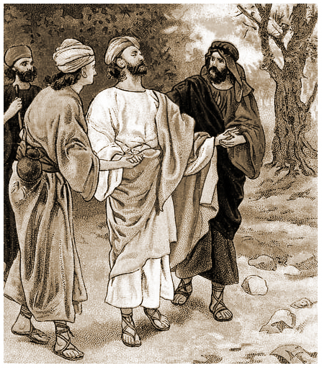
¹¹ And when I could not see for the glory of that light, being led by the hand of them that were with me, I came into Damascus.
¹² And one Ananias, a devout man according to the law, having a good report of all the Jews which dwelt there,
¹³ Came unto me, and stood, and said unto me, Brother Saul, receive thy sight. And the same hour I looked up upon him.

Slide 72
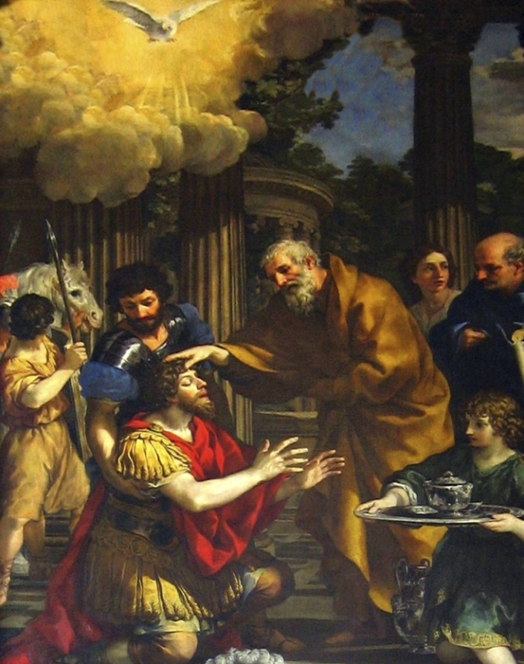
¹⁴ And he said, The God of our fathers hath chosen thee, that thou shouldest know his will, and see that Just One, and shouldest hear the voice of his mouth.
¹⁵ For thou shalt be his witness unto all men of what thou hast seen and heard.
¹⁶ And now why tarriest thou? arise, and be baptized, and wash away thy sins, calling on the name of the Lord.

Slide 73
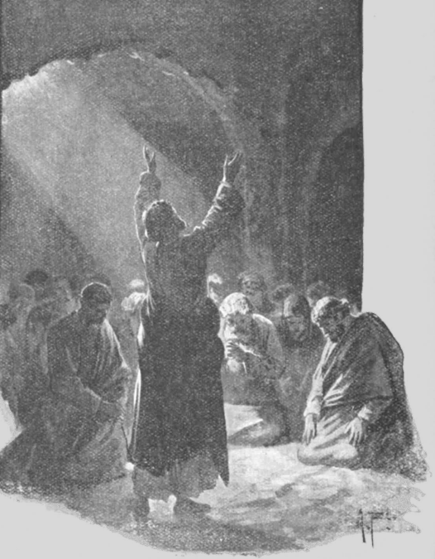
¹⁷ And it came to pass, that, when I was come again to Jerusalem, even while I prayed in the temple, I was in a trance;
¹⁸ And saw him saying unto me, Make haste, and get thee quickly out of Jerusalem: for they will not receive thy testimony concerning me.

Slide 74
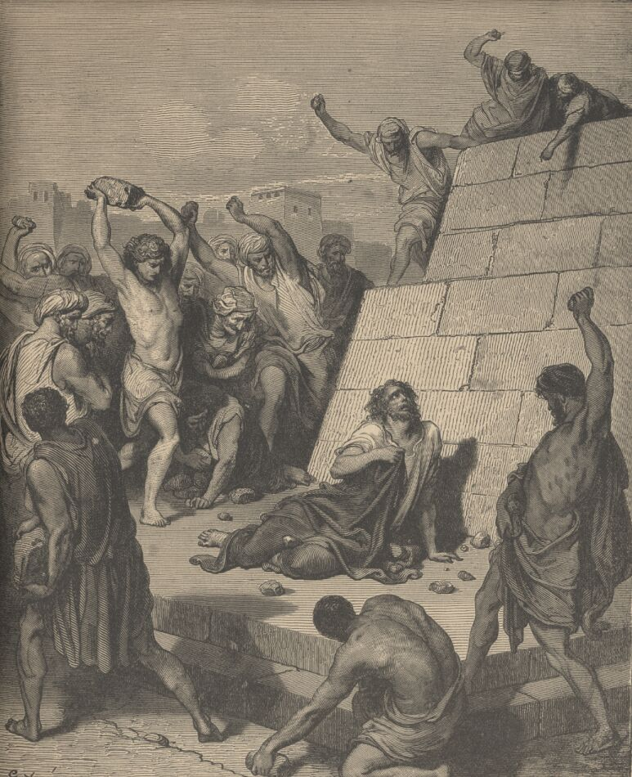
¹⁹ And I said, Lord, they know that I imprisoned and beat in every synagogue them that believed on thee:
²⁰ And when the blood of thy martyr Stephen was shed, I also was standing by, and consenting unto his death, and kept the raiment of them that slew him.

Slide 75
²¹ And he said unto me, Depart: for I will send thee far hence unto the Gentiles.
²² And they gave him audience unto this word,
The crowd was willing to listen to Paul until they heard the word Gentiles.

Slide 76
²¹ And he said unto me, Depart: for I will send thee far hence unto the Gentiles.
²² And they gave him audience unto this word, and then lifted up their voices, and said, Away with such a fellow from the earth: for it is not fit that he should live.
From the Nelson Study Bible: The Jews listen with some restraint to Paul’s account of God’s dealing in his life. But when Paul speaks one word, Gentiles, these Jews break into a frenzy. They cannot believe that God would send him to the Gentiles.

Slide 77
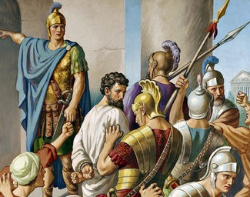
²³ And as they cried out, and cast off their clothes, and threw dust into the air,
²⁴ The chief captain commanded him to be brought into the castle, and bade that he should be examined by scourging; that he might know wherefore they cried so against him.
He planned to torture Paul until he confessed his true identity. The captain could not believe that a religious testimony would spark such outrage!

Slide 78
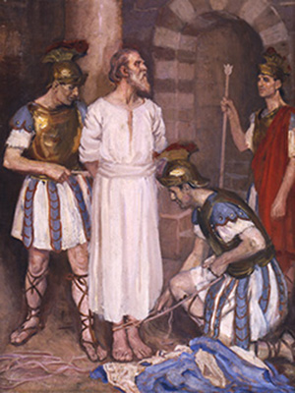
²⁵ And as they bound him with thongs, Paul said unto the centurion that stood by, Is it lawful for you to scourge a man that is a Roman, and uncondemned?
²⁶ When the centurion heard that, he went and told the chief captain, saying, Take heed what thou doest: for this man is a Roman.
²⁷ Then the chief captain came, and said unto him, Tell me, art thou a Roman? He said, Yea.

Slide 79
²⁸ And the chief captain answered, With a great sum obtained I this freedom. And Paul said, But I was free born.
New International Version: Then the commander said, “I had to pay a lot of money for my citizenship.” “But I was born a citizen,” Paul replied.

Slide 80
²⁹ Then straightway they departed from him which should have examined him: and the chief captain also was afraid, after he knew that he was a Roman, and because he had bound him.

Slide 81
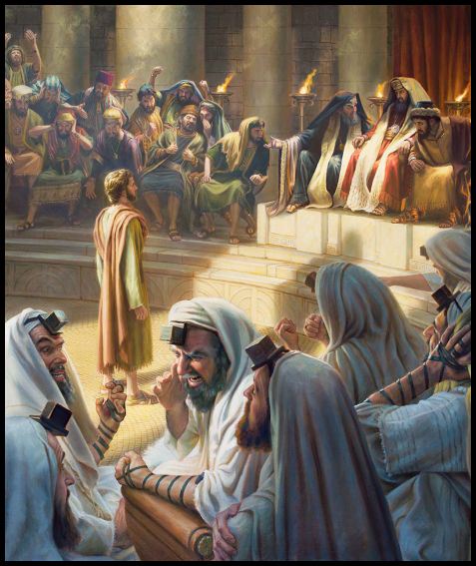
³⁰ On the morrow, because he would have known the certainty wherefore he was accused of the Jews, he loosed him from his bands, and commanded the chief priests and all their council to appear,
and brought Paul down, and set him before them.

Slide 82
L.D. CARY & SAM HOLT CATCH PHRASES
Chapter 19 – “10 + 9, Ephesus Time”
Chapter 20 – “Traveling A’Plenty”
Chapter 21 – “Confinement Begun”
Chapter 22 – “Before A Mob, Not A Few”
Chapter 23 – “Before The Council, You See”
Chapter 24 – “Felix Listens No More”
Chapter 25 – “Agrippa Arrives”
Chapter 26 – “Agrippa Realizes Paul’s Fix”
Chapter 27 – “Shipwreck & An Angel From Heaven”
Chapter 28 – “The End Of Our Wait”
“Before The Council, …You See”
Catch Phrase
Chapter Twenty-Three

Slide 83
Acts 23:
¹ And Paul, earnestly beholding the council, said, Men and brethren, I have lived in all good conscience before God until this day.

Slide 84
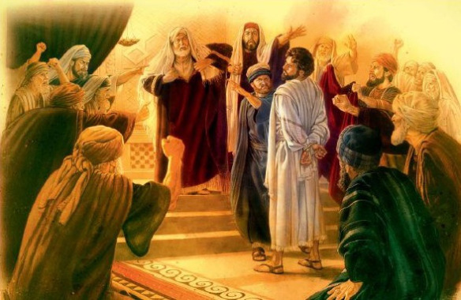
² And the high priest Ananias commanded them that stood by him to smite him on the mouth.

Slide 85
³ Then said Paul unto him, God shall smite thee, thou whited wall: for sittest thou to judge me after the law, and commandest me to be smitten contrary to the law?

Slide 86
³ Then said Paul unto him, God shall smite thee, thou whited wall: for sittest thou to judge me after the law, and commandest me to be smitten contrary to the law?
Matthew 23:27
Woe unto you, scribes and Pharisees, hypocrites! for ye are like unto whited sepulchres, which indeed appear beautiful outward, but are within full of dead men's bones, and of all uncleanness.

Slide 87
Exodus 22:28
Thou shalt not revile God, nor curse the ruler of thy people.
These are judges and magistrates.
1 Corinthians 8:5
For though there be that are called gods, whether in heaven or earth, (as there be gods many, and lords many,)
⁴ And they that stood by said, Revilest thou God's high priest?
⁵ Then said Paul, I wist not, brethren, that he was the high priest: for it is written, Thou shalt not speak evil of the ruler of thy people.

Slide 88
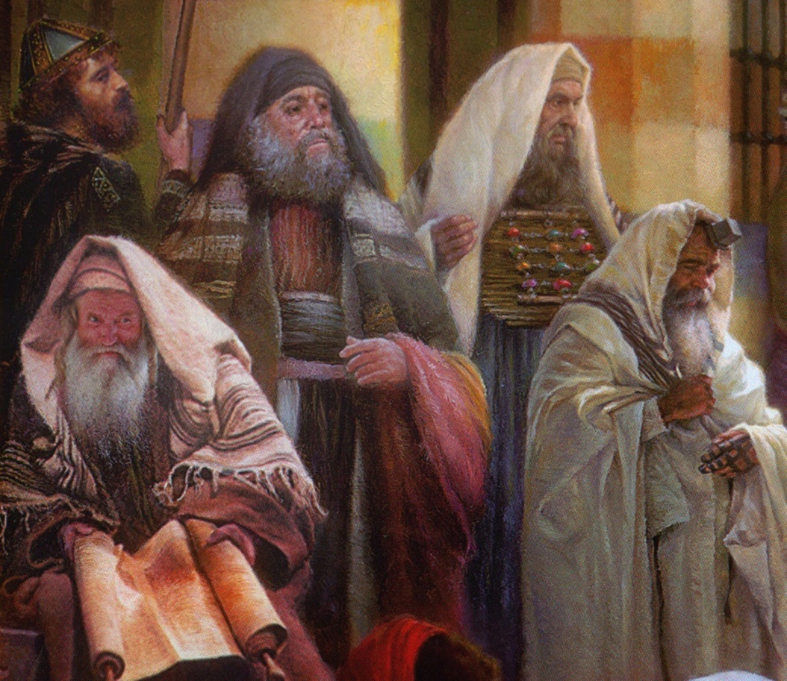
⁶ But when Paul perceived that the one part were Sadducees, and the other Pharisees, he cried out in the council, Men and brethren, I am a Pharisee, the son of a Pharisee: of the hope and resurrection of the dead I am called in question.
⁷ And when he had so said, there arose a dissension between the Pharisees and the Sadducees: and the multitude was divided.
⁸ For the Sadducees say that there is no resurrection, neither angel, nor spirit: but the Pharisees confess both.

Slide 89
⁹ And there arose a great cry: and the scribes that were of the Pharisees' part arose, and strove, saying, We find no evil in this man: but if a spirit or an angel hath spoken to him, let us not fight against God.
¹⁰ And when there arose a great dissension, the chief captain, fearing lest Paul should have been pulled in pieces of them, commanded the soldiers to go down, and to take him by force from among them, and to bring him into the castle.

Slide 90
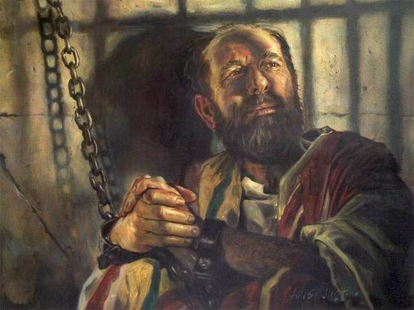
¹¹ And the night following the Lord stood by him, and said, Be of good cheer, Paul: for as thou hast testified of me in Jerusalem, so must thou bear witness also at Rome.

Slide 91
Did Paul disobey God by going to Jerusalem?
1) HIS INNER WITNESS
Acts 19:21
After these things were ended, Paul purposed in the spirit, when he had passed through Macedonia and Achaia, to go to Jerusalem, saying, After I have been there, I must also see Rome.
Acts 20:22-23
²² And now, behold, I go bound in the spirit unto Jerusalem, not knowing the things that shall befall me there:
²³ Save that the Holy Ghost witnesseth in every city, saying that bonds and afflictions abide me.

Slide 92
Did Paul disobey God by going to Jerusalem?
THE WITNESS OF OTHERS
Acts 21:11
And when he [Agabus] was come unto us, he took Paul's girdle, and bound his own hands and feet, and said, Thus saith the Holy Ghost, So shall the Jews at Jerusalem bind the man that owneth this girdle, and shall deliver him into the hands of the Gentiles.
Acts 21:12 and 14
¹² And when we [his friends and traveling companions] heard these things, both we, and they of that place, besought him not to go up to Jerusalem.
¹⁴ And when he would not be persuaded, we ceased [trying to dissuade him], saying, The will of the Lord be done.

Slide 93
Did Paul disobey God by going to Jerusalem?
THE WITNESS OF CHRIST
Acts 23:11 …Be of good cheer, Paul: for as thou hast testified of me in Jerusalem, so must thou bear witness also at Rome.
See how this agrees with Paul’s own witness:
Acts 19:21
…Paul purposed in the spirit …to go to Jerusalem, saying, After I have been there, I must also see Rome.
The Lord does not commend those who disobey him.

Slide 94
Did Paul disobey God by going to Jerusalem?
THE ONE “PROBLEM” VERSE
Acts 21:4-5
⁴ And finding disciples, we tarried there seven days: who said to Paul through the Spirit, that he should not go up to Jerusalem.
But it is not a problem when read in conjunction with the verse that follows:
⁵ And when we had accomplished those days [the seven days of tarrying], we departed and went our way...
This change in schedule put them in sync to rendezvous with Agabus

Slide 95
Paul's Arrest and Imprisonment - Part 1
Acts 21:15-23:11

Slide 96
Outline - Acts
II. The Ministry of Paul – Acts 13:1-28:31
Paul’s 1st Missionary Journey – Acts 13:1-15:35
Paul’s 2nd Missionary Journey – Acts 15:36-18:22
Paul’s 3rd Missionary Journey – Acts 18:23-21:14
Paul’s Arrest - 1 – Acts 21:15-23:11
Paul’s Arrest - 2 – Acts 23:12-25:12
Paul’s Arrest - 3 – Acts 25:13-26:32
Paul’s Journey to Rome – Acts 27:1-28:31

Slide 97
¹⁵ After these days we got ready and started on our way up to Jerusalem. ¹⁶ Some of the disciples from Caesarea also came with us, taking us to Mnason of Cyprus, a disciple of long standing with whom we were to lodge. ¹⁷ After we arrived in Jerusalem, the brethren received us gladly. ¹⁸ And the following day Paul went in with us to James, and all the elders were present.
- Acts 21:15-18

Slide 98
¹⁹ After he had greeted them, he began to relate one by one the things which God had done among the Gentiles through his ministry. ^{20a} And when they heard it they began glorifying God;
- Acts 21:19-20a

Slide 99
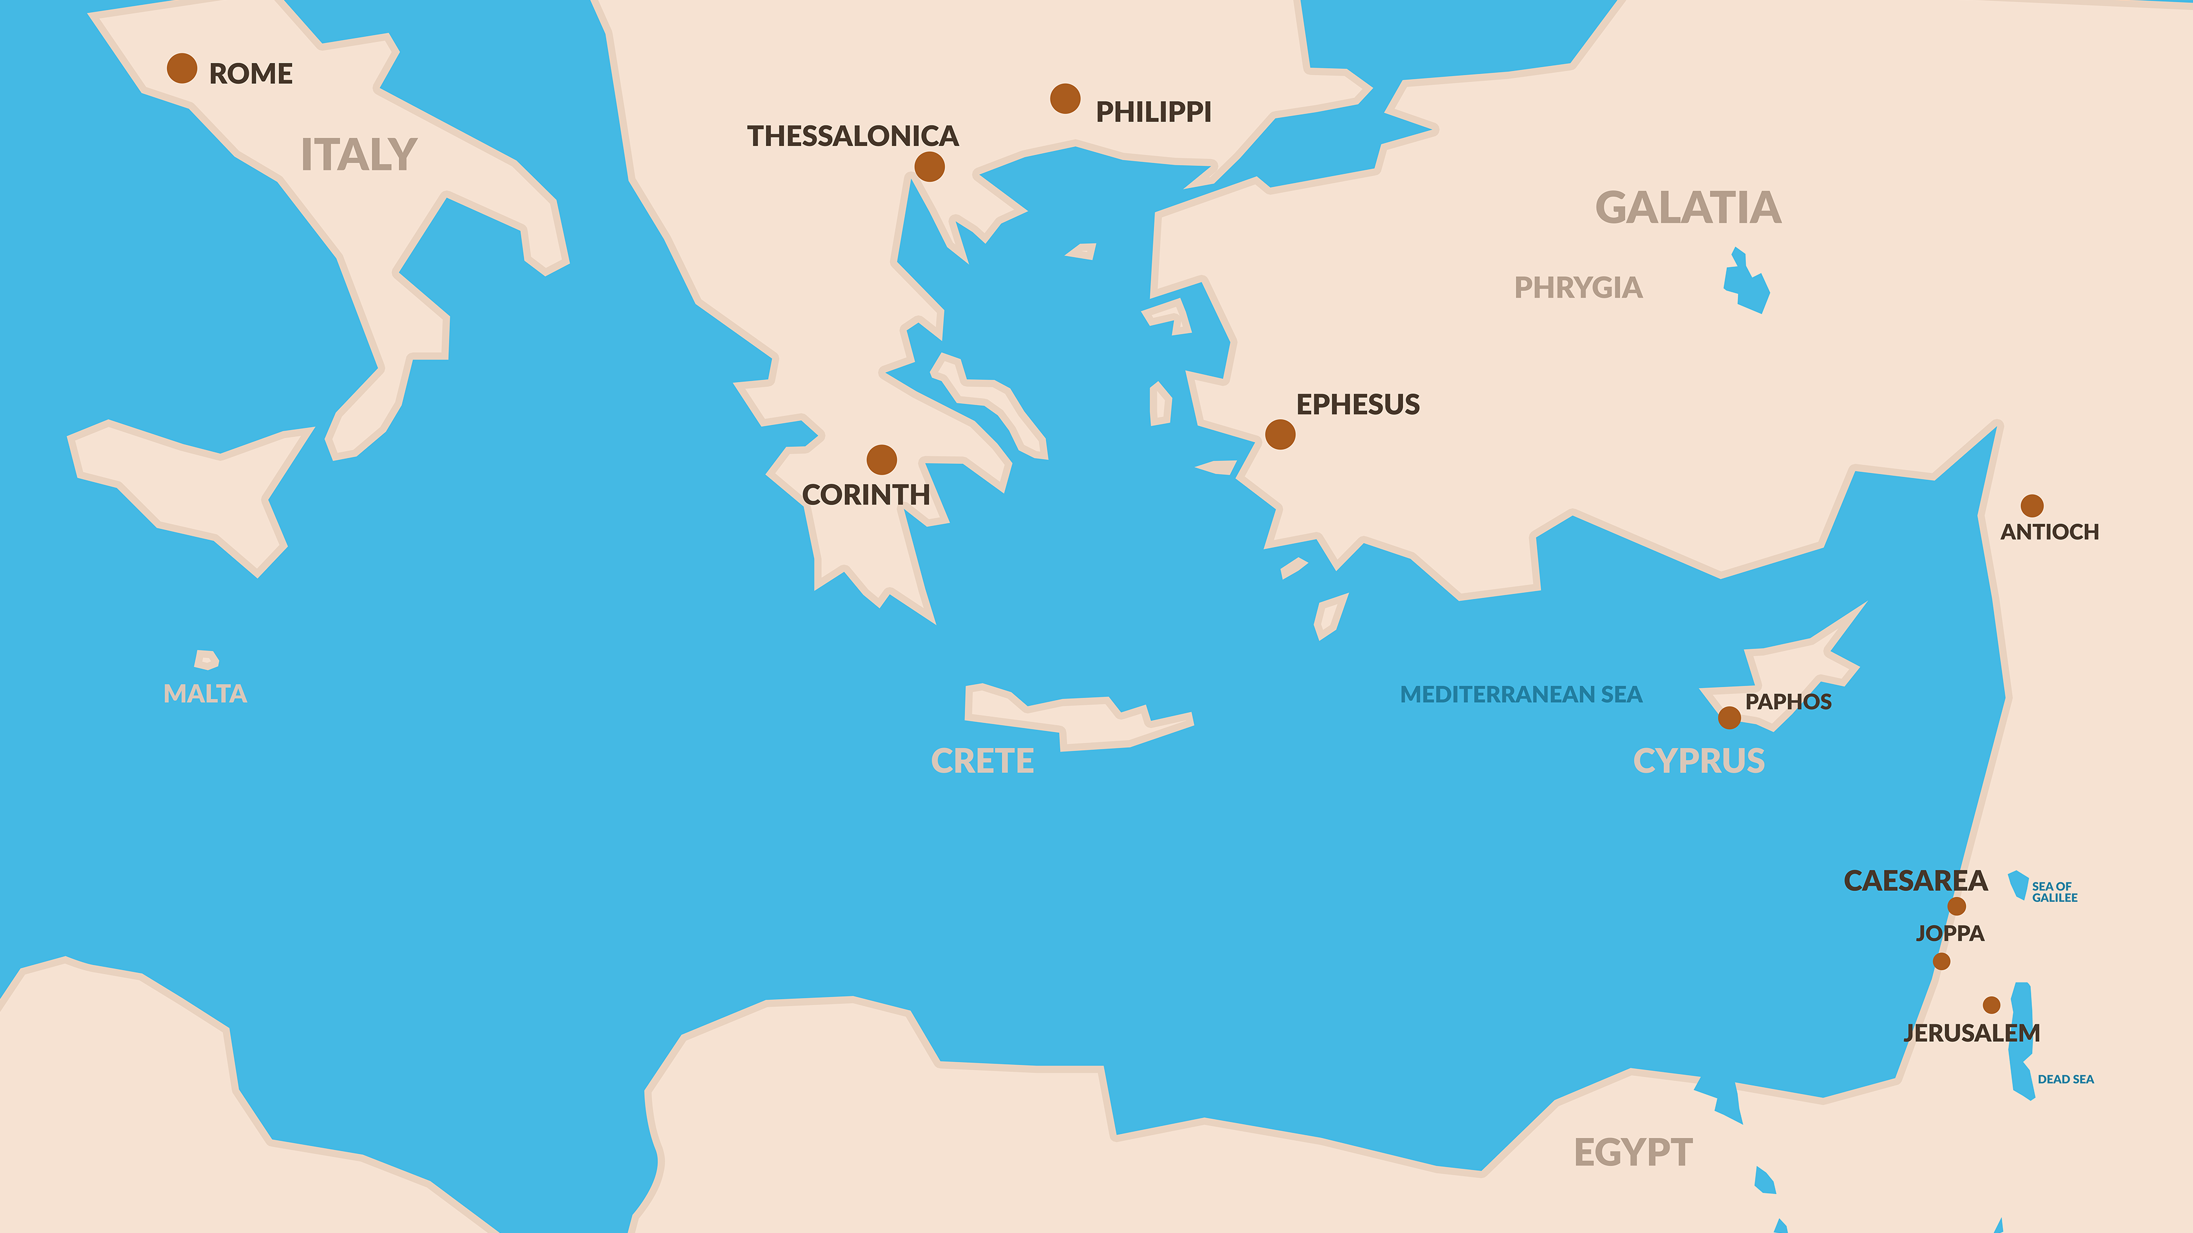

Slide 100
Missions Pattern
The Church Sends

Slide 101
Missions Pattern
The Church Sends
The Missionary Plants

Slide 102
Missions Pattern
The Church Sends
The Missionary Plants
The Church Oversees

Slide 103
^{20b} and they said to him, “You see, brother, how many thousands there are among the Jews of those who have believed, and they are all zealous for the Law; ²¹ and they have been told about you, that you are teaching all the Jews who are among the Gentiles to forsake Moses, telling them not to circumcise their children nor to walk according to the customs.
- Acts 21:20b-21

Slide 104
Judaizers – Keep Customs + Faith = Salvation Accusers – Abandon Customs + Faith = Salvation

Slide 105
²² What, then, is to be done? They will certainly hear that you have come. ²³ Therefore do this that we tell you. We have four men who are under a vow;
- Acts 21:22-23

Slide 106
take them and purify yourself along with them, and pay their expenses so that they may shave their heads; and all will know that there is nothing to the things which they have been told about you, but that you yourself also walk orderly, keeping the Law.
- Acts 21:24

Slide 107
²⁵ But concerning the Gentiles who have believed, we wrote, having decided that they should abstain from meat sacrificed to idols and from blood and from what is strangled and from fornication.” ²⁶ Then Paul took the men, and the next day, purifying himself along with them, went into the temple giving notice of the completion of the days of purification, until the sacrifice was offered for each one of them.
- Acts 21:25-26

Slide 108
CHAPTER 21 J. W. McGarvey’s Acts Commentary
VERSES 18 - 26
Thus far we have omitted special mention of one custom, because its importance demands for it a separate consideration. We refer to sacrifices. It is evident, from the transaction before us, as observed above, that James and the brethren in Jerusalem regarded the offering of sacrifices as at least innocent; for they approved the course of the four Nazarites, and urged Paul to join with them in the service, though it required them to offer sacrifices, and even sin-offerings. They could not, indeed, very well avoid this opinion, since they admitted the continued authority of the Mosaic law. Though disagreeing with them as to the ground of their opinion, as in reference to the other customs, Paul evidently admitted the opinion itself, for he adopted their advice, and paid the expense of the sacrifices which the four Nazarites offered.
McGarvey, J. W. (1872). A commentary on Acts of Apostles (p. 259). Lexington, KY: Transylvania Printing and Publishing Co.

Slide 109
CHAPTER 21 J. W. McGarvey’s Acts Commentary
VERSES 18 - 26
Peter finally discovered that he was wrong in that matter, and Paul at length discovered that he was wrong, in his connection with the offerings of these Nazarites. Some years later, the whole question concerning the Aaronic priesthood and animal sacrifices was thrust more distinctly upon his mind, and the Holy Spirit made to him a more distinct revelation of the truth upon the subject, and caused him to develop it to the Churches, in Ephesians, Colossians, and especially in Hebrews. In the last-named Epistle, written during his imprisonment in Rome, he exhibited the utter inefficiency of animal sacrifices; the sacrifice of Christ, once for all, the only sufficient sin-offering; and the abrogation of the Aaronic priesthood by that of Christ, who was now the only high priest and mediator between God and man. After these developments, he could not, for any earthly consideration, have repeated the transaction with the Nazarites; for it would have been to insult the great High Priest over the house of God, by presenting, before a human priest, an offering which could not take away sin, and which would proclaim the insufficiency of the blood of the atonement. We conclude, therefore, that the procedure described in the text was inconsistent with the truth as finally developed by the apostles, but not with so much of it as was then understood by Paul. This conclusion presents but another proof that the Holy Spirit, in leading the apostles “into the truth,” did so by a gradual development running through a series of years.
McGarvey, J. W. (1872). A commentary on Acts of Apostles (p. 260). Lexington, KY: Transylvania Printing and Publishing Co.

Slide 110
CHAPTER 21 J. W. McGarvey’s Acts Commentary
VERSES 18 - 26
Then came in the necessity for the destruction of their temple & city, so that it should be impossible for them to longer offer sacrifices which had been superseded. The destruction of the temple was not the legal termination of the Mosaic ritual; for it ceased to be legal with the death of Christ; but this brought to an end its illegal continuance.
He had certainly taught the Jews that they were no longer under the law, and that “the customs” were no longer binding, and this was, in one sense, “apostasy from Moses.” But he had not, as he was charged, taught them to abandon the customs; for he had insisted that they were innocent; and, in reference to circumcision, he had given no ground of offense whatever. Hence the charge, as understood by those who preferred it, was false; and it was with the utmost propriety that Paul consented to disabuse their minds, though the means he adopted for that purpose was improper.
McGarvey, J. W. (1872). A commentary on Acts of Apostles (p. 261). Lexington, KY: Transylvania Printing and Publishing Co.

Slide 111
CHAPTER 21 J. W. McGarvey’s Acts Commentary
VERSES 18 - 26
Nazarites had no purification to perform except when they became unclean during their vow; and there was no period of seven days connected with their vow, except in the instance just mentioned. In this instance, as the head was to be sheared on the seventh day, and the offerings presented on the eighth, there were just seven whole days employed. Paul’s part was to give notice to the priest of the beginning of these days, and to pay the expenses of the offerings; but he had to purify himself before he went in for this purpose.
McGarvey, J. W. (1872). A commentary on Acts of Apostles (pp. 261–262). Lexington, KY: Transylvania Printing and Publishing Co.

Slide 112
Vows
Done to ask, thank, honor God
Voluntary but regulated by Law
Three months duration
Burn shaved hair and offer sacrifice

Slide 113
¹⁹ For though I am free from all men, I have made myself a slave to all, so that I may win more. ²⁰ To the Jews I became as a Jew, so that I might win Jews; to those who are under the Law, as under the Law though not being myself under the Law, so that I might win those who are under the Law;
- I Corinthians 9:19-20

Slide 114
to those who are without law, as without law, though not being without the law of God but under the law of Christ, so that I might win those who are without law.
- I Corinthians 9:21

Slide 115
²⁷ When the seven days were almost over, the Jews from Asia, upon seeing him in the temple, began to stir up all the crowd and laid hands on him, ²⁸ crying out, “Men of Israel, come to our aid! This is the man who preaches to all men everywhere against our people and the Law and this place; and besides he has even brought Greeks into the temple and has defiled this holy place.”
- Acts 21:27-28

Slide 116
²⁹ For they had previously seen Trophimus the Ephesian in the city with him, and they supposed that Paul had brought him into the temple. ³⁰ Then all the city was provoked, and the people rushed together, and taking hold of Paul they dragged him out of the temple, and immediately the doors were shut.
- Acts 21:29-30

Slide 117
CHAPTER 21 J. W. McGarvey’s Acts Commentary
VERSES 31 - 34
The inability of the mob to agree upon any charge against him shows the precipitancy with which they had rushed upon him, while the multiplicity of charges which they vociferated shows the intensity of their hatred. The chiliarch was indifferent through total ignorance of the case & desired to act prudently; hence he determined to protect the prisoner, and hold him for examination under more favorable circumstances.
McGarvey, J. W. (1872). A commentary on Acts of Apostles (p. 262). Lexington, KY: Transylvania Printing and Publishing Co.

Slide 118
³⁷ As Paul was about to be brought into the barracks, he said to the commander, “May I say something to you?” And he said, “Do you know Greek? ³⁸ Then you are not the Egyptian who some time ago stirred up a revolt and led the four thousand men of the Assassins out into the wilderness?”
- Acts 21:37-38

Slide 119
³⁹ But Paul said, “I am a Jew of Tarsus in Cilicia, a citizen of no insignificant city; and I beg you, allow me to speak to the people.” ⁴⁰ When he had given him permission, Paul, standing on the stairs, motioned to the people with his hand; and when there was a great hush, he spoke to them in the Hebrew dialect, saying,
- Acts 21:39-40

Slide 120
CHAPTER 21 J. W. McGarvey’s Acts Commentary
VERSES 35 - 39
This conversation shows that the chiliarch was utterly ignorant of the character and history of his prisoner. The best conclusion he could form from the confused outcries of the mob was the one indicated in the question just quoted. When he learned that he was a Jew, he was still more perplexed concerning the rage of the people, and not less astonished at the coolness displayed by Paul. In the hope of learning something more definite, he at once gave him liberty to speak, and stood by, an interested hearer.
McGarvey, J. W. (1872). A commentary on Acts of Apostles (p. 263). Lexington, KY: Transylvania Printing and Publishing Co.

Slide 121
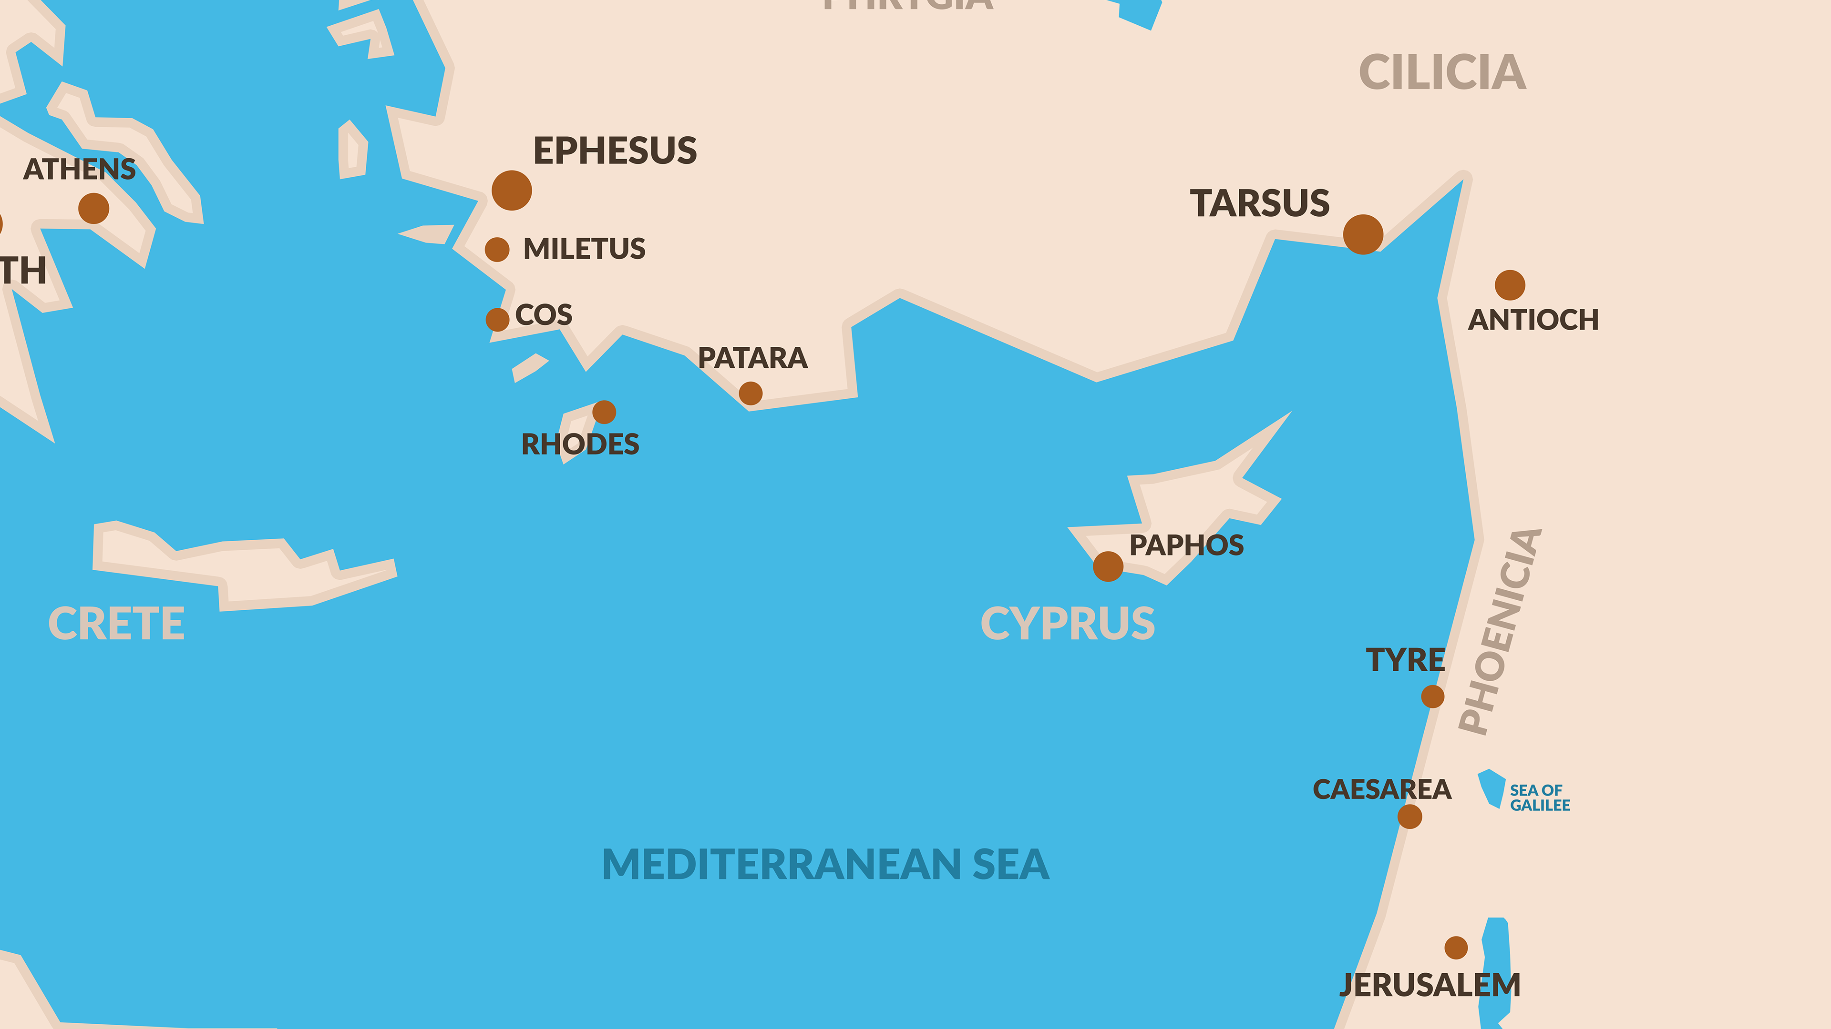
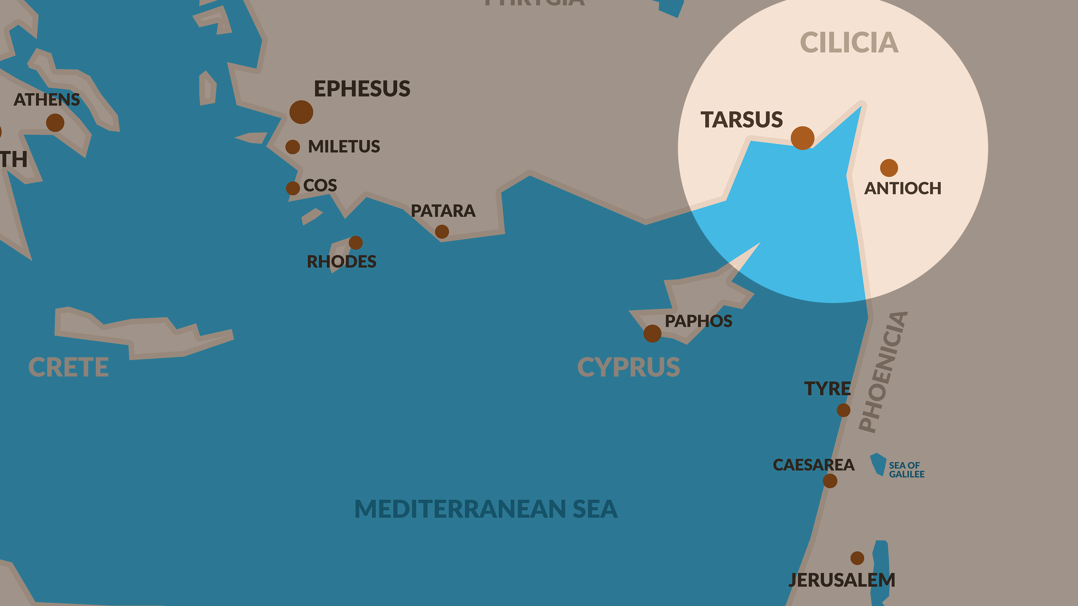

Slide 122
CHAPTER 22 J. W. McGarvey’s Acts Commentary
VERSES 1 & 2
Had he spoken in Greek, the majority of his hearers would have understood him; but, “the sound of the holy tongue in that holy place fell like a calm upon the troubled waters.” It was a mark of respect for Jewish nationality which they were not prepared to expect from Paul; and the result was, that the silence, which was only general at the waving of his hand, became universal at the utterance of his first sentence.
McGarvey, J. W. (1872). A commentary on Acts of Apostles (Ac 22:2). Lexington, KY: Transylvania Printing and Publishing Co.

Slide 123
“The Uncreated Light” as a Divine Energy
22:6 About noon a great light from heaven suddenly shone about me [ἐκ τοῦ οὐρανοῦ περιαστράψαι φῶς ἱκανον περὶ ἐμέ].
The three accounts that the book of Acts gives of the miraculous conversion of Saul on the road to Damascus (→9:1–4), which differ from one another in various details, all make a point of calling attention to the extraordinary light that overwhelmed him with its brightness. The first account of this light, which Luke includes as part of his own narrative, is the simplest of the three: “Suddenly a light from heaven flashed around him” (ἐξαίφνης τε αὐτὸν περιήστραψεν φῶς ἐκ τοῦ οὐρανοῦ) (9:3). Next, this account here in chapter 22 by Paul himself, speaking to a Jewish audience, basically repeats that version, with the addition that it took place “about noon.” But in the third account, also attributed to Paul, this time defending himself before King Agrippa, he elaborates on the light still further: “At midday, O king, I saw on the way a light from heaven, brighter than the sun [οὐρανόθεν ὑπὲρ τὴν λαμπρότητα τοῦ ἡλίου … φῶς], shining round me and those who journeyed with me” (26:13). This appears to suggest that no one had ever seen a light in all creation that was “brighter than the sun.” Therefore, this has been taken to belong to metaphysics rather than simply to physics, as a reference to an “uncreated light.”
Luke writes about this miraculous light in these three passages of Acts after having spoken in his “first book,” in which he “dealt with all that Jesus began to do and teach” (1:1), about the related miracle of the transfiguration of Jesus: “The appearance of his countenance was altered, and his raiment became dazzling white [λευκὸς ἐξαστράπτων]” (Luke 9:29). Matthew says that “his face shone like the sun, and his garments became white as light” (Matt. 17:2).

Slide 124
But Mark’s account of the light at the transfiguration (whether or not, as is usually supposed in modern New Testament scholarship, it is the earliest of the three to be written down, and whether or not Luke was acquainted with it in writing his own) comes closer than either Luke’s or Matthew’s does to serving as a commentary on the “light from heaven, brighter than the sun” in Luke’s final telling of the conversion of Saul: “And he was transfigured before them, and his garments became glistening, intensely white [στίλβοντα λευκὰ λίαν], as no fuller on earth could bleach them” (Mark 9:2–3). There does seem to be a parallel between Mark’s description, “intensely white, as no fuller on earth could bleach them,” and Luke’s description, “a light from heaven, brighter than the sun, shining round me”—a light of heaven not of earth, and transcendent in its whiteness and brilliance.
The biblical precedent for this unique light is found in the account of Moses speaking face to face with the Lord on Mount Sinai, so that when he descended from the mountain his face shone with a brilliance that was beyond human endurance to behold and he had to veil it when he spoke with the people of Israel (Exod. 34:29–35). For Paul, the immediate significance of “such splendor that the Israelites could not look at Moses’ face because of its brightness, fading as this was,” was to serve as an allegory for the relation between the law and the gospel (2 Cor. 3:7–8); but this divine light on Mount Sinai stood in close connection with the divine light on Mount Tabor at the transfiguration of Christ—and with the divine light that overwhelmed Paul on the Damascus road.
But if it was truly “divine” and “uncreated” and not “fading,” therefore falling on God’s side of the line of demarcation between Creator and creature, that raised the question: Where did this light fit into the doctrine of the divine? This definition of the uncreated light as divine “principle of action” or “energy” was legislated as dogma for the Eastern Church.
Pelikan, J. (2005). Acts (pp. 234–236). Grand Rapids, MI: Brazos Press.

Slide 125
CHAPTER 22 J. W. McGarvey’s Acts Commentary
VERSES 17 - 21
By allowing Paul to speak, Lysias expected to learn something about the charges against him, supposing that he would address himself immediately and strictly to a defense. What must have been his surprise, then, to hear him, after asking the people to hear his defense, proceed with a narrative, the bearing of which upon the case was so obscure? It must be confessed that the speech afforded very little of the light that he was seeking; and even to men who are better prepared to understand it than he, it’s still a source of astonishment. Here is a man in the hands of a heathen soldiery, with a prison-door opening behind him and before him a mob thirsting for his blood, whom to appease would save him from prison and perhaps, from death, yet appearing to be utterly oblivious to the danger which surrounded him, and though permitted to speak, making not the slightest effort to obtain release.
He could most truthfully have denied bringing Greeks into the temple, or speaking improperly of the people, the law, or that holy place; but the Apostle was so far elevated above all selfish considerations, that he desired no vindication of himself not involving a vindication of the cause he was pleading. He saw before him a deluded multitude rushing blindly to destruction, and though they were thirsting for his own blood, he pitied them, and resolved to give them light.
McGarvey, J. W. (1872). A commentary on Acts of Apostles (pp. 264–265). Lexington, KY: Transylvania Printing and Publishing Co.

Slide 126
²² They listened to him up to this statement, and then they raised their voices and said, “Away with such a fellow from the earth, for he should not be allowed to live!” ²³ And as they were crying out and throwing off their cloaks and tossing dust into the air,
- Acts 22:22-23

Slide 127
²⁴ the commander ordered him to be brought into the barracks, stating that he should be examined by scourging so that he might find out the reason why they were shouting against him that way. ²⁵ But when they stretched him out with thongs, Paul said to the centurion who was standing by, “Is it lawful for you to scourge a man who is a Roman and uncondemned?”
- Acts 22:24-25

Slide 128
CHAPTER 22 J. W. McGarvey’s Acts Commentary
VERSES 22 - 24
The idea of scourging a man who is assailed by a mob, to make him confess the cause for which he is assailed, is most abhorrent to all proper sense of justice, yet it prevailed in the most enlightened heathen nations of antiquity. Rome, it is true, exempted from its effects all who enjoyed the rights of citizenship; but the existence of such a distinction in a matter in which all human beings should have equal rights, is a further proof of their ignorance of the true principles of public justice. To the enlightening and the rectifying influence of Christianity, modern nations are indebted for many happy changes in jurisprudence.
McGarvey, J. W. (1872). A commentary on Acts of Apostles (p. 265). Lexington, KY: Transylvania Printing and Publishing Co.

Slide 129
²⁶ When the centurion heard this, he went to the commander and told him, saying, “What are you about to do? For this man is a Roman.” ²⁷ The commander came and said to him, “Tell me, are you a Roman?” And he said, “Yes.” ²⁸ The commander answered, “I acquired this citizenship with a large sum of money.” And Paul said, “But I was actually born a citizen.”
- Acts 22:26-28

Slide 130
²⁹ Therefore those who were about to examine him immediately let go of him; and the commander also was afraid when he found out that he was a Roman, and because he had put him in chains. ³⁰ But on the next day, wishing to know for certain why he had been accused by the Jews, he released him and ordered the chief priests and all the Council to assemble, and brought Paul down and set him before them.
- Acts 22:29-30

Slide 131
¹ Paul, looking intently at the Council, said, “Brethren, I have lived my life with a perfectly good conscience before God up to this day.” ² The high priest Ananias commanded those standing beside him to strike him on the mouth.
- Acts 23:1-2

Slide 132
The Testimony of a “Good Conscience”
23:1 I have lived before God in all good conscience up to this day.
It is a measure of the “afflictions, hardships, calamities, beatings, imprisonments, tumults” (2 Cor. 6:4–5) of Paul’s ministry that this is only one in a series of speeches delivered by him in self-defense, which appear here in five successive chapters of the Acts of the Apostles:
1. to a Jewish audience, speaking in Aramaic (22:3–21);
2. to the Jewish Sanhedrin (23:1–6), interrupted by various outbursts;
3. to Felix, Roman governor of Judea (24:10–21), in response to the official indictment as stated by Tertullus the lawyer-orator (ῥήτωρ) (24:2–8);
4. to Porcius Festus, another Roman governor of Judea (25:8–11);
5. to King Agrippa (26:2–23);
These apologias are, also because of the variation in the audience, excellent examples of how the classic Aristotelian definition of “pathos, the frame of mind of the audience,” shifted in Christian rhetoric as it was being addressed to Jews or to Gentiles (→24:1–2); and it is instructive to pay attention both to the differences and to the common elements between the apologias, as in the present one.
“Brethren, I have lived before God in all good conscience [πάσῃ συνειδήσει ἀγαθῇ] up to this day” was his description here to a Jewish audience. In the following chapter, speaking now to a Gentile audience, which included a Roman governor and a Roman attorney, he characterized his moral stance as that of one who “always take[s] pains to have a clear conscience [ἀπρόσκοπον συνείδησιν] toward God and toward men” (24:16).
Pelikan, J. (2005). Acts (pp. 245–247). Grand Rapids, MI: Brazos Press.

Slide 133
ONLY GOD’S WORD!

Slide 134
³ Then Paul said to him, “God is going to strike you, you whitewashed wall! Do you sit to try me according to the Law, and in violation of the Law order me to be struck?” ⁴ But the bystanders said, “Do you revile God’s high priest?”
- Acts 23:3-4

Slide 135
And Paul said, “I was not aware, brethren, that he was high priest; for it is written, ‘You shall not speak evil of a ruler of your people.’”
- Acts 23:5

Slide 136
CHAPTER 23 J. W. McGarvey’s Acts Commentary
VERSES 3 - 5
The flash of anger was but momentary. No sooner were the words spoken than his habitual self-control regained its ascendancy. He frankly admits that he had done wrong, but excuses himself by the fact that he knew not that it was the high priest. If he had been disposed to further excuse himself, by urging that the high priest deserved all he had said of him, his plea would have been true, but insufficient. For how can we return good for evil, if we return to men their deserts? It were well if his example should be imitated by all disciples who meet with injustice at the hands of their rulers.
McGarvey, J. W. (1872). A commentary on Acts of Apostles (Ac 23:5). Lexington, KY: Transylvania Printing and Publishing Co.

Slide 137
⁶ But perceiving that one group were Sadducees and the other Pharisees, Paul began crying out in the Council, “Brethren, I am a Pharisee, a son of Pharisees; I am on trial for the hope and resurrection of the dead!” ⁷ As he said this, there occurred a dissension between the Pharisees and Sadducees, and the assembly was divided.
- Acts 23:6-7

Slide 138
CHAPTER 23 J. W. McGarvey’s Acts Commentary
VERSES 6 - 10
The presence in which Paul stood was not unfamiliar to him. He doubtless remembered the faces of many in the Sanhedrim, and he was intimately acquainted with the party feelings which often distracted their councils and which had been known to stain the streets of Jerusalem with blood. Seeing they were determined not to do him justice, he resolved to take advantage of their party feuds in order to secure his own safety.
It will be observed, that in stating the difference between the two parties, Luke uses the term both when the reference is to three specifications, viz.: resurrection, angel, and spirit. This arose, no doubt, from the fact that the three specifications are really combined in two, as the existence of angels or spirits involves but the one question of the existence of purely spiritual beings.
McGarvey, J. W. (1872). A commentary on Acts of Apostles (p. 267). Lexington, KY: Transylvania Printing and Publishing Co.

Slide 139
CHAPTER 23 J. W. McGarvey’s Acts Commentary
VERSES 6 - 10
Under ordinary circumstances, it is not probable that so violent a dissension could have been so easily excited. The circumstance is indicative of an unusual exasperation of the parties just preceding this event. Such a state of things, combined with the complete agreement declared by Paul with the Pharisees on the points at issue, naturally inclined them to favor this release. He declared this agreement in strong terms, asserting not only that he was a Pharisee, but the son of a Pharisee, and that it was for the hope peculiar to the party that he was arraigned as a criminal. They saw that the establishment of his doctrine would certainly be the ruin of the opposing sect, and losing sight, for a moment, of its effects upon their own party; forgetting, too, the ill-founded charge against Paul, in reference to the law & temple, they declared that they could find no fault in the man. Perhaps, also, the awkward position they were in with reference to proof of those charges rendered them somewhat willing to find an excuse for admitting his innocence. But the slightest hint, on their part, of his innocence, was sufficient to arouse the Sadducees, because they saw that it was prompted chiefly by hatred to themselves. On the part of the Sadducees, the two most violent passions to which they were subject, hatred toward the disciples & jealousy toward the Pharisees, combined to swell the uproar which broke up the deliberations of the assembly. Paul was near being a victim to the storm which he had raised, when the Roman soldiery came to his rescue. Lysias was once more disappointed in his efforts to learn the truth about his case & must have been in greater perplexity than ever, as he commanded the soldiers to lead him back into the castle.
McGarvey, J. W. (1872). A commentary on Acts of Apostles (p. 267). Lexington, KY: Transylvania Printing and Publishing Co.

Slide 140
⁸ For the Sadducees say that there is no resurrection, nor an angel, nor a spirit, but the Pharisees acknowledge them all. ⁹ And there occurred a great uproar; and some of the scribes of the Pharisaic party stood up and began to argue heatedly, saying, “We find nothing wrong with this man; suppose a spirit or an angel has spoken to him?”
- Acts 23:8-9

Slide 141
And as a great dissension was developing, the commander was afraid Paul would be torn to pieces by them and ordered the troops to go down and take him away from them by force, and bring him into the barracks.
- Acts 23:10

Slide 142
But on the night immediately following, the Lord stood at his side and said, “Take courage; for as you have solemnly witnessed to My cause at Jerusalem, so you must witness at Rome also.”
- Acts 23:11

Slide 143
CHAPTER 23 J. W. McGarvey’s Acts Commentary
VERSE 11
But his speeches before the mob and the Sanhedrim had only exasperated his enemies, who were now, more than ever, intent upon his destruction; and his jailer, though disposed to do justice, knew not what to do but to keep him in prison. In whatever the direction he could look, prison walls or a bloody grave stood before him, and hedged up his way, either to Rome or to any other field of future usefulness. But just at the proper moment to save him from despair, solemn assurance is given, that his long-continued prayers would yet be answered, and he should preach the Word in Rome as he had done in Jerusalem. In tracing the fulfillment of this promise, we shall witness a remarkable illustration of the workings of providence in answer to prayer.
McGarvey, J. W. (1872). A commentary on Acts of Apostles (p. 268). Lexington, KY: Transylvania

Slide 144
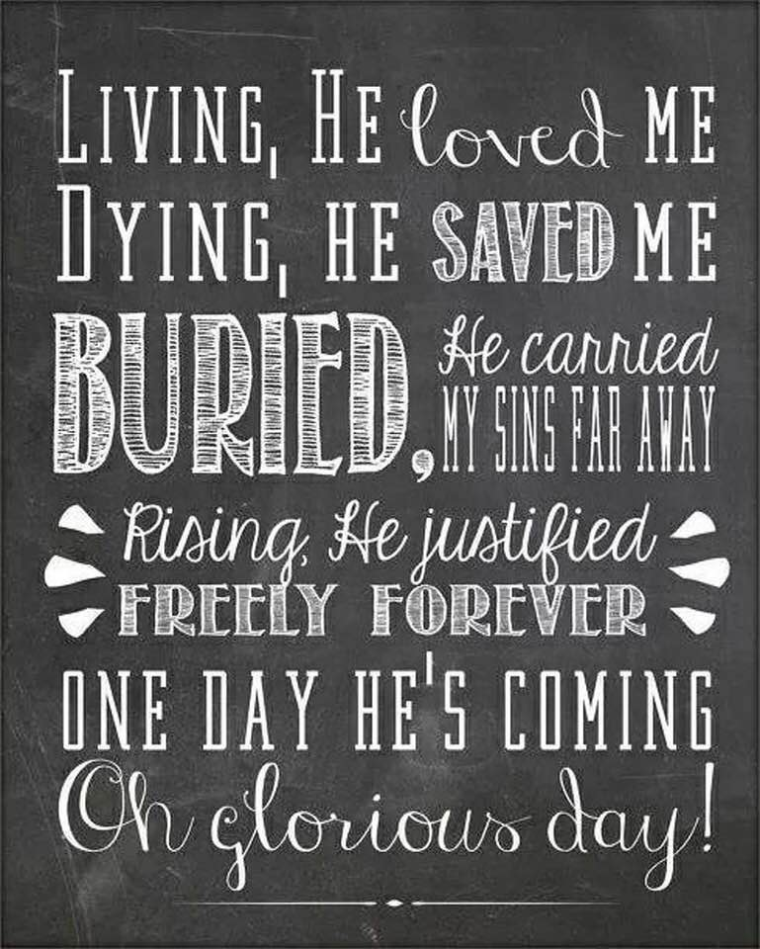

Slide 145
The NEW TESTAMENT BOOK OF ACTS

Slide 146
9/10

