Slide 1
ANSWERING CALVINISM’S PROOFTEXTS
by David Lee Burris

Slide 2
Iconoclastic French Reformer John Calvin Makes His Mark
By the 1550’s half of the city’s population was made up of foreign immigrants; when they left again, they spread Calvin’s ideas and practices throughout Europe. Many of them had received training at Calvin’s academy, the first great Protestant university.
His writings were of such high quality that even his theological opponents complemented them as to their style.
Where Luther extended on the argumentation of Augustine - Calvin brought the Augustinian argument to its natural and logical conclusion.
In his Institutes he quotes Augustine 228 times or two and one-half times all the other ancients taken together.
His most unique doctrine was that of the invisible and visible church. With some modification it is still adhered to today.
When he died in 1564, at his own request, his grave was marked only by a plain stone. Although his grave site is unknown & without epitaph – Calvin etched his life and his mind upon the whole world.

Slide 3
Calvin's Contribution To The
Destiny & Determinism Debate:
HUMAN MORAL RESPONSIBILITY

Slide 4
REFORMATION QUOTATIONS: THE DIFFERENCES BETWEEN JUSTIFICATION & SANCTIFICATION
JOHN CALVIN
“He [Paul] clearly indicates that to be justified means something different from being made new creatures & sanctified.”

Slide 5
Calvin’s Interpretation Of The Divine Sovereignty
“The confession of the sovereignty of God has become the hallmark of authentic Calvinism.” Evangelical Dictionary
From The Westminster Confession: “God from eternity, did unchangeably ordain whatsoever comes to pass.”

Slide 6
Calvin’s Interpretation Of God’s
Sovereignty Is Somewhat Flawed
MANY OF THE THINGS THAT HAPPEN IN THIS WORLD ARE NOTHING BUT THE OUTCOME OF THE SELFISH WILL OF SINFUL MEN IN DEFIANCE AGAINST THE DESIRED DIVINE WILL OF GOD!
THE BIBLE TEACHES THE FREE WILL-MORAL AGENCY OF MAN!

Slide 8
Fate & Free Will:
Agent Causation
- Versus -
Causal Determinism
- Versus -
Classical Compatibilism

Slide 9
INHERITING ORIGINAL SIN THE BLAST FROM THE PAST
Posterity’s Uncritical Acceptance Of Augustine’s Christian Platonism
Original sin would have God condemn men to an eternal hell for doing exactly what He forced them to do by transferring Adam’s sinful nature to them. Thus, the logical inference of original sin is that all the sins of mankind are ultimately traceable to God! The doctrine of original sin strikes at the very moral nature of God as He is portrayed in Scripture. God is perfectly holy, good, and righteous. Sin is so repugnant and diametrically opposed to God’s nature that He cannot even lie or be tempted by evil. Neither does He tempt men to sin. How, then, can Calvinists possibly reconcile the doctrine of original sin with the moral nature of God? The doctrine of original sin would logically require a total revamping of man’s concept of God. It is a slap in the face of God! Yet, original sin is perhaps the most pervasive, hallmark doctrine of Protestantism and Roman Catholicism. Let no one ever say that it does not matter what one believes. It matters to God!

Slide 10
INHERITING ORIGINAL SIN THE BLAST FROM THE PAST
Posterity’s Uncritical Acceptance Of Augustine’s Christian Platonism
Further testimony is borne to the heinousness of this doctrine in the fact that Protestants and Catholics make Jesus exempt from original sin. Of course, it would heap outrage upon outrage for them not to do so, but their having to do it only makes their error all the more conspicuous. Catholics have also seen fit to make Mary an exception to the rule by virtue of the doctrine of immaculate conception. If it is right for God to transfer Adam’s sin nature to his descendants, why would it be wrong for Him to do so in the case of Jesus? The practical need to make Jesus an exception is quite understandable, but the query is directed at the moral right to make Jesus an exception to that which blights all men. If it would have been wrong to transfer Adam’s sin nature to Jesus, why is it right for Him to do so in the cases of other men? How is it right to do to men what it would be wrong to do to Jesus? It appears that there is a double standard. The Catholics simply issue what amounts to an ipse dixit about it in the case of Mary. If God could arrange for Jesus to be born without original sin, why couldn’t He have arranged the very same thing for all men? Is God “a respector of persons”(Acts 10: 34)? Moreover, if Jesus had to be made like His brethren in all things(Hebrews 2) & was tempted in all things they are (chap. 4), how is it that He was preserved from the very thing that compels them to sin? If God gave to men that from which He preserved Jesus, then Jesus is different from His brethren in a most radical, fundamental, and irreconcilable way! The Hebrews writer’s claim becomes nothing.

Slide 11
INHERITING ORIGINAL SIN THE BLAST FROM THE PAST
Posterity’s Uncritical Acceptance Of Augustine’s Christian Platonism
Proponents of original sin sense this difficulty and try to resolve it by saying that Jesus’ virgin birth was necessitated by the need to preserve Him from original sin. For several reasons this solution falls short of its aim: (1) It would not resolve the moral dilemma for Calvinists, even if it were true! (2) Nowhere in the Scriptures is a doctrine of original sin assigned as a basis for Jesus’ virgin birth! (3) Sinfulness, or a sinful nature, is not genetically transferable anyway! (4) Even though Jesus was virgin-born, He was still a physical descendant of Adam because His mother was! Finally, when all is said and done, it may be observed that the real problem of original sin lies not in how it is transmitted but by the very fact that it is transmitted at all! No conceivable answer can absolve God from the responsibility He would have to bear for the sins of men if He creates them with sinful natures that compel them to sin. Calvinism is rotten at its taproot! Original sin, since it defies and defiles the very nature of God, is as fundamentally wrong as any false doctrine could be!

Slide 12
CALVIN COMPLETES AUGUSTINE Lapsarianism: Problems Both Philosophical & Theological
David Lee Burris:
Synod Of Dort: Elect Never Can Fall So Far As To “Forfeit The Grace Of Adoption Or State Of Justification – They Are Never Entirely Forsaken Into Eternal Ruin.”
Three Moral Wills Of Deity
Decretive Will or God as Sovereign
Preceptive Will or God’s Will that we react in a certain way even if we are free to chose.
Dispositional Will or that which is pleasing to God.
Infra-lapsarianism [also sub-lapsarianism]:
God created man wholly but permitted him to fall through the
self-determination of his free will. God made up His mind
about man’s punishment after the fall not before.
The Aquinas-Augustinian Modification:
The Future Not Fully Written – Omniscient God operates
through “Middle Knowledge.”
Middle Knowledge is the theological term for the parental space
given God’s children.God knows us doubly as our Creator & in
relationship as our Father. Theologian Augustine conceived
man as having an actual free choice within God’s pre-choice.
John Calvin would have nothing to do with this nonsense. He
agreed with the Lutheran concept regarding decisions of the
Hidden rather than revealed God & supported the school called
Supra-lapsarianism [also “deus absconditus”]
God before time and at the beginning with man decided the
masses of men would be lost – pre-destination of happy remedy
becomes fore-ordained fatalism of doom. In their pastoral care
dealing with the “evangelical despair” due to this belief in the
Doctrine of Election this school incorporated Luther’s idea of –
The Three Lamps Of Reason:
Light of Nature – Natural Law & Reason
Light of Grace – Faith & Gospel Resurrect
Light of Glory – We See How Just In Hereafter
Initial Dispute Calvinists Versus Arminians:
Repeating Pelagius – this would ascribe to God a two-fold
ignorance – one of His own creature & two of His own command.
Post-Augustine Free Will Modification
1. The Intentional Will Of God - would be what God would prefer to happen.
2. The Circumstantial Will Of God -would be what God does due to the circumstances arising that He did not intend.
3. The Ultimate Will Of God - is what God can ultimately achieve in the various circumstances of life due to the sinful rebellion of man.

Slide 13
Closeted Calvinism: Abominable Fantasy & Double Predestination
David Lee Burris:
Double Predestination Essene Concept Found In Dead Sea Scrolls!
Predestination is a religious doctrine according to which a person’s ultimate destiny, whether it be salvation or damnation, is determined by God alone prior to, and apart from, any worth or merit on the person’s part.
In some cases, it is claimed that God only determines those to be saved; in others, that his determinate purpose includes both those to be saved and those to be condemned. The latter teaching is called double predestination.
In other words, Double Predestination is the belief God creates some people who’s purpose in existing is to be sent to Hell!

Slide 14
CONCEALED CALVIN: Abominable Fantasy & Double Predestination
In His “Institutes” Book Calvin Said:
“In conformity, therefore, to the clear doctrine of the Scripture, we assert, that by an eternal and immutable counsel, God has once for all determined, both whom he would admit to salvation, and whom he would condemn to destruction… As God seals his elect by vocation and justification, so by excluding the reprobate from knowledge of his name and the sanctification of his Spirit, he affords an indication of the judgment that awaits them.”
This double doctrine of John Calvin was strongly affirmed by the Synod of Dort (1619) in Holland and in the Westminster Confession (1647) in England.

Slide 15
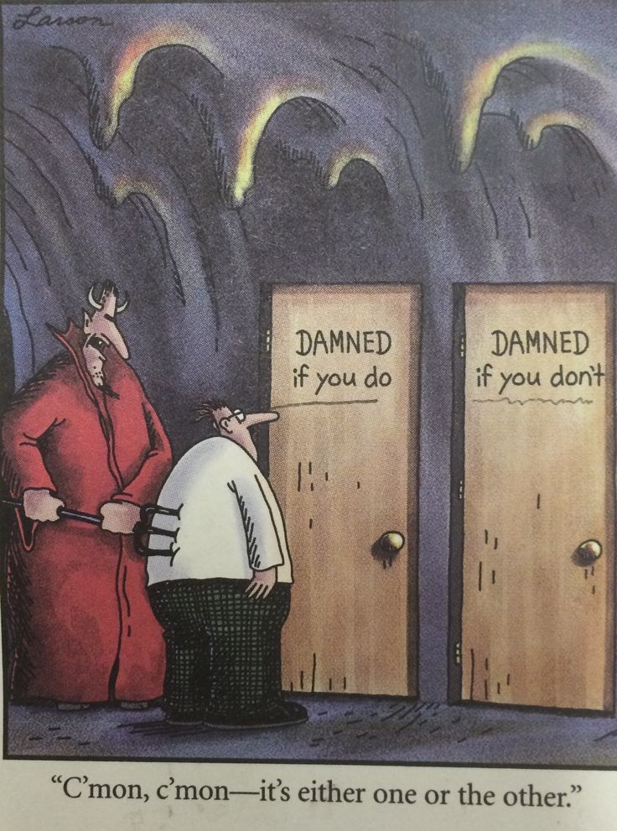

Slide 16
THESIS & ANTI-THESIS THEOLOGY
PLATO(Teacher) VERSUS ARISTOTLE(Student)
IRENAEUS(2nd Cent) VERSUS AUGUSTINE (4th)
AUGUSTINIAN VERSUS PELAGIAN NEMESIS
AUGUSTINIAN(Old)/THOMISM(New Church)
DESIDERIUS ERASMUS VS. MARTIN LUTHER
MARTIN LUTHER VERSUS ULRICH ZWINGLI
MARTIN LUTHER VERSUS JOHN CALVIN
JACOB ARMINIUS VERSUS JOHN CALVIN

Slide 17
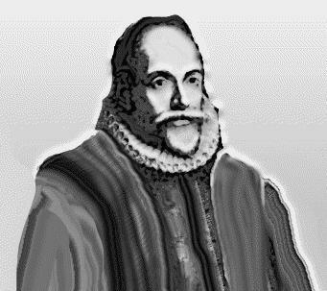
Jacob Arminius
While preparing to defend Calvin’s view of predestination, Arminius became convinced that Calvin was wrong.
The followers of Arminius summarized his views in the Remonstrance.
Jacob Arminius

Slide 18
The Arminian Remonstrance
The five points of the Remonstrance:
1. Every good human action occurs because of God’s grace; humans do nothing righteous on their own.
2. God saves every person choosing to trust Jesus.
3. Jesus died for everyone.
4. People can freely choose to accept or reject Jesus.
5. Scripture does not clearly state whether Christians can forfeit their salvation.

Slide 19
Response at the Synod of Dort
The five points of Calvinism:
1. No human being naturally desires God; by nature, every person is spiritually dead.
2. If someone trusts Jesus, it is because God chose to regenerate that person.
3. Jesus died for everyone who would trust in him.
4. When God regenerates someone, the person will not reject God’s grace.
5. Every authentic believer will persevere in faith and good works until the end.

Slide 20
Arminianism vs. Calvinism
The Arminian Remonstrance | The Calvinist response at the Synod of Dort
“Man cannot, of himself, think, will, or effect what is good.” | “Apart from regeneration, no one is willing to return to God.”
“God has from all eternity determined to save those who would believe.” | “Before the foundation of the world, God chose particular people in Christ to salvation.”
“Jesus Christ died for all men.” | “Christ redeemed only those who were chosen from eternity.”
“Grace is not irresistible.” | “Regeneration bends the will back to God.”
“Whether believers are capable of forsaking their life in Christ, must be more particularly determined.” | “God is faithful, powerfully preserving the converted in grace to the end.”

Slide 21
Five points of Arminianism
1. Free will or human ability
Free will consists of our ability to choose good over evil
We have the power to cooperate with God’s grace or resist it.

Slide 22
Five points of Arminianism
2. Conditional election
God’s choice (election) determined by knowledge of what man would do (foreseen faith).
Our choice of God, not God’s choice of us, is cause of salvation.

Slide 23
Five points of Arminianism
3. Universal redemption or general atonement
Jesus’ death and resurrection made it possible for all to be saved, but is effective only for those who choose to accept it.

Slide 24
Five points of Arminianism
4. Resistible grace
Our free will limits the Holy Spirit’s ability to draw us toward salvation; God’s grace can be resisted.
5. Falling from grace
Salvation can be lost, as it requires our cooperation.

Slide 25
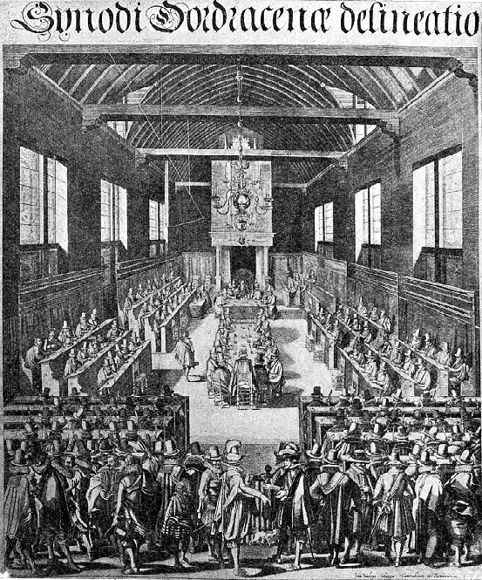
1618
Dutch Reformed Synod of Dordt, the Netherlands denounces Arminianism
The Synod responds to Arminius’ five criticisms of Calvinism with five points of Calvinism
The Synod of Dordt

Slide 26
Five points of Calvinism
(T.U.L.I.P.)
1. Total depravity (inability)
Sin affects every part of human nature, resulting in our inability to choose good over evil.

Slide 27
Five points of Calvinism
(T.U.L.I.P.)
1. Total depravity (inability)
Sin affects every part of human nature, resulting in our inability to choose good over evil.
We must be regenerated by the Holy Spirit in order to believe.

Slide 28
Five points of Calvinism
(T.U.L.I.P.)
2. Unconditional election
God’s choice (election) determined not by our foreseen response (faith); rather, faith and repentance are also gifts given by God.
God’s choice of us, not our choice of God, is the cause of salvation.

Slide 29
Five points of Calvinism
(T.U.L.I.P.)
3. Limited atonement
Jesus’ death and resurrection actually saved the elect.
It guarantees everything necessary for salvation, including the gift of faith.

Slide 30
Five points of Calvinism
(T.U.L.I.P.)
4. Irresistible grace
The Holy Spirit’s call is irresistible.
God’s grace never fails to result in salvation for those to whom it is extended.

Slide 31
Five points of Calvinism
(T.U.L.I.P.)
5. Perseverance of the saints
Salvation cannot be lost, as it is completely powered by God.
Thus the elect will persevere (be preserved) to the end.

Slide 32
BOOK – CHAPTER - VERSE
PRO – Isaiah 6: 9 - 11 | Total Depravity | CON – 2 Peter 3: 9
PRO – Romans 9: 13 | Unconditional Election | CON – Rev. 22: 17
PRO – Luke 13: 23, 24 | Limited Atonement | CON – 1 Timothy 2: 4
PRO – John 6: 44 | Irresistible Grace | CON – John 6: 45
PRO – John 10: 27, 28 | Perseverance “once always” | CON – Galatians 5: 4

Slide 33
DISPUTING ELECTION
Universalism & Reincarnation
Salvation By Grace – Infant Inclusive
Choice Conditioned By Imputed Faith
Salvation By Grace & Human Choice
Salvation Only To The Elect & All Infants
Salvation Only To Elect & Elect Infants
Fatalism: No Elect, No God, & No Hope

Slide 34
by Jesus People on Errors of Calvin
Five points of Calvinism
(T.U.L.I.P.)
2. Grace of God Is Redefined
One of the most common arguments that Calvinists use revolves around a unique definition of grace. “If people are saved ‘by grace alone,’” they say, “then people can’t play any part in their salvation. Salvation must be 100% the work of God if it is truly salvation by grace.” Calvinists have even labeled their distinctive doctrines as ‘the doctrines of grace,’ as if none else have a theology of grace!

Slide 35
by Jesus People on Errors of Calvin
Five points of Calvinism
(T.U.L.I.P.)
2. Grace of God Is Redefined
Calvinism’s distinctive doctrines could be better called ‘the doctrines of damnation,’ because they promise damnation to the majority of people. God offers no grace and no hope of salvation for them, as they are doomed from before they were born to an eternal hell!

Slide 36
by Jesus People on Errors of Calvin
Five points of Calvinism
(T.U.L.I.P.)
2. Grace of God Is Redefined
Calvinists believe that God could have saved everyone just as easily as He saved those whom He allegedly predestined for salvation, but He was pleased to save only a small minority of those He created in His image. The rest He was pleased to foreordain to hell. We cannot help but ask, ‘If God is love, what kind of love is that?’ John Wesley, founder of the Methodists, answered, ‘That is the kind of love that makes one’s blood run cold!

Slide 37
by Jesus People on Errors of Calvin
Five points of Calvinism
(T.U.L.I.P.)
2. Grace of God Is Redefined
Does salvation by grace require that human beings play no part in their salvation?
Imagine if I were bankrupt, but someone paid my debts and gave me a fresh start by means of a million dollar check & some great business advice. Would you say that my financial recovery was not ‘by grace alone’ because I had to deposit the check into my bank account in order to enjoy the benefits of my benefactor? Of course not.

Slide 38
by Jesus People on Errors of Calvin
Five points of Calvinism
(T.U.L.I.P.)
2. Grace of God Is Redefined
Does salvation by grace require that human beings play no part in their salvation?
So if such logic would be considered absurd by anyone & everyone, why is the same logic, when applied to salvation, swallowed by Calvinists?
Why do Calvinists accuse non-Calvinists of not having a gospel of grace simply because we maintain that those who are saved are those who, as the Bible teaches, don’t resist God’s gracious drawing? If you accept a birthday gift, is that a ‘work’ that lessens the grace of the giver?

Slide 39
by Jesus People on Errors of Calvin
Five points of Calvinism
(T.U.L.I.P.)
2. Grace of God Is Redefined
Calvinist logic that sets grace against human response is not a logic that can be supported by any scripture. There are no verses in the Bible that tell us that if salvation is of grace, then human free will plays no part in the salvation process. Rather, the Bible affirms that salvation is all of grace & also affirms that those who are saved are those who, by their own wills, do not resist God’s gracious drawing.
Calvinists elevate human reasoning above Scripture’s revelation, making God’s grace and human responsibility mutually exclusive concepts, while the Bible makes them mutually inclusive.

Slide 40
by Jesus People on Errors of Calvin
Five points of Calvinism
(T.U.L.I.P.)
2. Grace of God Is Redefined
Applying the same kind of human logic, we could claim that, because salvation is by grace alone and human responsibility plays no part, Christians can sin all they want without eternal consequences. Yet the same Bible that affirms salvation is by grace alone also affirms that the unrighteous ‘will not inherit the kingdom of God’ (1st Cor. 6: 9, 10). Does your will have anything to do with your not stealing? If your answer is yes, then you have just admitted that your will plays a part in whether or not you will inherit eternal life.

Slide 41
by Jesus People on Errors of Calvin
Five points of Calvinism
(T.U.L.I.P.)
2. Grace of God Is Redefined
Salvation is by grace from beginning to end - God graciously draws everyone in the world by means of His creation & their God-given consciences. He awes them and convicts them. He expects every person whom He so draws to seek Him{Acts 7:26, 27}. Those who seek Him do so only because of His gracious initiative. And Jesus promised that those who seek will find {Matt. 7:7}. Scripture affirms that God ‘is a rewarder of those who seek Him {Hebrews 11: 6}. If people are incapable of seeking God, as some claim, then we would have to wonder why the Bible says otherwise.

Slide 42
T.U.L.I.P.
CALVINISM
IS GOSPEL
REDACTED!

Slide 43
The Trouble With Tulips: Romans & Reformed Theology
By - Benjamin Witherington III
“They have a hard time understanding that holy love doesn’t involve determinism, however subtle. Indeed love, if it is real love, must be freely given and freely received, for God has chosen to relate to us as persons, not automata. They have a hard time dealing with the idea that God programmed into the system a certain amount of indeterminacy, risk, and freedom. And maybe, just maybe the good old Evangelical lust for certainty leads us all to quickly to fill in gaps and silences of Scripture, driving us to bad exegesis.”

Slide 44
The Trouble With Tulips: Romans & Reformed Theology
By - Benjamin Witherington III
“There are in fact profound exegetical problems with the T.U.L.I.P. theology of Calvinism and to a lesser extent Lutheranism. These theological ideas are linked, and, with the exception of the ‘T’ and the ‘L,’ are necessary corollaries of each other. For example, if one believes that God has predetermined people to be saved from before the foundation of the world, then of course election is unconditional, grace is irresistible, and perseverance is inevitable. These three linked ideas do not necessarily require the notion of total depravity or limited atonement.”

Slide 45
The Trouble With Tulips: Romans & Reformed Theology
By - Benjamin Witherington III
“There is then a logical consistency to this cluster of linked ideas, and it is the logic and coherency that seem to make it compelling, rather than its real exegetical ability. And of course the danger of any such necessary linking of ideas is that if one link in the chain is dropped then the chain ceases to hold. For example, if it can be demonstrated that apostasy from the true faith is not merely possible but is an idea that Christians are regularly warned against in the New Testament, then there is something wrong not only with the notion of perseverance but also with the ideas of irresistible grace and predetermination.”

Slide 46
Romans 5 & Hebrews 6

Slide 47
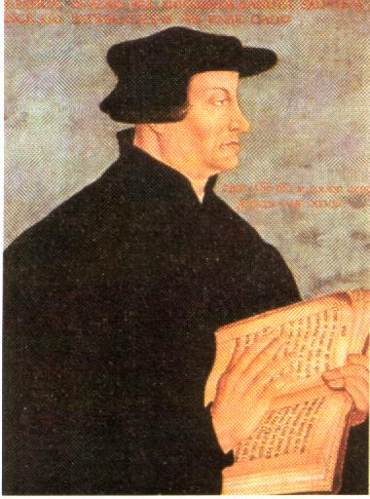
Romans 5:12-19 Adam and Jesus
Adam and Jesus are both very similar and very different.
Romans 5:12, 17, 18 The central question: What was the effect of Adam’s sin?
Does this passage support
“Original Sin”?
Zwingli: “In Adam’s fall,
we sinned all.”

Slide 48
The Effect of Adam’s Sin
a. Sin entered the world.
b. Death came to all (physical or spiritual or both?)
c. All sinned
We are not guilty of Adam’s sin, but because of what he did, all of us will sin. We have “fallen.”
5:13 Sin is not taken into account when there is no law… Romans 5:20, Romans 7:13
Q: Do you see sin as utterly sinful?

Slide 49
Romans 5:15-19 Adam and Jesus
5:15 The gift is not (exactly) like the trespass.
The gift: Jesus
The trespass: Adam similar but different.
One act let to many sins vs.
The many sins led to one act.
The gift followed many sins, while the condemnation followed one sin.
v. 18-19 condemnation for all and life for all….

Slide 50
The Second Adam in 1 Cor 15
1 Cor 15:20-23 This is about the physical resurrection, so he is discussing the physical results of Adam’s sin. NOT the same subject as Romans 5.
1 Cor 15:45-49 A difficult passage, but the same topic. Again, talking about physical things and the resurrection.

Slide 51
Romans 8:28-39 God’s provision for us
Romans 8:28 Q: Is God’s will always done?
Even the things that are NOT according to his will he can use for our benefit.
Romans 8:29 Does foreknowledge = predestination?
Paraphrase: Those who God, in his foreknowledge, knew would be saved by the blood of Jesus, he predestined the possibility of that salvation.

Slide 52
TULIP
Does Romans 8:29-30 give support for Calvinism/TULIP?
T Total depravity
U Unconditional Election
L Limited Atonement
I Irresistible Grace
P Perseverance of the Saints (once saved, always saved)
In a word: No!
1 Tim 2:4, Deut 30:19-20, 2 Cor 5:15

Slide 53
Romans 8:30
Paraphrase of Romans 8:30 (in a sense) all are predestined, but not all those who are predestined are called (hear the message), and not all those who are called are justified (saved) , and not all those who are justified are glorified (make it to heaven).
But… For those whom God foreknows, all of these are true of all of them.
Who is predestined, called, justified and glorified?
Calvin and Zwingli: a tiny minority who God chooses. All others were created in order to go to hell.
Paul: Those God foreknew would be saved.

Slide 54
Romans 8:30
Paraphrase of Romans 8:30 (in a sense) all are predestined, but not all those who are predestined are called (hear the message), and not all those who are called are justified (saved) , and not all those who are justified are glorified (make it to heaven).
But… For those whom God foreknows, all of these are true of all of them.
Who is predestined, called, justified and glorified?
Calvin and Zwingli: a tiny minority who God chooses. All others were created in order to go to hell.
Paul: Those God foreknew would be saved.

Slide 55
Romans 8:31-39 Security in Christ
Does this passage support “once saved, always saved”? (also John 10:27-29)
Answer: No! Nothing ourside ourselves can separate us, and nothing can snatch us out of Jesus’ hand, but we can walk away.
The point: We can and should feel very confident in Christ.
Q: Do you feel this way?

Slide 56
Romans Ch 9-11 God rejects Israel and chooses the Gentiles
Romans 9:1-5 Paul is getting really emotional here.
Why? Because he REALLY loves the Jews, but he is about to deliver some news they do not want to hear.
God has rejected (physical) Israel and has chosen the Gentiles.
The context: There are some Jewish Christians who are jealous and upset with God (and maybe with Paul) that he is allowing Gentiles into the kingdom so easily.

Slide 57
Romans 9:6-9 Not all Israel is Israel
Romans 9:6 Not all Israel are Israel (in two senses)
Romans 9:7 “It is through Isaac that your offspring will be reckoned” (Gal 4:21-31)
9:8 In other words, the children of promise, who walk by faith (not physical children) will be reconciled.
Q: What should we rely on? The promise.

Slide 58
Romans 9:10-16 God’s Predestination
Q: What is God’s predestination like? TULIP?
9:12-14
The older will serve the younger (Genesis 25:19-26)
Jacob have I lived, Esau I hated (Malachi 1:2-3
I will have mercy on whom I will have mercy (Exodus 33:19)
In all three cases, God chose Israel. Did they complain when that happened?
Answer: It is about God trying to bless his people.

Slide 59
Romans 9:17-29 More examples of God’s Predestination
Romans 9:17 Did God predestine that Pharaoh would go to hell? What about Judas?
The purpose in both cases: to free God’s people from slavery, physical and spiritual.
9:19 Jews: Fine. If so, then I am not responsible for my own sin.
9:20 Who are you, O man, to talk back to God.
9:22 God: If I use the stubbornness of the Jews in order to help the Gentiles be saved, you should be happy about that!

Slide 60
The Potter and the Clay
Romans 8:21 I am the potter.
Other potter/clay examples:
Jeremiah 18:1-10
God chooses Moses, Isaac, Jacob, David, Solomon, Jeremiah, Isaiah, Daniel and Jonah. All chosen for “special duty.”

Slide 61
Summary: God’s Predestination
God is sovereign and his will can trump our will, but:
1. He only intervenes in order to predestine
salvation for his people, “first for the Jews,
then for the Gentiles.”
2. Even when he “jerks people around” God
never steals their ability to choose whether,
ultimately, to serve God and to be saved.

Slide 62
Hebrews and Falling Away/Perseverance
They shall never enter my rest 3:11, 4:5
We have come to share in Christ if we hold firmly to the end the confidence we had at first. 3:14
They were not able to enter because of their unbelief 3:19
Be careful not to be found to have fallen short of it. 4:1
Some… did not go in because of their obedience 4:6
Let us make every effort to enter that rest so that no one will fall by following their example of disobedience 4:11
Do you get the point?

Slide 63
Historical type/antitype in the Exodus
OLD TESTAMENT TYPE
NEW TESTAMENT ANTITYPE
SLAVERY IN EGYPT
LOST, SLAVE TO SIN
WANDERING IN THE WILDERNESS
SAVED, BUT LIVING THE LIFE OF A DISCIPLE
ENTERING THE PROMISED LAND
ENTERING HEAVEN

Slide 64
Hebrews 6:4-6 Who is he talking to?
a. been enlightened (NT church “enlightened” = baptized)
b. tasted the heavenly gift (salvation?)
c. shared in the Holy Spirit
d. tasted the goodness of the word
e. tasted the coming age (saved)
Yes, you can fall away! Conclusion: You had better move on toward maturity in Christ.

Slide 65
Hebrews 6:4-8
It is impossible… if they fall away, to be brought back to repentance.
They are crucifying the Son of God all over again.
Land that produces thorns… will be burned.

Slide 66
Falling Away Hebrews 10:26-31
Crucifying the Son of God all over again.
Subjecting Jesus to public disgrace
Trampling the Son of God under foot. (Heb 10:29)
Insulted the Holy Spirit (Heb 10:29)
Blasphemed (spoken against) the Holy Spirit (Matt 12:32)
Committed the unforgivable sin (1 John 5:16 )
What is the “unforgivable sin?” To willfully, deliberately continue in sin. (Hebrews 10:26)

Slide 67
God’s Assurance: Hebrews 6:9-20
Two unchangeable things:
God’s Word
God’s Oath (Genesis 22:16-18)
Jesus, your anchor, is behind the veil with the Father

Slide 68
God’s Assurance: Hebrews 10:19-23
We have confidence to enter the Most Holy Place
Let us draw near to God… in full assurance of faith.
For he who promised is faithful.
Hebrews 10:35-36 Do not throw away your confidence; it will be richly rewarded…. You will receive what he has promised.

Slide 69
Other Textual Rebuttals

Slide 70
Answering Calvinist Proof-Texts for Total Depravity
Calvinist Proof-text #1 Exodus 20:4
This is about temporal/physical consequences.
Ezekiel 18 The soul who sins is the one who will die.
We cannot use Ezekiel 18 to disprove Exodus 20:4 or vice versa. We should ask, how can they both be true?

Slide 71
Calvinist Proof-text #2 Psalm 51:5
Psalm 51:5 Surely I was sinful at birth….
Answer: This is poetry, not a doctrinal statement. David is using hyperbole.
Is Psalm 51:4 literally true?
Psalm 58:3 is similar.

Slide 72
Calvinist Proof-text #3 Romans 3:9-12
Romans 3:9-12 None are righteous. None seek God.
True, but we must observe the whole balance of scripture. Paul does not expect us to take this in its most literal possible sense.
Matthew 13:17 Many prophets and righteous men longed to see…
Psalm 63:1 [David says] “O God, you are my God. Earnestly I seek you.
2 Chron 34:3 He began to seek the God of his father David.
Parallel: Ecclesiastes 7:20

Slide 73
Calvinism Proof-text(s) #4 Acts 13:48, 1 Pet 2:8
Arguably, the best “proof-texts” for total depravity and unconditonal election.
Acts 13:48 All who were appointed to eternal life believed.
1 Pet 2:8 They stumble… because this is what they were destined for.
These are two sides of a coin—Acts 13:8 is about the saved and 1 Pet 2:8 is about the lost.
Are these passages about a general rather than a specific election? Debatable. Which means that these passages are debatable.

Slide 74
Calvinist Proof-text #5 1 Cor 2:14
1 Cor 2:14 The man without the Spirit cannot understand God.
True, but Paul is addressing the Corinthians (1 Cor 1:2) and to the extent we are unspiritual, it is true of us, even as saved people.
We are saved, already, but not yet.
We are spiritual, already, but not yet.
This passage is addressing relative depravity, not total depravity, and to that extent it applies both to the lost and to the saved.

Slide 75
Summary
Calvinism is a theological system which was invented by Augustine, not by John Calvin. It came not from scripture, but either from his inherent dualism/Manichaeism or as a means to explain infant baptism or both. In any case, although the system is logical—indeed perhaps more “logical” than the truth—it is based on circular reasoning and on patently false assumptions about God. It is based on the assumption that if God gives us the choice of whether to accept his free gift or not, then this makes null and void his sovereignty. It is to be strongly rejected on multiple grounds. First, because it makes God the author of evil. Second, because it makes both the “love” of God for us and of us for Him to not be genuine love. Third, because it gives a theological basis for the twin false doctrines of praying Jesus into our hearts for salvation and once-saved-always-saved. The salvation of many millions of souls is at stake here. We cannot let this false theology remain unchallenged and we must inoculate the believers in our churches against this pernicious theological system.

Slide 76
Pontius Pilate
David Lee Burris:
Notice - Jewish Leaders Are To Pilate Being Both Obsequious & Appealing Pandectic
“What Is Truth?”

Slide 77
by Bob Taylor of the Firm Foundation
Five points of John Calvin
Along With All Catholicism
3. Rationale Fallacious Grounded
There is no coattail righteousness in the Bible - The righteousness of other people is not imputed to us. I am not a child of God simply because someone else is; I am not sober, righteous, and godly because someone else is. I am not on my way to heaven simply because somebody else is. There is no coattail righteousness taught in the Bible. In the realm of politics a man might sweep into lesser office by catching hold of the coattail of a much more popular politician. But no one is going to heaven by hanging onto the righteousness of another.

Slide 78
by Bob Taylor of the Firm Foundation
Five points of John Calvin
Along With All Catholicism
3. Rationale Fallacious Grounded
There is no coattail righteousness in the Bible - Transferred or borrowed righteousness is not taught in Holy Writ. The foolish virgins in Matthew 25 thought they could borrow righteousness, preparation and readiness from the wise five in that famed, familiar parable. They requested of the wise five what couldn’t be transferred or transmitted – righteousness and readiness to meet the Lord in peace!
It is also an egregious error, yet one widely held, that Deity transfers to us the personal righteousness of God the Father or the personal righteousness of Jesus Christ.

Slide 79
by Bob Taylor of the Firm Foundation
Five points of John Calvin
Along With All Catholicism
3. Rationale Fallacious Grounded
There are only two ways a person might be justified or counted righteous. I know of no 3rd alternative. (1) If a person never sinned & always maintained absolutely perfect obedience, he would be counted as righteous or justified simply upon the basis that he had never violated a single statute of the Lord’s will. Were this ever the case, then man might well glory and boast that he had earned or merited his heavenly salvation. His justification then would be a matter of debt–not of grace or favor. (2) The second way is for God to declare man justified by grace (God’s part) through an obedient faith (man’s part).

Slide 80
by Bob Taylor of the Firm Foundation
Five points of John Calvin
Along With All Catholicism
3. Rationale Fallacious Grounded
Righteousness is not something transferred to us. We do not inherit it – nor - we do not borrow it from those we think have a superabundance of it.
Peter told the first Gentiles to be converted under God’s glorious Gospel that acceptance to God comes from fearing (respecting) God and working righteousness. God’s plan of righteousness is revealed in the Gospel from “faith to faith” (Romans 1:16, 17). Those at Corinth had become righteous when they came into Christ Jesus (1st Cor. 1:30). They had become a washed, a sanctified, and a justified people (1st Cor. 6:11). This is how they became righteous. They remained in a righteous, justified or saved state as long as they did the Father’s will.

Slide 82
JUDGEMENT PREPARED
FIVE STATES FIVE STEPS
Five States of the Soul:
EXEMPTION:
Ezekiel 18: 20; Matthew 18: 1 – 3
CONDEMNATION:
Galatians 3: 22
JUSTIFICATION:
Romans 5: 1, 2; 8: 1, 2
DAMNATION:
Matthew 23: 3; Mark 16: 16
GLORIFICATION:
Romans 8: 17, 30; II Thess. 1: 7 - 12

Slide 84
JUDGEMENT PREPARED
FIVE STATES FIVE STEPS
Five Steps for Saving:
HEARING:
Romans 10: 17; Matthew 7: 24 - 27
BELIEVING:
Hebrews 11: 6; Mark 16: 15, 16
REPENTING:
Acts 2: 38; 17: 30; Luke 13: 3
CONFESSING:
Matthew 10: 32, 33; Acts 8: 36, 37
BAPTISM:
Romans 6: 3 – 5; Acts 8: 36 - 38

