Slide 1
CITIZENS OF THE KINGDOM
by David Lee Burris

Slide 2
What is the Kingdom of God?
Mustard Seeds
The Kingdom of God is….
The Kingdom of God is not…

Slide 3
What is the Kingdom of God?
I. The Kingdom of God is a “place” where God is king—where
God reigns.
II. The Kingdom of God is the topic Jesus spent by far the
most time talking about.
III. The Kingdom of God is a very big concept.
IV. The Kingdom of God is revealed in parables (because it
has to be)
V. The Kingdom of God is something which breaks out
suddenly and dramatically.
VI. The Kingdom of God is revealed in history.

Slide 4
What is the Kingdom of God?
VII. The Kingdom of God is not coextensive with or
equal to the church.
VIII. The Kingdom of God (Mark, Luke, John) is the
Kingdom of Heaven (Matthew)
IX. The Kingdom of God is already and not yet.
X. Nature—the physical earth is the Kingdom of God.
XI. Israel is the Kingdom of God.
XII. The Church is the Kingdom of God. (and I am not
contradicting myself)

Slide 5
What is the Kingdom of God?
XIII. The Garden of Eden is the Kingdom of God.
XIV. The Kingdom of God is any individual who has Jesus as his
or her king.
XV. The Kingdom of God is heaven.
XVI. The Kingdom of God is within (among) us.
XVII. The Kingdom of God is not a physical place.
XVIII. The Kingdom of God is not of this world.
XIX. The Kingdom of God is not a premillennial kingdom.

Slide 6
What is the Kingdom of God?
XX. The Kingdom of God is not Jesus reigning in Jerusalem.
XXI. The Kingdom of God is entered by being born again.
XXII. The Kingdom of God is something you are completely in
or completely out of.
XXIII. The Kingdom of God is a radical ethic in complete and
utter opposition to the worldly ethic and worldly kingdoms.
XXIV. The Kingdom of God is best described in the Sermon
on the Mount.
XXV. The unrighteous cannot live in the Kingdom of God.
XXVI. The Kingdom of God is a place where things are as
they ought to be.

Slide 7
What is the Kingdom of God?
XXVII. The Kingdom of God is a “place” where there is peace and justice.
XXVIII. The Kingdom of God cannot be moved.
XXIX. The Kingdom of God is a place where the Glory of God is
declared.
XXX. The Kingdom of God is a place where God’s will is done.
XXXI. The Kingdom of God is of inestimable value.
XXXII. The Kingdom of God is good news. The Gospel IS the
Kingdom of God.

Slide 8
What is the Kingdom of God?
XXXIII. The Kingdom of God is revealed, proclaimed,
preached, announced.
XXXIV. The Kingdom of God is not a friend of the
world.
XXXV. The Kingdom of God is not good news to
everyone.
XXXVI. The Kingdom of God is anywhere Jesus is.
XXXVII. The Kingdom of God is a relationship with God.

Slide 9
The Kingdom of God in the Old Testament
The Day of the Lord is a period of time when God openly intervenes in history and the affairs of men—both in judgment and in blessing. Joel 1:15 Woe because of that day!!!
Isaiah 2:12-22 Prideful individuals
Isaiah 13:6-13, 17-21 Babylon
Isaiah 34:4,8-10 Edom
Jeremiah 46:10 Egypt

Slide 10
The Kingdom of God in the Old Testament
Joel 2:1-2 Joel 2:11-17 Blow the trumpet! Jesus is coming back!!! v.13 you can still repent!
Joel 2:28-31 The Day of the Lord can be good news for some
Joel 3:9-14 Decision Time!
(Amos 5:18-20, Obadiah 15, Zephaniah 1:1f)
Malachi 4:5 John announces the Kingdom.

Slide 11
The Kingdom of God in the Old Testament
Israel in Canaan a picture/foreshadow of the Kingdom of God
Leaving Egypt a foreshadow. We enter the kingdom through water.
In the Wilderness: already but not yet in the kingdom.
Entering Canaan = entering the eternal rest with God. Hebrews 3:16-4:11 Our rest is in heaven.

Slide 12
Historical type/antitype in the Exodus
OLD TESTAMENT TYPE
NEW TESTAMENT ANTITYPE
SLAVERY IN EGYPT
LOST, SLAVE TO SIN
WANDERING IN THE WILDERNESS
SAVED, BUT LIVING THE LIFE OF A DISCIPLE
ENTERING THE PROMISED LAND
ENTERING HEAVEN

Slide 13
The Kingdom of God in the Old Testament
The Promised Land as a foreshadow of the future Kingdom of God
Deut 8:7-10 Milk and honey = streets of gold
Joshua 21:43-45 Israel in Canaan an idealization of the Kingdom of God.
1 Kings 4:25 A theocratic kingdom.

Slide 14
The Kingdom of God in the Old Testament
Hosea 11:1 We are called out of Egypt into the Kingdom of God.
Exodus 19:6 God’s plan: a kingdom of priests.
Revelation 1:6 Rev 5:10 Rev 20:6

Slide 15
Prophecies of the Kingdom of God
Prophesied Quality of the Kingdom of God | Old Testament Prophecies (and New Testament fulfillment)
Establishment of the Kingdom. | Jeremiah 31:31-34 (Hebrews 9:15) Ezekiel 36:24-27 (John 16:13-15, Acts 2:38)
Who will be the King? | Ezekiel 34:23,24 (John 10:14, Ephesians 1:22,23) Hosea 3:5 Joel 2:28-32 (Acts 2:16-21) Zechariah 13:1,2
Extent of the Kingdom of God. | Isaiah 49:6, 42:6 Isaiah 2:2-4 Isaiah 54:1 (Galatians 4:26-28) Ezekiel 17:22-24 Zechariah 2:10,11
Relationship between King and subjects. | Exodus 19:5,6 (1 Peter 2:9, 1 Timothy 2:5 Ezekiel 37:24-28 (2 Corinthians 6:6) Ezekiel 11:19,20 Hosea 1:10,11, 2:23 (Romans 9:25,26)
Relationships between subjects in the Kingdom of God. | Isaiah 11:6-10 (Galatians 3:26-28)
Persecution of the Kingdom of God. | Daniel 7:6-8 Daniel 7:19-25
Power and Endurance of the Kingdom of God. | Daniel 7:26,27 Amos 9:11 2 Samuel 7:12-14 Daniel 2:44

Slide 16
Prophecies of the Kingdom of God
Ezekiel 36:24-30
Hosea 3:5
Ezekiel 37:24-28 What a great picture!
Hosea 2:23
Conclusion: Zechariah 14:1-21

Slide 17
Parables of the
Kingdom by
Jesus ...

Slide 18
Greek: Para Bolle
Hebrew: “Mashal”

Slide 20
GOD’S SPIRITUAL KINGDOM’S BUILT OF UPSIDE-DOWN RELATIONSHIPS?!

Slide 22
The Wedding Garment @Christian Character

Slide 23
THE GENERAL PURPOSE OF PARABLES
Some teachers have defined parables as "earthly stories with heavenly meanings." The English word "parable" comes from the Greek word parabole, which means "to throw alongside." The word also is related to the word "parallel," which usually describes two similar things laid side-by-side. Two things that are "thrown alongside" each other are easier to compare. The goal of a parable is to compare one thing to another—with one of the objects being an important spiritual lesson and the other being an event from everyday life. For instance, Jesus compared His own relationship with His people to the relationship of a shepherd with his sheep (Luke 15: 1 - 7). He compared someone who teaches the gospel to a man planting a seed (Matthew 13:1-9), and He used such words as salt and light to describe the silent influence of a Christian (Matthew 5:13-16). – Apologetics Press

Slide 24
KINGDOM PARABLES: TAUGHT IN TWO SERIES
These are three similar parables of restoration, which the Lord uses to teach our various roles and responsibilities in restoring the lost. First, is the individual lost through his own ignorance, sought out by the shepherd, and returned. This is our basic responsibility for returning the lost. Next is the woman who finds the money which she has inadvertently misplaced. This emphasizes a greater responsibility for us to restore those who have been lost through our action, and perhaps little, or none of their own. Finally, the story of the personal responsibility of the individual to seek his own restoration. Thus, to have studied these parables separately would have been revealing, but when compared and contrasted as the Lord obviously intended for them to be, the lesson they teach is certainly a more comprehensive one of responsibility for losing and returning.
The key to these parables lies in noticing what the Lord uses as His example of the kingdom. In the first parable the kingdom is the treasure which we may find, and should then be willing to give all for it. In the second parable, though, the kingdom is not the pearl, which corresponds to the treasure of the first parable, but the Lord states that in this parable the kingdom is the man who is searching. This is a complete reversal of the parable before, although the example is basically the same. Thus, just as we search and purchase the kingdom, so does the Lord look for those servants who are of great price to Him; and we know that He was willing to give His all to make us citizens of that kingdom.
To complete the series, though, the next parable suggests that all that is caught will not be worthy of that supreme sacrifice and thus, will be destroyed or thrown back. This is similar to the parable of the tares, as well as Paul’s statements in I Corinthians 3:12-15. There, some would build on the foundation precious metals and stones, things that would endure, while others would build things that the trial would destroy. How many of us have wasted precious time and years in fields which are of no value, casting our pearls before swine?

Slide 25
KINGDOM PARABLES: TAUGHT IN TWO SERIES
First lesson: We should first find for ourselves that treasure, the Lord’s true kingdom. Second lesson: Then as citizens of that kingdom let us serve Him, who has paid the purchase for them, in the search for other pearls of value. Third lesson: Let us not waste valuable time catching fish of no value to Jesus, but diligently and fervently press that real treasure and those valuable pearls ever more closely to our breast. – John Welch

Slide 26
ACTUALLY THERE ARE 13 PARABLES W/UPSIDE-DOWN INVERTED FOCUS:

Slide 27
Matthew – Kingdom of Heaven Mark – Kingdom of God

Slide 28
“The kingdom of heaven is like…” in 13 of 43 parables.

Slide 29
Development of King & Kingdom
Theocratic Rulership
- God rules through prophets, judges and the Law of Moses.

Slide 30
Development of King & Kingdom
Theocratic Rulership
Human Kings Introduced
- Saul, David, Solomon, Divided Kingdom

Slide 31
Development of King & Kingdom
Theocratic Rulership
Human Kings Introduced
God and Human Rulers
- God is King and has a Kingdom

Slide 32
Development of King & Kingdom
Theocratic Rulership
Human Kings Introduced
God and Human Rulers
Man as Divine King
- I.E. Pharaoh, Caesar, God (Isaiah)

Slide 33
The King & The Kingdom in the O.T.
Isaiah
Zechariah
Obadiah
Messiah as King

Slide 34
The King & The Kingdom in the O.T.
Daniel - Messiah as Divine King
- Will Rule a Divine Kingdom

Slide 35
The King & The Kingdom in the N.T.
John the Baptist
- Divine Aspect of Kingdom
- Holy Spirit

Slide 36
The King & The Kingdom in the N.T.
Jesus the Messiah
- The Divine King & Kingdom

Slide 37
The King & The Kingdom in the N.T.
Divine Kingdom
- King at Center
- Spiritual in Nature
- Member by Faith
- Past → Prophesied
- Present → Church
- Future → United to Godhead

Slide 38
Kingdom Theology in Post N.T. Times
Augustine – R.C.
- Spiritual Monarchy

Slide 39
Kingdom Theology in Post N.T. Times
Augustine – R.C.
Reformers – Protestants
- Work of the Holy Spirit

Slide 40
Kingdom Theology in Post N.T. Times
Augustine – R.C.
Reformers – Protestants
Modern Theology
- Making the world a better place

Slide 41
Kingdom Theology in Post N.T. Times
Augustine – R.C.
Reformers – Protestants
Modern Theology
Jesus & the Kingdom Parables
- Fullness = God + Christ + Holy Spirit + Church + Angels + Spiritual Beings

Slide 42
The goal of this study is to understand the difference between where we are now and where we will end in the future.

Slide 43
The Kingdom Parables You are in or you are out.

Slide 44
Kingdom - Review
Progressive Revelation
Messiah – Ruler/King
Kingdom Near – John the Baptist
Jesus & the Kingdom
- United by Faith
- Spiritual not Political
- Kingdom Evolving

Slide 45
Why Parables?
Necessary Teaching
Hidden from Unbelievers & Opponents
Kingdom was Evolving

Slide 46
Parable – “…To lay along side.”

Slide 47
13 Kingdom Parables:
5 Agricultural
4 Money
2 Feasts
1 Fishing
1 Cooking

Slide 48
Review
Main preaching topic – the kingdom
Progressively revealed
Parables – Main teaching tool

Slide 49
Review
Main preaching topic – the kingdom
Progressively revealed
Parables – Main teaching tool
Parables explain the development of the kingdom

Slide 50
Review
Main preaching topic – the kingdom
Progressively revealed
Parables – Main teaching tool
Parables explain the development of the kingdom
13 of 43 parables were about the kingdom

Slide 51
The parable: the four soils

Slide 52
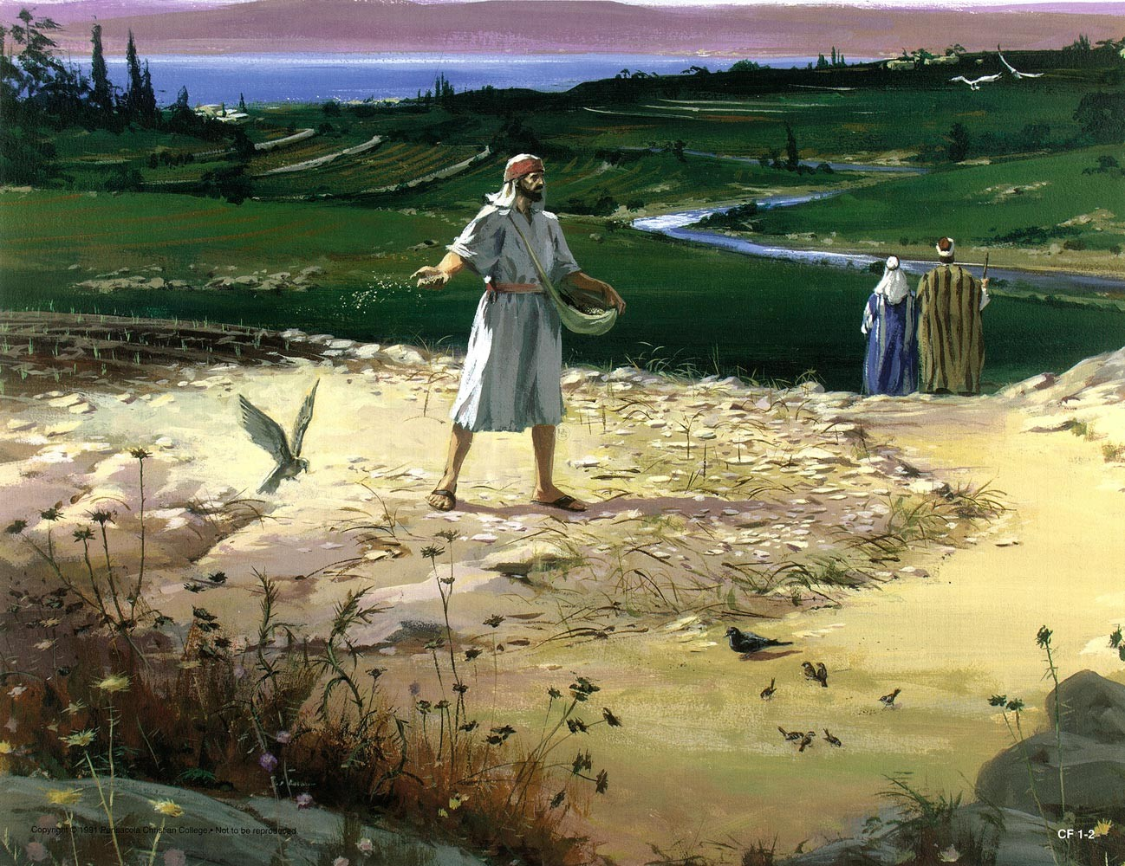

Slide 53
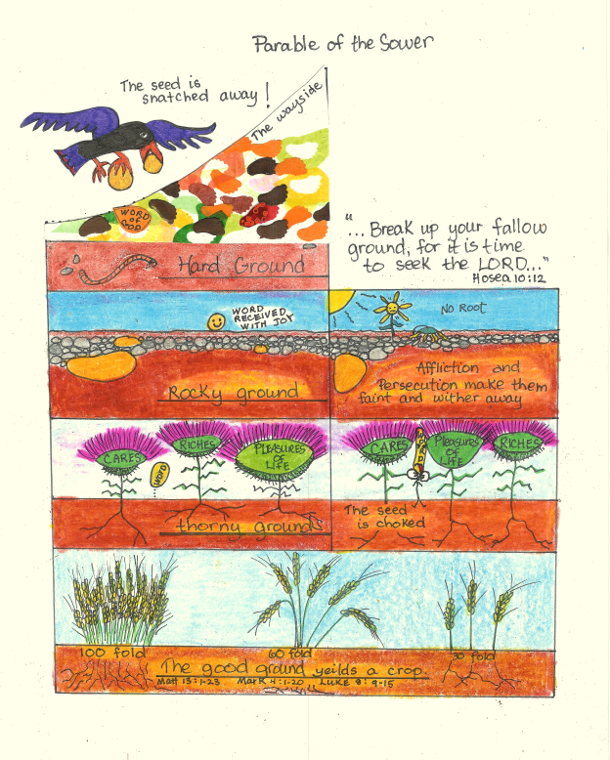

Slide 56
KINGDOM PARABLE: SOWING 4 SOIL TYPES
In the Palestine of Jesus’s day, a farmer would carry his seed in a pouch hanging from one shoulder. He would scoop a handful of seed and fling it on the field. The fields were divided into rows.
Between the rows were paths about three feet wide that the farmer walked on to get from one part of his field to another. Travelers also used these paths. You may remember reading about when Jesus and His disciples were walking through a field of grain, and His disciples were eating some of the grain. “At that time Jesus went through the grainfields on the Sabbath. His disciples were hungry and began to pick some heads of grain and eat them” (Matthew 12:1). They were walking on one of these paths through the fields. These paths were packed down and hardened from all the foot traffic.
The farmer Jesus told about encountered several kinds of soil in the field he was sowing. On the surface, all the soil looked the same. The difference only became obvious by the crop it produced. Let’s discuss those soils.
Rocky soil: The farmer encountered rocky ground, such as the sections of limestone covered by three or four inches of earth, as can be found in Palestine. In those places, the roots of the plants could go down only so far. The plants sprouted upward quickly because growth was upward instead of downward. But because their root systems were shallow, providing inadequate access to water and nutrients in the soil, the plants died very quickly from the heat of the sun. This kind of soil could not be identified simply by looking at it, because on the surface, it looked just fine.
Thorny soil: Some soil had the seeds of weeds in it. The weeds were not visible, but when the sowed seeds began to sprout, the weed seeds sprouted too. The weeds were in their native soil—they owned that ground. These weeds overpowered the good plants.
Good soil: The good soil was deep and rich and ready to receive seed. It had no weeds. The soil was cultivated by the farmer, and the soil had benefited from that cultivation. It was prepared to take the seed in, let it put down deep roots, nourish it, and cause it to grow fruit.
The Rule of Four
Jesus was again using a very familiar concept: the rule of four. Rabbinic literature identified four kinds of disciples. For example, here are four characteristics of a disciple:
1. Quick to learn and quick to lose: His gain is canceled by his loss.
2. Slow to learn and slow to lose: His loss is canceled by his gain.
3. Quick to learn and slow to lose: This is a good portion.
4. Slow to learn and quick to lose: This is an evil portion.
Another example comes from the Talmud: There are four qualities among those who sit at the feet of the sages: they are like a sponge, a funnel, a strainer, or a sieve. A sponge soaks up everything; a funnel takes it in at one end and lets it out at the other; a strainer lets the wine pass through but retains the lees; a sieve allows the bran to be removed and retains the flour.
Many other writers and rabbis have used the rule of four when comparing and contrasting disciples. We are reminded of how thoroughly versed Jesus was as a rabbi of Israel.
The four soil types were all part of the same field, and three of the soil types looked the same on the surface. I have noticed certain aspects of my life that would mirror each of these soils. Read through the parable again. Jesus will interpret the parable Himself, but before we look at His interpretation, answer this question: Do you see these four soils in your own life?
Dean, J. K. (2007). . Ashland, OH: New Hope Publishers.
Dean, J. K. (2007). Secrets jesus shared: kingdom insights revealed through the parables. Ashland, OH: New Hope Publishers.

Slide 57
KINGDOM PARABLE: THE SECRET GROWTH
It has been suggested that St. Matthew has given us in the Parable of the Tares another report of St. Mark’s Parable of the Seed growing secretly; but the only ground for this conjecture is that there are some verbal coincidences in the two records. The stories themselves and their teaching are quite distinct. More probably the Sower, the Seed, and the Tares formed originally a trilogy, delivered in that order, of which St. Mark has preserved the first and the second, and St. Matthew the first and the third, St. Luke keeping only the first.
To come now to St. Mark’s parable. Notice its special point. In common with the Parable of the Sower it begins with the picture of the process of sowing. But that process is dismissed at once: it is the subsequent growth of the seed on which the parable turns. The sower sows, the reaper will reap; but who takes care of the seed in the intermediate months? who sees to the sprouting, the maturing, the fructification? How are these things done and by whom? The whole process, as far as we can see, is automatic, due to the spontaneous action of the soil, or the inherent vitality of the germ and plant. Through the hours of night and day, while men sleep and while they work, that silent mystery of growth goes forward without human intervention; it is only at the beginning and the end that human instrumentality is employed.
Swete, H. B. (1920). (pp. 1617). London: Macmillan and Co.
Swete, H. B. (1920). The Parables of the Kingdom: A Course of Lectures (pp. 16–17). London: Macmillan and Co.

Slide 58
KINGDOM PARABLES: KINGDOM GROWTH
1. Seed is essential to provide kingdom-citizens! This fact is stated clearly in many places and it is illustrated here, as parables illustrate principles established elsewhere.
Man may sow seed, but the germ of life resides within the seed, producing after its kind. One will never sow one kind of seed and reap fruit of another kind; the plant is determined by the seed. The seed of the kingdom is the word of God (Lk. 8:11). Therefore, the seed is indispensable, if kingdom-citizens are to be made.
Many people fail to accept this principle, thinking that God operates independently of His revealed word. However, just as surely as night follows day, one will not find a Christian where the seed, the word of God, has not been planted ' Let us be aware of this fact and see the implications of it. (1) If we wish to grow, as citizens in the kingdom, we must have planted in our mind the word of God. (2) If we wish to gain others and bring them into the kingdom, we must be careful and sure to present to them the pure seed, unmixed with our ideology, etc.
2. Mystery in the Seed. None of us can explain why a seed placed in the ground, provided proper moisture, conditions, etc. will in time sprout, spring forth in a plant. However' we have all observed that such is the case. God, the Creator' has placed the life in the seed. Such is the way things are! We have no plants which are not so produced.
The principles that are operative in the plant and animal kingdom are also operating here. We need to see that such is true, and conclude "no planting, no harvest." The kind of seed planted will determine the kind of fruit that can be expected, if indeed fruit is produced. The Word of God produces faith (Rom. 10: 17; Jn. 20:30-31). Faith produces movement to obey the words, the requirements set forth therein (Rom. 6:16-18; Heb. 5:8-9). Repentance is a demand of "all" men everywhere (Acts 17:30-31). Confession is produced by the person whose faith leads him to repent, because Jesus points to the necessity of such (Matt. 10:32-33; Rom. 10:9-10). Baptism is the last of these steps in one's movement toward salvation in Christ, which bring about the establishment of the relationship (Rom. 6:3-4).
3. The progress is orderly! First the blade, then the ear, and finally the grain is produced. One will not become a citizen of the Kingdom, except in an orderly fashion: Seed planted, time to germinate, plant springing up - one coming in faith, obeying, because he understands that such is required of God. – Truth Magazine

Slide 59
The parable: wheat & tares

Slide 61
KINGDOM PARABLE: WHEATFIELD DARNEL
This parable evidently paints the darker side of the analogy between the cornfield and the Kingdom of God; and the question arises why this dark side should have been depicted so early in the course of the Gospel. There was as yet, so far as we know, no falling away among the disciples: no traitor Judas, no fallen Peter; while the Ananiases, Sapphiras, and Demases of the Apostolic age were as yet not heard of. ‘I own,’ writes Dr. Salmon, ‘I have always felt it as a problem demanding explanation, that our Lord should have dealt with this topic at so early a period of His ministry.’ Dr. Salmon himself suggests what is doubtless the true answer, that our Lord’s prescience supplied the intimate knowledge of the future that He shews in this parable. But His knowledge of men—He knew, St. John says, what was in man—in itself would perhaps have sufficed to lead Him to foresee that there must be a dark side to the operations of the Kingdom of God. It could not be otherwise, human nature being what it is. Even in the parable of the Sower there are intimations that in many cases the seed is sown in vain; that partial or even complete failure is to be expected. But the Parable of the Tares carries us further; it is not simple failure that we have here, but a deliberate attempt to counteract and so to destroy the work of God.
This is one of the two parables which are explained for us by our Lord Himself. According to St. Matthew the explanation was given in the house to the Twelve; not from the boat, not to the crowds. St. Mark tells us that it was the Lord’s habit at this time to follow up His public teaching by a private instruction when He was alone with the Apostles; and two samples are given by St. Matthew. It is quite arbitrary to say, as some do, that these explanations were added by a later generation, and that they embody only the traditional interpretation of the first century; they are ascribed to Jesus as distinctly as the parables themselves, and have an equal claim to be regarded as His.
Swete, H. B. (1920). (pp. 2324). London: Macmillan and Co.
Swete, H. B. (1920). The Parables of the Kingdom: A Course of Lectures (pp. 23–24). London: Macmillan and Co.

Slide 62
KINGDOM PARABLE: WHEATFIELD DARNEL
Reasons have sometimes been given for this which are not given in the parable itself: that the darnel and the wheat, being more or less alike in form, the wheat may be mistaken for darnel; or that the darnel can be converted into wheat, if it is left long enough. The latter is of course impossible; however long you let the darnel grow, it will not become wheat. Nor is there much risk of the one plant being mistaken for the other. The parable itself sufficiently explains the command when it adds, Lest while ye gather up the tares, ye root up the wheat also. Pull up the darnel, and the chances are that a wheat plant will come with it. And this is after all the gravest danger which besets the exercise of Church discipline. Not that you will mistake an Arius for an Athanasius, or a saint for a hypocrite, but that in uprooting the pretender or the blasphemer, you may uproot also many whom circumstances have attached to him, but who are at heart loyal subjects of the Divine Kingdom. Our Lord’s direction, however, cannot be taken to prohibit the Church from all exercise of discipline; the saying Whose soever sins ye retain, they are retained, serves to balance the command Let both grow together. And the latter saying must be held to apply not so much to the public action of the Church as a body, as to the conduct of individual Christians towards one another.
Swete, H. B. (1920). (pp. 2930). London: Macmillan and Co.
Swete, H. B. (1920). The Parables of the Kingdom: A Course of Lectures (pp. 29–30). London: Macmillan and Co.

Slide 63
KINGDOM PARABLES: THE MOST ABUSED
The Parable of the Tares (Matthew 13:24-30) is one of the most perverted and misapplied passages of God’s word. Brethren err in applying this passage to out treatment of erring brethren. Some brethren tell us that since the householder commands his servants to let the tares (the wicked) and the wheat (the righteous) grow together, it is wrong for a congregation to withdraw from a brother who refuses to repent of his sins.
One who is only casually acquainted with the New Testament can readily see that the Parable of the Tares cannot mean that congregations are forbidden to discipline disorderly members, for if it did it would contradict such plain passages as 1 Corinthians 5 and 2 Thessalonians 3:6, 14-15. It is equally obvious that the parable does not mean that it is wrong for us to expose error and rebuke brethren who teach and practice it, for if it did it would contradict such clear passages as 2 Timothy 4:2, Jude 3, Ephesians 5:11, and Titus 1:10-13.
Jesus explains the parable in verses 37-43. Let it be noted that the field in which the Lord sows wheat and the devil sows tares is not the church-the field is the world (verse 38). The children of the devil and the children of the kingdom exist in the world (the field) together until the end of the world. At the end of the world the angels will gather the tares out from the midst of God’s people and cast them into the furnace of fire.
Note also that the servants of verse 27, whom the householder told not to gather the tares, are not Christians. The Christians are represented by the wheat, not by the servants. The command to let the tares grow along with the wheat, therefore, is not meant for Christians. Our treatment of the wicked is not under discussion in the passage.
The uprooting of the tares represents a final separation of the tares from the wheat. The point of the parable is that the Lord permits the evil and the righteous to exist on earth side by side, not separating the two groups until the end of the world. We could not change that if we wanted to. When we rebuke sinners or when a congregation disciplines a member, the rebuking or the discipline does not bring about the separation forbidden in verses 28-30, for the sinners are still growing in the field (the world) with us – and will continue to do so until God brings about the separation at the end of the world. – Truth Magazine

Slide 64
The parable: mustard seed

Slide 66
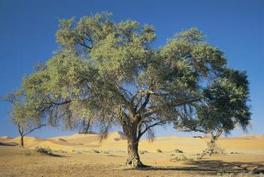

Slide 67
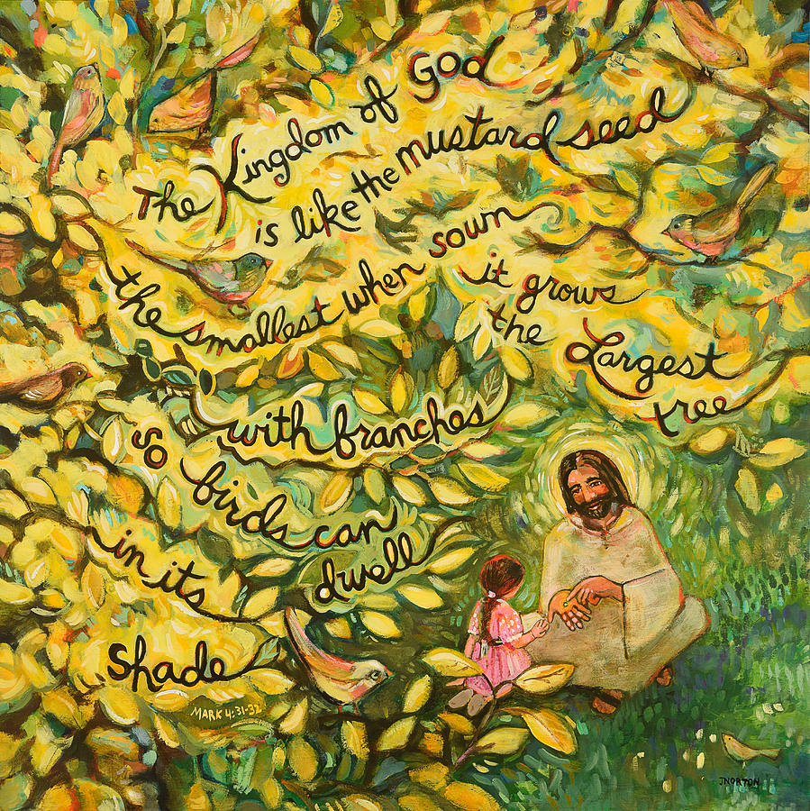

Slide 68
KINGDOM PARABLE: MUSTARD SEED TREE
Seed Talk
Seed is a repeated metaphor in Jesus’s parables. Jesus implies that a seed is what God built into creation to paint a picture of His Word.
The miracle of a seed is that it contains in it everything that the full-grown plant will become. A seed won’t grow and reveal its secrets unless it is planted. Once planted, a time during which no result is observable elapses. The first part of the process of growth happens in the root system, hidden to the eye. Once planted, the outer husk of the seed dies, and the life it contains begins to put down roots. Growth is happening, but it is not visible. Only when the root system is established will the visible growth begin. The visible growth comes in stages—little by little—not all at once.
The growth that a seed produces is life that comes out of death. The seed’s husk dies so that the seed’s life can be revealed.
“I tell you the truth, unless a kernel of wheat falls to the ground and dies, it remains only a single seed. But if it dies, it produces many seeds.”
—John 12:24
Where is the life in a seed? It’s in the seed’s embryo, which contains the blueprint for life. The husk, the tough outer layer that encases the seed, must be broken down so water and oxygen can reach the embryo, the life center. The outer layer must die so the life contained within the seed can emerge.
Dean, J. K. (2007). . Ashland, OH: New Hope Publishers.
Dean, J. K. (2007). Secrets jesus shared: kingdom insights revealed through the parables. Ashland, OH: New Hope Publishers.

Slide 69
The parable: good leaven

Slide 72
KINGDOM PARABLE: LEAVEN GOOD & BAD
The leaven, however, is capable of two very opposite uses as an illustration. The ancients regarded fermentation as a species of corruption, and therefore made leaven a figure of moral evil, and it is so used both in the Old and New Testaments. Under the Law no leaven was allowed in any offering made upon the altar, doubtless for this reason; and the same feeling, perhaps, lay at the root of the prohibition of leaven in the Passover week. It is interesting to find that a similar aversion to leaven exists in the Old Roman religion: for example, that most distinguished of Roman priestly officials, the Flamen Dialis, was forbidden to eat leavened bread.
The New Testament recognizes this aspect of leaven, as when St. Paul exhorts, Know ye not that a little leaven leaveneth the whole lump? Purge out the old leaven, the leaven, as he says below, of malice and wickedness. And our Lord Himself spoke deprecatingly of the leaven of the Pharisees and Sadducees, meaning their pernicious doctrine. This is indeed the prevalent view of leaven in the New Testament. Considered as a type of moral energy, its connotation is on the whole decidedly bad. For this reason some have taken the Parable of the Leaven as a prophecy of the spread of evil through the Church until the whole was corrupted: a very much worse version of the teaching of the Parable of the Tares, for in the Tares evil is represented as merely mixed with the good, in whatever proportions, whereas in the Leaven, if we hold their view, it is represented as finally triumphant and universally disseminated, the whole Kingdom of God on earth being leavened by it. But that is very far from being the prospect which our Lord holds out to His Church; whatever dark ages may come, evil is in the end to be conquered and not to conquer. Hence in this parable we must not press the idea of corruption which usually adheres to leaven, but think only of its characteristic power of spreading through a mass far greater than itself, and changing it, making the rest like itself.
Swete, H. B. (1920). (pp. 4142). London: Macmillan and Co.
Swete, H. B. (1920). The Parables of the Kingdom: A Course of Lectures (pp. 41–42). London: Macmillan and Co.

Slide 73
KINGDOM PARABLE: LEAVEN GOOD & BAD
This is far from being merely another way of representing the spread of the Kingdom of Heaven from small things to great which is foretold in the Parable of the Mustard Seed. The Mustard Seed, like the other parables of sowing, represents the law of growth as it is common to the vegetable and the spiritual kingdom. But the leaven does not in this sense grow; it makes its way through an alien mass, changing its character by a pervasive influence. This is quite a new view of the Kingdom of Heaven, and it is complementary to the former. Its progress is like that of a growing plant; but it is also like that of a permeating, a spreading influence. The Kingdom grows by its own inherent vitality, but it grows also by assimilating to itself that which has hitherto been of a different nature and even hostile to it. There was nothing in common use which so clearly illustrated this property as leaven; and so, notwithstanding the bad reputation which leaven had in symbolism, the Lord did not hesitate to use it for His own purpose. Good, He would say, spreads as well as evil, if not so fast. In Israel under the Law the Kingdom of God had not spread to other nations, for even the Dispersion merely sought to bring people of other nations over to the Israelite fold; there was no effort made to influence without proselytizing them. But the new Kingdom was not to be such; the men whom it dominated were to remain in their own homes and influence those around them, until the whole Empire, the whole world, the whole lump of humanity was leavened by the faith and moral teaching of Jesus Christ.
Swete, H. B. (1920). (pp. 4244). London: Macmillan and Co.
Swete, H. B. (1920). The Parables of the Kingdom: A Course of Lectures (pp. 42–44). London: Macmillan and Co.

Slide 74
The parable: hidden treasure & precious pearl

Slide 76
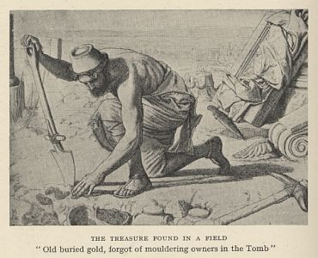

Slide 77
KINGDOM PARABLE: HID TREASURE FOUND
This again is built upon an incident which, if not of daily happening, is not uncommon in Eastern lands. A laborer, breaking up new soil, or going deeper than others have gone, strikes something hard, which rings under his pick-axe. He finds it to be an old wine jar, perhaps carefully sealed, but when the seal is broken, there comes out not wine, but gold and silver coins of three or four centuries ago. In lands where banks were not yet and where life and property were insecure, the owner of property was often at a loss how to dispose of it safely. A part of it was often buried in a place which the man did not make known even to wife or son; if he died leaving his secret untold, the treasure might lie under the soil for generations, till by a mere chance it was turned up by some peasant ploughing or digging. There were even people who spent their time in digging up waste land on the mere chance of striking on such treasures, but the man in the parable seems to have happened upon it by accident. But he does not at once tell all the world of the treasure which he has found, nor carry it to the nearest magistrate and surrender it. He dissembles his joy, but it moves him to take a momentous step. He sells his little all; it is just enough to buy the field, and the land is his, with all in it. So he becomes possessor of the treasure, and that done, cares nothing for the sacrifice he has made.
Swete, H. B. (1920). (pp. 4546). London: Macmillan and Co.
Swete, H. B. (1920). The Parables of the Kingdom: A Course of Lectures (pp. 45–46). London: Macmillan and Co.

Slide 78
KINGDOM PARABLE: THE FIELD TREASURE
Hidden Treasure
The first parable implies a man stumbled across something of great value hidden in a field. The description is vague. It certainly could have been something valuable that someone had buried for safekeeping, a common practice of the time; I think, though, that it was assumed that the treasure was something that occupied the whole field. In order to possess the treasure, one would have to possess the field. I think Jesus’s audience more likely understood the treasure to be something like a gold mine or a silver mine, with veins of the treasure running all through the field.
As I try to hear this story through the ears of His contemporaries, several things are suggested in the context. His audience would have heard all these things without Jesus having to spell them out.
The man evidently was not scrupulously honest. The hearer wouldn’t automatically think that he had integrity because he didn’t just take the treasure, but instead went to buy the field. After all, apparently he kept the treasure a secret and did not disclose it to the seller.
Also, by Jewish law, he sinned by not disclosing that which was lost. The treasure he found would not legally belong to him, but to the one who had misplaced it. Buying the field would not give him legal ownership of the treasure. Talmud was very detailed about how long one had to try to find the owner of a lost item before the finder could take possession of it legally. This buyer did not try to find the owner at all.
The last point makes me think that the field itself embodied the treasure—that the treasure was hidden in and inseparable from the field. It was not a treasure that could be dug up and carried off. It had to be mined and extracted.
Dean, J. K. (2007). . Ashland, OH: New Hope Publishers.
Dean, J. K. (2007). Secrets jesus shared: kingdom insights revealed through the parables. Ashland, OH: New Hope Publishers.

Slide 79
KINGDOM PARABLE: HID TREASURE FOUND
When the Kingdom of God comes thus to a man, it compels sacrifice; it may be, the sacrifice of everything. He sees things in a new light; the treasure must be secured at all costs, and he goes through with the business till it is done. The Lord evidently has in view the sacrifice to which He had called the Twelve, and was calling all who followed Him. It is the teaching of that hard saying, Whosoever of you forsaketh not all that he hath cannot be my disciple, and many more sayings of the Galilean ministry to the same effect. Yet in the Parable of the Hid Treasure, this great sacrifice is not imposed as a duty, but represented as an act inspired by the very joy of the great discovery: For joy thereof … he selleth all that he hath. And we see how provident, how businesslike, the man’s conduct really is: he gains very much more than he lost. No doubt the ethics of his conduct are not beyond criticism, for he bought the field for far less than its real worth from an unsuspecting owner. But in this parable, as in some others, we are not concerned with the ethical standard of the characters: indeed doubtful ethics cannot help towards acquiring the heavenly treasure. All that has to be considered is the greatness of the sacrifice and its wisdom; he who counts all things but loss for the excellency of the knowledge of Christ counts correctly, for so they are in the reckoning of eternity.
Swete, H. B. (1920). (pp. 4647). London: Macmillan and Co.
Swete, H. B. (1920). The Parables of the Kingdom: A Course of Lectures (pp. 46–47). London: Macmillan and Co.

Slide 80
KINGDOM PARABLE: “HIDDEN TREASURE”
Many sayings of the rabbis, as do the Holy Scriptures, equate wisdom and knowledge with treasure.
The belief of the Jewish people was that, on Mount Sinai, God revealed all truth to Moses. Moses wrote it down in the Torah—the first five books of the Bible. The words of the Torah contained all truth, but much of the truth was hidden. The role of sages and rabbis was to extract the hidden truths. They mined wisdom from every phrase and every word. The body of truth extracted from Torah was the Talmud, the oral law.
You can see how Jesus’s audience would have made many associations that we might miss. Knowledge of Torah and wisdom from above were often referred to as treasure. Much of that treasure was hidden from sight and could not be observed on the surface. It would not yield itself simply by digging a hole and grabbing hold of it. The treasure had to be mined, carefully and skillfully. The veins of treasure ran throughout the whole Torah, rather than being plopped into one hole, one place. Seekers, such as those in Jesus’s audience, were always on the lookout for new veins of treasure not yet discovered.
In this parable Jesus shared, the twist came when the man rushed out immediately and sold everything he owned and invested all in one field. This field was worth everything to him. Nothing else compared to possessing this field. Everything the man had owned, valued, and worked for previously seemed worthless. All that mattered was possessing the treasure hidden in the field.
Dean, J. K. (2007). . Ashland, OH: New Hope Publishers.
Dean, J. K. (2007). Secrets jesus shared: kingdom insights revealed through the parables. Ashland, OH: New Hope Publishers.

Slide 81
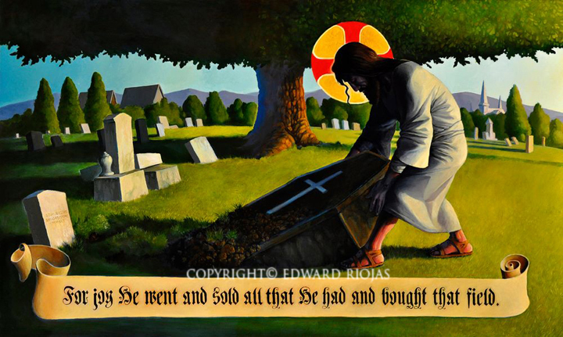

Slide 83
KINGDOM PARABLE: THE PRECIOUS PEARL
This may seem to be an exception to the rule that the parables represent common facts and scenes; for the Holy Land had no pearl fishery. But the Red Sea has beds of the pearl oyster, and the pearl was in high repute in Galilee and elsewhere in the East in our Lord’s time: Cast not your pearls before swine was a proverb which appealed to those who heard the Sermon on the Mount; the woman of fashion in St. Paul’s Epistle decks herself out with pearls, gold and costly raiment; the gateways of the New Jerusalem in St. John’s vision are made of monster pearls. Doubtless the pearl merchant was to be seen on the great roads of Galilee, passing between Herod’s capital and Tiberias, and the other great cities of the North, Damascus, Sidon, and Tyre. The merchant in the parable sought goodly pearls, fine specimens, and with these he was content. But one day he was offered a pearl far beyond all others in value, and he was determined to have it. As the peasant sold all that he had to buy the field where the treasure lay hid, so the merchant parted with all his stock in trade, all the goodly pearls he had been at such pains to acquire, for the sake of the one which excelled them all. Better be the owner of that one, than of a whole sackful of inferior gems!
Swete, H. B. (1920). (p. 49). London: Macmillan and Co.
Swete, H. B. (1920). The Parables of the Kingdom: A Course of Lectures (p. 49). London: Macmillan and Co.

Slide 84
KINGDOM PARABLE: THE PRECIOUS PEARL
Pearl of Great Value
The second of these twin parables goes like this: “Again, the kingdom of heaven is like a merchant looking for fine pearls. When he found one of great value, he went away and sold everything he had and bought it” (Matthew 13:45–46).
Jesus told the two parables as one. “Again” is the translation of a conjunction Jesus used that tied the two together into one. This is a very common rabbinical device—saying basically the same thing two different ways, adding depth to the picture.
In this second parable, the person who found the treasure was looking for that very treasure. He didn’t just happen upon some unspecified treasure. He had spent his career searching for fine pearls. He knew pearls. He had examined more pearls than he could count. He knew what to look for in a pearl.
After all that time, all his effort, all his investment, he found one pearl that he knew immediately was the one he had been looking for. In his mind’s eye, he compared it with all the other pearls he had bought over the years, and they all fell short. None of them could come close. This pearl was worth all the others combined … and more. This pearl was worth everything he owned.
Like the man who stumbled across a treasure in a field by accident, this man immediately sold all he had and bought what he treasured—the one pearl. The pearl cost him everything.
Who do you think the merchant was? Who in Jesus’s day had spent their lives searching out the treasures of Torah? Who among Jesus’s peers had been hungrily seeking the one pearl that would satisfy their quest for wisdom?
With these twin parables, Jesus invited both the scholarly, learned leader and the unschooled peasant into the kingdom. The cost was the same for both: everything they had. The reward was the same for both: everything He has.
Dean, J. K. (2007). . Ashland, OH: New Hope Publishers.
Dean, J. K. (2007). Secrets jesus shared: kingdom insights revealed through the parables. Ashland, OH: New Hope Publishers.

Slide 85
PARABLES SET @VALUE OF THE KINGDOM
As the Lord’s ministry progressed, the hostility of the Jewish leaders intensified. Accordingly, at a certain point in time, Jesus began to teach in parables.
Christ’s parables were human stories with a heavenly meaning. Their design was two-fold. First, his parables effectively communicated divine truths to those who were honest of heart.
Second, the story form concealed those truths from those who would abuse them, and thus seek the Savior’s death prematurely (Matt. 13:13ff).
In Matthew 13, there is a collection of seven parables which are intended to emphasize certain important spiritual concepts which God’s people need to appreciate.
Among these parables are two which are strikingly similar; and yet, they have a significant difference as well. These are the parables of “the hidden treasure,” and that of “the pearl of great price.” These one-sentence parables read as follows:
The kingdom of heaven is like unto a treasure hidden in the field; which a man found, and hid; and in his joy he goeth and selleth all that he hath, and buyeth that field.
Again, the kingdom of heaven is like unto a man that is a merchant seeking goodly pearls: and having found one pearl of great price, he went and sold all that he had, and bought it (Matt 13:44, 45).

Slide 86
PARABLES SET @VALUE OF THE KINGDOM
Similarities Between the Two Parables:
First, let us consider several similarities that are common to both of these narratives.
Initially we are struck with the fact that both of these parables deal with the kingdom of heaven. The term kingdom is employed in a variety of ways in the New Testament. It can refer to the reign of God over his people under the Mosaic system (Matt. 21:43). And it is used of the final abode of the saints, i.e., heaven itself (2 Tim. 4:18).
Frequently, however, “kingdom” simply denotes the church (Matt. 16:18-19; Col. 1:13; Rev. 1:6,9). Clearly, it is this latter sense to which the Lord alludes in the collection of “kingdom” parables of Matthew 13.
Jesus is thus teaching some great truths relative to the church which he would presently establish (Matt. 16:18).
Second, the exceeding great value of the kingdom is seen in that it is compared to both a treasure and a pearl of great price.

Slide 87
PARABLES SET @VALUE OF THE KINGDOM
The Kingdom: Worthy of Our Sacrifices
Another similarity between these two parables is the fact that both emphasize the deep sacrifice that one must be willing to make to obtain the blessings associated with the Lord’s kingdom.
In each case the man was willing to sell “all that he had” in order to embrace his treasure or pearl. Let us reflect upon some of the sacrifices that one must be willing to make on behalf of the Lord’s kingdom.
The Sacrifice of Self
The initial sacrifice that must be made in order to partake of the kingdom blessings is that of the sacrifice of oneself. Jesus taught that the person who would follow him must “deny himself” (Luke 9:23).
The hardest task that any of us will ever have is thrusting our own interests to the background and seeking the kingdom first (Matt. 6:33), but that is precisely what is required.
Paul left us a model for emulation: “I have been crucified with Christ; it is no longer I that liveth, but Christ liveth in me...” (Gal. 3:20).
There are far too many within the family of God who treat membership in the body of Christ as if it were a hobby, some sort of civic organization, or a mere weekend exercise.
The Sacrifice of Resources
A genuine Christian will sacrifice his time, talents, and money in the interests of the kingdom of God.
The parable of the talents (Matt. 25) is a somber warning of the consequences of failing to use what the Lord has placed at our disposal. Once one determines that he will truly give himself to God (2 Cor. 8:5), everything else will fall into place. As a favorite song has it, “heaven will be worth it all.”
We must all encourage one another to attempt to better catch the spirit of these two parables. Clearly they emphasize the value of the eternal, and the effort that must be expended in that interest.

Slide 88
PARABLES SET @VALUE OF THE KINGDOM
A Difference Between the Two Parables
A significant difference between the parable of the hidden treasure, and that of the pearl of great price, would seem to be that in the former, the man accidentally “found” the treasure, whereas in the latter narrative, the merchant was “seeking” the goodly pearl. Perhaps this represents two classes of persons which are exposed to the gospel.
On the one hand, there are those who are pursuing their lives, busily engaged in daily activities, and who are wholly unaware of what they are missing by ignoring spiritual realities. They may be exposed to the truth by means of a neighbor, a tract, or some other method of evangelism, and thus be thrilled with their new discovery. They stumble over the Word of grace, recognize its value, and readily receive it.
The Samaritan woman in John 4 may be an example of such. When she went for water to Jacob’s well that day, little did she dream that she would find the treasure of spiritual water whereby her thirst could be quenched eternally.
Then, on the other hand, there are those who know their lives are disheveled. They are so very unhappy, and are looking for something to provide them with contentment of soul.
In their hunger and thirst for righteousness they discover, perhaps with the assistance of the unseen hand of Providence, the pure gospel and forsake all to possess it.
Nicodemas, who sought out the Savior by night (John 3), appears to have had this frame of mind.

Slide 89
The parable: the dragnet

Slide 91
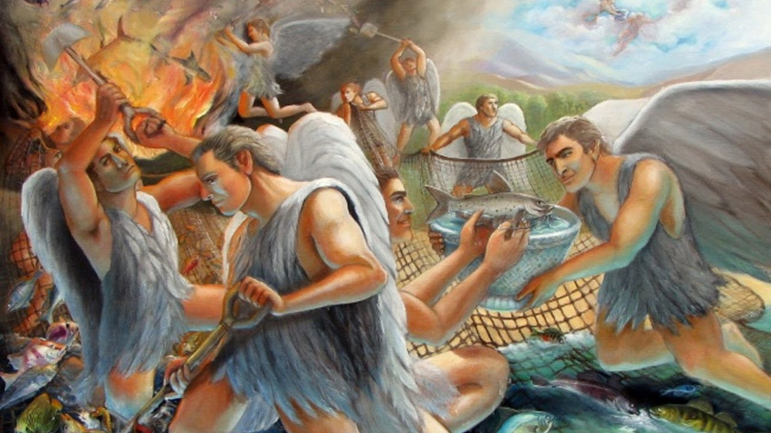

Slide 92
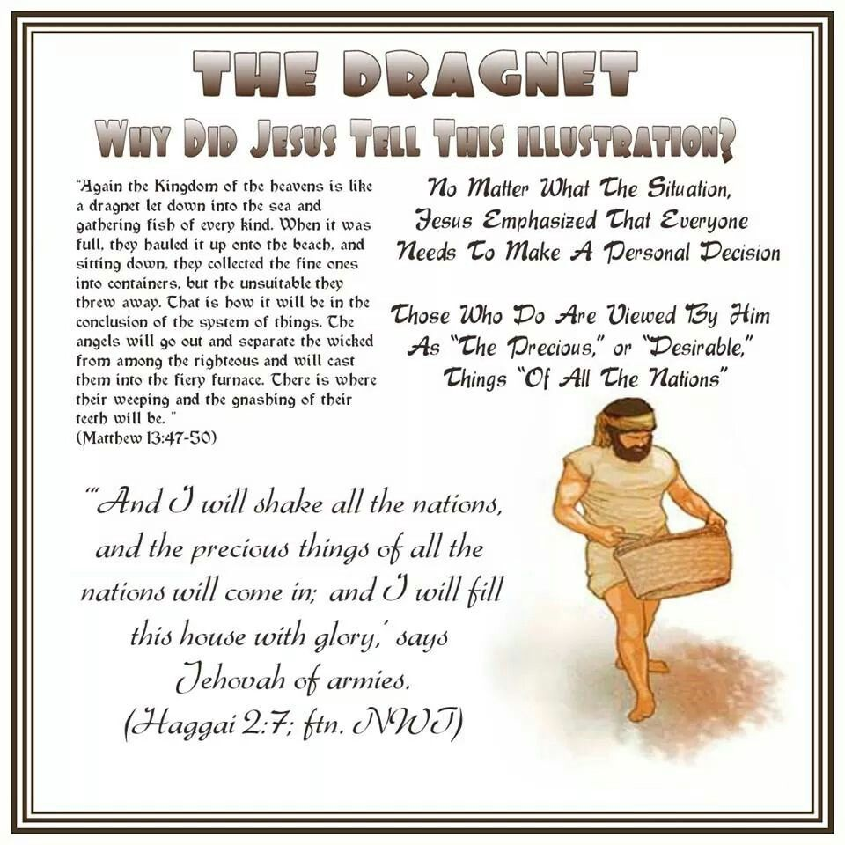

Slide 93
KINGDOM PARABLE: THE FISHER DRAGNET
As the series began with corn-growing, the prevalent business of the hills round the Lake, so it ends with a scene which must have been one of the most common on the shores of the Lake. The western shore was the fishing ground of Palestine; the freshwater fishes of Palestine are singularly numerous—twenty-two species have been counted peculiar to the country—and in the sunny hollow of the Sea of Galilee they lie in shoals. Thus it came to pass that fishermen formed a large part of the population of all the towns on the Lake and fish its chief food; while at Taricheae, at the S.W. end, there was a local trade of salting down fish, and the dried fish of the Lake were sold in the streets of Jerusalem and probably exported to other countries. The fishing industry was carried on partly in boats from which the fish were caught in throw-nets (ἀμφίβληστρα), but also partly from the shore by means of draw-nets (σαγῆναι) or ‘seines,’ as they call them still in Cornwall. The two sorts of nets are mentioned together in Habakkuk 1:15: He catcheth them in his net, and gathereth them in his drag. You will notice the difference: while the throw-net retained safely enough all that got inside it, unless indeed it broke before it could be pulled up or brought to land, the ‘drag’ or draw-net kept on getting more and more, sweeping the bottom of the sea clean as far as it went. Hence the draw-net would probably shew not only a larger haul, but a more varied one, gathering of every kind. In the fishing scenes of St. Luke 5 and St. John 21 it is the throw-nets that are used; here, for various reasons which will appear, the Lord chooses the drawnet.
Swete, H. B. (1920). (pp. 5254). London: Macmillan and Co.
Swete, H. B. (1920). The Parables of the Kingdom: A Course of Lectures (pp. 52–54). London: Macmillan and Co.

Slide 94
KINGDOM PARABLE: THE FISHER DRAGNET
Few scenes could have been more familiar than the sorting that followed the drawing in of the net. All of us know the fascination of watching the incoming of the great draw-net; the gradual contraction of the semi-circle of corks which at first floats far out on the water, but is at last drawn in to the shore; then at last, as the net comes up, the great seething mass of silver fish, leaping and struggling, as they are disgorged upon the bank. A ring of spectators gathers round, while the fish are hastily handled by the squatting men; the good, edible, sorts, fit for sale or for use, are collected in buckets, while the worthless, undersized, inedible, are flung aside into the sea or at a distance on the shore. Then there is a rapid counting of the result: that morning after the resurrection when Jesus bid the seven cast the net (δίκτυον) on the right side of the boat, the number was 153 large fish, and it was noted as wonderful that such a haul did not break the net; but the net in the Parable was the much larger seine (σαγήνη) and the take would be proportionally great. However, the sorting and counting soon come to an end, and then the fish that are worth keeping are sent off to Taricheae to be salted down, or to the fish markets of Tiberias and Capernaum, and the fishermen go off to their rest, or to fresh tasks elsewhere.
Swete, H. B. (1920). (pp. 5455). London: Macmillan and Co.
Swete, H. B. (1920). The Parables of the Kingdom: A Course of Lectures (pp. 54–55). London: Macmillan and Co.

Slide 95
KINGDOM PARABLE: THE FISHER DRAGNET
The last two clauses are exactly the same as the last two in the interpretation of the Tares, though there is nothing in the Parable of the Draw-net which suggests the fiery furnace or the wail of suffering; the refuse on the shore is not burnt, but carried away by the next storm. It may be that these clauses were no part of the original report, but were added as a kind of refrain by the person who collected the parables together. In any case I have already said about these terrible words all that I have to say to you, and so I will not notice them now. Enough remains to give us a lead as to the purpose of the Parable of the Draw-net.
The Parable of the Draw-net, you will have observed, is a fellow-parable to that of the Tares: the general idea which runs through them is the same, just as the Parables of the Treasure and the Pearl have a common conception and teaching. But a closer inspection shews points of difference in the two. It is not only the imagery which is different, but the standpoint and the general purpose. In the Parable of the Tares the main thought is of the manifold presence of evil within the Church and all the scandal and perplexity which this fact entails. If the final separation comes into sight, it is only as supplying an answer to the questions raised by the sight of the tares all over the field. But in the Parable of the Draw-net attention is directed not to the present, but to the future. While the net is in the sea, it cannot be seen whether the fish within are good or bad; the whole result is of the nature of a lottery till the time comes for drawing the net in. Even then the distinction between good and bad is not obvious to the bystander; it can only be determined by expert judges, who see in a moment what is good and what is worthless. So the judgement which the Parable of the Draw-net represents is of a very much more subtle and far-reaching kind than that of the Tares and Wheat. It turns, as we have seen, upon character rather than upon overt acts; on the general result of life, rather than on its details. And it goes very much further. In the Parable of the Tares there are but two kinds of grain, the wheat and the darnel, and there is no testing of either; the tares are all condemned, the wheat all saved. In the Parable of the Net there are fish of every sort enclosed, and all are separately scrutinized and accepted or rejected according to their fitness or unfitness for use.
Swete, H. B. (1920). (p. 55). London: Macmillan and Co.
Swete, H. B. (1920). The Parables of the Kingdom: A Course of Lectures (p. 55). London: Macmillan and Co.

Slide 96
The parable: day-laborers

Slide 97
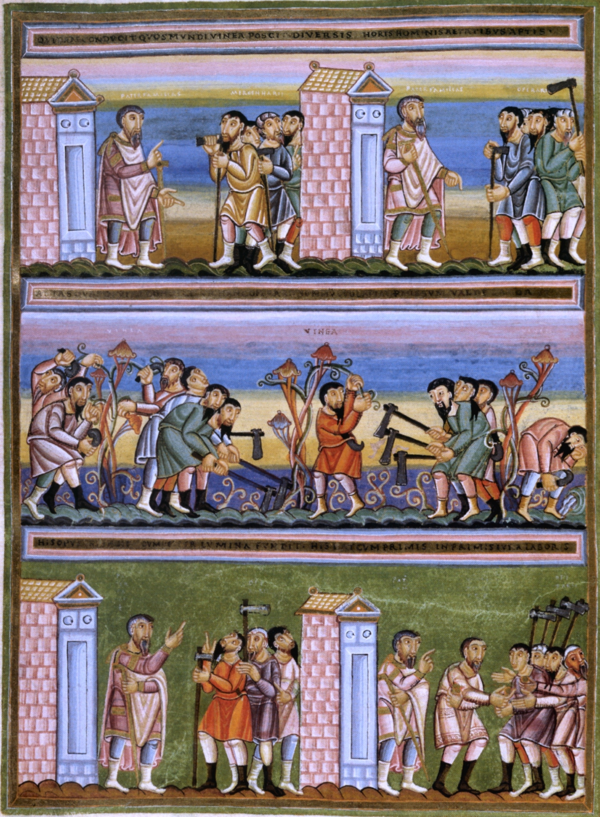

Slide 99
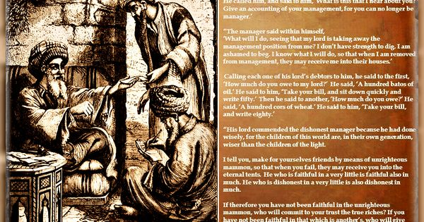

Slide 101
KINGDOM PARABLE: DAY-LABOR PAYMENT
Gracious Boss
When the workday was over, the landowner instructed his foreman to pay the laborers. Jewish law required that a day laborer be paid on the day he performed the work. “Do not hold back the wages of a hired man overnight” (Leviticus 19:13). “Do not take advantage of a hired man who is poor and needy, whether he is a brother Israelite or an alien living in one of your towns. Pay him his wages each day before sunset, because he is poor and is counting on it. Otherwise he may cry to the Lord against you, and you will be guilty of sin” (Deuteronomy 24:14–15). This law was put into place to protect the day laborer because he was poor and powerless and was at the mercy of the integrity of the one who hired him.
In the parable, nothing is unusual up to this point in the story. The setting is typical—all to be expected. Then came the twist: The landowner told the foreman to pay the workers hired last first. Now, that was upside-down—a very unusual plan of action. But the surprise was not over. When the foreman paid the workers hired at the end of the day, he paid them a full day’s wages! Can you just imagine their excitement? They had expected to take home barely enough money to buy food; instead, they would be taking home a full day’s pay! Anyone watching the scene, you would think, would surely get caught up in the joy of the workers who, unexpectedly, were paid more than they earned.
Why do you think the landowner had the foreman pay the workers hired last first? I think it was so all the laborers could see and experience the joy of their fellow hired laborers. These laborers probably saw each other every day as they gathered in the marketplace before dawn, hoping to be hired. They probably talked about their families and shared their fears and frustrations. They probably passed along information about employers they had worked for: who was to be trusted and who was not; who treated workers well and who abused them and took advantage of them. These men knew each other and knew one another’s families. I believe the landowner assumed that those hired early in the day would rejoice that their friends also got a full day’s pay.
Dean, J. K. (2007). . Ashland, OH: New Hope Publishers.
Dean, J. K. (2007). Secrets jesus shared: kingdom insights revealed through the parables. Ashland, OH: New Hope Publishers.

Slide 102
KINGDOM PARABLE: DAY-LABOR PAYMENT
Ungrateful Laborers
Instead, the workers who were hired first suddenly changed their perception. Rather than feeling fortunate to have had a full day of work, they felt cheated that they had to work a full day for the same wages their friends were getting for less effort.
They didn’t take into account the day of anxiety their friends had spent, wondering if they would be hired. While the early workers had the peace of mind all day that they were taken care of, their friends spent the day worrying about what they would do if they weren’t hired that day. Those who were hired in the last hour might have been just about to give up and go home empty-handed. They were picturing having to tell their families that they had not earned any wages that day.
The workers hired early had spent a full productive day, freed from the anxiety of not knowing where their pay would come from. On top of that, they received a fair day’s pay to take home, just as they had been promised.
The landowner must have been disappointed that the joy he hoped to share with them did not materialize when they saw their friends’ unexpected blessing. They were envious, and that stole their joy.
Jesus summarized the parable with these words: “So the last will be first, and the first will be last.” He probably did not use Hebrew words that meant “first” and “last” in terms of time, but rather words that meant “heavy” and “light” in terms of weight. The Hebrew words measured the value of something, or the “weight.” Those who are thought of as deserving less will get the same as those who seem to deserve more. God will allow those who have always been with Him to see and rejoice with those who spent much or most of their lives away and dead to the Father’s love.
Do you see echoes of the parable of the lost sons here?
Dean, J. K. (2007). . Ashland, OH: New Hope Publishers.
Dean, J. K. (2007). Secrets jesus shared: kingdom insights revealed through the parables. Ashland, OH: New Hope Publishers.

Slide 103
Two parableS of two feasts

Slide 104
The parable: the great feast

Slide 105
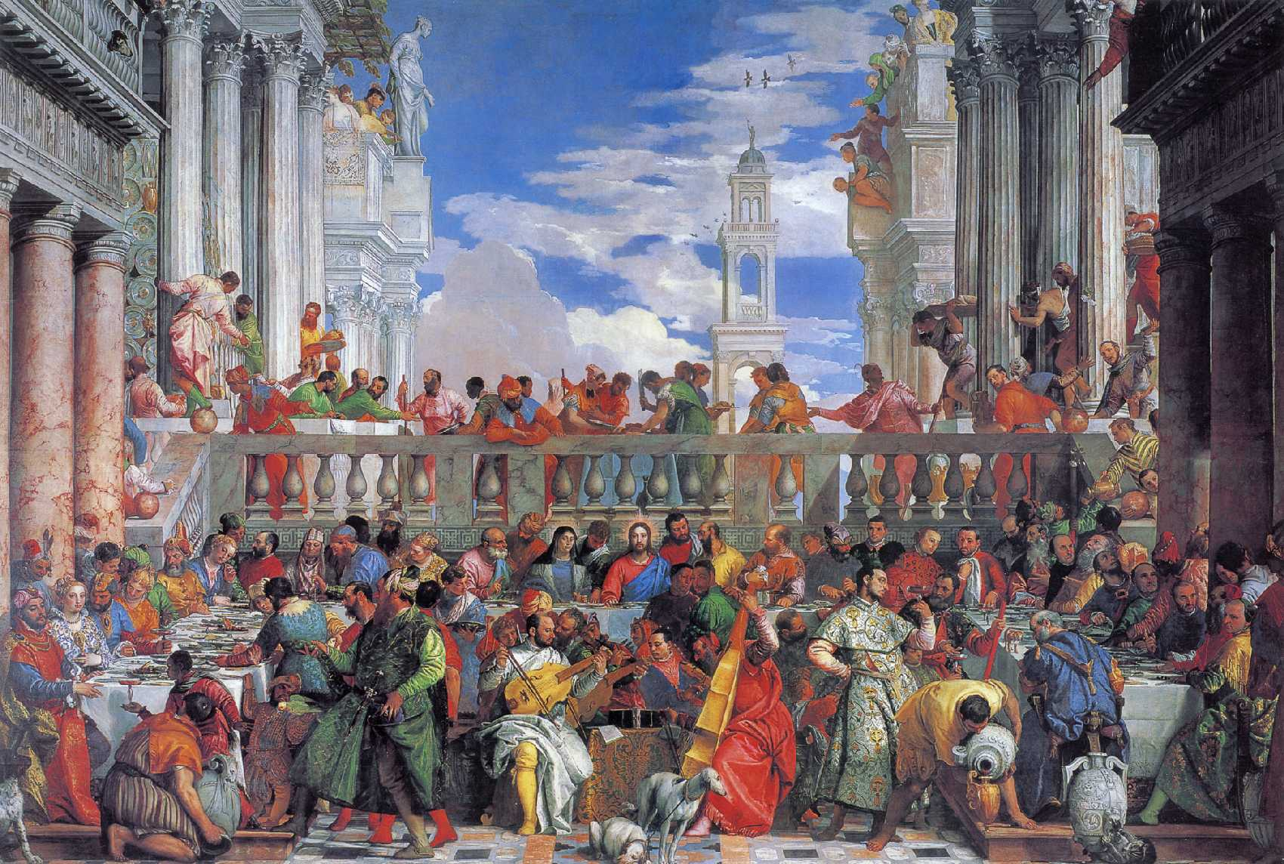

Slide 106
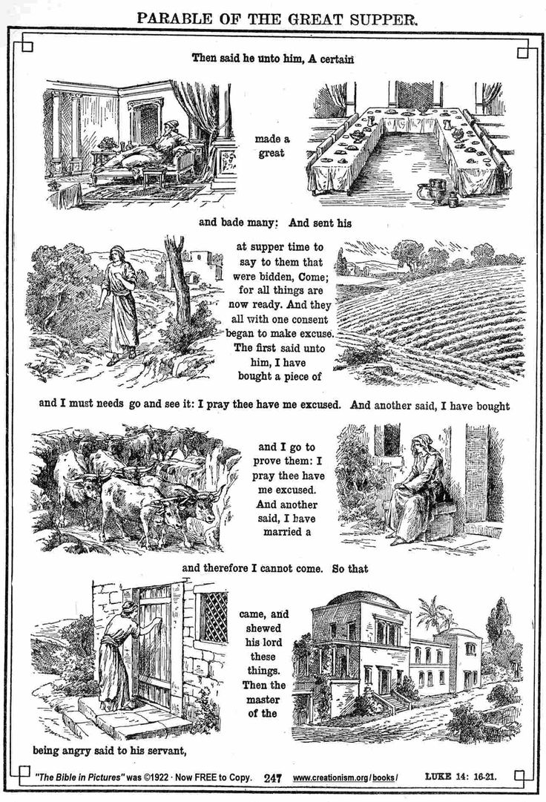

Slide 107
KINGDOM PARABLE: THE GREAT FEAST
The Guest List
Rabbinic literature contains more than 5,000 parables. A banquet was a frequent setting for parables. As Jesus started this parable, with a great banquet as the setting, His audience was in familiar territory.
In that day, a man would send out his servants to issue invitations to the banquet and to receive the responses of his guests. He would tell them the day, but not the hour. The hour would depend on when everything was ready. At the hour, a second invitation went out as the servants went back to the guests who had accepted and said, “The hour has come.” Guests were to be ready and dressed when the second invitation came. They would leave immediately and make their way to the banquet.
Jesus told a story of a man who prepared a grand banquet—one with the best wine, choicest food, finest musicians, and most valuable tableware. His household had been in a frenzy of preparation for days. The sounds and the sights and the smells of the banquet being prepared spilled out into the streets. Everyone knew about the banquet.
The parable begins when the host sends out his second summons to tell the guests who had accepted his first invitation that the meal was ready. The hour had come. Each of the invitees in the story had already accepted the invitation.
The audience was right with Him—up to this point. They were along for the ride, comfortable in their well-worn ideas. Now for the twist: Jesus veered off course. The guests, who should be honored by the invitation and eagerly awaiting the summons, had forgotten all about it. All kinds of other things had diverted their attention. They had put their own business ahead of the banquet. They were distracted from the focus.
I think Jesus was being humorous with these excuses. All of them were silly and contrived. Who would buy land and have only one day to go look at it? Who would buy oxen without having tried them first? Who would plan a marriage between the time of the invitation and the dinner? Each excuse was sillier than the one before.
I think that was the point. Silly things got in the way of enjoying the banquet.
Of course, this was an insult to the host. It caused him to lose face before the whole village. And what would he do with all the food and wine? Many days of preparation had been put into this banquet.
The host sent his servant out to bring in the poor, the blind, and the lame. These were the outcasts in Jewish society. They were thought to be unclean and, thus, unable to attend the great banquet of the kingdom.
When those had been brought in, the servant said, “There is still room.” Apparently grace, like nature, abhors a vacuum. The host told his servant to go out even further and invite with urgency those out in the countryside. The banquet was filled with people who had previously had no hope of sitting at a great banquet given by a great host.
Those who thought other things were more important missed the banquet altogether. Those who clung to their possessions and put their activities ahead of the invitation were, in the truest sense, poor, blind, and lame.
By clinging to what they owned, they lost everything.
Dean, J. K. (2007). . Ashland, OH: New Hope Publishers.
Dean, J. K. (2007). Secrets jesus shared: kingdom insights revealed through the parables. Ashland, OH: New Hope Publishers.

Slide 108
KINGDOM PARABLE: THE GREAT FEAST
The parable turns on the issue of a great number of invitations to the Kingdom of God, which precedes the actual enjoyment of it. He who sits down at the table of God will be a happy man, it had just been remarked; and the Lord replies, ‘Yet many who have been invited are refusing to come.’ The invitations had been issued by every prophet who had spoken of the Messianic kingdom and its feast of good things. The whole Jewish people were bidden by the call of Messianic prophecy. And since the days of the prophets of the Old Testament another call had come, and one which permitted no delay. John the Baptist had preached Repent ye; for the kingdom of heaven is at hand. A little later Jesus, the Son in the form of a slave, had taken up the call, and made it more imperative: The time is fulfilled, and the kingdom of God is at hand: repent ye, and believe in the gospel; and the Apostles spread abroad the message. So God had sent forth his slave at supper time to say to them that were bidden, Come; for all things are now ready. But those who were called shewed no readiness to come, now that the hour had struck. The Pharisees had stood almost wholly aloof from the Messianic movement. There were all the signs of a Divine call; they could not deny them. There were miracles, there was prophetic power, there was teaching with authority such as had not been heard in Israel. Everything pointed to a new call from God, but the leaders of the nation hung back. The parable represents the polite refusal by excuses which people would make in common life: a recent purchase of cattle or land, or the duty of attending to the newly-married wife. The excuses which the Scribes had to give for refusing the call of Jesus were appropriate to themselves, want of official verification, Galilean origin, and so forth; but excuses, nevertheless, which their conscience could not have really allowed, and which were not allowed by God.
Swete, H. B. (1920). (pp. 6869). London: Macmillan and Co.
Swete, H. B. (1920). The Parables of the Kingdom: A Course of Lectures (pp. 68–69). London: Macmillan and Co.

Slide 109
KINGDOM PARABLE: THE GREAT FEAST
The defection of the heads of the nation opened the way for an appeal to the masses. In the command Go out quickly into the streets and lanes of the city we hear the commission under which our Lord’s Galilean ministry was carried out. Quickly—for the ministry was brief indeed, whether we allow three years or one. Into the streets and lanes of the city, that is, amongst the crowds that thronged the thickly populated towns of Galilee and the south: to the ‘man in the street,’ as we say, yes, and to the man in the by-ways of the slums, but still the men of Israel, for as yet the embargo against Gentile peoples had not been taken off. But the parable looks forward to the extension of the call beyond the City of God. Presently the servant returns to his Master and reports, Yet there is room. That stage was reached when it was revealed to the Church that God had granted to the Gentiles also repentance unto life, and then came the first commission, Go out into the roads and hedgerows:—into the great roads which crossed Galilee carrying men east and west into the still more marvellous lines of communication which Rome had opened up across Asia Minor, Macedonia, Italy, wherever her proconsuls went, or her armies penetrated; and into the hedgerows, the φραγμοί, fences, loose stone walls more probably, which guided the traveller when he left the highroad and sought the remote villages and country towns.
Swete, H. B. (1920). (pp. 6970). London: Macmillan and Co.
Swete, H. B. (1920). The Parables of the Kingdom: A Course of Lectures (pp. 69–70). London: Macmillan and Co.

Slide 110
The parable: A wedding Feast

Slide 114
KINGDOM PARABLE: THE MARRIAGE FEAST
You will observe at once certain broad points of likeness between this parable and that of the Great Supper. Both describe a banquet, and an invitation to it, which is repeated at supper time. Both speak of a deliberate rejection of the invitation by those who received it. Both again relate the second mission of the servants to the highways. So much then the two stories have in common, but the rest is different. It is a small matter that the meal is a late one (δεῖπνον) in one tale and an early (ἄριστον) in the other; that may be merely a difference in the translation of the original Aramaic word used by our Lord. But it is significant that in the second parable the meal is a festivity in honour of the marriage of the King’s son. This imports into the second parable a whole train of ideas connected with the Divine Nuptials which is wholly absent from the first parable, and points quite clearly to our Lord Himself as the Son of God and the Bridegroom of the future Church. Again, since the affront is now done to a King, the consequences are represented as more serious; the guests who turn their backs on the royal marriage are not simply excluded, but when they proceed to abuse and kill the King’s messengers they are destroyed, and their city is burnt; herein we may detect quite clearly a forecast of the doom of Jerusalem. And towards the end of the parable, an entirely new scene is added which effectually distinguishes St. Matthew’s parable from St. Luke’s. In the Great Supper all who accept the invitation and take their places at the table appear to be approved; it is only those who turn away that are rejected. But in the Marriage Feast of the King’s Son even those who accept and obey the call are subjected to a scrutiny; the King not only destroys the murderers who killed his slaves, but comes in to inspect the guests, and rejects one who is not suitably arrayed. And the clue to the interpretation with which the parable ends is not, Many are called, but few obey the call; but, Many are called, but few chosen—πολλοὶ … κλητοὶ ὀλίγοι δὲ ἐκλεκτοί, words which lay emphasis on the possible rejection of many, even of most of those who are called, and of some even at the last.
Swete, H. B. (1920). (pp. 7678). London: Macmillan and Co.
Swete, H. B. (1920). The Parables of the Kingdom: A Course of Lectures (pp. 76–78). London: Macmillan and Co.

Slide 115
KINGDOM PARABLE: THE MARRIAGE FEAST
To understand these differences between the two parables we must attend to the different circumstances in which they were spoken. The Great Supper was addressed to a company at a Pharisee’s house, which was outwardly and ostensibly friendly to our Lord, and the attitude attributed in it to the leaders of the Jewish nation is one of polite refusal only. Up to this time their hostility to the Kingdom had hardly gone further. But the Marriage Feast of the King’s Son was spoken in the Temple precincts on the Tuesday in Holy Week to the members of the Sanhedrin who were already set on our Lord’s arrest and death: murder was in their hearts, the murder of Christ, and in the future of His followers; it was no longer a matter of simply turning away from their own salvation. And so the parable speaks in the plainest terms of murderers and their doom and their city’s doom: the Roman armies would come and set fire to that very part of the Temple buildings in which the parable was uttered.
Swete, H. B. (1920). (pp. 7879). London: Macmillan and Co.
Swete, H. B. (1920). The Parables of the Kingdom: A Course of Lectures (pp. 78–79). London: Macmillan and Co.

Slide 116
KINGDOM PARABLE: THE MARRIAGE FEAST
And it may be that the occasion accounts also for the episode of the King coming in to see the guests. For the end of the Ministry and earthly life is now so near that the Lord cannot but look forward beyond the near future to His coming again. In the Great Supper He foresees the call to the Gentiles, and what St. Paul calls, the obedience of the Gentiles, i.e. their general response to the call. In the Marriage Feast of the King’s Son, He looks further, to the day of the Parousia, when the King in the person of the returning Christ, will pass under review all who have been called, and will distinguish between guest and guest, choosing only such as have qualified themselves for the King’s presence.
Swete, H. B. (1920). (p. 79). London: Macmillan and Co.
Swete, H. B. (1920). The Parables of the Kingdom: A Course of Lectures (p. 79). London: Macmillan and Co.

Slide 117
KINGDOM PARABLE: THE MARRIAGE FEAST
The qualification is the wearing of an ἔνδυμα γάμου, a wedding-garment, such as befits the occasion. There is a somewhat similar parable to be found in the Talmud, in which the servants of a King having been suddenly summoned to a royal banquet, some of them came without changing their work-a-day clothes, and were condemned to stand and watch the rest enjoy their supper. There seems to be no evidence that there was any particular dress known as a wedding-robe (ἔνδυμα γάμου), or that such a dress was provided for every guest, and put on at the door, as the commentators have supposed. It seems as though all that is meant is that the guest whom the King in our parable rejects had not taken the trouble to prepare himself for the King’s presence, had not perhaps expected that he would meet the King’s eye, had hoped to pass muster among the rest. Hence his confusion when detected; he had not a word to say for himself. And the sentence is exactly just; he has not been at the trouble to make himself ready, and therefore cannot be permitted to remain in the company of those who have.
Swete, H. B. (1920). (pp. 7980). London: Macmillan and Co.
Swete, H. B. (1920). The Parables of the Kingdom: A Course of Lectures (pp. 79–80). London: Macmillan and Co.

Slide 118
KINGDOM PARABLES: THE TWO FEASTS
Now let us take the two parables together, and see what we learn from them in combination as to our Lord’s teaching about the Kingdom of Heaven or of God.
We see in them the Divine Kingdom represented as the preparing on God’s part of a great feast of good things for mankind, and the sending forth of a succession of messengers to invite men to it. The first messengers are sent to a chosen few, a limited number of guests, who however, when the time comes, first excuse themselves, and end by making away with the messengers. They receive the due reward of these deeds. Then the invitation is gradually widened: first, to the lowest of the people in the city, then to the passers-by on high road or field path in the open country; these come in, filling the empty hall. Lastly, when all the guests are assembled, the King Himself inspects the company, and singles out a man who has entered in his working dress, who is forthwith sent out into the night, and the banquet proceeds.
In the earlier invitation of selected guests it is impossible not to see, and those to whom the parable was spoken doubtless saw, the call of the chosen people of Israel; and in the latest, to which there was no limit, we can now easily detect the call of the Gentile world. The King’s scrutiny indicates that acceptance of the call is not the only part which men have to fulfil in the service of the Divine Kingdom. Faith, if it has not works, is dead; men’s lives must answer to their creed. The Divine call in the Gospel demands on the part of those to whom it comes not merely a passive acceptance or obedience, but a life-long personal effort, through the Holy Spirit, to prepare for the right use of God’s gifts. To forgo this effort is to forfeit the gift to which we were called. There is something beyond a high calling which is needful to eternal life, namely God’s final choice, and His choice falls on those who have made both calling and election sure.
Read together, the parables contain a double warning: to the Pharisees of our Lord’s time, a warning not to refuse the voice that called them to the feast of God; to us, Gentiles, who have been called in their place, a warning not to forget the scrutiny which will precede the final selection of the guests.
Swete, H. B. (1920). (pp. 8183). London: Macmillan and Co.
Swete, H. B. (1920). The Parables of the Kingdom: A Course of Lectures (pp. 81–83). London: Macmillan and Co.

Slide 119
GOD’S SPIRITUAL KINGDOM’S BUILT OF UPSIDE-DOWN RELATIONSHIPS?!

Slide 120
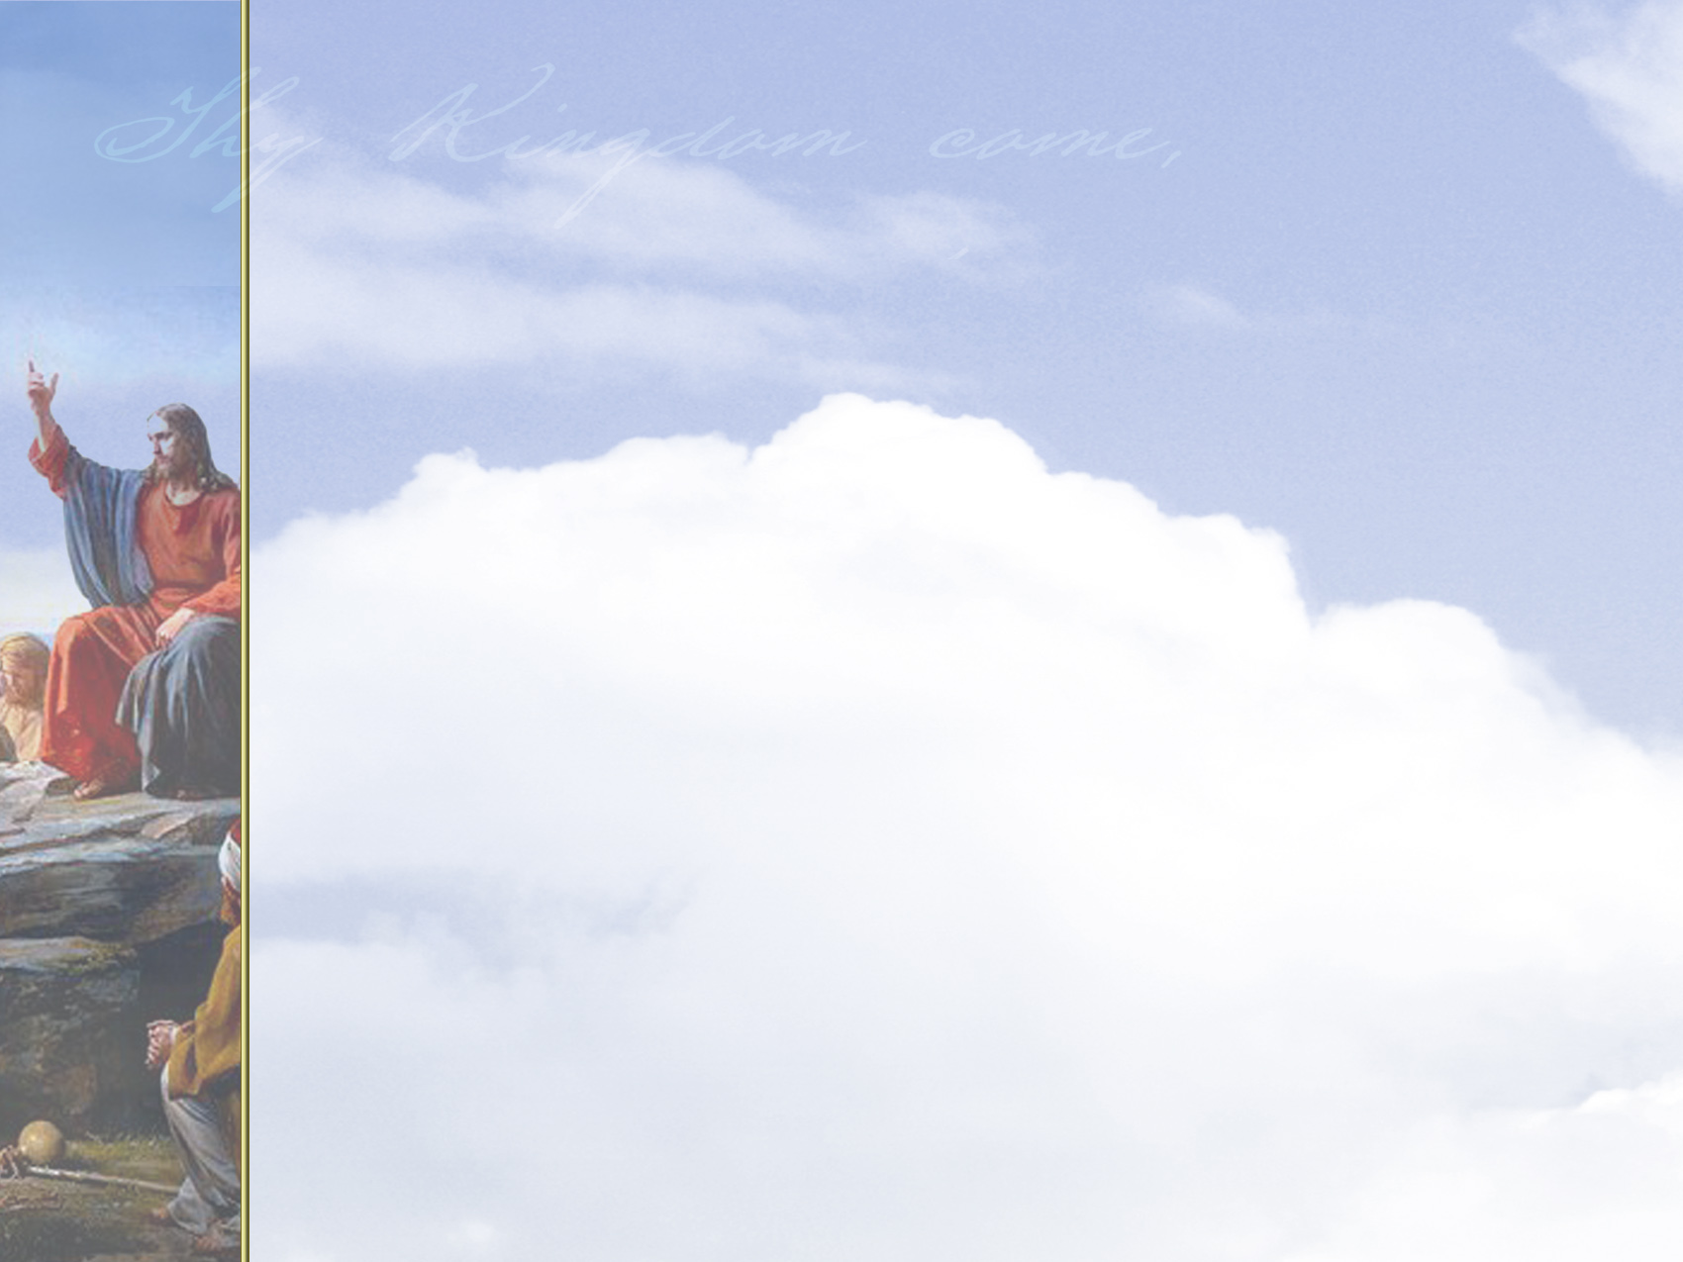
MENU

Slide 121
God’s
Sovereignty

Slide 122
God has supreme power and authority over everything in heaven and earth.
When we acknowledge God’s sovereignty, we affirm and welcome his reign in our lives.
We promise to live in ways that honor him.

Slide 123
But God’s kingdom is both here and now—and yet to come.
During Jesus’ life on earth, his ministry was “to proclaim freedom for the prisoners, to recover sight for the blind, to release the oppressed, and to proclaim the year of the Lord’s favor” (Luke 4:18, 19).

Slide 124
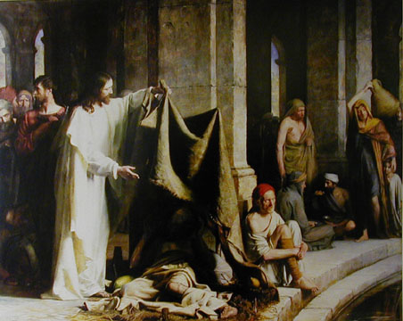
When Jesus was around, people were freed from sickness, suffering, and pain.
The Pool of Bethesda
Cark Bloch

Slide 125
Jesus said that the Kingdom of God was near (Mark 1:15).
When asked when the Kingdom of God would come, Jesus said, “The kingdom of God does not come with your careful observation, nor will people say, ‘Here it is,’ or ‘There it is,’ because the kingdom of God is within you.”

Slide 126
God’s kingdom will be evident in the lives of those who make him their Lord.
This petition asks the Lord to change our lives so that his goodness is always evident through us.

Slide 127
Some people have interpreted this prayer as an invitation to impact culture by passing laws calling people back to safer moral standards.
But Jesus made clear his Church’s mission: to lead people to himself.

Slide 128
Jesus commissioned all disciples to proclaim that Jesus is King and Lord over all (Matthew 28:18-20).
Our obedience to this commission helps spread God’s kingdom throughout the world.

Slide 129
Cultural Context: “Thy Kingdom Come”
It Is Essential To Keep In Mind That The Hebrew Language Emphasizes The Kind Of Action & Not The Time
In Later Hebrew, The Time Factor Became More Important, But The Emphasis Of The Petition Is Not Temporal
It Emphasizes Instead The Dynamic Force Of God’s Kingship Being Realized As His Will Is Done
Jesus’ Words Would Have Been In The Imperfect Tense, Which Indicates Incompleted Action – The Idea Is That A Process Is Taking Place.
Thus, This Statement Can Be Connected To The Growth Parables Of The Kingdom
It Is Linked Similarly To Matthew 12: 28 & Then In Turn To Exodus 8:19 & 31:18 – Conveying The Message Of Deliverance
The Mishnah Links The “Yoke Of The Kingdom” To The Ancient’s Affirmation Of Deuteronomy 6: 4
It Was Put Into Prayer Form & Was Known As The Shema Yisrael (“Hear, O Israel”) & Everyone Praying It Received As Similar The “Yoke Of The Kingdom”
Reciting This Prayer Of Acknowledgment Was Considered The First Step In The Spiritual Obedience To The Laws, Ordnances, & Commandments Of Ancient Israel

Slide 130
Cultural Context: “Thy Kingdom Come”
“Heaven” Was Often Substituted In Meaning For “God” Because Of The Special Sanctity Reserved For His Name. This Was Common In Jesus’ Day & Persons Accepting The Authority Of The Kingdom Of Heaven Were Said To Have Entered Into The Reign Of God.
The Mekilta, An Early Midrash, Comments On The Beginning Statement Of The Decalogue – “I Am The Lord Thy God” – Conditioning The Ancient’s Acceptance Of The Kingdom Of Heaven With The Omnipresent (God) “Doing Good For Us” – These Remarks Link The Liberation Of God’s People With The Theme Of The Kingdom
Therefore, God - In This Sense - Reigns By His Mighty Redemptive Acts Of Liberation!
Jesus’ Challenging Call To Repent Was An Essential Aspect Of His Proclamation Of The Kingdom
Furthermore, Jesus’ Public Ministry Demonstrated Many Acts Of Redemption That Were The Dynamic Realization Of God’s Kingdom.
In The Hebrew Translation Of The Blessing Of Matthew 5: 3 The Last Part Reads “They Make Up The Kingdom.” This Proper Translation Indicates As Well How The Kingdom Will Continue To Be Established.

Slide 131
“The Meaning Of The Millennium” by Robert Clouse DOUBLE APPLICATION: “THY KINGDOM COME”
“Amillennialists believe that the kingdom of God was founded by Christ at the time of his sojourn on earth, is operative in history now and is destined to be revealed in its fullness in the life to come. They understand the kingdom of God to be the reign of God dynamically active in human history through Jesus Christ. Its purpose is to redeem God’s people from sin and from demonic powers, and finally to establish the new heavens and the new earth. The kingdom of God means nothing less than God’s reign in Christ over his entire created universe. The kingdom of God is therefore both a present reality and a future hope.”

Slide 132
Amillennialism
What is Amillennialism?
Rather, the millennium symbolizes Christ’s reign in the lives of his people from the beginning of the church until his second coming.
Second Coming of Christ & Final Judgment
Millennium
Eternity
The Church Age
Tribulation

Slide 133
Amillennialism
What is Amillennialism?
Christ’s triumph over Satan through his death and resurrection in AD 30 restrained the power of Satan on the earth.
Second Coming of Christ & Final Judgment
Satan’s power is restrained
Millennium
Eternity
The Church Age
Tribulation
Notes:
See Revelation 20:1–3.

Slide 134
Amillennialism
What is Amillennialism?
Persecution of Christians (tribulation) will occur until Jesus comes again, as will the expansion of God’s kingdom (the millennium).
Second Coming of Christ & Final Judgment
Satan’s power is restrained
Millennium
Eternity
The Church Age
Tribulation

Slide 135
“A Case For Amillennialism” by Kim Riddlebarger DOUBLE APPLICATION: “THY KINGDOM COME”
“In other words, when the kingdom came in the person
of Jesus, the ‘age to come’ also had arrived, at least
in some provisional sense. The consummation of that
kingdom, when Jesus Christ returns to judge the world,
raise the dead, and make all things new, coincides with
the arrival of the ‘age to come’ in all its fullness. …the
presence of Jesus’ spiritual kingdom,‘the rule of Christ,’
is a reality which guarantees the consummation of the
kingdom of God yet to come. This is further reflected
in the Lord’s Prayer when Jesus exhorted believers to
pray for the consummation of that same kingdom which
dawned in his own person during his messianic mission
(Matthew 6: 9 – 13).” -- PAGES 109 & 110

Slide 136
Kingdom Models
Historical Heritage
FUTURE
TERTULLIAN
INTERIOR
ORIGEN
EXEGETICAL ERROR:
REVERSING ORDER
TYPE & ANTITYPE
INSTITUTIONAL
AUGUSTINE
COUNTER-SYSTEM
MONASTIC
THEOCRATIC
CALVIN
UTOPIAN
ANA-BAPTIST

Slide 138
CHRIST & THE CHURCH
KINGDOM
BODY
Government
Unity
CHURCH
KINGDOM
HOUSEHOLD
BODY-CHRIST
Family
Ownership
HOUSEHOLD
CHRIST

Slide 140
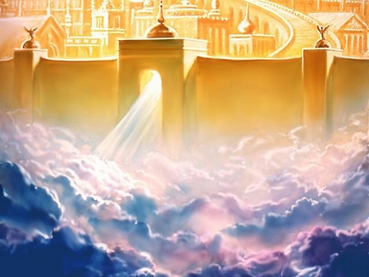
The Kingdom of God and The Day of the Lord

Slide 141
The Day of the Lord in the NT
2 Thess 1:6-10
Matt 24:36-39
2 Peter 3:8-10
We need to be ready for the Day of the Lord.
Phil 2:14-16 (and 2 Cor 1:12-14)
1 Cor 5:5 (Phil 1:9-10) Better now than later.
(2 Thess 2:1-4)
1 Thess 5:1-11
Finish: Zechariah 14:1-21

Slide 142
JUDGEMENT PREPARED
FIVE STATES FIVE STEPS
Five States of the Soul:
EXEMPTION:
Ezekiel 18: 20; Matthew 18: 1 – 3
CONDEMNATION:
Galatians 3: 22
JUSTIFICATION:
Romans 5: 1, 2; 8: 1, 2
DAMNATION:
Matthew 23: 3; Mark 16: 16
GLORIFICATION:
Romans 8: 17, 30; II Thess. 1: 7 - 12

Slide 144
JUDGEMENT PREPARED
FIVE STATES FIVE STEPS
Five Steps for Saving:
HEARING:
Romans 10: 17; Matthew 7: 24 - 27
BELIEVING:
Hebrews 11: 6; Mark 16: 15, 16
REPENTING:
Acts 2: 38; 17: 30; Luke 13: 3
CONFESSING:
Matthew 10: 32, 33; Acts 8: 36, 37
BAPTISM:
Romans 6: 3 – 5; Acts 8: 36 - 38

Slide 145
Citizens
of
Heaven
Philippians 3:20
HEAVEN

