Slide 1
The Soundness of Scripture
Source: Evidences for Christianity
Edited by David Lee Burris

Slide 2
Is What We Have Now What They Wrote Then?
Evidences for Christianity.com

Slide 3
Tough Questions
“Since you no longer have the New Testament documents and all you have now are error-ridden copies of copies of copies how can you possibly say that you know what the New Testament originally said?”
“How do you know that some early church council didn’t change the New Testament by leaving out doctrines they didn’t like, or inserting doctrines into the text that hadn’t been there before?”
“How can you say that you have God’s Word when you have Bibles that disagree with each other on what the words of the New Testament actually are? (John 5:4)”
Notes:
Please turn to John 5:4
The New Testament didn’t come to us as a single book that floated out of the clouds. It came to us through the teachings of the Apostles in the forms of letters, Gospels, etc. Then they were copied by people who wanted them.
Because the Christians were not trained scribes, they sometimes made mistakes when they copied the scriptures.

Slide 4
John 5:3-5
New King James Version
New International Version
³ In these lay a great multitude of sick people, blind, lame, paralyzed, waiting for the moving of the water. ⁴ For an angel went down at a certain time into the pool and stirred up the water; then whoever stepped in first, after the stirring of the water, was made well of whatever disease he had.^{[a]} ⁵ Now a certain man was there who had an infirmity thirty-eight years.
³ Here a great number of disabled people used to lie—the blind, the lame, the paralyzed. ^{[4] [a]} ⁵ One who was there had been an invalid for thirty-eight years.

Slide 5
Thesis Statement
Of the 400,000 textual variants in the New Testament, 99% of them are completely inconsequential.
No Christian doctrine is effected by textual variants.
The New Testament was never under the control of a central authority.
Multiple lines of transmission have preserved the text.
The text of the New Testament is tenacious.

Slide 6
What is a Textual Variant?
Any place where two manuscripts differ from eachother
Mark 9:29
Mark 9:29
He replied, “This kind can come out only by prayer.”
He replied, “This kind can come out only by prayer and fasting”

Slide 7
How many textual variants?
400,000 textual variants in the NT
180,000 words in the NT

Slide 8
How many textual variants?

Slide 9
How many textual variants?

Slide 10
Example of nonsense error
1 Thessalonians 2:7
1 Thessalonians 2:7
1 Thessalonians 2:7
Instead, we were like young children among you. Just as a nursing mother cares for her children,
But we were gentle among you, like a nursing mother taking care of her own children.
But we were horses among you, like a nursing mother taking care of her own children.

Slide 11
How many textual variants?
Notes:
Word order. For example “Jesus Christ” and “Christ Jesus”

Slide 12
How many textual variants?
Notes:
Word order. For example “Jesus Christ” and “Christ Jesus”

Slide 13
Meaningful but not viable
1 Thessalonians 2:9
1 Thessalonians 2:9
Surely you remember, brothers and sisters, our toil and hardship; we worked night and day in order not to be a burden to anyone while we preached the gospel of God to you.
3rd Century
Surely you remember, brothers and sisters, our toil and hardship; we worked night and day in order not to be a burden to anyone while we preached the gospel of Christ to you.
13th Century

Slide 14
How many textual variants?
Notes:
Word order. For example “Jesus Christ” and “Christ Jesus”

Slide 15
Point #1
Of the 400,000 Textual Variants, 99% are completely inconsequential.

Slide 16
Meaningful and Viable
Mark 1:40-41
Mark 1:40-41
A man with leprosy came to him and begged him on his knees, “If you are willing, you can make me clean.“
Jesus was indignant. He reached out his hand and touched the man. "I am willing," he said. "Be clean!"
A man with leprosy came to him and begged him on his knees, “If you are willing, you can make me clean.“
Jesus had compassion on him. He reached out his hand and touched the man. "I am willing," he said. "Be clean!“
Mark 11:15-19
Mark 3:5
Mark 6:34

Slide 17
Meaningful and Viable
Mark 16:8
Mark 1:40-41
Mark 1:40-41
Trembling and bewildered, the women went out and fled from the tomb. They said nothing to anyone, because they were afraid.
Trembling and bewildered, the women went out and fled from the tomb. They said nothing to anyone, because they were afraid.
When Jesus rose early on the first day of the week, he appeared first to Mary Magdalene, out of whom he had driven seven demons. She went and told those who had been with him and who were mourning and weeping. When they heard that Jesus was alive and that she had seen him, they did not believe it.
Afterward Jesus appeared in a different form to two of them while they were walking in the country. These returned and reported it to the rest; but they did not believe them either.
Later Jesus appeared to the Eleven as they were eating; he rebuked them for their lack of faith and their stubborn refusal to believe those who had seen him after he had risen.
He said to them, “Go into all the world and preach the gospel to all creation. Whoever believes and is baptized will be saved, but whoever does not believe will be condemned. And these signs will accompany those who believe: In my name they will drive out demons; they will speak in new tongues; they will pick up snakes with their hands; and when they drink deadly poison, it will not hurt them at all; they will place their hands on sick people, and they will get well.”
After the Lord Jesus had spoken to them, he was taken up into heaven and he sat at the right hand of God. Then the disciples went out and preached everywhere, and the Lord worked with them and confirmed his word by the signs that accompanied it.
Trembling and bewildered, the women went out and fled from the tomb. They said nothing to anyone, because they were afraid. Then they quickly reported all these instructions to those around Peter. After this, Jesus himself also sent out through them from east to west the sacred and imperishable proclamation of eternal salvation. Amen.
Notes:
Longer Ending:
When Jesus rose early on the first day of the week, he appeared first to Mary Magdalene, out of whom he had driven seven demons. She went and told those who had been with him and who were mourning and weeping. When they heard that Jesus was alive and that she had seen him, they did not believe it.
Afterward Jesus appeared in a different form to two of them while they were walking in the country. These returned and reported it to the rest; but they did not believe them either.
Later Jesus appeared to the Eleven as they were eating; he rebuked them for their lack of faith and their stubborn refusal to believe those who had seen him after he had risen.
He said to them, “Go into all the world and preach the gospel to all creation. Whoever believes and is baptized will be saved, but whoever does not believe will be condemned. And these signs will accompany those who believe: In my name they will drive out demons; they will speak in new tongues; they will pick up snakes with their hands; and when they drink deadly poison, it will not hurt them at all; they will place their hands on sick people, and they will get well.”
After the Lord Jesus had spoken to them, he was taken up into heaven and he sat at the right hand of God. Then the disciples went out and preached everywhere, and the Lord worked with them and confirmed his word by the signs that accompanied it.
Shorter Ending

Slide 18
Meaningful and Viable
John 5:3-5
John 5:3-5
In these lay a multitude of invalids—blind, lame, and paralyzed.^{[c]} ⁵ One man was there who had been an invalid for thirty-eight years.
In these lay a multitude of invalids—blind, lame, and paralyzed waiting for the moving of the water; ⁴for an angel of the Lord went down at certain seasons into the pool, and stirred the water: whoever stepped in first after the stirring of the water was healed of whatever disease he had ⁵ One man was there who had been an invalid for thirty-eight years.

Slide 19
Meaningful and Viable
Acts 15:40
Acts 15:40
But Paul chose Silas and departed, being commended by the brethren to the grace of God.
But Paul received Silas and departed, being commended by the brethren to the grace of God

Slide 20
Chose/Received
Chose
Received
ἐπιλεξάμενος
ἐπιΔεξάμενος
Notes:
This is a Permutation
Permutation: Letters that are hard to distinguish from each other

Slide 21
1 John 3:1
1 John 3:1
See what great love the Father has lavished on us, that we should be called children of God! The reason the world does not know us is that it did not know him
. See what great love the Father has lavished on us, that we should be called children of God! And that is what we are! The reason the world does not know us is that it did not know him.

Slide 22
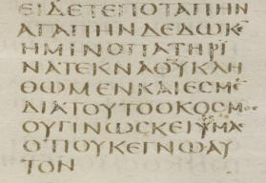
See what
Love has Given
to Us the Father
That Children
Of God we
Should be
Called and
We are

Slide 23
Similar Endings
ΤΕΚΝΛΘΥΚΛΗΘΨΜΕΝΚΛΙ
ΕΡΜΕΝΔΙΛΤΟΥΤΟΟΚΟΡΜΟΡ

Slide 24
Similar Endings
ΤΕΚΝΛΘΥΚΛΗΘΨΜΕΝΚΛΙ
ΕΡΜΕΝΔΙΛΤΟΥΤΟΟΚΟΡΜΟΡ

Slide 25
Point #2
No Christian doctrine is effected by textual variants.

Slide 26
Point #3
The New Testament was never under the control of a central authority.
When the council of Nicea met in 325 there were already copies of the New Testament documents that were buried in Egypt that would not be discovered for 1400 years.
Notes:
The Christians wanted their scriptures to be copied by everyone.

Slide 27
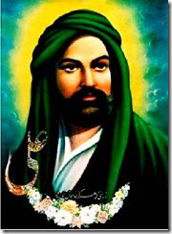
Islam
Uthman ibn Affan
3rd Caliph of Islam (644-656)

Slide 28
What if our early manuscripts are already corrupted?

Slide 29
Point #4
Multiple lines of transmission have preserved the text

Slide 30
Original
Copy
Copy
Copy
Copy
Copy
Copy
Copy
Copy
Copy
Copy
Copy
Copy
Copy
Copy
Copy
Copy
Copy
Copy
Copy
Copy
Copy
Copy
Copy
Copy
Copy
Copy
Copy
Copy
Copy
Copy
Copy
Copy
Copy
Copy
Copy
Copy
Copy
Copy
Copy
Copy
Copy
Copy
Copy
Copy
Copy
Copy
Copy
Copy
Copy
Copy
Copy
Copy
Copy
Copy
Copy
Copy
Copy
Copy
Copy

Slide 31
Point #5
The text is tenatious.

Slide 32
Comparison of Ancient Texts
Work of Antiquity | Number of Surviving Manuscripts | Time Between Original & Earliest Copy
Tacitus | 33 | 800 years
Thucydides | 96 | 200 years
Livy | 150 | 400 years
Homer | 1757 | 400 years
New Testament | 5,700 + | <50 years

Slide 33
Is What We Have Now Accurate?

Slide 34
The Bible Reliability, Inspiration and Inerrancy
Apologetics Research Society

Slide 35
Apologetic Strategies: John Oakes
Defending the Faith
History and Archaeology
How We Got the Bible (including response to form criticism, etc.)
Science
Contradictions in the Bible
Creating Faith
World View
Prophecy
Miracles/Resurrection
Claims of Jesus

Slide 36
Outline
I. General Introduction: How to handle apologetic questions.
II. New Testament Documents
III. New Testament Canon
IV. Old Testament Documents and Canon
V. Contrast: Extrabiblical documents
VI. Contrast: Scriptures of other religions.
VII. Definition and Defense of Biblical Inspiration.
VIII. Definition and Defense of Biblical Inerrancy.
IX. Supposed Bible Contradictions.
X. Internal Evidence; Consistency, etc.
XI. The Bible: The Best Book of….

Slide 37
Common Criticisms
The gospels were written in the second century and are fabrications, designed to make Jesus into some sort of God, with virtually no historical content at all.
2. There were dozens of gospels in existence in the second and third century. There was no consensus about which of these “gospels” was the most reliable picture of Jesus. In the 4th century, Constantine became emperor, what is now the Orthodox position won out. At this time, all the other gospels were suppressed, and the New Testament documents which remain were edited to fit Orthodox doctrine.
3. Bart Ehrman: The Orthodox Corruption of Scripture. The New Testament was a very fluid document until well into the fifth century, with copyists feeling free to edit the text in order to make it fit their own theology.

Slide 38
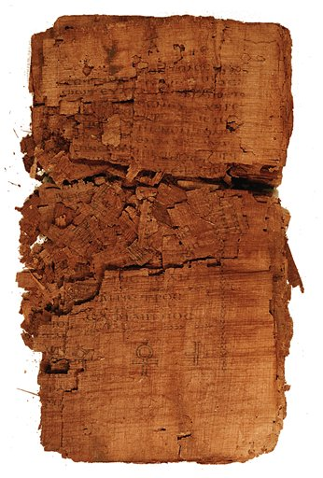
Judas: Another Gospel?

Slide 39
Is it Genuine?
Discovered in a subterranean chamber in Egypt in 1970’s.
Carbon-14 dating: AD 220-340.
A Coptic manuscript on papyrus.
Quoted by Iranaeus Against Heresies AD180.
Probably originated AD 150-170.
Bottom line, it is genuine!

Slide 40
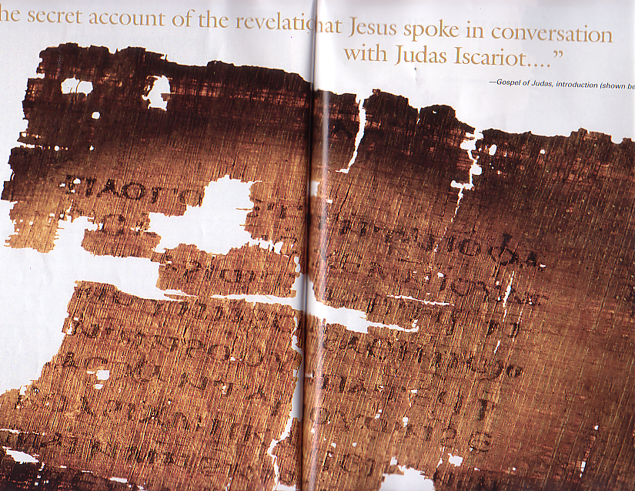
The Theme of the Gospel of Judas:
“The secret account of the revelation that Jesus spoke in conversation with Judas Iscariot.”
Judas was Jesus’ closest apostle.
Jesus revealed secret, deeper knowledge of his purpose and ministry to Judas. This Gospel reveals this deeper knowledge (gnosis).

Slide 41
Content (cont.)
A bizarre Gnostic cosmology put into the mouth of Jesus
“Come, that I may teach you about [secrets] no person [has] seen…” (GJ, p. 47)
12 Aeons (gods?) (see on Gnosticism below).
72 heavens and 72 luminaries: six for each of the Aeons.
360 firmaments and 360 luminaries: five for each of the heavens.
Characters such as Nebro, Yaldabaoth, Saklas, Galila, Yobel, Adonaios, Seth. “The first is Seth, who is called Christ” (GJ p. 52) Jesus is Seth, one of the five rulers of the underworld.

Slide 42
Content (cont.)
The key like comes near the end: “For you will sacrifice the man that clothes me.” (GJ p. 56) Believe it or not, this makes sense (to a Gnostic)!

Slide 43
What about the other “gospels?”
There were several Gnostic “gospels,” such as the Gospel of Thomas, the Gospel of Phillip, and the gospel of Judas.
These books were written AD 150-250 and definitely were not written by the apostles.
Even the Gnostics such as Marcion did not include them in their canon of scripture, because everyone knew they did not have apostolic authority.

Slide 44
The fictional conspiracy of the book
Quote from The Da Vinci Code
“…almost everything our fathers taught us about Christ is false.” (page 255, DVC)

Slide 45
Excerpt from DVC
“Constantine turned Jesus into a deity who existed beyond the scope of the human world, an entity whose power was unchallengeable. …It was all about power… the early Church literally stole Jesus from his original followers, hijacking His human message, shrouding it in an impenetrable cloak of divinity, and using it to expand their own power.” (page 253, DVC)

Slide 46
Excerpt from DVC
(speaking of the Council of Nicaea, in 325 A.D.) “My dear,’ Teabing declared, ‘until that moment in history, Jesus was viewed by His followers as a mortal prophet… a great and powerful man, but a man nonetheless. A mortal.”
“Not the Son of God?”
“Right,’ Teabing said, ‘Jesus’ establishment as ‘the Son of God’ was officially proposed and voted on by the Council of Nicaea. ‘…A relatively close vote at that.’ (page 253, DVC)

Slide 47
Excerpt from DVC
“More than eighty gospels were considered for the New Testament, and yet only a relative few were chosen for inclusion – Matthew, Mark, Luke and John among them.” (page 251, DVC)

Slide 48
The Gnostic “Gospels”
The “Gospel” of Thomas. Written about AD 150. Definitely not written by Thomas. A forgery.
1:22 They said to him, "Then shall we enter the kingdom as babies?" Jesus said to them, "When you make the two into one, and when you make the inner like the outer and the outer like the inner, and the upper like the lower, and when you make male and female into a single one, so that the male will not be male nor the female be female, when you make eyes in place of an eye, a hand in place of a hand, a foot in place of a foot, an image in place of an image, then you will enter [the kingdom].“
1:114 Simon Peter said to him, "Let Mary leave us, for women are not worthy of life.“ Jesus said, "I myself shall lead her in order to make her male, so that she too may become a living spirit resembling you males. For every woman who will make herself male will enter the kingdom of heaven.

Slide 49
II. New Testament Manuscript Evidence
Definitions
Manuscripts
Church Father Quotes
The Question of Greek Manuscript Errors

Slide 50
Definitions
manuscript
Any ancient document which contains all or parts of either the New of the Old Testament. The word literally means hand-written. Manuscripts may be in the original language or they may be a translation from the original language.
canon
The canon (Greek: reed, or measuring stick) of either the New or the Old Testament is the officially accepted list of books to be included in the scriptures.
scroll
A long piece of material, usually leather, which contains a number of pages of writing in rows, arranged in columns, designed to be rolled up and stored. This was the principal form of manuscripts before the time of Christ (2 Timothy 4:13).
codex
A long piece of either leather or papyrus, folded up in a format basically like a modern book. This was the most common form of manuscripts after about 200 AD.

Slide 51
Definitions (cont.)
papyrus
Papyrus is found in the Nile delta. Horizontal and vertical layers were glued together to create a light and easy-to-use writing substrate. Unfortunately, papyrus is the least likely of the ancient writing materials to survive for long periods without disintegrating. Commonly used in the first and second century.
vellum, parchment
Parchments are specially prepared sheep of goat skins used as writing materials. Vellum was made of calf or antelope skins. When papyrus became scarce in the early centuries AD, vellum became the chief material for creating manuscripts.
uncial
These are manuscripts which are written using all capital letters. The oldest Greek manuscripts are uncials.
Cursive/miniscule
These are manuscripts which use both capital and small letters, similar to a modern style of writing. The later manuscripts—after about AD 800—are usually cursives.

Slide 52
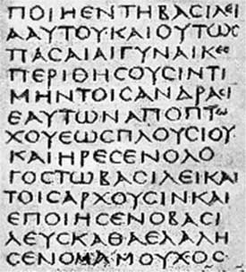
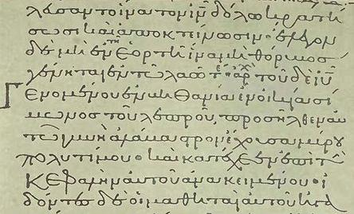
A Miniscule Manuscript
An Uncial Manuscript

Slide 53
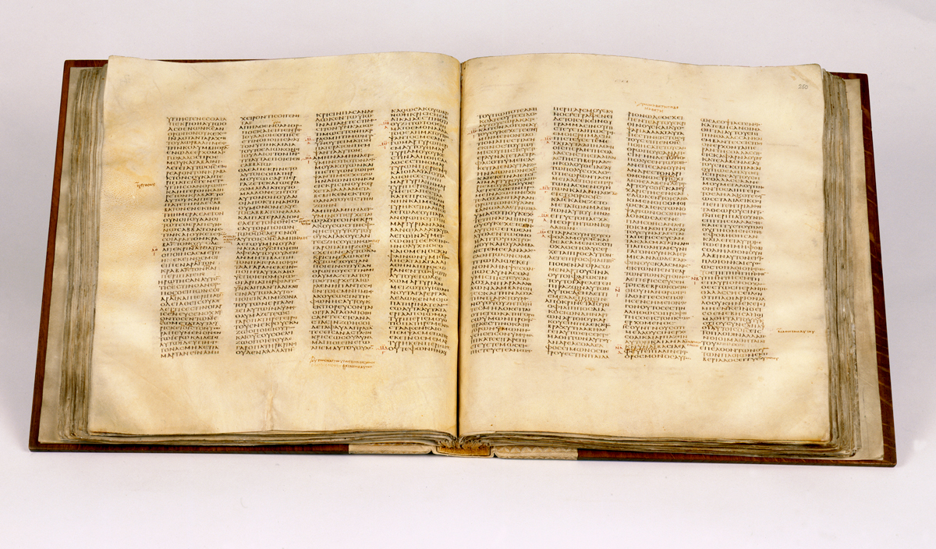
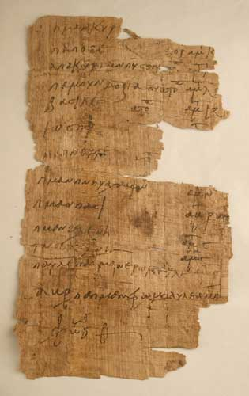
A papyrus manuscript
A vellum codex

Slide 54
Textual Evidence for Ancient Manuscripts
Author
Date
Oldest Copy
Interval
Copies
Aristophanes
400 BC
AD 900
1,300 years
45
Aristotle
340 BC
AD 1100
1,450 years
5
Demosthenes
300 BC
AD 1100
1,400 years
200
Julius Caesar
50 BC
AD 900
950 years
10
Herodotus
435 BC
AD 900
1,350 years
8
Homer
800 BC
AD 100
900 years
643
Plato
360 BC
AD 800
1,150 years
15
Sophocles
415 BC
AD 1000
1,400 years
7
Thucydides
410 BC
AD 900
1,300 years
8
Old Testament
1400 BC – 430 BC
250 BC
200-400 years
5,000
New Testament
AD 50-90
AD 125
50 years
8,000

Slide 55
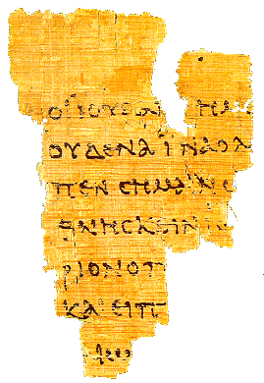
Manuscript evidence for the canonical gospels
The Rylands
Fragment
John 18:31-33, 37
AD 125

Slide 56
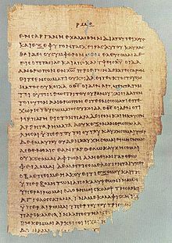
Chester Beatty Papyrus
2 Cor 11:33-12:9

Slide 57
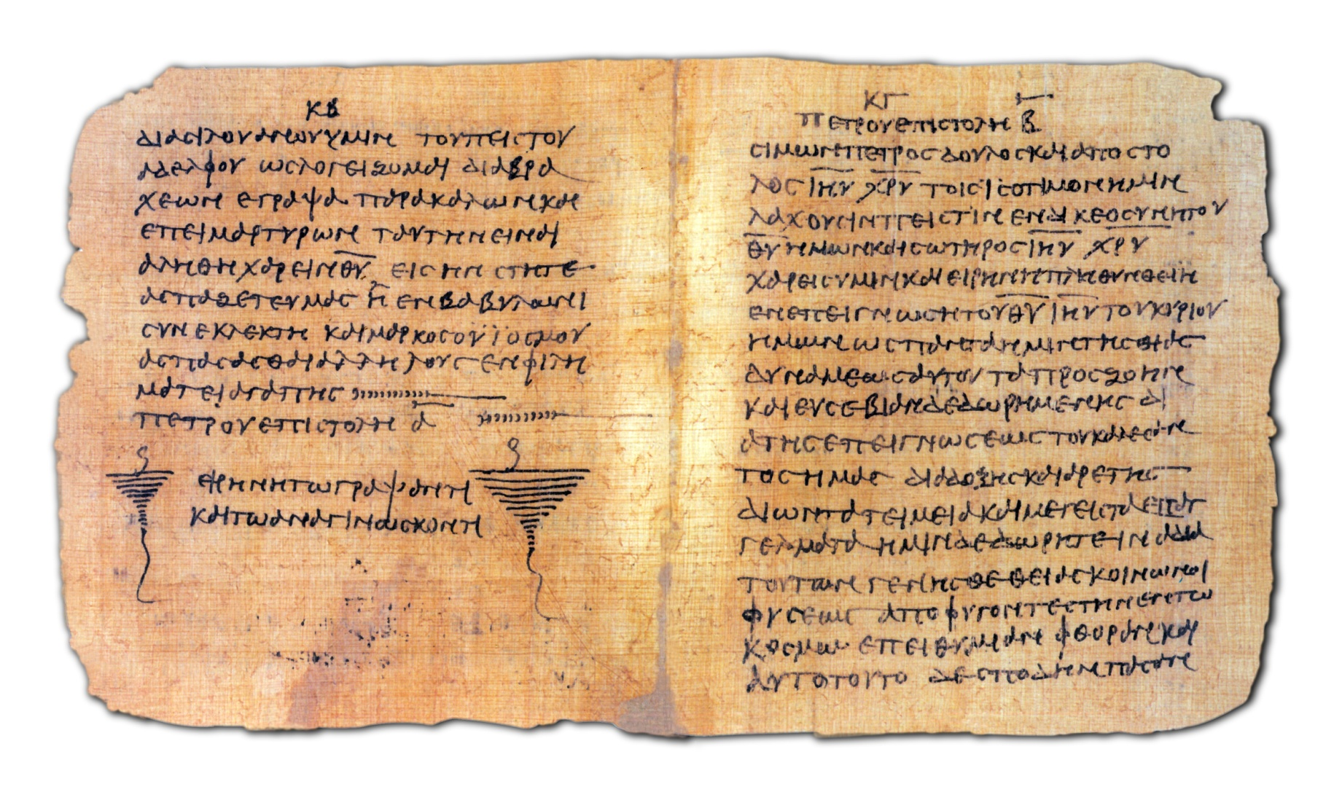
Bodmer Papyrus Codex

Slide 58
Codex Sinaiticus AD 350 British Museum

Slide 59
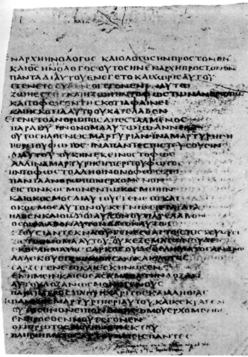
Codex Bezae D

Slide 60
John Rylands Papyrus (AD 125)
Chester Beatty Papyrus (AD 200)
Bodmer Papyri (AD 200)
Codex Vaticanus (AD 325)
Codex Sinaiticus (350 AD)
Codex Alexandrinus (400 AD)
Codex Bezae (450 AD)

Slide 61
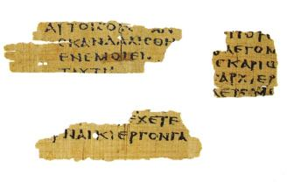
Magdalen Manuscript Matthew 3:5,26 AD 175

Slide 62
Text Types
Alexandrine
Western
Byzantine
Caeserean?

Slide 63
Other Evidence: Translations
Coptic (Alexandrine)
Old Syriac
Old Latin (Western?)
Jerome: The Vulgate

Slide 64
Church Father Quotes
Clement of Rome AD 95 or 96 quotes from ten of the twenty-seven New Testament books. Matthew, Mark Luke (possibly only two of the three), Acts, Romans 1 Corinthians, Hebrews, James, 1,2 Peter.
Ignatius d. AD 108 Letter to Ephesians: Matthew, Luke, John, Romans, 1,2 Corinthians, Ephesians, 2 Timothy, James, 1 Pet.
Also quoted in other letters, 1 Tim, 2 Thess, Acts, Hebrews, Galatians, Revelation.
Polycarp, writing to the Philippians in AD 120 quotes from Matthew, Mark, Luke, Acts, 1,2 Corinthians, Galatians, Ephesians, Philippians, 1,2 Thessalonians, 1,2 Timothy, Hebrews, 1 Peter, and 1,3 John
Nearly the entire New Testament can be reconstructed from quotes of the church fathers in the 2nd and 3rd centuries.
None of these ever quoted from a Gnostic gospel, ever! (although they quoted the OT Apocrypha)

Slide 65
What about the 200,000 manuscript errors in the New Testament?
Blow-up of text from Codex Sinaiticus
Showing uncial manuscript type
NOTEVERYONEWHOSAYSTOMELORDLORDWILLENTERTHEKINGDOMOFHEAVENBUTONLYHEWHODOESTHEWILLOFMYFATHERWHOISINHEAVEN

Slide 66
Copying Errors/Editing of the Text?
Slips of the pen
Lines repeated, switched, etc.
Scribes’ attempts to “improve” or “smooth” the text.
Interpolations.

Slide 67
Significant Textual Issues
About 60 in number
Matthew 11:19 for example
But wisdom is proved right by her actions/deeds
But wisdom is proved right by her children
Compare to Luke 7:35

Slide 68
Textual (Lower) Criticism
Age and quality of witnesses.
Unharmonized reading is preferred.
The “more difficult” reading is preferred.

Slide 69
Significant Textual Issues
John 7:53-8:11 Woman caught in adultery
Acts 8:37 If you believe with all your heart…
1 John 5:7 There are three that testify…
John 5:4 The angel stirred the water…
Mark 16:9-20

Slide 70
Orthodox Corruption of Scripture?
Luke 3:22
You are my beloved Son; in you I am well pleased.
Vaticanus, Sinaiticus, Alexandrinus, etc.
You are my beloved Son; today I have begotten you.
Bezae, Justin Martyr, Clement of Alexandria, Old Latin
Compare to Mark 1:11
Compare to Psalm 2:7

Slide 71
Even the hyper-critic Bart Ehrman says:
I do not think that the "corruption" of Scripture means that scribes changed everything in the text, or even most things. The original texts certainly spoke at great length about Jesus' crucifixion and resurrection. The issues involved in the corruption of the text usually entail nuances of interpretation. These are important nuances; but most of the New Testament can be reconstructed by scholars with reasonable certainty -- as much certainty as we can reconstruct *any* book of the ancient world.

Slide 72
Summary:
Westcott and Hort 1881. .1%? 1%? 2%?
No significant point of doctrine or theology is at stake.
The Greek text we have at this point is a nearly perfect representation of the autographs of the New Testament.

Slide 73
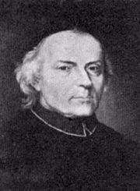
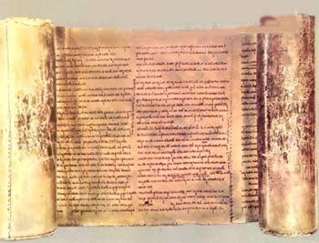
III. The Canon of the New Testament
The Muratorian Fragment?
Ledovio Muratori

Slide 74
Development of the New Testament Canon
A collection of Paul’s letters, perhaps not including the Pastoral Epistles, was circulating among the churches by the 90s AD
Four gospels circulating and recognized as apostolic by AD 100 or even by AD 90.
Marcion: AD 140 Developed and alternative canon.
A still fluid, but developing list of canonical books being read in the church by AD 150. “The memoirs of the apostles.”

Slide 75
Development of the New Testament Canon
Irenaeus AD 180. Gosples “the four pillars” of the church.
Muratorian Fragment. AD 180.
By AD 200, the New Testament as we know it was canonized by acclamation of the church.
Origen 220 AD Still some doubt about Hebrews, 2 Peter, 2,3 John, Jude, Revelation.
Shepherd of Hermas, Epistle of Barnabas, Didache “profitable for reading in the church.”

Slide 76
Summary
The New Testament canon was selected by consensus of the church in the second century as those books with apostolic authority.
The evidence is conclusive that the Greek New Testament we have is virtually identical to the original writings of the inspired writers.

Slide 77
IV. The Hebrew Text of the Old Testament
A section of the Psalms from the Dead Sea Scrolls

Slide 78
Reliability of the Old Testament Hebrew and Aramaic Text
The Masoretic Text
The Dead Sea Scrolls
The Septuagint and Other Early Translations

Slide 79
Early Translations of the Old Testament
Samaritan Pentateuch 400 BC 6000 errors?
Septuagint 200 BC
Syriac Version AD 100
Quotes from the Mishnah/Talmud

Slide 80
The Hebrew Text of the Old Testament
The Cairo Codex: The former and latter prophets AD 895
The Aleppo Codex: Oldest Hebrew manuscript of the entire Old Testament AD 920
The Leningrad Codex: Manuscript of the whole Old Testament AD 1008
The Masoretes and the Masoretic Text. These guys were fanatics!

Slide 81
The Masoretes AD 500-1000 Tiberias
Before starting to copy the scrolls or codices, the scribe required by the Masoretes to go through an elaborate ceremony. In order to preserve the integrity of the text, the Masorete scribes counted all the letters in the Old Testament. They kept track of such arcane details as the middle verse of the Pentateuch (Leviticus 8:7). They also found the middle verse of the entire Hebrew Bible (Jeremiah 6:7). They were aware of the middle word of the whole Old Testament, as well as the middle word of each book. They also kept record of the middle letter and verse of each book. Taking it to the extreme, they also counted the number of times each Hebrew letter appeared in each book and counted the number of verses which contained all the letters of the Hebrew alphabet. All this was intended to produce exact copies of the Scriptures. All this without word processors.

Slide 82
The Talmudists (AD 100-400) were radical too!!!
A synagogue roll must be written on the skins of clean animals, prepared for the particular use of the synagogue by a Jew. These must be fastened together with strings taken from clean animals. Every skin must contain a certain number of columns, equal throughout the entire codex. The length of each column must not extend over less than forty-eight, or more than sixty lines; and the breadth must consist of thirty letters. The whole copy must be first lined; and if three words be written in it without a line, it is worthless. The ink should be black, neither red, green, nor any other color and be prepared according to a definite recipe. An authentic copy must be the exemplar, from which the transcriber ought not in the least deviate. No word or letter, not even a yod (a vowel mark), must be written from memory, the scribe not having looked at the codex before him…. Between every consonant the space of a hair or thread must intervene; between every word, the breadth of a narrow consonant; between every new section, the breadth of nine consonants; between every book, three lines. The fifth book of Moses must terminate exactly with a line, but the rest need not do so. Besides this, the copyist must sit in full Jewish dress, wash his whole body, not begin to write the name of God with a pen newly dipped in ink, and should a king address him while writing that name he must take no notice of him…. The rolls in which these regulations are not observed are condemned to be buried in the ground or burned; or they are banished to the schools, to be used as reading books.

Slide 83
But… There is still that annoying 1400 years or so!

Slide 84
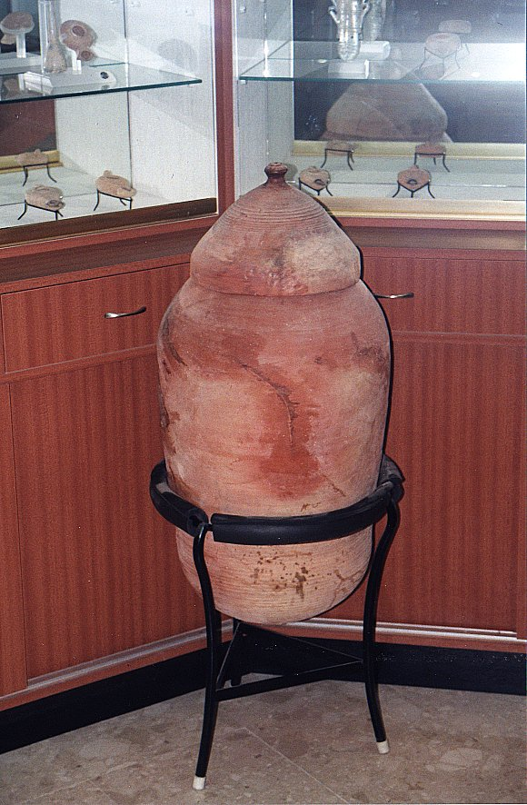
All this changed in 1947 with an Arab child in the hills east of Jerusalem….

Slide 85
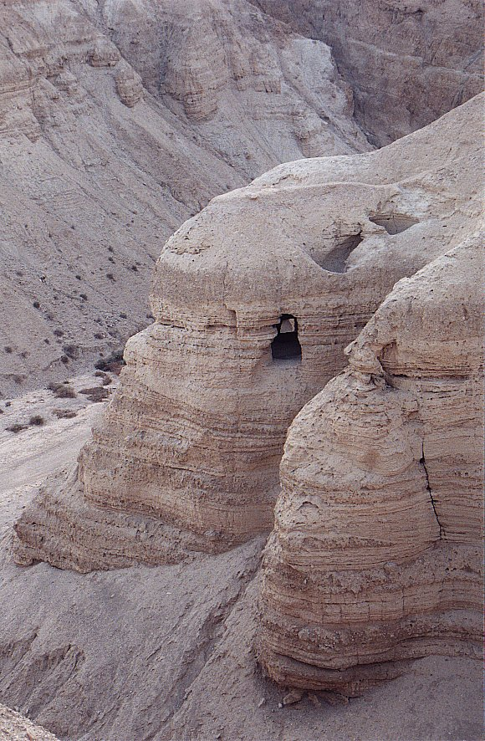
Qumran
Cave #4

Slide 86
The Effect of the Dead Sea Scrolls
Last Old Testament Book Written Autograph | Dead Sea Scrolls Written | Oldest Old Testament Manuscript Before Dead Sea Scrolls

Slide 87
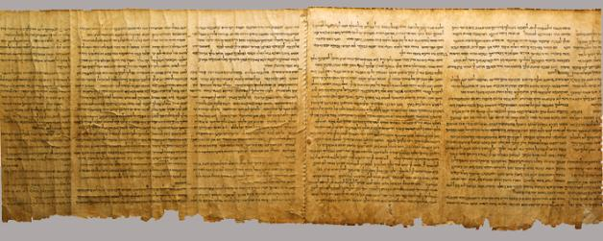
Important Dead Sea Scrolls
Isaiah 58:6-65:4
Isaiah A 13 changes t0 1952 RSV
Isaiah B
Samuel
1 & 2 Samuel 250 BC
Psalms
Exodus paleo-Hebrew 200 BC

Slide 88
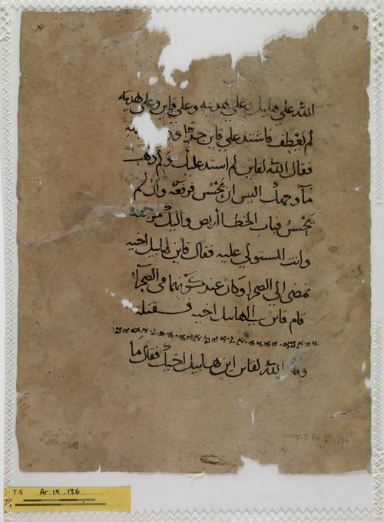
Other Hebrew Bible Translations
Samaritan Pentateuch 400 BC
6000 errors?
Septuagint 250 BC
Aramaic Targums about 0 BC
Old Syriac AD 100
Old Latin AD 100
Vulgate Jerome AD 386
Arab Translation of Samaritan Pentateuch

Slide 89
Textual Errors in the Hebrew Bible
Names and numbers
Amerixan vs American 510 vs 51 or 5100 or 500 soldiers
The Hebrew letters kaleth (ד) and resh (ר) are very difficult to distinguish. Similarly, the letters he (ה) and heth (ח) could easily be mistaken for one another.

Slide 90
VI. Old Testament Canon
Targums, Talmud, Mishna
Josephus Not 10,000 but 22 books
New Testament!!!
Council of Jamnia AD 90-100 Confirmed that Ecclesiastes and Song of Solomon should remain included in the accepted canon. Did NOT create an OT canon.

Slide 91
Old Testament Apocrypha
Included in the Septuagint?
Included by Jerome in Vulgate under protest.
Never quoted by Jesus. Mentioned in Jude, alluded to in Hebrews.
Used extensively by the Church Fathers, esp. after AD 200. 1 Esdras included in Coptic Bibles.
Finally rejected definitively by Jewish Rabbis.

Slide 92
Old Testament Reliability: A Summary
The canon of the Old Testament was set by general consensus of the Jewish rabbis perhaps as early as 300 BC, but almost certainly by 200 BC. The council of Jamnia more or less confirmed this list of books.
The Hebrew and Aramaic text of the Old Testament is remarkable close to that of the original writings.

Slide 93
VI. Further Evidence: Compare to Extra-Biblical Writings
Old Testament Apocrypha
Other Jewish Extra-Biblical Writings (1 Esdras, 1 Enoch, etc…)
Church Father writings not included in NT canon.
Heretical Writings (Gospel of Thomas, Gospel of Peter, Gospel of Judas, etc.)

Slide 94
Documents Considered for Inclusion in the New Testament
Shepherd of Hermas, Epistle of Barnabas, Didache, 1st Clement “profitable for reading in the church.”
Epistle of Barnabas:
Unfounded allegorical interpretation of the Old Testament.
Anti-Semitic attitude which contradicts Paul’s statements.
Shepherd of Hermas.
Highly allegorized interpretation of the Old Testament.

Slide 95
VII. Bible Inspiration: Compare to the Scriptures of Other Religions
Islam
Bahai
Mormonism (Don’t go there!)
Hinduism, Buddhism, etc.
In all religions, it is clear the Bible is the standard of inspiration to which all others are compared!!!!

Slide 96
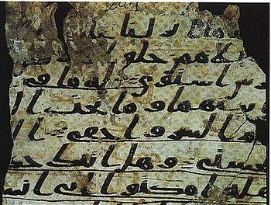
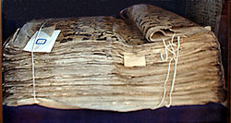
Islam
Sana’a Manuscript
AD 710
Tashkent Manuscript AD 850

Slide 97
Muslim Apologetics
Numerology.
Scientific accuracy?
Fulfilled Prophecy?
Historical Accuracy?
Perfectly reliable text?
Beauty of the Arabic text.
The main thing: Undermine the Bible at any cost!

Slide 98
Quranic view of biblical inspiration
Follow the Injil 5:47
( euvaggelion ) (below)
Follow the O.T. 6:92, 37:117, 40:53
“Qur’an unchanged” MS Discoveries...
“The people of the Injil shall rule in accordance with Allah’s revelations therein. Anyone who does not rule in accordance with Allah’s revelations -- these are the wicked!”
Inconsistency: Use OT and NT to refute Christians. Why, if the scriptures are “corrupt”?

Slide 99
Historical errors in the Qur’an
Ishmael = Isaac 37:102
2 trees in Eden = 1 tree 20:120
Noah’s 4th son drowns 11:43
Zechariah silent 3 days (not 9 months) 3:41
Pharaoh’s magicians repent 20:70
Judges 7 / 1 Sam 17 conflated 2:249
Jesus’ childhood miracles 3:49, 5:110, 19:30

Slide 100
Theory of Abrogation
Whatever Mohammad said later “abrogates” his previous sayings. Sura 16:101 We substitute one revelation for another.
Examples: Only 4 wives. Jihad?
The Satanic Versus Sura 53:19-20 "Have ye thought upon al-Lat and al-Uzza and Manat, the third, the other?"
Abrogated: "These are the exalted cranes (intermediaries) Whose intercession is to be hoped for."
vs.
"Are yours the males and His the females? That indeed were an unfair division."

Slide 101
Scientific Errors in the Qur’an
23:14—Creation from the clot of blood
“Then we made the sperm into a clot of congealed blood; then from that clot we made a lump; and we made out of that lump bones and clothed the bones with flesh.”
18:86—Traveling west…
“… till, when he reached the setting-place of the sun, he found it setting in a muddy spring.”

Slide 102
Scientific errors in Qur’an (II)
21:33—Sun and stars orbit the earth
41:12 7--“heavens”, stars, comets in “lowest heaven
34:9, 52:44—Piece of sky falls and kills someone
36:4, 23:14--Man deposits child into the mother

Slide 103
Purported Prophecies (I)
Deut 18:15-18
¹⁵The Lord your God will raise up for you a prophet like me from among your own brothers. You must listen to him. ¹⁶For this is what you asked of the Lord your God at Horeb on the day of the assembly when you said, "Let us not hear the voice of the Lord our God nor see this great fire anymore, or we will die.“ ¹⁷The Lord said to me: "What they say is good. ¹⁸ I will raise up for them a prophet like you from among their brothers; I will put my words in his mouth, and he will tell them everything I command him.

Slide 104
Purported Prophecies (I)
Deut 18:15-18—“From among their brothers”
Cf. Deut 17:15 (brother ≠ foreigner)
Deut 34:10—“Since then no prophet has risen in Israel like Moses, whom the Lord knew face to face, who did all those miraculous signs and wonders the Lord sent him to do in Egypt”
Like Moses = miraculous signs and wonders, which Mohammed never did, but Jesus clearly did.

Slide 105
Purported Prophecies (III)
Deut 33:1-2 This is the blessing that Moses the man of God pronounced on the Israelites before his death. ² He said:
“The LORD came from Sinai
and dawned over them from Seir;
he shone forth from Mount Paran.
He came with myriads of holy ones
from the south, from his mountain slopes.”
Muslims claim: Sinai = Moses
Seir = Jesus
Paran = Mohammed
Paran is nowhere near Mecca (Hab 3:3)

Slide 106
Purported Prophecies (III)
Isa 21:7 when he sees…riders on donkeys or riders on camels, let him be fully alert”
Muslim claim: riders on donkeys = Jesus, riders on camels = Mohammed. Context: fall of Babylon!
Jn 14:16 parakletos → periclytos (praised one)—without any MS supp. Moreover, 14:26 shows the helper is the Spirit. Jn 16—The helper to abide forever. (M is dead.) 14:26—Helper to be sent in Jesus’ name; but no Muslim would allow this! Besides, Acts 1:5—helper to come in not many days – not in the 7th century!

Slide 107
Bahai Scriptures inspired?
Prophecies in Bible fulfilled by the Bab or Baha Ullah?
Dan 8:13-14, Revelation 11:3, Rev 12:1
Prophecies of Baha Ullah fulfilled?
Ottoman Empire to fall apart
Demise of Abdul Aziz
Ali Pasha will lose his position as vizier

Slide 108
Scriptures of Hinduism
Vedas Poems. Ritualistic, priestly. 1500-1000 BC. Especially the Rig Veda. Include the Brahmanas.
Upanishads Highly philosophical essays about brahman, atman, transmigration of atman, karma and so forth. 800-600 BC.
Epics (Ramayana, Mahabarata, Bhagavad Gita) Mythic adventures of Rama, Krishna and others.
Puranas Largely local legends, myths, many local deities. AD 400-1000. This is the “scripture” of most local Hindus.
Tantras Religious discussions/teachings.

Slide 109
Hindu Scriptures Inspired and Reliable?
Written down 500 BC. Oldest manuscripts of the Rig Veda AD 1300. Nearly 3000 years after it was written.
Scriptures self-contradictory.
Does anyone actually consider these scriptures inspired in the sense Christians defend the Bible?

Slide 110
Buddhist Scriptures Inspired and Reliable?
No universal canon.
Pali Canon: Tripitaka. Collected AD 400.
Oral tradition from 500 BC until 100 BC.
Oldest manuscripts AD 100.

Slide 111
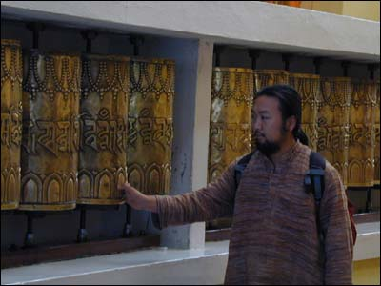
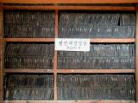

Slide 112
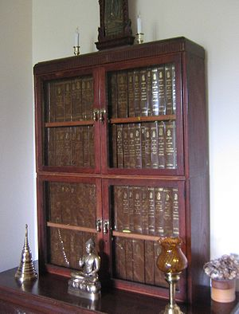
Thai Pali Canon

Slide 113
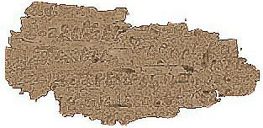
Oldest Buddhist Text AD 100

Slide 114
Inspiration and Inerrancy
Inspiration: Is the Bible inspired by God?
Inerrancy: Is the Bible inerrant?

Slide 115
VIII. Inspiration: Is the Bible Inspired by God?
The entire Bible, although authored by men, is divinely and authoritatively the revelation of God.
2 Peter 1:19-21, 2 Tim 3:16, 1 Thess 2:13, 2 Peter 3:15-16
Is there such a thing as inspired opinion? (1 Cor 7:12 I, not the Lord)
What about John 9:31? Is there inspired error?

Slide 116
Verbal Inspiration
Galatians 3:16 An argument based on singular vs. plural of a noun.
Luke 20:37-38 An argument based on tense of a verb.
Jesus and Paul clearly believed in verbal inspiration.

Slide 117
Do we read inspired Scripture?
No! Translations are not inspired.
No! Translations are made from uninspired copies.
The autographs (the original written letters/histories/proverbs, etc. are inspired.
Does uninspired copying affect our faith?

Slide 118
How Do We Know the Bible is Inspired?
Can I prove Esther 3:4 is inspired?
Remember: Do not oversell your evidence.
Also, do not undersell your evidence.

Slide 119
Evidence of Biblical Inspiration
1. Historical Reliability.
2. Fulfilled Prophecy.
3. Fulfilled foreshadow and prefigure. In the Bible, history itself becomes a prophecy! (RFB p. 238-239 for examples)
4. Consistency of doctrine and theology.
5. Lack of contradiction.
6. Scientific wisdom.
7. Jesus believed it was inspired (Matt 15:6) and he did miracles and was resurrected from the dead.
8. Quality of the text. Ridiculously compact. Genesis 1 philosophically dense.

Slide 120
Can I be confident the Bible is inspired by God?
The preponderance of the evidence… What’s the most rational conclusion?
The rest is filled in by faith.

Slide 121
IX. Is the Bible Inerrant?
Inerrant: The Bible contains no errors whatsoever. This is the standard fundamentalist view.
Translation issues. Translations are not perfect.
Copyist errors. It is a fact that Hebrew and Greek texts have errors.
Inerrancy needs to be defined carefully.

Slide 122
Definitions of Inerrancy
“The inerrancy of Scripture means that Scripture in the original manuscripts does not affirm anything that is contrary to fact.” - Wayne Grudem (Systematic Theology, page 90)
Chicago Statement 1978

Slide 123
Is the Bible Inerrant? Are There Mistakes in the Autographs (Original Manuscripts)?
Does the sun move across the sky?
Are the gospels or Bible in general exact transcriptions?
Are the “days” in Genesis 1 literal?
Did Jesus clear the temple twice?
Are there chronological errors in the NT?
What about paraphrases of scripture or quotes from uninspired translations?
Hyperbole: Against you, you only have I sinned….
Was Moses literally in the desert exactly 40 years
Be cautious about imposing a modernist/Western concept of inerrancy.

Slide 124
Bible “Errors”? (cont.)
Is David mistaken? Psalm 51:4 Against you only have I sinned. Psalm 51:5 Original sin?
Psalm 103:12 How far is it from the East to the West?
Do Bible writers misquote the OT? Is it an “error” if they quote from an unispired translation (the Septuagint)? Are they paraphrasing? Is that a mistake?
Bottom line, Inspiration is very solid, but inerrancy should be defined and defended carefully.

Slide 125
Chicago Statement
We further deny that inerrancy is negated by Biblical phenomena such as a lack of modern technical precision, irregularities of grammar or spelling, observational descriptions of nature, the reporting of falsehoods, the use of hyperbole and round numbers, the topical arrangement of material, variant selections of material in parallel accounts, or the use of free citations.

Slide 126
X. Supposed Contradictions in the Bible
Claim: The Bible is full of obvious errors of fact and of doctrine, which is proved by all the contradictions it has with itself.
Possible Reactions:
Ignore the questions (a bad idea)
Think carefully and “Be prepared to give an answer” (1 Peter 3:15)

Slide 127
Bible “Contradictions”
Identical events described by two different authors have details of fact that appear to contradict.
Claims that a doctrine which is taught in two different passages is contradictory.
Numbers of objects, people or years in two different passages do not agree.

Slide 128
Questions To Ask
1. Is this a legitimate contradiction? In other words, is there a perfectly reasonable explanation of the supposed contradiction that can be found simply by reading the relevant passages in context, giving the benefit of the doubt to biblical reliability.
2. Is there any chance that a scribal error could explain the apparent discrepancy? This will be a particularly relevant question in the supposed contradiction involves numbers from the Old Testament Text.
3. Is it possible that the two passages, rather than contradictions one another, actually complement one another? In other words, is it possible that the two apparently discrepant scriptures, when taken together, actually create a fuller picture of what God is trying to communicate?

Slide 129
Categories of Bible “Contradictions”
Contradictions of Fact: (Illustration: eyewitnesses to a crime)
Genesis 7:17 vs Genesis 8:3
Genesis 37:36 vs Genesis 39:1
Matthew 27:5 vs Acts 1:18
John 19:17 vs Mark 15:21-23
Actual contradictions! 2 Samuel 8:4 vs 1 Chron 18:4
Contradictions of Doctrine:
Exodus 20:4-5 vs Ezek 18:19-20
Exodus 20:8 vs Isaiah 1:13
Ephesians 2:8-9 vs James 2:24
Proverbs 26:4 and Proverbs 26:5

Slide 130
Bible Contradictions (cont.)
“David took seven hundred (2 Samuel 8:4) or seven thousand (1Chronicles 18:4) horsemen from Hadadezer. Which is correct?”

Slide 131
More Difficult Supposed Contradictions
Exodus 20:4-5 vs Ezek 18:19-20
All-time most difficult: Matt 10:10, Luke 9:3 vs Mk 6:8 Were they to carry a staff?

Slide 132
1. Why are there 41 generations from David to Jesus in Luke, but only 28 generations in Matthew?
2. Can you explain the apparent contradiction between Genesis 50:12 and Acts 7:15-16? (regarding the cave Abraham built)
3. How do you explain the apparent contradiction between Mark 16:5-7 (one angel) and Luke 24:4-7 (two angels)
4. Did Saul kill himself (1 Sam 31) or did the Amalekite soldier kill him? (2 Sam 1)
5. Please explain the contradiction created by 2 Samuel 24, where it says that Satan incited
David and 1 Chronicles 21 where it says that God incited David
6. Please explain to me the discrepancies, both theological and numerical, between 2 Samuel 24 and 1 Chronicles 21
7. Leviticus 26:19 mentions iron when the iron age did not start in Canaan until 1150 BC. Doesn’t this prove that Moses did not write Leviticus?
8. How do you resolve the difference between 23,000 mentioned as killed in 1 Corinthians 10:8 and the 24,000 mentioned in Numbers?
9. Was it one thief (Luke) or both (Matthew) who mocked Jesus? How can you resolve this?
10. Where did Jesus first appear to the eleven disciples? It there a contradiction in the gospel accounts?
11. How do you reconcile: 1) Gen.23:2 with Joshua 14: 13 - 15 and 2) Gen. 14:14 with Judges 18:29?
12. Please explain the contradiction between Acts 9:7 and 22:9
13. How does one reconcile the accounts in Matthew and Mark of the demoniac, as one mentions two and the other mentions only one man being possessed?

Slide 133
Bible Errors/Contradictions?
Matthew 2:23 Where is the prophecy that Jesus will be called a Nazarene? Answer: Isaiah 11:1-2, Zechariah 6:9-15
Two different and contradictory Genealogies in Matthew & Luke. Answer: Matthew’s genealogy of Joseph and Luke is genealogy of Mary (Joseph the son in law of Heli)
Matthew 2:15 Mistakenly makes Hosea 11:1 a prophecy (no, it is a fulfilled foreshadow, not a fulfilled historical prophecy)

Slide 134
More Thoughts on Biblical Inspiration
The Bible has dozens of authors, yet a miraculously consistent message and theme.
Mesopotamians, Egyptians, Bedouins and Greeks
Priests, farmers, soldiers, kings, fishermen, prophets and prime ministers Historians, poets, seers, teachers
The whole Bible is about Jesus. (John 5:39-40)
Moses frees God’s people
Abraham offers his only son
A snake is lifted up on a pole.
No dualism, polytheism, animism, deism.
Balance of judgment and grace.
Etc.

Slide 135
The Bible is the best book in the world on…
Psychology
Teaching Look at Jesus’ parables
Literature (Psalms)
Wisdom (Proverbs)
Philosophy
Character, Ethics
Child Raising
Finances
Government Q: Other????
The Bible works
Changed Lives. John 7:17

Slide 136
History, Archaeology and the Bible
Dr. John Oakes

Slide 137
IMPORTANT PERIODS IN THE HISTORY OF ISRAEL
Period in the History of Israel
Dates
The Patriarchs
Abraham, Isaac, Jacob and Joseph
2050-1800 BC
Moses and Joshua
The Exodus and the Conquest
1450-1400 BC
The Period of the Judges
Deborah, Jephthah, Gideon and Samuel
1400-1050 BC
The United Kingdom
Saul, David, Solomon and Rehoboam
1050-931 BC
The Northern Kingdom (Samaria)
Destruction and captivity under Assyria
931-722 BC
The Southern Kingdom (Judah)
Destruction and captivity under Babylon
931-586 BC
Defeat and destruction of Jerusalem
The period of the exile in Babylon
605-536 BC
Return of the captives, rebuilding of the
temple and of Jerusalem
536-440 BC
The period “between the Testaments”
440-6 BC
THE PATRIARCHAL PERIOD
We will begin, then, with the time of Abraham. In the Bible, Abraham is the father of Israel

Slide 138
DOMINANT POWERS DURING THE HISTORY OF ISRAEL
Dominant Power
Dates
Hittites and Egyptians
2000-900 BC
Assyria
900-606 BC
Babylon
605-539 BC
Persia
538-331 BC
Alexander and the Greek Dynasties
330-63 BC
Rome
After 63 BC

Slide 139
Ziggurat in Ur

Slide 140
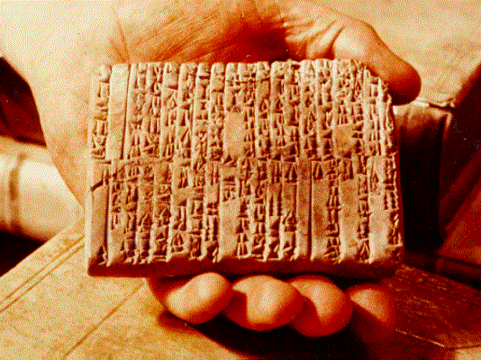
One of the Ebla Tablets about 2100 BC
Nahor, Terug, Abram, Sarai

Slide 141
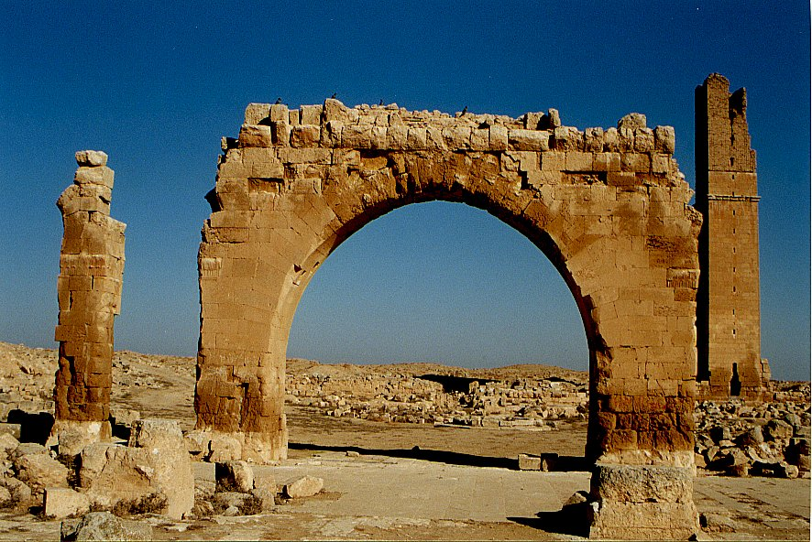
Haran Ruins In Mesopotamian Plane Near Sanli Urfa, Turkey

Slide 142
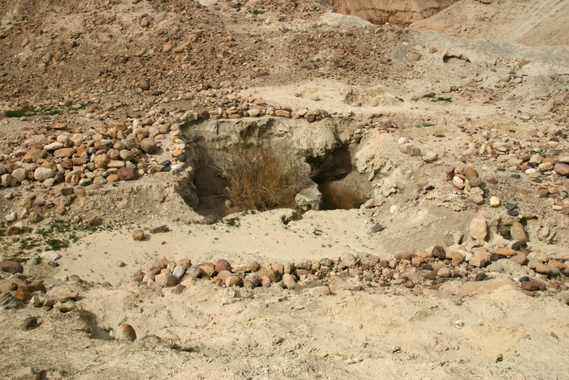
Ruins at Bab ed-Dhra (Sodom)

Slide 143
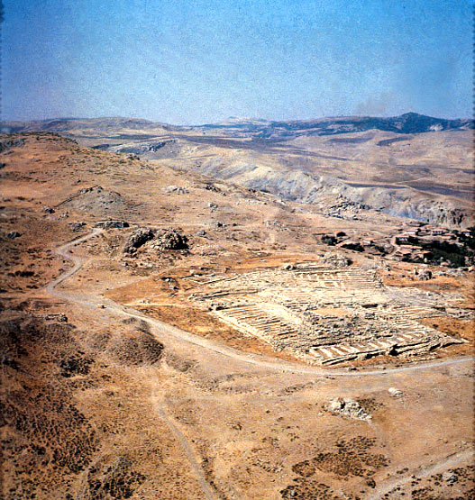
Ruins of Hattusha, capital of the Hittites

Slide 144
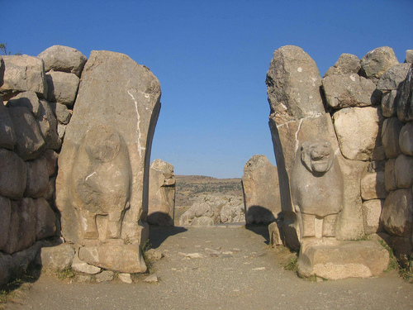
The Lion Gate in Hattusha

Slide 145
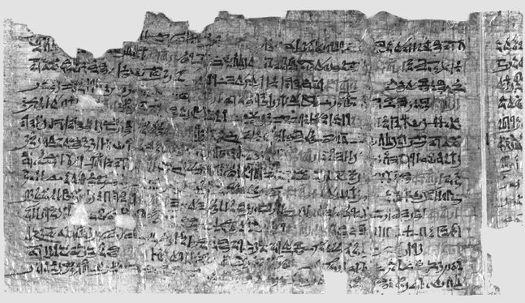
Papyrus Ipuwer
• 2:2—The river is blood = The river was turned to blood—Exod 7:20 • 2:6— Blood is everywhere = Blood is throughout all the land of Egypt— Exod 7:21 • 4:14—Trees are destroyed = And the hail… broke every tree in the field— Exod 9:25 • 9:11—The land is not light = And Moses stretched forth his hand… and there was a thick darkness— Exod 10:22 • 2:13—He who places his brother in the ground is everywhere = For there was not a house where there was not someone dead— Exod 12:30

Slide 146
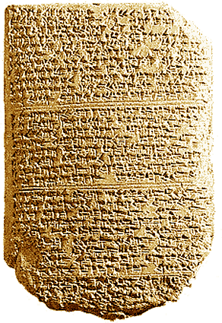
‘The Habiru plunder all lands of the king. If archers
are here this year, then the lands of the king, the
lord, will remain; but if the archers are not here,
then the lands of the king, my lord, are lost.’
One of the Tel El Amarna Letters c. 1400 BC

Slide 147
Archaeological Facts about Jericho
1. The city was strongly fortified in the Late Bronze I period, the time of the Conquest according to the biblical chronology (Joshua 2:5,7,15).
2. The city was massively destroyed by fire (Joshua 6:24).
3. The fortification walls collapsed at the time the city was destroyed, possibly by earthquake activity (Joshua 6:20).
4. The destruction occurred at harvest time, in the spring, as indicated by the large quantities of grain stored in the city (Joshua 2:6, 3:15, 5:10).
5. The siege of Jericho was short, as the grain stored in the city was not consumed (Joshua 6:15,20).
6. Contrary to what was customary, the grain was not plundered, in accordance to the command given to Joshua (Joshua 6:17,18).

Slide 148
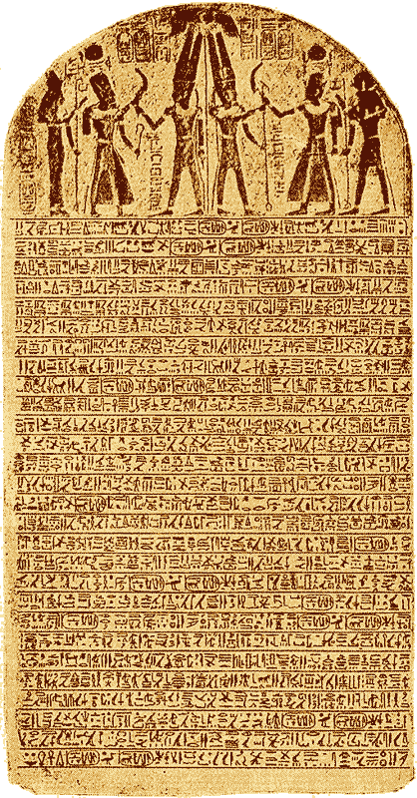
The Stele of Merneptah Egypt, 1230 BC
Mentions the Israelites in Canaan

Slide 149
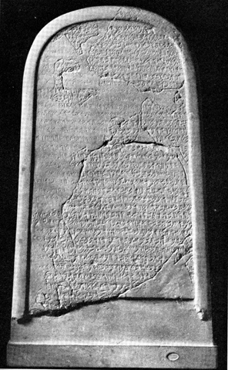
The Moabite Stone or Mesha Stele 870 BC
the Louvre
Ahab “of the house of Omri”
1 Kings 16:28

Slide 150
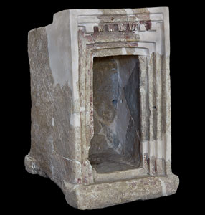
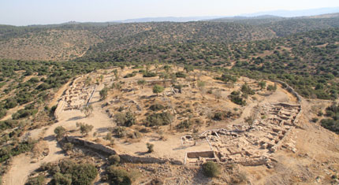
Khirbet Qieyafa

Slide 151
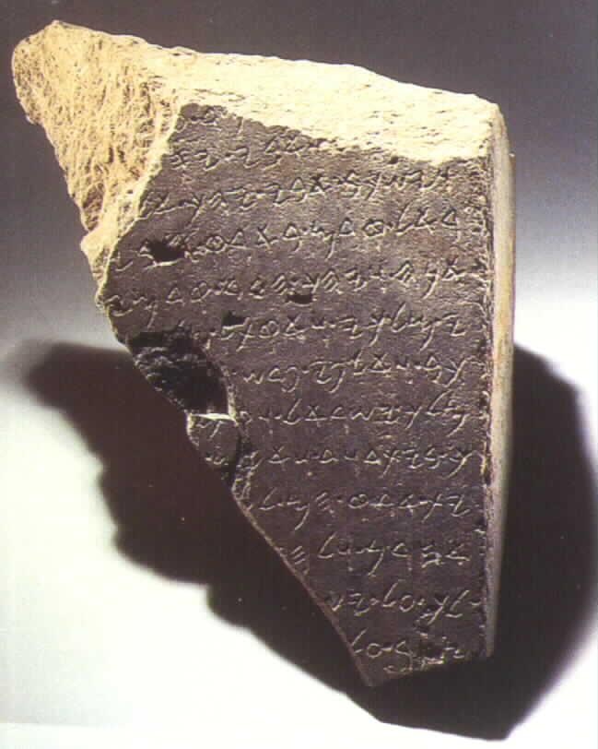
The Tel Dan Inscription
820 BC
2 Kings 8:28-29
‘I killed Jehoram, son of Ahab, king of Israel and I killed Ahaziah, son of Jehoram, king of the house of David”

Slide 152
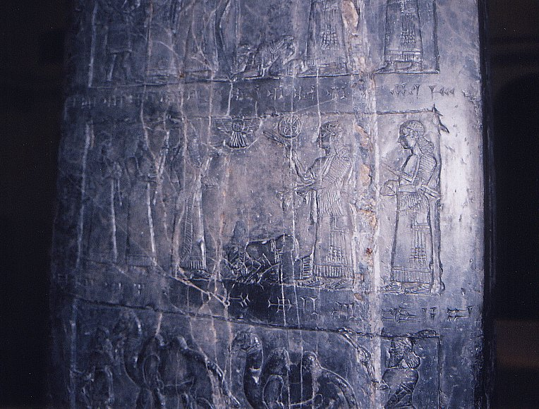
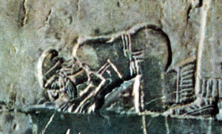
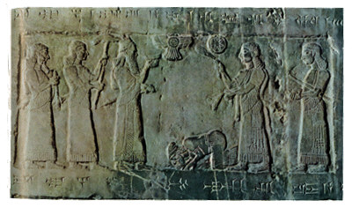
Black Obelisk of Shalmanezer III 840 BC
British Museum 2 Kings 17:3-6

Slide 153
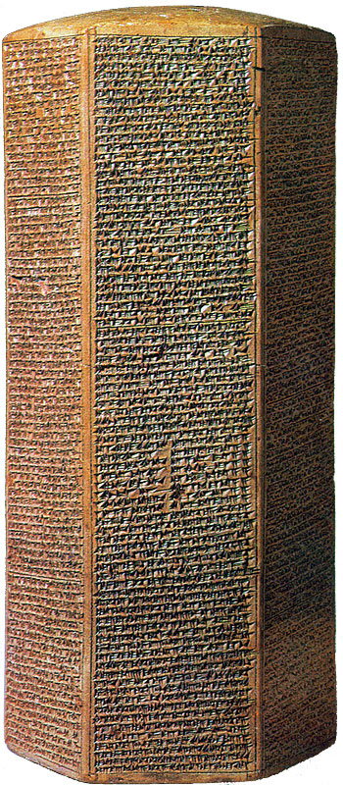
The Sennacherib Cylinder or Taylor Prism British Museum, London (2 Kings 18) 691 BC
As to Hezekiah the
Jew… I made him…
“like a bird in a cage”

Slide 154
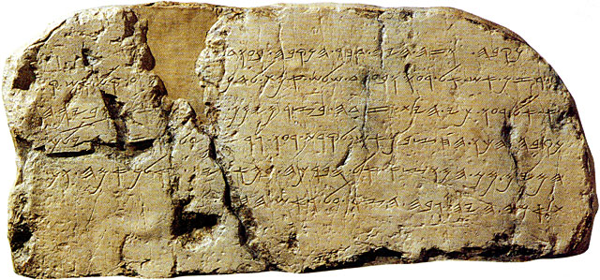
The Siloam Inscription.
2 Kings 20:20-21
"Now the rest of the acts of Hezekiah--all his might, and how he made a pool and a tunnel and brought water into the city--are they not written in the book of the chronicles of the kings of Judah? So Hezekiah rested with his fathers."

Slide 155
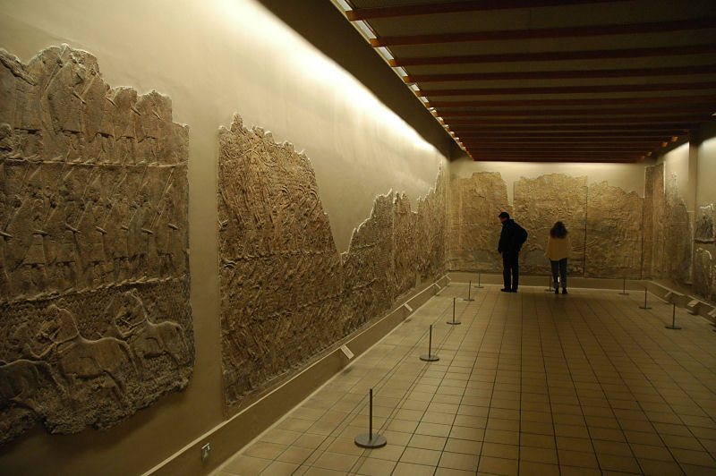
Lachish Room, British Museum

Slide 156
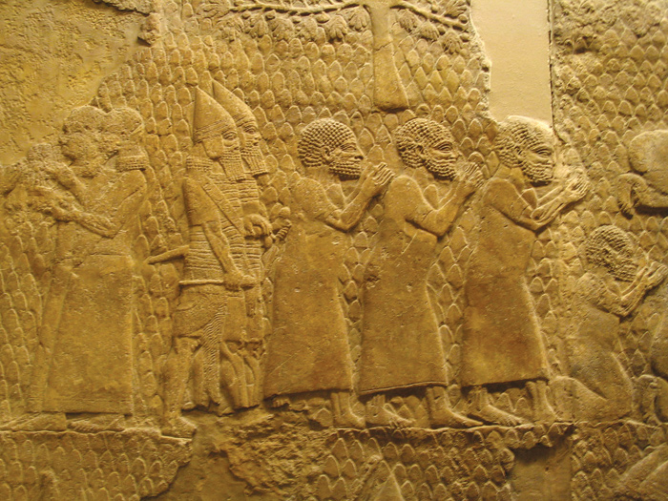
Israeli Captives Being Led from Lachish

Slide 157
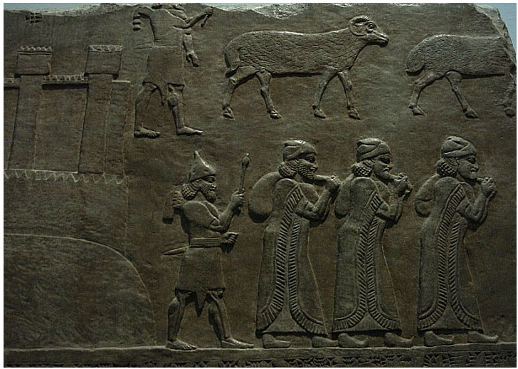
Plunder being carried off to Assyria

Slide 158
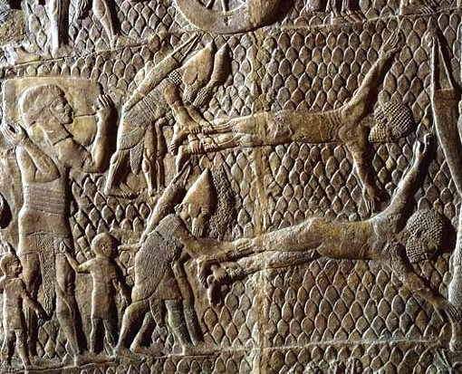
Jewish captives skinned alive in front of Lachish Walls

Slide 159
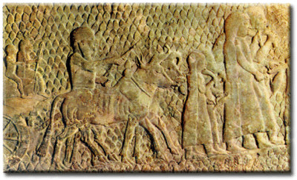
Jews being led to captivity from Lachish

Slide 160
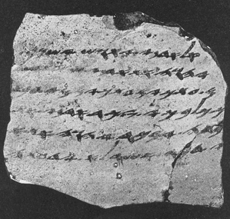
One of the Lachish Letters, 588 BC
Jeremiah 34:6,7

Slide 161
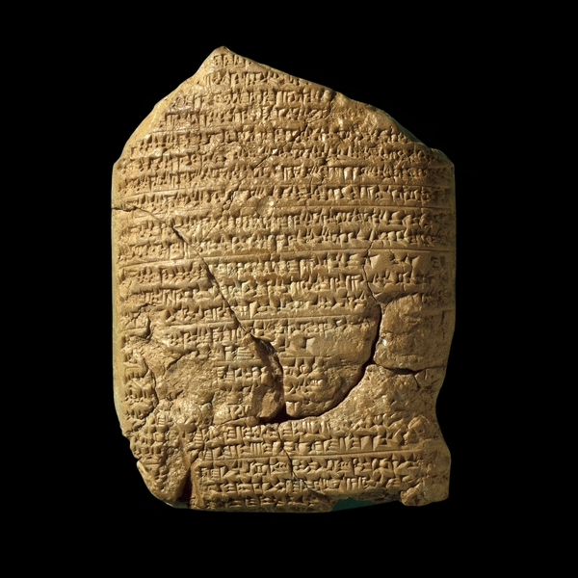
The Babylonian Chronicles British Museum, London, 597 BC 2 Kings 24:10-17
[In] the seventh year, the month of Kislev, the king of Babylonia mustered his forces and marched to Syria. He camped against the city of Judah (Jerusalem) and on the second day of the month of Adar he took the city and captured the king. He appointed a king of his own choice there, took its heavy tribute and brought them to Babylon.

Slide 162
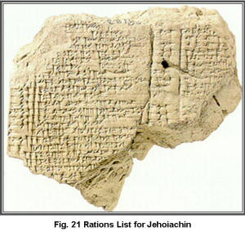
Yaukin (Jehoiachin), king of the land of Judah

Slide 163
Cyrus Cylinder British Museum 535 BC
Ezra 1:2-4

Slide 164
Pilate Inscription Cesarea Maritima AD 30
Discovered 1961
Tiberius, Pontius Pilatus, Prefect of Judea

Slide 165
Archaeological Evidence

Slide 166
The Pool of Siloam

Slide 167
Caiaphas Ossuary
“Caiaphas, son of Joseph”

Slide 168
Black Obelisk of Shalmanezer III 840 BC
British Museum 2 Kings 17:3-6

