Slide 1
The Olivet Discourse
by David Lee Burris

Slide 2
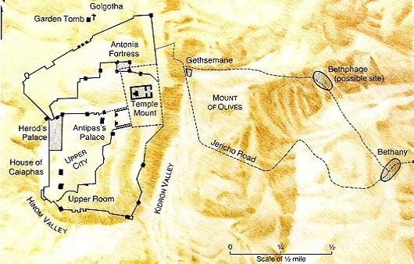
Jesus Last Week Travels – Monday
?
Barren Fig Tree
?
Jesus Laments
Jesus Christ
Spends Night
Matthew 21:17

Slide 3
A Day of Rejection
Mk 11:12-14
  Mt 21:19, Fig tree immediately withers
  Similar to a Parable
    Lk 13:1-9, unless you repent you shall likewise perish
    Jesus’ last year of his Ministry
    Given opportunity
  This latter was not
The Barren Fig Tree
Rejected by the King

Slide 4
A Day of Rejection
Lesson
  Time for repentance was past
  Time for “judgment”
    Mt 23:34-39
Application
  God has a purpose for us
  Lk 13, repent or we shall likewise perish
    Patience and Effort
  But one day…
The Barren Fig Tree
Rejected by the King

Slide 5
A Day of Rejection
Mk 11:20-24
  The Next Day (Tuesday)
  Vs. 20, The fig tree is Dried up
  Have Faith in God
    To Move Mountains
      Disciple had a weak faith
      Mt 17:14-21, healing of the son who had a devil
      Lk 17:5-6, move trees
Dead Fig Tree
Notes:
We have skipped the cleaning of the temple, next weeks lesson.

Slide 6
A Kings Rejection
Barren Fig Tree
  Opportunity had Past – Time of Judgment
  Fulfill God’s Purpose
    Bear Fruit – Or be Rejected
    Have Faith
    Forgive – Or be Rejected

Slide 7
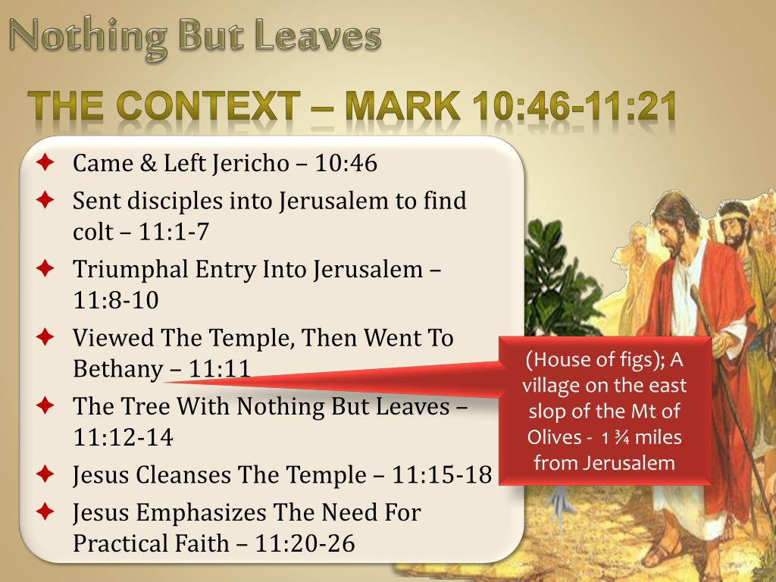

Slide 8
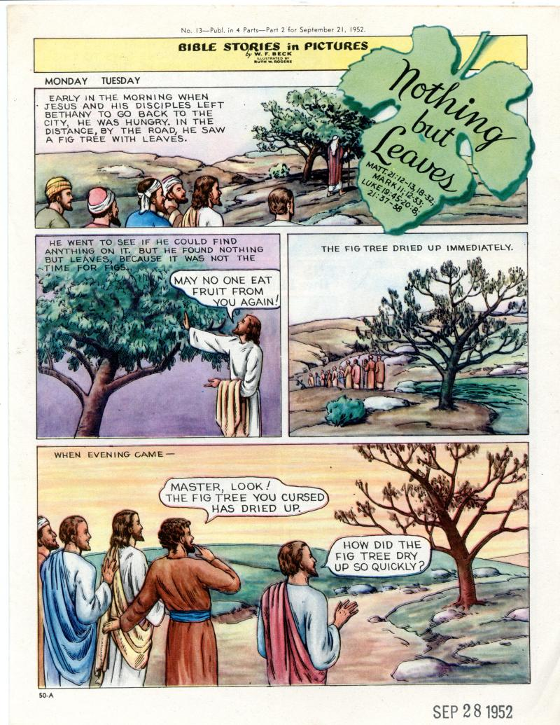

Slide 9
Mark 11:14 - Why Was the Fig Tree Cursed?
This incident is related by Mark and, in a more compressed form, by Matthew. According to Mark, Jesus and his disciples spent the night following his entry into Jerusalem in Bethany. Next morning they returned to Jerusalem. On the way he felt hungry, and “seeing in the distance a fig tree in leaf, he went to find out if it had any fruit. When he reached it, he found nothing but leaves, because it was not the season for figs.” Then Jesus cursed the tree: “May no one ever eat fruit from you again.” They continued on their way into Jerusalem, where that day he cleansed the temple; in the evening they returned to Bethany. Next morning, as they passed the same place, they saw the fig tree withered away to its roots. And Peter remembered and said to him, “Rabbi, look! The fig tree you cursed has withered!” (Mk 11:20–21). Was it not unreasonable to curse the tree for being fruitless when, as Mark expressly says, “it was not the season for figs”? The problem is most satisfactorily cleared up in a discussion called “The Barren Fig Tree” published many years ago by W. M. Christie, a Church of Scotland minister in Palestine under the British mandatory regime. He pointed out first the time of year at which the incident is said to have occurred (if, as is probable, Jesus was crucified on April 6th, a.d. 30, the incident occurred during the first days of April). “Now,” wrote Christie, “the facts connected with the fig tree are these. Toward the end of March the leaves begin to appear, and in about a week the foliage coating is complete. Coincident with [this], and sometimes even before, there appears quite a crop of small knobs, not the real figs, but a kind of early forerunner. They grow to the size of green almonds, in which condition they are eaten by peasants and others when hungry. When they come to their own indefinite maturity they drop off.” These precursors of the true fig are called taqsh in Palestinian Arabic. Their appearance is a harbinger of the fully formed appearance of the true fig some six weeks later. So, as Mark says, the time for figs had not yet come. But if the leaves appear without any taqsh, that is a sign that there will be no figs. Since Jesus found “nothing but leaves”—leaves without any taqsh—he knew that “it was an absolutely hopeless, fruitless fig tree” and said as much. But if that is the true explanation of his words, why should anyone trouble to record the incident as though it had some special significance? Because it did have some special significance. As recorded by Mark, it is an acted parable with the same lesson as the spoken parable of the fruitless fig tree in Luke 13:6–9. In that spoken parable a landowner came three years in succession expecting fruit from a fig tree on his property, and when year by year it proved to be fruitless, he told the man in charge of his vineyard to cut it down because it was using up the ground to no good purpose. In both the acted parable and the spoken parable it is difficult to avoid the conclusion that the fig tree represents the city of Jerusalem, unresponsive to Jesus as he came to it with the message of God, and thereby incurring destruction. Elsewhere Luke records how Jesus wept over the city’s blindness to its true well-being and foretold its ruin “because you did not know the time of your visitation” (Luke 19:41–44 RSV). It is because the incident of the cursing of the fig tree was seen to convey the same lesson that Mark, followed by Matthew, recorded it.
Kaiser, W. C., Jr., Davids, P. H., Bruce, F. F., & Brauch, M. T. (1996). Hard sayings of the Bible (pp. 441–442). Downers Grove, IL: InterVarsity.

Slide 10
Olivet Context: The Waste of Space Fig Tree
When Will These Things Happen?
Learn from the fig tree (vs. 32-35)
Just as plants spout leaves and begin to be fruitful tells us that summer is near, so also these signs will note that the destruction of Jerusalem is near. Notice verse 34, “I assure you: This generation will not pass away until these things take place.” Premillennialists take this passage as the second coming and the coming tribulation that will occur after the rapture. If that is true, then that generation must still be alive somewhere. Is there somewhere nearly 2000 year old people? Ridiculous! What Jesus was saying here is that within that generation’s lifespan, these things would happen. It would not be something for a really long time, not far into the future, but shortly these things would happen. Everything else may pass away, but his words about this event would surely occur. There was no doubt.

Slide 11
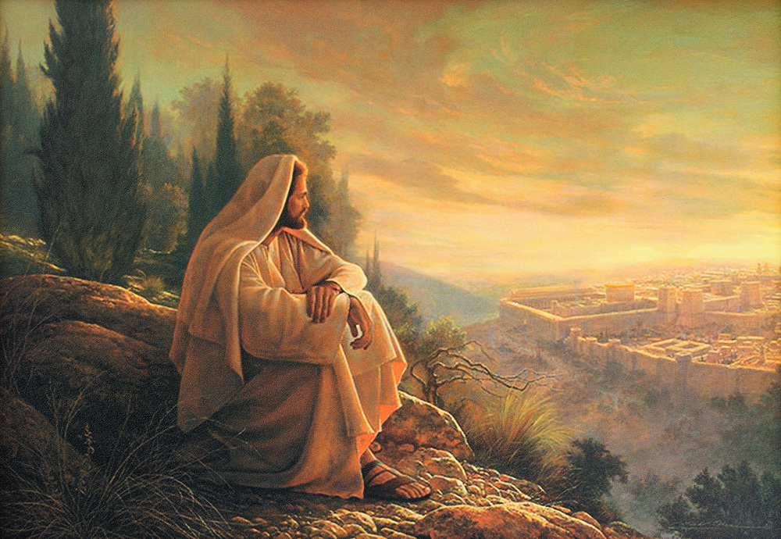
O’ Jerusalem, Jerusalem!

Slide 12
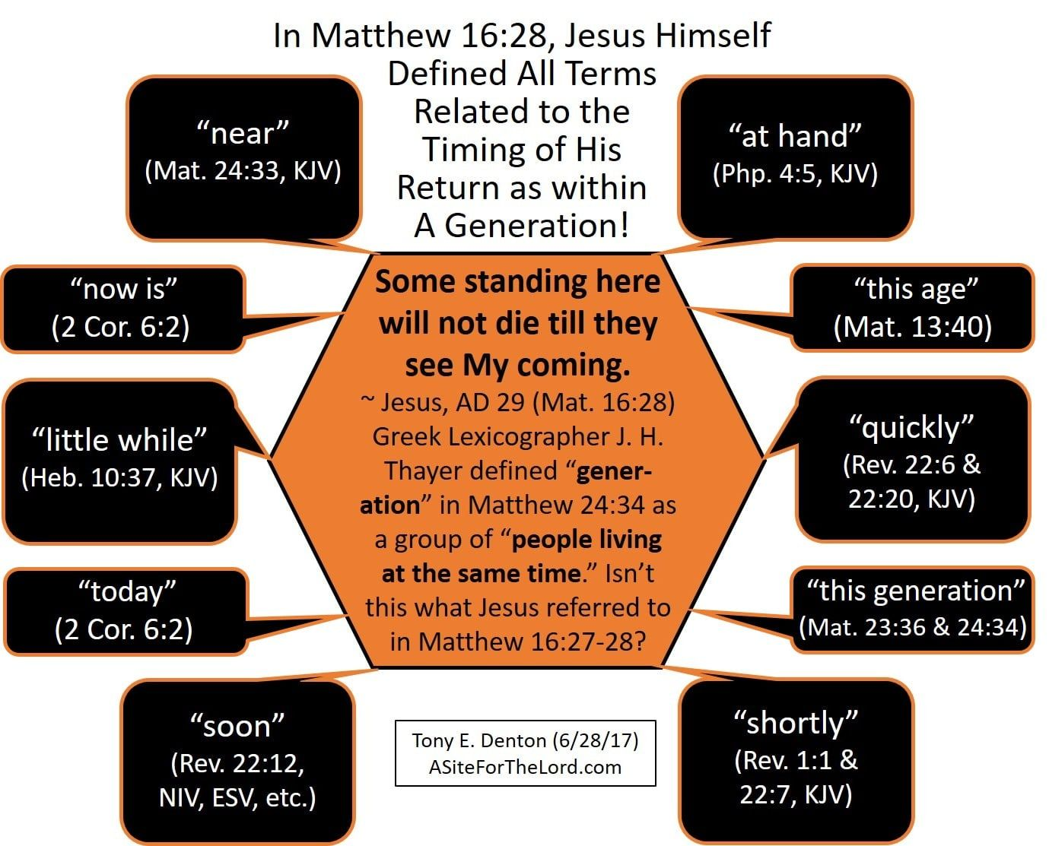

Slide 13
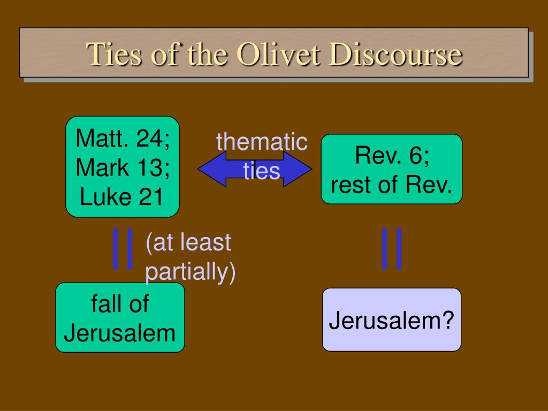
COMPREHENSIVE OLIVET
W/O CHAPTER DIVISION
W/ CHAIN LINK VERSE

Slide 14
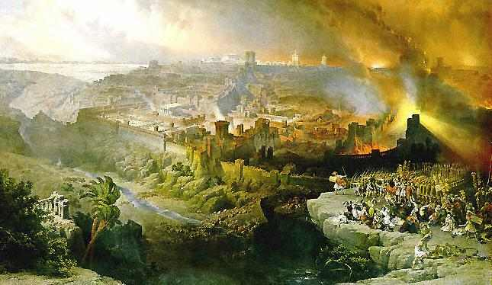
Matthew 24

Slide 15
Matthew 24:1-2
Then Jesus went out and departed from the temple, and His disciples came up to show Him the buildings of the temple. ² And Jesus said to them, “Do you not see all these things? Assuredly, I say to you, not one stone shall be left here upon another, that shall not be thrown down.”

Slide 16
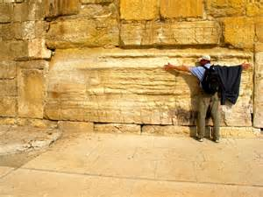
These Things?
The Temple was still under construction at this time, and the disciples must have been curious onlookers at the massive stones.
But Jesus said it would be destroyed!
“These things” referred to the destruction of the Jerusalem.

Slide 17
Jesus’ Prophecy
Both Matthew and Mark note that the conversation began between the disciples and Jesus as they were leaving the temple. Herod the Great’s rebuilding and restoration of the Jerusalem temple had transformed it into one of the wonders of the ancient world. The disciples’ admiration would have been similarly expressed by any Greek, Roman, or Jewish visitor to the temple. The disciples’ amazement is shared even by modern visitors who see the huge blocks in the remaining Herodian walls, and these were only the substructure, not the temple proper. Herod was quite famous for a provincial client king at the time, and the temple dramatically increased Greek and Roman tourism, particularly because it was built in such a way that non-Jews had partial access through the court of Gentiles.
Josephus, the most important Jewish historian of the first century, described the beauty and magnificence of the temple in these words:
The exterior of the building wanted nothing that could astound either mind or eye. For, being covered on all sides with massive plates of gold, the sun was no sooner up than it radiated so fiery a flash that persons straining to look at it were compelled to avert their eyes, as from the solar rays. To approaching strangers, it appeared from a distance like a snow-clad mountain; for all that was not overlaid with gold was of purest white. From its summit protruded sharp golden spikes to prevent birds from settling upon and polluting the roof. Some of the stones in the building were forty-five cubits in length, five in height and six in breadth.
The Jerusalem temple was a magnificent sight and an astounding architectural achievement: “Easily the tallest structure in the city, it dominated the urban landscape. At about 1,550,000 square feet (thirty-five acres), it was also the largest sanctuary site in the ancient world.”
The religious importance of the temple for the Jewish people cannot be overestimated. This was the place where worship took place and God could be entreated. This was the ultimate symbol of God’s election of the Jewish people and of his commitment and promises to them: “The temple was thus regarded as the place where YHWH lived and ruled in the midst of Israel, and where, through the sacrificial system which reached its climax in the great festivals, he lived in grace, forgiving them, restoring them, and enabling them to be cleansed of defilement and so to continue as his people.”
Jesus’ departure from the temple represents the end of his teaching ministry in Jerusalem. It is possible that this departure symbolizes judgment and the temple’s abandonment by God in the same way that the glory of God left the temple and came to rest on the mountain east of the city in Ezekiel’s vision (10:18–19; 11:22–23), but neither Matthew nor Mark make this explicit while Luke doesn’t mention Jesus’ departure at all.
The disciples would have been shocked by Jesus’ prophetic response. In reply to their awe at the temple’s grandeur, Jesus prophesied that it would be razed to the ground. Jesus’ prophecy of the temple’s destruction would have made a profound impact on his Jewish listeners, many of whom viewed the temple as indestructible. During Jesus’ trial later that week, false witnesses distorted this prophecy and claimed that Jesus had personally threatened to destroy the temple (Matt. 26:61; 27:40). This is reminiscent of the way in which King Jehoiakim had the prophet Uriah killed for prophesying the destruction of Jerusalem (Jer. 26:20–23) and Jewish priests and prophets wanted Jeremiah killed for prophesying against the city (Jer. 26:11).
Köstenberger, A. J., Stewart, A. E., & Makara, A. (2017). Jesus and the Future: Understanding What He Taught about the End Times (pp. 34–37). Bellingham, WA: Lexham Press.

Slide 18
Jesus’ Prophecy – cont.
Jesus’ prophecy of the temple’s destruction was used at his trial to support the death sentence. This charge continued to linger after Jesus’ death and was also leveled against Stephen, one of his followers (Acts 6:13–14). For some Jews, Jesus’ prophecy of the temple’s destruction was enough to discredit him and his followers in subsequent generations. Jesus’ original listeners, of course, would have been familiar with Old Testament prophecies of the destruction of Solomon’s temple that had occurred in 586 BC, but they wouldn’t have viewed the current temple as susceptible to such judgment (Jer. 7:11–14; 26:1–23; Micah 3:12).
The statement that not “one stone” would be left “upon another” indicates utter destruction that reverses the building process (Hag. 2:15). Some stones still rest upon another from the substructure and retaining wall of the temple Mount (the Wailing Wall), so Jesus was either referring to the temple buildings or was using prophetic hyperbole to stress the reality of total and irreversible destruction. His prophetic statement receives extra weight by the phrase “Truly, I say to you,” which prefaces it in Matthew’s Gospel. Jesus’ statement is emphatic and final: The temple is going to be destroyed.
This prophecy is significant for at least three reasons. First, by predicting the temple’s demise Jesus made clear to his disciples that he was fully aware of what lay ahead. His power to predict the future was also evident in his foreknowledge of Judas’s betrayal and Peter’s denial. Jesus was not merely guessing, and he certainly didn’t simply prophesy things people were itching to hear. He was a genuine prophet; in fact, he was “the” prophet of whom Moses spoke:
The LORD your God will raise up for you a prophet like me from among you, from your brothers—it is to him you shall listen—just as you desired of the LORD your God at Horeb on the day of the assembly, when you said, “Let me not hear again the voice of the LORD my God or see this great fire any more, lest I die.” And the LORD said to me, “They are right in what they have spoken. I will raise up for them a prophet like you from among their brothers. And I will put my words in his mouth, and he shall speak to them all that I command him. And whoever will not listen to my words that he shall speak in my name, I myself will require it of him.” (Deut. 18:15–18)
Second, the fact that no Gospel writer mentions the fulfillment of this prophecy suggests that these accounts were written before Jerusalem fell and the temple was destroyed by the Romans in AD 70. If any of them had known about the prophecy’s fulfillment, he would surely have commented on it. The Gospel writers weren’t making up prophecies after the fact (vaticinia ex eventu) but recording a legitimate prophecy uttered before the events transpired.
Third, and perhaps most importantly, this prophecy sets the stage for the entire Olivet Discourse. Any interpretation of Matthew 24, Mark 13, and Luke 21 that doesn’t relate in some way to the historical destruction of the temple is on the wrong track. This prophecy sets the topic for the discourse. This doesn’t mean that Jesus couldn’t talk about other things beyond the destruction of Jerusalem in the Olivet Discourse, but this event is surely the starting point as we seek to understand what else Jesus might have said about the future.
Köstenberger, A. J., Stewart, A. E., & Makara, A. (2017). Jesus and the Future: Understanding What He Taught about the End Times (pp. 34–37). Bellingham, WA: Lexham Press.

Slide 19
Deuteronomy 18:21-22
And if you say in your heart, ‘How shall we know the word which the Lord has not spoken?’— ²² when a prophet speaks in the name of the Lord, if the thing does not happen or come to pass, that is the thing which the Lord has not spoken; the prophet has spoken it presumptuously; you shall not be afraid of him.

Slide 20
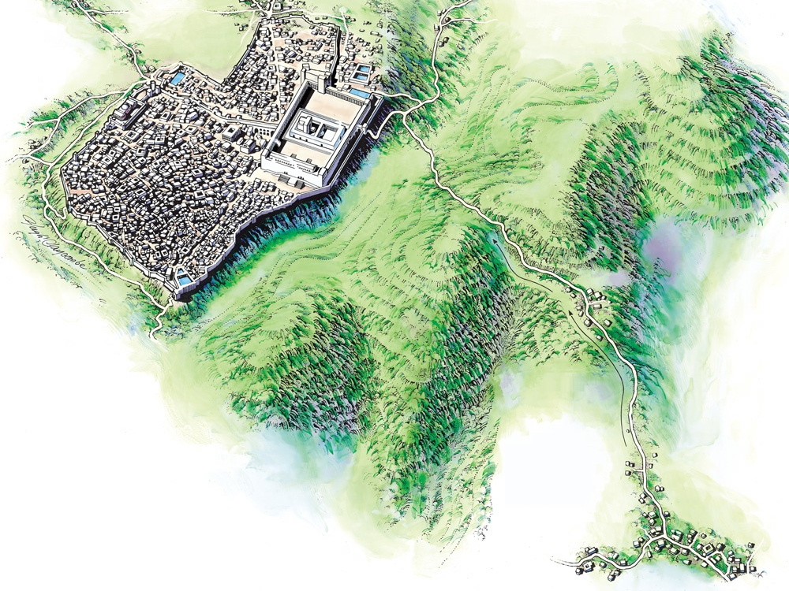

Mt. of Olives
Bethphage
Jerusalem
Bethany
Jesus Came to the Mount of Olives
Notes:
Links on this slide will be activated in PowerPoint Show mode

Slide 21
The Disciples’ Questions
Luke doesn’t comment on the location, but Matthew and Mark indicate that Jesus and his followers had moved to the Mount of Olives, about halfway to where they were spending the night in Bethany. During the walk, the disciples were probably still processing the shock of Jesus’ prophecy and couldn’t wait to ask for more details. Jesus had made clear that the temple would be destroyed but didn’t specify the time or sign that would precede its destruction. This naturally led to the questions posed by the disciples: When would these things happen? What sign would indicate that they were about to take place? In Mark and Luke, the disciples’ dual question doesn’t seem to go beyond Jesus’ prophecy about the temple’s destruction. They wanted to know when it would take place and what sign would precede the catastrophe.
However, the way in which the question is expanded in Matthew’s account seems to point beyond the destruction of the temple toward Jesus’ second coming. In Matthew, the disciples ask: “Tell us, when will these things be [the destruction of the temple as in Mark and Luke], and what will be the sign of your coming and of the end of the age?”
It is likely that the disciples would have understood the temple’s demise as a cataclysmic event that would take place only at the end of the present evil age and the dawning of the promised age to come. They would have thought of one, not two, events separated by thousands of years, so from the perspective of the original disciples the question in Matthew is the same as that in Mark and Luke. For now, it will suffice to note that many interpreters think that Matthew is in fact distinguishing two separate events with his expanded question. First, when will these things take place (i.e., when will the temple be destroyed?). Second, what will be the sign of Jesus’ second coming and of the end of the age? If this is correct, it suggests that Jesus in the Olivet Discourse is discussing two distinct historical events separated from each other by a certain amount of time. This is rendered more likely in Matthew by the additional material he features at the end of his version of the discourse that is not included in Mark and Luke (most of Matt. 24:37–25:46). This unique Matthean material pertains to the future second coming.
The Main Interpretive Question
The question to keep in mind as we move forward is bound up with these two main events: When is Jesus prophesying about the destruction of Jerusalem and the temple by the Romans in the year 70, and when is he prophesying about his second coming? The initial question asked by the disciples focused on the timing of the destruction of the temple, so it would make sense for Jesus to begin by responding to that question first.
Köstenberger, A. J., Stewart, A. E., & Makara, A. (2017). Jesus and the Future: Understanding What He Taught about the End Times (pp. 37–39). Bellingham, WA: Lexham Press.

Slide 22
Separation In Jesus Response to Apostle’s Questions

Slide 23
From Matthew 24:3
The disciples of Jesus privately asked Jesus later on Mt. Olives three questions:
1) When will these things be?
2) What will be the sign of Your coming?
3) What will be the sign of the end of the age?

Slide 24
3 Questions – 3 Answers!
Unfortunately, many today try to roll these three questions into one event.
Such was the premise behind the landmark book written in 1970 by Hal Lindsey called * “The Late Great Earth”.
This book is the centerpiece of the Pre-Millennial Dispensation theory so prevalent in the religious world today.

Slide 25
Jesus Begins His Response
Question 3:
Answer: Found in vv.4-31
What will be the sign of the end of the age?

Slide 26
Jesus began his answer to the disciples’ question concerning the timing of the destruction of Jerusalem and the end of the age by giving a series of non-signs. These are persons or events (false messiahs, wars, famines, and earthquakes) that will appear or take place but won’t indicate that the end is near and won’t constitute the sign for which they were asking. It’s interesting that even though many think these verses describe signs prior to the end, Jesus explicitly warned the disciples against being deceived, cautioning them that these things don’t yet constitute the end. They mark only the beginning of “birth pains.” The metaphor of birth pains may indicate that these things will increase in intensity as time goes on, though this isn’t explicitly stated.
Yet what “end” is in view: the destruction of Jerusalem and the temple or Jesus’ second coming? At this point, it’s not necessary to distinguish between the two since Jesus isn’t listing signs of the end but rather persons or events that could trouble or confuse his followers but were just an ordinary part of unfolding history. They are not signs of the end, and his followers must be on guard not to be deceived and think that these things are signaling the end. Even as these things have been evident through history, they were all also fulfilled between the years 30 and 70, so the non-signs don’t necessarily point beyond the cataclysmic events of the year 70.
First, Jesus warned that some would claim to be the Messiah and deceive many. It’s not that these people would claim to be Jesus but that they would claim to be the true Jewish Messiah. If a Christian were to follow one of these false messianic claimants, it would involve a rejection of trust in Jesus as Messiah. Any followers of these false messiahs would also share their fate.
Köstenberger, A. J., Stewart, A. E., & Makara, A. (2017). Jesus and the Future: Understanding What He Taught about the End Times (pp. 41–42). Bellingham, WA: Lexham Press.

Slide 27
Signs of the end of the (Jewish) age
1. False Messiahs
2. Wars and Rumors of Wars
3. Famines
4. Pestilences
5. Earthquakes
6. Christian tribulations
7. False Prophets
8. Falling Away
9. Spreading of the Gospel worldwide

Slide 28
Second, Jesus warned of wars and rumors of wars. In the 30s and early 60s there were disturbances and conflicts with the Parthian empire to the East. The Parthians were a long-standing threat to Rome, and Palestine was a buffer and pawn throughout the long conflict. Apart from the Parthians, there was constant unrest within Palestine itself. Finally, the Jewish revolt against the Romans began in the year 66. Apart from actual fighting, there would have been constant rumors of war during the years 30–70.
Third, famine was a constant threat in the ancient world, and first-century Roman emperors often minted coins featuring Ceres (the goddess of agriculture and grain crops) and Annona (the goddess of grain supply) as imperial propaganda to assure citizens that the emperor could guarantee a steady supply of food. The emperors were primarily concerned with the supply of grain to the city of Rome and to the legions, and the provinces often had to fend for themselves as best they could. Josephus describes a terrible famine that took place in the years 46 to 48: “It was in the administration of Tiberius Alexander that the great famine occurred in Judaea, during which Queen Helena bought grain from Egypt for large sums and distributed it to the needy” (Josephus, Antiquities 20.101; cf. Antiquities 3.320; 20.51–53). This was a significant famine, and Luke described how Agabus prophesied about it with the result that the church in Antioch raised support and sent it to the Judean Christians through Barnabas and Saul (Acts 11:28–30).
Fourth, Jesus prophesied that there would be earthquakes. Earthquakes were known in the ancient world but were not scientifically understood and often caused considerable alarm. Josephus describes an earthquake that took place during the Jewish War of the years 66–70:
For in the course of the night a terrific storm broke out: the winds blew a hurricane, rain fell in torrents, lightning was continuous, accompanied by fearful thunder-caps and extraordinary rumblings of earthquake. Such convulsion of the very fabric of the universe clearly foretokened destruction for mankind, and the conjecture was natural that these were portents of no trifling calamity. In this the Idumaeans and the city folk were of one mind: the former being persuaded that God was wroth at their expedition and that they were not to escape retribution for bearing arms against the metropolis, Ananus and his party believing that they had won the day without a contest and that God was directing the battle on their behalf. (Josephus, Jewish War 4.286–88)
According to Josephus, many interpreted the cosmic upheaval (storm, wind, lightning, thunder, earthquake) as a sign of impending doom, while some of the defenders interpreted it as a sign that God would destroy their enemies…
It is important to keep in mind that Jesus didn’t list these things—false messiahs, wars, famines, earthquakes—so that his followers could know that the end was near but that they wouldn’t be unduly concerned or alarmed by the occurrence of these things. They weren’t signs of the end, and Jesus distanced these ordinary but destructive events of human history from “the end.” In the Old Testament, the metaphor of “birth pains” is often connected with the destruction of a city, so “end” here likely relates to the destruction of Jerusalem and the temple in the year 70.
Köstenberger, A. J., Stewart, A. E., & Makara, A. (2017). Jesus and the Future: Understanding What He Taught about the End Times (pp. 44–46). Bellingham, WA: Lexham Press.

Slide 29
Did all this come to pass?
It is imperative to understand the timing of the New Testament.
ALL DATES ARE APPROXIMATE!
33-Death of Jesus
35-Death of Stephen
40-Conversion of Cornelius
49-Jerusalem Conference
62-James killed in Jerusalem
64-Temple completed
64-Nero’s persecution
64-Traditional date of Peter’s death
66-Traditional date of Paul’s death
70-Jerusalem destroyed
The majority of the New Testament was written BEFORE the fall of Jerusalem, and serves as a historical guide.

Slide 30
The Fall of Jerusalem
Using both Biblical and historical sources, we can piece together the events that transpired leading up to the fall of Jerusalem and the eventual destruction of the Temple.
This will be the focus of the afternoon sermon, The Fall of Jerusalem.

Slide 31
Gospel spread worldwide
(Acts 2:5) And there were dwelling in Jerusalem Jews, devout men, from every nation under heaven.
(Colossians 1:23) if indeed you continue in the faith, grounded and steadfast, and are not moved away from the hope of the gospel which you heard, which was preached to every creature under heaven, of which I, Paul, became a minister.

Slide 32
The Abomination of Desolation
This phrase comes originally from the book of Daniel and was understood to mean that the Temple (and especially the altar of sacrifice) was to be desecrated by pagans. The rabbis had associated this prophecy with an event that occurred in 167 BC.
However, Jesus uses the image again to speak of a future event – at least subsequent to AD 30.

Slide 33
Daniel 12:11
“And from the time that the daily sacrifice is taken away, and the abomination of desolation is set up, there shall be one thousand two hundred and ninety days.

Slide 34
A comparison
(Matthew 24:15)
“Therefore when you see the ‘abomination of desolation,’ spoken of by Daniel the prophet, standing in the holy place”
(Luke 21:20)
“But when you see Jerusalem surrounded by armies, then know that its desolation is near.
The ‘abomination of desolation” = “surrounded by armies”.

Slide 35
Jesus adopted this well-known language of “abomination of desolation” to prophesy a future similar ritual pollution of the temple. His reference to Daniel indicates that the desolation of 167 BC didn’t complete the fulfillment of Daniel’s prophecies. This could be understood in terms of double fulfillment or in terms of typology by which the earlier prophesied desecration of 167 BC was a type of the later more extensive and final desecration of the year 70. The comment by Matthew and Mark, “Let the reader understand,” likely points to the continuity between Daniel, the abomination of desolation of 167 BC, and the future abomination of desolation: The temple would be ritually polluted.
Although many interpretations have been proposed, there are two main but related possibilities with regard to the fulfillment of the abomination of desolation, the sign that the temple was about to be destroyed. First, the pollution of the temple by the Zealot defenders of Jerusalem around the years 67–68 is the fulfillment, perhaps involving the appointment of the unqualified Phanni as high priest (Josephus, Jewish War 4.147–57). This would have happened early enough to be a sign for Christians to flee before all possibility of escape was cut off. This is quite likely and related to the second possibility.
Second, Luke helpfully provides clarification for readers who may have been confused by the mention of the abomination of desolation in Matthew and Mark. When Luke wrote his Gospel, he had access to Matthew, Mark, or both. Perceiving the possibility of confusion among his Gentile readers regarding the abomination of desolation, he clarified: “When you see Jerusalem surrounded by armies, then know that its desolation has come near” (Luke 21:20, emphasis added). He retains the key word “desolation” but tells us what Jesus meant by it: all that will transpire during the siege of Jerusalem by the Romans. The Roman siege itself didn’t desecrate the temple (although Titus and the Romans certainly did once they got access to it in the year 70), but, as mentioned, the war against the Romans in Judea was well underway when the Zealots desecrated the temple. Luke indicates that there will still be time to flee the city (21:21), so he has in mind the beginning of the advance of the Roman armies against Jerusalem before they had dug a trench and erected a wall around the city to cut off flight. Luke’s insights must not be ignored at this point; he provides an early, canonical, and inspired description of what Jesus meant by “the abomination of desolation” in its original historical context.
The desecration of the temple by the Zealots and their pseudo-high priest and the approach of Roman armies were signs for Jesus’ followers to flee from Judea without any delay to gather material possessions. Most of the inhabitants of Judea fled to Jerusalem for safety from the Roman armies, and according to Josephus, the city’s population swelled to over one million people (Jewish War 6.420). In contrast, Jesus instructed his followers to leave the city and flee to the mountains. As with all situations involving displacement, it would be a particularly precarious time for pregnant and nursing mothers, which could be exacerbated by bad wintry weather. Matthew highlights the extra difficulty escape on the Sabbath would present for the Jewish Christians in Judea (24:20).
According to church tradition, the early Christians fled Jerusalem, not to the mountains, but to Pella in Perea. The ancient church historian Eusebius (AD 260–340) reported the following:
The people of the church in Jerusalem had been commanded by a revelation, vouchsafed to approved men there before the war, to leave the city and to dwell in a certain town of Perea called Pella. And after the flight of those who believed in Christ, the Justice of God then visited upon them all their acts of violence to Christ and his apostles, by destroying that generation of wicked persons root and branch from among men.
Köstenberger, A. J., Stewart, A. E., & Makara, A. (2017). Jesus and the Future: Understanding What He Taught about the End Times (pp. 55–57). Bellingham, WA: Lexham Press.

Slide 36
What was the “abomination of desolation”?
Apparently, it was not a single event, but was rather a culmination of events dealing with the destruction of Jerusalem by the Roman armies. It ended with the removal of artifacts of the Temple by the Romans, and the slaughter of the Jews.
The Jewish way of life and religion effectively ended at this time.

Slide 37
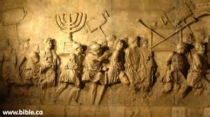
Arch of Titus in Rome

Slide 38
Luke 23:28-30
But Jesus, turning to them, said, “Daughters of Jerusalem, do not weep for Me, but weep for yourselves and for your children. ²⁹ For indeed the days are coming in which they will say, ‘Blessed are the barren, wombs that never bore, and breasts which never nursed!’ ³⁰ Then they will begin ‘to say to the mountains, “Fall on us!” and to the hills, “Cover us!”’

Slide 39
Why not on the Sabbath?
(Nehemiah 13:19) So it was, at the gates of Jerusalem, as it began to be dark before the Sabbath, that I commanded the gates to be shut, and charged that they must not be opened till after the Sabbath.
Thankfully, the Christians that saw the signs were able to escape beforehand. Tradition holds that most fled to Pella.

Slide 40
From Josephus
Approximately 100,000 Jews were taken captive
Nearly 1.2 million Jews died in the siege
The city was destroyed, as well as the Temple
The carnage was made worse by the strong belief of the Jews that God would protect and spare His Temple. Instead of leaving the city like the Christians, the Jews flocked to Jerusalem for safety.
Only one problem with their logic…

Slide 41
A comparison
(Matthew 21:13)
And He said to them, “It is written, ‘My house shall be called a house of prayer,’ but you have made it a ‘den of thieves.’”
(Matthew 23:38)
See! Your house is left to you desolate; ³⁹ for I say to you, you shall see Me no more till you say, ‘Blessed is He who comes in the name of the Lord!’ ”
Notice the change from “My house” to “your house”

Slide 42
There the eagles will be….
There are two basic interpretations to this passage.
The Roman emblem was an eagle
Would be better translated “vulture”

Slide 43
Signs from Heaven
Sun darkened
Moon darkened
Stars fall from heaven
Powers of earth shaken

Slide 44
Isaiah 13:9-10 (Babylon)
Behold, the day of the Lord comes,
Cruel, with both wrath and fierce anger,
To lay the land desolate;
And He will destroy its sinners from it.
¹⁰ For the stars of heaven and their constellations
Will not give their light;
The sun will be darkened in its going forth,
And the moon will not cause its light to shine.
THERE ARE SEVERAL OTHER EXAMPLES OF THIS TYPE OF FIGURATIVE LANGUAGE IN THE OLD TESTAMENT!

Slide 45
Sign of the Son of man
NKJV: Then the sign of the Son of Man will appear in the heaven…
Berry’s Interlinear: And then shall appear the sign of the Son of Man in the heaven…
It appears that “heaven” is the location of the Son of Man, not the sign!

Slide 46
“Tribes” and “they”
Notice carefully the words Jesus used in verse 30. It is specifically noted that the “tribes” would mourn – not the whole world but rather just the Jews.
Likewise, “they” would see the Son of Man coming on the clouds.
This is not in reference to the 2nd coming, but rather the divine judgment that was being exhibited.

Slide 47
Revelation 14:14
Then I looked, and behold, a white cloud, and on the cloud sat One like the Son of Man, having on His head a golden crown, and in His hand a sharp sickle.
This is an image of divine judgment. Notice the similar language!

Slide 48
Luke 21:22
For these are the days of vengeance, that all things which are written may be fulfilled.
The Roman armies surrounding Jerusalem were nothing more than an instrument of God’s judgment. Israel had broken their covenant, and God was going to punish them with vengeance.

Slide 49
Who are the “Elect”?
While the Jews would see their Temple be destroyed (and consequently their entire religion), the “elect” would be gathered together from all over the world.
Elect = Church

Slide 50
Colossians 3:1, 12
If then you were raised with Christ…
…Therefore, as the elect of God, holy and beloved

Slide 51
Jesus Continues His Answer
Question 1:
Answer: Found in vv.32-35
When will these things be?

Slide 52
When? It is near!
Using a parable of a fig tree showing its leaves before dropping its fruit, Jesus said “these things” (destruction of Jerusalem) would be near.
He even qualifies it further – the fall of Jerusalem would take place within the current generation. Generally, a generation is considered to be 30-40 years. If Jesus spoke these words in ~ AD 30, that would give a range of AD 30 – 70.

Slide 53
There are several reasons to think that with the parable of the fig tree Jesus is briefly transitioning back to conclude his answer to the disciples’ question about when the temple will be destroyed and not talking about the second coming. First, we noted above that the language of “these things” and “all these things” intentionally mirrors the question of the disciples at the beginning of the Olivet Discourse. This is an indication that Jesus is concluding his answer to that question and not necessarily pointing to everything said in the Olivet Discourse up to that point (i.e., the “these things” and “all these things” do not include the second coming). Second, the parable of the fig tree is used as an illustration of how signs indicate the approach of a given event. In the case of the fig tree, the sprouting of leaves indicates the approach of summer. By analogy, Jesus explained that when his followers would see certain things, they would know that a given event was near. The language mirrors the language used earlier in the Olivet Discourse concerning the abomination of desolation, which would be a sign indicating the destruction of Jerusalem.
  Köstenberger, A. J., Stewart, A. E., & Makara, A. (2017). Jesus and the Future: Understanding What He Taught about the End Times (p. 74). Bellingham, WA: Lexham Press.

Slide 54
These two verbal connections—“these things” and “when you see”—are strong indications that Jesus is here concluding his answer to the question about when the temple would be destroyed. This conclusion helps with a translation difficulty. The Greek text in Matthew and Mark only uses a third person singular verb, so the context must determine whether he, she, or it is near. If the translator thinks Jesus is using the fig tree parable to describe his second coming, the context would suggest “he” (as in the ESV throughout), but if the translator thinks Jesus is referring to the destruction of Jerusalem, “it” would be a better translation (as suggested by us in brackets in the chart above). When the disciples were going to witness the events Jesus had predicted, particularly the ritual desecration of the temple—the abomination of desolation—and the approach of Roman armies, they would know that “it [the destruction of the city] was near.”
This conclusion is confirmed by Jesus’ plain answer to the question about the timing of the temple’s destruction: It would take place within that generation. The various attempts to explain “this generation” as a general way to describe the present age, the race of the Jews, or the final generation living when Jesus returns are rendered unlikely by the way in which Jesus regularly used the phrase “this generation” throughout the Gospels to describe the generation of people alive at the time.
Köstenberger, A. J., Stewart, A. E., & Makara, A. (2017). Jesus and the Future: Understanding What He Taught about the End Times (p. 75). Bellingham, WA: Lexham Press.

Slide 55
THE KEY: VERSE 34
Assuredly, I say to you, this generation will by no means pass away till all these things take place.

Slide 56
Jesus Concludes His Answer
Question 2:
Answer: Found in vv.36-44
What will be the sign of Your coming?

Slide 57
No one knows!
While the end of the (Jewish) age and the fall of Jerusalem and the Temple would be preceded by many signs, there will be no such signs for the 2nd coming of Jesus Christ.

Slide 58
Life as usual…
1) As the days of Noah
2) Eating and drinking
3) Giving in marriage
4) Oblivious
The contrast between the two events without a doubt shows that Jesus was referring to two separate events: the fall of Jerusalem in AD 70 and his 2nd coming.

Slide 59
THE KEY: VERSE 42
Watch therefore, for you do not know what hour your Lord is coming.

Slide 60
A contrast
Fall of Jerusalem
Signs
Prolonged
Days
Local
“Know”
Abnormal
2nd Coming
No signs
Immediate
Day
Universal
“Know not”
Normal

Slide 61
Conclusion
3 Questions and 3 Separate Answers:
1) When will these things be?
Near – within a generation (AD 30-70)
2) What will be the sign of Your coming?
None!
3) What will be the sign of the end of the age?
Several (vv.4-31)

Slide 62
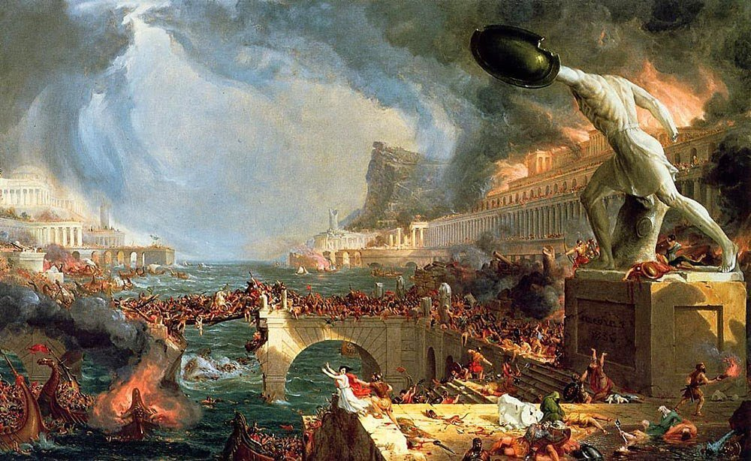
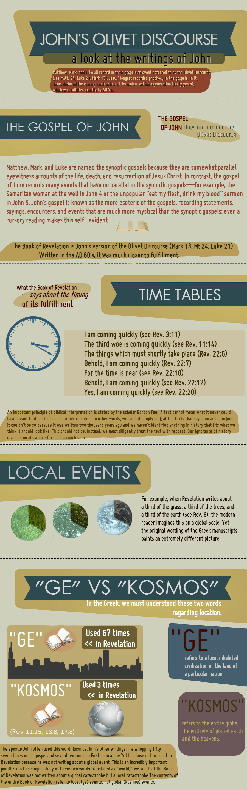

Slide 63
COMPREHENSIVE OLIVET
W/O CHAPTER DIVISION
W/ CHAIN LINK VERSE

Slide 64
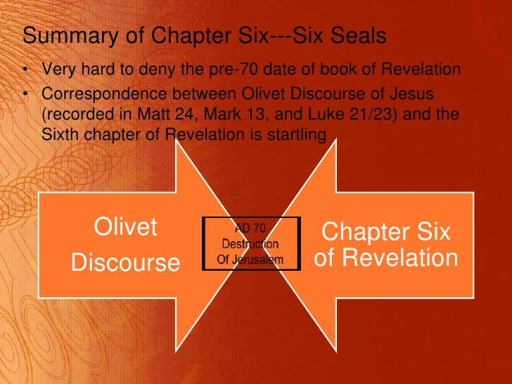

Slide 65

UNDERSTANDING JOEL’S PROPHECYas INTRO-TO-intro-to THE NEW TESTAMENT BOOK OF REVELATION

Slide 66
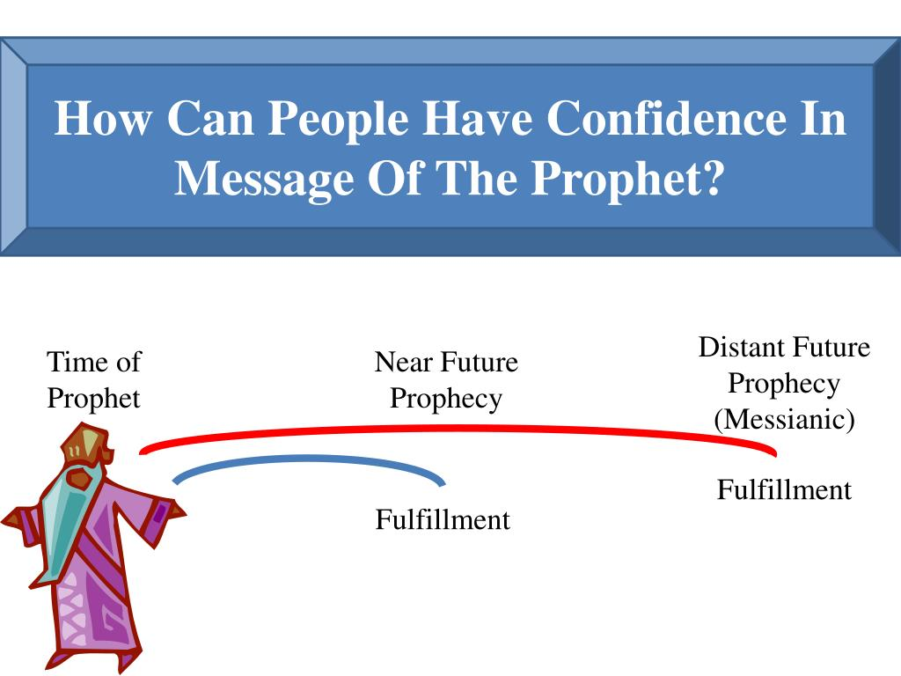

Slide 67
UNDERSTANDING REVELATION…
By - Understanding Joel’s Prophecy

Slide 68
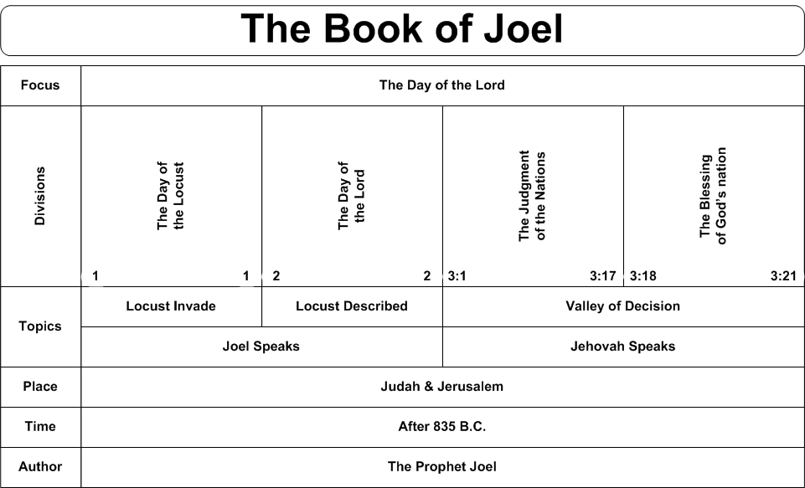

Slide 69
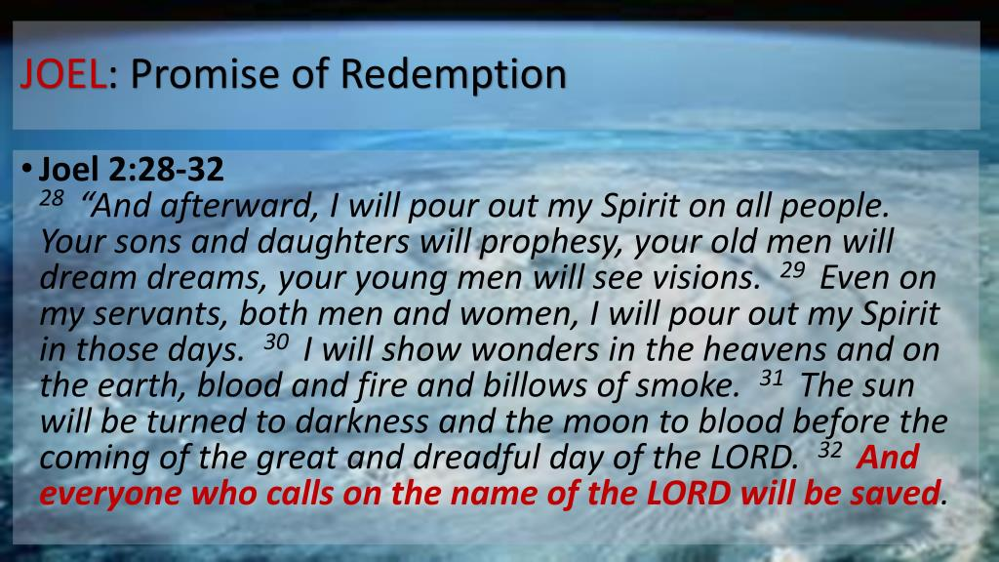

Slide 70
Joel 2:28 ¶ And it shall come to pass afterward, that I will pour out my spirit upon all flesh; and your sons and your daughters shall prophesy, your old men shall dream dreams, your young men shall see visions: 29 And also upon the servants and upon the handmaids in those days will I pour out my spirit. 30 And I will shew wonders in the heavens and in the earth, blood, and fire, and pillars of smoke. 31 The sun shall be turned into darkness, and the moon into blood, before the great and the terrible day of the LORD come. 32 And it shall come to pass, that whosoever shall call on the name of the LORD shall be delivered: for in mount Zion and in Jerusalem shall be deliverance, as the LORD hath said, and in the remnant whom the LORD shall call.

Slide 71
Introduction:
Joel’s prophecy is the key to understanding what the new Testament teaches about the Holy Spirit and understanding about the Holy Spirit’s work is a key to understanding Revelation.
Due to the failure of the religious world to understand the purpose of the miraculous operation of the Holy Spirit, multiplied errors have develop around the subject.
The religious world makes no distinction between the miraculous operation of the Spirit and the Spirit working through the Word.

Slide 72
The miraculous operations of the Spirit are commonly applied to sinner and saint without any reference to the purpose and the temporary nature of these miraculous gifts.
While we have recognized, to some degree, the purpose of miraculous gifts and their duration, we have, at the same time, taken passages that deal with the miraculous and ignored the background, the context, and read into these passages a direct, but non-miraculous, operation.
This is what has caused the confusion we’re having today.

Slide 73
When passages that have to do with miraculous operation are interpreted to mean a non-miraculous indwelling, it results in a situation that none can explain.
It necessitates an operation apart from the Word.
Passages are quoted to sustain this position, but if called upon to explain how this operation works, no answer can be given.
Since miracles have ceased, no man can establish when this non-miraculous indwelling works.

Slide 74
But if it does something in addition to the Word, then people are searching for it, and the only thing left to rely on are feelings, moods, experiences, and similar things.
Feelings as evidence allow every man to decide how, what, and where the Spirit leads.
In spite of what its adherents say about the Spirit not leading contrary to the Word, the theory does not work out that way.

Slide 75
Joel’s prophecy is a summary of the miraculous operation of the Spirit by which the gospel was given and confirmed.
Joel’s prophecy is never out of sight when reference is made to the Holy Spirit in the New Testament.
There are two reasons that Joel’s prophecy is not understood:

Slide 76
  Denominational people think Joel indicates that a direct and miraculous operation of the Spirit would continue after revelation was completed and confirmed. They miss the entire meaning and purpose of the prophecy and its fulfillment.
  A second reason that Joel's prophecy is not understood, is that some in the church conclude that if it is allowed its full meaning, then miracles will have to continue today.
In an attempt to avoid what they think is a difficulty, passages are read and explained without any reference to Joel’s prophecy.

Slide 77
JOEL’S PROPHECY LIMITS THE BEGINNING AND THE END OF THE DIRECT MIRACULOUS OPERATION OF THE SPIRIT.
Joel’s prophecy is among the first of the prophets.
Some think that he may be the earliest.
Thus, his prophecy becomes the key to understanding what he other prophets say about the Spirit in the Christian Age.
There is no such thing as a prophecy of a non-miraculous, personal indwelling in the Old Testament.

Slide 78
Any prophet that refers to the Spirit and points to the Christian Age has reference to the same thing as Joel.
When one reads the other prophets and sees the non-miraculous, personal indwelling, he is simply reading into the prophets what is not there.
Acts 2 gives the beginning of the fulfillment of Joel’s prophecy: Acts 2:16 But this is that which was spoken by the prophet Joel.
There is no argument about its beginning.
Does Joel also indicate the ending of miraculous operation of the Spirit?

Slide 79
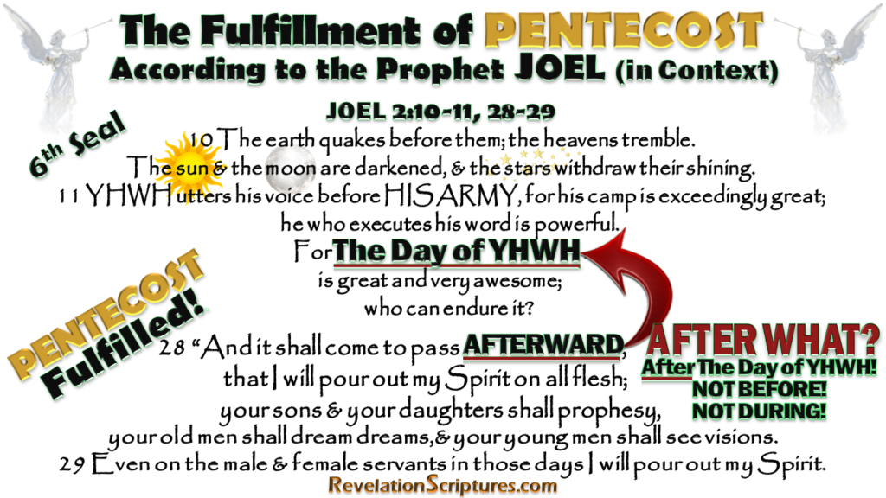

Slide 80
I think so.
The prophecy of Joel involves not only Pentecost, but also the fall of Jerusalem in A.D. 70; thus, his prophecy is placed between these two events.
I am conscious of the questions that will be raised by this statement, but let us weigh the evidence and see if there is proof to sustain the proposition.

Slide 81
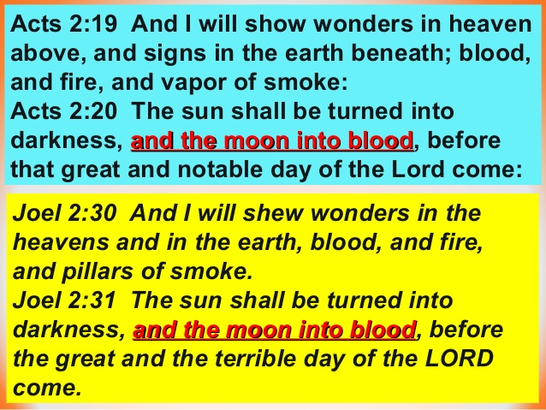

Slide 82
Note that Jesus in discussing the destruction of Jerusalem quotes the language in Joel 2:30-31.
Joel 2:30 And I will shew wonders in the heavens and in the earth, blood, and fire, and pillars of smoke. 31 The sun shall be turned into darkness, and the moon into blood, before the great and the terrible day of the LORD come. 32 And it shall come to pass, that whosoever shall call on the name of the LORD shall be delivered: for in mount Zion and in Jerusalem shall be deliverance, as the LORD hath said, and in the remnant whom the LORD shall call.
Mt 24:29 Immediately after the tribulation of those days shall the sun be darkened, and the moon shall not give her light, and the stars shall fall from heaven, and the powers of the heavens shall be shaken:

Slide 83
Again In Marks account of Jesus and the end of Jerusalem.
Joel 2:30 And I will shew wonders in the heavens and in the earth, blood, and fire, and pillars of smoke. 31 The sun shall be turned into darkness, and the moon into blood, before the great and the terrible day of the LORD come. 32 And it shall come to pass, that whosoever shall call on the name of the LORD shall be delivered: for in mount Zion and in Jerusalem shall be deliverance, as the LORD hath said, and in the remnant whom the LORD shall call.
Mr 13:24 ¶ But in those days, after that tribulation, the sun shall be darkened, and the moon shall not give her light, 25 And the stars of heaven shall fall, and the powers that are in heaven shall be shaken.

Slide 84
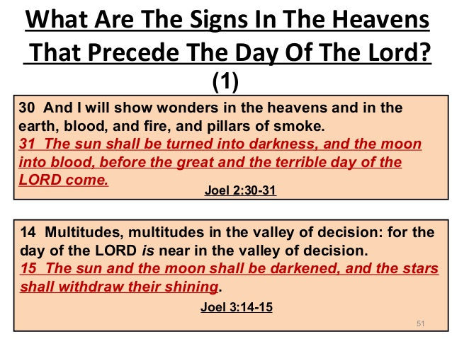

Slide 85
Joel 2:30 And I will shew wonders in the heavens and in the earth, blood, and fire, and pillars of smoke. 31 The sun shall be turned into darkness, and the moon into blood, before the great and the terrible day of the LORD come. 32 And it shall come to pass, that whosoever shall call on the name of the LORD shall be delivered: for in mount Zion and in Jerusalem shall be deliverance, as the LORD hath said, and in the remnant whom the LORD shall call.
Luke 21:11 And great earthquakes shall be in divers places, and famines, and pestilences; and fearful sights and great signs shall there be from heaven.
The Quotation of these verses by Christ in Matthew 24:29, Mark 13:24 & Luke 21 is proof that Joel’s prophecy of the coming of the Holy Spirit also included the fall of Jerusalem.

Slide 86
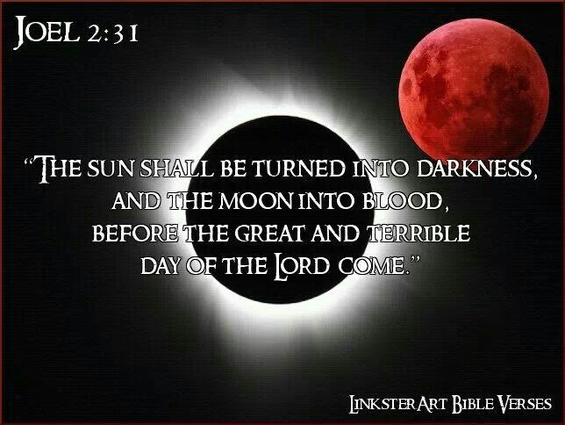

Slide 87
Matthew wrote especially for the Jews.
Mt 3:10 And now also the axe is laid unto the root of the trees: therefore every tree which bringeth not forth good fruit is hewn down, and cast into the fire. 11 I indeed baptize you with water unto repentance: but he that cometh after me is mightier than I, whose shoes I am not worthy to bear: he shall baptize you with the Holy Ghost, and with fire: 12 Whose fan is in his hand, and he will throughly purge his floor, and gather his wheat into the garner; but he will burn up chaff with unquenchable fire.
Verse 10 is a direct reference to the destruction of Jerusalem which happened in 70 AD.
Verse 11 points to Pentecost (Acts 2) “baptize you with…” Jews to be given 40 years as individuals to Repent.
Verse 12 passes into the final and eternal judgment.

Slide 88
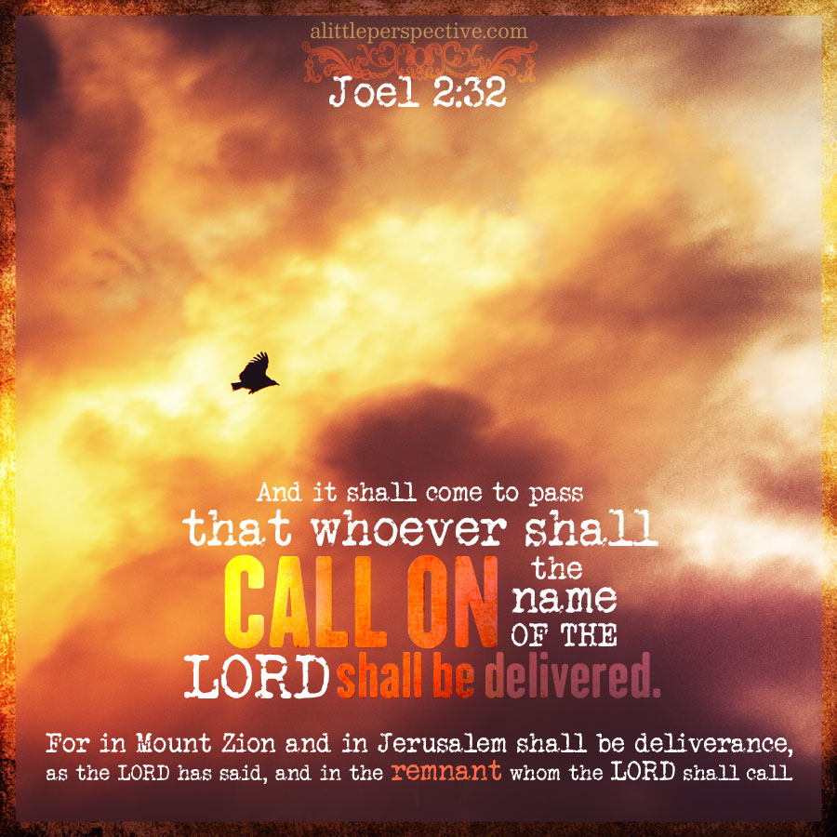

Slide 89
JERUSALEM’S FALL PROPHESIED EARLY IN THE OLD TESTAMENT
The Old Testament points to the destruction of the City of Jerusalem.
It is referred to in several of the prophets: Zechariah 14; Malachi 3 & 4; as well as Joel and Daniel.
Note Daniel’s prophecy of the fall of Jerusalem.
  Dan 9:20 ¶ And whiles I was speaking, and praying, and confessing my sin and the sin of my people Israel, and presenting my supplication before the LORD my God for the holy mountain of my God

Slide 90
Dan 9:21 Yea, whiles I was speaking in prayer, even the man Gabriel, whom I had seen in the vision at the beginning, being caused to fly swiftly, touched me about the time of the evening oblation. 22 And he informed me, and talked with me, and said, O Daniel, I am now come forth to give thee skill and understanding. 23 At the beginning of thy supplications the commandment came forth, and I am come to shew thee; for thou art greatly beloved: therefore understand the matter, and consider the vision. 24 Seventy weeks are determined upon thy people and upon thy holy city, to finish the transgression, and to make an end of sins, and to make reconciliation for iniquity, and to bring in everlasting righteousness, and to seal up the vision and prophecy, and to anoint the most Holy.

Slide 91
Dan 9:25 Know therefore and understand, that from the going forth of the commandment to restore and to build Jerusalem unto the Messiah the Prince shall be seven weeks, and threescore and two weeks: the street shall be built again, and the wall, even in troublous times. 26 And after threescore and two weeks shall Messiah be cut off, but not for himself: and the people of the prince that shall come shall destroy the city and the sanctuary; and the end thereof shall be with a flood, and unto the end of the war desolations are determined. 27 And he shall confirm the covenant with many for one week: and in the midst of the week he shall cause the sacrifice and the oblation to cease, and for the overspreading of abominations he shall make it desolate, even until the consummation, and that determined shall be poured upon the desolate.

Slide 92
Dan 9:25 Know therefore and understand, that from the going forth of the commandment to restore and to build Jerusalem unto the Messiah the Prince shall be seven weeks, and threescore and two weeks: the street shall be built again, and the wall, even in troublous times. 26 And after threescore and two weeks shall Messiah be cut off, but not for himself: and the people of the prince that shall come shall destroy the city and the sanctuary; and the end thereof shall be with a flood, and unto the end of the war desolations are determined. 27 And he shall confirm the covenant with many for one week: and in the midst of the week he shall cause the sacrifice and the oblation to cease, and for the overspreading of abominations he shall make it desolate, even until the consummation, and that determined shall be poured upon the desolate.

Slide 93
Whatever may be the difficulty in figuring the seventy weeks in relation to the fall of Jerusalem, there cannot be any doubt that it is included.
Christ settles this.
Matthew 24 is a prophecy concerning the fall of the City of Jerusalem.
In the midst of the prophecy, Christ said, “When ye therefore shall see the abomination of desolation spoken of by Daniel the prophet, stand in the holy place,” (Matthew 24:15)

Slide 94
Jesus identifies the prophecy of Daniel so as to include the fall of Jerusalem.
Luke 21:20 makes it clear that the reference is to the Roman army: “And when ye shall see Jerusalem compassed with armies, then know that the desolation thereof is nigh.”
If we can accept the words of Christ, Daniel, by inspiration, saw Jerusalem fall.
This takes on added significance when it is remembered that Daniel was in Babylonian captivity when this prophecy was made.

Slide 95
Jeremiah had prophesied of the Babylonian captivity and the return. (Jeremiah 25: 11,12; 29: 10)
Daniel 9:2 In the first year of his reign I Daniel understood by books the number of the years, whereof the word of the LORD came to Jeremiah the prophet, that he would accomplish seventy years in the desolations of Jerusalem.
Daniel knew the nation would return from captivity, yet he prophesied of a future fall of the nation and city in contrast with the return from Babylonian captivity.

Slide 96
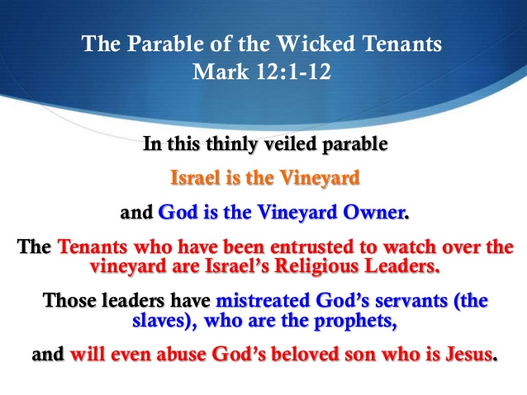

Slide 97
2. THE FALL OF JERUSALEM SEPARATED JUDAISM FROM THE CHURCH
The fall of Jerusalem separated Judaism from Christianity.
Judaism was a God-ordained religion.
This made it possible for Judaizing teachers to deceive and confuse people as long as the temple existed.
It was one thing to appeal to people to give up paganism with its religion as it was never approved by God.
It was still another thing to call on the Jews to lay aside Judaism which was given by God and at one time acceptable to God.

Slide 98
It is easy to see how Judaizing teachers used this in opposing the church.
But when Jerusalem fell, the temple was destroyed, and they could no longer use this as a means of trying to confuse people.
While the temple stood, many thought of the church as only a sect of Judaism.
Christianity had its roots in Judaism.
The types and shadows of Judaism pointed to the church.
The prophecies of the Old Testament foretold of the establishment of another kingdom (Daniel 2, 7, 9; Isaiah 2:1-4).

Slide 99
The fact that Christianity had its roots in Judaism did not mean that it was a continuance of it, or just an advancement within it.
The gospel was an entirely different system from Judaism.
The sacrifice of Christ was not just another sacrifice, it was a different kind of sacrifice (Hebrews 9: & 10).
When Paul went to Rome, they asked to hear “concerning this sect that was everywhere spoken against,” (Acts 28:22).
This indicates that many considered the church as just another sect of Judaism like the Pharisees and the Sadducees.

Slide 100
When Jerusalem fell, it ended any thoughts of the church being only a sect of Judaism.
The fall of the nation left neither root nor branch: Malachi 4:1 ¶ For, behold, the day cometh, that shall burn as an oven; and all the proud, yea, and all that do wickedly, shall be stubble: and the day that cometh shall burn them up, saith the LORD of hosts, that it shall leave them neither root nor branch.
When Jerusalem fell, God pulled up Judaism by the roots and burned the branches.
Nothing was left but the ashes of Judaism.
One might as well expect to use the ashes of a house that has burned down to rebuild it as to expect to put life back into Judaism.

Slide 101
Thus, when Jerusalem fell, Judaism was plucked up by the roots and burned.
This left nothing but the church.
The fall of Jerusalem forever separated Judaism and the Lord’s Church.
Notice carefully these verses: Heb 12:27 And this word, Yet once more, signifieth the removing of those things that are shaken, as of things that are made, that those things which cannot be shaken may remain. 28 Wherefore we receiving a kingdom which cannot be moved, let us have grace, whereby we may serve God acceptably with reverence and godly fear: 29 For our God is a consuming fire.

Slide 102
When Jerusalem fell, Judaism went down to rise no more, leaving only the kingdom that Daniel saw remaining, and one that could not be moved.
The fall of Jerusalem closed the door of Judaism and left only the church remaining.

Slide 103
3. THE FALL OF JERUSALEM ANSWERS THE QUESTION OF THE PROMISE TO ABRAHAM
The fall of Jerusalem answers the question as to the meaning of God’s promise to Abraham.
In Genesis 12 God made 3 promises to Abraham:
“I will make of thee a great nation,” Gen. 12:2
“Unto thy seed will I give this land,” Gen. 12:7
“In thee shall all families of the earth be blessed,” Genesis 12:3
In order for a nation to develop from Abraham, they needed a land.
The nation and the land belonged together.

Slide 104
The reason back of the nation and the land was the spiritual promise – the Messiah, the Son of God, and the Saviour of the world.
The entire Old Testament from Genesis 12 through Malachi develops around the land of Canaan.
The birth, life, death, and resurrection of Christ are in the land of Canaan.
The church had its beginning in Jerusalem.
A careful reading of the book of Acts shows the shift from the city of Jerusalem.
The church was scattered out of Jerusalem (Acts 8:4).

Slide 105
The gospel was preached to Samaritans (Acts 8).
The conversion of Saul is recorded in Acts 9.
This is placed here because Saul was to be the apostle to the Gentile world.
In Acts 10 & 11 is recorded the conversion of Cornelius, the first Gentile.
The purpose is to show that the gospel is for the Gentiles as well as the Jews.
In the last part of Acts 11 is the beginning of the church in Antioch.
Here is the first Gentile congregation.
It is from here, not Jerusalem, that Paul goes on his missionary journey.

Slide 106
Antioch becomes the center from which the gospel radiates world-wide.
This is not by accident.
It is according to God’s purpose.
This change from Jerusalem to Antioch, as the center of the spread of the gospel, is in keeping with the change from national and fleshly Israel to the universal and spiritual church.
The church is now the Israel of God (Gal. 6:16).
The church is the nation, but it is spiritual, not fleshly (1 Peter 2:8-9).
When the nation went into Babylonian captivity, God brought it back to the land.

Slide 107
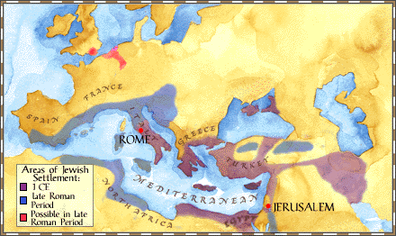
The Antiochene School Of Theology Practiced An Approach To Scriptural Interpretation With Literal Emphasis Rather Than Spiritual Meanings Not Immediately Evident From The Text
Antioch Center Of Christian Theology

Slide 108
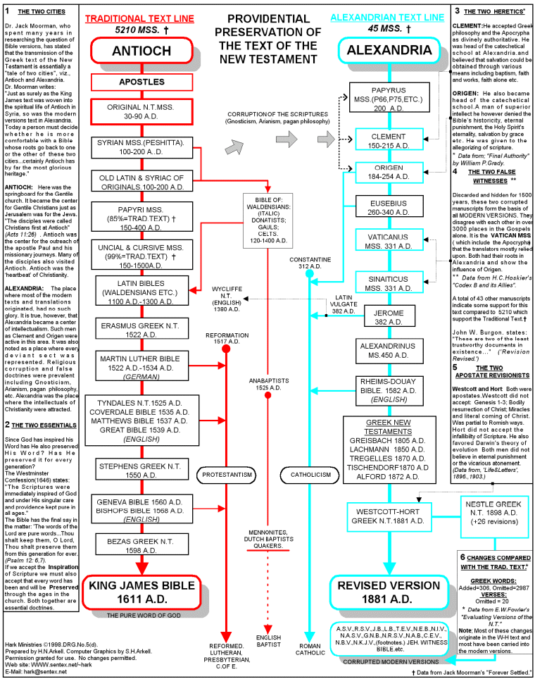

Slide 109
This was necessary for the spiritual promise to be fulfilled in Christ.
But Christ has come.
He has fulfilled the spiritual promise.
There is no more place for the mission of the nation.
Since the nation has fulfilled its mission in the coming of Christ, there is no further need for the land.
When Jerusalem fell, this was God’s way of saying that the promise to Abraham had found its fulfillment in Christ.
When Jerusalem fell, it left nothing but the spiritual promise and the gospel as man’s only hope.

Slide 110
Any future for the Jews will be found in the gospel and as an individual, not as a nation.
The fall of Jerusalem crowns the promise that God made to Abraham.
The fulfillment of the promise began at Pentecost.
When God brought judicial sentence on the nation in the fall of Jerusalem, it was His way of saying, “The gospel is the answer to the promise to Abraham.”
The only hope for Jews or Gentiles is to be found in the gospel of Christ.

Slide 111
The fall of Jerusalem is a warning to all man and for all times that God is through with the Jews as a nation.
The fall of Jerusalem is a warning to all man and for all times that their only hope is the gospel of Christ.

Slide 112
4. THE FALL OF JERUSALEM CLOSED THE QUESTION OF THE MESSIAH
The fall of Jerusalem closed the question of the promised Messiah.
In Matthew 24, verses 5 and 24, Christ points out that there would be false messiahs following His rejection and crucifixion.
Mt 24:5 For many shall come in my name, saying, I am Christ; and shall deceive many.
Mt 24:24 For there shall arise false Christs, and false prophets, and shall shew great signs and wonders; insomuch that, if it were possible, they shall deceive the very elect.

Slide 113
It is not strange that when the Jews rejected Christ, the promised Messiah, that there were false Messiahs who used the false expectation of the Jews to deceive them.
In rejecting Christ as the Messiah, the Jews would surely still look for one as long as the temple stood, which was the heart of Judaism.
There would be the means of deceiving the Jews about the Messiah.
It is of interest to note that until Christ came, there were no false Messiahs.
His coming and His rejection left the door open to blinded Jews to still look for one.

Slide 114
When Jerusalem fell, this forever closed the door on that question.
The temple and the records were destroyed.
The Messiah was the promised seed (Genesis 12:3; 22:18).
This promise was renewed to Isaac (26:4) and to Jacob (28:14)
In Genesis 49:10, it is limited to the tribe of Judah.
Gen 49:10 The sceptre shall not depart from Judah, nor a lawgiver from between his feet, until Shiloh come; and unto him shall the gathering of the people be.

Slide 115
Then in 2nd Samuel 7:10-13, it is limited in Judah to the house of David.
2nd Samuel 7:10 Moreover I will appoint a place for my people Israel, and will plant them, that they may dwell in a place of their own, and move no more; neither shall the children of wickedness afflict them any more, as beforetime, 11 And as since the time that I commanded judges to be over my people Israel, and have caused thee to rest from all thine enemies. Also the LORD telleth thee that he will make thee an house. 12 And when thy days be fulfilled, and thou shalt sleep with thy fathers, I will set up thy seed after thee, which shall proceed out of thy bowels, and I will establish his kingdom. 13 He shall build an house for my name, and I will stablish the throne of his kingdom for ever.

Slide 116
This accounts for Matthew’s introduction in Matthew 1:1:
Mt 1:1 ¶ The book of the generation of Jesus Christ, the son of David, the son of Abraham.
Abraham and David sum up the promised line.
Then Matthew gives the genealogy from Abraham through David to Christ.
If the babe born in Bethlehem is not the promised Messiah, then we can never know whether this promise will be fulfilled.
When the temple was destroyed, it took with it the record of the line of descendants from Abraham.
There is no way that a Jew can establish that he is of the line of Abraham and David.

Slide 117
If the Christ that was born in Bethlehem is not the Messiah, there will never be one.
God’s judgment on the Jewish Nation and the fall of Jerusalem closed the door on the question of the Messiah.
It is also well to remember that if Jesus is not the Messiah, the whole Bible collapses.
Christ, the Messiah, is the heart of both the Old and the New Testament.
If he has not come, it would be impossible to determine it since AD 70, and the promise of God is left hanging without ever being fulfilled.
But if God’s promise to Abraham falls, down goes the integrity of the entire Bible.

Slide 118
Is it any wonder that God closed the doors on the question of the Messiah when Jerusalem fell.
We either have the Messiah and the Bible stands firm, or we can forget about the Bible and walk in darkness forever.

Slide 119
5. SETTLED THE QUESTION OF SONS OF GOD
The fall of Jerusalem settled the question as to who are the sons of God.
The struggle between the Jews, Judaizing teachers, and the apostles, and especially the apostle Paul, runs through all the Epistles.
The attempt of Judaizing teachers to bind circumcision on the Gentiles and obligate them to keep the law is evident in the Galatian letter.
Chapters 3, 4, 5 of Galatians deal with this question.

Slide 120
In chapter 3 Paul shows that the promise to Abraham includes the Gentiles
Galatians 3:8 And the scripture, foreseeing that God would justify the heathen through faith, preached before the gospel unto Abraham, saying, In thee shall all nations be blessed.
And that the law was temporary: Galatians 3:19 ¶ Wherefore then serveth the law? It was added because of transgressions, until the seed should come to whom the promise was made; and it was ordained by angels in the hand of a mediator.

Slide 121
In chapter 3 Paul shows that the promise to Abraham includes the Gentiles (continued)
And that the law pointed to Christ. Ga 3:23 But before faith came, we were kept under the law, shut up unto the faith which should afterwards be revealed. 24 Wherefore the law was our school-master to bring us unto Christ, that we might be justified by faith. 25 But after that faith is come, we are no longer under a schoolmaster.
Then in verses 26 to 29 Paul draws his conclusion: “For ye are all the children of God by faith in Christ Jesus.” (v. 26)
Notice the word “all” – Jew and Gentile.
“By faith” – not flesh. “In Christ”- not in Abraham.

Slide 122
“For as many of you as have been baptized into Christ have put on Christ,” (Gal.3:27)
“As many” – that is , without distinction, whether Jew or Gentile.
Those “baptized into Christ” – not those baptized and then circumcised.
Thus, the one baptized into Christ, whether Jew or Greek, bond or free, male or female, were one in Christ and Abraham’s seed and heirs according to the promise (Gal. 3:28-29)
This shows the attempt of false teachers to try to maintain that in order for a Gentile to be a son of God, it was necessary for him not only to be baptized, but also to be circumcised and keep the law.

Slide 123
Of course, the apostles, and especially Paul, denied this claim, and this Epistle shows that it was false.
But God had one final argument in answer to these false teachers.
When Jerusalem fell, that was God’s way of saying, “I will show you once and for all who the sons of God are.”
Consider this passage, “Rev 10:7 But in the days of the voice of the seventh angel, when he shall begin to sound, the mystery of God should be finished, as he hath declared to his servants the prophets.

Slide 124
What was the mystery declared by the prophet?
Paul leaves no doubt about this.
Eph 3:3 How that by revelation he made known unto me the mystery; (as I wrote afore in few words, 4 Whereby, when ye read, ye may understand my knowledge in the mystery of Christ) 5 Which in other ages was not made known unto the sons of men, as it is now revealed unto his holy apostles and prophets by the Spirit; 6 That the Gentiles should be fellowheirs, and of the same body, partakers of his promise in Christ by the gospel:
The mystery was that Jew and Gentile would be heirs in Christ by the gospel.

Slide 125
John sees this question settled when Jerusalem fell.
Notice the connection between the mystery and the fall of Jerusalem in Romans 16.
In Romans 16:25 Paul ties together the gospel and the preaching of Jesus Christ. Then he states that it was “according to the revelation of the mystery, which was kept secret since the world began.”
Back in verse 20, Paul points to the fall of Jerusalem. Rom 16:20 And the God of peace shall bruise Satan under your feet shortly.
Is there no connection between his reference to the mystery and the fall of Jerusalem?

Slide 126
While the teaching of the New Testament makes plain that both Jew and Gentile stood on equality before God in one body, God had one last and final answer to settle the question.
When Jerusalem fell, the mystery had its concluding answer and proof that all baptized into Christ were sons of God whether Jews or Gentiles.
The outpouring of the Holy Spirit on Cornelius and his household was God’s first argument that he was no respecter of person.
The Epistles insist on this all the way through them.

Slide 127
The fall of Jerusalem clenches the argument once and for all, and, thus, the fall of Jerusalem answers another Bible question as to who are the sons of God.
The fall of Jerusalem and the end of Judaism was God’s way of saying, “sons of God are those who are obedient to the faith and are added to the church by the Lord.”

Slide 128
6. FALL OF JERUSALEM AND THE END OF THE MIRACULOUS AGE
Joel’s prophecy of the coming of the Spirit comprehends the beginning and the ending of the miraculous operation of the Spirit.
The miraculous age of the Spirit in Joel’s prophecy is placed between Pentecost and the fall of Jerusalem.
During this period, revelation was completed and confirmed.
During this period, the church grew from its infancy to its maturity.’

Slide 129
7. THE FALL OF JERUSALEM IS A SYMBOL OF THE FINAL JUDGMENT.
The fall of Jerusalem was God’s judicial sentence on the unbelief of the Jewish nation.
Peter refers to the fall of Jerusalem and uses the word “judgment” in reference to it: “For the time is come that JUDGMENT must begin at the house of God; and if it first begin at us, what shall the end be of them that obey not the gospel of God? And if the righteous scarcely be saved, where shall the ungodly and the sinner appear?” (1st Peter 4:17-18).

Slide 130
The fall of Jerusalem was God’s judgment on the nation for its rejection of Christ.
The fall of the nation under God’s sentence of judgment is a symbol of the final judgment on all who are not faithful Christians.
Will there be a final judgment?
Did God’s judgment fall on the Jewish nation?
The final judgment and the punishment of the wicked is as certain as Christ and the apostles’ announcement of judgment on Judaism that came to pass.
The fall of Jerusalem is warning to unbelievers and impenitents that they will just as certain face God in judgment and be lost forever.

Slide 131
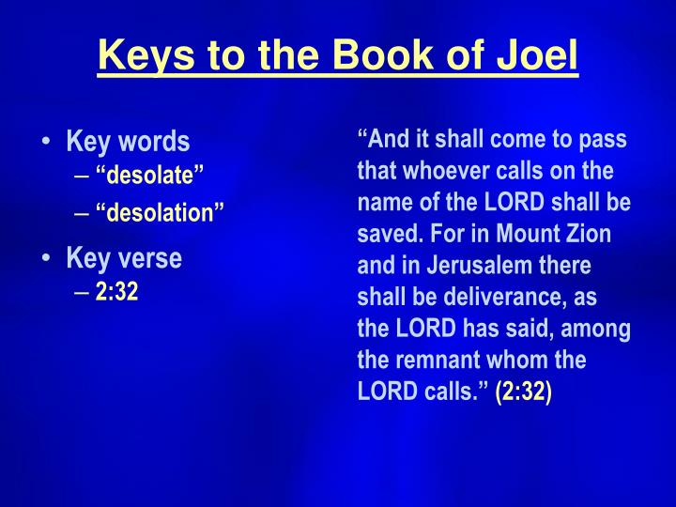

Slide 132
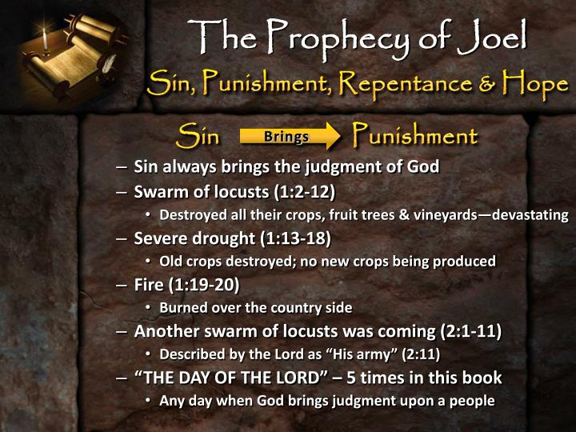

Slide 133
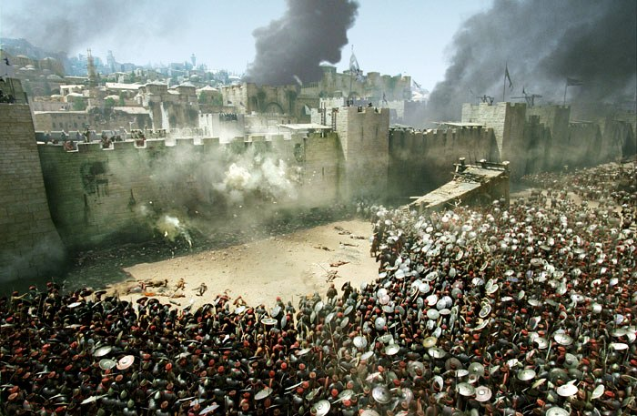
The Fall of Jerusalem
AD 66- 70

Slide 134
Signs of the end of the (Jewish) age
False Messiahs
Wars and Rumors of Wars
Famines
Pestilences
Earthquakes
Christian tribulations
False prophets
Falling away
Spreading of the Gospel worldwide

Slide 135
Matthew 24:34
Assuredly, I say to you, this generation will by no means pass away till all these things take place.

Slide 136
False Messiahs
NON-BIBLICAL
Menahem
Simon the Proselyte
BIBLICAL
Theudas of Judea
Judas of Galilee
“The Egyptian”

Slide 137
Acts 5:33-34 Theudas & Judas
For some time ago Theudas rose up, claiming to be somebody. A number of men, about four hundred, joined him. He was slain, and all who obeyed him were scattered and came to nothing.
³⁷ After this man, Judas of Galilee rose up in the days of the census, and drew away many people after him. He also perished, and all who obeyed him were dispersed.

Slide 138
Acts 21:38 “The Egyptian”
Are you not the Egyptian who some time ago stirred up a rebellion and led the four thousand assassins out into the wilderness?”

Slide 139
Messianic Pretenders: AD 30–70
1. An unnamed Samaritan (AD 36): “The Samaritan nation too was not exempt from disturbance. For a man … rallied them, bidding them go in a body with him to Mount Gerizim, which in their belief is the most sacred of mountains.… But before they could ascend, Pilate blocked their projected route up the mountain with a detachment of cavalry and heavy-armed infantry.… Many prisoners were taken, of whom Pilate put to death the principal leaders and those who were most influential among the fugitives” (Josephus, Antiquities 18.85–87).
2. Theudas (AD 44–46): “During the period when Fadus was procurator of Judaea, a certain imposter named Theudas persuaded the majority of the masses to take up their possessions and to follow him to the Jordan River. He stated that he was a prophet and that at his command the river would be parted and would provide them an easy passage. With this talk he deceived many. Fadus, however, did not permit them to reap the fruit of their folly, but sent against them unexpectedly, slew many of them and took many prisoners. Theudas himself was captured, whereupon they cut off his head and brought it to Jerusalem” (Josephus, Antiquities 20.97–99; cf. Acts 5:36).
3. Unnamed imposters (AD 52–58): “In Judaea matters were constantly going from bad to worse. For the country was again infested with bands of brigands and imposters who deceived the mob. Not a day passed, however, but that Felix captured and put to death many of these imposters and brigands” (Josephus, Antiquities 20.160–61).
4. Other unnamed imposters (AD 52–58): “Moreover, imposters and deceivers called upon the mob to follow them into the desert. For they said that they would show them unmistakable marvels and signs that would be wrought in harmony with God’s design. Many were, in fact, persuaded and paid the penalty for their folly; for they were brought before Felix and he punished them” (Josephus, Antiquities 20.167–68).
5. The Egyptian (AD 52–58): “At this time there came to Jerusalem from Egypt a man who declared that he was a prophet and advised the masses of the common people to go out with him to the mountain called the Mount of Olives, which lies opposite the city at a distance of five furlongs. For he asserted that he wished to demonstrate from there that at his command Jerusalem’s walls would fall down, through which he promised to provide them an entrance into the city. When Felix heard of this he ordered his soldiers to take up their arms. Setting out from Jerusalem with a large force of cavalry and infantry, he fell upon the Egyptian and his followers, slaying four hundred of them and taking two hundred prisoners. The Egyptian himself escaped from the battle and disappeared” (Josephus, Antiquities 20.169–72; cf. Acts 21:38).
6. Another unnamed imposter (AD 59–62): “Festus also sent a force of cavalry and infantry against the dupes of a certain imposter who had promised them salvation and rest from troubles, if they chose to follow him into the wilderness. The force which Festus dispatched destroyed both the deceiver himself and those who had followed him” (Josephus, Antiquities 20.188).
7. Leaders of the Jewish Revolt (AD 66–70): Several leaders of the Jewish revolt likely presented themselves as messianic figures. Menahem raided Masada for weapons and “returned like a veritable king to Jerusalem” (Josephus, Jewish War 2.434). John of Gischala acted like a tyrant (Jewish War 2.585–89; 4.121–27). And Simon bar-Giora changed the coinage from “The Freedom of Zion” to read “The Redemption of Zion,” indicating a probable messianic aspect to his propaganda and self-presentation (Jewish War 4.503–83; 7.26–32).
8. Vespasian (AD 70): Although Vespasian did not claim messiahship for himself, Josephus presented him in such terms: “But what more than all else incited them to the war was an ambiguous oracle, likewise found in their sacred scriptures [Num. 24:17–19?], to the effect that at that time one from their country would become ruler of the world. This they understood to mean someone of their own race, and many of their wise men went astray in their interpretation of it. The oracle, however, in reality signified the sovereignty of Vespasian, who was proclaimed Emperor on Jewish soil” (Josephus, Jewish War 6.312–13; cf. Suetonius, Life of Vespasian 4.5; Tacitus, Histories 5.13).
Köstenberger, A. J., Stewart, A. E., & Makara, A. (2017). Jesus and the Future: Understanding What He Taught about the End Times (pp. 42–44). Bellingham, WA: Lexham Press.

Slide 140
Wars and Rumors of Wars
The time of Jesus was part of what the Romans called “Pax Romana”, or the “Roman Peace”. It was a time of great stability in the Empire.
This would all change by the year AD 68, when there were extensive civil wars raging across the Empire during the so-called “Year of the Four Emperors”.

Slide 141
Famines
AD 40-41 Rome
AD 45-47 Egypt
AD 46-48 Jerusalem (Queen Helena)

Slide 142
Acts 11:27-28
Then one of them, named Agabus, stood up and showed by the Spirit that there was going to be a great famine throughout all the world, which also happened in the days of Claudius Caesar.

Slide 143
Earthquakes
AD 46 Crete
AD 51 Rome
AD 53 Apamaia
AD 60-62 Laodicea, Colossae, Hierpolis
AD 62 Campania
AD 63 Pompeii

Slide 144
Acts 16:26 Philippi
Suddenly there was a great earthquake, so that the foundations of the prison were shaken; and immediately all the doors were opened and everyone’s chains were loosed.

Slide 145
Christian tribulations
Peter and John (Acts 4)
Stephen (Acts 7)
James (Acts 12)
Paul
Tradition holds Peter was killed in AD 64, while Paul met his fate in 66. Of the Apostles, only John was believed to live out a natural life, and that was with banishment to Patmos.

Slide 146
False Prophets
Jude 4
For certain men have crept in unnoticed, who long ago were marked out for this condemnation, ungodly men, who turn the grace of our God into lewdness and deny the only Lord God and our Lord Jesus Christ.

Slide 147
Falling Away
1 Timothy 1:18-19
This charge I commit to you, son Timothy, according to the prophecies previously made concerning you, that by them you may wage the good warfare, ¹⁹ having faith and a good conscience, which some having rejected, concerning the faith have suffered shipwreck

Slide 148
Spreading of the Gospel
After the Day of Pentecost, the Church grew rapidly. By the writing of the book of Colossians (in approximately AD 60-62), the Apostle Paul felt comfortable enough to declare that the Gospel had been taught to “every creature under heaven”. (Colossians 1:23)

Slide 149
Colossians 1:5-6
…because of the hope which is laid up for you in heaven, of which you heard before in the word of the truth of the gospel, ⁶ which has come to you, as it has also in all the world

Slide 150
Signs of the end of the (Jewish) age
In the years following the life of Jesus, all of the signs that He predicted had come true. There was no excuse for the Christian NOT to know what was coming!

Slide 151
Matthew 24:32
“Now learn this parable from the fig tree: When its branch has already become tender and puts forth leaves, you know that summer is near.

Slide 152
Jerusalem would fall!
Matthew 23:37-38
“O Jerusalem, Jerusalem, the one who kills the prophets and stones those who are sent to her! How often I wanted to gather your children together, as a hen gathers her chicks under her wings, but you were not willing! ³⁸ See! Your house is left to you desolate

Slide 153
Matthew 21:13 “My House”
“It is written, ‘My house shall be called a house of prayer,’ but you have made it a ‘den of thieves.’”

Slide 154
Matthew 23:38 “Your House”
See! Your house is left to you desolate

Slide 155
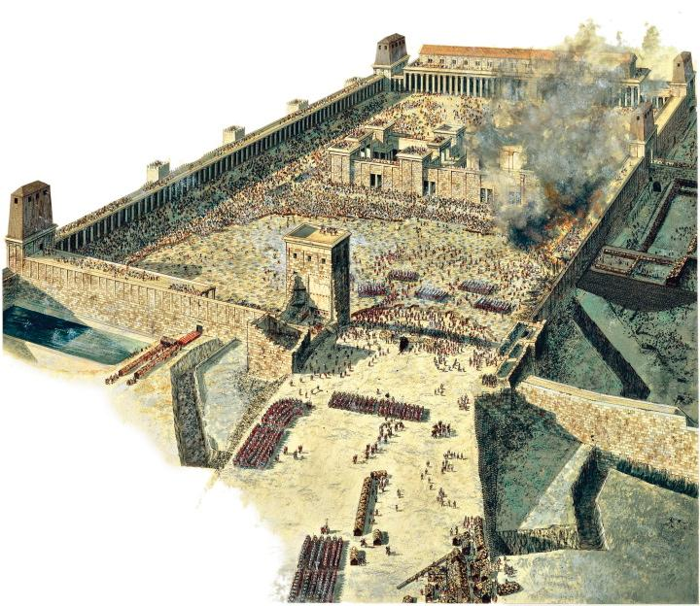
The Fall of Jerusalem

Slide 156
MATTHEW 24:14 – “And this gospel of the kingdom will be preached in all the world as a witness to all the nations, and then the End will come.”

Slide 157
THE END OF DAYS REFERENCED IN MATTHEW 24:3-34 AND ACTS 1:20 IS THE ELIMINATION OF PHYSICAL ISRAEL ALONG WITH JERUSALEM AS RELIGIOUS CAPITOL & CENTER OF MOSAIC SYSTEM OBSERVANCE

Slide 158
What was the catalyst for the Jewish Revolt of AD 66? Believe it or not, money. The Roman procurator, Gessius Florus, was stationed in Caesarea. Funds were running low, so Gessius helped himself to a large amount of silver from the Temple Treasury.
This led to a backlash from the Jews, who began to mock and deride Gessius. In response, troops were sent into Jerusalem and 3,600 Jews were massacred – mainly civilians. In response, two men emerged as leaders of the Jewish people, Eleaser and Menahem. Eleaser was the son of Ananias the priest, and held the title of the captain of the Temple. Menahem was a more violent person, and he believed that God would raise up a Messiah to defeat the Roman army and preserve Jerusalem and the Temple.
Menahem took troops south of Jerusalem to the strongly guarder Roman garrison at Masada, and somehow was able to rout the Romans! He returned to Jerusalem as a conquering hero, and began to assume control of the city and the Temple, even claiming to be the Messiah. He was killed by Eleaser on the Temple grounds in a bitter power struggle.
This was only the start of problems for the Jews. Word soon reached the Roman governor Cestius Gallus, who ruled from Antioch, some 300 miles from Jerusalem. In an attempt to quell this latest Jewish uprising, he gathered together some 20,000 Roman troops and began the march to Jerusalem.

Slide 159
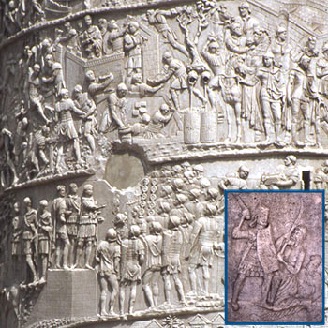


Slide 160
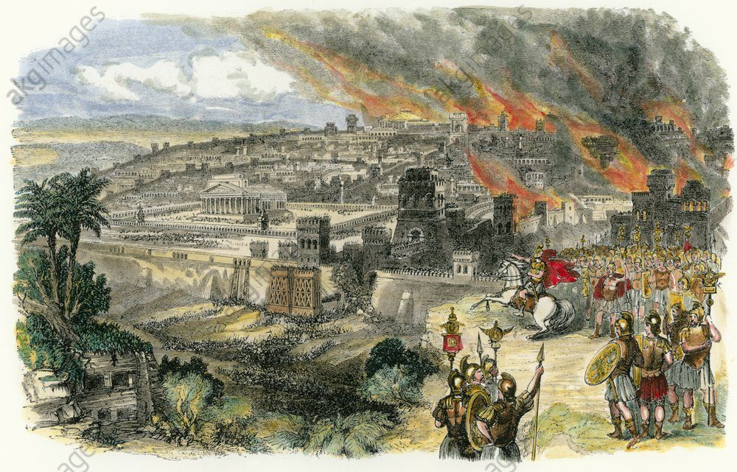

Slide 161
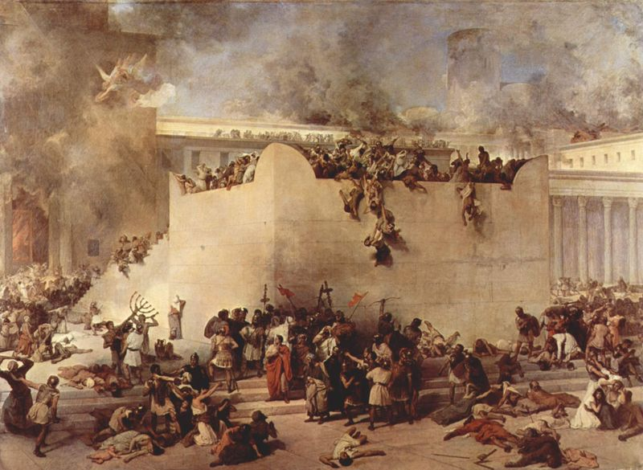
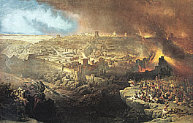

jerusalem
TEMPLE

Slide 162
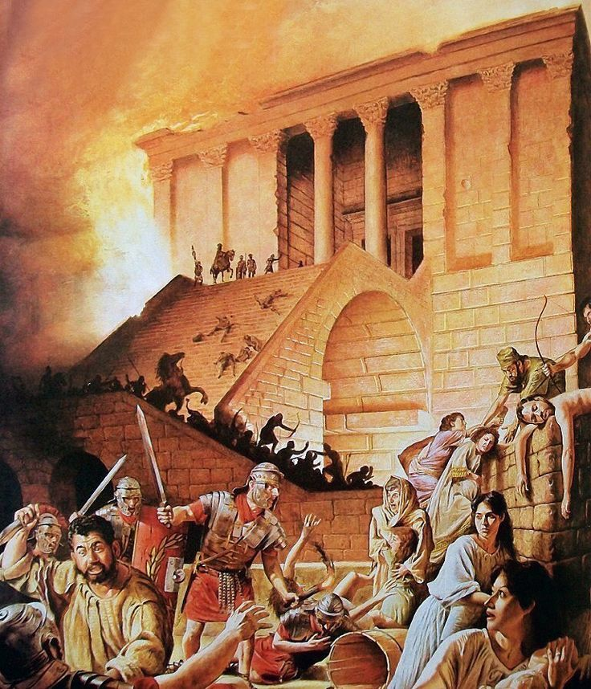

Slide 163
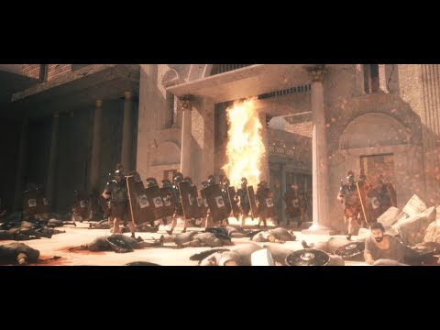

Slide 164
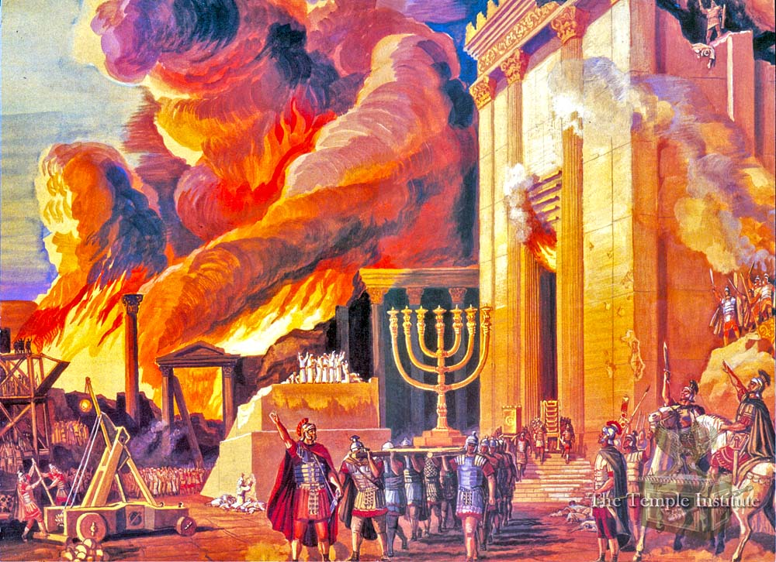

Slide 165
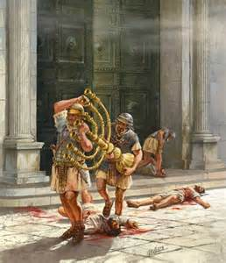
The Fall of Jerusalem

Slide 166
Jesus didn’t just listen to the disciples’ question about the temple and give them an entirely unrelated answer; he answered their question with a threefold prophetic description of (1) events that wouldn’t constitute the sign (false messiahs, wars, famines, earthquakes, persecutions, etc.), (2) the sign itself (the abomination of desolation), and (3) the terrible suffering and tribulation of the judgment on Jerusalem that would lead to the destruction of the temple.
Everything Jesus described so far in the Olivet Discourse was fulfilled during the years 30–70. There is nothing in the Olivet Discourse up to this point indicating that Jesus has begun to talk about a distant future event unrelated to the destruction of Jerusalem and the temple in the year 70. There is no indication that he is referring to the end-time rapture, a seven-year period of tribulation, or the destruction of a rebuilt Jerusalem. The discourse is solidly grounded in Jesus’ original historical situation as a response to his disciples’ question as to when the current temple would be destroyed. However, there are good reasons to think that Jesus transitioned to answer the second question (included only in Matthew’s Gospel) about his coming and the end of the age.
Köstenberger, A. J., Stewart, A. E., & Makara, A. (2017). Jesus and the Future: Understanding What He Taught about the End Times (pp. 62–63). Bellingham, WA: Lexham Press.

Slide 167
The Olivet Discourse
Millennialism Impacts Christian Watchfulness. The Olivet Discourse is easiest understood by observing that the Apostles were asking the typical ethno-centric question of the end of the world as they knew it (TEOTWAWKI) but truth be told - they were asking two basic questions – one of the destruction of the temple along with the city of Jerusalem - and the other as regards the end of the world. The fact that Christ gave His answer in two-part – the pivotal passage at Matthew 24: 34 – is of greatest illumination to our subject today. If we consider that Matthew 24: 3 – 34 parallels the events described in Revelation 20: 1, 2 to the End of that Age and Matthew 24: 35 – Matthew 25: 13 parallel events afterwards and until the End of Satan’s Story or End of the World - we can then observe the following contrasts: Events Local Versus Events Global; “This Generation” Versus “The Days of Your Fathers”; “That Day” Versus “Those Days”; and Signs Versus Suddenness.

Slide 168
The Olivet Discourse
Signs Versus Suddenness: Brother Larry Ray Hafley writes – “Jesus told of the signs preceding the destruction of Jerusalem; namely, ‘false Christs and false prophets,’ and wars and rumors of wars, famines and earthquakes – ‘all these are the beginnings of sorrows’ (Matthew 24: 6 – 8). Further He told them of ‘the abomination of desolation’ (Roman Eagle Standard), the Roman army (Matthew 24: 15; Luke 21: 20). ‘Then know that the desolation thereof is nigh’ (Luke 21: 20). They could ‘know’ the destruction of Jerusalem was ‘nigh,’ but the Coming of the Son of Man and the consequent Judgment were to be without warning (Matthew 24: 42, 43, 50; 25: 13). Compare ‘then know’ with ‘know not’ (Luke 21: 20; Matthew 24: 39). ‘So shall also the Coming of the Son of Man be.’

Slide 169
The “Signs” of Matthew Twenty-four
Our major thrust now will be to argue the case that the “signs” of Matthew 24:4ff do not find their fulfillment in the final return of Christ.
First, whereas dispensationalists argue for a twentieth-century fulfillment of these signs, accompanied by a nuclear holocaust (Lindsey 1970, 135-57), contextual indicators clearly reflect the fact that Jesus had reference to an ancient and local situation. Consider the following factors.
The impending destruction would involve the Jewish temple—“the holy place” (24:15), and the city of Jerusalem (Luke 21:20)—not New York, Paris, etc., as alleged by Lindsey and others. The temple has lain in ruins for more than nineteen centuries, and there is no evidence that it will ever be rebuilt.
The Jerusalem disciples were warned to flee unto the mountains (v. 16)—hardly efficacious advice if a nuclear attack were envisioned. However, according to Eusebius, the early Christians understood this admonition, and fled to Pella, beyond the Jordan, when the Romans advanced toward the city (Ecclesiastical History III.5).
Christ warned: “Let him that is on the housetop not go down to take out the things that are in his house” (v. 17). Again, such instruction hardly would be appropriate under the conditions of a nuclear assault. “On the house top” is the last place one would want to be! But the admonition made perfect sense in view of the fact that the houses of old Jerusalem were flat-roofed and situated close to one another. Accordingly, Christians might proceed, by way of “the road of roofs,” to the edge of the city, thus escaping the invading soldiers (Edersheim 1957, 93).
.

Slide 170
The “Signs” of Matthew Twenty-four – cont.
Jesus urged: “Pray ye that your flight be not in the winter” nor “on a sabbath” (v. 20). This anticipates primitive conditions when winter travel could be rigorous; moreover, the gates of Jerusalem would be closed on the sabbath (Nehemiah 13:19), which would make escape more difficult.
Second, though the destruction of Jerusalem was seen as a sort of “coming” of Christ (cf. Matthew 10:23; 24:30,33; Luke 21:27)—i.e., in judgment upon the Hebrew nation—such was emphatically distinguished from the event known as the “second” coming (cf. Hebrews 9:28). The Lord cautioned that if any false teacher should attempt to proclaim his visible coming in connection with Jerusalem’s fall, the bogus prophet was to be ignored, because the second coming would be apparent universally (vv. 23-27), whereas the destruction of Jerusalem was but a local event. Jerusalem’s fall would only reflect a sign of Christ’s providential coming in destructive judgment upon the holy city (vv. 29-31), not the Savior’s visible, final coming.
Third, it is very significant that the Lord, in connection with his discussion of the destruction of Jerusalem, introduced the remarkable prophecy that had been given five centuries earlier to the prophet Daniel. Jesus said:
When therefore ye see the abomination of desolation, which was spoken of through Daniel the prophet, standing in the holy place (let him that readeth understand), then let them that are in Judea flee (24:15,16).

Slide 171
The Olivet Discourse
The desolation and annihilation of ‘the buildings of the temple’ were to be seen by signs. ‘When ye shall see these things, know it is near, even at the doors… But of that day and hour knoweth no man, no, not the angels of heaven, but My Father Only’ (Matthew 24: 33, 36).
At least three times, Jesus specifically indicated that He was giving tangible evidence of the destruction of Jerusalem (Matthew 24: 8, 25, 33) but the second coming and the judgment were to be sudden, unknown, as when a thief strikes (Matthew 24: 42, 44, 50; 25: 13; 1st Thessalonians 5: 2 – 4; 2nd Peter 3; 10).

Slide 172
What Are Not the Signs
It is noteworthy that people are being told today that the end is near due to the following "signs". And yet, Jesus specifically said—these are not the signs! 1. False Messiahs (24:4-5): Josephus records that the governor of Judea (Felix: A.D. 53-60), put to death many Messianic impostors. "And now these impostors and deceivers persuaded the multitude to follow them into the wilderness and pretended that they would exhibit manifest wonders and signs" (Ant,. Of The Jews, Book 20,8, pp. 5-6). 2. Wars and rumors of wars(24:6): During the lifetime of Jesus peace had prevailed in the Empire, but shortly after His death, Palestine and the Empire experienced strife and many insurrections. In Rome, four emperors came to violent deaths in a period of 18 months. Jewish insurrections took place in the reign of Claudius (A.D. 41-54) and Nero (A.D. 55-68). During these years the Parthians were a continual source of trouble to Rome. 24:6 "but that is not the end". But how often are people today told that such things are proof that the end is near? 3. Famines and earthquakes (24:7): Famines (Acts 11:28). Four famines are recorded as taking place between the years A.D. 41-54 and many earthquakes are mentioned as happening prior to A.D. 70. Earthquakes struck Crete, Smyrna, Miletus, Chios, Samos, Laodicea, Hierapolis, Colossae, Rome and Judea. "But all these things are merely the beginning of birth pangs".

Slide 173
The Olivet Discourse
Jesus spoke of ‘great tribulation, such as was not since the beginning of the world to this time, no nor ever shall be’ (Matt. 24: 21). This implies that time will continue after ‘this time,’ but there is no sense in saying, ‘nor shall ever be’ if the end of the world and the (final) judgment were being studied. The same argument can be made from the next verse (Matthew 24: 22). Those days evidently will ‘be shortened;’ they will end, and the elect shall be saved because of it. But if the end of the world were in view, the elect would be saved whether the days were shortened or not.

Slide 174
The Olivet Discourse
Finally, Matthew 25 supplements Matthew 24: 35 – 51. The judgment of Matthew 25 involves and includes ‘all nations’ (Matthew 25: 32). It is the final judgment (Matthew 25: 34, 41, 46). The ten virgins parable says, ‘be prepared,’ ‘watch.’ The parable of the talents stresses the necessity of diligence and faithfulness (Matthew 25: 21, 23, 26 linking @Matthew 24: 42–51).

Slide 175
O’ Jerusalem, Jerusalem!

Slide 177
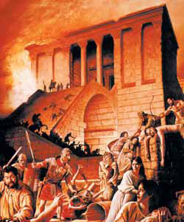

jerusalem
OLD TEMPLE
The New Temple

Slide 178
- END FOLLOWED BY NEW BEGINNING –
ACTS 1:21 – “And it shall come to pass That whosoever shall call upon the name of the LORD Shall be saved.”
-- Links to Christ’s Call -
Acts 1:8c - “Witnesses to Me … To the End of the Earth.”

Slide 179
We’ve reached the end of the Olivet Discourse and can succinctly summarize our position about which sections relate to the events of the year 70 and which relate to the second coming. We have argued that Mark 13:5–23 (and parallels in Matthew and Luke) relate to the destruction of the temple, 13:24–27 refers to the future second coming of Jesus as traditionally understood, 13:28–31 provides a parable about the destruction of the temple and concludes that topic, and 13:32–37 provides a parable about the second coming and concludes that topic. This understanding of the Olivet Discourse seems to be the best interpretation of all the available evidence.
In the Olivet Discourse, Jesus thus focuses on two future events. One of these events, the destruction of the temple, was in Jesus’ near future (his current generation) and is in our past. The other event, Jesus’ return, has not yet taken place and is still future. Every generation of Christians must remain vigilant and be active in the Father’s work because that day will come unexpectedly, and when it comes, there will be no time to prepare.
Several conclusions arise from the reading of the Olivet Discourse argued for above. First, readers who view the Olivet Discourse as referring exclusively to events associated with a seven-year period of tribulation between the rapture and Jesus’ second coming may want to reconsider their view of Jesus’ reference to “this generation” and the way in which the Olivet Discourse is a specific answer to a question from the disciples about when the temple would be destroyed. Jesus didn’t ignore their question or give them an entirely unrelated answer. Nothing in the Olivet Discourse indicates that Jesus taught a future rapture of believers that would be followed by a seven-year period of tribulation centered on the Jewish people and Jerusalem. Jesus’ comments about the tribulation and destruction of Jerusalem and the temple relate to the terrible judgment of the year 70.
Second, conversely, readers who seek to interpret all of the Olivet Discourse as referring to the destruction of the temple in the year 70 unduly minimize the importance of Matthew’s expanded question at the beginning of the discourse and the way in which Jesus’ words in the discourse about cosmic upheaval and the coming of the Son of Man were understood by the earliest Christians (or at least by Paul and Matthew).
We have argued that Jesus answered both questions at the beginning of Matthew’s Gospel concerning when the temple would be destroyed and when Jesus would come and the current age would come to an end. Luke guides us in knowing when Jesus transitioned from speaking about the destruction of the temple to his future coming. An indefinite period, called “the times of the Gentiles,” separates the two events (Luke 21:24). This is the period in which we continue to live as we wait for Jesus’ return.
Köstenberger, A. J., Stewart, A. E., & Makara, A. (2017). Jesus and the Future: Understanding What He Taught about the End Times (pp. 85–86). Bellingham, WA: Lexham Press.

