Slide 1
Satan’s scheme & plan for your life
By David L. Burris

Slide 2
Satan’s Hatred Versus God’s Love
The Mind of Satan
Satan’s Plan To Entrap
The Gateway to Satan
God’s Plan of Rescue
The Portal Of Prayer

Slide 3
“God loves you and has a wonderful plan for your life!”
That’s the good news.
The bad news is that Satan hates you and has a destructive plan for your life.
Even secularists are beginning to believe. Newspapers carry stories of demon worship and openly discuss the growing belief that there is a personal devil. We should not be surprised that there is empirical evidence that Satan exists, for we have met him in our own lives and in the experiences of others. More important, we know incredible details about him from the pages of the Bible. Not only does he exist, but he is actively seeking recruits.
In fact, I believe that he has already made meticulous plans for our downfall. All that is left for us to do is to step into the carefully laid trap. Unfortunately, the trap is hidden—it blends in with our aptitudes and surroundings and looks as if it is the route to fulfillment. Though it appears harmless, the consequences could be disastrous should we fall into it.
Satan is on the prowl, stalking and setting traps for God’s people (and yes, for unbelievers, too). He stays out of view, waiting for an unguarded moment. If we could know the extent of his knowledge of us … if we could understand his fiendish delight should we become a discredit to Christ, we would pore over the Scriptures to learn about him and about the weaponry God has given us for the battle.
Satan himself is abhorrent to us. Knowing that, he comes using different disguises and different names. His goal is to get us to do something he wants while making us think that the idea is wholly ours.
Understandably, his chief point of attack is the human mind. He has varying degrees of access (depending on the amount of sin we tolerate) and uses his opportunities to the hilt. Since he is not a gentleman and plays only by his own rules, he influences our thoughts and feelings without formal invitation. He is most pleased when his activity is completely hidden.
To alleviate any suspicion or fear, he gives his ideas familiar names that make us feel comfortable. Even the wolf in Little Red Riding Hood was cunning enough to know that he could not say to the grandmother, “Let me in, for I am the wolf!” Instead he disguised his voice and whispered, “I’m Little Red Riding Hood!”
Satan’s full-time occupation is making sin look good to us. Whatever the lure he employs, it is a highly intelligent spiritual being who plots our downfall. His intention is to cause us shame and to neutralize our effectiveness for Christ.
Satan also has tens of thousands of lesser spirits under his authority who have varying degrees of intelligence and power. They are highly organized and are his servants who do his bidding.
Of course there would still be addictions, violence, and wasted lives in the world if Satan and his demons did not exist. Satan plays a key role in tempting us, and, should we say yes to his promptings, he will tighten the chains to keep us bound.
Lutzer, E. W. (1990). Coming to grips with satan’s plan for your life. Chicago, IL: Moody Publishers.

Slide 4
Satan’s Plan for Our Lives
Hunters study animals to become familiar with their likes and dislikes, their habits and whereabouts. Animals don’t usually get caught by accident; they are lured into circumstances that look attractive but conceal a deadly hook. If you are catching a mouse you use cheese; a bear will be drawn to a piece of fresh meat; for fish you use worms. You promise your prey what it wants to have but give it what you want it to have. Let’s apply this simple analogy to satanic entrapment.
First, Satan tries to develop a keen understanding of his intended victim. Just as we know that mice prefer cheese to dead worms, so Satan knows our weaknesses and habits. He and his demons are keen observers of human nature, but he needs even more specific knowledge of each victim in order to set a trap that will succeed. It is reasonable to assume that evil spirits (one or more) are actually assigned to us to observe our habits and weaknesses.
Second, just as we must determine whether the mouse lives in the basement or the bedroom, so evil spirits observe where we work and with whom we work. They are particularly interested in our daily habits. Of even greater interest is our secret life—those attitudes and behaviors we keep from others. This provides them with the most fruitful area of temptation.
Third, just as it would be foolish for us to think we could catch a mouse without a trap, so Satan knows that he must remain hidden. A mousetrap is important because it can be used in our stead; it can catch our victim while we remain out of view. Furthermore, a trap can hold out the promise of food and fulfillment while keeping the ultimate consequences concealed. Mice see only the cheese and do not understand the wire and the powerful spring. Likewise, Satan wants to keep us ignorant of the intriguing dynamics taking place in the spirit world. He wants our circumstances to appear to be ordinary; his traps do not arouse undue suspicion. Yet behind the trap is the trapper; behind the lie is the liar.
Satan has as many lures as there are human weaknesses. To change the analogy, he leads us into a hallway with many different doors. To him it does not matter which of these doors we choose, because any one of them will lead to the same dark room of satanic involvement and control. - Lutzer, E. W. (1990). Coming to grips with satan’s plan for your life. Chicago, IL: Moody Publishers.

Slide 5
Satan’s Hatred Versus God’s Love
THE MIND OF SATAN

Slide 6
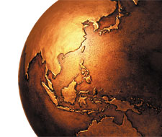
The Prince Of This World
John 12: 31; 14: 30; 16: 11

Slide 7
“The God Of This World”
@ 2nd Corinthians 4: 4 - “…hath blinded the minds of them which believe not, lest the light of the glorious gospel of Christ… should shine unto them.”

Slide 8
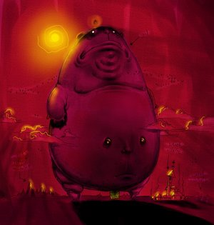
Nature's God: The Belly!

Slide 9
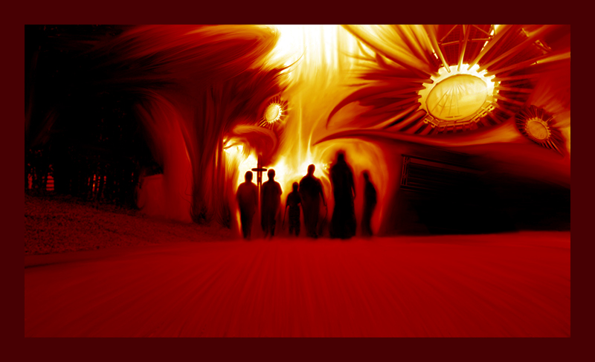
  THE NATURE OF EVIL

Slide 10
  THE NATURE OF EVIL:
  Chaos in the Moral Order

Slide 11
  THE NATURE OF EVIL:
  Evil as Part of Our Nature

Slide 12

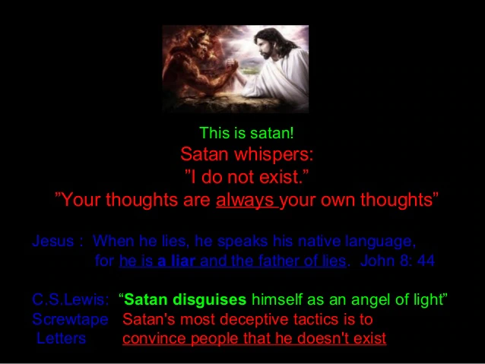
SECULAR SOCIETY: SATAN’S A SYMBOL

Slide 13
The Person of Satan
EVIL AS A PERSON. God Is Love and Satan Is Hate - Monotheistic Religions generally portray Supranatural Powers Contrasted Regarding Humankind from Its Inception – Altruistic & Malevolent – The Figure of Evil Devil is always as Hateful Trickster.
As Heaven only becomes real to us in its contrast to Hell – So, Faith in God’s Existence and that of His Son Jesus Christ as that of Truth Personified - Lends Credibility to the Concept of the Dark Lord and His Demonic Minions as Liars and Evil Personified. According to a 2009 Barna Survey, only 35% of those that self-identify as Christians believe Satan exists. Charles Baudelaire said: “The greatest trick the devil ever pulled was convincing the world he doesn’t exist.” As Evil as Force Is Not Simply Social Construct, Evil As Person Is Not Just Ancient Mythology. Brethren We Must Take Satan Seriously!

Slide 14
I. THE EXISTENCE OF SATAN
(Satan is the master deceiver. He has so deceived the world’s six billions of people that the majority of them do not believe that be exists. Many of those who do believe in his existence believe that he exists as a grotesque monster in a far-away hell or as a person to be studied in seminary classrooms and theological textbooks but not as a person to be feared in everyday life. All of these beliefs are contrary to the Biblical revelation concerning Satan.)
A. NEGATIVE
  1. Satan Is not a myth—Many people believe that Satan is a myth, a person existing only in the imagination of men and not in reality, but this is contrary to the Biblical revelation concerning Satan.
  2. Satan is not an invention—Some believe that Satan is an invention of priestcraft, that priests and preachers invented Satan (and hell) to scare their flocks and so hold them in subjection and obedience, but Biblically this is not true.
  3. Satan is not a superstition—Many believe that Satan is a superstition, a relic of the superstitious beliefs of the Middle Ages but this belief is contrary to Biblical teaching.
  4. Satan is not an abstract principle of evil—Some teach that God is the abstract principle of good and that God’s name should be spelled with two “o’s” (good) and that the devil is the abstract principle of evil and that the devil’s name should be spelled with no “d” (evil), but these beliefs are erroneous.
  5. Satan is not a bogie—He is not a hobgoblin, a specter, a person invented to scare children into obedience and goodness.
  6. Satan is not a grotesque monster—He is not, as he is pictured in paintings and on billboards, a grotesque monster, with horns, hoofs, a forked tail, a tight-fitting red asbestos suit, and a pitchfork. This description comes from “The Inferno,” a Middle-Ages’ poem written by the Italian poet Dante.
  7. Satan is not just a suitable subject for a good joke—Millions of persons use him in this way (but see Jude 9).
B. POSITIVE
  1. Satan is a person
  Persons are beings having intellect, sensibility, and will (the members of the godhead, the members of the angelic orders, and the members of the human family are persons.) In the Bible, Satan is pictured as possessing these three attributes. He thinks, he knows, he plots, he devises, he desires, he hates, he speaks, he tempts, he accuses, etc. All of these things are associated with a person and not with an abstract principle.
  2. Satan is a supernatural person
  He is a person not subject to the laws of nature for apparently he has an immaterial body, but he can make himself visible to men and can converse with them, Matt. 4:1–11.
  3. Satan is a normal person
  Nowhere in the Bible is Satan pictured as a weird, grotesque person but as a person meeting all the norms of personality.
    Gingrich, R. E. (2000). (pp. 45). Memphis, TN: Riverside Printing.
Gingrich, R. E. (2000). The History of Satan (pp. 4–5). Memphis, TN: Riverside Printing.

Slide 15
Your Adversary The Devil

Slide 16
There is a lot of misunderstanding about Satan

Slide 17
I. Names of Satan

Slide 18
Satan – this name literally means adversary
Acts 5:3
[3] But Peter said, Ananias, why hath Satan filled thine heart to lie to the Holy Ghost, and to keep back part of the price of the land?

Slide 19
The Devil – means one who engages in slander
Mt. 4:1 – here he is called “the devil”
The main object of his slander is God - he used this in the Garden of Eden and still uses it today

Slide 20
He is the tempter
Mt. 4:3 “and when the tempter came to him”
He cannot make one sin, but he can and does tempt
Js. 1:13-15

Slide 21
He is the serpent – he is very crafty
Rev. 12:9
[9] And the great dragon was cast out, that old serpent, called the Devil, and Satan, which deceiveth the whole world: he was cast out into the earth, and his angels were cast out with him.

Slide 22
He is the dragon
Re. 12:9
Intimidating and frightening

Slide 23
He is the murderer – He wants to destroy
Jn. 8:44
[44] Ye are of your father the devil, and the lusts of your father ye will do. He was a murderer from the beginning, and abode not in the truth, because there is no truth in him. When he speaketh a lie, he speaketh of his own: for he is a liar, and the father of it.

Slide 24
He is the liar
Jn. 8:44
He is dishonest and corrupt of speech
False teachers, the morally corrupt etc., are his children

Slide 25
He is the roaring lion – frightening, fierce, causing fear & dread
1 Pet. 5:8
[8] Be sober, be vigilant; because your adversary the devil, as a roaring lion, walketh about, seeking whom he may devour:

Slide 26
He is Beelzebul or Beelzebub
Mt. 12:24
[24] But when the Pharisees heard it, they said, This fellow doth not cast out devils, but by Beelzebub the prince of the devils.

Slide 27
The name means “lord of the flies” – refers to his corrupting nature
He is “ruler of the demons”

Slide 28
He is the evil one or wicked one
1 John 3:12
“Not as Cain, who was of that wicked one, and slew his brother. And wherefore slew he him? Because his own works were evil, and his brother's righteous.”
He is morally and socially worthless – wicked – evil – bad

Slide 29
The accuser of the brethren
Rev. 12:10
[10] And I heard a loud voice saying in heaven, Now is come salvation, and strength, and the kingdom of our God, and the power of his Christ: for the accuser of our brethren is cast down, which accused them before our God day and night.

Slide 30
The prince of this world
Eph. 2:2
² in which you once walked according to the course of this world, according to the prince of the power of the air, the spirit who now works in the sons of disobedience,

Slide 31
He has power in the earthly realm until the final overthrow at the second coming of Christ and the judgment
He has limited power to fight against Christ and His church

Slide 32
Ultimately he will fail
1 Jn. 5:4
[4] For whatsoever is born of God overcometh the world: and this is the victory that overcometh the world, even our faith.

Slide 33
III. Lessons for us

Slide 34
1. Satan, our enemy, is very clever
2 Cor. 11:13-14
[13] For such are false apostles, deceitful workers, transforming themselves into the apostles of Christ.
[14] And no marvel; for Satan himself is transformed into an angel of light.

Slide 35
2 Cor. 11:3 – he is beguiling (misleading, full of tricks)
3 But I fear, lest somehow, as the serpent deceived (beguiled) Eve by his craftiness, so your minds may be corrupted from the simplicity[a] that is in Christ.

Slide 36
1 Jn. 5:19 – he is very deceptive
[19] And we know that we are of God, and the whole world lieth in wickedness.

Slide 37
2. The devil is strong
Satan’s power has been limited by Christ’s death and resurrection – but he is still a powerful enemy
He opposes God’s people and the work they do
We must depend upon God for strength

Slide 38
1 Pet. 5:9
[9] Whom resist stedfast in the faith, knowing that the same afflictions are accomplished in your brethren that are in the world.

Slide 39
James 4:7-8
[7] Submit yourselves therefore to God. Resist the devil, and he will flee from you.
[8] Draw nigh to God, and he will draw nigh to you. Cleanse your hands, ye sinners; and purify your hearts, ye double minded.

Slide 40
3. This great enemy can be overcome
Eph. 6:10-18
[10] Finally, my brethren, be strong in the Lord, and in the power of his might.
[11] Put on the whole armour of God, that ye may be able to stand against the wiles of the devil.

Slide 41
[12] For we wrestle not against flesh and blood, but against principalities, against powers, against the rulers of the darkness of this world, against spiritual wickedness in high places.

Slide 42
[13] Wherefore take unto you the whole armour of God, that ye may be able to withstand in the evil day, and having done all, to stand.

Slide 43
[14] Stand therefore, having your loins girt about with truth, and having on the breastplate of righteousness;
[15] And your feet shod with the preparation of the gospel of peace;

Slide 44
[16] Above all, taking the shield of faith, wherewith ye shall be able to quench all the fiery darts of the wicked.
[17] And take the helmet of salvation, and the sword of the Spirit, which is the word of God:

Slide 45
[18] Praying always with all prayer and supplication in the Spirit, and watching thereunto with all perseverance and supplication for all saints;

Slide 46
We must be obedient to Christ and build a spiritual relationship with Him

Slide 47
1 Jn. 3:8 - Christ came to destroy the works of the devil
[8] He that committeth sin is of the devil; for the devil sinneth from the beginning. For this purpose the Son of God was manifested, that he might destroy the works of the devil.

Slide 48
Heb. 2:14 – Christ succeeded
[14] Forasmuch then as the children are partakers of flesh and blood, he also himself likewise took part of the same; that through death he might destroy him that had the power of death, that is, the devil;

Slide 49
Before you can put on the Christian armor, you must put on Christ
Gal. 3:26-28

Slide 50
Some points gleaned from “Your Adversary the Devil”, by Neal Pollard, Meeting Christ – Called unto heaven. 31st Annual Southwest Lectures, 2012

Slide 51
Satan –
His Nature

Slide 52
Introduction
“Some people think that if you believe in the devil, you never really graduated from childhood. Or as one put it, ‘Belief in a personal Satan is part of mankind’s nursery furniture.’” Allen Webster

Slide 53
Introduction
The Bible makes it clear that Satan is real
Jesus recognized the reality of the devil of spoke of him often

Slide 54
I. Satan Is A Slanderer
Devil = slanderer or accuser
Job 1:7-8
Ps. 109:6

Slide 55
I. Satan Is A Slanderer
When Satan accuses us today – remember that we have an Advocate in Heaven – Christ Jesus
1 Jn. 2:1-2

Slide 56
II. He Is A Counterfeiter Of God
2 Cor. 11:13-15

Slide 57
II. He Is A Counterfeit Of God
He has counterfeit: gods, religions, churches, Bibles,
He is content with men practicing idolatry or being involved in false religions

Slide 58
II. He Is A Counterfeit Of God
The only way to determine the genuine and the fake is by the word of God
1 Jn. 4:1
1 Th. 5:21

Slide 59
III. He Is Liar, Deceiver & Murderer
Since Eden he has been lying to mankind
Jn. 8:44

Slide 60
III. He Is Liar, Deceiver & Murderer
He introduced death into the world
2 Cor. 11:3

Slide 61
IV. He Is The Ruler Of This World
Jn. 12:31
2 Cor. 4:4

Slide 62
IV. He Is The Ruler Of This World
He has more followers presently than God does
Mt. 7:13-14

Slide 63
IV. He Is The Ruler Of This World
Eventually Satan will bow as will every one of his followers
Rom. 14:11

Slide 64
V. He Is Our Adversary
1 Pet. 5:8-9

Slide 65
V. He Is Our Adversary
The word Satan means adversary!
He is always nearby laying traps for us
2 Tim. 2:24
Eph. 6:11-12

Slide 66
VI. He Is A Destroyer
It is his goal to wreck every couple’s marriage, every person’s health, every minds sanity, etc.

Slide 67
VI. He Is A Destroyer
He wants to wreck every peaceful heart, every friendship, every good work, the unity in every congregation, every sermon’s effectiveness, and every souls destiny!

Slide 68
The deceit, the lie of the devil consists of this, that he wishes to make man believe that he can live without God's Word. Thus he dangles before man's fantasy a kingdom of faith, of power, and of peace, into which only he can enter who consents to the temptations; and conceals from men that he, as the devil, is the most unfortunate and unhappy of beings, since he is finally and eternally rejected by God.
Dietrich Bonhoeffer

Slide 69
The Mind of Satan
Story of Satan is in The Tension Between God’s Perfect Vs. Permissive Will - or rather between That What God Approves Versus That What God Accepts. God’s Permissive Will is what God allows even though it is sin. Even with such allowance, God remains in control - His multi-generational purposes all the while being accomplished. The definitive feature of God’s Permissive Will is that it is never outside of His Perfect Will.
God’s Perfect Decretive Eternal Will includes His Redemptive Plans for The Human Race, His Specific Plans for both Physical & Spiritual Israel and His Intermediate & Ultimate Plans for the Fallen Angels & their Leader – the Archangel Satan.

Slide 70
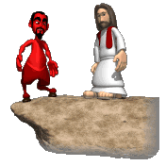
A Premise!
If God is for it, Satan is against it
If Satan is for it, God is against it

Slide 71

The Mind of Satan
Story of Satan is in The Tension Between God’s Perfect Vs. Permissive Will - or rather between That What God Approves Versus That What God Accepts. God’s Permissive Will is what God allows even though it is sin. Even with such allowance, God remains in control - His multi-generational purposes all the while being accomplished. The definitive feature of God’s Permissive Will is that it is never outside of His Perfect Will.
God’s Perfect Decretive Eternal Will includes His Redemptive Plans for The Human Race, His Specific Plans for both Physical & Spiritual Israel and His Intermediate & Ultimate Plans for the Fallen Angels & their Leader – the Archangel Satan.
SATAN HATES YOU & ME!

Slide 72
Let’s Talk About Satan
Some Things We Should Know

Slide 73
Introduction
In the recent news there has been much talk about identifying who the enemy is.
Not only is it wise to know who the enemy is, but we also need to know as much about him as possible.
That way, we are prepared for whatever he sends our way, and we will be prepared for it.
Since Satan is our enemy, let us learn some things about him……

Slide 74
Satan Is Real
Satan talked with God (Job 1:6-12; 2:1-6)
This is also the ONLY time in human history where God allowed Satan any power at all.
Satan talked with Christ (Matthew 4:1-11).
Satan stood up against Israel and moved David to number Israel (1 Chronicles 24:1).
However the parallel account in 1 Kings 24 says that the Lord was angry against Israel, and David was moved to have a census taken.

Slide 75
Satan Is Real
There is no other account of Satan talking with anyone recorded in Scripture that I am aware of.
Now some might take us back to the garden of Eden, but that is circumstantial.
The scripture in Genesis only mentions the serpent. The New Testament tells us that Eve was deceived.
Satan is called the great deceiver, so the opinion is that Satan was speaking through the serpent.

Slide 76
Satan Is Limited
The only occasion where Satan did something in the physical realm was recorded in Job.
Satan is blamed for much of the problems of this world.
Rightfully so, because he is the god of this world, and being the top dog means all things that happen are his responsibility.
But Satan gets blamed for more than he does.

Slide 77
Satan Is Limited
We read that Satan has been bound up until the end of time (Revelation 20:2,7)
Today, Satan does not have the power to move a blade of grass or a mist. Satan has no power to make you or me do anything.
Satan has no power, except what we give him.

Slide 78
Satan Is Limited
There are places in the scriptures where it says Satan entered a heart, caused a natural disaster, and other things.
But these instances all came about because of the sin that the people were committing.
Remember that James 1:14-15 tells us that we are tempted by OUR OWN LUSTS.

Slide 79
Satan Is An Accuser
Satan was ready to accuse Joshua the High Priest in Zechariah 3:1—but in verse 2 the Lord said to Satan ”The LORD rebuke you, Satan!”
Satan accused Job of obedience with false motives, yet God knew better.
Michael the archangel disputed with Satan over the body of Moses.
So Satan does also with all righteous souls.
He/she sinned is the accusation, which is true, but these have been washed of their sins and no longer live in their sins.

Slide 80
Satan Has No Power On Earth
Do not blame Satan if you sin.
Satan has NEVER MADE anyone sin.
Yet he has caused people to sin the sin they were going to do anyway.
Satan has no power in the physical realm.

Slide 81
Satan Has No Power On Earth
God does not make people obey Him even if He has the power to do so.
Even Satan does not have that power.
Satan is limited to the spiritual realm.
Even though it is said of him that he is the prince of the power of the air, he cannot make anyone sin against God.

Slide 82
Since Satan Is Limited:
He stands as the antithesis of God and all that is good.
Satan is equated with evil, and evil is that which destroys.
Thus, the destroyer as one of his names or titles.
So how does Satan influence us if we are enticed by our own lusts?
That is really the critical question.

Slide 83
Other Qualities Of Satan.
What? Satan has qualities?
Yes, he does, and after hearing these qualities perhaps you might be envious of Satan and seek to follow these qualities.
This may be difficult to swallow, but you will see shortly what I mean.

Slide 84
KNOWLEDGE OF SCRIPTURE
Satan knows every word of the Bible.
Although his employment of Scripture is certainly abusive, the tempter is indubitably well versed.
In an instant he can perfectly recall an obscure passage and quote it verbatim.
Despite the wicked misapplication, his knowledge of the inspired text far excels that of many so-called disciples.
Study and search the scriptures.
2nd Timothy 2:15; 3:15-17; Acts 17:11
Christians must get to know the text. Don’t let Satan put you to shame.

Slide 85
BELIEF IN GOD
The demons certainly believe in God, confess Christ, and even offer worship!
James 2:19; Acts 19:11-17; Luke 4:31-35
Some pretend Christians don’t even do all that, much less go any further.
The devil is less foolish than atheists because he at least acknowledges God. (Psalm 14:1).
If we come to God, we must believe in His existence and trust Him to reward His diligent seekers. (Hebrews 11:6)
Do you seek God any more diligently than the devil does?

Slide 86
FEAR OF HELL
Clearly, demons worried that the Lord would banish them to torments. (Mark 5:1-7)
After all, that’s the whole reason God made hell: to punish the devil and his angels. (Matthew 25:41).
Yet, some who say they believe in God, blatantly mock His justice in eternally punishing sinners.
Yet, Scripture shows that scare tactics are an appropriate means of motivating obedience to the gospel. (2nd Corinthians 5:9-11; Luke 12:4-5; 2nd Thessalonians 1:7-9)
Hell is real. The devil knows it and so should we!

Slide 87
TRUST IN GOD’S PROVISION
Satan understood that righteous Job was protected by God. (Job 1:6-10).
Those whose trust really is in God should never despair, knowing that He will fulfill our needs if we put Him first. (Psalm 37:25-26; Matthew 6:25-34)

Slide 88
Qualities Of Satan
Up to now, we can see that Satan has qualities that we really recognize we need to have these things.
For the most part I feel we all can say that we have accomplished these qualities in ourselves.
Yet there is one more quality that Satan has that should really put us to shame.

Slide 89
ZEAL TO WIN SOULS
Our adversary the devil actively stalks his prey. He wages spiritual warfare against us. He has devices at play. He is a master of disguise. He seeks to undo the spread of the gospel. Satan relentlessly pursues souls. (1st Peter 5:8; Ephesians 6:11; 2nd Corinthians 2:11; 11:3, 13-15; Luke 8:12).
We are wise if we win souls to Christ. Whether we are preachers and teachers or merely students inviting others to meet the Master, there is work to be done (Proverbs 11:30; Matthew 28:19; Acts 8:4; John 1:40-42; 4:39-42).
Does Satan out us to shame in the zeal for souls department?

Slide 90
Satan Can Become Your Master
While we might dispute such a statement, it is true.
Romans 6:16 tells us we are the servants of the one we serve.
That is either God by practicing righteousness and obedience or Satan by failing to do what God commands.
And we know that most of the world serves Satan.

Slide 91
Conclusion
We certainly do not want to minimize his influence…
Yet at the same time if we are determined to serve Christ and God, Satan does not need to scare us.
Satan may come into this room, and we need not fear him, because he has no power if we’re children of God.
What we must remember is that Satan is trying to keep you out of heaven, and he is always on the job.

Slide 92


Slide 93


THE BIG LIE
“who exchanged the truth of God for the lie, and worshiped and served the creature rather than the Creator…”
Romans 1: 25

Slide 94
Humanistic Foundation For Our False Consciousness: The Big Lies Of The Devil
The Ego-Centric Lies Of The Garden: The Earth Belongs To The Living – T. Jefferson
Ego-Centric Lying In The Wilderness: Concept Of Self-Ownership & Self-Determination
The Lying Ego Of Eden’s Garden Was Exposed On The Cross!
The Lying Ego In The Wilderness Was Overcome By The Resurrection!

Slide 95
There Are Three Aspects To: Sharing Satan’s Sins & Believing Satan’s Lies
We Measure Ourselves By Ourselves - i.e. … 2nd Corinthians Chapter 10 & Verse 12
We Lie To Ourselves About Ourselves – i.e. … Proverbs 21: 2 Vs. “The Good Test” – As Per: An All-Covering Love – Long-suffering Love – A Love That Returns Good For Evil – Unselfishness Of Our Love – The Self-forgetting Love - Love That Doesn’t Change – The Honesty Of Our Love – The Humility Of Love – Undivided Love – The Purity Of Love
Network & Facilitate The Vision & Mission Of This World’s Prince Rather Than The Prince Of Peace!

Slide 96
HIS GREATEST DECEPTION
God could have exterminated Satan or confined him to another planet. But He chose instead to let him rule the world and to allow evil to take its destructive course. In the end, God’s plan will triumph on the earth, but it will be through conflict, not by sovereign fiat.
Thus after the creation of Adam and Eve, Satan appeared in the Garden of Eden to lure our first parents away from obeying God. Please note carefully: by that point Satan was keenly aware that his act of disobedience had transformed him into a wicked being, the moral antithesis of God.
He was irritated by the fellowship that existed between man and God. No doubt it reminded him of the time when he had experienced such a blessed relationship. Not content with his own evil nature or any comradery with other fallen angels, he sought to draw mankind into his misery. This appeared to be a master stroke against God.
Let us examine Satan’s deceptive ploy at work.
First, he cast doubt on the integrity of God. “Indeed, has God said, ‘You shall not eat from any tree of the garden?’” (Genesis 3:1). Whether we accept the translation of the King James Version, “every tree of the garden,” or the New American Standard Version, “any tree of the garden,” (italics mine), the point is the same: “Do you mean to tell me that God has restricted you—for no good reason?”
The strategy was brilliant. By asking a question, he avoided directly attacking God, which would have aroused suspicion. Yet he had introduced the thought that perhaps God’s command was arbitrary and unnecessary. He had opened the door for “rational” dialogue.
Note how his question got Eve to shift her focus: rather than focusing on the hundreds of trees from which she could eat, she began to concentrate on the one tree that was forbidden.
Second, he contradicted God directly. If Eve ate of the forbidden fruit, he claimed that she would not die but would become “like God, knowing good and evil” (v. 5). That was a direct attack on the motive of God. The command, Satan says, was not for Eve’s benefit but to protect God’s selfish interests. The Almighty fears rivalry in His kingdom, he insinuated. He is intimidated by all that Eve will become if she eats the fruit. If God really loved Eve He would let her eat, but because of His own selfish interests He makes a restriction. What kind of a God would do that?
When Satan saw both Adam and Eve eat the forbidden fruit, he must have had a moment of fiendish delight. The human race had joined his rebellion. He had tricked these two foolish people into defying the Almighty.
Lutzer, E. W. (1990). Coming to grips with satan’s plan for your life. Chicago, IL: Moody Publishers.

Slide 97
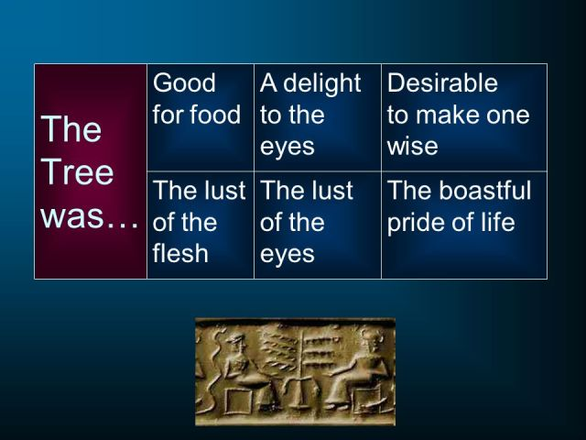

Slide 98
“People Of The Lie” by M. Scott Peck, M.D.
“This willful failure of submission that characterizes malignant narcissism is depicted in the story of Satan. Satan refused to submit to God’s judgment that Christ was superior to him… For Satan to have accepted God’s judgment, he would have to accept his own imperfection. This he could not or would not do. It was unthinkable that he was imperfect. Consequently, submission was impossible and both the rebellion and fall inevitable.”

Slide 99
“People Of The Lie” by M. Scott Peck, M.D.
Q: “What is the cause of this overweening pride, this arrogant self-image?” A: ‘Malignant Narcissism’ type characterized by an unsubmitted will… (Erich Fromm) “In the conflict between their guilt & their will, it is the guilt that must go and the will that must win.”

Slide 100



Slide 101
“People Of The Lie” by M. Scott Peck, M.D.
David Lee Burris: Charles Colson Citation – “[Mike] Wallace’s subsequent summation of Dinur’s terrible discovery – ‘Eichmann is in all of us’ – is a horrifying statement; but it indeed captures the central truth about man’s nature.”
“They are acutely sensitive to social norms and what others think of them… While they seem to lack any motivation to be good, they intensely desire to appear good. Their ‘goodness’ is all on a level of pretense. It is, in effect, a lie. This is why they are the ‘people of the lie.’ Actually, the lie is designed not so much to deceive others as to deceive themselves. They cannot or will not tolerate the pain of self-reproach.”

Slide 102


Slide 103
Rom 8:3-8 For what the law could not do in that it was weak through the flesh, God did by sending His own Son in the likeness of sinful flesh, on account of sin: He condemned sin in the flesh, 4 that the righteous requirement of the law might be fulfilled in us who do not walk according to the flesh but according to the Spirit. 5 For those who live according to the flesh set their minds on the things of the flesh, but those who live according to the Spirit, the things of the Spirit. 6 For to be carnally minded is death, but to be spiritually minded is life and peace. 7 Because the carnal mind is enmity against God; for it is not subject to the law of God, nor indeed can be.

Slide 104
Two Kinds Of People in the World
Those who choose to walk after the flesh.
Those who choose to walk after the Spirit.

Slide 105
Those whose choice is the flesh
Flesh here denotes sinful, human nature apart from God
Rom 3:12-18 They have all turned aside; They have together become unprofitable; There is none who does good, no, not one.“ 13 "Their throat is an open tomb; With their tongues they have practiced deceit"; "The poison of asps is under their lips"; 14 "Whose mouth is full of cursing and bitterness." 15 "Their feet are swift to shed blood; 16 Destruction and misery are in their ways; 17 And the way of peace they have not known.“ 18 "There is no fear of God before their eyes."

Slide 106
Such do not have God's rightful expectation, the act of making us what we should justly be and what God originally created us to be
Rom 8:3-5 For what the law could not do in that it was weak through the flesh, God did by sending His own Son in the likeness of sinful flesh, on account of sin: He condemned sin in the flesh, 4 that the righteous requirement of the law might be fulfilled in us who do not walk according to the flesh but according to the Spirit.
Just obeying a law has been difficult for man all down through history. People feel that laws are made to be broken instead of obeyed. By God sending his only son we should be able to see this is more than just giving a law, God has invested himself in our Salvation through his son.

Slide 107
Paul elaborates on this change brought about through Christ
Rom 7:4-6 Therefore, my brethren, you also have become dead to the law through the body of Christ, that you may be married to another — to Him who was raised from the dead, that we should bear fruit to God. 5 For when we were in the flesh, the sinful passions which were aroused by the law were at work in our members to bear fruit to death. 6 But now we have been delivered from the law, having died to what we were held by, so that we should serve in the newness of the Spirit and not in the oldness of the letter.
No longer just a law but a way of life, we can start over fresh with a new life separate and apart from the struggles brought about by SIN. Christ offers us a freedom from the things that brought death in the past.

Slide 108
A distinctly different kind of life is offered to us all
Gal 5:16-21 I say then: Walk in the Spirit, and you shall not fulfill the lust of the flesh. 17 For the flesh lusts against the Spirit, and the Spirit against the flesh; and these are contrary to one another, so that you do not do the things that you wish. 18 But if you are led by the Spirit, you are not under the law.
19 Now the works of the flesh are evident, which are: adultery, fornication, uncleanness, lewdness, 20 idolatry, sorcery, hatred, contentions, jealousies, outbursts of wrath, selfish ambitions, dissensions, heresies, 21 envy, murders, drunkenness, revelries, and the like; of which I tell you beforehand, just as I also told you in time past, that those who practice such things will not inherit the kingdom of God.
Most act like sinners because they are sinners but you don’t have to make that choice, you can choose to be led by the Spirit and take a much safer path.

Slide 109
This is not about you just changing what you are doing but the very act of changing who you are
John 3:1-8 There was a man of the Pharisees named Nicodemus, a ruler of the Jews. 2 This man came to Jesus by night and said to Him, "Rabbi, we know that You are a teacher come from God; for no one can do these signs that You do unless God is with him.“ 3 Jesus answered and said to him, "Most assuredly, I say to you, unless one is born again, he cannot see the kingdom of God.“ 4 Nicodemus said to Him, "How can a man be born when he is old? Can he enter a second time into his mother's womb and be born?" 5 Jesus answered, "Most assuredly, I say to you, unless one is born of water and the Spirit, he cannot enter the kingdom of God. 6 That which is born of the flesh is flesh, and that which is born of the Spirit is spirit. 7 Do not marvel that I said to you, 'You must be born again.' 8 The wind blows where it wishes, and you hear the sound of it, but cannot tell where it comes from and where it goes. So is everyone who is born of the Spirit."
A change of who you are and how you think and live

Slide 110
Here John explains how it works
1 John 3:4-6 Whoever commits sin also commits lawlessness, and sin is lawlessness. 5 And you know that He was manifested to take away our sins, and in Him there is no sin. 6 Whoever abides in Him does not sin. Whoever sins has neither seen Him nor known Him.
7 Little children, let no one deceive you. He who practices righteousness is righteous, just as He is righteous. 8 He who sins is of the devil, for the devil has sinned from the beginning. For this purpose the Son of God was manifested, that He might destroy the works of the devil. 9 Whoever has been born of God does not sin, for His seed remains in him; and he cannot sin, because he has been born of God.

Slide 111
Others choose to walk in the Spirit
The ‘believer” made a choice at one point to turn their life around in a positive direction. There is no neutral walk so a person has to choose which path they will take.
The mindset of the believer confirms “ you are what you think”
Rom 8:6-8 For to be carnally minded is death, but to be spiritually minded is life and peace. 7 Because the carnal mind is enmity against God; for it is not subject to the law of God, nor indeed can be. 8 So then, those who are in the flesh cannot please God.

Slide 112
A good “rule of thumb to guide our thinking is this
Rom 12:3-4 For I say, through the grace given to me, to everyone who is among you, not to think of himself more highly than he ought to think, but to think soberly, as God has dealt to each one a measure of faith.
There is no conflict between what he does, where he goes, and what he thinks as there is no conflict between what he does and what he is.
If you are experiencing conflict, then you may need to -- “TAKE A LOOK AT WHO YOU HAVE BECOME”
The concern of unbelievers is not what they are, but how far they can go and get away with it. Gradification of the flesh is what is on their mind constantly.
The concern of the believer is pleasing God not self.

Slide 113
Mindset of the believer
Set on spiritual things
We become by choice, a partaker of God’s nature
We love the right things and hate the evil things just as God does
A person may claim to be saved, but if his lifestyle remains unchanged, his claim is false and deceptive.
1 Cor 6:9-11 Do you not know that the unrighteous will not inherit the kingdom of God? Do not be deceived. Neither fornicators, nor idolaters, nor adulterers, nor homosexuals, nor sodomites, 10 nor thieves, nor covetous, nor drunkards, nor revilers, nor extortioners will inherit the kingdom of God. 11 And such were some of you. But you were washed, but you were sanctified, but you were justified in the name of the Lord Jesus and by the Spirit of our God.

Slide 114
Their spirit is saved and sanctified because they have repented of their sin and turned to Jesus Christ for salvation. In their regenerated state, their mindset is not that of conformity to the flesh, in which sin never ceases to dwell, but opposition to sin and true repentance.
They have an aversion to yielding to the flesh. In order for this to come about, there must first be true repentance from sin.
Acts 2:38-39 Then Peter said to them, "Repent, and let every one of you be baptized in the name of Jesus Christ for the remission of sins; and you shall receive the gift of the Holy Spirit.

Slide 115
The Mind of the Beast
“In Daniel chapter 4 verse 16, we read: “Let his mind be changed from that of a man and let him be given the mind of an animal, till seven times pass by for him.” Who was this man? Nebuchadnezzar, the great king and rebuilder of Babylon, was one of the most powerful men in ancient history. In the pages of the Bible there are two great rival cities. We first hear of Babylon under its Hebrew name Babel in the well known story of Genesis chapter 11. It becomes prominent later in Old Testament history. Jerusalem is first mentioned in the book of Joshua, but is not important till the time of King David. He captures it from the Jebusites and makes it his capital. From then on it is prominent throughout scripture, and is seldom long out of the news today. The book of Revelation ends with the destruction of Babylon and the new Jerusalem descending from heaven as a bride adorned for her husband. Egypt and Babylon were the two great empires of ancient times. Both are full of deep spiritual significance. The first great deliverance of scripture was from Egypt. The second was from Babylon. All God’s people Israel came out of Egypt. Only a minority of them returned from Babylon. What do these two countries represent? Every Bible reader knows the story of Moses and the exodus from Egypt, the ten plagues, the first Passover, the destruction of the Egyptians in the Red Sea and the bringing to birth of God’s people Israel. Everyone has at least a basic knowledge that Jesus is the new Passover Lamb who has brought us out of a spiritual Egypt and created us as a new spiritual people. The deliverance from Babylon is less familiar. Babylon was the great home of false religion. The essence of false religion is that it is based on man and man’s works. It has no real reference to God. It promotes and exalts man. Nebuchadnezzar was king of Babylon when the Jews were there in captivity. Chapter four of Daniel describes Nebuchadnezzar’s fall and restoration in his own words. His troubles began when he proudly said: “Is not this the great Babylon I have built as the royal residence, by my mighty power and for the glory of my majesty?” These words echo those of the first builders of Babel centuries before as they built their tower in total independence of and disregard for God. “Come, let us build ourselves a city,” they said, “with a tower that reaches to the heavens, so that we may make a name for ourselves and not be scattered over the face of the whole earth.” They also have the same spirit as the builders of countless spiritual babels from that day to this.” – Internet Search

Slide 116

Satan’s Hatred Versus God’s Love
THE MIND OF SATAN
SATAN’S PLAN TO ENTRAP

Slide 117
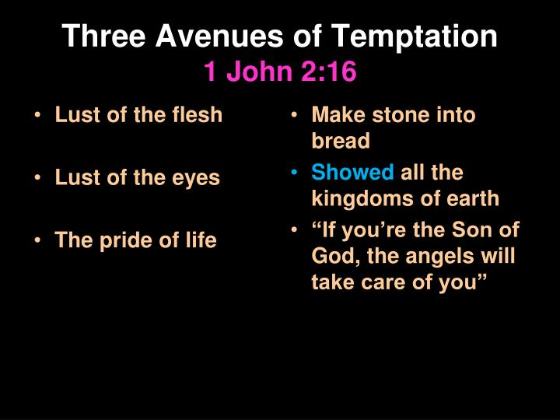

Slide 118


Slide 119
Consider the plight of Job on a worldwide scale. Were Satan to be unleashed without restriction upon the earth at any time, the results would be immediate worldwide devastation, destruction and Chaos the likes of which we could not even imagine.” [NOTE: Not the 2nd Coming Compared to Antediluvian World’s Inhumanity of Man to Man as described in Genesis 6: 1-13 & Luke 17: 26.]
World Power Was Satan’s To Offer – “After this perfect period of time Satan is allowed to operate in a more direct fashion on the earth than previously. Not without restriction by any means. During the temptation of Jesus by Satan, he made a statement to Jesus which has a direct bearing on this. “And the devil said to Him, ‘All this power will I give thee, and the glory of them: for that is delivered unto me; and to whomsoever I will I give it’.” (Luke 4: 6)
Satan Tempted Twice Face to Face – “Satan was able to come face to face and tempt Jesus directly. Satan does not do that now. And there is no record of him ever tempting anyone face to face beyond the garden. Satan had to get special permission from God to afflict Job in the way he did and there is no indication that Job ever met Satan face to face. In fact, it is evident from Job’s complaints that neither he or his companions knew Satan was directly involved in the matter. There is no indication that Job ever knew of the meeting between God and Satan concerning him.”

Slide 120
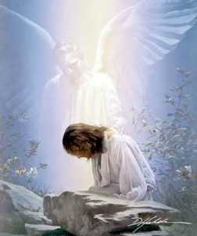
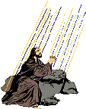
Nature Of This Temptation: Shortcut That Avoids Death

Slide 121
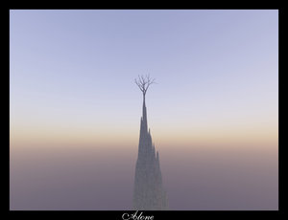
Flashback From Tempting Thought Satan Revisit In Matthew 16: 21
(22) “Far be it from You, Lord; this[crucifixion] shall not happen to You!”
(23) “Get behind Me, Satan! You are an offense to Me, for you are not mindful of the things of God, but the things of men.”

Slide 122
Flashback From Tempting Thought Satan Revisit In Matthew 16: 21
(23) “Get behind Me, Satan! You are an offense to Me, for you are not mindful of the things of God, but the things of men.”
“Peter is to get behind him, opiso mu, which means to follow, do not dictate, and so Peter’s proper position is to be with Jesus and follow where he is going, not to determine the conditions under which Jesus is going to be the Messiah!” - Tim Johnson

Slide 123



Slide 124
Christ’s Confrontation
When the devil tempted Jesus, he treated Him as an exceptional human, but not as God in the flesh
Col 2:9-10 For in him dwelleth all the fulness of the Godhead bodily. 10 And ye are complete in him, which is the head of all principality and power:
John 1:14 And the Word was made flesh, and dwelt among us, (and we beheld his glory, the glory as of the only begotten of the Father,) full of grace and truth.

Slide 125
We As Believers ...
Are not so led by the Spirit to be tempted by the devil
The devil is an adversary whom Peter compares to "a roaring lion”
1 Peter 5:8 Be sober, be vigilant; because your adversary the devil, as a roaring lion, walketh about, seeking whom he may devour:

Slide 126
Therefore He ....
Teaches us to pray
Matt 6:13-15 And lead us not into temptation, but deliver us from evil: For thine is the kingdom, and the power, and the glory, for ever. Amen.
14 For if ye forgive men their trespasses, your heavenly Father will also forgive you:
15 But if ye forgive not men their trespasses, neither will your Father forgive your trespasses.

Slide 127
Devil Too Sure Of Himself
Satan's pride was the basic cause of his downfall from heaven
Luke 10:18 And he said unto them, I beheld Satan as lightning fall from heaven.
He was not created as a devil but as an angel. He then rebelled against the supremacy of God
Isa 14:12-15

Slide 128
Devil Too Sure Of Himself
Isa 14:12-14 How art thou fallen from heaven, O Lucifer, son of the morning! how art thou cut down to the ground, which didst weaken the nations!
13 For thou hast said in thine heart, I will ascend into heaven, I will exalt my throne above the stars of God: I will sit also upon the mount of the congregation, in the sides of the north:
14 I will ascend above the heights of the clouds; I will be like the most High.

Slide 129
Devil Too Sure Of Himself
Ezek 28:13-17 Thou hast been in Eden the garden of God; every precious stone was thy covering, the sardius, topaz, and the diamond, the beryl, the onyx, and the jasper, the sapphire, the emerald, and the carbuncle, and gold: the workmanship of thy tabrets and of thy pipes was prepared in thee in the day that thou wast created. 14 Thou art the anointed cherub that covereth; and I have set thee so: thou wast upon the holy mountain of God; thou hast walked up and down in the midst of the stones of fire. 15 Thou wast perfect in thy ways from the day that thou wast created, till iniquity was found in thee. 16 By the multitude of thy merchandise they have filled the midst of thee with violence, and thou hast sinned: therefore I will cast thee as profane out of the mountain of God: and I will destroy thee, O covering cherub, from the midst of the stones of fire. 17 Thine heart was lifted up because of thy beauty, thou hast corrupted thy wisdom by reason of thy brightness: I will cast thee to the ground, I will lay thee before kings, that they may behold thee.

Slide 130
A Bishop must ... or...
1 Tim 3:2-6 A bishop then must be blameless, the husband of one wife, vigilant, sober, of good behaviour, given to hospitality, apt to teach; 3 Not given to wine, no striker, not greedy of filthy lucre; but patient, not a brawler, not covetous; 4 One that ruleth well his own house, having his children in subjection with all gravity;
5 (For if a man know not how to rule his own house, how shall he take care of the church of God?)
6 Not a novice, lest being lifted up with pride he fall into the condemnation of the devil.

Slide 131
Satan's Activity In World ...
"the prince of the power of the air"
Eph 2:2-3 Wherein in time past ye walked according to the course of this world, according to the prince of the power of the air, the spirit that now worketh in the children of disobedience:
3 Among whom also we all had our conversation in times past in the lusts of our flesh, fulfilling the desires of the flesh and of the mind; and were by nature the children of wrath, even as others.

Slide 132
Satan's Activity In World ...
Now is limited
Rev 12:7-9 And there was war in heaven: Michael and his angels fought against the dragon; and the dragon fought and his angels,
8 And prevailed not; neither was their place found any more in heaven.
9 And the great dragon was cast out, that old serpent, called the Devil, and Satan, which deceiveth the whole world: he was cast out into the earth, and his angels were cast out with him.

Slide 133
In Every Confrontation...
Jesus defeated him Matt 4:1-11
Luke 11:14-17 And he was casting out a devil, and it was dumb. And it came to pass, when the devil was gone out, the dumb spake; and the people wondered. 15 But some of them said, He casteth out devils through Beelzebub the chief of the devils. 16 And others, tempting him, sought of him a sign from heaven. 17 But he, knowing their thoughts, said unto them, Every kingdom divided against itself is brought to desolation; and a house divided against a house falleth
Luke 11:20 But if I with the finger of God cast out devils, no doubt the kingdom of God is come upon you.

Slide 134
Twice Satan Said ...
Matt 4:3 And when the tempter came to him, he said, If thou be the Son of God, command that these stones be made bread.
Matt 4:6 And saith unto him, If thou be the Son of God, cast thyself down: for it is written, He shall give his angels charge concerning thee: and in their hands they shall bear thee up, lest at any time thou dash thy foot against a stone.
“If” – Devil didn’t believe enough to obey

Slide 135
The Devil Tried With Shortcuts ...
Part of fallen human nature is impatience, especially when our physical comforts or desires are concerned.
The devil thought he could convince Christ to change stones into bread after his forty-day fast. But Christ would not work a miracle for His mere comfort. We should likewise be wary of those who suggest constant miracles in order to bypass the hardships of life.

Slide 136
The Devil Tried With Shortcuts ...
The devil's second temptation also involved a miraculous flaunting of supernatural power rather than waiting for His supernatural resurrection.
He tried to tempt Christ with immediate rule over all the kingdoms of the world instead of waiting for His triumphant Second Coming.

Slide 137
The Devil Tried With Peter ...
Matt 16:21-23 From that time forth began Jesus to shew unto his disciples, how that he must go unto Jerusalem, and suffer many things of the elders and chief priests and scribes, and be killed, and be raised again the third day. 22 Then Peter took him, and began to rebuke him, saying, Be it far from thee, Lord: this shall not be unto thee.
23 But he turned, and said unto Peter, Get thee behind me, Satan: thou art an offence unto me: for thou savourest not the things that be of God, but those that be of men.

Slide 138
The Devil Still Tries Today ...
One Church is as good as another
We are all going to the same place
It’s ok to put other things before God
As long as you are sincere
Not imperative to read or study Bible
Faith only is most wholesome doctrine
Sprinkling just as good as baptism
Once saved always saved
Just preach them into heaven at death

Slide 139
Satan’s Basic Objective and Modus Operandi
To make your life as miserable as possible
To steal kill and destroy
To get you to blame God for your problems
To function in a way that is difficult for you to detect (angel of light)

Slide 140
4 Realities
A Christian is not exempt from Satanic attack in fact his attack on us has been predicted and promised
The deadly D’s of the Devil
  Discourage, defeat, deceive, dehabilitate etc
If we are not being attacked it probably indicates we are not a threat to the kingdom of darkness. Jesus and the apostles told us that the battle would be real
We are unaware of Satan’s schemes so we are unaware how deeply he has become intertwined in our life.

Slide 141
Understanding Satan’s Schemes
Ephesians 6:11 Put on the full armor of God so that you can take your stand against the devil’s schemes.
2 Corinthians 11:14 And no wonder, for Satan himself masquerades as an angel of light.
2 Corinthians 2:9,11 The reason I wrote to you was to see if you would stand the test and be obedient in everything; in order that Satan might not outwit us. For we are not unaware of his schemes.

Slide 142
Understanding Satan’s Schemes
Noema (schemes) has the concept of evil intent and is used to describe the mind games that affect our life when we believe lies and act based on that perception
Noema (schemes) always has an evil purpose. It is never used of God and its exclusive use describes that which arises from the mal-intent of either man’s sinful nature or the work of Satan and demons

Slide 143
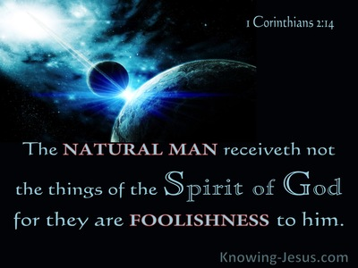
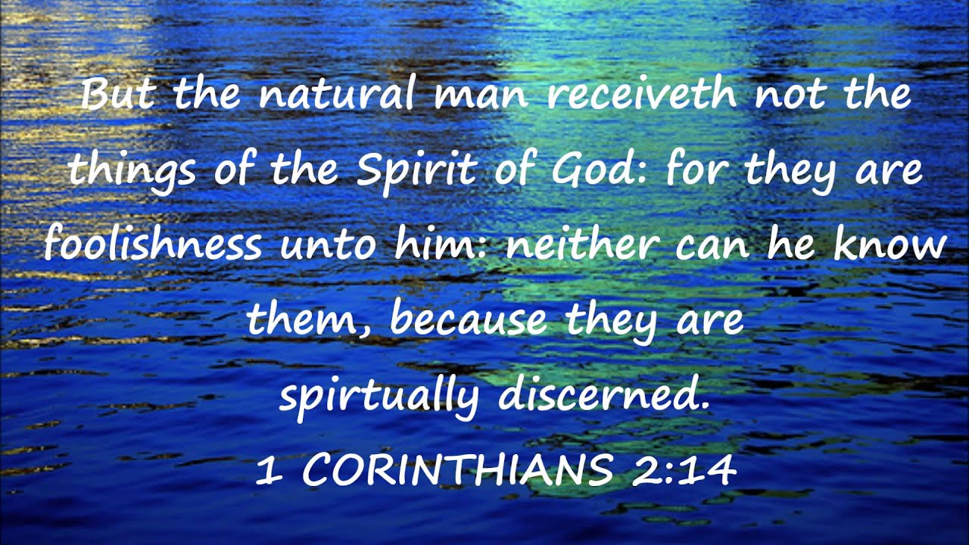

Slide 144
NATURAL LAW & NATURAL MAN
Paul’s Usage of the term Psuchikos Anthroopos
Biblically, in each of the five cases that “psuchikos” is used the term is contrasted with “pneumatikos” or with the spiritual. The contrast in 1st Corinthians 2: 14 is between a man inspired of God and one who has no such revelation (1Cor.2.12ff).
Paul seems to have adopted the Jewish understanding which denoted physical life as opposed to the supernatural life.

Slide 145
NATURAL LAW & NATURAL MAN
Paul’s Usage of the term Psuchikos Anthroopos
Paul seems to have adopted the Jewish understanding which denoted physical life as opposed to supernatural life.
The scriptural context of the Biblical term, “psuchikos anthroopos” is inspiration not salvation. The “natural man” tried to find, by his own wisdom, the “things” of God, but such must be revealed. Reference:
1st Corinthians Chapter Two & Verse Ten

Slide 146
1Corinthians 2:14 “But a natural man does not accept the things of the Spirit of God, for they are foolishness to him; and he cannot understand them, because they are spiritually appraised”
“Natural”: “Refers to one who obeys the promptings of his bodily nature, unspiritual or carnal” (Lenski p. 115). “He's the man who stands aloof from the wisdom of God and who depends on his foolish wisdom” (McGuiggan p. 46). “Does not accept”:“Rejects, refuses to accept” (Robertson p. 89). “The things of the Spirit of God”: The things that the Spirit revealed through the Apostles (2:11-13), the natural man rejects the gospel message. Many consider this "natural" man to be a non-Christian, and such a person would certainly qualify. Yet, the Corinthians were in danger to becoming this "natural" man, “for you are still fleshly” (1 Corinthians 3:1-3). Paul defines the "natural" man as anyone who rejects the teachings delivered by the Spirit, and some Christians did that in the First Century (14:37; 2 Thessalonians 3:6,14).
Therefore, the "natural" man is not a man so depraved that he cannot understand the gospel without the direct operation of the Holy Spirit. The phrase does not accept implies a choice, a conscious decision. He hears it, he understands what is being said, but he does not like it. The enemies of Jesus ("natural men") understood what He taught. (Matthew 21:45; 27:63). Those who rejected Paul's message, understood the concepts he was presenting (Acts 17:32; 22:22; 25:25 (Felix, a "natural" man, understood exactly what Paul was driving at). The Bible does not picture the sinner as “unable” to repent, but rather as “unwilling” to repent (Acts 13:46 “since you repudiate it”; Revelation 2:21 “She does not want to repent”).

Slide 147
1 Corinthians 2:14 “For they are foolishness to him”: Again note, the various unconverted Jews and Gentiles that had rejected Paul's preaching, "understood" that Paul was preaching a crucified Messiah, it's simply that they thought such a concept was ridiculous, “but we preach Christ crucified, to Jews a stumbling block and to Gentiles foolishness” (1 Corinthians 1:23). To this day people consider the message of the New Testament to be foolishness for various reasons. It's important to note that one's attitude toward's the gospel, reveals one's true self. Those that reject the gospel message are automatically labeled as "unspiritual". "People are revealed for who they are by their response to the cross" (Fee p. 117).
1 Corinthians 2:14 “And he cannot understand them”: In order to consider it "foolishness", he must know something about the gospel, if only what it claims. Paul has already stressed that man cannot know God apart from revelation (2:8-9; 1:21). Hence, the man or woman who has rejected the gospel message has just cut himself or herself off from the only true information that we have about God. “Because they are spiritually appraised”: “Appreciated by spiritual insight” (Wms); “because it takes spiritual insight to see its true value” (Gspd)
“Men access things differently according to their frames of reference. A fitness fanatic will (very often) have no appreciation at all for chess or sedentary pursuits. A man who has time only for making money frowns on holidays as a ‘waste of time’. The natural man judges everything by his worldly wisdom & spiritual things are ridiculed” (McGuiggan p. 46). How are things spiritually appraised? Clearly, by the Scriptures (Acts 17:11; 1 Thessalonians 5:21; Hebrews 5:14). Therefore, the person who has no appreciation for the revelation of the Spirit, is going to be wrong about many things. So why were the Corinthians enthralled with people who rejected God’s revelation? (Jeremiah 8:9 “Behold, they have rejected the word of the Lord, and what kind of wisdom do they have?”).

Slide 148
1 Corinthians 2:15 “But he who is spiritual appraises all things, yet he himself is appraised by no one.”
“Spiritual”: The person who accepts the revelation from the Spirit (1 Corinthians 14:37). “Appraises all things”: “Can find out the real value of everything” (Beck). “All things”:
All things that pertain to salvation, all things that are vital for his relationship with God. He is also able to properly evaluate the importance of many common things in everyday life, such as money, relationships, spouse, children, and so on (Hebrews 5:14; Psalm 119:99-105). The key to this ability, is not any inherent wisdom in the believer but his or her acceptance of the Word of God and the willingness to apply what it teaches to daily living. “Yet he himself”: The Christian. “Is appraised by no one”:“He is properly valued by none” (Ber) (Hebrews 11:38). The world does appraise the Christian, it does make a judgment about him. “That is, those who are not Christ's do not know how to understand him. The natural man regards him as an enigma, the spiritual man is marching to another drummer” (McGuiggan p. 47). The person who has rejected the gospel, has just labeled himself or herself as an unqualified assessor of "value". Why are we so concerned about human "approval", when these same people cannot even properly assess the value of God’s word?
“'The profane person cannot understand holiness; but the holy person can well understand the depths of evil” (Fee p. 118). The Christian is qualified to talk about the life of sin, but the non-Christian is not qualified to ridicule the life in Christ. So, to whom should we listen? If we are needing advice about an important decision in life, whose counsel should we seek?

Slide 149
1st Cor. 2: 16 “For who has known the mind of the Lord, that he will instruct Him? But we have the mind of Christ.”
“For”: This is a quotation from Isaiah 40:13, and is also quoted in Romans 11:34. “Who has known the mind of the Lord”: “Who is the person who wants to match wits with God?” (Fee p. 119). Read Job chapters 38-40, when you think you are ready. In order to properly judge Paul and other Christians, such men would have to know the mind of the Lord, and without revelation, that could only be accomplished if you had been the Lord's teacher! In this context, the only way that a person can know what God thinks about something, is to read God’s revelation through the apostles (1 Corinthians 2:9-13). Apart from such revelation, man is completely blind concerning spiritual truths and realties (Jeremiah 10:23; Isaiah 55:8-9). “We have the mind of Christ”: “The thoughts of Christ as they are revealed by the Spirit” (Fee p. 119). As already shown in verses 6-13 “We who are spiritual have the very thoughts of Christ!” (Phi)
Therefore, all those in the world who sit in judgment upon Christianity and faithful Christians, are manifesting a spirit, that Paul says is exactly the same as a person who would claim to be God's teacher. With the Scriptures, we have the very thoughts and mind of Christ, therefore we can properly judge and evaluate all things (Psalm 119:105).

Slide 150
Applications
Even Christians can fall into the trap of becoming a “natural man” (1 Corinthians 3:1-3). It is so easy to look at the Scriptures from a worldly perspective. For example, how many people read Matthew 7:12 “treat people the same way you want them to treat you”, and immediately think, “Yea, people need to be treating me the way I want to be treated”. That is a “natural man” interpretation of that verse. Instead of applying the verse immediately to themselves and their need to serve others, the natural man thinks only of him or herself.
“This is a difficult statement; who can listen to it” (John 6:60). “As a result of this many of His disciples withdrew and were not walking with Him anymore” (John 6:66). The natural man wants all the benefits of Christianity (peace, happiness, security, salvation, and so on), without the effort. The natural man is unwilling to spend the time and search the Scriptures to figure out what Jesus is expecting of him (6:56). The natural man wants to find a “short-cut” around a life of earnest faithfulness. The natural man does not want to wrestle with the Scriptures and bring his own will into line with God’s will. The natural man does not want to buffet his own body (1 Corinthians 9:27), but wants God to do all the work for him. There are too many people in this world, and even some in the church who are sitting around and waiting for some divine intervention to give them the help or motivation they need to do the right thing. The only intervention that we will receive is from the gospel message, “Behold, I stand at the door and knock” (Revelation 3:20); “He who has an ear, let him hear what the Spirit says to the churches” (3:22); (Luke 16:29,31). – Mark Dunagan

Slide 151
Satan Tests & Human Trains to Restrain From Life’s Potential
“I have come that they may have life, and that they may have it more abundantly.” (John 10: 10)
From the 70’s book “Fully Human, Fully Alive” by John Powell:
“By way of a general description, fully alive people are those who are using all of their human faculties, powers, and talents. They are using them to the full. These individuals are fully functioning in their external and internal senses. They are comfortable with and open to the full experience and expression of all human emotions. Such people are vibrantly alive in mind, heart, and will.” (p.11)
“Fully alive people are also alive in their minds. They are very much aware of the wisdom in the statement ‘the unreflected life is not worth living.’ Fully alive people are always thoughtful and reflective. Most of all, perhaps, these people are alive in will and heart.” (p.12)

Slide 152
Psychological Therapeutic Process of Systematic Desensitization: Counter-Conditioning By Way Of Graduated Exposure
There are several variations of exposure therapy utilized by Satan. These include:
In vivo exposure: Directly facing a sinful object, situation or activity in real life.
Imaginal exposure: Vividly imagining the sinful object, situation or activity.
Virtual reality exposure: In some cases, virtual reality technology can be used to achieve similar results.
Interoceptive exposure: Deliberately bringing on physical sensations that are harmless by themselves, yet linked to the stimuli.
Exposure therapy can also be paced by Satan in different ways. These include:
Graded exposure: The objects, activities or situations of temptation are ranked according to difficulty. They begin with mildly or moderately difficult exposures, then progress to harder ones.
Flooding: Using the exposure sin hierarchy to begin exposure with the most difficult tasks.
Systematic desensitization: In some cases, exposure can be combined with relaxation, entertainment and exercise to make them feel more manageable and to associate the sinful objects, activities or situations with relaxation and entertainment.
Exposure therapy has proved effective for Satan in several ways, including:
Habituation: Over time, people find that their reactions to sinful objects or situations decrease.
Extinction: Exposure can help weaken previously learned associations between sinful objects, activities or situations and bad outcomes.
Self-efficacy: Exposure can help show the sinner that he/she is capable of confronting his/her sinful temptation and can overcome the feelings of anxiety.
Emotional processing: During exposure, the sinner can learn to attach new tolerant beliefs about sinful objects, activities or situations, and can become more comfortable with the sinful experience.

Slide 153
Satan’s Hatred Versus God’s Love
THE MIND OF SATAN
SATAN’S PLAN TO ENTRAP
THE GATEWAY TO SATAN

Slide 154

Model Prayer In Line Item Analysis
Give Us This Day Our Daily Bread.
And Forgive Us Our Debts,
As We Forgive Our Debtors.
And Lead Us Not Unto Temptation,
But Deliver Us From The Evil One.

Slide 155




Slide 156
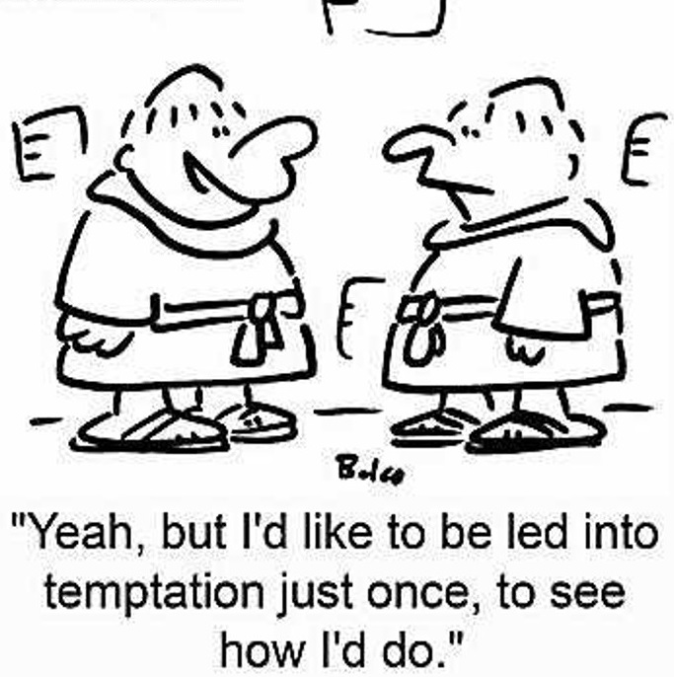

Slide 157
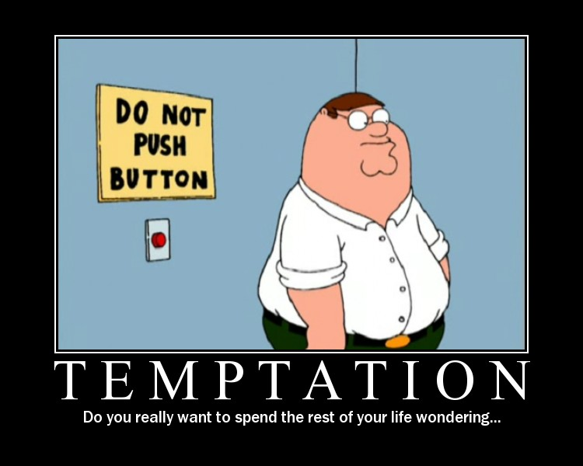

Slide 158
Lead Us Not Into Temptation
Sin comes naturally
All of us are weak.
All of us are tempted.
All of us were fallen have fallen and will fall

Slide 159
Lead Us Not Into Temptation
All of us need protection
All of us have and will go down the wrong path naturally apart from Gods guidance and strength.
Our prayer should always be the expression of our desire to be led in the paths of righteousness.

Slide 160
The Process Of Temptation
A simple evil thought.
A strong imagination, or impression made on the imagination, by the thing to which we are tempted.
Delight in viewing it.
A desire empowered by promised pleasure. There is pleasure in sin
Consent of the will to perform it.

Slide 161
Lead us Not
From “phero” to keep from falling
Eis (into, unto, toward)
It is acknowledging the real weakness of the flesh to wander into that place of falling.
As His children we want more than anything else to please and glorify Him so we are asking that He would protect us from that assault which would cause us to fall and be defeated

Slide 162
Lead us not into temptation
What does it mean?
God never leads us into sin or tempts us to sin James 1:13. Always understand the hard by the clear
We are weak and we know it. The flesh has a great tendency to yield to the temptation of sin.
We all love to absolve ourselves of responsibility for the sins we commit
We need God to guide our feet into paths of righteousness

Slide 163
Lead us not into temptation
What does it mean?
We are asking God to keep His promise and not allow us to be overcome by anything the enemy throws against us. Satan is in the constant business of tempting us. He does want us to fall into temptation
There are 3 real enemies we face, all conspiring to lead us away from God. The world, the flesh, and the devil

Slide 164
Lead us not into temptation
What does it mean?
It is a petition asking God to protect us by controlling our path that we would not yield to temptation (the prayer of submission to do His will has already been expressed)
It is a statement of submission and acknowledgement of our complete dependence upon him. He has such control over our lives and the tempter that in all temptation we can be victorious because He is our Master

Slide 165
Temptation peirasmos pi-ras-mos
Translated as the fatal piercing of a spear
That assault which is beyond the grace and strength we have presently experienced
A trial that finds its root in the intent and work of Satan to destroy us

Slide 166
Understanding Temptation
Something that seeks to overcome the limits of my strength and resources
That which would compromise the integrity of my character
That which allows the weakness of the flesh to be victorious
That mindset which results in my rebelling against God
That assault that comes from the evil one

Slide 167
A Few Observations
There is a power hierarchy
    God
    Angels/demons
    Humanity
We cannot resist temptation. Try and you’ll see!

Slide 168
A Few Observations
God has promised in every situation
  We would not be tempted beyond what we can bear
  He will provide in every situation a way of escape
The only guaranteed means of escape is yielding to the One who is more powerful and can make us more than conquerors

Slide 169
WHAT PAUL TEACHES US ABOUT TEMPTATION
TEXT: 1 Corinthians 10:13

Slide 170
Introduction:
Since all of us have sinned and sin is the result of temptation, then all of us are tempted.
Even Jesus, though He never sinned, was also tempted in all points as we are.
Thus, the Bible definitely teaches that we can face our temptations and overcome them if we truly love God.

Slide 171
We can bear our temptations
ASV: “There hath no temptation taken you but such as man can bear”
This simply means that no temptation is so unique, so powerful, that we cannot overcome it: Jas. 1:12
The example of Jesus shows us this: Hebrews 2:17-18, 4:15

Slide 172
We can bear our temptations
However, dealing with temptation isn’t about us alone but about looking to God for strength: Eph. 6:10-11.
When we approach temptation with the attitude, “I’m only human,” or “I cannot help myself,” then we are defeated before we even get started.

Slide 173
God is faithful.
Paul says that “God is faithful, who will not allow you to be tempted beyond what you are able”—in other words, God has made us a promise regarding temptation, and God is always faithful to keep His promises.
This God to whom we look for strength is the God of our salvation who doesn’t want anyone to perish in sin: 2 Pet. 3:9

Slide 174
God is faithful.
But God’s faithfulness must be met by trust and obedience on our part: Tit. 1:2, 2:11-12
Only by doing this can we benefit from God’s faithfulness: Hebrews 6:18-19.
The temptations themselves may not be removed, but Paul says that God “with the temptation will also make the way of escape” —and it can be found by those who look for it.

Slide 175
God will provide the way of escape
The example of Jesus gives us courage in knowing we can resist the devil as He did: Matt. 4:1-11
It also shows us the value of having a knowledge of God’s word to help us in temptation: Ps. 119:11

Slide 176
God will provide the way of escape
And Jesus teaches us that prayer can be a defense against the attacks of Satan: Matthew 6:9, 13.
If we seek spiritual maturity, wisdom, and discernment as we walk life’s path, God has promised that He will provide a way of escape to help keep us from falling into and yielding to temptation.

Slide 177
Our faith will enable us to bear it.
Paul says that because God is faithful and will not suffer or allow us to be tempted above or beyond what we are able but will with the temptation make a way of escape, our faith in God’s promises and provisions will make it possible “that you may be able to bear it”
Thus, we must conclude God has already provided everything that we need to “bear it”: Romans 8:31-32
Again, we have to take advantage of these provisions: Romans 13:11-14

Slide 178
Our faith will enable us to bear it.
But when we combine His faithfulness with our faithfulness, the result is victory: 1 John 5:3-4.
True faith, that is characterized by love and devotion to God and necessitates trusting in Him, His faithfulness, and the instruction of His word, will make it possible for us to overcome the temptations of this world.

Slide 179
Conclusion:
Because of what Paul says in this verse, no one can truthfully say, “I have to sin—I can’t help it.”
But the fact is that we all do sin and thus need forgiveness, yet God has made provision for that too.
The Blood of Jesus is that provision.

Slide 180
THE CHRISTIAN AND TEMPTATIONS.
Matthew 6:13;
Matthew 26:41;
James 1:12-15.

Slide 181
Introduction
Living the life of a Christian is not a bed of ease or life of idleness.
It requires much toil and labor.
It will be a constant fight with temptation.
The Christian's greatest danger is succumbing to temptation.
Remember the song that we sing: "Yield Not To Temptation, For Yielding Is Sin".

Slide 182
WHAT IS TEMPTATION?
It is the enticing or inducement to yield to the lust of the flesh. James 1:14. To put to trial for proof.
After one becomes a Christian he has the same desires and temptations facing him that he had before.
He does not receive a "second blessing" as some may claim, to remove the temptation from him.
It is a trial or testing of one's faith and loyalty to God.
Read James 1:12; Job 1:6-2:10.
Note the temptations put before Christ.
Matthew 4:1-11.

Slide 183
Source Of Temptations To Do Evil
Never from God. James 1:13.
God tries or proves His children but doesn’t induce them to do evil. Genesis 22:1,2.
God does permit us to be tempted but not beyond our capability to overcome.
1 Corinthians 10:12,13.
Always From Satan. Matthew 4:1; 1 Corinthians 7:5.

Slide 184
Source Of Temptations To Do Evil
Satan's avenues of sin. 1 John 2:15,16.
Adam and Eve in the Garden of Eden.
Genesis 3.
They were tempted in three ways:
Lust of the flesh--good to eat.
Lust of the eyes--delight to behold.
Pride of life--make one wise.

Slide 185
Source Of Temptations To Do Evil
Christ was tempted in the same way.
Lust of the flesh--stones to bread.
Lust of the eyes--kingdoms of the world.
Pride of life--cast thyself down.
One can be tempted from within.
James 1:14; 1 John 2:15,16

Slide 186
Temptations Are Sure To Come
By no circumstances, environment, or conditions are we exempt.
Not by character or spiritual power.
Jesus was tempted right after receiving the Spirit. Matthew 3:16; 4:1.
Not by Sonship. Matthew 3:17.
Not by solitude. Jesus was alone on occasions. Matthew 4:2.

Slide 187
Benefits Of Temptations
To be tempted is not to sin, but only when one yields to the temptation to sin.
There is a song that I have already mentioned that says: "Yield Not To Temptation, For Yielding Is Sin."
To man who yields it is a curse--but the man who overcomes is blessed. James 1:2-15.

Slide 188
Benefits Of Temptations
One who yields is made weaker--one who overcomes is made stronger.
It creates in us patience. James 1:2,3.
It will increase our desire to go to heaven where we will be free from all temptations. Philippians 1:21-23.
He shall be crowned. James 1:12.

Slide 189
Overcoming Temptations
God's people can overcome any temptation.
1 Corinthians 10:12,13.
What is the way of escape?
The way of escape is through preparation.
Psalm 119:11.
Jesus overcame because He filled His heart with the word. Matthew 4:1-11.
By way of prayer and watchfulness. Matthew 26:41.
By way of strong purpose.
Daniel 1:8; 1 Corinthians 9:27.
Man with his heart set is hard to move.

Slide 190
Overcoming Temptations
May be by way of flight. 1 Cor. 10:14; 2 Tim. 2:22.
May be by way of fight. Eph. 6:10-18; 1 Tim. 6:12.
By avoiding bad company. Psa. 1:1,2; 1 Cor. 15:33.
By attending all the assemblies of the church. Heb. 10:25.
Such is needed to strengthen us.
Neglecting worship services is the first step toward apostasy.
It is a long, tempting step from Sunday morning to Sunday morning, leaving off Sunday evenings and Wednesdays.

Slide 191
Overcoming Temptations
It is said that : seven days between worship periods make one weak.
Keep busy for the Lord--idleness is the devil's workshop.
With regard to overcoming temptation, finding the way of escape provided by the Lord:
It is all a matter of want to. We must look for the escape that the Lord has provided.

Slide 192
Conclusion
Are you a victim of temptation? Have you succumbed or yielded to such?
The Lord has made provision for those who fall.
To you that have fallen, get up (repent), confess and pray.
To you that are still in the grasp of Satan and have not become children of God, then you too can overcome temptation by: Hearing God's Word. Believing in God and His Word. Repenting of your sins. Confessing with your mouth what you believe in your heart, that Jesus is the Son of God, and then be baptized by a burial in water for the remission of your sins. Then live soberly, righteously, and godly the rest of your life and heaven will be your home.
Paul tells us that as Children of God we can do all things through Christ Who strengthens us. Philippians 4:13.

Slide 193
SATAN’S DOORWAYS
REBELLION/SELF-WILL
Because the first sin that was ever committed by Lucifer was rebellion, this sin properly must be listed first. Satan wants us to think that self-will is not abhorrent to God.
Children who rebel against parental authority or adults who refuse to submit to Christ and to church leadership—these and a dozen other kinds of rebellion delight the evil one. The “look out for number one” philosophy did not originate in the human mind but was first embraced by Lucifer when he substituted his will for God’s.
Rebellion is like the sin of witchcraft, and insubordination is like idolatry (1 Samuel 15:23). The rebellion of drugs and violence all play in concert with the devil’s tune.
When Paul was listing the qualifications for leadership within the church, he warned that new converts were not ready for such responsibility because of the temptation to pride. He wrote, “and not a new convert, lest he become conceited and fall into the condemnation incurred by the devil” (1 Timothy 3:6).
Our rebellion is as detestable to God as Satan’s. To become Satan’s servant we need not invite him into our life; we need only to live in rebellion against God and against our properly constituted authorities.
DISHONESTY
One day a couple decided to sell a piece of property and give some of the proceeds to the church. So far, so good. But they also agreed to pretend that they were contributing all of the money from the sale. Like many of us, they wanted to appear to be better Christians than they really were. The apostle Peter rebuked them and asked the husband, “Ananias, why has Satan filled your heart to lie to the Holy Spirit, and to keep back some of the price of the land?” (Acts 5:3).
Dishonesty in speech and actions is not only consistent with Satan’s character, but when we act thus, we play into his hand. To lie is to submit to the authority of the father of lies, the devil.
FEAR
The fear of witnessing for Christ, which all of us tend to experience, seems so natural that we seldom think Satan had anything to do with it. Yet, interestingly, before Peter denied that he knew his Savior, Christ explained, “Simon, Simon, behold, Satan has demanded permission to sift you like wheat; but I have prayed for you, that your faith may not fail; and you, when once you have turned again, strengthen your brothers” (Luke 22:31-32).
Fear is one of Satan’s most popular weapons. People are afraid of crowds, afraid of the future, afraid of what people will think of them, afraid to witness, afraid to live. John wrote, “Fear involves punishment, and the one who fears is not perfected in love” (1 John 4:18).
To serve fear is to serve Satan (Hebrews 2:14-15).

Slide 194
SATAN’S DOORWAYS
MORAL IMPURITY/ADDICTIONS
There are several reasons sexual temptations and perversions are often exploited by demonic powers. One is because of the powerful nature of sexual attraction and of the desire for fulfillment. Satan always strikes where we are weakest. Another reason is that the basic unit of society is the family, and sexual sin destroys those relationships.
When Paul was warning the married couples in Corinth about the dangers of prolonged sexual abstinence, he encouraged them to “come together again lest Satan tempt you because of your lack of self-control” (1 Corinthians 7:5).
Satan wants the desires of the flesh to become addictions. People may become governed by alcoholism, drugs, gluttony, or sexual addictions of various kinds. Satan inflames these desires so that they take over a victim’s life.
It is not necessary to attend a seance to serve Satan. All you need to do is pursue your particular lustful desires with abandon, letting them take you wherever they may lead. Those who serve lust serve the devil.
COVETEOUSNESS
Coveting the wealth of others may seem to be a harmless occupation. Indeed, our society glories in its unabashed quest for wealth. Some who are millionaires many times over are excruciatingly stingy, hoarding every dime for themselves. According to Time magazine, one tycoon whose wealth exceeded $400 million was not known to have given as much as a pair of cuff links to charity.
Why this irrational fascination with more wealth than one could ever use? Paul warned, “For this you know with certainty, that no immoral or impure person or covetous man, who is an idolater, has an inheritance in the kingdom of Christ and God” (Ephesians 5:5).
Covetousness is idolatry, and behind every idol are demonic spirits (1 Corinthians 10:19-20). Satan does not mind which idol we choose, as long as it distracts us from the worship of the true God. Many people who know nothing about Satan have become his most loyal worshipers by becoming consumed with a covetous spirit.
GUILT
The name Adversary means “Accuser.”
The prophet Zechariah in one of his visions saw the high priest Joshua (not to be confused with the successor to Moses) standing before the Lord, clothed in filthy garments, which symbolized the sins of the nation. Satan was present too, standing at his right hand to accuse him. But God took the filthy garments from Joshua and clothed him with festal robes (Zechariah 3:1-7).
Whereas the Holy Spirit uses guilt to drive us to Christ for forgiveness, Satan uses guilt to drive a wedge between God and us. He accomplishes this by (1) making us believe that our sins are too great for God to forgive, or (2) making us feel guilty for sins that have already been forgiven.
Satan lies not only with words but with emotions. He attempts to create feelings that alienate us from God, from others, and even from ourselves. He finds it most helpful if we brood in isolation and believe our most painful depressions.
Don’t let the irony escape you. Satan incites us to sin, and then if we follow his suggestions, he is the first to heap condemnation upon our conscience. He condemns us for the same sins he entices us to commit!
Thankfully, Satan’s work of accusation will finally come to an end: “Now the salvation, and the power, and the kingdom of our God and the authority of His Christ have come, for the accuser of our brethren has been thrown down, who accuses them before our God day and night” (Revelation 12:10).

Slide 195
SATAN’S DOORWAYS
MURDER/HATRED
We might think that when Cain killed Abel in a fit of jealousy and anger, it was a purely human (though criminal) response to a family feud. But Christ taught that Satan was a murderer from the beginning (John 8:44); therefore we should not think it strange that John wrote that Cain killed his brother because he “was of the evil one” (1 John 3:12).
John affirms that one who does not love his brother is acting like a child of the devil. In contrast, the children of God love one another. And then John adds this startling comment: “Everyone who hates his brother is a murderer; and you know that no murderer has eternal life abiding in him” (1 John 3:15). That explains why some who are controlled by an evil spirit have a persistent desire to commit suicide. Such destruction gives Satan great momentary delight.
He is a murderer and a hater. And those who practice these sins come under his authority.
DOCTRINAL DIVISION
Satan inspires people to veer off into false cults that dethrone Christ. He leads people into strange and preferably occultic doctrines.
“But the Spirit explicitly says that in later times some will fall away from the faith, paying attention to deceitful spirits and doctrines of demons” (1 Timothy 4:1). These doctrines may range from asceticism to doctrines that incite hypocritical rationalizations that lead to a hard heart. (Both are mentioned in this context.)
False cults teach that Christ is not fully God or that He is not unique because all of us are gods just as He was. Both heresies mislead multitudes.
There is no need to visit a fortune-teller in order to give your soul to satanic powers. Simply accept false doctrine that obscures the true message of the gospel.
ANGER
One sign of demonic activity is irrational, uncontrollable anger. Fits of temper often erupt with little or no provocation. Paul wrote, “Be angry, and yet do not sin; do not let the sun go down on your anger, and do not give the devil an opportunity” (Ephesians 4:26-27).
The Greek word for “opportunity” is topos, which means “a foothold.” Anger, like other sins, allows an evil spirit to gain at least partial entry into one’s life. That wedge in the door can become the basis for further anger and demonic exploitation.
Lutzer, E. W. (1990). Coming to grips with satan’s plan for your life. Chicago, IL: Moody Publishers.

Slide 196
Overcoming And Defeating
Temptations
Yes, it is possible.
It is always our choice.

Slide 197
INTRODUCTION
Unfortunately, it has become common practice to give in to almost every temptation that Satan is capable of throwing at mankind.
Too many people have decided that giving in to temptation is not very significant...after all, everyone is doing it!
However, that is not what God wants from us.
He wants for us to stand and fight against the wiles of the Devil, and has provided everything that we need to be successful (2 Peter 3:1).
Consider just a few suggestions to help in the task of defeating temptations:

Slide 198
Remember that you are spiritual in nature.
The apostle Paul wrote that we are to put off the old man of sin, and raise up a new man that will be a spiritual man (Romans 6:1-14).
This means that we must make the choice to not allow the physical, carnal side to have more influence over our actions than our spiritual side.
There is a constant battle that will rage between the two, but we must see to it that the spiritual side is successful (Romans 7:15-8:11: Galatians 5:16-17).
It is possible for us to be successful, but we must be dedicated to our spiritual life, rather than being so focused on worldliness and sinful pleasures that distract us.
Seek first the kingdom of God and His righteousness (Matthew 6:33).

Slide 199
Remember that God will provide a way of escape.
One of the greatest promises that God has made to us is that He will never tempt us beyond what we are able to bear, and that He will always provide a way of escape when He allows us to be tempted (1 Corinthians 10:12-13).
Sometimes, we may feel like there is no other option but to give in to temptation.
But, we can gain confidence and courage from this passage, which assures us that there will always be another option!
Perhaps we can look back on times where we have stumbled on Satan's temptations, and see (in hindsight) the way that had been available to us to escape from the temptation.

Slide 200
We can use these memories to help us in the future.
We can be assured that God has provided help, if we will only look for it.
This should be one of the most encouraging passages that a Christian can consider.
If you are facing a temptation, you can know that God knows that you can withstand it!
If that’s not enough to encourage you to faithfulness, then what is?

Slide 201
Know and understand the consequences of failure.
James tells us the pattern that is used by Satan to entrap us as mankind (James 1:14-15).
The end result, if we give in to the temptations that are thrust upon us, is that we sin, and sin brings forth death.
The consequence of failing to stand up to temptation is that we will be separated from God (Isaiah 59:1-2).
This should be frightening to us, if we are rational thinking beings!

Slide 202
How can one not be frightened by the consequence of being eternally separated from God?
That is the punishment for those who physically die while spiritually separated from God (spiritually dead).
This realization should cause us to want to be faithful to God, and encourage us to defeat the temptations that Satan hurls.

Slide 203
Prepare to confront Satan.
Jesus, when He was being tempted by Satan answered him by quoting scripture.
"It is written" is a powerful defense against any and every temptation that can affect men.
We must be prepared to confront Satan when he brings the temptations that pique our desires!
The only way to do that is to spend time in the pages of God's word.

Slide 204
We must study enough to understand what God wants us to do--and how to refute the deceit of the Devil!
The apostle Paul wrote that we need to put on the whole armor of God (Ephesians 6:10-17).
A part of the armor described is the "sword of the Spirit, which is the word of God."
If we do not know how to wield the sword of the Spirit, we will not survive long in the spiritual battle!

Slide 205
We can defeat temptation.
but only if we dedicate ourselves to the spiritual nature that is demanded of us.
We must make the decision that our spiritual well-being is what is important, forsaking the physical nature of worldliness and sin.
This is a decision that has to be made each and every day.
It is a decision that must be made each time we are faced with temptation.
We cannot ever let our guard down, as that will be the time that Satan will attack.
He is a "roaring lion, seeking whom he may devour“ (1 Peter 5:8).

Slide 206
CONCLUSION
If we are successful, there will be a great reward.
James tells us that those who are successful in overcoming temptation have a crown of life awaiting them (James 1:12).
Every person will be tempted.
It is up to each individual to determine how he or she will deal with the temptation.
Will you overcome, and receive a crown of life?

Slide 207


Slide 208
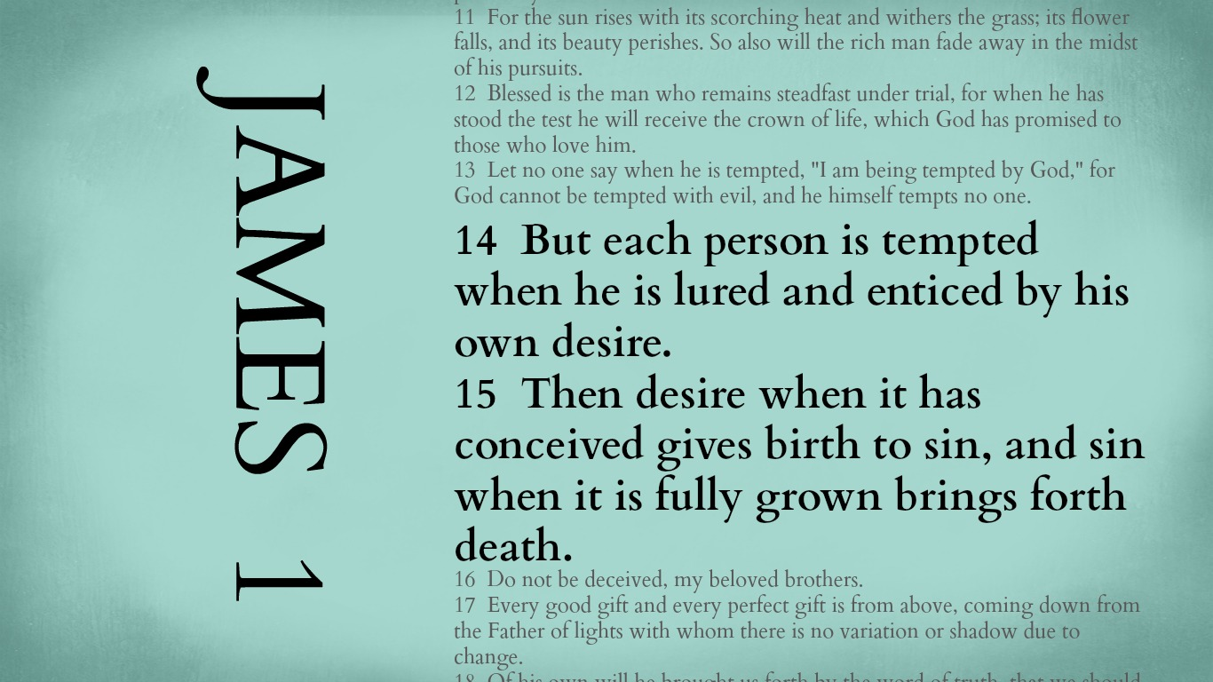
“You cannot keep birds from flying over your head but you can keep them from building a nest in your hair.” – Martin Luther

Slide 209
Stage 1: Desire
The first stage of the temptation cycle is “desire.” Now, the original Greek word used here is epi-thu-MEE-ah. Sometimes it’s translated evil desire. Sometime it’s translated lust or craving. But the word does not primarily refer to a desire for evil THINGS as much as it describes a strong desire for anything, even a good thing. The force of the word is not so much about the object of desire being bad as it is the strength of the desire. You might think of it not as just a drive or a desire but an overdrive or an over-desire.
For instance, it is normal to desire relationships with others, to want to be close to others.
Or you might really desire respect.
Or you might really desire refuge from the stresses of life.
Or you might really desire to be rewarded or recognized.
Or you might really have a desire for revenge, a latent sense of anger about something in your life.
Maybe one of these desires really speaks to your own experience, or maybe they all do, or maybe there’s another desire I haven’t named that’s hiding deep down in your heart. Either way, James says this is where all temptation starts: it starts in our strong cravings, our over-desires.
Stage 2: Enticement
This leads to enticement, that feeling of being lured to something. Now, often this can be broken into two steps: triggers and tempting thoughts.
A trigger is anything that gets the process started, anything that gets the motor going. This can be something really obvious or it might be something not so obvious, something internal that creates a state of tension like hunger, stress, exhaustion, or boredom. It might be a relational trigger like someone insulting you or rejecting you. A trigger is simply an external event or an internal state of mind that serves as a catalyst.
The second part of enticement is when your over-desire meets that trigger and it leads to the first tempting thought. This might be a very pronounced thought or maybe just an emotion that boils under the surface, a sort of inclination to do something about the tension you feel. This tempting thought might be experienced as a growing fantasy, or it might be experienced as a sort of trance-like state: a numbness to the world around you as the thought brews in your mind. This tempting thought is often accompanied by some kind of emotion like frustration or preoccupation or anticipation or a growing obsession.

Slide 210
Stage 3: Conception
Next, James said there comes the state of conception. This is when desires become action. Psychologists often talk about the idea of ritualization, the habit or habits we fall into that get us closer to the object of our desire. This is when someone engages in what can be referred to as “SUDs,” or, “seemingly unimportant decisions.” You tell yourself what you’re doing is no big deal. At this stage, you’re suffering from impaired thinking: you tell yourself the action is innocent, but really your feet are on autopilot as that first tempting thought takes control.
Now, after putting feet to your desires, you get closer and closer to the moment of indulgence, and then you do. You indulge. The space between conception and birth might take a day, hours, or maybe only minutes, but birth is the natural follow-through of conception. This is the next stage of what James calls the birth of sin. We give into the temptation fully. After this, the sin grows stronger & this is when we start to experience defeated thoughts like, “I might as well keep going,” or “It’s no use resisting this,” and we feel that sense of a loss of control, that flood of desire that feels like it can’t be stopped. In reality, this tidal wave started BEFORE the moment of indulgence. It started back at the first tempting thought, but we feel it the strongest in the moments before indulgence and as the indulgence grows.
In the field of neuroscience, this is called hypofrontality. We have a region of our brains call our prefrontal cortex. This region of the brain is meant to slam on the breaks from all the impulses we feel and help us make sane, wise decisions based on our goals and our values. But hypofrontality happens when, after we’ve given into temptation over and over and over many times, this region of our brain grows weaker and weaker, like a muscle that atrophies. Scientists can even see these changes on a brain scanner.

Slide 213
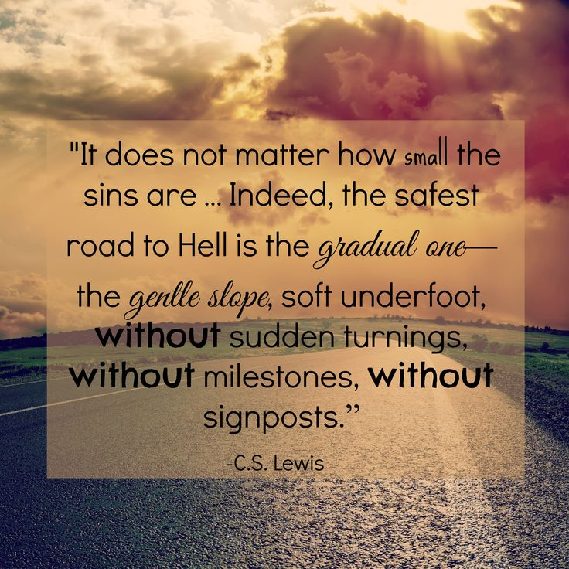

Slide 214

Satan’s Hatred Versus God’s Love
THE MIND OF SATAN
SATAN’S PLAN TO ENTRAP
THE GATEWAY TO SATAN
GOD’S PLAN OF RESCUE

Slide 215
And forgive us our sins, as we forgive those sin against us
And lead us not into temptation, but deliver us from evil:
For Thine is the kingdom, and the power, and the glory, forever. Amen.

Slide 216

Cultural Context: “Lead Us Not Into Temptation,
1) Once Again, An Example Of Hebrew Parallelism With The Second Line Reinforcing The First.
2) With This Situation, The Second Phrase Elaborates More Fully As To Resulting Implications.
3) The Word “Temptation” In The Hebrew Frequently Has The Sense Of “Testing” Or “Trials.”
4) The Narrative Of Jesus’ Temptation Relates Three Tests Administered By Satan In An Attempt To Make Him Stumble.
5) In The Context Of The Disciples’ Prayer, The Word “Temptation” Points In Pre-Supposition To The Natural Inclination Of Human Beings Toward Sinful Behavior; To Avoid Sin, One Must Not Place Themselves In A Position To Be Put To The Test!
6) According To The Rabbis This Was King David’s Mistake – He Brought Himself To The Test & Failed Miserably.
7) The Tradition Teaches Warning. To Paraphrase: One Can Estimate Neither The Power Of Temptation Nor Their Ability To Resist – The Safest Course Is To Resist Through Running – To Find An Avenue Of Escape!
BUT DELIVER US FROM EVIL!

Slide 217
Cultural Context: “Lead Us Not Into Temptation,
BUT DELIVER US FROM EVIL!
The Next Line Of The Parallelism, “Deliver Us From Evil,” Goes Beyond The Sense Of One’s Test Or Trial – It Introduces The Idea Of Our Supplication To Be Saved From The Evil Force Connected With Our Temptation.
Prayers Of The Late Jewish Antiquity Display An Awareness Of The Awesome Power Of Evil – Which Can Overcome An Individual & Control Them.
One Of The Psalm Scrolls Among Those Of The Dead Sea Reads: “Do Not Let Satan Rule Over Me To Lead Me Astray.”
This Reading In Hebrew Is Almost Identical To That Of David’s Psalm 119: 133 – “Let No Iniquity Get Dominion Over Me.”
12) The Request Involves Much More Than Merely Asking To Overcome A Desire To Sin.
13) One Must Defeat This Powerful & Concrete Force That Seeks To Influence One’s Life.
In Other Words, All Christians Everywhere, Throughout History, Must Each Battle & Defeat Not Only Our Own Flesh But That Contrary Supernatural Personality – That Old Adversary Of Man & Woman From Way Back In The Garden – Satan!
In This Personal Conflict From The Dawn Of Human History We Have Help From God. As The Apostle Paul Writes In 1st Corinthians 10: 13 – “No Temptation Has Overtaken You That Is Not Common To Man. God Is Faithful, & He Will Not Let You Be Tempted Beyond Your Strength, But With That Temptation Will Also Provide The Way Of Escape, That You May Be Able To Endure It.”
However, We Are Often Brought To The Brink Of Our Breaking Point Such That We Discover For Ourselves Those Spiritual Strengths & Weaknesses On Which We Need To Work!

Slide 218
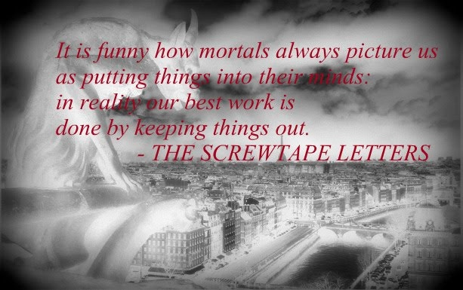

Slide 219
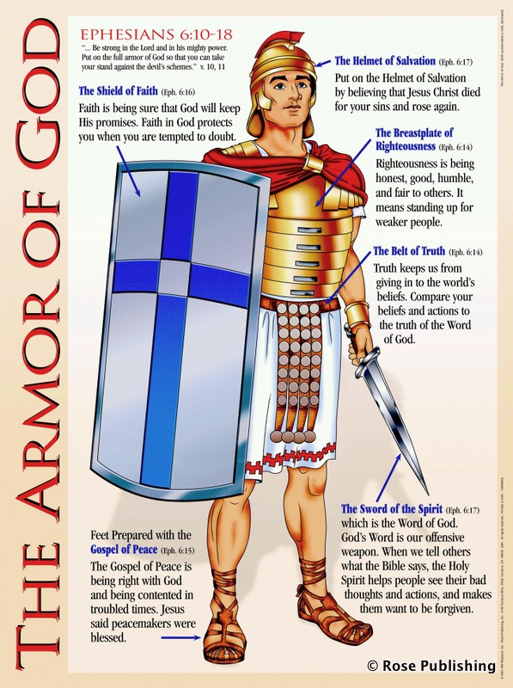
The Armor Of God

Slide 220
The Armor of God
Ephesians 6:13-17
Use every piece of God’s armor to resist the enemy in the time of evil, so that after the battle you will still be standing firm.
Stand your ground, putting on the sturdy belt of truth and the body armor of God’s righteousness.
For shoes, put on the peace that comes from the Good News, so that you will be fully prepared.

Slide 221
In every battle you will need faith as your shield to stop the fiery arrows aimed at you by Satan.
Put on salvation as your helmet, and take the sword of the Spirit, which is the word of God.

Slide 222
Understanding The Text
Deliver us from evil (evil one)
  rhoumai rhoo'-om-ahee, middle voice (We can’t do it ourselves) deliver, deliverer
  poneros pon-ay-ros nominative case translated KJV as evil, wicked, bad but in this case the intent of Christ is to refer to Satan “the Evil One”. Satan is the personification of evil
Be our deliverer from the wicked/evil one

Slide 223
Deliver us from evil, (Evil One)
We are in a battle
It is a battle for which we are ill-equipped in the natural
Our battle is not against flesh & blood but against principalities & powers and against spiritual wickedness in high places. Satan is out to get us!

Slide 224
We need to know that the victory over the evil one is not won by us but has been won for us
Satan mounts an attack on all fronts
  The eye gate
  The ear gate
  The emotional gate
  The mind gate
  The will gate
  Any other gates he can get in. That’s what tempatation is about

Slide 225
We cannot defeat Satan by ourselves and do not have the strength for victory on our own
We are in a Spiritual Battle-Zone. Satan wants spiritually impotent Christians who are no threat to him.
The One who defeated Satan at Calvary can defeat Satan in our life if we will but ask

Slide 226
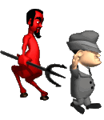
How Does Satan Work

Slide 227
God
1st Coming Of Christ
Nation
Disarm
Divert
Family
Distort
Fall
Discourage
Defeat
The Deadly D’s of the Devil
Destroy

Slide 228

1st Coming
Of Christ
2nd Coming Of Christ
Church
Disarm
Divert
Distort
Discourage
Sending of
Holy Spirit
Defeat
The Deadly D’s of the Devil
Destroy

Slide 229
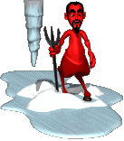
Satanic Strategies
Diverted Trust
Everything is relative (No absolute Truth)
Trust in human reason
Bending or compromising God’s Word to justify unethical behavior
Selfishness
Discredit your reputation
Negative attitudes
Fueling the Ego
Getting anger to rule your life

Slide 230

Why the Armor of God?
The problems we face are beyond our human strength or ability to conquer
The enemy is stronger than we are.
God’s desire is not our survival but victory
God knows what we need for victory and that’s what He’s given to us.
There is a modern world view which excludes biblical truth and will trap us in a morass of carnality. On our own we are destined to fail spiritually

Slide 231
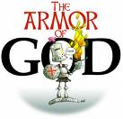
Protection
The weapons of our warfare can tear down strong holds.
2 Corinthians 10:4 For the weapons of our warfare are not carnal, but mighty through God to the pulling down of strong holds;

Slide 232
Protection
Without God’s help our lives are wide open to Satan’s tactics and antics
We need a hedge of protection around our minds, emotions, spirits and wills.

Slide 233
I Corinthians 10:12-13
If you think you are standing strong, be careful, for you, too, may fall into the same sin. But remember that the temptations that come into your life are no different from what others experience. And God is faithful. He will keep the temptation from becoming so strong that you can’t stand up against it. When you are tempted, he will show you a way out so that you will not give in to it.

Slide 234
What Is The Armor Of God?
It is God’s gift to us for our protection
Putting on the armor is putting on Christ.

Slide 235
Romans 13.12-14
The night is far spent; The day is at hand. Let is therefore take off the deeds of darkness, Let us put on the armor of light… … … … … …
Let us live honestly, as in the day, Not in reveling and drunkenness, Not in lust and licentiousness, Not in strife and jealousy;
But clothe yourselves with the Lord Jesus Christ, And make no provisions for your earthly nature and the gratification of its lusts.

Slide 236
What Is The Armor Of God
It is God’s gift to us for our protection
We need to put on daily the armor of God
Putting on the armor is putting on Christ.
God’s promise is victory in the midst of struggle not immunity from the struggle

Slide 237
1Peter 4
Do not think it strange, beloved, that a fiery ordeal has come to test you, as though some surprising thing had befallen you.
But be glad in the degree in which you share in the sufferings of Christ; so that when his glory shall be revealed, you too may be glad with triumphant gladness.

Slide 238
The Armor of God
The belt of truth to protect my emotions from being carnally governed. It assures me that He is truth and as I know Him and His will I will be protected from the enemies lies
We have all to some degree been influenced by the lies of world

Slide 239
The Armor of God
The breastplate of righteousness to assure me of my standing before God when accusations come. It allows me to see the truth about myself and that I have no standing before God apart from the the righteousness of Christ
Real assurance comes when I mentally accept the reality that - in addition to my own obedience – I’m beneficiary of the meritorious righteousness of Jesus Christ

Slide 240
The Armor of God
The Gospel of peace are my shoes so that where I walk peace will follow. I’m a minister of reconciliation. As I remain in Him I find myself with a calm in the midst of the storm, and as I follow him His peace reigns in my heart
You will keep him in perfect peace, the one whose mind focuses on you.
Isaiah 26:3

Slide 241
The Armor of God
The shield of faith so the enemies lies and deception will not penetrate my life. As I believe God and say “Amen” to His promises the lies and deception of the enemy are diverted away from me.
Faith is “a force” and stops the enemy in his tracks. Satan has no weapon that can nullify faith

Slide 242
The Armor of God
The helmet of salvation so that your mind is protected and renewed by the power of the gospel. My confidence is that He is my deliverer now, that He will never forsake me here and when the end comes I will be with Him forever
The battleground is the mind. Whatever we think about we become and do!
Victory comes through the renewal of the mind (Romans 12:1-2)

Slide 243
The Armor of God
The Sword of the Spirit which is God’s word is the weapon of choice for fighting the enemy. If God said it I can believe it. Hiding His word in your heart is a is the quickest way to respond to the attacks.
Knowing and using God’s word are not the same. It is “faithing” as we stand on his word when the attacks come

Slide 244
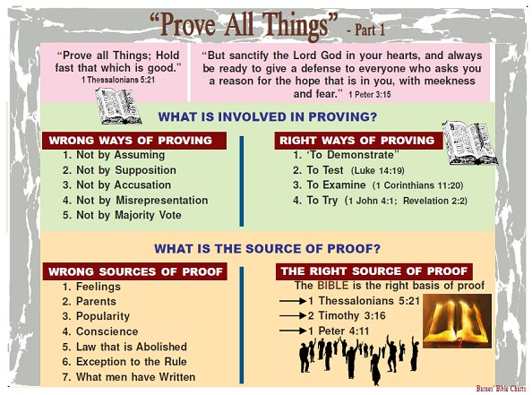

Slide 245
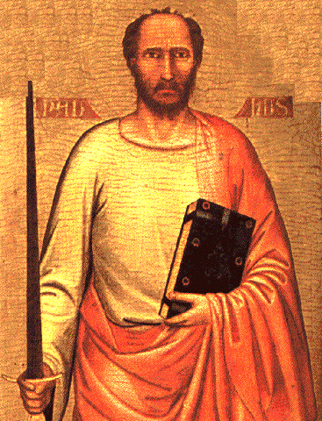
The Apostle Paul
THE SPIRITUAL SWORD

Slide 246
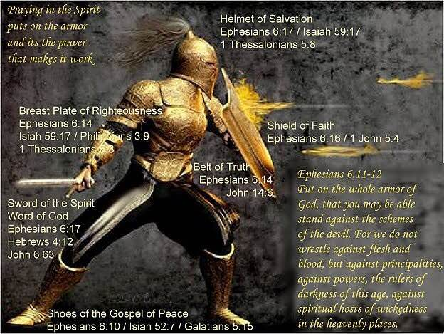

Slide 247

The Double-Edged Spiritual Sword
“For the word of God is living and powerful, and sharper than any two-edged sword, piercing even to the division of soul and spirit, and joints and marrow, and is a discerner of the thoughts and intents of the heart.”
- Hebrews 4: 12

Slide 248
The Double-Edged Spiritual Sword
INCLUDES the Word of God, the sword of the Spirit with double edge, one edge for convicting and converting some, and the other for condemning and destroying the unbelieving… sharper “more cutting” two-edged – sharpened at both edge and back. Its double power seems implied by its being “two-edged.” “It judges all that is in the heart, for there it passes through, at once punishing and searching…” [Chrysostom].
* Jamieson-Fausset-Brown On Hebrews 4:12

Slide 249
The Double-Edged Spiritual Sword
Philo similarly speaks of “God passing between the parts of Abraham’s sacrifices (Genesis 15: 17) where it is a burning lamp… which sword never ceases to divide all sensible things… {Paul’s audience was familiar with Philo}… even to dividing asunder of soul and spirit – i.e., reaching through to the separation of the animal soul, the lower part of man’s incorporeal nature, the seat of animal desires, which he has in common with the brutes… and of the joints and marrow-
* Jamieson-Fausset-Brown On Hebrews 4:12

Slide 250
The Double-Edged Spiritual Sword
As the knife of the Levitical priest reached to dividing parts, closely united as the joints of the limbs, and penetrated to the innermost parts, as the marrows; so the word of God divides the closely joined parts of man’s immaterial being, soul and spirit and penetrates to the innermost parts of the spirit. The Word’s dividing and far penetrating power has both a punitive and healing effect. discerner of the thoughts- “capable of judging the purposes.” intents- rather, “conceptions [Crellius]; “ideas” [Alford] refers to the intellect.
* Jamieson-Fausset-Brown On Hebrews 4:12

Slide 251

We need help

Slide 252
Satan Is Busy
So we need to resist him even more

Slide 253
How Busy Is Satan?
“Be sober, be vigilant; because your adversary the devil, as a roaring lion, walketh about, seeking whom he may devour.” (1 Pet. 5:8)

Slide 254
Satan Is real
Some people deny the existence of Satan.
These same people deny the existence of God, and Christ.
Satan is real and he is at work today!
That fact should invoke more than passing concern among those who seek for eternal life.

Slide 255
Satan Is Real
The devil is a very powerful being.
He is a god, not some dumb stone idol, but a deity (2 Cor 4:4) who can blind minds to the truth, work signs and wonders and cause people to be utterly deceived. (2 Thes 2:9-10)

Slide 256
Resist The Devil
Resistance Requires
Ability
People have the ability to resist Satan.
It isn’t that people have no way of fighting against Satan.
Unlike the idea portrayed in some T.V. and Motion Picture Films, there is a simple defense.
James 4:7 says. “Resist the devil and he will flee from you.”

Slide 257
Resist The Devil
Recognition – how do you know Satan?
Ministers
One needs to recognize that Satan has ministers, who these pretenders are and where they are working.
There is always the possibility of a serious attack!
Many a battle has been lost because the enemy was not seen or the aggression not detected until the arrow of defeat struck its mark, leaving only the dying.

Slide 258
Resist The Devil
Satan is the greatest when it comes to deceiving.
Thus, Paul issued a warning in 2 Cor 11:14-15: “And no marvel; for Satan himself is transformed into an angel of light. Therefore, it is no great thing if his ministers also be transformed as the ministers of righteousness.”
That means that Satan and his ministers present themselves as men of God, preaching salvation.
“While they promise them Liberty, they themselves are the servants of corruption.” (2 Pet 2:19)

Slide 259
Resist The Devil
Love For Truth
Satan can be withstood if one has a love for truth.
If they do not they will be condemned to be deceived and devoured. (2 Thes 2:9-10)
Realize What Truth Is - God’s word. (Jhn 17:17)

Slide 260
Resist The Devil
Realize What Truth Is And Is Not
That it is not found in denominationalism.
Since denominations are denominated because of their differing beliefs and since varying beliefs produce confusion, there is cause for concern.
1 Cor 14:33 says that God is not the author of confusion.
Thus, God did not author denominationalism, Satan did!
God authored but one faith. (Eph 4:5)

Slide 261
Conclusion
Unlike us:
Satan stays busy trying to draw us away from God.
Satan does not give up.
Satan does not give a half-hearted effort.
Satan knows what his goal is and is dedicated to fulfill that goal.
Are you willing to resist the Devil?

Slide 262
Satan –
His Works

Slide 263
Introduction
1 Pet. 5:8
Be sober, be vigilant; because your adversary the devil, as a roaring lion, walketh about, seeking whom he may devour:

Slide 264
I. He Deceives
2 Cor. 2:11
2 Cor. 11:3
2 Cor. 11:14

Slide 265
2 Cor. 2:11
Lest Satan should get an advantage of us: for we are not ignorant of his devices

Slide 266
2 Cor. 11:3
But I fear, lest by any means, as the serpent beguiled Eve through his subtilty, so your minds should be corrupted from the simplicity that is in Christ.

Slide 267
2 Cor. 11:14
And no marvel; for Satan himself is transformed into an angel of light.

Slide 268
II. He Takes Away The Word Of God
Mt. 13:19
When any one heareth the word of the kingdom, and understandeth it not, then cometh the wicked one, and catcheth away that which was sown in his heart. This is he which received seed by the way side.

Slide 269
II. He Takes Away The Word Of God
He often does this by misusing Scripture
Mt. 4:6

Slide 270
Mt. 4:6
And saith unto him, If thou be the Son of God, cast thyself down: for it is written, He shall give his angels charge concerning thee: and in their hands they shall bear thee up, lest at any time thou dash thy foot against a stone.

Slide 271
III. He Wants To Control The Mind
Acts 5:3-4
But Peter said, Ananias, why hath Satan filled thine heart to lie to the Holy Ghost, and to keep back part of the price of the land? [4] Whiles it remained, was it not thine own? and after it was sold, was it not in thine own power? why hast thou conceived this thing in thine heart? thou hast not lied unto men, but unto God.

Slide 272
III. He Wants To Control The Mind
Books, magazines, radio, television, the Internet, conversation, etc.

Slide 273
IV. He Attacks Bodies & Destroys Possessions
Think about Job
Paul
2 Cor. 12:7

Slide 274
2 Cor. 12:7
And lest I should be exalted above measure through the abundance of the revelations, there was given to me a thorn in the flesh, the messenger of Satan to buffet me, lest I should be exalted above measure.

Slide 275
IV. He Attacks Bodies & Destroys Possessions
Satan uses illness and disaster to tempt us

Slide 276
V. He Seeks To Make Us Proud
1 Tim. 3:6
Proverbs 16:18

Slide 277
1 Tim. 3:6
Not a novice, lest being lifted up with pride he fall into the condemnation of the devil.

Slide 278
Proverbs 16:18
Pride goeth before destruction, and an haughty spirit before a fall.

Slide 279
VI. He Persecutes
Rev. 2:10
Fear none of those things which thou shalt suffer: behold, the devil shall cast some of you into prison, that ye may be tried; and ye shall have tribulation ten days: be thou faithful unto death, and I will give thee a crown of life.

Slide 280
VI. He Persecutes
-“God’s people are soldiers on the battlefield, but sometimes they are the battlefield” Allen Webster
- If we obey God only in the good times and fall under every trial then our faith is shallow

Slide 281
VI. He Persecutes
Faith that cannot withstand the test cannot be trusted
Js. 1:1-2
Js. 1:12
1 Pet. 1:3-9

Slide 282
Js. 1:2-3
My brethren, count it all joy when ye fall into divers temptations;
[3] Knowing this, that the trying of your faith worketh patience.

Slide 283
Js. 1:12
Blessed is the man that endureth temptation: for when he is tried, he shall receive the crown of life, which the Lord hath promised to them that love him.

Slide 284
VII. When We Sin He Accuses And Discourages
He never gives up
Lk. 4:13
And when the devil had ended all the temptation, he departed from him for a season.

Slide 285
What Satan Does & What We Must Do
1. He Deceives
Think
2. He Takes Away The Word Of God
Concentrate
3. He Wants To Control The Mind
Discern

Slide 286
What Satan Does & What We Must Do
4. He Attacks Bodies & Destroys Possessions
Endure
5. He Seeks To Make Us Proud
Resist

Slide 287
What Satan Does & What We Must Do
6. He Persecutes
Withstand
7. When We Sin He Accuses And Discourages
Press on. Trust in God!

Slide 288


Slide 289


Slide 290
The Prayer Of Deliverance
“The evil from which we pray to be delivered is not that which is most oppressive in life, such as poverty, worries, hardship, burdens, sacrifices, pain, injustice, tyranny, and so on; it is the chain of circumstances that leads us into temptation, disturbing the balance, pushing life off-center, distorting the perspective. It will be seen at once that the so-called ‘good things’ of life are just as liable to cause such disturbance as the painful and hard realities. These things all possess the potential power to lead or force us into temptation & by that I mean all the things that can possibly come between us & God… Alfred Delp
"THE EVIL ONE"

Slide 291
Satan’s Hatred Versus God’s Love
THE MIND OF SATAN
SATAN’S PLAN TO ENTRAP
THE GATEWAY TO SATAN
GOD’S PLAN OF RESCUE
THE PORTAL OF PRAYER!

Slide 292

Remember Your Own Heart
Remember Your Temper
Measured At Our Weakest Point
Don't Let Joy Turn To Sorrow
Notes:
A Man who carries gunpower about with him, may well ask and pray that he may not be led where sparks are flying. If I have a heart like a bomb shell, ready to explode at every moment, I may well pray that God will keep me away from the fire that might destroy me.
Some are hot and quick tempered, which sets them off at a drop of a hat. Should they pray that no one will set them off or do they work on the problem of being quick tempered. Learn to be patient, kind and temperate in all things. Have a long fuse or no fuse at all. We all have some temper in us but Christians find a way to use self control to keep it in check.
A rope or chain is only as strong as it’s weakest point or weakest link. If we break down due to a weakness, it brings us down altogether. Everyone of us has weaknesses, where trials and temptations hit us the hardest. Because of these every Christian should pray not to be lead into temptation but deliver us from evil. How many fall that are tempted, way too many. Take warning, many a Christian has fallen and from time to time continues to fall. When discipline has to come before the Church we are reminded how gently we ought to deal with this because we know that it could be us next to fall. Maybe under the same circumstances, we would have fallen too. But to say that we all sin does not help to keep us from being lost in the end. When I see another man shipwrecked, I should be even more careful to navigate my own ship more purposefully.
David’s life after sinning with Bathsheba – Sin affects your life for ever more – Here is a Christian – Pray that you enter not into temptation but if you do – don’t let it beat you

Slide 293


Slide 294
A call from darkness to light
Rom 13:12-14 The night is far spent, the day is at hand: let us therefore cast off the works of darkness, and let us put on the armour of light. 13 Let us walk honestly, as in the day; not in rioting and drunkenness, not in chambering and wantonness, not in strife and envying. 14 But put ye on the Lord Jesus Christ, and make not provision for the flesh, to fulfil the lusts thereof.
Walk Honestly
Make No Provision
For The Flesh

Slide 295


Slide 296
Walk as children of light
Eph 5:6-8 Let no man deceive you with vain words: for because of these things cometh the wrath of God upon the children of disobedience. 7 Be not ye therefore partakers with them. 8 For ye were sometimes darkness, but now are ye light in the Lord: walk as children of light:
Eph 5:11 And have no fellowship with the unfruitful works of darkness, but rather reprove them.
We must make right choices!
No Fellowship With Darkness or we forfeit the crown!
Being deceived can be our demise!
Our choices determine our destiny!
God only gives us what we deserve!

Slide 297
Spiritual Transformation:
Benchmark To Hallmark
Overcoming Evil With Good

Slide 298
The transformed disciple seeks to overcome evil with good.
Insight into the transformed life..
But How?

Slide 299

Questioning – Exploring – Petitioning

Slide 300
Questions

Slide 301

Should We Question God?

Slide 302

PRESUPPOSITIONS
Goes does exist
God is omniscient (“all-knowing”)
God is omnipresent (“always present”)
God is omnipotent (“all-powerful”)
God is omnibenevolent (“all-good”)
The Bible is the Word of God
God desires us to know Him

Slide 303
DOES IT MEAN WE DON’T TRUST HIM?
We must rely on God’s understanding (Prov. 3:5-6)
When we trust God, He will grant us peace and safety (Ps. 4:5-8, 9:9-10, 20:7-8, 25:105, 56:10-11)
Questioning God is not in itself wrong
(Hab. 1:1-17; Ps. 10, 44, 74, 77)
Disobedience, hypocrisy, complaining, or insincerity can make questioning God wrong
(1 Sam. 28:6, Job. 38:2)
We must ask with the right heart for it to be the right question…

Slide 304
MOSES
Moses questioned God on several occasions:
  When God called him to lead Israel from bondage (Ex. 3:11)
  When Israel was punished after Moses/Aaron first went to Pharaoh (Ex. 5:22-23)
  When God wanted to destroy Israel for making the golden calf (Ex. 32:11-13)
Lesson: God will answer questions, but we better be ready to accept the answer!

Slide 305
GIDEON
Gideon had several questions about/for God when he was approached to deliver Israel (Jdg. 6:12-13)
He had a sincere desire to understand God
Lesson: God accepts sincere questions from those with righteous hearts

Slide 306
JOB
The entire book of Job contains questions to God
Ultimately, Job’s questions were answered by God…in a sense (Job 38:1-4)
God admonished and taught Job to keep proper perspective when questioning God
Lesson: We must keep a proper attitude toward God if we question Him!

Slide 307
CHRIST
As Christ hung in pain, he questioned God (Matt. 27:46)
Christ was human (like us) and perfect (unlike us); there cannot be anything sinful about asking God questions!
We are told to be like Christ (
Lesson: Even Christ questioned God…so we should be able to as well!

Slide 308
CONCLUSION
Nothing in the Bible indicates it is wrong to question God
We must be have the right attitude/heart
We must keep faith in him so we will be heard
We must be ready to accept whatever answer He gives (or has already given)

Slide 309
possibilities

Slide 310
Can We Really Change God’s Mind?

Slide 311
the
OneGod
Deuteronomy 4:35, 39
Deuteronomy 6:4
1 Kings 8:60
1 Chronicles 17:20
Isaiah 43:11
Zechariah 14:9
Galatians 3:20
James. 2:19

Slide 312
Understanding the Dilemma
God is omniscient
(1 Jn. 3:20; Heb. 4:12-13; Ps. 139-1:24; Matt. 10:29-30)
God does not change
(Ps. 7:11; Mal. 3:6; Num. 23:19; 1 Sam. 15:29; Is. 46:9-11; Ez. 24:14; Jms. 1:17)
God changed or repented in the past
(Gen. 6:6-7; Ex. 32:14; Jonah 3:10)
Faithful prayers can make a difference
(Jms. 5:16; 1 Pt. 3:10-12; Jn. 15:29; Phi. 1:4;
1 Ths. 5:17; Eph. 6:18; Lk. 2:37, 18:6-8)

Slide 313
Different Response?
Human attempts to explain God’s actions (not literal)
Change?...
…not a change if God already knows what He is going to do! (Is. 46:10-11)

Slide 314
“God’s decrees are not irrecovable, his will is not absolutely inflexible, and his judgments are not arbitrary. On the contrary, His actions exhibit love, concern and pity for man, and are designed to deal with him in a way commensurate with both justice and mercy.”
(Questions & Answers, Vol. 2; Guy N. Woods)

Slide 315
Conditional Warnings & Promises
The warnings and promises of God are often conditional and depend on actions of those to whom they apply:
Save a nation if they turns from evil
(Jer. 18:7-10)
Save the cities if there were 10 righteous souls (Gen. 18:22-33)
Implied conditions are just as valid as specific ones!

Slide 316
God Does NOT Change…
God’s Character is Unchanged
(Ps. 102:27; Mal. 3:6; Jms. 1:17)
God’s Nature is Unchanged
(Heb. 1:12; Acts 17:31)
God’s Purpose is Unchanged
(Heb. 6:17; Rom. 9:11; Job 23:13; Ps. 33:11; Is. 46:10)
God’s Promises are Unchanged
(Num. 23:19; 1 Sam. 15:29; Rom. 11:29)

Slide 317
Why Should I Pray?
Prayer does not inform God, it involves God
Prayer does not change God, it changes us
Prayer does not get our will done in heaven, it gets God’s will done on earth
Prayer is not because God needs us, but because we need God!

Slide 318
Lessons to Consider
We can trust God and have confidence in all He does!
God does not need to change
We should pray
God is disappointed when we fail to
follow his commands

Slide 319
petitioning

Slide 320
When God Does Not Hear!

Slide 321
God Does NOT Change…
God’s Character is Unchanged
(Ps. 102:27; Mal. 3:6; Jms. 1:17)
God’s Nature is Unchanged
(Heb. 1:12; Acts 17:31)
God’s Purpose is Unchanged
(Heb. 6:17; Rom. 9:11; Job 23:13; Ps. 33:11; Is. 46:10)
God’s Promises are Unchanged
(Num. 23:19; 1 Sam. 15:29; Rom. 11:29)

Slide 322
Why Should I Pray?
Prayer does not inform God, it involves God
Prayer does not change God, it changes us
Prayer does not get our will done in heaven, it gets God’s will done on earth
Prayer is not because God needs us, but because we need God!

Slide 323
Understanding the Dilemma
Things Which Negate
Though we have these precious revelations that God is concerned about us and willing to fill our needs, many prayers go unanswered because of things in our prayers and things in our lives which negate the prayer.

Slide 324
Seven Conditional Warnings & Promises
I. Lack of faith. Jesus commanded, “Therefore I say to you, all things for which you pray and ask, believe that you have received them, and they shall be granted you” (Mk. 11:24). That faith that God can and will give what we ask, if it be according to His will, is necessary for that prayer to be answered is also seen from this passage: “But if any of you lacks wisdom, let him ask of God, who gives to all men generously and without reproach, and it will be given to him. But let him ask in faith without doubting, for the one who doubts is like the surf of the sea driven and tossed by the wind. For let not that man expect that he will receive anything from the Lord, being a double-minded man, unstable in all his ways” (Jas. 1:5-8). The prayer that is offered without faith is not going to accomplish very much.

Slide 325
Seven Conditional Warnings & Promises
2. Asking amiss. James said, “Ye ask, and receive not, because ye ask amiss, that ye may consume it upon your lusts” (4:3). The word “amiss” is translated from kakos which means “with bad intent” or “for the wrong reason.” The context shows that some asked in prayer for things after which they had lusted and over which they had fought, although they did not want these things for the right reason. So frequently, our prayers are filled with requests designed to fill our inordinate desires for material things. We ask and do not receive and wonder why! We do not receive because we ask for the wrong reasons.

Slide 326
Seven Conditional Warnings & Promises
3. Self-righteousness. The parable of the prayers of the Pharisee and the publican demonstrates that a self-righteous attitude negates prayer (study Lk. 18:9-14). The Pharisee was a haughty man who acted as if his works justified him before God, failing to realize that all of us, no matter how righteous, are sinners before God (Rom. 3:23; Gal. 3:10). If we manifest a similar self-righteous attitude, our prayers will also be negated.

Slide 327
Seven Conditional Warnings & Promises
4. Failure to forgive others. The parable of the unmerciful slave (Mt. 18:21-35) shows that the man who refuses to forgive those who sin against him will not receive forgiveness from our merciful Father above. Jesus said, “But if you forgive men for their transgressions, your heavenly Father will also forgive you. But if you do not forgive men, then your Father will not forgive your transgressions” (Mt. 6:14-15). Regardless of how men have treated us, we must love our enemies (Mt. 5:44) and leave vengeance in the hands of our just God (Rom. 12:19-21).

Slide 328
Seven Conditional Warnings & Promises
5. Sinfulness. The Scriptures teach that God will not hear the prayer of the man who habitually refuses to sub= mit to God’s will. “He who turns away his ear from listening to the law, even his prayer is an abomination” (Prov. 28:9). “If I regard wickedness in my heart, the Lord will not hear” (Isa. 66:18). “Behold, the Lord’s hand is not so short that it cannot save; neither is his ear so dull it cannot hear. But your iniquities have made a separation between you and your God, and your sins have hid His face from you, so that He does not hear” (Isa. 59:1-2). The man who walks in darkness cannot enjoy fellowship with God (1 Jn. 1:5-10).

Slide 329
Seven Conditional Warnings & Promises
6. Praying for a show. Jesus said, “And when you pray, you are not to be as the hypocrites; for they love to stand and pray in the synagogues and on the street corners, in order to be seen by men. Truly I say to you, they have their reward in full” (Mt. 6:5). The word translated “have . . . in full” is apecho. The word was a technical term to refer to an account in business transactions which had been paid in full. What Jesus is saying is this: The man who prays to be seen by men has received full payment for what he has done when he hears mere men saying, “Brother-Piety surely can lead a beautiful prayer.” We must be careful that we offer our prayers because of our devotion to God rather than to be seen of men. Our personal, private devotions to God are a safeguard to worship for show (Mt. 6:6).

Slide 330
Seven Conditional Warnings & Promises
7. Vain repetition. Again, Jesus said, “And when you are praying, do not use meaningless repetition, as the Gentiles do, for they suppose that they will be heard for their many words” (Mt. 6:7). Jesus did not condemn repetition in prayer; indeed, He instructed us to be persistent in presenting our requests to the Lord (Lk. 18:1-8). What He condemned was meaningless or vain repetitions. We must be careful that some of the cliches which we use in prayer not become meaningless (for example, “Thank you Father, for this another beautiful Lord’s day,” “May the speaker have a ready recollection of what he has studied,” “Be with the sick the world over and especially those of the Household of faith,” etc.). Most of our cliches are scriptural things to pray for; we must be careful less they become mere meaningless repetition.

Slide 331
Faithless Petitions Flounder
A lack of faith can certainly hinder one’s prayers. James declares that we must pray “in faith, nothing doubting” (Jas. 1:6). He describes the doubter as being like the restless sea. He has two minds—one of faith and the other of doubt. Hence, shall not receive his requests from the Lord.
Elsewhere we read that true faith requires us to believe that God “is a rewarder of them that seek after him” (Heb. 11:6).
In a world of doubt and confusion, how can we have confidence that God is truly listening and responding to our prayers.
There are at least two reasons. First, since God is almighty (Gen. 17:1) and can do all things (Job 42:2) consistent with his nature and will, he is obviously able to answer prayer.
Second, we should be so glad to have a God who is, at his very nature, a loving God (1 Jn. 4:8). He is, to put it in our crass colloquialism, loaded rich in mercy (Eph. 2:4).
Because of his love and abundant mercy, he longs to answer his children’s requests in harmony with their genuine needs.

Slide 332
Ignorance Impedes Our Invocation
Another reason prayers may be weakened is because of our ignorance.
The disciples once approached Christ as he was praying. They asked: “Lord, teach us to pray, even as John also taught his disciples” (Lk. 11:1).
Doesn’t this reveal that there must be a correct way to pray that comes as a consequence of teaching? It is frequently the case that Christians “know not how to pray” as they ought (Rom. 8:26).
For instance, it may be that some saints do not know of God’s willingness to answer our prayers, hence, they have not because they ask not (Jas. 4:2; cf. Phil. 4:6). Ignorance concerning the purpose of prayer can hinder. For example, prayer should be according to God’s will in order to be heard (1 Jn. 5:24). But how can we pray effectively according to his will if we don’t know his will.
Here’s an example. It is not proper to pray for miracles, since those signs served a unique place in the divine plan (Mk. 16:17-20; Heb.2:2-4) and thus, have been terminated (1 Cor. 13:8-13; Eph. 4:8-16). (See: What Does the Bible Say About Miracles? )
And what about praying that God should save someone—someone we dearly love—but who remains in rebellion to the gospel plan of salvation (1 Jn. 5:16). The more we study and understand God’s will as revealed in his word, the more effectively we can pray.

Slide 333
Impurity Inhibits Intercession
If prayer is to reach the throne of grace, the supplicant must strive with deadly seriousness to conform his life to the holy will of the Lord God. The Bible is replete with instructions to this end.
Isaiah warned Israel of old that Jehovah would not hear them because of their sins (Isa. 59:2). The Savior solemnly taught that we must abide in him and allow his words to abide in us if we would have our petitions fully answered (Jn. 15:7).
Peter declared that “the eyes of the Lord are upon the righteous, and his ears unto their supplication” (1 Pet.3:12). Yes, the prayers of the righteous person avails much (Jas. 5:6).
But the requests of those who deliberately turn away from hearing the Creator’s will are abominable in his sight (Prov. 28:9).

Slide 334
Pride Prohibits Prayer
No one is qualified to approach the great God of the universe with a spirit of smugness.
He is the Lord, God Almighty (Gen. 17:1). We are but dust (Gen. 3:19). He is Creator. We, the created (Psa. 100:3). He is holy (Psa. 9:9), yet we are sinners (Rom. 3:9, 10).
Accordingly, prayer must ever be characterized by a spirit of lowliness.
This lesson is taught in one of the Lord’s parables. Two men went up to the temple to pray (Lk. 18:9ff). One was a Pharisee and the other was a publican. Pride made the difference as to whose prayer was heard.
When the Pharisee arrived at the temple, he struck a pose and eulogized himself. I thank thee, that I am not as the rest of men." He viewed himself as a self-made man, and he adored his creator! In stark relief, however, the publican contritely sought the Lord’s mercy as a sinner. He was justified rather than the other.
The lesson of the parable is this. Arrogance can negate prayer! Humility will bless it!

Slide 335
Unforgiving Attitudes Overthrow Prayer
One of the most utterly devasting things that the Christian can do to hinder, indeed, to virtually cancel the effect of his prayers is to harbor a surly, unforgiving attitude toward others he feels have sinned against him (whether is real or imagined).
Christ taught the disciples to pray: “Forgive us our debts, as we also have forgiven our debtors.” In conclusion he warned: But if ye forgive not men their trespasses, neither will your Father forgive your trespasses (Mt. 6:12, 15). Judgment is without mercy to him that shows no mercy (Jas. 2:13).
Peter once asked the Lord: “How oft shall my brother sin against me, and I forgive him? until seven times?”
The Jewish rabbis felt that three times to forgive was quite sufficient (cf. Barclay, 213). Likely, Peter assumed he was being generous, but the Lord cautioned that forgiveness was to be extended seventy times seven (i.e., limitless!).
Then in order to illustrate the gravity of having an unforgiving spirit, Jesus told the parable of the unmerciful servant. In this divine narrative, the king represents God. The first servant and his vast debt is you and me and the fact that our sins have put us head-over-heels in debt to God. It is debt that we can never pay off by acts of human merit. It must be a matter of forgiveness.
The second indebtedness calls attention to the trespasses others commit against us. How astounding it is that we, who have been given Heaven’s saving grace are sometimes so unwilling to forgive others. The Lord warns that we cannot receive his forgiveness unless we are willing, from the heart, to forgive each other.

Slide 336
The Sabotage of Selfish Prayers
Finally, some short-circuit their prayers due to their own selfishness. James says: “Ye ask, and receive not, because ye ask amiss, that ye may spend it in your pleasures” (Jas. 4:3).
The word for pleasures is hedone. Here it suggests the desire of one who is so wrapped up in the physical world that he has little interest in fulfilling his true purpose on earth (cf. Isa.43:7; Eccl. 12:13). Though “religious,” the individual here considered prays only out of a base spirit of selfishness.
Perhaps we need to analyze the motivation behind our prayers. When we petition for material things, is it that we might use them to the glory of God or that we might be more comfortable?
That the prayers of many members of the church to this end are selfish prayers is clearly evinced by the fact that most of their possessions are employed to accommodate themselves, while only a pittance is offered to the Lord. But if our petitions are directed to the end that we may effectively serve our Savior, God can open the windows of heaven and pour out blessings in abundance (Mal. 3:10; Prov. 3:9, 10; Lk. 6:38).

Slide 337
Don’t Forget To Be Thankful! When Paul wrote to Timothy (1st Timothy 2: 1), he told him that he should offer supplications, prayers, intercessions and giving of thanks for all men. “Supplications” are our requests regarding our needs. “Prayers” are any discourse with God, which would include petitions, praise and thanksgiving. “Intercessions” are our pleas to God on behalf of others. “Thanksgiving” obviously expresses our thanks for the multitude of blessings, both physical and spiritual, which we enjoy in this life. When we offer our prayers, we always want to remember to be thankful for the multitude of blessings God has bestowed upon us. Christians are saved by the grace of God, through the sacrifice of Jesus Christ, and through compliance with the terms and conditions set forth in the New Testament. Someone was concerned enough about us to tell us of the love of God and show us the things that we need to do to be saved. Certainly Christians are thankful for this blessing. But, we are also given great privileges, opportunities and comforts that are physical in their nature and it would be an act of utter ingratitude if we were not thankful for these physical blessings as well.

Slide 338
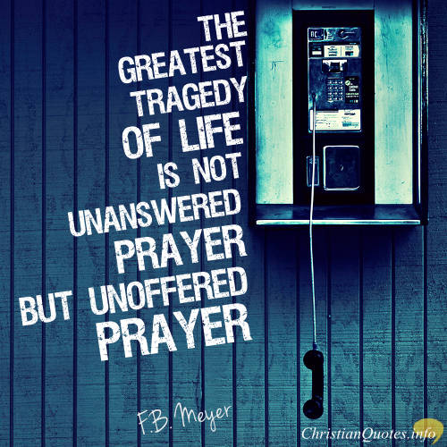

Slide 339
When God Does Not Answer!

Slide 340
God Does NOT Change…
God’s Character is Unchanged
(Ps. 102:27; Mal. 3:6; Jms. 1:17)
God’s Nature is Unchanged
(Heb. 1:12; Acts 17:31)
God’s Purpose is Unchanged
(Heb. 6:17; Rom. 9:11; Job 23:13; Ps. 33:11; Is. 46:10)
God’s Promises are Unchanged
(Num. 23:19; 1 Sam. 15:29; Rom. 11:29)

Slide 341
Why Should I Pray?
Prayer does not inform God, it involves God
Prayer does not change God, it changes us
Prayer does not get our will done in heaven, it gets God’s will done on earth
Prayer is not because God needs us, but because we need God!

Slide 342
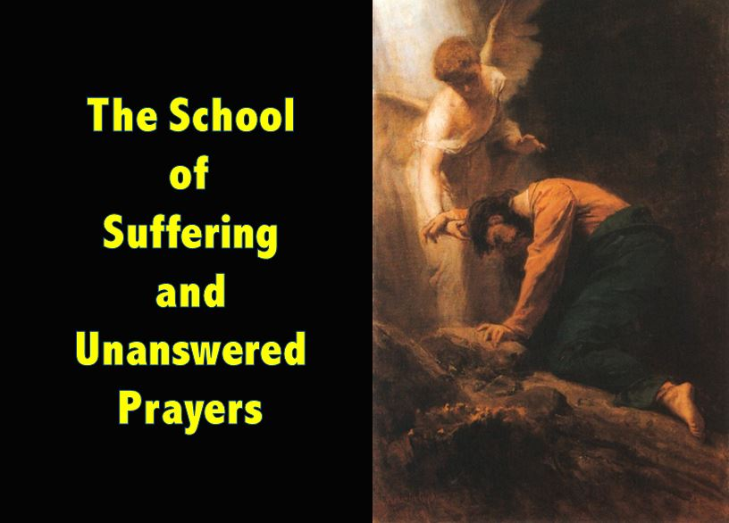

Slide 343
Understanding the Dilemma
When we have prayed by Biblical Formula and in the Right Attitude but yet God Remains Silent. How is that to be understood?

Slide 344
Conditional Warnings & Promises
PERSISTENCE
The persistence of the petition is another factor that the Bible indicates has a bearing on the efficacy of prayer. In Luke 18:1, the gospel writer stated: “Then He [Jesus—KB] spoke a parable to them, that men always ought to pray and not lose heart” (emp. added). The parable Jesus told in this context was about a widow who made a request to an unjust judge. Her request was noble and right, but the unjust judge did not feel obligated to comply with her appeal. Due to her persistence, however, and her “continual coming” to the judge, he finally granted her petition. Jesus then commented that if an unjust judge can be swayed by persistence, how much more effective is the persistent prayer of a virtuous person when addressed to the righteous Judge of all the Earth.
Additionally, Jesus told of a man who visited his neighbor at midnight requesting bread to feed a guest. Initially, the neighbor refused the request, but eventually he complied. Jesus stated: “I say to you, though he will not rise and give to him because he is his friend, yet because of his persistence he will rise and give him as many as he needs” (emp. added). Jesus then coupled this parable with the instructions to be persistent in requests to God (vss. 9-13). In fact, throughout the Scriptures, persistence plays a prominent role in effective prayer (see Philippians 1:4; 1 Thessalonians 5:17; Ephesians 6:18; Luke 2:37).

Slide 345
David’s Unanswered Persistent Prayer
Chapters 11 and 12 of 2 Samuel are almost parenthetical, then, as they depict this exceptional period in David's life. This was a time when he was not a “man after God's heart.” And so we find chapter 11 beginning with a description of Israel going to battle, while David stays at home (11:1). We find verses 26-31 of chapter 12 reporting how David showed up for the war, and when it was won, all Israel returned home to Jerusalem. There is a sense of closure, of finality, here, which I think the author intended us to feel. In addition, we find that our text records the death of Bathsheba's first son, followed rather quickly by the account of the birth of the second, Solomon, who was to rule on the throne of his father, David.

Slide 346
David’s Unanswered Persistent Prayer
The tragic death of David’s son is a consequence of David's sin, but it is not the penalty David deserves for his sin. The penalty for adultery and murder is death, on each count. David deserves to die, on two counts: adultery and murder. But Nathan has made it very clear that David's sin has been “taken away.” The death of this child is a painful consequence of David's sin, but it is not punishment for his sin, per se. That punishment has been taken away, borne by the Lord Jesus Christ.

Slide 347
David’s Unanswered Persistent Prayer
God could not look the other way when David sinned, for his disobedience to God's commands was a matter of public knowledge. As his victories and triumphs were known among the Gentiles, so his sins would be widely known as well. By taking the life of this child, conceived in sin, God makes a statement to those looking on. If God does not deal with the sin of His saints, they might reason, then He will not be concerned with mine, either. Thus, they will mock God with the confidence that they can get away with their sin.

Slide 348
David’s Unanswered Persistent Prayer
David mourns as a sign of his repentance as he beseeches God to spare the life of his son.
Is it right for David to beseech God to spare the life of this child when He has already said that He is going to take the life of the child? I believe the answer is “Yes!” David knew that some prophecies were warnings of what God would do unless men repented. God sometimes foretold future judgment, which would come to pass if men did not repent. The hope for divine relenting in response to human repenting is set down in Jeremiah 18:5-8.

Slide 349
David’s Unanswered Persistent Prayer
Is it possible that David felt this child might be the heir to his throne? If this were the case, then David surely had reason to hope that God would spare the child's life.
David was certainly right in his assumption that the life of this child was in God's hands, and that his best course of action was to appeal to God to spare the child's life. David believed in the sovereignty of God, and thus he rested his case with God. David's prayers are not only the expression of his repentance, but the exercise of his faith. Believing in God's sovereignty did not keep David from taking action (fasting and praying); his faith prompted him to act.

Slide 350
David’s Unanswered Persistent Prayer
It is what happens from this point on that perplexes David's servants. While the child was ill they had not been able to get David up from the ground, nor to eat any food. They assumed it would only get worse once he knew the child was dead. Instead, David arose from the ground, washed and anointed himself, changed his clothes, and went into the house of the Lord, where he worshipped. When he had finished worshipping God, he came home and asked for food. When they set it before him, he ate it.

Slide 351
David’s Unanswered Persistent Prayer
The death of this child came as no surprise to David because it had already been foretold by Nathan. Through Nathan God had informed David that this son, the fruit of David's sinful union with Bathsheba, “Uriah’s widow,” would surely die. The death of this child was the revealed will of God. For David to mourn excessively would have been to express his regret over God's will. David's actions indicated that he had accepted the death of this child as God's will.

Slide 352
David’s Unanswered Persistent Prayer
Nathan had already explained the reason for death of this child to David. The purpose for the death of this child was not to punish David. The appropriate punishment for David's sins under the law would have been the death penalty. Nathan has not given David news of a reduced sentence, but of complete forgiveness, because the guilt and punishment for his sins had been “taken away” (12:13). The purpose for this child's death was instructive. It was meant to silence any blasphemy on the part of the “enemies of God.” Lest any might wrongly conclude that Israel's God was oblivious to David's sin in the breaking of God's law, God made it apparent that He would not wink at sin, even the sin of a man after His own heart. The death of David's son was an object lesson to the enemies of God.

Slide 353
David’s Unanswered Persistent Prayer
David's mourning during the child's sickness was an act of repentance, not the mourning of the loss of a loved one:
22 He said, “While the child was still alive, I fasted and wept; for I said, 'Who knows, the LORD may be gracious to me, that the child may live.' 23 “But now he has died; why should I fast? Can I bring him back again? I will go to him, but he will not return to me.”
The death of this child was accepted as God's final answer to David's petitions for the child's life. This is the substance of David's answer to the question posed by his servants. While the child was alive, David fasted, wept, and prayed. But now the child is dead. David has done all that he could. God has given David a clear and final answer: “No.” David sees death as the time to cease those activities which were only appropriate in life. Someone has said, “Where there's life, there's hope.” As far as David's hope for the healing of this child is concerned, God has indicated to David that he should cease his efforts to persuade God to relent concerning this child's death.

Slide 354


Slide 355


Slide 356
Conditional Warnings & Promises
PERSISTENCE
The persistence of the petition is another factor that the Bible indicates has a bearing on the efficacy of prayer. In Luke 18:1, the gospel writer stated: “Then He [Jesus—KB] spoke a parable to them, that men always ought to pray and not lose heart” (emp. added). The parable Jesus told in this context was about a widow who made a request to an unjust judge. Her request was noble and right, but the unjust judge did not feel obligated to comply with her appeal. Due to her persistence, however, and her “continual coming” to the judge, he finally granted her petition. Jesus then commented that if an unjust judge can be swayed by persistence, how much more effective is the persistent prayer of a virtuous person when addressed to the righteous Judge of all the Earth.
Additionally, Jesus told of a man who visited his neighbor at midnight requesting bread to feed a guest. Initially, the neighbor refused the request, but eventually he complied. Jesus stated: “I say to you, though he will not rise and give to him because he is his friend, yet because of his persistence he will rise and give him as many as he needs” (emp. added). Jesus then coupled this parable with the instructions to be persistent in requests to God (vss. 9-13). In fact, throughout the Scriptures, persistence plays a prominent role in effective prayer (see Philippians 1:4; 1 Thessalonians 5:17; Ephesians 6:18; Luke 2:37).

Slide 357
Paul’s Unanswered Persistent Prayer
2nd Corinthians 12: 8
In 2 Corinthians 12, Paul recounts being afflicted with that mysterious “thorn in the flesh,” because of the glorious revelation he’d experienced fourteen years earlier. He states that on three occasions he’d begged “the Lord” to remove it (2 Cor. 12:8).
Who was the Lord?
Let the context speak. The response to Paul’s prayers had been a firm “no” (implied) — with the extension, “My grace is sufficient for you.” The apostle then gloried in the fact that the “power of Christ” would be sufficient for him (2 Cor. 12:9).
Alford Plummer says that the term “besought” (parakaleo) is frequently used of those who asked of Christ’s help, but not when referring to the Father (Plummer, 353; see also Barnett, 571).

Slide 358
Paul’s Unanswered Persistent Prayer
WHAT WAS THE APOSTLE PAUL’S “THORN IN THE FLESH?”
No one knows for sure what Paul's thorn in the flesh was. There have been various theories offered, such as a chronic sickness and bad eyesight. We just don't know because the Bible does not tell us. It doesn't mean we can't offer some educated guesses, but first, let's take a look at the relevant Scripture.
Paul said in 2 Corinthians 12:7-8, "Because of the surpassing greatness of the revelations, for this reason, to keep me from exalting myself, there was given me a thorn in the flesh, a messenger of Satan to torment me-to keep me from exalting myself! 8 Concerning this I implored the Lord three times that it might leave me." This problem may very well have been the same one he mentioned in Galatians 4:13-14, "but you know that it was because of a bodily illness that I preached the gospel to you the first time; 14 and that which was a trial to you in my bodily condition you did not despise or loathe, but you received me as an angel of God, as Christ Jesus Himself." Neither verse tells us what the issue was, but the affliction may have been painful as could be designated by the word "thorn." But then again, if it were an issue with his eyesight, that could be considered a thorn in the flesh that was not painful. Let's take a look at that option.
In Acts 9:3 Paul says, "As he [Paul] was traveling, it happened that he was approaching Damascus, and suddenly a light from heaven flashed around him." Because of this light, Paul fell to the ground and was blinded for three days (Acts 9:8-9; 22:11). Also, Paul says something very interesting in Galatians 4:15, "Where then is that sense of blessing you had? For I bear you witness that, if possible, you would have plucked out your eyes and given them to me." Could it be that because of the encounter with Christ Paul had been blinded, and this is why the Galatians wanted to, so to speak, pluck their eyes out for him? It seems like a real possibility.
At any rate, Paul had asked three times to be delivered of affliction, but God did not heal him. The reason is obvious, as is stated by Paul himself, that it was to keep him humble (2 Cor. 12:7). It is worth noting that our afflictions which are permitted by God are often for the same reason. We cannot see how pervasive sin really is in us, and sometimes we're humbled by our afflictions and return to God and trust him. This, of course, is a good thing. - C.A.R.M. Resources

Slide 359
Paul’s Unanswered Persistent Prayer
WHAT WAS THE APOSTLE PAUL’S “THORN IN THE FLESH?”
There are two other passages of Scripture that those who believe Paul’s thorn in the flesh was sickness have tried to use to verify that. One is Galatians 4:13-15. Here Paul says that he preached the Gospel to these Galatians through an infirmity of the flesh, and in verse 15, he makes reference to these people being willing to poke out their own eyes and give them to him. From this, many commentators have contended that Paul’s thorn was a rare, ancient disease which was characterized by runny, puffy eyes.
The next scripture used to say Paul’s thorn was bad eyes is also in Galatians, chapter 6, verse 11. It says, “Ye see how large a letter I have written unto you with mine own hand.” People have said Paul’s eyes were so bad that he had to write in large letters, and this is what he was making reference to.

Slide 360
Paul’s Unanswered Persistent Prayer
PAUL’S PRAYER NOT ANSWERED BECAUSE OF SIN BUT FOR A HIGHER PURPOSE
There were individuals who possessed faith, and yet were not healed of their ailments. The apostle Paul obviously had plenty of faith. He had an “infirmity” that was so painful that he called it “a thorn in the flesh” and “a messenger of Satan” (2 Corinthians 12:7-10). Yet his earnest prayers to God for relief did not result in his being healed. Timothy was a faithful and effective servant of the Lord. He had “frequent illnesses” and stomach trouble of such severity as to warrant Paul referring to it by inspiration. But rather than simply healing him, or telling him to “pray for healing,” Paul advised him to use a little wine as a tonic (1 Timothy 5:23). Another Christian worker and companion of Paul in his evangelistic travels, Trophimus (Acts 20:4: 21:29), had to be left at Miletus due to his sickness (2 Timothy 4:20). Epaphroditus was an extremely valuable worker in the kingdom of Christ, so much so that Paul referred to him as “my brother and fellow-worker and fellow-soldier…and minister to my need” (Philippians 2:25). When he became sick “nigh unto death” (Philippians 2:27,30)—likely due to his exhausting kingdom activity and service to Paul—Paul did not heal him. These examples demonstrate that personal faith was not prerequisite to the reception of a miracle in the first century. Miracles were inextricably bound to the authentication of the spoken Word of God.

Slide 361
What purposes do our "thorns" serve?
First, they serve as an antidote for pride. And pride, like fat, causes men to swell larger than they ought and is very painful to remove and keep removed.
Second, such thorns nurture our dependency upon God, humbling us and helping us recognize our need for God's help.
Third, these physical problems build strength. A person builds strength purposefully only when he recognizes his weakness. Strength and endurance come only at the price of some suffering. Ask any athlete.
Our suffering in the flesh develops character, temper control and better dispositions, to name just a few things. We must never forget that God's power is made perfect in our weakness. God is glorified most when our personal weakness is evident and his strength shines through in our life despite our personal impotency.
What is your thorn? Is it a sickness when you want to be well to serve the Lord? Or, might it be poverty, when you could wish to have money to help the Lord's cause? An unbelieving spouse? Limited education or abilities?
Remember, God's ways are not our ways. He has at times used the most unlikely men to accomplish his purposes. So, let us recognize that sometimes we may be praying for the removal of something from our lives for which God has a purpose. Taking the burden away may be our answer but God's answer may be giving us the strength to handle the burden, thus increasing our faith and that of others. – Truth Magazine

Slide 362
PRAYERS MUST ACCORD WITH GOD’S WILL
In Jesus’ instructions to His disciples regarding prayer, He explained that they should include in their prayers the idea that God’s will should be done (Matthew 6:10). The apostle John, who would have been well-aware of Jesus’ teaching on prayer, stated: “Now this is the confidence that we have in Him, that if we ask anything according to His will, He hears us. And if we know that He hears us, whatever we ask, we know that we have the petitions that we have asked of Him” (1 John 5:14-15, emp. added). Notice that if we do not include verse 14 of 1 John 5, we could make the passage say, “whatever we ask, we know that we have the petitions that we have asked of Him.” Yet to do that would be to leave off the important qualifying statement that the request should be in accordance with God’s will, and should be offered from a heart that is humble enough to accept God’s will—even if that means that the request is denied. When the skeptic pulls snippets of verses from the gospel accounts concerning prayer, he or she is guilty of leaving off just such important qualifying information.

Slide 363
When we consider the idea of praying “according to God’s will,” we can see how important this qualifier is. No requests will be granted that attempt to violate or circumvent God’s ultimate will. For instance, suppose a person were to pray: “God, please save my mother even though she does not believe in Jesus Christ and refuses to repent of her sins, please let her go to heaven anyway, in Jesus’ name, Amen.” Would God grant that petition? The Bible is clear that He certainly would not, because to do so would be to violate His ultimate will that salvation is through the name of Jesus (Acts 4:12).
Furthermore, certain events and actions in this physical world are required for God to accomplish His will on this Earth. For instance, if one of Jesus’ apostles had asked God to spare the life of Jesus and not let Him die on the cross, that request would not have been in accord with God’s ultimate will and would not have been answered in the affirmative. Mark 8:33 provides an excellent example of this when Peter rebuked Jesus for predicting His own death. Jesus responded to Peter, saying: “Get behind Me, Satan! For you are not mindful of the things of God, but the things of men.” Whereas Peter most likely thought his actions were in accord with God’s will, they were not. To further illustrate, the many events in the life of the Old Testament character Joseph may have seemed unfair at the time. No doubt Joseph prayed to be freed from slavery or to be released from jail. But at the end of Joseph’s life, we see that God’s will was to make him a great leader in Egypt and to save the Jewish nation through him. Joseph recognized this, and said to his brothers who had sold him into Egypt: “Do not be afraid, for am I in the place of God? But as for you, you meant evil against me; but God meant it for good, in order to bring it about as it’s this day, to save many people alive” (Genesis 50:20). Joseph’s slavery & incarceration were the vehicles by which God brought Joseph to power, accomplishing His will.

Slide 364
“Joseph in Prison” by Elton D. Higgs:
How far away the fields where grazed my father’s sheep, Where in my sleep the visions spoke,
Affirming that my special coat was well deserved; And in my youth I knew that God had favored me.
A willing instrument I was, rebuking in my father’s name.
My brother’s worldly ways. And then the pit, the chains, the foreign land –
No one then to listen to my dreams! But God was gracious to me still,
As Potiphar repaid the works of God in me, And I regained my virtuous pride.
In confidence I turned aside, The evil of my master’s wife,
Rebuked in righteous words her monstrous lust.
And for my trouble once again, I lie imprisoned and disgraced.
Has God seduced me too, and cast me off - For basking in His favor?
It seems but scant reward,To be the chief of those who languish in the dark.
How shall I deal with One who rips away, What He Himself bestowed?
My robe of innocence my brothers drenched in blood;
My robe of righteousness was snatched,To scandalize my name.
How shall I be clothed, my Lord, Lying naked to Your will?”

Slide 365


Slide 366
Conditional Warnings & Promises
“but the Spirit himself makes intercession for us”
The expression “Spirit himself” is emphatic; it expresses an activity of the Holy Spirit personally, rather than what he may accomplish through a representative medium (cf. John 4:2). While the pronoun auto (“itself” – KJV; “himself” – ASV) is a neuter form, it is more appropriate here to render it as a masculine, since the Holy Spirit is a person, not a thing. This has the precedent of Scripture itself (cf. John 14:26 where the masculine ekeinos is used of the “Spirit”—a neuter term).
“with groanings which cannot be uttered”
The term “groanings” (stenagmois) denotes a sigh or groan. It is used (in various forms) more than fifty times in the Greek version of the Old Testament, and it reflects a “human lament” which suffering people are powerless to remedy on their own (Balz and Schneider 1993, 272). For instance, it describes the anguish of the Israelite people under the burdens of Egypt (Exodus 2:23; cf. Acts 7:34).
The notion that the “groanings” refer to “speaking in tongues” is to be rejected totally. Stott comments: “These groans can hardly be glossolalia, since those ‘tongues’ or languages were expressed in words which some could understand and interpret” (1994, 245).
But whose groanings are these? Though some would attribute them to the Holy Spirit, the better view appears to be that they are the Christian’s groanings, which are conveyed on his behalf by the Spirit unto God. Clearly the term refers to the Christian’s plight a few verses earlier in this chapter (v. 23), though a different point of focus is in view.
The context seems to suggest that the groanings originate because “we know not how to pray as we ought” in a knowledgeable and articulate way. It would seem, therefore, more in harmony with the general tenor of the Bible as a whole, then, to conclude that it is the Christian who gives rise to these “mute sighs, the expression of which is suppressed by grief” (Thayer 1958, 25), rather than the groanings issuing from the omnipotent Spirit of God.
Hardeman Nichols observes: “Surely the Holy Spirit who has the ability to completely reveal the mind of God to man would have no difficulty in pleading man’s cause to God” (1980, 350).
It is not impossible, though, that there may be a blending of two thoughts. Some think that the groanings, though originating with the Christian, actually are “shared by the Holy Spirit and the believer” (McComiskey 1976, 424).
John Stott suggests that “the Holy Spirit identifies with our groans,” so that “we and he groan together” (245). One thing is certain: when the groanings reach God, they are perfectly clear to him.
It is imperative, though, that we emphasize this point: it must not be concluded that the Father could not know of our plight apart from the Spirit’s intercession; no, rather, it is the role of the Spirit as a companion in the Christian’s life that is being emphasized. His work has been divinely orchestrated, consistent with the planning of the entire Godhead.
H. Leo Boles wrote: “Since [the Holy Spirit] dwells in Christians, he helps them in the act of prayer. Prayer is to God the Father in the name of Christ, and by the help of the Holy Spirit. Hence, each member of the Godhead is included in acceptable prayer” (1983, 256).

Slide 367
Conditional Warnings & Promises
“and he who searches the hearts”
The heart-searcher of this passage is generally conceded to be God, the Father, mentioned subsequently in the verse. God is said to “search” the heart of man.
The word means to examine, to investigate. It is a form of the figure known as anthropomorphism (representing God with human traits), the design of which, in this text, is to emphasize the all-knowing aspect of deity (cf. 1st Chronicles 28:9; Psalms 7:9; Proverbs 17:3; 1 Thessalonians 2:4). Similar expressions are used both of Christ (Revelation 2:23) and of the Spirit (1st Corinthians 2:10).
The present tense form argues for the concept of a God who is ever aware of our needs. The “heart,” of course, is the soul or spirit of man, the rational, feeling aspect of the human being—that part made in the very image of God himself (Genesis 1:26-27; Daniel 7:15; 1 Corinthians 2:11; Romans 10:9-10).

Slide 368
Conditional Warnings & Promises
“knows what is the mind of the spirit”
Again the verb (oida), employed as a present tense (see above), reveals the fact that the Father and the Spirit are constantly in close communication with one another, if we may express ourselves in the same sort of accommodative language discussed just above. God is ever aware of the Spirit’s insights into our souls, hence can adequately respond to our needs.
Cottrell suggests that Paul’s argument here is one where the reasoning proceeds from the less likely to the more likely: “If God knows what is in the minds of created beings who are qualitatively different from him and relatively independent of him, then surely he knows what is in the mind of the Spirit himself, who is qualitatively equal with God and one in nature with him” (1996, 498).

Slide 369
Conditional Warnings & Promises
“because [that – ASV] he intercedes for the saints”
The present tense of the verb (“intercedes”) depicts the characteristic activity of the Spirit on behalf of the Christian. (For the meaning of “intercede,” see above.)
The term “saints,” as used in the New Testament, is a general term for those who are faithful to God. It is commonly used for the members of various congregations of the Lord’s people (cf. Romans 1:7; 1 Corinthians 1:2; Ephesians 1:1; Philippians 1:1). It is linguistically related to the words “holy” and “sanctified.” It refers to a person who, by virtue of his obedience to the gospel plan of salvation (cf. Ephesians 5:26) and his consecration of life has become “separated unto God” (cf. 1 Thessalonians 4:3-4, 7; Romans 6:19, 22; Hebrews 12:14).
The Holy Spirit is delighted to operate on behalf of a people dedicated to righteousness. The Roman Catholic concept of “sainthood” bears utterly no relationship to the New Testament Scriptures.

Slide 370
Conditional Warnings & Promises
“according to the will of God”
The Greek text simply says, “according to God.” The translators of both the King James Version and the American Standard Version have supplied the words “the will of” (as indicated by the italics) for clarification purposes. God the Father and the Holy Spirit operate in perfect unison in the interest of Christian people.
Perhaps it is not out of place at this point to remind ourselves that, unlike the so-called “gods” of the ancient pagan world, the members of the sacred Godhead are never at variance with one another. They function in absolute harmony.

Slide 371
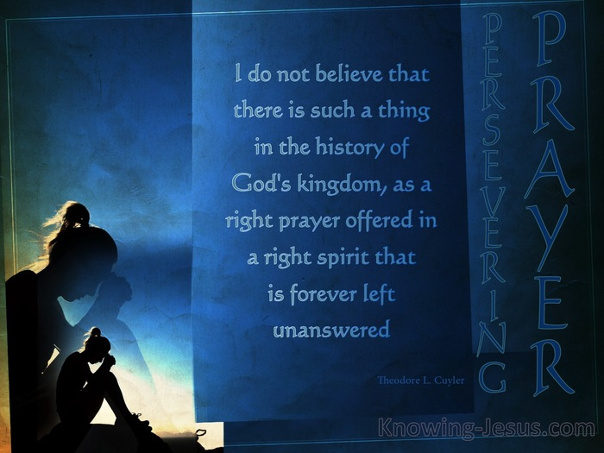

Slide 372


Slide 373
  AVOID THE ANGELIC SIN OF SATAN – THE SPIRITUAL EVIL OF PRIDE

Slide 374
C.S. Lewis in Mere Christianity wrote: “It was through pride that the devil became the devil… Pride or self-conceit leads to every other vice… It is the complete Anti-God State of Mind.” 1st John 2: 16 tells us that worldly pride of life has always served as a distraction to authentic spiritual growth & formation. Our story really starts in the Garden of Eden when the first couple were introduced to the original trickster Satan. It was in the Garden that mankind first shared in the Prideful Sin of Satan by way of human self-exaltation. In the Post-Eden Fallen World the problem of pride became socially pandemic. Aristotle & Augustine described the classical civilizations as driven by pride. Aristotle stated that “Greeks identify happiness with honor” and Augustine stated of the early Romans that “for the love of praise – the love of money was overcome.” This was the Bible World of the First Century into which the Son of God was Born.
We may ask - How is this problem of human nature to be countered? Jesus Christ taught us in two ways – by indirect example & by direct command. In Luke 4 - Jesus provides us his own self in positive example as he prepared for his earthly ministry & was tempted by the devil while in the wilderness. Satan tempted Christ by questioning the Godhead in mutual esteem & Jesus responded by giving honor to the Father by quoting Him in scripture. Satan also tempted Jesus in an end justifies the means modification of God’s Plan. Jesus responded that to alter God’s markers & methodology was to tempt the Father. In Luke 14 – Jesus provides us timeless precept & principle that applies in Old World Acquired Honor Society & New World Achieved Honor Society – in rule of thumb. The Master Teacher instructs that we should in every occasion not self-exalt but self-level leaving others the responsibility to determine our formal ranking & deserved social status.

Slide 375
C.S. Lewis tells us in Mere Christianity that “without this (worldly) comparison-competition - pride is gone.” In the Freedom of Self Forgetfulness Lewis States: “The thing we remember from meeting a truly gospel-humble person is how much they seemed to be totally in us. Because the essence of gospel-humility is not thinking more of myself or thinking less of myself, it is thinking of myself less.”
To “Think of Ourselves Less” is the clue to combat “Satan’s Favorite Go-To Temptation of Human Pride.” The Master Teacher’s use of paradox as a device to convey a spiritual message combined with the task of translating the more nuanced Greek into modern English has caused some minor confusion. These translations – taken out of context – and extended to their logical conclusion have suggested God commands an impossible standard. In his dairy “The Year of Living Biblically” A.J. Jacob’s claims Exodus 20: 17 means to avoid coveting you must not view advertising & from Proverbs 11: 2 he interprets that the humble should not engage in competitive sports. Even some Bible students have had difficulty with Jesus’ counter-intuitive pronouncement that it is the meek which shall inherit. When meekness is falsely equated with weakness some out of fear have tended toward a bi-polar spirituality & many have made of themselves “merchandise” as claimed by con artists like Lucian of Samosata.
In meekly “Thinking of Ourselves Less” there is nothing to fear. In fact, meekness is in opposition of fear – “it is moral courage.”
In other words, when the gospel-humble with moral courage overcome the tempter trickster – ultimately they inherit & God Will Exalt! - David Burris, The Prince of This World & The Pride of Life

Slide 376


Slide 377
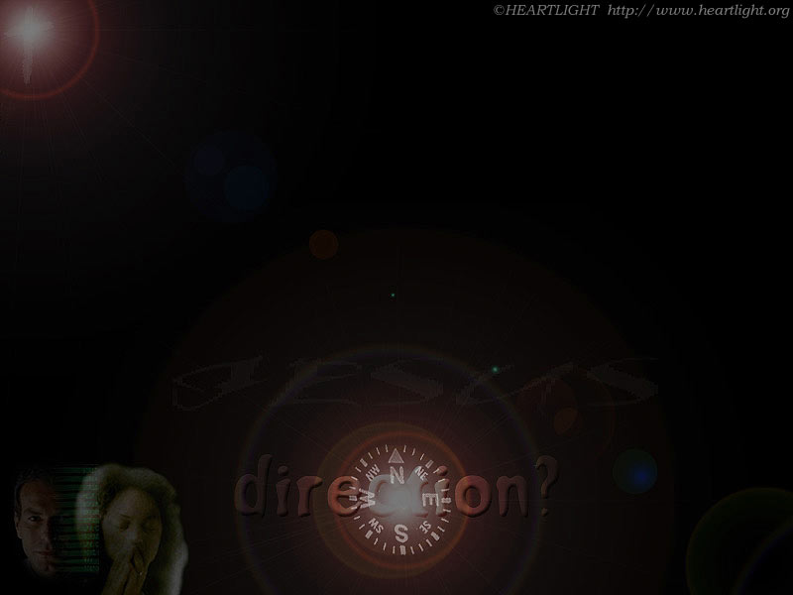

Where Are You Pointed?
Paradise?
Perdition?

Slide 378
JUDGEMENT PREPARED
FIVE STATES FIVE STEPS
Five States of the Soul:
EXEMPTION:
Ezekiel 18: 20; Matthew 18: 1 – 3
CONDEMNATION:
Galatians 3: 22
JUSTIFICATION:
Romans 5: 1, 2; 8: 1, 2
DAMNATION:
Matthew 23: 3; Mark 16: 16
GLORIFICATION:
Romans 8: 17, 30; II Thess. 1: 7 - 12

Slide 379



Slide 380
JUDGEMENT PREPARED
FIVE STATES FIVE STEPS
Five Steps for Saving:
HEARING:
Romans 10: 17; Matthew 7: 24 - 27
BELIEVING:
Hebrews 11: 6; Mark 16: 15, 16
REPENTING:
Acts 2: 38; 17: 30; Luke 13: 3
CONFESSING:
Matthew 10: 32, 33; Acts 8: 36, 37
BAPTISM:
Romans 6: 3 – 5; Acts 8: 36 - 38

