Slide 1
The Kings of Israel & Judah United & Divided
Edited by David Lee Burris

Slide 2
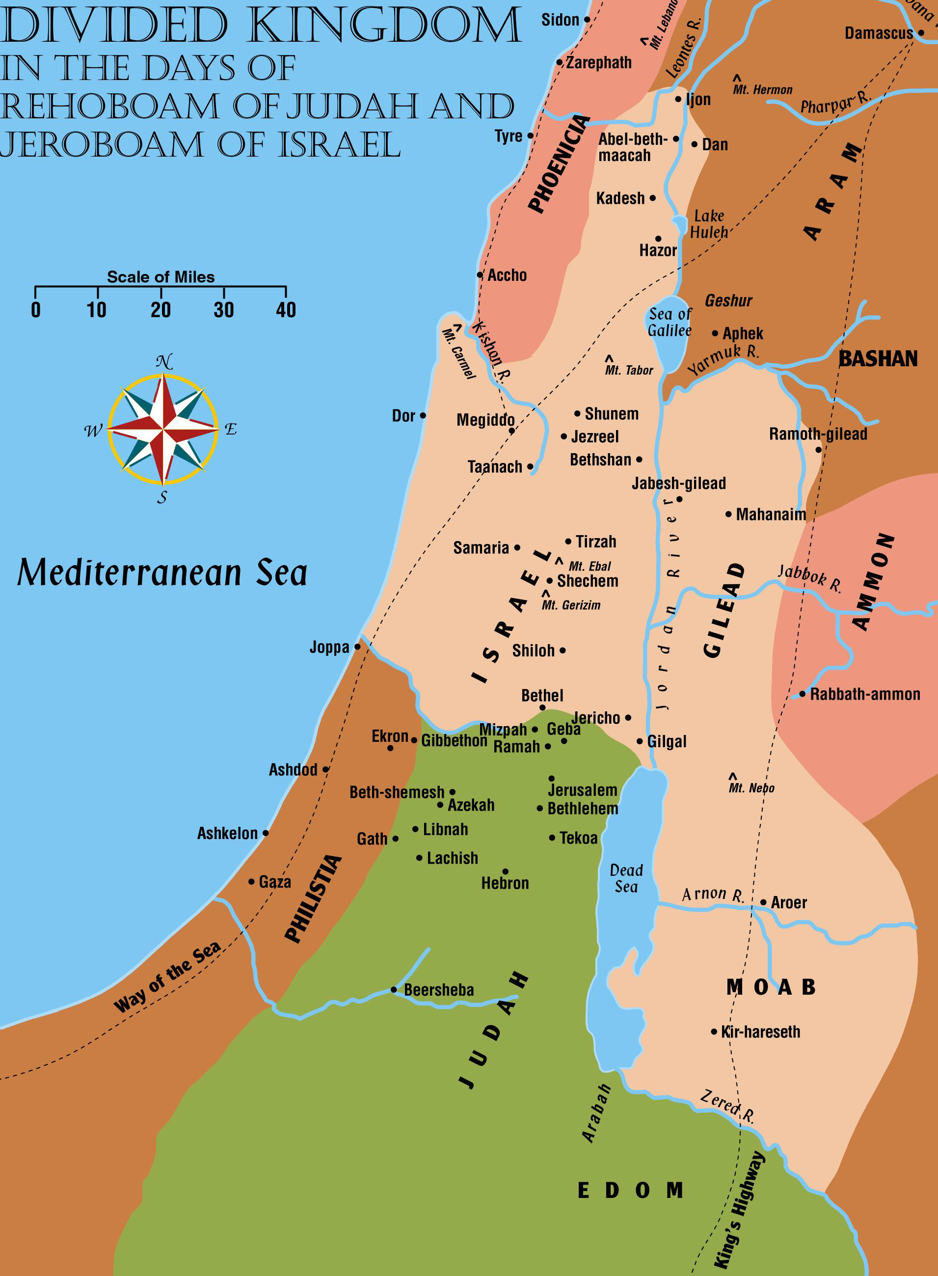
Chart of the Kings Part 1

Slide 3
Overview of the Charts
The following charts of the Kings is an outline only
Not all stories about all the kings are included
Only parts of the passages are included
No effort made to correlate all passages with the historical accounts
Some kings have more than one spelling
Only those enemy kings are mentioned that have a direct role in the Bible story

Slide 4
Overview of the Charts
The following charts of the Kings is an outline only
All the kings of Judah (except Athaliah who usurped the throne for six years) were of the line of David
The dynasty of the kings of Israel changed 9 times
Many prophets mentioned during this period
Occasional mention of “sons of prophets”
This term applied to schools or guilds of prophets
Samuel is the first one mentioned as having these “schools” (1 Sam 10:5-10; 19:20-23)

Slide 5
Overview of the Charts
The following charts of the Kings is an outline only
The charts include the prophets of God who had direct contact with the kings or played a prominent role in the Bible story
The writing prophets are underlined
A total of 5 different maps for the period covered by the charts of the kings will be used
The maps will show the kingdoms at their strongest and at their weakest points
They will also show the boundaries of their worst enemies

Slide 6
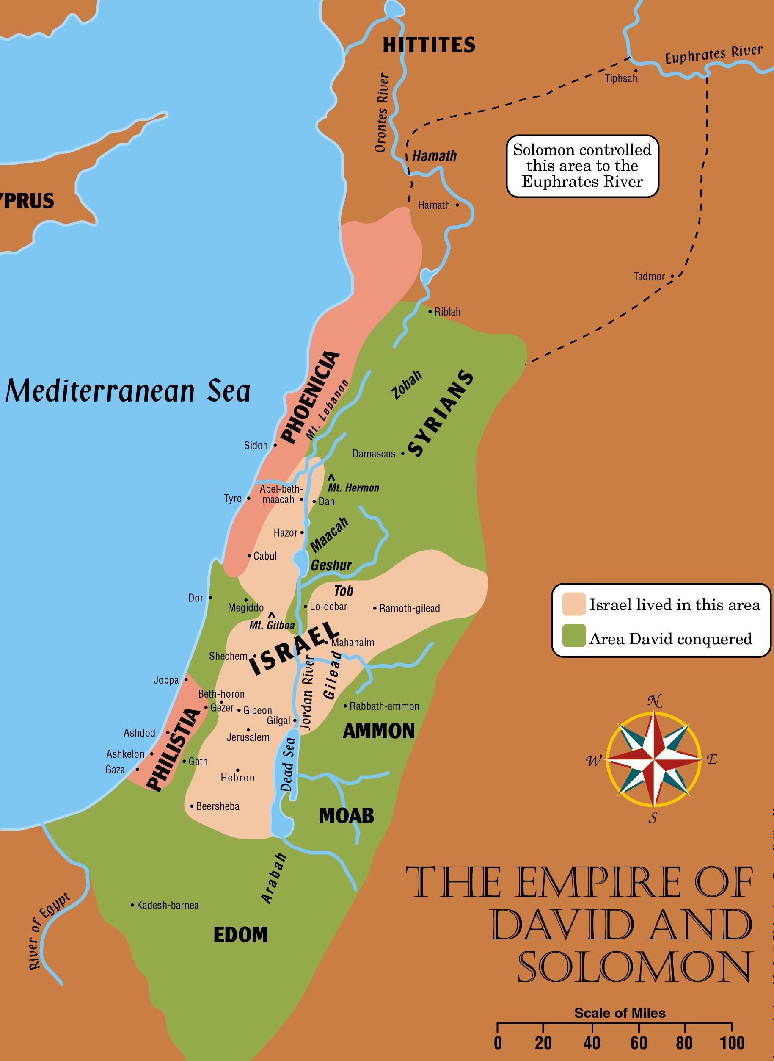
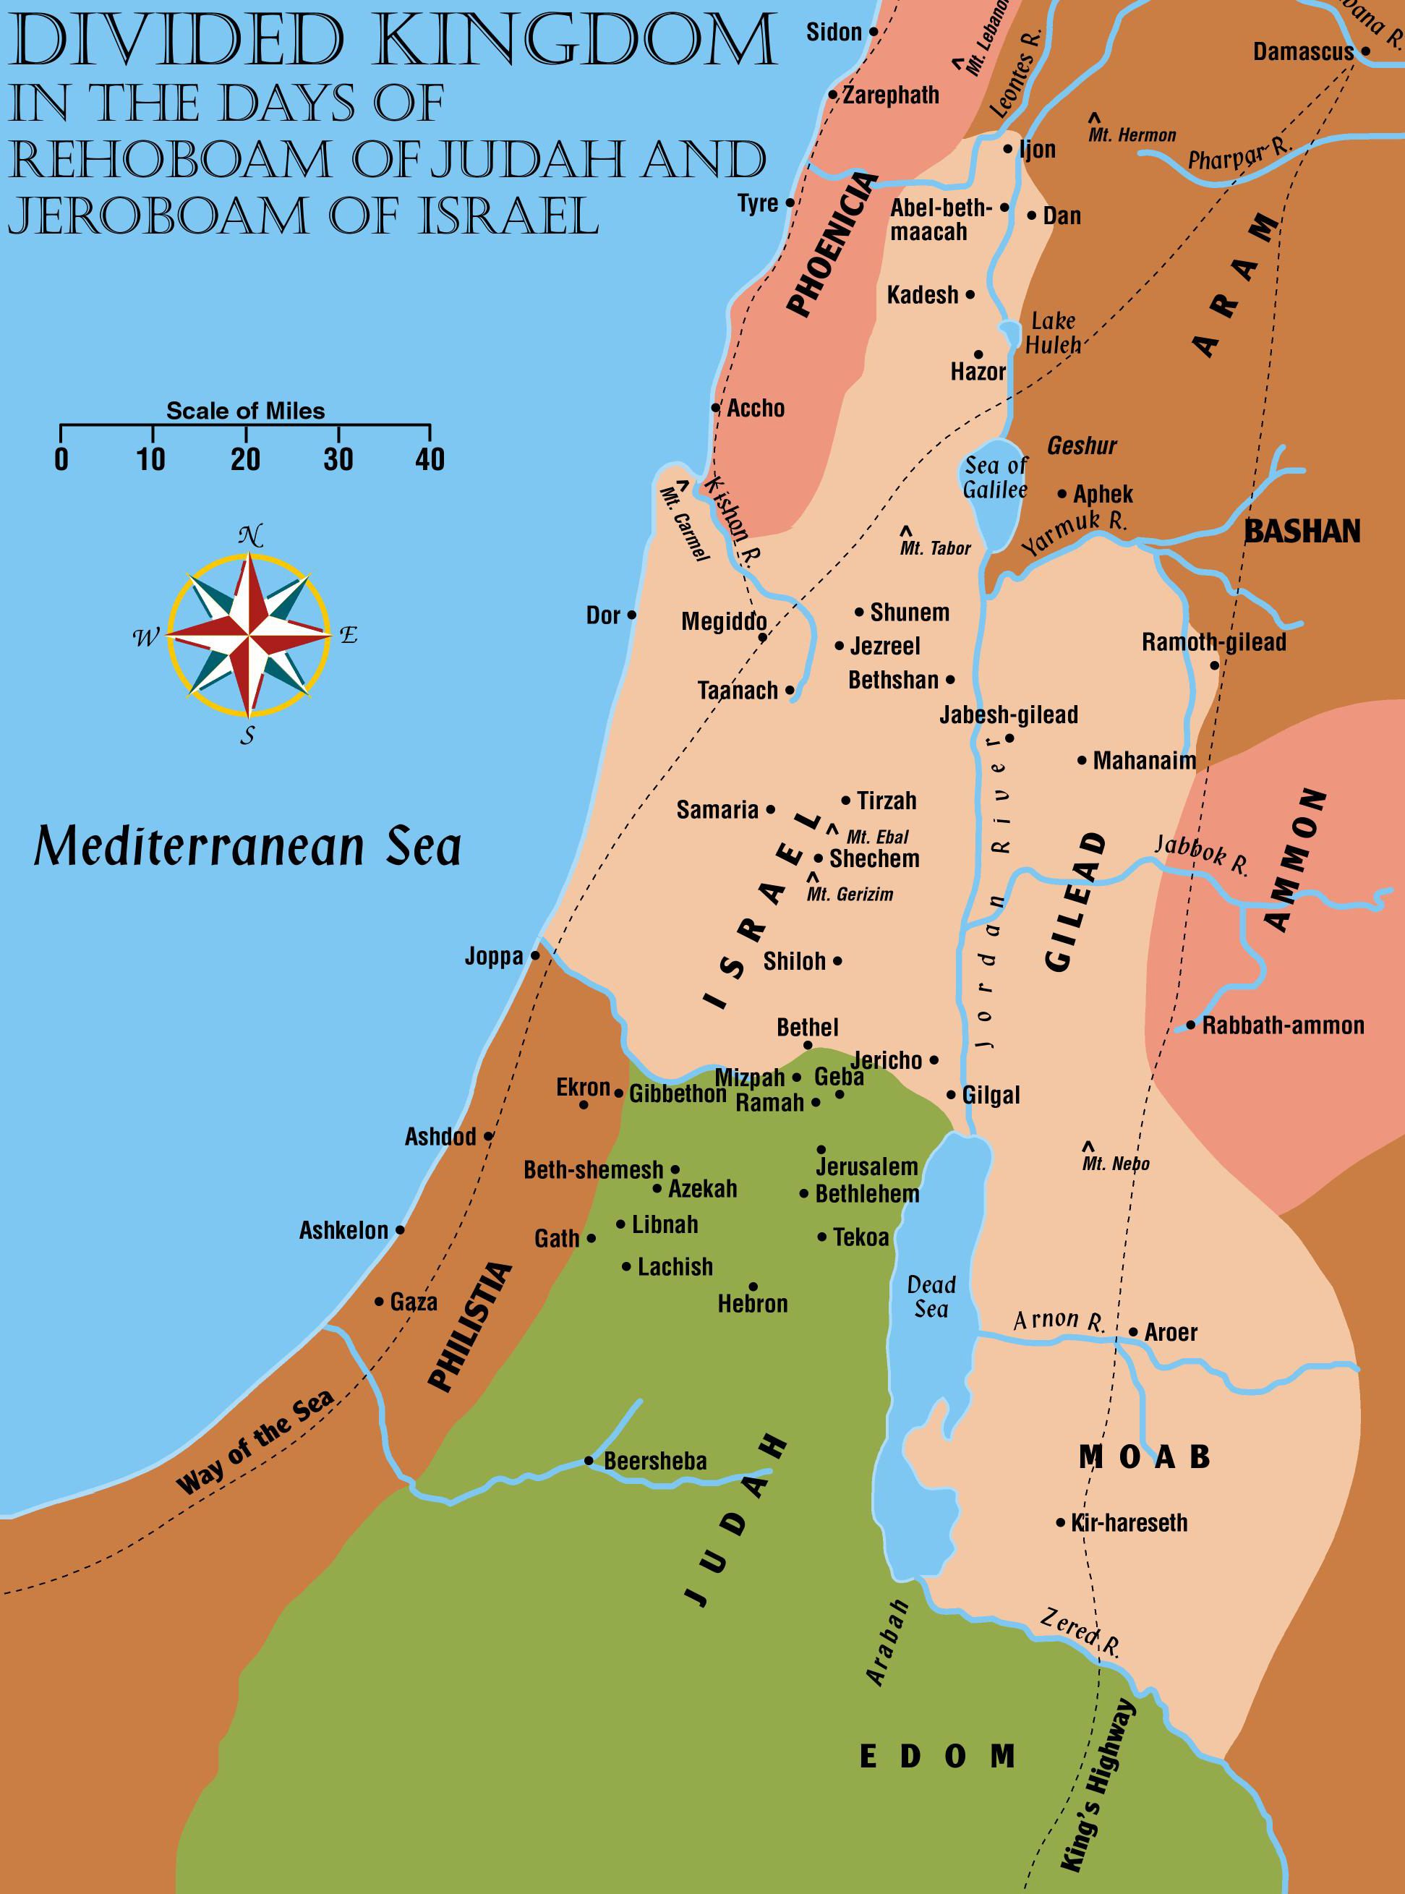

Slide 7
Kings of Judah and Israel
Judah (approx 922-843)
Rehoboam
Abijam
Asa
Jehoshaphat
Jehoram
Ahaziah
Israel (approx 922-843)
Jeroboam
Nadab
Baasha
Elah
Zimri
Omri
Ahab (Elijah)
Ahaziah (Elijah)
Jehoram (Elisha)
Good King
Worst King

Slide 8
Rehoboam (Judah) 17 years 1 Kings 12:1-24; 14:21-31; 2 Chron 10:1-12:16
“more evil than fathers had done”
Son of Solomon
Refused to lighten people’s burdens
Ten tribes rebel
Only Judah and Benjamin remain loyal
Forbidden to fight Israel
Returned to the capital of Jerusalem
Faithful to God for 3 years
Levites and other faithful Israelites join his kingdom
Fortified border cities
Forsook God
Prophets: Shemaiah, Man of God
Shishak of Egypt attacked both Israel and Judah. His Egyptian records have been found listing 150 cities he attacked. Rehoboam gave him wealth from the temple to spare Jerusalem.

Slide 9
Jeroboam (Israel) 22 years 1 Kings 11:26-40; 12:1-14:20; 2 Chron 10:1-17; 13:1-20
New Dynasty Begins
Assumes kingship of the 10 tribes called Israel
God promises to establish his house if he is faithful
Set up golden calves at Dan and Bethel
Established new priesthood and feast days
Destruction of shrine at Bethel predicted
Tirzah becomes capital of Israel
Prophet Ahijah:
Prophesied about the divided kingdom 11:26-39

Slide 10
Abijam (Judah) 3 years 1 Kings 14:31-15:8; 2 Chron 13:1-14:1
Walked in the ways of Rehoboam
Still worshiped in the temple
Abijam and Jeroboam fought in the hill country of Ephraim
Jeroboam was defeated

Slide 11
Asa (Judah) 41 years 1 Kings 15:8-25; 16:8, 29; 2 Chron 14:2-16:14
good and obedient king for 35 of his 41 years.
Did right before God
Put away idols from the land
Was delivered from Zerah the Ethiopian and his million men
Many years of peace because of Asa’s faithfulness
Many from Israel moved to Judah
Hired help from Ben-Hadad of Damascus to fight against Baasha of Israel
Hanani reproved Asa. Asa casts him into prison
Asa becomes diseased in his feet and does not seek God’s help
Prophets:
Azariah and Hanani
Enemies:
Zerah the Ethiopian – probably of an Egyptian Army

Slide 12
Nadab (Israel) 2 years 1 Kings 15:25-31
Did evil as his father
Was slain by Baasha
Murdered by his own people

Slide 13
Baasha (Israel) 24 years 1 Kings 15:16-16:7; 2 Chron 16:1-6
New Dynasty Begins
Destroyed ALL of Jeroboam’s family
Fortified Ramah to keep his subjects from joining Asa’s kingdom
Jehu foretold of the destruction of Baasha’s family (1 Kings 16:3-4)
Prophet:
Jehu
Enemies:
Ben-Hadad of Syria

Slide 14
Elah (Israel) 2 years 1 Kings 16:8-14
Slain by Zimri, an army officer, as he was “drinking himself drunk”
Murdered by his own people
See Proverbs 23:29-35

Slide 15
Zimri (Israel) 1 week 1 Kings 16:10-20
New Dynasty Begins
Killed all of Baasha’s family
Attacked by Omri at Tirzah
Burned the Palace over himself to avoid being captured

Slide 16
Omri (Israel) 12 years 1 Kings 16:16-28
New Dynasty Begins
Overcame his rival, Tibni
Bought hill from Shemer, and built the capital city of Samaria
Little is said of Omri in the Bible
He was powerful politically
For the next 100 years, Israel is referred to as the “house of Omri” in Assyrian records

Slide 17
Ahab (Israel) 22 years 1 Kings 16:28-22:40; 2 Chron 18:1-34
Prophets:
Elijah, Elisha, Micaiah
The most wicked king yet
Married Jezebel, daughter of Eth-Baal, king of the Sidonians
Marriage strengthened the alliance between Israel and Phoenicia
Baal worship became the official religion of Israel
Jericho is rebuilt fulfilling prophecy of Joshua (Josh 6:26)
Enemies:
Ben-Hadad of Syria
Assyrian records tell of a battle at Karkar on the Orontes River with Ahab and Ben-hadad part of the opposing coalition

Slide 18
Ahab (Israel) - Continued 22 years 1 Kings 16:28-22:40; 2 Chron 18:1-34
Israel punished by a 3 year drought
Syrians besiege Samaria and are defeated
Attack again at Aphek and are defeated
Ahab takes Naboth’s vineyard
Micaiah prophecies Ahab’s death – Ahab is slain in battle
Prophets:
Elijah, Elisha, Micaiah
Elijah and the prophets of Baal had a contest on Mt Carmel
Elijah flees from Jezebel to Beersheba and on to Horeb. He later anoints Elisha

Slide 19
Jehoshaphat (Judah) 25 years 1 Kings 15:24; 22:2-33, 41-50; 2 Chron 17:1-21:1
Very good king
Appointed teachers to teach the law to the people of Judah
Received tribute from the Philistines and the Arabians
Joined forces with Ahab to try to recover Ramoth-Gilead from the Syrians
He is rebuked for his alliance with Ahab
Moab, Ammon, and the Meunites rebel against Judah
Joins forces with Jehoram to subdue Mesha
Prophets:
Jehu, Eliezer

Slide 20
Ahaziah (Israel) 2 years 1 Kings 22:48-53; 2 Kings 1:1-18; 2 Chron 20:35-37
Worshiped Baal and Jeroboam’s golden calves
Moab rebelled against Israel
Joins forces with Jehoshaphat to have a navy at Ezion-Geber
Jehoshaphat is reproved and the effort fails
Mortally wounded in a fall
Prophets:
Elijah, Elisha
Enemies:
Mesha of Moab – His stele, the “Moabite Stone” has been found. Tells of his victories in both Israel and Judah

Slide 21
Jehoram (Israel) 12 years 2 Kings 3:1-9:29
Prophet:
Elisha
Elijah is translated about this time
Several stories told of miracles of Elisha. His activities spanned the reigns of several kings
The story of Naaman takes place during this time frame
Son of Ahab, brother of Ahaziah
Wicked, but not like Ahab
Numerous conflicts with Syria
Samaria besieged until the people were nearly starving and then spared by Divine intervention
Wounded in battle with the Syrians at Ramoth-Gilead
Murdered by his own people

Slide 22
Jehoram (Judah) 8 years 2 Kings 8:16-24; 2 Chron 21:1-20
Very wicked king
Killed all of his brothers
Married Athaliah, daughter of Ahab and Jezebel
Edom revolts against Judah
Judah attacked by the Philistines and the Arabs that were near the Ethiopians
They took all that he had except Jehoahaz (Ahaziah) and Athaliah
Prophet:
Obadiah
Probably prophesies now against Edom

Slide 23
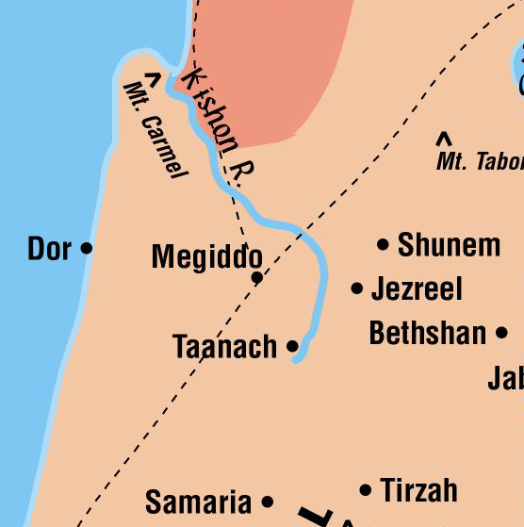
Ahaziah (Judah) 1 year 2 Kings 8:24-9:29; 2 Chron 22:1-9
Very wicked
Goes to visit Jehoram in Jezreel where he is recovering from wounds
Jehu is anointed king in Ramoth-Gilead and hurries to Jezreel where he kills both kings!
Murdered by his
own people

Slide 24
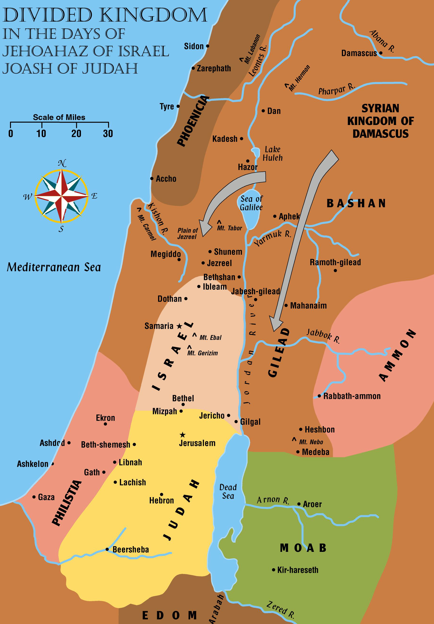
Chart of the Kings Part 2

Slide 25
Kings of Judah and Israel (2)
Judah (approx 843-697)
Athaliah (Joel)
Joash (Joel, Zechariah)
Amaziah
Uzziah (Isaiah)
Jotham (Isaiah, Micah)
Ahaz (Isaiah, Micah)
Hezekiah (Isaiah, Micah)
Israel (approx 843-721)
Jehu (Elisha)
Jehoahaz (Elisha)
Jehoash (Elisha)
Jeroboam II (Jonah, Amos, Hosea)
Zechariah (Hosea)
Shallum (Hosea)
Menahem (Hosea)
Pekahiah (Hosea)
Pekah (Hosea)
Hoshea (Hosea)
Good King
Worst King

Slide 26
Athaliah (Judah) 6 years 2 Kings 11:1-20; 2 Chron 22:10-23:21
Usurped the throne but it would soon return to the line of David
The daughter of Ahab and Jezebel (king Ahab of Israel)
She killed all of her grandsons – except Joash
Usurped the throne and was very wicked
Worshiped Baal and destroyed part of the Temple
She was executed
Murdered by her own people

Slide 27
Jehu (Israel) 28 years 2 Kings 9:1-10:36; 12:1; 2 Chron 22:7-9
New Dynasty Begins
Ruthlessly killed Jezebel
Fulfilled the prophecy of Elijah
Killed all of Ahab’s family, relatives and officials
Killed the Baal worshipers
He had the opportunity to turn Israel back to Jehovah
Turned to Jeroboam’s golden calves instead – God was angry!
Israel began to lose much territory
Prophet:
Elisha

Slide 28
Joash (Judah) 40 years 2 Kings 11:1-12:21; 2 Chron 22:10-24:27
Prophets:
Joel,
Zechariah
(the son of Jehoiada)
Under Jehoiada:
Baal temple is destroyed
The temple of the Lord is repaired
When Jehoiada dies, Joash abandons the worship at the temple
Turns to idols and rebuked by Zechariah – the son of Jehoiada
Has Zechariah killed
Takes treasures from the temple to pay off Hazael to not fight Jerusalem
Murdered by his own people
Enemies:
Hazael attacks Judah. Hazael dies and his son Ben-Hadad is made king of Syria

Slide 29
Jehoahaz (Israel) 17 years 2 Kings 13:1-9, 22-25
Wicked
Worshiped Jeroboam’s golden calves
Israel brought down by the power of Hazael of Syria
His army is reduced to a token force
He prayed for help
God promised to send Israel a “savior”
Prophet:
Elisha

Slide 31
Jehoash (Israel) 16 years 2 Kings 13:10-14:22
Wicked
Worshiped Jeroboam’s golden calves
Elisha predicts three victories over Syria
Defeated Ben-hadad 3 times
Regained cities that had been taken by Hazael
Prophet:
Elisha

Slide 32
Amaziah (Judah) 29 years 2 Kings 14:1-22; 2 Chron 25:1-28
As good as Joash at first, but became more wicked
Subdued Edom and captured Sela
Executed the servants who murdered his father
Fought against Jehoash at Bethshemesh and was defeated
Was killed in a conspiracy by his own people

Slide 33
Jeroboam II (Israel) 41 years 2 Kings 14:23-29
Jehovah delivers Israel
Restores Israel’s border from the entrance to Hamath to the sea of Arabah (Dead Sea)
People and king continued in full-fledged apostasy from God
Recovered Damascus and Hamath
Prophets:
Amos, Hosea, Jonah
Jonah – Sent to Nineveh of Assyria to cry out against it

Slide 34
Uzziah (Judah) 52 years 2 Kings 14:21-22; 15:1-7; 2 Chron 26:1-25
A good king under the influence of Zechariah the prophet
Warred against the Philistines
Broke the walls of Gath, Jabneh and Ashdod
Fortified the walls of Jerusalem
Built a very strong army
Time of prosperity – people gave lip service to God (Isa 1:11-15)
Was stricken with leprosy
Prophets:
Zechariah,
Isaiah
(He was an advisor to the kings of Judah)

Slide 35
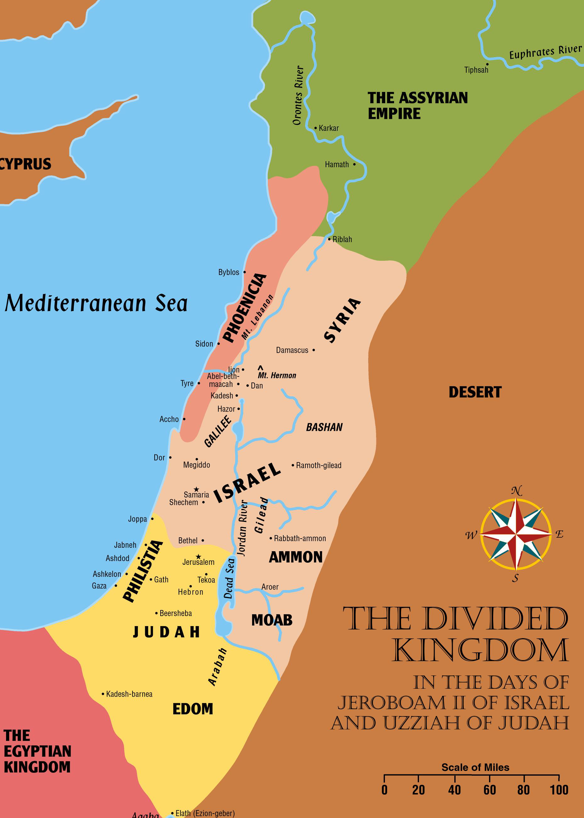
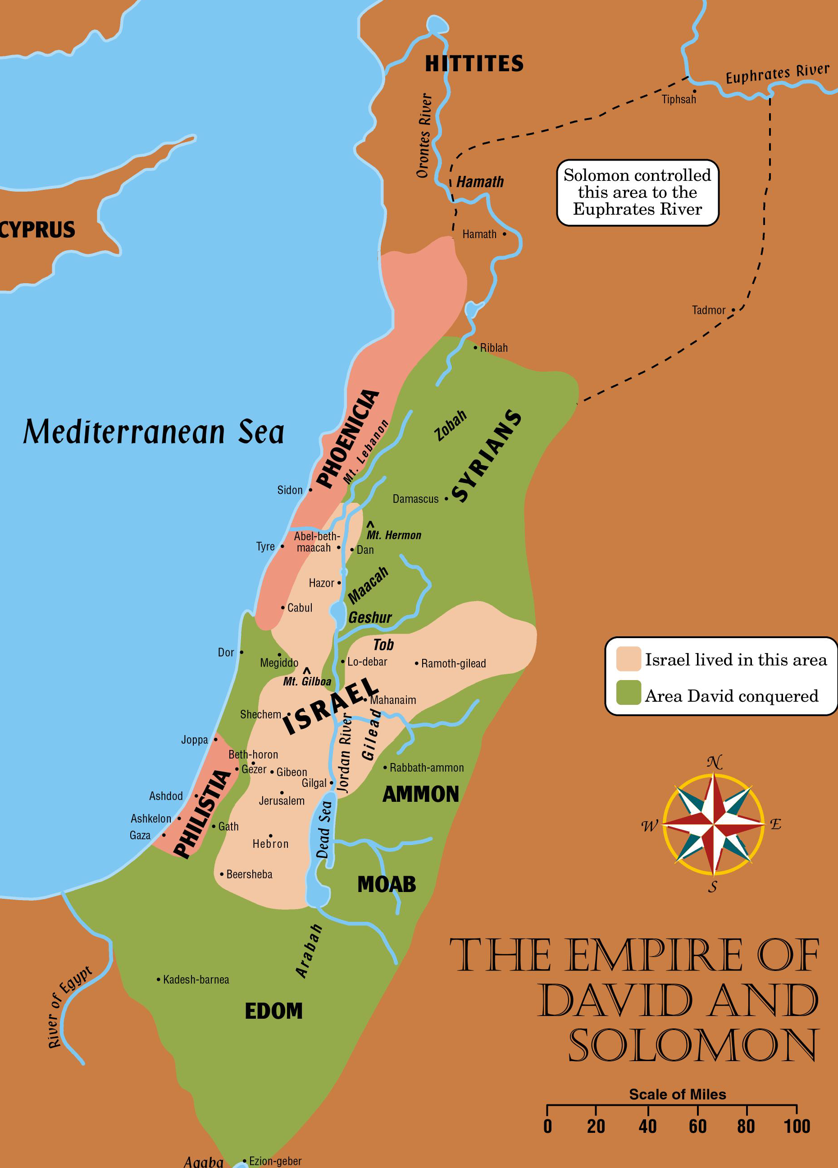

Slide 36
Zechariah (Israel) 6 months 2 Kings 15:8-12
Wicked
Worshiped the golden calves
4th descendant of Jehu to reign
Fulfilled prophecy (2 Kings 10:30)
Killed by Shallum
Murdered by his own people
Prophets:
Hosea

Slide 37
Shallum (Israel) 1 month 2 Kings 15:13-15
New Dynasty Begins
Wicked
Slain by Menahem
Murdered by his own people
Prophet:
Hosea

Slide 38
Menahem (Israel) 10 years 2 Kings 15:14-22
New Dynasty Begins
Prophet:
Hosea
Very cruel
Fought Tiphsah and Tirzah because they “opened not to him”
Ripped open the pregnant women
Israel invaded by Pul, king of Assyria
Forced to pay an enormous tribute
Enemies:
Pul of Assyria took the title of Tiglath-Pileser III

Slide 39
Pekahiah (Israel) 2 years 2 Kings 15:23-26
Wicked
Son of Menahem
Slain by Pekah, his captain
Murdered by his own people
Prophet:
Hosea
“my people are destroyed for lack of knowledge” (Hosea 4:6)

Slide 40
Pekah (Israel) 20 years 2 Kings 15:25-31; 16:1-5; 2 Chron 28:5-15
New Dynasty Begins
Prophets:
Hosea, Oded
Very wicked
Worshiped golden calves
Rebelled against Assyria
Made an alliance with Rezin of Syria for their mutual protection from Assyria
Pekah and Rezin began trying to force Judah to join their alliance
Jerusalem was attacked by Pekah and Rezin
Did not take the city but many killed and captives taken from Judah
Murdered by his own people
Enemies:
Tiglath-Pileser invades Syria, Israel, Phoenicia, Philistia

Slide 41
Jotham (Judah) 16 years 2 Kings 15:5, 32-38; 2 Chron 26:21; 27:1-9
Did that which was right in God’s sight
The people were corrupt
Subjugated the Ammonites
Prophets:
Isaiah, Micah

Slide 42
Ahaz (Judah) 16 years 2 Kings 16:1-20; 2 Chron 28:1-27
Terribly wicked king
Worshiped Baal
Burned his children in the fire to Molech
Judah invaded by Edom and the Philistines
Sent to the king of Assyria for help
Tiglath-pileser came against Damascus and took the city – killed Rezin
Began worshiping gods of Syria
Prophets:
Isaiah, Micah

Slide 43
Hoshea (Israel) 9 years 2 Kings 15:30; 17:1-18:1, 9-12
New Dynasty Begins
Prophet:
Hosea
Enemies:
So of Egypt, Shalmaneser V of Assyria besieged Samaria. Siege finished by Sargon II
Wicked – but not as bad as the kings before him
Became tributary to the king of Assyria
Made an alliance with So, king of Egypt
Rebelled against Shalmaneser king of Asyria
Samaria besieged by the Assyrians
Foreigners brought in from Babylon and other places. Mixed with the poor left in the land–became known as “Samaritans”
Israel
is
finished!

Slide 44
Hezekiah (Judah) 29 years 2 Kings 18:1-20:21; 2 Chron 28:27-32:33
Good king
Destroyed the idols
Trusted in the Lord
Cleansed the temple
Restored the daily sacrifices
Made the effort to renew the spiritual life of Judah
Great Passover feast kept
With those from Asher, Manasseh, and Zebulun attending
Prophets:
Isaiah, Micah

Slide 45
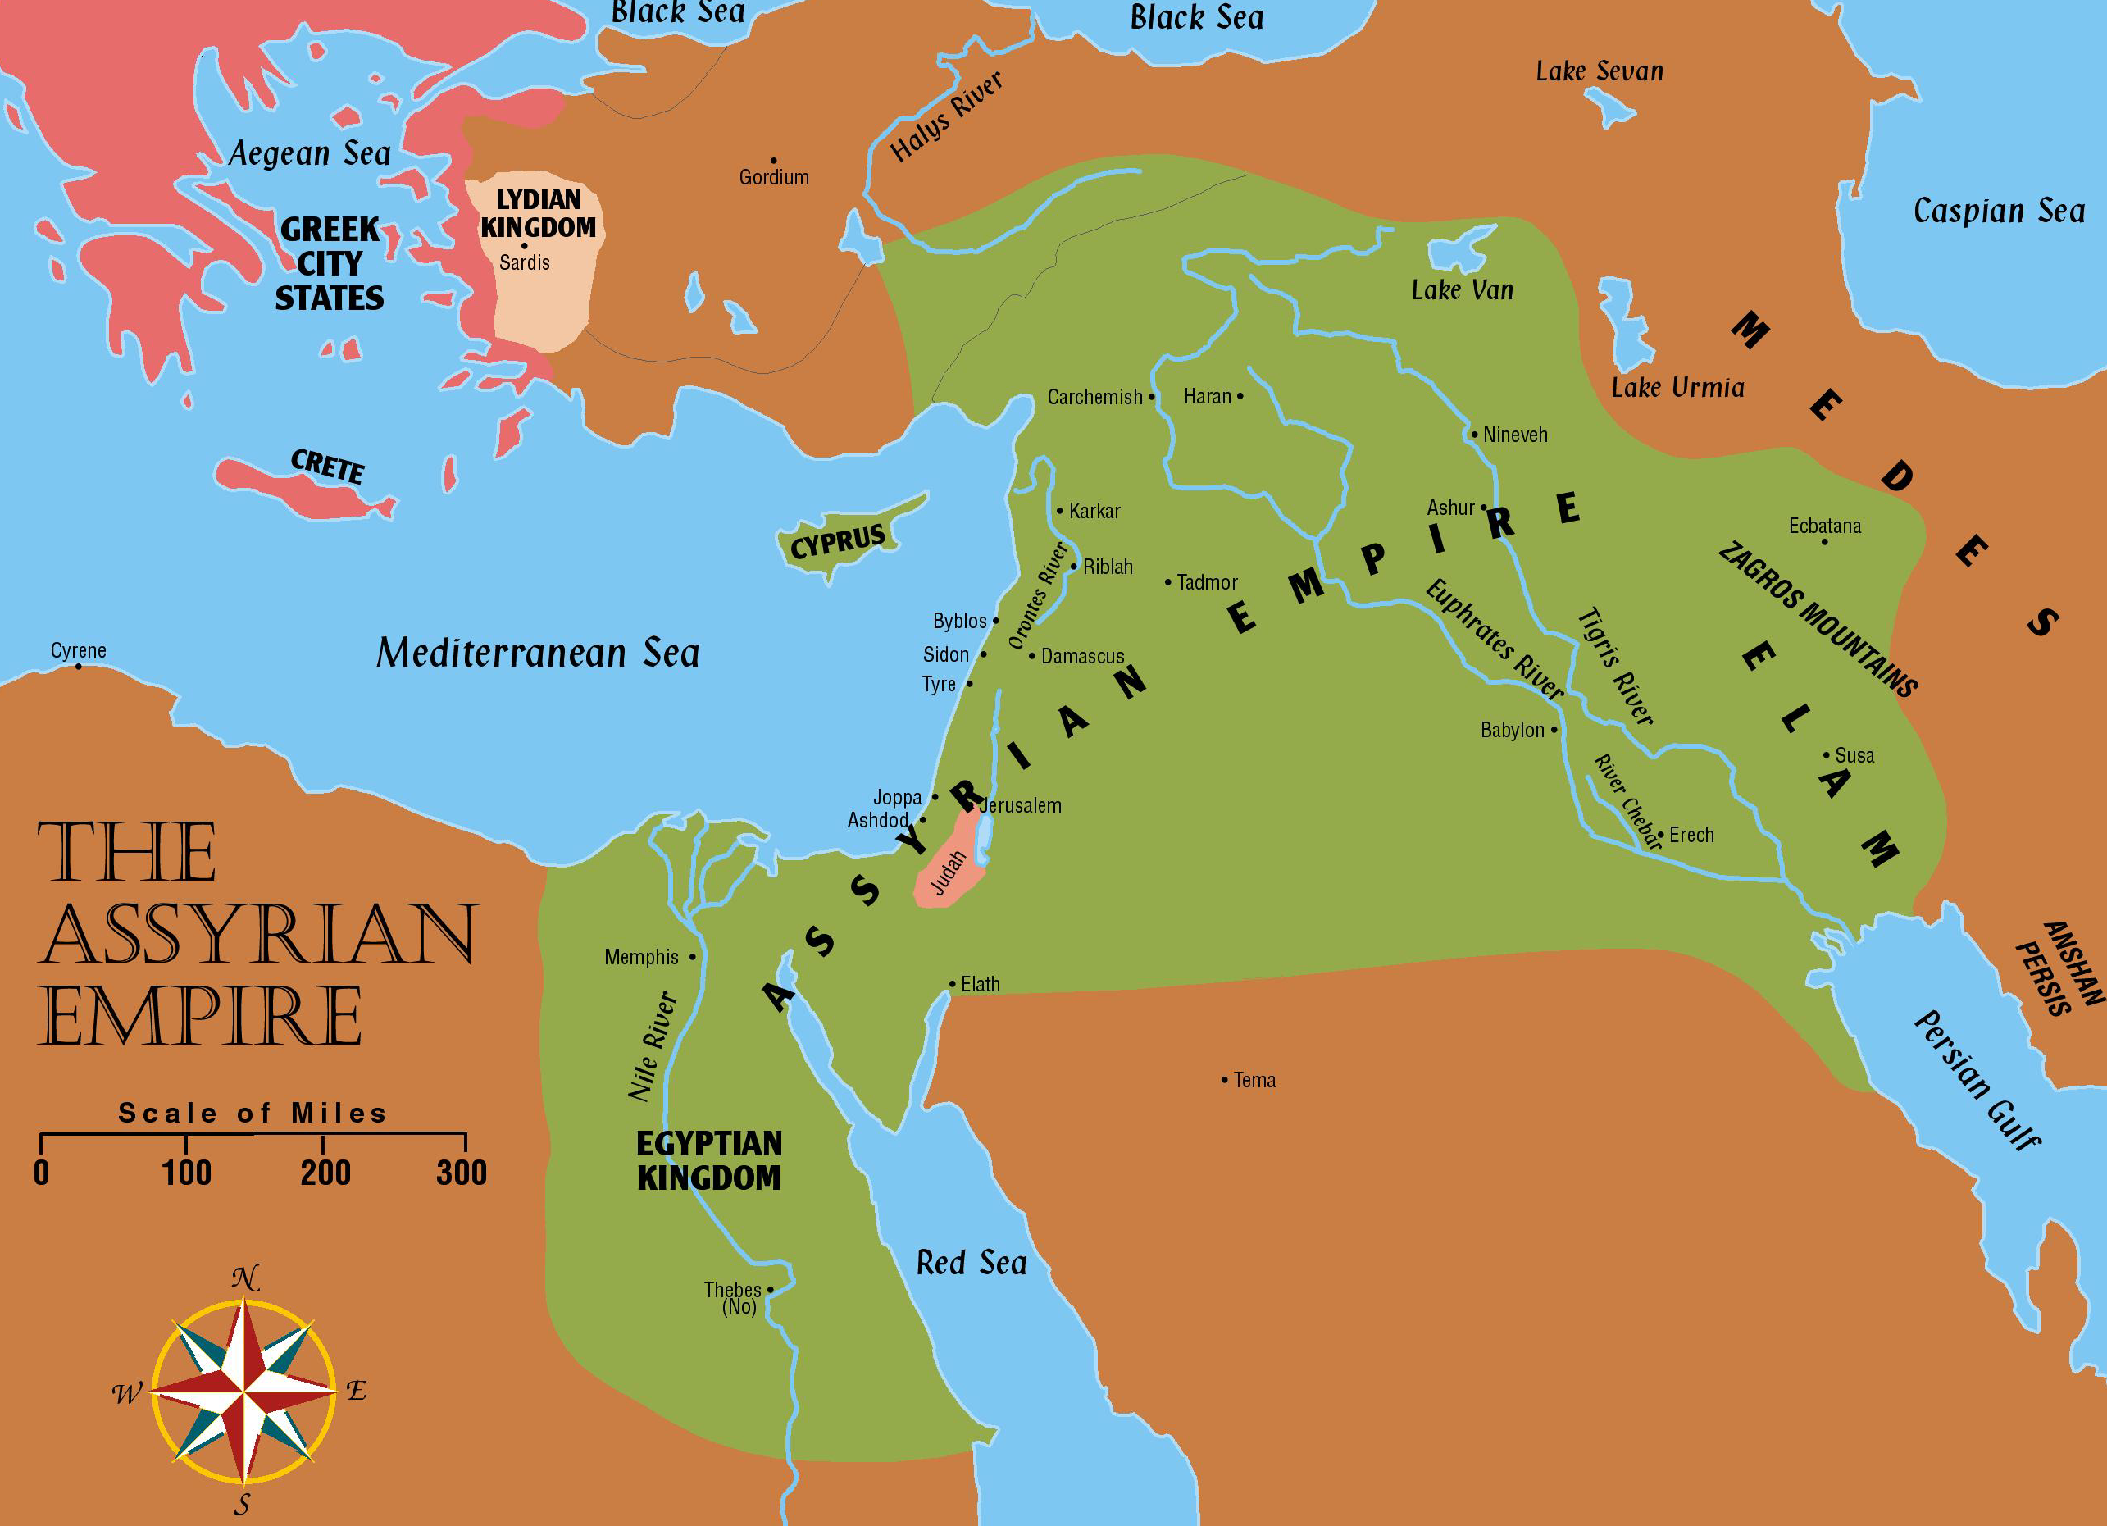
Chart of the Kings Part 3

Slide 46
Kings of Judah and Israel (3)
Judah (approx 697-586)
Hezekiah (Isaiah, Micah, Hosea)
Fits at the end of lesson 28 and the beginning of 29. He is the pivot king that bridges the periods of the divided kingdom and Judah alone
Manasseh (Isaiah)
Amon
Josiah (Zephaniah, Nahum, Jeremiah, Habakkuk)
Jehoahaz (Zephaniah, Jeremiah)
Jehoiakim (Jeremiah)
Jehoiachin (Jeremiah)
Zedekiah (Jeremiah, Ezekiel)
Good King
Worst King

Slide 47
Hezekiah (Judah) 29 years 2 Kings 18:1-20:21; 2 Chron 28:27-32:33; Isaiah 36-39
Prophets:
Isaiah, Micah, Hosea
In his 14th year, Sennacherib of Assyria came up against all the fenced cities of Judah and took them
Hezekiah prayed for help and God struck the Assyrian host with a plague
Hezekiah became ill and was first told he would die; then his life was extended 15 years (2 Kings 20:1-11)
Emissaries from Babylon came to visit Hezekiah. Showed them the treasures of Jerusalem. Isaiah rebuked him. Predicted that the treasures would be taken to Babylon
Enemies:
Sennacherib of Assyria,
Merodach-Baladan of Babylon

Slide 48
Manasseh (Judah) 55 years 2 Kings 21:1-18; 2 Chron 32:33-33:20
Very wicked
Built altars and set up image of Asherah in the house of God
Burned his sons in the fire
Dealt in witchcraft and related matters
Worse than the Amorites who were cast out before the Israelites in Joshua’s day
Was taken captive by the king of Assyria and put in prison in Babylon
Repented; prayed to God; and was allowed to come back to Jerusalem
Prophet:
Isaiah

Slide 49
Amon (Judah) 2 years 2 Kings 21:18-26; 2 Chron 33:21-25
Wicked like Manasseh
He did not repent
Killed by his own servants

Slide 50
Josiah (Judah) 31 years 2 Kings 21:26-23:30; 2 Chron 33:25-35:27
Prophets:
Zephaniah, Nahum, Jeremiah, Habakkuk
Prophetess Huldah:
“the destruction of Judah was inevitable; but postponed for Josiah’s sake”
Most likely the BEST king Judah ever had in its history
Judah’s destruction is still declared mainly because of the sins of Manasseh
He purged idols from Judah and Jerusalem and from the cities of Manasseh, Ephraim, Simeon, and Naphtali
Gave orders for the temple to be repaired
Workmen found a copy of the law of Moses
Josiah dismayed at the message
Assembled his people; read the law publicly; renewed the covenant with God

Slide 51
Josiah (Judah) - Continued 31 years 2 Kings 21:26-23:30; 2 Chron 33:25-35:27
Prophets:
Zephaniah, Nahum, Jeremiah, Habakkuk
Began a campaign to destroy idolatry
Defiled Topeth in the valley of the sons of Hinnom to stop the worship of Molech
Destroyed the high places in Jerusalem that Solomon had built for his heathen wives
Destroyed the shrine to the golden calf at Bethel fulfilling the prophecy of 1 Kings 13:1-3
He and those of his kingdom observed the greatest Passover since Samuel’s day
He was slain in battle with Pharaoh-Necho at Megiddo
Primary Enemy:
Assyria was in the process of falling to the Medes and Babylonians
Pharaoh-Necho of Egypt

Slide 52
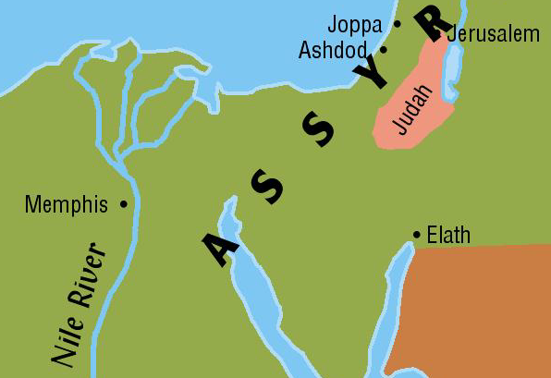
Jehoahaz (Judah) 3 months 2 Kings 23:31-34; 2 Chron 36:1-3
Very wicked
Son of Josiah – made king by the people
Taken as prisoner to Egypt where he died
Prophets:
Zephaniah, Jeremiah

Slide 53
Jehoiachim (Judah) 11 years 2 Kings 23:34-24:6; 2 Chron 36:4-8; Jer 22:18-19; 36:1-32
Prophets:
Jeremiah
Daniel, chosen to serve in the court of the kings of Babylon
Very wicked
Another son of Josiah – made king by Pharoah-Necho
Nebuchadnezzar of Babylon made Judah his tributary
Jehoiakim was loyal 3 years, then rebelled
Bands of Chaldeans, Arameans, Moabites, and Ammonites came up against Judah
Nebuchadnezzar besieged Jerusalem
Took captives and treasures from the city
Daniel was included in this group
Jeremiah predicts a 70 year captivity (25:8-11)
Primary Enemy:
Nebuchadnezzar of Babylon

Slide 54
Jehoiachin (Judah) 3 months 2 Kings 24:6-16; 25:27-30; 2 Chron 36:8-10; Jer 22:24-30
Wicked
Son of Jehoiakim
Nebuchadnezzar besieged Jerusalem
Jehoiachin and his officials surrendered and went out to the king
He and 10,000 craftsmen of Judah were deported to Babylon
Ezekiel the prophet was taken
Recognized by the Jews as the rightful heir to David’s throne in the lineage of Christ
Released from prison and allowed a place of honor among captive kings in Babylon
Prophets:
Jeremiah
Ezekiel, the prophet to the common Jew in Babylonian captivity

Slide 55
Zedekiah (Judah) 11 years 2 Kings 24:17-25:7; 2 Chron 36:10-23; Jer 34, 37, 52
Wicked
Another son of Josiah
Made puppet king by Nebuchadnezzar
Rebelled against Babylon – Jerusalem was besieged
Jerusalem fell; the walls were battered into rubble
City was burned; the temple was destroyed
All remaining treasures from temple were taken
Remaining people except the very poorest taken captive
Zedekiah’s sons and officials killed before his eyes
His eyes were put out and he was taken captive
Prophet:
Jeremiah
Jeremiah: “too late to avoid destruction.”

Slide 56
Gedaliah (Judah) 2 months 2 Kings 25:22-26; Jer 40:1-44:30
Not a king
Not of the royal blood line
Appointed as “puppet governor” over the remaining poor in the land
Set up headquarters at Mizpah
Jews who had fled to Moab, Ammon, Edom and other countries came back and harvested abundant crops
The King of Ammon hired Ishmael to murder Gedaliah – and he also killed many others
Remaining Jews fled to Egypt taking Jeremiah with them
Judah
is
fallen!

Slide 57
The Years of the Kings
Israel
Fell to the Assyrians in 721 B.C.
Judah
Fell to the Babylonians in 586 B. C.
Years of the Kings:
United Kingdom 1042 B.C. – 922 B.C. (120)
Divided Kingdom (Israel) 922 B.C. – 721 B.C. (201)
Divided Kingdom (Judah) 922 B.C. – 586 B.C. (336)
Total Years Under the Kings – 456
All dates are approximate

