Slide 1

The Love Song of King Solomon Book of Poetry & Book of Wisdom
By David Lee Burris
Notice: Significant # Slides of Open Source 2007 SITS Conference Archive

Slide 2
short study of the song of solomon
INTRODUCTION & METHODOLOGY
Dramatization of ROMANTIC LOVE
expository analysis Chapter & verse
timeless wisdom @marriage & dating

Slide 3
Written as poetry full of wisdom
Introduction & methodology
Dramatization Of Romantic Love
Expository Analysis Chapter & Verse
Timeless Wisdom @Marriage & Dating

Slide 4
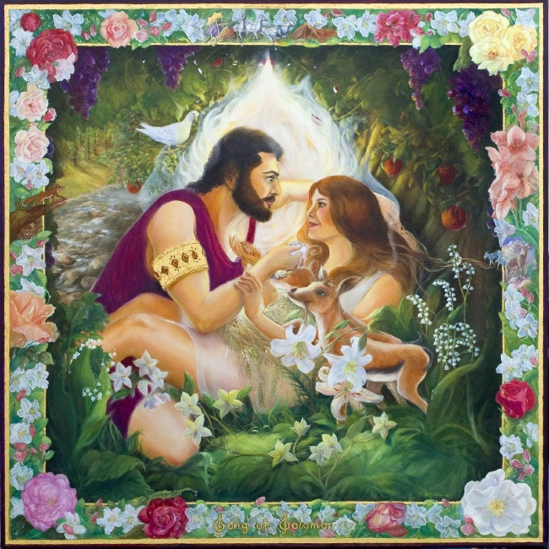

Slide 5


Slide 6
introductory INFORMATION

Slide 7
THE OUTLINE OF THE BOOK
A. THE INTRODUCTORY VERSE (1:1)
B. THE BEGINNING LOVE OF THE BRIDE FOR THE BRIDEGROOM (1:2–2:7)
C. THE FALTERING LOVE OF THE BRIDE FOR THE BRIDEGROOM (2:8–3:5)
D. THE DEVELOPING LOVE OF THE BRIDE FOR THE BRIDEGROOM (3:6–5:1)
E. THE MATURING LOVE OF THE BRIDE FOR THE BRIDEGROOM (5:2–7:13)
F. THE EVER-SEEKING LOVE OF THE BRIDE FOR THE BRIDEGROOM (8:1–14)
Gingrich, R. E. (2006). The Song of Solomon (p. 4). Memphis, TN: Riverside Printing.

Slide 8
THE CANONICITY OF THE BOOK
The books of “Esther”, “Job”, “Ecclesiastes”, and “The Song of Solomon” gained undisputed admission into the canon of Scripture at the Council of Jamnia in A. D. 90, only after a struggle of many years duration and only after the doubts and objections of many of God’s people had been overcome. Why the doubts concerning the inspiration of “The Song of Solomon”? Because the name of God occurs only once in the book and then only in a phrase of apposition (8:6, “which hath a most vehement flame”. K.J.V., should be translated “a flame of Jah”), and because the book seems to be wholly secular and even sensuous in its contents and devoid of that which is religious and spiritual. What are the factors which finally overcame the doubts of many of God’s Old Testament people, the Jews, concerning the book’s inspiration and gained for it a place in the canon of the Scriptures? These factors are two in number: (1) The seven-fold occurrence of Solomon’s name in the book, 1:1, 5; 3:7, 9, 11; 8:11, 12, and (2) the belief of many Jews that the book is an allegory depicting the mutual love of God and His people Israel.
Gingrich, R. E. (2006). The Song of Solomon (pp. 1–2). Memphis, TN: Riverside Printing.

Slide 9
The time between finding the perfect husband and the day of your marriage can seem like an eternity. It feels as if you are conscious of the passing of every second. Yet at the same time there is so much that needs to be done before the wedding that it seems impossible to have it all come together at the right moment. Even in these hectic days of a young woman’s life, God has given her guidance. She is not the first young woman who has been distraught over the hurry-up-and-wait days just prior to marriage.
The Song of Solomon is an unusual book. It is the only book that is written entirely from a woman’s point of view. It is also written as a play where we listen to the conversations of various people. It is only by listening carefully to what the people say that we can piece together the background events.
The name of the book comes from the first verse: “The song of songs, which is Solomon’s.” The phrase “song of songs” can either mean that it is the very best song (or poem) or it can mean that is a song (or poem) that is composed of smaller songs. It is likely the vagueness is due to the fact that both meanings are intended by the author because both statements are true. The Song of Solomon is both an excellent example of Hebrew poetry and it is a large poem composed of smaller poems. The phrase “which is Solomon’s” can mean it was either written by Solomon or written for Solomon. We don’t know which is intended. We do know that Solomon wrote many songs – a thousand and five as a matter of fact (I Kings 4:32). The uncertainty is whether this was one of them.
There are two things that make the Song of Solomon difficult to understand. First, since it is a poem, it uses images to depict ideas and emotions in our minds. However, these images are from a culture with which most of us are unfamiliar. To tell a young lady that her hair looks like a flock of goats coming down the mountain sounds like an insult to modern ears. In that culture goats were plentiful and generally were dark-haired. To see goats coming down the mountain in the distance where it would be hard to distinguish one goat from the other invokes a picture of dark, flowing hair that bounces and moves.
The second difficulty to understanding the Song of Solomon is that it is a play, but the parts for each of the players are not marked in the original text. The story is told by conversations. Most translations have sections marked with character names, such as “Solomon,” “Shulammite,” “Lover,” “Beloved,” “Daughters of Jerusalem,” and others. All of these markings are guesses by the translators. Where you or I may decide to place the divisions may be quite different. In fact, where you think the divisions should go will be heavily influenced by what you think the song is about. The divisions is not completely impossible to determine. Hebrew has male, female modifiers for pronouns and verbs. In addition there are tenses that allow you to determine if one person or several people are being discussed. By using a detailed lexicon, you can track when the modifiers and tenses change and thus determine when the speakers change.
There are two main views to the story in the Song of Solomon. The first is that the Song is a story of a young woman who is to wed the King of Israel. The story line goes from the time of her arrival in Jerusalem, through her engagement, her wedding and their first night together, to their first quarrel, and ends in their mature years together. The second view sees the story as a love triangle. The young woman is being wooed by the King of Israel, but she is really in love with a young shepherd from her hometown. She has a great deal of difficulty deciding whom to marry, but ultimately decides to follow her heart and marry the shepherd. I have studied both views, but I find the love triangle view awkward. It glosses over images that would be inappropriate feelings for an unmarried woman and requires using flashbacks (or flash-forwards in some cases) to keep the wrong things from happening at the wrong time. I find the first view simpler to understand, so this will be the view I will present. However, this is not to say that first view is without difficulties. Since this poem deals with King Solomon, many people have a hard time linking this song of love to a man who eventually has 700 wives and 300 concubines. Even within the song, the king is mentioned to already have 60 queens, 80 concubines, and an unspecified number of unmarried maidens in the wings. How could such a man truly love a country maiden from Israel?
One explanation that has been offered up is that Solomon’s marriages were mostly political arrangements (I Kings 3:1; 11:1-4). Though he loved his wives in his old age, at least at some point earlier in his life, Solomon did not treat his foreign wives with equal status to an Israelite (II Chronicles 8:11). While his many wives eventually lead Solomon astray, it is suggested that early on, Solomon’s wives were perhaps wives in name only and that the only wife that Solomon and the people truly viewed as his wife was the woman he married from his own nation. – La Vista Church of Christ

Slide 10
INTERPRETATIVE METHODOLOGY

Slide 11
Methods of Interpreting the Song
Allegorical (Jewish; Christian)
Typological
Anthological
Literal/Dramatic (Two Person; Three Person)

Slide 12

Allegory?
Anthology?

Slide 13
Allegory?
Christ and His Bride
KJV headings
Some of our hymns

Slide 14
Allegory?
Christ and His Bride
identity of the bride…
the individual believer
the church corporate
the Virgin Mary

Slide 15
Allegory?
Among the known advocates...
Hippolytus (died sometime after 235)
earliest known advocate
breasts (4:5) = the Old & New Covenants

Slide 16
Allegory?
Among the known advocates...
Origen (185 - c. 254)
his “rash act”
his commentary
examples of his interpretation...
Beams/rafters,
“describing the Church which is the spiritual house”
beams “those who protect the church”
“stronger ones…are called rafters”
Ergo, bishops = rafters & priests = beams
Little foxes, the "opposing forces and the wicked powers of demons who by means of base thoughts and perverted notions destroy the bloom of the virtues of the soul and ruin the fruit of faith"
The kisses of his mouth - “the words of faith and love and peace” that came from the mouth of Christ himself, contrasted with the kisses delivered by the angels and the prophets.
Ointments - the anointing of the Holy Spirit. LXX reads, "and the fragrance of your ointments is above all the spices." Origen took the spices to be the "words of the Law and the Prophets."
The daughters of Jerusalem - "the daughters of this earthly Jerusalem who, seeing the Church of the Gentiles, despise and vilify her"
Being dark - due to "the sun of Justice" having "looked askance" because of the Gentiles' "unbelief and disobedience"; "by reason of her former sins"
Our bed (NAS, ESV: “couch”) is the place we share with Christ.
The lily of the valley is Christ
The bride "represents the church gathered from the Gentiles"

Slide 17
Allegory?
Accounting for the historical dominance of the allegorical interpretation
Jewish interpretations
Metaphors in Scripture
Greek philosophy
Ascetic Gnosticism
Origen's bent

Slide 18
Allegory?
Evaluating the Allegorical Interpretation
Inconceivably Ignored by NT writers

Slide 19
Allegory?
Evaluating the Allegorical Interpretation
Garrett: "Fairly unambiguous allusions to love play appear in the text...Such language is simply inappropriate as a description of the love between God and his people, other biblical metaphors notwithstanding.”
Inconceivably Ignored by NT writers
But why??

Slide 20
Allegory?
Evaluating the Allegorical Interpretation
Inconceivably Ignored by NT writers
Ineffective
Can we criticize Origen without indicting ourselves?

Slide 21
Allegory?
Anthology?

Slide 22
Anthology?
THE ARGUMENT FOR THE ANTHOLOGY VIEW:
(no doubt this is too simplistic)
drama didn't exist among Jews
Seems similar to some (Syrian, Egyptian) love poems of the time

Slide 23
AGAINST THE ANTHOLOGY VIEW:
THE EVIDENCE THAT THE SONG IS A LITERARY UNIT
Difficulty of making this argument...
Nonetheless...
Anthology?

Slide 24
AGAINST THE ANTHOLOGY VIEW:
THE EVIDENCE THAT THE SONG IS A LITERARY UNIT
Anthology?
Seven distinct units that seem to be related and arranged symmetrically
Identified by...
theme of Separation/Union
by distinctive content (e.g., dialogue, event, etc.)

Slide 25
AGAINST THE ANTHOLOGY VIEW:
THE EVIDENCE THAT THE SONG IS A LITERARY UNIT
Anthology?
Seven distinct units that seem to be related and arranged symmetrically
Arranged symmetrically
opening words of mutual love and desire
  young man's invitation to the young woman
    young woman's nighttime search
      their wedding day
    young woman's nighttime search
  young woman's invitation to the young man
closing words of mutual love and desire

Slide 26
AGAINST THE ANTHOLOGY VIEW:
THE EVIDENCE THAT THE SONG IS A LITERARY UNIT
Anthology?
Seven distinct units that seem to be related and arranged symmetrically
Arranged symmetrically
Related by imagery, phrases, themes
imagery, e.g. “gazelle”
phrases: adjuring the daughters of Jerusalem
theme of city vs. country

Slide 27
AGAINST THE ANTHOLOGY VIEW:
THE EVIDENCE THAT THE SONG IS A LITERARY UNIT
Anthology?
Seven distinct units that seem to be related and arranged symmetrically
Arranged symmetrically
Related by imagery, phrases, themes
Pleasant Countryside
opening words of mutual love and desire
  young man's invitation to the young woman
    young woman's nighttime search
      their wedding day
    young woman's nighttime search
  young woman's invitation to the young man
closing words of mutual love and desire
troubled city night
troubled city night
Pleasant Countryside

Slide 28
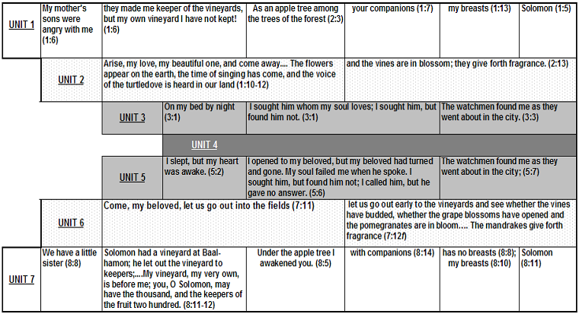
AGAINST THE ANTHOLOGY VIEW:
THE EVIDENCE THAT THE SONG IS A LITERARY UNIT
Anthology?
Seven distinct units that seem to be related and arranged symmetrically
Arranged symmetrically
Related by imagery, phrases, themes

Slide 29
Allegory?
Anthology?
CONCLUSION: The Song…
...celebrates romantic, sexual love.
...is a unit, composed of several parts designed to fit together as a whole.
...the case for unity seems to point to a climactic point at the center of the Song which raises questions I cannot yet answer.

Slide 30

The song of Solomon answers questions about romantic love

Slide 32
A challenging book!

Slide 33
Origen & Jerome Reported That Old Testament Students Traditionally Delayed Reading The Song of Solomon Until Reaching The Age of Thirty

Slide 34
A challenging book!
Approached four ways

Slide 35
Methods of Interpreting the Song
Allegorical (Jewish; Christian)
Typological
Anthological
Literal/Dramatic (Two Person; Three Person)

Slide 36
A challenging book!
Approached four ways
A biblical approach (2Tim. 3:16-17) requires identifying the main characters

Slide 37
The Consensus View:
  Solomon and
  the Shulammite

Slide 38
The Consensus View:
  Solomon and
  the Shulammite
A brief history:

Slide 39
The Consensus View:
  Solomon and
  the Shulammite
A brief history:
the earliest Jewish approach

Slide 40
The Consensus View:
  Solomon and
  the Shulammite
A brief history:
the earliest Jewish approach
the early church did the same

Slide 41
The Consensus View:
  Solomon and
  the Shulammite
A brief history:
the earliest Jewish approach
the early church did the same
there have been variations

Slide 42
The Consensus View:
  Solomon and
  the Shulammite
A brief history:
the earliest Jewish approach
the early church did the same
there have been variations
some suggested a drama

Slide 43
The Consensus View:
  Solomon and
  the Shulammite
A brief history:
the earliest Jewish approach
the early church did the same
there have been variations
some suggested a drama
from the beginning, expositors saw only two characters: Solomon and the Shulammite

Slide 44
The Consensus View:
  Solomon and
  the Shulammite
Historically, the consensus

Slide 45
The Consensus View:
  Solomon and
  the Shulammite
Historically, the consensus
This is the plain reading of the text

Slide 46
The Consensus View:
  Solomon and
  the Shulammite
Historically, the consensus
This is the plain reading of the text
the Shulammite addresses one suitor

Slide 47
The Consensus View:
  Solomon and
  the Shulammite
Historically, the consensus
This is the plain reading of the text
the Shulammite addresses one suitor
there is no conflict/competitive language

Slide 48
The Consensus View:
  Solomon and
  the Shulammite
Historically, the consensus
This is the plain reading of the text
the Shulammite addresses one suitor
there is no conflict/competitive language
in the absence of such language, a simple reading of the text implies only two main characters

Slide 49
Song of Songs
Problems with the 2-character approach.
Solomon is never pictured as a shepherd.
Solomon’s polygamy
--60 wives/80 concubines, 6:8.
--Contributing cause to apostasy 1Kgs.11
--Cf. Eccl. 7:28
--Cf. SoS 5:9.
--Unique, exclusive love 2:16; 6:3.
--“Friendship factor” of 5:16.
Notes:
Is this book used by God to show his marvelous affection for this girl who is to become number 61?
Solomon’s many wives are mentioned as a contributing cause to his apostasy (1 Kings 11:4ff.)
“Now the Lord was angry with Solomon…” (v. 9).
Because you have done this, and you have not kept My covenant and My statutes, which I have commanded you, I will surely tear the kingdom from you…” (v.11).
cf. Nehemiah’s summary statement: “Did not Solomon king of Israel sin regarding these things? Yet among the many nations there was no king like him, and he was loved by his God, and God made him king over all Israel; nevertheless the foreign women caused even him to sin” (13:26).
If the book is about Solomon’s wooing of yet another wife, would this not seem to be at least a passive endorsement of Solomon’s polygamy?
Consider the import of Eccl. 7:28: “which I am still seeking but have not found. I have found one man among a thousand, but I have not found a woman among all these.”
Is he using poetic license, hyperbole?
Did the woman who was so wonderful in Song of Solomon fall out of favor with him?
Consider also the question asked by the “daughters of Jerusalem”: “How is your beloved better than others, most beautiful of women? How is your beloved better than others, that you charge us so?” (5:9 NIV).
Can you imagine this question being posed in regard to Solomon, with all his fame, riches, impressive building projects, and wisdom?
One could answer that since this is poetry, it just furnished the occasion for the woman to enumerate his wonderful qualities.
There is a unique, special, and exclusive kind of love described.
“My beloved is mine, and I am his” (2:16; 6:3).
Does not this lose effectiveness if taken to mean, “My beloved is mine (and 60 wives and 80 concubines) and I am his (as well as are the aforementioned women).
“I am my beloved’s, And his desire is for me” (7:10).
Again, how is this something special if his desire is on the way to number a thousand women?
Likewise, consider the “friendship factor” of 5:16: “This is my beloved, and this is my friend, O daughters of Jerusalem.”
If Solomon is intended, that friendship would seem to be very limited and short-lived.
This does express God’s design in marriage.
The adulterous woman “leaves the companion of her youth And forgets the covenant of her God” (Prov. 2:17).
Would Solomon truly be able to exemplify this important aspect of marriage?

Slide 50
The Consensus View:
  Solomon and
  the Shulammite
A New Proposal:
  A love triangle

Slide 51
The Consensus View:
  Solomon and
  the Shulammite
A New Proposal:
  A love triangle
“Solomon loves the Shulammite who loves the shepherd”

Slide 52
The Consensus View:
  Solomon and
  the Shulammite
A New Proposal:
  A love triangle
Some problems with this view:

Slide 53
The Consensus View:
  Solomon and
  the Shulammite
A New Proposal:
  A love triangle
Some problems with this view:
  No real textual evidence for existence of third character

Slide 54
The Consensus View:
  Solomon and
  the Shulammite
A New Proposal:
  A love triangle
Some problems with this view:
  The Shulammite never resists a lover’s advances

Slide 55
The Consensus View:
  Solomon and
  the Shulammite
A New Proposal:
  A love triangle
Some problems with this view:
  This view turns Solomon into a “villain”

Slide 56
The Consensus View:
  Solomon and
  the Shulammite
A New Proposal:
  A love triangle
Some problems with this view:
  This view makes Solomonic authorship virtually impossible

Slide 57
The Consensus View:
  Solomon and
  the Shulammite
A New Proposal:
  A love triangle
Some problems with this view:
  Without dramatic arrangement, this view is unsustainable

Slide 58
The Consensus View:
  Solomon and
  the Shulammite
A New Proposal:
  A love triangle
Some problems with this view:
  There is no obvious plot or storyline in the book

Slide 59
The Consensus View:
  Solomon and
  the Shulammite
A New Proposal:
  A love triangle
Some problems with this view:
  Distinguishing the male speakers from each other is highly subjective

Slide 60
The Consensus View:
  Solomon and
  the Shulammite
A New Proposal:
  A love triangle
Some problems with this view:
  Additionally, there are problems encountered in the text itself

Slide 61
Song of Songs
Evidence for the 3-character approach.
Solomon:
--1:4: “The king has brought me into his chambers.”
--1:5: “Like the curtains of Solomon.”
--1:12: “While the king was at his table, My perfume gave forth its fragrance.
--3:7: “Behold, it is the traveling couch of Solomon.”

Slide 62
Song of Songs
Evidence for the 3-character approach.
Shulammite:
--6:13: “Come back, come back, O Shulammite; Come back, come back, that we may gaze at you! Why should you gaze at the Shulammite, As at the dance of the two companies?”
--Young’s Analytical Concordance defines the term “Shulammite” as, “A female inhabitant of Shulem (or Shunem), in Issachar” (883).

Slide 63
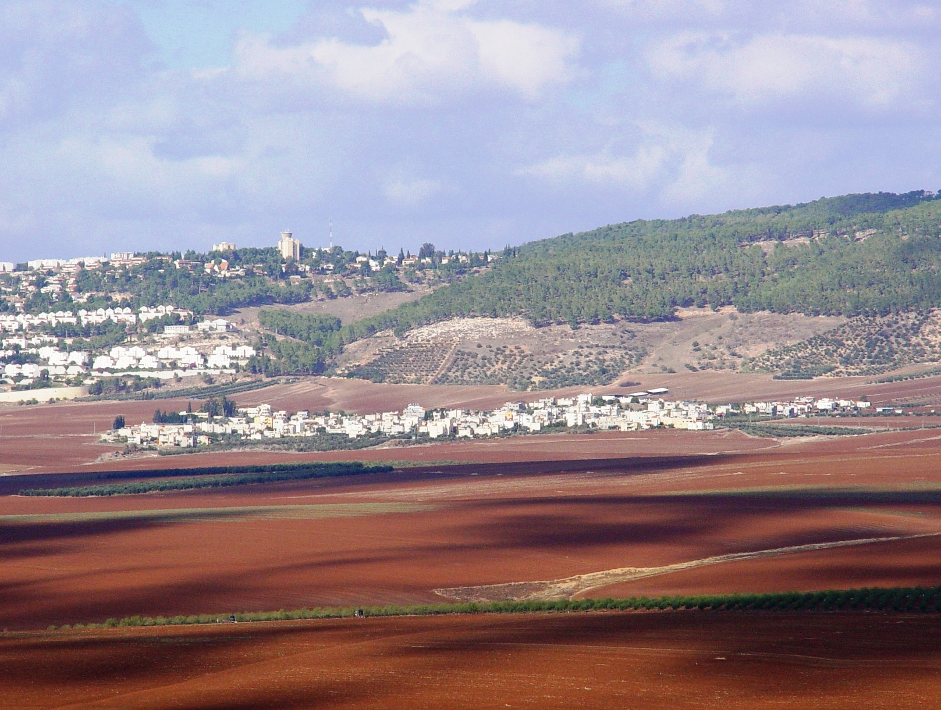

Slide 64
The town of Shunem was also known as Shulem, due to the common interchange between n (n) and l (l) in in Hebrew (Aharoni, 123), as seen in Eusebius' Onomasticon in which Shunem = Shulem
Notes:
Throughout the book a young woman is speaking, or being spoken to.

Slide 65
Song of Songs
Evidence for the 3-character approach.
Shepherd.
--1:7 Tell me, O you whom my soul loves, Where do you pasture your flock, Where do you make it lie down at noon? For why should I be like one who veils herself Beside the flocks of your companions?
--Response, 1:8: If you yourself do not know, Most beautiful among women, Go forth on the trail of the flock And pasture your young goats By the tents of the shepherds.

Slide 66
Song of Songs
Evidence for the 3-character approach.
Shepherd.
--2:16: My beloved is mine, and I am his; He pastures his flock among the lilies.
--cf. NKJV: My beloved is mine, and I am his. He feeds his flock among the lilies.
--“The Hebrew participle haro’eh hf@rohA occurs nearly one hundred times, and is the common term for feeding domestic animals (cf. 1:7f.), i.e. performing the function of a shepherd” (Carr.102).

Slide 67
Song of Songs
Evidence for the 3-character approach.
Shepherd.
--6:3 "I am my beloved's and my beloved is mine, He who pastures his flock among the lilies.“
--cf. NKJV: I am my beloved's, And my beloved is mine. He feeds his flock among the lilies.
--Also, RSV: I am my beloved's and my beloved is mine; he pastures his flock among the lilies.

Slide 68
Song of Songs
How some dismiss the 3-character approach.
“The bride is one brought up on country life, and who in the purity and simplicity of her heart addresses even Solomon himself as her shepherd.”
“In love every groom is King Solomon, a shepherd, and even a gazelle; and every bride is a princess and country maiden.”

Slide 69
Song of Songs
How some dismiss the 3-character approach.
“King Solomon, disguised as a shepherd, visited his vineyards, saw the Shulamite, and fell in love with her (1:1-2:7) She pictures their times together as a rich banquet. The next spring, he came to her and proposed marriage, and she accepted, but he had to go away for a time, promising to come back. While he was absent, she dreamed about him (3:1-5). Then he returned and revealed that he was King Solomon” (Wiersbie.541).

Slide 70
Song of Songs
  In the Royal Tents in Issachar—Love Introduced, 1:1-3:5.
  Song 6:11,12, May help explain how the Shulamite was taken to be presented to Solomon: “I went down to the garden of nuts To see the verdure of the valley, To see whether the vine had budded And the pomegranates had bloomed. 12 Before I was even aware, My soul had made me As the chariots of my noble people. (NKJV). Dewelt: She was taken to the palace of King Solomon. Perhaps this palace was one of his northern summer houses…” (317).

Slide 71
Song of Songs
In the Royal Tents in Issachar—Love Introduced, 1:1-3:5.
1:7: Remembering her shepherd
--He is in her thoughts.
1:8: The chorus of women/daughters of Jerusalem.
--1:9-15 Solomon’s first advance.
--1:15-2:1 “This voice is that of the shepherd…she is remembering how he would speak to her” (Waldron.218).

Slide 72
Song of Songs
In the Royal Tents in Issachar—Love Introduced, 1:1-3:5.
-- 2:3-6 Shulamite continues reminiscing about the shepherd
--One can have a banquet with raisins and apples if there is true love (2:5).
--2:7-17 A soliloquy.
--3:1-5 Shulammite relates her dream.

Slide 73
Song of Songs
The Royal Procession Entering Jerusalem, 3:6-11
--3:6 Question calls attention to the entrance of Solomon
--3:7 His body guards.
--3:9-11 His wealth, seen in sedan chair, crown.

Slide 74
Song of Songs
In The Royal Palace in Jerusalem—Love Tested, 4:1-8:4.
--4:1-5 Solomon’s second effort, and the response.
--4:6 Shulamite speaking
--4:7-15-5:1 The shepherd speaks in her memory.
--5:2-8 Shulammite relates 2nd dream.

Slide 75
Song of Songs
In Issachar: the Shepherd and Shulamite—Love Victorious, 8:5-14.
--8:5a: Setting is now back in Issachar.
--8:5b Shepherd speaks.
--8:6-7 Shulammite speaks.
--Discusses characteristics of love.
--Solomon is pictured at the end of the Song as one who buys and sells love (Longman, NICOT.41).
--8:11-12 “Solomon could keep his wealth, his vineyards, his servants, and his fruits! I am not for sale!”

Slide 76
Read it like watching a musical.
We must pay close attention to what the characters are saying to figure out what is going on.
While at the table, the king smells her perfume (Song of Solomon 1:12). They are having a formal dinner together.
They are walking among houses of “cedars” and “cypresses” (Song of Solomon 1:17). They are walking among the trees in the spring.
The woman seeks her love on her bed at night and cannot find him (Song of Solomon 3:1). She is about to have a dream.
The dialogue in the book also goes back and forward so much that it can be confusing (see the transition between chapters 1-2). However, some Bibles help you with this problem by identifying each speaker above the text in the margin.

Slide 77
The song of Solomon chapter-by-chapter

Slide 78


Slide 79
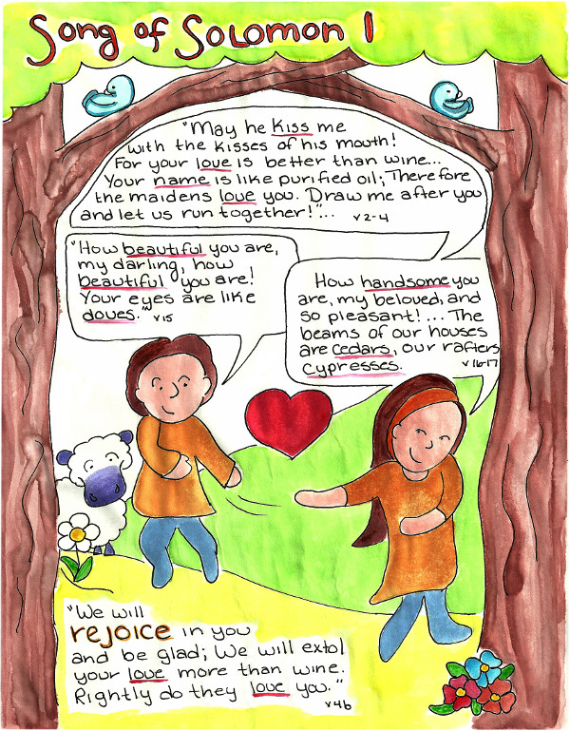

Slide 80
“Rightly Do They Love You” (Song of Solomon 1)
A. Introduction to the Maiden, the Beloved, and the Daughters of Jerusalem (1:1–6)
1. Title: The Song of All Songs (1)
2. Opening Words of the Maiden (2–4a)
3. An Interjection from the “Daughters of Jerusalem” (4b)
4. The Shulamite Enters the King’s Chamber (4c)
5. The Daughters of Jerusalem Remark on the Couple and Their Love (4d)
6. The Shulamite Considers Her Own Shortcomings in Appearance (4e–6)
B. Endearing Words between Young Lovers (1:7–17)
1. The Shulamite Speaks to Her Beloved (7)
2. The Beloved Praises His Lover (8–10)
3. The Daughters of Jerusalem Offer Gifts to the Shulamite (11)
4. The Shulamite Describes How Precious Her Beloved Is to Her (12–14)
5. The Beloved Praises the Beauty of the Shulamite (15)
6. The Shulamite Responds with Kind Words (16–17)
Guzik, D. (2013). Song of Solomon. Santa Barbara, CA: David Guzik.

Slide 81

CHAPTER 1 La Vista Church of Christ Commentary
PARAPHRASE SUMMARY OF CHAPTER VERSES
Our opening scene is the arrival of a young woman.
²“May he kiss me with the kisses of his mouth!
For your love is better than wine.
³“Your oils have a pleasing fragrance,
Your name is like purified oil;
Therefore the maidens love you.
⁴“Draw me after you and let us run together!
The king has brought me into his chambers.”

Slide 82
CHAPTER 1 La Vista Church of Christ Commentary
PARAPHRASE SUMMARY OF CHAPTER VERSES
The original text does not state which actors are expressing which lines. However, this does not mean the division of the text is totally arbitrary. We can make some very sound guesses based on the pronouns and phrases being used.
You will find most translations assign these lines to The Shulammite, The Bride, or The Beloved. The name Shulammite comes from Song of Solomon 6:13. Some commentators speculate that this means the young woman came from the region or town of Shulam. However, if this is true, it is the only place in the Scriptures that this place is mentioned and we are unable to locate it through archeology. A better explanation for the name is to notice that Solomon’s name means “peace” in Hebrew with a male connotation (Shelomoh). The female form of the word for peace is shulammith. In other words, Shulammith would be a way of saying “Mrs. Solomon.” This would also explain why she is not so named earlier in the Song, as she does not marry Solomon until the end of chapter 3.
From her opening lines, we see a giddy young lady who is madly in love. She wants nothing more than to smooch and run through the fields with her man. Everything about him pleases her. She likes his cologne. She likes his good reputation, and she is not the only one who perks up when his name is mentioned. A good reputation is an important quality. It is a better indicator of the worth a person than his looks or butterflies in your stomach.
Even more subtly we see something of this young woman’s character. She holds what we would call a traditional view of the roles of men and women. Man leads and a woman follows.
Solomon has brought the young woman to his palace for their engagement period. Traveling even short distances was difficult in those days and a king is constantly busy. If the two of them are to get acquainted, she would have to live nearby.
The chambers mentioned are not Solomon’s personal bed chambers. They refer to Solomon’s palace, which has many rooms (or chambers). Likely, the young woman was brought to the woman’s section of the palace where she is introduced to the other ladies of the court.

Slide 83
CHAPTER 1 La Vista Church of Christ Commentary
PARAPHRASE SUMMARY OF CHAPTER VERSES
⁴ “We will rejoice in you and be glad;
We will extol your love more than wine
Notice the change from singular pronouns to plural pronouns. This indicates we have shifted to a new set of players. They are named in Song of Solomon 1:5 as the daughters of Jerusalem. As I just stated, these are the ladies of the court, the wives of Solomon’s political marriages, potential brides for future arrangements, as well as the wives of Solomon’s noblemen who attended him at court (Song of Solomon 6:8).
Imagine if you were one of many wives to a great king and the king has just introduced you to his next bride-to-be. But this is not just the bride of another politically arranged marriage. No, this woman would become the official queen of the king. How would you greet her? You probably would greet her with a pasted-on smile and a few polite words. They don't speak to the young woman. The "you" in verse 4 refers to a male; thus, they are talking to Solomon telling him how happy they are for him. They then say they tell everyone how great a lover he is because his love is intoxicating. Did you notice that they just stole the girl's line and applied it to themselves? They are basically saying, "We had Solomon's love first!"

Slide 84
CHAPTER 1 La Vista Church of Christ Commentary
PARAPHRASE SUMMARY OF CHAPTER VERSES
We will learn more about their true feelings about this young upstart a bit later. However, the next few lines return to the young woman and let us see her discomfort in being in the presence of so many fine people.
⁴ “Rightly do they love you.
⁵ “I am black but lovely,
O daughters of Jerusalem,
Like the tents of Kedar,
Like the curtains of Solomon.
⁶ “Do not stare at me because I am swarthy,
For the sun has burned me.
My mother’s sons were angry with me;
They made me caretaker of the vineyards,
But I have not taken care of my own vineyard.”

Slide 85
CHAPTER 1 La Vista Church of Christ Commentary
PARAPHRASE SUMMARY OF CHAPTER VERSES
The young woman mentioned in verse 3 that all the maidens loved the king and now that she has seen the palace and the behavior of these fine women in the presence of Solomon, she can see that their love for him is just. In fact, all of these fineries are making her aware of her humble appearance.
While she admits to being lovely in form, the young woman is painfully aware of her deep tan from working outdoors in a vineyard. In those days, most people would be dark from exposure to the sun. Only noblewomen, who did not have to work for a living, could afford to stay inside. It was considered a sign of wealth to have pale skin. In contrast to the light skin of these women, our young bride-to-be is as dark as the heavy cloth used for tents by the people of Kedar or the curtains used in Solomon’s palace to block out the sun in the early morning.
Not only is the young woman embarrassed by her looks, but she can feel the eyes of these maidens comparing her looks to their own. The young woman feels the need to explain herself to these noble ladies. She was forced to work in a vineyard by her stepbrothers. We assume they were not full brothers because they are called her mother’s sons. Perhaps, as often happens in families where the siblings are not full-blood relatives, the brothers’ treatment of their half-sister was less than ideal or even kind. Instead of setting her aside as a treasure to be married-off one day, they forced her to pull her own load in supporting the family. The fact that she had to work did not give her time to take care of her appearance.

Slide 86
CHAPTER 1 La Vista Church of Christ Commentary
PARAPHRASE SUMMARY OF CHAPTER VERSES
One of the symbols used frequently in the Song of Solomon is that of a vineyard. Vineyards are places of cool beauty in hot countries such as Israel, but they require a lot of maintenance to achieve their full potential. One’s own vineyard is an allusion to your own body, which can also be a thing of beauty, but requires care to reach its full potential.
Now, before you get feeling too sorry for this young woman, we will learn by the end of the Song that the reason she and Solomon meet was because the vineyard she worked in just happened to be owned by the king. It was because the king noticed a beautiful, industrious woman in his vineyard that this young woman eventually became engaged and married to the mighty King Solomon. At this early time, she sees her forced labors as a detriment, but when she matures she will see the benefit that came from her stepbrothers’ decision.

Slide 87
CHAPTER 1 La Vista Church of Christ Commentary
PARAPHRASE SUMMARY OF CHAPTER VERSES
⁷ “Tell me, O you whom my soul loves,
Where do you pasture your flock,
Where do you make it lie down at noon?
For why should I be like one who veils herself
Beside the flocks of your companions?”

Slide 88
CHAPTER 1 La Vista Church of Christ Commentary
PARAPHRASE SUMMARY OF CHAPTER VERSES
Before Solomon leaves her, his beloved asks him where he takes his noon break. The reference to his flocks could be just poetic imagery or a figurative reference to Solomon’s duties among his people – his flock, or it could be a literal reference to some sheep Solomon personally tended. It was typical in those days for kings to be expected to have a trade (II Kings 3:4). Saul in his early kingship was once found driving oxen (I Samuel 11:5). Perhaps Solomon kept sheep in his younger days before David selected him as his successor and he continued to watch a flock for the peace it gave him. We do know that Solomon owned herds (Ecclesiastes 2:7). He also was a “hands-on” king, getting personally involved in his projects (Ecclesiastes 2:11). (See the later discussion on Song of Solomon 6:2).

Slide 89
CHAPTER 1 La Vista Church of Christ Commentary
PARAPHRASE SUMMARY OF CHAPTER VERSES
Solomon’s fiancee is concerned about appearance. She doesn’t want to be seen wandering aimlessly around like a prostitute looking for hire.
The outfit of a prostitute varies greatly by region and time period. During biblical times, prostitutes wore veils over their faces so they could not be readily identified (Genesis 38:14-15). Shepherding can be a lonely business with long stretches of nothing to do but watch sheep graze. Prostitutes had a steady market among the shepherds and were often seen wandering the hillsides where the sheep grazed.
The young woman had enough concern about her appearance compared to the ladies of the court. She doesn’t want to leave the wrong impression about her character among those who might have a chance to see her.

Slide 90
CHAPTER 1 La Vista Church of Christ Commentary
PARAPHRASE SUMMARY OF CHAPTER VERSES
⁸ “If you yourself do not know,
Most beautiful among women,
Go forth on the trail of the flock
And pasture your young goats
By the tents of the shepherds.

Slide 91
CHAPTER 1 La Vista Church of Christ Commentary
PARAPHRASE SUMMARY OF CHAPTER VERSES
Given the nature of this answer, I have a hard time imagining this young woman’s love-of-her-life saying this, despite many translators attributing the remark to Solomon. The remark is more fitting of a flock of jealous women who see their chance to put the newcomer in her place.
They basically said, “Well, if you don’t know how to find the king on his break, you just take that trail over there that goes out to the pasture land where the other shepherds are. Oh, and don’t forget to bring your goats with you.” I can just imagine the insincere grins on the women’s faces.
Most common people did not carry money around with them. Instead, they usually bartered for items and services, trading what they had for something someone else possessed. The typical payment for the use of a prostitute was a young goat (Genesis 38:16-18). One could often spot a prostitute by the flock of small goats that followed her.
Our young woman was concerned about the proper protocol to see the king on his noon break and the advice she receives is the very thing she wants to avoid. These women are out to embarrass the young maid and embarrass her well!
Fortunately, Solomon rescues his beloved bride-to-be. In front of these grand and haughty women, Solomon praises the beauty of his beloved.

Slide 92
CHAPTER 1 La Vista Church of Christ Commentary
PARAPHRASE SUMMARY OF CHAPTER VERSES
⁹ “To me, my darling, you are like
My mare among the chariots of Pharaoh.
¹⁰ “Your cheeks are lovely with ornaments,
Your neck with strings of beads.”

Slide 93
CHAPTER 1 La Vista Church of Christ Commentary
PARAPHRASE SUMMARY OF CHAPTER VERSES
One of the phrases that Solomon always uses to refer to his fiancee is “my darling” or “my love.” Now some of you may not think it fabulous to be compared to a horse, but Solomon is referring to the lead horse in the king of Egypt’s parade chariot. Pharaoh's chariot would be pulled by the finest stallions in Egypt, but to get all those stallions to behave, a mare would be placed at the front. The stallions will go wherever the mare goes. First impressions are important and the mare chosen to lead the team drawing Pharaoh’s chariot was the finest mare that could be found anywhere. Here she was concerned about how poorly she looked among all these fine women and Solomon said she was the most beautiful among rare beauties! She had compli-mented Solomon on the fact that all the young ladies loved him. Now Solomon is hinting that all the young men are watching wherever she goes.
He goes on to say that the jewelry she selected that day complimented the beauty of her cheeks and her necklace enhanced the beauty of her neck. So much for her fears of being too tanned!
Gentlemen, take note! Notice that Solomon allayed her discomfort by complimenting just the right thing. If he had denied that she was too dark-skinned, she would have thought he was just saying that to please her. Instead, his sincere compliment turned what she viewed as a detri-ment into a desired quality. In other words, Solomon showed her respect in front of others.

Slide 94
CHAPTER 1 La Vista Church of Christ Commentary
PARAPHRASE SUMMARY OF CHAPTER VERSES
The ladies of the court didn’t miss the hint thrown their way. Solomon loves this woman, so they better behave themselves. His compliment is a disguised rebuke to the ladies that they had overstepped their bounds.
¹¹ “We will make for you ornaments of gold
With beads of silver.”
“Okay, Solomon likes jewelry on his new trophy. I’ll tell you what darling, let's see if we can’t dress you up really fine.” The ladies' offer to make new jewelry for the young woman is not so much generosity on their part as an attempt to regain the good graces of Solomon.

Slide 95
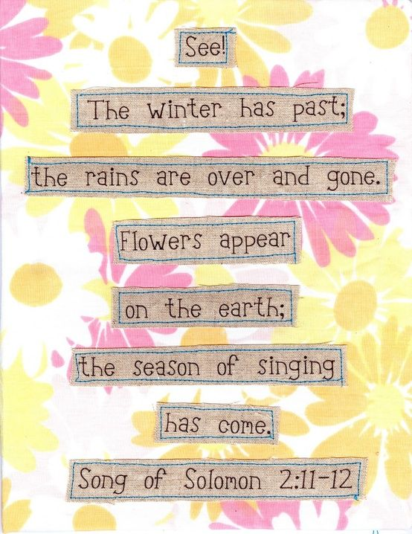

Slide 96
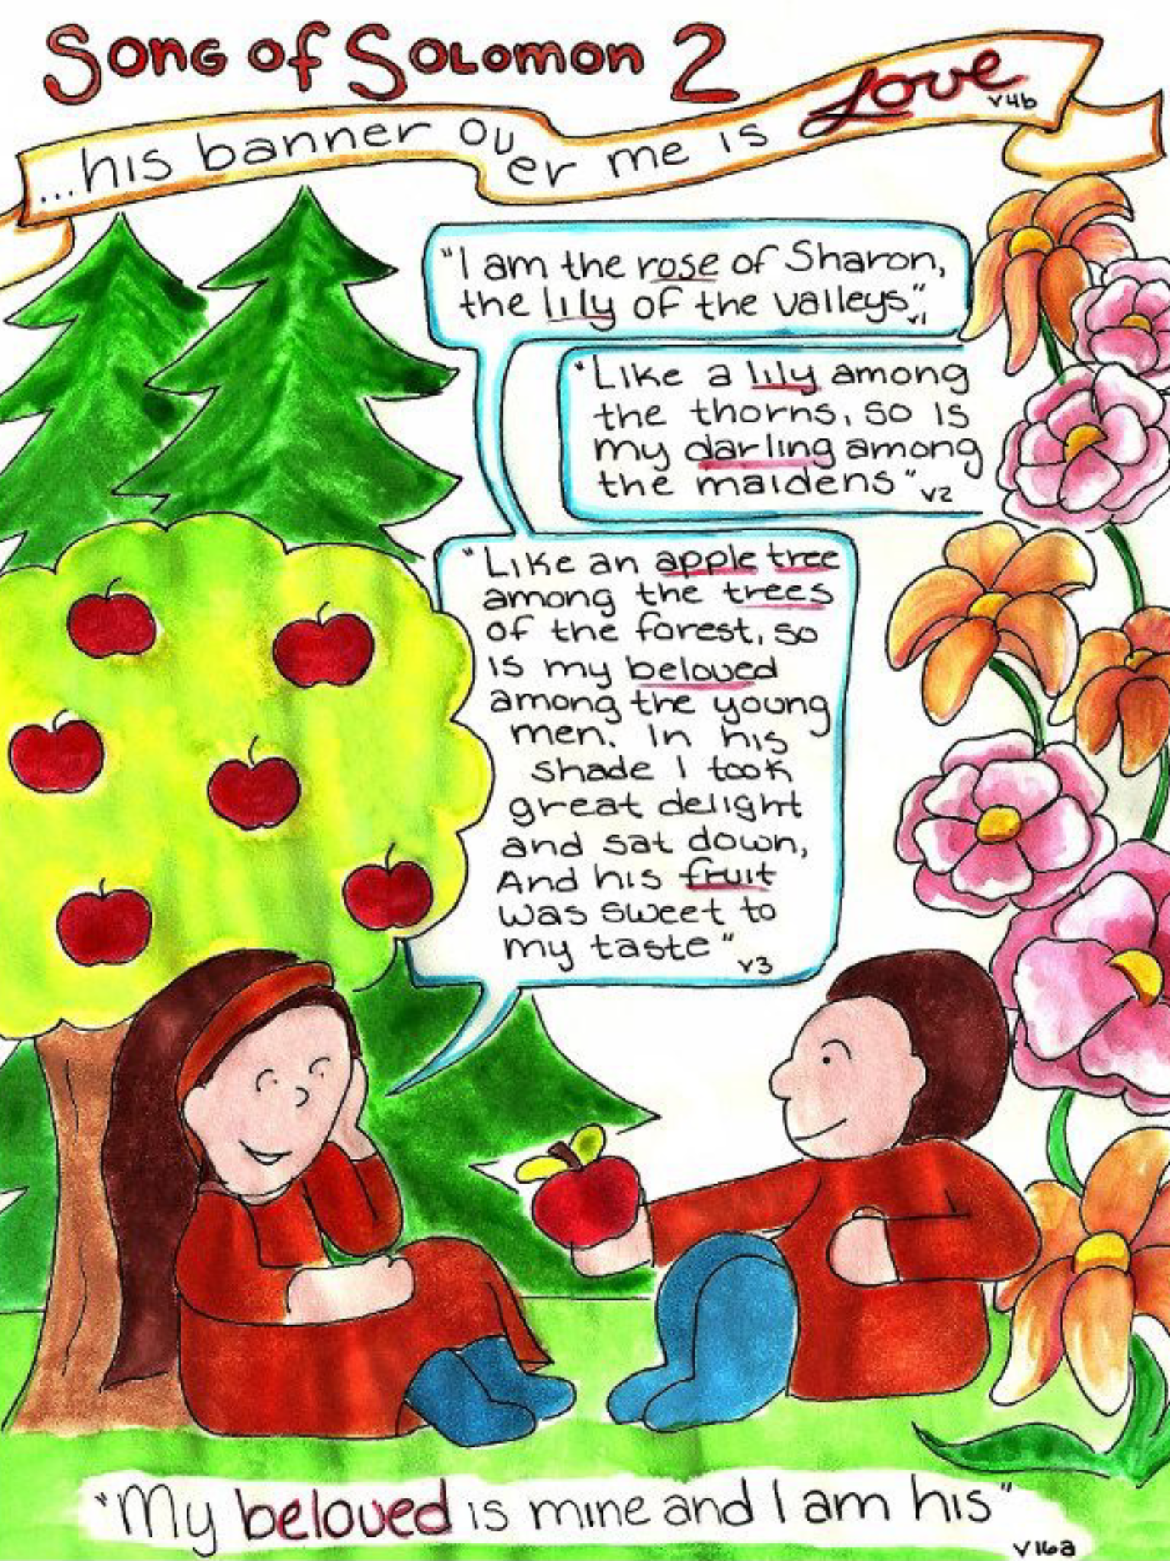

Slide 97
“My Beloved Is Mine and I Am His” (Song of Solomon 2)
A. The Maiden and Her Beloved Continue to Praise Each Other (2:1–3)
1. The Maiden Describes Herself to Her Beloved (1)
2. The Beloved Responds to the Maiden (2)
3. The Maiden Enjoys the Loving Presence of Her Beloved (3)
B. The Maiden Muses over Her Love Relationship with Her Beloved (2:4–17)
1. The Maiden Thinks about the Provision and Intimacy She Has Found (4–7)
2. The Maiden Happily Thinks over a Visit from Her Beloved (8–14)
3. The Maiden’s Brothers Warn of the “Little Foxes” (15)
4. The Maiden Thinks about Her Beloved (16–17)
Guzik, D. (2013). Song of Solomon. Santa Barbara, CA: David Guzik.

Slide 98
CHAPTER 2 La Vista Church of Christ Commentary
PARAPHRASE SUMMARY OF CHAPTER VERSES
We come to another scene illustrating the developing love between the young woman and Solomon. They are spending time together to get to know each other. Here we find them talking together in a massive cedar forest.
¹⁵ “How beautiful you are, my darling,
How beautiful you are!
Your eyes are like doves.”
Solomon opens our scene, complementing the beauty of his fiancee. This time his focus is on her eyes, to which he compares to doves. Exactly what aspect of doves he is referring to is much debated, but it is likely the vagueness is purposeful because no single characteristic is being selected but a combination of all. Wild doves are grey in color, so he may have been referring to the color of her eyes. Domesticated doves are often white, so Solomon may be describing her dark pupil in the midst of her white eyes. Doves, even in those days, were seen as peaceful birds, so he may have been referring to the contented look in her eyes. The eyes of doves are dark and round, so he may have been referring to her round, dark eyes.

Slide 99
CHAPTER 2 La Vista Church of Christ Commentary
PARAPHRASE SUMMARY OF CHAPTER VERSES
She, in turn, returns the compliment.
¹⁶ “How handsome you are, my beloved,
And so pleasant!
She then turns to their surroundings and asks her lover to imagine the forest as their home.
¹⁶ Indeed, our couch is luxuriant!
¹⁷ “The beams of our houses are cedars,
Our rafters, cypresses.

Slide 100
CHAPTER 2 La Vista Church of Christ Commentary
PARAPHRASE SUMMARY OF CHAPTER VERSES
The grass they are reclining on has become a luxuriant couch. The stately cedars have become the pillars supporting their home while the branches overhead form the rafters and the roof. One finds it hard to imagine one of the elegant noblewomen enjoying the outdoors as much as this young woman.
2 ¹ “I am the rose of Sharon,
The lily of the valleys.”
As beautiful as the house is, the crowning jewel is the woman of the house. She compares herself to two flowers. We don’t know precisely which blossoms she had in mind. Many different flowers have been called the “rose of Sharon” and the lily of the valleys is a general term. Sharon itself is a coastal plain between Joppa and Mount Carmel on which grows numerous wildflowers.

Slide 101
CHAPTER 2 La Vista Church of Christ Commentary
PARAPHRASE SUMMARY OF CHAPTER VERSES
Even though we don’t know the exact flowers, we can take note of the change in this young woman. No longer is she the shy young maiden who is concerned about her complexion and lack of care for her personal appearance. She can confidently state to her love that she is beautiful.
² “Like a lily among the thorns,
So is my darling among the maidens.”
Solomon not only agrees, but he does her one better by saying that compared to the other ladies in the court, she is like a lily growing among thorns. The contrast between her beauty and the beauty of those around her is so great that it is not worth comparing. A gentleman should never fear to flatter his fiancee even if the compliment may be hard to believe. A woman needs to know that she holds her husband-to-be’s full attention.

Slide 102
CHAPTER 2 La Vista Church of Christ Commentary
PARAPHRASE SUMMARY OF CHAPTER VERSES
³ “Like an apple tree among the trees of the forest,
So is my beloved among the young men.
In his shade I took great delight and sat down,
And his fruit was sweet to my taste.”

Slide 103
CHAPTER 2 La Vista Church of Christ Commentary
PARAPHRASE SUMMARY OF CHAPTER VERSES
She returns a similar compliment. She refers to him as a productive apple tree in a forest of plain-old-every-day trees. He stands out, he is desirable to have, and he shows vitality. She wants to be with him always and enjoy the company of his being close by. She enjoys his “fruits:” the warmth of his love for her and his sweet kisses upon her lips.
We see their relationship maturing. She’s becoming comfortable with him and she is looking forward to their future together. It demonstrates her feelings of safety and security.

Slide 104
CHAPTER 2 La Vista Church of Christ Commentary
PARAPHRASE SUMMARY OF CHAPTER VERSES
⁴ “He has brought me to his banquet hall,
And his banner over me is love.
⁵ “Sustain me with raisin cakes,
Refresh me with apples,
Because I am lovesick.
⁶ “Let his left hand be under my head
And his right hand embrace me.”
⁷ “I adjure you, O daughters of Jerusalem,
By the gazelles or by the hinds of the field,
That you do not arouse or awaken my love
Until she pleases.”

Slide 105
CHAPTER 2 La Vista Church of Christ Commentary
PARAPHRASE SUMMARY OF CHAPTER VERSES
The action moves to a banqueting hall. The phrase literally means “house of wine.” It refers to a place where formal social gatherings are conducted.
The love between these two people has been building. The banner she is referring to is the battle standard used in battle to relay instructions about troop movements. During the noise of battle, you cannot rely on anyone’s voice being loud enough and messengers between flanks can be slow or even killed in the action. Our young woman is saying that Solomon has his signal flag up and is broadcasting to everyone that he is in love with this young woman. Perhaps you have seen this when a couple walks into a room and you know they are in love. Every move they make and the way they gaze at each other tells everyone how they feel about each other.
She is so excited that she feels herself becoming faint. She needs something sweet to sustain herself so she can get through the evening. Her feelings are so strong that she is almost becoming ill from being in love.
And she begins to fantasize. Solomon is laying next to her. His left arm is under her head and with his right arm is pressing her tight against his body. . . .
HOLD IT! STOP RIGHT THERE!

Slide 106
CHAPTER 2 La Vista Church of Christ Commentary
PARAPHRASE SUMMARY OF CHAPTER VERSES
Fantasies are nice but we must restrain our thoughts. These two love birds are not married yet and fantasies about sex are not appropriate at this stage in the relationship (Matthew 5:28). The young woman gets a grip on herself and temporarily steps out of her role. Turning to the audience, she warns the young women there not to arouse or awaken love until the proper time. We tend to rush things too quickly and if we allow ourselves to fantasize about inappropriate behavior, it will not be long before we start acting out our fantasies (Proverbs 23:7). Gazelles and does are sleek, graceful creatures who, when startled, will quickly disappear. By bring up these animals, the young woman is warning that in a rush for love, we can easily lose the very thing we are pursuing.

Slide 107
CHAPTER 2 La Vista Church of Christ Commentary
PARAPHRASE SUMMARY OF CHAPTER VERSES
True, lasting love needs time to develop. It cannot be forced and hurried along. Moving into sexual relations before love has come to fruition and before a solid commitment is made will spoil the very love these two people want to have for each other. How much trust can a couple have for each other, if they know that sexual passion overrides their reason? If they cannot restrain themselves even for the relatively short period before marriage, how will either of them know for certain that the other can restrain himself from sexual temptation after the marriage?

Slide 108
CHAPTER 2 La Vista Church of Christ Commentary
PARAPHRASE SUMMARY OF CHAPTER VERSES
⁸ “Listen! My beloved!
Behold, he is coming,
Climbing on the mountains,
Leaping on the hills!
⁹ “My beloved is like a gazelle or a young stag.
Behold, he is standing behind our wall,
He is looking through the windows,
He is peering through the lattice.

Slide 109
CHAPTER 2 La Vista Church of Christ Commentary
PARAPHRASE SUMMARY OF CHAPTER VERSES
The long winter of waiting is now coming to an end. Spring has arrived and with the budding flowers comes the time of the marriage ceremony. As the winter months, the prior months have been long and relatively dreary. With the coming spring and the approaching wedding, beauty has reawakened in the world.
Under Jewish traditions, engaged couples generally spent a year getting to know each other before the actual wedding took place. Assuming this tradition reached backed to the days of Solomon, then we can assume a year has almost past since the young woman arrived at the palace.
We see the excitement of Solomon through the eyes of the young woman. He comes bounding in to see his beloved woman like a gazelle or a stag. He is so excited that he can barely stand still! He is in a rush, running from place to place. He is full of boundless energy.
From this section, we learn that the area the young women reside in is walled off from the rest of the palace. Even the king cannot enter. Instead, he must impatiently wait outside the wall, peering through the latticework in the windows to see if she is coming yet.

Slide 110
CHAPTER 2 La Vista Church of Christ Commentary
PARAPHRASE SUMMARY OF CHAPTER VERSES
She has left him waiting long enough and as she greets him, he says . . .
¹⁰ “My beloved responded and said to me,
‘Arise, my darling, my beautiful one,
And come along.
¹¹ ‘For behold, the winter is past,
The rain is over and gone.
¹² ‘The flowers have already appeared in the land;
The time has arrived for pruning the vines,
And the voice of the turtledove has been heard in our land.
¹³ ‘The fig tree has ripened its figs,
And the vines in blossom have given forth their fragrance.
Arise, my darling, my beautiful one,
And come along!’”

Slide 111
CHAPTER 2 La Vista Church of Christ Commentary
PARAPHRASE SUMMARY OF CHAPTER VERSES
Notice that Solomon’s terms of endearment for this young woman are increasing as his love is increasing. No longer is she just his darling. Now she is his darling and his beautiful one.
Winter in Israel is a time of overcast skies and frequent rains, but these have ended just as their wait for marriage is about to end. Flowers have appeared. The gardeners are out. The birds are singing.
The Hebrew word zamir only appears in Song of Solomon 2:12. It is a noun derived from the verb zamar. The verb can mean either "to prune" or "to sing" depending on the verb stems used. This has lead to a debate as to the meaning of the noun. Some translations say "prune" and others "sing."

Slide 112
CHAPTER 2 La Vista Church of Christ Commentary
PARAPHRASE SUMMARY OF CHAPTER VERSES
Regardless, the budding of spring illustrates their love blossoming. It is nearing the time for it to bear fruit. Like many fruit-bearing plants, some pruning is needed for maximum harvest. If these two lovers are to enjoy a rich harvest of love, now, while the relationship is still new and tender, some gentle pruning needs to be done.

Slide 113
CHAPTER 2 La Vista Church of Christ Commentary
PARAPHRASE SUMMARY OF CHAPTER VERSES
Many relationships begin with an infatuation between two people. People dream of the man or woman they are going to marry and their heart leaps when they stumble across the man or woman of their dreams. But as they spend time together, they realize that many of their dreams do not match reality. He is not as handsome as she thought at first. She has a few annoying habits that he didn’t expect. As a result, some of the dreams wither and die.
Yet, too, as you spend time with your beloved you find there is more to him or her than you first expected. He has a unique way of looking at the world. She has a charming way with children that you never noticed before. New shoots of endearing love spring up, replacing the dead shoots of disappointment.

Slide 114
CHAPTER 2 La Vista Church of Christ Commentary
PARAPHRASE SUMMARY OF CHAPTER VERSES
However, for the relationship to grow to its maximum potential, time must be spent between the couple in resolving those disappointments. You can’t build a marriage always longing for what you thought should have been. You have to face reality and decide if what is really there is good enough.
¹⁴ “O my dove, in the clefts of the rock,
In the secret place of the steep pathway,
Let me see your form,
Let me hear your voice;
For your voice is sweet,
And your form is lovely.”

Slide 115
CHAPTER 2 La Vista Church of Christ Commentary
PARAPHRASE SUMMARY OF CHAPTER VERSES
And so the two of them go off to quiet places where they can just talk. There are plenty of distractions in life and demands on our times, but at this critical junction in a couple’s lifetime must be set aside just for the two of them.
Solomon wants to spend time doing seemingly nothing more than to gaze at his love and listen to her speak. Now is the time that he can learn who she is inside – what her hopes, her dreams, and her aspirations may be. He calls her his dove, perhaps indicating that she brings him peace of mind.
¹⁵ “Catch the foxes for us,
The little foxes that are ruining the vineyards,
While our vineyards are in blossom.”

Slide 116
CHAPTER 2 La Vista Church of Christ Commentary
PARAPHRASE SUMMARY OF CHAPTER VERSES
While grapes are in bloom, the vines are tender and the blossoms can easily be knocked off. Growers of grapes frequently had problems with fox cubs playing in the vineyards. Their antics would knock blossoms off and break the new shoots. So the growers had to set traps for the foxes and remove them from the vineyards so the vines could grow unmolested.
In new relationships, even ones that have been established for a year, problems are going to arise. It is tempting to ignore them. Who wants the distraction? There is hope that they will go away and not harm the relationship too much in the future. However, for love to reach its fullest potential, the problems need to be dealt with while the relationship is still new and little damage has been done.

Slide 117
CHAPTER 2 La Vista Church of Christ Commentary
PARAPHRASE SUMMARY OF CHAPTER VERSES
¹⁶ “My beloved is mine, and I am his;
He pastures his flock among the lilies.
¹⁷ “Until the cool of the day when the shadows
flee away,
Turn, my beloved, and be like a gazelle
Or young stag on the mountains of Bether.”

Slide 118
CHAPTER 2 La Vista Church of Christ Commentary
PARAPHRASE SUMMARY OF CHAPTER VERSES
As this couple resolves their differences, their love for one another solidifies. They belong to each other and no one else. True, he must spend time among the other lilies, but at the end of each day, he always returns to his fairest flower.
Once again she expresses her desire for him. She longs for the time they can spend the whole night together, until the dawn breaks being passionate with each other. Literally in Hebrew, she speaks of the day coming to blow the shadows away. As they are not yet married, he must leave, but in her heart she wants him to turn back to her and put that boundless energy in him to use, playing like a stag upon her breasts.

Slide 119
CHAPTER 2 La Vista Church of Christ Commentary
PARAPHRASE SUMMARY OF CHAPTER VERSES
The phrase “mountains of Bether” is a subtle phrase containing many layers of meaning. Bether means a cutting or a cleavage. So in one sense, she is referring to the cleavage of her breasts (her mountains), and she’s expressing a desire for the physical delights of sex. But the same word is used in reference to cutting animal sacrifices in half. It is not mentioned often in the Bible, but when God made a covenant with Abraham, Abraham cut various animals in half and the presence of God in Abraham’s vision moved between the two halves sealing the covenant (Genesis 15:10). Later God talks about other covenants that were made when people moved between the two halves of a calf (Jeremiah 34:18-19). So this idea of moving between two halves invokes the image of a covenant that cannot be lightly broken. The marriage of two people is the establishment of a covenant (Malachi 2:14). Hence she is also expressing her longing for the sealing of their covenant in marriage for which she has kept herself pure in expectation of that day.

Slide 120


Slide 121
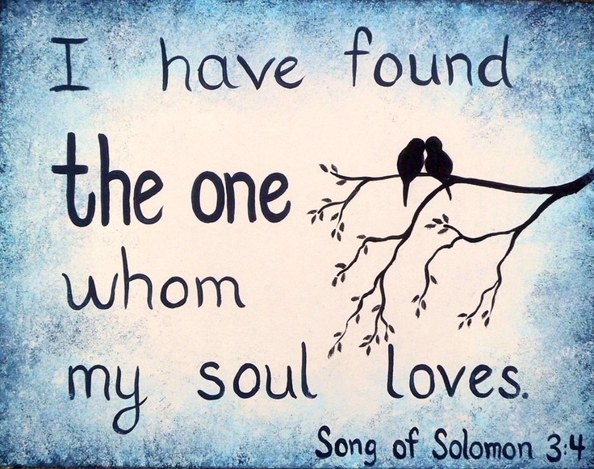

Slide 122
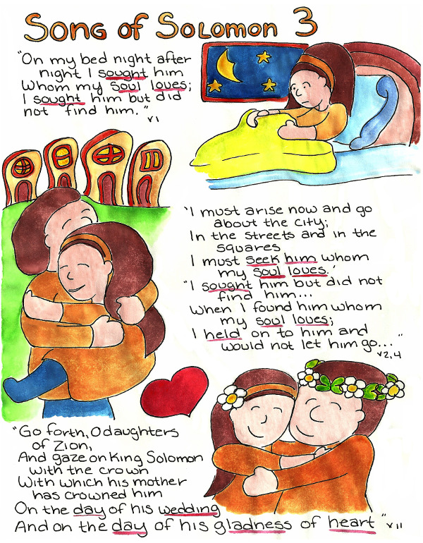

Slide 123
A Troubled Night, a Glorious Wedding (Song of Solomon 3)
A. The Maiden Searches for Her Beloved (3:1–5)
1. The Restless Maiden Searches for Her Beloved (1–3)
2. Finding Her Beloved (4)
3. An Exhortation to the Maiden’s Companions (5)
B. The Spectacular Arrival of the Wedding Party (3:6–11)
1. Solomon’s Entourage Brings the Maiden to the Wedding (6–8)
2. Solomon Enthroned and Crowned (9–11)
Guzik, D. (2013). Song of Solomon. Santa Barbara, CA: David Guzik.

Slide 124
CHAPTER 3 La Vista Church of Christ Commentary
PARAPHRASE SUMMARY OF CHAPTER VERSES
Pre-Wedding Jitters. Who has not been nervous just prior to their wedding day? You have carefully searched and selected a companion whom you are about to state vows before the almighty God that you will join your lives together to live as one. Was a mistake made? Was some thing important overlooked? Perhaps it was too good to be true and he or she will reject you at the last moment. How do you really know that your beloved loves you and you alone?

Slide 125
CHAPTER 3 La Vista Church of Christ Commentary
PARAPHRASE SUMMARY OF CHAPTER VERSES
3 ¹ “On my bed night after night I sought him
Whom my soul loves;
I sought him but did not find him.
² ‘I must arise now and go about the city;
In the streets and in the squares
I must seek him whom my soul loves.’
I sought him but did not find him.
³ “The watchmen who make the rounds in the city found me,
And I said,’Have you seen him whom my soul loves?’
⁴ “Scarcely had I left them
When I found him whom my soul loves;
I held on to him and would not let him go
Until I had brought him to my mother’s house,
And into the room of her who conceived me.”
⁵ “I adjure you, O daughters of Jerusalem,
By the gazelles or by the hinds of the field,
That you will not arouse or awaken my love
Until she pleases.”

Slide 126
CHAPTER 3 La Vista Church of Christ Commentary
PARAPHRASE SUMMARY OF CHAPTER VERSES
For several nights our heroine has been having nightmares. She dreams that she cannot find Solomon despite her most diligent search. She wonders everywhere in the city and cannot find a trace of him. Night falls and the watchmen come across her still looking. Just she leaves them, she suddenly finds him. She is determined not to let go of him until the marriage is final.
She is terrified that she will lose her beloved Solomon at the last minute.
Her desire is to bring him to her mother’s house, to the room and the bed on which she was conceived, and there have him to herself. There are comfort and security in being in your own home. It was this security that she longs for in her relationship with Solomon, but it won’t be there until they were married. One ancient marriage rite was to spend the night of your marriage in the room where you were born (Genesis 24:67).

Slide 127
CHAPTER 3 La Vista Church of Christ Commentary
PARAPHRASE SUMMARY OF CHAPTER VERSES
Once again she has gone too far in her thoughts and she warns her audience not to arouse passions before their appropriate time. In her desire for security, she dreamed of having sex with Solomon as a way of binding him to her. Perhaps some would even think it would be justified since they would be married shortly anyway. However, this woman understood that intercourse was only honorable within the bonds of marriage (Hebrews 13:4, note that the word often translated “bed” is the Greek word for sexual intercourse). You cannot fully bind someone to you through the act of sex. The bonds of marriage, the covenant, must be in place first, then the two hearts can be joined in sexual passion.
Too many people want the security of a permanent relationship, but they are scared to commit themselves for life. So they play at marriage. They live together, they share each other’s body, but they leave the back door open because, after all, it was only pretend anyway. The sexual relationship does bind two souls (I Corinthians 6:15-17), but it is not a tight enough bond by itself. It is too easily and too frequently broken.

Slide 128
CHAPTER 3 La Vista Church of Christ Commentary
PARAPHRASE SUMMARY OF CHAPTER VERSES
When two people lie with one another before marriage, even though they have full intentions on marrying soon, they introduce doubt into their relationship. If he could not restrain himself for the short time before your wedding how do you fully know he will exercise restraint after you are joined as husband and wife? One of the foundations of love is trust (I Corinthians 13:4-8). When that trust is broken in even a small way, it can take years to rebuild – if it is rebuilt at all.
You know that a couple is rushing marriage when they say things like:
“If it doesn’t work, we can get a divorce.”
“We’ve come this far, it would be embarrassing to end it now.”
“I want this person for as long as our love lasts.”
"I’ll be faithful as long as I can.”
Remarks such as these are not honest assessments. They are expressions of a person wanting to rush into marriage. Such a person is looking for a sexual affair and not a lifelong marriage.

Slide 129
CHAPTER 3 La Vista Church of Christ Commentary
PARAPHRASE SUMMARY OF CHAPTER VERSES
The Wedding. We expect the marriage of a king to be accompanied by much pomp, and in this, we are not disappointed.
⁶ “What is this coming up from the wilderness
Like columns of smoke,
Perfumed with myrrh and frankincense,
With all scented powders of the merchant?
⁷ “Behold, it is the traveling couch of Solomon;
Sixty mighty men around it,
Of the mighty men of Israel.
⁸ “All of them are wielders of the sword,
Expert in war;
Each man has his sword at his side,
Guarding against the terrors of the night.
⁹ “King Solomon has made for himself a sedan chair
From the timber of Lebanon.
¹⁰ “He made its posts of silver,
Its back of gold
And its seat of purple fabric,
With its interior lovingly fitted out
By the daughters of Jerusalem.
¹¹ “Go forth, O daughters of Zion,
And gaze on King Solomon with the crown
With which his mother has crowned him
On the day of his wedding,
And on the day of his gladness of heart.”

Slide 130
CHAPTER 3 La Vista Church of Christ Commentary
PARAPHRASE SUMMARY OF CHAPTER VERSES
The scene is told from the viewpoint of a neutral third party – the narrator if you will. It opens with a view of a cloud of dust rising in the distance. As it draws near, we first notice the smells of expensive perfumes, as if we had stumbled into the marketplace of merchants in the perfume business. The procession comes closer and we see the platform carrying Solomon. It is one of those covered chairs that’s born on shoulders of men. Surrounding the sedan chair are 60 mighty warriors. They serve as groomsmen to the king.
As the procession moves by, we see the beauty of the platform being carried. No expense has been spared in this wedding. Even the noblewomen have a hand in the outfitting of the chair. And, of course, the one that everyone wants to see – especially the ladies – is the groom himself. Solomon is wearing a crown given to him by his mother just for this occasion.
Of the wedding ceremony itself, we are not told. Perhaps, as with most weddings, it becomes a large blur in the minds of the participants. The vows are made before the Almighty, but the exact details are lost in the excitement and joy of the occasion.

Slide 132


Slide 133
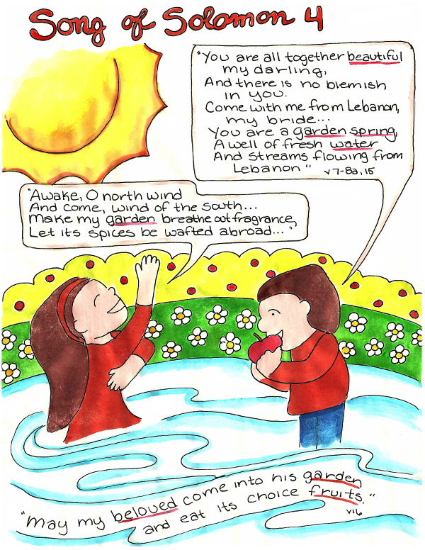

Slide 134
The Beauty of Consummated Love (Song of Solomon 4)
A. The Beloved Praises the Appearance and Character of the Maiden (4:1–11)
1. The Beloved Praises the Appearance of the Maiden (1–5)
2. The Beloved Longs to Consummate His Love for the Maiden (6)
3. The Beloved Praises the Maiden’s Character Of His Desire to Be with Her (7–8)
4. The Beloved Expresses the Depth of His Passion for the Maiden (9–11)
B. The Consummation of the Love between the Maiden & the Beloved (4:12–5:1b)
1. The Beloved Praises the Virginity of the Maiden (12–15)
2. The Maiden Yields Her Virginity to Her Beloved (16)
3. The Beloved Receives the Offered Virginity of the Maiden (5:1a)
4. The Comment from Heaven (5:1b)
Guzik, D. (2013). Song of Solomon. Santa Barbara, CA: David Guzik.

Slide 135
CHAPTER 4 La Vista Church of Christ Commentary
PARAPHRASE SUMMARY OF CHAPTER VERSES
First Night Together. Now comes the time for which our heroine has long desired. Now is the time that they can share their love in a more physical way. The scene opens with Solomon speaking.
4 ¹ “How beautiful you are, my darling,
How beautiful you are!
Your eyes are like doves behind your veil;
Your hair is like a flock of goats
That have descended from Mount Gilead.
² “Your teeth are like a flock of newly shorn ewes
Which have come up from their washing,
All of which bear twins,
And not one among them has lost her young.
³ “Your lips are like a scarlet thread,
And your mouth is lovely.
Your temples are like a slice of a pomegranate
Behind your veil.
⁴ “Your neck is like the tower of David,
Built with rows of stones
On which are hung a thousand shields,
All the round shields of the mighty men.
⁵ “Your two breasts are like two fawns,
Twins of a gazelle
Which feed among the lilies.
⁶ “Until the cool of the day
When the shadows flee away,
I will go my way to the mountain of myrrh
And to the hill of frankincense.
⁷ “You are altogether beautiful, my darling,
And there is no blemish in you.

Slide 136
CHAPTER 4 La Vista Church of Christ Commentary
PARAPHRASE SUMMARY OF CHAPTER VERSES
Solomon has nothing but praise for his bride. He doesn’t just use vague flattery but enumerates each captivating feature he sees.
He lifts her veil and once again compares her eyes to doves. (See the comments on chapter 1 verse 15.) The choice of the dove is important. The name “Solomon” means “peace.” His new bride is later called “Shulammith” which is the female form of the word for peace. The dove is often used as a symbol of peace. As with much of the Song of Solomon, there are many layers of meaning which can be mined from the words.
Solomon then moves to her hair that was revealed with her veil was removed. He compares it to a flock of goats coming down a mountain. To our modern-day ears, this almost sounds insulting. Who would want to hear that her hair reminds someone else of goats? Goats in that region were dark-haired, almost black in color. This gives us a clue as to Shulammith’s haircolor. Goat herds in those days were often quite large. Watching shepherds leading their flocks down a distant mountain, you could not see each individual goat, but you could see a flow of dark color moving and bouncing down the hillside. To Solomon, his bride was the mountain where her dark hair flows and bounces gently down.

Slide 137
CHAPTER 4 La Vista Church of Christ Commentary
PARAPHRASE SUMMARY OF CHAPTER VERSES
The praise brings a smile to his bride’s lips and Solomon begins to praise her teeth. Continuing with the shepherding theme, he compares her teeth to a flock of newly shorn sheep who have just been bathed. Sheep wool is normally white, but the wool becomes gray from the dirt in the outdoors. Shearing the sheep exposes the clean, fresh wool underneath and a freshly bathed sheep is even whiter yet. So in a poetic way, Solomon is saying her teeth are pearly white. He also says they all have twins (they are even and matched), and none of them are missing. This is very noticeable in a country that did not benefit from modern dentistry.
One cannot mention teeth without mentioning their frame. Her lips, Solomon says are like scarlet thread. This is not to say they were thin like a thread, but that their color was deep red of the scarlet thread. He finds the shape of her mouth lovely and perhaps takes the opportunity to place a kiss thereupon.

Slide 138
CHAPTER 4 La Vista Church of Christ Commentary
PARAPHRASE SUMMARY OF CHAPTER VERSES
All this praise and attention brings a blush to her cheeks, to which Solomon gives notice. Her complexion is compared to a slice of ripe pomegranate. The flesh inside of a pomegranate is rosy color. His praise is much like an American saying she has a peaches-and-cream complexion. The blush of the peach reminds one of the blushes of a woman, embarrassed but pleased with the things being said about her.
Solomon moves his eyes down to her neck which he compares to the tower of David. By this, he means that her neck is impressive and shows a strength of character. The tower of David was decorated with shields around its sides so that from a distance it looked like a necklace. Not only is he complimenting her jewelry, but he is also alluding to the fact that she had the integrity to shield herself. She kept herself pure for her husband.

Slide 139
CHAPTER 4 La Vista Church of Christ Commentary
PARAPHRASE SUMMARY OF CHAPTER VERSES
Opening her robe, Solomon gives praise to her breasts. He compares them to twin fawns of a gazelle. By calling them twins, he says they are evenly matched. By referring to them as fawns, he conjures the allusion of soft, gentle creatures that fills one with a desire to hold. But as gazelles, he acknowledges that he must approach quietly and gently or they may be frightened off.
Remember, shortly before the wedding, our young woman expressed her desire for Solomon to be like a young stag playing upon her breasts? (Song of Solomon 2:17.) Here Solomon answers her request by promising to stay with her all night, until the dawn comes, enjoying the delights of her fragrant breasts. (See also Proverbs 5:18-19.)
⁸ “Come with me from Lebanon, my bride,
May you come with me from Lebanon.
Journey down from the summit of Amana,
From the summit of Senir and Hermon,
From the dens of lions,
From the mountains of leopards.”

Slide 140
CHAPTER 4 La Vista Church of Christ Commentary
PARAPHRASE SUMMARY OF CHAPTER VERSES
The region of Lebanon was a wild country. Great forests of cedars covered the mountainsides and they were the home of many wild animals.
Though she long desired to have sex with Solomon, as is befitting the right of a wife, the idea was frightening when the actual time approached. Her thoughts scattered in her fear. Solomon gently calls her back to him and calms her fears. He will not behave like a wild animal. Sexual relations will come when she is ready for it.
Weddings are stressful events. So many preparations must be made and you hope they will turn out as planned. Yet the wedding is hardly over before you are in the arms of your love and nervous about this thing called sex that you heard so much about. The very anticipation of it can make a person ill. In fact, most couples are nervous.

Slide 141
CHAPTER 4 La Vista Church of Christ Commentary
PARAPHRASE SUMMARY OF CHAPTER VERSES
⁹ “You have made my heart beat faster, my sister, my bride;
You have made my heart beat faster with a single glance of
your eyes,
With a single strand of your necklace.
¹⁰ “How beautiful is your love, my sister, my bride!
How much better is your love than wine,
And the fragrance of your oils
Than all kinds of spices!
¹¹ “Your lips, my bride, drip honey;
Honey and milk are under your tongue,
And the fragrance of your garments is like the
fragrance of Lebanon.

Slide 142
CHAPTER 4 La Vista Church of Christ Commentary
PARAPHRASE SUMMARY OF CHAPTER VERSES
Events are now progressing to more serious matters. He is aroused by his wife. His heart is beating faster. Just a glance from her is giving him a rush. It doesn’t take much; even a glimpse of a link of her necklace causes his heart to race.
Solomon calls her his sister, his bride. It was considered a term of endearment to refer to your wife as your sister. Your sister was close to you. She knew everything about you. She was a good friend as you grew up. Now she has been replaced by your wife, the woman who is your best friend and companion.
As their passions arise, Solomon extolls that her love is more intoxicating than wine. The Hebrew word here appears to refer to the physical actions that result from the desire of two people. In Song of Solomon 1:2, the young woman used a similar phrase to complement Solomon’s kisses. The use of the same word in Ezek 16:8 and 23:17 also focuses on the physical expressions of love’s desire. Hence, Solomon is saying he is becoming giddy as she kisses and caresses his body.

Slide 143
CHAPTER 4 La Vista Church of Christ Commentary
PARAPHRASE SUMMARY OF CHAPTER VERSES
As their bodies warm, the aromas of her perfumes smell better to him in his passion than all other fragrances combined.
Their kisses become deep and compassionate. No longer content with just her lips, his tongue joins her tongue and he finds the result very sweet. Today, this is called “French kissing.”
As the last of her garments come off, he takes time to enjoy their fragrant aroma of cedars. Notice that time is being taken to enjoy each phase of the lovemaking. Solomon is not in a rush to enter into his wife, even though the desire is strong. As any woman will tell her man, lovemaking is more than coupling together. A woman needs to know she is loved in order to fully express love physically.

Slide 144
CHAPTER 4 La Vista Church of Christ Commentary
PARAPHRASE SUMMARY OF CHAPTER VERSES
¹² “A garden locked is my sister, my bride,
A rock garden locked, a spring sealed up.
¹³ “Your shoots are an orchard of pomegranates
With choice fruits, henna with nard plants,
¹⁴ Nard and saffron, calamus and cinnamon,
With all the trees of frankincense,
Myrrh and aloes, along with all the finest spices.
¹⁵ “You are a garden spring,
A well of fresh water,
And streams flowing from Lebanon.”

Slide 145
CHAPTER 4 La Vista Church of Christ Commentary
PARAPHRASE SUMMARY OF CHAPTER VERSES
Two imagines are combined to describe Shulammith’s passion. Solomon describes it in such beautiful words that it seems almost crass to describe what is happening in plain words.
The first image is that of a private garden, walled off from others, locked behind a garden gate. Behind that gate is an orchard filled with many delights for the sight, the taste, and the smell. The garden Solomon is referring to is Shulammith’s body which she has kept locked up from men – saving herself for her husband. As her passions flare, her garden gate is opening up. With that opening come odors of her passion to which some husbands are sensitive. It is the fragrance of the delights that are about to come.

Slide 146
CHAPTER 4 La Vista Church of Christ Commentary
PARAPHRASE SUMMARY OF CHAPTER VERSES
The second image is that of flowing water. Water is sometimes used to describe sexual intercourse in the Scriptures. For example, in Proverbs 5:15-20 Solomon warns of the unreasonableness of seeking sexual satisfaction with someone who is not your wife. One should drink water (intercourse) with his own wife. The water in your own well is clean, pure, and refreshing. In those days enclosed sewage systems were not commonly in use. Instead, gutters were made along the sides of the streets. When you were done with washing the dishes or had completed your bath, you opened up a window and poured out the used water. No one in their right mind would quench their thirst by drinking from the street gutters. It is disgusting and unhealthy! Yet there are men who will seek to quench their desire for sex with women who have been used by countless men prior to them – and it is just as disgusting and unhealthy!

Slide 147
CHAPTER 4 La Vista Church of Christ Commentary
PARAPHRASE SUMMARY OF CHAPTER VERSES
¹⁶ “Awake, O north wind,
And come, wind of the south;
Make my garden breathe out fragrance,
Let its spices be wafted abroad.
May my beloved come into his garden
And eat its choice fruits!”
5 ¹ I have come into my garden, my sister, my bride;
I have gathered my myrrh along with my balsam.
I have eaten my honeycomb and my honey;
I have drunk my wine and my milk.

Slide 148
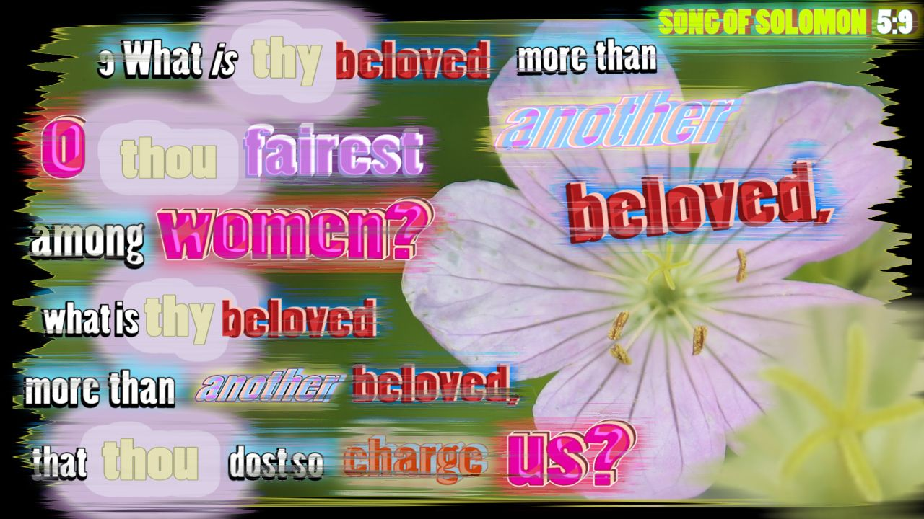

Slide 149
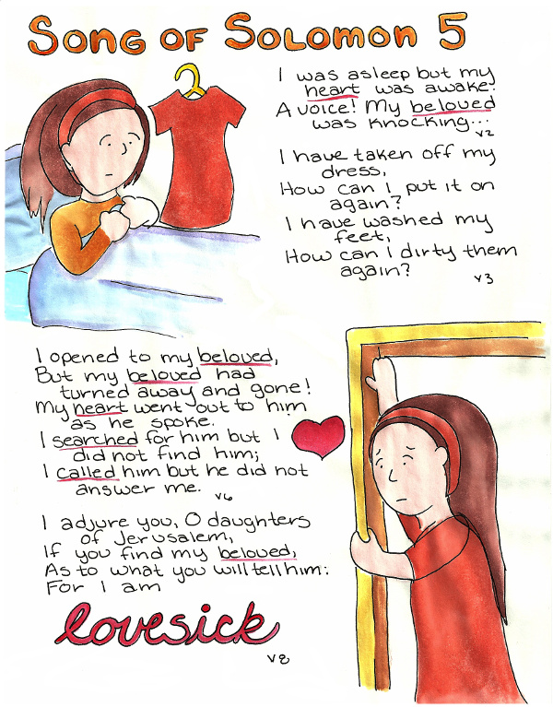

Slide 150
The Maiden’s Dream (Song of Solomon 5)
A. The Maiden Describes Her Dream (5:2–8)
1. The Maiden Dreams of Her Beloved Coming to Her at Night (2)
2. The Maiden Fails to Meet Her Beloved at the Door (3–6)
3. The Maiden’s Disappointing Search for Her Beloved (7–8)
B. The Maiden Describes Her Beloved (5:9–16)
1. The Daughters of Jerusalem Ask about the Beloved (9)
2. The Maiden Responds by Describing the Beloved (10–16)
  .
Guzik, D. (2013). Song of Solomon. Santa Barbara, CA: David Guzik.

Slide 151
CHAPTER 5 La Vista Church of Christ Commentary
PARAPHRASE SUMMARY OF CHAPTER VERSES
¹ “Eat, friends;
Drink and imbibe deeply, O lovers.”
The speaker is neither Solomon nor his bride, as the tense has changed from first-person to third-person. Some commentators see this as the well-wishing of their friends, but this would imply that some of their friends were looking on during this most intimate of times between a husband and wife. A more likely source is that these are the words of the narrator, more specifically, God who gives his blessing to their union (Proverbs 18:22). God is always present, even at our most intimate moments. It was He who created us and created sex for the enjoyment of husbands & wives. We expect our merciful Father to approve of the joining of a man and woman in marriage and to encourage them to fully enjoy the delights of that union (Ecclesiastes 9:9).

Slide 152
CHAPTER 5 La Vista Church of Christ Commentary
PARAPHRASE SUMMARY OF CHAPTER VERSES
I suppose the story could stop right here and we could float away on the clouds from the beauty of this marriage, but then the picture would be incomplete. Every marriage faces problems. Every husband and wife relationship must overcome difficulties, some of them of their own making.
Some indefinite period of time has passed after the wedding. Our new scene opens with Solomon approaching a locked bedroom door while his wife sleeps on the bed inside.
² “I was asleep but my heart was awake.
A voice! My beloved was knocking:
‘Open to me, my sister, my darling,
My dove, my perfect one!
For my head is drenched with dew,
My locks with the damp of the night.”

Slide 153
CHAPTER 5 La Vista Church of Christ Commentary
PARAPHRASE SUMMARY OF CHAPTER VERSES
Shulammith was sleeping soundly when a knock caused her to stir. She was groggy, but she heard the voice of her husband outside the door. He gently called through the door, asking her to let him in. He apologized for being late, but he just got in from the outdoors. We realize that it must have been early in the morning because his hair is damp from the dew that had settled.
³ “I have taken off my dress,
How can I put it on again?
I have washed my feet,
How can I dirty them again?
⁴ “My beloved extended his hand through the opening,
And my feelings were aroused for him.
⁵ “I arose to open to my beloved;
And my hands dripped with myrrh,
And my fingers with liquid myrrh,
On the handles of the bolt.

Slide 154
CHAPTER 5 La Vista Church of Christ Commentary
PARAPHRASE SUMMARY OF CHAPTER VERSES
As she heard him at the door, she was embarrassed at her careless attitude. She saw his hand reach through an opening near the door, perhaps attempting to unlock it for himself. The sight of just his arm stirs her into action and she jumps out of bed. When she touches the lock, she was startled to find it wet with his favorite cologne made from an expensive spice called myrrh. Paper was less common in those days, so instead of love notes, couples sometimes poured a little of their favorite perfume on an object their beloved would be sure to find. It was a simple way of saying, “I was here and thinking of you.” Solomon wasn’t trying to force his way in, he was quietly leaving a message.
⁶ “I opened to my beloved,
But my beloved had turned away and had gone!
My heart went out to him as he spoke.
I searched for him but I did not find him;
I called him but he did not answer me.
⁷ “The watchmen who make the rounds in the city found me,
They struck me and wounded me;
The guardsmen of the walls took away my shawl from me.

Slide 155
CHAPTER 5 La Vista Church of Christ Commentary
PARAPHRASE SUMMARY OF CHAPTER VERSES
She quickly opens the door, but Solomon had already left. Now he will think that she didn’t care enough about him to even open the door of their own bedroom. He didn’t know she came, but just too slow.
Shulammith begins to search for him, calling his name, but getting no answer. Her search takes her out into the city, where the night watchmen find her wandering aimlessly through the streets. The situation brings to remembrance the young woman’s nightmares before her wedding of losing Solomon and not being able to find him. She did lose him, not because he left, but because she had become too complacent in her marriage.
The guards mistake her for a prostitute or some other low-life looking for trouble. They start to rough her up, but when her shawl is removed, they discover they were striking the queen. Shulammith doesn’t seem to care or to notice. The only thing on her mind is that she has to find Solomon.

Slide 156
CHAPTER 5 La Vista Church of Christ Commentary
PARAPHRASE SUMMARY OF CHAPTER VERSES
She goes to the noblewomen, Solomon’s other wives, to see if they know what has happened to him.
⁸ “I adjure you, O daughters of Jerusalem,
If you find my beloved,
As to what you will tell him:
For I am lovesick.”
She pleads with the women that if they find Solomon before she does to let him know that she has become ill from desiring him.
However, before these ladies will agree to help her in her search, they ask her two very pointed questions that open her eyes to her own fault in this matter.
⁹ “What kind of beloved is your beloved,
O most beautiful among women?
What kind of beloved is your beloved,
That thus you adjure us?”

Slide 157
CHAPTER 5 La Vista Church of Christ Commentary
PARAPHRASE SUMMARY OF CHAPTER VERSES
Their first question is “What kind of man are you claiming to love so deeply that you want us to deliver a message to him on your behalf?” The question is wise and telling. It was Shulammith who did not want, at first, to get out of bed just to open the door for her husband. It is a frequent problem between couples. We put all our energies into winning the love of our spouse, but once we have committed ourselves to our spouse, we begin to take the relationship for granted. “Of course, he loves me!” “Of course, she will always be there for me!” Instead of thinking about fulfilling the needs of our spouse, we begin to think about our own needs. The question of why is he so special is important for Shulammith to remember.
Yet, there is a second barb to this question as well. Why does Shulammith want the noblewomen to tell Solomon how much she loves him? If the relationship is as it is supposed to be, why isn’t she able to tell Solomon herself? Sure, she can’t find him, but why not just find out where he is and go directly to him?

Slide 158
CHAPTER 5 La Vista Church of Christ Commentary
PARAPHRASE SUMMARY OF CHAPTER VERSES
¹⁰ “My beloved is dazzling and ruddy,
Outstanding among ten thousand.
¹¹ “His head is like gold, pure gold;
His locks are like clusters of dates
And black as a raven.
¹² “His eyes are like doves
Beside streams of water,
Bathed in milk,
And reposed in their setting.
¹³ “His cheeks are like a bed of balsam,
Banks of sweet-scented herbs;
His lips are lilies
Dripping with liquid myrrh.
¹⁴ “His hands are rods of gold
Set with beryl;
His abdomen is carved ivory
Inlaid with sapphires.
¹⁵ “His legs are pillars of alabaster
Set on pedestals of pure gold;
His appearance is like Lebanon
Choice as the cedars.
¹⁶ “His mouth is full of sweetness.
And he is wholly desirable.
This is my beloved and this is my friend,
O daughters of Jerusalem.”

Slide 159
CHAPTER 5 La Vista Church of Christ Commentary
PARAPHRASE SUMMARY OF CHAPTER VERSES
Her answer echoes Solomon’s description of her on their wedding night. He is important to her because he is the most handsome man around. She describes him from head to toe. He has the golden complexion of an outdoorsman with raven black hair of tightly packed curls. His eyes are a peaceful gray and the whites of his eyes are like milk. The cologne he wears on his cheeks is wonderful to enjoy and his kisses are tender, soft, and fragrant. His hands are solid and beautiful. His abdomen looks like it was carved and he is lovely to behold (in other words, he is in great shape). He has strong legs that carry him with great endurance.
These are all physical things. Sure, Solomon has a great body, but that cannot be the reason Shulammith wants him so badly.
Well, he says the sweetest things to her and he really is desirable in every way.
But again, this doesn’t really answer the question. It is not until we get to the very end that we reach the real reason for her love. He is her beloved and her friend. Life doesn’t have much meaning without the companionship of a close friend (Ecclesiastes 4:9-11).

Slide 160
Pet names: Solomon refers to the Shulammite as his “love” (4:1; 6:4 etc.), “bride” (5:1) and “dove” (5:2)
while she refers to him as her “beloved” (5:2 etc.). The importance of these terms cannot be overestimated.
When a man and woman call each other by special words that indicate their affection for one another they
are illustrating their interest and care for one another. Said terms breed confidence and strengthen the bond
of marriage. The uses of such labels are indicators of a strong marriage.
• God’s Marital Blessing (Prov. 18:22; 19:4): A study of the Song of Solomon illustrates a man and
woman’s intense interest and love for each other. The question arises in the Bible students mind as to how
far this should go in relationship to one’s place with God. Let the prudent student of God’s word understand
that God blesses and intends for man and woman to enjoy each other’s affection. Solomon wrote, “Let thy
fountain be blessed; And rejoice in the wife of thy youth” (Prov. 5:18). Again, the wise king said, “Live
joyfully with the wife whom thou lovest all the days of thy lie of vanity, which he hath given thee under the
sun, all thy days of vanity: for that is thy portion in life, and in thy labor wherein thou laborest under the
sun” (Eccl. 9:9). Marital joy comes also in the form of having the greatest friend on this earth (see Prov.
18:24). The Shulammite said of Solomon, “This is my beloved, and this is my friend” (Song 5:16).
• The Woman is the Weaker Vessel (I Pet. 3:7): The Shulammite girl seems to be self conscience about
what others think regarding her rural background (see Song 1:5-6). When Solomon publicly embraces the
Shulammite girl (a public sign of his affection and approval) she seemed to be eased (see Song 2:4-7).
Public displays of attention can be healthy for a relationship. The more emotional woman needs attention, affection, and approval not only in private but in all circles of life. Men would do well to tastefully let the
world know that the woman that is next to his side is his and that he approves of her (i.e., holding hands,
embracing, and an occasional kiss). It seems that Solomon’s use of the royal guard and personal chariot to
escort the Shulammite girl into the royal city for their wedding was an outward public sign of his inner love
for her (see Song 3:7-11). – Internet Search “Song of Solomon”

Slide 161


Slide 162
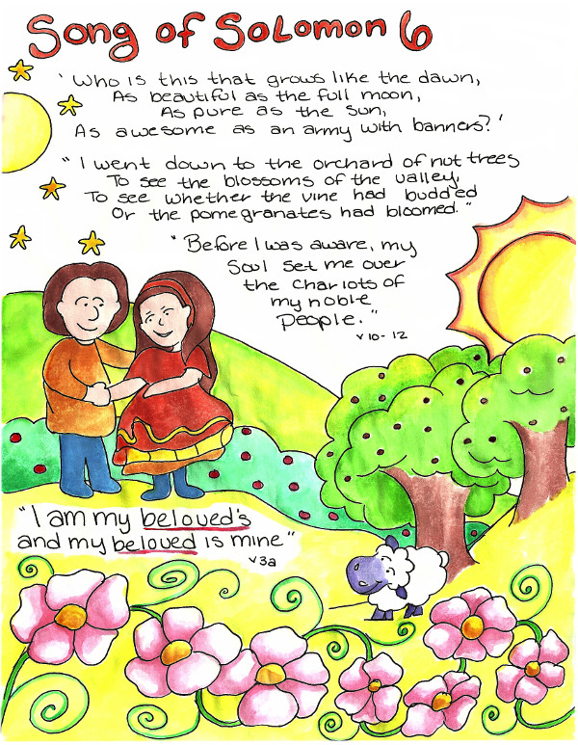

Slide 163
Reunited in Love (Song of Solomon 6)
A. The Maiden Describes a Restoration of Their Love Relationship (6:1–3)
1. A Further Question from the Daughters of Jerusalem (1)
2. The Maiden Describes Her Relationship to Her Beloved Man (2–3)
B. Enjoyment of the Restored Relationship (6:4–13b)
1. The Beloved Describes the Physical Appearance of His Maiden (4–7)
2. The Beloved Describes His Maiden as Compared to Other Women (8–10)
3. The Maiden Describes Her Meeting with the Beloved (11–12)
4. The Daughters of Jerusalem Appeal to the Maiden (13a)
5. The Response of the Maiden to the Daughters of Jerusalem (13b)
Guzik, D. (2013). Song of Solomon. Santa Barbara, CA: David Guzik.

Slide 164
CHAPTER 6 La Vista Church of Christ Commentary
PARAPHRASE SUMMARY OF CHAPTER VERSES
6 ¹ “Where has your beloved gone,
O most beautiful among women?
Where has your beloved turned,
That we may seek him with you?”
On the surface, the noblewomen’s second question seems odd. They ask the woman where she thinks Solomon may be. Shulammith came to them asking for help in finding Solomon so why are they asking her where he is?
As with the first question, the point being made is astute. They are hinting that Shulammith knew in the depth of her heart where Solomon would most likely be, but she was avoiding confronting him. Her fear that Solomon had rejected her for her shameful behavior has been keeping her from seeking him out directly. That is why she wanted the noblewomen to approach him on her behalf. She wanted someone else to cushion the blow.

Slide 165
CHAPTER 6 La Vista Church of Christ Commentary
PARAPHRASE SUMMARY OF CHAPTER VERSES
It is here that we see that the women are not totally without heart. They offer to go with her for moral support, but they insist that she go to Solomon.
² “My beloved has gone down to his garden,
To the beds of balsam,
To pasture his flock in the gardens
And gather lilies.
³ “I am my beloved’s and my beloved is mine,
He who pastures his flock among the lilies.”

Slide 166
CHAPTER 6 La Vista Church of Christ Commentary
PARAPHRASE SUMMARY OF CHAPTER VERSES
Shulammith was able to answer the question. She knew in her heart where Solomon would be. Before they were married, Solomon would spend time among the sheep in his garden when he needed time away from the hectic life of a king (Song of Solomon 1:7, 2:16). Her rejection of him would send him to a quiet place where he could think. Balsam is a herb used for healing wounds and he needed time to heal the wounds she gave to his spirit.
She repeats the phrase she said in Song of Solomon 2:16 to say that they belong to each other. However, there is a subtle difference. Before, her hold on his love was foremost. Now, his hold on her love occupies her first thoughts.

Slide 167
CHAPTER 6 La Vista Church of Christ Commentary
PARAPHRASE SUMMARY OF CHAPTER VERSES
We can see Shulammith almost cringing as she approaches Solomon with her head hanging down. The noblewomen are standing nearby, but not close enough to hear what she and Solomon need to say privately. Before she can open her mouth, Solomon greets her.
⁴ “You are as beautiful as Tirzah, my darling,
As lovely as Jerusalem,
As awesome as an army with banners.
⁵ “Turn your eyes away from me,
For they have confused me;
Your hair is like a flock of goats
That have descended from Gilead.
⁶ “Your teeth are like a flock of ewes
Which have come up from their washing,
All of which bear twins,
And not one among them has lost her young.
⁷ “Your temples are like a slice of a pomegranate
Behind your veil.
⁸ “There are sixty queens and eighty concubines,
And maidens without number;
⁹ But my dove, my perfect one, is unique:
She is her mother’s only daughter;
She is the pure child of the one who bore her.
The maidens saw her and called her blessed,
The queens and the concubines also, and they praised her, saying,
¹⁰ ‘Who is this that grows like the dawn,
As beautiful as the full moon,
As pure as the sun,
As awesome as an army with banners?’

Slide 168
CHAPTER 6 La Vista Church of Christ Commentary
PARAPHRASE SUMMARY OF CHAPTER VERSES
What an unexpected and beautiful greeting! There is not one word about the insult she gave him. There is no mention of the tension between them. All that Solomon talks about is how much he loves her.
Solomon shows the type of love all husbands should have for their wives. Paul told men to love their wives as Christ loved the church (Ephesians 5:25). The Greek word translated as love is the word agape. It is a love of devotion – a love that continues to give even if it is not returned. This is the love that Christ had for us. He loved us so much that even when we were sinners – enemies of God – Christ died for us (Romans 5:8). The physical make-up of a man allows him to give love even when he does fully feel like it. Men’s hormones are stable for most of their life. They tend to see the world in a consistent manner. This makes it possible for a man to make the first move to repair a broken relationship.

Slide 169
CHAPTER 6 La Vista Church of Christ Commentary
PARAPHRASE SUMMARY OF CHAPTER VERSES
Too often a man wants to solve the problem, figuring the relationship with his wife will follow along after it. What Solomon shows is that it doesn’t matter what is the problem. Once the relationship is repaired, any problem can be addressed and overcome. But if two people are unwilling to get along with each other, then no amount of problem-solving will help because there will always be another problem waiting to drive a deeper wedge between them.
Solomon begins by comparing his wife’s beauty to the cities of Tirzah and Jerusalem. These were the two leading cities of Israel in the glory days of Solomon’s reign. Jerusalem was the capital of Solomon’s kingdom in the south and Tirzah was a mighty city in the north. When Solomon’s kingdom was split after his death, Tirzah became the capital of the northern kingdom for many generations.

Slide 170
CHAPTER 6 La Vista Church of Christ Commentary
PARAPHRASE SUMMARY OF CHAPTER VERSES
He also found her beauty to be as awe-inspiring as a great army in full military dress with colorful banners flying above them.
He asks that she not look directly at him because her eyes arouse him, keeping him from making connected thoughts. She is still desirable to him. He is still a giddy schoolboy in her presence.
Solomon then begins to enumerate the specific features of his wife that he finds especially attractive. Many of these qualities are the same as the ones of which he praised on their wedding night. It demonstrates that his love hasn’t changed in the years that have followed. Her hair is still dark, flowing, and bouncy like a flock of goats coming down off a mountain. Her teeth are still white, even, and matched with none missing. Her complexion is still as rosy as the flesh of pomegranate fruit. But here he stops. He doesn’t move on to more erotic descriptions because he doesn’t want to leave the impression that the only reason he wants this relationship repaired is so he can get in bed with her.

Slide 171
CHAPTER 6 La Vista Church of Christ Commentary
PARAPHRASE SUMMARY OF CHAPTER VERSES
It is a delicate balancing act. He lets her know she is still his desire, but he doesn’t push it to leave her thinking that is the only thing on his mind.
Even though Solomon now has sixty wives, eighty concubines, and many maidens desiring him, he finds Shulammith unique. She is the only one that he wants. There is no one else like her. Her mother only had one daughter and she didn’t need another daughter for her first and only daughter was the best that there could be.
Though you might think Solomon is biased, he points out that even the women who would be inclined to not like Shulammith – the other wives, concubines, and maidens – have only praise for her. She is beautiful in form, pure in character, and awe-inspiring in presence. This speech has left Shulammith shaking her head in wonder.

Slide 172
CHAPTER 6 La Vista Church of Christ Commentary
PARAPHRASE SUMMARY OF CHAPTER VERSES
¹¹ “I went down to the orchard of nut trees
To see the blossoms of the valley,
To see whether the vine had budded
Or the pomegranates had bloomed.
¹² “Before I was aware, my soul set me
Over the chariots of my noble people.”
She originally came down to the garden to see if there were any blossoms left on her vineyard of love. Remember the concern in Song of Solomon 2:15 that the small problems would knock the delicate buds of love off before they had a chance to form? Now she was faced with a seemingly large problem that could have destroyed all the fully formed blossoms. But not only did she find the love intact, but before she realized what was happening her husband, her soul, had greatly honored her before everyone (Ephesians 5:28-29; I Peter 3:7).

Slide 173
CHAPTER 6 La Vista Church of Christ Commentary
PARAPHRASE SUMMARY OF CHAPTER VERSES
She begins to move off – perhaps to contemplate the change in her position. However, the women who came along with her aren’t ready for her to leave.
¹³ “Come back, come back, O Shulammite;
Come back, come back, that we may gaze at you!”
Most likely they want to know what happened. Did he accept her apology? Are they back together again? What did he say?
¹³ Why should you gaze at the Shulammite,
As at the dance of the two companies?
We are not absolutely certain who replied to the ladies. Shulammith could be referring to herself in the third person or Solomon could be the speaker. It doesn’t matter for the message is the same. The women want to know what happened, yet the evidence is plainly before them. What more can they expect of Shulammith? Should she perform a festive dance like they have when two large groups camp near each other? She and Solomon are back together again and that is all that matters.

Slide 174
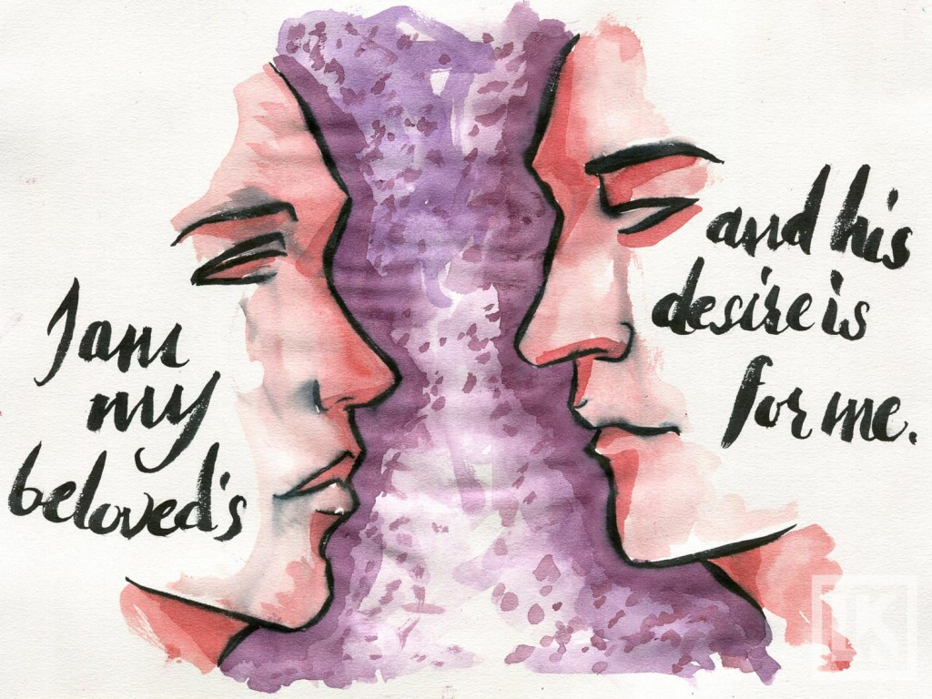

Slide 175
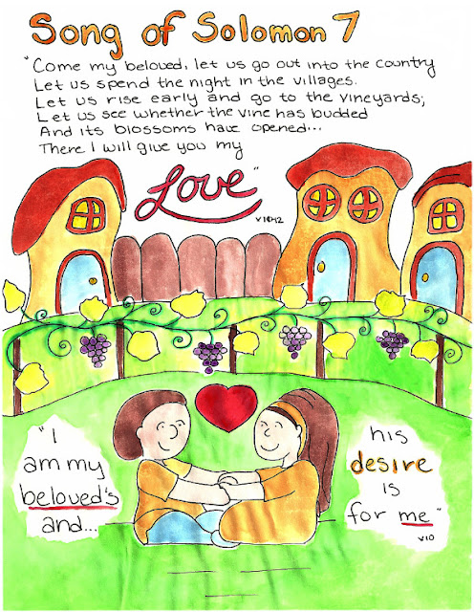

Slide 176
The Maiden’s Beauty (Song of Solomon 7)
A. The Maiden Is Described for a Third Time (7:1–9a)
1. Description of the Maiden’s Body (1–3)
2. Description of the Maiden’s Head, Face, and Hair (4–5)
3. Description of the Beloved’s Desire (6–9a)
B. The Maiden Longs for Intimacy with Her Beloved (7:9b–13)
1. The Longing for Intimacy (9b–10)
The Invitation to Intimacy (11–13)
Guzik, D. (2013). Song of Solomon. Santa Barbara, CA: David Guzik.

Slide 177
CHAPTER 7 La Vista Church of Christ Commentary
PARAPHRASE SUMMARY OF CHAPTER VERSES
7 ¹ “How beautiful are your feet in sandals,
O prince’s daughter!
The curves of your hips are like jewels,
The work of the hands of an artist.
² “Your navel is like a round goblet
Which never lacks mixed wine;
Your belly is like a heap of wheat
Fenced about with lilies.
³ “Your two breasts are like two fawns,
Twins of a gazelle.
⁴ “Your neck is like a tower of ivory,
Your eyes like the pools in Heshbon
By the gate of Bath-rabbim;
Your nose is like the tower of Lebanon,
Which faces toward Damascus.
⁵ “Your head crowns you like Carmel,
And the flowing locks of your head are like purple threads;
The king is captivated by your tresses.
⁶ “How beautiful and how delightful you are,
My love, with all your charms!
⁷ “Your stature is like a palm tree,
And your breasts are like its clusters.
⁸ “I said, ‘I will climb the palm tree,
I will take hold of its fruit stalks.’
Oh, may your breasts be like clusters of the vine,
And the fragrance of your breath like apples,
⁹ And your mouth like the best wine!”

Slide 178
CHAPTER 7 La Vista Church of Christ Commentary
PARAPHRASE SUMMARY OF CHAPTER VERSES
Even after years of becoming familiar with each other, nothing is rushed in their enjoyment of each other’s bodies. As Solomon describes each intimate detail of her body, we can see him in our minds touching and caressing each captivating portion of her. This time Solomon starts at her feet & moves upwards. She has the beautiful feet of a princess. Her thighs and hip are precisely formed as if carved by a jeweler. Her navel brings him satisfaction (perhaps as he tickles it). Her waist is narrow & white, like a bundle of wheat tied with lilies. Her breasts are soft, matched, and desirable to be stroked. Her neck is white and stately, showing dignity in character. Her eyes are gentle pools – deep, dark, and inviting. Her nose is stately. Her head is as majestic as a high mountain. Purple is the color of royalty, so Solomon is saying her hair is royal. As he weaves his fingers through her hair, he pretends to be caught, claiming that he has been taken captive by her hair.

Slide 179
CHAPTER 7 La Vista Church of Christ Commentary
PARAPHRASE SUMMARY OF CHAPTER VERSES
Solomon has listed ten features that describe how beautiful, delightful, and charming is his wife. Ten is another special number among the Hebrews. It represents things that are complete. Hence Solomon is implying that nothing is lacking in his wife.
Notice that his description is more sensual than on the night of their wedding. They are familiar with each other and are not embarrassed to enjoy any part of each other. They also play around more in their lovemaking. Solomon compares his wife to a palm tree with her breast being ripe fruit waiting to be picked. He starts down at her feet and slides up her body, taking time to enjoy the tenderness of her breasts, the fragrance of her breath, and the intoxicating kisses from her lips.

Slide 180
CHAPTER 7 La Vista Church of Christ Commentary
PARAPHRASE SUMMARY OF CHAPTER VERSES
⁹ It goes down smoothly for my beloved,
Flowing gently through the lips of those who fall asleep.
Taking up the imagery of drinking, Shulammith describes the climax of their lovemaking. They join together very smoothly. This is not the mad passionate love of the young, but the smooth practiced responses of two who have spent their lives together. As the scene fades we find they have fallen asleep together while still joined as one.

Slide 181
CHAPTER 7 La Vista Church of Christ Commentary
PARAPHRASE SUMMARY OF CHAPTER VERSES
¹⁰ “I am my beloved’s,
And his desire is for me.
¹¹ “Come, my beloved, let us go out into the country,
Let us spend the night in the villages.
¹² “Let us rise early and go to the vineyards;
Let us see whether the vine has budded
And its blossoms have opened,
And whether the pomegranates have bloomed.
There I will give you my love.
¹³ “The mandrakes have given forth fragrance;
And over our doors are all choice fruits,
Both new and old,
Which I have saved up for you, my beloved.
8 ¹ “Oh that you were like a brother to me
Who nursed at my mother’s breasts.
If I found you outdoors, I would kiss you;
No one would despise me, either.
² “I would lead you and bring you
Into the house of my mother, who used to instruct me;
I would give you spiced wine to drink from the juice of my pomegranates.
³ “Let his left hand be under my head
And his right hand embrace me.”

Slide 182
CHAPTER 7 La Vista Church of Christ Commentary
PARAPHRASE SUMMARY OF CHAPTER VERSES
This the third expression of unity between Shulammith and Solomon. While it essentially states the same thing as found in Song of Solomon 2:16 & 6:3, it is subtly different. Our heroine is fully secure in her relationship with her husband and she has fully lost herself in him.
She approaches Solomon with a suggestion to get away from the city and visit the country. Ostensibly, the visit is to check on the progress of their vineyards, but what she has in mind is much more personal. Recall that vineyards sometimes refer to the person in this poem. She is suggesting they check up on their love for each other and see if it is still in full bloom. Basically, she is suggesting they get away for a time of lovemaking underneath the grapevines.
Shulammith tells her husband that she has a full supply of choice mandrakes saved up. Mandrakes, also known as “love apples,” were considered to be aphrodisiacs (Genesis 30:14-16).

Slide 183


Slide 184
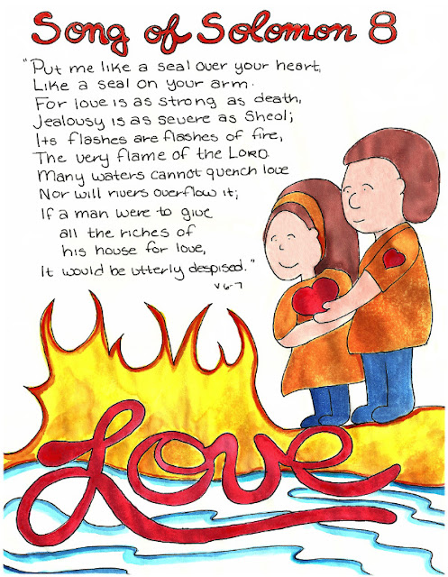

Slide 185
On Mountains of Spices (Song of Solomon 8)
A. The Maiden’s Loving Words (8:1–4)
1. The Maiden’s Passion for Her Beloved (1–2)
2. The Maiden’s Plea to the Daughters of Jerusalem (3–4)
B. Final Words from the Loving Couple, Their Family & Friends (8:5–14)
1. A Relative Speaks to the Loving Couple (5)
2. The Maiden Describes the Strength of Her Love (6–7)
3. The Maiden’s Brothers (8–9)
4. The Maiden Answers Her Brothers (10)
5. The Maiden Understands Her Value (11–12)
6. The Beloved Answers His Maiden (13)
7. The Maiden Calls out to Her Beloved (14)
Guzik, D. (2013). Song of Solomon. Santa Barbara, CA: David Guzik.

Slide 186
CHAPTER 8 La Vista Church of Christ Commentary
PARAPHRASE SUMMARY OF CHAPTER VERSES
In their society, it was considered impolite for husbands & wives to publicly show affection for each other, though it was considered proper for affection to be shown between family members. Therefore, she wishes they were siblings so that she could kiss him in public without causing a scene.
⁴ “I want you to swear, O daughters of Jerusalem,
Do not arouse or awaken my love
Until she pleases.”
Once again, Shulammith breaks out of her role to warn the women in the audience not to force this type of love until the proper time. She and her husband have been married for quite a while now. They are comfortable with each other and are deeply in love. Their love has fully awakened and they are ready for it. Unmarried women are not prepared for this level of involvement with a man, so don’t push it.

Slide 187
CHAPTER 8 La Vista Church of Christ Commentary
PARAPHRASE SUMMARY OF CHAPTER VERSES
⁵ “Beneath the apple tree I awakened you;
There your mother was in labor with you,
There she was in labor and gave you birth.
⁶ “Put me like a seal over your heart,
Like a seal on your arm.
For love is as strong as death,
Jealousy is as severe as Sheol;
Its flashes are flashes of fire,
The very flame of the LORD.
⁷ “Many waters cannot quench love,
Nor will rivers overflow it;
If a man were to give all the riches of his house for love,
It would be utterly despised.”

Slide 188
CHAPTER 8 La Vista Church of Christ Commentary
PARAPHRASE SUMMARY OF CHAPTER VERSES
Recall the warnings not to awaken love before the proper time? Shulammith confidently states that she has awakened Solomon’s love. The apple tree is seen as the sweetheart tree and their love was awakened in romance, just as Solomon was born in romance. His parents were as deeply in love as she and Solomon.
She then gives a beautiful description of what is love. She wants to be like a seal. In those days a person did not sign documents with an ink pen. Each person had a personal seal – usually a small cylinder of stone with etchings on it. The stone was rolled over soft clay to make an impression and indicated that it was from the person. Seals were valuable possessions. If someone else acquired it, it was possible for them to forge documents in their name. To keep a seal safe, it was typical to bind it close to the body, such as strapping it to the chest or tying it to the upper arm. By comparing herself to a seal, she is saying that she wants to be Solomon’s valued personal possession – someone he treasured (Ephesians 5:29) and does not want to lose. A binding above the heart shows an emotional bond between them. A binding on the arm shows a strong relationship that is not easily broken.
Shulammith also compares love to lightning – the flashes of fire from the sky. By this, she means that love is intense in the depth and strength of its feelings. It is so intense that dowsing it with the waters of problems will not put out the feeling. True love cannot be easily overcome.

Slide 189
CHAPTER 8 La Vista Church of Christ Commentary
PARAPHRASE SUMMARY OF CHAPTER VERSES
Finally, this type of love cannot be bought. Love doesn’t come by the spending of money or the showering of lavish gifts. Love’s power is built from spiritual foundations and not from this in this material world.
⁸ “We have a little sister,
And she has no breasts;
What shall we do for our sister
On the day when she is spoken for?
⁹ “If she is a wall,
We will build on her a battlement of silver;
But if she is a door,
We will barricade her with planks of cedar.”

Slide 190
CHAPTER 8 La Vista Church of Christ Commentary
PARAPHRASE SUMMARY OF CHAPTER VERSES
The people standing by are impressed with this example of love before them. They would like advice for their younger sister. She has not yet started developing into a woman, but they would like to give her the best chance of finding true love when she does mature. “What preparations,” they ask, “should we make for our sister?”
They continue by describing their current plans. If it turns out that she shows a strong strength of character and she will not easily give her love to any man, then they plan to enhance her beauty by showing off her best features. They will reward her sound judgment. However, if it turns out that she “man-hungry,” pursuing every handsome body that comes her way, then they will protect her by preserving her virtue. Some women grow up desiring to be promiscuous and, while they are young, they need to be protected from themselves.

Slide 191
CHAPTER 8 La Vista Church of Christ Commentary
PARAPHRASE SUMMARY OF CHAPTER VERSES
¹⁰ “I was a wall, and my breasts were like towers;
Then I became in his eyes as one who finds peace.
¹¹ “Solomon had a vineyard at Baal-hamon;
He entrusted the vineyard to caretakers.
Each one was to bring a thousand shekels of silver for its fruit.
¹² “My very own vineyard is at my disposal;
The thousand shekels are for you, Solomon,
And two hundred are for those who take care of its fruit.”

Slide 192
CHAPTER 8 La Vista Church of Christ Commentary
PARAPHRASE SUMMARY OF CHAPTER VERSES
Shulammith recalls that in her youth she was a wall. She had the strength of character to repel the advances of men. She kept her resolve until the day she married Solomon. The phrase “Then I became in his eyes as one who finds peace” is a pun in Hebrew. Solomon means peace and she found peace in her Solomon. This is why she is known as Shulammith, the female version of the Hebrew word for peace.
Recall from chapter 1 that Shulammith mentioned that she used to work in a vineyard. That vineyard was located in Baal-Hamon and was owned by Solomon. Caretakers were hired to tend the vineyard and expected to turn a good profit from its fruit. It was there, while Solomon was inspecting his vineyard, that she and he first met. It echos the meeting of Ruth and Boaz in Ruth chapter 2. Perhaps her own stepbrothers were the primary caretakers of Solomon’s vineyard.
Though Solomon owned the vineyard, Shulammith owned herself. She chose whom she would marry, but she owes a great debt of gratitude to her husband for noticing her. He gave her the chance to blossom as no one else would have been able to do. She also recognized a debt of gratitude to her stepbrothers, though not as great as that for Solomon. Even though she did not like working in the vineyard, without being there, she would have never met Solomon. She may have thought her stepbrothers were mean, but she sees now that they had protected her.

Slide 193
Epilogue (8:13-14)
The Song then ends with them calling for each other and going off together, joined in marriage (8:13-14). He wants to hear her voice and be in her company. She wants him to come to her and enjoy being with her. She encourages him to be like a gazelle or a young stag on the mountains. She invites him to be joined with her in love and intimacy. When both husband & wife give themselves completely to one another, the marriage becomes what God wanted it to be. Both are enthralled and enjoy the marital benefits. Marriage becomes beautiful and fulfilling, rather than what the world portrays marriage, as if some antiquated concept. Marriage is the pinnacle of love that carries the couple to new joys and heights. - Church of Christ Bible Study

Slide 195
Timeless messages: marriage & courtship

Slide 196
What this book Contributes
Thoughts that help us in selecting the right kind of mate.
--Most people have more than one possibility as they select a spouse.
--Upon what is that selection to be based?
--The Shulammite could have “plaits of gold with studs of silver” (1:11), and all the perks of Solomon’s kingdom.
--Contrast with what the shepherd could offer.
--“What happened to the Shulamite comes to pass in the history of almost every young man and woman. Especially in a country of endless possibilities like our own is this true. She was places between opposite attractions that represented the true and the false ideals of life” (Griffis.82).

Slide 197
What this book Contributes
Thoughts that help us in selecting the right kind of mate.
--She does not base her choice on riches.
--“If a man were to give all the riches of his house for love, It would be utterly despised” (8:7, NAS). If one were to give all the wealth of his house for love, it would be utterly scorned (NIV).

Slide 198
What this book Contributes
Thoughts that help us in selecting the right kind of mate.
And then vv.11-12: ASV: Solomon had a vineyard at Baal-hamon; He let out the vineyard unto keepers; Every one for the fruit thereof was to bring a thousand pieces of silver. My vineyard, which is mine, is before me: Thou, O Solomon, shalt have the thousand, And those that keep the fruit thereof two hundred.”
Her heart was not for sale.
The ability to see the worth of a humble person, and the beauty of true love.
Victory over true love over physical infatuation.

Slide 199
What this book Contributes
Human sexuality is of divine design.
--Gen. 2.
--No reference in Song to procreation.
--There is so much to which me must say, “No” (works of the flesh, impurity of all kinds, sexual immorality). This book provides and opportunity to say, “Yes” to sexual expression in the God-given and divinely approved sphere of marriage (Heb. 13:4)

Slide 200
What this book Contributes
Human sexuality is of divine design.
--Is it unreasonable that a biblical book would be devoted to an elaboration of Prov. 5:15-20; Eccl. 9:9, etc.?
--Let us make wise use of this book, which contains an expansion of the marvel perceived in Proverbs 30:19: “the way of a man with a maiden” (NIV).

Slide 201
A Sensible Conclusion:
  One man and
  One woman

Slide 202
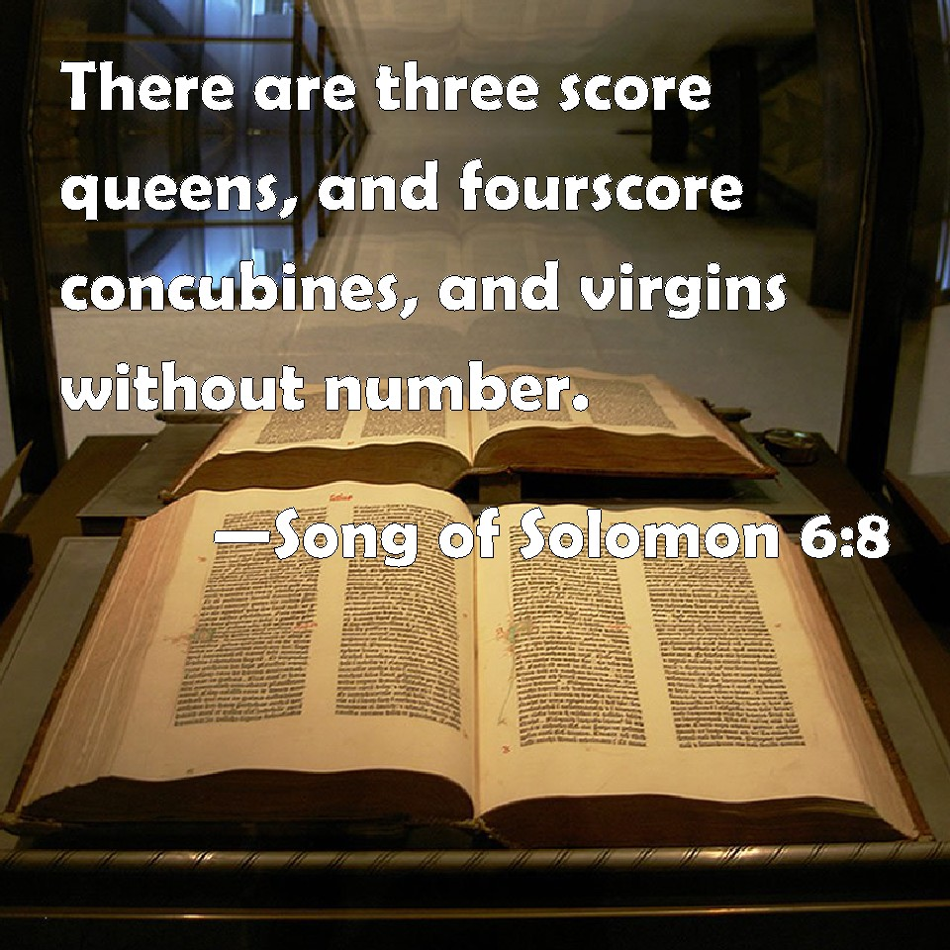

Slide 203
A Sensible Conclusion:
  One man and
  One woman
The man may be Solomon

Slide 204
A Sensible Conclusion:
  One man and
  One woman
The man may be Solomon
Or he may be a shepherd, her “Solomon”

Slide 205
A Sensible Conclusion:
  One man and
  One woman
The value of this understanding:

Slide 206
A Sensible Conclusion:
  One man and
  One woman
The value of this understanding:
a simpler, purer experience of love

Slide 207
A Sensible Conclusion:
  One man and
  One woman
The value of this understanding:
a simpler, purer experience of love
it fits Solomon’s exhortation, Proverbs 5:18-19

Slide 208
A Sensible Conclusion:
  One man and
  One woman
The value of this understanding:
a simpler, purer experience of love
it fits Solomon’s exhortation, Proverbs 5:18-19
it allows the simplest reader to derive a direct, edifying message: a healthy and robust sexuality between husband and wife is a blessing from God!

Slide 209
"The poem is God's commendation of true mating love and his condemnation of Solomon 's polygamy... Three principles lead me to accept this view: 1) The Bible is a complete book and as such it must deal with all aspects of human experience. Mating love is a strong factor in life and unless this poem deals with it, it is omitted from God ‘s book. 2) The very structure and evidence of the poem. 3) If such a virtuous girl's marriage to Solomon was the theme, then Solomon ’s polygamy would be tacitly endorsed. " (Hailey, p. 24). [Hailey, Homer. Bible Class Notes: Wisdom Literature. Temple Terrace: Florida College Bookstore. Revised 1972.]

Slide 210
The Sexual Relationship in Christian Marriage

Slide 211
Key Points
Sex was created by God to be enjoyed regularly by husband and wife.
A deeper understanding of the differences in husband and wife make for a more fulfilling relationship.
Common problems that prevent fulfillment.

Slide 212
The Function of Marriage
Procreation (Gen. 3:16)
Companionship (Gen. 2:18; Mal. 2:14)
Prevention of sexual immorality (1 Cor. 7:1-9)
Pleasure (Prov. 5:15-20; Song of Songs)

Slide 213
Biblical Marriage Analogies
Old Testament
  The spiritual relationship between God and Israel is characterized as marriage and the breaking of that spiritual covenant as adultery (Isa. 54:5; 62:5; Jer. 3:14; 7:9; 16:21; 23:10; 31:32; Ezek. 16; Hosea 2:19-20)
  The Prophet Hosea
  Song of Songs

Slide 214
Biblical Marriage Analogies
New Testament
  The relationship between Christ and His disciples is characterized as a marriage (Eph. 5:22-33)
  Harlot and the Bride (Rev. 17-18; 21:2, 9-10)
  Marriage analogies in the Parables
    The Parable of the Wedding Feast (Mt. 22:2-14)
    The Parable of the Wise and Foolish Virgins (Mt. 25:1-13)
    “I go to prepare a place for you…” (Jn. 14:1-3)

Slide 215
Intimacy in Marriage
Biblical language suggests the level of intimacy in marriage (Gen. 4:1; Lk. 1:34; Mt. 1:25)
  “Scripture suggest that just as we can know God, so we can know our husband or wife in a deeper, higher, more intimate way through the physical act of marriage.” (Wheat, page 19)

Slide 216
Intimacy in Marriage
The Law of Moses commands intimacy in marriage (Deut. 24:5)
  “To “cheer up” the wife means literally in Hebrew “to know sexually and understand what is exquisitely pleasing to her.” (Wheat, page 23)

Slide 217
“One Flesh”
Broadest context (Gen. 2:24; Mt. 19:5-6; Mk. 10:8; Eph. 5:31)
Narrowest context (1 Cor. 6:16)

Slide 218
Key Point
Sex, by design, is intended for pleasure.
  “There are no restrictions, sexually within marriage provided it is loving.” (Penner, page 127)

Slide 219
“Dwell with Understanding”
General gender differences
Specific gender differences
Specific personality differences

Slide 220
“…He who made them at the beginning made them male and female”
“Sex for sex’s sake is not very appealing to a woman. But sex as the natural outcome of relational intimacy is very appealing. The way to approach sex with a woman is through relationship.” (McBurney, page 106)

Slide 221
The Difference in Need
“What’s the #1 need for a man in a marriage? Affirmation? It’s important, but not the top need. Most women think men are ‘after only one thing,’ but that’s far too simplistic. The #1 need is not sex, but sexual fulfillment. There’s a…difference.” (Leman, page 149)

Slide 222
“Dwell with Understanding”
General gender differences
Specific gender differences

Slide 223
Gender “Anomalies”
Death
Sickness
Family life
Social environment
Abuse
Divorce
Education
Religious background

Slide 224
Key elements of individual outlook of sexual fulfillment:
Parents
Social input
Religious input
Early sexual experiences
Early marital experiences
Effect of children

Slide 225
“Dwell with Understanding”
General gender differences
Specific gender differences
Specific personality differences – Example: Sibling Birth Order

Slide 226
Exceptions to the Rules
Physical/emotional differences
Gender
Years between children
Miscarriage or death of a child
Parental interaction with individual children
Parental criticism
Blended families

Slide 227
Other Challenges:
Physiology
Communication
Family Values
Unrealistic expectations
Misguided priorities
Understanding love

Slide 228
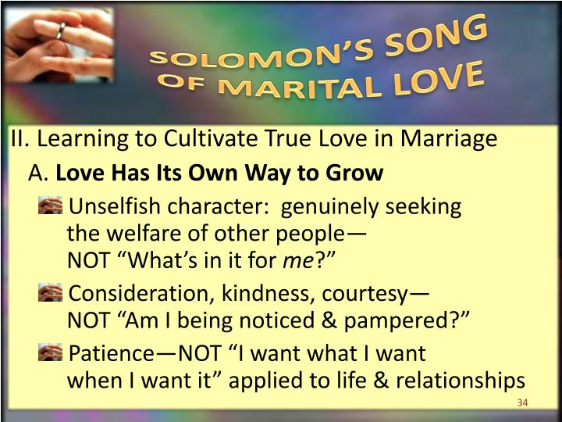

Slide 229
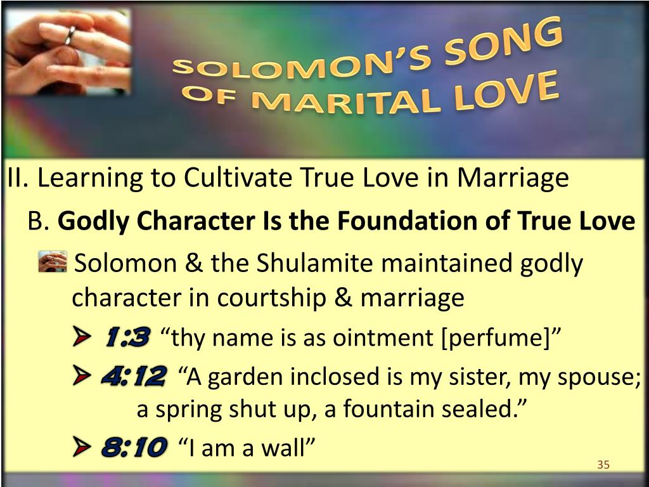

Slide 230
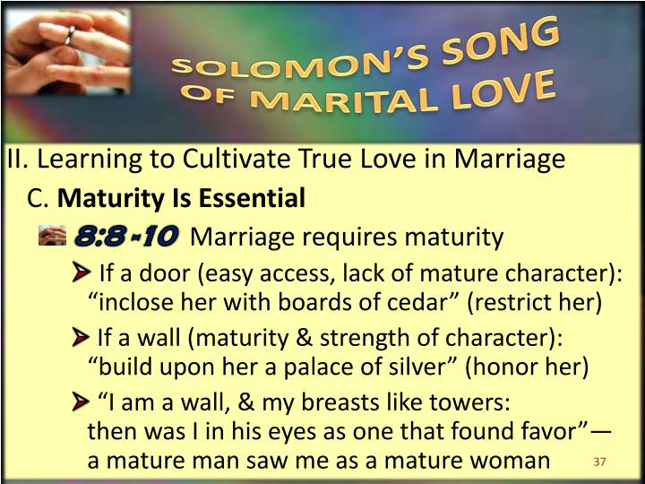

Slide 231
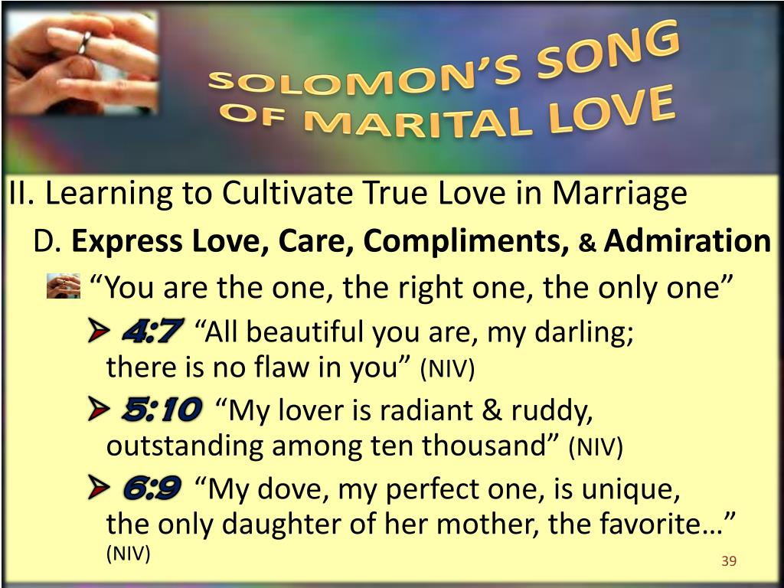

Slide 232
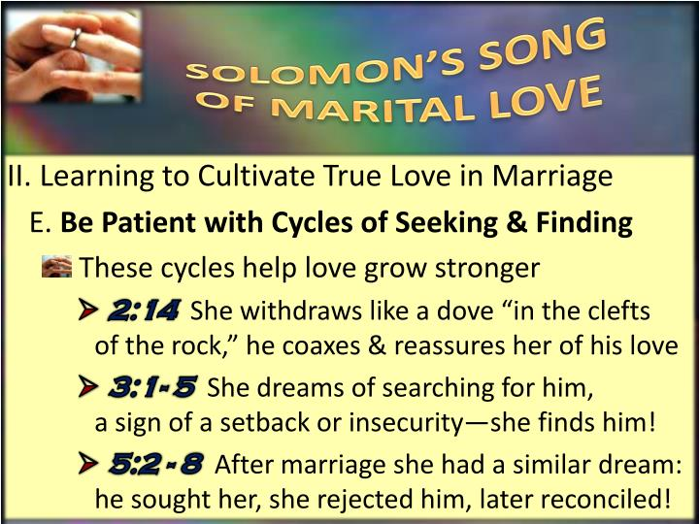

Slide 233
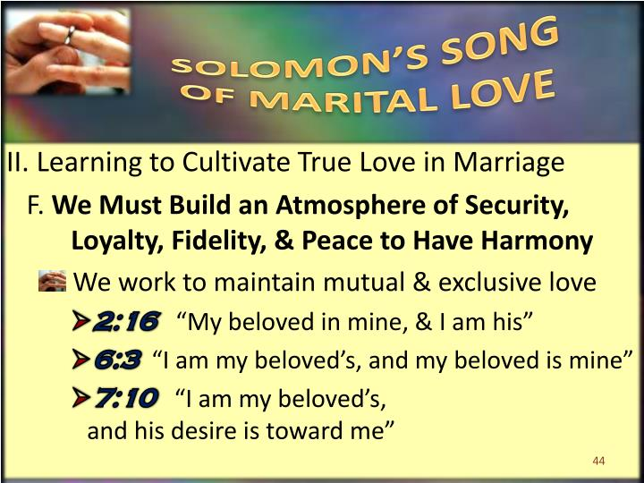

Slide 234
Courtship Guidance & Dating Lessons

Slide 235
drawing Proper Lines in Dating by David Posey
A date is the crucible where your commitment to “flee fornication” is put to the test, sometimes in the extreme. Ideally, both parties have the same desire to please God act becomingly. But if your companion gives in to temptation, it is important to know that you can make sure that the date des not degenerate into a struggle of the flesh. The word “no” must be on tip of your tongue. You need to have the courage to say “take me home” (or, I’d better take you home) if the date takes a potentially ugly turn (lust, under any circumstances, is ugly, because it is sin). In other words, you need to be a Christian at all times.
There is plenty of help. The Bible clearly defines proper conduct in passages like Galatians 5:19, Ephesians 5:3, and 1st Thessalonians 4:4-5, all of which condemn fornication and lust. In the Old Testament, the Song of Soloman is a fountain of wisdom and will help form proper attitudes about courtship and dating.
For years, students of the book incorrectly allegorized it into a message about Christ and the church. Perhaps they were embarrassed by the candid language in the book which is obviously about the beauty of romantic love.
The heroine of the Song is a young Shulamite woman who is beautiful, but not particularly “popular.” Her brothers put her to work pruning vines (1:6), trapping foxes (2:15) tending flocks (1:8) and when a handsome stranger shows up, she is embarrassed because she has not time to groom herself as she would like (1:6, “my own vineyard”). According to one interpretation, she did not recognize the stranger as King Solomon, mistaking him for a shepherd (1:7). But Solomon speaks kindly to her, praising her for her natural beauty (1:8-10,15; 2:2)
There is plenty of mutual praise by both Solomon and the Shulamite. But the most enlightened statement may be one made by the Shulamite in 2:7, 3:5 and with slight variation 8:4 – “I charge you, O daughters of Jerusalem, By the gazelles or by the does of the field, Do not stir up or awaken love until it pleases.” In other words, there is an appropriate time, and not before, to express love physically. It has become of this commitment by the young lady that Solomon could say of her on their wedding day, “A garden enclosed is my sister, my spouse. A spring shut up, A fountain sealed” (4:12).

Slide 236
drawing Proper Lines in Dating by David Posey
In other words, there is an appropriate time, and not before, to express love physically. It has become of this commitment by the young lady that Solomon could say of her on their wedding day, “A garden enclosed is my sister, my spouse. A spring shut up, A fountain sealed” (4:12).
This is God’s blueprint for holy romance. It teaches patience, respect, and genuine love for the other person. Unfortunately, these principles are not promoted I our culture today. Thus, young people often face extreme pressure to “give in” and deny their own hearts and their God, just for a moment of pleasure.
What specific steps can you take to keep yourself pure until your wedding day and make sure you can look back at your dating years as a time full of good memories, instead of guilt? First, you’re going to have to be strong enough to be a Christian wherever you are and whatever you do – a non-conformist (see Romans 12:1-2). Being religious is not enough. A Gallop poll found that many young people, even those who say religion is important, do not feel that premarital sex is wrong.
Frankly, you will be inclined to commit fornication if you permeate your mind with thoughts about it. The more you look at words and pictures that promote it, the more inclined you’ll be to “see for yourself.” It is patent folly to think otherwise.
If you’re serious about avoiding fornication, you’ll exercise discretion in the choices of where you go, what you see and what you listen to. If you spend five or six hours watching a movie full of sexual content, listening to music that clearly promotes immorality and then go to a place where you are alone, you are playing with fire, indeed. And, while it’s not popular to say so today, dancing only fans the flames.
People, young and old, eventually do what they want to do. If you are really interested in pleasing God, you will be stubborn about drawing the proper lines in dating. And the people you date will respect you for it, as Solomon respected the Shulamite. And if they don’t, they aren’t worthy of a second thought! - - Memorial Church of Christ Bulletin Volume 30 No. 38 Sept. 2022

Slide 237
GILL’S EXPOSITION OF THE ENTIRE BIBLE
I am the rose of Sharon, and the lily of the valleys. Whether Christ, or the church, is here speaking, is not certain: most of the Jewish writers (t), and some Christian interpreters (u), take them to be the words of the church, expressing the excellency of her grace, loveliness, and beauty, she had from Christ; and intimating also her being in the open fields, exposed to many dangers and enemies, and so needed his protection. The church may be compared to a "rose", for its beautiful color and sweet odor (w), and for its delight in sunny places, where it thrives best, and is most fragrant. This figure is exceeding just; not only the beauty of women is expressed by the color of the rose (x), as is common in poems of this kind; to give instances of it would be endless (y); some have had the name of Rhoda from hence; see Acts 12:13. No rose can be more beautiful in color, and delightful to the eye, than the church is in the eyes of Christ, as clothed with his righteousness, and adorned with the graces of his Spirit: nor is any rose of a more sweet and fragrant smell than the persons of believers are to God and Christ, being considered in him; and even their graces, when in exercise, yea, their duties and services, when performed in faith; and, as the rose, they grow and thrive under the warming, comforting, and refreshing beams of the sun of righteousness, where they delight to be. The church may also be compared to a "lily of the valleys", as she is, in the next verse, to one among thorns. This is a very beautiful flower; Pliny (z) says it is next in nobleness to the rose; its whiteness is singularly excellent; no plant more fruitful, and no flower exceeds it in height; in some countries, it rises up three cubits high; has a weak neck or body, insufficient to bear the weight of its head. The church may be compared to a lily, for her beauty and fragrance, as to a rose; and the redness of the rose, and the whiteness of the lily, meeting in her, make her somewhat like her beloved, white and ruddy; like the lily, being arrayed in fine linen, clean and white, the righteousness of the saints; and like it for fruitfulness, as it is in good works, under the influence of divine grace, and grows up on high into her head, Christ Jesus; and though weak in herself, yet strong in him, who supports her, and not she him: and the church may be compared to a "lily of the valleys"; which may not describe any particular lily, and what we now call so; but only expresses the place where it grows, in low places, where plants are in danger of being plucked and trodden upon; though they may have more moisture and verdure than those in higher places; so the church of Christ is sometimes in a low estate, exposed to enemies, and liable to be trampled and trodden under foot by them, and to be carried away with the flood of persecution, were it not guarded by divine power; and, being watered with the dews of grace, it becomes flourishing and fruitful. But the more commonly received opinion is, that these are the words of Christ concerning himself; and which indeed best become him, and are more agreeable to his style and language, John 14:6; and suit best with the words in the Sol 2:2, as one observes (a); nor is it unfitly taken by the bridegroom to himself, since it is sometimes given by lovers to men (b). Christ may be compared to a rose for its color and smell; to the rose for its red color: and which may be expressive of the truth of his humanity, and of his bloody sufferings in it; and this, with the whiteness of the lily, finishes the description of him for his beauty, Sol 5:10; and for its sweet smell; which denotes the same things for which he is before compared to spikenard, myrrh, and camphire. The rose, as Pliny says (c), delights not in fat soils and rich clays, but in rubbish, and roses that grow there are of the sweetest smell; and such was the earth about Sharon (d); and to a rose there Christ is compared, to show the excellency and preferableness of him to all others. The word is only used here and in Isaiah 35:1. Where it is in many versions rendered a "lily": it seems to be compounded of two words; one which signifies to "cover" and hide, and another which signifies a "shadow"; and so may be rendered, "the covering shadow": but for what reason a rose should be so called is not easy to say; unless it can be thought to have the figure of an umbrella; or that the rose tree in those parts was so large, as to be remarkable for its shadow; like that Montfaucon (e) saw, in a garden at Ravenna, under the shadow of the branches of which more than forty men could stand: Christ is sometimes compared to trees for their shadow, which is pleasant and reviving, as in Sol 2:3. Some render it, "the flower of the field" (f); which may be expressive of the meanness of Christ in the eyes of men; of his not being of human production; of his being accessible; and of his being liable to be trampled upon, as he has been. And as he is compared to a rose, so to a "lily", for its color, height, and fruitfulness; expressive of his purity in himself, of his superiority to angels and men, and of his being filled with the fruits and blessings of grace; and to a lily of the valleys, denoting his wonderful condescension in his low estate of humiliation, and his delight in dwelling with the humble and lowly: some render the words, "I am the rose of Sharon, with the lily of the valleys" (g); by the former epithet meaning himself; and by the latter his church, his companion, in strict union and communion with him; of whom the following words are spoken.

Slide 238
double Application:
Literal & Metaphor
Past – Present – Future The Love Of Christ For His Bride -The Church

Slide 239
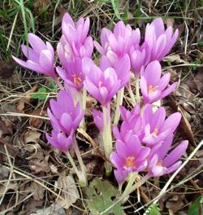
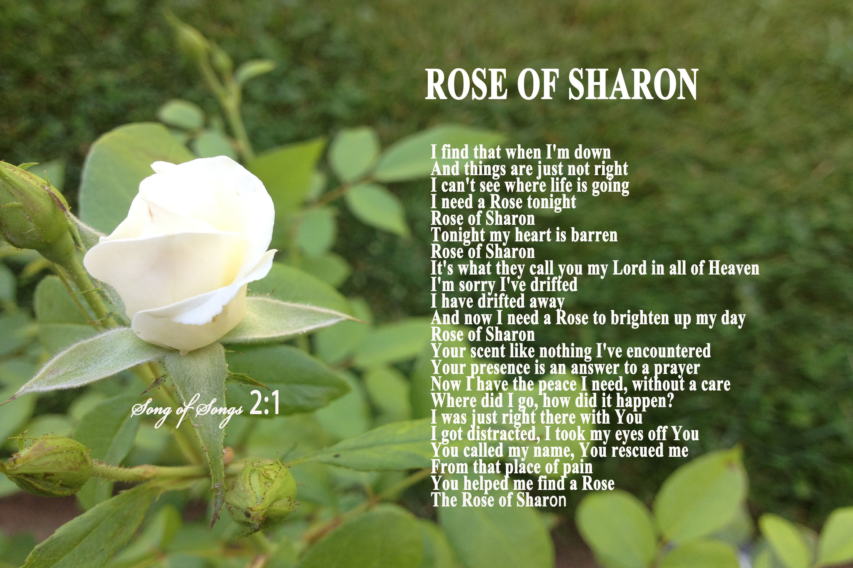

Slide 240
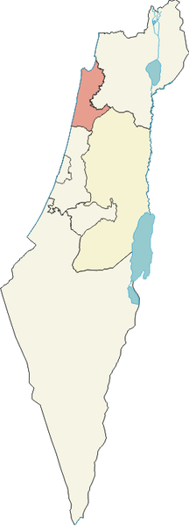

“Rose of Sharon”
...is the autumn-flowering pale-lilac meadow-saffron, i. e. Colchicum autumnale … in the park-like tract (about 8-12 miles wide and 44 long) of the Palestinian Maritime Plain extending along the Mediterranean from Joppa to Mt. Carmel.
Paul Haupt. Journal of Biblical Literature, 36:1/2, 147. 1917
Colchicum autumnale is most commonly known as autumn crocus, but in various regions it is known as naked-ladies, colchicum, and meadow saffron…
http://biotech.icmb.utexas.edu/botany/acrohst.html

Slide 241
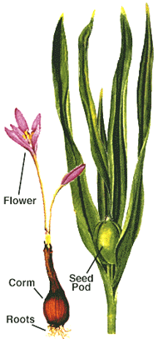
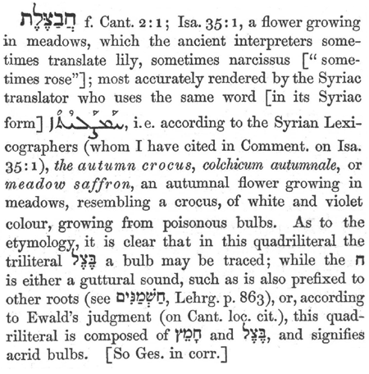
“Rose of Sharon”
It's a perennial herb in the lily family… which grows from a corm (a solid bulb)...
http://biotech.icmb.utexas.edu/botany/acrohst.htm

Slide 242
“Rose of Sharon”
...each stalk produces a single white-to-purplish-pink flower that resembles a crocus.
The extreme toxicity of this plant has been known since the times of ancient Greece, but in the fifth century, herbalists in the Byzantine Empire discovered it could be used to treat rheumatism and arthritis, and the Arabs began to use it for gout. The useful active ingredient in the plant is an alkaloid called colchicine... http://biotech.icmb.utexas.edu/botany/acrohst.html

Slide 243
GILL’S EXPOSITION OF THE ENTIRE BIBLE
I am the rose of Sharon, and the lily of the valleys. Whether Christ, or the church, is here speaking, is not certain: most of the Jewish writers (t), and some Christian interpreters (u), take them to be the words of the church, expressing the excellency of her grace, loveliness, and beauty, she had from Christ; and intimating also her being in the open fields, exposed to many dangers and enemies, and so needed his protection. The church may be compared to a "rose", for its beautiful color and sweet odor (w), and for its delight in sunny places, where it thrives best, and is most fragrant. This figure is exceeding just; not only the beauty of women is expressed by the color of the rose (x), as is common in poems of this kind; to give instances of it would be endless (y); some have had the name of Rhoda from hence; see Acts 12:13. No rose can be more beautiful in color, and delightful to the eye, than the church is in the eyes of Christ, as clothed with his righteousness, and adorned with the graces of his Spirit: nor is any rose of a more sweet and fragrant smell than the persons of believers are to God and Christ, being considered in him; and even their graces, when in exercise, yea, their duties and services, when performed in faith; and, as the rose, they grow and thrive under the warming, comforting, and refreshing beams of the sun of righteousness, where they delight to be. The church may also be compared to a "lily of the valleys", as she is, in the next verse, to one among thorns. This is a very beautiful flower; Pliny (z) says it is next in nobleness to the rose; its whiteness is singularly excellent; no plant more fruitful, and no flower exceeds it in height; in some countries, it rises up three cubits high; has a weak neck or body, insufficient to bear the weight of its head. The church may be compared to a lily, for her beauty and fragrance, as to a rose; and the redness of the rose, and the whiteness of the lily, meeting in her, make her somewhat like her beloved, white and ruddy; like the lily, being arrayed in fine linen, clean and white, the righteousness of the saints; and like it for fruitfulness, as it is in good works, under the influence of divine grace, and grows up on high into her head, Christ Jesus; and though weak in herself, yet strong in him, who supports her, and not she him: and the church may be compared to a "lily of the valleys"; which may not describe any particular lily, and what we now call so; but only expresses the place where it grows, in low places, where plants are in danger of being plucked and trodden upon; though they may have more moisture and verdure than those in higher places; so the church of Christ is sometimes in a low estate, exposed to enemies, and liable to be trampled and trodden under foot by them, and to be carried away with the flood of persecution, were it not guarded by divine power; and, being watered with the dews of grace, it becomes flourishing and fruitful. But the more commonly received opinion is, that these are the words of Christ concerning himself; and which indeed best become him, and are more agreeable to his style and language, John 14:6; and suit best with the words in the Sol 2:2, as one observes (a); nor is it unfitly taken by the bridegroom to himself, since it is sometimes given by lovers to men (b). Christ may be compared to a rose for its color and smell; to the rose for its red color: and which may be expressive of the truth of his humanity, and of his bloody sufferings in it; and this, with the whiteness of the lily, finishes the description of him for his beauty, Sol 5:10; and for its sweet smell; which denotes the same things for which he is before compared to spikenard, myrrh, and camphire. The rose, as Pliny says (c), delights not in fat soils and rich clays, but in rubbish, and roses that grow there are of the sweetest smell; and such was the earth about Sharon (d); and to a rose there Christ is compared, to show the excellency and preferableness of him to all others. The word is only used here and in Isaiah 35:1. Where it is in many versions rendered a "lily": it seems to be compounded of two words; one which signifies to "cover" and hide, and another which signifies a "shadow"; and so may be rendered, "the covering shadow": but for what reason a rose should be so called is not easy to say; unless it can be thought to have the figure of an umbrella; or that the rose tree in those parts was so large, as to be remarkable for its shadow; like that Montfaucon (e) saw, in a garden at Ravenna, under the shadow of the branches of which more than forty men could stand: Christ is sometimes compared to trees for their shadow, which is pleasant and reviving, as in Sol 2:3. Some render it, "the flower of the field" (f); which may be expressive of the meanness of Christ in the eyes of men; of his not being of human production; of his being accessible; and of his being liable to be trampled upon, as he has been. And as he is compared to a rose, so to a "lily", for its color, height, and fruitfulness; expressive of his purity in himself, of his superiority to angels and men, and of his being filled with the fruits and blessings of grace; and to a lily of the valleys, denoting his wonderful condescension in his low estate of humiliation, and his delight in dwelling with the humble and lowly: some render the words, "I am the rose of Sharon, with the lily of the valleys" (g); by the former epithet meaning himself; and by the latter his church, his companion, in strict union and communion with him; of whom the following words are spoken.

Slide 244
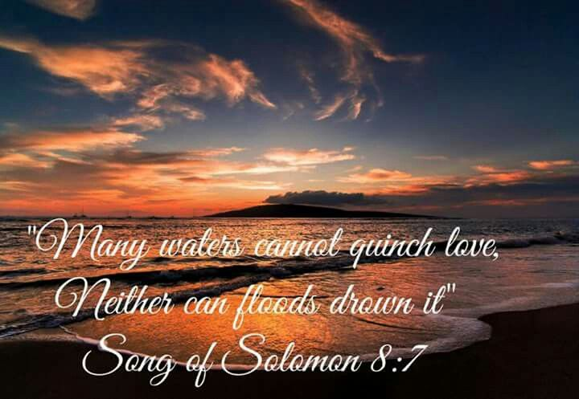

Slide 245
Summary & conclusion

Slide 246
THE RIGHT LOVING PARTNER …
… IS HEALING & SALVATION!!

Slide 247
MAKING THE WRONG BASIC CHOICES…
IS EARTHLY & EVERLASTING MISERY!!!

