Slide 1
Christian Apostasy & Protestant Reformation
by David Lee Burris, Editor

Slide 2
ONE CHURCH in the BIBLE
Time | Place | Founder | Church
Pentecost | Jerusalem | Christ | Church of Christ
606 A.D. | Rome, Italy | Boniface III | Roman Catholic
1520 | Germany | Martin Luther | Lutheran
1534 | England | King Henry VIII | Church of England
1536 | Switzerland | John Calvin | Presbyterian
1607 | Holland | John Smythe | Baptist
1739 | England | John Wesley | Methodist
1830 | USA | Joseph Smith | Latter Day Saints
1830 | USA | William Miller | 7th Day Adventists
1866 | USA | Mary Baker Eddy | Christian Scientist
1872 | USA | Charles Russell | Jehovah Witnesses

Slide 3
Church Identifiers
Proof Texts
Founder/Foundation Jesus Christ
Matthew 16: 18
Member Profile Baptism Added
Acts 2: 41
Action Focus Save Souls
Phil 4: 14-18
Professed Doctrine The New Testament
Ephesians 2: 20
Organic Structure Local Congregation
Acts 14: 23
Physical Location All The Nations
Matt 28: 18-20

Slide 4
MEMBERSHIP
The NT Church
Saved By Blood
Saved By Baptism
BIBLE
TEACHES
What
When
Rev. 1:5
Heb. 9:14
Matt. 26:28
Rom. 5:9
Washed
Consc. Clean
Sins Remitted
Made Free
Acts 22:16
1 Pet. 3:21
Acts 2:38
Rom. 6:3-5, 17-18
Blood of Christ Saves When We Obey
God’s Command To Be Baptized!

Slide 5
Acts 2:40-42, “And with many other words he testified and exhorted them, saying, "Be saved from this perverse generation." 41 Then those who gladly received his word were baptized; and that day about three thousand souls were added to them. 42 And they continued steadfastly in the apostles' doctrine and fellowship, in the breaking of bread, and in prayers”;

Slide 6
Acts 2:46-47, “So continuing daily with one accord in the temple, and breaking bread from house to house, they ate their food with gladness and simplicity of heart, 47 praising God and having favor with all the people. And the Lord added to the church daily those who were being saved.”

Slide 7
Why Study Church History?
Learn the Mistakes of History → Avoid them? Those who cannot learn from history are doomed to repeat it.
Discover our own roots (Restoration Movement)
Avoid swinging the pendulum Grace ↔ Legalism Doctrine ↔ Zeal, Emotion, Heart Asceticism ↔ Freedom

Slide 8
How is True Christianity Lost?
Growth of splinter, heretical groups with false teachings.
Gradual drift of the “true church” from biblical practice for ‘supposed” good and sincere reasons.

Slide 9
But, men have their own ideas & soon departed from God’s original plan…
“Apostasy” = drifting away from the original standard
Immediately after the est. of the church, apostasy began (judaizing) Acts 15:5-11, but many other subjects as well
How did today’s religious world get the way we see it?

Slide 11
Early Schisms and Heresies
Judaizers legalism Gal 1:8
Ebionites Denied deity of Jesus
Gnostics Deny humanity of Jesus, deep knowledge
Docetism Jesus not a physical person
Marcionites Jehovah an evil god. Established canon.
Montanists Charismatics, modern-day revelation
Novatianists Division over discipleship
Arians Denied deity of Jesus

Slide 12
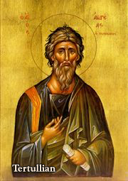
Doctrine of the Trinity
Tertullian AD 160-220
The Father and the Son are different “not in condition, but in degree; not in substance, but in form; not in power, but in aspect”

Slide 13
Church Councils
Nicaea AD 325
Arianism Jesus homoousios With the Father
Constantinople AD 381
Nicene Creed Holy Spirit also homoousious
Ephesus AD 431
Nestorianism condemned, Pelagius anathematized.
Calchedon AD 451
Define the “two natures” of Jesus
Constantinople II AD 553
Monophysitism
Constantinople III AD 680
Monothelitism
Nicaea II AD 787

Slide 14
Nicene Creed
We believe in one God, the Father Almighty, Maker of heaven and earth, and of all things visible and invisible.
And in one Lord Jesus Christ, the only-begotten Son of God, begotten of the Father before all worlds; God of God, Light of Light, very God of very God; begotten, not made, being of one substance (homoousios, of the same substance, consubstantial as opposed to homoiousios) with the Father, by whom all things were made.
Who, for us men and for our salvation, came down from heaven, and was incarnate by the Holy Spirit of the virgin Mary, and was made man; and was crucified also for us under Pontius Pilate; He suffered and was buried; and the third day He rose again, according to the Scriptures; and ascended into heaven, and sits on the right hand of the Father; and He shall come again, with glory, to judge the quick and the dead; whose kingdom shall have no end.
And I believe in the Holy Ghost, the Lord and Giver of Life; who proceeds from the Father and the Son; who with the Father and the Son together is worshipped and glorified; who spoke by the prophets.
And I believe one holy catholic and apostolic Church. I acknowledge one baptism for the remission of sins; and I look for the resurrection of the dead, and the life of the world to come. Amen.
Is this what we believe?

Slide 15
Chalcedon AD 451
“In agreement with the holy fathers we all unanimously teach that we should confess that our Lord Jesus Christ is one and the same Son; the same perfect in Godhead and the same perfect in manhood, truly God and truly man, the same of a rational soul and body; consubstantial with the Father in Godhead and the same consubstantial with us in manhood; like us in all things except sin; begotten of the Father before all ages as regards his Godhead and in the last days the same, for us and for our salvation, begotten of the Virgin Mary, the theotokos (as opposed to the Christotokos of the Nestorians) (the God-bearer, the mother of God) as regards his manhood; one and the same Christ, Son, Lord, only-begotten, made known in two natures without confusion, without change, without division, without separation…

Slide 16
Chalcedon (cont.)
“Without confusion and without change”
to oppose monophysitism/Coptic Christianity
Monophysite = one nature
“Without division, without separation”
to oppose Nestorianism
Q: Are we splitting hairs here?

Slide 17
Constantinople AD 553
Anathematized Origin
Constantinople III AD 680
Opposed monothelitism “one will”
Nicaea II AD 787
Iconoclasm. It is heretical to say that one cannot be aided in worship by using an icon.

Slide 18
Augustine (354-430) The Sovereignty of God
Laid groundwork for Christendom, Medieval Christianity and Reformation theology
The City of God, Christendom, Church and State
Original Sin: Mankind totally depraved
Predestination
Sacramentalism Baptism, Ordination etc ex opere opero
Transubstantiation
Immaculate Conception
Reacted against Donatists
Reacted against Pelagius, Pelagianism

Slide 19
Highlights in 3rd and 4th Centuries
Persecutions
Decius 249-251 Valerian 253-260
Diocletian 303-304 Galerain, Licinius
Edict of Milan 313 Toleration of Christianity
Constantine, Emperor of all Rome 323
Beginning of “Christendom”
Council of Nicaea
Arianism
Nicene Creed
Julian the Apostate

Slide 20
The Historical Figures Who Have Shaped Religious Beliefs
Augustine – (354AD -430AD) “tolle lege” (“take up & read”) He thought this was God’s grace to him (Romans 13:13 - he must stop his sinful life) *His beliefs shaped Catholic doctrine all the way to today.

Slide 21
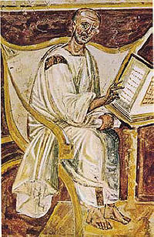
Augustine: 354-430
Sovereignty of God
Total depravity
Monoergism
Predestination
Original Sin
Infant baptism for salvation
Sacramentalism
Transubstantiation
City and State: Christendom
Opposed Donatists
Opposed Pelagius
Augustine of Hippo (from 6th century)

Slide 22
The Error of Augustine’s Main Doctrines
We are by nature sinners (Eph 2:3; Ps 51:5). We all have sinned because sin entered the world through Adam: "Therefore, just as sin entered the world through one man, and death through sin, and in this way death came to all men, because all sinned" (Rom 5:12).
Therefore, we are unable to do God's will (Rom 6:16; 7:14). We were affected by the fall of Adam, contrary to what Pelagius taught.

Slide 23
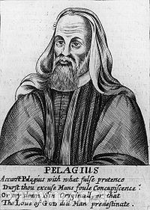
Pelagius AD c. 354-430
Works Salvation?

Slide 24
Pelagius

Slide 25
The “Pelagian Heresy”
Denied “Original Sin” (Ezek 18:4)
God expects humans to direct their own lives by “free will” if that will is guided by the Bible (Phil 2:12)
Grace does not interfere with “free will”
Urged return to Bible as the only spiritual guide & authority

Slide 26
Pelagius Excommunicated At the Hand of Augustine
Augustine remains to this day the most influential person in his teachings to the Catholic Church, other than the apostle Paul (“Confessions”)

Slide 27
Another way to lose it: The Church Drifts
Orthodoxy vs Orthopraxy
Heterodoxy vs Heteropraxy
Theme: Almost all these examples of drift from Orthopraxy started out as a reasonable and seemingly wise response to a real problem (heresy) at the time!
Irenaeus: Defended against heresy using “Church tradition”, The rule of faith, and the authority of apostolic succession.

Slide 28
The Apostolic Church Drifts…
Leadership/Church Organization
Doctrine of Baptism
Asceticism, Monasticism
Creeds
Sacerdotalism/Priesthood clergy and laity
Lord’s Supper becomes a sacrifice
Sacramentalism: Liturgy, Church Calendar
Veneration of “Saints”
Hermeneutics
Allegorizing of Scripture vs Historical/Analytical approach

Slide 29
Branches of Christianity after 500
Western Christendom Rome Legalistic and Hierarchical
Easter Christendom Byzantium Spiritual Experiential & Mystical
Coptic Church (Alexandria, Cairo) Monophysite One nature. Alexandrine School. Focused on divine nature of Jesus and minimized his humanity. Mary: Theotokos
Church of the East Nestorianism Dyophysite. Two Natures. Antiochene School. Focus on human nature of Jesus and his suffering. Mary: Christotokos

Slide 30
In time, man drifted from God’s will in the type of organization used for the church…
God’s pattern:
Each church to be self-ruled by leaders from that church
Plurality of elders to rule over every church
Bible to be the standard for belief, NOT MAN!
Man’s departure:
No congregation to be self-ruled; all subject to centralized rule
Ultimately, only one bishop in the main church ruling all
Pope now the ultimate spiritual authority, NOT GOD!

Slide 31
Highlights of Medieval Christianity
Final Schism of East and West 1054
Corruption of the Papacy
Celibacy of Priests mandatory
Baptism by sprinkling adopted
Purgatory, Cult of Saints, Indulgences, etc.
Crusades
1st 1096-1099 Capture Jerusalem, Establish Feudal States
2nd 1147-1149 Complete failure
3rd 1187-1192 Capture Acre, Mediterranean coast
- 8th 1270-1271
Cult of Mary
Growth of Monasticism in West
Dominicans (Dominic, 1170-1221)
Franciscans (Francis of Assisi 1182-1226)

Slide 32
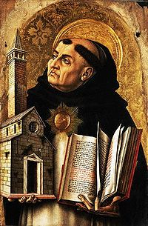
Thomas Aquinas
1225-1274
Aristotle
Revelation by reason
Scholasticism
Arguments for existence of God
Natural Theology
“Summa Theologica”

Slide 33
Thomas Aquinas:
“God, therefore, is the first cause, who moves causes both natural and voluntary. And just as by moving natural causes He does not prevent their actions from being natural, so by moving voluntary causes He does not deprive their actions of being voluntary; but rather is He the cause of this very thing in them, for He operates in each thing according to his own nature.”
In other words, Thomas Aquinas believed in free will and not a strict monergism.

Slide 34
Inventions in Technology Aided the Spread of the Protestant Movement
Johannes Gutenberg - German
1398-1468
*Invented moveable type print & printing press
**Europeans learned method to make paper from wood & cloth fiber from China
***First printed copies of the Bible are placed into the hands of scholars other than the Catholic Church

Slide 35
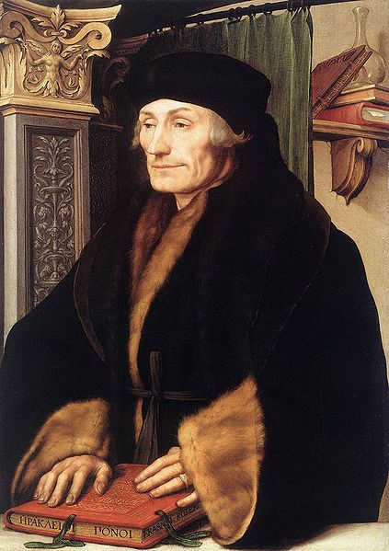
The Catholic Reformation
Erasmus 1466-1536
Sought to reform Roman Church according to humanist principles.
“Praise of Folly” attacks relics, pilgrimages, monasticism, Catholic hierarchy
“On the Freedom of the Will” 1524
Greek New Testament 1514

Slide 36
True Christianity in the Middle Ages?
Paulicians 650-900’s Asia Minor
Albigenses, Cathars 1000’s -1200’s Southern France
Henry the Monk 1100
Arnold of Brescia 1155 Italy
Peter of Bruys 1140 Northern Italy
Waldensians 1175-1500’s Peter Waldo Switzerland

Slide 37
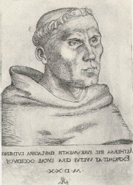
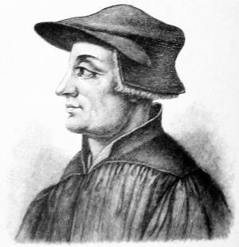
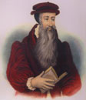
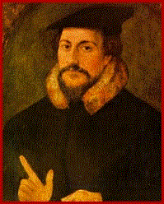
The Reformation Fathers
Martin Luther
1483-1546
German
Ulrich Zwingli
1484-1531
Swiss
John Knox
1505-1572
Scottish
John Calvin
1509-1569
French

Slide 38
The Reformation
John Wyclif England, 1324-1384
John Huss Bohemia, 1374-1415
Martin Luther Germany, 1483-1546
Ulrich Zwingli Switzerland, 1484-1531
William Tyndale England, 1494-1536
John Calvin France, 1509-1564
John Knox Scotland, 1505-1572

Slide 39
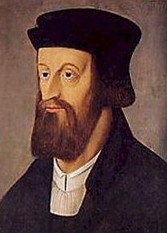
John Wyclif 1324-1384
Translated Vulgate into English Opposed indulgences, idols, priesthood The Pope is the antichrist Followers known as Lollards
Declared heretics 1401

Slide 40
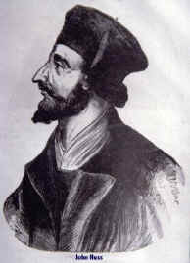
John Huss 1374-1415 Bohemia
Influenced by Wyclif Bible the only authority Only God can forgive sin Burned at the stake Hussites virtually wiped out by the Inquisition Brethren and Moravian Churches

Slide 41
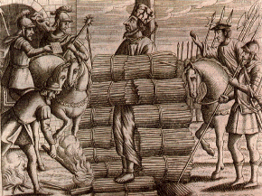
John Huss Burned at the stake, 1415

Slide 42
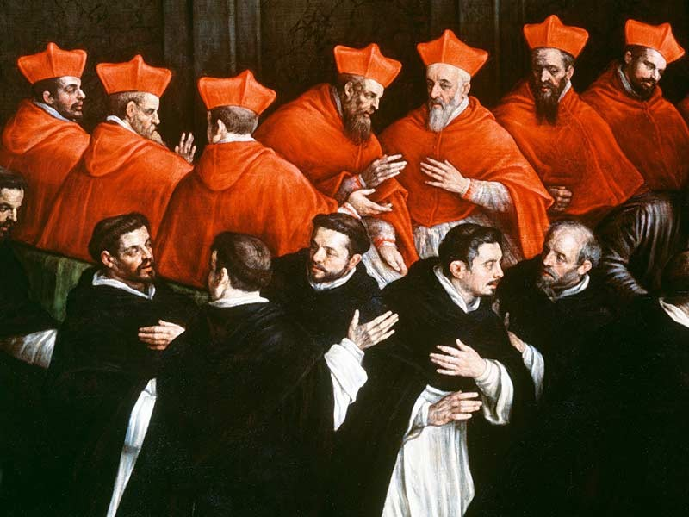

Slide 43
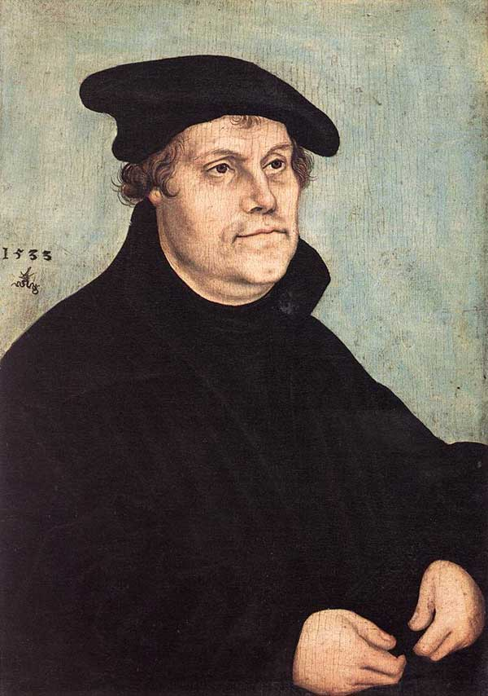
Martin Luther 1483-1546
Augustinian Monk
95 Theses in Wittenburg 1517
Studied Romans
Grace Through Faith Only
Scripture Only
Predestination
Book of James a “book of straw.”
Kept much of Catholic worship practices

Slide 44
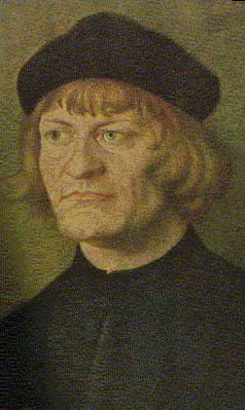
Ulrich Zwingli (1484-1531)
Swiss Reformer
More radical than Luther
Rejected almost all Catholic forms of worship. “Four bare walls and a sermon.”
Differed on the Lord’s Supper
Lord’s Supper and Baptism are “symbolic ceremonies.”
His influence led to the Anabaptists
Principle influence on John Calvin
Died as a soldier fighting a Catholic Swiss canons.

Slide 45
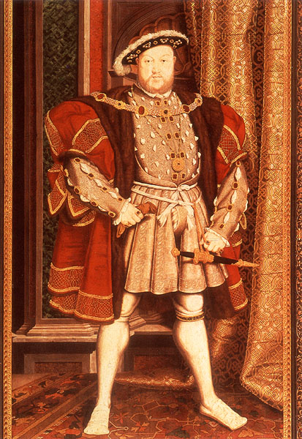
English King Henry VIII The Reluctant Protestant
Henry Tudor – 1491-1547
*Was declared “Defender of the Faith” by pope for his opposition to Luther & “Protestantism”
Authorized the first English language Bible
Split with Catholic Church to found the Anglican Church (Not truly Protestant)

Slide 46
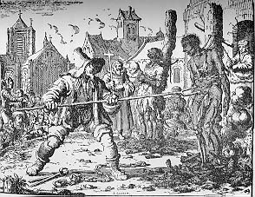
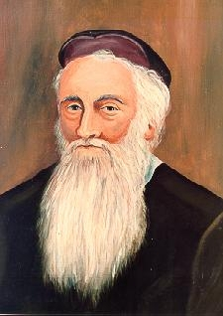
The Anabaptist Movement (1530’s and later)
The Radical Reformation
Menno Simmons 1496-1561
Martyrdom of Anabaptists

Slide 47
The Anabaptist Movement (cont.)
Baptism by immersion of adults after confession of faith for salvation.
Bible the only authority.
Separation of church and state.
Emphasized both life and doctrine
Pacifists (usually)
Many martyrs
Began evangelistic, but became exclusive and withdrawn. (Mennonites, Amish, Hutterites)
Tended to be very schismatic

Slide 48
John Calvin 1509-1564
Followed Zwingli
Most influential theologian of the Reformation
Emphasized Historical/Covenantal Theology
Wrote Institutes of Christian Religion
Established an autocratic theocracy in Geneva
Best known for his strong emphasis on predestination/monergism.
God has two wills: his revealed will (1 Tim 2:3-4) and his secret will: foreordination of souls
Calvinist denominations: Presbyterian, Dutch Reformed, Puritan, Baptist . . .

Slide 49
Renewed Debate in 16th Century
John Calvin – (1509-1569) Authored all the tenets of the “TULIP” which are simply re-digested ancient Greek philosophies along with strong influence of Augustine
James Arminius – (1560 -1609) Opposed Calvinism
Bible Only Authority:
a. External testimony of men
b. Arguments in Scriptures itself
c. The internal witness of God

Slide 50
5 Points of Calvinism
T – Total Depravity
(Ezek. 18:20; Mt. 18:3; Rom. 2:10-12; Heb. 12:9)
U – Unconditional Election
(1 Tim. 2:4; 2 Pet. 3:9; Mt. 11:28-30; Rev. 22:17)
L – Limited Atonement
(Heb. 2:9; 1 Jn. 2:2; Ti. 2:11-12; Mt. 26:28)
I – Irresistible Grace
(Acts 7:51; 7:57; 13:46; Lk. 8:11-15)
P – Perseverance of the Saints
(2 Pet. 2:20-22; Gal. 5:4; Acts 8:20-23; 1 Tim. 4:1)

Slide 51
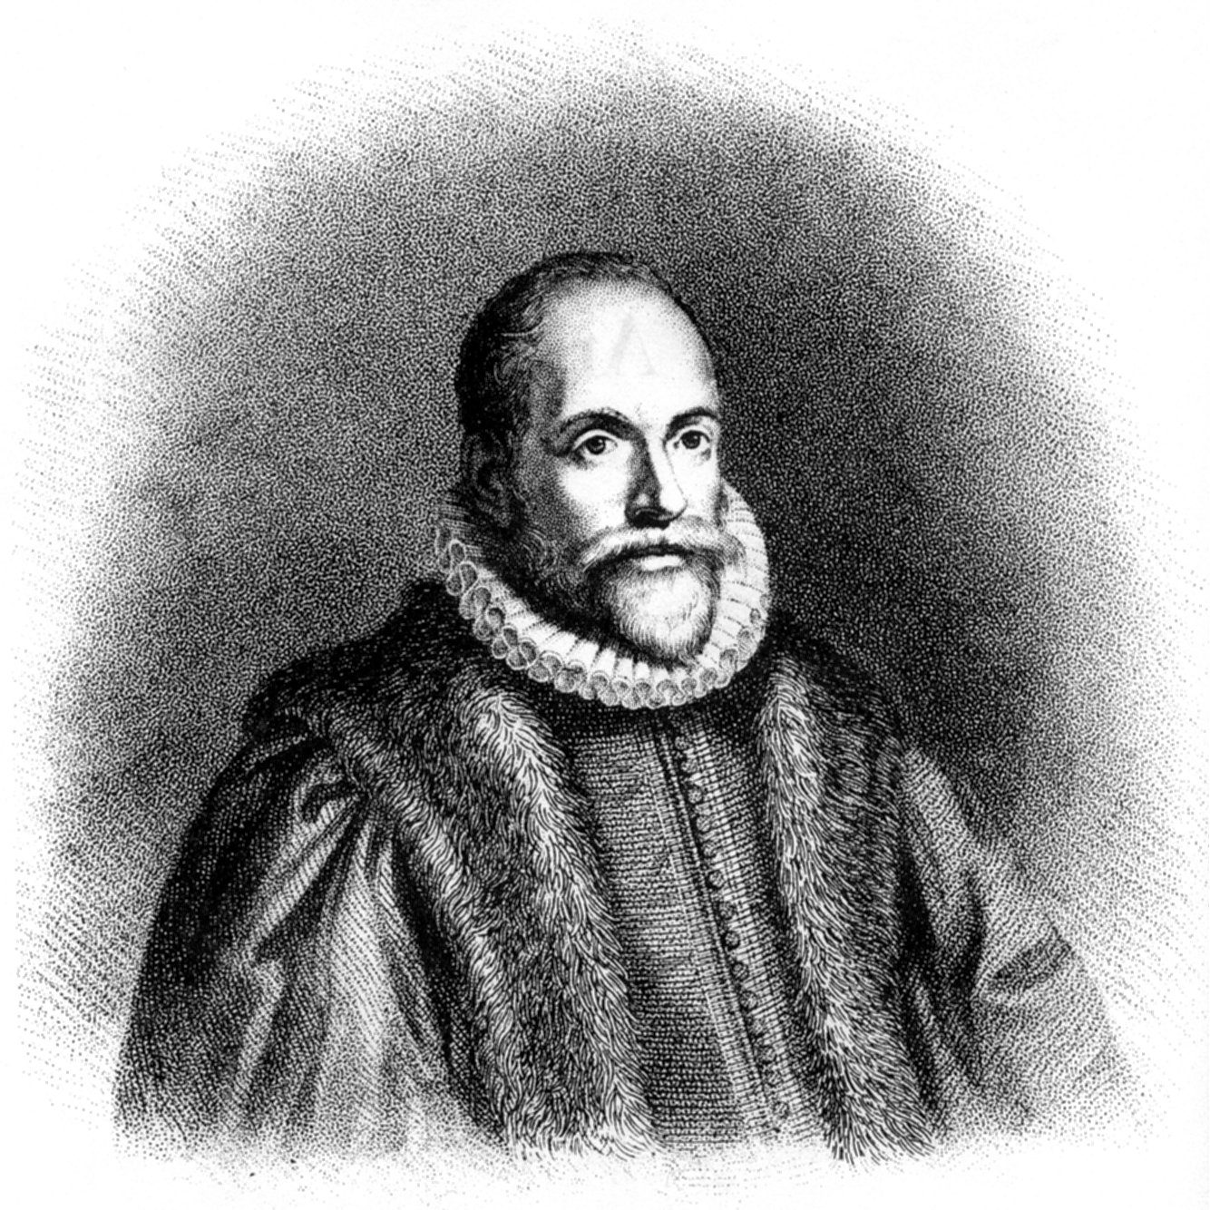
Jacob Arminius (1569-1609)
“Arminianism”
Semi-Pelagianism?
Opposed supra-lapsarianism
Prevenient grace. In the sense that God foreknows, but does not predetermine.
Calvinism makes God the author of sin.
Wesleyan Movement Called The Second Reformation & Influenced Restoration

Slide 52
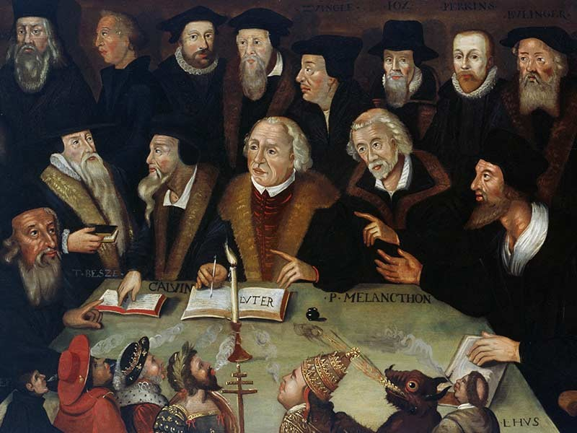

Slide 53
Church History
The Reformation
Origin of the Lutheran Church (1521)
Place: Wittenberg, Germany
Founder: Martin Luther
Prominent Doctrines:
Salvation by Faith Only
Infant Baptism
Consubstantiation
Direct Operation of Holy Spirit on the Sinner
Organization:
Local: church council with pastor
Synod: pastors & lay representatives
General Body

Slide 54
“I pray you leave my name alone, and call not yourselves Lutherans, but Christians. I have not been crucified for anyone. How then, does it befit me, a miserable bag of dust and ashes, to give my name to the children of God? Cease my dear friends, to cling to these party names and distinctions: away with all; and let us call ourselves only Christians.”
FIRST PROTESTANT & EARLY MARTIN LUTHER:

Slide 55
Church History
The Reformation
Origin of the Church of England (1534)
Place: England
Founder: King Henry VIII
Reason: Pope refused his request for a divorce
Prominent Doctrines:
King of England is Head of the Church
A Catholic Church under English Rule
Interesting History:
Brought to America in 1578
American Revolution destroyed it
Reorganized in 1783 as the Episcopal Church

Slide 56
“God never made Protestant Episcopalians, nor Presbyterians, nor Congregationalists, nor any other sectarian name. He made Christians, and they chose to call themselves by less lovely names.”
ANGLICAN BISHOP ANDERSON:

Slide 57
Church History
The Reformation
Origin of the Presbyterian Church (1540)
Place: Scotland
Founder: John Calvin and John Knox
Prominent Doctrines:
Calvinism
Called the Lord’s Day the Christian Sabbath
Baptism by Sprinkling or Pouring
Organization:
Elders in each congregation
Presbytery consisting of a number of churches
Annual General Assembly
Total Depravity
Unconditional Election
Limited Atonement
Irresistible Grace
Perseverance of the Saints

Slide 58
The Counter-Reformation
Council of Trent 1545-1563
Eliminated many Medieval excesses (indulgences, etc.)
Gave official status to many Catholic teachings.
Declared church tradition equal to biblical authority.
Condemned Luther and others as heretics.
Confirmed works sanctification.
Confirmed sacraments, especially the priesthood. (opposing the priesthood of all believers)

Slide 59
Church History
The Reformation
Origin of the Baptist Church (1607)
Place: Holland
Founder: John Smythe
Prominent Doctrines:
Total Depravity & Salvation by Faith Only
Baptism Not essential to salvation
Baptism essential to membership in Baptist Church
Candidates for baptism must be voted on
Impossibility of Apostasy (once saved always saved)
Closed Communion observed usually on 1st Sunday
Organization:
Pastor and Deacons – officers in local church
Conventions and Associations

Slide 60
Historical Chain of Events
CHURCH OF CHRIST, 34 AD (Origin Recorded in Acts 2, Jerusalem)
****Departure From God’s Word Known As Apostasy Begins****
2. Roman Catholic Church, 606 AD (Rome) & Eastern Orthodox Church (Constantinople)
3. Lutheran Church, 1529 AD, (Augsburg, Germany) Martin Luther

Slide 61
4. Reformed Churches, 1530's,(All of Western Europe) Ulrich Zwingli & John Calvin
5. Presbyterian, 1530's, (Scotland) John Knox
6. Ana-Baptists, 1609, (Holland) John Smyth, Evolved into 27 Major denominations = Baptist Churches
7. Methodist Church, 1729, (England) John Wesley

Slide 62
“It appears that CHRISTIANS was the first GENERAL appellative of the followers of our blessed Lord; and there is presumptive evidence that this appellative came by DIVINE APPOINTMENT. How very few of those who profess this religion are satisfied with this title.”
METHODIST ADAM CLARK:

Slide 63
Different Churches – Different Doctrines
Infant
Sprinkling
Baptism
Immersion
Rom. 6:3-4
Mk. 16:16
Adult
Transubstantiation
Lord’s Supper
Consubstantiation
1 Cor. 11:25
Memorial
Instrumental
Music
Vocal
Eph. 5:19

Slide 64
Catholicism Is Impetus For Apostasy
Error
Nicolaitans (?)
Augustine
Luther
Calvin
Knox
Zwingli
Henry VIII
Descarte
Truth
Christ (in Revelation)
Pelagius
Arminius

Slide 65
The Rise of Cartesian Thought
Rene Descarte – 1596-1650
“Methodological Scepticism”
“Cogito Ergo Sum” = “I doubt therefore I am”
*Conclusion: Beginning of the “Age of Reason”
**Rationalism & Deism now begin to lead in European thought
***No providential acts by God

Slide 66
Deism Rises From Cartesian Thought
1. Only one God
2. God has perfect intellectual & moral nature
3. There is no special providence
4. Man has a rational nature which alone can let him know what is real
5. Universe operates w/o God’s special action
6. All other religious beliefs or practices conflicting with these tenets are to be regarded critically & with condescension

Slide 67
Enlightenment Rationalism: Ideals Political & Religious
Intellectual Movement With Focus On Inner Self
Legitimate Authority Is Not Of Church Or Clergy
Reason vs. Revealed: Self - Defines & Discovers
Kant Religion: Moral Givenness / Imperative Duty
Theology : Experience-based - Subjective / Private
Descartes: Our Knowledge Of Divine Deductive
Locke Empiricism: All Knowledge Is Inductive
Labeled: “Scottish Common Sense Philosophy”
Know: Reflection, Reduction, Analysis, Analogy
Scottish Entitlement Theories : Politics & Religion
John Locke: “The Reasonableness of Christianity”

Slide 68
Enlightened Rationalism
The Enlightenment refers to the political and social theories that developed primarily in France during the 18th century.
John Locke, an Englishman, proposed the radical idea of natural rights.
Locke claimed that the purpose of government was to protect the natural rights of “life, liberty, and property.”

Slide 69
Enlightened Rationalism
The French expanded this idea in the work of Frenchmen like Rousseau, Voltaire, and Montesquieu.
Rousseau argued that people have the right and responsibility to rebel against a ruler who fails to protect their natural rights while Voltaire advocated that people have the right to freedom of speech, press, and religion.

Slide 70
Western Practical Philosophy: Utility Theories Of The Good
Question: What Makes A Life A Good Life?
Paradigm Shift: Descriptive Not Normative.
Good Base Theory Of Derivative Hierarchy:
1. At the base are the things of genuine good value.
2. Actions are good in terms of whether they produce these things
of good category.
3. Actions motivated by attempt to produce the good are right acts.
4. Traits of character that result in right action are virtues.
Natural Law Majoritarian Jeremy Bentham;
Founder Equates “Desires” & “Oughts” In Utility:
“Nature has placed mankind under the governance of two sovereign
masters, pain and pleasure. It is for them alone to point out what
we ought to do, as well as to determine what we shall do…”

Slide 71
The Origins Of SOCIAL THEORY
Relations To Power & Religious Roleplay

Slide 72
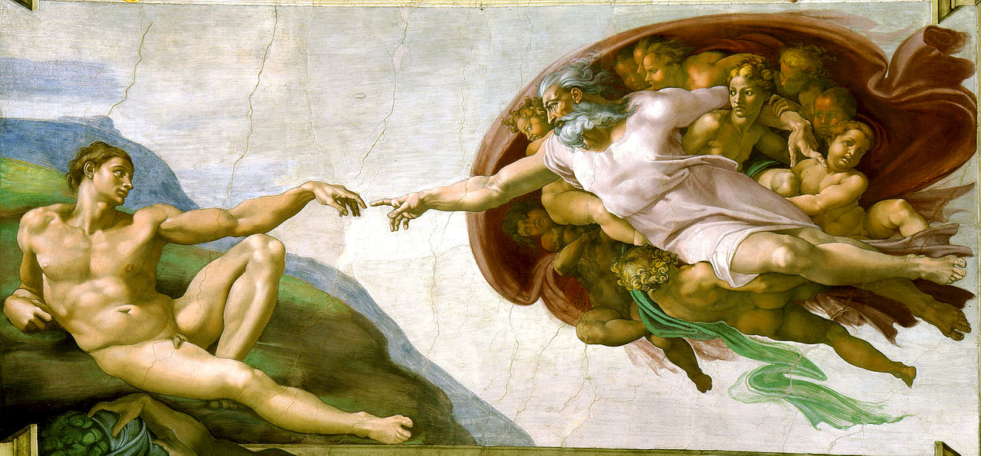
Natural Rights

Slide 73
NATURAL LAW & NATURAL MAN Paul’s Usage of the term Psuchikos Anthroopos
Biblically, in each of the five cases that “psuchikos” is used the term is contrasted with “pneumatikos” or with the spiritual. The contrast in 1st Corinthians 2: 14 is between a man inspired of God and one who has no such revelation (1Cor.2.12ff).
Paul seems to have adopted the Jewish understanding which denoted physical life as opposed to the supernatural life.

Slide 74
NATURAL LAW & NATURAL MAN Paul’s Usage of the term Psuchikos Anthroopos
Paul seems to have adopted the Jewish understanding which denoted physical life as opposed to supernatural life.
The scriptural context of the Biblical term, “psuchikos anthroopos” is inspiration not salvation. The “natural man” tried to find, by his own wisdom, the “things” of God, but such must be revealed. Reference:
1st Corinthians Chapter Two & Verse Ten

Slide 75
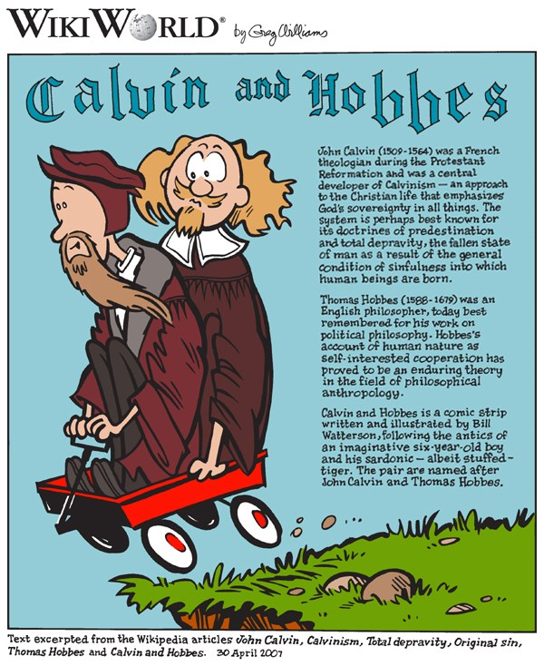

Slide 76
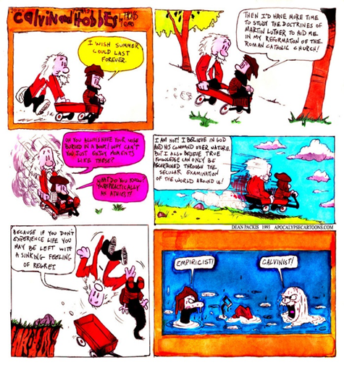

Slide 77
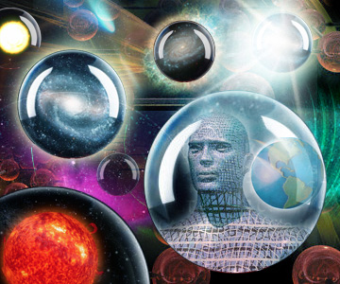
The Nature of Man

Slide 78
Calvin and (Thomas) Hobbes
Thomas Hobbes: Authored The Leviathan(1651)
Held the belief that people in a nutshell were stupid…
Well intentioned, but stupid.
Citizens need a strong leader to tell them what to do.
Given the chance, they will mess up society.
In nature…“no society; and which is worst of all, continual fear, and danger of violent death; and the life of man, solitary, poor, nasty, brutish, and short.”

Slide 79
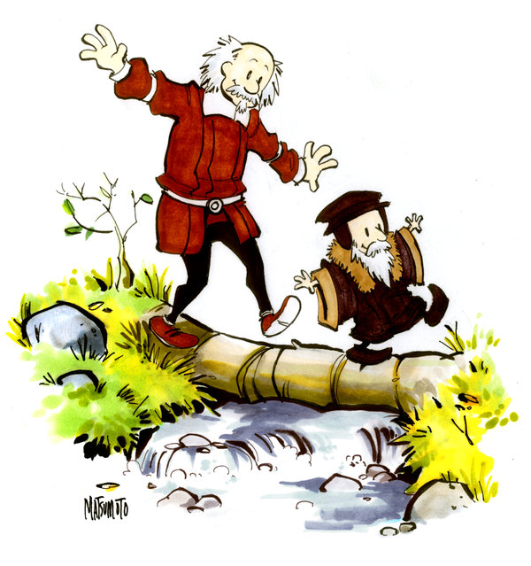

Slide 80
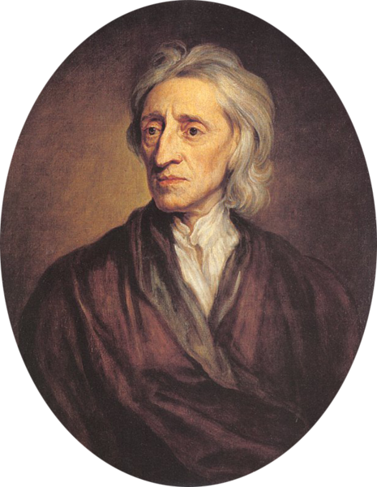
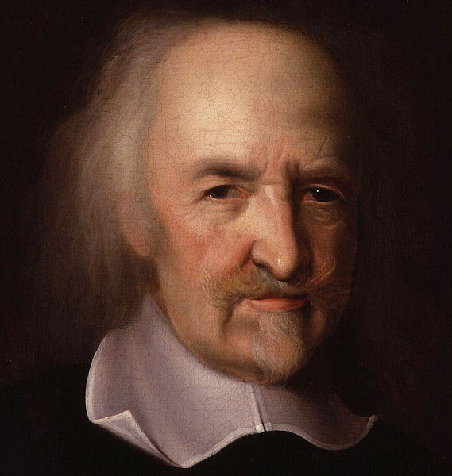
HOBBES
vs
LOCKE

Slide 81
Thomas Hobbes
Leviathan (1651)
Defense of Philosophical Absolutism

Slide 82
Human Nature

Slide 83
Solitary Poor Nasty Brutish Short

Slide 84
Job 41
CLICK to Read

Slide 85
leviathan

Slide 86
LEVIATHAN
A ruler should be powerful enough to be beyond challenge.

Slide 87
Hobbes vs. Locke
Question | HOBBES | LOCKE | Agree?
The Original State of Humankind
Divine Right or Social Contract?
State of NATURE
SOCIAL Contract
COMPARE (How are they similar?)

Slide 88
The Enlightenment and the Church
Isaac Newton and the Mechanical Universe 1687 Principia.
DesCartes and Rationalism.
David Hume, Voltaire and others begin to apply skepticism to Christian Theology
Deism: Intellectual/Rational revision of Christianity Deny trinity, virgin birth, resurrection of Jesus, etc. Joseph Priestly establishes the Unitarian Church. Franklin, Washington, Jefferson all deists.
John Locke and logical empiricism.

Slide 89
“It’s fundamental thesis is the author’s conviction that the Christian faith, as he understands it, stripped of the superfluous and confusing dogmatic accretions of creeds and theologies, appeals to reason & common sense.”
JOHN LOCKE'S "THE REASONABLENESS OF CHRISTIANITY"

Slide 90
The Great Awakenings Compared
First Great Awakening | Second Great Awakening
Religious Revivals
Emotional, Fire & Brimstone Preaching
Calvinist Influence [Sinfulness Inherent] | Arminian Influence [Sinfulness a Choice]
Conversion Experience
Spread of Non-traditional Denominations
Promoted Democratic Ideals
American Revolution | Antebellum Reform

Slide 91
Pietist and Revivalist Movements
John (1703-1791) and Charles (1707-1788) Wesley
Stressed holiness, piety, personal relationship with God
Arminian theology
Reformer of Anglicanism
Strong organizer: “Methodism”
George Whitehead Revivalist Preacher
Friend of Wesley, but differed on Calvinism.
Jonathan Edwards and the Great Awakening (1730s and 40s)
“A sinner in the hands of an angry God.”
Sought an outward sign of God’s grace.

Slide 92
Early Search Of Ancient Order First Steps Among Arminian Pietists
David Lee Burris:
O’Kelly Supporters Opposed The Episcopal Form Of Church Government & Called Themselves ”“Republican Methodists”
Christians Only Christianity Condition {18th Cent.}:
The churches were impotent. Lengthy & theologically abstruse
creeds were made rigid tests of fellowship. The clergy usurped
the interpretation of Scripture and assumed priestly functions.
The Bible was virtually a closed book to the masses…
5 Tenets - O’Kelley–Haggard Move From Wesley Methodist
The Lord Jesus is the only Head of the Church.
The use of the name “Christian” to the exclusion of all party and sectarian names.
The Holy Bible, or the scriptures of the Old and New Testament, the only creed and a sufficient rule of faith and practice.
Christian Character, or vital piety, the only test of church fellowship and membership.
The right of private judgment and the liberty of conscience the privilege and duty of all.

Slide 93
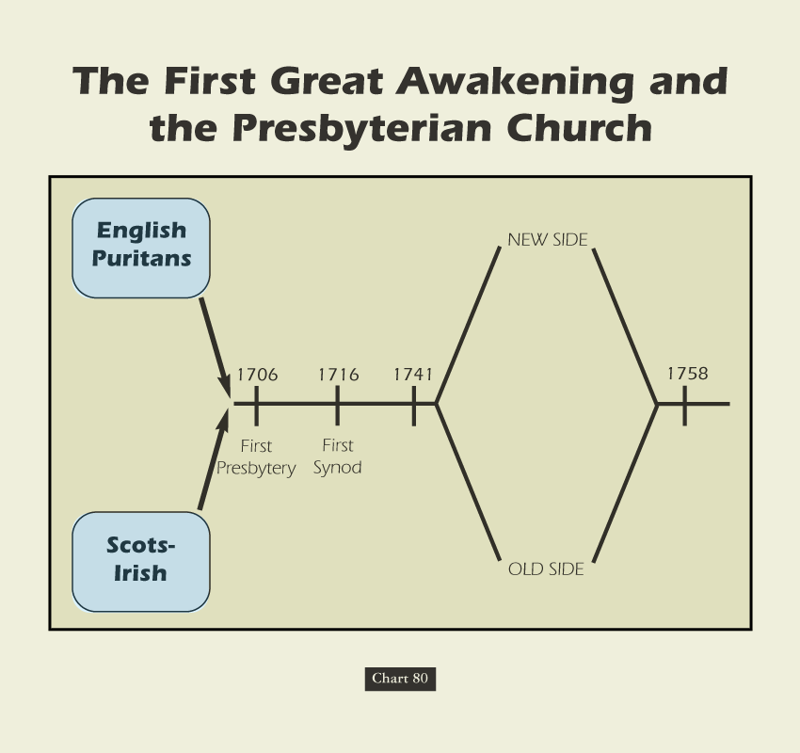

Slide 94
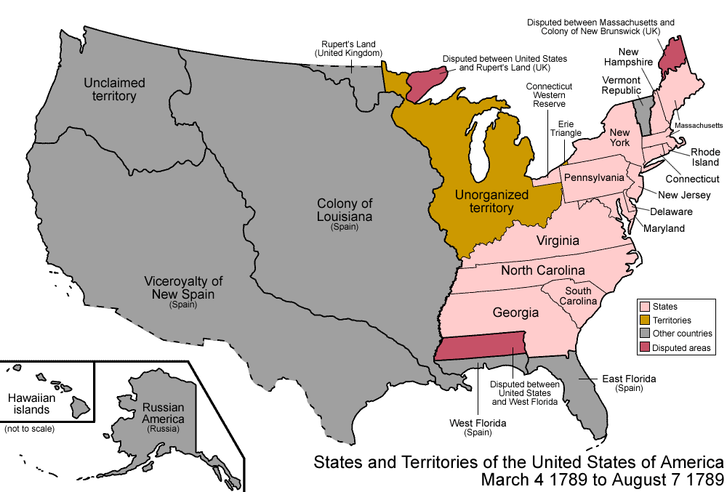

Slide 95
Sweet’s Story of American Religion: Presbyterians
“Of all the American churches at the opening of the national era, the Presbyterian was the most strategically located for an immediate advance into the West. The Scotch-Irish constituted the last great wave of emigration previous to the Revolution and by 1760 Scotch-Irish Presbyterian churches were to be found scattered along from ‘the frontiers of New England to the frontiers of South Carolina.’”

Slide 96
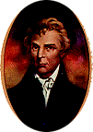
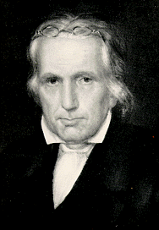
A Restoration Plea:
"In Doctrine, Unity."
"In Opinion, Liberty."
"In All Things, Love!"
* Restorer Plea Same As Reformer Meiderlin on “Essentials”

Slide 97
The Stone/Campbell Movement
Restoration or Reformation?

Slide 98
Influences
Francis Bacon and inductive logic: the scientific approach to the facts of the Bible.
John Locke: the “Christian Philosopher”
The Scottish school of Common Sense Philosophy (Adam Smith, Thomas Reid, etc.)
The Seceder Presbyterians, the Sandemanians and other radical restorationist sects.

Slide 99
David Lee Burris:
Lawyer’s Maxim: “The big print giveth, the small print taketh away!”
Approach
Freedom
Responsibility
Legalism
No
Yes
License
Yes
No
Liberty
Yes
Yes

Slide 100
ANTINOMIANISM CHARGES IN CHURCH HISTORY
Emphasis On Liberty
Emphasis On Legalism
FIRST CENTURY NICOLAITANS
 |  | FIRST CENTURY JUDAIZERS
REFORMATION PERIOD MELANCHTHON
 |  | REFORMATION PERIOD ARICOLIANS
REFORMATION PERIOD LUTHERANS
 |  | REFORMATION PERIOD CALVINISTS
RESTORATION PERIOD CAMPBELLITES
BIBLICAL CHRISTIANITY

Slide 101
Thomas Campbell’s Assessment: The Two Principles In Tension
David Lee Burris:
Thomas Confessed He Had Overlooked The Importance Of Baptism In His Efforts To Obtain Christian Unity!
“The authority of primitive Christianity and obligation of Christian unity should be cooperative and mutually corrective.”

Slide 102
David Lipscomb’s Approach: The Two Principles In Tension
“We will maintain the truth, press the truth upon him, compromise not one word or iota of that truth, yet forbear with the ignorance & weakness of our brother who is anxious but not yet able to see the truth. How do I know that the line beyond which ignorance damns, is behind me, not before him?”

Slide 103
Why Study Church History?
Learn the Mistakes of History → Avoid them? Those who cannot learn from history are doomed to repeat it.
Discover our own roots (Restoration Movement)
Avoid swinging the pendulum Grace ↔ Legalism Doctrine ↔ Zeal, Emotion, Heart Asceticism ↔ Freedom

