Slide 1
Context & Setting Of The Sermon On The Mount
by David Lee Burris, Editor

Slide 3
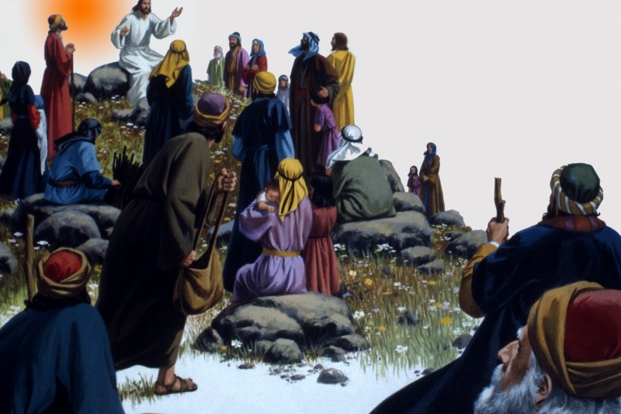

Slide 5
Introduction
The greatest desire of God is that man experience genuine happiness.
Man’s happiness is still God’s primary objective (John 14:26; Philippians 4:6-8; Revelation 7:16, 17)
God has revealed how happiness can be secured while living on earth.

Slide 6
“Blessed” (μαχάριος)
Incorporates the meaning of wholeness, joy, well-being, and, total peace/tranquility of spirit; an inner-satisfaction expressed by our Lord in John 14:27.

Slide 7
“This blessedness is broader and deeper than happiness…It lies not in outward circumstances, but in the inward life; not in what a man has, but in what he is.”

Slide 8
Introduction
The beatitudes of the Bible focus our attention upon the requirements necessary for one to find true happiness.
We do not have to wait until Heaven in order to find genuine happiness in our souls!

Slide 9
True happiness is found only when one follows God’s directions and finds true “blessedness.”
Those who are truly “blessed” will draw others to the Lord’s salvation.

Slide 10
“The Beatitudes may very well be the most unforgettable of all Christ’s teachings. They attract the child, and they confound the scholar, always pouring forth their true meaning to those who experience the wisdom of their insight in everyday life.”

Slide 11
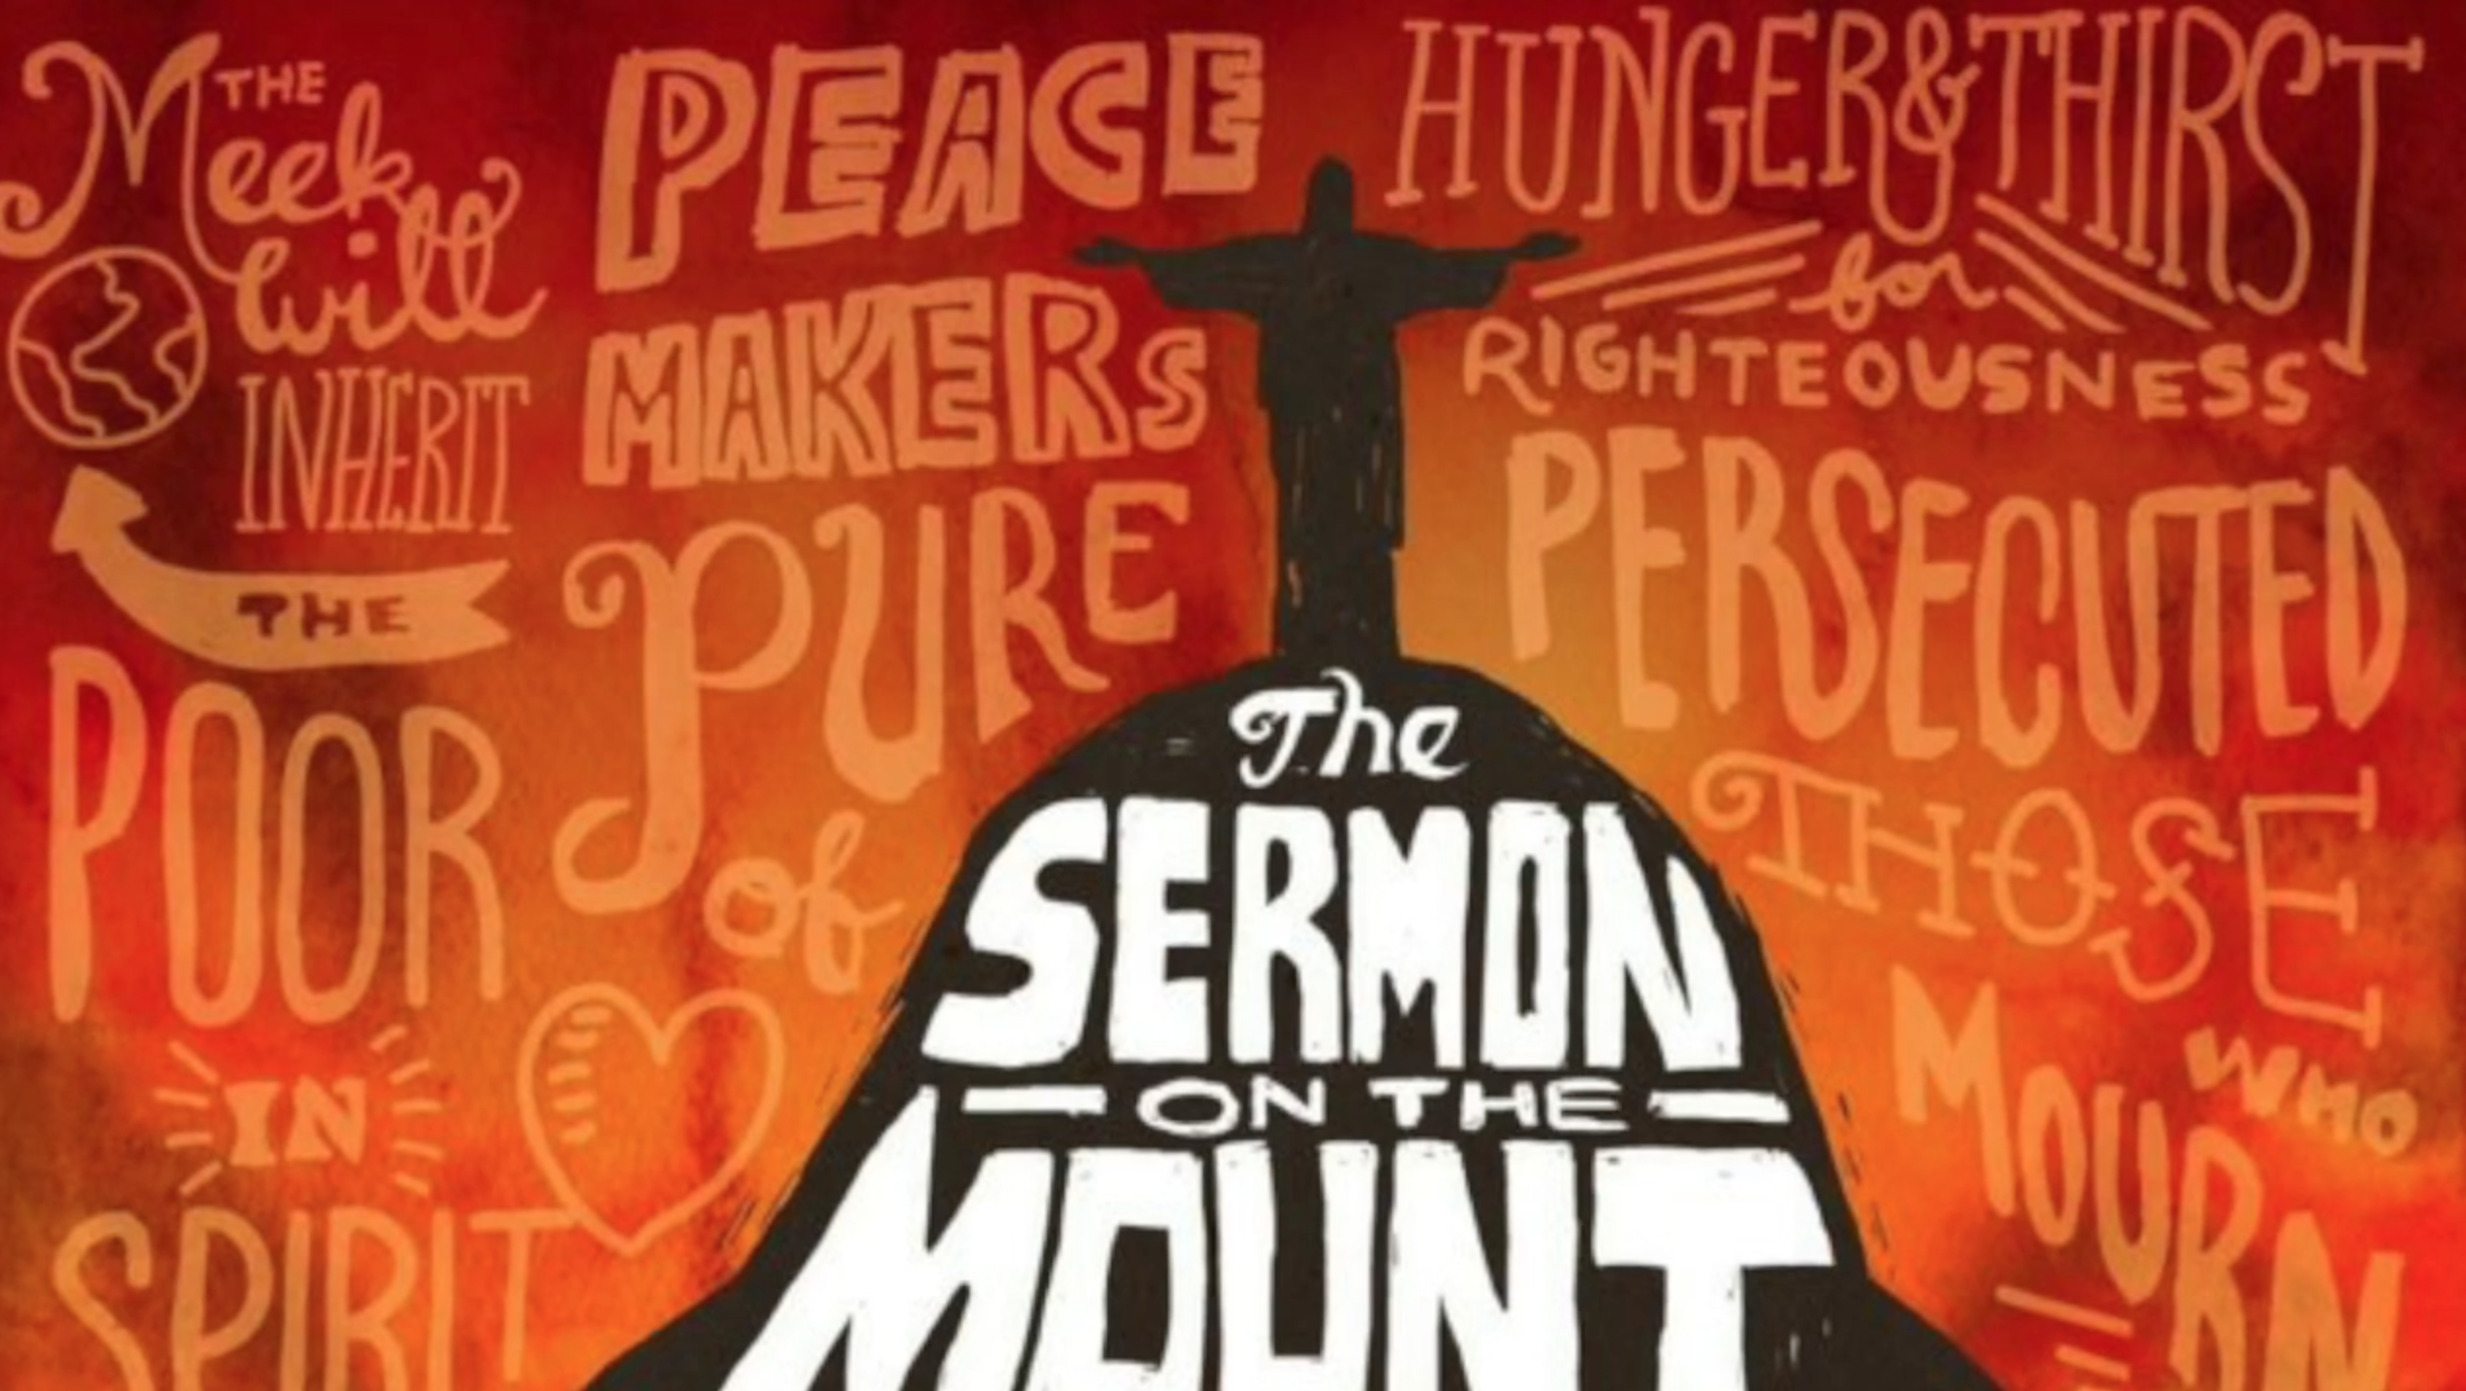

Slide 13
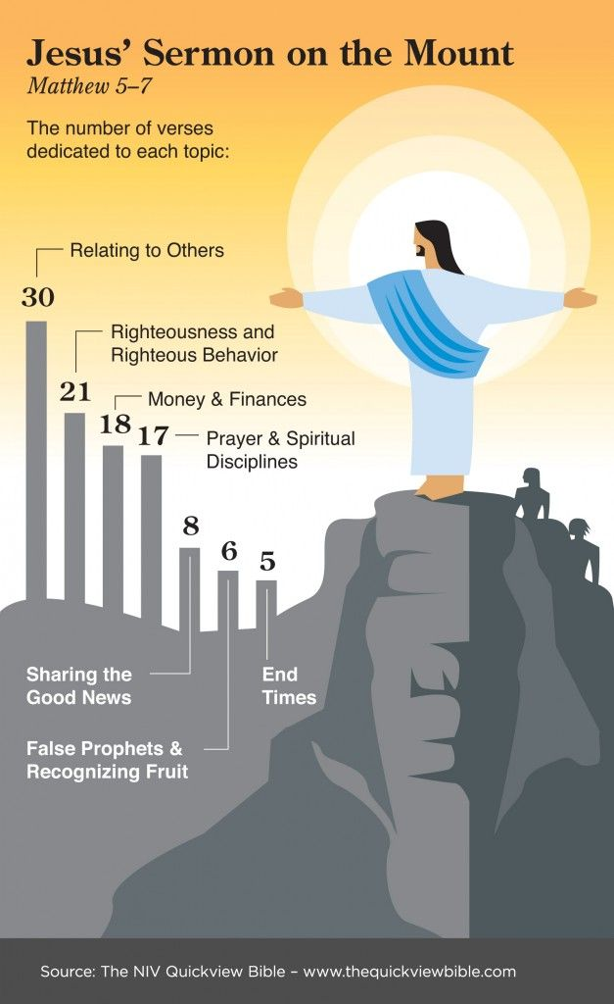

Slide 14
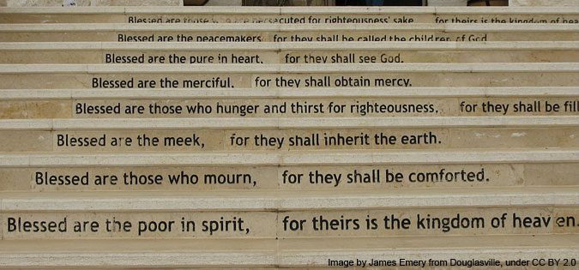

Slide 18
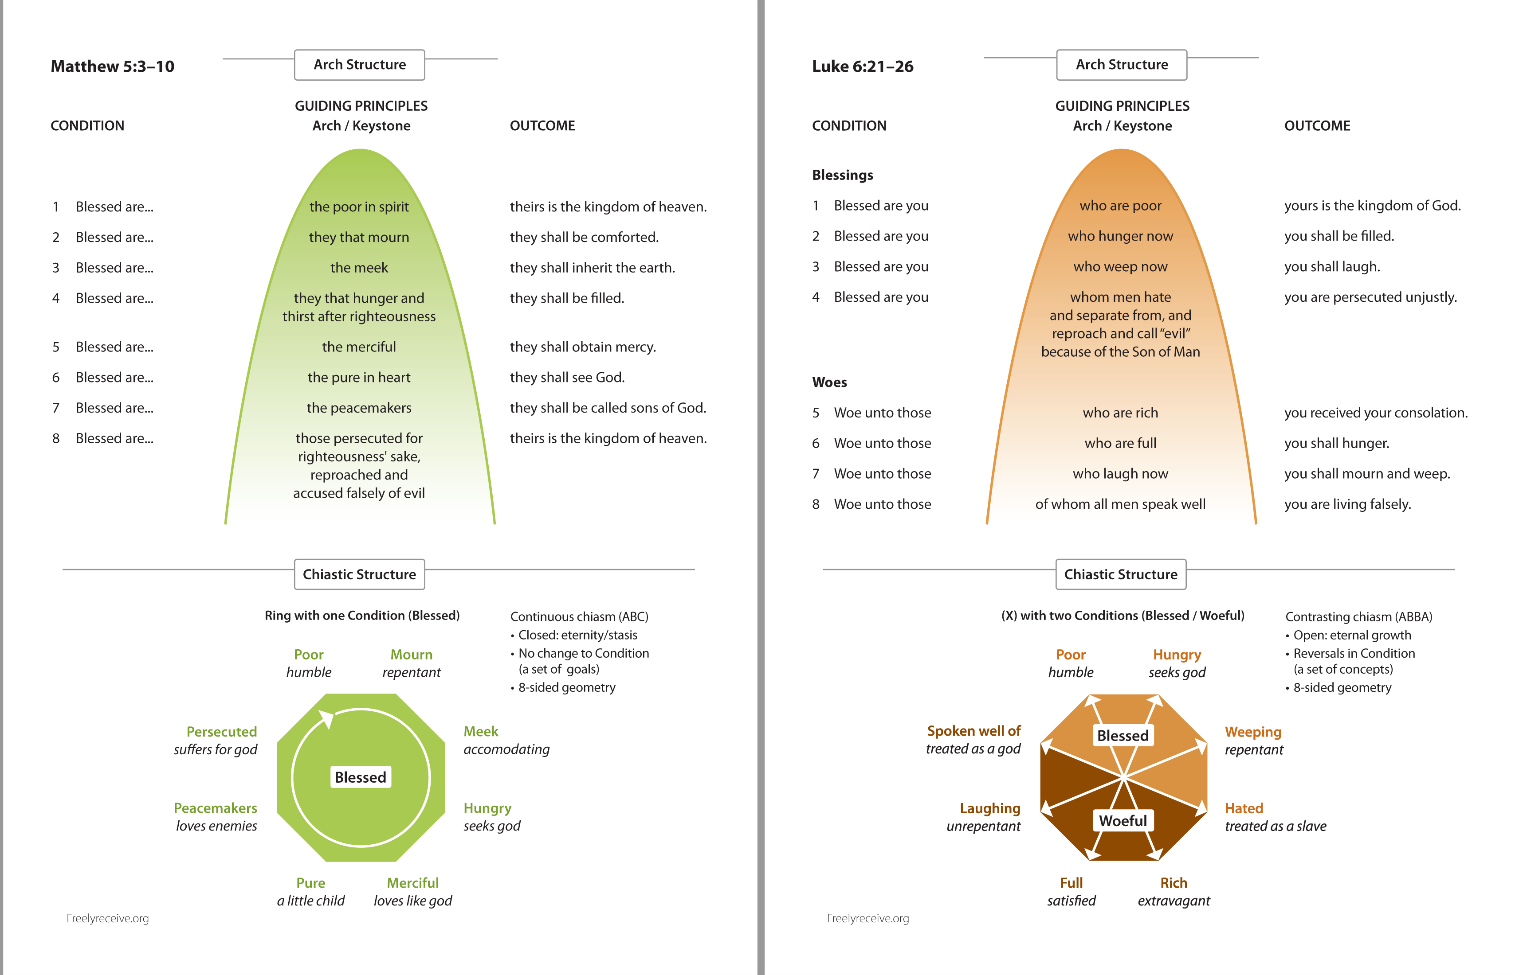

Slide 19
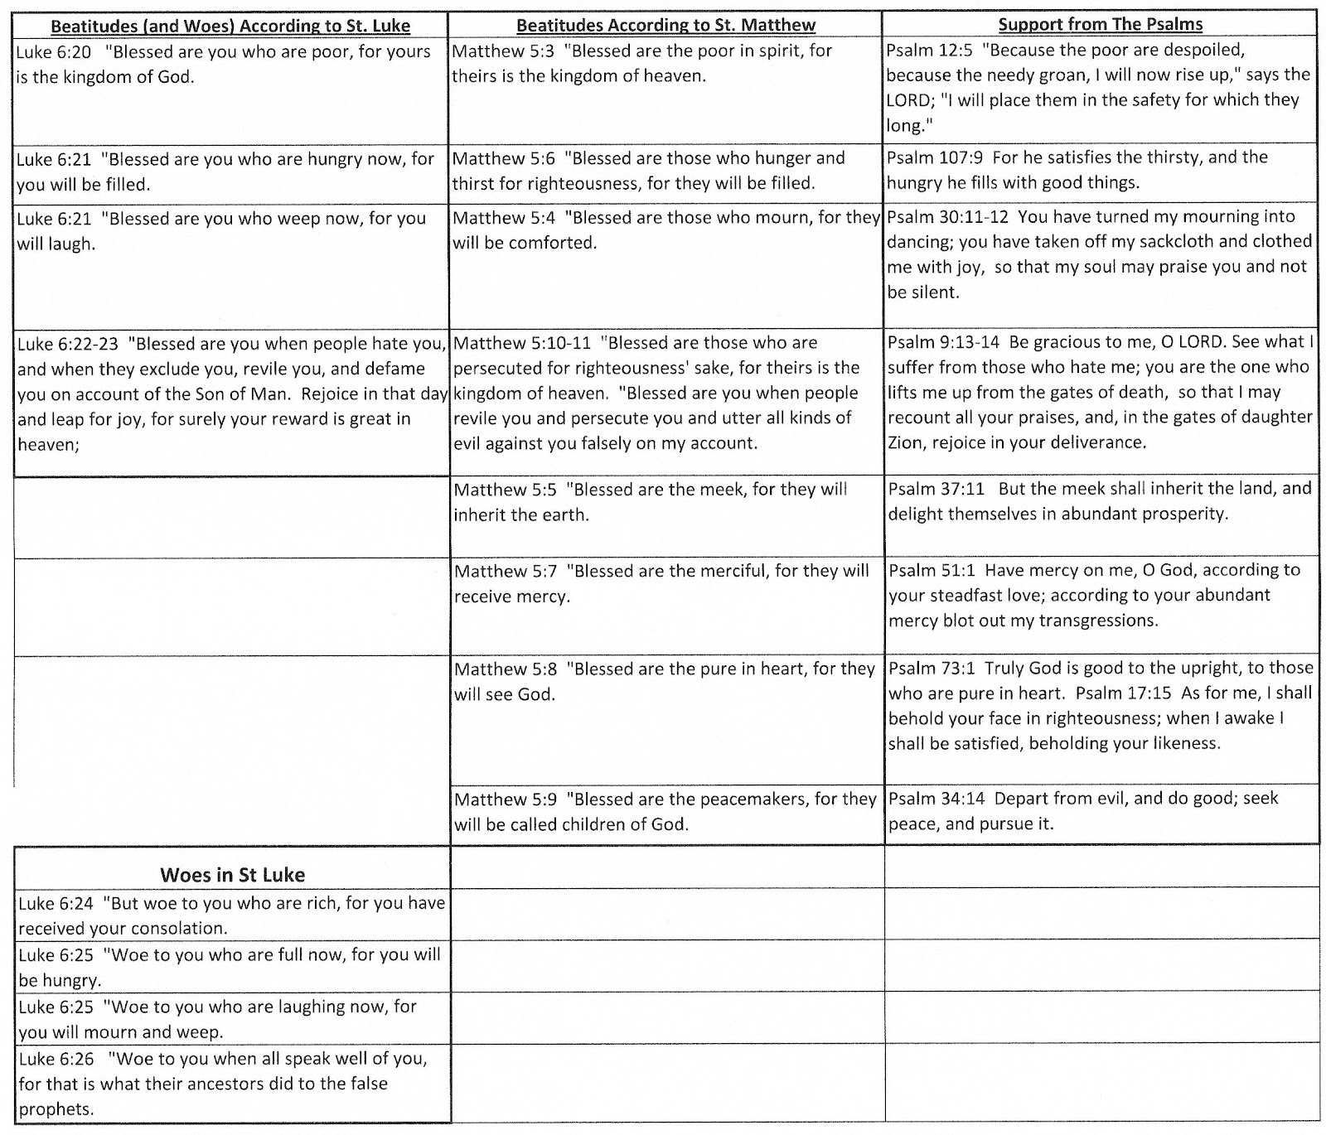

Slide 20
The Context of the Sermon on the Mount
In those days John the Baptist came preaching in the wilderness of Judea, and saying, "Repent, for the kingdom of heaven is at hand!“ (Matthew 3:1-2)
"The law and the prophets were until John. (Luke 16:16a)
Since that time the kingdom of God has been preached…
Notes:
1. The context of the sermon on the mount is often overlooked and not studied as it should be.
2. Historical facts concerning the time and place of the coming of Jesus are relevant to the teachings of Jesus.
>>>>>>>>>>>>>>>>>>>
3. Without context, John would have been seen as a wild man ranting in the desert when Matthew recorded what he was saying and doing:
In those days John the Baptist came preaching in the wilderness of Judea, and saying, "Repent, for the kingdom of heaven is at hand!“ (Matthew 3:1-2) >>>>>>>>>>>>>>>>>>>>
4. Jesus Himself declared that the Law of Moses ended when John the Baptist came to declare the necessity of repentance
"The law and the prophets were until John. (Luke 16:16a)
>>>>>>>>>>>>
5. Jesus enforces the fact that the kingdom of God is in fact being preached.
Since that time the kingdom of God has been preached… (Luke 16:16b)

Slide 21
The Context of the Sermon on the Mount
Now when Jesus heard that John had been put in prison, He departed to Galilee. ¹³ And leaving Nazareth, He came and dwelt in Capernaum... ¹⁴ that it might be fulfilled which was spoken by Isaiah the prophet, saying… by the way of the sea, beyond the Jordan, Galilee of the Gentiles: (Matthew 4:12-15)
The people who sat in darkness have seen a great light, and upon those who sat in the region and shadow of death Light has dawned.” (Matthew 4:16)
Notes:
1. Jesus began his ministry explaining “The new light is the kingdom, and it was coming through the New Covenant which brings forgiveness, not the Law of Moses”.
>>>>>>>>>>>>>>>>>>>>>>>>>>>>
Now when Jesus heard that John had been put in prison, He departed to Galilee. And leaving Nazareth, He came and dwelt in Capernaum, which is by the sea, in the regions of Zebulun and Naphtali, that it might be fulfilled which was spoken by Isaiah the prophet, saying: "THE LAND OF ZEBULUN AND THE LAND OF NAPHTALI, BY THE WAY OF THE SEA, BEYOND THE JORDAN, GALILEE OF THE GENTILES:
>>>>>>>>>>>>>>>>>>>>>
verse 16 - THE PEOPLE WHO SAT IN DARKNESS HAVE SEEN A GREAT LIGHT, AND UPON THOSE WHO SAT IN THE REGION AND SHADOW OF DEATH LIGHT HAS DAWNED." From that time Jesus began to preach and to say, "Repent, for the kingdom of heaven is at hand." (Matthew 4:12-16)

Slide 22
The Context of the Sermon on the Mount
From that time Jesus began to preach and to say, "Repent, for the kingdom of heaven is at hand." (Matthew 4:17)
And Jesus went about all Galilee, teaching in their synagogues, preaching the gospel of the kingdom, and healing all kinds of sickness and all kinds of disease among the people. (Matthew 4:23)
Notes:
1. It is noted that, this is the beginning of the ministry of Jesus here on the earth.
>>>>>>>>>>>>>>>>>>>>>>
From that time Jesus began to preach and to say, "Repent, for the kingdom of heaven is at hand."
(Matthew 4:17)
2. Jesus has started in Galilee and in the Jewish synagogues, teaching them first, in their places of worship, just as He will command His apostles to do.
>>>>>>>>>>>>>>>>>>>>>>>
And Jesus went about all Galilee, teaching in their synagogues, preaching the gospel of the kingdom, and healing all kinds of sickness and all kinds of disease among the people.
(Matthew 4:23)

Slide 23
And Jesus, walking by the Sea of Galilee, saw two brothers, Simon called Peter, and Andrew his brother, casting a net into the sea; for they were fishermen. Then He said to them, "Follow Me, and I will make you fishers of men.
" They immediately left their nets and followed Him. (Matthew 4:18-20)
Going on from there, He saw two other brothers, James the son of Zebedee, and John his brother, in the boat with Zebedee their father, mending their nets.
He called them, and immediately they left the boat and their father, and followed Him. (Matthew 4:21-22)
Notes:
And Jesus, walking by the Sea of Galilee, saw two brothers, Simon called Peter, and Andrew his brother, casting a net into the sea; for they were fishermen. Then He said to them, "Follow Me, and I will make you fishers of men."
>>>>>>>>>>>>>>>>>>>>>
They immediately left their nets and followed Him. (Matthew 4:18-20)
>>>>>>>>>>>>>>>>>>>>>
Going on from there, He saw two other brothers, James the son of Zebedee, and John his brother, in the boat with Zebedee their father, mending their nets.
>>>>>>>>>>>>>>>>>>>>>
He called them, and immediately they left the boat and their father, and followed Him.
(Matthew 4:21-22)
1. Why did the apostles forsake all?
2. The immediate context of these scriptures does not tell us, but later in Matthew we will be told.

Slide 24
The Context of the Sermon on the Mount
Why did the apostles leave all they had?
Then Peter began to say to Him, "See, we have left all and followed You." So Jesus answered and said, "Assuredly, I say to you, there is no one who has left house or brothers or sisters or father or mother or wife or children or lands, for My sake and the gospel's, who shall not receive a hundredfold now in this time—houses and brothers and sisters and mothers and children and lands, with persecutions—and in the age to come, eternal life. (Mark 10:28-30)
Notes:
1. The was after the rich young ruler left Jesus’s presence sorrowfully because he had many possessions.
2. The Apostles knew that they didn’t leave all for the Law of Moses but for the Lord and the Gospel.
Then Peter began to say to Him, "See, we have left all and followed You."
>>>>>>>>>>>>>>>>>>>>
So Jesus answered and said, "Assuredly, I say to you, there is no one who has left house or brothers or sisters or father or mother or wife or children or lands,
for My sake and the gospel’s,
>>>>>>>>>>>>>>>>>>>
who shall not receive a hundredfold now in this time—houses and brothers and sisters and mothers and children and lands, with persecutions—and in the age to come, eternal life. (Mark 10:28-30)

Slide 25
The Context of the Sermon on the Mount
Why did the apostles leave all they had?
Then Peter said, “See, we have left all and followed You.” ²⁹ So He said to them, “Assuredly, I say to you, there is no one who has left house or parents or brothers or wife or children, for the sake of the kingdom of God, ³⁰ who shall not receive many times more in this present time, and in the age to come eternal life.” Luke 18:28-30
Notes:
1. They left all for the sake of the kingdom of God in Matt. 4:18-22.
2. And Luke agrees with Matthew’s, and Mark’s, accounts, it was for the kingdom of God.
Then Peter said, "See, we have left all and followed You." So He said to them, "Assuredly, I say to you, there is no one who has left house or parents or brothers or wife or children, for the sake of the kingdom of God, who shall not receive many times more in this present time, and in the age to come eternal life." (Luke 18:28-30)
3. Would the very next verses be talking about the Law of Moses?
a. No, they are here to preach the Kingdom of God.
And Jesus went about all Galilee, teaching in their synagogues, preaching the gospel of the kingdom, and healing all kinds of sickness and all kinds of disease among the people. (Matthew 4:23)

Slide 26
The Context of the Sermon on the Mount
Whoever therefore breaks one of the least of these commandments, and teaches men so, shall be called least in the kingdom of heaven; but whoever does and teaches them, he shall be called great in the kingdom of heaven. For I say to you, that unless your righteousness exceeds the righteousness of the scribes and Pharisees, you will by no means enter the kingdom of heaven. (Matthew 5:19-20)
Notes:
1. The righteousness of the scribes and the Pharisees was built upon man’s interpretation of the Law of Moses.
2. There was nothing wrong with the Law of Moses other than it ended with the coming of John!
3. Even before the coming of John, the Jewish people could not keep and comply with he Law of Moses.
>>>>>>>>>>>>>>>>>>>>>>>>>
Whoever therefore breaks one of the least of these commandments, and teaches men so, shall be called least in the kingdom of heaven; but whoever does and teaches them, he shall be called great in the kingdom of heaven. For I say to you, that unless your righteousness exceeds the righteousness of the scribes and Pharisees, you will by no means enter the kingdom of heaven. (Matthew 5:19-20)

Slide 27
The Context of the Sermon on the Mount
In this manner, therefore, pray: Our Father in heaven, Hallowed be Your name. Your kingdom come. Your will be done On earth as it is in heaven. (Matthew 6:9-10)
But seek first the kingdom of God and His righteousness, and all these things shall be added to you. (Matthew 6:33)
Notes:
1. Jesus taught the Kingdom of God even when He was teaching the apostles to pray, He knew that the kingdom would come after His death, burial and resurrection, so He instructed them to pray for it’s coming.
In this manner, therefore, pray: Our Father in heaven, Hallowed be Your name. Your kingdom come. Your will be done On earth as it is in heaven. (Matthew 6:9-10)
>>>>>>>>>>>>>>>>>>>>>>>>>>
2. Jesus taught the disciples not to care for the things of this world because they will not matter after death, He wanted them to take care of their souls.
But seek first the kingdom of God and His righteousness, and all these things shall be added to you. (Matthew 6:33)

Slide 28
The Context of the Sermon on the Mount
"Not everyone who says to Me, 'Lord, Lord,' shall enter the kingdom of heaven, but he who does the will of My Father in heaven. (Matthew 7:21)
Notes:
1. Jesus knew and warned the disciples that there would be hypocrites and liars.
2. He know that many would try to enter the church for destructive purposes and warned the about the future of these people.
>>>>>>>>>>>>>>>>>>>>>>>
"Not everyone who says to Me, 'Lord, Lord,' shall enter the kingdom of heaven, but he who does the will of My Father in heaven. (Matthew 7:21)

Slide 29
The Context of the Sermon on the Mount
Then Jesus went about all the cities and villages, teaching in their synagogues, preaching the gospel of the kingdom, and healing every sickness and every disease among the people. (Matthew 9:35)
And as you go, preach, saying, 'The kingdom of heaven is at hand.’ (Matthew 10:7)
Notes:
1. Jesus took the solution directly to the problem, teaching in the Jewish synagogue as well as the population at large.
Then Jesus went about all the cities and villages, teaching in their synagogues, preaching the gospel of the kingdom, and healing every sickness and every disease among the people. (Matthew 9:35)
>>>>>>>>>>>>>>>>>>>>>>>>>>>>>
And as you go, preach, saying, 'The kingdom of heaven is at hand.' (Matthew 10:7)

Slide 30
Before, Through, and After the Sermon on the mount, the theme is the Kingdom of Heaven, not the Law of Moses
Notes:
1. Before, Through, and After the Sermon on the mount, the theme is the Kingdom of Heaven, not the Law of Moses

Slide 31
The Beatitudes
Blessed are the poor in spirit, Matthew 5:3
Blessed are those who mourn… the meek… those who hunger and thirst after righteousness… the merciful… the pure in heart… the peacemakers. Matthew 5:4-9
Blessed are those who are persecuted for righteousness’ sake, Matthew 5:10
“for theirs is the kingdom of heaven” is an “inclusio”
Notes:
1. The Beatitudes begin and end with “for theirs is the kingdom of Heaven”.
2. This is the main emphasis.
3. Inclusio is the Latin word for inclusion.
4. An inclusio is a fairly common literary device, esp. in the O.T., they acts as bookends to draw attention to what is included.
5. The fact that “kingdom of heaven” is used shows what is being emphasized by the teaching.
>>>>>>>>>>>>>>>>>>>>>>>
"Blessed are the poor in spirit, For theirs is the kingdom of heaven. (Matthew 5:3)
>>>>>>>>>>>>>>>>>>>>>>> Blessed are those who mourn… the meek… those who hunger and thirst after righteousness… the merciful… the pure in heart… the peacemakers. Matthew 5:4-9
>>>>>>>>>>>>>>>>>>>>>>>
Blessed are those who are persecuted for righteousness' sake, For theirs is the kingdom of heaven. (Matthew 5:10)
>>>>>>>>>>>>>>>>>>>>>>>
“for theirs is the kingdom of heaven” is an “inclusio”
>>>>>>>>>>>>>>>>>>>>>>>

Slide 32
The Beatitudes
Objection:
Blessed are the meek, for they shall inherit the earth. Matthew 5:5
Notes:
1. There is one objection made for Matthew 5:5; “Blessed are the meek, for they shall inherit the earth.
>>>>>>>>>>>>>>>>>>>>>>
2. Earth is from ge {ghay}, and it can only mean earth or land.
3. Samuel G. Dawson, religious author, argues it refers to the land of Israel, part of the promise of the Old Law.
4. The fact that the land of Israel is being promised proves this is part of the Old Law instead of the New Covenant.
5. Is it true that Christians will inherit physical earthly Jerusalem as promised in the Old Testament?

Slide 33
Messianic Prophecies Including the Land
The sun shall no longer be your light by day, nor for brightness shall the moon give light to you; But the Lord will be to you an everlasting light, and your God your glory. ²⁰ Your sun shall no longer go down, nor shall your moon withdraw itself; For the Lord will be your everlasting light, and the days of your mourning shall be ended. ²¹ Also your people shall all be righteous; They shall inherit the land forever, the branch of My planting, the work of My hands, that I may be glorified. (Isaiah 60:19-21)
Notes:
1. There are Messianic Prophecies Including the Land in the Old Testament.
2. Note the word Messianic in this descriptor.
The sun shall no longer be your light by day, nor for brightness shall the moon give light to you; But the Lord will be to you an everlasting light, and your God your glory. ²⁰ Your sun shall no longer go down, nor shall your moon withdraw itself; For the Lord will be your everlasting light, and the days of your mourning shall be ended. ²¹ Also your people shall all be righteous; They shall inherit the land forever, the branch of My planting, the work of My hands, that I may be glorified. (Isaiah 60:19-21)
3. If you leave it in context, Isaiah is talking about the “New Heaven and the New Earth”, not the one that Peter says will be burned up.
But the day of the Lord will come as a thief in the night, in which the heavens will pass away with a great noise, and the elements will melt with fervent heat; both the earth and the works that are in it will be burned up. (2 Peter 3:10)
4. What else did Peter say about things for us to look forward to?
Nevertheless we, according to His promise, look for new heavens and a new earth in which righteousness dwells. (2 Peter 3:13)
5. Peter is obviously way ahead of Dawson in his scripture knowledge.

Slide 34
Messianic Prophecies Including the Land
The Gentiles shall see your righteousness, And all kings your glory. You shall be called by a new name, Which the mouth of the LORD will name. You shall also be a crown of glory In the hand of the LORD, And a royal diadem In the hand of your God. You shall no longer be termed Forsaken, Nor shall your land any more be termed Desolate; But you shall be called Hephzibah, and your land Beulah; For the LORD delights in you, And your land shall be married. For as a young man marries a virgin, So shall your sons marry you; And as the bridegroom rejoices over the bride, So shall your God rejoice over you. (Isaiah 62:2-5)
Notes:
The Gentiles shall see your righteousness, And all kings your glory. You shall be called by a new name, Which the mouth of the LORD will name. You shall also be a crown of glory In the hand of the LORD, And a royal diadem In the hand of your God. You shall no longer be termed Forsaken, Nor shall your land any more be termed Desolate; But you shall be called Hephzibah, and your land Beulah; For the LORD delights in you, And your land shall be married. For as a young man marries a virgin, So shall your sons marry you; And as the bridegroom rejoices over the bride, So shall your God rejoice over you. (Isaiah 62:2-5)
1. In relation to the Old Israel, did the Gentiles see their righteousness, were they called by a new name from the mouth of the LORD? I think not!
2. Old Israel had forsaken God long before He forsook them.
3. Hephzibah = khef-tsee' baw From H2656 my delight (is) in her;
4. Beulah = Married as in Christ will marry the Church, His Bride.
5. Jews and Gentiles form the New Israel with the new name given by God “Christians”.

Slide 35
Messianic Prophecies Including the Land
For thus says the Lord God: “Indeed I Myself will search for My sheep and seek them out. ¹² As a shepherd seeks out his flock on the day he is among his scattered sheep, so will I seek out My sheep and deliver them from all the places where they were scattered on a cloudy and dark day. And I will bring them out from the peoples and gather them from the countries, and will bring them to their own land… Ezekiel 34:11-16, 23-25
Notes:
1. Notice Lord is not all capitals indicating that Jesus, the Son of God is the one doing the searching.
I am the good shepherd; and I know My sheep, and am known by My own. (John 10:14)
2. Jesus said that He would go and prepare a place for us and return again for us.
And if I go and prepare a place for you, I will come again and receive you to Myself; that where I am, there you may be also. (John 14:3)

Slide 36
Messianic Prophecies Including the Land
I will establish one shepherd over them, and he shall feed them— My servant David. He shall feed them and be their shepherd. ²⁴ And I, the Lord, will be their God, and My servant David a prince among them; I, the Lord, have spoken. ²⁵ I will make a covenant of peace with them, and cause wild beasts to cease from the land. (Ezekiel 34:11-16, 23-25)
Notes:
I will establish one shepherd over them, and he shall feed them— My servant David. He shall feed them and be their shepherd. ²⁴ And I, the Lord, will be their God, and My servant David a prince among them; I, the Lord, have spoken. ²⁵ I will make a covenant of peace with them, and cause wild beasts to cease from the land. Ezekiel 34:23-25
1. Jesus is the one shepherd, the head of the church.
2. He is of the root of David.
But one of the elders said to me, "Do not weep. Behold, the Lion of the tribe of Judah, the Root of David, has prevailed to open the scroll and to loose its seven seals." (Revelation 5:5)
3. The covenant of peace is the New Testament.
4. The will be no wild beast in Heaven.
Time Check – Only If you have time.
Also: Ezekiel 37:11-14 The fulfillment – John 5:25 Then He said to me, "Son of man, these bones are the whole house of Israel. They indeed say, 'Our bones are dry, our hope is lost, and we ourselves are cut off!' Therefore prophesy and say to them, 'Thus says the Lord GOD: "Behold, O My people, I will open your graves and cause you to come up from your graves, and bring you into the land of Israel. Then you shall know that I am the LORD, when I have opened your graves, O My people, and brought you up from your graves. I will put My Spirit in you, and you shall live, and I will place you in your own land. Then you shall know that I, the LORD, have spoken it and performed it," says the LORD.' "
(Ezekiel 37:11-14)
Most assuredly, I say to you, the hour is coming, and now is, when the dead will hear the voice of the Son of God; and those who hear will live. (John 5:25)

Slide 37
Messianic Prophecies Including the Land
David My servant shall be king over them, and they shall all have one shepherd; they shall also walk in My judgments and observe My statutes, and do them. ²⁵ Then they shall dwell in the land… and My servant David shall be their prince forever. ²⁶ Moreover I will make a covenant of peace with them, and it shall be an everlasting covenant with them; I will establish them and multiply them, and I will set My sanctuary in their midst forevermore. ²⁷ My tabernacle also shall be with them; indeed I will be their God, and they shall be My people. (Ezekiel 37:24-27)
Notes:
²⁴ David My servant shall be king over them, and they shall all have one shepherd; they shall also walk in My judgments and observe My statutes, and do them. ²⁵ Then they shall dwell in the land… and My servant David shall be their prince forever. ²⁶ Moreover I will make a covenant of peace with them, and it shall be an everlasting covenant with them; I will establish them and multiply them, and I will set My sanctuary in their midst forevermore. ²⁷ My tabernacle also shall be with them; indeed I will be their God, and they shall be My people. Ezekiel 37:24-27
1. “David my servant” is a clear reference to Jesus Christ, Jesus would come in the fullness of time.
2. Jesus will be our prince forever in the land referred to as “New Heaven and the New Earth”.
3. Once again we see the covenant of peace which is an everlasting covenant.
4. The New Testament is that covenant of peace.
------------------------------------
See Ezek 37:15-22 – I will be their God and they shall be my people!

Slide 38
Messianic Prophecies Including the Land
David My servant shall be king over them, and they shall all have one shepherd; they shall also walk in My judgments and observe My statutes, and do them. ²⁵ Then they shall dwell in the land… and My servant David shall be their prince forever. ²⁶ Moreover I will make a covenant of peace with them, and it shall be an everlasting covenant with them; I will establish them and multiply them, and I will set My sanctuary in their midst forevermore. ²⁷ My tabernacle also shall be with them; indeed I will be their God, and they shall be My people. (Ezekiel 37:24-27)
Notes:
See Ezek 37:15-22 – I will be their God and they shall be my people!

Slide 39
Messianic Prophecies Including the Land
David My servant shall be king over them, and they shall all have one shepherd; they shall also walk in My judgments and observe My statutes, and do them. ²⁵ Then they shall dwell in the land… and My servant David shall be their prince forever. ²⁶ Moreover I will make a covenant of peace with them, and it shall be an everlasting covenant with them; I will establish them and multiply them, and I will set My sanctuary in their midst forevermore. ²⁷ My tabernacle also shall be with them; indeed I will be their God, and they shall be My people. Ezekiel 37:24-27
Notes:
See Ezek 37:15-22 – I will be their God and they shall be my people!

Slide 40
Messianic Prophecies Including the Land
On that day I will raise up the tabernacle of David, which has fallen down, and repair its damages; I will raise up its ruins, and rebuild it as in the days of old; ¹² That they may possess the remnant of Edom, and all the Gentiles who are called by My name,” says the Lord who does this thing… ¹⁵ I will plant them in their land, and no longer shall they be pulled up from the land I have given them,” says the Lord your God. Amos 9:11-15
Notes:
On that day I will raise up the tabernacle of David, which has fallen down, and repair its damages; I will raise up its ruins, and rebuild it as in the days of old; ¹² That they may possess the remnant of Edom, and all the Gentiles who are called by My name,” says the Lord who does this thing… ¹⁵ I will plant them in their land, and no longer shall they be pulled up from the land I have given them,” says the Lord your God. Amos 9:11-15
-------------------------
Quoted in Acts 15:16-17 by James
The land is their new, safe, secure home, it is the kingdom that shall break in pieces the nations of men and endure for ever.
It is the church the gates of Hades will not prevail against.
'AFTER THIS I WILL RETURN AND WILL REBUILD THE TABERNACLE OF DAVID, WHICH HAS FALLEN DOWN; I WILL REBUILD ITS RUINS, AND I WILL SET IT UP; SO THAT THE REST OF MANKIND MAY SEEK THE LORD, EVEN ALL THE GENTILES WHO ARE CALLED BY MY NAME, SAYS THE LORD WHO DOES ALL THESE THINGS.'
(Acts 15:16-17)

Slide 41
The Context Is Not Moses!
Matthew 5:3 Blessed are the poor in spirit, for theirs is the kingdom of heaven.
Matthew 5:5 Blessed are the meek, for they shall inherit the earth.
Matthew 5:10 Blessed are those who are persecuted for righteousness’ sake, for theirs is the kingdom of heaven.
Notes:
1. The context of today’s lesson is not Moses and the Law of Moses, it is the Law of Christ that Christ was teaching on the Sermon on the Mount.
a. Because there is no “inclusio” on Matthew 5:5 some consider it separate from the other Beatitudes.
2. Many still insist that the word translated “earth” also means land.
3. Samuel G. Dawson makes a big deal of that fact, trying to prove it is referring to the physical land promise to Israel.
4. He fails to realize that Jesus is coming to fulfill the Law of Moses.
5. The Law prophesied of the time when God’s people would receive the “Land” as a secure and permanent home.

Slide 42
Matthew 5: 1-12

Slide 43
Matthew 5:1-4
And seeing the multitudes, He went up on a mountain, and when He was seated His disciples came to Him. Then He opened His mouth and taught them, saying: " Blessed are the poor in spirit, For theirs is the kingdom of heaven. Blessed are those who mourn, For they shall be comforted.

Slide 44
What are the Beatitudes?
They deal with the state of one’s heart.
Man puts much emphasis on the outward, Jesus on the inward.

Slide 45
The Term “Blessed”
It is deeper than happy, it includes peace and contentment.

Slide 47
Objection: “You have heard that it was said…” refers to perversions of the Pharisees
Matt 5:21 You have heard that it was said to those of old, ‘You shall not murder
Matt 5:27 You have heard that it was said to those of old, ‘You shall not commit adultery.’
Matt 5:31 Furthermore it has been said, ‘Whoever divorces his wife, let him give her a certificate of divorce.’
Matt 5:33 Again you have heard that it was said to those of old, ‘You shall not swear falsely…
Notes:
1. Objection: “You have heard that it was said…” refers to perversions of the Pharisees
>>>>>>>>>>>>>>>>>>>>
2. Matt 5:21 You have heard that it was said to those of old, ‘You shall not murder
>>>>>>>>>>>>>>>>>>>>
3. Matt 5:27 You have heard that it was said to those of old, ‘You shall not commit adultery.’
>>>>>>>>>>>>>>>>>>>>
4. Matt 5:31 Furthermore it has been said, ‘Whoever divorces his wife, let him give her a certificate of divorce.’
>>>>>>>>>>>>>>>>>>>>
5. Matt 5:33 Again you have heard that it was said to those of old, ‘You shall not swear falsely…
6. It is true that all of these scriptures have their foundation in the Old Testament.

Slide 48
Objection: “You have heard that it was said…” refers to perversions of the Pharisees
The context:
And seeing the multitudes, He went up on a mountain, and when He was seated His disciples came to Him. Then He opened His mouth and taught them, saying: Matthew 5:1-2
Notes:
1. The context: Is the beginning of the teachings of Jesus about His New Law. And seeing the multitudes, He went up on a mountain, and when He was seated His disciples came to Him. Then He opened His mouth and taught them, saying: Matthew 5:1-2
2. Jesus built His foundation upon the elements of the Old Testament.
3. Jesus will be speaking to three groups of people at different points in His discourse, starting with the educated scribes and Pharisees.

Slide 49
Objection: “You have heard that it was said…” refers to perversions of the Pharisees
Speaking to the educated Pharisees:
But He said to them, “Have you not read what David did when he was hungry, he and those who were with him: ⁴ how he entered the house of God and ate the showbread which was not lawful for him to eat, nor for those who were with him, but only for the priests? ⁵ Or have you not read in the law that on the Sabbath the priests in the temple profane the Sabbath, and are blameless? Matthew 12:3-5
Notes:
1. Jesus is speaking to the crowd of educated Pharisees and those He knew could read, He says:
But He said to them, “Have you not read what David did when he was hungry, he and those who were with him: ⁴ how he entered the house of God and ate the showbread which was not lawful for him to eat, nor for those who were with him, but only for the priests? ⁵ Or have you not read in the law that on the Sabbath the priests in the temple profane the Sabbath, and are blameless? Matthew 12:3-5
2. Jesus knew that both the scribes and Pharisees had read the Septuagint and were familiar whit the Law of Moses.

Slide 50
Objection: “You have heard that it was said…” refers to perversions of the Pharisees
Speaking to the educated Pharisees:
And He answered and said to them, “Have you not read that He who made them at the beginning ‘made them male and female,’ Matthew 19:4
Notes:
1. Still speaking to the educated Pharisees:
And He answered and said to them, “Have you not read that He who made them at the beginning ‘made them male and female,’ Matthew 19:4

Slide 51
Objection: “You have heard that it was said…” refers to perversions of the Pharisees
Speaking to the educated Sadducees:
For in the resurrection they neither marry nor are given in marriage, but are like angels of God in heaven. ³¹ But concerning the resurrection of the dead, have you not read what was spoken to you by God…? Matthew 22:30-31
Notes:
1. Speaking to the educated Sadducees:
For in the resurrection they neither marry nor are given in marriage, but are like angels of God in heaven. ³¹ But concerning the resurrection of the dead, have you not read what was spoken to you by God…? Matthew 22:30-31
2. The Sadducees did not believe in the resurrection from the dead, but Jesus knew that they had read the Messianic Prophecies.

Slide 52
Objection: “You have heard that it was said…” refers to perversions of the Pharisees
Speaking to the uneducated multitudes:
Matt 5:21 You have heard that it was said to those of old, ‘You shall not murder
Matt 5:27 You have heard that it was said to those of old, ‘You shall not commit adultery.’
Matt 5:31 Furthermore it has been said, ‘Whoever divorces his wife, let him give her a certificate of divorce.’
Matt 5:33 Again you have heard that it was said to those of old, ‘You shall not swear falsely…
Notes:
1. Speaking to the uneducated multitudes, Jesus turned to their hearing:
Matt 5:21 You have heard that it was said to those of old, ‘You shall not murder
Matt 5:27 You have heard that it was said to those of old, ‘You shall not commit adultery.’
Matt 5:31 Furthermore it has been said, ‘Whoever divorces his wife, let him give her a certificate of divorce.’
Matt 5:33 Again you have heard that it was said to those of old, ‘You shall not swear falsely…

Slide 53
Objection: “You have heard that it was said…” refers to perversions of the Pharisees
Speaking to the educated and uneducated
Blessed is he who reads and those who hear the words of this prophecy, and keep those things which are written in it; for the time is near. Revelation 1:3
Notes:
1. Speaking to the educated and uneducated, Jesus had this to say: Blessed is he who reads and those who hear the words of this prophecy, and keep those things which are written in it; for the time is near. Revelation 1:3

Slide 54
You have heard that it was said…
You have heard that it was said to those of old, ‘You shall not murder, and whoever murders will be in danger of the judgment.’ ²² But I say to you that whoever is angry with his brother without a cause shall be in danger of the judgment… (Matthew 5:21-22a)
You shall not murder. Exodus 20:13
Notes:
"You have heard that it was said to those of old, 'YOU SHALL NOT MURDER, and whoever murders will be in danger of the judgment.' But I say to you that whoever is angry with his brother without a cause shall be in danger of the judgment. (Matthew 5:21-22a)
1. The judgment in the Old Law for murder was execution.
2. No provisions were given for begin angry.
3. A man was not put on trial for anger; although it has always been against God’s will.
4. In the New Covenant, the new King can bring judgment on those who are angry without cause. (Matthew 5: 22a)
You shall not murder. Exodus 20:13

Slide 55
You have heard that it was said…
You have heard that it was said to those of old, ‘You shall not murder, and whoever murders will be in danger of the judgment.’ ²² But I say to you that whoever is angry with his brother without a cause shall be in danger of the judgment… Matthew 5:21-22
He who strikes a man so that he dies shall surely be put to death… Exodus 21:12-14
Whoever kills any man shall surely be put to death. Leviticus 24:17
Notes:
1. In addition to Matthew 5:21-22 we have the Old Testament Scriptures for the foundation of Jesus’ teachings.
>>>>>>>>>>>>>>>>>>>>>>>>
He who strikes a man so that he dies shall surely be put to death… Exodus 21:12-14
>>>>>>>>>>>>>>>>>>>>>>>>
Whoever kills any man shall surely be put to death. Leviticus 24:17

Slide 56
You have heard that it was said…
You have heard that it was said to those of old, ‘You shall not commit adultery.’ ²⁸ But I say to you that whoever looks at a woman to lust for her has already committed adultery with her in his heart. Matthew 5:27-28
You shall not commit adultery. Exodus 20:14
Notes:
1. When Jesus taught about adultery,
>>>>>>>>>>>>>>>>>>>>>>>
You have heard that it was said to those of old, ‘You shall not commit adultery.’ ²⁸ But I say to you that whoever looks at a woman to lust for her has already committed adultery with her in his heart. Matthew 5:27-28
>>>>>>>>>>>>>>>>>>>>>>>>
2. He had a foundation in the Old Law in Exodus 20:14.
You shall not commit adultery. - Exodus 20:14

Slide 57
You have heard that it was said…
You have heard that it was said to those of old, ‘You shall not commit adultery.’ ²⁸ But I say to you that whoever looks at a woman to lust for her has already committed adultery with her in his heart. Matthew 5:27-28
The man who commits adultery with another man’s wife, he who commits adultery with his neighbor’s wife, the adulterer and the adulteress, shall surely be put to death. Leviticus 20:10
Notes:
1. Concerning adultery, Jesus’ teaching of looking in lust at a woman was adultery of the heart, He did not call for civil law to put both of them to death as it was under the Old Law.
The man who commits adultery with another man’s wife, he who commits adultery with his neighbor’s wife, the adulterer and the adulteress, shall surely be put to death. Leviticus 20:10
>>>>>>>>>>>>>>>>>>>
2. Even before the Law, Job understood lusting was wrong, but there were no provisions for putting a man on trial and punishing him under the Law of Moses.
3. Christ, being King of His Kingdom, now shows that in the new kingdom judgment will be based on thoughts too.
4. (The Lord is capable of prosecuting “thought crimes” unlike the ability of men.)

Slide 58
You have heard that it was said…
You have heard that it was said, ‘An eye for an eye and a tooth for a tooth.’ ³⁹ But I tell you not to resist an evil person. But whoever slaps you on your right cheek, turn the other to him also. ⁴⁰ If anyone wants to sue you and take away your tunic, let him have your cloak also. ⁴¹ And whoever compels you to go one mile, go with him two. Matthew 5:38-41
Notes:
You have heard that it was said, ‘An eye for an eye and a tooth for a tooth.’ ³⁹ But I tell you not to resist an evil person. But whoever slaps you on your right cheek, turn the other to him also. ⁴⁰ If anyone wants to sue you and take away your tunic, let him have your cloak also. ⁴¹ And whoever compels you to go one mile, go with him two. Matthew 5:38-41 1. The Law of Christ is superior to the Law of Moses.
2. You right a wrong by reflecting you Christ like nature.
3. Do more good for him than he could do bad to you.

Slide 59
You have heard that it was said…
You have heard that it was said, ‘An eye for an eye and a tooth for a tooth.’ Matthew 5:38-41
If a man causes disfigurement of his neighbor, as he has done, so shall it be done to him — ²⁰ fracture for fracture, eye for eye, tooth for tooth; as he has caused disfigurement of a man, so shall it be done to him. Leviticus 24:19-20
Exodus 21:22-25, Deut. 19:15-21
Notes:
1. The old law taught fairness in the eyes and mind of child.
>>>>>>>>>>>>>>>>>>>>>>>>>
You have heard that it was said, ‘An eye for an eye and a tooth for a tooth.’ Matthew 5:38-41
>>>>>>>>>>>>>>>>>>>>>>>>>
If a man causes disfigurement of his neighbor, as he has done, so shall it be done to him — ²⁰ fracture for fracture, eye for eye, tooth for tooth; as he has caused disfigurement of a man, so shall it be done to him. Leviticus 24:19-20
>>>>>>>>>>>>>>>>>>>>>>>>>
2. The punishment should meet the crime, not exceed the crime.
3. If someone knocked a tooth out, you don’t kill him in return but limit the punishment to just knock out one of his teeth.

Slide 60
You have heard that it was said…
Again you have heard that it was said to those of old, ‘You shall not swear falsely, but shall perform your oaths to the Lord.’ ³⁴ But I say to you, do not swear at all… Matthew 5:33-34
And you shall not swear by My name falsely, nor shall you profane the name of your God: I am the Lord. Leviticus 19:12
Num. 30:1-5, Deut. 10:20, 23:21-23
Notes:
Again you have heard that it was said to those of old, ‘You shall not swear falsely, but shall perform your oaths to the Lord.’ ³⁴ But I say to you, do not swear at all… Matthew 5:33-34
1. Under the Old Law, the Jews were accustom to swearing by anything valuable.
2. Any oath they made to the Lord must be kept, they were forbidden to swear falsely.
>>>>>>>>>>>>>>>>>>>>>
And you shall not swear by My name falsely, nor shall you profane the name of your God: I am the Lord. Leviticus 19:12
1. Falsely is the operative word when swearing by God’s name under the Old Testament.
>>>>>>>>>>>>>>>>>>>>
Num. 30:1-5, Deut. 10:20, 23:21-23
You shall fear the LORD your God; you shall serve Him, and to Him you shall hold fast, and take oaths in His name. (Deuteronomy 10:20)
-----------------------------------
"When you make a vow to the LORD your God, you shall not delay to pay it; for the LORD your God will surely require it of you, and it would be sin to you. But if you abstain from vowing, it shall not be sin to you. That which has gone from your lips you shall keep and perform, for you voluntarily vowed to the LORD your God what you have promised with your mouth. (Deuteronomy 23:21-23)
------------------------------------
If a man makes a vow to the LORD, or swears an oath to bind himself by some agreement, he shall not break his word; he shall do according to all that proceeds out of his mouth. (Numbers 30:2)

Slide 61
You have heard that it was said…
You have heard that it was said, ‘You shall love your neighbor and hate your enemy.’ ⁴⁴ But I say to you, love your enemies, bless those who curse you, do good to those who hate you, and pray for those who spitefully use you and persecute you, ⁴⁵ that you may be sons of your Father in heaven; for He makes His sun rise on the evil and on the good, and sends rain on the just and on the unjust. Matthew 5:43-45
Notes:
You have heard that it was said, ‘You shall love your neighbor and hate your enemy.’ ⁴⁴ But I say to you, love your enemies, bless those who curse you, do good to those who hate you, and pray for those who spitefully use you and persecute you, ⁴⁵ that you may be sons of your Father in heaven; for He makes His sun rise on the evil and on the good, and sends rain on the just and on the unjust. Matthew 5:43-45
1. To love your enemy is to do your enemy no harm.

Slide 62
You have heard that it was said…
You have heard that it was said, ‘You shall love your neighbor and hate your enemy.’ Matthew 5:43-45
You shall not take vengeance, nor bear any grudge against the children of your people, but you shall love your neighbor as yourself: I am the Lord. Leviticus 19:18
Notes:
You have heard that it was said, ‘You shall love your neighbor and hate your enemy.’ Matthew 5:43-45
1. Jesus said that we must love our enemy and do them no harm.
>>>>>>>>>>>>>>>>>>>>>>>>
You shall not take vengeance, nor bear any grudge against the children of your people, but you shall love your neighbor as yourself: I am the Lord. Leviticus 19:18
2. If you would do no harm to yourself, you must do no harm to your neighbor as well.

Slide 63
You have heard that it was said…
You have heard that it was said, ‘You shall love your neighbor and hate your enemy.’ Matthew 5:43-45
An Ammonite or Moabite shall not enter the assembly of the Lord… You shall not seek their peace nor their prosperity all your days forever. ⁷ You shall not abhor an Edomite, for he is your brother. You shall not abhor an Egyptian, because you were an alien in his land. Deuteronomy 23:3-7
Notes:
1. Not to abhor and Edomite or Egyptian implies that an Ammonite or Moabite is to be abhorred under the Old Law.
2. But Jesus is teaching a new law.

Slide 64
You have heard that it was said…
You have heard that it was said, ‘You shall love your neighbor and hate your enemy.’ Matthew 5:43-45
Also you shall destroy all the peoples whom the Lord your God delivers over to you; your eye shall have no pity on them… Deuteronomy 7:15-16
Notes:
1. Looking at more Old Testament teachings”
>>>>>>>>>>>>>>>>>>>>>>>>
Also you shall destroy all the peoples whom the Lord your God delivers over to you; your eye shall have no pity on them… Deuteronomy 7:15-16
---------------------------------------
Deut. 7:1-4, 25:17-19 say the same thing and for the same reason.
----------------------------------------
For they will turn your sons away from following Me, to serve other gods; so the anger of the LORD will be aroused against you and destroy you suddenly.
(Deuteronomy 7:4)

Slide 65
You have heard that it was said…
You have heard that it was said, ‘You shall love your neighbor and hate your enemy.’ Matthew 5:43-45
I hate the assembly of evildoers… Psalm 26:5
I hate those who regard vain idols… Psalm 31:6
I hate those who are double-minded… Psalm 119:113
Notes:
I hate the assembly of evildoers… Psalm 26:5
>>>>>>>>>>>>>>>>>
I hate those who regard vain idols… Psalm 31:6
>>>>>>>>>>>>>>>>>
I hate those who are double-minded… Psalm 119:113
1. In the Apostolic Bible text, to hate can be to love less as in detest.
2. David is here declaring to God that he has no part with the wicked of this world.

Slide 66
You have heard that it was said…
You have heard that it was said, ‘You shall love your neighbor and hate your enemy.’ Matthew 5:43-45
Do I not hate them, O Lord , who hate You? And do I not loathe those who rise up against You? I hate them with perfect hatred; I count them my enemies. Psalm 139:21-22
Notes:
Do I not hate them, O Lord , who hate You? And do I not loathe those who rise up against You? I hate them with perfect hatred; I count them my enemies.
1. Here, David is asking God to examine his heart and purge him from his sins, the enemies of God are his own enemies because his life and thoughts are tied t to God’s.
2. Compare this to Jesus and Stephen.
Then Jesus said, "Father, forgive them, for they do not know what they do." And they divided His garments and cast lots. (Luke 23:34)
Then he knelt down and cried out with a loud voice, "Lord, do not charge them with this sin." And when he had said this, he fell asleep. (Acts 7:60)

Slide 67
You have heard that it was said…
Furthermore it has been said, ‘Whoever divorces his wife, let him give her a certificate of divorce.’ Matthew 5:31-32
But I say to you that whoever divorces his wife for any reason except sexual immorality causes her to commit adultery; and whoever marries a woman who is divorced commits adultery. (Matthew 19:9)
Notes:
"Furthermore it has been said, 'Whoever divorces his wife, let him give her a certificate of divorce.’
But I say to you that whoever divorces his wife for any reason except sexual immorality causes her to commit adultery; and whoever marries a woman who is divorced commits adultery. (Matthew 5:31-32)
1. This is reiterated in Matthew 19:9.
Πορνεία porneia por-ni'-ah
From G4203; harlotry (including adultery and incest); figuratively idolatry: - fornication.

Slide 68
You have heard that it was said…
Furthermore it has been said, ‘Whoever divorces his wife, let him give her a certificate of divorce.’ Matthew 5:31-32
When a man takes a wife and marries her, and it happens that she finds no favor in his eyes because he has found some uncleanness in her, and he writes her a certificate of divorce, puts it in her hand, and sends her out of his house, Deuteronomy 24:1-4
Notes:
When a man takes a wife and marries her, and it happens that she finds no favor in his eyes because he has found some uncleanness in her, and he writes her a certificate of divorce, puts it in her hand, and sends her out of his house, Deuteronomy 24:1-4

Slide 69
You have heard that it was said…
Furthermore it has been said, ‘Whoever divorces his wife, let him give her a certificate of divorce.’ Matthew 5:31-32
when she has departed from his house, and goes and becomes another man’s wife, ³ if the latter husband detests her and writes her a certificate of divorce, puts it in her hand, and sends her out of his house… ⁴ then her former husband who divorced her must not take her back to be his wife…Deuteronomy 24:1-4
Notes:
1. Marriage was sacred and binding; as was divorce under the Old Law.
then her former husband who divorced her must not take her back to be his wife…

Slide 70
You have heard that it was said…
Furthermore it has been said, ‘Whoever divorces his wife, let him give her a certificate of divorce.’
But I say to you that whoever divorces his wife for any reason except sexual immorality causes her to commit adultery; and whoever marries a woman who is divorced commits adultery. Matthew 5:31-32
Notes:
1. The New Covenant had not yet come when He spoke these words, so they are set in the context of the time of Moses, but Jesus is clearly saying, here is the way it was, but I say unto you… It is now different.

Slide 71
"The law and the prophets were until John. Since that time the kingdom of God has been preached, and everyone is pressing into it. (Luke 16:16)
Notes:
"The law and the prophets were until John. Since that time the kingdom of God has been preached, and everyone is pressing into it. (Luke 16:16)
1. The Lord is teaching a new system in this sermon.

Slide 72
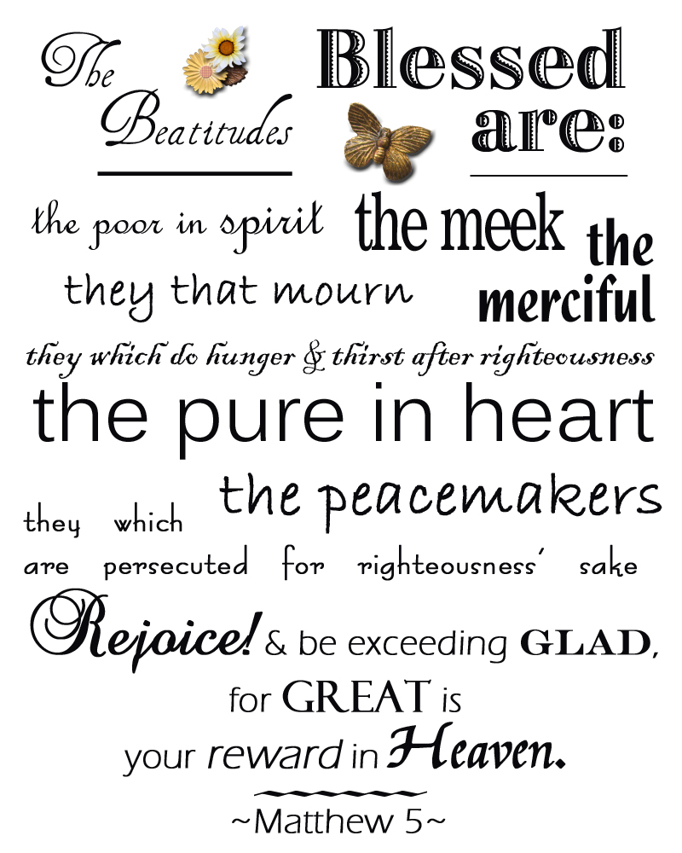

Slide 73
Outline
Sermon on the Mount
Citizens of the Kingdom (5:2-16)
Characteristics [Beatitudes] (5:2-12)
Their influence on the world (5:13-16)
Righteousness of the Kingdom (5:17 - 7:12)
Harmonizes with the Old Testament (5:17-19)
Exceeds the righteousness of the Scribes & Pharisee (5:20-48)
Relationship to God (6)
Relationship to man (7:1-12)
Exhortation to Enter the Kingdom (7:13-27)
Enter the narrow gate that leads to life (7:13-14)
Don’t let false prophets turn you aside (7:15-20)
Only the obedient enter the kingdom (7:21-27)

Slide 74
Sermon on the Mount
The Citizens of the Kingdom (5:1-16)
The Righteousness of the Kingdom (5:17-48)
Sincere Devotion in the Kingdom (6:1-18)
Trusting God in the Kingdom (6:19-34)
Relating to Man in the Kingdom (7:1-12)
Entering the Kingdom (7:13-27)

Slide 75
Sermon on the Mount
Matthew 5-7
The Message
The Kingdom of God
Matt. 4:23 – preaching gospel of kingdom
“Kingdom” repeated throughout: (5:3, 10, 19, 20; 6:10; 33; 7:21)

Slide 76
The Citizens of the Kingdom
(Matt. 5:1-16)
Review
Characteristics of the Citizens (5:2-12)
The Influence of the Citizens on the World (5:13-16)
Sermon on the Mount

Slide 77
The Sermon On The Mount
The Sermon on the Mount was a great message that has been extensively studied and expounded upon.
Lengthy series have been developed on the various thoughts Jesus presented on this occasion.

Slide 78
Introduction
It is described by some as the greatest sermon preached by Jesus.
It is certainly the longest recorded sermon in scripture.
Today we want to examine the Sermon on the Mount.

Slide 79
Two Sermons?
Background of the Sermon
Called such because of Matt. 5:1-2.
Jesus was described as going upon a mountain.
In reality, it could have a hill with a level area.
We are not told specifically where the Sermon on the Mount took place.
It is most commonly believed to have been presented at a place called, “The Horns of Hattin” just outside of Capernaum which was a seaside town on the north side of Sea of Galilee.

Slide 80
Two Sermons?
The “Sermon on the Plain” as recorded in Luke 6:20-49, is believed by some to be the same sermon as recorded by Luke.
If so, we do not have the exact wording of the sermon in either account, but a summary from two different perspectives (bearing in the mind the different audiences to whom these gospels were written).
It is possible that these were two different occasions when the same sermon was presented by Jesus.
Jesus needed to deliver the same message on more than one occasion.

Slide 81
Two Sermons?
He traveled from city to city and would present His message often to an entirely new audience.
They needed to hear what had been previously said (when appropriate).
It is not uncommon for a traveling preacher today (i.e. those who hold many gospel meetings) to present the same lesson on several occasions, even in the same region because the audiences are different and the message is still needed (or even requested).
That would explain differences in the two accounts.

Slide 82
The Message Of The Sermon
The Citizens of the Kingdom
The attitude of behavior demonstrated by them.
Their character and blessedness – in the beatitudes – Matthew 5:3-12
Their relationship to the world by their proper example – Matthew 5:13-16

Slide 83
The Message Of The Sermon
The Righteousness of the Kingdom
Making the application in our lives.
What is righteousness?
Vine’s, “The character or quality of being right.”
It was formerly spelled, “rightwiseness” which gives its expressed meaning.

Slide 84
The Message Of The Sermon
Thayer says it is one who is as he ought to be.
Kittel (TDNT – abridged) describes it as “Right conduct before God.”
In other words, Jesus is challenging His audience (and us) to live what we profess and to ensure that it is what God desires.
The many passages that refer to the righteousness of God demonstrate that He is the pattern we are to seek to apply in our lives
Matthew 6:33, James 1:20, etc.)

Slide 85
The Message Of The Sermon
The need for a righteousness greater than the scribes and Pharisees
– Matt. 5:17-48 NOTE: Many of the aspects Jesus addresses here were parts of the Law of Moses.
However, with their traditions, they had set aside the intent and even fulfillment of various laws.
Jesus called them BACK to complete respect for the law in their conduct.
And as followers of Him, they were NOW expected to go even further.

Slide 86
The Message Of The Sermon
5:17-19 - The need to obey God’s law.
In this case, it was the Law of Moses.
But the emphasis is on a need to submit to God’s will as it applies to you.
While we are under a New Law, we are still obligated to keep it! (James 1:22-25, 2:10, 14-24, etc.)

Slide 87
The Message Of The Sermon
5:20 – The need for true and deep seated righteousness.
5:21-26 – You must control your anger.
Not only the acts but the attitudes.
5:27-30 – You must control your lusts.
There is sin in lustful thoughts as well.

Slide 88
The Message Of The Sermon
5:31-32 – You must respect your vows to your spouse.
5:33-37 – You must respect ALL your vows.
Live honorably and let your word be your bond.
5:38-42- In righteousness, go further than unrighteous society (i.e. turn the other cheek, 2nd mile service, etc.)
5:43-48 – Love all men, even your enemies.

Slide 89
The Message Of The Sermon
Righteousness in relationship to God – Matthew 6:1-33
NOTE: In this chapter, Jesus addresses action related to our service to God.
It is here we find Jesus dealing with worship to God.
It too must be with a proper attitude and according to God’s instructions.

Slide 90
The Message Of The Sermon
6:1-4 – Charitable deeds.
We need to be willing to share what we have with others.
6:5-15 – Prayers.
Let us pray simply and sincerely to God and not to be seen.
6:16-18 – Fasting.
As they fasted, it was inward and directed toward God.

Slide 91
The Message Of The Sermon
6:19-21 – Where is your treasure? In heaven or on earth?
6:22-23 – Watch what you bring into your body – be pure.
6:24 – You CANNOT serve two masters at the same time.
6:25-34 – About worry, DON’T!
Learn to trust in God.
Put Him first, and other matters will take care of themselves.

Slide 92
The Message Of The Sermon
Righteousness in relationship to his fellow man – Matthew 7:1-12
NOTE: It is equally important that we strive to get along with mankind.
We must act properly toward man if we are to be a positive effect in this world.
It is also essential to set us apart.

Slide 93
The Message Of The Sermon
7:1-6 – Concerning judging others.
We need to be careful to ensure that our judgments are righteous (fair and honest).
Note the warning if we judge with prejudice!
Vs. 6, Don’t cast your pearls before swine – use your time wisely.

Slide 94
The Message Of The Sermon
7:7-11 – Ask of God and it will be given. Seek and you will find. Knock and it will be opened to you.
God knows what you need in this life and how to give you good things.
7:12 – the “golden rule” – the principle to live by in all that we do.

Slide 95
The Message Of The Sermon
Exhortation to enter the Kingdom (the invitation)
NOTE: Jesus concludes His sermon with an invitation to those present to follow Him.
7:13-14 – there are two paths that we must choose between.
Life is about these choices – right & wrong; good & evil; heaven or hell.
7:15-20 – Beware of false prophets and teachers.
They will try and take your salvation from you.
Judge them by their fruits (i.e. according to the word – cf. 1 John 4:1)

Slide 96
The Message Of The Sermon
7:21-23 – Who will enter the kingdom of heaven?
Those who do His will!
7:24-27 – the two paths are again introduced, this time based upon our willingness to hear and accept His message.
The wise build wisely and the foolish build foolishly.
What type of a house are you building?

Slide 97
Summary Conclusion
In summary as we look at the Sermon on the Mount, we are taught who we must be like to be happy in the great beatitudes. We are also taught we are to be salt and the light in the midst of this world and a city that can be seen on a hill. We are taught to fulfill the law and the prophets as we are to bring it to the interior part of our hearts as Jesus is teaching. We are to be a people who do no violence to others, not to even to think about it. We are to be people that do not commit adultery, or even think about it. We are to be people who are honest in dealing with one another and letting our speech be ‘yes’ and ‘no.’ Jesus expects us to be people who are faithful in our marital relationship. We are to be non-retaliatory and non-resistant in the way we respond to others, even loving our enemies. We are to be people that give our alms not to be seen in an outward way by others, but seen by our heavenly Father. We are to pray, not by constant repetitiousness but in a simple way to our heavenly Father, worshipping him, pouring out our daily needs, forgiving others and praying that we would not be led into temptation by Satan. We are to fast in a way that is invisible to others, but visible to our Father in heaven. We are to store treasure in heaven by the way we give to others, but not have a greedy eye to gain material and money, lest our whole body be lead in a destructive way. We are not to live in anxiety, but casting all our care upon him for our daily needs. Whatever we do in word and deed, we must do in all in the name of the Lord Jesus. We are not to judge others in a negative, legalistic way; but rather, be persistent in our prayers, to enter through the narrow gate, and evaluate our life by our fruit. We are also to evaluate the lives of those who teach by the fruit of their lives. In doing these things, we build our lives upon the rock solid foundation of Christ’s teaching rather than self-reliant ignorance which would be to ignore Christ’s teaching and do the opposite. May we as believers always desire to build our lives first of all in Jesus, upon the salvation that he brings to us and in his atonement. Let us build upon the application growing out of the way he has taught us in the wonderful Sermon on the Mount.
Staats, G. (2013). . (D. Odegard, Ed.) (pp. 3738). Gary Staats.
Staats, G. (2013). The Teaching of Christ in the Sermon on the Mount: A Brief Christological Commentary of the Flow of Thought. (D. Odegard, Ed.) (pp. 37–38). Gary Staats.

