Slide 1
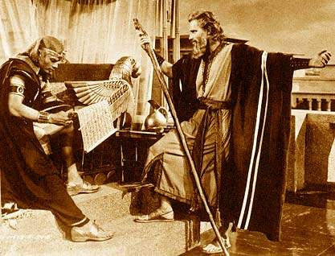
Moses & the Red Sea Crossing
Truth or Fiction?

Slide 2
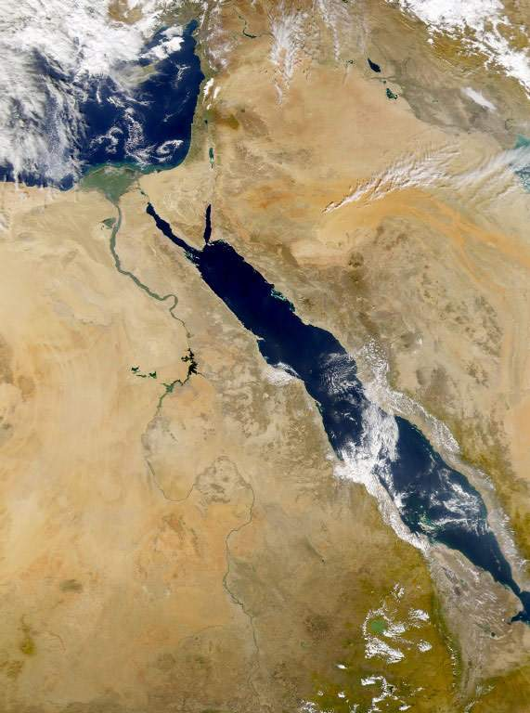
Geographies – The Red Sea!
Land of Goshen
Gulf of Aqaba

Slide 3
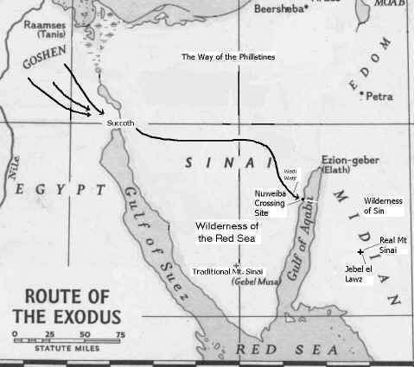
They traveled from Goshen
via Succoth
through this wadi
exiting at Nuweiba beach

Slide 4
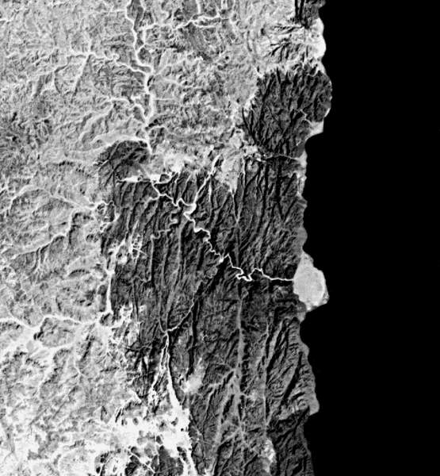
Nuweiba Beach
Satellite picture of the wadi leading to the only exit: Nuweiba Beach!

Slide 5
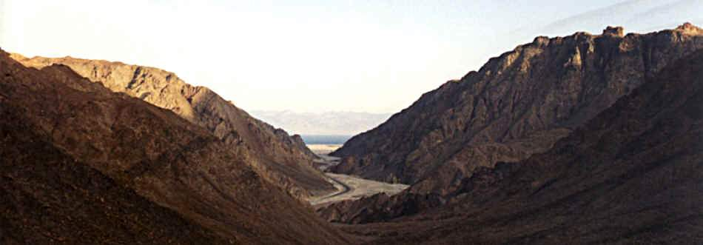
Coming out on Nuweiba Beach

Slide 7
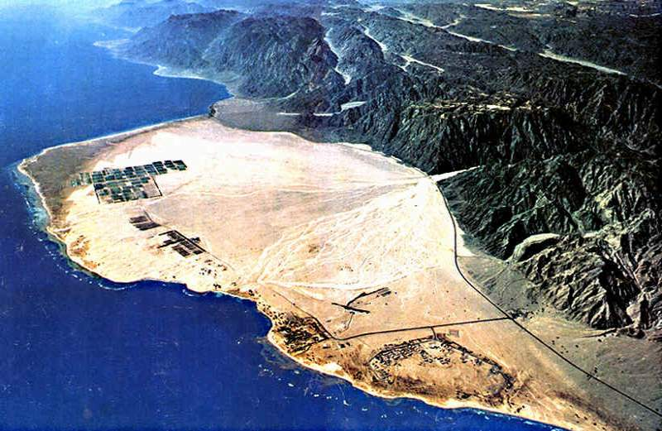

Slide 8
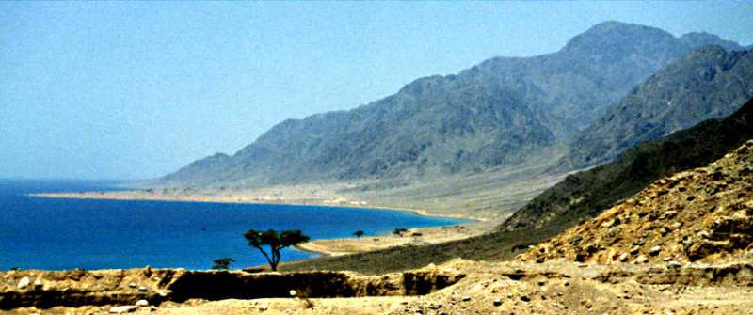
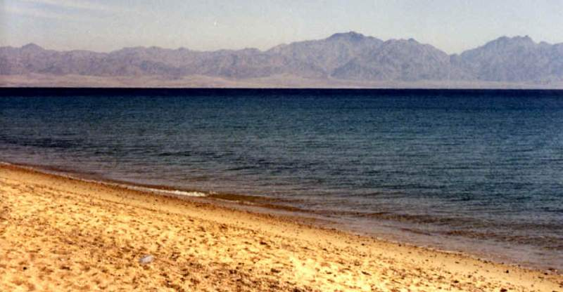
Side Views

Slide 9
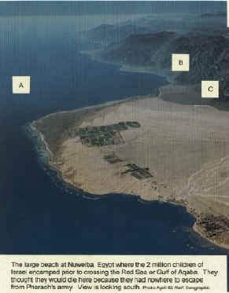
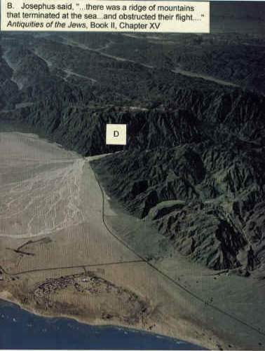
Nuweiba beach at the gulf of Aqaba from where they presumably crossed over…
Pretty big beach no? For 2 million people?
I always did wonder how that pillar of fire could have stopped the Egyptians by night. Just go around it! No sir! Those hills were too steep for their chariots!

Slide 10
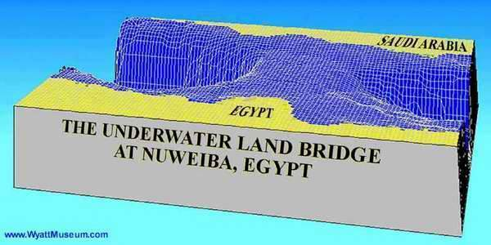
Checking sonar depth measurements, Wyatt discovered an underwater land bridge exactly between Nuweiba Beach & the Saudi side.

Slide 11
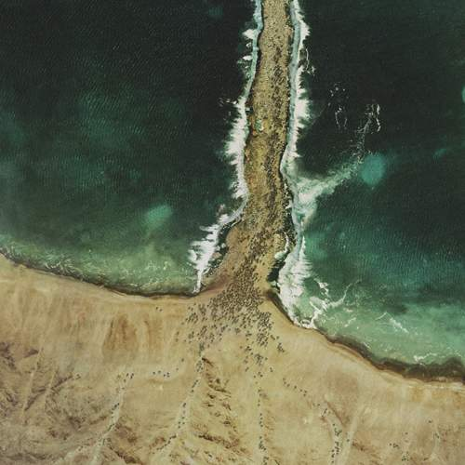
God divided the sea by an Eastern storm exposing this underwater land bridge & Moses went over it as if it were dry land! That’s how 2-3 million of them could cross!
Exodus 14:21-22 “Moses stretched out his hand over the sea; and the LORD caused the sea to go [back] by a strong east wind all that night, and made the sea dry [land], and the waters were divided. And the children of Israel went into the midst of the sea upon the dry [ground]: and the waters [were] a wall unto them on their right hand, and on their left.”

Slide 12
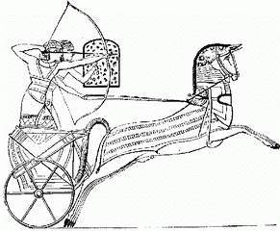
According to the Bible account Pharaoh’s chariots tried to pursue them
original picture of Pharaoh’s chariots
EX. 14:23 The Egyptians pursued, and went in after them to the midst of the sea, even all Pharaoh's horses, his chariots, and his horsemen. 24 …it came to pass, that in the morning watch the LORD 25 took off their chariot wheels, that they drave them heavily: so that the Egyptians said, Let us flee from the face of Israel; for the LORD fighteth for them against the Egyptians. 26 And the LORD said unto Moses, Stretch out thine hand over the sea, that the waters may come again upon the Egyptians, upon their chariots, and upon their horsemen. 27 And Moses stretched forth his hand over the sea, and the sea returned to his strength when the morning appeared; and the Egyptians fled against it; and the LORD overthrew the Egyptians in the midst of the sea. 28 And the waters returned, and covered the chariots, and the horsemen, and all the host of Pharaoh that came into the sea after them; there remained not so much as one of them.

Slide 13
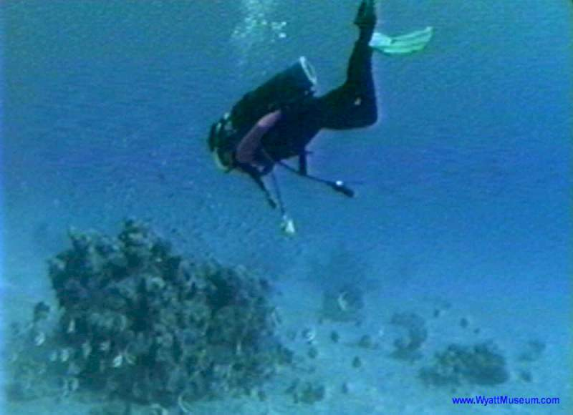
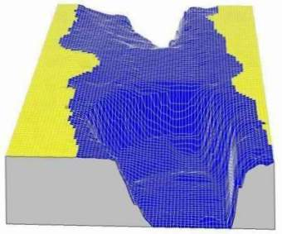
So Wyatt decided to go scuba diving & look underwater there! Guess what he discovered…

Slide 14
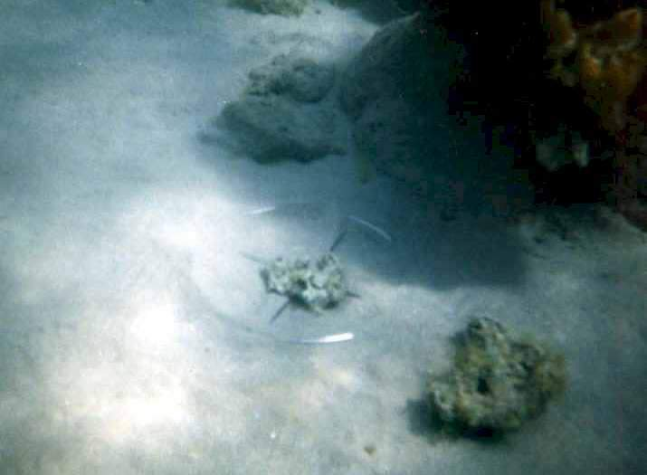
Wheels of Pharaoh’s chariots that got drowned when trying to pursue them!
Artefacts found include wheels, chariot bodies, as well as human and horse bones. Divers have located such on the Saudi coastline opposite Nuweiba as well.

Slide 15
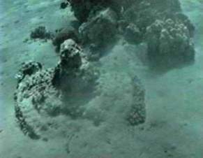
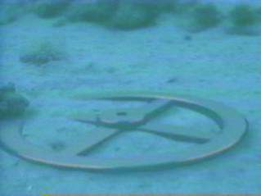
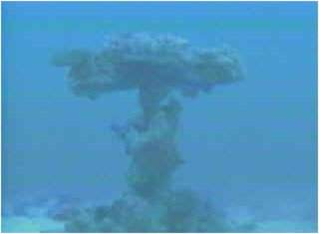
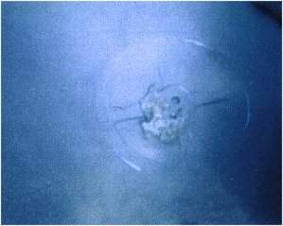
Since 1987, Ron Wyatt found three four-spoke gilded chariot wheels.
Coral does not grow on gold, hence the shape has remained very distinct, although the wood inside the gold veneer has disintegrated making them too fragile to move.
The hope for future expeditions is to explore the deeper waters with remote cameras or mini-subs.

Slide 16
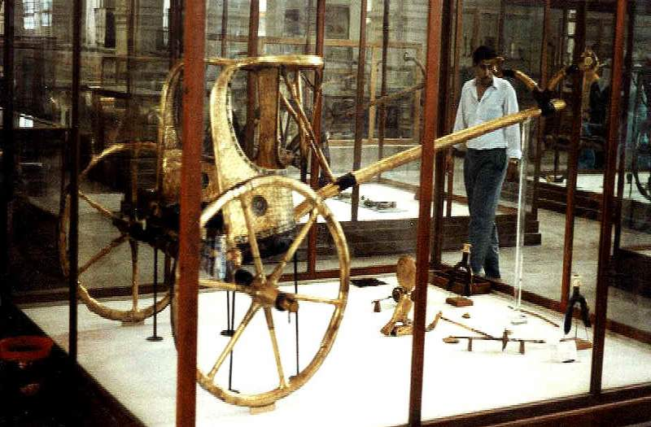
A coral-encrusted chariot wheel, filmed off the Saudi coastline, matches chariot wheels found in Tutankhamen's tomb.

Slide 17
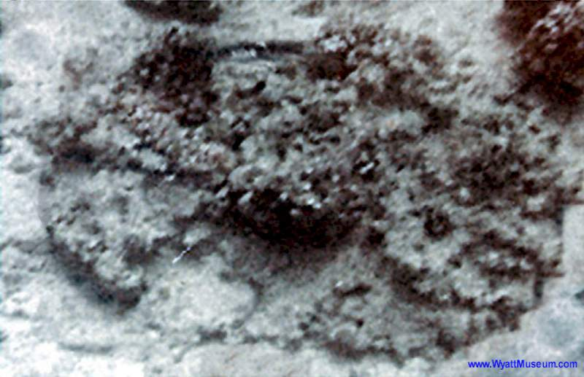
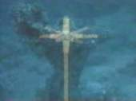
Chariot wheel and axle covered with coral and up-ended.
Exodus 14:25 'And took off their chariot wheels, that they drave them heavily...'

Slide 18
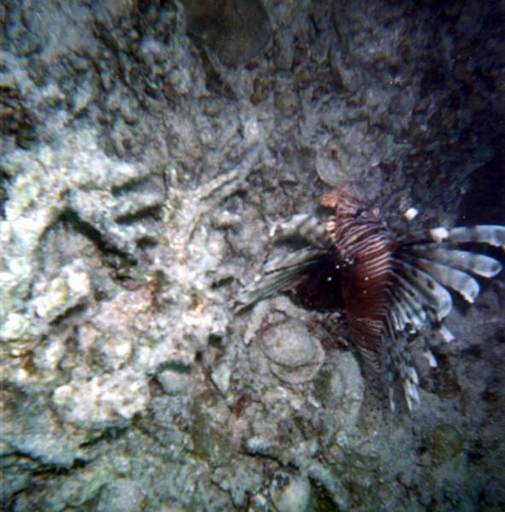
Mineralized bone, one of many found at the crossing site tested by the Department of Osteology at Stockholm University, was found to be a human femur, from the right leg of a 165-170cm tall man.
It is essentially 'fossilized, ' i.e., replaced by minerals and coral, hence cannot be dated by radiocarbon methods, although this specimen was obviously from antiquity.

Slide 19
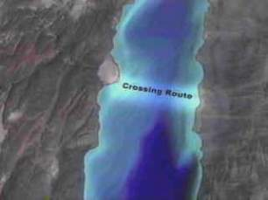
Solomon's Memorial Pillars.
When Ron Wyatt first visited Nuweiba in 1978, he found a Phoenician style column lying in the water. Unfortunately the inscriptions had been eroded away, hence the column's importance was not understood until 1984 when a second granite column was found on the Saudi coastline opposite -- identical to the first, except on this one the inscription was still intact!

Slide 20
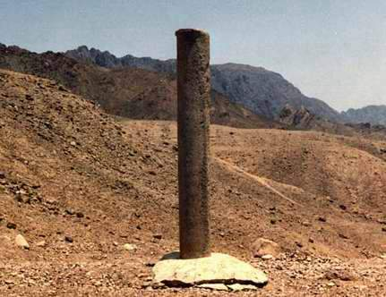
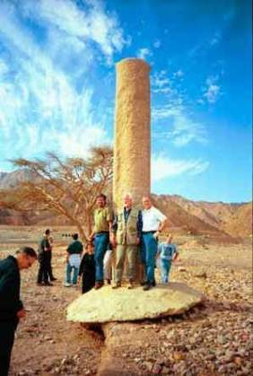
Ron Wyatt found 2 pillars King Solomon put on both beaches to commemorate the Red Sea crossing!
In Phoenician letters (Archaic Hebrew), it contained the words: Mizraim (Egypt ); Solomon; Edom; death; Pharaoh; Moses; and Yahweh, indicating that King Solomon had set up these columns as a memorial to the miracle of the crossing of the sea.
Saudi Arabia does not admit tourists, and perhaps fearing unauthorized visitors, the Saudi Authorities have since removed this column, and replaced it with a flag marker where it once stood.

Slide 21
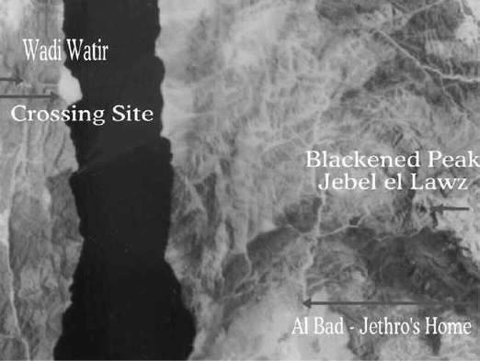
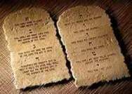
They crossed the Red Sea to Saudi Arabia where according to these archeologists the real Holy Mountain Sinai is.
From here
Where Moses got the 10 commandments

Slide 22
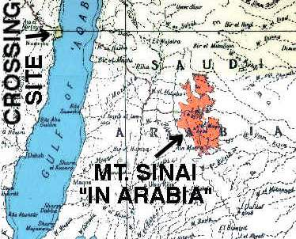

Slide 23
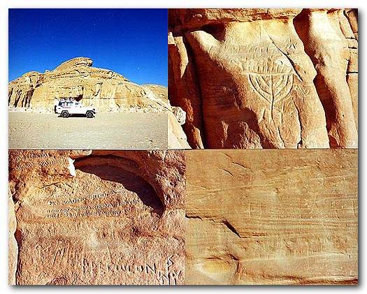
Hebrew Inscriptions Found in Arabia

