Slide 1
Paul In Caesarea
by David Burris, Editor/Contributor
Before Felix – Festus – Agrippa II

Slide 2
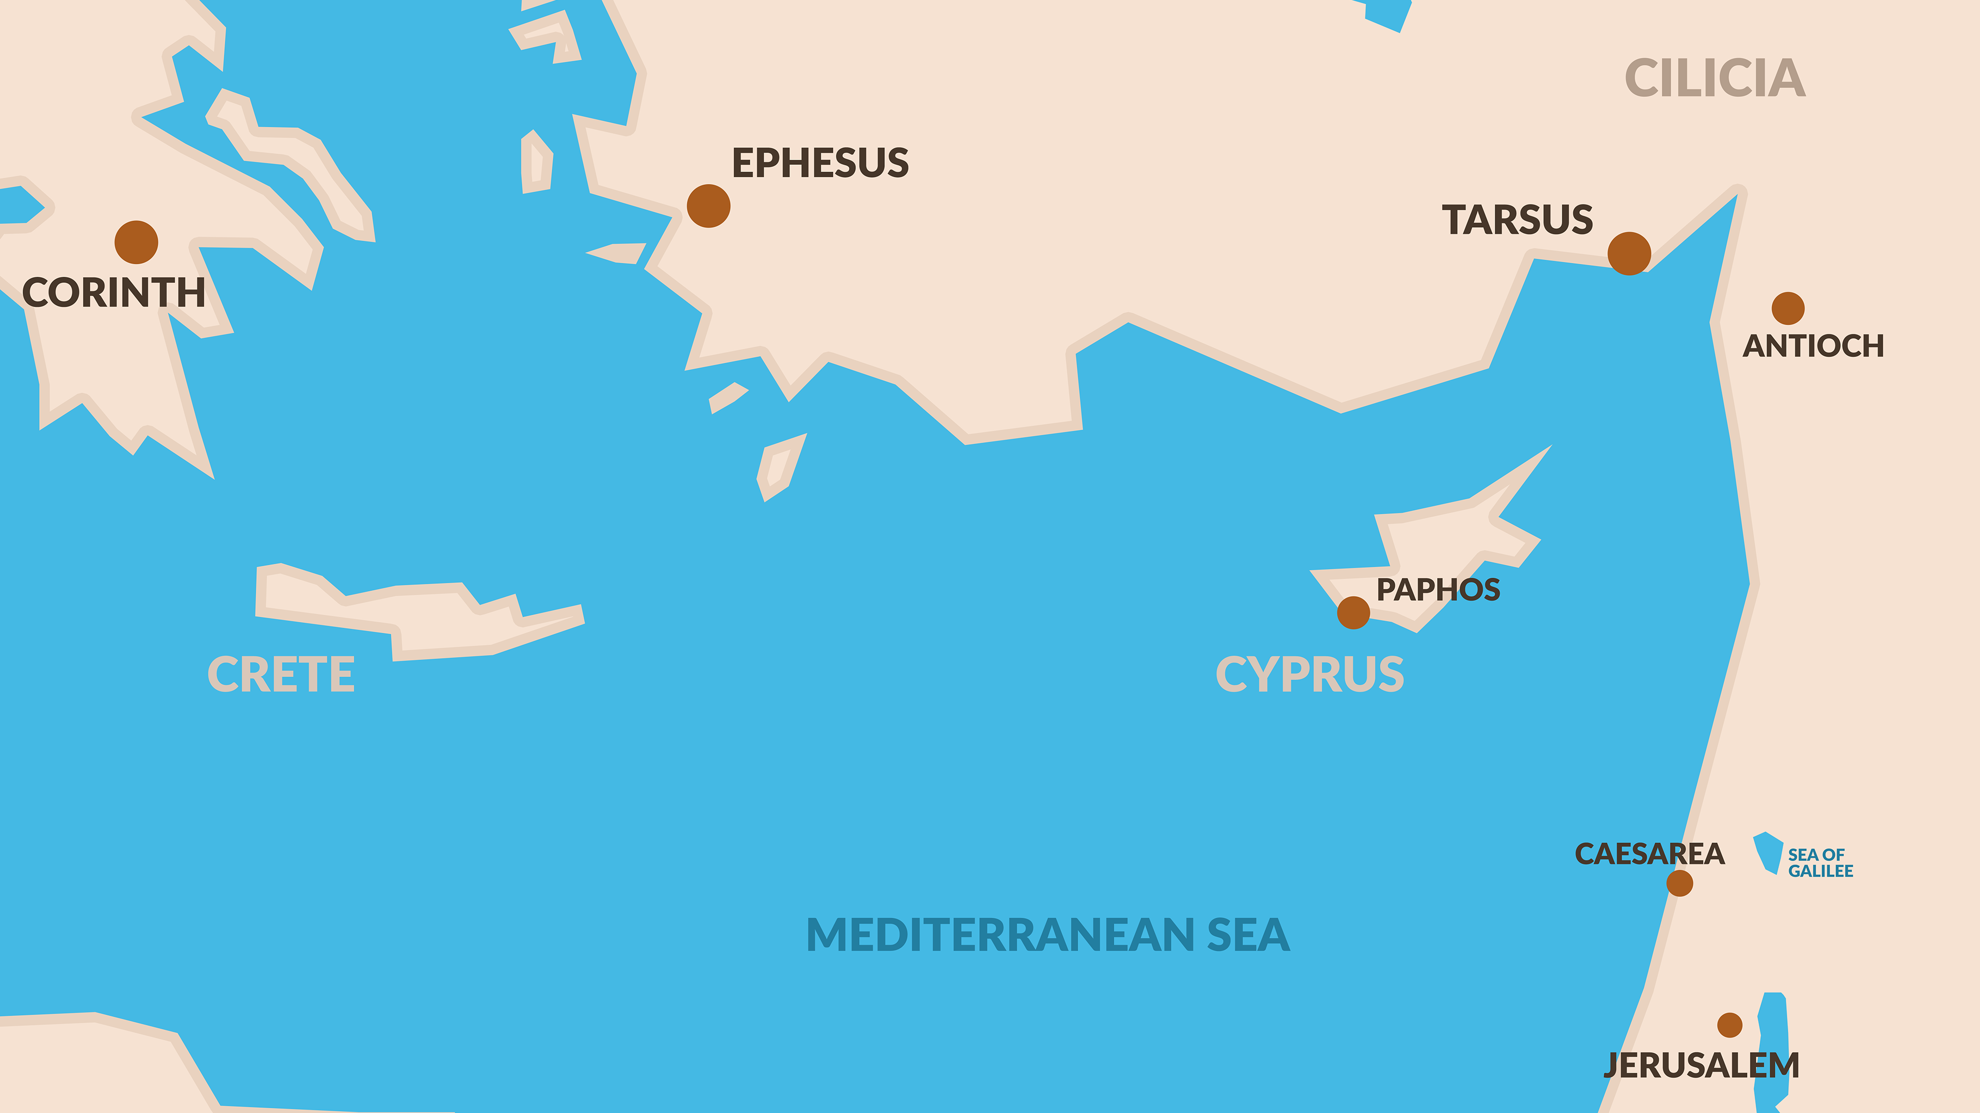

Slide 3
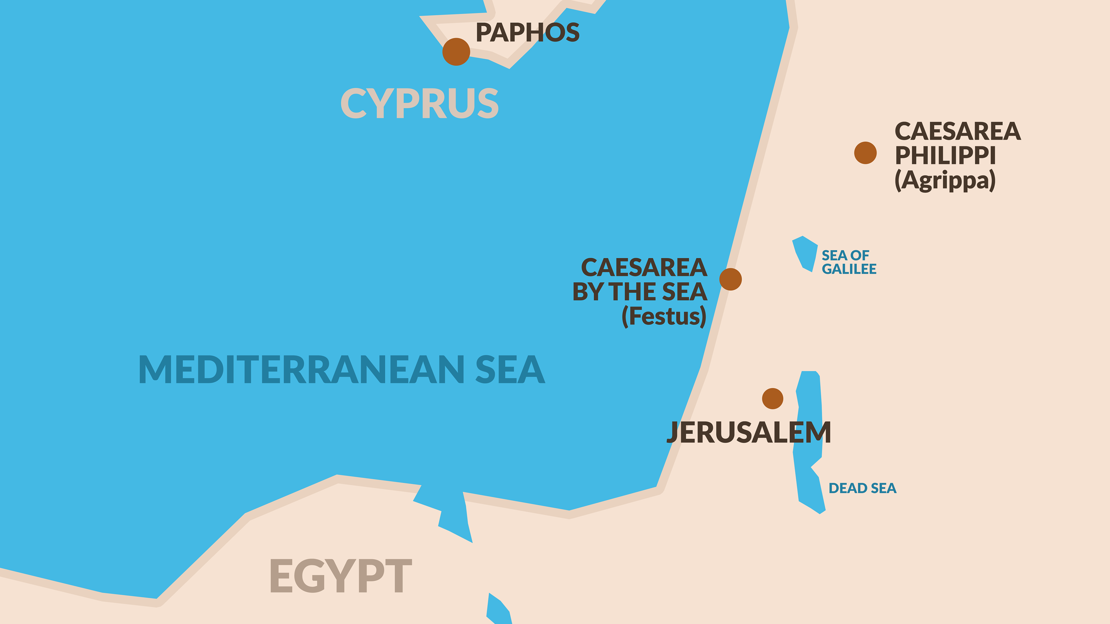

Slide 5
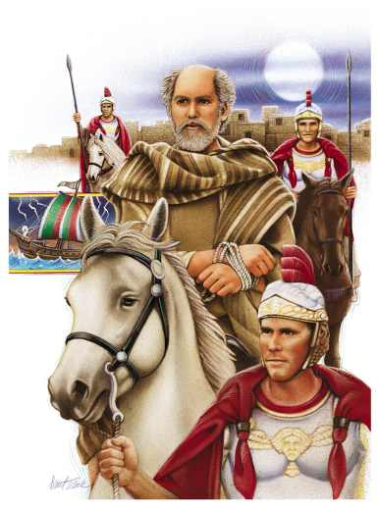
Acts 23
³¹ Then the soldiers, as it was commanded them, took Paul, and brought him by night to Antipatris.
³² On the morrow they left the horsemen to go with him, and returned to the castle:
³³ Who, when they came to Caesarea, and delivered the letter to the governor, presented Paul also before him.
Notes:
31: An ti PA tris or An-tip'-a-triss

Slide 6
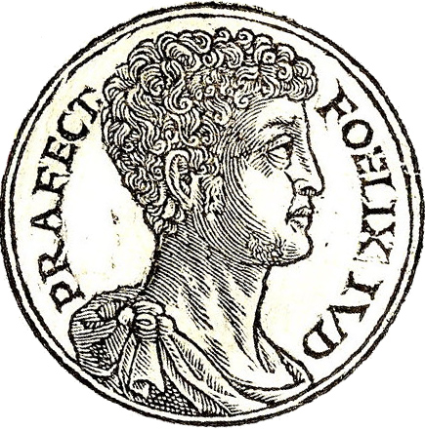
³⁴ And when the governor had read the letter, he asked of what province he was. And when he understood that he was of Cilicia;
³⁵ I will hear thee, said he, when thine accusers are also come.
And he commanded him to be kept in Herod's judgment hall.
Antonius Felix Claudius Caesar made him governor
of Judaea in AD 53.
Notes:
34: Ci LI shi a

Slide 7
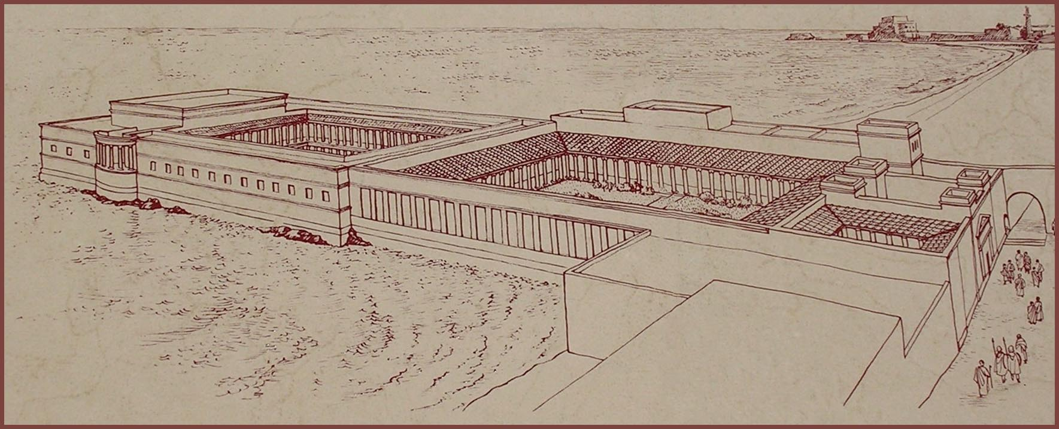
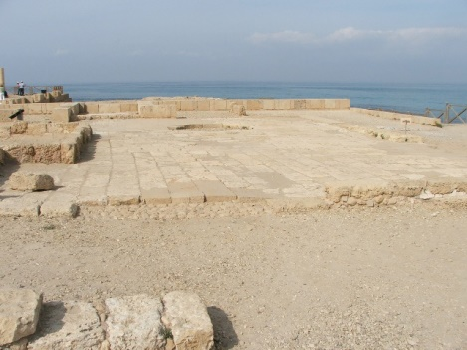
The Judgment Hall or Praetorium was the headquarters of the Roman military governor.
Notes:
pray TOR i um

Slide 8
Three Charges Against Paul
Caused Dissention
Led a Renegade Sect
Desecrated the Temple

Slide 9
L.D. CARY & SAM HOLT CATCH PHRASES
Chapter 19 – “10 + 9, Ephesus Time”
Chapter 20 – “Traveling A’Plenty”
Chapter 21 – “Confinement Begun”
Chapter 22 – “Before A Mob, Not A Few”
Chapter 23 – “Before The Council, You See”
Chapter 24 – “Felix Listens No More”
Chapter 25 – “Agrippa Arrives”
Chapter 26 – “Agrippa Realizes Paul’s Fix”
Chapter 27 – “Shipwreck & An Angel From Heaven”
Chapter 28 – “The End Of Our Wait”
“Felix Listens No More”
Catch Phrase
Chapter Twenty-Four

Slide 10
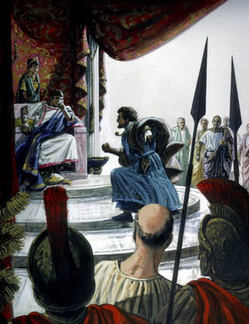
Acts 24
¹ And after five days Ananias the high priest descended with the elders, and with a certain orator named Tertullus, who informed the governor against Paul.
² And when he was called forth, Tertullus began to accuse him, saying,
Seeing that by thee we enjoy great quietness, and that very worthy deeds are done unto this nation by thy providence,
³ We accept it always, and in all places, most noble Felix, with all thankfulness.
⁴ Notwithstanding, that I be not further tedious unto thee, I pray thee that thou wouldest hear us of thy clemency a few words.
Notes:
1. Ter TUL lus

Slide 11
⁵ For we have found this man a pestilent fellow, and a mover of sedition among all the Jews throughout the world, and a ringleader of the sect of the Nazarenes:
Notes:
1. Ter TUL lus

Slide 12
⁵ For we have found this man a pestilent fellow, and a mover of sedition among all the Jews throughout the world, and a ringleader of the sect of the Nazarenes:
The Jews would not call them Christians as that was derived from the word for Messiah; so Tertullus was instructed to call them Nazarenes.
(Companion Bible)
Notes:
1. Ter TUL lus

Slide 13
⁵ For we have found this man a pestilent fellow, and a mover of sedition among all the Jews throughout the world, and a ringleader of the sect of the Nazarenes:
⁶ Who also hath gone about to profane the temple: whom we took, and would have judged according to our law.
⁷ But the chief captain Lysias came upon us, and with great violence took him away out of our hands,
⁸ Commanding his accusers to come unto thee: by examining of whom thyself mayest take knowledge of all these things, whereof we accuse him.
⁹ And the Jews also assented, saying that these things were so.
Notes:
1. Ter TUL lus

Slide 14
CHAPTER 24 J. W. McGarvey’s Acts Commentary
VERSES 2 - 9
The complimentary words with which this speech is introduced were not undeserved by Felix; for he had restored tranquility to the country, when it was disturbed, first by hordes of robbers; afterward by organized bands of Assassins, and more recently, by that Egyptian for whom Lysias at first mistook Paul. In suppressing all these disturbances, his administration had been prosperous.
The accusation against Paul, sustained by the testimony of the Jews, contained three specifications. It charged him, first, with exciting the Jews to sedition; second, with being the ringleader of the sect of Nazarenes; third, with profaning of the temple. Tertullus also took occasion to vent his indignation against Lysias, for interfering by violence, as he falsely alleged against him, with the judicial proceedings of the Sanhedrin. Finally, he asserts that Felix would be able, if he would examine Lysias, to gain from his lips a knowledge of all of which they were now informing him.
McGarvey, J. W. (1872). A commentary on Acts of Apostles (Ac 24:9). Lexington, KY: Transylvania Printing and Publishing Co.

Slide 15
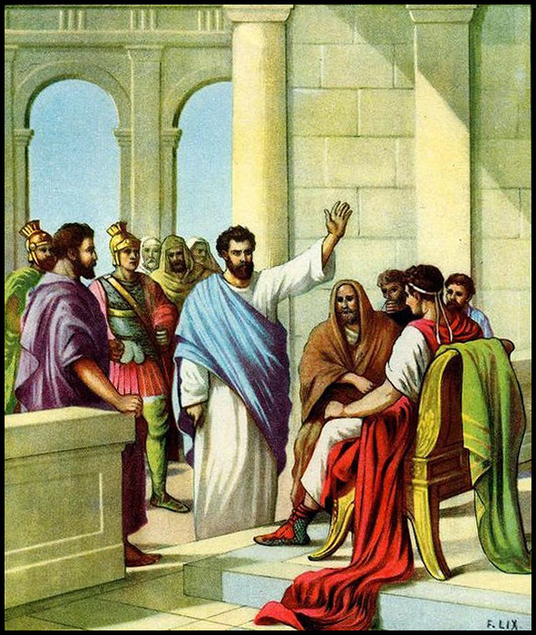
¹⁰ Then Paul, after that the governor had beckoned unto him to speak, answered,
Forasmuch as I know that thou hast been of many years a judge unto this nation, I do the more cheerfully answer for myself:
¹¹ Because that thou mayest understand, that there are yet but twelve days since I went up to Jerusalem for to worship.
¹² And they neither found me in the temple disputing with any man, neither raising up the people, neither in the synagogues, nor in the city:
¹³ Neither can they prove the things whereof they now accuse me.

Slide 16
¹⁴ But this I confess unto thee, that after the way which they call heresy, so worship I the God of my fathers, believing all things which are written in the law and in the prophets:
¹⁵ And have hope toward God, which they themselves also allow, that there shall be a resurrection of the dead, both of the just and unjust.
¹⁶ And herein do I exercise myself, to have always a conscience void of offence toward God, and toward men.

Slide 17
¹⁷ Now after many years I came to bring alms to my nation, and offerings.
¹⁸ Whereupon certain Jews from Asia found me purified in the temple, neither with multitude, nor with tumult.
¹⁹ Who ought to have been here before thee, and object, if they had ought against me.
²⁰ Or else let these same here say, if they have found any evil doing in me, while I stood before the council,
²¹ Except it be for this one voice, that I cried standing among them, Touching the resurrection of the dead I am called in question by you this day.

Slide 18
CHAPTER 24 J. W. McGarvey’s Acts Commentary
VERSES 10 - 21
This speech contains a distinct reply to each specification made by Tertullus. In answer to the charge of stirring up sedition, he shows first, that it had been only twelve days since he went up to Jerusalem. As it had now been five days since he left there, and he had been in prison one day previous to leaving, his previous stay there could have been only six days, which would have afforded no sufficient time for stirring up sedition. Moreover, they could not prove that he was engaged even in disputation with any one, in the temple, in the synagogues, or in any party of the city. As to being a ringleader of the sect of the Nazarenes, he frankly confesses that he belongs to what they call a sect: yet he believes all the law and the prophets, hopes for a resurrection of the dead, and is habitually struggling to lead a conscientious life. Finally, in reference to the charge of profaning the temple, implying disrespect for the Jewish people, he declares that the very object of his visit to Jerusalem was to bear alms to the people; and that when the Jews from Asia seized him in the temple, he was purified, and engaged about alms-giving, and the offerings of the temple. In conclusion, he notes the significant fact, that those who first seized him & knew what he was doing, were not there to testify; while he challenges those who were present to state a single act of his that was wrong, unless it were the very heinous offense of declaring he believed, with the great mass of the Jews, in the resurrection of the dead. The last point was made, and presented in the ironical form which it bears, in order to show Felix it was party jealousy which instigated his Sadducee prosecutors.
McGarvey, J. W. (1872). A commentary on Acts of Apostles (p. 272). Lexington, KY: Transylvania Printing and Publishing

Slide 19
²² And when Felix heard these things, having more perfect knowledge of that way, he deferred them, and said,
When Lysias the chief captain shall come down, I will know the uttermost of your matter.
²³ And he commanded a centurion to keep Paul, and to let him have liberty, and that he should forbid none of his acquaintance to minister or come unto him.
Felix knew more about Christianity than they realized.
The Roman centurion Cornelius – who came to Christ through the ministry of Peter – also lived in Caesarea.
It is possible that from him and others Felix concluded that Christianity was not such an evil thing as was being told him.

Slide 22
THOSE OUTSIDE THE MOVEMENT & THE UNLEARNED TYPICALLY REFERRED TO THE EARLY CHURCH & THE FIRST CHRISTIANS AS “PEOPLE OF THE WAY”

Slide 26
CHAPTER 24 J. W. McGarvey’s Acts Commentary
VERSE 23
When the Jews were dismissed, if Felix had possessed a strict regard for justice, he would have released Paul. As it was, he only relaxed the rigor of his previous confinement. (23) “And he commanded the centurion that Paul should be guarded, but have relaxation, and to forbid none of his friends to minister to him or visit him.” His confinement was now the least rigorous which was considered compatible with safe-keeping. He was under what was called the military custody, being placed in charge of a soldier, whose left arm was chained to Paul’s right, and who was responsible with his own life for the safety of his prisoner. The Apostle’s guards were relieved at regular intervals, and the “relaxation” allowed Paul was, probably, an occasional release from the chain.
McGarvey, J. W. (1872). A commentary on Acts of Apostles (p. 273). Lexington, KY: Transylvania Printing and Publishing Co.

Slide 27
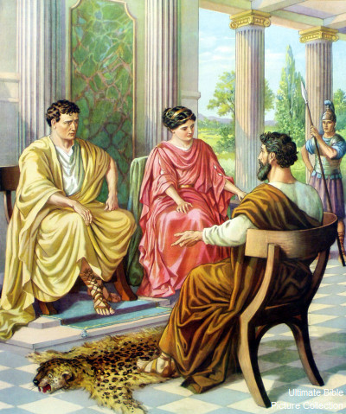
²⁴ And after certain days, when Felix came with his wife Drusilla, which was a Jewess, he sent for Paul, and heard him concerning the faith in Christ.

Slide 28
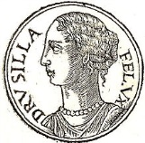
²⁴ And after certain days, when Felix came with his wife Drusilla, which was a Jewess, he sent for Paul, and heard him concerning the faith in Christ.
Drusilla was the daughter of Herod Agrippa.
She died in the eruption of Mount Vesuvius that destroyed Pompeii in AD 79.

Slide 29
CHAPTER 24 J. W. McGarvey’s Acts Commentary
VERSE 24
Drusilla, according to Josephus, was a daughter of Herod Agrippa, whose persecutions of the apostles, and miserable death, we have considered in commenting on the twelfth chapter. She was a woman of remarkable beauty, the lawful wife of Azizus, king of Emesa, but was now living in adulterous intercourse with Felix. Concerning Felix, Tacitus testifies, that “with every kind of cruelty and lust, he exercised the authority of a king with the temper of a slave.”⁵
McGarvey, J. W. (1872). A commentary on Acts of Apostles (p. 273). Lexington, KY: Transylvania Printing and Publishing Co.

Slide 30
²⁵ And as he reasoned of righteousness, temperance, and judgment to come, Felix trembled, and answered, Go thy way for this time; when I have a convenient season, I will call for thee.
²⁶ He hoped also that money should have been given him of Paul, that he might loose him: wherefore he sent for him the oftener, and communed with him.
²⁷ But after two years Porcius Festus succeeded Felix: and Felix, willing to shew the Jews a pleasure, left Paul bound.

Slide 31
CHAPTER 24 J. W. McGarvey’s Acts Commentary
VERSE 25
The common version, “Felix trembled,” may be true, but it is claiming more for the effect of Paul’s discourse than is asserted by Luke. He was “filled with fear,” which shows that Paul addressed him on these appropriate topics, not in a spirit of bravado, but in that earnest and solemn strain which alone can penetrate the heart. This feeling was the beginning necessary to a change of life; but lust and ambition smothered the kindling fires of conscience, and the common excuse of alarmed but impenitent sinners was urged to get rid of the too faithful monitor.
It is a sad warning to all who thus procrastinate, that to neither Felix nor Drusilla did the season ever come which they thought convenient to listen to such preaching. Felix was soon dismissed in disgrace from his office; and Drusilla, with a son by Felix, perished in that eruption of Mount Vesuvius which engulfed the cities of Pompeii and Herculaneum.
McGarvey, J. W. (1872). A commentary on Acts of Apostles (p. 273). Lexington, KY: Transylvania Printing and Publishing Co.

Slide 32
CHAPTER 24 J. W. McGarvey’s Acts Commentary
VERSES 26 & 27
Having learned, from Paul’s own lips, that he had been up to Jerusalem to bear alms from distant Churches to the poor, and knowing something, perhaps of the general liberality of the disciples toward one another, he could have no doubt, judging them according to the usage of the age, that they would be willing to purchase Paul’s freedom at a high price. That it was not done, shows that the disciples had too elevated a standard of morality to buy from a corrupt judge release from even unjust and protracted imprisonment.
These two years, if we judge from the silence of history, were the most inactive of Paul’s career. There are no epistles which bear this date & though his friends and brethren had free access to him, we have no recorded effects of their interviews with him. The only moments in which he emerges into our view, from the obscurity of his prison, are those in which he appeared before his judges. We shall, on this account, contemplate his conduct on these occasions with the deeper interest.
McGarvey, J. W. (1872). A commentary on Acts of Apostles (p. 274). Lexington, KY: Transylvania Printing and Publishing Co.

Slide 33
Acts 24:24-25 – Paul before Felix
[24] And after certain days, when Felix came with his wife Drusilla, which was a Jewess, he sent for Paul, and heard him concerning the faith in Christ.
[25] And as he reasoned of righteousness, temperance, and judgment to come Felix trembled, and answered, Go thy way for this time; when I have a convenient season, I will call for thee.

Slide 34
Felix and Festus – they were Roman governors of Judea; The KJV calls them “Procurator”
King Agrippa (II) – was the last of the family of Herod. He ruled an area assigned to him by Rome

Slide 35
L.D. CARY & SAM HOLT CATCH PHRASES
Chapter 19 – “10 + 9, Ephesus Time”
Chapter 20 – “Traveling A’Plenty”
Chapter 21 – “Confinement Begun”
Chapter 22 – “Before A Mob, Not A Few”
Chapter 23 – “Before The Council, You See”
Chapter 24 – “Felix Listens No More”
Chapter 25 – “Agrippa Arrives”
Chapter 26 – “Agrippa Realizes Paul’s Fix”
Chapter 27 – “Shipwreck & An Angel From Heaven”
Chapter 28 – “The End Of Our Wait”
“Agrippa Arrives”
Catch Phrase
Chapter Twenty-Five

Slide 36
Acts 25:
¹ Now when Festus was come into the province, after three days he ascended from Caesarea to Jerusalem.
² Then the high priest and the chief of the Jews informed him against Paul, and besought him,
³ And desired favour against him, that he would send for him to Jerusalem, laying wait in the way to kill him.
⁴ But Festus answered, that Paul should be kept at Caesarea, and that he himself would depart shortly thither.
⁵ Let them therefore, said he, which among you are able, go down with me, and accuse this man, if there be any wickedness in him.
⁶ And when he had tarried among them more than ten days, he went down unto Caesarea; and the next day sitting on the judgment seat commanded Paul to be brought.

Slide 37
CHAPTER 25 J. W. McGarvey’s Acts Commentary
VERSES 1 - 5
He further told them, as we learn from his speech to Agrippa, that it was contrary to Roman law to condemn a man to death before he had an opportunity for defense, face to face with his accusers. All this shows that Festus was, at this time, disposed to see justice done. He, of course, knew nothing of the plot to waylay Paul: for they kept this purpose concealed, while they professed another.
McGarvey, J. W. (1872). A commentary on Acts of Apostles (Ac 25:5). Lexington, KY: Transylvania Printing and Publishing Co.

Slide 38
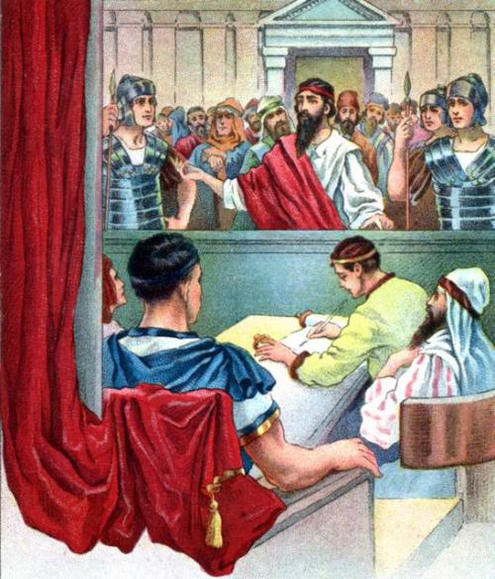
⁷ And when he was come, the Jews which came down from Jerusalem stood round about,
and laid many and grievous complaints against Paul, which they could not prove.
⁸ While he answered for himself, Neither against the law of the Jews, neither against the temple, nor yet against Caesar, have I offended any thing at all.
⁹ But Festus, willing to do the Jews a pleasure, answered Paul, and said, Wilt thou go up to Jerusalem, and there be judged of these things before me?

Slide 39
¹⁰ Then said Paul, I stand at Caesar's judgment seat, where I ought to be judged: to the Jews have I done no wrong, as thou very well knowest.
¹¹ For if I be an offender, or have committed any thing worthy of death, I refuse not to die:
but if there be none of these things whereof these accuse me, no man may deliver me unto them.
I appeal unto Caesar.
¹² Then Festus, when he had conferred with the council, answered, Hast thou appealed unto Caesar? unto Caesar shalt thou go. . .

Slide 40
CHAPTER 25 J. W. McGarvey’s Acts Commentary
VERSES 10 & 11
The purpose of the Jews was well understood by Paul. He remembered the purpose of the similar request preferred before Claudius Lysias, and perceived his only safety was in frustrating their present attempt. Fortunately, the very imprisonment which exposed him to danger also furnished the means of his safety. This appeal every Roman citizen had the right to make, and it required a transfer of the case to the imperial court in Rome. The statement, “I stand at Cæsar’s judgment-seat,” was intended to justify him in refusing to be taken for any trial proceedings away from Cæsarea, which was the appointed capital of the province where the courts were properly held.
McGarvey, J. W. (1872). A commentary on Acts of Apostles (p. 275). Lexington, KY: Transylvania Printing and Publishing Co.

Slide 41
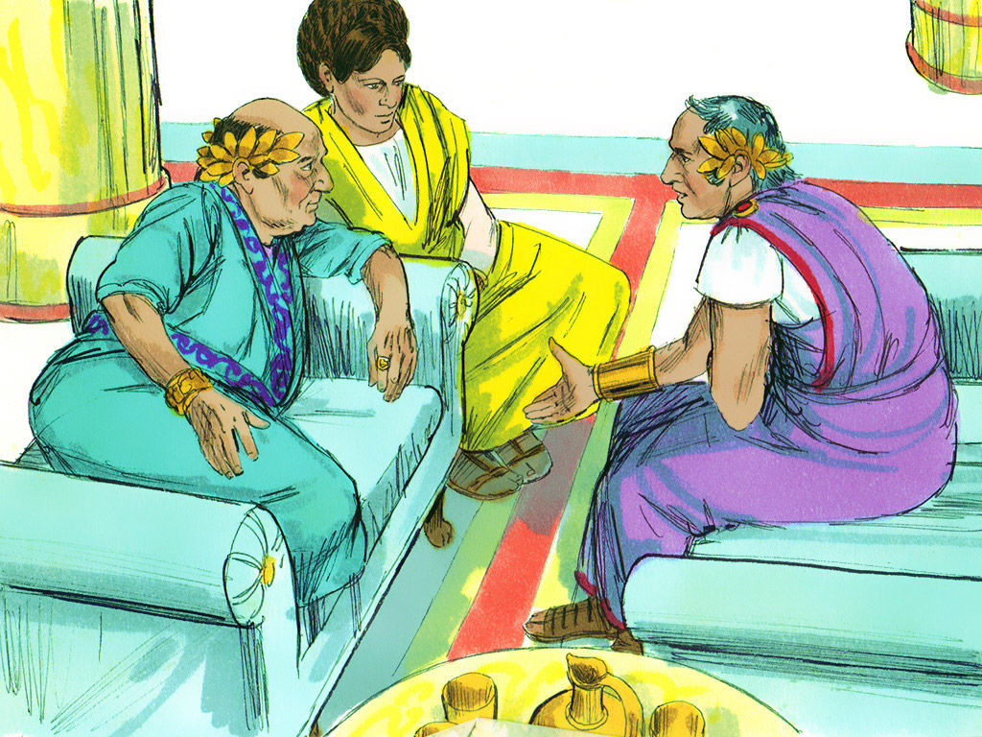
¹³ And after certain days king Agrippa and Bernice came unto Caesarea to salute Festus.

Slide 42
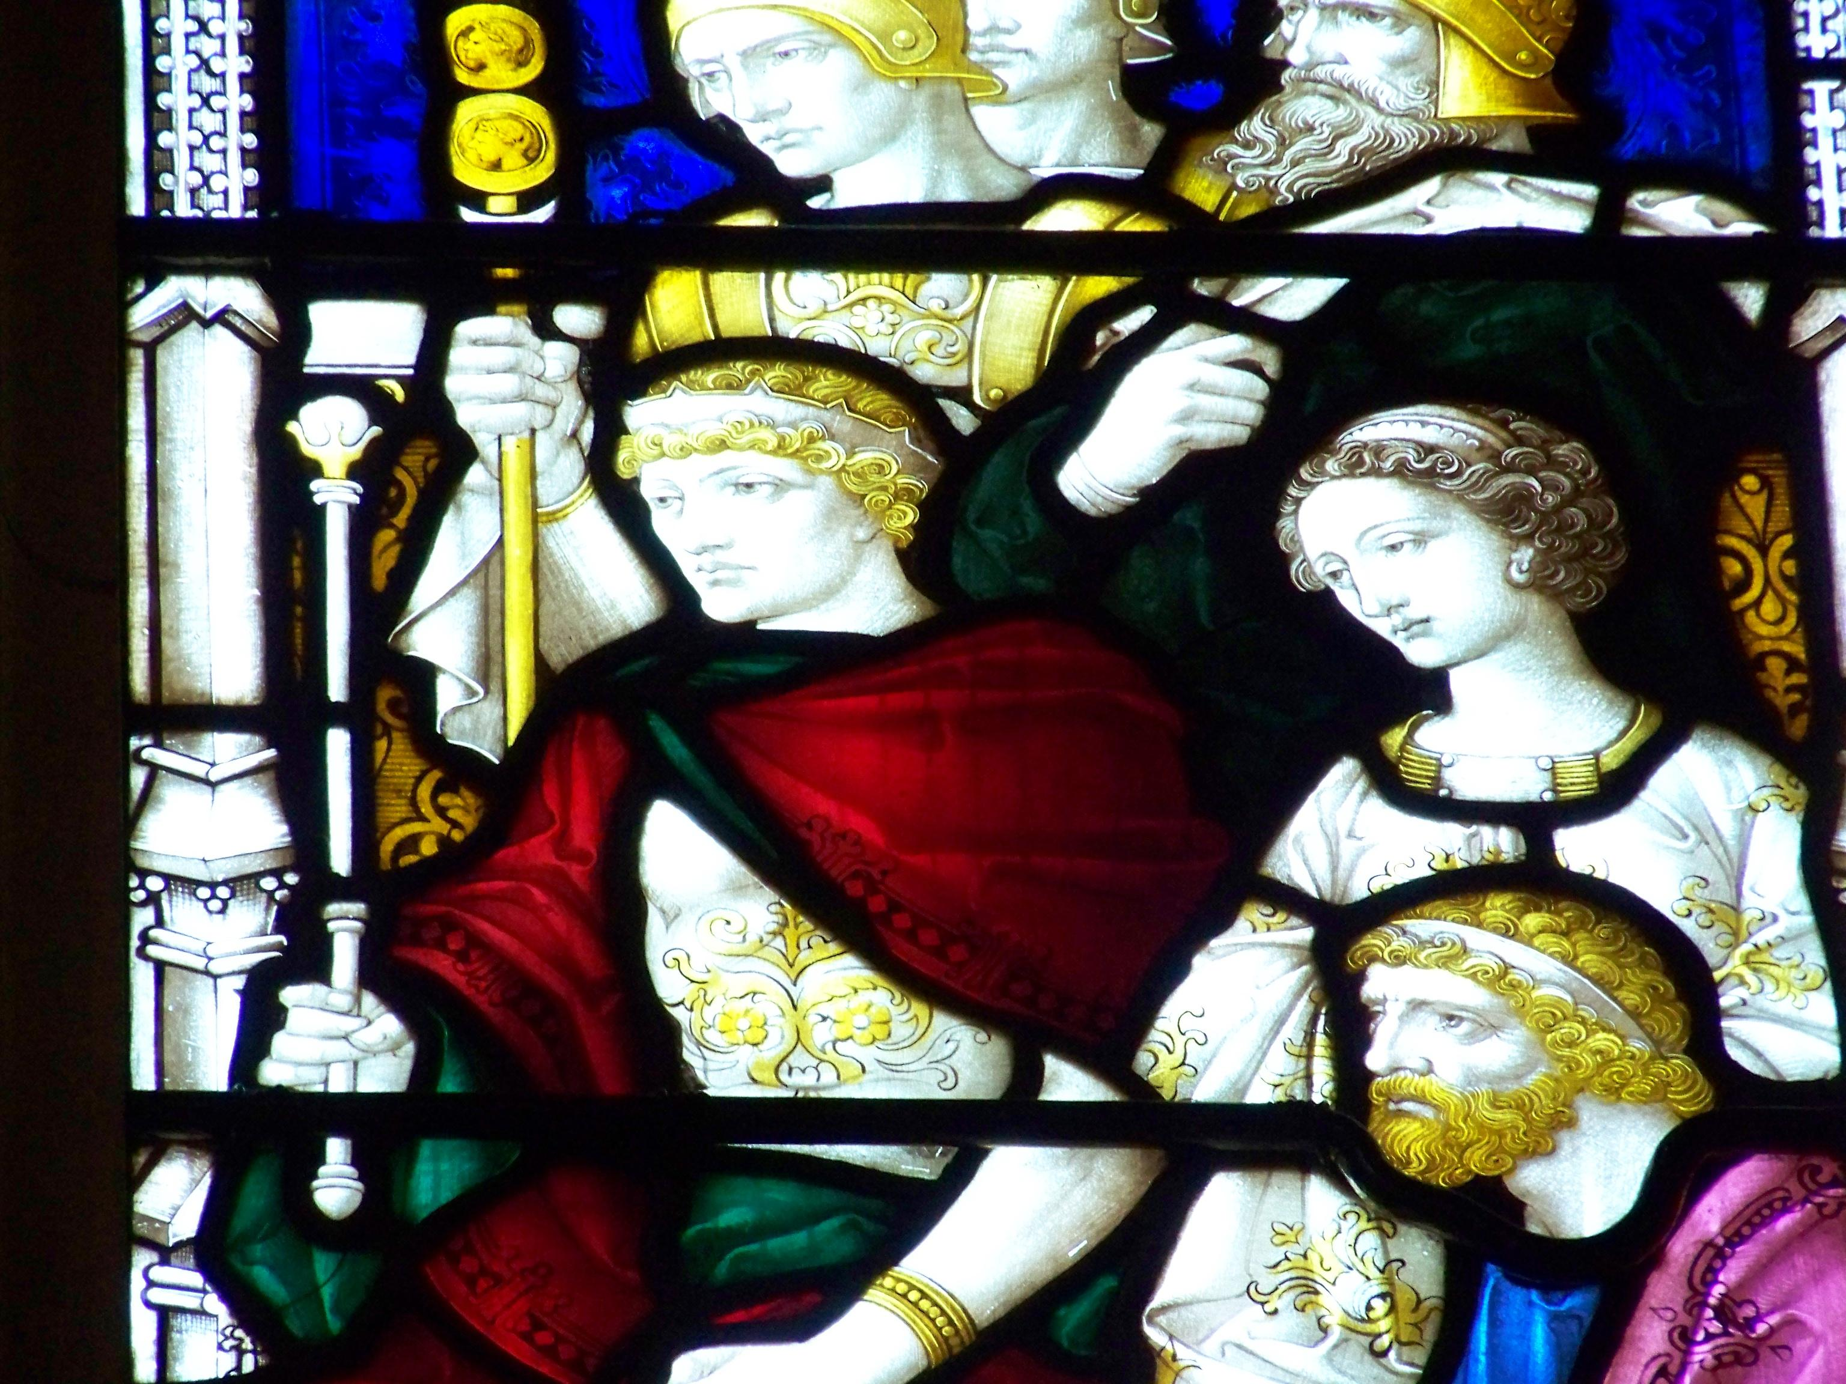
BERNICE AGRIPPA’S SISTER

Slide 43
¹³ And after certain days king Agrippa and Bernice came unto Caesarea to salute Festus.
Herod Agrippa II was the last king of the Herodian dynasty that ruled from 40 BC to AD 92.

Slide 44
CHAPTER 25 J. W. McGarvey’s Acts Commentary
VERSE 13
The custom of extending congratulations to men newly inducted into high office, which has prevailed in every age of the world, led to the next important incidents of Paul’s confinement in Cæsarea. This Agrippa was the son of the Herod who murdered the Apostle James. He was, at this time, king of Chalcis, but afterward of Galilee. Bernice was his sister. She had been married to her uncle, Herod, former king of Chalcis, but he had died, and she was still a widow. She afterward married Polemo, king of Cilicia. Like nearly all the Herod family, both male and female, she was licentious and ambitious. But she and Agrippa, being Jews by birth, were better able to understand Paul’s case than Festus.
McGarvey, J. W. (1872). A commentary on Acts of Apostles (p. 276). Lexington, KY: Transylvania Printing and Publishing Co.

Slide 45
¹³ And after certain days king Agrippa and Bernice came unto Caesarea to salute Festus.
¹⁴ And when they had been there many days, Festus declared Paul's cause unto the king, saying,
There is a certain man left in bonds by Felix:
¹⁵ About whom, when I was at Jerusalem, the chief priests and the elders of the Jews informed me, desiring to have judgment against him.

Slide 46
¹⁸ Against whom when the accusers stood up, they brought none accusation of such things as I supposed:
¹⁹ But had certain questions against him of their own superstition, and of one Jesus, which was dead, whom Paul affirmed to be alive.
²⁰ And because I doubted of such manner of questions, I asked him whether he would go to Jerusalem, and there be judged of these matters.
¹⁶ To whom I answered, It is not the manner of the Romans to deliver any man to die, before that he which is accused have the accusers face to face, and have licence to answer for himself concerning the crime laid against him.
¹⁷ Therefore, when they were come hither, without any delay on the morrow I sat on the judgment seat, and commanded the man to be brought forth.

Slide 47
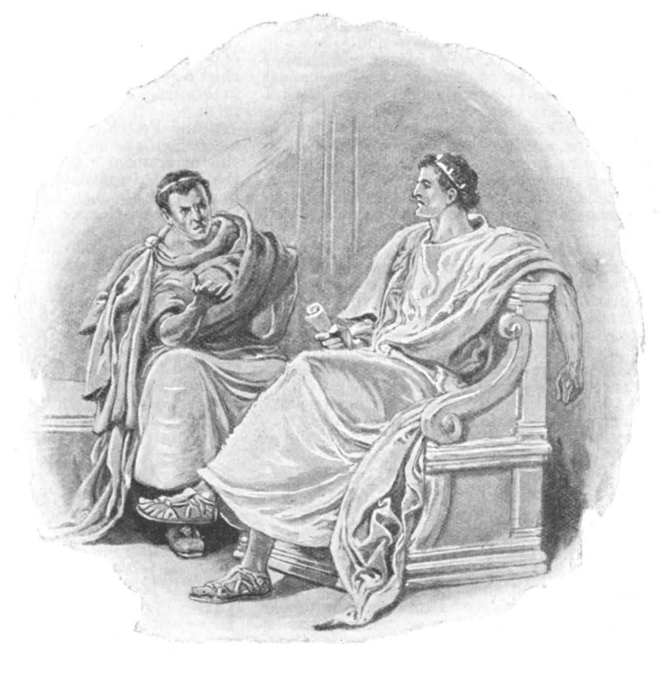
²¹ But when Paul had appealed to be reserved unto the hearing of Augustus, I commanded him to be kept till I might send him to Caesar.
²² Then Agrippa said unto Festus, I would also hear the man myself.
Tomorrow, said he, thou shalt hear him.

Slide 48
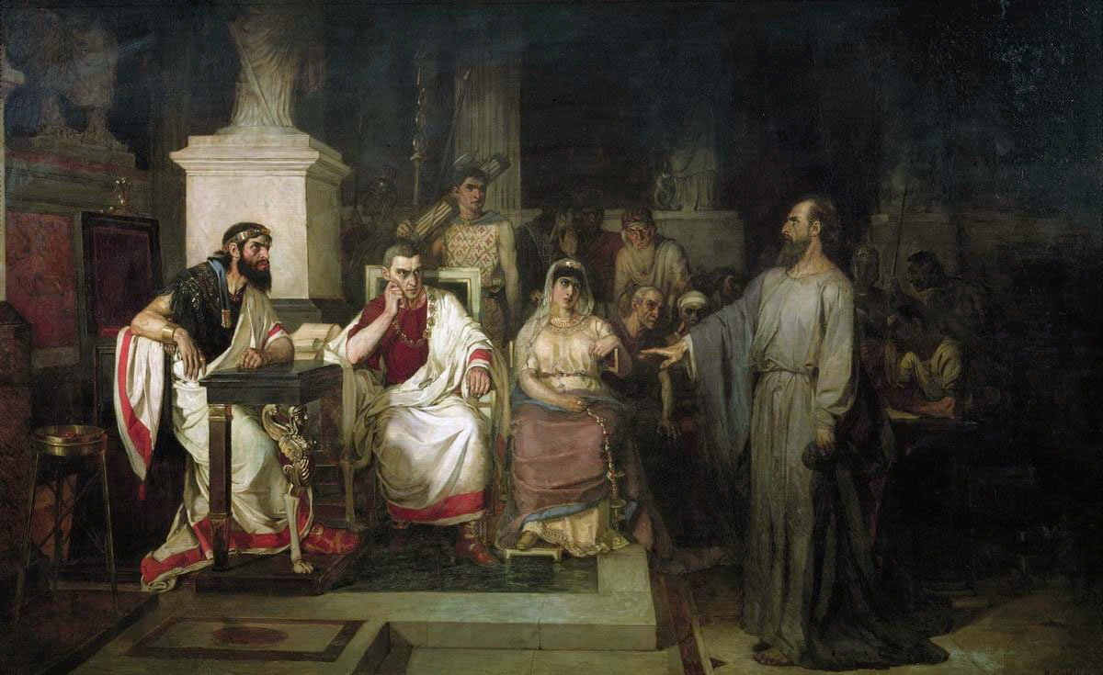
²³ And on the morrow, when Agrippa was come, and Bernice, with great pomp, and was entered into the place of hearing, with the chief captains, and principal men of the city, at Festus' commandment Paul was brought forth.

Slide 49
²⁴ And Festus said,
King Agrippa, and all men which are here present with us,
ye see this man,
about whom all the multitude of the Jews have dealt with me,
both at Jerusalem, and also here,
crying that he ought not to live any longer.
²⁵ But when I found that he had committed nothing worthy of death,
and that he himself hath appealed to Augustus,
I have determined to send him.
²⁶ Of whom I have no certain thing to write unto my lord.
Wherefore I have brought him forth before you,
and specially before thee, O king Agrippa,
that, after examination had, I might have somewhat to write.
²⁷ For it seemeth to me unreasonable to send a prisoner, and not withal to signify the crimes laid against him.

Slide 50
Lets go back in history to check this Herod’s Ancestors
Agrippa’s forefathers weren’t so very noble!*
* Felix had been described as “most noble” in Chapter 24 & Verse 3.

Slide 51
The Herod Family
The Establishment Sect
“The name of several Roman rulers in the Palestine region during Jesus’ earthly ministry and the periods shortly before His birth and after His resurrection”
Herod the Great
Herod Archelaus
Herod Antipas
Herod Agrippa I
Herod Agrippa II
Characters
Main

Slide 52
Chronology
CAESARS
Augustus 31 BC – 14 AD
Tiberius 14 AD – 37 AD
Caligula 37 AD – 41 AD
Claudius 41 AD – 54 AD
Nero 54 AD – 68 AD
Vespasian 69 AD – 79 AD
Titus 79 AD – 81 AD
Domitian 81 AD – 96 AD
HERODS
The Great 37 BC – 4 BC
(Judea, then territory east of Palestine. At Christ’s birth was ruler of all Palestine. After death the province was divided)
Archelaus 4 BC – 6 AD
(Judea and Samaria)
Antipas 4 BC – 39 AD
(Galilee and Perea)
Philip 4 BC – 34 AD
(Country east of Galilee)
Agrippa I 37 AD – 44 AD
(King of the whole country)
Agrippa II 50 AD – 100 AD

Slide 53
Herod The Great
FOUR UNIONS & MANY CHILDREN

Slide 54
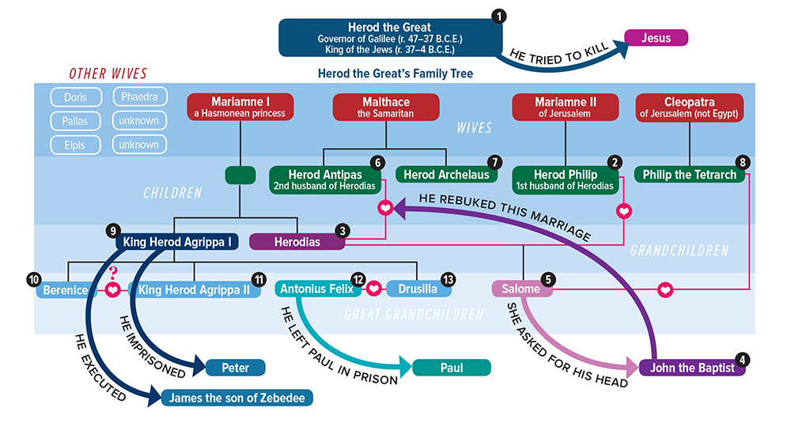
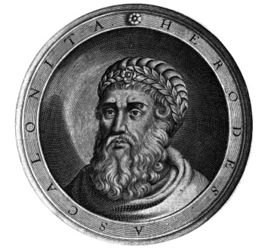
Herod the Great was the king of Judaea when Christ was born. It was he who committed the “Massacre of the Innocents.”
He was succeeded by his son Archelaus.
Notes:
(aar-chuh-LAL-uhs)

Slide 55
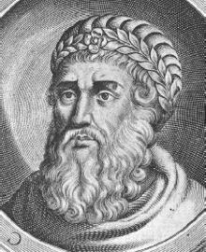

Slide 56
Herod The Great – son of Antipater
Came to power after the Maccabeans dynasty was crushed, he ruled in Palestine from 40 BC
His kingdom comprised Judea, Samaria, Galilee, Idumea, Batanea, and Peraea
He had great skills but was hated by Jews
He laid heavy taxes on the Jews and was brutal on rebellions
He massacred his family and a great many rabbis and the children of Bethlehem & hoped to include Jesus, but he suddenly died in 4 BC
Concerned that no one would grieve over him

Slide 57
Herod the Great
Obsessed with establishing his dynasty
Story of his life is strewn with the ghosts of people whom he suspected of treason or disloyalty
Ordered the death of 45 members of the Sanhedrin who had opposed him
What is the Sanhedrin?

Slide 58
Sanhedrin
Highest ruling body and court of justice among the Jewish people in the time of Jesus.
Made up of chief priests, elders, scribes
Headed by the high priest of Israel
Had 71 members – high priest was always the president of the Sanhedrin council
No power of capital punishment – reserved for Roman power
Handed Jesus over to Pilate after Jesus’ mock trial

Slide 59
Herod the Great
Anyone that grew in popularity would be killed – including his own family
Killed two brothers-in-law, 3 sons, and a wife
Killed last man in the Hasmonean dynasty
Felt threatened about the Jewish king
Jews hated Herod – Not a real Jew (Idumean)
Cruel and unjust
Professed to observe the law of Moses yet his life was a mockery to what it taught

Slide 60
The Wise Men
Came from the East
To worship the Christ child
Stopped at the palace of Herod the Great
Scribes determined that the child would be born in Bethlehem of Judea (Micah 5:2)
Warned to go home because Herod planned to harm the child
Herod furious so he ordered all babies of Bethlehem slain up to two years old

Slide 61
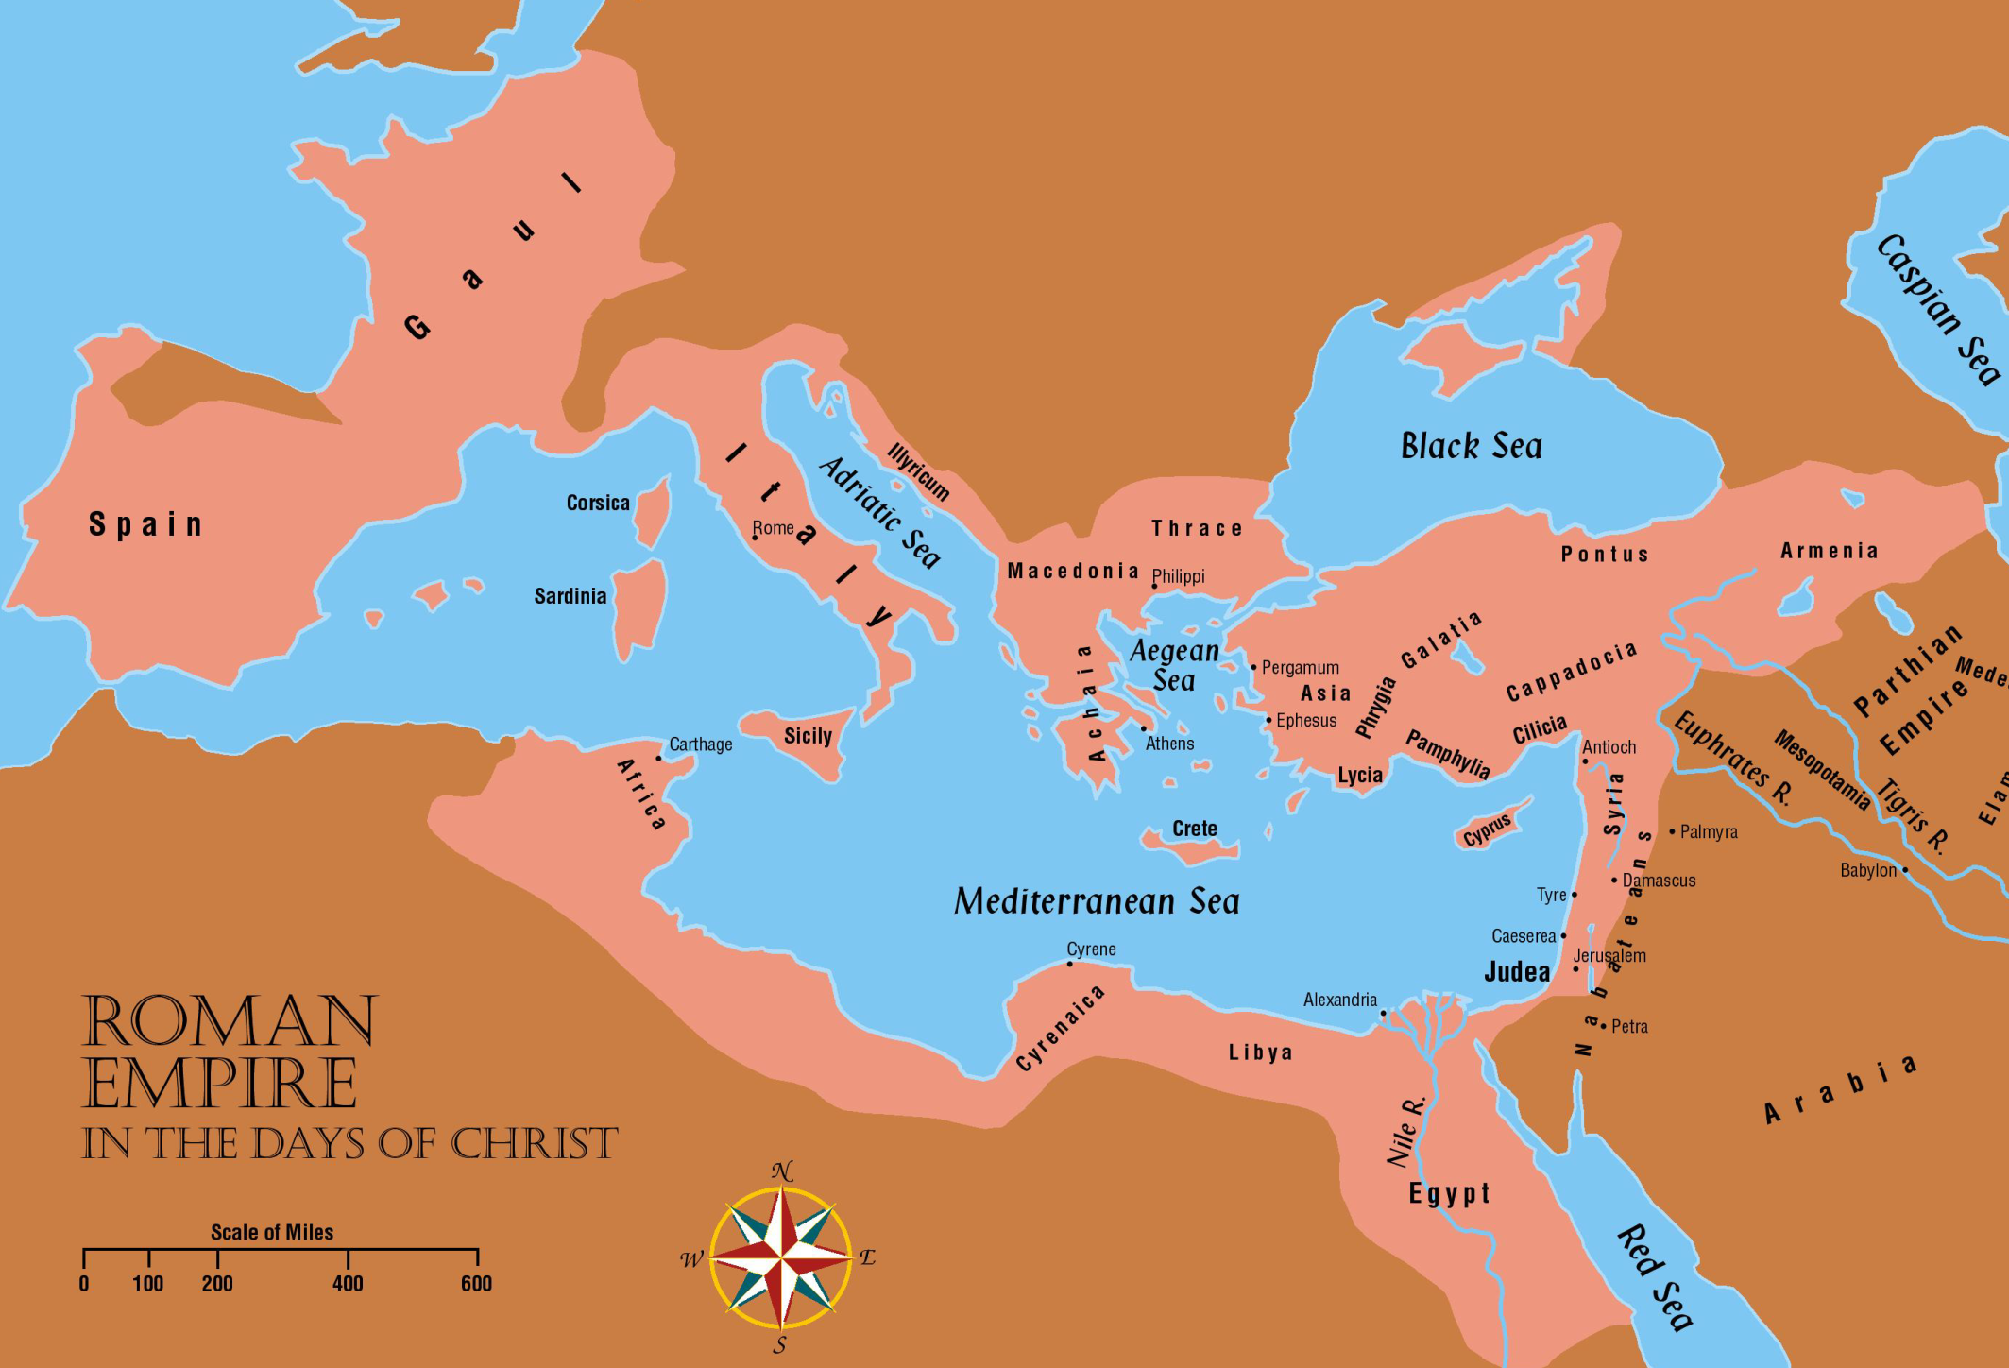
Wise men may have been astrologers from Media

Slide 62
Herod the Great
Good Points:
Renovated Jerusalem
Started rebuilding the temple as stated in John 2:20
Began in 19 BC and completed in 27 AD
Some work continued until AD 64
Temple was more beautiful than the one that Zerubbabel built in 530 B.C.
“Then the Jews said, "It has taken forty-six years to build this temple, and will You raise it up in three days?”

Slide 63
The JEWS during the days of the Herod’s
Had religious liberty
High priest recognized as religious head of all Jews
Allowed to pay the Temple tax
Rome usually allowed only her own tax
Allowed to observe the Sabbath day
Sanhedrin court allowed to continue
Came into being sometime during the years of Greek domination

Slide 64
The JEWS during the days of the Herod’s
Many cities were rebuilt or beautified by Herod
The city of Caesarea, in honor of Augustus Caesar was built
This city, plus other seaport cities that were enlarged gave the Jews ready access to sea trade
Jerusalem was renovated
The wall Pompey tore down was rebuilt

Slide 65
Herod The Great’s Queen Problems
29 BC – Josephus writes that Herod had great passion & also great jealousy concerning his wife, Mariamne I. She learns of Herod's plans to murder her, and stops sleeping with him. Herod puts her on trial on a charge of adultery. His sister, Salome I, was chief witness against her. Mariamne I's mother Alexandra made an appearance and incriminated her own daughter. Historians say her mother was next on Herod's list to be executed and did this only to save her own life. Mariamne was executed, and Alexandra declared herself Queen, stating that King Herod was mentally unfit to serve. Josephus wrote that this was Alexandra's strategic mistake; Herod executed her without trial.

Slide 66
Executed Brother in law
28 BC – Herod executed his brother-in-law Kostobar (husband of Salome, father to Berenice) for conspiracy
12 BC – Herod suspected both his sons (from his marriage to Mariamne I) Alexander and Aristobulus of threatening his life. He took them to Aquileia to be tried. Augustus reconciled the three.

Slide 67
Nothing was normal for Herod
4 BC – Young disciples smashed the golden eagle over the main entrance of the Temple of Jerusalem after the Pharisee teachers claimed it was an idolatrous Roman symbol. Herod arrested them, brought them to court, and sentenced them. Augustus approved the death penalty for Antipater. Herod then executed his son and again changed his will: Archelaus (from the marriage with Malthace) would rule as king over Herod's entire kingdom, while Antipas (by Malthace) and Philip (from the fifth marriage with Cleopatra of Jerusalem) would rule as Tetrarchs over Galilee and Peraea (Transjordan. As Augustus didn’t confirm his will, no one got the title of King; however, the three sons did get the stated territories.

Slide 68
Wife | Children
Doris | Son Antipater III Executed 4 BC
Mariamne I, daughter of Hasmonean Alexandros | Son Alexander, executed 7 BC Son Aristobulus IV, executed 7 BC Daughter Salampsio , Cypros
Mariamne II, daughter of High Priest Simon | Son Herod II Boethus
Malthace was a Samaritan woman | Son Herod Archelaus - Son Herod Antipas - Daughter Olympias
Cleopatra of Jerusalem | Sons: Herod Herod Phillip II

Slide 69
Herod The First was followed by..
Herod’s three sons were each given a territory
Herod Archelaus obtained Judea and Samaria, he was a tyrant like his father and lost his position in 6 AD and only served 10 years
Herod Antipas obtained Galilee and Pereae, he renounced his first wife and married Herodias the former wife of his half brother Herod Phillip who brought along her daughter Salome with her. He was partial to the Hellenists (Greeks)

Slide 70
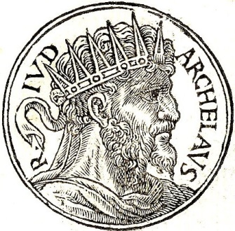
Matthew 2:22 But when [Joseph] heard that Archelaus did reign in Judaea in the room of his father Herod, he was afraid to go thither: notwithstanding, being warned of God in a dream, he turned aside into the parts of Galilee:
Notes:
Herod the Great was succeeded by his son Archelaus (aar-chuh-LAL-uhs)

Slide 71
Archelaus
4 BC - 6 AD
Ruled in Judea and Samaria (Matthew 2:19-23)
Proved to be almost as cruel as his father
After serious protest by the Jews he was finally deposed of after 10 years
Southern land was annexed and made into the Roman province of Judea (6AD)
Governed by “procurators”
Pontius Pilate was the 5th procurator to serve in Judea

Slide 72
Philip
Son of Herod the Great (Matthew 14:1-12)
Was disinherited because of disloyalty
Living in Rome with his wife Herodias
Antipas visited them and took Herodias away with him

Slide 73
His third son Herod Phillip II was put in charge of the provinces between Jordan and Damascus
He was supposed to be a humane ruler
His capital was Caesarea Philippi.
In the year AD 30 he married Salome, whose father was his half brother and whose mother was his niece. He died in 34 A.D.
All three of his sons ruled as tetrarchs rather than kings

Slide 74
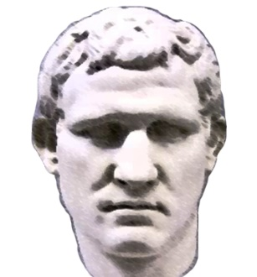
Herod Antipas was the tetrarch of Galilee during the time of Christ’s ministry on earth. He was married to his niece, Herodias, who had been the wife of his brother Philip.
This is the Herod who beheaded John the Baptist and mocked Jesus by putting him in “a gorgeous robe” (Lk 23).
Notes:
Herod the Great was succeeded by his son Archelaus (aar-chuh-LAL-uhs)

Slide 75
Herod Antipas
6 AD - 39 AD
Jesus grew up in Galilee under the rule of Herod Antipas (Luke 23:5-12)
Was not as cruel as his father and Archelaus
Was in Jerusalem on the day of Jesus’ trial
Pilate sent Jesus to him when he learned that Jesus was from Galilee

Slide 76
Second Generation Herod’s Much Less Great Whipped By The Women In Their Life
Matthew 14:6-7 But when Herod's birthday was kept, the daughter of Herodias danced before them, and it pleased Herod. 7 Whereupon he promised with an oath to give her whatsoever she would ask.
Matthew 14:8-10 And she, being before instructed of her mother, said, Give me here John Baptist's head in a charger. 9 And the king was sorry: nevertheless for the oath's sake, and them which sat with him at meat, he commanded it to be given her. 10 And he sent, and beheaded John in the prison.

Slide 77
Agrippa The Great
GRANDSON TO HEROD THE GREAT

Slide 78
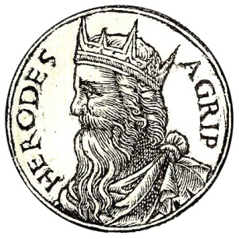
Agrippa I, the grandson of Herod the Great, killed James and imprisoned Peter. He died “because he gave not God the glory: and he was eaten of worms, and gave up the ghost” (Acts 12)
Notes:
Herod the Great was succeeded by his son Archelaus (aar-chuh-LAL-uhs)

Slide 79
Agrippa I
37 AD - 44 AD
After Christ returned to heaven, Herod Agrippa I was made ruler over most of the territory that Herod the Great had controlled
He was the brother to Herodias
He persecuted the early church to win the favor of the Jews
Killed the apostle James and imprisoned Peter – intending to kill him also
Died around 44 AD

Slide 80
His Lifespan
10 BC to 44AD
Total life lived in 54 years
He was the Grandson of Herod The Great
Son of Aristobulus & Berenice (Two Bernice’s)
Berenice was the daughter of the Salome that was sister of Herod The Great and married her cousin who was executed by her father and she was also accused of being involved in the plot
She was also mother to Herod III,
Her second husband, Theudion was similarly put to death for conspiring against Herod

Slide 81
Marcus Julius Agrippa -
He is the noted “King (Herod) Agrippa” in the book of Acts of the Apostles and was often called “Agrippa The Great”
Herod had sent him to Rome for education after the execution of his father and was befriended by Claudius the future emperor
He always had financial problems
Agrippa was imprisoned for being overheard to say that he wanted Tiberius killed.
Agrippa much later in 44AD, went to Caesarea where he had games in honor of Claudius who had befriended him in Rome

Slide 83
The Owl Perched Over His Head
Agrippa had been told while in prison himself in his earlier days, that it was an omen that he would be released in a speedy fashion
He was also told that if he ever saw this sight of an owl again it would be an omen that he would die within five days with great pains in the heart and the abdomen
In reality, he did die in almost the same way when God struck him down for his unspoken blasphemy - being eaten of worms

Slide 84
Agrippa uses his friendship with Caligula to gain power
Following Tiberius' death and the ascension of Agrippa's friend Caligula, Agrippa was set free and made governor first of the territories of Batanaea and Trachonitis that his cousin Herod II had held, then of the tetrarchy of Lysanias, with the title of "king". Caligula also presented him with a golden chain of a weight equal to the iron one he had worn in prison. In 39 AD, Agrippa returned to Rome, and brought about the banishment of his uncle, Herod Antipas, whose tetrarchy over Galilee & Peraea he then was granted.

Slide 87
Being A Court Insider Secured His Ambitions
Agrippa acquired Antipas' tetrarchy in the year 40 and Samaria and Judea came under his rule in 41, so that he finally reigned over the entire kingdom of his grandfather.
He was the only Herod who, though at heart a Hellenist, tried by his policies to win the support of the more orthodox Jews
He was doing all he could to be found favorable by the Jews and the Greeks

Slide 88
The Friendship Between Caligula & Agrippa the First Was Consequential
The next crisis in which Agrippa played a role began in Egypt, where the Greek inhabitants began complaining that the Jewish inhabitants were not showing proper deference to the emperor by erecting statues of him in the style of a god. [Summer/Fall] Representatives of the pro-statue faction went to Rome to bring the issue to Gaius Caligula’s attention. Caligula sent Petronius to the Middle East as the new Legate of Syria, with specific order to place divine statues of the emperor within the Jerusalem Temple. If opposed, he was to annihilate the opposition and sell the remainder of the Jews into slavery.

Slide 90
The Friendship Between Caligula & Agrippa the First Was Consequential
[Fall/Winter] With three Roman legions and a large Syrian auxiliary force, Petronius arrived at Ptolemais, where he ordered them into their winter quarters, intending to accomplish his task the following spring. Tens of thousands of Jews soon arrived at Ptolemais, begging him not to do what he had come to do. Travelling to Tiberius, Galilee, crowds of a similar size gathered for more than 40 days, petitioning him not to carry out Caligula’s orders. Aristobulus, Agrippa’s brother, along with other Jewish leaders, convinced Petronius to risk his own life by writing to Caligula and asking him to revoke his order.
[Meanwhile, back at Rome] Agrippa the First (now 50 yrs. old) invited Gaius Caligula to a very extravagant banquet and after many drinks requested a special favor of him – to then revoke the order regarding placement of his divine statues in the Jerusalem Temple. Shocked by the audacity of his friend Agrippa, he nonetheless, issued an order telling Petronius not to install those statues if he hadn’t yet done so.

Slide 92
Agrippa The First Sought To Please The Jewish Leaders
He was a ruthless leader in many ways.
In AD 44 at about the time of the passover
Acts 12:1-3 Now about that time Herod the king stretched forth his hands to vex certain of the church. 2 And he killed James the brother of John with the sword. 3 And because he saw it pleased the Jews, he proceeded further to take Peter also.
He had James beheaded just to please the Jews.

Slide 93
While Pleasing Them He Angered God
²⁰ And Herod was highly displeased with them of Tyre and Sidon: but they came with one accord to him, desired peace; because their country was nourished by the king's country.
²¹ And upon a set day Herod, arrayed in royal apparel, sat upon his throne, and made an oration unto them.
²² And the people gave a shout, saying, It is the voice of a god, and not of a man.
²³ And immediately the angel of the Lord smote him, because he gave not God the glory: and he was eaten of worms, and gave up the ghost.

Slide 94
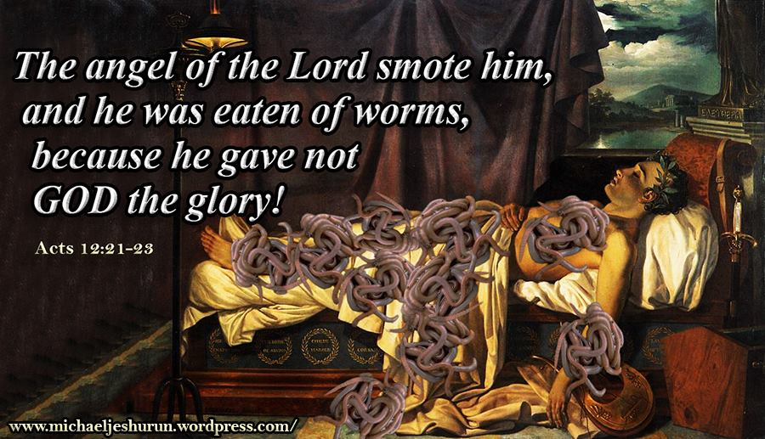

Slide 95
Worksheet of the Herod’s
Antipater
___________The first of the Herod family to have power in Palestine
___________Ordered John the Baptist killed
___________Killed the babies of Bethlehem
___________Jesus was tried before him
___________Killed James the apostle
___________Heard Paul’s defense
___________Herodias was his wife first
___________Joseph took the child Jesus to Nazareth when he heard this man was reigning in Judea
___________Rebuilt the temple
___________Imprisoned Peter
___________Jesus grew up in his territory
___________Built Caesarea
Antipas
Herod Great
Antipas
Agrippa I
Agrippa II
Herod Philip
Archelaus
Herod Great
Agrippa I
Antipas
Herod Great

Slide 97
Agrippa The Second
GREAT GRANDSON TO HEROD THE GREAT SON TO GOD STRIKEN AGRIPPA THE GREAT

Slide 98
CHAPTER 24 J. W. McGarvey’s Acts Commentary
VERSE 24
Drusilla, according to Josephus, was a daughter of Herod Agrippa, whose persecutions of the apostles, and miserable death, we have considered in commenting on the twelfth chapter. She was a woman of remarkable beauty, the lawful wife of Azizus, king of Emesa, but was now living in adulterous intercourse with Felix. Concerning Felix, Tacitus testifies, that “with every kind of cruelty and lust, he exercised the authority of a king with the temper of a slave.”⁵
McGarvey, J. W. (1872). A commentary on Acts of Apostles (p. 273). Lexington, KY: Transylvania Printing and Publishing Co.

Slide 99
BERNICE AGRIPPA’S SISTER

Slide 100
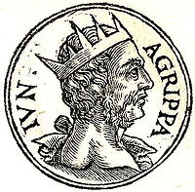
Agrippa II was the great-grandson of Herod the Great. His “wife” Bernice was actually his sister.
He is the king who heard Paul’s testimony in Caesarea. He was the last king of the Herodian dynasty.
Notes:
Herod the Great was succeeded by his son Archelaus (aar-chuh-LAL-uhs)

Slide 101
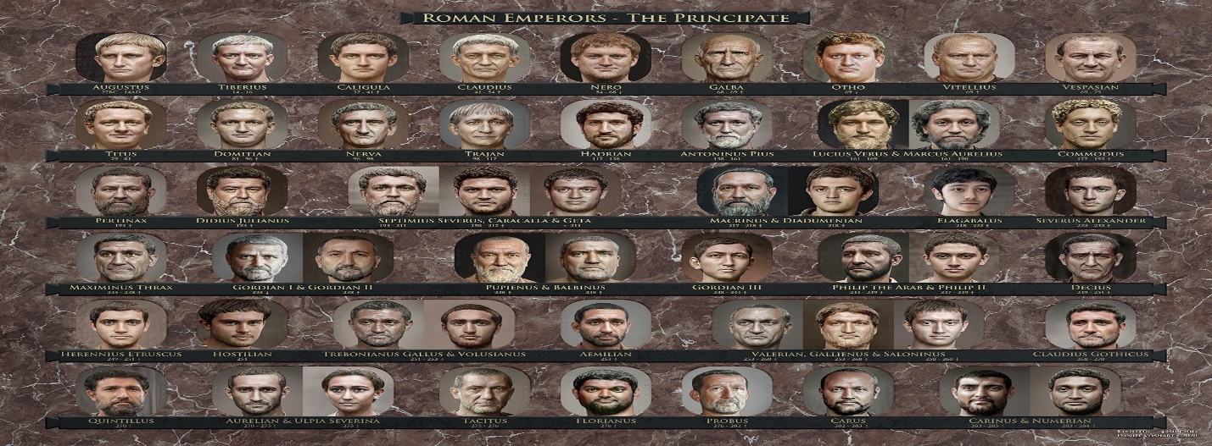

Slide 102
Agrippa II
50 AD - 100 AD
After Agrippa I’s death the land was divided again
Judea was now comprised of what had been Judea, Samaria, Galilee, and Perea
Agrippa II was given the Northeastern section
Went to Caesarea to visit a new procurator named Festus

Slide 103
Agrippa II (continued)
50 AD - 100 AD
While at Caesarea he heard the case of the apostle Paul who had appealed his case to Caesar
Paul described him as being “expert in all customs and questions which are among the Jews”
Agrippa’s family outwardly observed the law of Moses (Acts 25:13ff)
“almost thou persuade me to be a Christian (Acts 26:28)

Slide 104
^{25:13} And after certain days king Agrippa and Bernice came unto Caesarea to salute Festus.
¹⁴ And when they had been there many days, Festus declared Paul's cause unto the king, saying,
There is a certain man left in bonds by Felix:
¹⁵ About whom, when I was at Jerusalem, the chief priests and the elders of the Jews informed me, desiring to have judgment against him.

Slide 105
¹⁸ Against whom when the accusers stood up, they brought none accusation of such things as I supposed:
¹⁹ But had certain questions against him of their own superstition, and of one Jesus, which was dead, whom Paul affirmed to be alive.
²⁰ And because I doubted of such manner of questions, I asked him whether he would go to Jerusalem, and there be judged of these matters.
¹⁶ To whom I answered, It is not the manner of the Romans to deliver any man to die, before that he which is accused have the accusers face to face, and have licence to answer for himself concerning the crime laid against him.
¹⁷ Therefore, when they were come hither, without any delay on the morrow I sat on the judgment seat, and commanded the man to be brought forth.

Slide 106
²¹ But when Paul had appealed to be reserved unto the hearing of Augustus, I commanded him to be kept till I might send him to Caesar.
²² Then Agrippa said unto Festus, I would also hear the man myself.
Tomorrow, said he, thou shalt hear him.

Slide 107
CHAPTER 25 J. W. McGarvey’s Acts Commentary
VERSES 14 - 21
Festus knew that the charges against Paul had reference to the Jewish law; but he still had not a sufficient understanding of the case to report it intelligibly to the emperor, as he now had to do, under Paul’s appeal. He determined, therefore, to obtain the benefit of Agrippa’s more familiar acquaintance with Jewish affairs. From this speech it appears that the perplexity of Festus was not so much in reference to the main issue between the Jews and Paul, as in reference to the bearing which the case had upon Roman law. He discovered that the main issue between the parties had reference to that “Jesus who had died, and whom Paul affirmed to be alive.”
McGarvey, J. W. (1872). A commentary on Acts of Apostles (p. 276). Lexington, KY: Transylvania Printing and Publishing Co.

Slide 108
²³ And on the morrow, when Agrippa was come, and Bernice, with great pomp, and was entered into the place of hearing, with the chief captains, and principal men of the city, at Festus' commandment Paul was brought forth.

Slide 109
²⁴ And Festus said,
King Agrippa, and all men which are here present with us,
ye see this man,
about whom all the multitude of the Jews have dealt with me,
both at Jerusalem, and also here,
crying that he ought not to live any longer.
²⁵ But when I found that he had committed nothing worthy of death,
and that he himself hath appealed to Augustus,
I have determined to send him.
²⁶ Of whom I have no certain thing to write unto my lord.
Wherefore I have brought him forth before you,
and specially before thee, O king Agrippa,
that, after examination had, I might have somewhat to write.
²⁷ For it seemeth to me unreasonable to send a prisoner, and not withal to signify the crimes laid against him.

Slide 110
CHAPTER 25 J. W. McGarvey’s Acts Commentary
VERSES 23 - 27
Festus belonged to one peculiar class of men, who found it difficult to decide how to treat Christians. The bigoted Jews, whose national prejudices were assailed by the new preachers, were prompt to decide that “they ought not to live any longer.” The blind devotees of heathen worship, like those in Philippi and Ephesus, were of the same opinion; especially when the new doctrine came into conflict with their worldly interests. The firm friend of impartial justice, such as Gallio, could easily see that they were unjustly persecuted. But to the skeptical politician, like Festus, who regarded all religion as a mere superstitious homage paid to dead heroes, and who aimed to so administer government as to be popular with the most powerful class of his area subjects, it was a more difficult question. He saw clearly that Paul was guilty of nothing worthy of death or of bonds; therefore, he would not consent that the Jews should kill him; yet he was equally unwilling to offend them by releasing him. He was incapable, from his worldly & selfish nature, of appreciating Paul’s noble devotion to the good of humanity, and equally unable to understand the enmity of the Jews toward him. He must now, of necessity, send him to the emperor, but he confessed that he had no good reason to give the emperor for doing so, and was about to do an unreasonable act. In this predicament it was quite natural that he should call for the advice of Agrippa.
McGarvey, J. W. (1872). A commentary on Acts of Apostles (p. 277). Lexington, KY: Transylvania Printing and Publishing Co.

Slide 111
Paul before Festus and Agrippa
Acts 25:24 And Festus said, King Agrippa, and all men which are here present with us, ye see this man, about whom all the multitude of the Jews have dealt with me, both at Jerusalem, and also here, crying that he ought not to live any longer.
Acts 25:25 But when I found that he had committed nothing worthy of death, and that he himself hath appealed to Augustus, I have determined to send him.

Slide 112
When we glanced back in history to check the Herod Family we saw…
Agrippa’s forefathers weren’t so very noble!*
* Festus is described as “most noble” in Chapter 26 & Verse 25.

Slide 113
Agrippa was a really bad, self serving & brutal man but ….
Could the New Testament gospel touch even him?

Slide 114
Agrippa said to Paul, “You are permitted to speak for yourself.” Then Paul gesturing stretched out his hand and proceeded to make his defense:
- Acts 26:1

Slide 115
Son of The Agrippa Who “Stretched Forth His Hand” To Vex The Church

Slide 117
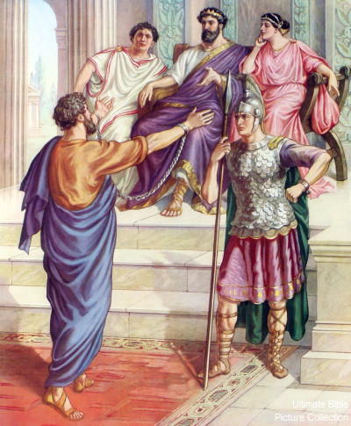
Acts 26:
¹ Then Agrippa said unto Paul, Thou art permitted to speak for thyself.
Then Paul stretched forth the hand, and answered for himself:
² I think myself happy, king Agrippa, because I shall answer for myself this day before thee touching all the things whereof I am accused of the Jews:
³ Especially because I know thee to be expert in all customs and questions which are among the Jews: wherefore I beseech thee to hear me patiently.

Slide 118
⁴ My manner of life from my youth, which was at the first among mine own nation at Jerusalem, know all the Jews;
⁵ Which knew me from the beginning, if they would testify, that after the most straitest sect of our religion I lived a Pharisee.

Slide 119
the most straitest
exceedingly exact
careful
sect
the same word as “heresy”
a body of men following their own tenets.
The Pharisees were the most precise and rigorous in interpreting the Mosaic law, and in observing even the more minute precepts of the law and tradition. (Thayer’s Greek Lexicon)
⁴ My manner of life from my youth, which was at the first among mine own nation at Jerusalem, know all the Jews;
⁵ Which knew me from the beginning, if they would testify, that after the most straitest sect of our religion I lived a Pharisee.

Slide 120
⁶ And now I stand and am judged for the hope of the promise made of God unto our fathers:
⁷ Unto which promise our twelve tribes, instantly serving God day and night,
hope to come.
For which hope's sake, king Agrippa, I am accused of the Jews.
⁸ Why should it be thought a thing incredible with you, that God should raise the dead?

Slide 121
CHAPTER 26 J. W. McGarvey’s Acts Commentary
VERSES 4 - 8
The Pharisees were the least likely of all the Jewish sects to be unfaithful to Jewish institutions. It was, therefore, much in Paul’s favor that he was able to call even his enemies to witness that from his youth he had lived in the strict discipline of that sect. It was yet more so, to say that he was still a firm believer in the leading doctrine of the party, and to reiterate the assertion made on two former occasions, that it was on account of the hope of a resurrection he was accused. This wasn’t the avowed cause, but it was the real cause of their false accusations; for the assumptions that Christ had risen from the dead was the ground-work of all Jewish opposition and persecution. He interprets the promise made by God to the fathers, by which he doubtless means the promise, “In thee and in thy seed shall all the families of the earth be blessed,” as referring to the resurrection, because that’s the consummation of all the blessings of the gospel. He exposes the inconsistency of his enemies by observing, that it was even Jews who were accusing him of crime in demonstrating this great hope so cherished by the twelve tribes. Then, turning from Agrippa to the whole multitude. he asks, with an air of astonishment, if they really deem it an incredible thing that God should raise the dead. If not, why should he be accused of crime for declaring that it had been done?
McGarvey, J. W. (1872). A commentary on Acts of Apostles (p. 278). Lexington, KY: Transylvania Printing and Publishing Co.

Slide 122
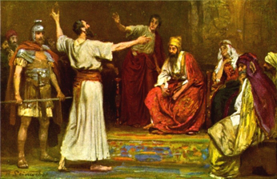
⁹ I verily thought with myself, that I ought to do many things contrary to the name of Jesus of Nazareth.
¹⁰ Which thing I also did in Jerusalem: and many of the saints did I shut up in prison, having received authority from the chief priests; and when they were put to death, I gave my voice against them.
¹¹ And I punished them oft in every synagogue, and compelled them to blaspheme; and being exceedingly mad against them, I persecuted them even unto strange cities.

Slide 123
CHAPTER 26 J. W. McGarvey’s Acts Commentary
VERSES 9 - 11
With such a record as this, there was no room to suspect him of any such bias as would render him an easy or a willing convert to Christ. On the contrary, it must have appeared to Agrippa, and the whole audience, most astonishing that such a change could take place. Their curiosity to know what produced the change must have been intense, and he proceeds to gratify it.
McGarvey, J. W. (1872). A commentary on Acts of Apostles (p. 278). Lexington, KY: Transylvania Printing and Publishing Co.

Slide 124
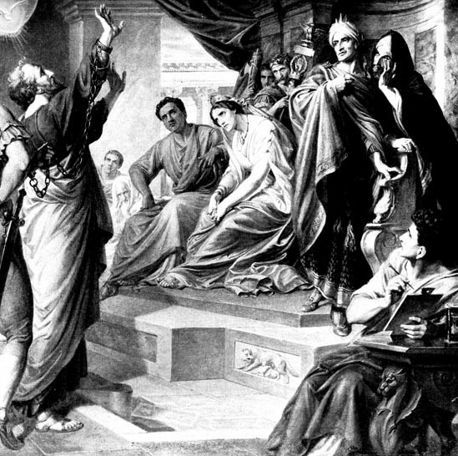
¹² Whereupon as I went to Damascus with authority and commission from the chief priests,
¹³ At midday, O king, I saw in the way a light from heaven, above the brightness of the sun, shining round about me and them which journeyed with me.
¹⁴ And when we were all fallen to the earth, I heard a voice speaking unto me, and saying in the Hebrew tongue, Saul, Saul, why persecutest thou me? it is hard for thee to kick against the pricks.
¹⁵ And I said, Who art thou, Lord? And he said, I am Jesus whom thou persecutest.

Slide 125
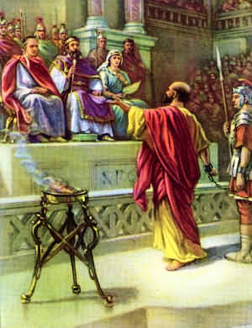
¹⁶ But rise, and stand upon thy feet: for I have appeared unto thee for this purpose, to make thee a minister and a witness both of these things which thou hast seen, and of those things in the which I will appear unto thee;
¹⁷ Delivering thee from the people, and from the Gentiles, unto whom now I send thee,
¹⁸ To open their eyes, and to turn them from darkness to light, and from the power of Satan unto God, that they may receive forgiveness of sins, and inheritance among them which are sanctified by faith that is in me.

Slide 126
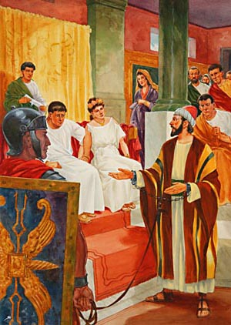
¹⁹ Whereupon, O king Agrippa, I was not disobedient unto the heavenly vision:
²⁰ But shewed first unto them of Damascus, and at Jerusalem, and throughout all the coasts of Judaea, and then to the Gentiles,
that they should repent and turn to God, and do works meet for repentance.
²¹ For these causes the Jews caught me in the temple, and went about to kill me.

Slide 127
²² Having therefore obtained help of God, I continue unto this day,
witnessing both to small and great,
saying none other things than those which the prophets and Moses did say should come:
²³ That Christ should suffer, and that he should be the first that should rise from the dead,
and should shew light unto the people, and to the Gentiles.

Slide 128
CHAPTER 26 J. W. McGarvey’s Acts Commentary
VERSES 22 & 23
That the Jews had not succeeded, with all their mobs, and conspiracies, and corruption of rulers, in destroying his life, was a matter of astonishment, and Agrippa might well admit that it was owing to the protecting providence of God.
Here he assumes that, instead of dishonoring Moses, he and his brethren alone were teaching the things which both Moses and prophets had foretold; that it was required, by their writings, that the Messiah should suffer and rise from the dead.
McGarvey, J. W. (1872). A commentary on Acts of Apostles (p. 279). Lexington, KY: Transylvania Printing and Publishing Co.

Slide 129
CHAPTER 26 J. W. McGarvey’s Acts Commentary
VERSES 22 & 23
By the statement that Christ first showed light to the people and the Gentiles by his resurrection, he must mean that he was the first to bring the subject into clear light, by an actual resurrection to glory; for there had already been some light upon it, as is proved by the Apostle’s previous statement in reference to the hope to which the twelve tribes had been, in all their worship, seeking to attain.
McGarvey, J. W. (1872). A commentary on Acts of Apostles (p. 279). Lexington, KY: Transylvania Printing and Publishing Co.

Slide 130
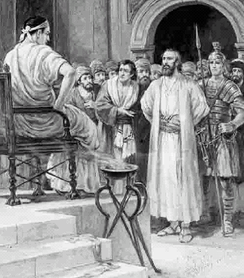
²⁴ And as he thus spake for himself, Festus said with a loud voice, Paul, thou art beside thyself; much learning doth make thee mad.
²⁵ But he said, I am not mad, most noble Festus; but speak forth the words of truth and soberness.

Slide 131
CHAPTER 26 J. W. McGarvey’s Acts Commentary
VERSE 24
It presented to him a man who from his youth had lived in strict devotion to a religion whose chief characteristic was the hope of a resurrection from the dead; who had once persecuted to death his present friends, but had been induced to change his course by a vision from heaven; and who, from that moment, had been enduring stripes, and imprisonment, and constant exposure to death, in his efforts to inspire men with his own hope of a resurrection. Such a career he could not reconcile with those maxims of ease or of ambition which he regarded as the highest rule of life. Moreover, he saw this strange man, when called to answer to accusations of crime, appear to forget himself & attempt to convert his judges rather than to defend himself. There was a magnanimity of soul displayed in both the past and the present of his career, which was above the comprehension of the sensuous politician, and which he could not reconcile with sound reason. He seems to have forgotten where he was, and the decorum of the occasion, so deeply was he absorbed in listening to and thinking of Paul.
McGarvey, J. W. (1872). A commentary on Acts of Apostles (pp. 279–280). Lexington, KY: Transylvania Printing and Publishing Co.

Slide 132
CHAPTER 26 J. W. McGarvey’s Acts Commentary
VERSE 25
Paul saw at once, from the tone and manner of Festus, as well as from the admission of his great learning, that the charge of insanity wasn’t intended as an insult; but it was the sudden outburst of a conviction which had just seized the mind of the perplexed and the astonished governor. His answer, therefore, was most respectful. (25) “But he said, I am not mad, most noble Festus, but speak forth words of truth and soberness.” He saw, however, that Festus was beyond the reach of conviction; for a man who could see in the foregoing portion of this speech only the ravings of a madman, could not easily be reached by the argument, or touched by the pathos of the gospel.
McGarvey, J. W. (1872). A commentary on Acts of Apostles (p. 280). Lexington, KY: Transylvania Printing and Publishing Co.

Slide 133
²⁶ For the king knoweth of these things, before whom also I speak freely: for I am persuaded that none of these things are hidden from him; for this thing was not done in a corner.
²⁷ King Agrippa, believest thou the prophets? I know that thou believest.

Slide 134
²⁸ Then Agrippa said unto Paul, Almost thou persuadest me to be a Christian.
²⁹ And Paul said, I would to God, that not only thou, but also all that hear me this day,
were both almost, and altogether such as I am, except these bonds.

Slide 135
Cambridge Bible for Schools and Colleges
Acts 11:26. and the disciples were called Christians first in Antioch] It is most probable that this name was given them by the heathen in ridicule. The disciples of Jesus never give it to themselves, and as the use of it would imply that those who bore it were the followers of the Messiah, the Christ, it is certain it would not be given to them by the Jews.
The reason for a new distinctive term is apparent. When these new Gentile converts were joined to the Church of Antioch, none of the former distinctive appellations would embrace the whole body. They were no longer only of the Nazarenes or the Galilæans or Greek-Jews, and as to the people of Antioch they probably seemed a strange medley, they would not be unlikely to apply to them such a hybrid form as “Christian,” a Greek word with a Latin termination.
The name is probably used in mockery by Agrippa (Acts 26:28), “With but little persuasion thou wouldest fain make me a Christian,” but in the only other and later instance of the use of the name in the N. T. (1 Peter 4:16) we can see that what had been at first a taunt had soon come to be a name in which to glory, “If any man suffer as a Christian, let him not be ashamed.”

Slide 136
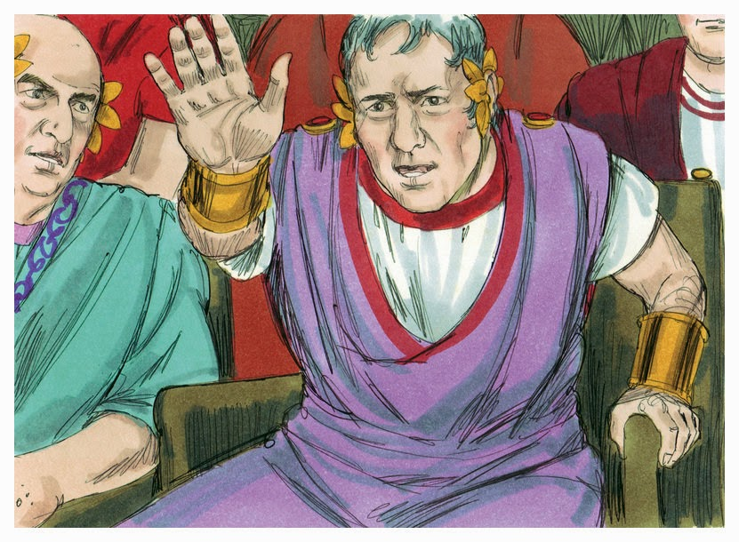
³⁰ And when he had thus spoken, the king rose up, and the governor, and Bernice, and they that sat with them:
³¹ And when they were gone aside, they talked between themselves, saying, This man doeth nothing worthy of death or of bonds.
³² Then said Agrippa unto Festus, This man might have been set at liberty, if he had not appealed unto Caesar.

Slide 137
Review of Chapter 26
Acts 26:1 Then Agrippa said unto Paul, Thou art permitted to speak for thyself. Then Paul stretched forth the hand, and answered for himself:
Paul explains his meeting with Jesus and all the details to King Agrippa II son of Agrippa I, he is the seventh and last of the Herod Kingship line.
Festus then says Paul is mad
Acts 26:26 For the king knoweth of these things, before whom also I speak freely: for I am persuaded that none of these things are hidden from him; for this thing was not done in a corner.

Slide 138
Agrippa was a really bad, self serving & brutal man but ….
Could the New Testament gospel touch even him?

Slide 139
Pauls statement to Agrippa
Acts 26:27-28 King Agrippa, believest thou the prophets? I know that thou believest. 28 Then Agrippa said unto Paul, Almost thou persuadest me to be a Christian.
Acts 26:30-32 And when he had thus spoken, the king rose up, and the governor, and Bernice, and they that sat with them: 31 And when they were gone aside, they talked between themselves, saying, This man doeth nothing worthy of death or of bonds. 32 Then said Agrippa unto Festus, This man might have been set at liberty, if he had not appealed unto Caesar.

Slide 140
CHAPTER 26 J. W. McGarvey’s Acts Commentary
VERSES 30 - 32
The decision that he had done nothing worthy of death or of bonds was the judgment of the whole company, while Agrippa went further, and said that he ought, by right, to be set at liberty. If Festus had decided thus honestly before Paul had made his appeal, he would have been released; but as the appeal had now been made, to Cæsar he must go. Whether Festus now knew any better than before what to write to Cæsar, Luke leaves to the imagination of the reader.
McGarvey, J. W. (1872). A commentary on Acts of Apostles (p. 281). Lexington, KY: Transylvania Printing and Publishing Co.

Slide 141
CHAPTER 26 J. W. McGarvey’s Acts Commentary
VERSES 30 - 32
The course of remark and the feeling of the audience had now reached that painful crisis in which it was necessary either to yield at once to the power of persuasion, or to break up the interview. Unfortunately for the audience, and especially for Agrippa, the latter alternative was chosen. The heart that beats beneath a royal robe is too deeply encased in worldly cares to often or seriously entertain the claims of such a religion as that of Jesus. A spurious religion, which shifts its demands to suit the rank of its devotees, has been acceptable to the great men of the nations, because it helps to soothe an aching conscience, and is often useful in controlling the ignorant masses; but men of rank and power are seldom willing to become altogether such as the Apostle Paul. They turn away from too close a pressure of the truth, as did Paul’s royal auditory.
McGarvey, J. W. (1872). A commentary on Acts of Apostles (p. 281). Lexington, KY: Transylvania Printing and Publishing Co.

Slide 142
God’s Plan Of Salvation In The Book Of Acts

Slide 145
Mark 16:16 (NASB) ¹⁶ "He who has believed and has been baptized shall be saved; but he who has disbelieved shall be condemned.
GIFT PROMISED BY THE HOLY SPIRIT
Acts 2:21
Luke 24:47 (NASB) ⁴⁷ and that repentance for forgiveness of sins would be proclaimed in His name to all the nations, beginning from Jerusalem.
BELIEVE
REPENT
BE BAPTIZED
SALVATION
REMISSION OF SINS
Acts 2:21 (NASB) ²¹ 'AND IT SHALL BE THAT EVERYONE WHO CALLS ON THE NAME OF THE LORD WILL BE SAVED.'
AND
AND
FOR
Acts 2:39 (NASB) ³⁹ "For the promise is for you and your children and for all who are far off, as many as the Lord our God will call to Himself."
Acts 2:4 (NASB) 4 And they were all filled with the Holy Spirit and began to speak with other tongues, as the Spirit was giving them utterance.
Acts 2:37-38 (NASB) 37 Now when they heard this, they were pierced to the heart, and said to Peter and the rest of the apostles, " Brethren, what shall we do?" 38 And Peter said to them, " Repent, and let each of you be baptized in the name of Jesus Christ for the forgiveness of your sins; and you shall receive the gift of the Holy Spirit.
Acts 2:38 (NASB) ³⁸ Peter said to them, "Repent, and each of you be baptized in the name of Jesus Christ for the forgiveness of your sins; and you will receive the gift of the Holy Spirit.
Acts 2:41 (NASB) ⁴¹ So then, those who had received his word were baptized; and that day there were added about three thousand souls. Acts 2:47 (NASB) ⁴⁷ praising God and having favor with all the people. And the Lord was adding to their number day by day those who were being saved.
Romans 6:23 (NASB) ²³ For the wages of sin is death, but the free gift of God is eternal life in Christ Jesus our Lord.
Acts 3:19 (NASB) ¹⁹ "Therefore repent and return, so that your sins may be wiped away, in order that times of refreshing may come from the presence of the Lord;
1 John 2:25 (NASB) ²⁵ This is the promise which He Himself made to us: eternal life.
Notes:
Peter had taught them that Salvation would come to all those who call on the name of the Lord, 2:21
It is obvious they wanted to know how does one call on the name of the Lord to be saved so they ask “What shall we do?” 2:37
The gift is eternal life Rom 6:23
In the next chapter Peter answers with:

Slide 146
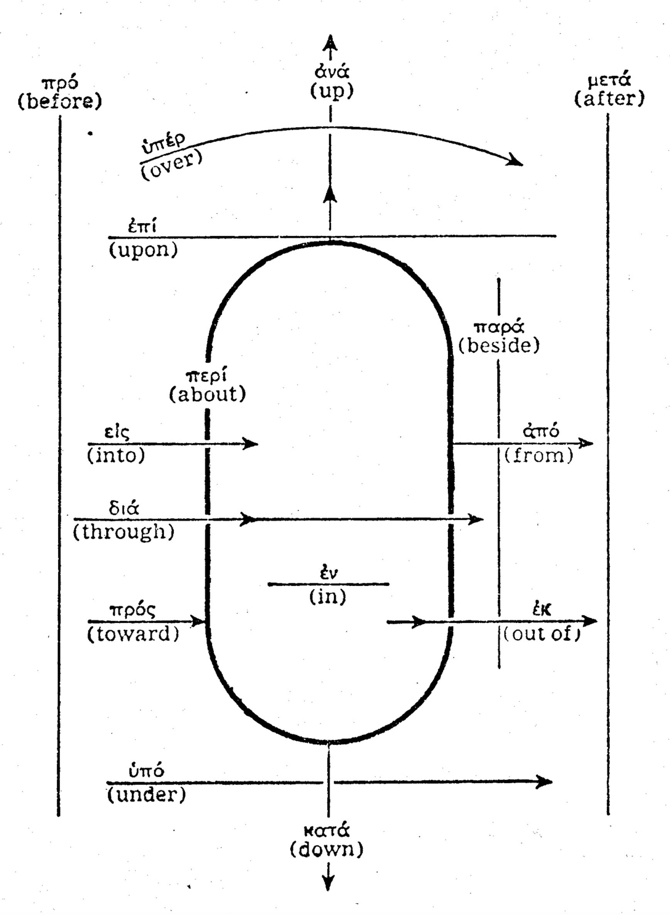
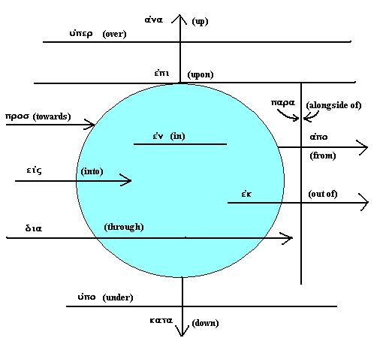
Greek Prepositions Chart 1
Acts 2:38 (NASB77) ³⁸ And Peter said to them, " Repent, and let each of you be baptized in the name of Jesus Christ for the forgiveness of your sins; and you shall receive the gift of the Holy Spirit.
Greek Prepositions Chart 2
forgiveness of your
sins
Repent and
be Baptized
Eis
(into)
For
(NASB)
Eis
(into)
For
(NASB)

Slide 147
Greek Prepositions Chart 1
Matthew 26:28 (NASB77) ²⁸ for this is My blood of the covenant, which is poured out for many for forgiveness of sins.
forgiveness of sins
Eis
For
into
My blood
Poured out
Acts 2:38 (NASB77) ³⁸ And Peter said to them, " Repent, and let each of you be baptized in the name of Jesus Christ for the forgiveness of your sins; and you shall receive the gift of the Holy Spirit.

Slide 148
Literal (word for word) English Translations
King James Version (1769 update)
American Standard Version (1901)
Revised Standard Version (1952)
New King James Version (1982 )
New American Standard Bible (1977)
English Standard Version (2001)

Slide 149
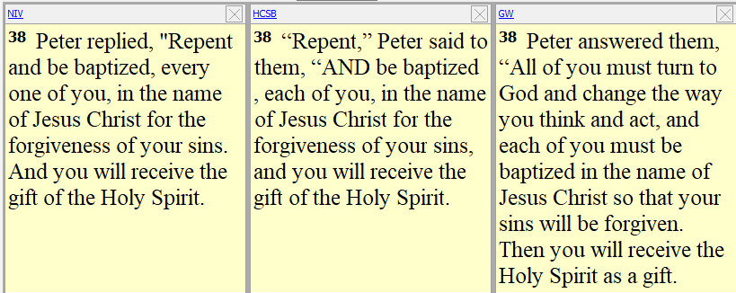
Thought for Thought English Translations (Dynamic Equivalence) Acts 2:38
New International Version (1984)
Holman Christian Standard Bible (2004)
God’s Word (1995)

Slide 150
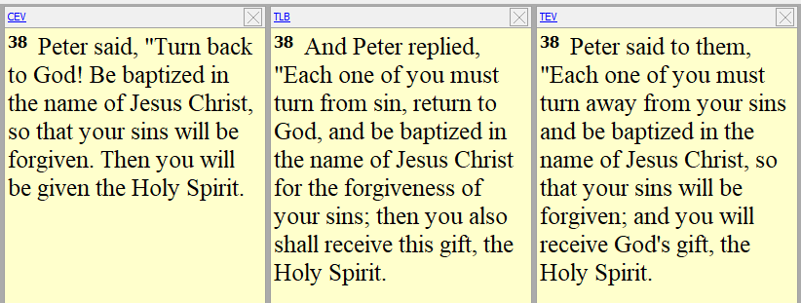
Thought for Thought English Translations (Dynamic Equivalence) Acts 2:38
Contemporary English Version (1995)
The Living Bible (1971 paraphrase)
Today’s English Version (1976 ABS)

Slide 151
Thought for Thought English Translations (Dynamic Equivalence) New Living Translation (corrects error) Acts 2:38
New Living Translation 2nd Edition (2004)
New Living Translation 5th Edition (2015)
2:38 Peter replied, “Each of you must repent of your sins, turn to God, and be baptized in the name of Jesus Christ to show that you have received forgiveness for your sins. Then you will receive the gift of the Holy Spirit.
38 Peter replied, “Each of you must repent of your sins and turn to God, and be baptized in the name of Jesus Christ for the forgiveness of your sins. Then you will receive the gift of the Holy Spirit.

Slide 152
“WHAT MUST I DO TO BE SAVED?”
A. The answer to this question is critical: Acts 2:37; Acts 16:30
B. The answer: Acts 16:31
1. How can they believe? Ro 10:13-17; Ro 1:16; Acts 15:7
a. The word was preached, is Common to all belief in the book Acts: Acts 2:37; 8:5, 35; 10:33, 36; 16:13-14, 16:32
b. Preaching the Gospel includes the command to be baptized: Acts 2:37-38; Acts 8:5, 12, 35-36; Acts 16:14-15; 16:32-33
Romans 1:16 (NASB) ¹⁶ For I am not ashamed of the gospel, for it is the power of God for salvation to everyone who believes, to the Jew first and also to the Greek.
Acts 16:32-33 (NASB) (THE PHILIPPIAN JAILER - Gentile) ³² And they spoke the word of the Lord to him together with all who were in his house. ³³ And he took them that very hour of the night and washed their wounds, and immediately he was baptized, he and all his household.
Acts 16:14-15 (NASB) (LYDIA – Jewess and household) ¹⁴ A woman named Lydia, from the city of Thyatira, a seller of purple fabrics, a worshiper of God, was listening; and the Lord opened her heart to respond to the things spoken by Paul. ¹⁵ And when she and her household had been baptized, she urged us, saying, "If you have judged me to be faithful to the Lord, come into my house and stay." And she prevailed upon us.
Acts 8:35-36 (NASB) (THE ETHIOPIAN EUNUCH) ³⁵ Then Philip opened his mouth, and beginning from this Scripture he preached Jesus to him. ³⁶ As they went along the road they came to some water; and the eunuch *said, "Look! Water! What prevents me from being baptized?"
Acts 8:5 (NASB) (THE SAMARITANS – Jews and Proselytes) ⁵ Philip went down to the city of Samaria and began proclaiming Christ to them. Acts 8:12 (NASB) ¹² But when they believed Philip preaching the good news about the kingdom of God and the name of Jesus Christ, they were being baptized, men and women alike.
Acts 2:37-38 (NASB) (THE JEWS ON PENTECOST) ³⁷ Now when they heard this, they were pierced to the heart, and said to Peter and the rest of the apostles, "Brethren, what shall we do?" ³⁸ Peter said to them, "Repent, and each of you be baptized in the name of Jesus Christ for the forgiveness of your sins; and you will receive the gift of the Holy Spirit. (see verse 41)
Believe on the Lord Jesus
Acts 2:37 (NASB) (THE JEWS ON PENTECOST) ³⁷ Now when they heard this, they were pierced to the heart, and said to Peter and the rest of the apostles, "Brethren, what shall we do?"
Believe in the Lord Jesus, and you will be saved
Acts 16:31 (NASB) (THE PHILIPPIAN JAILER - GENTILE) ³¹ They said, "Believe in the Lord Jesus, and you will be saved, you and your household."
Acts 15:7 (NASB) (THE GENTILES) ⁷ After there had been much debate, Peter stood up and said to them, "Brethren, you know that in the early days God made a choice among you, that by my mouth the Gentiles would hear the word of the gospel and believe.
Romans 10:13-17 (NASB) ¹³ for "WHOEVER WILL CALL ON THE NAME OF THE LORD WILL BE SAVED." Joel 2:32 ¹⁴ How then will they call on Him in whom they have not believed? How will they believe in Him whom they have not heard? And how will they hear without a preacher?
Gospel preached
¹⁵ How will they preach unless they are sent? Just as it is written, "HOW BEAUTIFUL ARE THE FEET OF THOSE WHO BRING GOOD NEWS OF GOOD THINGS!" Isa 52:7 ¹⁶ However, they did not all heed the good news; for Isaiah says, "LORD, WHO HAS BELIEVED OUR REPORT?" Isa 53:1 ¹⁷ So faith comes from hearing, and hearing by the word of Christ.
Acts 16:13-14 (NASB) (JEWISH WOMEN AT RIVER - LYDIA) ¹³ And on the Sabbath day we went outside the gate to a riverside, where we were supposing that there would be a place of prayer; and we sat down and began speaking to the women who had assembled. ¹⁴ A woman named Lydia, from the city of Thyatira, a seller of purple fabrics, a worshiper of God, was listening; and the Lord opened her heart to respond to the things spoken by Paul.
Acts 8:5 (NASB) (THE SAMARITANS – hated Jewish sect of northern tribes) ⁵ Philip went down to the city of Samaria and began proclaiming Christ to them.
Acts 16:32 (NASB) (THE PHILIPPIAN JAILER - Gentile ) ³² And they spoke the word of the Lord to him together with all who were in his house.
Acts 2:37 (NASB) (THE JEWS ON PENTECOST) ³⁷ Now when they heard this, they were pierced to the heart, and said to Peter and the rest of the apostles, "Brethren, what shall we do?"
Acts 10:33, 36 (NASB) (CORNELIUS – FIRST GENTILES) ³³ "So I sent for you immediately, and you have been kind enough to come. Now then, we are all here present before God to hear all that you have been commanded by the Lord."
³⁶ "The word which He sent to the sons of Israel, preaching peace through Jesus Christ (He is Lord of all)—
Believers Baptized
Acts 8:35 (NASB) (THE ETHIOPIAN EUNUCH – Jew or Proselyte) ³⁵ Then Philip opened his mouth, and beginning from this Scripture he preached Jesus to him.
Acts 16:30 (NASB) (THE PHILIPPIAN JAILER - GENTILE) ³⁰ and after he brought them out, he said, "Sirs, what must I do to be saved?"

Slide 153
Acts 10:47-48 (NASB77) 47 " Surely no one can refuse the water for these to be baptized who have received the Holy Spirit just as we did, can he?" 48 And he ordered them to be baptized in the name of Jesus Christ. Then they asked him to stay on for a few days.
Acts 15:7-11 (NASB77) 7 And after there had been much debate, Peter stood up and said to them, "Brethren, you know that in the early days God made a choice among you, that by my mouth the Gentiles should hear the word of the gospel and believe. 8 "And God, who knows the heart, bore witness to them, giving them the Holy Spirit, just as He also did to us; 9 and He made no distinction between us and them, cleansing their hearts by faith. 10 "Now therefore why do you put God to the test by placing upon the neck of the disciples a yoke which neither our fathers nor we have been able to bear? 11 "But we believe that we are saved through the grace of the Lord Jesus, in the same way as they also are."
Heard
Heard
Acts 2:36-41 (NASB77) 36 "Therefore let all the house of Israel know for certain that God has made Him both Lord and Christ -- this Jesus whom you crucified." 37 Now when they heard this, they were pierced to the heart, and said to Peter and the rest of the apostles, " Brethren, what shall we do?" 38 And Peter said to them, " Repent, and let each of you be baptized in the name of Jesus Christ for the forgiveness of your sins; and you shall receive the gift of the Holy Spirit. 39 "For the promise is for you and your children, and for all who are far off, as many as the Lord our God shall call to Himself." 40 And with many other words he solemnly testified and kept on exhorting them, saying, " Be saved from this perverse generation!" 41 So then, those who had received his word were baptized; and there were added that day about three thousand souls.
Believed
Believed
Repented
Repented
Acts 11:18 (NASB77) 18 And when they heard this, they quieted down, and glorified God, saying, "Well then, God has granted to the Gentiles also the repentance that leads to life."
Acts 17:30 (NASB77) 30 "Therefore having overlooked the times of ignorance, God is now declaring to men that all everywhere should repent,
Acts 11:14 (NASB77) 14 and he shall speak words to you by which you will be saved, you and all your household.'
SAME GOSPEL TO BOTH JEW AND GENTILES
THE JEWS ON PENTECOST
THE GENTILES ACTS 10-11
Baptized
Baptized
Romans 1:16 (NASB77) 16 For I am not ashamed of the gospel, for it is the power of God for salvation to everyone who believes, to the Jew first and also to the Greek.
Forgiven of sins
Forgiven of sins
Added to saved
Added to saved

