Slide 1
SATAN’S Beatitudes
by David Lee Burris, Editor

Slide 2


Slide 3
Blessed are those…
1. …who are easily offended, for they will soon get angry and quit
  How many times have Christians gotten offended and quit the church?
  It could be for various reasons, but it happens too much
  Perhaps they are offended by the message

Slide 4
Blessed are those…
1. …who are easily offended, for they will soon get angry and quit
  It’s worth noting that Jesus offended with His message
  John 6:60-61
  Many left Him, never to return (vs. 66)
  What was Jesus’ response?

Slide 5
Blessed are those…
1. …who are easily offended, for they will soon get angry and quit
  Jesus asked the 12 if they desired to leave Him as well (v. 67)
  Some might be offended by other things
  We must ask ourselves, are we easily offended?

Slide 6
Blessed are those…
1. …who are easily offended, for they will soon get angry and quit
  How do we react when someone offends us?
  It’s never ok to just walk away from the church
  Never let the actions or words of another keep you from heaven

Slide 7
Blessed are those…
2. …who gossip, for they shall cause strife and division that please me
  We spoke last time about strife and division
  Here, it is the tongue that causes the issue
  James spoke very directly about the danger of the tongue (Js. 3)

Slide 8
Blessed are those…
2. …who gossip, for they shall cause strife and division that please me
  “A perverse man sows strife, and a whisperer separates the best of friends” (Prov. 16:28)
  Paul condemns those who are gossips (Rom. 1:29)

Slide 9
Blessed are those…
2. …who gossip, for they shall cause strife and division that please me
  Paul feared this among the Corinthians as well (II Cor. 12:20)
  Paul warned Timothy about some of the younger widows who were gossips because they were idle (I Tim. 5:13)

Slide 10
Blessed are those…
2. …who gossip, for they shall cause strife and division that please me
  Satan wants gossip because it causes strife
  Jesus wants His people to handle things between themselves and the offending party (Matt. 18:15-17), because it creates peace
  Which one would describe you?

Slide 11
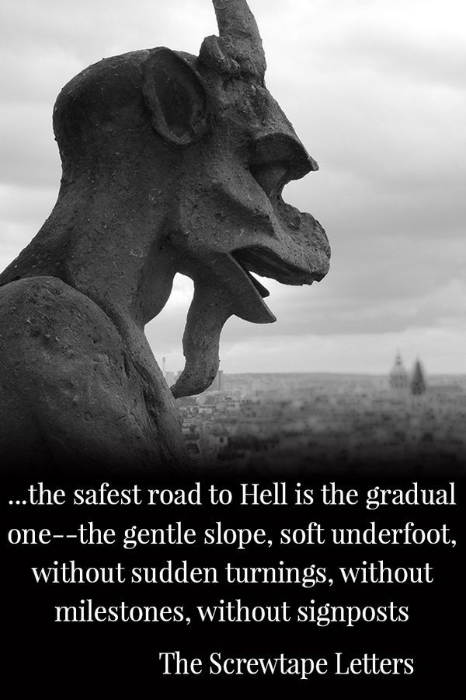

Slide 12
Blessed are…
3. …the complainers. I’m all ears to them.
  “Do all things without complaining and disputing” (Phil. 2:14)
  Satan loves those who only see the negative and discourage others with it
  We are to do our Christian duty without complaints (I Pet. 4:9)

Slide 13
Blessed are…
3. …the complainers. I’m all ears to them.
  Paul speaks of learning from the mistakes of the Israelites in I Corinthians 10
  We are not to complain as they did (v. 10)
  There is a such thing as a productive complaint (Acts 6:1)

Slide 14
Blessed are…
4. …the trouble makers. They shall be called my children.
  Solomon once said that God hates those who sow discord among the brethren (Prov. 6:19)
  God is a God of peace and desires harmony between His people

Slide 15
Blessed are…
4. …the trouble makers. They shall be called my children.
  “A perverse man sows strife, and a whisperer separates the best of friends” (Prov. 16:28)
  Paul told Timothy to avoid foolish and ignorant disputes (II Tim. 2:23)

Slide 16
Blessed are…
4. …the trouble makers. They shall be called my children.
  There are still men like Diotrephes today; he was not an one of a kind
  He stirred up because he loved to be the one getting all the glory (III Jn. 9-10)
  Satan loved a one such as him

Slide 17
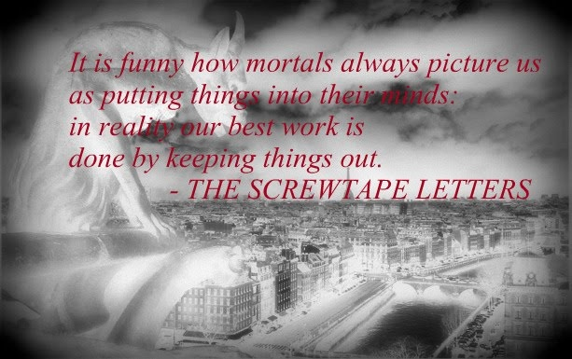

Slide 18
Blessed are…
5. …is he who professes to love God but hates his brother and sister…
  How do we feel about our brothers and sisters?
  All of them?
  We are certainly commanded to love God, but that’s not all

Slide 19
Blessed are…
5. …is he who professes to love God but hates his brother and sister…
  The second great command is like the first (to love God); it’s to love our neighbors (Matt. 22:36-40)
  The law is based on these two
  If we say we love God but hate our brother, we are a liar (I Jn. 4:20-21)

Slide 20
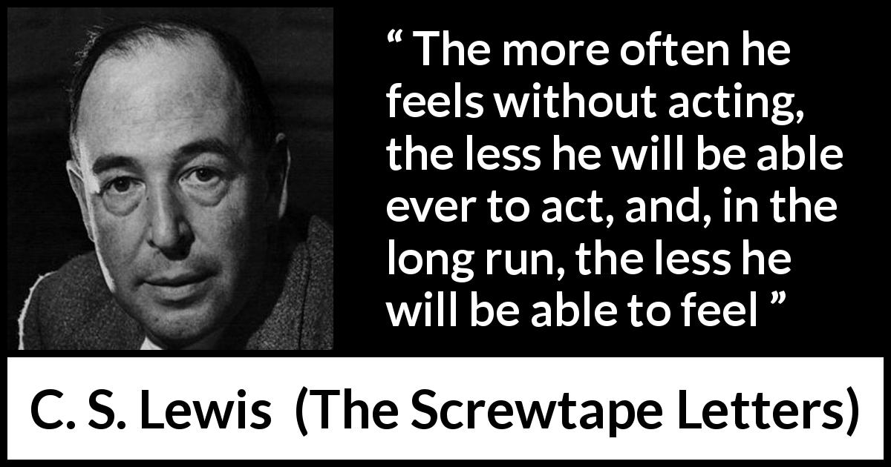

Slide 21
Blessed are you…
6. …who, when you read this, think it is about other people and not yourself.
  Satan’s message…
  “I’ve got you too!”
  We tend to look harder and longer at the flaws and sins of others than we do ourselves

Slide 22
Blessed are you…
6. …who, when you read this, think it is about other people and not yourself.
  That’s why Jesus spoke of the speck versus timber plank in Matthew 7
  We are so good that we can see the speck in a brother’s eye while having a plank in our own eyes

Slide 23
Blessed are you…
6. …who, when you read this, think it is about other people and not yourself.
  Satan wants us more in tune to my brother’s issues than my own
  The challenge for us is to think of everything in terms of ourselves first
  That’s why Paul said examine yourselves (II Cor. 13:5)

