Slide 1
Vision-quest of the Blind-sighted
David L. Burris, Editor/Writer

Slide 2


Slide 3
Spiritual Blindness
“For this people’s heart is waxed gross, and their ears are dull of hearing, and their eyes they have closed; lest at any time they should see with their eyes and hear with their ears, and should understand with their heart, and should be converted, and I should heal them.”
(Matthew 13:15)

Slide 4
Introduction
In this text, Jesus mentions several ailments that have afflicted many throughout time — heart, hearing and vision problems.
The ailments mentioned here are not the physical type many seek a cure for by going to a medical doctor.
The ailments Jesus mentions in this passage are spiritual ailments, which only obedience to the Word of God can cure!
The particular ailment that we will center our attention on in this lesson is spiritual blindness!

Slide 5
Spiritual Blindness
In Ephesians 4:17-19, the apostle Paul addressed this ailment, when he wrote, “This I say therefore, and testify in the Lord, that ye henceforth walk not as other Gentiles walk, in the vanity of their mind, Having the understanding darkened, being alienated from the life of God through the ignorance that is in them, because of the blindness of their heart: Who being past feeling have given themselves over unto lasciviousness, to work all uncleanness with greediness.”
Here Paul warned the Ephesian brethren of the symptoms of this dreadful disease!

Slide 6
Spiritual Blindness
When Paul wrote to the Corinthians, he warned them of blindness as well, saying, “But if our gospel be hid, it is hid to them that are lost: In whom the god of this world hath blinded the minds of them which believe not, lest the light of the glorious gospel of Christ, who is the image of God, should shine unto them” (2 Corinthians 4:3-4).
Here, he mentions those who were blinded by the “god of this world” — the Devil!
Hence, they were separated from God because they would not believe and obey the Truth of the Gospel!

Slide 7
Spiritual Blindness
These few passages establish the truth that blindness is a serious spiritual condition, a condition that will lead to spiritual death.
But, what are some common causes of spiritual blindness?
Lets examine some of them.

Slide 8
Blind Guides
Jesus said, “...And if the blind lead the blind, both shall fall into the ditch” (Matt. 15:14b).
“For the leaders of this people cause them to err; and they that are led of them are destroyed” (Isaiah 9:16).
In Isaiah’s day, the prophets caused the people to err and they led the people of God astray.

Slide 9
Blind Guides
Today, many so called gospel preachers are tickling the ears of people who do not have a love for the truth and are walking in spiritual darkness as a result.
Solomon wrote in Proverbs 28:10, “Whoso causeth the righteous to go astray in an evil way, he shall fall himself into his own pit: but the upright shall have good things in possession.”

Slide 10
Blind Guides
Many religious people are being led astray by false teachers.
Jesus warned of false teachers in his day!
In the sermon on the mount He said, “Beware of false prophets, which come to you in sheep’s clothing, but inwardly they are ravening wolves. Ye shall know them by their fruits. Do men gather grapes of thorns, or figs of thistles? Even so every good tree bringeth forth good fruit; but a corrupt tree bringeth forth evil fruit. A good tree cannot bring forth evil fruit, neither can a corrupt tree bring forth good fruit” (Matthew 7:15-18).

Slide 11
Blind Guides
Are you blindly following a preacher, because he is YOUR preacher or do you search the scriptures daily to find out whether the things that he teaches and preaches are so, as the Bereans of Acts 17:11?
Matthew 23:33, “Ye serpents, ye generation of vipers, how can ye escape the damnation of hell?”
Are you being led by a blind guide, a false teacher, a snake (the two legged kind), as Jesus described them?

Slide 12
Fear Of Men
Some brethren fear what one may think if they tell someone they are a Christian.
Some of brethren fear what visitors might think when a gospel preacher specifically refutes denominational doctrine from the pulpit with the Truth of the Gospel.
Some preachers, practice the politically correct methodology of “DON’T ASK —DON’T TELL.”

Slide 13
Fear Of Men
John wrote in Revelation 21:8, “But the fearful (“cowardly” - NKJV), and unbelieving, and the abominable, and murderers, and whoremongers, and sorcerers, and idolaters, and all liars, shall have their part in the lake which burneth with fire and brimstone: which is the second death.”
Did you notice who the fearful are grouped with by the apostle John?
Solomon wrote, “The fear of man bringeth a snare: but whoso putteth his trust in the LORD shall be safe” (Proverbs 29:25).

Slide 14
Fear Of Men
Neither the pulpit nor the army of Christ is a place for a fearful soul, for, the Bible teaches that the fearful will NOT enter kingdom of heaven!
Some so called “gospel preachers,” fear that they will lose their “job” or popularity if they speak the truth on a controversial subject.

Slide 15
Fear Of Men
Peter and the apostles did not cower down to men and cease to teach and preach the truth! Acts 5:41,42 “And they departed from the presence of the council, rejoicing that they were counted worthy to suffer shame for his name. And daily in the temple, and in every house, they ceased not to teach and preach Jesus Christ.”
No, they were not fearful of man!
They feared God!

Slide 16
Fear Of Men
Who do you fear, man or God?
Remember the words of Jesus in Matthew 10:28, “And fear not them which kill the body, but are not able to kill the soul: but rather fear him which is able to destroy both soul and body in hell.”

Slide 17
Prejudice
Prejudice is defined by Webster’s Dictionary as, “preconceived judgment or opinion or and adverse opinion or leaning formed without just grounds or before sufficient knowledge.”
Prejudice has caused many to reject the Truth of God’s word before giving it a fair hearing.
Many are entangled in religious error because they are unwilling to examine what they believe, teach and practice and compare it to what the Bible teaches.

Slide 18
Prejudice
Countless souls have been and will be doomed in an eternal flame because of false teaching.
Many are blinded by prejudice!
When the apostle Paul made his defense in Acts 22, he had to contend with people who were blinded to the truth because of prejudice.
The Jews were willing to hear him until he made mention that God had selected him to go to the Gentiles (whom the Jews despised); then the people went in to a rage, they cast off their clothes, threw dust in the air and demand that Paul be beaten (Acts 22:22-24).

Slide 19
Religious Confusion
There are many religions in this world.
All of which are false and vain with the exception of the religion that is authorized by Jesus Christ.
Jesus said, “I am the way, the truth, and the life: no man cometh unto the father, but by me” (John 14:6).
In Matthew 15:7-9 Jesus said, “Ye hypocrites, well did Esaias prophesy of you, saying, This people draweth nigh unto me with their mouth, and honoureth me with their lips; but their heart is far from me. But in vain they do worship me, teaching for doctrines the commandments of men.”

Slide 20
Religious Confusion
In Matthew 15:13, Jesus said, “Every plant, which my heavenly Father hath not planted, shall be rooted up.”
Jesus has reference here to every false religion and commandment of men which will be ultimately defeated and uprooted by God and his Word.
In John 17:17-19, He said, “Sanctify them through thy truth: thy word is truth. As thou hast sent me into the world, even so have I also sent them into the world. And for their sakes I sanctify myself, that they also might be sanctified through the truth.”
The religion of Jesus Christ is the ONLY religion that is true!
Peace and unity with God and his people are possible ONLY when people believe it and obey it.

Slide 21
Family Ties
Some people are members of a particular religion because their father, mother or other family members were members of that religion.
Some will justify the sinfulness of a family member rather than rebuking the family member for the sin they are involved in because of family ties.
Some parents become highly indignant and enraged when the Bible class teacher has to tell the parents that their “dear sweet” little Johnny acted like anything thing but a little angel in the Bible class.

Slide 22
Family Ties
Some brethren have “changed their tune” on controversial subjects such as Marriage, Divorce and Remarriage, because a family member or close friend is living in an adulterous marriage.
You will often hear these brethren say, “I have re-thought the subject and have come to a new understanding.”
Really, they have compromised the truth and are blinded to the truth by family ties!

Slide 23
Family Ties
In 1 Samuel 3:12, 13, the text says, “In that day I will perform against Eli all things which I have spoken concerning his house: when I begin, I will also make an end. For I have told him that I will judge his house for ever for the iniquity which he knoweth; because his sons made themselves vile, and he restrained them not” .
Eli evidently failed to restrain his sons because he was blinded by family ties!
What about you?

Slide 24
BLINDNESS IS A CHOICE!
There are many ways in which a person can suffer spiritual blindness.
But in all these ways we have discussed, we find that it is still a choice one makes for themselves.

Slide 25


Slide 26
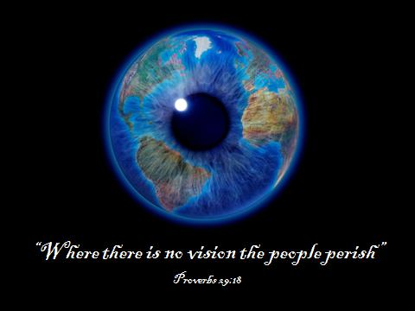
BLINDSIGHTEDNESS

Slide 27

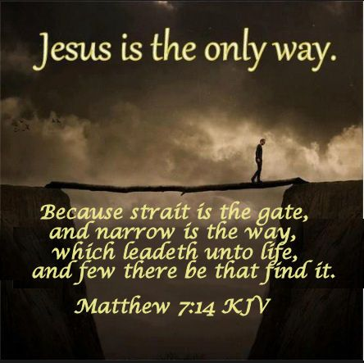
Christian journey is a narrow road

Slide 28
Blindsighted: Legally Blind Means Partially Blind
Acts 9:18 - Our Eyes Are Sometimes Scaled During Our Spiritual Journey
Genesis 3 – Because of the fall, man lost continual commune with God.
Spiritually Speaking We Are Somewhat Handicapped In Seeing Dangers of the Road
However, like many “legally blind” people we are only “Partially Blind.” The partially blind use all their other four senses to compensate. Scientists have proven that these partially blind people who are called “blind-sighted” can also train their eyes to see better. The blind-sighted can see movement and momentum in order to avoid being “blindsided.” They can make a “good catch” by improving their reflexes. Furthermore, with adjustments to their corrective lens they can see the sharp edges of objects and pathway obstacles in order to avoid injury and to successfully negotiate(navigate) a hostile terrain.
In other words, the spiritually blind-sighted can learn to anticipate in the short-term and find purpose beyond the immediate difficulty. Moreover, scientists have also demonstrated that blind-sighted individuals do better as the rest of us up the light – light coming from the destination [Matthew 5:14] – light in the walkway [1st John 1:7] – light from those ahead [Ephesians 5:8].

Slide 29
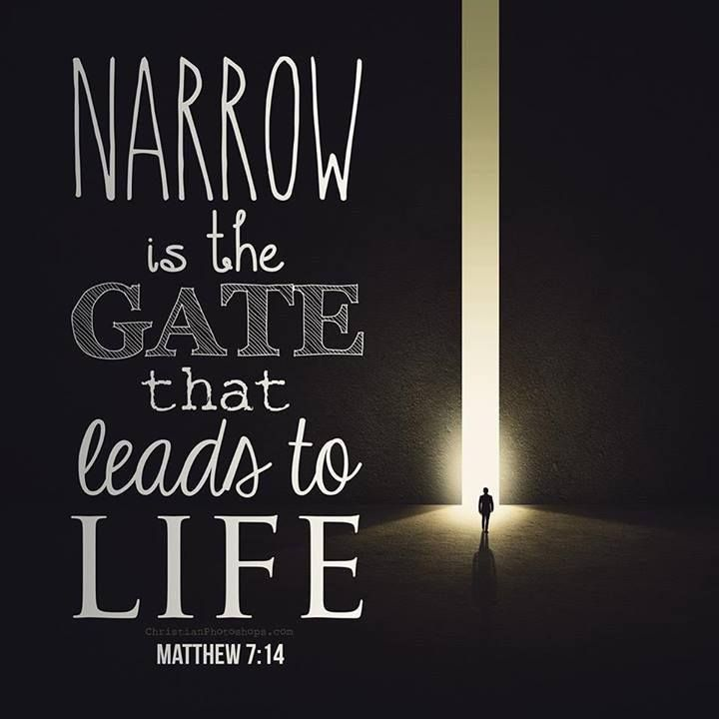
Christian journey is a narrow road

Slide 30
Are You A
Navigator?
But we are talking about the fact that every Christian SHOULD be a navigator.

Slide 31
A Navigator Identifies The Destination:
She/He's the guy that takes you from where you are to where you want to be.
Paul observed that "our citizenship is in heaven" (Philippians 3:20) and spent his life trying to get other people to catch a vision of his destination.
Before we go anywhere, we must know where we are.
We need someone to show us where we are before we can look forward to going somewhere.
Many people do not know where they are.

Slide 32
A Navigator Plots The Course:
There must be some way to get from point "A" to point "B".
The Savior said, "I am the way...no one comes to the Father but through Me" (John 14:6).
So, Jesus is the course and a good navigator who is going to put you on track with the Lord will lead you through Jesus.
That right track is the narrow way (Matthew 7:13-14)

Slide 33
A Navigator Thinks Ahead:
Jesus never promised that being a Christian would be without problems and obstacles.
The Bible calls them "stumbling blocks" (Romans 14:13; Matthew 18:6).
A good navigator will, wherever possible, look ahead and identify these sources of stumbling.
To be forewarned is to be forearmed (prepared).

Slide 34
A Navigator Makes Course Corrections:
Once having identified the obstacles you have to figure a way around, over, or under the problem.
A good navigator possesses something many others do not -- experience.
Having experience and a certain level of spiritual maturity usually qualifies one to help others through their problems...
This is why we should be ready to help the weak (Romans 15:1-7).

Slide 35
A Navigator Stays With People:
You wouldn't expect a navigator to "jump ship" just as you were facing a crisis.
In times of trouble is when you need a navigator the most.
So, a good navigator is going to be with you "through thick and thin."
He's not going to abandon you in the hour of trial.

Slide 36
"THE NEED FOR VISION"
Any successful endeavor requires a vision...
Proverbs 29:18 “Where there is no vision, the people are unrestrained..”

Slide 37

CHRISTIAN VISIONQUEST

Slide 39
“If we really want to live a flourishing life, we need to become vision-focused and put our goals into the context of that vision. If we’re the craftsmen of our lives, think of goals as a tool and your life’s vision as the blueprint.” – Vision Over Goals

Slide 40
INTRODUCTION
The word "vision":
Literally means the ability to see things that are visible
But it is also used to mean the ability to see other things
"unusual competence in discernment or perception; intelligent foresight" (American Heritage Dictionary)

Slide 41
INTRODUCTION
"Vision is the art of seeing things invisible" (Jonathan Swift)
Such ventures as business or politics require "men of vision"
Companies require CEOs with vision, countries require leaders with vision
Without the ability to visualize worthy goals and how these can be realized, very little of importance is achieved

Slide 42
The Need For Vision
In the Lord's work, we desperately need an elevated vision of what it is all about...
We need greater goals (what can be done) and greater objectives (how it can be done)
Jesus certainly had a great vision: saving of souls! – cf. Matthew 9:36-38; John 4:35

Slide 43
The Need For Vision
We need to have visions that are worthy of the "King of kings and Lord of lords"
What can help us to elevate and enlarge our vision in the Lord's work?
Let's first notice how an inadequate vision can actually stifle our work...

Slide 44
The Need For Proper Vision
Not all "vision" is good...
Some have "tunnel vision" - focusing on small and often insignificant problems in the church
Some have "visions of despair" - seeing only the negative, never the positive

Slide 45
TWO WAYS OUR VISION CAN BE INADEQUATE
AN ILLUSTRATION OF AN INADEQUATE VISION...
Suppose a man is driven by the "vision" of "making as much money as possible"
Two things may keep him from making as much money as he should
He may be limited in his idea of what is "a lot of money”
He may never make any specific plans other than have the vague notion of "making as much as possible"

Slide 46
TWO WAYS OUR VISION CAN BE INADEQUATE
His problem?
His vision:
May be too small concerning what can be done
May be too general without any plan for what he can be doing now to make his vision a reality

Slide 47
TWO WAYS OUR VISION CAN BE INADEQUATE
OUR VISION OF THE LORD'S WORK MAY LIKEWISE BE INADEQUATE...
We may have the vision of "teaching as many people the gospel as possible"
A noble vision on the surface, but we might be afflicted by the same shortcomings:
We may be thinking too small concerning what can be done
We may think too generally about what we should be doing

Slide 48
TWO WAYS OUR VISION CAN BE INADEQUATE
THE PROBLEM OF A VISION THAT’S TOO GENERAL . . . No dream has ever been achieved except by someone who dared to flesh it out in terms of the specific details necessary to make the dream a reality
For example, it is fine to plan:
To go to heaven
To serve the Lord faithfully
To do the work of evangelism

Slide 49
TWO WAYS OUR VISION CAN BE INADEQUATE
But how do we do such things?
By what means do we get those results?
What specific, measurable actions will take us where we want to be?
How much time, effort, and money will it take?
We need to see our vision of the Lord's work in concrete terms of things we can actually do and plan specifically how much we are going to do!

Slide 50
TWO WAYS OUR VISION CAN BE INADEQUATE
THE PROBLEM OF A VISION THAT IS TOO LITTLE . . .
When we do think specifically about the Lord's work, we often fail to set our sights high enough
Perhaps we are hindered by past experience
Personal efforts of the past may not have born fruit

Slide 51
TWO WAYS OUR VISION CAN BE INADEQUATE
Congregational efforts did not seem to go anywhere
Perhaps we have been fed a steady diet of defeatism
Told by others that people are not interested in spiritual matters anymore
Telling ourselves that people are not interested

Slide 52
TWO WAYS OUR VISION CAN BE INADEQUATE
With small visions, many churches and individuals seem content with:
Just "keeping house for the Lord"
Just an occasional conversion, usually involving our children or spouses
Bottomline, with the limited vision of many
churches, little is done & little’s accomplished

Slide 53
TWO WAYS OUR VISION CAN BE INADEQUATE
I believe the Lord intends greater things for His church, especially for those servants with a willingness to work (cf. Matthew 13:31-33; 1st Corinthians 16:8-9; Revelation 3:8).
What does a vision worthy of our Lord's work require?
Perhaps the following thoughts might be a step in the right direction...

Slide 54
WHAT OUR VISION NEEDS
OUR VISION NEEDS TO BE GREAT . . .
OUR VISION NEEDS SPECIFIC ACTION-STEPS . .

Slide 55
WHAT OUR VISION NEEDS
OUR VISION NEEDS FAITH...
Faith in the power of the gospel
To save souls - Romans 1:16-17
To produce souls that have been born again –
1 Peter 1:22-25
Faith in the power of the Lord
To open doors for His prepared servants –
1 Corinthians 16:8-9; Revelation 3:8
To empower His servants wanting to do His will - Philippians 4:13; Ephesians 3:16,20

Slide 56
WHAT OUR VISION NEEDS
OUR VISION NEEDS BOLDNESS...
A virtue displayed often by the early Christians - Acts 4:13; 9:27; 13:46; 14:3; 19:8; 28:31
For which they prayed and solicited prayers –
Acts 4:29,30; Ephesians 6:19-20
A boldness based upon our hope in Christ –
2 Corinthians 3:12
To say what needs to be said, when it needs to be said, despite the circumstances –
1 Thessalonians 2:2

Slide 57
WHAT OUR VISION NEEDS
OUR VISION NEEDS PERSISTENCE...
Not losing heart, for we shall reap in due time - Galatians 6:9
Always abounding, knowing that our labor is not in vain - 1 Corinthians 15:58
Many visions are never realized because people give up too soon!

Slide 58

The End

