Slide 1

War Between States DIVIDES NATION&Splits RESTORATION MOVEMENT
By David Lee Burris

Slide 2
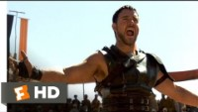
Gladiators Were Captive Slaves Fighting To Satisfy Bloodlust!

Slide 3

THE HOLY MAN TELEMACHUS SHUTS DOWN
THE COLOSSEM GAMES IN THE YEAR 370 A.D.

Slide 4
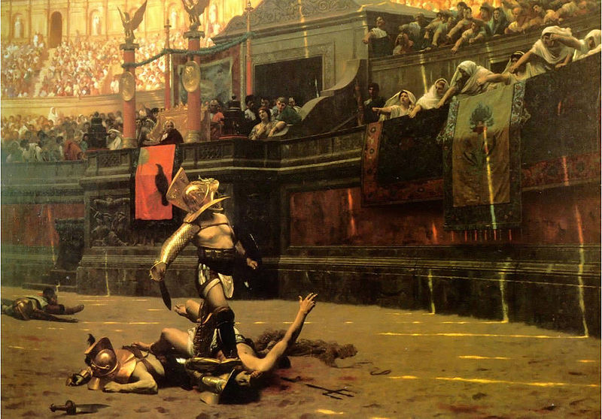
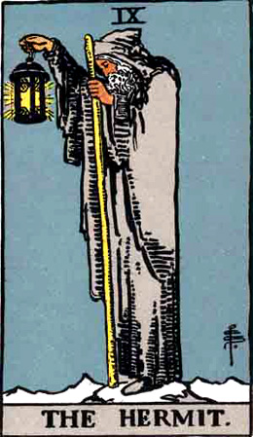

Slide 5
From Foxes Book Of Martyrs:
“A rudely clad, robed figure appeared for a moment among the audience, and then boldly leaped down into the arena. Without hesitating an instant he advanced upon two gladiators engaged in a life-and-death struggle, and laying his hand upon one of them sternly reproved him for shedding innocent blood, and then turning toward the thousands of angry faces ranged about him, called upon them in a solemn, deep-toned voice which resounded through the deep enclosure.

Slide 6
From Foxes Book Of Martyrs:
“‘Do not require God’s mercy in turning away the swords of your enemies by murdering each other.’ Angry shouts and cries at once drowned his voice: ‘This is no place for preaching!’ Thrusting aside the stranger, the gladiators would again have attacked each other, but the man stood between holding them apart, and trying in vain to be heard. ‘Sedition! sedition! down with him!’ was the cry; and the gladiators, at once, stabbed him to death, and he perished, in the midst of the arena. He had died, but not in vain, for the shock of such a death before their eyes turned the hearts of the people: they saw the hideous aspects of their favorite vice; and no other fight of gladiators was ever held there.”

Slide 7
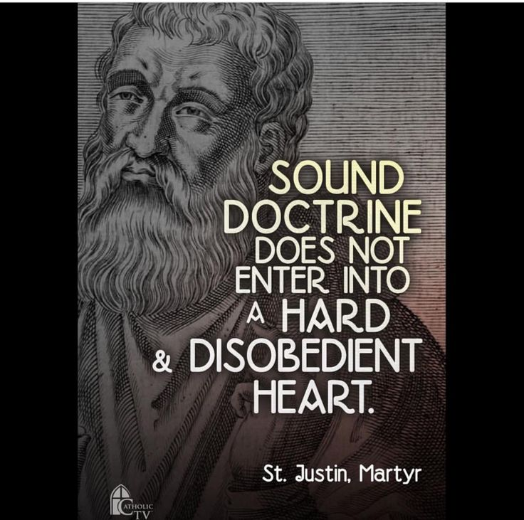

Slide 8
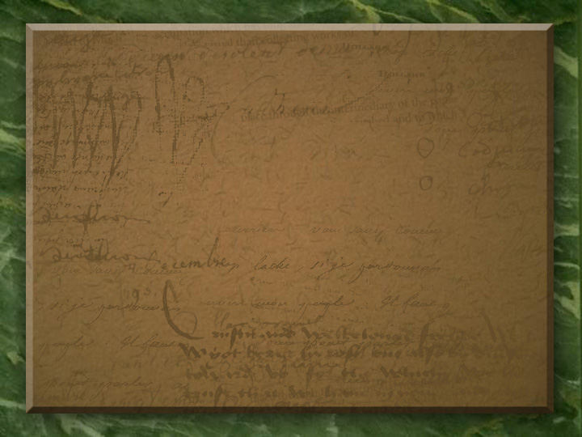
Roman Persecution: Julian The Apostate
“Julian ascended the throne as Caesar in 360. He was the nephew of Constantine the Great who ‘Christianized’ the Roman world. Julian sought to re-establish pagan worship in the Empire & was thereafter known as ‘The Apostate.’ Julian openly began to persecute Christians and he withdrew the legal protection granted them by Constantine. He accused Christians of seeking to obtain followers by bribing the sick. ‘These impious Galileans,’ he wrote, ‘give themselves to this kind of humanity [the sick] as men allure children with candy, so they… bring converts to their impiety. Now we can see what it is that makes these Christians such powerful enemies of our gods. It is brotherly love which they manifest towards strangers and towards the sick and the poor.’”

Slide 9
Searching For & Saving Of Exposed & Disposed Of Baby Girls Created Good Reputation & Caused Gender Disparity In The Early Church!

Slide 10
Roman Persecution: Julian The Apostate
Julian Went On To Say - “[Christianity] has been specially advanced through the loving service rendered to strangers and through their care of the burial of the dead. It is a scandal that there is not a single Jew who is a beggar and that the [Christians] care not only for their own poor but for ours as well; while those who belong to us look in vain for the help we should render them.”

Slide 11

Roman Persecution: Julian The Apostate
“Julian had been educated in Athens along side a committed Christian by the name of Agaton. Although he persecuted Christians, he invited his friend Agaton to serve in his court. Julian frequently teased his Christian friend. One day, in front of a large group of wealthy Romans, Julian asked, ‘Agaton, how is your carpenter of Nazareth? Is he finding work these days?’ Agaton smiled and answered, ‘He is perhaps taking time away from building mansions for the faithful to build a coffin for your Empire.’ Less than two years later, on June 26, 363, Julian lay dying with a Persian arrow in his chest. He had led his troops in an attempt to take the ancient Persian Empire. Julian grasped a handful of dirt, red with his own blood. Flinging the dirt Heavenward he uttered his last words, ‘Vicisti Galilaee.’ That is, ‘You have conquered, Galilean.’”

Slide 12



The Church Across The Ages
of people, events
life and faith from
Glimpses
Early Christians Speak
Justin Martyr, An Early Leader Wrote To Emperor Pius:
“We formerly rejoiced in uncleanness of life, but now love only chastity, before we used the magic arts, but now dedicate ourselves to the true and unbegotten God; before we loved money & possessions more than anything, but now we share what we have and to everyone who is in need; before we hated one another and killed one another and would not eat with those of another race, but now we have come to a common life and pray for our enemies and try to win over those who hate us without just cause.”

Slide 13

Slave Preachers @Post-Constantine
What was the standard church practice in 400 A.D. regarding ordination of slaves?
It Was Forbidden!
Theoretically, it was permissible; practically, slaves weren’t expedient
If an owner didn’t want his slave ordained, the church ordained him anyway and provided compensation
The Owner Could Prevent!
x

Slide 14
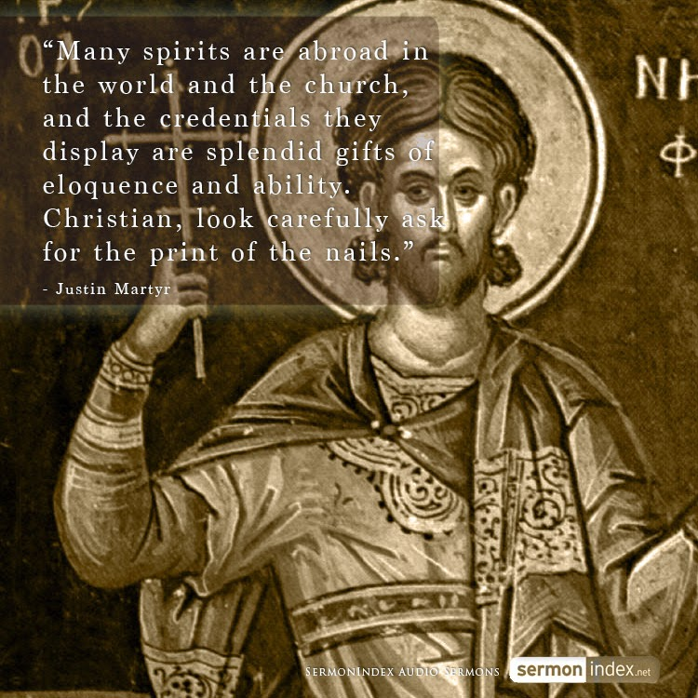

Slide 15
The Church Across The Ages
of people, events
life and faith from
Glimpses
Slave Makes Good!
Christians drew members into their fellowship from every rank and race, an affront to proper, class-conscious Romans. A former slave who had worked the mines actually became the bishop of Rome – Callistus in 217.

Slide 16



“Slavery is an institution of the law of nations,
by which one man is made the property of another,
CONTRARY TO NATURAL RIGHT ."
~ The Justinian Code, 535 A.D.

Slide 17

The ancient world recognized degrees of slavery. Though much of their literature present freedom and slavery as exact opposites Greek and Roman culture support many degrees in between. The lowest slaves worked in unskilled manual labor. If someone was punished with slavery this is the kind of work they would likely be condemned to. Mines, mills, porters, bearers, etc. These slaves had no rights and few privileges. They were human beasts of burden. These slaves had the smallest chance of gaining their freedom. It's difficult to impress the master when all you do is haul things around and perform one mundane activity over and over again. But has already been pointed out by others there were also privileged slaves. These were the ones who often lived away from the master and rendered a payment (paramone) to the master. They were skilled workers like slave bankers, craftsmen, overseers, and the like. Though everything they earned legally belonged to the master it was customary that the master receive this paramone and not everything that the slave earned. The slave could then save up their earnings to eventually earn their freedom. Because they often lived away from the master or worked along side him, they had better chances of being granted freedom for their good work and were more in control of their own lives. Those that lived away from the master were in control of their own movements and lives with the exception of the payment to the master. These individuals functioned much like subcontractors. Even slaves who gained their freedom often lacked all of the freedoms that society could offer. Freedom did not mean citizenship so freedmen could not participate in politics and were excluded from other activities. When a slave bought their freedom it was fairly common that the agreement be sealed with a sort of contract. The slave would agree to render a fixed amount and often agree to perform services for their master at the former master's request. This obligation to provide for the former master could last until the master's death and, rarely, even afterward. If the obligations proved to be too burdensome a freedman could offer suit in Athens and if he won would be given unconditional freedom(not citizenship), but if he lost he would re re-enslaved. The stigma of having been a slave lasted for life and severely limited future opportunities.

Slide 18
The ancient world recognized degrees of slavery – continued.
Some points about Classical slavery: It was customary in Rome to free a slave after he had reached the age of 30 if he had rendered good service. This practice was far more common with domestic and skilled slaves in the city than with agrarian or unskilled slaves. It was recommended that a master in Athens immediately discuss with a slave what would be required of them to buy their freedom and how they would earn it. The master would try to arrange a marriage with the slave and have him start a family. If a slave knew what was required of him to gain his freedom and his freedom lay before him a a real possibility why risk rebellion or escape, especially if the slave had family also owned by the master. It was to encourage productivity and reduce rebellion or flight. It was recognized that slaves were human beings. It was just also recognized that these people were property. As such, slaves were to be treated with a certain level of decency (not hubris). Now many masters clearly had no compunctions about ruthlessly beating their slaves, but literary evidence from Rome and court records from Athens suggest that there was an expectation (and sometimes law) to treat slaves as people if only to avoid rebellion.

Slide 19
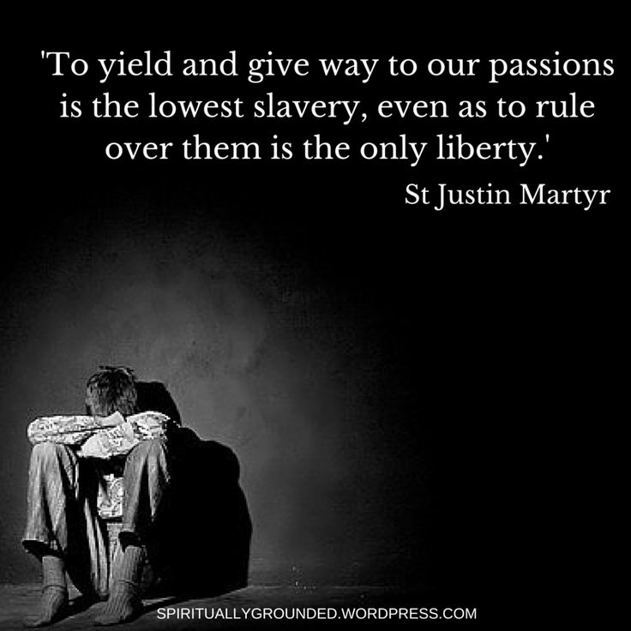
Does the N.T. Forbid Or Regulate Slavery?

Slide 20

NOT TO REFORM BUT TO RESTORE:
BIBLE WORDS
IN BIBLE WAYS.

Slide 21
READ: Ex 21 – Deut 15: 12-18 – Deut 24: 7 – Lev 25: 39-55
Note the following: (1) God required humane treatment of servants. (2) Servants were freed after six years. (3) Servants were paid for the six years of work (twice the wages of a hired servant). (4) Servants were treated as family. (5) Selling people into slavery was a capital crime (it brought the death penalty). (6) The Children of Israel were not to make slaves of their fellow Jews. (7) Fellow Jews were essentially made into hired servants. (8) It appears that these rules also applied to non-Jews.
Word Slave @Jeremiah 2:14 & Slaves @Revelation 18:13

Slide 22
Pulpit Commentary @Colossians 3: 22 - 24
Verse 22. - Ye servants (literally, bondmen), be obedient in all things to your lords according to the flesh (Ephesians 6:5-9; 1 Timothy 6:1, 2; Titus 2:9, 10; 1 Corinthians 7:21-24; Romans 13:1, 5; 1 Peter 2:18-25). The duties of servants & masters are prominent here (ver. 22- Colossians 4:1), in view of the emphasis thrown upon the lordship of Christ; and partly, no doubt, with reference to the case of the runaway slave Onesimus (Colossians 4:9; Epistle to Philemon) "Servant" is δοῦλος, bondman, as in Colossians 1:1 and commonly in St. Paul. In 1 Peter 2:18 we have the milder οἰκετής, domestic. The vast majority of servants of all kinds at this time in the Greek and Roman world were slaves. In most districts the slaves were much more numerous than the free population. And they were undoubtedly numerous in the early Church. The gospel has always been welcome to the poor and oppressed. The attitude of St. Paul and of Christianity towards slavery claims consideration under the Epistle to Philemon; on this point see Lightfoot's 'Introduction.' Here and in Ephesians 6:5 (comp. vers. 7, 8) the apostle calls the master κύριος ("lord") in reference to "the Lord Christ" (vers. 22 b, 24); elsewhere in the New Testament, as in common Greek, the opposite of δοῦλος is δεσποτής (1 Timothy 6:1, 2; 2 Timothy 2:21, etc.), "According to flesh," that is, "in outward, earthly relationship" (comp. Romans 4:1): Christ is the Lord in the absolute and abiding sense of the word (similarly, "in the flesh" and "in the Lord," Philemon 1:16). Not with acts of eye service (literally, not in eye services), as man pleasers, but in singleness of heart, fearing the Lord (Ephesians 6:6; Ephesians 5:21; 1 Thessalonians 2:4; Galatians 1:10; Matthew 6:22; Luke 11:34; James 1:5-8; Psalm 123:2; Isaiah 8:13; Revelation 2:23). "Eye service" is plural here, according to Revised Text; singular in Ephesians 6:6. Here the word ὀφθαλμοδουλεία first oocurs in Greek, like ἐθελοθρησκεία (Colossians 2:23). It strikes at the besetting sin of servants of all kinds. Ανθρωπάρεσκος ("man pleaser") occurs in the LXX, Psalm 52:6 (comp. 1 Thessalonians 2:6; Galatians 1:10). The servant whose aim it is to please his earthly master in what will catch his eye, plays a double part, acting in one way when observed, in another when left to himself; with this duplicity is contrasted "singleness of heart" (Romans 12:8; 2 Corinthians 11:3; ἀπλότης in 2 Corinthians 8:2 and 1 Cor 9:11, 13 has a different application). "Fearing the Lord" more than the eye of his earthly lord, the Christian servant will always act in "singleness of heart;" for "the eyes of the Lord are in every place." In the same manner the apostle ("bondman of Christ Jesus," Colossians 1:1) speaks of his own relations to men and to the Lord Christ respectively (1 Corinthians 4:3-5; 2 Corinthians 5:11; Galatians 1:10; 1 Thessalonians 2:4-6, etc.: comp. John 5:37-44). The reading "God" of Received Text is a copyist's emendation, a sample of a large class of corruptions of the text, where a word more familiar in any given connection is, more or less unconsciously, substituted for the original word. Colossians 3:22

Slide 23
Ellicott’s Commentary @Ephesians 6: 5 - 9
4 c.) In Ephesians 6:5-9 the hardest form of subjection, that of slaves to masters, is dealt with, still under the same idea that both are “in Christ.” The slave is the servant of Christ in obeying his master, the master is a fellow-servant with his slave to the same Divine Lord. We notice on this particular subject a remarkable emphasis, and a singular closeness of parallelism between this Epistle and the Epistle to the Colossians; probably to be accounted for by the presence of Onesimus with St. Paul at the time, which would naturally press on him some special consideration of the relation of Christianity to slavery. Accordingly, Apostle Paul’s general attitude towards slavery will be best considered in the Philemon Epistle. Here it will be sufficient to note that while the institution, unnatural as it is, left untouched, the declaration of common fellowship in Christ enunciates a principle absolutely incompatible with slavery, and one that’s destined to destroy it.
(5) Your masters according to the flesh.—This phrase (used also in Colossians 3:12) at once implies the necessary limitation of all human slavery. It can subjugate and even kill the body, but it cannot touch the spirit; and it belongs only to the visible life of this world, not to the world to come. The slave is a man in spiritual and immortal being, not a “living tool” or “chattel,” as even philosophy called him.
With fear and trembling.—The phrase is a favourite one with St. Paul. (See 1Corinthians 2:3; 2Corinthians 7:15; Philippians 2:12, in all which cases it is applied to the condition of man as man under the weight of solemn responsibility before God.) It recognises the “spirit of bondage unto fear” (Romans 8:15) necessarily belonging to all who are “under law,” i.e., under obedience to the will of another, as enforced upon them by compulsion; and this fear, moreover, is viewed as showing itself in “trembling” anxiety to obey. So St. Peter commands (1Peter 2:18), “Servants, be subject to your masters with all fear, not only to the good and gentle, but also to the froward;” and it is to be noted that he describes the suffering herein implied as a fellowship with the sufferings of the Lord Jesus Christ (Ephesians 6:21-24).
Singleness of your heart, as unto Christ.—The phrase “singleness of heart,” is here used in its proper sense, from which all others (see Romans 12:8; 2Corinthians 8:2; 2Corinthians 9:11; 2Corinthians 9:13) may be derived. It means having but one aim, and that the one which we profess to have, with no duplicity of reservation or hypocrisy. Such singleness of heart cannot be given perfectly to any merely human service, because no such service has a right to our whole heart; hence St. Paul adds, “as unto Christ,” bidding them look on their service as a part of the service to Him who can claim absolute devotion.

Slide 24
MacLaren's Expositions @Philemon
I. The first point to notice is that decisive step of sending back the fugitive slave.
Then does Christianity sanction slavery ? Certainly not; its principles cut it up by the roots. A gospel, of which the starting-point is that all men stand on the same level, as loved by the one Lord, and redeemed by the one cross, can have no place for such an institution. A religion which attaches the highest importance to man’s awful prerogative of freedom, because it insists on every man’s individual responsibility to God, can keep no terms with a system which turns men into chattels. Therefore Christianity cannot but regard slavery as sin against God, and as treason towards man. The principles of the gospel worked into the conscience of a nation destroy slavery. Historically it is true that as Christianity has grown slavery has withered. But the New Testament never directly condemns it, and by regulating the conduct of Christian masters, and recognizing the obligations of Christian slaves, seems to contemplate its continuance, and to be deaf to the sighing of the captives.
This attitude was probably not a piece of policy or a matter of calculated wisdom on the part of the Apostle. He no doubt saw that the Gospel brought a great unity in which all distinctions were merged, and rejoiced in thinking that "in Christ Jesus there is neither bond or free"; but whether he expected the distinction ever to disappear from actual life is less certain. It is by no means necessary to suppose that the Apostles saw the full bearing of the truths they had to preach, in their relation to social conditions. They were inspired to give the Church the principles. It remained for future ages, under Divine guidance, to apprehend the destructive and formative range of these principles.
However this may be, the attitude of the New Testament to slavery is the same as to other unchristian institutions. It brings the leaven, and lets it work. That attitude is determined by three great principles. First, the message of Christianity is primarily to individuals, and only secondarily to society. It leaves the units whom it has influenced to influence the mass. Second, it acts on spiritual and moral sentiment, and only afterwards and consequently on deeds or institutions. Third, it hates violence, and trusts wholly to enlightened conscience. So it meddles directly with no political or social arrangements, but lays down principles which will profoundly affect these, and leaves them to soak into the general mind. If an evil needs force for its removal, it is not ready for removal. If it has to be pulled up by violence, a bit of the root will certainly be left and will grow again. When a dandelion head is ripe, a child’s breath can detach the winged seeds; but until it is, no tempest can move them. The method of violence is noisy and wasteful, like the winter torrents that cover acres of good ground with mud and rocks, and are past in a day. The only true way is, by slow degrees to create a state of feeling which shall instinctively abhor and cast off" the evil. Then there will be no hubbub and no waste, and the thing once done will be done for ever.
So has it been with slavery; so will it be with war, and intemperance, and impurity, and the miserable anomalies of our present civilization. It has taken eighteen hundred years for the whole Church to learn the inconsistency of Christianity with slavery. We are no quicker learners than the past generations were. God is patient, and does not seek to hurry the march of His purposes. We have to be imitators of God, and shun the "raw haste" which is "half-sister to delay."
But patience is not passivity. It is a Christian s duty to "hasten the day of the Lord," and to take part in the educational process which Christ is carrying on through the ages, by submitting himself to it in the first place, and then by endeavoring to bring others under its influence. His place should be in the van of all social progress. It does not become Christ’s servants to be content with the attainments of any past or present, in the matter of the organization of society on Christian principles. "God has more light to break forth from His word." Coming centuries will look back on the obtuseness of the moral perceptions of nineteenth century Christians in regard to matters of Christian duty which, hidden from us, are sun-clear to them, with the same half-amused, half-tragic wonder with which we look back to Jamaica planters or South Carolina rice growers, who defended slavery as a missionary institution, and saw no contradiction between their religion and their practice. We have to stretch our charity to believe in these men’s sincere religion. Succeeding ages will have to make the same allowance for us, and will need it for themselves from their successors. The main thing is, for us to try to keep our spirits open to all the incidence of the gospel on social and civic life, and to see that we are on the right side, and trying to help on the approach of that kingdom which does " not cry, nor lift up, nor cause its voice to be heard in the streets, "but has its coming" prepared as the morning," that swims up, silent and slow, and flushes the heaven with an unsetting light.
Turning The World Upside Down!

Slide 25
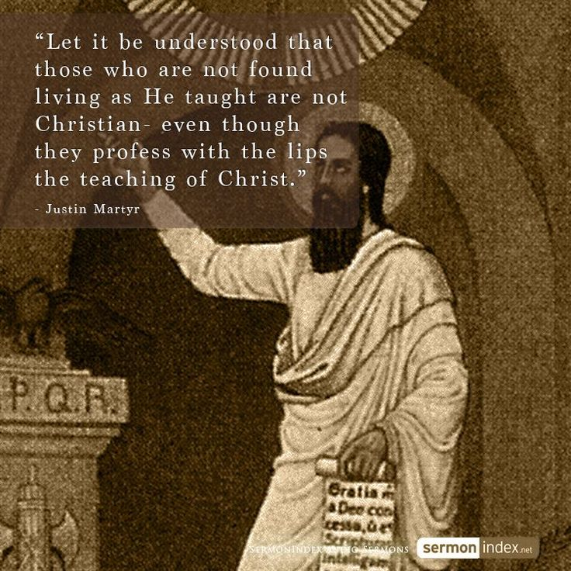

Slide 26
Hope
Hope has two beautiful daughters:
Their names are anger and courage.
Anger that things are the way they are.
Courage to make them the way they ought to be.
* Augustine of Hippo

Slide 27

David Lee Burris:
Christian Emperor Theodosius invited Thessalonians to free games but sent his troops into the circus with orders to kill the 10,000 men, women, and children.
“The first recorded instance of Christians killing Pagans occurred shortly after {status change year 313}. In short order, the militant church extended its power by conquering lands & peoples throughout Europe, compelling them to become baptized Christians or die… As Charlemagne instructed his Christian troops in their conquest of the Saxons: ‘If there is anyone of the Saxon people lurking among them unbaptized, and if he scorns to come to baptism & stay a pagan - let him die’”.
"The first cause of slavery is sin -
that one man should be
put in bonds by another;
- Augustine On Slavery -
and this happens only by the judgment of God,
IN WHOSE EYES IT IS NO CRIME!"
- Gregory Boyd, Myth Of A Christian Nation

Slide 28
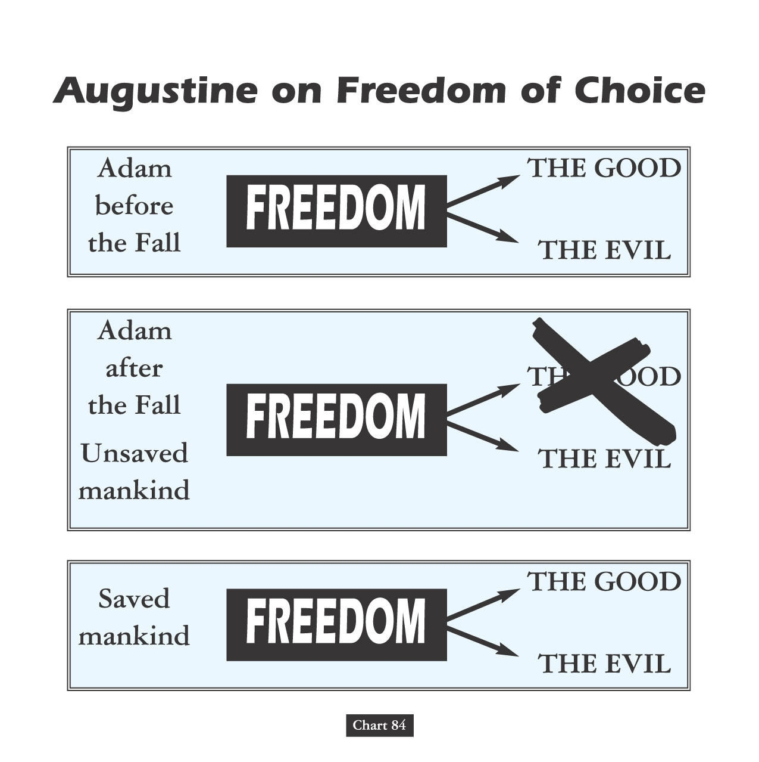
Both Popes Leo & Gregory Declare Slavery
Not A Peculiar - But - A Divine Institution!
"Slaves Are Men That From
The Vileness Of Their Condition
Must Not Enter The Clergy."

Slide 29
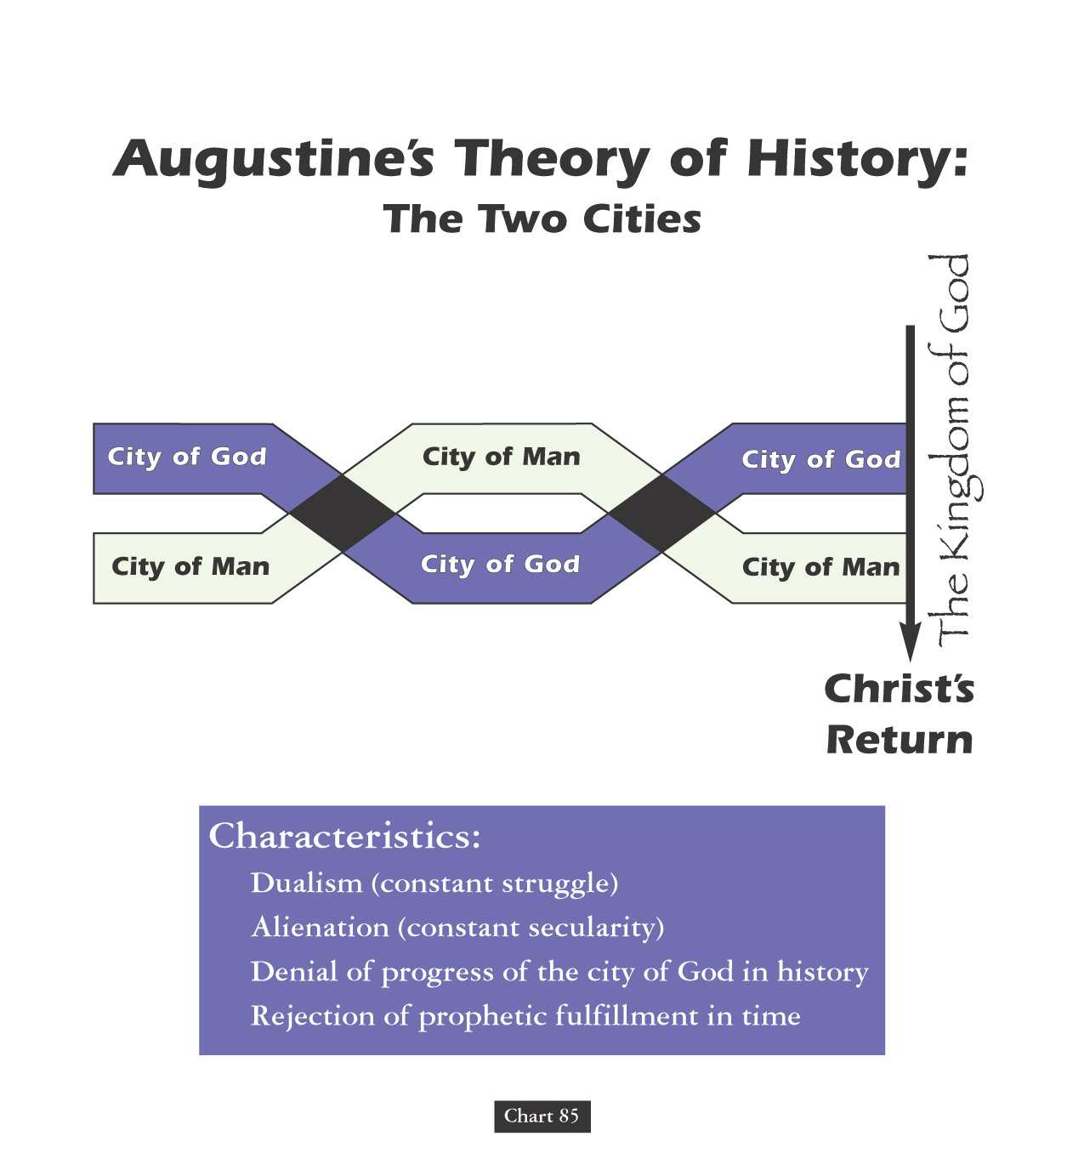
David Lee Burris:
He warned saying that they were subject to being mocked “by those who have read of more and worse things in the history of the world.”
Papacy Owned Slaves
From Franciscan Scholar Joseph McCabe:
"The Papacy,
by the year 600,
had tens of thousands of slaves.
Every abbey had slaves!"

Slide 30

Encomienda and Enslavement
Spanish and Portuguese settlers and soldiers in the Americas subdued native populations, under pretenses of evangelizing them.
Through the encomienda system, natives were “entrusted” to Spanish settlers who forced them to work as slaves on sugar plantations.
In exchange for their forced labor the Spanish Crown required those holding local grants to provide the natives with religious instruction.

Slide 31
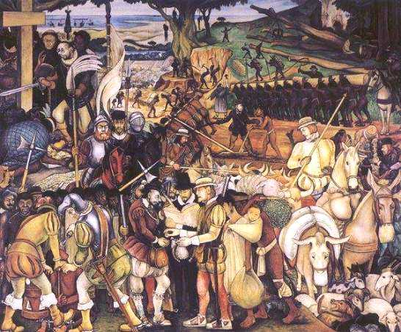
“The Spanish kick them and beat them with sticks to make them get up; They do not allow them to stop and gasp for breath, and even knock their teeth out with the pommel of their swords.”
- Dominican Bartolome de Las Casas

Slide 32
Encomienda and Enslavement
European diseases and brutality destroyed so many natives that there were no longer sufficient laborers for the sugar plantations.
The solution? Enslavement and importation of Africans.
Some settlers even claimed that, according to Genesis 9: 25, God intended Africans to be slaves.

Slide 33
David Lee Burris:
He warned saying that they were subject to being mocked “by those who have read of more and worse things in the history of the world.”
Papacy Owned Slaves
Father Sandoval, a Catholic priest in the Americas wrote to Brother Luis Brandaon, a Church official in Africa, asking if the enslavement of Africans was legal according to Church doctrine. Brother Brandaon’s response, dated March 12, 1610, answered, ‘Your Reverence writes me that you would like to know whether the Negroes who are sent to your parts have been legally captured. To this I reply that I think your Reverence should have no scruples on this point, because this is a matter which has been questioned by the Board of Conscience in Lisbon, and all its members are learned and conscious men. We have been here ourselves for forty years and never did they consider the trade as illicit. Therefore we and the Fathers of Brazil buy these slaves for our service without any scruple.”

Slide 34

IN THE providential BOOK OF JOB

Slide 35
GOD’S LIGHTNING ARE CHARGED ARROWS!

Slide 36
THE THUNDER IS HIS VOICE!

Slide 37
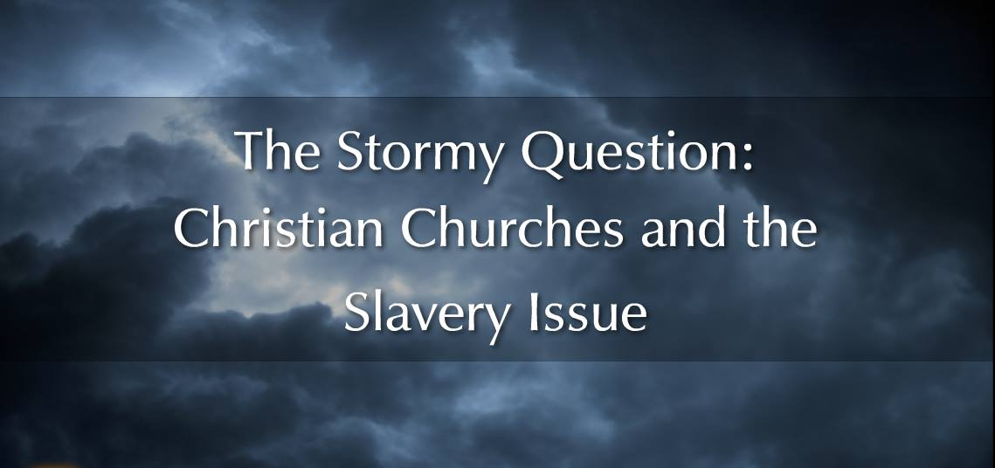


Slide 38
David Lee Burris:
Christian Emperor Theodosius invited Thessalonians to free games but sent his troops into the circus with orders to kill the 10,000 men, women, and children.
“John Calvin W/O Problem@
- DOUBLE PRE-DESTINATION -
AMERICAN SLAVERY & SLAVES
OR SLAVERS & SLAVEHOLDERS
- Of A Christian Nation

Slide 39
David Lee Burris:
Christian Emperor Theodosius invited Thessalonians to free games but sent his troops into the circus with orders to kill the 10,000 men, women, and children.
Calvin himself never opposed slavery. Most prominent Calvinist in Americas was Jonathan Edwards, he and George Whitefield are two most prominent preachers of great awakening. Edwards supported and even practiced slavery. Whitefield although Methodist, rejected the abolitionist views of Wesley and adopted some of the Calvinist theology into his preachings. He actively supported slavery. When Georgia outlawed slavery, Whitefield travelled there to promote the pro-slavery viewpoint.
“The first recorded instance of Christians killing Pagans occurred shortly after {status change year 313}. In short order, the militant church extended its power by conquering lands & peoples throughout Europe, compelling them to become baptized Christians or die… As Charlemagne instructed his Christian troops in their conquest of the Saxons: ‘If there is anyone of the Saxon people lurking among them unbaptized, and if he scorns to come to baptism & stay a pagan - let him die’”.
- Gregory Boyd, Myth Of A Christian Nation

Slide 40
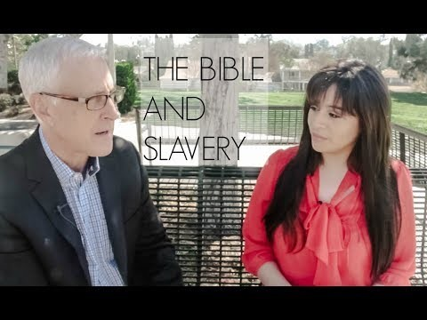
SLAVERY AS FOUND IN SCRIPTURE:

Slide 41
Calvin and (Thomas) Hobbes
Thomas Hobbes: Authored The Leviathan(1651)
Held the belief that people in a nutshell were stupid…
  Well intentioned, but stupid.
Citizens need a strong leader to tell them what to do.
  Given the chance, they will mess up society.
In nature…“no society; and which is worst of all, continual fear, and danger of violent death; and the life of man, solitary, poor, nasty, brutish, and short.”

Slide 42
All in the Fine Print..
Social Contract: An agreement among a society in order to cooperate for social benefits.
  Locke: People give up the right to enact justice in exchange for life, liberty and gain the right to impartial protection of property.
    Monopoly on violence.

Slide 43
Two Treatises on Government, John Locke
1690 England (after Glorious Revolution); CONSTITUTIONALISM
In NATURAL STATE of MAN…
• People are naturally good & peaceful.
- Gov’t is largely unnecessary. Only need comes about because a very small # of people are not honest, and will steal.
- Person who was stolen from cannot set punishment, as they will take it too personal. Might want death for person who stole their bread.

Slide 44
Thus, to Locke, Government is created to settle disputes where individual people might act irrationally (like in a property dispute). Government’s job is to preserve people’s rights:
• Have NATURAL Rights: Life, liberty and Property
- Remember American Declaration of Independence? Life, liberty and happiness? Thomas Jefferson got it from Locke… in fact, Jefferson’s first draft said the 3 rights above… but property didn’t sound quite right as justification for revolt. Happiness was more idealistic.

Slide 45
Another Cool Thing About Locke...
• If gov’t. does not uphold their rights,
people have Right to Overthrow Gov’t
- Think about what this saying. In Absolutism, the king answers Only to God. Locke says that if a king doesn’t respect the wishes of his people, he’s out of a job. This was the idea behind Parliament appointing William and Mary… James II had not protected the rights of his people, so they (Parliament) had the right to depose him.
- Interestingly, the American colonists clung to this idea when it came time for independence. Seemed the British king wasn’t following Locke’s laws in 1760s/1770s, so they had a right to overthrow him.

Slide 46
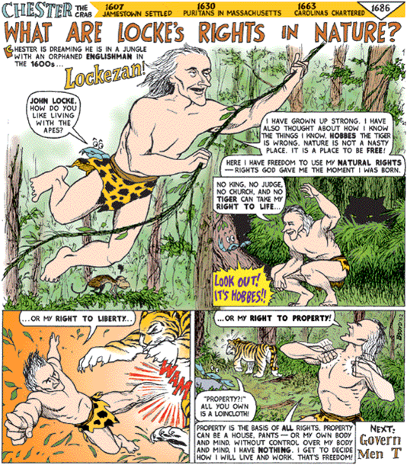

Slide 47
A LONG HABIT OF NOT
THINKING A THING BEING WRONG
GIVES IT A SUPERFICIAL APPEARANCE
OF BEING THOUGHT RIGHT.
- Thomas Paine

Slide 48
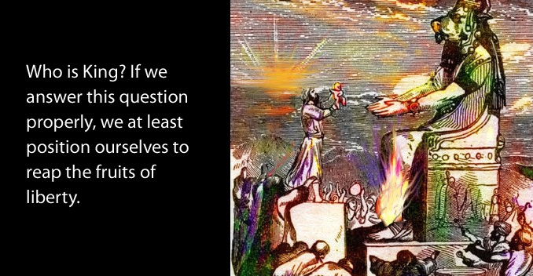
But it’s Paine who is most singled out as America’s true philosophical founder. Paine’s Common Sense did put forth arguments for independence from Great Britain, but how did Paine argue his case? What were his sources? Did he follow deistic lines of argumentation similar to those of the French revolutionaries? “He constructed his arguments from materials that were familiar to the average colonist, favoring allusions to popular history, nature, and scripture rather than Montesquieu, Tacitus, and Cicero.” There is no hint of Deism in Common Sense.
A. J. Ayer remarks that “the first argument that Paine brings against the institution of kingship is scriptural.” Paine declared that “government by kings was first introduced into the world by the Heathens, from which the children of Israel copied the custom. . . As the exalting of one man so greatly above the rest cannot be justified on the equal rights of nature, so neither can it be defended on the authority of scripture; for the will of the Almighty, as declared by Gideon and the prophet Samuel, expressly disapproves of government by kings. All anti-monarchical parts of scripture have been smoothly glossed over in monarchical governments, but they undoubtedly merit the attention of countries which have their governments yet to form. ‘Render unto Caesar the things which are Caesar’s’ is the scriptural doctrine of courts, yet it is no support of monarchical government, for the Jews at that time were without a king, and in a state of vassalage to the Romans.”

Slide 49
Although looking to the horizon of
individual lives history appears
quite predictable and linear
- this is a false perception.

Slide 50
In reality, events are continually curved generationally
trending in terms of regression or social progress
and analyzed as circular over the centuries.

Slide 51
The normative exceptions in historical observation
are what Nassim Nicholas Taleb calls Black Swans -
where as he says “History does not crawl, it jumps.”

Slide 52
These world class epic events include the
Wittenburg Hammer heard round the world
Lexington Bridge Shot heard round the world.

Slide 53
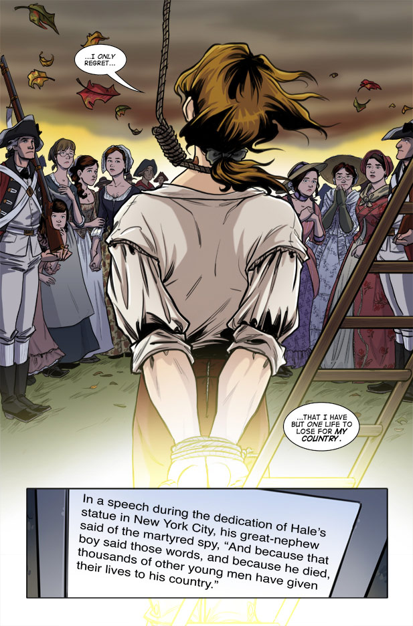

Slide 54
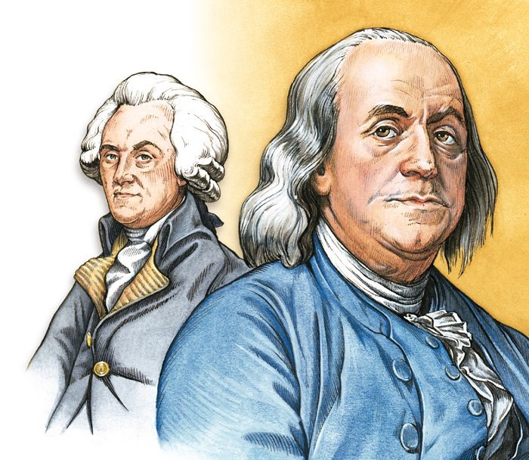
providence
“I received your Letter of the 22d past, and am glad to find that you desire to revive the affectionate Intercourse, that formerly existed between us. It will be very agreeable to me; indeed nothing has ever hurt me so much and affected me with such keen Sensations, as to find myself deserted in my old Age by my only Son; and not only deserted, but to find him taking up Arms against me, in a Cause, wherein my good Fame, Fortune and Life were all at Stake. You conceived, you say, that your Duty to your King and Regard for your Country requir’d this. I ought not to blame you for differing in Sentiment with me in Public Affairs. We are Men, all subject to Errors. Our Opinions are not in our own Power; they are form’d and govern’d much by Circumstances; that are often as inexplicable as they are irresistible.”

Slide 55
“We have it in our power,”
Thomas Paine declared,
“to begin the world over again!”

Slide 56
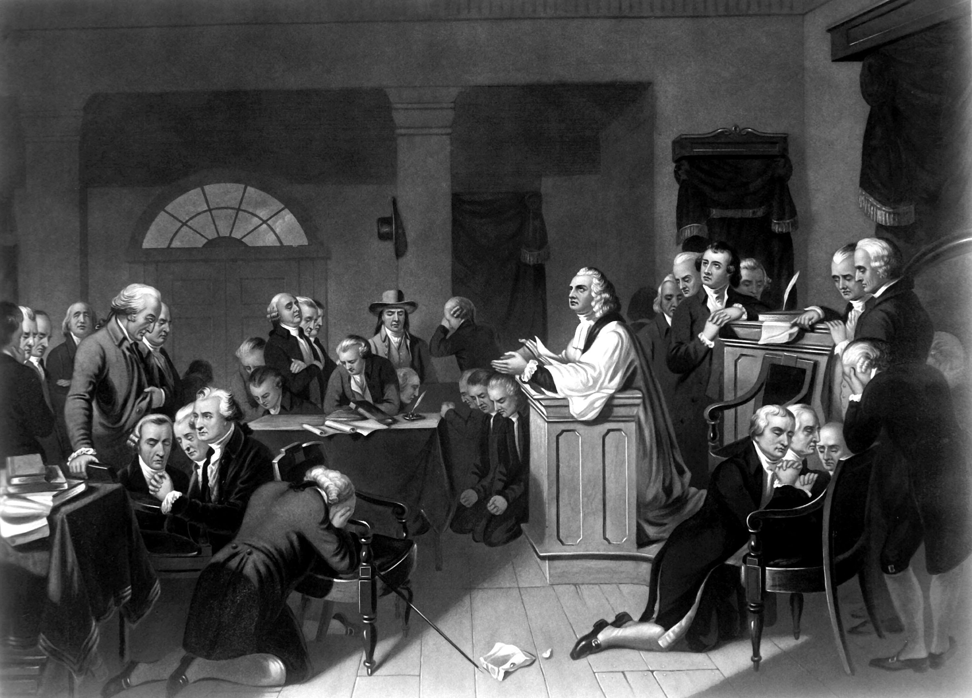
Revolutionary Continental Congress
1st Prayer In 1774 Led By Jacob Duche
"O Lord,
look down in mercy,
we beseech Thee,
on these American States,
who have fled to Thee
from the rod of the oppressor
and thrown themselves
on Thy gracious protection."

Slide 57
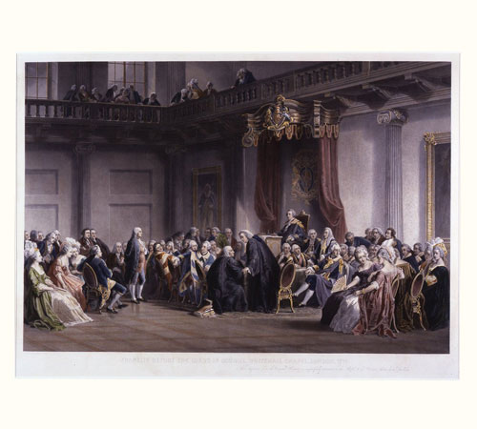
During the session of [the First Continental] Congress, a gentlemen, residing in the city of Philadelphia, anxious to learn the chief of the strangers who had assembled from the several colonies, observed to Mr. Secretary Thomson, that he had heard much of Mr. Washington from Virginia, and would be glad to know how he could distinguish him. Mr. Thomson replied, "You can easily find him when Congress goes to prayers—Mr. Washington is the gentleman who kneels down." Thus, in the prime of life, did this gentleman, who was as noted for his modesty as for his merit, manifest to the world his sense of the overruling providence of God, and of the power of prayer with him who giveth to all men liberally and upbraideth not. (p. 51-52)

Slide 58
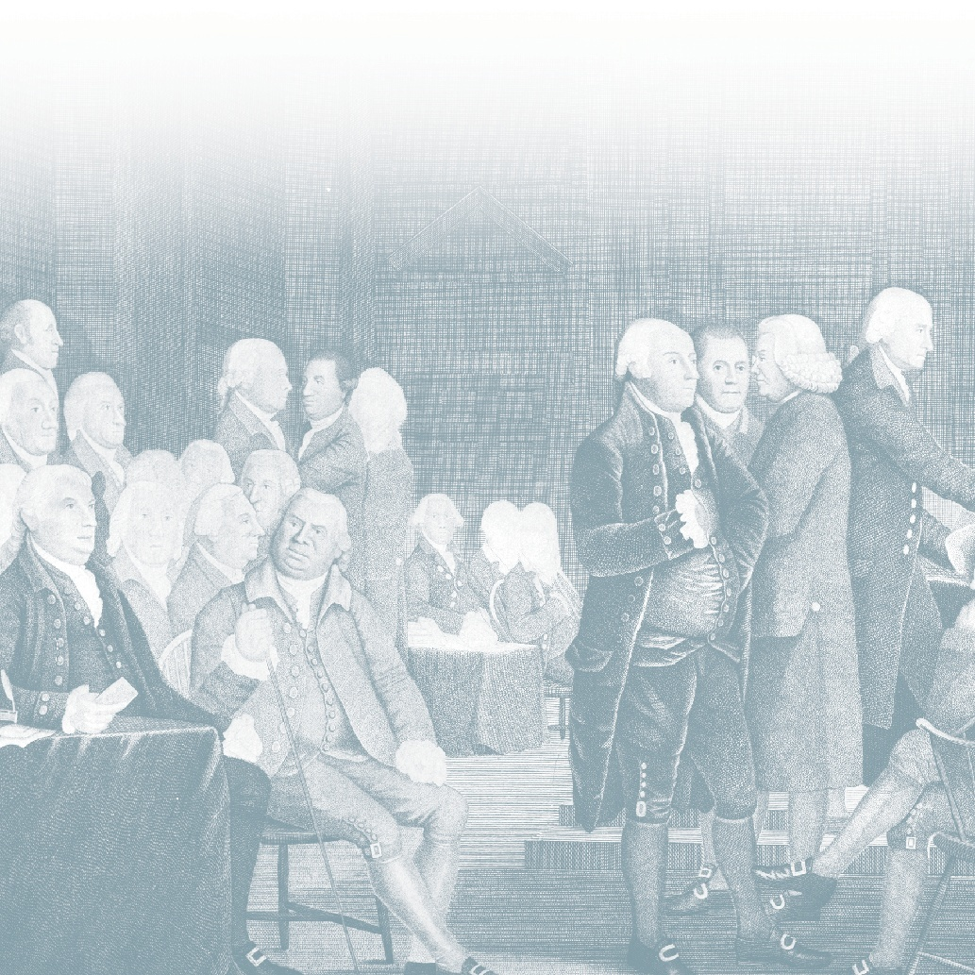
Manly Hall described a rousing speech delivered by a mysterious “unknown speaker” before the signing of the Declaration of Independence. The “strange man,” wrote Hall, invisibly entered and exited the locked doors of the Philadelphia statehouse on July 4th, 1776, delivering an oration that bolstered the wavering spirits of the delegates. “God has given America to be free!” commanded the mysterious speaker, urging the men to overcome their fears of the noose, axe, or gibbet, and to seal destiny by signing the great document. Newly emboldened, the delegates rushed forward to add their names. They looked to thank the stranger only to discover that he had vanished from the locked room.

Slide 59
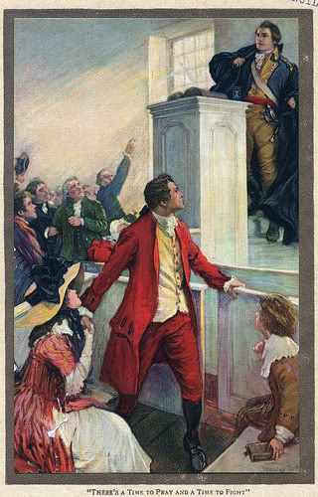
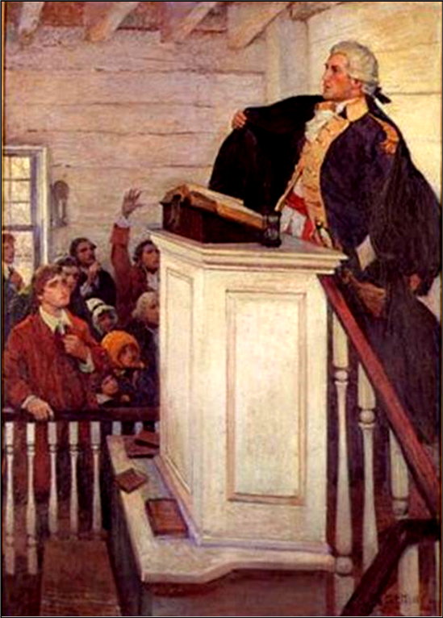

Slide 60
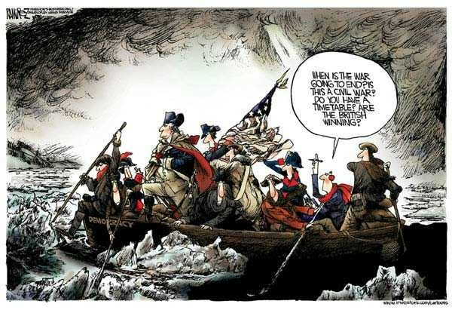
Historic Formula Hinge Factor:
The Theory That World History Shaped As Much By Chance & Error As By Courage & Heroism
David Lee Burris:
College Course Quote – “The social scum and religious eccentrics England had sent there [America] proved to be so unpredictably resourceful that the mother country was beginning to sustain an unfavorable balance of trade with America.”
PRAYER ANSWERED THROUGH
ARRANGED COINCIDENCE

Slide 61
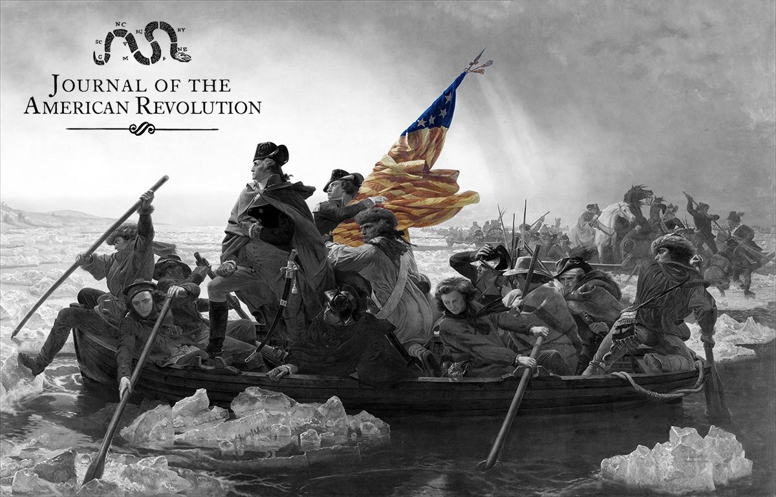

Slide 62
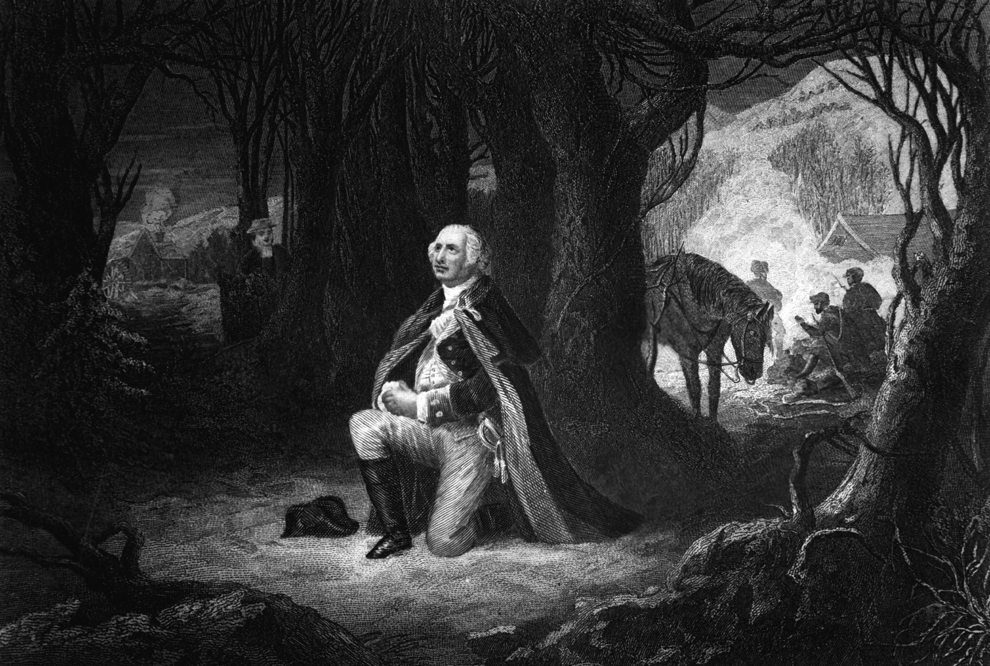
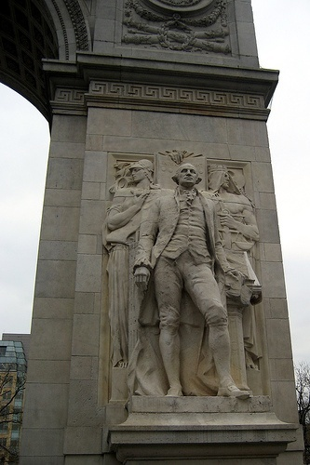
Bulletproof George Washington
David Lee Burris:
Indian Chief – Washington had the “special guardianship of the Great Spirit” During The F&I Wars.
General Lee @ Washington's Funeral:
Vice shuddered in his presence,
and virtue always felt his fostering hand;
the purity of his private character
gave effulgence to his public virtues.

Slide 63
Bulletproof George Washington
David Lee Burris:
Indian Chief – Washington had the “special guardianship of the Great Spirit” During The F&I Wars.
General Lee @ Washington's Funeral:
THE FINGER OF AN
OVERRULING PROVIDENCE
POINTING AT WASHINGTON WAS
NEITHER MISTAKEN NOR UNOBSERVED!

Slide 64
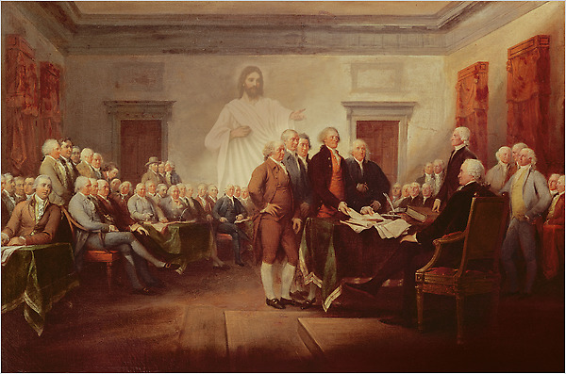
The Foundation
"The Hand of providence has been so conspicuous in all this, that he must be worse than an infidel that lacks faith, and more than wicked, that has not gratitude enough to acknowledge his obligations." -- George Washington

Slide 65

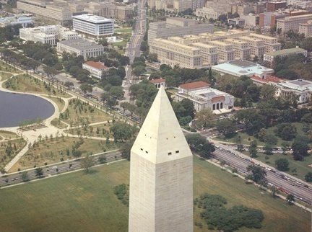
“Laus Deo”
“Praise Be To God!”
Washington Monument

Slide 66
18th Cent
Divine Providence:
Old world & New world
“Alle Kunst ist umsunst Wenn ein Engel auf das Zundloch brunzt!”
FROM GERMAN TO ENGLISH:
“All skill is in vain if an angel pees down your musket’s touch-hole!”

Slide 67
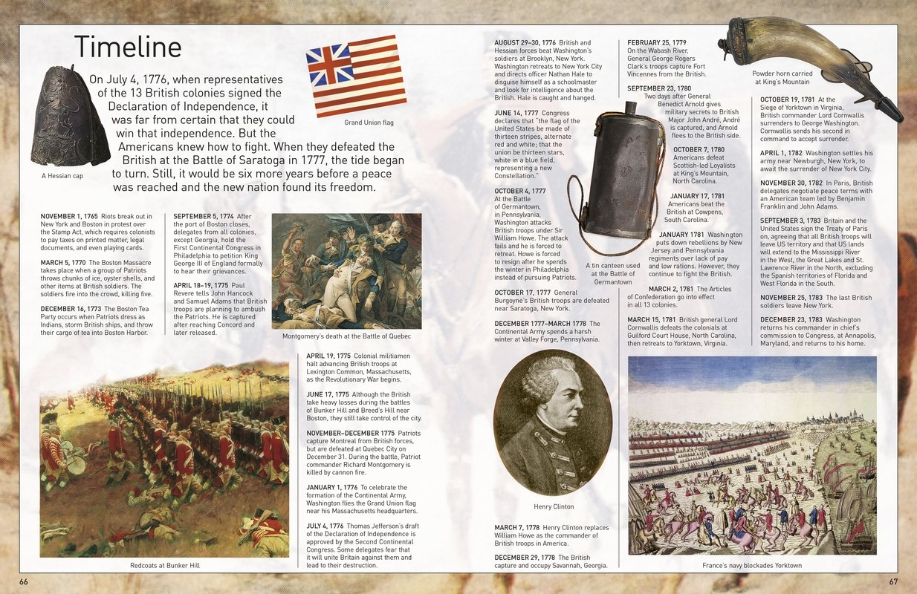

Slide 68


Slide 69
“We have it in our power,”
Thomas Paine declared,
“to begin the world over again!”

Slide 70


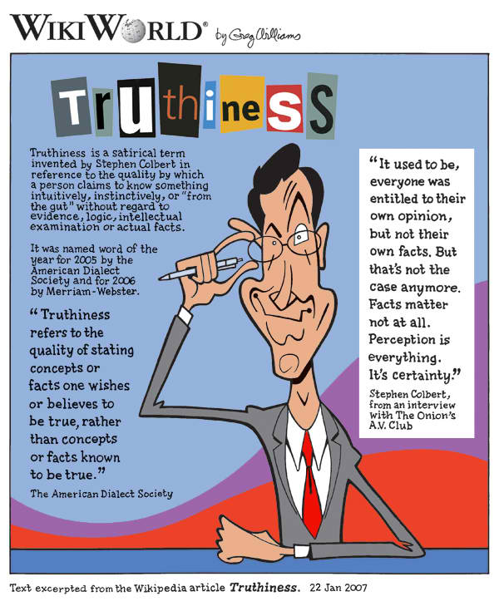
DISTORTIONS OF ABSOLUTE RIGHT
“Because of distortions and for no other reason, the average person thinks there is an occasional distinction between logical right and expedient right, between logical right and moral right, and also between expedient right and moral right. Despite widespread misconceptions, it seems
almost too prosaic to say that there is not. There is no distinction in the word itself; the distinction is only in the modifier used before the word, and the modifier designates an ingredient rather than a distinction. Right is certainly not absolute unless it has all the ingredients.” - HUMANETICS

Slide 71
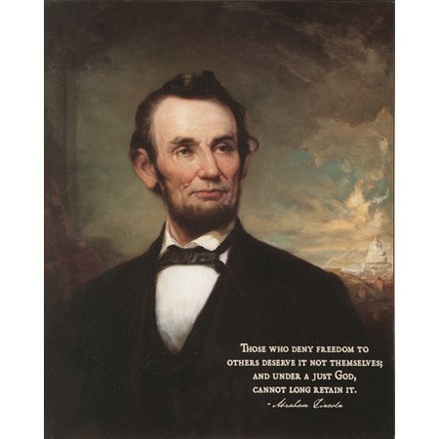
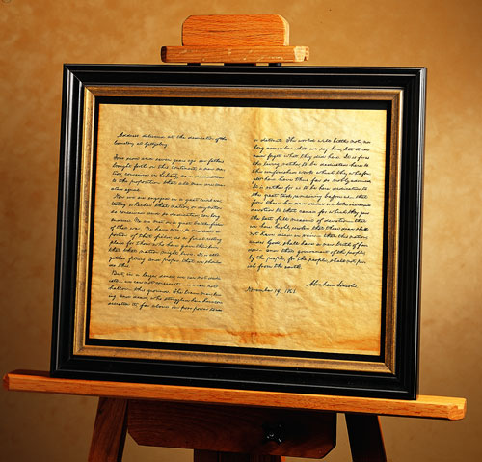
David Lee Burris: EARLY INDICATORS OF EMERGING PROBLEMS
Extra-Church Alliances: Campbells Opposed American Sunday School Union From The Start But Alexander Eventually Reversed On The American Bible Society Becoming Life Director; Intra-Church Organizing: During Decade Of The 1830’s “Area-Wide Cooperation Meetings” Began To Occur & By The 1840’s There Were Some Statewide Meetings To Coordinate Evangelism & Preacher Support; There Were Two Failed Efforts At National Bible Societies One Inter-Denominational & The Other Internal Each Was Headed By Alexander Campbell;
Alexander Wrote A Series Of 16 Articles Staring in 1849 Insisting On National Organizing To Expedite Efforts Of Evangelism In Terms Of Education – Benevolence – Overseas Missions
American Missionary Society Was Formed In Cincinnati In October Of That Year & With Article Three Of The Society Constitution Controversial In Its Requirement In Dues Of Membership
Alexander Campbell On The Structure Of The Church – “Creative Freedom In Action” & Slogan “Disorganization Is Death.”
CAMPBELL RESERVED THE TITLE ‘BISHOP’ FOR HIMSELF & THUS ‘BISHOP’S PRESS & BISHOP’S COLLEGE IN BETHANY
Until David Lipscomb The Disciples Moved Onward Under The Banner “Whatever Is Good For The Church As A Whole Should Be Done By The Church As A Whole”
Principle Of Human Worth Compromised
THE SLAVERY BILL by Leland Gregory
“A lot of revisionists have torn into Thomas Jefferson because he owned slaves. Some have gone so far as to removing his picture from the currency. But if we’re going to be consistent, we’re going to be short a lot of money. There have been nine other presidents who also owned slaves:
George Washington[on the quarter & one dollar bill],
Andrew Jackson[$20], Grant[$50], & six not on currency – Andrew Johnson, Zachary Taylor, James Polk, & John Tyler – U.S. president elected to the C.S.A. Congress.”

Slide 72
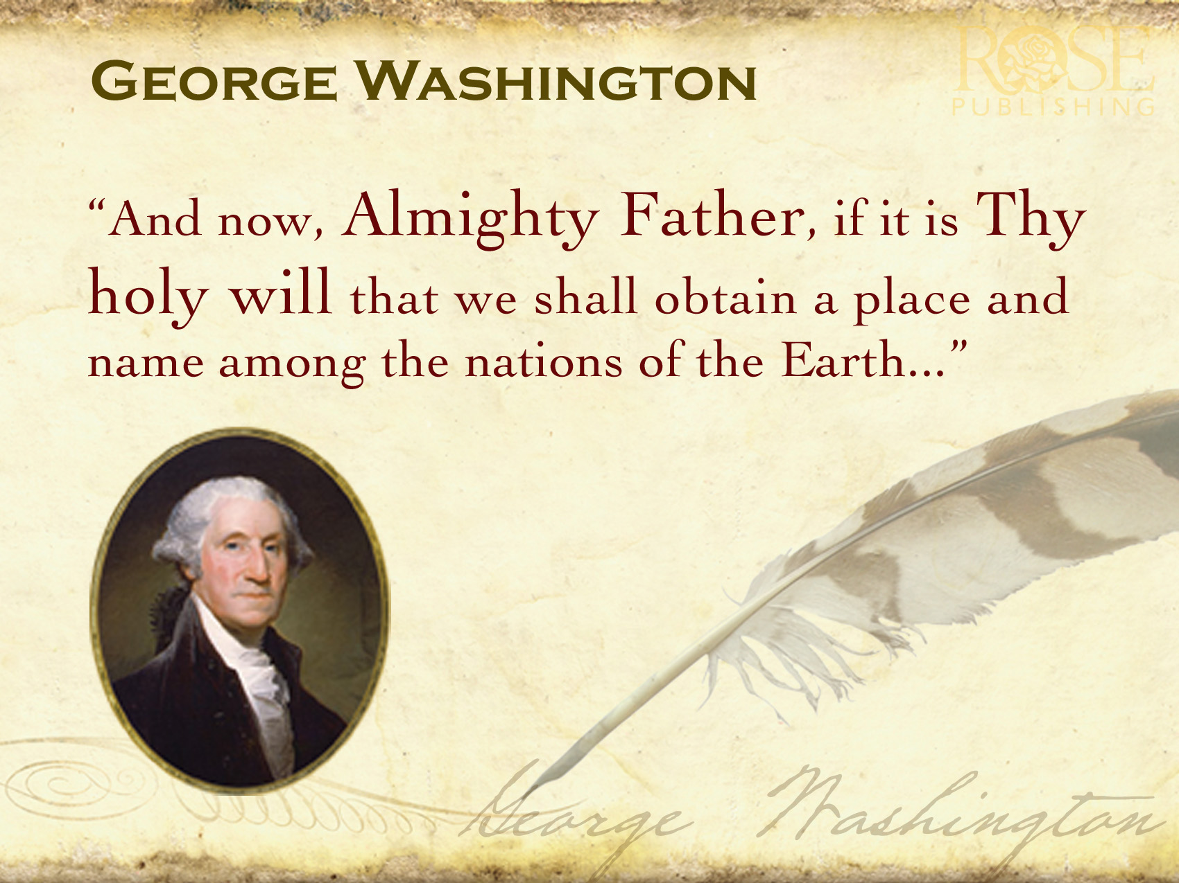
* Per burns Book – Early “harsh slave owner”
“There is not a man living who wishes more sincerely then I do to see a plan for the abolition of it (slavery) adopted.” - Washington
His coat of arms motto was: "The deed is proven by the action."

Slide 73
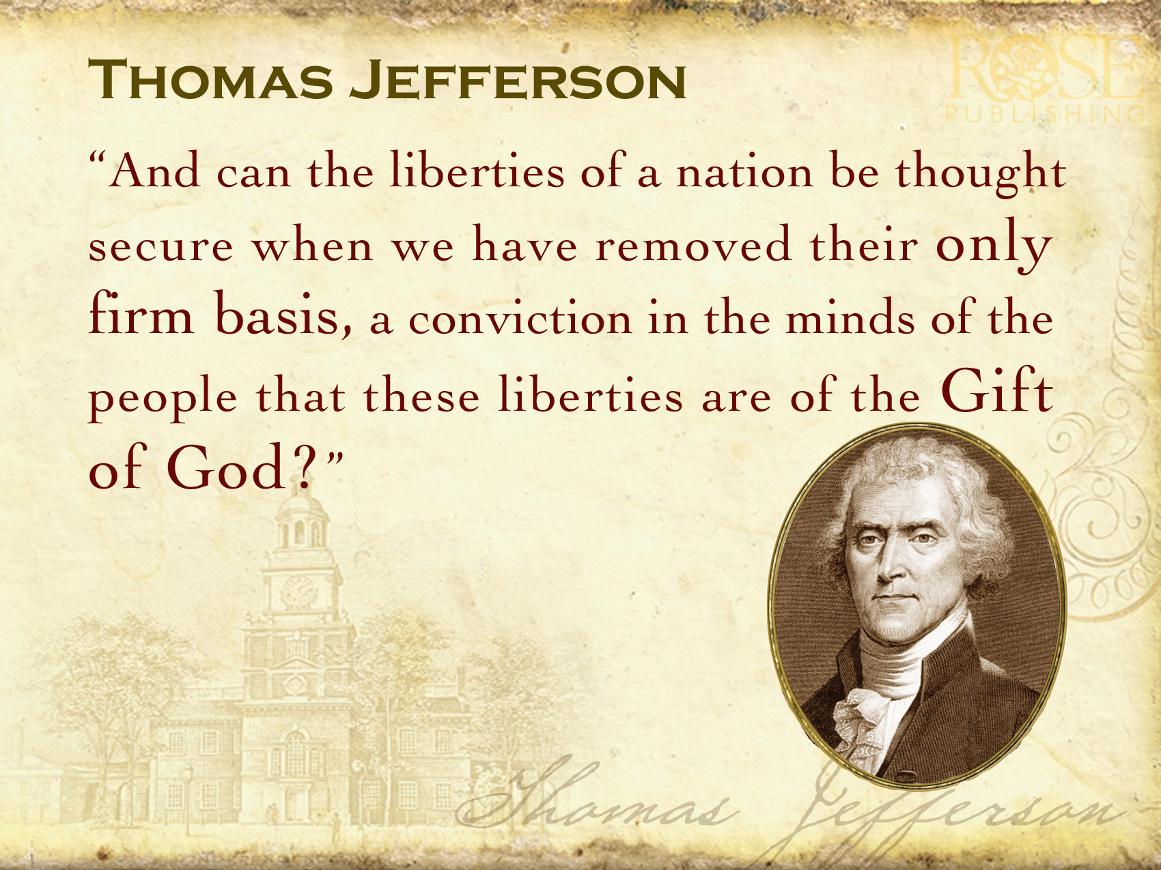

“Irony was also at work, meaning that impressive resolutions of some problems closed off options to solve others. By circumscribing federal power, especially at the executive level… the founders placed the despotism threat on permanent defense, but in so doing made it virtually impossible to end slavery or reach a just accommodation with the Native Americans.” - J. J. Ellis, American Creation

Slide 74
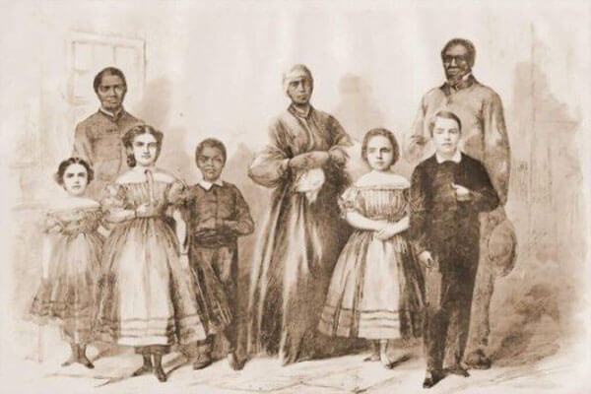
Four Children of Jefferson & Hemings

Slide 75
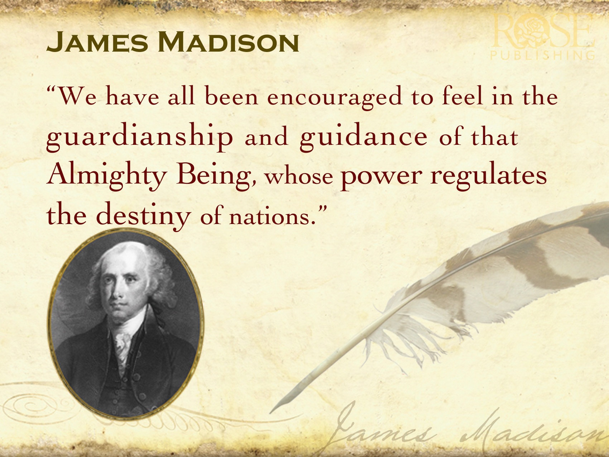
“We have seen the mere distinction of color made in the most enlightened period of time, a ground of the most oppressive dominion ever existed by man over man.” - James Madison

Slide 76
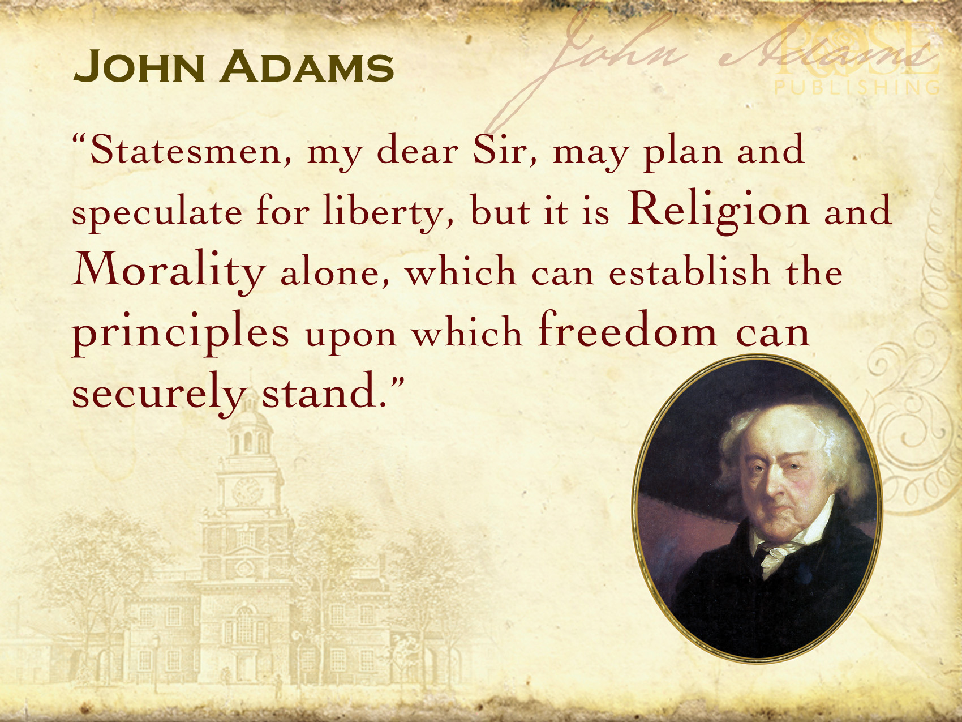
Every measure of prudence ought to be assumed for the eventual total extirpation of slavery from the United States.
– John Adams

Slide 77

"Power always thinks it has a
great soul and vast views beyond
the comprehension of the weak;
and that it is doing God's service
when it is violating all his laws."
~ John Adams

Slide 78
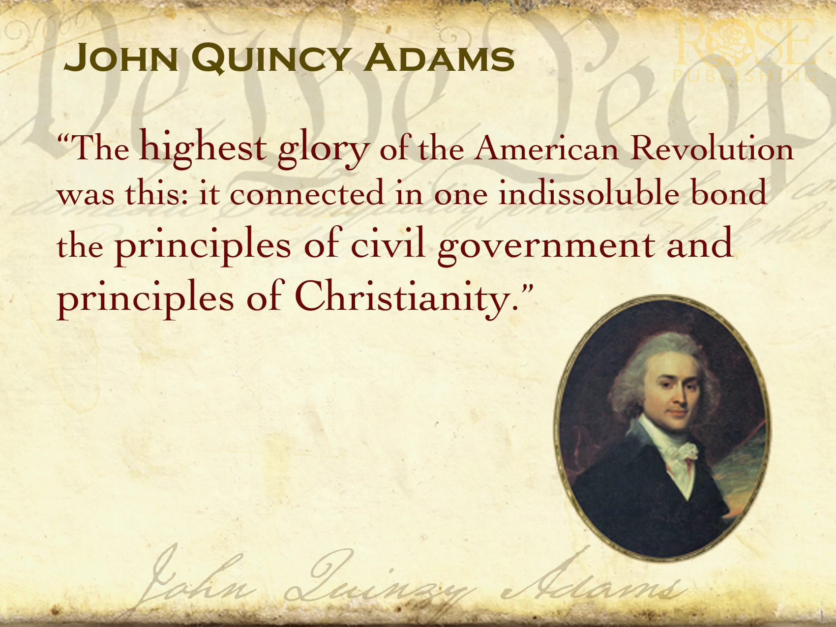
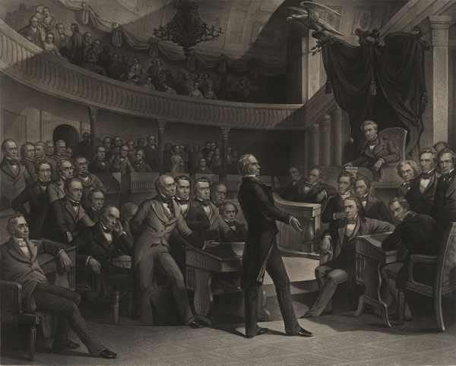
John Quincy Adams was not an abolitionist, but he wanted the slavery issue debated. After serving four years as President, he was elected to the U.S. Congress, where he served for seventeen years. During his congressional career, he tried to bring the slavery discussion to the House floor. However, the gag laws forbade it. In 1844 he got rid of those laws!

Slide 79
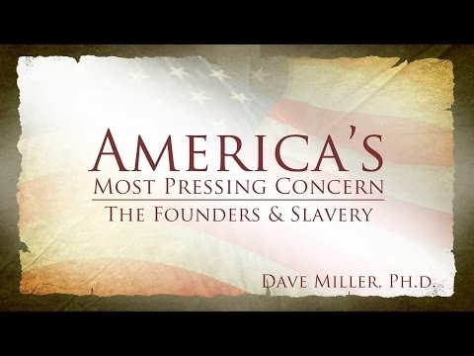
WVBS VIDEO SCHOOL: FOUNDERS @SLAVERY

Slide 80

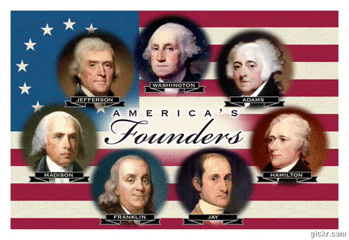
LaBianca outlines four different kinds of history, different takes on the past: (1) the desired past,
(2) the contested past,
(3) the forbidden past and (4) the propaganda past.

Slide 81

Customary Indentured Servitude
Until Bacon’s 1676 Rebellion
After Race-Based Slavery
Statutory/Permanent

Slide 82

Human Slavery 1676 to 1793:
Accepted As A Necessary Evil
From Cotton Gin Thru Civil War:
Justified As A Positive Good
Historic Snakecycle

Slide 83
David Lee Burris: WOULD IT HAVE BEEN POLITICS IN THE PULPIT AS STONE SAID?
In 1849: “There are usually pews for their race in the back of the auditorium.”
Contrast To William Wilberforce Of England Who Considered A Change In His Political Career Along With His New Christianity But Was Encouraged To Work Within The System For Change – He Talked The British Empire Into Abolishing The Practice Altogether!
Era’s Men of Intellect Knew That The
Dismal Science Supported Abolition
For Dismal Science (the study of economics) was born as an epithet meant to dismiss those arguing that slaves deserved their freedom. In fact, the first recorded mention of the phrase ‘dismal science’ occurs in 1849 related to a great debate in England that in our nation would be resolved by the American Civil War.
Thomas Carlyle deployed the term in a magazine polemic entitled ‘An Occasional Discourse on the Negro Question.’ In that essay, Carlyle savaged the two groups who were leading the British fight against slavery: economists and evangelicals.

Slide 84
David Lee Burris: WOULD IT HAVE BEEN POLITICS IN THE PULPIT AS STONE SAID?
In 1849: “There are usually pews for their race in the back of the auditorium.”
Contrast To William Wilberforce Of England Who Considered A Change In His Political Career Along With His New Christianity But Was Encouraged To Work Within The System For Change – He Talked The British Empire Into Abolishing The Practice Altogether!
Era’s Men of Intellect Knew That The
Dismal Science Supported Abolition
Carlyle argued that if blacks were left to the laws of supply & demand, the way he saw commercial society – they would be condemned to a life of misery. For their and society’s sake, what they needed was a ‘beneficent whip.’

Slide 85
BOOK OF CALAMITIES\SUFFERING\FACES IN THE HOLD
Between September 6th and December 22nd sixty cases of severe dysentery broke out among the 440 captives on the slave ship Zong sailing from the West African Coast to deliver its human cargo to the sugar plantations on the island of Jamaica . This was significantly above the average mortality rate of 12.5% normal to this valuable merchandise on this particular passage. Captain Collingwood was gravely concerned for the potential financial loss to the vessel’s owners should the disease spread further and weaken even more.
Collingwood wrote in his journal a proposal of alternative action: “It would not be so cruel to throw the poor sick wretches into the sea as to suffer them to linger out a few days under the disorders to which they were afflicted.”
The latter remedy had the added advantage of being covered by insurance – thirty pounds indemnity for each of the jettisoned slaves. But the underwriters refused to pay. The case was brought to court where the jury found for the ship’s owners, on the grounds that there was no more wrong attached to disposing of an ailing slave than to putting down a horse with a broken leg. The insurers appealed, and a second trial ensued. In the end, the magistrate ruled for the insurers – citing an unreferenced “higher law” than property law.
* Charles Finney Took A Stand Against Slavery!

Slide 86
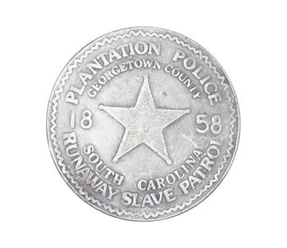
A HIGHER LAW?

Slide 87
SOCIAL THEORIST GEORGE FITZHUGH TYPICAL:
“Slavery here relieves the African from a more cruel slavery in Africa – it christianizes, protects, supports and civilizes him; it governs better than ‘wage slave’ free laborers at the North are governed. The master labors for the slave, they exchange industrial value. But the capitalist, living on his income, gives nothing to his subjects. He lives by mere exploitations.”

Slide 88
In the Dred Scott v Sanford Decision, 1856, written by Chief Justice Roger B. Taney, who was appointed by Democrat President Andrew Jackson we read:
"Slaves had for more than a century before been regarded as beings of an inferior order... so far inferior, that they had no rights which the white man was bound to respect; and that the Negro might justly and lawfully be reduced to slavery for his benefit."

Slide 89
David Lee Burris: EARLY INDICATORS OF EMERGING PROBLEMS
Extra-Church Alliances: Campbells Opposed American Sunday School Union From The Start But Alexander Eventually Reversed On The American Bible Society Becoming Life Director; Intra-Church Organizing: During Decade Of The 1830’s “Area-Wide Cooperation Meetings” Began To Occur & By The 1840’s There Were Some Statewide Meetings To Coordinate Evangelism & Preacher Support; There Were Two Failed Efforts At National Bible Societies One Inter-Denominational & The Other Internal Each Was Headed By Alexander Campbell;
Alexander Wrote A Series Of 16 Articles Staring in 1849 Insisting On National Organizing To Expedite Efforts Of Evangelism In Terms Of Education – Benevolence – Overseas Missions
American Missionary Society Was Formed In Cincinnati In October Of That Year & With Article Three Of The Society Constitution Controversial In Its Requirement In Dues Of Membership
Alexander Campbell On The Structure Of The Church – “Creative Freedom In Action” & Slogan “Disorganization Is Death.”
CAMPBELL RESERVED THE TITLE ‘BISHOP’ FOR HIMSELF & THUS ‘BISHOP’S PRESS & BISHOP’S COLLEGE IN BETHANY
Until David Lipscomb The Disciples Moved Onward Under The Banner “Whatever Is Good For The Church As A Whole Should Be Done By The Church As A Whole”
OUR NATIONAL INIQUITY
“I know the Lord is always on the side of the right.
But it is my constant anxiety and prayer that I
and this nation will be on the Lord’s side!”
"We have been the recipients of the choicest bounties of heaven.
We have been preserved, the many years, in peace and prosperity.
We have grown in numbers, wealth & power,
as no other nation has ever grown.
BUT WE HAVE FORGOTTEN GOD!"

Slide 90
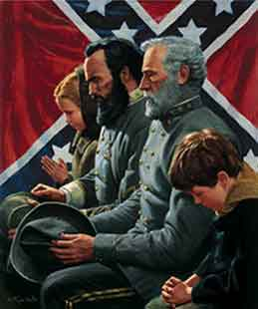
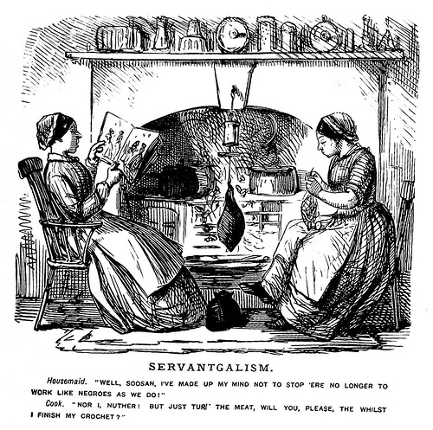
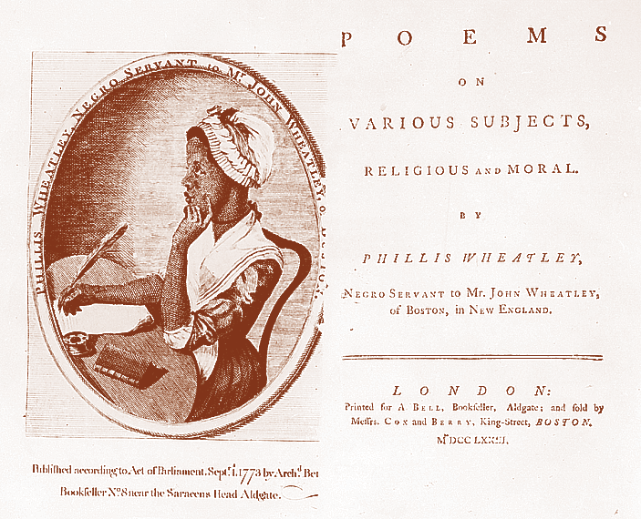
“Both (parties) read the same Bible, and pray to the same God; and each invokes His aid against the other. It may seem strange that any men should dare to ask a just God’s assistance in wringing their bread from the sweat of other men’s faces.”
David Lee Burris:
To Our Shame The Social Issues That Concerned The Restoration Movement To The Exclusion Of Slavery Both Thirty Years Prior & Thirty Years After The Civil War Were Recreation Related: Dancing – Card Playing – Horse Racing – Cock Fights – Gambling. Tobacco & Temperance Issues Did Divide. The Only Social Issue Non-Recreational Getting Attention Was That Of Secret Societies – i.e. Masonry.
- Abraham Lincoln

Slide 91

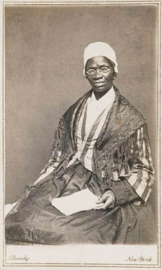
Slavery, War, and Social Reform
Isabella, an African-American slave, gained her freedom in 1843.
She changed her name to “Sojourner Truth” and travelled “up and down the land, showing people their sins,” calling Christians to see the need for social reforms.
Sojourner Truth

Slide 92
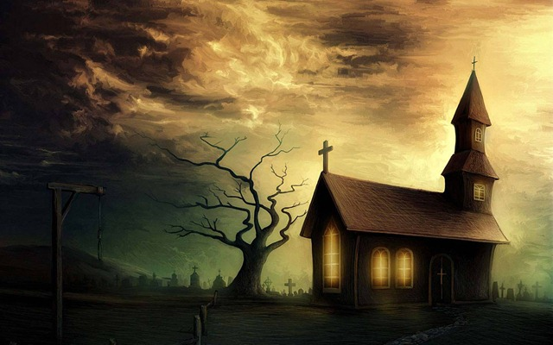
We maintain that no compensation should be given to the planters emancipating their slaves:
Because it would be a surrender of the great fundamental principle,
that man cannot hold property in man; Because slavery is a crime, and therefore is not an article to be sold; Because the holders of slaves are not the just proprietors of what they claim; Freeing the slave is not depriving them of property, but restoring it to its rightful owner; it is not wronging the master, but righting the slave — restoring him to himself!
From the Anti-Slavery Society

Slide 93


Civilized Culture Index: Civic Virtues Compensate Vice
Invisible Coordination: Cultural Inculcation
Invisible Coordination: Lone Internalization
Failure Indicator: Utility Value Wrong Acts
Social Gaming: Self-Interest Act Is To Evil
Signal: High Good Not Equal Order Of Evil
Vertical Virtuous Cannot Right Large Scale:
Horror Class Horizontal Human Exploitation
Horror Class Horizontal Human Oppression
Horror Class Horizontal Human Degradation

Slide 94

“We are tempted to try to equate ‘humanity’ with the ‘animal,’ but we are in error to speak of one who acts immorally, that is one who harms or degrades another or himself, as being, ‘merely human.’ The phrase is almost always associated with the more base, degenerate, animal like behavior. In addition to this deterioration, unknown to him he has become victim of the ‘law of mortigression’ Natures law of momentum, applied to human behavior states: A personality in process of deterioration tends to continue in the process unless acted upon by an outside force.” - William Justice, Jr.

Slide 95
Civilized Culture Index: Comparative Calculus Changes
Secular: Reality Not Inevitably Geared Toward An Effortless Triumph Of Good
Renaissance Age & Enlightenment Era – European & American - Religious & Political – Reformers & Revolutionaries – Similarly Ranked Values & Disvalues
While Adversity Can Create Conditions For Dignified & Courageous Heroics – It Cannot Be Reasoned As Justification

Slide 96
Civilized Culture Index: Comparative Calculus Changes
Arminians Of Church Reformation Age: Middle Theology Countering Calvinism
Dual Dispute: Humanism & Universalism
Agree Against Calvin’s Hopeless Fatalism
But Disagree This World “Best Of Possible”
Framers Of Political Reformation Age: Royal Society Splits @Naturalism
Division: Man’s Nature & Natural Order

Slide 97
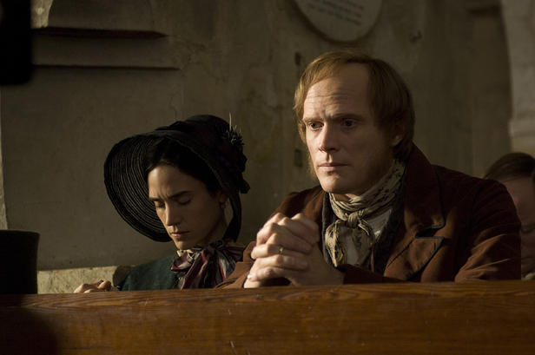
Monogenesis Still Supported Slavery

Slide 98
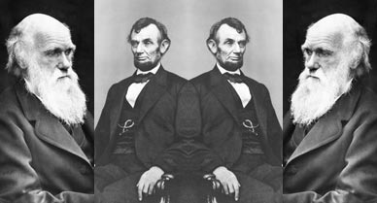
DARWIN DEVOLVES SLAVERY STATIC
LINCOLN LIBERATES SLAVERY SWEPT

Slide 99
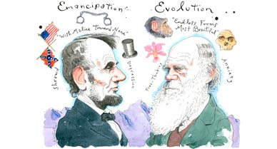
Karl Marx Also Was Their Contemporary.
Europe’s Reporter For New York Tribune. His History Chronicle Had Consequence.
“History Repeats Itself,
First As Tragedy,
SECOND AS FARCE!”

Slide 100
“There is a growing taste for opinionism in the Reformation ranks. This must be quashed out or there is an end to all moral and religious improvement. It has ever been the harbinger of schism, the forerunner of all discord and vain jangling.
It has been the plague of Christendom.
What is an opinion? Persuasion without proof, say some lexicographers. It is speculation built on probable evidence. It is neither knowledge or faith; but in the absence of these, it is an inference, a conclusion to which the mind assents according to its information or mode of reasoning…
To walk by opinions rather than faith is effectually to make the Book of God of no authority!”
- Alexander Campbell in 1837

Slide 101
The Moral Change Process: Cognitional & Conceptual Developments
1st Level: Pre-Conventional Is Structured In Terms Of An Obedience To Tools & Rules.
2nd Level: Critical Reflection Of Rule Roles & Basic Conventions; Accepted Tool Of Social Relation & Maintenance Of Social Order.
3rd Level: Post-Conventional Individual & Minority Focus On Rights & Universal Principles - Natural Law & Analogic Method
Source: Kohlberg, Psychology Of Moral Development

Slide 102
Symbiontic
What
People
Value
Must Match
How
Value
People

Slide 103


God’s Two Methods
Willing change:
  Reflect on the cross
  Soften the heart
  Yields to God’s way of thinking
Grudging change:
  External difficulties
  Soften the heart
  Yields

Slide 104
Does God Exist?\Oct90\Revolution Or Evolution?\Cecil Hook
David Lee Burris:
Notes On Roman Stylized Slavery: “Legally claiming personal bankruptcy opened the door for many to make their fortunes handling the affairs of the great houses of the prominent families of the cities. Slowly but surely these temporary slaves became essential to the maintenance of the household and then the dependency relationship would be reversed. Shortly thereafter these skilled individuals would buy out their contract and become manor caretakers – in other words – they went from self-enslavement to quoting their own salary in short order!” Myself
Was it sinful for christians to own slaves?
Would it have been proper to buy a slave?
What about one person enslaving another?
“Paul insists, ‘Do not become slaves of men?’ (1st Cor 7:23). If it is wrong for me to become a slave, it is wrong for me to enslave someone else. Through the working out of the Golden Rule, this great social change was to evolve…”

Slide 105
Does God Exist?\Oct90\Revolution Or Evolution?\Cecil Hook
David Lee Burris:
Notes On Roman Stylized Slavery: “Legally claiming personal bankruptcy opened the door for many to make their fortunes handling the affairs of the great houses of the prominent families of the cities. Slowly but surely these temporary slaves became essential to the maintenance of the household and then the dependency relationship would be reversed. Shortly thereafter these skilled individuals would buy out their contract and become manor caretakers – in other words – they went from self-enslavement to quoting their own salary in short order!” Myself
Was it sinful for christians to own slaves?
Would it have been proper to buy a slave?
What about one person enslaving another?
“Paul insists, ‘Do not become slaves of men?’ (1st Cor 7:23). If it is wrong for me to become a slave, it is wrong for me to enslave someone else. Through the working out of the Golden Rule, this great social change was to evolve…”
“God wants change in all individuals and societies. He does not, however, demand or expect that change to be an immediate leap from depravity to perfection. Conduct of a mature disciple is not demanded of a newborn in Christ; neither is infancy an acceptable standard for those who have had time and opportunity to grow toward the fullness of Christ!”

Slide 107
Powerless in the face of authority
No man has authority to restrain the wind with the wind, or authority over the day of death; there’s no discharge in the time of war, and evil will not deliver those who practice it. (Ecl 8:8)

