Slide 1

War Between States DIVIDES NATION&Splits RESTORATION MOVEMENT
By David Lee Burris

Slide 2
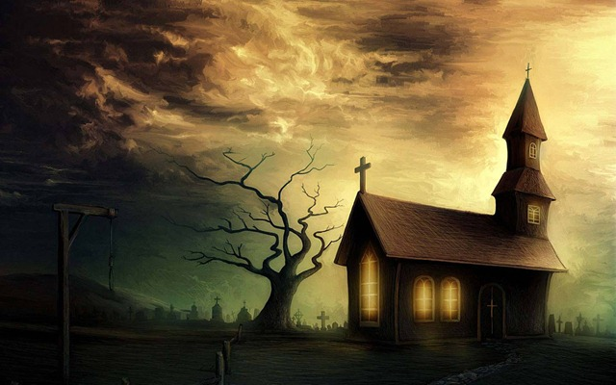
Uncle Tom’s Cabin:
O, church of Christ,
read the signs of the times!
Is not this power
the spirit of HIM whose kingdom is
yet to come?

Slide 3

Does God Exist?\Oct90\Revolution Or Evolution?\Cecil Hook
David Lee Burris:
Notes On Roman Stylized Slavery: “Legally claiming personal bankruptcy opened the door for many to make their fortunes handling the affairs of the great houses of the prominent families of the cities. Slowly but surely these temporary slaves became essential to the maintenance of the household and then the dependency relationship would be reversed. Shortly thereafter these skilled individuals would buy out their contract and become manor caretakers – in other words – they went from self-enslavement to quoting their own salary in short order!” Myself
Was it sinful for christians to own slaves?
Would it have been proper to buy a slave?
What about one person enslaving another?
“Paul insists, ‘Do not become slaves of men?’ (1st Cor 7:23). If it is wrong for me to become a slave, it is wrong for me to enslave someone else. Through the working out of the Golden Rule, this great social change was to evolve…”

Slide 4
Does God Exist?\Oct90\Revolution Or Evolution?\Cecil Hook
David Lee Burris:
Notes On Roman Stylized Slavery: “Legally claiming personal bankruptcy opened the door for many to make their fortunes handling the affairs of the great houses of the prominent families of the cities. Slowly but surely these temporary slaves became essential to the maintenance of the household and then the dependency relationship would be reversed. Shortly thereafter these skilled individuals would buy out their contract and become manor caretakers – in other words – they went from self-enslavement to quoting their own salary in short order!” Myself
Was it sinful for christians to own slaves?
Would it have been proper to buy a slave?
What about one person enslaving another?
“Paul insists, ‘Do not become slaves of men?’ (1st Cor 7:23). If it is wrong for me to become a slave, it is wrong for me to enslave someone else. Through the working out of the Golden Rule, this great social change was to evolve…”
“God wants change in all individuals and societies. He does not, however, demand or expect that change to be an immediate leap from depravity to perfection. Conduct of a mature disciple is not demanded of a newborn in Christ; neither is infancy an acceptable standard for those who have had time and opportunity to grow toward the fullness of Christ!”

Slide 5
The Moral Change Process: Cognitional & Conceptual Developments
1st Level: Pre-Conventional Is Structured In Terms Of An Obedience To Tools & Rules.
2nd Level: Critical Reflection Of Rule Roles & Basic Conventions; Accepted Tool Of Social Relation & Maintenance Of Social Order.
3rd Level: Post-Conventional Individual & Minority Focus On Rights & Universal Principles - Natural Law & Analogic Method
Source: Kohlberg, Psychology Of Moral Development

Slide 6

Symbiontic
What
People
Value
Must Match
How
Value
People

Slide 7

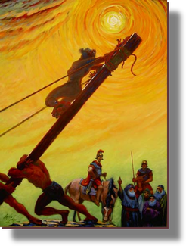

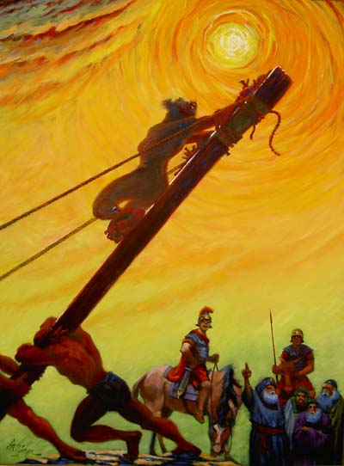
God’s Two Methods
Willing change:
  Reflect on the cross
  Soften the heart
  Yields to God’s way of thinking
Grudging change:
  External difficulties
  Soften the heart
  Yields

Slide 8
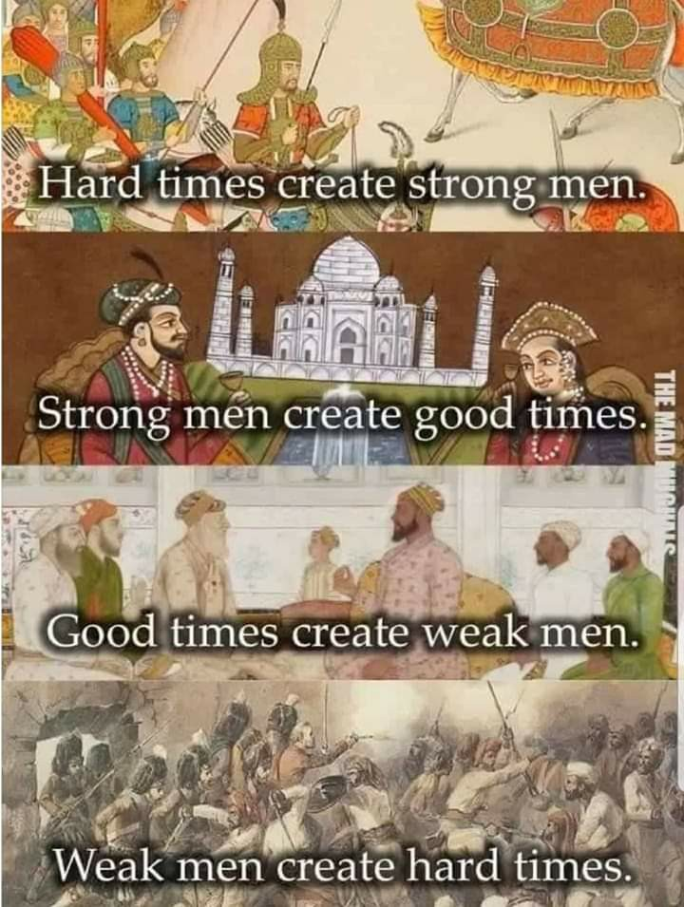

Slide 9

IN THE providential BOOK OF JOB

Slide 10
GOD’S LIGHTNING ARE CHARGED ARROWS!

Slide 11
THE THUNDER IS HIS VOICE!

Slide 12
Powerless in the face of authority
No man has authority to restrain the wind with the wind, or authority over the day of death; there’s no discharge in the time of war, and evil will not deliver those who practice it. (Ecl 8:8)

Slide 13
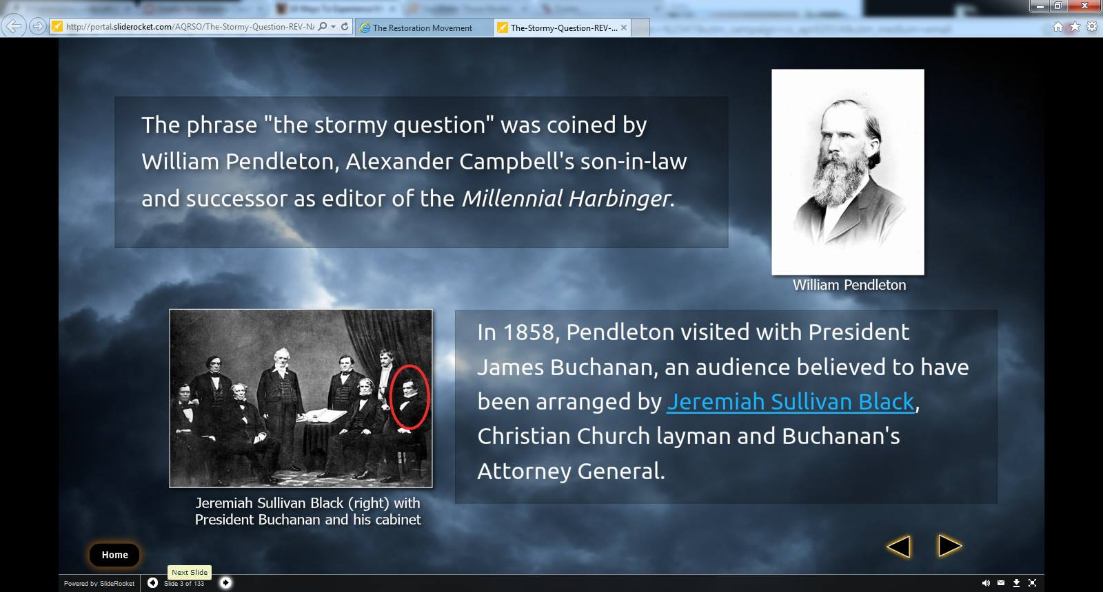

Slide 14
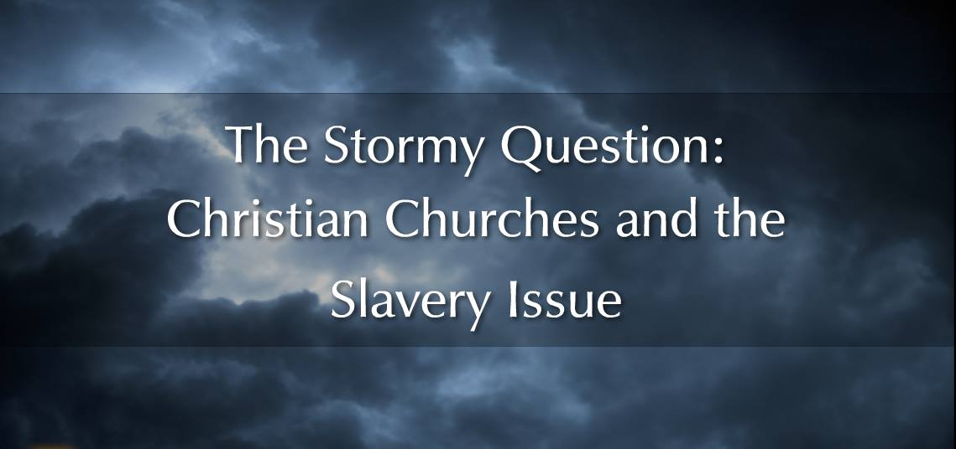


Slide 15
The Great Awakenings Compared
First Great Awakening | Second Great Awakening
Religious Revivals
Emotional, Fire & Brimstone Preaching
Calvinist Influence [Sinfulness Inherent] | Arminian Influence [Sinfulness a Choice]
Conversion Experience
Spread of Non-traditional Denominations
Promoted Democratic Ideals
American Revolution | Antebellum Reform

Slide 16



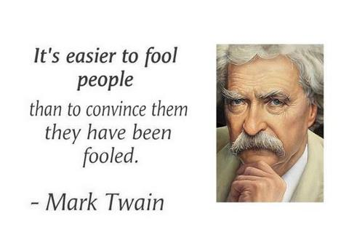
Liturgical Religion
AD 1830
Eschatological Religion
Institutional Development FROM THE 2ND GREAT AMERICAN AWAKENING

Slide 17
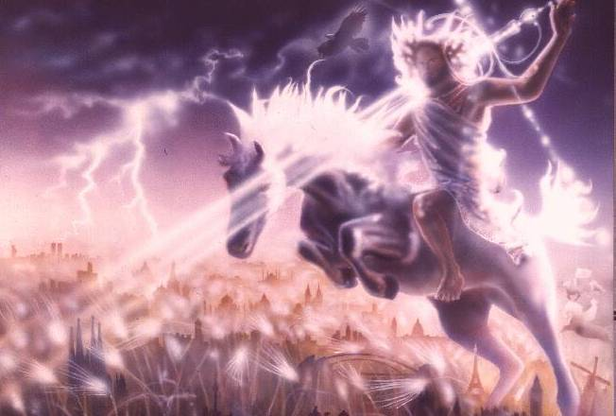
  MILLENNIAL MADNESS
  “He Hath Loosed The Fateful Lightning Of His Terrible Swift Sword…”
  - Abolitionist Julia Ward Howe

Slide 18
DISPENSATIONAL PREOCCUPATION
BIASED PERCEPTIONS
Preoccupation with the end of the world can lead to a biased perception of the real world. People so oriented see in history & see in contemporary life only what fits their idea of what the end times will be.

Slide 19
BIASED PERCEPTIONS
They see evidence of things getting increasingly worse, ignoring evidence of any advancements in areas of life. Those who see only one side of what’s going on in the world become a source of humor to those who see the big picture!

Slide 20
DISPENSATIONAL PREOCCUPATION
FATALISTIC ATTITUDE
Those who believe the Second Coming is immediate adopt a fatalistic attitude and then fall prey to a siege mentality:
“There’s nothing that can be done about the world’s problems. Don’t prepare for any future; just hunker down and wait.”

Slide 21
FATALISTIC ATTITUDE
Instead of working to solve problems, they say,
“This is prophecy being fulfilled,
The end is here;
there’s no need to do anything.”
By sitting on their hands when they should be actively involved, they fulfill their own prophecies and assure a worse world for their children!

Slide 22
Uncle Tom’s Cabin:
O, church of Christ,
read the signs of the times!
Is not this power
the spirit of HIM whose kingdom is
yet to come?

Slide 23

Cultural Context: “Thy Kingdom Come”
It Is Essential To Keep In Mind That The Hebrew Language Emphasizes The Kind Of Action & Not The Time
In Later Hebrew, The Time Factor Became More Important, But The Emphasis Of The Petition Is Not Temporal
It Emphasizes Instead The Dynamic Force Of God’s Kingship Being Realized As His Will Is Done
Jesus’ Words Would Have Been In The Imperfect Tense, Which Indicates Incompleted Action – The Idea Is That A Process Is Taking Place.
Thus, This Statement Can Be Connected To The Growth Parables Of The Kingdom
It Is Linked Similarly To Matthew 12: 28 & Then In Turn To Exodus 8:19 & 31:18 – Conveying The Message Of Deliverance
The Mishnah Links The “Yoke Of The Kingdom” To The Ancient’s Affirmation Of Deuteronomy 6: 4
It Was Put Into Prayer Form & Was Known As The Shema Yisrael (“Hear, O Israel”) & Everyone Praying It Received As Similar The “Yoke Of The Kingdom”
Reciting This Prayer Of Acknowledgment Was Considered The First Step In The Spiritual Obedience To The Laws, Ordinances, & Commandments Of Ancient Israel

Slide 24
Cultural Context: “Thy Kingdom Come”
“Heaven” Was Often Substituted In Meaning For “God” Because Of The Special Sanctity Reserved For His Name. This Was Common In Jesus’ Day & Persons Accepting The Authority Of The Kingdom Of Heaven Were Said To Have Entered Into The Reign Of God.
The Mekilta, An Early Midrash, Comments On The Beginning Statement Of The Decalogue – “I Am The Lord Thy God” – Conditioning The Ancient’s Acceptance Of The Kingdom Of Heaven With The Omni-present (God) “Doing Good For Us” – These Remarks Link Liberation Of God’s People With The Theme Of The Kingdom
Therefore, God - In This Sense - Reigns By His Mighty Redemptive Acts Of Liberation!
Jesus’ Challenging Call To Repent Was An Essential Aspect Of His Proclamation Of The Kingdom
Furthermore, Jesus’ Public Ministry Demonstrated Many Acts Of Redemption That Were The Dynamic Realization Of God’s Kingdom.
In The Hebrew Translation Of The Blessing Of Matthew 5: 3 The Last Part Reads “They Make Up The Kingdom.” This Proper Translation Indicates As Well How The Kingdom Will Continue To Be Established.

Slide 25

“The Meaning Of The Millennium” by Robert Clouse DOUBLE APPLICATION: “THY KINGDOM COME”
“Amillennialists believe that the kingdom of God was founded by Christ at the time of his sojourn on earth, is operative in history now and is destined to be revealed in its fullness in the life to come. They understand the kingdom of God to be the reign of God dynamically active in human history through Jesus Christ. Its purpose is to redeem God’s people from sin and from demonic powers, and finally to establish the new heavens and the new earth. The kingdom of God means nothing less than God’s reign in Christ over his entire created universe. The kingdom of God is therefore both a present reality and a future hope.”

Slide 26
Kingdom Models
Historical Heritage
FUTURE
TERTULLIAN
INTERIOR
ORIGEN
EXEGETICAL ERROR:
REVERSING ORDER
TYPE & ANTITYPE
INSTITUTIONAL
AUGUSTINE
COUNTER-SYSTEM
MONASTIC
THEOCRATIC
CALVIN
UTOPIAN
ANA-BAPTIST

Slide 27



Redeeming America: Road To War Curtis D. Johnson, 1993\Pages 164 & 184
“The Disciples of Christ, following the lead of Alexander Campbell, were generally in the postmillennial camp, as were the Baptists…
Millennialism continued to have an enormous influence over the United States on the eve of the Civil War. When the great conflict came, Americans spoke of the war using millennial language. Having been steeped in biblical prophecy and apocalyptic images for decades, it is not surprising that the Civil War generation described the conflict in Armageddon-like terms and tried to fit current events into a broader prophetic context and God’s role in history to make sense of the four years of carnage.”

Slide 28
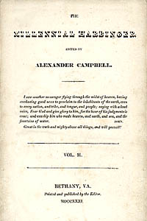
1830
January 4, Millennial Harbinger Begins
July 5, Last Issue Of The Christian Baptist

Slide 29
AN END TIMES MOVEMENT
Christadelphians – Prophesies and Pacifism
Christadelphians, a religious sect, was founded by Dr. John Thomas, son of a British Congregationalist minister. During Thomas’ immigration to the United States in 1832, the ship encountered several violent storms. Thomas vowed that he would devote his life to the study of religion if God would spare his life. Shortly after his arrival in the United States, Thomas briefly associated himself with the Campbellites, while sharing their belief that Jesus Christ would return to earth in 1866. But as he continued study with the Cambellites, he soon disagreed with their teachings, left the group disfellowshipped, and began his own religious sect called the “Brethren of Christ.”

Slide 30

Edward Hallett Carr On the Study of History
How Vs. Why ~ Or ~ Function Versus Cause
“Historians, like other people, sometimes fall into rhetorical language & speak of an occurrence as ‘inevitable’ when they mean merely that the conjunction of events leading one to expect it was overwhelmingly strong.”
Determinism Vs. Free Will. “In practice, historians do not assume that events are inevitable before they’ve taken place. They frequently discuss alternative courses available to the actors in the story on the assumption that the option was open, though they go on quite correctly to explain why one course was eventually chosen rather than the other. Nothing in history is inevitable except in the sense that, for it to have happened otherwise, the antecedent causes would have had to be different.”
Historical Accident Or Arranged Coincidence? “These so-called accidents represent a sequence of cause & effect interrupting historically & clashing – ‘a collision of two independent causal chains’.”
The Historian Marx. “Marx offered an apology for chance in history under three heads. First, it could accelerate or retard but not radically alter the course of events. Second, one chance compensated for another, so that in the end chance cancelled itself out. Third, chance was especially illustrated in the character of individuals.”
Meinecke’s Historical Observation: “The search for causalities in history is impossible without reference to values . . . behind the search for causalities there always lies, directly or indirectly, the search for values.”

Slide 31
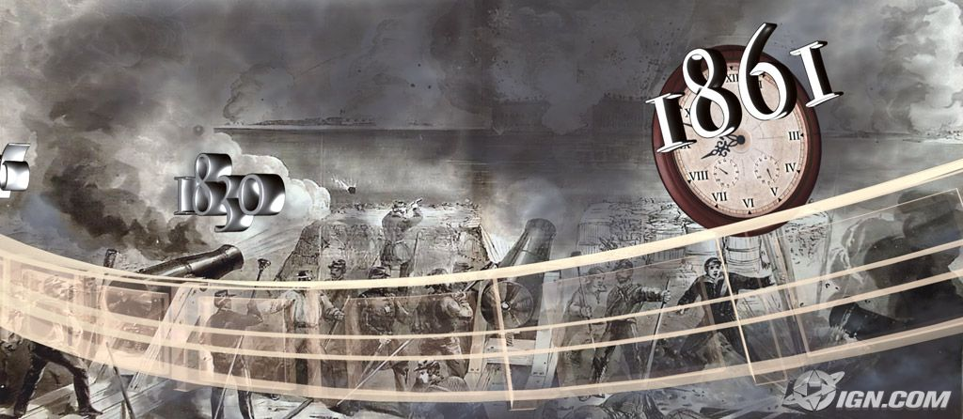
David Lee Burris: 1859 Wall Street Revival Continued With Southern Army & Worldwide To Entire English Speaking World Converting Moody & Spurgeon Leaders Of The Late Century
East – West Divide Spurred Growth While North – South Split Stymied It!
“There is nothing more common, than to confound the terms of the American revolution with those of the late American war… The American war is over: but this is far from being the case with the American revolution. On the contrary, nothing but the first act of the great drama is closed.”
- Benjamin Rush

Slide 32
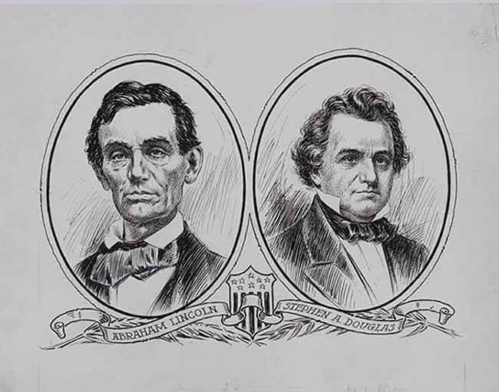
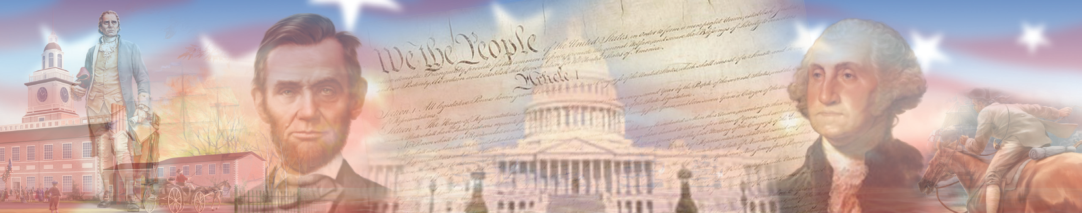
TWO SIDES CONFLICT CHOOSING BETWEEN THE TWO FOUNDING DOCUMENTS
An evenly divided country with insufficient majorities for amending proposal(2/3) and ratification(3/4).

Slide 33
Mine eyes have seen the glory of the coming of the Lord. He is trampling out the wine press, where the grapes of wrath are stored, He hath loosed the fateful lightnings of His terrible swift sword, His Truth Is Marching On!

Slide 34
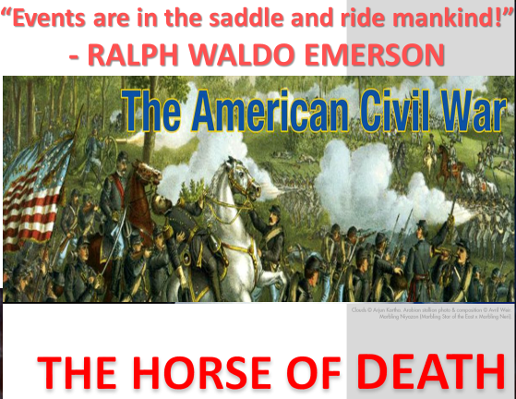

Slide 35
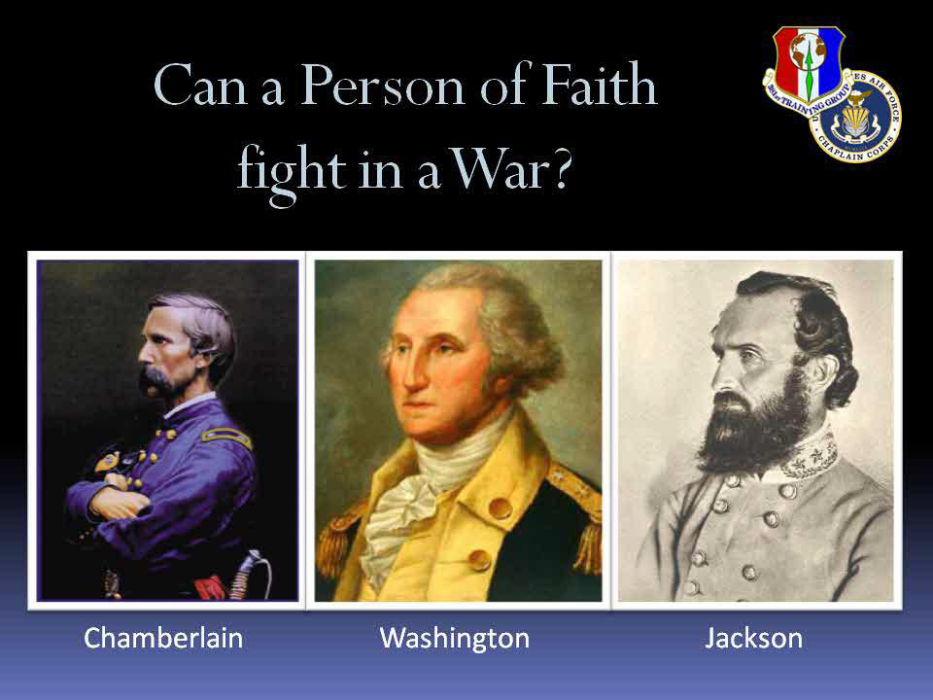

Slide 36
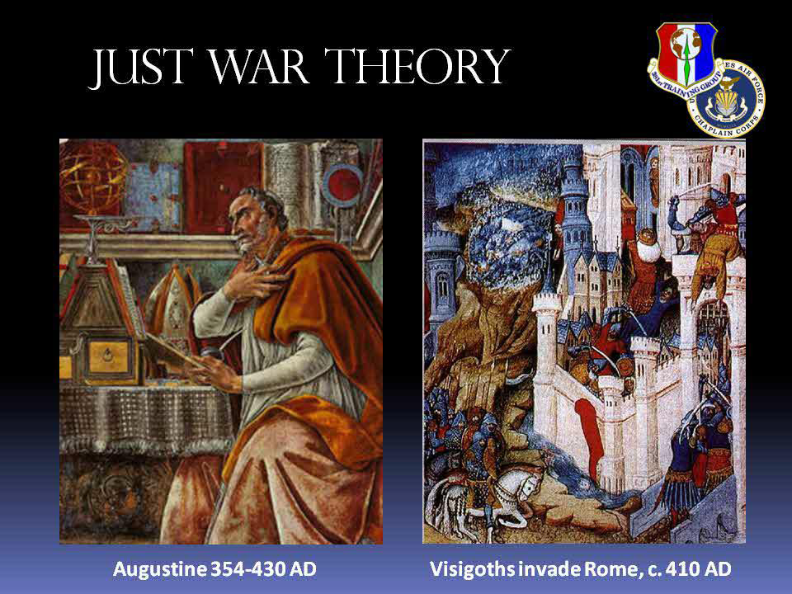

Slide 37
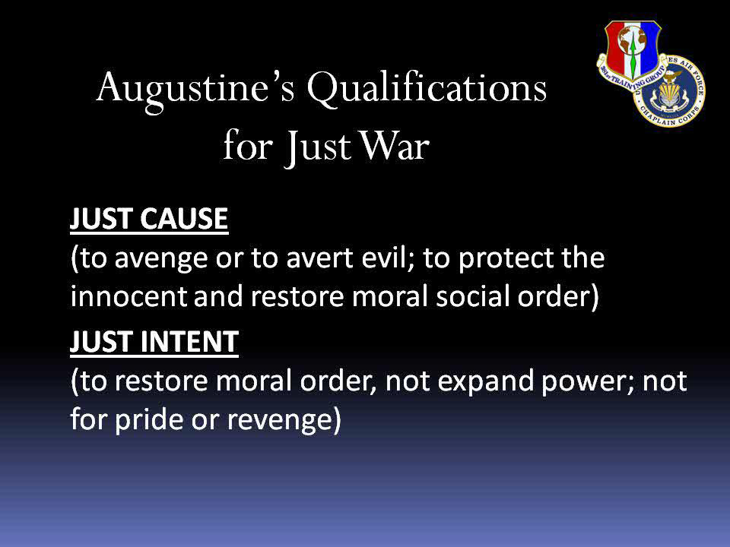

Slide 38
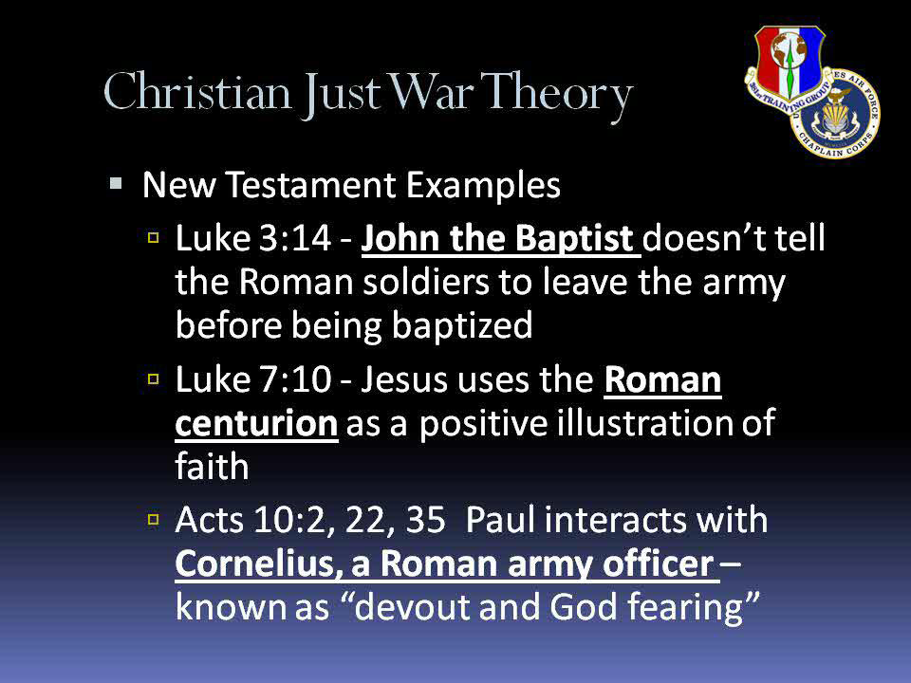

Slide 39
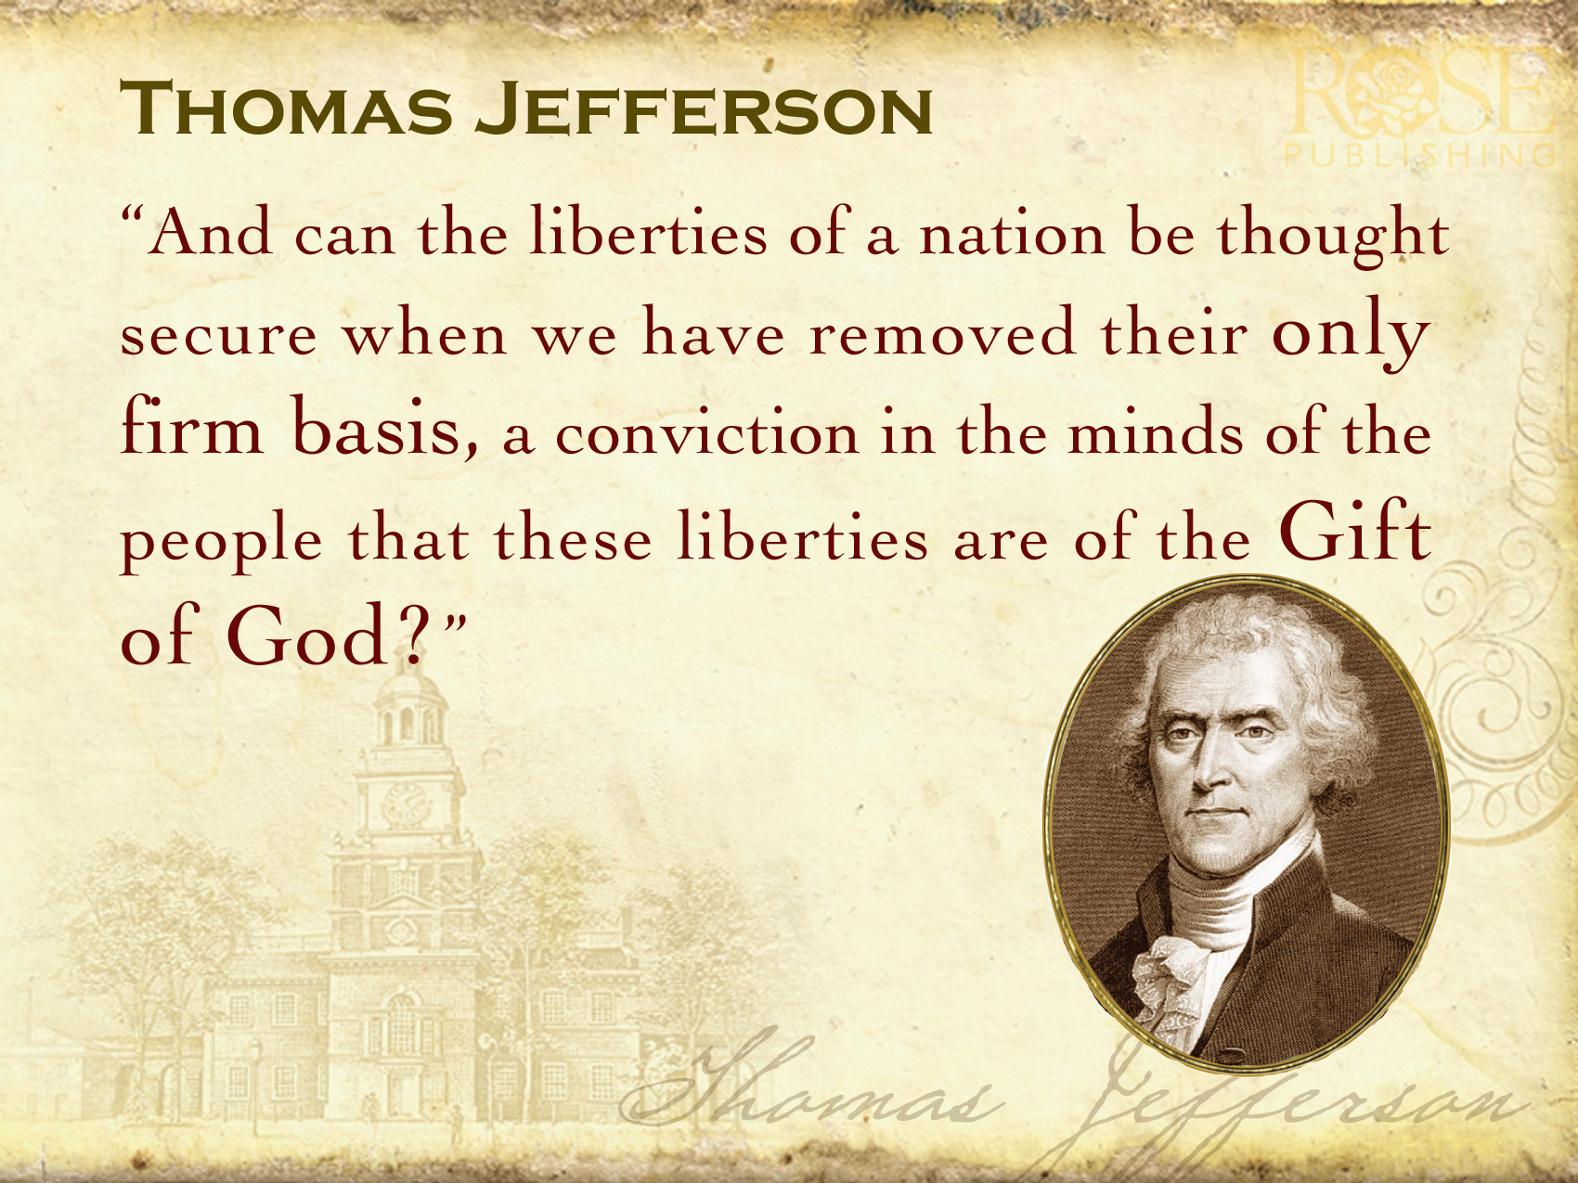
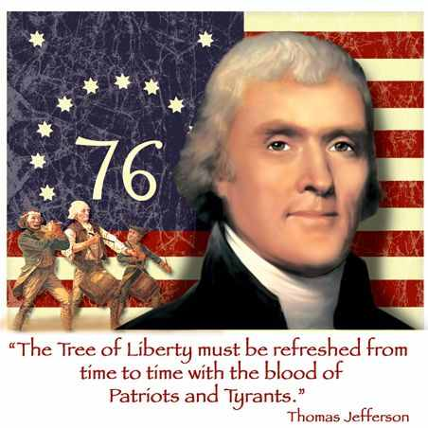
Notice that just war theory is not part of the Manichean world of our popular imagination, where we are basically Good and the other side is pretty much Evil, so “whatever it takes” is fine. No, we are in the world of Solzhenitsyn, who as a prisoner came to realize that “the line separating good & evil passes not thru states, nor between classes, nor between political parties either – but right through every human heart.” We are not completely good, yet it matters that we try to do good – and when we use force, we must use extreme care, or we are likely to slip into doing evil ourselves.

Slide 40
CARNAL WARFARE & CHRISTIAN PARTICIPATION
Religious & Civil Wars
Are Historically Unjust

Slide 41
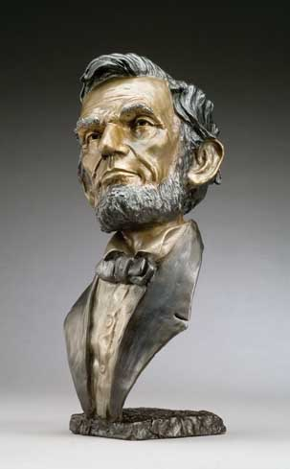
The dogmas of the quiet past are inadequate to the stormy present.
The occasion is piled high with difficulty and we must rise to the occasion.
As our case is new, so must we
think anew and act anew!
- Abraham Lincoln

Slide 42
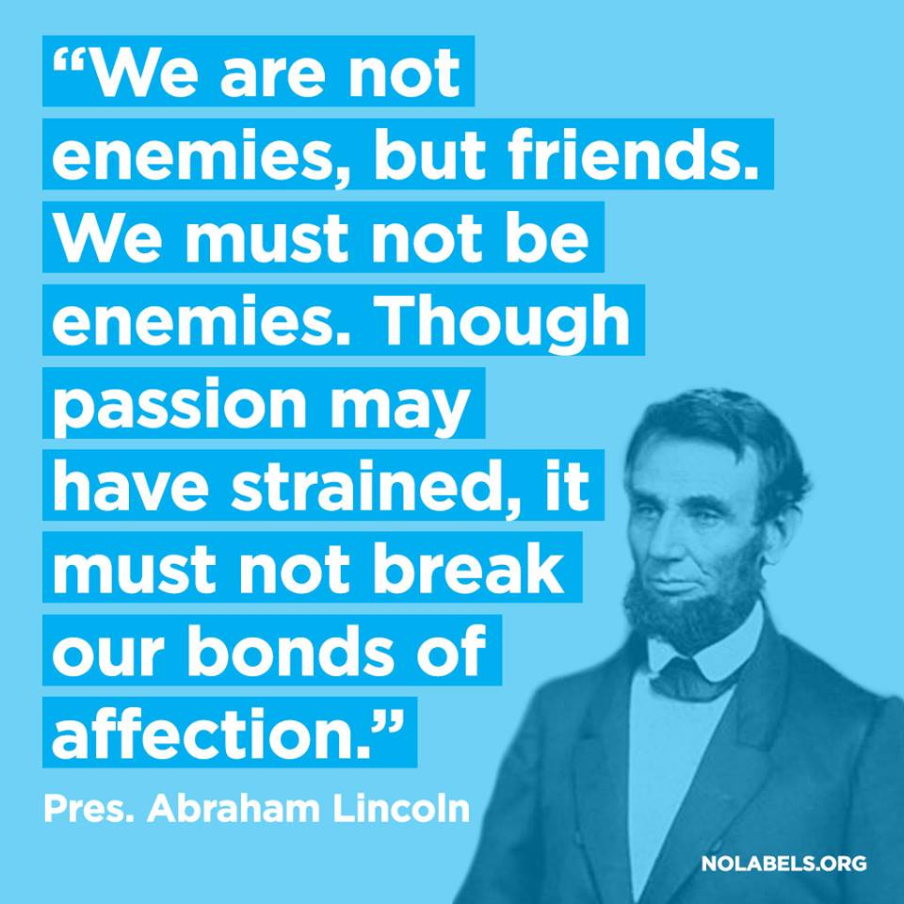

Slide 43
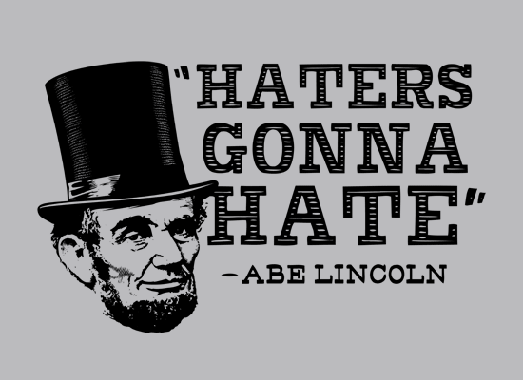


Slide 44
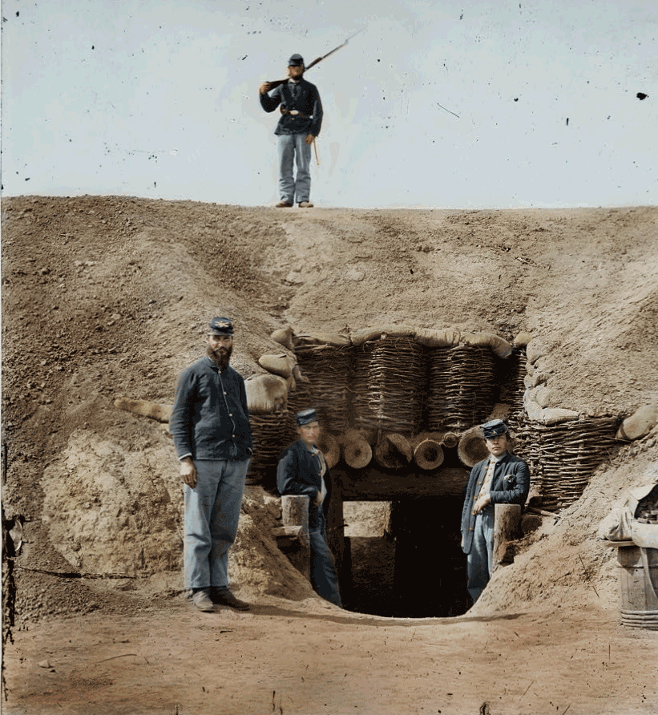

Slide 45
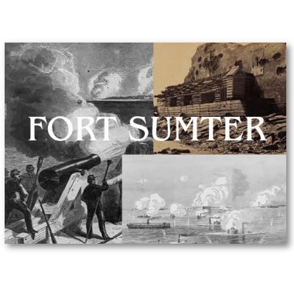
“Broken eggs can never be mended!” - Lincoln

Slide 46
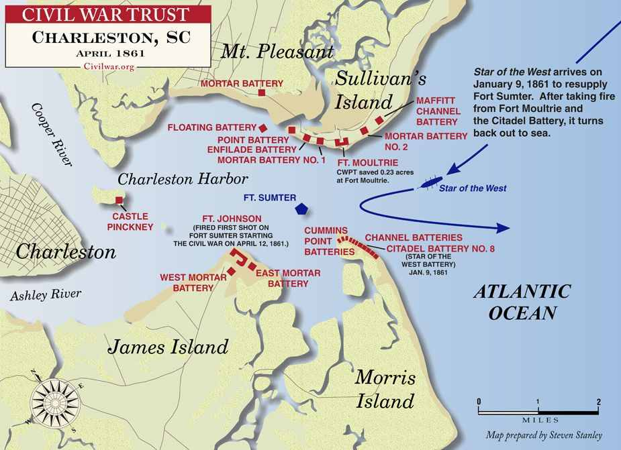

Slide 47
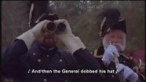

Slide 48
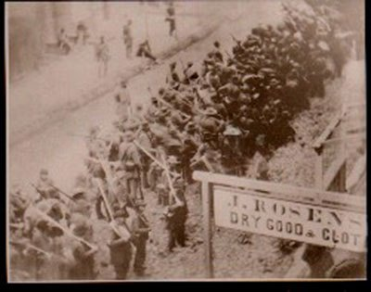
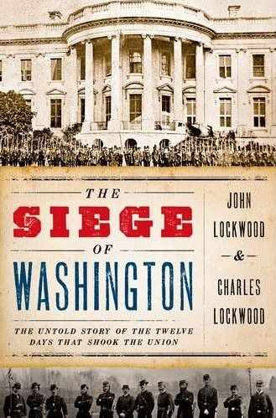
SOUTHERN OFFENSIVE

Slide 49
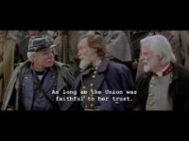

Slide 50
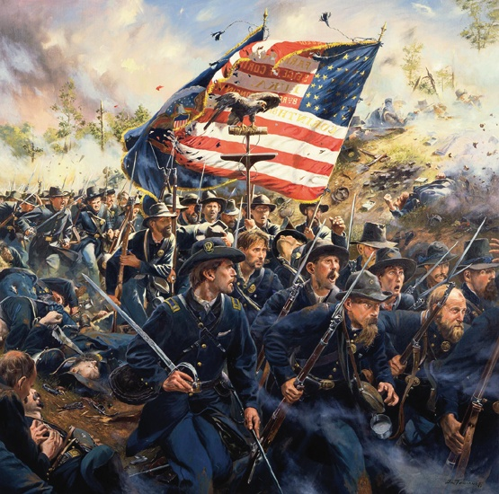
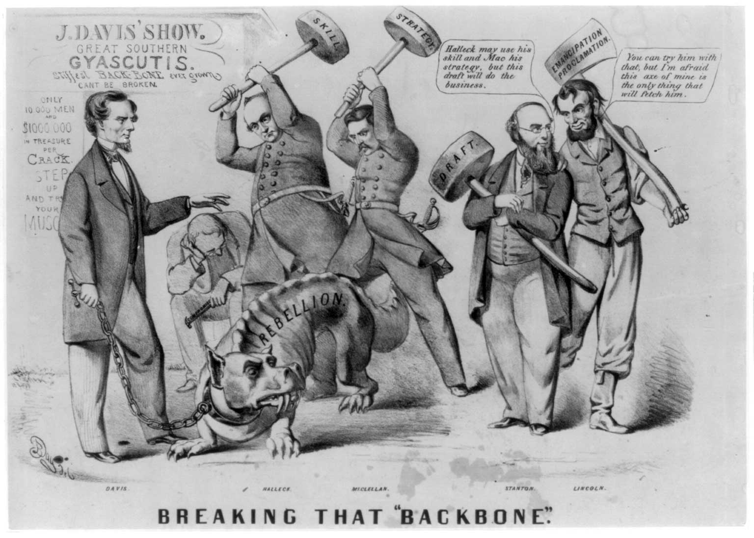
“We’ll hang Jeff Davis to a sour apple tree.”

Slide 51
Lincoln/Stanton
“General in Chief”
McClellan
General in Chief
Patterson
Scott
General in Chief
McDowell
J. Johnston
McClellan
Buell
Dept of the OHIO
Battle of 1st Bull Run
(21 July 1861)
Halleck
Dept of the MO
Jackson
Beauregard
Halleck
Dept of the MI
Battle of Pea Ridge
(6-8 March 1862)
J. Johnston
Forts Henry& Donelson
(2-16 Feb 1862)
McClellan
Pope
A.S. Johnston
Troop Strength
(Thousands)
Grant
Burnside
Shiloh
(6-7 April 1862)
Buell
100
90
A.S. Johnston
80
Beauregard
70
60
50
40
30
20
10
Opening Moves
East
Major Campaigns
1862
Opening Moves West
Coastal Actions
U.S.
C.S.
Notes:
Disposition of Eastern forces as of July 1861:
Early July – Union forces under McClellan secured much of what will be West Virginia.
General Joe Johnston (12,000 troops) guarded the northern entrance to the Shenandoah Valley. Union forces under General Robert Patterson (18,000) occupied Harpers Ferry and were to fix Johnston’s troops.
General Irwin McDowell commanded the main Union force (35,000) and planned to move to Centerville. General Winfield Scott was the General in Chief of all Union forces.
General P.G.T. Beauregard commanded the main Confederate force facing the main Union Army vic. Manassas.
16 July – McDowell began movement toward Centerville.
16-20 July – J. Johnston, w/ the aid of an excellent screen by J.E.B. Stuart, slipped away from Patterson and made a rapid movement (partially by rail) to join Beauregard and thus even the force ratio.
21 July – First Bull Run. Confederate victory resulted in Union withdrawal back to Washington. McDowell is replaced by McClellan (who had success in W. VA). Shortly after, (Nov) Scott resigned and McClellan becomes GinC in addition to commanding the Washington troops.
Union Navy began the war with 90 Ships (only 42 were sea worthy and only 4 were in local waters). By December 1862 the Navy had grown to 264 and was beginning to establish the blockade of the southern coastline. To reduce the patrol area, the Navy and the Army conducted a series of joint operations to occupy or deny the use of many of the south’s major ports. Taking southern ports also served the Union navy as forward bases where they could re-supply/re-fuel their ships. (allowing for more ships to be constantly on station rather than traveling back to a northern base)
One of the first bases taken was Hatteras Inlet (29 Aug 1861) which in turn served as the base of operations for General Burnsides (Cdr, Dept of NC). Burnsides attacked and occupied Roanoke Island (8 Feb 62), Elizabeth City (10 Feb 62) and New Bern (14 Mar 62).
One of the most important bases captured was Port Royal (7 Nov 61) which served as a central supply base throughout the war.
March/April 62 saw a large portion of GA/FL cut off: Fernandina GA (4 Mar), Brunswick GA (9 Mar), St. Augustine FL (11 Mar), Apalachicola FL (2 Apr) and Jacksonville (9 Apr).
11 Apr – Fort Pulaski (outside of Savannah) fell, effectively closing that port.
Disposition of the West (Jan 1862):
Dept of Ohio Commanded by Gen. Don Carlos Buell. – 45,000 troops.
Dept of MO Commanded by Gen. Henry Halleck – 91,000 troops.
To counter these two Union Dept’s., Gen. Albert Sidney Johnston commanded 43,000 thinly spread troops. (See Analysis: Overview #1)
2 Feb – Grant moves 15,000 troops down the Tennessee River and lands north of Fort Henry (6 Feb).
5 Feb – Flag Officer Foote, Commanding the Union Gunboats in this operation, defeated Fort Henry prior to Grant’s arrival. Many of the Confederate troops escaped to Fort Donaldson to the east.
Grant moved east and laid siege to Fort Donaldson with his troops and gunboats (13 Feb) – Ft Donaldson fell 16 Feb.
The loss of Forts H & D cut the railway link btwn Bowling Green and Memphis and placed the Confederate forces at Bowling Green and Columbus in very exposed positions.
Johnston pulled his Bowling Green forces back to Murfreesboro (Buell followed and occupied Nashville on 24 Feb) then pulled back further to consolidate the two confederate wings at Corinth (completed by 24 March).
Still heavily outnumbered, the Confederates stripped troops from coastal defenses at New Orleans and Mobile.
5-11 March – Grants troops moved up the Tennessee River to cut the Memphis/Chattanooga rail link.
As stated in the boarder state slide, the Union victory at Pea Ridge put the State of Missouri in Union Control for the rest of the war.
11 March – Halleck is given overall command of the Western Theater (Dept of Mississippi) w/ three subordinate commanders:
Pope: Army of the Mississippi Grant: Army of the Tennessee Buell: Army of the Ohio
Buell was ordered to join Grant, but moved very slowly (16 Mar- 5 Apr).
McClellan began his Peninsula Campaign. Seaborne mvmt: Mar 19 to early April. (McClellan had been relieved of his GinC duties by this time – no replacement was named)
J. Johnston moved south to counter McClellan’s move on the Peninsula.
J. Johnston left Jackson back at the Shenandoah Valley. His aggressive action resulted in the Union leaving three corps (one in W. VA, one in Northern Shenandoah and one near Washington) to prevent Jackson from threatening the capital.
6 April – Before Buell is able to link up with Grant, A. S. Johnston attacks Grant at Shiloh while the Confederates have numerical superiority.
Confederates attacked with initial success, but Grant held out while Buell’s forces began arriving late in the day. A.S. Johnston was mortally wounded and P.T.G. Beauregard took command.
7 April – Reinforced by Buell, Grant attacked and defeated the Confederate Army, which withdrew back to fortifications at Corinth.
7 April – Pope captured Island #10 (mostly due to naval efforts)

Slide 52
Lincoln/Stanton
“General in Chief”
Battle of Seven Pines
(31 May-1 June 1862)
Seven Days Battles
(26 June - 1 July 1862)
Halleck
Dept of the MI
Jackson
J. Johnston
Lee
Corinth Occupied
(30 May 1862)
McClellan
Pope
Grant
Burnside
Troop Strength
(Thousands)
Buell
Grant
Thomas
Buell
Pope
Buell
100
90
80
Bragg
Beauregard
70
60
50
Farragut Takes
New Orleans
(24 April-1 May 1862)
40
30
20
10
Butler
Major Campaigns
1862
U.S.
C.S.
Notes:
24 April-1 May: Farragut drove his fleet past the forts guarding the mouth of the Mississippi and occupied the unguarded city of New Orleans. (troops had earlier shifted to participate at Shiloh) The city was occupied by Union troops under Butler. Farragut will eventually travel all the way to Vicksburg, but the Confederates fortify Port Hudson and end Union control of the river at that point.
10 May - Pensacola fell to Union forces. Confederates were left with only Mobile Bay AL, Charleston SC and Wilmington NC as major ports still under their control.
5-24 May – After a month of the Union Army gathering siege guns and reinforcements, Confederates pull back before the Federals can unleash this force. McClellan follows Johnston to Richmond.
26 May – Prior to McDowell’s Corp moving south to support McClellan, Jackson’s aggressive actions once again kept the three Union Corps occupied in the Shenandoah Valley. The union forces attempted to trap Jackson in the Valley before he could withdraw from his exposed northern position (not shown).
31 May – As Jackson escaped the trap, J. Johnston attacked McClellan at Fair Oaks. This battle resulted in a stalemate, but Johnston was wounded and replaced with Gen. Robert E. Lee.
30 April-30 May – While McClellan slowly moved up the Peninsula, Buells three Armies, that he organized into thee wings, crept even slower toward Corinth (not wanting to repeat the Confederate surprise attack of Shiloh) (Grant had been re-assigned as 2nd in Command, with Thomas in Cmd of the Army of the TN)
Before the Union could attack, Beauregard evacuated south to Tupelo and Union forces occupy Corinth on 30 May. The vital rail link btwn Memphis and Chattanooga was now cut.
Confederate forces at Fort Pillow, being cut off with the loss of Corinth, abandon the fort.
6 June – Union Gunboats defeat Confederate gunboats at Memphis, which also fell. West Tennessee and the Northern Mississippi River (as far south as Vicksburg) was now in Union control.
Buell’s Army of the Ohio is ordered to capture the critical rail juncture of Chattanooga. Buell again moved very slowly (10-28 June, to get north of Decatur)
Army of TN and MI are dispersed throughout West Tennessee to repair and protect rail lines. Grant was named the West Tennessee District Cdr.
26 & 27 June – Cmd Changes – Pope was transferred East to form and command the Army of Virginia (3 Corps fighting Jackson in the Shenandoah) and Bragg replaced Beauregard as the Confederate Department Cdr.
25 June-1 July – Jackson slipped away from the Shenandoah and joined with Lee who attacked McClellan at Mechanicsville to began the Seven Days Battles.
Army of the Potomac (AOP) withdrew to the south and made a stand a Malvern Hill.

Slide 53
Antietam
(17 Sept 1862)
Halleck
General in Chief
Lincoln/Stanton
“General in Chief”
Second Bull Run
(29-30 Aug 1862)
Lee
XII
McClellan
Jackson
Perryville
(8 Oct 1862)
Pope
Pope
Burnside
Lee
XI
Fredericksburg
(13 Dec 1862)
Longstreet
Halleck
Dept of the MI
Lee
Buell
Smith
Bragg
Lee
McClellan
Rosecrans
Stones River
(31 Dec 1862)
Smith
Burnside
Troop Strength
(Thousands)
Grant
Buell
Bragg
100
90
Bragg
80
Van Dorn
Price
Bragg
Van Dorn
J. Johnston
70
Pemberton
60
50
40
30
20
10
Major Campaigns
1862
Banks
Major Campaigns
1863
Butler
U.S.
C.S.
Notes:
Pope consolidated the Army of VA and Halleck was transferred to the East to become the General in Chief. No overall Cdr for the West was named: Grant and Buell must rely on mutual cooperation.
19 July – Jackson was sent to Gordonsville to defend against the Army of VA.
28 July – 28 Aug – Bragg transfered his Army by rail to Chattanooga and left Van Dorn and Price to observe/block/fix Grants forces.
The Confederate plan was to attack north with two armies under Bragg and Kirby Smith. The objective was to invade KY, cut Buell’s supply lines and turn to defeat his army. Then the Confederates would turn on Grant. It was hoped that they would also get recruits from KY as they moved through this border state.
Lee also had a desire at this time to attack north: to destroy Pope’s AV before it could operate in conjunction with the AOP. However, Lee could not move his other subordinate, Longstreet, while the AOP was still on the Peninsula. Halleck and Lincoln, however, decided to pull the AOP back to the Washington area and consolidate it with the AV. Overall command of the two armies was never identified.
14 Aug – McClellan began his seaborne movement back to Washington area and linked three corps with Pope before the beginning of the 2nd Bull Run. Kirby Smith also made his northern movement at this time (14-30 Aug) and occupied Lexington KY.
29-30 Aug. Lee defeated Pope at the 2nd Bull Run. Union forces withdrew to Washington and consolidated as the AOP under McClellan. Lee then planned to attack north, into Maryland, which became a simultaneous effort with Bragg.
1st Half of Sept: Both Bragg and Lee begin movement into Union Territory (Lee is also anticipating getting Maryland recruits from this border state – neither state provided the Confederate Armies with many new soldiers) Both Union Cdrs reacted similarly: Rapidly consolidating/reorganizing their forces and moving to intercept the invading army. On 17 Sept, after initial contact at South Mountain, the AOP attacked the ANV at Antietam.
Lee was defeated and withdrew west across the Potomac.
After several maneuvers, Buell, again slowly, moved to prevent Bragg from linking up with Smith’s army. The two enemy armies conducted a meeting engagement at Perryville.
Bragg was defeated, but was allowed by Buell to escape. Bragg linked up with Smith, and withdrew south to Murfreesboro by early Nov.
Command Change – 17 October, Pemberton was put in charge of Confederate forces in Mississippi and Joe Johnston took command of the Department of the West, which included Pemberton’s command and Bragg’s Army of Tennessee.
Command Change - Buell moved his army to Nashville, but this movement was slow yet again. His continued lethargic style finally got him replaced with Rosecrans.
Command Change - After much goading from Lincoln and Halleck, McClellan finally moved the AOP south to Warrenton (26 Oct-6 Nov), leaving the XII Corp to guard his rear at Harpers Ferry. Lee countered by leaving Jackson in the Shenandoah Valley and facing the AOP with Longstreet. Much like Buell, McClellan lacked aggressiveness in almost every movement/operation, and was also relieved and replaced by Burnside on 6 November. (See Analysis: Overview #2)
15-17 November, Burnside rapidly shifted the AOP to the nearly unoccupied Fredericksburg, catching Lee off guard and spread out. Burnside had planned to strike south toward Richmond, forcing Lee to rush to its defense.
What the plan relied upon, however, was speed. Due to a coordination mishap with Halleck, the Pontoon Bridges needed to cross the Rappahannock did not arrive until 25 November, and Burnside was not prepared to cross them until 10 December. This delay gave Lee ample time to consolidate his army and prepare fortifications.
The resulting Battle of Fredericksburg (a piecemealed frontal attack against prepared positions) was one of the worst Union defeats of the war and left the two armies facing each other at Fredericksburg for the rest of the winter.
Nov. 1862 - Grant consolidated his forces and moved south. Grant’s final objective was to capture Vicksburg and control the Mississippi, thus cutting off all Confederate states west of that river. (the red line indicates Grant’s supply line)
Grants plan of attack was to keep a portion of his army along the overland route to threaten and occupy/fix Pemberton’s main forces.
Sherman would travel with several divisions down the Mississippi and strike/capture a lightly defended Vicksburg from the north.
18-28 December - Prior to execution of this plan, Van Dorn (and Forrest-Not shown) conducted a cavalry raid that cut Grant’s supply lines.
With Grant no longer a threat the Confederates were able to reinforce Vicksburg.
Consequently, Sherman’s attack on 29-31 December was a failure against well prepared positions. Sherman withdrew to Miliken’s Bend.
Command Change – Banks Replaced Butler as Commander of the Department of the Gulf.
31 Dec 1862 – 3 Jan 1863: Rosecrans, with the eventual objective to control East Tennessee, attacked Bragg at Stones River. After a close and bloody battle, Bragg fell back to Tullahoma.

Slide 54
Troop Strength
(Thousands)
100
Halleck
General in Chief
90
Hooker
80
Burnside
70
60
Lee
50
40
Longstreet
Rosecrans
30
20
Grant
Bragg
10
U.S.
C.S.
J. Johnston
Grant
Pemberton
Banks
Major Campaigns
1863
Notes:
Grant moved his command and several divisions to join Sherman vic. Milliken’s Bend in January 1863.
Grant’s three Major Options/Execution to attempt to capture Vicksburg. (See Analysis for detailed description of these plans: Overview #3)
Command Change: Hooker replaced Burnside in January, 1863. Burnsides was put in Command of the Department of the Ohio.
Longstreet, with two divisions, was sent to block Union Action vicinity Suffolk, and stayed to gather supplies.

Slide 55
Troop Strength
(Thousands)
100
Halleck
General in Chief
90
Hooker
80
Chancellorsville
(27 Apr-6 May)
Burnside
70
Burnside
60
Lee
50
40
Longstreet
Rosecrans
30
20
Bragg
10
U.S.
C.S.
J. Johnston
Grant
Pemberton
Pemberton
Grant
Banks
Banks
Major Campaigns
1863
Notes:
Chancellorsville Campaign (27 April-6 May) – Hooker attempted (and succeeded) to turn Lee’s flank but was defeated in one of Lee’s greatest achievements. (See Detailed Chancellorsville Battle Analysis-separate slide show) Jackson, however, was killed at this battle. Longstreet, recalled in reaction to the Chancellorsville crisis, rejoined the ANV after the battle was over.
5-29 April. Grant moved South (Sherman conducts deception operations to convince Pemberton the Union would attack from the north) while gunboats and transports ran past the Vicksburg batteries. On 30 April, these transports ferried the Union Army of the Tennessee across to the eastern bank of the Mississippi River. There were three possible options for how Grant could have conducted his attack from this point:
1. Attack south to support Banks’ planned attack on Port Hudson and open up a supply line with New Orleans.
Disadvantage: Grant’s flank/rear would be open to an attack by Confederate troops in Vicksburg/Jackson. He would be giving up the initiative to the enemy.
2. Direct assault on Vicksburg and let Banks seize Port Hudson on his own.
Disadvantage: Open to flank assault by Confederate forces from Jackson while engaging enemy forces at the Vicksburg fortifications. Again, this allows for enemy to retain a certain amount of initiative. This also relies on Bank’s success to create a supply line from the south.
3. Attack Jackson first to defeat forces there, then turn on Vicksburg. Grant would have less to fear from a counter attack conducted by the Vicksburg forces, as he would still have freedom of maneuver (Option 2 would have tied him to attacking a fixed point: the Vicksburg fortifications). Plus, to alleviate the problem of a supply line from the south, Grant would live off the land as much as possible. Thus, if the Vicksburg force attempted to cut his line, there would be no line to cut. Grant conducted Option #3.
Joe Johnston, Confederate Commander of the West, moved to Jackson to personally gather and command the troops there.

Slide 56
Troop Strength
(Thousands)
Lee
100
Halleck
General in Chief
90
Grant
General in Chief
Meade
Meade
80
Gettysburg
(1-3 July)
Hooker
70
Hooker
Burnside
Lee
60
Longstreet
50
40
Rosecrans
Burnside
30
20
Bragg
Longstreet
Sherman
10
Sherman
Rosecrans
Thomas
Bragg
U.S.
C.S.
J. Johnston
Hooker
Chickamauga
(19-20 Sept)
Pemberton
Sherman
J. Johnston
Grant
Banks
Major Campaigns
1863
Notes:
Grant attacked Jackson and defeated J. Johnston. (14 May), turned west and defeated Pemberton at Champion Hill (16 May) and laid siege to Vicksburg. Banks laid siege to Port Hudson on 24 May.
9-30 June: Following victory at Chancellorsville, Lee again attacked into northern territory. (See Analysis: Overview #4)
Hooker began to pursue, but was replaced with Meade due to his slowness in responding.
26 June – After much preparation and continuous prodding by Washington, Rosecrans finally moved the Army of the Cumberland to attack Bragg.
1-3 July – Lee was defeated by Meade and withdraws back to VA. (See detailed BA-TBP)
4 July – Vicksburg surrendered to Grant and Port Hudson falls to Banks (9 July). This results in the Mississippi River falling under Union control and the Confederates withdrawing east (Not shown: Johnston had put up a half hearted attempt to relieve Vicksburg and then again attempted to defend Jackson, but was heavily outnumbered)
4 July – Rosecrans outmaneuvered Bragg on his right flank. Bragg was forced to withdraw back to Chattanooga, and arrives on this day.
16 Aug – 3 Sept: Burnsides occupied Knoxville.
16 Aug – 4 Sept: Rosecrans again out-maneuvered Bragg, this time, to his south (left flank), and forces him to evacuate Chattanooga. (Between a strong demonstration operation, and the estimate Rosecrans would attack in conjunction with Burnsides movement to the north, Bragg had assumed the attack would come to the north)
With the loss of Chattanooga and Knoxville, the Confederates lost a vital rail line that rapidly connected eastern and western states.
The effect was immediately felt – it was determined to reinforce Bragg with Longstreet’s Corps from the ANV. 8-18 Sept: Longstreet was forced to travel a longer route to reach Bragg. This required several train changes due to changes in track gage, and Longstreet arrived just in time for the upcoming battle (but still missing 4 Brigades that were still en-route).
19-20 Sept – Bragg defeated Rosecrans in the Battle of Chickamauga. (See detailed BA-TBP) Rosecrans withdrew back to Chattanooga and Bragg laid ‘siege’ to the Union Army (the Union Army was not cut off from its supply lines, but the existing line was so difficult to traverse, supplies were very short. The arrival of Hookers Corps, and their subsequent attack to the west of Chattanooga, opened a much better supply route: the Cracker Line).
Washington decided to reinforce the Army of the Cumberland with two Corps from the AOP under Hooker and two Corps from The Army of the Tennessee under Sherman.
Grant was assigned as the overall commander. Grant replaced Rosecrans with Thomas.
Thinking his line was secure, (located on mountains surrounding Chattanooga) Bragg sent Longstreet north to attack Burnside at Knoxville (Longstreet did not succeed).
24-25 Nov – Bragg was defeated in the Battles of Lookout Mountain and Missionary Ridge and withdrew from Chattanooga. By December, Longstreet withdrew east, and by May 1864, his Corps was back with the ANV. (See Analysis: Overview #5)
As a result of this action, Grant was assigned as the General in Chief of all Union forces (March 64); Sherman took overall command in the west and controlled the Army of the Cumberland (Thomas), Army of the Tennessee (McPherson) and the army of the Ohio (Essentially one Corps from Burnsides command in Knoxville, now under Schofield – Burnside took his old IX Corp back to the AOP in March 64); Finally, all of Tennessee was now secure and Chattanooga became a staging area for Sherman’s drive toward Atlanta.
Also, as a result of this action, Joe Johnston replaced Bragg as Commander of the Army of Tennessee.

Slide 57
Grant
General in Chief
Sigel
Meade
Lee
Butler
Sherman
J. Johnston
Banks
Major Campaigns
1864-1865
Grant’s Plan
1864
Major Campaigns
1863
Notes:
Grant’s Strategic Plan for 1864
After continuously disjointed efforts by the Union (Even in 1863, Rosecrans and Meade did not assist each others efforts, allowing for Longstreet to shift his Corps and effect the Battle of Chickamauga), Grant, as General in Chief, was finally in a position to unify the Union effort. (see Analysis: Overview #6 for more detail)
Army of the Potomac (Meade) – The Main Effort in the East. Objective was to destroy the Army of Northern Virginia (Lee).
Army of the James (Butler) – Attacks to Seize Richmond – Support effort of the AOP who was to eventually join the AOP. (Grant actually envisions this as the Right wing to Sherman’s Left wing, with the AOP in the center)
Dept. of West VA (Sigel) – Attack down the Shenandoah Valley to divert Confederate troops and destroy war materials in that area.
Sherman’s Army (Army of the Cumberland - Thomas, Army of the Tennessee – McPherson, Army of the Ohio – Schofield) – The Main Effort in the West - Destroy the Army of Tennessee (Johnston) and destroy the war resources of the Confederate interior.
Department of the Gulf (Banks) – Seize Mobile Bay as a base of operations to support Sherman.
Grant intended for all this to happen simultaneously, so as to overwhelm the Confederate forces and to impede their ability to use interior lines and transfer troops back and forth between theaters. However, due to political reasons, Banks was diverted to the Red River, a campaign that ended disastrously for that General.

Slide 58
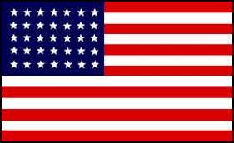
Grant
General in Chief
Hunter
Sheridan
Sigel
Meade
Early
Lee
Lee
Butler
Grant
General in Chief
Meade
Thomas
Hood
J. Johnston
Sherman
Sherman
Schofield
Hood
J. Johnston
Sherman
Hood
Banks
Major Campaigns
1864-1865
The Union Prevails
Notes:
Early May, Butler landed at Bermuda Hundred, but was halted by a force under Beauregard and the Army of the James became trapped in that area.
15 May – Sigel was defeated by a smaller Confederate force under Breckenridge and was replaced by Hunter.
The AOP attacks the ANV and in a series of battles, arrived on the outskirts of Richmond. This series of battles was a great departure from previous campaigns. Previous engagements of this magnitude would have forced one of the Armies to withdraw and re-organize. Grant, instead, continued to advance and attempted to gain Lee’s right flank. Lee, in turn, was forced to outmarch and meet the AOP before that could happen. As a result, casualties were catastrophic, but the Union could replace their losses effectively, the Confederacy could not. The Major Battles: 5-7 May: Wilderness / 8-19 May: Spotsylvania / 23-26 May: North Anna / 3 June: Cold Harbor.
12-22 June - After a disastrous attack at Cold Harbor, Grant decided to break away from Lee and attempted to cut the rail lines leading into Petersburg. This would both free the Army of the James from their trapped position and force Lee to either defend his Capital, or flee West.
Lee, initially caught by surprise, was able to react due to a faulty Union attack against Beauregard's right flank. Lee blocks the AOP and trench warfare ensues for the rest of the year.
June-October 1864: The only significant maneuver in the East was in the Shenandoah Valley. Hunter successfully renewed the Union offensive started by Sigel. Lee sent Early’s Corps back to defeat Hunter and retake the Shenandoah. Early does both, and then conducts a raid that threatens Washington. To finally rid the Union of this threat, Sheridan was assigned to gather the Army of the Shenandoah, and in a series of battles eventually defeated Early and devastates the Shenandoah Valley.
May 7 – Sherman began his attack on Atlanta. Unlike the East, his three Armies worked in conjunction and continuously out maneuvered/enveloped Johnston’s army. Johnston was forced to constantly withdraw or lose his army.
27 June – After several attempts to envelop the elusive Johnston, Sherman decided to concentrate his forces in a frontal attack on the Confederates at Kennesaw Mountain. He is thrown back with great loss and reverted back to maneuver. As Johnston was forced back again, he was replaced with Hood (17 July). President Davis was tired of Johnston’s continuous retreat with seemingly little results.
20-28 July – Hood fell back to the defenses of Atlanta and as Sherman attempted to cut off his rail lines, the more aggressive Hood attacks him three times, chewing up a large portion of his Army.
5 August – While both Armies are entrenched around Atlanta, Admiral Farragut seized Mobile Bay.
26-31 August – After building up his forces in August, Sherman mobilized the majority of his army out of the entrenchments ,and attempted to swing around and cut off the last rail line from the west. Hood realized he would be trapped, and evacuated his army to the south, giving Atlanta to the Union. Sherman occupied Atlanta rather than pursue Hood.
Change in Confederate strategy – Hood now oriented his force on the Union supply line back to Nashville. This would draw the Union forces away from GA. The eventual objective would be Nashville, and if successful, Hood would push east and join Lee.
29 Sept-31 Oct: Hood did some minor damage on the Union rail line, then pushes west. Sherman initially followed him, but broke off the pursuit.
Sherman did not want to chase Hood all over the south. After finally convincing Grant, Sherman planed to split his forces, with the majority heading east to the coast.
Sherman planned to accomplish this by severing his supply line, and leaving Thomas at Nashville to gather forces and defend against any attack Hood might make.
Late November – Both Union and Confederate armies start moving in opposite directions. Sherman moved toward Savanna, destroying Confederate war materials and living off the land. He was essentially unopposed. Hood moved toward Nashville. Two Corps under Schofield, who had been released from Sherman’s main army, met Hood’s attack at Franklin.
30 November, after repelling Hood, Schofield withdrew back to Thomas at Nashville. Hood had lost a great part of his Army at Franklin, but continued on to Nashville. Unable to attack the superior Union force, he entrenched his broken army in front of Nashville.
10-21 December – Sherman arrived at, then captured Savannah.
15-16 December – Thomas attacked and destroyed Hood’s Army.
15 Jan 1865 – Fort Fisher falls to amphibious assault. Wilmington is captured as a Union Port. Johnston was again reinstated as a Confederate Commander to gather forces and repel Sherman’s Army.
Jan-April 1865 – While Sherman moved north, Schofield was transferred to Wilmington NC to support him. Johnston attempts several time stop Sherman, but was overwhelmed by his large force.
April 1865 – After the battle of Five Forks, when Grant attempted once again to gain the confederate right flank, Lee attempted to break free and join Johnston to the south. He was pursued by the AOP and finally forced to surrender at Appomattox on 9 April. Johnston called for an armistice on 14 April, and finally surrendered on 26 April.

Slide 59
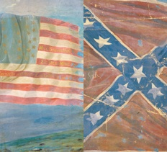
Half of all men of military age in the North mustered as soldiers during the American Civil War.
Roughly 80% of all military –age men in the South served as soldiers. (In part, the South was able to spare a greater percentage of men because slaves left behind could continue the daily work.)

Slide 60
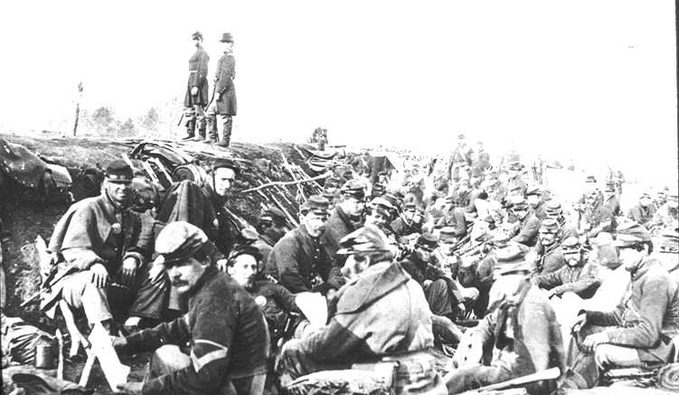

Joshua Chamberlain On Gettysburg Southerners
“There stood before us the embodiment of manhood – men whom neither toils and sufferings, nor the fact of death, nor hopelessness could bend from their resolve.”

Slide 61
RELIGIOUS
DIVISIONS

Slide 62
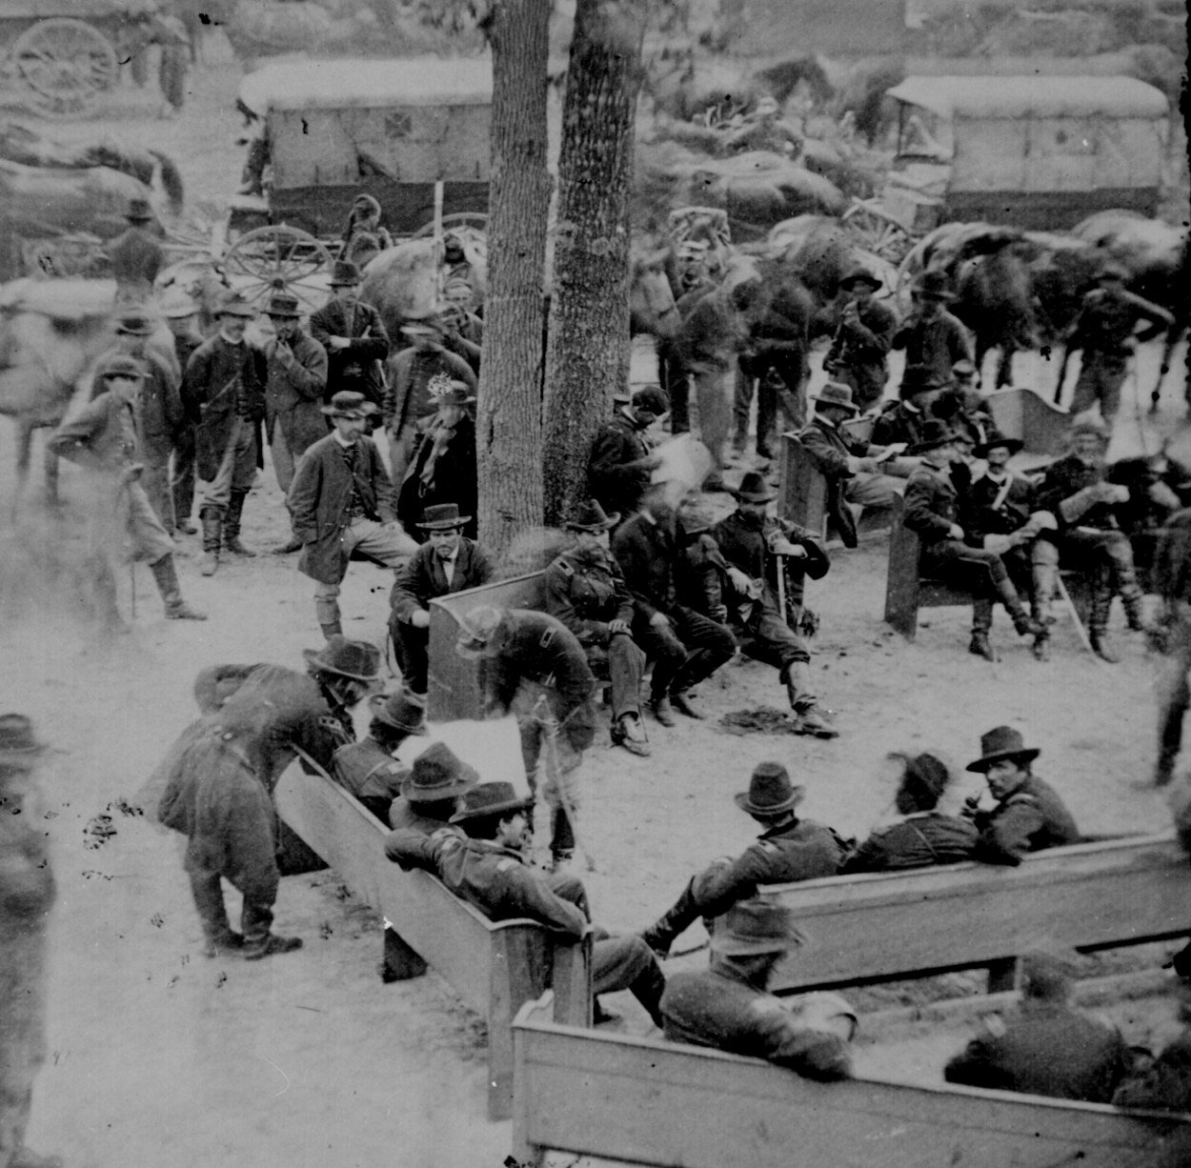
Principle Of Human Worth Christian Compromised
“Tragically, no less than everyone else, the clergy were virtually cheerleaders all. One more easily forgives generals, journalists and soldiers for their moral silence. But clergy – especially the majority Protestant clergy – had traditionally opposed reflexive patriotic rhetoric from the pulpit. They supposedly answered to a higher authority. True, the rare critical voices sounded among the clergy… But these voices are precious few & for one simple reason – nationalism.”
- IN INTRO TO STOUT’S: UPON THE ALTAR OF THE NATION

Slide 63
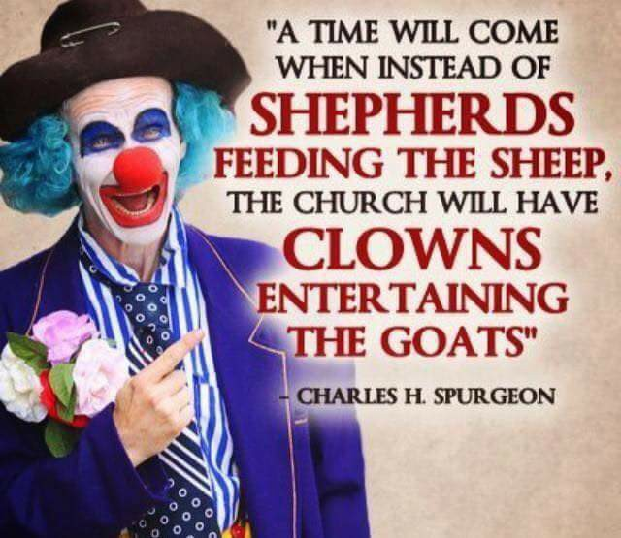

Slide 64


Slide 65


Slide 66

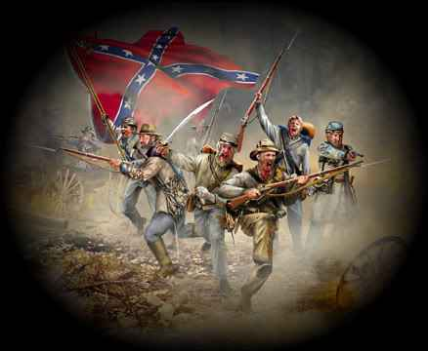
THE REBEL YELL
Southerners attacking with a full cry appeared to their enemies to be demons.
One Billy Yank recalled with dismay ‘that terrible scream & barbarous howl.’
Another union soldier confessed that hearing the rebel yell
- - “made the hair stand up on my head.”

Slide 67
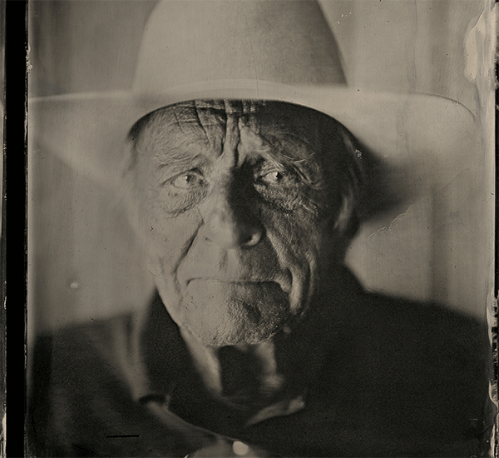

Slide 68
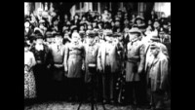

Slide 69
Let Loose in the Land:
GOD OR SATAN?
“In hate, - evoked by kindred lands,
But late beslavering with caress,
Lo, Moloch, dripping crimson, stands, And curses where he cannot bless.
He wings the blot and hurls the spear, A demon loosed, that rends in rage, Sends havoc through the homes most dear & butchers youth & tramples age!”
- William Gilmore Simms, The Fiend Unbound

Slide 70
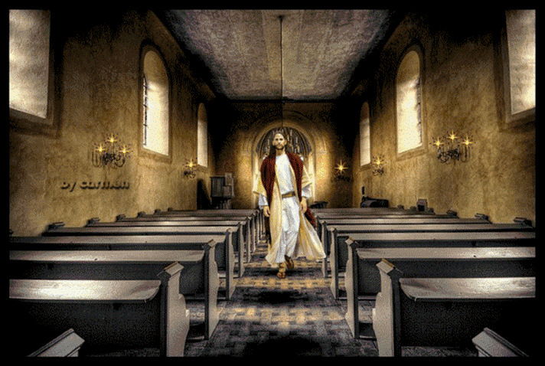

Slide 71
Civil War: Brother Faces Brother
From Flaws & Fissures To Faults
David Lee Burris:
Definition: Presentism - “Present-day standards of behavior are used to evaluate people who lived in the distant past – when such standards would have been unthinkable.”; James A. Garfield -
“If there is one thing on this earth that mankind love and admire better than another, it is a brave man; It is the man who dares to look the devil in the face and tell him he is a devil.”; On The Evil Of Slavery Was “Inclined To Believe That The Sin Of Slavery Is One Of Which It May Be Said That Without The Shedding Of Blood There Is No Remission.”
J. W. McGarvey -- “We will not take up arms against, fight and kill the brethren we have labored for twenty years to bring into the kingdom of God.”
“The Texas chaplain told of his friend, Alf Johnson, who when he saw wounded federal soldiers beg for medical help, instead ruthlessly shoot them… Graham asked Hall how he could feel this way toward his brethren in the North, and Hall replied that they were all infidels.”
The Hollywood Epic Length “Gods & Generals” Was Limited Still
Independence Declaration Ideals Constitutionally Compromised
Plus 100 Years: Concept Of National Sin Causes Regional Conflict
Causes Church Loss Of Moral Authority & Divisions North-South
Both Campbell’s & Barton Stone’s Sons Wore Confederate Grey {Campbell Family Slaveholders & After War Stand Stayed Same}
War & Conscience by Allen Isbell on page 189: “…(Future U. S. President) Garfield delivered recruiting speeches on the steps of many churches(of Christ) through the Western Reserve.”

Slide 72
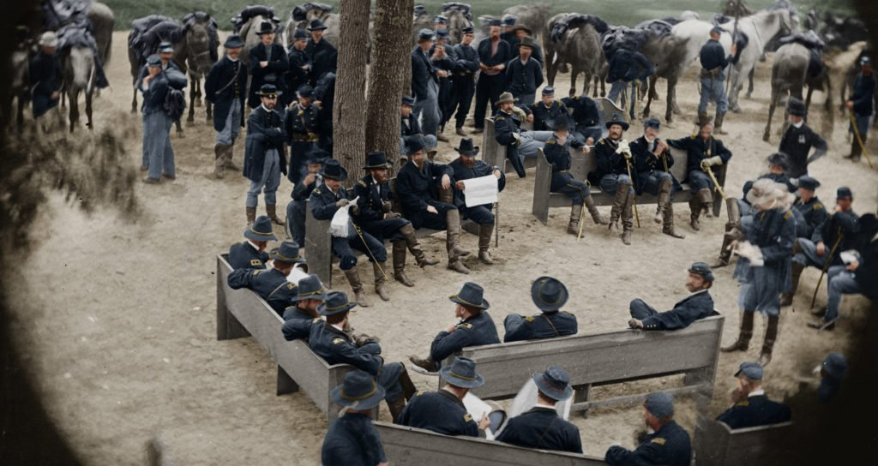

Slide 73
The Church During The Civil War
Leading Up To The War Discussion Of The Slavery Issue Was Discussed In Journals
Some Like James Shannon In Missouri Were Strong Activists For Slavery
Others Like Pardee Butler Of Kansas Was Equally Strong Activist Against Slavery
Mississippi Preacher, T.W. Caskey Was Involved In Preparation Of The Document Leading To Secession In That State, 1861
During War Many Lost Their Faith
Many Enlisted In The Military, Preachers Became Chaplains
  Fanning Visited Atlanta. Dr. A.G. Thomas, A Preacher, Wore A Feather In His Hat And A Glittering Sword In His Right Hand. Fanning Said He Doubted If Thomas Would Be Able To Hold The Word Of Georgia In One Hand And The Sword Of The Spirit In The Other – GA Vol VII, No. 2, Feb. 1861 p.39
  W.H. Hopson Resigned His Post At Main Street Church Of Christ Lexington, Kentucky Because Of His Disposition Toward The South. J.W. McGarvey Took His Place, 1862

Slide 74
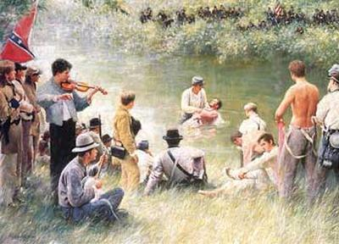
Southern Military
Religious Revival
Could Not Offset Overall Negative Impact Of The War!

Slide 75
The Church During The Civil War
  250 Boys From Hiram College Joined The Union Forces
  James A Garfield Was A Union Officer Acquiring Rank Of Brigadier-General
  T.B. Larimore Served With The Southern Forces
  B.F. Hall Was Chaplain With The Texas Rangers
Colleges & Publications Sought To Ignore The War Refusing Anti-War Articles To Be Printed
  W.D. Carnes Sought To Keep It Out Of Franklin College, But When War Was Began The Entire Student Body Left, Joining The South
  1860, Fall Arkansas College Began At Fayetteville, William Baxter President, Battles At Pea Ridge And Prairie Grove Was Fought Nearby. School Burned
Preachers Avoided It In Their Preaching
Many Journals Ceased Publication For Economic Reasons
Biggest Wedge Was When The Missionary Society Condemned The South, Southern Brethren Were Appalled, 1862
Officially The Churches Of Christ Was The Only Church In The US Not To Split During The Civil War

Slide 76
Civil War: Brother Faces Brother
From Flaws & Fissures To Faults
David Lee Burris:
Definition: Presentism - “Present-day standards of behavior are used to evaluate people who lived in the distant past – when such standards would have been unthinkable.”; James A. Garfield -
“If there is one thing on this earth that mankind love and admire better than another, it is a brave man; It is the man who dares to look the devil in the face and tell him he is a devil.”; On The Evil Of Slavery Was “Inclined To Believe That The Sin Of Slavery Is One Of Which It May Be Said That Without The Shedding Of Blood There Is No Remission.”
J. W. McGarvey -- “We will not take up arms against, fight and kill the brethren we have labored for twenty years to bring into the kingdom of God.”
“The Texas chaplain told of his friend, Alf Johnson, who when he saw wounded federal soldiers beg for medical help, instead ruthlessly shoot them… Graham asked Hall how he could feel this way toward his brethren in the North, and Hall replied that they were all infidels.”
The Hollywood Epic Length “Gods & Generals” Was Limited Still
Independence Declaration Ideals Constitutionally Compromised
Plus 100 Years: Concept Of National Sin Causes Regional Conflict
Causes Church Loss Of Moral Authority & Divisions North-South
Both Campbell’s & Barton Stone’s Sons Wore Confederate Grey {Campbell Family Slaveholders & After War Stand Stayed Same}
War & Conscience by Allen Isbell on page 189: “…(Future U. S. President) Garfield delivered recruiting speeches on the steps of many churches(of Christ) through the Western Reserve.”

